Slide 1
2L– Look What is New from What Works Clearinghouse TM! Seven Recommendations for Teacher-Delivered Behavioral Interventions in Grades K-5
Presenters:
Kathleen Lynne Lane, University of Kansas
Tabathia Baldy,Georgia Department of Education
Kent McIntosh, University of Oregon
Topic: Classroom PBIS
Keywords: behavioral supports, elementary, research-based

Slide 2
Learning Objectives
Participants will learn seven evidence-based practices practical for teachers to implement in their classrooms
Participants will learn how to distinguish between practices with strong and moderate evidence of effectiveness
Access resources freely available on the Institute for Education Sciences website to support professional learning and implementation of recommended practices

Slide 3
Agenda
Welcome
Background
Seven Recommendations
Resources
Evaluation & Questions

Slide 4

Background
In collaboration with expert panelists, the What Works Clearinghouse™ (WWC) distilled that research into practical recommendations for elementary educators.
The Teacher-Delivered Behavior Interventions in Grades K-5 Practice Guide details seven evidence based practices for teachers to use in their classrooms to support students in demonstrating prosocial and expected behavior.

Slide 5
Panel
Panel Members
Staff & Project Officer
Kathleen Lynne Lane (Chair)
Tabathia Baldy
Tammy Becker
Catherine Bradshaw
Kent McIntosh
Rhona Nese
Ruthie Payno-Simmons
Kevin Sutherland
Allison Dymnicki
Brian Freeman
Sebastian Lemire
Shawn Moulton
Allan Porowski
Laura Holian
Jonathan Jacobson

Slide 6
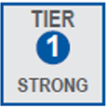
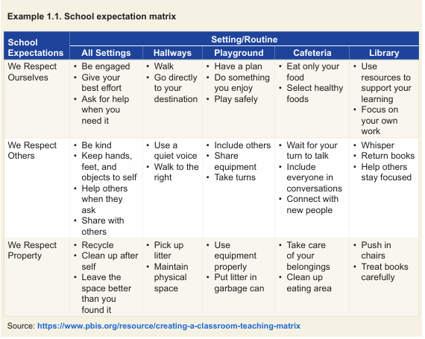
Recommendation 1: Co-establish, model, and teach clear expectations for student behavior consistent with schoolwide expectations.
Implementation Steps
Start with schoolwide expectations if available
Co-establish and post classroom behavior expectations
Teach clear behavior expectations
Adjust instruction and revisit behavior expectations if expectations are not being met

Slide 7
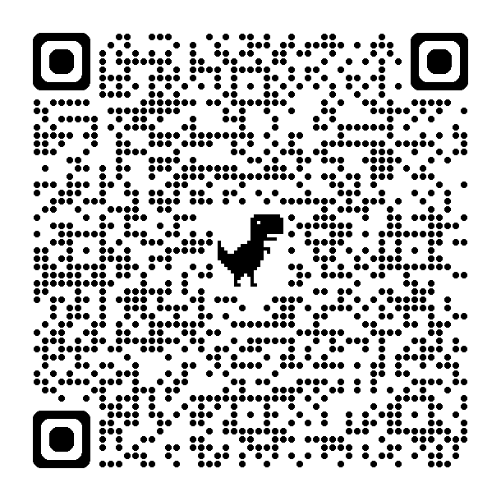
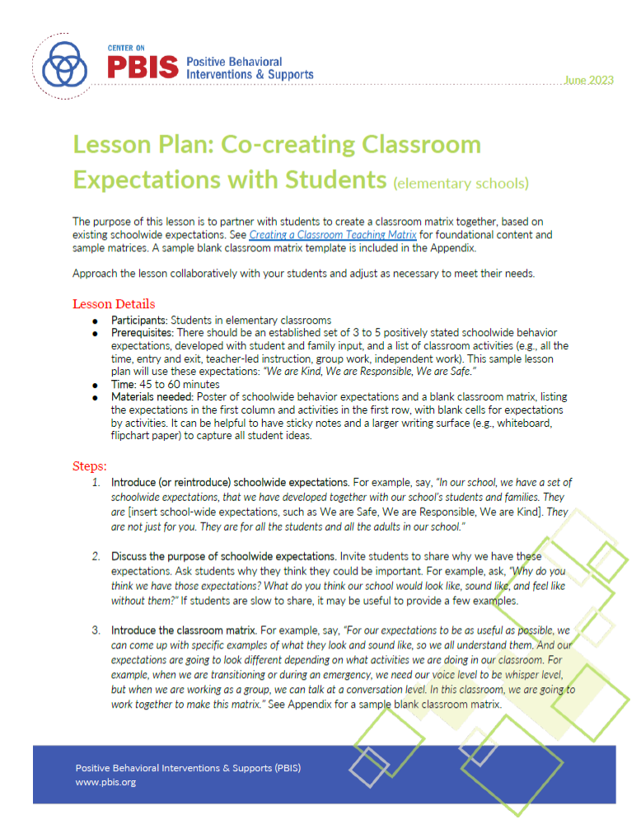
Co-Creating Classroom Expectations
Lesson Plan
PBIS Lesson Plan: Co-Creating Classroom Expectations with Students
Notes:
Facilitate students in defining what are respectful interactions (what respect looks, sounds and feels like)

Slide 8
Co-Creating Expectations Lesson Plan
Introduce (or reintroduce) schoolwide expectations.
Discuss the purpose of schoolwide expectations.
Facilitate students in generating examples of agreed behavior by each classroom routine (e.g., entry, small group work, teacher-led instruction).
Distill the examples into a finalized matrix with 3 to 4 of the best examples per routine.
Collaboratively design a plan for monitoring and support.

Slide 9
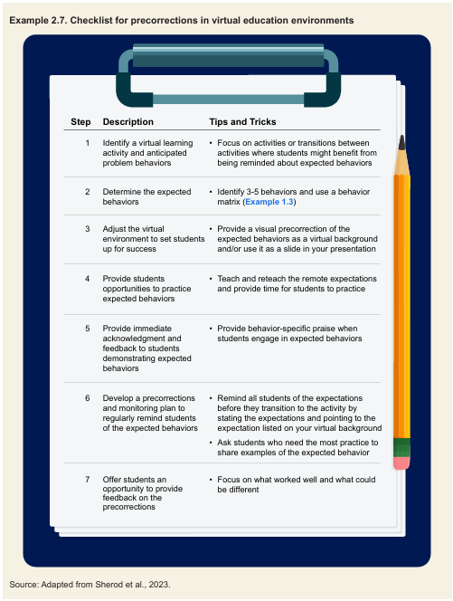
Recommendation 2: Remind students to engage in expected behaviors.
Implementation Steps
Select the expected behaviors to focus on for specific times and transitions during the school day
Consider the type and level of intensity of the precorrections to use
Deliver precorrections using supportive and action-oriented language
Reinforce delivered precorrections by providing immediate acknowledgment of students engaging in expected behaviors
Ask students for feedback on which precorrection approaches they prefer

Slide 10
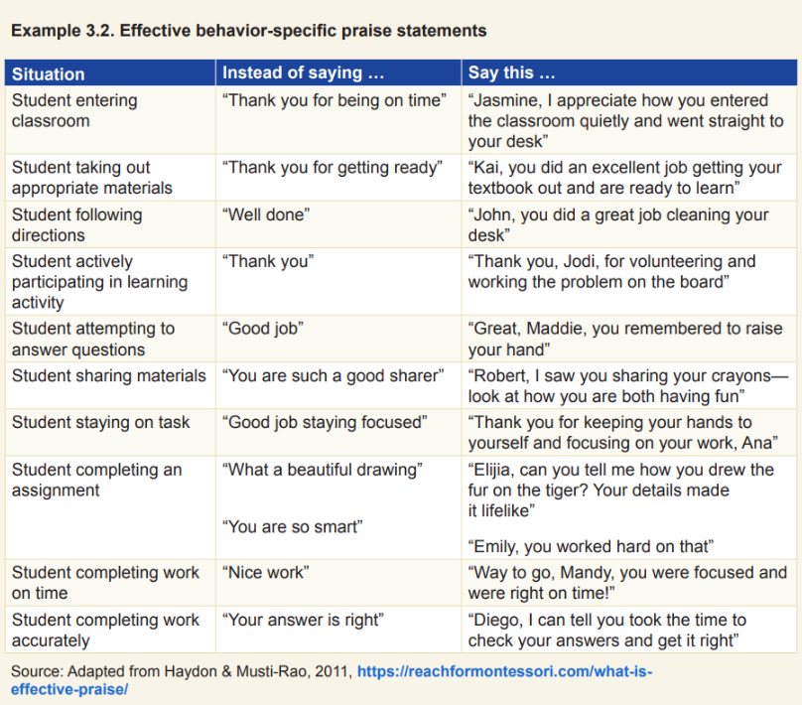
Recommendation 3: Acknowledge students for demonstrating expected behaviors through positive attention, praise, and rewards.
Implementation Steps
Engage students and their parents and other caregivers in deciding on culturally relevant praise and rewards for expected behaviors
Focus praise on behavior and effort rather than ability
Be sincere when delivering praise
Focus rewards on the behavior of the entire class, groups of students, or individual students
Scan the classroom continuously to look for and acknowledge students meeting expectations

Slide 11

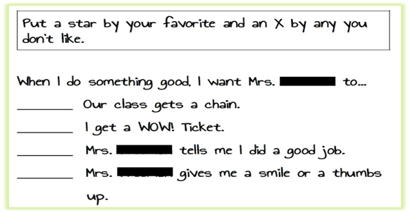
Praise Preference Assessment
A way to identify what type(s) of acknowledgements students like or dislike receiving for showing desired behaviors
Could be in survey or interview formats
Notes:
Definition slide to get everyone on same page

Slide 12

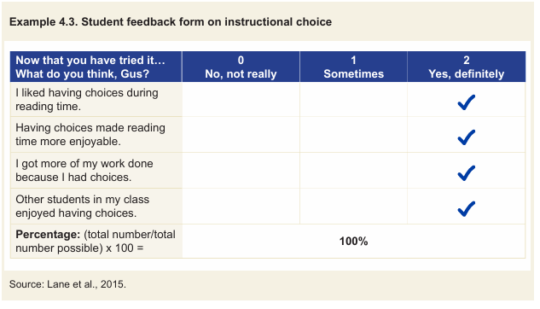
Recommendation 4: Offer instructional choices to students to increase engagement and agency.
Implementation Steps
Determine which type of choices you feel comfortable offering and create a menu of choices
Use the menu of choices to determine which type of choices to add to a particular lesson
After choice is built into the lesson, offer each student the established choices
Ask the student to make their choice, providing ample time for the student to respond
Listen to or observe the student’s response and provide them with the selected option
Offer students an opportunity to give feedback on the choice they selected

Slide 13
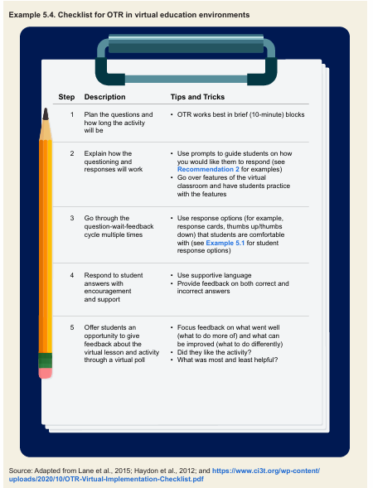
Recommendation 5: Provide students frequent and varying opportunities to respond to and engage in activities.
Implementation Steps
Identify the instructional goal
Prepare a list of questions and potential responses
Teach students how to respond
Ask a question, wait for a response, view the response, provide feedback, repeat
Provide opportunities for reflecting on learning

Slide 14
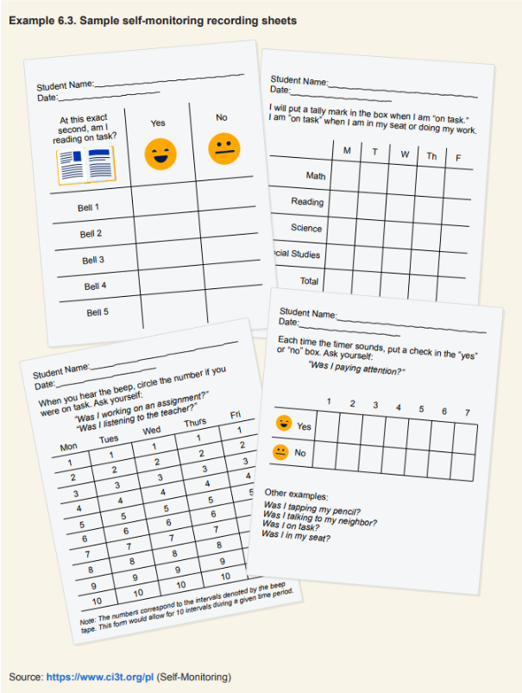
Recommendation 6: Teach students to monitor and reflect on their own behavior.
Implementation Steps
Establish the prerequisite conditions
Identify and operationally define the challenging and expected behaviors
Design the self-monitoring procedures and monitoring tool
Teach the student the self-monitoring procedures
Monitor student progress
Consider maintenance and follow-up

Slide 15
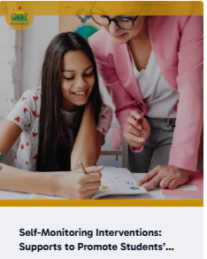

Self-monitoring: On-demand Resource
Ci3T website

Slide 16
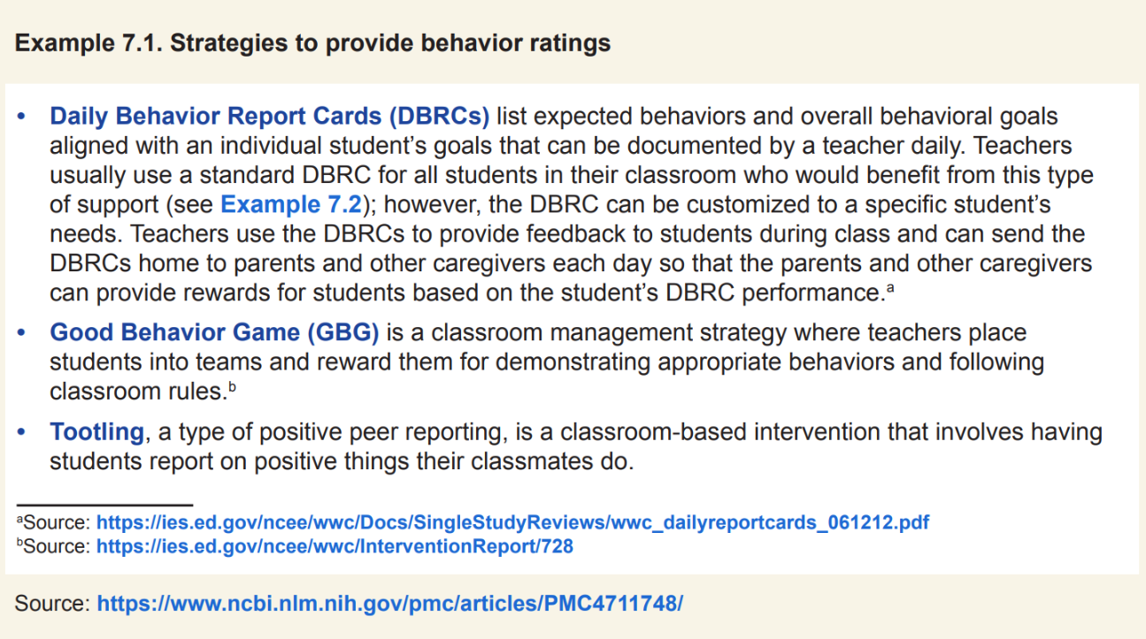
Recommendation 7: Use behavior ratings to provide feedback to students.
Implementation Steps
Engage students and their parents and other caregivers in co-developing behavior ratings
Break the school day into natural segments for feedback and ratings
Optional: For interventions focused on groups of students, determine how to divide students into groups
Teach and provide students opportunities to practice behavior expectations or implement the game procedures
Review data for individual students, groups of students, or the entire class to show progression towards rewards, posting ratings for groups or the entire class as appropriate
Optional: Use group-based rewards

Slide 17
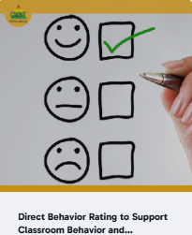
Direct Behavior Ratings: On-demand Resource
Ci3T website

Slide 18

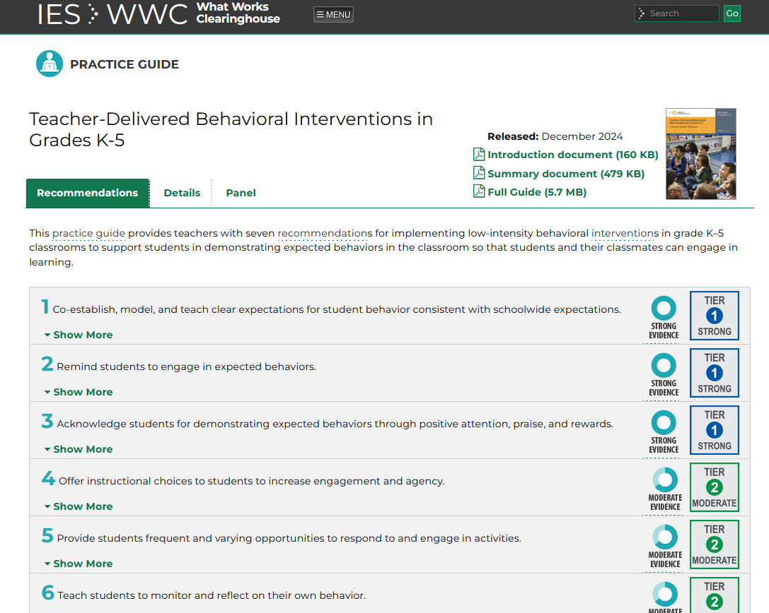
Resource Spotlight!
Notes:
What Works Clearing House Practice Guide – Teacher-Delivered Behavioral Interventions in Grades K-5 https://ies.ed.gov/ncee/wwc/PracticeGuide/31

Slide 19
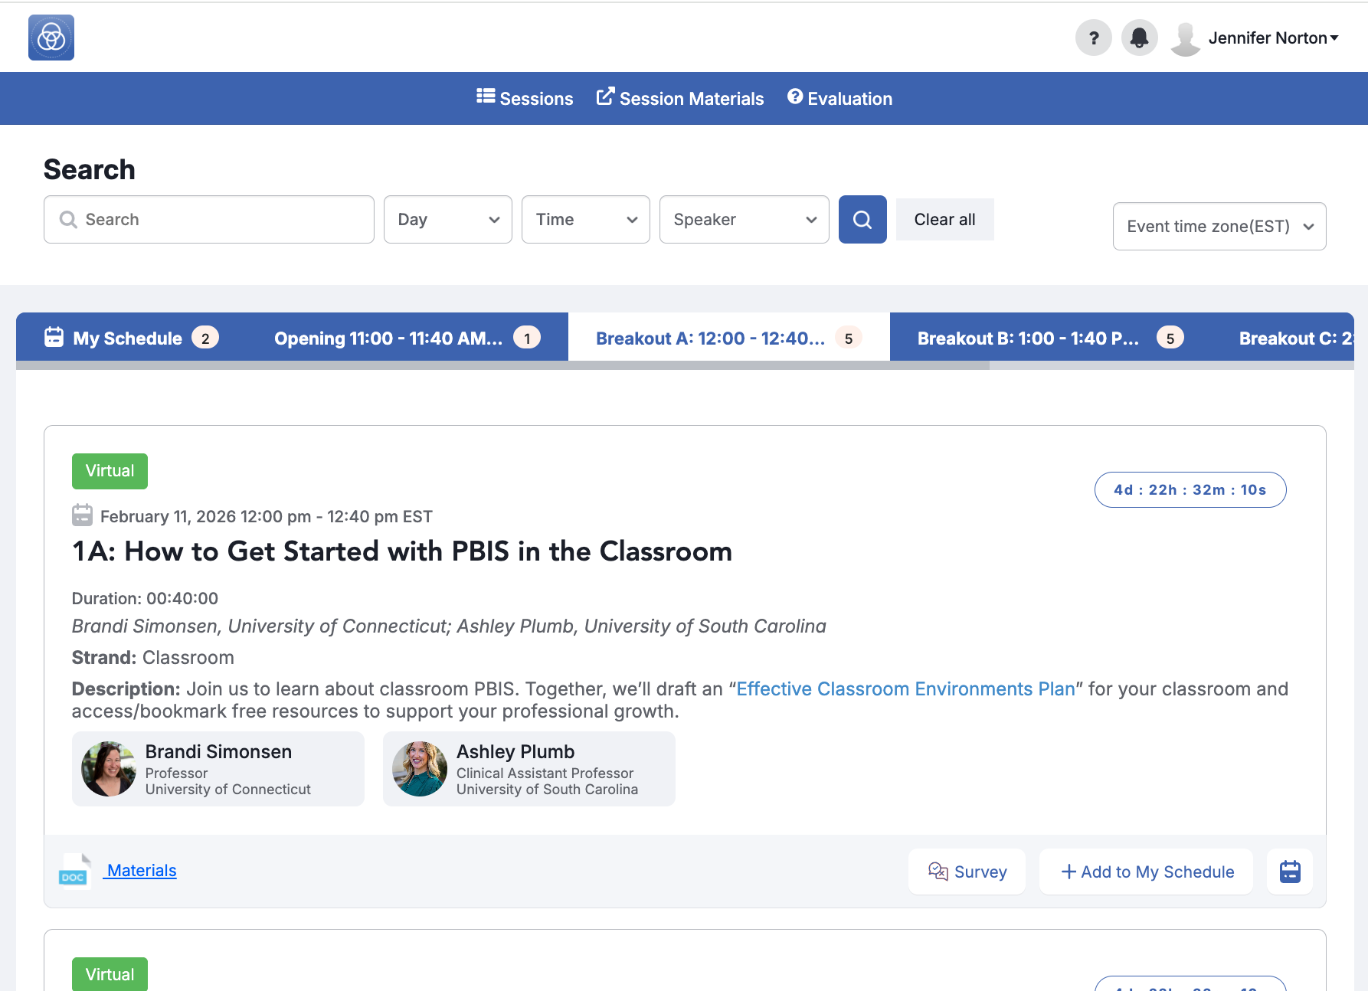
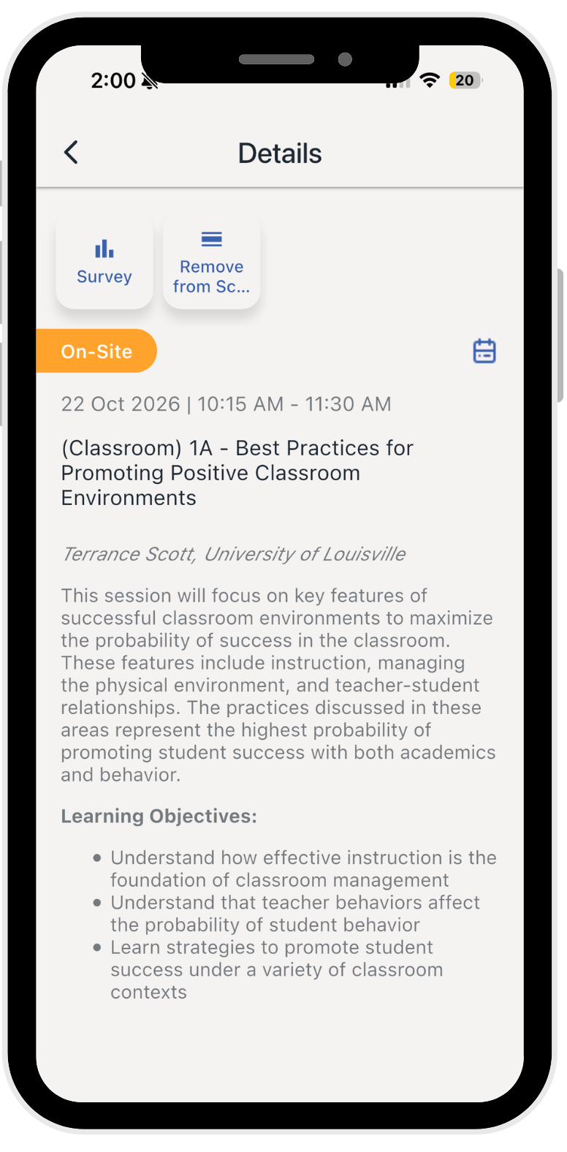



We Value Your Feedback
✅ Complete all session evaluations and the overall evaluation in the event app.
Each session evaluation can be found in its listing in the agenda.
The overall evaluation can be found in the general menu.
Notes:
Data is one of the five Essential Elements of PBIS! So help us, and make sure to complete evaluations for EVERY session you are in, as well as for the keynotes, and for the overall event.

