Slide 1
5i
Systematic Screening in Tiered Systems:
Using Data Effectively and Efficiently
Presenters:
Kathleen Lynne Lane | University of Kansas
Mark Buckman | University of Kansas
Lacy Lahr | Sedro-Woolley Public Schools
Stephanie “Heather” Swenson | Sedro-Woolley Public Schools
Topic: Data-based Decision Making
Keywords: Assessment, Climate, Screening

Slide 2
Learning Objectives
Use screening data to inform Tier 1 practices
Empower teachers with strategies to maximize engagement
Collaborate with families and others to connect students to Tier 2 and Tiere 3 interventions
Access freely available practice guides and briefs to select, install, and interpret screening data
Institute of Education Sciences, U.S. Department of Education
R324N190002 University of Kansas
R324X220067 University of Kansas

Slide 3
Agenda
Welcome
Situating Systematic Screening in Integrated Tiered Systems
Using Screening Data to:
  Inform Instruction at Tier 1
  Empower Teachers with Low-Intensity Strategies
  Connect Students to Tier 2 and Tier 3 Interventions
Highlighting Systematic Screening in Sedro-Woolley
Accessing Resources
Evaluation + Q&A

Slide 4
Situating Systematic Screening in Integrated Tiered Systems
A focus on integrated tiered systems
The research reported here was supported by the Institute of Education Sciences, U.S. Department of Education, through Grants R324N190002 and R324X220067 to University of Kansas. The opinions expressed are those of the authors and do not represent views of the Institute or the U.S. Department of Education.

Slide 5
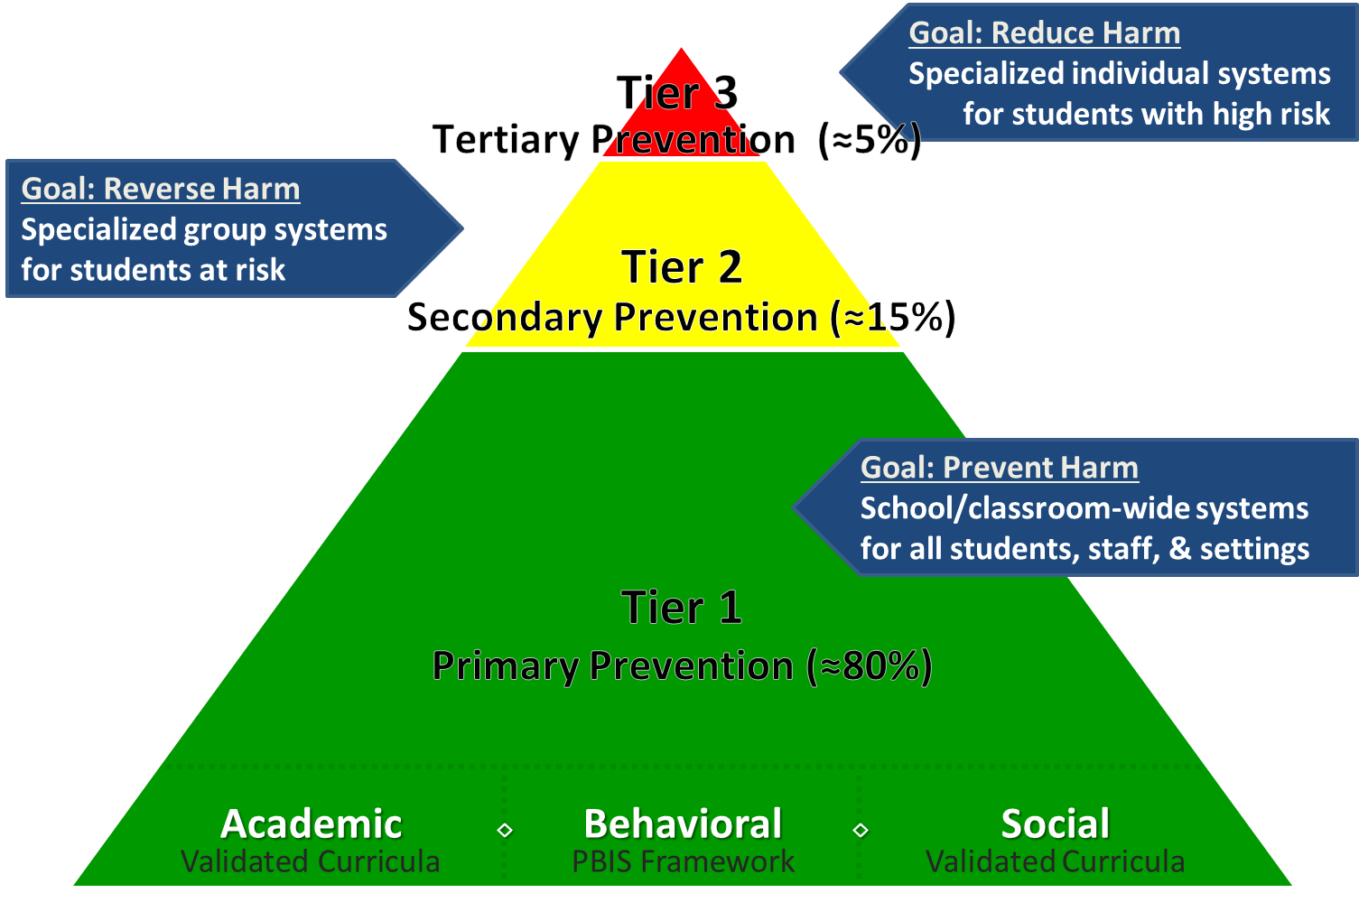
Comprehensive, Integrated, Three-Tiered (Ci3T) Models of Prevention

Slide 6
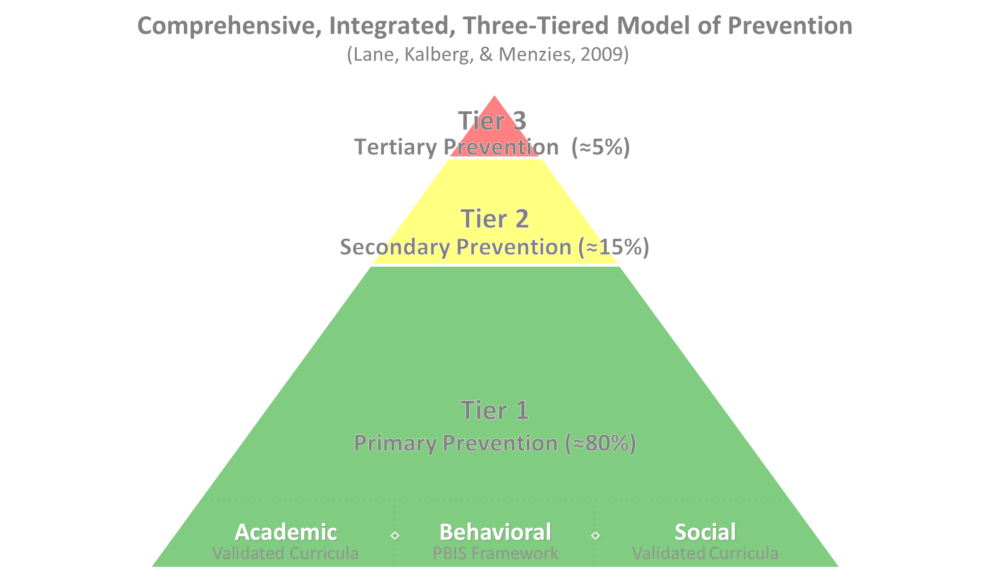

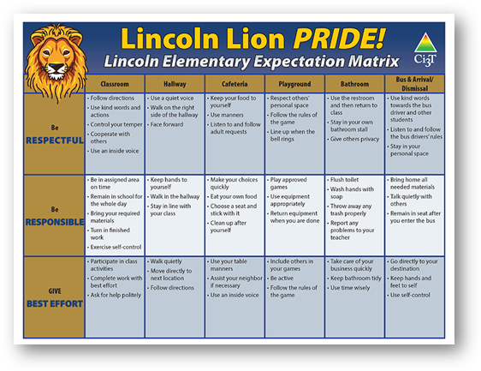
Tier 1
Positive Behavioral Interventions and Supports
District & State Standards Quality Instruction
Validated Curricula and Resources

Slide 7

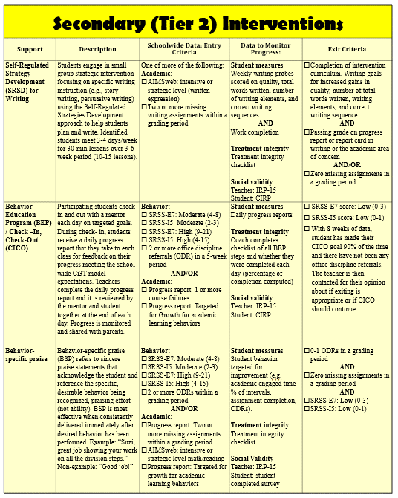
Tier 2 Intervention Grid
Notes:
In addition to the module featured here outlining how to use multiple sources of data to connect students with Tier 2 supports, we offer a full suite of modules highlighting validated Tier 2 interventions such as Self-Regulated Strategy Development (SRSD) for Writing and Check-In/Check Out that may appear in your Secondary (Tier 2) Intervention Grid

Slide 8

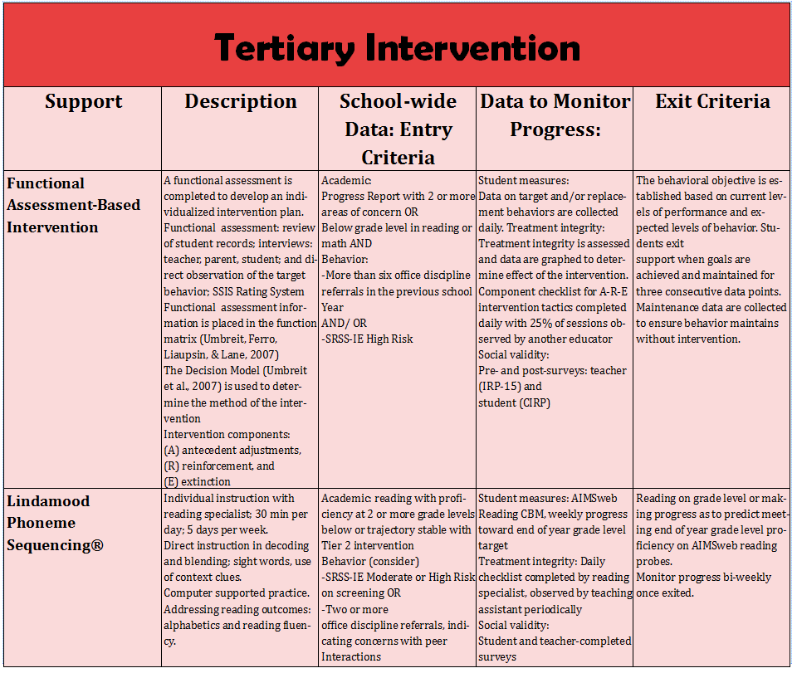
Tier 3 Intervention Grid
Notes:
In addition to the module featured here outlining how to use multiple sources of data to connect students with Tier 3 supports, we offer a full suite of modules highlighting validated Tier 3 interventions such as Functional Assessment-Based Intervention (FABI) that may appear in your Tertiary (Tier 3) Intervention Grid

Slide 9
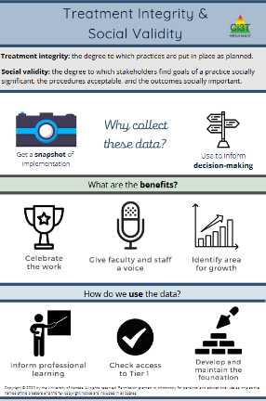
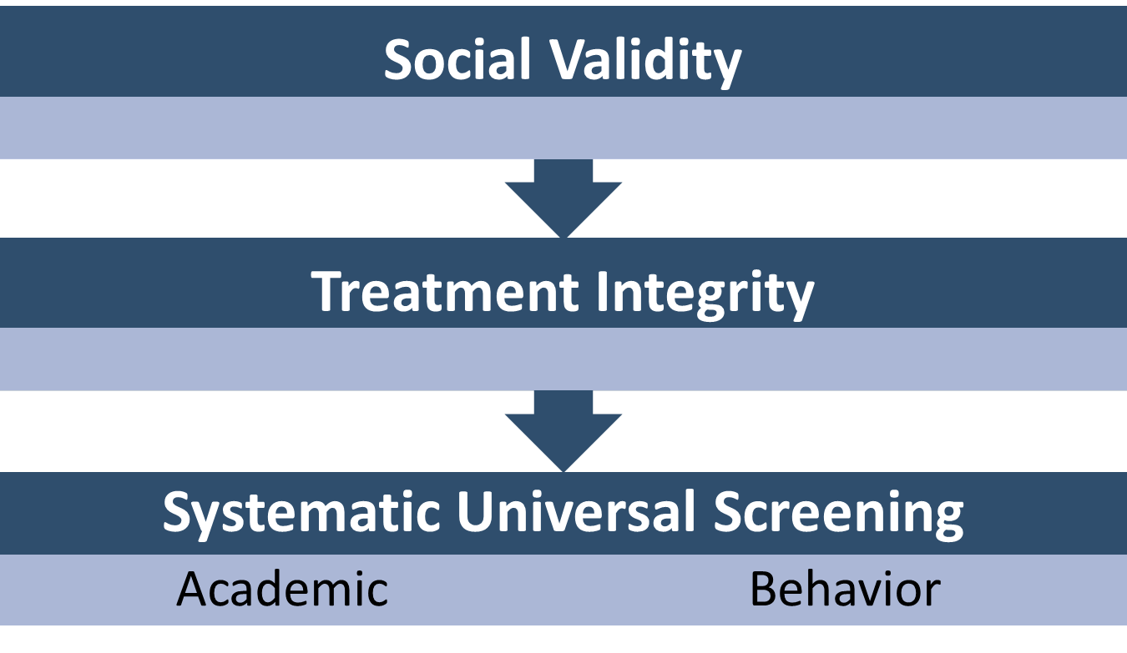
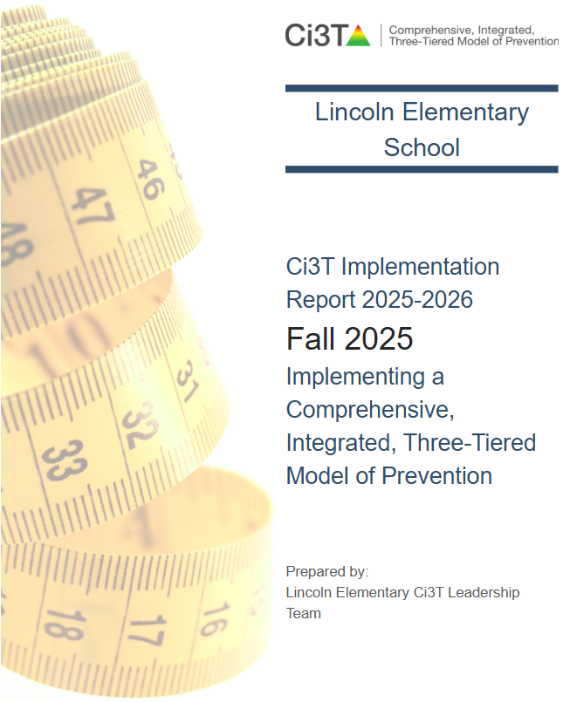
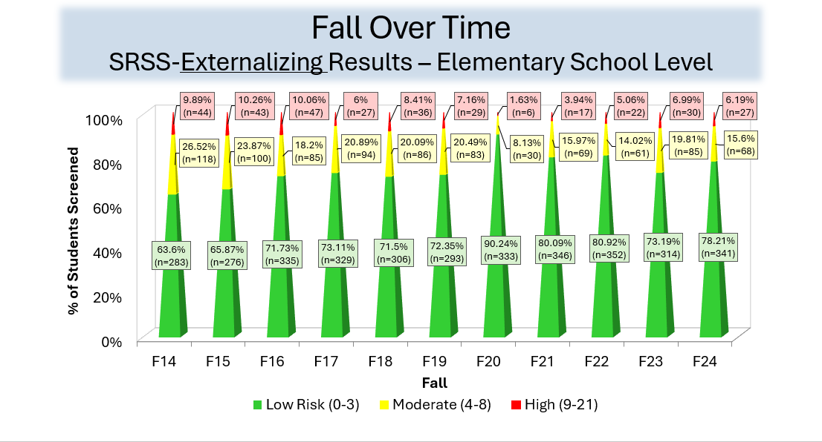
Essential Components of Primary (Tier 1) Prevention Efforts

Slide 10
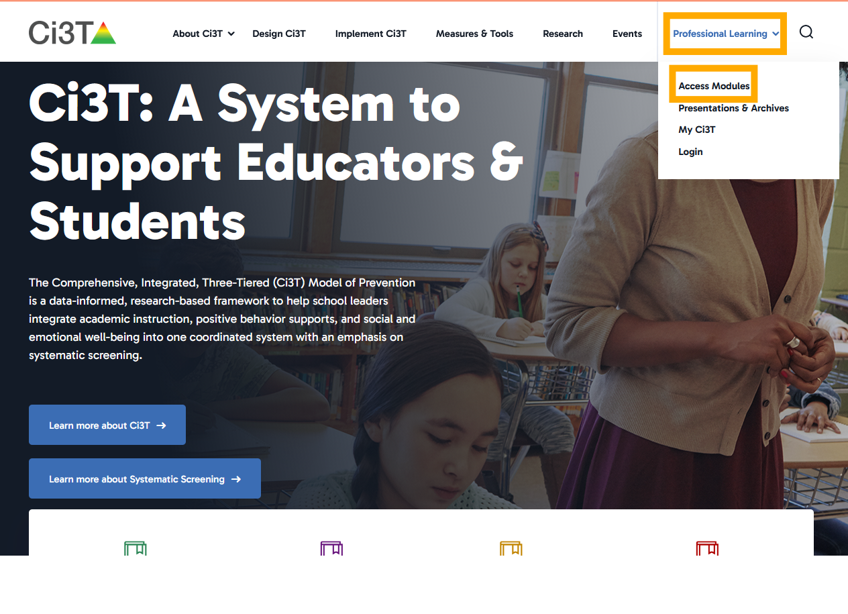

Access Instructions: Ci3T Modules

Slide 11
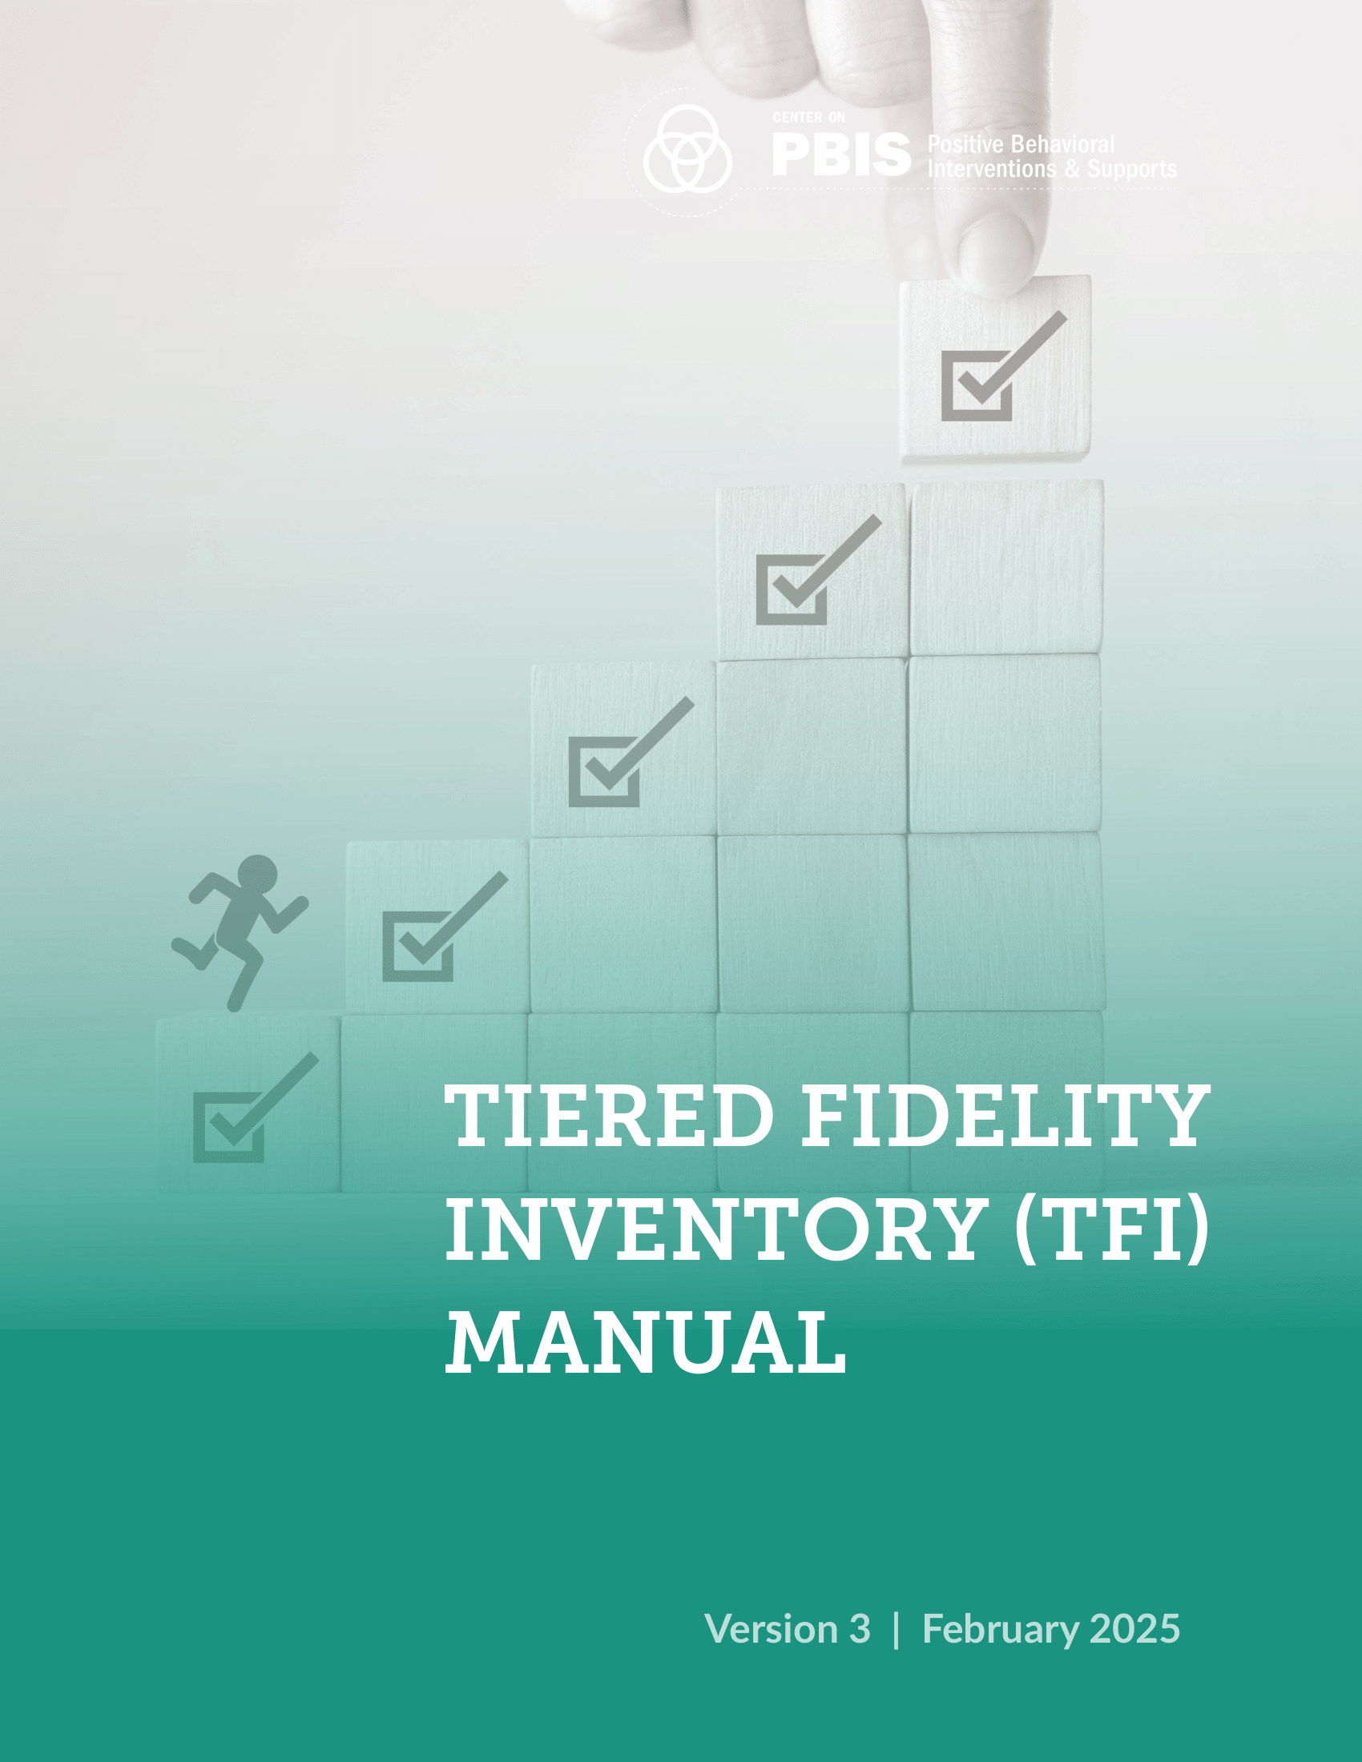
TFI Version 3 Connection
TFI Item | Description
1.18 USING SCHOOL AND COMMUNITY DATA TO INFORM TIER 1 | Tier 1 leadership team has regular access to and uses a variety of additional schoolwide (e.g., school climate surveys, attendance, nurse or counselor visit logs, universal screening) and community data sources (e.g., community resource profiles, basic needs [e.g., food and housing], health care access, community events), to develop and regularly re-evaluate a profile of overall strengths and needs that informs the development and delivery of equitable Tier 1 foundational and classroom practices
1.10 CLASSROOM PRACTICE | Educators consistently and equitably implement positive and proactive classroom practices—including building relationships with students; developing a safe environment; prompting predictable routines and expected behavior; actively providing OTRs, active supervision, and specific feedback (i.e., specific praise and supportive corrections); and ensuring a high ratio (≥ 5:1) of positive to corrective feedback.

Slide 12
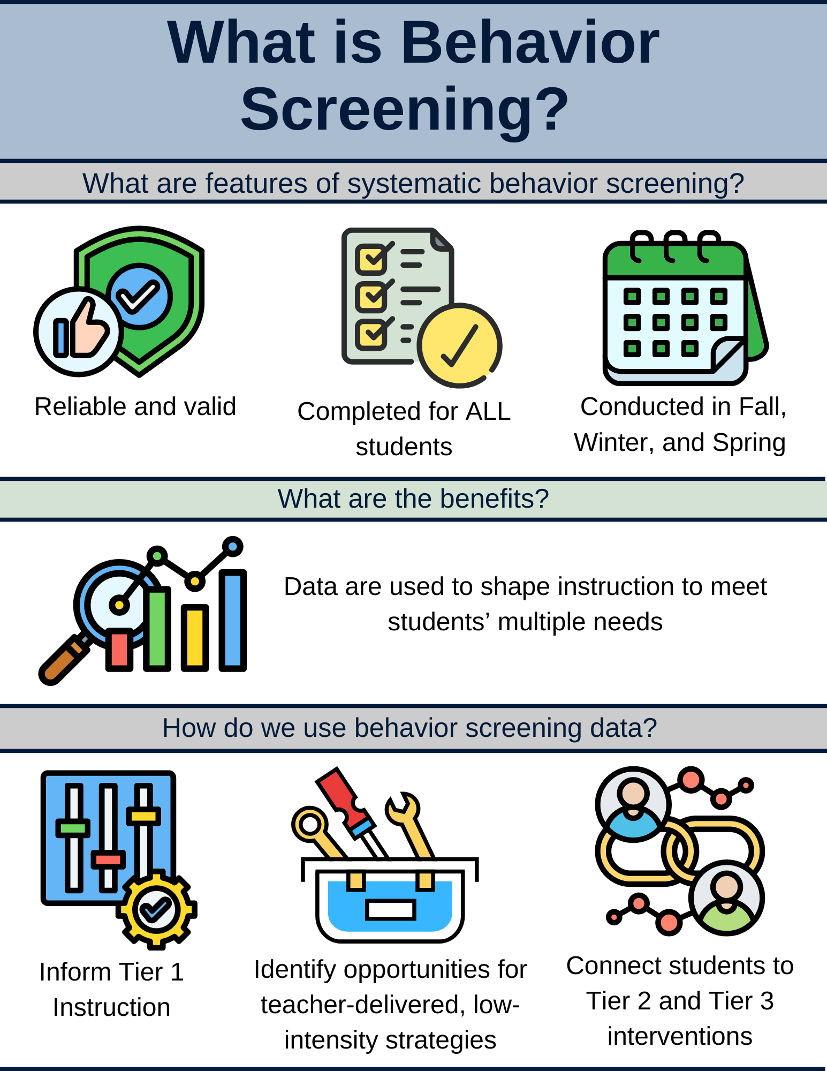
What is Behavior Screening? (1 of 2)

Slide 13
What is Behavior Screening? 2

Slide 14
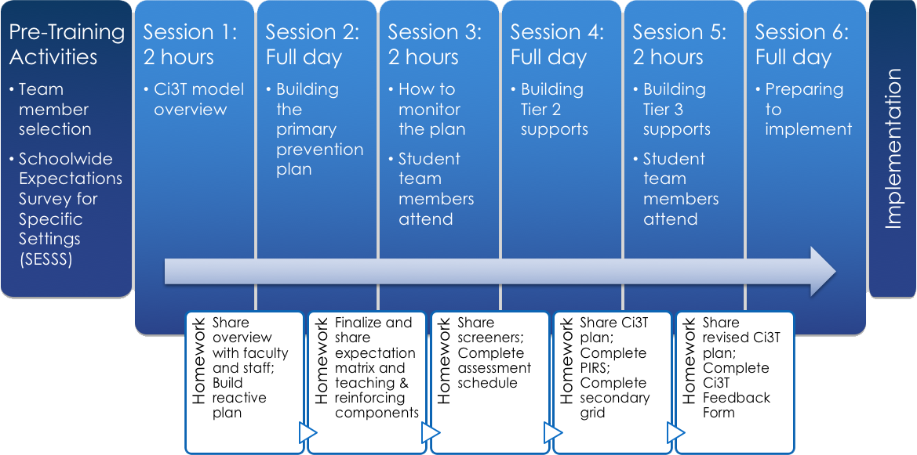
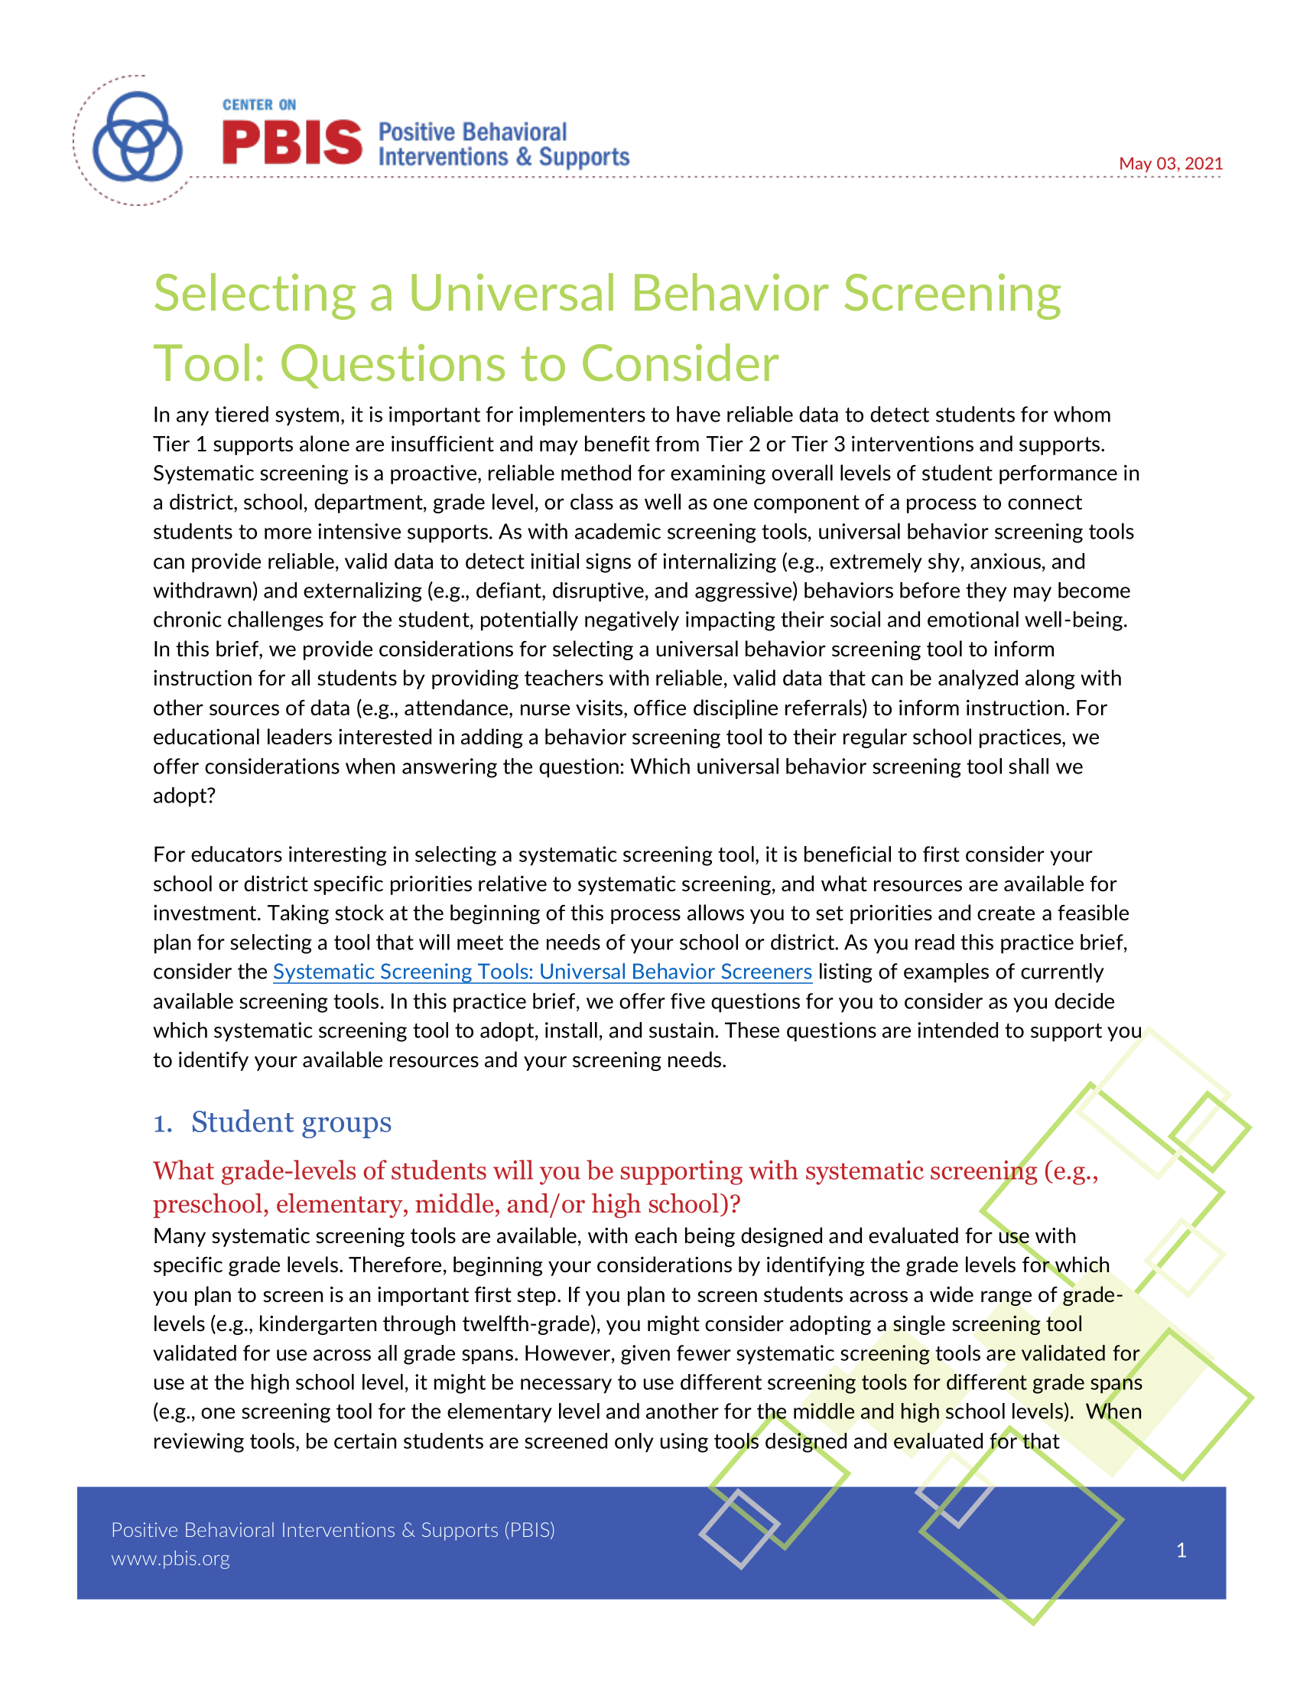
Selecting a Systematic Screener
Notes:
https://www.pbis.org/resource/selecting-a-universal-behavior-screening-tool-questions-to-consider

Slide 15
Using Systematic Screening Data to:
Inform Instruction at Tier 1
A focus on integrated tiered systems
The research reported here was supported by the Institute of Education Sciences, U.S. Department of Education, through Grants R324N190002 and R324X220067 to University of Kansas. The opinions expressed are those of the authors and do not represent views of the Institute or the U.S. Department of Education.

Slide 16
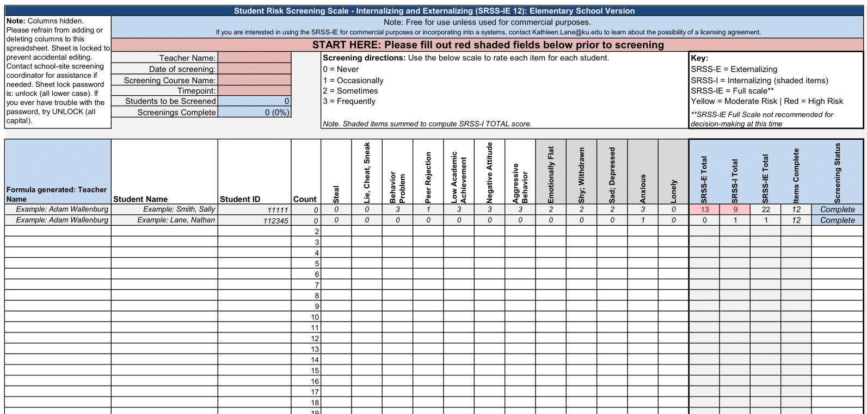
Student Risk Screening Scale – Internalizing and Externalizing
(SRSS-IE; Drummond, 1994; Lane & Menzies, 2009)
Elementary

Slide 17
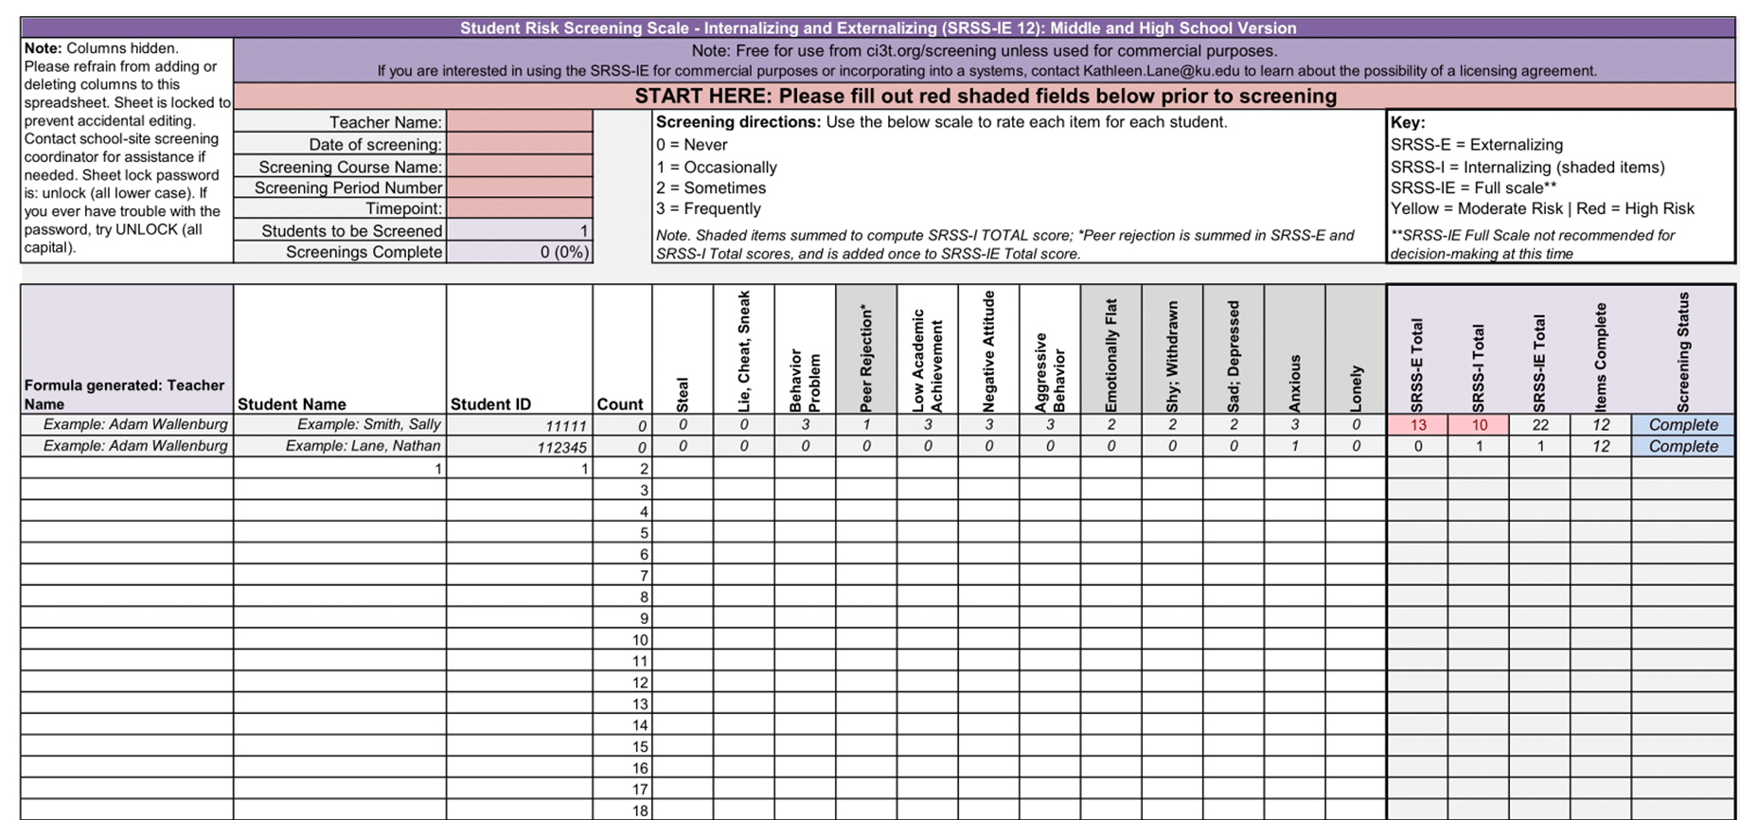
Student Risk Screening Scale – Internalizing and Externalizing
(SRSS-IE; Drummond, 1994; Lane & Menzies, 2009)
Secondary

Slide 18
SRSS-IE: Cut Scores
Elementary School
Middle and High School
SRSS-E7 | SRSS-I5
Items 1-7 | Items 8-12
0-3 = low risk 4-8 = moderate risk 9-21 = high risk | 0-1 = low risk 2-3 = moderate risk 4-15 = high risk
SRSS-E7 | SRSS-I6
Items 1-7 | Items 4, 8-12
0-3 = low risk 4-8 = moderate risk 9-21 = high risk | 0-3 = low risk 4-5 = moderate risk 6-18 = high risk
Elementary School Level:
Lane, K. L., Oakes, W. P., Swogger, E. D., Schatschneider, C., Menzies, H., M., & Sanchez, J. (2015). Student risk screening scale for internalizing and externalizing behaviors: Preliminary cut scores to support data-informed decision making. Behavioral Disorders, 40, 159-170.
Middle and High School Levels:
Lane, K. L., Oakes, W. P., Cantwell, E. D., Schatschneider, C., Menzies, H., Crittenden, M., & Messenger, M. (2016). Student Risk Screening Scale for Internalizing and Externalizing Behaviors: Preliminary cut scores to support data-informed decision making in middle and high schools. Behavioral Disorders, 42(1), 271-284

Slide 19
Fall Over Time
SRSS-Externalizing Results – Elementary School Level
Notes:
Fill in <year> based on current academic year. This is located in column A of the data sheet. Edit by right clicking and selecting “Edit data”.

Slide 20
Fall Over Time
SRSS-Internalizing Results – Elementary School Level
Notes:
Fill in <year> based on current academic year. This is located in column A of the data sheet. Edit by right clicking and selecting “Edit data”.

Slide 21
Behavioral and Academic Screening
How are students responding?
Inform Tier 1 Instruction
Identify opportunities for teacher-delivered, low-intensity strategies
Connect students to Tier 2 and Tier 3 interventions

Slide 22

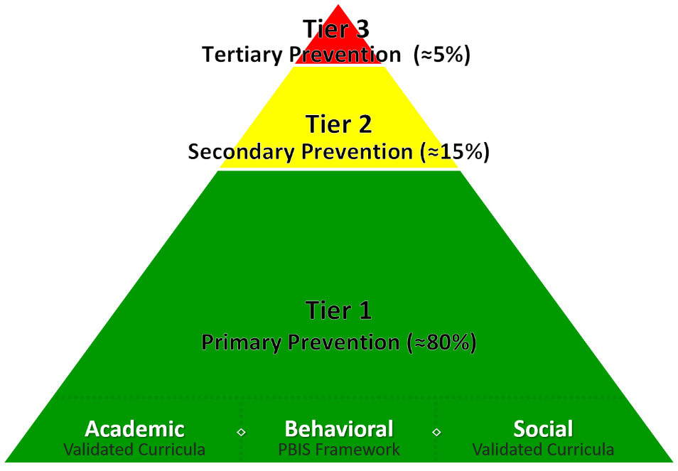
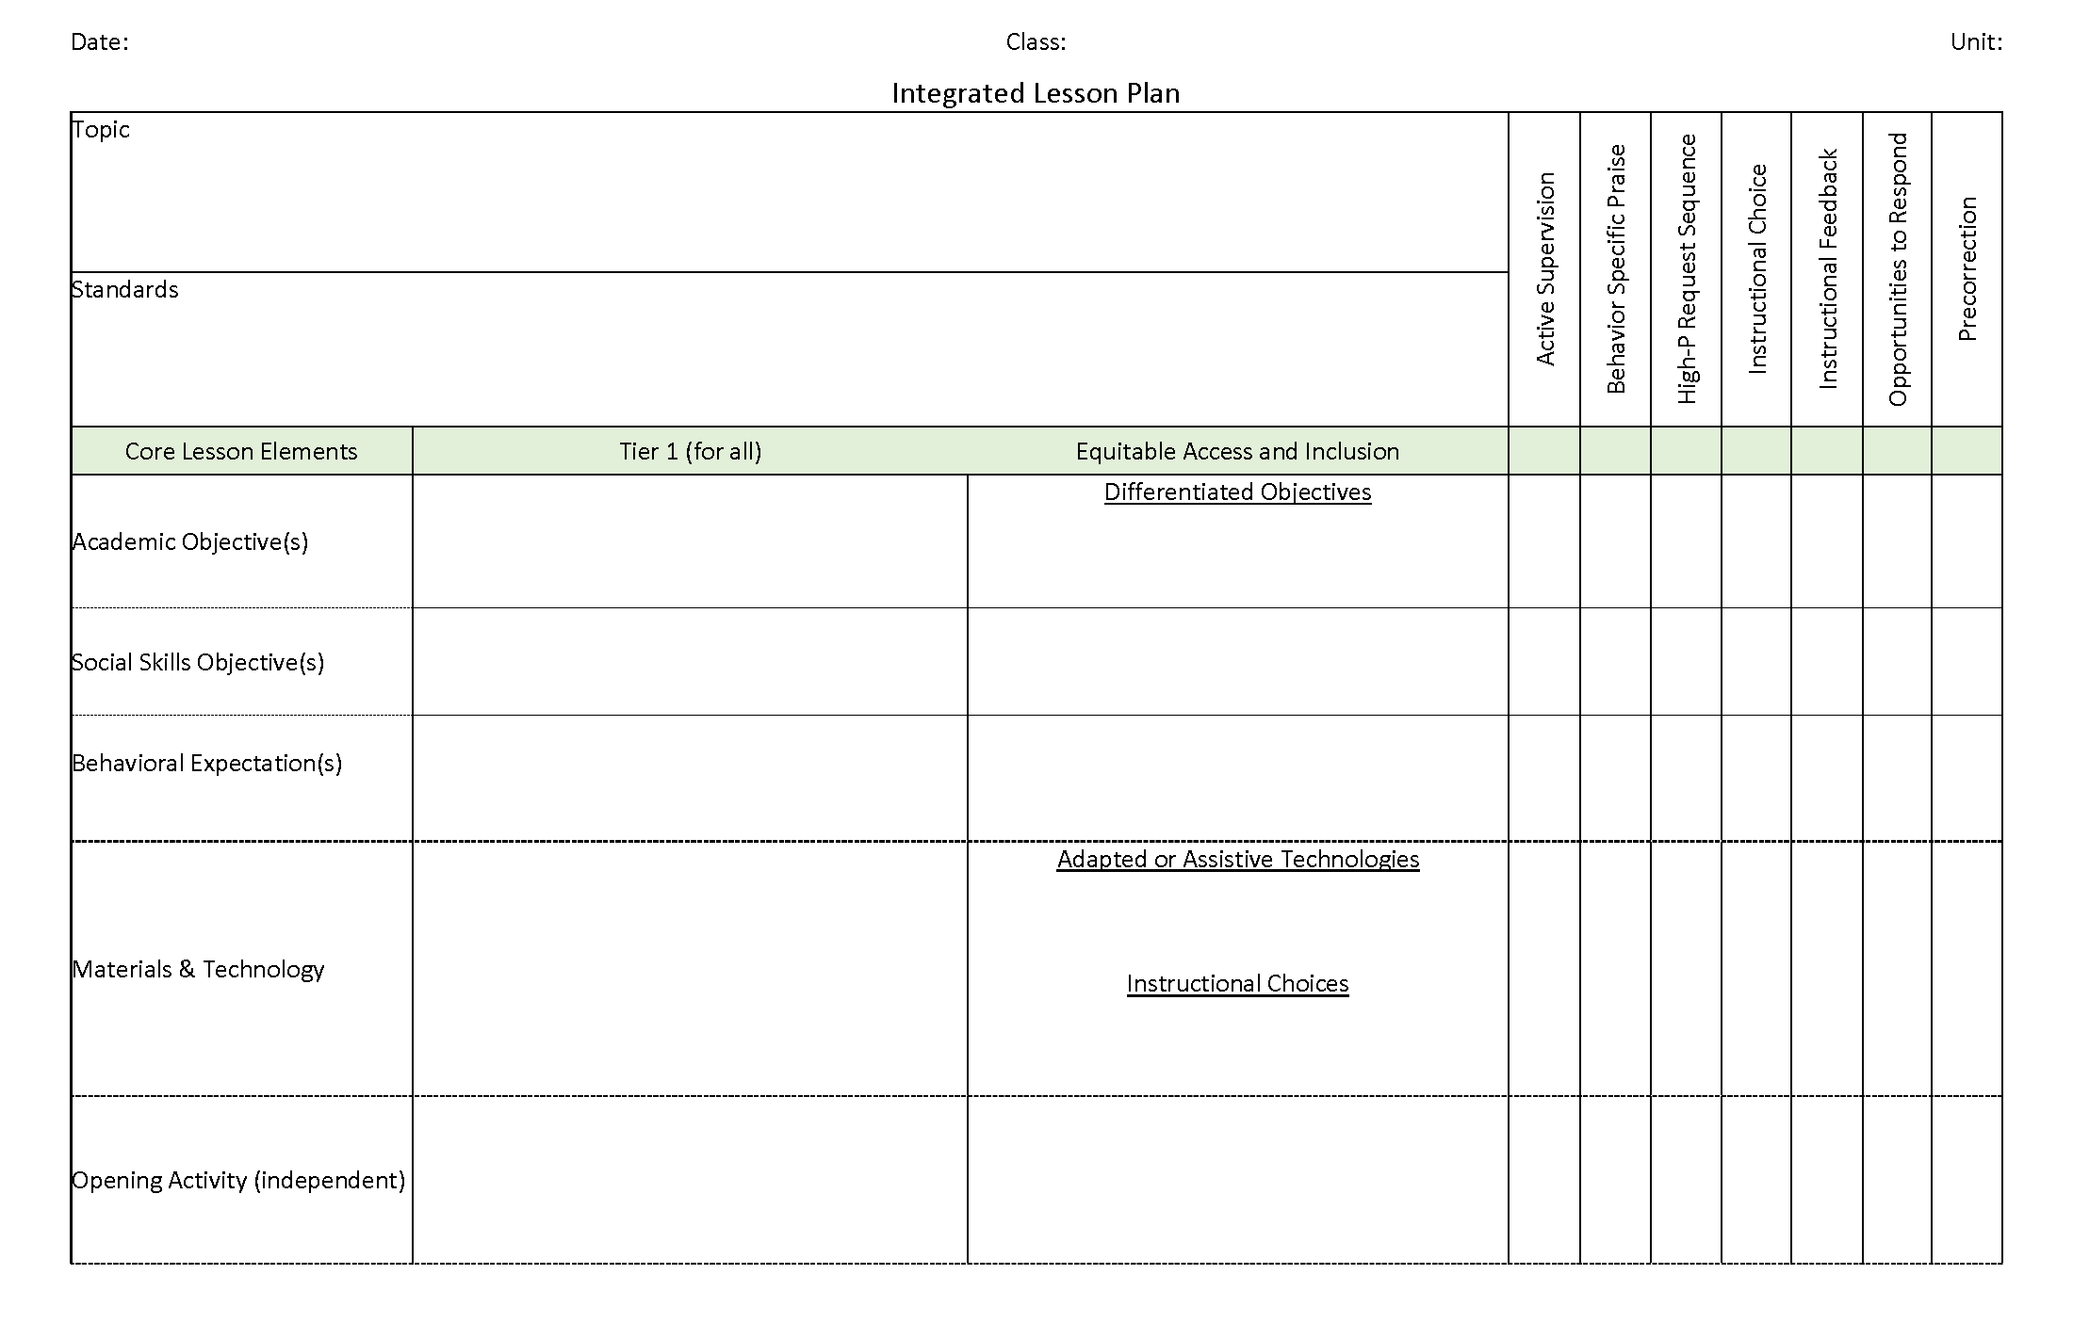
Ci3T Integrated Lesson Planning
Citation. Oakes, W. P., Lane, K. L., Lane, K. S., & Buckman, M. M. (2019). Ci3T integrated lessons plan template. www.ci3t.org.
Completed examples available in: Ci3T Project ENHANCE Research Team. (2022, July). Embedding and integrating Ci3T domains into daily instruction. Author. https://doi.org/10.17161/ci3t.42880

Slide 23
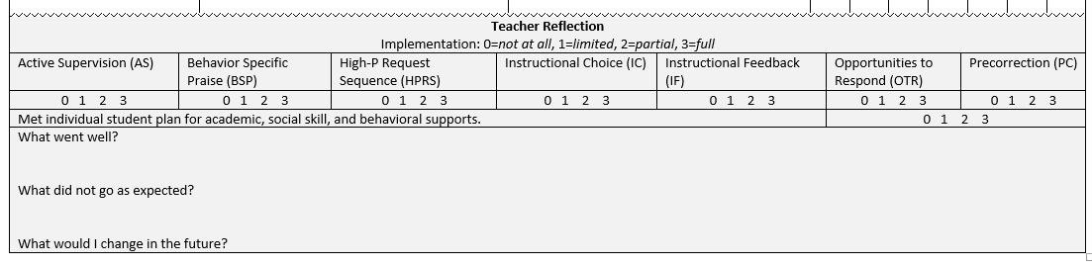
Integrated Lesson Plan
Citation. Oakes, W. P., Lane, K. L., Lane, K. S., & Buckman, M. M. (2019). Ci3T integrated lessons plan template. www.ci3t.org.​

Slide 24
Using Systematic Screening Data to:
Empower Teachers with Low-Intensity Strategies
A focus on integrated tiered systems
The research reported here was supported by the Institute of Education Sciences, U.S. Department of Education, through Grants R324N190002 and R324X220067 to University of Kansas. The opinions expressed are those of the authors and do not represent views of the Institute or the U.S. Department of Education.

Slide 25
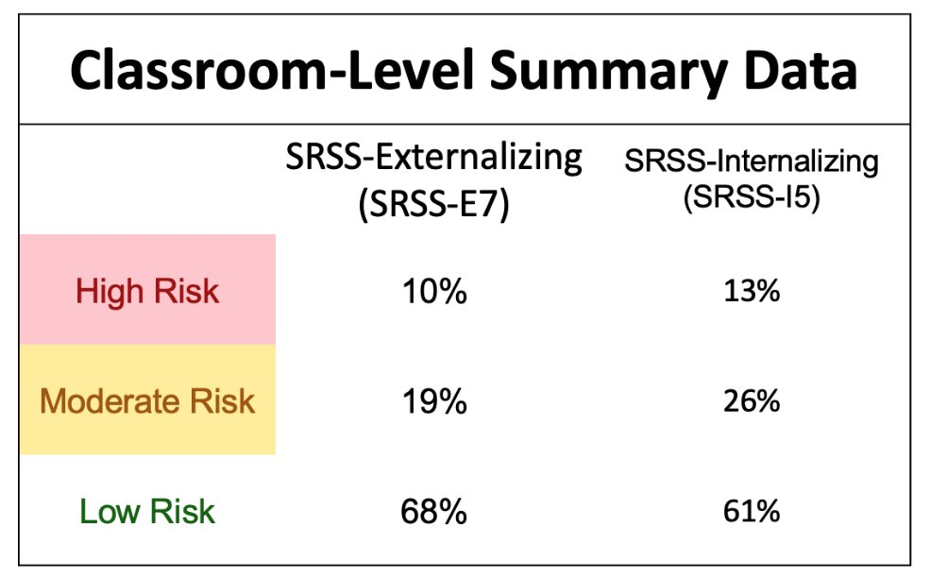
Data to Indicate a Focus on Low-Intensity Teacher-Delivered Strategies

Slide 26

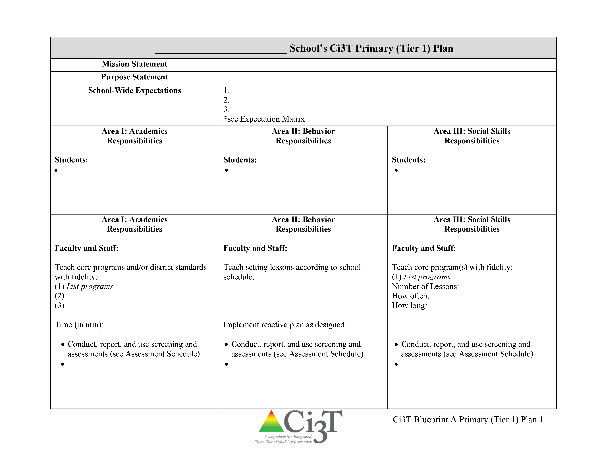

Low-Intensity Teacher-Delivered Strategies

Slide 27

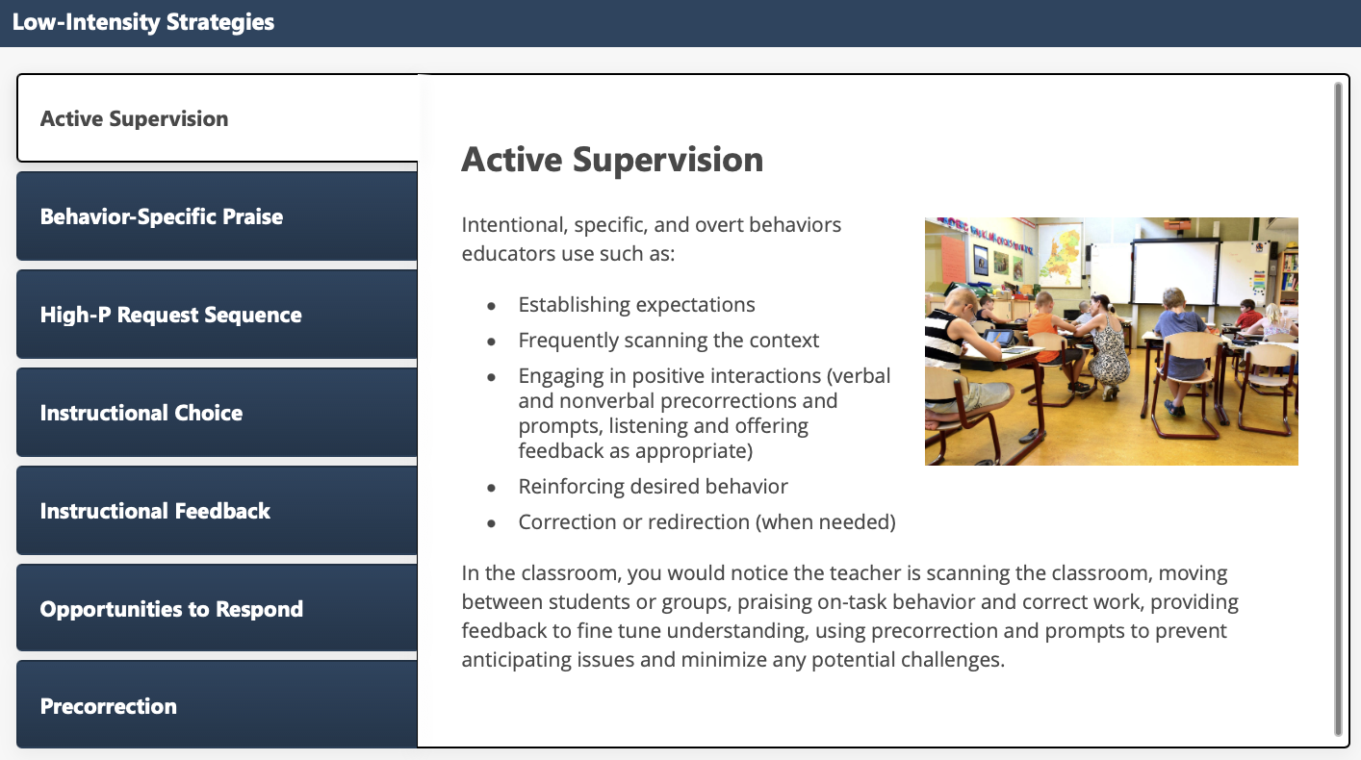
Low-Intensity Strategies: Academic Supervision

Slide 28
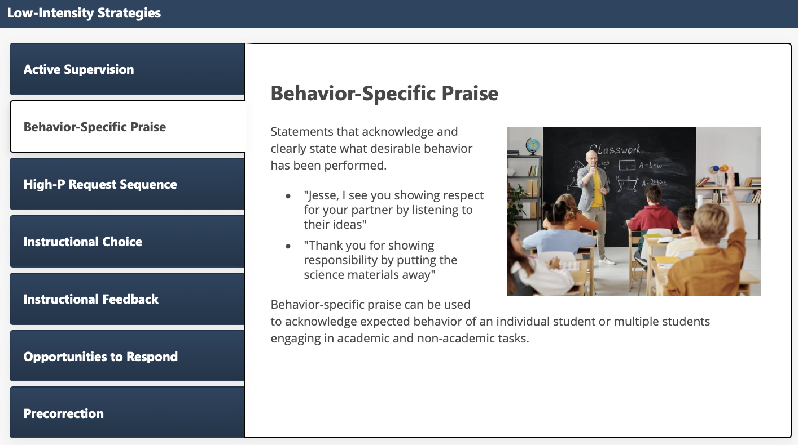
Low-Intensity Strategies: Behavior-Specific Praise

Slide 29
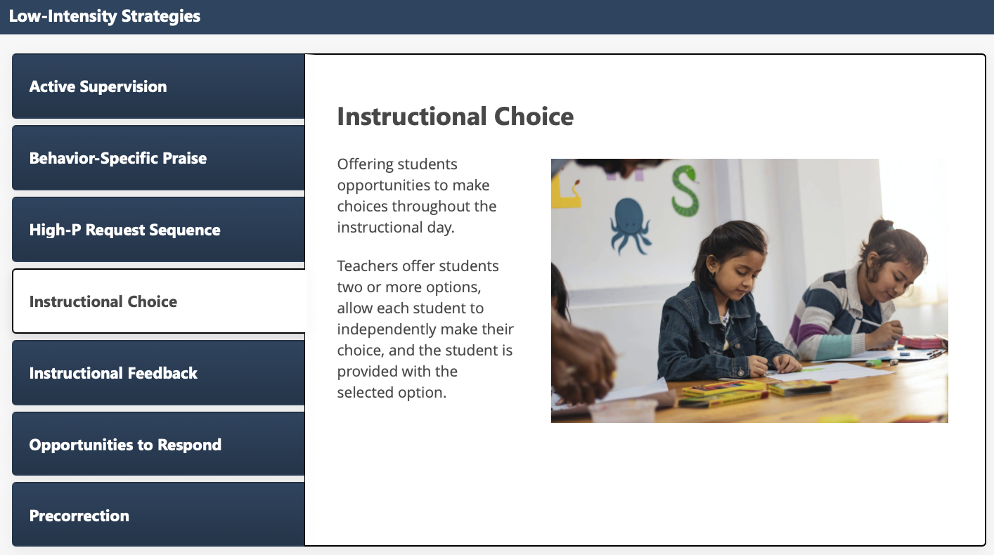
Low-Intensity Strategies: Instructional Choice

Slide 30
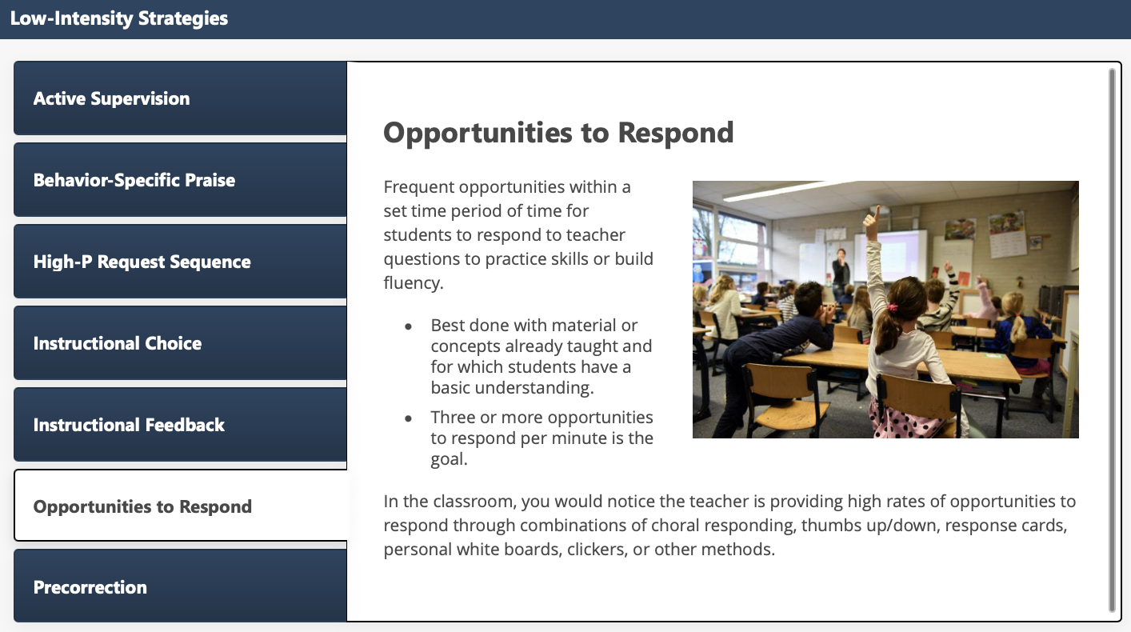
Low-Intensity Strategies: Opportunities to Respond

Slide 31
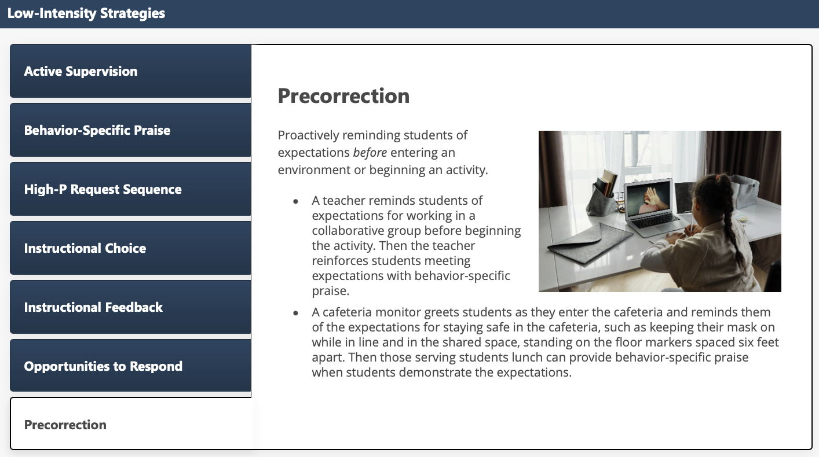
Low-Intensity Strategies: Precorrection

Slide 32

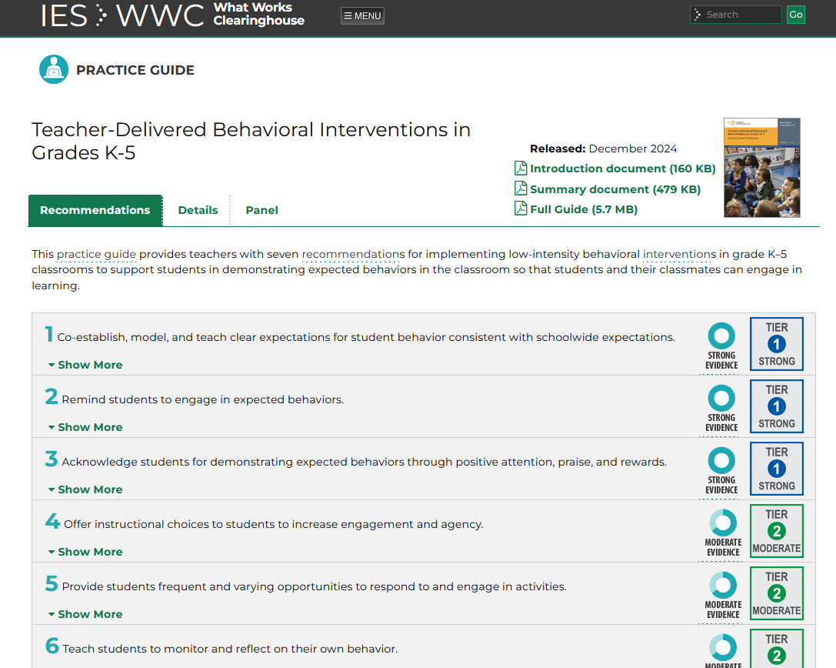
Resource Spotlight! See Presentation from 2L
Notes:
What Works Clearing House Practice Guide – Teacher-Delivered Behavioral Interventions in Grades K-5 https://ies.ed.gov/ncee/wwc/PracticeGuide/31

Slide 33
Using Systematic Screening Data to:
Connect Students to Tier 2 and Tier 3 Interventions
A focus on integrated tiered systems
The research reported here was supported by the Institute of Education Sciences, U.S. Department of Education, through Grants R324N190002 and R324X220067 to University of Kansas. The opinions expressed are those of the authors and do not represent views of the Institute or the U.S. Department of Education.

Slide 34
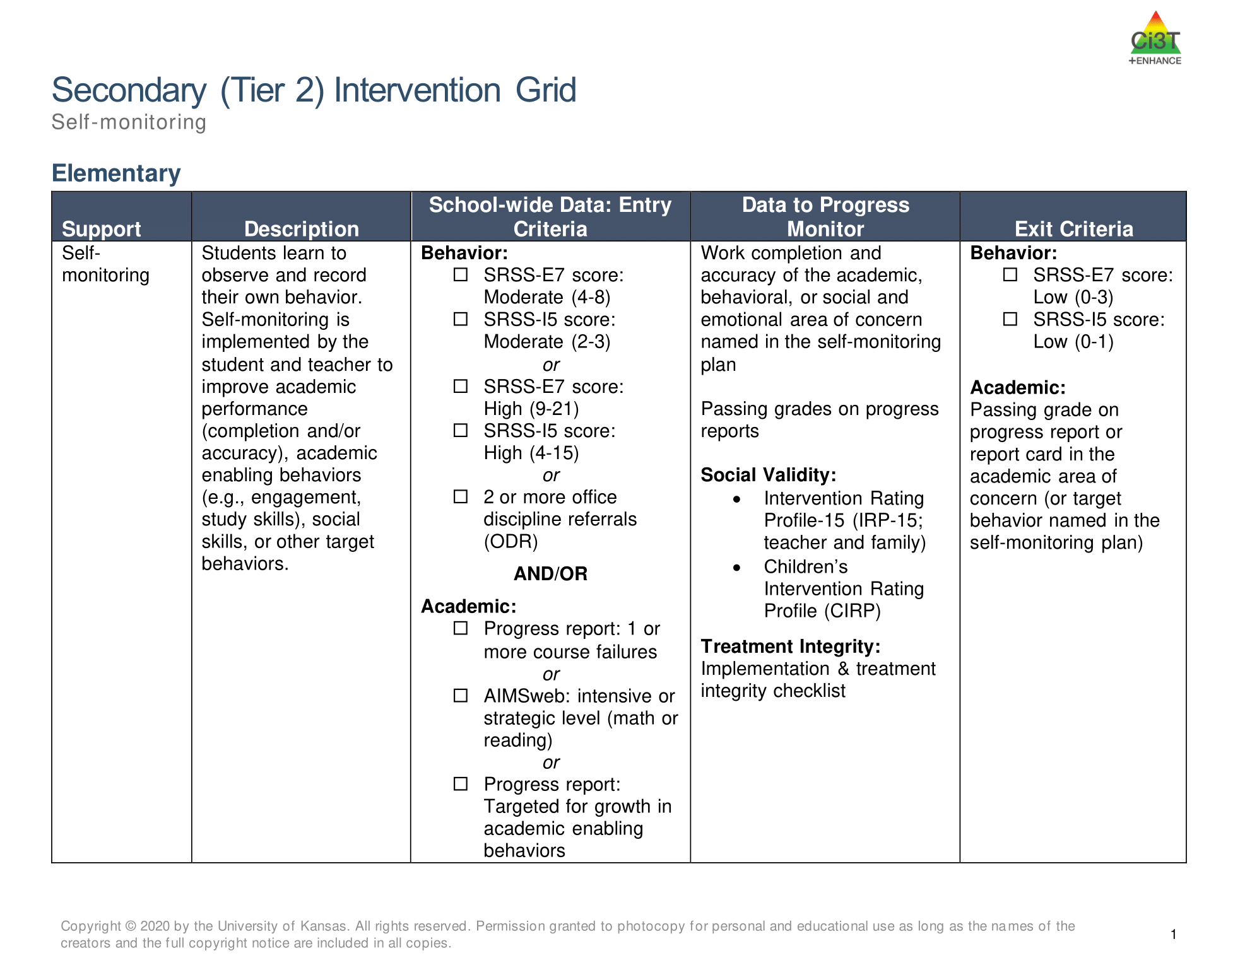
Tier 2 and Tier 3 Intervention Grids
Notes:
Support is the name of the strategy, practice, or program. Notice this is not the name of a person or role.

Slide 35
Secondary (Tier 2) Intervention Grid

Slide 36

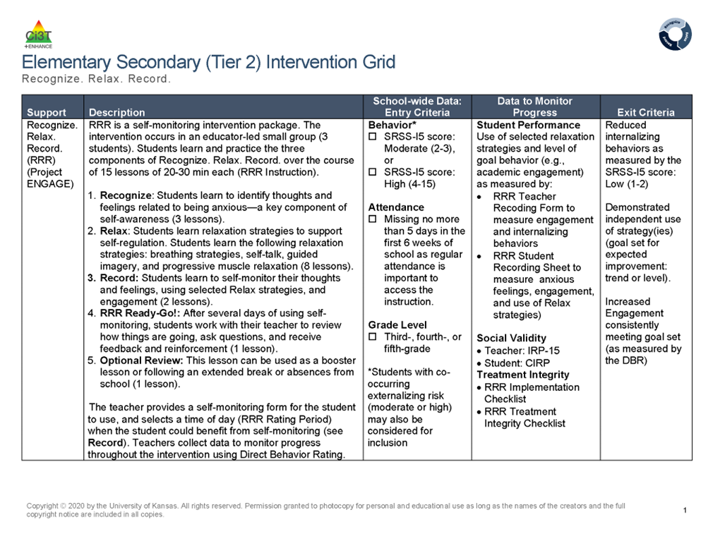
Tier 2: Recognize. Relax. Record.

Slide 37
Tertiary (Tier 3) Intervention Grid

Slide 38

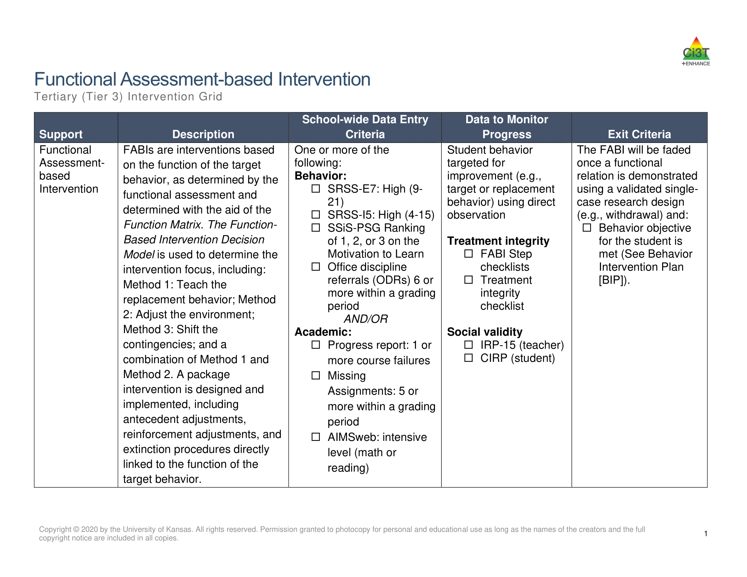
Tier 3: Functional Assessment-Based Intervention

Slide 39
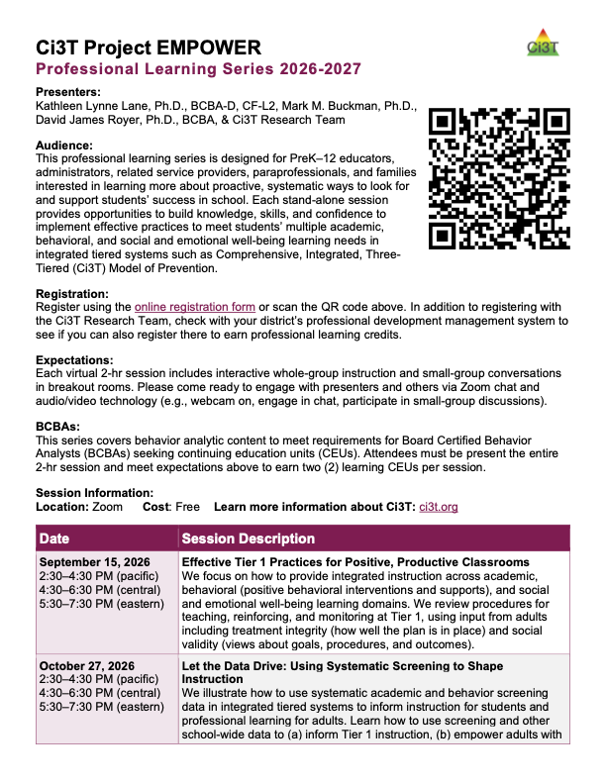
Project EMPOWER
EMPOWER Session | Date
Effective Tier 1 Practices for Positive, Productive Classrooms | September 15, 2026
Let the Data Drive: Using Systematic Screening to Shape Instruction | October 27, 2026
Ci3T in Action: Integrated Lesson Planning for Optimal Instruction | November 17, 2026
A 6-Step Instructional Approach for Responding to Challenging Behavior in Schools | January 20, 2027
A Tier 2 Intervention for Managing Anxious Feelings: Recognize. Relax. Record. | March 23, 2027
A Tier 3 Intervention: Functional Assessment-Based Intervention | April 28, 2027

Slide 40
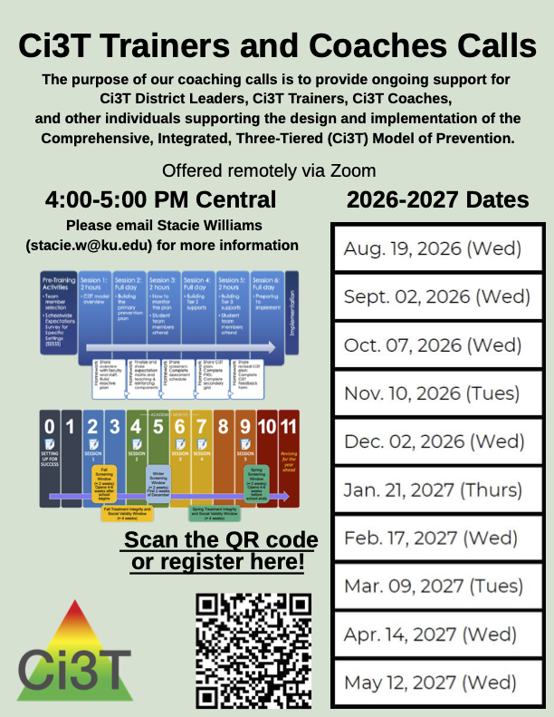
Ci3T Trainers and Coaches Calls
Ci3T Trainers and Coaches Calls Session | Date
Ci3T Trainers and Coaches Call 1 | August 19, 2026 (Wednesday)
Ci3T Trainers and Coaches Call 2 | September 2, 2026 (Wednesday)
Ci3T Trainers and Coaches Call 3 | October 7, 2026 (Wednesday)
Ci3T Trainers and Coaches Call 4 | November 10, 2026 (Tuesday)
Ci3T Trainers and Coaches Call 5 | December 2, 2026 (Wednesday)
Ci3T Trainers and Coaches Call 6 | January 21, 2027 (Thursday)
Ci3T Trainers and Coaches Call 7 | February 17, 2027 (Wednesday)
Ci3T Trainers and Coaches Call 8 | March 9, 2027 (Tuesday)
Ci3T Trainers and Coaches Call 9 | April 14, 2027 (Wednesday)
Ci3T Trainers and Coaches Call 10 | May 12, 2027 (Wednesday)
Notes:
Ci3T Trainers and Coaches Calls are a great opportunity to come and ask questions! These are not recorded the agenda focuses on “open mic” time where people can come to ask their honest questions and talk through implementation challenges. This is a great avenue to ask questions, listen, and learn from Ci3T implementers across the country and internationally.

Slide 41
Highlighting Systematic Screening in Sedro-Woolley
A focus on integrated tiered systems
The research reported here was supported by the Institute of Education Sciences, U.S. Department of Education, through Grants R324N190002 and R324X220067 to University of Kansas. The opinions expressed are those of the authors and do not represent views of the Institute or the U.S. Department of Education.

Slide 42
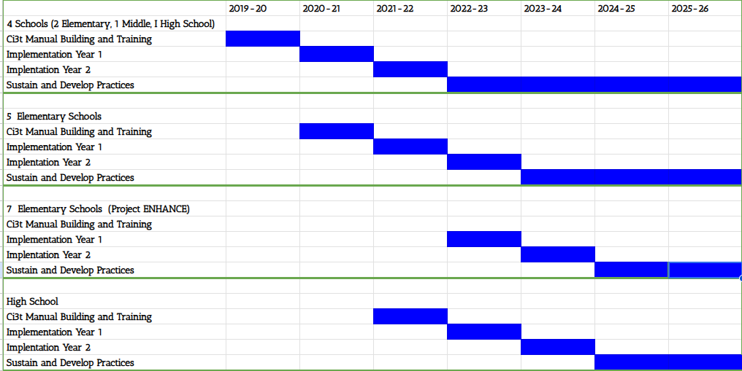
Our Ci3T Journey

Slide 43
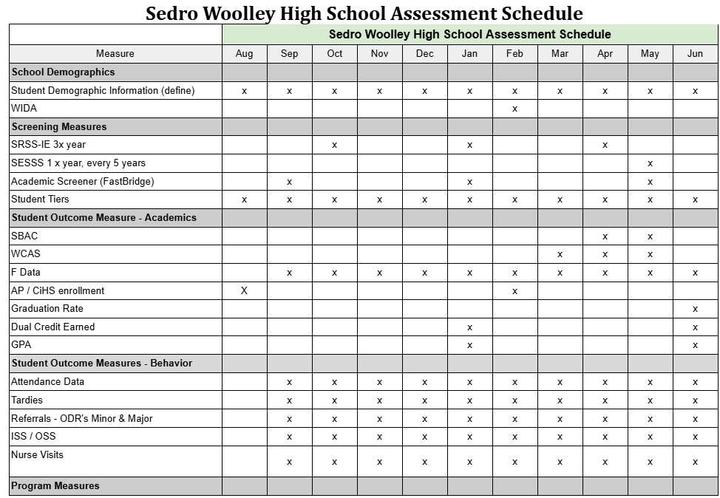
Assessment Schedule

Slide 44
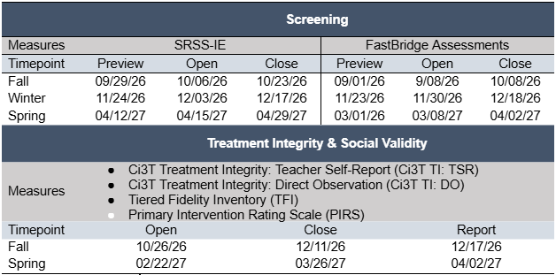
Assessment Schedule – Behavior Screening

Slide 45
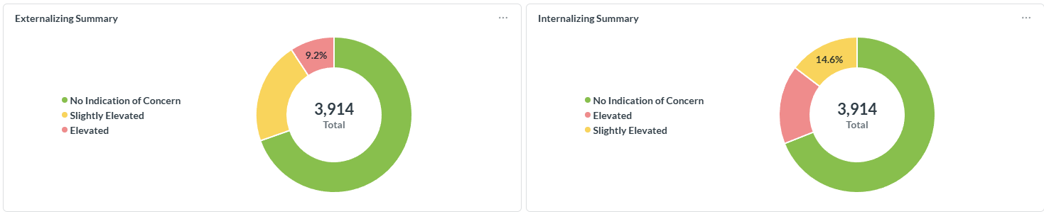
Behavior Screening Data Collection
21.21%
69.6%
16.38%
68.98%

Slide 46
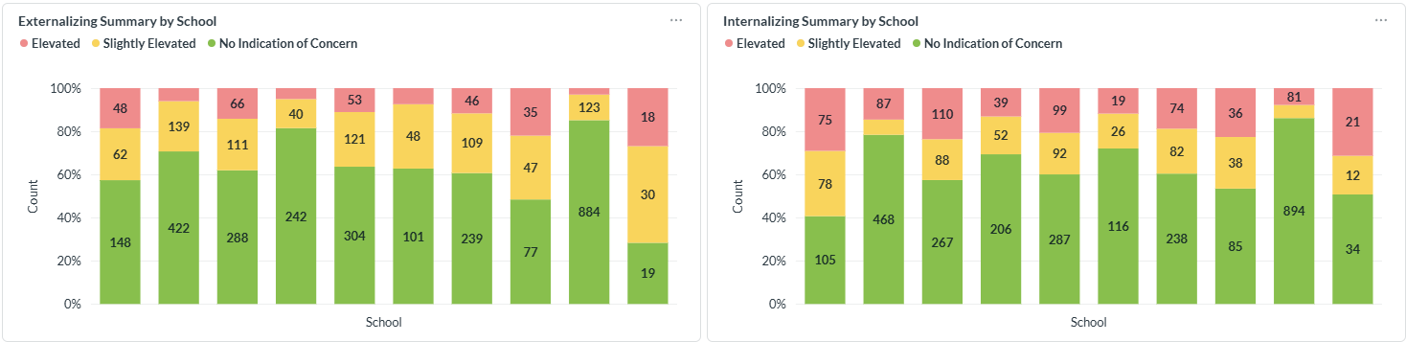
Behavior Screening Data Collection – by school

Slide 47
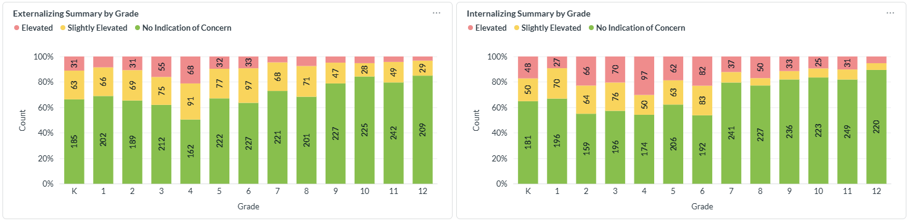
Behavior Screening Data Collection – by grade

Slide 48
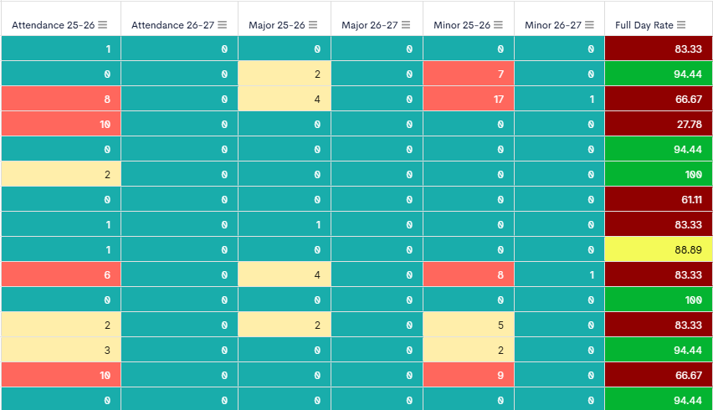
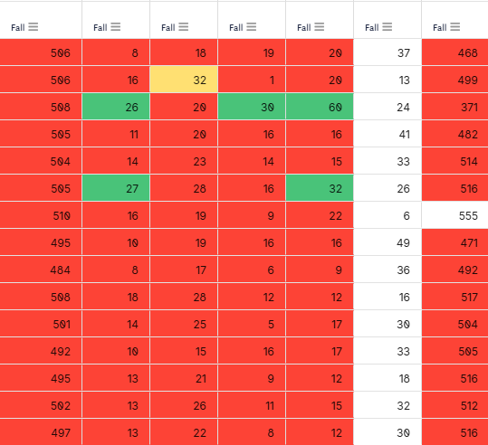
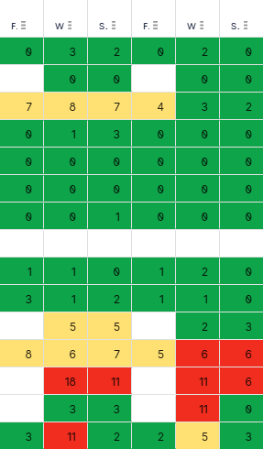
Utilizing a Student Dashboard
Example 1
Attendance
Office Discipline Referrals
Academic Screening Data
SRSS-IE Data

Slide 49
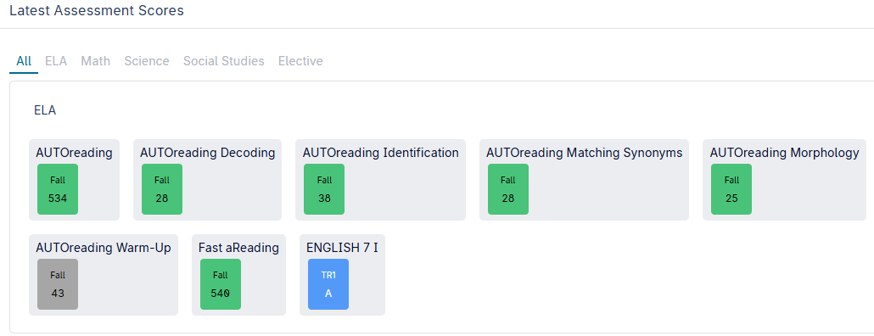
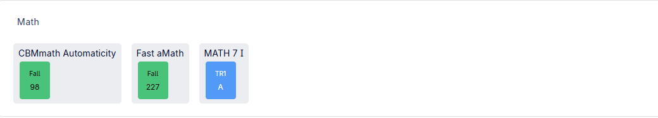
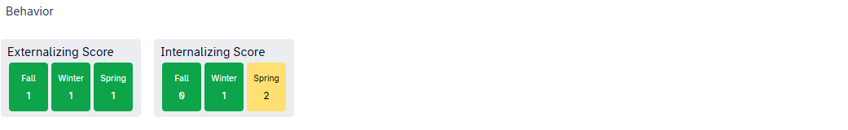
Utilizing a Student Dashboard
Example 2

Slide 50
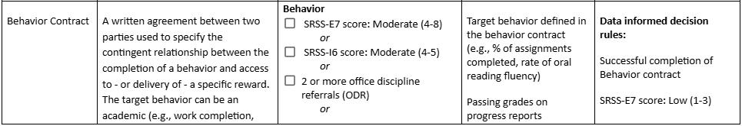
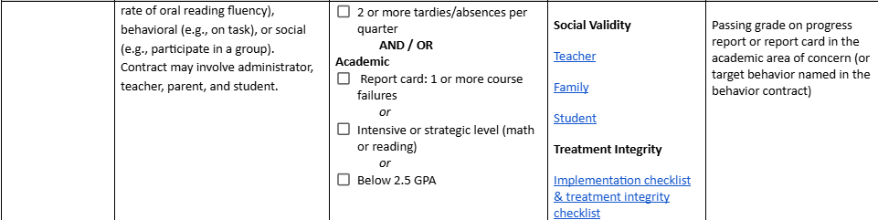
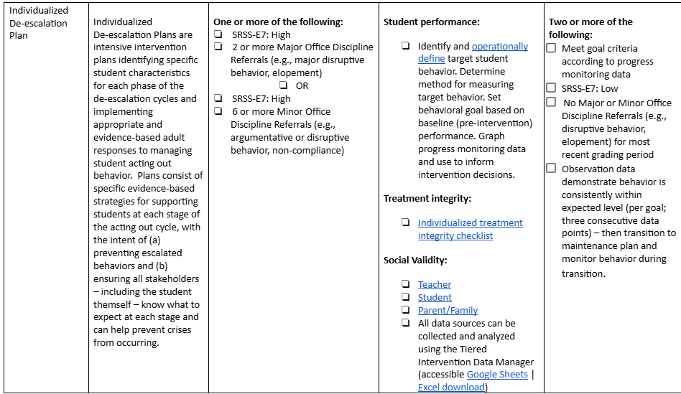
Connecting Students to Interventions
Tier 2 Interventions
Tier 3 Interventions

Slide 51
Connecting Students to Interventions
Samish Elementary
LAP funding (braided funding model with SpEd)
Master Schedule that protects core instruction for ALL learners
Scheduled Intervention blocks = acceleration for all
Inclusionary Plan developed at the beginning of the year and Belonging rubric completed/reviewed 3x per year for students with the highest needs in general education
Cascade Middle School
School-wide interventions- 3 days/week
No interruption to core instruction time
Math and Reading Focused- need dependent, based on data
Group size based on level of intervention need
All hands on deck- groups taught by all staff

Slide 52
Accessing Resources
A focus on integrated tiered systems
The research reported here was supported by the Institute of Education Sciences, U.S. Department of Education, through Grants R324N190002 and R324X220067 to University of Kansas. The opinions expressed are those of the authors and do not represent views of the Institute or the U.S. Department of Education.

Slide 53



Systematic Screening Resources
Notes:
https://www.pbis.org/resource/resources-to-support-systematic-screening-in-k-12-schools

Slide 54
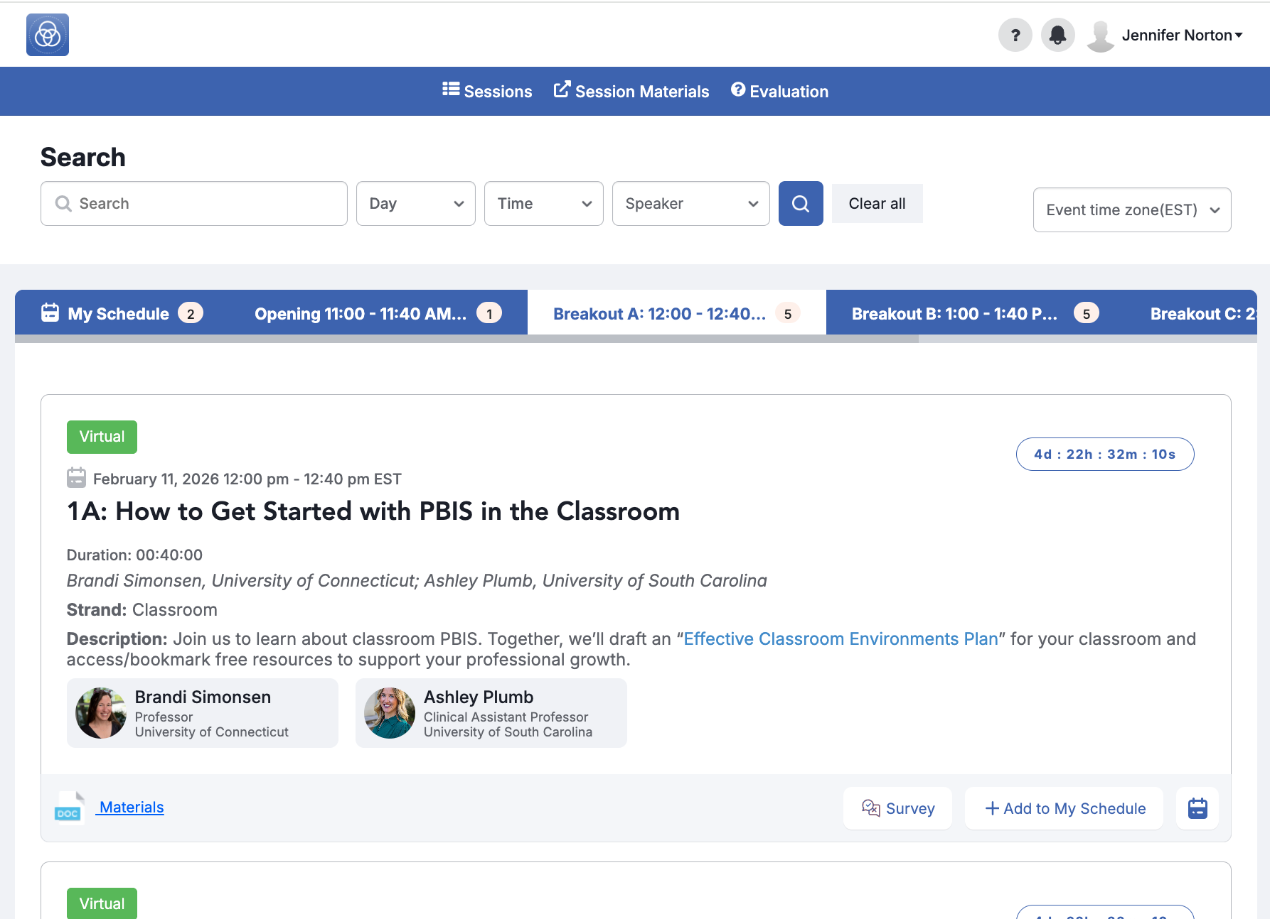
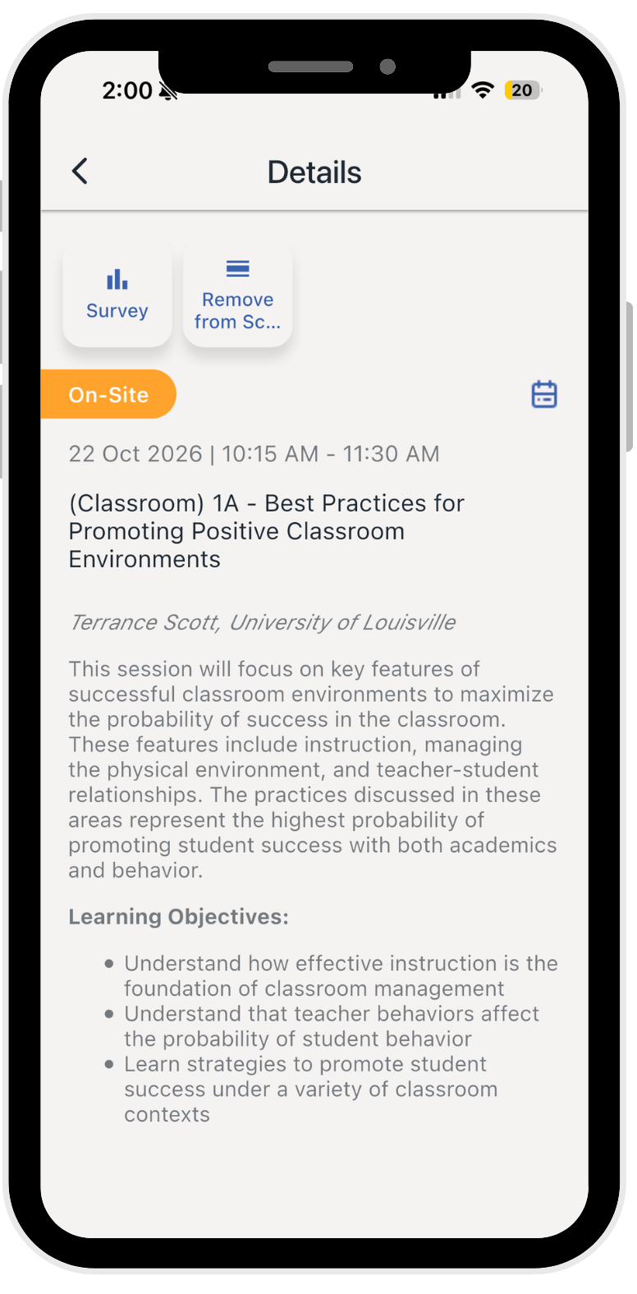



We Value Your Feedback
✅ Complete all session evaluations and the overall evaluation in the event app.
Each session evaluation can be found in its listing in the agenda.
The overall evaluation can be found in the general menu.
Notes:
Data is one of the five Essential Elements of PBIS! So help us, and make sure to complete evaluations for EVERY session you are in, as well as for the keynotes, and for the overall event.

