Slide 1
From Data to Action: Using Systematic Screening Data to Inform Instruction
EMPOWER Session 2

Slide 2
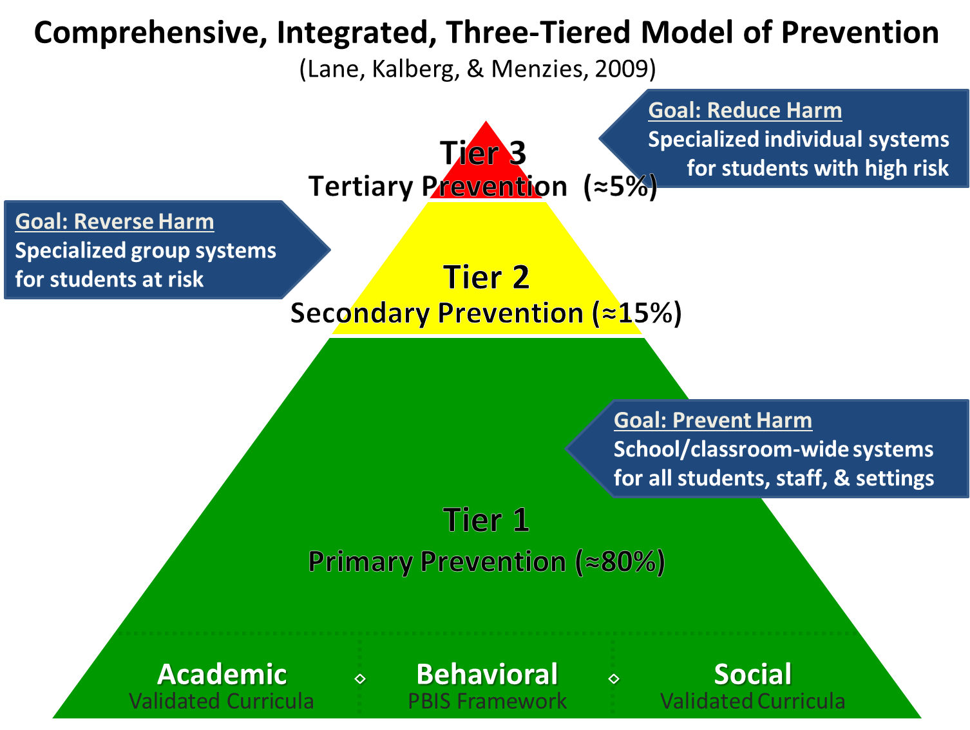
Comprehensive, Integrated, Three-Tiered Model of Prevention

Slide 3
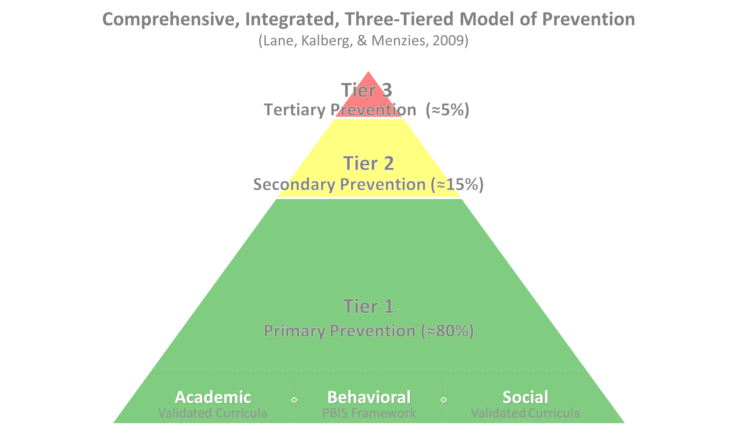

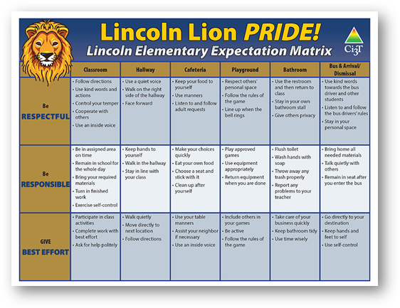
Tier 1
Positive Behavioral Interventions and Supports
District & State Standards Quality Instruction
Validated Curricula and Resources

Slide 4

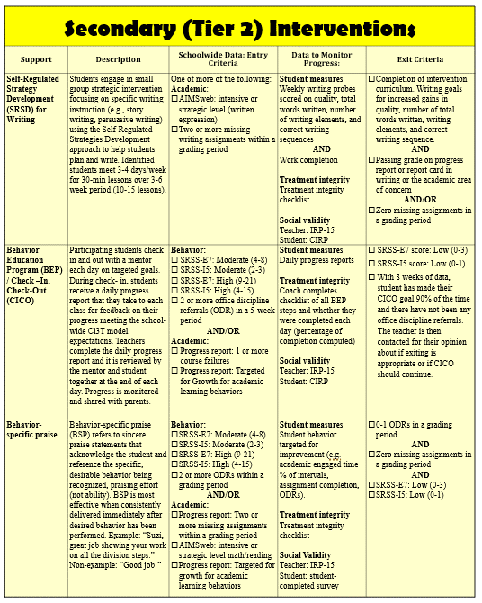
Tier 2 Intervention Grid
Notes:
In addition to the module featured here outlining how to use multiple sources of data to connect students with Tier 2 supports, we offer a full suite of modules highlighting validated Tier 2 interventions such as Self-Regulated Strategy Development (SRSD) for Writing and Check-In/Check Out that may appear in your Secondary (Tier 2) Intervention Grid

Slide 5

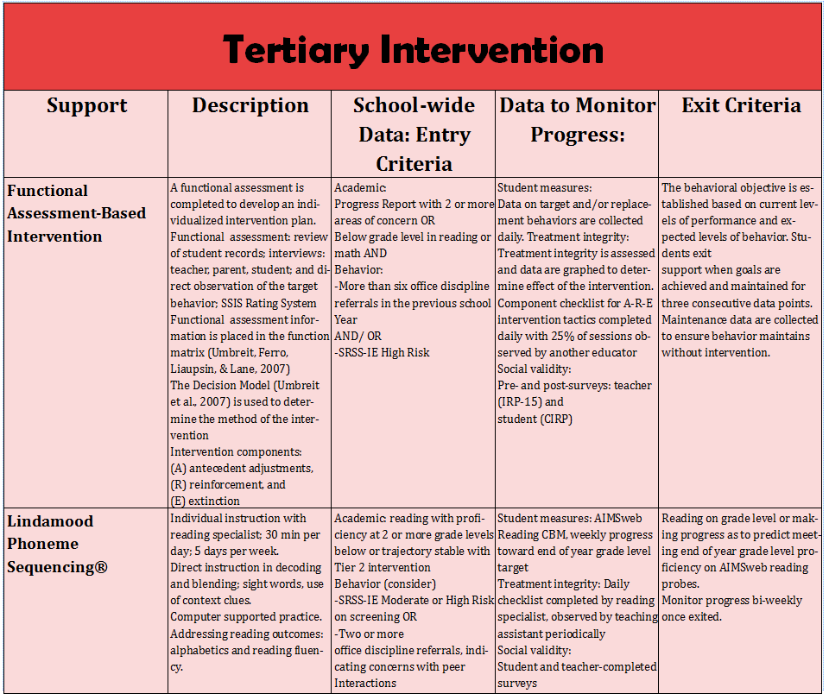
Tier 3 Intervention Grid
Notes:
In addition to the module featured here outlining how to use multiple sources of data to connect students with Tier 3 supports, we offer a full suite of modules highlighting validated Tier 3 interventions such as Functional Assessment-Based Intervention (FABI) that may appear in your Tertiary (Tier 3) Intervention Grid

Slide 6
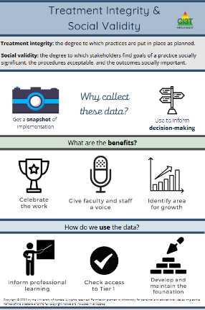
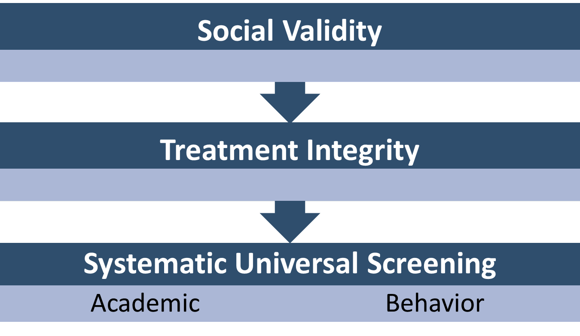
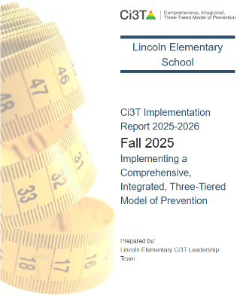
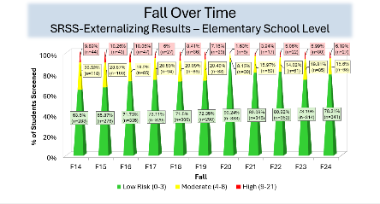
Essential Components of Tier 1 Efforts

Slide 7
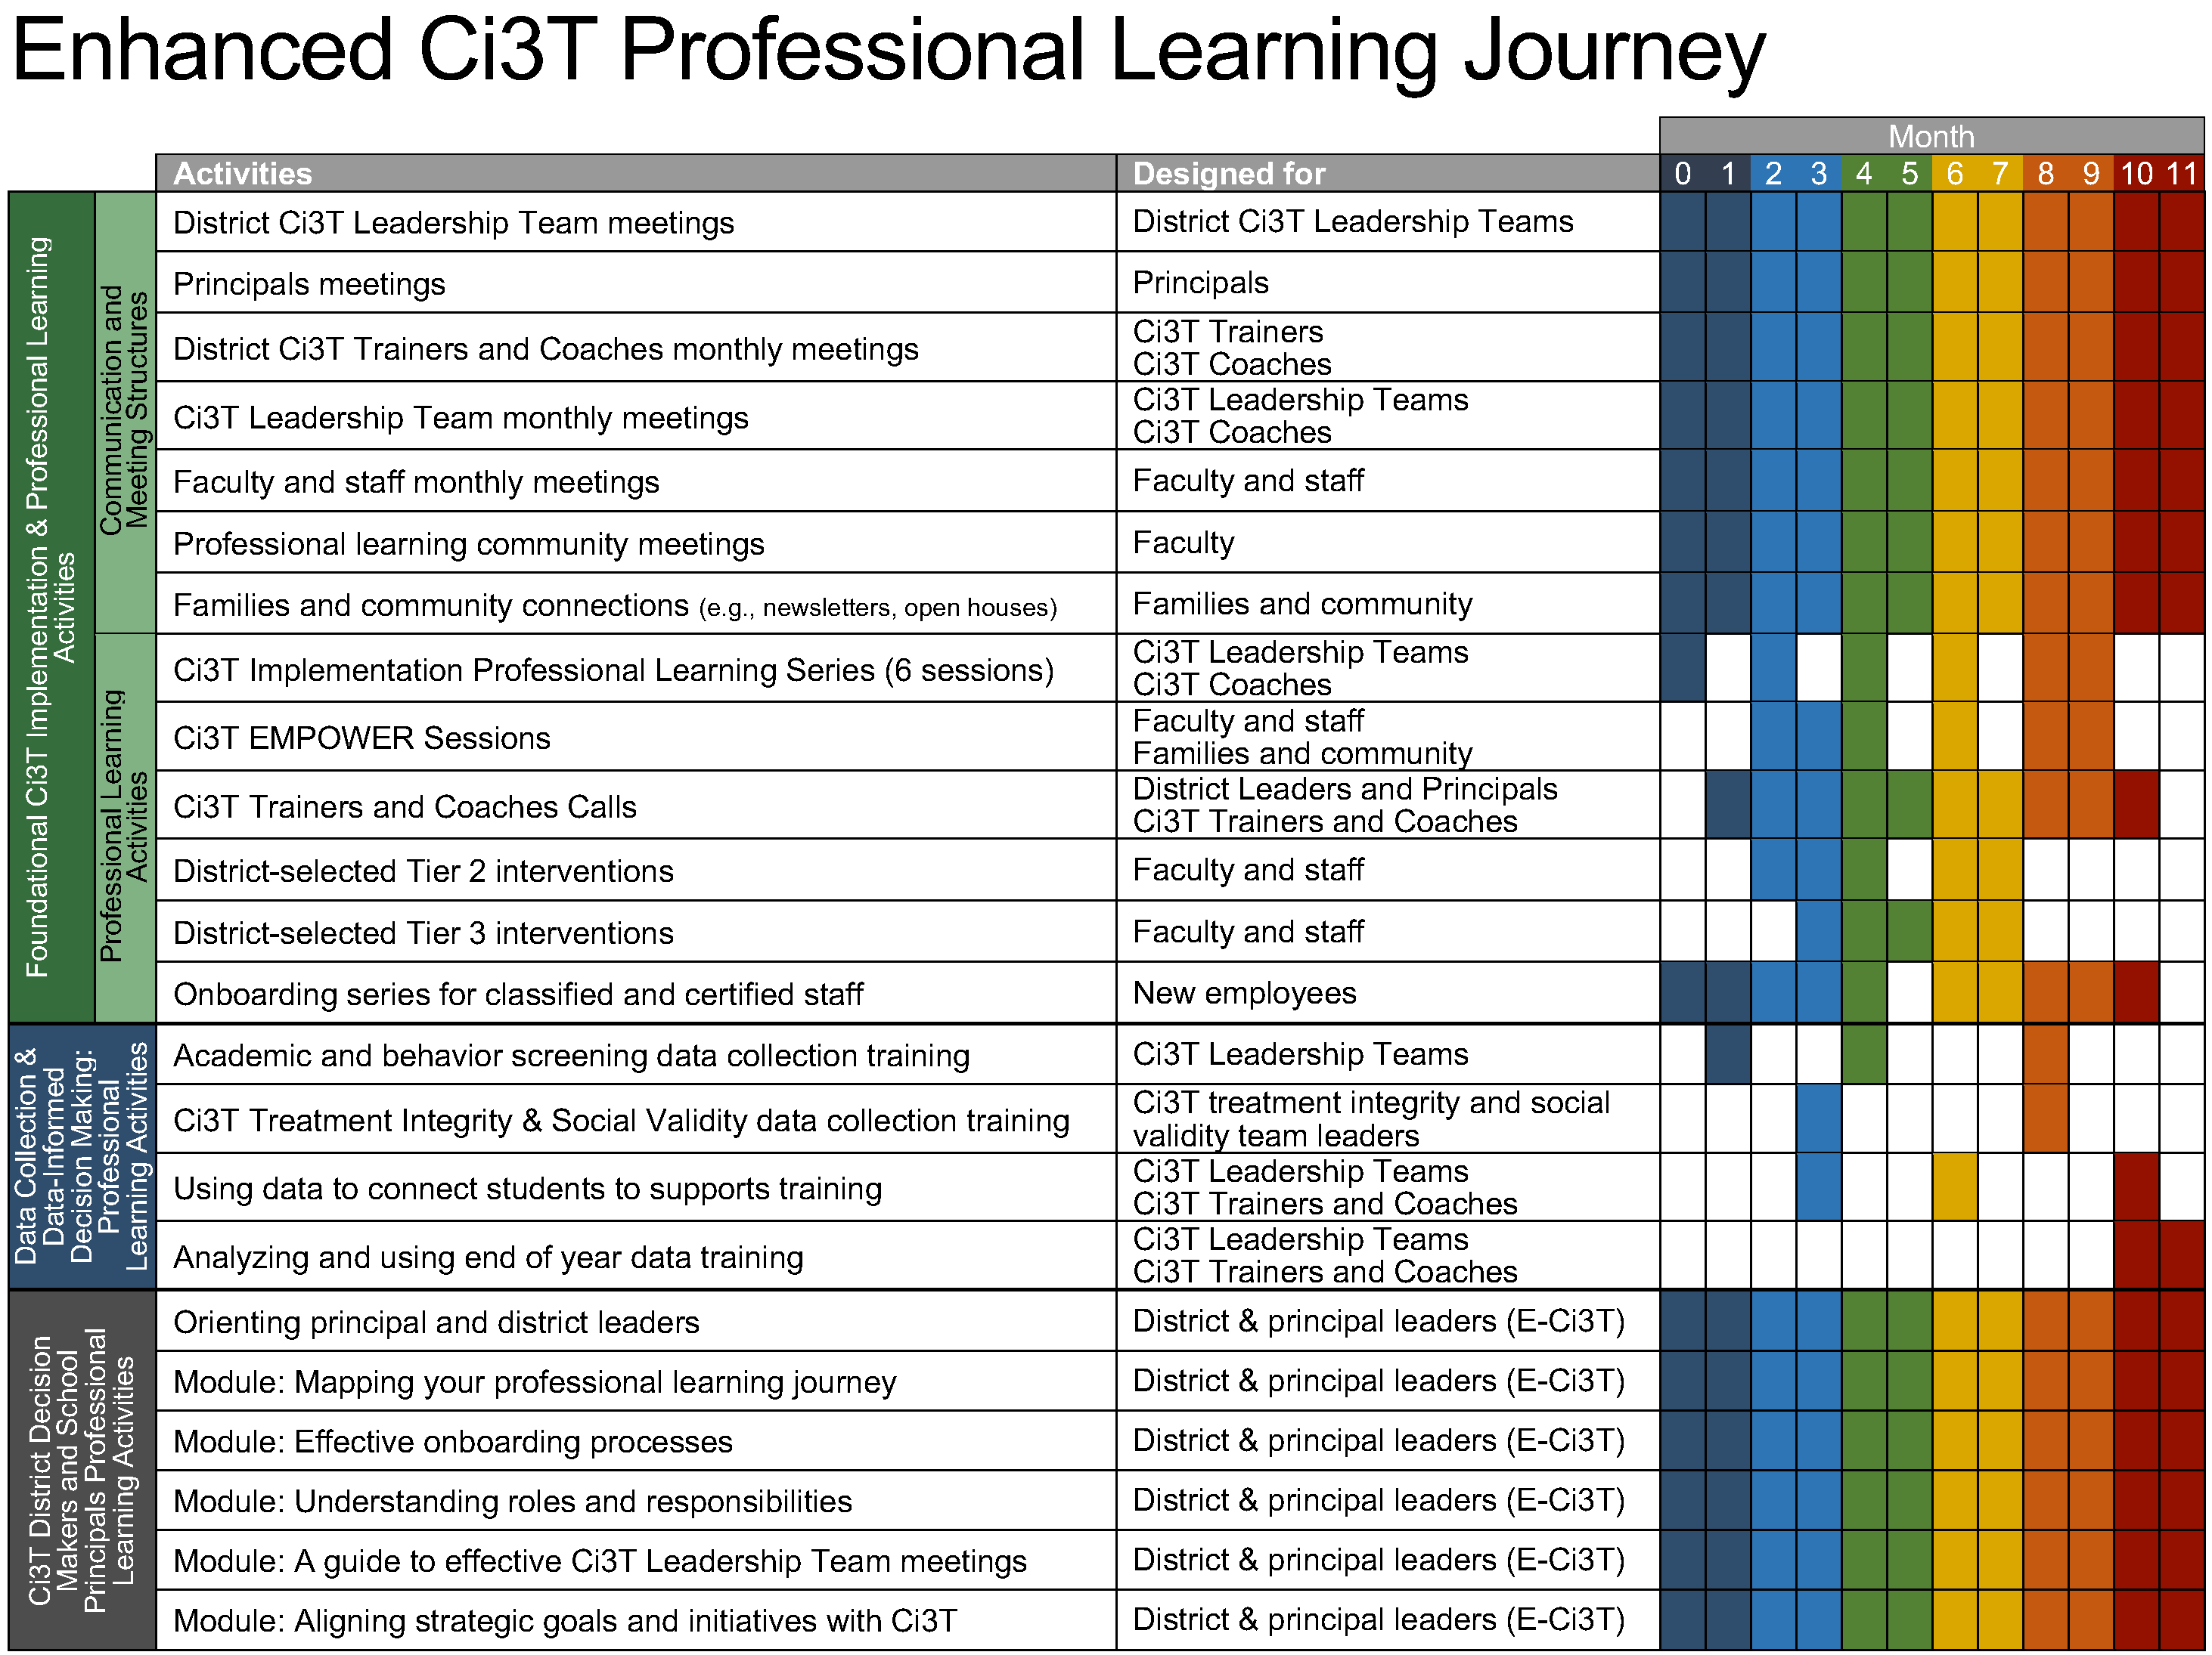
Ci3T Implementation Series and Delivery

Slide 8
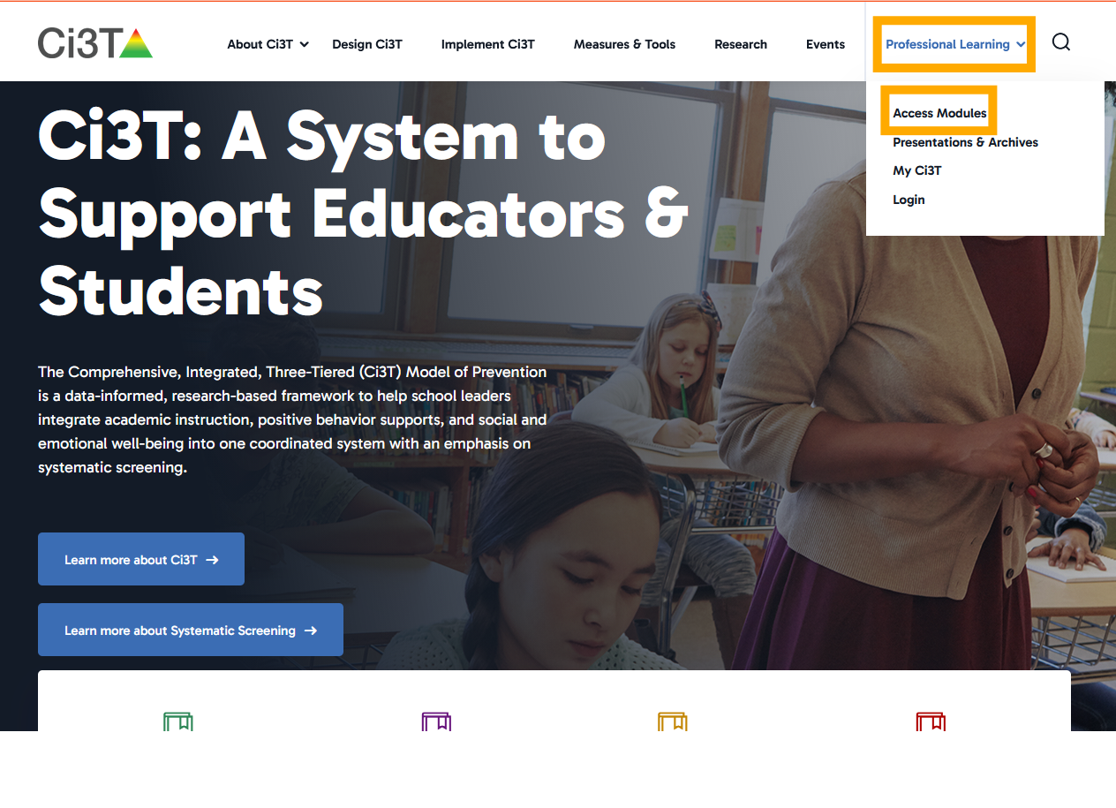

Access Instructions: Ci3T Modules

Slide 9
Session Outcomes
Explain the purpose and key features of systematic screening within Comprehensive, Integrated, Three-tiered (Ci3T) models of prevention.
Describe how to use systematic screening data to inform instruction at Tier 1, empower teachers use of low-intensity strategies, and connect students to validated Tier 2 and Tier 3 supports.
Explain the importance of monitoring treatment integrity, social validity, and student performance at each level of prevention.

Slide 10

TFI Version 3 Connection
TFI Item | Description
1.18 USING SCHOOL AND COMMUNITY DATA TO INFORM TIER 1 | Tier 1 leadership team has regular access to and uses a variety of additional schoolwide (e.g., school climate surveys, attendance, nurse or counselor visit logs, universal screening) and community data sources (e.g., community resource profiles, basic needs [e.g., food and housing], health care access, community events), to develop and regularly re-evaluate a profile of overall strengths and needs that informs the development and delivery of equitable Tier 1 foundational and classroom practices
1.10 CLASSROOM PRACTICE | Educators consistently and equitably implement positive and proactive classroom practices—including building relationships with students; developing a safe environment; prompting predictable routines and expected behavior; actively providing OTRs, active supervision, and specific feedback (i.e., specific praise and supportive corrections); and ensuring a high ratio (≥ 5:1) of positive to corrective feedback.

Slide 11
Agenda
Welcome
Situating Systematic Screening in Ci3T Models
Using Systematic Screening Data to:
  Inform Instruction at Tier 1
  Empower Teachers with Low-Intensity Strategies
  Connect Students to Validated Tier 2 and Tier 3 Supports
Wrapping Up and Moving Forward

Slide 12
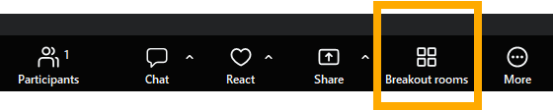
Updated Procedures: Breakout Rooms
During work times, you will choose your own breakout room!
Breakout rooms will not open / close – our coaches will help keep track of time so you know when to return to the main room
If you need help moving to a breakout room, let us know in the chat!
Notes:
We are so glad you’re here! Our goal is to have a warm, welcoming, positive, and productive learning environment with many engagement opportunities! To support these efforts, we are implementing two new procedures.
First, we are not going to open and close breakout rooms. This means you will need to move yourself into a breakout room and come back when the talk time is over! Our coaches will help you keep time. If you are on a phone or have difficulty moving yourself into a breakout room, just let us know in the chat and we are happy to help.

Slide 13
Updated Procedures: Session Evaluation
Please update your zoom name to include your first and last name
  If you need help renaming yourself – please let us know in the chat!
If you would like a certificate of attendance, please complete the Session Evaluation within 24 hours (the certificate is generated automatically)
If we have a plan in place to share attendance with your district, we will use the completed session evaluations as verification of attendance and share that list within 3 business days
If you are a BCBA pursuing continuing education units (CEUs), please complete the Session Evaluation within 24 hours – be sure to enter the 4 passwords!
Notes:
Our second set of procedures helps simplify the process for verifying attendance.

Slide 14
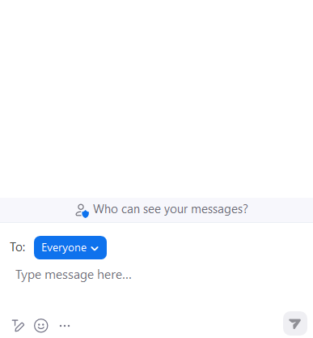
Let’s Chat: What Brings You Here?
Let’s take a moment to revisit our shared purpose…
What brings you here today?
What interests or excites you about today’s content?

Slide 15
Situating Systematic Screening in Ci3T Models

Slide 16
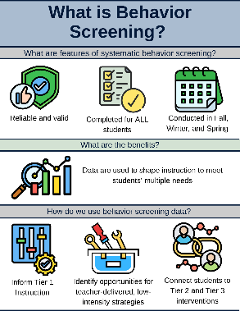
Essential Components Tier 1 Efforts
Systematic Screening

Slide 17
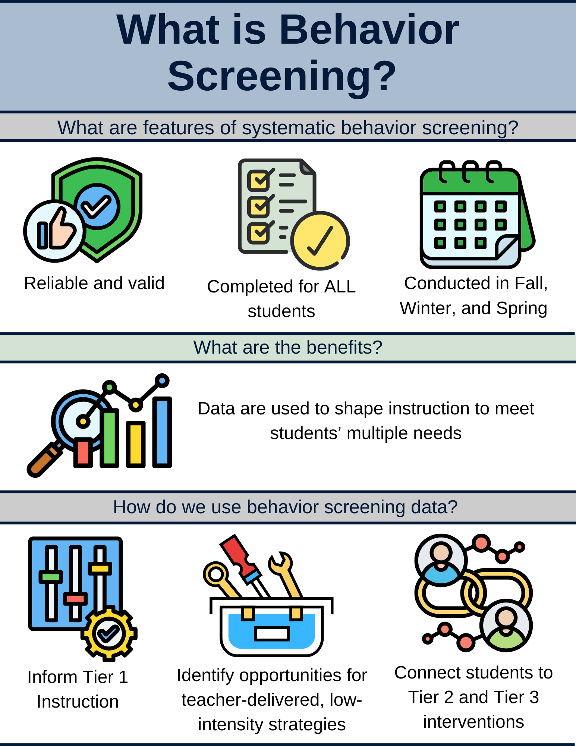
What is Behavior Screening? (1 of 2)

Slide 18
What is Behavior Screening? (2 of 2)

Slide 19
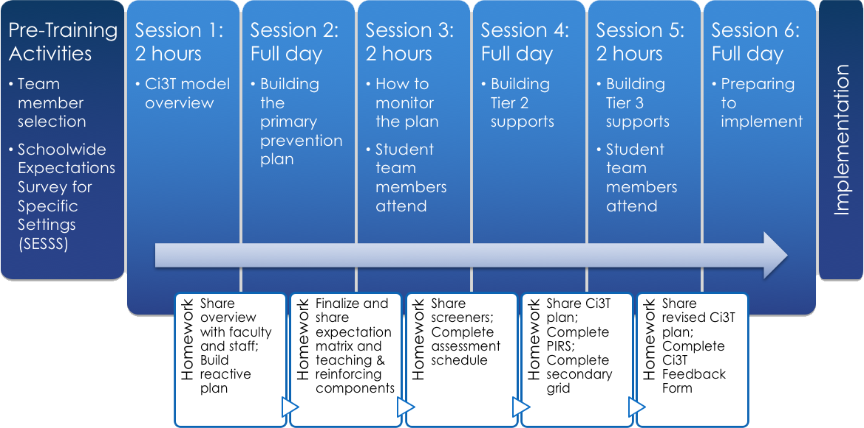

Selecting a Systematic Screener
Notes:
https://www.pbis.org/resource/selecting-a-universal-behavior-screening-tool-questions-to-consider

Slide 20
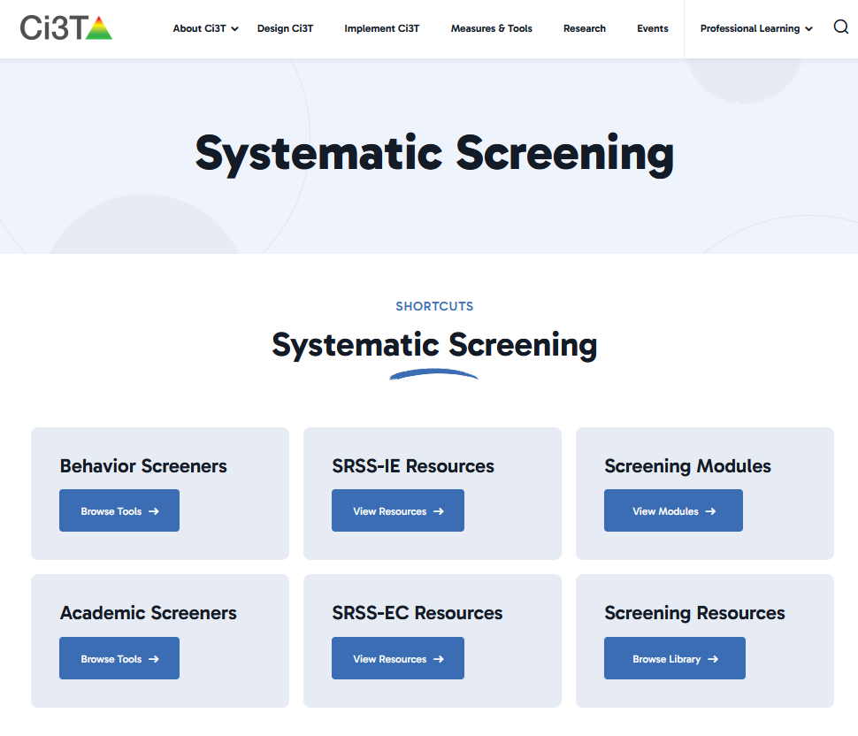
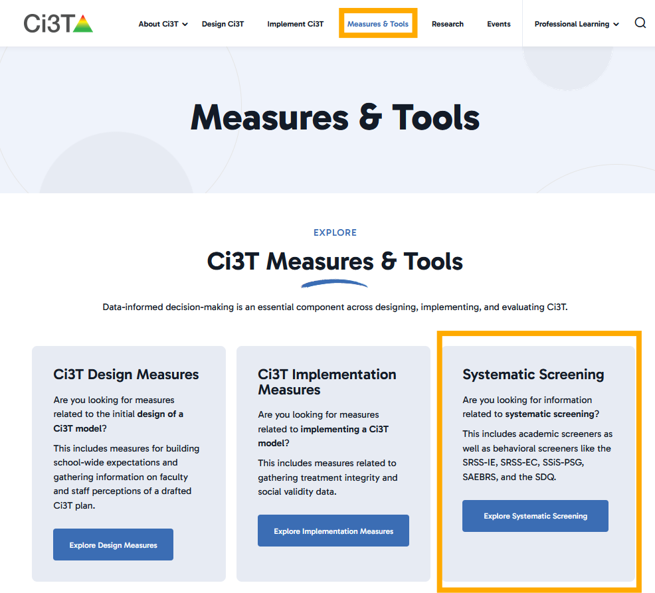
Systematic Screening on Ci3T.org
Notes:
https://www.ci3t.org/measures/screening/

Slide 21
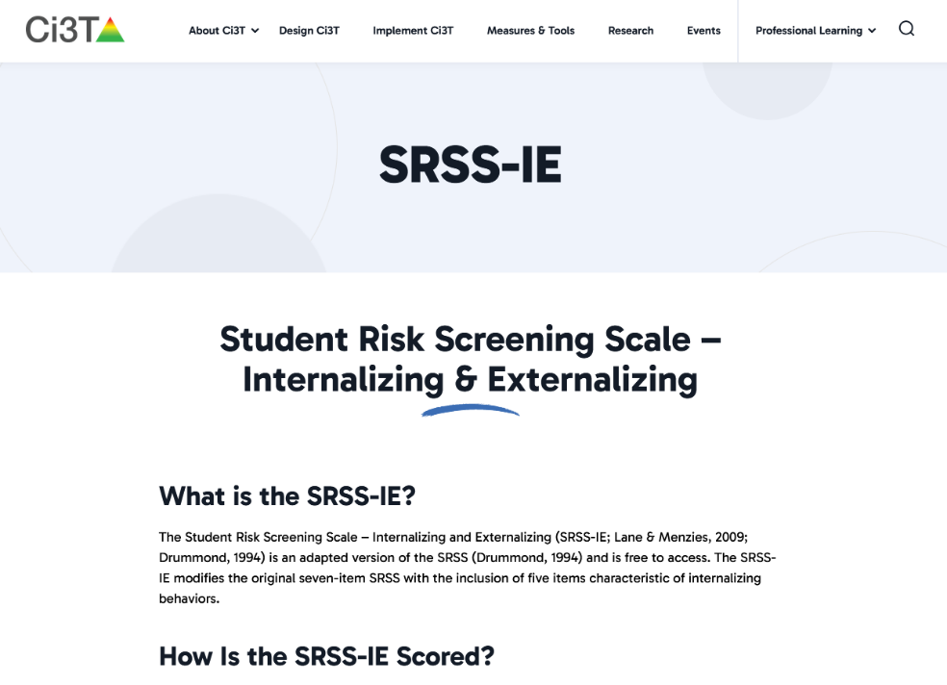
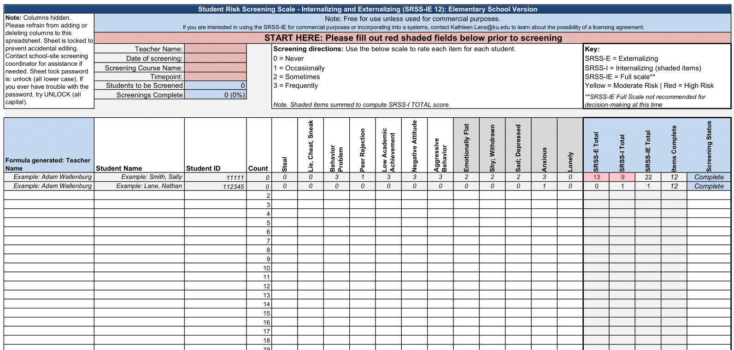
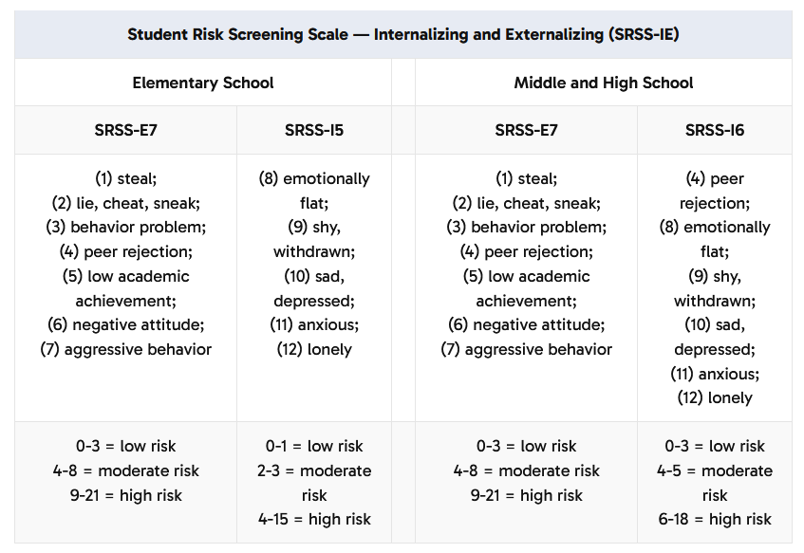

Student Risk Screening Scale – Internalizing and Externalizing (SRSS-IE)
(SRSS-IE; Drummond, 1994; Lane & Menzies, 2009)
Notes:
As we approach Fall behavior screening windows, we invite you to review SRSS-IE resources on the website.

Slide 22
Student Risk Screening Scale – Internalizing and Externalizing (SRSS-IE; Drummond, 1994; Lane & Menzies, 2009)
Elementary

Slide 23
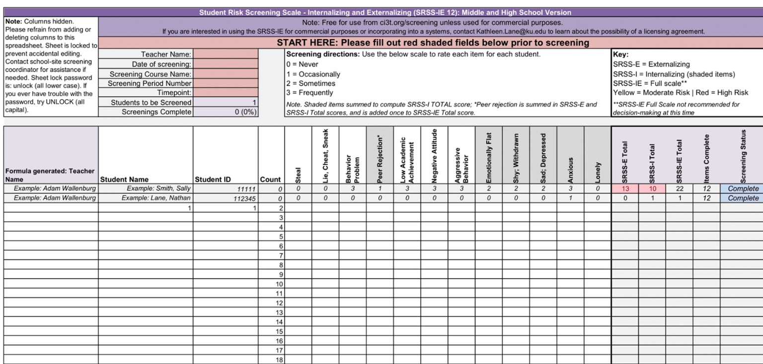
Student Risk Screening Scale – Internalizing and Externalizing (SRSS-IE; Drummond, 1994; Lane & Menzies, 2009)
Secondary

Slide 24
SRSS-IE: Cut Scores
Elementary School
Middle and High School
SRSS-E7 | SRSS-I5
Items 1-7 | Items 8-12
0-3 = low risk 4-8 = moderate risk 9-21 = high risk | 0-1 = low risk 2-3 = moderate risk 4-15 = high risk
SRSS-E7 | SRSS-I6
Items 1-7 | Items 4, 8-12
0-3 = low risk 4-8 = moderate risk 9-21 = high risk | 0-3 = low risk 4-5 = moderate risk 6-18 = high risk
Elementary School Level:
Lane, K. L., Oakes, W. P., Swogger, E. D., Schatschneider, C., Menzies, H., M., & Sanchez, J. (2015). Student risk screening scale for internalizing and externalizing behaviors: Preliminary cut scores to support data-informed decision making. Behavioral Disorders, 40, 159-170.
Middle and High School Levels:
Lane, K. L., Oakes, W. P., Cantwell, E. D., Schatschneider, C., Menzies, H., Crittenden, M., & Messenger, M. (2016). Student Risk Screening Scale for Internalizing and Externalizing Behaviors: Preliminary cut scores to support data-informed decision making in middle and high schools. Behavioral Disorders, 42(1), 271-284

Slide 25
Fall Over Time
SRSS-Externalizing Results – Elementary School Level
Notes:
Fill in <year> based on current academic year. This is located in column A of the data sheet. Edit by right clicking and selecting “Edit data”.

Slide 26
Fall Over Time
SRSS-Internalizing Results – Elementary School Level
Notes:
Fill in <year> based on current academic year. This is located in column A of the data sheet. Edit by right clicking and selecting “Edit data”.

Slide 27
Fall 2024
SRSS-Internalizing Results – Elementary School Grade Level
Grade Level | N Screened | Low n (%) | Moderate n (%) | High n (%)
K | 46 | 26 (56.52) | 9 (19.57) | 11 (23.91)
1 | 60 | 41 (68.33) | 9 (15.00) | 10 (16.67)
2 | 85 | 66 (77.65) | 15 (17.65) | 4 (4.71)
Notes:
Fill in <year> based on current academic year. This is located in column A of the data sheet. Edit by right clicking and selecting “Edit data”.

Slide 28
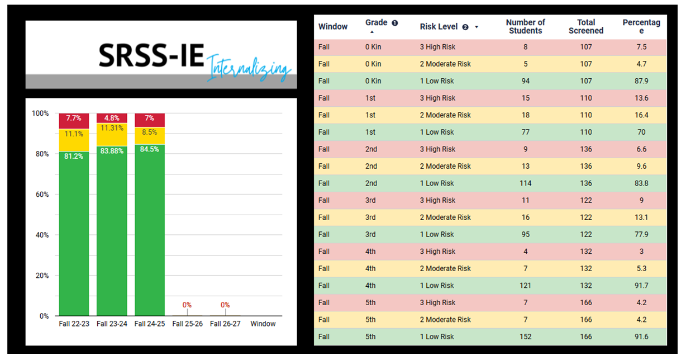
SRSS-IE Internalizing Summary

Slide 29

Academic Screening

Slide 30
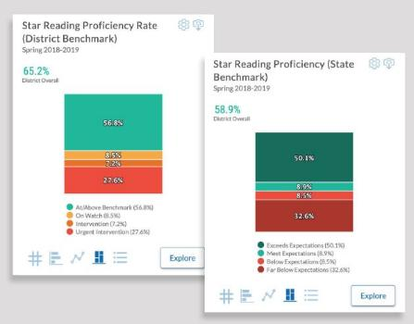
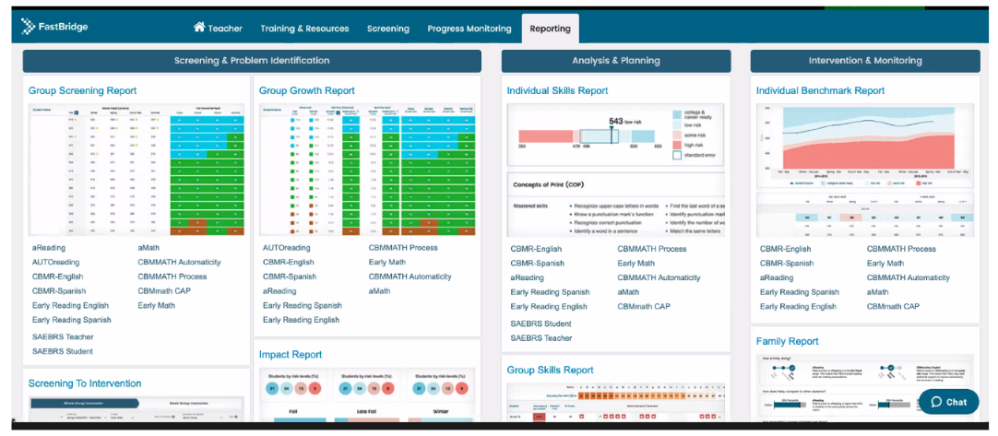
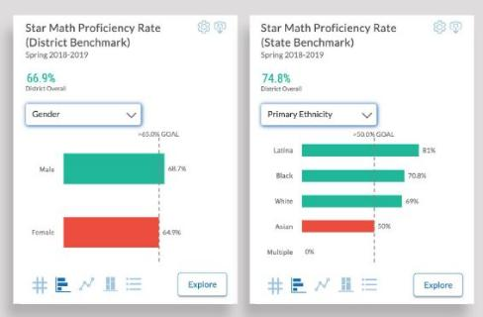

Academic Screening: Examples

Slide 31
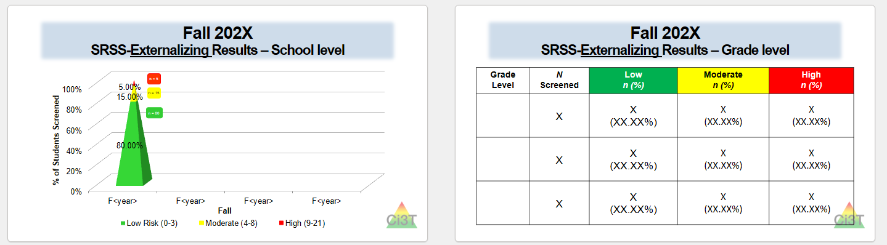
Sharing Systematic Screening Data
Once academic and behavior screening data are collected, data are shared at the:
Schoolwide level
Grade/department/class level
Individual student level

Slide 32
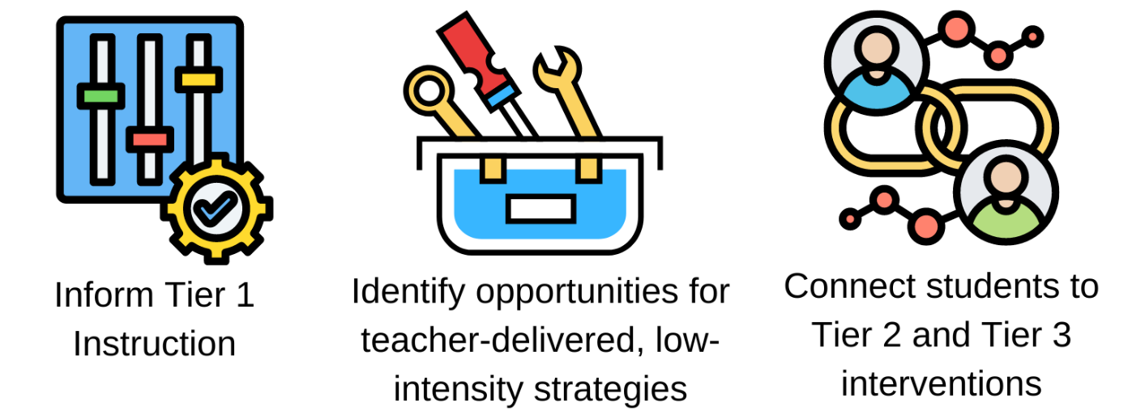
Using Systematic Screening Data
These academic and behavior screening data are then reviewed alongside other data collected as part of typical school practices (e.g., attendance, office discipline referrals, grades) to:

Slide 33

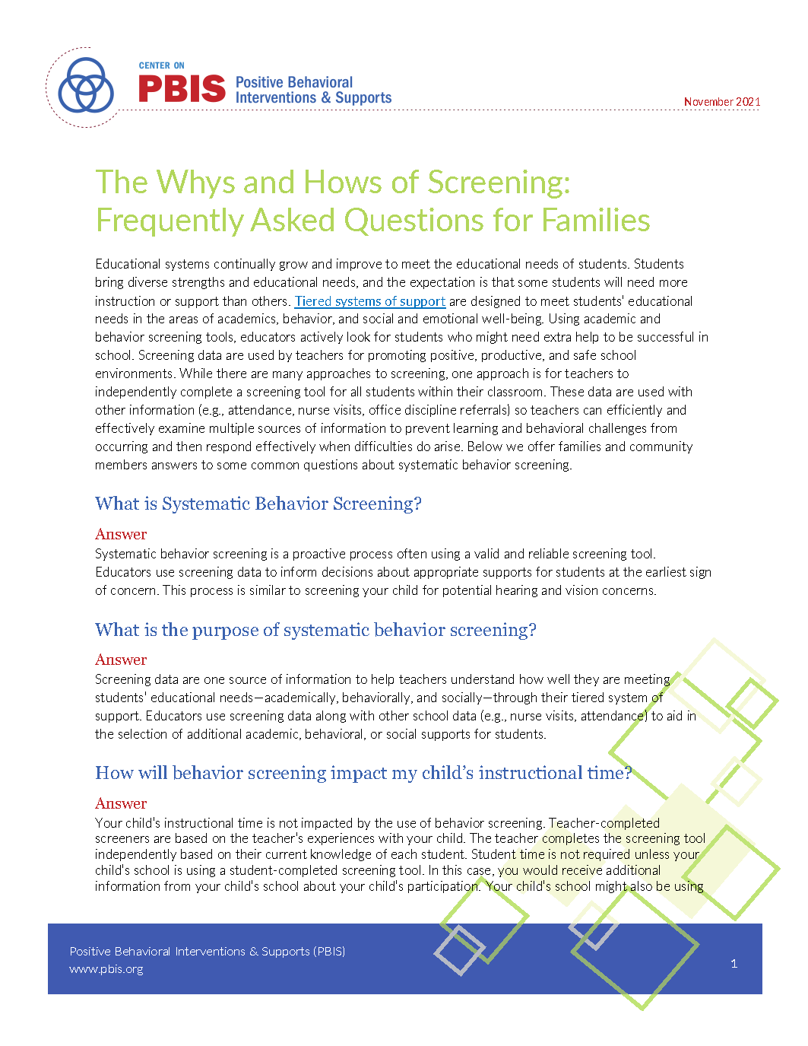
Systematic Screening Resources:
PBIS.org
Notes:
https://www.pbis.org/resource/resources-to-support-systematic-screening-in-k-12-schools

Slide 34
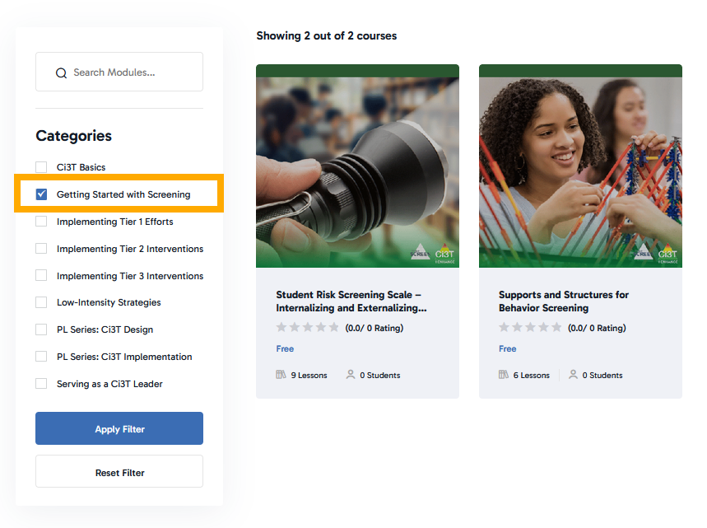
Systematic Screening Resources:
Ci3T Modules

Slide 35












Let’s Talk: Systematic Screening
What are some of the potential benefits of systematic screening?
What are some of the potential challenges of systematic screening?
What questions do you have about systematic screening?
Notes:
10-min timer

Slide 36
Using Systematic Screening Data to…
Inform Instruction at Tier 1
Empower Teachers with Low-Intensity Strategies
Connect Students to Validated Tier 2 and Tier 3 Supports

Slide 37

Putting Screening Data into Action!

Slide 38
Inform Instruction at Tier 1

Slide 39
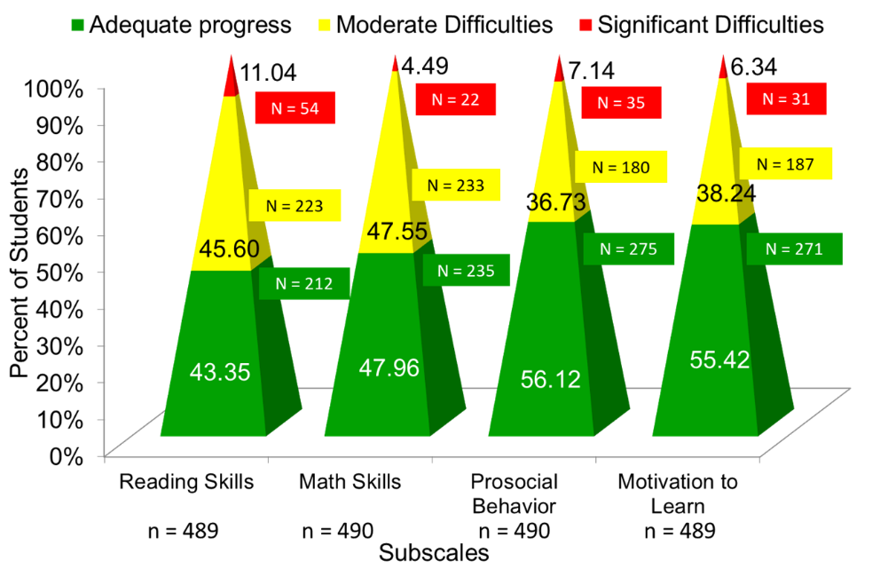
Data to Indicate a Focus on Tier 1: School Level
Social Skills Improvement System – Performance Screening Guide Spring 2012 – Total School
Lane, K. L., Oakes, W. P., & Magill, L. (2013). Primary prevention efforts: How do we implemented and monitor the Tier 1 component of our Comprehensive, Integrated, Three-Tiered (Ci3T) Model?, Preventing School Failure, 58(1), 143-158.

Slide 40

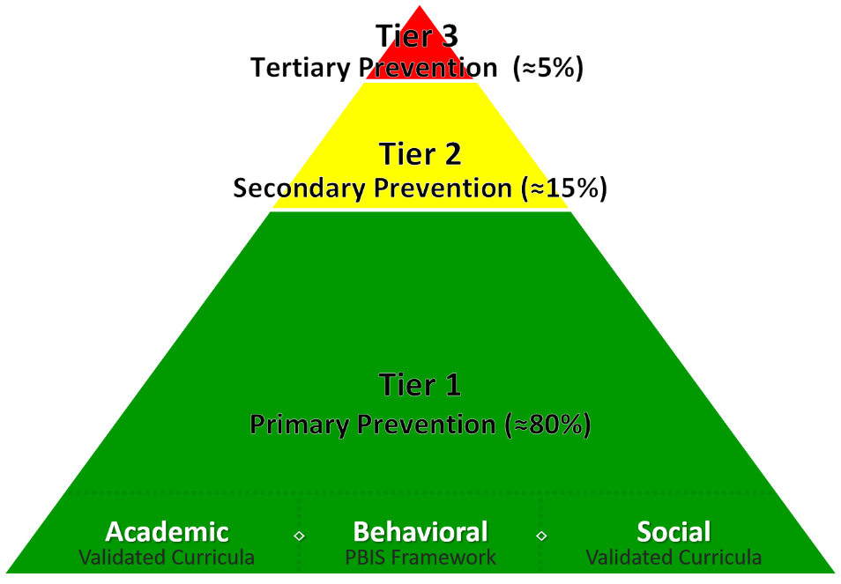
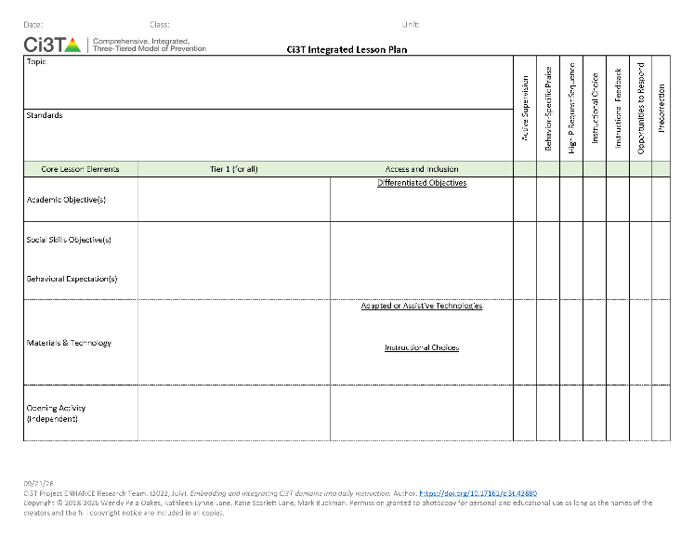
Ci3T Integrated Lesson Planning
Template and completed examples available in: Ci3T Project ENHANCE Research Team. (2022, July). Embedding and integrating Ci3T domains into daily instruction. Author. https://doi.org/10.17161/ci3t.42880

Slide 41
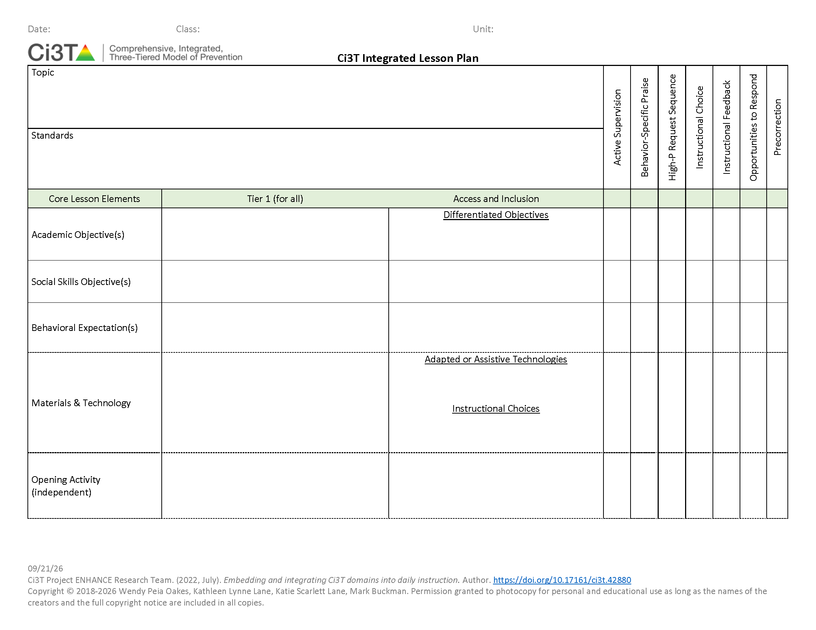
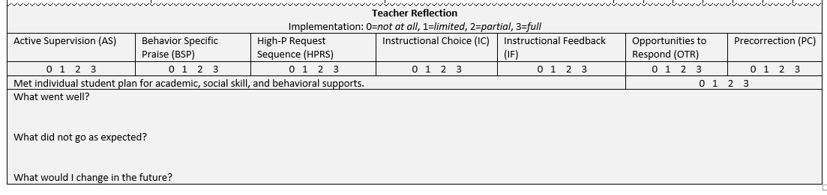
Integrated Lesson Plan
Notes:
Integrated Lesson Plan. Includes strategies such as active supervision, behavior specific praise, high-p request sequence, instructional choice, instructional feedback, opportunities to respond, and precorrection. Also includes core lesson elements, which are academic objectives, social skills objectives, and behavioral expectations.

Slide 42


Integrating Academic, Behavior and Social Domains Video
Notes:
Watch video 01:35
https://youtu.be/tRhmenV7M10

Slide 43
Let’s Chat: Ci3T Integrated Lesson Plan
What is one way you could integrate social skills or a behavioral objective into an upcoming lesson?
What low-intensity teacher-delivered strategies might you be able to integrate into an upcoming lesson?

Slide 44
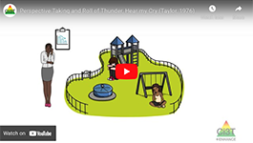
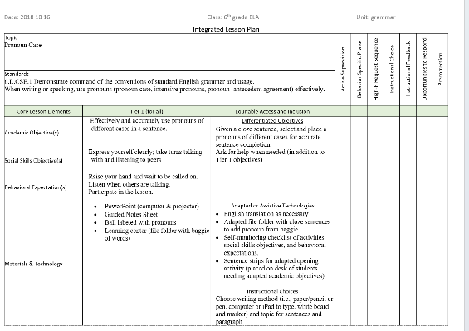

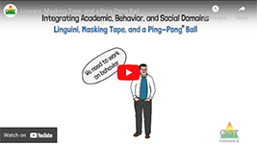
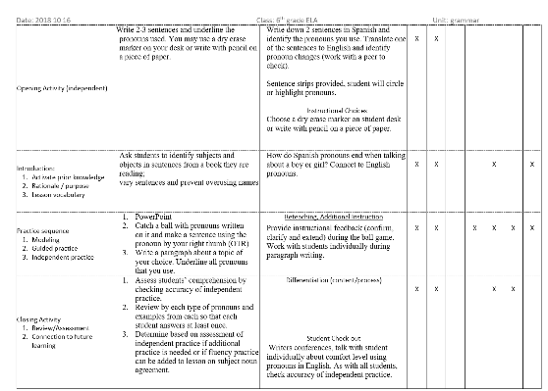
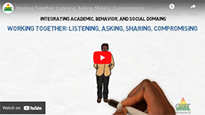
Ci3T Integrated Lesson Plan Module Connection

Slide 45

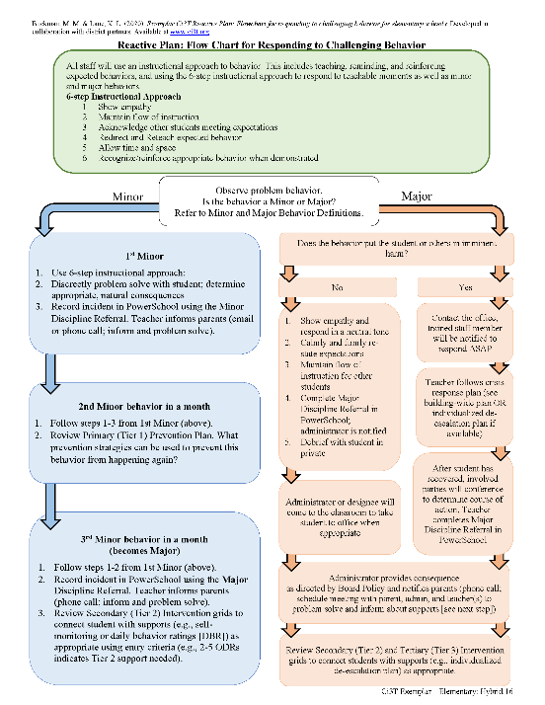

A Focus on: Responding to Challenging Behavior

Slide 46
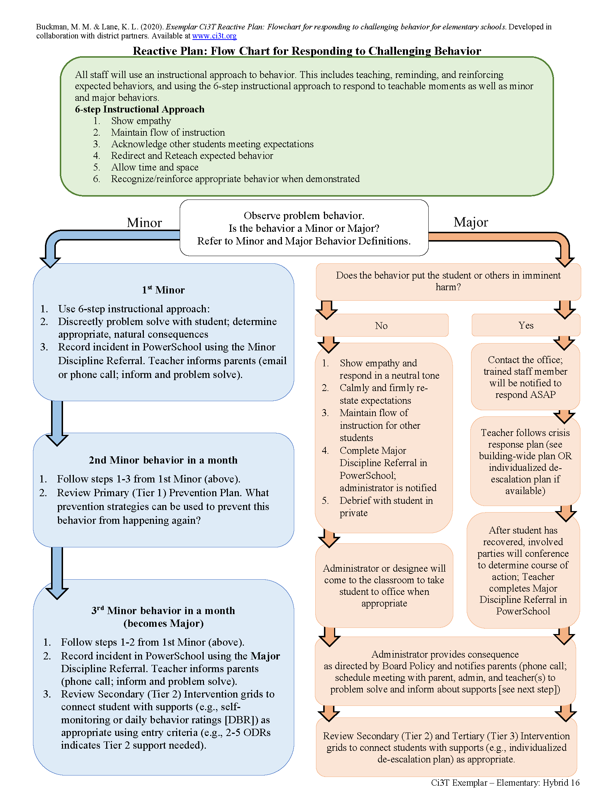
Reactive Plan: Flow Chart for Responding to Challenging Behavior

Slide 47

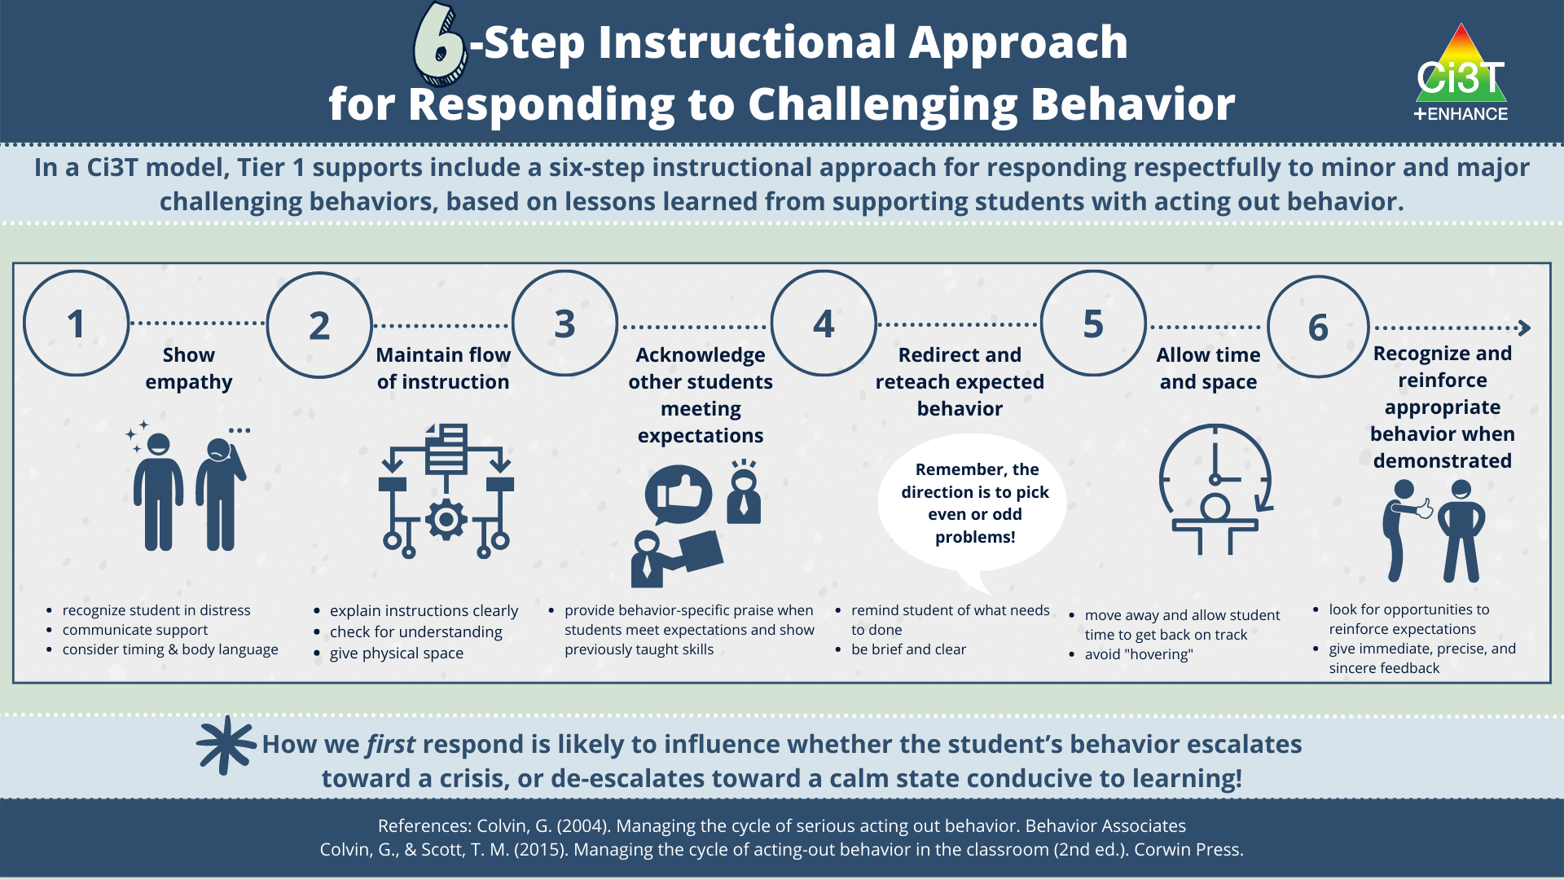
6-Step Instructional Approach for Responding to Challenging Behavior

Slide 48
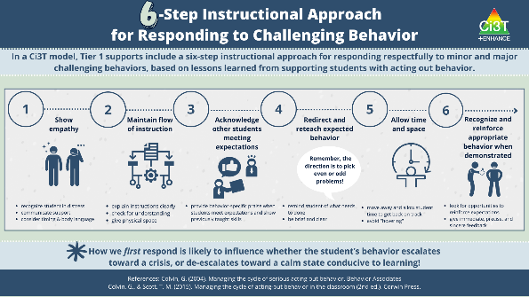
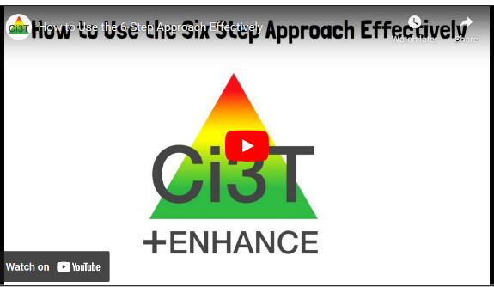



Module Connection!
6-Step Instructional Approach for Responding to Challenging Behavior

Slide 49
Empower Teachers with Low-Intensity Strategies

Slide 50
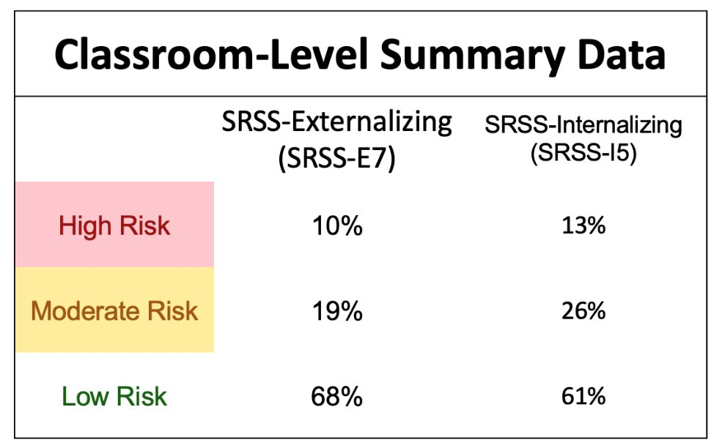
Data to Indicate a Focus on Low-Intensity Teacher-Delivered Strategies

Slide 51
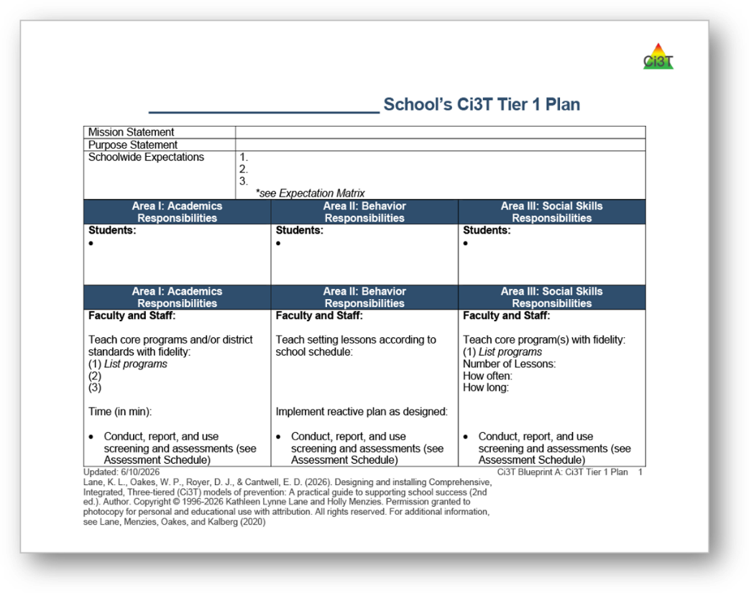

Low-Intensity Teacher-Delivered Strategies

Slide 52

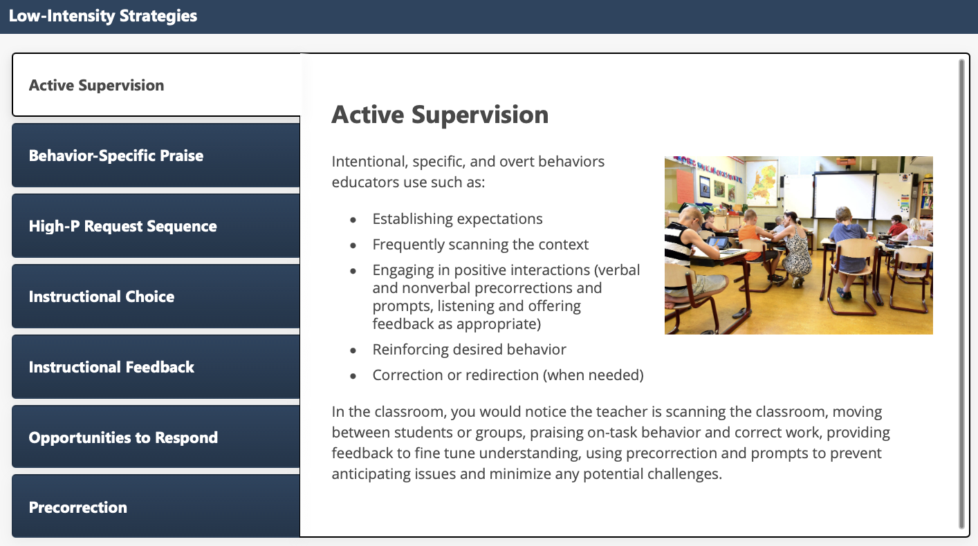
Low-Intensity Strategies: Academic Supervision

Slide 53
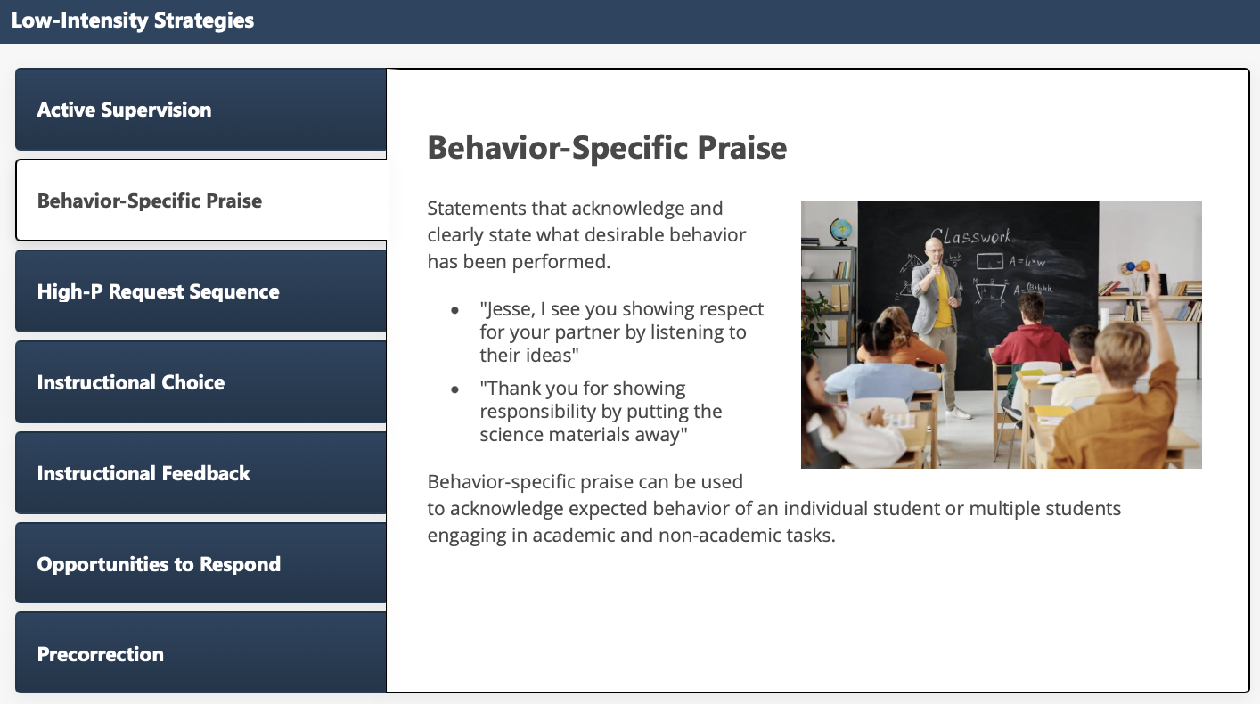
Low-Intensity Strategies: Behavior-Specific Praise

Slide 54
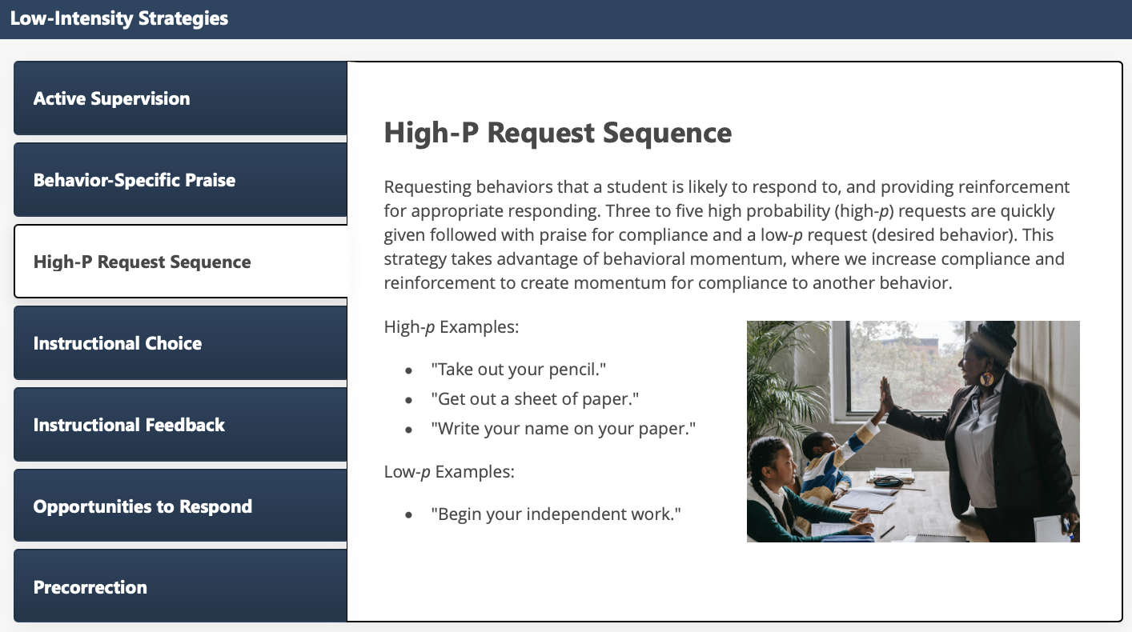
Low-Intensity Strategies: High-P Request Sequence

Slide 55

Low-Intensity Strategies: Instructional Choice

Slide 56

Low-Intensity Strategies: Instructional Feedback

Slide 57

Low-Intensity Strategies: Opportunities to Respond

Slide 58

Low-Intensity Strategies: Precorrection

Slide 59







Module Connection!
Instructional Feedback

Slide 60


Resource Spotlight!
Notes:
What Works Clearing House Practice Guide – Teacher-Delivered Behavioral Interventions in Grades K-5- https://ies.ed.gov/ncee/wwc/PracticeGuide/31
Notice similar strategies and connections. In this presentation, we will situate these low-intensity strategies withing Ci3T

Slide 61











Breakout Rooms: Tier 1 and Low-Intensity Strategy Resource Exploration
Systematic Screening | Ci3T Integrated Lesson Plan | Six-Step Intructional Approach | Low-Intensity Strategies
Notes:
15-min timer
Facilitators provide overview/orientation to module (< 2 min)
Prompt to register if have not done so already
Point out key features – table of resources (model how to use)
Independent Exploration
Someone in main room to manage difficulty accessing modules

Slide 62
Connect Students to Validated Tier 2 and Tier 3 Supports

Slide 63



Getting Started with Data-Informed Decision Making

Slide 64

Using Multiple Sources of Data to Connect Students with Tier 3 Supports
attendance
office discipline referrals
behavior
screening
academic screening

Slide 65

Tier 2 and Tier 3 Intervention Grids
Notes:
Support is the name of the strategy, practice, or program. Notice this is not the name of a person or role.

Slide 66

What are Tier 2 Interventions?
Evidenced-based or research-based strategies, practices, and programs
Additive (i.e., compliment rather than replace Tier 1 efforts)
Implemented by teachers, interventionists, counselors, paraprofessionals, and other staff
Occur in a variety of formats and locations (e.g., small-group, 1:1, embedded within whole group instruction)

Slide 67


Tier 2: Recognize.Relax.Record

Slide 68

Let’s Chat: Tier 2
Which Tier 2 interventions are offered in your setting?
How do you connect students to Tier 2 supports at your school?

Slide 69


What are Tier 3 Interventions?

Slide 70
Clarifying Tier 3 Supports 1

Slide 71
Clarifying Tier 3 Supports 2

Slide 72




Tier 3: Stand-Alone Intervention

Slide 73



Tier 3: Intensification of Tier 2 Support
Notes:
Sometimes – Tier 3 is an intensification of a Tier 2 support such as coupling a Tier 2 support (i.e., counselor-led social skills group) with an individual follow up.

Slide 74


Tier 3: Wraparound Support

Slide 75



Selecting an Intervention

Slide 76


Considerations for Selecting an Intervention
Collaborate with families, colleagues, and the student to review available options
Consider what you know about the student (e.g., strengths, preferences, pre-requisite skills)
Consider possible function of the behavior
  Check-in/Check-out may be more effective for students for whom accessing adult attention is reinforcing
Consider your own strengths, support available (e.g., coach, professional learning), and feasibility of available options
Adjust as needed based on pre-intervention social validity

Slide 77

Let’s Practice Together!
Notes:
Facilitator has copy of Ci3T Data Dashboard- https://docs.google.com/spreadsheets/d/135hDmcTOIjAwb_8Ci-hNR38uF9vs7oUcVzjeSxVM2a8/edit?usp=sharing
Model:
Filter
Moderate ext
Below grade level reading
Attendance – now what do you notice
Ci3T Implementation Manual
What intervention(s) might be appropriate for this student? (e.g., self-monitoring w/ reading, breathing strategy)

Slide 78




Module Connection!
The Tier 2 Process: Using Data to Connect Students to Validated Supports

Slide 79




Module Connection!
The Tier 3 Process: Using Data to Connect Students to Validated Supports

Slide 80



















Breakout Rooms: Choose Your Own Adventure!
Explore Tier 2 Module Independently explore The Tier 2 Process: Using Data to Connect Students to Validated Supports module | Explore Tier 3 Module Independently explore The Tier 3 Process: Using Data to Connect Students to Validated Supports module | Facilitated Breakout Room Guided practice connecting students to validated Tier 2 and Tier 3 supports using Ci3T Data Dashboard and Exemplar Ci3T Manual
Notes:
15-min timer

Slide 81

Wrapping Up and Moving Forward

Slide 82

Action Items
Action Item | Person(s) Responsible | Planned Completion Date | Date Completed
Submit BCBA CEU form | Elise | 10/28/26
Email instructional coach to schedule time to review Fall screening data to connect students with Tier 2 supports | Jordan | 10/29/26

Slide 83
Reminder: Updated Procedures
Session Evaluation
If you would like a certificate of attendance, please complete the Session Evaluation within 24 hours (the certificate is generated automatically)
If we have a plan in place to share attendance with your district, we will use the completed session evaluations as verification of attendance and share that list within 3 business days
If you are a BCBA pursuing continuing education units (CEUs), please complete the Session Evaluation within 24 hours – be sure to enter the 4 passwords!

Slide 84


Join us at future professional learning!
Notes:
EMPOWER
Trainer and Coaches Calls

Slide 85




Thank you!
Thank you!
ci3t.org
Notes:
You will receive a brief session evaluation – we value your feedback and would greatly appreciate you taking a few minutes to share your thoughts on what you liked about the session and how we can improve

