Slide 1
Functional Assessment-Based Interventions:
From Start to Finish
John Umbreit, Ph.D.
Kathleen Lynne Lane, Ph.D., BCBA-D, CF-L2
Elise Sarasin, M.S.E.

Slide 2

Agenda
Welcome
Situating FABI in Tiered Systems: A FABI Overview
A 5-step Process to Implement FABI
  FABI Step 1: Identify Students Who Might Benefit from a FABI
  FABI Step 2: Conduct a Functional Assessment
  FABI Step 3: Collect Baseline Data
  FABI Step 4: Designing the Functional Assessment-Based Intervention
  FABI Step 5: Test Intervention Outcomes
Wrapping Up and Moving Forward

Slide 3
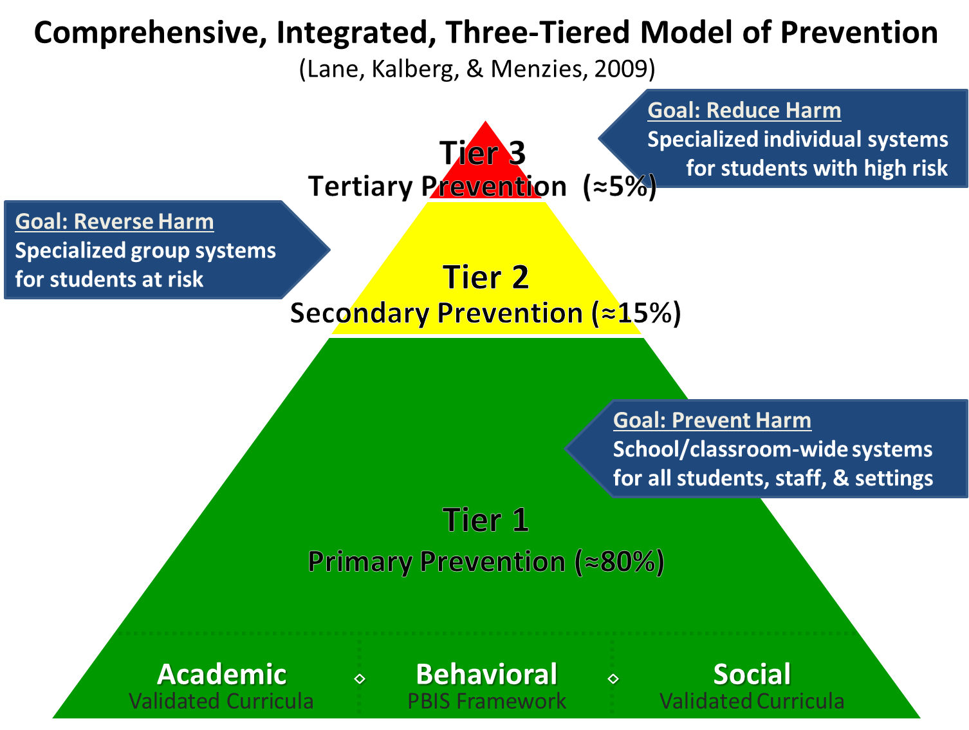
Comprehensive, Integrated, Three-Tiered Model of Prevention

Slide 4
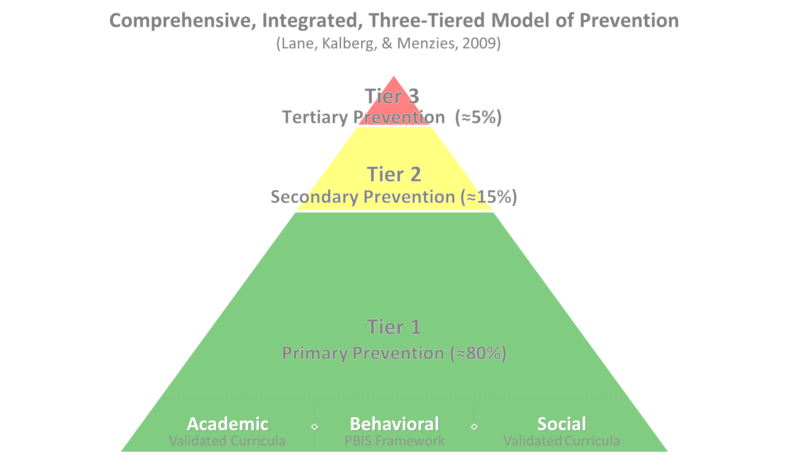

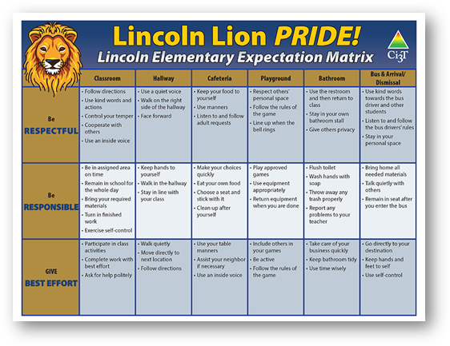
Ci3T Tier 1 Supports
Positive Behavioral Interventions and Supports
District & State Standards Quality Instruction
Validated Curricula and Resources

Slide 5


Tier 1

Slide 6

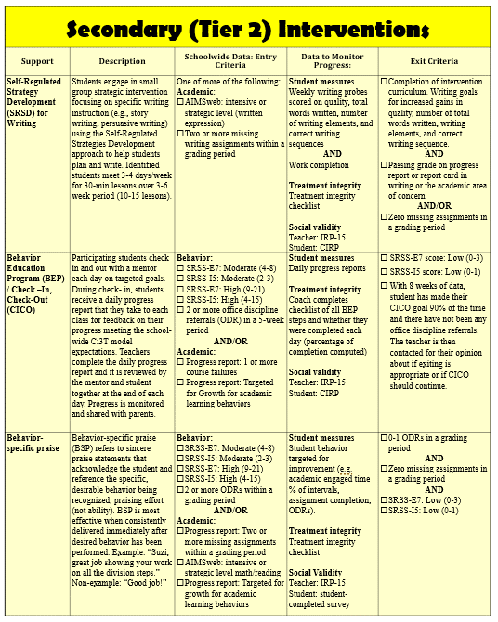
Tier 2
Tier 2 Intervention Grid
Notes:
In addition to the module featured here outlining how to use multiple sources of data to connect students with Tier 2 supports, we offer a full suite of modules highlighting validated Tier 2 interventions such as Self-Regulated Strategy Development (SRSD) for Writing and Check-In/Check Out that may appear in your Secondary (Tier 2) Intervention Grid

Slide 7

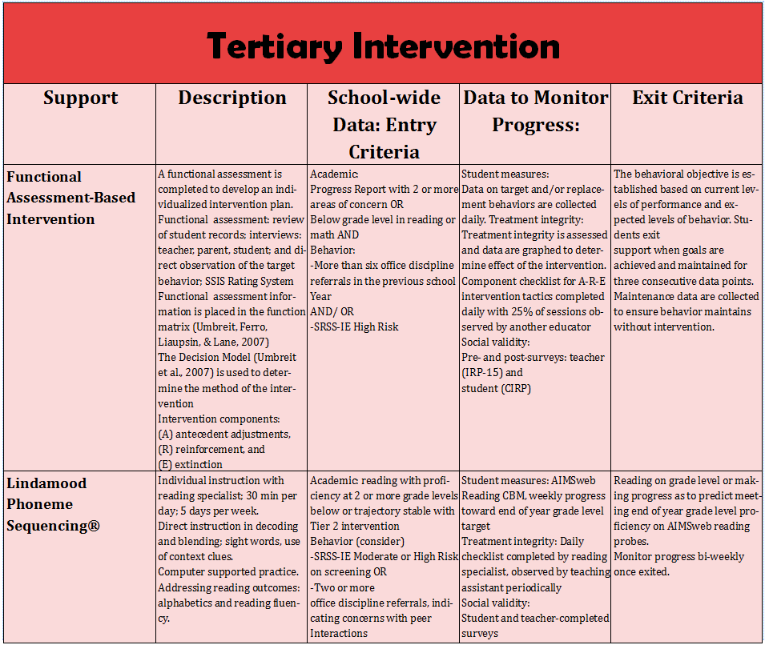
Tier 3
Tier 3 Intervention Grid
Notes:
In addition to the module featured here outlining how to use multiple sources of data to connect students with Tier 3 supports, we offer a full suite of modules highlighting validated Tier 3 interventions such as Functional Assessment-Based Intervention (FABI) that may appear in your Tertiary (Tier 3) Intervention Grid

Slide 8

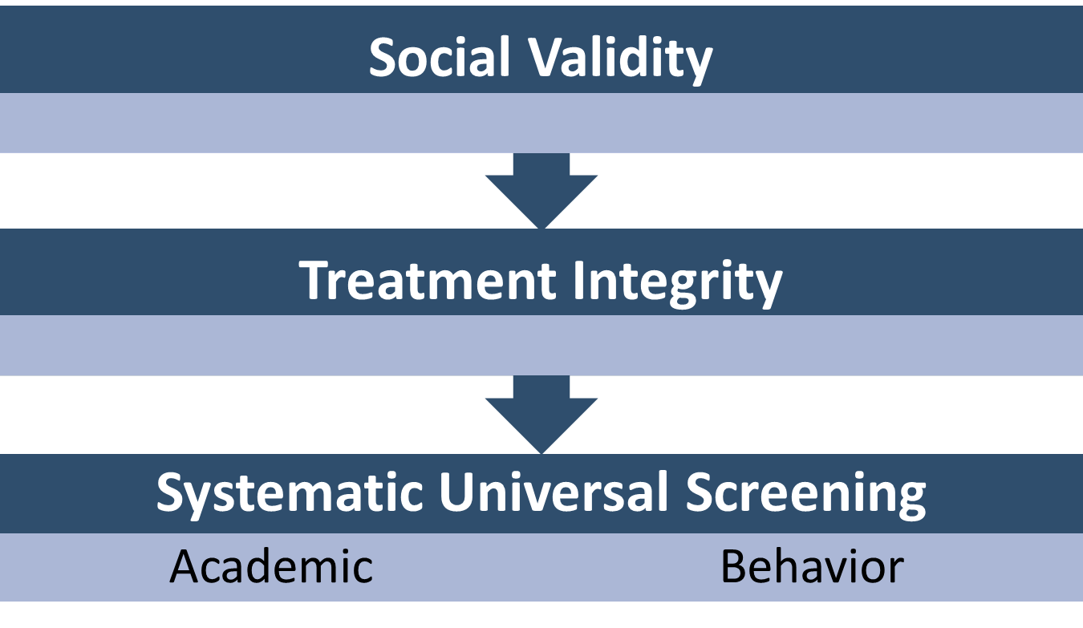

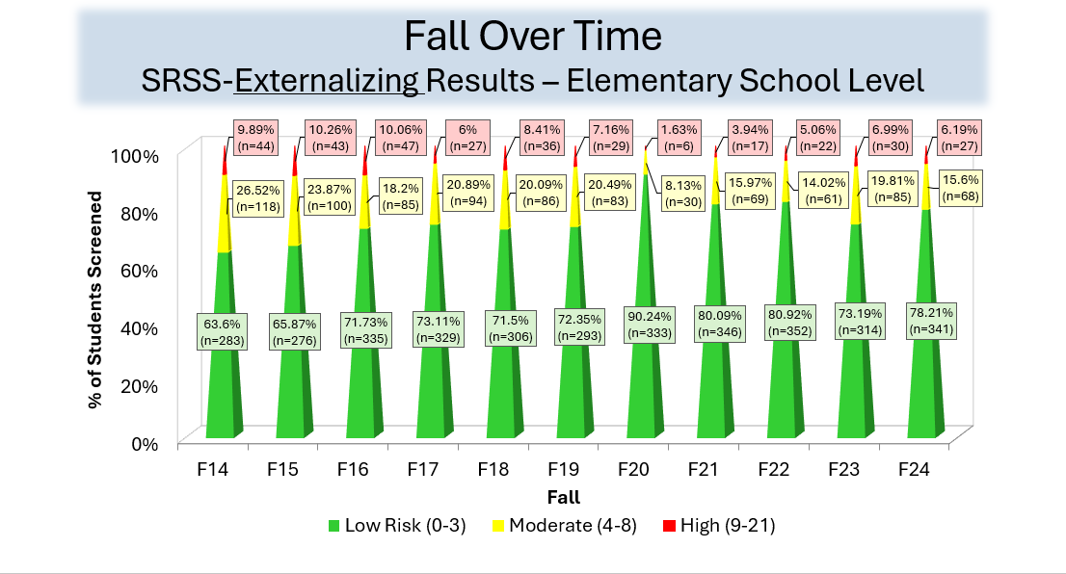
Essential Components of Tier 1 Efforts

Slide 9
Session Outcomes
Describe a five-step process for conducting Functional Assessment-based Interventions (FABIs) for student requiring behavioral interventions.
Practice using the Function Matrix to analyze multiple sources of data to determine why a challenging behavior occurs
Demonstrate how to use the Function-based Intervention Decision Model to inform function-based intervention development.

Slide 10
Situating FABI in Tiered Systems:
A FABI Overview

Slide 11
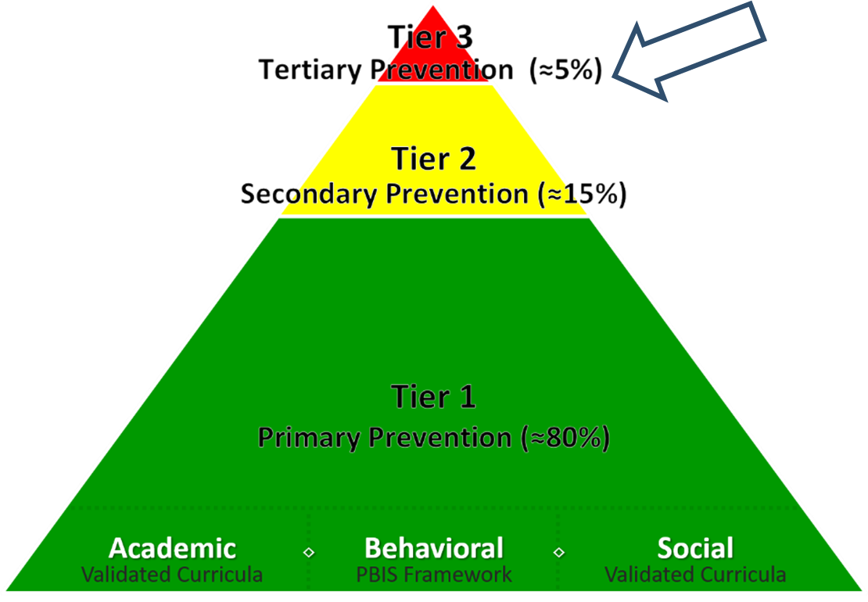
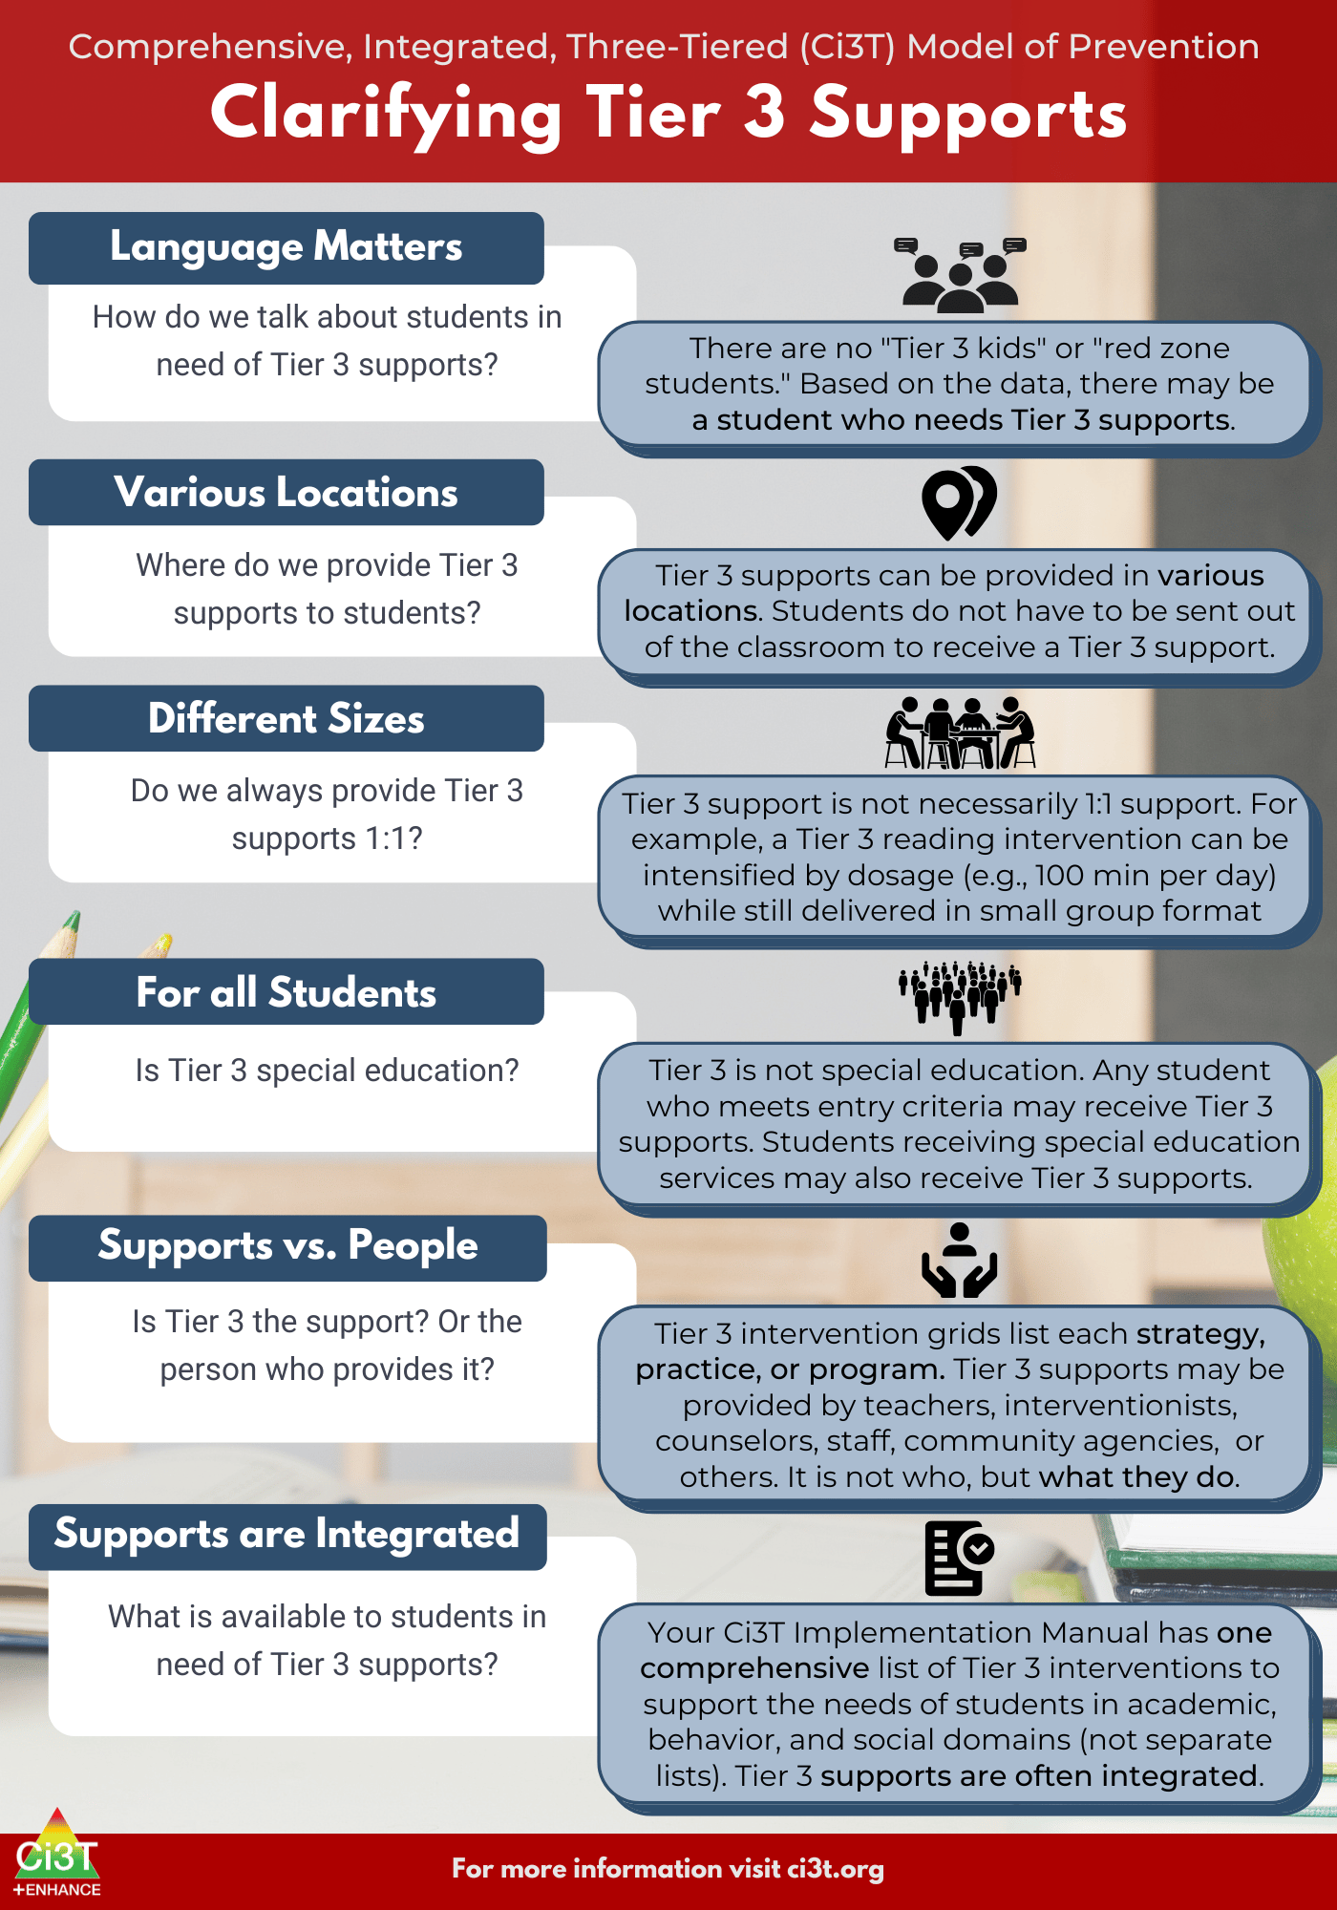
What are Tier 3 Interventions?

Slide 12
Clarifying Tier 3 Supports 1

Slide 13
Clarifying Tier 3 Supports 2

Slide 14
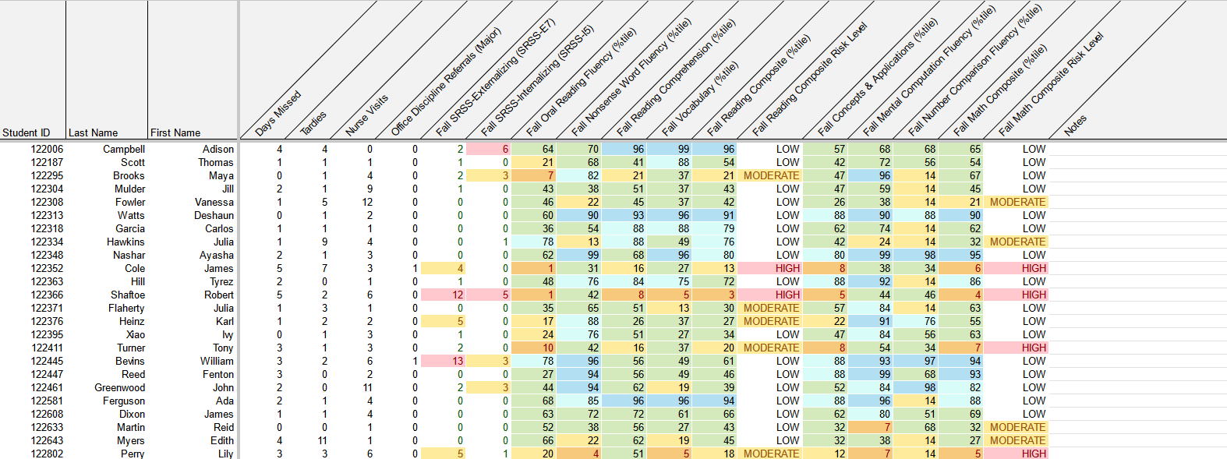
Using Multiple Sources of Data to Connect Students with Tier 3 Supports
attendance
office discipline referrals
behavior
screening
academic screening

Slide 15


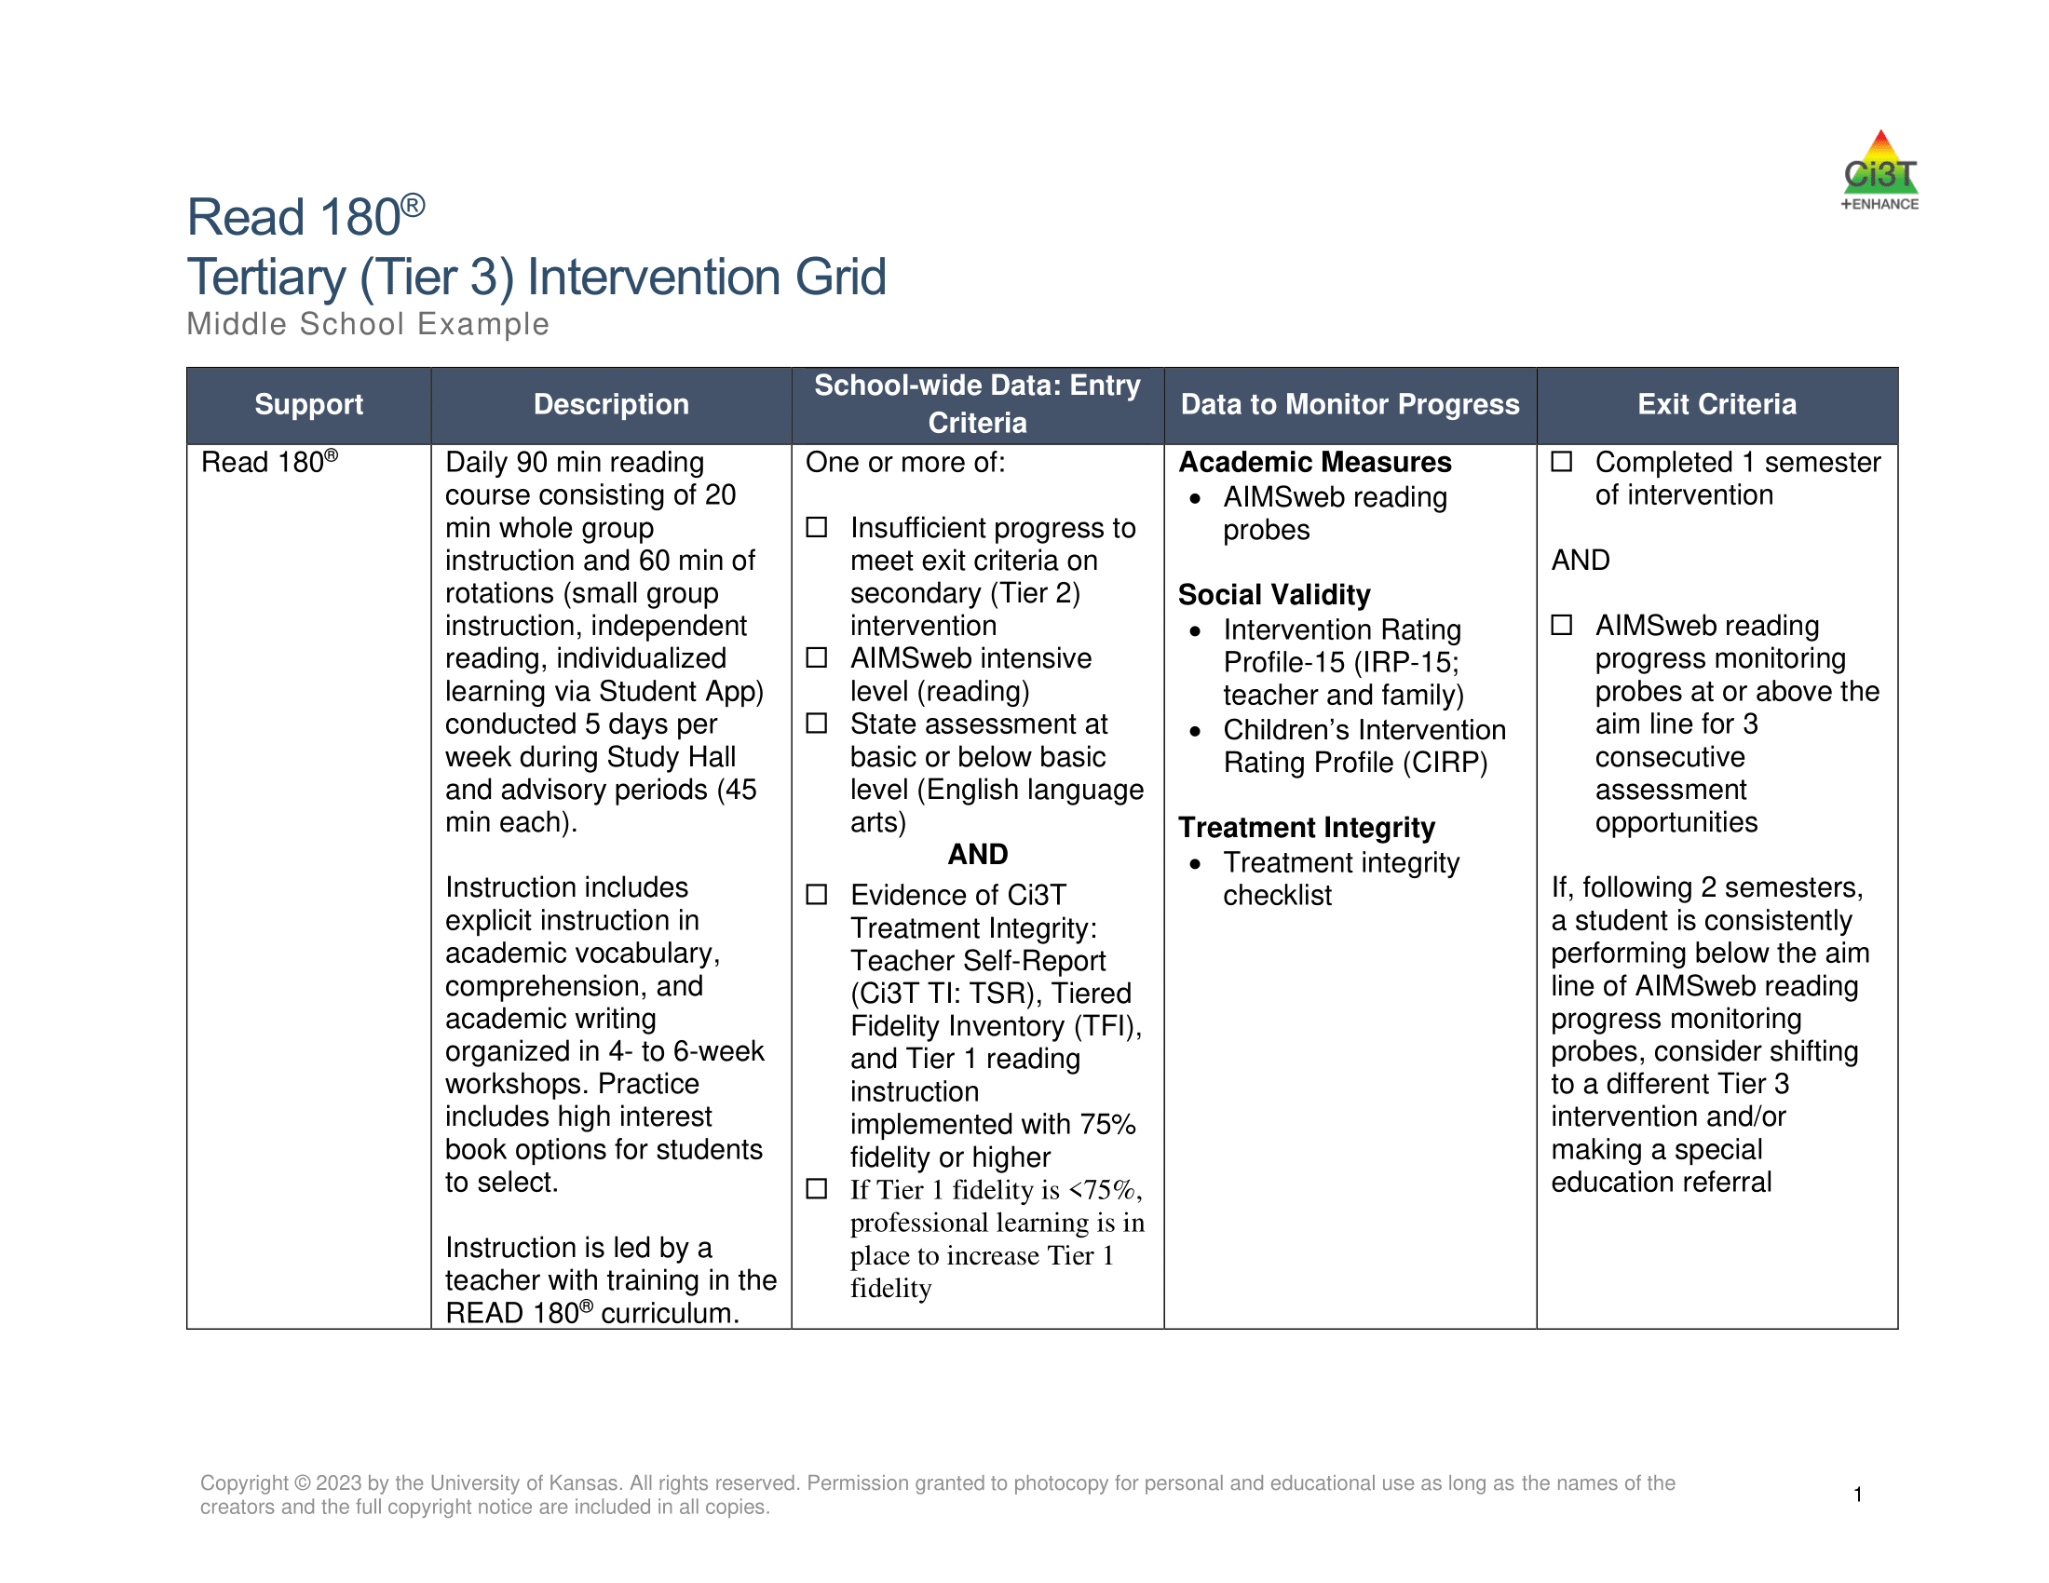
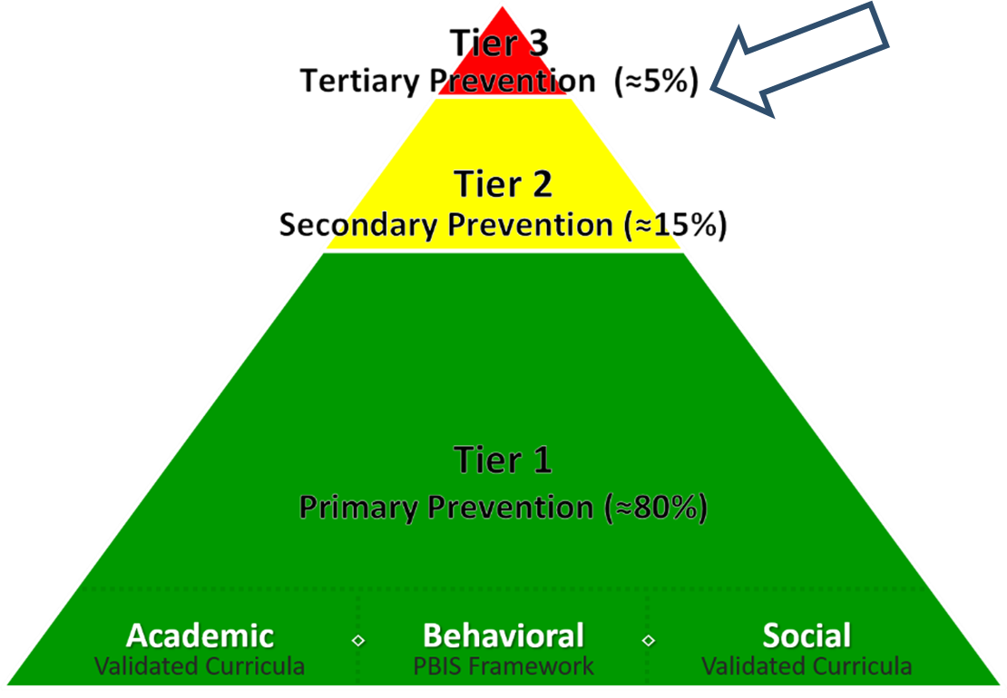
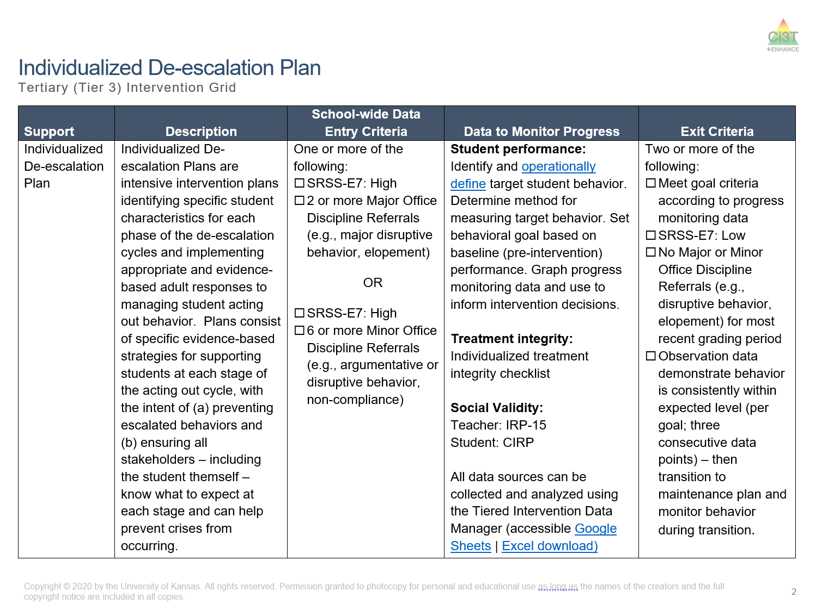
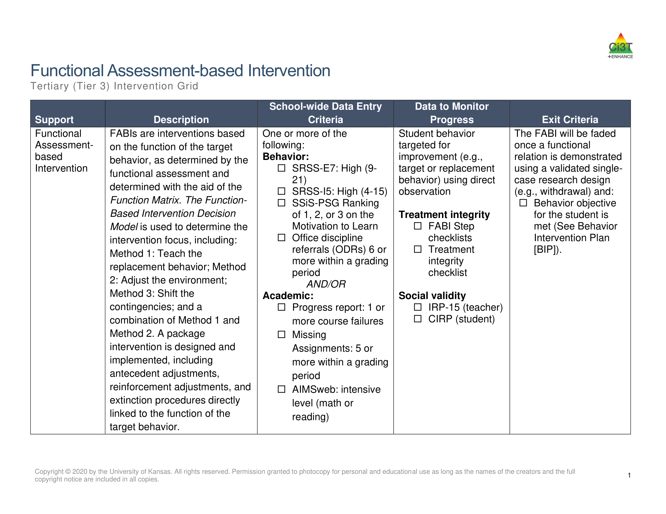
Tier 3 Intervention Grid

Slide 16

Functional Assessment-based Intervention Grid

Slide 17
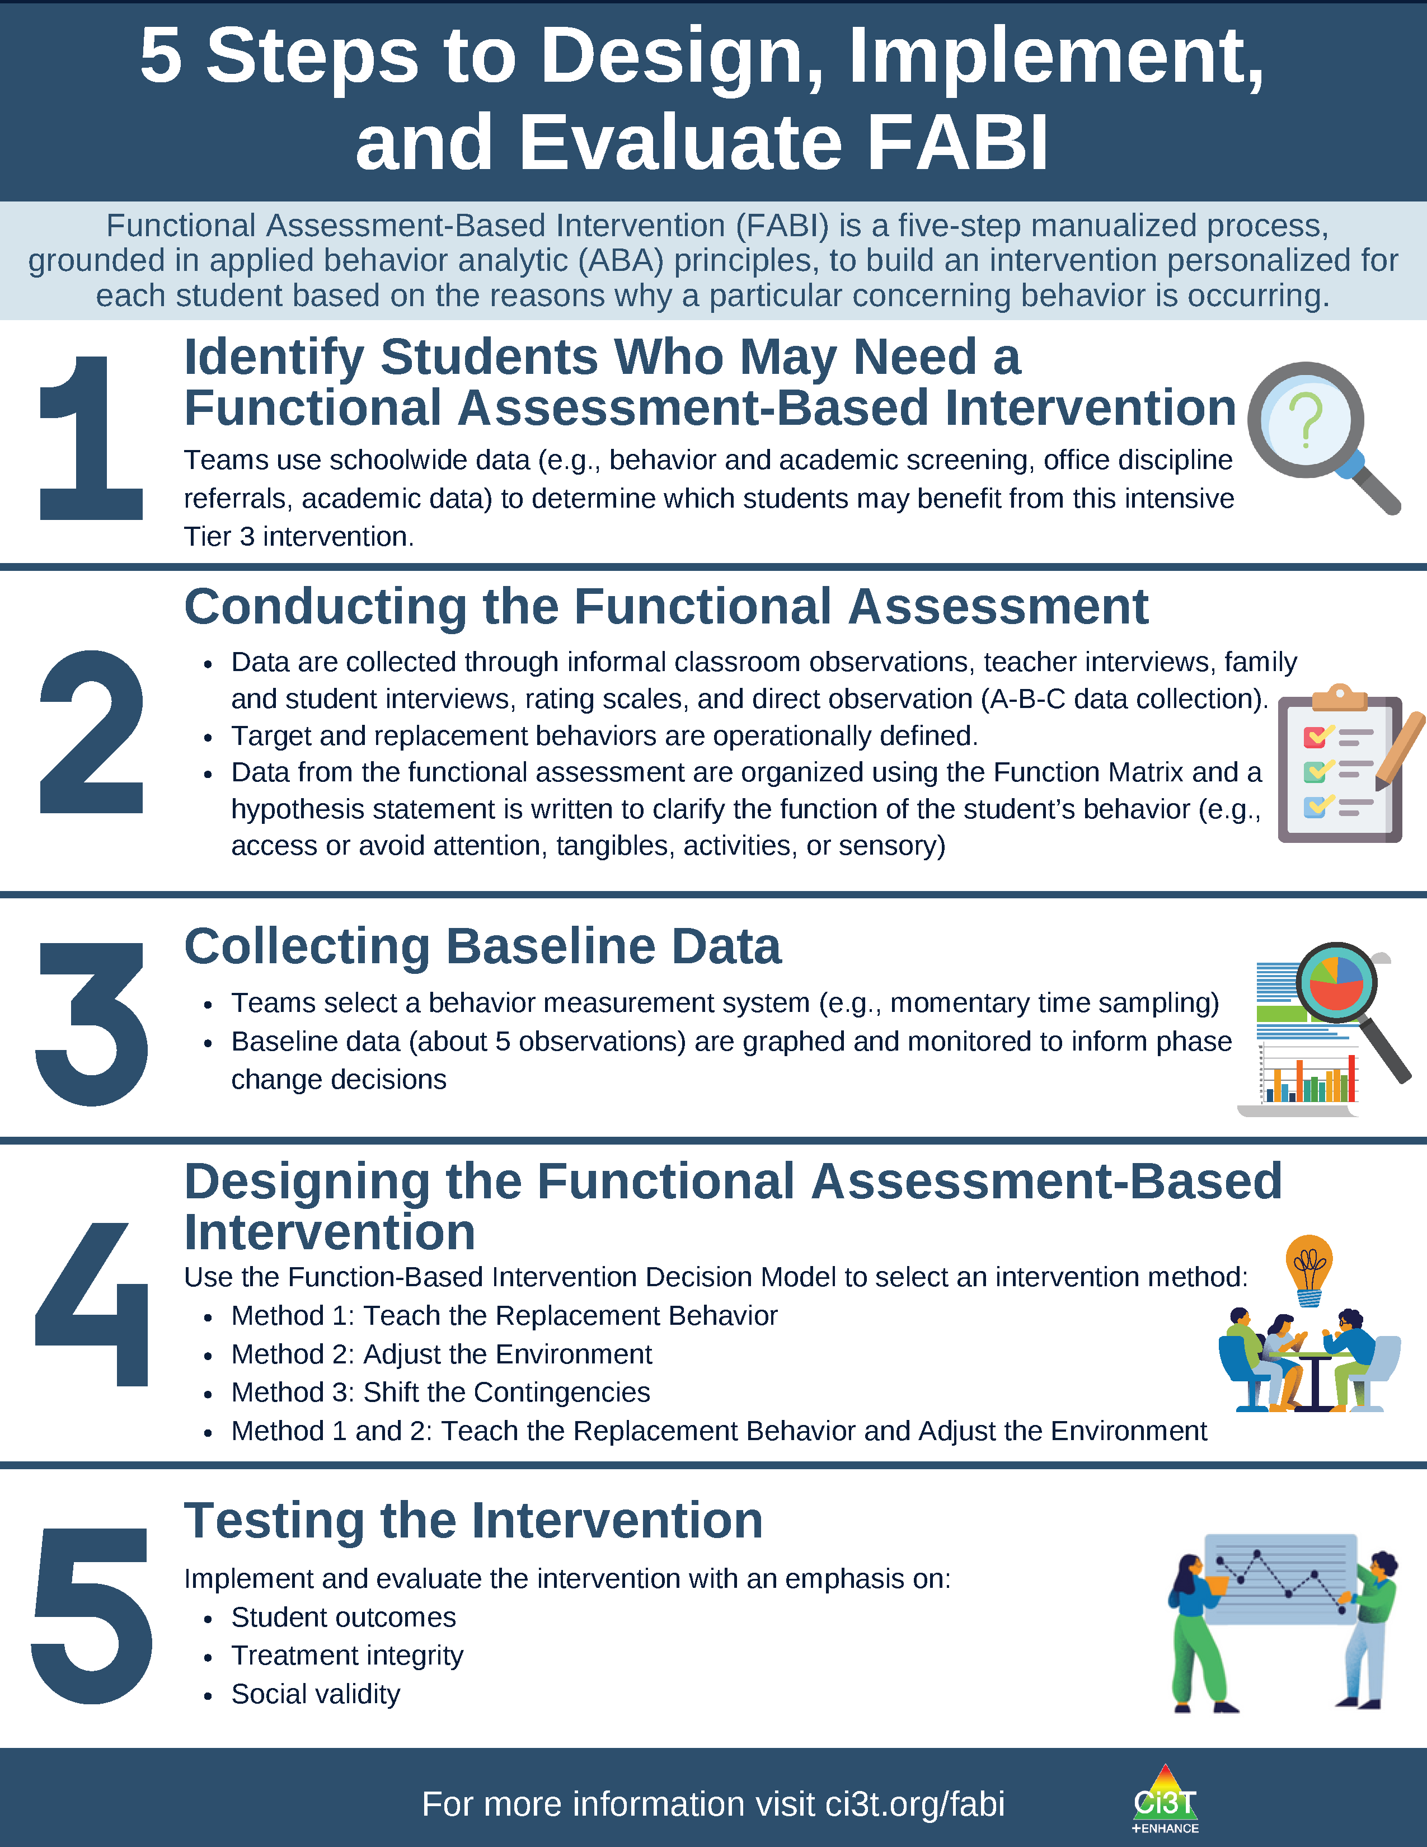
What is Functional Assessment-Based Intervention (FABI)?
Customized intervention designed for each student based on the reasons why a particular concerning behavior is occurring
Developed through a five-step, team-based, manualized process
Grounded in applied behavior analytic (ABA) principles (e.g., reinforcement, antecedent, consequence)
Notes:
PRESENTER NOTE:
FABI is one type of FBA (functional behavioral assessment)
Can be used as a Tier 3 intervention, as we are discussing in this presentation
Can also be used as a process to conduct a functional behavioral assessment (FBA) and develop a behavior intervention plan (BIP) for student’s with IEPs as required under certain conditions of IDEA
See state regulations for more information regarding FBAs as part of a student’s IEP

Slide 18

Looking back …

Slide 19
Let’s Talk: Initial Impressions
Which Tier 3 interventions are offered in your setting?
Share your initial impressions of FABI as a Tier 3 intervention.

Slide 20

A 5-Step Process to Implement FABI

Slide 21
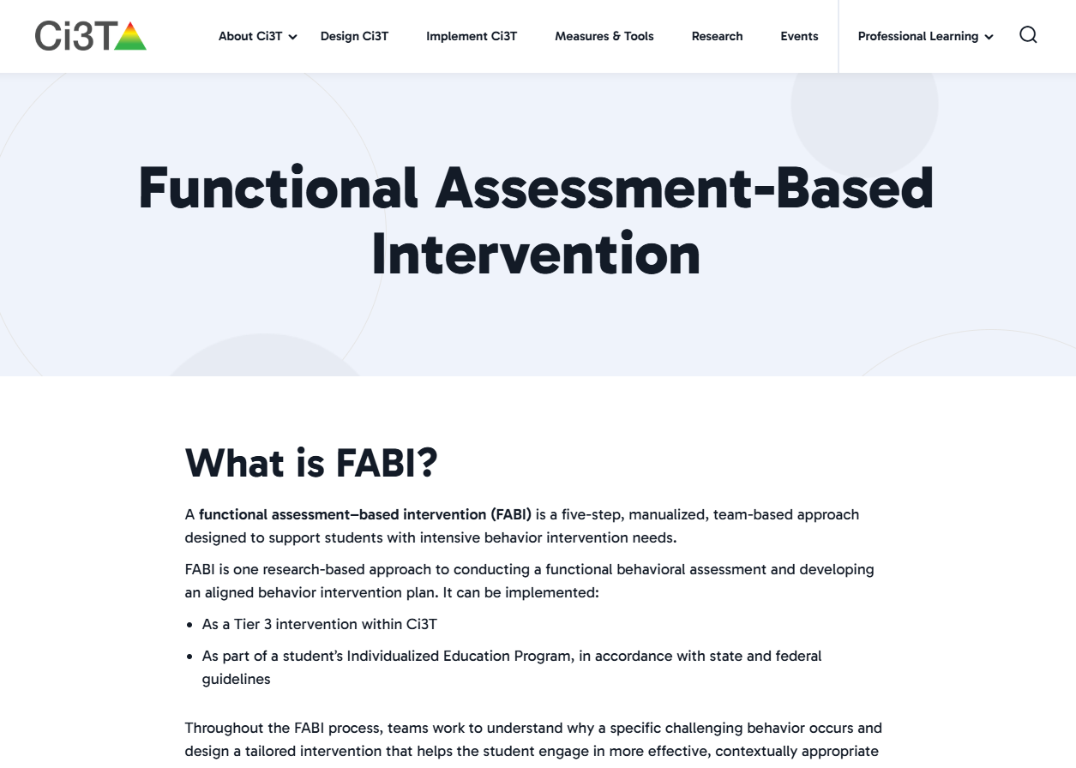

Opportunities to Learn More
Notes:
Our intention in this professional learning is to provide high-level overview of FABI and opportunities to practice the key components. If you are interested in learning more or implementing FABI in your setting, we encourage you to access these additional resources to more comprehensively learn about each of the five steps.

Slide 22

Step 1
Identifying Students Who May Need a FABI

Slide 23
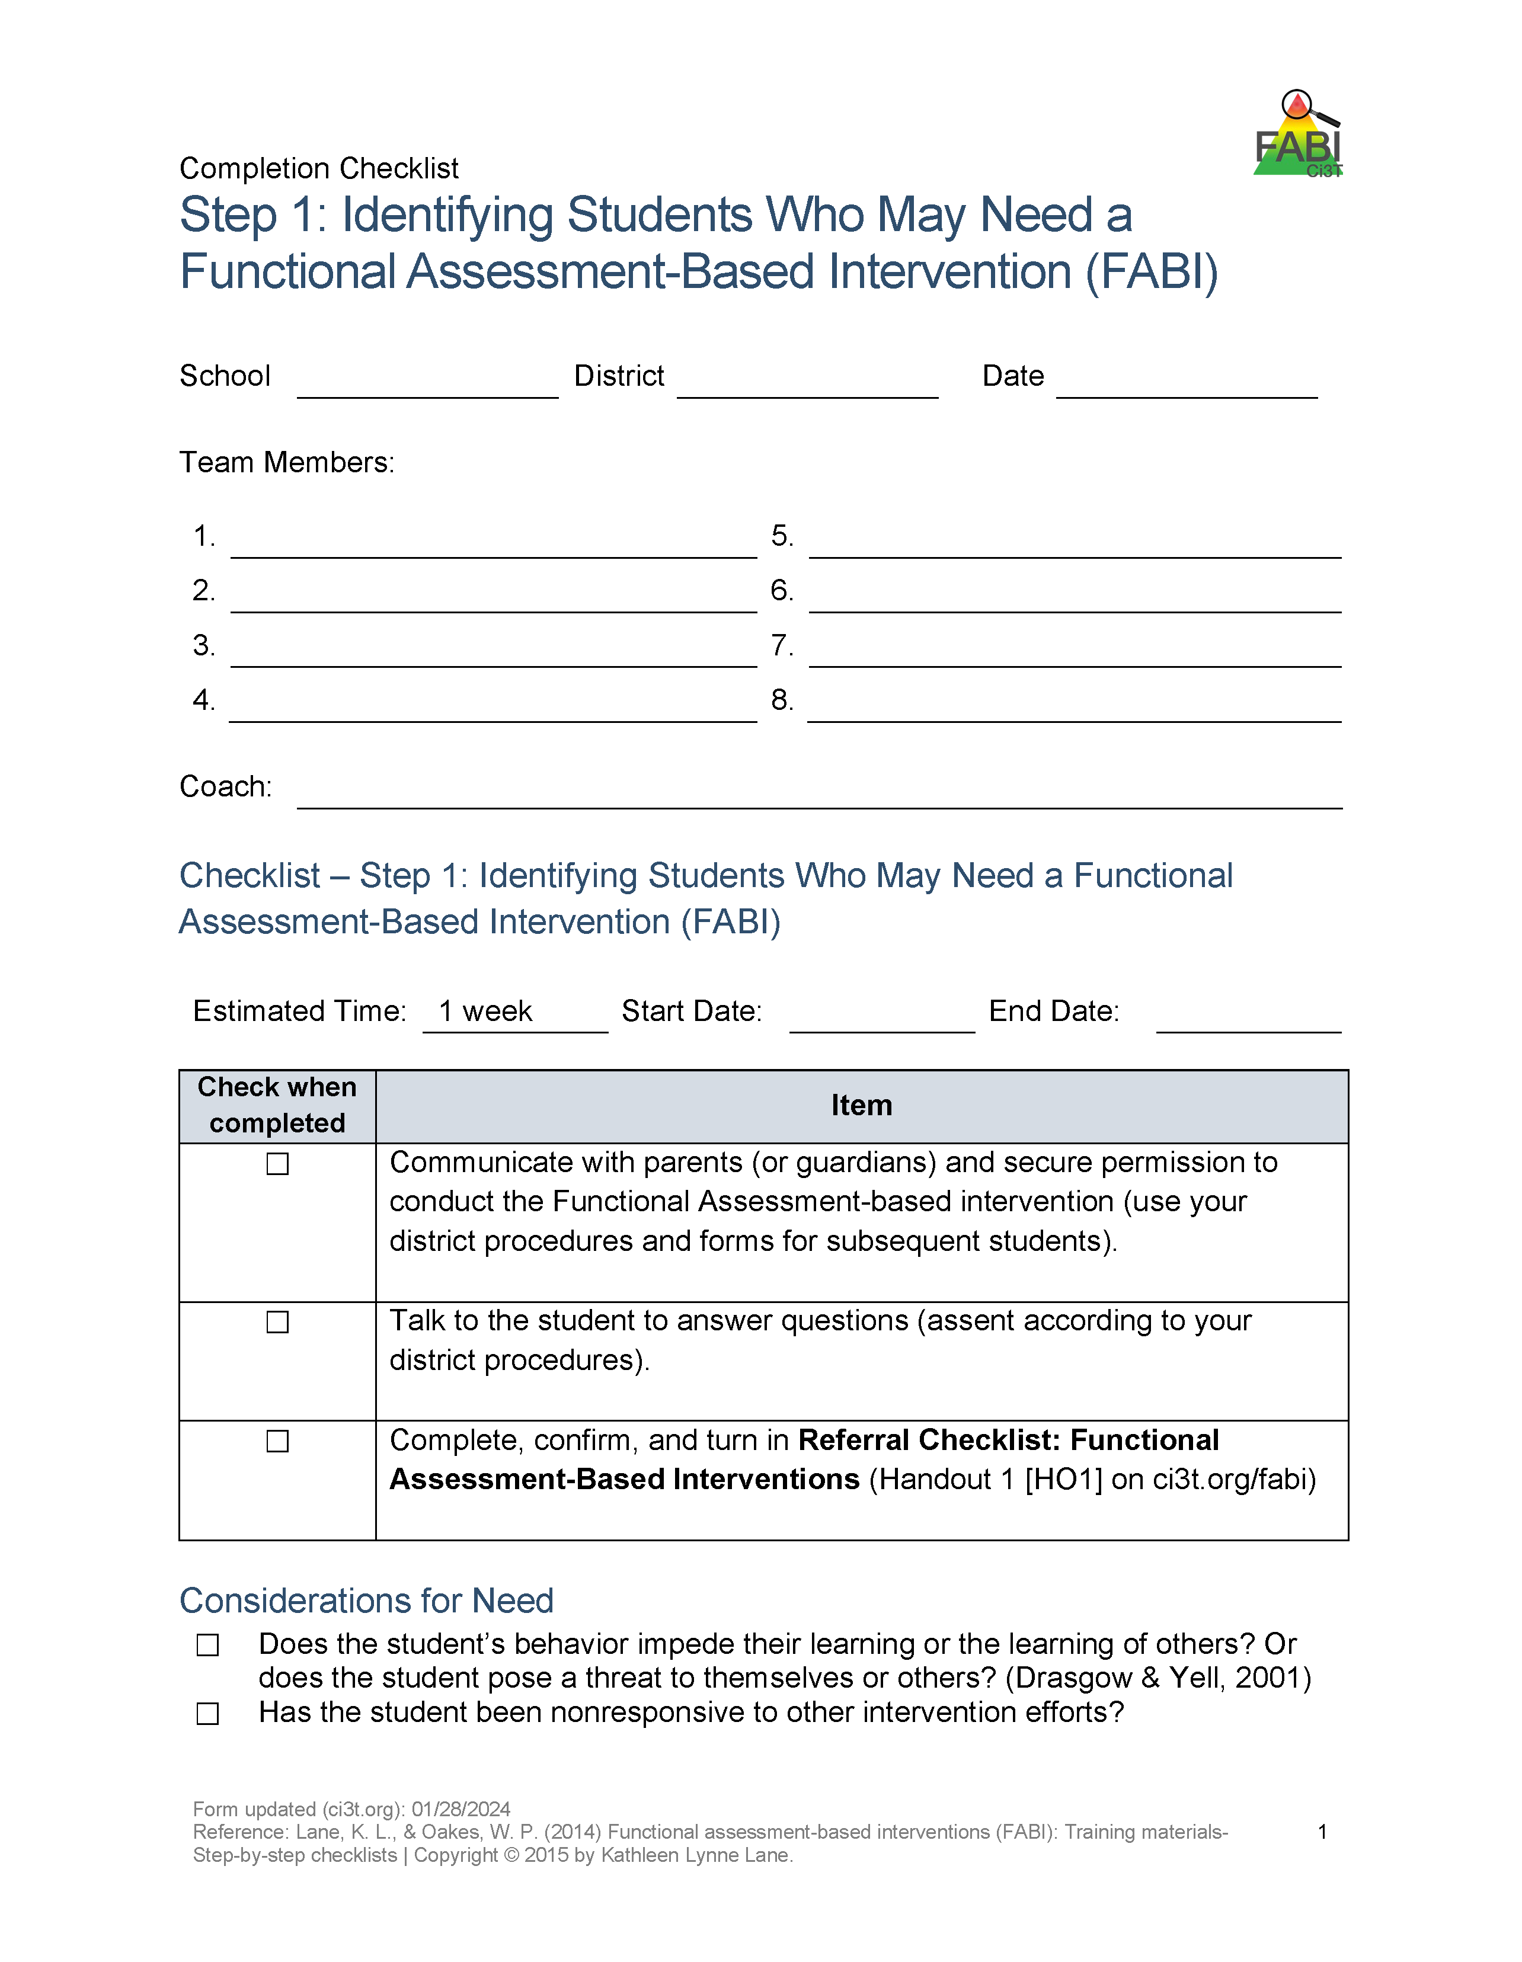
Step 1: Identifying Students Who May Need a FABI
Review multiple sources of data
Connect with family member(s)
Meet with student

Slide 24
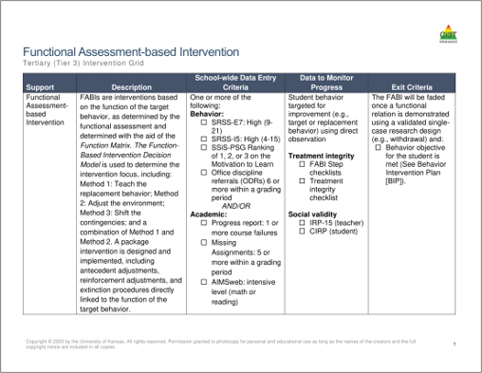
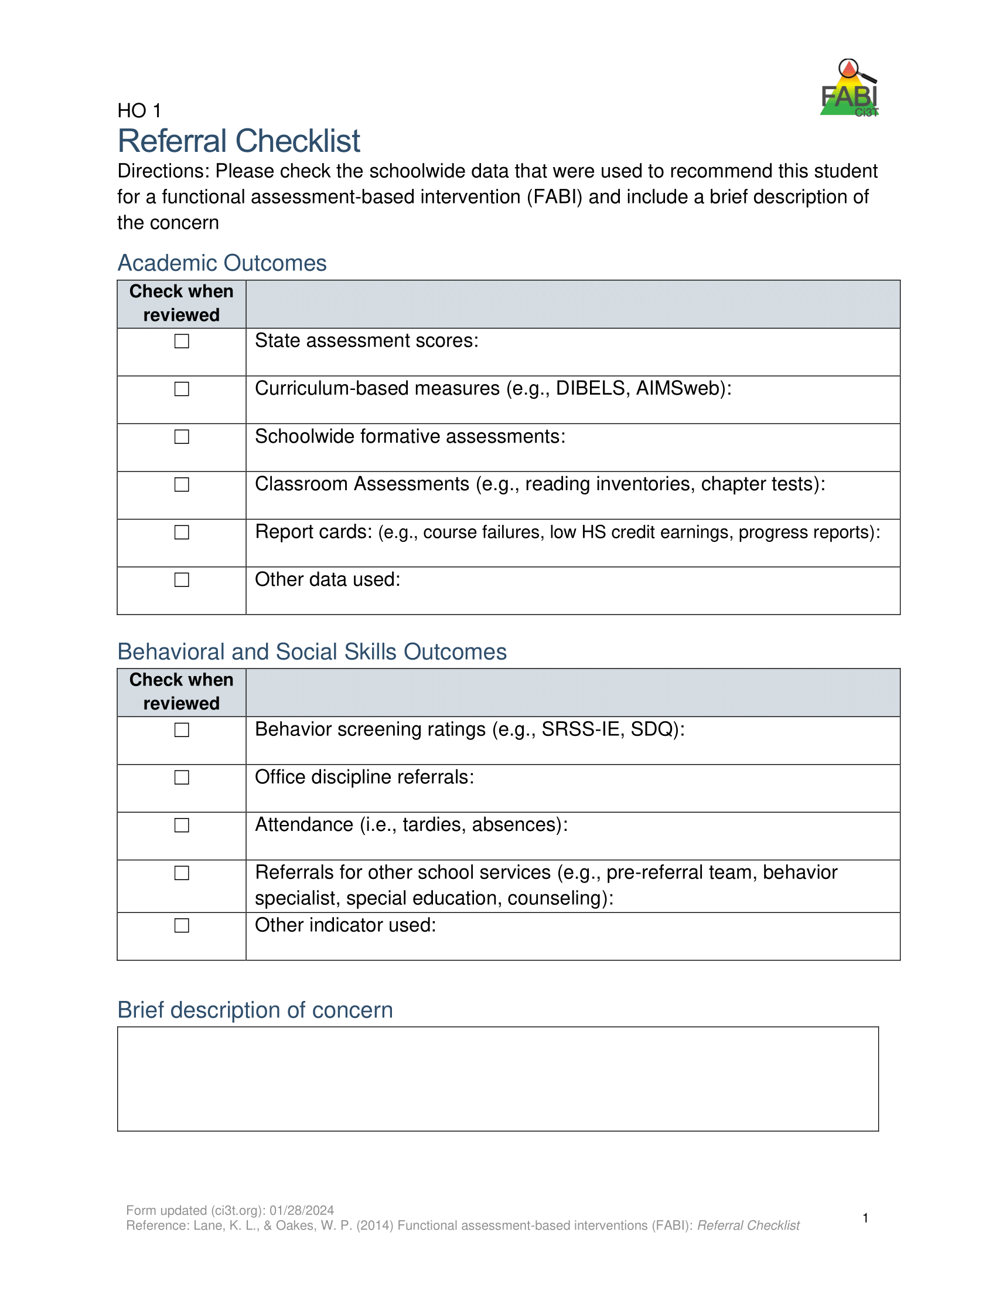
Review multiple sources of data
Use the Tertiary (Tier 3) Intervention Grid and referral checklist to review multiple sources of data such as:
  Academic assessment data (e.g., screening, curriculum-based measures)
  Behavior screening tools
  Office discipline referrals (ODRs)
  Attendance records

Slide 25
Connect with Family Member(s) and Student
Family Member(s)
Student
Describe FABI and role family member will play throughout FABI process
Explore other Tier 3 interventions
Secure permission following district procedures
Explain goals of FABI and how the student will be involved throughout the FABI process
Provide opportunity for student to ask questions

Slide 26
FABI Step1: Tips and Considerations

Slide 27

Step 2
Conducting the Functional Assessment

Slide 28

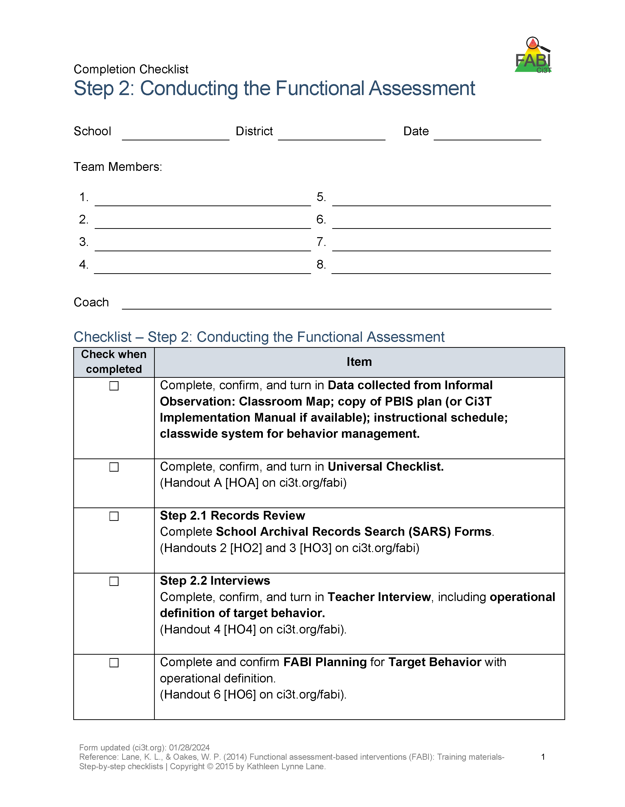
Step 2: Conducting the Functional Assessment
Understanding the learning environment and context
Records review
Interviews
Operationally define target behavior
Rating scales
A-B-C data collection
Use Function Matrix to identify the hypothesized function(s)
Identify replacement behavior
Notes:
Today, we are going to focus on these three components of Step 2

Slide 29
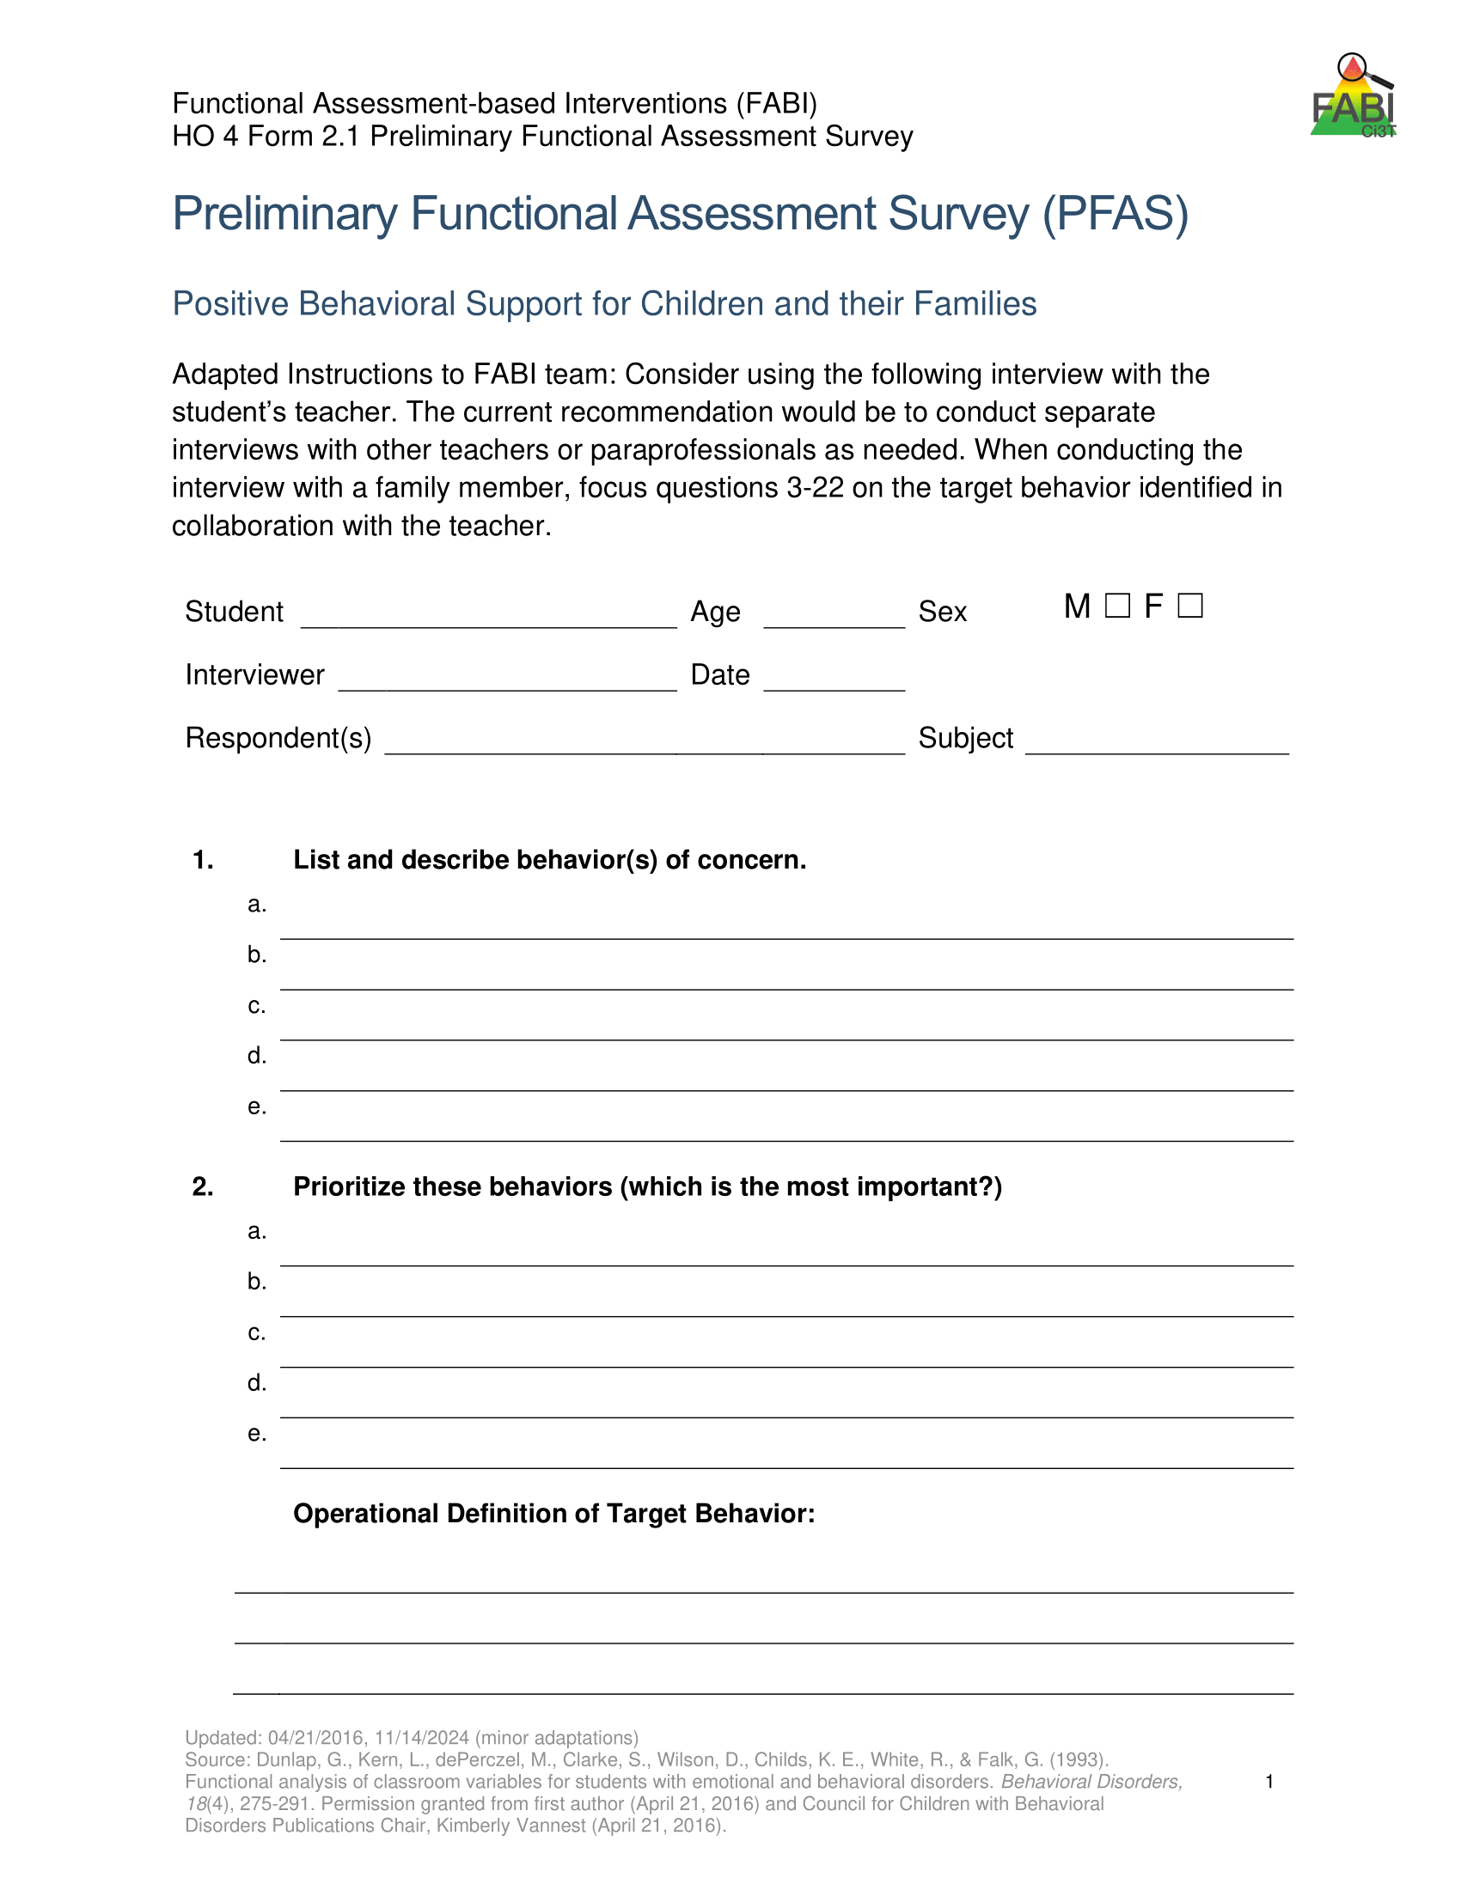
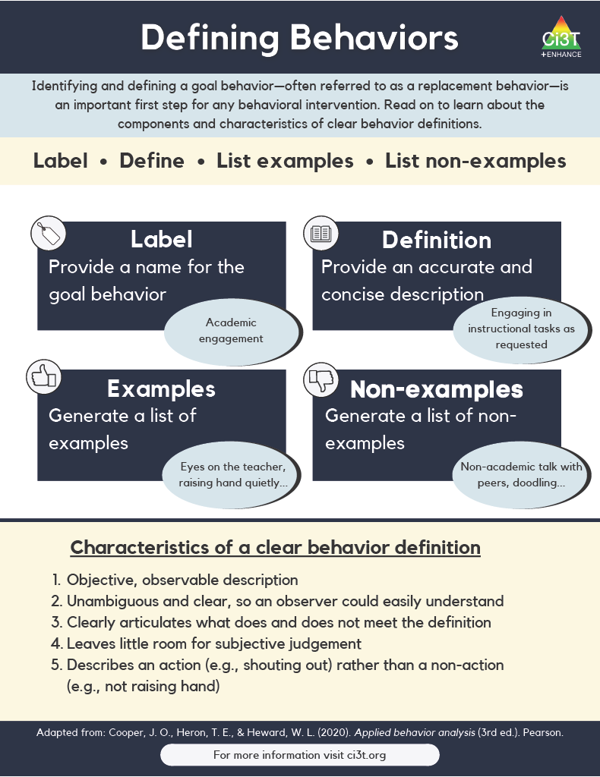
Operationally Defining the Target Behavior
Notes:
During the teacher interview, you will work with the teacher to identify all behaviors of interest and then create a prioritized list to determine the one keystone behavior. In other words, what is the one behavior, that if modified, could allow students to enjoy school more fully?
This becomes the target behavior (or the behavior you are seeking to reduce) which you will then operationally define

Slide 30
Defining Behaviors 1

Slide 31
Defining Behaviors 2

Slide 32
Example Operational Definition
Component | Description
Label | Off-task
Definition | Off-task is defined as attending to activities in class other than assignments.
Examples | Playing with materials inappropriately, talking to peers, putting head on the desk, drawing, and looking around the room
Non-Examples | Completing assignments using materials only for assignments, and watching the teacher when delivering instruction

Slide 33
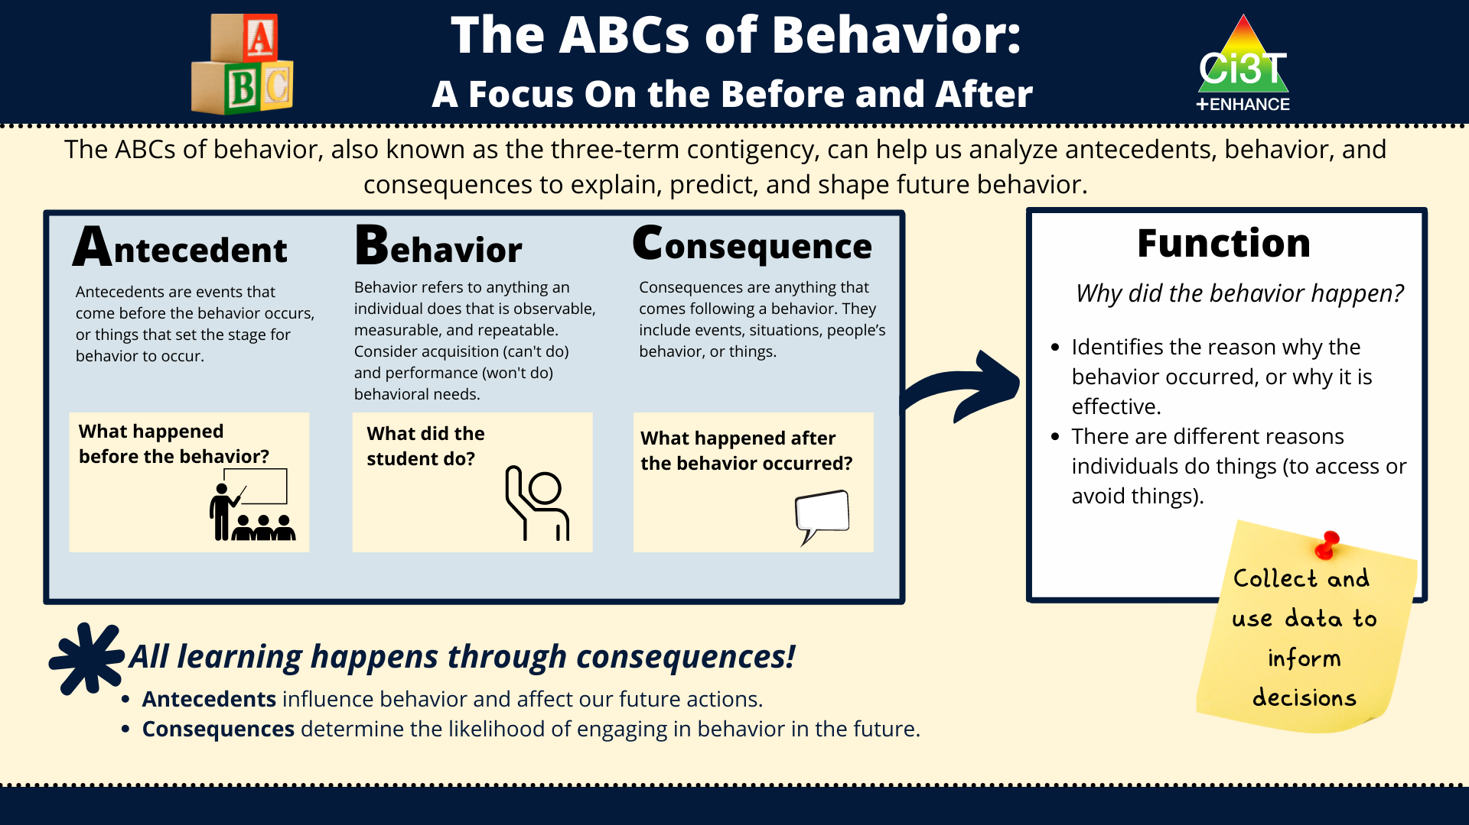
The ABCs of Behavior: A Focus on the Before and After

Slide 34
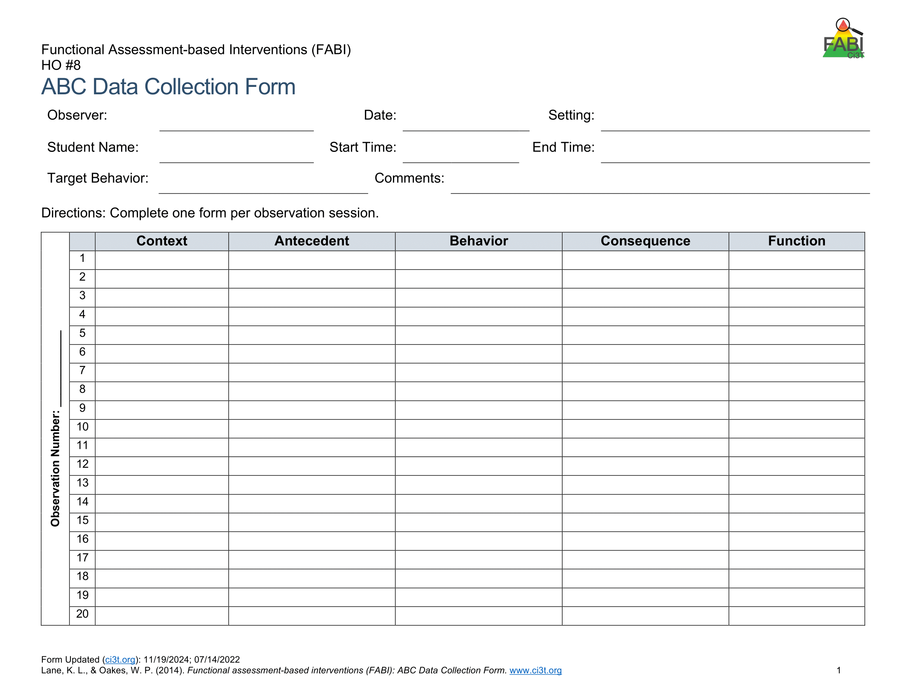
Direct Observation
(A-B-C Data Collection)
Determine the time of day and setting during which the behavior most often occurs
3 observation sessions (minimum)
Aim to observe 8-10 occurrences of the target behavior or three hours of observations
Record only instances of target behavior
Each instance of the target behavior will be numbered and later placed in the Function Matrix

Slide 35

A-B-C Data Collection Example
Reading instruction
Pencil breaks
Student throws pencil
Teacher looks at student
Notes:
(talking points synced with animations)
Each time the target behavior occurs you will record details in a new row. Each instance of the target behavior will be numbered and later placed in the function matrix.
You will note the context in which the behavior occurred such as reading instruction, morning circle time, or math instruction
Next, note the antecedent, or what happened immediately before the behavior
Then, record the target behavior itself. Remember – you are only recoding instances of target behavior
Last, record the consequence, or what happened immediately after the target behavior
The last column with the function of the behavior, such as access to or avoidance of attention, tasks or tangibles, or sensory experiences will be completed later.

Slide 36
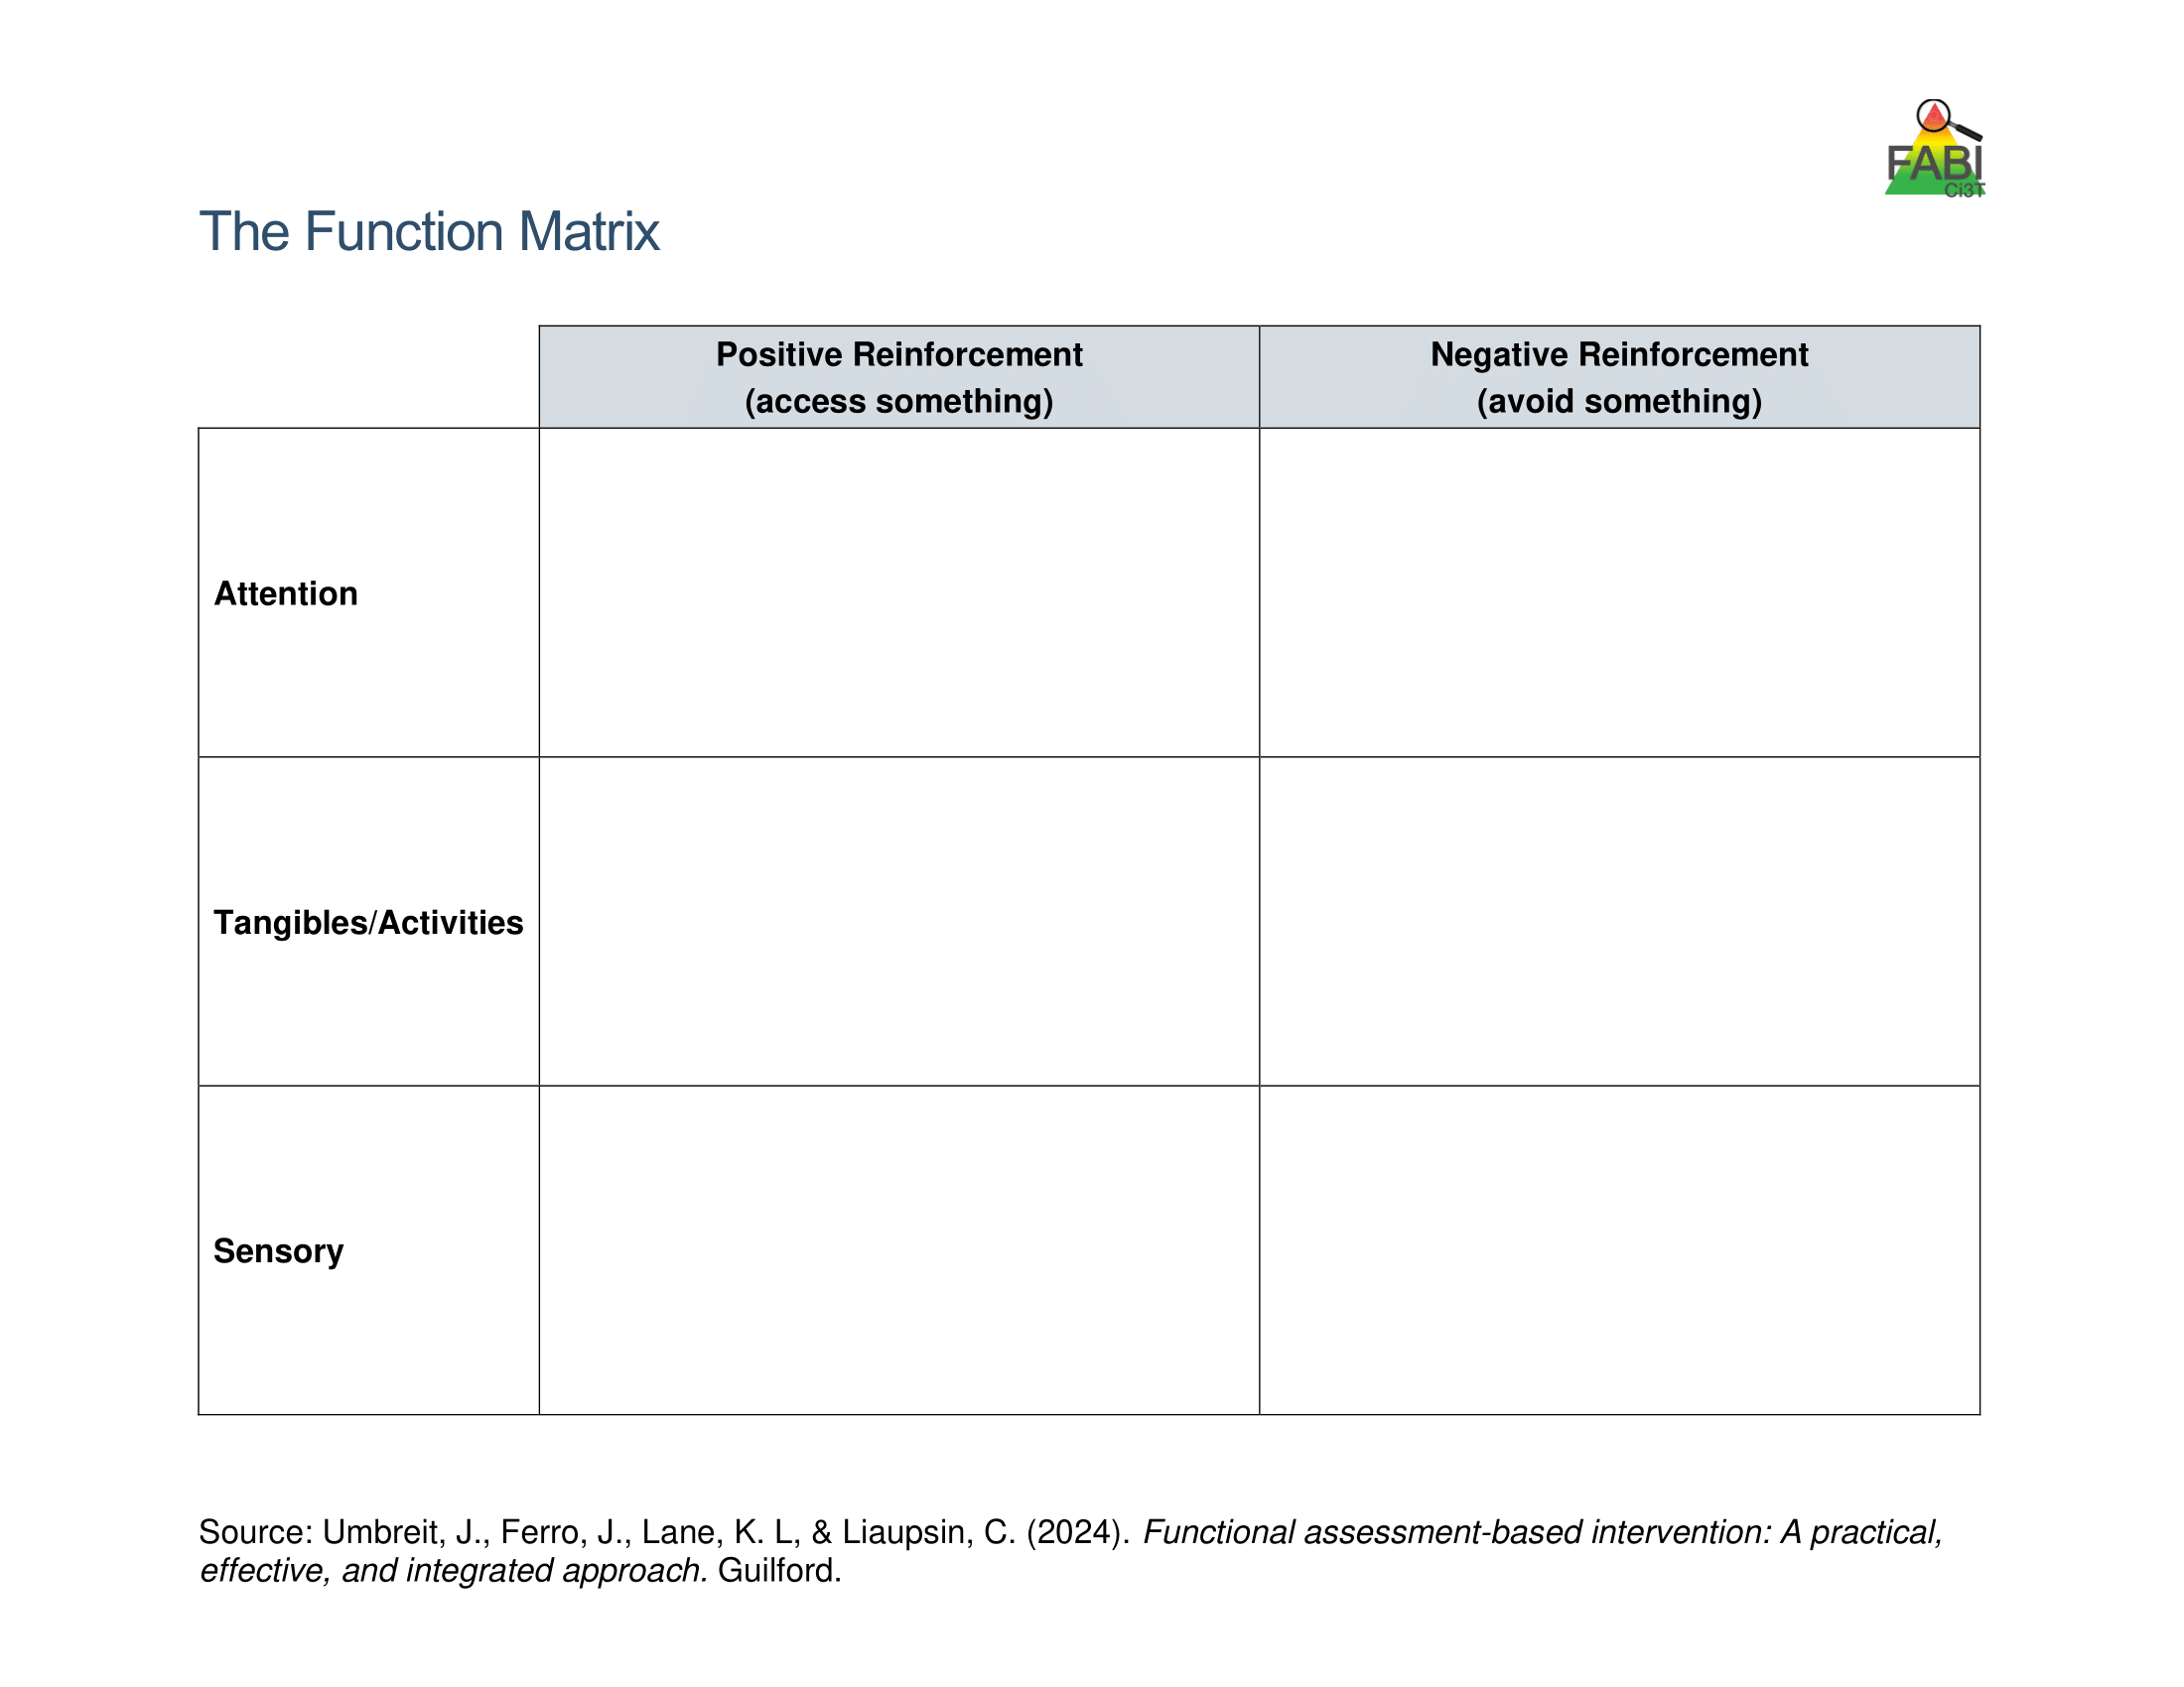
Using the Function Matrix to identify the hypothesized function(s)
Peers laugh
Teacher provides 1:1 assistance
Work alone
Ignored by peers or adults
Preferred activity (e.g., tablet)
Do not have to complete academic task
Access to fidgets
Noise cancelling headphones
Notes:
The Function Matrix, developed by Umbreit and colleagues is a practical, effective, and novel tool for visually organizing multiple sources of information from informal observations, interviews, rating scales, and A-B-C observation data to identify the function of the target behavior.
The Function Matrix is organized based on the principles of applied behavior analysis, with columns reflecting the two ways behaviors are reinforced: positive reinforcement (meaning to get or access something) and negative reinforcement (meaning to escape or avoid something). Then, the three rows reflect three behavioral categories (the “something or somethings”) the person is trying get or avoid.
For example (these are synced to animations)
Access attention of peers or adults – which can look like a teacher providing 1:1 assistance, delivering a reprimand, or engaging in conversation
Avoid attention by working alone or being ignored
Access tangibles/activities like time on the computer
Avoid tangibles or activities – escaping academic task
Access sensory experiences like fidgets or movement breaks
Avoid sensory experiences such as noise-cancelling headphones to escape the noise of a cafeteria or auditorium

Slide 37
Function Matrix
 | Positive Reinforcement (access something) | Negative Reinforcement (avoid something)
Attention | Teacher Interview – “During Independent work time, frequently comes to me to ask a question during math. Often, she already knows the answer” Parent Interview “She wants me to check her homework every night. Not just one math problem but all of them.” ABC Data- 1.2, 1.3, 2.1, 2.4, 3.1
Tangibles/Activities |  | Records Review - Tammy’s low grades were due to lack of class work completion. Teacher Interview- “She is the last one to get started when it is time for independent reading.” Student Interview- “I hate worksheets, they’re so boring” ABC Data: 1.1, 1.4, 2.2, 2.3, 2.5, 3.2
Sensory
Number of the observation
session (Day 1)
Number of the occurrence in the
observation session
(second instance of the behavior on Day 1)
Source: Umbreit, Ferro, Lane, & Liaupsin (2024); Umbreit, Ferro, Liaupsin, & Lane (2007); Umbreit, Lane, & Dejud (2004)
Notes:
Information from all parts of the functional assessment are added to Function Matrix. This includes: informal observations, interviews, rating scales, and A-B-C observation data.
ABC Data are using the following notation (synced to animations)
Number of the observation session (e.g., observation session 1, 2, 3)
Period, number of the occurrence of target behavior in that observation session (e.g., the second instance of behavior) – this is the number of the row.

Slide 38
Let’s Practice!
Determining the Function - 1
Antecedent | Behavior | Consequence
Teacher faced away | Eddie hums | Teacher attends

Slide 39
Let’s Practice!
Determining the Function - 2
Antecedent | Behavior | Consequence
Teacher provides redirect “Jackson, pick up your pencil and start writing” | Jackson begins to tantrum (falls out of seat, kicks legs, yells “no no, no”) | Teacher sends Jackson to a buddy room

Slide 40
Let’s Practice!
Determining the Function - 3
Antecedent | Behavior | Consequence
Teacher hands out math computation worksheet, starts the timer, and tells students that they will be timed in completing the math worksheet | The student then tears up the worksheet | The teacher scolds the student and has the student clean up the mess without completing the worksheet

Slide 41
Hypothesized Function
During [context], [student name] engages in [target behavior] in order to [maintaining function(s)].
Example:
During independent reading activities (CONTEXT), Frank (STUDENT NAME) engages in noncompliant behavior (TARGET BEHAVIOR) to (a) escape too difficult tasks and (b) access peer and teacher attention (MAINTAINING FUNCTIONS).

Slide 42
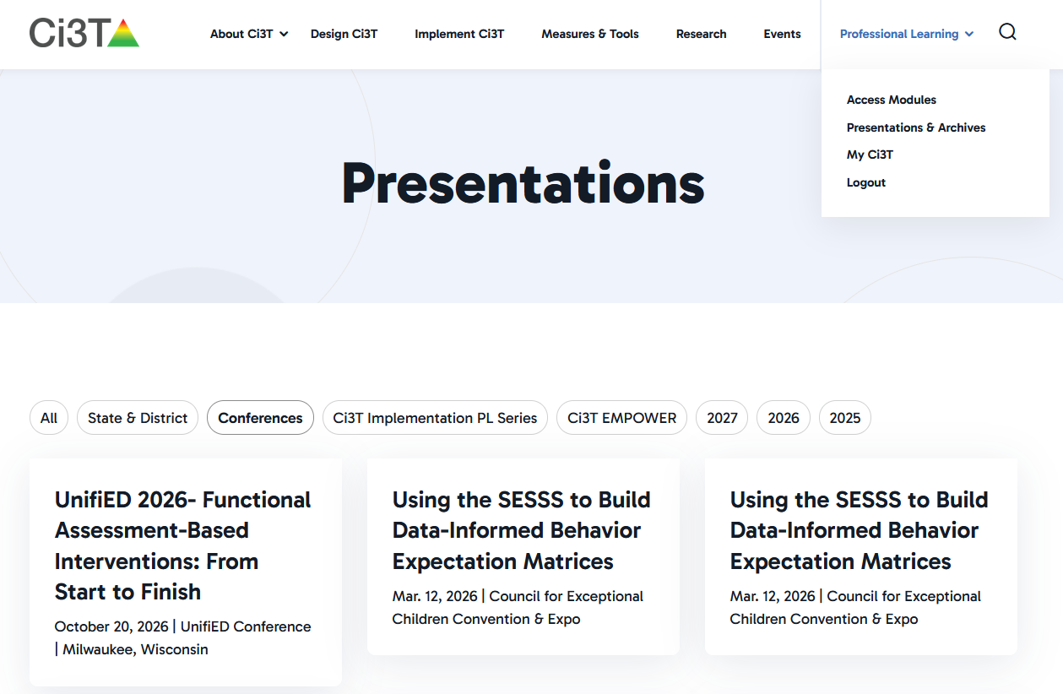
Work Time Preparation

Slide 43












Let’s Practice: Function Matrix
Work with a colleague to complete the Function Matrix.
Notes:
10-min

Slide 44
FABI Step 2: Tips and Considerations

Slide 45

Step 3
Collecting Baseline Data

Slide 46
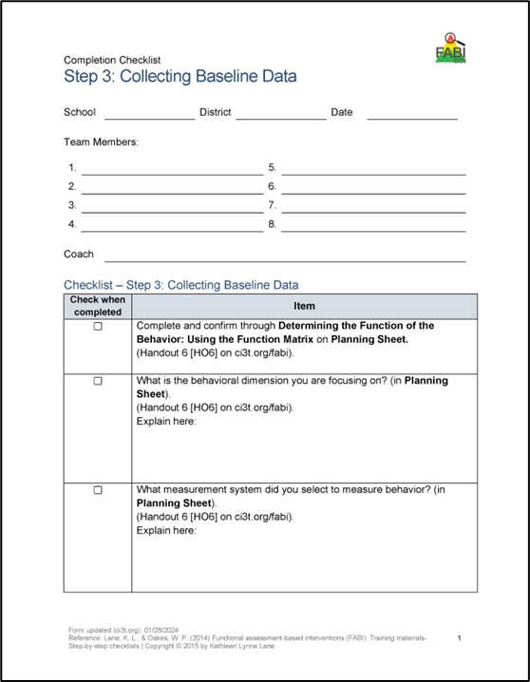
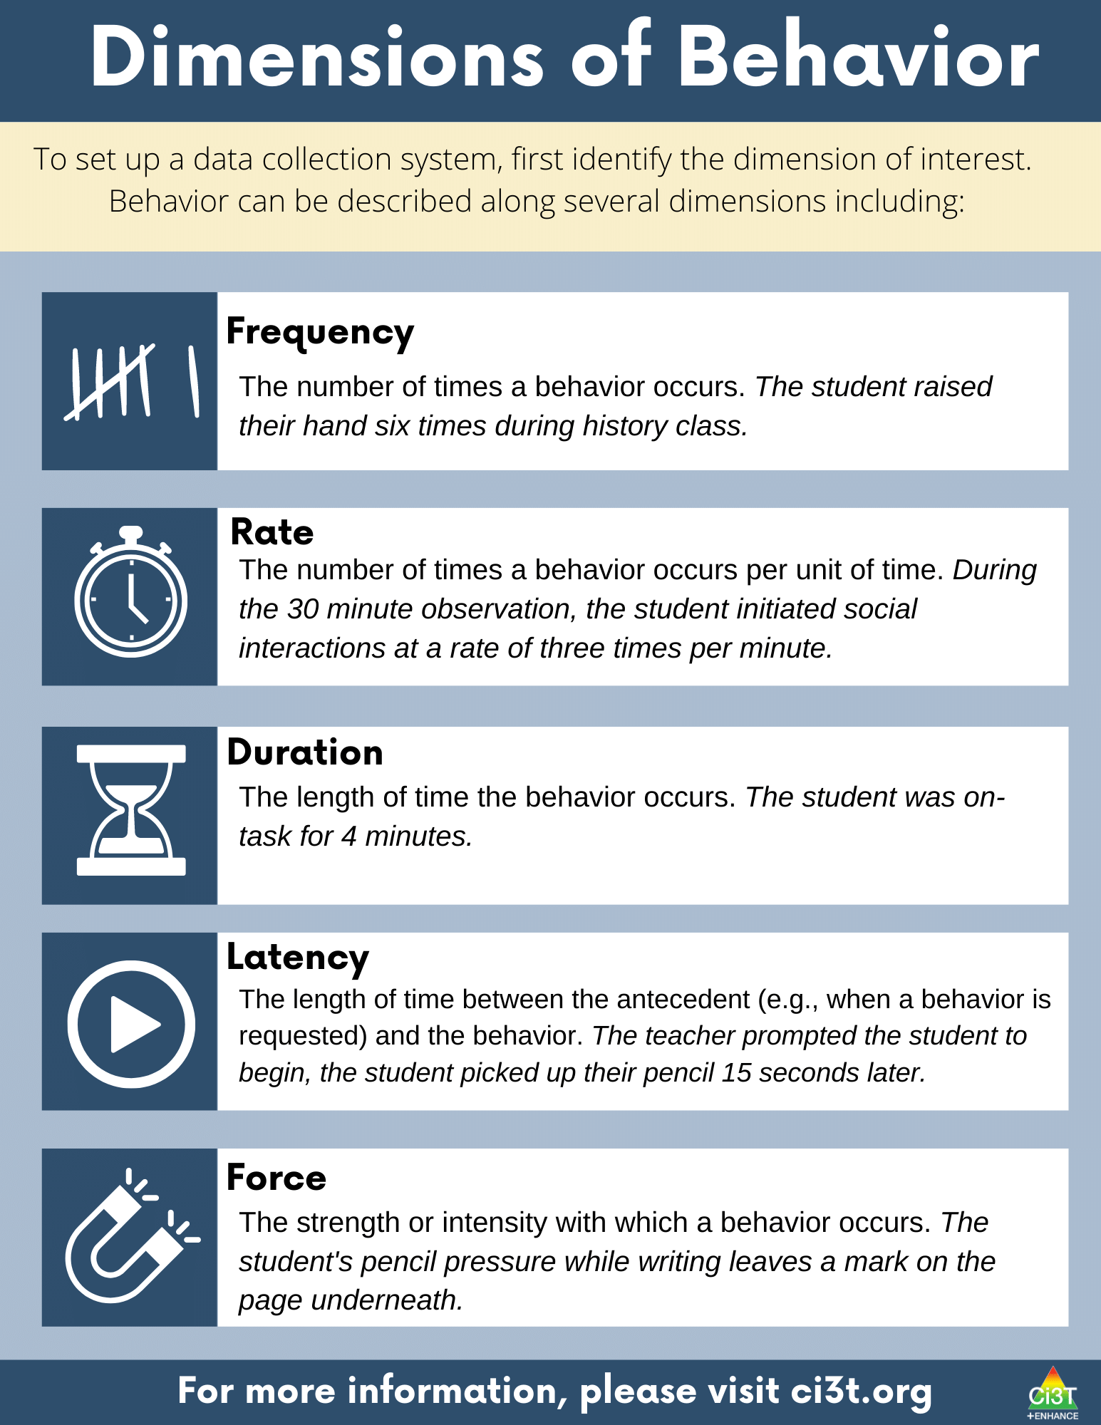
Step 3: Collecting Baseline Data
Determine behavioral dimension of focus
Select a measurement system
Develop data collection procedures
Train data collectors
Collect baseline data
Graph baseline data
Notes:
Today, we are going to focus on these three components of Step 3

Slide 47
Dimensions of Behavior 1

Slide 48
Dimensions of Behavior 2

Slide 49
Let’s Practice – Dimensions of Behavior
 | Dimension
Susan worked math problems for 15 minutes | Duration
Jessica initiated use of her communication device six times | Frequency
Once directed to return to his seat, it took 7 minutes for Charlie to leave the beanbag in the class reading area | Latency
Levi completed four math problems in 10 minutes | Rate
?
?
?
?

Slide 50
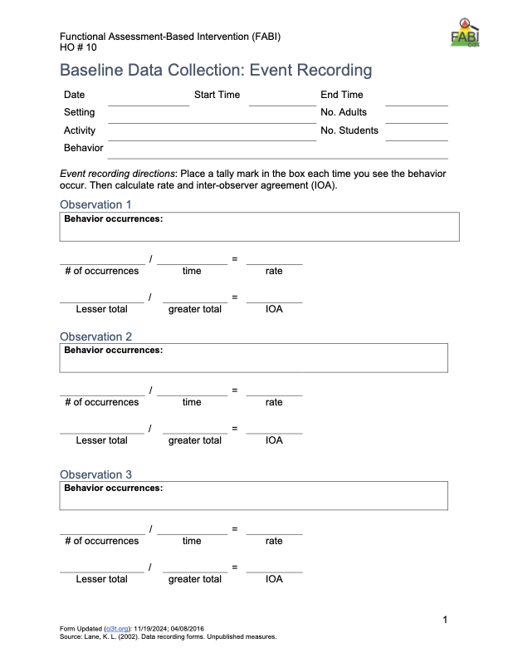
Types of event-based measurement:
  Frequency
  Rate
Most appropriate for behaviors that are:
  Countable and discrete (e.g., relatively brief, clear start and end, and uniform in length).
  Examples: talking out of turn, swearing, pushing
Select a Measurement System: Event-Based

Slide 51
Tips for Event-Based Recording
Select a specific period for data collection (e.g., first 20 minutes of the day, recess, math block)
Keep track of each time the target behavior occurs within that specified time
  Tally marks on paper (e.g., post it, label, data-collection sheet)
  Move paperclips from one pocked to another
  Counter

Slide 52
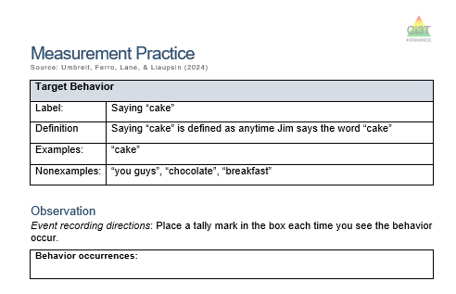
Let’s Practice – Frequency Recording
We will watch a portion of this Jim Gaffigan video clip
Notes:
https://youtu.be/ofRn9zCjy8s?si=1W6vo_yTak1yDSQ7&t=88

Slide 53
Debrief – Frequency Recording
How many times did Jim say the word cake?
What about frequency recording was challenging?
Given those challenges, how could the measurement procedures be improved?
Notes:
PRESENTER NOTES:
Jim says cake 18 times
Challenges
Pancake? Cupcake?
Hearing / audio quality
Frequency (happened a lot, hard to keep up) -
Procedures could be improved by:
Revising operational definition – whether or not to “count” compound words
Set up with good vantage point / audio to conduct observation
Consider whether frequency is appropriate / feasible (e.g., if happening too much to keep up maybe partial interval would be more appropriate)

Slide 54
Select a Measurement System: Time-Based
Time Based
  Duration
  Latency
  Interval (whole-interval, partial interval, momentary time sampling)
Most appropriate for behaviors that are:
  Not countable or discrete (e.g., less defined start/end, span a period of time) and/or vary in length each time
  Examples of non-uniform behaviors include: academic engagement, off-task, leaving designated area (e.g., desk, carpet spot), tantrum

Slide 55
Tips for Time-Based Recording
Duration and Latency
Select a specific period for data collection (e.g., first 20 minutes of the day, recess, math block)
Use a stopwatch (or app) to note:
  Duration – when behavior begins and ends
  Latency – start timer when direction is given, stop timer when student engages in expected behavior

Slide 56
Tips for Time-Based Recording
Interval Recording
Select a specific period for data collection (e.g., first 20 minutes of the day, recess, math block)
Divide observation period into equal intervals (e.g., 30 second, 1 minute)
Set up cue to go off at end of each interval (e.g., audio cue, phone or watch app, MotivAider)
Record whether behavior occurred:
  Whole-interval: behavior occurred the entire interval
  Partial-interval: behavior occurred at any time during the interval
  Momentary Time Sampling: behavior occurred at exact moment interval ends

Slide 57

Wrapping Up Step 3
Determine behavioral dimension of focus
Select a measurement system
Develop data collection procedures
Train data collectors
Collect baseline data
Graph baseline data
Reminder- although we aren’t discussing these today developing data collection procedures, training data collectors, and collecting baseline data are key components of this step!

Slide 58
FABI Step 3: Tips and Considerations

Slide 59

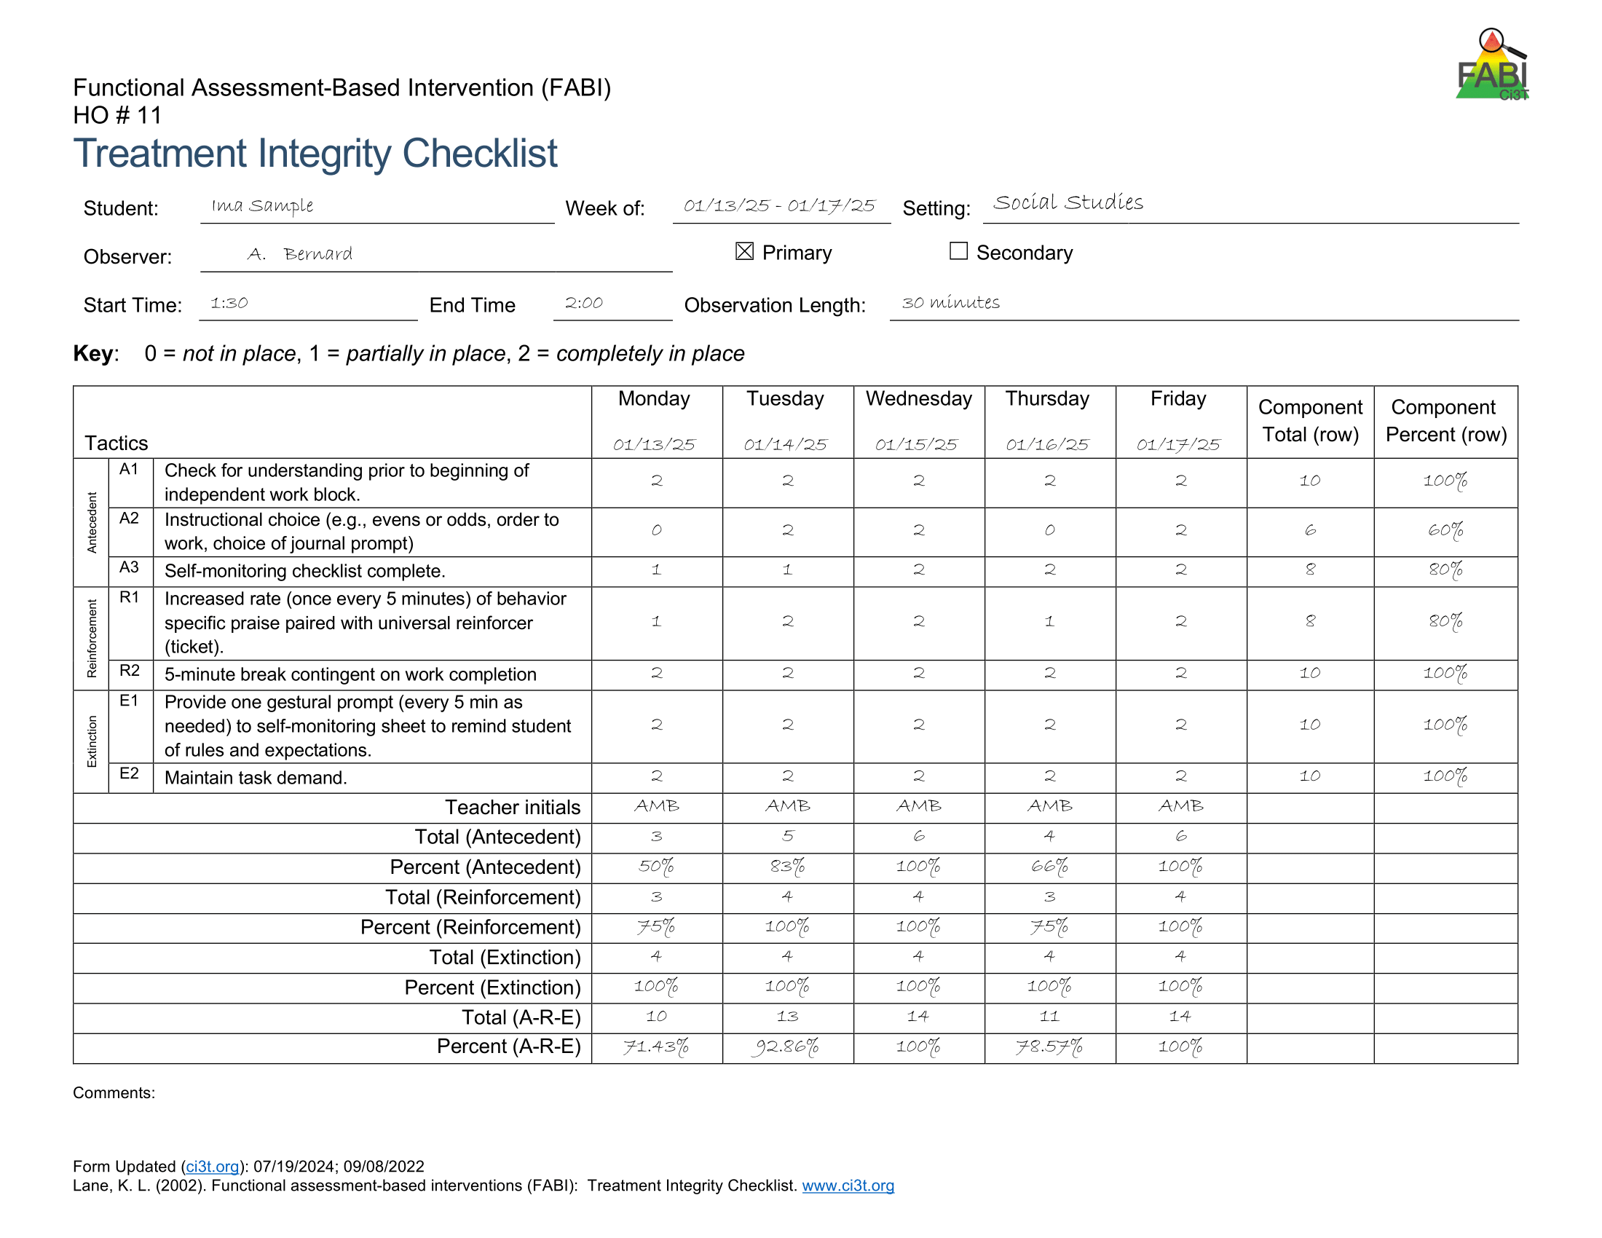
Step 4
Design the FABI

Slide 60

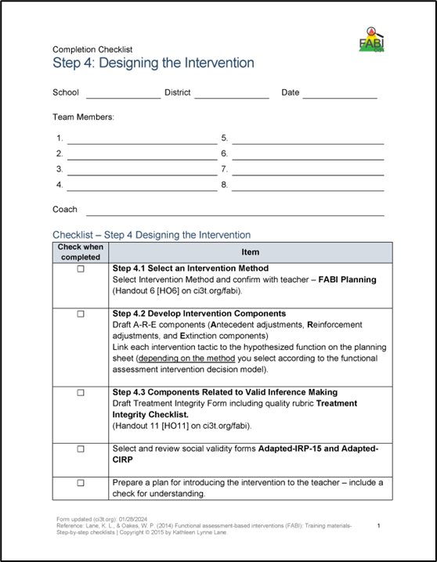
Step 4: Design the FABI
Select an intervention method
Develop A-R-E intervention components
Draft treatment integrity checklist
Assess pre-intervention social validity
Develop intervention materials
Introduce FABI to educators and family
Introduce FABI to student
Revise and finalize FABI
Notes:
Today, we are going to focus on these components of Step 4

Slide 61

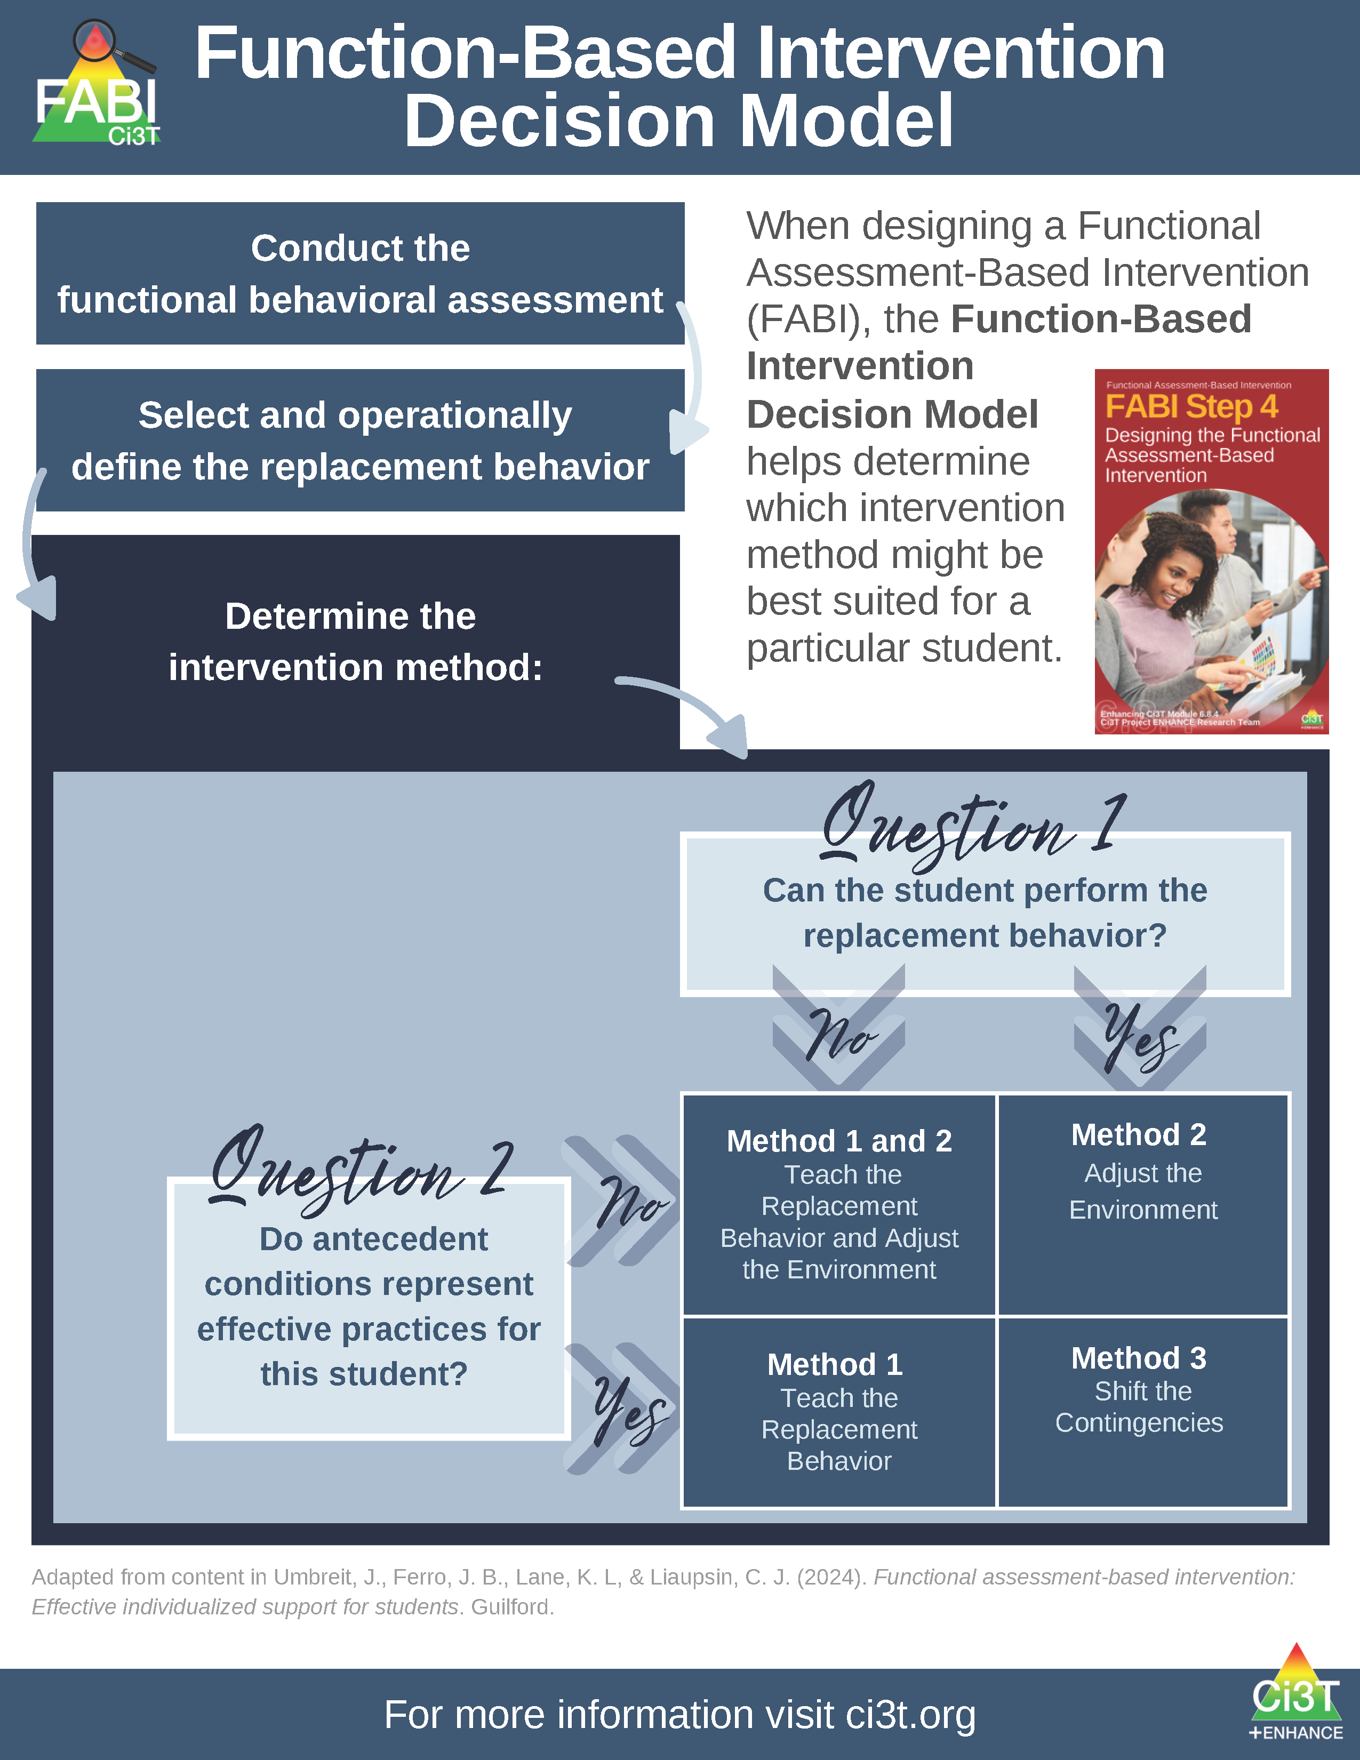
Function-Based Intervention Decision Model
An intervention method is selected based on the response to these two questions:
Can the student perform the replacement behavior?
Do antecedent conditions represent effective practices for this student?

Slide 62
Function-Based Intervention Decision Model 1

Slide 63
A-R-E Components
Antecedent Adjustments - adjusting the antecedent conditions to increase likelihood replacement behavior will occur and (if applicable) providing instruction in the replacement behavior
Reinforcement Shifts - reinforcing the replacement behavior to strengthen its occurrence
Extinction Procedures - ensuring that the target behavior is not followed by reinforcement

Slide 64
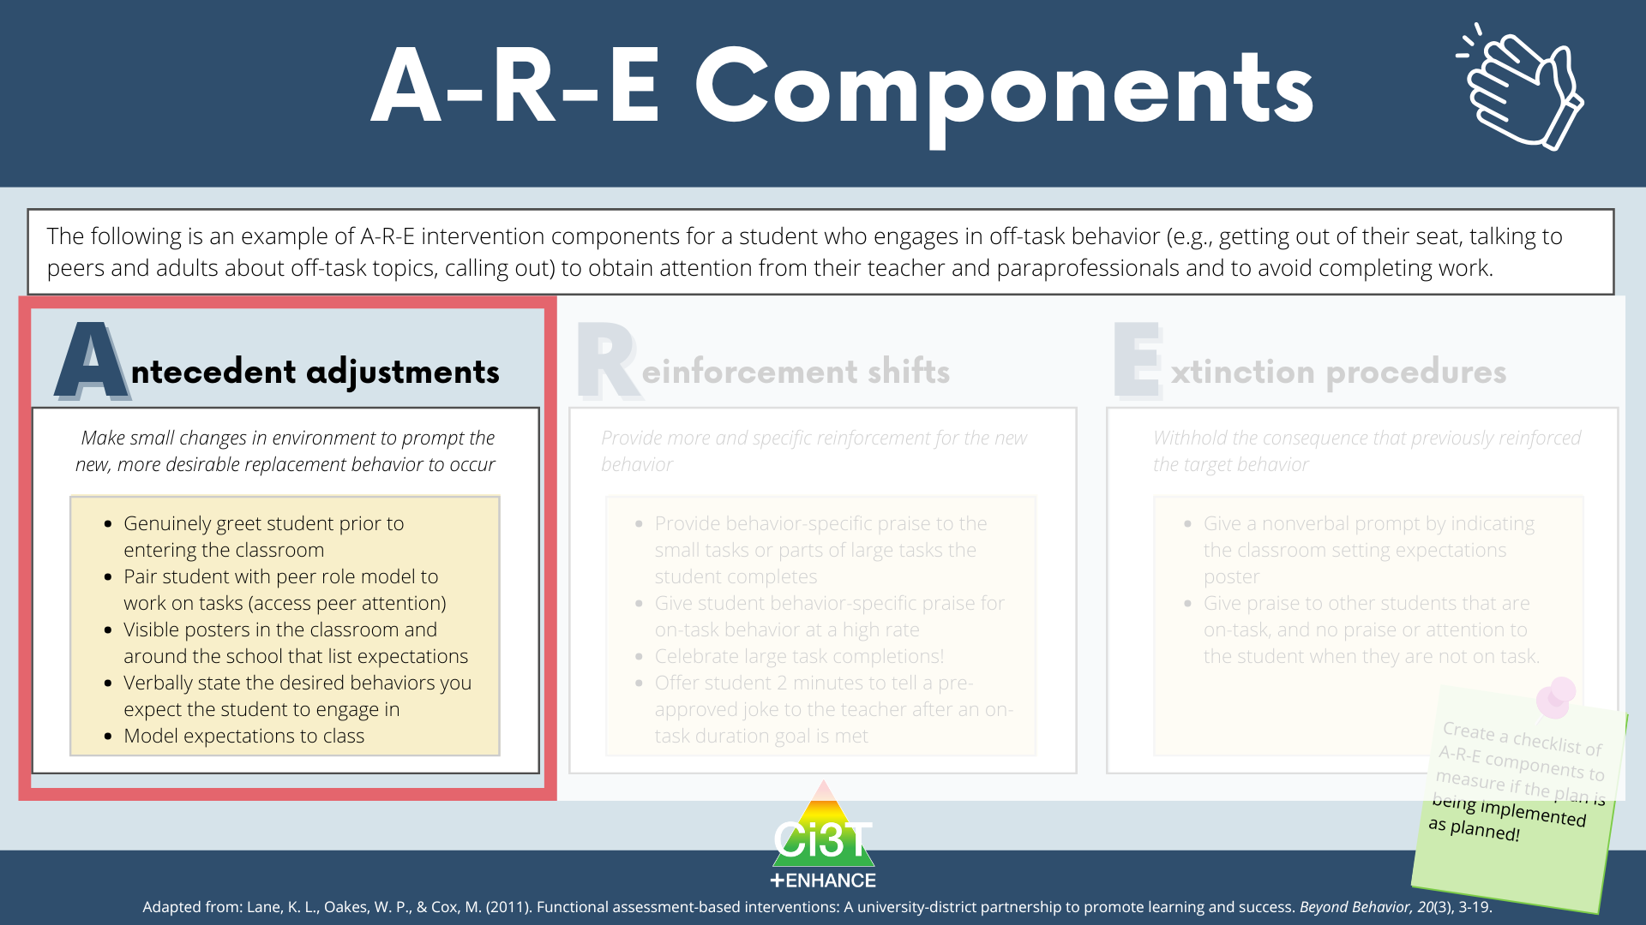
A-R-E Components: Antecedent Adjustments

Slide 65
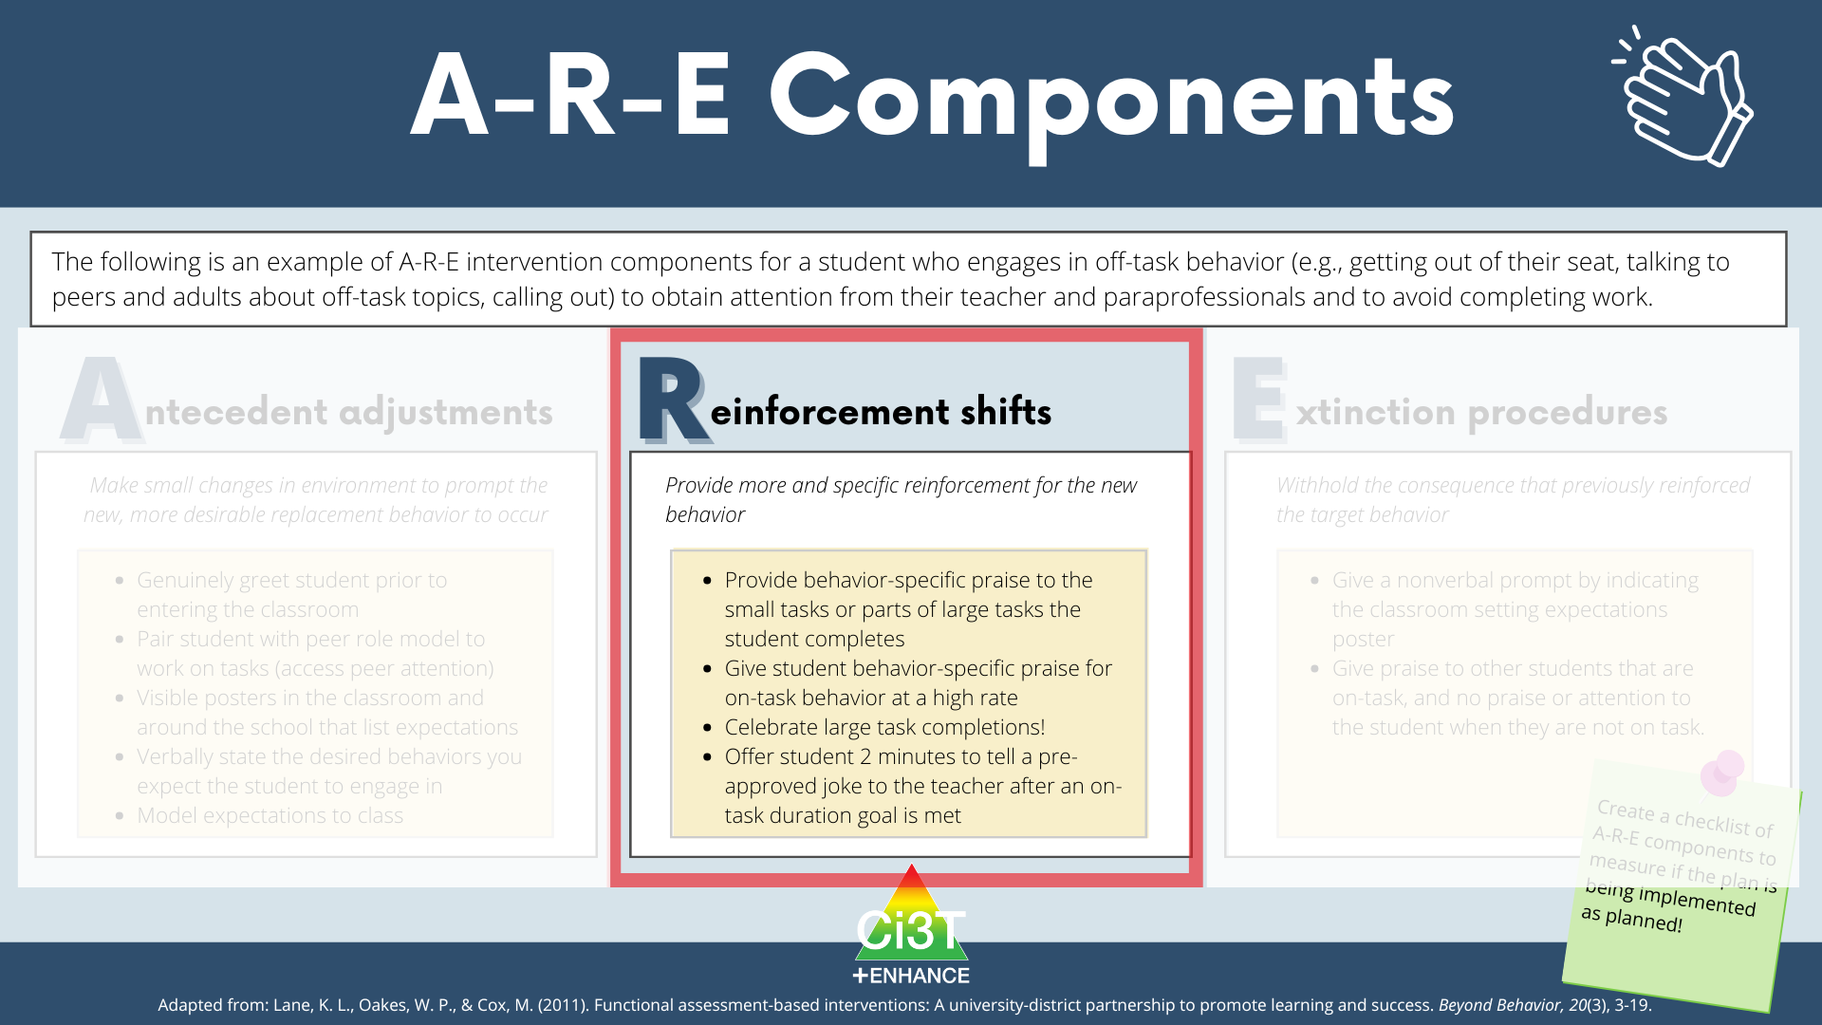
A-R-E Components: Reinforcement Shifts

Slide 66
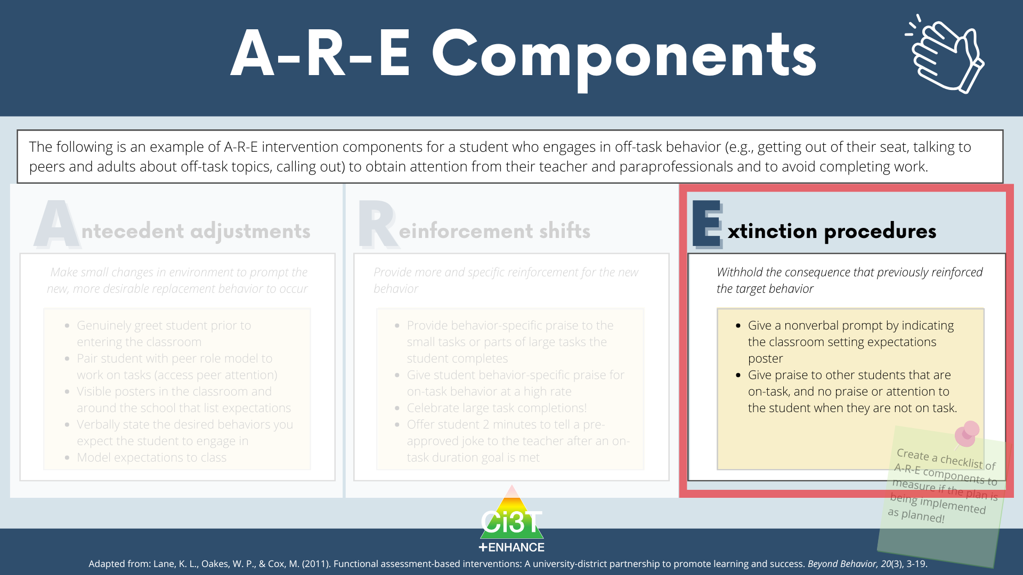
A-R-E Components: Extinction Procedures

Slide 67
Illustration 1:
David (2nd Grade)
Germer, K. A., Kaplan, L. M., Giroux, L. N., Markham, E. H., Ferris, G. J., Oakes, W. P., & Lane, K. L. (2011). A function-based intervention to increase a second-grade student's on-task behavior in a general education classroom. Beyond Behavior, 20(3).

Slide 68
Target Behavior: Off -Task Behavior
Component | Description
Label | Off-task
Definition | Off-task behavior refers to engaging in behaviors or making verbal comments unrelated to instructional tasks.
Examples | leaving assigned instructional area without teacher permission inappropriately making comments to teacher or peers unrelated to instruction attending to anything other than the academic task doing unassigned tasks using instructional materials inappropriately
Non-Examples | staying in assigned instructional area appropriately making comments to teacher or peers related to instruction attending to academic tasks working on assigned task using instructional materials appropriately

Slide 69
Replacement Behavior: On-Task
Component | Description
Label | On-task
Definition | On-task behavior refers to engaging in behaviors or making verbal comments related to instructional tasks.
Examples | staying in assigned instructional area appropriately making comments to teacher or peers related to instruction attending to academic tasks working on assigned task using instructional materials appropriately
Non-Examples | leaving assigned instructional area without teacher permission inappropriately making comments to teacher or peers unrelated to instruction attending to anything other than the academic task doing unassigned tasks using instructional materials inappropriately

Slide 70
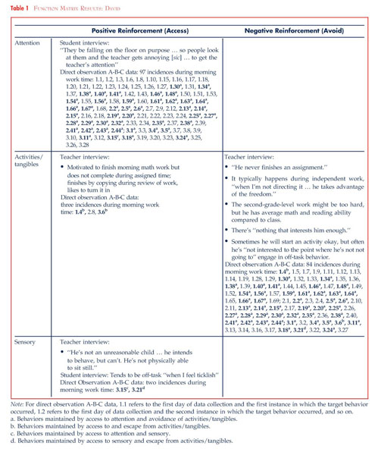
Function Matrix - David

Slide 71
Hypothesized Function: David
When presented with an instructional task, David engages in off-task behavior (such as leaving instructional areas, inappropriately making comments, and engaging in unassigned tasks) to access attention and/or to escape tasks.
In other words, when David is off-task he gets attention from his teacher and peers and does not have to complete assignments (positive reinforcement-attention and negative reinforcement-activity)

Slide 72
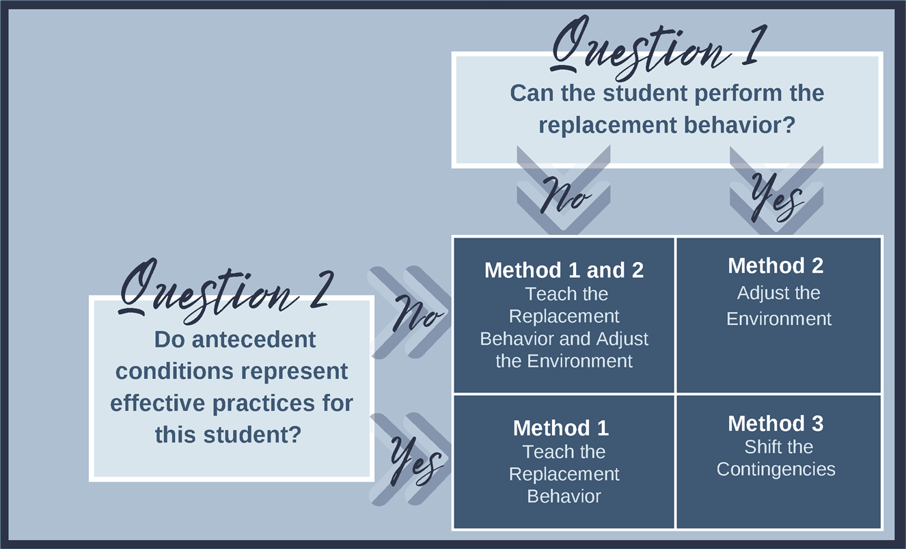
Function-Based Intervention Decision Model: David

Slide 73
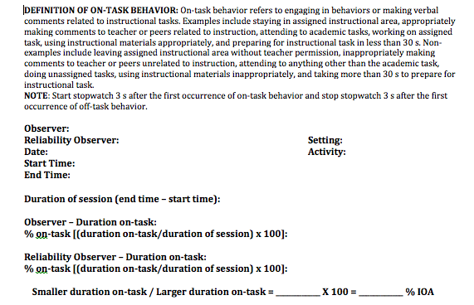
Measurement
Duration
  Measured academic engagement
  20-min sessions during morning instructional time

Slide 74
Component 1- Adjust the Antecedents
Adjust Antecedents | Adjust antecedent variables so the conditions that set the occasion for the target behavior are eliminated and new conditions are established in which the replacement behavior is more likely to occur. | Seating change - David will sit facing the whiteboard Stoplight system Self-monitoring system Teacher will review picture schedule for the morning work period prior to the work period. Teacher will check-in with David at the beginning of independent tasks to ensure that he understood the assignment.

Slide 75
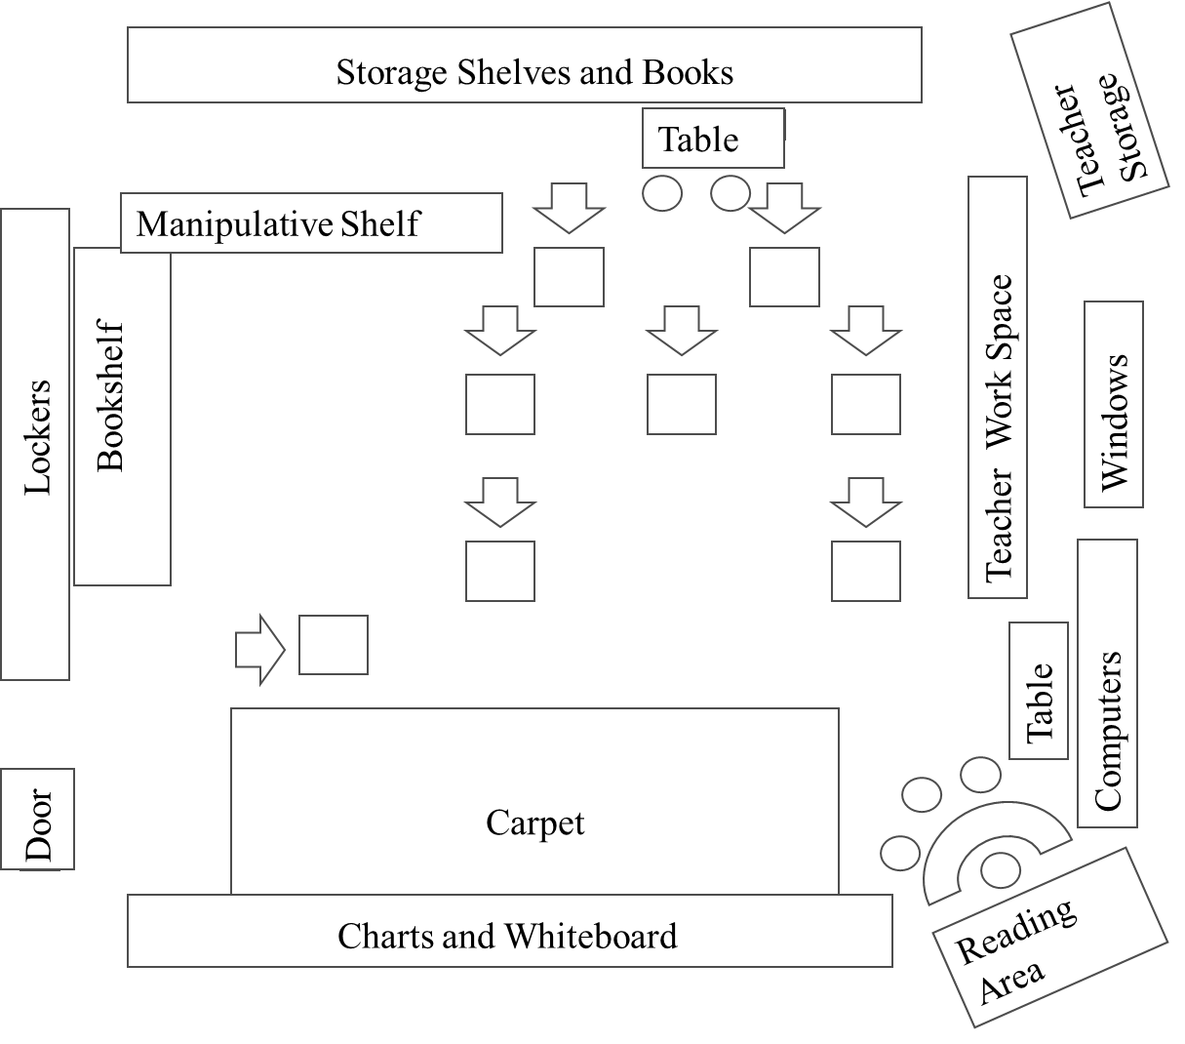
Classroom Example: Intervention Seating
Note: David’s seat pre-intervention
Note: David’s seat during the intervention

Slide 76
Antecedent Adjustment: Stoplight System
Affixed to the side of David’s desk
  David used a clothespin to signal which “light” he was on
Green, yellow, and red “lights”
  Green: “I’m doing my work!”
  Yellow: “I’m asking a friend for help!”
  Red: “I still need help! I’m asking my teacher.”
“I’m done!” to signal completion

Slide 77
Component 2- Reinforcement Rates
Reinforcement Rates | Provide appropriate reinforcement for the replacement behavior. | Teacher will provide behavior-specific praise when David is on-task. Teacher will acknowledge David’s need for help when his clothespin was on red and assist him as quickly as possible. Teacher will check David’s work upon completion, provide praise, and allow him to take a short break. At the end of the morning independent work period, teacher will help David complete his self-monitoring form and write one specific incidence of good behavior at the bottom.

Slide 78
Component 3- Extinguish the Target Behavior
Extinguish Target Behavior | Withhold the consequence that previously reinforced the target behavior. | Teacher will provide no praise or attention when David is off-task, with the exception of one verbal or gestural redirect per minute. When David is off-task, teacher will praise other students who are behaving appropriately.

Slide 79
Treatment Integrity

Slide 80
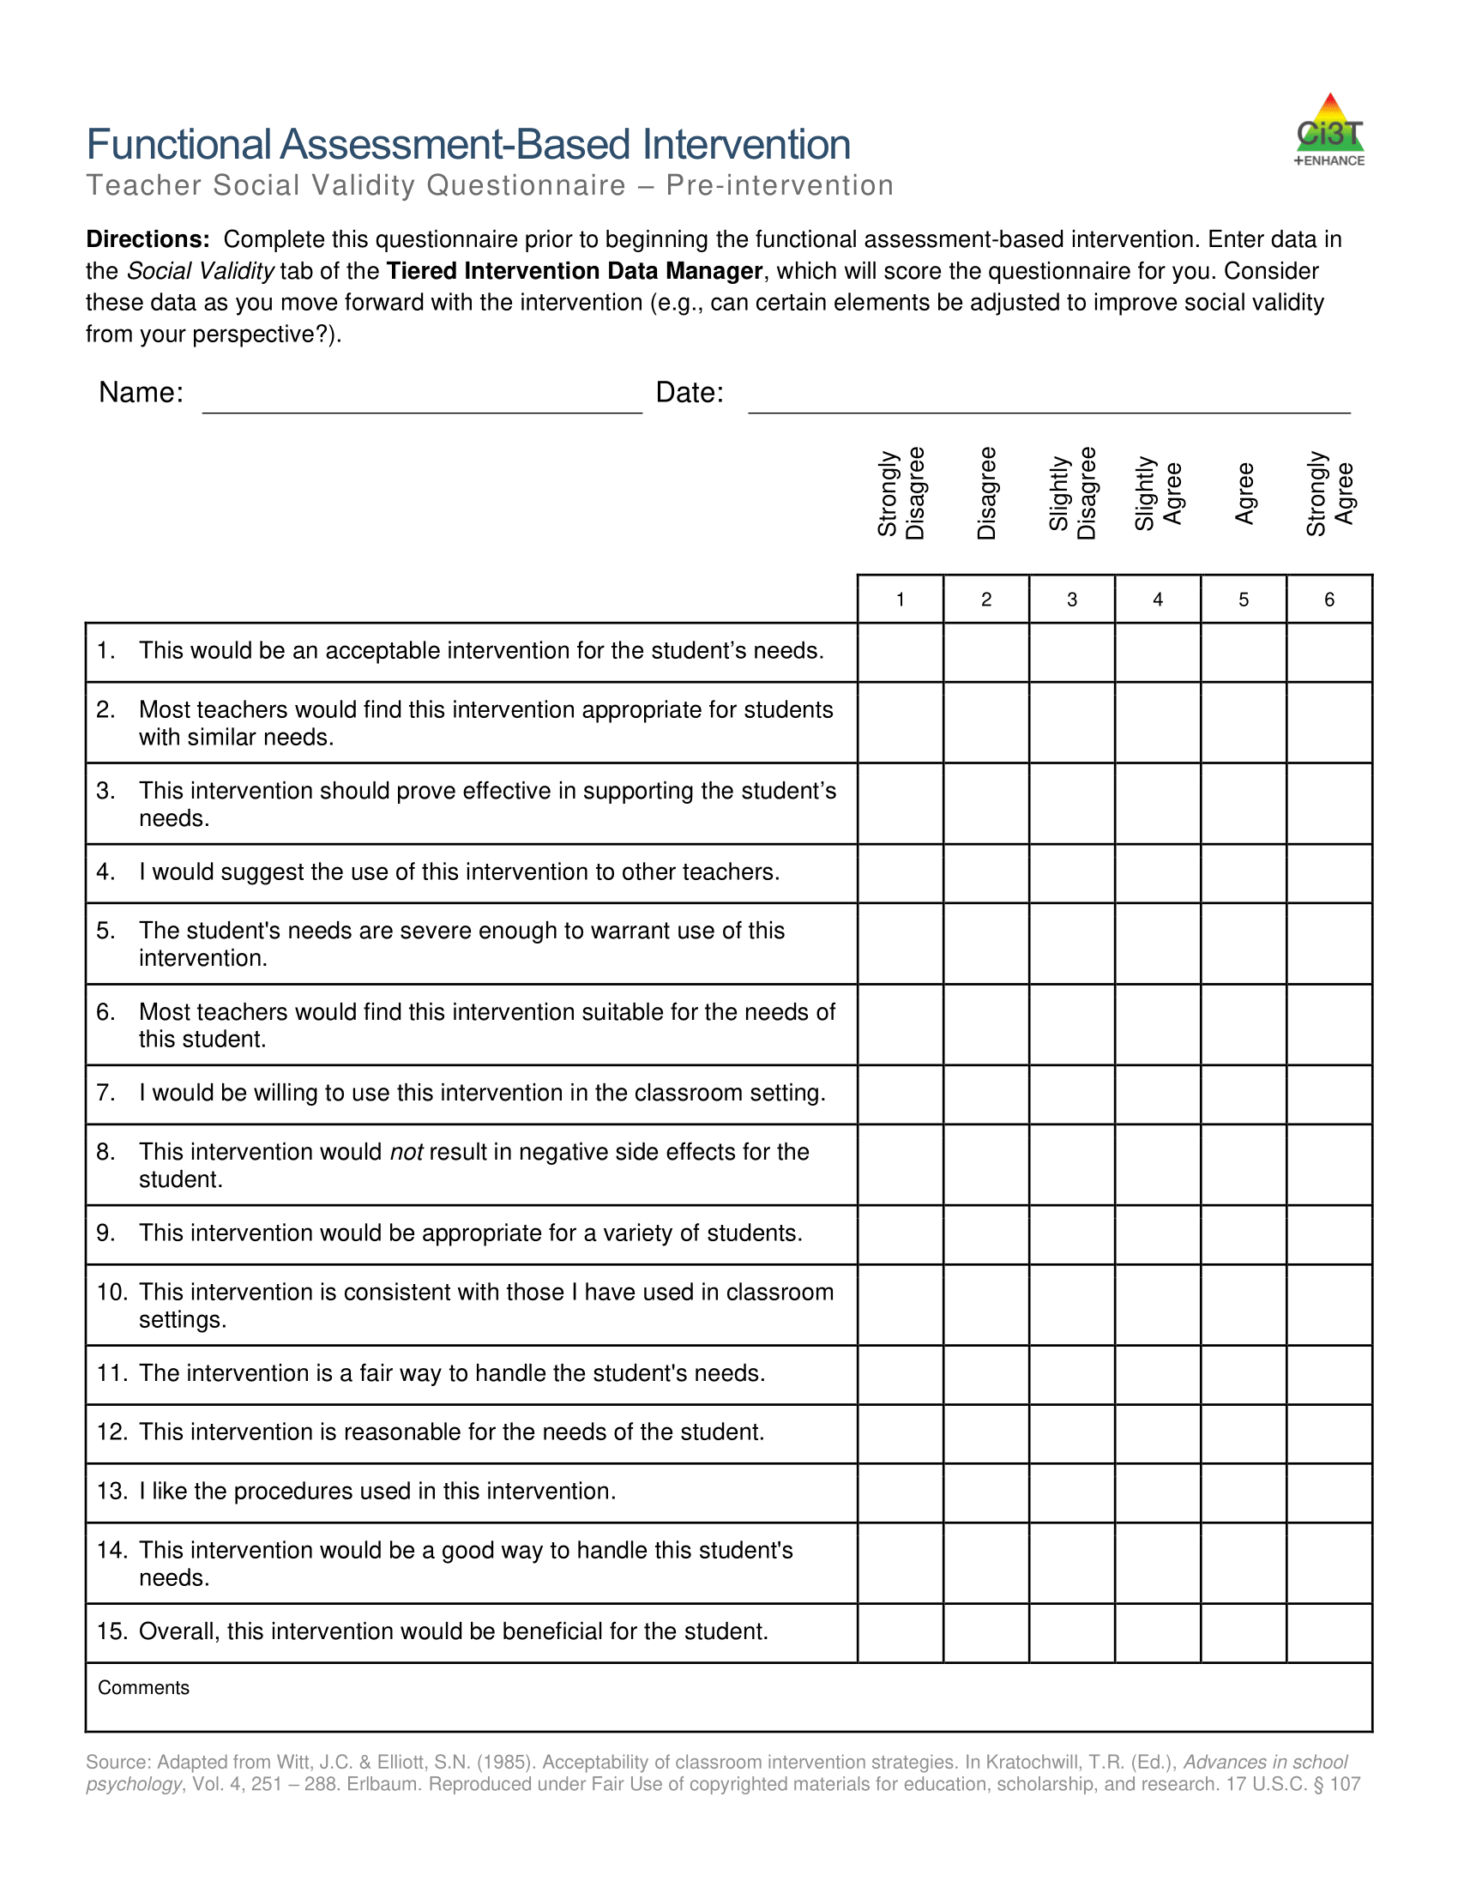
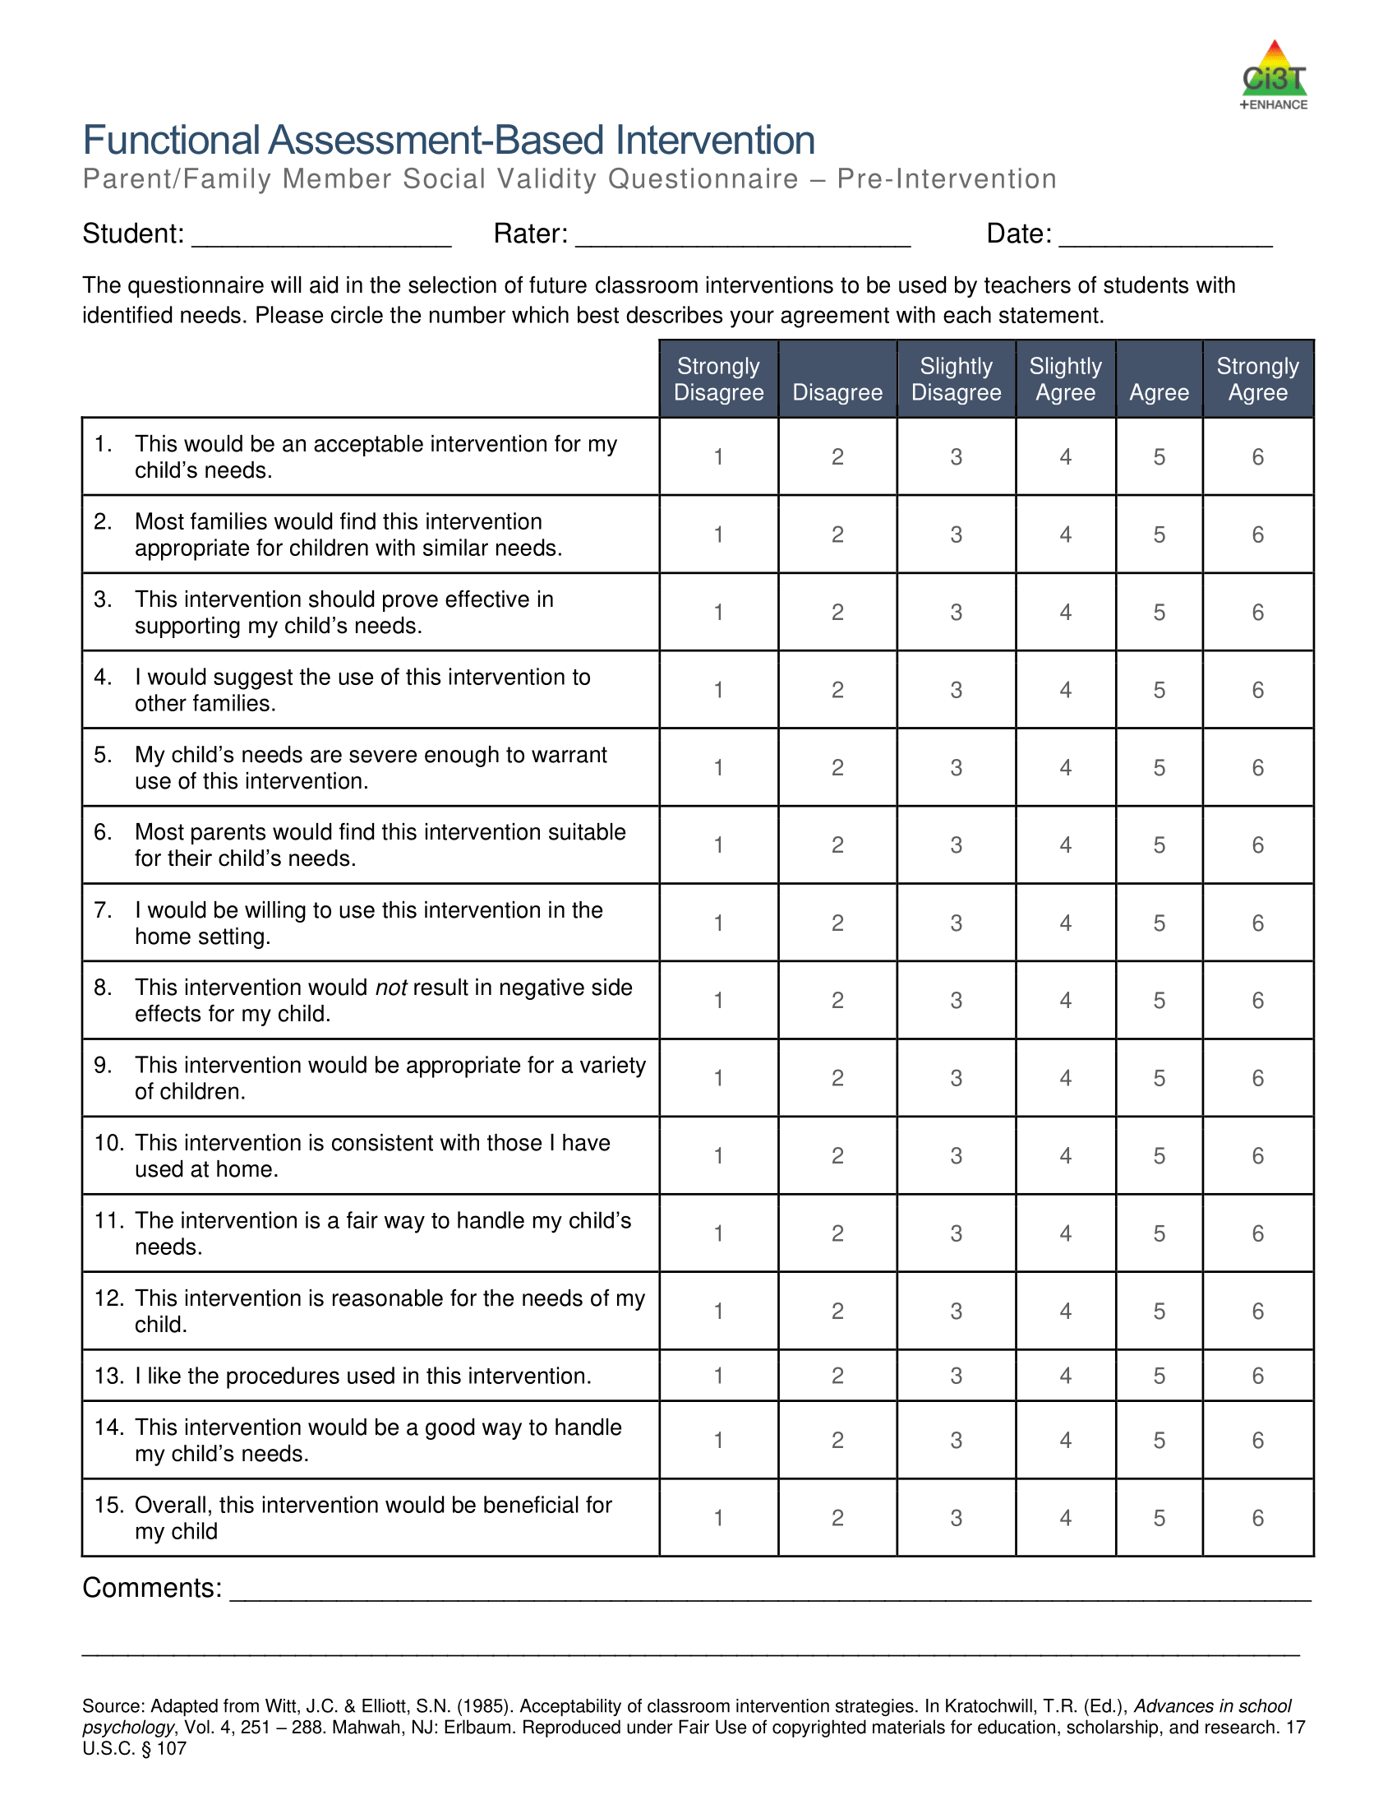
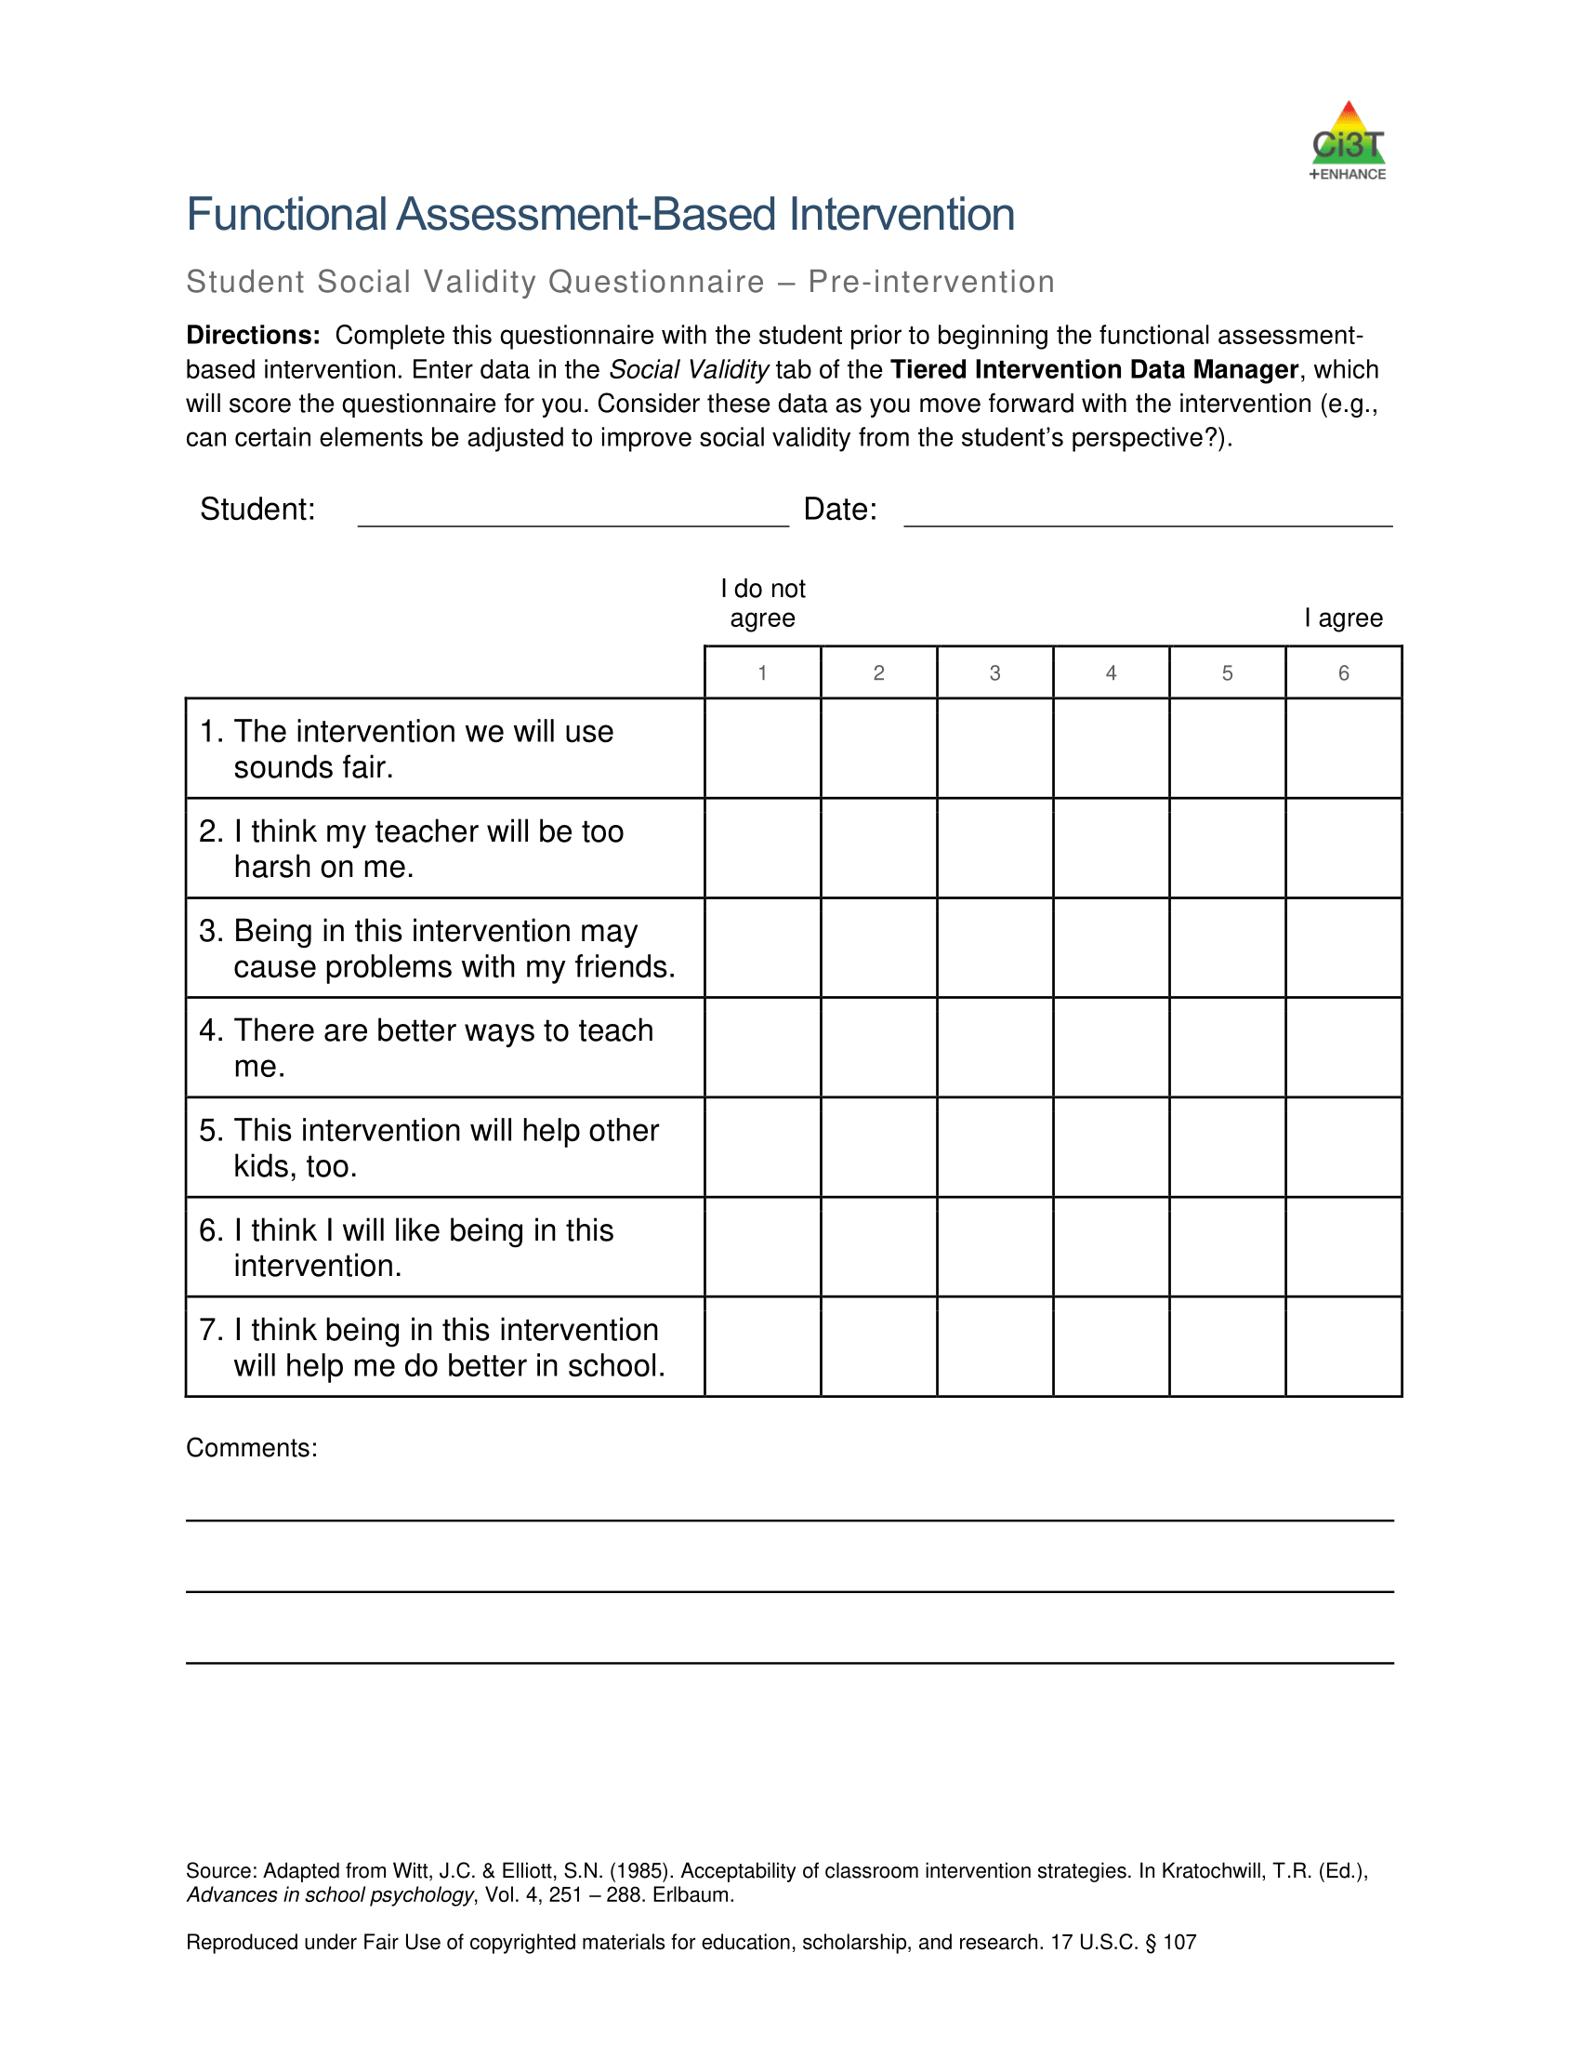
Pre-Intervention Social Validity

Slide 81
Session Materials

Slide 82
Let’s Practice: A-R-E Components
Work with your colleagues to:
Use the function-based intervention decision model to choose an intervention method
Generate A-R-E components
Notes:
10-min

Slide 83
FABI Step 4: Tips and Considerations

Slide 84

Step 5
Test the Intervention

Slide 85

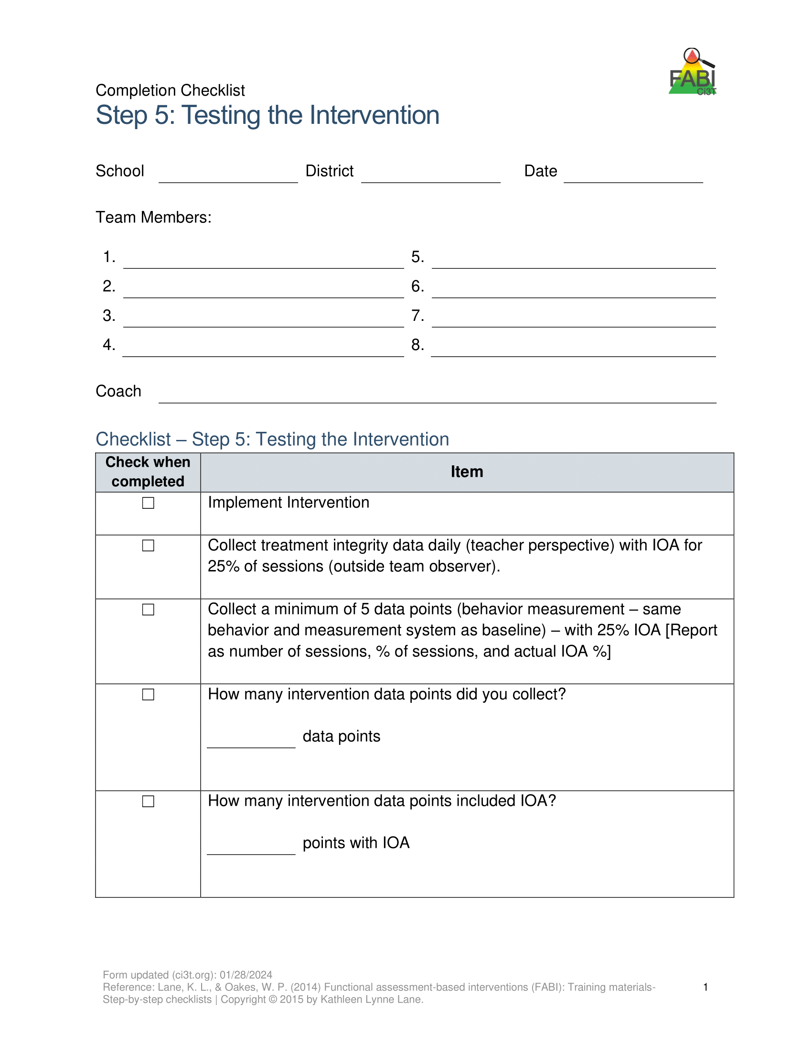
Step 5: Testing the Intervention
Implement the intervention
Monitor treatment integrity
Collect and graph data
Implement a single-case design to “test” how well intervention is working
  ABAB
  Multiple baseline
  Changing criterion
Assess social validity
Fade the intervention

Slide 86
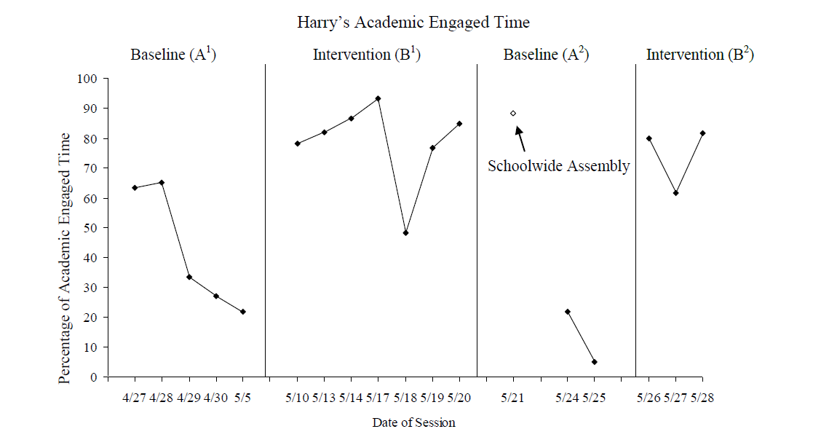
Harry’s Intervention Outcomes
Cox, M., Griffin, M. M., Hall, R., Oakes, W. P., & Lane, K. L. (2011). Using a Functional Assessment-Based Intervention to Increase Academic Engaged Time in an Inclusive Middle School Setting. Beyond Behavior, 20(3).

Slide 87
FABI Step 5: Tips and Considerations

Slide 88
Talk Time: Connect-Extend-Challenge
How are the ideas and information presented today connected to what you already know or do?
What new ideas did you get that extended or broadened your thinking?
What challenges or puzzles have come up in your mind from the ideas and information presented?
Notes:
5-minutes

Slide 89
Wrapping Up and Moving Forward

Slide 90
Resources to Support FABI Implementation
Notes:
Our intention in this professional learning is to provide high-level overview of FABI and opportunities to practice the key components. If you are interested in learning more or implementing FABI in your setting, we encourage you to access these additional resources to more comprehensively learn about each of the five steps.

Slide 91






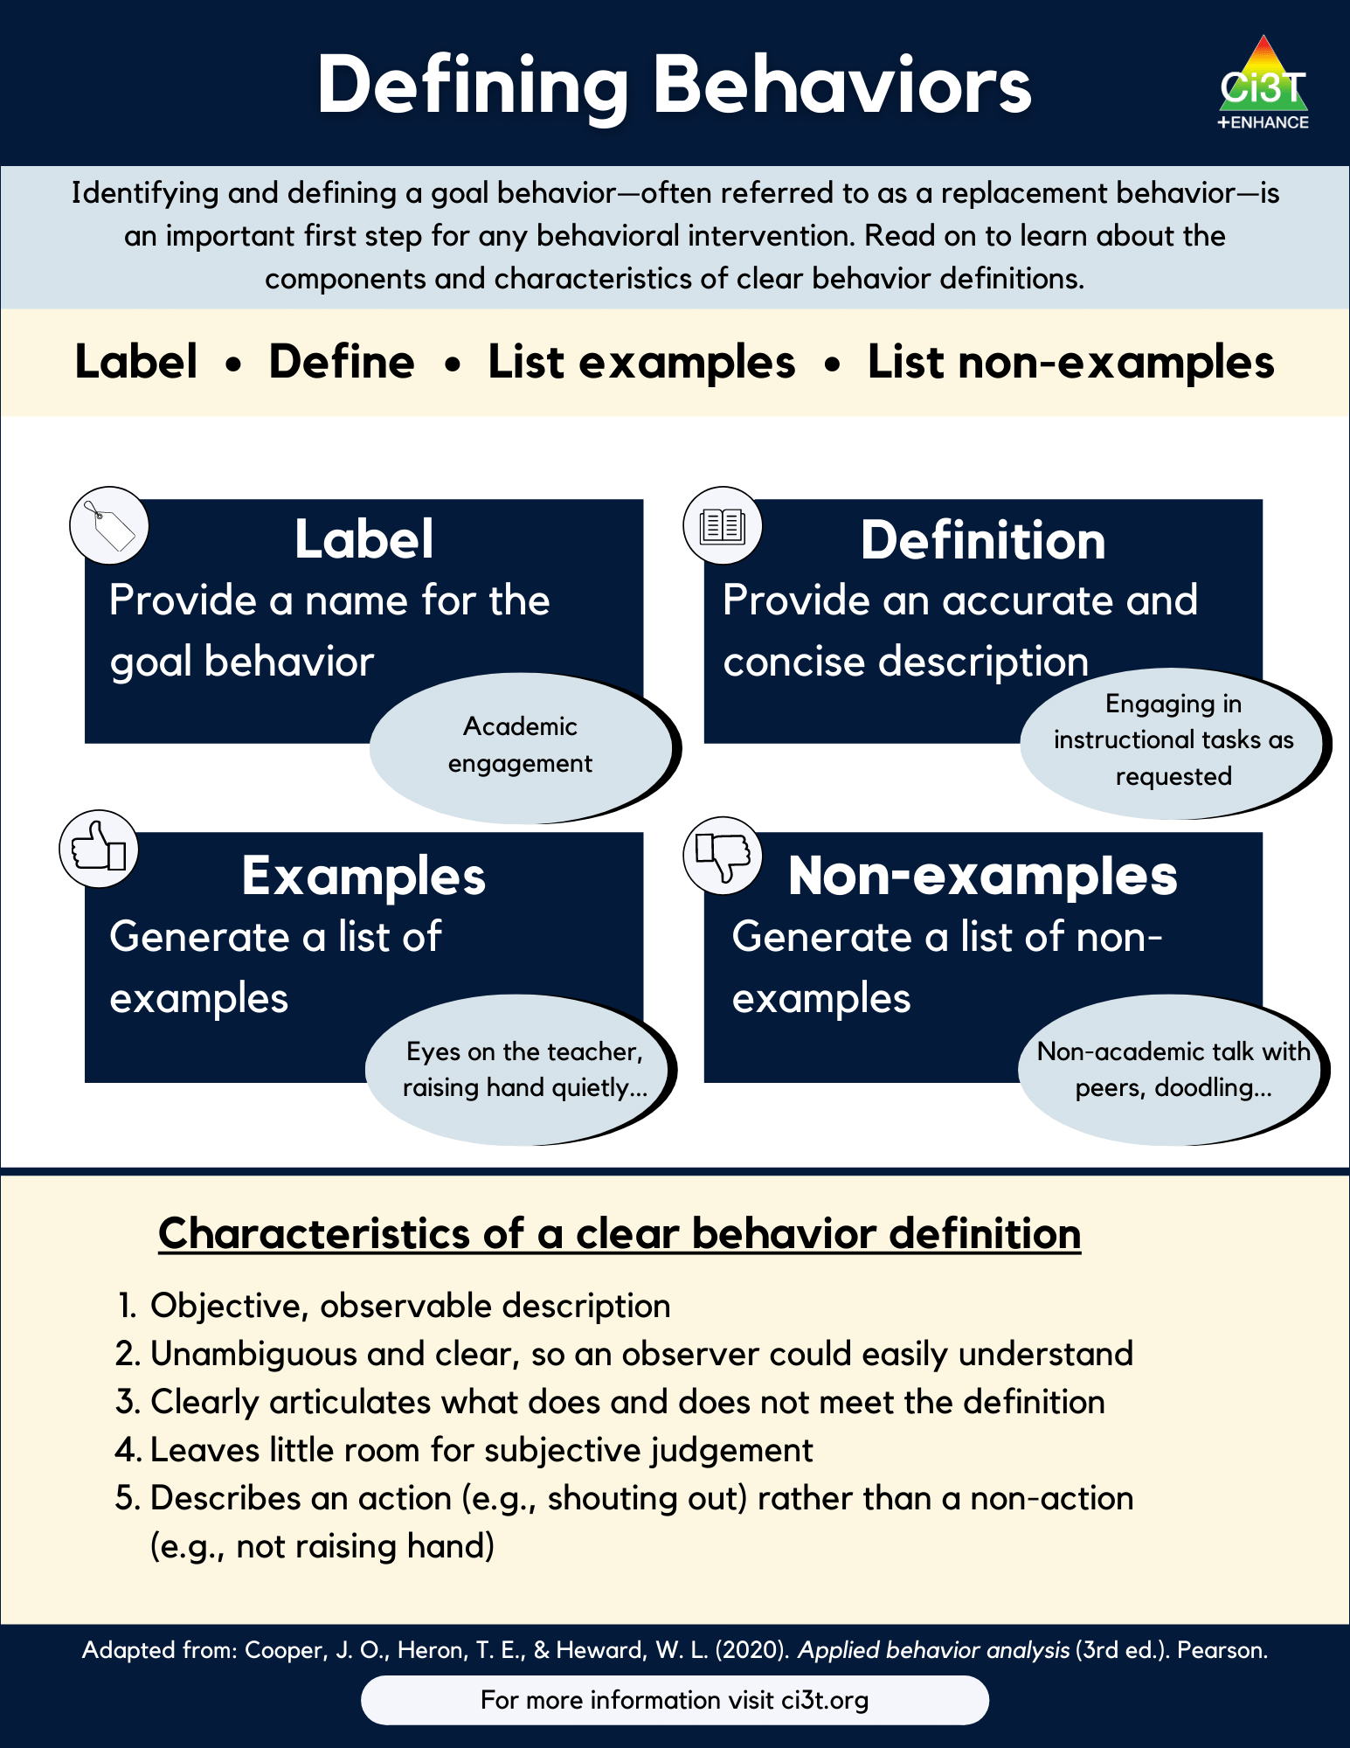
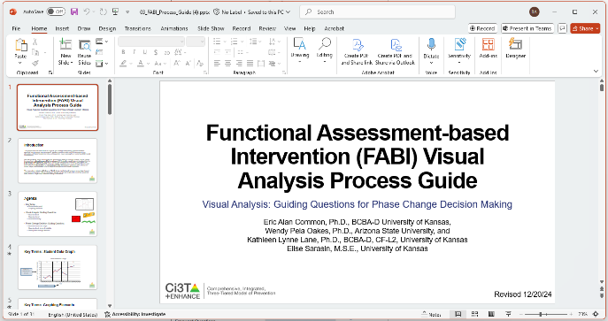

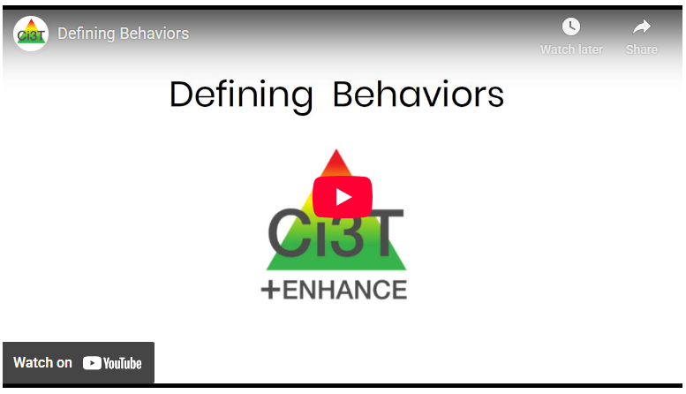
Learn More about FABI at ci3t.org/fabi!

Slide 92


Access Instructions: Ci3T Modules

Slide 93
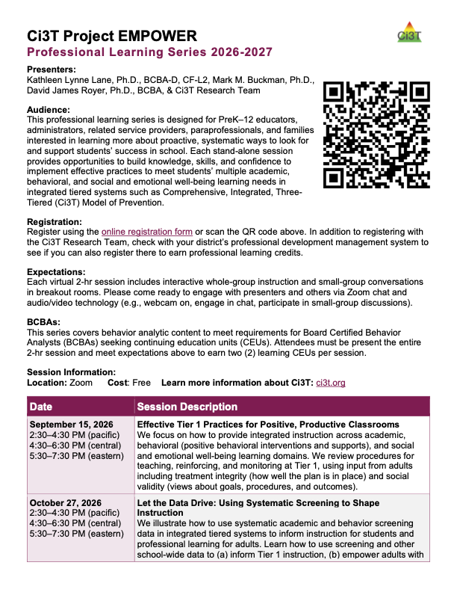
Learn More at Project EMPOWER!
EMPOWER Session | Date
Effective Tier 1 Practices for Positive, Productive Classrooms | September 15, 2026
Let the Data Drive: Using Systematic Screening to Shape Instruction | October 27, 2026
Ci3T in Action: Integrated Lesson Planning for Optimal Instruction | November 17, 2026
A 6-Step Instructional Approach for Responding to Challenging Behavior in Schools | January 20, 2027
A Tier 2 Intervention for Managing Anxious Feelings: Recognize. Relax. Record. | March 23, 2027
A Tier 3 Intervention: Functional Assessment-Based Intervention | April 28, 2027
Notes:
We hope to see you at a future EMPOWER session! Just like tonight - each session is free, 2hrs, and hosted on Zoom. About 2 weeks following a session we post a video recording so if you are unable to make it (or if there’s a session that already passed that you are interested in), we invite you to access those recordings!

Slide 94
Action Items
Action Item | Person(s) Responsible | Planned Completion Date | Date Completed
Schedule time to review FABI modules |  | 11/12/26
Register for EMPOWER session – 2 CEUs for BCBAs |  | 12/1/26

Slide 95



Concluding Thoughts:
John Umbreit
Ph.D.
Kathleen Lynne Lane
Ph.D., BCBA-D, CF-L2
Elise Sarasin
M.S.E

