Slide 1

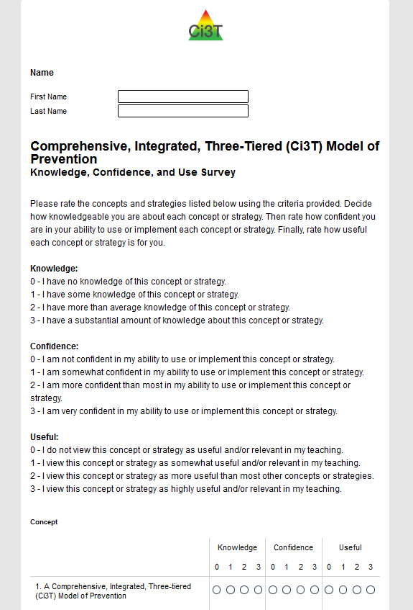
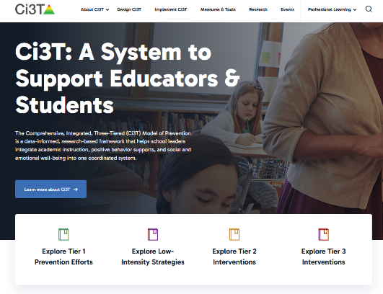
Session 1 Starter Activity
Ci3T Implementation Manual | Ci3T Website | KCU
Locate and open your Ci3T Implementation Manual | Explore the new Ci3T website. If you have not yet done so, please visit ci3t.org/registration for instructions on how to set up an account! | If you have not yet done so already, please complete your Knowledge, Confidence, Use (KCU) Survey!

Slide 2
Implementing Comprehensive, Integrated, Three-tiered (Ci3T) Models: Setting up for Success
Ci3T Implementation Professional Learning Series Session #1

Slide 3
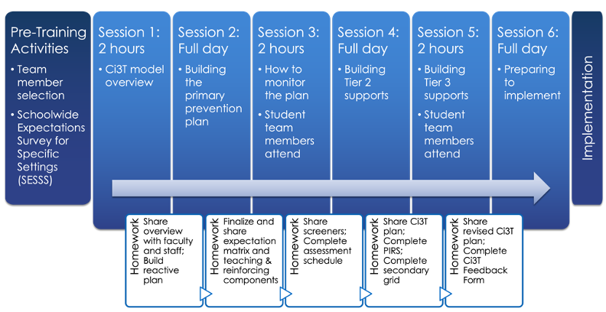
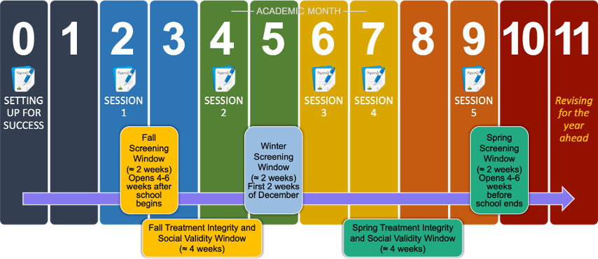
Ci3T Professional Learning Journey!
Ci3T Design Professional Learning Series
Ci3T Implementation Professional Learning Series
From Design to Implementation

Slide 4
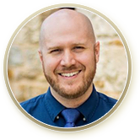
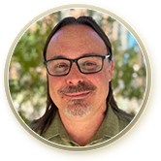

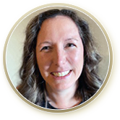
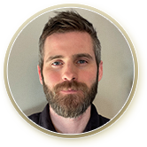
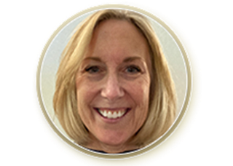
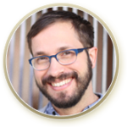



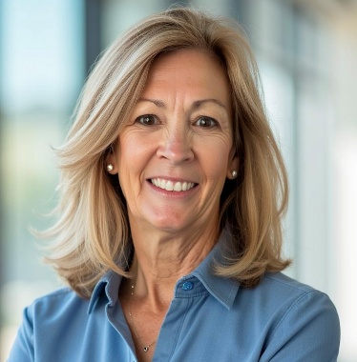
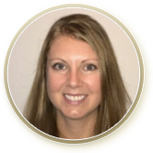
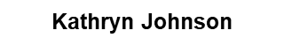
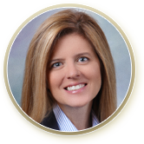

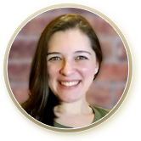
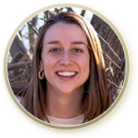


Ci3T Trainers and Coaches
Grant Allen
Matthew Aschliman
Allison Bernard
Carrie Brandon
Mark Buckman
Amy Buffington
Donna Cauley
Eric Common
Howard Diacon
Kathleen Lynne Lane
Jessica Matus
Wendy P. Oakes
David Royer
Elise Sarasin
Rebecca Sherod
Joni Weiss
Stacie Williams

Slide 5
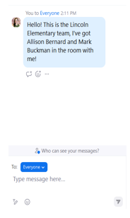

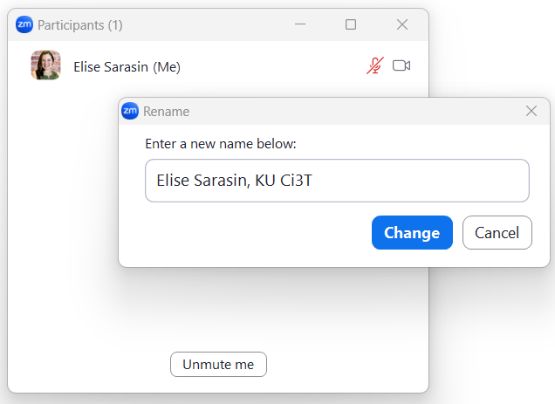
Zoom Logistics
If you are conducting separate trainings, please email us a list of the names, email addresses, and schools of those attending! This helps us to share our reach with our funders.
To help us put you in breakout rooms with your colleagues today we are renaming you with your school initials and first and last name
If there are multiple people in the room with you, please list their first and last names and email in the chat!

Slide 6
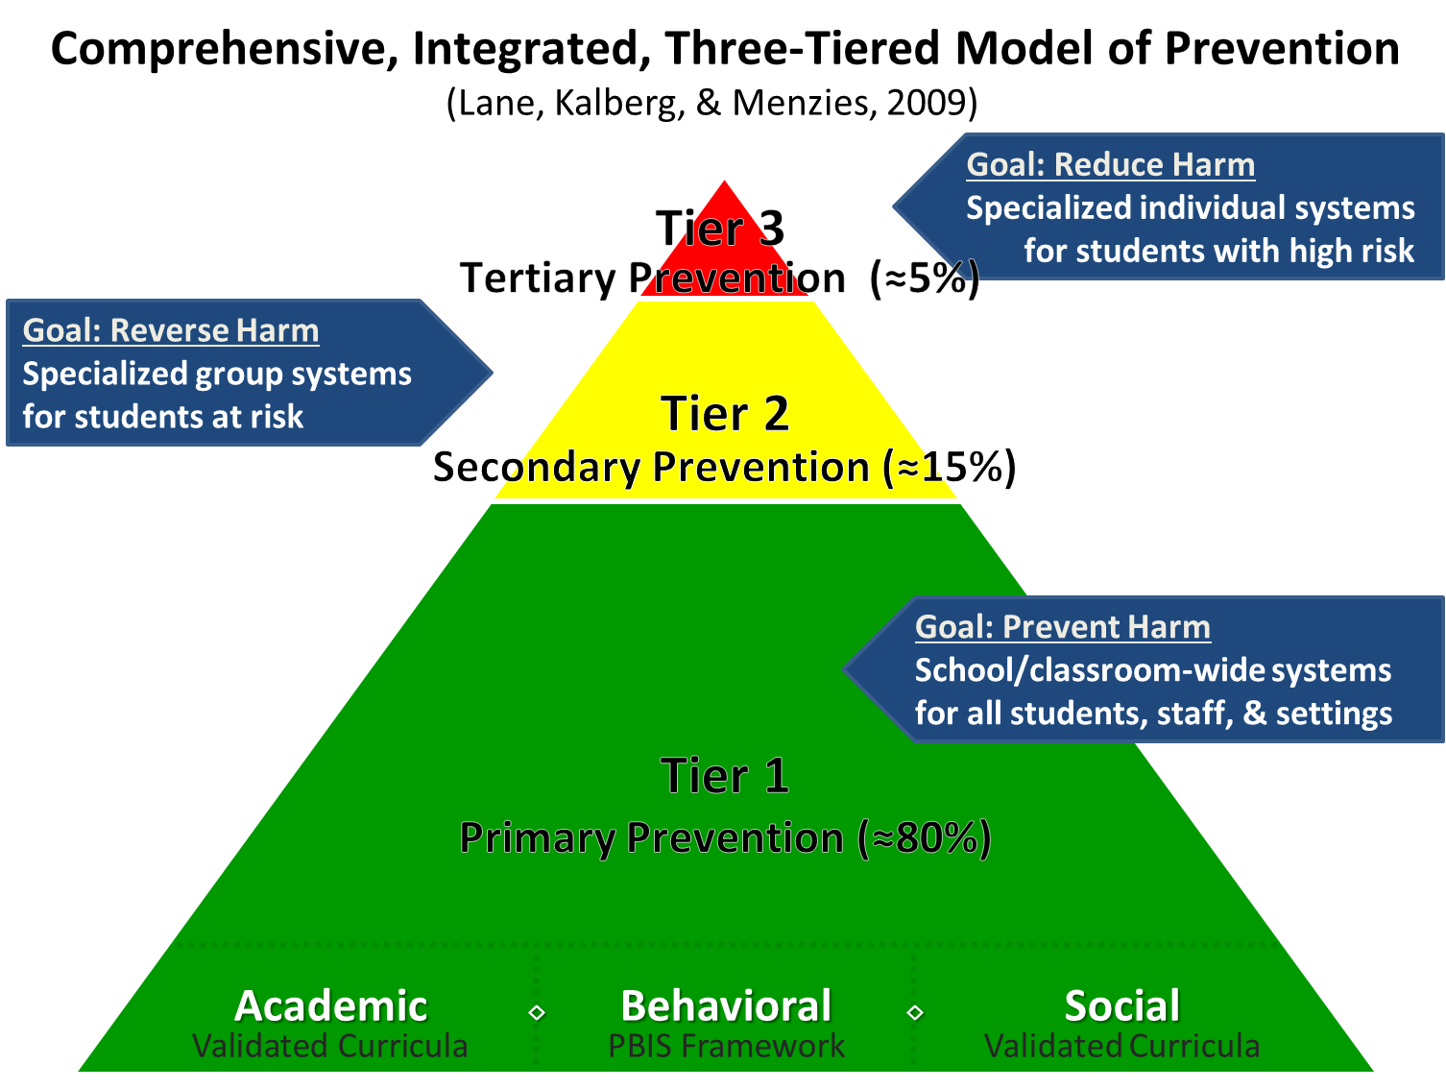
Comprehensive, Integrated, Three-Tiered Model of Prevention

Slide 7
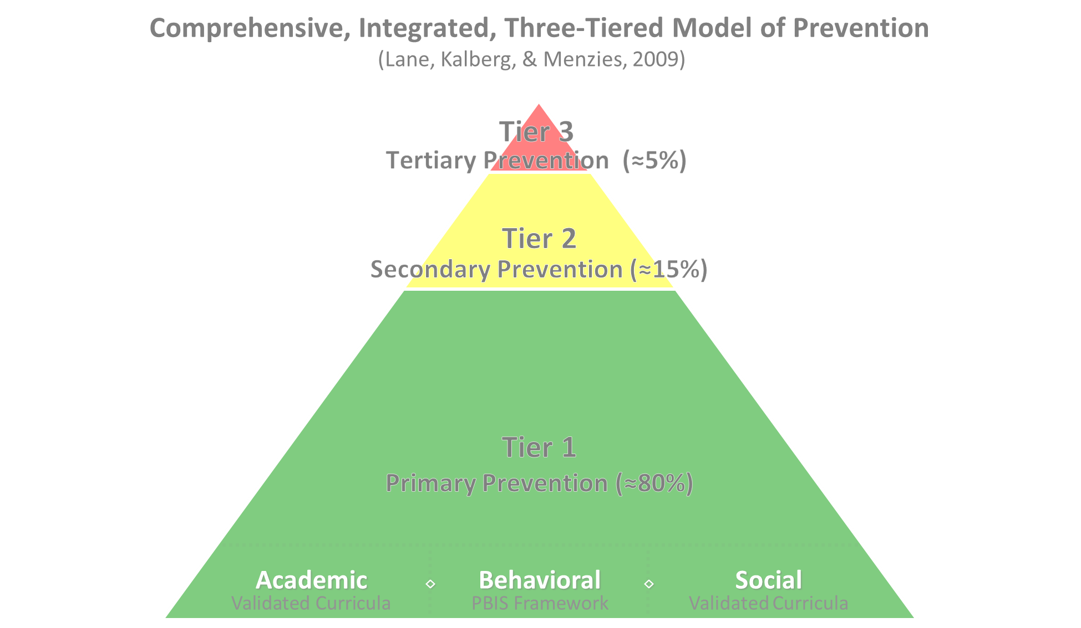

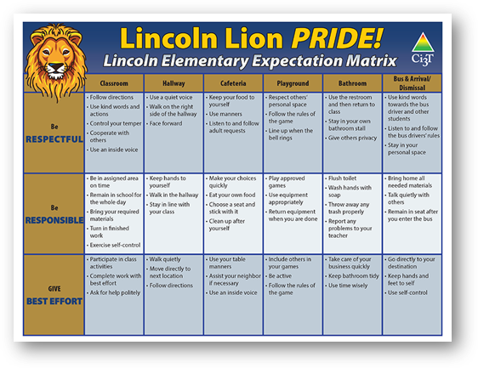
Tier 1
Positive Behavioral Interventions and Supports
District & State Standards Quality Instruction
Validated Curricula and Resources

Slide 8

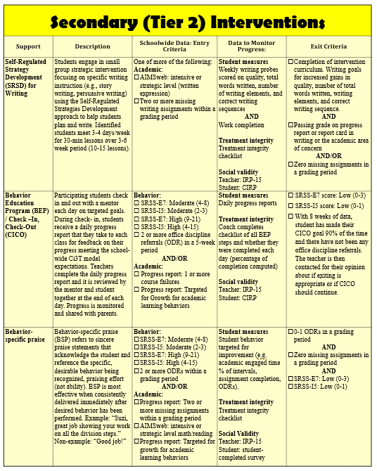
Tier 2 Intervention Grid
Notes:
In addition to the module featured here outlining how to use multiple sources of data to connect students with Tier 2 supports, we offer a full suite of modules highlighting validated Tier 2 interventions such as Self-Regulated Strategy Development (SRSD) for Writing and Check-In/Check Out that may appear in your Secondary (Tier 2) Intervention Grid

Slide 9
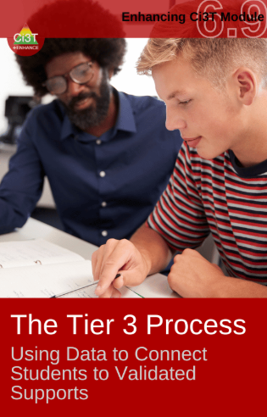
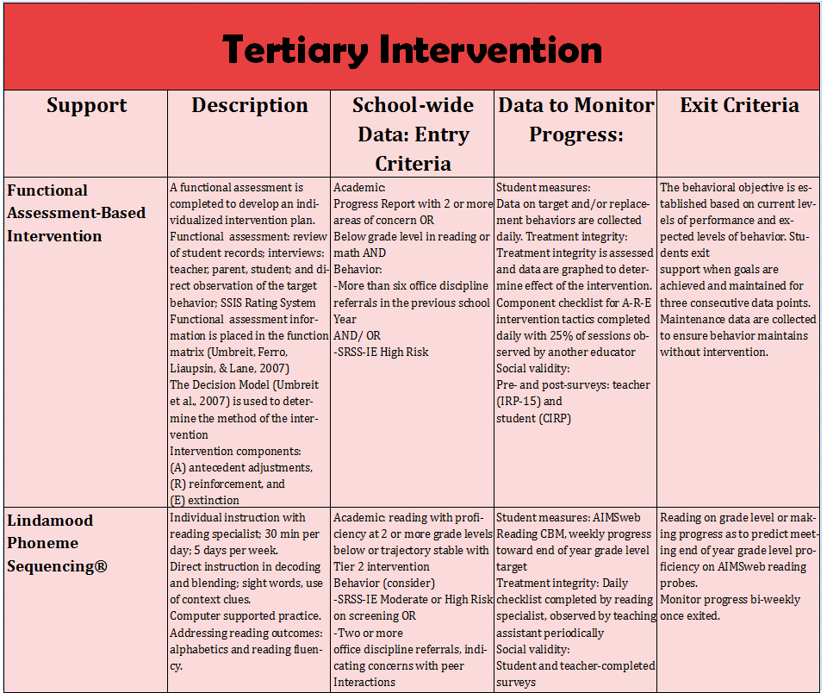
Tier 3 Intervention Grid
Notes:
In addition to the module featured here outlining how to use multiple sources of data to connect students with Tier 3 supports, we offer a full suite of modules highlighting validated Tier 3 interventions such as Functional Assessment-Based Intervention (FABI) that may appear in your Tertiary (Tier 3) Intervention Grid

Slide 10
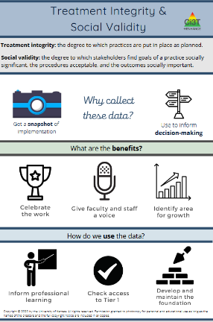
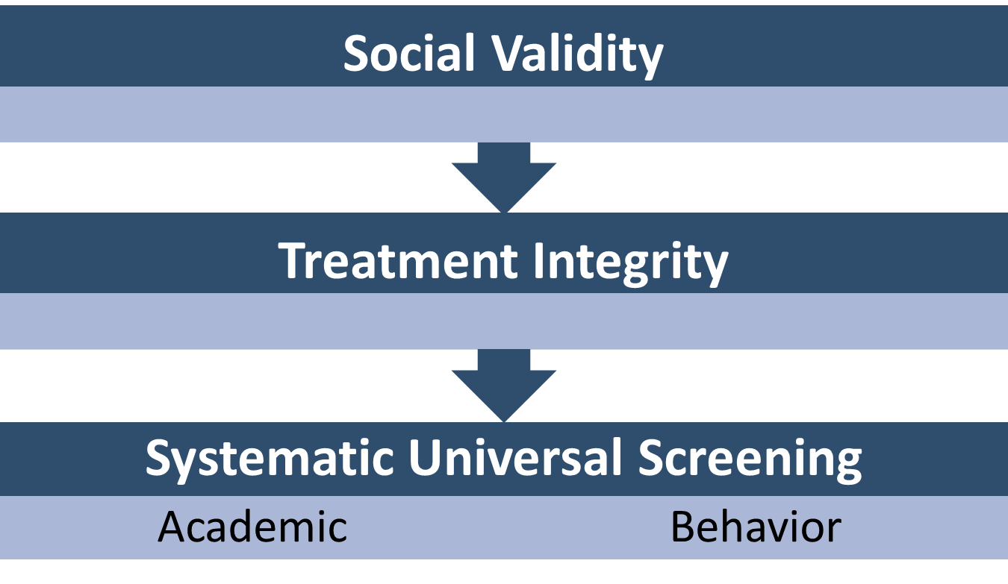

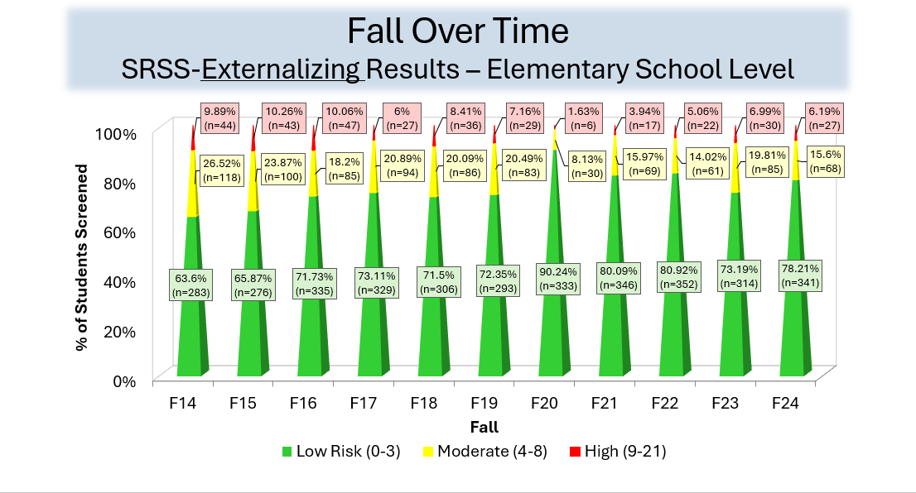
Essential Components Tier 1 Efforts

Slide 11
Knowledge, Confidence, Use (KCU) Survey
Notes:
If you are a district participating as a research partner in Sustaining Ci3T, we appreciate your time and effort in sharing your knowledge, confidence, and as the school year begins!
If you are not participating in Sustaining Ci3T but would like to measure your or your team’s knowledge, confidence, and use, a version of the KCU survey is available on our website at ci3t.org/measures

Slide 12

Work Time: KCU Survey
If you have not yet done so already, please complete your Knowledge, Confidence, Use (KCU) Survey!
If you have finished your KCU survey, we invite you to explore the newly updated ci3t.org!
Notes:
Give 15 minutes for KCU

Slide 13
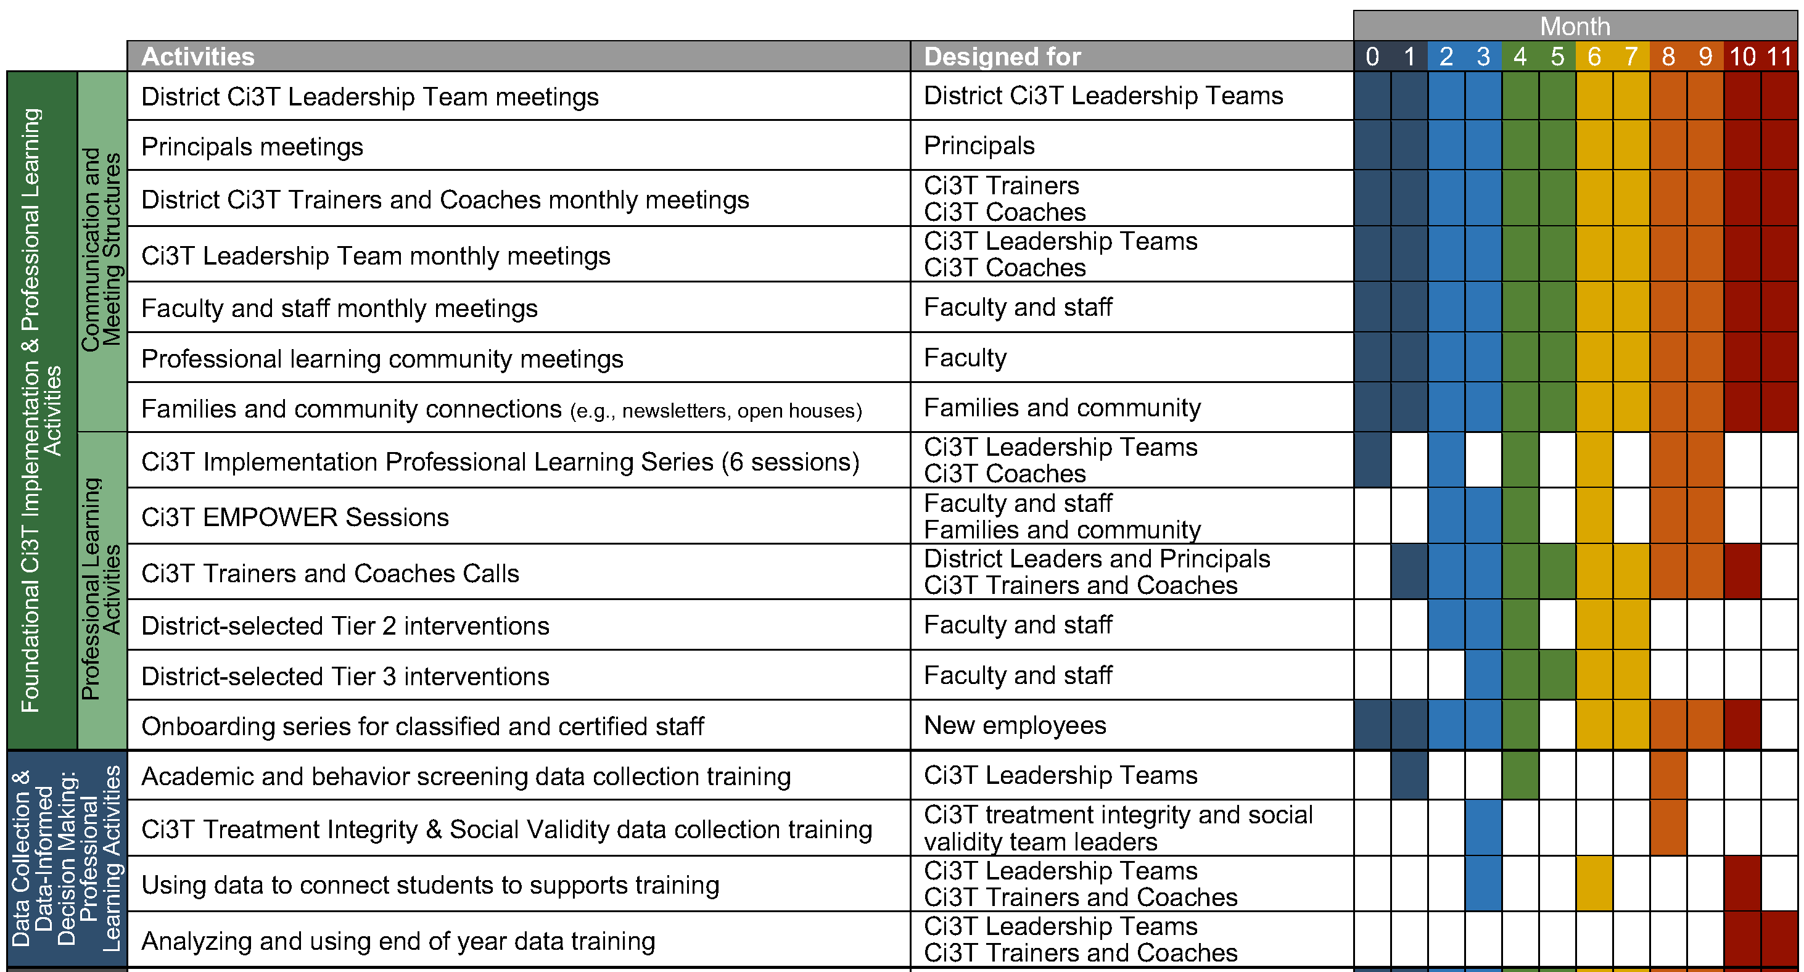
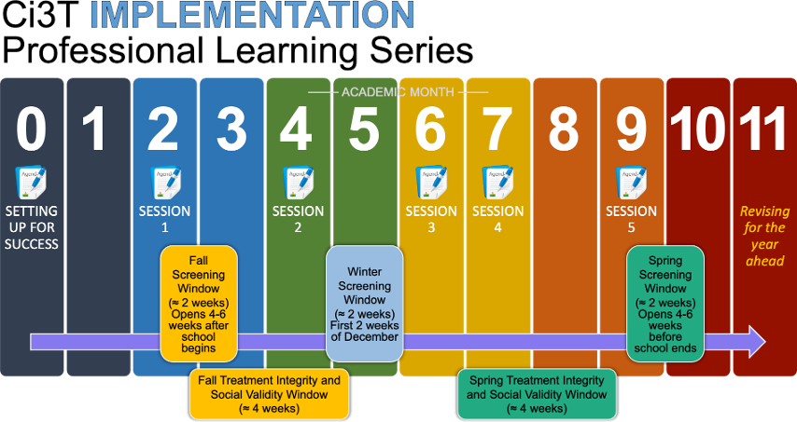
Ci3T Implementation Series and Delivery

Slide 14
Session Outcomes
Reflect and refine plans to implement procedures for teaching faculty and staff, students, and parents and community members as the school year begins
Develop strategies for facilitating effective team meetings and communicating with faculty, staff, and families.
Prepare to collect and use fall academic and behavioral screening for all students and fall treatment integrity and social validity data for faculty and staff.

Slide 15
Agenda
Welcome
Implementing your Ci3T Tier 1 Plan
Scheduling for Success
Preparing to Collect Data
Wrapping Up and Moving Forward

Slide 16


Professional Learning Strands
Ci3T Essentials Strand
Ci3T Sustainability Strand
Designed for teams in the initial installation stage, new building leaders, and those wanting a more scaffolded experience.
Designed for teams with multiple years of high-fidelity implementation.
Notes:
We will start and end each session together.
Each session, teams will have the opportunity to choose a strand:
Ci3T Essentials
Ci3T Sustainability

Slide 17

Session 1 Strand Selection
Is this your school’s first year of Ci3T Implementation?
Do you consider your school to be in the initial installation stage?
Is your school re-launching Ci3T?
Do you have a new building leader?
Do you have a large percentage of new faculty and staff?
Are you leading your own Ci3T Implementation Professional Learning Series?
If you answered yes to any of these questions, we recommend the Ci3T Essentials Strand!

Slide 18
Implementing Your Ci3T Plan
Reflecting on Success: What went well with your roll out?
Reviewing Implementation Resources
Rolling out Tier 1: Continuing Through the Year
Implementing Procedures

Slide 19
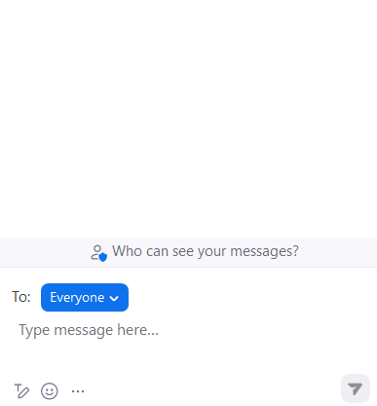
Introductions!
In the chat, please share:
Name
Role
Location (state or district)
Emoji that represents your beginning of the school year
Click the smiley face for emoji options!

Slide 20
Session Outcome 1
Reflect and refine plans to implement procedures for teaching faculty and staff, students, and parents and community members as the school year begins
Develop strategies for facilitating effective team meetings and communicating with faculty, staff, and families.
Prepare to collect and use fall academic and behavioral screening for all students and fall treatment integrity and social validity data for faculty and staff.

Slide 21

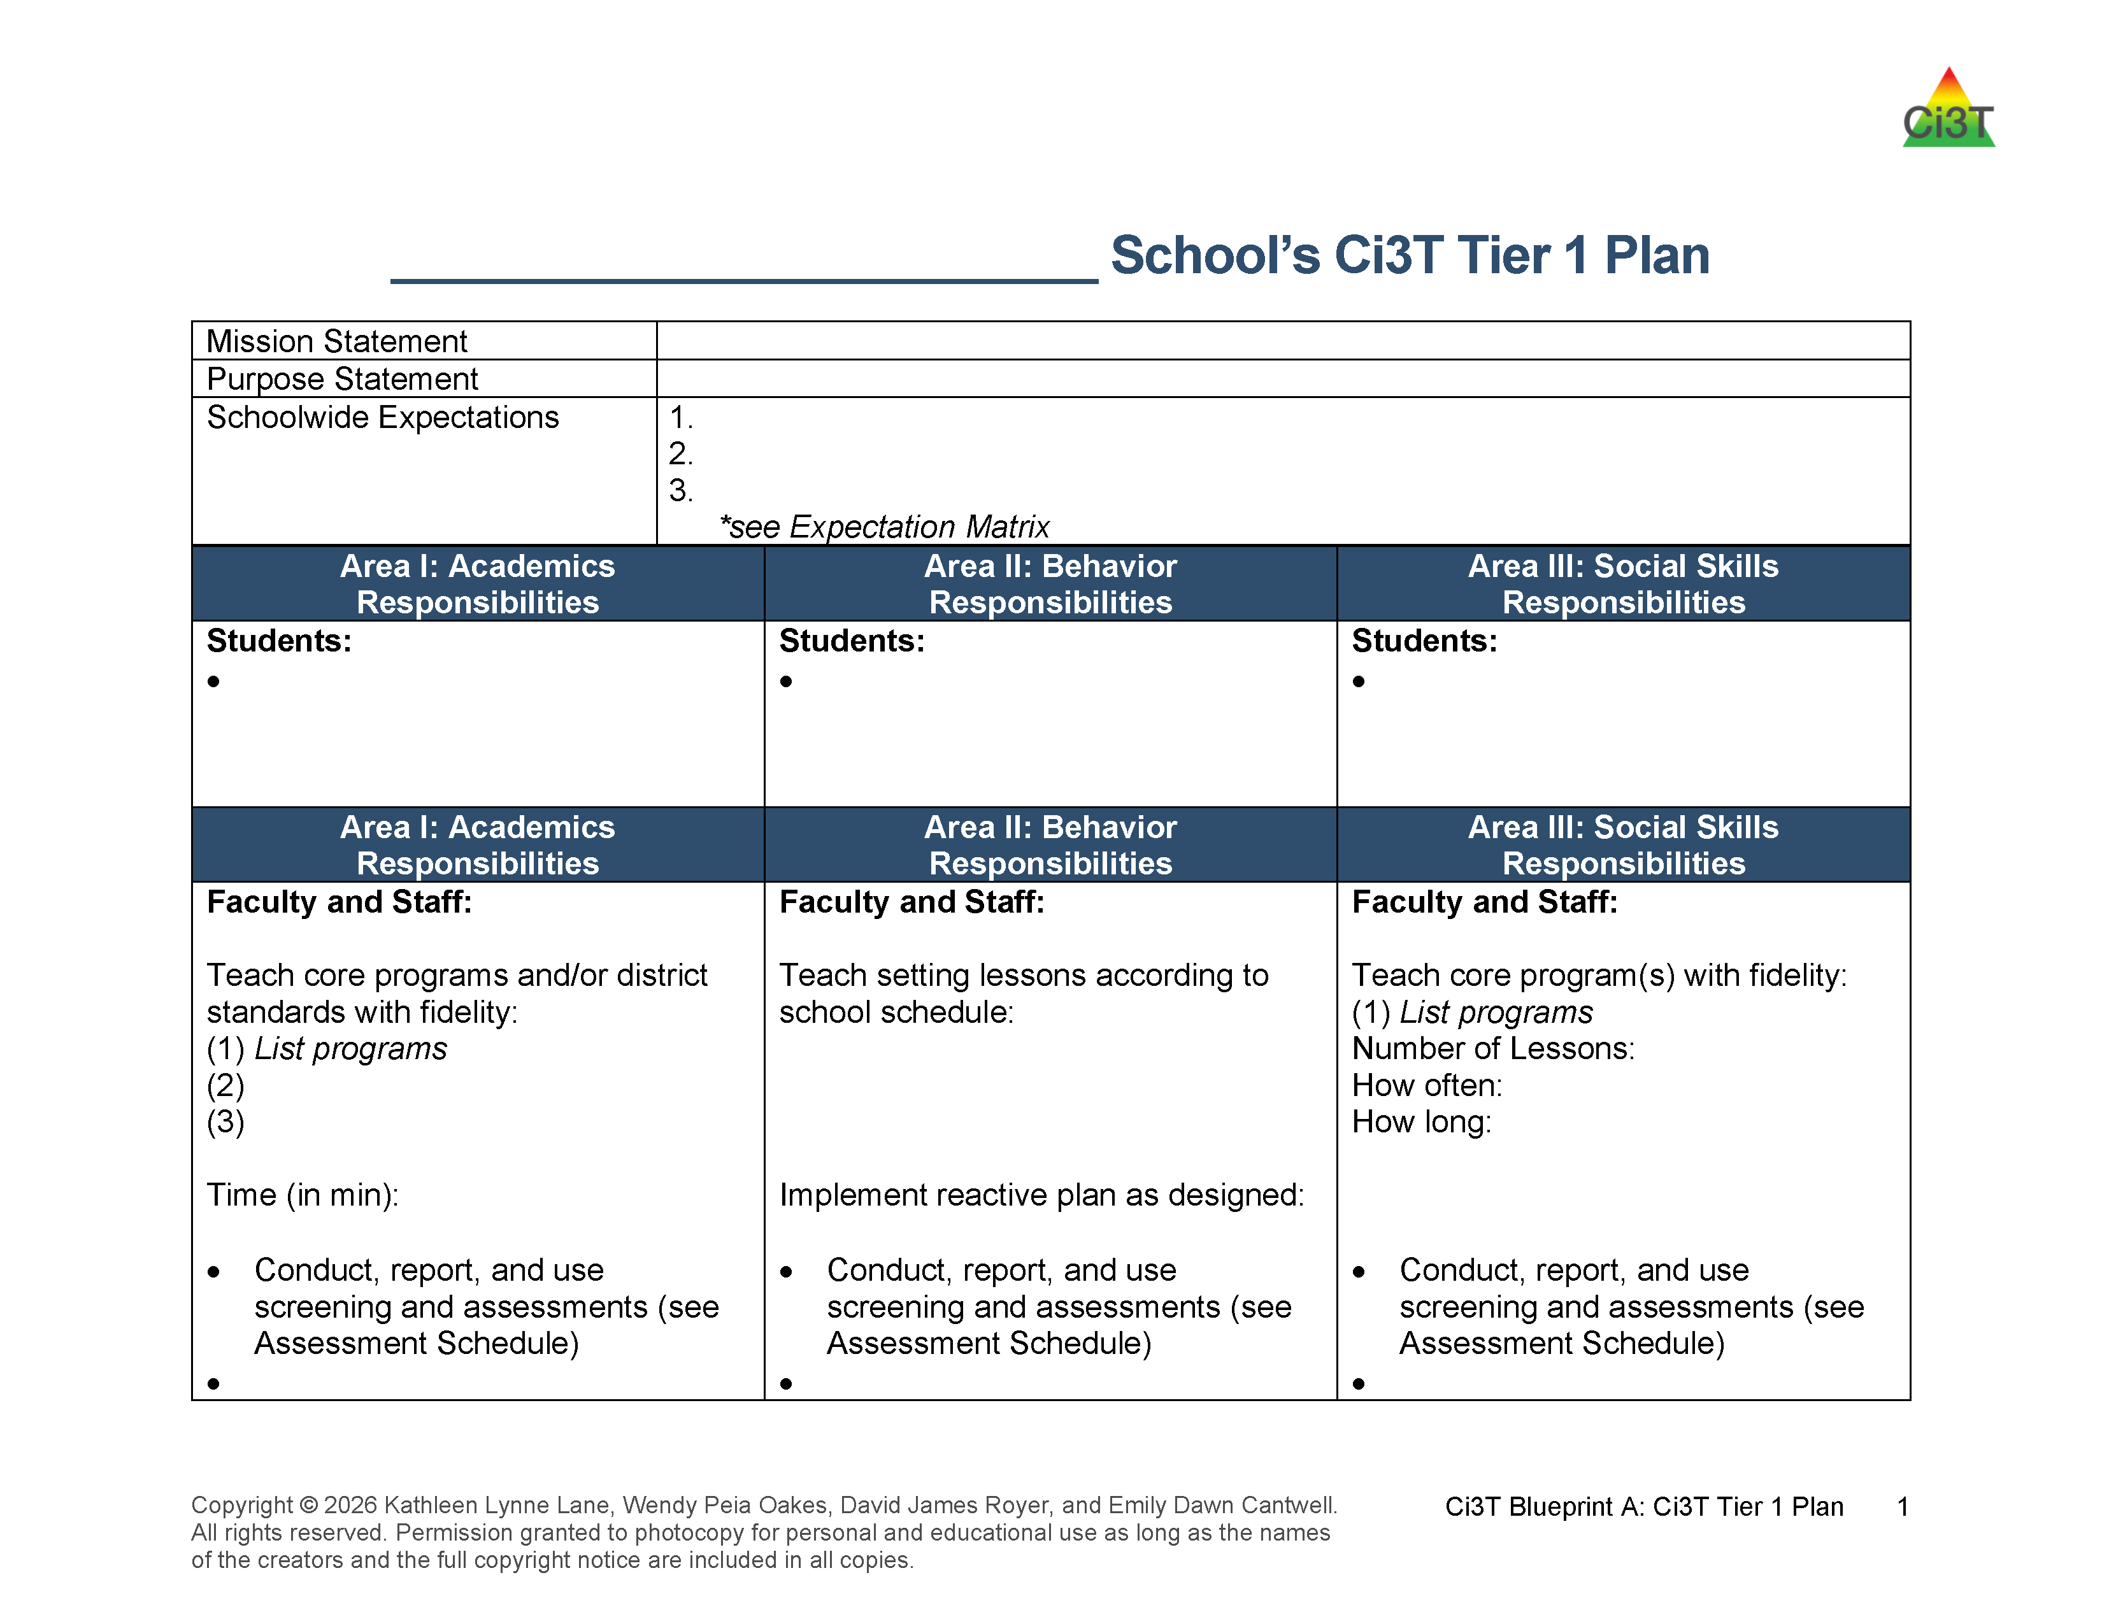

Ci3T Tier 1 Plan: Roles and Responsibilities
Locate in your Ci3T Implementation Manual

Slide 22

Academic
VALIDATED
CURRICULUM

Slide 23
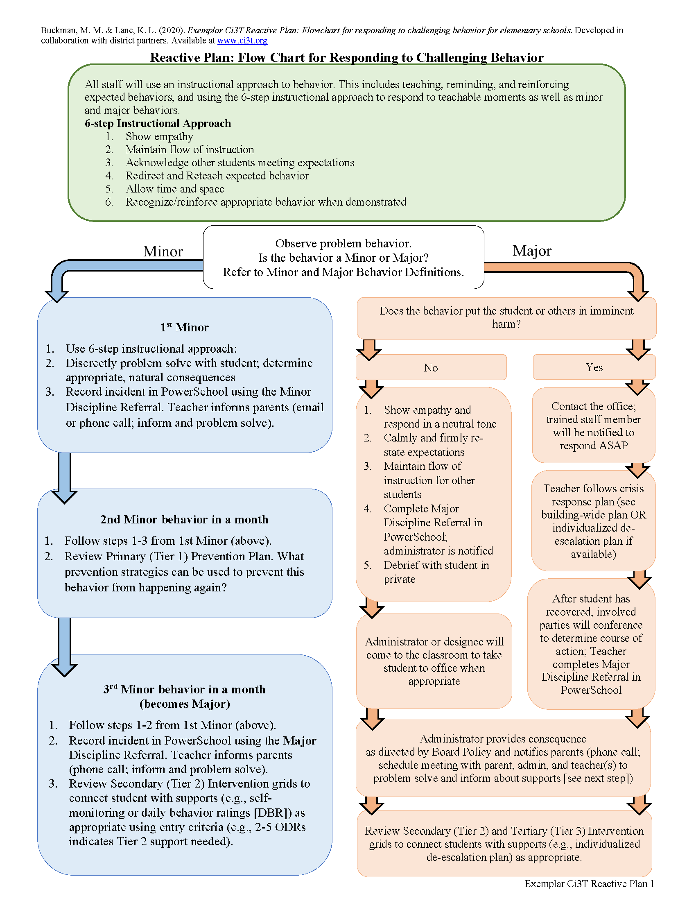
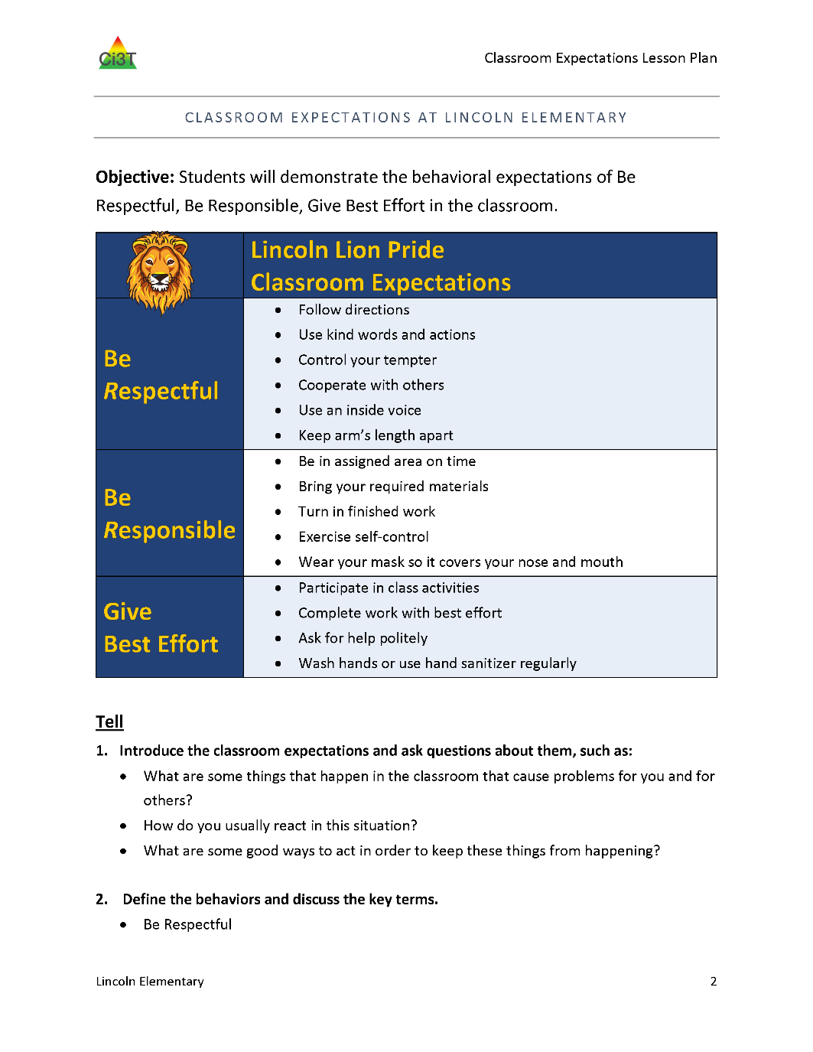
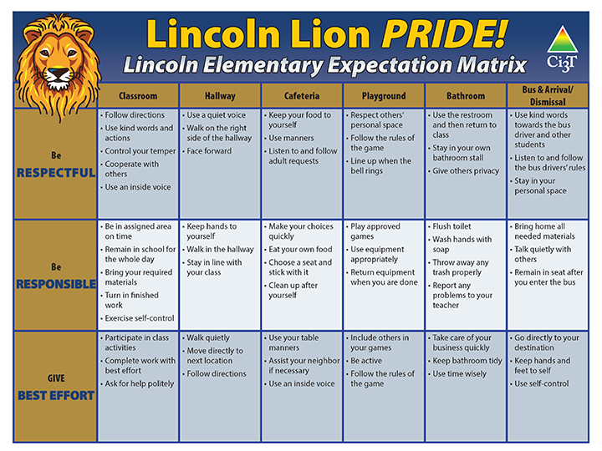
Behavior

Slide 24
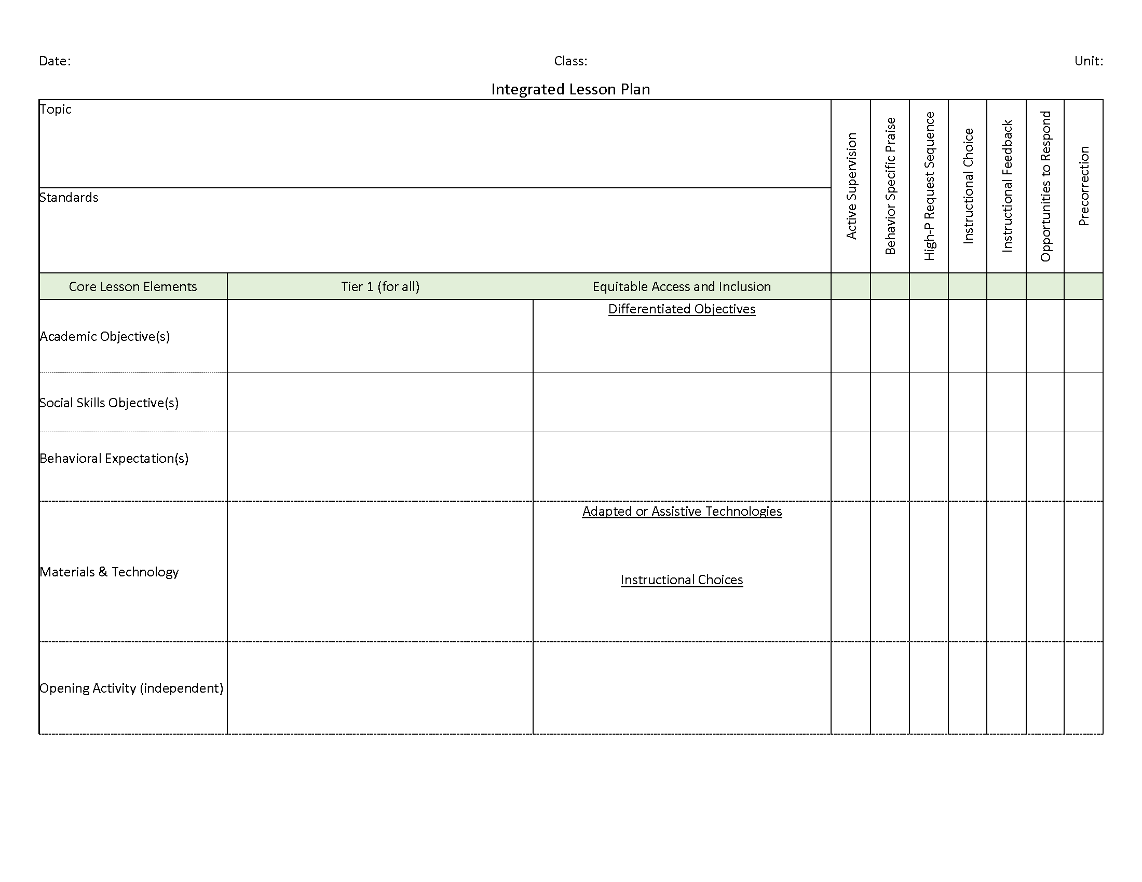

Social and Emotional Well-Being
VALIDATED
CURRICULUM

Slide 25
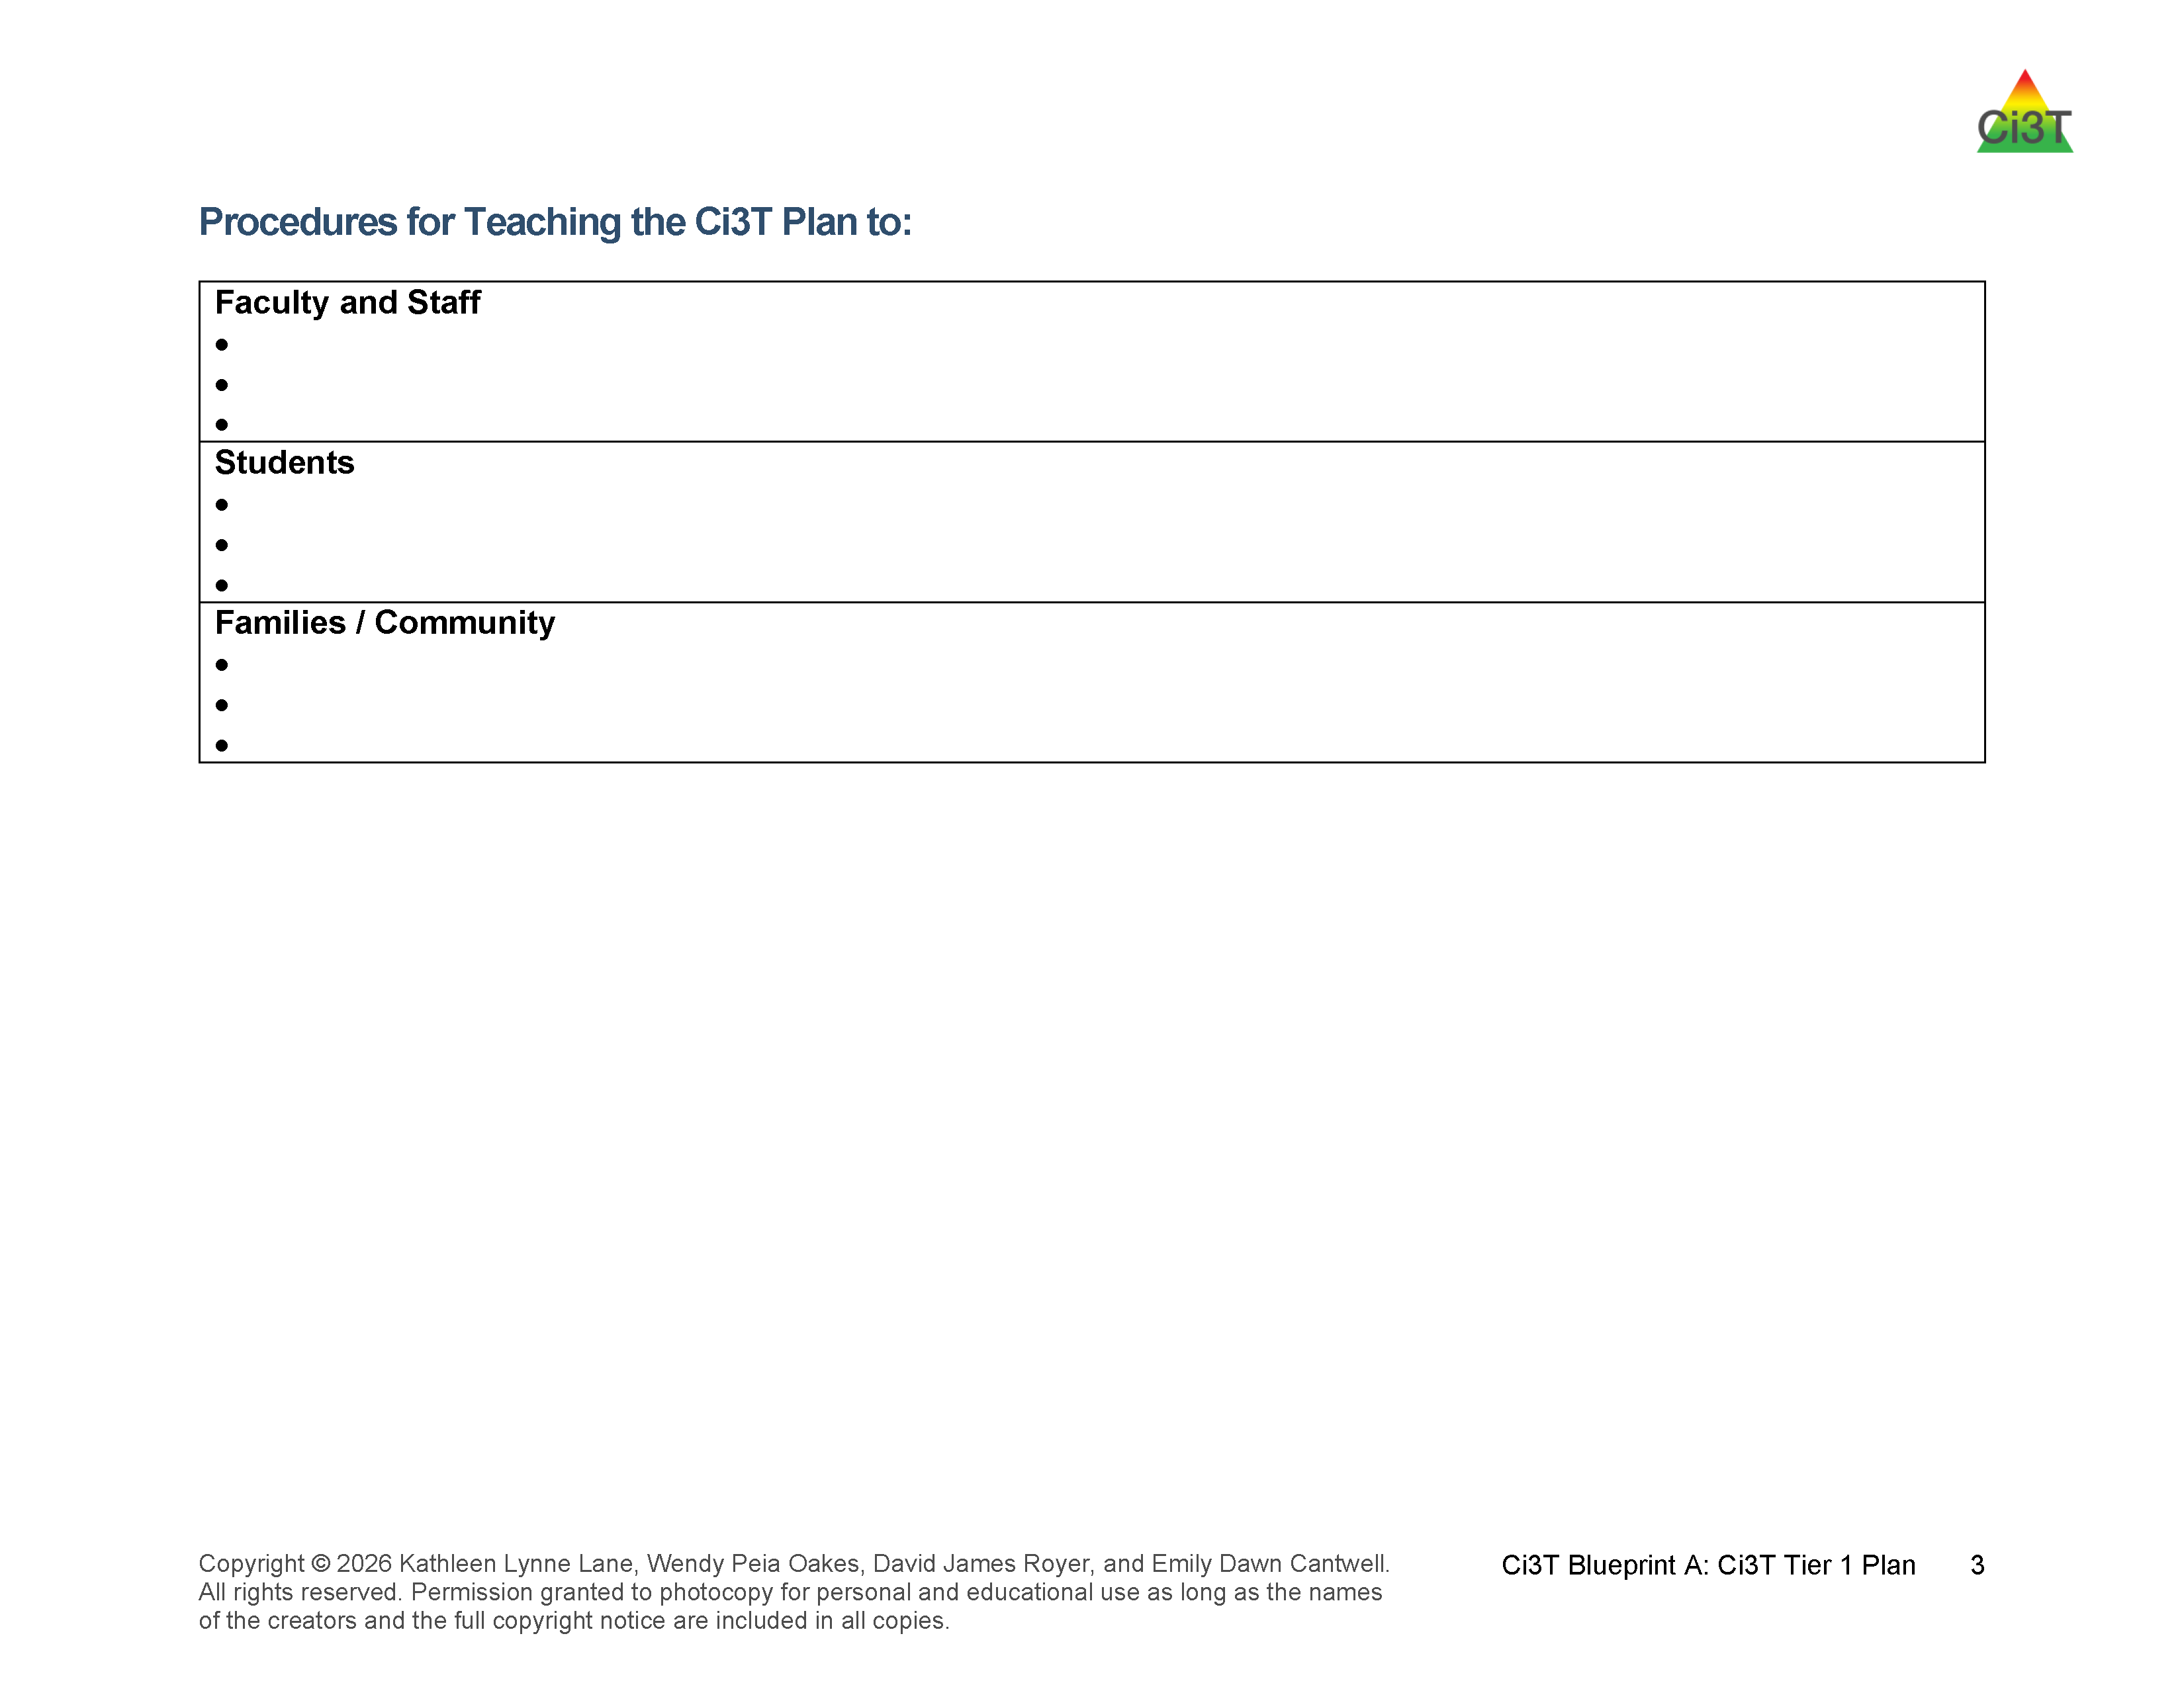
Procedures for Teaching
Locate in your Ci3T Implementation Manual

Slide 26
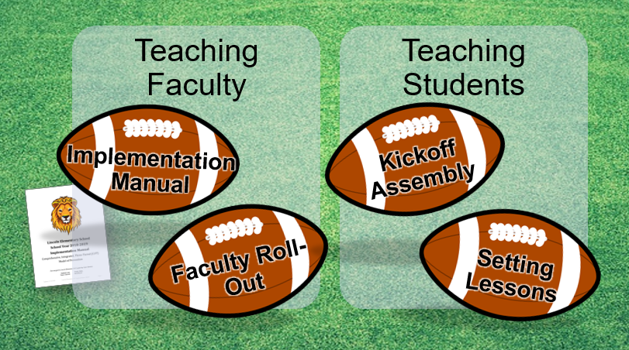
Beginning of Year Roll Out

Slide 27
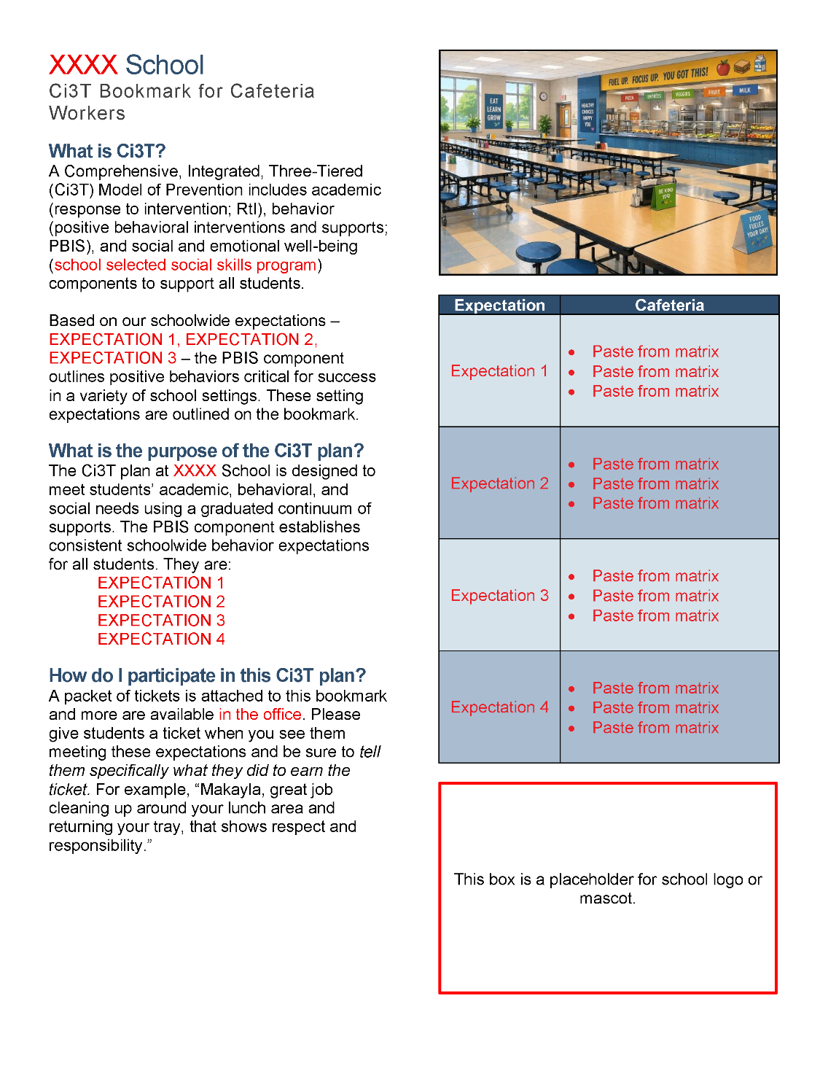
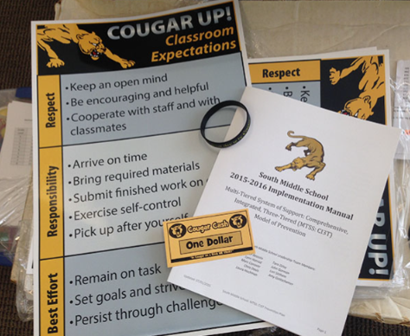

Beginning of Year Roll Out:
Faculty & Staff
Notes:
Ci3T Implementation Manual, Expectation Matrix, and resources like ticket tip sheets and bookmarks are printed and part of a welcome kit (e.g., delivered to classrooms, distributed as part of faculty & staff meeting)
In addition to making sure everyone has a copy, create intentional opportunities to build familiarity with your school’s Ci3T Implementation Manual. For example – you might build 15 minutes into back-to-school PD for a scavenger hunt of the Ci3T Implementation Manual and / or the Ci3T website – a sample scavenger hunt is available in The Tier 2 Process Module

Slide 28
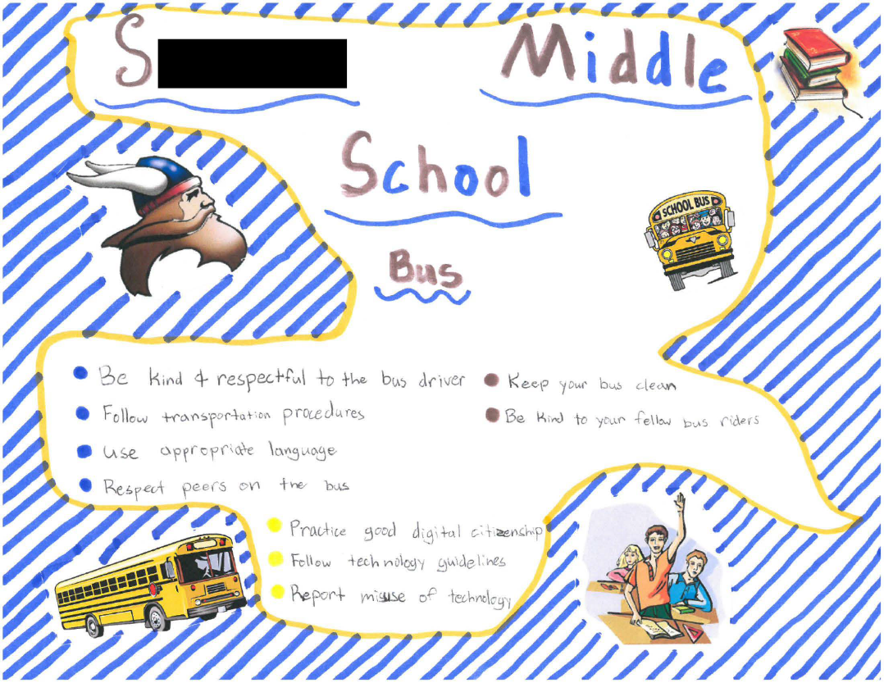
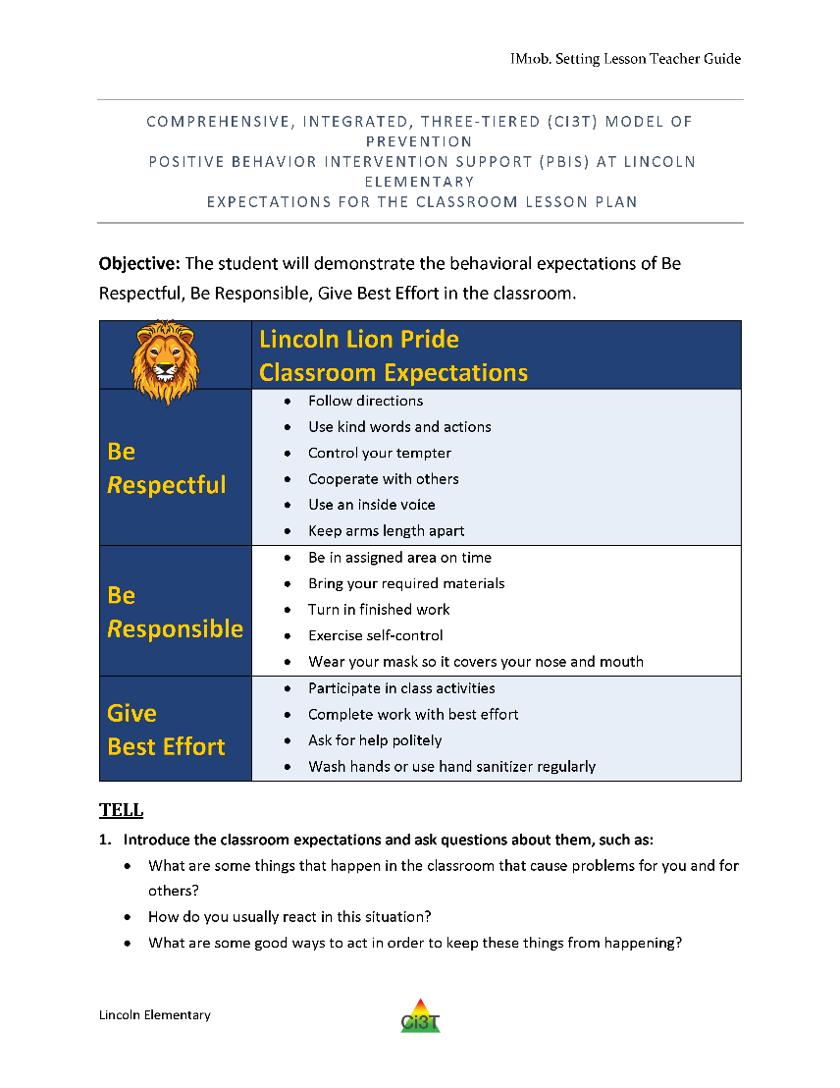

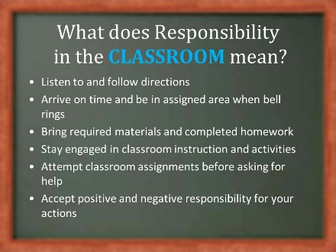

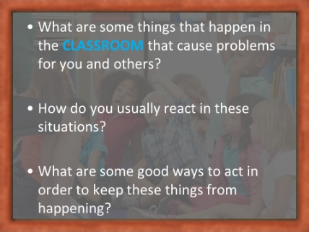
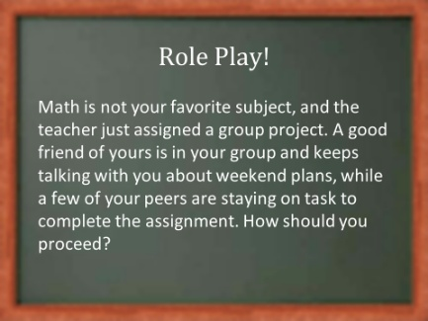
Beginning of Year Roll Out:
Students
Lessons
Posters
Videos
Announcements
Assemblies
IM10b
IM10a
Shared with permission.

Slide 29

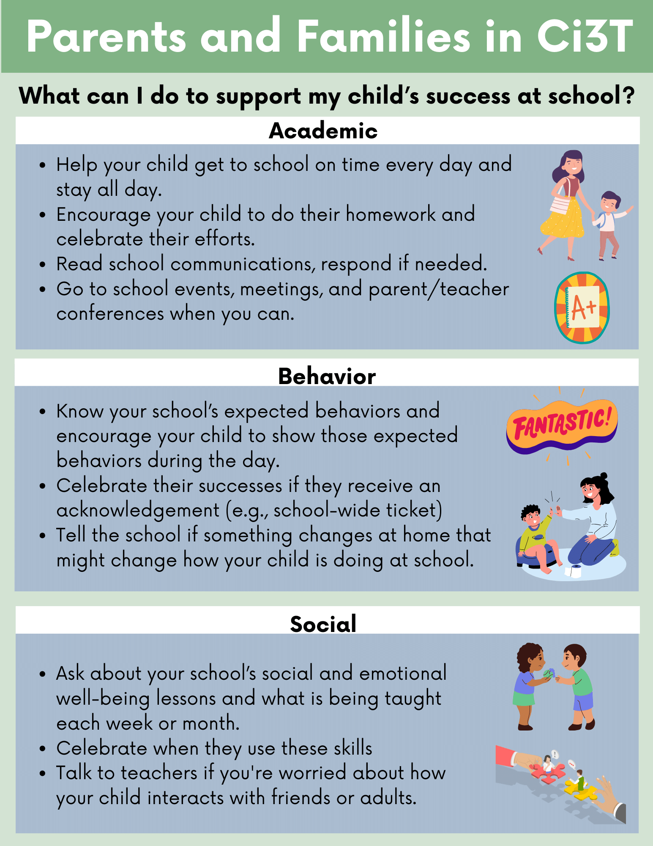
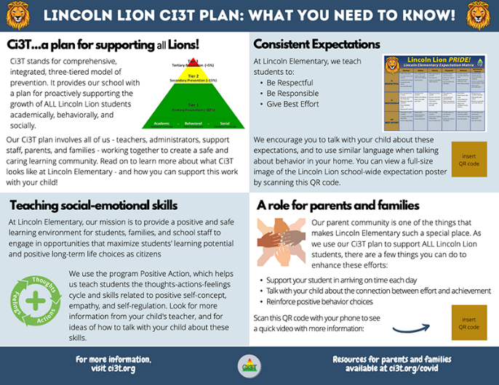
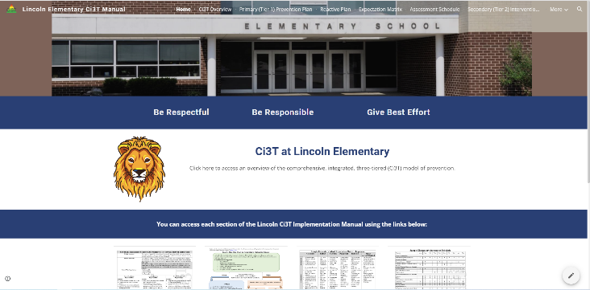
Beginning of Year Roll Out:
Family & Community
Back-to-School Night
Communication to families
  Letters
  Brochures
  Infographics
School website
Contacts with community businesses
Shared with permission.
Notes:
Consider opportunities to share about Ci3T with families such as back to school night or open house, brochures, and updating your school website. You might also consider sharing infographics featured in this module!

Slide 30
Celebrating Success!
What part of your beginning of year roll out went well?

Slide 31
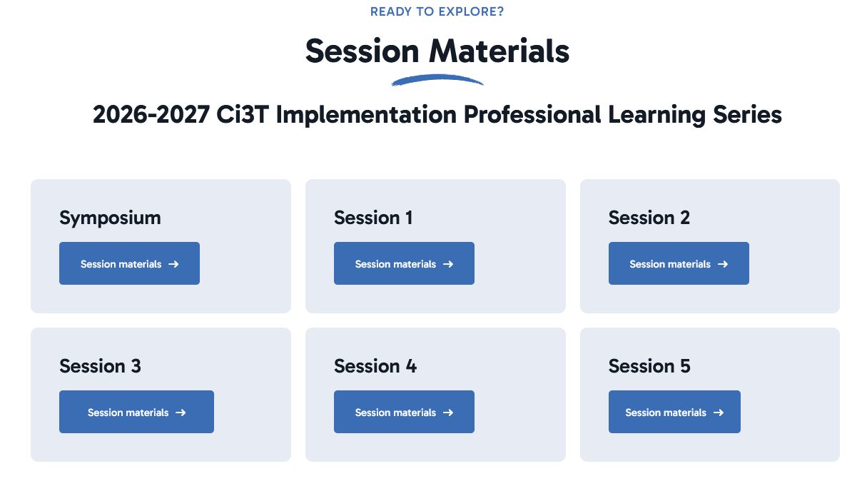
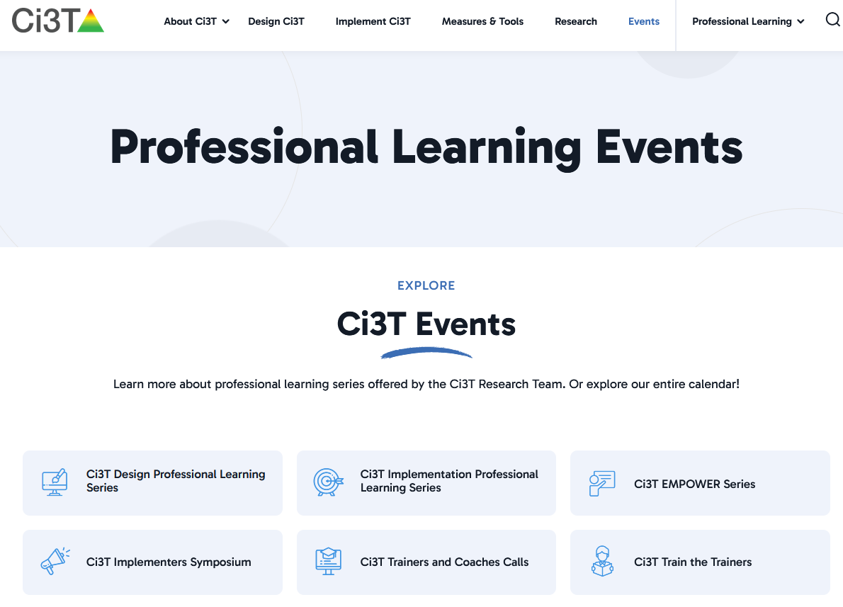
Ci3T Essentials Work Time Preparation
Notes:
Direct Link (put in chat): https://www.ci3t.org/presentations/ci3t-implementation-pl-series-session-1/

Slide 32
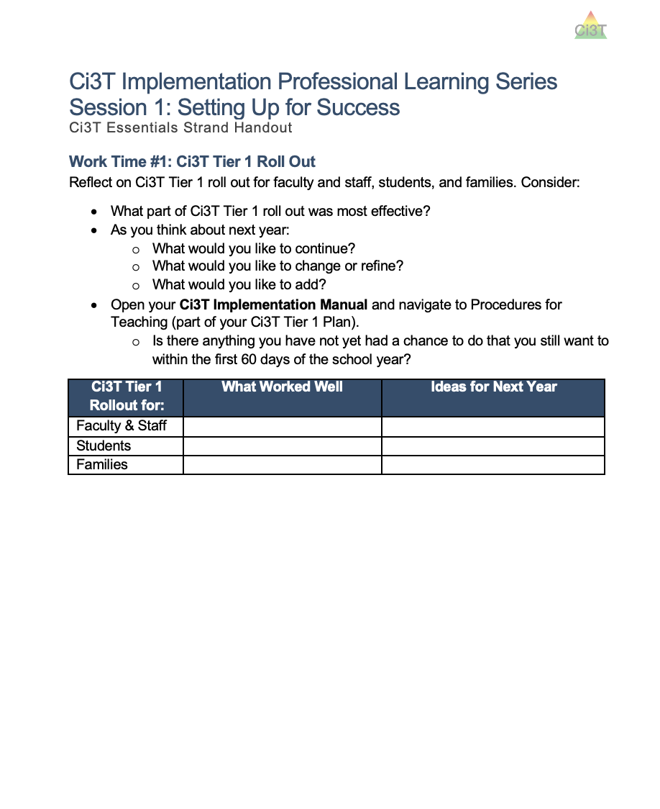












Work Time: Ci3T Tier 1 Roll Out
Open your Ci3T Implementation Manual and navigate to Procedures for Teaching (part of your Ci3T Tier 1 Plan)
Reflect on Ci3T Tier 1 roll out for faculty and staff, students, and families (see Ci3T Essentials Handout page 1)
Notes:
10-min

Slide 33
Rolling out Tier 1: Continuing Through the Year
Locate in your Ci3T Implementation Manual

Slide 34


Procedures for Teaching:
Middle School Example

Slide 35




Reviewing Implementation Resources:
IM01 Ci3T Implementation Materials

Slide 36


Procedures for Teaching
Faculty and Staff
How and when will we review procedures for teaching with faculty and staff?
  Do faculty and staff have access to our Ci3T Implementation Manual?
Are there any additional implementation materials we need?
What additional professional learning do faulty & staff need?

Slide 37

Access Instructions: Ci3T Modules

Slide 38

Ci3T Modules:
Ci3T Basics
New resource!

Slide 39




Ci3T Modules:
Implementing Tier 1 Efforts

Slide 40

Ci3T Modules: New Website Feature!

Slide 41

Professional Learning Opportunities:
Project EMPOWER
EMPOWER Session | Date
Effective Tier 1 Practices for Positive, Productive Classrooms | September 15, 2026
Let the Data Drive: Using Systematic Screening to Shape Instruction | October 27, 2026
Ci3T in Action: Integrated Lesson Planning for Optimal Instruction | November 17, 2026
A 6-Step Instructional Approach for Responding to Challenging Behavior in Schools | January 20, 2027
A Tier 2 Intervention for Managing Anxious Feelings: Recognize. Relax. Record. | March 23, 2027
A Tier 3 Intervention: Functional Assessment-Based Intervention | April 28, 2027

Slide 42




Procedures for Teaching:
Students
How and when will we re-teach expectations for students?
Are there any additional implementation resources we need?

Slide 43




Procedures for Teaching:
Families & Community
How will we continue to share information about our Ci3T plan with families and our community?
Are there any additional implementation materials we need?
Notes:
Opportunities to share plans with family and community
Open-house / parent night
Newsletter
School website
Apps or text message/phone blast

Slide 44

Procedures for Reinforcing
Locate in your Ci3T Implementation Manual

Slide 45

Procedures for Reinforcing:
High School Example

Slide 46

Procedures for Reinforcing:
High School Example Continued

Slide 47





Procedures for Reinforcing
Faculty & Staff
How are we reinforcing faculty and staff behaviors?
What reinforcers are most meaningful to our faculty & staff?
Faculty & Staff Recognition

Slide 48





Procedures for Reinforcing
Students
How are behavior-specific praise and tickets being used in our school?
What reinforcers are most meaningful to students?
How do we plan to adjust reinforcement rates?

Slide 49

Procedures for Monitoring
Locate in your Ci3T Implementation Manual

Slide 50


Procedures for Monitoring:
Student Measures (Middle School)

Slide 51

Procedures for Monitoring:
Program Measures (Middle School)

Slide 52


Ci3T Essentials Work Time: Implementing Your Tier 1 Plan
Open your Ci3T Implementation Manual
Use guiding questions on Worktime #2 section of Ci3T Essentials Handout to:
  Reflect on Tier 1 implementation
  Complete Ci3T Implementation Materials inventory
Notes:
10-min

Slide 53
Scheduling for Success
Structuring Your Ci3T Team
Long-range Planning: The Importance of Planning Ahead
Conducting Effective Meetings
Communicating with Faculty, Staff, and Families

Slide 54
Session Outcome 2
Reflect and refine plans to implement procedures for teaching faculty and staff, students, and parents and community members as the school year begins
Develop strategies for facilitating effective team meetings and communicating with faculty, staff, and families.
Prepare to collect and use fall academic and behavioral screening for all students and fall treatment integrity and social validity data for faculty and staff.

Slide 55
Let’s Chat: Effective Meetings
Meetings are most effective when….

Slide 56
Qualities of Effective Team Meetings
Team composition
Team roles (e.g., notetaker, timekeeper)
Strategically scheduled
Data-informed
Agenda
Digital workspace
Notes:
Team composition – decision makers, representatives across grade-levels / departments. Do we have the right people at the table.
Team roles (e.g., note taker, timekeeper)
Strategically scheduled – predicable, let’s you stay “in front of” upcoming priorities, creates natural feedback look (collect data, look at data, make plans, share back out with faculty and staff)
Agenda – meeting has clear purpose, space to record decisions and next steps
Workspace – materials are organized, have access to what you need (e.g., data reports)

Slide 57




Structuring your Ci3T Team

Slide 58


Long Range Planning
Ci3T Leadership Team meetings
Faculty and Staff meetings
Data Collection
  Academic and Behavior Screening
  Treatment Integrity & Social Validity
Professional Learning
  Ci3T Implementation Professional Learning Series
  EMPOWER Sessions
  Enhancing Ci3T Modules
  District-offered professional learning

Slide 59


Scheduling Your Ci3T Leadership Team Meetings & Faculty and Staff Meetings
Notes:
Might consider stacking these monthly meetings:
There are 5 Ci3T Implementation Sessions throughout the year either led by our research team or your district. Often, teams find it helpful to schedule their Ci3T Leadership Team meetings for after those sessions. Implementation sessions are a great place to start conversations – look at data, start making plans. Helpful to have time set aside to continue to conversation.
The other piece to consider, is scheduling monthly Ci3T Leadership Teams before faculty and staff. For example, if you know your faculty and staff always meets the 3rd Wednesday of the month, maybe you hold the first Wednesday for Ci3T Leadership Team, that way you’re always working ahead
Choosing a regular meeting date (e.g., the second Tuesday of the month) can add predictability to the schedule.
Consider creating the calendar for your faculty and staff meetings at the same time as your Ci3T Leadership Team meetings. For example, you might intentionally schedule staff meetings the week following your Ci3T Leadership Team meetings. This provides an automatic mechanism for sharing Ci3T updates (e.g., sharing data) at your staff meetings.
As you finalize the schedule, send digital calendar invites (e.g., Google Calendar, Outlook, iCal) to all members or post dates on a shared school calendar. Consider setting up the calendar events with week-before and day-before alerts.
If possible, avoid cancelling meetings. Holding meetings consistently communicates the priority of this time and avoids confusion (“Are we meeting this month?”).

Slide 60
Backwards Planning from Assessment Windows
What data preparation activities are needed?
  Setting up behavior screening rosters
  Professional learning for how to complete SRSS-IE
When might data collection happen during a meeting?
  Behavior screening
  Treatment Integrity and Social Validity Measures
  Tiered Fidelity Inventory
When will our Ci3T Leadership Team review data?
When will we share data back with faculty and staff?
Notes:
Note when important data collection activities need to be planned for (e.g., planning for conducting systematic screening, preparing for staff to complete treatment integrity and social validity surveys) or when data collection needs to occur during the meeting (e.g., completion of the Tiered Fidelity Inventory). This will make sure your meetings are timed in a way that will support the use of data.

Slide 61


Putting it All Together: An Illustration
Ci3T Implementation Manual revisions
7 / 8 / 26
8 / 5 / 26
9 / 9 / 26
10 / 7 / 26
11 / 11 / 26
12 / 9 / 26
1 / 13 / 27
2 / 10 / 27
3 / 10 / 27
4/ 14 / 27
5 / 12 / 27
6 / 9 / 27
3:00 – 4:00 pm
3:00 – 4:00 pm
3:00 – 4:00 pm
3:00 – 4:00 pm
3:00 – 4:00 pm
3:00 – 4:00 pm
3:00 – 4:00 pm
3:00 – 4:00 pm
3:00 – 4:00 pm
3:00 – 4:00 pm
3:00 – 4:00 pm
3:00 – 4:00 pm
7 / 15 / 26
8 / 12 / 26
9 / 16 / 26
10 / 14 / 26
11 / 18 / 26
12 / 16 / 26
1 / 20 / 27
2 / 17 / 27
3 / 17 / 27
4/ 21 / 27
5 / 19 / 27
6 / 16 / 27
3:00 – 4:00 pm
3:00 – 4:00 pm
3:00 – 4:00 pm
3:00 – 4:00 pm
3:00 – 4:00 pm
3:00 – 4:00 pm
3:00 – 4:00 pm
3:00 – 4:00 pm
3:00 – 4:00 pm
3:00 – 4:00 pm
3:00 – 4:00 pm
3:00 – 4:00 pm
plans to collect academic and behavior screening data
Review ODR reports (disaggregated by grade, location, behavior type)
Review SRSS-IE and academics screening data; plan for staff to complete TI/SV surveys
complete TFI
Review TI/SV, review ODR and attendance
Plan Spring TI/SV data collection; review Winter screening data
Review ODR and attendance, make plans for staff to do TI/SV surveys
Complete TFI
Review Spring TI/SV
Review Spring screening data

Slide 62


Conducting Effective Meetings:
Ci3T Leadership Team Agenda
One document with agendas for the entire year
One document for each meeting
Notes:
In your handout, we linked these two agenda options. Both templates provide structure to help guide Ci3T Leadership Team Meetings. Let’s take a closer look!

Slide 63
Ci3T Leadership Team Agenda Template
Meeting Logistics
One document for the entire year
Notes:
This template is set up so there is one document with all agendas for the school year. An advantage of this format is – it’s easy to look back at prior meetings. You can use the search feature within the document or scroll to remind yourself about decisions previously made.
(animation – agenda moves up, arrow fades, new arrow appears) Both agendas include helpful reminders for before and after the meeting to help ensure meetings are both effective and efficient. For example, sharing the agenda ahead of time and sending follow up communication to ensure action items get completed.

Slide 64

Ci3T Leadership Team Agenda Template
Action Items
Notes:
Both agendas also have space to record action items.

Slide 65



Ci3T Leadership Team Agenda Template
Monthly Meeting Prompts
Appendix with guiding questions
Notes:
Each monthly agenda is set up with a predictable structure. Before the meeting, teams update the agenda with specific items they wish to discuss. It’s unlikely the team will discuss Tier 1, Tier 2, and Tier 3 at every single meeting. Some meetings might focus more heavily on Tier 1 and that’s ok! Just leave the rows blank if you aren’t discussing that item.
(animation – appendix with prompts appears) At the end of the document is an appendix with guiding questions. This is a great resource if you find yourself wanting inspiration on what to talk about during meetings or how you might extend your conversations even further.

Slide 66

Digital Workspace
Central location accessible to all Ci3T Leadership Team members
Dedicated location for:
  Ci3T Implementation Manual
  Ci3T LT monthly meeting agendas
  Data reports used for decision-making
  Implementation materials
Notes:
We’ve talked about who serves on your Ci3T Leadership Team, how to schedule Ci3T Leadership Team meetings to support implementation efforts, and how to leverage meeting agendas to facilitate effective and efficient meetings. Now, let’s think about digital workspaces to keep everything organized!
Digital workspace is typically set up as a shared folder in a platform like Google Drive, Dropbox, or SharePoint. It’s important this is a central location (NOT a personal drive).

Slide 67


Digital Workspace Example
Notes:
For example,
Add additional images to show the inside of the PL series and one other folder

Slide 68
Communicating with Faculty, Staff, and Families
Faculty and staff
  Consider plans for sharing updates with all staff including cafeteria, custodial, transportation, office, paraeducators, and related service providers
Students
Parents & Families
Community
  Consider dedicating space on school website to give parents and community members access to updates

Slide 69

Ci3T Essentials Work Time: Scheduling for Success
Use guiding questions and resources in Work Time #3 of Ci3T Essentials Handout to:
reflect on preparation activities
make an action plan for any items not yet compete
Notes:
10-min

Slide 70
Preparing to Collect Data
Preview: Academic and Behavior Screening
Preview: Ci3T Treatment Integrity Team Leader Training

Slide 71
Session Outcome 3
Reflect and refine plans to implement procedures for teaching faculty and staff, students, and parents and community members as the school year begins
Develop strategies for facilitating effective team meetings and communicating with faculty, staff, and families.
Prepare to collect and use fall academic and behavioral screening for all students and fall treatment integrity and social validity data for faculty and staff.

Slide 72



Preparing to Screen: SRSS-IE Resources

Slide 73



Preparing to Screen: Communicating with Faculty & Staff

Slide 74


Preparing to Screen: Communicating with Families
Notes:
https://www.pbis.org/resource/tips-for-communicating-with-your-community-about-systematic-screening-what-does-your-district-and-school-leadership-team-need-to-know
https://www.pbis.org/resource/the-whys-and-hows-of-screening-frequently-asked-questions-for-families

Slide 75
Preparing for Fall Treatment Integrity and Social Validity
Opportunity to share the “why” of treatment integrity and social validity with staff
  Email or newsletter
  Faculty and staff meeting
Faculty or staff meeting to complete Treatment Integrity and Social Validity Measures
Ci3T Leadership Team Meeting to complete Tiered Fidelity Inventory (TFI)

Slide 76





Treatment Integrity and Social Validity Module Connection

Slide 77

Ci3T Treatment Integrity Team Leader Training
Collaborate with your district to determine who will conduct Ci3T Treatment Integrity: Direct Observation
Training for those conducting Ci3T Treatment Integrity: Direct Observation is embedded within the module Preparing to Collect Social Validity and Treatment Integrity Data

Slide 78

Wrapping Up and Moving Forward

Slide 79
Sharing Next Steps!
What is 1 action item you or your team is taking following today’s session?
What is 1 topic you will discuss at your next Ci3T monthly meeting?

Slide 80
Wrap Up and Preview
Today
Implementing your Ci3T Tier 1 Plan
Scheduling for Success
Preparing to Collect Data
Next time
Preparing to Collect and Use Social Validity & Treatment Integrity Data
Conducting Systematic Screening
Using Fall Screening Data to Inform Instruction
Facilitating Communication and Collaboration Practices

Slide 81
Action Items
Action Item | Person(s) Responsible | Planned Completion Date | Date Completed
Send calendar invites for Ci3T Leadership Team meetings | Mark | 09/10/26
Share What is Behavior Screening infographic in upcoming Principal Newsletter | Wendy | 09/14/26
Build worktime to explore What is Ci3T module in October new teacher professional learning | Allison | 09/25/26

Slide 82
At Your Next Ci3T Leadership Meeting
Complete set-up of your Ci3T Leadership Team Agenda
Prepare for Fall academic and behavior screening
Prepare for Fall treatment integrity and social validity window

Slide 83

At Your Next Faculty & Staff Meeting
Share successes
Confirm all faculty and staff can access your school’s Ci3T Implementation Manual
Review Procedures for Teaching and Procedures for Reinforcing

Slide 84



If you are here as a District Ci3T Coach

Slide 85
Project EMPOWER
EMPOWER Session | Date
Effective Tier 1 Practices for Positive, Productive Classrooms | September 15, 2026
Let the Data Drive: Using Systematic Screening to Shape Instruction | October 27, 2026
Ci3T in Action: Integrated Lesson Planning for Optimal Instruction | November 17, 2026
A 6-Step Instructional Approach for Responding to Challenging Behavior in Schools | January 20, 2027
A Tier 2 Intervention for Managing Anxious Feelings: Recognize. Relax. Record. | March 23, 2027
A Tier 3 Intervention: Functional Assessment-Based Intervention | April 28, 2027
Notes:
We hope to see you at a future EMPOWER session! Each session is free, 2hrs, and hosted on Zoom. About 2 weeks following a session we post a video recording so if you are unable to make it (or if there’s a session that already passed that you are interested in), we invite you to access those recordings!

Slide 86

Ci3T Trainers and Coaches Calls
Ci3T Trainers and Coaches Calls Session | Date
Ci3T Trainers and Coaches Call 1 | August 19, 2026 (Wednesday)
Ci3T Trainers and Coaches Call 2 | September 2, 2026 (Wednesday)
Ci3T Trainers and Coaches Call 3 | October 7, 2026 (Wednesday)
Ci3T Trainers and Coaches Call 4 | November 10, 2026 (Tuesday)
Ci3T Trainers and Coaches Call 5 | December 2, 2026 (Wednesday)
Ci3T Trainers and Coaches Call 6 | January 21, 2027 (Thursday)
Ci3T Trainers and Coaches Call 7 | February 17, 2027 (Wednesday)
Ci3T Trainers and Coaches Call 8 | March 9, 2027 (Tuesday)
Ci3T Trainers and Coaches Call 9 | April 14, 2027 (Wednesday)
Ci3T Trainers and Coaches Call 10 | May 12, 2027 (Wednesday)
Notes:
Ci3T Trainers and Coaches Calls are a great opportunity to come and ask questions! These are not recorded the agenda focuses on “open mic” time where people can come to ask their honest questions and talk through implementation challenges. This is a great avenue to ask questions, listen, and learn from Ci3T implementers across the country and internationally.

Slide 87



Thank you!
Thank you!
ci3t.org
Notes:
You will receive a brief session evaluation – we value your feedback and would greatly appreciate you taking a few minutes to share your thoughts on what you liked about the session and how we can improve

