Slide 1
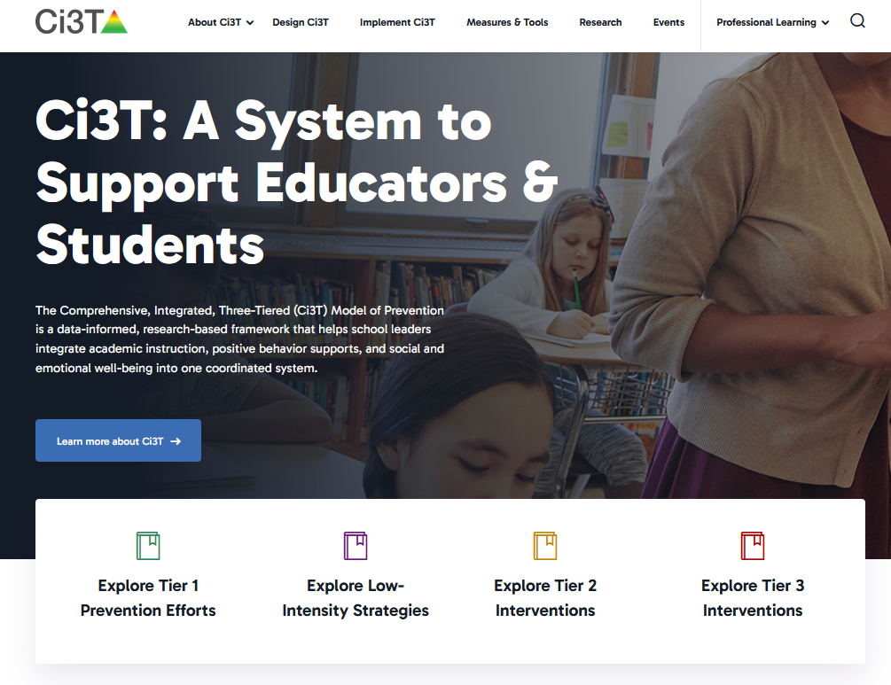
Exploring Ci3T
Creating Positive, Productive Environments: Using Comprehensive, Integrated, Three-tiered (Ci3T) Models to Meet Students’ Multiple Needs
Kathleen Lynne Lane, Ph.D. BCBA-D, CF-L2
University of Kansas
We invite you to visit ci3t.org/registration to create an account!

Slide 2
Agenda
Welcome
What is Ci3T?
Data-Informed Decision Making
  Tier 1
  Low-Intensity Strategies
  Tier 2 and Tier 3
Ci3T Professional Learning Journey
Wrapping Up and Moving Forward

Slide 3


Gratitude
Why Ci3T?
The Ci3T Journey

Slide 4

Ci3T Phased Roll Out
 | 2026-2027 | 2027-2028 | 2028-2029 | 2029-2030 | 2030-2031 | 2031-2032 | 2032-2033
Getting Started with Ci3T | x
Ci3T Design |  | x
Ci3T Implementation Year 1 |  |  | x
Ci3T Implementation Year 2 |  |  |  | x
Sustain and Develop Practices |  |  |  |  | x | x | x

Slide 5

Getting Started with Ci3T (1 of 2)
2026–2027 School Year
Activity
Aug
Sept
Oct
Nov
Dec
Jan
Feb
Mar
Apr
May
Shared Outcomes
Getting Started with Ci3T PL Series
4 Sessions
Purpose: Explore Ci3T and build shared knowledge, language, and vision.
Districtwide activities to begin Ci3T Design and Implementation efforts, building upon:
Shared vision
Districtwide certainties
Strong practices already in place
Aug. 27: Educational Leaders’ Session
Leading in Ci3T Systems (in-person)
Aug. 31: Keynote + Breakouts
Exploring Ci3T (in-person)
Nov. 3: Keynote + Breakouts
A Closer Look at Tier 1 (in-person)
Mar. 2: Keynote + Breakouts
A Closer Look at Tier 2 and 3 (virtual)
District Leadership Team Meetings + Ci3T Research Team
10 one-hour meetings
Purpose: Establish district ‘certainties’ for Ci3T strategies, practices, programs, and assessments.
1
2
3
4
5
6
7
8
9
10
School-Site Team Meetings +
Ci3T Research Team
5 one-hour meetings with each school
Purpose: Reflect on each school’s context, needs, and current practices, connecting them to Ci3T learning and districtwide planning.
1
2
3
4
5

Slide 6
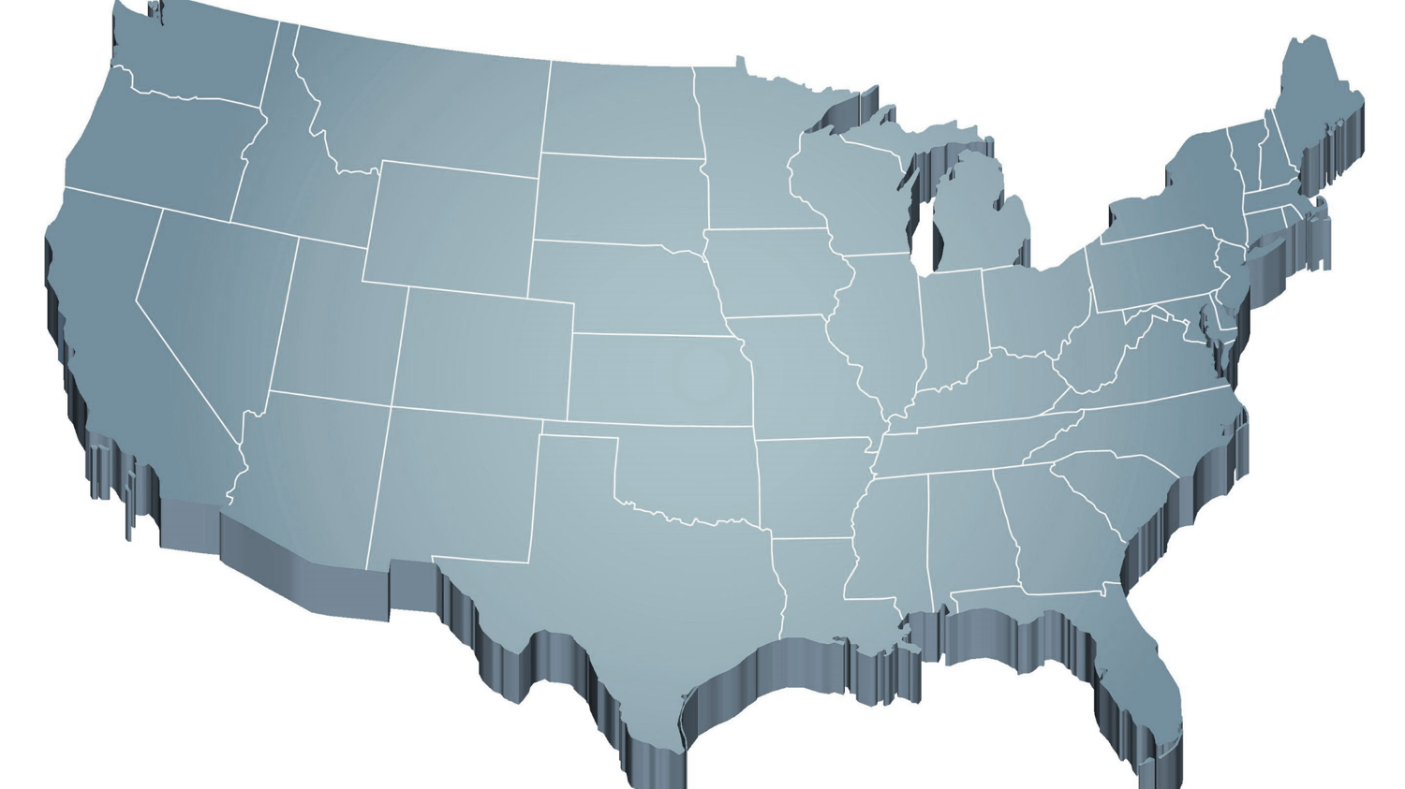
Internalizing and Externalizing
Internalizing
Externalizing
ED <1%
EBD 12-20%
Source: Forness, S.R., Freeman, S.F., Paparella, T., Kauffman, J.M., & Walker, H.M. (2012). Special education implications of point and cumulative prevalence for children with emotional or behavioral disorders. Journal of Emotional and Behavioral Disorders, 20, 4-18.

Slide 7
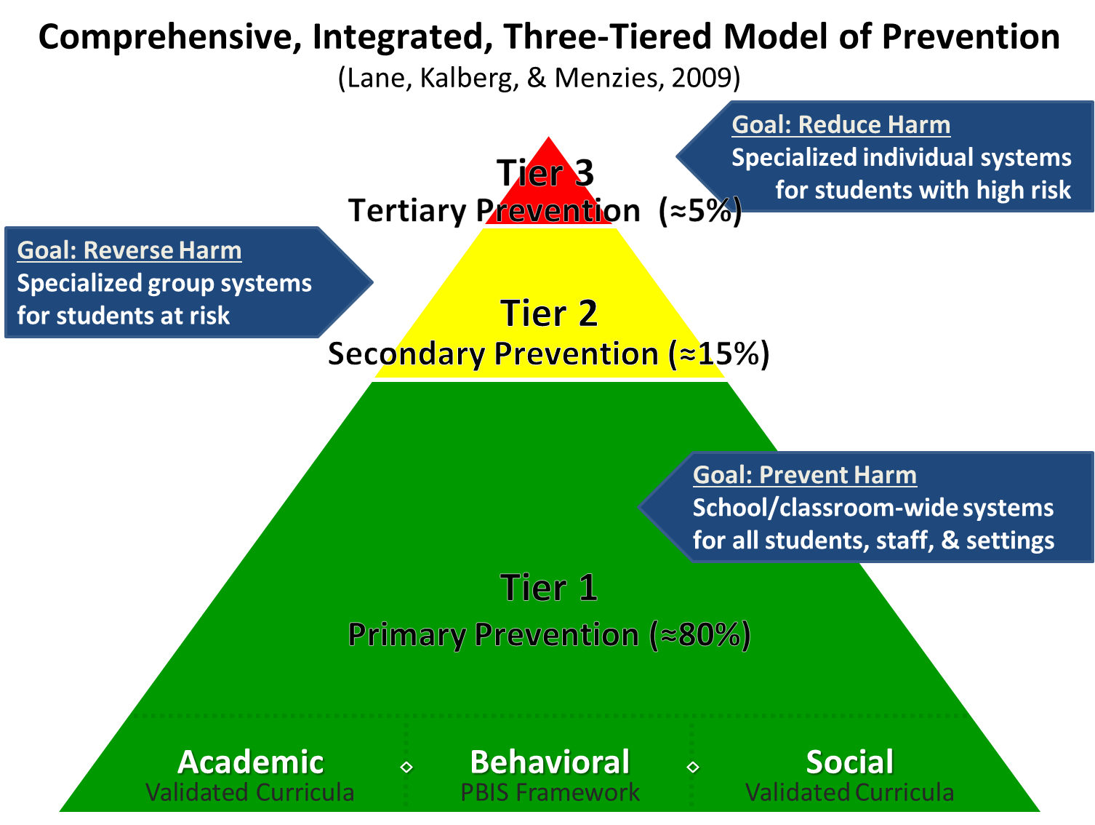
Comprehensive, Integrated, Three-Tiered Model of Prevention

Slide 8
What is Ci3T?

Slide 9
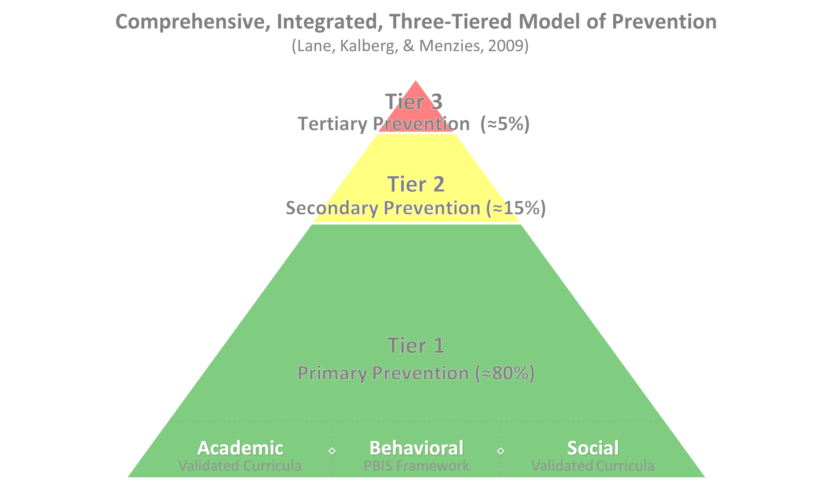

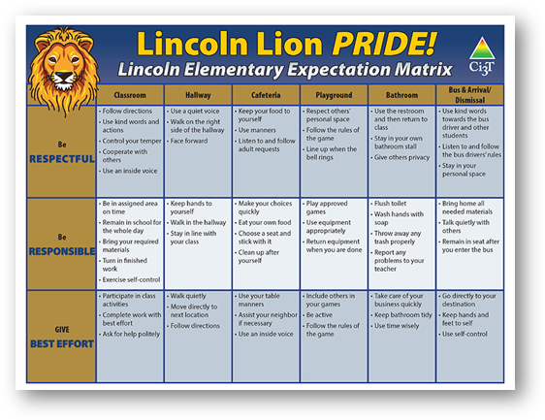
Ci3T Tier 1 Supports
Positive Behavioral Interventions and Supports
District & State Standards Quality Instruction
Validated Curricula and Resources

Slide 10

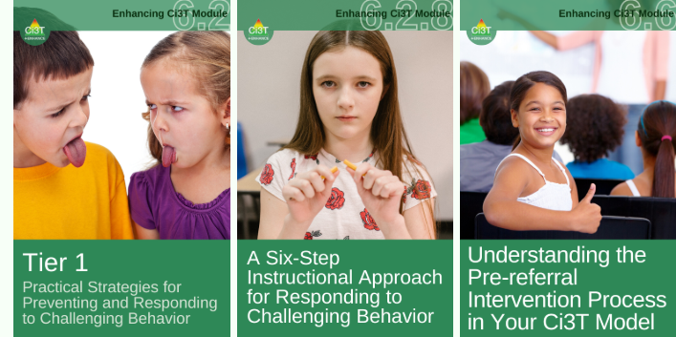
Tier 1

Slide 11

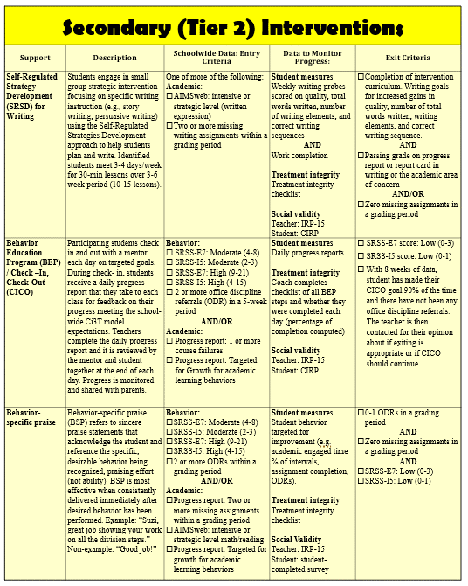
Tier 2
Tier 2 Intervention Grid

Slide 12
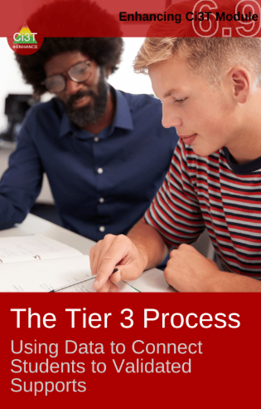
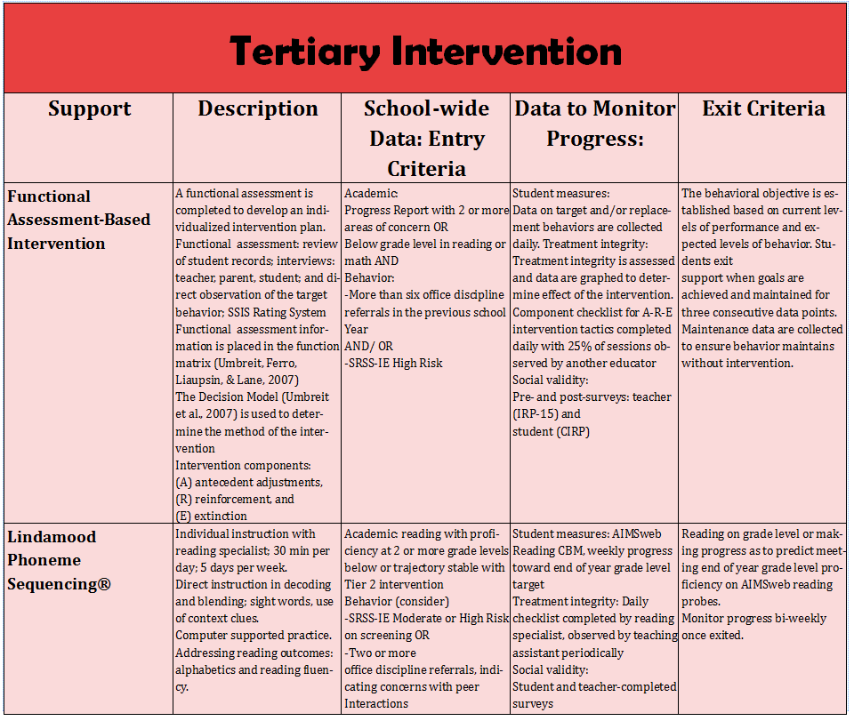
Tier 3
Tier 3 Intervention Grid

Slide 13
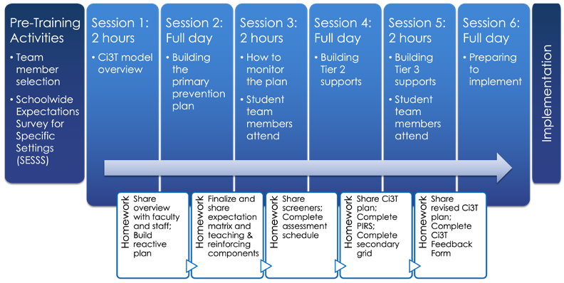
Ci3T Design Professional Learning Series

Slide 14



Ci3T Implementation Manual

Slide 15
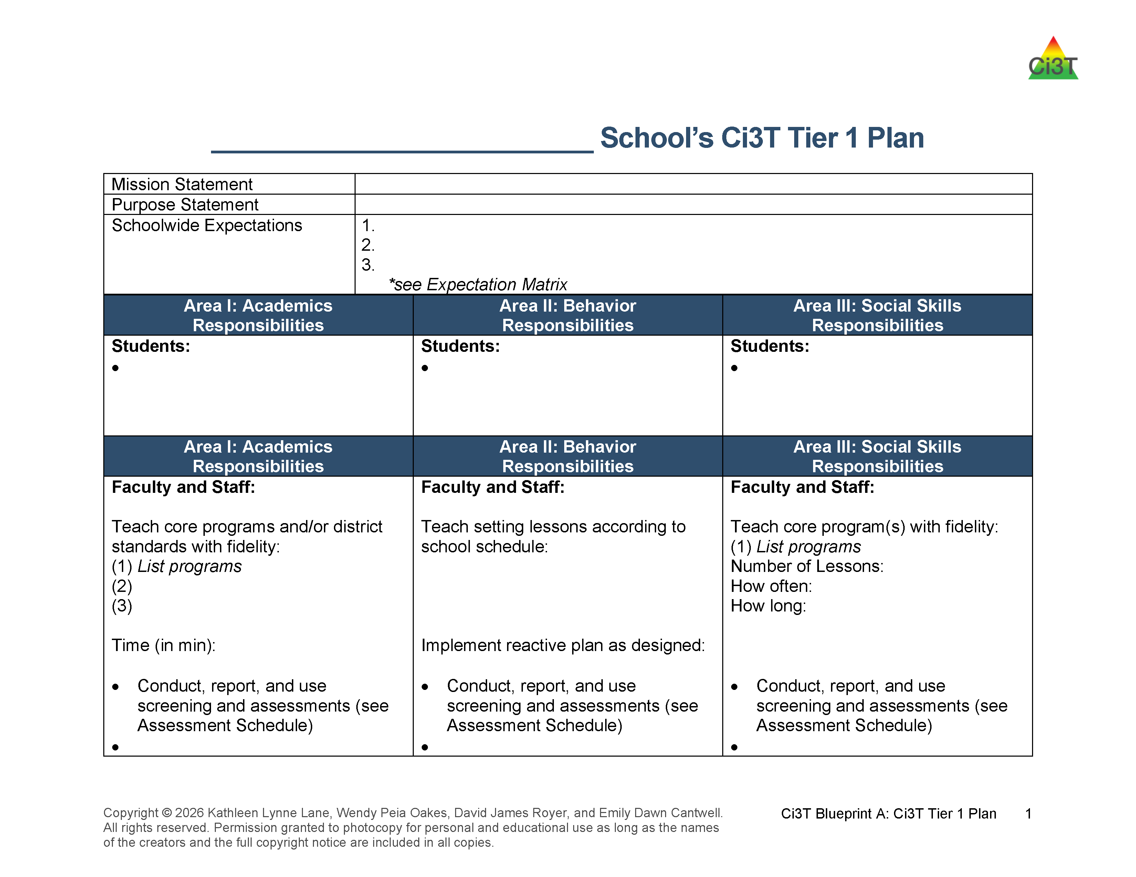
Ci3T Tier 1 Plan

Slide 16
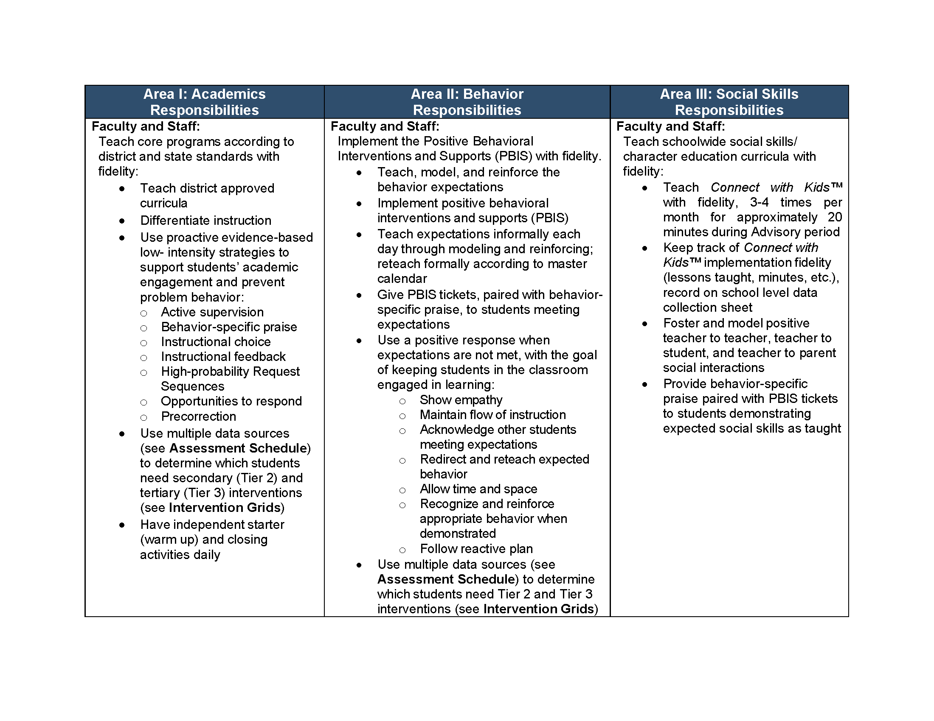
Procedures for Monitoring Tier 1 Plan
Ci3T Tier 1 Plan: Procedures for Teaching
Ci3T Tier 1 Plan: Procedures for Reinforcing
Ci3T Tier1 Plan: Procedures for Monitoring

Slide 17
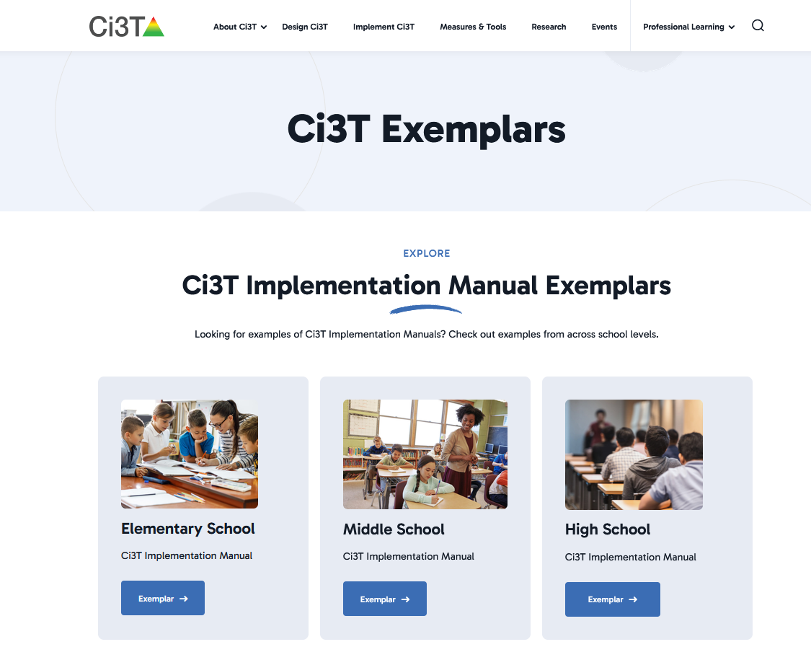

Exemplar Ci3T Implementation Manuals

Slide 18
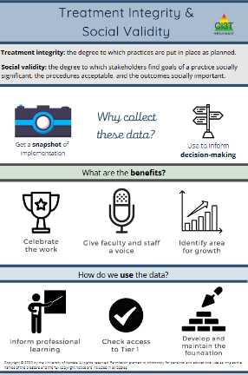
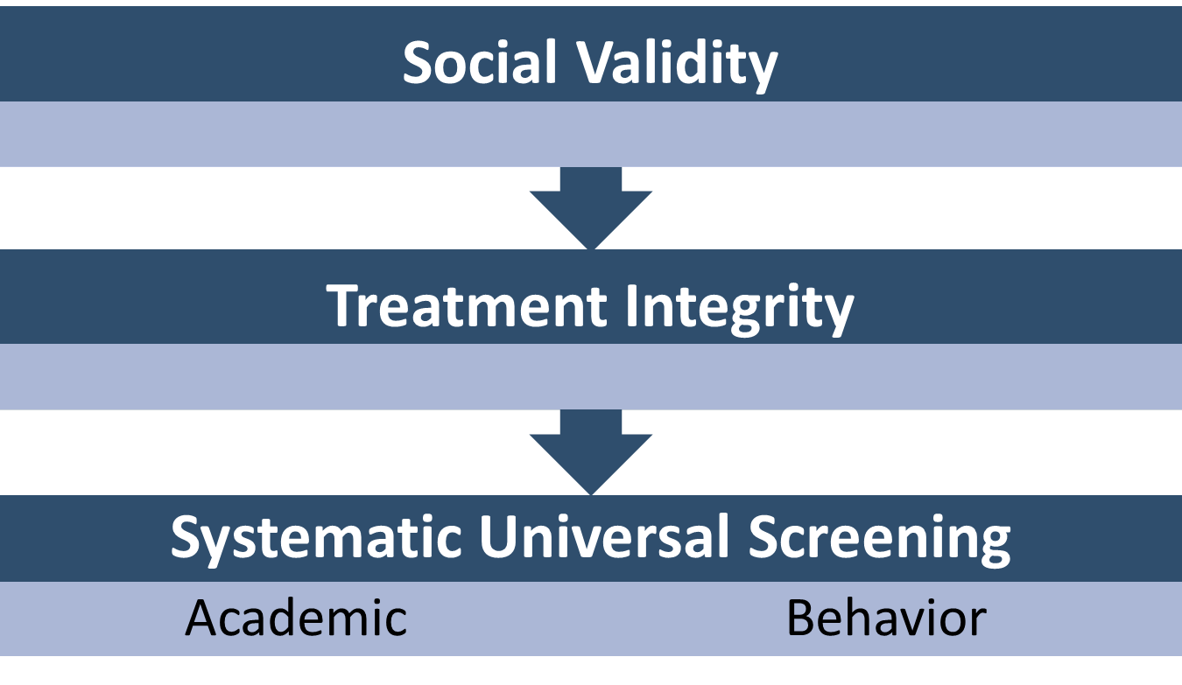
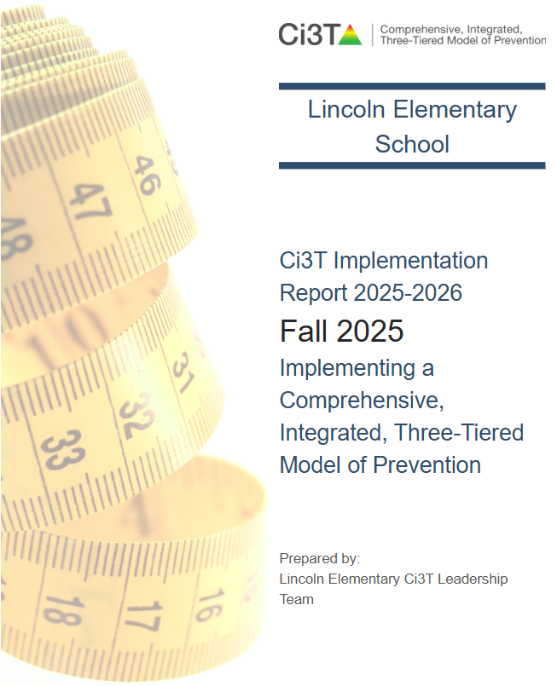
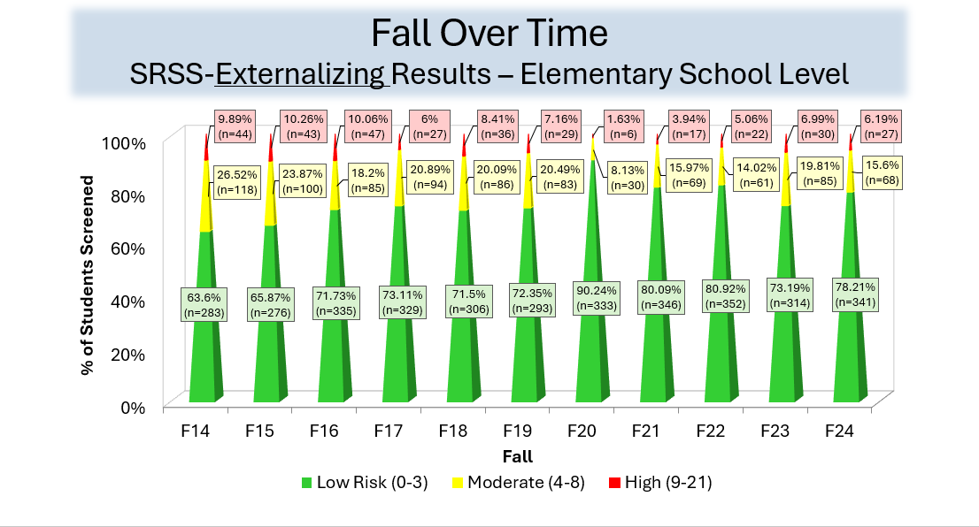
Essential Components Tier 1 Efforts

Slide 19







Turn & Talk: Ci3T
What are some potential benefits of an integrated system like Ci3T?
How could Ci3T build on existing strengths and effective practices currently in place in your district?
Notes:
5-minutes

Slide 20

Systematic Screening … Logistics
Fall
Winter
Spring
Selecting
Installing
Analyzing

Slide 21
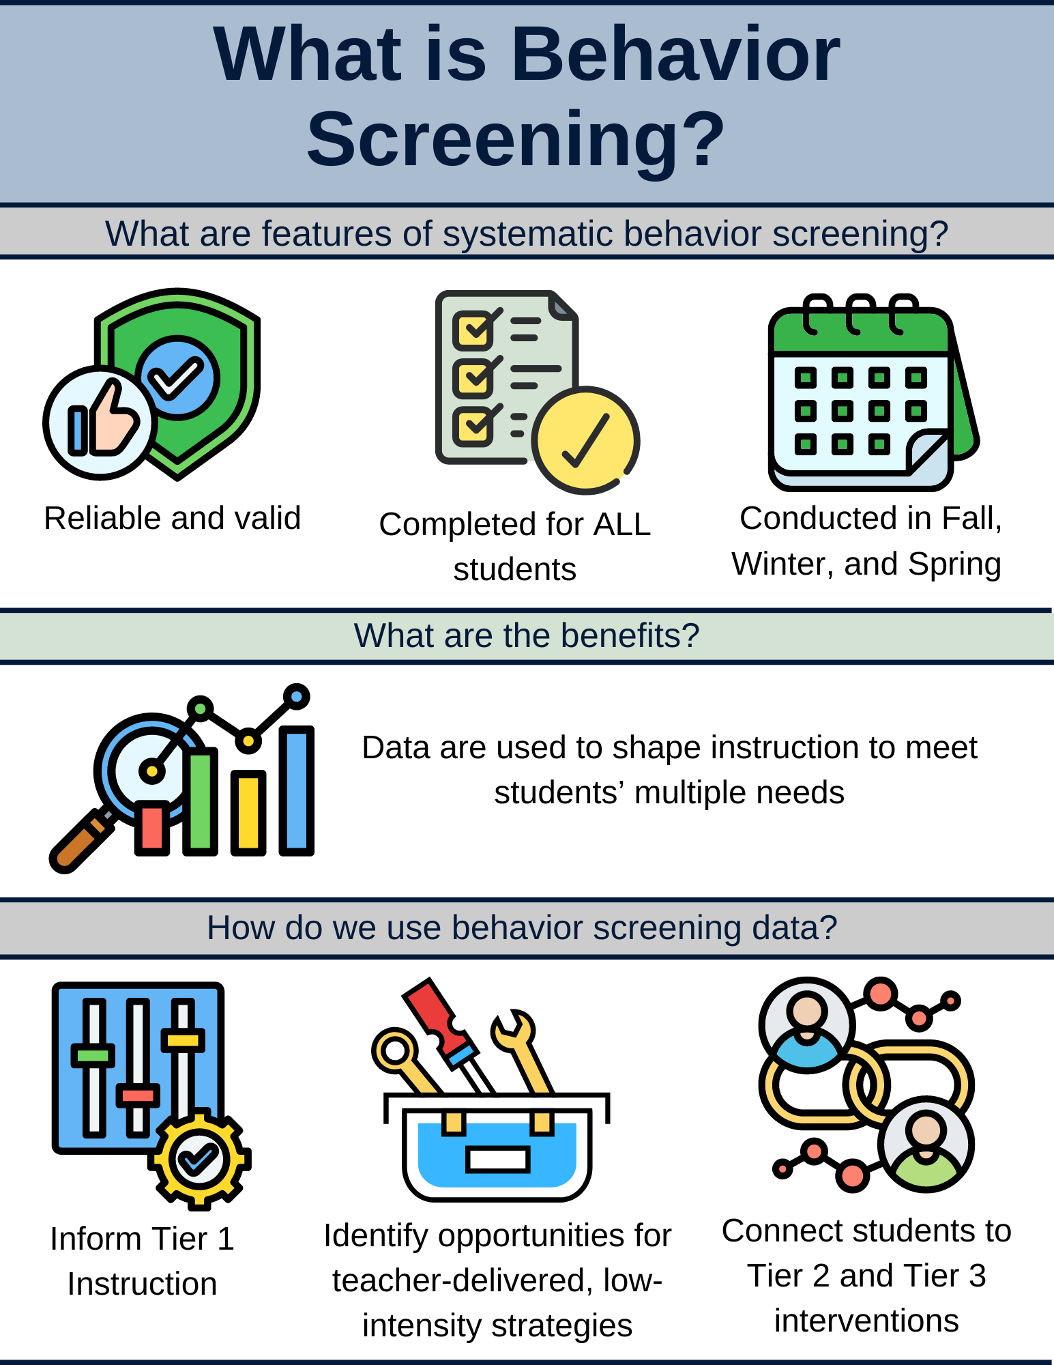
What is Behavior Screening? 1

Slide 22
What is Behavior Screening? 2

Slide 23
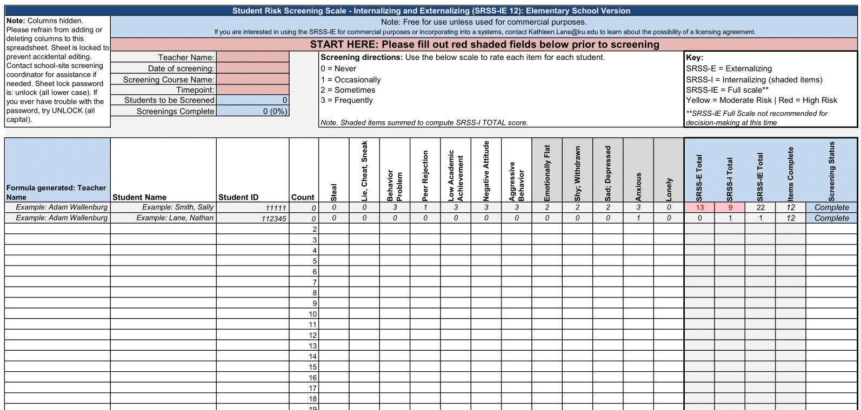
Student Risk Screening Scale – Internalizing and Externalizing (SRSS-IE; Drummond, 1994; Lane & Menzies, 2009)
Elementary

Slide 24
SRSS-IE: Cut Scores
Elementary School
Middle and High School
SRSS-E7 | SRSS-I5
Items 1-7 | Items 8-12
0-3 = low risk 4-8 = moderate risk 9-21 = high risk | 0-1 = low risk 2-3 = moderate risk 4-15 = high risk
SRSS-E7 | SRSS-I6
Items 1-7 | Items 4, 8-12
0-3 = low risk 4-8 = moderate risk 9-21 = high risk | 0-3 = low risk 4-5 = moderate risk 6-18 = high risk
Elementary School Level:
Lane, K. L., Oakes, W. P., Swogger, E. D., Schatschneider, C., Menzies, H., M., & Sanchez, J. (2015). Student risk screening scale for internalizing and externalizing behaviors: Preliminary cut scores to support data-informed decision making. Behavioral Disorders, 40, 159-170.
Middle and High School Levels:
Lane, K. L., Oakes, W. P., Cantwell, E. D., Schatschneider, C., Menzies, H., Crittenden, M., & Messenger, M. (2016). Student Risk Screening Scale for Internalizing and Externalizing Behaviors: Preliminary cut scores to support data-informed decision making in middle and high schools. Behavioral Disorders, 42(1), 271-284

Slide 25
Fall Over Time
SRSS-Externalizing Results – Elementary School Level
Notes:
Fill in <year> based on current academic year. This is located in column A of the data sheet. Edit by right clicking and selecting “Edit data”.

Slide 26
Fall Over Time
SRSS-Internalizing Results – Elementary School Level
Notes:
Fill in <year> based on current academic year. This is located in column A of the data sheet. Edit by right clicking and selecting “Edit data”.

Slide 27
Fall 2024
SRSS-Internalizing Results – Elementary School Grade Level
Grade Level | N Screened | Low n (%) | Moderate n (%) | High n (%)
K | 46 | 26 (56.52) | 9 (19.57) | 11 (23.91)
1 | 60 | 41 (68.33) | 9 (15.00) | 10 (16.67)
2 | 85 | 66 (77.65) | 15 (17.65) | 4 (4.71)
Notes:
Fill in <year> based on current academic year. This is located in column A of the data sheet. Edit by right clicking and selecting “Edit data”.

Slide 28
Student Risk Screening Scale
Fall 2004-2012 • Middle School
Source: Lane, K. L., Oakes, W. P., & Magill, L. M. (2014). Primary prevention efforts: How do we implement and monitor the Tier 1 component of our comprehensive, integrated, three-tiered model of prevention? Preventing School Failure, 58, 143-158. doi: 10.1080/1045988X.2014.893978 [Figure 4. Middle school behavior screening data over time at the fall time point. Adapted from Figure 4.6 p. 127 Lane, K. L., Menzies, H. M, Oakes, W. P., & Kalberg, J. R. (2012). Systematic screenings of behavior to support instruction: From preschool to high school. New York, NY: Guilford Press.]

Slide 29
Behavior & Academic Characteristics of SRSS Risk Groups (Middle School)
Variable |  | Risk
 | Low (n = 422) M (SD) | Moderate (n = 51) M (SD) | High (n = 12) M (SD) | Significance Testing
ODR | 1.50 (2.85) | 5.02 (5.32) | 8.42 (7.01) | L<M<H
In-School Suspensions | 0.08 (0.38) | 0.35 (1.04) | 1.71 (2.26) | L<M<H
GPA | 3.35 (0.52) | 2.63 (0.65) | 2.32 (0.59) | L>M, H M=H
Course Failures | 0.68 (1.50) | 2.78 (3.46) | 4.17 (3.49) | L<M, H M=H
(Lane, Parks, Kalberg, & Carter, 2007)

Slide 30
Winter Over Time
SRSS-Externalizing Results – High School Level
Notes:
Fill in <year> based on current academic year. This is located in column A of the data sheet. Edit by right clicking and selecting “Edit data”.

Slide 31
Winter 2024
SRSS-Externalizing Results – High School Grade Level
Grade Level | N Screened | Low n (%) | Moderate n (%) | High n (%)
9 | 349 | 276 (79.08) | 46 (13.18) | 27 (7.74)
10 | 353 | 298 (84.42) | 40 (11.33) | 15 (4.25)
11 | 363 | 335 (92.29) | 21 (5.79) | 7 (1.93)
12 | 354 | 328 (92.66) | 24 (6.78) | 2 (0.56)
Notes:
Fill in <year> based on current academic year. This is located in column A of the data sheet. Edit by right clicking and selecting “Edit data”.

Slide 32
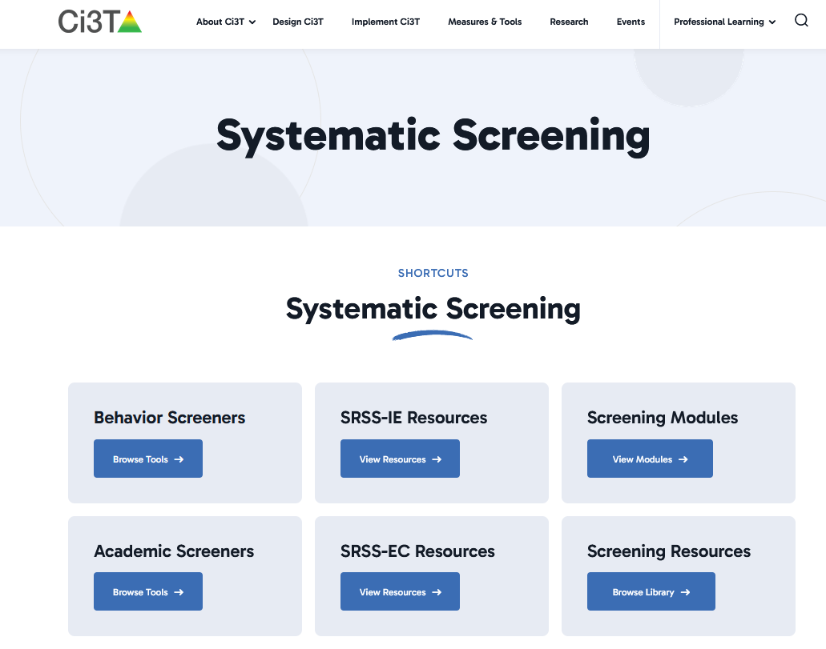
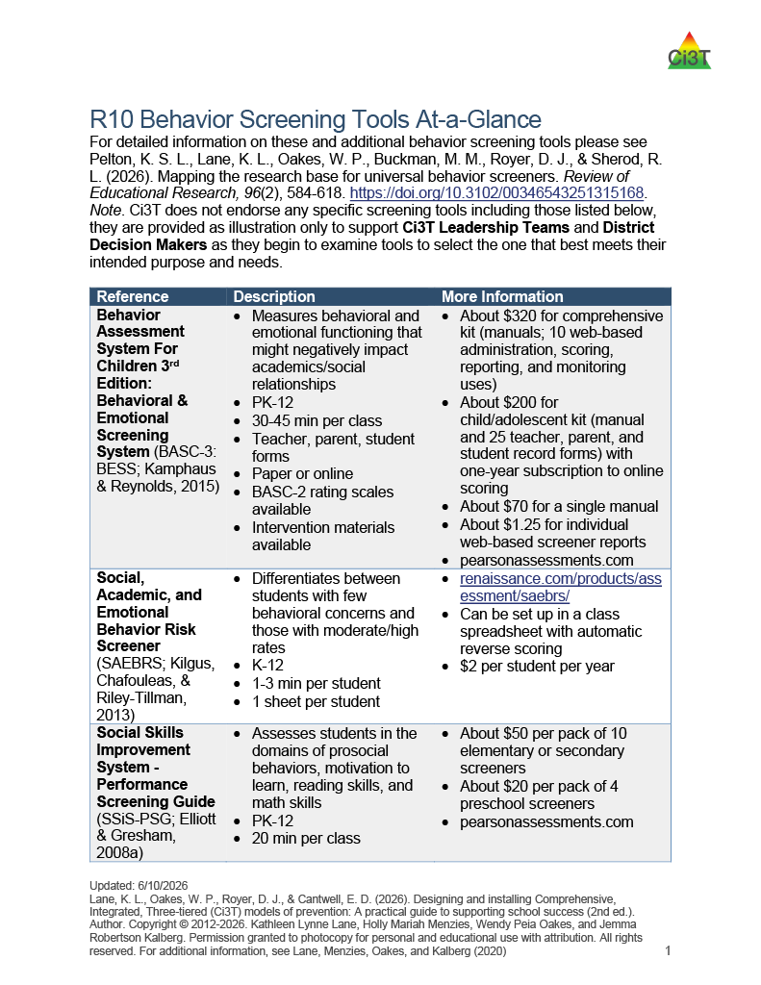
Learn More About Options
Notes:
https://www.ci3t.org/measures/screening/

Slide 33
Academic Screening

Slide 34
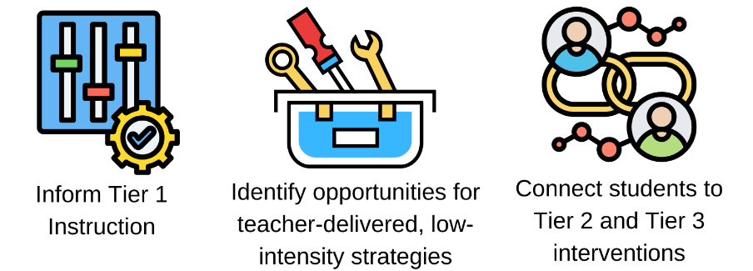
Using Academic and Behavior
Screening Data
These academic and behavior screening data are then reviewed alongside other data collected as part of typical school practices (e.g., attendance, office discipline referrals, grades) to:

Slide 35
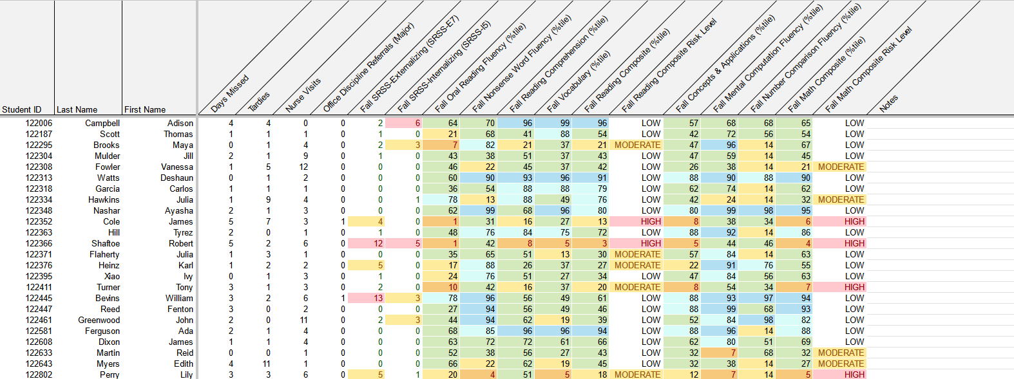
Reviewing Multiple Sources of Data in an Integrated Way
attendance
behavior
screening
academic screening

Slide 36
Data-Informed Decision Making:
Using Systematic Screening Data to Inform Instruction at Tier 1
Tier 1
Low-Intensity Strategies
Tier 2 and Tier 3

Slide 37
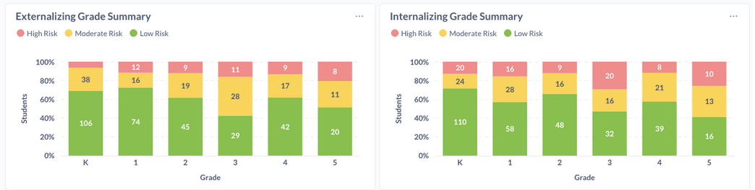
Data to Indicate a Focus on Tier 1: Breakdown by Grade-Level

Slide 38
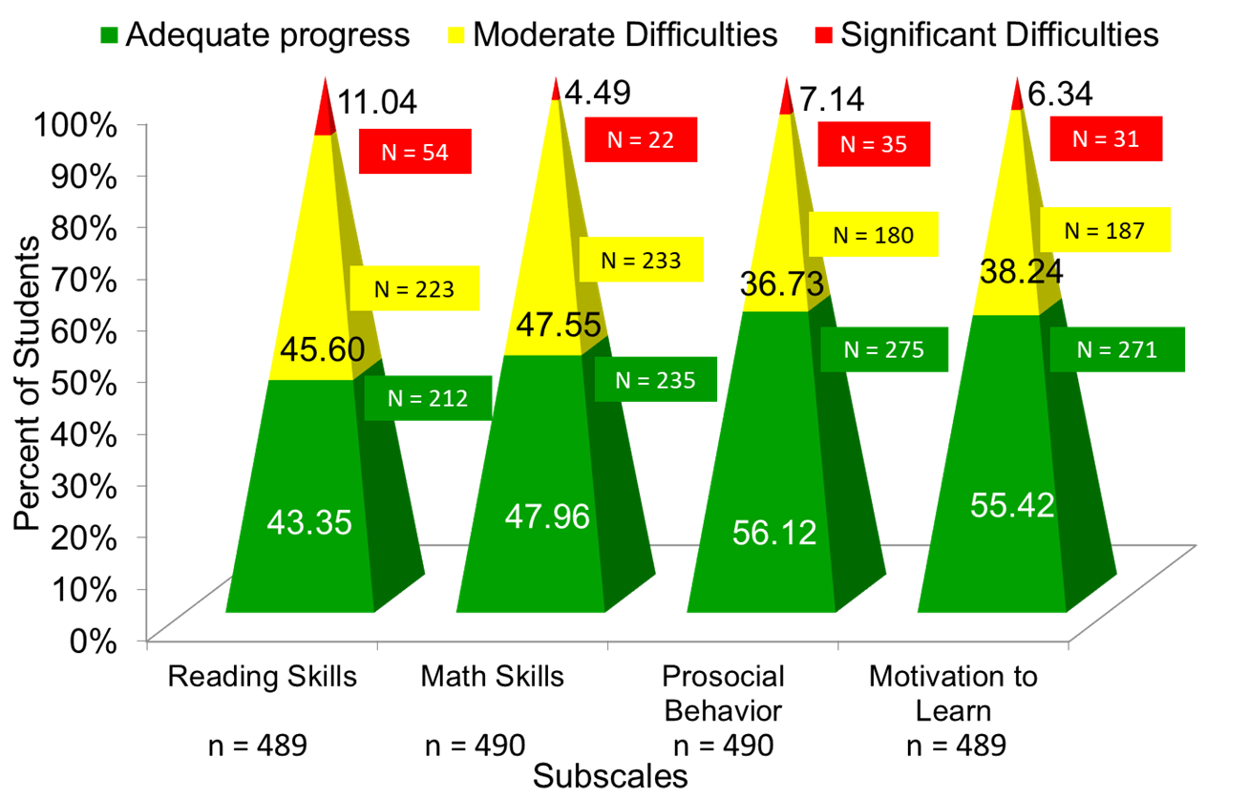
Data to Indicate a Focus on Tier 1: School Level
Social Skills Improvement System – Performance Screening Guide Spring 2012 – Total School
Lane, K. L., Oakes, W. P., & Magill, L. (2013). Primary prevention efforts: How do we implemented and monitor the Tier 1 component of our Comprehensive, Integrated, Three-Tiered (Ci3T) Model?, Preventing School Failure, 58(1), 143-158.

Slide 39
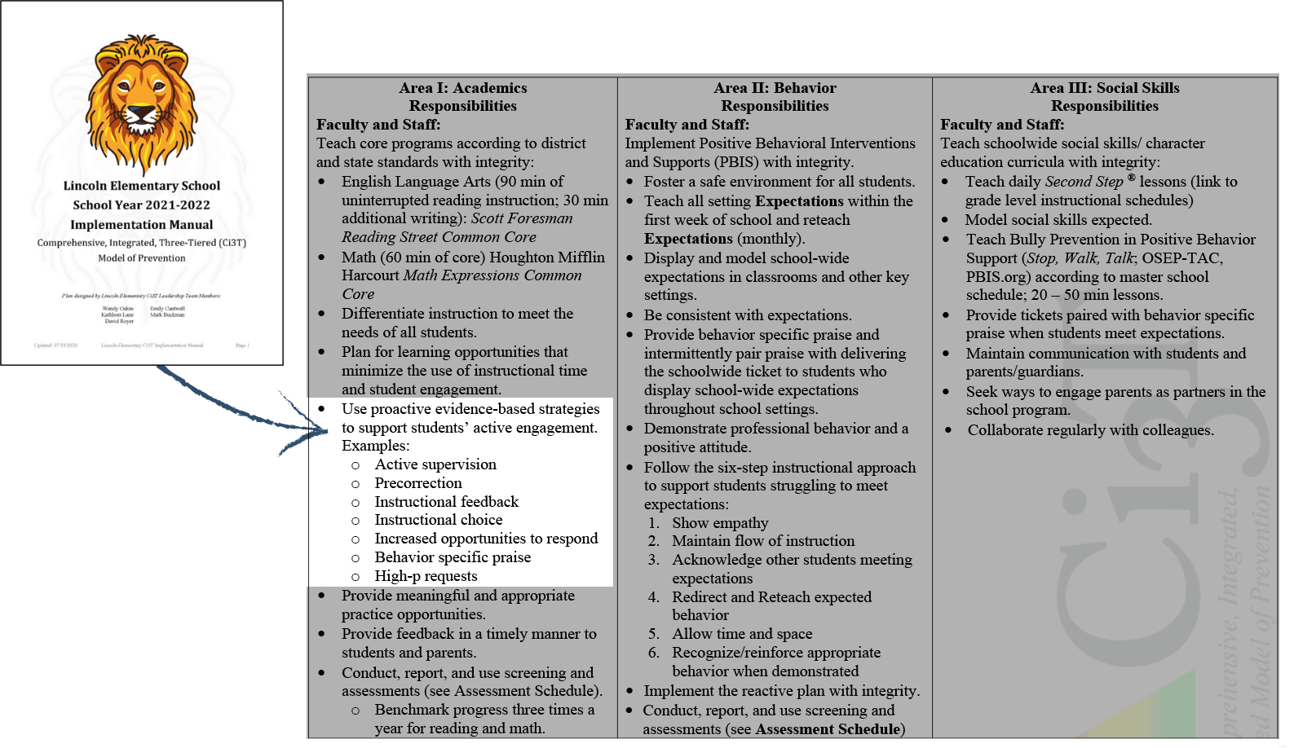
Low-Intensity, Teacher-Delivered Strategies at Tier 1
Notes:
If you have Ci3T in place, here’s where it is in your Ci3T Implementation manual

Slide 40
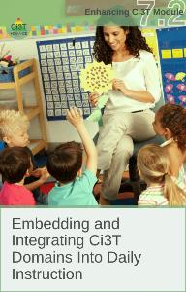
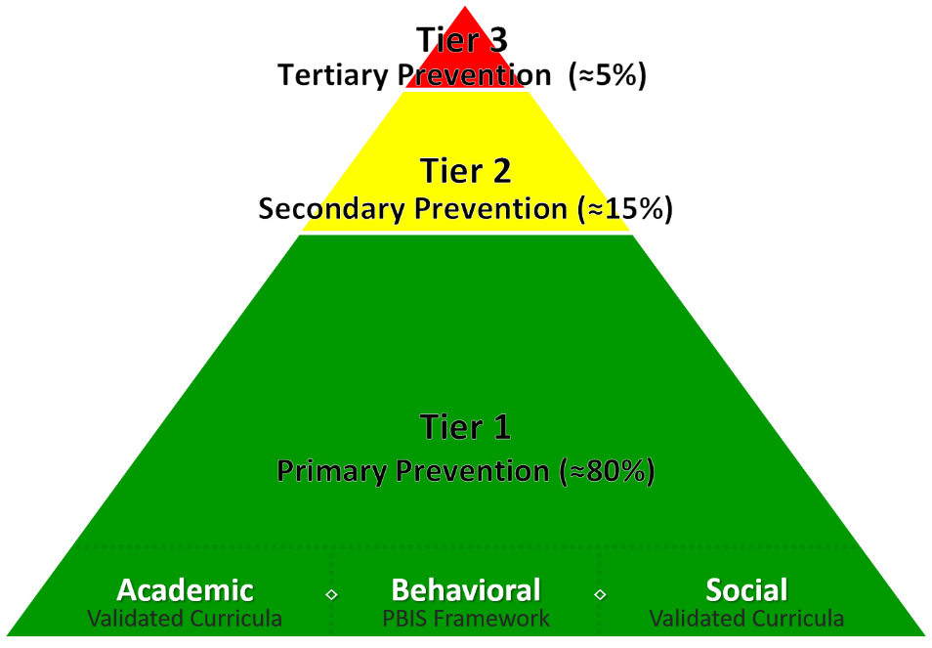
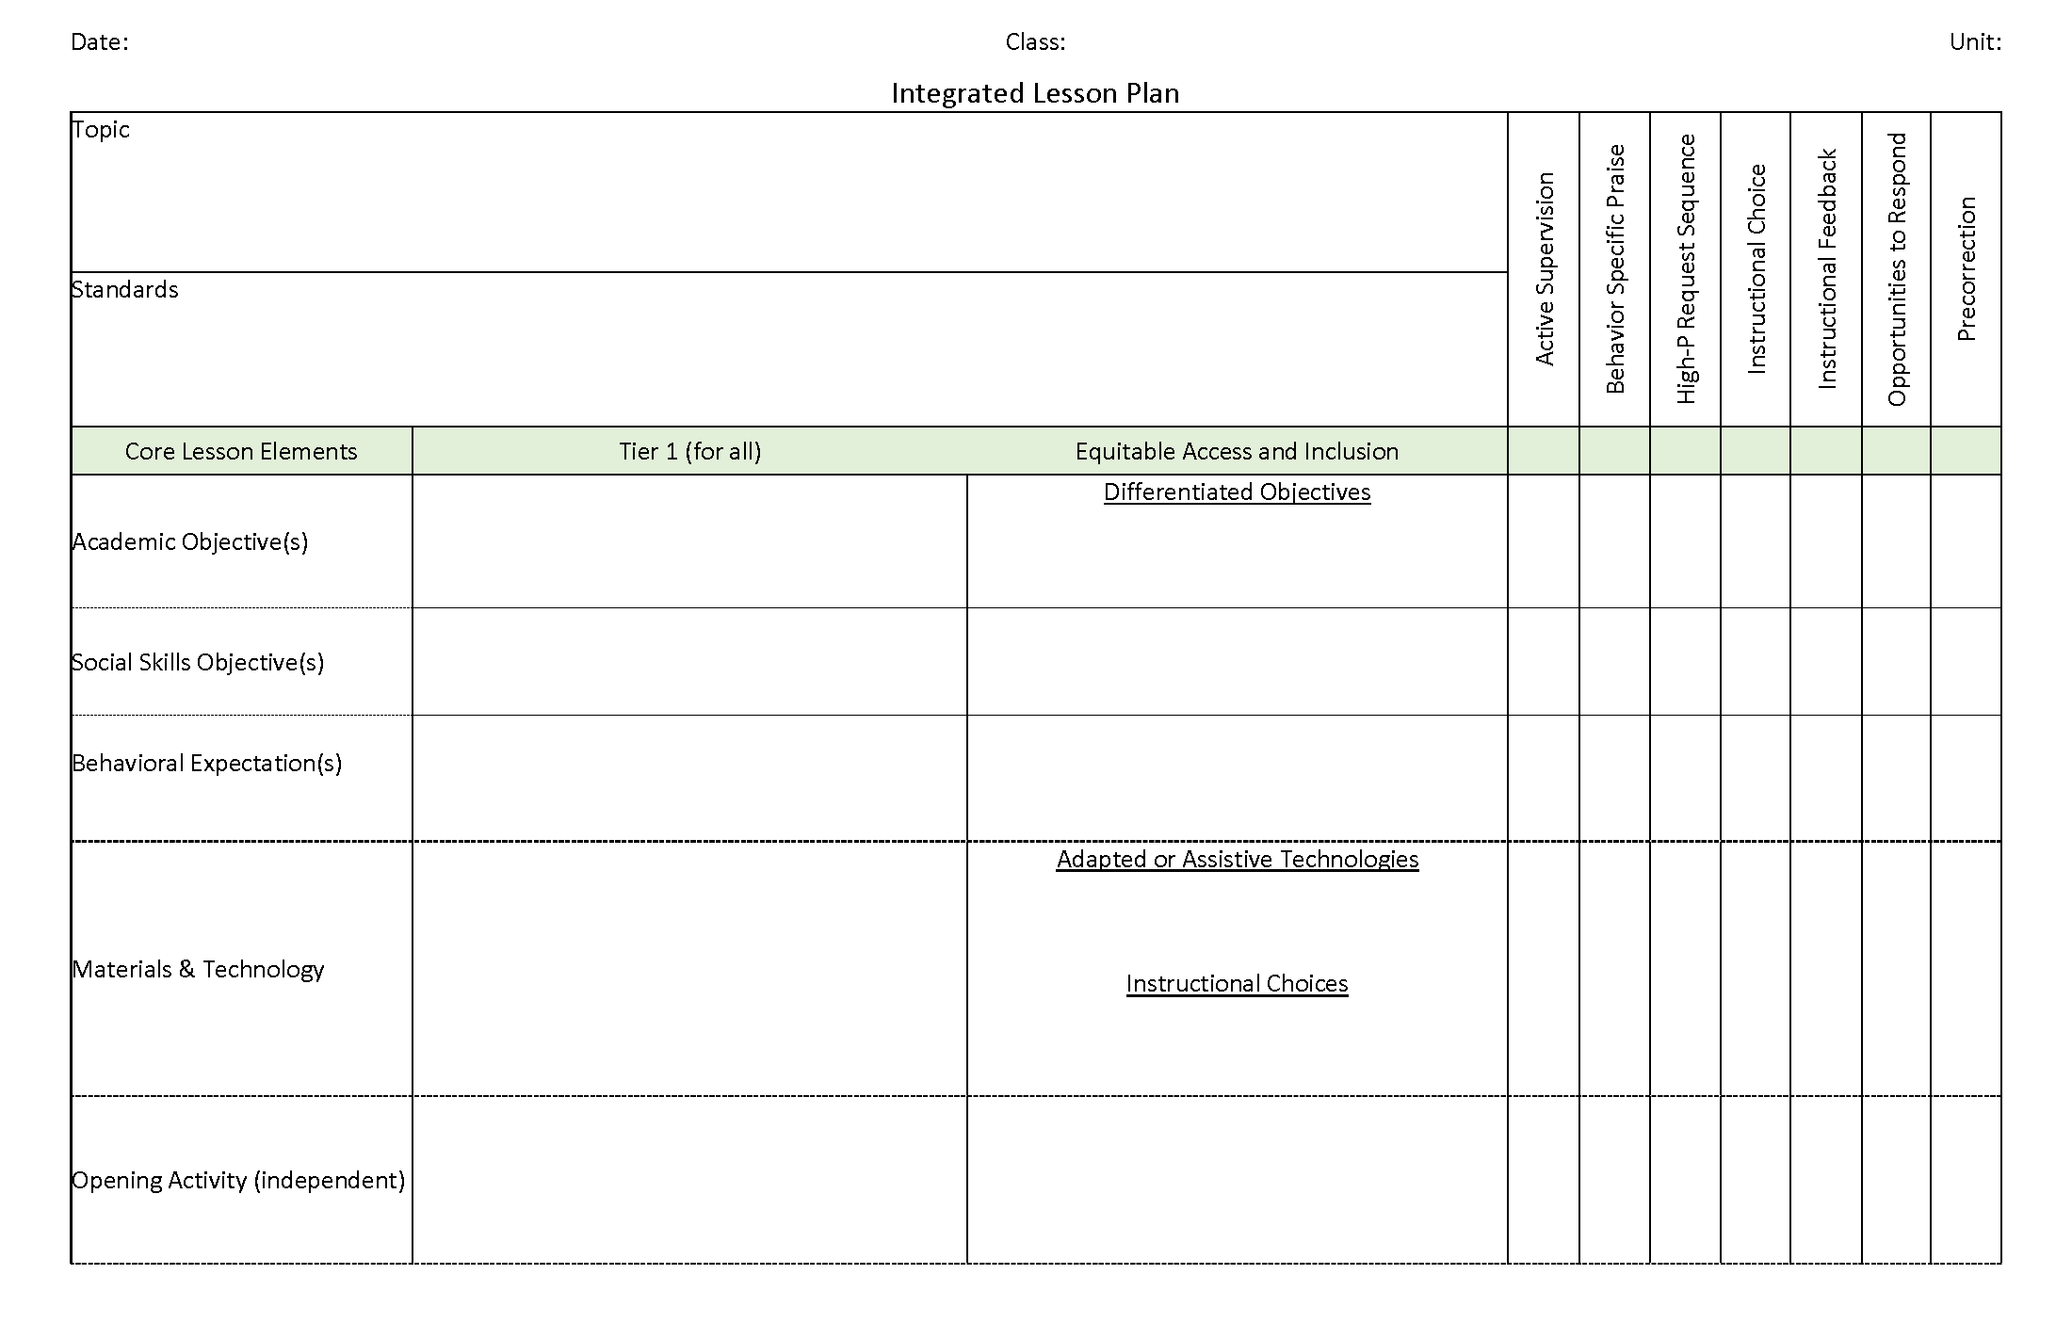
A Focus on: Integrated Lesson Planning
Citation. Oakes, W. P., Lane, K. L., Lane, K. S., & Buckman, M. M. (2019). Ci3T integrated lessons plan template. www.ci3t.org.
Completed examples available in: Ci3T Project ENHANCE Research Team. (2022, July). Embedding and integrating Ci3T domains into daily instruction. Author. https://doi.org/10.17161/ci3t.42880

Slide 41
Planning for Integrated Instruction

Slide 42
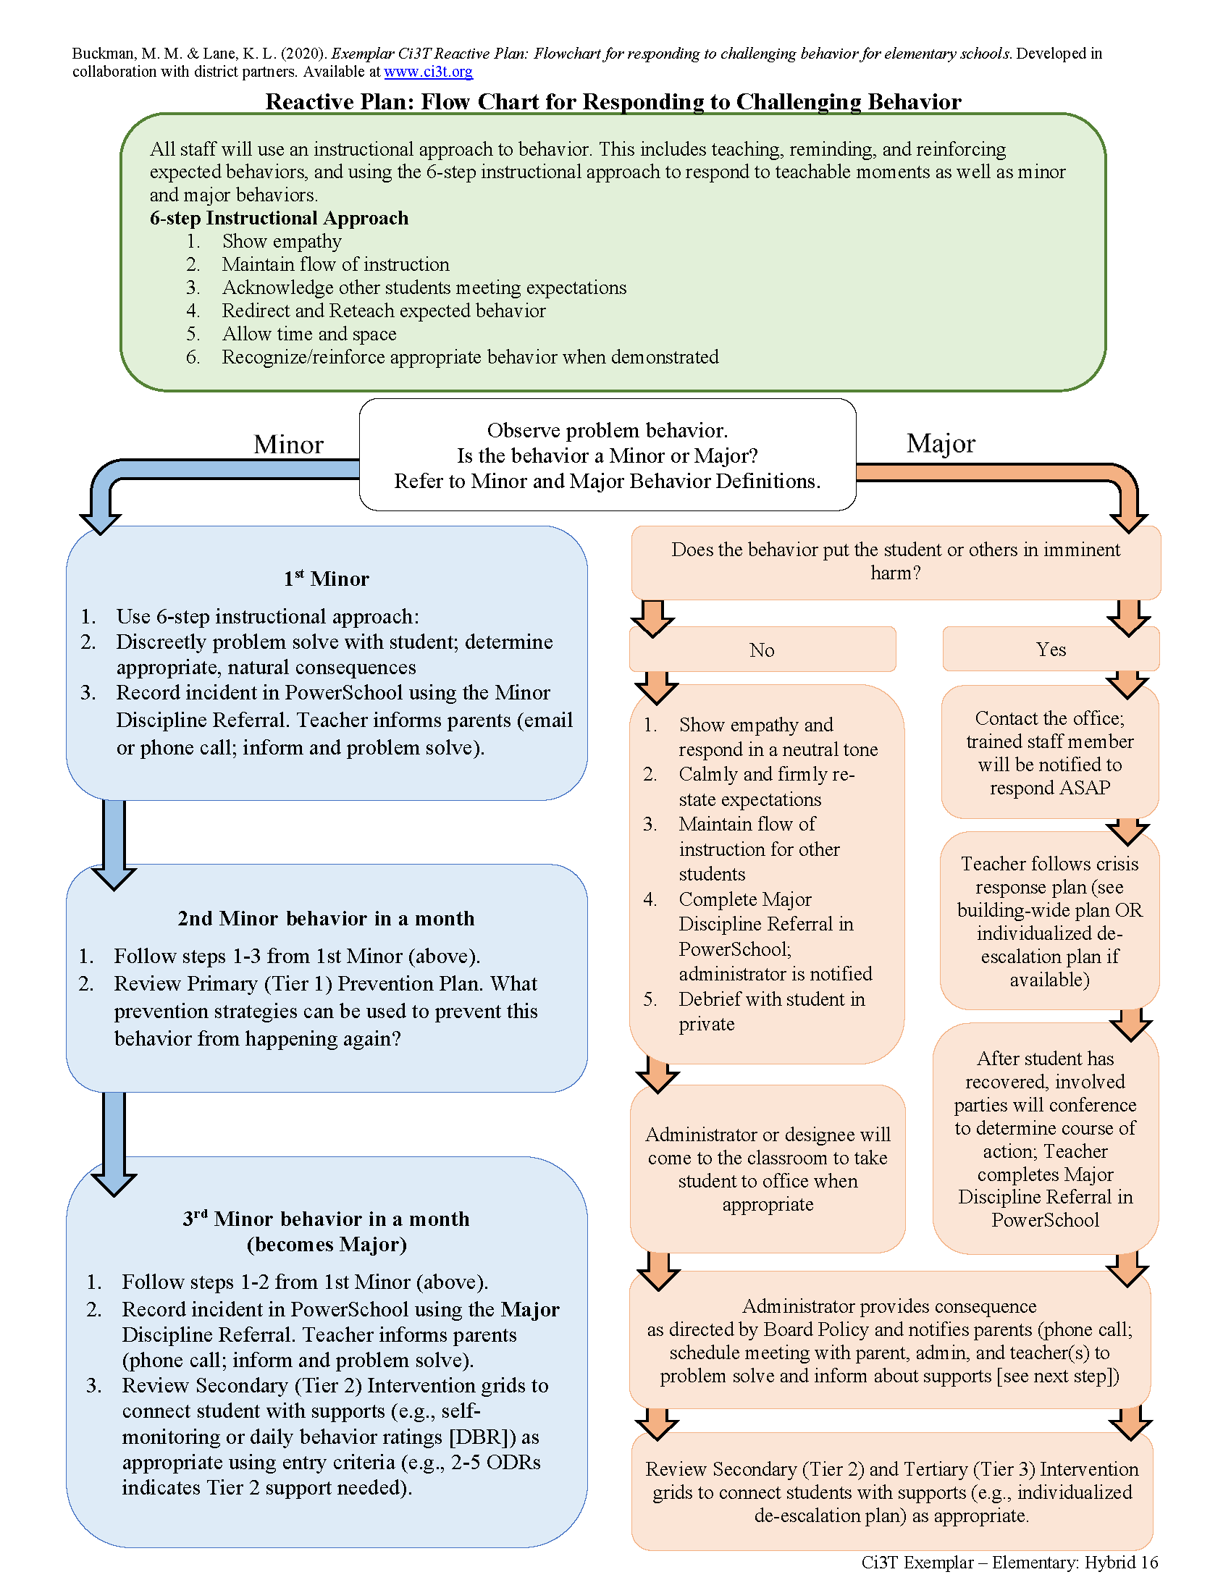
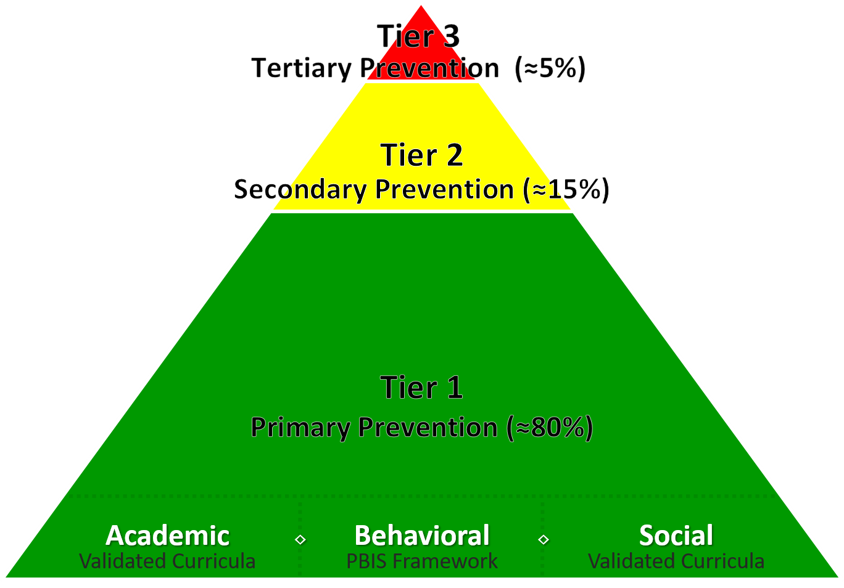
A Focus on: Responding to Challenging Behavior

Slide 43

6-Step Instructional Approach for Responding to Challenging Behavior
Step 1
  Show empathy
Step 2
  Maintain the flow of instruction
Step 3
  Acknowledge other students meeting expectations
Step 4
  Redirect and reteach expected behavior
Step 5
  Allow time and space
Step 6
  Recognize and reinforce

Slide 44
Data-Informed Decision Making:
Low-Intensity Strategies
Tier 1
Low-Intensity Strategies
Tier 2 and Tier 3

Slide 45
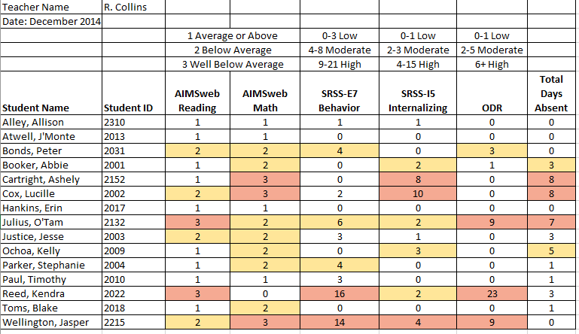
Examining Academic and Behavioral Data
Lane, K. L., Menzies, H. M., Ennis, R. P., & Oakes, W. P. (2015). Supporting Behavior for School Success: A Step-by-Step Guide to Key Strategies. Guilford Press.
Notes:
Lane, K. L., Oakes, W. P., Ennis, R. P., & Hirsch, S. E. (2014). Identifying students for secondary and tertiary prevention efforts: How do we determine which students have Tier 2 and Tier 3 needs? Preventing School Failure, 58, 171-182, DOI: 10.1080/1045988X.2014.895573

Slide 46

Ci3T Tier 1 Plan: Low-Intensity Teacher-Delivered Strategies
Area II: Academics Responsibilities Faculty and Staff: Teach core programs according to district and state standards with integrity Use teacher-delivered, low-intensity strategies to support students’ active engagement | Area II: Behavior Responsibilities Faculty and Staff: Implement Positive Behavioral Interventions and Supports (PBIS) with integrity. Teach all setting Expectations within the first week of school and reteach Expectations (monthly). Display and model school-wide expectations in classrooms and other key settings. Implement the reactive plan with integrity. | Area II: Social Responsibilities Faculty and Staff: Teach schoolwide social skills/ character education curricula with integrity: Teach daily Second Step ® lessons (link to grade level instructional schedules) Seek ways to engage parents as partners in the school program

Slide 47
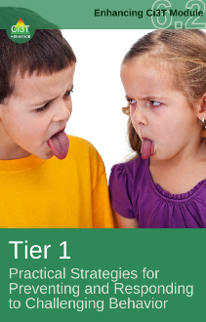
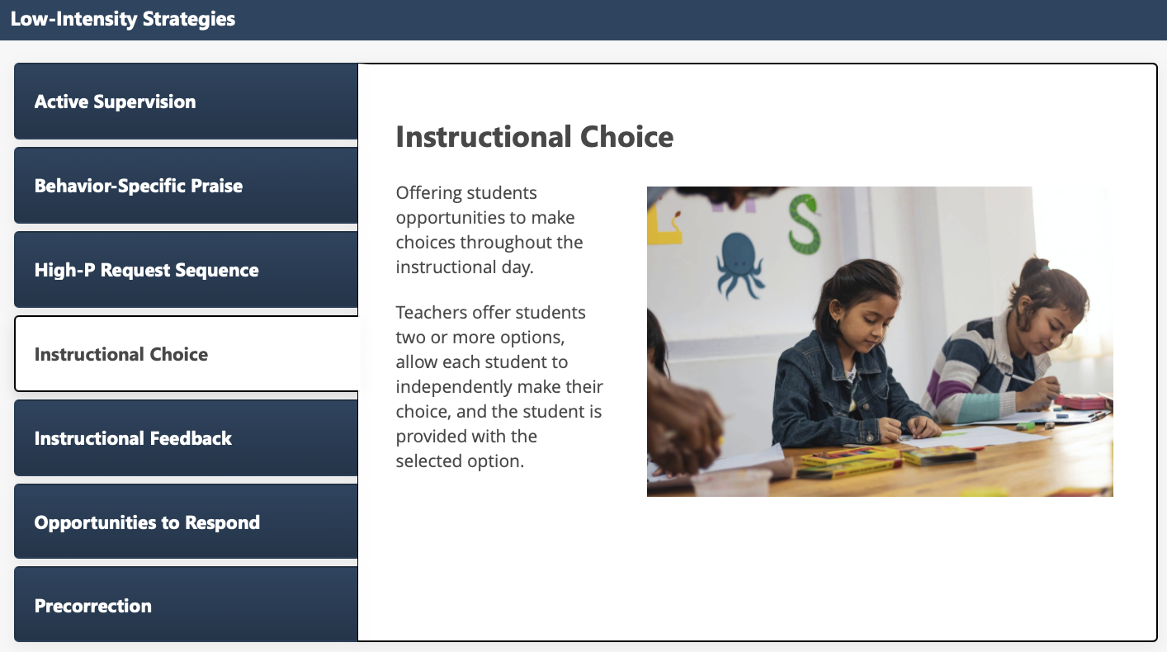
Low-Intensity Strategies Interaction Instructional Choice

Slide 48
Low-Intensity Strategy Experts
Low-Intensity Strategy | Franklin High School On-Site Expert
Behavior-Specific Praise: Identifying the specific expectation the student met. “Niama, I noticed you outlined your paper and used the graphic organizer to draft your essay. Well done!” “Justice, thank you for pushing in your chair to keep the walkway safe.” | Eric Common, Behavior Specialist Mark Buckman, Special Education Grant Allen, Parent Volunteer Paloma Pérez-Clark, School Psychologist
Opportunities to Respond: Providing 4-6 opportunities per minute for students to respond individually, choral, verbal, written, gesture, or symbol. “Show me thumbs or thumbs down if...” “Show me on your white board what…” “Turn to your elbow partner and say…” “All together now, what is…” | David Royer, Administration Emily Cantwell, 12th Grade Scarlett Lane, 11rd Grade Mallory Messenger, Counselor
Instructional Choice: Providing within-task or between task choices to increase academic engaged time and motivation. “Ronaldo, our of our 3 learning objectives today, which would you like to work on first?” “Suzy, do you want to work on the laptop, or handwrite your answers for this assignment?” | Abbie Jenkins, 10th Grade Scarlett Lane, 11th Grade José Sousa, PE Liane Johl, 9th Grade

Slide 49
Data-Informed Decision Making:
Tier 2 and Tier 3
Tier 1
Low-Intensity Strategies
Tier 2 and Tier 3

Slide 50
Secondary (Tier 2) Intervention Grid
Tier 2 Intervention Grid
Notes:
In addition to the module featured here outlining how to use multiple sources of data to connect students with Tier 2 supports, we offer a full suite of modules highlighting validated Tier 2 interventions such as Self-Regulated Strategy Development (SRSD) for Writing and Check-In/Check Out that may appear in your Secondary (Tier 2) Intervention Grid

Slide 51
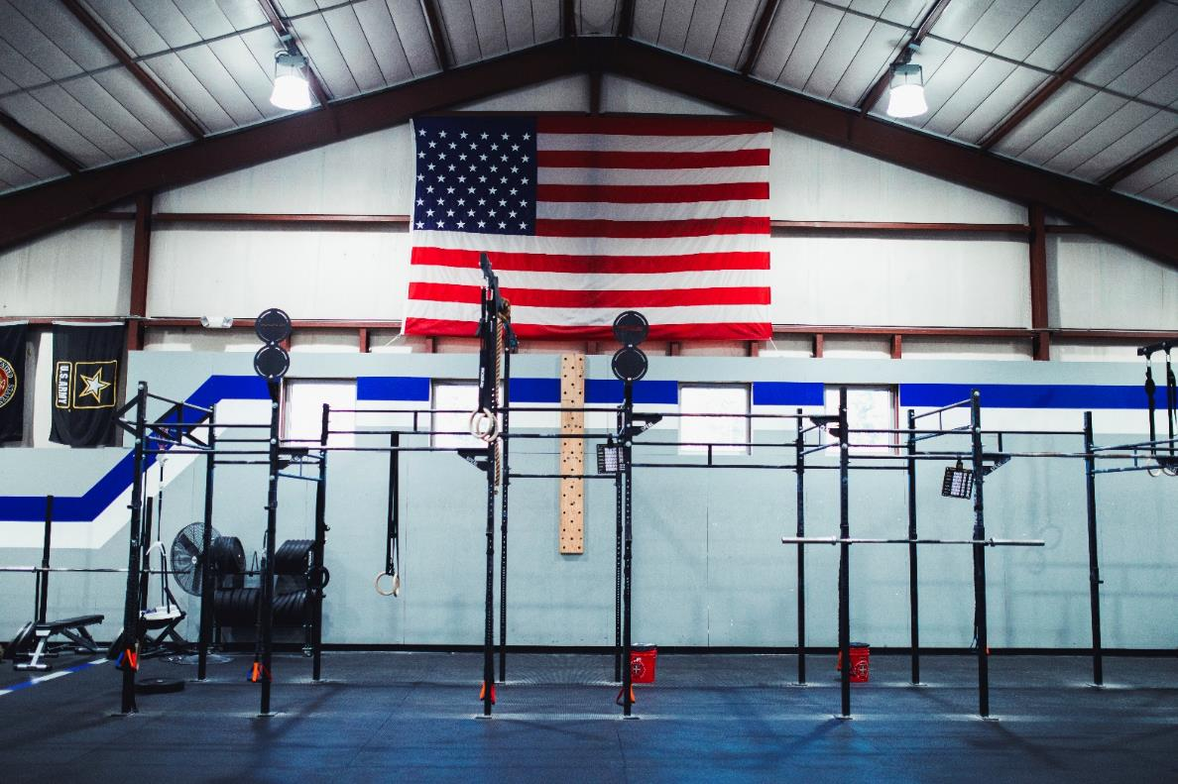

Crossfit Gym

Slide 52
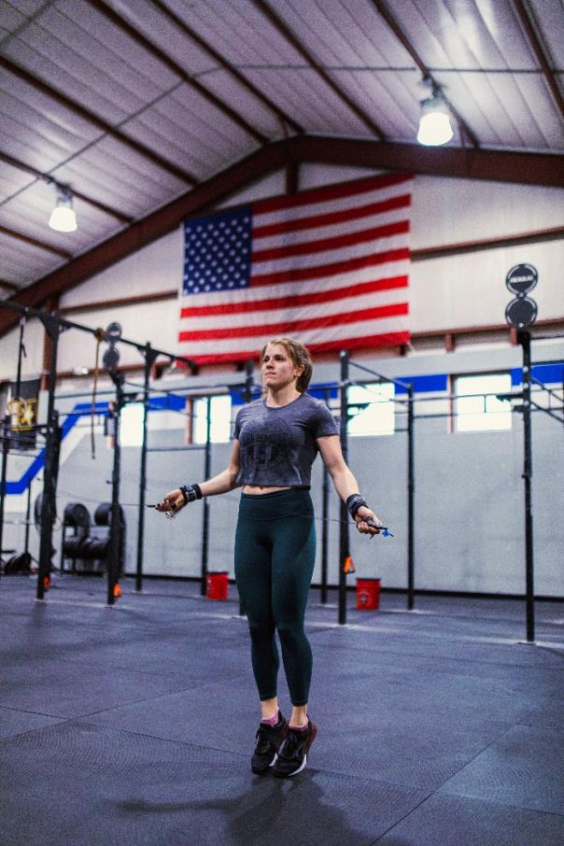

Jumping Rope

Slide 53


Pull-up Bar

Slide 54
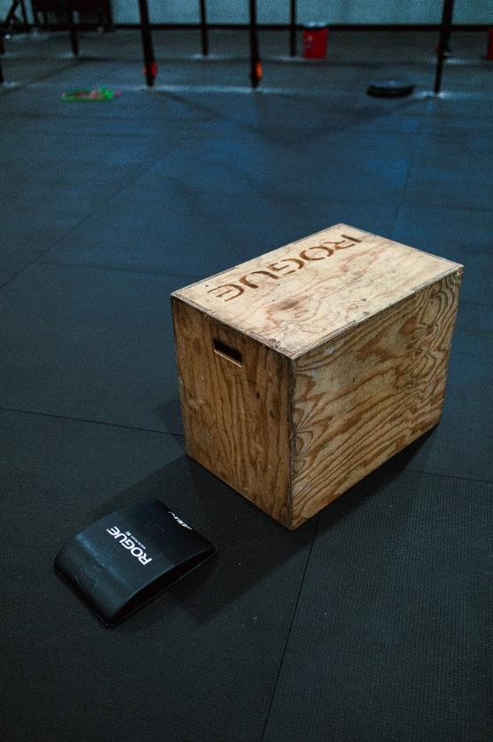

Crossfit Activities

Slide 55
Illustration: Reviewing Multiple Sources of Data in an Integrated Way
attendance
behavior
screening
academic screening

Slide 56
Ci3T Model of Prevention: Tier Informs Tier 2 and Tier 3
Comprehensive, Integrated, Three-Tiered Model of Prevention
(Lane, Kalberg, & Menzies, 2009)
Tier 3
Tertiary Prevention (≈5%)
Tier 2
Secondary Prevention (≈15%)
Tier 1
Primary Prevention (≈80%)
Academic ◇ Behavioral ◇ Social
Validated Curricula PBIS Framework Validated Curricula

Slide 57
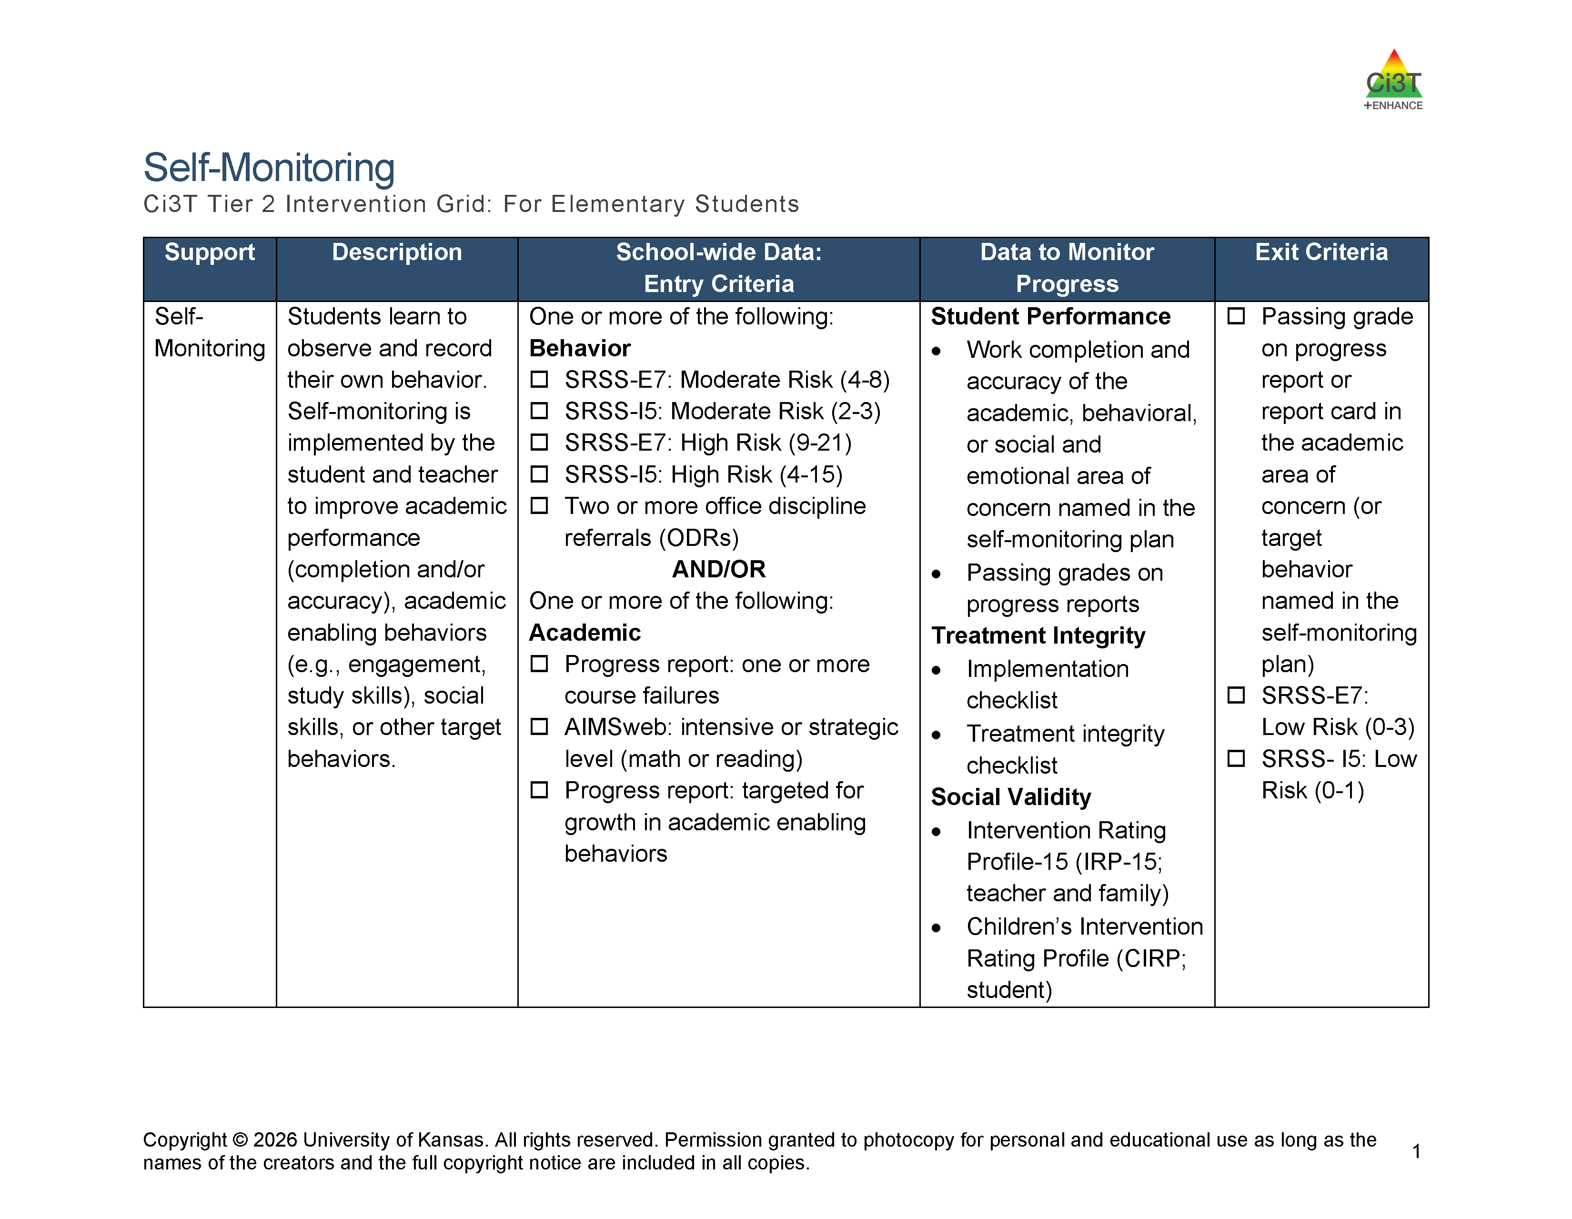
Tier 2 and Tier 3 Intervention Grids
Notes:
Support is the name of the strategy, practice, or program. Notice this is not the name of a person or role.

Slide 58
Tier 3 in a Ci3T Model of Prevention
Tier 3 Intervention Grid
Notes:
In addition to the module featured here outlining how to use multiple sources of data to connect students with Tier 3 supports, we offer a full suite of modules highlighting validated Tier 3 interventions such as Functional Assessment-Based Intervention (FABI) that may appear in your Tertiary (Tier 3) Intervention Grid

Slide 59
Turn & Talk:
Data-Informed Decision Making
How do you currently screen for students’ academic and behavioral performance?
What are some potential benefits of systematic screening?
How could Ci3T build on data-informed decision-making practices currently in place at your district?
Notes:
5-minutes

Slide 60
Ci3T Professional Learning Journey
Getting Started with Ci3T
Ci3T Design
Ci3T Implementation

Slide 61
Preview: Ci3T Phased Roll Out
 | 2026-2027 | 2027-2028 | 2028-2029 | 2029-2030 | 2030-2031 | 2031-2032 | 2032-2033
Getting Started with Ci3T | x
Ci3T Design |  | x
Ci3T Implementation Year 1 |  |  | x
Ci3T Implementation Year 2 |  |  |  | x
Sustain and Develop Practices |  |  |  |  | x | x | x

Slide 62
Getting Started with Ci3T (2 of 2)
2026–2027 School Year
Activity
Aug
Sept
Oct
Nov
Dec
Jan
Feb
Mar
Apr
May
Shared Outcomes
Getting Started with Ci3T PL Series
4 Sessions
Purpose: Explore Ci3T and build shared knowledge, language, and vision.
Districtwide activities to begin Ci3T Design and Implementation efforts, building upon:
Shared vision
Districtwide certainties
Strong practices already in place
Aug. 27: Educational Leaders’ Session
Leading in Ci3T Systems (in-person)
Aug. 31: Keynote + Breakouts
Exploring Ci3T (in-person)
Nov. 3: Keynote + Breakouts
A Closer Look at Tier 1 (in-person)
Mar. 2: Keynote + Breakouts
A Closer Look at Tier 2 and 3 (virtual)
District Leadership Team Meetings + Ci3T Research Team
10 one-hour meetings
Purpose: Establish district ‘certainties’ for Ci3T strategies, practices, programs, and assessments.
1
2
3
4
5
6
7
8
9
10
School-Site Team Meetings +
Ci3T Research Team
5 one-hour meetings with each school
Purpose: Reflect on each school’s context, needs, and current practices, connecting them to Ci3T learning and districtwide planning.
1
2
3
4
5

Slide 63
2027-2026: Ci3T Design

Slide 64
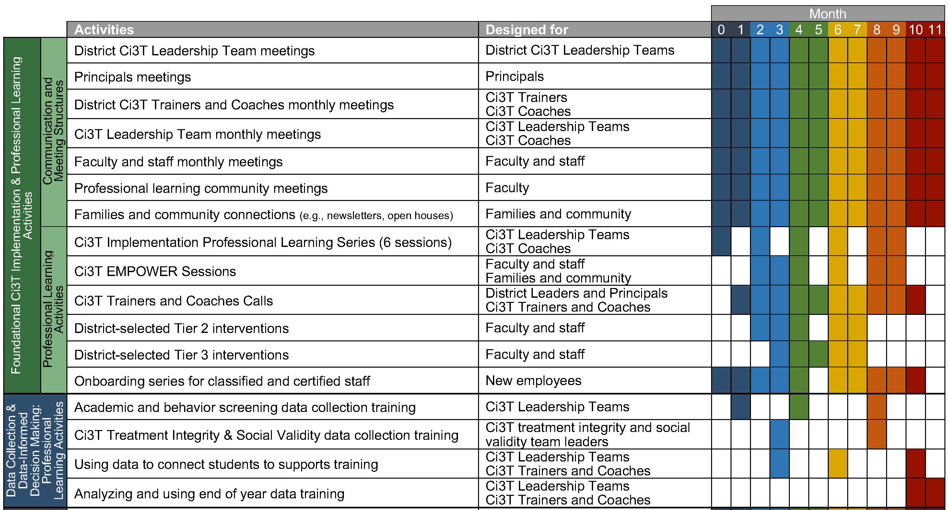
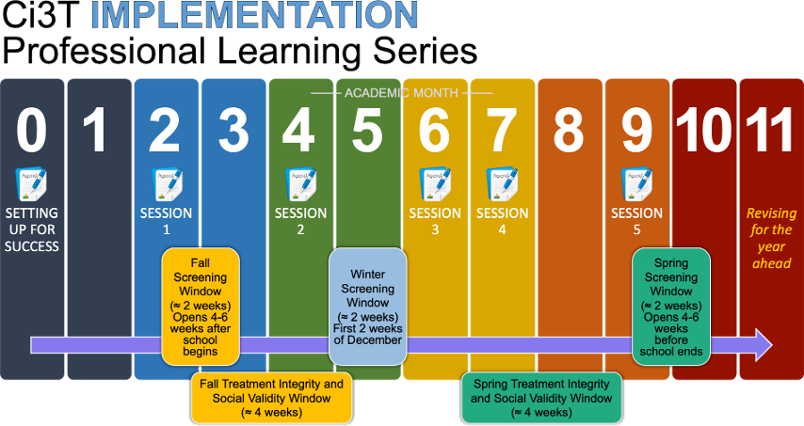
2028-2029: Ci3T Implementation Begins!

Slide 65
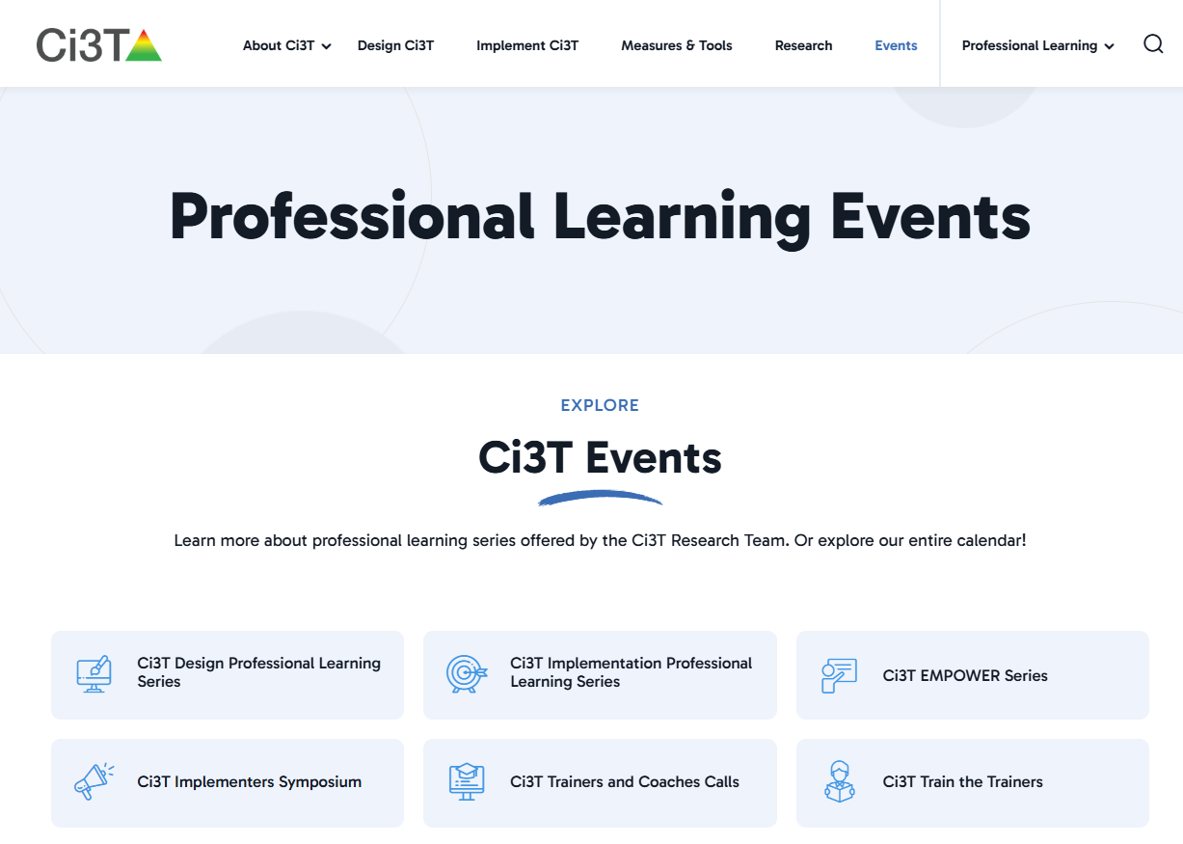
Ci3t.org/events

Slide 66
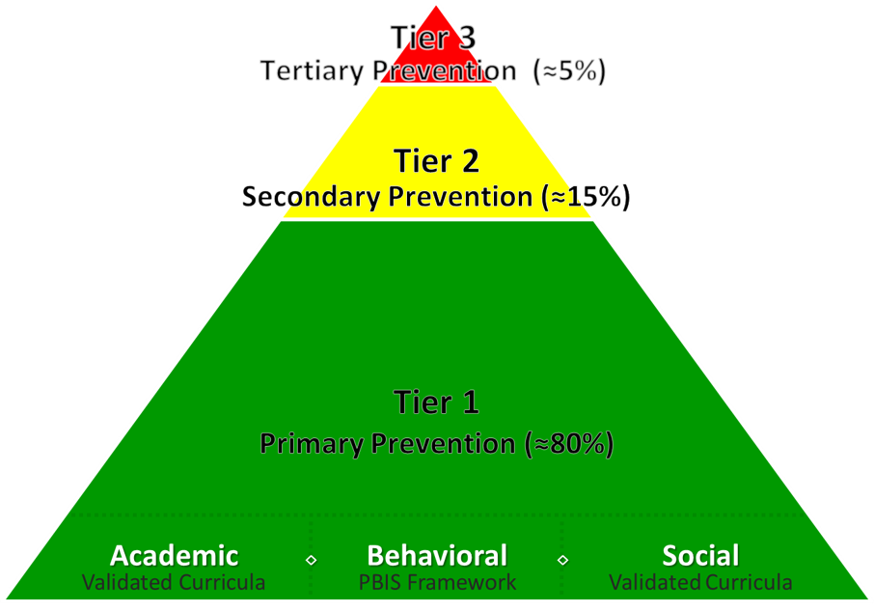
Wrapping Up and Moving Forward
Kathleen Lynne Lane, Ph.D., BCBA-D, CF-L2
kathleen.lane@ku.edu
Mark Buckman, Ph.D.
Buckman@ku.edu

