Slide 1

Tier 2 and Tier 3 Interventions in Ci3T: Building on Tier 1
Mark Matthew Buckman, Ph.D.
University of Kansas
We invite you to visit ci3t.org/registration to create an account!

Slide 2
Turn & Talk | 60 seconds
If you magically gained
one extra free hour today…
How would you spend it?
Turn to someone near you and share your answer.

Slide 3
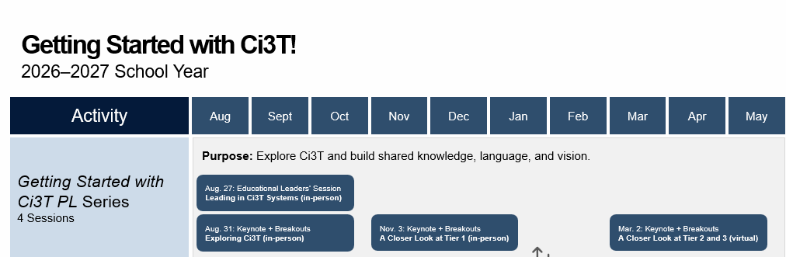
Agenda
Welcome
Beyond Tier 1
A Closer Look at Tier 2 Interventions
A Closer Look at Tier 3 Interventions
Wrapping Up and Moving Forward

Slide 4
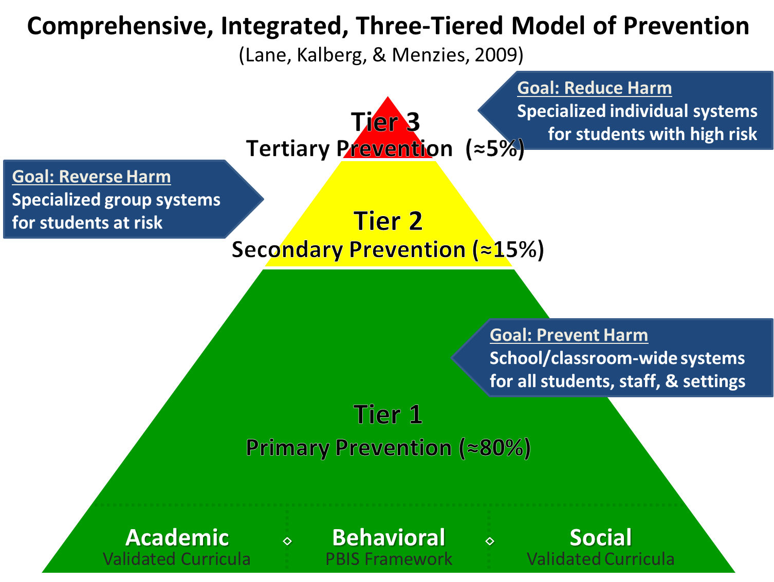
Comprehensive, Integrated, Three-Tiered Model of Prevention
Notes:
Ci3T builds from a strong foundation. At its behavioral core is PBIS, which has a well-established research base: schools implementing PBIS—particularly with fidelity—generally experience fewer office discipline referrals and suspensions.
The potential benefits extend to educators. Across studies of Ci3T schools, educators show stronger efficacy, particularly for classroom management and instructional strategies, along with healthier patterns on two dimensions of burnout: less depersonalization and greater personal accomplishment.
That does not mean Ci3T eliminates the pressures educators face—emotional exhaustion has not consistently declined—but it suggests that shared structures and common practices can help educators feel more capable, effective, and connected to their work.

Slide 5
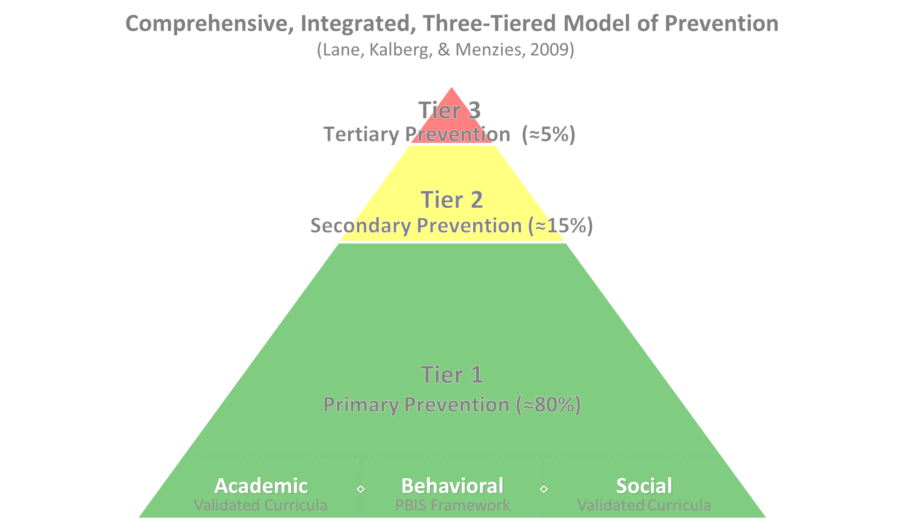

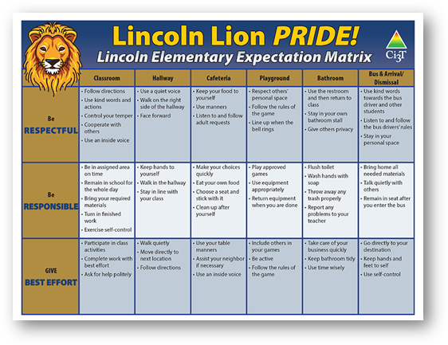
Ci3T Tier 1 Supports
Positive Behavioral Interventions and Supports
District & State Standards Quality Instruction
Validated Curricula and Resources

Slide 6


Tier 1

Slide 7

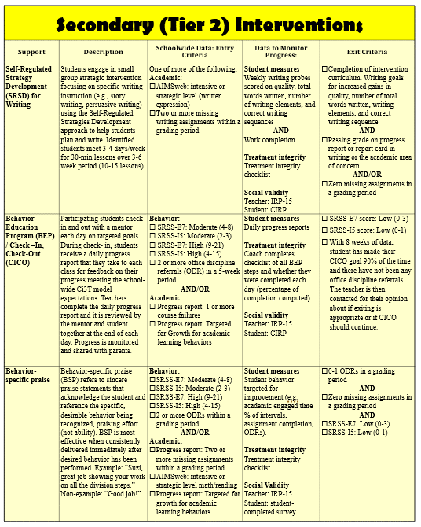
Tier 2
Tier 2 Intervention Grid
Notes:
In addition to the module featured here outlining how to use multiple sources of data to connect students with Tier 2 supports, we offer a full suite of modules highlighting validated Tier 2 interventions such as Self-Regulated Strategy Development (SRSD) for Writing and Check-In/Check Out that may appear in your Secondary (Tier 2) Intervention Grid

Slide 8

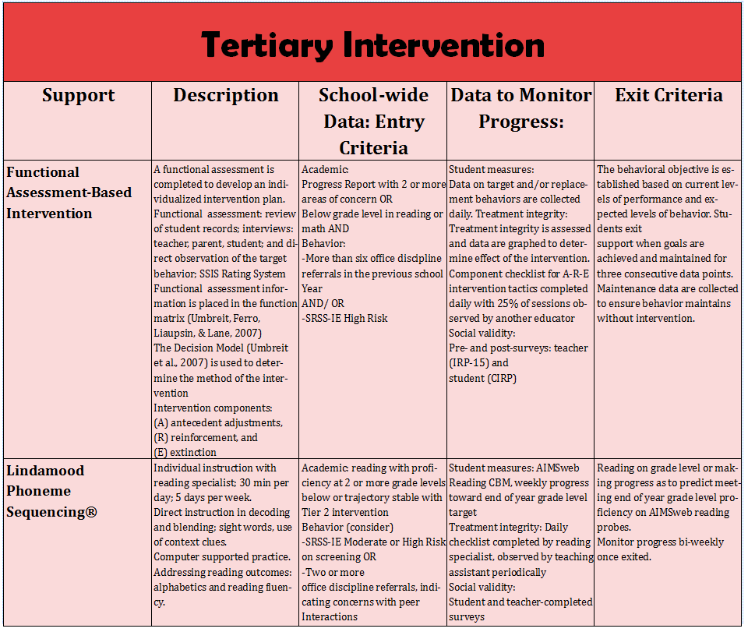
Tier 3
Tier 3 Intervention Grid
Notes:
In addition to the module featured here outlining how to use multiple sources of data to connect students with Tier 3 supports, we offer a full suite of modules highlighting validated Tier 3 interventions such as Functional Assessment-Based Intervention (FABI) that may appear in your Tertiary (Tier 3) Intervention Grid

Slide 9
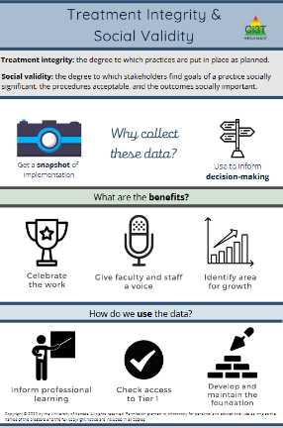
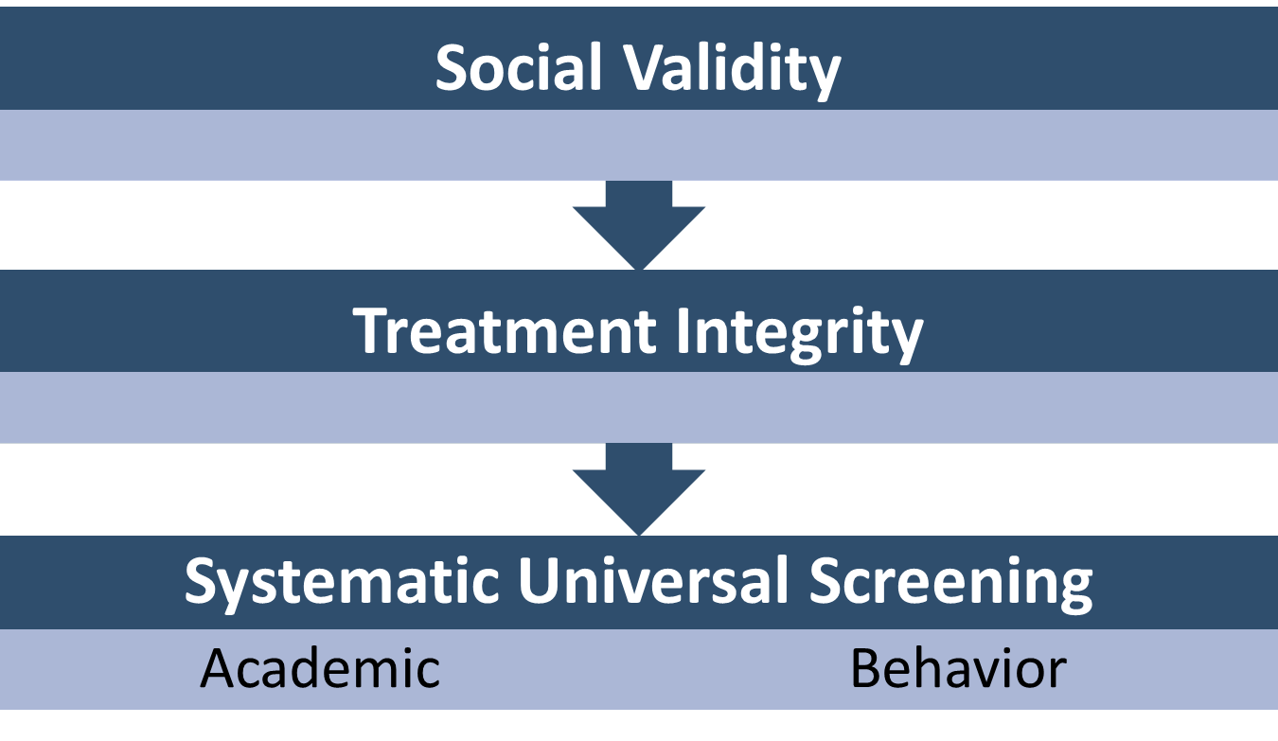
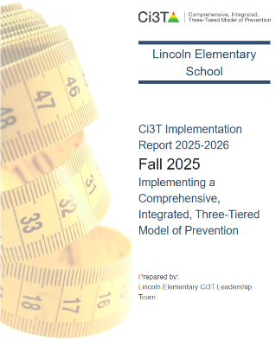
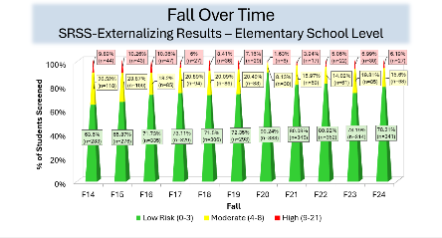
Essential Components of Primary (Tier 1) Prevention Efforts

Slide 10

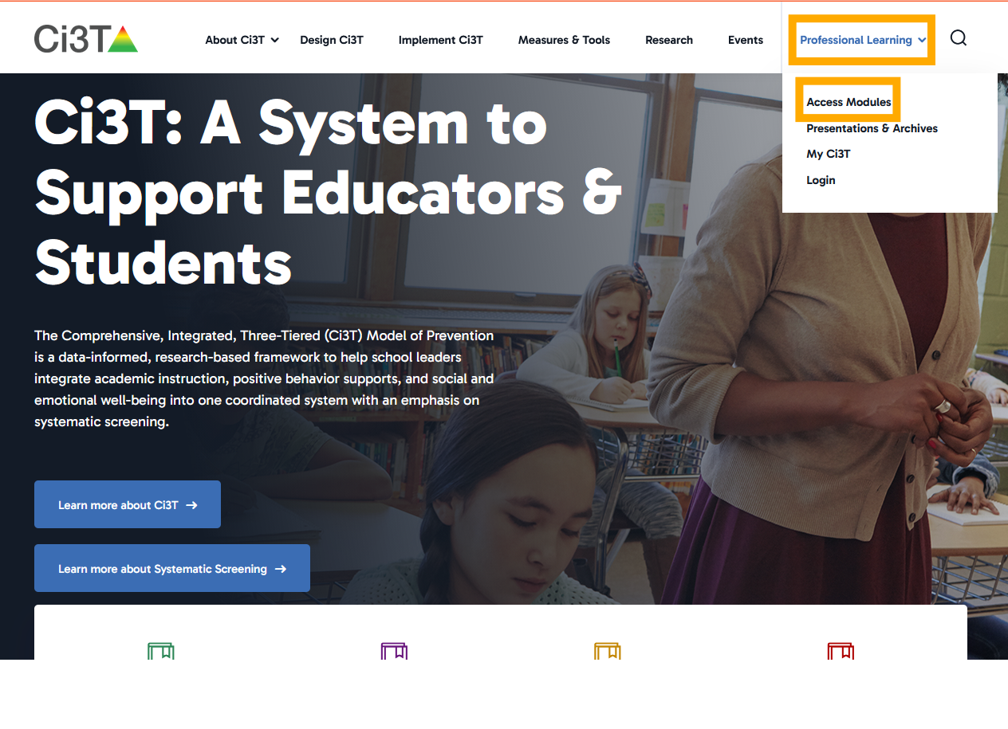
Ci3T Modules

Slide 11
Session Outcomes
Explain how Tier 2 and Tier 3 interventions fit within a Ci3T model and how schoolwide data, including universal screening, are used to determine which students may benefit from available interventions.
Describe the defining features of effective Tier 2 and Tier 3 interventions, including increased opportunities for instruction, additional structure and predictability, frequent performance feedback, family partnerships, and individualized adaptations.
Identify examples of Tier 2 and Tier 3 interventions that support students' academic, behavioral, and social and emotional well-being.

Slide 12
Beyond Tier 1
Situating Tier 2 and Tier 3 within Ci3T Model of Prevention

Slide 13
Tier 1: A Common Toolkit
Comprehensive, Integrated, Three-Tiered Model of Prevention
(Lane, Kalberg, & Menzies, 2009)
Opportunities to Respond
Tier 3
Tertiary Prevention (≈5%)
Behavior-Specific Praise
Active Supervision
Tier 2
Secondary Prevention (≈15%)
Instructional Feedback
High-p Requests
Precorrection
Tier 1
Primary Prevention (≈80%)
Instructional Choice
Academic ◇ Behavioral ◇ Social
Validated Curricula PBIS Framework Validated Curricula

Slide 14
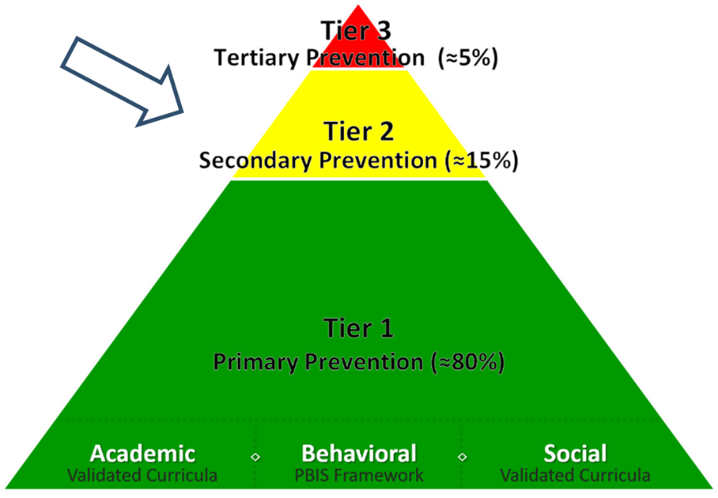
What are Tier 2 and Tier 3 Interventions?
Evidence-based or research-based strategies, practices, and programs
Additive (i.e., complement rather than replace Tier 1 efforts)
Implemented by teachers, interventionists, counselors, paraprofessionals, and other staff
Occur in a variety of formats and locations (e.g., small-group, 1:1, embedded within whole group instruction)

Slide 15

What are the active ingredients?
1 or more of the following:
additional instruction/time for student skill development
additional structure/predictability
increased opportunity for feedback (e.g., daily progress report)
increased communication with families
include planned modifications to address a range of behavioral function, mental health needs, or academic skills.

Slide 16


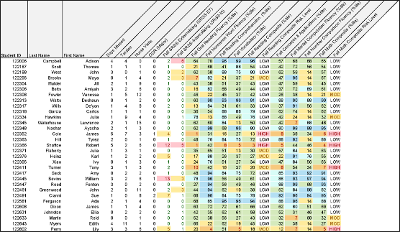
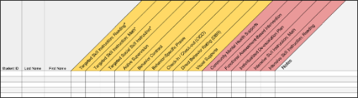
Getting Started with Data-Informed Decision Making

Slide 17
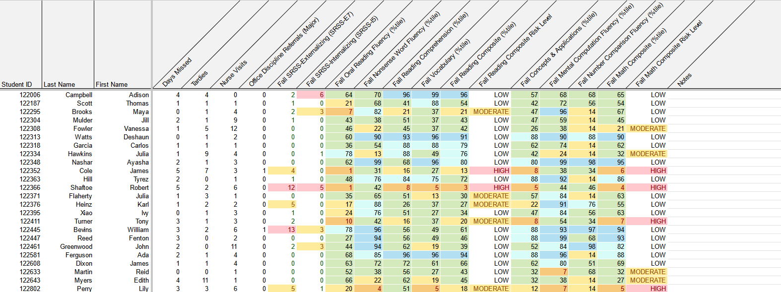
Illustration: Reviewing Multiple Sources of Data in an Integrated Way
attendance
behavior
screening
academic screening

Slide 18
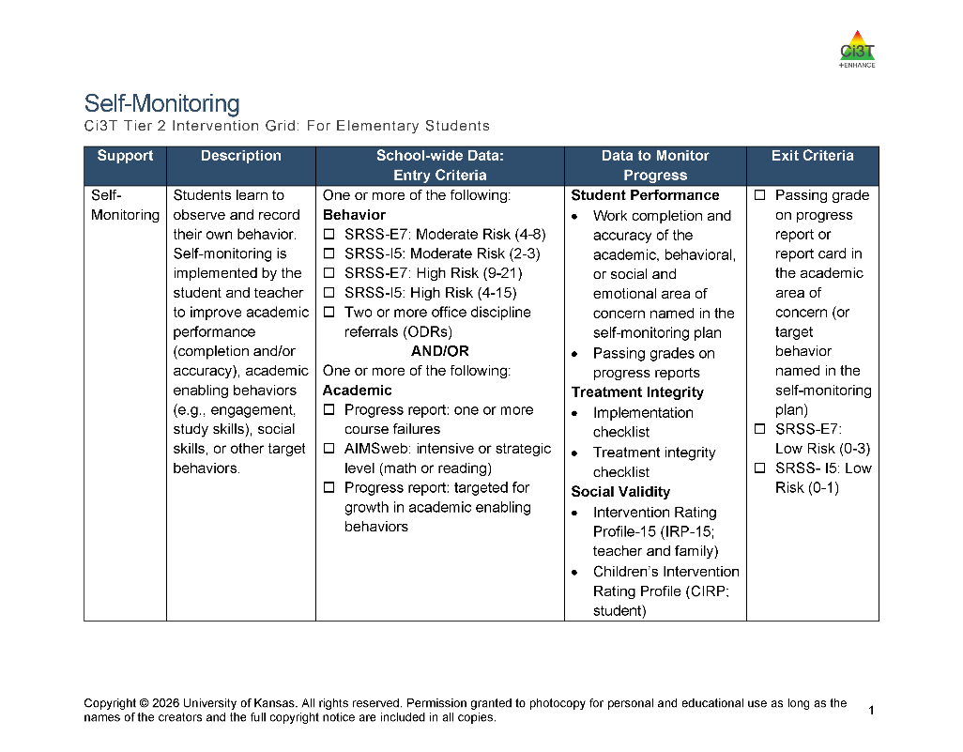
Tier 2 and Tier 3 Intervention Grids
Notes:
Support is the name of the strategy, practice, or program. Notice this is not the name of a person or role.

Slide 19
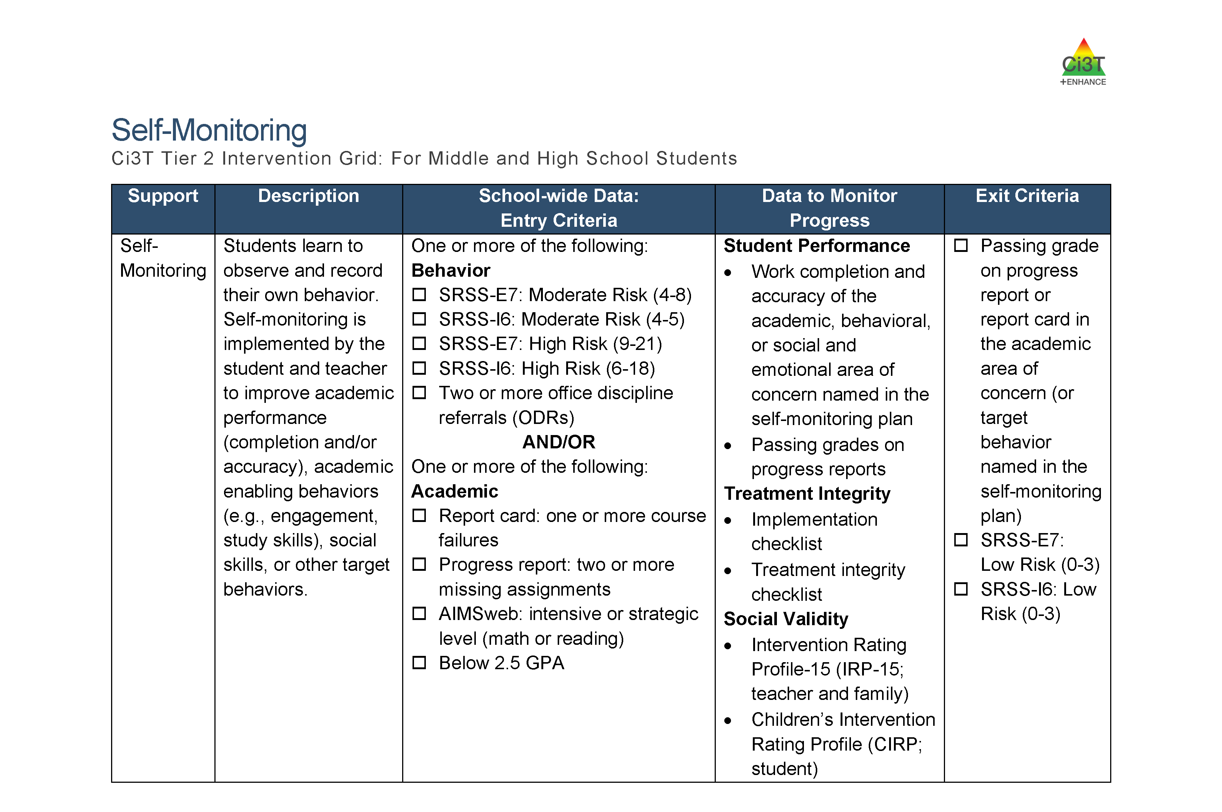
Using a Tier 2 Intervention Grid to Connect Students with Supports

Slide 20
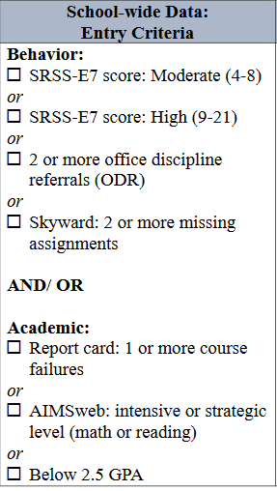
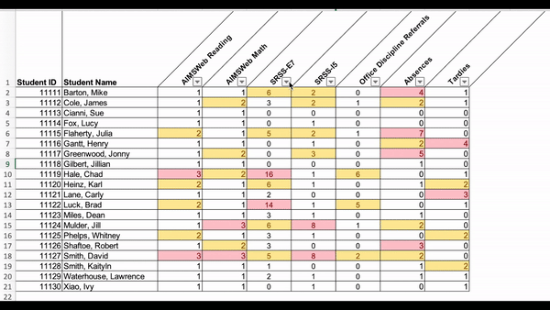
Data in Action: Filtering Data

Slide 21
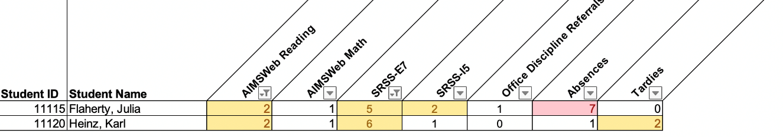
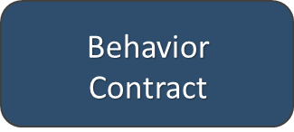

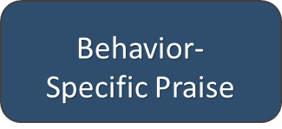

Data in Action: Matching Data to Entry Criteria
Other Tier 2 Options

Slide 22





You Discuss: Tier 2 and Tier 3
What Tier 2 and Tier 3 interventions are currently offered?
How do you currently look for students who might benefit from Tier 2 and Tier 3 interventions?
What would some of the benefits be of having Tier 2 and Tier 3 interventions grids illustrating interventions available for students needing more than Tier 1 supports?
Notes:
3-min timer

Slide 23
A Closer Look at Tier 2 Interventions

Slide 24
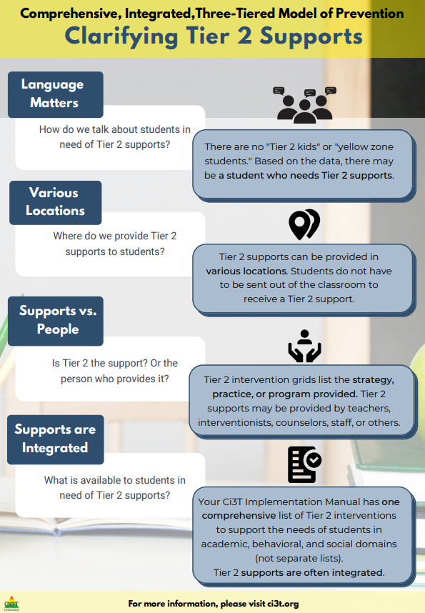
Secondary (Tier 2) Intervention Grid
Tier 2 Intervention Grid
Notes:
In addition to the module featured here outlining how to use multiple sources of data to connect students with Tier 2 supports, we offer a full suite of modules highlighting validated Tier 2 interventions such as Self-Regulated Strategy Development (SRSD) for Writing and Check-In/Check Out that may appear in your Secondary (Tier 2) Intervention Grid

Slide 25

Comprehensive, Integrated, Three-Tiered Model of Prevention Clarifying Tier 2 Supports

Slide 26
Comprehensive, Integrated, Three-Tiered Model of Prevention Clarifying Tier 2 Supports Infographic

Slide 27

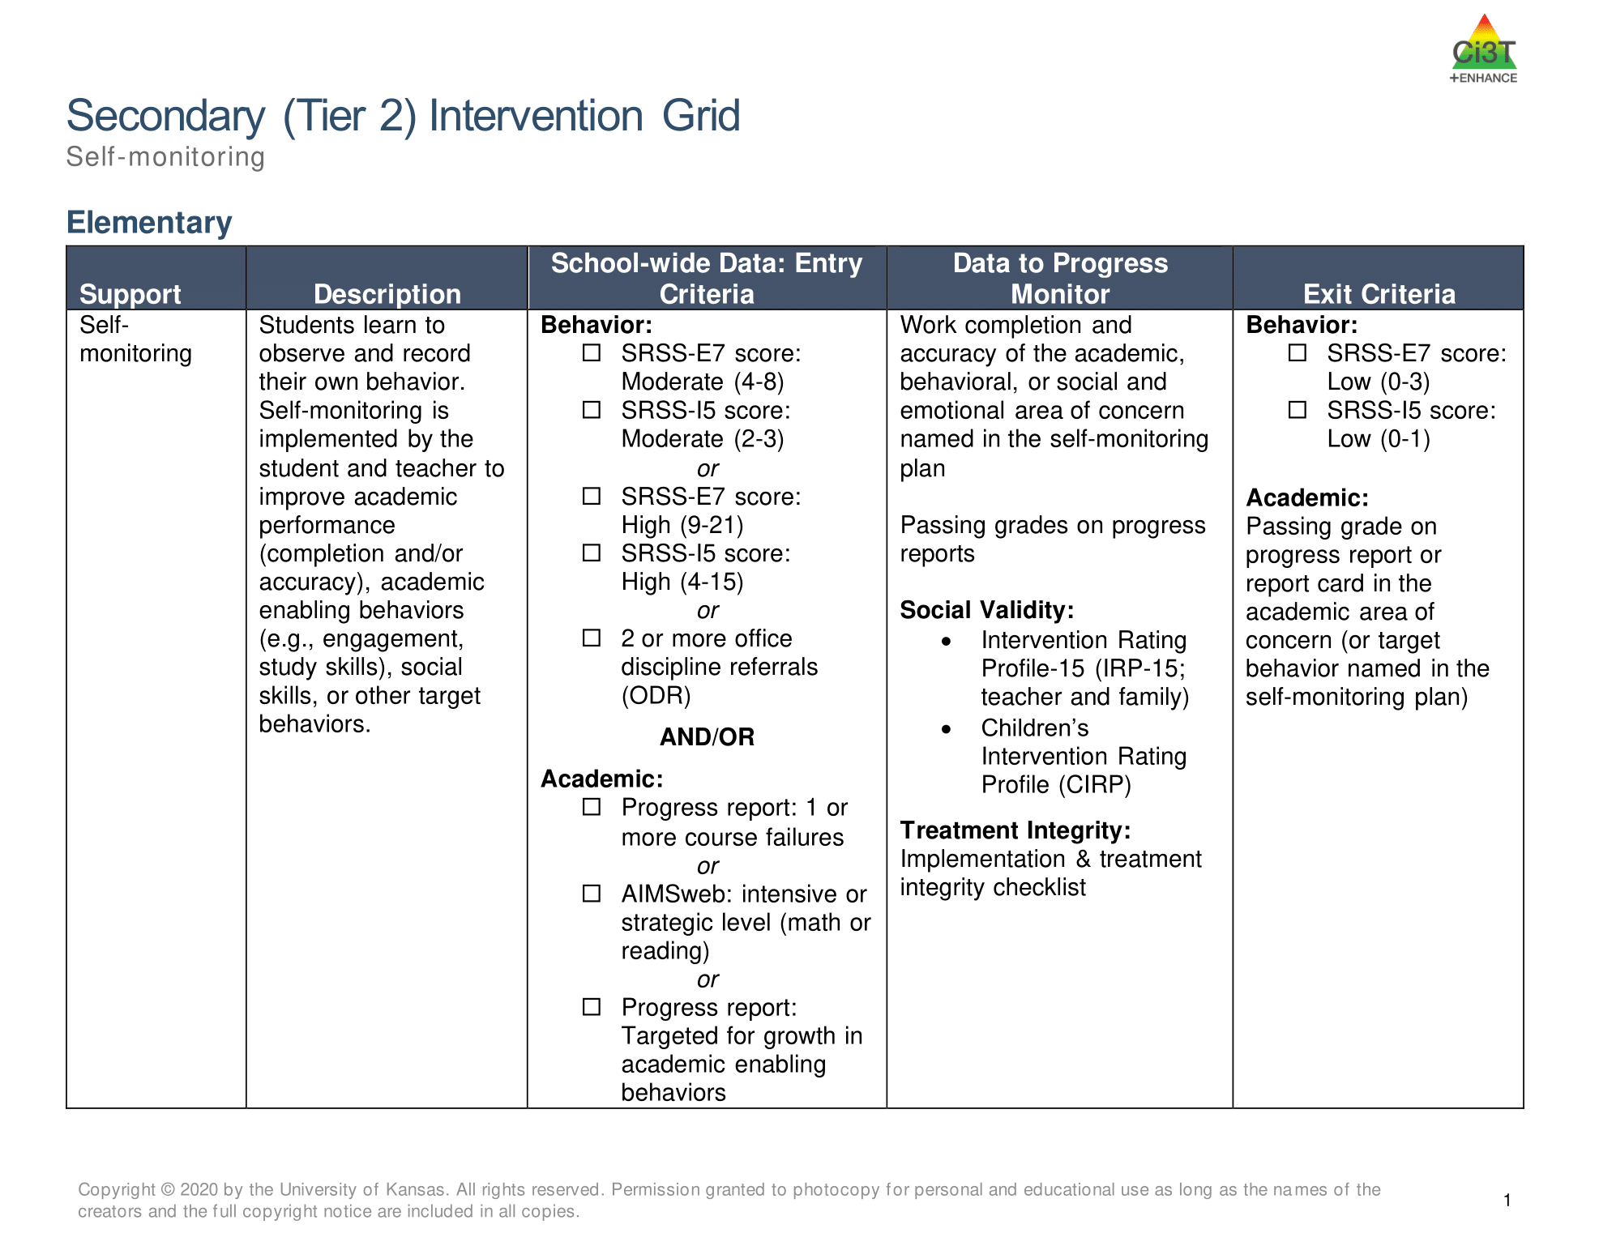
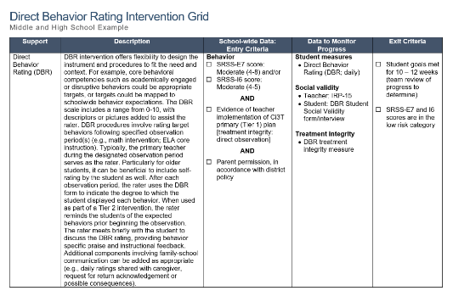
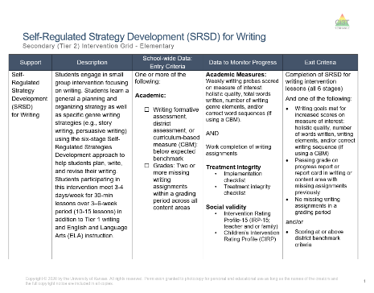
Secondary (Tier 2) Intervention

Slide 28

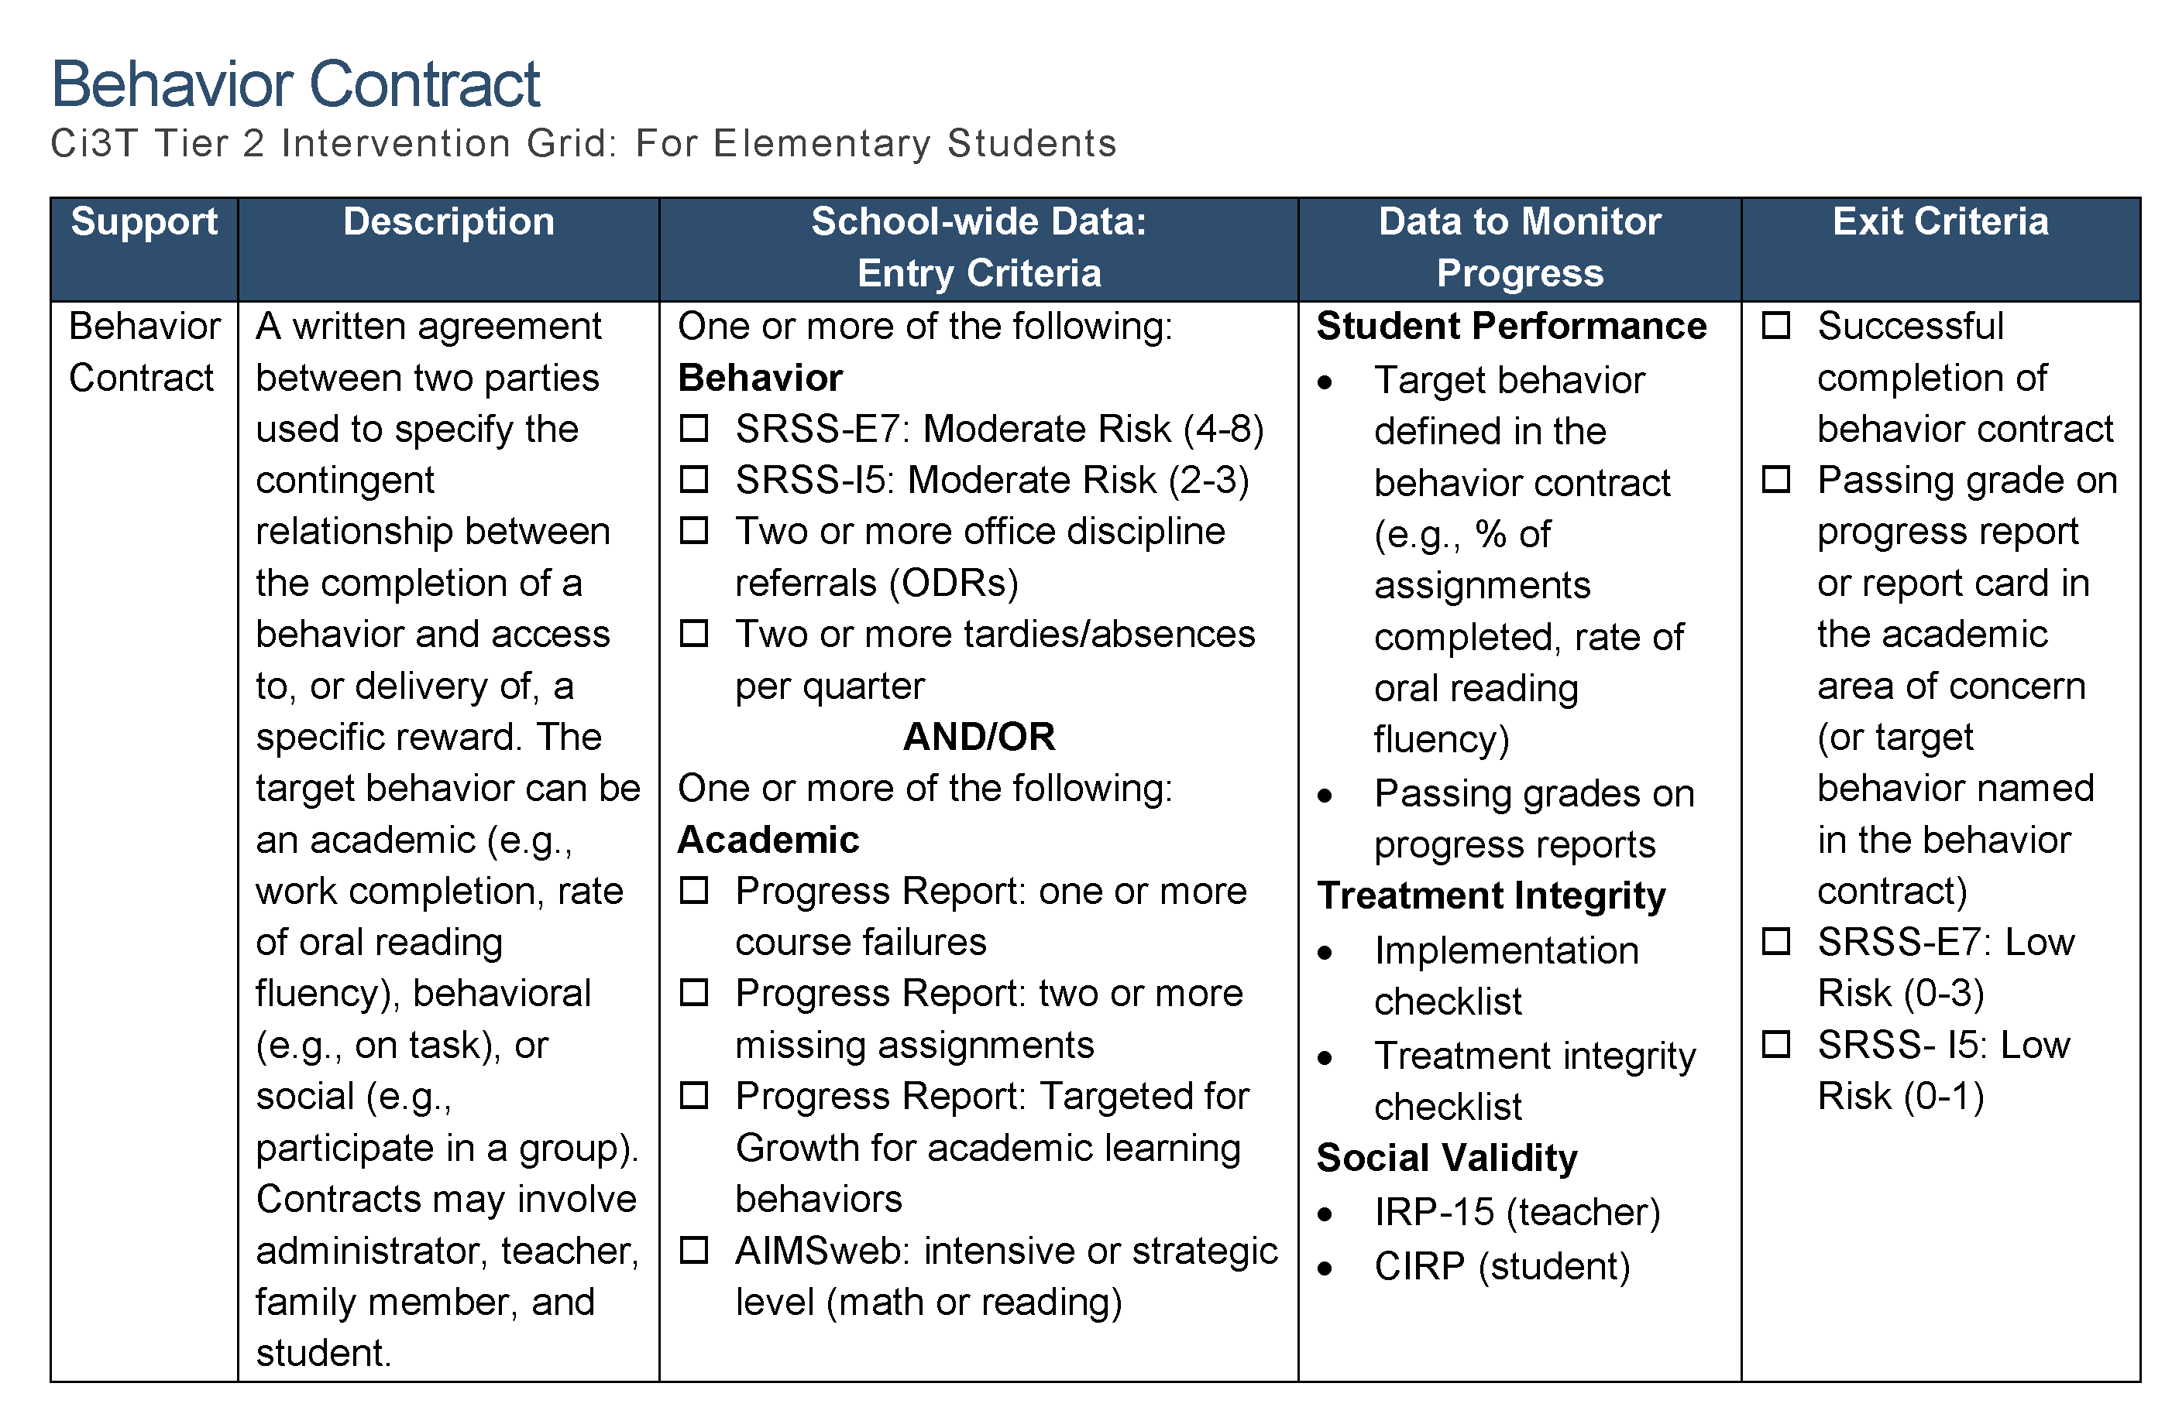
Tier 2: Behavior Contract Grid

Slide 29
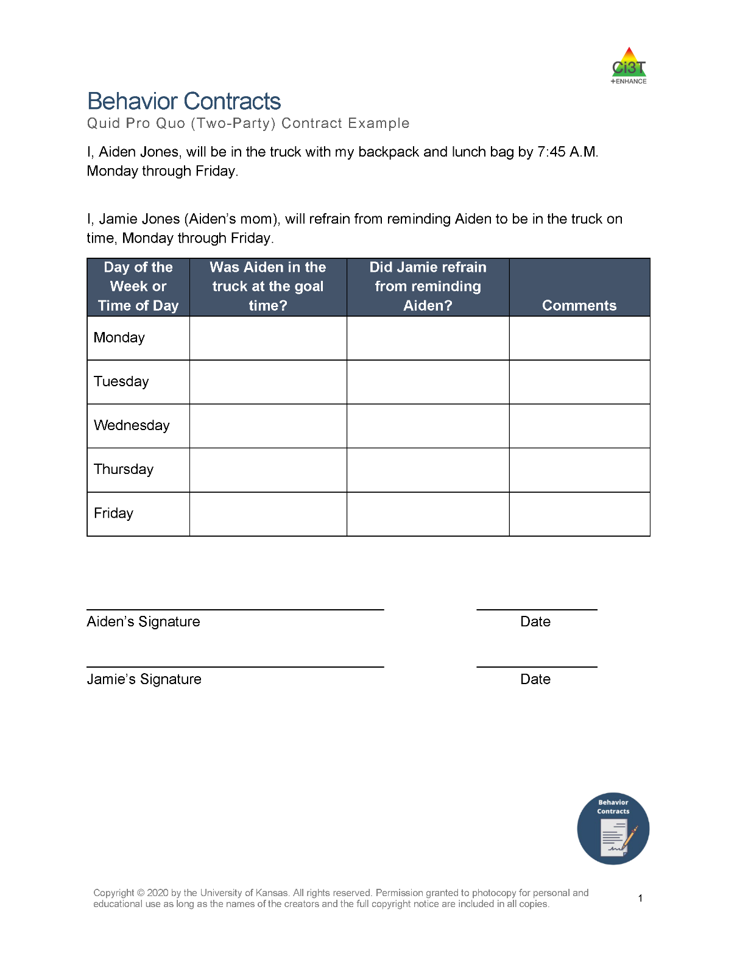
Tier 2: Behavior Contract Example
Notes:
Consider a high-school student who completes algebra assignments but makes frequent errors by rushing and skipping problem-solving steps. The student and teacher develop a behavior contract with a goal of using the agreed-upon problem-solving routine and achieving at least 80% accuracy on a brief daily practice set. The teacher provides immediate corrective feedback, the student records accuracy, and meeting the weekly goal earns an agreed-upon privilege. The team reviews the data regularly and adjusts the academic instruction or contract when needed.
The teacher still provides explicit instruction, modeling, guided practice, and corrective feedback. The behavior contract adds motivation, structure, and self-monitoring around using those skills accurately.

Slide 30
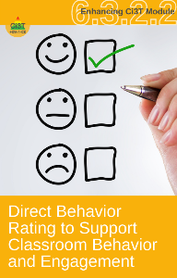
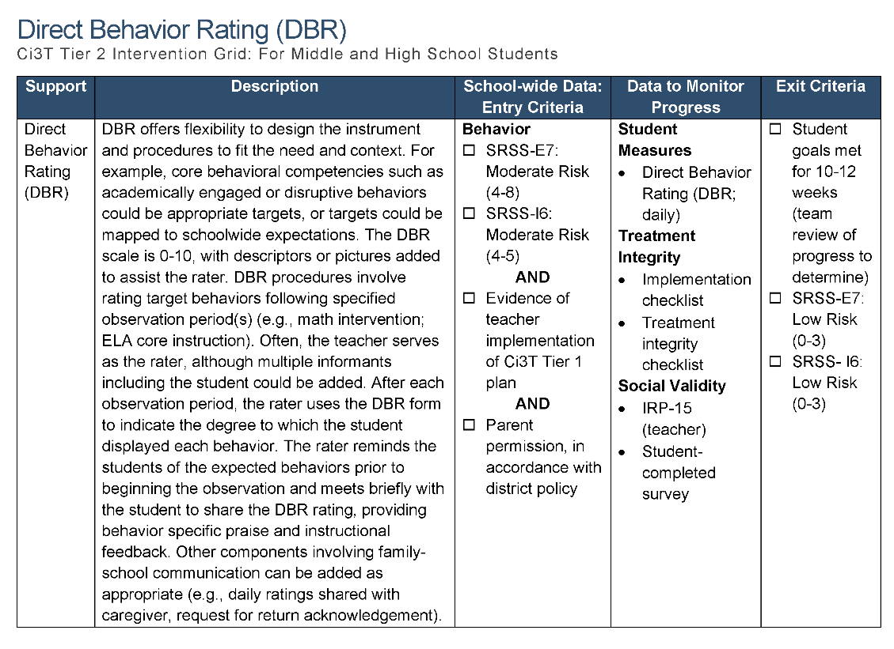
Tier 2: Direct Behavior Rating (DBR) Grid

Slide 31
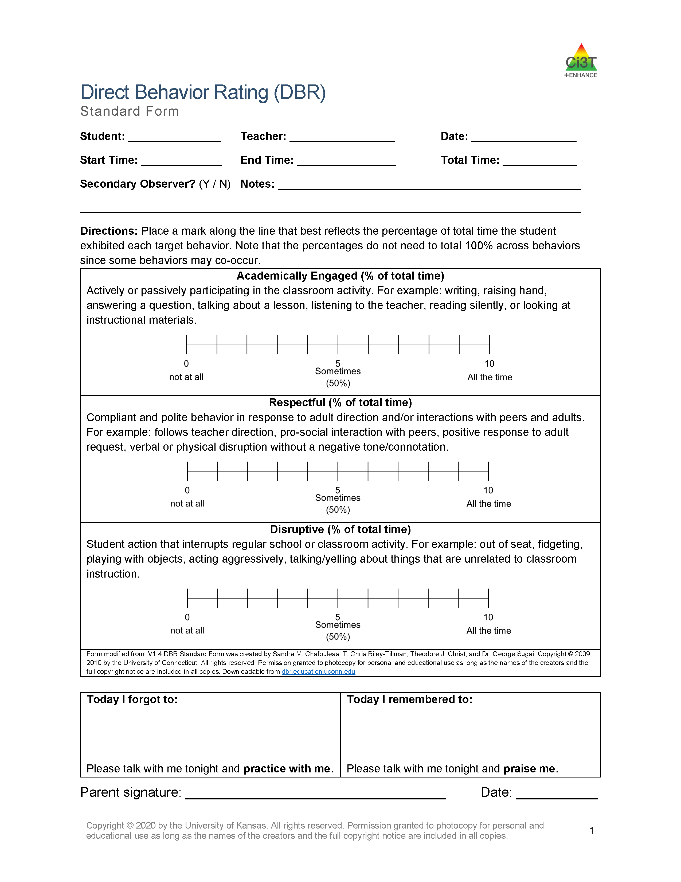
Tier 2: Direct Behavior Rating (DBR) Example

Slide 32
Tier 2: Direct Behavior Rating (DBR) Example 2

Slide 33
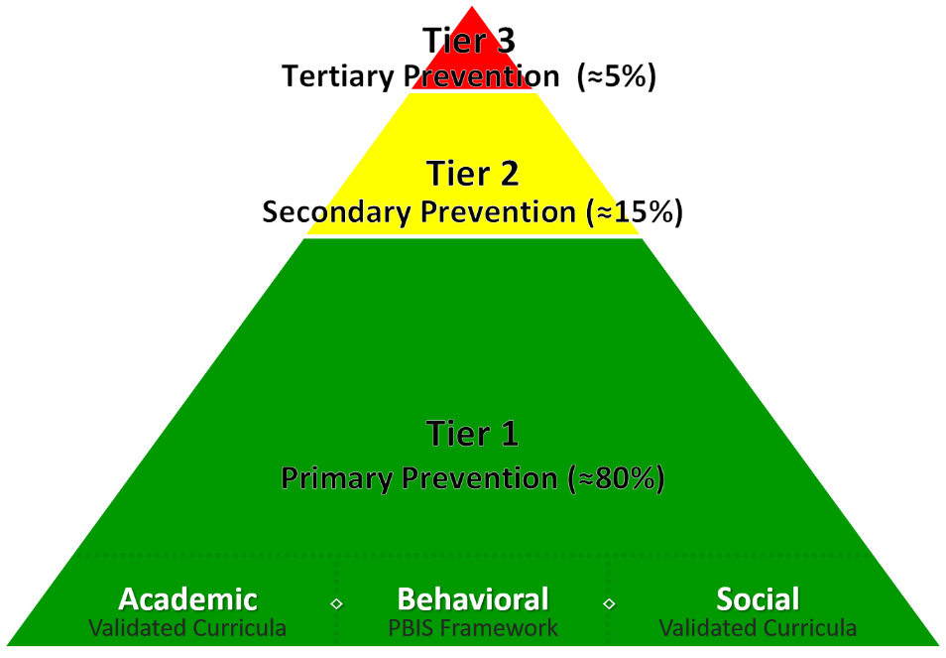

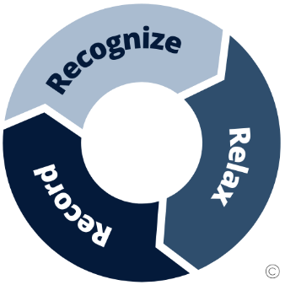
Tier 2: Recognize.Relax.Record.

Slide 34
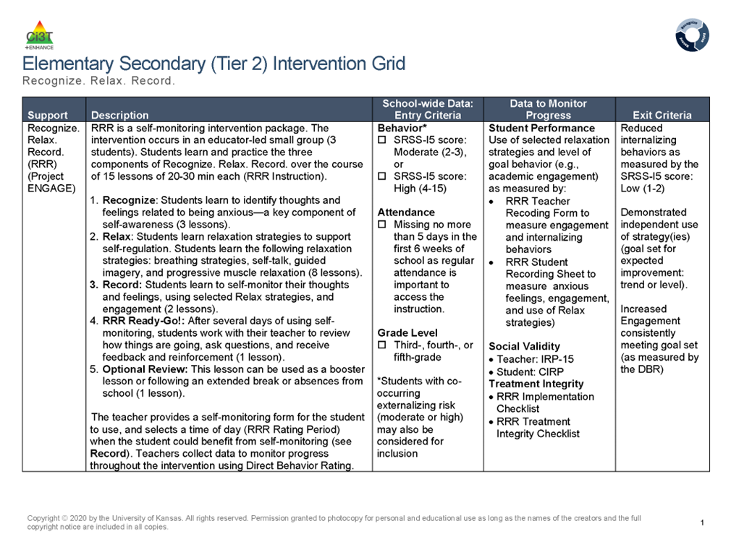
RRR Tier 2 Intervention Grid

Slide 35

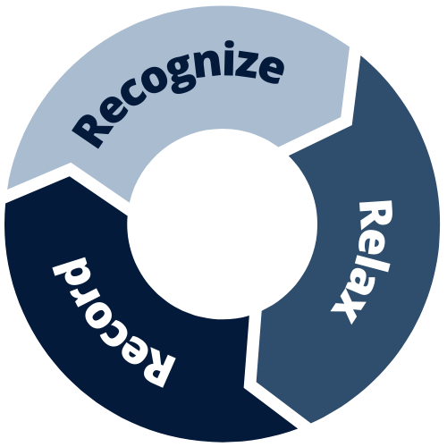
What is Recognize. Relax. Record.?
An intervention package containing three components:
Recognize
  identify thoughts and feelings related to being anxious
Relax
  manage anxious thoughts and feelings using relaxation strategies
Record
  self-monitor thoughts and feelings, use of relaxation strategies, and engagement (social or academic)

Slide 36





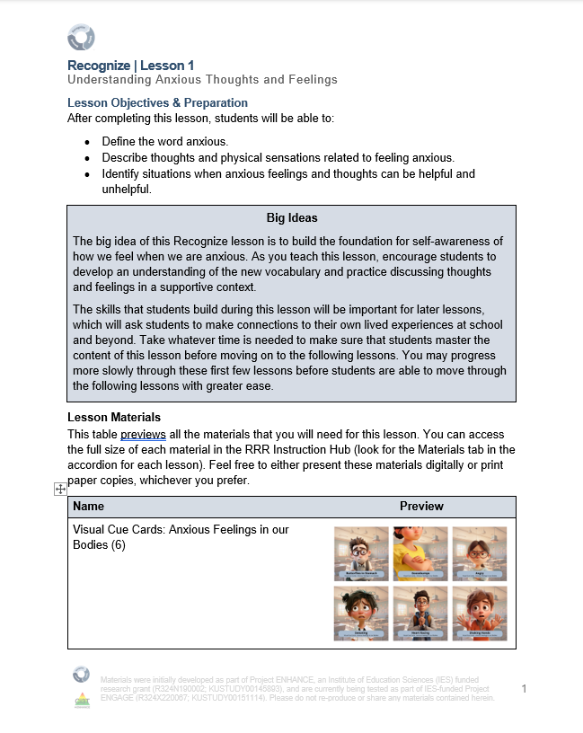




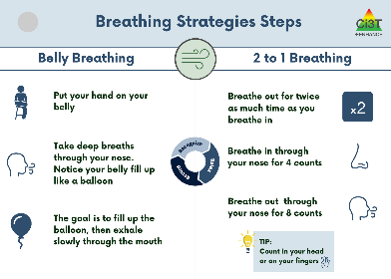
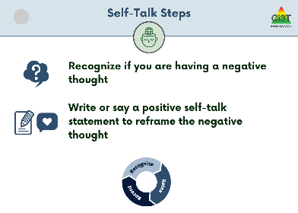
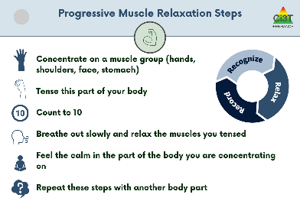
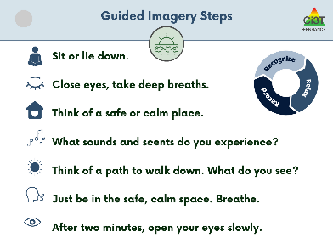
RRR Materials

Slide 37
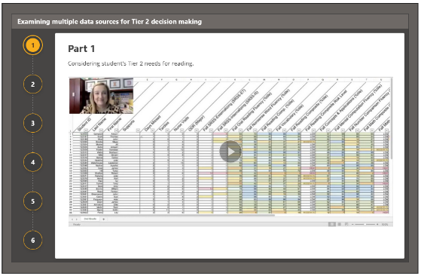


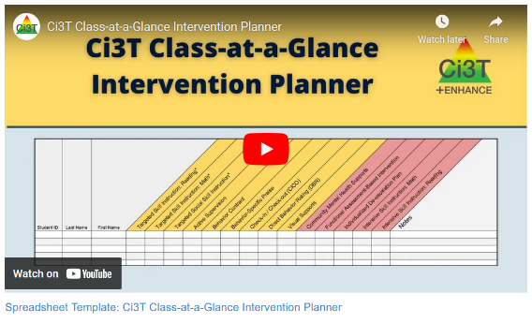
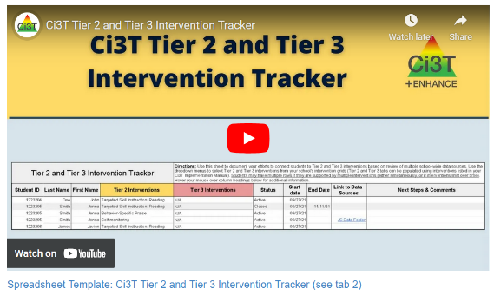
Module Connection!
The Tier 2 Process: Using Data to Connect Students to Validated Supports

Slide 38







You Discuss: Tier 2
Choose one Tier 2 intervention that caught your attention
  Behavior Contracts
  Recognize. Relax. Record.
What makes it more than Tier 1? Remember the active ingredients!
How does it build on strong practices already in place?
What structures and supports would help a school deliver it consistently?
Active Ingredients
Skill development
Predictability
Feedback
Communication and collaboration
Individualization
Notes:
5-min timer

Slide 39
A Closer Look at Tier 3 Interventions

Slide 40
Tier 3 in a Ci3T Model of Prevention
Tier 3 Intervention Grid
Notes:
In addition to the module featured here outlining how to use multiple sources of data to connect students with Tier 3 supports, we offer a full suite of modules highlighting validated Tier 3 interventions such as Functional Assessment-Based Intervention (FABI) that may appear in your Tertiary (Tier 3) Intervention Grid

Slide 41
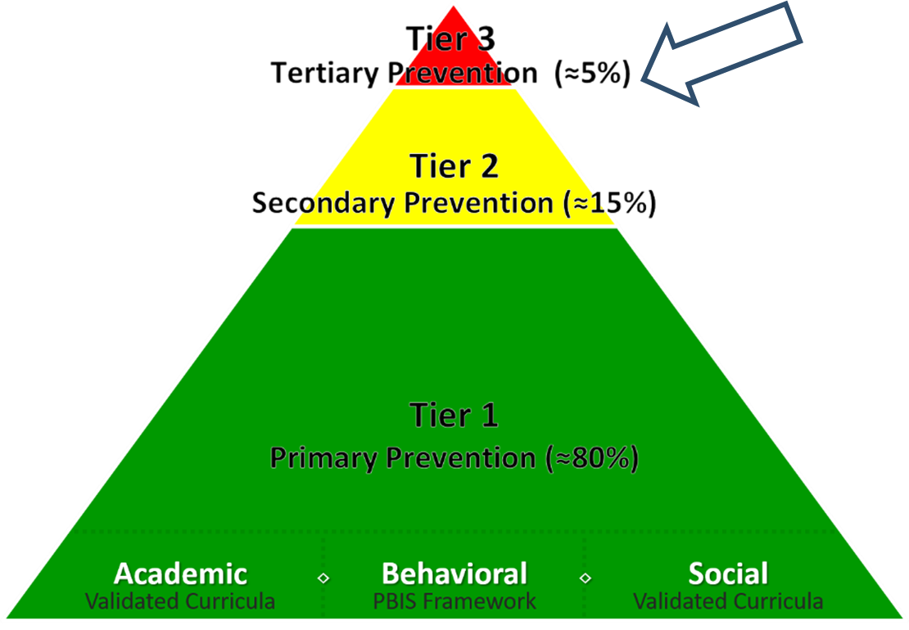
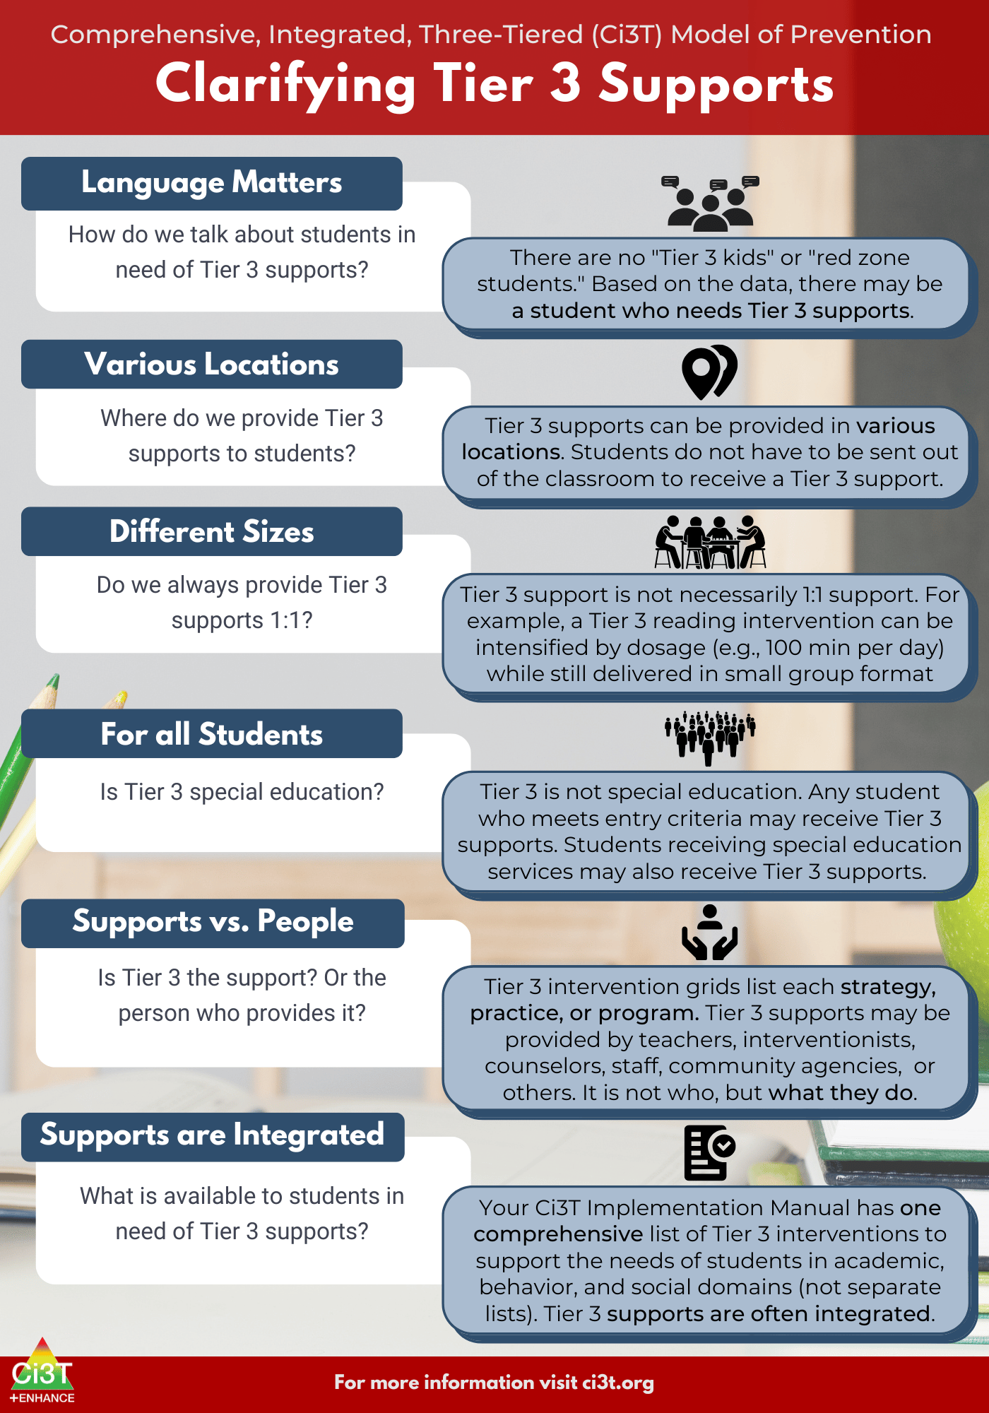
What are Tier 3 Interventions?

Slide 42
Clarifying Tier 3 Supports 1

Slide 43
Clarifying Tier 3 Supports 2

Slide 44

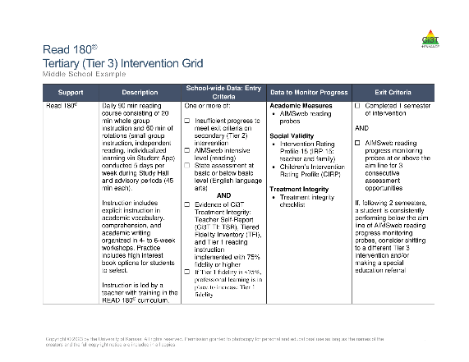
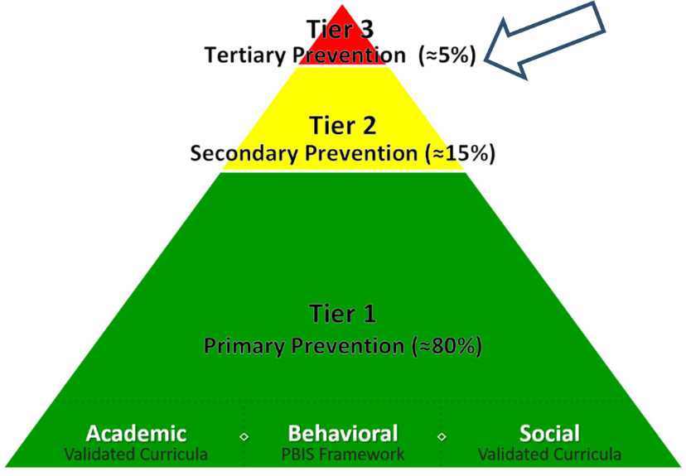
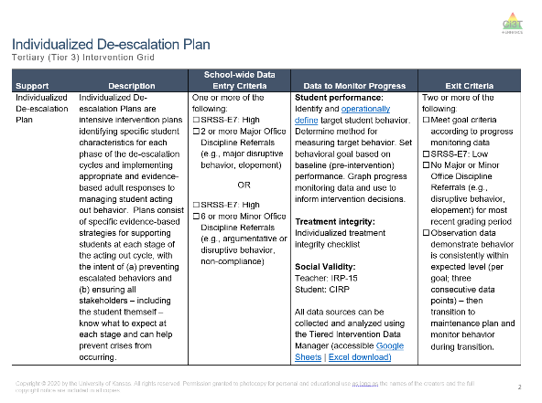
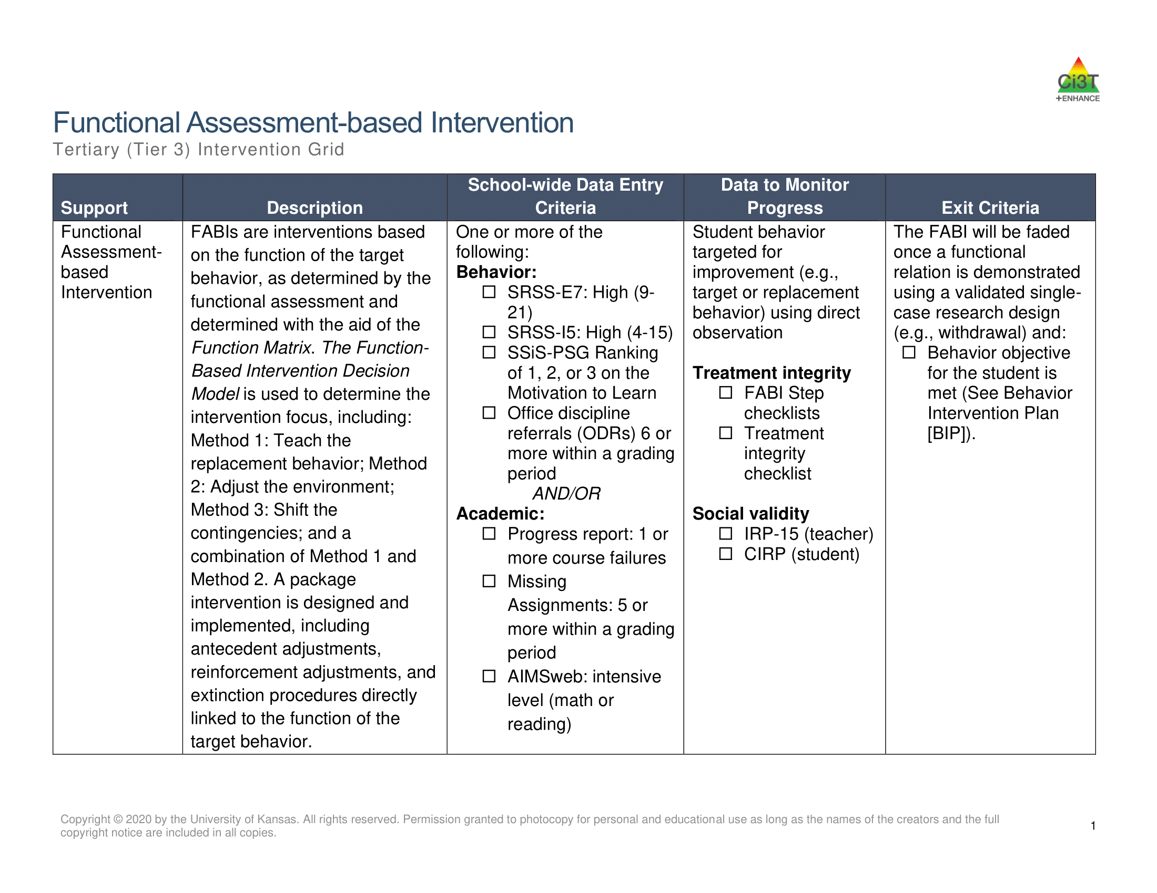
Tertiary (Tier 3) Intervention Grid
Tertiary (Tier 3) Intervention Grid 2

Slide 45

Tier 3: Functional Assessment-Based Intervention

Slide 46







Changes in Harry’s Behavior
Cox, M., Griffin, M. M., Hall, R., Oakes, W. P., & Lane, K. L. (2012). Using a functional assessment-based intervention to increase academic engaged time in an inclusive middle school setting. Beyond Behavior, 2, 44 – 54.

Slide 47
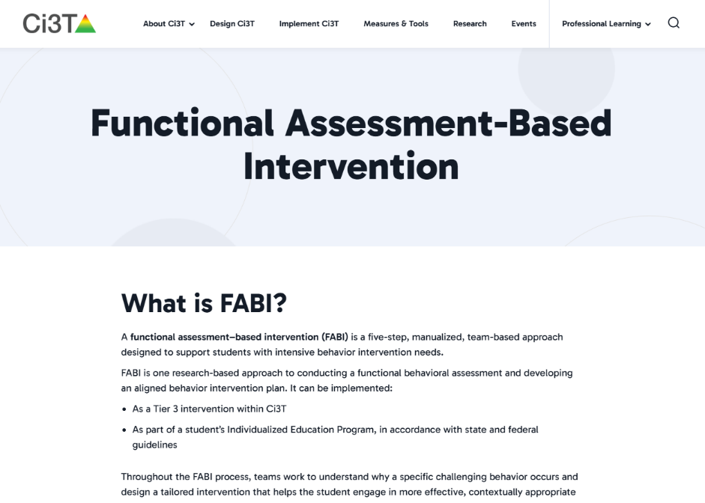


To learn more please visit ci3t.org!

Slide 48


Tier 3: Individualized De-Escalation Plan Grid

Slide 49

Tier 3: Individualized De-Escalation Plan
Acting Out Cycle

Slide 50


Tier 3: Reading Intervention

Slide 51




Module Connection!
The Tier 3 Process: Using Data to Connect Students to Validated Supports

Slide 52
You Discuss: Tier 3
Choose one Tier 3 intervention that caught your attention
  Functional Assessment-based Interventions (FABI)
  Individualized De-escalation Plans
  Reading Intervention
What makes it more intensive than Tier 2? Remember the active ingredients!
What information would help a team tailor it to the student’s strengths and needs?
What structures and supports would help a school deliver it consistently?
Active Ingredients
Skill development
Predictability
Feedback
Communication and collaboration
Individualization
Notes:
5-min timer

Slide 53

Wrapping Up and Moving Forward

Slide 54
Preview: Ci3T Phased Roll Out
 | 2026-2027 | 2027-2028 | 2028-2029 | 2029-2030 | 2030-2031 | 2031-2032 | 2032-2033
Getting Started with Ci3T | x
Ci3T Design |  | x
Ci3T Implementation Year 1 |  |  | x
Ci3T Implementation Year 2 |  |  |  | x
Sustain and Develop Practices |  |  |  |  | x | x | x

Slide 55

Getting Started with Ci3T!
2026–2027 School Year
Activity
Aug
Sept
Oct
Nov
Dec
Jan
Feb
Mar
Apr
May
Shared Outcomes
Getting Started with Ci3T PL Series
4 Sessions
Purpose: Explore Ci3T and build shared knowledge, language, and vision.
Districtwide activities to begin Ci3T Design and Implementation efforts, building upon:
Shared vision
Districtwide certainties
Strong practices already in place
Aug. 27: Educational Leaders’ Session
Leading in Ci3T Systems (in-person)
Aug. 31: Keynote + Breakouts
Exploring Ci3T (in-person)
Nov. 3: Keynote + Breakouts
A Closer Look at Tier 1 (in-person)
Mar. 2: Keynote + Breakouts
A Closer Look at Tier 2 and 3 (virtual)
District Leadership Team Meetings + Ci3T Research Team
10 one-hour meetings
Purpose: Establish district ‘certainties’ for Ci3T strategies, practices, programs, and assessments.
1
2
3
4
5
6
7
8
9
10
School-Site Team Meetings +
Ci3T Research Team
5 one-hour meetings with each school
Purpose: Reflect on each school’s context, needs, and current practices, connecting them to Ci3T learning and districtwide planning.
1
2
3
4
5

Slide 56

2027-2028: Ci3T Design

Slide 57


2028-2029: Ci3T Implementation Begins!

Slide 58

Ci3t.org/events

Slide 59

Project EMPOWER
EMPOWER Session | Date
Effective Tier 1 Practices for Positive, Productive Classrooms | September 15, 2026
Let the Data Drive: Using Systematic Screening to Shape Instruction | October 27, 2026
Ci3T in Action: Integrated Lesson Planning for Optimal Instruction | November 17, 2026
A 6-Step Instructional Approach for Responding to Challenging Behavior in Schools | January 20, 2027
A Tier 2 Intervention for Managing Anxious Feelings: Recognize. Relax. Record. | March 23, 2027
A Tier 3 Intervention: Functional Assessment-Based Intervention | April 28, 2027
Notes:
We hope to see you at a future EMPOWER session! Just like tonight - each session is free, 2hrs, and hosted on Zoom. About 2 weeks following a session we post a video recording so if you are unable to make it (or if there’s a session that already passed that you are interested in), we invite you to access those recordings!

Slide 60
Action Items
Action Item | Person(s) Responsible | Planned Completion Date | Date Completed
Create an account on ci3t.org | Kathleen | 8/31/2026
Review What is Ci3T? Module | Kathleen | 9/1/2026
Register to attend EMPOWER sessions of interest | Kathleen | 9/5/2026
Attend: EMPOWER Session Effective Tier 1 Practices for Positive, Productive Classrooms | Kathleen | 9/15/2026

Slide 61
Thank you!
Mark Buckman, Ph.D.
Buckman@ku.edu

