Slide 1
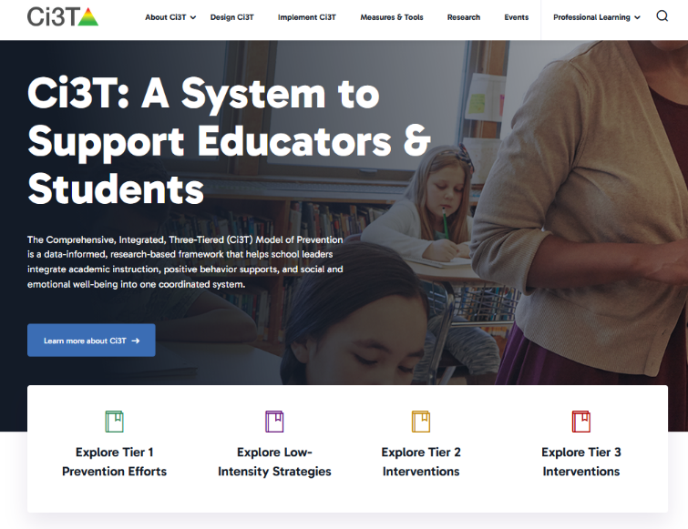
Ci3T Implementers Symposium in Salina
Kathleen Lynne Lane, Ph.D., BCBA-D, CF-L2
Elise Sarasin, M.S.E.
Allison Bernard, M.Ed.
Kathryn Johnson, M.A.
We invite you to explore ci3t.org!

Slide 2
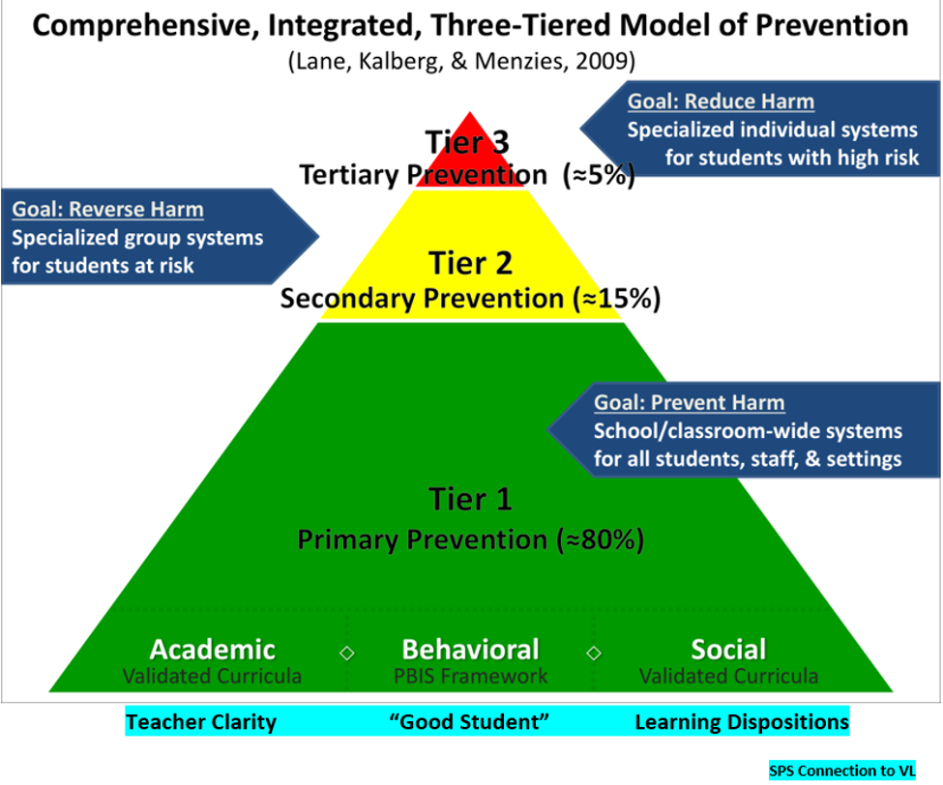
Comprehensive, Integrated, Three-Tiered Model of Prevention 1

Slide 3
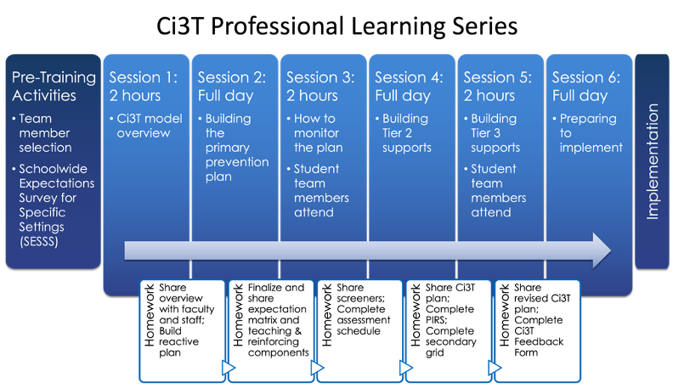
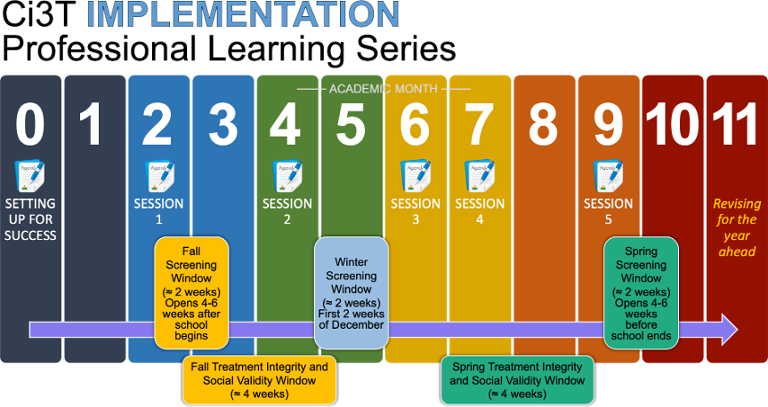

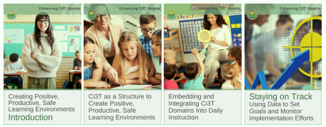


Ci3T Comprehensive
Professional Learning Plan

Slide 4
Session Outcomes
Create and calendar out implementation plans for the 2026-2027 academic year (e.g., Ci3T Leadership Team meetings, faculty & staff meetings, opportunities to complete behavior screening)
Use needs of faculty, staff, and students to inform professional learning for faculty and staff and updates to your school’s Ci3T Implementation Manual
Prepare to share key Ci3T information with faculty, staff, students, and families at the beginning of the 2026-2027 school year
  Develop Professional learning activities for faculty and staff when teachers return (before students arrive)
  Develop roll-out plans for the first 30 days of the school year

Slide 5
Agenda
Morning Session
Afternoon Session
Welcome
Planning for your 2026-2027 Ci3T Journey
  Team Map Activity
  Scheduling for Success
    Ci3T Leadership Team & Faculty and Staff Meetings
    Professional Learning Opportunities
    Professional Learning to Support Data Collection and Data-Informed Decision Making
Working Lunch (45 mins)
Q&A
Setting Up for the Year Ahead
  Procedures for Teaching
    Faculty and Staff
    Students
    Family and Community
  Procedures for Reinforcing
    Faculty and Staff
    Students
Wrapping Up and Moving Forward

Slide 6

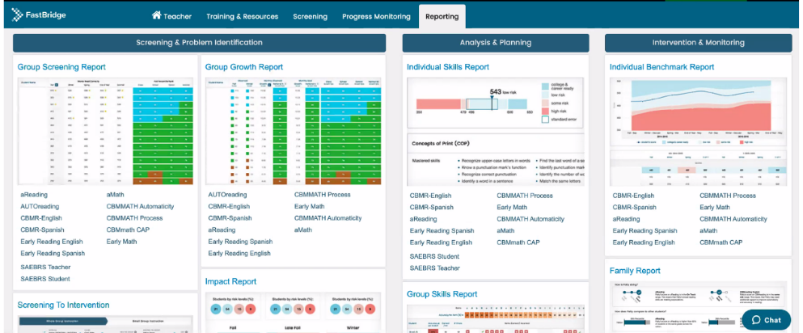
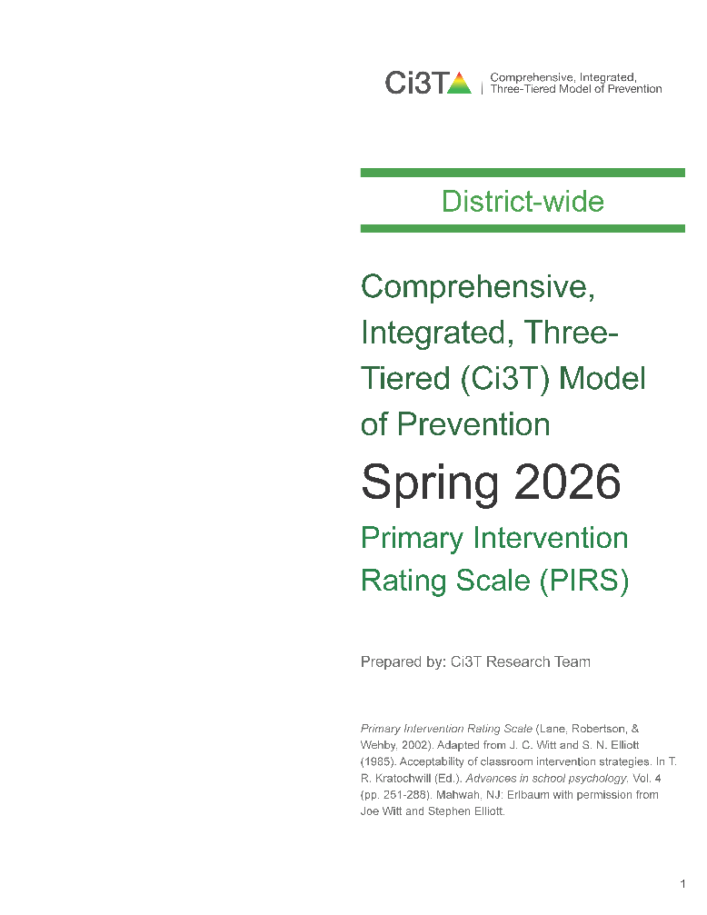
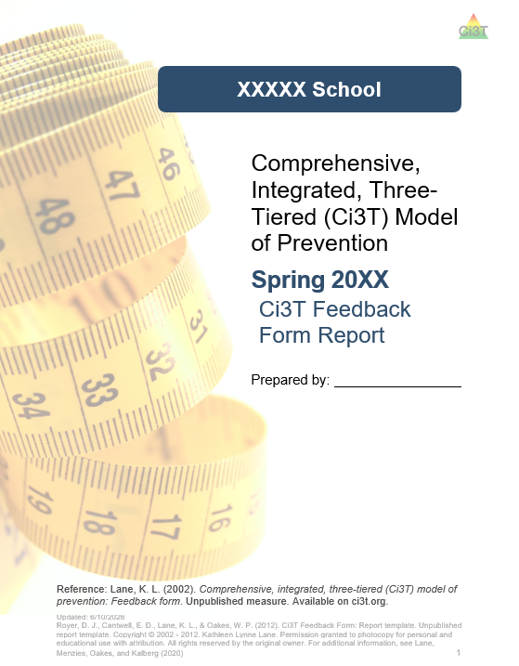

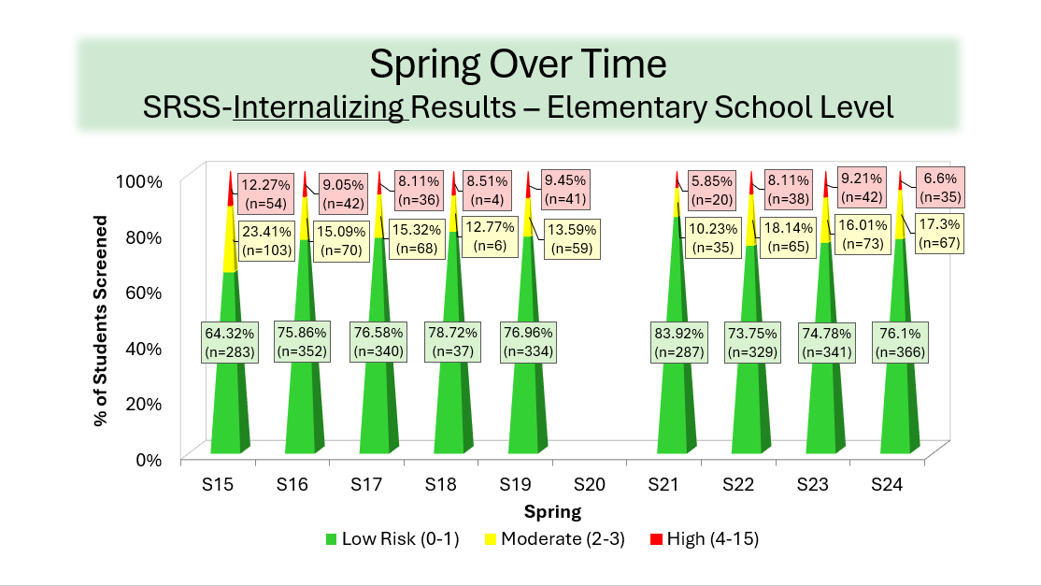
Materials for Today’s Session
Ci3T Implementation Manual
Primary Intervention Rating Scale (Pre-Implementation) & Ci3T Feedback Form
Spring Screening Data

Slide 7



Question & Answer Preparation

Slide 8
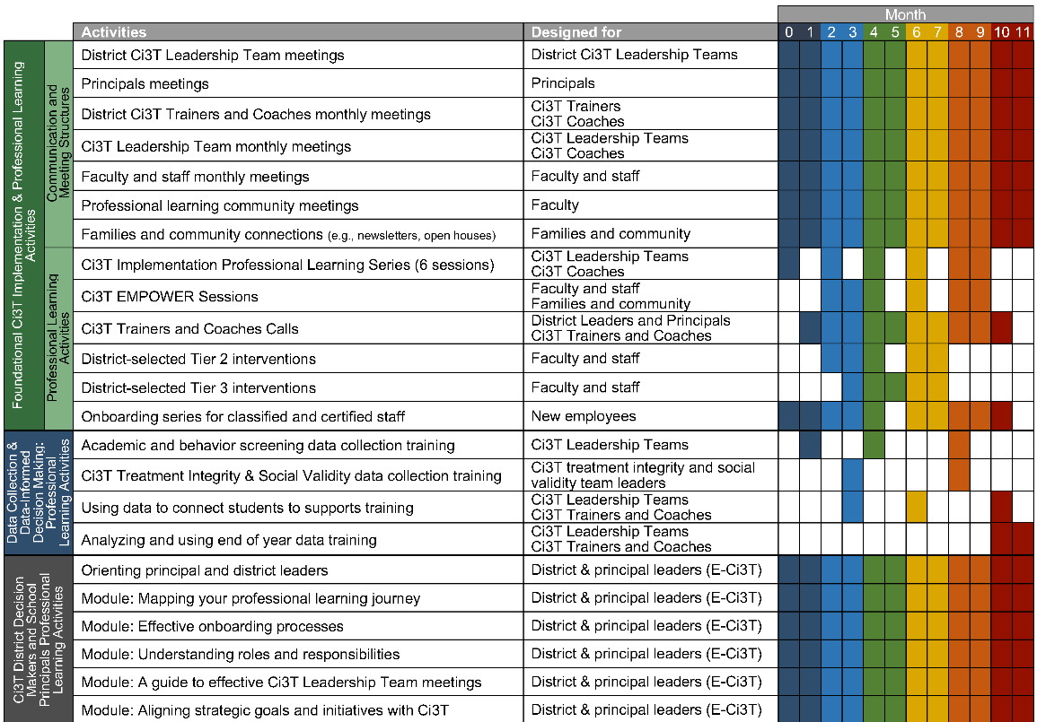
Planning for your 2026-2027 Ci3T Journey
Ci3T Leadership Team Meetings
Faculty & Staff Meetings
Data Collection
Professional Learning

Slide 9

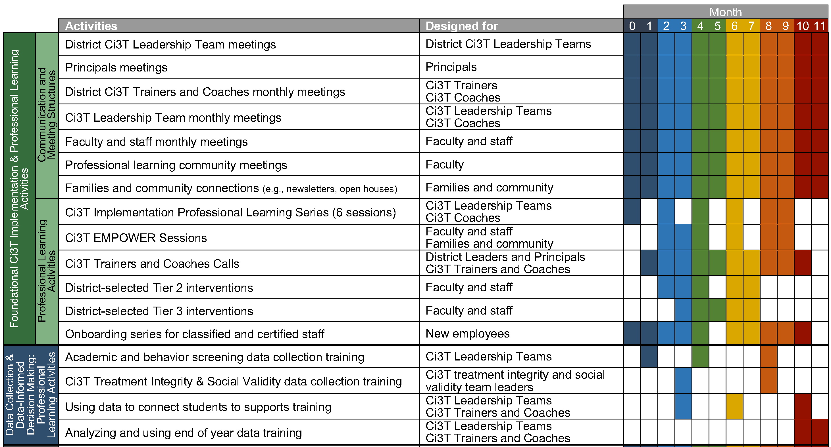
Ci3T Professional Learning Journey

Slide 10
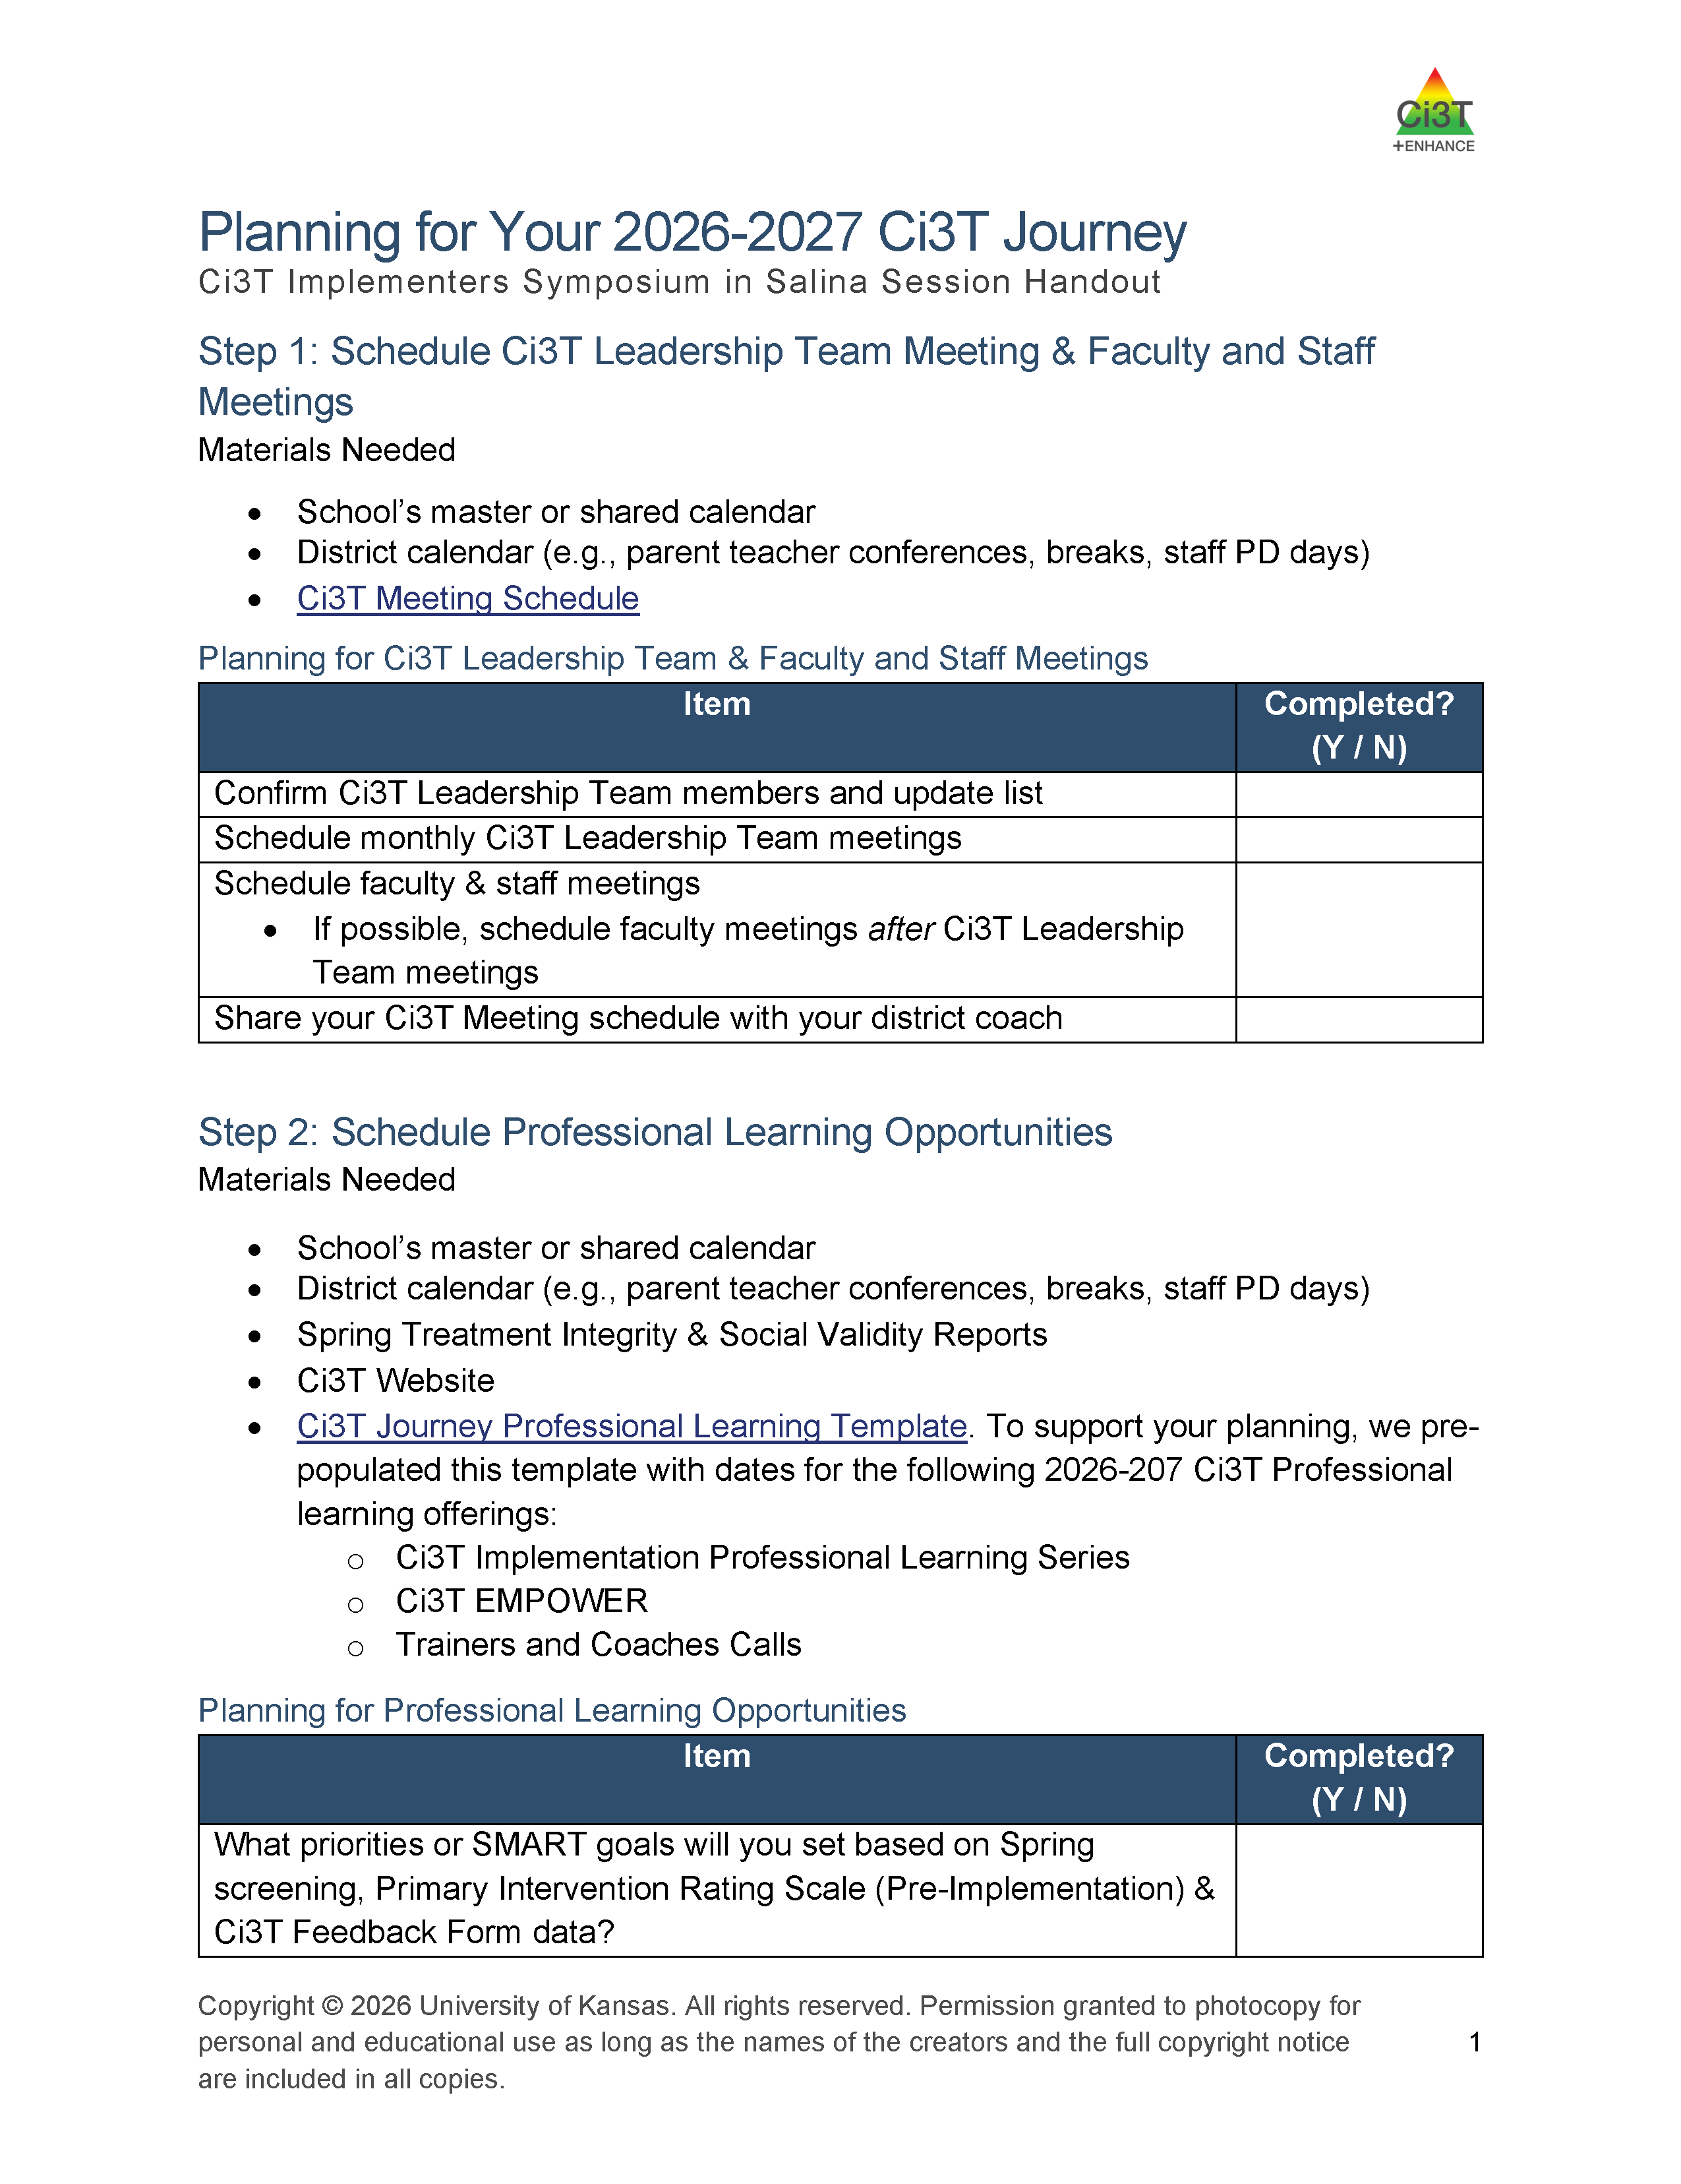
Long Range Planning
Ci3T Leadership Team meetings
Faculty and Staff meetings
Data Collection
Professional Learning
  Ci3T Implementation Professional Learning Series
  EMPOWER Sessions
  Enhancing Ci3T Modules
  District-offered professional learning

Slide 11
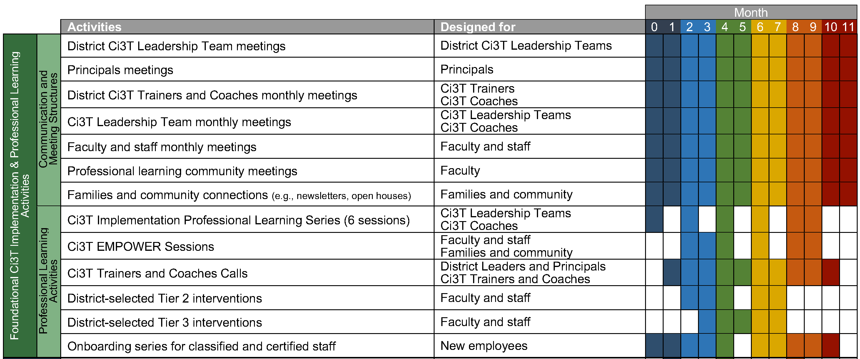
Step 1: Schedule Ci3T Leadership Team Meetings & Faculty and Meetings

Slide 12
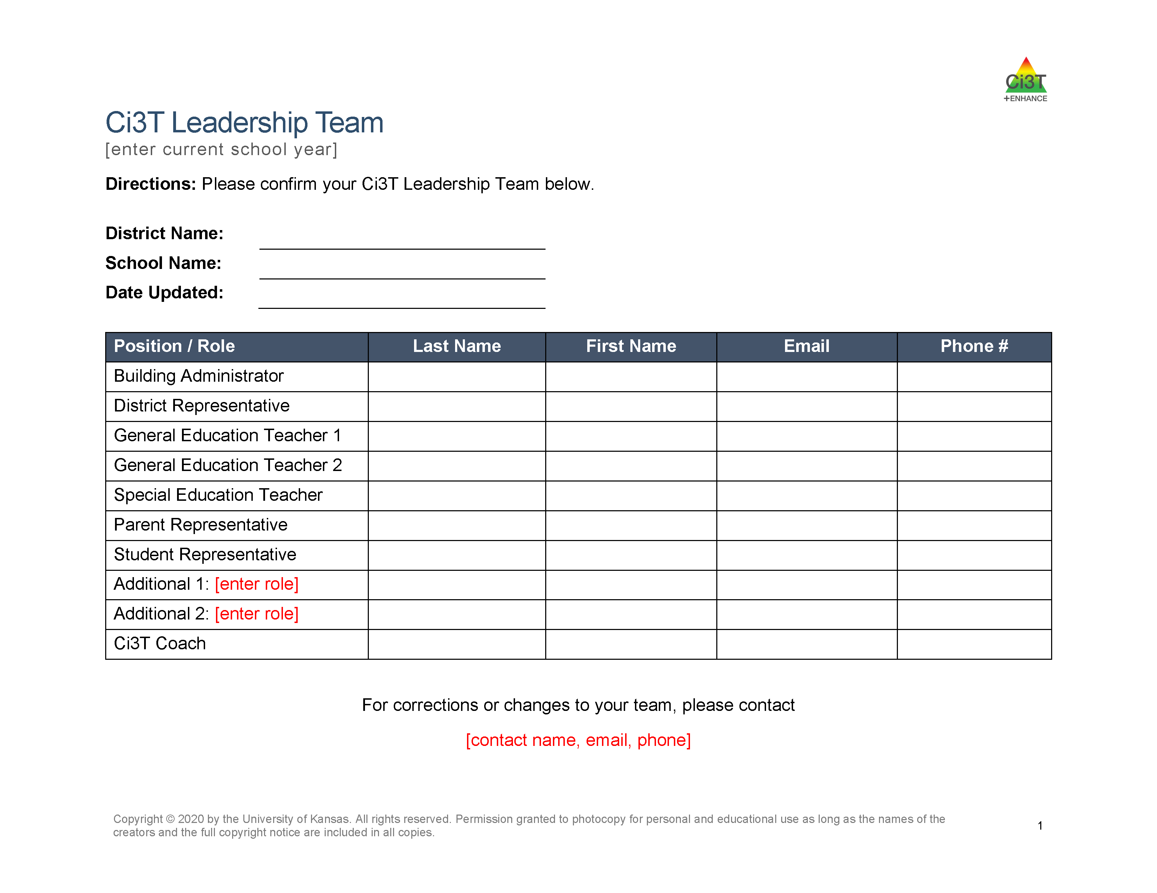

Confirm Ci3T Leadership Team Members
Notes:
Administrator(s)
General education teachers representative of your school
Elementary: a lower-grades and an upper-grades teacher
Secondary: a teacher from each grade level or department
Special education teacher(s)
Support staff
e.g., counselor, psychologist, social worker
Parent representative(s)
Student representative(s) such as from student council

Slide 13

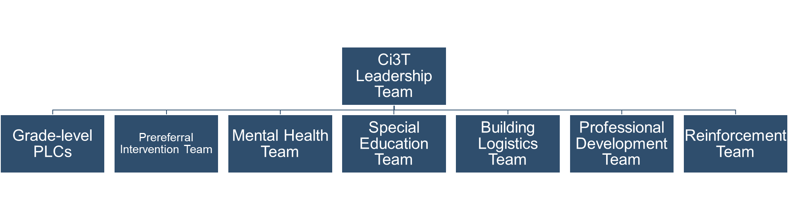
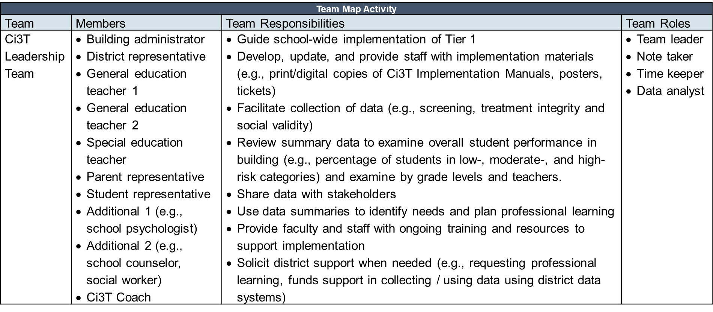
Team Map Activity

Slide 14
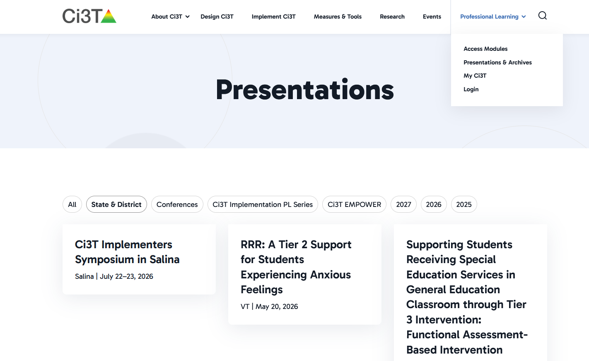
Work Time Preparation

Slide 15
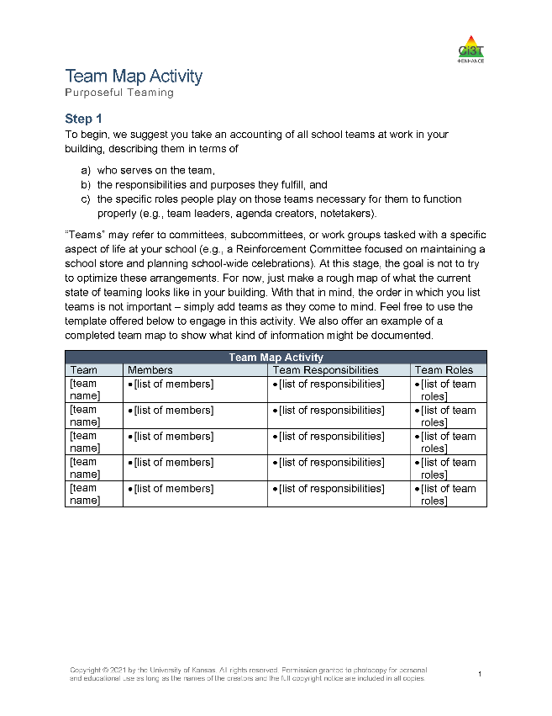

































Work Time: Team Map Activity
Confirm Ci3T Leadership Team members
Complete Team Mapping Activity
Notes:
30-minutes

Slide 16

Preparing to Build Your Calendar
You will need:
District Calendar (e.g., parent teacher conferences, breaks)
Assessment schedule
  Academic and Behavior Screening Windows
  Social Validity & Treatment Integrity Windows
Dates for Professional Learning Opportunities
  Ci3T Professional Learning opportunities (e.g., EMPOWER sessions)
  District Professional Development Schedule (e.g., faculty meeting 1st Tuesday of the month, weekly PLCs)

Slide 17
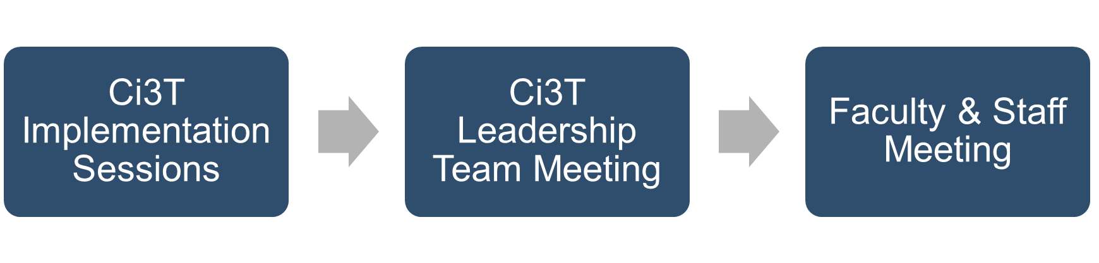
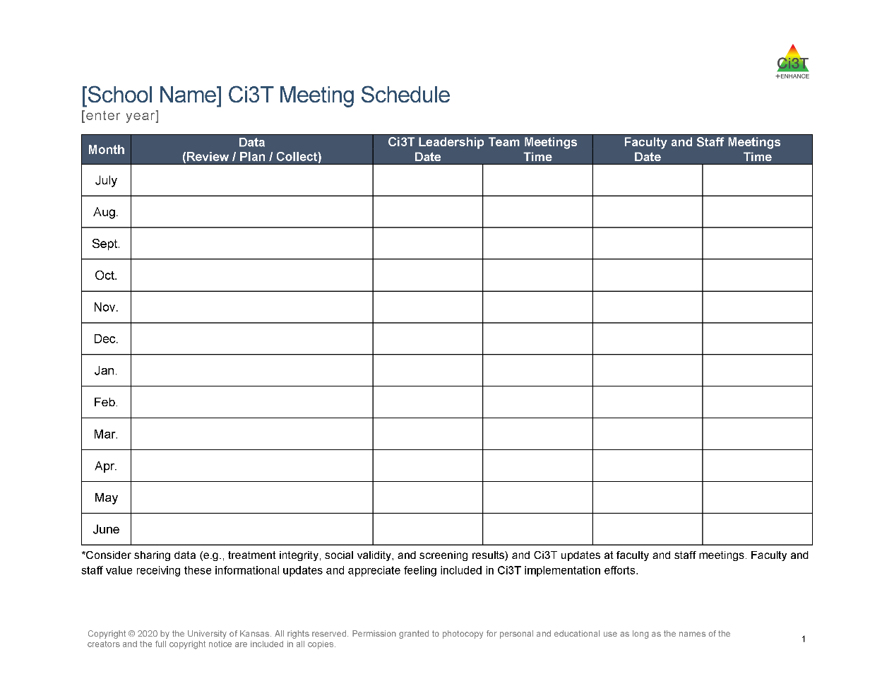
Scheduling Your Ci3T Leadership Team Meetings & Faculty and Staff Meetings
Notes:
Might consider stacking these monthly meetings:
There are 5 Ci3T Implementation Sessions throughout the year either led by our research team or your district. Often, teams find it helpful to schedule their Ci3T Leadership Team meetings for after those sessions. Implementation sessions are a great place to start conversations – look at data, start making plans. Helpful to have time set aside to continue to conversation.
The other piece to consider, is scheduling monthly Ci3T Leadership Teams before faculty and staff. For example, if you know your faculty and staff always meets the 3rd Wednesday of the month, maybe you hold the first Wednesday for Ci3T Leadership Team, that way you’re always working ahead
Choosing a regular meeting date (e.g., the second Tuesday of the month) can add predictability to the schedule.
Consider creating the calendar for your faculty and staff meetings at the same time as your Ci3T Leadership Team meetings. For example, you might intentionally schedule staff meetings the week following your Ci3T Leadership Team meetings. This provides an automatic mechanism for sharing Ci3T updates (e.g., sharing data) at your staff meetings.
As you finalize the schedule, send digital calendar invites (e.g., Google Calendar, Outlook, iCal) to all members or post dates on a shared school calendar. Consider setting up the calendar events with week-before and day-before alerts.
If possible, avoid cancelling meetings. Holding meetings consistently communicates the priority of this time and avoids confusion (“Are we meeting this month?”).

Slide 18
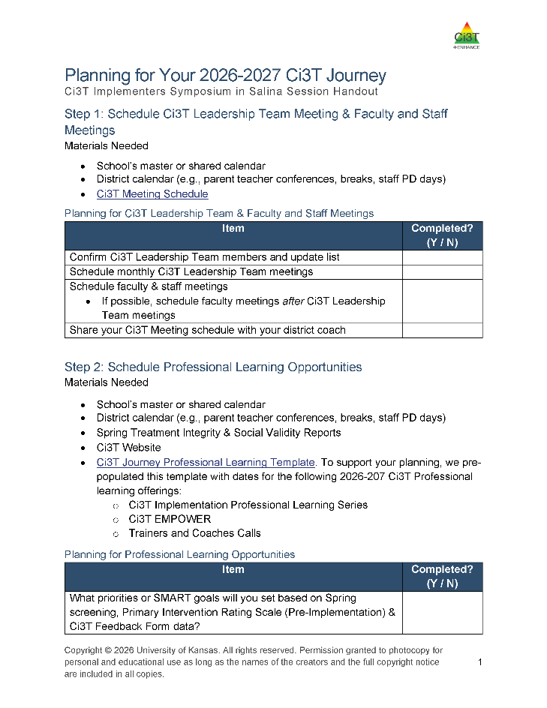
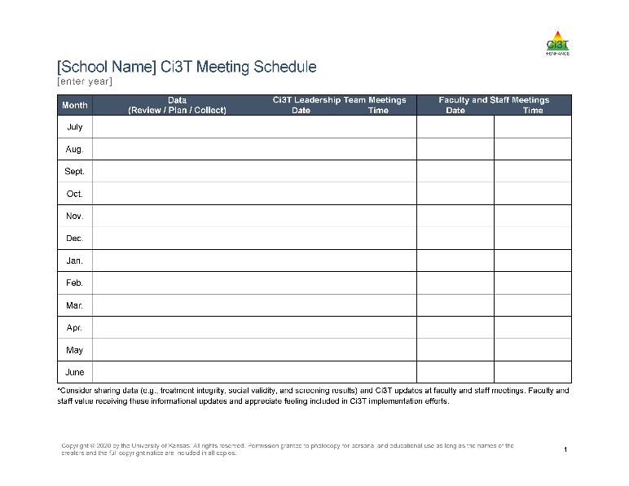
Work Time: Scheduling Ci3T Leadership Team and Faculty & Staff Meetings
Schedule Ci3T Leadership Team meetings
Schedule Faculty & Staff Meetings
Notes:
15-minutes

Slide 19
Step 2: Schedule Professional Learning Opportunities
Notes:
The next step is to think about the professional learning opportunities that are available. This includes opportunities for your own professional learning as a Ci3T LT member in addition to the professional learning you will offer to faculty and staff.

Slide 20
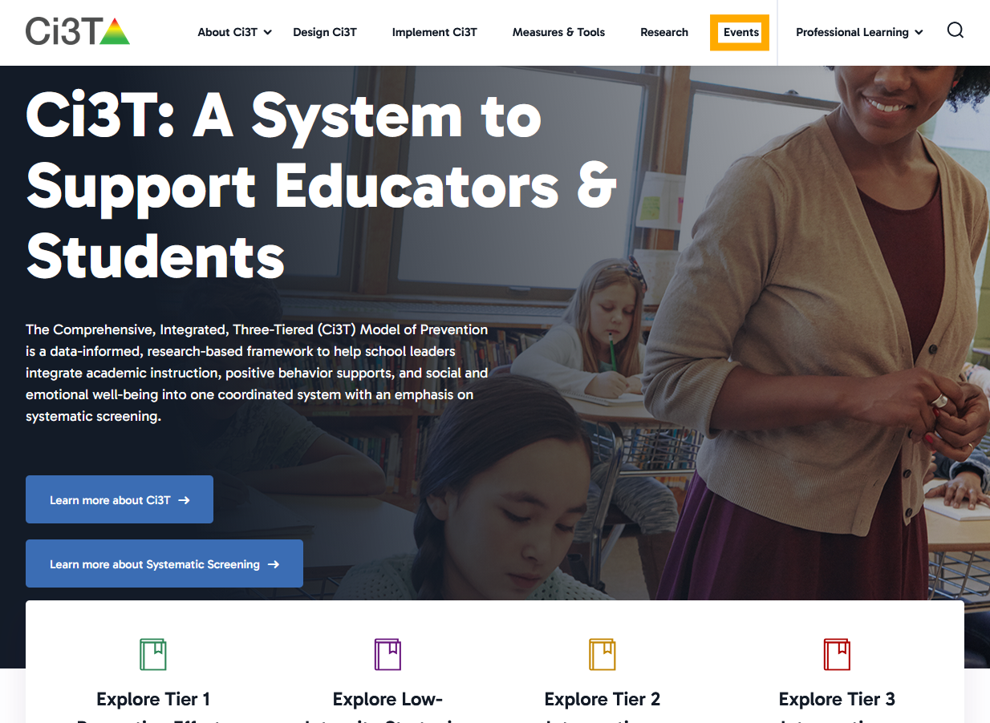
Ci3T: A System to Support Educators and Students Website: Events

Slide 21
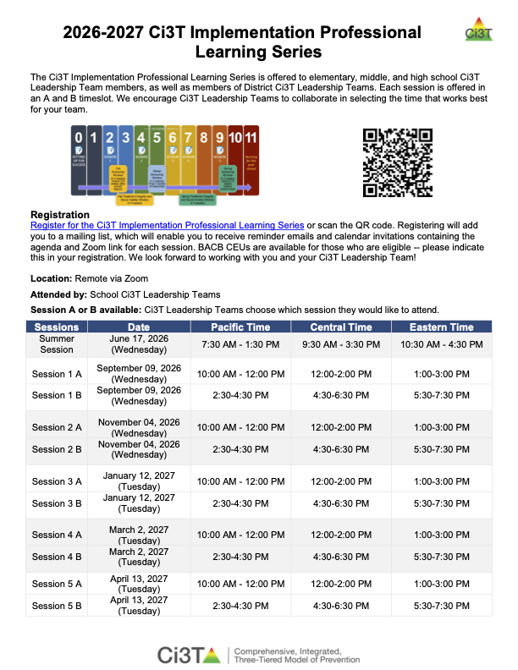
Ci3T Implementation Professional Learning Series
Sessions | Date | Pacific Time | Central Time | Eastern Time
Summer Session | June 17, 2026 (Wednesday) | 7:30 AM - 1:30 PM | 9:30 AM - 3:30 PM | 10:30 AM - 4:30 PM
Session 1 A | September 09, 2026 (Wednesday) | 10:00 AM - 12:00 PM | 12:00-2:00 PM | 1:00-3:00 PM
Session 1 B | September 09, 2026 (Wednesday) | 2:30-4:30 PM | 4:30-6:30 PM | 5:30-7:30 PM
Session 2 A | November 04, 2026 (Wednesday) | 10:00 AM - 12:00 PM | 12:00-2:00 PM | 1:00-3:00 PM
Session 2 B | November 04, 2026 (Wednesday) | 2:30-4:30 PM | 4:30-6:30 PM | 5:30-7:30 PM
Session 3 A | January 12, 2027 (Tuesday) | 10:00 AM - 12:00 PM | 12:00-2:00 PM | 1:00-3:00 PM
Session 3 B | January 12, 2027 (Tuesday) | 2:30-4:30 PM | 4:30-6:30 PM | 5:30-7:30 PM
Session 4 A | March 2, 2027 (Tuesday) | 10:00 AM - 12:00 PM | 12:00-2:00 PM | 1:00-3:00 PM
Session 4 B | March 2, 2027 (Tuesday) | 2:30-4:30 PM | 4:30-6:30 PM | 5:30-7:30 PM
Session 5 A | April 13, 2027 (Tuesday) | 10:00 AM - 12:00 PM | 12:00-2:00 PM | 1:00-3:00 PM
Session 5 B | April 13, 2027 (Tuesday) | 2:30-4:30 PM | 4:30-6:30 PM | 5:30-7:30 PM
Notes:
Next year, we will continue to offer the Ci3T Implementation Professional Learning Series. These sessions are spread out throughout the school year and designed to support Ci3T implementation efforts through data-informed decision making and professional learning. We will continue to offer two time slots for each session so your team can opt into the session that works best for your schedule.
Thanks in large part to your feedback, we will be offering differentiated sessions next year. This means we will have different content for initial implementers (i.e., schools in their first few years of implementation) and more experienced implementers.
For initial implementers, we will use a structure similar to our current sessions with an emphasis on building knowledge and skills related to Ci3T implementation efforts. Think – slower pace and more guided practice.
For our advanced implementers, we will offer abbreviated content (e.g., you don’t need us to walk through the minutia of treatment integrity/social validity reports each time) and more opportunities for application, collaboration with your team, and learning from each other
We’re excited for this innovation and hope this supports teams in navigating their Ci3T implementation efforts in a more tailored way.

Slide 22
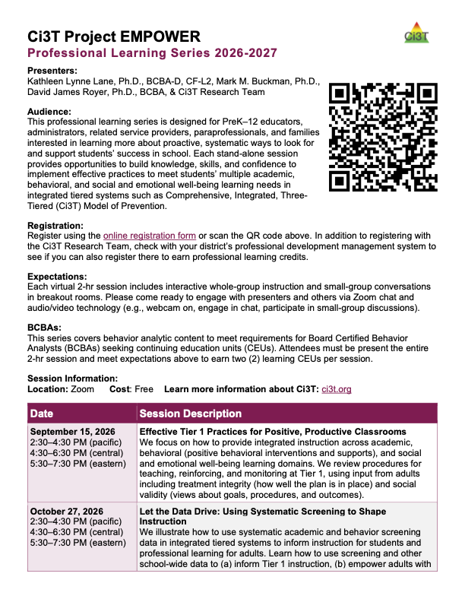
Project EMPOWER
EMPOWER Session | Date
Effective Tier 1 Practices for Positive, Productive Classrooms | September 15, 2026
Let the Data Drive: Using Systematic Screening to Shape Instruction | October 27, 2026
Ci3T in Action: Integrated Lesson Planning for Optimal Instruction | November 17, 2026
A 6-Step Instructional Approach for Responding to Challenging Behavior in Schools | January 20, 2027
A Tier 2 Intervention for Managing Anxious Feelings: Recognize. Relax. Record. | March 23, 2027
A Tier 3 Intervention: Functional Assessment-Based Intervention | April 28, 2027
Notes:
Additionally, we will offer 6 EMPOWER sessions. These are free, stand-alone sessions. Each session is 2hrs and hosted on Zoom. They are designed for current and future educators – including teachers, paraprofessionals, and student teachers- and are extremely practical with an emphasis on ensuring educators walk away with something they can implement in their classroom right away. These sessions can be a great way to distribute leadership and expertise throughout your building! For example, invite 1-2 staff members to attend an EMPOWER session and share their learning/key takeaways at an upcoming faculty and staff meeting.

Slide 23
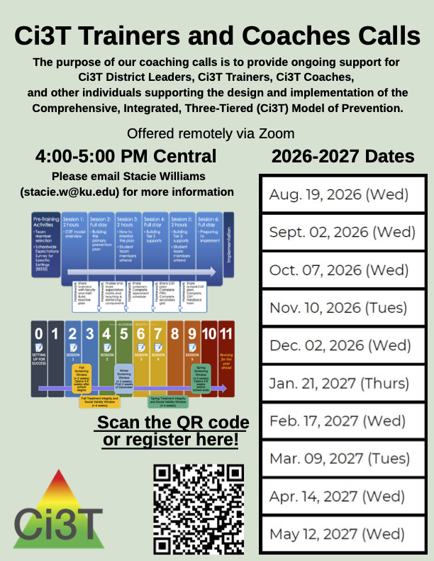
Ci3T Trainers and Coaches Calls
Ci3T Trainers and Coaches Calls Session | Date
Ci3T Trainers and Coaches Call 1 | August 19, 2026 (Wednesday)
Ci3T Trainers and Coaches Call 2 | September 2, 2026 (Wednesday)
Ci3T Trainers and Coaches Call 3 | October 7, 2026 (Wednesday)
Ci3T Trainers and Coaches Call 4 | November 10, 2026 (Tuesday)
Ci3T Trainers and Coaches Call 5 | December 2, 2026 (Wednesday)
Ci3T Trainers and Coaches Call 6 | January 21, 2027 (Thursday)
Ci3T Trainers and Coaches Call 7 | February 17, 2027 (Wednesday)
Ci3T Trainers and Coaches Call 8 | March 9, 2027 (Tuesday)
Ci3T Trainers and Coaches Call 9 | April 14, 2027 (Wednesday)
Ci3T Trainers and Coaches Call 10 | May 12, 2027 (Wednesday)
Notes:
Ci3T Trainers and Coaches Calls are a great opportunity to come and ask questions! These are not recorded the agenda focuses on “open mic” time where people can come to ask their honest questions and talk through implementation challenges. This is a great avenue to ask questions, listen, and learn from Ci3T implementers across the country and internationally.

Slide 24
School or District Professional Learning
Onboarding (e.g., new staff orientation)
District-wide PD Days
Predictably scheduled professional leaning opportunities
  Professional Learning Communities (PLCs)
  1 hour on the 3rd Wednesday of the month

Slide 25


Responding to Data
What professional learning is necessary to respond to:
Spring screening data
Primary Intervention Rating Scale (PIRS) Pre-Intervention
Ci3T Feedback Form

Slide 26
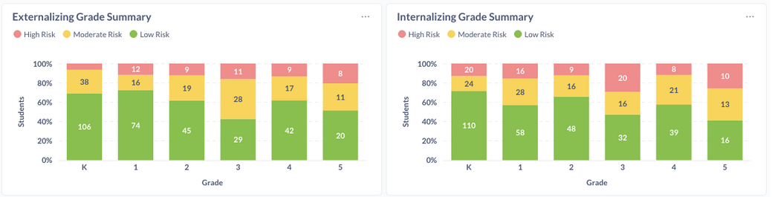
Responding to Data:
Spring Behavior Screening Data
Notes:
Spring Screening Data indicates Tier 1 is not yet meeting the needs of 75-80% of students.

Slide 27
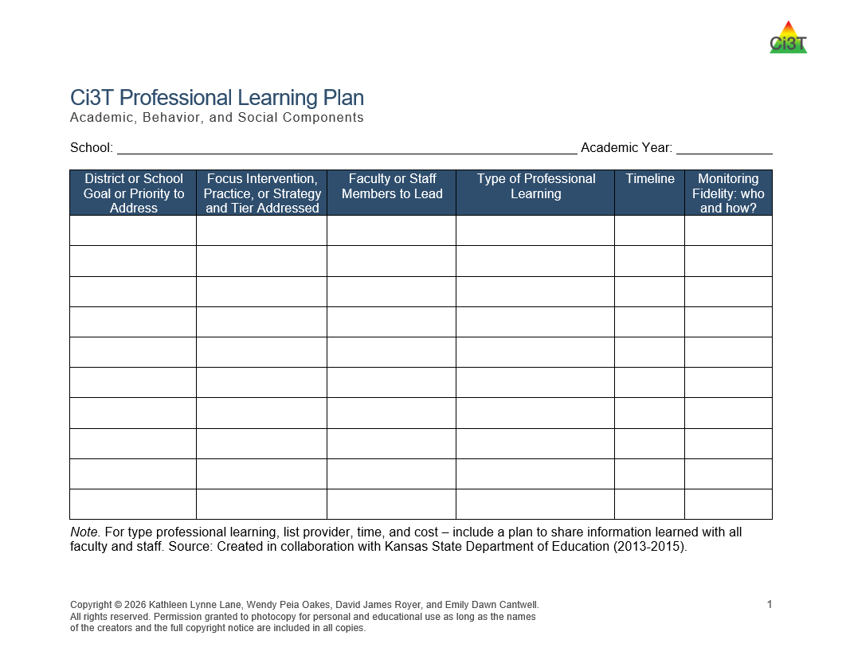
Responding to Data
R04 Ci3T Professional Learning Plan

Slide 28
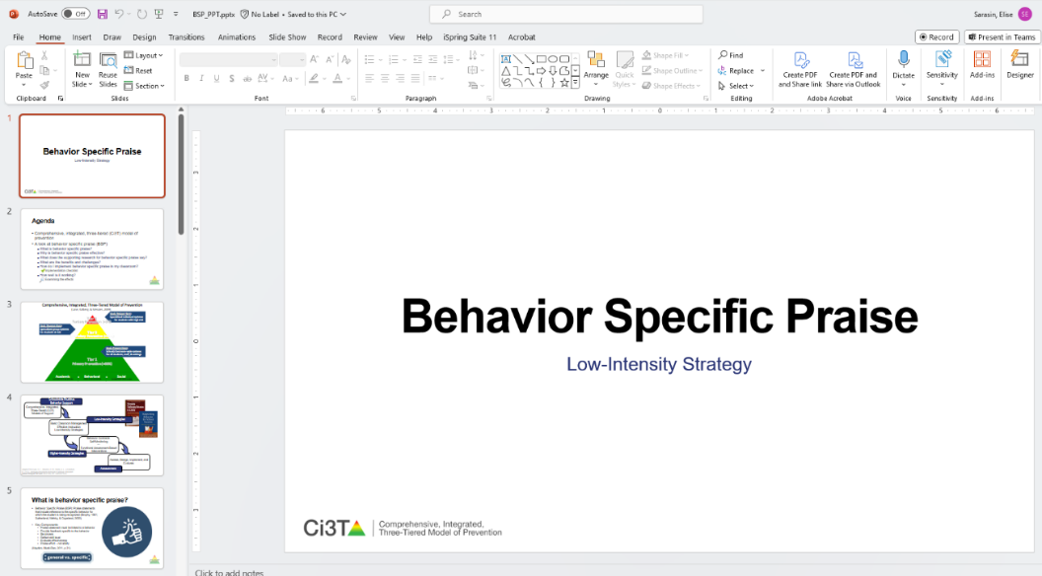

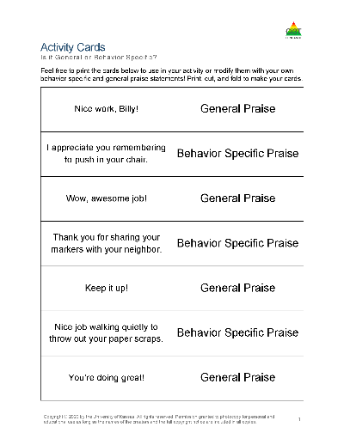
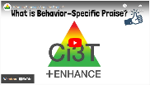
Responding to Data:
Data-Informed Professional Learning
Stand-alone professional learning session
Multi-part professional learning series
  “book” study using Behavior-Specific Praise module
  kick-off session at faculty & staff meeting with follow up in PLCs
Assign Behavior-Specific Praise module
Build into newsletter (e.g., video, infographic, staff spotlight)
Hi Lincoln Elementary!
Happy Monday ☺
Our strategy of the month is behavior-specific praise! Check out this video (3 mins) to learn more!
Notes:
You might choose one or more of the following:
Stand-alone professional learning session – use PPT presentation, activity cards, and resources from the module
Multi-part series
Module book study
Kick-off session at faculty & staff meeting with follow up in PLCs
Assign Behavior-Specific Praise module
Build into newsletter (e.g., video, infographic, staff spotlight)

Slide 29
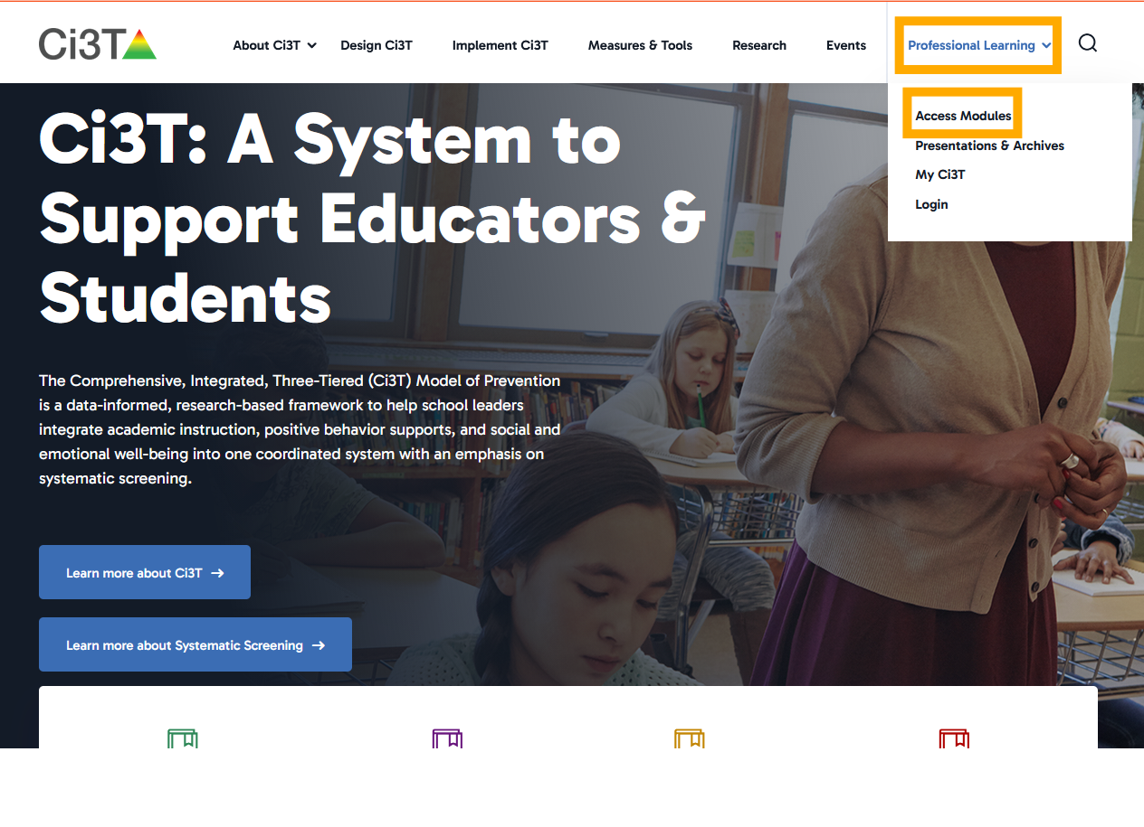
Ci3T: A System to Support Educators and Students Website: Professional Learning, Access Modules

Slide 30
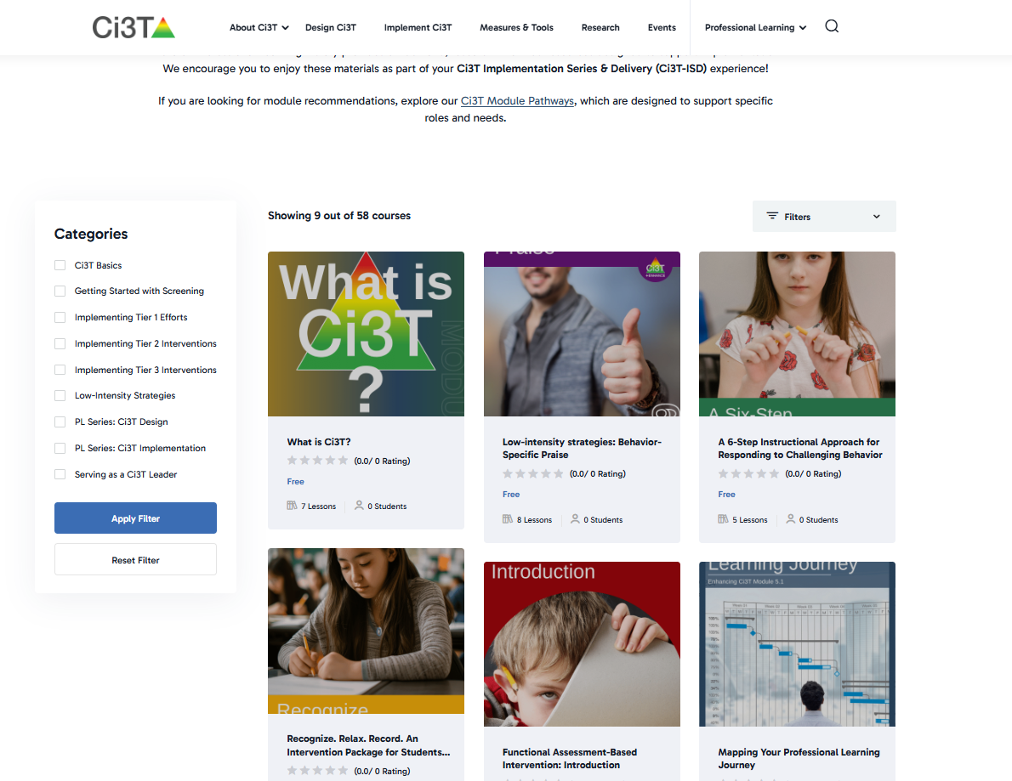
Ci3T Website: Using the Filter

Slide 31
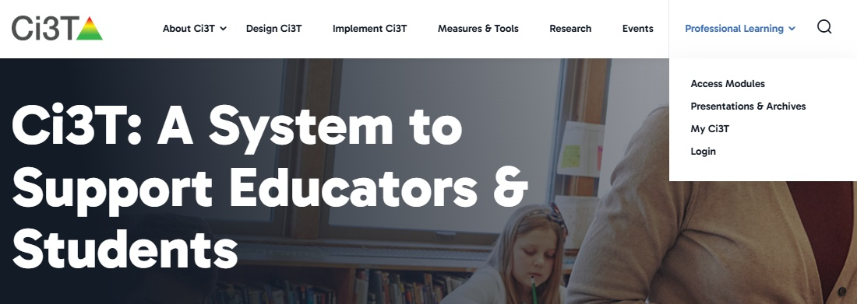
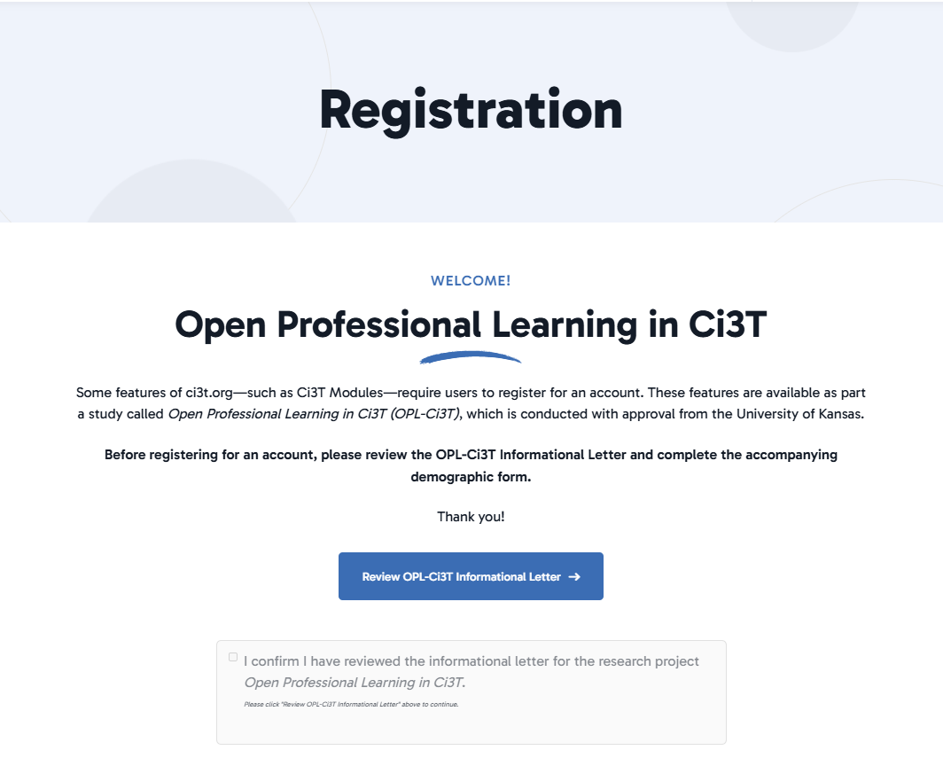
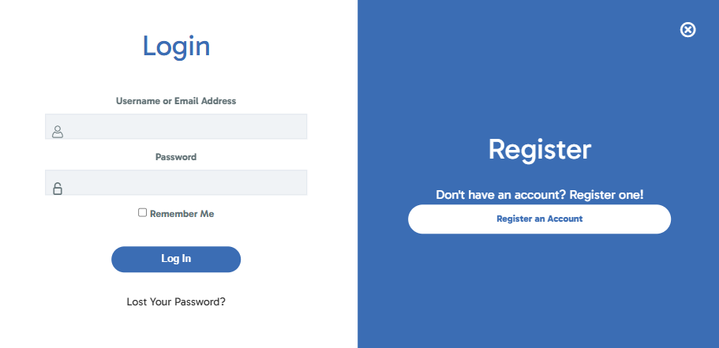
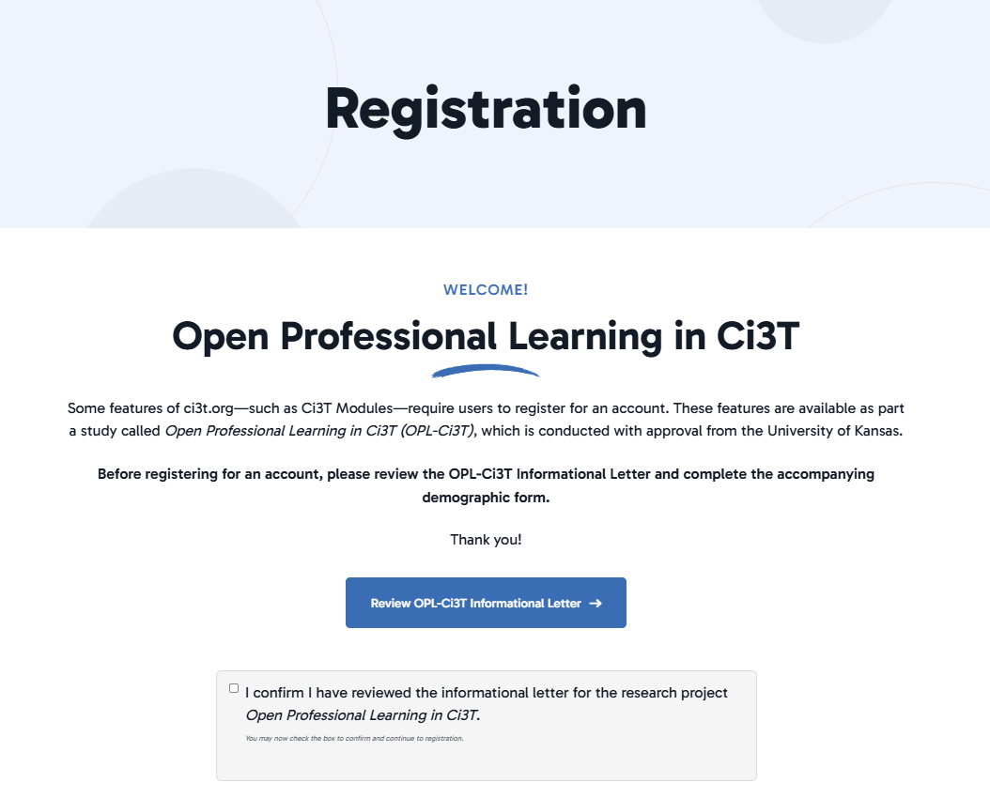
Module Access: Account Creation
Review
OPL-Ci3T
Informational Letter
Confirm review
Create an account

Slide 32

Work Time: Scheduling Professional Learning Opportunities
What professional learning priorities might you set based on:
  PIRS Pre-Implementation
  Ci3T Feedback Form (see R04: Ci3T Professional Learning Plan)
  Spring screening data
Schedule professional learning opportunities
Notes:
30-minutes

Slide 33
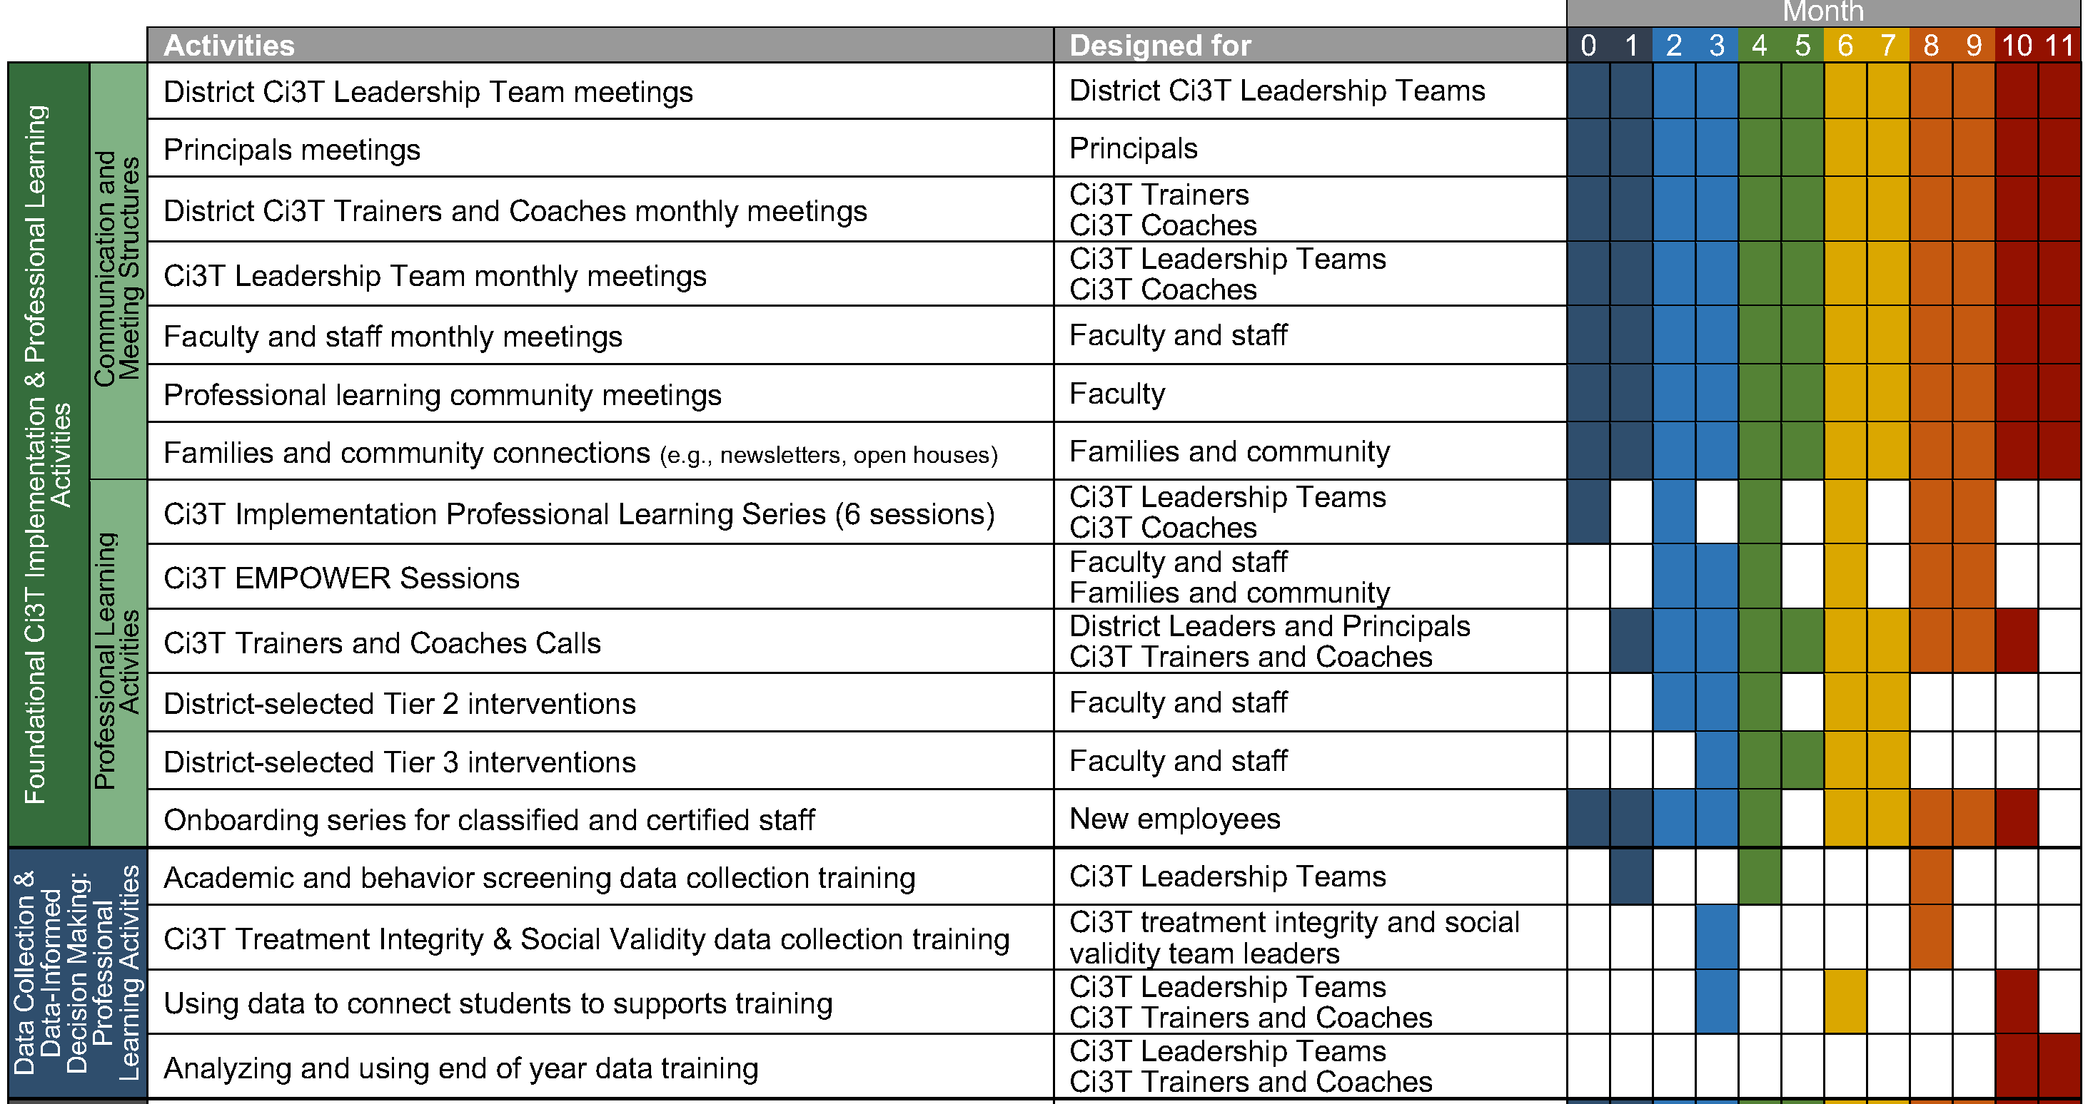
Step 3: Schedule Professional Learning to Support Data Collection and Data-informed Decision Making

Slide 34
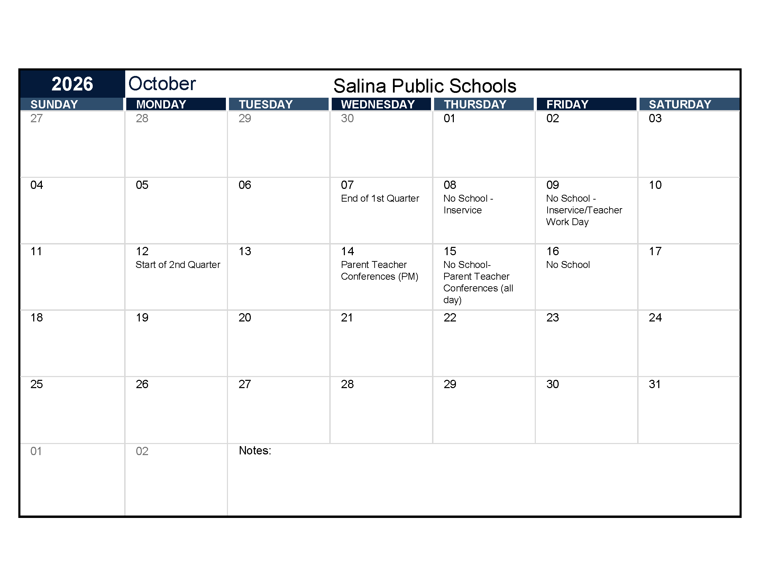
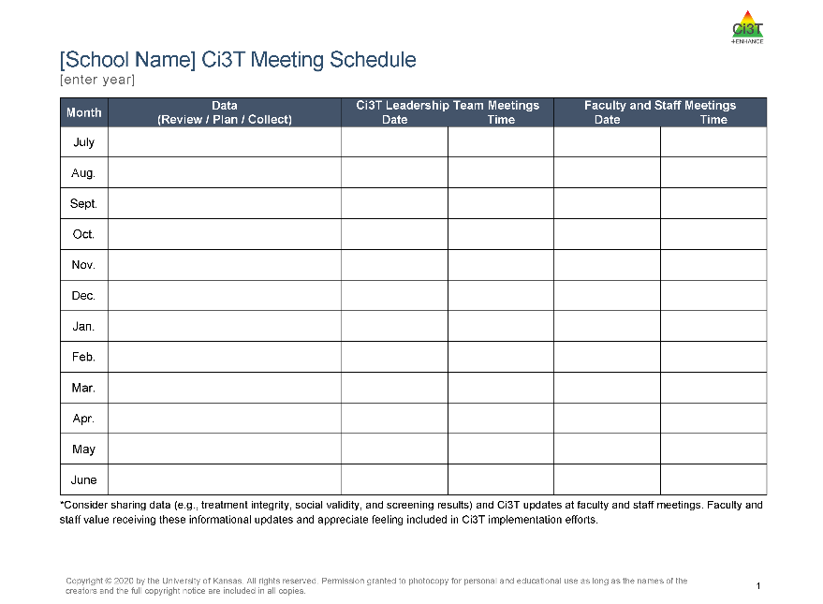
Backwards Planning from Assessment Windows
First – add academic and behavior screening windows and treatment integrity and social validity windows to your calendar
Then, use this these windows to backwards plan:
  Agenda items for Ci3T Leadership Team Meeting
  Faculty & Staff Meetings
  Additional Professional Learning
Treatment Integrity and Social Validity Windows
Timepoint | Open | Close | Report
Fall | 10/07/26 | 11/20/26 | 12/04/26
Spring | 02/15/27 | 03/26/27 | 04/07/27

Slide 35
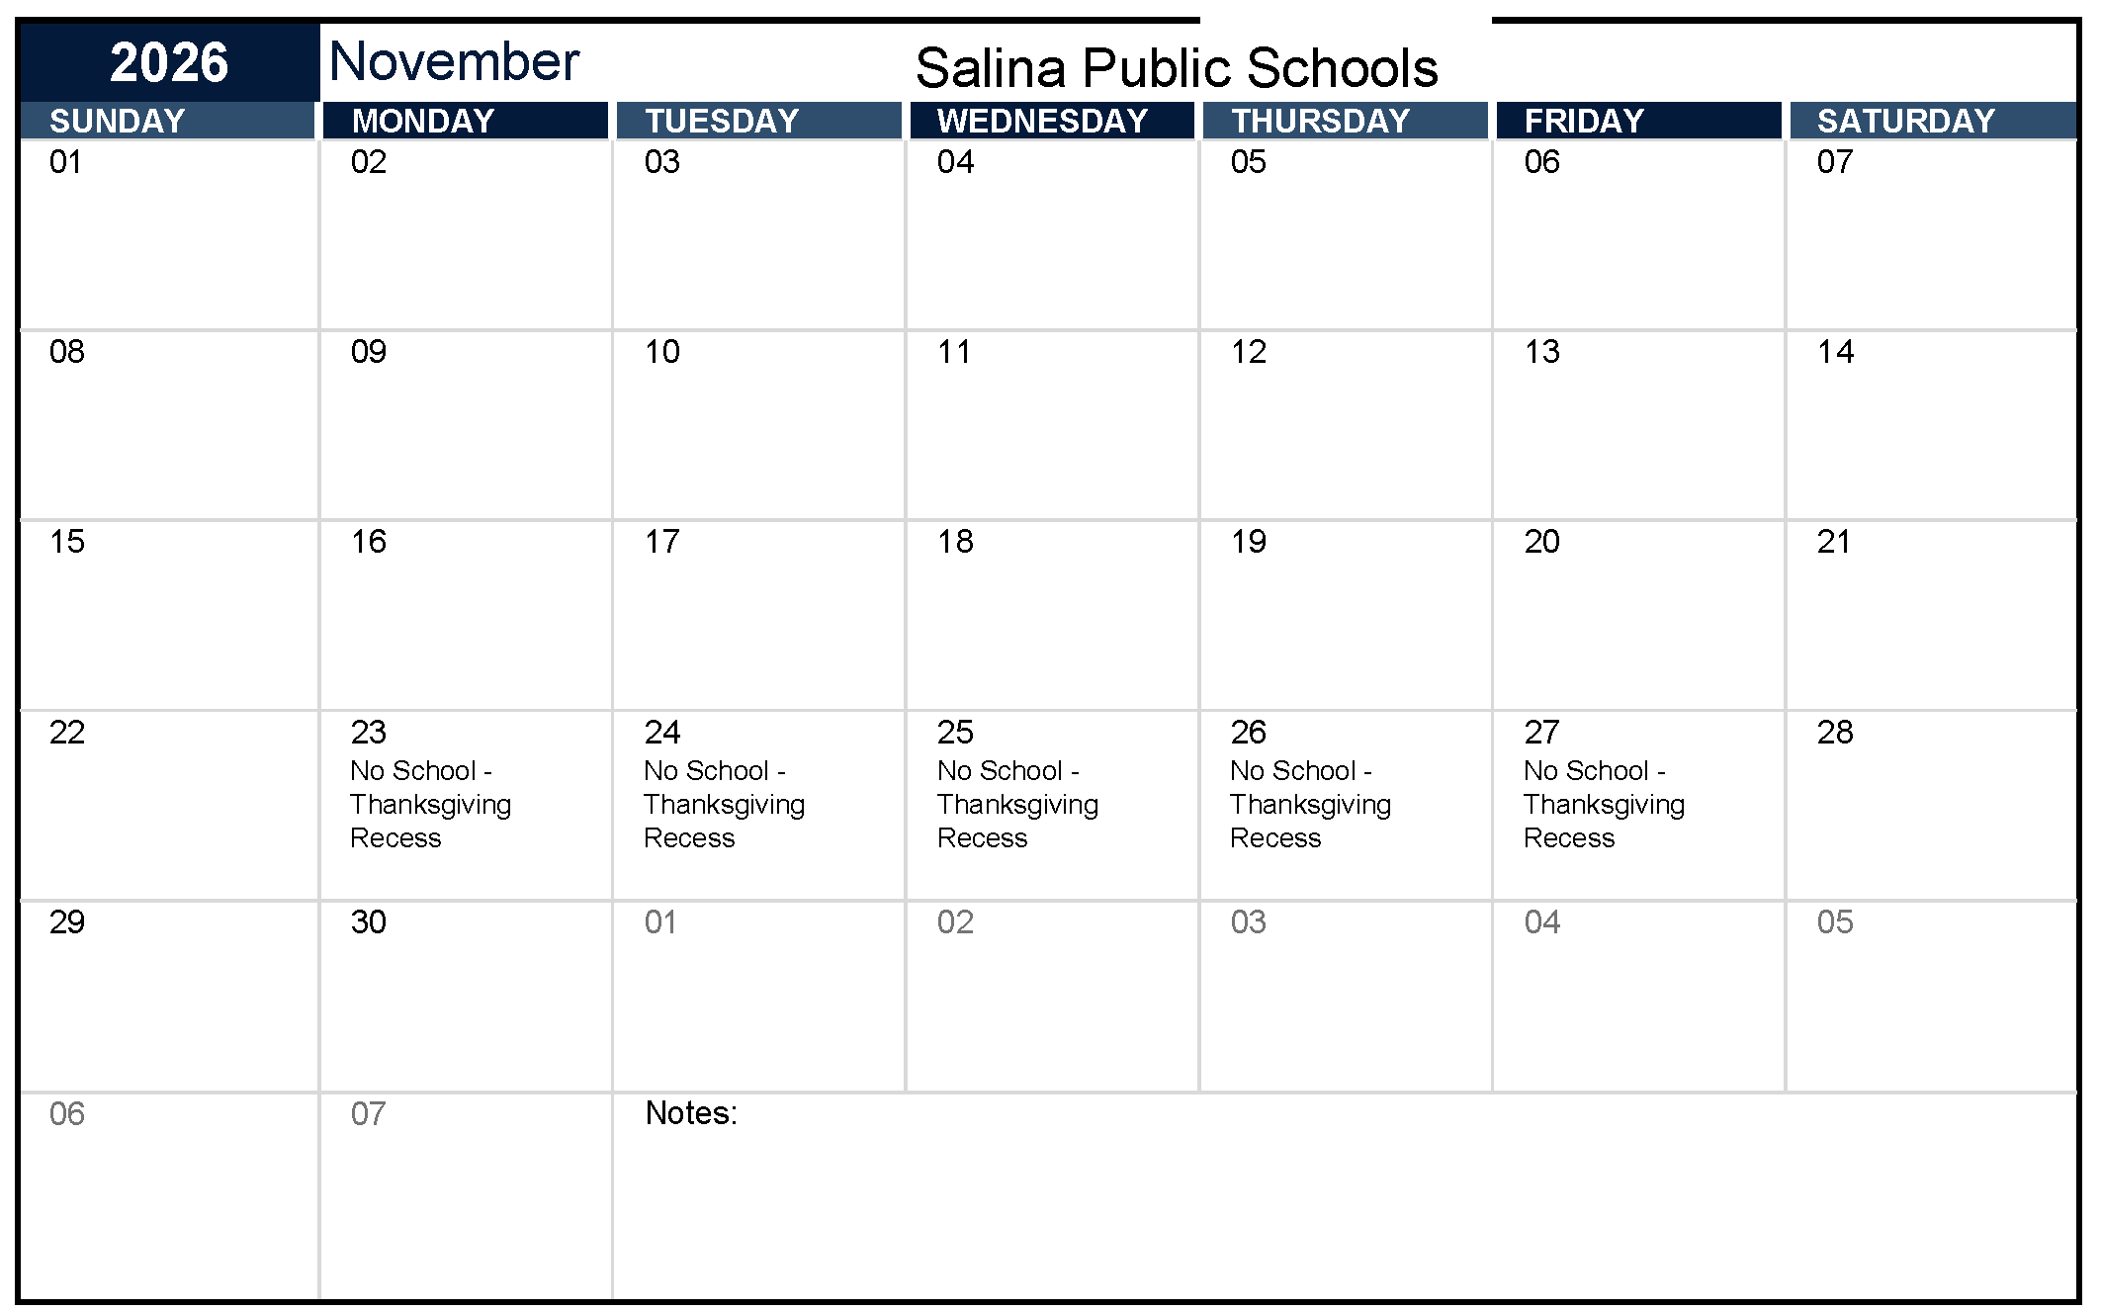
Backwards Planning: Faculty and Staff Measure Completion
Treatment Integrity and Social Validity Windows
Timepoint | Open | Close | Report
Fall | 10/07/26 | 11/20/26 | 12/04/26
Spring | 02/15/27 | 03/26/27 | 04/07/27
When during this window can we set aside time during a faculty meeting for staff to complete these measures?
Measures include:
Primary Intervention Rating Scale (PIRS)
Ci3T Treatment Integrity: Teacher Self-Report (Ci3T TI: TSR)
Ci3T Treatment Integrity: Direct Observation (Ci3T TI: DO)
Tiered Fidelity Inventory (TFI)
Notes:
Can tell people proactively – don’t worry, I set aside time for us to do this as a team in November.

Slide 36

Backwards Planning: TFI Completion
Faculty and Staff Complete SV & TI
Consider allocating an existing Ci3T Leadership Team meeting towards TFI completion
Treatment Integrity and Social Validity Windows
Timepoint | Open | Close | Report
Fall | 10/07/26 | 11/20/26 | 12/04/26
Spring | 02/15/27 | 03/26/27 | 04/07/27
We also need to complete the TFI during this window. When will our Ci3T Leadership Team meet to do this?
Measures include:
Primary Intervention Rating Scale (PIRS)
Ci3T Treatment Integrity: Teacher Self-Report (Ci3T TI: TSR)
Ci3T Treatment Integrity: Direct Observation (Ci3T TI: DO)
Tiered Fidelity Inventory (TFI)

Slide 37
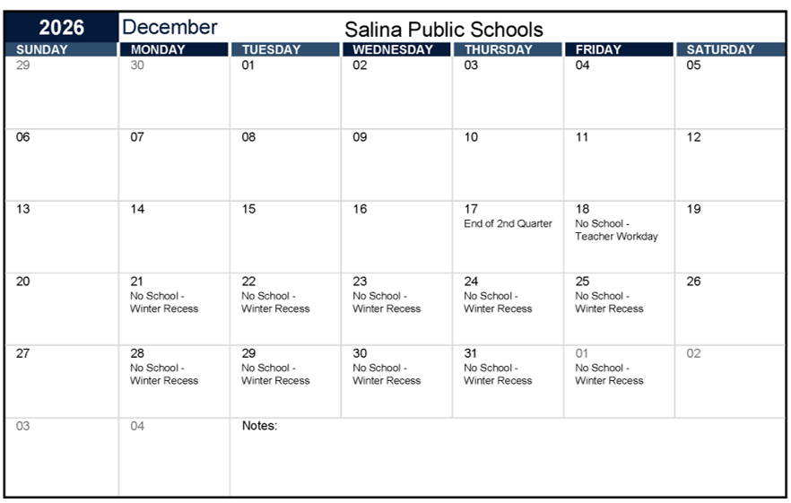
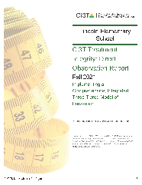

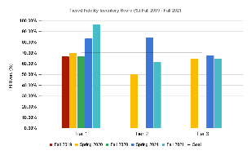
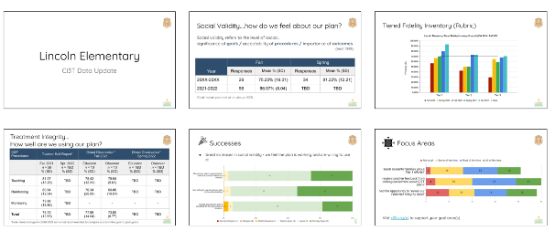
Backwards Planning: Sharing Out Data
When will our
Ci3T Leadership team meet to review these data?
Session 3 of the Ci3T Implementation Professional Learning Series (January 12, 2027) is focused on reviewing and responding to these data!
When will we share out these data with faculty and staff?
Treatment Integrity and Social Validity Windows
Timepoint | Open | Close | Report
Fall | 10/07/26 | 11/20/26 | 12/04/26
Spring | 02/15/27 | 03/26/27 | 04/07/27
Measures include:
Primary Intervention Rating Scale (PIRS)
Ci3T Treatment Integrity: Teacher Self-Report (Ci3T TI: TSR)
Ci3T Treatment Integrity: Direct Observation (Ci3T TI: DO)
Tiered Fidelity Inventory (TFI)
Notes:
Feedback is a gift; people took the time to complete those measures and share their perspective and experiences.
Want to make sure, proactively setting aside time to review and respond to those data with your Ci3T Leadership Team AND close-the-loop by sharing data and key takeaways with staff.

Slide 38


Putting it All Together: An Illustration
Ci3T Implementation Manual revisions
7 / 8 / 26
8 / 5 / 26
9 / 9 / 26
10 / 7 / 26
11 / 11 / 26
12 / 9 / 26
1 / 13 / 27
2 / 10 / 27
3 / 10 / 27
4/ 14 / 27
5 / 12 / 27
6 / 9 / 27
3:00 – 4:00 pm
3:00 – 4:00 pm
3:00 – 4:00 pm
3:00 – 4:00 pm
3:00 – 4:00 pm
3:00 – 4:00 pm
3:00 – 4:00 pm
3:00 – 4:00 pm
3:00 – 4:00 pm
3:00 – 4:00 pm
3:00 – 4:00 pm
3:00 – 4:00 pm
7 / 15 / 26
8 / 12 / 26
9 / 16 / 26
10 / 14 / 26
11 / 18 / 26
12 / 16 / 26
1 / 20 / 27
2 / 17 / 27
3 / 17 / 27
4/ 21 / 27
5 / 19 / 27
6 / 16 / 27
3:00 – 4:00 pm
3:00 – 4:00 pm
3:00 – 4:00 pm
3:00 – 4:00 pm
3:00 – 4:00 pm
3:00 – 4:00 pm
3:00 – 4:00 pm
3:00 – 4:00 pm
3:00 – 4:00 pm
3:00 – 4:00 pm
3:00 – 4:00 pm
3:00 – 4:00 pm
plans to collect academic and behavior screening data
Review ODR reports (disaggregated by grade, location, behavior type)
Review SRSS-IE and academics screening data; plan for staff to complete TI/SV surveys
complete TFI
Review TI/SV, review ODR and attendance
Plan Spring TI/SV data collection; review Winter screening data
Review ODR and attendance, make plans for staff to do TI/SV surveys
Complete TFI
Review Spring TI/SV
Review Spring screening data

Slide 39
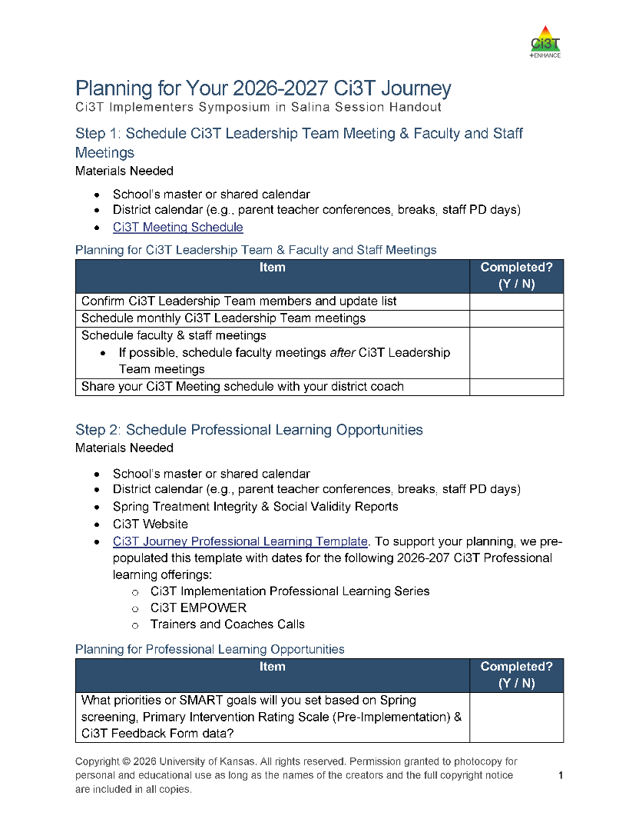
Work Time: Professional Learning to Support Data-Informed Decision Making
Add academic screening, behavior screening, and treatment integrity and social validity windows to your calendar
Schedule time for:
  Preparing for data collection
  Faculty and staff to complete measures
  Ci3T Leadership Team to review data and make action plans
  Sharing data back with faculty and staff
Notes:
20-minutes

Slide 40
Session Outcomes: Check-In
Create and calendar out implementation plans for the 2026-2027 academic year (e.g., Ci3T Leadership Team meetings, faculty & staff meetings, opportunities to complete behavior screening)
Use needs of faculty, staff, and students to inform professional learning for faculty and staff and updates to your school’s Ci3T Implementation Manual
Prepare to share key Ci3T information with faculty, staff, students, and families at the beginning of the 2026-2027 school year
  Develop Professional learning activities for faculty and staff when teachers return (before students arrive)
  Develop roll-out plans for the first 30 days of the school year

Slide 41
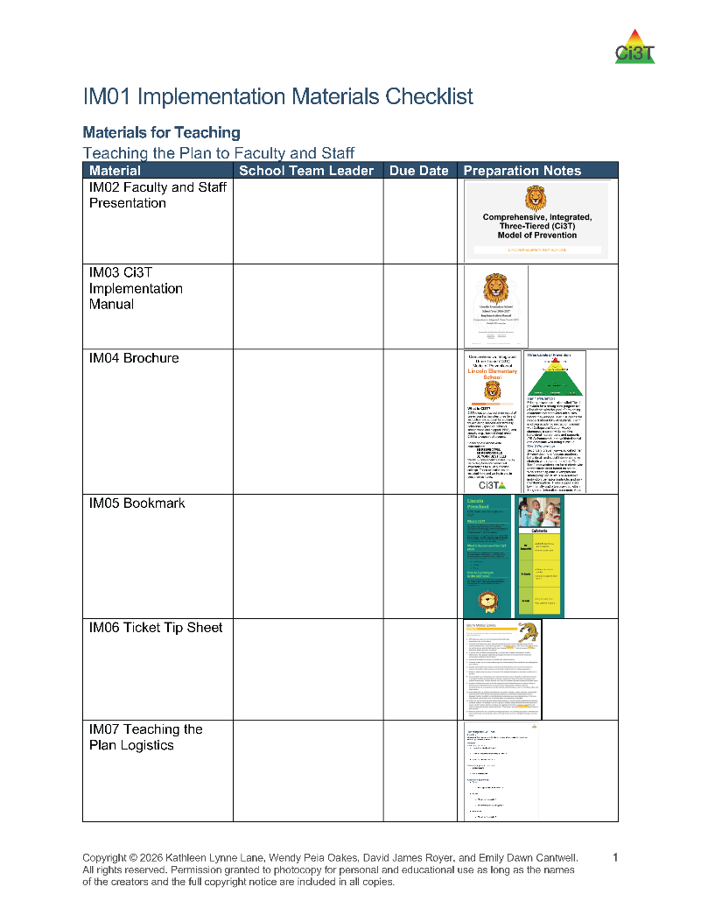
Working Lunch
Use IM01 Ci3T Implementation Materials Checklist to review the materials you have prepared so far
Which materials are complete?
Which materials are drafted and need refinement?
Are there additional materials you would like to prepare?
We will return at 12:15 pm
Notes:
20-minutes

Slide 42
Question & Answer Part 1

Slide 43
Setting Up for the Year Ahead
Welcoming back the adults in your building
Welcoming back students and families

Slide 44



Preparing for your Kickoff
Teaching Faculty
Teaching Students
Implementation Manual
Kickoff Assembly
Faculty Roll-Out
Setting Lessons

Slide 45

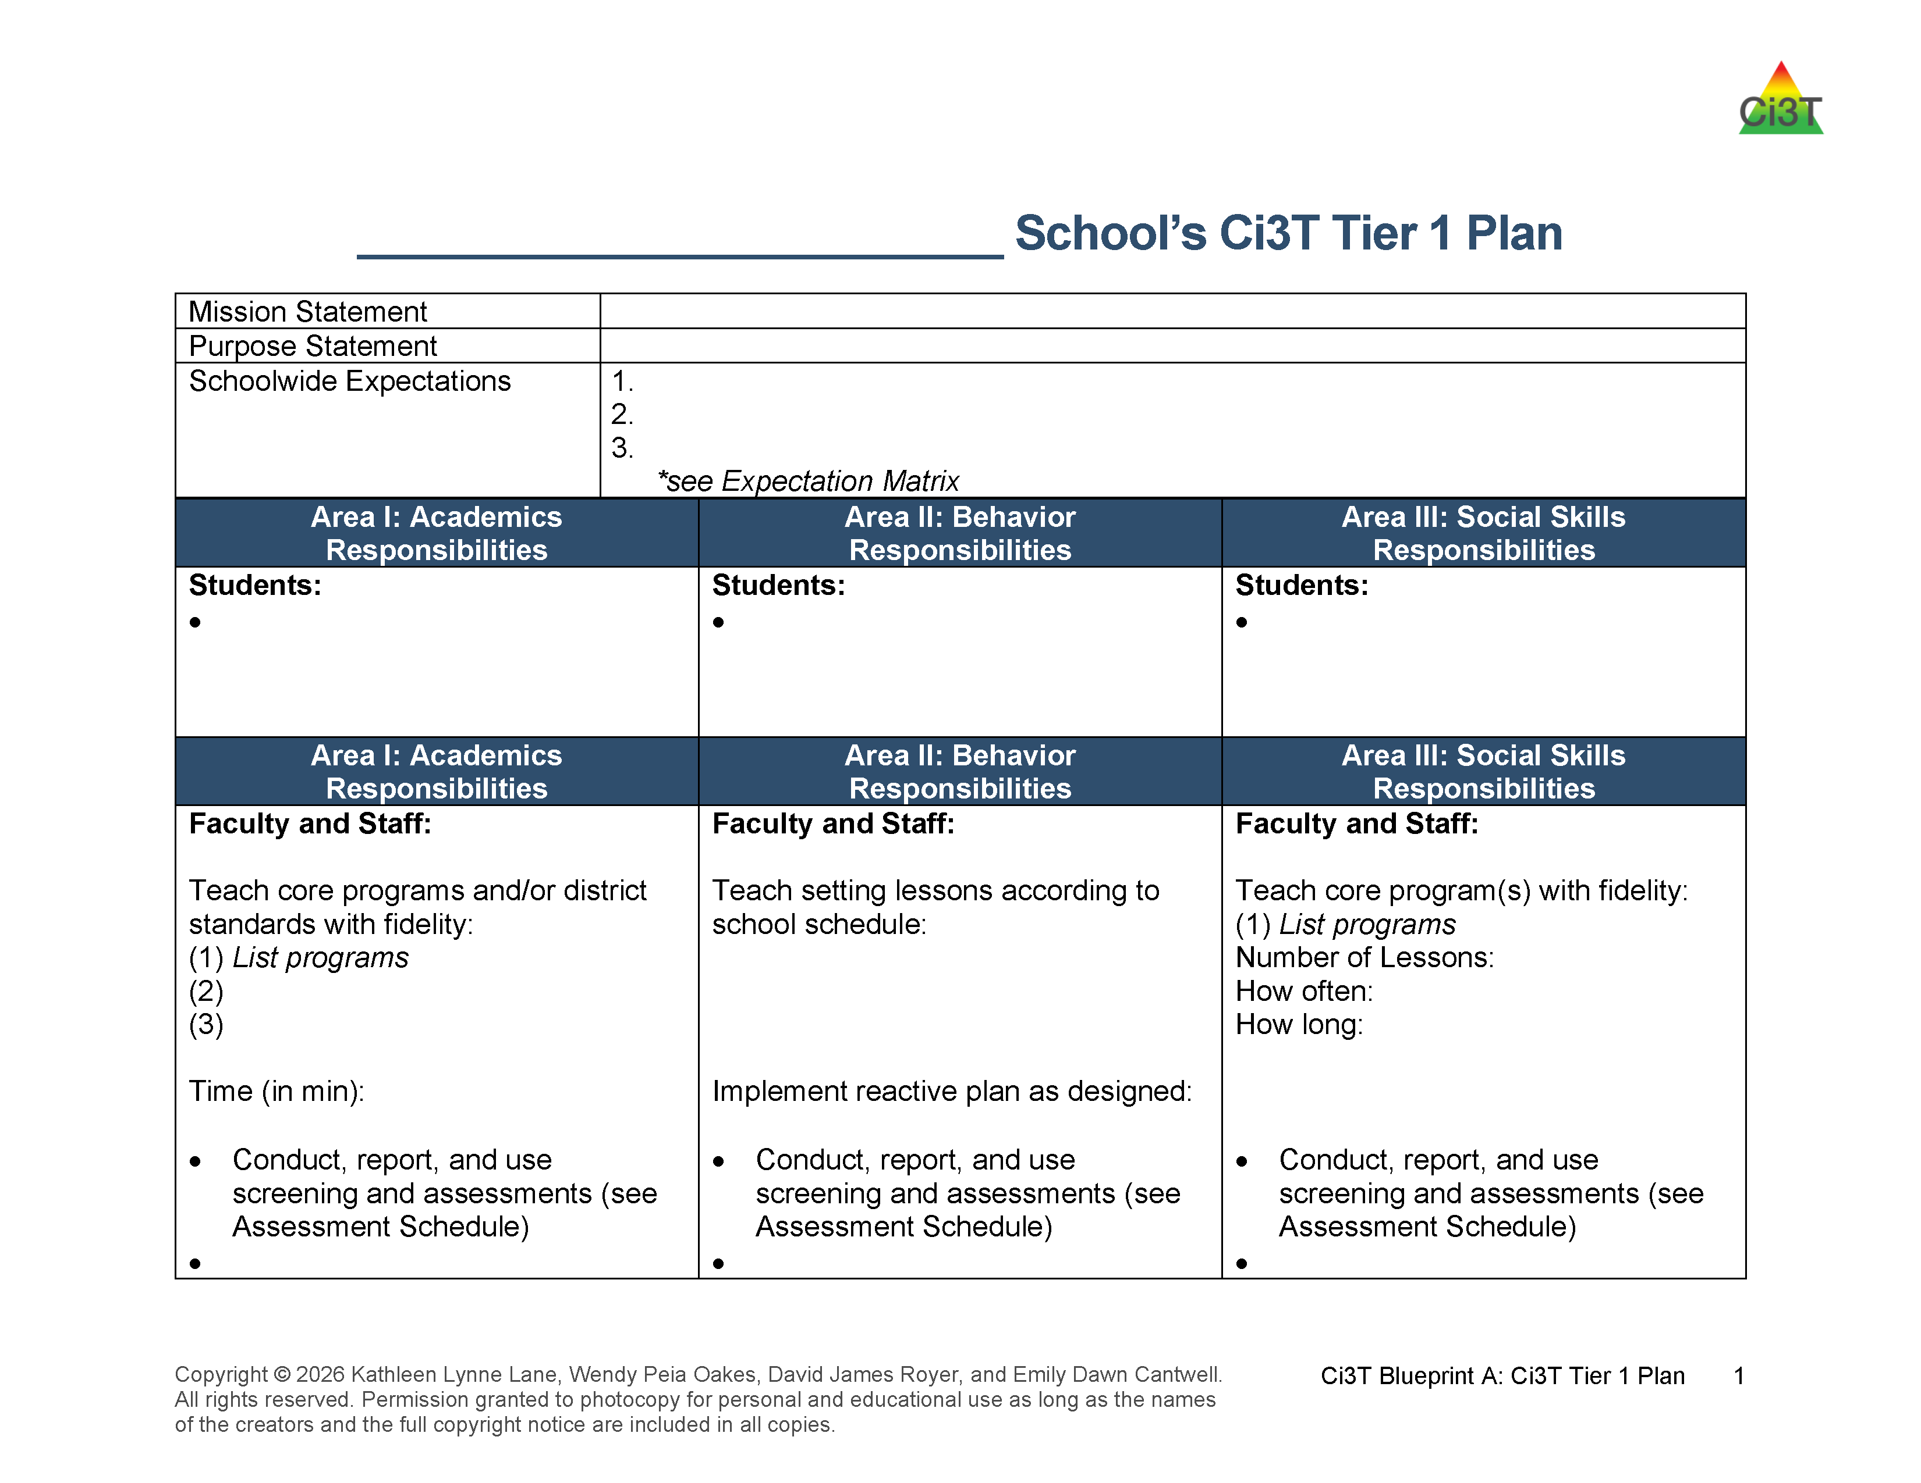


Ci3T Tier 1 Plan: Faculty and Staff Roles and Responsibilities
Locate in your Ci3T Implementation Manual

Slide 46



Academic
VALIDATED
CURRICULUM
Visible Learning
Notes:
low-intensity strategies work to support our Visible Learning focus to create greater opportunities for classroom discussion and engagement with high-level questions.

Slide 47
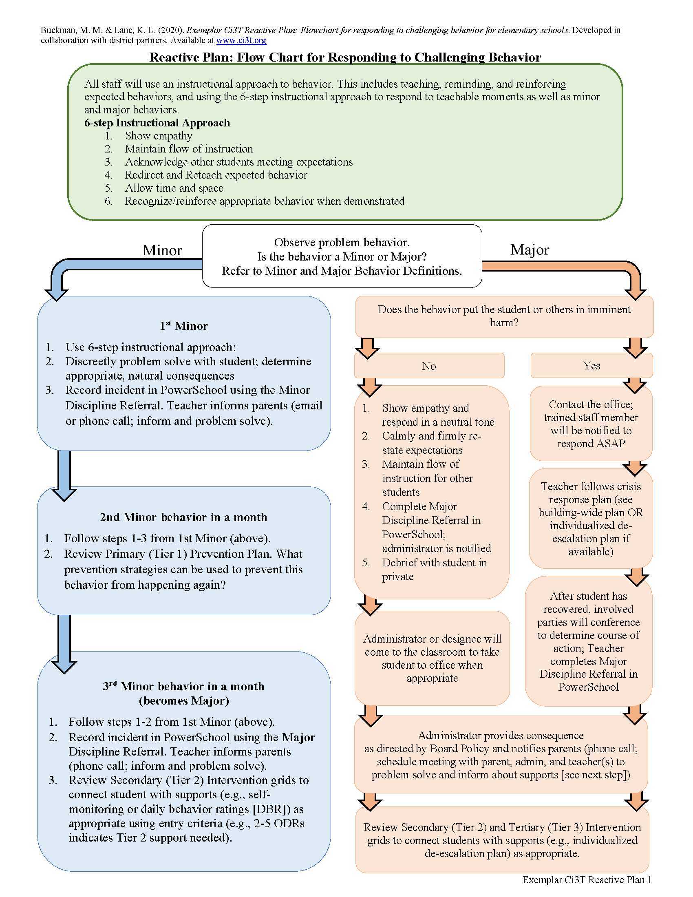
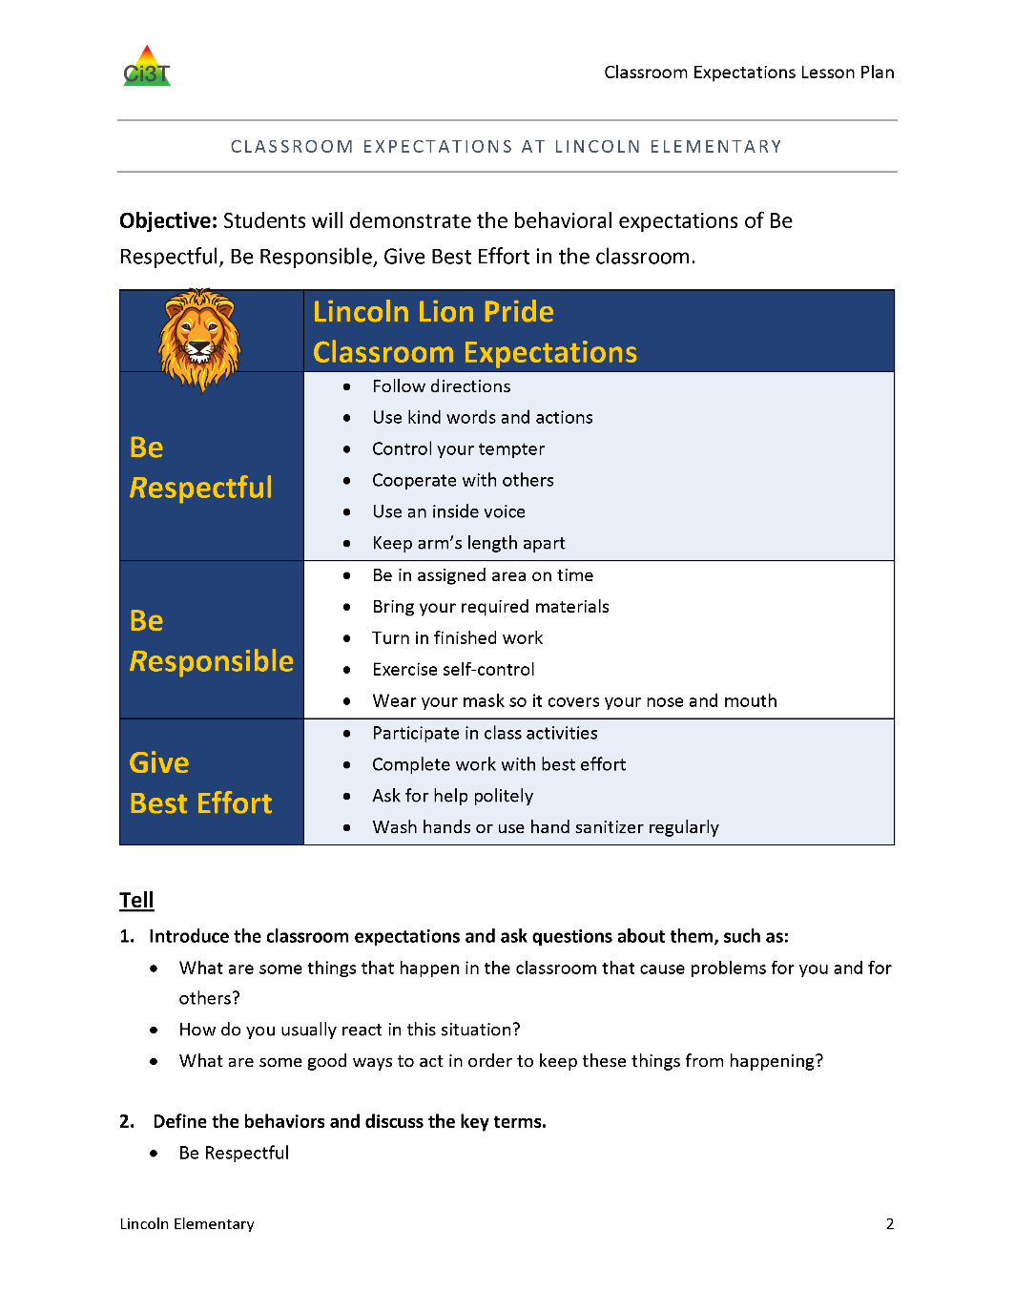

Behavior

Slide 48



Social and Emotional Well-Being
VALIDATED
CURRICULUM
Notes:
CharacterStrong is a district resource for social and emotional well-being and that there is a scope and sequence to provide guidance to buildings.

Slide 49

Procedures for Teaching
Locate in your Ci3T Implementation Manual

Slide 50


IM01 Implementation Materials Checklist
Notes:
Many of the ideas we are about to feature are included in IM01 Implementation Materials Checklist (a resource you used during the Design series when you built your Ci3T model!) and have newly updated templates!

Slide 51

Procedures for Teaching Example: Faculty and Staff
  REMEMBER
  This is a school-wide plan: ALL students, faculty, and staff are included. Practices are used across all school settings
Consider feedback prior to presenting
Notes:
51

Slide 52



Procedures for Teaching Faculty & Staff:
Beginning of Year Roll Out
Notes:
Ci3T Implementation Manual, Expectation Matrix, and resources like ticket tip sheets and bookmarks are printed and part of a welcome kit (e.g., delivered to classrooms, distributed as part of faculty & staff meeting)
In addition to making sure everyone has a copy, create intentional opportunities to build familiarity with your school’s Ci3T Implementation Manual. For example – you might build 15 minutes into back-to-school PD for a scavenger hunt of the Ci3T Implementation Manual and / or the Ci3T website – a sample scavenger hunt is available in The Tier 2 Process Module

Slide 53






Procedures for Teaching Faculty & Staff:
Universal Reinforcement Roll Out
Notes:
As you consider how to roll out your universal reinforcement system, use your Spring TI data to guide decisions for when and how you will share details with faculty and staff.
For example, if Spring data indicated the universal reinforcement system is not yet being implemented consistently – specifically delivering tickets for students who meet school-wide expectations and opportunities to exchange tickets, you might choose to:
Allocate time during back-to-school PD to reset, explain the “why” behind the system, and clarify expectations
Connect faculty and staff with module resources such as frequently asked questions, videos, and infographics professional learning
Distribute Ci3T Tips for Tickets (Ci3T Implementation Material – 06)
Prioritize monitoring use of universal reinforcement system – including celebrating successes in communication with faculty and staff

Slide 54




Procedures for Teaching Faculty & Staff:
Onboarding
Notes:
In addition to back-to-school professional learning for all faculty and staff, you will also need a plan to onboard faculty and staff who are new to your building
Be sure to consider opportunities to onboard all staff including: paraprofessionals, related service providers, bus drivers, substitute teachers, custodial staff, and cafeteria staff
Onboarding could include:
Session for teachers new to your school with a deeper dive into the Ci3T Implementation Manual and more about the “why” behind your Ci3T Plan
Brief video overview that can be shared via email or with a QR code
Bookmarks and one-pagers for each setting like the bus or cafeteria

Slide 55
Work Time: Procedures for Teaching (Faculty & Staff)
What professional learning is needed to onboard new staff?
What beginning of year professional learning is needed for all staff (e.g., understanding tickets and reinforcement, integrated lesson planning).
What Implementation Materials are needed to teach the Tier 1 plan to:
  Faculty and Staff (e.g., teachers, paraprofessionals, related service providers, cafeteria staff, custodial staff)
  Bus drivers
  Substitutes and volunteers
District-level support available for teaching bus drivers, food service, and custodial staff!
Notes:
30-minutes

Slide 56
Procedures for Teaching Example: Students
REMEMBER: Student engagement increases student ownership!

Slide 57




Procedures for Teaching Students
Beginning of Year Roll Out 1
Posters
  IM08: Poster School-Wide Expectations
  IM08b: Poster Expectation Matrix
  IM09 Poster Expectations – Specific Settings
  Student created materials
IM09
IM08
IM08B
Shared with permission.

Slide 58







Procedures for Teaching Students
Beginning of Year Roll Out 2
Lessons
  IM10a Setting Lessons Presentation
  IM10b Setting Lessons Teacher Guide
Videos
Announcements
Assemblies
IM10b
IM10a
Shared with permission.

Slide 59
Procedures for Teaching Students
Scheduling Beginning of Year Roll Out
You might consider adding the following to your 2026-2027 Ci3T Implementation Calendar
Beginning of year kick-off assembly
Behavior expectation lessons (by setting)

Slide 60
Work Time: Procedures for Teaching (Students)
How and when will expectations lessons be taught to students?
What Implementation Materials are needed to teach the Tier 1 plan to students?
Notes:
20-minutes

Slide 61
Procedures for Teaching Example: Parents & Community

Slide 62




Procedures for Teaching Family & Community
Back-to-School Night
Communication to families
  Letters
  Brochures
  Infographics
School website
Contacts with community businesses
See district communication templates
Shared with permission.
Notes:
Consider opportunities to share about Ci3T with families such as back to school night or open house, brochures, and updating your school website. You might also consider sharing infographics featured in this module!

Slide 63
Work Time: Procedures for Teaching (Family & Community)
When and how will you share your Ci3T plan with families and the community?
What Implementation Materials are needed to share the plan with families and community members?
Notes:
10-minutes

Slide 64

Procedures for Reinforcing
Locate in your Ci3T Implementation Manual

Slide 65



Procedures for Reinforcing Faculty & Staff
(1) day of lunch duty coverage

Slide 66
Work Time: Procedures for Reinforcing (Faculty & Staff)
When and how will you reinforce staff for implementing your school’s Ci3T plan?
Notes:
10-minutes

Slide 67








Procedures for Reinforcing Students

Slide 68
Scheduling Procedures for Reinforcement
You might consider adding the following to your 2026-2027 Ci3T Implementation Calendar
School store
Assemblies
Field trips
Staff appreciation days

Slide 69
Work Time: Procedures for Reinforcing (Students)
What procedures for reinforcement are in place for students?
Notes:
20-minutes

Slide 70
Wrapping Up and Moving Forward

Slide 71
Question & Answer Part 2

Slide 72
Wrapping Up
Today we spent time:
Planning for your 2026-2027 Ci3T Journey
  Ci3T Leadership Team members
  Ci3T Leadership Team meetings
  Faculty & staff meetings
  Data collection (e.g., screening, treatment integrity and social validity)
  Professional learning
Setting up for the year ahead
  Beginning of year roll out for staff, students, and families

Slide 73
Next Steps
Finalize your 2026-2027 Ci3T Implementation Manual
Ensure all Ci3T implementation materials (e.g., tickets, expectation posters) are prepared for the first day of school
Implement your plan to teach the Ci3T plan to students, staff, and families and reinforce their efforts relative to implementing the plan

Slide 74

Session Evaluation
Notes:
https://kusurvey.ca1.qualtrics.com/jfe/form/SV_bIbrKQr8RpLAf66

Slide 75


Thank you!
Thank you!
ci3t.org
#Ci3T
@Ci3Tmodel
Tag us in your Ci3T highlights, we love to see Ci3T in action!
Follow us on Instagram for updates and new resources!
Notes:
Tag us in your Ci3T highlights- we would love to see Ci3T in action! Follow us on Instagram for updates and links to resources! @Ci3TModel
You will receive a brief session evaluation – we value your feedback and would greatly appreciate you taking a few minutes to share your thoughts on what you liked about the session and how we can improve

