Slide 1



Welcome: LPS Learning Exchange Session 2
Functional Assessment-Based Intervention (FABI): An Effective Approach for Supporting Students with Intensive Behavior Intervention Needs
Elise Sarasin, M.S.E
Kathleen Lynne Lane, PhD., BCBA-D, CF-L2
This project was funded in part by Project EPIC (USDE, OSEP Award Number: H325D220011) and Project ENHANCE (IES Project Number R324N190002)
Part 3: April 17, 2026

Slide 2
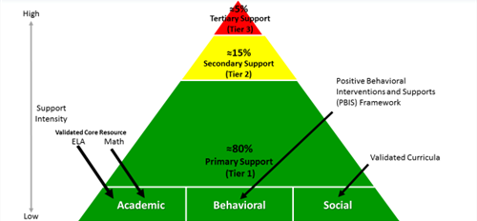

Reflect & Connect: Ci3T
Why is it be important to identify where today’s learning connects to our Ci3T framework?
What is your role in supporting students’ academic, behavior and social needs?
Today, we are focused on Tier 3 to support students with intesive intervention needs across domains

Slide 3
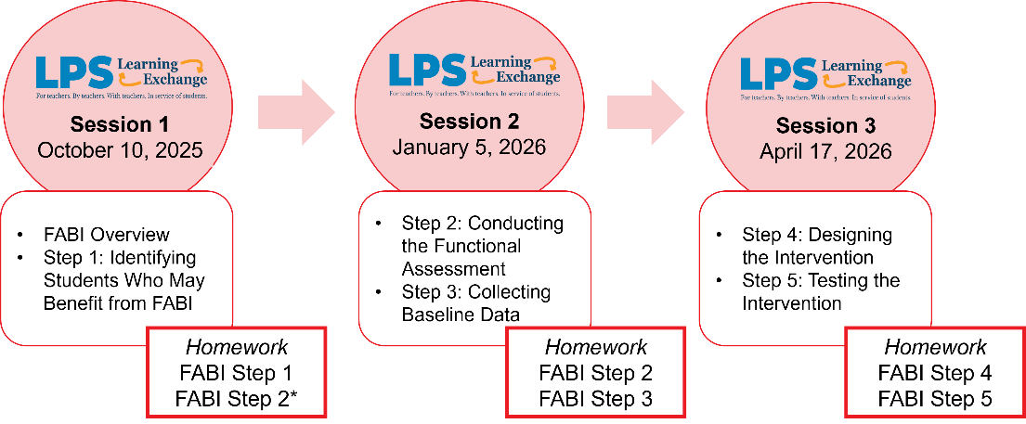
LPS Learning Exchange Series Progression

Slide 4

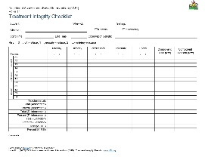
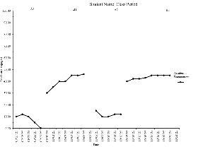
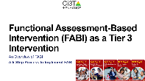
Knowledge, Application, Impact Points
On-Task Behavior: Jackson
You can earn 2 x PD points for application and 3 x for impact!
We are happy to review your materials before you upload ☺
Notes:
Tonight’s session lays the foundation with knowledge building and getting you oriented to the modules that can support application and impact efforts!

Slide 5
Session 3 Outcomes
Select an appropriate intervention method using the Function-Based Intervention Decision Model.
Create antecedent-reinforcement-extinction (A-R-E) components, with specific tactics linked to the maintaining function.
Describe how to test FABI including evaluation of student outcomes, treatment integrity, and social validity.

Slide 6
Agenda
Welcome
Review: Functional Assessment-Based Intervention Process
FABI Step 4: Designing the Functional Assessment-Based Intervention
  Function-Based Intervention Decision Model
  A-R-E Components
FABI Step 5: Testing the Intervention
  Student Outcomes
  Treatment Integrity
  Social Validity
Putting it All Together
Wrapping Up and Moving Forward

Slide 7

Functional Assessment-Based Intervention (FABI)

Slide 8
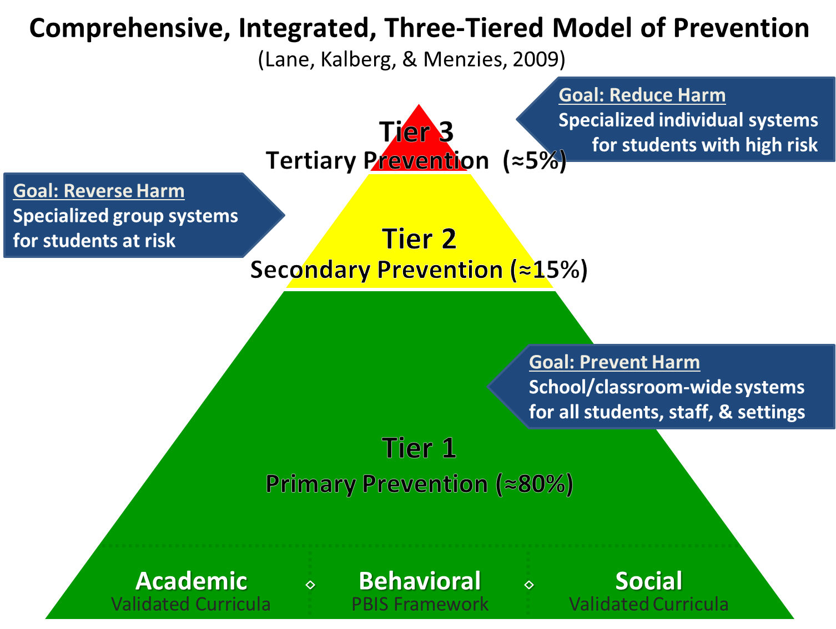
Comprehensive, Integrated, Three-Tiered Model of Prevention 1

Slide 9
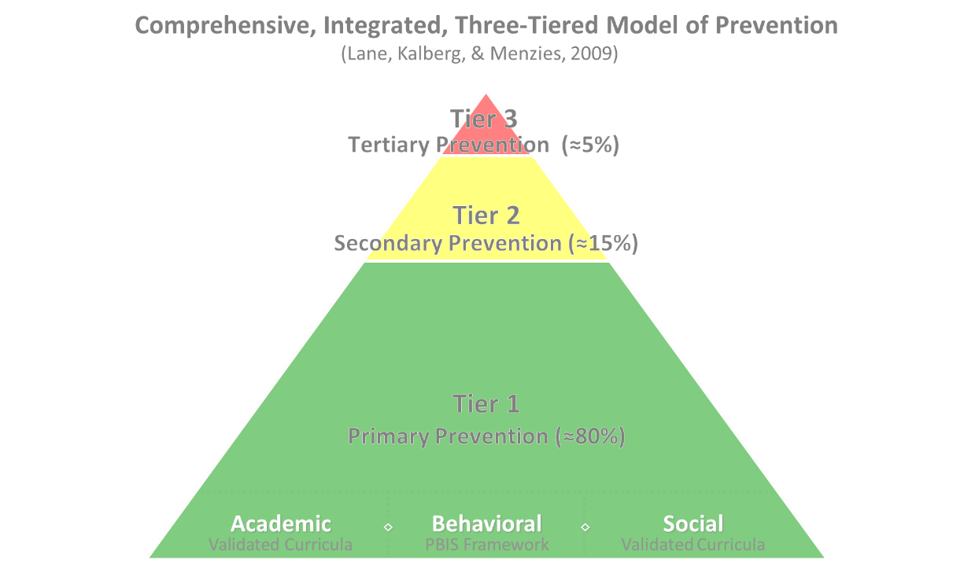

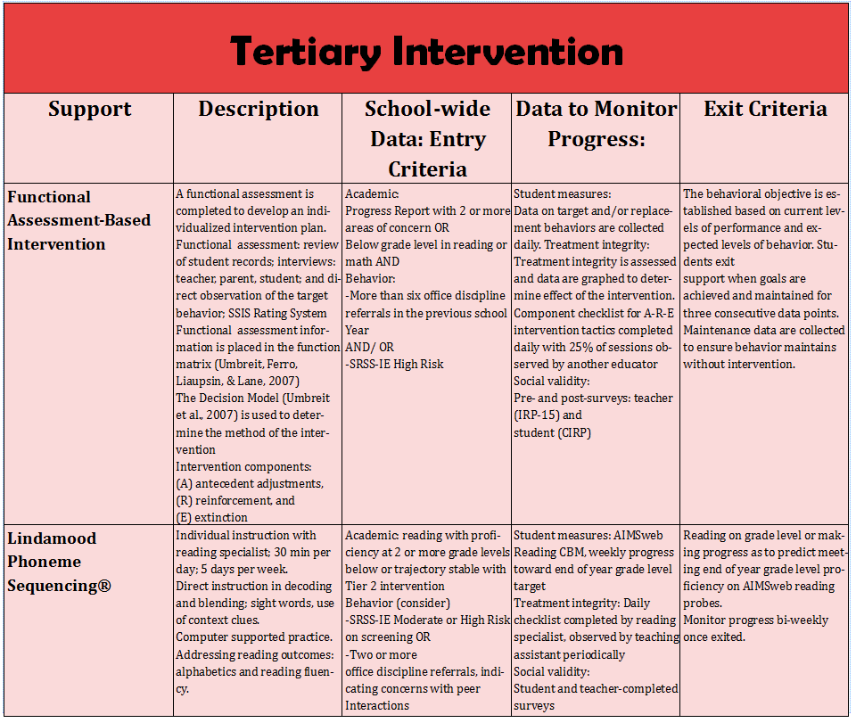
Tertiary (Tier 3) Intervention Grid
Tertiary (Tier 3) Intervention Grid
Notes:
In addition to the module featured here outlining how to use multiple sources of data to connect students with Tier 3 supports, we offer a full suite of modules highlighting validated Tier 3 interventions such as Functional Assessment-Based Intervention (FABI) that may appear in your Tertiary (Tier 3) Intervention Grid

Slide 10

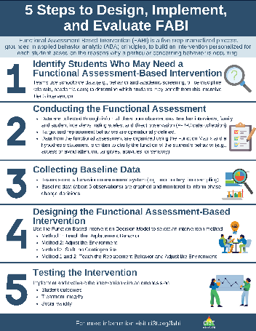
What is Functional Assessment-Based Intervention (FABI)?
Customized intervention designed for each student based on the reasons why a particular concerning behavior is occurring
Developed through a five-step, team-based, manualized process
Grounded in applied behavior analytic (ABA) principles (e.g., reinforcement, antecedent, consequence)
Notes:
PRESENTER NOTE:
FABI is one type of FBA (functional behavioral assessment)
Can be used as a Tier 3 intervention, as we are discussing in this presentation
Can also be used as a process to conduct a functional behavioral assessment (FBA) and develop a behavior intervention plan (BIP) for student’s with IEPs as required under certain conditions of IDEA
See state regulations for more information regarding FBAs as part of a student’s IEP

Slide 11
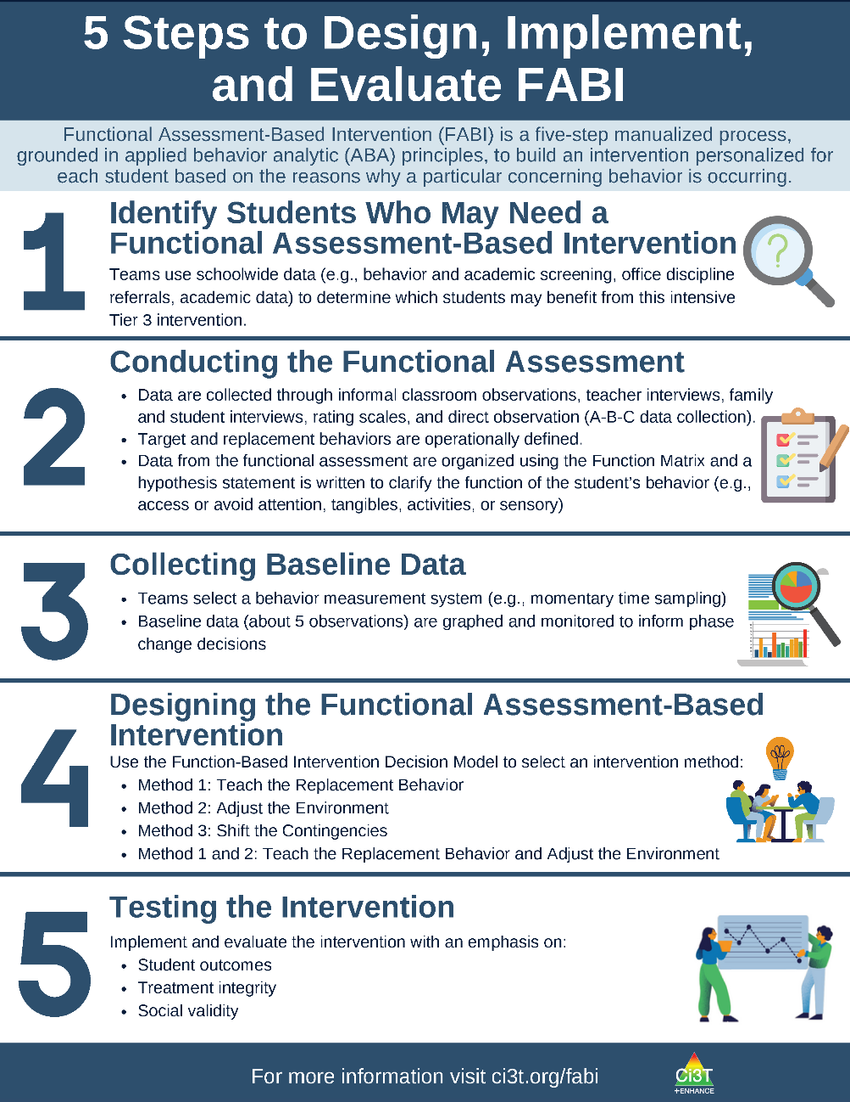
5 Steps to Design, Implement, and Evaluate FABI 1

Slide 12
5 Steps to Design, Implement, and Evaluate FABI 2

Slide 13

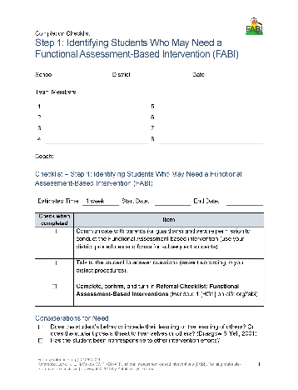
Step 1: Identifying Students Who May Need a FABI
Review multiple sources of data
Connect with family member(s)
Meet with student

Slide 14

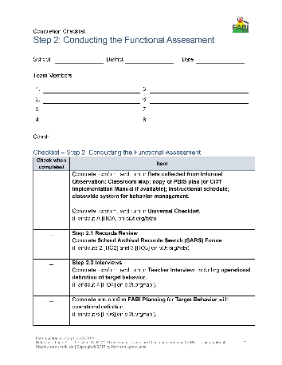
Step 2: Conducting the Functional Assessment
Understanding the learning environment and context
Records review
Interviews
Operationally define target behavior
Rating scales
A-B-C data collection
Use Function Matrix to identify the hypothesized function(s)
Identify replacement behavior

Slide 15

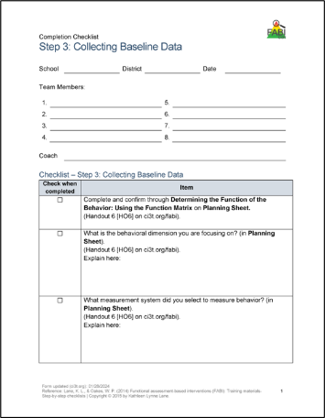
Step 3: Collecting Baseline Data
Determine behavioral dimension of focus
Select a measurement system
Develop data collection procedures
Train data collectors
Collect baseline data
Graph baseline data

Slide 16

Step 4: Design the FABI
Function-Based Intervention Decision Model

Slide 17

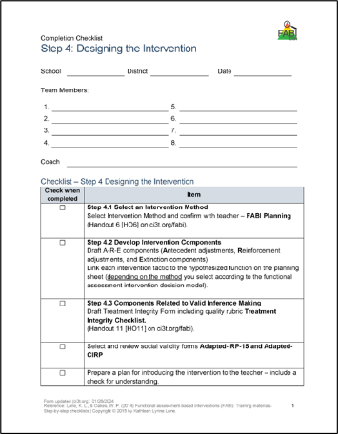
FABI Step 4 Overview
Select an intervention method
Develop A-R-E intervention components
Draft treatment integrity checklist
Assess pre-intervention social validity
Develop intervention materials
Introduce FABI to educators and family
Introduce FABI to student
Revise and finalize FABI

Slide 18

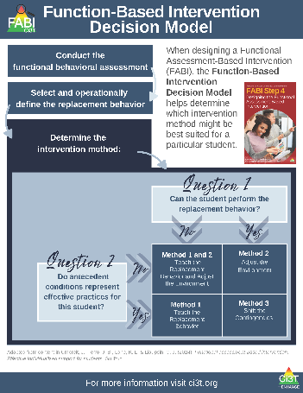
Function-Based Intervention Decision Model
An intervention method is selected based on the response to these two questions:
Can the student perform the replacement behavior?
Do antecedent conditions represent effective practices for this student?

Slide 19
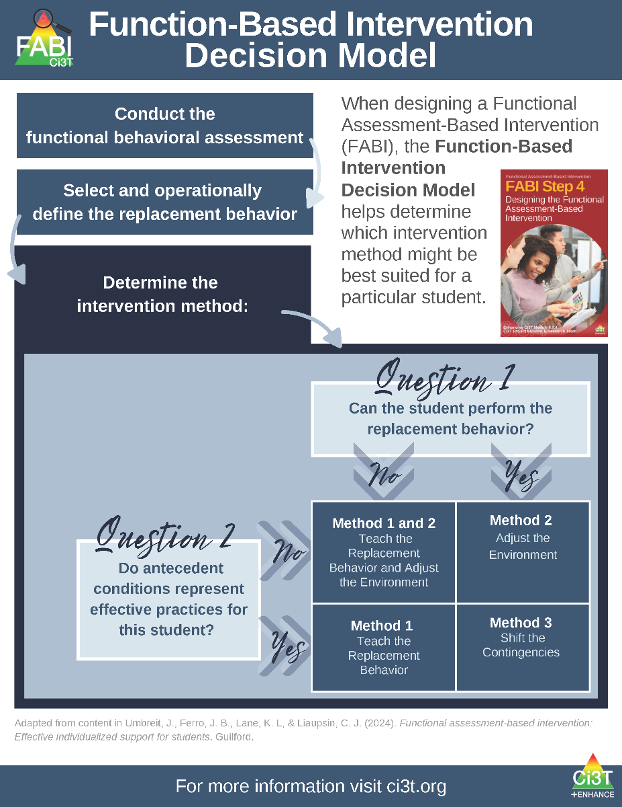
Function-Based Intervention Decision Model 1

Slide 20
Let’s Practice: Function-Based Intervention Decision Model
Use the Function-Based Intervention Decision Model to select an intervention method for each scenario
Method 1: Teach the Replacement Behavior
Method 2: Adjust the Environment
Method 3: Shift the Contingencies
Combination of Method 1 & 2: Teach the Replacement Behavior and Adjust the Environment
Notes:
10-min timer

Slide 21
Step 4: Design the FABI
A-R-E Components

Slide 22
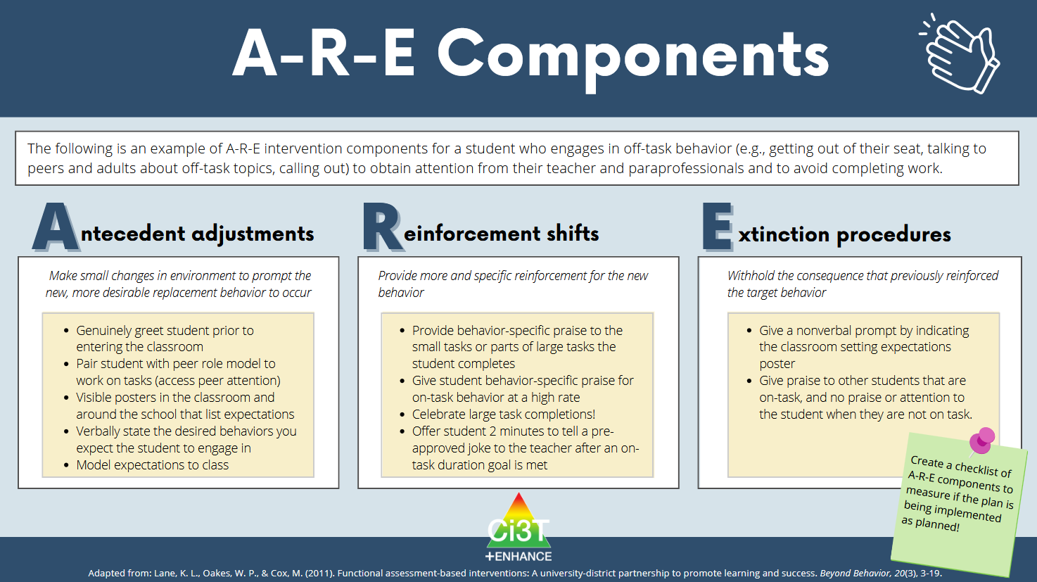

Slide 23
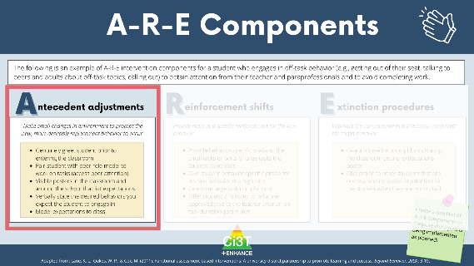
Antecedent Adjustments
Adjusting the antecedent conditions to increase likelihood replacement behavior will occur (i.e., “set the stage” for success) and (if applicable) teach the replacement behavior
Notes:
Antecedent Strategies: Proactive adjustments to "set the stage" for success (e.g., choice-making, high-p request sequences, visual schedules).
safety.

Slide 24
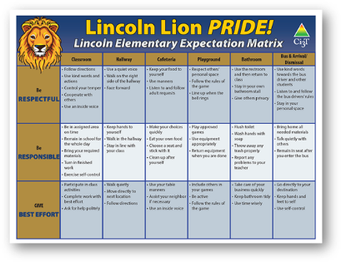
Antecedent Adjustments: Environmental
School-wide expectations are posted and visible
Furniture arrangement allows for easy movement
Materials are well organized and easy to access when needed

Slide 25
Antecedent Adjustments: Instructional & Task Demand
Starter (e.g., warm-up, do now) and closing (e.g., exit ticket) activities
Check for understanding before beginning independent work
Instructional choice

Slide 26
Antecedent Adjustments: Social
Partner work or assigned “buddy”
Having students work in small group
Option to work independently or with a partner/group

Slide 27
Antecedent Adjustments: Physiological
Provide student with a snack (i.e., ensuring they are not hungry)
Provide motor break prior to instruction (i.e., allowing student to expend extra energy)

Slide 28
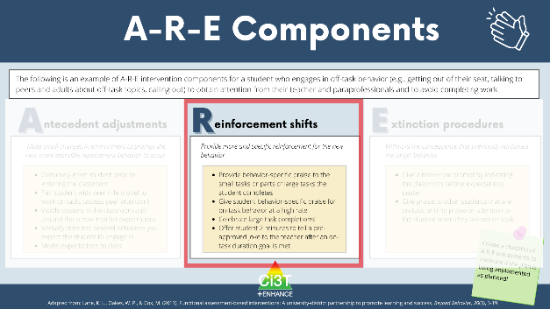
Reinforcement Shifts
Reinforcing the replacement behavior to strengthen its occurrence (i.e., the replacement behavior is more efficient and effective than the target behavior)

Slide 29
Types of Reinforcement Shifts
Change the type of reinforcement (i.e., what is provided)
  Public versus private behavior-specific praise
  Update menu with preferred reinforcers (e.g., break, time with preferred adult)
Change the rate of reinforcement (i.e., how frequently reinforcement is provided)
  More frequent praise (e.g., after every occurrence of replacement behavior, once every 2 minutes)

Slide 30
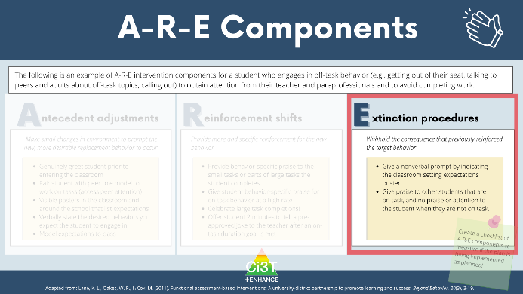
Extinction Procedures
Ensuring the target behavior is no longer followed by reinforcement
Notes:
Extinction (and Safety): Ensuring the maintaining function is no longer accessed through the problem behavior, while maintaining student dignity and safety.

Slide 31
Illustration:
David (2nd Grade)
Germer, K. A., Kaplan, L. M., Giroux, L. N., Markham, E. H., Ferris, G. J., Oakes, W. P., & Lane, K. L. (2011). A function-based intervention to increase a second-grade student's on-task behavior in a general education classroom. Beyond Behavior, 20(3).

Slide 32
Target Behavior: Off -Task Behavior
Component | Description
Label | Off-task
Definition | Off-task behavior refers to engaging in behaviors or making verbal comments unrelated to instructional tasks.
Examples | leaving assigned instructional area without teacher permission inappropriately making comments to teacher or peers unrelated to instruction attending to anything other than the academic task doing unassigned tasks using instructional materials inappropriately taking more than 30 s to prepare for instructional task
Non-Examples | staying in assigned instructional area appropriately making comments to teacher or peers related to instruction attending to academic tasks working on assigned task using instructional materials appropriately preparing for instructional task in less than 30 s

Slide 33
Replacement Behavior: On-Task
Component | Description
Label | On-task
Definition | On-task behavior refers to engaging in behaviors or making verbal comments related to instructional tasks.
Examples | staying in assigned instructional area appropriately making comments to teacher or peers related to instruction attending to academic tasks working on assigned task using instructional materials appropriately preparing for instructional task in less than 30 s
Non-Examples | leaving assigned instructional area without teacher permission inappropriately making comments to teacher or peers unrelated to instruction attending to anything other than the academic task doing unassigned tasks using instructional materials inappropriately taking more than 30 s to prepare for instructional task.

Slide 34
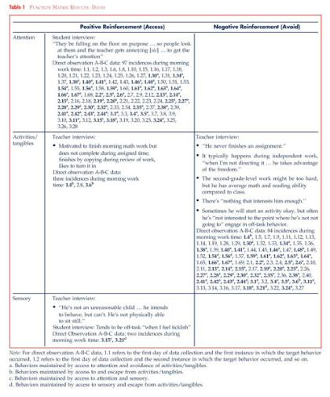
Function Matrix
Function Matrix 1

Slide 35
Hypothesized Function
Hypothesized Function 1
When presented with an instructional task, David engages in off-task behavior (such as leaving instructional areas, inappropriately making comments, and engaging in unassigned tasks) to access attention and/or to escape tasks.
In other words, when David is off-task he gets attention from his teacher and peers and does not have to complete assignments (positive reinforcement-attention and negative reinforcement-activity)

Slide 36
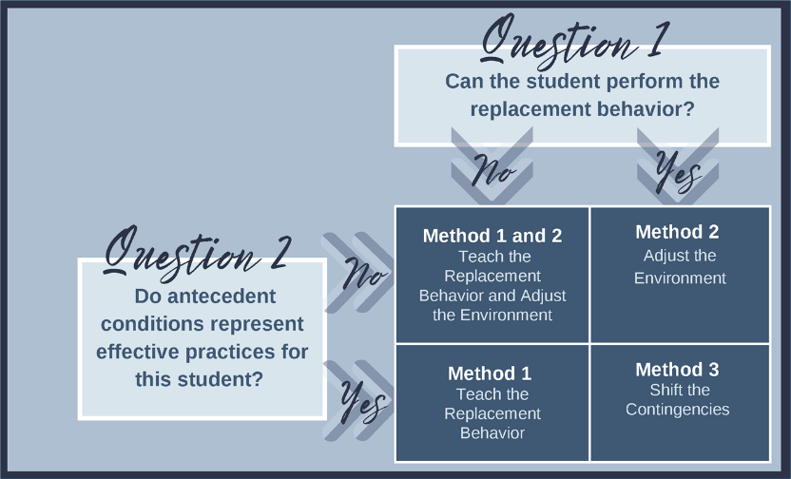
Function-Based Intervention Decision Model
Function-Based Intervention Decision Model 1

Slide 37
Component 1- Adjust the Antecedents
Component 1- Adjust the Antecedents 1
Adjust Antecedents | Adjust antecedent variables so the conditions that set the occasion for the target behavior are eliminated and new conditions are established in which the replacement behavior is more likely to occur. | Seating change - David will sit facing the whiteboard (reduce distraction, proximity to teacher) Requesting help visual (green, yellow, red) Self-monitoring system Teacher will review picture schedule for the morning work period prior to the work period. Teacher will check-in with David at the beginning of independent tasks to ensure that he understood the assignment.

Slide 38
Component 2- Reinforcement Rates
Component 2- Reinforcement Rates 2
Reinforcement Rates | Provide appropriate reinforcement for the replacement behavior. | Teacher will provide behavior-specific praise when David is on-task. Teacher will acknowledge David’s need for help when his clothespin was on red and assist him as quickly as possible. Teacher will check David’s work upon completion, provide praise, and allow him to take a short break. At the end of the morning independent work period, teacher will help David complete his self-monitoring form and write one specific incidence of good behavior at the bottom.

Slide 39
Component 3- Extinguish the Target Behavior
Component 3 - Extinguish the Target Behavior 1
Extinguish Target Behavior | Withhold the consequence that previously reinforced the target behavior. | Teacher will provide no praise or attention when David is off-task, with the exception of one verbal or gestural redirect per minute. When David is off-task, teacher will praise other students who are behaving appropriately.

Slide 40
Let’s Chat: Illustration #1 Debrief
What other antecedent adjustments, reinforcement shifts, or extinction procedures could support David?
How might A-R-E components for David be different if he were in middle or high school?

Slide 41
Break!

Slide 42
Tips for Generating A-R-E Components
Ensure A-R-E components are aligned to function(s) of student’s behavior
Consider social validity – what is feasible and contextually appropriate?
Use A-R-E form aligned to your intervention method

Slide 43
Illustration 2: Harry
5th Grader
Cox, M., Griffin, M. M., Hall, R., Oakes, W. P., & Lane, K. L. (2011). Using a Functional Assessment-Based Intervention to Increase Academic Engaged Time in an Inclusive Middle School Setting. Beyond Behavior, 20(3).

Slide 44
Target Behavior: Off -Task Behavior
Off-task is defined as attending to activities in class other than assignments
Examples
Playing with materials inappropriately, talking to peers, putting head on the desk, drawing, and looking around the room
Non-examples
Completing assignments using materials only for assignments, and watching the teacher when delivering instruction

Slide 45
Replacement Behavior: Academic Engagement
Academic engagement is defined as anytime Harry is attending to class instructions and/or assignments
Examples
Completing assignments using materials only for assignments, and watching the teacher when delivering instruction
Non-examples
Playing with materials inappropriately, talking to peers, putting head on the desk, drawing, and looking around the room

Slide 46
Function Matrix
Function Matrix 2
 | Positive Reinforcement (Access something) | Negative Reinforcement (Avoid something)
Attention | ABC 1.1, ABC 1.2, ABC 1.19, ABC 2.1(peer), ABC 2.2, ABC 2.3, ABC 2.4, ABC 2.7, ABC 2.8, ABC 2.10, S.I. # 4 (wants peer att.)
Tangibles/ activities | ABC 2.9, S.I. #4 (wants more fun activity) | ABC 1.2, ABC 1.3, ABC 1.4, ABC 1.6, ABC 1.7, ABC 1.8, ABC 1.9, ABC 1.10, ABC 1.11, ABC 1.12, ABC 1.13, ABC 1.14-1.19, ABC 2.1, ABC 2.2, ABC 2.4, ABC 2.5, ABC 2.6, ABC 2.7, ABC 2.9, Avoiding work when not structured. T.I. #4, T.I. #9, S.I. #2 & #3
Sensory | ABC 1.1, ABC 1.5, ABC 1.6, ABC 1.18, ABC 1.19, ABC 2.1, ABC 2.2, ABC 3.1-3.4

Slide 47
Hypothesized Function
Hypothesized Function 2
When presented with academic tasks or instruction, Harry became off-task (engaged in an activity other than the one assigned) to escape tasks and gain attention.
That is, Harry, engaged in off-task behaviors
to access teacher and/or peer attention
(positive reinforcement- attention)
or to escape the instruction by the teacher
or the activity that the teacher assigned
(negative reinforcement- activity).

Slide 48
Function-Based Intervention Decision Model
Function-Based Intervention Decision Model 2

Slide 49
Component 1- Adjust the Antecedents
Component 1- Adjust the Antecedents 3
Adjust Antecedents | Adjust antecedent variables so the conditions that set the occasion for the target behavior are eliminated and new conditions are established in which the replacement behavior is more likely to occur. | Integrate instructional choice into independent work (e.g., complete evens or odds, select any six problems to complete, choice of math manipulative to use)
Notes:
WWC - https://ies.ed.gov/ncee/wwc/PracticeGuide/31
Low-Intensity, Teacher Delivered Strategies (module)

Slide 50
Component 2- Reinforcement Rates
Component 2- Reinforcement Rates 2
Reinforcement Rates | Provide appropriate reinforcement for the replacement behavior. | Provide behavior-specific praise paired with a universal reinforcer (e.g., ticket) when Harry begins independent work

Slide 51
Component 3- Extinguish the Target Behavior
Component 3- Extinguish the Target Behavior 2
Extinguish Target Behavior | Withhold the consequence that previously reinforced the target behavior. | Non-verbal redirection (e.g., gestural prompt)

Slide 52
Let’s Chat: Illustration #2 Debrief
How might A-R-E components for Harry be different if he were in pre-k or high school?
What about A-R-E component generation is most intuitive or easiest to do?
What about A-R-E component generation is most challenging?
  How might you overcome those challenges?
  What supports would help navigate those challenges?

Slide 53
Step 4: Design the FABI
Preparing to Implement the Intervention

Slide 54
FABI Step 4: Preparing to Implement the Intervention
Select an intervention method
Develop A-R-E intervention components
Draft treatment integrity checklist
Assess pre-intervention social validity
Develop intervention materials
Introduce FABI to educators and family
Introduce FABI to student
Revise and finalize FABI

Slide 55
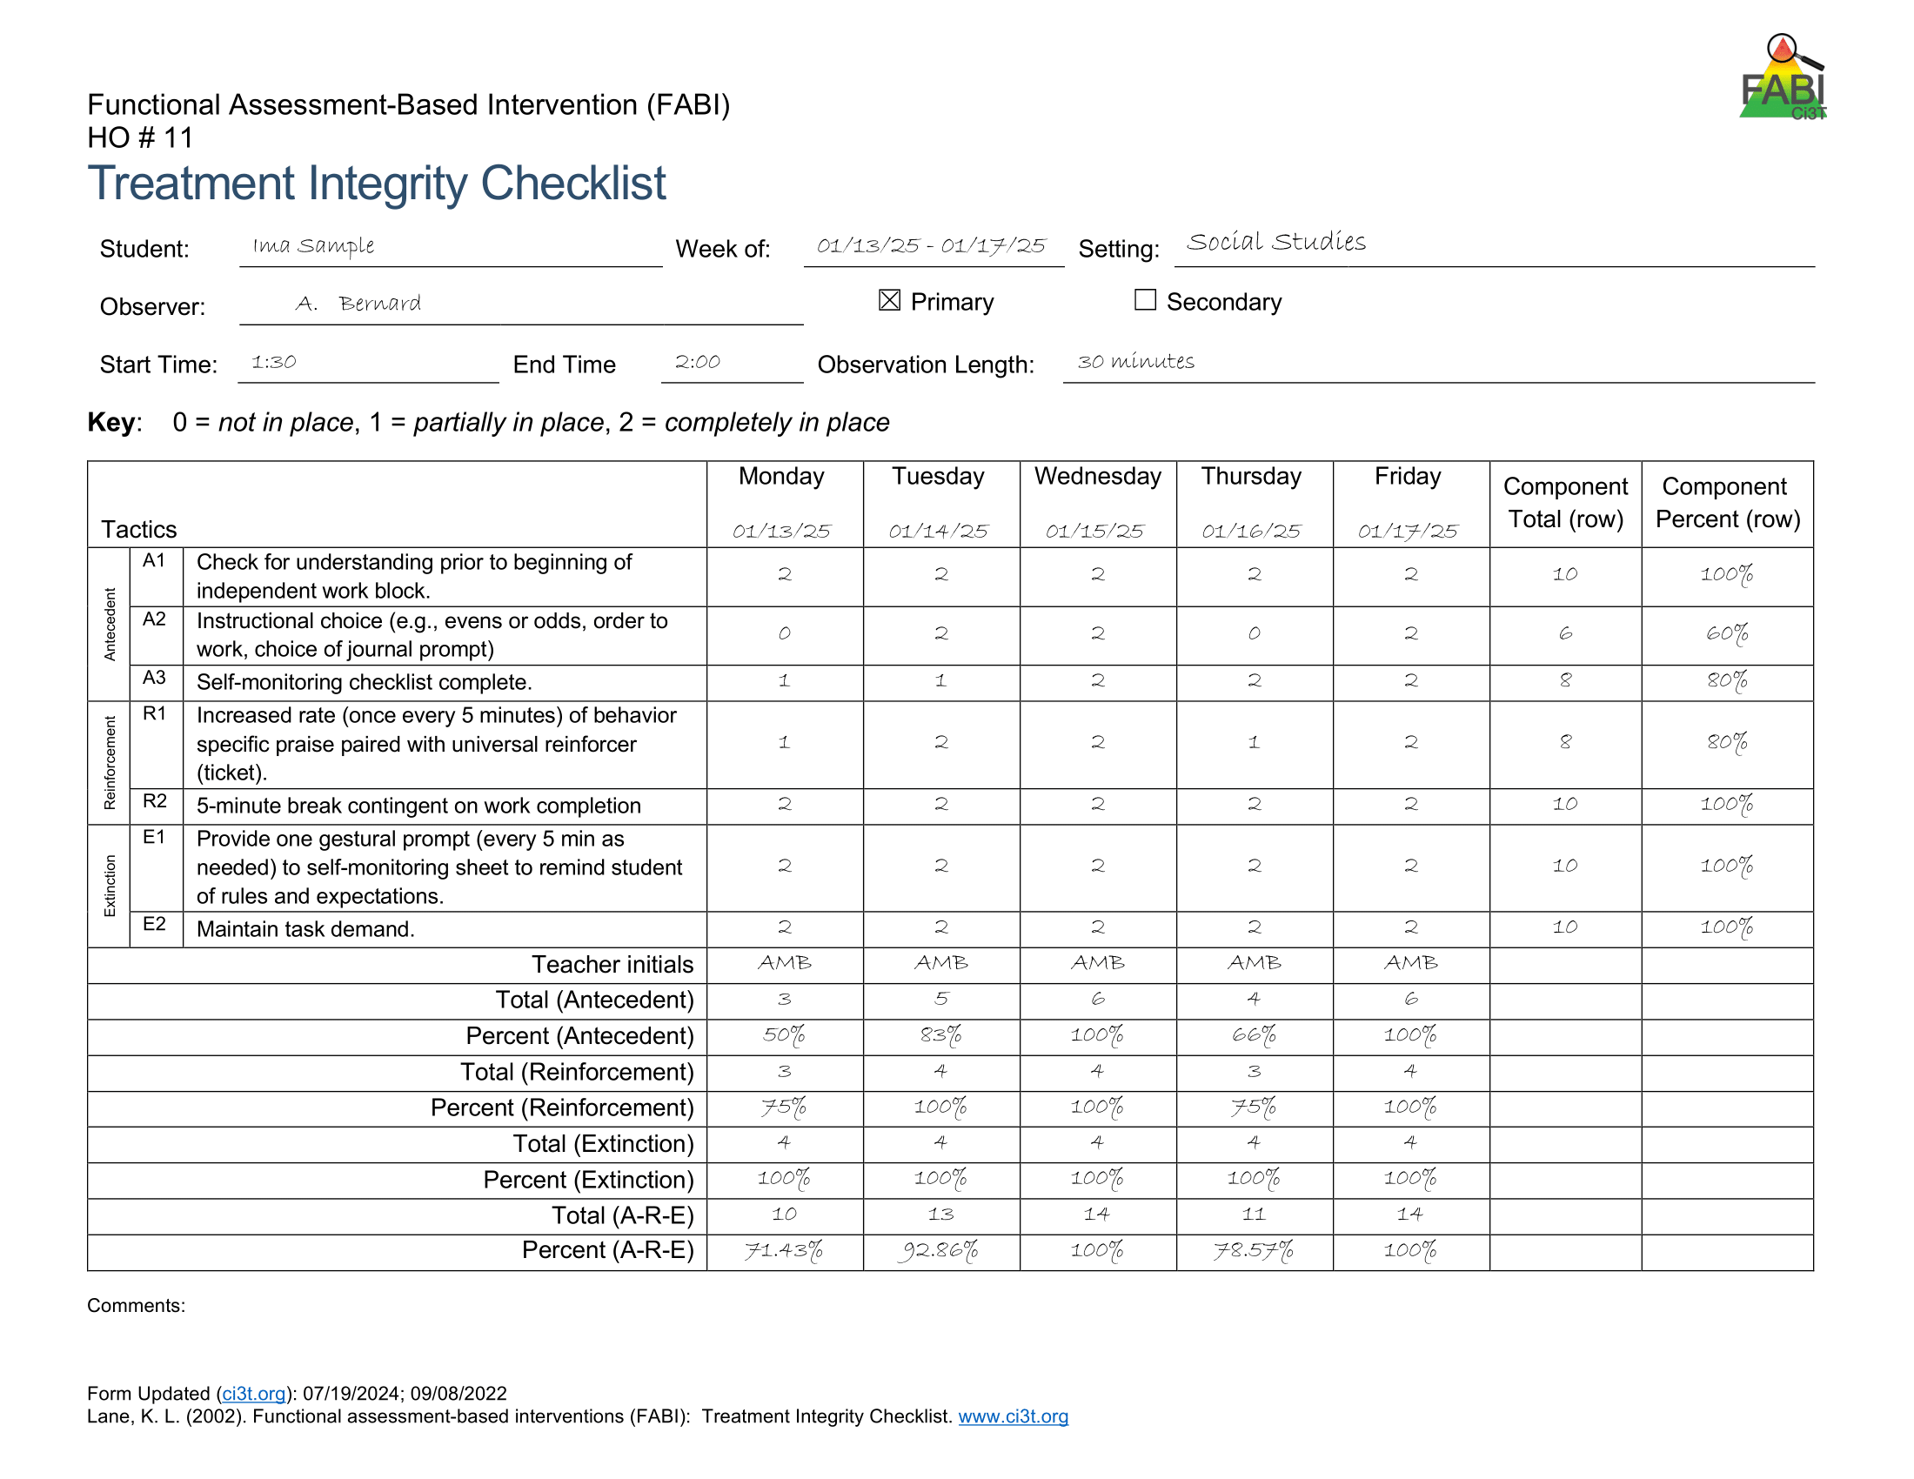
Treatment Integrity
The degree to which intervention procedures are implemented as intended
Factors impacting treatment integrity:
Complexity of intervention
Materials / resources
Time needed to implement intervention components

Slide 57
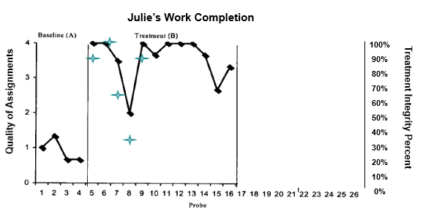
Why Collect Treatment Integrity Data?

Slide 58
Pre-Intervention Social Validity
Social Significance of goals
  Is the replacement behavior functional for the student’s daily life?
  Do the goals align with the values of the student and their family?
  Do benefits of intervention outweigh costs?
Social acceptability of procedures
  Is the intervention appropriate for the problem behavior?
  Is the intervention fair and reasonable from the perspective of the student? Family? Educator?
  Is the intervention intrusive or stigmatizing?
Social importance of effects
  Will this change in behavior have a meaningful impact on the student’s day-to-day experiences?
  Will the people involved (i.e., teacher, family, student) be satisfied if the goal is achieved?

Slide 59
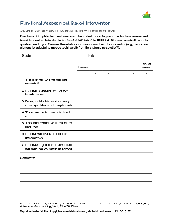
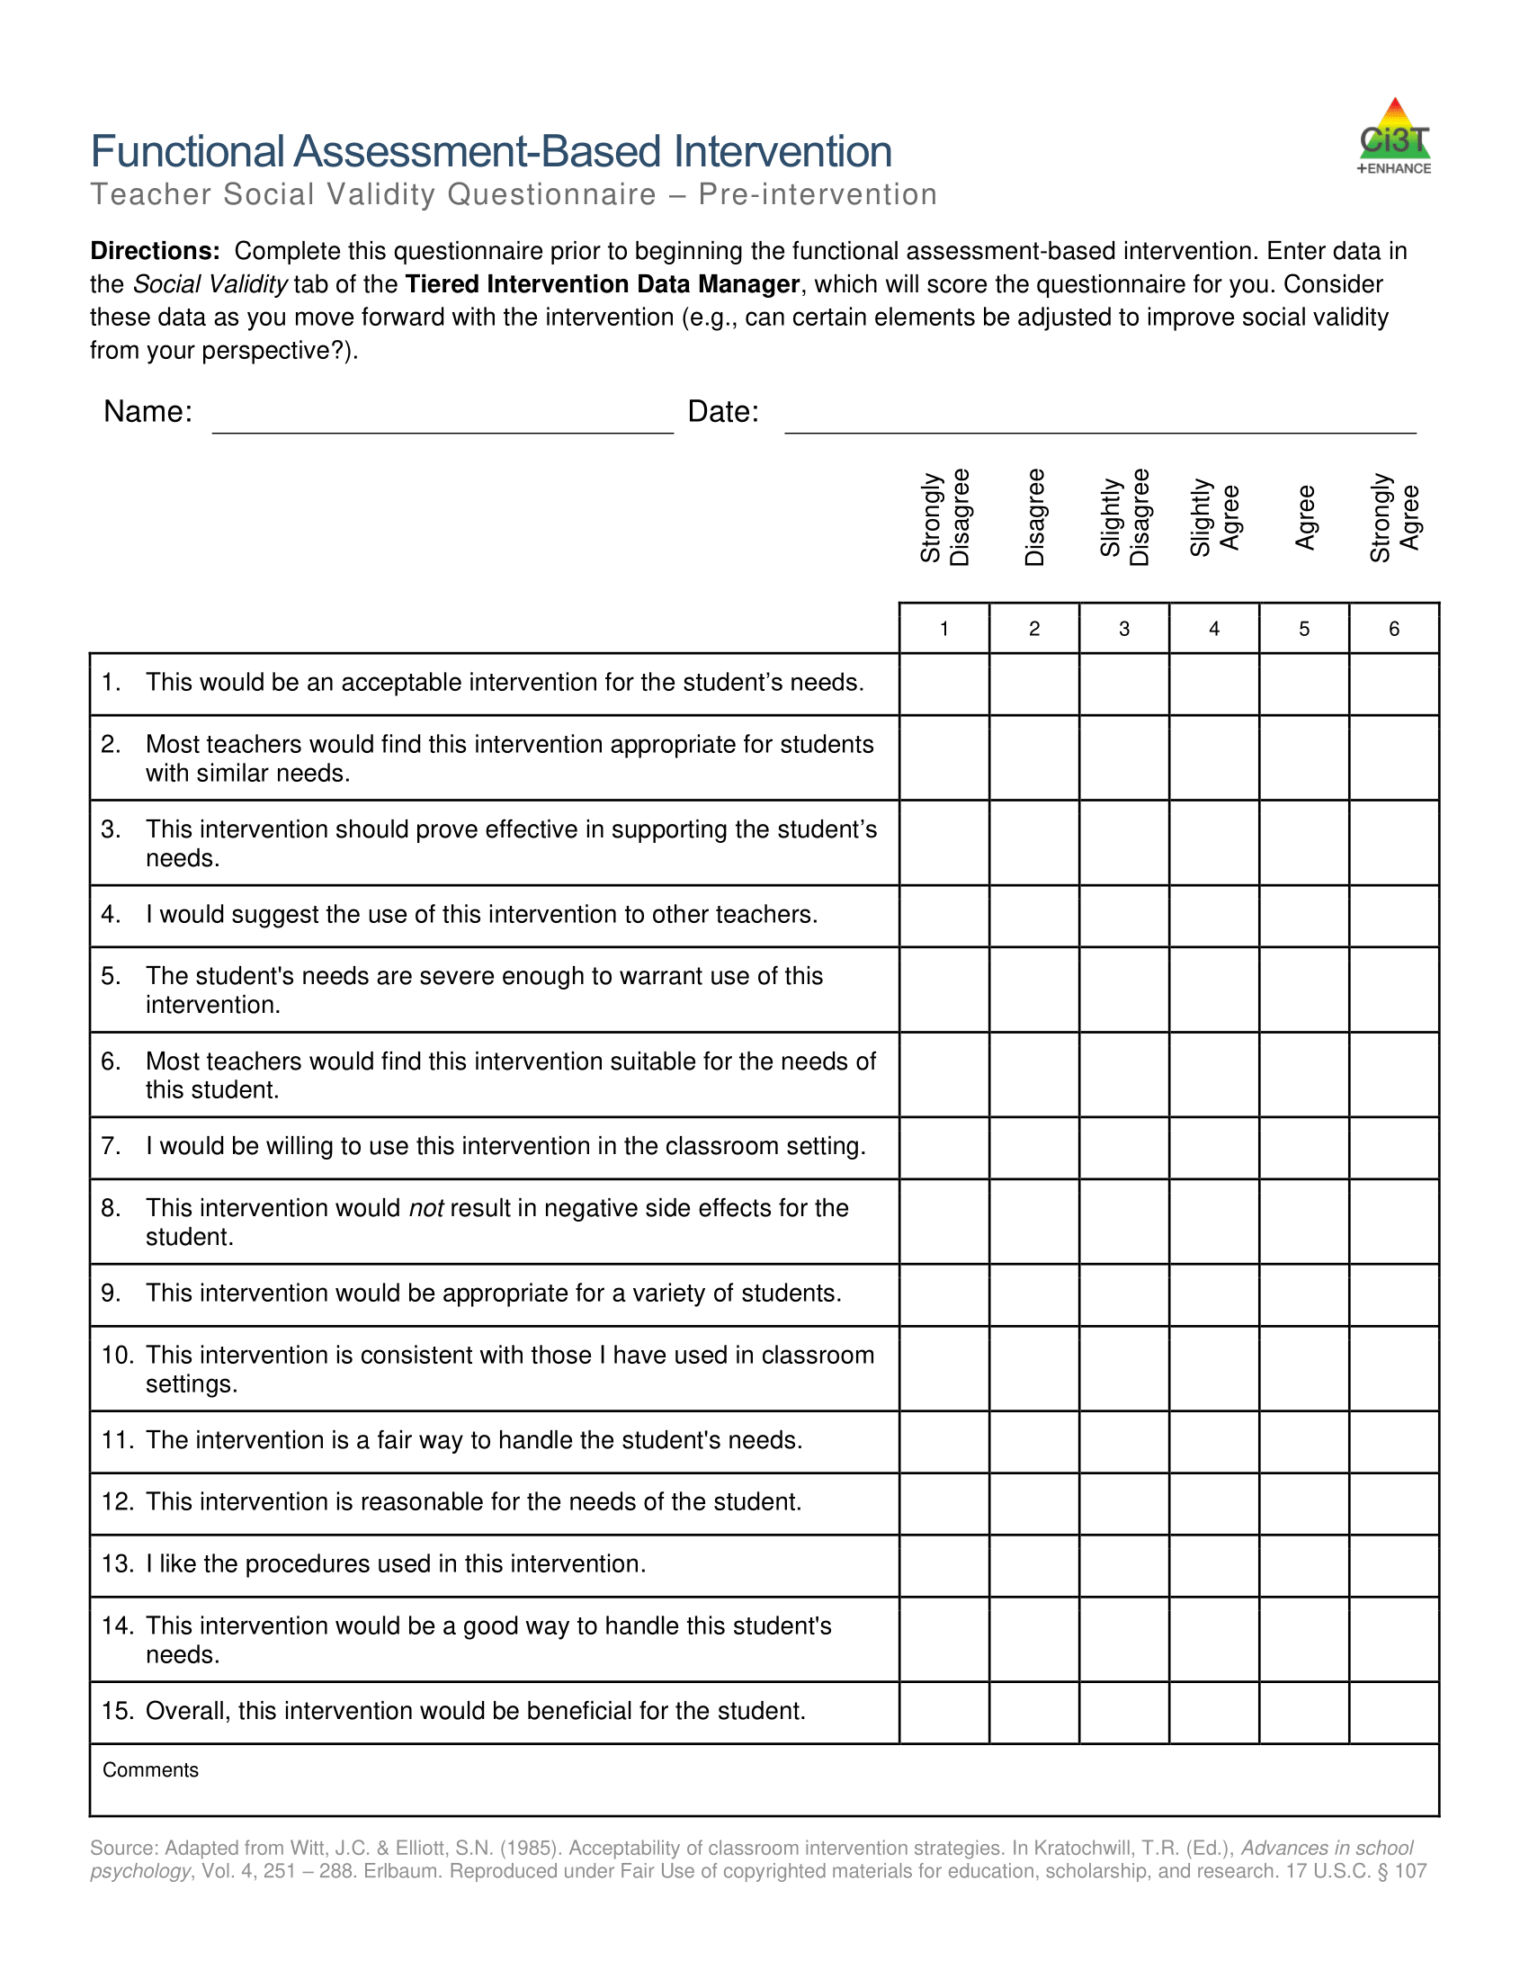
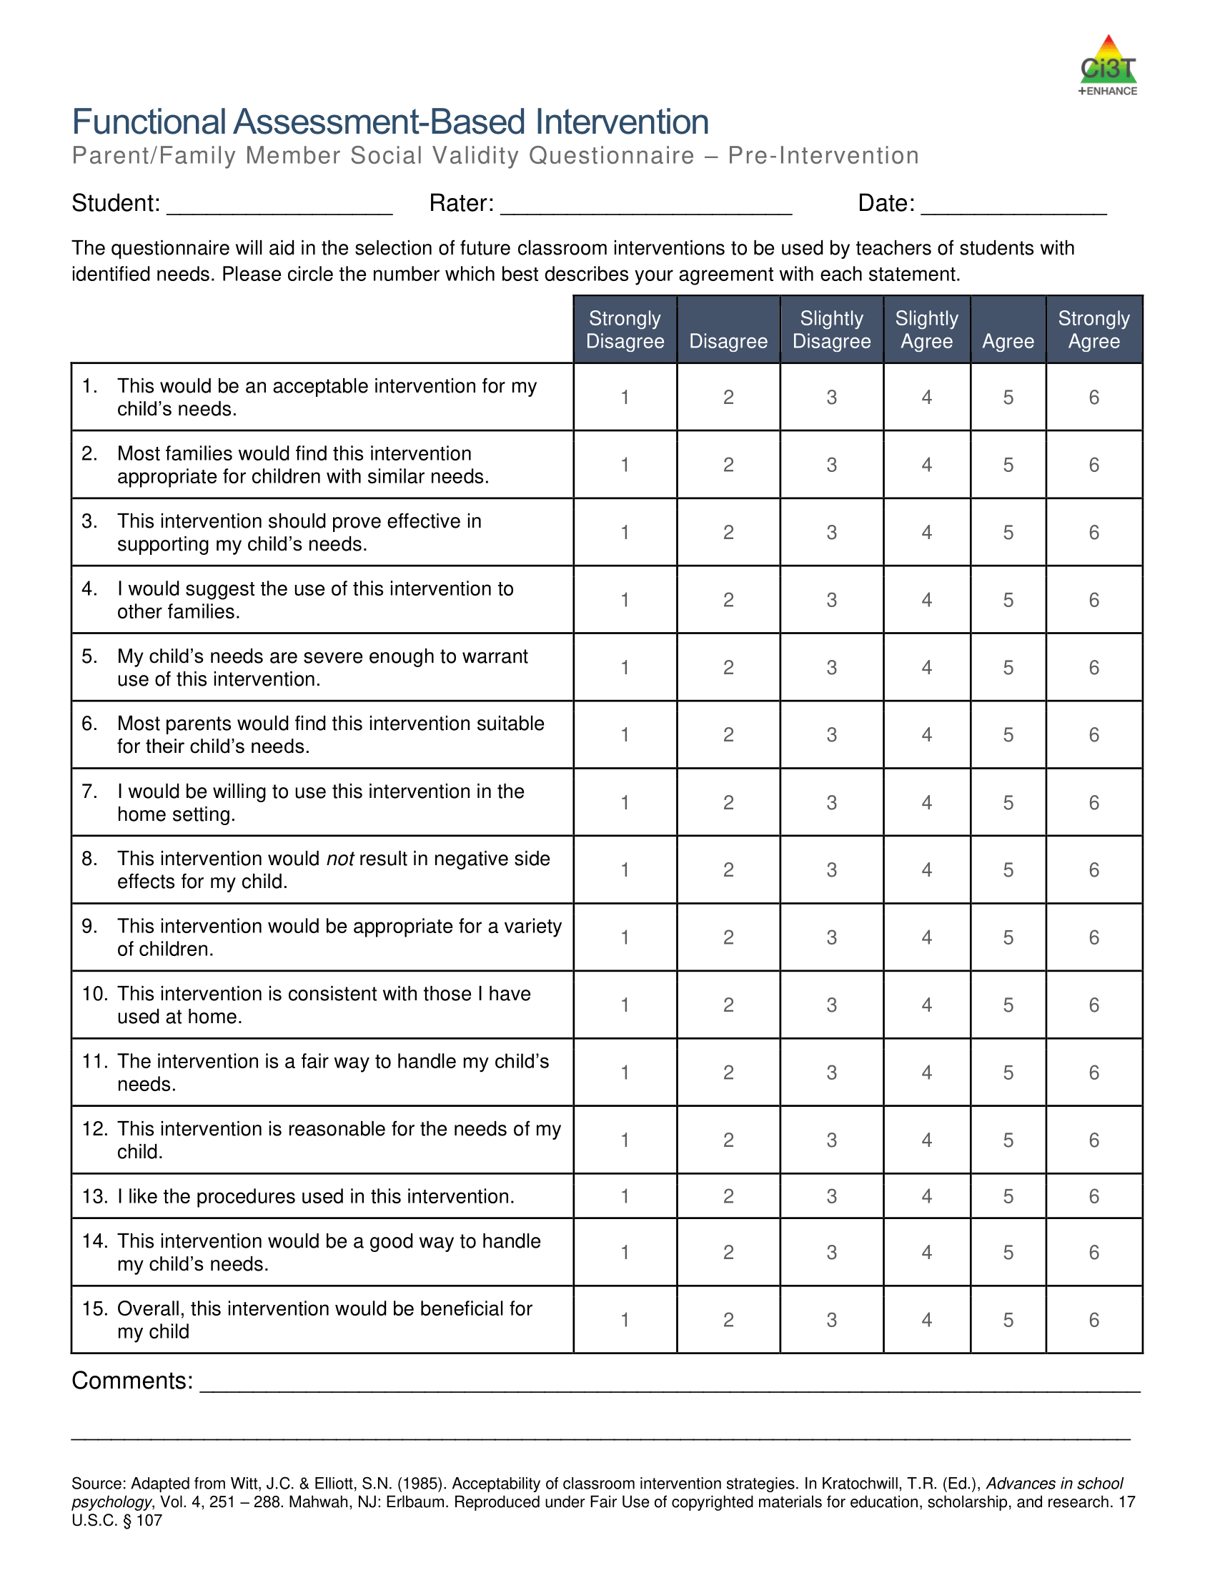
Measuring Pre-Intervention Social Validity
Rating scales
Interviews
Social comparison - Is the target student’s behavior substantially different from typical peer?
Notes:
Rating Scales: TEI (Treatment Evaluation Inventory), Intervention Rating Profile-15
Social Comparisons: Is the target student’s behavior substantially different from typical peer? Requires measuring both

Slide 60
Introducing the FABI
Revise drafted A-R-E components to address any concerns shared in pre-intervention social validity
Introduce FABI to the adults who will implement the intervention (e.g., classroom teacher, counselor, paraprofessional)
  Explain intervention procedures
  Model
  Practice (e.g., role play) with feedback
  Check for understanding (role play, multiple choice, scenarios)
Introduce FABI to the student

Slide 61

FABI Step 5: Test the Intervention

Slide 62

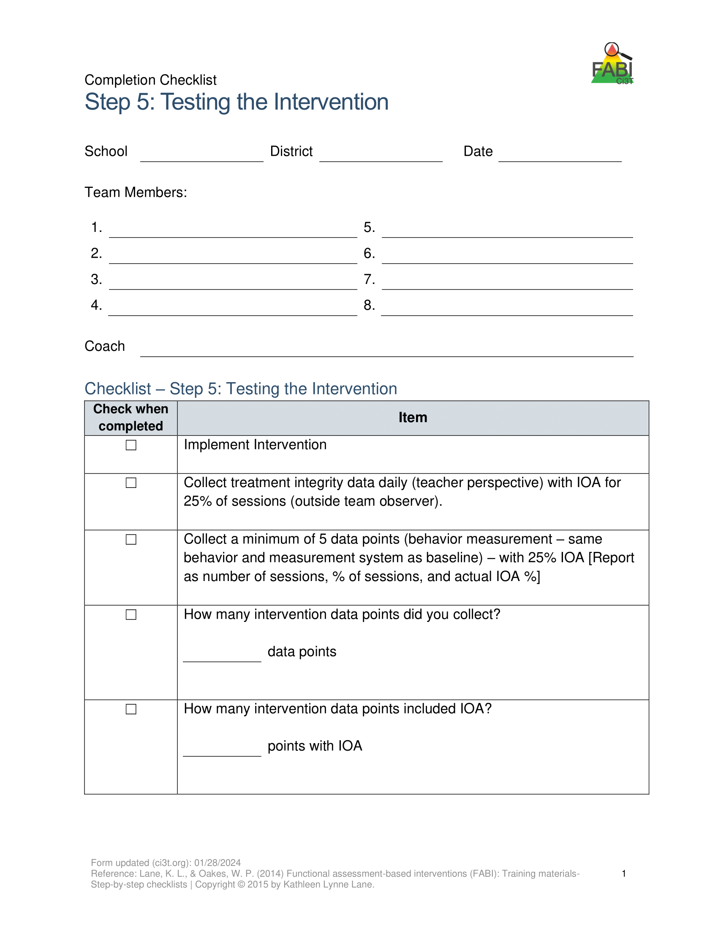
Step 5: Testing the Intervention
Implement the intervention
Monitor treatment integrity
Collect and graph data
Implement a single-case design to “test” how well intervention is working
  ABAB
  Multiple baseline
  Changing criterion
Assess social validity
Fade the intervention

Slide 63
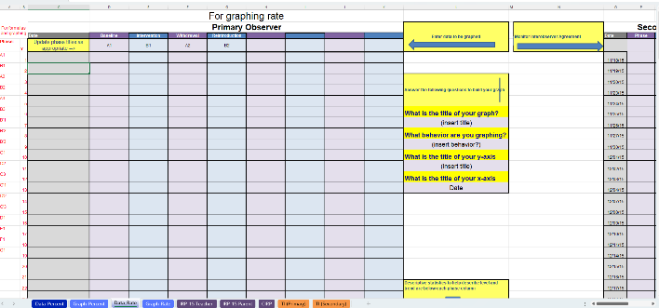
How Well is the Intervention Working? Data Sources to Consider
Treatment Integrity
Student Outcomes
Social validity

Slide 64
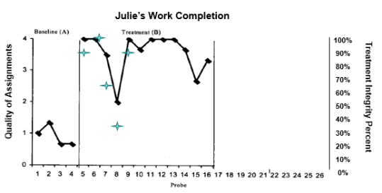
Treatment Integrity: The extent to which the FABI is implemented as designed

Slide 65
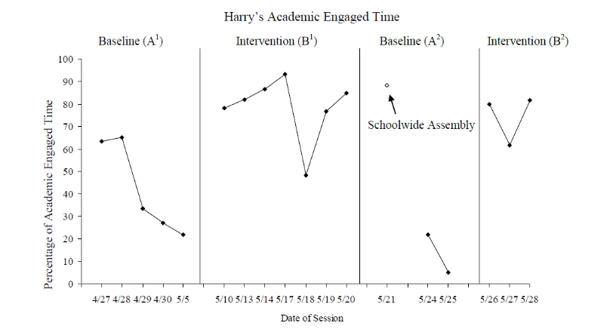
Student Outcomes
Cox, M., Griffin, M. M., Hall, R., Oakes, W. P., & Lane, K. L. (2011). Using a Functional Assessment-Based Intervention to Increase Academic Engaged Time in an Inclusive Middle School Setting. Beyond Behavior, 20(3).

Slide 66
Measuring Student Outcomes
Use the same measurement procedures as baseline
  Measurement form (e.g., average duration, momentary time sampling)
  Observation time and location
  Primary and secondary observer
Collect Interobserver Agreement (IOA) for 25% of sessions (~1-2x week)

Slide 67
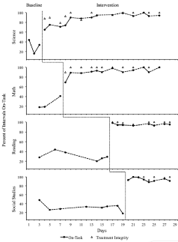
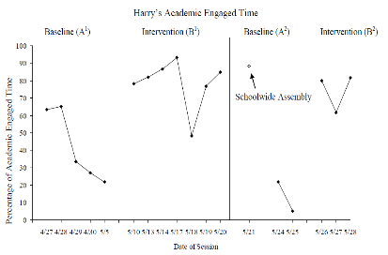
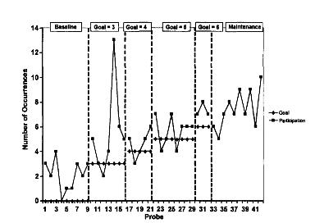
Using Single-Case Design to “Test” How Well the Intervention is Working
ABAB Design
(Cox et al., 2011)
Changing Criterion
(Lane et al., 2007)
Multiple Baseline
(Gann et al., 2014)
Notes:
ABAB
Multiple baseline
Changing criterion

Slide 68
Post-Intervention Social Validity
Rating Scales
Interviews
Social Comparisons
Future Use- does the teacher use the intervention with subsequent students who present similar concerns
Treatment integrity- behavioral marker for social validity
Notes:
Rating Scales: TEI (Treatment Evaluation Inventory), Intervention Rating Profile-15
Social Comparisons: Is the target student’s behavior substantially different from typical peer? Requires measuring both
Future Use: Does the teacher use the intervention with subsequent students who present similar concerns?
TI: behavioral marker for SV

Slide 69
Break!

Slide 70

Putting it All Together

Slide 71
Let’s Practice: Putting it All Together
Use the Function-Based Intervention Decision Model to select an intervention method for your student (or one of the case studies!)
Draft A-R-E components
Consider
  How would you collect pre-intervention social validity?
  What challenges do you anticipate with treatment integrity? How might you proactively address those concerns?
  What single-case design would you use to “test” how well the intervention is working (e.g., ABAB, changing criterion, multiple baseline)
Notes:
10-min timer

Slide 72
Wrapping Up and Moving Forward

Slide 73
Learning Exchange Series Progression: Next Steps

Slide 74
Optional: FABI Support
We are happy to provide support as you complete FABI Steps 4 and 5 ☺
Please email us to schedule a zoom call or in-person meeting
  Kathleen Lynne Lane kathleen.lane@ku.edu
  Elise Sarasin elise.sarasin@ku.edu

Slide 75


Opportunities to Learn More

Slide 76
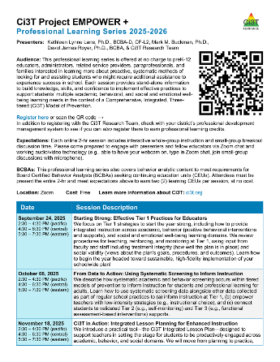
Project EMPOWER+
EMPOWER+ Session | Date
Starting Strong: Effective Tier 1 Practices for Educators | September 24, 2025 (Wednesday)
From Data to Action: Using Systematic Screening to Inform Instruction | October 8, 2025 (Wednesday)
Ci3T In Action: Integrated Lesson Planning for Enhanced Instruction | November 18, 2025 (Tuesday)
Mastering Behavior Specific Praise and Precorrection | January 21, 2026 (Wednesday)
A 6-Step Instructional Approach for Responding to Challenging Behaviors: A Tier 1 Practice | February 10, 2026 (Tuesday)
A Tier 2 Support for Students Experiencing Anxious Feelings: Recognize. Relax. Record. | March 25, 2026 (Wednesday)
A Tier 3 Support for Students with Intensive Intervention Needs: Functional Assessment-Based Intervention (FABI) | April 28, 2026 (Tuesday)
Notes:
Builds knowledge and skill sets aligned to FABI Steps. For example – BSP and pre-correct often Antecedent Adjustment

Slide 77
Reminder: Knowledge, Application, Impact Points
On-Task Behavior: Jackson
In Kansas, you can earn 2 x PD points for application and 3 x for impact!
We are happy to review your materials before you upload!
Notes:
Tonight’s session lays the foundation with knowledge building and getting you oriented to the modules that can support application and impact efforts!

Slide 78
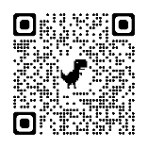
Application & Impact
Also, did you know when you apply your learning…
you can take your learning activity in MLP to “Application” and earn double the points?
and demonstrate its’ impact, you can get triple your original knowledge points?
Check out the example below!
A total of 6 points
for Salary Enhancement
Original Activity = 2 points
These are “knowledge
points” and can be used for
relicensure.
Application = 4 points
These are “application points”
and can be used towards horizontal movement on the salary schedule.
Impact = 2 add’l points
These are “impact points” and can be used towards horizontal movement on the salary schedule.
And, the BEST part?
Application and Impact points can be used to move horizontally
on the salary schedule! Click HERE to learn more (or use the QR code). See your PDC Representative if you have questions!
Use code: lnhgi6q
Notes:
lnhgi6q

Slide 79




Thank You!
Elise Sarasin
elise.sarasin@ku.edu
Kathleen Lynne Lane
kathleen.lane@ku.edu

