Slide 1

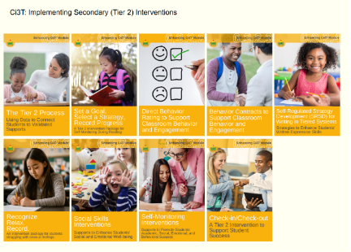
Starting Activity
Step 1: Go to ci3t.org/enhance
Step 2: If you have not already registered to access Enhancing Ci3T Modules, consider doing so.
Step 3: Sign into the Recognize. Relax. Record. module (see Ci3T: Implementing Secondary (Tier 2) Interventions)

Slide 2

Recognize. Relax. Record. A Tier 2 Support for Students Experiencing Anxious Feelings A Presentation for SVSU Public Schools
Kathleen Lynne Lane, Ph. D., BCBA-D, CF-L2, University of Kansas
Allison M. Bernard, M. Ed., University of Kansas
Amy A. Buffington, M. Ed., University of Kansas
Kathryn L. Johnson, M.A., University of Kansas
We invite you to visit ci3t.org/enhance to access our collection of Enhancing Ci3T Modules following a one-time registration process!
This presentation was funded in part by Project ENHANCE (U.S. Department of Education, Institute of Education Sciences: Award Number: R324N190002), Project ENGAGE (U.S. Department of Education, Institute of Education Sciences: Award Number: R324X220067), and Project EPIC (U.S. Department of Education, Office of Special Education Programs, Award Number: H325D220011).

Slide 3











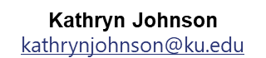
Project ENGAGE Research Team
Rebecca L. Sherod-Adams
rebeccasherod@asu.edu
Joni Weiss
joni.weiss@ku.edu

Slide 4
Session Outcomes
Explain how to review school-wide data to determine which students might benefit from this Tier 2 intervention.
Describe three key components of Recognize. Relax. Record.
Describe how to implement Recognize. Relax. Record. in a classroom setting.
Explain how to measure (a) implementation (treatment integrity), (b) users’ views of goals, procedures, and outcomes (social validity), and (c) student behavior (e.g., engagement, anxious feelings).

Slide 5
Agenda
Welcome
Situating Secondary (Tier 2) Interventions in Ci3T Models
Describing Key Components of Recognize. Relax. Record.
Implementing Recognize. Relax. Record.
Baseline
RRR Instruction
RRR In-Class
Measuring what Matters: Treatment Integrity, Social Validity, and Student Behavior
Wrapping Up and Moving Forward

Slide 6
A Focus on Students with Internalizing Behaviors

Slide 7
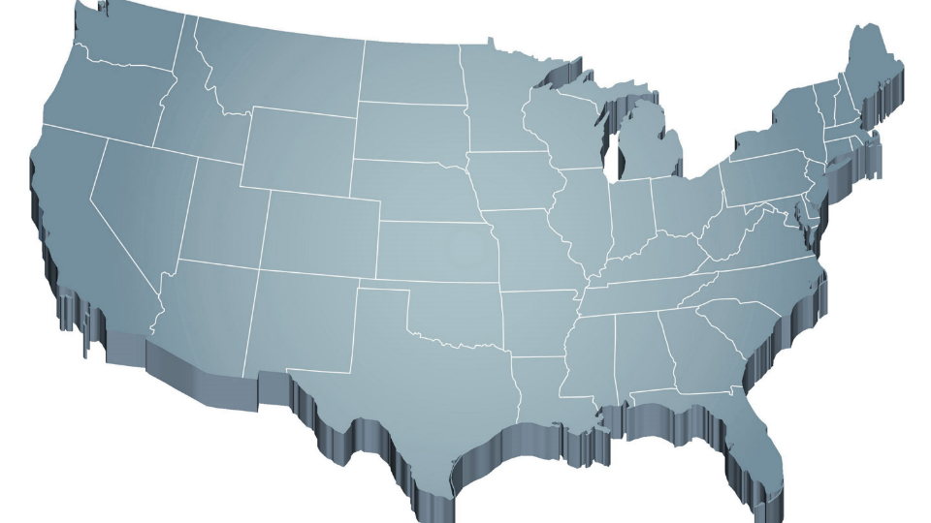
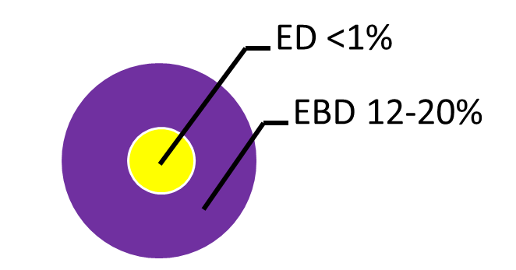
Thank you for your commitment!
Shift to a systems level perspective
Internalizing
Externalizing
Source: Forness, S.R., Freeman, S.F., Paparella, T., Kauffman, J.M., & Walker, H.M. (2012). Special education implications of point and cumulative prevalence for children with emotional or behavioral disorders. Journal of Emotional and Behavioral Disorders, 20, 4-18.

Slide 8
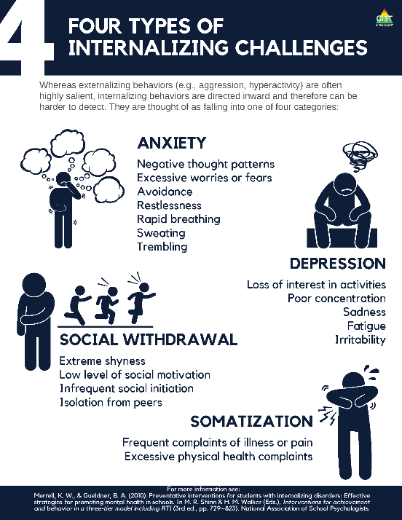
What are internalizing behaviors? (1of 2)
Compared to externalizing behaviors, internalizing behaviors tend to be:
More covert
Less disruptive
but…
Internalizing challenges often co-occur with externalizing behaviors.

Slide 9
What are internalizing behaviors? (2 of 2)
Some examples include:
frequent complaints of illness or pain,
social withdrawal,
irritability,
poor concentration,
restlessness,
emotional outbursts,
rapid breathing,
sweating, or
trembling/shaking.

Slide 10

Why should we be concerned about internalizing behaviors?
Internalizing concerns are associated with multiple worrisome outcomes compared to students who do not have internalizing behavior patterns, such as:
Lower levels of academic achievement (e.g., grade point average, GPA; Vaillancourt et al., 2013)
Lower levels of school adaptation (e.g., ability to learn, ability to meet behavioral expectations, happiness/adjustment; Pedersen et al., 2019)
Higher levels of school dropout (Weist et al., 2018)
Higher levels of social rejection (Weist et al., 2018)
Increased engagement in risk-taking behaviors (e.g., substance use, suicide; Weist et al., 2018)
Increased risk of physical health problems (Jamnik & DiLalla, 2019)

Slide 11
Who do internalizing behaviors impact? (
≈ 32% of children experience an anxiety disorder at some point during their childhood (Merikangas et al., 2010)
Onset typically occurs during elementary years (Merikangas et al., 2010)
Prevalence of behavioral, social, and emotional well-being challenges may be on the rise:
Lebrun-Harris and colleagues (2022) found an increase in anxiety and behavioral/conduct disorder from 2016-2020.

Slide 12
Who do internalizing behaviors impact? (Graph)

Slide 13
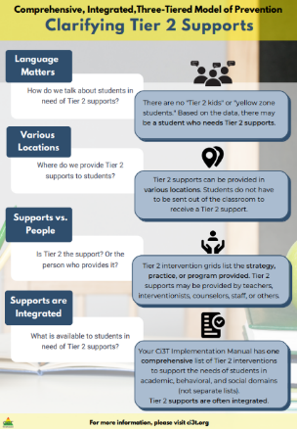
Situating Secondary (Tier 2) Interventions in Ci3T Models

Slide 14

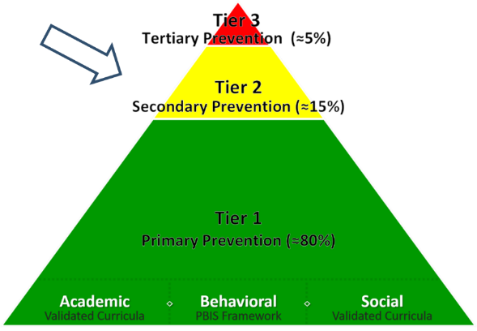
What are Tier 2 Interventions?
Evidenced-based or research-based strategies, practices, and programs
Additive (i.e., compliment rather than replace Tier 1 efforts)
Implemented by teachers, interventionists, counselors, paraprofessionals, and other staff
Occur in a variety of formats and locations (e.g., small-group, 1:1, embedded within whole group instruction)

Slide 15
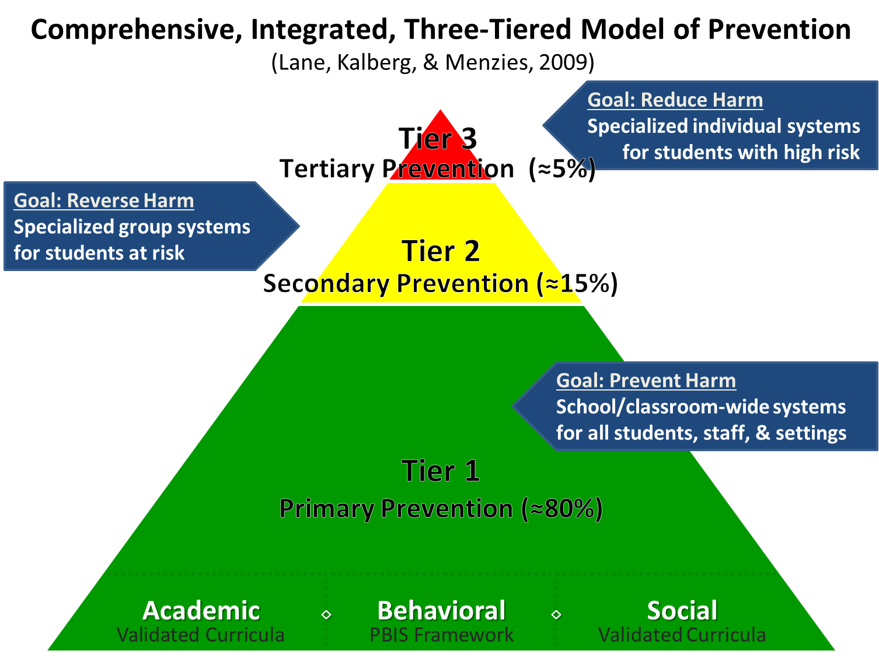

Comprehensive, Integrated, Three-Tiered Model of Prevention 1

Slide 16
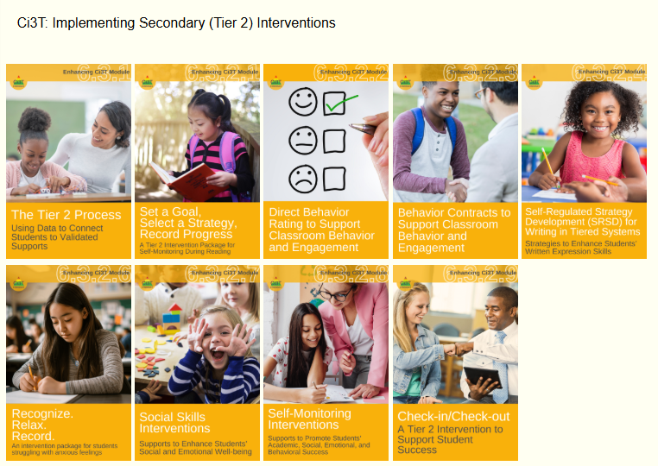
Ci3T: Implementing Secondary (Tier 2) Interventions

Slide 17
An Overview of Recognize.Relax.Record

Slide 18

Comprehensive, Integrated, Three-Tiered Model of Prevention 2

Slide 19

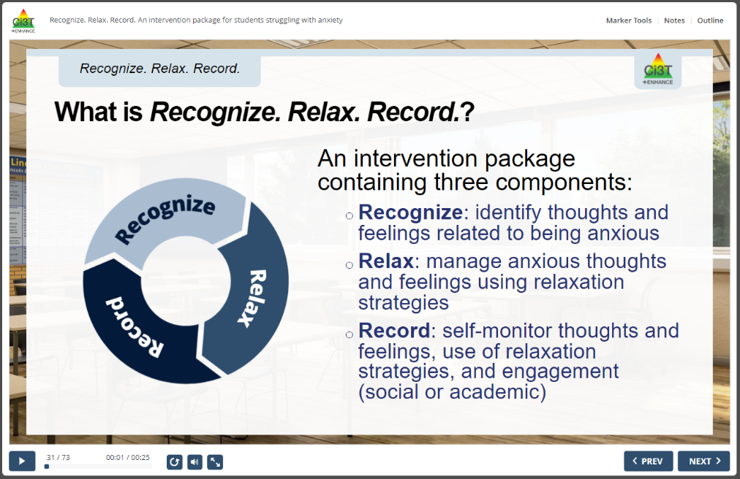
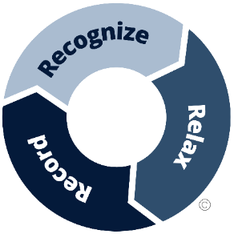
RRR Interactive Resource

Slide 20


What does the supporting research for Recognize. Relax. Record. say?
What Does the Supporting Research for Recognize. Relax. Record. Say? 1
Social-emotional competencies
Self-awareness
Self-management
Social awareness
Responsible decision-making
Relationship Skills
Recognize.
Social-emotional competencies, such as self-awareness and self-management, are related to important long-range outcomes
high school graduation
college degree completion
obtaining employment
Durlak et al., 2011
Adapted from CASEL Framework (2020)

Slide 21
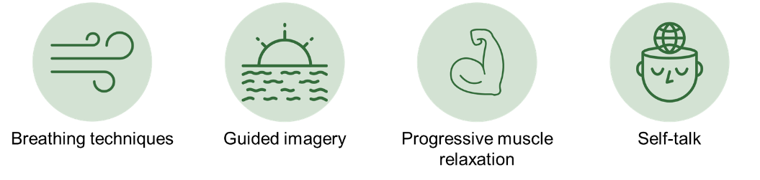
What does the supporting research for Recognize. Relax. Record. say?
What Does the Supporting Research for Recognize. Relax. Record. Say? 2
Relax.
Relaxation training is commonly used in research-based cognitive behavioral interventions for children with anxiety
Chorpita & Daleiden, 2009

Slide 22
What does the supporting research for Recognize. Relax. Record. say?
What Does the Supporting Research for Recognize. Relax. Record. Say? 3
Record
Self-management interventions effective for
behavioral and social outcomes
reading, math, and other content areas at elementary
Levendoski & Cartledge, 2000
productivity, engagement, and academic performance at middle and high school
Carr & Punzo, 1993
students with emotional and behavioral disorders
students educated in general and special education classrooms
A.M. Briesch & Briesch, 2016; Briesch & Chafouleas, 2009; Mooney et al., 2005

Slide 23
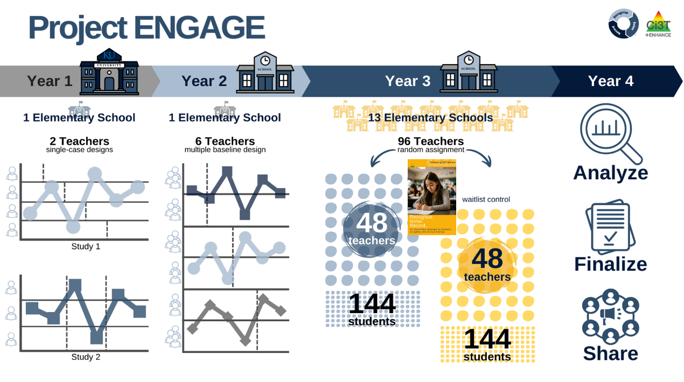
Project ENGAGE
A special thank you to teachers who participated! It was gift to learn from and with you!!!

Slide 24
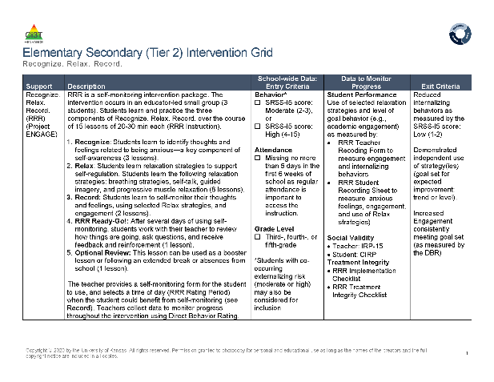
Recognize. Relax. Record. Secondary (Tier 2) Intervention Grid
Recognize. Relax. Record. Secondary (Tier 2) Intervention Grid 2

Slide 25
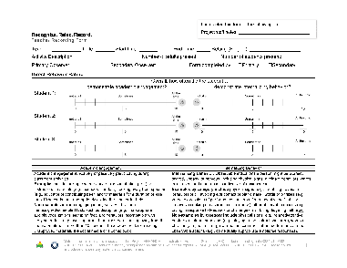
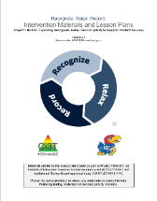
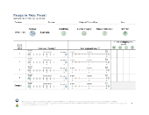
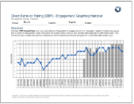
Three Components of Recognize. Relax. Record.
Baseline
RRR Instruction
RRR
In-Class
1
2
3
4
5
6
7
8
9
10
11
12
13
14
15

Slide 26
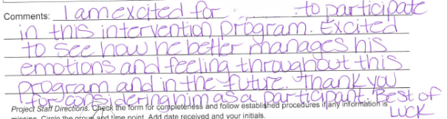
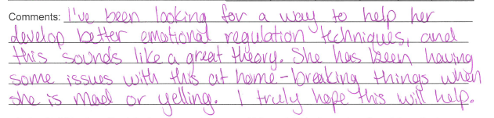
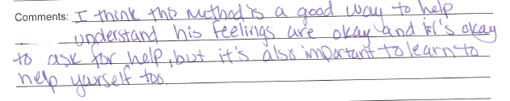
Feedback from Families Before Intervention

Slide 27












Talk Time (1 of 2)
What are your initial impressions of RRR?
What does internalizing behavior look like for your students?
Thinking back to previous or current groups of students you have taught, are there students you think might have benefited from RRR?
To what extent do you feel comfortable providing interventions to support students with internalizing behaviors?

Slide 28
Implementing RRR
A 7 step process

Slide 29
Step 1
Use data to connect students to RRR

Slide 30
Recognize. Relax. Record. Secondary (Tier 2) Intervention Grid
Recognize. Relax. Record. Secondary (Tier 2) Intervention Grid 2

Slide 31
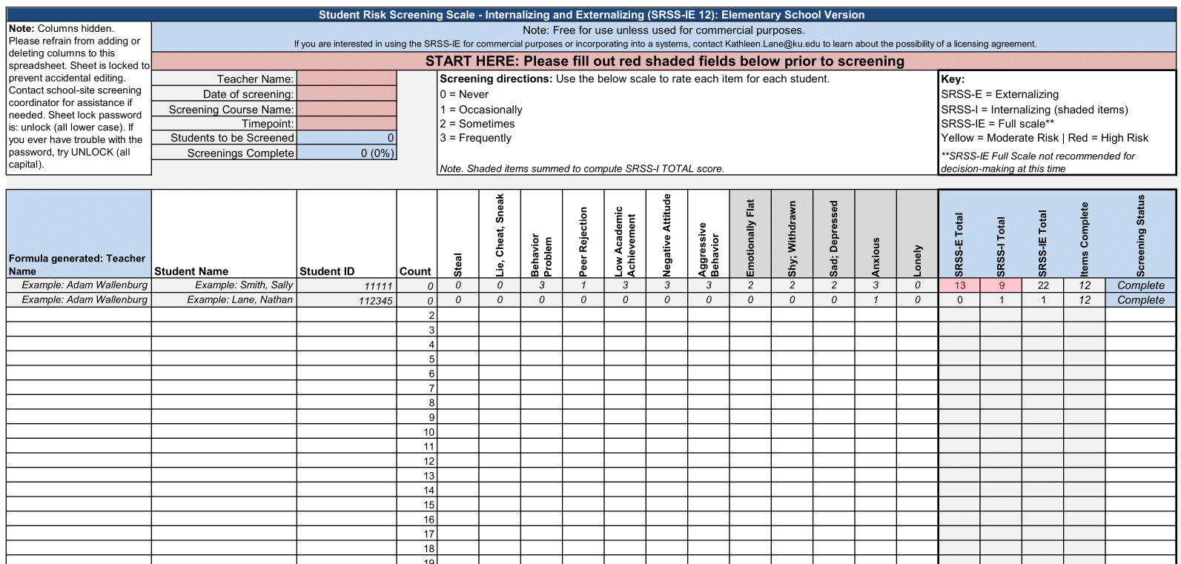
Using data to connect students to Recognize. Relax. Record.

Slide 32
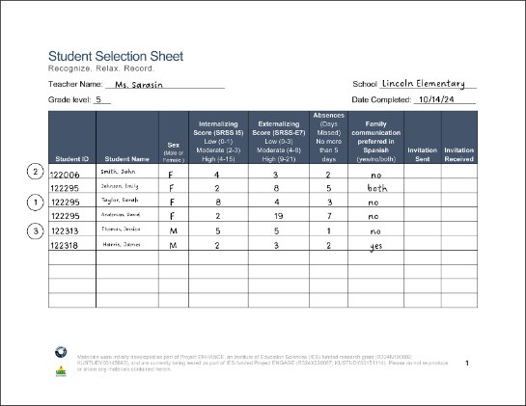
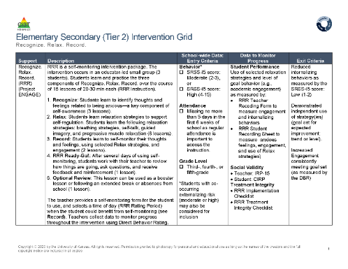
Step 1 Use data to connect students to Recognize. Relax. Record.
Screening

Slide 33
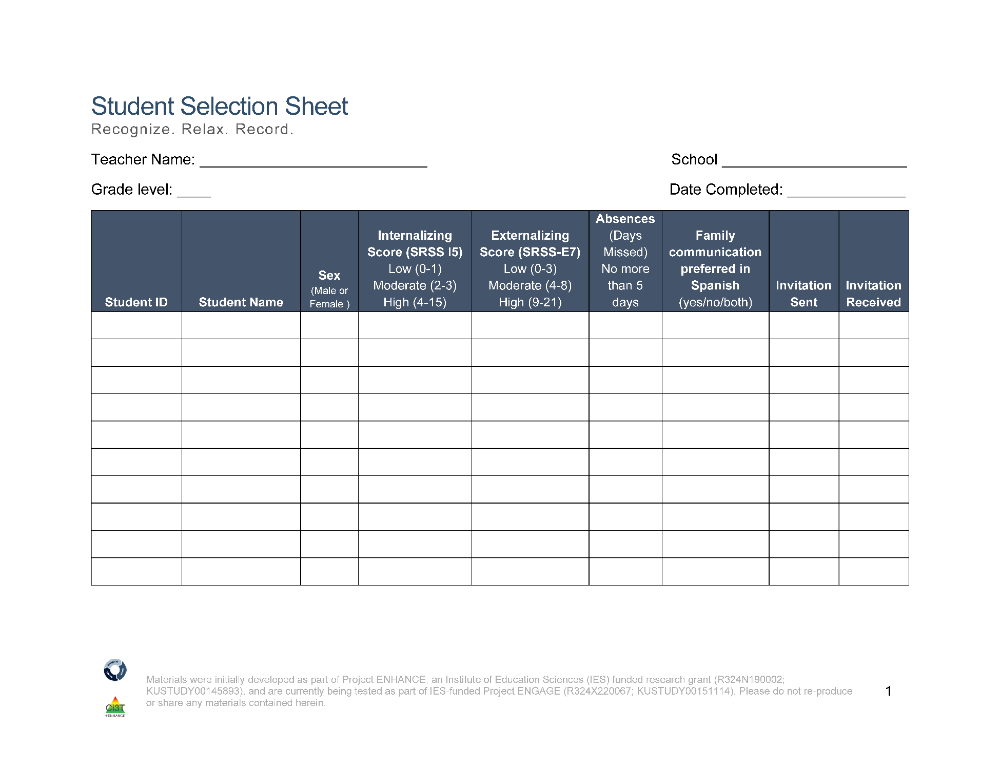
Student Selection Sheet
Ms. Sarasin
Lincoln Elementary
5
10/14/24
2
122006
Smith, John
F
4
3
2
no
122295
Johnson, Emily
F
2
8
5
both
1
122295
Taylor, Sarah
F
8
4
3
no
122295
Anderson, David
F
2
19
7
no
3
122313
Thomas, Jessica
M
5
5
1
no
122318
Harris, James
M
2
3
2
yes
Notes:
Fully translate materials and consent form

Slide 34
Step 2
Plan RRR Procedures

Slide 35
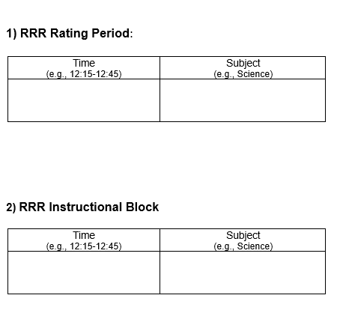
Step 2 Plan RRR Procedures
Step 2 Plan RRR Procedures 1
Collaborate with parents, families, and colleagues
Gather data to identify students’ strengths, abilities, and needs
Schedule
RRR Rating Period
Time when baseline (Direct Behavior Rating) data collected
Time when students will use self-monitoring during RRR In-Class phase
RRR Instruction Block
Time when small-group instruction will occur (15 lessons, 20-30 min each)
2:00-2:40
Monday-Thursday
Math
10:00-10:25
Monday, Wednesday, Thursday
Independent Work Time

Slide 36
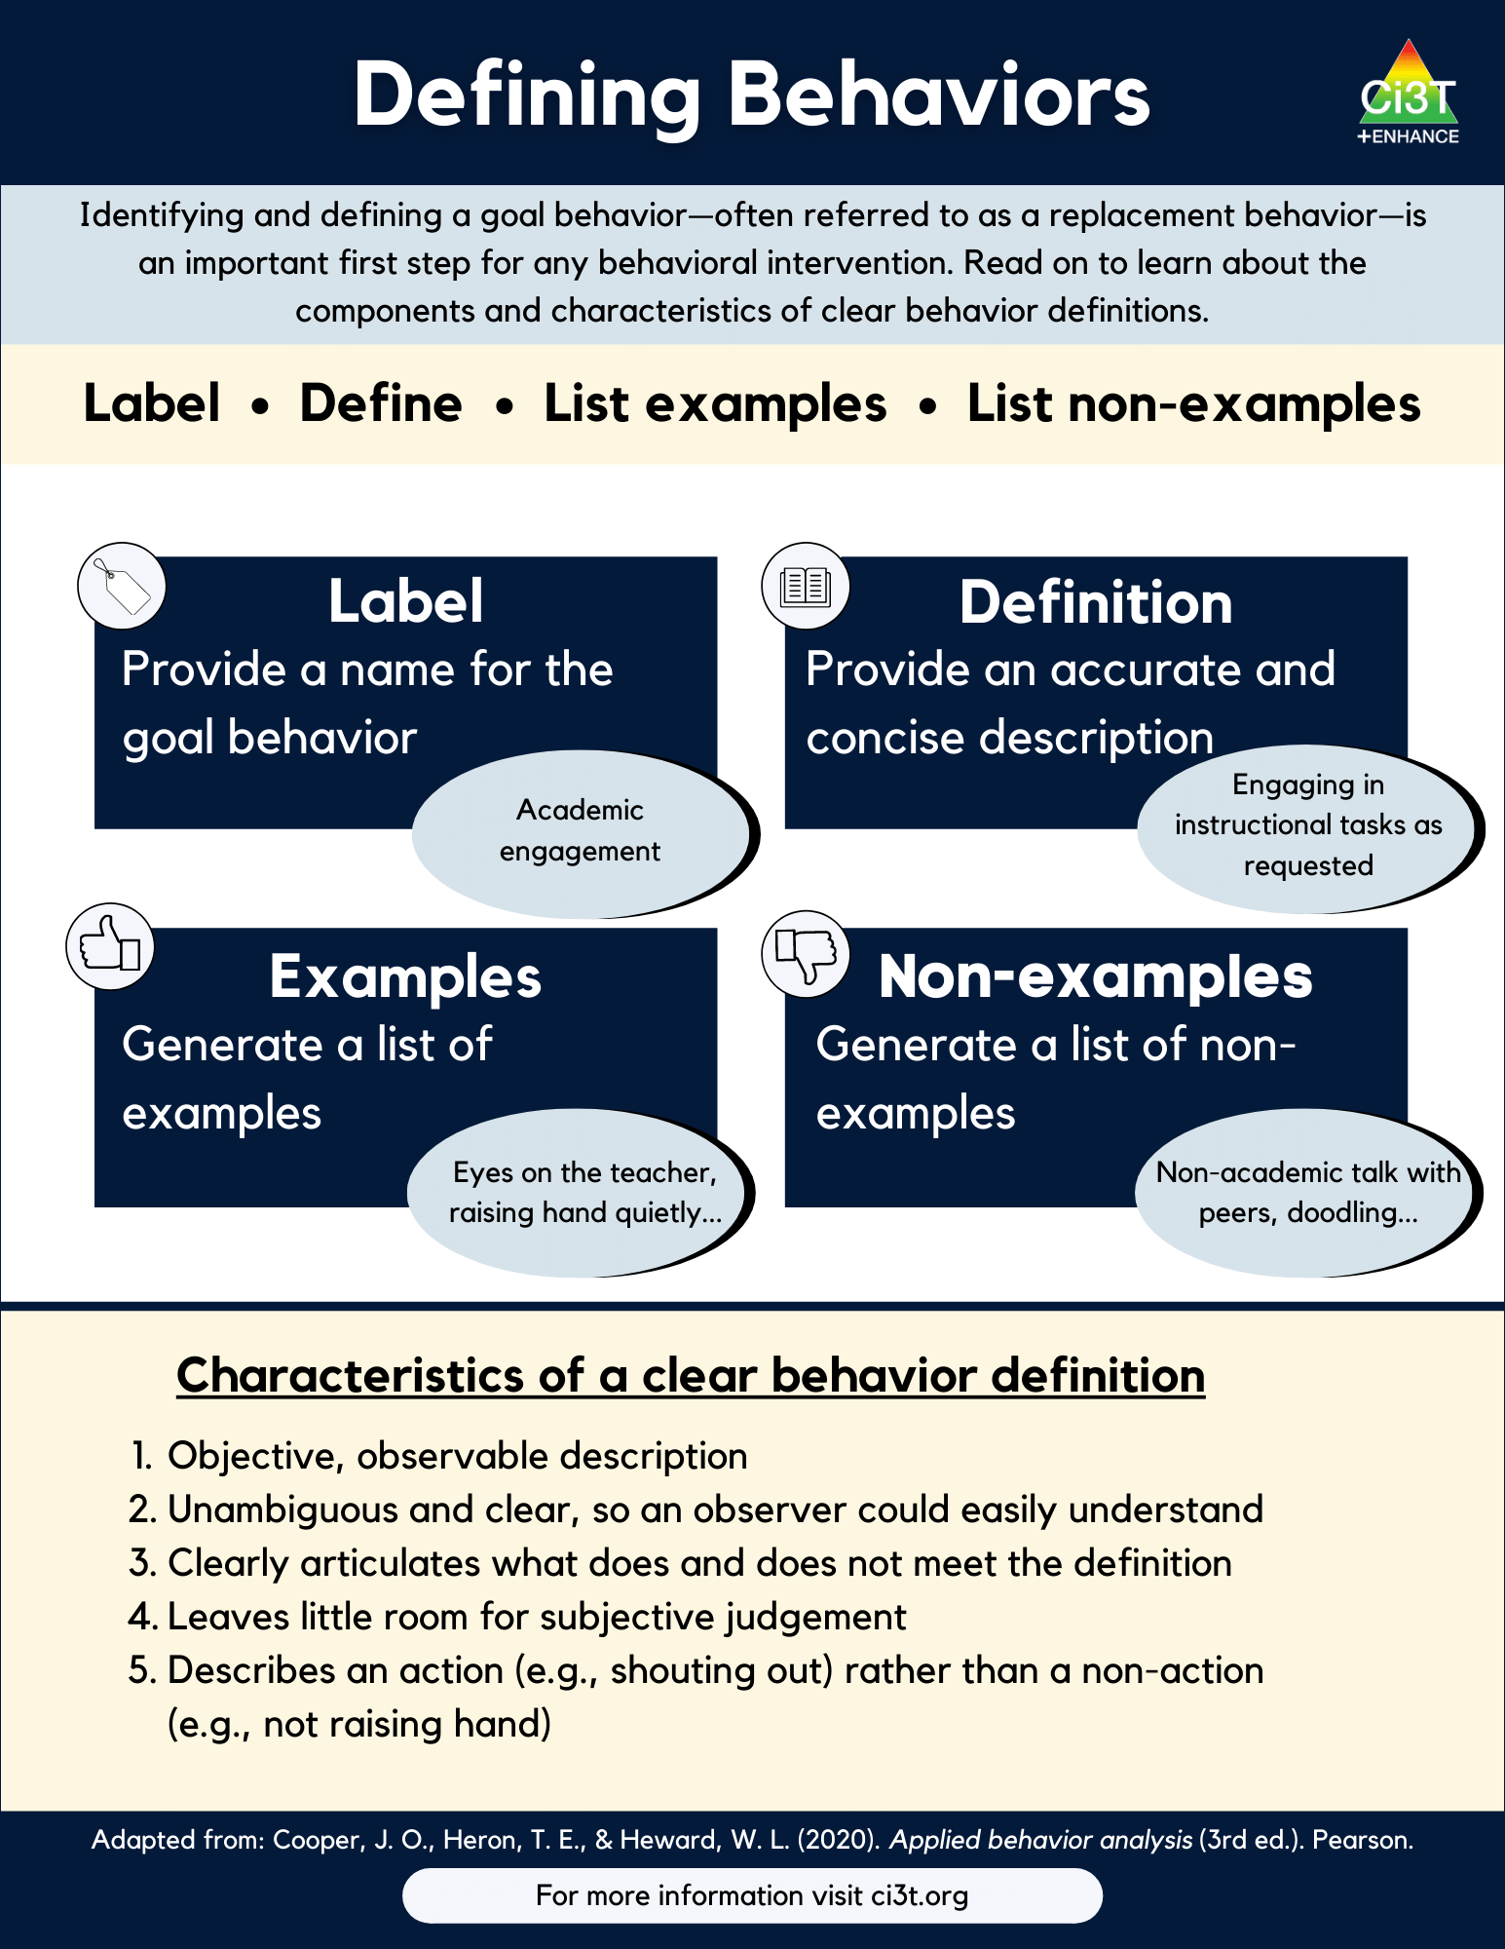
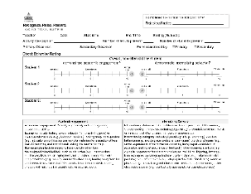
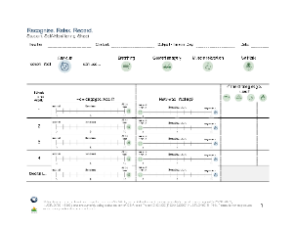
Step 2 Plan RRR Procedures
Step 2 Plan RRR Procedures 2
Prepare intervention forms and procedures
Teacher Recording Form (Direct Behavior Rating)
Student Self-Monitoring Sheet
Operationalize behaviors of interest

Slide 37
Step 3
Begin baseline data collection

Slide 38
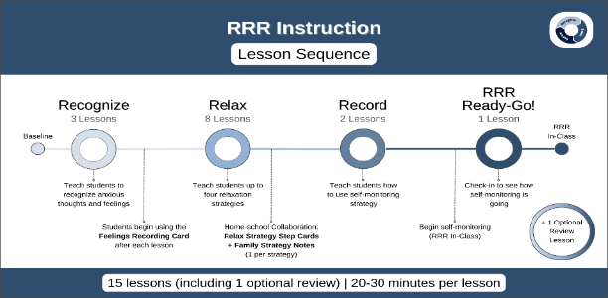
Baseline

Slide 39
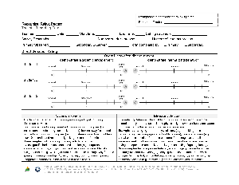
Baseline
Baseline 2
This is the time (approximately two weeks) before beginning RRR instruction
Nothing else changes!
This allows for a comparison pre-intervention performance to post-intervention performance
During this time, teachers will collect Direct Behavior Rating (DBR) data four times a week (Monday-Thursday)
Goal is to collect ~6-8 data points during this time!

Slide 40
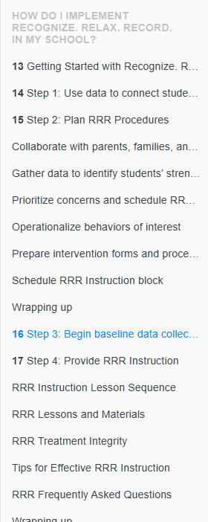
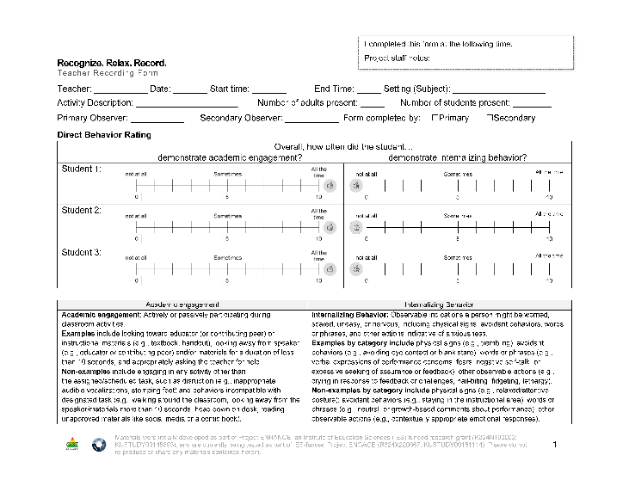
RRR Module Highlight! (1of 2)

Slide 41
Direct Behavior Rating

Slide 42
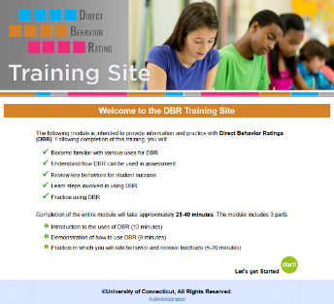
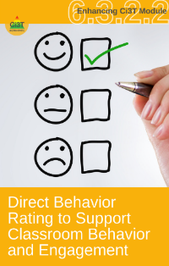
Direct Behavior Rating (DBR)
A tool that involves a brief rating of target behavior immediately following a specified observation period.
Source: University of Connecticut. (n.d.). Direct behavior rating: Assessment training module. [video training module].
www.dbrtraining.education.uconn.edu/video.php

Slide 43
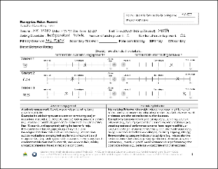
How is DBR used in this intervention?
DBR data are collected during the RRR Rating Period a 40-minute instructional block during which students would most benefit from using their new strategies to increase engagement and regulate anxious feelings
Later in the intervention (during RRR In-Class), students will self-monitor their own behavior during this time
Teachers will collect DBR data throughout all stages of intervention:
Baseline (~6-8 days)
RRR Instruction
RRR In-Class

Slide 44
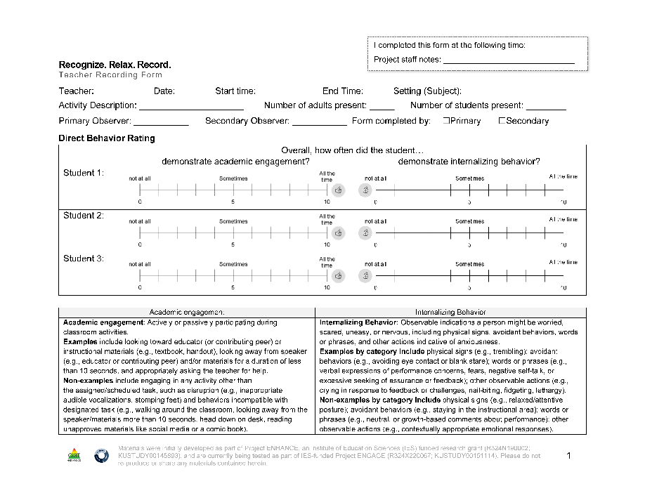
Teacher Recording Form
DBR data are collected using the Recognize.Relax.Record Teacher Recording Form to measure students’:
Academic engagement
Internalizing behavior

Slide 45
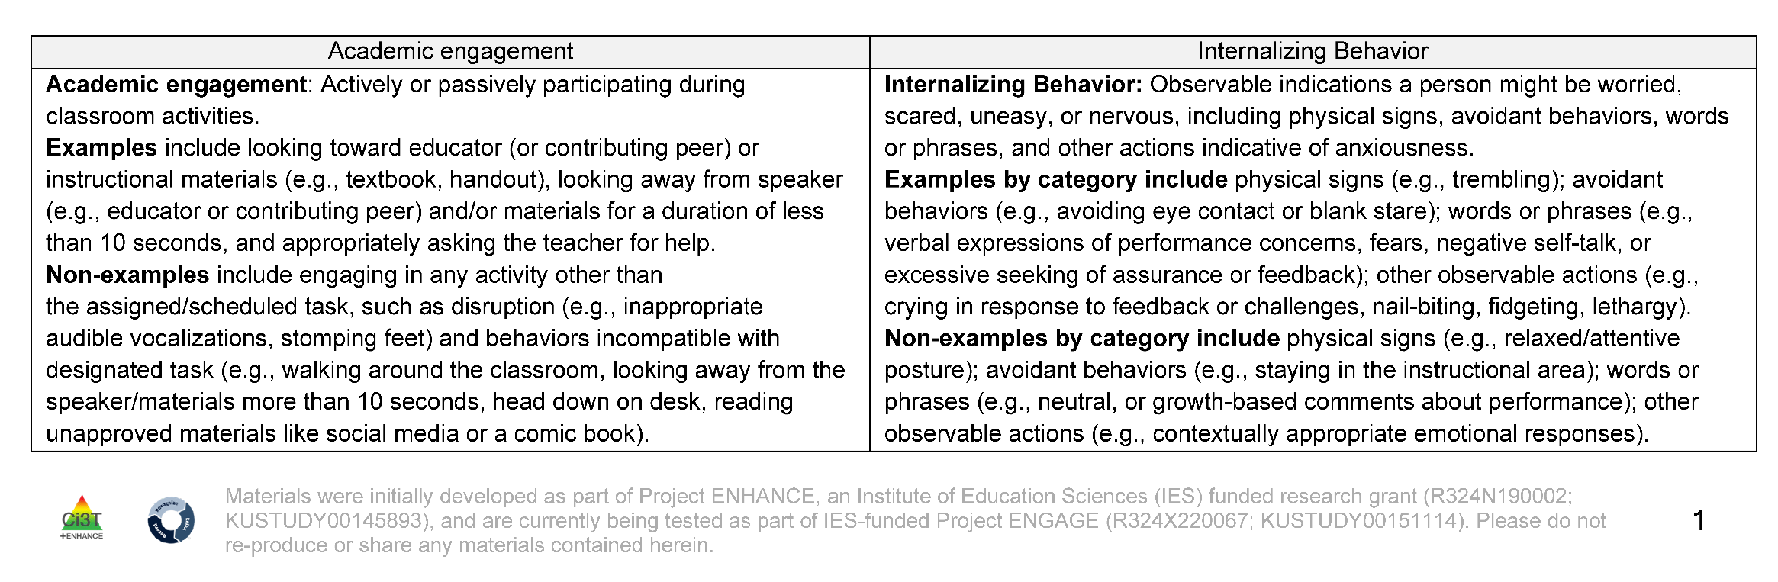
Operational Definition: Academic Engagement

Slide 46
Operational Definition: Internalizing Behavior

Slide 47
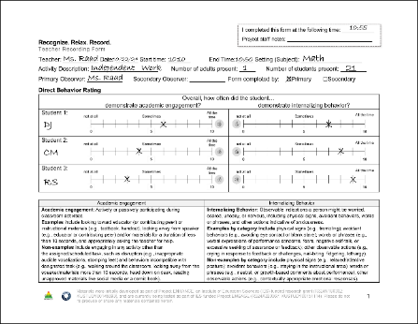
DBR Procedures: RRR Rating Period
DBR Procedures: RRR Rating Period 1
Plan to collect DBR data four times a week
Generally, Monday through Thursday
At the end of the RRR Rating Period, complete the Teacher Recording Form

Slide 48
DBR in Action
Academic Engagement & Internalizing Behavior

Slide 49
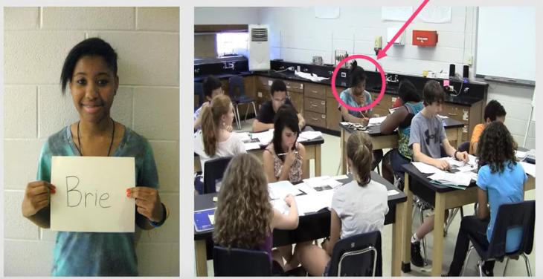
Brie
Context: Students are completing seat work.
Internalizing behavior for Brie looks like:
Head down
Complete shut down / withdrawal
Notes:
https://www.youtube.com/watch?v=XjT5eYz_00U&t=15s

Slide 50
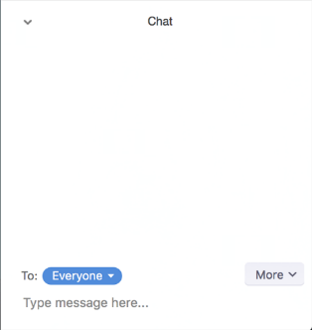
Let’s Chat: Brie
Discuss how you rated Brie’s:
Engagement
Internalizing Behavior

Slide 51
Whole Group: Brie
Engagement – 1
For most of the observation, Brie is engaging in behavior other than the assigned task (e.g., talking, poking peers, tapping pencil)
At the very beginning and end of the clip, Brie appears to be attempting to engage in the assigned activity
Internalizing – 0
Don’t see evidence of head down or complete withdrawal/shut down

Slide 52
DBR Procedures: RRR Rating Period
DBR Procedures: RRR Rating Period 2
Plan to collect DBR data four times a week
Generally, Monday through Thursday
At the end of the RRR Rating Period, complete the Teacher Recording Form

Slide 53
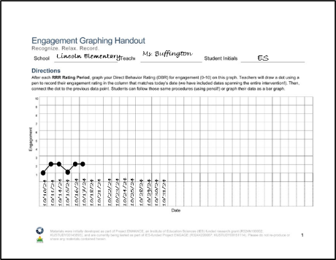
RRR Engagement Graphing Procedures
Each student will have their own Engagement Graphing Handout
Later in the intervention (during RRR In-Class), students will also add their total engagement ratings to this graph!
Once you have completed the Teacher Recording Form, graph each student’s overall engagement score on their graph

Slide 54
Example of an Engagement Graphing Handout

Slide 55
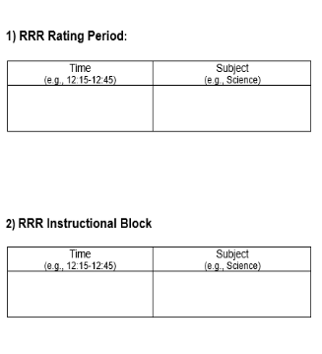
Let’s Chat
During what time of day would be beneficial for conducting DBR with your students?
Notes:
Alright, so now that we have

Slide 56
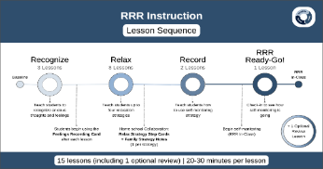
Step 4
Provide RRR Instruction
Notes:
Alright, so now that we’ve learned about our DBR procedures, I’m going to jump into step 4 and tell you a bit more about providing RRR instruction.

Slide 57

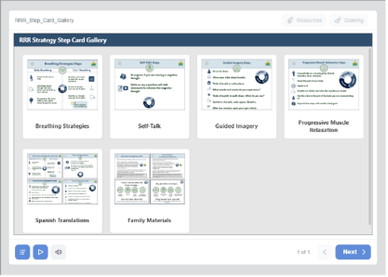
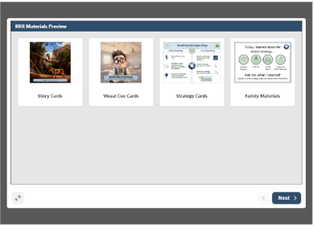
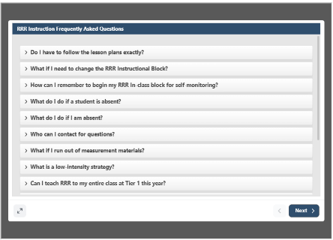
Accessing Materials
Notes:
If you would like to follow along, you may access the materials that I’m going to review in this next section by logging in to the RRR module online and navigating to the Instructional Hub.

Slide 58
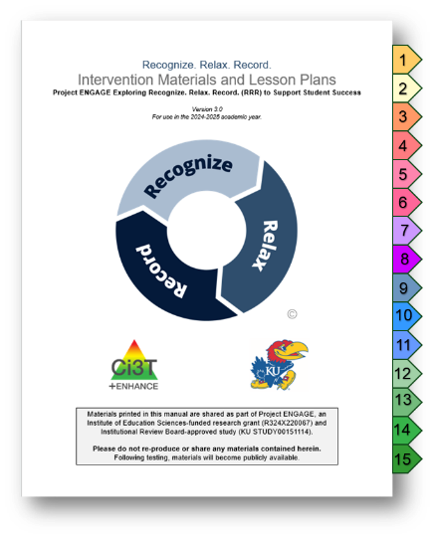
Lesson Plans Overview
15 lessons available
Recognize - 3 lessons
Relax - 8 lessons*
Record - 2 lessons
Ready-Go!
Review (optional)
20-30 min each lesson
Semi-scripted
Teacher-led
Notes:
The first set of materials that I am going to introduce you to is our lesson plans.
We have 15 semi-scripted, teacher-led lessons available that each take about 20-30 minutes to teach.
These include:
3 lessons for students to learn how to recognize their anxious feelings
8 lessons for students to learn new relax strategies for managing their anxious feelings
2 lessons for students to learn how to self-monitor and record their anxious feelings and engagement
1 “Ready, go!” lesson
1 optional review lesson to revisit any previous lessons

Slide 59
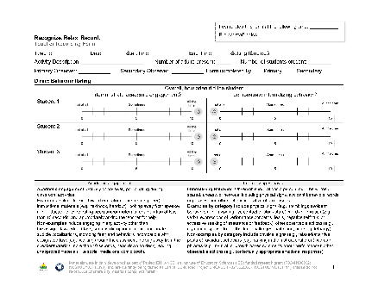

RRR Instruction
Deliver small group RRR Lessons
~20-30 minutes per lesson
Up to 15 lessons (with optional lessons); likely to teach only 10-13 lessons
Taught during a different time than RRR Rating Period
Teachers continue to collect DBR data four times a week (Monday-Thursday) during the RRR Rating Period
Notes:
RRR lessons will be delivered in small groups during a 20-30 minute instructional period, which is different from the RRR in-class rating period, and will consist of 10-15 lessons.
The Relax lessons for learning 4 strategies to manage anxious feelings consist of a Day 1 and Day 2 lesson plan, so some teachers may teach all 8 lessons, whereas other teachers may only teach 4, depending on student need.
While still teaching the lessons, teachers will collect baseline DBR data at least 4 times a week during the RRR in-class rating period.

Slide 60
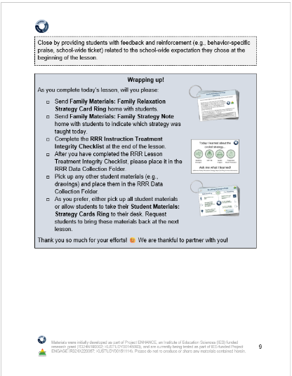




Family Materials (1)
Guidance for sending materials is in each lesson plan, as appropriate
Notes:
Guidance is provided at the end of each of the Relax lessons in the blue boxes titled “Wrapping up!” for sending family materials home.
Family materials are available in both English and Spanish and consist of small flyers indicating which strategy their child has learned that day, as well strategy card rings detailing how to use each strategy.

Slide 61






Teacher Materials
Notes:
Teacher materials can be accessed in the instructional hub and consist of story cards, game materials, strategy card rings, relax strategy icons, a Google slide deck, and more.

Slide 62
Video Model: The Instructional Hub
Notes:
https://www.youtube.com/watch?v=iAD6Np17co0

Slide 63


Key Intervention Lesson Features (2)
Treatment Integrity
Pacing guide
Headings
Tell
Show
Do
Practice & Monitor
Generalize & Close
Notes:
Within each lesson plan, there are a few consistent key features.
Each lesson includes a pacing guide illustrating the tell/show/do/practice & monitor/generalize & closing process as well as a reminder to use your RRR treatment integrity form to help guide you through each lesson, which I will talk about more in a later section.
The pacing guide is flexible, since lessons are semi-scripted, so you can always adjust the pacing and content.

Slide 64






Key Intervention Lesson Features (3)
Situational stories and other examples
Notes:
Also included in some lessons are scripted stories with illustrated story cards, and built in examples, which can be edited to meet the needs of students.
Since many teachers are likely to be providing instruction at a small group table, we have included an example of how you might like to set up for your lesson.
Here we show how you can have the visuals, such as story cards, projected on a second screen or monitor, while you use your laptop to follow along with the lesson plan.
However you choose to present the visuals is up to you! Some teachers may prefer to print out the story cards instead, which students love as well.

Slide 65


Lesson Activities
Embedded materials throughout
Notes:
Also, embedded in the relax lessons, are drawing activities which consist of opportunities for students to draw and write about their own feelings and experiences.

Slide 66

Student Examples 1
Guided Imagery Example
Anxious feelings:
public speaking
Identifying anxious feelings in your body: sweating
Notes:
Here are some examples of drawings that real students produced while engaging in these lessons.
In this first example, we can see that a student drew a picture of peaceful place that they will visualize when using the guided imagery strategy.
In this second example, the student drew a picture of a situation that makes them feel anxious – which creates a great opportunity for the teacher to get to know their student a little bit better.
In this third example, the student drew a picture of what it feels like for them when they experience anxious feelings.

Slide 67



Student Examples 2
Anxious feelings:
soccer tryouts
Guided Imagery Example
Guided Imagery Example
Notes:
Here are some additional student examples. Overall, we really love these activities because they provide students with an opportunity to share a little bit more about their own experiences and open a dialogue with their teacher, which can then be used to inform later instruction.

Slide 68

RRR Ready-Go!
Final lesson in sequence
Lesson taught after students have had a few days of RRR In-Class
Flexible lesson to review:
Self-Monitoring Sheet
Engagement Graphing Handout
Notes:
After all lessons have been taught and students have practiced self-monitoring during the in-class rating period a few times, the RRR Ready, go! lesson can be used by teachers to review, reflect, and refine in-class procedures with students.

Slide 69


Optional Review Lesson
Optional customizable lesson to use as needed following an extended break in instruction.
Notes:
Also included is an optional review lesson to revisit any previous lessons, for example after an extended break from school for a holiday or long-weekend.
This lesson is completely customizable for teachers to use when planning instruction for any topics they might want to revisit.

Slide 70
3 Intervention Components
Notes:
Now that I have given you a quick overview of the lesson plans, I’m going to dive a little deeper into each of the 3 intervention components.

Slide 71

Recognize. Relax. Record. Intervention Component
Recognize. Relax. Record. Intervention Component 1
Recognizing and understanding our emotions is a key component for self-awareness
Students learn to:
Lesson 1: Understanding anxious feelings
Lesson 2: Identifying anxious thoughts and feelings
Lesson 3: Choosing strategies to help manage anxious thoughts and feelings
Notes:
The Recognize component of the intervention involves teaching students to recognize and understand their own emotions to build self-awareness.
During the 3 Recognize lessons, students will learn to understand and identify their anxious thoughts and feelings, as well as select a relax strategy to help manage them.

Slide 72

Recognize. Relax. Record. Intervention Component
Recognize. Relax. Record. Intervention Component 2
Students learn strategies to respond when they feel anxious
Breathing Strategies
Self-talk
Guided Imagery
Progressive Muscle Relaxation
For each strategy, students will:
Define
Learn to use
Recognize situations for when to use
Demonstrate (and practice)
Notes:
The Relax component of the intervention involves teaching students new strategies to use when they feel anxious.
These 4 strategies include: breathing strategies, self-talk, guided imagery, and progressive muscle relaxation.
During these lessons, students will define and learn how to use each strategy, with multiple opportunities for practice.

Slide 73

Recognize. Relax. Record. Intervention Component
Recognize. Relax. Record. Intervention Component 3
Students learn how to monitor their own feelings and behaviors
Lesson 1: Learning to Self-Monitor (Record) our Behaviors
Focus: Academic Engagement
Lesson 2: Learning to Self-Monitor (Record) our Thoughts, Feelings, and Behaviors
Focus: Anxious thoughts and feelings
Focus: Use of relaxation strategies
Notes:
The Record component of the intervention involves teaching students how to self-monitor feelings and behaviors.
During these two lessons, students will learn how to record their academic engagement, anxious thoughts and feelings, and use of relaxation strategies.

Slide 74



Preparing Students for RRR In-Class
Notes:
To help students record their anxious feelings and engagement, they will use the RRR student self-monitoring sheet and engagement graph handout and teachers will play a video to prompt student self-monitor.
Students learn the procedures for using these materials during the two record lessons.
Later on in step 5, I will play a video showing what this process might look like in your own classrooms.

Slide 75


Video Model: Opening & Closing a Lesson
Notes:
https://www.youtube.com/watch?v=3OIThVRb47o

Slide 76















Work Time
Step 1: Go to ci3t.org/enhance
Step 2: Locate the Recognize. Relax. Record. module (see Ci3T: Implementing Secondary (Tier 2) Interventions)
Locate the RRR Instructional Hub (see Steps) Explore one of the lesson plans.
Step 3: Sign into the module using your district email (if you haven’t yet registered, directions will be provided to do so)
Step 4: On the toolbar, Section 13 (Getting Started with Recognize. Relax. Record.). Scroll down until you find the RRR Instructional Hub.
Notes:
Now, we have about 10 minutes of work time for you to use to locate the RRR instructional hub and explore one of the lesson plans
If you need any help signing into the module or locating the hub, please let us know in the chat, otherwise we hope you enjoy this time and will see you back here in just a little bit to go over step 5.

Slide 77
Step 5
Implement RRR In-Class and Monitor Student Performance
Notes:
Hi, welcome back everyone, I hope you enjoyed the time reviewing the RRR lesson plans and materials.
Now that we have learned about RRR instruction, I’m going to give you a quick overview of our in-class procedures.

Slide 78



RRR In-Class
Teachers continue to collect DBR data four times a week (Monday-Thursday)
Students use the Student Self-Monitoring sheet to self-monitor their engagement, anxious feelings, and use of relaxation strategies
Teachers facilitate self-monitoring (e.g., audio cue, brief check-ins)
Notes:
After all lessons have been taught, the RRR in-class phase of the intervention will begin.
This involves teachers continuing to collect DBR data 4 days a week, just as they have already been doing while teaching the lessons, however now students will join in and rate their behavior as well.
Teachers will facilitate student use of the self-monitoring form and provide support by playing audio cues and briefly checking in with students.

Slide 79

Student Self-Monitoring Sheet
Notes:
The student self-monitoring sheet consists of a few different components.
First, here at the top, are icons for each of the strategies that students have learned. This just serves to remind students of the strategies available for them to use if they begin to experience anxious feelings during this self-monitoring period.
Over here on the left side are numbered time blocks indicating the four rating intervals.
Over here on the right side are boxes for students to checkmark if they use any of the strategies during each of the intervals.
Finally, down here on the bottom of the page, is a space for students to record their overall scores, which indicate the averages of all the intervals.

Slide 80

Self-Monitoring Treatment Integrity Checklist
Self-Monitoring Treatment Integrity Checklist located on the back of the RRR Rating Form
Completed daily at end of RRR In-Class Period
rate all procedures on a scale from 0 (not implemented) to 3 (fully implemented)
each procedure is rated for each student
Notes:
To help teachers follow RRR in-class procedures, they can use the treatment integrity checklist to rate on a scale of 0-3 whether they did not, partially, mostly, or fully implemented each procedure for each student.

Slide 81
Video Model: RRR In-Class Procedures
Notes:
Here is a video demonstrating in-class procedures.

Slide 82

Student Check-In and Feedback: Tips from Teachers
Student skips an interval
“That was the third ding, fill out your ratings in this row”
Student ratings are very different than teacher ratings
“I see you rated yourself a 9 for engagement. I noticed you playing inside your desk and drawing in your math book so my rating for you would be a 5 or 6. Can you tell me about your rating?
Nonverbal feedback (e.g., thumbs up, smile, nod)
Notes:
Here is some additional guidance for implementing RRR in-class procedures when students need additional prompting or help with their ratings.
When a student misses a rating interval, teachers can show students where to fill in their ratings.
When a student’s ratings are very different from the teacher’s, they can provide specific feedback, such as “_____”.
Teachers can also provide nonverbal feedback, such as a smile or nod.

Slide 83

Student Check-in and Feedback Practice
We are going to review 3 example RRR Student Self-Monitoring Sheets to practice checking in with students and delivering feedback
View form (on slide)
Consider
What do you notice?
What feedback would you give this student?
Whole Group Discussion

Slide 84


Self-monitoring practice 1
For Poll:
What do you notice?
Student is not using strategies
Student is missing interval scoring
Student is using too many strategies

Slide 85

James
I noticed...student did not score two intervals
Feedback:
“Oops! Looks like we missed a few. Remember- every time you hear the ding you will complete a row on the form. Is there anything that is making it tricky to complete?”

Slide 86


Self-monitoring practice 2
For Poll:
What do you notice?
Overall score is inconsistent with interval ratings
The student is not anxious enough
The student is highly anxious and engaged

Slide 87

Riley
I noticed... overall rating does not match interval ratings
Feedback:
“Great job remembering to fill out the form for every interval! I noticed you rated anxious feelings as mostly 1s but then a 6 for overall score. Remember, your overall score represents how you did throughout the whole math lesson. If your interval ratings are 1s and 2s, your overall score would also be a 1 or 2”.

Slide 88


Self-monitoring practice 3
For Poll:
What do you notice?
Overall score is too high
The student is anxious, but no strategies have been used
Engagement should be higher

Slide 89

Sophie
I noticed... Sophie reports feeling anxious but does not indicate using any relaxation strategies.
Feedback:
“It looks like you were feeling a bit anxious today. Remember, you can use your strategies! If you are feeling anxious during math tomorrow, what strategy do you want to try?”

Slide 90



Engagement Graphing (1of 2)
Notes:
At the end of the RRR Rating Period, students add their overall engagement score to their graph.
Students can either add a dot OR shade the column like a bar graph.
Then, once you check in the with student you will add your own dot the graph.

Slide 91

Engagement Graphing (2 of 2)
Notes:
Graphing is meant to be a quick routine to support students in their self-monitoring.
This is a really great resource for students and teachers to use to track engagement over time and monitor student progress.

Slide 92

Engagement Graphing Handout
Opportunities for feedback & discussion with students!
Notes:
As you continue to use the graphing handout, some additional tips we have for you are to mark when students have been absent, as shown here in the red box, or leave notes down at the bottom indicating why scores might be missing, for example due to testing to just not collecting data on that particular day for whatever reason.
In general, this graphing handout can be used as an opportunity to provide students with feedback and open up discussion with them about their continued use of the RRR strategies and self-monitoring.

Slide 93
Step 6
Monitor maintenance and generalization
Notes:
Thanks, Kathryn!

Slide 94


RRR Module Highlight! (2 of 2)
Notes:
Now that we are finished with the instruction and in-class sections of the intervention, we want to encourage the maintenance and generalization of the skills the students have learned and practiced. Throughout the lessons, we really encourage students to share what they are learning with other adults, friends and family members and to use their strategies in other settings- not just in academic learning times. We have been happy to hear students share with us that they are telling their friends about the strategies on the playground, during state assessments, and at home.

Slide 95


Step 6 Monitor maintenance and generalization
Notes:
To support maintenance and generalization, we have materials such as the strategy cards for both students and families that Kathryn showcased earlier. We also have this infographics specifically for families to help them support their students at home.

Slide 96
Step 7
Seek input from students, families, and teachers
Notes:
Our final step of the intervention is to seek input from students, families and teachers.

Slide 97



Step 7: Seek input from student, families, and teachers
Notes:
It’s important for us to know what the stakeholders think about RRR so we have social validity forms available for students, parents and teachers to fill out before and after the intervention.

Slide 98

Feedback from Families
Notes:
Here is an example of some feedback from one of our families.

Slide 99

Social Validity Interviews …
Social Validity Interviews 1
From Teachers … Group 1
“Literally saw a shift in body language after lessons.”
“I wish everyone put together lessons like you guys did. It was so well put together.”
“At first I thought it was going to be a lot of work, but it worked seamlessly into our routine.”
“Boys wanted to talk about their graphs and how they improved.”
“You came and changed my life.”
From Teachers … Group 2
“Instead of internalizing she was able to verbalize her feelings more and talk about things that have happened at home. She has gained confidence in expressing her feelings.”
“In this school we have a lot of trauma and students struggling. I think kids with anxiety are often overlooked-they have a need and now we have something to do for them for the first time.”
“I don’t always feel like I know students well that don’t have big behaviors. It was good for me to get to know them a little better.”
“This program had done wonders for this student in a short amount of time.”
Notes:
We had the privilege to interview almost all of the teachers after the intervention and they gave us overwhelmingly great feedback. Here are a few examples.
3, 4
2,3

Slide 100
Student Interviews
“I got really mad at home and did some breathing.”
It definitely made me improve on a bunch of stuff. Helped with my self-control.”
“Helped when I couldn’t sleep at night.”
“When I am frustrated, it helps me remember to take a breath.”
“This would help my friends in math say, “I can do this”.”
“When my brother makes me mad, I take deep breaths and visualize being somewhere calm.”
Notes:
My favorite interviews were with the students who shared how the intervention helped them.

Slide 101












Talk Time (2 of 2)
What are some potential benefits of implementing RRR in your setting?
What are some benefits of having the general education teacher be person teaching RRR lessons?
Notes:
For our final break out room, we’d like to invite you to talk about potential benefits of implementing RRR in your classroom and also discuss what are some benefits of having the general education teacher be the person teaching the lessons. Enjoy your time and we’ll see you in about 10 minutes.

Slide 102
Considerations for Implementing RRR
Notes:
Welcome back and thank you for your discussion during the talk time!
Finally, we’d like to share a few recommendations from teachers who have taught Triple R.

Slide 103


Teacher Recommendations (1 of 2)
Hang strategy cards on desks
Set phone reminders for RRR Rating Period
Whole-class participates in self-monitoring
Student leaders
Passing out materials
Reminders for in-class procedures
Notes:
Here a few tips:

Slide 104

Teacher Recommendations (2 of 2)
Showcase icons in classroom for all to see
Laptop & monitor
Students teach whole class relax strategies as Tier 1 practice
Set timers for lesson activities

Slide 105
Wrap Up and Moving Forward
Notes:
Okay, thanks so much and I will let Kathleen wrap up for us.

Slide 106
Action Items
Action Item | Person(s) Responsible | Planned Completion Date | Date Completed
Review systematic screening data (spring) to see which students might benefit from Recognize. Relax. Record. (RRR) | Amy | 05/21/26
Explore the possibility of implementing RRR with your school site colleagues and principal | Amy | 05/26/26
Explore the module and instructional hub | Amy | 05/27/26

Slide 107

Ci3T Project EMPOWER
EMPOWER+ Session | Date
Effective Tier 1 Practices for Positive, Productive Classrooms | September 15, 2026 (Tuesday)
Let the Data Drive: Using Systematic Screening to Shape Instruction | October 27, 2026 (Tuesday)
Ci3T In Action: Integrated Lesson Planning for Optimal Instruction | November 17, 2026 (Tuesday)
A 6-Step Instructional Approach for Responding to Challenging Behaviors in Schools | January 20, 2027 (Wednesday)
A Tier 2 Intervention for Managing Anxious Feelings: Recognize. Relax. Record. | March 23, 2027 (Tuesday)
A Tier 3 Intervention: Functional Assessment-Based Intervention (FABI) | April 28, 2027 (Wednesday)

Slide 108


Thank you!
Thank you!
ci3t.org
#Ci3T
@Ci3Tmodel
Tag us in your Ci3T highlights, we love to see Ci3T in action!
Follow us on Instagram for updates and new resources!
Kathleen Lane
kathleen.lane@ku.edu

