Slide 1
<SCHOOL NAME>
DELETE THIS BOX ONCE LOGO UPDATED
To change logo, go to View then Theme Builder. Click on first slide of template, click on Lion Logo to delete and add your school’s logo
Ci3T Data Update
20XX-20XX School Year

Slide 2

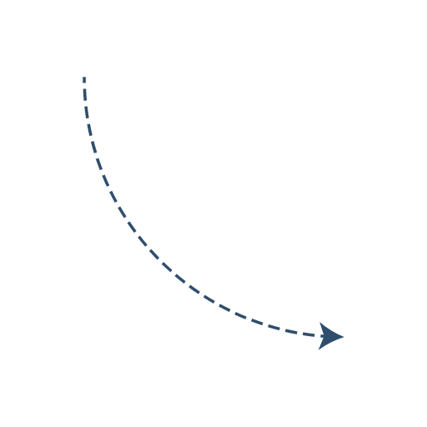
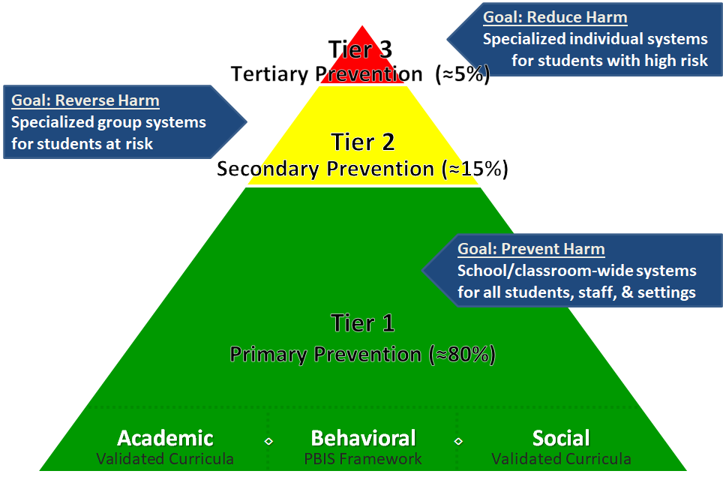

Slide 3
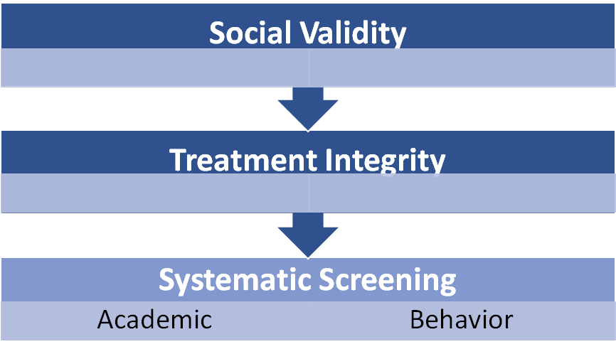

Slide 4


Slide 5
Social Validity....how do we feel about our plan?
Social validity refers to the level of social…
significance of goals / acceptability of procedures / importance of outcomes (Wolf, 1978)
Year | Fall |  | Spring
 | Responses | Mean % (SD) | Responses | Mean % (SD)
2022-2023
2023-2024
2024-2025
Goal: mean percent at or above 80%

Slide 6
Treatment Integrity...how well are we using our plan?
Treatment integrity is the degree to which the plan is being put in place as designed
3 data sources:
Method | Measure Name | Completed by who?
 |  | All Staff | Randomly Selected Classrooms | Ci3T Leadership Team
Survey | Ci3T Treatment Integrity: Teacher Self-Report | X
Observation | Ci3T Treatment Integrity: Direct Observation |  | X
Rubric | Tiered Fidelity Inventory |  |  | X
Notes:
Teaching (academic instruction, teaching school-wide expectations, Second Step)
Reinforcing (acknowledging students for meeting expectations, responding when challenging behavior occurs)
Monitoring (using data to make decisions)

Slide 7
Teacher Self-Report (Survey) and
Direct Observation
Ci3T Procedures | Teacher Self-Report* |  | Direct Observation* Fall 20XX |  | Direct Observation* Spring 20XX
 | Fall 20XX n = % (SD) | Spr. 20XX n = TBD % (SD) | Educator n = TBD % (SD) | Observer n = TBD % (SD) | Educator n = TBD % (SD) | Observer n = TBD % (SD)
Teaching | 00.00% (SD) | TBD | 00.00% (SD) | 00.00% (SD) | TBD | TBD
Reinforcing | 00.00% (SD) | TBD | 00.00% (SD) | 00.00% (SD) | TBD | TBD
Monitoring | 00.00% (SD) | TBD | - | - | - | -
Total | 00.00% (SD) | TBD | 00.00% (SD) | 00.00% (SD) | TBD | TBD

Slide 8
Tiered Fidelity Inventory (Rubric)
Pull TFI Over Time Graph to this slide
DELETE THIS BOX BEFORE SHARING
Notes:
Teaching (academic instruction, teaching school-wide expectations, Second Step)
Reinforcing (acknowledging students for meeting expectations, responding when challenging behavior occurs)
Monitoring (using data to make decisions)

Slide 9

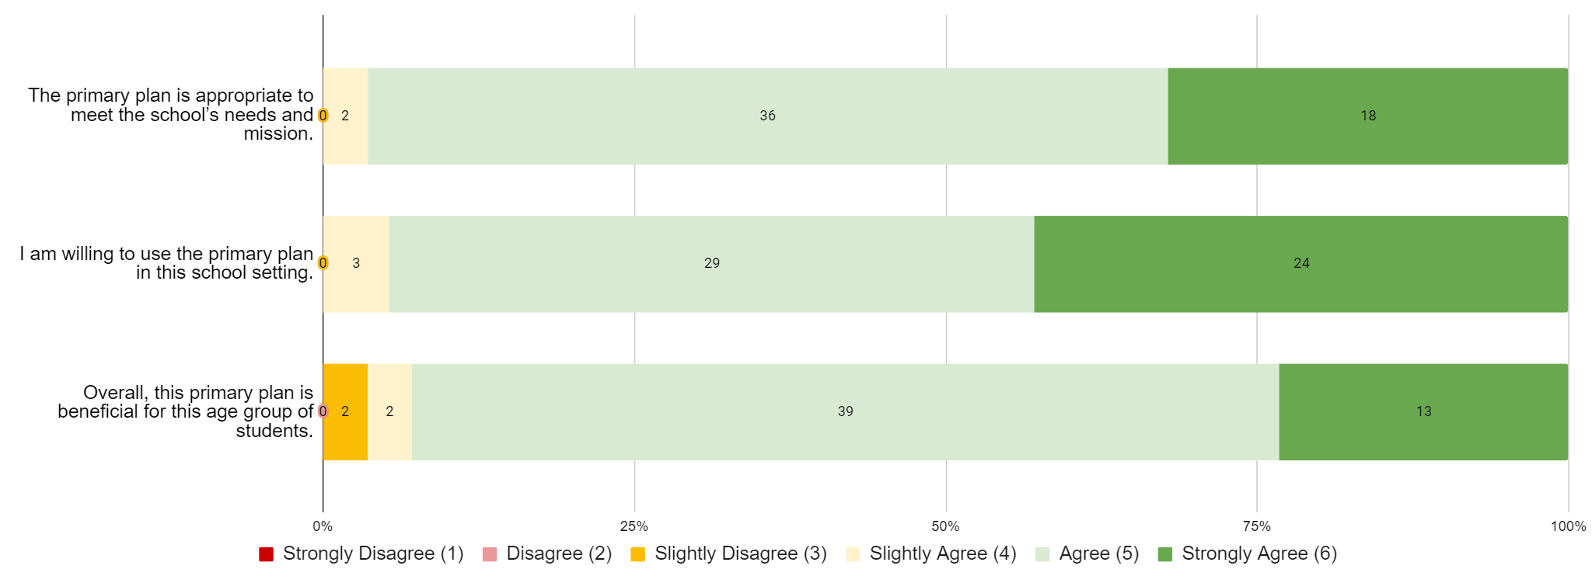
Successes
Record successes highlighted by the Ci3T leadership team and/or
Pull in successes from Social Validity and/or Treatment Integrity Reports. Examples below. DELETE TEXT BOX & EXAMPLES BEFORE ADDING CONTENT
Great increases in social validity - we feel the plan is working and are willing to use it!

Slide 10

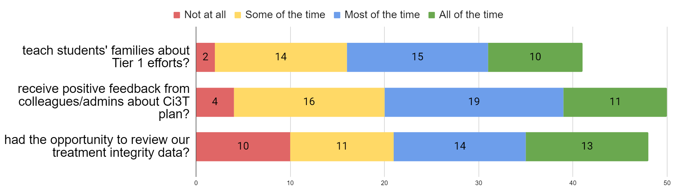
Focus Areas
Record Focus Areas discussed by the Ci3T leadership team and/or
Pull in areas of focus from Social Validity and/or Treatment Integrity Reports
Example below. DELETE TEXT BOX & EXAMPLES BEFORE ADDING CONTENT
Visit ci3t.org/pl to support your goal area(s)

