Slide 1
XXXXX School
Ci3T Implementation Report
Social Validity and Treatment Integrity
20XX – 20XX
____________________________________
Fall 20XX

Slide 2
Essential Components of
Primary Prevention Efforts
Social Validity
Treatment Integrity
Systematic Screening
Academic
Behavior
Notes:
Add slides to the end of the presentation to report Year End Summaries of screening measures. These should be screening measures you collect and use for determining which students need Secondary and Tertiary levels of support. For example, you might list Office Discipline Referrals (ODRs), the Student Risk Screening Scale (SRSS), AIMSweb, DIBELS, and/or Benchmarks.

Slide 3
Social Validity

Slide 4
Social Validity: Primary Intervention Rating Scale (PIRS)
Educator Survey
(Lane, Robertson, & Wehby 2002)
The purpose of this survey was to obtain information that will aid in determining the effectiveness and usefulness of the Ci3T plan.
Educators read each statement regarding the primary plan and select the number that best describes their agreement with each statement.
  Fall data indicate teachers’ expectations and initial perceptions of the primary plan.
  Spring data indicate the degree to which expectations were met and perceptions at the end of a year of implementation.
  Comments are used by the Ci3T leadership team to revise specific elements of the plan over the summer for the next school year.

Slide 5
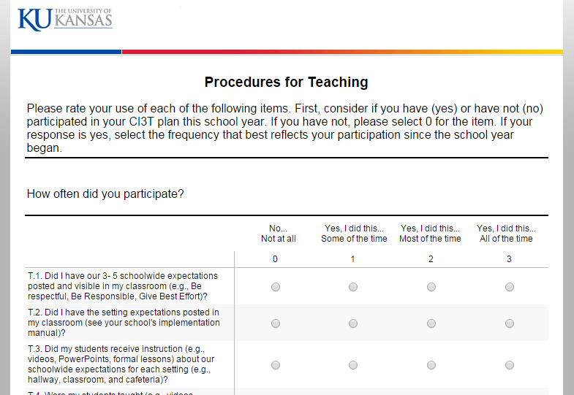
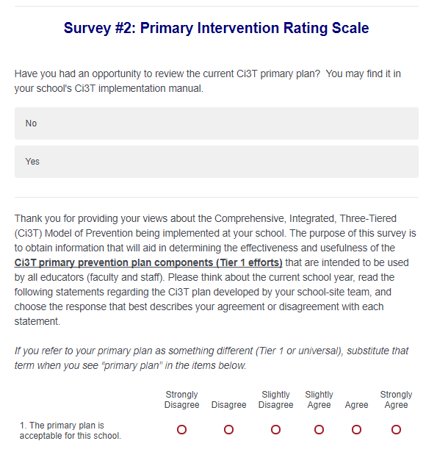
Social Validity: Primary Intervention Rating Scale
All faculty and staff received an emailed link to Qualtrics for the TSR and PIRS surveys

Slide 6
Social Validity: PIRS Results
Year of Implementation | Fall |  | Spring
 | n | % (SD) | n | % (SD)
20XX-20XX
Social validity refers to the level of:
Social significance of intervention goals
Social acceptability of intervention procedures
Social importance of intervention outcomes
(Wolf, 1978)

Slide 7
Treatment Integrity

Slide 8
Treatment Integrity (TI)
The degree to which the plan is implemented as designed
Treatment integrity provides information on the elements of the plan that are being implemented
Treatment integrity is needed to accurately interpret the effectiveness of the school’s Ci3T plan

Slide 9
Measuring Treatment Integrity
We used three measures of treatment integrity:
Ci3T Treatment Integrity: Teacher Self-Report (Ci3T TI: TSR)
  For all components of the Ci3T plan (Lane et al., 2009)
Ci3T Treatment Integrity: Direct Observation (Ci3T TI: DO)
  For two perspectives: observer and educator (30-minute snapshot; Lane et al., 2009)
School-wide Evaluation Tool (SET) version 2.0
  For the PBIS component of the Ci3T plan (Todd et al., 2012)

Slide 10
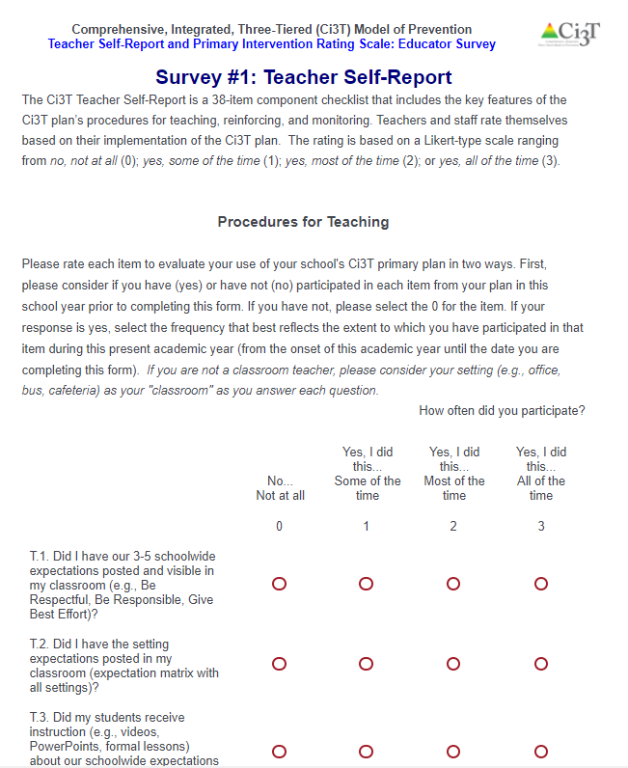
Treatment Integrity: Teacher Self-Report
All faculty and staff received an emailed link to Qualtrics for the TSR and PIRS surveys

Slide 11
Treatment Integrity: Direct Observation from
Two Perspectives
Conducted during the fall and spring treatment integrity window
Educators observed were randomly selected from a stratified sample
  stratified across grade levels or instructional content (e.g., first grade, special education, English courses)
Educators are defined as school personnel who directly instruct students
Observers were trained to criterion on SET and direct observation protocols
Educators were asked to rate the use of components based on the same 30-minute snapshot

Slide 12
Treatment Integrity: Teacher Self-Report and
Direct Observation Results
20XX-20XX
Treatment Integrity Procedures | Teacher Self-Report Mean (SD) |  | Direct Observation Fall 20XX Mean (SD) |  | Direct Observation Spring 20XX Mean (SD)
 | Fall 20XX n = | Spring 20XX n = | Educator n = | Observer n = | Educator n = | Observer n =
Teaching
Reinforcing
Monitoring |  |  | - | - | - | -
Total
Note. Monitoring procedures are not observed. A subset of observable teaching and reinforcement procedures are identified for observation. (-) = not applicable.

Slide 13
Treatment Integrity: School-wide Evaluation Tool
(SET; Sugai, Lewis-Palmer, Todd & Horner, 2012)
  The School-wide Evaluation Tool (SET) consists of 7 subscales, each addressing a different component of school-wide positive behavioral interventions and supports as well as an overall summary score

Slide 14
Treatment Integrity: SET Results – XXXXX School
Category | Total Points Earned |  | Total Points Possible | % Earned
 | Fall 20XX | Spring 20XX |  | Fall 20XX | Spring 20XX
Expectations Defined |  |  | 4
Behavioral Expectations Taught |  |  | 10
On-going System for Rewarding Behavioral Expectations |  |  | 6
System for Responding to Behavioral Violations |  |  | 8
Monitoring & Decision-Making |  |  | 8
Management |  |  | 16
District-Level Support |  |  | 4
TOTAL SCORE | Goal: 80% on Behavioral Expectations Taught and Overall Scores
Notes:
Category
Total Points Earned
Total Points Possible
% Earned
Total Points Earned
Total Points Possible
% Earned

Slide 15
Treatment Integrity: SET Results
Percentage of Points Earned
Notes:
Right-click on graph area and select edit data to input/update SET results.

Slide 16
  Implementing Ci3T Models of Prevention
  Your school’s Ci3T liaison or coach is:
  NAME
  EMAIL
  For more information:
  www.ci3t.org

