Slide 1
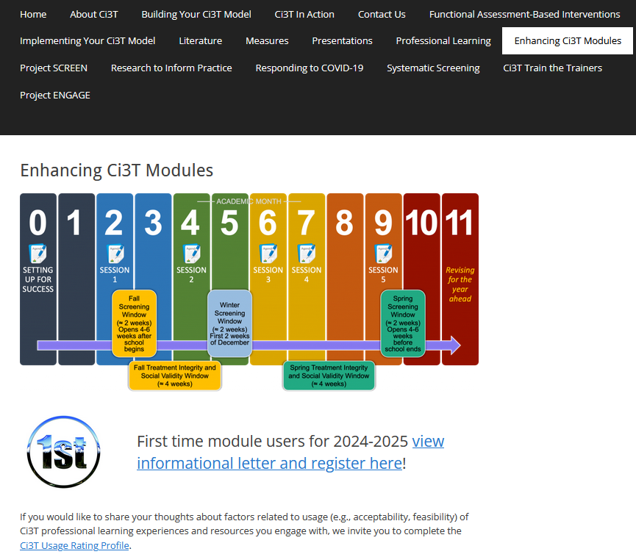
Supporting Students Receiving Special Education Services in General Education Classroom through Tier 3 Intervention:
Functional Assessment-Based Intervention
Kathleen Lynne Lane, Ph.D., BCBA-D, CF-L2
Mark Matthew Buckman, Ph.D.
Elise Sarasin, MSE
If you have not done so already, we invite you to visit ci3t.org/enhance to access modules after a one-time registration process!

Slide 2
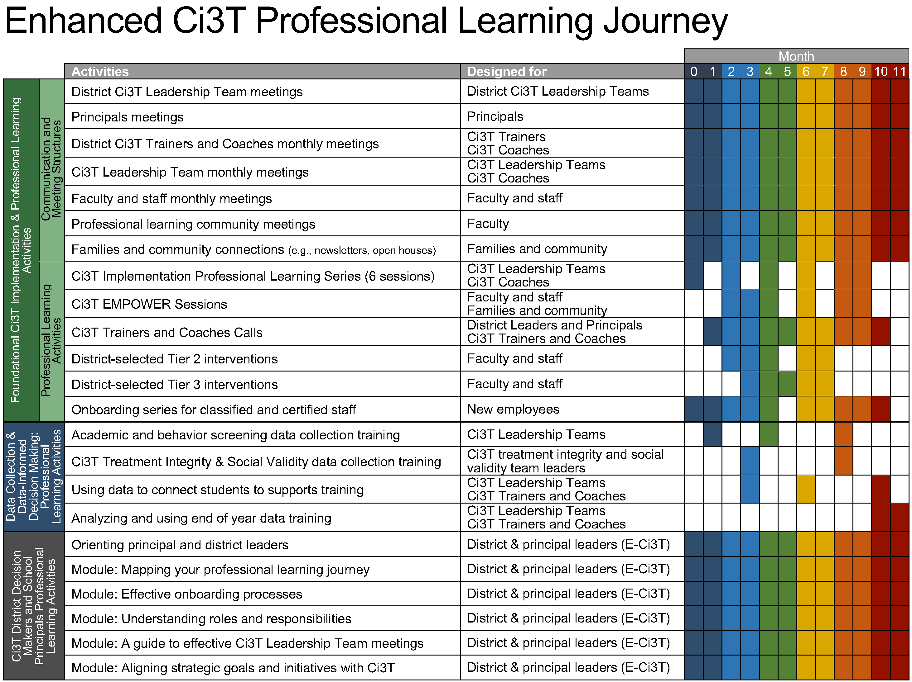
Agenda
Welcome
Creating Positive, Productive Learning Environments Using Ci3T
Using Screening Data to Inform Instruction
Functional Assessment-Based Intervention (FABI)
Wrapping Up and Moving Forward

Slide 3
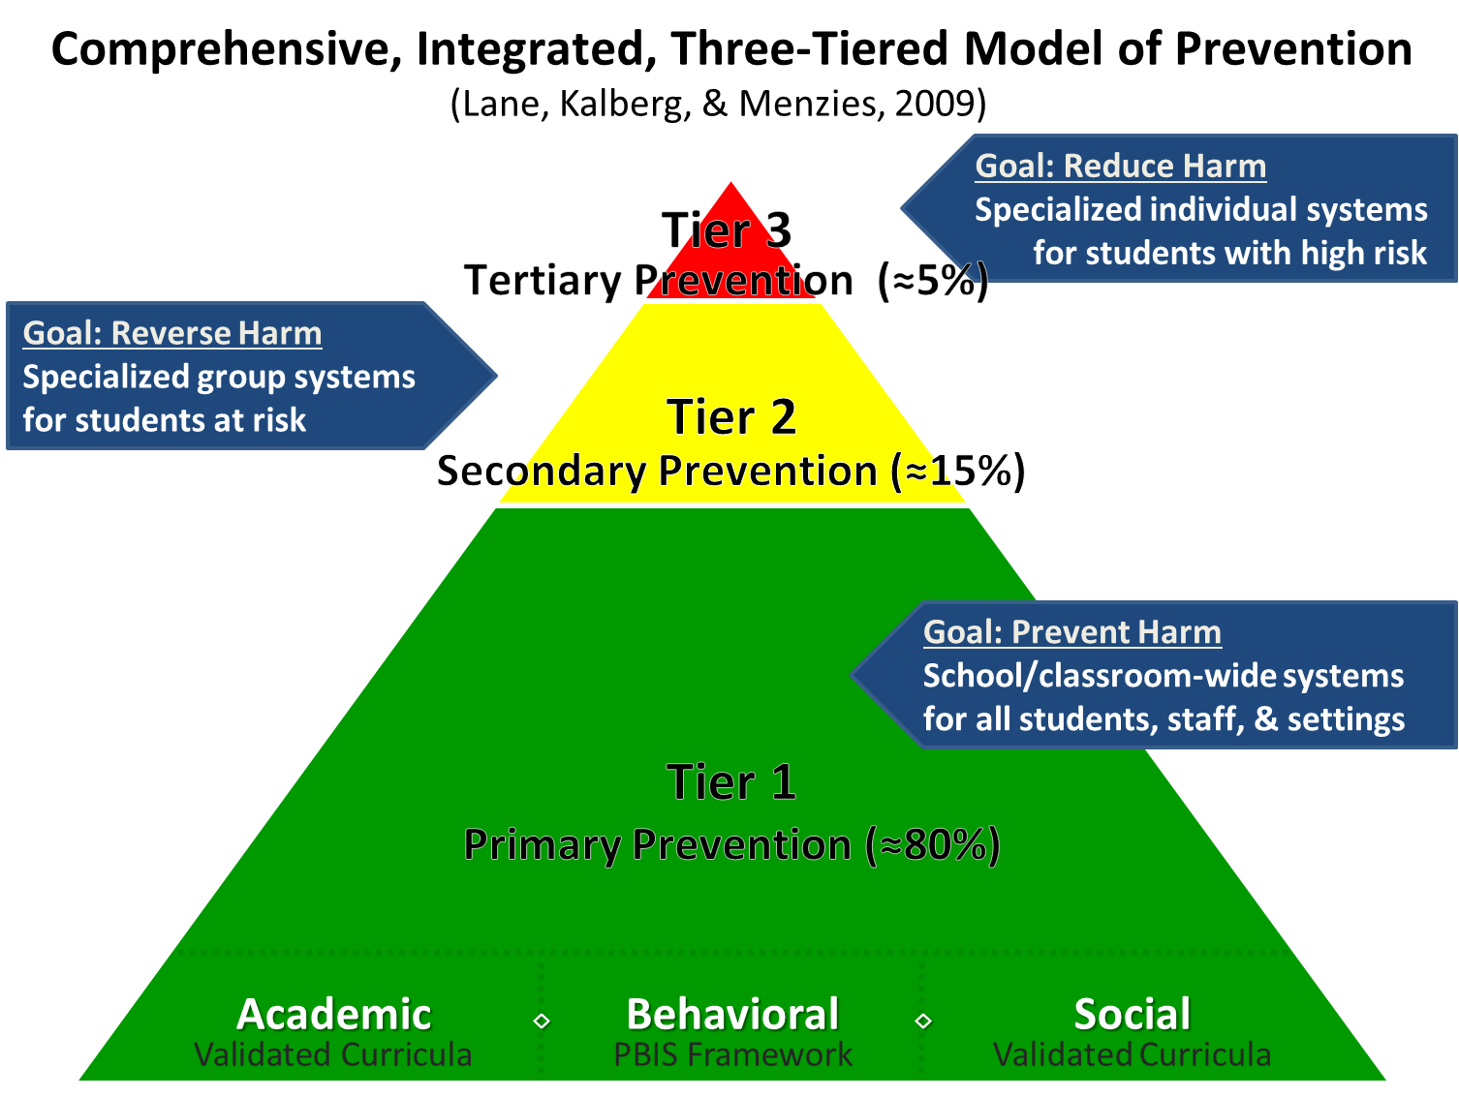
Comprehensive, Integrated, Three-Tiered Model of Prevention 1

Slide 4
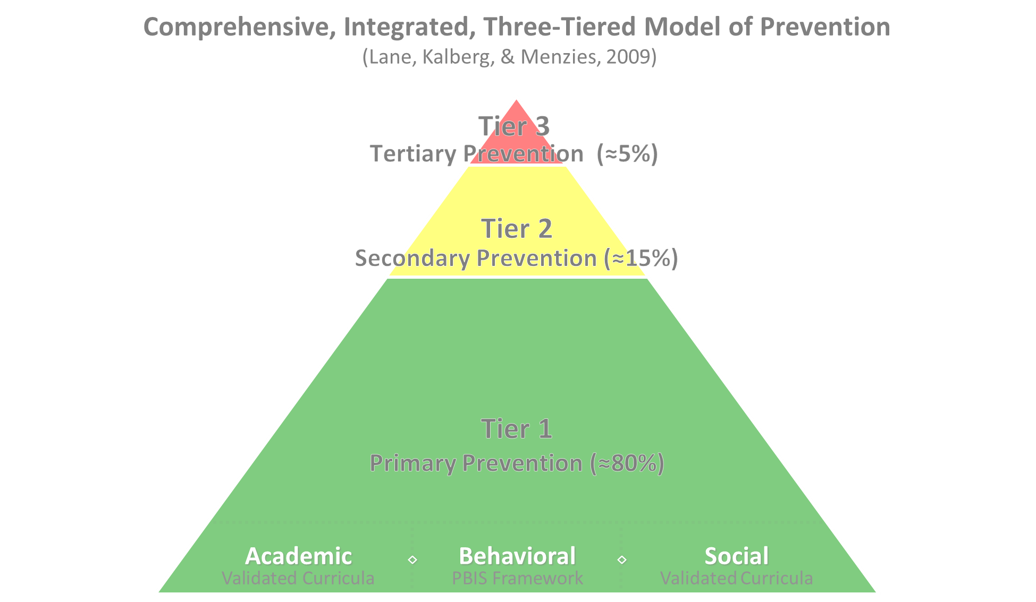

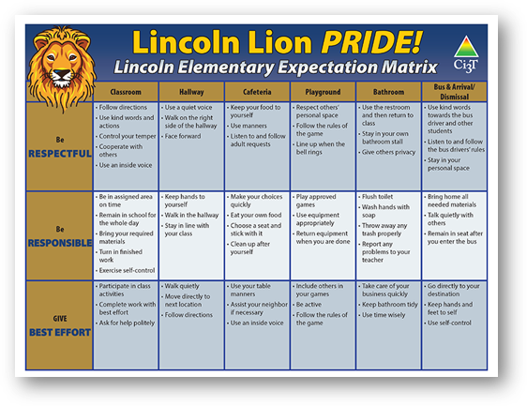
Comprehensive, Integrated, Three-Tiered Model of Prevention 2
Positive Behavioral Interventions and Supports
District & State Standards Quality Instruction
Validated Curricula and Resources

Slide 5


Primary Prevention (Tier 1)

Slide 6

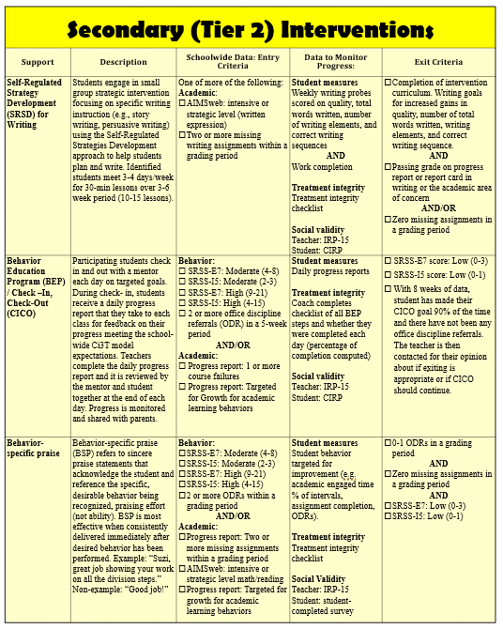
Secondary (Tier 2) Intervention Grid
Notes:
In addition to the module featured here outlining how to use multiple sources of data to connect students with Tier 2 supports, we offer a full suite of modules highlighting validated Tier 2 interventions such as Self-Regulated Strategy Development (SRSD) for Writing and Check-In/Check Out that may appear in your Secondary (Tier 2) Intervention Grid

Slide 7

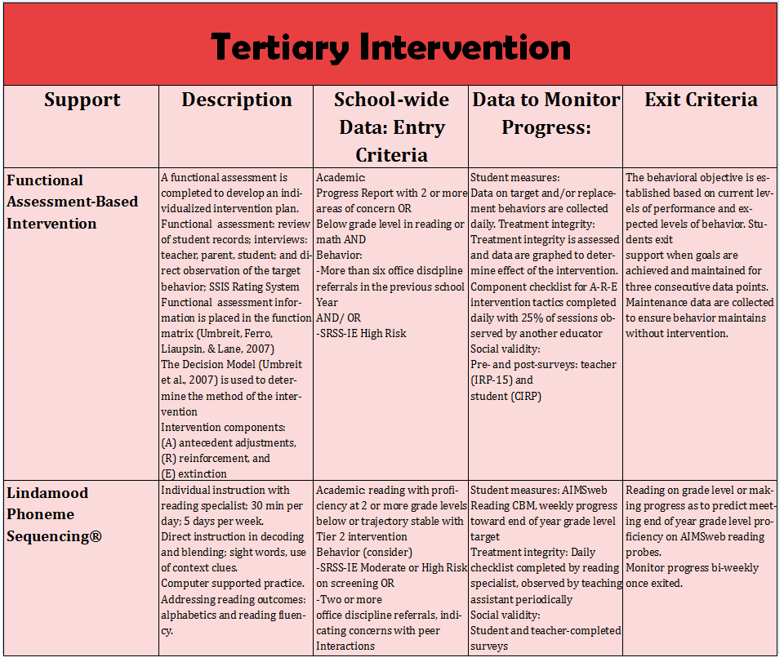
Tertiary (Tier 3) Intervention Grid
Notes:
In addition to the module featured here outlining how to use multiple sources of data to connect students with Tier 3 supports, we offer a full suite of modules highlighting validated Tier 3 interventions such as Functional Assessment-Based Intervention (FABI) that may appear in your Tertiary (Tier 3) Intervention Grid

Slide 8

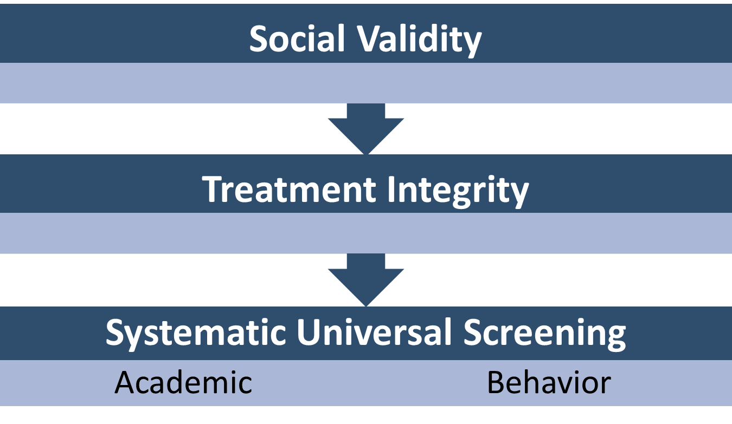
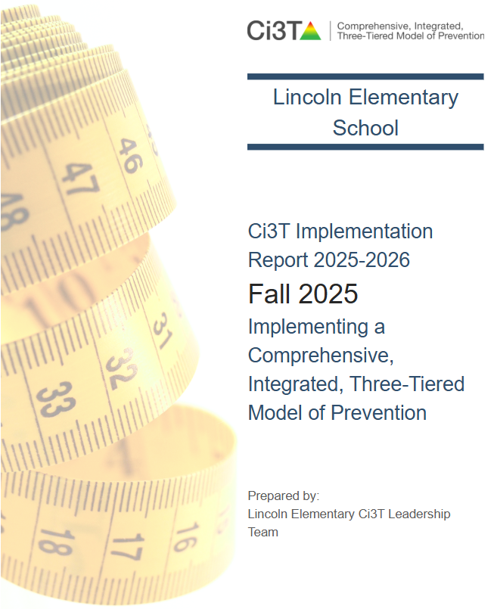
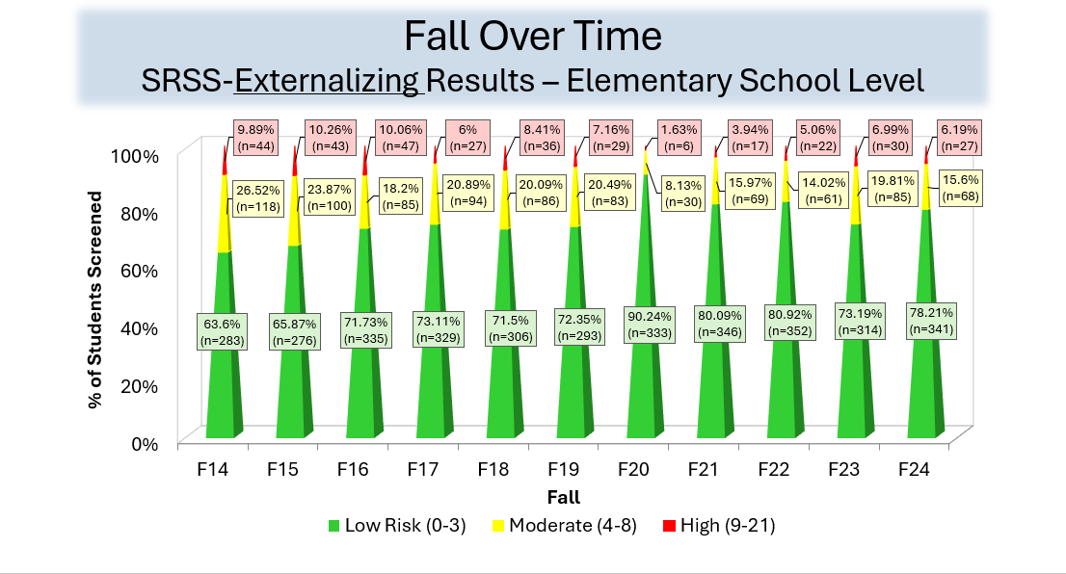
Essential Components of Primary (Tier 1) Prevention Efforts
Essential Components of Primary (Tier 1) Prevention Efforts 1

Slide 9


Enhancing Ci3T Modules
ci3t.org/enhance

Slide 10
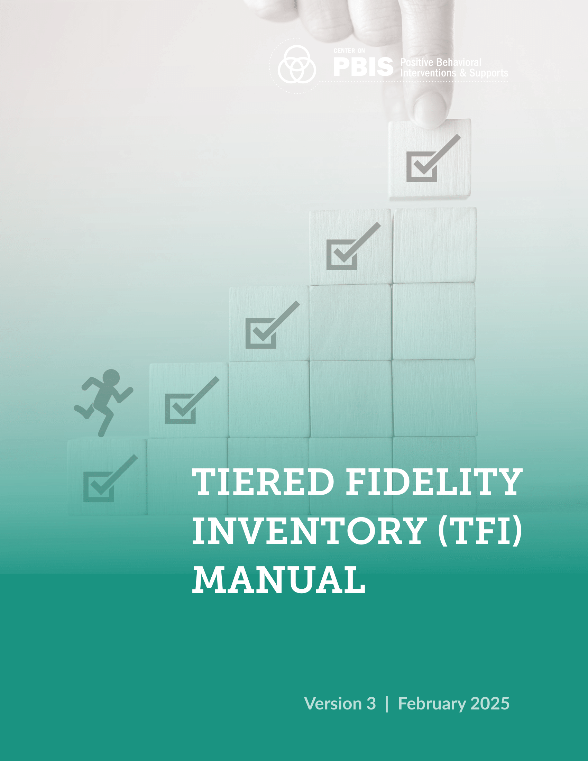
TFI Version 3 Connection
TFI Item | Description
3.5 INDIVIDUAL SUPPORT PLAN PROTOCOL | Tier 3 leadership team develops, implements and monitors the use of an individual support plan protocol to guide the development of individualized support plans based on individualized assessment data (item 3.16), including decision rules for matching plan to student level of need (e.g., brief, comprehensive, wraparound) and all of the following plan elements: Prevention strategies Teaching strategies Consequence strategies To encourage or reinforce contextually appropriate behaviors To prevent reinforcement of and respond to contextually inappropriate behaviors Safety elements that prioritize alternatives to restrain where needed Systematic process for assessing fidelity and impact Action plan for putting the comprehensive support plan in place Adaptations or modifications to Tier 1 and 2 supports are priorities before adding new interventions

Slide 11
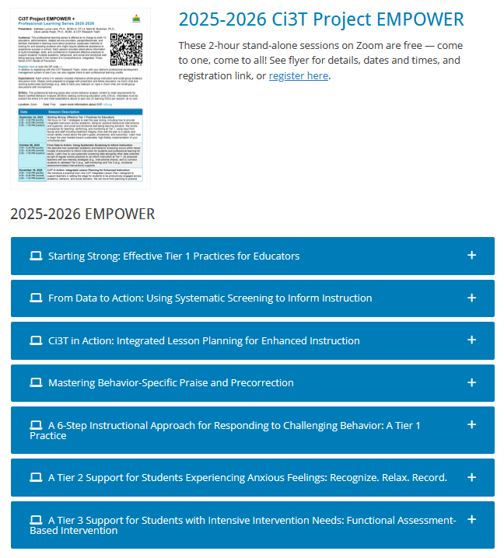
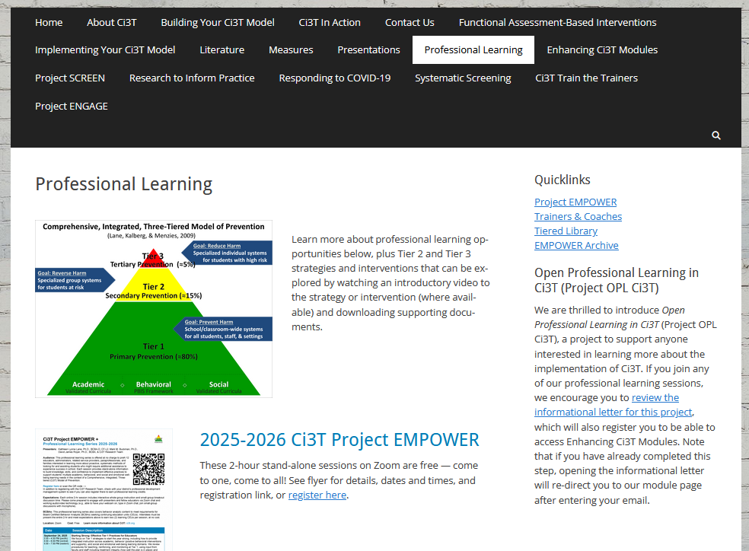
Accessing Professional Learning Materials
Accessing Professional Learning Materials 1
ci3t.org/pl

Slide 12
Using Screening Data to Inform Instruction

Slide 13

Systematic Screening … Logistics
Fall
Winter
Spring
Selecting
Installing
Analyzing

Slide 14
Fall Over Time
SRSS-Externalizing Results – Elementary School Level
Notes:
Fill in <year> based on current academic year. This is located in column A of the data sheet. Edit by right clicking and selecting “Edit data”.

Slide 15
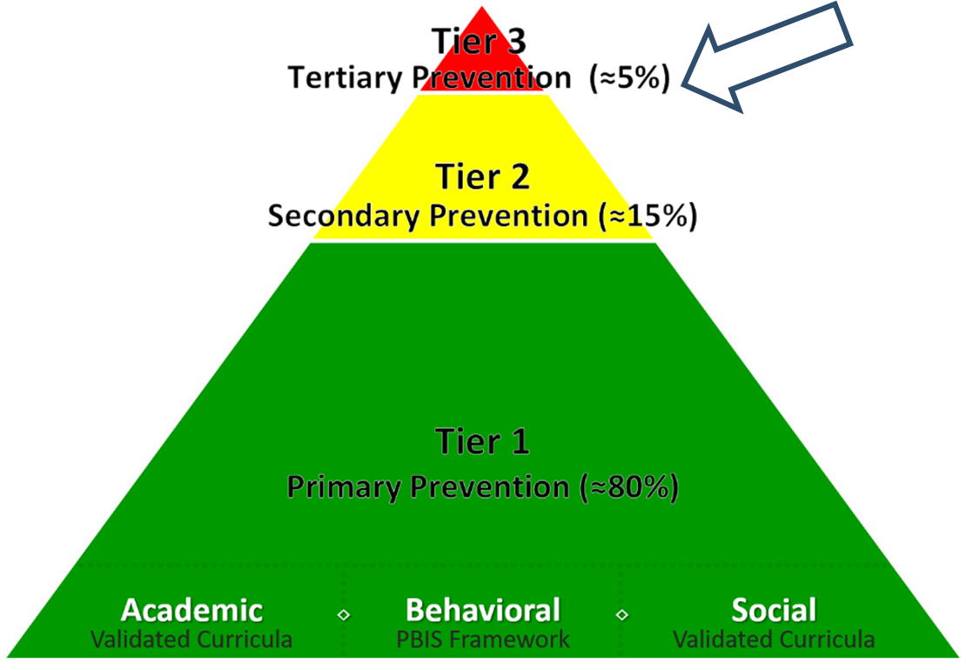
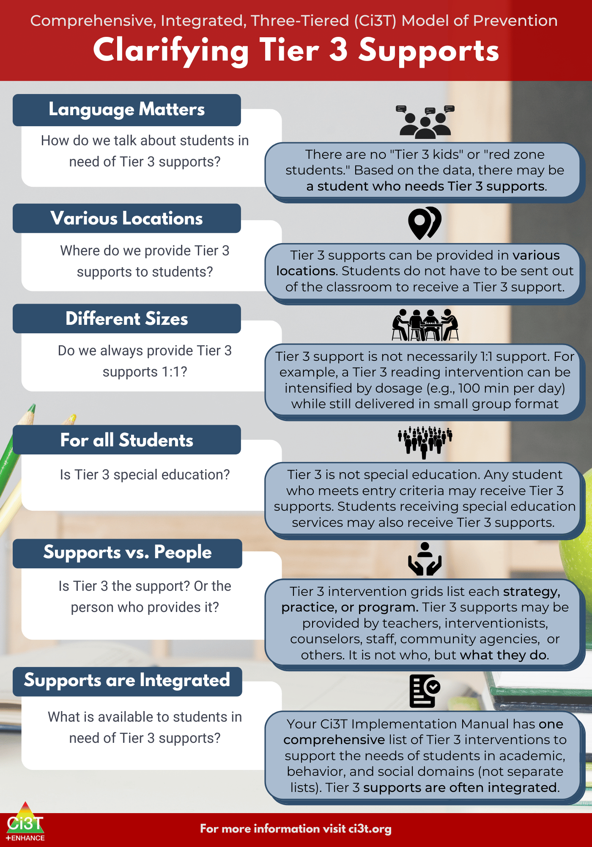
What are Tier 3 Interventions?

Slide 16
Clarifying Tier 3 Supports 1

Slide 17
Clarifying Tier 3 Supports 2

Slide 18


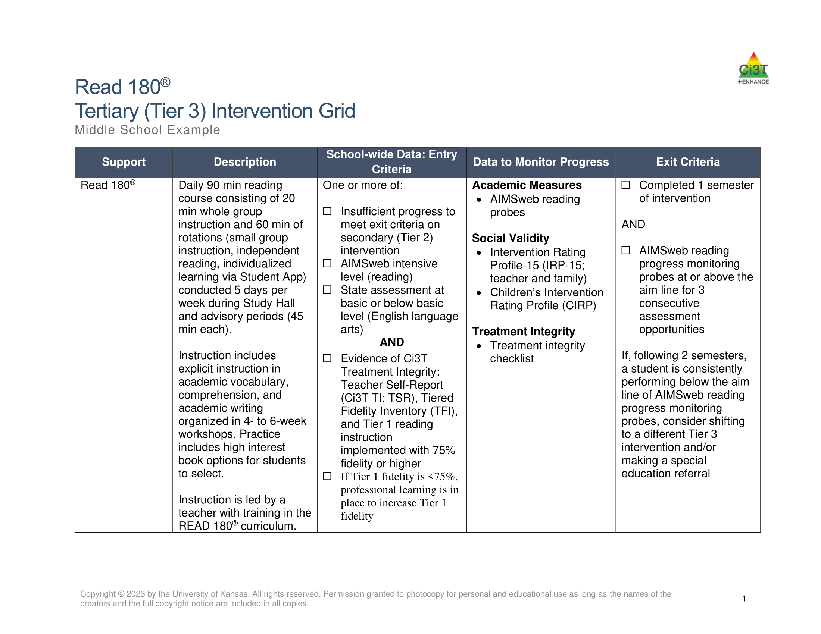
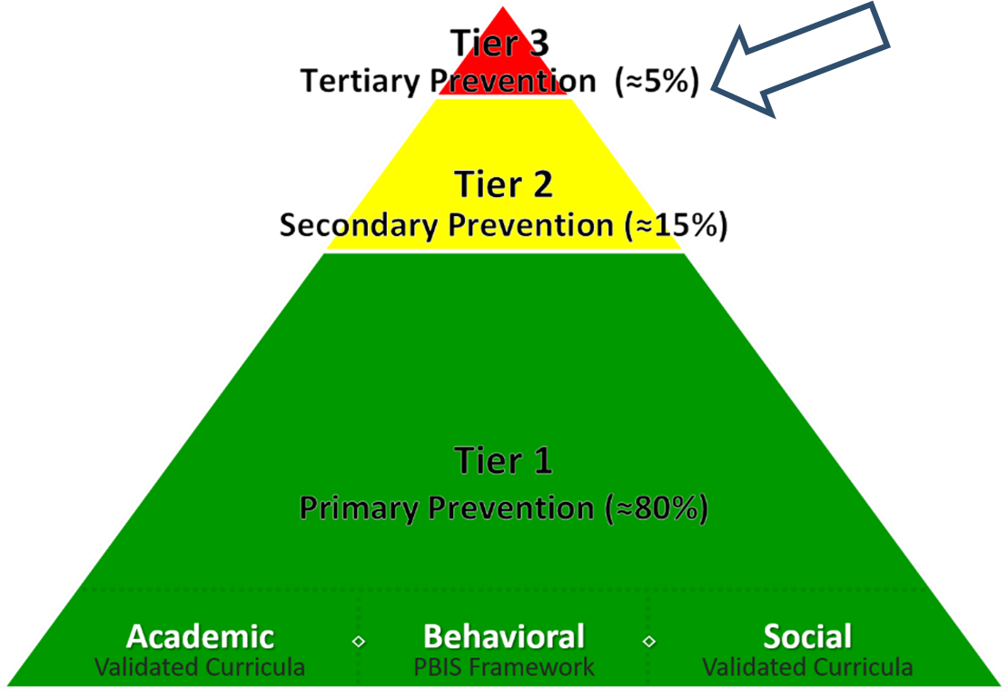
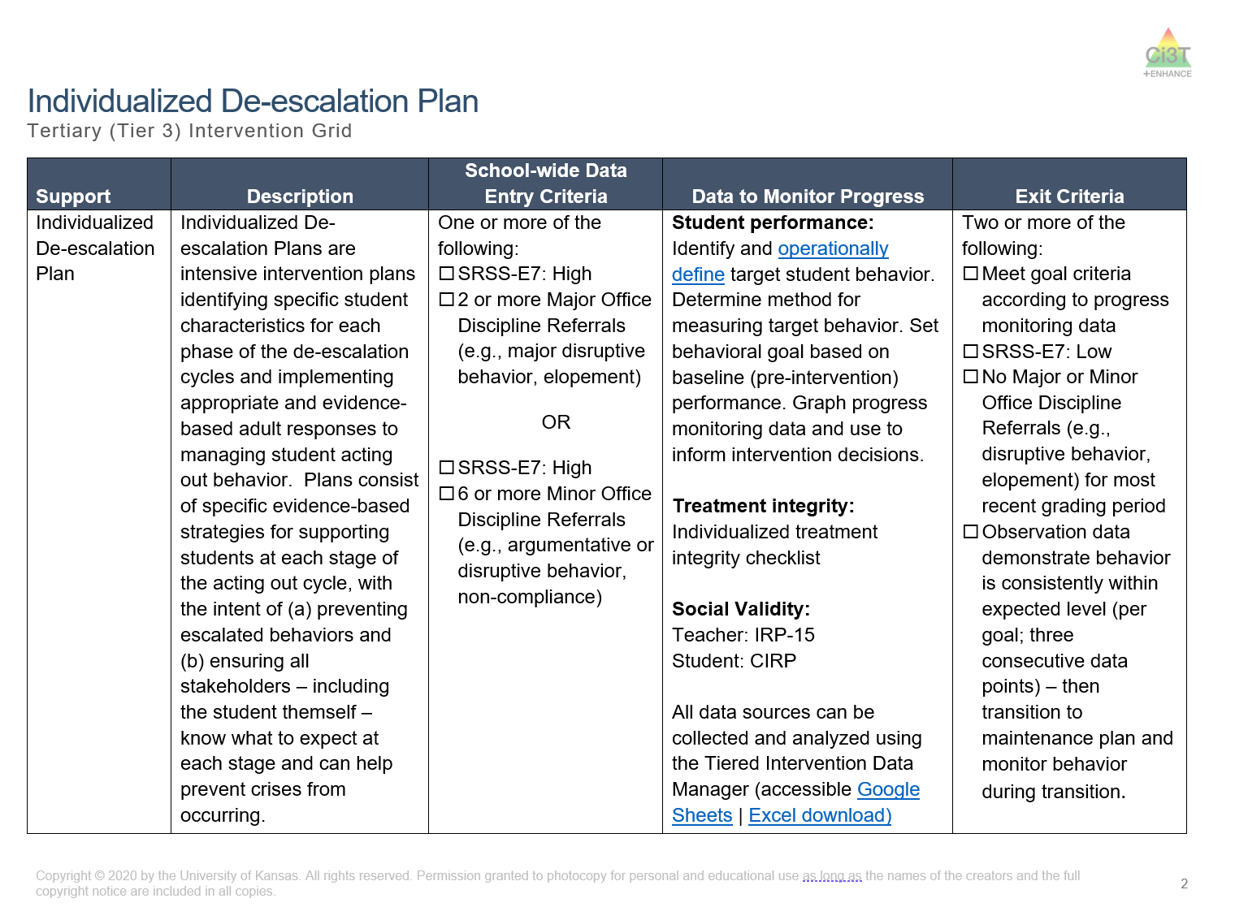
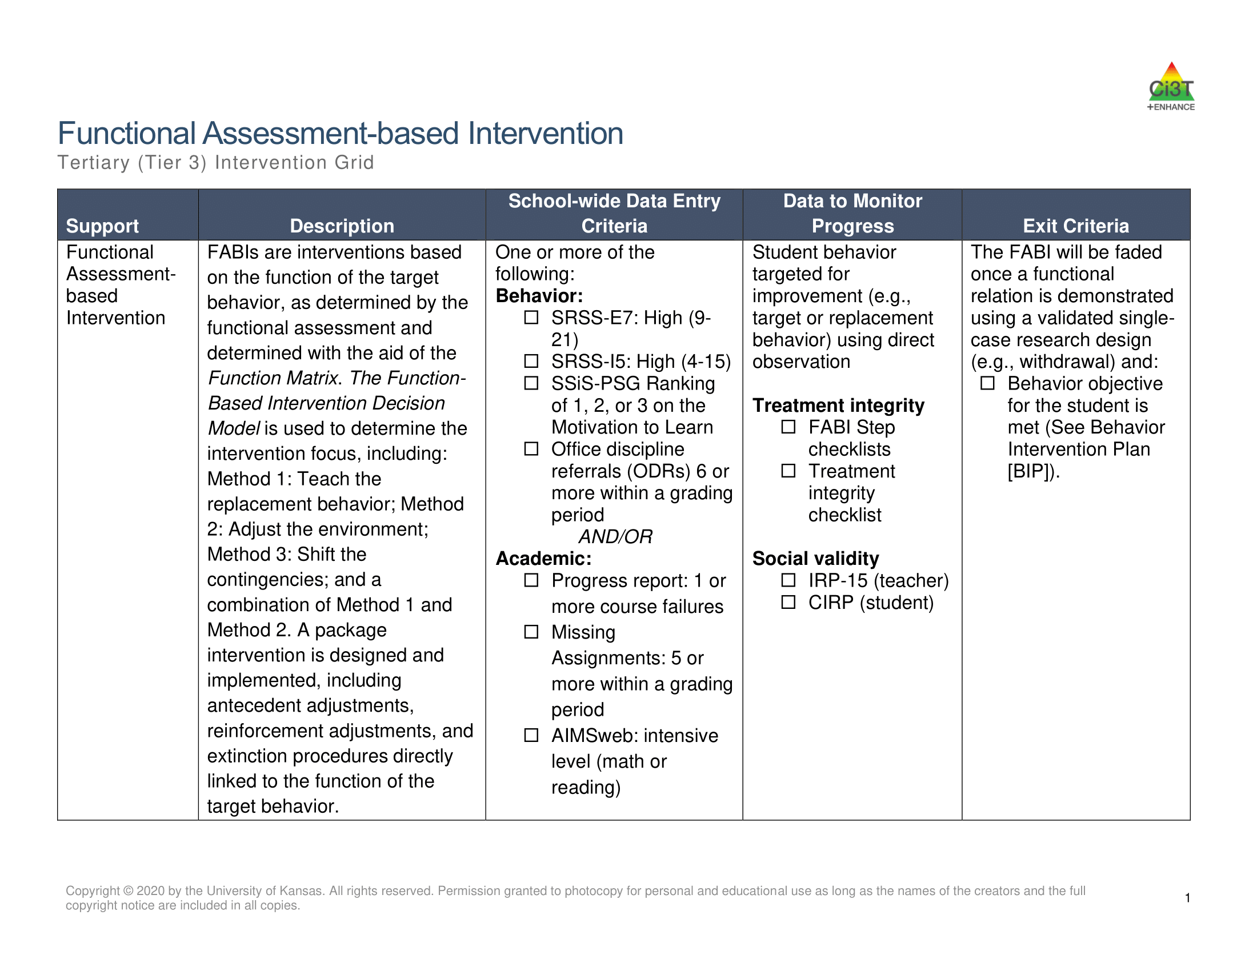
Tertiary (Tier 3) Intervention Grids

Slide 19

Components of Tier 3 Intervention Grid
Notes:
Support- name of strategy, practice, or program. Notice this is not the name of a person or role

Slide 20

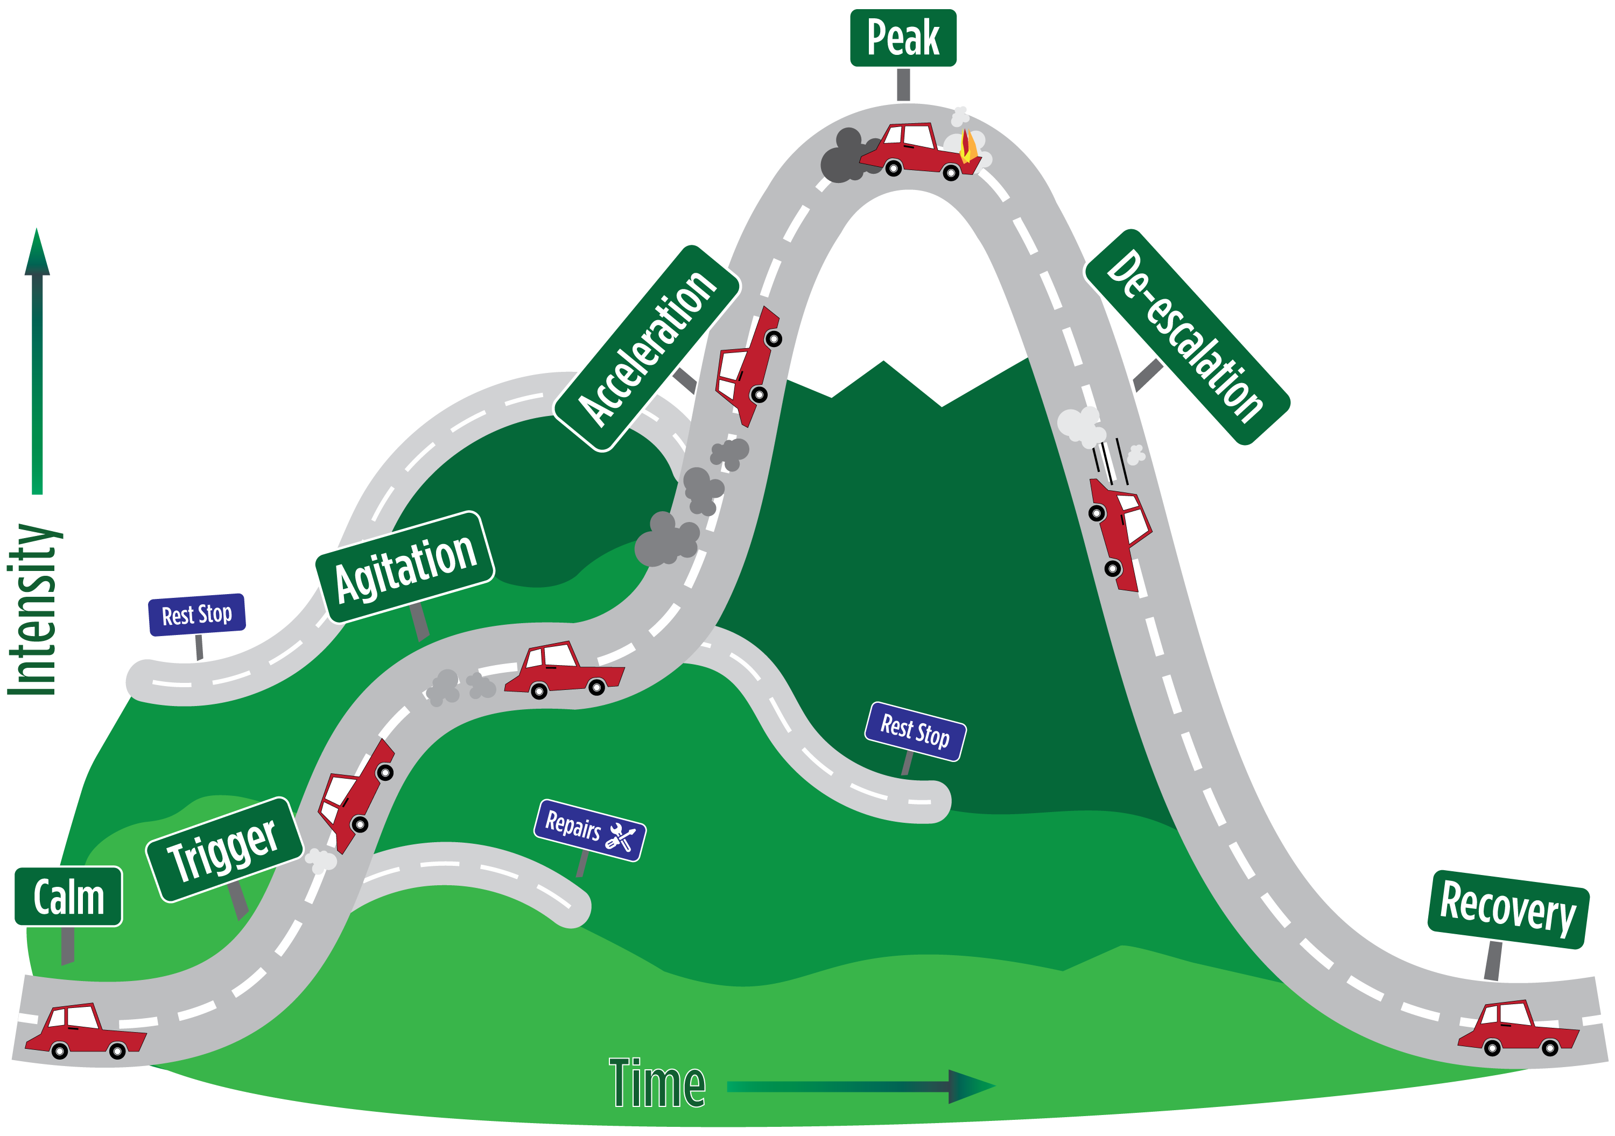
Tier 3: Stand-Alone Intervention

Slide 21

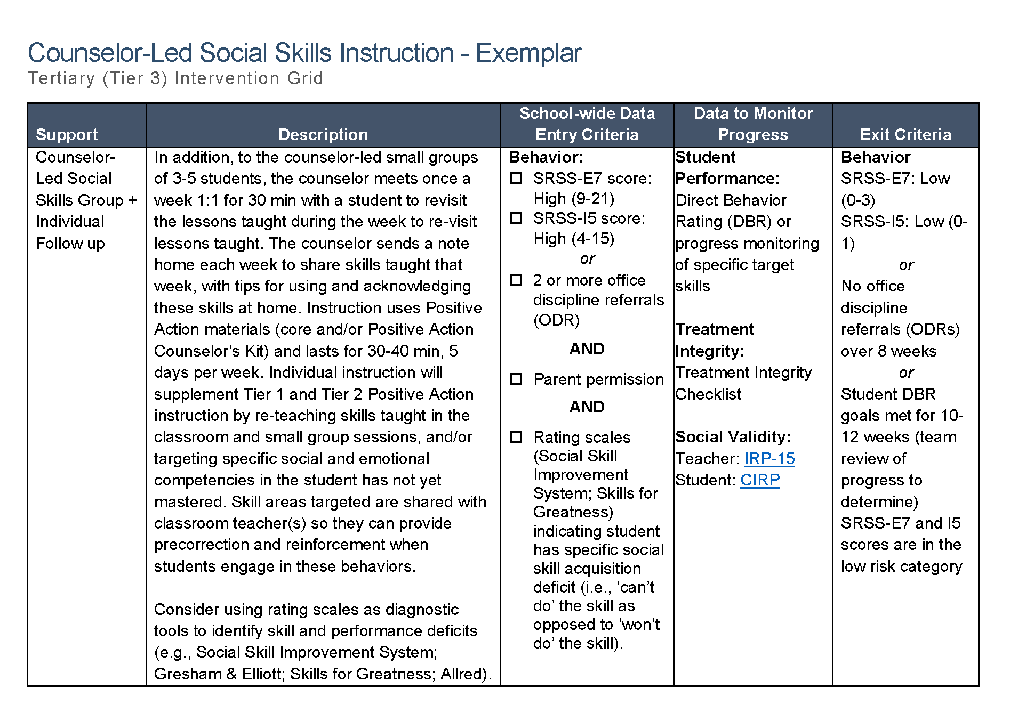
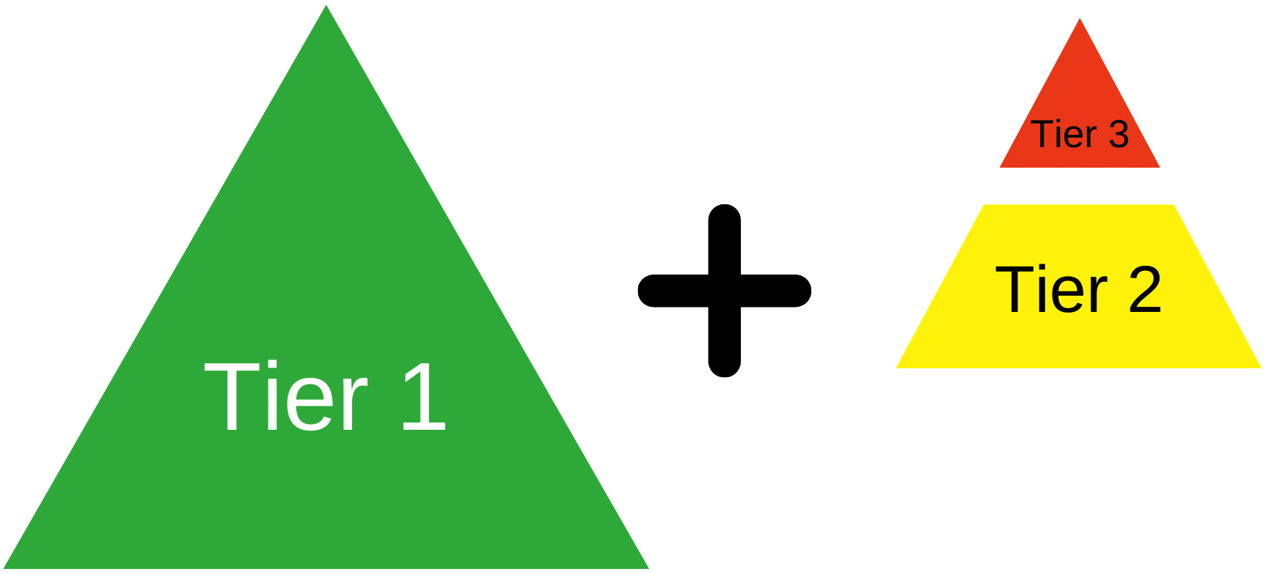
Tier 3: Intensification of Tier 2 Support
Notes:
Sometimes – Tier 3 is an intensification of a Tier 2 support such as coupling a Tier 2 support (i.e., counselor-led social skills group) with an individual follow up.

Slide 22
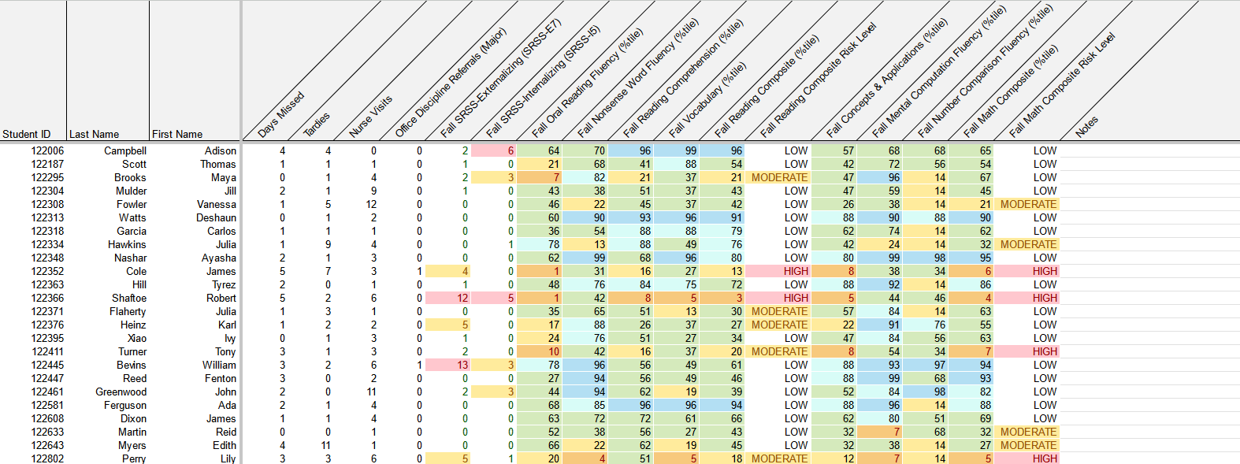
Using Multiple Sources of Data to Connect Students with Tier 3 Supports
attendance
office discipline referrals
behavior
screening
academic screening

Slide 23

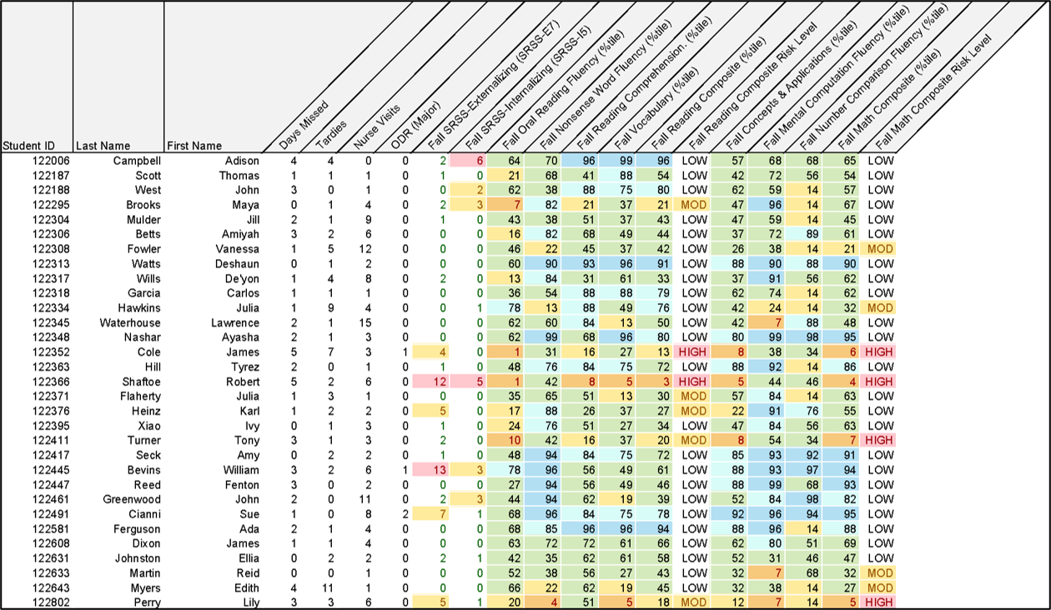
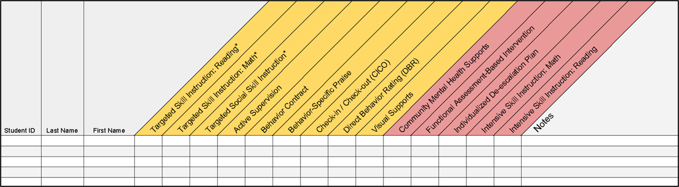
Getting Started with Data-Informed Decision Making

Slide 24

Functional Assessment-Based Intervention (FABI)
An Overview of FABI
A 5-Step Process to Implement FABI

Slide 25

Functional Assessment-based Intervention Grid

Slide 26
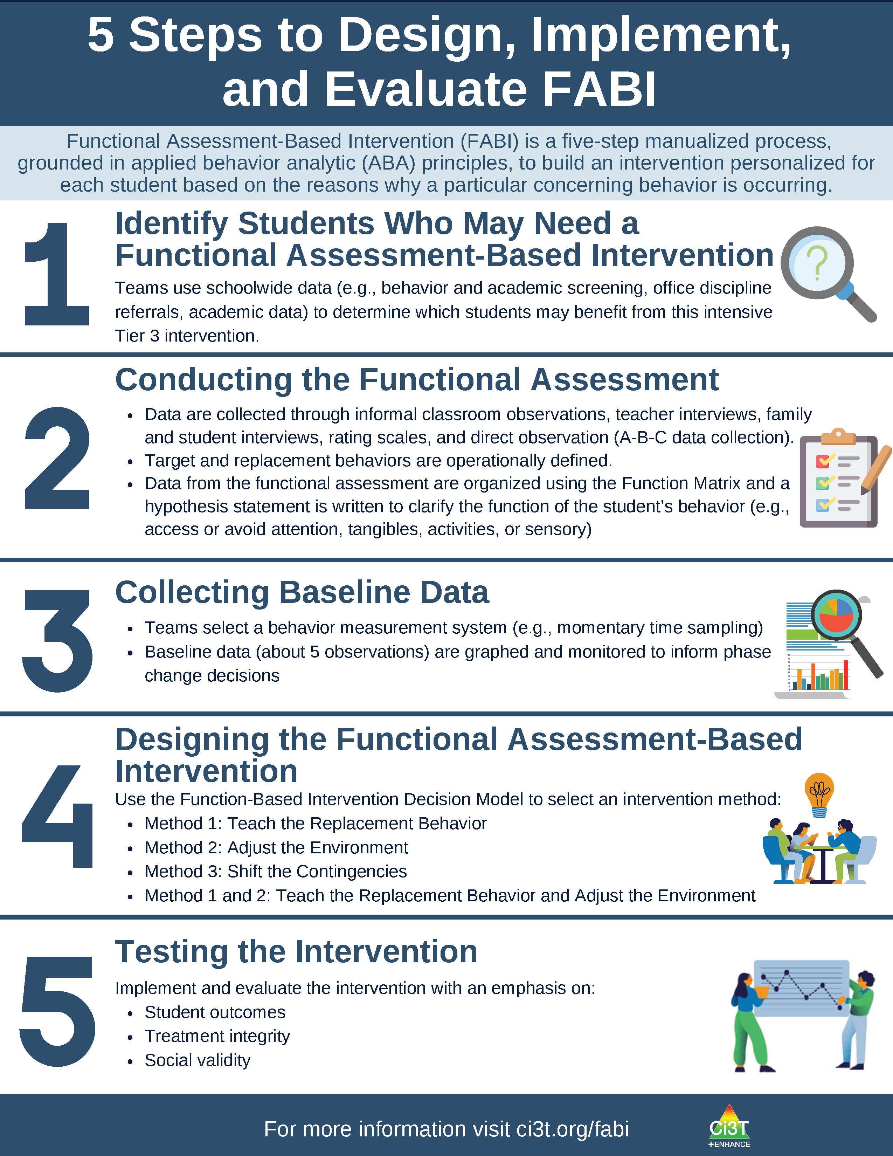
What is Functional Assessment-Based Intervention (FABI)?
Customized intervention designed for each student based on the reasons why a particular concerning behavior is occurring
Developed through a five-step, team-based, manualized process
Grounded in applied behavior analytic (ABA) principles (e.g., reinforcement, antecedent, consequence)
Notes:
PRESENTER NOTE:
FABI is one type of FBA (functional behavioral assessment)
Can be used as a Tier 3 intervention, as we are discussing in this presentation
Can also be used as a process to conduct a functional behavioral assessment (FBA) and develop a behavior intervention plan (BIP) for student’s with IEPs as required under certain conditions of IDEA
See state regulations for more information regarding FBAs as part of a student’s IEP

Slide 27
5 Steps to Design, Implement, and Evaluate FABI 1

Slide 28
5 Steps to Design, Implement, and Evaluate FABI 2

Slide 29
Why is FABI effective?
Individualized based on the function of behavior (i.e., why the behavior occurs) and needs of the student and environment
Focuses on skill-building and supporting pro-social behavior (i.e., replacement behavior)
Step-by-step manualized process
Team-based process fosters collaboration between educators, families, and the student

Slide 30
Building Your FABI Team
Two people who serve on this “standing” team
  Member of Ci3T Leadership Team
  Staff with behavioral expertise (e.g., behavior specialist, instructional coach, counselor, school psychologist)
Classroom teacher(s) of the student who might benefit from this support
Family member of the student
Student

Slide 31
What are the Benefits and Challenges of Implementing FABI?
Benefits
Challenges
Collaborative, team-based process integrating student, educator, and caregiver voice and perspective
Strong evidence-base demonstrating effectiveness for wide range of students (pre-K – 12), behaviors, and settings
Fully manualized process with templates and checklists to support design and implementation
Time and resource intensive
May require additional training (e.g., measuring behavior, ABC data collection)
Adjustment from more ”traditional” FBA/BIP practices

Slide 32

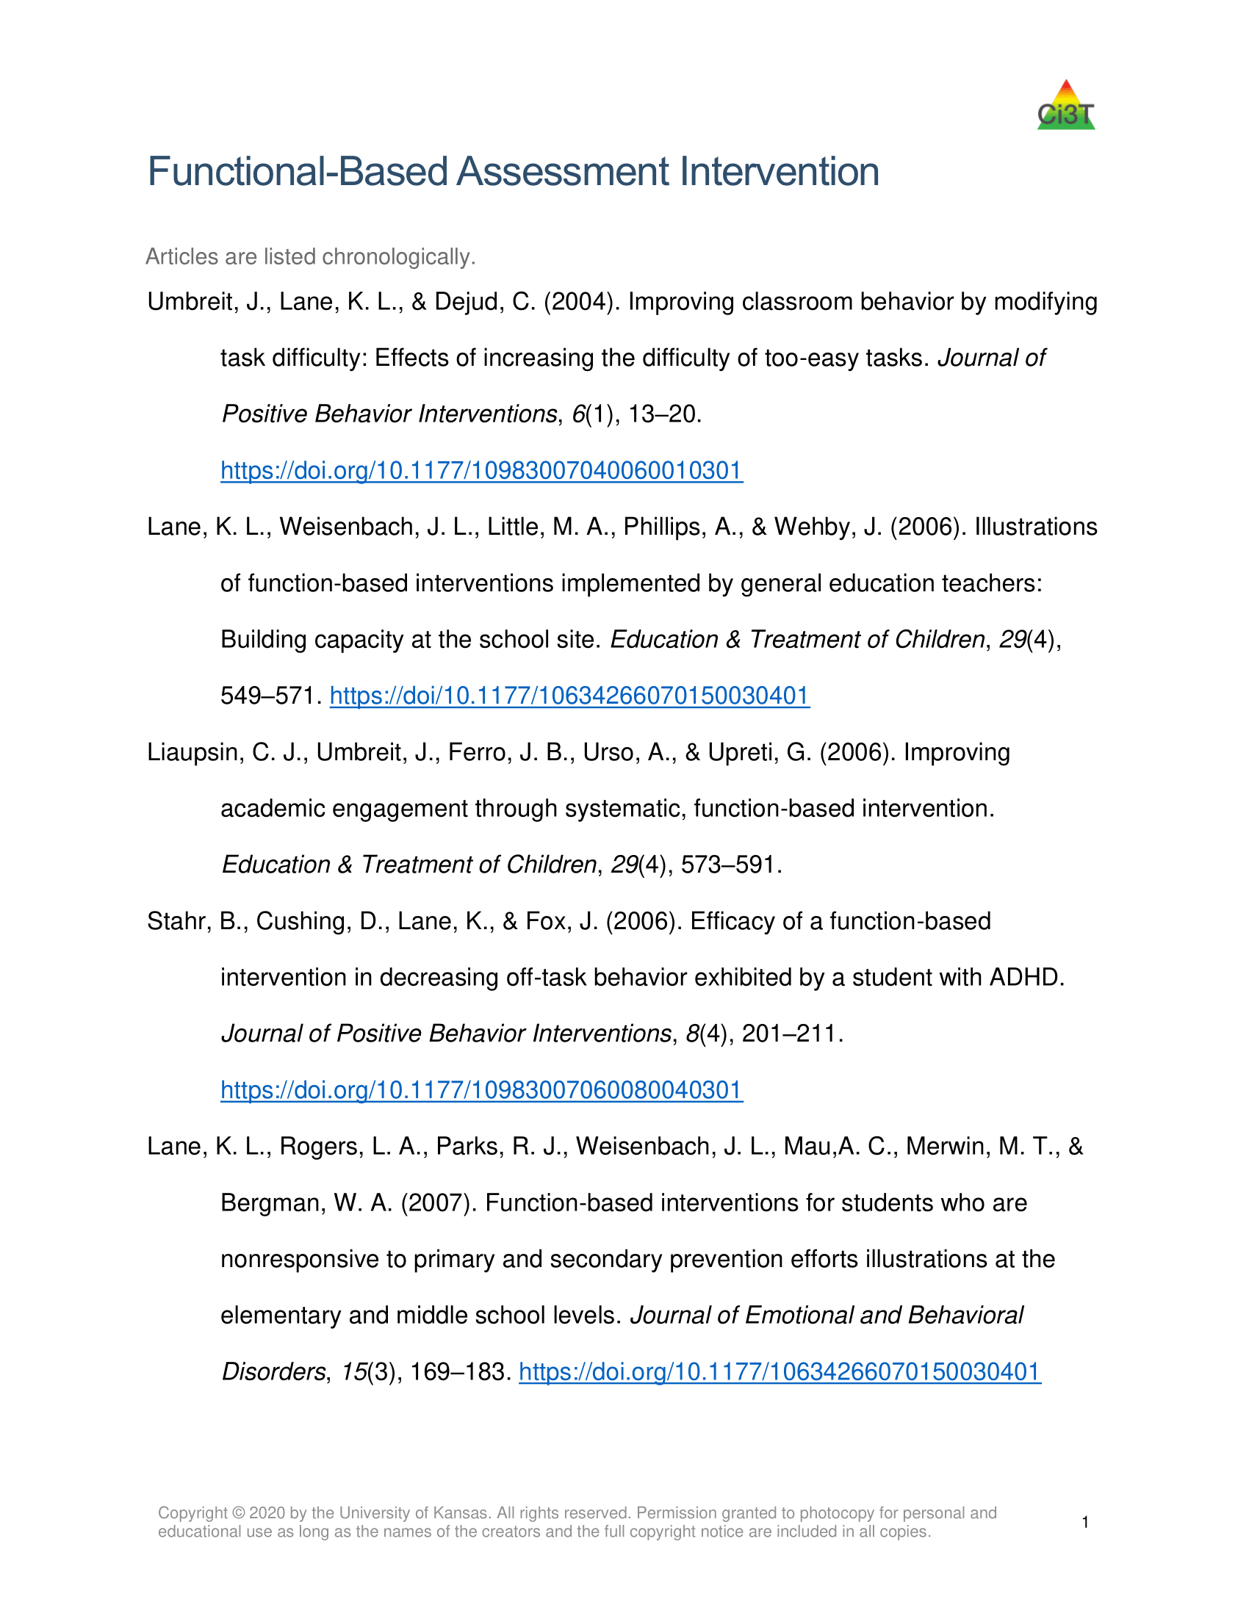







Examining the Evidence-Base
28 studies published to date
Project FUNCTION
Notes:
Over the past 20+ years FABI has been studied across a range of students (pre-K – 12), behaviors, and settings and found to be highly effective in reducing challenging behavior and increasing contextually appropriate behaviors
In the FABI Introduction module, we offer a handout listing all FABI studies published to date. For those interested in diving into the research, we invite you to download this handout!
Today, we’re going to focus on a few examples from Project FUNCTION (describe Project FUNCTION)

Slide 33
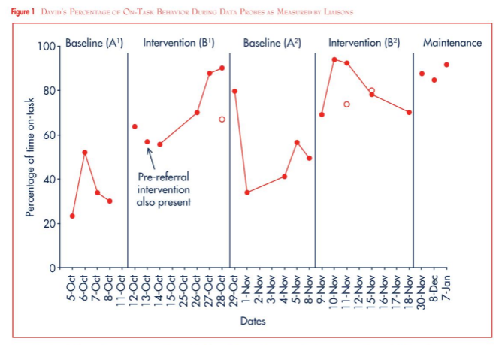
Project FUNCTION:
Elementary Example
Germer, K. A., Kaplan, L. M., Giroux, L. N., Markham, E. H., Ferris, G. J., Oakes, W. P., & Lane, K. L. (2011). A function-based intervention to increase a second-grade student's on-task behavior in a general education classroom. Beyond Behavior, 20(3), 19-30.
Notes:
First up, we have David a 2nd grade student. We will do a deep dive into David’s FABI later in the presentation but, as you can see here, the intervention was effective in increasing the percentage of time on-task.

Slide 34
Project FUNCTION:
Middle School Example
Cox, M., Griffin, M. M., Hall, R., Oakes, W. P., & Lane, K. L. (2011). Using a functional assessment-based intervention to increase academic engaged time in an inclusive middle school setting. Beyond Behavior, 20(3), 44 – 54.
Notes:
Next up, we have Harry a middle school student, with the intervention occurring within a co-taught general education math class. The intervention was comprised of antecedent adjustments including access to sensory items, daily bell-work activities, and CICO. Reinforcement shifts including a break card contingent on work completion and increased delivery of PBIS tickets paired with BSP, and extinction procedures of using gestural prompts only.
This case is one that really speaks to feasibility and social validity – if you look at the x-axis, you’ll note this intervention occurred from late April to May. This teacher, who was preparing to go on maternity leave, was so interested in developing a FABI and believed FABI could help Harry have a more productive and successful school experience that they that they were willing to take this on even as the school year came to a close (and we all know how hectic the end of the school year can be! As you can see here, the intervention was extremely effective in increasing Harry’s academic engagement.

Slide 35
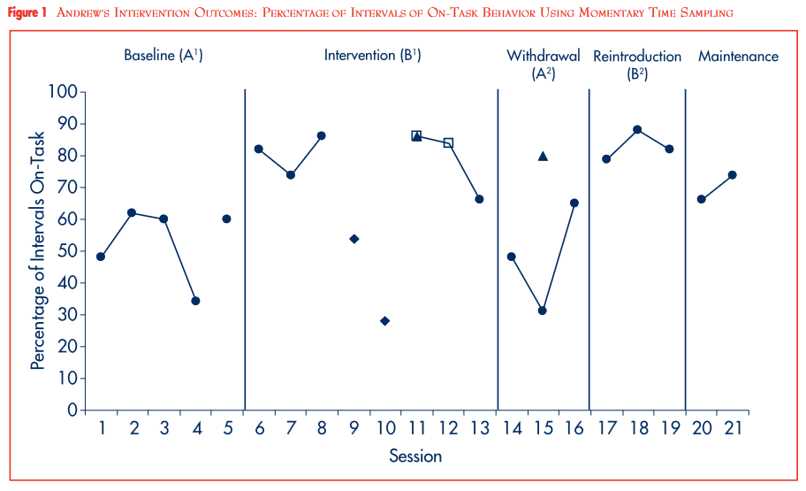
Project FUNCTION:
High School Example
Majeika, C. E., Walder, J. P., Hubbard, J. P., Steeb, K. M., Ferris, G. J., Oakes, W. P., & Lane, K. L. (2011). Improving on-task behavior using a functional assessment-based intervention in an inclusive high school setting. Beyond Behavior, 20(3), 55–66.
Notes:
Finally, we wanted to highlight a high school example. Here we have Andrew, this intervention took place in a general education English class and included a behavior contract, change of seating to be closer to the teacher, self-monitoring, increased teacher use of pre-correction and active supervision, increased use of behavior-specific praise and tickets associated with school-wide PBIS system, and opportunities to exchange tickets for preferred reinforcers such as time with preferred adult, 3-minute break, HW pass, or a positive note home. For extinction procedures, the team chose to use brief if/then redirects followed by withholding attention, praising peers who are on-task, and maintaining the task demand.
As the graph depicts, the FABI was effective in increasing Andrew’s on-task behavior. Those outlier data points (the ones with the diamond/rhombus) represent days where class took place in a computer lab with a substitute teacher and the FABI was not being implemented.
Before we transition into the next section of the presentation and a deeper dive into each of the steps, we wanted to highlight these representative studies to showcase how FABI has been successfully used to support students with intensive behavioral needs from PK-12 in learning and demonstrating more contextually appropriate behavior and increasing the extent to which they are able to successfully engage in general education environments.

Slide 36
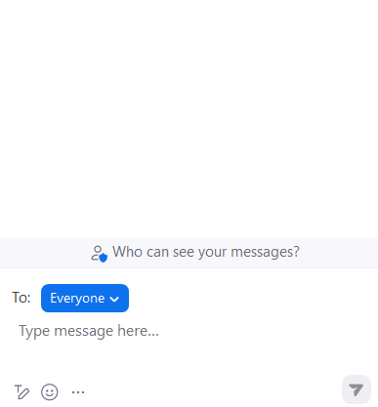
Let’s Chat: Initial Thoughts
What are your initial thoughts and reactions?
  What components of FABI seem most feasible?
  What might be challenging about implementing FABI?

Slide 37

Functional Assessment-Based Intervention (FABI) as a Tier 3 Intervention
An Overview of FABI
A 5-Step Process to Implement FABI

Slide 38
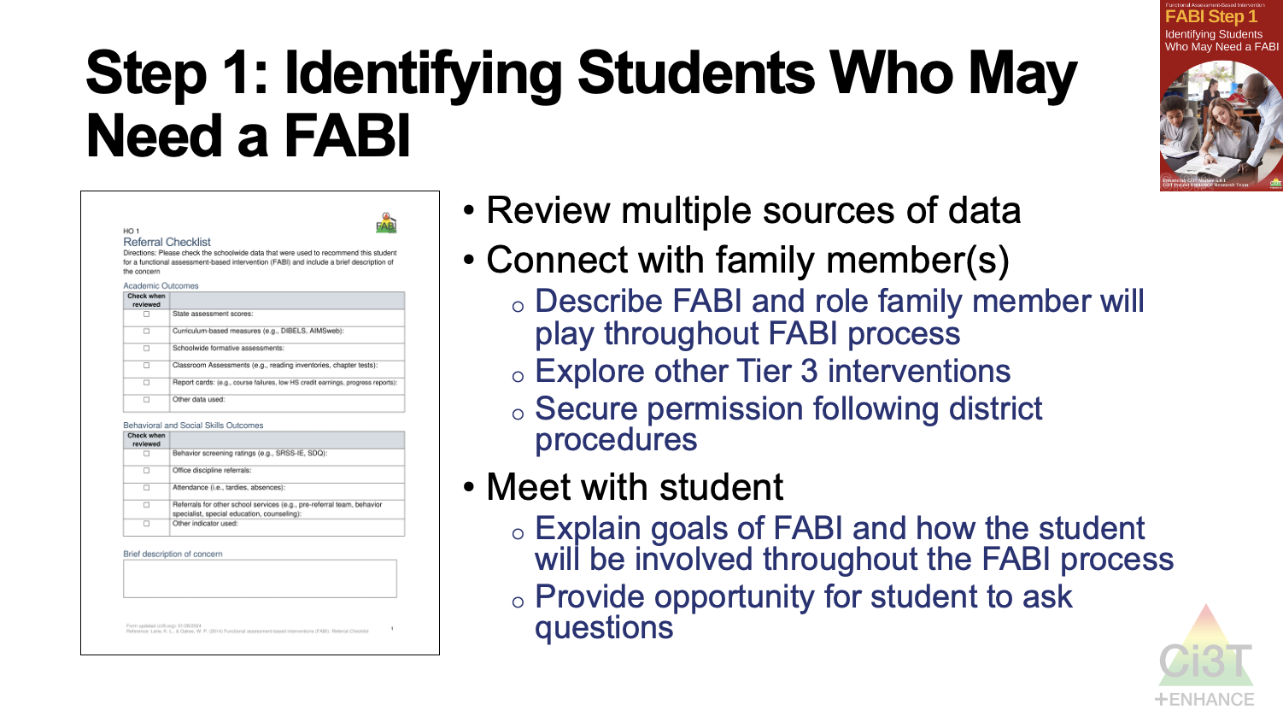

Session Preview
Notes:
In this next section we will break down and provide a high-level overview for each of the five steps to implement FABI
Throughout the presentation, we will pause and invite participation in the chat or move into breakout rooms to give you the change to apply what you are learning!

Slide 39


Opportunities to Learn More
Opportunities to Learn More 1
Notes:
Our intention in this professional learning is to provide high-level overview of FABI and opportunities to practice the key components. If you are interested in learning more or implementing FABI in your setting, we encourage you to access these additional resources to more comprehensively learn about each of the five steps.

Slide 40

FABI Step 1: Identifying Students Who May Need a FABI

Slide 41
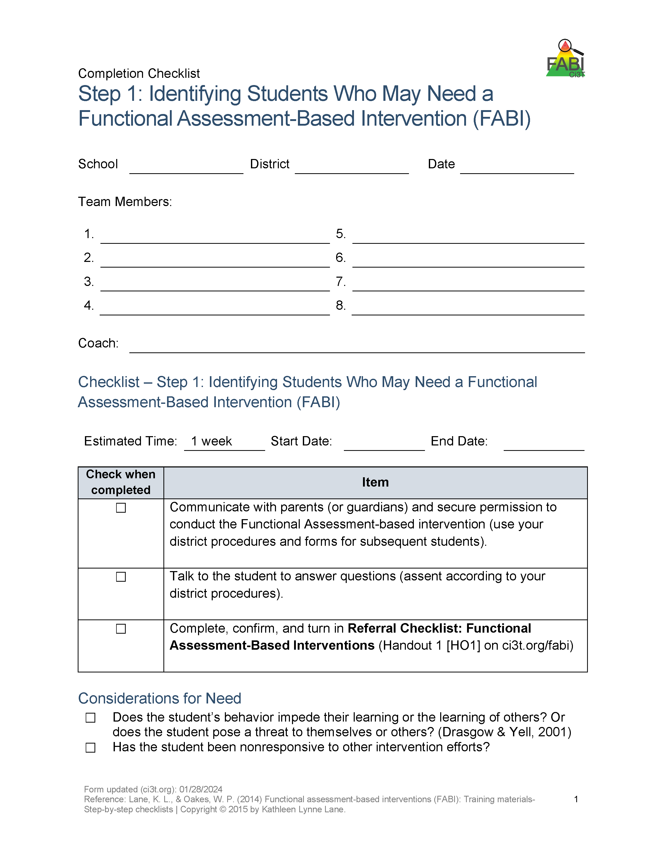
Step 1: Identifying Students Who May Need a FABI
Step 1: Identifying Students Who May Need a FABI 2
Review multiple sources of data
Connect with family member(s)
Meet with student

Slide 42
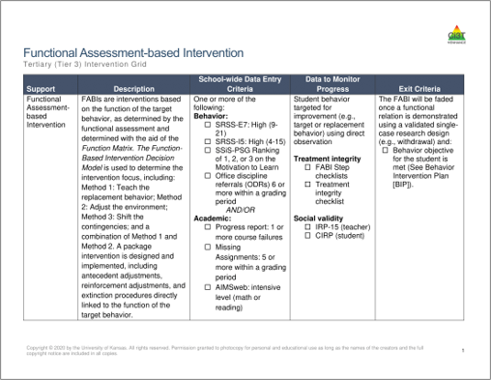
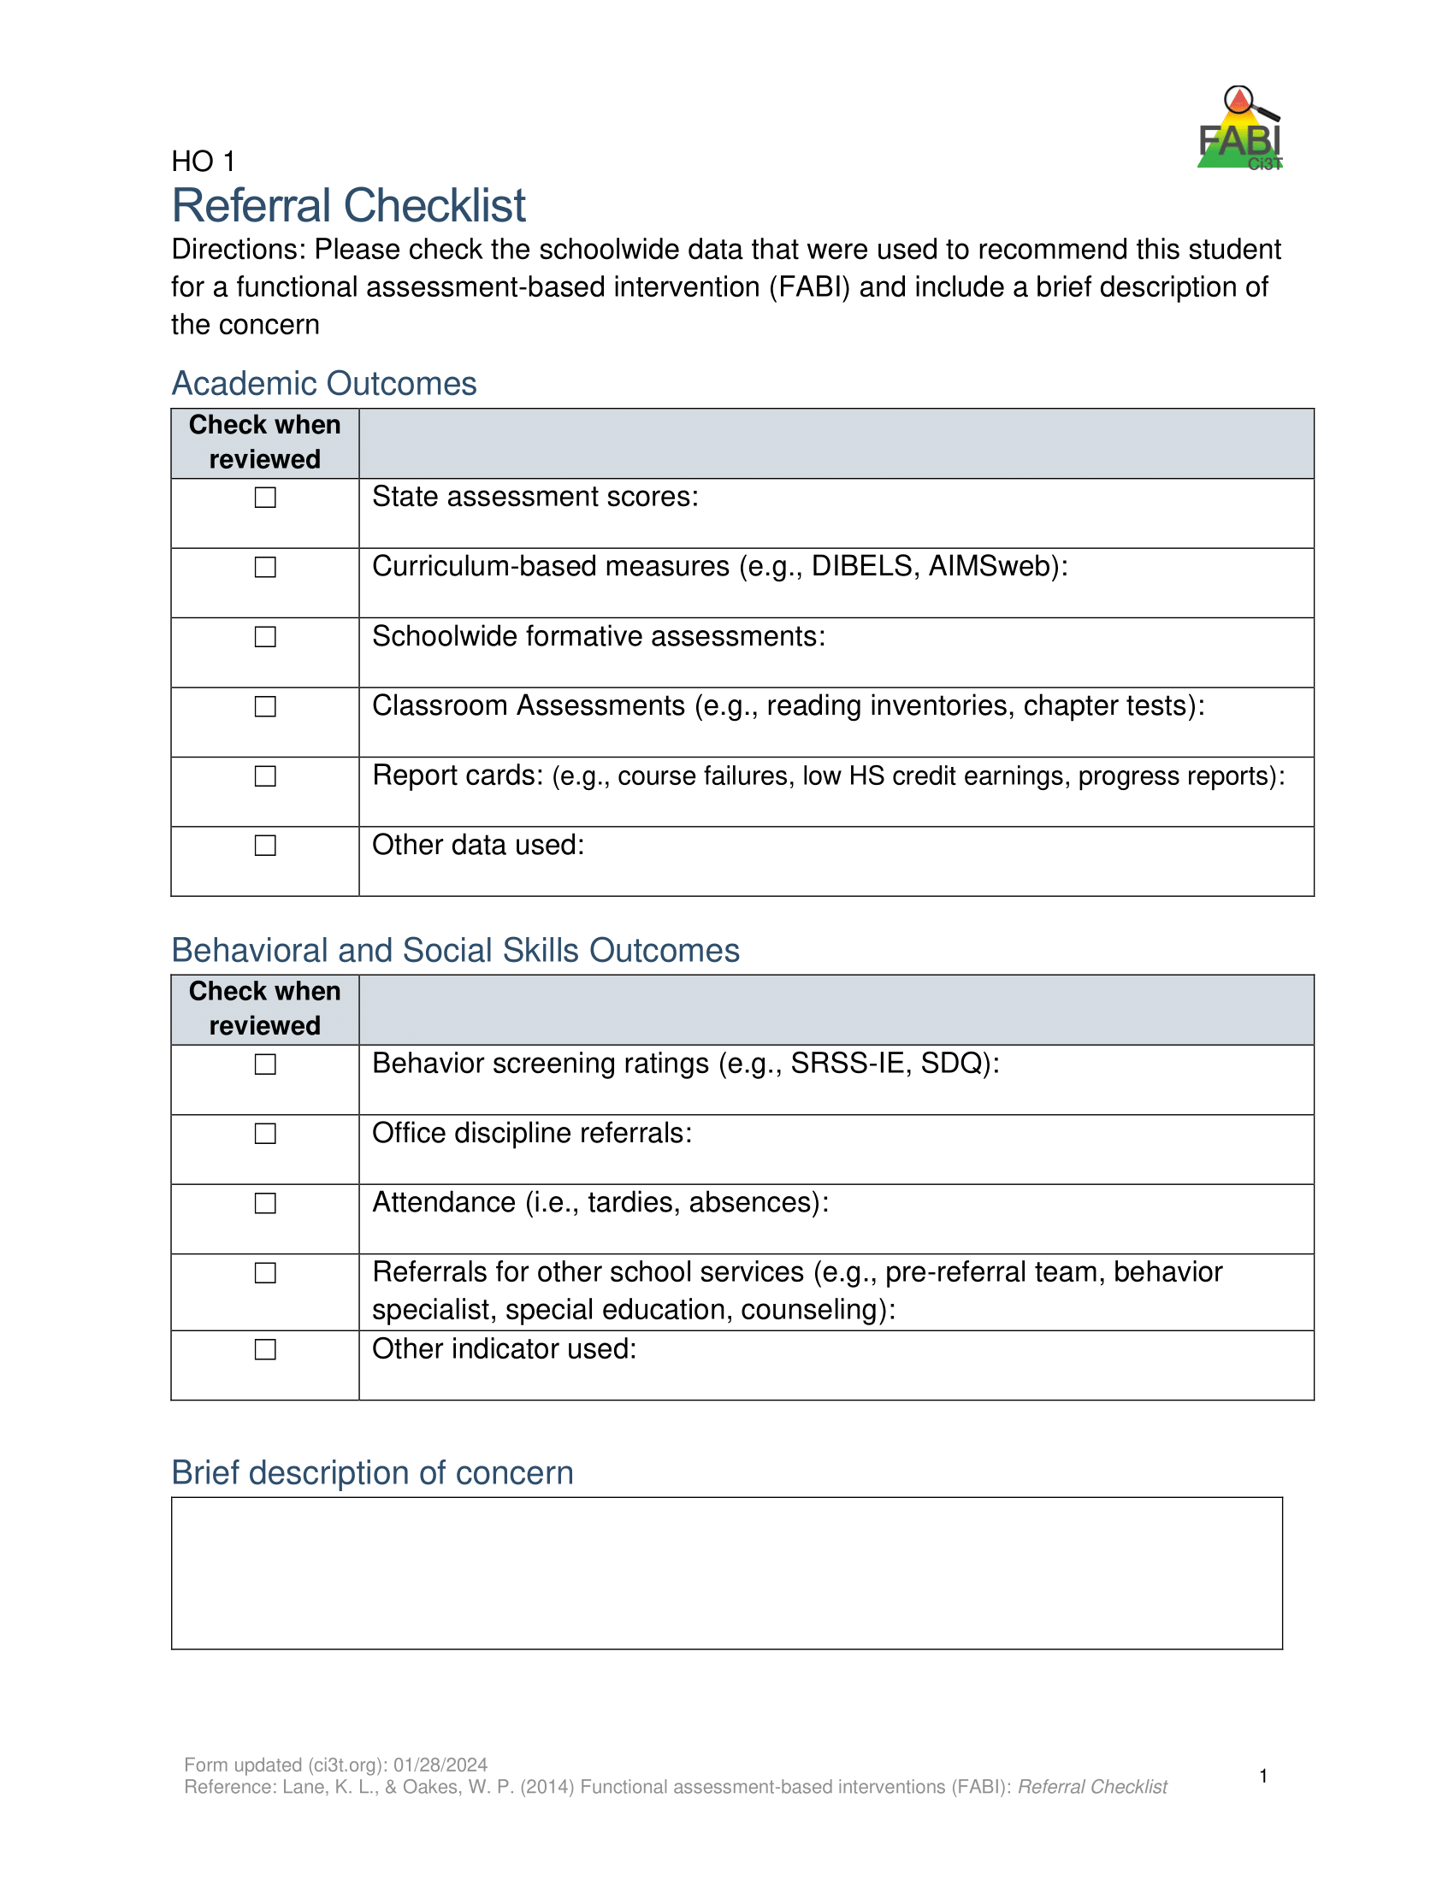
Review multiple sources of data
Use the Tertiary (Tier 3) Intervention Grid and referral checklist to review multiple sources of data such as:
  Academic assessment data (e.g., screening, curriculum-based measures)
  Behavior screening tools
  Office discipline referrals (ODRs)
  Attendance records

Slide 43
Connect with Family Member(s) and Student
Family Member(s)
Student
Describe FABI and role family member will play throughout FABI process
Explore other Tier 3 interventions
Secure permission following district procedures
Explain goals of FABI and how the student will be involved throughout the FABI process
Provide opportunity for student to ask questions

Slide 44

FABI Step 2: Conducting the Functional Assessment

Slide 45

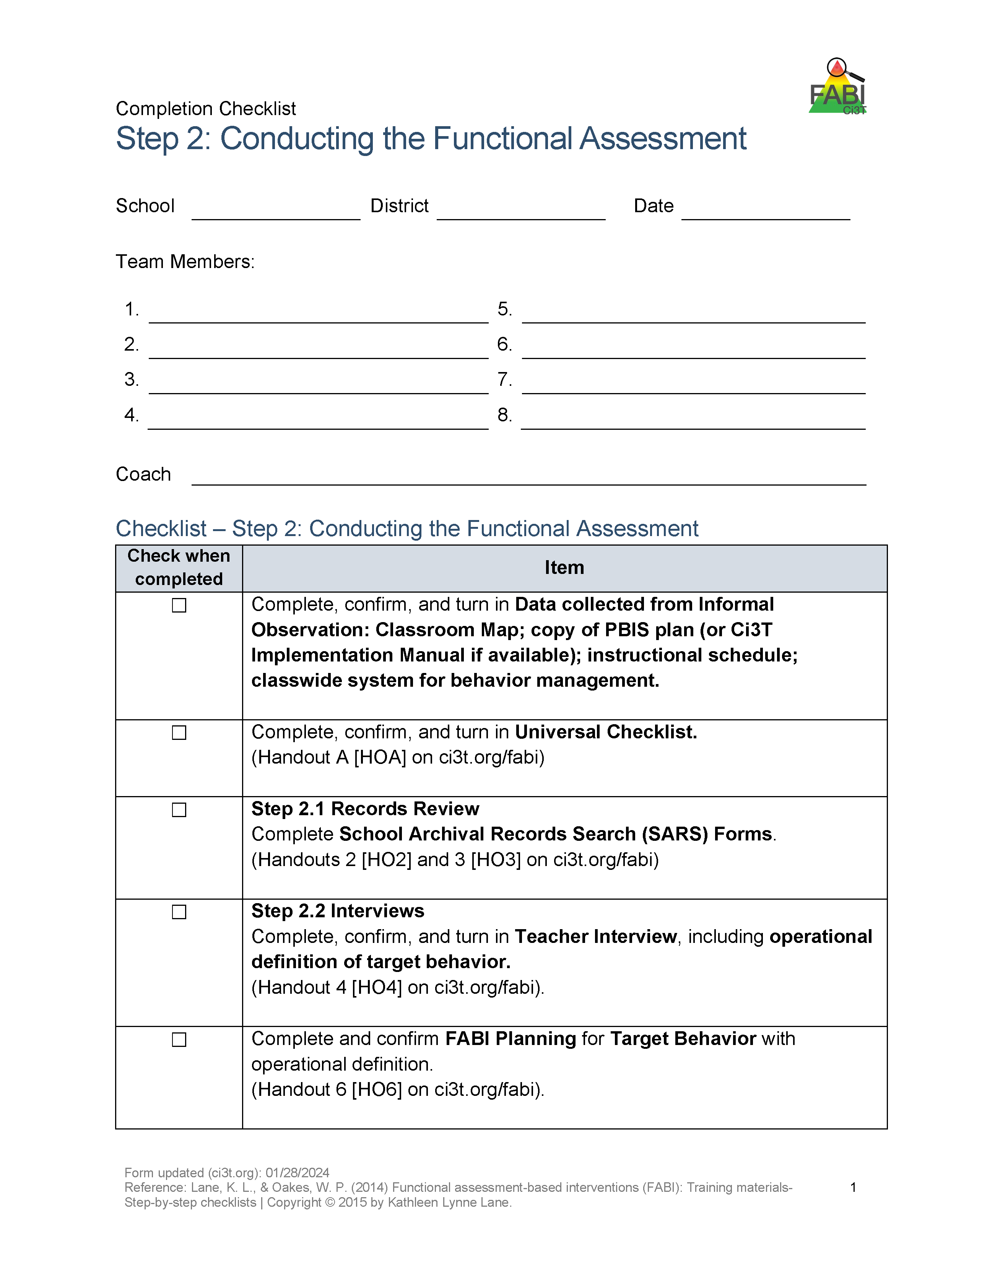
Step 2: Conducting the Functional Assessment
Step 2: Conducting the Functional Assessment 2
Understanding the learning environment and context
Records review
Interviews
Operationally define target behavior
Rating scales
A-B-C data collection
Use Function Matrix to identify the hypothesized function(s)
Identify replacement behavior
Notes:
Today, we are going to focus on these three components of Step 2

Slide 46
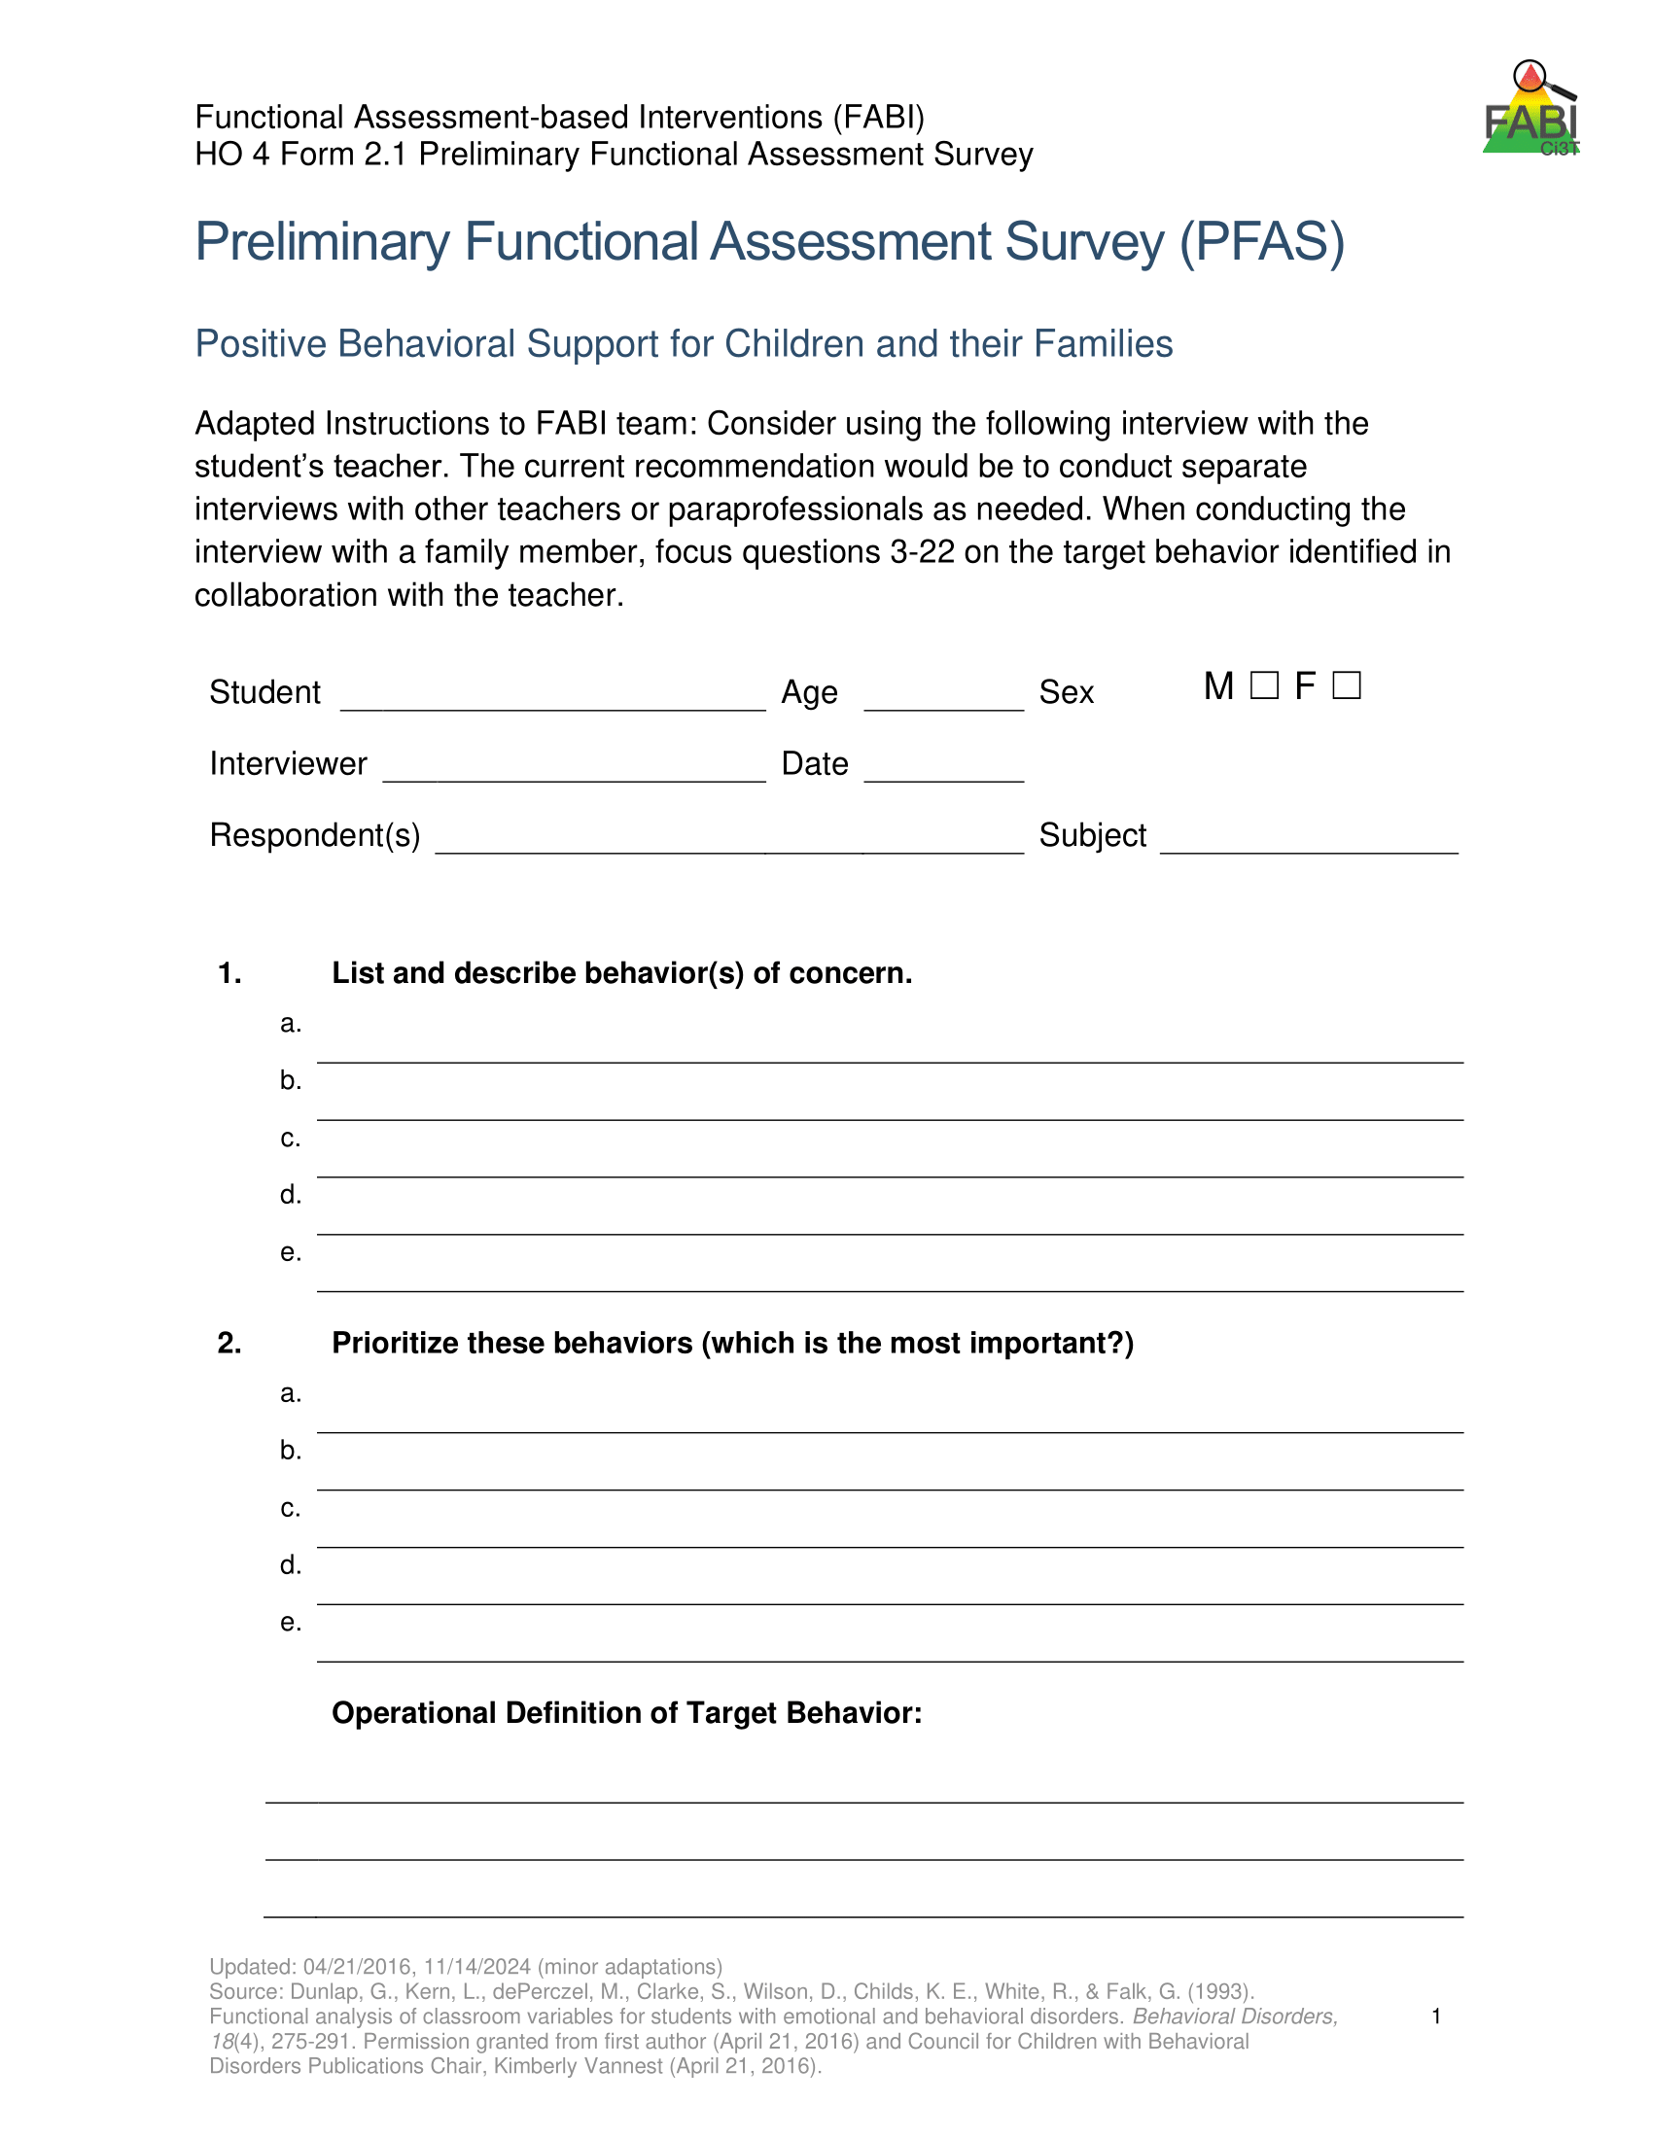
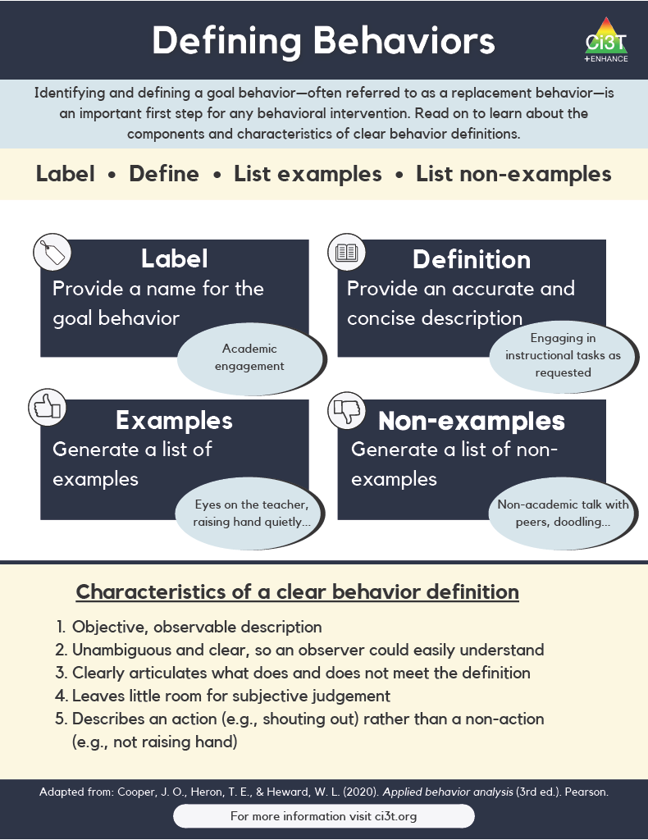
Operationally Defining the Target Behavior
Notes:
During the teacher interview, you will work with the teacher to identify all behaviors of interest and then create a prioritized list to determine the one keystone behavior. In other words, what is the one behavior, that if modified, could allow students to enjoy school more fully?
This becomes the target behavior (or the behavior you are seeking to reduce) which you will then operationally define

Slide 47
Example Operational Definition
Example Operational Definition 1
Component | Description
Label | Off-task
Definition | Off-task is defined as attending to activities in class other than assignments.
Examples | Playing with materials inappropriately, talking to peers, putting head on the desk, drawing, and looking around the room
Non-Examples | Completing assignments using materials only for assignments, and watching the teacher when delivering instruction

Slide 48
Conduct Interviews: Teachers, Families, Students

Slide 49
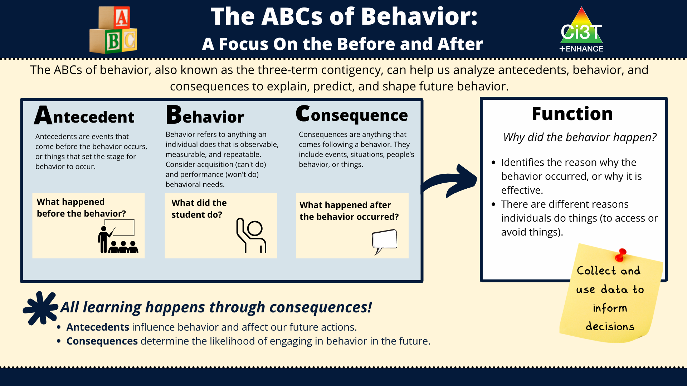
Direct Observation (A-B-Cs of Behavior)

Slide 50
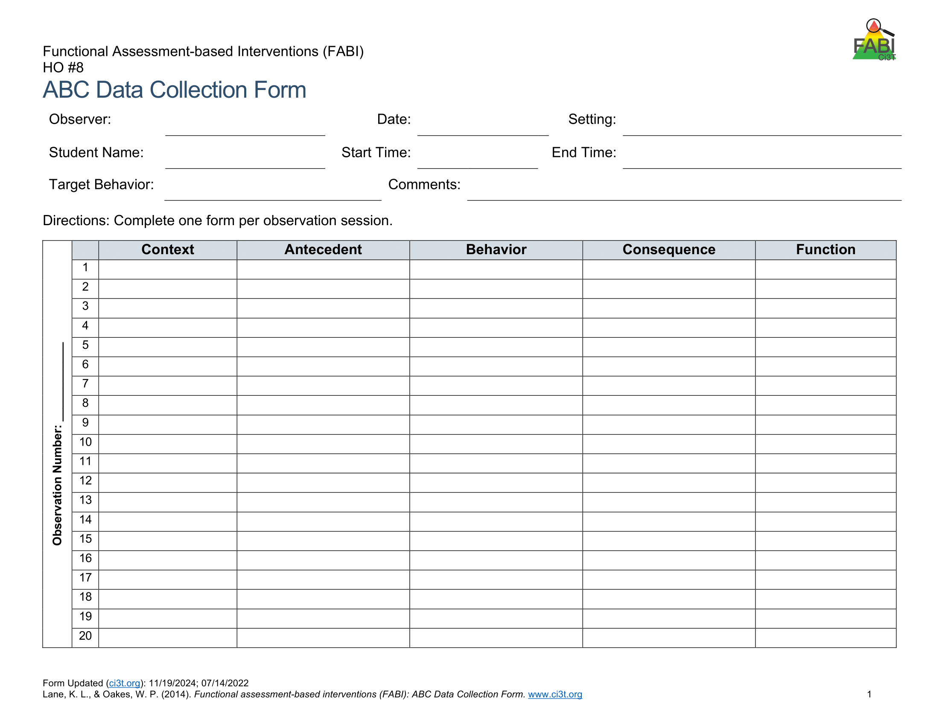
Direct Observation (A-B-C Data Collection)
Direct Observation (A-B-C Data Collection) 2
Determine the time of day and setting during which the behavior most often occurs
3 observation sessions (minimum)
Aim to observe 8-10 occurrences of the target behavior or three hours of observations
Record only instances of target behavior
Each instance of the target behavior will be numbered and later placed in the Function Matrix

Slide 51

A-B-C Data Collection Example
Reading instruction
Pencil breaks
Student throws pencil
Teacher looks at student
Notes:
Each time the target behavior occurs you will record details in a new row. Each instance of the target behavior will be numbered and later placed in the function matrix.
You should will note the context in which the behavior occurred, such as reading instruction, morning circle time, or math instruction, and the antecedent, or what happened immediately before the behavior.
Additionally, record the target behavior itself, the consequence, or what happened immediately after the target behavior.
The function of the behavior, such as access to or avoidance of attention, tasks or tangibles, or sensory experiences will be completed later.

Slide 52
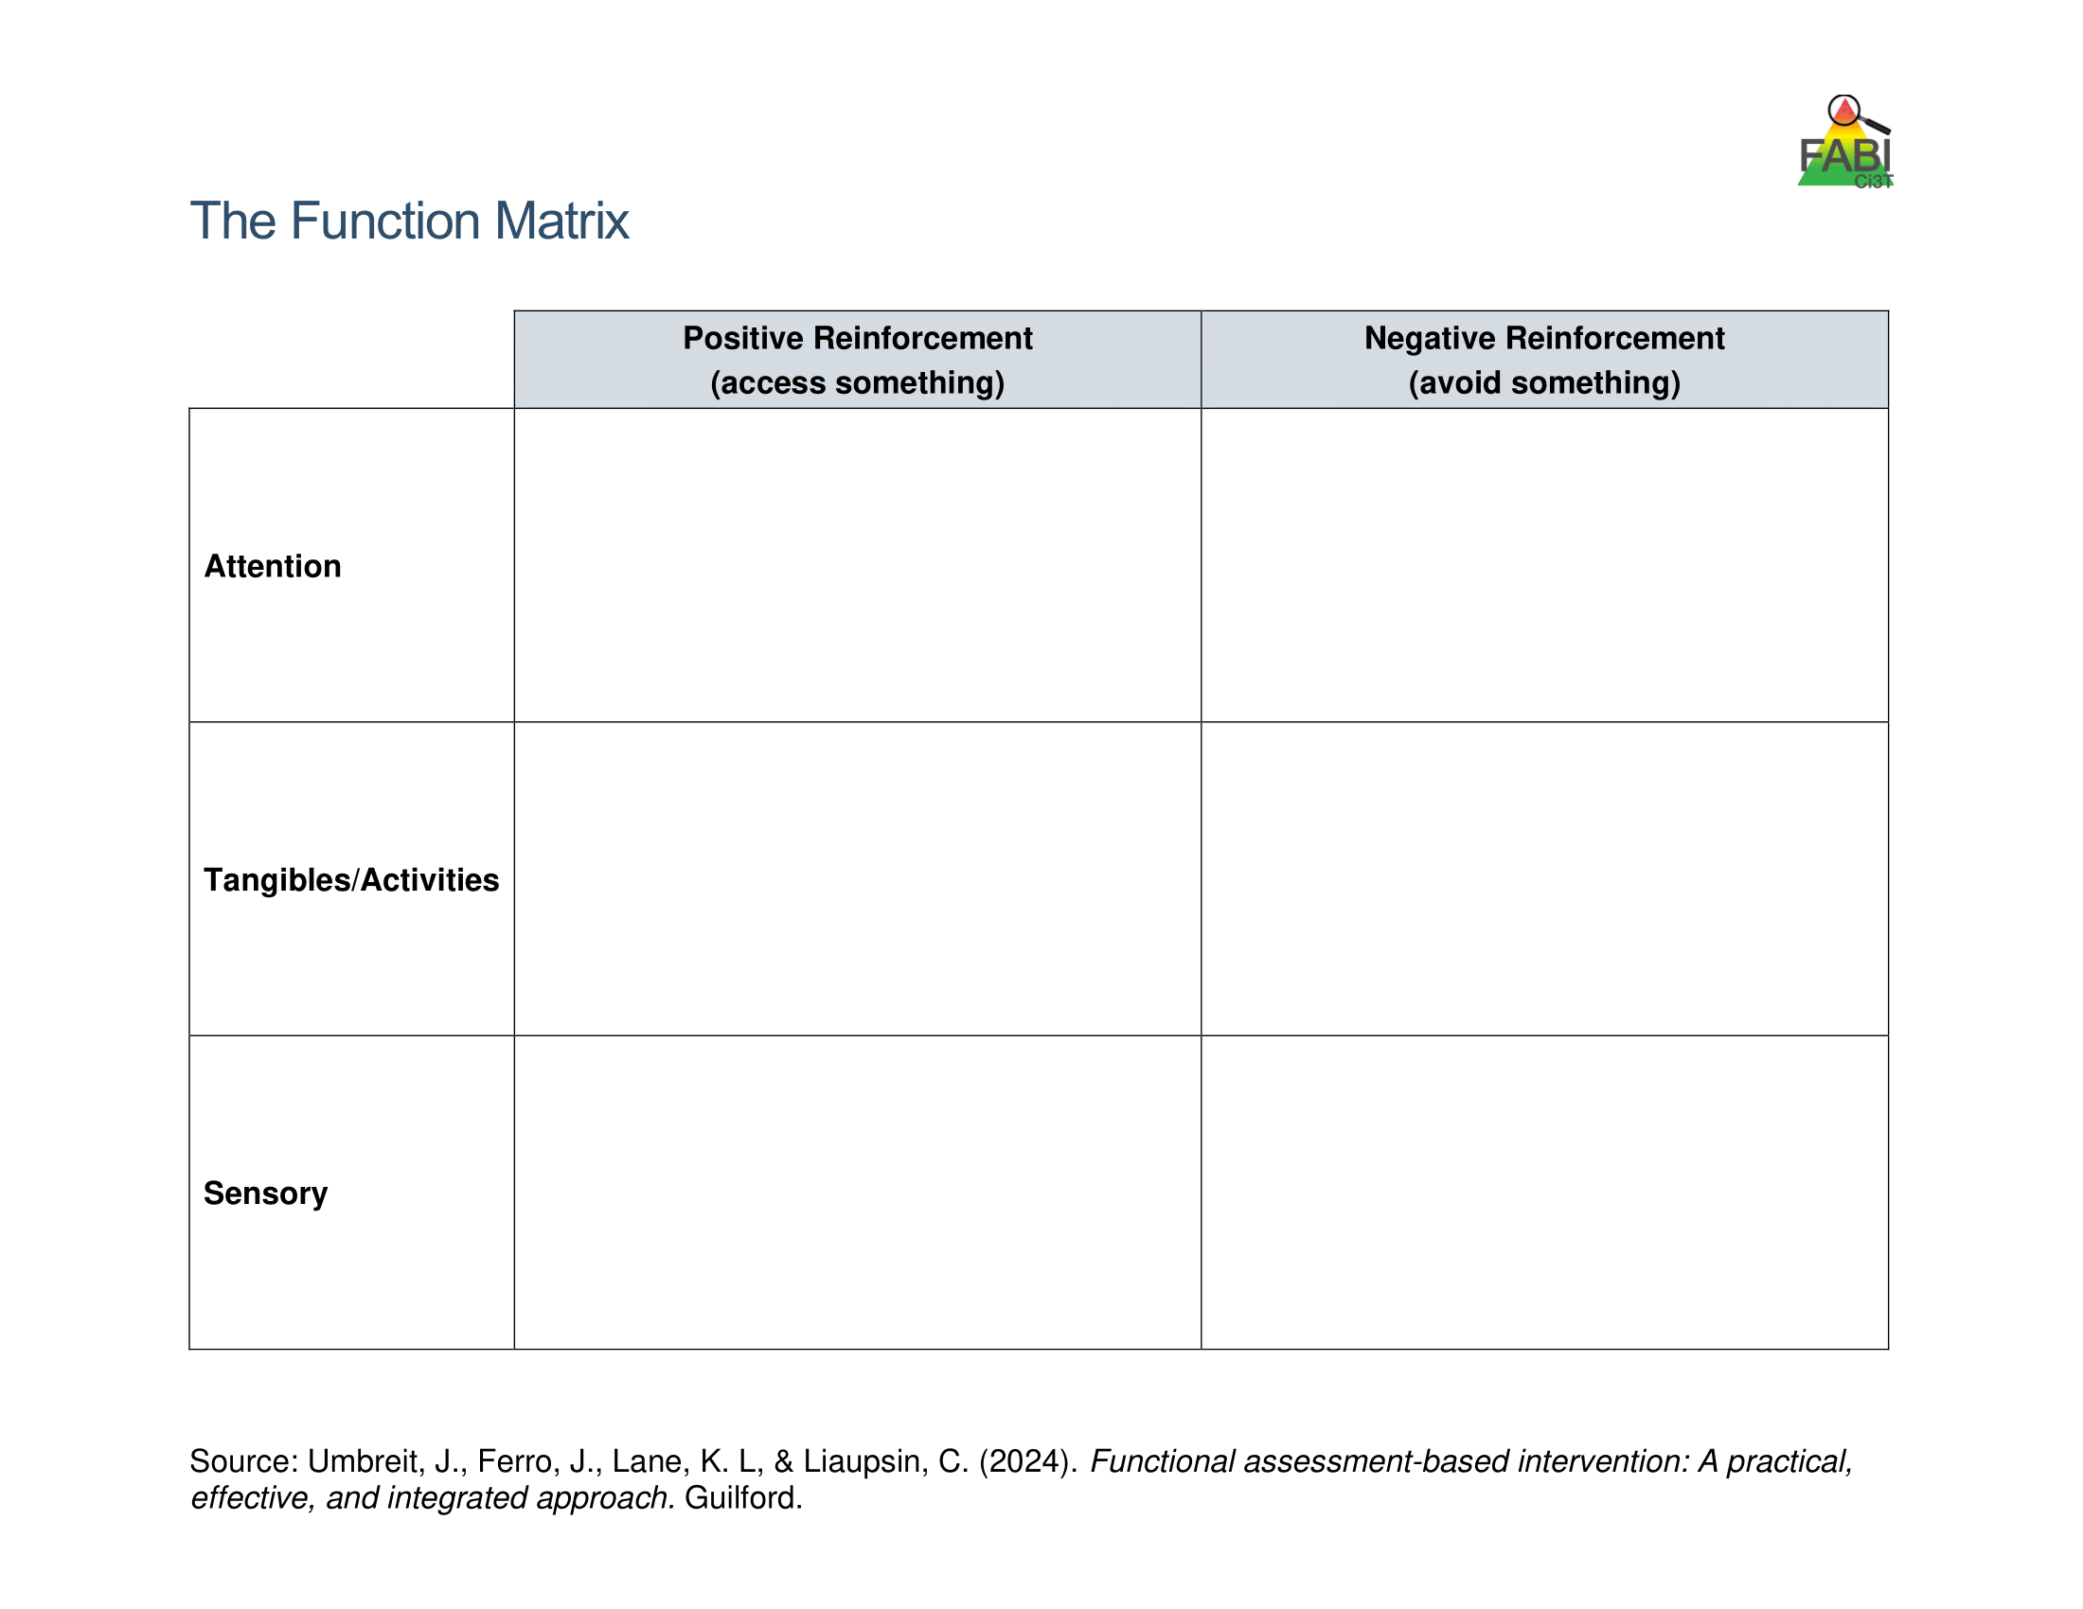
Use Function Matrix to identify the hypothesized function(s)
Peers laugh
Teacher provides 1:1 assistance
Work alone
Ignored by peers or adults
Preferred activity (e.g., tablet)
Do not have to complete academic task
Access to fidgets
Noise cancelling headphones
Notes:
The Function Matrix, developed by Umbreit and colleagues is a practical, effective, and novel tool for visually organizing multiple sources of information from informal observations, interviews, rating scales, and A-B-C observation data to identify the function of the target behavior.
The Function Matrix is organized based on the principles of applied behavior analysis, with columns reflecting the two ways behaviors are reinforced: positive reinforcement (meaning to get or access something) and negative reinforcement (meaning to escape or avoid something).
Then, the three rows reflect three behavioral categories (the “something or somethings”) the person is trying get or avoid: attention, tangibles or activities, and sensory experiences.

Slide 53
Function Matrix
 | Positive Reinforcement (access something) | Negative Reinforcement (avoid something)
Attention | Teacher Interview – “During Independent work time, frequently comes to me to ask a question during math. Often, she already knows the answer” Parent Interview “She wants me to check her homework every night. Not just one math problem but all of them.” ABC Data- 1.2, 1.3, 2.1, 2.4, 3.1
Tangibles/Activities |  | Records Review - Tammy’s low grades were due to lack of class work completion. Teacher Interview- “She is the last one to get started when it is time for independent reading.” Student Interview- “I hate worksheets, they’re so boring” ABC Data: 1.1, 1.4, 2.2, 2.3, 2.5, 3.2
Sensory
Number of the observation
session (Day 1)
Number of the occurrence in the
observation session
(second instance of the behavior on Day 1)
Source: Umbreit, Ferro, Lane, & Liaupsin (2024); Umbreit, Ferro, Liaupsin, & Lane (2007); Umbreit, Lane, & Dejud (2004)
Notes:
Information from all parts of the functional assessment are added to Function Matrix. This includes: informal observations, interviews, rating scales, and A-B-C observation data.
ABC Data are using the following notation: Number of the observation session (e.g., observation session 1, 2, 3) dot number of the occurrence of target behavior in that observation session (e.g., the second instance of behavior) – this is the number of the row.

Slide 54
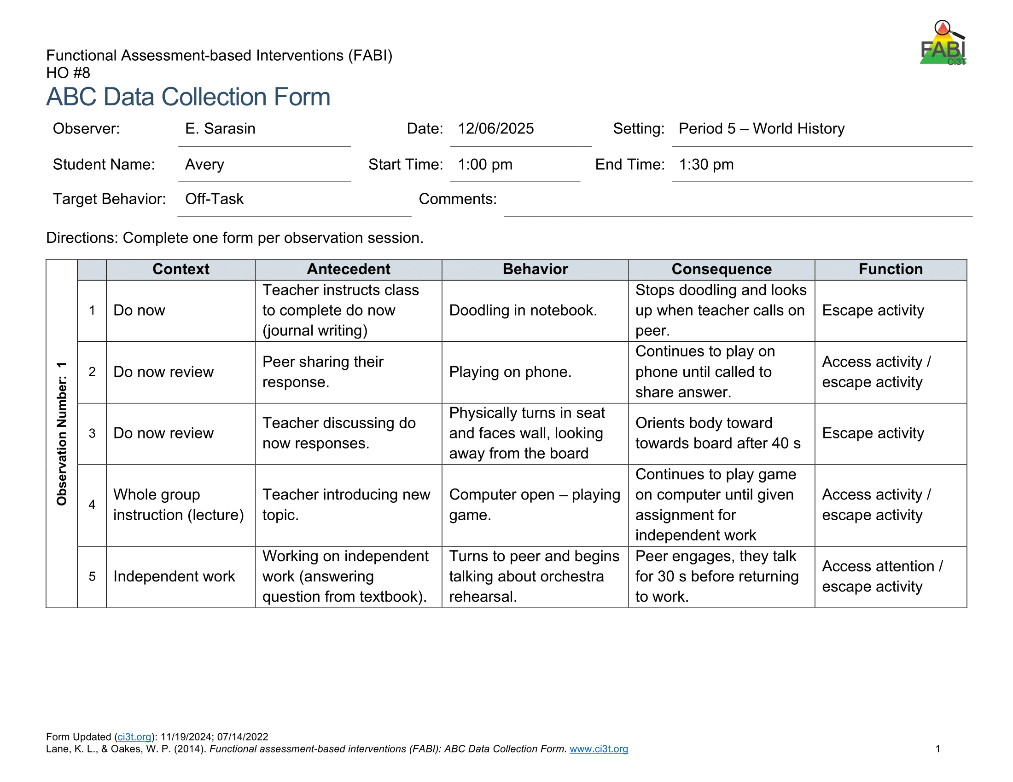
Let’s Practice!
Let’s Practice! 1
What’s the Function?
Access – Attention
Avoid – Attention
Access – Tangibles / Activities
Avoid – Tangibles / Activities
Access – Sensory
Avoid - Sensory
?
?
?
?
?

Slide 55
Hypothesized Function
During [context], [student name] engages in [target behavior] in order to [maintaining function(s)].
Example:
During independent reading activities (CONTEXT), Frank (STUDENT NAME) engages in noncompliant behavior (TARGET BEHAVIOR) to (a) escape too difficult tasks and (b) access peer and teacher attention (MAINTAINING FUNCTIONS).

Slide 56
Accessing Professional Learning Materials
Accessing Professional Learning Materials 2
ci3t.org/pl

Slide 57












Let’s Practice: Function Matrix
In a breakout room, work with your
group to complete the Function Matrix.
Notes:
10-min

Slide 58

FABI Step 3: Collecting Baseline Data

Slide 59
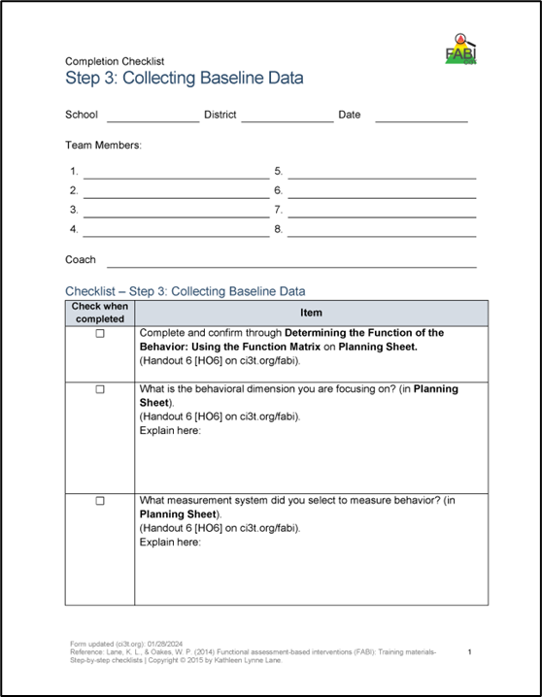
Step 3: Collecting Baseline Data
Determine behavioral dimension of focus
Select a measurement system
Develop data collection procedures
Train data collectors
Collect baseline data
Graph baseline data
Notes:
Today, we are going to focus on these three components of Step 3

Slide 60
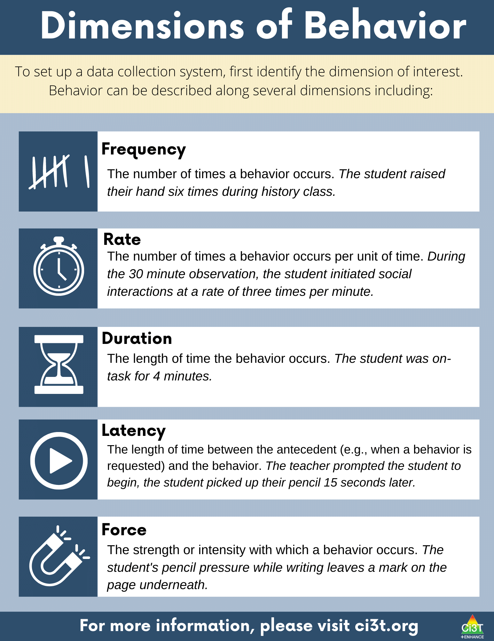
Dimensions of Behavior 1

Slide 61
Dimensions of Behavior 2

Slide 62
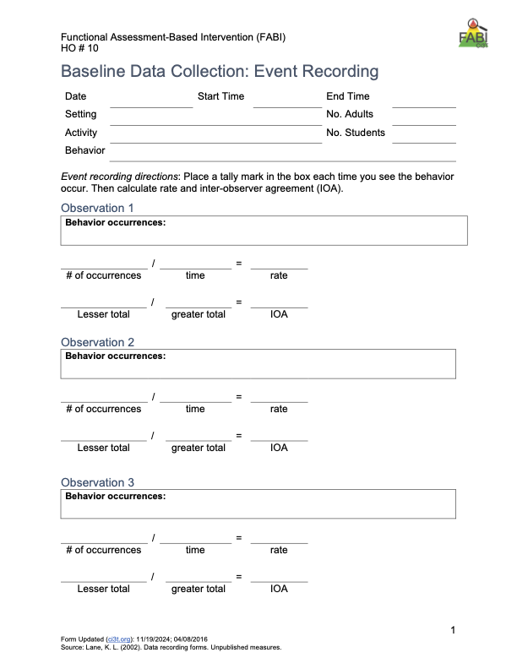
Types of event-based measurement:
  Frequency
  Rate
Most appropriate for behaviors that are:
  Countable and discrete (e.g., relatively brief, clear start and end, and uniform in length).
  Examples: talking out of turn, swearing, pushing
Select a Measurement System: Event-Based

Slide 63
Tips for Event-Based Recording
Select a specific period for data collection (e.g., first 20 minutes of the day, recess, math block)
Keep track of each time the target behavior occurs within that specified time
  Tally marks on paper (e.g., post it, label, data-collection sheet)
  Move paperclips from one pocked to another
  Counter

Slide 64

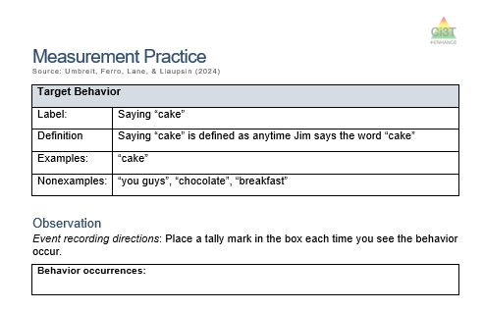
Let’s Practice – Frequency Recording
Notes:
https://youtu.be/ofRn9zCjy8s?si=1W6vo_yTak1yDSQ7&t=88

Slide 65
Debrief – Frequency Recording
How many times did Jim say the word cake?
What about frequency recording was challenging?
Given those challenges, how could the measurement procedures be improved?
Notes:
PRESENTER NOTES:
Jim says cake 18 times
Challenges
Pancake? Cupcake?
Hearing / audio quality
Frequency (happened a lot, hard to keep up) -
Procedures could be improved by:
Revising operational definition – whether or not to “count” compound words
Set up with good vantage point / audio to conduct observation
Consider whether frequency is appropriate / feasible (e.g., if happening too much to keep up maybe partial interval would be more appropriate)

Slide 66

Step 3: Collecting Baseline Data
Determine behavioral dimension of focus
Select a measurement system
Develop data collection procedures
Train data collectors
Collect baseline data
Graph baseline data
Reminder- although we aren’t discussing these today developing data collection procedures, training data collectors, and collecting baseline data are key components of this step!

Slide 67

FABI Step 4: Design the FABI

Slide 68

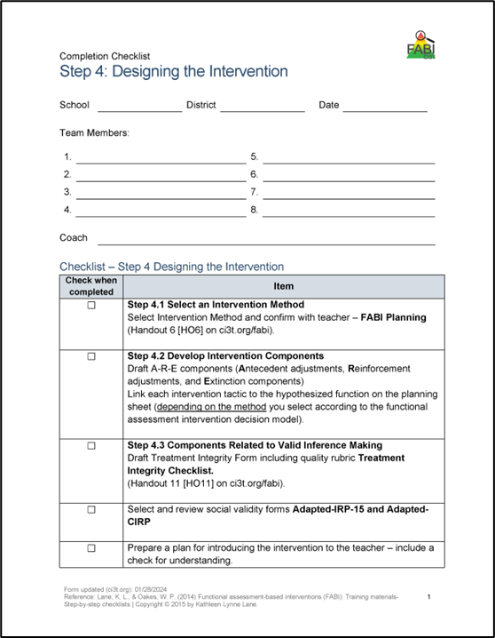
Step 4: Design the FABI
Select an intervention method
Develop A-R-E intervention components
Draft treatment integrity checklist
Assess pre-intervention social validity
Develop intervention materials
Introduce FABI to educators and family
Introduce FABI to student
Revise and finalize FABI
Notes:
Today, we are going to focus on these components of Step 4

Slide 69

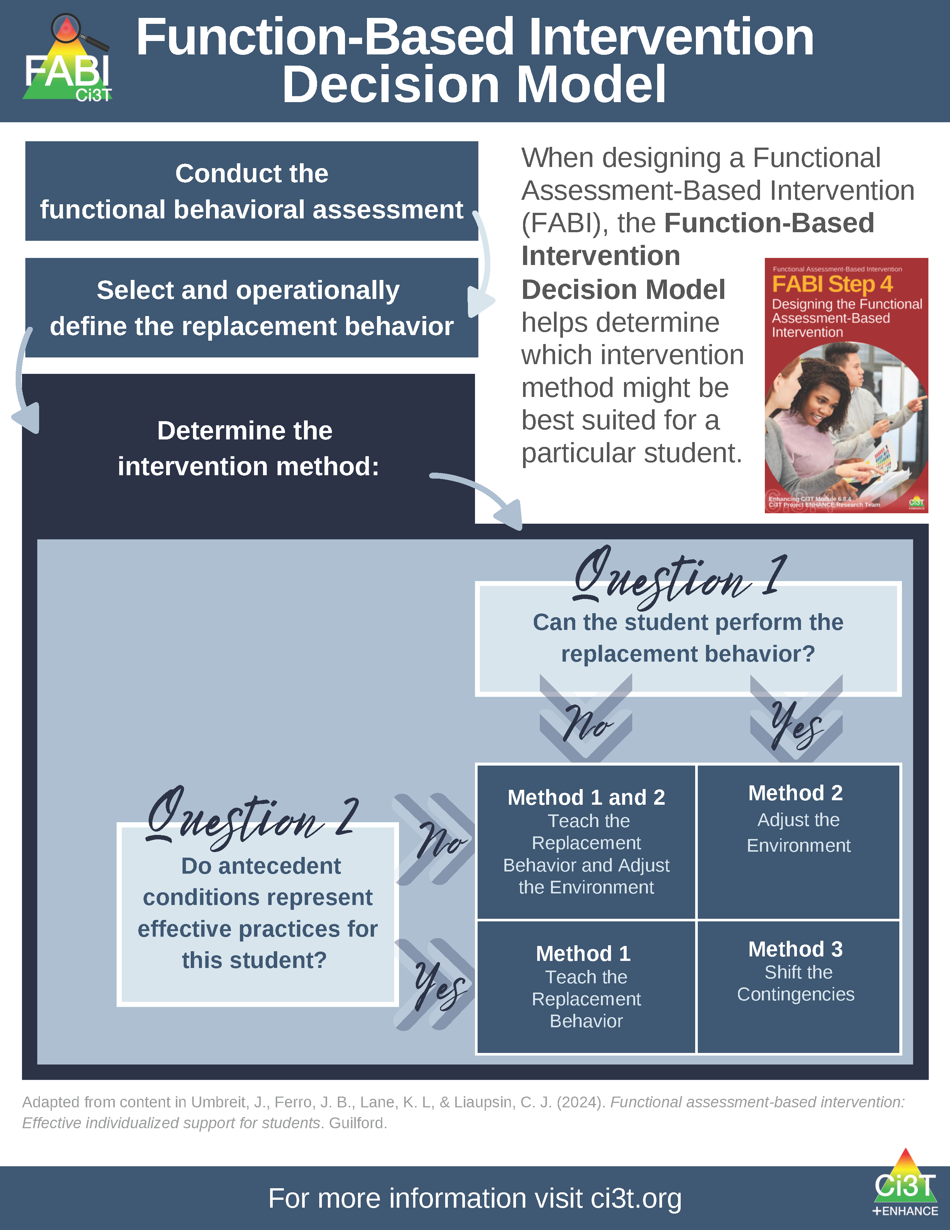
Function-Based Intervention Decision Model
An intervention method is selected based on the response to these two questions:
Can the student perform the replacement behavior?
Do antecedent conditions represent effective practices for this student?

Slide 70
Function-Based Intervention Decision Model 1

Slide 71
A-R-E Components
Antecedent Adjustments - adjusting the antecedent conditions to increase likelihood replacement behavior will occur and (if applicable) providing instruction in the replacement behavior
Reinforcement Shifts - reinforcing the replacement behavior to strengthen its occurrence
Extinction Procedures - ensuring that the target behavior is not followed by reinforcement

Slide 72
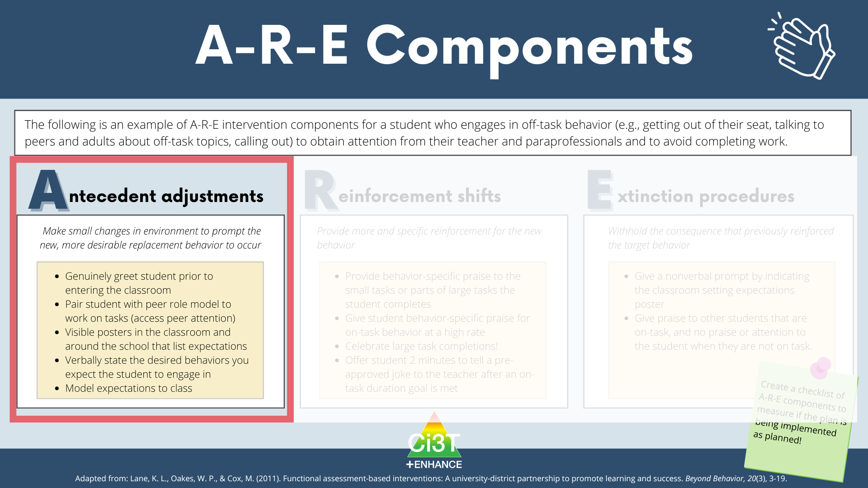
A-R-E Components 1

Slide 73
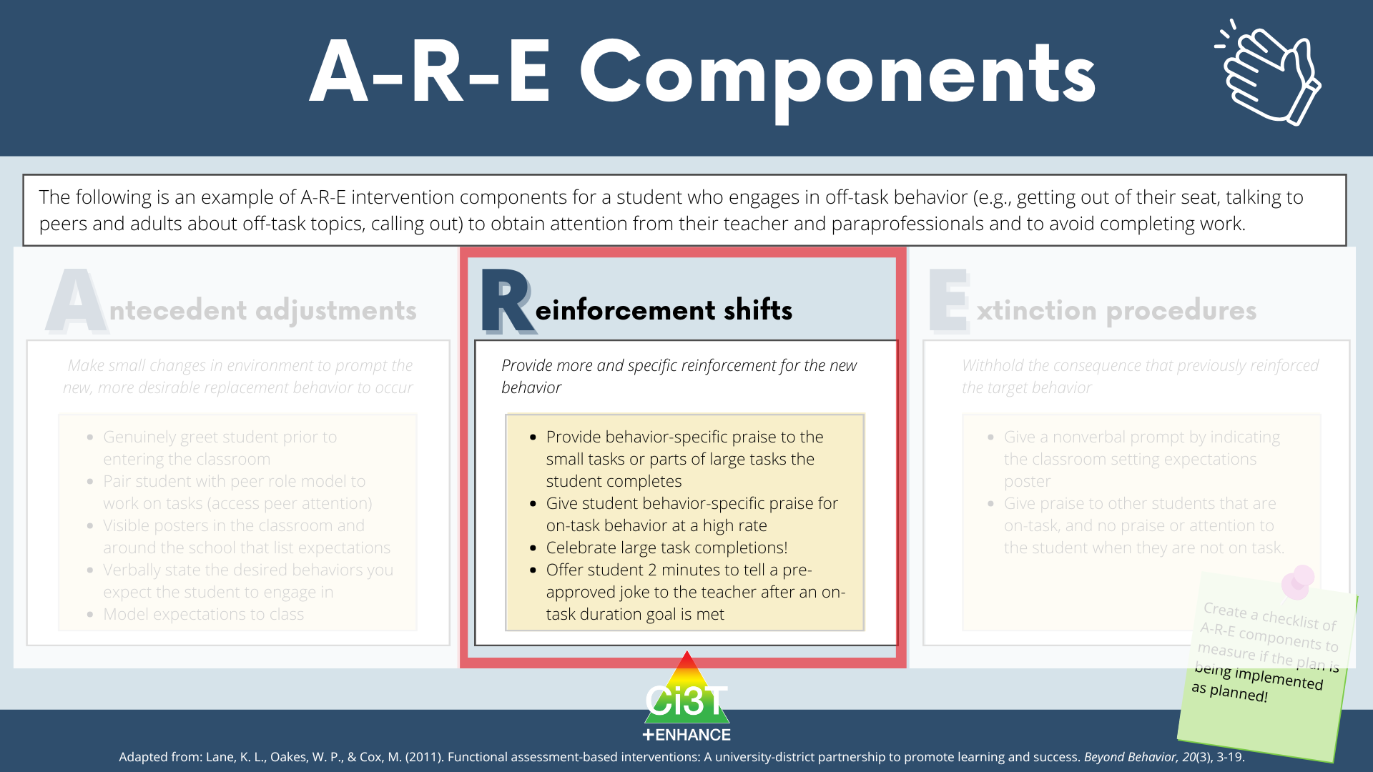
A-R-E Components 2

Slide 74
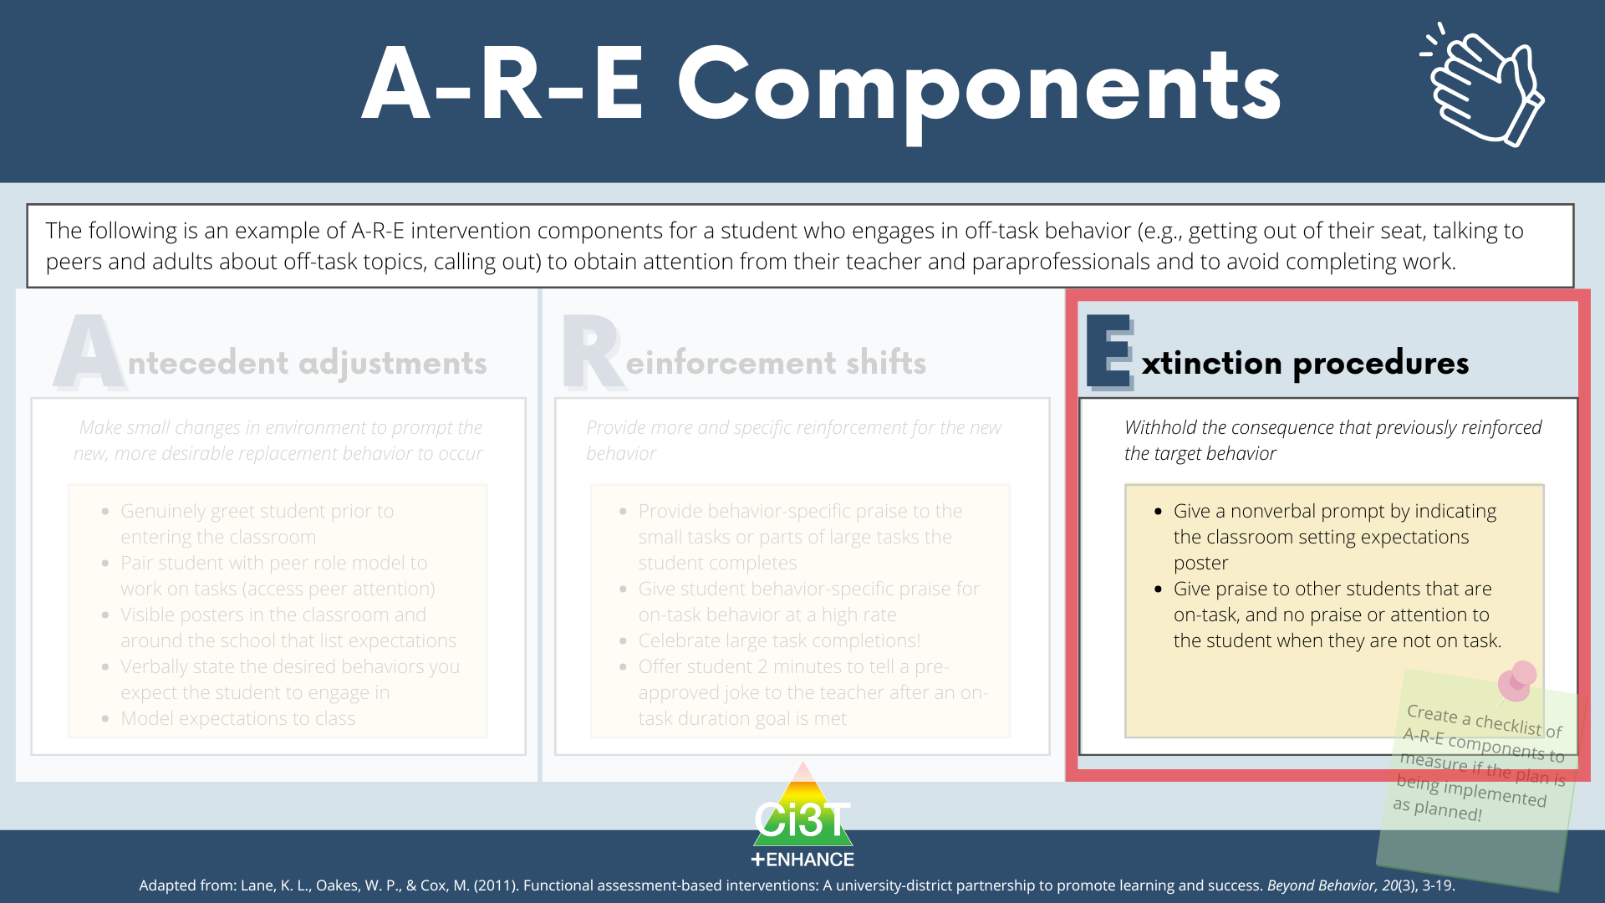
A-R-E Components 3

Slide 75
Illustration 1:
David (2nd Grade)
Germer, K. A., Kaplan, L. M., Giroux, L. N., Markham, E. H., Ferris, G. J., Oakes, W. P., & Lane, K. L. (2011). A function-based intervention to increase a second-grade student's on-task behavior in a general education classroom. Beyond Behavior, 20(3), 19-30.

Slide 76
Target Behavior: Off -Task Behavior
Component | Description
Label | Off-task
Definition | Off-task behavior refers to engaging in behaviors or making verbal comments unrelated to instructional tasks.
Examples | leaving assigned instructional area without teacher permission inappropriately making comments to teacher or peers unrelated to instruction attending to anything other than the academic task doing unassigned tasks using instructional materials inappropriately taking more than 30 s to prepare for instructional task
Non-Examples | staying in assigned instructional area appropriately making comments to teacher or peers related to instruction attending to academic tasks working on assigned task using instructional materials appropriately preparing for instructional task in less than 30 s

Slide 77
Replacement Behavior: On-Task
Component | Description
Label | On-task
Definition | On-task behavior refers to engaging in behaviors or making verbal comments related to instructional tasks.
Examples | staying in assigned instructional area appropriately making comments to teacher or peers related to instruction attending to academic tasks working on assigned task using instructional materials appropriately preparing for instructional task in less than 30 s
Non-Examples | leaving assigned instructional area without teacher permission inappropriately making comments to teacher or peers unrelated to instruction attending to anything other than the academic task doing unassigned tasks using instructional materials inappropriately taking more than 30 s to prepare for instructional task.

Slide 78

Function Matrix
Function Matrix 1

Slide 79
Hypothesized Function
Hypothesized Function 1
When presented with an instructional task, David engages in off-task behavior (such as leaving instructional areas, inappropriately making comments, and engaging in unassigned tasks) to access attention and/or to escape tasks.
In other words, when David is off-task he gets attention from his teacher and peers and does not have to complete assignments (positive reinforcement-attention and negative reinforcement-activity)

Slide 80

Function-Based Intervention Decision Model
Function-Based Intervention Decision Model 1

Slide 81

Measurement
Measurement 1
Duration
  Measured academic engagement
  20-min sessions during morning instructional time

Slide 82
Component 1- Adjust the Antecedents
Component 1- Adjust the Antecedents 1
Adjust Antecedents | Adjust antecedent variables so the conditions that set the occasion for the target behavior are eliminated and new conditions are established in which the replacement behavior is more likely to occur. | Seating change - David will sit facing the whiteboard Stoplight system Self-monitoring system Teacher will review picture schedule for the morning work period prior to the work period. Teacher will check-in with David at the beginning of independent tasks to ensure that he understood the assignment.

Slide 83

Antecedent Adjustment: Change of Seating
Note: David’s seat pre-intervention
Note: David’s seat during the intervention

Slide 84
Antecedent Adjustment: Stoplight System
Stoplight System
Affixed to the side of David’s desk
  David used a clothespin to signal which “light” he was on
Green, yellow, and red “lights”
  Green: “I’m doing my work!”
  Yellow: “I’m asking a friend for help!”
  Red: “I still need help! I’m asking my teacher.”
“I’m done!” to signal completion

Slide 85
Component 2- Reinforcement Rates
Component 2- Reinforcement Rates 2
Reinforcement Rates | Provide appropriate reinforcement for the replacement behavior. | Teacher will provide behavior-specific praise when David is on-task. Teacher will acknowledge David’s need for help when his clothespin was on red and assist him as quickly as possible. Teacher will check David’s work upon completion, provide praise, and allow him to take a short break. At the end of the morning independent work period, teacher will help David complete his self-monitoring form and write one specific incidence of good behavior at the bottom.

Slide 86
Component 3- Extinguish the Target Behavior
Component 3 - Extinguish the Target Behavior 1
Extinguish Target Behavior | Withhold the consequence that previously reinforced the target behavior. | Teacher will provide no praise or attention when David is off-task, with the exception of one verbal or gestural redirect per minute. When David is off-task, teacher will praise other students who are behaving appropriately.

Slide 87

Treatment Integrity

Slide 88



Pre-Intervention Social Validity

Slide 89
Let’s Chat: ARE Components
What other antecedent adjustments, reinforcement shifts, or extinction procedures could support David?
How might A-R-E components for David be different if he were in middle or high school?
What components of FABI Step 4 seem most beneficial or helpful?
What might be challenging about completing FABI Step 4? How might you support teams to overcome those challenges?
Notes:
10-min

Slide 90

FABI Step 5: Test the Intervention

Slide 91


Step 5: Testing the Intervention
Implement the intervention
Monitor treatment integrity
Collect and graph data
Implement a single-case design to “test” how well intervention is working
  ABAB
  Multiple baseline
  Changing criterion
Assess social validity
Fade the intervention

Slide 92

Harry’s Intervention Outcomes
Harry’s Intervention Outcomes 1
Cox, M., Griffin, M. M., Hall, R., Oakes, W. P., & Lane, K. L. (2011). Using a Functional Assessment-Based Intervention to Increase Academic Engaged Time in an Inclusive Middle School Setting. Beyond Behavior, 20(3).

Slide 93

Harry’s Intervention Outcomes
Harry’s Intervention Outcomes 2
Cox, M., Griffin, M. M., Hall, R., Oakes, W. P., & Lane, K. L. (2011). Using a Functional Assessment-Based Intervention to Increase Academic Engaged Time in an Inclusive Middle School Setting. Beyond Behavior, 20(3).

Slide 94
Wrapping Up and Moving Forward

Slide 95
Opportunities to Learn More
Opportunities to Learn More 2

Slide 96
Action Items
Action Item | Person(s) Responsible | Planned Completion Date | Date Completed
Schedule time to review FABI modules | David | 04/29/26
Email behavior specialist to coordinate FABI book study for next school year | David | 04/29/26

Slide 97

Project EMPOWER+ 2025-2026
EMPOWER+ Session | Date
Starting Strong: Effective Tier 1 Practices for Educators | September 24, 2025 (Wednesday)
From Data to Action: Using Systematic Screening to Inform Instruction | October 8, 2025 (Wednesday)
Ci3T In Action: Integrated Lesson Planning for Enhanced Instruction | November 18, 2025 (Tuesday)
Mastering Behavior Specific Praise and Precorrection | January 21, 2026 (Wednesday)
A 6-Step Instructional Approach for Responding to Challenging Behaviors: A Tier 1 Practice | February 10, 2026 (Tuesday)
A Tier 2 Support for Students Experiencing Anxious Feelings: Recognize. Relax. Record. | March 25, 2026 (Wednesday)
A Tier 3 Support for Students with Intensive Intervention Needs: Functional Assessment-Based Intervention (FABI) | April 28, 2026 (Tuesday)

Slide 98

Project EMPOWER+ 2026-2027
EMPOWER+ Session | Date
Effective Tier 1 Practices for Positive, Productive Classrooms | September 15, 2026
Let the Data Drive: Using Systematic Screening to Shape Instruction | October 27, 2026
Ci3T in Action: Integrated Lesson Planning for Optimal Instruction | November 17, 2026
A 6-Step Instructional Approach for Responding to Challenging Behavior in Schools | January 20, 2027
A Tier 2 Intervention for Managing Anxious Feelings: Recognize. Relax. Record. | March 23, 2027
A Tier 3 Intervention: Functional Assessment-Based Intervention | April 28, 2027

Slide 99

Ci3T Trainers and Coaches Calls
Ci3T Trainers and Coaches Calls Session | Date
Ci3T Trainers and Coaches Call 1 | August 20, 2025 (Wednesday)
Ci3T Trainers and Coaches Call 2 | September 3, 2025 (Wednesday)
Ci3T Trainers and Coaches Call 3 | October 1, 2025 (Wednesday)
Ci3T Trainers and Coaches Call 4 | November 5, 2025 (Wednesday)
Ci3T Trainers and Coaches Call 5 | December 2, 2025 (Tuesday)
Ci3T Trainers and Coaches Call 6 | January 22, 2026 (Thursday)
Ci3T Trainers and Coaches Call 7 | February 17, 2026 (Tuesday)
Ci3T Trainers and Coaches Call 8 | March 10, 2026 (Tuesday)
Ci3T Trainers and Coaches Call 9 | April 15, 2026 (Wednesday)
Ci3T Trainers and Coaches Call 10 | May 13, 2026 (Wednesday)

Slide 100


Thank you!
Thank you!
ci3t.org
#Ci3T
@Ci3Tmodel
Tag us in your Ci3T highlights, we love to see Ci3T in action!
Follow us on Instagram for updates and new resources!
Notes:
Tag us in your Ci3T highlights- we would love to see Ci3T in action! Follow us on Instagram for updates and links to resources! @Ci3TModel
You will receive a brief session evaluation – we value your feedback and would greatly appreciate you taking a few minutes to share your thoughts on what you liked about the session and how we can improve

