Slide 1
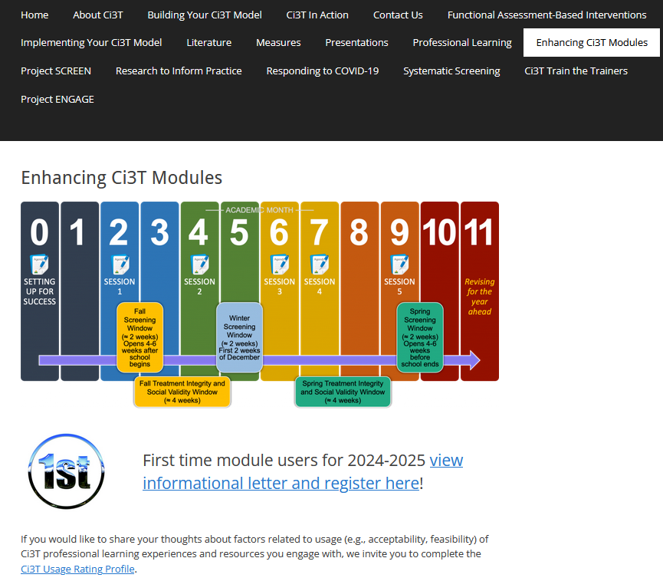
Tier 1 for the Win!
Ci3T Integrated Lesson Planning &
6 Step Instructional Process for Responding to Challenging Behavior
Elise Sarasin
Kathryn Johnson
If you have not done so already, we invite you to visit ci3t.org/enhance to access modules after a one-time registration process!

Slide 2
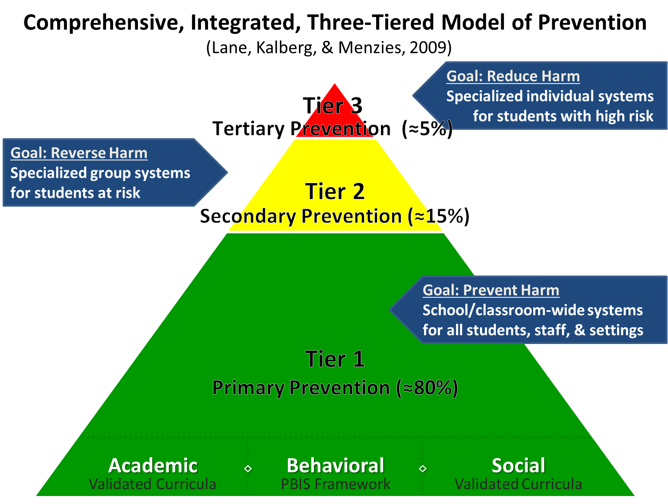
Comprehensive, Integrated, Three-Tiered Model of Prevention 1

Slide 3
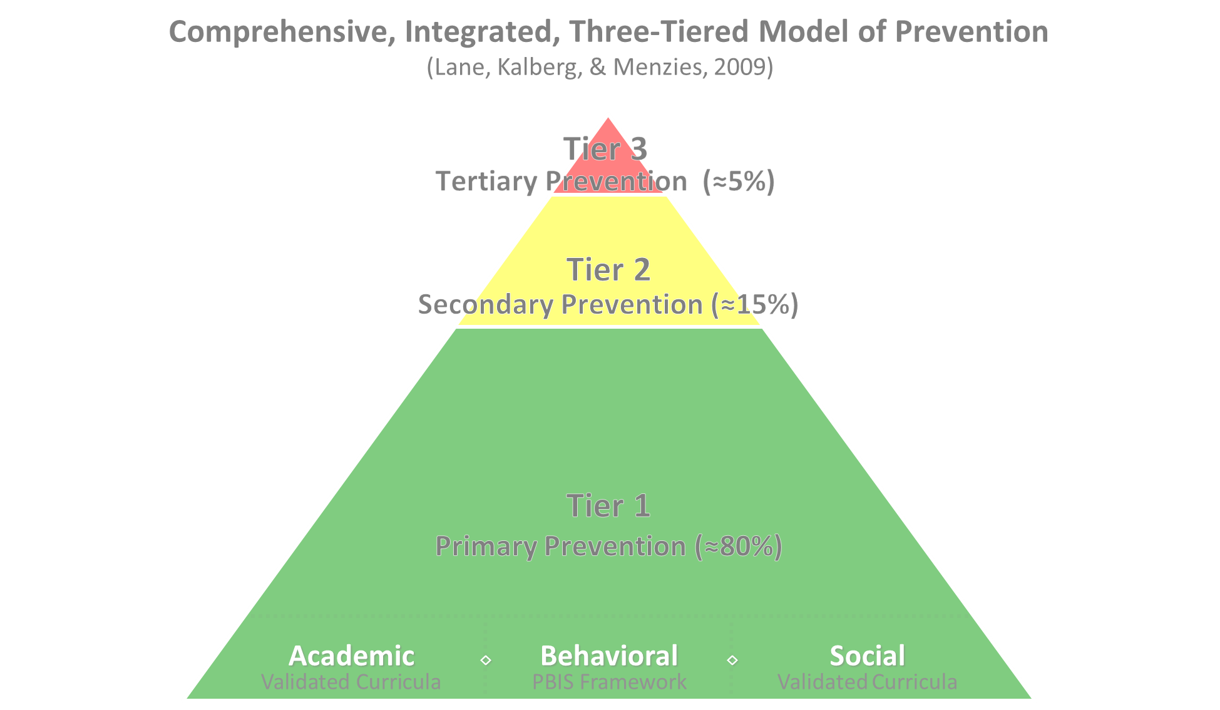

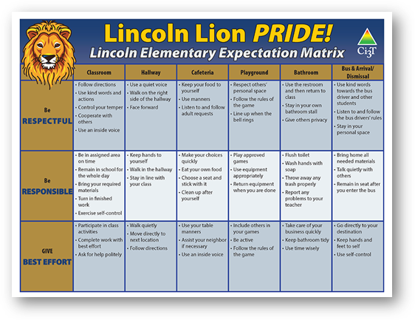
Comprehensive, Integrated, Three-Tiered Model of Prevention 2
Positive Behavioral Interventions and Supports
District & State Standards Quality Instruction
Validated Curricula and Resources

Slide 4

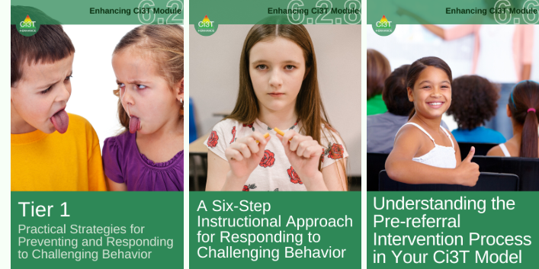
Primary Prevention (Tier 1)

Slide 5

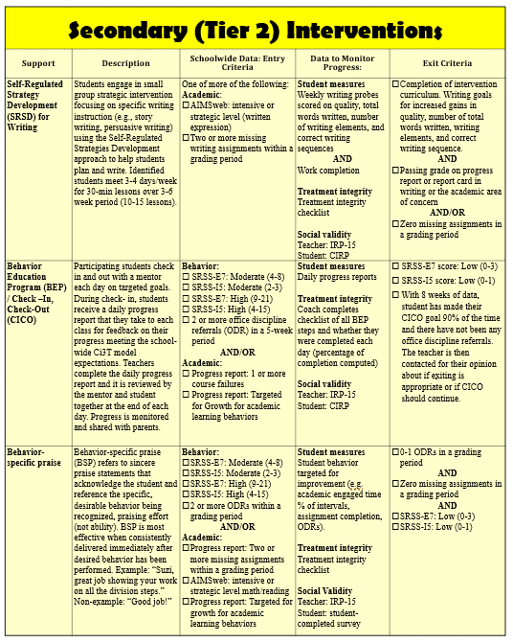
Secondary (Tier 2) Intervention Grid
Notes:
In addition to the module featured here outlining how to use multiple sources of data to connect students with Tier 2 supports, we offer a full suite of modules highlighting validated Tier 2 interventions such as Self-Regulated Strategy Development (SRSD) for Writing and Check-In/Check Out that may appear in your Secondary (Tier 2) Intervention Grid

Slide 6

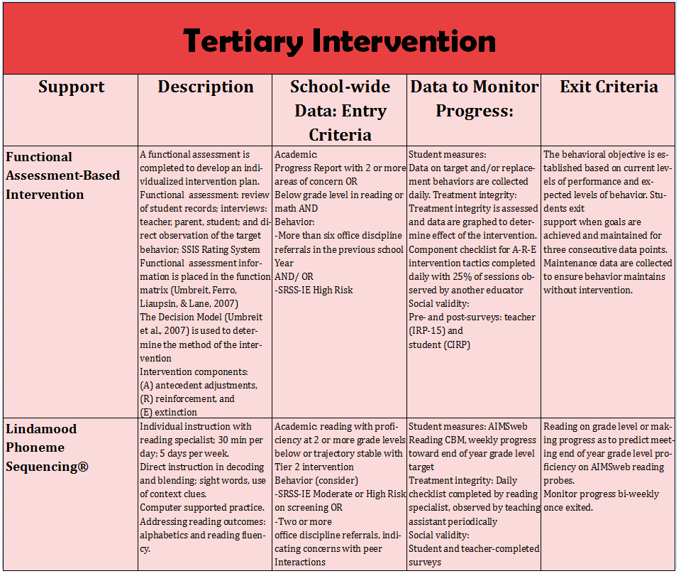
Tertiary (Tier 3) Intervention Grid
Notes:
In addition to the module featured here outlining how to use multiple sources of data to connect students with Tier 3 supports, we offer a full suite of modules highlighting validated Tier 3 interventions such as Functional Assessment-Based Intervention (FABI) that may appear in your Tertiary (Tier 3) Intervention Grid

Slide 7


Enhancing Ci3T Modules
ci3t.org/enhance

Slide 8
Session Outcomes
Describe key features of the Ci3T Integrated Lesson Plan
Identify opportunities to incorporate low-intensity strategies into instruction
Describe a 6-step instructional approach for responding to challenging behaviors

Slide 9
Agenda
Welcome
Ci3T Integrated Lesson Plan
6-step Instructional Approach for Responding to Challenging Behavior
Wrapping Up and Moving Forward

Slide 10

Ci3T Integrated Lesson Plan

Slide 11

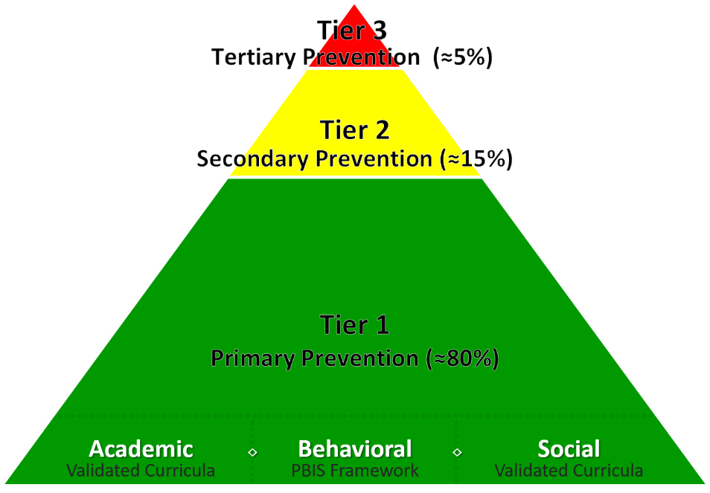
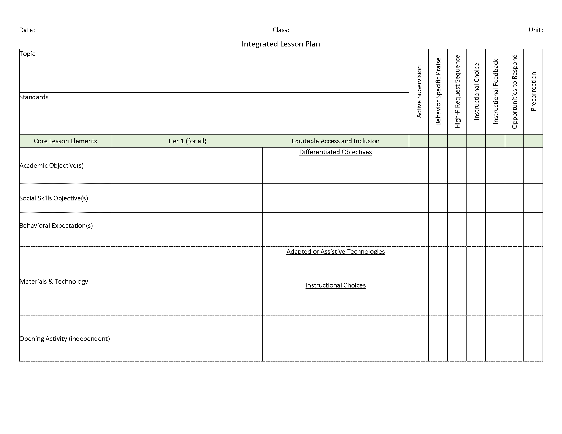
Ci3T Integrated Lesson Planning
Citation. Oakes, W. P., Lane, K. L., Lane, K. S., & Buckman, M. M. (2019). Ci3T integrated lessons plan template. www.ci3t.org.
Completed examples available in: Ci3T Project ENHANCE Research Team. (2022, July). Embedding and integrating Ci3T domains into daily instruction. Author. https://doi.org/10.17161/ci3t.42880

Slide 12
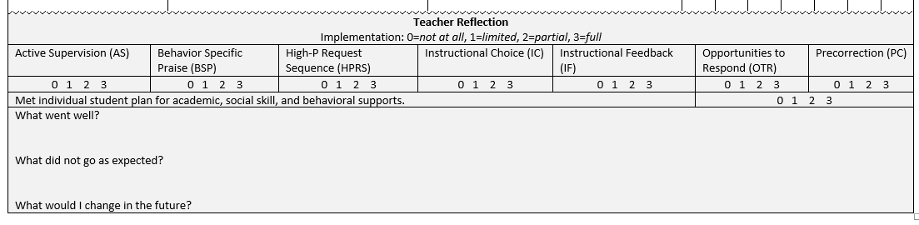
Integrated Lesson Plan
Citation. Oakes, W. P., Lane, K. L., Lane, K. S., & Buckman, M. M. (2019). Ci3T integrated lessons plan template. www.ci3t.org.​

Slide 13
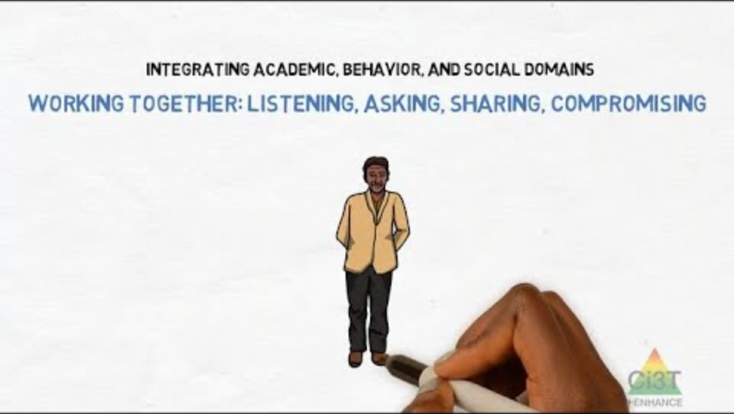
Integrated Lesson Plan: An Illustration
Notes:
Watch video 01:40

Slide 14




Let’s Chat: Ci3T Integrated Lesson Plan
What are your initial thoughts and reactions?
  What seems most feasible?
  What seems most challenging?
What is one way you could integrate social skills or a behavioral objective into an upcoming lesson?
Notes:
2-minute timer

Slide 15
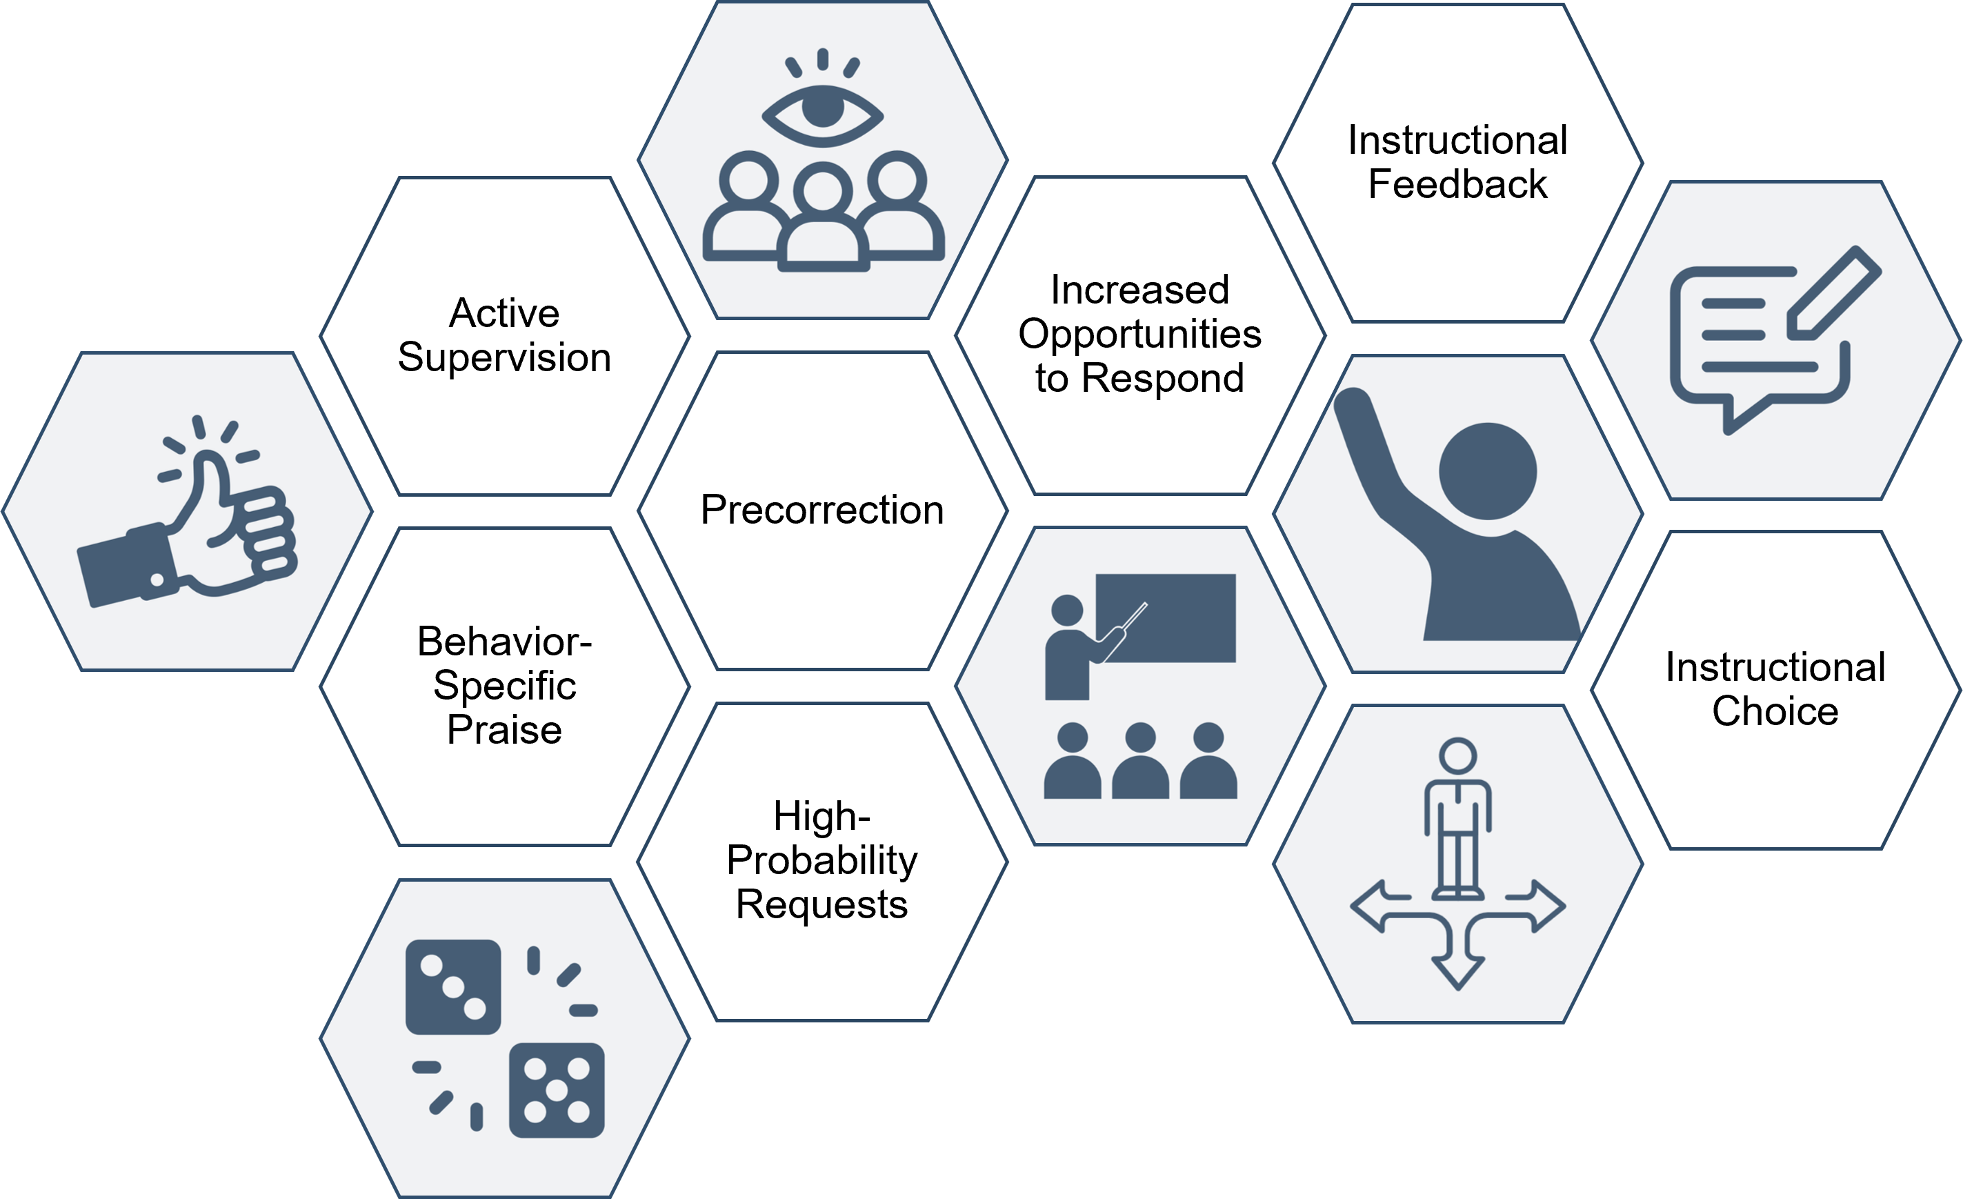
Opportunities to Incorporate Low-Intensity Strategies
Where in my lesson might I incorporate a low-intensity strategy?
Citation. Oakes, W. P., Lane, K. L., Lane, K. S., & Buckman, M. M. (2019). Ci3T integrated lessons plan template. www.ci3t.org.​
Completed examples available in: Ci3T Project ENHANCE Research Team. (2022, July). Embedding and integrating Ci3T domains into daily instruction. Author. https://doi.org/10.17161/ci3t.42880

Slide 16

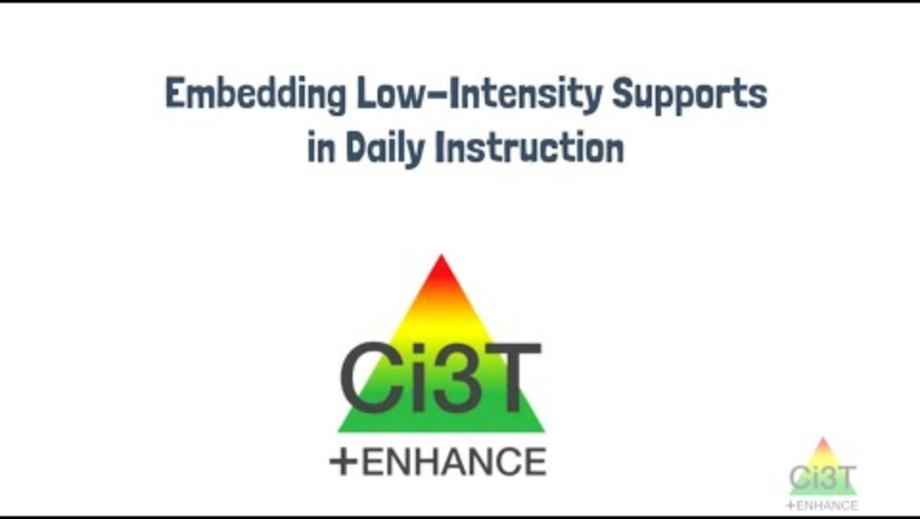
Embedding Low-Intensity Strategies in Daily instruction
Notes:
02:45

Slide 17
Let’s Chat: Low-Intensity Strategies
Which low-intensity teacher-delivered strategies do you use most often?
What opportunities exist to integrate low-intensity teacher-delivered strategies into lessons or daily routines?
Notes:
2-minute timer

Slide 18

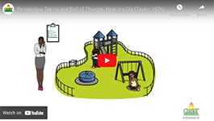
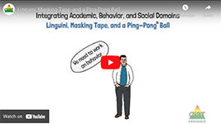
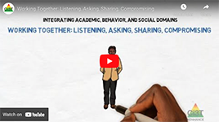
Module Connection!
Ci3T Integrated Lesson Plan
Citation. Oakes, W. P., Lane, K. L., Lane, K. S., & Buckman, M. M. (2019). Ci3T integrated lessons plan template. www.ci3t.org.​
Completed examples available in: Ci3T Project ENHANCE Research Team. (2022, July). Embedding and integrating Ci3T domains into daily instruction. Author. https://doi.org/10.17161/ci3t.42880

Slide 19
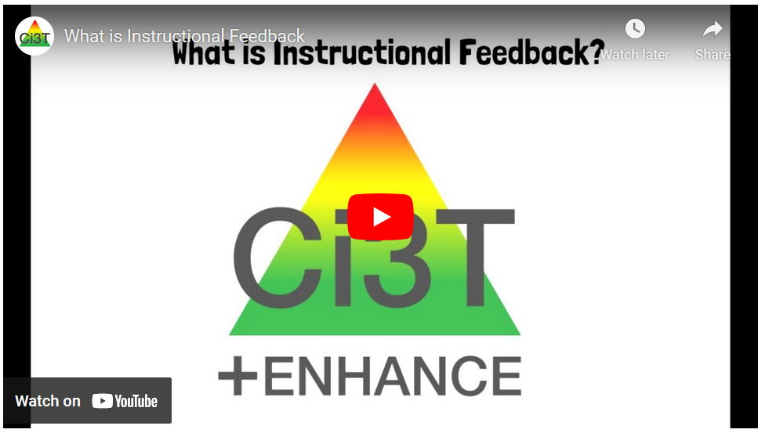
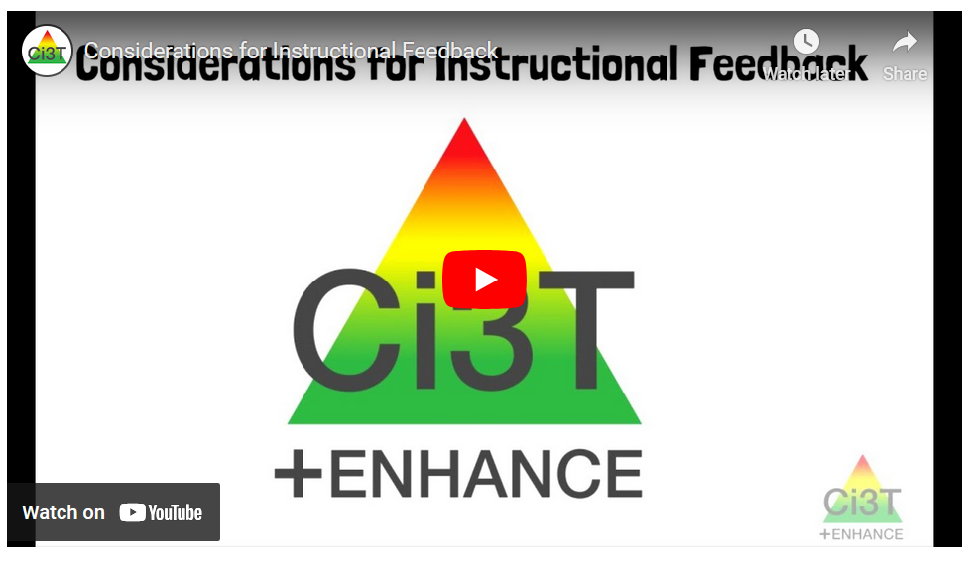

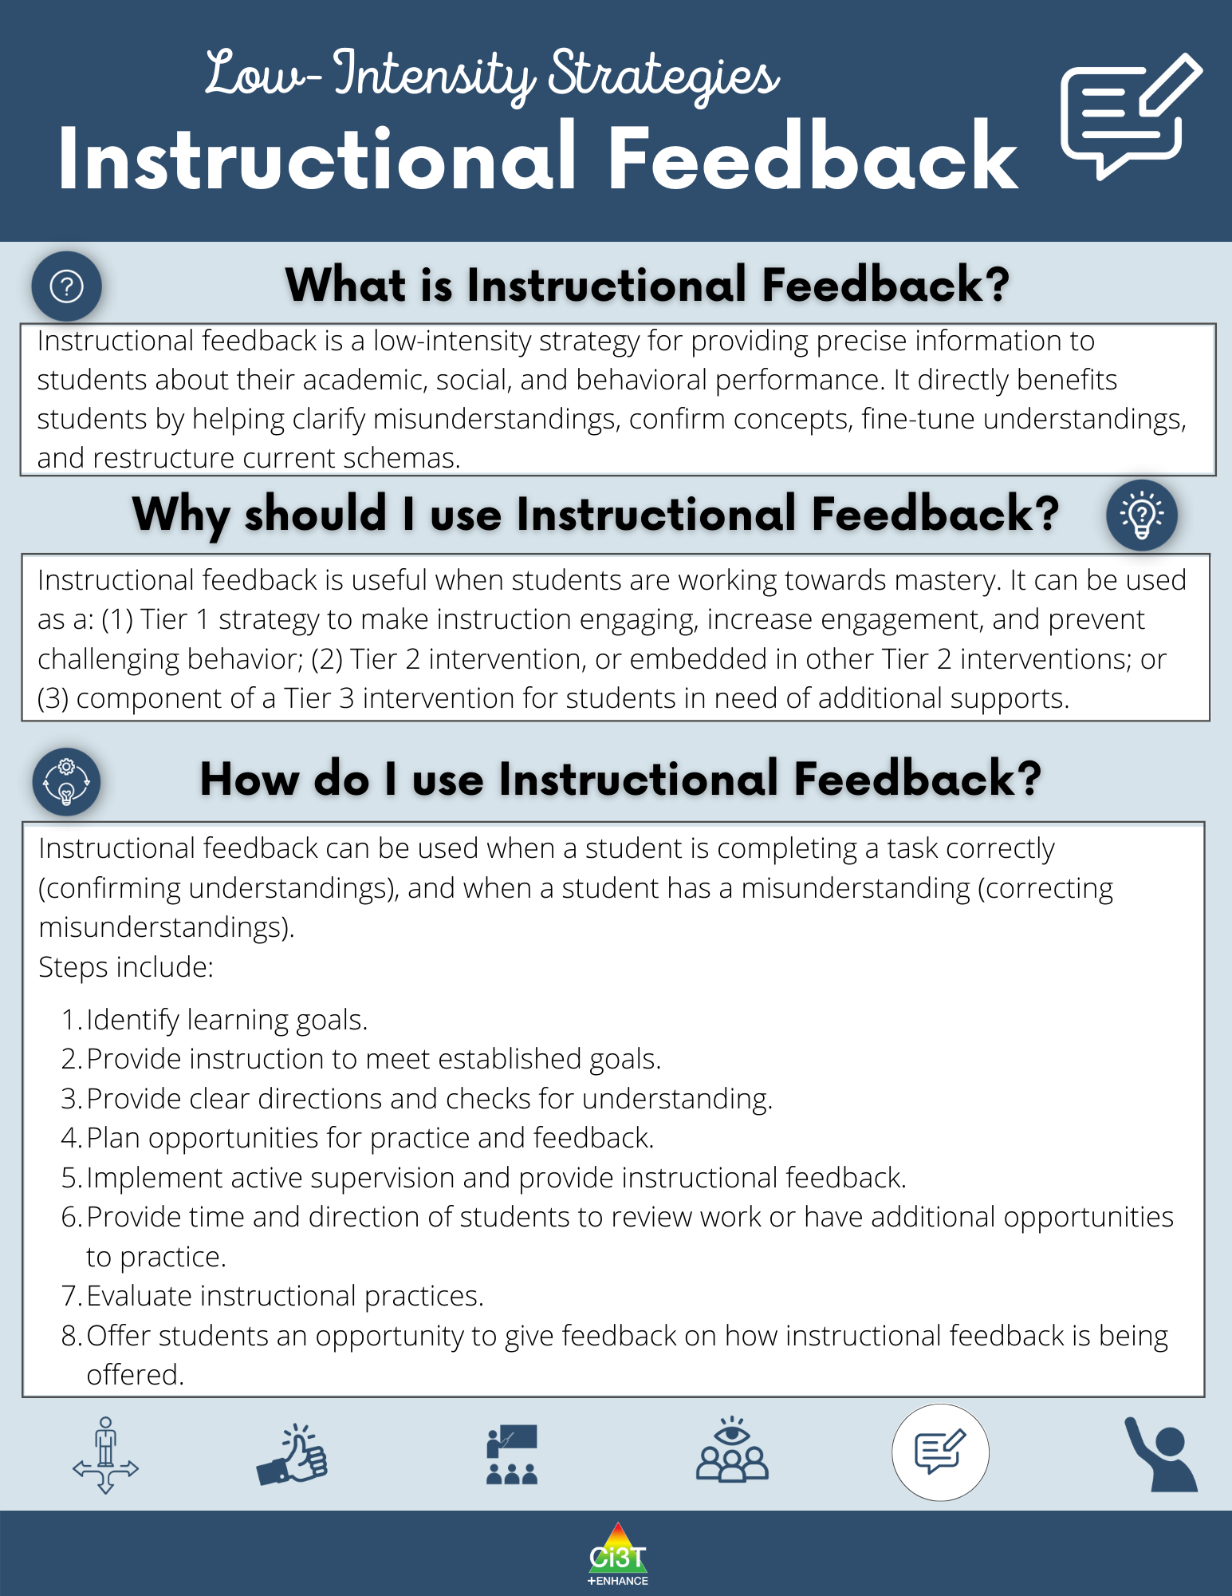
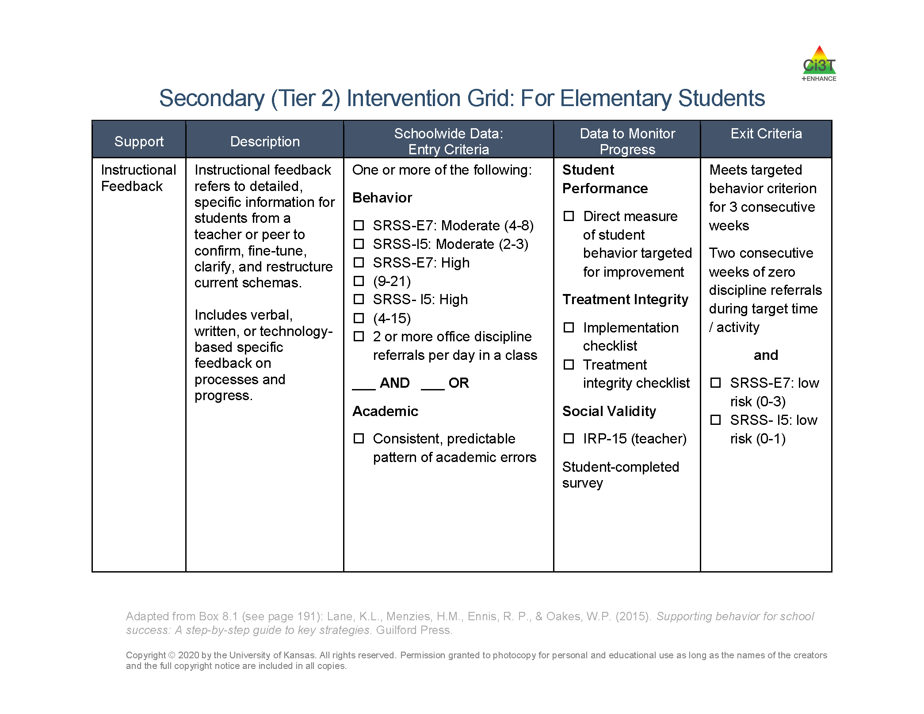
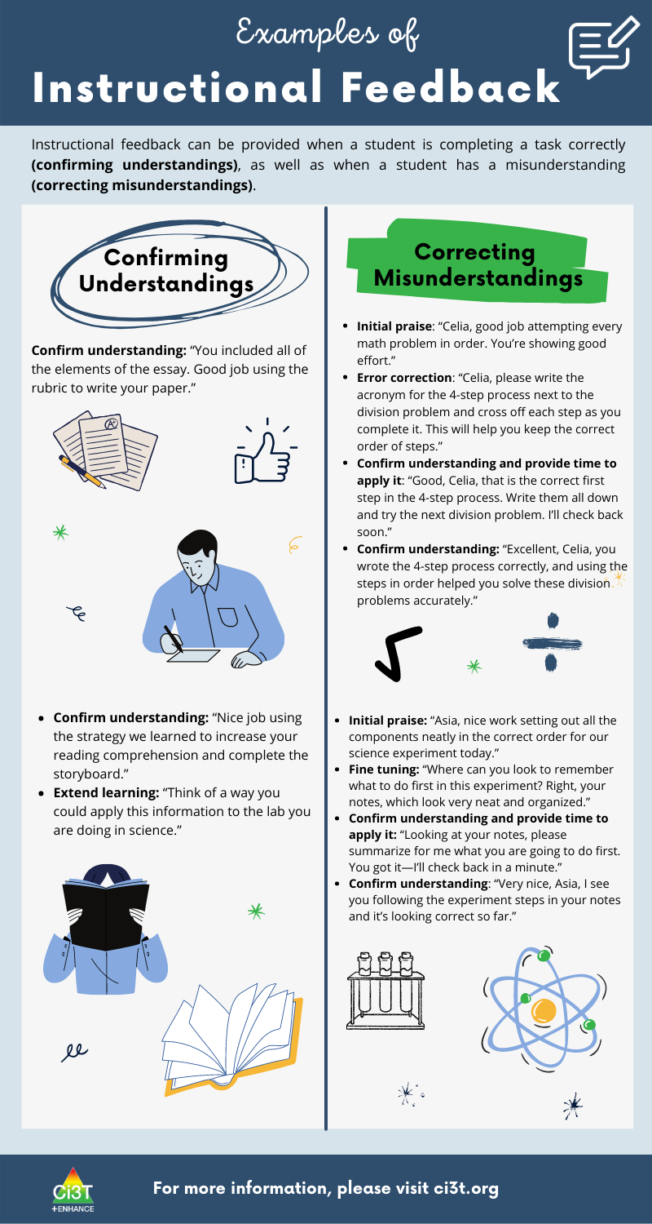
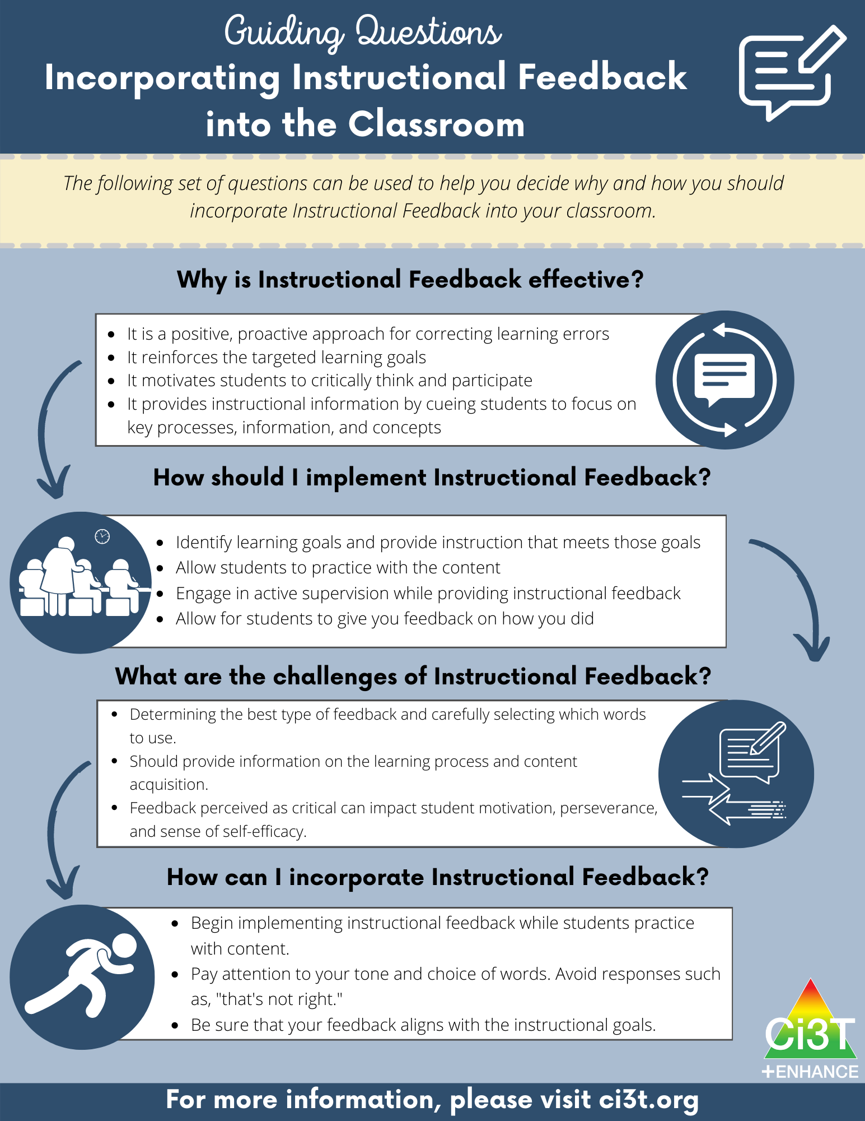
Module Connection!
Instructional Feedback

Slide 20
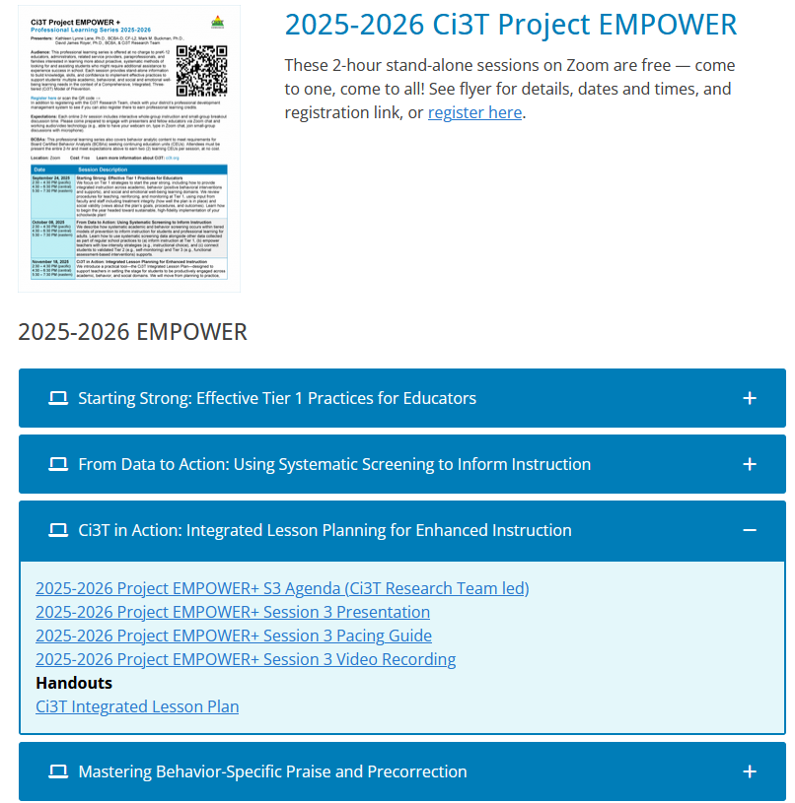
EMPOWER Session 3 Recording

Slide 21









Ci3T Integrated Lesson Plan Work Time
Open an upcoming lesson plan
Write a social skills objective based on:
  social skills students will need to successfully engage in the lesson
  connections to your district’s Tier 1 social skills curriculum
Write a behavioral objective connected to your school-wide expectations
Identify opportunities to integrate low-intensity strategies
Notes:
10-min timer

Slide 22

6-step Instructional Approach for Responding to Challenging Behavior

Slide 23

Comprehensive, Integrated, Three-Tiered Model of Prevention 3
Notes:
6-Step is a Tier 1 approach; can be used in a variety of settings for both categories of major challenging behavior: externalizing & internalizing. Often we think challenging behavior of externalizing

Slide 24
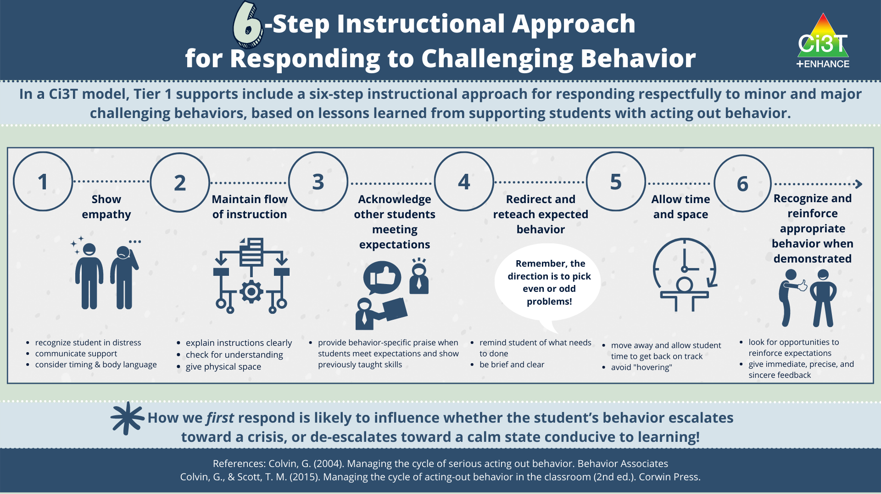
6-Step Instructional Approach for Responding to Challenging Behavior 1
Notes:
Escalation vs de-escalates. We can be proactively plan, but situations do arise that need to be addressed. How adults first respond greatly matters; great infographic. We know teachers that have printed this out and placed in a key location in their room as a reminder

Slide 25

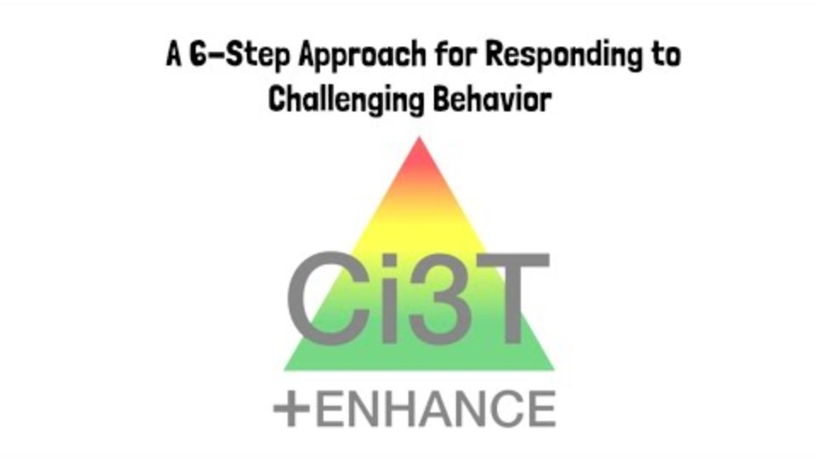
A 6-Step Approach for Responding to Challenging Behavior Video

Slide 26
Let’s Chat: 6-Step Instructional Approach
What components of the six-step instructional approach do you implement most effectively or consistently?
What components of the six-step instructional approach could you strengthen or seek to implement with greater consistency?

Slide 27
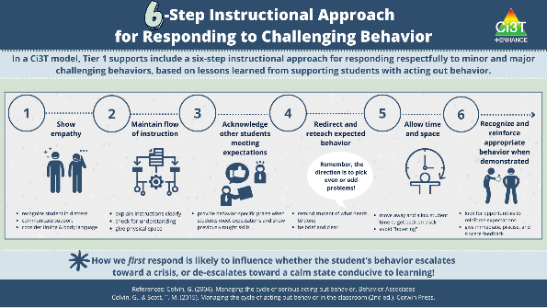
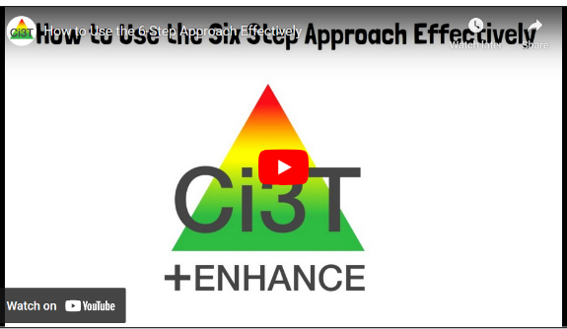



Module Connection!
6-Step Instructional Approach for Responding to Challenging Behavior

Slide 28
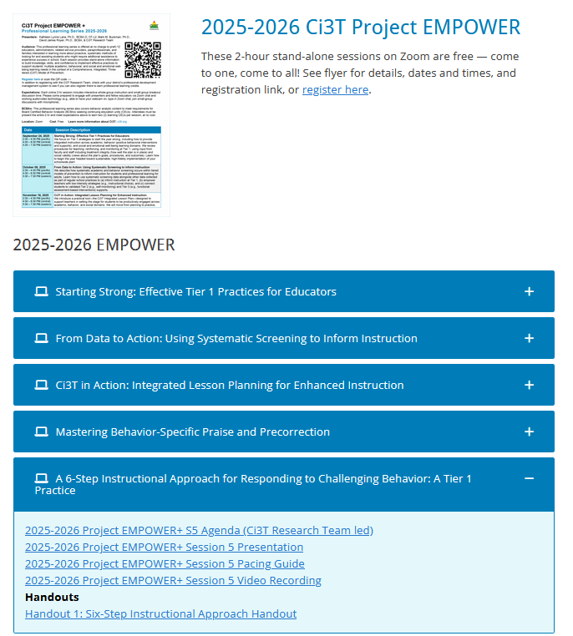
EMPOWER Session 5 Recording

Slide 29
Wrapping Up and Moving Forward

Slide 30
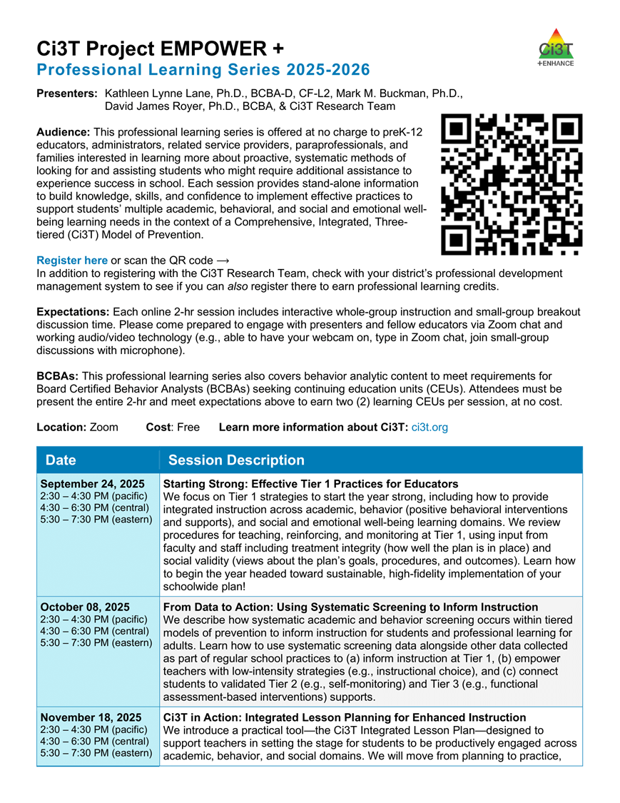
Project EMPOWER+
EMPOWER+ Session | Date
Starting Strong: Effective Tier 1 Practices for Educators | September 24, 2025 (Wednesday)
From Data to Action: Using Systematic Screening to Inform Instruction | October 8, 2025 (Wednesday)
Ci3T In Action: Integrated Lesson Planning for Enhanced Instruction | November 18, 2025 (Tuesday)
Mastering Behavior Specific Praise and Precorrection | January 21, 2026 (Wednesday)
A 6-Step Instructional Approach for Responding to Challenging Behaviors: A Tier 1 Practice | February 10, 2026 (Tuesday)
A Tier 2 Support for Students Experiencing Anxious Feelings: Recognize. Relax. Record. | March 25, 2026 (Wednesday)
A Tier 3 Support for Students with Intensive Intervention Needs: Functional Assessment-Based Intervention (FABI) | April 28, 2026 (Tuesday)

Slide 31
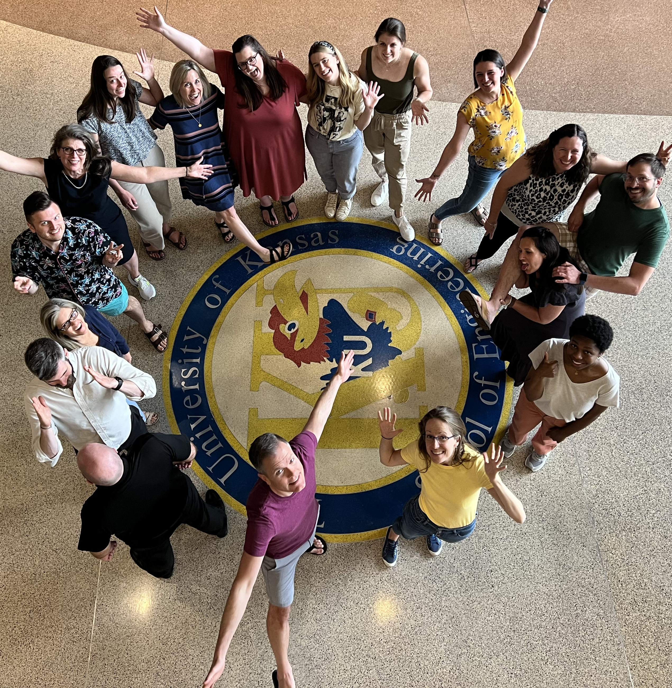

Thank you!
Thank you!
ci3t.org
#Ci3T
@Ci3Tmodel
Tag us in your Ci3T highlights, we love to see Ci3T in action!
Follow us on Instagram for updates and new resources!
Notes:
Tag us in your Ci3T highlights- we would love to see Ci3T in action! Follow us on Instagram for updates and links to resources! @Ci3TModel
You will receive a brief session evaluation – we value your feedback and would greatly appreciate you taking a few minutes to share your thoughts on what you liked about the session and how we can improve

