Slide 1
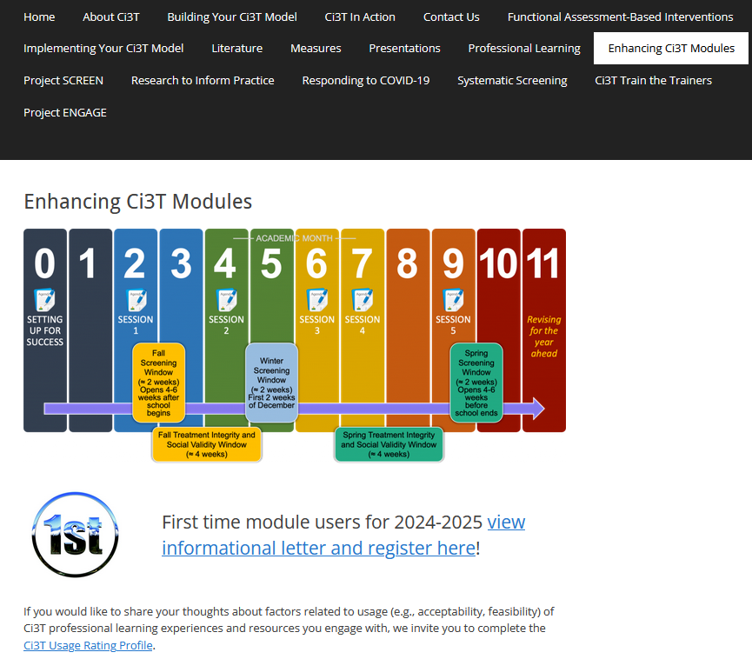
Ci3T Implementers Symposium
Elise Sarasin, M.S.E
Stacie Williams, B.S.
Kathleen Lynne Lane, Ph.D., BCBA-D, CF-L2
Mark Buckman, Ph.D.
If you have not done so already, we invite you to visit ci3t.org/enhance to access modules and complete a one-time registration process!

Slide 3
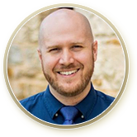
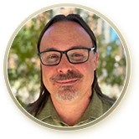
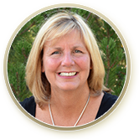
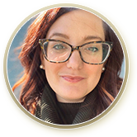
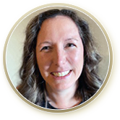
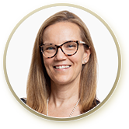
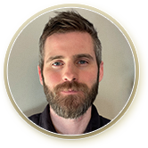
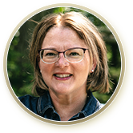
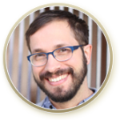
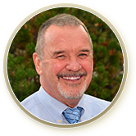
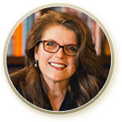
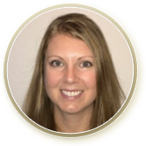
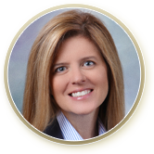
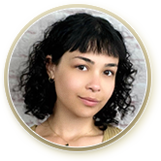
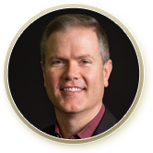
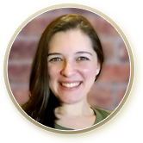
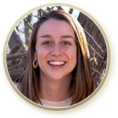
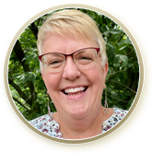
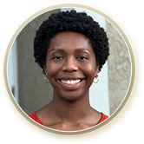
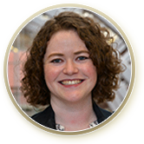
Ci3T Research Team
Grant Allen
Matthew Aschliman
Tammy Becker
Allison Bernard
Carrie Brandon
Amy Briesch
Mark Buckman
Sandy Chafouleas
Eric Common
Howard Diacon
Kathleen Lynne Lane
Jessica Matus
Wendy P. Oakes
Jenna Raad
David Royer
Elise Sarasin
Rebecca Sherod
Joni Weiss
Stacie Williams
Kate Williamson

Slide 4

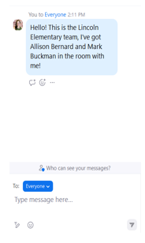
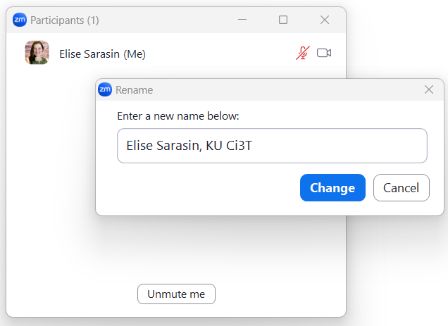

Zoom Logistics
If you are facilitating a Ci3T Leadership Team Symposium session at a satellite location, please email us a list of the names, email addresses, and schools of those attending.
To help us put you in breakout rooms with your colleagues today we are renaming you with your school initials and first and last name
If there are multiple people in the room with you, please list their first and last names and email in the chat!

Slide 5


Enhancing Ci3T Modules
ci3t.org/enhance

Slide 6
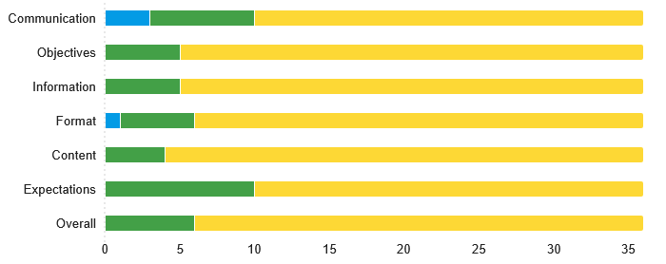

2024 Implementers Symposium Feedback

Slide 7
2024 Implementers Symposium Feedback
Thank you for the specific and constructive comments! Some trends we noticed based on comments:
Appreciation for extended work time with team
Appreciation for coaching support during breakout rooms
Desire for additional guidance in how to find materials on website and within modules
Howard Diacon

Slide 8
Session Outcomes
Finalize Ci3T Leadership Team membership for the 2025-2026 academic year
Create and calendar out implementation plans for the 2025-2026 academic year
Use needs of faculty, staff, and students – as identified in social validity, treatment integrity, and spring screening data – to inform professional learning for faculty and staff, use of effective practices to support students (e.g., low-intensity strategies, Tier 2 and 3 interventions), and updates to your school’s Ci3T Implementation Manual.
Prepare to share key Ci3T information with faculty, staff, students and families at the beginning of the 2025-2026 school year

Slide 9
Agenda
Welcome
Planning for your 2025-2026 Ci3T Journey
Ci3T Leadership Team Work Time
Break (45 mins)
Setting Up for the Year Ahead
Ci3T Leadership Team Work Time
Wrapping Up and Moving Forward

Slide 10
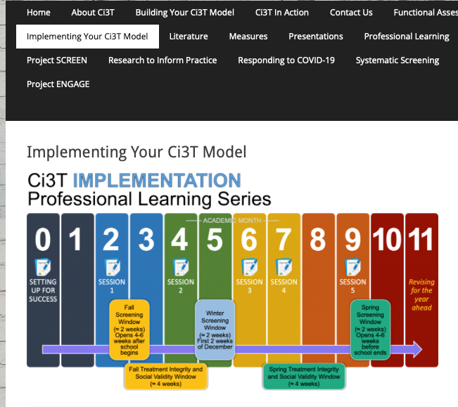
Accessing Professional Learning Materials
ci3t.org/imp

Slide 11
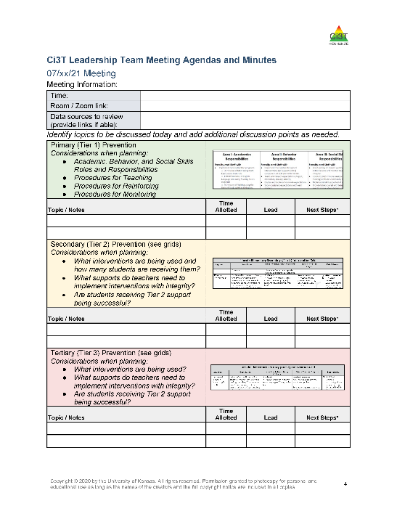

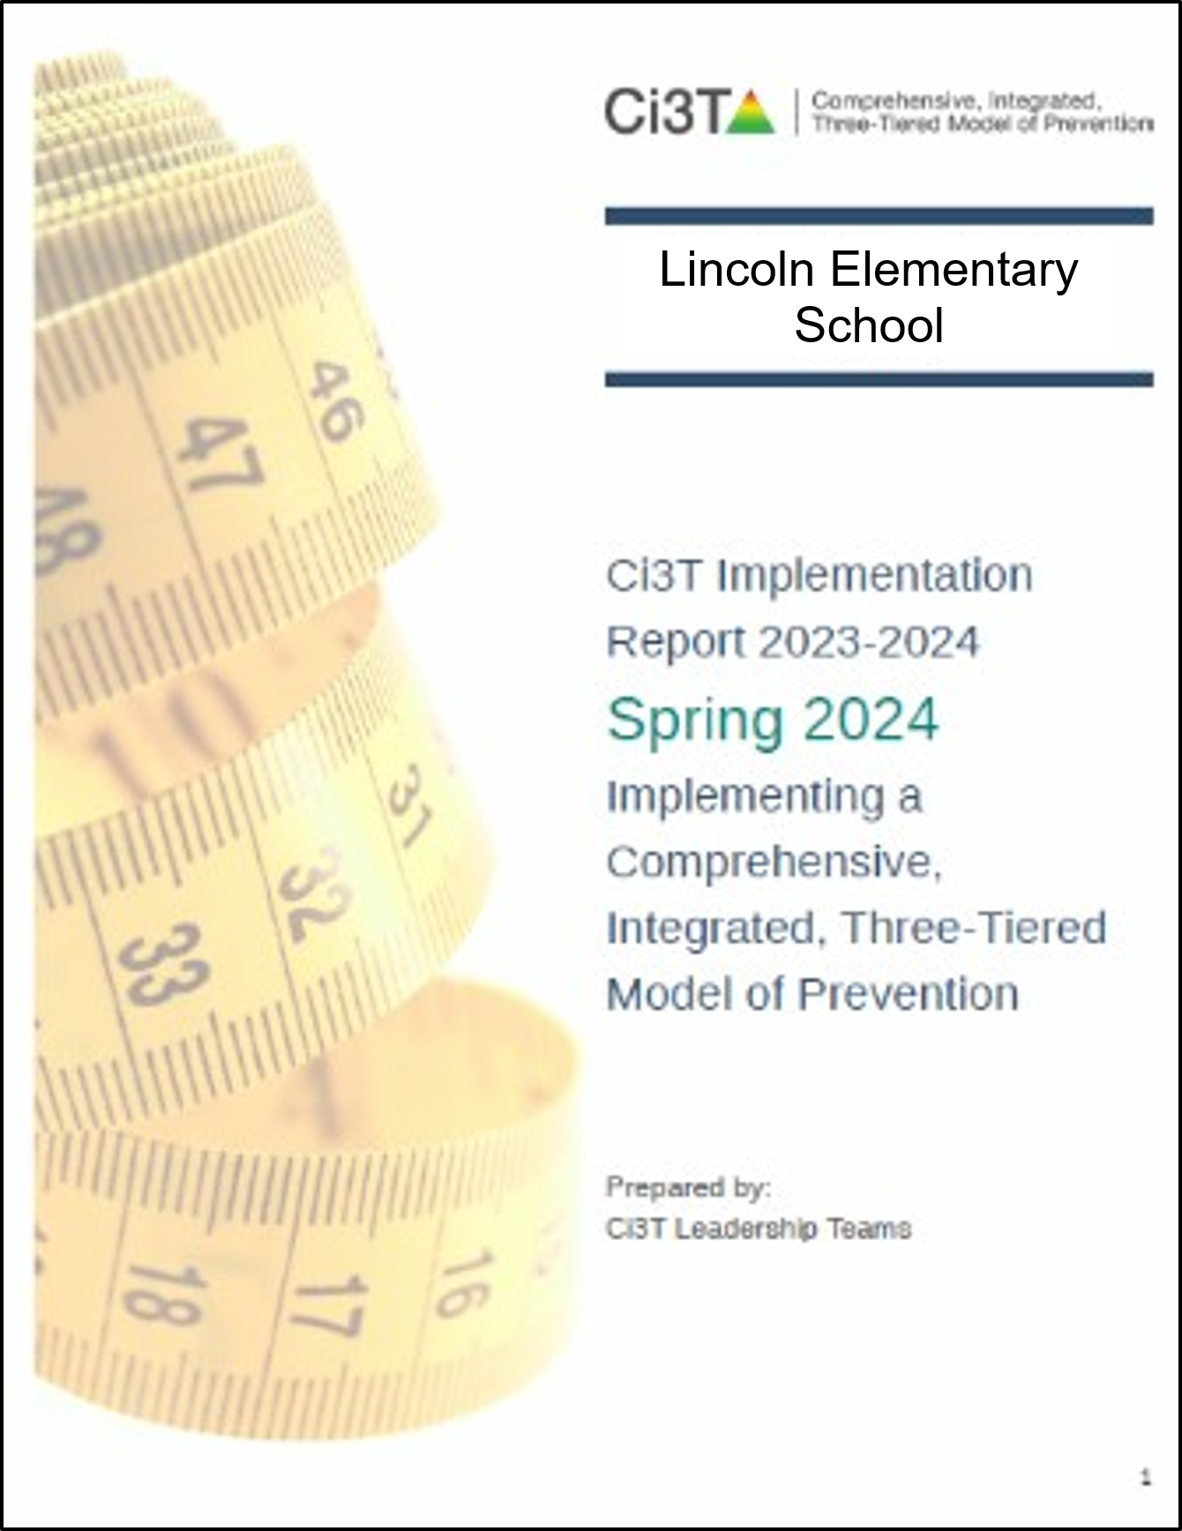
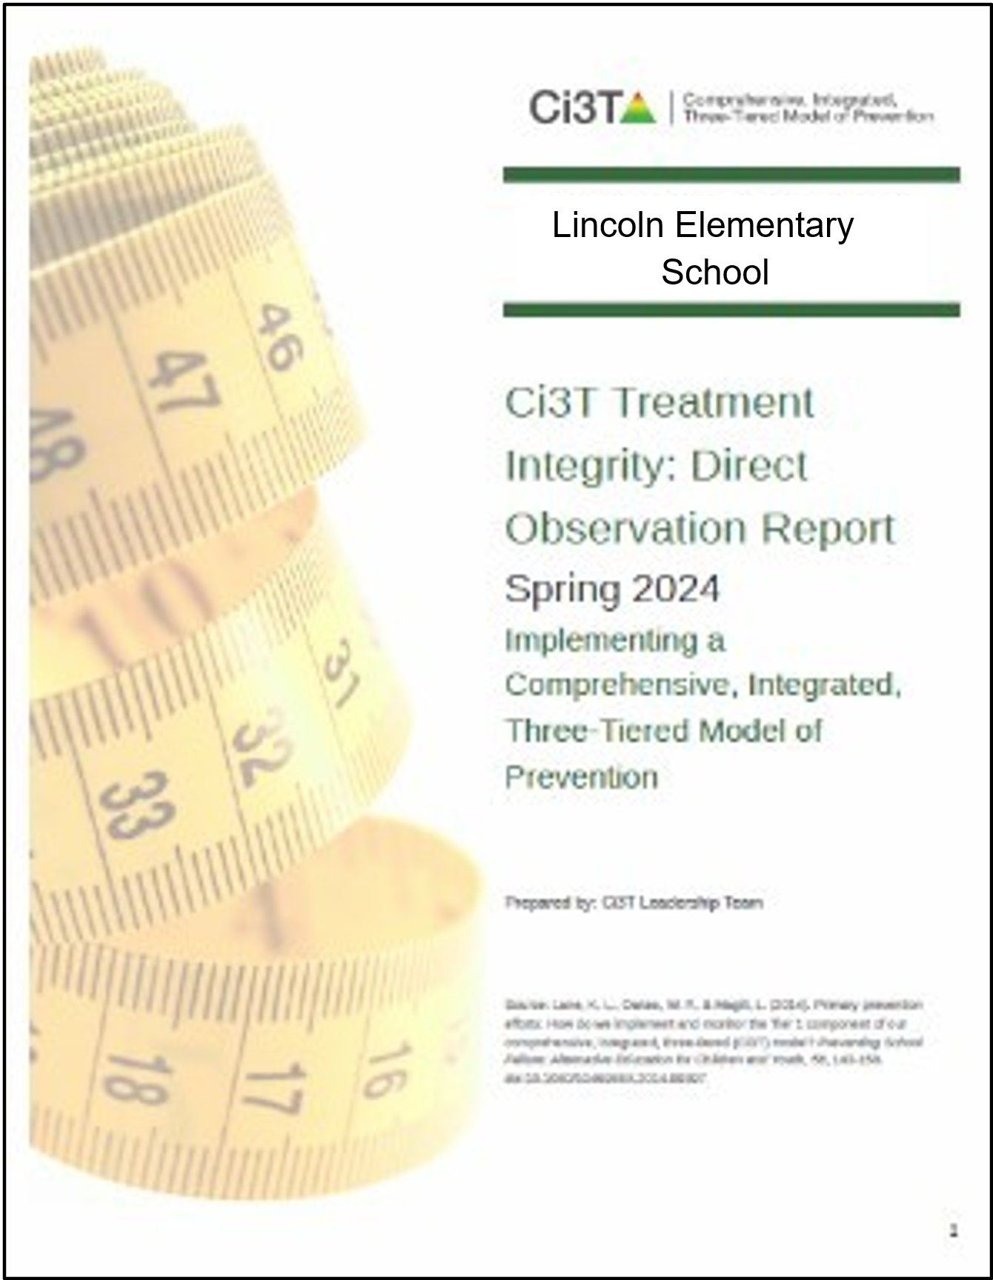
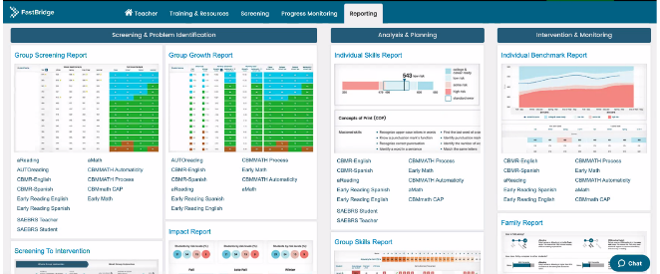

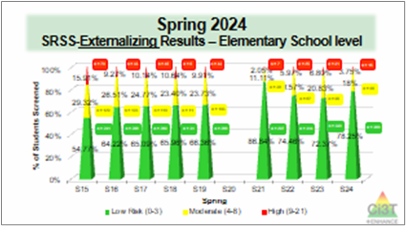
Materials for Today’s Session
Ci3T Leadership Team Agenda
Ci3T Implementation Manual
Spring Social Validity and Treatment Integrity Data
Spring Screening Data

Slide 12

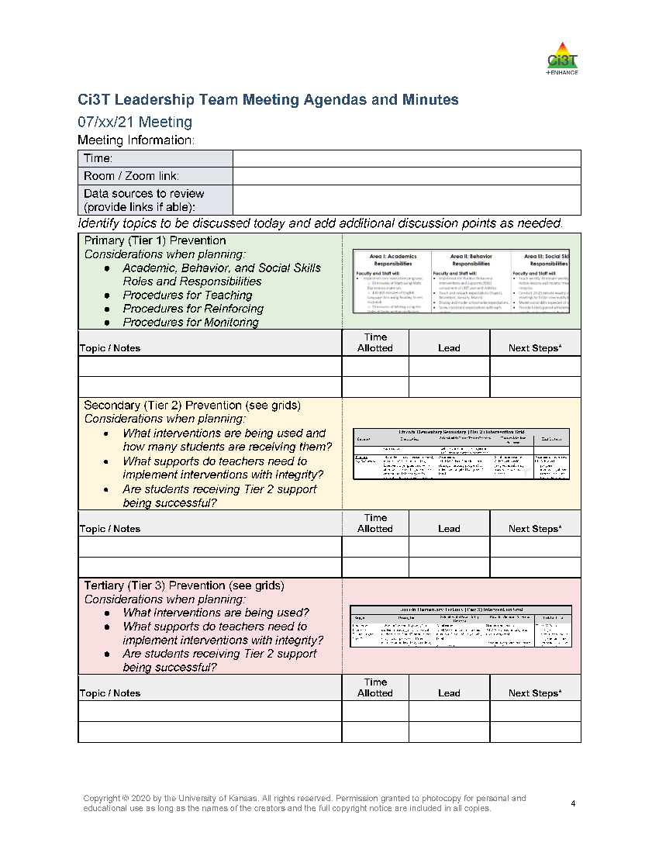
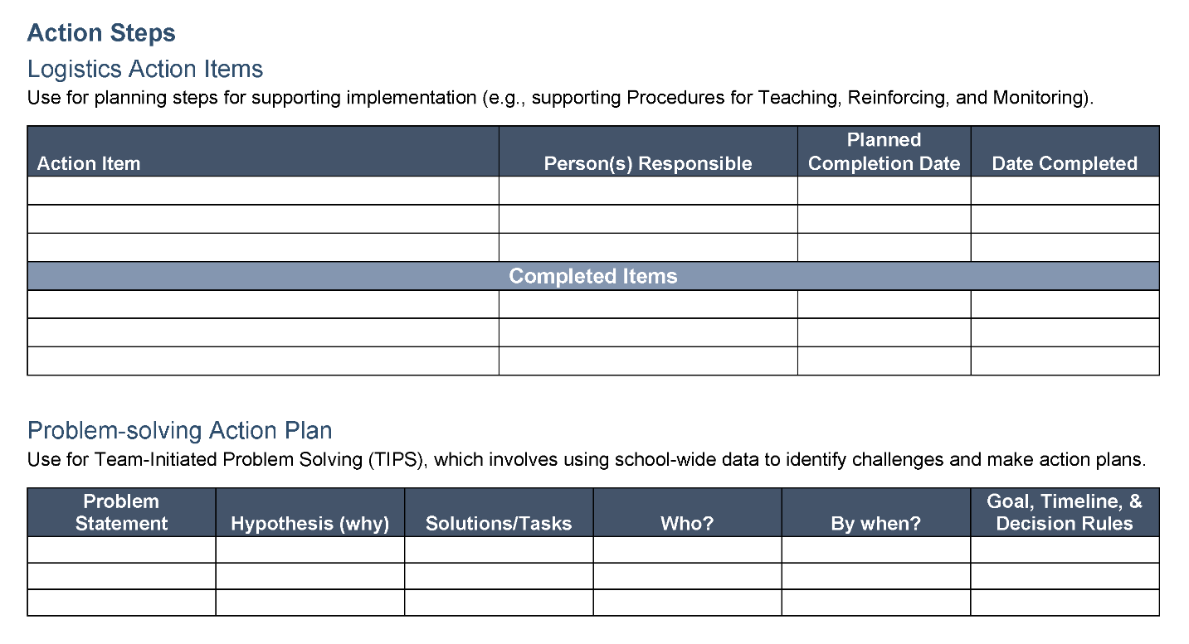
Ci3T Leadership Team Agenda Template

Slide 13
Enhancing Ci3T Modules

Slide 14
Enhancing Ci3T Modules
ci3t.org/enhance

Slide 15
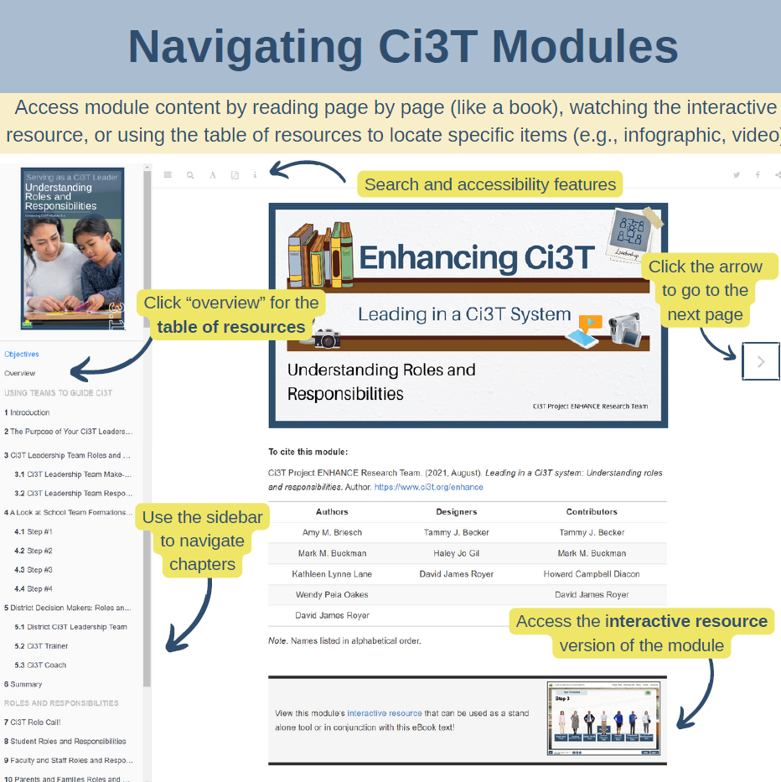
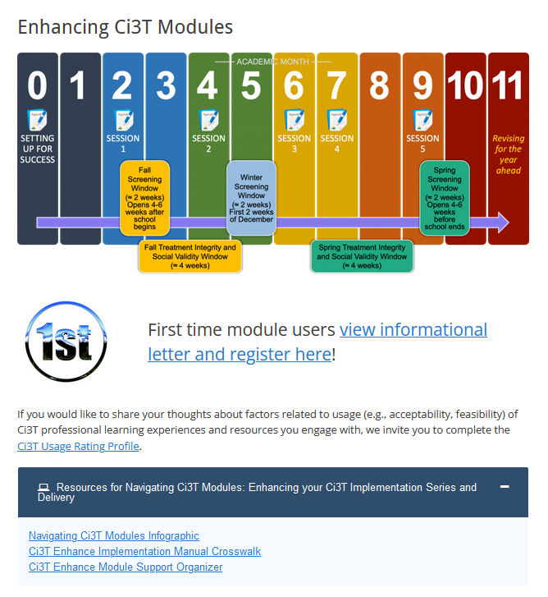
Navigating Ci3T Modules Infographic

Slide 16
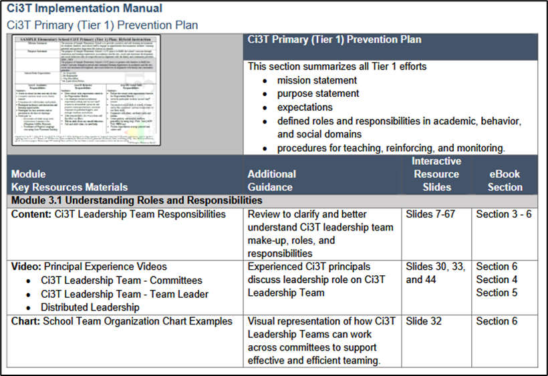
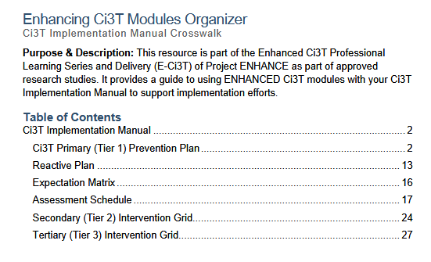
Implementation Manual Crosswalk

Slide 17
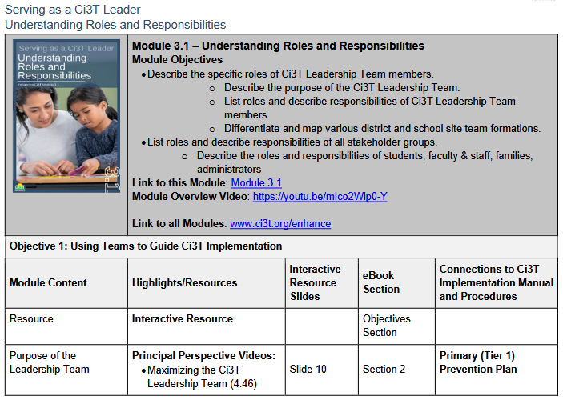
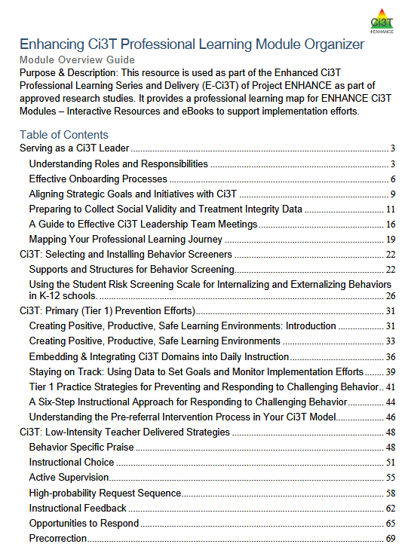
Module Support Organizer

Slide 18
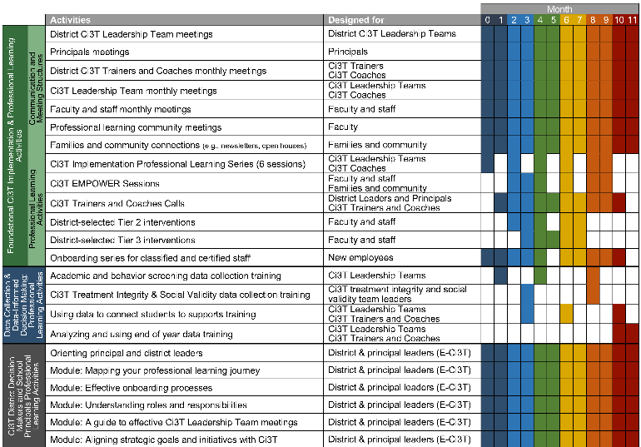
Planning for your 2025-2026 Ci3T Journey
Ci3T Leadership Team Meetings
Faculty & Staff Meetings
Data Collection
Professional Learning

Slide 19
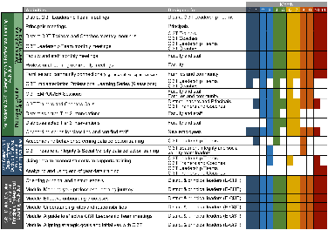
Session Outcomes
Finalize Ci3T Leadership Team membership for the 2025-2026 academic year
Create and calendar out implementation plans for the 2025-2026 academic year
Use needs of faculty, staff, and students – as identified in social validity, treatment integrity, and spring screening data – to inform professional learning for faculty and staff, use of effective practices to support students (e.g., low-intensity strategies, Tier 2 and 3 interventions), and updates to your school’s Ci3T Implementation Manual.
Prepare to share key Ci3T information with faculty, staff, students and families at the beginning of the 2025-2026 school year

Slide 20

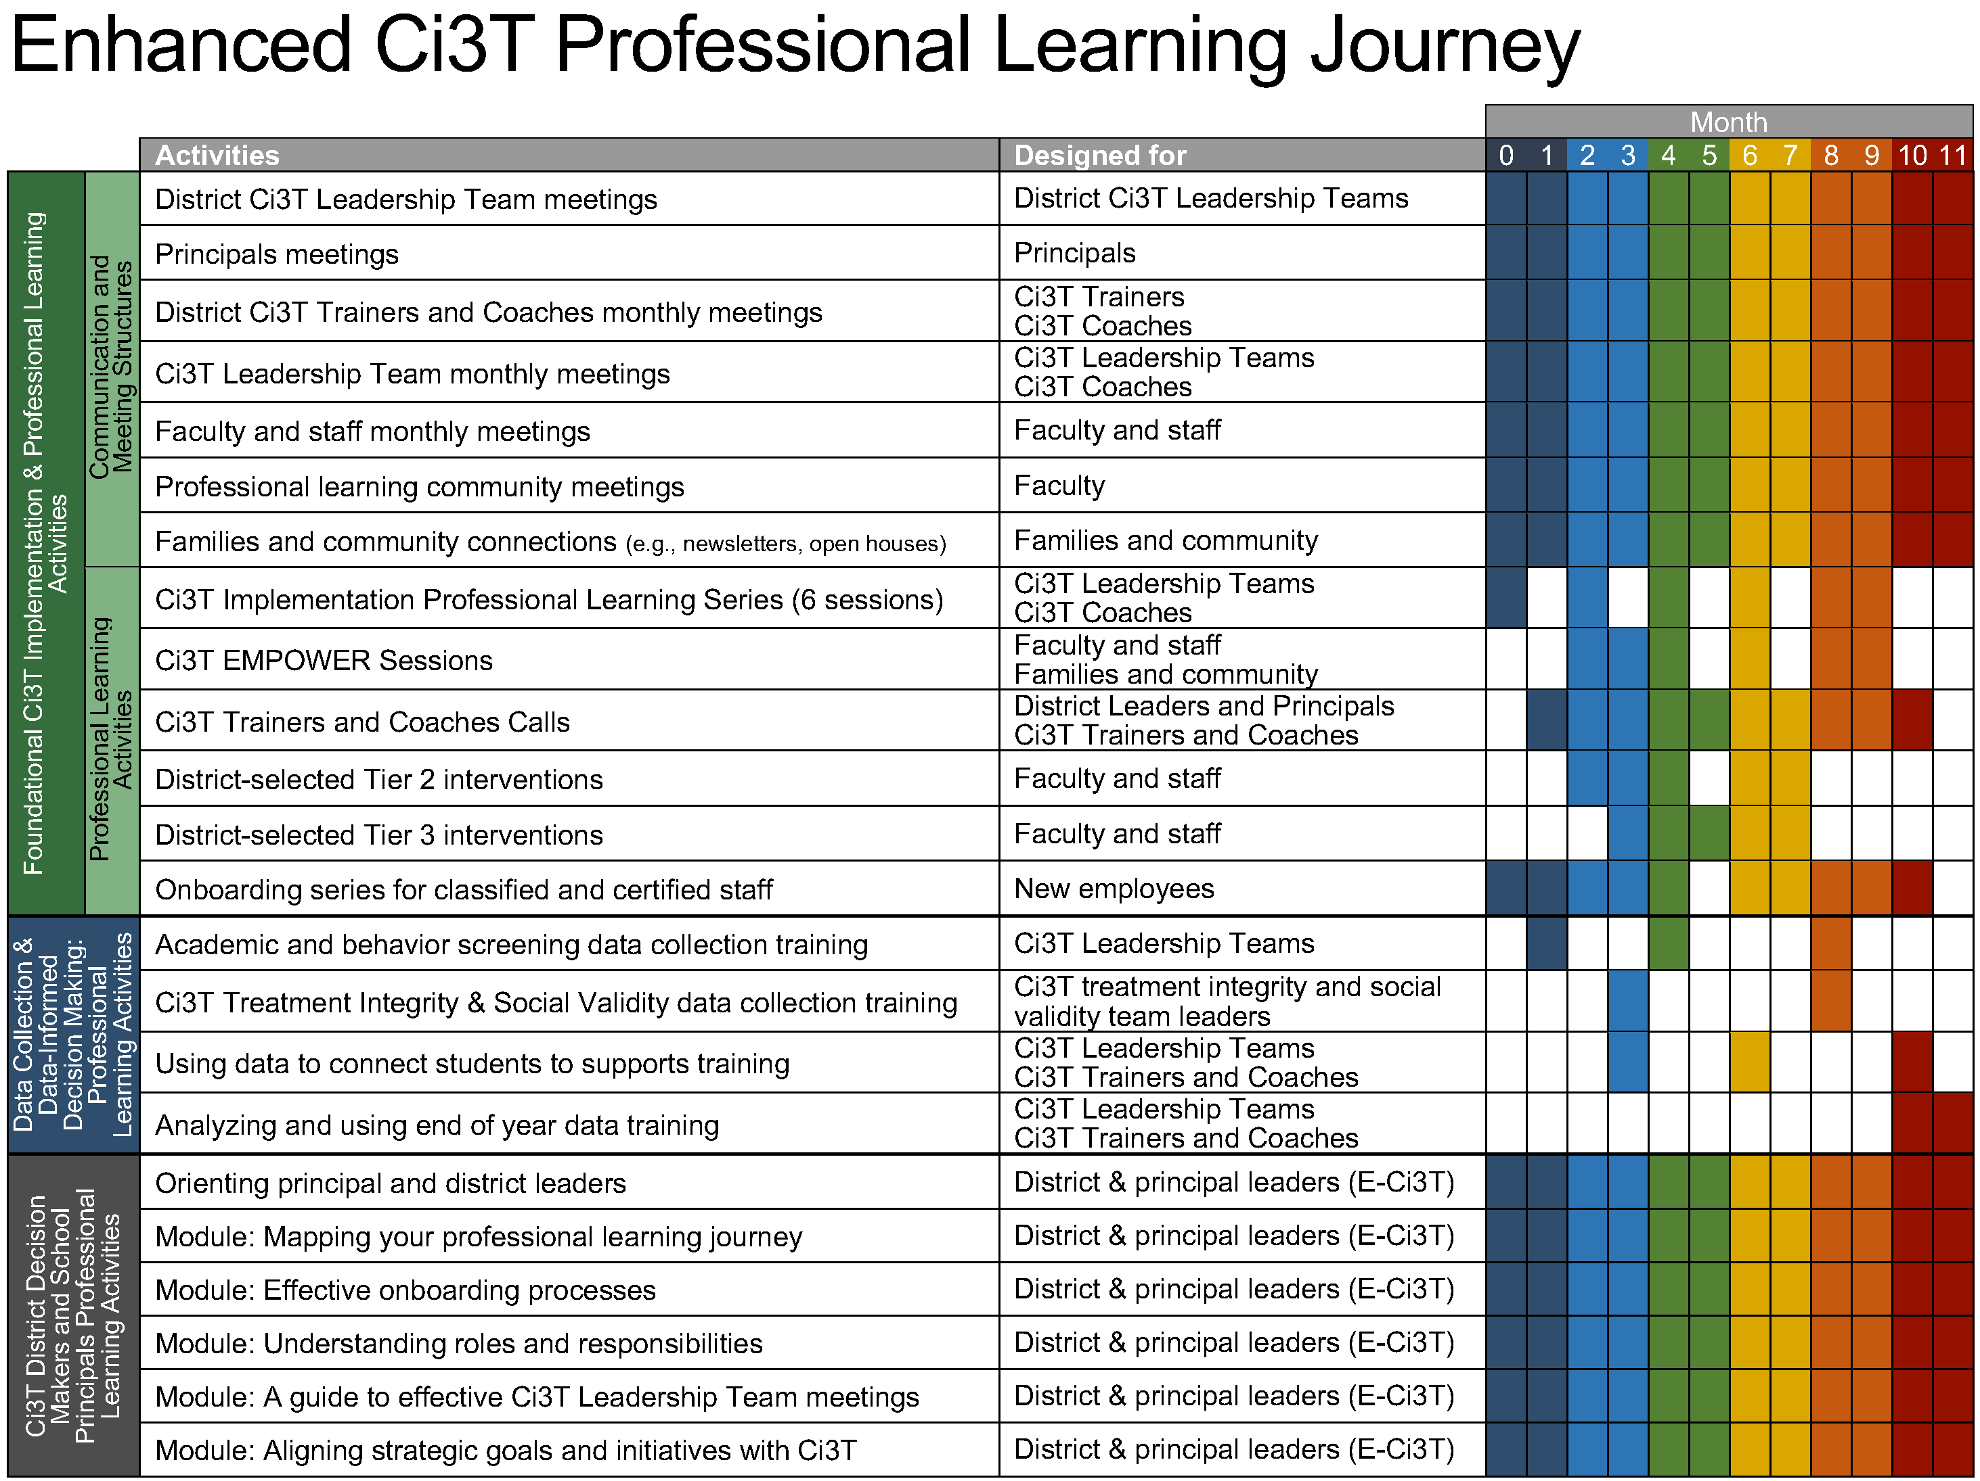
Ci3T Professional Learning Journey

Slide 21

Preparing to Build Your Calendar
You will need:
District Calendar (e.g., parent teacher conferences, breaks)
Assessment schedule
  Academic and Behavior Screening Windows
  Social Validity & Treatment Integrity Windows
Dates for Professional Learning Opportunities
  Ci3T Professional Learning opportunities (e.g., EMPOWER sessions)
  District Professional Development Schedule (e.g., faculty meeting 1st Tuesday of the month, weekly PLCs)

Slide 22
Step 1: Schedule Ci3T Leadership Team Meetings & Faculty and Meetings

Slide 23
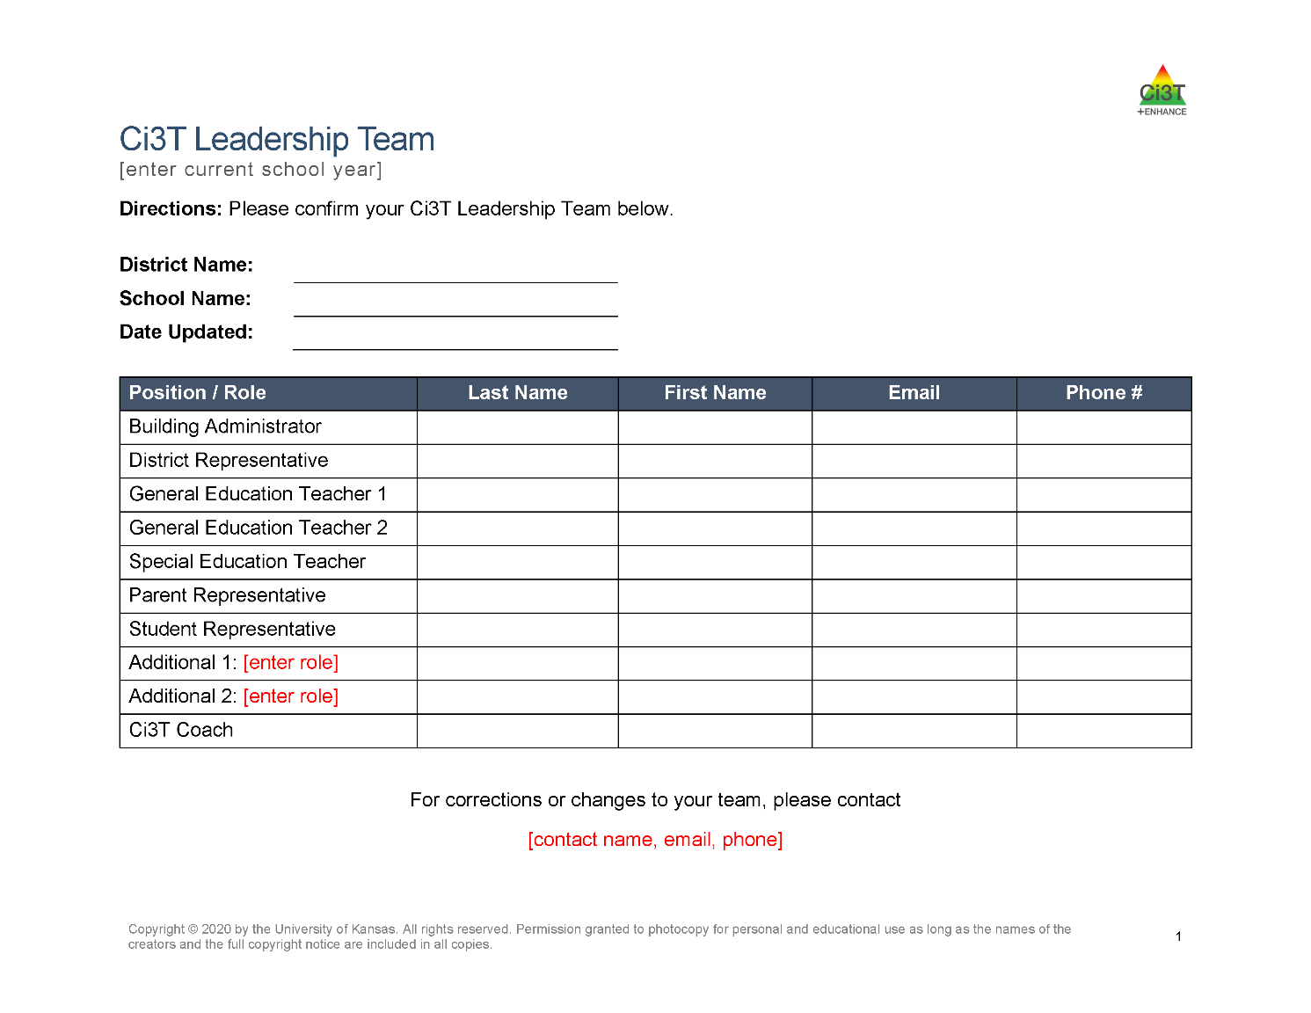

Confirm Ci3T Leadership Team Members

Slide 24
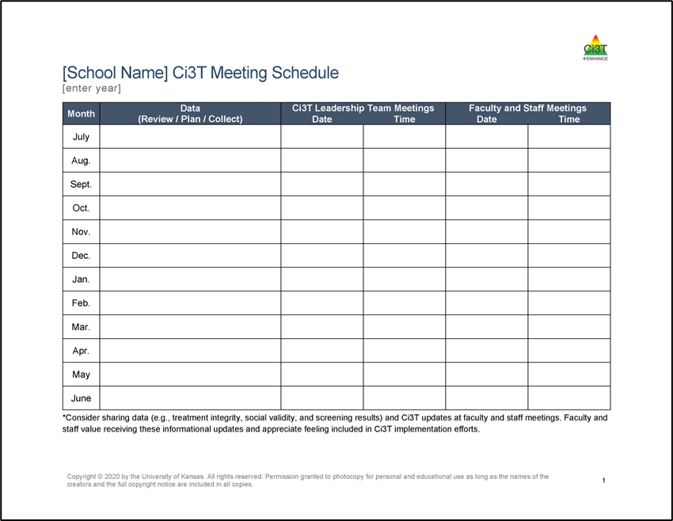
Schedule Ci3T Leadership Team Meetings & Faculty and Meetings
Ci3T Implementation Sessions
Ci3T Leadership Team Meeting
Faculty & Staff Meeting
Notes:
3 steps or phases to planning out your calendar. The first is scheduling your monthly Ci3T Leadership Team meetings and faculty and staff meetings.
Might consider stacking these monthly meetings:
There are 5 Ci3T Implementation Sessions throughout the year either led by our research team or your district. Often, teams find it helpful to schedule their Ci3T Leadership Team meetings for after those sessions. Implementation sessions are a great place to start conversations – look at data, start making plans. Helpful to have time set aside to continue to conversation.
The other piece to consider, is scheduling monthly Ci3T Leadership Teams before faculty and staff. For example, if you know your faculty and staff always meets the 3rd Wednesday of the month, maybe you hold the first Wednesday for Ci3T Leadership Team, that way you’re always working ahead

Slide 25
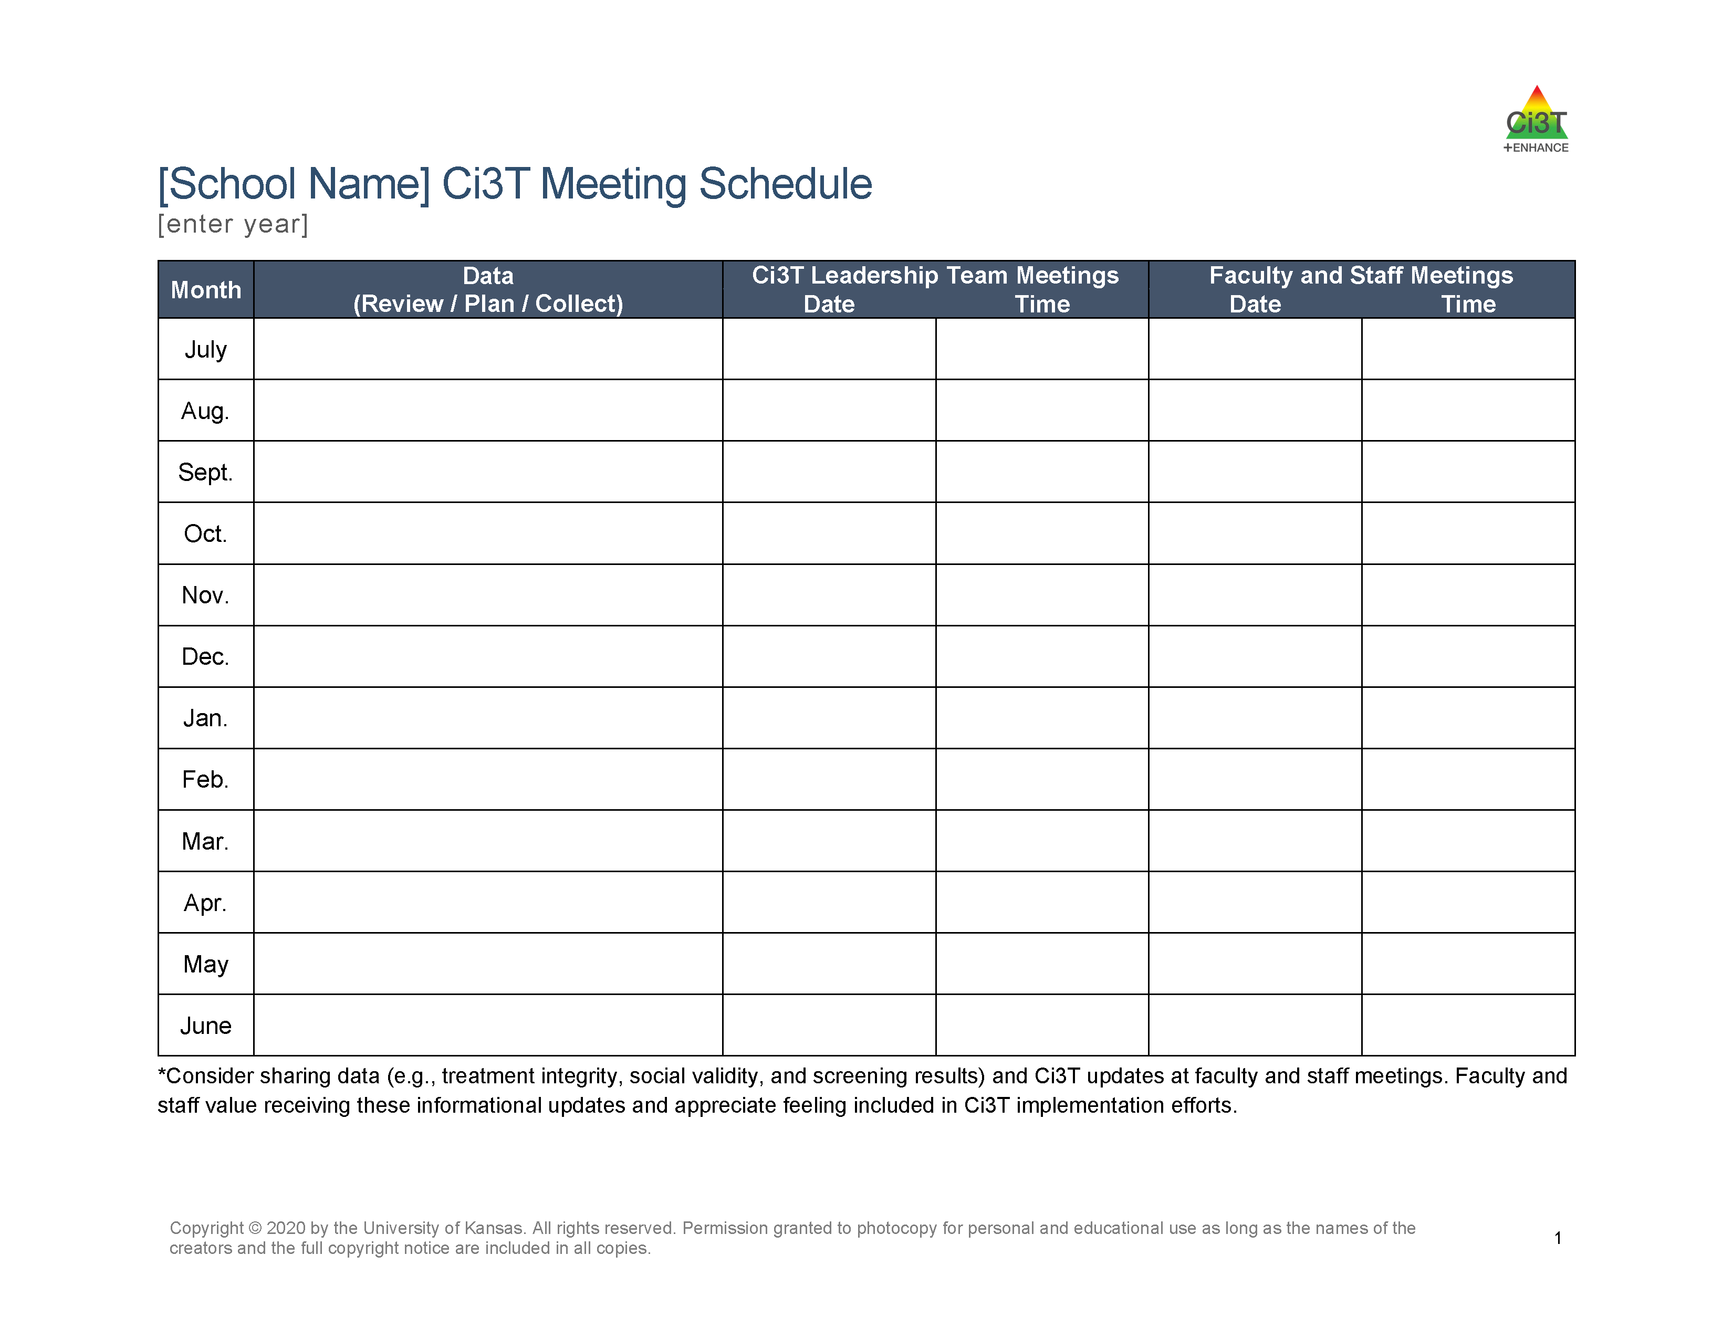

An Illustration
Ci3T Implementation Manual revisions
7 / 8 / 25
8 / 5 / 25
9 / 9 / 25
10 / 7 / 25
11 / 11 / 25
12 / 9 / 25
1 / 13 / 26
2 / 10 / 26
3 / 10 / 26
4/ 14 / 26
5 / 12 / 26
6 / 9 / 26
3:00 – 4:00 pm
3:00 – 4:00 pm
3:00 – 4:00 pm
3:00 – 4:00 pm
3:00 – 4:00 pm
3:00 – 4:00 pm
3:00 – 4:00 pm
3:00 – 4:00 pm
3:00 – 4:00 pm
3:00 – 4:00 pm
3:00 – 4:00 pm
3:00 – 4:00 pm
7 / 15 / 25
8 / 12 / 25
9 / 16 / 25
10 / 14 / 25
11 / 18 / 25
12 / 16 / 25
1 / 20 / 26
2 / 17 / 26
3 / 17 / 26
4/ 21 / 26
5 / 19 / 26
6 / 16 / 26
3:00 – 4:00 pm
3:00 – 4:00 pm
3:00 – 4:00 pm
3:00 – 4:00 pm
3:00 – 4:00 pm
3:00 – 4:00 pm
3:00 – 4:00 pm
3:00 – 4:00 pm
3:00 – 4:00 pm
3:00 – 4:00 pm
3:00 – 4:00 pm
3:00 – 4:00 pm
Plans to collect academic and behavior screening data
Review ODR reports (disaggregated by grade, location, race/ethnicity, behavior type)
Review SRSS-IE and academics screening data; plan for staff to complete TI/SV surveys
Complete TFI
Review TI/SV, review ODR and attendance
Plan Spring TI/SV data collection; review Winter screening data
Review ODR and attendance, plan for staff to complete TI/SV surveys
Complete TFI
Review Spring TI/SV
Review Spring screening data

Slide 26
Step 2: Schedule Professional Learning Opportunities
Notes:
The next step is to think about the professional learning opportunities that are available. This includes opportunities for your own professional learning as a Ci3T LT member in addition to the professional learning you will offer to faculty and staff.

Slide 27
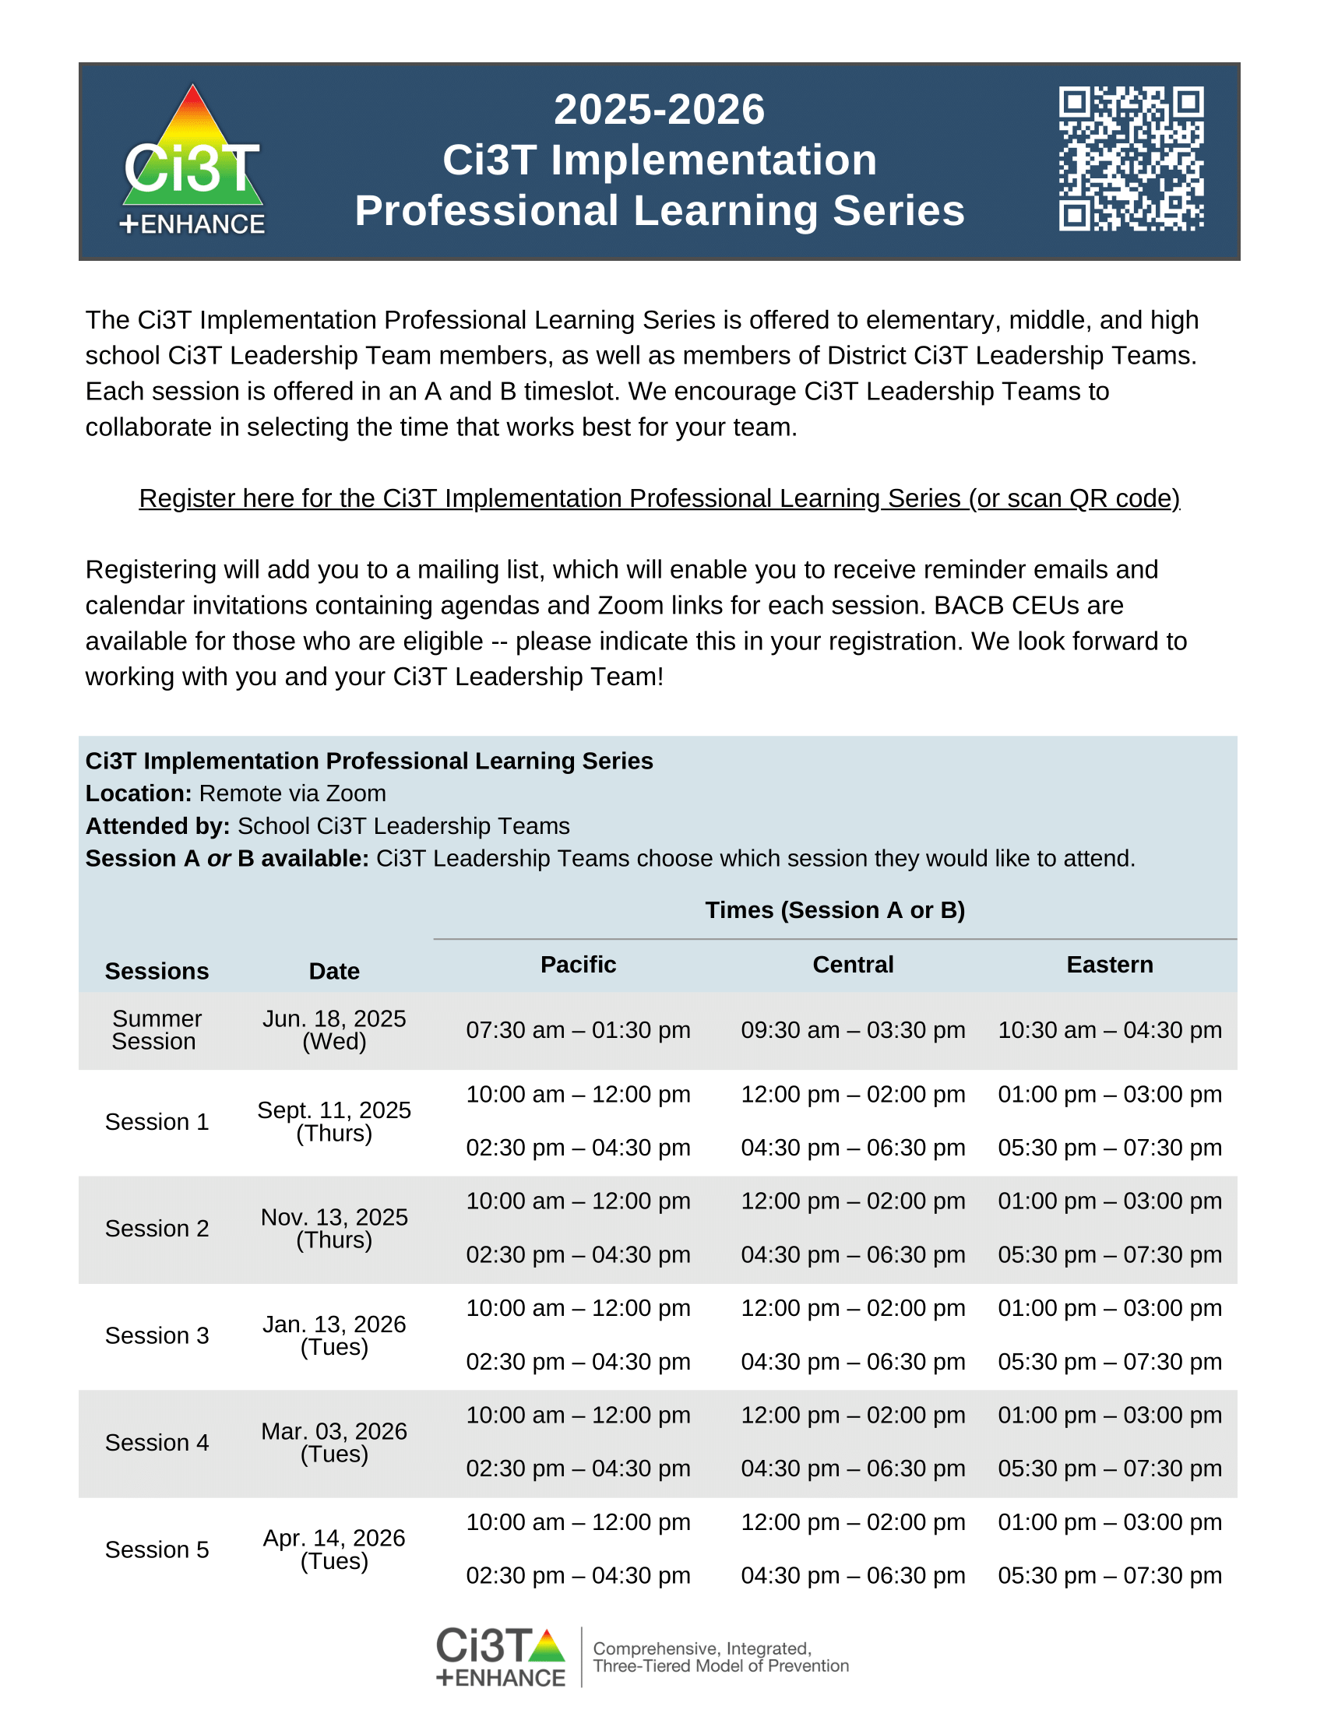
Ci3T Implementation Professional Learning Series
Ci3T Implementation Professional Learning Series Location: Remote via Zoom Attended by: Ci3T Leadership Teams Sessions A and B are available. Ci3T Leadership Teams select which one they would like to attend.
Session | Date | Times (Session A and B)
 |  | Pacific | Central | Eastern
Summer Session | June 18, 2025 (Wed) | 7:30 am – 1:30 pm | 9:30 am – 3:30 pm | 10:30 am – 4:30 pm
Session 1 | Sept.11, 2025 (Thurs) | 10:00 am – 12:00 pm | 12:00 pm – 2:00 pm | 1:00 pm – 3:00 pm
 |  | 2:30 pm – 4:30 pm | 4:30 pm – 6:30 pm | 5:30 pm – 7:30 pm
Session 2 | Nov. 13, 2025 (Thurs) | 10:00 am – 12:00 pm | 12:00 pm – 2:00 pm | 1:00 pm – 3:00 pm
 |  | 2:30 pm – 4:30 pm | 4:30 pm – 6:30 pm | 5:30 pm – 7:30 pm
Session 3 | Jan. 13, 2026 (Tues) | 10:00 am – 12:00 pm | 12:00 pm – 2:00 pm | 1:00 pm – 3:00 pm
 |  | 2:30 pm – 4:30 pm | 4:30 pm – 6:30 pm | 5:30 pm – 7:30 pm
Session 4 | Mar. 03, 2026 (Tues) | 10:00 am – 12:00 pm | 12:00 pm – 2:00 pm | 1:00 pm – 3:00 pm
 |  | 2:30 pm – 4:30 pm | 4:30 pm – 6:30 pm | 5:30 pm – 7:30 pm
Session 5 | Apr. 14, 2026 (Tues) | 10:00 am – 12:00 pm | 12:00 pm – 2:00 pm | 1:00 pm – 3:00 pm
 |  | 2:30 pm – 4:30 pm | 4:30 pm – 6:30 pm | 5:30 pm – 7:30 pm

Slide 28
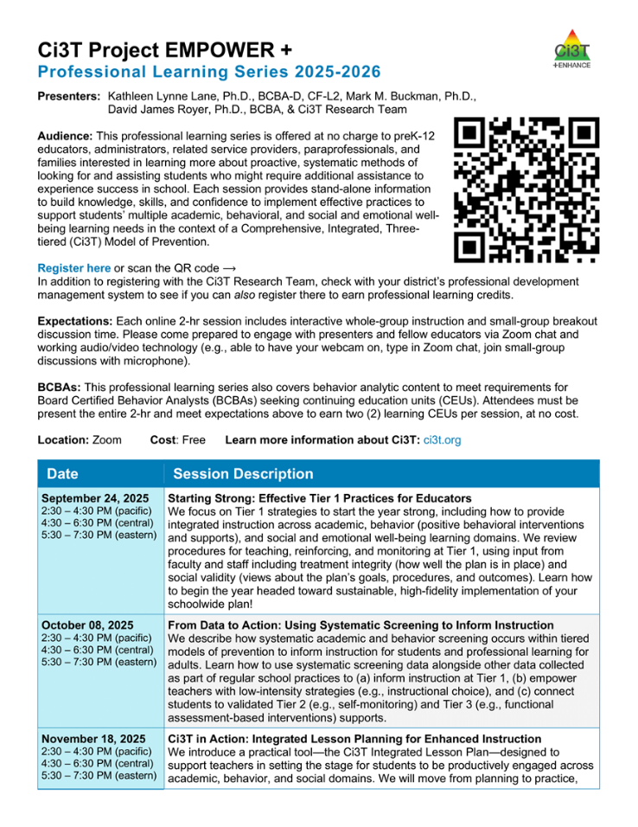
Project EMPOWER+
Ci3T Project EMPOWER Location: Remote via Zoom Attended by: Ci3T Leadership Teams, Ci3T Trainers and Coaches, Faculty and Staff, Families (adults only), Community Members
Session | Date | Times
Starting Strong: Effective Tier 1 Practices for Educators | Sep. 24, 2025 (Wed) | 2:30 - 4:30 p.m. (Pacific) 4:30 - 6:30 p.m. (Central) 5:30 - 7:30 p.m. (Eastern)
From Data to Action: Using Systematic Screening to Inform Instruction | Oct. 8, 2025 (Wed) | 2:30 - 4:30 p.m. (Pacific) 4:30 - 6:30 p.m. (Central) 5:30 - 7:30 p.m. (Eastern)
Ci3T In Action: Integrated Lesson Planning for Enhanced Instruction | Nov. 18, 2025 (Tues) | 2:30 - 4:30 p.m. (Pacific) 4:30 - 6:30 p.m. (Central) 5:30 - 7:30 p.m. (Eastern)
Mastering Behavior Specific Praise and Precorrection | Jan. 21, 2026 (Wed) | 2:30 - 4:30 p.m. (Pacific) 4:30 - 6:30 p.m. (Central) 5:30 - 7:30 p.m. (Eastern)
A 6-Step Instructional Approach for Responding to Challenging Behaviors: A Tier 1 Practice | Feb. 10, 2026 (Tues) | 2:30 - 4:30 p.m. (Pacific) 4:30 - 6:30 p.m. (Central) 5:30 - 7:30 p.m. (Eastern)
A Tier 2 Support for Students Experiencing Anxious Feelings: Recognize. Relax. Record. | Mar. 25, 2026 (Wed) | 2:30 - 4:30 p.m. (Pacific) 4:30 - 6:30 p.m. (Central) 5:30 - 7:30 p.m. (Eastern)
A Tier 3 Support for Students with Intensive Intervention Needs: Functional Assessment-Based Intervention (FABI) | Apr. 28, 2026 (Tues) | 2:30 - 4:30 p.m. (Pacific) 4:30 - 6:30 p.m. (Central) 5:30 - 7:30 p.m. (Eastern)

Slide 29
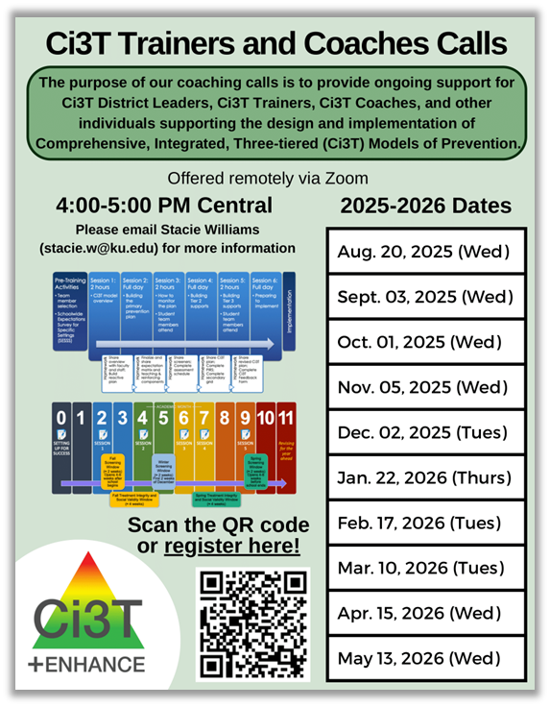
Ci3T Trainers and Coaches Calls
Ci3T Trainers and Coaches Calls Location: Remote via Zoom Attended by: Ci3T Leadership Teams, Ci3T Trainers and Coaches, Faculty and Staff, Families (adults only), Community Members
Session | Date | Times (Central)
Ci3T Trainers and Coaches Call 1 | Aug. 20, 2025 (Wed) | 4:00 – 5:00 p.m.
Ci3T Trainers and Coaches Call 2 | Sept. 03, 2025 (Wed) | 4:00 – 5:00 p.m.
Ci3T Trainers and Coaches Call 3 | Oct. 01, 2025 (Wed) | 4:00 – 5:00 p.m.
Ci3T Trainers and Coaches Call 4 | Nov. 05, 2025 (Wed) | 4:00 – 5:00 p.m.
Ci3T Trainers and Coaches Call 5 | Dec. 02, 2025 (Tues) | 4:00 – 5:00 p.m.
Ci3T Trainers and Coaches Call 6 | Jan. 22, 2026 (Thurs) | 4:00 – 5:00 p.m.
Ci3T Trainers and Coaches Call 7 | Feb. 17, 2026 (Tues) | 4:00 – 5:00 p.m.
Ci3T Trainers and Coaches Call 8 | Mar. 10, 2026 (Tues) | 4:00 – 5:00 p.m.
Ci3T Trainers and Coaches Call 9 | Apr. 15, 2026 (Wed) | 4:00 – 5:00 p.m.
Ci3T Trainers and Coaches Call 10 | May 13, 2026 (Wed) | 4:00 – 5:00 p.m.

Slide 30
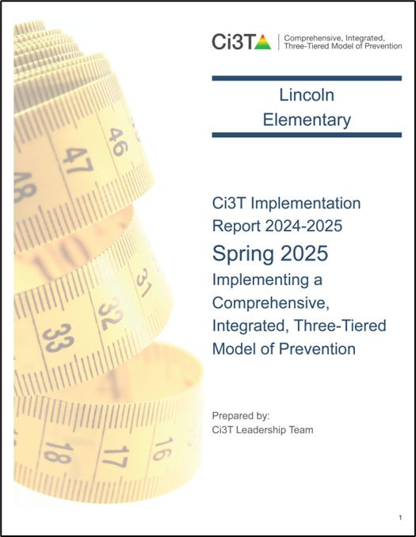
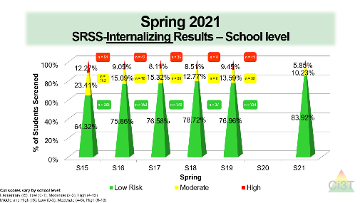

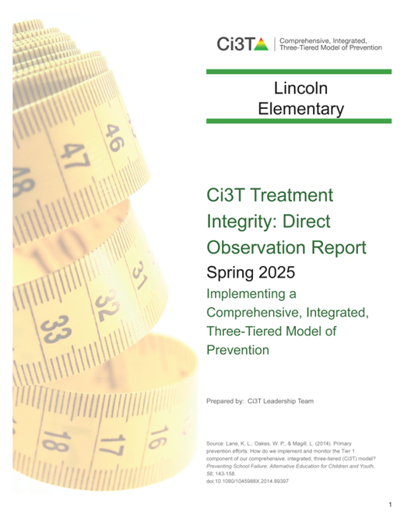



Responding to Spring Data
What professional learning is necessary to respond to screening, treatment integrity, and social validity data?
Notes:
As you’re thinking about professional learning opportunities, you might also consider your Spring academic and behavior screening and treatment integrity and social validity.
We’re going to walk through a few examples of what that might look like.

Slide 31






Stand Alone Professional Learning
Notes:
For example, based on Spring Treatment Integrity data, you might decide to set a goal around Behavior Specific Praise. Then, you might schedule a stand-alone PD during faculty and staff meeting or teacher workday.
During this time, you could leverage module materials such as: an editable PowerPoint, video, infographics, or this built in general praise versus BSP activity.

Slide 32







Professional Learning Series – Book Club
Notes:
As another example, you might look at your data and notice there’s an opportunity to focus on low intensity strategies and decide to leverage a more collaborative professional learning structure such as PLC or opt-in book club.
If you decide to do a book club, many of your districts have at least a few copies of these so you could preview them. These books are very practical, educator friendly. Here’s the strategy, here’s why it works, here’s how you do it. You could spread this out over the semester or entire year – read a chapter, give people time to try it, create space to come back together to share success and problem solve.
Another option, if you’re interested in this structure but want something a little shorter, could be an article club. We are very excited about this recent release of free open-access articles about low-intensity strategies written by some of the wonderful people on our team. These articles are less than 10 pages and were written for families and educators who want to learn about the strategy and how to implement it. This could let you leverage a book club style but with something shorter.
Finally, you could replicate a book study structure using modules! This could look like assigning certain sections of the eBook or Interactive resource and bringing people together periodically throughout the semester to discuss their key takeaways, give people time to try it, and create space to come back together to share success and problem solve.

Slide 33




Standing Agenda Item
10 Minute Tip for Success
Highlight & Celebrate Staff
Share Monthly Data
Notes:
Low on getting recognition / looking at data
10 minute tip for success
Highlight teachers/celebrate
Share monthly data

Slide 34





Embed into Existing Communication
Hi Lincoln Elementary!
Happy Monday ☺
Our strategy of the month is active supervision! Check out this video (3 mins) to learn more! This week, in PLCs your team will select a setting (e.g., playground) to
focus your active supervision
efforts. Come with ideas!
Hi Lincoln Elementary!
Happy Monday ☺
This week we will continue
our focus on active
Supervision! If you’d like a
refresher – please check
out this infographic!
Hi Lincoln Elementary!
Happy Monday ☺
As we close out this month, I wanted to
shout out a few teammates who are
crushing their active supervision goals!
Check out these videos for examples of
active supervision in action!
Notes:
You might also consider taking advantage of existing communication structures like a weekly email or staff newsletter. In these communications you can sprinkle in infographics, videos, and highlight examples of the experts in your building.

Slide 35



Module Connections

Slide 36
Step 3: Schedule Professional Learning to Support Data Collection and Data-informed Decision Making

Slide 37



Backwards Planning from Assessment Windows
First – add academic and behavior screening windows and treatment integrity and social validity windows to your calendar
Then, use this these windows to backwards plan:
  Agenda items for Ci3T Leadership Team Meeting
  Faculty & Staff Meetings
  Additional Professional Learning

Slide 38


You might allocate this faculty meeting to prepare for parent teacher conferences
Parent Teacher Conferences
Which means time for treatment integrity and social validity might need to happen later in the window
When during this window can we set aside time during a faculty meeting for staff to complete these measures?
Notes:
Can tell people proactively – don’t worry, I set aside time for us to do this as a team in November.

Slide 39



Parent Teacher Conferences
Faculty and Staff Complete SV & TI
Consider allocating an existing Ci3T Leadership Team meeting towards TFI completion
We also need to complete the TFI during this window. When will our Ci3T Leadership Team meet to do this?

Slide 40





When will our Ci3T Leadership team meet to review these data?
Review TI & SV Reports
Share TI & SV with Staff
When will we share out these data with faculty and staff?
Notes:
Feedback is a gift; people took the time to complete those measures and share their perspective and experiences.
Want to make sure, proactively setting aside time to review and respond to those data with your Ci3T Leadership Team AND close-the-loop by sharing data and key takeaways with staff.

Slide 41


Module Connections

Slide 42




Let’s talk… and make plans!
Prepare your 2025-2026 Ci3T Implementation Calendar
Ci3T Leadership Team monthly meeting dates
Faculty and Staff monthly meeting dates
Professional learning opportunities
  EMPOWER Session
  Coaches and Trainers calls
  School-level trainings (e.g., PLCs, faculty meetings, book clubs)
Professional learning to support data collection and data-informed decision making
  Academic and behavior screening (fall, winter, spring)
  Treatment integrity & social validity (fall, spring)

Slide 43





Work Time Logistics
Handouts and materials
can be downloaded directly
from our website!
In addition to coaches popping in to support you, we have breakout rooms set up to discuss:
Ci3T Implementation Manual
School-wide Expectations Survey for Specific Settings (SESSS)
Tier 2 and Tier 3 Intervention Grids
Activities for Faculty and Staff Meetings
Universal Screening
Notes:
Link to materials: https://www.ci3t.org/imp

Slide 44
Work Time Logistics
Enjoy this planning block with your team!
We will come back together at:
9:55 am PST | 11:55 pm CST | 12:55 pm EST
Notes:
Link to materials: https://www.ci3t.org/imp

Slide 45


Wrap Up & Next Steps
Finalize Ci3T Leadership Team membership for the 2025-2026 academic year
Create and calendar out implementation plans for the 2025-2026 academic year
Use needs of faculty, staff, and students – as identified in social validity, treatment integrity, and spring screening data – to inform professional learning for faculty and staff, use of effective practices to support students (e.g., low-intensity strategies, Tier 2 and 3 interventions), and updates to your school’s Ci3T Implementation Manual.
Prepare to share key Ci3T information with faculty, staff, students and families at the beginning of the 2025-2026 school year
Enjoy your break! See you back at:
10:45 PST 12:45 CST 1:45 EST

Slide 46
Setting Up for the Year Ahead
Welcoming back the adults in your building
Welcoming back students and families

Slide 47
Session Outcomes
Finalize Ci3T Leadership Team membership for the 2025-2026 academic year
Create and calendar out implementation plans for the 2025-2026 academic year
Use needs of faculty, staff, and students – as identified in social validity, treatment integrity, and spring screening data – to inform professional learning for faculty and staff, use of effective practices to support students (e.g., low-intensity strategies, Tier 2 and 3 interventions), and updates to your school’s Ci3T Implementation Manual.
Prepare to share key Ci3T information with faculty, staff, students and families at the beginning of the 2025-2026 school year

Slide 48


Ci3T Primary Plan: Faculty and Staff Roles and Responsibilities

Slide 49

Academics
Area II: Academics Responsibilities Faculty and Staff: Teach core programs according to district and state standards with integrity Use teacher-delivered, low-intensity strategies to support students’ active engagement | Area II: Behavior Responsibilities Faculty and Staff: Implement Positive Behavioral Interventions and Supports (PBIS) with integrity. Teach all setting Expectations within the first week of school and reteach Expectations (monthly). Display and model school-wide expectations in classrooms and other key settings. Implement the reactive plan with integrity. | Area II: Social Responsibilities Faculty and Staff: Teach schoolwide social skills/ character education curricula with integrity: Teach daily Second Step ® lessons (link to grade level instructional schedules) Seek ways to engage parents as partners in the school program

Slide 50


Academics
Area II: Academics Responsibilities Faculty and Staff: Teach core programs according to district and state standards with integrity Use teacher-delivered, low-intensity strategies to support students’ active engagement | Area II: Behavior Responsibilities Faculty and Staff: Implement Positive Behavioral Interventions and Supports (PBIS) with integrity. Teach all setting Expectations within the first week of school and reteach Expectations (monthly). Display and model school-wide expectations in classrooms and other key settings. Implement the reactive plan with integrity. | Area II: Social Responsibilities Faculty and Staff: Teach schoolwide social skills/ character education curricula with integrity: Teach daily Second Step ® lessons (link to grade level instructional schedules) Seek ways to engage parents as partners in the school program

Slide 51
Ci3T Primary Plan: Faculty and Staff Roles and Responsibilities

Slide 52

Behavioral
Area II: Academics Responsibilities Faculty and Staff: Teach core programs according to district and state standards with integrity: Use teacher-delivered, low-intensity strategies to support students’ active engagement | Area II: Behavior Responsibilities Faculty and Staff: Implement Positive Behavioral Interventions and Supports (PBIS) with integrity. Teach all setting Expectations within the first week of school and reteach Expectations (monthly). Display and model school-wide expectations in classrooms and other key settings. Implement the reactive plan with integrity. | Area II: Social Responsibilities Faculty and Staff: Teach schoolwide social skills/ character education curricula with integrity: Teach daily Second Step ® lessons (link to grade level instructional schedules) Seek ways to engage parents as partners in the school program

Slide 53



Behavioral
Area II: Academics Responsibilities Faculty and Staff: Teach core programs according to district and state standards with integrity: Use teacher-delivered, low-intensity strategies to support students’ active engagement | Area II: Behavior Responsibilities Faculty and Staff: Implement Positive Behavioral Interventions and Supports (PBIS) with integrity. Teach all setting Expectations within the first week of school and reteach Expectations (monthly). Display and model school-wide expectations in classrooms and other key settings. Implement the reactive plan with integrity. | Area II: Social Responsibilities Faculty and Staff: Teach schoolwide social skills/ character education curricula with integrity: Teach daily Second Step ® lessons (link to grade level instructional schedules) Seek ways to engage parents as partners in the school program

Slide 54


Slide 56






Module Connection!

Slide 57
Ci3T Primary Plan: Faculty and Staff Roles and Responsibilities

Slide 58







Social-Emotional Well-being
Area II: Academics Responsibilities Faculty and Staff: Teach core programs according to district and state standards with integrity: Use teacher-delivered, low-intensity strategies to support students’ active engagement | Area II: Behavior Responsibilities Faculty and Staff: Implement Positive Behavioral Interventions and Supports (PBIS) with integrity. Teach all setting Expectations within the first week of school and reteach Expectations (monthly). Display and model school-wide expectations in classrooms and other key settings. Implement the reactive plan with integrity. | Area II: Social Responsibilities Faculty and Staff: Teach schoolwide social skills/ character education curricula with integrity: Teach daily Second Step ® lessons (link to grade level instructional schedules) Seek ways to engage parents as partners in the school program

Slide 59
Procedures for Teaching
How will the Ci3T Leadership Team help teach the Ci3T plan to:
Faculty and Staff
Students
Families and Community

Slide 60


Procedures for Teaching – Module Highlights

Slide 61





Beginning of year rollout for staff
Locate in your Ci3T Implementation Manual

Slide 62





Beginning of year rollout for staff
Notes:
Brief video overview for new faculty, staff, substitutes, bus drivers
Scavenger hunt of Ci3T manual and / or the Ci3T website – a sample scavenger hunt is available in The Tier 2 Process Module

Slide 63



Beginning of year rollout for staff
New staff PD
Notes:
Onboarding and professional development opportunities for new staff
Calendar of scope and sequence for social skills lessons

Slide 64



Beginning of year rollout for students
Templates (and exemplars!) of this
expectation lesson plan and expectations
PowerPoint are available for you to
customize!
Locate in your Ci3T Implementation Manual

Slide 65

Beginning of year rollout for students
You might consider updating your Ci3T Implementation Calendar to include key dates for beginning of year roll out such as:
Beginning of the year kick off assembly
Behavior expectations lessons (by setting)

Slide 66






Beginning of year rollout for families
Locate in your Ci3T Implementation Manual
Notes:
Consider opportunities to share about Ci3T with families such as back to school night or open house, brochures, and updating your school website. You might also consider sharing infographics featured in this module!

Slide 67
Procedures for Reinforcing
How will the Ci3T Leadership Team reinforce behavior related to implementing the plan for:
Faculty and Staff
Students
Families and Community

Slide 68









Students
Locate in your Ci3T Implementation Manual

Slide 69
Add to your Ci3T Implementation Calendar
You might consider updating your Ci3T Implementation Calendar to include key dates for reinforcement such as:
School store
Assemblies
Trips / events

Slide 70



Staff
Locate in your Ci3T Implementation Manual
(1) day of recess coverage

Slide 71

Reminder: Module Crosswalk and Overview Guide

Slide 72



Let’s talk… and make plans!
Prepare beginning of year roll out of your Ci3T plan
What professional learning is needed to onboard new staff?
What beginning of year professional learning is needed for all staff (e.g., understanding tickets and reinforcement, integrated lesson planning).
How and when will expectations lessons be taught to students?
How and when will you share your Ci3T plan with families and the community?
What procedures for reinforcement are in place for students?
How will you reinforce staff for implementing your school’s Ci3T plan?

Slide 73
Wrapping Up and Moving Forward

Slide 74
Wrap Up
Today we spent time:
Planning for your 2025-2026 Ci3T Journey
  Ci3T Leadership Team members
  Ci3T Leadership Team meetings
  Faculty & staff meetings
  Data collection (e.g., screening, treatment integrity and social validity)
  Professional learning
Setting up for the year ahead
  Beginning of year roll out for staff, students, and families

Slide 75
Next Steps
Finalize your 2025-2026 Ci3T Implementation Manual
Ensure all Ci3T implementation materials (e.g., tickets, expectation posters) are prepared for the first day of school
Implement your plan to teach the Ci3T plan to students, staff, and families and reinforce their efforts relative to implementing the plan
Reach out to a member of the Ci3T team – we’d be happy to support you!

Slide 76


Action Planning
Send calendar invites for 2025-2026 Ci3T Leadership Team Meetings
Elise
06/30/25
Finalize 2025-2026 Ci3T Implementation Manual
Allison
06/30/25
Draft setting expectation lessons
Mark
07/15/25
Register for Ci3T Implementation Symposium
Mark
05/07/25
05/07/25
Notes:
Encourage you to leave a note in your Ci3T LT agenda to indicate where your team will pick up at your next meeting and to record any action items.

Slide 77

We need your feedback!
You should have received an email from Stacie Williams with a brief survey
Your feedback is important – we’re excited to hear what you liked about the symposium and how we can continue to improve!

Slide 78






@Ci3Tmodel
@Ci3Tmodel
Tag us in your Ci3T highlights, we love to see Ci3T in action!
Follow us on X and Instagram for updates and new resources!
Thank you!
ci3t.org
#Ci3T
Notes:
Tag us in your Ci3T highlights- we’d love to see Ci3T in action! Follow us on Twitter or Instagram for updates and links to resources! @Ci3TModel
You will receive a brief session evaluation – we value your feedback and would greatly appreciate you taking a few minutes to share your thoughts on what you liked about the session and how we can improve

