Slide 1
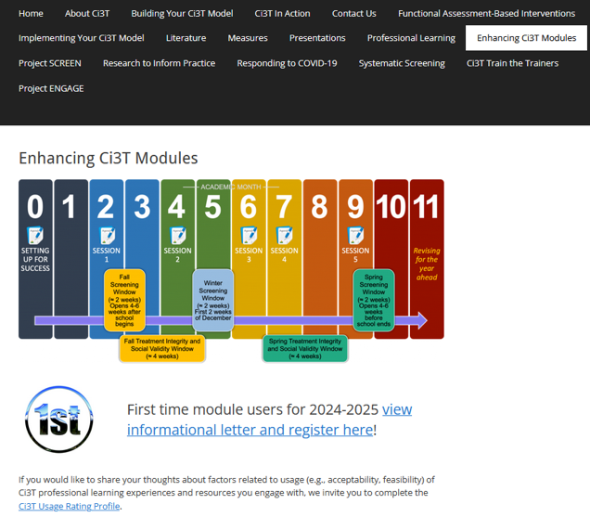
Implementing Comprehensive, Integrated, Three-tiered (Ci3T) Models: Planning for the Year Ahead
Enhanced Ci3T Implementation Series and Delivery (E-Ci3T) Session 5
If you have not done so already, we invite you to visit ci3t.org/enhance to access modules and complete a one-time registration process!

Slide 2

Ci3T Research Team

Slide 3
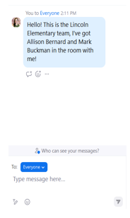

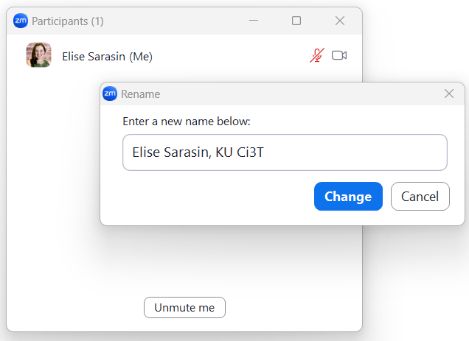
Zoom Logistics
If you are facilitating a Ci3T Leadership Team Symposium session at a satellite location, please email us a list of the names, email addresses, and schools of those attending.
To help us put you in breakout rooms with your colleagues today we are renaming you with your school initials and first and last name
If there are multiple people in the room with you, please list their first and last names and email in the chat!

Slide 4
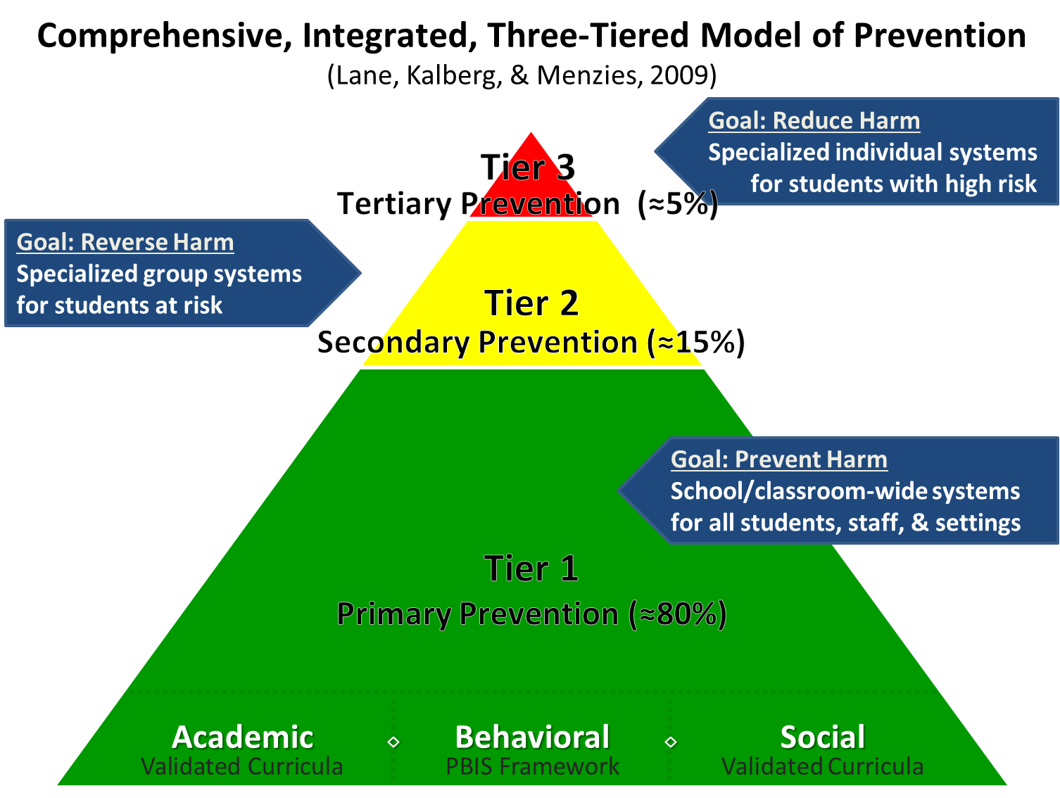
Comprehensive, Integrated, Three-Tiered Model of Prevention 1

Slide 5
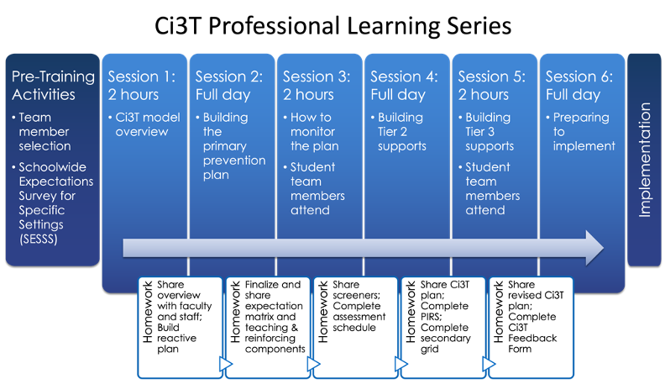
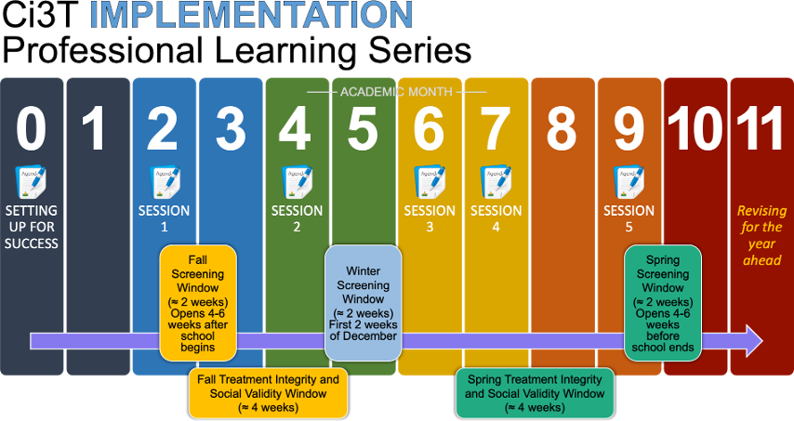




Ci3T Comprehensive Professional Learning Plan

Slide 6
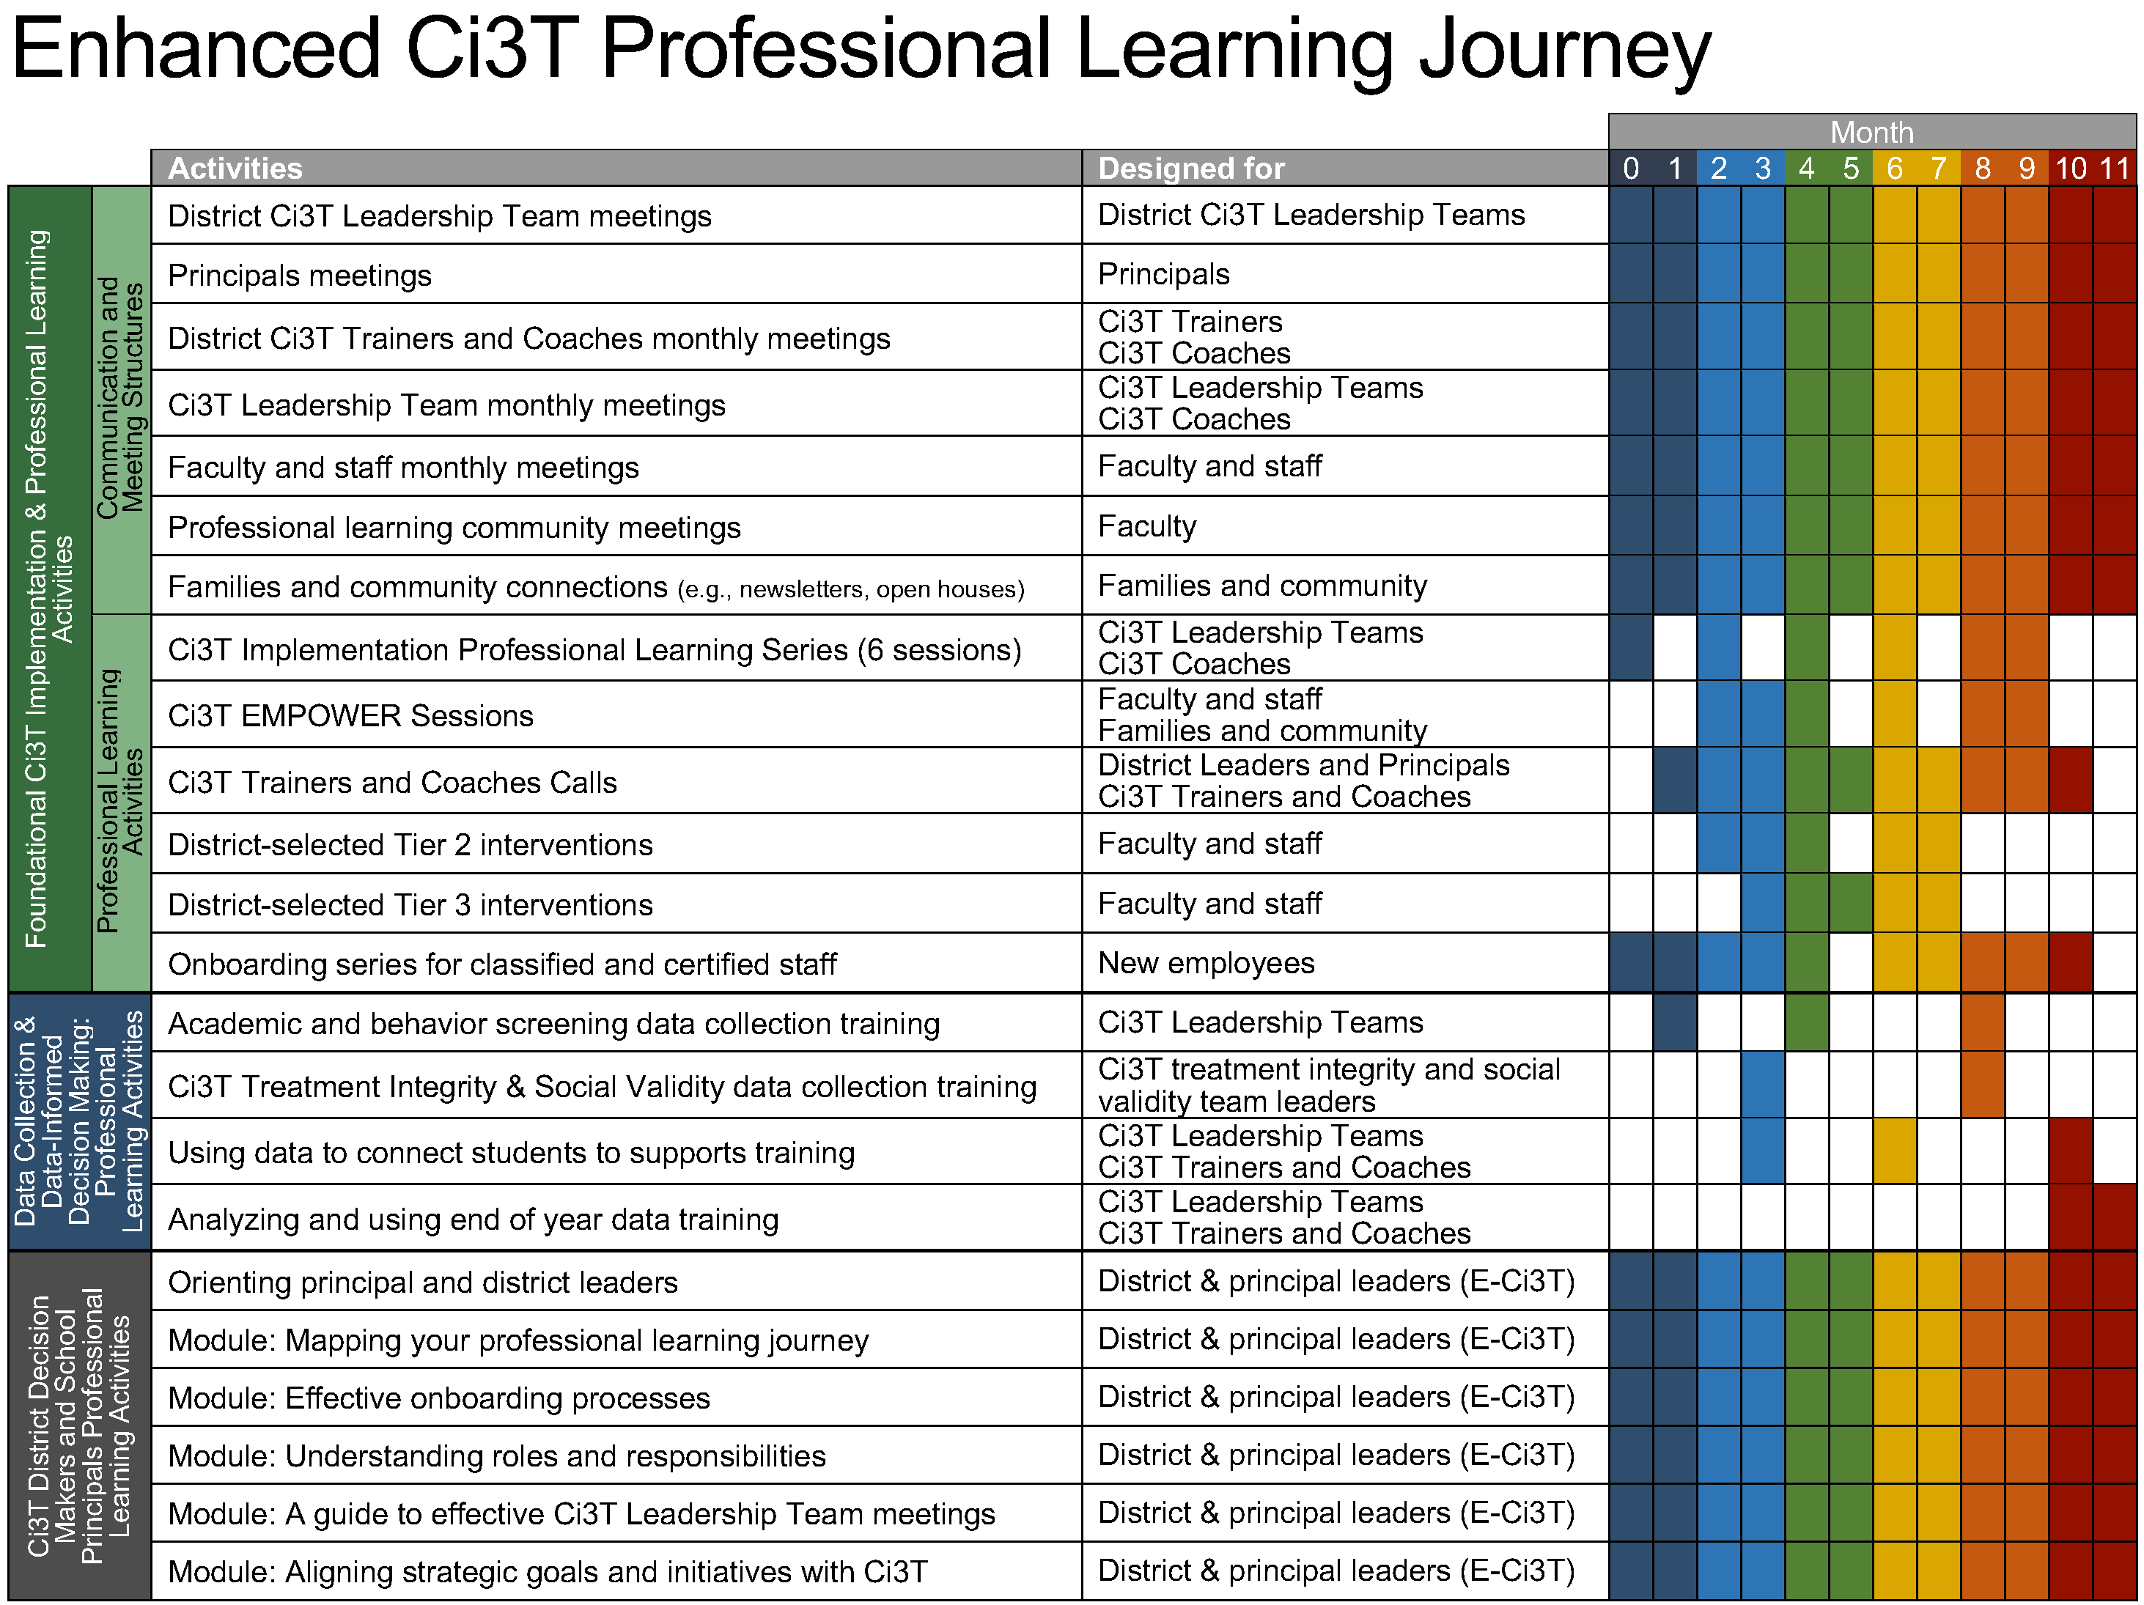
Enhanced Ci3T Implementation Series and Delivery

Slide 7
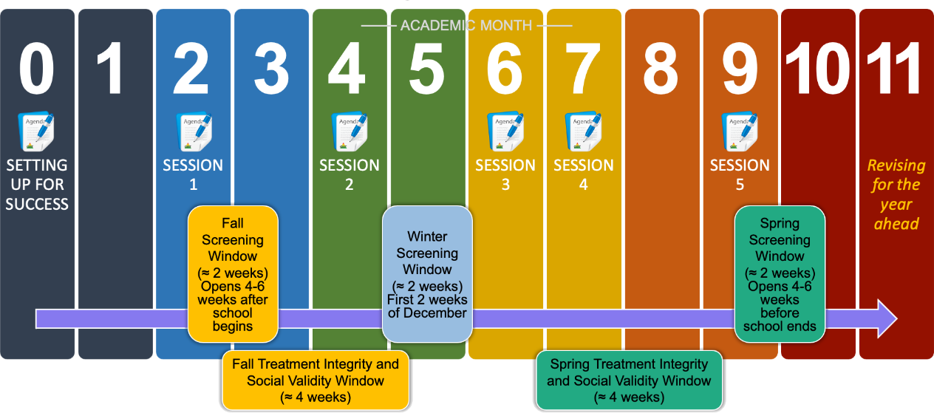
Ci3T Implementation Professional Learning Series
Notes:
The Ci3T Implementation Professional Learning Series is a 6-part series that spans the academic year. Sessions are timed to correspond to important milestones including: the beginning of the school year (e.g., kicking off the year, rolling out the Ci3T plan), screening windows, and treatment integrity and social validity windows.
Each session is data-informed, meaning attending Ci3T Leadership Team members review data, which are used to (a) identify successes, (b) identify focus areas (e.g., aspects of implementation that require additional attention, often via professional learning), and (c) create action plans to share data back and address focus areas.
Sessions applicable for both new and seasoned implementers as the focus is on predicable components of Ci3T implementation, space to review and respond to data, exploring resources to support implementation efforts, and beginning conversations and action plans.

Slide 8
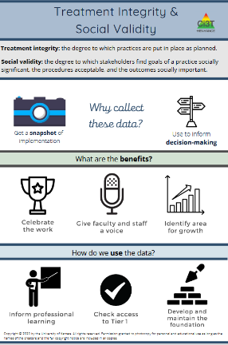
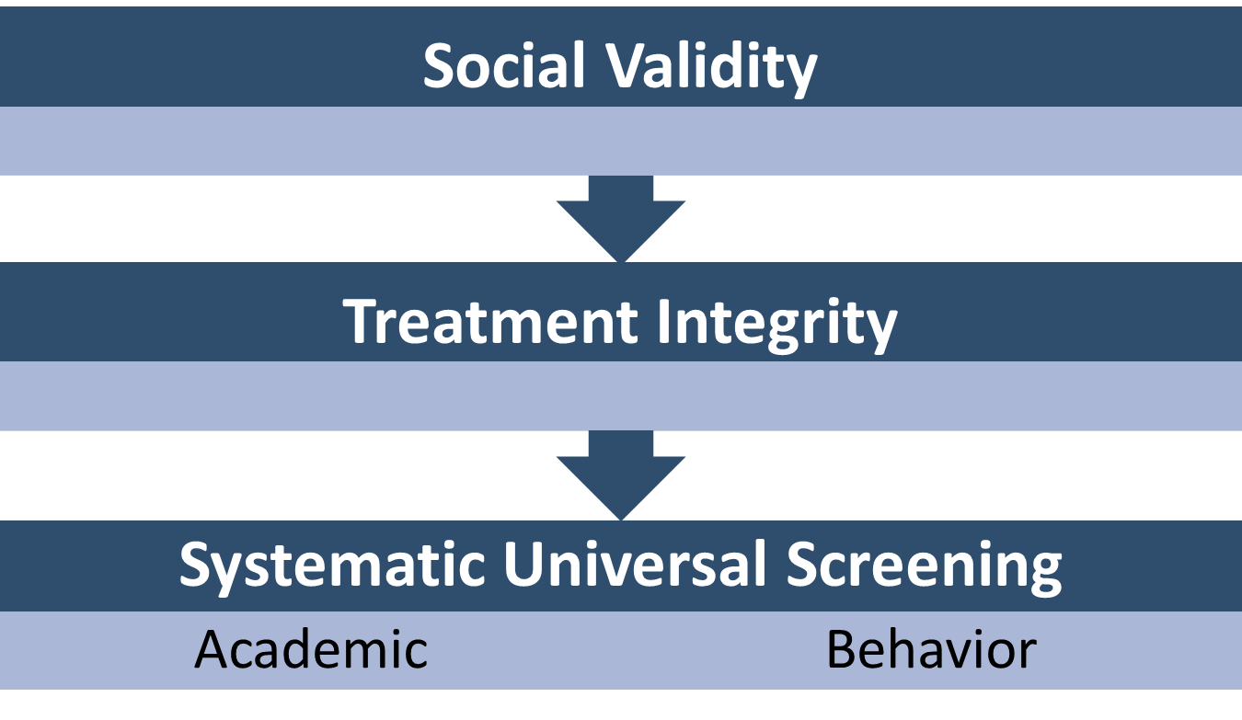

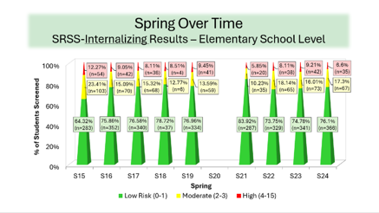
Essential Components of Primary (Tier 1) Prevention Efforts
Essential Components of Primary (Tier 1) Prevention Efforts 1

Slide 9



Enhancing Ci3T Modules
ci3t.org/enhance

Slide 10
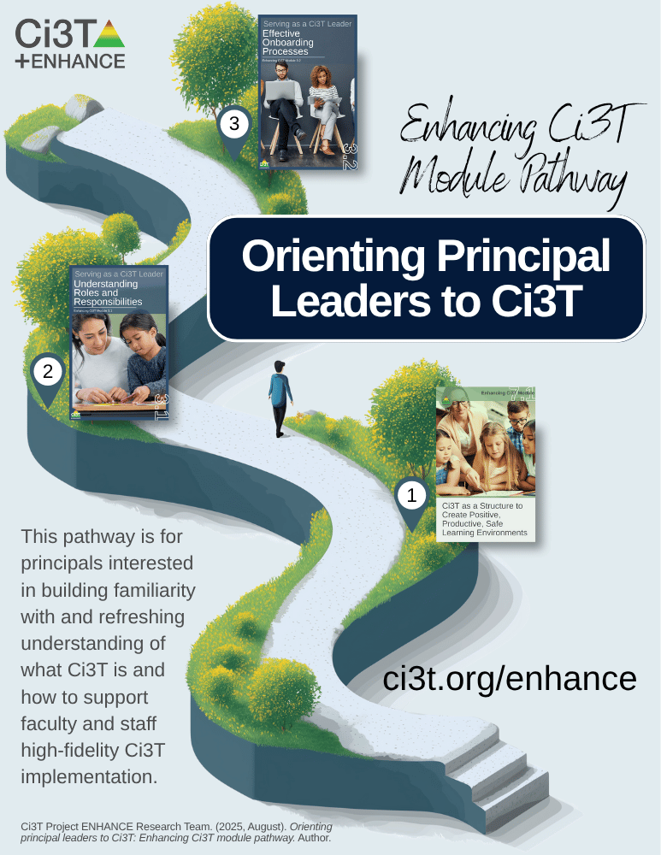
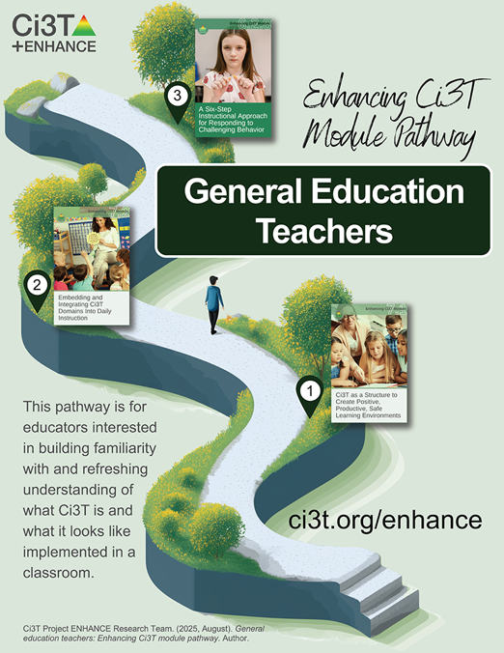
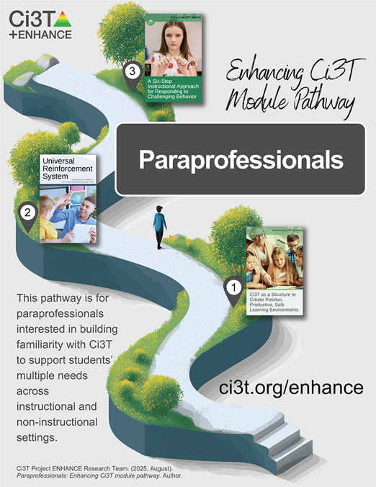
Module Pathways

Slide 11
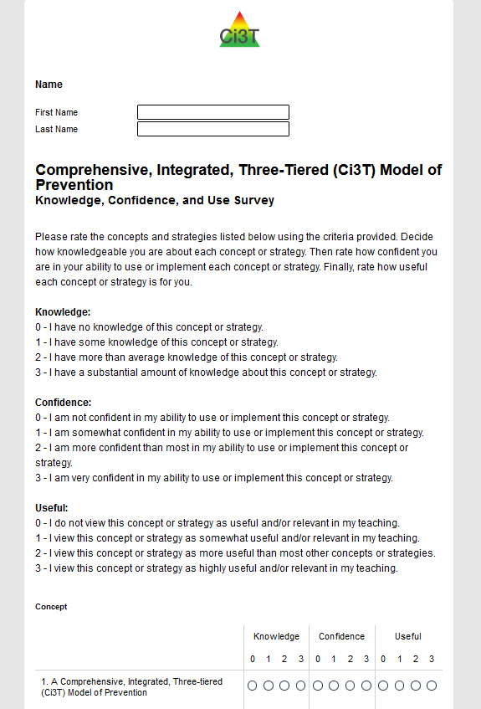
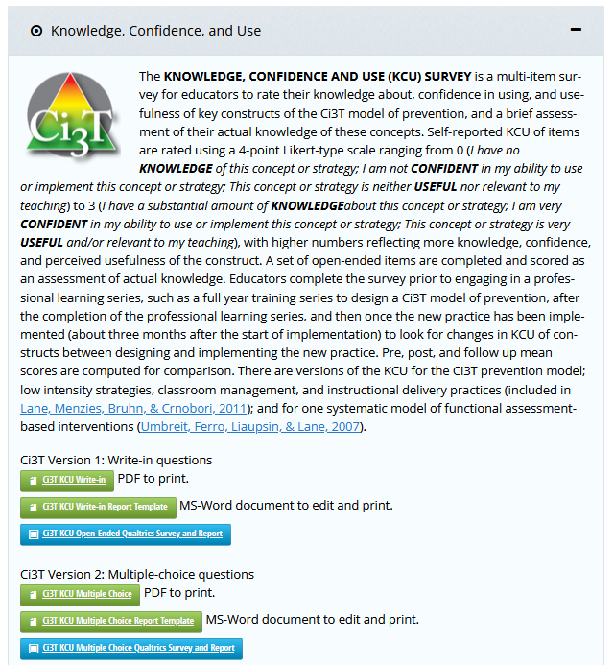
Knowledge, Confidence, Use (KCU) Survey
ci3t.org/measures
Notes:
If you are a district participating as a research partner in Sustaining Ci3T, we appreciate your time and effort in sharing your knowledge, confidence, we wrap up the school year!
If you are not participating in Sustaining Ci3T but would like to measure your or your team’s knowledge, confidence, and use, a version of the KCU survey is available on our website at ci3t.org/measures

Slide 12



















Work Time
First,
Then, explore one of the following modules:
If you have not yet done so already, please complete your Knowledge, Confidence, Use (KCU) Survey
What content could you build into upcoming professional learning to help finish the year strong?
How might this module support 2026-2027 beginning of year professional learning?
What content could you use to share Spring screening data?
How might this module support 2026-2027 behavior screening at your school?
Notes:
Give 15 minutes for KCU

Slide 13
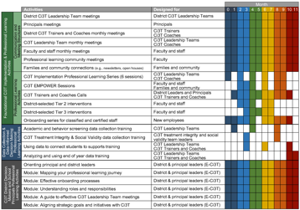
Session Outcomes
Session Outcomes 1
Interpret social validity, treatment integrity, and spring screening data at the school- and classroom-level to identify successes and focus areas relative to Ci3T implementation.
Use needs of faculty, staff, and students – as identified in social validity, treatment integrity, and spring screening data – to inform professional learning for faculty and staff, use of effective practices to support students (e.g., low-intensity strategies, Tier 2 and 3 interventions), and updates to your school’s Ci3T Implementation Manual.

Slide 14
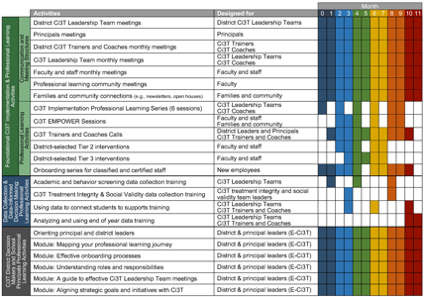
Agenda
Welcome
Procedures for Monitoring
Review your School’s Social Validity & Treatment Integrity Data
Review your School’s Spring Screening Data
Planning for the Year Ahead 2025-2026
Focusing on Data-Informed Professional Learning
Wrapping Up and Moving Forward

Slide 15
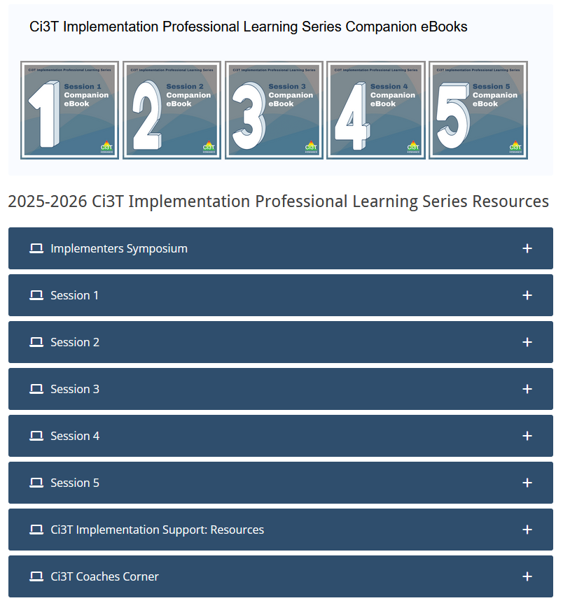
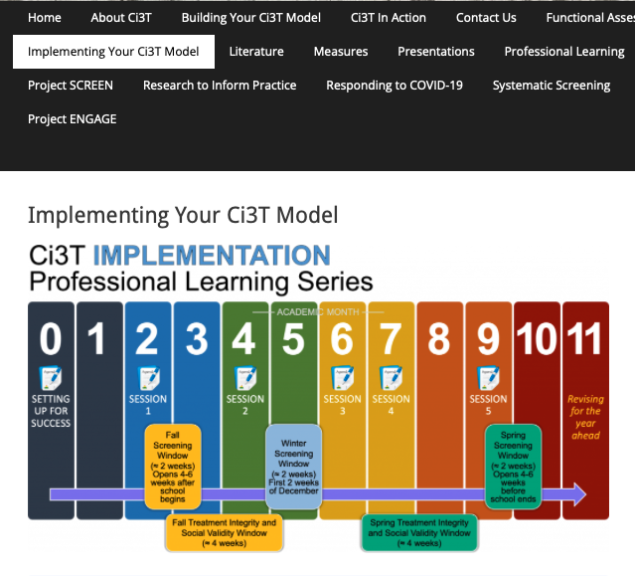
Accessing Professional Learning Materials
Accessing Professional Learning Materials 1
ci3t.org/imp

Slide 16
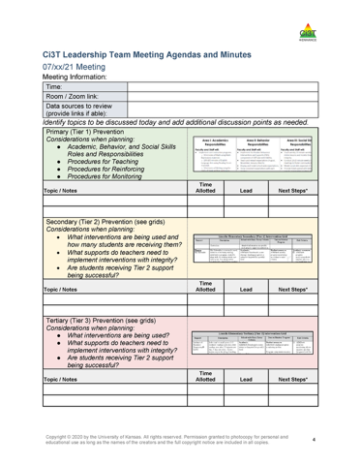

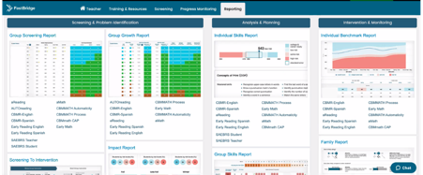

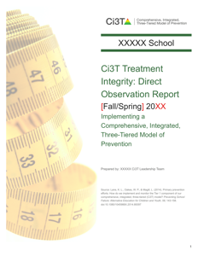

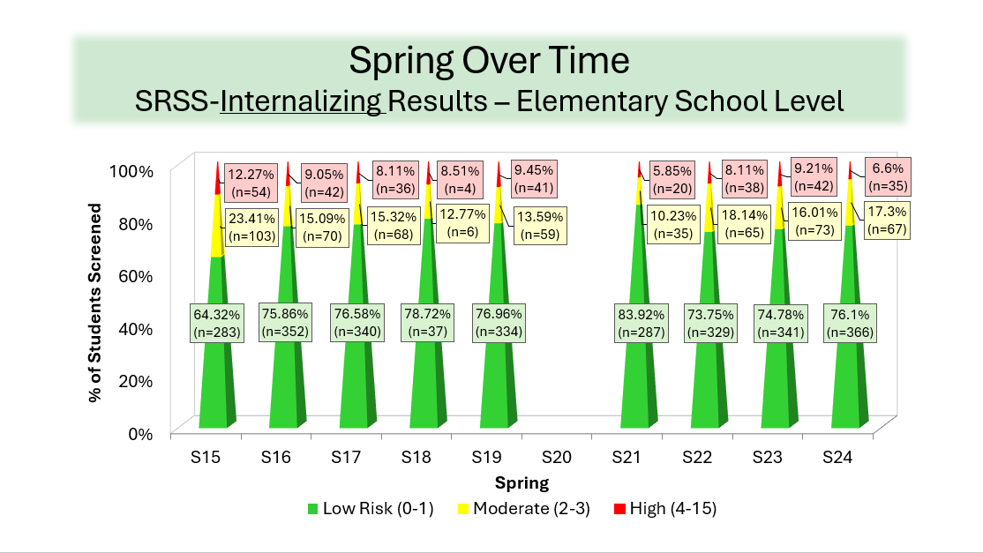
Materials for Today’s Session
Ci3T Leadership Team Agenda
Ci3T Implementation Manual
Screening Data
Spring Treatment Integrity and Social Validity Data

Slide 17

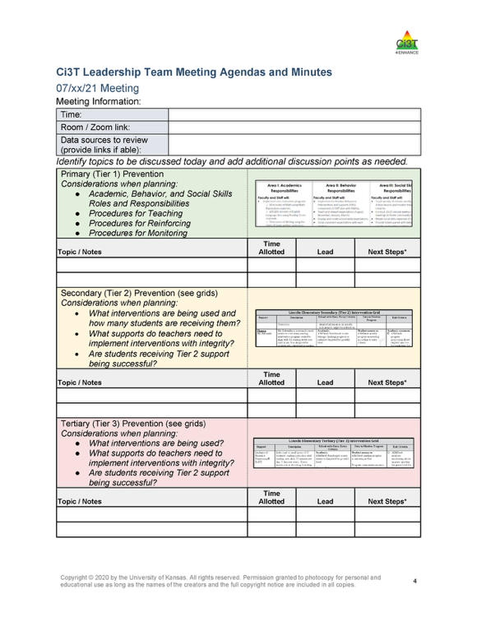
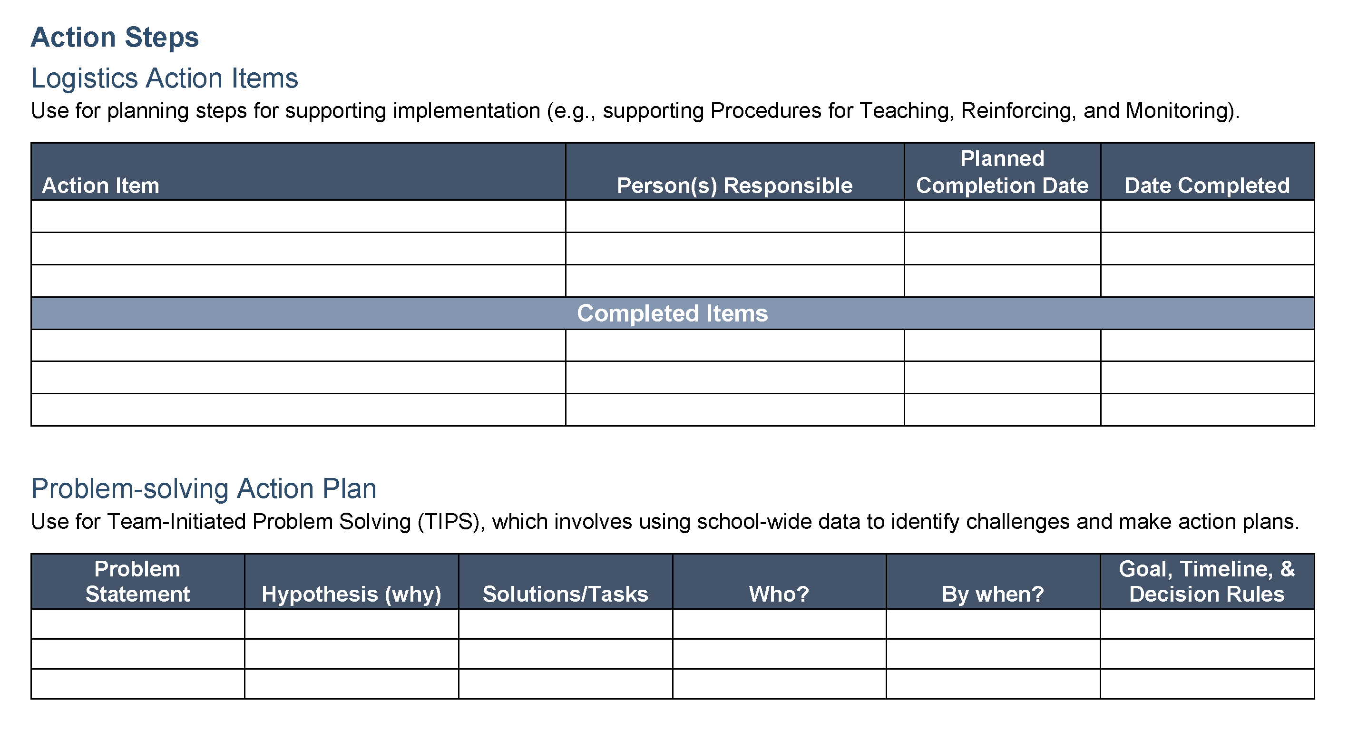

Ci3T Leadership Team Agenda Template
1.2 TEAM OPERATING PROCEDURES
Tier 1 leadership team has (a) regular meeting format/agenda that prompts the regular review of Tier 1 practices, systems, and data, (b) minutes available to all staff for review, (c) established and regularly used team norms, (d) defined meeting roles (e.g., timekeeper, facilitator, recorder), (e) regular (e.g., quarterly) two-way data sharing and communication with advanced tiers teams to inform decision making, (f) a current action plan, (g) procedure for evaluating fidelity of team operating procedures (e.g., Team Initiated Problem Solving [TIPS] Fidelity Checklist) at least twice annually, and (h) a formal process to monitor the impact of team norms and procedures on ensuring all team members are able to participate as equal partners

Slide 18
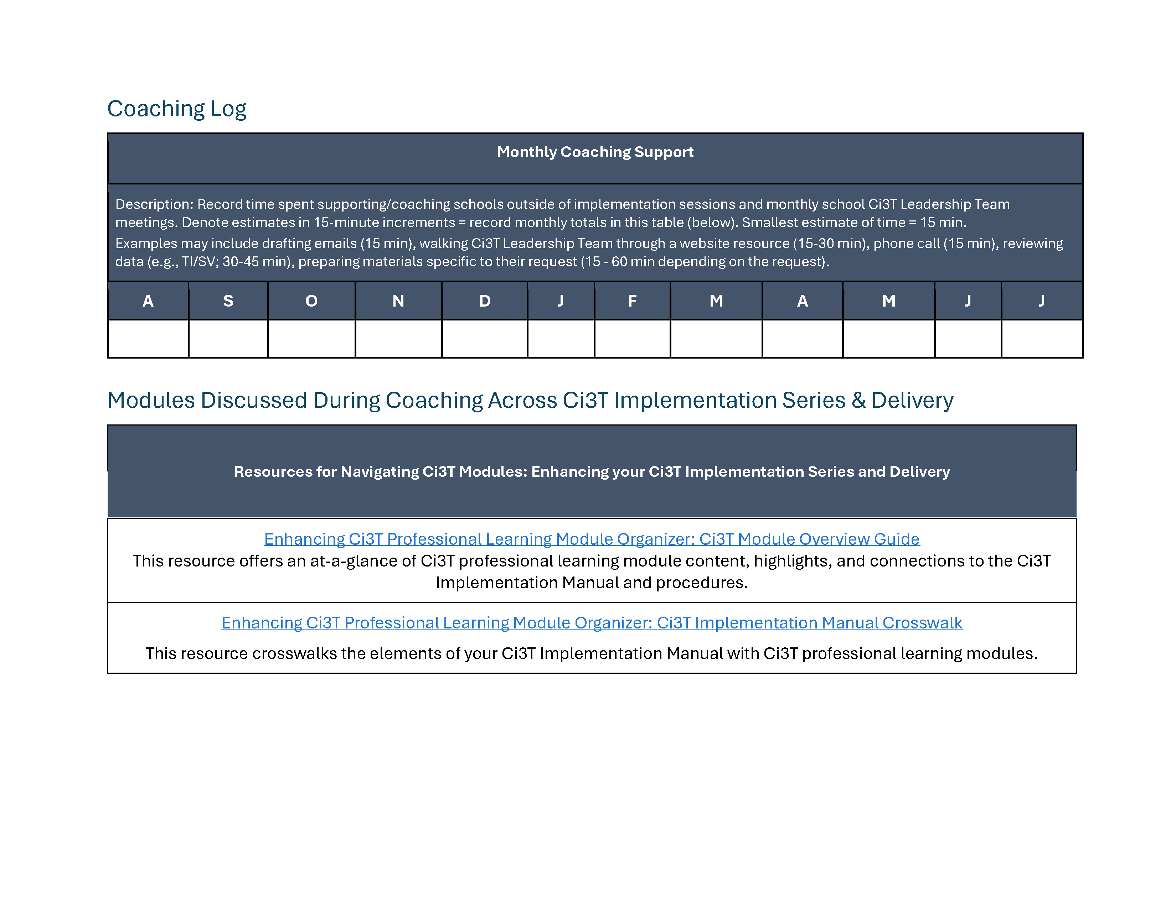
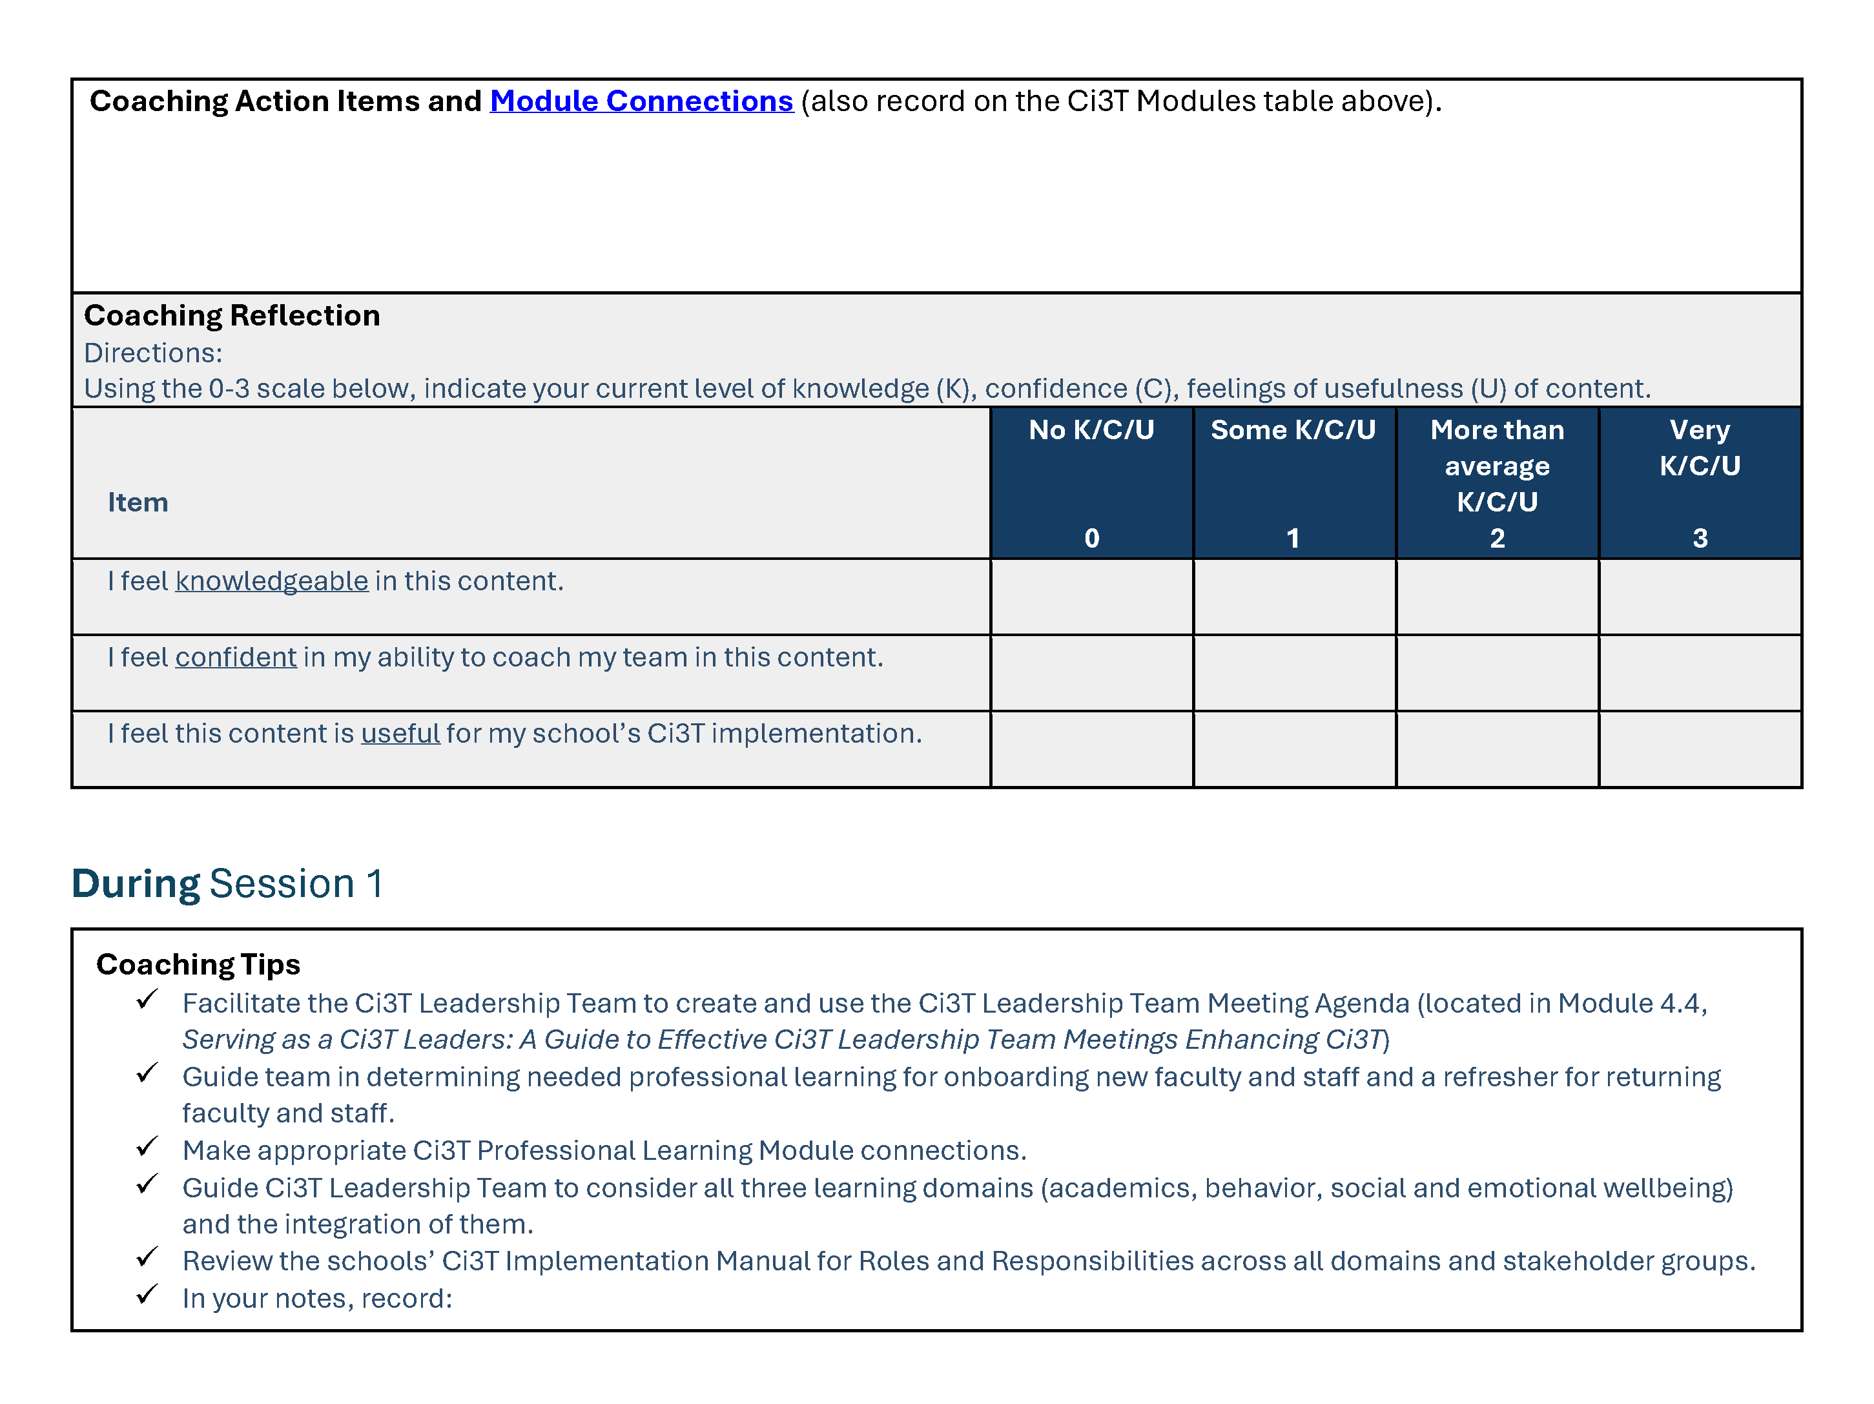
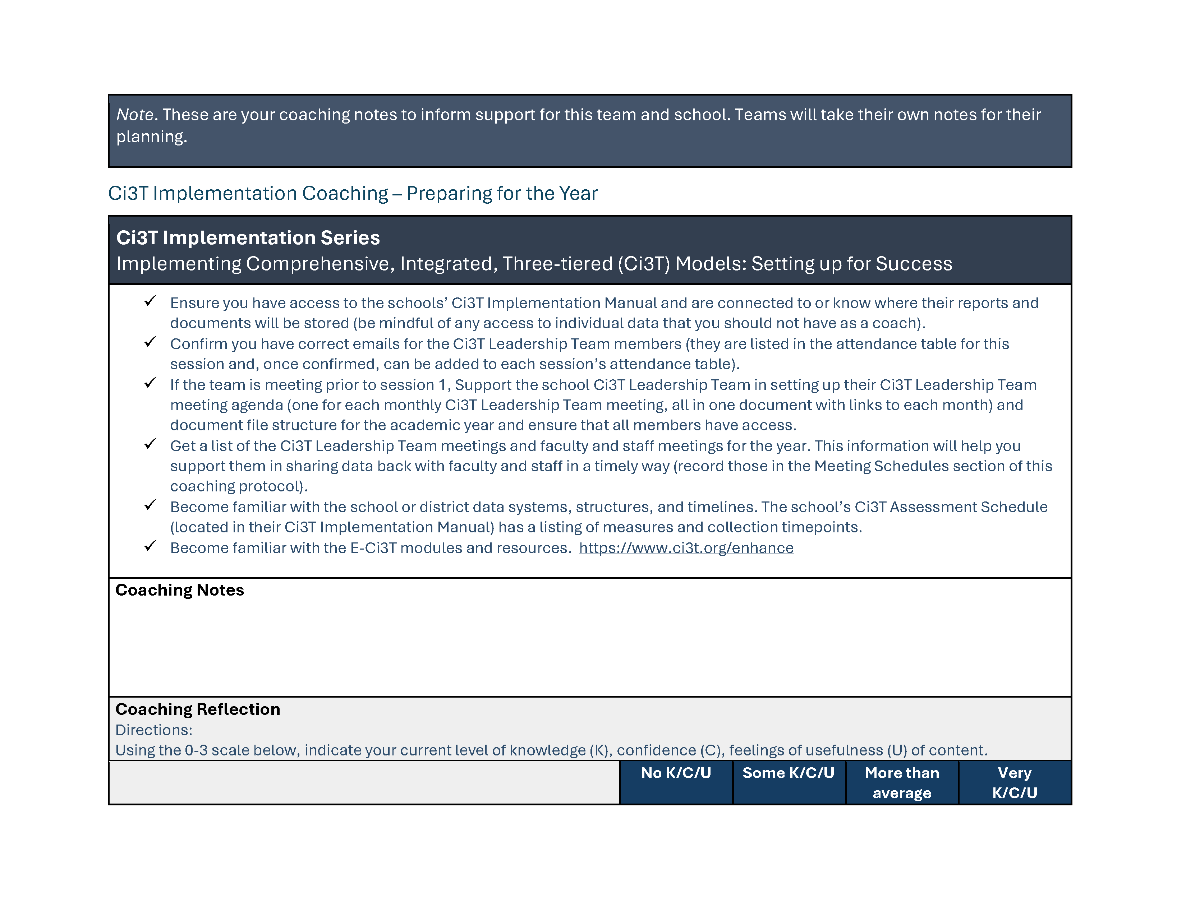
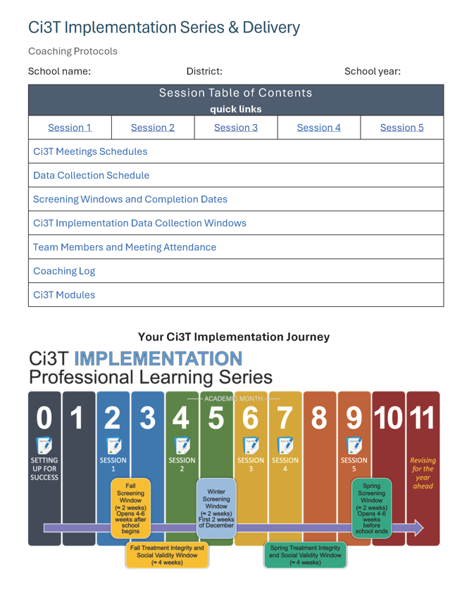
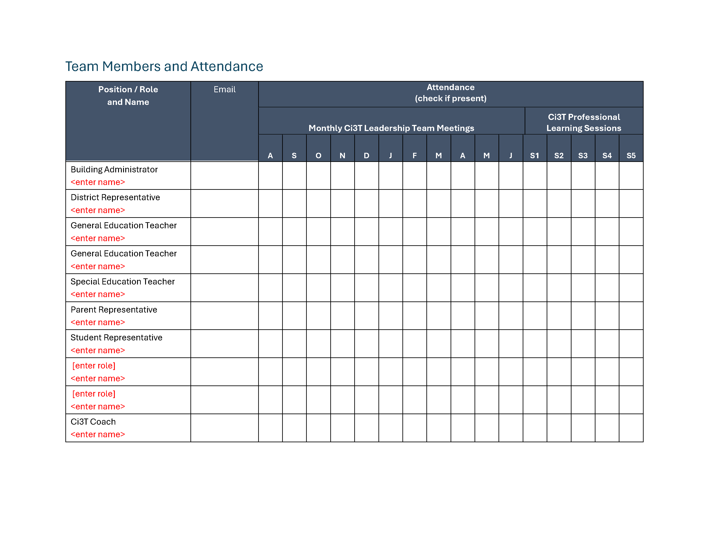
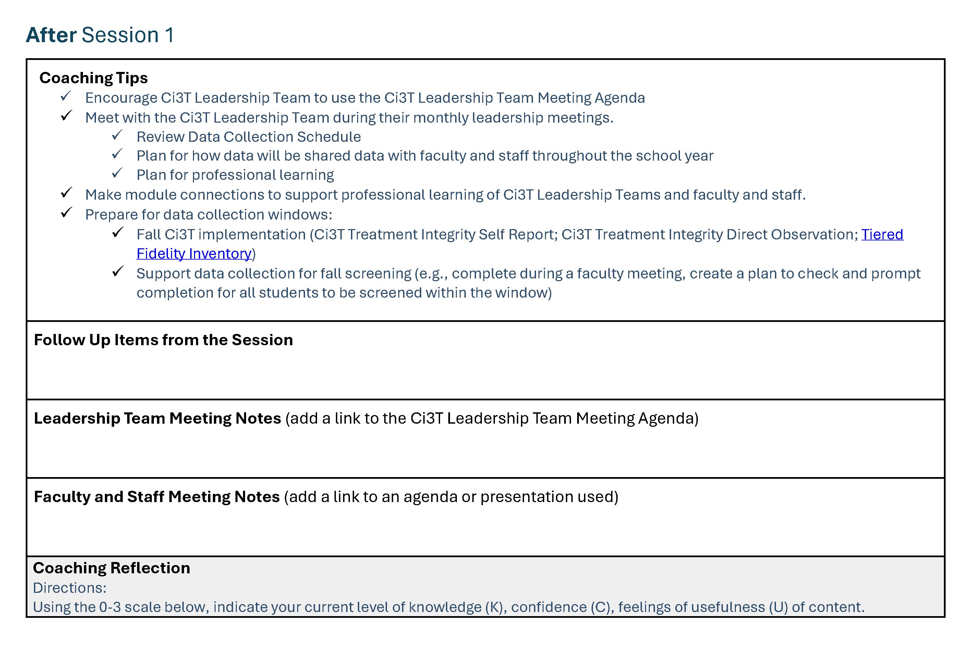
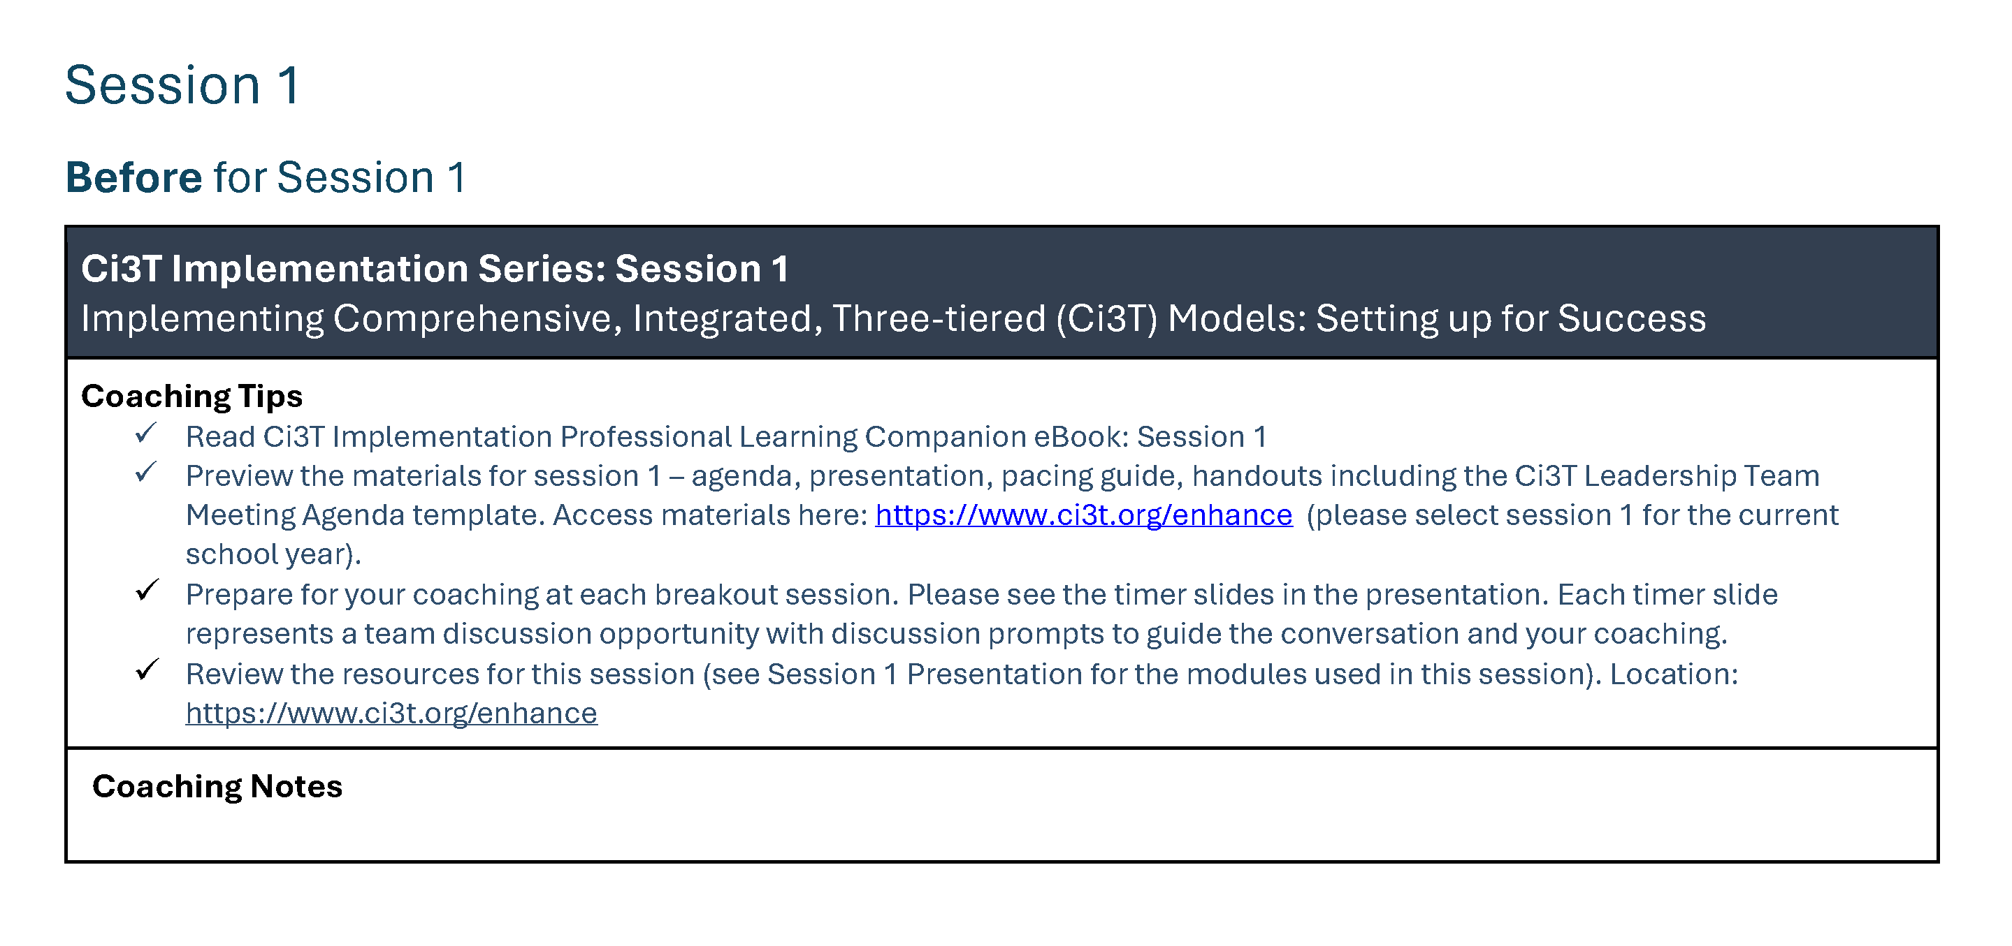
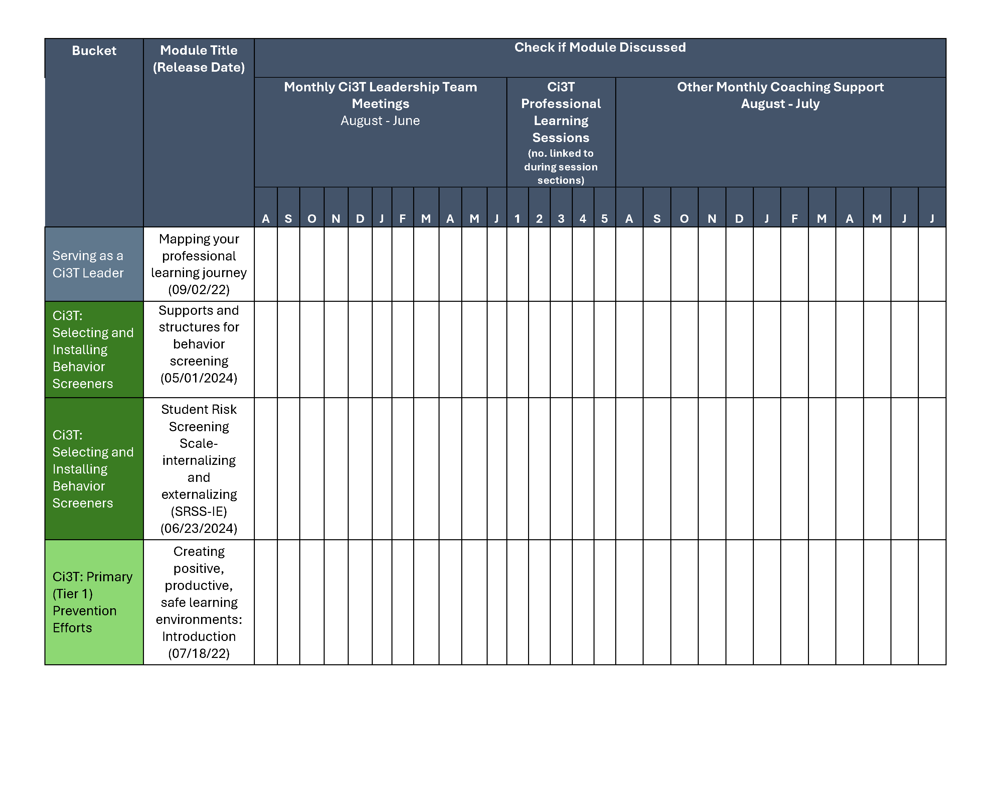
Coaching Protocol

Slide 19
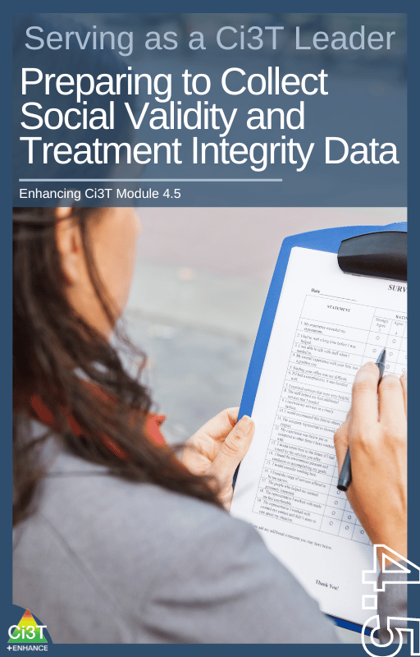
Procedures for Monitoring
Review your School’s Social Validity & Treatment Integrity Data
Review your School’s Spring Screening Data
1.19 DECISION MAKING WITH FIDELITY DATA
Tier 1 leadership team reviews and uses schoolwide (e.g., TFI, BoQ, TIC, SAS, SET) and other fidelity data (e.g.,
classroom implementation, Tier 1 SEB curriculum, staff wellness systems) at least annually.

Slide 20
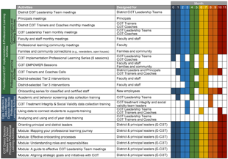
Session Outcomes
Session Outcomes 2
Interpret social validity, treatment integrity, and spring screening data at the school- and classroom-level to identify successes and focus areas relative to Ci3T implementation.
Use needs of faculty, staff, and students – as identified in social validity, treatment integrity, and spring screening data – to inform professional learning for faculty and staff, use of effective practices to support students (e.g., low-intensity strategies, Tier 2 and 3 interventions), and updates to your school’s Ci3T Implementation Manual.

Slide 21
Procedures for Monitoring
Review your School’s Social Validity & Treatment Integrity Data
Review your School’s Spring Screening Data
1.19 DECISION MAKING WITH FIDELITY DATA
Tier 1 leadership team reviews and uses schoolwide (e.g., TFI, BoQ, TIC, SAS, SET) and other fidelity data (e.g.,
classroom implementation, Tier 1 SEB curriculum, staff wellness systems) at least annually.

Slide 22
Essential Components of Primary (Tier 1) Prevention Efforts
Essential Components of Primary (Tier 1) Prevention Efforts 1

Slide 23
Social Validity How do stakeholders view the plan?
Social validity refers to the level of:
Social significance of intervention goals
Social acceptability of intervention procedures
Social importance of intervention outcomes
(Wolf, 1978)
Assessed using the Primary Intervention Rating Scale (PIRS)
Social Validity: PIRS Results
Year | Fall: n | Fall: % (SD) | Spring: n | Spring: % (SD)
2025-2026 | 32 | 85.39 (8.89) | TBD | TBD
1.14 FACULTY AND STAFF ENGAGEMENT
Tier 1 leadership teams purposefully and regularly engage all faculty and staff in co-designing and actively revising
the content and the implementation of foundational Tier 1 practices (items 1.3-1.10) and systems (items 1.12-
1.13) based on the regular review of schoolwide and community data.

Slide 24
Treatment Integrity Are we implementing our plan as intended?
Treatment integrity can refer to:
Adherence
Dosage
Quality
Assessed using:
Ci3T Treatment Integrity: Teacher Self-Report
Ci3T Treatment Integrity: Direct Observation
Tiered Fidelity Inventory (TFI)
Ci3T Procedures | Fall 2025 Teacher Self-Report* | Educator Direct Observation* | Observer Direct Observation*
 | n = 45 % (SD) | n = 6 % (SD) | n = 7 % (SD)
Teaching | 80.43% (10.86) | 70.72% (13.81) | 75.02% (17.05)
Reinforcing | 80.83% (12.89) | 62.06% (15.33) | 34.99% (16.02)
Monitoring | 75.49% (18.06) | - | -
Total | 79.10% (11.87) | 67.66% (14.03) | 62.28% (14.58)

Slide 25
Logistics Planning
Method | Measure Name | Completed by: All Staff | Completed by: Randomly Selected Classrooms | Completed by: Ci3T Leadership Team
Survey | Ci3T Treatment Integrity: Teacher Self-Report and Primary Intervention Rating Scale | X
Observations | Ci3T Treatment Integrity: Direct Observation |  | X
Rubric | Tiered Fidelity Inventory (TFI) |  |  | X

Slide 26

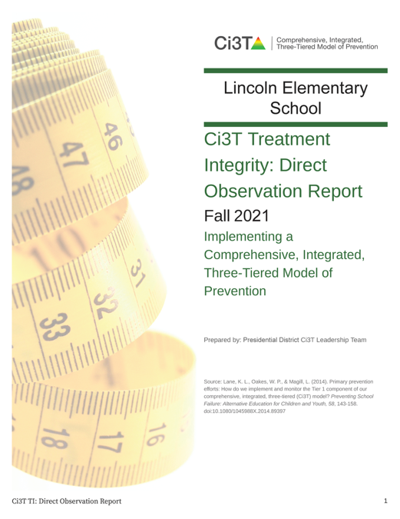
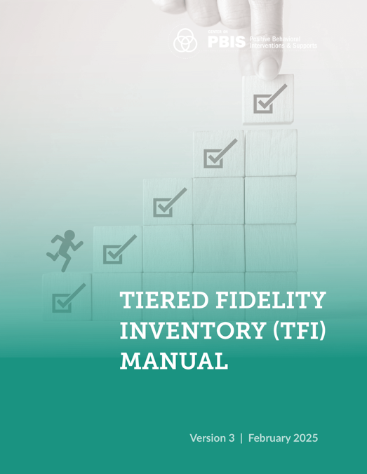
Treatment Integrity and Social Validity Data Sources
Treatment Integrity and Social Validity Data Sources 1
Fall 2025
Primary Intervention Rating Scale (Social Validity)
Ci3T Treatment Integrity: Teacher Self Report
Ci3T Treatment Integrity: Direct Observation
Tiered Fidelity Inventory

Slide 27

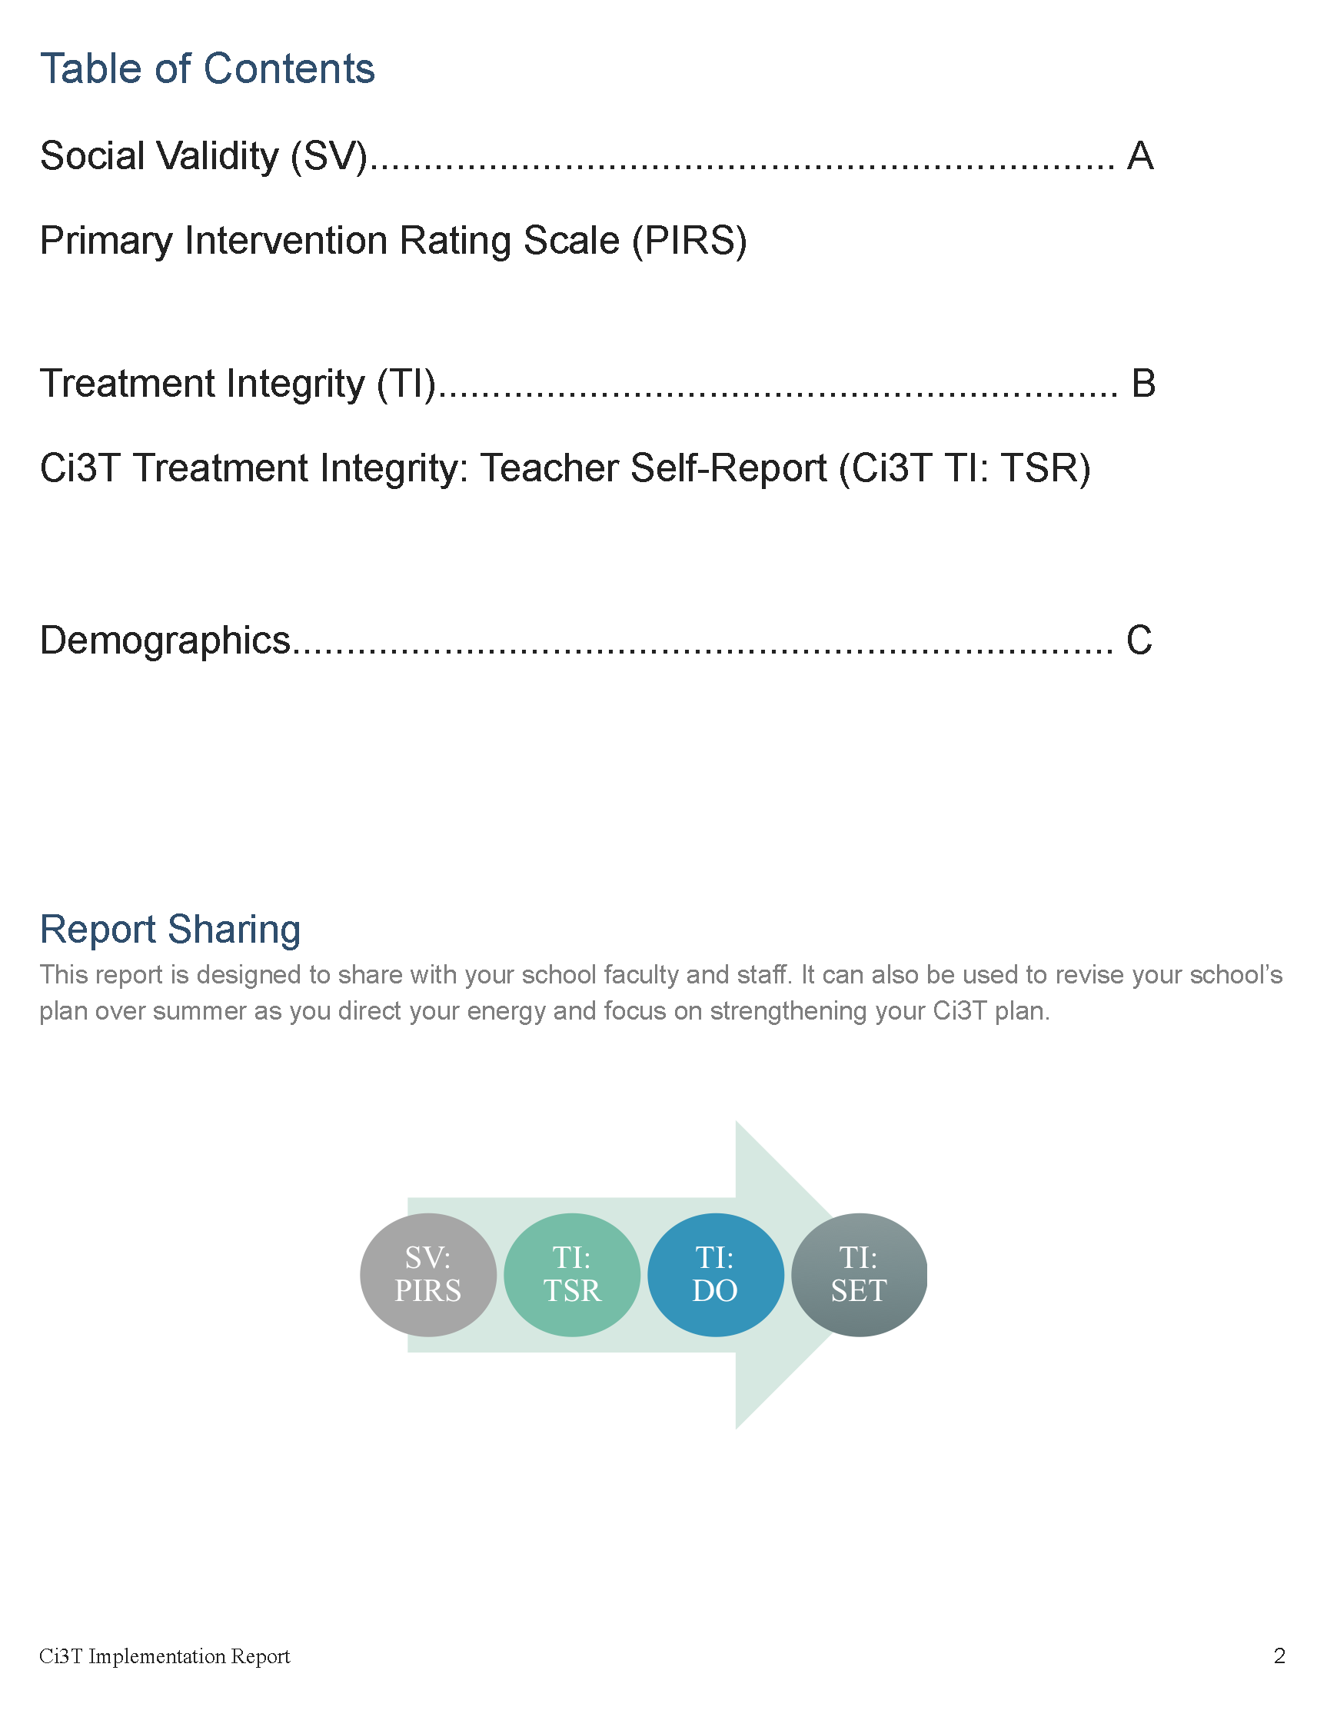
Ci3T Implementation Report
Primary Intervention Rating Scale (Social Validity; PIRS)
Ci3T Treatment Integrity: Teacher Self Report (Ci3T TI: TSR)
Demographics (e.g., role)

Slide 28
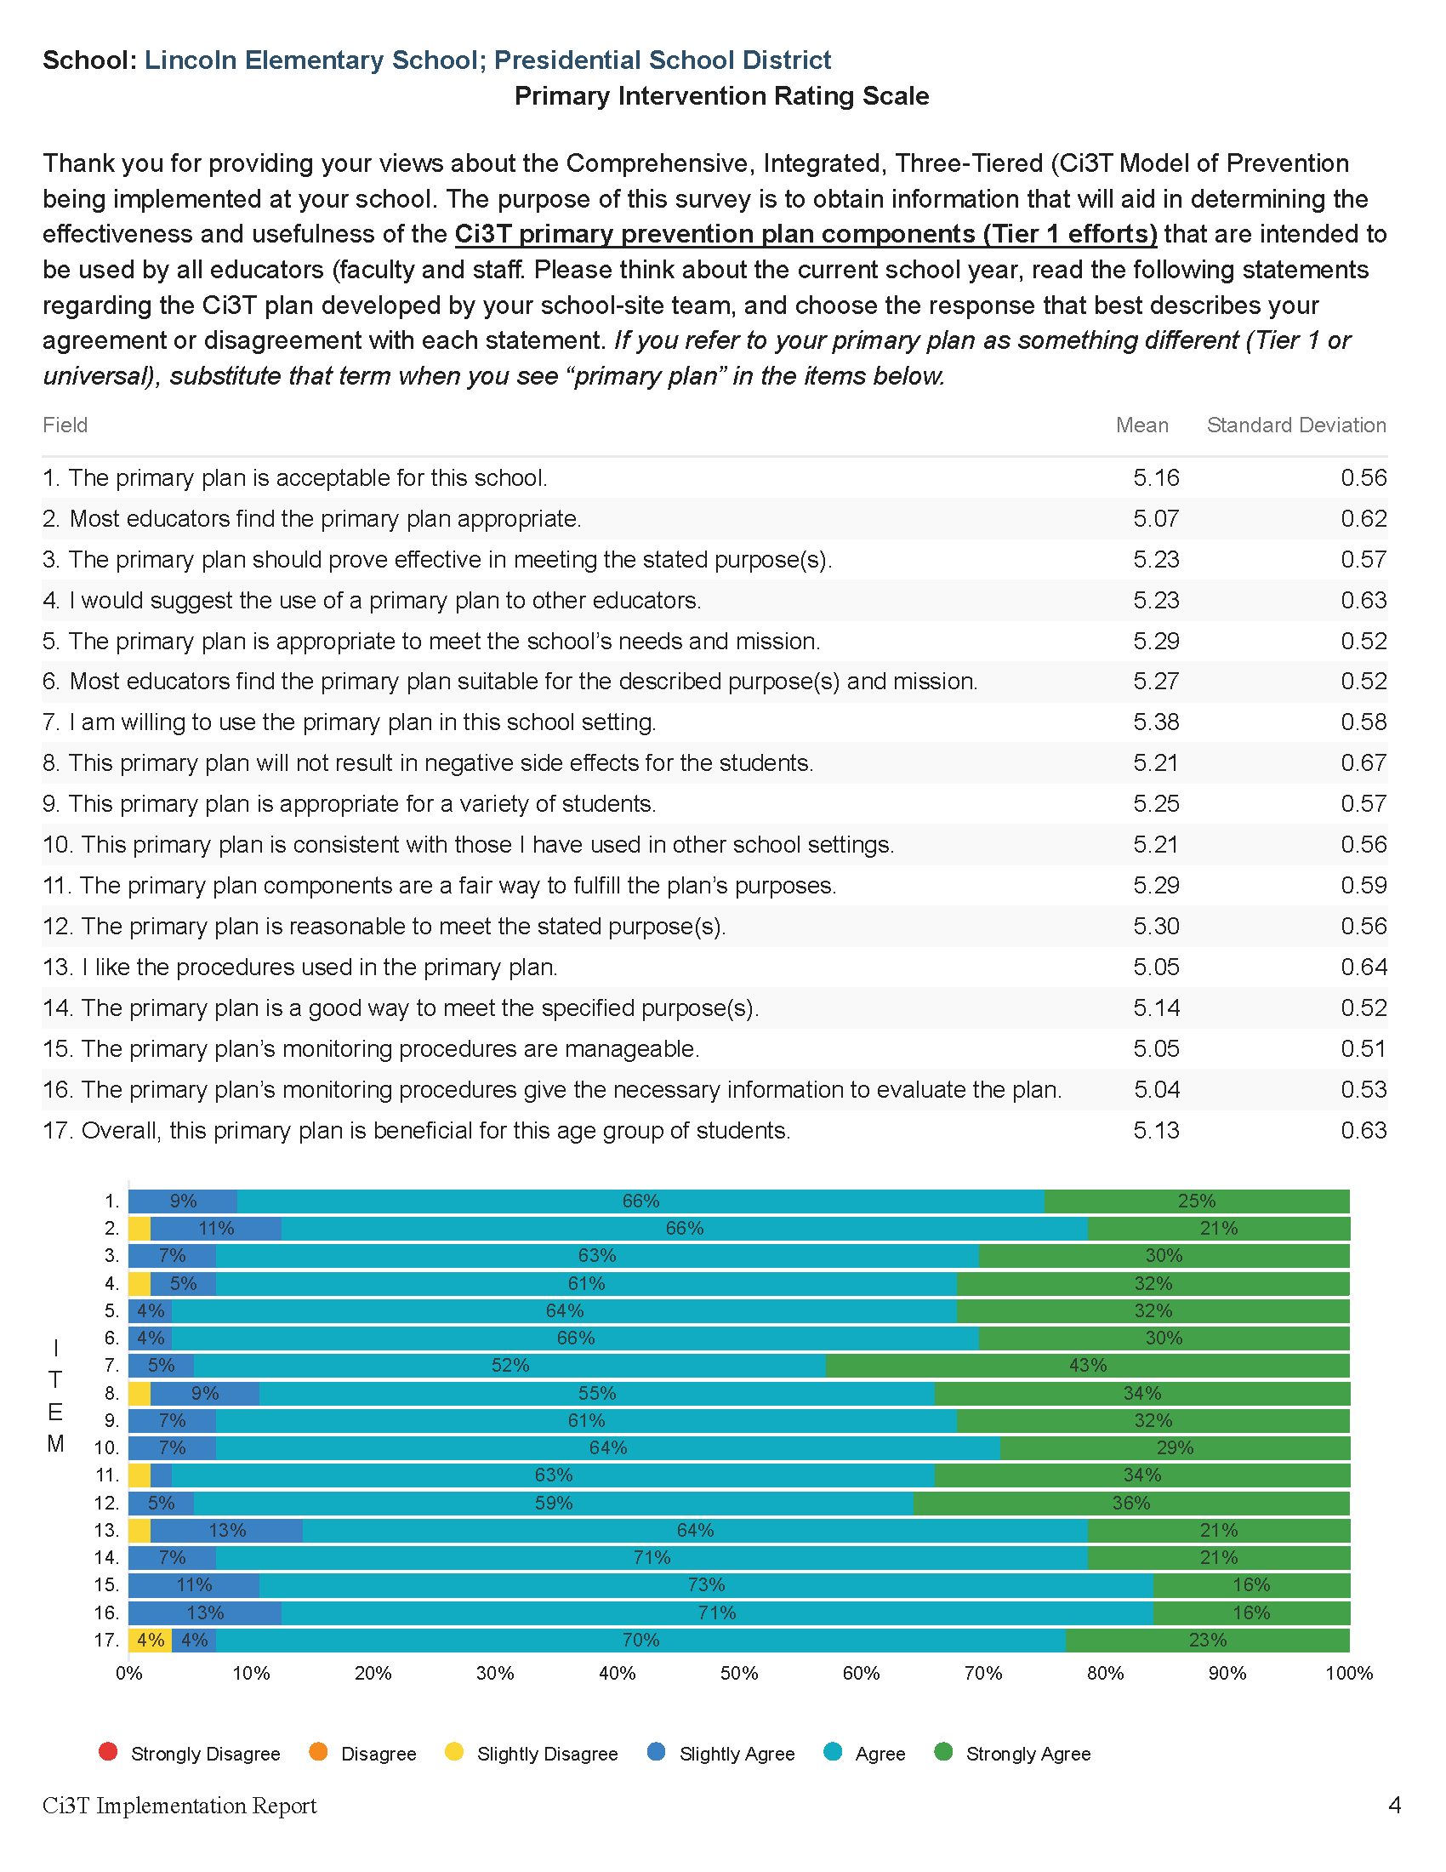
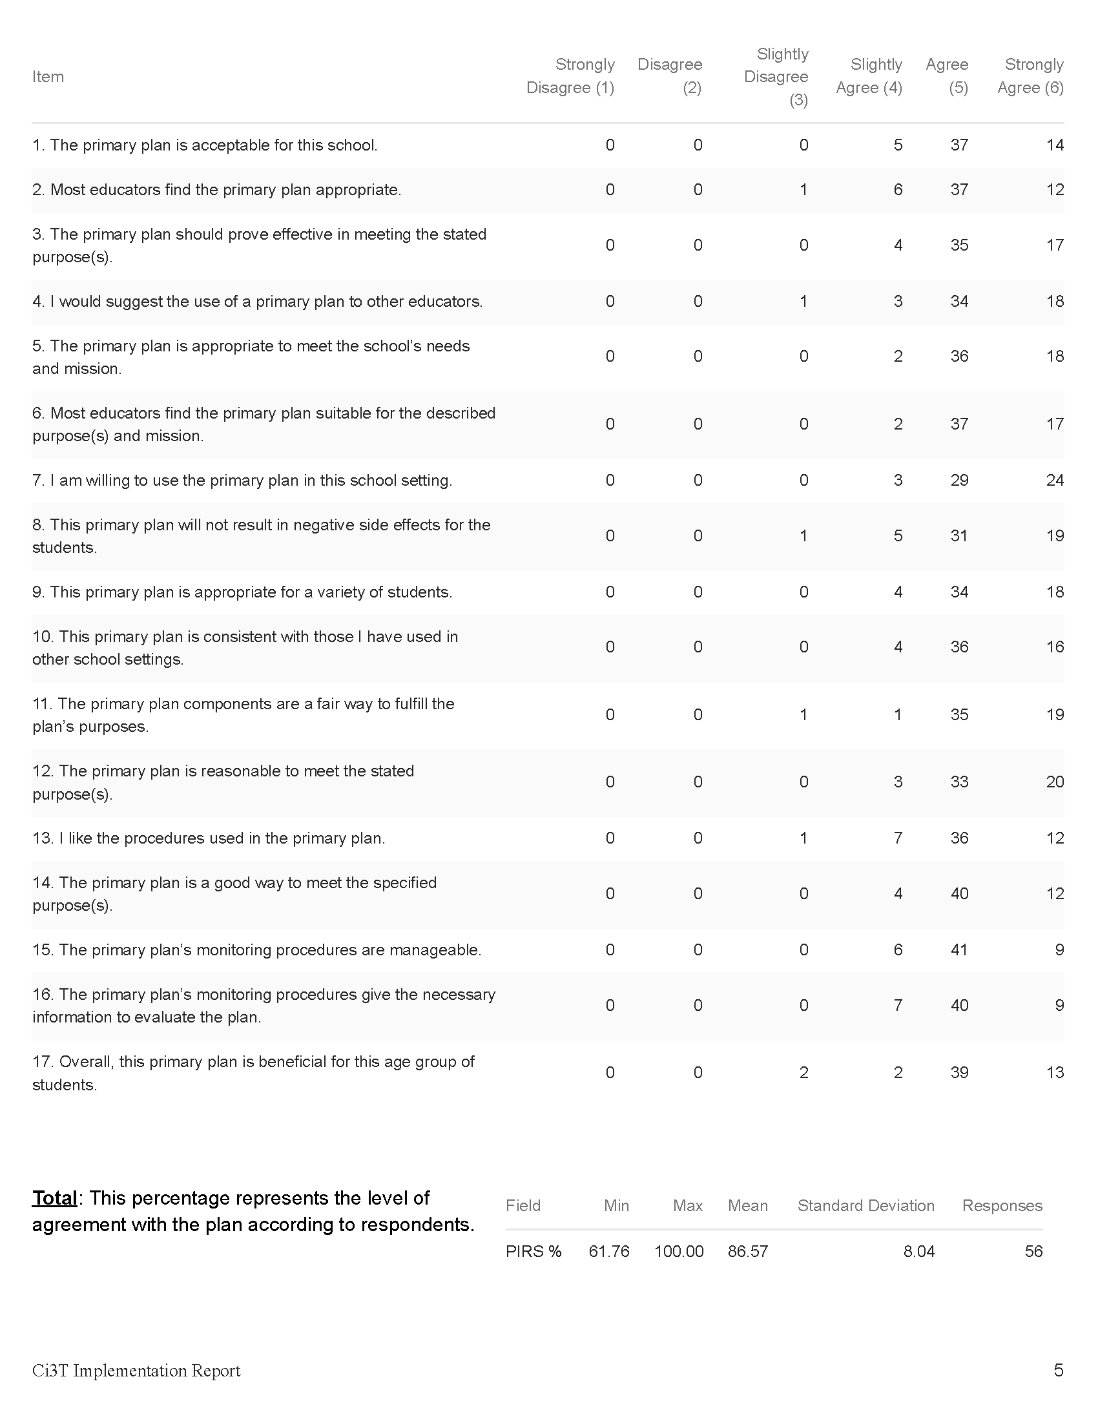
Primary Intervention Rating Scale (PIRS)
Item-level data reported by response category
(e.g., number of people who “strongly agreed”)
Item-level data reported as mean and standard deviation (scale = 1-6)
Item-level data visualization
Total PIRS %
(mean and standard deviation)

Slide 29
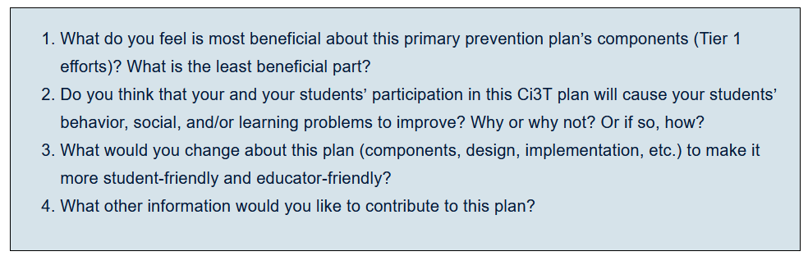
Primary Intervention Rating Scale Open Ended Items
Read through comments
Highlight success (literally!)
Look for themes for celebrations and focus areas

Slide 30

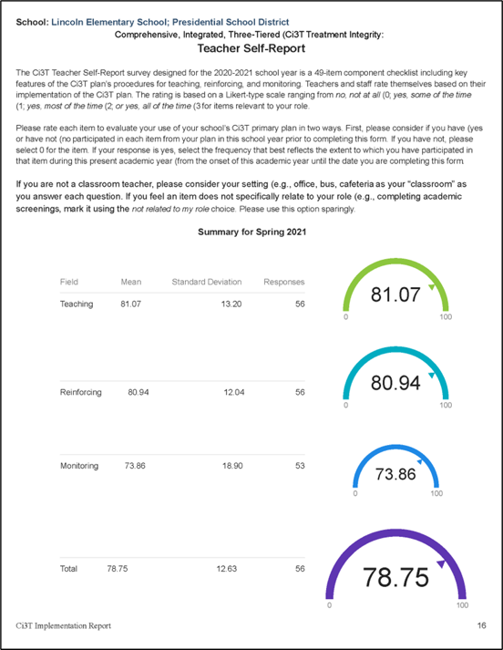
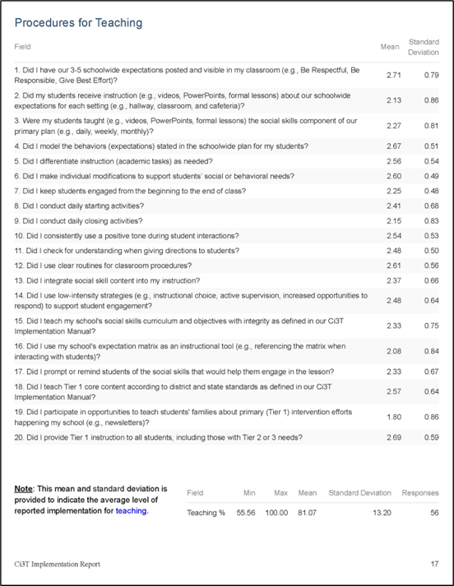
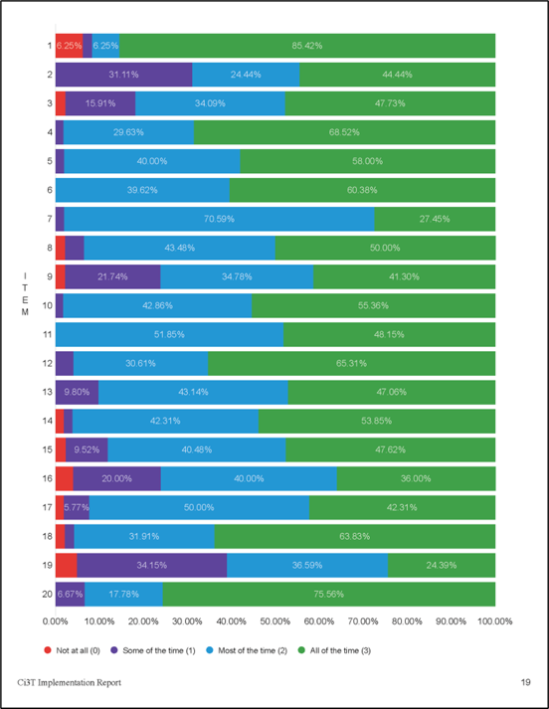
Ci3T Treatment Integrity: Teacher Self Report (Ci3T TI: TSR)
Total Scores
(mean and standard deviation)
Item-level data reported as mean and standard deviation (scale = 0-3)
Item-level data visualization

Slide 31
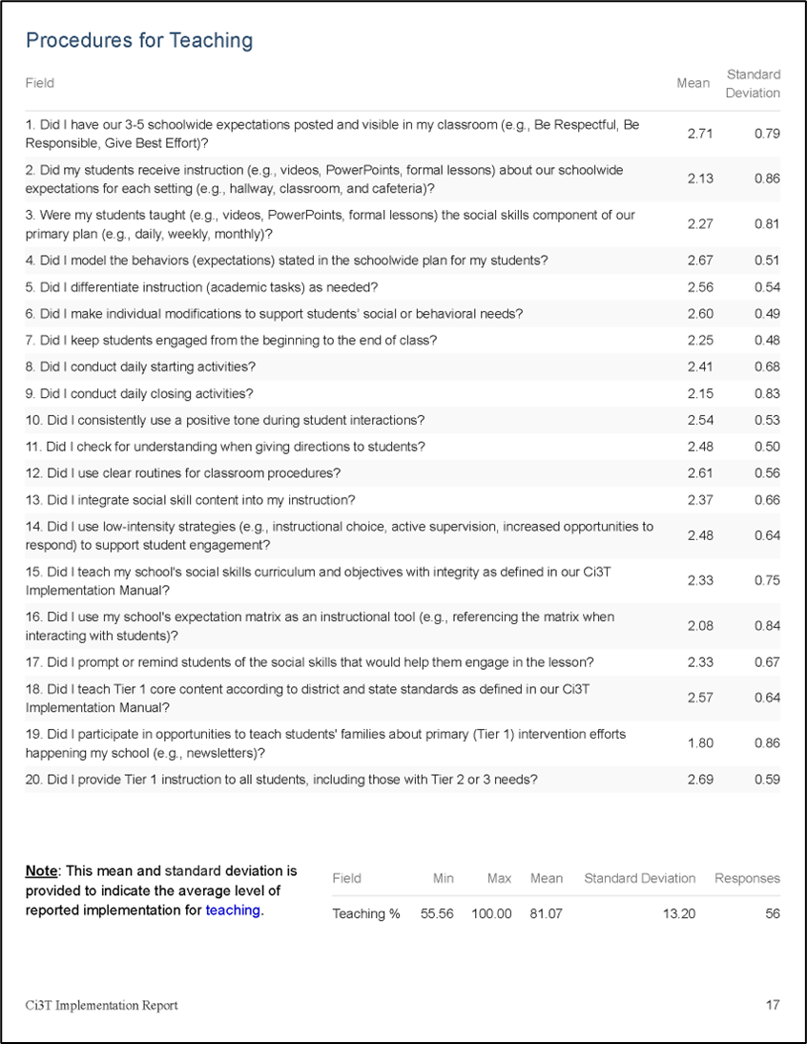
Ci3T TI: TSR Strengths and Areas of Focus

Slide 32
Treatment Integrity and Social Validity Data Sources
Treatment Integrity and Social Validity Data Sources 2
Fall 2025
Primary Intervention Rating Scale (Social Validity)
Ci3T Treatment Integrity: Teacher Self Report
Ci3T Treatment Integrity: Direct Observation
Tiered Fidelity Inventory

Slide 33
Ci3T Treatment Integrity: Direct Observation Report
Subset of Ci3T TI: TSR items
Stratified, random selection of educators
Personnel who directly instruct students
Observers trained to criterion
30-min observations
Educator perspective
Observer perspective

Slide 34
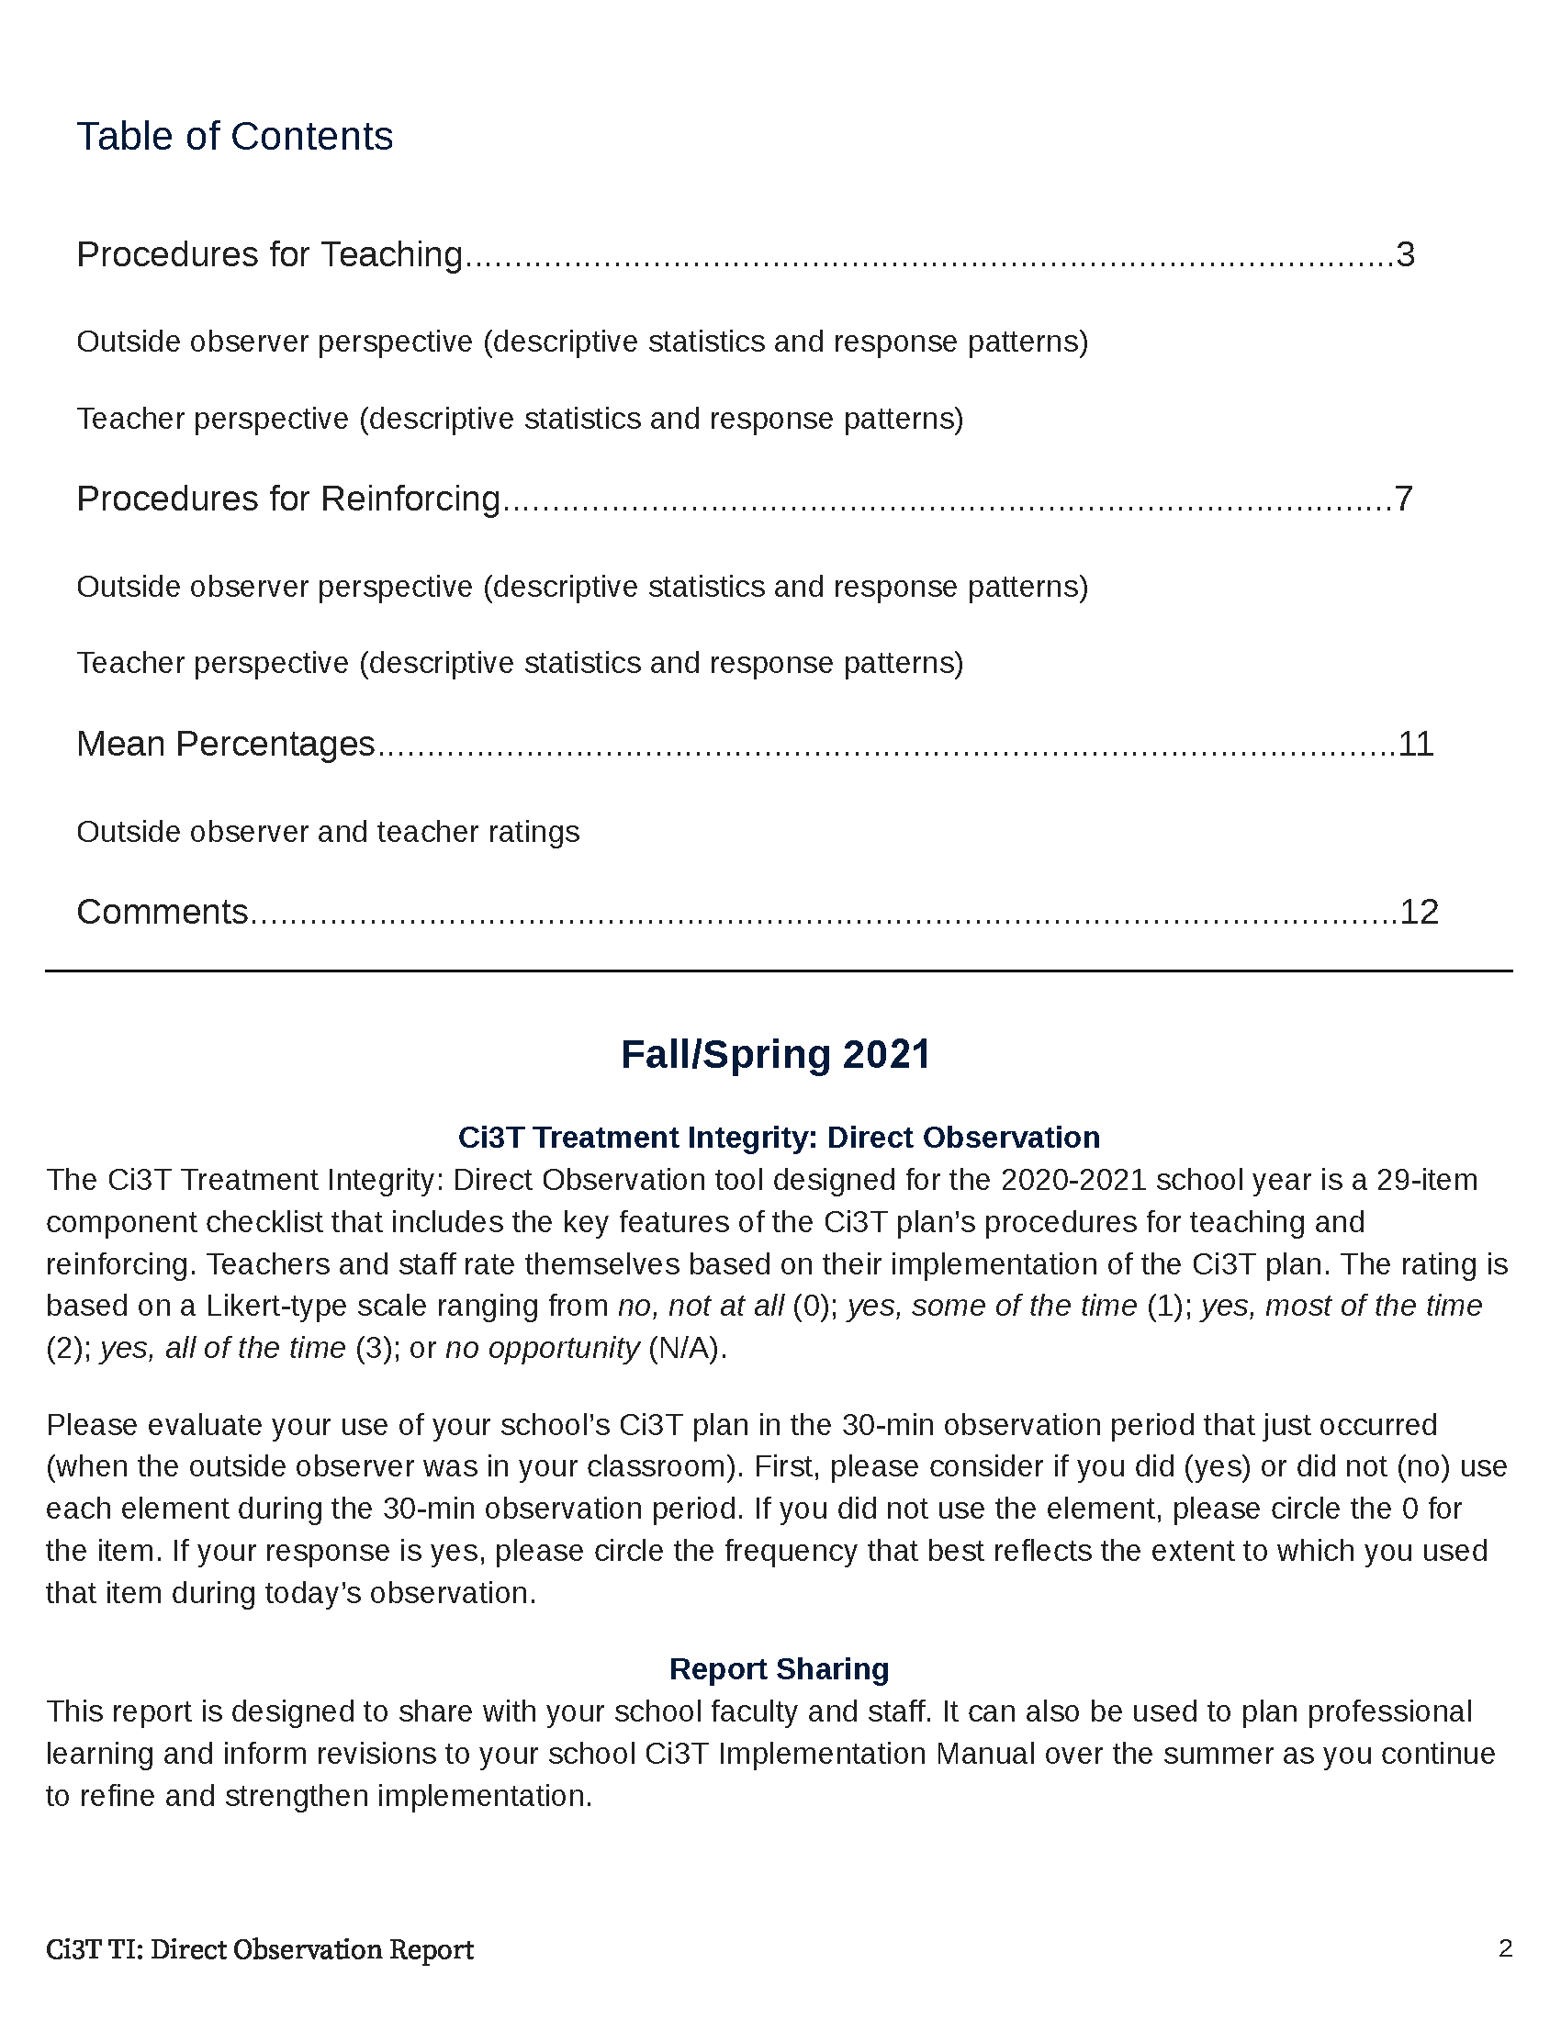
Ci3T Treatment Integrity: Direct Observation (Ci3T TI:DO)

Slide 35
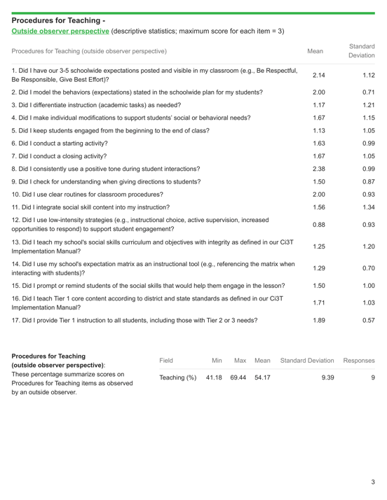
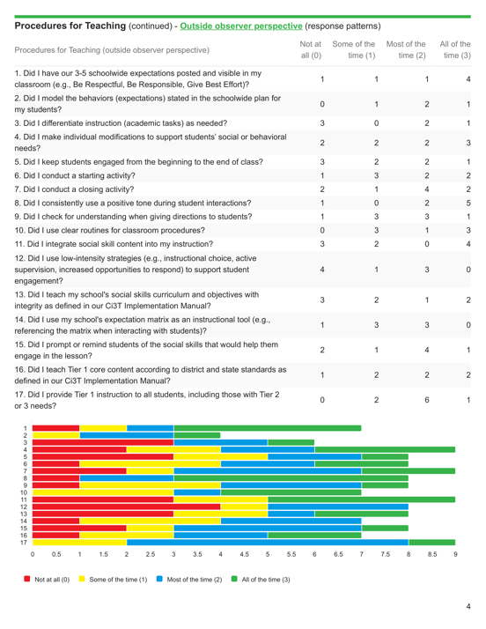
Ci3T TI:DO Outside Perspective
Item-level data reported by response category
(e.g., number of people who “strongly agreed”)
Item-level data reported as mean and standard deviation (scale = 0-3)
Total %
(mean and standard deviation)
Item-level data visualization

Slide 36
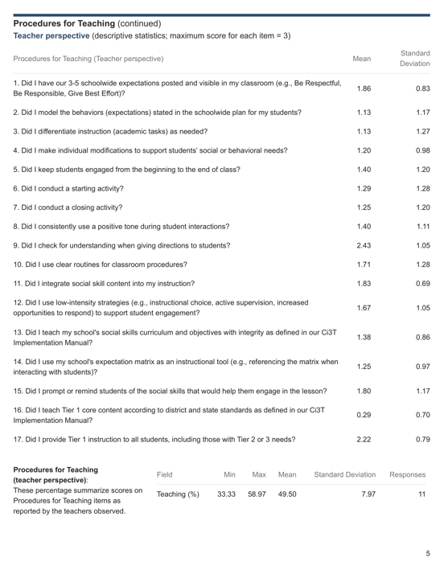

Ci3T TI:DO Educator Perspective
Item-level data reported by response category
(e.g., number of people who “strongly agreed”)
Item-level data reported as mean and standard deviation (scale = 0-3)
Total %
(mean and standard deviation)
Item-level data visualization

Slide 37

Ci3T TI:DO Strengths and Areas of Focus

Slide 38

Ci3T TI: DO Mean Percentages

Slide 39
Treatment Integrity and Social Validity Data Sources
Treatment Integrity and Social Validity Data Sources 3
Fall 2025
Primary Intervention Rating Scale (Social Validity)
Ci3T Treatment Integrity: Teacher Self Report
Ci3T Treatment Integrity: Direct Observation
Tiered Fidelity Inventory

Slide 40



Tiered Fidelity Inventory (TFI)

Slide 41

Sharing TFI Data

Slide 42







Sharing and Using Your Data

Slide 43
Accessing Professional Learning Materials
Accessing Professional Learning Materials 2
ci3t.org/imp

Slide 44


Accessing Professional Learning Materials – Session Handout

Slide 45




























Let’s Discuss
Locate your school’s Social Validity and Treatment Integrity Data
(e.g.,Ci3T Implementation Report, Ci3T Treatment Integrity: Direct Observation Report, Tiered Fidelity Inventory)
2) Review data and:
Highlight successes
Discuss concerns and identify areas of focus
Use HO Working with Treatment Integrity and Social Validity Data to record plans for addressing these focus areas
Notes:
20-min timer

Slide 46

Procedures for Monitoring
Review your School’s Social Validity & Treatment Integrity Data
Review your School’s Spring Screening Data

Slide 47
Essential Components of Primary (Tier 1) Prevention Efforts
Essential Components of Primary (Tier 1) Prevention Efforts 1

Slide 48


Behavior Screening

Slide 49






Systematic Behavior Screening

Slide 50

Student Risk Screening Scale – Internalizing and Externalizing (SRSS-IE; Drummond, 1994; Lane & Menzies, 2009) Elementary

Slide 51

Student Risk Screening Scale – Internalizing and Externalizing (SRSS-IE; Drummond, 1994; Lane & Menzies, 2009) Secondary

Slide 52
SRSS-IE: Cut Scores
Elementary School
Middle and High School
SRSS-E7 | SRSS-I5
Items 1-7 | Items 8-12
0-3 = low risk 4-8 = moderate risk 9-21 = high risk | 0-1 = low risk 2-3 = moderate risk 4-15 = high risk
SRSS-E7 | SRSS-I6
Items 1-7 | Items 4, 8-12
0-3 = low risk 4-8 = moderate risk 9-21 = high risk | 0-3 = low risk 4-5 = moderate risk 6-18 = high risk
Elementary School Level:
Lane, K. L., Oakes, W. P., Swogger, E. D., Schatschneider, C., Menzies, H., M., & Sanchez, J. (2015). Student risk screening scale for internalizing and externalizing behaviors: Preliminary cut scores to support data-informed decision making. Behavioral Disorders, 40, 159-170.
Middle and High School Levels:
Lane, K. L., Oakes, W. P., Cantwell, E. D., Schatschneider, C., Menzies, H., Crittenden, M., & Messenger, M. (2016). Student Risk Screening Scale for Internalizing and Externalizing Behaviors: Preliminary cut scores to support data-informed decision making in middle and high schools. Behavioral Disorders, 42(1), 271-284

Slide 53
Spring Over Time SRSS-Externalizing Results – Elementary School Level
Notes:
Fill in <year> based on current academic year. This is located in column A of the data sheet. Edit by right clicking and selecting “Edit data”.

Slide 54
Spring 2025 SRSS-Externalizing Results – Elementary School Grade Level
Grade Level | N Screened | Low n (%) | Moderate n (%) | High n (%)
K | 66 | 44 (66.67) | 14 (21.21) | 8 (12.12)
1 | 59 | 48 (81.36) | 5 (8.47) | 6 (10.17)
2 | 85 | 59 (69.41) | 18 (21.18) | 8 (9.41)
Notes:
Fill in <year> based on current academic year. This is located in column A of the data sheet. Edit by right clicking and selecting “Edit data”.

Slide 55
Spring Over Time SRSS-Internalizing Results – Elementary School Level
Notes:
Fill in <year> based on current academic year. This is located in column A of the data sheet. Edit by right clicking and selecting “Edit data”.

Slide 56
Spring 2025 SRSS-Internalizing Results – Elementary School Grade Level
Grade Level | N Screened | Low n (%) | Moderate n (%) | High n (%)
K | 66 | 49 (74.24) | 13 (19.70) | 4 (6.06)
1 | 59 | 33 (55.93) | 13 (22.03) | 13 (22.03)
2 | 85 | 79 (92.94) | 4 (4.71) | 2 (2.35)
Notes:
Fill in <year> based on current academic year. This is located in column A of the data sheet. Edit by right clicking and selecting “Edit data”.

Slide 57


Reviewing Screening Data
Ci3T Leadership Teams review screening data at the following levels:
Screening Practice
School-wide (e.g., Tier 1 efforts)
Grade or department (e.g., Tier 1 efforts, low-intensity strategies)
Class level (e.g., low-intensity strategies)
Individual student level (e.g., Tier 2 and Tier 3)

Slide 58

Academic Screening

Slide 59

Reviewing Multiple Sources of Data in an Integrated Way
attendance
behavior
screening
academic screening

Slide 60
Sharing Systematic Screening Data
Once academic and behavior screening data are collected, data are shared at the:
School-wide (e.g., Tier 1 efforts)
Grade or department (e.g., Tier 1 efforts, low-intensity strategies)
Class level (e.g., low-intensity strategies)
Individual student level (e.g., Tier 2 and Tier 3)

Slide 61
Accessing Professional Learning Materials
Accessing Professional Learning Materials 3
ci3t.org/imp

Slide 62


Accessing Professional Learning Materials – Screening Handouts

Slide 63


Let’s Discuss 2
At your next Ci3T Leadership Team Meeting…
Use the Working with Your Screening Data Handout to review Spring screening data Where are there strengths or bright spots? What are the greatest areas of need? School-level (e.g., Tier 1)? Grade or department level (e.g., Tier 1, low intensity strategies)? Classroom level (e.g., low intensity strategies)? Student-level (e.g., Tier 2 & Tier 3) Determine when and how to share Spring screening data with faculty and staff
Notes:
15-min timer

Slide 64

Planning for the Year Ahead 2026-2027
Review 2025-2026 data: Treatment integrity, social validity, screening, attendance
Review Your Ci3T Implementation Manual for 2026-2027
Incorporate revisions provided by your district: Ci3T District Masters – Updates
Use 2025-2026 data to inform revision for your Ci3T Implementation Manual
1.12 SCHOOLWIDE PROFESSIONAL DEVELOPMENT AND COACHING
Tier 1 leadership team develops, documents, and implements a comprehensive, data-informed, and differentiated professional development system (PBIS/MTSS for staff), supported by adequate FTE and aligned to other relevant school initiatives, that includes initial and ongoing training, coaching, and supportive performance feedback to all school or community-employed faculty/staff on foundational knowledge and Tier 1 practices (items 1.3-1.9).

Slide 65
Session Outcomes
Session Outcomes 3
Interpret social validity, treatment integrity, and spring screening data at the school- and classroom-level to identify successes and focus areas relative to Ci3T implementation.
Develop corresponding professional learning opportunities to empower faculty and staff with effective practices to inform instruction at each level of prevention (e.g., Tier 1, low-intensity strategies, Tier 2 and Tier 3 interventions) according to needs identified in social validity, treatment integrity, and spring screening data.

Slide 66


Action Planning
Notes:
Encourage you to leave a note in your Ci3T LT agenda to indicate where your team will pick up at your next meeting and to record any action items.

Slide 67




Ci3T Implementation Manual Review
Also available as a handout ci3t.org/enhance
ci3t.org/imp

Slide 68




Ci3T Implementation Manual Review

Slide 69



Professional Learning: Long Range Planning

Slide 70




Using Data to Revise Your Ci3T Plan
Add in plans for Tier 2 & 3

Slide 71

Check to see if your district has updated their District Master Blueprint
Teach, display, and model school-wide expectations
Teach school-wide social skills…model social skills
Notes:
As you look at your Primary Plan where to you see this expectations for teachers. If you do not see it explicitly stated, consider adding this to your summer revision list.

Slide 72
Enhancing Ci3T Modules
ci3t.org/enhance

Slide 73


Procedures for Reinforcing 1

Slide 74

Common Misconceptions
Tickets don’t work.
It’s too complicated to collect and keep track of tickets.
Tickets don’t build intrinsic motivation. This isn’t preparing them for the real world
Fifth graders don’t care about tickets.

Slide 75



Professional Learning
Professional Learning 1

Slide 76


Professional Learning
Professional Learning 2

Slide 77

Procedures for Teaching 1

Slide 78



Focus: Embedding Low-Intensity Strategies
1.10 CLASSROOM PRACTICES
Educators consistently and equitably implement positive and proactive classroom practices—including building relationships with students; developing a safe environment; prompting predictable routines and expected behavior; actively providing OTRs, active supervision, and specific feedback (i.e., specific praise and supportive corrections); and ensuring a high ratio (≥ 5:1) of positive to corrective feedback.
Citation. Oakes, W. P., Lane, K. L., Lane, K. S., & Buckman, M. M. (2019). Ci3T integrated lessons plan template. www.ci3t.org.​
Completed examples available in: Ci3T Project ENHANCE Research Team. (2022, July). Embedding and integrating Ci3T domains into daily instruction. Author. https://doi.org/10.17161/ci3t.42880

Slide 79


Low-Intensity Strategies: Active Supervision

Slide 80
Winter Over Time SRSS-Externalizing Results – High School Level
Notes:
Fill in <year> based on current academic year. This is located in column A of the data sheet. Edit by right clicking and selecting “Edit data”.

Slide 81



Encourage Review of Tier 2 and Tier 3 Enhancing Ci3T Modules
2.5 OPTIONS FOR TIER 2 INTERVENTIONS
Tier 2 continuum has multiple ongoing SEB support interventions available schoolwide that meet a range of student SEB internalizing or externalizing needs and behavioral functions, are designed to support groups of students, have documented evidence of effectiveness, and provide (a) additional instruction/time for student skill development, (b) additional structure/predictability, (c) increased opportunity for feedback (e.g., daily progress report), (d) increased communication with families, and (e) include planned modifications to address a range of behavioral function, mental health needs, or academic skills.

Slide 82


The Acting Out Cycle
Whether the problem behavior is managed safely or not
or is defused
in a large measure depends on
YOUR INITIAL RESPONSE
-Dr. Geoff Colvin

Slide 83



Individualized De-escalation Plan

Slide 84
Focusing on Data-Informed Professional Learning
Ci3T Monthly Leadership Team Meetings
Project EMPOWER: Building Capacity
Ci3T Trainer and Coaches Calls
Ci3T Summer Symposium

Slide 85
Foundational Ci3T Implementation & Professional Learning Activities

Slide 86



Enhanced Ci3T Professional Learning Journey 1

Slide 87
Enhanced Ci3T Professional Learning Journey 2

Slide 88
Enhanced Ci3T Professional Learning Journey 3

Slide 89



Ci3T Monthly Leadership Team Meetings & Faculty and Staff Meetings

Slide 90

Ci3T Implementation Professional Learning Series
Sessions | Date | Pacific Time | Central Time | Eastern Time
Summer Session | June 17, 2026 (Wednesday) | 7:30 AM - 1:30 PM | 9:30 AM - 3:30 PM | 10:30 AM - 4:30 PM
Session 1 A | September 09, 2026 (Wednesday) | 10:00 AM - 12:00 PM | 12:00-2:00 PM | 1:00-3:00 PM
Session 1 B | September 09, 2026 (Wednesday) | 2:30-4:30 PM | 4:30-6:30 PM | 5:30-7:30 PM
Session 2 A | November 04, 2026 (Wednesday) | 10:00 AM - 12:00 PM | 12:00-2:00 PM | 1:00-3:00 PM
Session 2 B | November 04, 2026 (Wednesday) | 2:30-4:30 PM | 4:30-6:30 PM | 5:30-7:30 PM
Session 3 A | January 12, 2027 (Tuesday) | 10:00 AM - 12:00 PM | 12:00-2:00 PM | 1:00-3:00 PM
Session 3 B | January 12, 2027 (Tuesday) | 2:30-4:30 PM | 4:30-6:30 PM | 5:30-7:30 PM
Session 4 A | March 2, 2027 (Tuesday) | 10:00 AM - 12:00 PM | 12:00-2:00 PM | 1:00-3:00 PM
Session 4 B | March 2, 2027 (Tuesday) | 2:30-4:30 PM | 4:30-6:30 PM | 5:30-7:30 PM
Session 5 A | April 13, 2027 (Tuesday) | 10:00 AM - 12:00 PM | 12:00-2:00 PM | 1:00-3:00 PM
Session 5 B | April 13, 2027 (Tuesday) | 2:30-4:30 PM | 4:30-6:30 PM | 5:30-7:30 PM

Slide 91

Project EMPOWER+
EMPOWER+ Session | Date
Effective Tier 1 Practices for Positive, Productive Classrooms | September 15, 2026
Let the Data Drive: Using Systematic Screening to Shape Instruction | October 27, 2026
Ci3T in Action: Integrated Lesson Planning for Optimal Instruction | November 17, 2026
A 6-Step Instructional Approach for Responding to Challenging Behavior in Schools | January 20, 2027
A Tier 2 Intervention for Managing Anxious Feelings: Recognize. Relax. Record. | March 23, 2027
A Tier 3 Intervention: Functional Assessment-Based Intervention | April 28, 2027

Slide 92

Ci3T Trainers and Coaches Calls
Ci3T Trainers and Coaches Calls Session | Date
Ci3T Trainers and Coaches Call 1 | August 19, 2026 (Wednesday)
Ci3T Trainers and Coaches Call 2 | September 2, 2026 (Wednesday)
Ci3T Trainers and Coaches Call 3 | October 7, 2026 (Wednesday)
Ci3T Trainers and Coaches Call 4 | November 10, 2026 (Tuesday)
Ci3T Trainers and Coaches Call 5 | December 2, 2026 (Wednesday)
Ci3T Trainers and Coaches Call 6 | January 21, 2027 (Thursday)
Ci3T Trainers and Coaches Call 7 | February 17, 2027 (Wednesday)
Ci3T Trainers and Coaches Call 8 | March 9, 2027 (Tuesday)
Ci3T Trainers and Coaches Call 9 | April 14, 2027 (Wednesday)
Ci3T Trainers and Coaches Call 10 | May 12, 2027 (Wednesday)

Slide 93

Ci3T Implementers Symposium
Wednesday, June 17, 2026
7:30 a.m. – 1:30 p.m. (Pacific)
9:30 a.m. – 3:30 p.m. (Central)
10:30 a.m. – 4:30 p.m. (Eastern)

Slide 94
Accessing Professional Learning Materials
Accessing Professional Learning Materials 4
ci3t.org/imp

Slide 95



















Reflect & Plan
Plan and schedule action items for closing out the current year and preparing for the upcoming year: Identify potential Ci3T Implementation Manual revisions Schedule time with your Ci3T Leadership Team to: complete Ci3T Implementation Manual revisions prepare for implementation in 2026-2027 Create plans for spring data sharing (e.g., social validity, treatment integrity, academic & behavior screenings) | Plan data-informed professional learning for the upcoming year: What are strengths of our current communication and professional learning systems? How can we share data updates and professional learning opportunities with faculty and staff more regularly? What resources and professional learning do faculty and staff require? Consider: Enhanced Ci3T Professional Learning Modules Empower Sessions Ci3T Trainers and Coaches Calls
Write any action items in your Ci3T Leadership Team Meeting Agenda
Use “Ci3T Imp Manual Review” to revise
Notes:
10-min timer

Slide 96
Wrapping Up and Moving Forward

Slide 97


Let’s Chat!
What is 1 action item you or your team is taking following today’s session?

Slide 98

Project EMPOWER+
EMPOWER+ Session | Date
Starting Strong: Effective Tier 1 Practices for Educators | September 24, 2025 (Wednesday)
From Data to Action: Using Systematic Screening to Inform Instruction | October 8, 2025 (Wednesday)
Ci3T In Action: Integrated Lesson Planning for Enhanced Instruction | November 18, 2025 (Tuesday)
Mastering Behavior Specific Praise and Precorrection | January 21, 2026 (Wednesday)
A 6-Step Instructional Approach for Responding to Challenging Behaviors: A Tier 1 Practice | February 10, 2026 (Tuesday)
A Tier 2 Support for Students Experiencing Anxious Feelings: Recognize. Relax. Record. | March 25, 2026 (Wednesday)
A Tier 3 Support for Students with Intensive Intervention Needs: Functional Assessment-Based Intervention (FABI) | April 28, 2026 (Tuesday)

Slide 99

Ci3T Trainers and Coaches Calls
Ci3T Trainers and Coaches Calls Session | Date
Ci3T Trainers and Coaches Call 1 | August 20, 2025 (Wednesday)
Ci3T Trainers and Coaches Call 2 | September 3, 2025 (Wednesday)
Ci3T Trainers and Coaches Call 3 | October 1, 2025 (Wednesday)
Ci3T Trainers and Coaches Call 4 | November 5, 2025 (Wednesday)
Ci3T Trainers and Coaches Call 5 | December 2, 2025 (Tuesday)
Ci3T Trainers and Coaches Call 6 | January 22, 2026 (Thursday)
Ci3T Trainers and Coaches Call 7 | February 17, 2026 (Tuesday)
Ci3T Trainers and Coaches Call 8 | March 10, 2026 (Tuesday)
Ci3T Trainers and Coaches Call 9 | April 15, 2026 (Wednesday)
Ci3T Trainers and Coaches Call 10 | May 13, 2026 (Wednesday)

Slide 100
Wrap Up and Preview
Today
Next time
Procedures for Monitoring
Review your School’s Social Validity & Treatment Integrity Data
Review your School’s Spring Screening Data
Planning for the Year Ahead 2026-2027
Focusing on Data-Informed Professional Learning
We hope you have a wonderful conclusion to the school year!
Invitation: Ci3T Implementation Symposium!
Invitation: Partner Spotlight!

Slide 101
Homework
At your next Ci3T Leadership Team meeting:
Begin planning updates to your Ci3T Implementation Manual for next year; consider:
Takeaways from data reviews conducted this year (social validity, treatment integrity, student outcomes)
District Master updates
Update your Ci3T Leadership Team structures for next year, including membership, meeting dates, agendas
Plan data-informed professional learning to support your staff in 2025-2026
At your next faculty meeting:
Share successes
Share spring implementation report and screening data
Share revisions to Ci3T Implementation Manual based on spring data
Share professional learning resources and opportunities

Slide 102

Action Planning
Notes:
Encourage you to leave a note in your Ci3T LT agenda to indicate where your team will pick up at your next meeting and to record any action items.

Slide 103


Coaching Protocol Reminder
Notes:
If you’re a coach, you might consider setting aside time to review coaching protocol for Session 1 especially the after coaching tips, action items, and reflection!

Slide 104



Thank you!
Thank you!
ci3t.org
#Ci3T
@Ci3Tmodel
Tag us in your Ci3T highlights, we love to see Ci3T in action!
Follow us on Instagram for updates and new resources!
Notes:
Tag us in your Ci3T highlights- we would love to see Ci3T in action! Follow us on Instagram for updates and links to resources! @Ci3TModel
You will receive a brief session evaluation – we value your feedback and would greatly appreciate you taking a few minutes to share your thoughts on what you liked about the session and how we can improve

