Slide 1
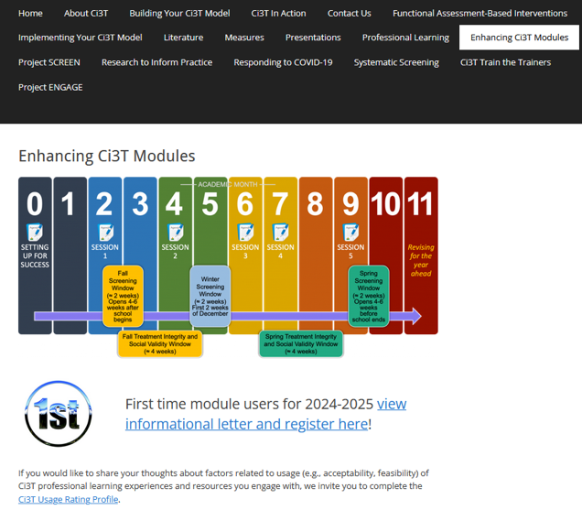
Implementing Comprehensive, Integrated, Three-tiered (Ci3T) Models: Using Data to Inform Professional Learning
Enhanced Ci3T Implementation Series and Delivery (E-Ci3T) Session 3
If you have not done so already, we invite you to visit ci3t.org/enhance to access modules and complete a one-time registration process!

Slide 2

Ci3T Research Team

Slide 3
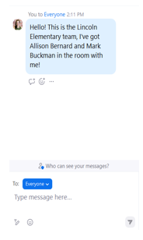

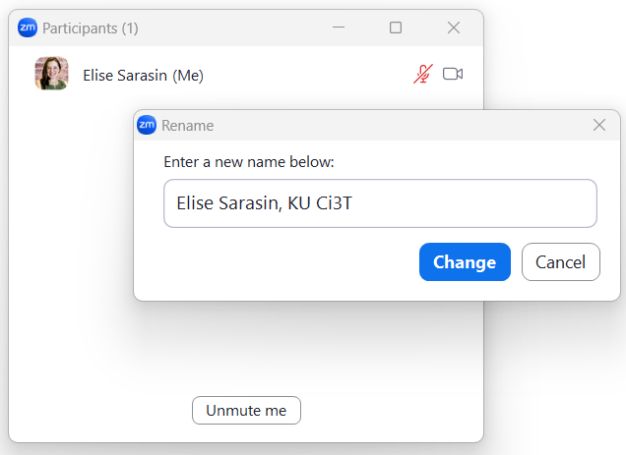
Zoom Logistics
If you are facilitating a Ci3T Leadership Team Symposium session at a satellite location, please email us a list of the names, email addresses, and schools of those attending.
To help us put you in breakout rooms with your colleagues today we are renaming you with your school initials and first and last name
If there are multiple people in the room with you, please list their first and last names and email in the chat!

Slide 4
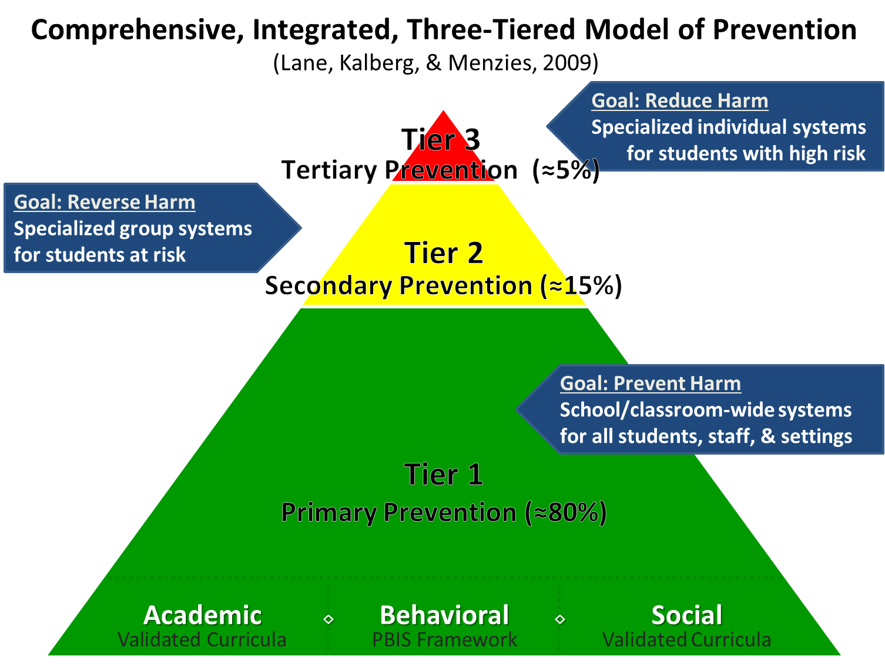
Comprehensive, Integrated, Three-Tiered Model of Prevention 1

Slide 5
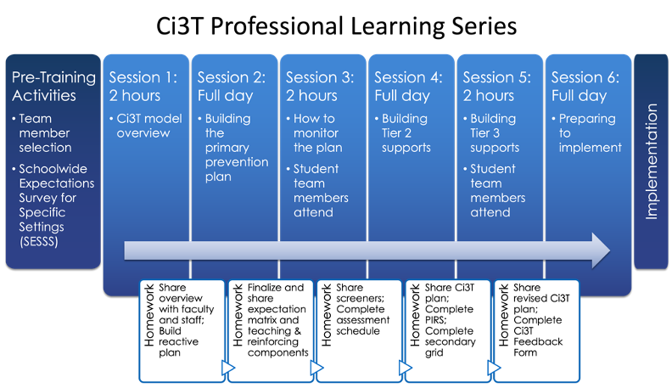
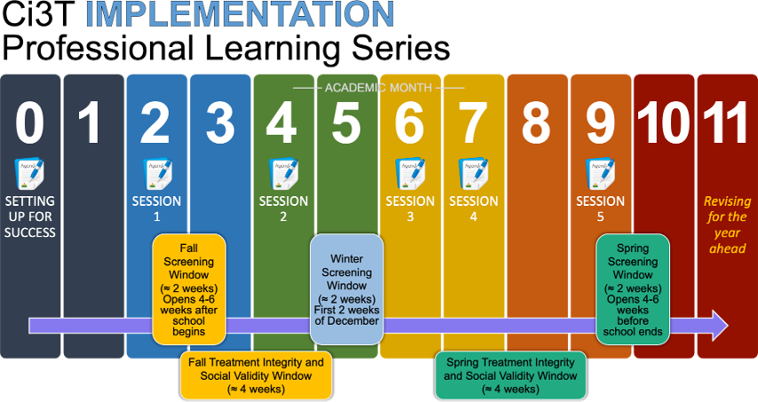

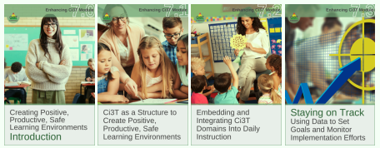


Ci3T Comprehensive
Professional Learning Plan

Slide 6
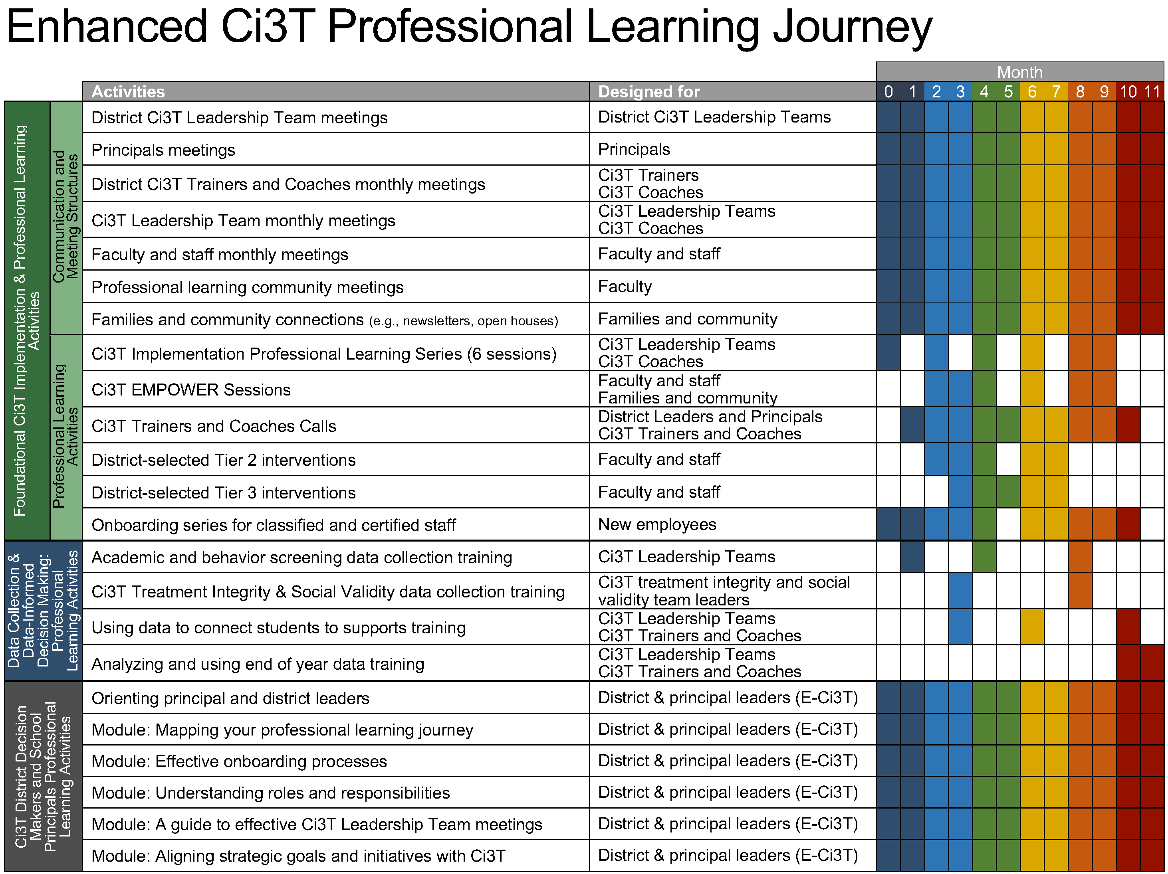
Enhanced Ci3T Implementation Series and Delivery

Slide 7
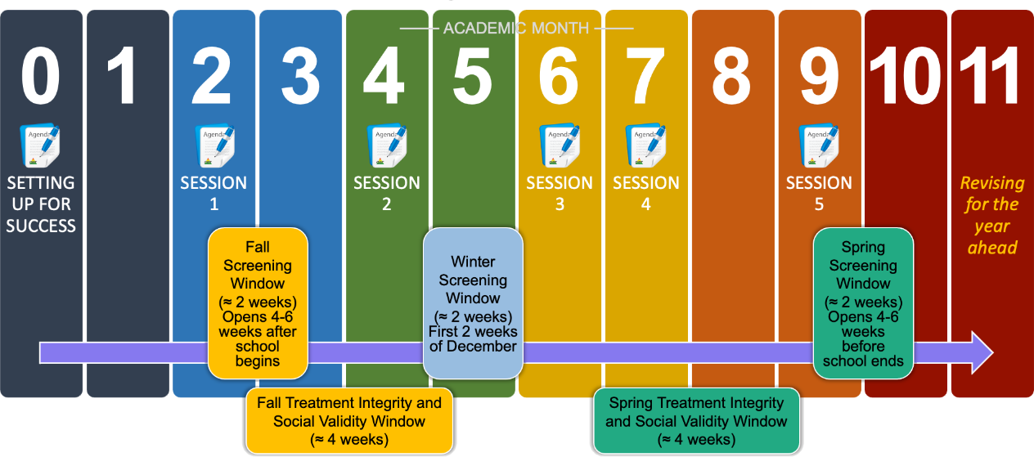
Ci3T Implementation Professional Learning Series
Notes:
The Ci3T Implementation Professional Learning Series is a 6-part series that spans the academic year. Sessions are timed to correspond to important milestones including: the beginning of the school year (e.g., kicking off the year, rolling out the Ci3T plan), screening windows, and treatment integrity and social validity windows.
Each session is data-informed, meaning attending Ci3T Leadership Team members review data, which are used to (a) identify successes, (b) identify focus areas (e.g., aspects of implementation that require additional attention, often via professional learning), and (c) create action plans to share data back and address focus areas.
Sessions applicable for both new and seasoned implementers as the focus is on predicable components of Ci3T implementation, space to review and respond to data, exploring resources to support implementation efforts, and beginning conversations and action plans.

Slide 8
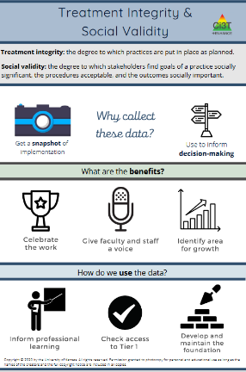
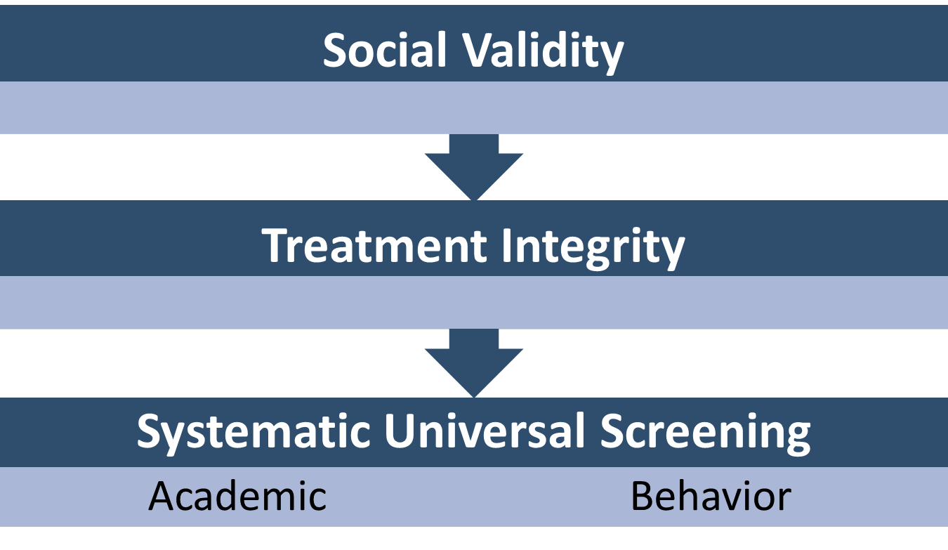
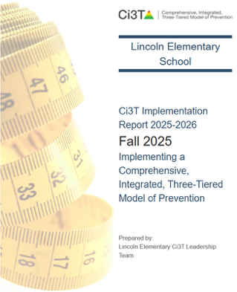
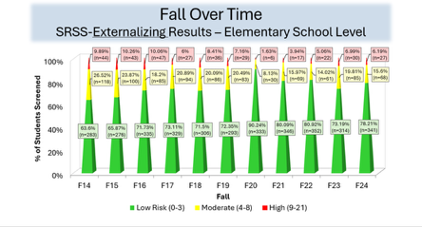
Essential Components of Primary (Tier 1) Prevention Efforts
Essential Components of Primary (Tier 1) Prevention Efforts 1

Slide 9



Enhancing Ci3T Modules
ci3t.org/enhance

Slide 10
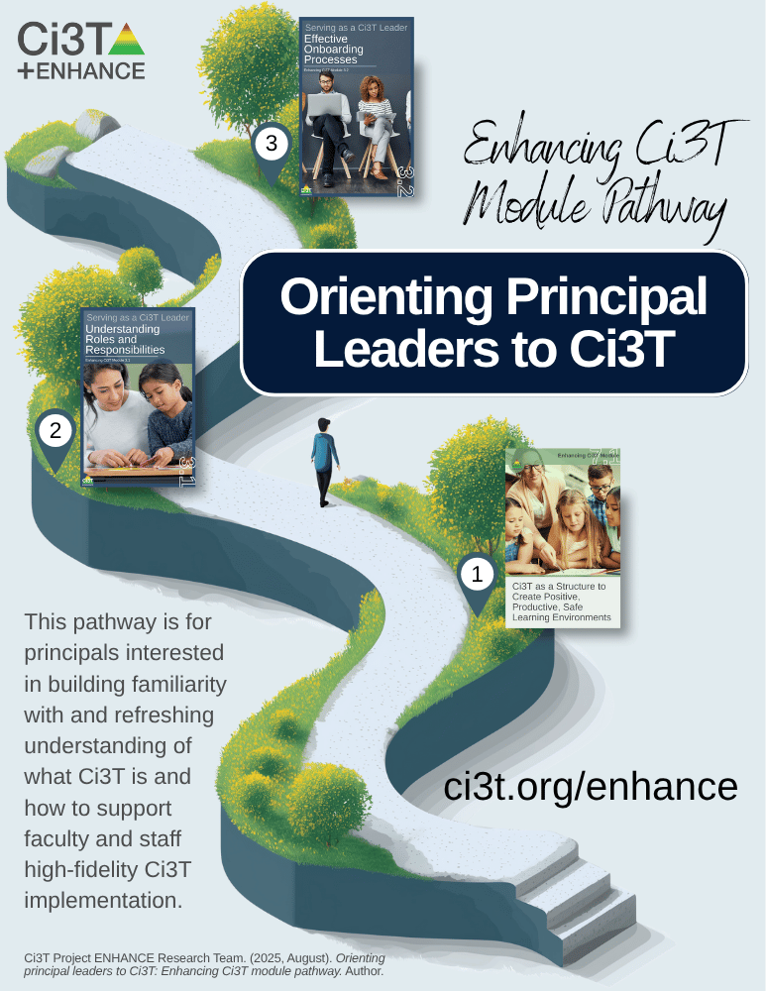
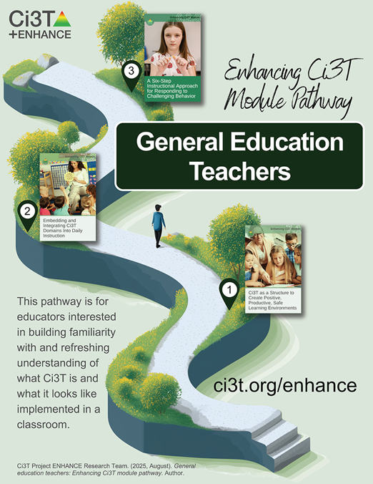
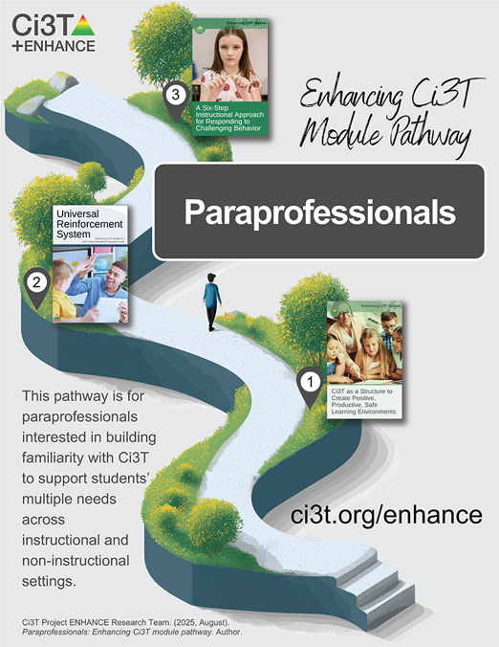
Module Pathways

Slide 11
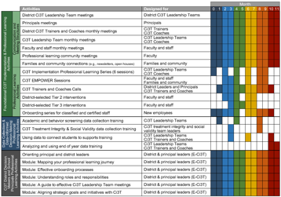
Session Outcomes
Interpret social validity, treatment integrity, and winter screening data at the school- and classroom-level to identify successes and focus areas relative to Ci3T implementation.
Develop corresponding professional learning opportunities to empower faculty and staff with effective practices to inform instruction at each level of prevention (e.g., Tier 1, low-intensity strategies, Tier 2 and Tier 3 interventions) according to needs identified in social validity, treatment integrity, and winter screening data.

Slide 12
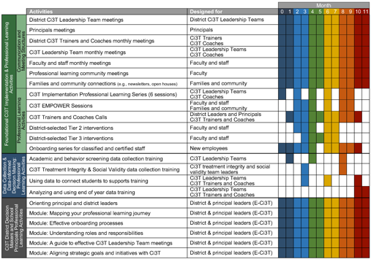
Agenda
Welcome
Procedures for Monitoring
  Review Social Validity and Treatment Integrity Data
  Review your Winter Screening Data
Data-Informed Decision-Making
  Set Professional Learning Targets and Resources
  Develop Communication Plans with Staff and Families
Wrapping Up and Moving Forward

Slide 13
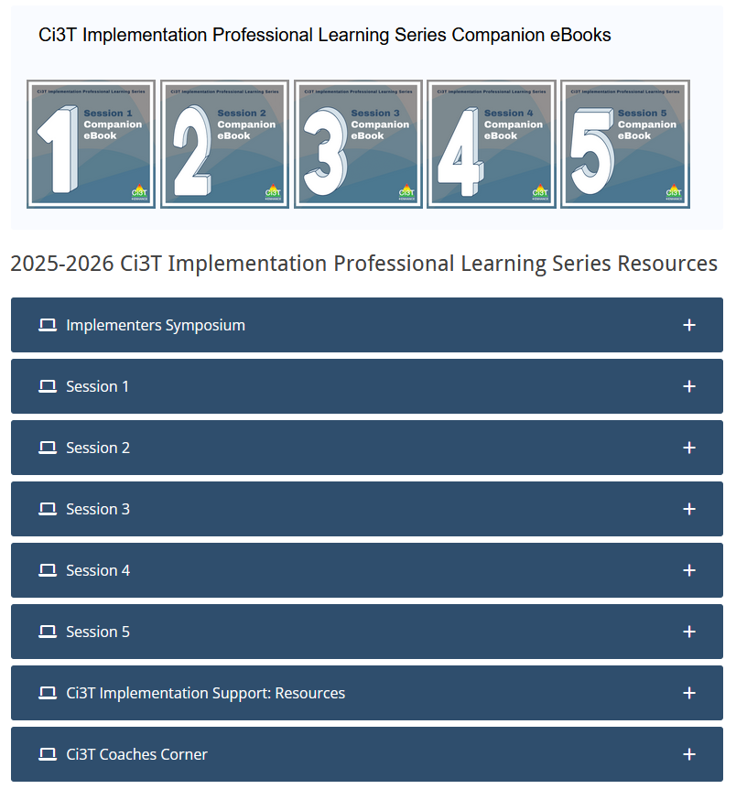
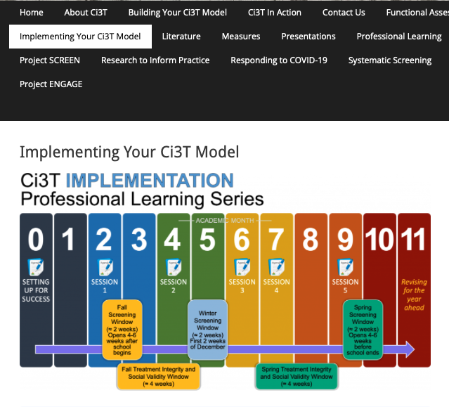
Accessing Professional Learning Materials
Accessing Professional Learning Materials 1
ci3t.org/imp

Slide 14
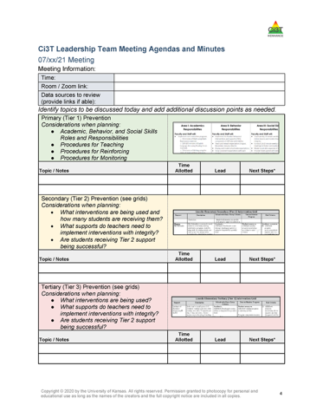

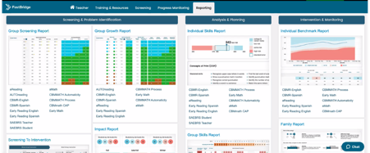
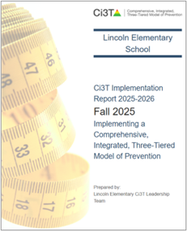
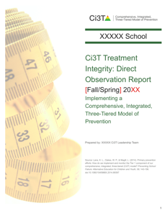
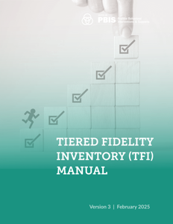
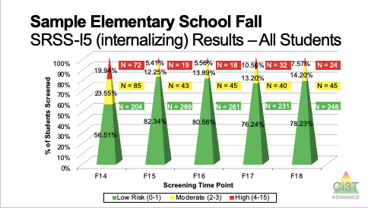
Materials for Today’s Session
Ci3T Leadership Team Agenda
Ci3T Implementation Manual
Winter Screening Data
Fall Treatment Integrity and Social Validity Data

Slide 15

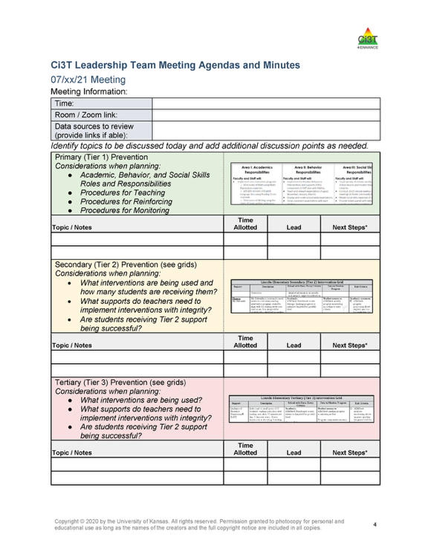
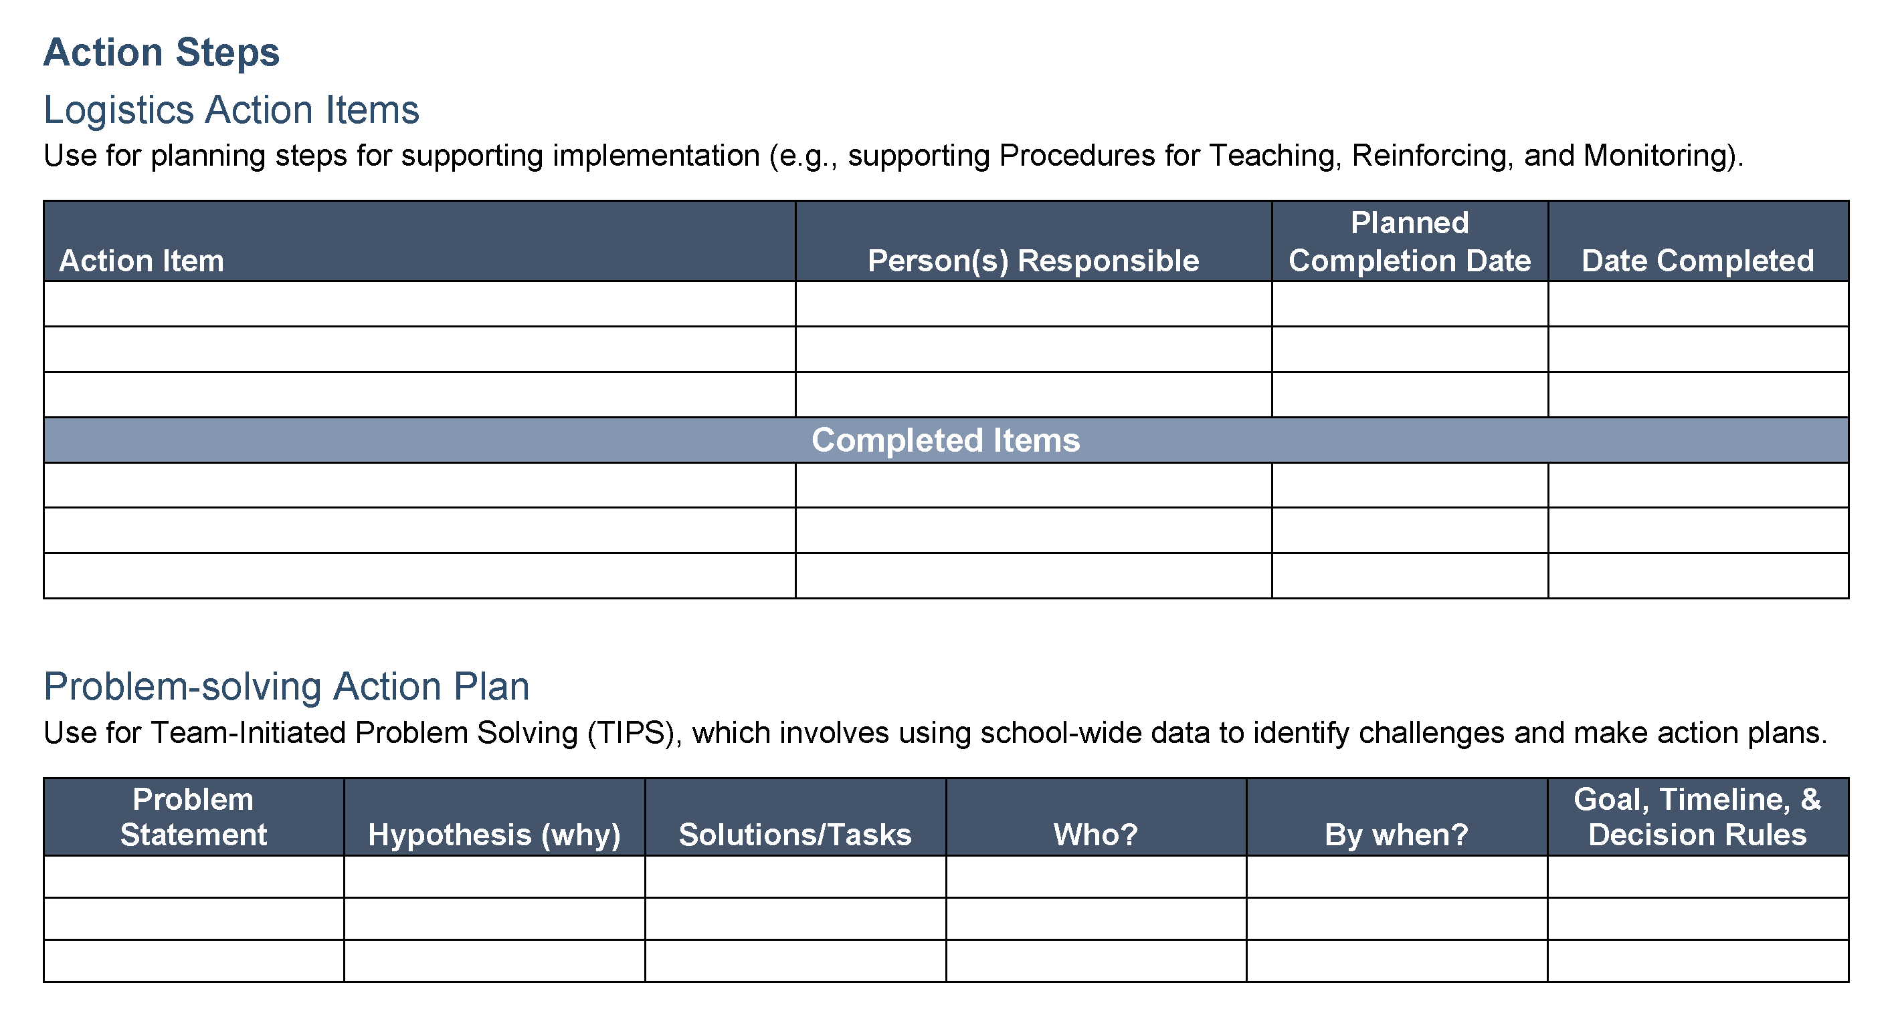

Ci3T Leadership Team Agenda Template
1.2 TEAM OPERATING PROCEDURES
Tier 1 leadership team has (a) regular meeting format/agenda that prompts the regular review of Tier 1 practices, systems, and data, (b) minutes available to all staff for review, (c) established and regularly used team norms, (d) defined meeting roles (e.g., timekeeper, facilitator, recorder), (e) regular (e.g., quarterly) two-way data sharing and communication with advanced tiers teams to inform decision making, (f) a current action plan, (g) procedure for evaluating fidelity of team operating procedures (e.g., Team Initiated Problem Solving [TIPS] Fidelity Checklist) at least twice annually, and (h) a formal process to monitor the impact of team norms and procedures on ensuring all team members are able to participate as equal partners

Slide 16
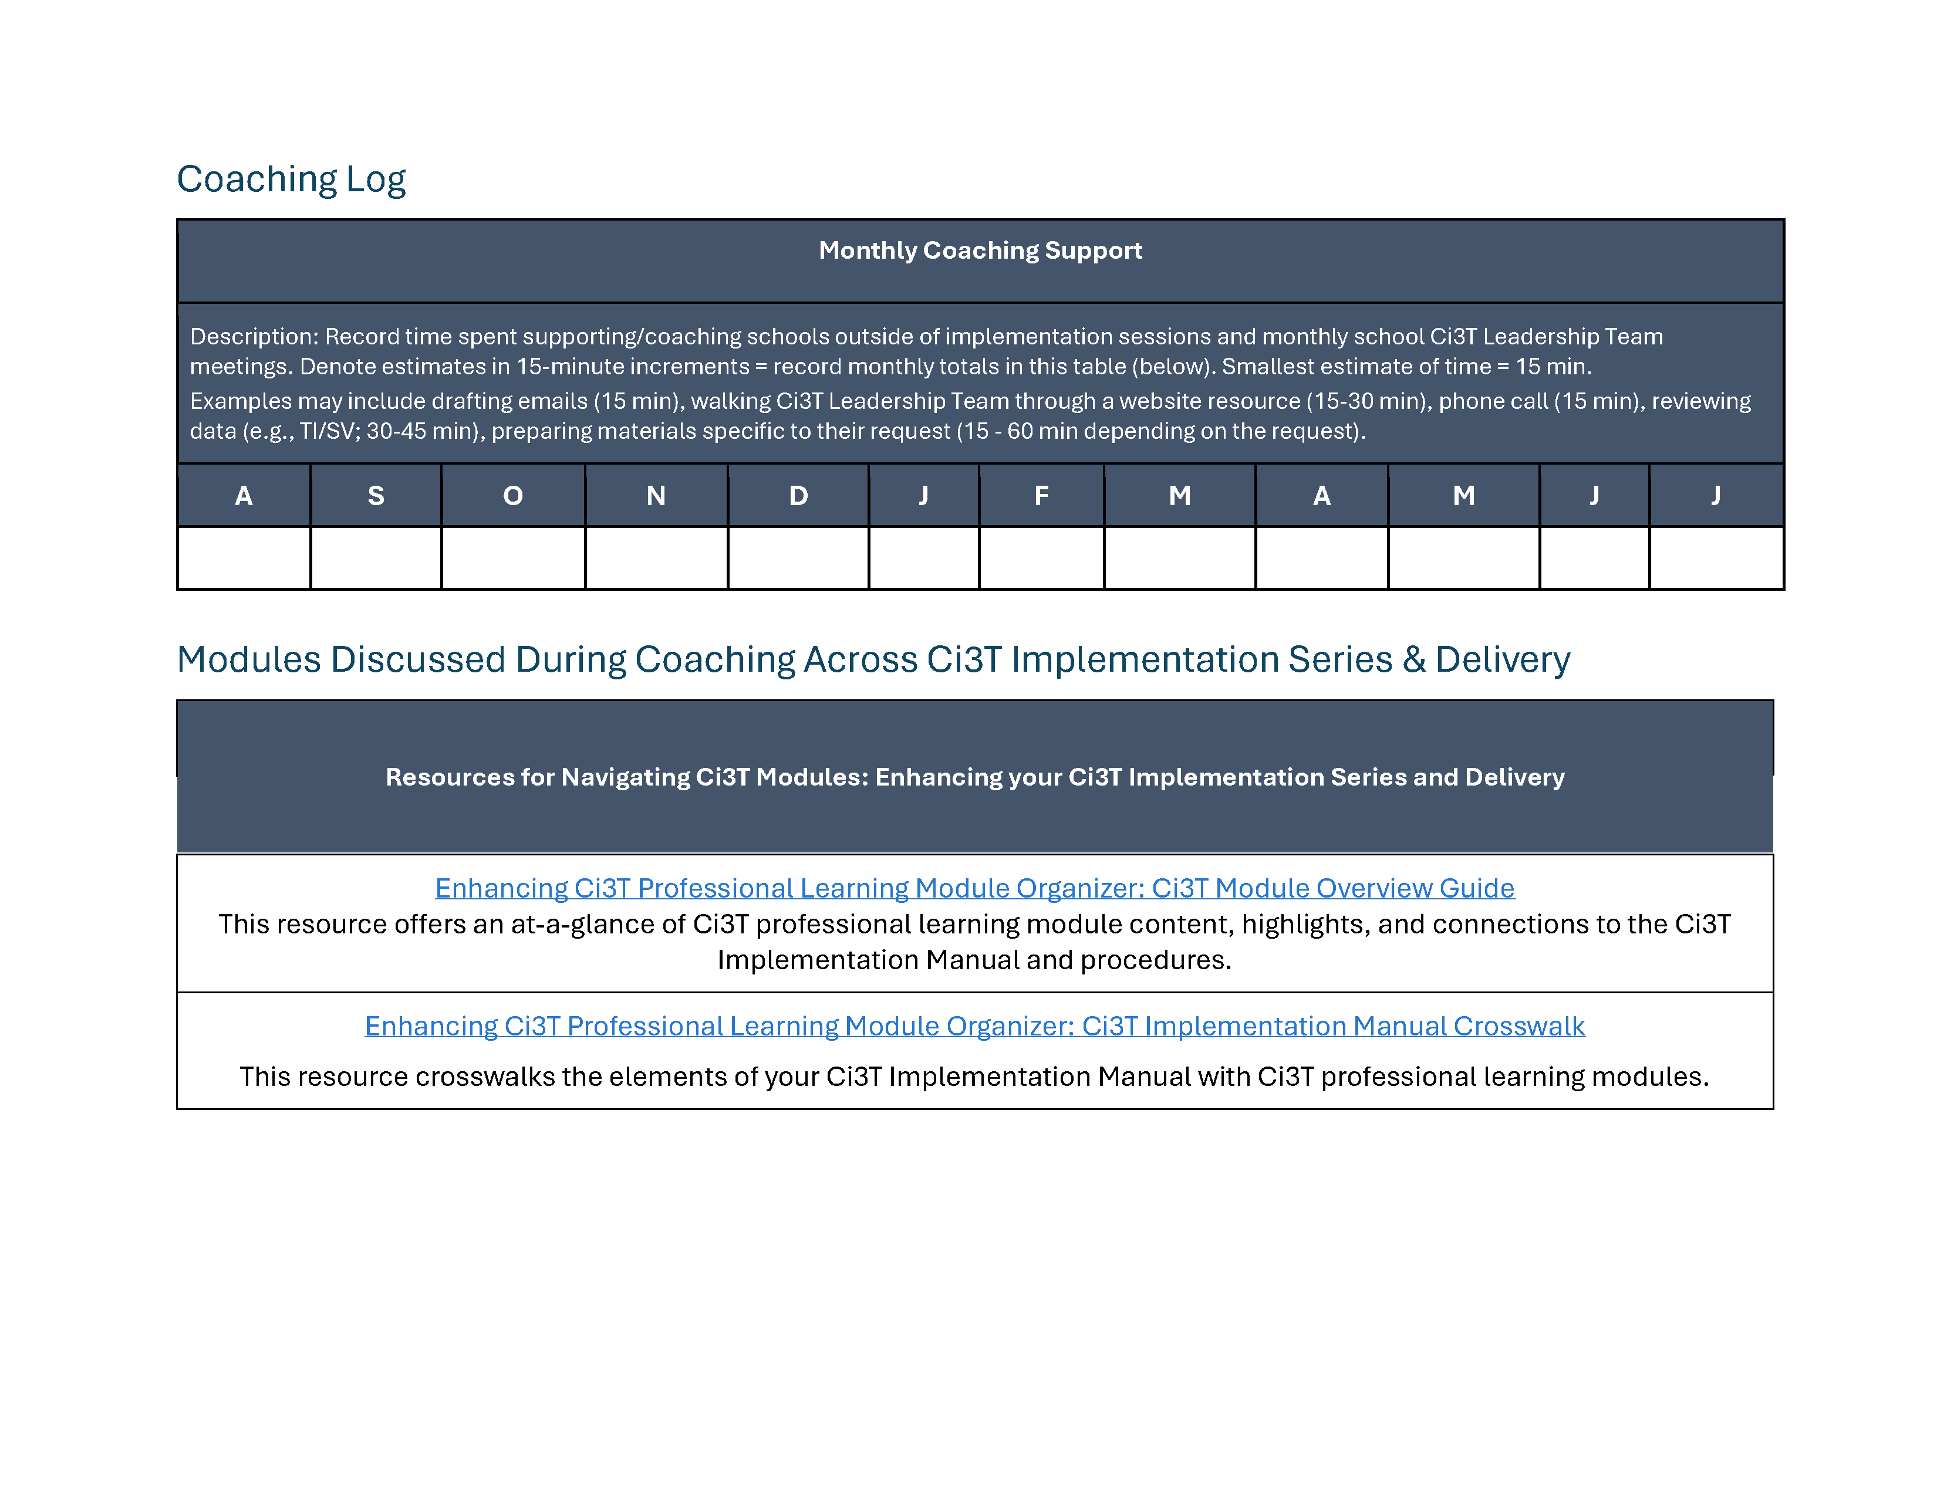
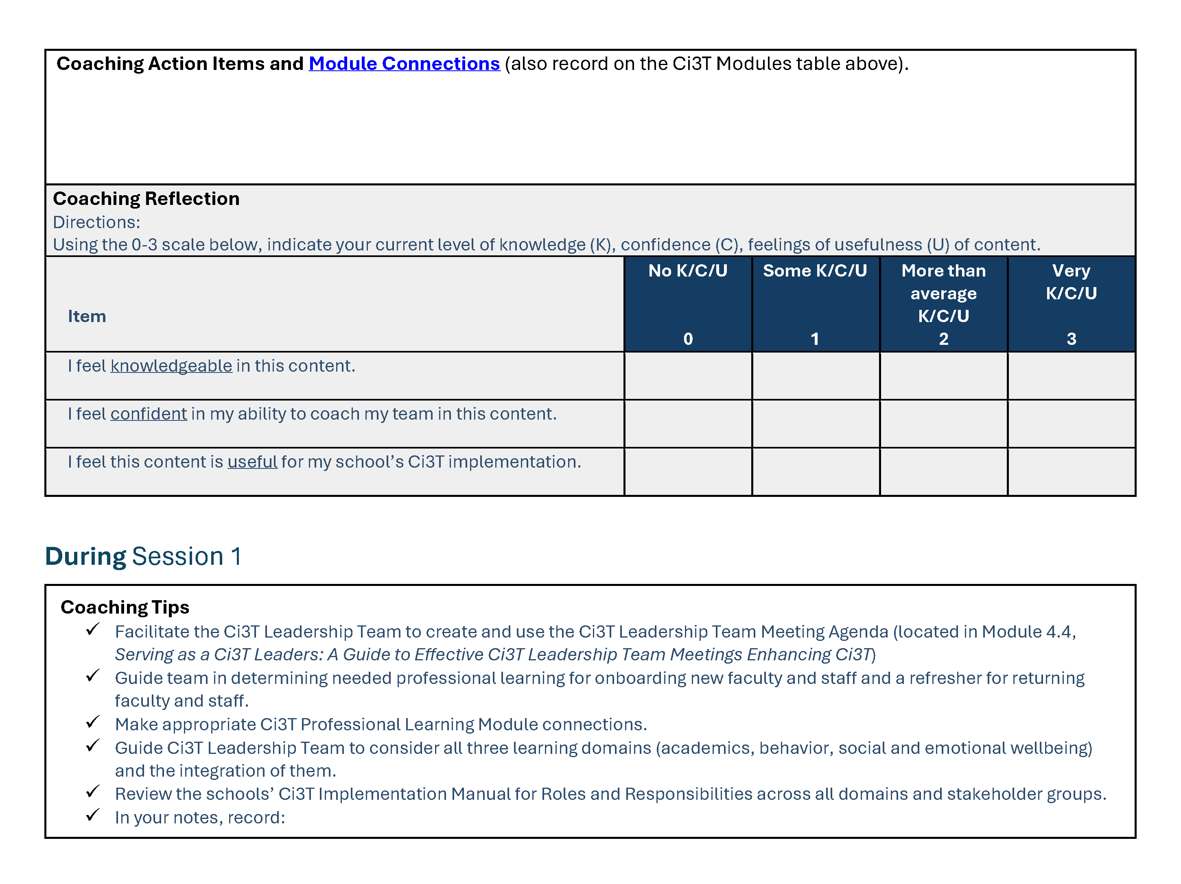
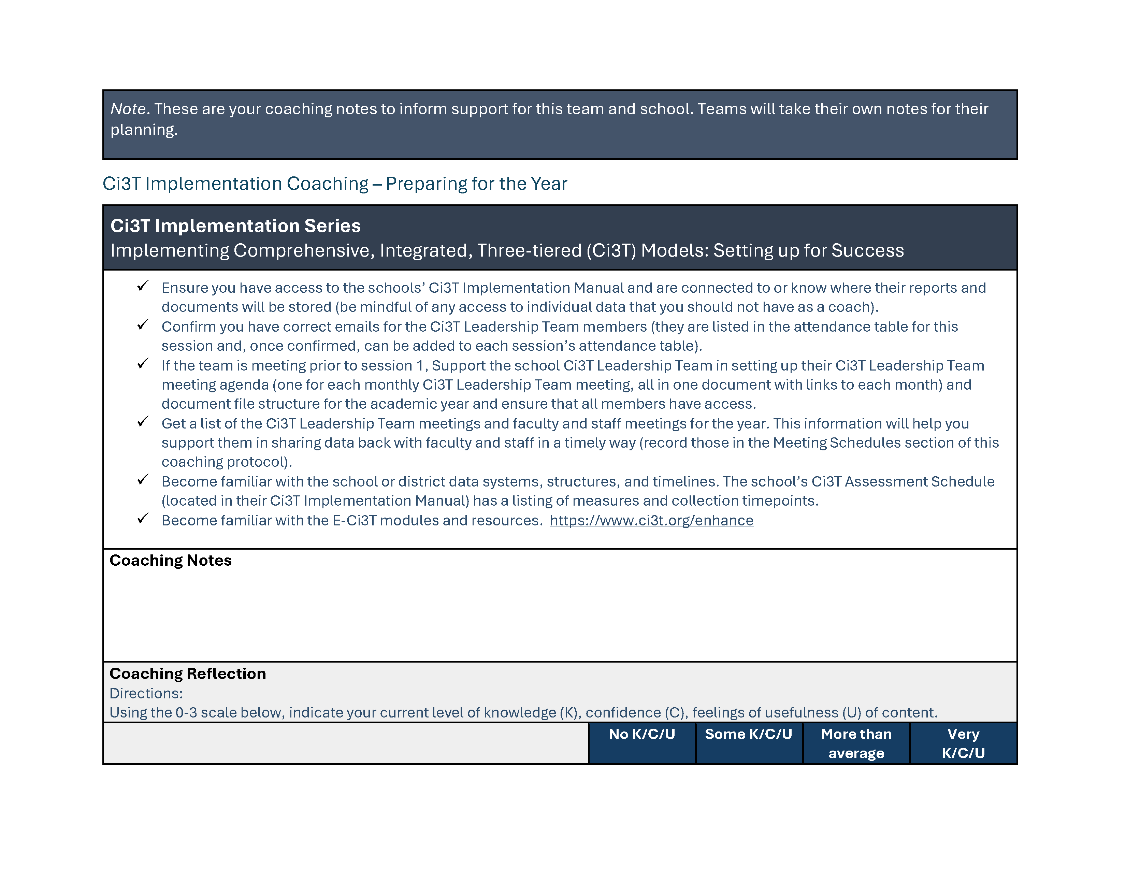
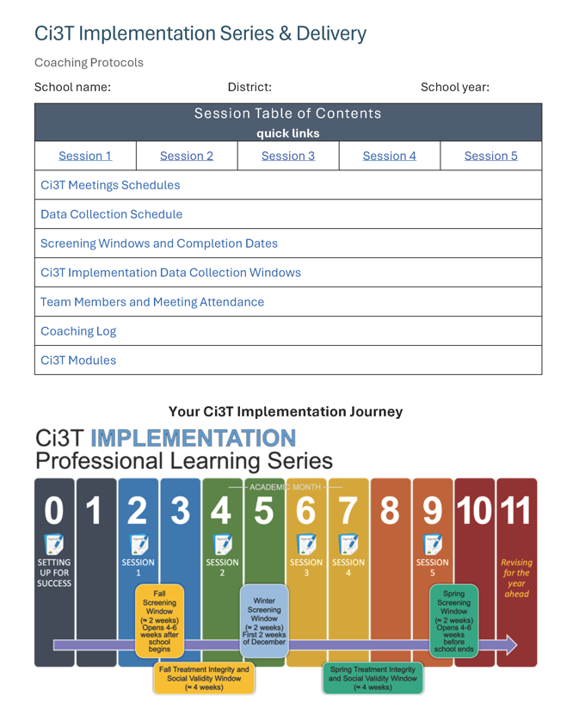
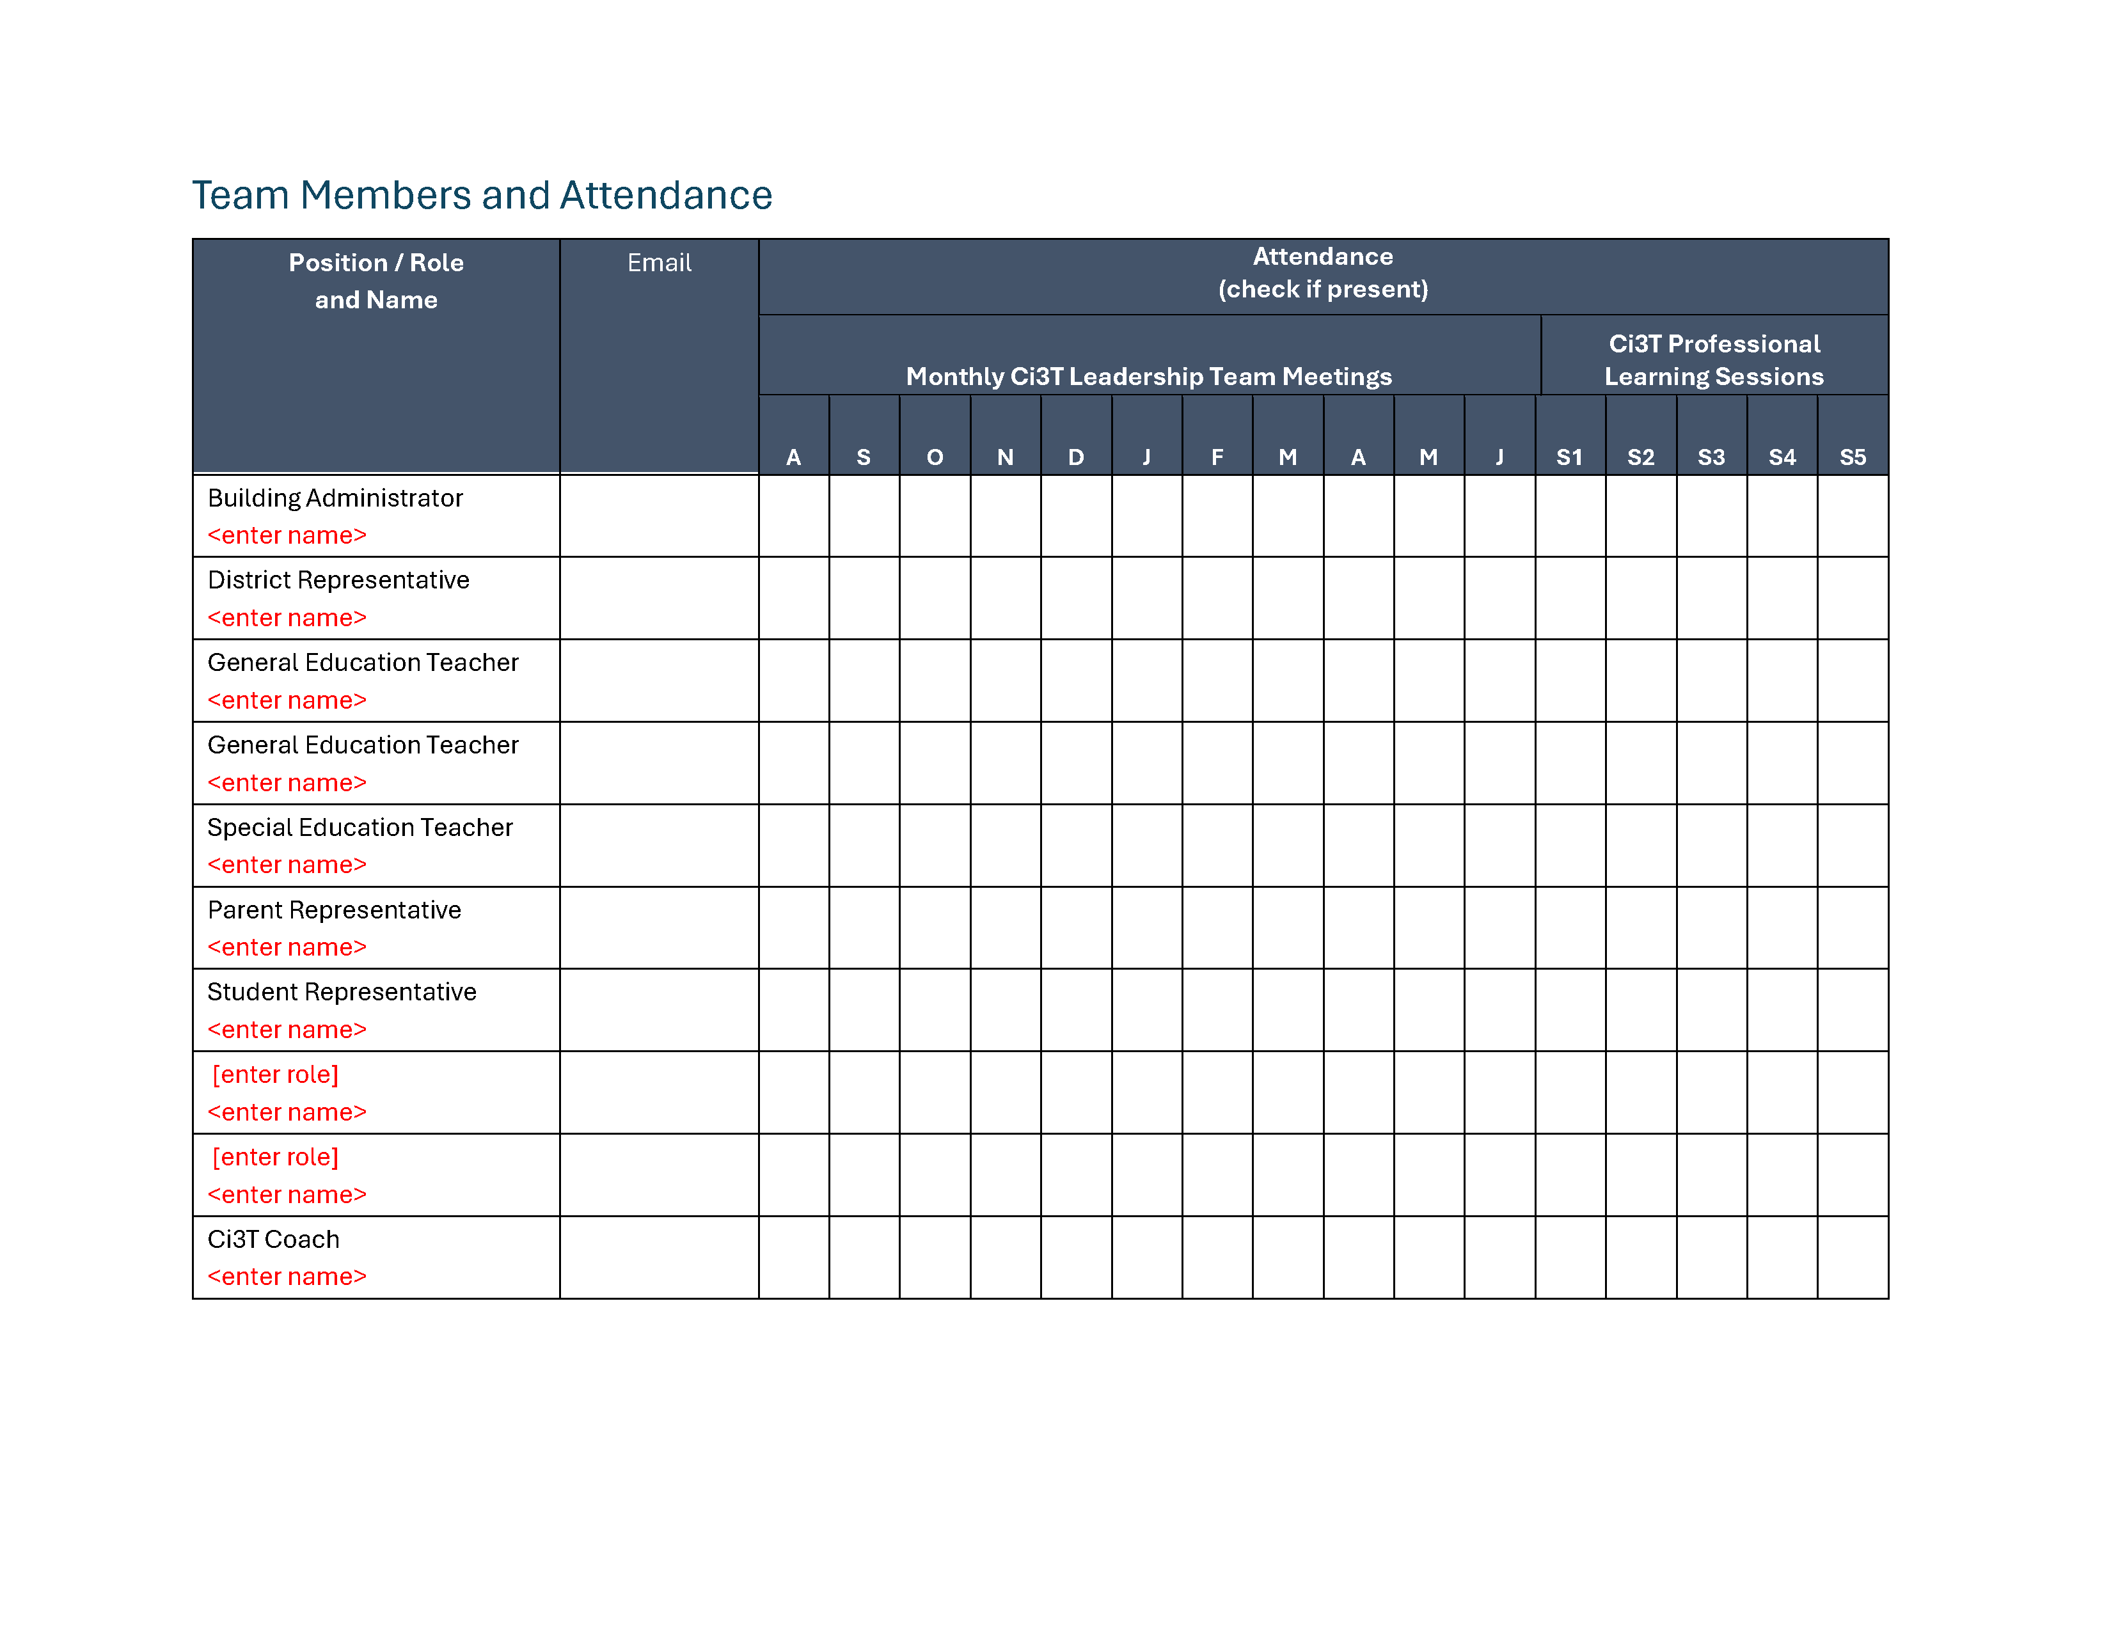
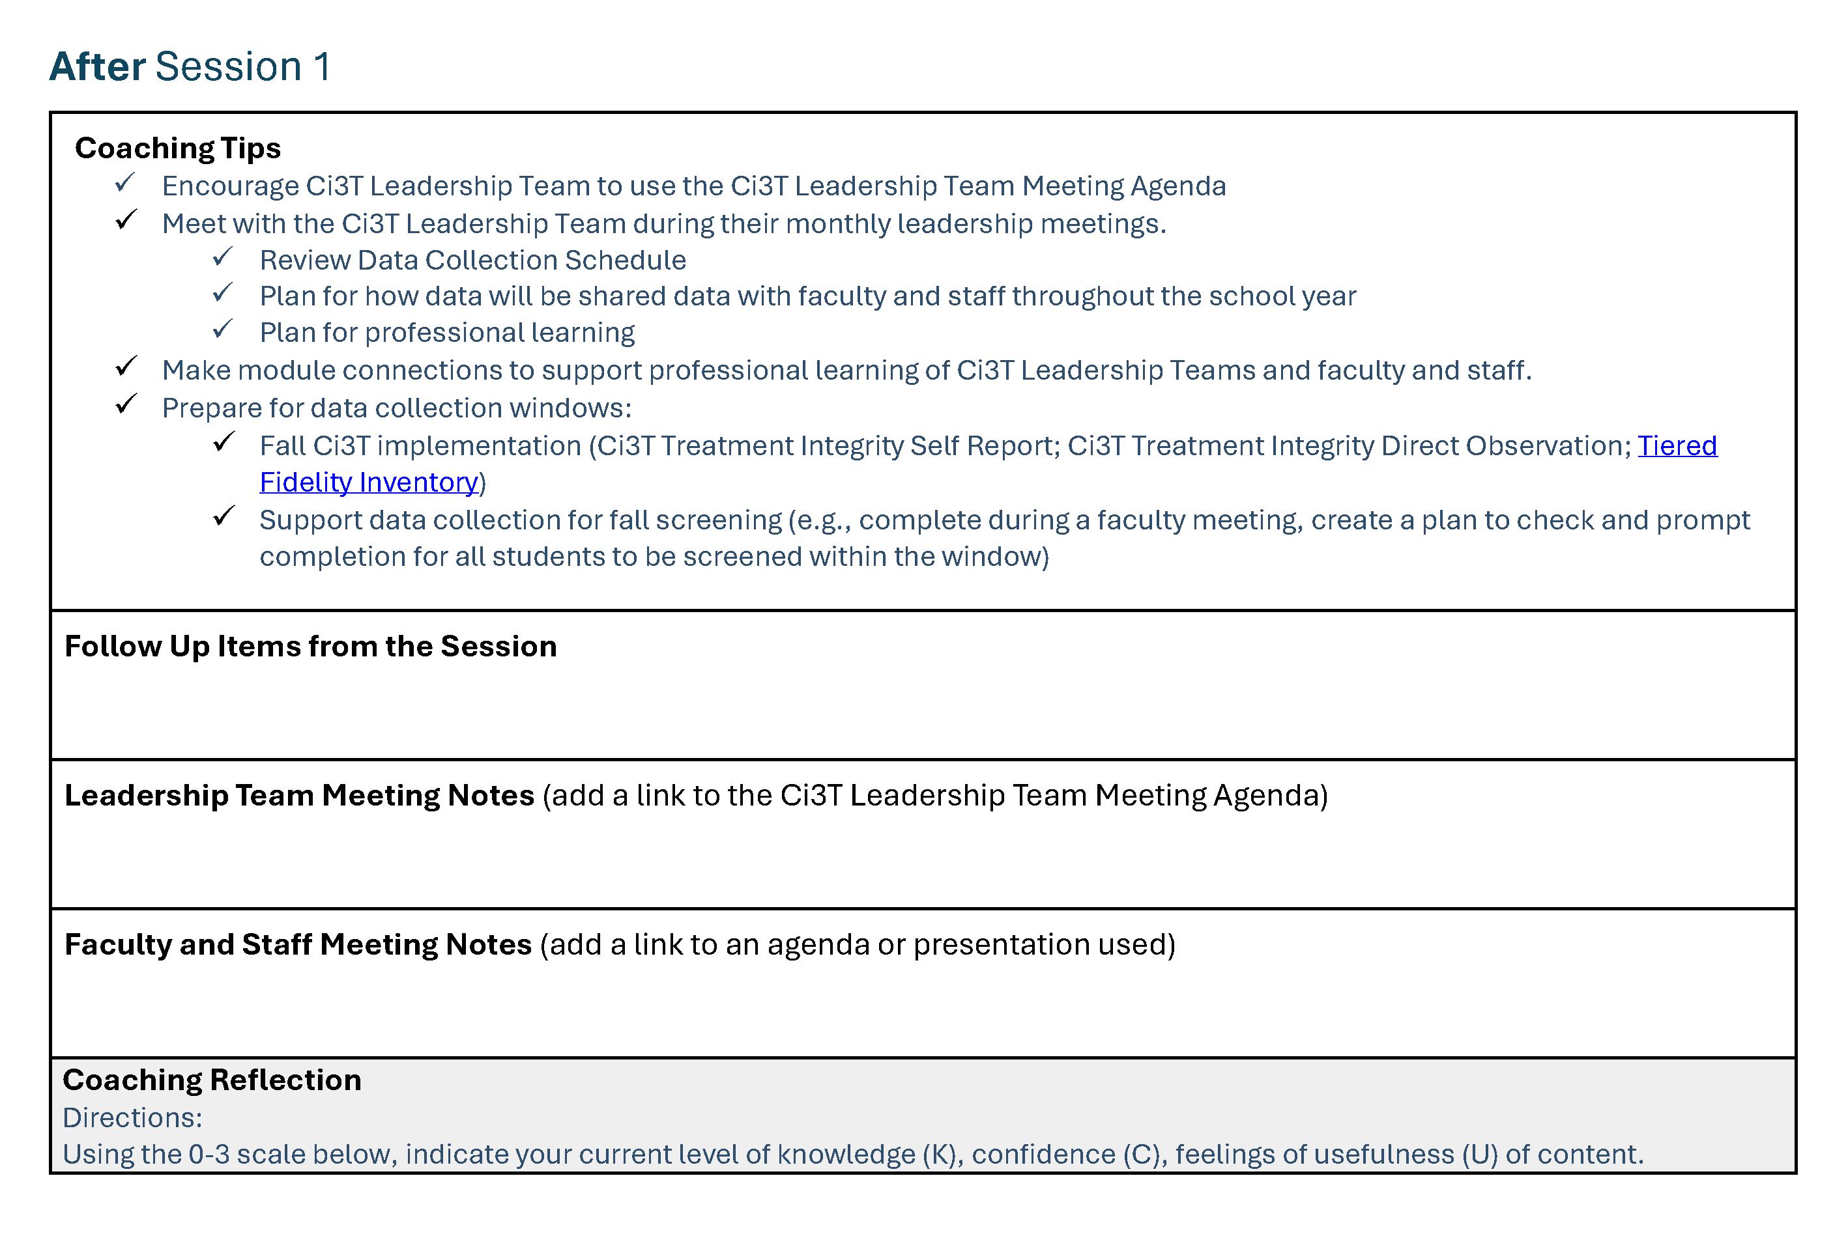
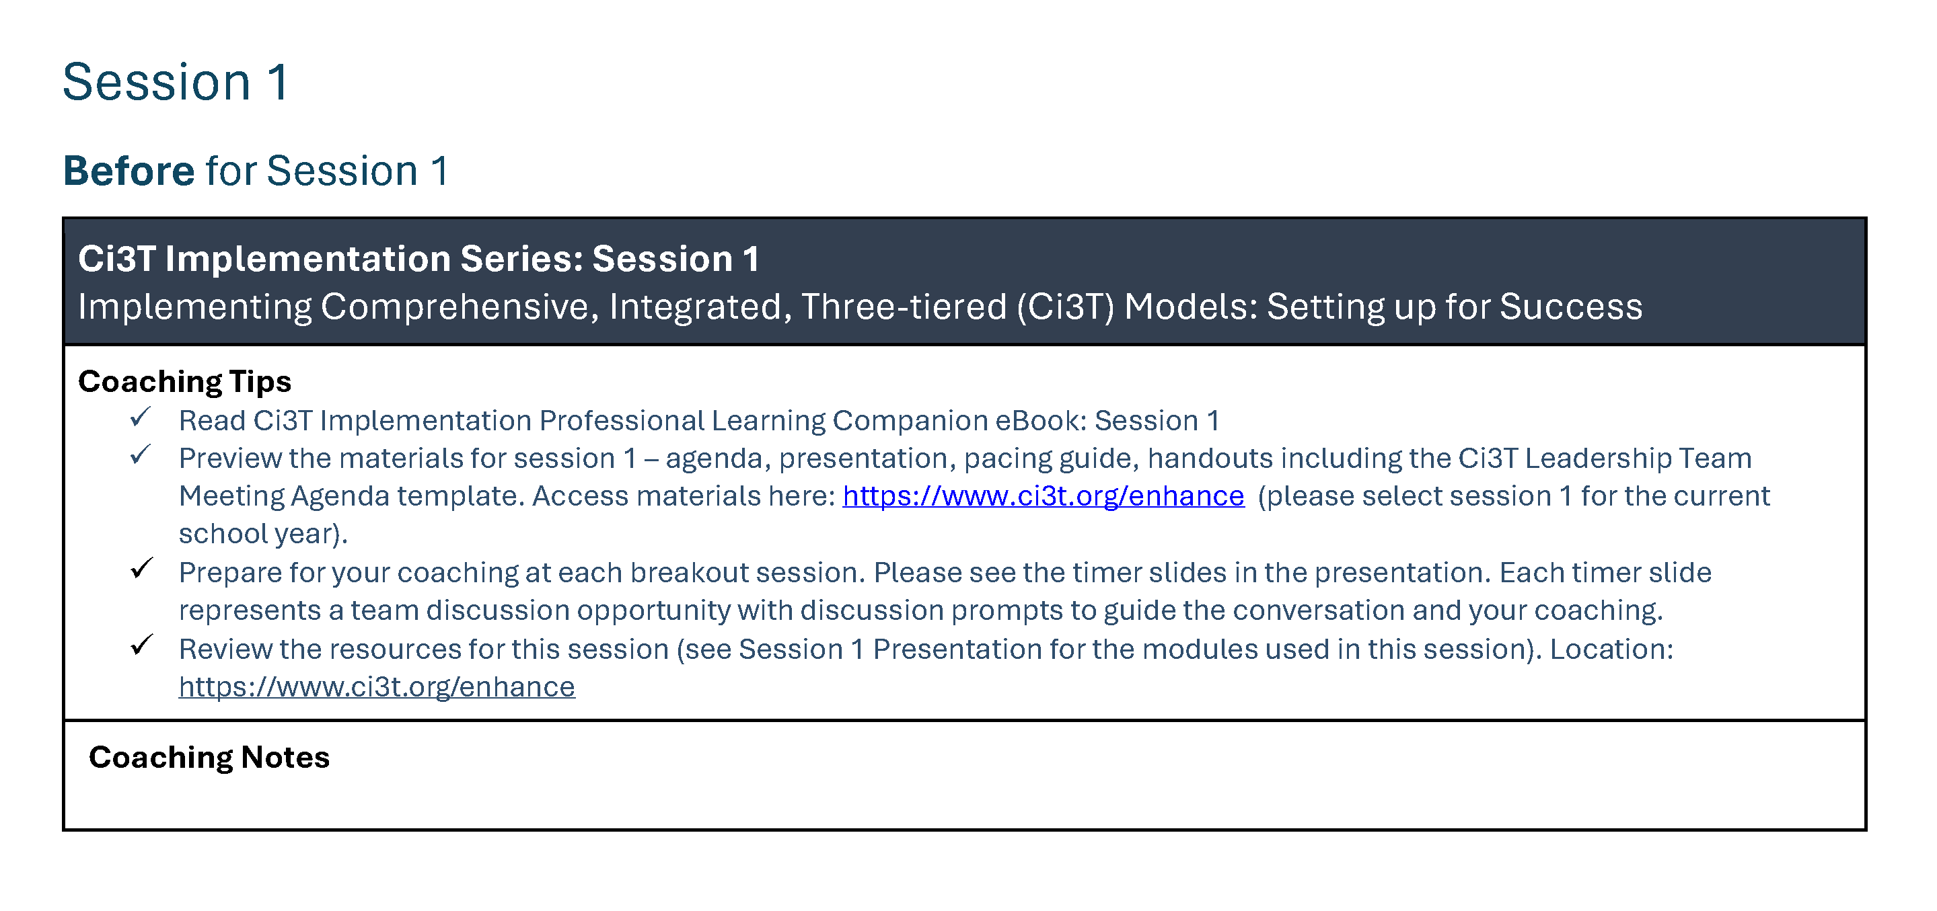
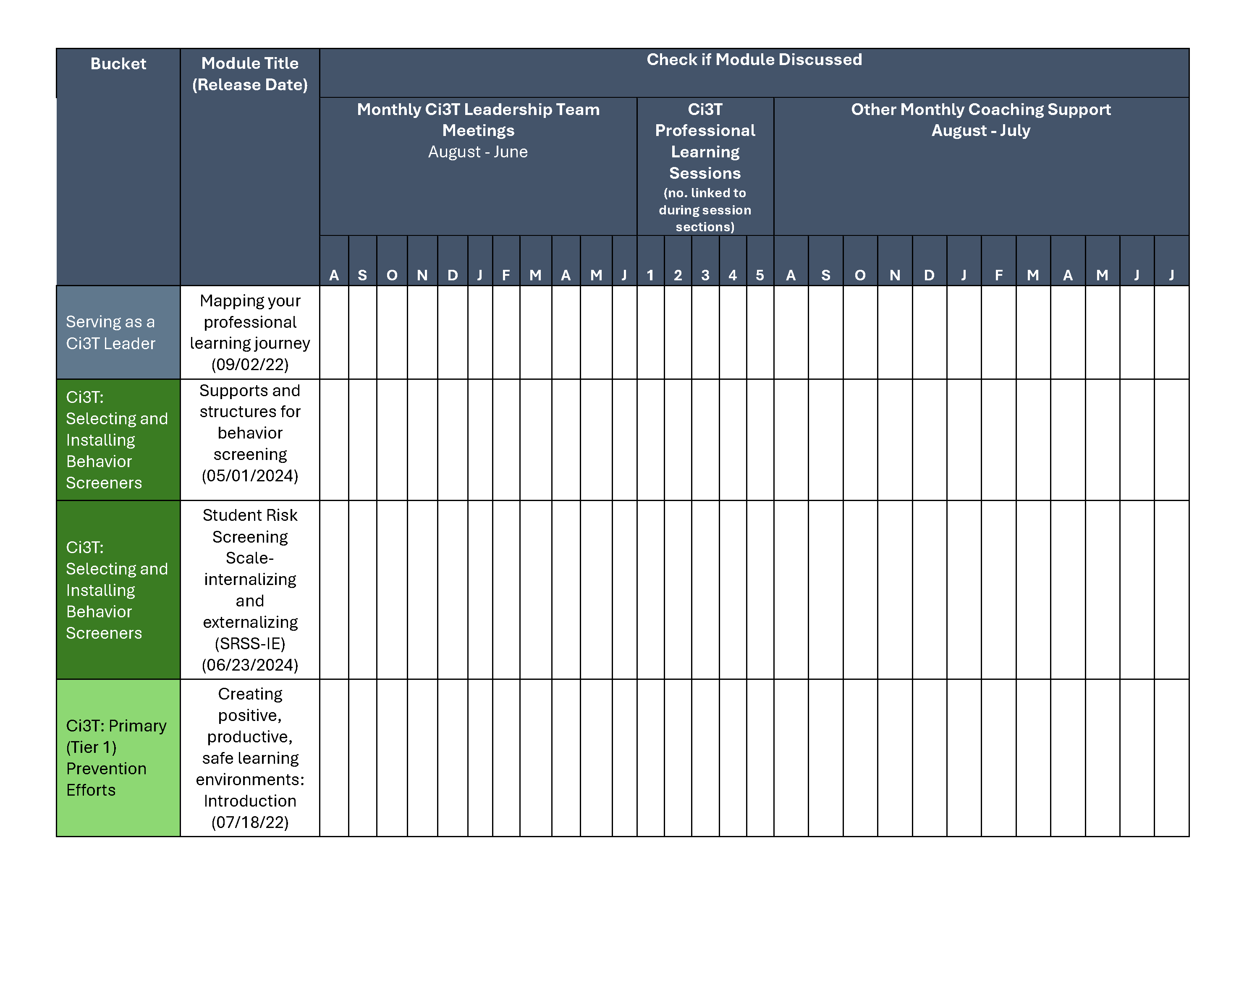
Coaching Protocol

Slide 17
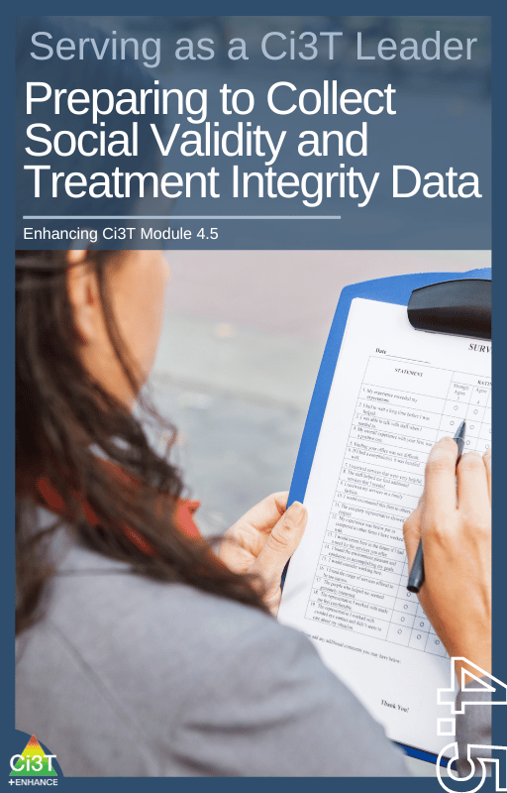
Procedures for Monitoring
Review Social Validity & Treatment Integrity Data
Review your School’s Winter Screening Data
1.19 DECISION MAKING WITH FIDELITY DATA
Tier 1 leadership team reviews and uses schoolwide (e.g., TFI, BoQ, TIC, SAS, SET) and other fidelity data (e.g.,
classroom implementation, Tier 1 SEB curriculum, staff wellness systems) at least annually.

Slide 18
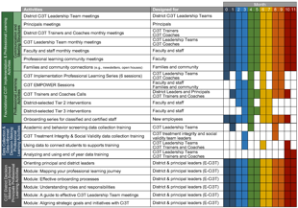
Session Outcomes
Session Outcomes 1
Interpret social validity, treatment integrity, and winter screening data at the school- and classroom-level to identify successes and focus areas relative to Ci3T implementation.
Develop corresponding professional learning opportunities to empower faculty and staff with effective practices to inform instruction at each level of prevention (e.g., Tier 1, low-intensity strategies, Tier 2 and Tier 3 interventions) according to needs identified in social validity, treatment integrity, and winter screening data.

Slide 19
Essential Components of Primary (Tier 1) Prevention Efforts
Essential Components of Primary (Tier 1) Prevention Efforts 2

Slide 20
Social Validity
How do stakeholders view the plan?
Social validity refers to the level of:
Social significance of intervention goals
Social acceptability of intervention procedures
Social importance of intervention outcomes
(Wolf, 1978)
Assessed using the Primary Intervention Rating Scale (PIRS)
Social Validity: PIRS Results
Year | Fall: n | Fall: % (SD) | Spring: n | Spring: % (SD)
2025-2026 | 32 | 85.39 (8.89) | TBD | TBD
1.14 FACULTY AND STAFF ENGAGEMENT
Tier 1 leadership teams purposefully and regularly engage all faculty and staff in co-designing and actively revising
the content and the implementation of foundational Tier 1 practices (items 1.3-1.10) and systems (items 1.12-
1.13) based on the regular review of schoolwide and community data.

Slide 21
Treatment Integrity
Are we implementing our plan as intended?
Treatment integrity can refer to:
Adherence
Dosage
Quality
Assessed using:
Ci3T Treatment Integrity: Teacher Self-Report
Ci3T Treatment Integrity: Direct Observation
Tiered Fidelity Inventory (TFI)
Ci3T Procedures | Fall 2025 Teacher Self-Report* | Educator Direct Observation* | Observer Direct Observation*
 | n = 45 % (SD) | n = 6 % (SD) | n = 7 % (SD)
Teaching | 80.43% (10.86) | 70.72% (13.81) | 75.02% (17.05)
Reinforcing | 80.83% (12.89) | 62.06% (15.33) | 34.99% (16.02)
Monitoring | 75.49% (18.06) | - | -
Total | 79.10% (11.87) | 67.66% (14.03) | 62.28% (14.58)

Slide 22
Social Validity and Treatment Integrity Logistics Planning
Method | Measure Name | Completed by: All Staff | Completed by: Randomly Selected Classrooms | Completed by: Ci3T Leadership Team
Survey | Ci3T Treatment Integrity: Teacher Self-Report and Primary Intervention Rating Scale | X
Observations | Ci3T Treatment Integrity: Direct Observation |  | X
Rubric | Tiered Fidelity Inventory (TFI) |  |  | X

Slide 23
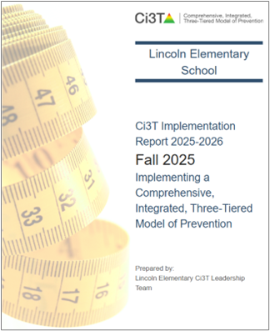
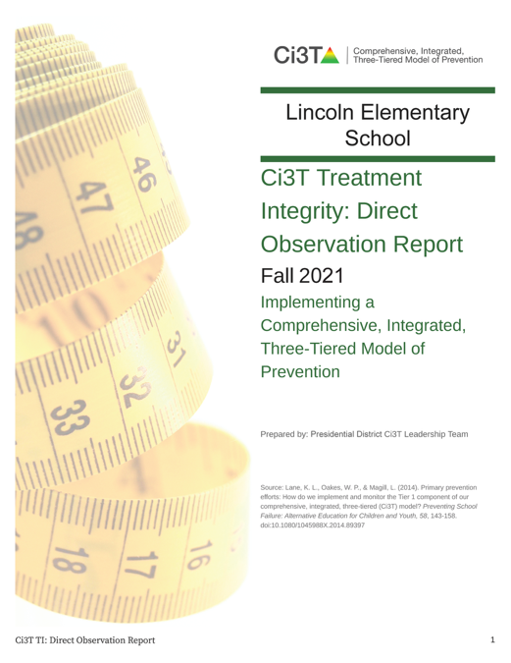

Treatment Integrity and Social Validity Data Sources
Treatment Integrity and Social Validity Data Sources 1
Fall 2025
Primary Intervention Rating Scale (Social Validity)
Ci3T Treatment Integrity: Teacher Self Report
Ci3T Treatment Integrity: Direct Observation
Tiered Fidelity Inventory

Slide 24

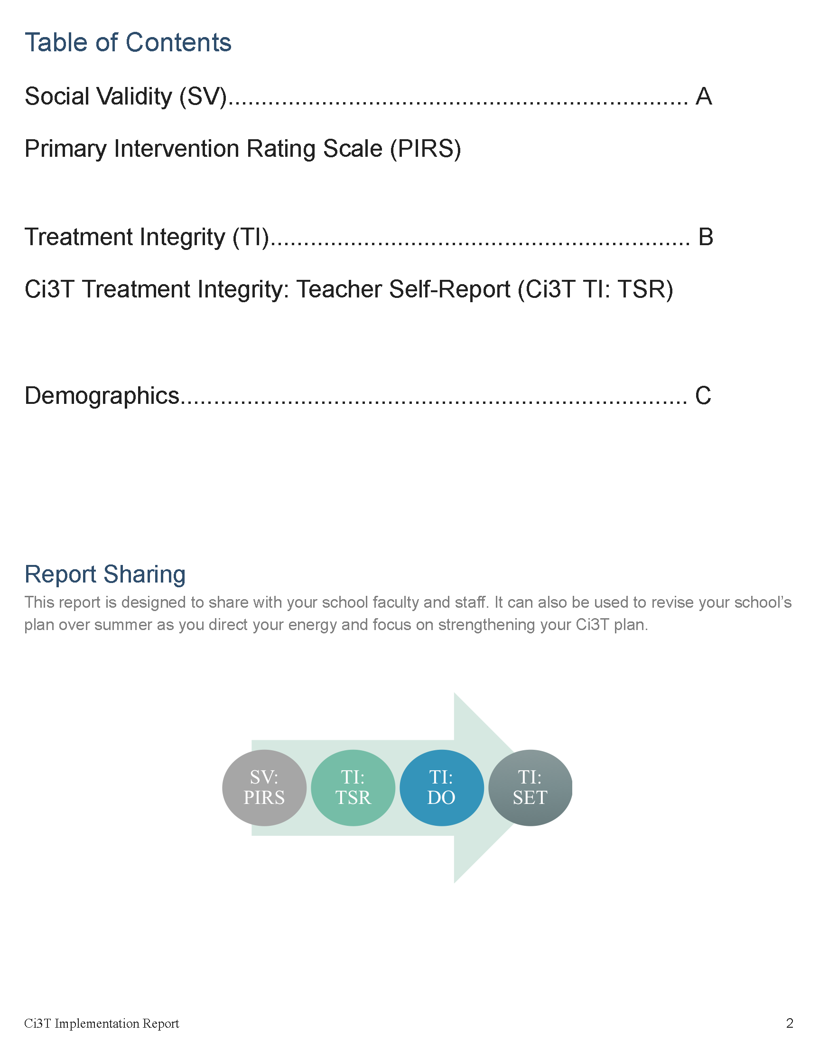
Ci3T Implementation Report
Primary Intervention Rating Scale (Social Validity; PIRS)
Ci3T Treatment Integrity: Teacher Self Report (Ci3T TI: TSR)
Demographics (e.g., role)

Slide 25
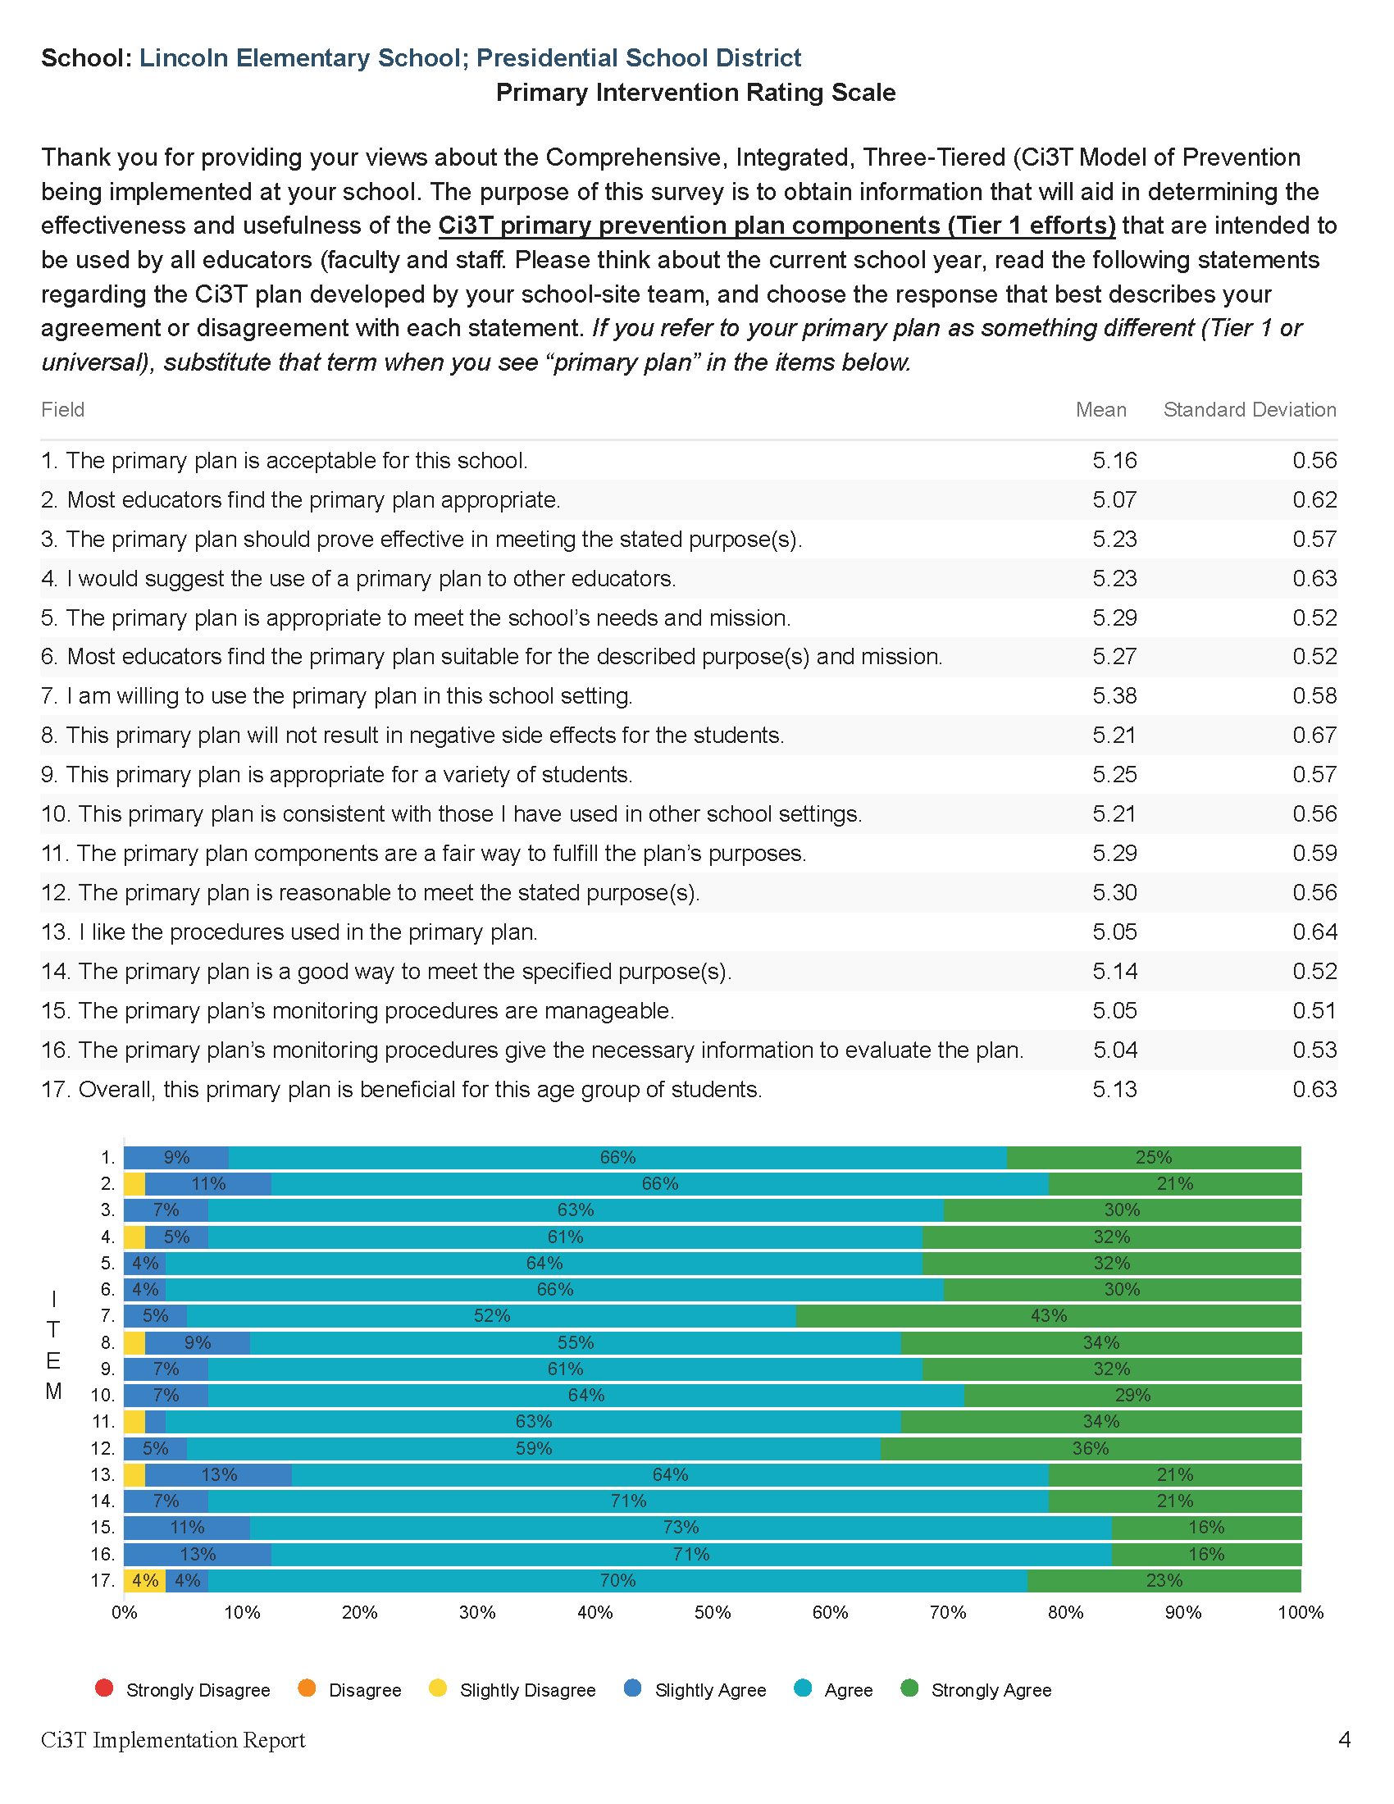
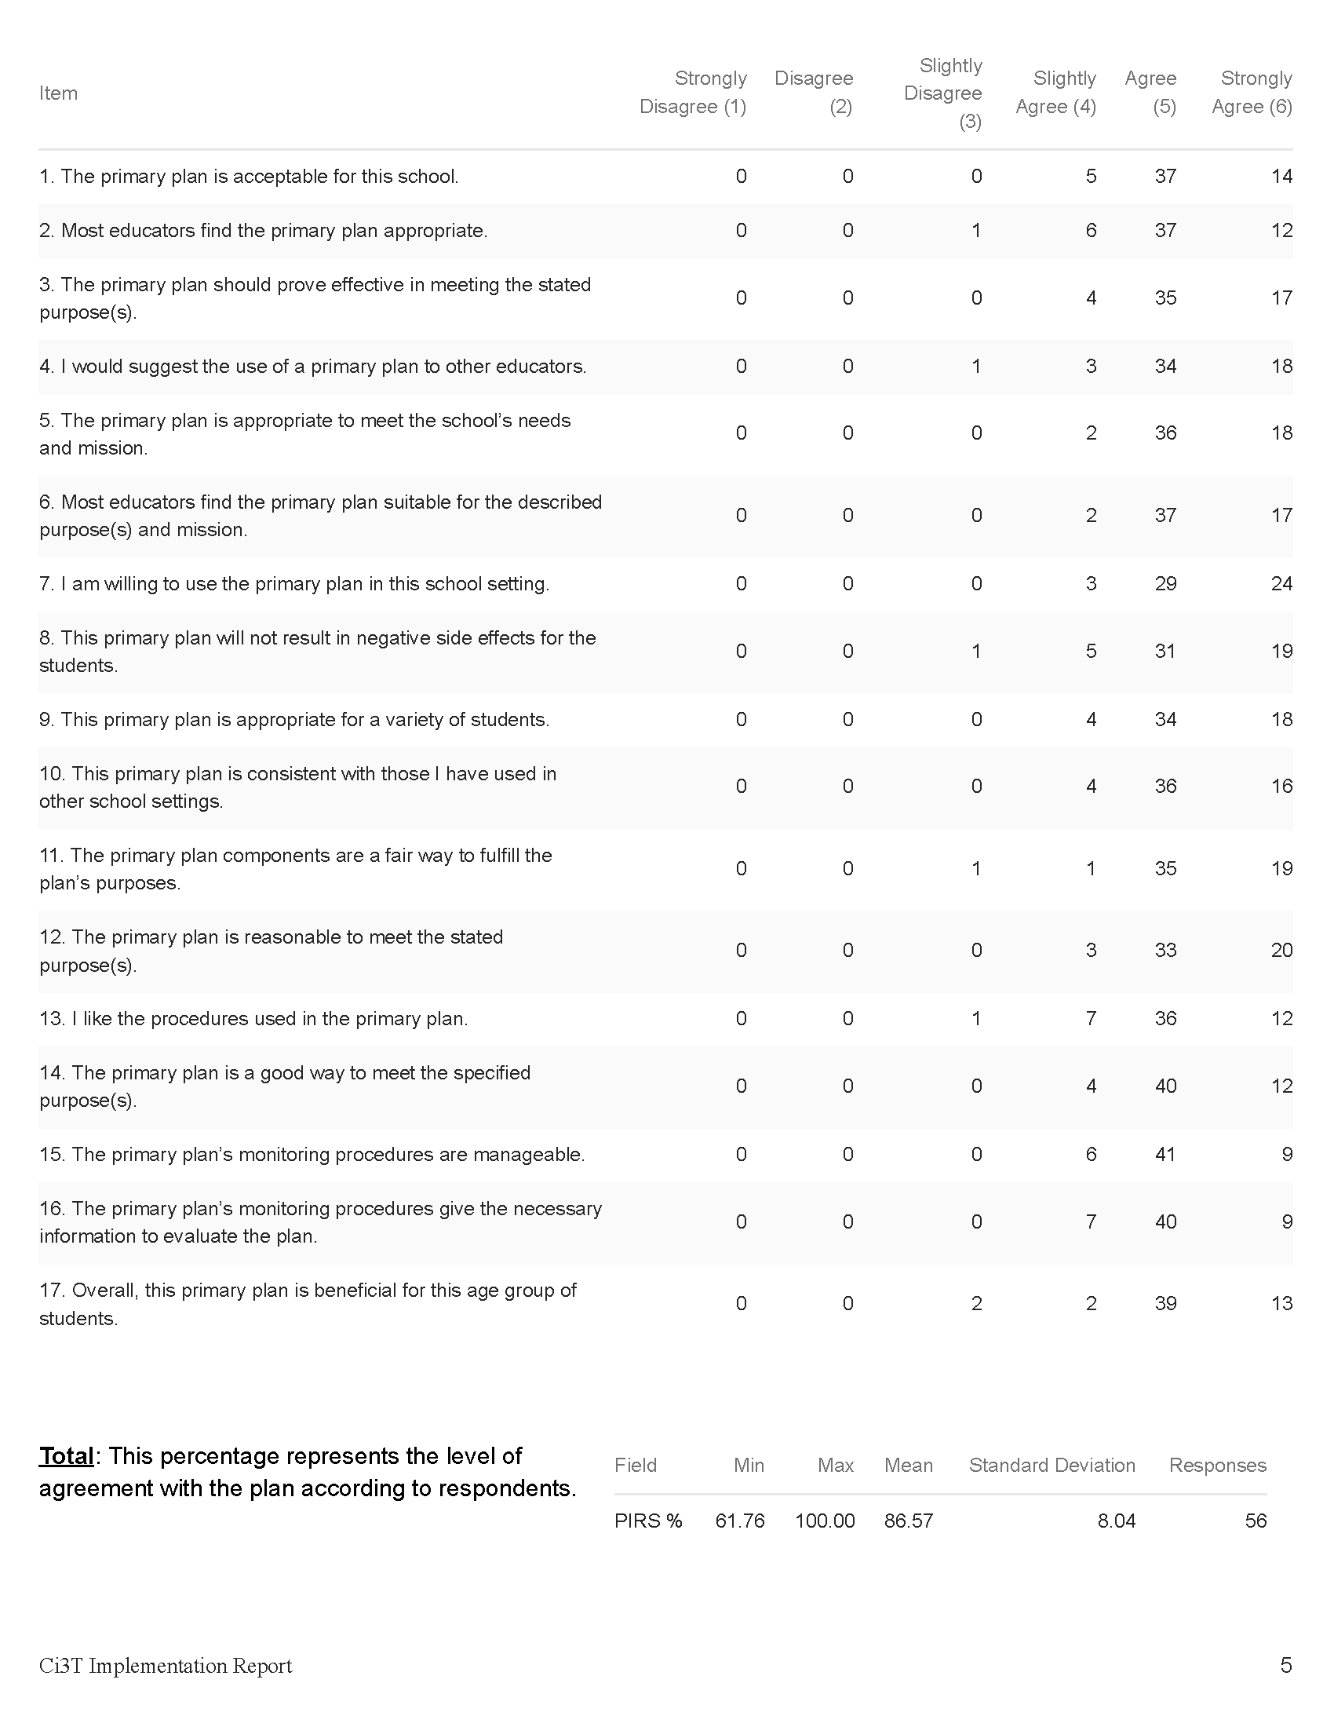
Primary Intervention Rating Scale (PIRS)
Item-level data reported by response category
(e.g., number of people who “strongly agreed”)
Item-level data reported as mean and standard deviation (scale = 1-6)
Item-level data visualization
Total PIRS %
(mean and standard deviation)

Slide 26
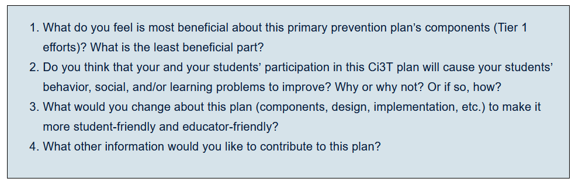
Primary Intervention Rating Scale Open Ended Items
Read through comments
Highlight success (literally!)
Look for themes for celebrations and focus areas

Slide 27

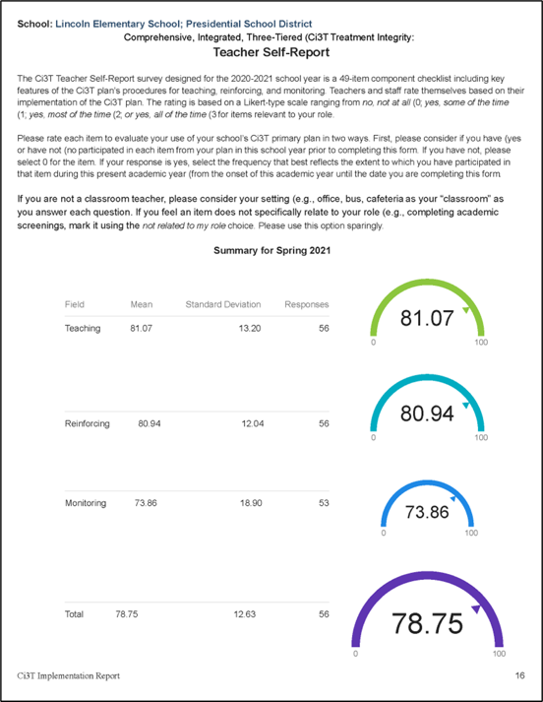
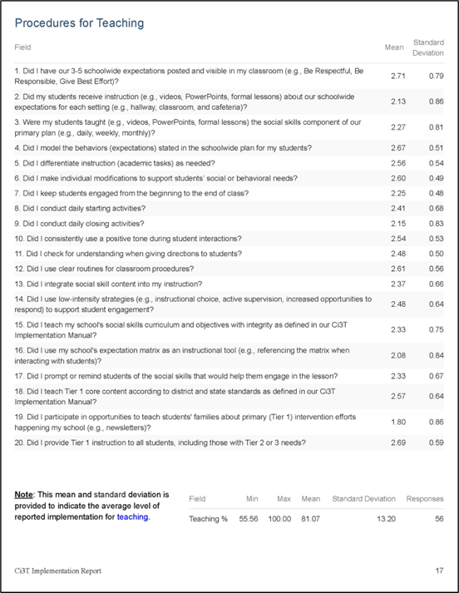
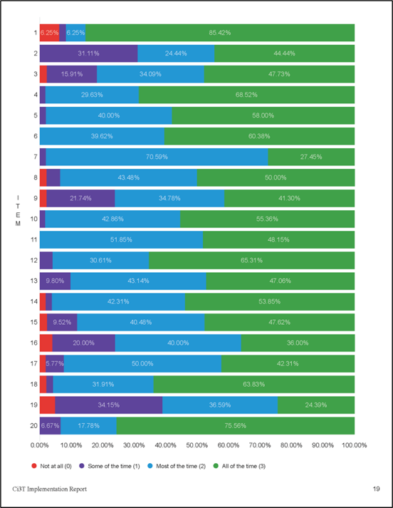
Ci3T Treatment Integrity: Teacher Self Report (Ci3T TI: TSR)
Total Scores
(mean and standard deviation)
Item-level data reported as mean and standard deviation (scale = 0-3)
Item-level data visualization

Slide 28
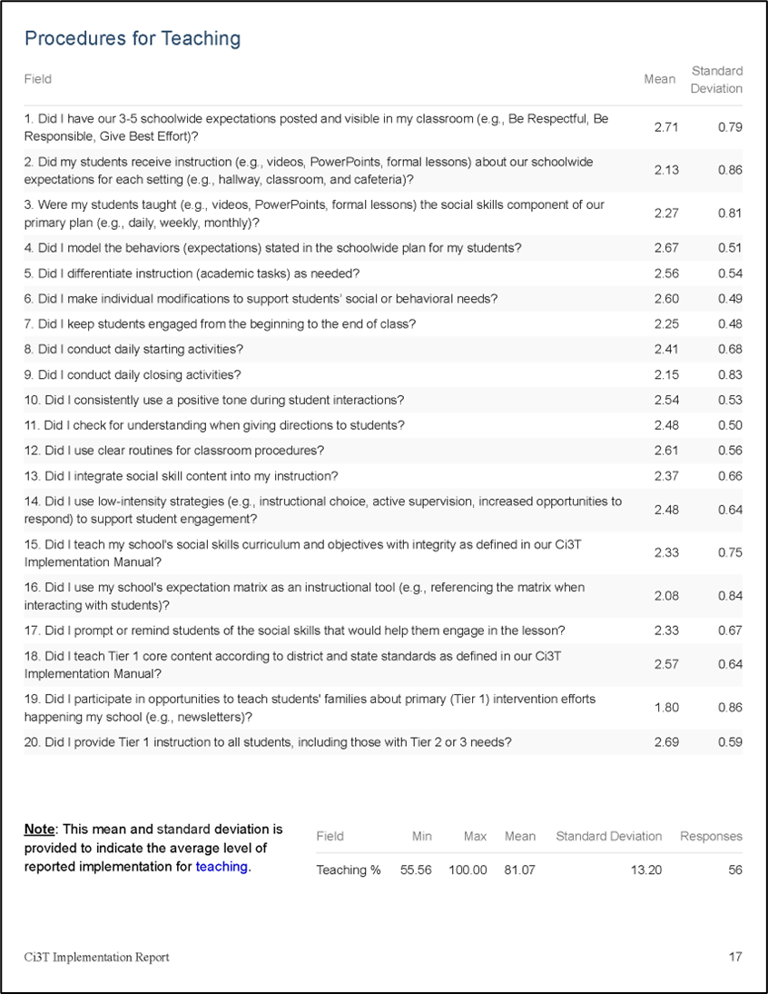
Ci3T TI: TSR Strengths and Areas of Focus

Slide 29
Treatment Integrity and Social Validity Data Sources
Treatment Integrity and Social Validity Data Sources 2
Fall 2025
Primary Intervention Rating Scale (Social Validity)
Ci3T Treatment Integrity: Teacher Self Report
Ci3T Treatment Integrity: Direct Observation
Tiered Fidelity Inventory

Slide 30
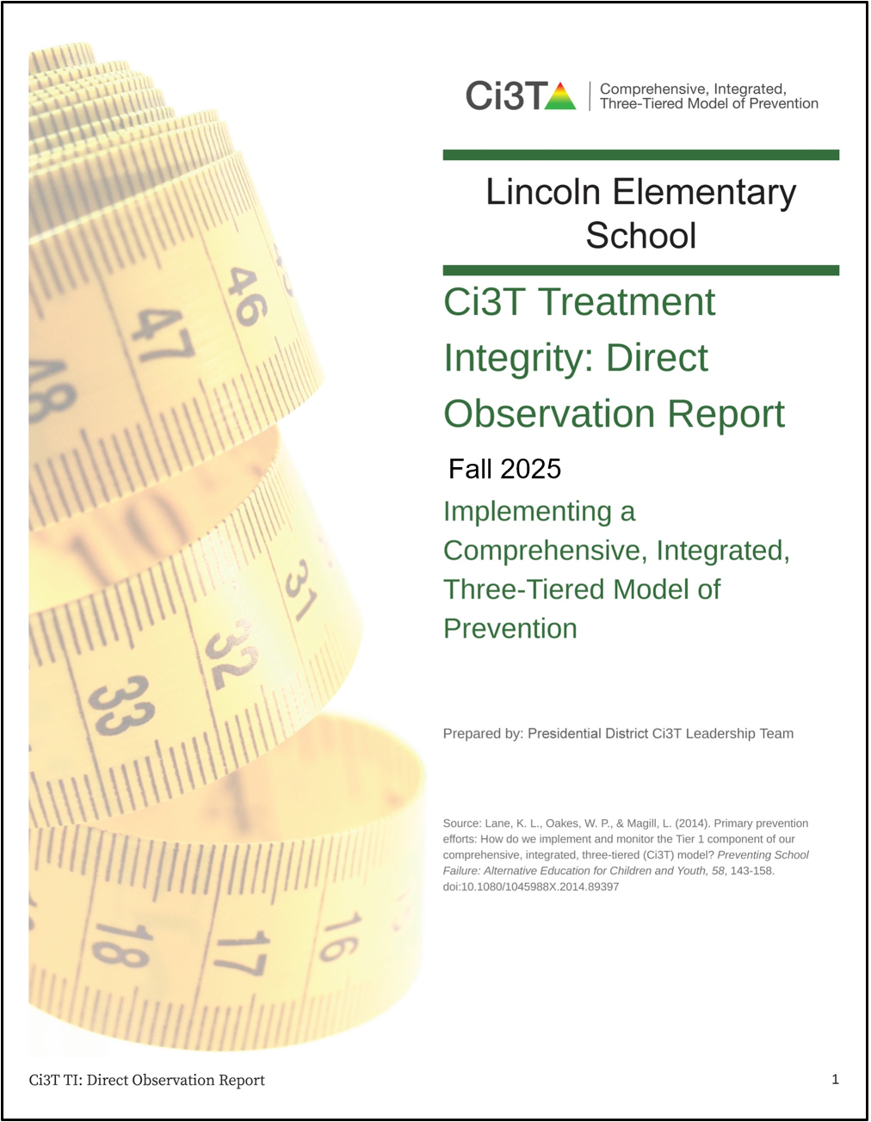
Ci3T Treatment Integrity: Direct Observation Report
Subset of Ci3T TI: TSR items
Stratified, random selection of educators
  Personnel who directly instruct students
Observers trained to criterion
30-min observations
  Educator perspective
  Observer perspective

Slide 31
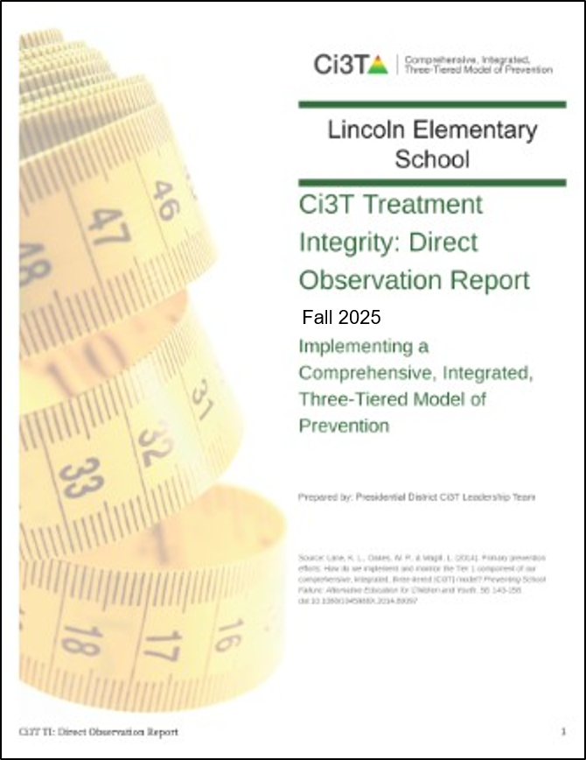

Ci3T Treatment Integrity: Direct Observation (Ci3T TI:DO)

Slide 32


Ci3T TI:DO Outside Perspective
Item-level data reported by response category
(e.g., number of people who “strongly agreed”)
Item-level data reported as mean and standard deviation (scale = 0-3)
Total %
(mean and standard deviation)
Item-level data visualization

Slide 33


Ci3T TI:DO Educator Perspective
Item-level data reported by response category
(e.g., number of people who “strongly agreed”)
Item-level data reported as mean and standard deviation (scale = 0-3)
Total %
(mean and standard deviation)
Item-level data visualization

Slide 34

Ci3T TI:DO Strengths and Areas of Focus

Slide 35

Ci3T TI: DO Mean Percentages

Slide 36
Treatment Integrity and Social Validity Data Sources
Treatment Integrity and Social Validity Data Sources 3
Fall 2025
Primary Intervention Rating Scale (Social Validity)
Ci3T Treatment Integrity: Teacher Self Report
Ci3T Treatment Integrity: Direct Observation
Tiered Fidelity Inventory

Slide 37



Tiered Fidelity Inventory (TFI)

Slide 38

Sharing TFI Data

Slide 39
Accessing Professional Learning Materials
Accessing Professional Learning Materials 1
ci3t.org/imp

Slide 40


Accessing Professional Learning Materials 2
Accessing Professional Learning Materials

Slide 41




























Let’s Discuss
Locate your school’s Social Validity and Treatment Integrity Data
(e.g.,Ci3T Implementation Report, Ci3T Treatment Integrity: Direct Observation Report, Tiered Fidelity Inventory)
2) Review data and:
Highlight successes
Discuss concerns and identify areas of focus
Use HO Working with Treatment Integrity and Social Validity Data
to record plans for addressing these focus areas
Notes:
20 minute timer

Slide 42

Procedures for Monitoring
Review your School’s Social Validity & Treatment Integrity Data
Review your School’s Winter Screening Data
1.18 USING SCHOOL AND COMMUNITY DATA TO INFORM TIER 1
Tier 1 leadership team has regular access to and uses a variety of additional schoolwide (e.g., school climate surveys, attendance, nurse or counselor visit logs, universal screening) and community data sources (e.g., community resource profiles, basic needs [e.g., food and housing], health care access, community events), to develop and regularly re-evaluate a profile of overall strengths and needs that informs the development and delivery of equitable Tier 1 foundational and classroom practices (items 1.4-1.10).

Slide 43
Session Outcomes
Session Outcomes 2
Interpret social validity, treatment integrity, and winter screening data at the school- and classroom-level to identify successes and focus areas relative to Ci3T implementation.
Develop corresponding professional learning opportunities to empower faculty and staff with effective practices to inform instruction at each level of prevention (e.g., Tier 1, low-intensity strategies, Tier 2 and Tier 3 interventions) according to needs identified in social validity, treatment integrity, and winter screening data.

Slide 44
Essential Components of Primary (Tier 1) Prevention Efforts
Essential Components of Primary (Tier 1) Prevention Efforts 1

Slide 45


Behavior Screening

Slide 46






Systematic Behavior Screening

Slide 47

What is Behavior Screening? 1

Slide 48
What is Behavior Screening? 2

Slide 49

Student Risk Screening Scale – Internalizing and Externalizing (SRSS-IE; Drummond, 1994; Lane & Menzies, 2009)
Elementary

Slide 50

Student Risk Screening Scale – Internalizing and Externalizing (SRSS-IE; Drummond, 1994; Lane & Menzies, 2009)
Secondary

Slide 51
SRSS-IE: Cut Scores
Elementary School
Middle and High School
SRSS-E7 | SRSS-I5
Items 1-7 | Items 8-12
0-3 = low risk 4-8 = moderate risk 9-21 = high risk | 0-1 = low risk 2-3 = moderate risk 4-15 = high risk
SRSS-E7 | SRSS-I6
Items 1-7 | Items 4, 8-12
0-3 = low risk 4-8 = moderate risk 9-21 = high risk | 0-3 = low risk 4-5 = moderate risk 6-18 = high risk
Elementary School Level:
Lane, K. L., Oakes, W. P., Swogger, E. D., Schatschneider, C., Menzies, H., M., & Sanchez, J. (2015). Student risk screening scale for internalizing and externalizing behaviors: Preliminary cut scores to support data-informed decision making. Behavioral Disorders, 40, 159-170.
Middle and High School Levels:
Lane, K. L., Oakes, W. P., Cantwell, E. D., Schatschneider, C., Menzies, H., Crittenden, M., & Messenger, M. (2016). Student Risk Screening Scale for Internalizing and Externalizing Behaviors: Preliminary cut scores to support data-informed decision making in middle and high schools. Behavioral Disorders, 42(1), 271-284

Slide 52
Winter Over Time
SRSS-Externalizing Results – Middle School Level
Notes:
Fill in <year> based on current academic year. This is located in column A of the data sheet. Edit by right clicking and selecting “Edit data”.

Slide 53
Winter 2024
SRSS-Externalizing Results – Middle School Grade Level
Grade Level | N Screened | Low n (%) | Moderate n (%) | High n (%)
6 | 160 | 146 (91.25) | 12 (7.50) | 2 (1.25)
7 | 131 | 109 (83.21) | 8 (6.11) | 14 (10.69)
8 | 166 | 136 (81.93) | 24 (14.46) | 6 (3.61)
Notes:
Fill in <year> based on current academic year. This is located in column A of the data sheet. Edit by right clicking and selecting “Edit data”.

Slide 54
Winter Over Time
SRSS-Internalizing Results – Middle School Level
Notes:
Fill in <year> based on current academic year. This is located in column A of the data sheet. Edit by right clicking and selecting “Edit data”.

Slide 55
Winter 2024
SRSS-Internalizing Results – Middle School Grade Level
Grade Level | N Screened | Low n (%) | Moderate n (%) | High n (%)
6 | 160 | 149 (93.13) | 4 (2.50) | 7 (4.38)
7 | 131 | 123 (93.89) | 2 (1.53) | 6 (4.58)
8 | 166 | 142 (85.54) | 13 (7.83) | 11 (6.63)
Notes:
Fill in <year> based on current academic year. This is located in column A of the data sheet. Edit by right clicking and selecting “Edit data”.

Slide 56


Reviewing Screening Data
Ci3T Leadership Teams review screening data at the following levels:
Screening Practice
School-wide (e.g., Tier 1 efforts)
Grade or department (e.g., Tier 1 efforts, low-intensity strategies)
Class level (e.g., low-intensity strategies)
Individual student level (e.g., Tier 2 and Tier 3)

Slide 57

Academic Screening
Academic Screening 1

Slide 58



Academic Screening
Academic Screening 2
Notes:
Might consider beginning by looking at data broadly
compared against district or state benchmarks
Subgroup analyses

Slide 59



Academic Screening
Academic Screening 3
Notes:
Then, might zoom in at the grade-level looking at distribution across risk category, mastery, or growth

Slide 60

Reviewing Multiple Sources of Data in an Integrated Way
attendance
behavior
screening
academic screening

Slide 61
Accessing Professional Learning Materials
Accessing Professional Learning Materials 3
ci3t.org/imp

Slide 62

Accessing Professional Learning Materials 4
Accessing Professional Learning Materials

Slide 63


















Let’s Discuss 1
Let’s discuss!
Use the Working with Your Screening Data Handout to review winter screening data Where are there strengths or bright spots? What are the greatest areas of need? School-level (e.g., Tier 1)? Grade or department level (e.g., Tier 1, low intensity strategies)? Classroom level (e.g., low intensity strategies)? Student-level (e.g., Tier 2 & Tier 3)
Notes:
15-min timer

Slide 64
Data-Informed Decision Making:
Data-Informed Decision Making: Set Professional Learning Targets and Resources
Set Professional Learning Targets and Resources
Develop Communication Plans with Staff and Families
1.12 SCHOOLWIDE PROFESSIONAL DEVELOPMENT AND COACHING
Tier 1 leadership team develops, documents, and implements a comprehensive, data-informed, and differentiated professional development system (PBIS/MTSS for staff), supported by adequate FTE and aligned to other relevant school initiatives, that includes initial and ongoing training, coaching, and supportive performance feedback to all school or community-employed faculty/staff on foundational knowledge and Tier 1 practices (items 1.3-1.9).

Slide 65
Session Outcomes
Session Outcomes 3
Interpret social validity, treatment integrity, and winter screening data at the school- and classroom-level to identify successes and focus areas relative to Ci3T implementation.
Develop corresponding professional learning opportunities to empower faculty and staff with effective practices to inform instruction at each level of prevention (e.g., Tier 1, low-intensity strategies, Tier 2 and Tier 3 interventions) according to needs identified in social validity, treatment integrity, and winter screening data.

Slide 66
Scenario 1: Reinforcement at Tier 1
1.5 SCHOOLWIDE ACKNOWLEDGMENT
Educators consistently and equitably implement a written process for delivering behavior-specific praise that is (a) linked to schoolwide expectations, (b) used across settings, (c) documented (e.g., electronically tracked, count of tokens) and (d) differentiated to meet students’ needs to acknowledge students’ academic and SEB skills in amanner valued by students.

Slide 67


Procedures for Reinforcing 1

Slide 68


Procedures for Reinforcing 2

Slide 69

Common Misconceptions
Tickets don’t work.
It’s too complicated to collect and keep track of tickets.
Tickets don’t build intrinsic motivation. This isn’t preparing them for the real world
Fifth graders don’t care about tickets.

Slide 70
Considerations When Responding to These Data
Find the bright spots!
  Who is giving out tickets consistently?
  What might be contributing to this success?
  Could we replicate those strategies in other areas?
Consider potential root causes
  Did we set expectations and provide professional learning for staff?
  Are there efficiencies we can leverage to make universal reinforcement system more feasible? (e.g., prepopulating tickets with teacher names)
  Do we need to adjust our reinforcer menu?

Slide 71



Professional Learning
Professional Learning 1

Slide 72


Professional Learning
Professional Learning 2

Slide 73

Build Momentum with a Ci3T Challenge

Slide 74

Ci3T Challenge Example Handout 1

Slide 75
Ci3T Challenge Example Handout 2

Slide 76




Update Reinforcer Menu

Slide 77


Let’s Chat!
Let’s Chat! 1
What is the most unique reinforcer you have offered?
OR
What is the most popular reinforcer on your menu?

Slide 78

Action Planning
Action Planning 1

Slide 79
Scenario 2: Ci3T Integrated Lesson Planning
1.10 CLASSROOM PRACTICES
Educators consistently and equitably implement positive and proactive classroom practices—including building relationships with students; developing a safe environment; prompting predictable routines and expected behavior; actively providing OTRs, active supervision, and specific feedback (i.e., specific praise and supportive corrections); and ensuring a high ratio (≥ 5:1) of positive to corrective feedback.

Slide 80

Data to Indicate a Focus on Tier 1: School Level
Social Skills Improvement System – Performance Screening Guide Spring 2012 – Total School
Lane, K. L., Oakes, W. P., & Magill, L. (2013). Primary prevention efforts: How do we implemented and monitor the Tier 1 component of our Comprehensive, Integrated, Three-Tiered (Ci3T) Model?, Preventing School Failure, 58(1), 143-158.

Slide 81

Implementation Report 1
Notes:
In addition to student-level data, procedures for teaching is below 80% indicating Tier 1 is not yet in place as planned

Slide 82


Procedures for Teaching 1

Slide 83

Procedures for Teaching 2
Notes:
We see similar patterns looking at Direct Observation Report

Slide 84



Focus: Integrated Lesson Planning
Citation. Oakes, W. P., Lane, K. L., Lane, K. S., & Buckman, M. M. (2019). Ci3T integrated lessons plan template. www.ci3t.org.​
Completed examples available in: Ci3T Project ENHANCE Research Team. (2022, July). Embedding and integrating Ci3T domains into daily instruction. Author. https://doi.org/10.17161/ci3t.42880

Slide 85




Integrated Lesson Plan
Citation. Oakes, W. P., Lane, K. L., Lane, K. S., & Buckman, M. M. (2019). Ci3T integrated lessons plan template. www.ci3t.org.​

Slide 86





Share Module Resources
Citation. Oakes, W. P., Lane, K. L., Lane, K. S., & Buckman, M. M. (2019). Ci3T integrated lessons plan template. www.ci3t.org.​
Completed examples available in: Ci3T Project ENHANCE Research Team. (2022, July). Embedding and integrating Ci3T domains into daily instruction. Author. https://doi.org/10.17161/ci3t.42880

Slide 87

Share EMPOWER+ Resource
Share video recording in an upcoming staff newsletter
Play a portion of the video recording and facilitate discussion at PLC meeting
Download PowerPoint and present at next faculty and staff meeting

Slide 88


Join us at future EMPOWER+ to learn more!
EMPOWER+ Session | Date
Starting Strong: Effective Tier 1 Practices for Educators | September 24, 2025 (Wednesday)
From Data to Action: Using Systematic Screening to Inform Instruction | October 8, 2025 (Wednesday)
Ci3T In Action: Integrated Lesson Planning for Enhanced Instruction | November 18, 2025 (Tuesday)
Mastering Behavior Specific Praise and Precorrection | January 21, 2026 (Wednesday)
A 6-Step Instructional Approach for Responding to Challenging Behaviors: A Tier 1 Practice | February 10, 2026 (Tuesday)
A Tier 2 Support for Students Experiencing Anxious Feelings: Recognize. Relax. Record. | March 25, 2026 (Wednesday)
A Tier 3 Support for Students with Intensive Intervention Needs: Functional Assessment-Based Intervention (FABI) | April 28, 2026 (Tuesday)

Slide 89

Action Planning
Action Planning 2

Slide 90
Scenario 3: Focus on Tier 2 and Tier 3
2.3 SCREENING
Tier 2 leadership team uses decision rules and multiple sources of data (e.g., discipline referrals, academic progress, screening tools, attendance, nominations), available from multiple informants (e.g., teacher, family, student), at multiple points in time (e.g., screening at identified points, on-going data review, on-going access to nomination process) to identify students who require Tier 2 internalizing or externalizing supports and to inform the modification or intensification of Tier 1 supports as needed.

Slide 91
Winter Over Time
SRSS-Externalizing Results – High School Level
Notes:
Fill in <year> based on current academic year. This is located in column A of the data sheet. Edit by right clicking and selecting “Edit data”.

Slide 92
Winter 2024
SRSS-Externalizing Results – High School Grade Level
Grade Level | N Screened | Low n (%) | Moderate n (%) | High n (%)
9 | 349 | 276 (79.08) | 46 (13.18) | 27 (7.74)
10 | 353 | 298 (84.42) | 40 (11.33) | 15 (4.25)
11 | 363 | 335 (92.29) | 21 (5.79) | 7 (1.93)
12 | 354 | 328 (92.66) | 24 (6.78) | 2 (0.56)
Notes:
Fill in <year> based on current academic year. This is located in column A of the data sheet. Edit by right clicking and selecting “Edit data”.

Slide 93


Implementation Report 2
Notes:
In addition to student-level data, procedures for teaching, reinforcing, and monitoring indicate Tier 1 is being implemented as planned.

Slide 94
Need for strategies to support students
We’ve got to figure something out. It’s the same group of kids in the office every day.
What we’re doing at Tier 1 works for most kids. What about the ones who are still so far behind?
Notes:
Staff are letting us know that they want more strategies to support students with Tier 2 and Tier 3 needs

Slide 95




Professional Learning
Model the process of connecting students to Tier 2 and Tier 3 supports in an upcoming faculty, grade-level, or department-level meeting.

Slide 96


Encourage Review of Tier 2 and Tier 3 Enhancing Ci3T Modules

Slide 97

Join us at future EMPOWER+ to learn more! 3
Join us at future EMPOWER+ to learn more!
EMPOWER+ Session | Date
Starting Strong: Effective Tier 1 Practices for Educators | September 24, 2025 (Wednesday)
From Data to Action: Using Systematic Screening to Inform Instruction | October 8, 2025 (Wednesday)
Ci3T In Action: Integrated Lesson Planning for Enhanced Instruction | November 18, 2025 (Tuesday)
Mastering Behavior Specific Praise and Precorrection | January 21, 2026 (Wednesday)
A 6-Step Instructional Approach for Responding to Challenging Behaviors: A Tier 1 Practice | February 10, 2026 (Tuesday)
A Tier 2 Support for Students Experiencing Anxious Feelings: Recognize. Relax. Record. | March 25, 2026 (Wednesday)
A Tier 3 Support for Students with Intensive Intervention Needs: Functional Assessment-Based Intervention (FABI) | April 28, 2026 (Tuesday)

Slide 98

Join us at future EMPOWER+ to learn more! 4
Join us at future EMPOWER+ to learn more!
EMPOWER+ Session | Date
Starting Strong: Effective Tier 1 Practices for Educators | September 24, 2025 (Wednesday)
From Data to Action: Using Systematic Screening to Inform Instruction | October 8, 2025 (Wednesday)
Ci3T In Action: Integrated Lesson Planning for Enhanced Instruction | November 18, 2025 (Tuesday)
Mastering Behavior Specific Praise and Precorrection | January 21, 2026 (Wednesday)
A 6-Step Instructional Approach for Responding to Challenging Behaviors: A Tier 1 Practice | February 10, 2026 (Tuesday)
A Tier 2 Support for Students Experiencing Anxious Feelings: Recognize. Relax. Record. | March 25, 2026 (Wednesday)
A Tier 3 Support for Students with Intensive Intervention Needs: Functional Assessment-Based Intervention (FABI) | April 28, 2026 (Tuesday)

Slide 99

Action Planning
Action Planning 3

Slide 100


Data-Informed Decision Making:
Data-Informed Decision Making: Develop Communication Plans with Staff and Families
Password Three
Growth
Set Professional Learning Targets and Resources
Develop Communication Plans with Staff and Families
1.14 FACULTY AND STAFF ENGAGEMENT
Tier 1 leadership teams purposefully and regularly engage all faculty and staff in co-designing and actively revising the content and the implementation of foundational Tier 1 practices (items 1.3-1.10) and systems (items 1.12-1.13) based on the regular review of schoolwide and community data.

Slide 101
Foundational Ci3T Implementation & Professional Learning Activities
Foundational Ci3T Implementation & Professional Learning Activities 1

Slide 102
Foundational Ci3T Implementation & Professional Learning Activities
Foundational Ci3T Implementation & Professional Learning Activities 2

Slide 103


Sharing Treatment Integrity and Social Validity Data

Slide 104

Sharing Treatment Integrity and Social Validity Data

Slide 105


Example: Making Explicit Connections

Slide 106
Sharing Systematic Screening Data
Once academic and behavior screening data are collected, data are shared at the:
School-wide (e.g., Tier 1 efforts)
Grade or department (e.g., Tier 1 efforts, low-intensity strategies)
Class level (e.g., low-intensity strategies)
Individual student level (e.g., Tier 2 and Tier 3)

Slide 107
Accessing Professional Learning Materials
Accessing Professional Learning Materials 2
ci3t.org/imp

Slide 108


Accessing Professional Learning Materials
Accessing Professional Learning Materials 3

Slide 109


Let’s discuss!
Professional Learning Targets and Resources What are the next steps to respond to your social validity and treatment integrity data? What are the next steps to respond to your winter screening data? Be ready to share at least one concrete action step your team is taking coming out of today’s session! | Communication plans When and how will you share Treatment Integrity and Social Validity data with staff? When and how will you share Winter screening data with faculty and staff? What new strategies to communicate and collaborate with faculty & staff are you interested in trying?
Notes:
15-min timer

Slide 110

Wrapping Up and Moving Forward
Password Four
Renewal

Slide 111


Let’s Chat!
Let’s Chat! 2
What is 1 action item you or your team is taking following today’s session?

Slide 112

Project EMPOWER+
EMPOWER+ Session | Date
Starting Strong: Effective Tier 1 Practices for Educators | September 24, 2025 (Wednesday)
From Data to Action: Using Systematic Screening to Inform Instruction | October 8, 2025 (Wednesday)
Ci3T In Action: Integrated Lesson Planning for Enhanced Instruction | November 18, 2025 (Tuesday)
Mastering Behavior Specific Praise and Precorrection | January 21, 2026 (Wednesday)
A 6-Step Instructional Approach for Responding to Challenging Behaviors: A Tier 1 Practice | February 10, 2026 (Tuesday)
A Tier 2 Support for Students Experiencing Anxious Feelings: Recognize. Relax. Record. | March 25, 2026 (Wednesday)
A Tier 3 Support for Students with Intensive Intervention Needs: Functional Assessment-Based Intervention (FABI) | April 28, 2026 (Tuesday)

Slide 113

Ci3T Trainers and Coaches Calls
Ci3T Trainers and Coaches Calls Session | Date
Ci3T Trainers and Coaches Call 1 | August 20, 2025 (Wednesday)
Ci3T Trainers and Coaches Call 2 | September 3, 2025 (Wednesday)
Ci3T Trainers and Coaches Call 3 | October 1, 2025 (Wednesday)
Ci3T Trainers and Coaches Call 4 | November 5, 2025 (Wednesday)
Ci3T Trainers and Coaches Call 5 | December 2, 2025 (Tuesday)
Ci3T Trainers and Coaches Call 6 | January 22, 2026 (Thursday)
Ci3T Trainers and Coaches Call 7 | February 17, 2026 (Tuesday)
Ci3T Trainers and Coaches Call 8 | March 10, 2026 (Tuesday)
Ci3T Trainers and Coaches Call 9 | April 15, 2026 (Wednesday)
Ci3T Trainers and Coaches Call 10 | May 13, 2026 (Wednesday)

Slide 114
Wrap Up and Preview
Today
Next time
Procedures for Monitoring
  Review your School’s Social Validity & Treatment Integrity Data
  Review your School’s Winter Screening Data
Data-informed Decision-making
  Professional Learning Targets and Resources
  Communication Plans
Data-Informed Decision-Making
Working Across the Tiers
  Integrated Lesson Planning
  Tier 2
  Tier 3

Slide 115

Homework
At your next Ci3T Leadership Team meeting:
  Prepare treatment integrity and social validity report and presentation for faculty meeting
  Prepare professional learning connections based on implementation successes and areas for refinement
At your next faculty meeting:
  Share successes
  Share fall implementation report (treatment integrity and social validity
  Share winter screening data
  Share professional learning resources and opportunities aligned to areas for refinement

Slide 116


Action Planning
Action Planning 4
Notes:
Encourage you to leave a note in your Ci3T LT agenda to indicate where your team will pick up at your next meeting and to record any action items.

Slide 117


Coaching Protocol Reminder
Notes:
If you’re a coach, you might consider setting aside time to review coaching protocol for Session 1 especially the after coaching tips, action items, and reflection!

Slide 118




Thank you!
Thank you!
ci3t.org
#Ci3T
@Ci3Tmodel
Tag us in your Ci3T highlights, we love to see Ci3T in action!
Follow us on Instagram for updates and new resources!
Notes:
Tag us in your Ci3T highlights- we would love to see Ci3T in action! Follow us on Instagram for updates and links to resources! @Ci3TModel
You will receive a brief session evaluation – we value your feedback and would greatly appreciate you taking a few minutes to share your thoughts on what you liked about the session and how we can improve

