Slide 1
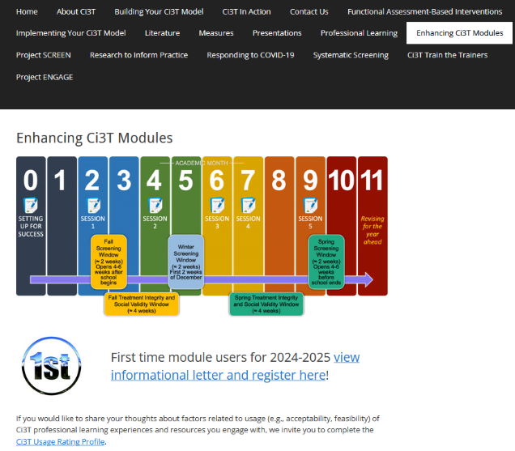
Implementing Comprehensive, Integrated, Three-tiered (Ci3T) Models: Planning for the Year Ahead
Enhanced Ci3T Implementation Series and Delivery (Guided E-Ci3T) Session 5
If you have not done so already, we invite you to visit ci3t.org/enhance to access modules and complete a one-time registration process!

Slide 3
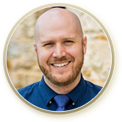







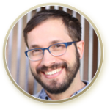



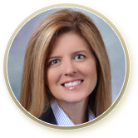



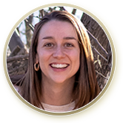



Ci3T Research Team
Grant Allen
Matthew Aschliman
Tammy Becker
Allison Bernard
Carrie Brandon
Amy Briesch
Mark Buckman
Sandy Chafouleas
Eric Common
Howard Diacon
Kathleen Lynne Lane
Jessica Matus
Wendy P. Oakes
Jenna Raad
David Royer
Elise Sarasin
Rebecca Sherod
Joni Weiss
Stacie Williams
Kate Williamson

Slide 4

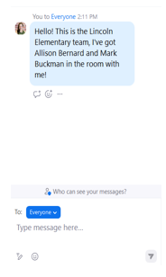
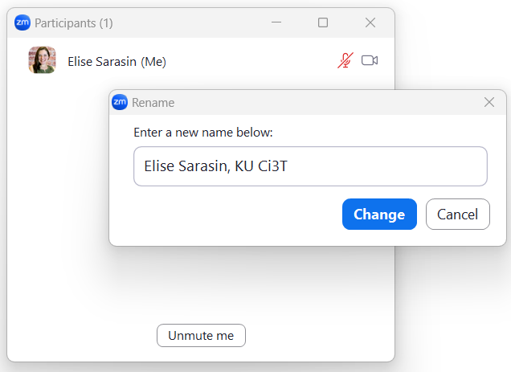

Zoom Logistics
If you are facilitating a Ci3T Leadership Team Symposium session at a satellite location, please email us a list of the names, email addresses, and schools of those attending.
To help us put you in breakout rooms with your colleagues today we are renaming you with your school initials and first and last name
If there are multiple people in the room with you, please list their first and last names and email in the chat!

Slide 5
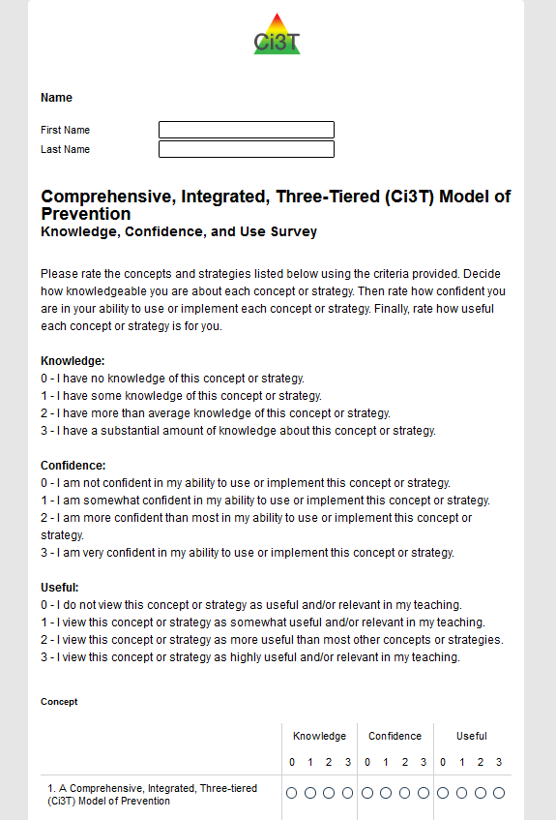
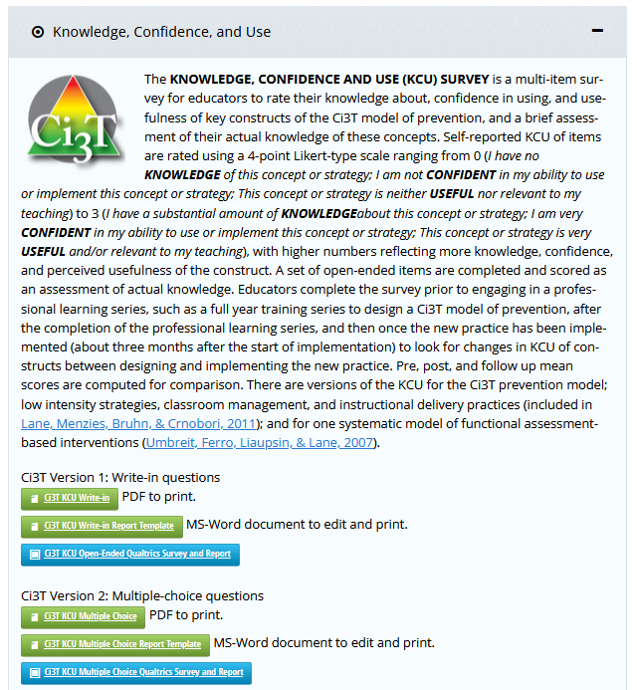
Knowledge, Confidence, Use (KCU) Survey
ci3t.org/measures
Notes:
If you are a district participating as a research partner in Sustaining Ci3T, we appreciate your time and effort in sharing your knowledge, confidence, and as the school year begins!
If you are not participating in Sustaining Ci3T but would like to measure your or your team’s knowledge, confidence, and use, a version of the KCU survey is available on our website at ci3t.org/measures

Slide 6



Enhancing Ci3T Modules
ci3t.org/enhance

Slide 7
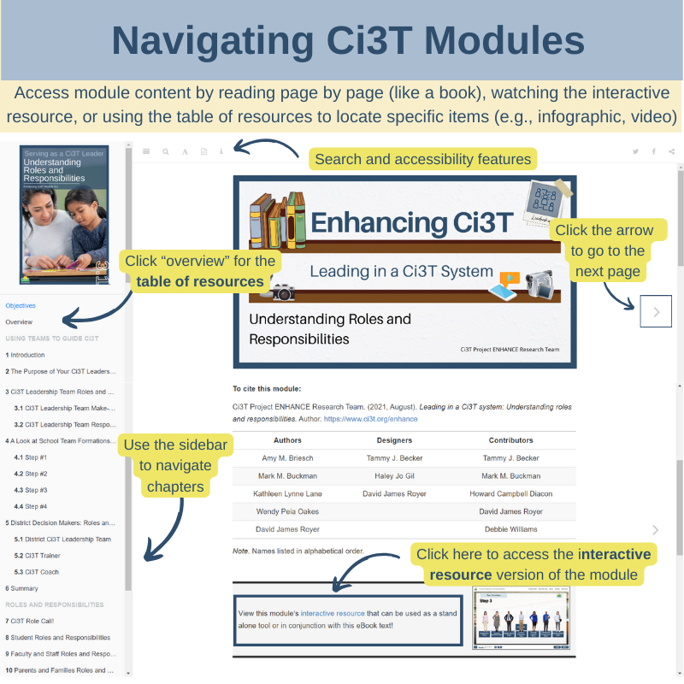

Slide 8
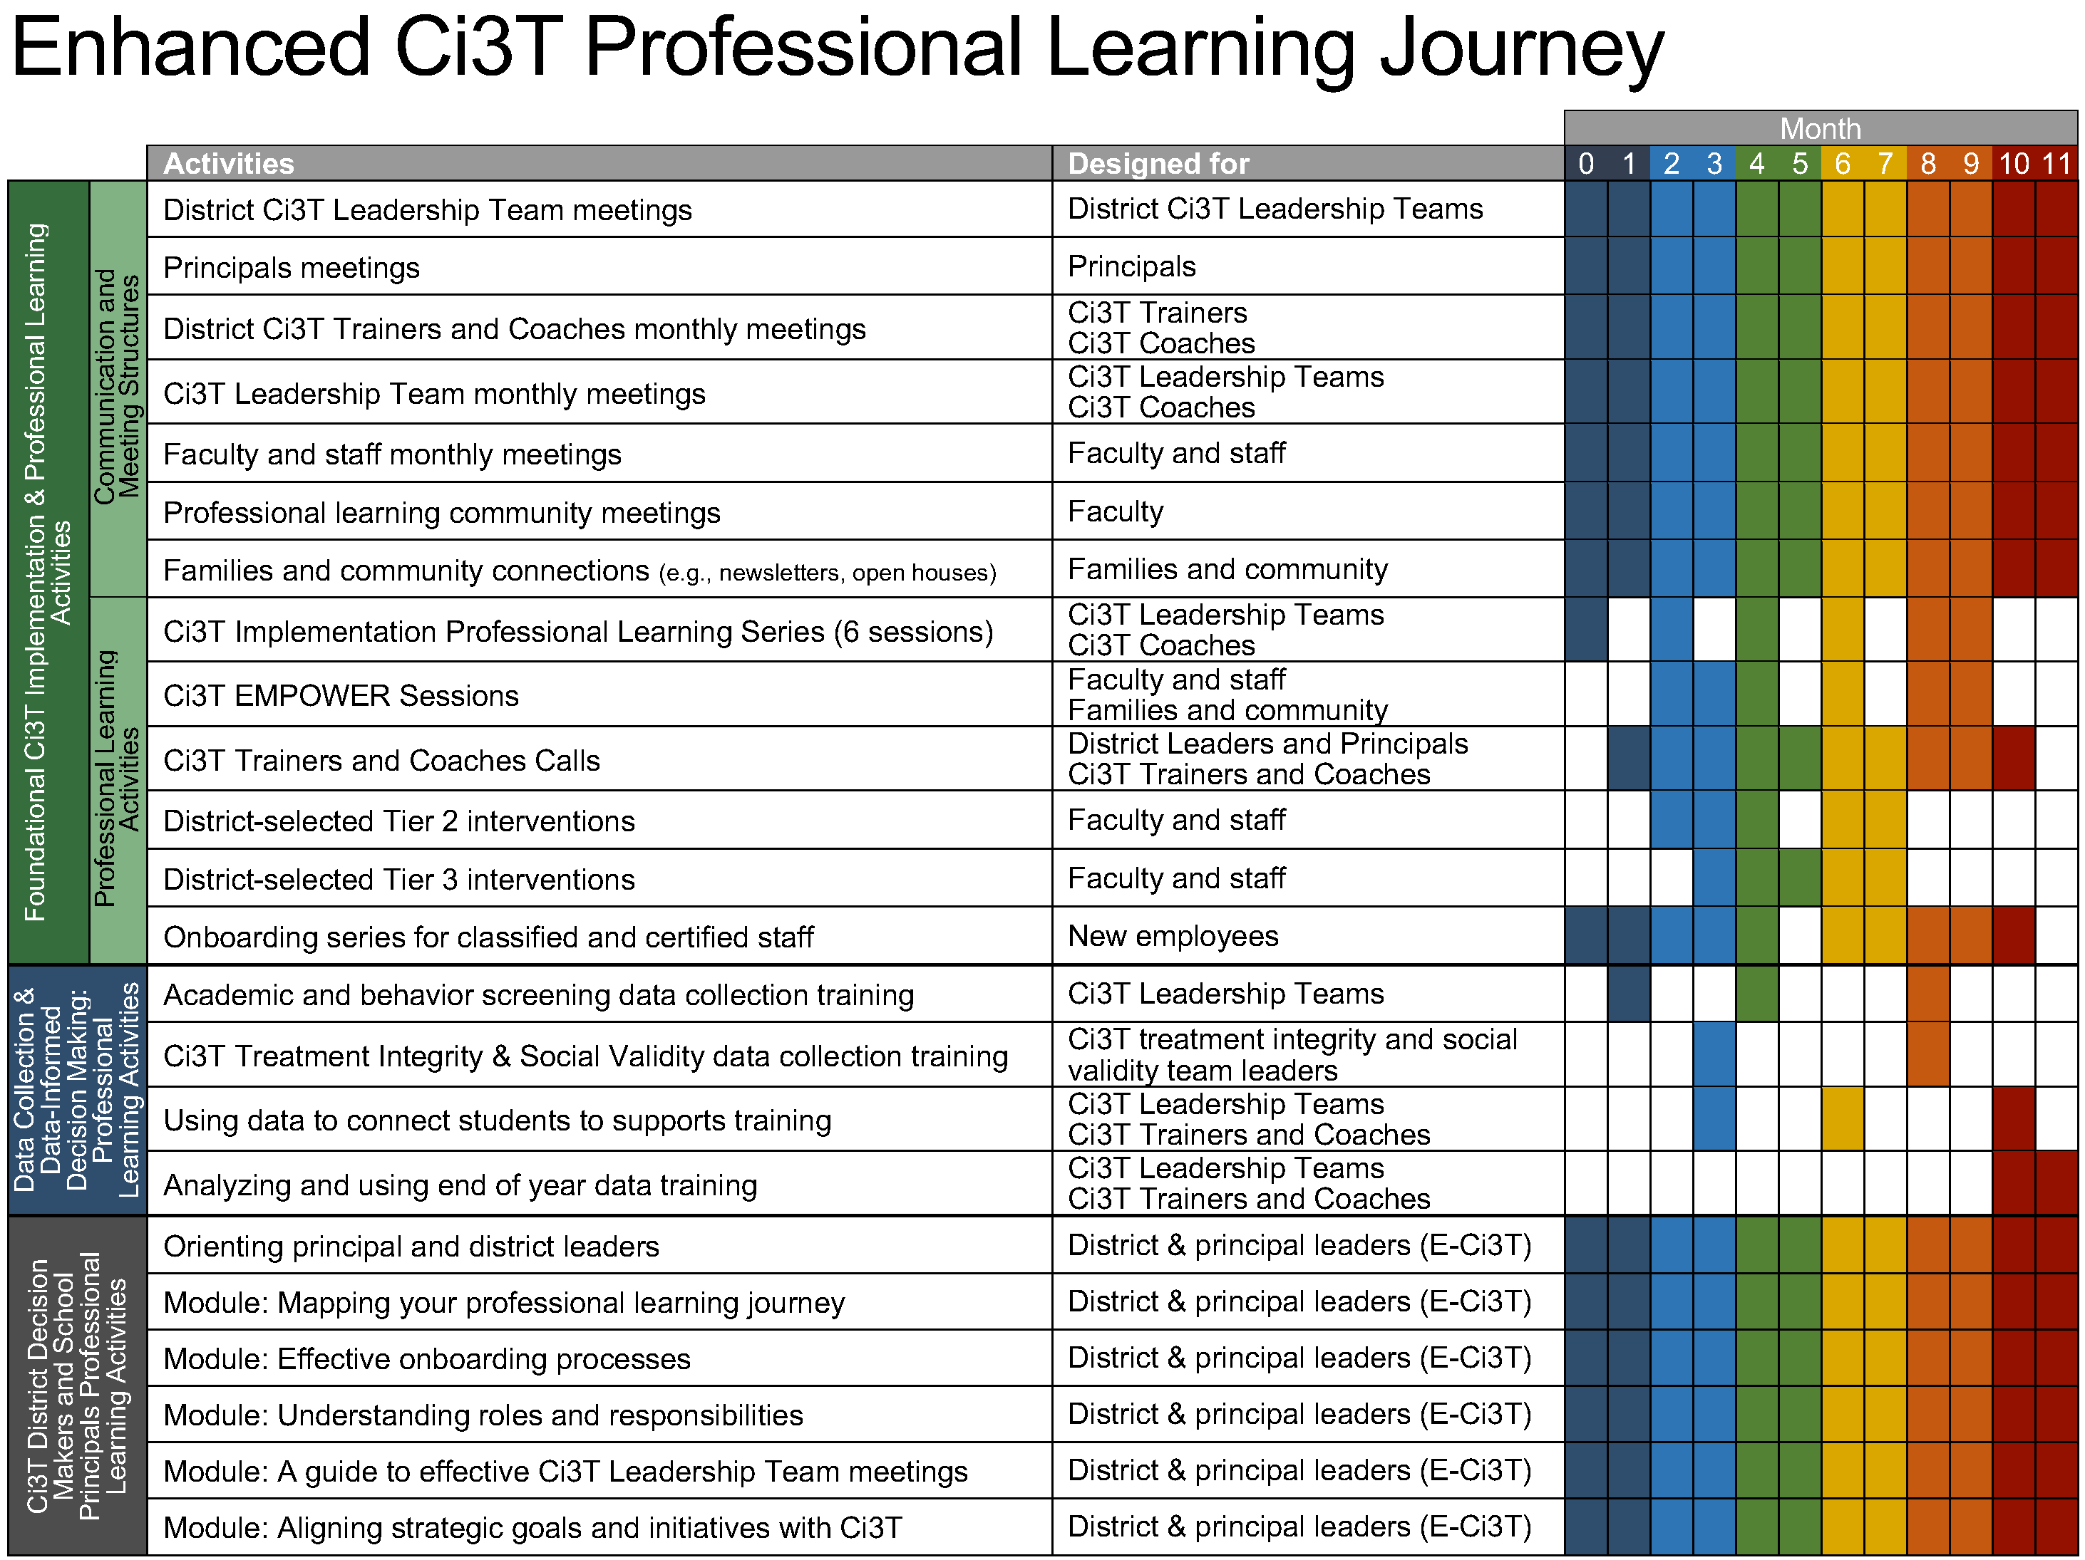
Enhanced Ci3T Implementation Series and Delivery

Slide 9
Foundational Ci3T Implementation & Professional Learning Activities

Slide 10
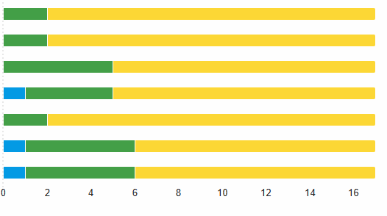
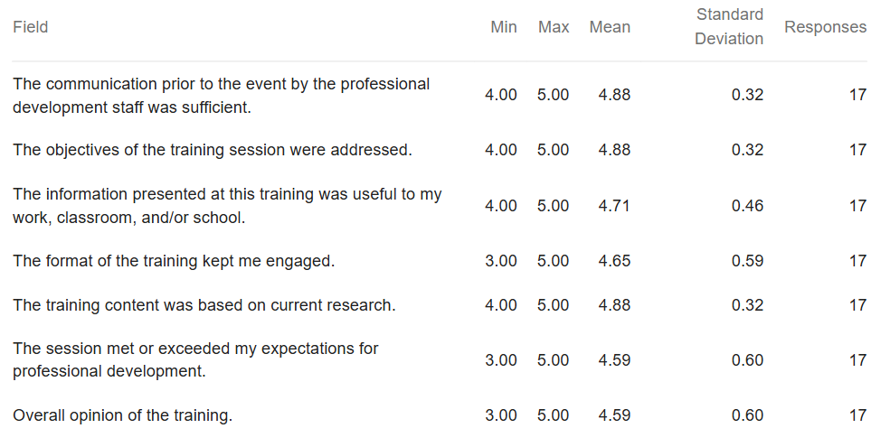

Session 4 Feedback
Communication
4 [12%]
5 [88%]
Objectives
4 [12%]
5 [88%]
Usefulness of Information
4 [29%]
5 [71%]
Format
4 [24%]
5 [71%]
Content
4 [12%]
5 [88%]
Expectations Met
4 [29%]
5 [65%]
Overall Opinion
4 [29%]
5 [65%]

Slide 11
Session 4 Feedback
Thank you for the specific and constructive comments! Some trends we noticed based on comments:
Appreciation for Jigsaw breakout room and the opportunity to learn from other schools and leadership teams
Reviewing module content during the session continues to be helpful
Additional video resources would be helpful
Notes:
We’ve used this feedback to adjust today’s session – prioritizing time with your team and offering opportunities for differentiation based on what your data is showing. We will continue to put direct links in chat and include slides to help orient you to where materials can be located! Remember- you can always download this presentation for screenshots of where materials are located and modules references will be in top right hand corner.

Slide 12
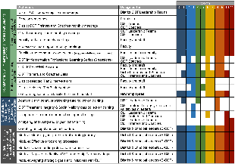
Session Outcomes
Interpret social validity, treatment integrity, and spring screening data at the school- and classroom-level to identify successes and focus areas relative to Ci3T implementation.
Use needs of faculty, staff, and students – as identified in social validity, treatment integrity, and spring screening data – to inform professional learning for faculty and staff, use of effective practices to support students (e.g., low-intensity strategies, Tier 2 and 3 interventions), and updates to your school’s Ci3T Implementation Manual.

Slide 13
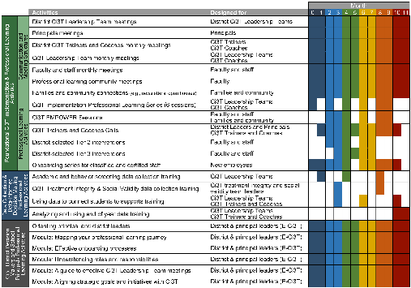
Agenda
Welcome
Procedures for Monitoring
  Review your School’s Social Validity & Treatment Integrity Data
  Review your School’s Spring Screening Data
Planning for the Year Ahead 2025-2026
Focusing on Data-Informed Professional Learning
Wrapping Up and Moving Forward

Slide 14
Knowledge, Confidence, Use (KCU) Survey
ci3t.org/measures
Notes:
If you are a district participating as a research partner in Sustaining Ci3T, we appreciate your time and effort in sharing your knowledge, confidence, and as the school year begins!
If you are not participating in Sustaining Ci3T but would like to measure your or your team’s knowledge, confidence, and use, a version of the KCU survey is available on our website at ci3t.org/measures

Slide 15
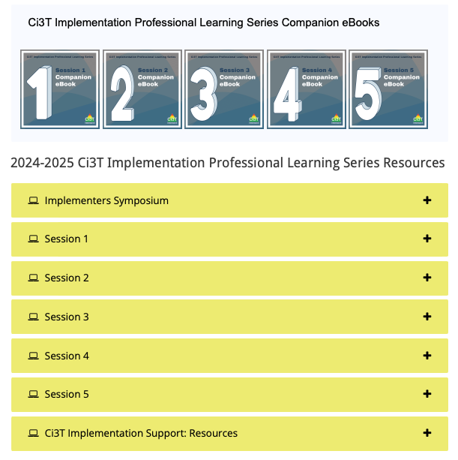
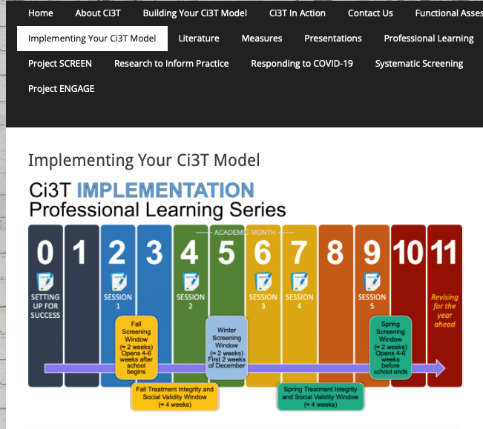
Accessing Professional Learning Materials
ci3t.org/imp

Slide 16
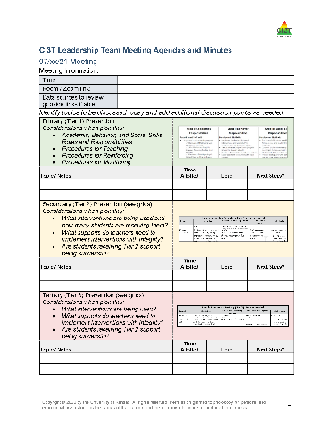

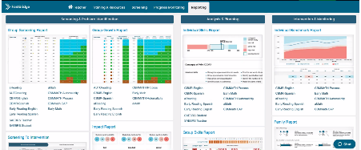

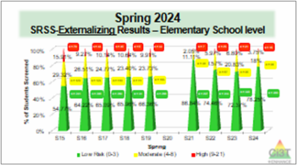
Materials for Today’s Session
Ci3T Leadership Team Agenda
Ci3T Implementation Manual
Spring Social Validity and Treatment Integrity Data
Spring Screening Data

Slide 17

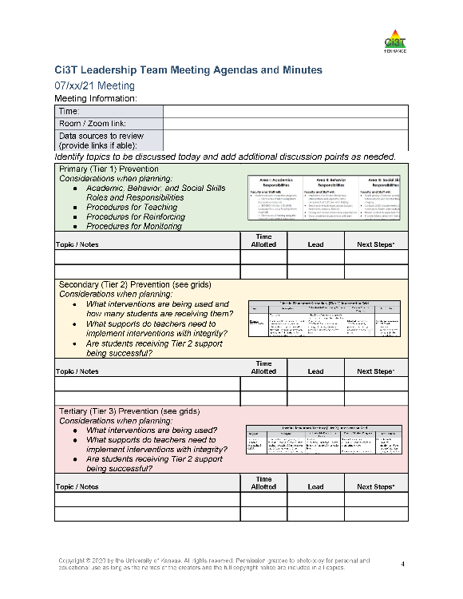
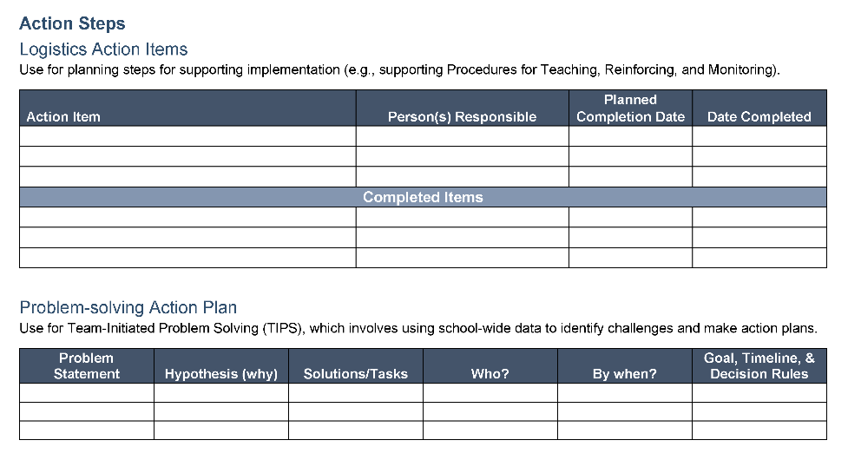
Ci3T Leadership Team Agenda Template

Slide 18
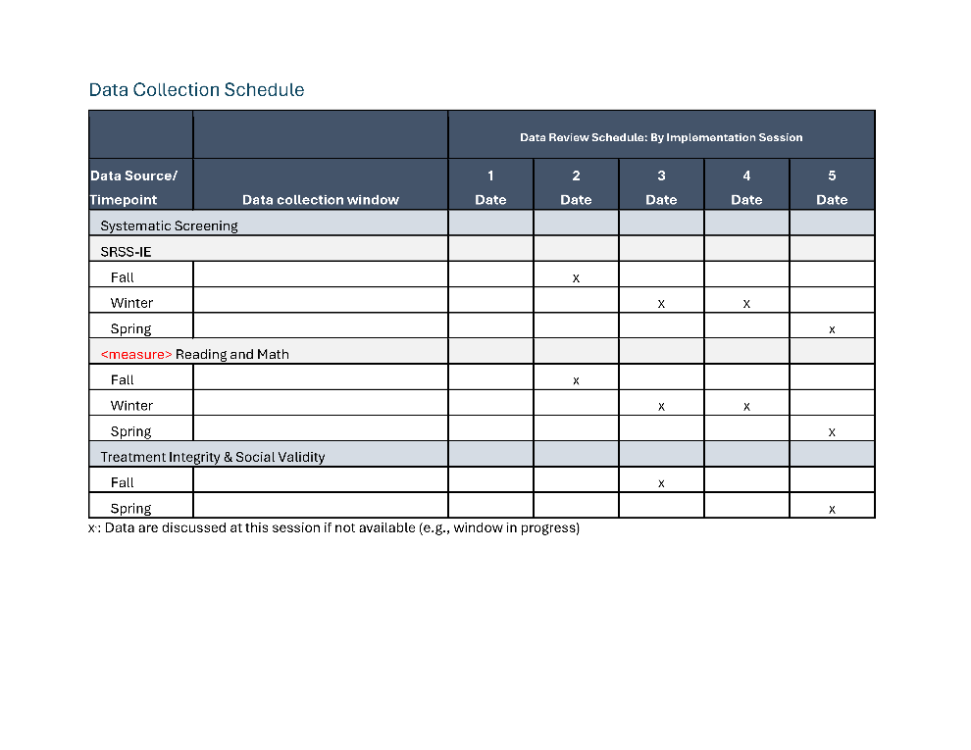
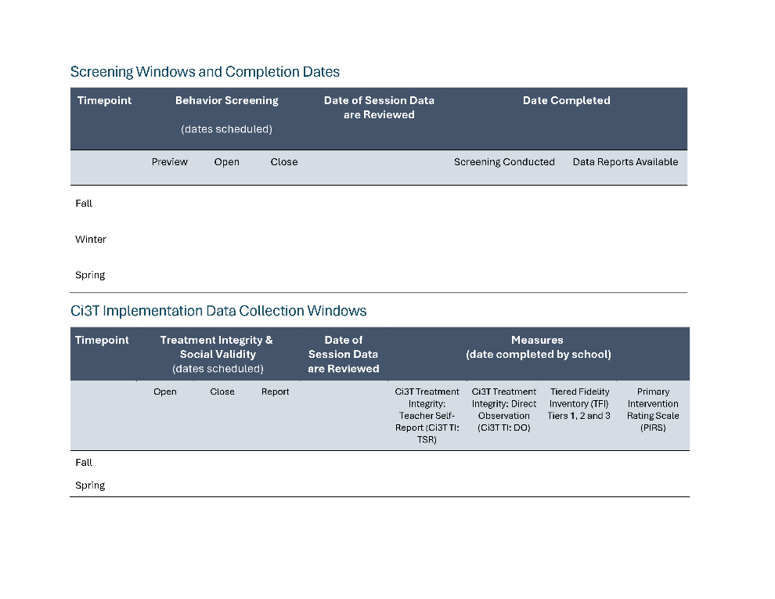
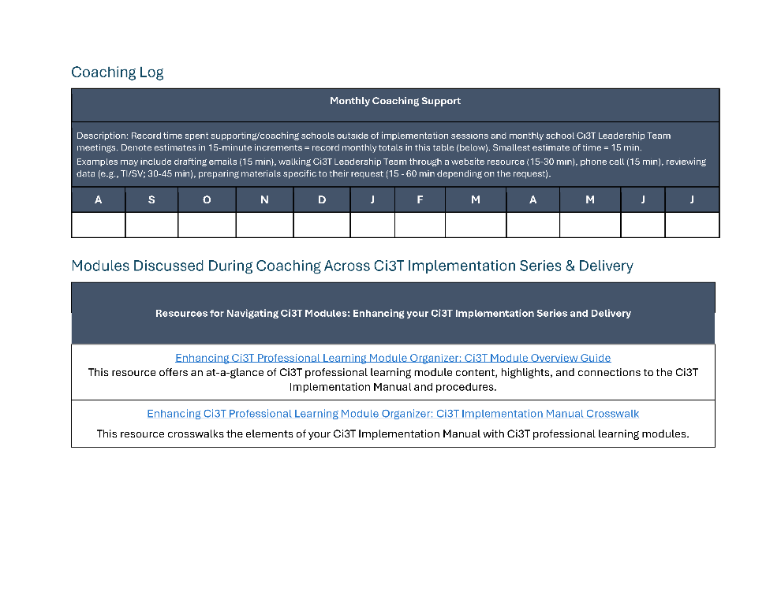
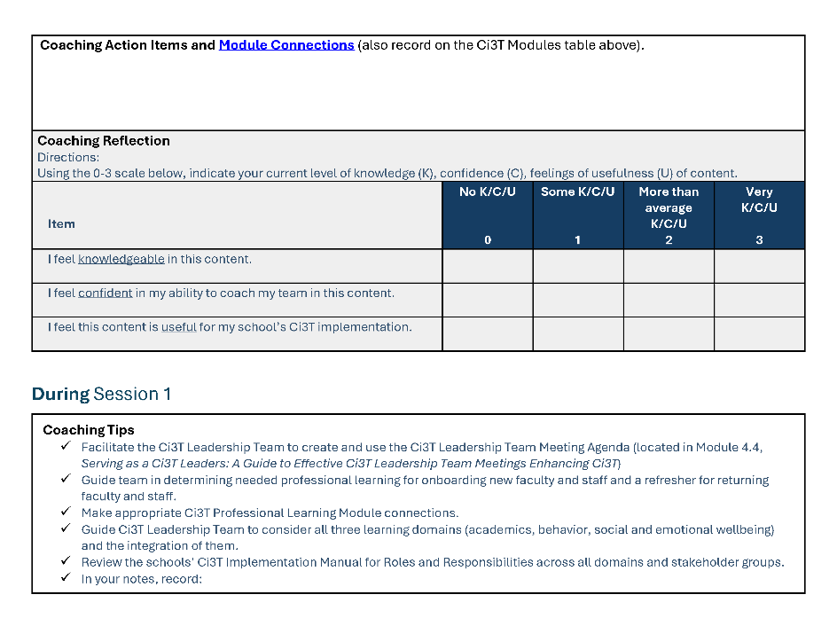
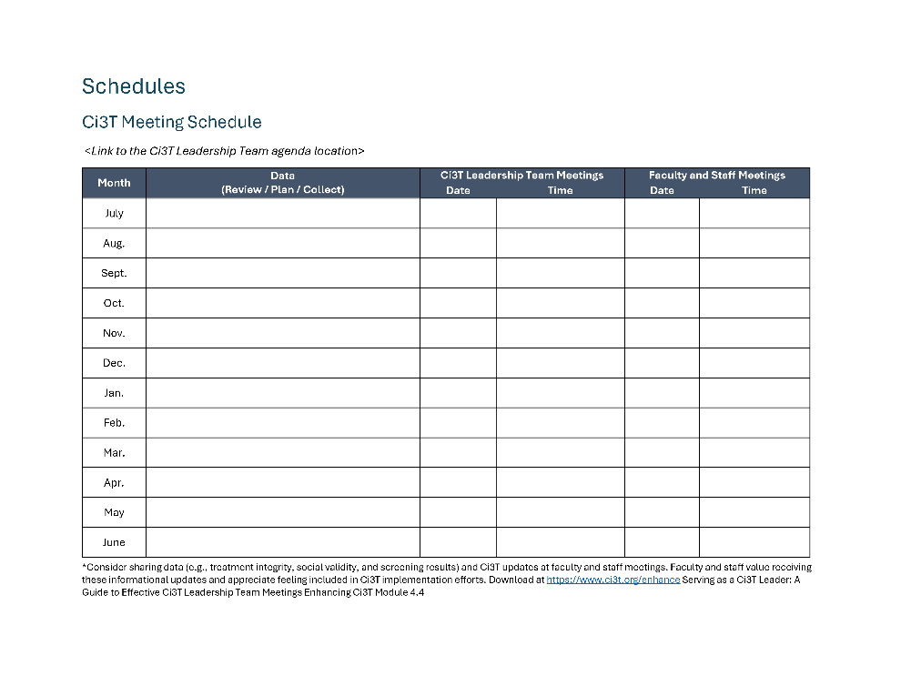
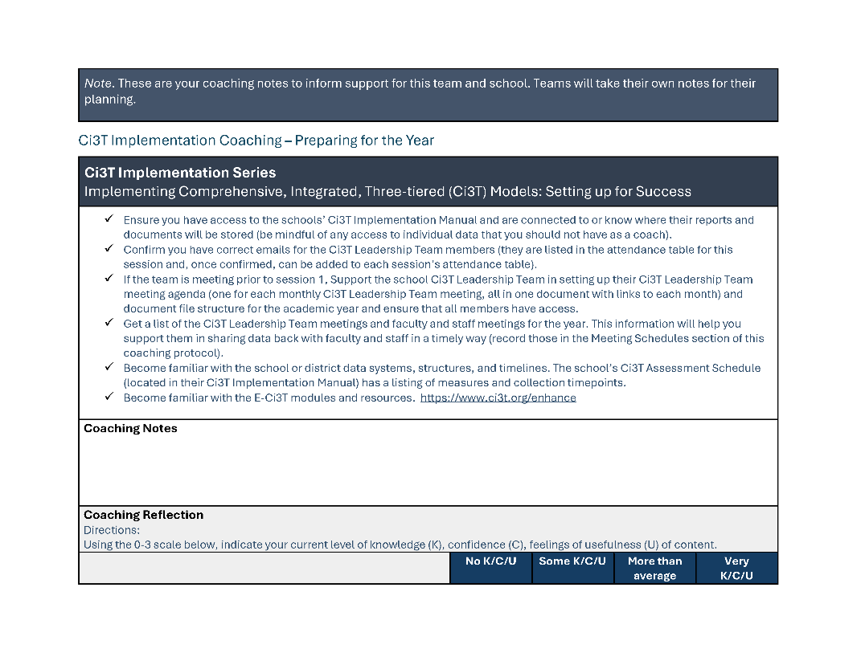
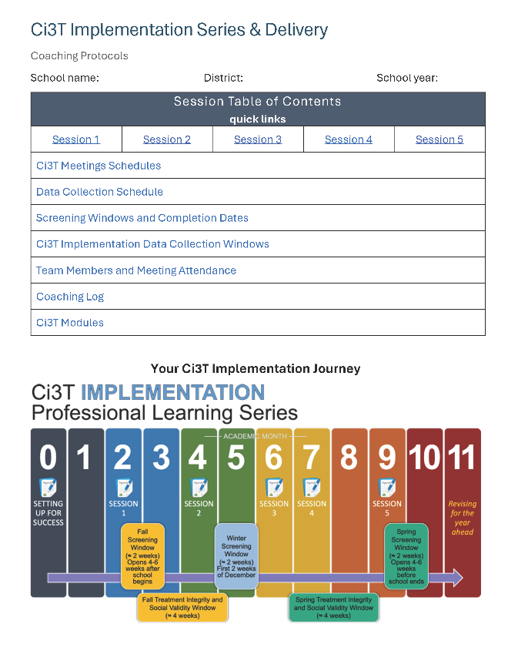
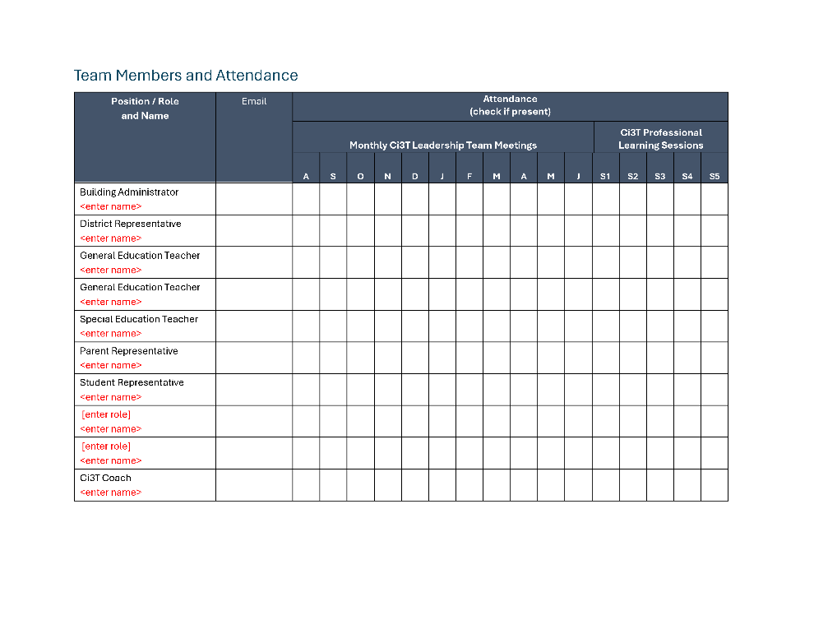
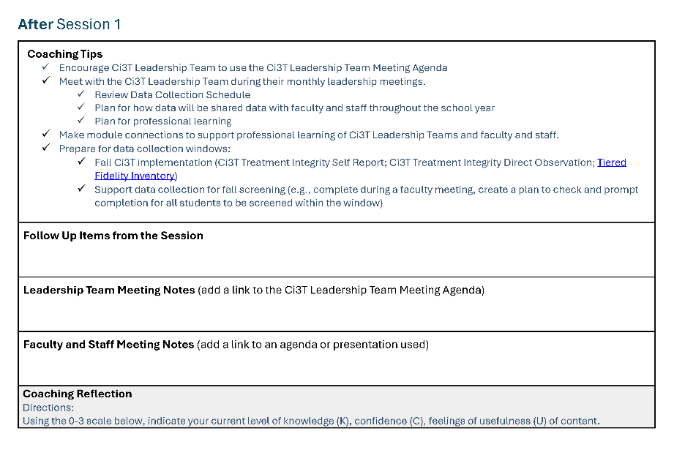
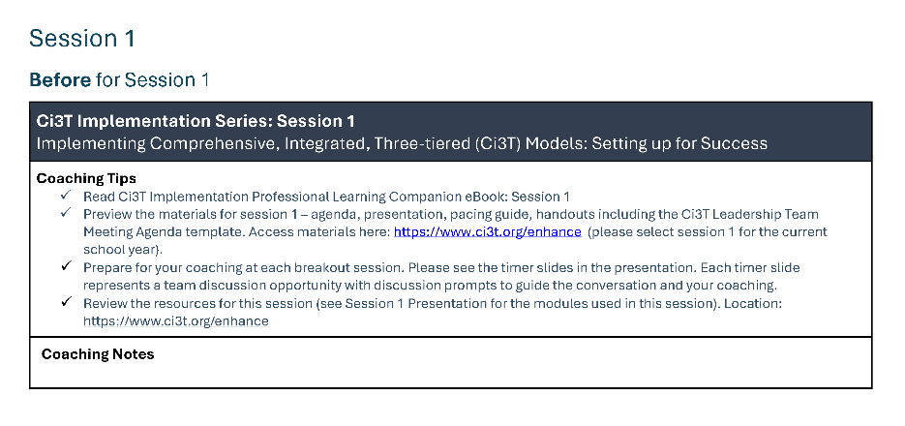
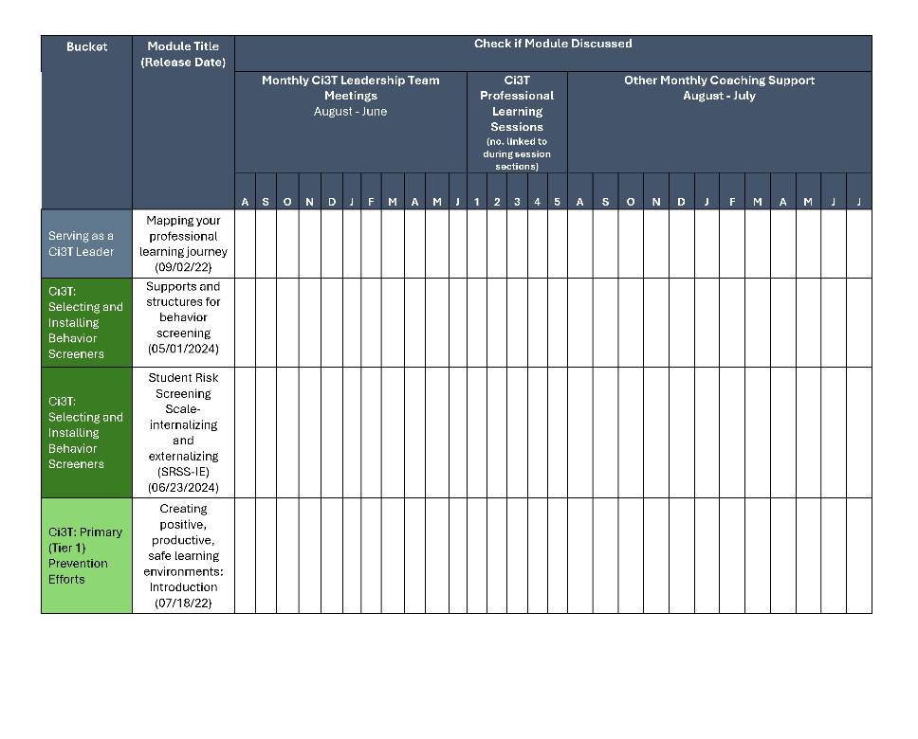
Coaching Protocol

Slide 19
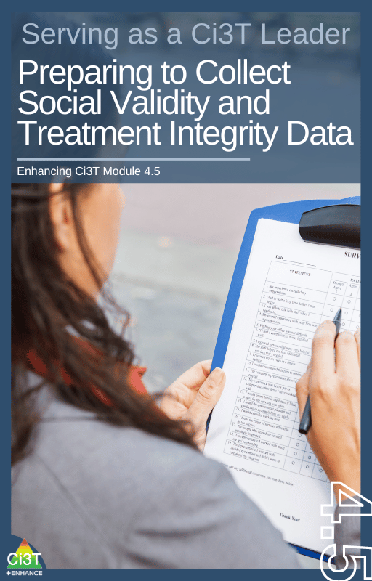
Procedures for Monitoring
Review your School’s Social Validity & Treatment Integrity Data
Review your School’s Spring Screening Data

Slide 20
Session Outcomes
Interpret social validity, treatment integrity, and spring screening data at the school- and classroom-level to identify successes and focus areas relative to Ci3T implementation.
Use needs of faculty, staff, and students – as identified in social validity, treatment integrity, and spring screening data – to inform professional learning for faculty and staff, use of effective practices to support students (e.g., low-intensity strategies, Tier 2 and 3 interventions), and updates to your school’s Ci3T Implementation Manual.

Slide 21
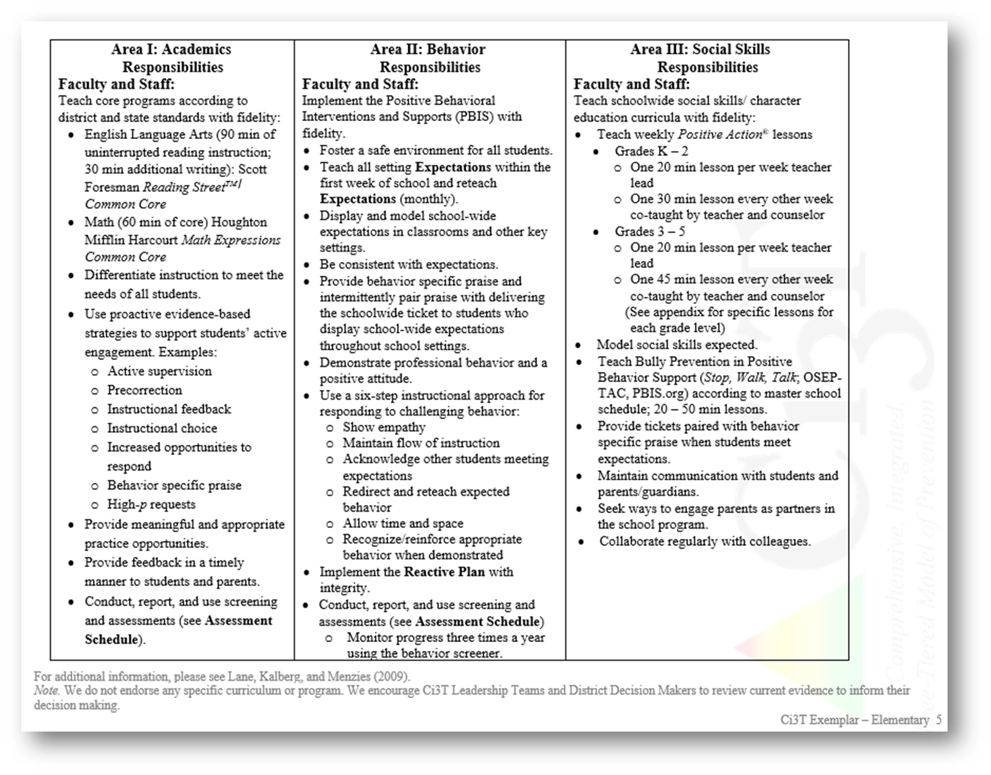
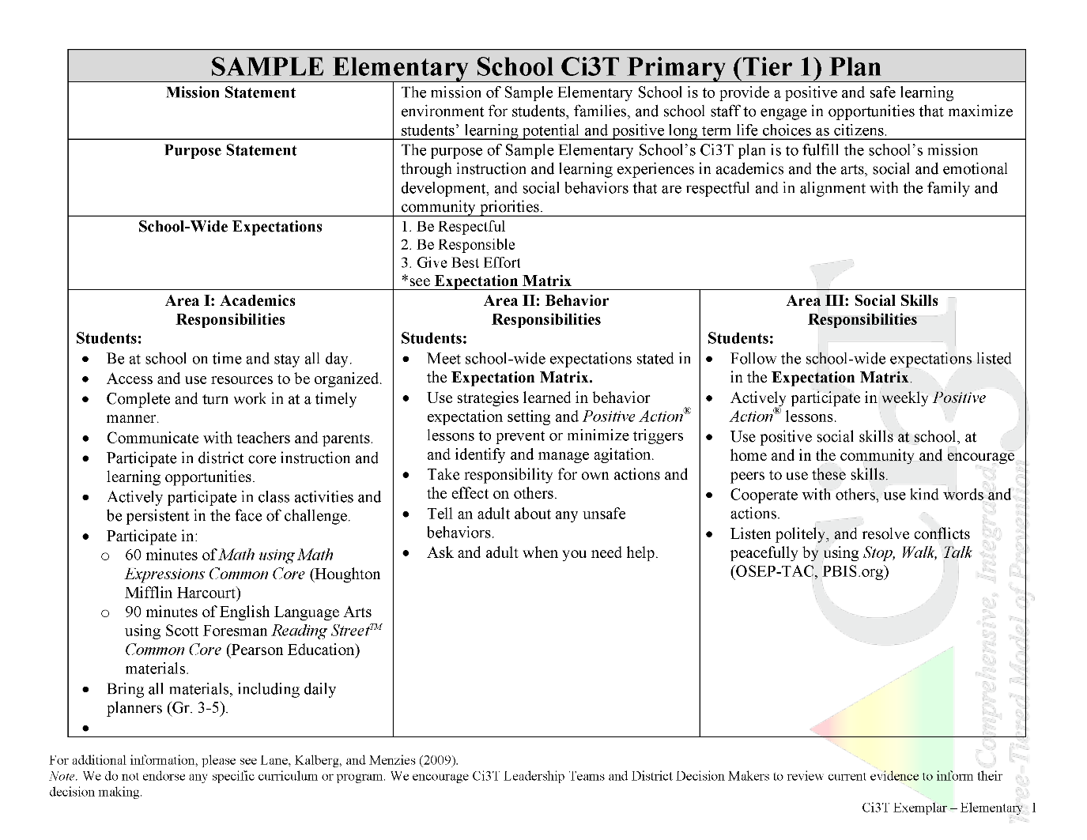
Procedures for Teaching
Procedures for Reinforcing
Procedures for Monitoring

Slide 22

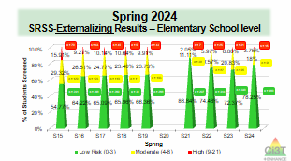
Essential Components of Primary (Tier 1) Prevention Efforts
Social Validity
Systematic Universal Screening
Academic
Behavior
Treatment Integrity
ci3t.org/measures
ci3t.org/screening
for behavior

Slide 23
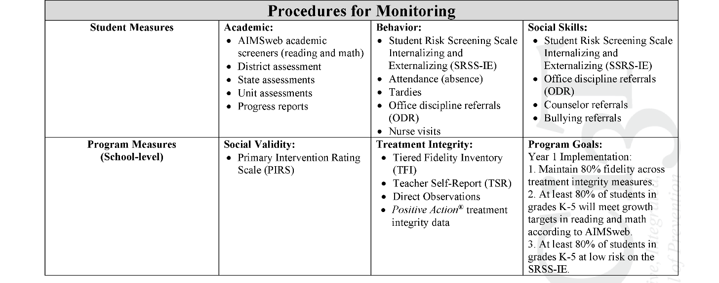
Ci3T Primary Plan
Procedures for Monitoring: Elementary
Program Measures and Goals

Slide 24
Sample Elementary Assessment Schedule
Measure | Aug | Sep | Oct | Nov | Dec | Jan | Feb | Mar | Apr | May
School Demographics
Student Demographic Information | X | X | X | X | X | X | X | X | X | X
Screening Measures
Behavior Screeners: SRSS-IE |  | X |  |  | X |  |  |  | X
Academic Screeners: AIMSWeb | X | X |  |  |  | X |  |  |  | X
Student Outcome Measures - Academic
State & District assessment |  |  |  |  |  |  |  | X | X
Progress reports |  |  |  | X |  |  | X |  |  | X
Student Outcome Measures - Behavior
Absences |  | X | X | X | X | X | X | X | X
Office discipline referrals (ODR) |  | X |  |  | X |  |  |  | X
Counselor referrals | X | X | X | X | X | X | X | X | X | X
Nurse visits | X | X | X | X | X | X | X | X | X | X
Program Measures
Primary Intervention Rating Scale |  |  | X |  |  |  |  | X
School-wide Evaluation Tool |  |  | X |  |  |  |  | X
Ci3T TI: Teacher Self-Report |  |  | X |  |  |  |  | X
Ci3T TI: Direct Observation |  |  | X |  |  |  |  | X
Second Step® Treatment Integrity |  |  | X |  |  |  |  | X
Adapted from Lane, K. L., Oakes, W. P., Cantwell, E. D., & Royer, D. J. (2018). Building and installing comprehensive, integrated, three-tiered (Ci3T) models of prevention: A practical guide to supporting school success V1.2. KOI Education. (Interactive eBook)

Slide 25
Procedures for Monitoring
Review your School’s Social Validity & Treatment Integrity Data
Review your School’s Spring Screening Data

Slide 26
Social Validity
How do stakeholders view the plan?
Social validity refers to the level of:
Social significance of intervention goals
Social acceptability of intervention procedures
Social importance of intervention outcomes
(Wolf, 1978)
Assessed using the Primary Intervention Rating Scale (PIRS)
Social Validity: PIRS Results
Year | Fall |  | Spring
 | n | % (SD) | n | % (SD)
2023-2024 | 32 | 85.39 (8.89) | 43 | 81.45 (12.22)

Slide 27
Treatment Integrity
Are we implementing our plan as intended?
Treatment integrity can refer to:
Adherence
Dosage
Quality
Assessed using:
Ci3T Treatment Integrity: Teacher Self-Report
Ci3T Treatment Integrity: Direct Observation
Tiered Fidelity Inventory (TFI)
Ci3T Procedures | Teacher Self-Report* | Direct Observation*
 | Spring 2025 n = 45 % (SD) | Educator n = 6 % (SD) | Observer n = 7 % (SD)
Teaching | 80.43% (10.86) | 70.72% (13.81) | 75.02% (17.05)
Reinforcing | 80.83% (12.89) | 62.06% (15.33) | 34.99% (16.02)
Monitoring | 75.49% (18.06) | - | -
Total | 79.10% (11.87) | 67.66% (14.03) | 62.28% (14.58)

Slide 28
Logistics Planning
Method | Measure Name | Completed by…
Method | Measure Name | All Staff | Randomly Selected Classrooms | Ci3T Leadership Team
Survey | Ci3T Treatment Integrity: Teacher Self-Report and Primary Intervention Rating Scale | X
Observations | Ci3T Treatment Integrity: Direct Observation |  | X
Rubric | Tiered Fidelity Inventory (TFI) |  |  | X

Slide 29
Using Treatment Integrity and
Social Validity Data
Individualized Feedback and Coaching
Data-informed
Linked to school-wide plan
Professional Learning for all Staff
On-demand resources
Free-access PL events
Revising the Ci3T Plan
Annual revisions based on stakeholder feedback and values

Slide 30

Treatment Integrity and Social Validity Data Sources
Lincoln Elementary School
Lincoln Elementary
School
Primary Intervention Rating Scale (Social Validity)
Ci3T Treatment Integrity: Teacher Self Report
Ci3T Treatment Integrity: Direct Observation
Tiered Fidelity Inventory

Slide 31
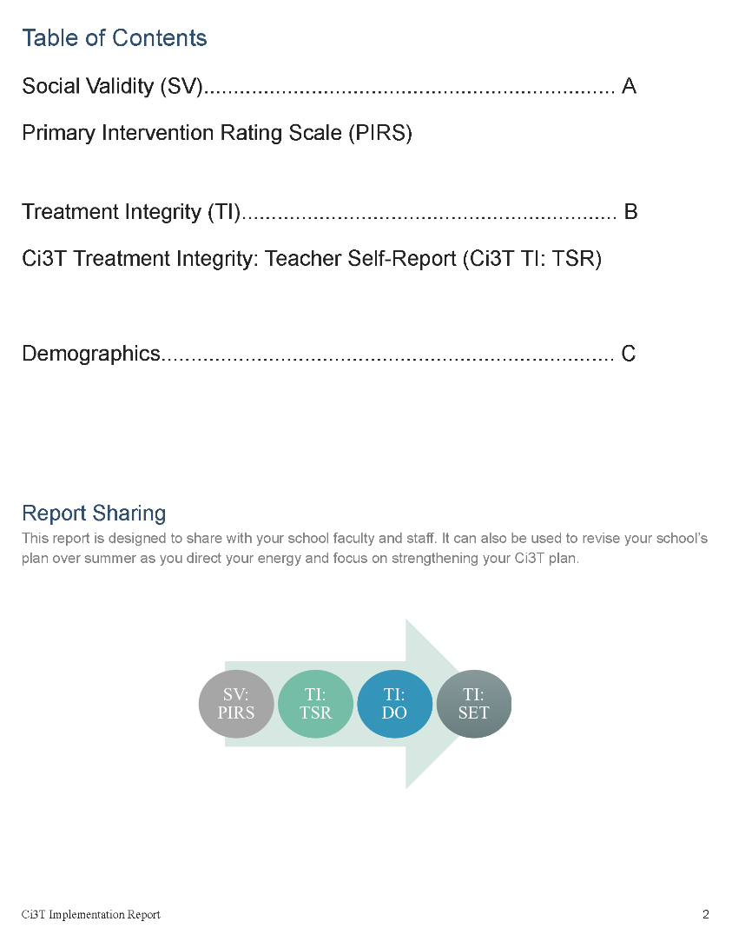

Slide 32
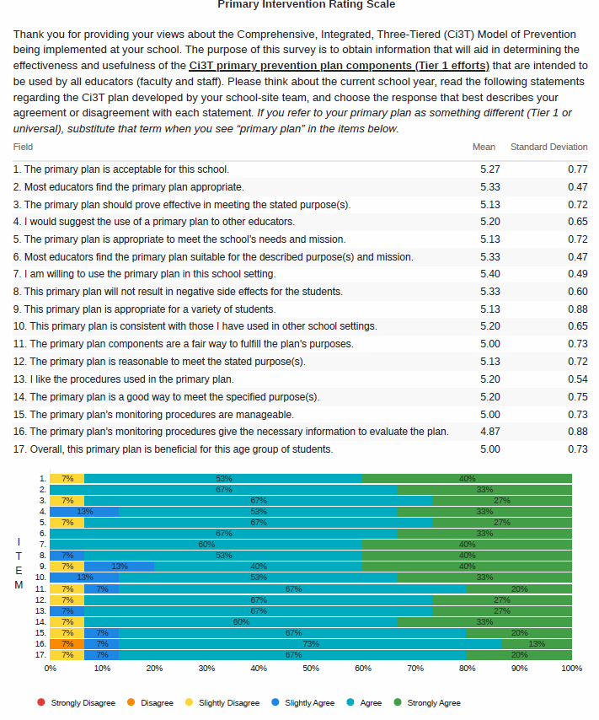

Slide 33
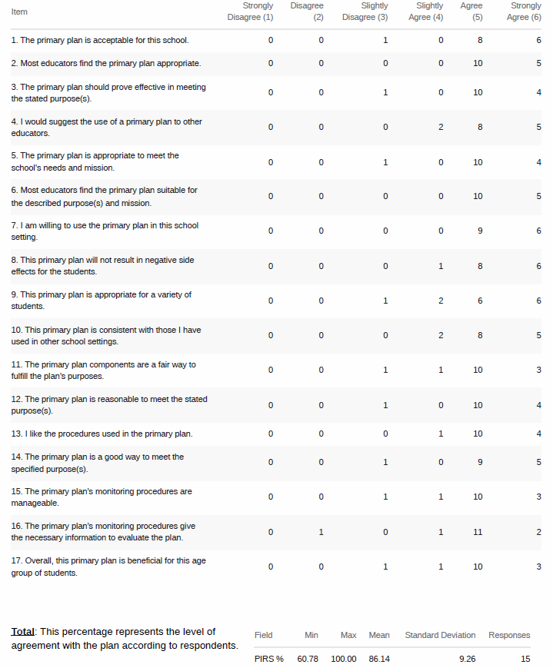

Slide 34
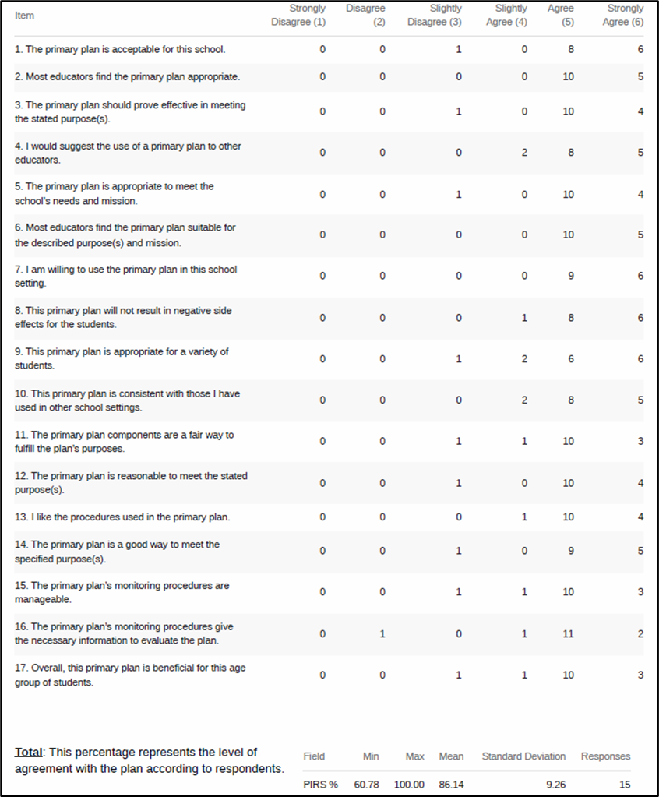

Slide 35
Open-Ended Questions:
A) What do you feel is most beneficial about this primary prevention plan’s components (Tier 1 efforts)? B) What is the least beneficial part?
Do you think that your and your students’ participation in this Ci3T plan will cause your students’ behavior, social, and/or learning problems to improve? Why or why not? Or if so, how?
What would you change about this plan (components, design, implementation etc.) to make it more student-friendly and educator-friendly?
What other information would you like to contribute about this plan?
Read through comments
Highlight success (literally!)
Look for themes for celebrations and focus areas

Slide 36
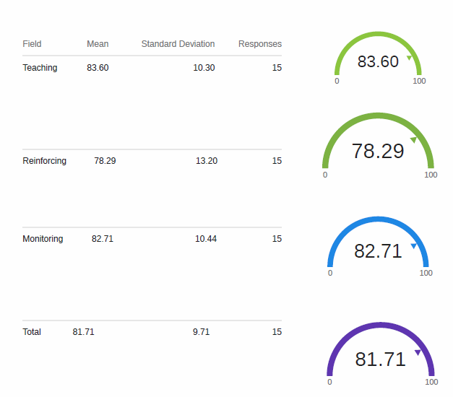

Slide 37
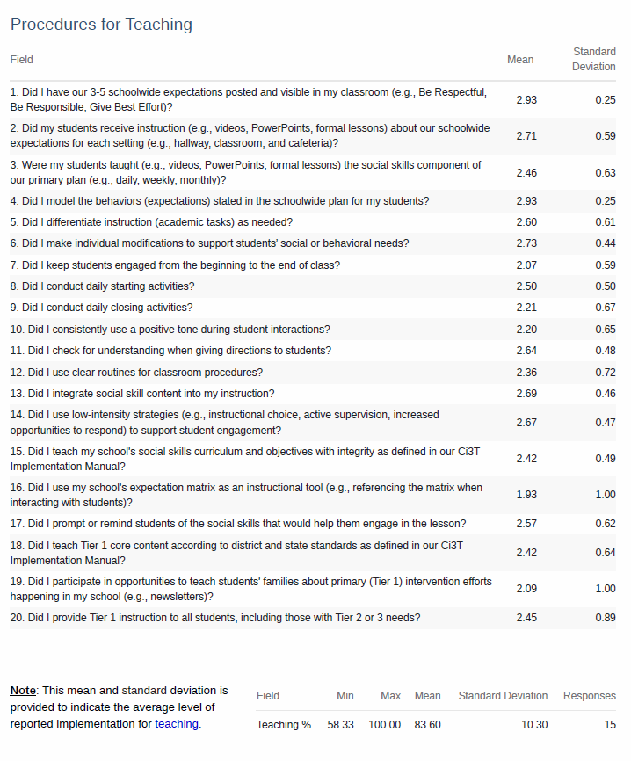

Slide 38
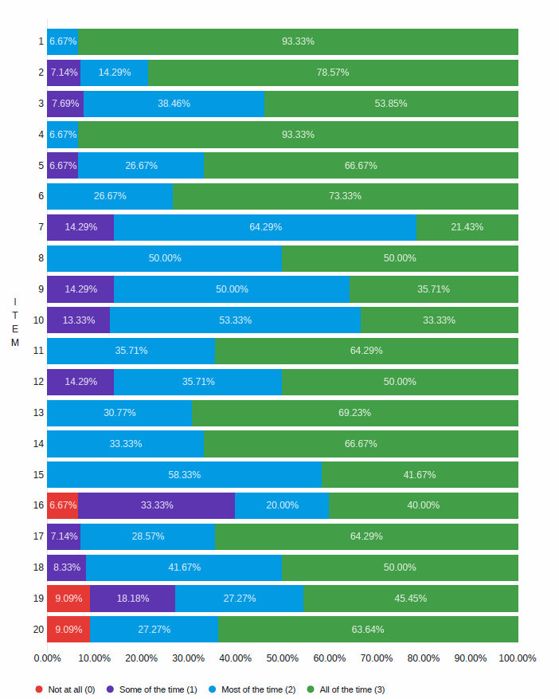

Slide 39
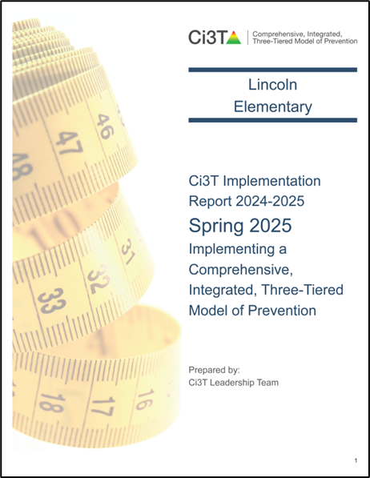
Treatment Integrity and Social Validity Data Sources
Primary Intervention Rating Scale (Social Validity)
Ci3T Treatment Integrity: Teacher Self Report
Ci3T Treatment Integrity: Direct Observation
Tiered Fidelity Inventory

Slide 40
Ci3T Treatment Integrity
Direct Observation (Ci3T TI: DO)
Subset of Ci3T TI: TSR
Stratified, random selection of educators
  Personnel who directly instruct students
Observers trained to criterion
30-min observations
  Educator perspective
  Observer perspective

Slide 41
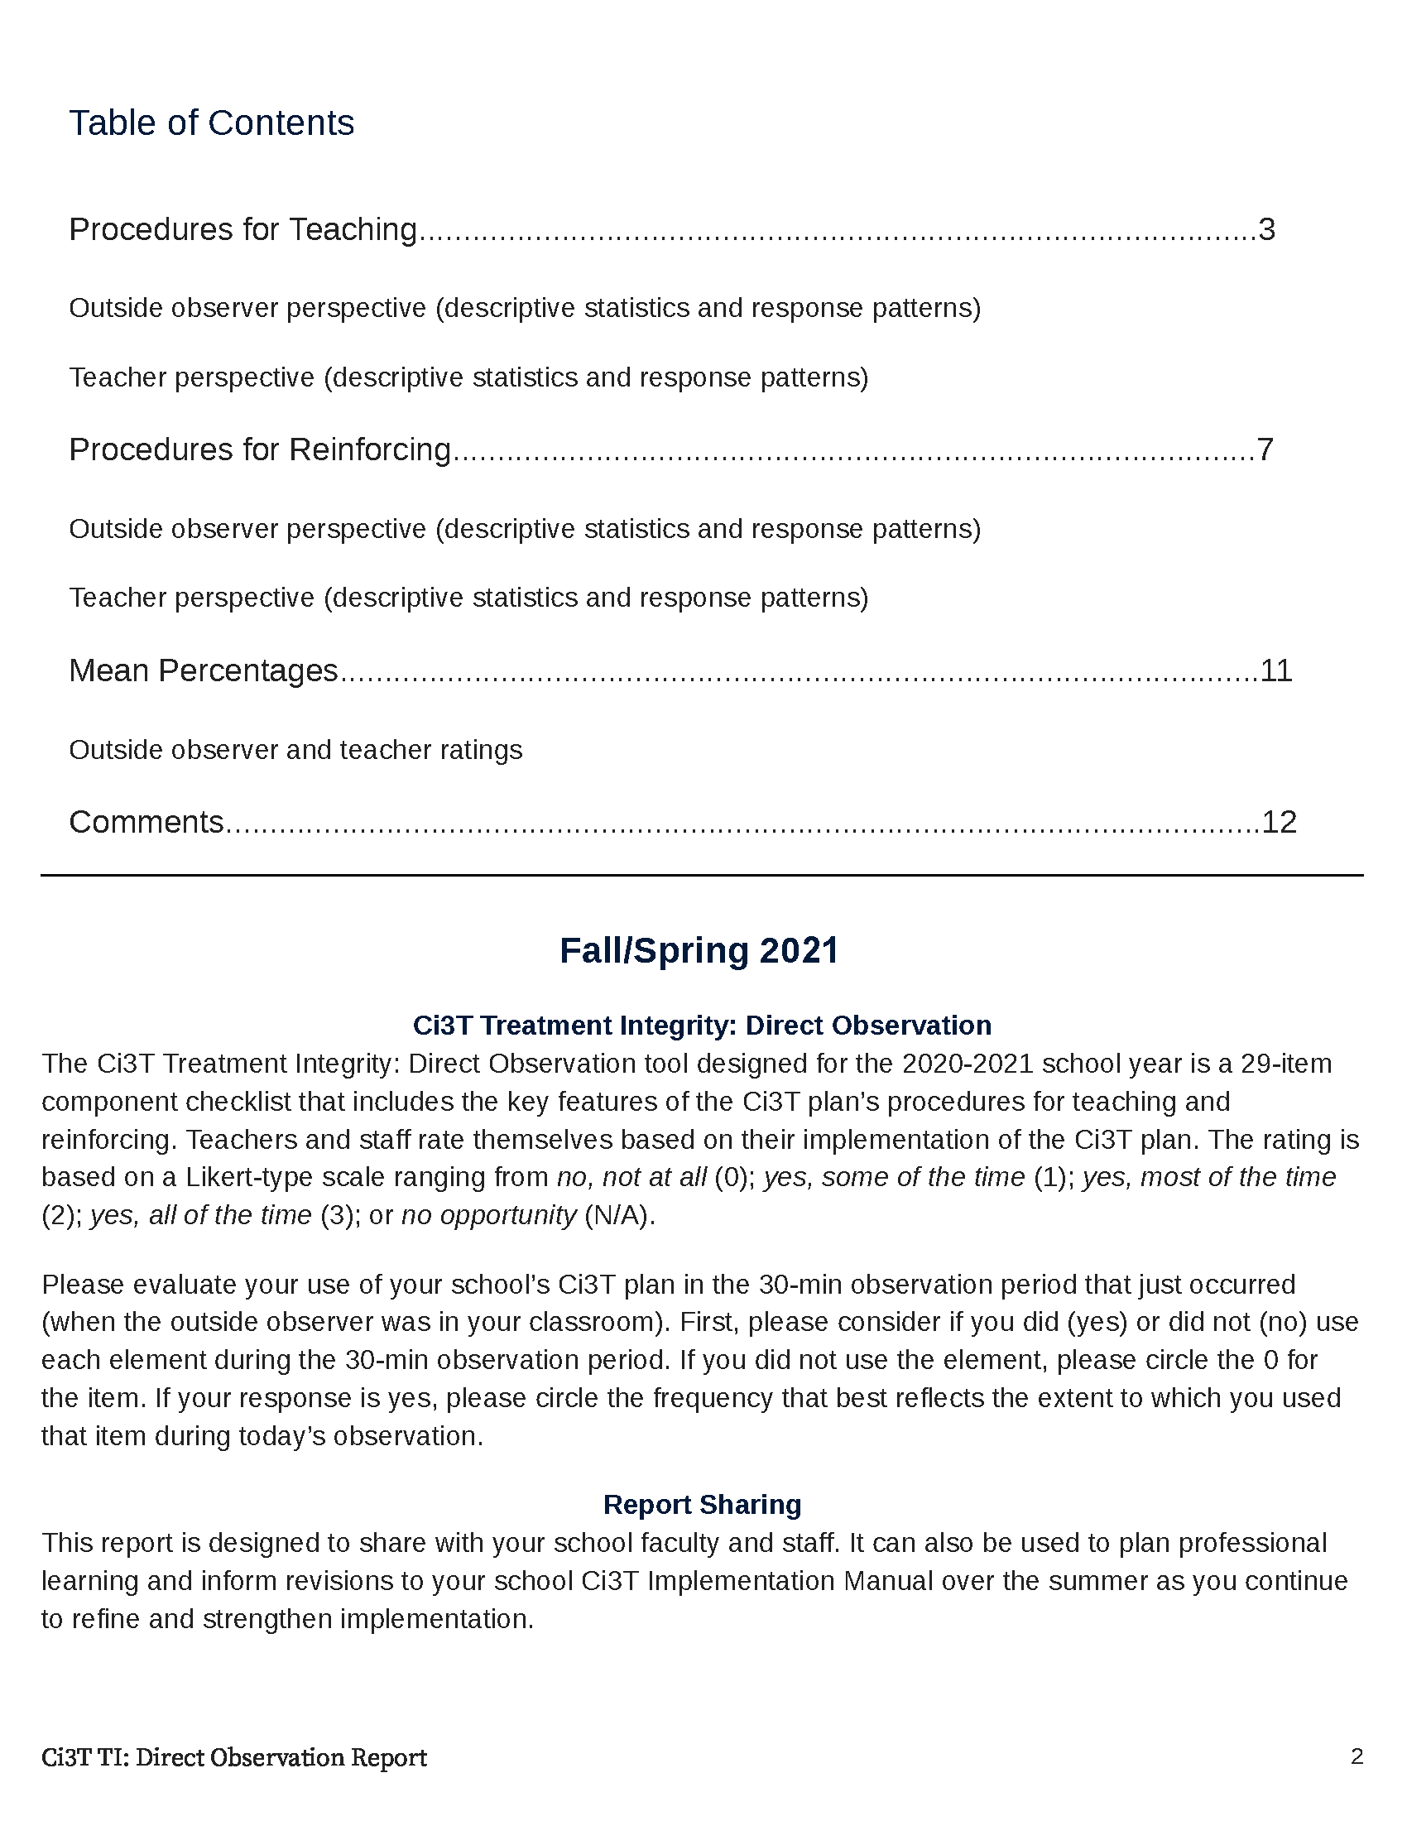
Spring 2024

Slide 42
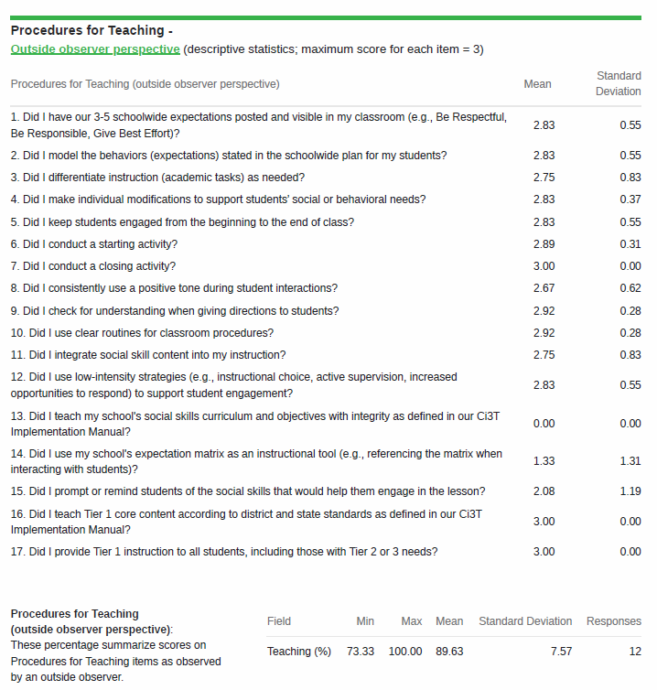

Slide 43
Notes:
Convergent validity. What the outside observer noticed during direct observation matches what your staff indicated In teacher self-report.

Slide 45
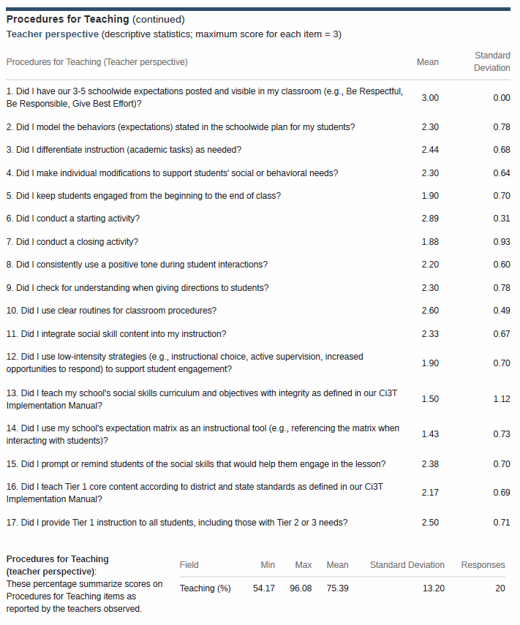

Slide 46
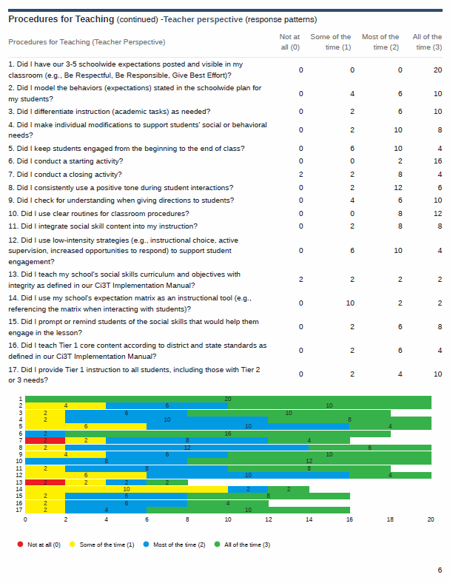

Slide 47



Slide 48


Slide 49
Treatment Integrity and Social Validity Data Sources
Primary Intervention Rating Scale (Social Validity)
Ci3T Treatment Integrity: Teacher Self Report
Ci3T Treatment Integrity: Direct Observation
Tiered Fidelity Inventory

Slide 50


Notes:
When we look at the Tiered Fidelity Inventory, we can see that Tier 1 is looking good and is consistently above that fidelity criterion. Tier 2 and Tier 3 are not yet where we’d like them to be.

Slide 51







Sharing and Using Your Data

Slide 52
Accessing Professional Learning Materials
ci3t.org/imp

Slide 53


Accessing Professional Learning Materials

Slide 54



























Let’s Discuss
Locate your school’s Social Validity and Treatment Integrity Data
(e.g.,Ci3T Implementation Report, Ci3T Treatment Integrity: Direct Observation Report, Tiered Fidelity Inventory)
2) Review data and:
Highlight successes
Discuss concerns and identify areas of focus
Use HO Working with Treatment Integrity and Social Validity Data
to record plans for addressing these focus areas
Notes:
20-min timer

Slide 55

Procedures for Monitoring
Review your School’s Social Validity & Treatment Integrity Data
Review your School’s Spring Screening Data

Slide 56
Session Outcomes
Interpret social validity, treatment integrity, and winter screening data at the school- and classroom-level to identify successes and focus areas relative to Ci3T implementation.
Develop corresponding professional learning opportunities to empower faculty and staff with effective practices to inform instruction at each level of prevention (e.g., Tier 1, low-intensity strategies, Tier 2 and Tier 3 interventions) according to needs identified in social validity, treatment integrity, and winter screening data.

Slide 57


Essential Components of Primary (Tier 1) Prevention Efforts
Social Validity
Systematic Universal Screening
Academic
Behavior
Treatment Integrity
ci3t.org/measures
ci3t.org/screening
for behavior

Slide 58

Behavior Screening

Slide 59




Systematic Behavior Screening

Slide 60

Student Risk Screening Scale – Internalizing and Externalizing (SRSS-IE; Drummond, 1994; Lane & Menzies, 2009)
Elementary

Slide 61

Student Risk Screening Scale – Internalizing and Externalizing (SRSS-IE; Drummond, 1994; Lane & Menzies, 2009)
Secondary

Slide 62
SRSS-IE: Cut Scores
Elementary School |  | Middle and High School
SRSS-E7 | SRSS-I5 | SRSS-E7 | SRSS-I6
Items 1-7 | Items 8-12 | Items 1-7 | Items 4, 8-12
0-3 = low risk 4-8 = moderate risk 9-21 = high risk | 0-1 = low risk 2-3 = moderate risk 4-15 = high risk | 0-3 = low risk 4-8 = moderate risk 9-21 = high risk | 0-3 = low risk 4-5 = moderate risk 6-18 = high risk
Elementary School Level:
Lane, K. L., Oakes, W. P., Swogger, E. D., Schatschneider, C., Menzies, H., M., & Sanchez, J. (2015). Student risk screening scale for internalizing and externalizing behaviors: Preliminary cut scores to support data-informed decision making. Behavioral Disorders, 40, 159-170.
Middle and High School Levels:
Lane, K. L., Oakes, W. P., Cantwell, E. D., Schatschneider, C., Menzies, H., Crittenden, M., & Messenger, M. (2016). Student Risk Screening Scale for Internalizing and Externalizing Behaviors: Preliminary cut scores to support data-informed decision making in middle and high schools. Behavioral Disorders, 42(1), 271-284

Slide 63
Spring 2024
SRSS-Externalizing Results – Elementary School level
n = 70
n = 43
n = 45
n = 5
n = 43
n = 7
n = 25
n = 31
n = 15
n = 38
n = 90
n = 87
n = 95
n = 129
n = 123
n = 110
n = 11
n = 103
n = 241
n = 298
n = 289
n = 31
n = 288
n = 297
n = 314
n = 330
n = 380
Notes:
Fill in <year> based on current academic year. This is located in column A of the data sheet. Edit by right clicking and selecting “Edit data”.

Slide 64
Spring 2024
SRSS-Externalizing Results – Elementary Grade level
Grade Level | N Screened | Low n (%) | Moderate n (%) | High n (%)
K | 66 | 43 (65.15%) | 20 (30.30%) | 3 (4.55%)
1 | 79 | 65 (82.28%) | 9 (11.39%) | 5 (6.33%)
2 | 78 | 54 (69.23%) | 20 (25.64%) | 4 (5.13%)

Slide 65
Spring 2024
SRSS-Internalizing Results – Elementary School Level
n = 54
n = 42
n = 36
n = 103
n = 70
n = 68
n = 283
n = 352
n = 340
Cut scores vary by school level:
Elementary (I5): Low (0-1), Moderate (2-3), High (4-15)
Middle and High (I6): Low (0-3), Moderate (4-5), High (6-18)
Notes:
Fill in <year> based on current academic year. This is located in column A of the data sheet. Edit by right clicking and selecting “Edit data”.
IMPORTANT NOTE: The INTERNALIZING subscale and CUT SCORES are specific to school level.
Elementary: SRSS-I5, Items 8-12, 0-1 = low risk, 2-3 = moderate risk, 4-15 = high risk
Middle and High: SRSS-I6, Items 4, 8-12, 0-3 = low risk, 4-5 = moderate risk, 6-18 = high risk

Slide 66
Spring 2024
SRSS-Internalizing Results – Elementary Grade Level
Grade Level | N Screened | Low n (%) | Moderate n (%) | High n (%)
3 | 62 | 51 (82.26%) | 11 (17.74%) | 0 (0.00%)
4 | 81 | 62 (76.54%) | 13 (16.05%) | 6 (7.41%)
5 | 90 | 64 (71.11%) | 13 (14.44%) | 13 (14.44%)

Slide 67
Reviewing Screening Data
Ci3T Leadership Teams review screening data at the following levels:
Screening Practice
School-wide (e.g., Tier 1 efforts)
Grade or department (e.g., Tier 1 efforts, low-intensity strategies)
Class level (e.g., low-intensity strategies)
Individual student level (e.g., Tier 2 and Tier 3)

Slide 68

Academic Screening

Slide 69

Reviewing Multiple Sources of Data in an Integrated Way
attendance
behavior
screening
academic screening

Slide 70
Accessing Professional Learning Materials
ci3t.org/imp

Slide 71


Accessing Professional Learning Materials

Slide 72



At your next Ci3T Leadership Team Meeting…
Use the Working with Your Screening Data Handout to review Spring screening data Where are there strengths or bright spots? What are the greatest areas of need? School-level (e.g., Tier 1)? Grade or department level (e.g., Tier 1, low intensity strategies)? Classroom level (e.g., low intensity strategies)? Student-level (e.g., Tier 2 & Tier 3) Determine when and how to share Spring screening data with faculty and staff
Notes:
15-min timer

Slide 73


ci3t.org users
June 24, 2024 to March 24, 2025

Slide 74


ci3t.org users
July 1, 2022 to March 24, 2025

Slide 75
Planning for the Year Ahead 2025-2026
Review 2024-2025 data: Treatment integrity, social validity, screening, attendance
Review Your Ci3T Implementation Manual for 2025-2026
Incorporate revisions provided by your district: Ci3T District Masters – Updates
Use 2024-2025 data to inform revision for your Ci3T Implementation Manual

Slide 76
Session Outcomes
Interpret social validity, treatment integrity, and winter screening data at the school- and classroom-level to identify successes and focus areas relative to Ci3T implementation.
Develop corresponding professional learning opportunities to empower faculty and staff with effective practices to inform instruction at each level of prevention (e.g., Tier 1, low-intensity strategies, Tier 2 and Tier 3 interventions) according to needs identified in social validity, treatment integrity, and winter screening data.

Slide 77


Action Planning
Review 2025- 2026 Implementation Data
Elise
05/24/25
Incorporate updates from the district
Allison
05/15/25
Attend Ci3T Implementation Symposium- update plan!
Mark
06/18/25
Notes:
Encourage you to leave a note in your Ci3T LT agenda to indicate where your team will pick up at your next meeting and to record any action items.

Slide 78




Ci3T Implementation Manual Review
Also available
as a
handout
ci3t.org/enhance
ci3t.org/imp

Slide 79





Slide 80





Professional Learning: Long Range Planning

Slide 81




Using Data to Revise Your Ci3T Plan
Add in plans for Tier 2 & 3

Slide 82


Check to see if your district has updated their District Master Blueprint
Teach, display, and model school-wide expectations
Teach school-wide social skills…, model social skills
Notes:
As you look at your Primary Plan where to you see this expectations for teachers. If you so not see it explicitly stated consider adding this to your summer revision list.

Slide 83
Enhancing Ci3T Modules
ci3t.org/enhance

Slide 84



Slide 85
Tickets don’t work.
It’s too complicated to collect and keep track of tickets.
Tickets don’t build intrinsic motivation. This isn’t preparing them for the real world
Fifth graders don’t care about tickets.

Slide 86



Professional Learning

Slide 87


Professional Learning

Slide 88


Slide 89



Focus:
Embedding Low-Intensity Strategies

Slide 90



Slide 91
Winter 2024
SRSS-Externalizing Results – High School Level
n = 47
n = 72
n = 36
n = 36
n = 40
n = 8
n = 17
n = 38
n = 119
n = 113
n = 47
n = 137
n = 134
n = 114
n = 90
n = 65
n = 1259
n = 1280
n = 1188
n = 994
n = 447
n = 717
n = 750
n = 920

Slide 92


Encourage Review of Tier 2 and Tier 3 Enhancing Ci3T Modules

Slide 93


Whether the problem behavior is managed safely or not
or is defused
in a large measure depends on
YOUR INITIAL RESPONSE
-Dr. Geoff Colvin

Slide 94




Slide 95
Focusing on Data-Informed Professional Learning
Ci3T Monthly Leadership Team Meetings
Project EMPOWER: Building Capacity
Ci3T Trainer and Coaches Calls
Ci3T Summer Symposium

Slide 96
Foundational Ci3T Implementation & Professional Learning Activities

Slide 97




Slide 98


Slide 100



Ci3T Monthly Leadership Team
Meetings & Faculty and Staff Meetings

Slide 101

Ci3T Implementation Professional Learning Series
Ci3T Implementation Professional Learning Series Location: Remote via Zoom Attended by: Ci3T Leadership Teams Sessions A and B are available. Ci3T Leadership Teams select which one they would like to attend.
Session | Date | Times (Session A and B)
 |  | Pacific | Central | Eastern
Summer Session | June 18, 2025 (Wed) | 7:30 am – 1:30 pm | 9:30 am – 3:30 pm | 10:30 am – 4:30 pm
Session 1 | Sept.11, 2025 (Thurs) | 10:00 am – 12:00 pm | 12:00 pm – 2:00 pm | 1:00 pm – 3:00 pm
 |  | 2:30 pm – 4:30 pm | 4:30 pm – 6:30 pm | 5:30 pm – 7:30 pm
Session 2 | Nov. 13, 2025 (Thurs) | 10:00 am – 12:00 pm | 12:00 pm – 2:00 pm | 1:00 pm – 3:00 pm
 |  | 2:30 pm – 4:30 pm | 4:30 pm – 6:30 pm | 5:30 pm – 7:30 pm
Session 3 | Jan. 13, 2026 (Tues) | 10:00 am – 12:00 pm | 12:00 pm – 2:00 pm | 1:00 pm – 3:00 pm
 |  | 2:30 pm – 4:30 pm | 4:30 pm – 6:30 pm | 5:30 pm – 7:30 pm
Session 4 | Mar. 03, 2026 (Tues) | 10:00 am – 12:00 pm | 12:00 pm – 2:00 pm | 1:00 pm – 3:00 pm
 |  | 2:30 pm – 4:30 pm | 4:30 pm – 6:30 pm | 5:30 pm – 7:30 pm
Session 5 | Apr. 14, 2026 (Tues) | 10:00 am – 12:00 pm | 12:00 pm – 2:00 pm | 1:00 pm – 3:00 pm
 |  | 2:30 pm – 4:30 pm | 4:30 pm – 6:30 pm | 5:30 pm – 7:30 pm

Slide 102

Project EMPOWER+
Ci3T Project EMPOWER Location: Remote via Zoom Attended by: Ci3T Leadership Teams, Ci3T Trainers and Coaches, Faculty and Staff, Families (adults only), Community Members
Session | Date | Times
Starting Strong: Effective Tier 1 Practices for Educators | Sep. 24, 2025 (Wed) | 2:30 - 4:30 p.m. (Pacific) 4:30 - 6:30 p.m. (Central) 5:30 - 7:30 p.m. (Eastern)
From Data to Action: Using Systematic Screening to Inform Instruction | Oct. 8, 2025 (Wed) | 2:30 - 4:30 p.m. (Pacific) 4:30 - 6:30 p.m. (Central) 5:30 - 7:30 p.m. (Eastern)
Ci3T In Action: Integrated Lesson Planning for Enhanced Instruction | Nov. 18, 2025 (Tues) | 2:30 - 4:30 p.m. (Pacific) 4:30 - 6:30 p.m. (Central) 5:30 - 7:30 p.m. (Eastern)
Mastering Behavior Specific Praise and Precorrection | Jan. 21, 2026 (Wed) | 2:30 - 4:30 p.m. (Pacific) 4:30 - 6:30 p.m. (Central) 5:30 - 7:30 p.m. (Eastern)
A 6-Step Instructional Approach for Responding to Challenging Behaviors: A Tier 1 Practice | Feb. 10, 2026 (Tues) | 2:30 - 4:30 p.m. (Pacific) 4:30 - 6:30 p.m. (Central) 5:30 - 7:30 p.m. (Eastern)
A Tier 2 Support for Students Experiencing Anxious Feelings: Recognize. Relax. Record. | Mar. 25, 2026 (Wed) | 2:30 - 4:30 p.m. (Pacific) 4:30 - 6:30 p.m. (Central) 5:30 - 7:30 p.m. (Eastern)
A Tier 3 Support for Students with Intensive Intervention Needs: Functional Assessment-Based Intervention (FABI) | Apr. 28, 2026 (Tues) | 2:30 - 4:30 p.m. (Pacific) 4:30 - 6:30 p.m. (Central) 5:30 - 7:30 p.m. (Eastern)

Slide 103

Ci3T Trainers and Coaches Calls
Ci3T Trainers and Coaches Calls Location: Remote via Zoom Attended by: Ci3T Leadership Teams, Ci3T Trainers and Coaches, Faculty and Staff, Families (adults only), Community Members
Session | Date | Times (Central)
Ci3T Trainers and Coaches Call 1 | Aug. 20, 2025 (Wed) | 4:00 – 5:00 p.m.
Ci3T Trainers and Coaches Call 2 | Sept. 03, 2025 (Wed) | 4:00 – 5:00 p.m.
Ci3T Trainers and Coaches Call 3 | Oct. 01, 2025 (Wed) | 4:00 – 5:00 p.m.
Ci3T Trainers and Coaches Call 4 | Nov. 05, 2025 (Wed) | 4:00 – 5:00 p.m.
Ci3T Trainers and Coaches Call 5 | Dec. 02, 2025 (Tues) | 4:00 – 5:00 p.m.
Ci3T Trainers and Coaches Call 6 | Jan. 22, 2026 (Thurs) | 4:00 – 5:00 p.m.
Ci3T Trainers and Coaches Call 7 | Feb. 17, 2026 (Tues) | 4:00 – 5:00 p.m.
Ci3T Trainers and Coaches Call 8 | Mar. 10, 2026 (Tues) | 4:00 – 5:00 p.m.
Ci3T Trainers and Coaches Call 9 | Apr. 15, 2026 (Wed) | 4:00 – 5:00 p.m.
Ci3T Trainers and Coaches Call 10 | May 13, 2026 (Wed) | 4:00 – 5:00 p.m.

Slide 104

Ci3T Implementers Symposium
Wednesday, June 18, 2025
7:30 a.m. – 1:30 p.m. (Pacific)
9:30 a.m. – 3:30 p.m. (Central)
10:30 a.m. – 4:30 p.m. (Eastern)

Slide 105



















Reflect & Plan
Plan and schedule action items for closing out the current year and preparing for the upcoming year: Identify potential Ci3T Implementation Manual revisions Schedule time with your Ci3T Leadership Team to: complete Ci3T Implementation Manual revisions prepare for implementation in 2025-2026 Create plans for spring data sharing (e.g., social validity, treatment integrity, academic & behavior screenings) | Plan data-informed professional learning for the upcoming year: What are strengths of our current communication and professional learning systems? How can we share data updates and professional learning opportunities with faculty and staff more regularly? What resources and professional learning do faculty and staff require? Consider: Enhanced Ci3T Professional Learning Modules Empower Sessions Ci3T Trainers and Coaches Calls
Write any action items in your Ci3T Leadership Team Meeting Agenda
Use “Ci3T Imp Manual Review” to revise
Notes:
15-min timer

Slide 106
Wrapping Up and Moving Forward

Slide 107
Project EMPOWER +
Ci3T EMPOWER⁺ Sessions Location: Remote via Zoom Attended by: School Ci3T Leadership Teams, Ci3T District Trainers and Coaches, Faculty and Staff, Families (adults only). Community Members
Session | Date | Times
1. Ci3T FIT: Start the Year Strong | Sep. 24, 2024 (Tues) | 2:30 - 4:30 p.m. (Pacific) 4:30 - 6:30 p.m. (Central) 5:30 - 7:30 p.m. (Eastern)
2. Data-Informed Instruction: This is how we do it! | Oct. 9, 2024 (Wed) | 2:30 - 4:30 p.m. (Pacific) 4:30 - 6:30 p.m. (Central) 5:30 - 7:30 p.m. (Eastern)
3. Practical, Low Intensity Strategies to Maximize Engagement and Limit Disruption: Part 1 | Precorrection & Active Supervision | Nov. 19, 2024 (Tues) | 2:30 - 4:30 p.m. (Pacific) 4:30 - 6:30 p.m. (Central) 5:30 - 7:30 p.m. (Eastern)
4. Practical, Low Intensity Strategies to Maximize Engagement and Limit Disruption: Part 2 | Instructional Choice and Increased Opportunities to Respond | Jan. 22, 2025 (Wed) | 2:30 - 4:30 p.m. (Pacific) 4:30 - 6:30 p.m. (Central) 5:30 - 7:30 p.m. (Eastern)
5. Tier 2: Behavior Contracts | Feb. 11, 2025 (Tues) | 2:30 - 4:30 p.m. (Pacific) 4:30 - 6:30 p.m. (Central) 5:30 - 7:30 p.m. (Eastern)
6. Tier 2: Direct Behavior Ratings (DBR) | Mar. 26, 2025 (Wed) | 2:30 - 4:30 p.m. (Pacific) 4:30 - 6:30 p.m. (Central) 5:30 - 7:30 p.m. (Eastern)
7. Tier 3: Functional Assessment-based Interventions (FABI) | Apr. 29, 2025 (Tues) | 2:30 - 4:30 p.m. (Pacific) 4:30 - 6:30 p.m. (Central) 5:30 - 7:30 p.m. (Eastern)

Slide 108
Wrap Up and Preview
Today
Next time
Procedures for Monitoring
  Review your School’s Social Validity & Treatment Integrity Data
  Review your School’s Spring Screening Data
Planning for the Year Ahead 2025-2026
Focusing on Data-Informed Professional Learning
We hope you have a wonderful conclusion to the school year!
Invitation: Ci3T Implementation Symposium!
Invitation: Partner Spotlight!

Slide 109

Homework
April 21, 2025 – May 9, 2025
At your next Ci3T Leadership Team meeting:
  Begin planning updates to your Ci3T Implementation Manual for next year; consider:
    Takeaways from data reviews conducted this year (social validity, treatment integrity, student outcomes)
    District Master updates
  Update your Ci3T Leadership Team structures for next year, including membership, meeting dates, agendas
  Plan data-informed professional learning to support your staff in 2025-2026
At your next faculty meeting:
  Share successes
  Share spring implementation report and screening data
  Share revisions to Ci3T Implementation Manual based on spring data
  Share professional learning resources and opportunities

Slide 110
Action Planning
Review 2025- 2026 Implementation Data
Elise
05/24/25
Incorporate updates from the district
Allison
05/15/25
Attend Ci3T Implementation Symposium- update plan!
Mark
06/18/25
Notes:
Encourage you to leave a note in your Ci3T LT agenda to indicate where your team will pick up at your next meeting and to record any action items.

Slide 111


Coaching Protocol Reminder
Notes:
If you’re a coach, you might consider setting aside time to review coaching protocol for Session 1 especially the after coaching tips, action items, and reflection!

Slide 112






@Ci3Tmodel
@Ci3Tmodel
Tag us in your Ci3T highlights, we love to see Ci3T in action!
Follow us on X and Instagram for updates and new resources!
Thank you!
ci3t.org
#Ci3T
Notes:
Tag us in your Ci3T highlights- we’d love to see Ci3T in action! Follow us on Twitter or Instagram for updates and links to resources! @Ci3TModel
You will receive a brief session evaluation – we value your feedback and would greatly appreciate you taking a few minutes to share your thoughts on what you liked about the session and how we can improve

