Slide 1
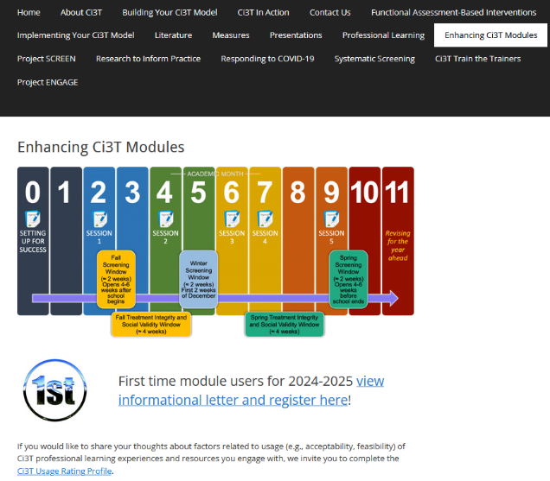
Implementing Comprehensive, Integrated, Three-tiered (Ci3T) Models: Supporting Student Success Across the Tiers
Enhanced Ci3T Implementation Series and Delivery (Guided E-Ci3T) Session 4
If you have not done so already, we invite you to visit ci3t.org/enhance to access modules and complete a one-time registration process!

Slide 3




















Ci3T Research Team
Grant Allen
Matthew Aschliman
Tammy Becker
Allison Bernard
Carrie Brandon
Amy Briesch
Mark Buckman
Sandy Chafouleas
Eric Common
Howard Diacon
Kathleen Lynne Lane
Jessica Matus
Wendy P. Oakes
Jenna Raad
David Royer
Elise Sarasin
Rebecca Sherod
Joni Weiss
Stacie Williams
Kate Williamson

Slide 4

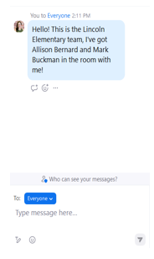
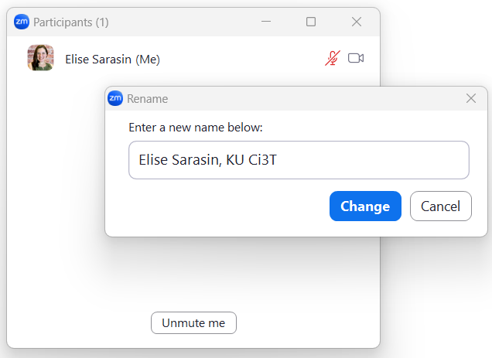

Zoom Logistics
If you are facilitating a Ci3T Leadership Team Symposium session at a satellite location, please email us a list of the names, email addresses, and schools of those attending.
To help us put you in breakout rooms with your colleagues today we are renaming you with your school initials and first and last name
If there are multiple people in the room with you, please list their first and last names and email in the chat!

Slide 5



Enhancing Ci3T Modules
ci3t.org/enhance

Slide 6
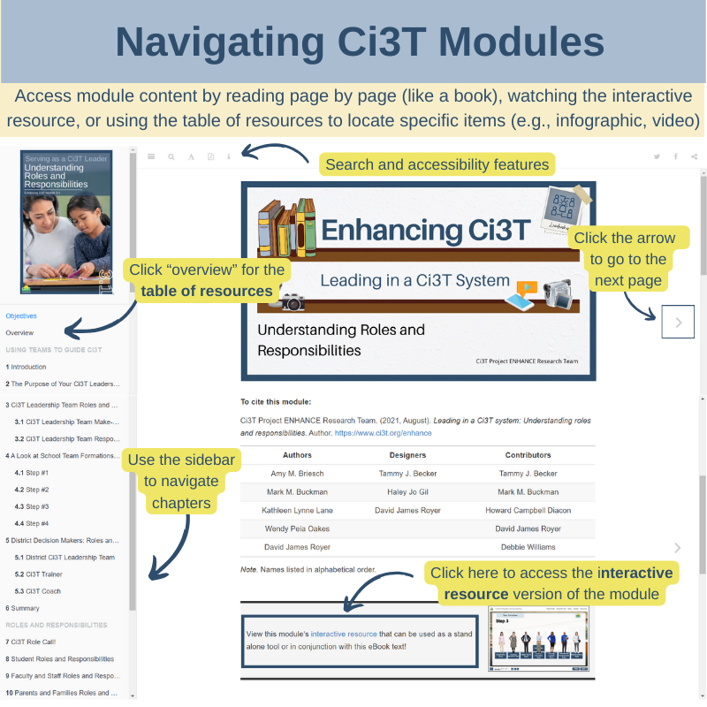

Slide 7
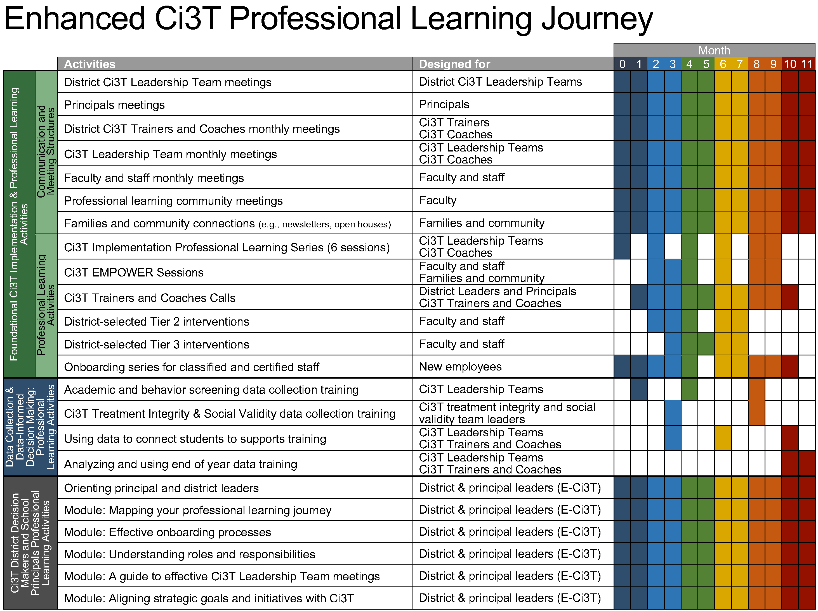
Enhanced Ci3T Implementation Series and Delivery

Slide 8
Foundational Ci3T Implementation & Professional Learning Activities

Slide 9
Session Outcomes
Identify continued professional learning needs from the previous session based on available data (e.g., screening, social validity, and treatment integrity).
Develop integrated lesson plans featuring low-intensity strategies to address academic, behavioral, and social and emotional well-being in an integrated fashion to maximize engagement and prevent challenging behaviors from occurring.
Refine data-informed, decision making at Tier 2 and Tier 3, by using school-wide data to connect students to additional strategies, practices, and programs.
Identify professional learning resources available to support work across Tiers 1, 2, and 3, and make plans to connect faculty and staff to these resources.

Slide 10


Agenda
Welcome
Data-Informed Decision-Making
  Sharing Data with Stakeholders
  Using Data to Inform Professional Learning and Instruction
Integrated Lesson Planning at Tier 1
Planning and Implementing Tier 2 Interventions
Planning and Implementing Tier 3 Interventions
Wrapping Up and Moving Forward
If you are a Board Certified Behavior Analyst (BCBA), you may accrue up to 2 continuing education units (CEUs) for attending this session. See agenda for task list alignment. Throughout the session we will share 4 key words, write those down to turn in after the session!

Slide 11
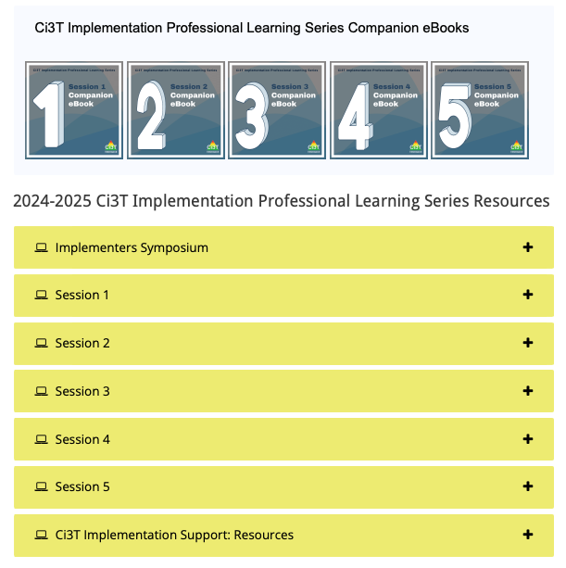
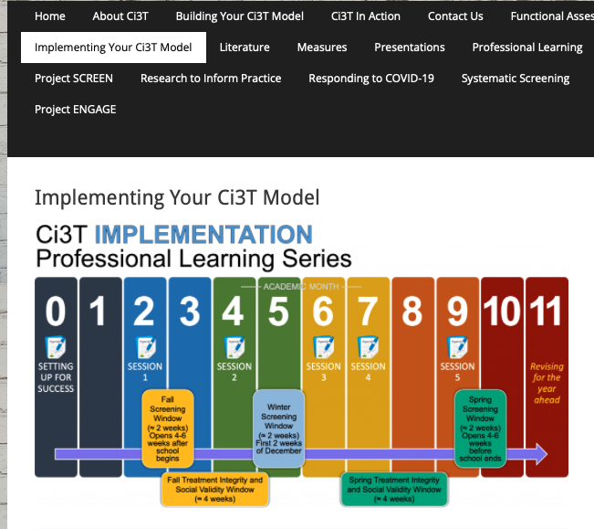
Accessing Professional Learning Materials
ci3t.org/imp

Slide 12
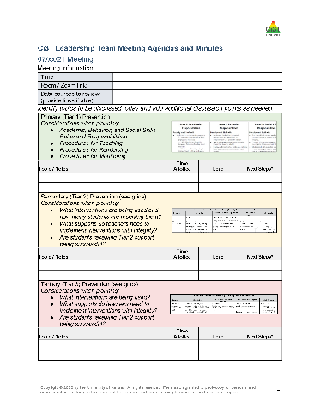

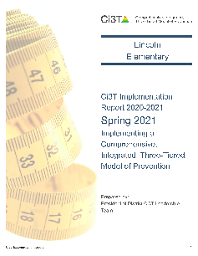
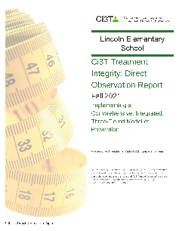
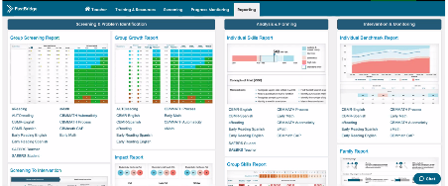

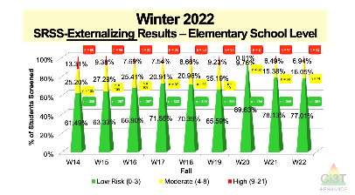
Materials for Today’s Session
Ci3T Leadership Team Agenda
Ci3T Implementation Manual
Fall Social Validity and Treatment Integrity Data
Winter Screening Data

Slide 13

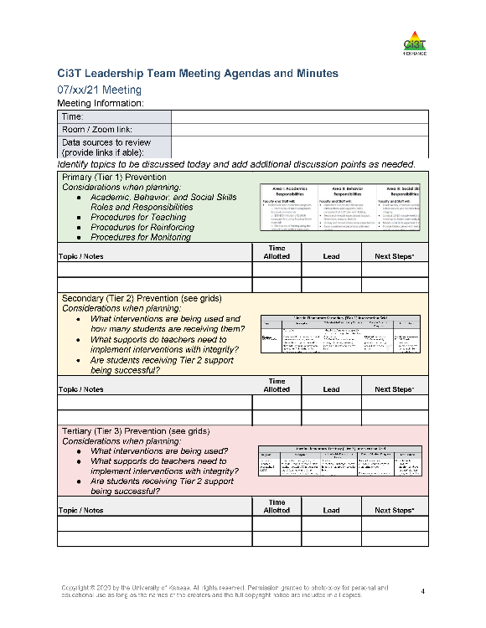
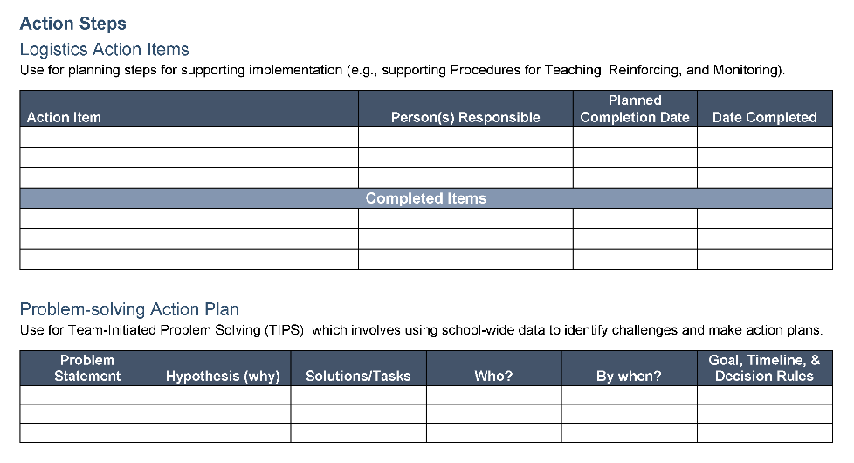
Ci3T Leadership Team Agenda Template

Slide 14
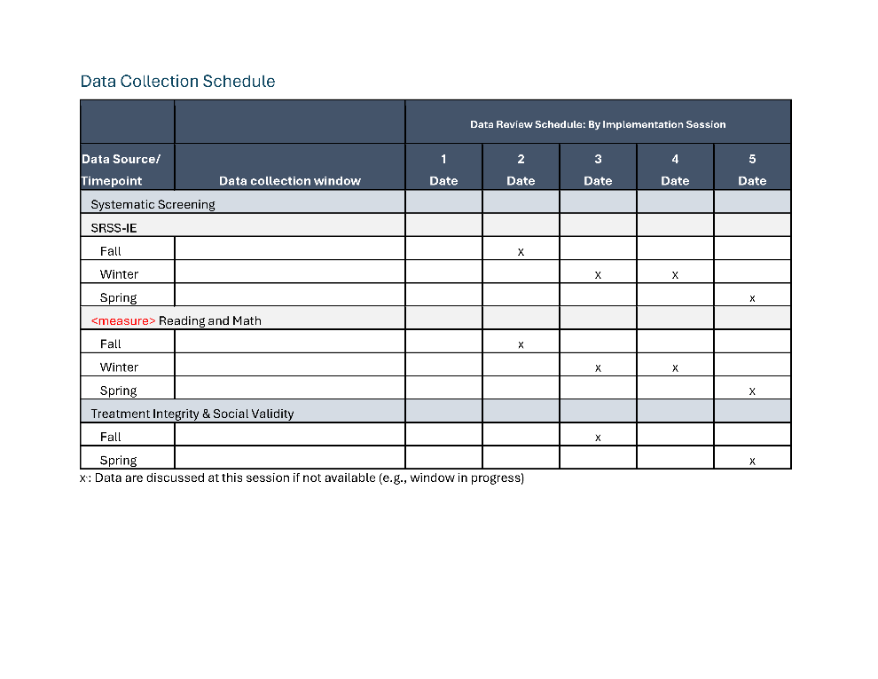
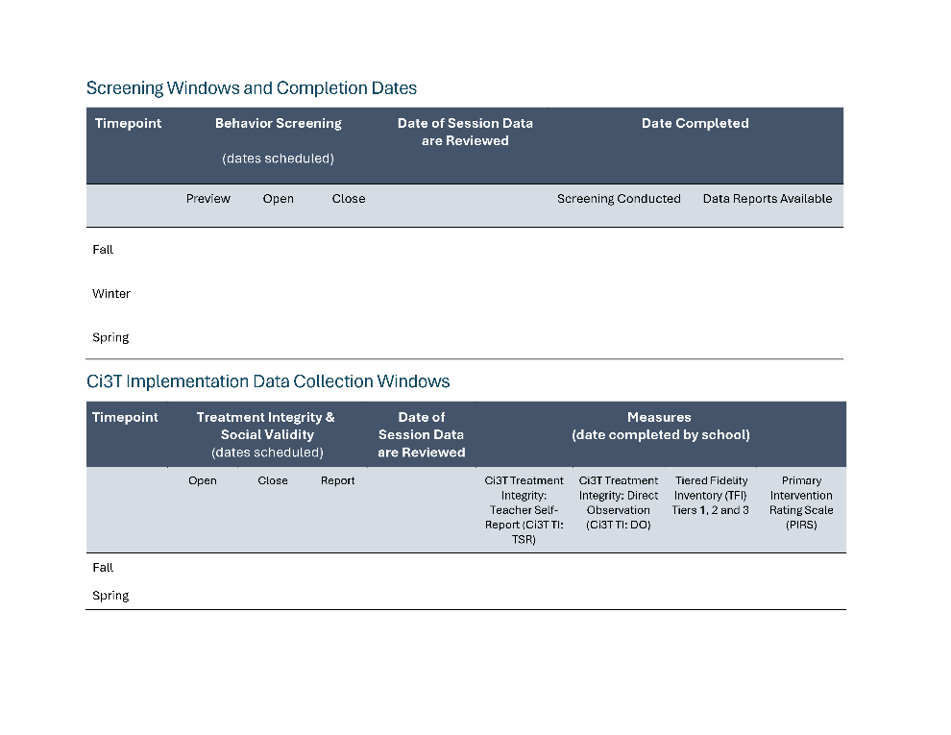
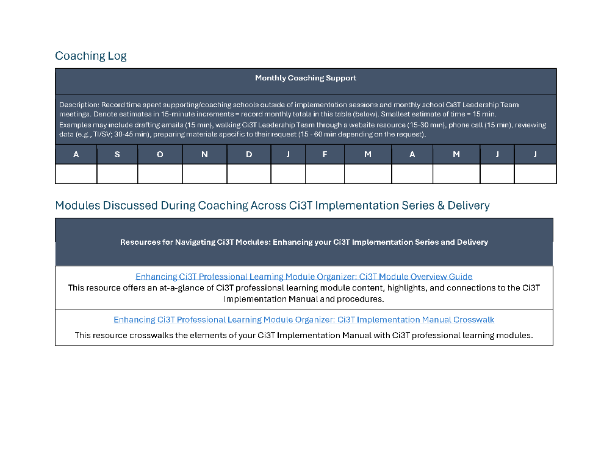
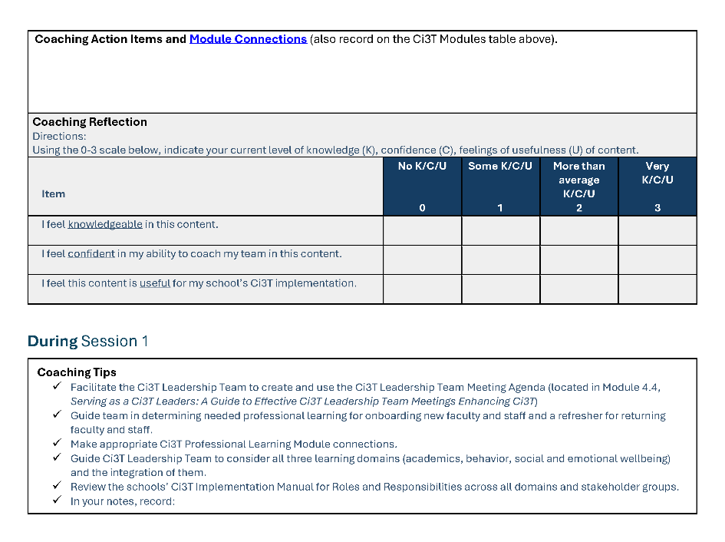
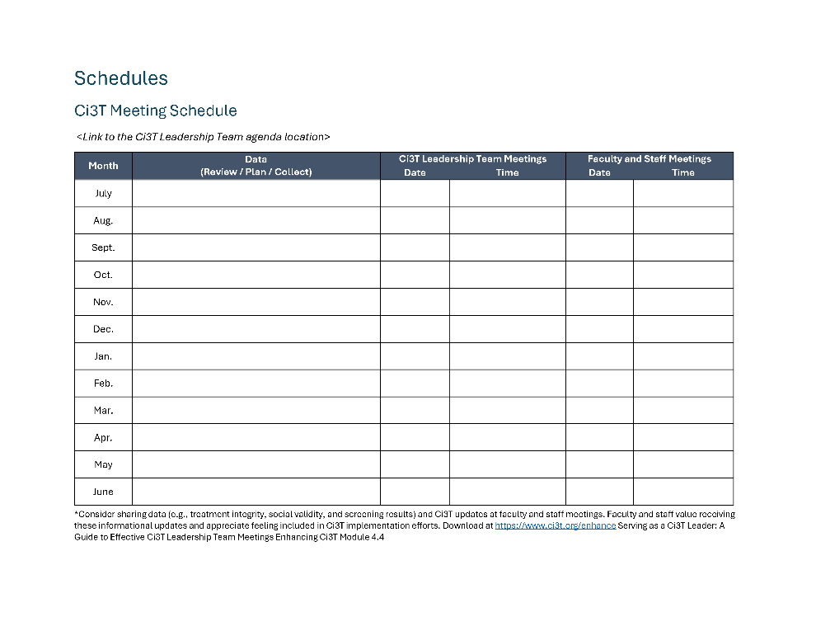
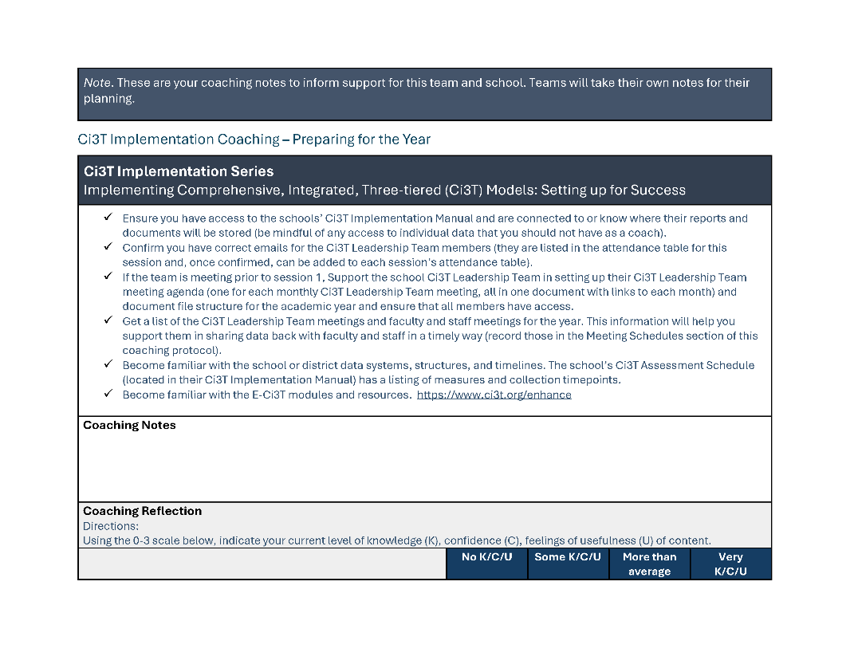
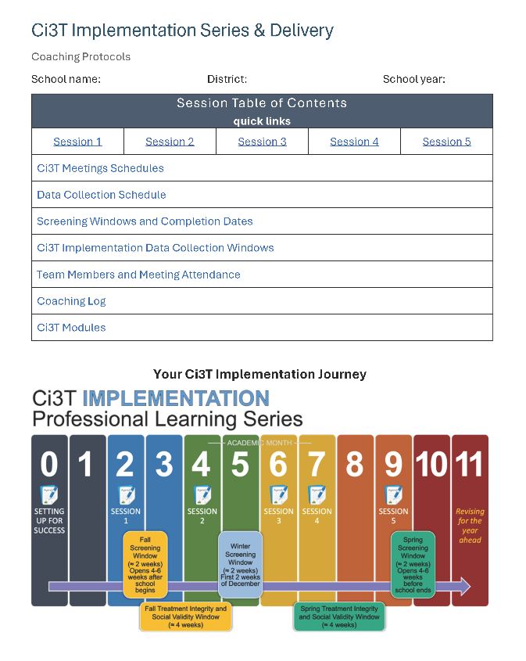
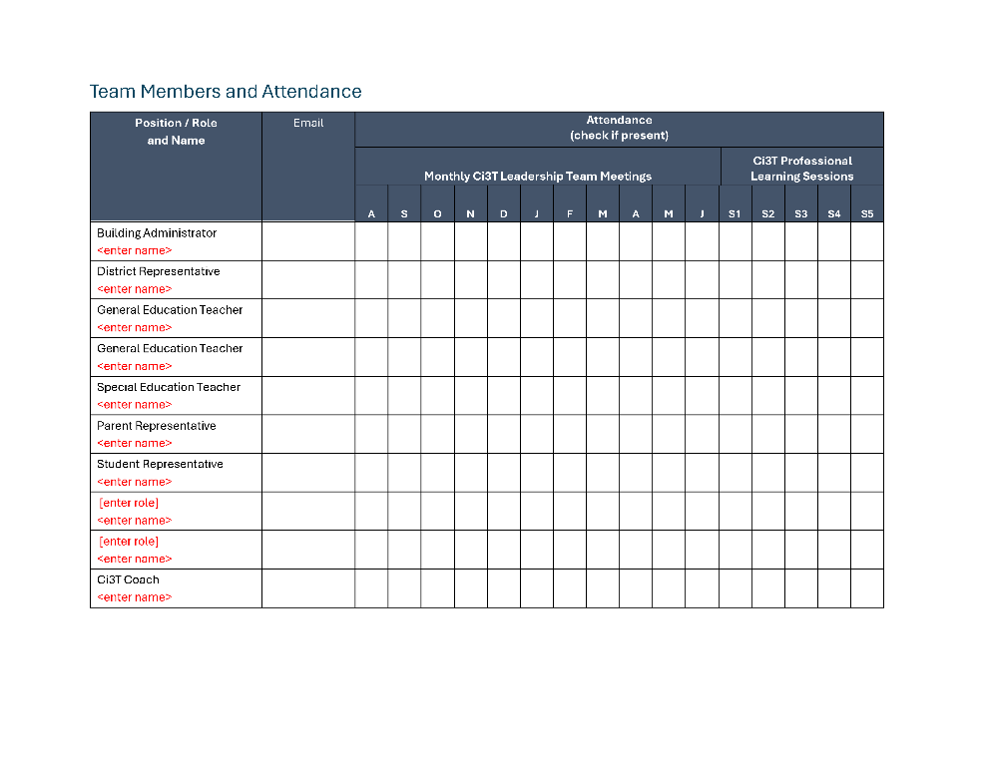
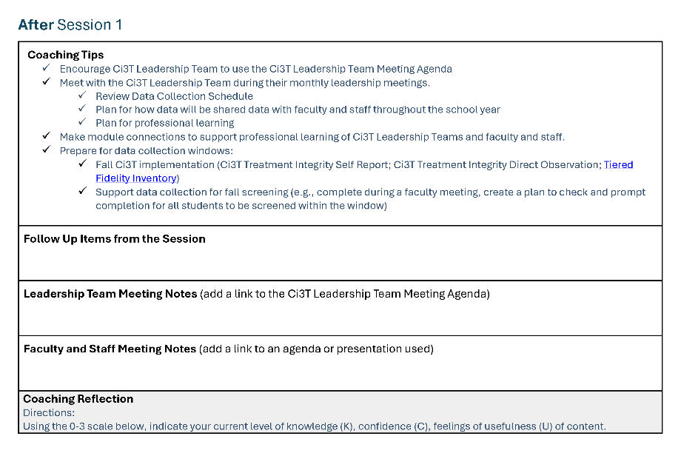
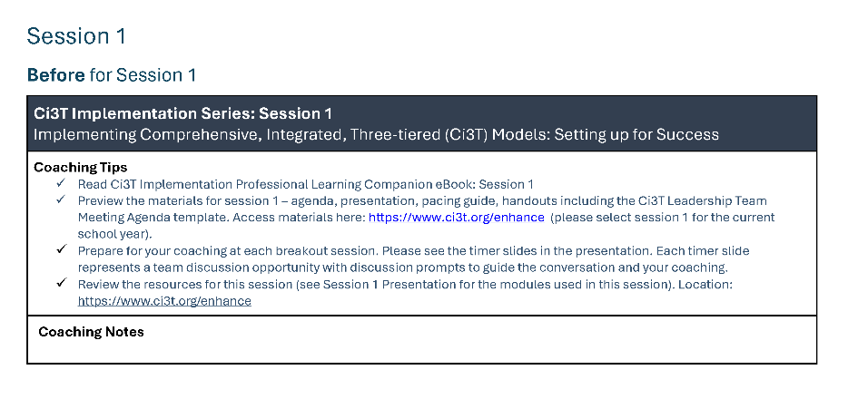
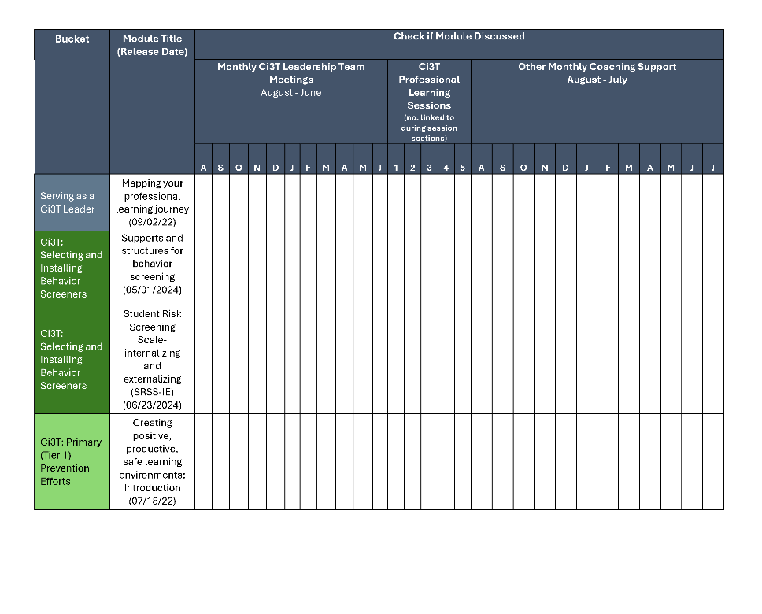
Coaching Protocol

Slide 15
Data-Informed Decision-Making
Sharing Data with Stakeholders
Using Data to Inform Professional Learning and Instruction

Slide 16
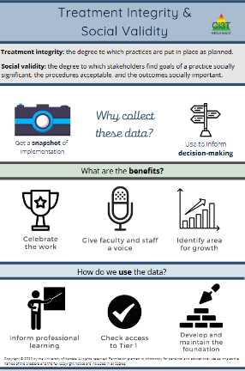
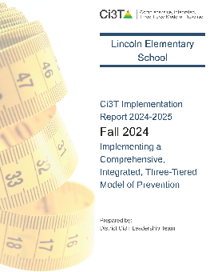
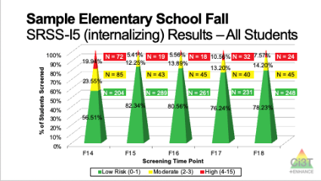
Essential Components of Primary (Tier 1) Prevention Efforts
Social Validity
Systematic Universal Screening
Academic
Behavior
Treatment Integrity
ci3t.org/measures
ci3t.org/screening
for behavior

Slide 17
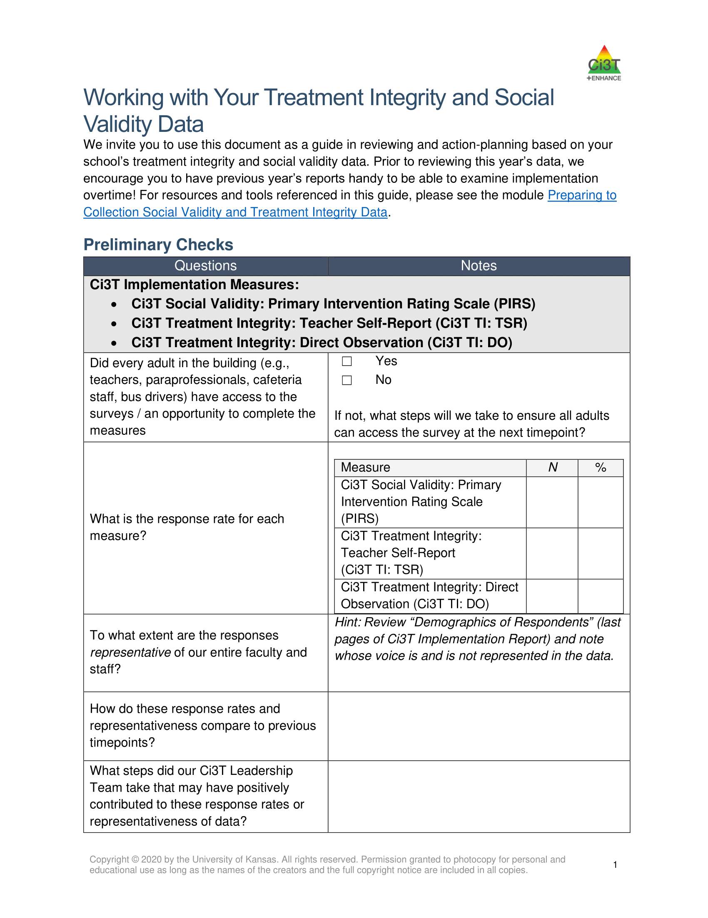
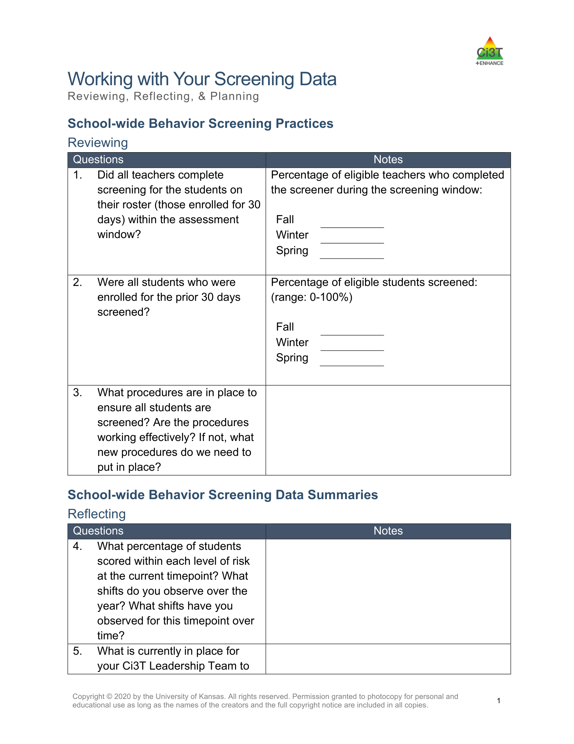
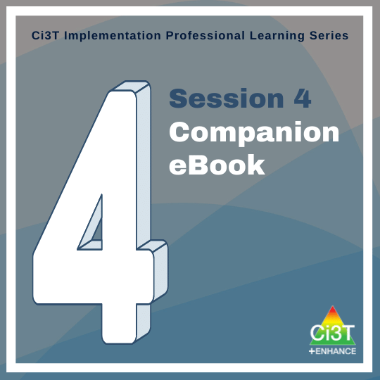
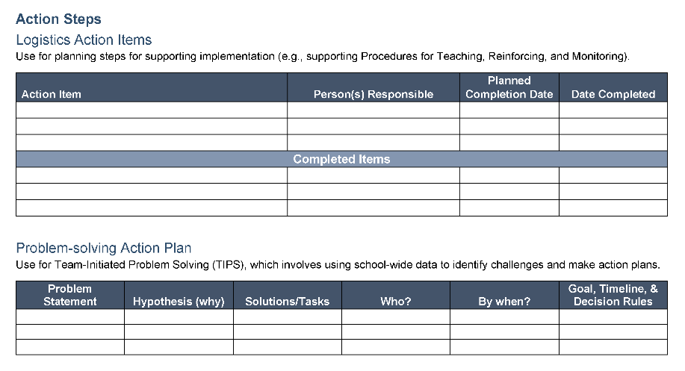

Slide 18

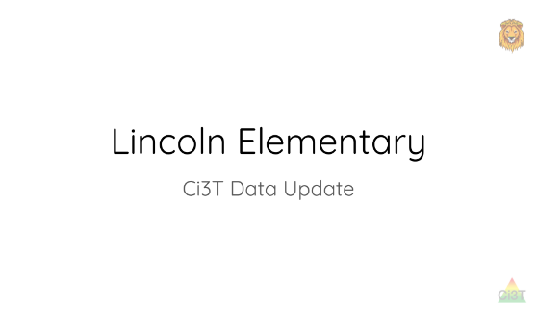
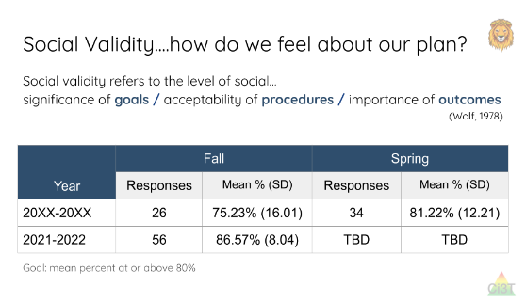
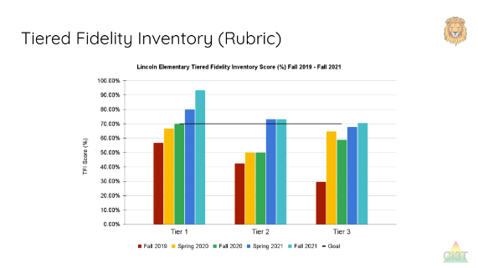
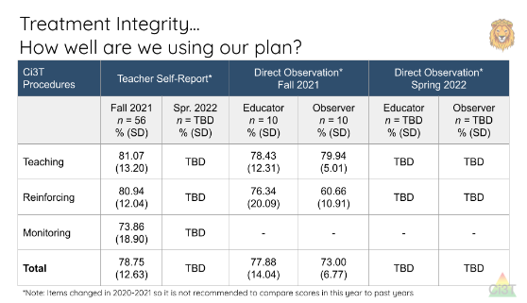
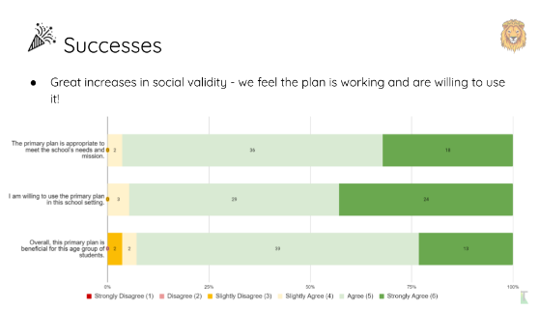
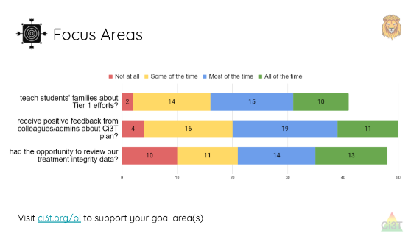
Sharing Treatment Integrity and Social Validity Data

Slide 19
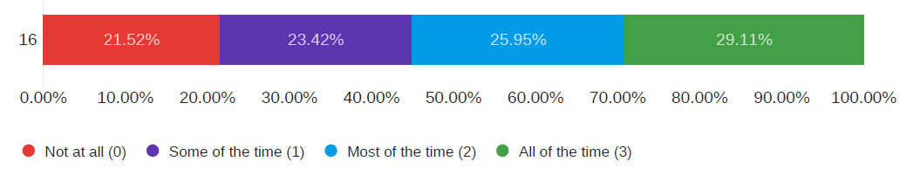
Sharing Treatment Integrity and Social Validity Data

Slide 20
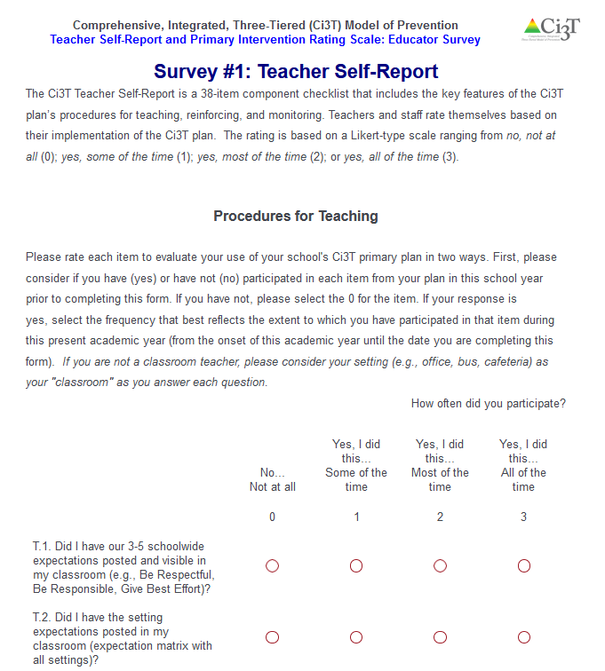
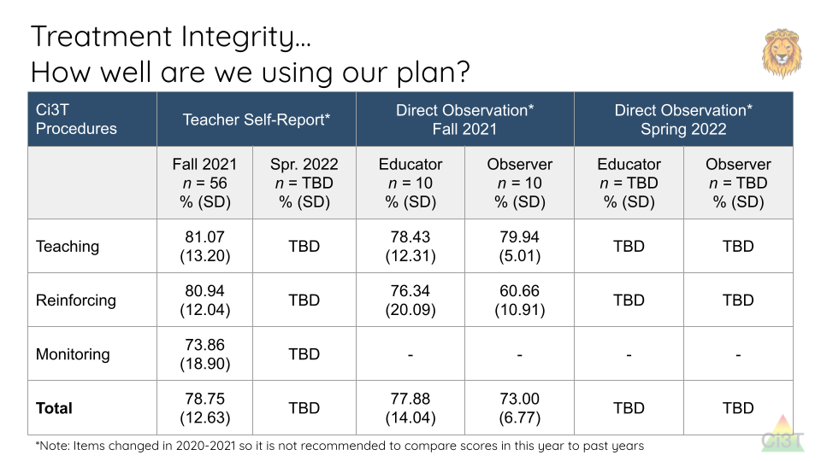
Example: Making Explicit Connections

Slide 21

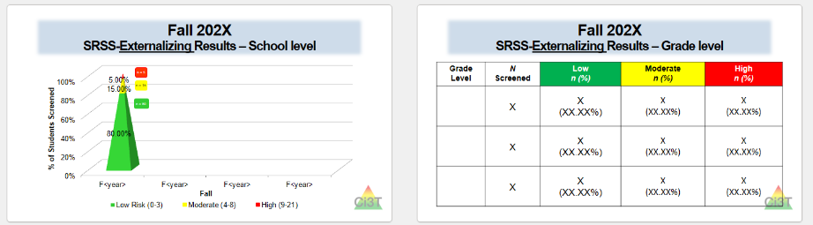
Sharing Systematic Screening Data
Once academic and behavior screening data are collected, data are shared at the:
School-wide (e.g., Tier 1 efforts)
Grade or department (e.g., Tier 1 efforts, low-intensity strategies)
Class level (e.g., low-intensity strategies)
Individual student level (e.g., Tier 2 and Tier 3)

Slide 22
Foundational Ci3T Implementation & Professional Learning Activities

Slide 23
Foundational Ci3T Implementation & Professional Learning Activities

Slide 24
Foundational Ci3T Implementation & Professional Learning Activities

Slide 25
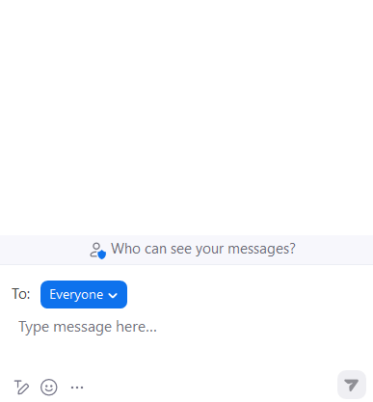


Let’s Chat!
What is one success your team had in sharing:
treatment integrity and social validity data with faculty and staff?
winter screening data with faculty and staff?
data or Ci3T updates with families?

Slide 26
Data-Informed Decision-Making
Sharing Data with Stakeholders
Using Data to Inform Professional Learning and Instruction

Slide 27
Session Outcomes
Identify continued professional learning needs from the previous session based on available data (e.g., screening, social validity, and treatment integrity).
Develop integrated lesson plans featuring low-intensity strategies to address academic, behavioral, and social and emotional well-being in an integrated fashion to maximize engagement and prevent challenging behaviors from occurring.
Refine data-informed, decision making at Tier 2 and Tier 3, by using school-wide data to connect students to additional strategies, practices, and programs.
Identify professional learning resources available to support work across Tiers 1, 2, and 3, and make plans to connect faculty and staff to these resources.

Slide 28
Notes:
In session 3 we started analyzing and building action plans around Fall Treatment Integrity and Social Validity Data and Winter Screening Data

Slide 29


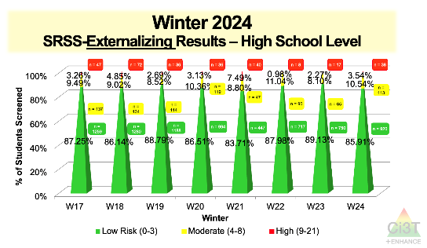
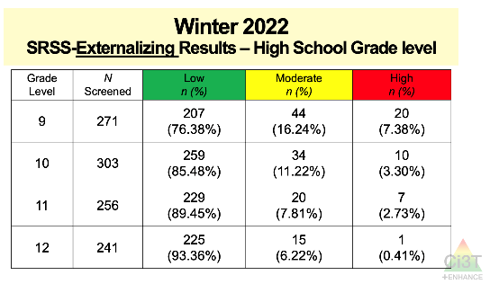

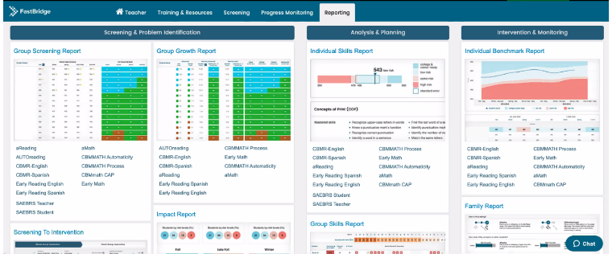
Using Multiple Sources of Data to Identify Professional Learning Needs
Notes:
We considered how to look at these data together to identify professional learning needs

Slide 30
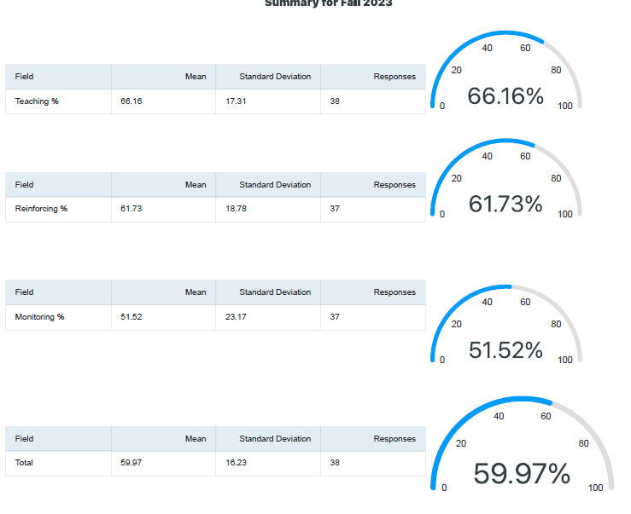
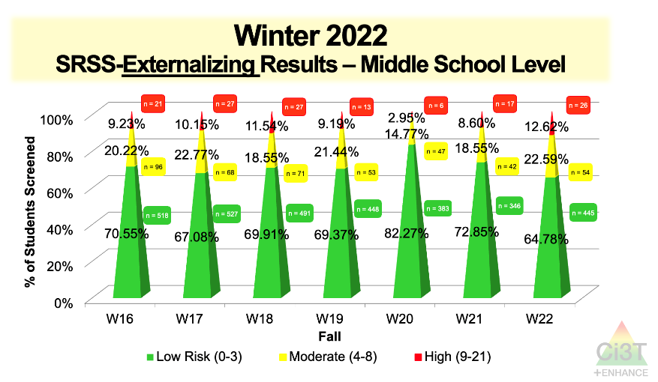

Using Multiple Sources of Data to Identify Professional Learning Needs: An Example
Notes:
Screening data indicate an opportunity to strengthen Tier 1 instruction (currently 64%, which is less than 75-80% we’d like to see).
Treatment integrity data also indicate an opportunity to focus on Tier 1 instruction (below 80% goal)

Slide 31
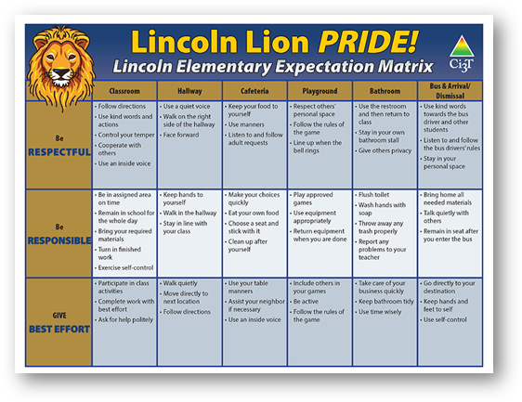

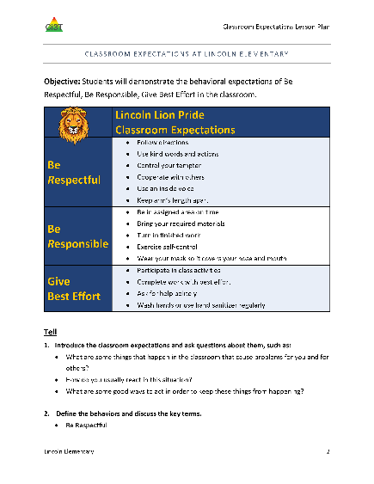
Using Multiple Sources of Data to Identify Professional Learning Needs: An Example
.
Notes:
After reviewing item-level data, the team decides to focus on:
Ensuring Expectation Matrices are posted in all classrooms and throughout the school (e.g., hallway, cafeteria)
Explicitly re-teaching expectations – Ci3T Leadership Team wrote lesson plans for teaching expectations and set a schedule to teach in the first week following break during advisory period
Spending time in faculty and staff meeting to review expectations with teachers for universal reinforcement system and launch a ”February Challenge” to increase use of expectation matrix as instructional tool and implementation of universal reinforcement system

Slide 32








Professional Learning Avenues
Stand-alone professional learning
Book / article study
Build into PLC (e.g., video, infographic)
Independent module exploration
Building on-site experts
Hi Lincoln Elementary!
Happy Monday ☺
Our strategy of the month is active supervision! Check out this video (3 mins) to learn more! This week, in PLCs your team will select a setting (e.g., playground) to
focus your active supervision
efforts. Come with ideas!

Slide 33

Using Multiple Sources of Data to Identify Instructional Needs
attendance
behavior
screening
academic screening
Notes:
We can also apply this same thinking to our screening data to identify areas of instructional need

Slide 34



Ci3T Data Dashboard

Slide 35

Ci3T Data Dashboard In Action!
Notes:
Watch Part 1 only (4:55)
https://ci3t.org/ispring/M6_Tier2_Dashboard_Principal

Slide 36




Module Connection!
The Tier 2 Process: Using Data to Connect Students to Validated Supports

Slide 37



















Let’s discuss!
How did we share treatment integrity, social validity, and winter screening data with stakeholders (e.g., faculty & staff, families)? Are there any additional steps we need to take to share these data? How did we respond to our treatment integrity, social validity, and winter screening data based on the ideas we generated in Session 3? Are there any additional steps we need to take to complete action items? What systems do we have in place to examine multiple sources of data to inform professional learning and instruction? What professional learning needs might we address next, based on our treatment integrity, social validity, and winter screening data?
Notes:
15 min timer

Slide 38

Integrated Lesson Planning at Tier 1

Slide 39
Session Outcomes
Identify continued professional learning needs from the previous session based on available data (e.g., screening, social validity, and treatment integrity).
Develop integrated lesson plans featuring low-intensity strategies to address academic, behavioral, and social and emotional well-being in an integrated fashion to maximize engagement and prevent challenging behaviors from occurring.
Refine data-informed, decision making at Tier 2 and Tier 3, by using school-wide data to connect students to additional strategies, practices, and programs.
Identify professional learning resources available to support work across Tiers 1, 2, and 3, and make plans to connect faculty and staff to these resources.

Slide 40


A Focus on: Integrated Lesson Planning

Slide 41



Slide 42

Integrated Lesson Plan: An Illustration
Notes:
Watch video 01:40

Slide 43


Integrated Lesson Plan: 6th Grade Example

Slide 44


Slide 45
Let’s Chat!
What other social skills or behavioral objectives might be appropriate for this lesson?
What other opportunities exist to integrate low-intensity teacher-delivered strategies into this lesson?

Slide 46






Module Connection!

Slide 47


Embedding Low-Intensity Strategies in Daily instruction
Notes:
02:45

Slide 48



Module Connection!

Slide 49







Module Connection!
Instructional Feedback

Slide 50


Work Time Preparation
Start by downloading the template and examples!

Slide 51


















Let’s Discuss!
Work with your Ci3T Leadership Team to develop an integrated lesson plan
Notes:
15-min timer

Slide 52
Planning and Implementing Tier 2 Interventions

Slide 53
Session Outcomes
Identify continued professional learning needs from the previous session based on available data (e.g., screening, social validity, and treatment integrity).
Develop integrated lesson plans featuring low-intensity strategies to address academic, behavioral, and social and emotional well-being in an integrated fashion to maximize engagement and prevent challenging behaviors from occurring.
Refine data-informed, decision making at Tier 2 and Tier 3, by using school-wide data to connect students to additional strategies, practices, and programs.
Identify professional learning resources available to support work across Tiers 1, 2, and 3, and make plans to connect faculty and staff to these resources.

Slide 54


Secondary (Tier 2) Intervention Grids

Slide 55



Getting Started with Data-Informed Decision Making

Slide 56

Tier 2 Intervention Grid
Notes:
Support- name of strategy, practice, or program. Notice this is not the name of a person or role

Slide 57


Data in action

Slide 58

Data in action

Slide 59


Data in action
Other Tier 2 options…
Behavior Contract
Direct Behavior Rating
Behavior Specific Praise
Instructional Choice

Slide 60

Connection to Treatment Integrity!
TFI Item 2.3
Screening: Tier 2 team uses decision rules and multiple sources of data (e.g., ODRs, academic progress, screening tools, attendance, teacher/family/ student nominations) to identify students who require Tier 2 supports. | Multiple data sources used (e.g., ODRs, time out of instruction, attendance, academic performance) Team decision rubric Team meeting minutes School policy | 0 = No specific rules for identifying students who qualify for Tier 2 supports 1 = Data decision rules established but not consistently followed or used with only one data source 2 = Written policy exists that (a) uses multiple data sources for identifying students, and (b) ensures that families are notified promptly when students enter Tier 2 supports

Slide 61


Connection to Treatment Integrity!
TFI Item 2.6
Options for Tier 2 Interventions: Tier 2 team has multiple ongoing behavior support interventions with documented evidence of effectiveness matched to student need. | School Tier 2 handbook Targeted Interventions Reference Guide | 0 = No Tier 2 interventions with documented evidence of effectiveness are in use 1 = Only 1 Tier 2 intervention with documented evidence of effectiveness is in use 2 = Multiple Tier 2 interventions with documented evidence of effectiveness matched to student need

Slide 62





Selecting an Intervention
How do I decide when the entry criteria are similar for multiple interventions?

Slide 63
Selecting an Intervention
Collaborate with families, colleagues, and the student to review available options
Consider what you know about the student (e.g., strengths, preferences, pre-requisite skills)
Consider possible function of the behavior
  Check-In/Check-Out may be more effective for students who find accessing adult attention reinforcing
Consider your own strengths, support available (e.g., coach, professional learning), and feasibility of available options
Adjust as needed based on pre-intervention social validity

Slide 64

Document Decisions and Plans for Next Steps

Slide 65
Connection to Treatment Integrity!
TFI Item 2.3
Level of Use: Team follows written process to track proportion of students participating in Tier 2 supports, and access is proportionate. | Tier 2 enrollment data Tier 2 team meeting minutes Progress monitoring tool | 0 = Team does not track number of students responding to Tier 2 interventions 1 = Team defines criteria for responding to each Tier 2 intervention and tracks students, but fewer than 5% of students are enrolled 2 = Team defines criteria and tracks proportion, with at least 5% of students receiving Tier 2 supports

Slide 66



Structures for Success: Shared Digital Space
Example of Tier 2 Intervention Drive in shared digital space

Slide 67




Tier 2 Intervention Drive – Templated Intervention Materials
Notes:
All materials necessary for an intervention located in one central location. Teachers can “make a copy” of the entire folder and then personalize for the student.

Slide 68


Tier 2 Intervention Drive – Group or Individual Student Folders
Be sure to store these folders in a secure
location accessible to all relevant parties

Slide 69



Tier 2 Intervention Drive – Group or Individual Student Folders

Slide 70


Tier 2 Professional Learning Resources
Notes:
Low-intensity strategies can be used across the tiers including as a stand-alone Tier 2 intervention OR as part of a multi-component Tier 2 intervention (e.g., using pre-correction as part of a behavior contract)

Slide 71


Tier 2 Professional Learning Resources
Notes:
What Works Clearing House Practice Guide – Teacher-Delivered Behavioral Interventions in Grades K-5-
https://ies.ed.gov/ncee/wwc/PracticeGuide/31

Slide 72






Tier 2 Professional Learning Resources

Slide 73
Tier 2 Professional Learning Resources
Ci3T EMPOWER⁺ Sessions Location: Remote via Zoom Attended by: School Ci3T Leadership Teams, Ci3T District Trainers and Coaches, Faculty and Staff, Families (adults only). Community Members
Session | Date | Times
1. Ci3T FIT: Start the Year Strong | Sep. 24, 2024 (Tues) | 2:30 - 4:30 p.m. (Pacific) 4:30 - 6:30 p.m. (Central) 5:30 - 7:30 p.m. (Eastern)
2. Data-Informed Instruction: This is how we do it! | Oct. 9, 2024 (Wed) | 2:30 - 4:30 p.m. (Pacific) 4:30 - 6:30 p.m. (Central) 5:30 - 7:30 p.m. (Eastern)
3. Practical, Low Intensity Strategies to Maximize Engagement and Limit Disruption: Part 1 | Precorrection & Active Supervision | Nov. 19, 2024 (Tues) | 2:30 - 4:30 p.m. (Pacific) 4:30 - 6:30 p.m. (Central) 5:30 - 7:30 p.m. (Eastern)
4. Practical, Low Intensity Strategies to Maximize Engagement and Limit Disruption: Part 2 | Instructional Choice and Increased Opportunities to Respond | Jan. 22, 2025 (Wed) | 2:30 - 4:30 p.m. (Pacific) 4:30 - 6:30 p.m. (Central) 5:30 - 7:30 p.m. (Eastern)
5. Tier 2: Behavior Contracts | Feb. 11, 2025 (Tues) | 2:30 - 4:30 p.m. (Pacific) 4:30 - 6:30 p.m. (Central) 5:30 - 7:30 p.m. (Eastern)
6. Tier 2: Direct Behavior Ratings (DBR) | Mar. 26, 2025 (Wed) | 2:30 - 4:30 p.m. (Pacific) 4:30 - 6:30 p.m. (Central) 5:30 - 7:30 p.m. (Eastern)
7. Tier 3: Functional Assessment-based Interventions (FABI) | Apr. 29, 2025 (Tues) | 2:30 - 4:30 p.m. (Pacific) 4:30 - 6:30 p.m. (Central) 5:30 - 7:30 p.m. (Eastern)

Slide 74



Project EMPOWER+

Slide 75

Click the flyer to register for future sessions!
Access a recording for the sessions that have already occurred!

Slide 76
Planning and Implementing Tier 3 Interventions

Slide 77
Session Outcomes
Identify continued professional learning needs from the previous session based on available data (e.g., screening, social validity, and treatment integrity).
Develop integrated lesson plans featuring low-intensity strategies to address academic, behavioral, and social and emotional well-being in an integrated fashion to maximize engagement and prevent challenging behaviors from occurring.
Refine data-informed, decision making at Tier 2 and Tier 3, by using school-wide data to connect students to additional strategies, practices, and programs.
Identify professional learning resources available to support work across Tiers 1, 2, and 3, and make plans to connect faculty and staff to these resources.

Slide 78





Tertiary (Tier 3) Intervention Grids

Slide 79


Tier 3 Intervention Grid
Notes:
Notice the same features of Tier 3 grids

Slide 80
Getting Started with Data-Informed Decision Making
Notes:
Same process as pairing students with Tier 2 supports

Slide 81


Tier 3: Functional Assessment-Based Intervention

Slide 82



FABI Professional Learning Resources

Slide 83
FABI Professional Learning Resources
Ci3T EMPOWER⁺ Sessions Location: Remote via Zoom Attended by: School Ci3T Leadership Teams, Ci3T District Trainers and Coaches, Faculty and Staff, Families (adults only). Community Members
Session | Date | Times
1. Ci3T FIT: Start the Year Strong | Sep. 24, 2024 (Tues) | 2:30 - 4:30 p.m. (Pacific) 4:30 - 6:30 p.m. (Central) 5:30 - 7:30 p.m. (Eastern)
2. Data-Informed Instruction: This is how we do it! | Oct. 9, 2024 (Wed) | 2:30 - 4:30 p.m. (Pacific) 4:30 - 6:30 p.m. (Central) 5:30 - 7:30 p.m. (Eastern)
3. Practical, Low Intensity Strategies to Maximize Engagement and Limit Disruption: Part 1 | Precorrection & Active Supervision | Nov. 19, 2024 (Tues) | 2:30 - 4:30 p.m. (Pacific) 4:30 - 6:30 p.m. (Central) 5:30 - 7:30 p.m. (Eastern)
4. Practical, Low Intensity Strategies to Maximize Engagement and Limit Disruption: Part 2 | Instructional Choice and Increased Opportunities to Respond | Jan. 22, 2025 (Wed) | 2:30 - 4:30 p.m. (Pacific) 4:30 - 6:30 p.m. (Central) 5:30 - 7:30 p.m. (Eastern)
5. Tier 2: Behavior Contracts | Feb. 11, 2025 (Tues) | 2:30 - 4:30 p.m. (Pacific) 4:30 - 6:30 p.m. (Central) 5:30 - 7:30 p.m. (Eastern)
6. Tier 2: Direct Behavior Ratings (DBR) | Mar. 26, 2025 (Wed) | 2:30 - 4:30 p.m. (Pacific) 4:30 - 6:30 p.m. (Central) 5:30 - 7:30 p.m. (Eastern)
7. Tier 3: Functional Assessment-based Interventions (FABI) | Apr. 29, 2025 (Tues) | 2:30 - 4:30 p.m. (Pacific) 4:30 - 6:30 p.m. (Central) 5:30 - 7:30 p.m. (Eastern)

Slide 84


FABI Professional Learning Resources

Slide 85

FABI Professional Learning Resources

Slide 86


Tier 3: Individualized De-Escalation Plan

Slide 87


Tier 3: Individualized De-Escalation Plan

Slide 88




Individualized De-Escalation Plan Professional Learning Resources

Slide 89


Individualized De-Escalation Plan Professional Learning Resources

Slide 90








Jigsaw Preview
Tier 2 and 3 Supports
Self-Monitoring | Direct Behavior Rating | Individualized De-Escalation Plan | Internalizing Concerns at Tier 3 | Functional Assessment-Based Intervention (FABI) | Structures for Success

Slide 91

















Let’s Talk!
Read over the list of Tier 2 and Tier 3 supports listed in your school’s Ci3T Implementation Manual.
Jigsaw breakout session: Divide your team members to attend these sessions:
  Tier 2 Direct Behavior Rating
  Tier 3 Managing Acting-Out Behavior at Tier 3
  Tier 3 Supporting Students with Internalizing Concerns at Tier 3
  Tier 3 Functional Assessment-Based Intervention (FABI)
  Structures for Success (e.g., shared digital space, intervention tracker)
Post in the chat the one you would like to attend so your Ci3T Leadership Team members can divide up to learn more!
Notes:
15-min timer

Slide 92
Wrapping Up and Moving Forward

Slide 93
Let’s Chat!
What is one action item you or your team will take following today’s session?

Slide 94
ENHANCE Ci3T Implementation Professional Learning Series
Ci3T Implementation Professional Learning Series Location: Remote via Zoom Attended by: School Ci3T Leadership Teams Sessions A and B available: Ci3T Leadership Teams can select which they would like to attend.
Session | Date | Times (Session A and B)
 |  | Pacific | Central | Eastern
Summer Session | June. 24, 2024 (Mon) | 7:30 am – 1:30 pm | 9:30 am – 3:30 pm | 10:30 am – 4:30 pm
Session 1 | Sept. 10, 2024 (Tues) | 9:00 am – 11:00 am | 11:00 am – 01:00 pm | 12:00 pm – 2:00 pm
 |  | 2:30 pm – 4:30 pm | 4:30 pm – 6:30 pm | 5:30 pm – 7:30 pm
Session 2 | Nov. 12, 2024 (Tues) | 9:00 am – 11:00 am | 11:00 am – 01:00 pm | 12:00 pm – 2:00 pm
 |  | 2:30 pm – 4:30 pm | 4:30 pm – 6:30 pm | 5:30 pm – 7:30 pm
Session 3 | Jan. 14, 2025 (Tues) | 9:00 am – 11:00 am | 11:00 am – 1:00 pm | 12:00 pm – 2:00 pm
 |  | 2:30 pm – 4:30 pm | 4:30 pm – 6:30 pm | 5:30 pm – 7:30 pm
Session 4 | Mar. 04, 2025 (Tues) | 9:00 am – 11:00 am | 11:00 am – 1:00 pm | 12:00 pm – 2:00 pm
 |  | 2:30 pm – 4:30 pm | 4:30 pm – 6:30 pm | 5:30 pm – 7:30 pm
Session 5 | Apr. 15, 2025 (Tues) | 9:00 am – 11:00 am | 11:00 am – 1:00 pm | 12:00 pm – 2:00 pm
 |  | 2:30 pm – 4:30 pm | 4:30 pm – 06:30 pm | 5:30 pm – 7:30 pm

Slide 95
Project EMPOWER +
Ci3T EMPOWER⁺ Sessions Location: Remote via Zoom Attended by: School Ci3T Leadership Teams, Ci3T District Trainers and Coaches, Faculty and Staff, Families (adults only). Community Members
Session | Date | Times
1. Ci3T FIT: Start the Year Strong | Sep. 24, 2024 (Tues) | 2:30 - 4:30 p.m. (Pacific) 4:30 - 6:30 p.m. (Central) 5:30 - 7:30 p.m. (Eastern)
2. Data-Informed Instruction: This is how we do it! | Oct. 9, 2024 (Wed) | 2:30 - 4:30 p.m. (Pacific) 4:30 - 6:30 p.m. (Central) 5:30 - 7:30 p.m. (Eastern)
3. Practical, Low Intensity Strategies to Maximize Engagement and Limit Disruption: Part 1 | Precorrection & Active Supervision | Nov. 19, 2024 (Tues) | 2:30 - 4:30 p.m. (Pacific) 4:30 - 6:30 p.m. (Central) 5:30 - 7:30 p.m. (Eastern)
4. Practical, Low Intensity Strategies to Maximize Engagement and Limit Disruption: Part 2 | Instructional Choice and Increased Opportunities to Respond | Jan. 22, 2025 (Wed) | 2:30 - 4:30 p.m. (Pacific) 4:30 - 6:30 p.m. (Central) 5:30 - 7:30 p.m. (Eastern)
5. Tier 2: Behavior Contracts | Feb. 11, 2025 (Tues) | 2:30 - 4:30 p.m. (Pacific) 4:30 - 6:30 p.m. (Central) 5:30 - 7:30 p.m. (Eastern)
6. Tier 2: Direct Behavior Ratings (DBR) | Mar. 26, 2025 (Wed) | 2:30 - 4:30 p.m. (Pacific) 4:30 - 6:30 p.m. (Central) 5:30 - 7:30 p.m. (Eastern)
7. Tier 3: Functional Assessment-based Interventions (FABI) | Apr. 29, 2025 (Tues) | 2:30 - 4:30 p.m. (Pacific) 4:30 - 6:30 p.m. (Central) 5:30 - 7:30 p.m. (Eastern)

Slide 96

Sustaining and Disseminating Professional Learning
 | 0 | 1 | 2 | 3 | 4 | 5 | 6 | 7 | 8 | 9 | 10 | 11
 | July | Aug | Sep | Oct | Nov | Dec | Jan | Feb | Mar | Apr | May | Jun
Ci3T EMPOWER |  |  | Ci3T EMPOWER Session 1 | Ci3T EMPOWER Session 2 | Ci3T EMPOWER Session 3 |  | Ci3T EMPOWER Session 4 | Ci3T EMPOWER Session 5 | Ci3T EMPOWER Session 6 | Ci3T EMPOWER Session 7
Designate two staff to attend trainings to become on-site coaches
Ci3T fit: Start the year strong
Data-informed instruction
Precorrection & active supervision
Instructional choice & OTR
Behavior Contracts
Direct behavior ratings
FABI
10 min @ next faculty meeting

Slide 97
Wrap Up and Preview
Today
Next time
Data-Informed Decision-Making
Working Across the Tiers
  Integrated Lesson Planning
  Tier 2
  Tier 3
Procedures for Monitoring
  Review your school’s social validity and treatment integrity data
  Review your school’s spring screening data
Planning for the Year Ahead 2025-2026
Focusing on Data-Informed Professional Learning

Slide 98


Action Planning
Schedule time during PLCs- integrated lesson plan demo
Elise
03/12/25
Invite staff to attend EMPOWER sessions in weekly email
David
03/12/25
Notes:
Encourage you to leave a note in your Ci3T LT agenda to indicate where your team will pick up at your next meeting and to record any action items.

Slide 99


Coaching Protocol Reminder
Notes:
If you’re a coach, you might consider setting aside time to review coaching protocol for Session 1 especially the after coaching tips, action items, and reflection!

Slide 100






@Ci3Tmodel
@Ci3Tmodel
Tag us in your Ci3T highlights, we love to see Ci3T in action!
Follow us on X and Instagram for updates and new resources!
Thank you!
ci3t.org
#Ci3T
Notes:
Tag us in your Ci3T highlights- we’d love to see Ci3T in action! Follow us on Twitter or Instagram for updates and links to resources! @Ci3TModel
You will receive a brief session evaluation – we value your feedback and would greatly appreciate you taking a few minutes to share your thoughts on what you liked about the session and how we can improve

