Slide 1
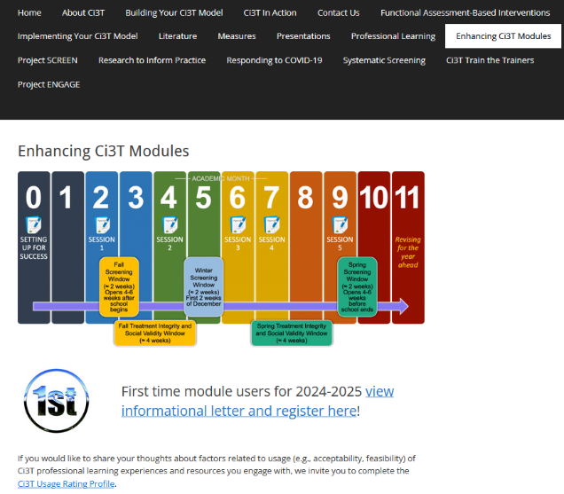
Implementing Comprehensive, Integrated, Three-tiered (Ci3T) Models: Using Data to Inform Professional Learning
Enhanced Ci3T Implementation Series and Delivery (Guided E-Ci3T) Session 3
If you have not done so already, we invite you to visit ci3t.org/enhance to access modules and complete a one-time registration process!

Slide 3
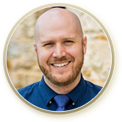





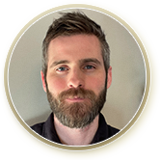

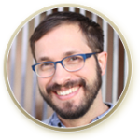


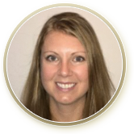
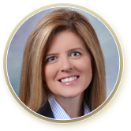
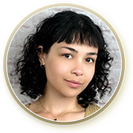

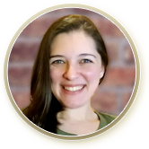
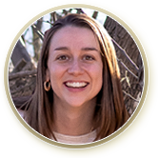



Ci3T Research Team
Grant Allen
Matthew Aschliman
Tammy Becker
Allison Bernard
Carrie Brandon
Amy Briesch
Mark Buckman
Sandy Chafouleas
Eric Common
Howard Diacon
Kathleen Lynne Lane
Jessica Matus
Wendy P. Oakes
Jenna Raad
David Royer
Elise Sarasin
Rebecca Sherod
Joni Weiss
Stacie Williams
Kate Williamson

Slide 4

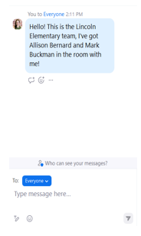
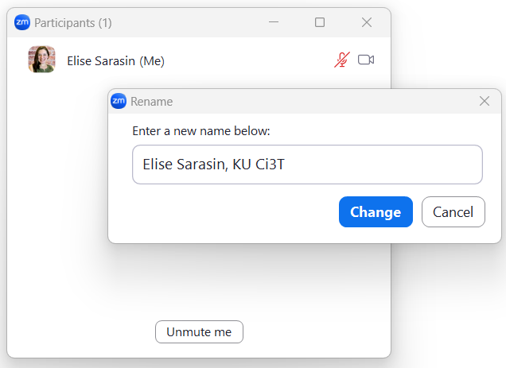

Zoom Logistics
If you are facilitating a Ci3T Leadership Team Symposium session at a satellite location, please email us a list of the names, email addresses, and schools of those attending.
To help us put you in breakout rooms with your colleagues today we are renaming you with your school initials and first and last name
If there are multiple people in the room with you, please list their first and last names and email in the chat!

Slide 5



Enhancing Ci3T Modules
ci3t.org/enhance

Slide 6
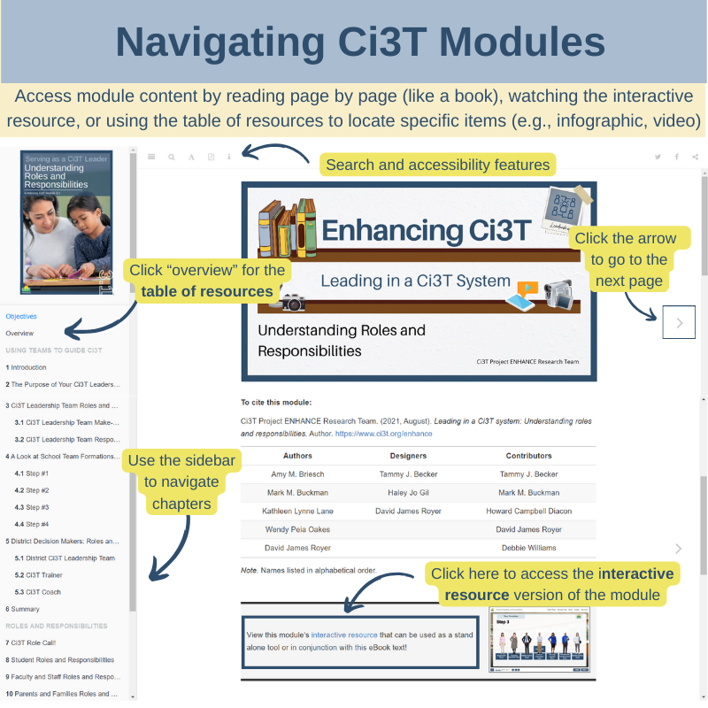

Slide 7
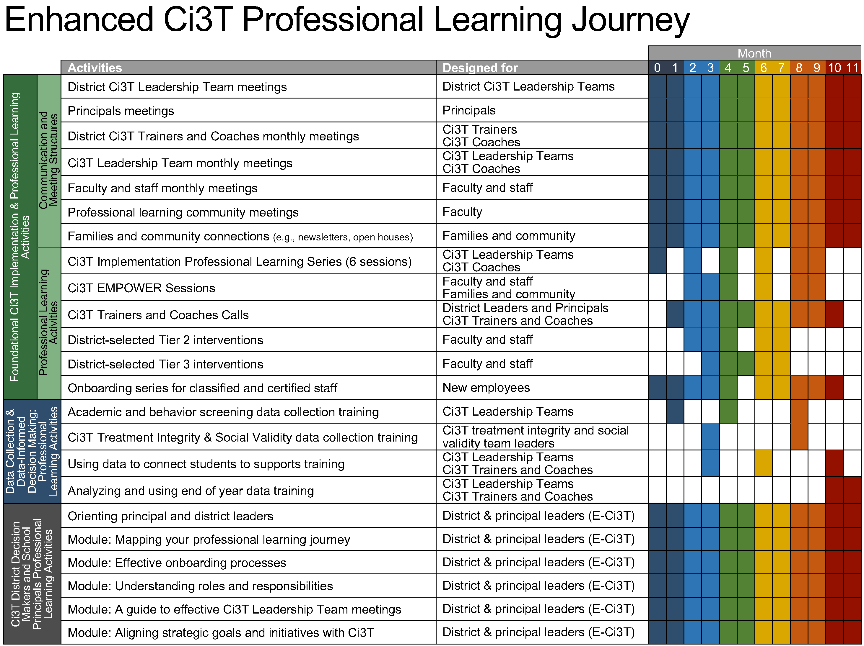
Enhanced Ci3T Implementation Series and Delivery

Slide 8
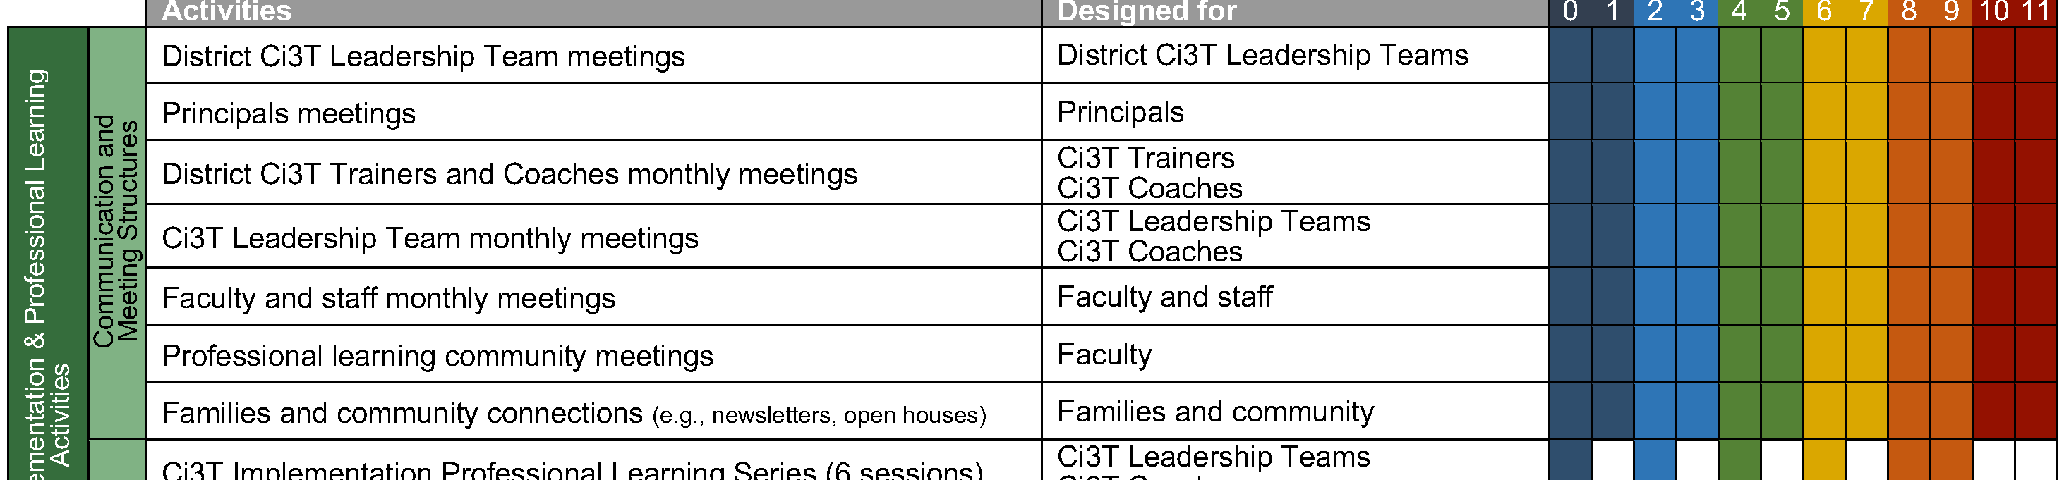
Foundational Ci3T Implementation & Professional Learning Activities

Slide 9
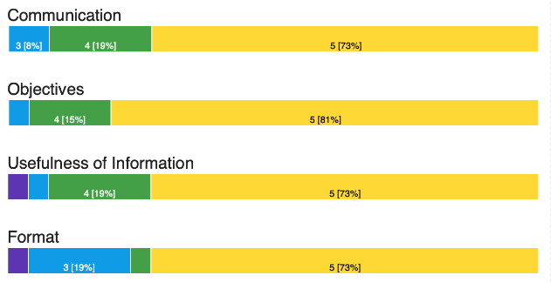
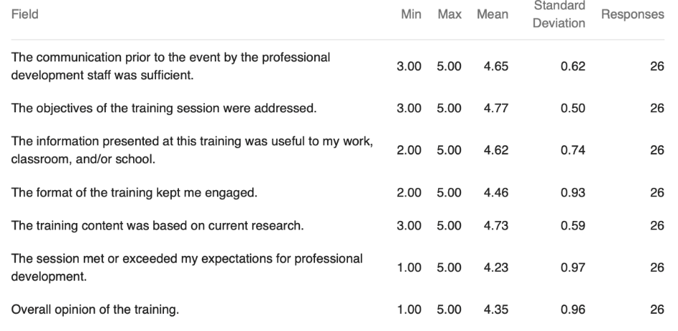
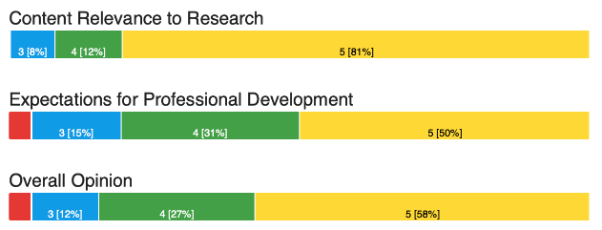

Session 2 Feedback

Slide 10
Session 2 Feedback
Thank you for the specific and constructive comments! Some trends we noticed based on comments:
Appreciated the jigsaw activity
Appreciated time in breakout rooms to work with your team
Accessing resources during presentation can be difficult with pacing (but links in chat help!)
Notes:
We’ve used this feedback to adjust today’s session – prioritizing time with your team and offering opportunities for differentiation based on what your data is showing. We will continue to put direct links in chat and include slides to help orient you to where materials can be located! Remember- you can always download this presentation for screenshots of where materials are located and modules references will be in top right hand corner.

Slide 11
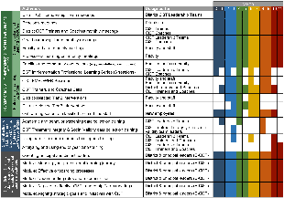
Session Outcomes
Interpret social validity, treatment integrity, and winter screening data at the school- and classroom-level to identify successes and focus areas relative to Ci3T implementation.
Develop corresponding professional learning opportunities to empower faculty and staff with effective practices to inform instruction at each level of prevention (e.g., Tier 1, low-intensity strategies, Tier 2 and Tier 3 interventions) according to needs identified in social validity, treatment integrity, and winter screening data.

Slide 12
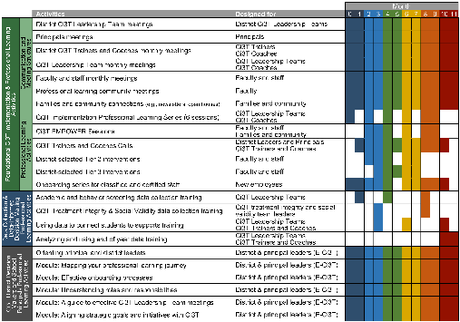

Agenda
Welcome
Procedures for Monitoring
  Review Fall Social Validity and Treatment Integrity Data
  Review Winter Screening Data
Data-Informed Decision-Making
  Set Professional Learning Targets and Resources
  Develop Communication Plans with Staff and Families
Wrapping Up and Moving Forward
If you are a Board Certified Behavior Analyst (BCBA), you may accrue up to 2 continuing education units (CEUs) for attending this session. See agenda for task list alignment. Throughout the session we will share 4 key words, write those down to turn in after the session!

Slide 13
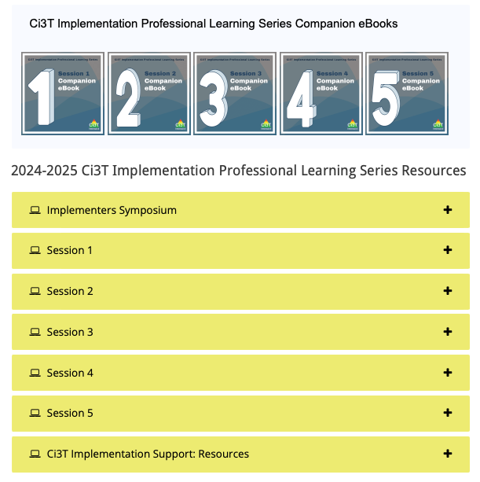
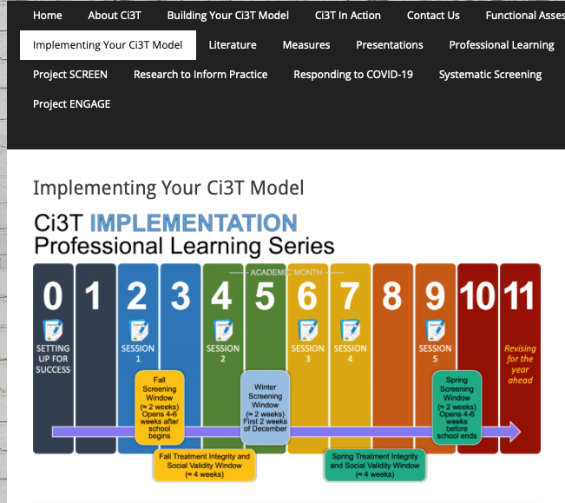
Accessing Professional Learning Materials
ci3t.org/imp

Slide 14
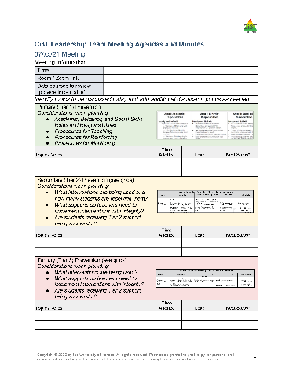

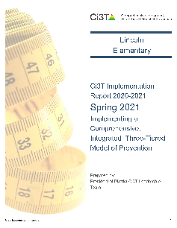
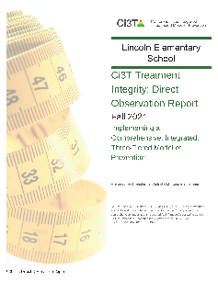
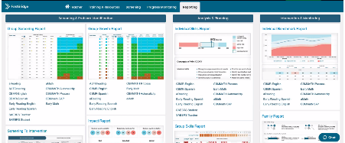

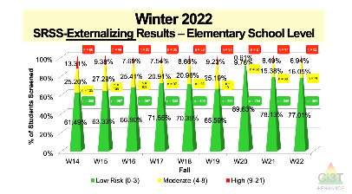
Materials for Today’s Session
Ci3T Leadership Team Agenda
Ci3T Implementation Manual
Fall Social Validity and Treatment Integrity Data
Winter Screening Data

Slide 15

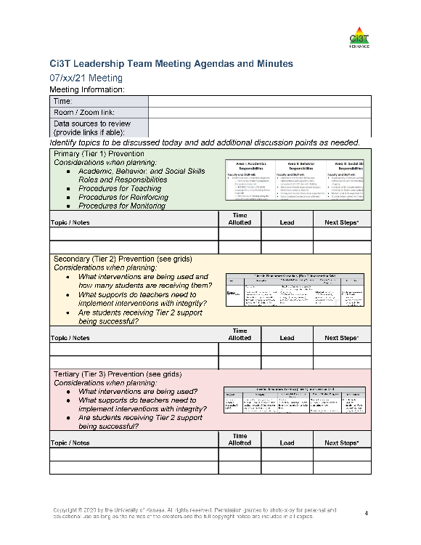
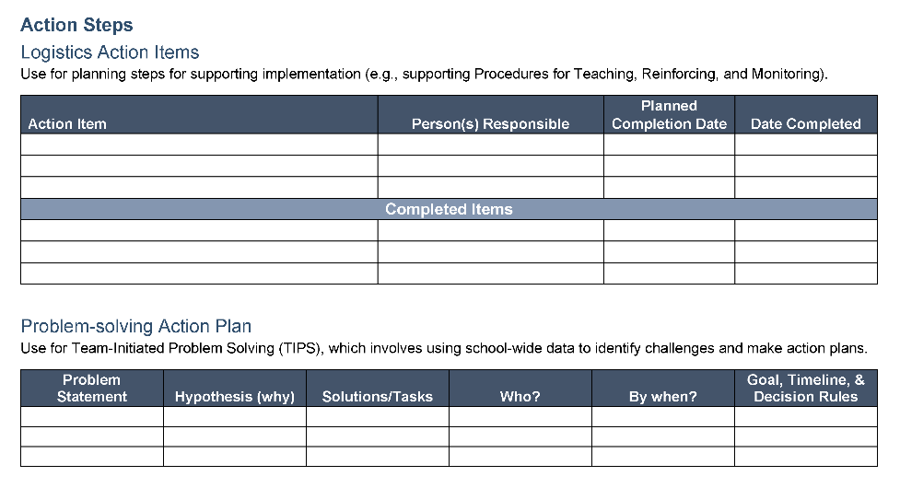
Ci3T Leadership Team Agenda Template

Slide 16
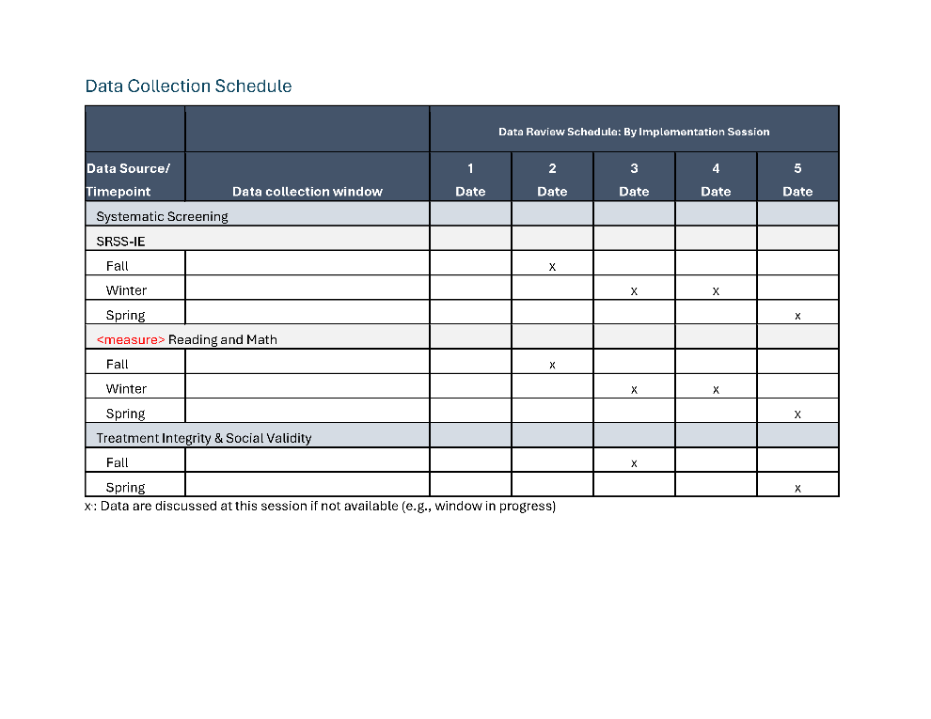
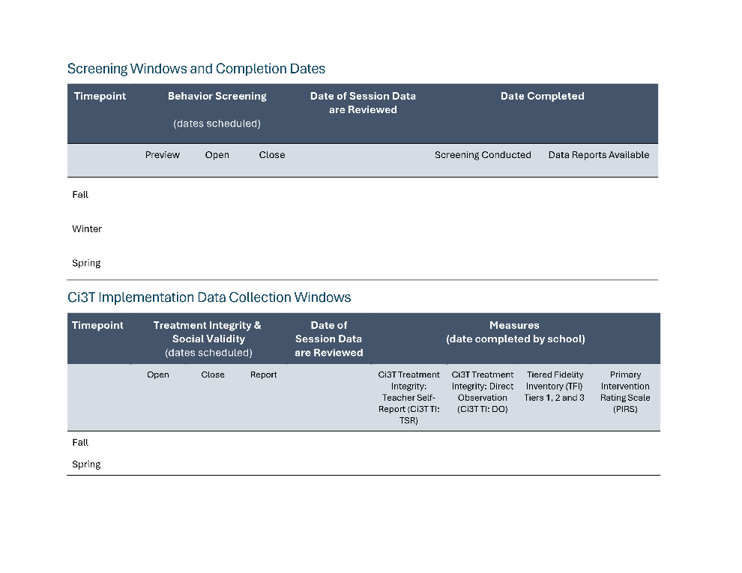
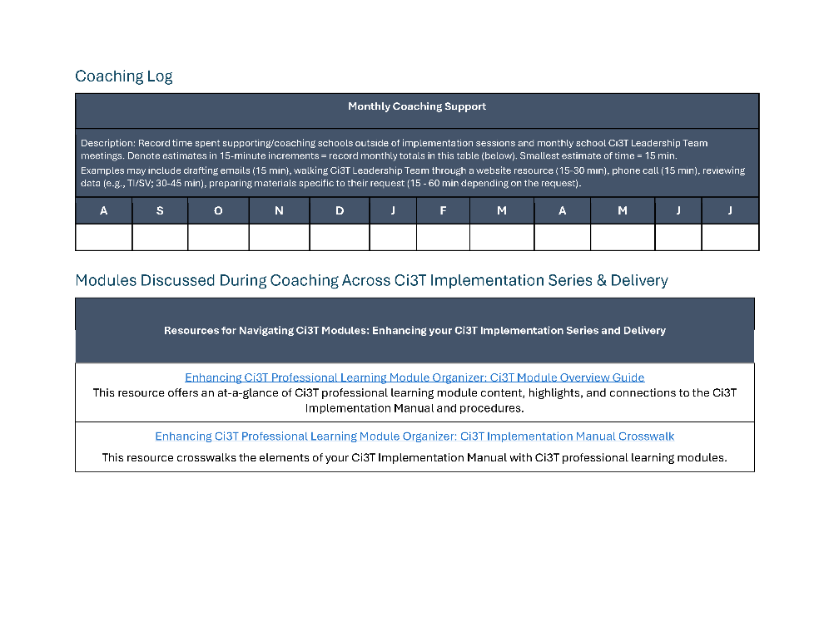
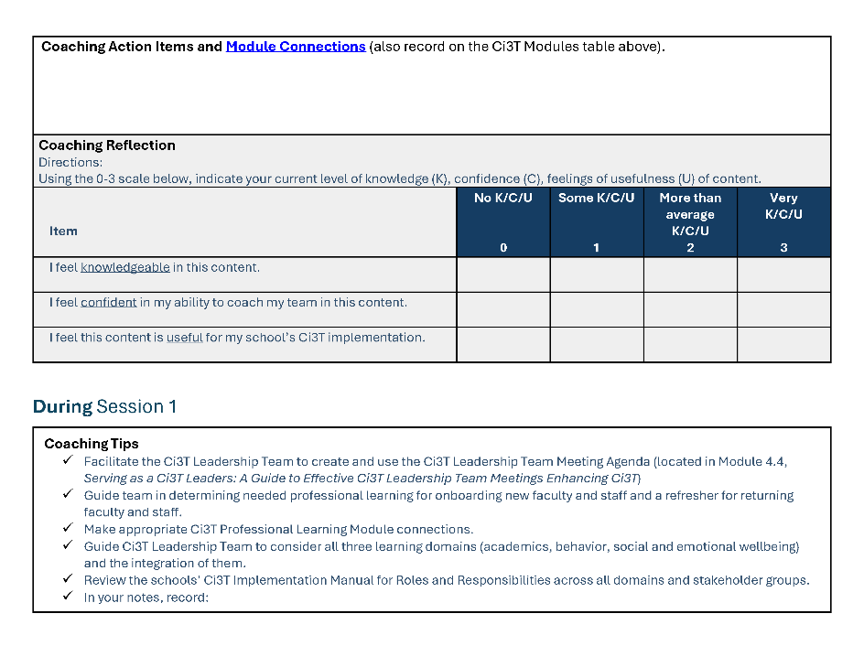
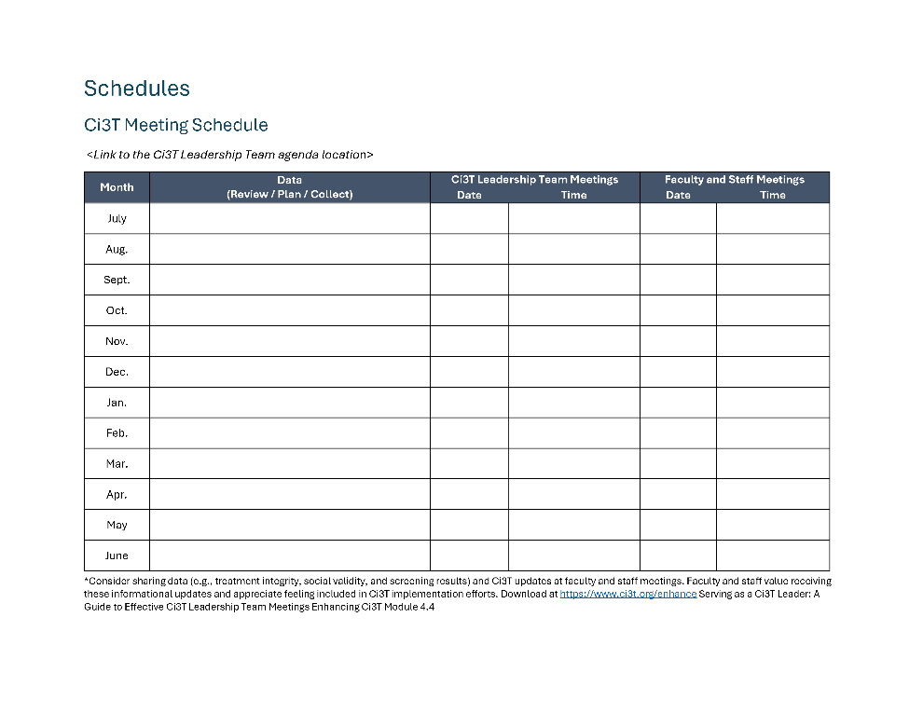
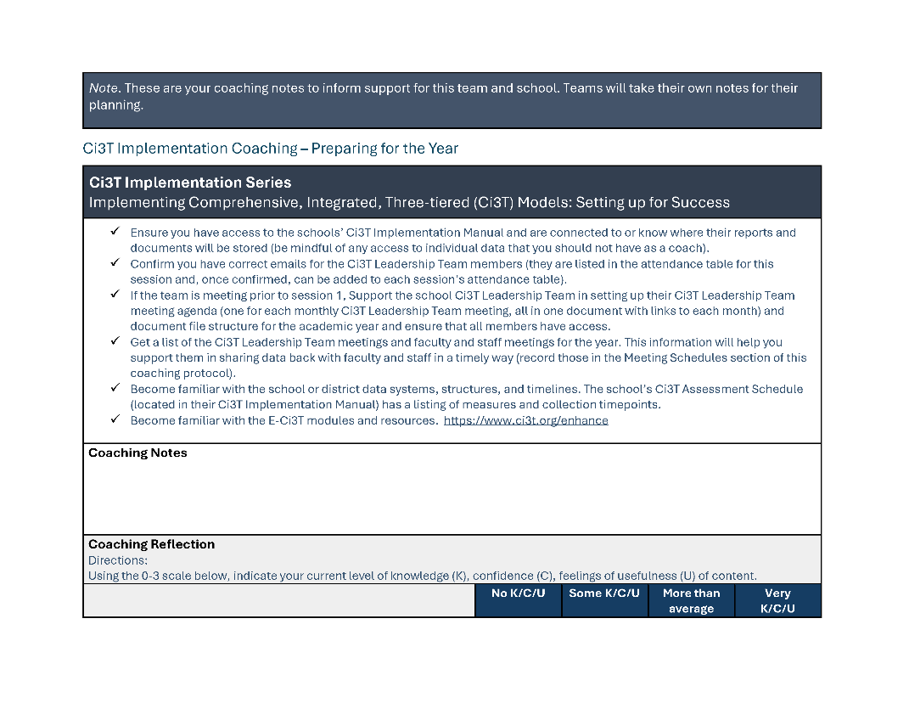
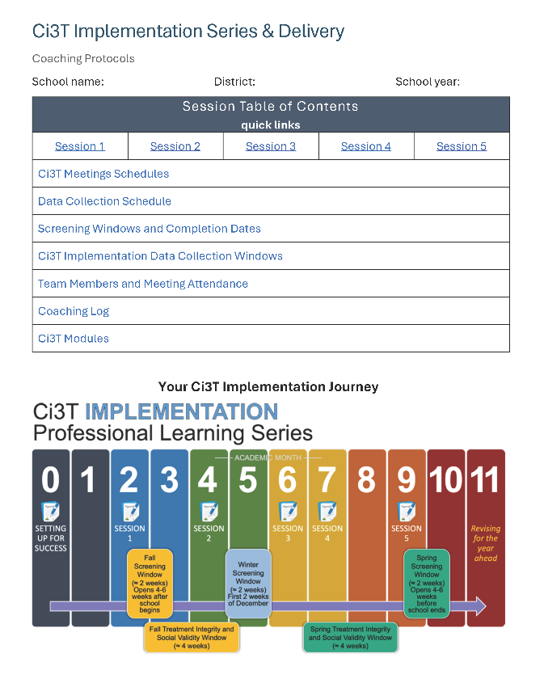
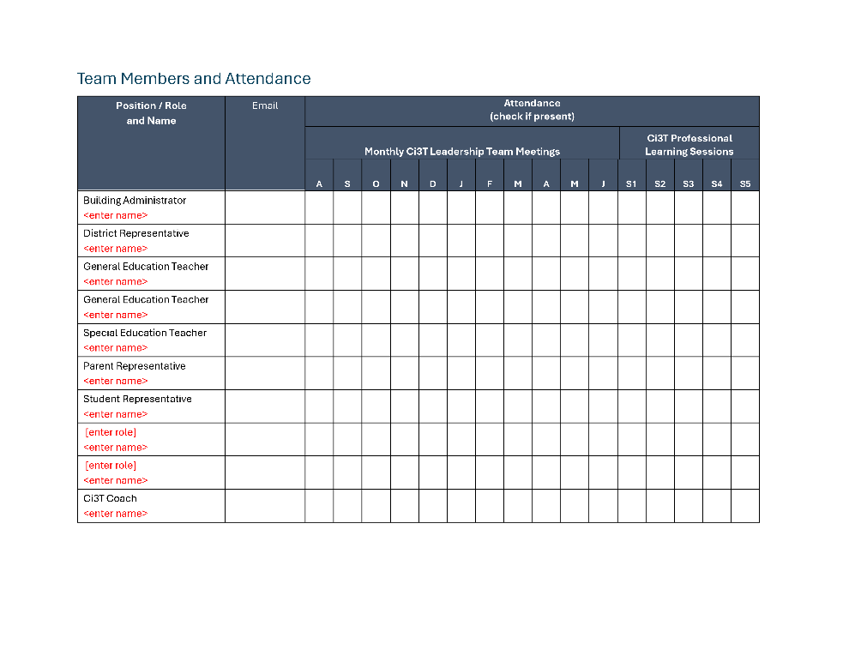
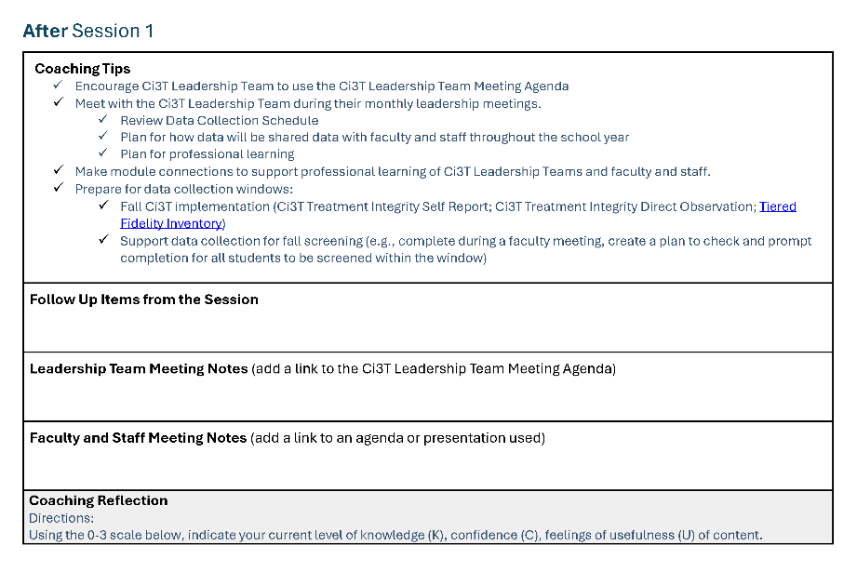
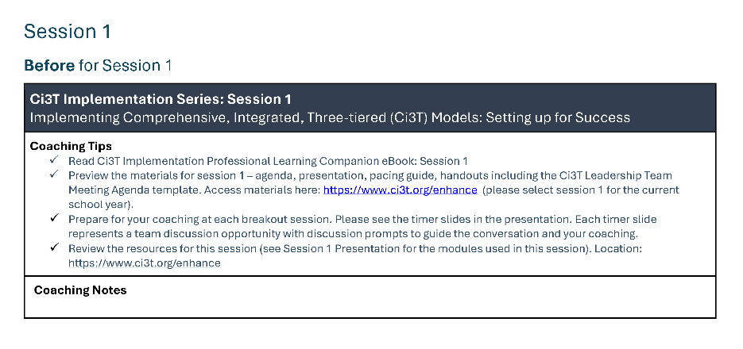
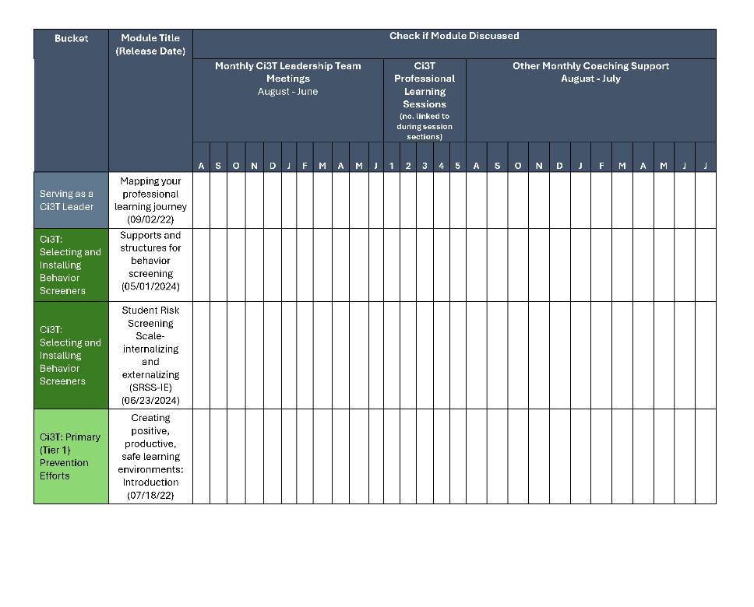
Coaching Protocol

Slide 17
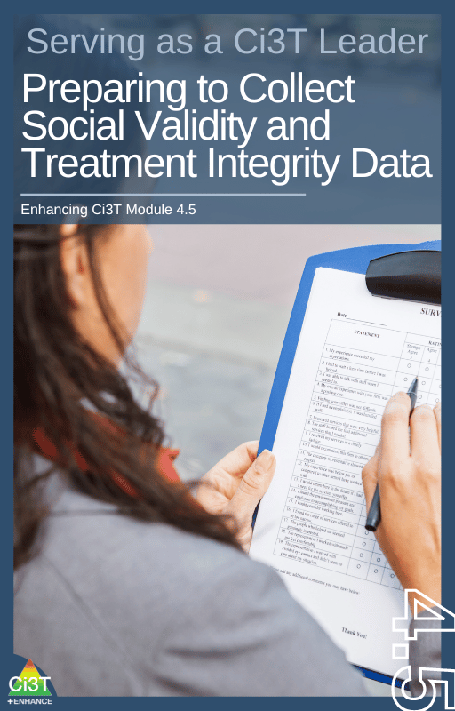
Procedures for Monitoring
Review your School’s Social Validity & Treatment Integrity Data
Review your School’s Winter Screening Data

Slide 18
Session Outcomes
Interpret social validity, treatment integrity, and winter screening data at the school- and classroom-level to identify successes and focus areas relative to Ci3T implementation.
Develop corresponding professional learning opportunities to empower faculty and staff with effective practices to inform instruction at each level of prevention (e.g., Tier 1, low-intensity strategies, Tier 2 and Tier 3 interventions) according to needs identified in social validity, treatment integrity, and winter screening data.

Slide 19
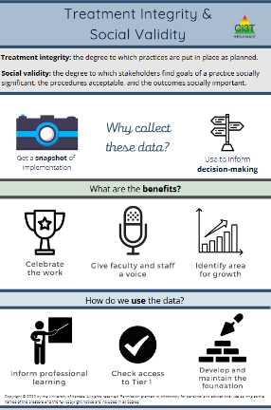
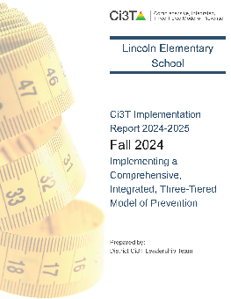
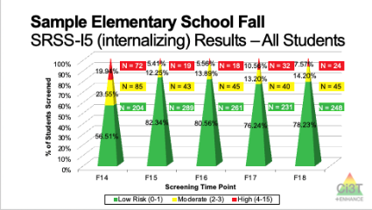
Essential Components of Primary (Tier 1) Prevention Efforts
Social Validity
Systematic Universal Screening
Academic
Behavior
Treatment Integrity
ci3t.org/measures
ci3t.org/screening
for behavior

Slide 20
Social Validity
How do stakeholders view the plan?
Social validity refers to the level of:
Social significance of intervention goals
Social acceptability of intervention procedures
Social importance of intervention outcomes
(Wolf, 1978)
Assessed using the Primary Intervention Rating Scale (PIRS)
Social Validity: PIRS Results
Year | Fall |  | Spring
 | n | % (SD) | n | % (SD)
2024-2025 | 32 | 85.39 (8.89) | TBD | TBD

Slide 21
Treatment Integrity
Are we implementing our plan as intended?
Treatment integrity can refer to:
Adherence
Dosage
Quality
Assessed using:
Ci3T Treatment Integrity: Teacher Self-Report
Ci3T Treatment Integrity: Direct Observation
Tiered Fidelity Inventory (TFI)
Ci3T Procedures | Teacher Self-Report* | Direct Observation*
 | Fall 2024 n = 45 % (SD) | Educator n = 6 % (SD) | Observer n = 7 % (SD)
Teaching | 80.43% (10.86) | 70.72% (13.81) | 75.02% (17.05)
Reinforcing | 80.83% (12.89) | 62.06% (15.33) | 34.99% (16.02)
Monitoring | 75.49% (18.06) | - | -
Total | 79.10% (11.87) | 67.66% (14.03) | 62.28% (14.58)

Slide 22
Logistics Planning
Method | Measure Name | Completed by…
Method | Measure Name | All Staff | Randomly Selected Classrooms | Ci3T Leadership Team
Survey | Ci3T Treatment Integrity: Teacher Self-Report and Primary Intervention Rating Scale | X
Observations | Ci3T Treatment Integrity: Direct Observation |  | X
Rubric | Tiered Fidelity Inventory (TFI) |  |  | X

Slide 23



Treatment Integrity and Social Validity Data Sources
Primary Intervention Rating Scale (Social Validity)
Ci3T Treatment Integrity: Teacher Self Report
Ci3T Treatment Integrity: Direct Observation
Tiered Fidelity Inventory

Slide 24
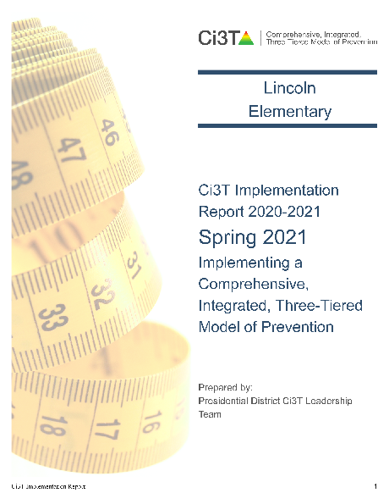
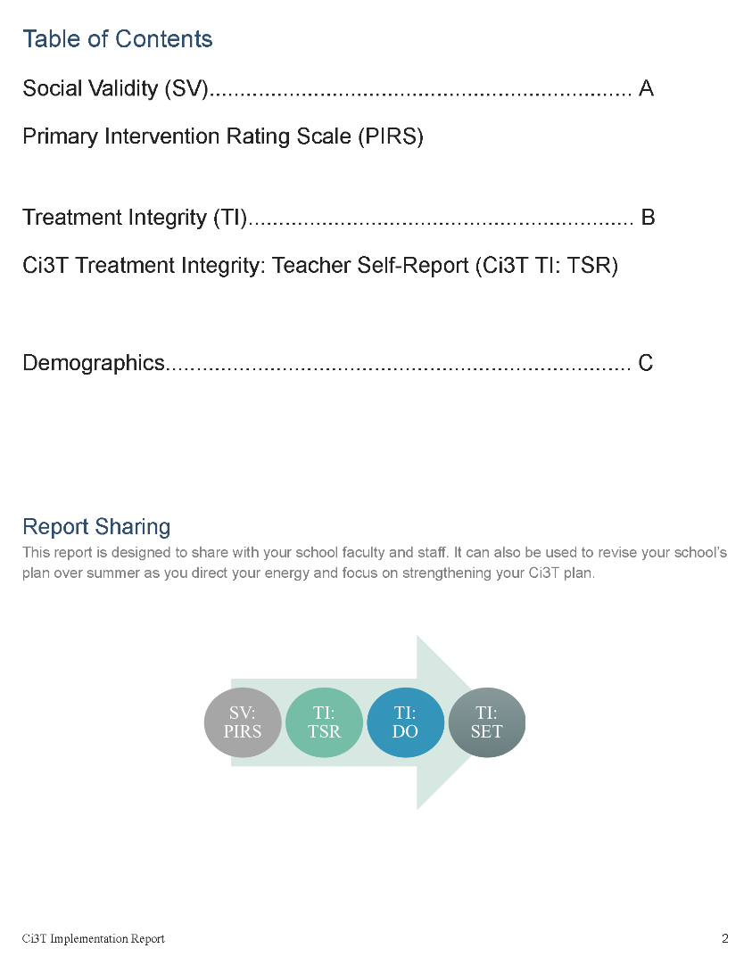

Slide 25
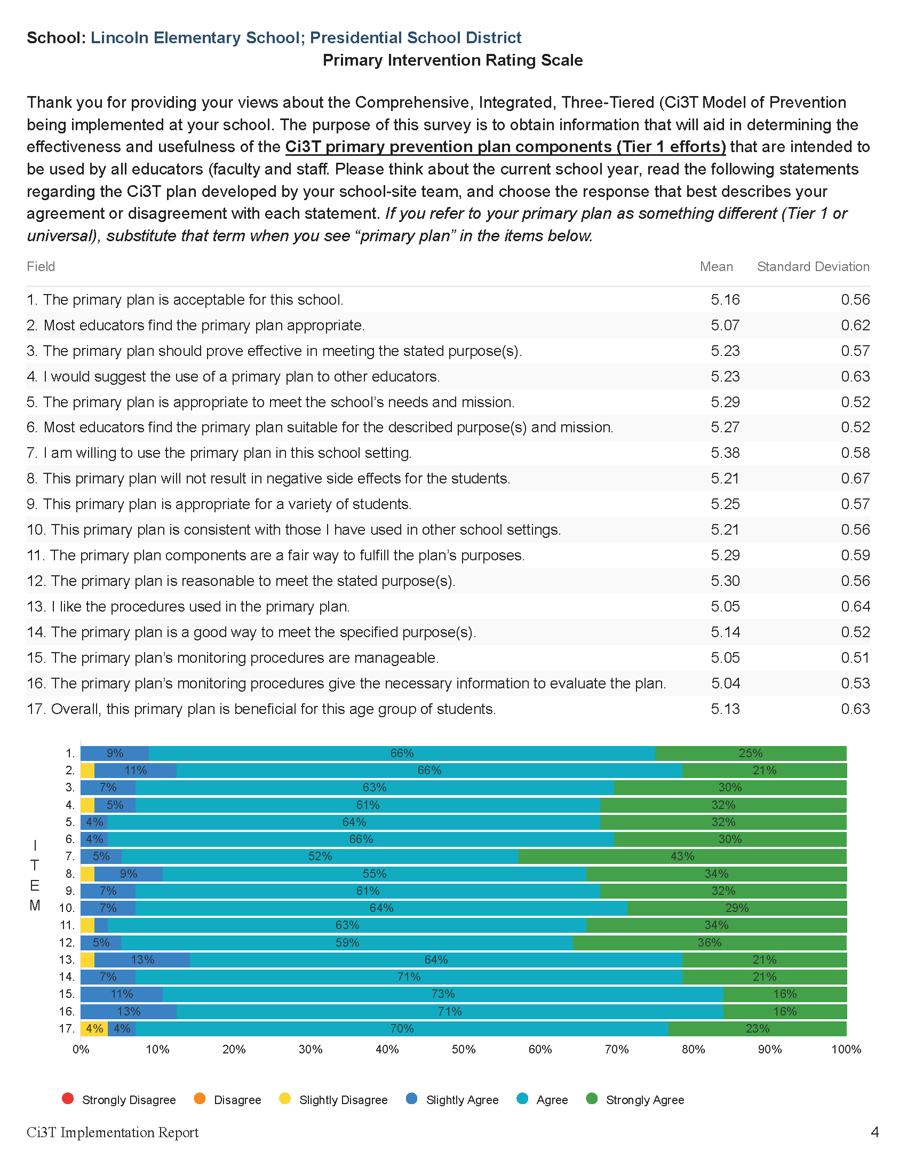

Slide 26
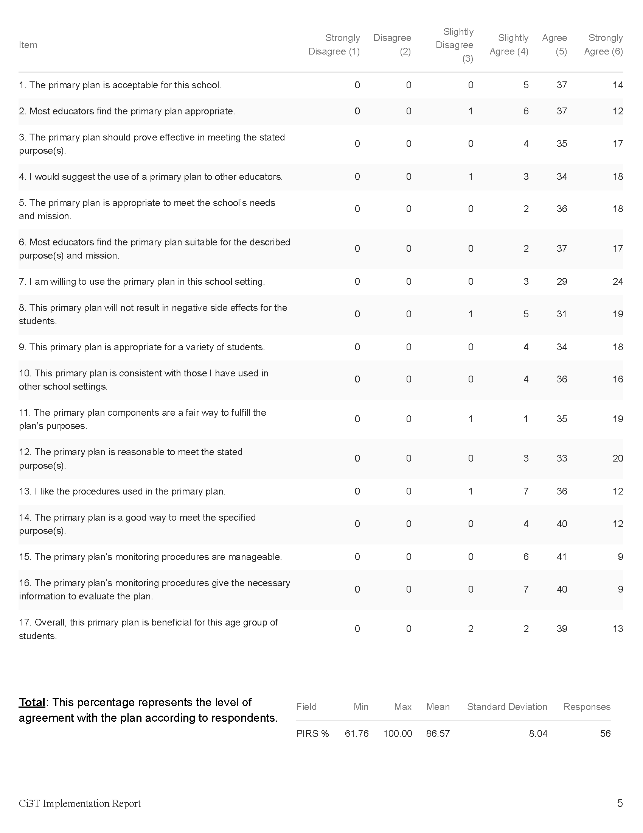

Slide 28
Open-Ended Questions:
A) What do you feel is most beneficial about this primary prevention plan’s components (Tier 1 efforts)? B) What is the least beneficial part?
Do you think that your and your students’ participation in this Ci3T plan will cause your students’ behavior, social, and/or learning problems to improve? Why or why not? Or if so, how?
What would you change about this plan (components, design, implementation etc.) to make it more student-friendly and educator-friendly?
What other information would you like to contribute about this plan?
Read through comments
Highlight success (literally!)
Look for themes for celebrations and focus areas

Slide 29
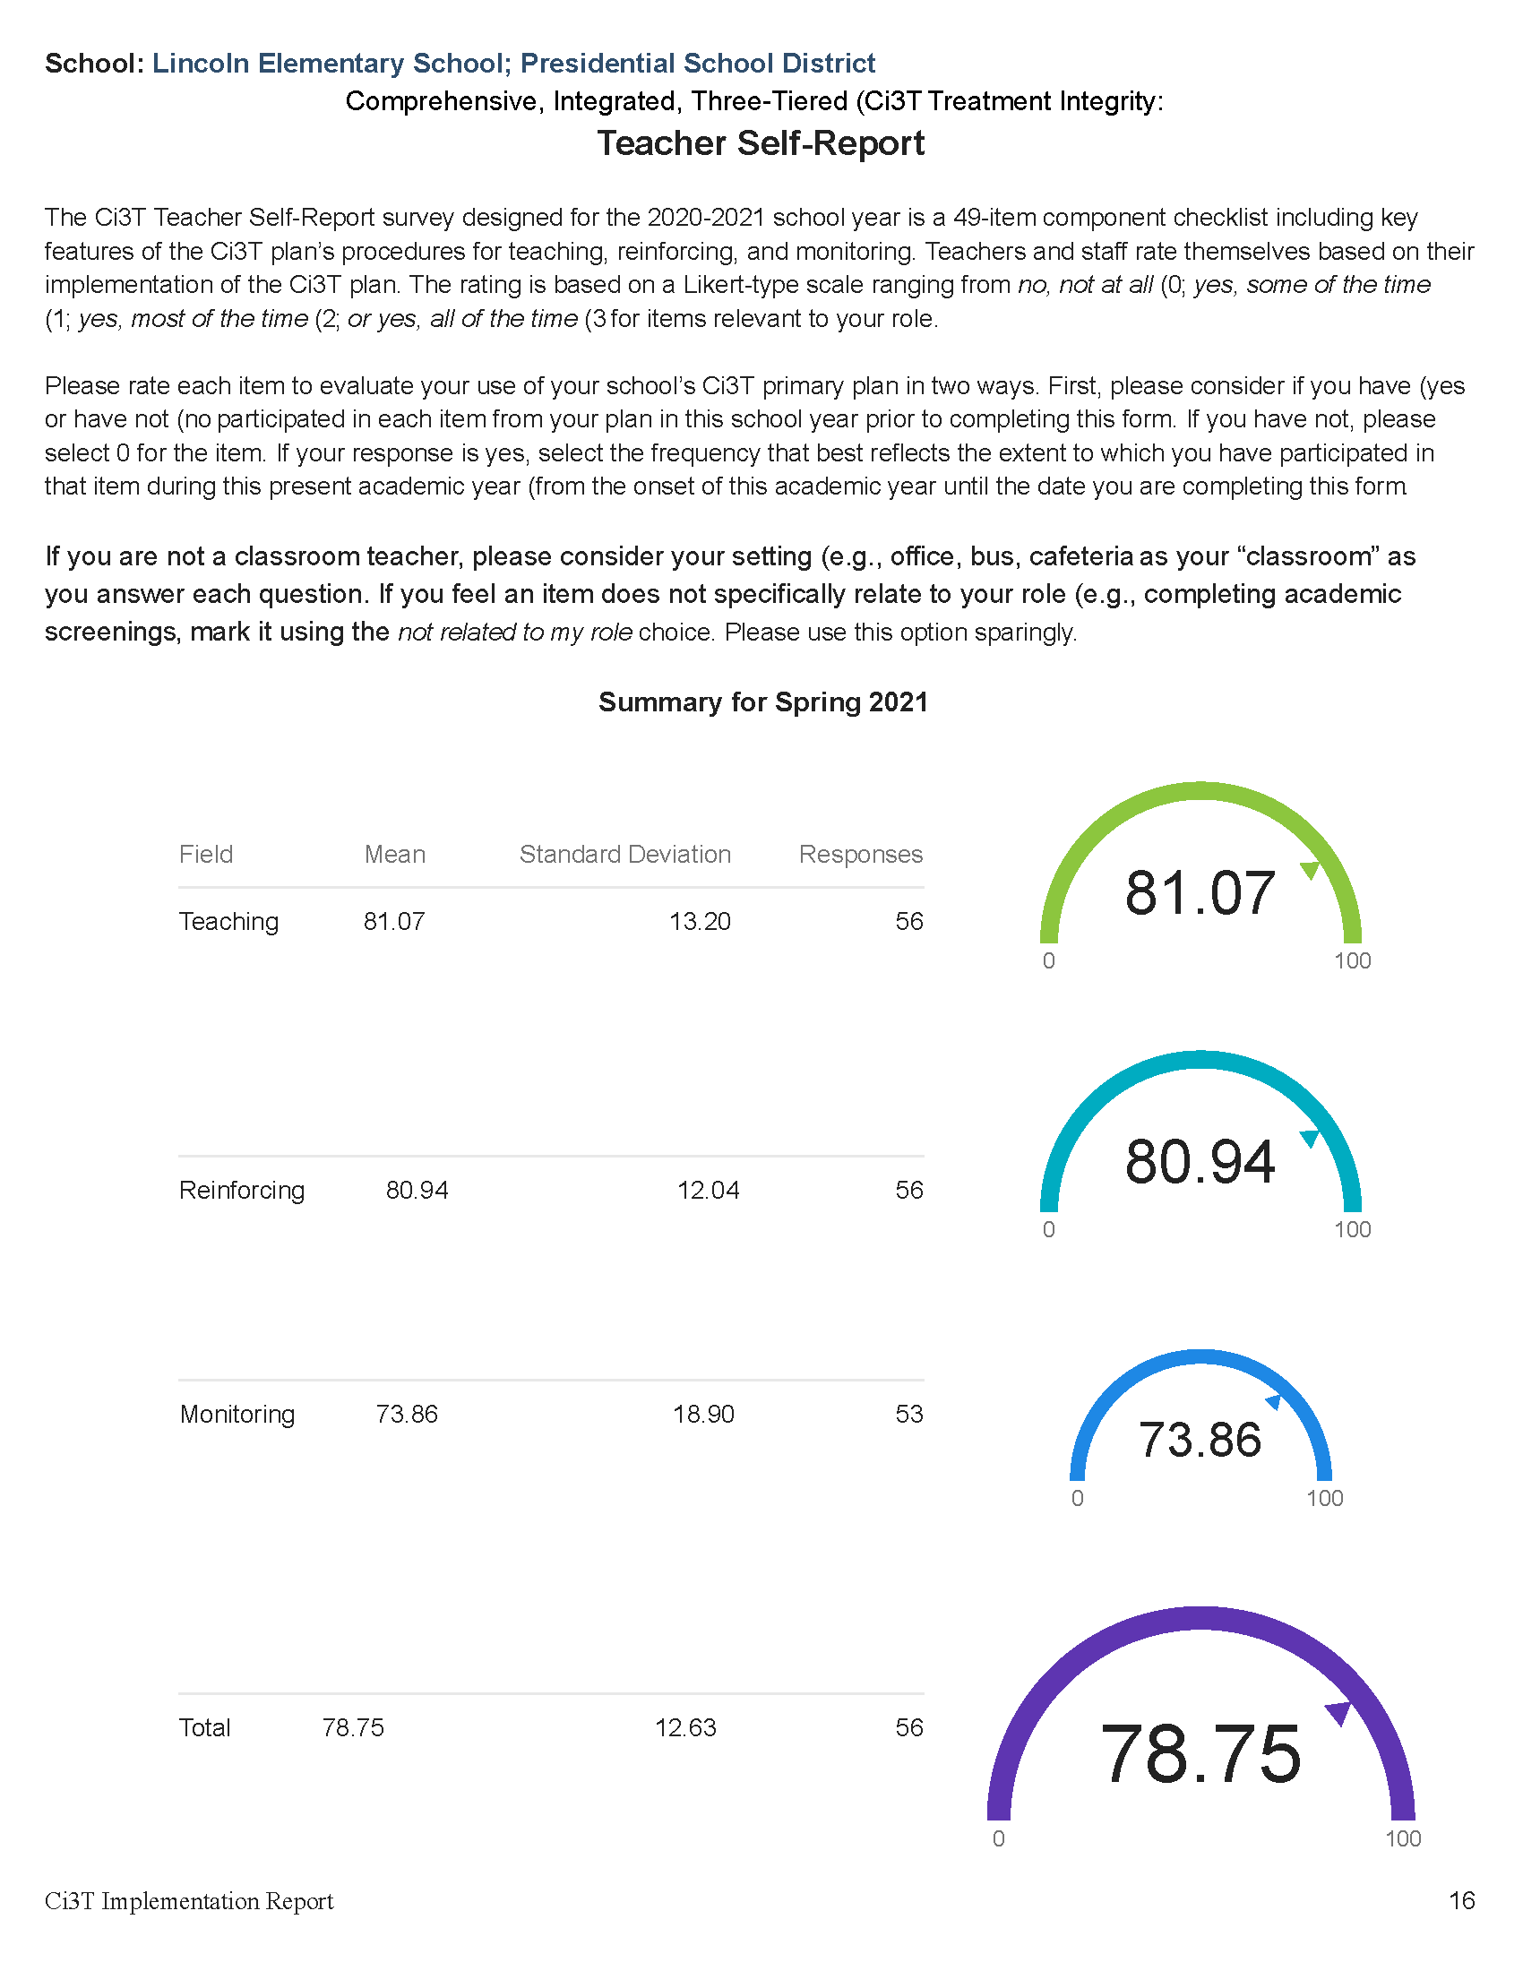

Slide 30
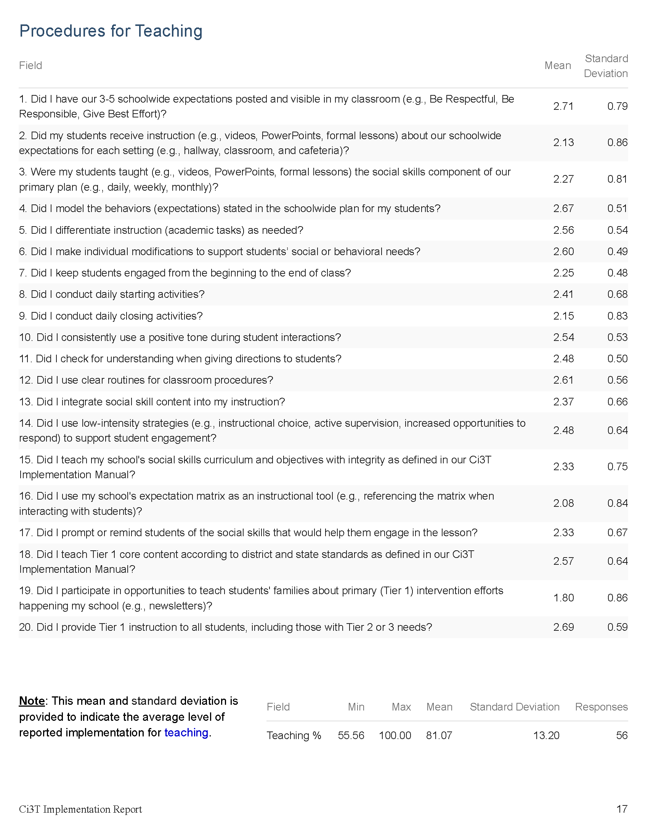

Slide 31
Notes:
#11 = bright spot. Might be helpful to consider- what led to this success? Could we replicate those strategies in other areas?
#16 = potential area of emphasis

Slide 32
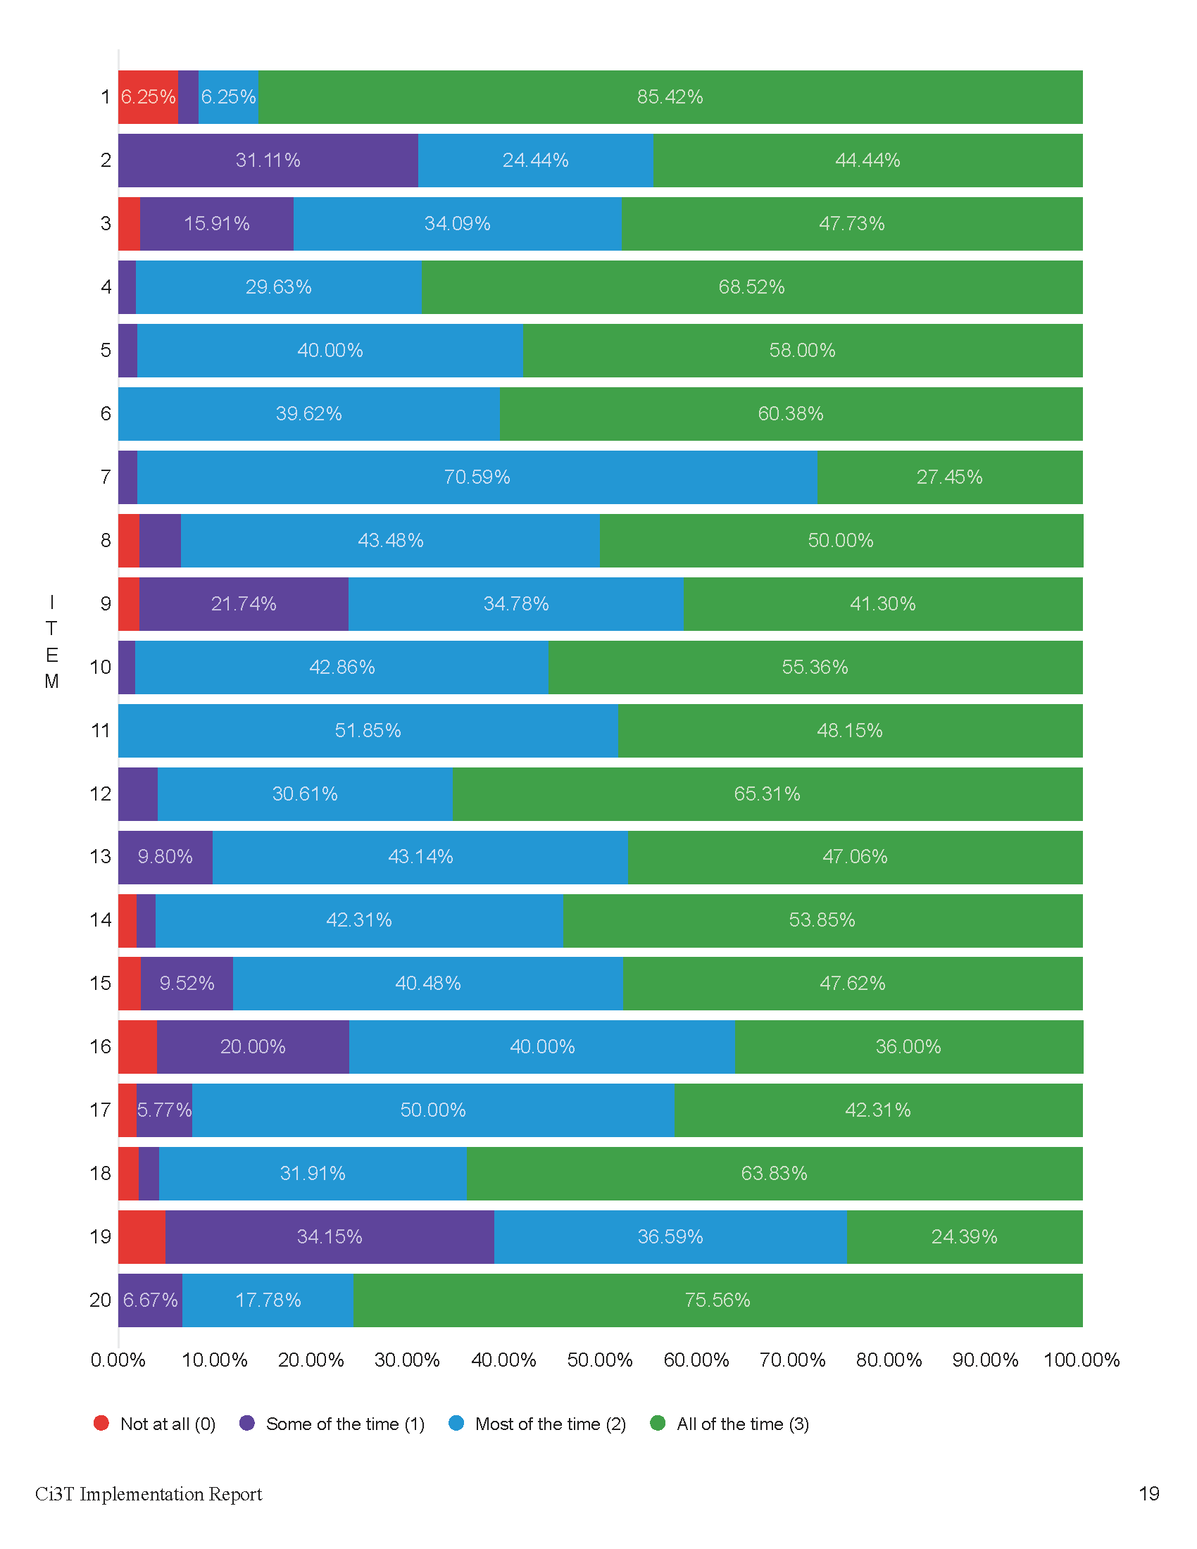

Slide 33

Notes:
Graphs provide a visual way to look at the data. For example:
#11 = Did I check for understanding when giving directions to students?
This visual representation helps us see that everyone responded “most of the time” or “all of the time” to this question. This is worth celebrating!
#16 – Did I use my school’s expectation matrix as an instructional tool (e.g., referencing the matrix when interacting with students)?
This visual representation of the data underscores that this might be an area to focus on – 20% responding some of the time and ~4% not at all

Slide 34
Treatment Integrity and Social Validity Data Sources
Primary Intervention Rating Scale (Social Validity)
Ci3T Treatment Integrity: Teacher Self Report
Ci3T Treatment Integrity: Direct Observation
Tiered Fidelity Inventory

Slide 35

Ci3T Treatment Integrity
Direct Observation (Ci3T TI: DO)
Subset of Ci3T TI: TSR
Stratified, random selection of educators
  Personnel who directly instruct students
Observers trained to criterion
30-min observations
  Educator perspective
  Observer perspective

Slide 36


Slide 37


Slide 38
Notes:
Convergent validity. What the outside observer noticed during direct observation matches what your staff indicated In teacher self-report.

Slide 40


Slide 41


Slide 42



Slide 43


Slide 44
Treatment Integrity and Social Validity Data Sources
Primary Intervention Rating Scale (Social Validity)
Ci3T Treatment Integrity: Teacher Self Report
Ci3T Treatment Integrity: Direct Observation
Tiered Fidelity Inventory

Slide 45


p.24

Slide 46


Slide 47

p.25

Slide 48
Accessing Professional Learning Materials
ci3t.org/imp

Slide 49


Slide 50




























Let’s Discuss
Locate your school’s Social Validity and Treatment Integrity Data
(e.g.,Ci3T Implementation Report, Ci3T Treatment Integrity: Direct Observation Report, Tiered Fidelity Inventory)
2) Use the Working with your Treatment Integrity and Social Validity Data handout to review data and:
Highlight successes
Discuss areas for refinement and plans for addressing these focus areas
Notes:
20-min timer

Slide 51

Procedures for Monitoring
Review your School’s Social Validity & Treatment Integrity Data
Review your School’s Winter Screening Data

Slide 52
Session Outcomes
Interpret social validity, treatment integrity, and winter screening data at the school- and classroom-level to identify successes and focus areas relative to Ci3T implementation.
Develop corresponding professional learning opportunities to empower faculty and staff with effective practices to inform instruction at each level of prevention (e.g., Tier 1, low-intensity strategies, Tier 2 and Tier 3 interventions) according to needs identified in social validity, treatment integrity, and winter screening data.

Slide 53
Essential Components of Primary (Tier 1) Prevention Efforts
Social Validity
Systematic Universal Screening
Academic
Behavior
Treatment Integrity
ci3t.org/measures
ci3t.org/screening
for behavior

Slide 54

Behavior Screening

Slide 55




Systematic Behavior Screening

Slide 56


Slide 58

Student Risk Screening Scale – Internalizing and Externalizing (SRSS-IE; Drummond, 1994; Lane & Menzies, 2009)
Elementary

Slide 59

Student Risk Screening Scale – Internalizing and Externalizing (SRSS-IE; Drummond, 1994; Lane & Menzies, 2009)
Secondary

Slide 60
SRSS-IE: Cut Scores
Elementary School |  | Middle and High School
SRSS-E7 | SRSS-I5 | SRSS-E7 | SRSS-I6
Items 1-7 | Items 8-12 | Items 1-7 | Items 4, 8-12
0-3 = low risk 4-8 = moderate risk 9-21 = high risk | 0-1 = low risk 2-3 = moderate risk 4-15 = high risk | 0-3 = low risk 4-8 = moderate risk 9-21 = high risk | 0-3 = low risk 4-5 = moderate risk 6-18 = high risk
Elementary School Level:
Lane, K. L., Oakes, W. P., Swogger, E. D., Schatschneider, C., Menzies, H., M., & Sanchez, J. (2015). Student risk screening scale for internalizing and externalizing behaviors: Preliminary cut scores to support data-informed decision making. Behavioral Disorders, 40, 159-170.
Middle and High School Levels:
Lane, K. L., Oakes, W. P., Cantwell, E. D., Schatschneider, C., Menzies, H., Crittenden, M., & Messenger, M. (2016). Student Risk Screening Scale for Internalizing and Externalizing Behaviors: Preliminary cut scores to support data-informed decision making in middle and high schools. Behavioral Disorders, 42(1), 271-284

Slide 61
Winter 2022
SRSS-Externalizing Results – Middle School Level
n = 21
n = 27
n = 27
n = 13
n = 6
n = 17
n = 26
n = 47
n = 96
n = 68
n = 71
n = 53
n = 42
n = 54
n = 491
n = 448
n = 383
n = 346
n = 445
n = 518
n = 527
Notes:
If you would like to update this slide with data from your school or district- Fill in <year> based on current academic year. This is located in column A of the data sheet. Edit by right clicking and selecting “Edit data”.

Slide 62
Winter 2022
SRSS-Externalizing Results – Middle School Grade level
Grade Level | N Screened | Low n (%) | Moderate n (%) | High n (%)
6 | 96 | 68 (70.83%) | 17 (17.71%) | 11 (11.46%)
7 | 126 | 79 (62.70%) | 32 (25.40%) | 15 (11.90%)
8 | 79 | 48 (60.76%) | 19 (24.05%) | 12 (15.19%)

Slide 63
Winter 2022
SRSS-Internalizing Results – Middle School Level
n = 79
n = 52
n = 54
n = 60
n = 23
n = 44
n = 42
n = 41
n = 37
n = 40
n = 32
n = 45
n = 30
n = 31
n = 55
n = 70
n = 306
n = 312
n = 356
n = 342
n = 349
n = 351
n = 432
n = 229
Notes:
If you would like to update this slide with data from your school or district- Fill in <year> based on current academic year. This is located in column A of the data sheet. Edit by right clicking and selecting “Edit data”.

Slide 64
Winter 2022
SRSS-Internalizing Results – Middle School Grade Level
Grade Level | N Screened | Low n (%) | Moderate n (%) | High n (%)
6 | 96 | 76 (79.17%) | 8 (8.33%) | 12 (12.50%)
7 | 126 | 93 (73.81%) | 14 (11.11%) | 19 (15.08%)
8 | 79 | 60 (75.95%) | 9 (11.39%) | 10 (12.66%)

Slide 65
Winter 2022
SRSS-Externalizing Results – High School Level
n = 47
n = 72
n = 36
n = 36
n = 40
n = 8
n = 17
n = 38
n = 119
n = 113
n = 47
n = 137
n = 134
n = 114
n = 90
n = 65
n = 1259
n = 1280
n = 1188
n = 994
n = 447
n = 717
n = 750
n = 920
Notes:
If you would like to update this slide with data from your school or district- Fill in <year> based on current academic year. This is located in column A of the data sheet. Edit by right clicking and selecting “Edit data”.

Slide 66
Winter 2022
SRSS-Externalizing Results – High School Grade level
Grade Level | N Screened | Low n (%) | Moderate n (%) | High n (%)
9 | 271 | 207 (76.38%) | 44 (16.24%) | 20 (7.38%)
10 | 303 | 259 (85.48%) | 34 (11.22%) | 10 (3.30%)
11 | 256 | 229 (89.45%) | 20 (7.81%) | 7 (2.73%)
12 | 241 | 225 (93.36%) | 15 (6.22%) | 1 (0.41%)

Slide 67
Winter 2022
SRSS-Internalizing Results – High School Level
n = 165
n = 106
n = 83
n = 99
n = 55
n = 65
n = 52
n = 87
n = 73
n = 65
n = 50
n = 34
n = 59
n =48
n = 56
n = 167
n = 1111
n = 1307
n = 1109
n = 1000
n = 445
n = 691
n = 710
n = 923
Notes:
If you would like to update this slide with data from your school or district- Fill in <year> based on current academic year. This is located in column A of the data sheet. Edit by right clicking and selecting “Edit data”.

Slide 68
Winter 2022
SRSS-Internalizing Results – High School Grade Level
Grade Level | N Screened | Low n (%) | Moderate n (%) | High n (%)
9 | 271 | 222 (81.92%) | 19 (7.01%) | 30 (11.07%)
10 | 303 | 265 (87.46%) | 20 (6.60%) | 18 (5.94%)
11 | 256 | 216 (84.38%) | 9 (3.52%) | 31 (12.11%)
12 | 241 | 225 (93.36%) | 8 (3.32%) | 8 (3.32%)

Slide 69
Reviewing Screening Data
Ci3T Leadership Teams review screening data at the following levels:
Screening Practice
School-wide (e.g., Tier 1 efforts)
Grade or department (e.g., Tier 1 efforts, low-intensity strategies)
Class level (e.g., low-intensity strategies)
Individual student level (e.g., Tier 2 and Tier 3)

Slide 70

Academic Screening

Slide 71



Academic Screening
Notes:
Might consider beginning by looking at data broadly
compared against district or state benchmarks
Subgroup analyses

Slide 72



Academic Screening
Notes:
Then, might zoom in at the grade-level looking at distribution across risk category, mastery, or growth

Slide 73

Reviewing Multiple Sources of Data in an Integrated Way
attendance
behavior
screening
academic screening

Slide 74

















Let’s discuss!
Use the Working with Your Screening Data Handout to review winter screening data Where are there strengths or bright spots? What are the greatest areas of need? School-level (e.g., Tier 1)? Grade or department level (e.g., Tier 1, low intensity strategies)? Classroom level (e.g., low intensity strategies)? Student-level (e.g., Tier 2 & Tier 3)
Notes:
15-min timer

Slide 75

Data-Informed Decision Making:
Set Professional Learning Targets and Resources
Develop Communication Plans with Staff and Families

Slide 76
Session Outcomes
Interpret social validity, treatment integrity, and winter screening data at the school- and classroom-level to identify successes and focus areas relative to Ci3T implementation.
Develop corresponding professional learning opportunities to empower faculty and staff with effective practices to inform instruction at each level of prevention (e.g., Tier 1, low-intensity strategies, Tier 2 and Tier 3 interventions) according to needs identified in social validity, treatment integrity, and winter screening data.

Slide 77
Scenario 1

Slide 78



Slide 79



Slide 80
Tickets don’t work.
It’s too complicated to collect and keep track of tickets.
Tickets don’t build intrinsic motivation. This isn’t preparing them for the real world
Fifth graders don’t care about tickets.

Slide 81
Considerations When Responding to These Data
Find the bright spots!
  Who is giving out tickets consistently?
  What might be contributing to this success?
  Could we replicate those strategies in other areas?
Consider potential root causes
  Did we set expectations and provide professional learning for staff?
  Are there efficiencies we can leverage to make universal reinforcement system more feasible? (e.g., prepopulating tickets with teacher names)
  Do we need to adjust our reinforcer menu?

Slide 82



Professional Learning

Slide 83


Professional Learning

Slide 84

Build Momentum with a Ci3T Challenge
.

Slide 85

School-Wide Challenge
.

Slide 86
School-Wide Challenge
.

Slide 87




Update Reinforcer Menu

Slide 88



Let’s Chat!
What is the most unique reinforcer you have offered?
OR
What is the most popular reinforcer on your menu?

Slide 89

Action Planning
Print tickets and deliver to teacher mailboxes
Elise
01/21/25
Prepare 15-minute presentation for faculty & staff mtg
Allison
01/28/25

Slide 90
Scenario 2

Slide 91
Winter 2022
SRSS-Externalizing Results – Middle School Level
n = 21
n = 27
n = 27
n = 13
n = 6
n = 17
n = 26
n = 47
n = 96
n = 68
n = 71
n = 53
n = 42
n = 54
n = 491
n = 448
n = 383
n = 346
n = 445
n = 518
n = 527

Slide 92
Winter 2022
SRSS-Externalizing Results – Middle School Grade level
Grade Level | N Screened | Low n (%) | Moderate n (%) | High n (%)
6 | 96 | 68 (70.83%) | 17 (17.71%) | 11 (11.46%)
7 | 126 | 79 (62.70%) | 32 (25.40%) | 15 (11.90%)
8 | 79 | 48 (60.76%) | 19 (24.05%) | 12 (15.19%)

Slide 93

Notes:
In addition to student-level data, procedures for teaching is below 80% indicating Tier 1 is not yet in place as planned

Slide 94


Slide 95

Notes:
We see similar patterns looking at Direct Observation Report

Slide 96

Focus 1: Expectation Matrix
Print and distribute an expectation matrix posters
Model how to use expectation matrix as instructional tool at upcoming faculty and staff meeting
Include reminder to use expectation matrix as instructional tool in weekly newsletter

Slide 98
Notes:
We see similar patterns looking at Direct Observation Report

Slide 99



Focus 2: Embedding Low-Intensity Strategies

Slide 100


Slide 101


Activity: Integrating academic, behavior, and social domains Time: 15-30 min Take an Integrated Approach Identify an academic learning target or objective and draft ideas for a lesson plan. Determine the ways students will engage in learning. Select a social skill recently taught or one you would like students to practice. Review your expectation matrix and determine behaviors that might need precorrection for successful engagement. Please note that the order can vary depending on the opportunities for practice desired.

Slide 102

Great idea! Let’s schedule this for our next faculty meeting!
Activity: Integrating academic, behavior, and social domains Time: 15-30 min Take an Integrated Approach Identify an academic learning target or objective and draft ideas for a lesson plan. Determine the ways students will engage in learning. Select a social skill recently taught or one you would like students to practice. Review your expectation matrix and determine behaviors that might need precorrection for successful engagement. Please note that the order can vary depending on the opportunities for practice desired.

Slide 103
Action Planning
Print (12) copies of Expectation Matrix poster
David
01/21/25
Add Integrated Lesson Planning to PLC agenda
Elise
01/21/25

Slide 104
Scenario 3

Slide 105
Winter 2024
SRSS-Externalizing Results – High School Level
n = 47
n = 72
n = 36
n = 36
n = 40
n = 8
n = 17
n = 38
n = 119
n = 113
n = 47
n = 137
n = 134
n = 114
n = 90
n = 65
n = 1259
n = 1280
n = 1188
n = 994
n = 447
n = 717
n = 750
n = 920

Slide 106
Winter 2022
SRSS-Externalizing Results – High School Grade level
Grade Level | N Screened | Low n (%) | Moderate n (%) | High n (%)
9 | 271 | 207 (76.38%) | 44 (16.24%) | 20 (7.38%)
10 | 303 | 259 (85.48%) | 34 (11.22%) | 10 (3.30%)
11 | 256 | 229 (89.45%) | 20 (7.81%) | 7 (2.73%)
12 | 241 | 225 (93.36%) | 15 (6.22%) | 1 (0.41%)

Slide 107

Notes:
In addition to student-level data, procedures for teaching, reinforcing, and monitoring indicate Tier 1 is being implemented as planned.

Slide 108


Notes:
When we look at the Tiered Fidelity Inventory, we can see that Tier 1 is looking good and is consistently above that fidelity criterion. Tier 2 and Tier 3 are not yet where we’d like them to be.

Slide 109
We’ve got to figure something out, it’s the same group of kids in the office every day.
What we’re doing at Tier 1 works for most kids. What about the ones who are still so far behind?
Notes:
Staff are letting us know that they want more strategies to support students with Tier 2 and Tier 3 needs

Slide 110




Professional Learning
Model the process of connecting students to Tier 2 and Tier 3 supports in an upcoming faculty, grade-level, or department-level meeting.

Slide 111


Encourage Review of Tier 2 and Tier 3 Enhancing Ci3T Modules

Slide 112

Sustaining and Disseminating Professional Learning
 | 0 | 1 | 2 | 3 | 4 | 5 | 6 | 7 | 8 | 9 | 10 | 11
 | July | Aug | Sep | Oct | Nov | Dec | Jan | Feb | Mar | Apr | May | Jun
Ci3T EMPOWER |  |  | Ci3T EMPOWER Session 1 | Ci3T EMPOWER Session 2 | Ci3T EMPOWER Session 3 |  | Ci3T EMPOWER Session 4 | Ci3T EMPOWER Session 5 | Ci3T EMPOWER Session 6 | Ci3T EMPOWER Session 7
Designate two staff to attend trainings to become on-site coaches
Ci3T fit: Start the year strong
Data-informed instruction
Precorrection & active supervision
Instructional choice & OTR
Behavior Contracts
Direct behavior ratings
FABI
10 min @ next faculty meeting

Slide 113
Action Planning
Add connecting students to Tier 2 and Tier 3 supports to upcoming grade-level meeting agendas
Rebecca
01/21/25

Slide 114
Data-Informed Decision Making:
Set Professional Learning Targets and Resources
Develop Communication Plans with Staff and Families

Slide 115
Foundational Ci3T Implementation & Professional Learning Activities

Slide 116
Foundational Ci3T Implementation & Professional Learning Activities

Slide 117






Sharing Treatment Integrity and Social Validity Data

Slide 118

Sharing Treatment Integrity and Social Validity Data

Slide 119


Example: Making Explicit Connections

Slide 120

Sharing Systematic Screening Data
Once academic and behavior screening data are collected, data are shared at the:
School-wide (e.g., Tier 1 efforts)
Grade or department (e.g., Tier 1 efforts, low-intensity strategies)
Class level (e.g., low-intensity strategies)
Individual student level (e.g., Tier 2 and Tier 3)

Slide 121



















Let’s discuss!
Professional Learning Targets and Resources What are the next steps to respond to your social validity and treatment integrity data? What are the next steps to respond to your winter screening data? Be ready to share at least one concrete action step your team is taking coming out of today’s session! | Communication plans When and how will you share Treatment Integrity and Social Validity data with staff? When and how will you share Winter screening data with faculty and staff? What new strategies to communicate and collaborate with faculty & staff are you interested in trying?
Notes:
15-min timer

Slide 122
Wrapping Up and Moving Forward

Slide 123
Let’s Chat!
What is 1 action item you or your team is taking following today’s session?

Slide 124
ENHANCE Ci3T Implementation Professional Learning Series
Ci3T Implementation Professional Learning Series Location: Remote via Zoom Attended by: School Ci3T Leadership Teams Sessions A and B available: Ci3T Leadership Teams can select which they would like to attend.
Session | Date | Times (Session A and B)
 |  | Pacific | Central | Eastern
Summer Session | June. 24, 2024 (Mon) | 7:30 am – 1:30 pm | 9:30 am – 3:30 pm | 10:30 am – 4:30 pm
Session 1 | Sept. 10, 2024 (Tues) | 9:00 am – 11:00 am | 11:00 am – 01:00 pm | 12:00 pm – 2:00 pm
 |  | 2:30 pm – 4:30 pm | 4:30 pm – 6:30 pm | 5:30 pm – 7:30 pm
Session 2 | Nov. 12, 2024 (Tues) | 9:00 am – 11:00 am | 11:00 am – 01:00 pm | 12:00 pm – 2:00 pm
 |  | 2:30 pm – 4:30 pm | 4:30 pm – 6:30 pm | 5:30 pm – 7:30 pm
Session 3 | Jan. 14, 2025 (Tues) | 9:00 am – 11:00 am | 11:00 am – 1:00 pm | 12:00 pm – 2:00 pm
 |  | 2:30 pm – 4:30 pm | 4:30 pm – 6:30 pm | 5:30 pm – 7:30 pm
Session 4 | Mar. 04, 2025 (Tues) | 9:00 am – 11:00 am | 11:00 am – 1:00 pm | 12:00 pm – 2:00 pm
 |  | 2:30 pm – 4:30 pm | 4:30 pm – 6:30 pm | 5:30 pm – 7:30 pm
Session 5 | Apr. 15, 2025 (Tues) | 9:00 am – 11:00 am | 11:00 am – 1:00 pm | 12:00 pm – 2:00 pm
 |  | 2:30 pm – 4:30 pm | 4:30 pm – 06:30 pm | 5:30 pm – 7:30 pm

Slide 125
Project EMPOWER +
Ci3T EMPOWER⁺ Sessions Location: Remote via Zoom Attended by: School Ci3T Leadership Teams, Ci3T District Trainers and Coaches, Faculty and Staff, Families (adults only). Community Members
Session | Date | Times
1. Ci3T FIT: Start the Year Strong | Sep. 24, 2024 (Tues) | 2:30 - 4:30 p.m. (Pacific) 4:30 - 6:30 p.m. (Central) 5:30 - 7:30 p.m. (Eastern)
2. Data-Informed Instruction: This is how we do it! | Oct. 9, 2024 (Wed) | 2:30 - 4:30 p.m. (Pacific) 4:30 - 6:30 p.m. (Central) 5:30 - 7:30 p.m. (Eastern)
3. Practical, Low Intensity Strategies to Maximize Engagement and Limit Disruption: Part 1 | Precorrection & Active Supervision | Nov. 19, 2024 (Tues) | 2:30 - 4:30 p.m. (Pacific) 4:30 - 6:30 p.m. (Central) 5:30 - 7:30 p.m. (Eastern)
4. Practical, Low Intensity Strategies to Maximize Engagement and Limit Disruption: Part 2 | Instructional Choice and Increased Opportunities to Respond | Jan. 22, 2025 (Wed) | 2:30 - 4:30 p.m. (Pacific) 4:30 - 6:30 p.m. (Central) 5:30 - 7:30 p.m. (Eastern)
5. Tier 2: Behavior Contracts | Feb. 11, 2025 (Tues) | 2:30 - 4:30 p.m. (Pacific) 4:30 - 6:30 p.m. (Central) 5:30 - 7:30 p.m. (Eastern)
6. Tier 2: Direct Behavior Ratings (DBR) | Mar. 26, 2025 (Wed) | 2:30 - 4:30 p.m. (Pacific) 4:30 - 6:30 p.m. (Central) 5:30 - 7:30 p.m. (Eastern)
7. Tier 3: Functional Assessment-based Interventions (FABI) | Apr. 29, 2025 (Tues) | 2:30 - 4:30 p.m. (Pacific) 4:30 - 6:30 p.m. (Central) 5:30 - 7:30 p.m. (Eastern)

Slide 126
Sustaining and Disseminating Professional Learning
 | 0 | 1 | 2 | 3 | 4 | 5 | 6 | 7 | 8 | 9 | 10 | 11
 | July | Aug | Sep | Oct | Nov | Dec | Jan | Feb | Mar | Apr | May | Jun
Ci3T EMPOWER |  |  | Ci3T EMPOWER Session 1 | Ci3T EMPOWER Session 2 | Ci3T EMPOWER Session 3 |  | Ci3T EMPOWER Session 4 | Ci3T EMPOWER Session 5 | Ci3T EMPOWER Session 6 | Ci3T EMPOWER Session 7
Designate two staff to attend trainings to become on-site coaches
Ci3T fit: Start the year strong
Data-informed instruction
Precorrection & active supervision
Instructional choice & OTR
Behavior Contracts
Direct behavior ratings
FABI
10 min @ next faculty meeting

Slide 127
Wrap Up and Preview
Today
Next time
Procedures for Monitoring
  Review your School’s Social Validity & Treatment Integrity Data
  Review your School’s Winter Screening Data
Data-informed Decision-making
  Professional Learning Targets and Resources
  Communication Plans
Data-Informed Decision-Making
Working Across the Tiers
  Integrated Lesson Planning
  Tier 2
  Tier 3

Slide 128


Action Planning
Schedule time during PLCs- winter screening data review
Elise
01/21/25
Prepare 15-min PD on BSP for 02/02 faculty meeting
Allison
01/21/25
Prepare TI/SV data presentation for 02/02 faculty meeting
Mark
01/22/25
Notes:
Encourage you to leave a note in your Ci3T LT agenda to indicate where your team will pick up at your next meeting and to record any action items.

Slide 129


Coaching Protocol Reminder
Notes:
If you’re a coach, you might consider setting aside time to review coaching protocol for Session 1 especially the after coaching tips, action items, and reflection!

Slide 130






@Ci3Tmodel
@Ci3Tmodel
Tag us in your Ci3T highlights, we love to see Ci3T in action!
Follow us on X and Instagram for updates and new resources!
Thank you!
ci3t.org
#Ci3T
Notes:
Tag us in your Ci3T highlights- we’d love to see Ci3T in action! Follow us on Twitter or Instagram for updates and links to resources! @Ci3TModel
You will receive a brief session evaluation – we value your feedback and would greatly appreciate you taking a few minutes to share your thoughts on what you liked about the session and how we can improve

