Slide 1
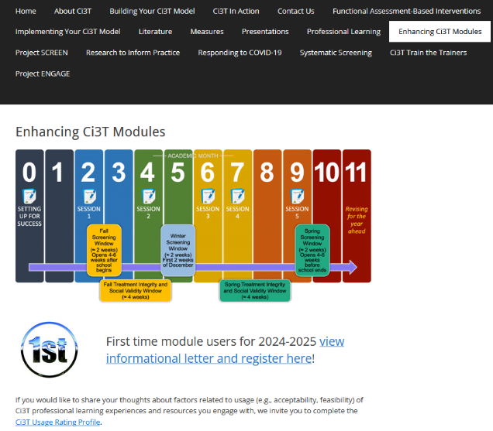
Implementing Comprehensive, Integrated, Three-tiered (Ci3T) Models: Using Data to Inform Instruction
Enhanced Ci3T Implementation Series and Delivery (Guided E-Ci3T) Session 2
If you have not done so already, we invite you to visit www.ci3t.org/enhance to access modules and complete a one-time registration process!

Slide 3
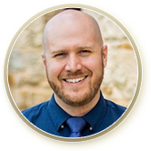





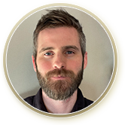

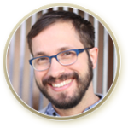



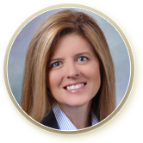


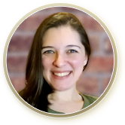




Ci3T Research Team
Grant Allen
Matthew Aschliman
Tammy Becker
Allison Bernard
Carrie Brandon
Amy Briesch
Mark Buckman
Sandy Chafouleas
Eric Common
Howard Diacon
Kathleen Lynne Lane
Jessica Matus
Wendy P. Oakes
Jenna Raad
David Royer
Elise Sarasin
Rebecca Sherod
Joni Weiss
Stacie Williams
Kate Williamson

Slide 4

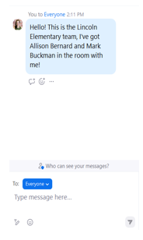
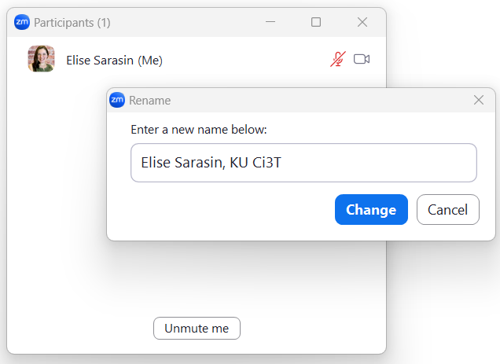

Zoom Logistics
If you are facilitating a Ci3T Leadership Team Symposium session at a satellite location, please email us a list of the names, email addresses, and schools of those attending.
To help us put you in breakout rooms with your colleagues today we are renaming you with your school initials and first and last name
If there are multiple people in the room with you, please list their first and last names and email in the chat!

Slide 5



Enhancing Ci3T Modules
ci3t.org/enhance

Slide 6
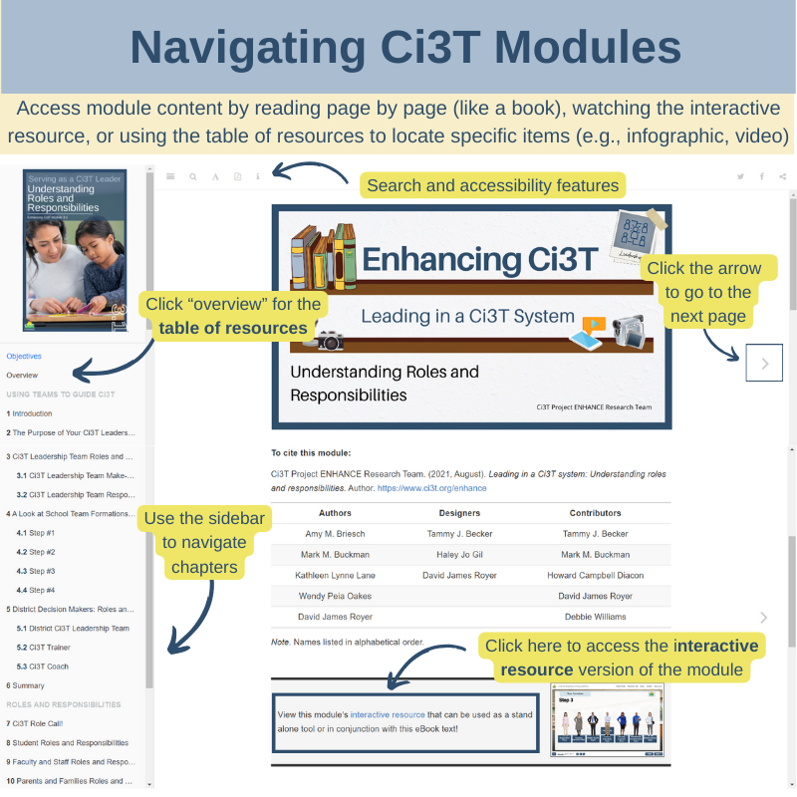

Slide 7
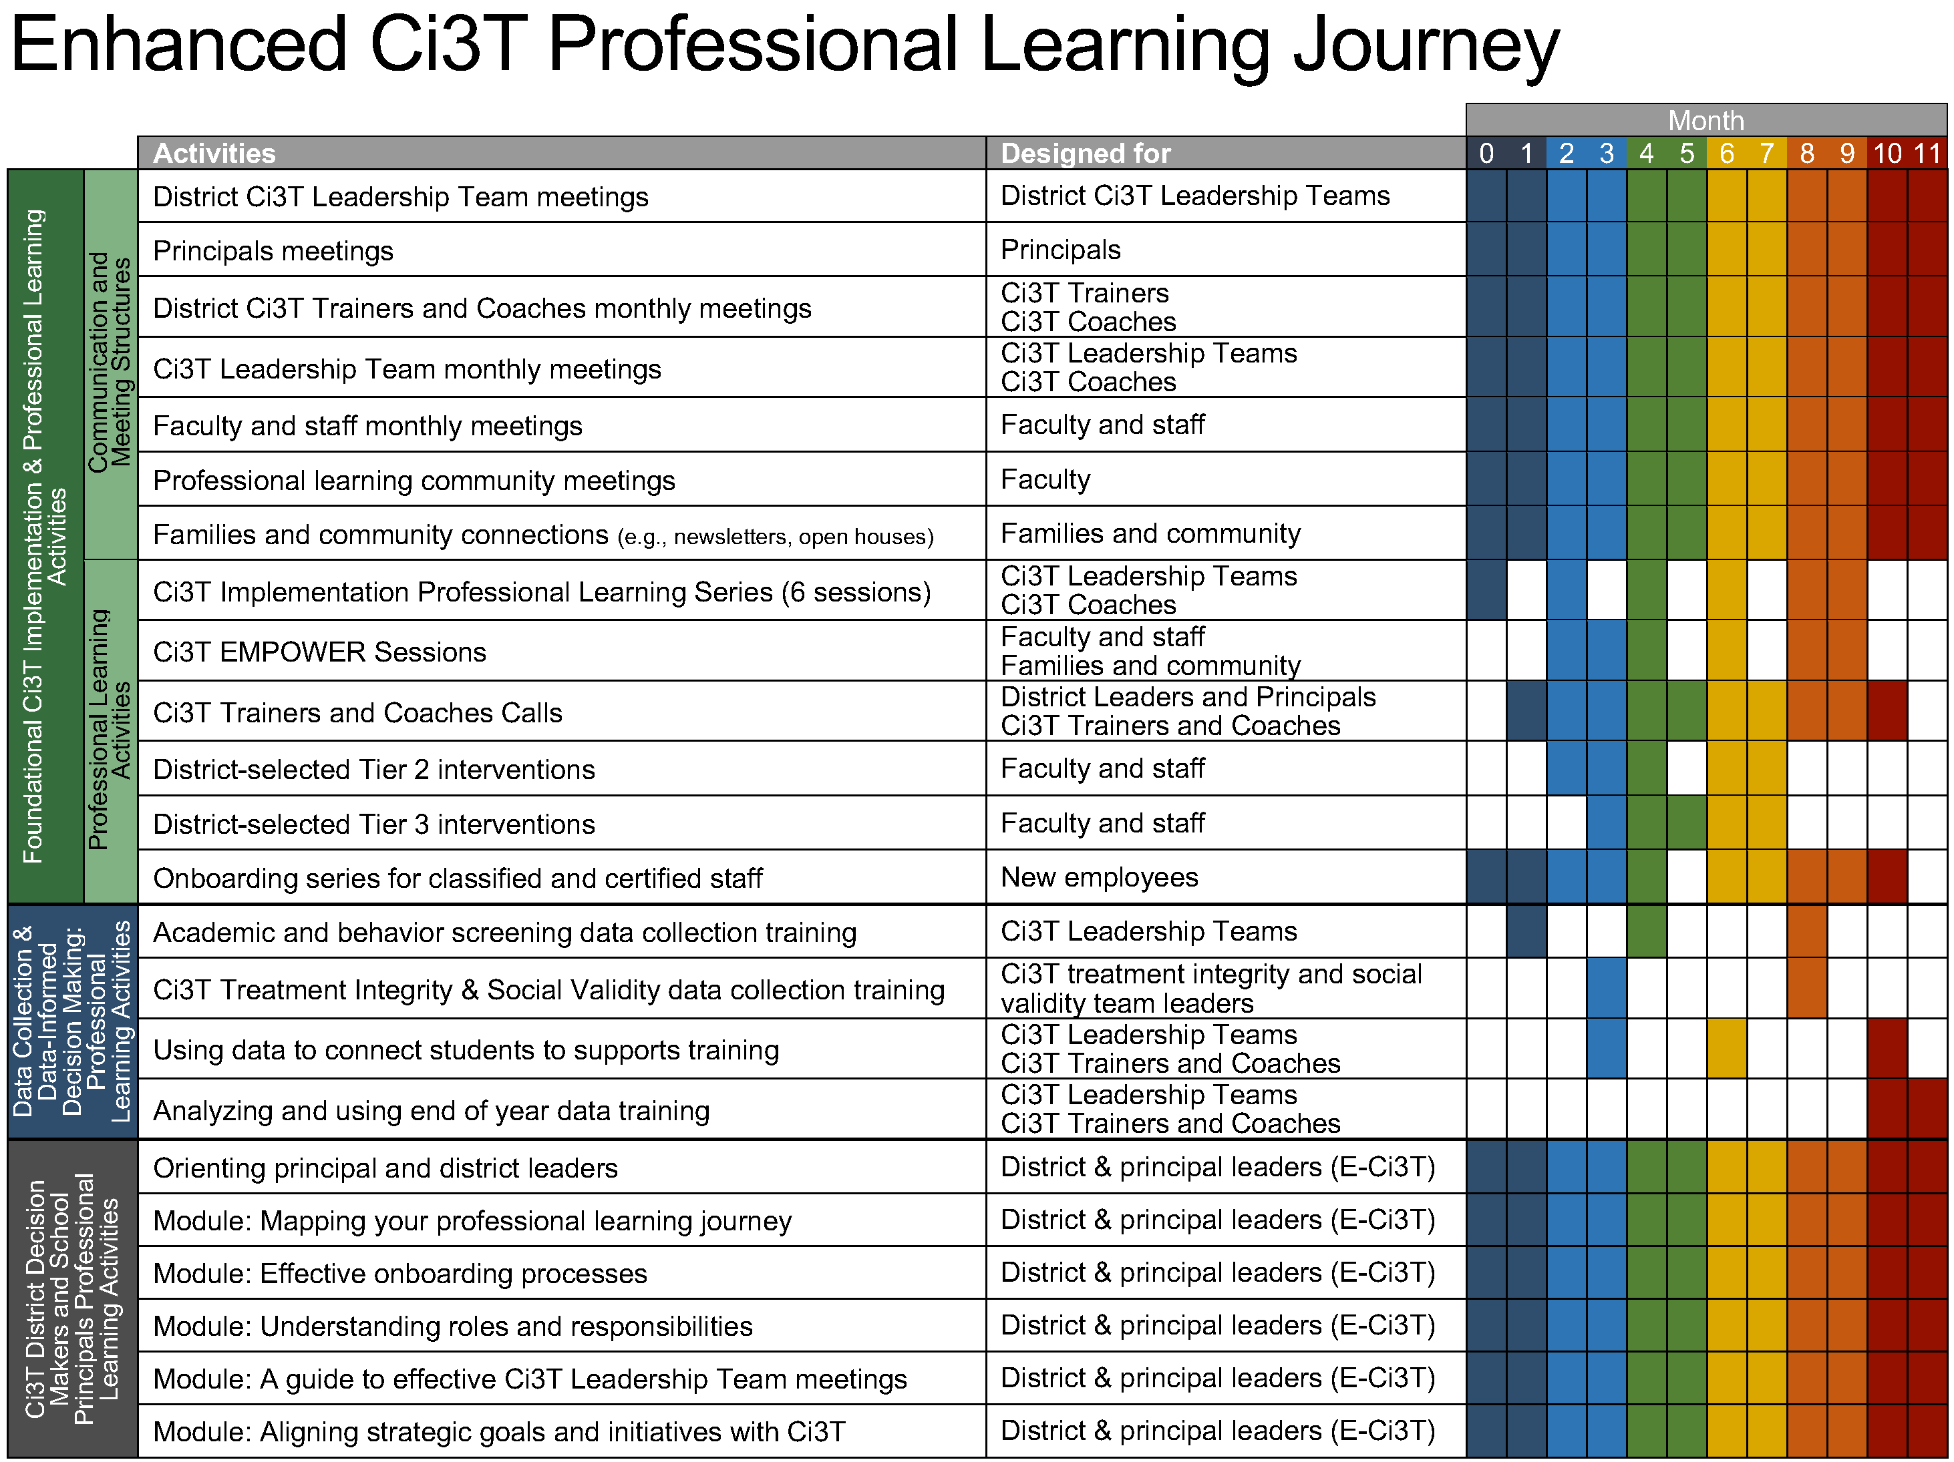
Enhanced Ci3T Implementation Series and Delivery

Slide 8
Foundational Ci3T Implementation & Professional Learning Activities

Slide 9
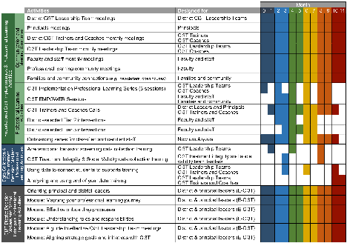
Session Outcomes
Finalize plans to collect and use social validity and treatment integrity data.
Interpret fall screening data at the school- and classroom-level to inform professional learning and use of effective practices to support students (e.g., low-intensity strategies, Tier 2 and 3 interventions).
3. Reflect on use of strategies for communicating to and supporting all stakeholders and make adjustments as necessary to support the creation of collaborative, positive, productive, and safe learning environments

Slide 10
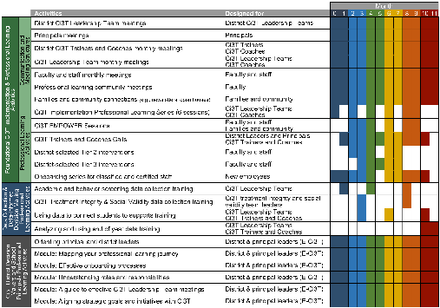
Agenda
Welcome
Preparing to Collect and Use Social Validity & Treatment Integrity Data
Systematic Screening in a Ci3T Model of Prevention
Using Fall Screening Data to Inform:
  Primary (Tier 1) Prevention Efforts
  Teacher-Delivered, Low-Intensity Strategies
  Secondary (Tier 2) and Tertiary (Tier 3) Supports
Facilitating Clear Communication and Collaborations with Stakeholders
Wrapping Up and Moving Forward

Slide 11
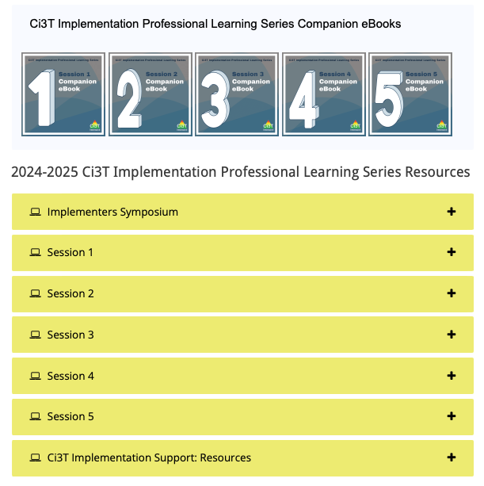
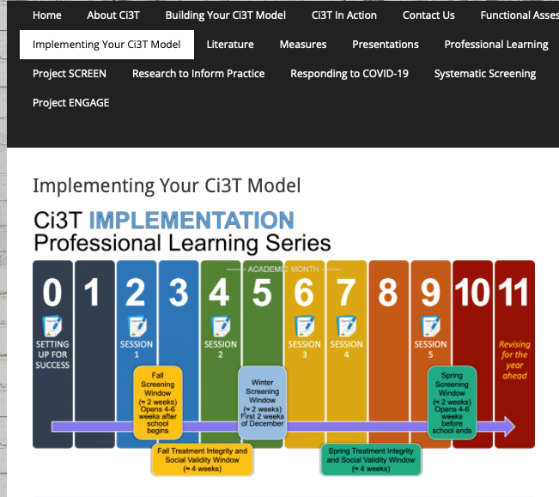
Accessing Professional Learning Materials
ci3t.org/imp

Slide 12
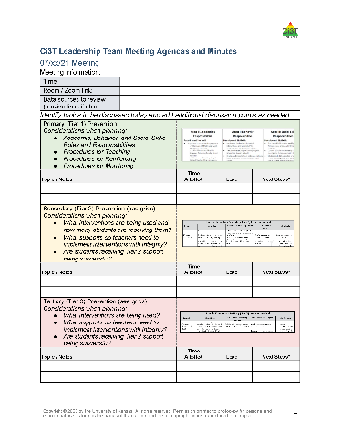

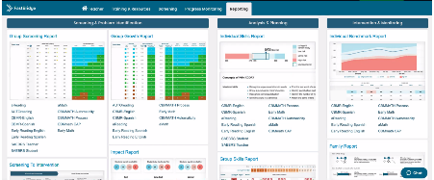

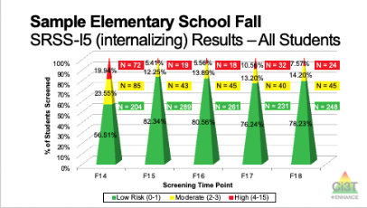
Materials for Today’s Session
Ci3T Leadership Team Agenda
Ci3T Implementation Manual
Fall Screening Data
Log into website

Slide 13

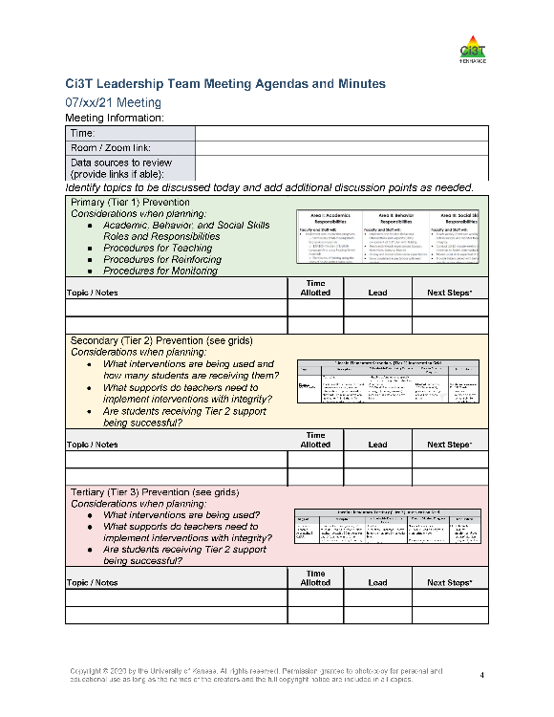
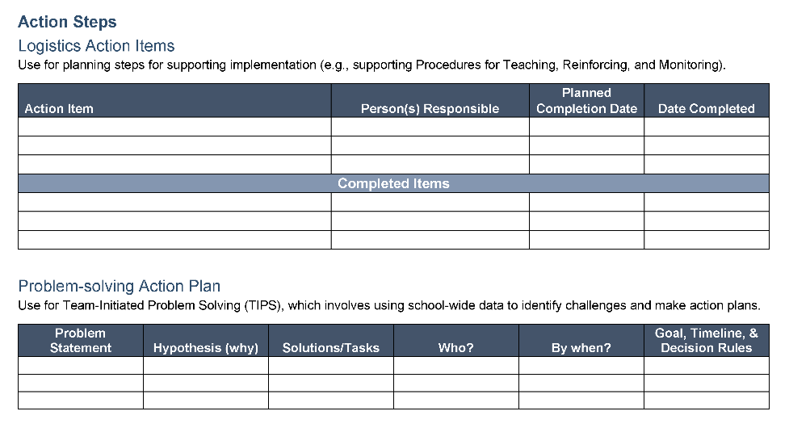
Ci3T Leadership Team Agenda Template

Slide 14
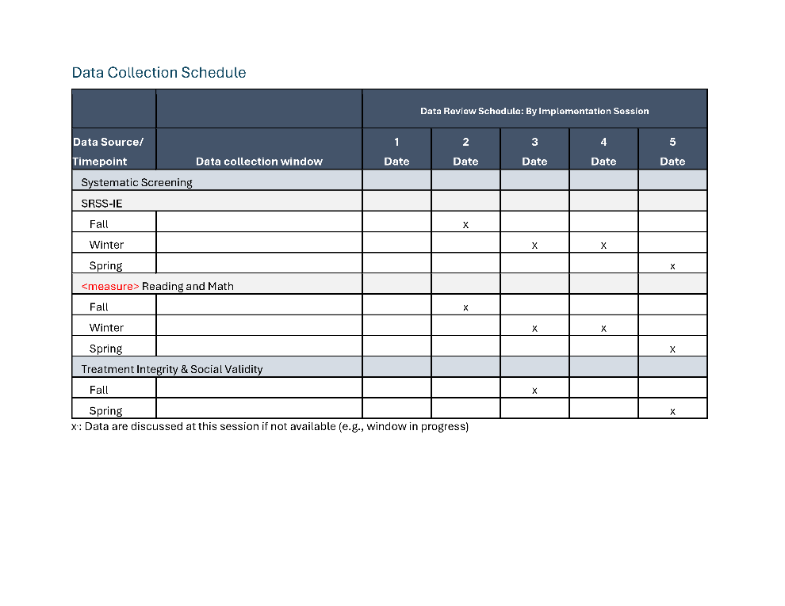
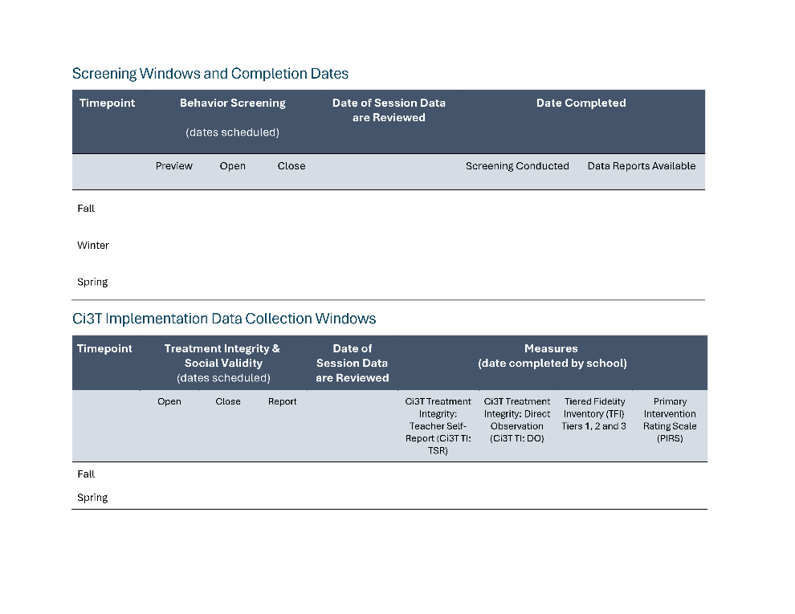
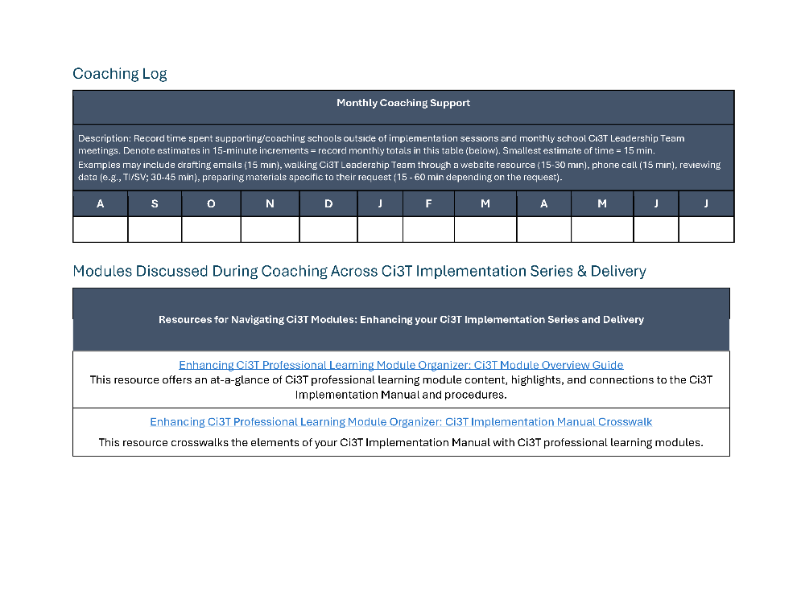
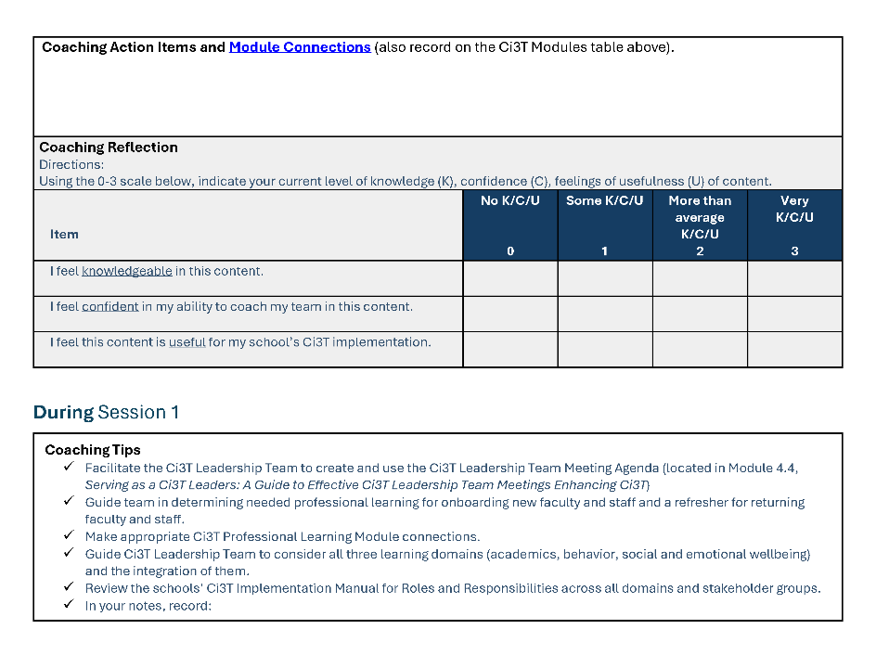
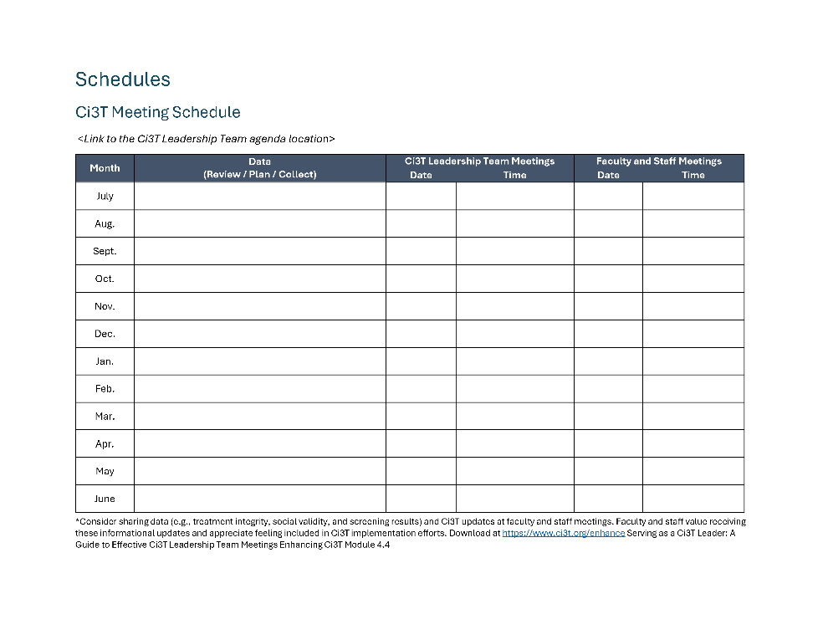
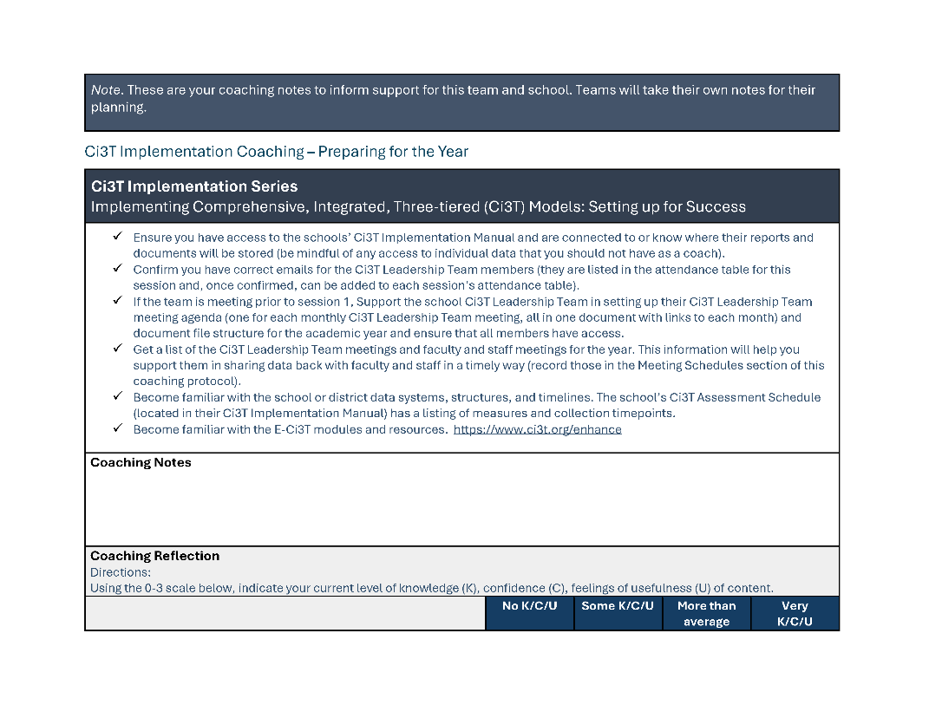
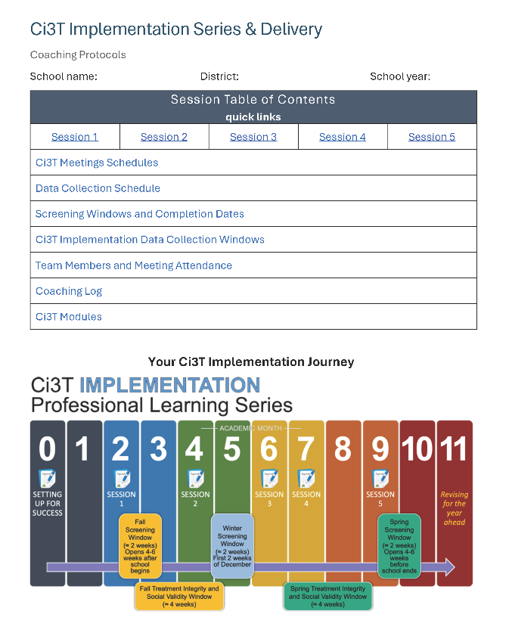
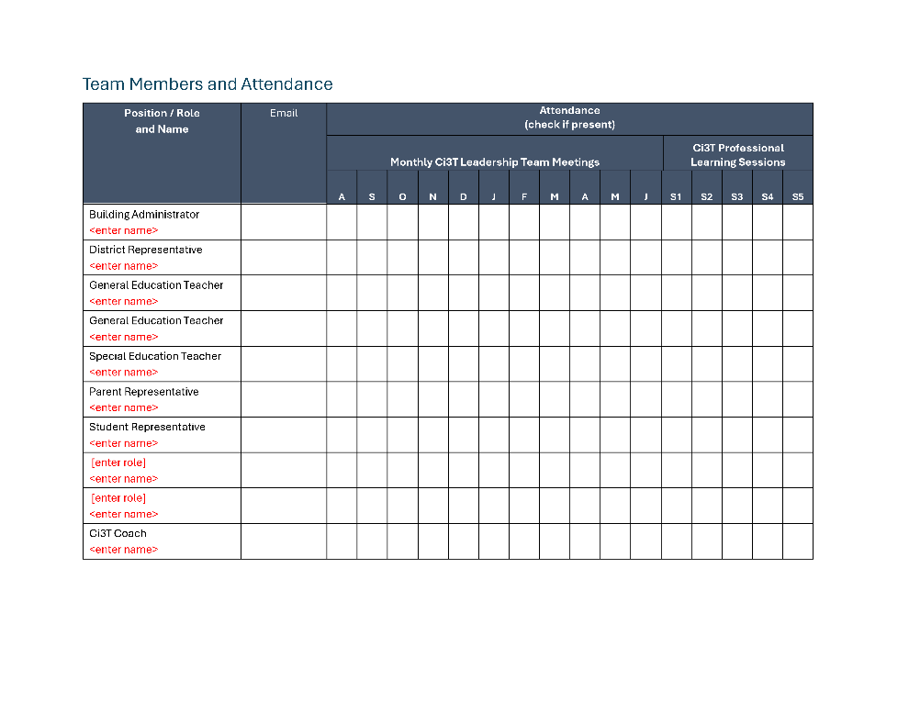
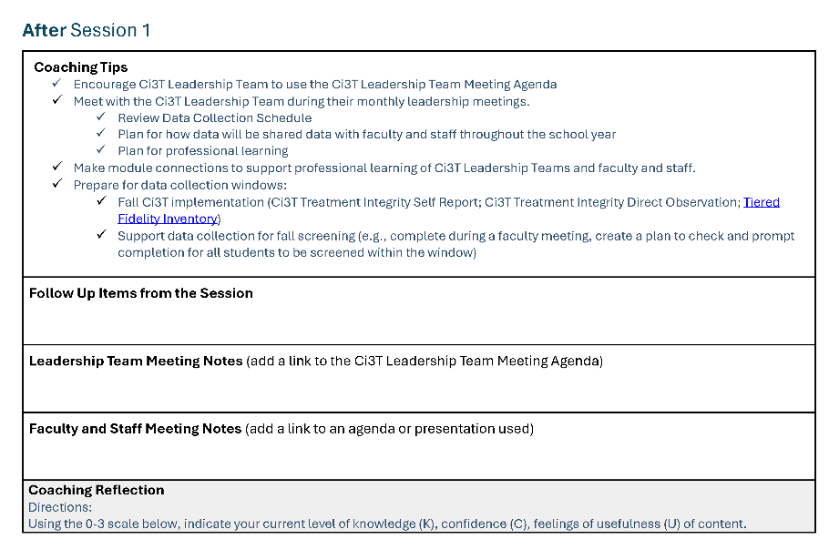
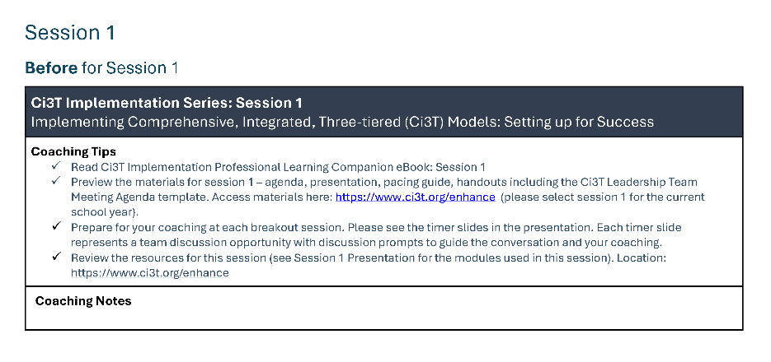
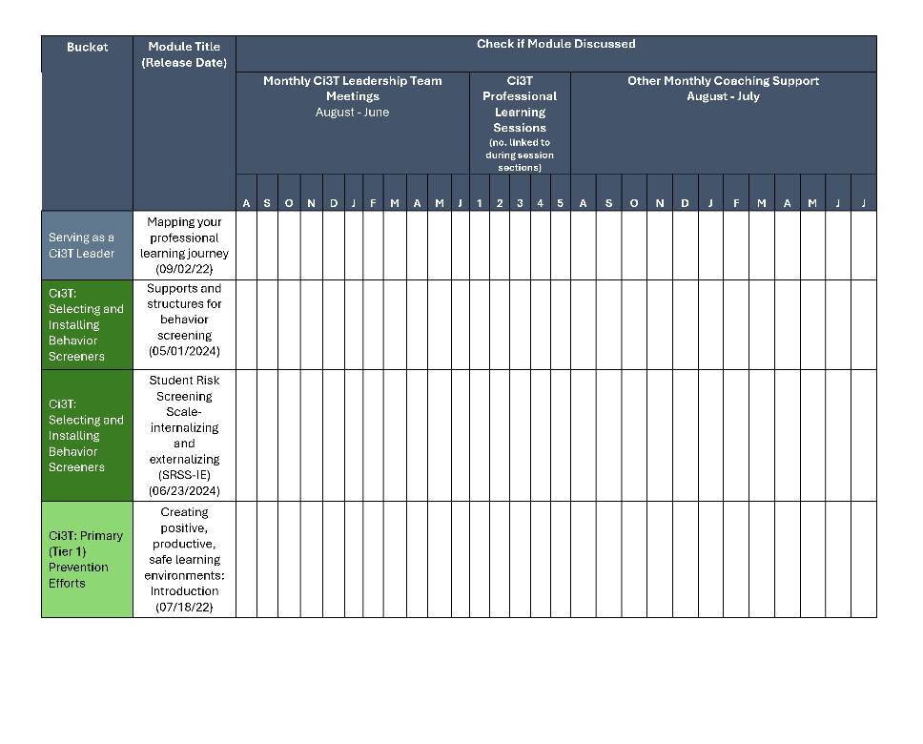
Coaching Protocol

Slide 15

Preparing to Collect and Use Social Validity and Treatment Integrity Data

Slide 16
Session Outcomes
Finalize plans to collect and use social validity and treatment integrity data.
Interpret fall screening data at the school- and classroom-level to inform professional learning and use of effective practices to support students (e.g., low-intensity strategies, Tier 2 and 3 interventions).
3. Reflect on use of strategies for communicating to and supporting all stakeholders and make adjustments as necessary to support the creation of collaborative, positive, productive, and safe learning environments

Slide 17
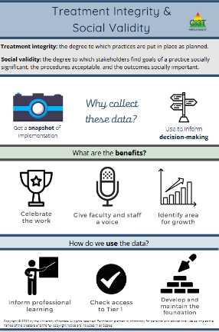
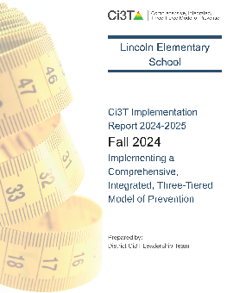

Essential Components of Primary (Tier 1) Prevention Efforts
Social Validity
Systematic Universal Screening
Academic
Behavior
Treatment Integrity
ci3t.org/measures
ci3t.org/screening
for behavior

Slide 18
Preparing to Collect SV & TI Data
Prioritize opportunities to share the “why” of treatment integrity and social validity with staff
  Email or newsletter
  Faculty and staff meeting
Consider allocating faculty or staff meeting to complete Treatment Integrity and Social Validity Measures
Identify time during an upcoming Ci3T Leadership Team Meeting to complete the Tiered Fidelity Inventory (TFI)
Collaborate with your district to determine who will conduct Ci3T Treatment Integrity: Direct Observation

Slide 19
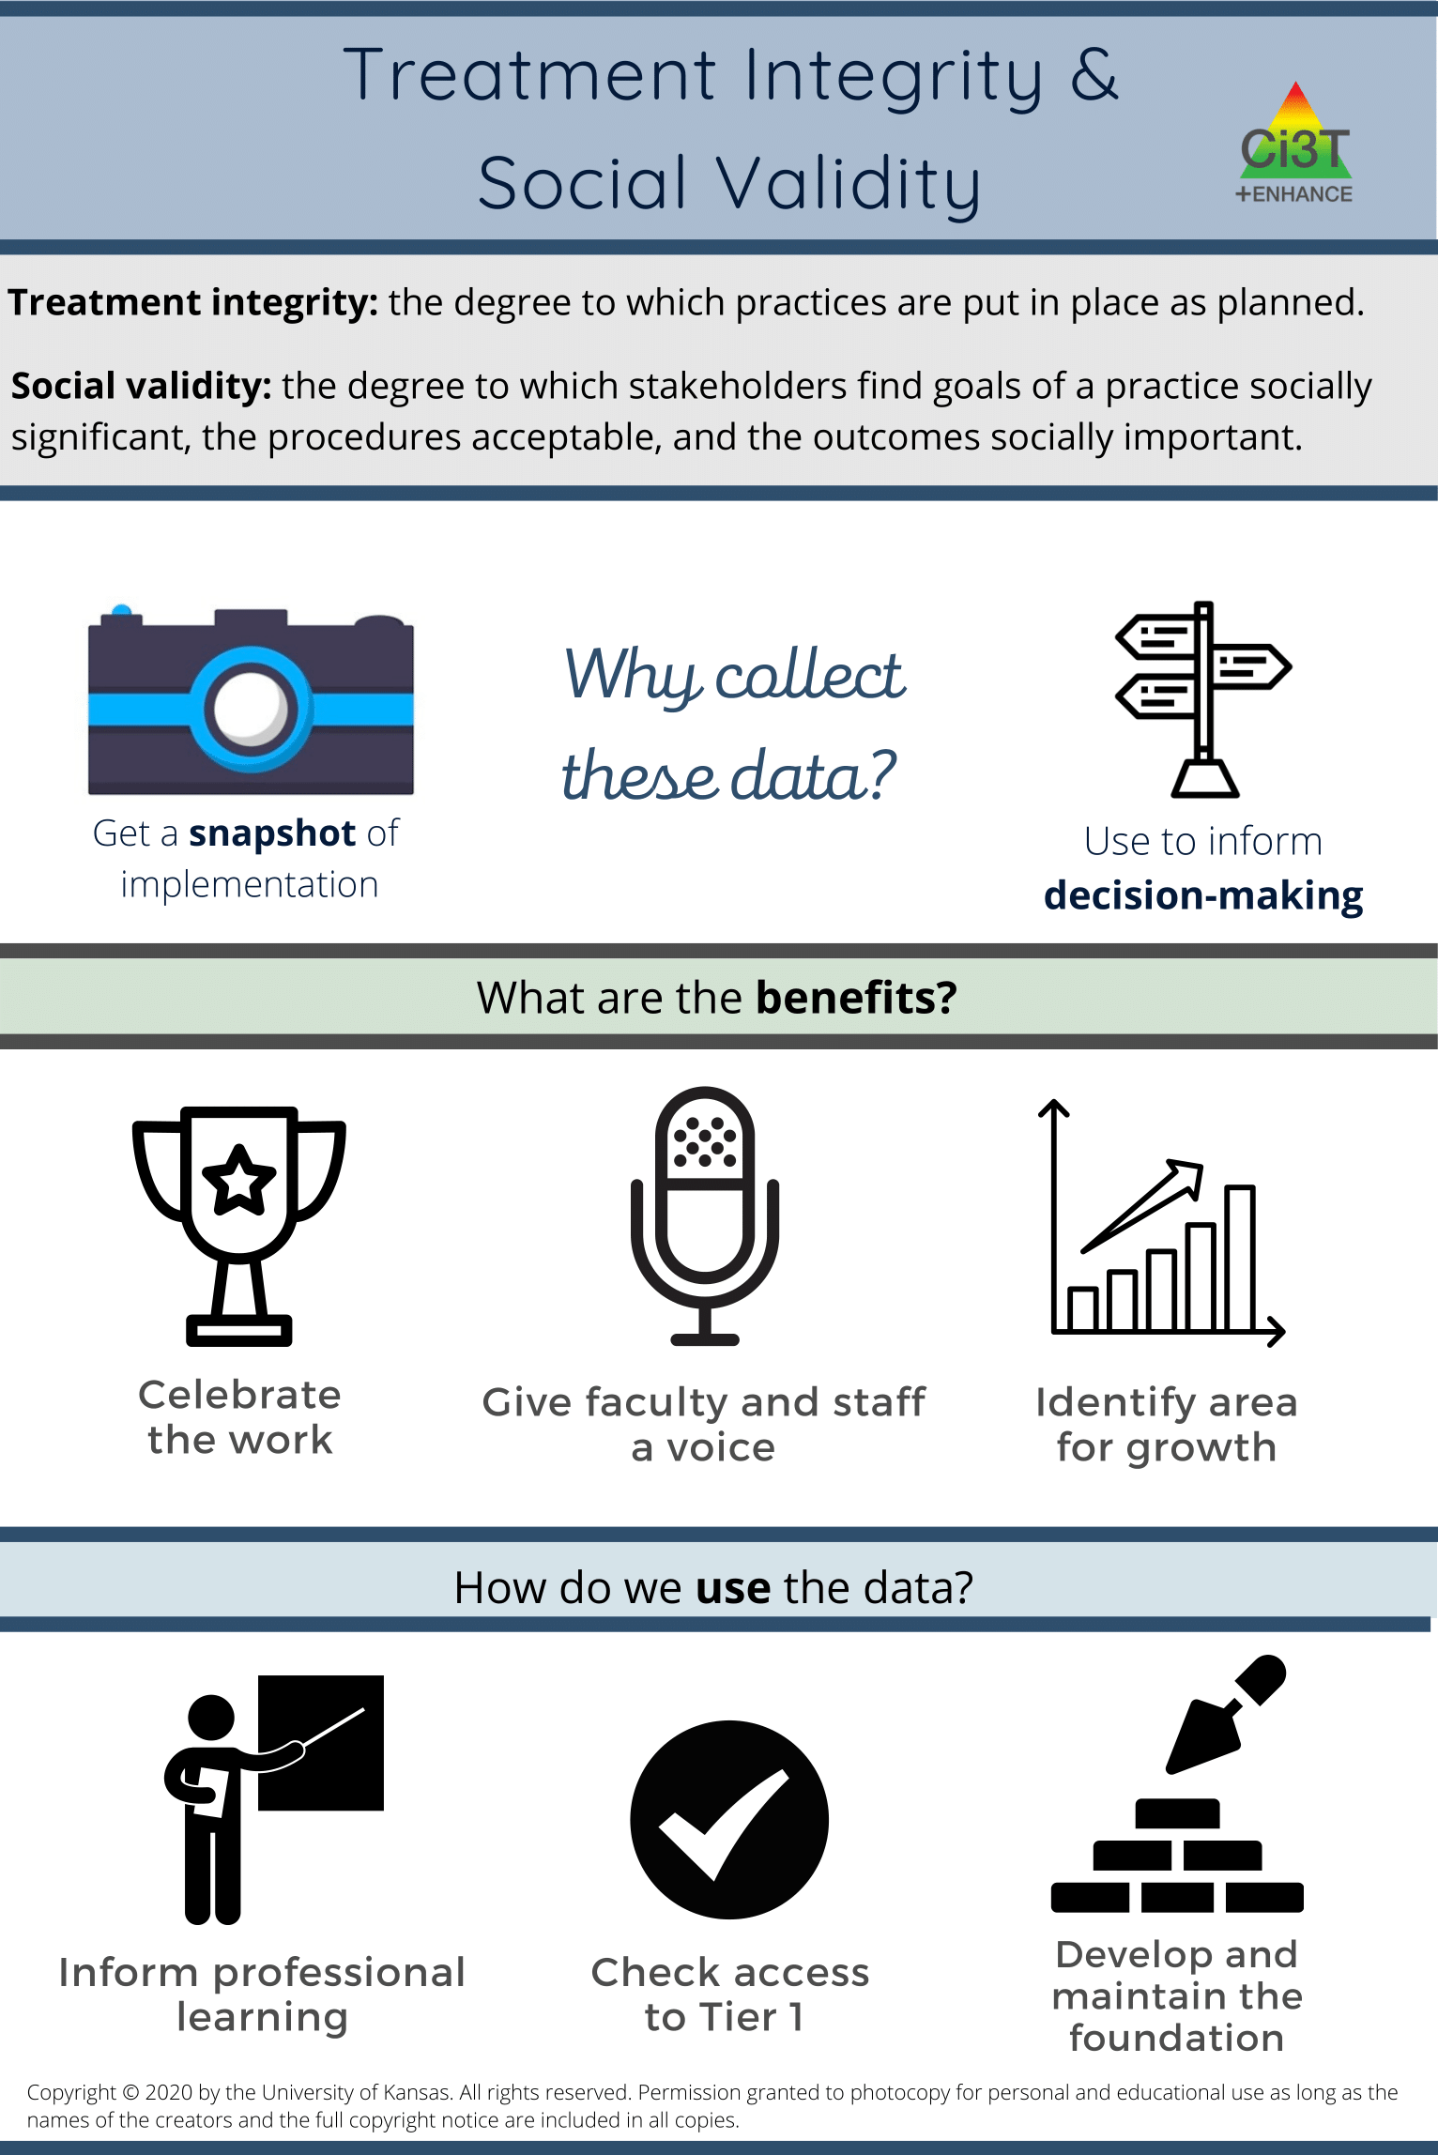
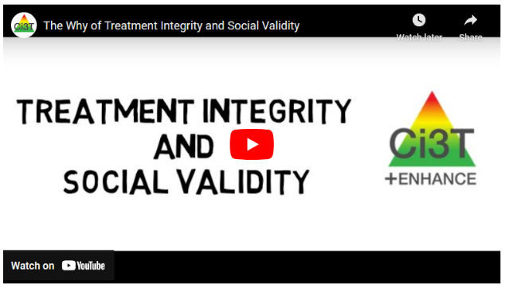
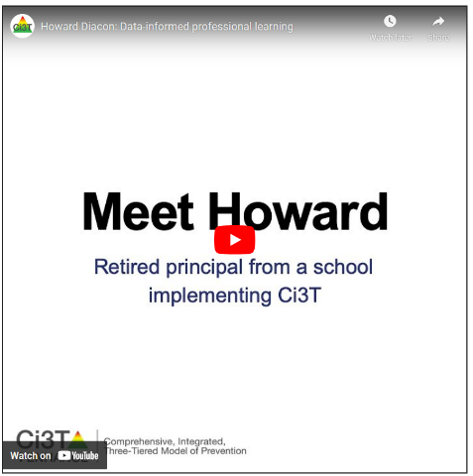

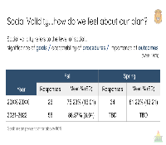
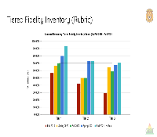
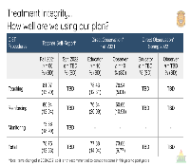
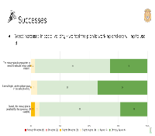
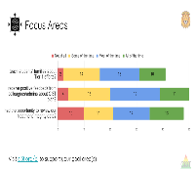
Resources

Slide 20
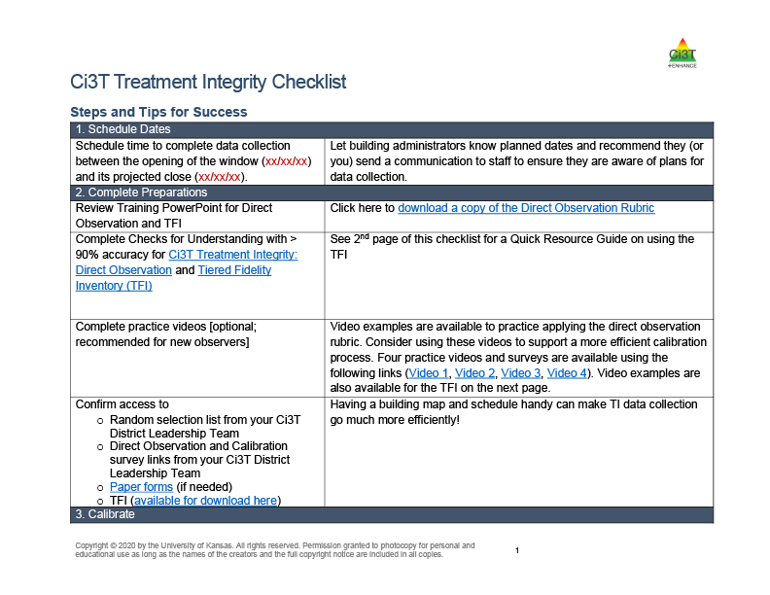
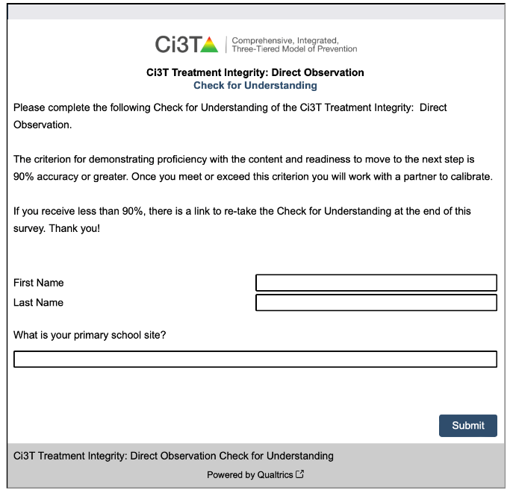
Resources

Slide 21
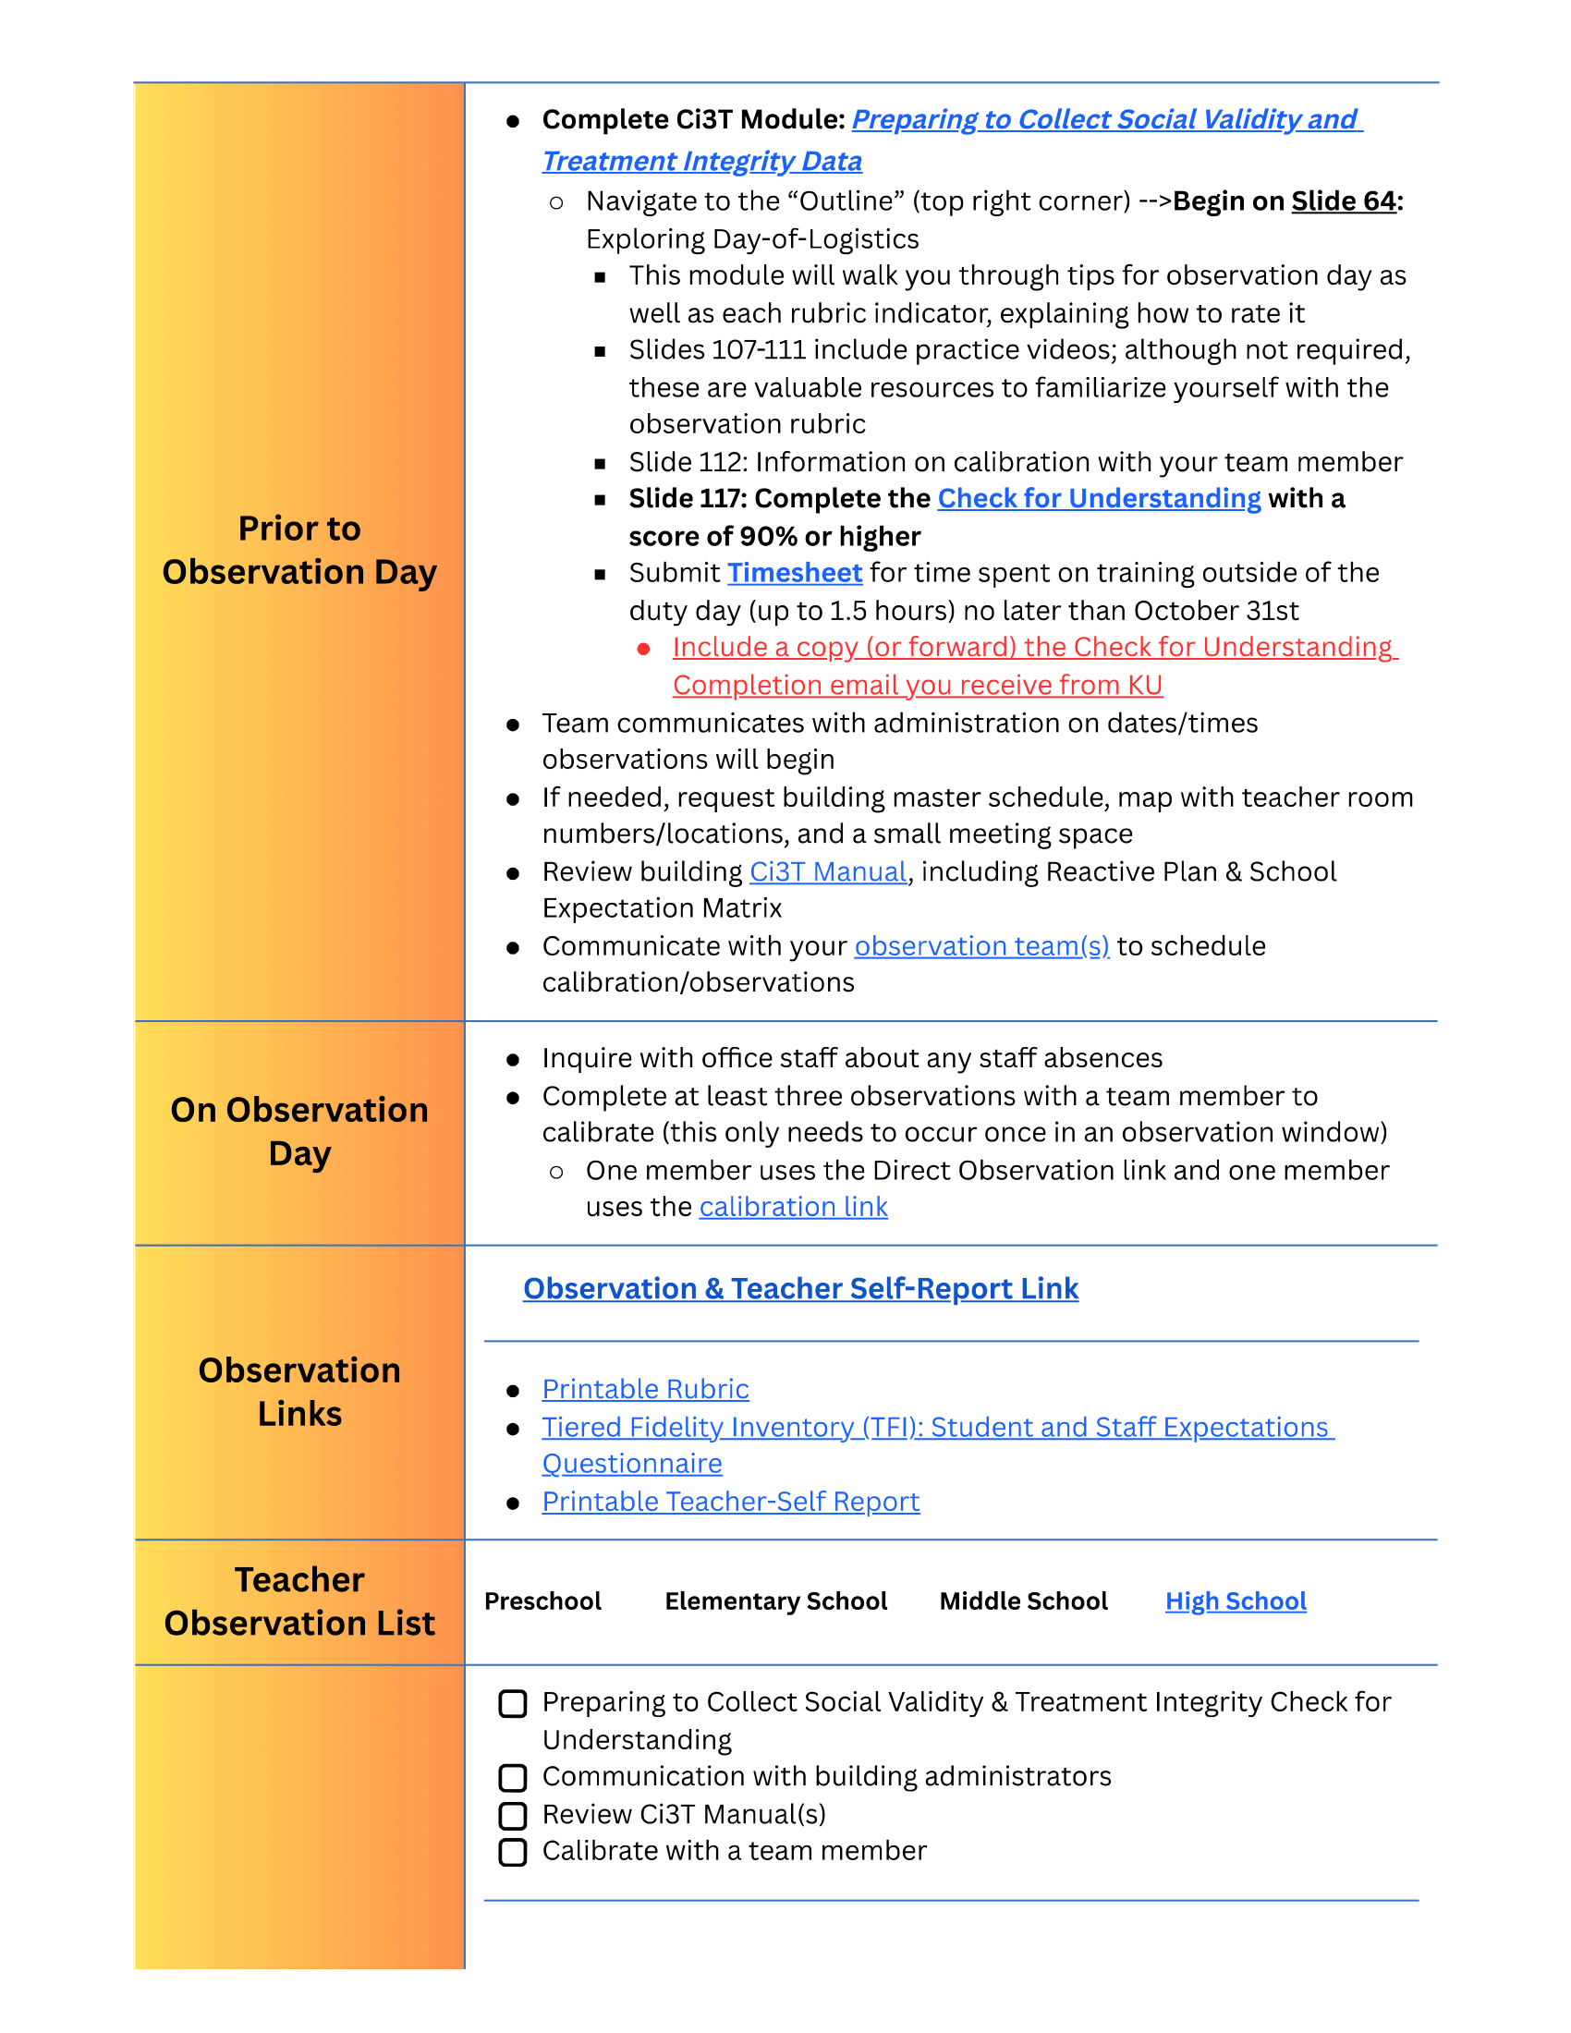
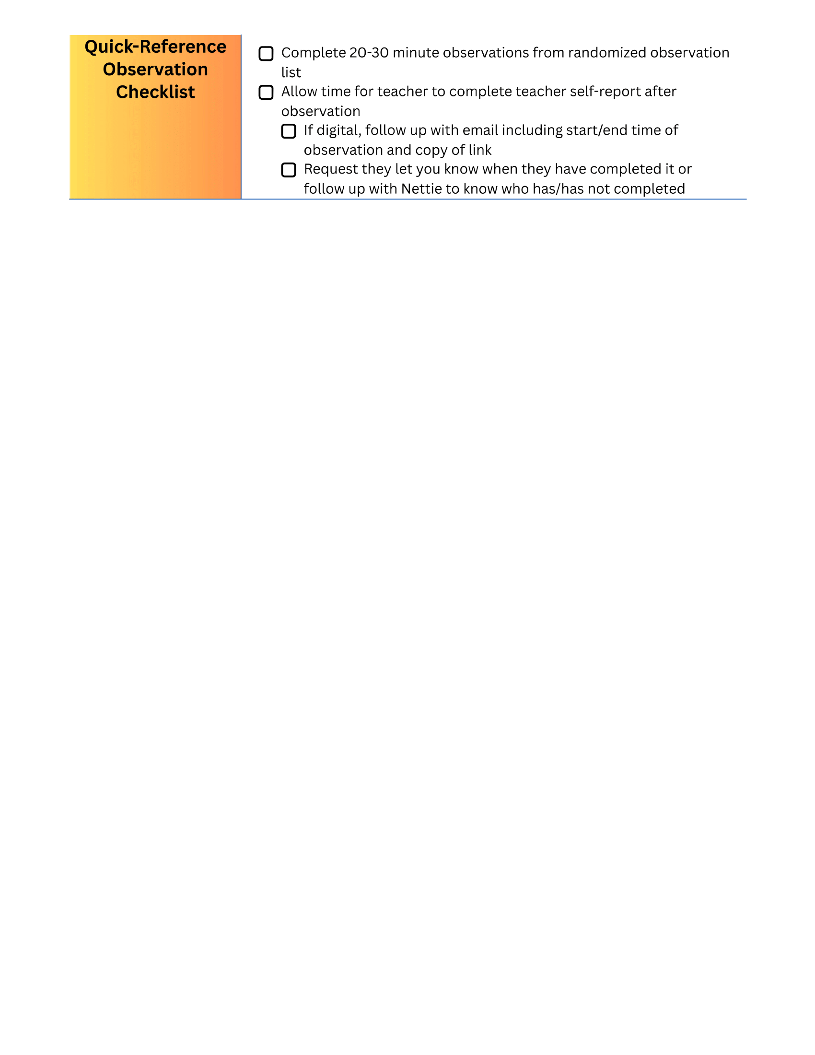
District Innovation!

Slide 22
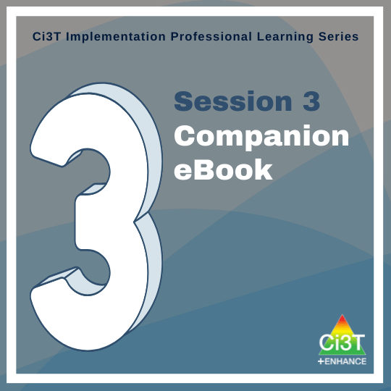
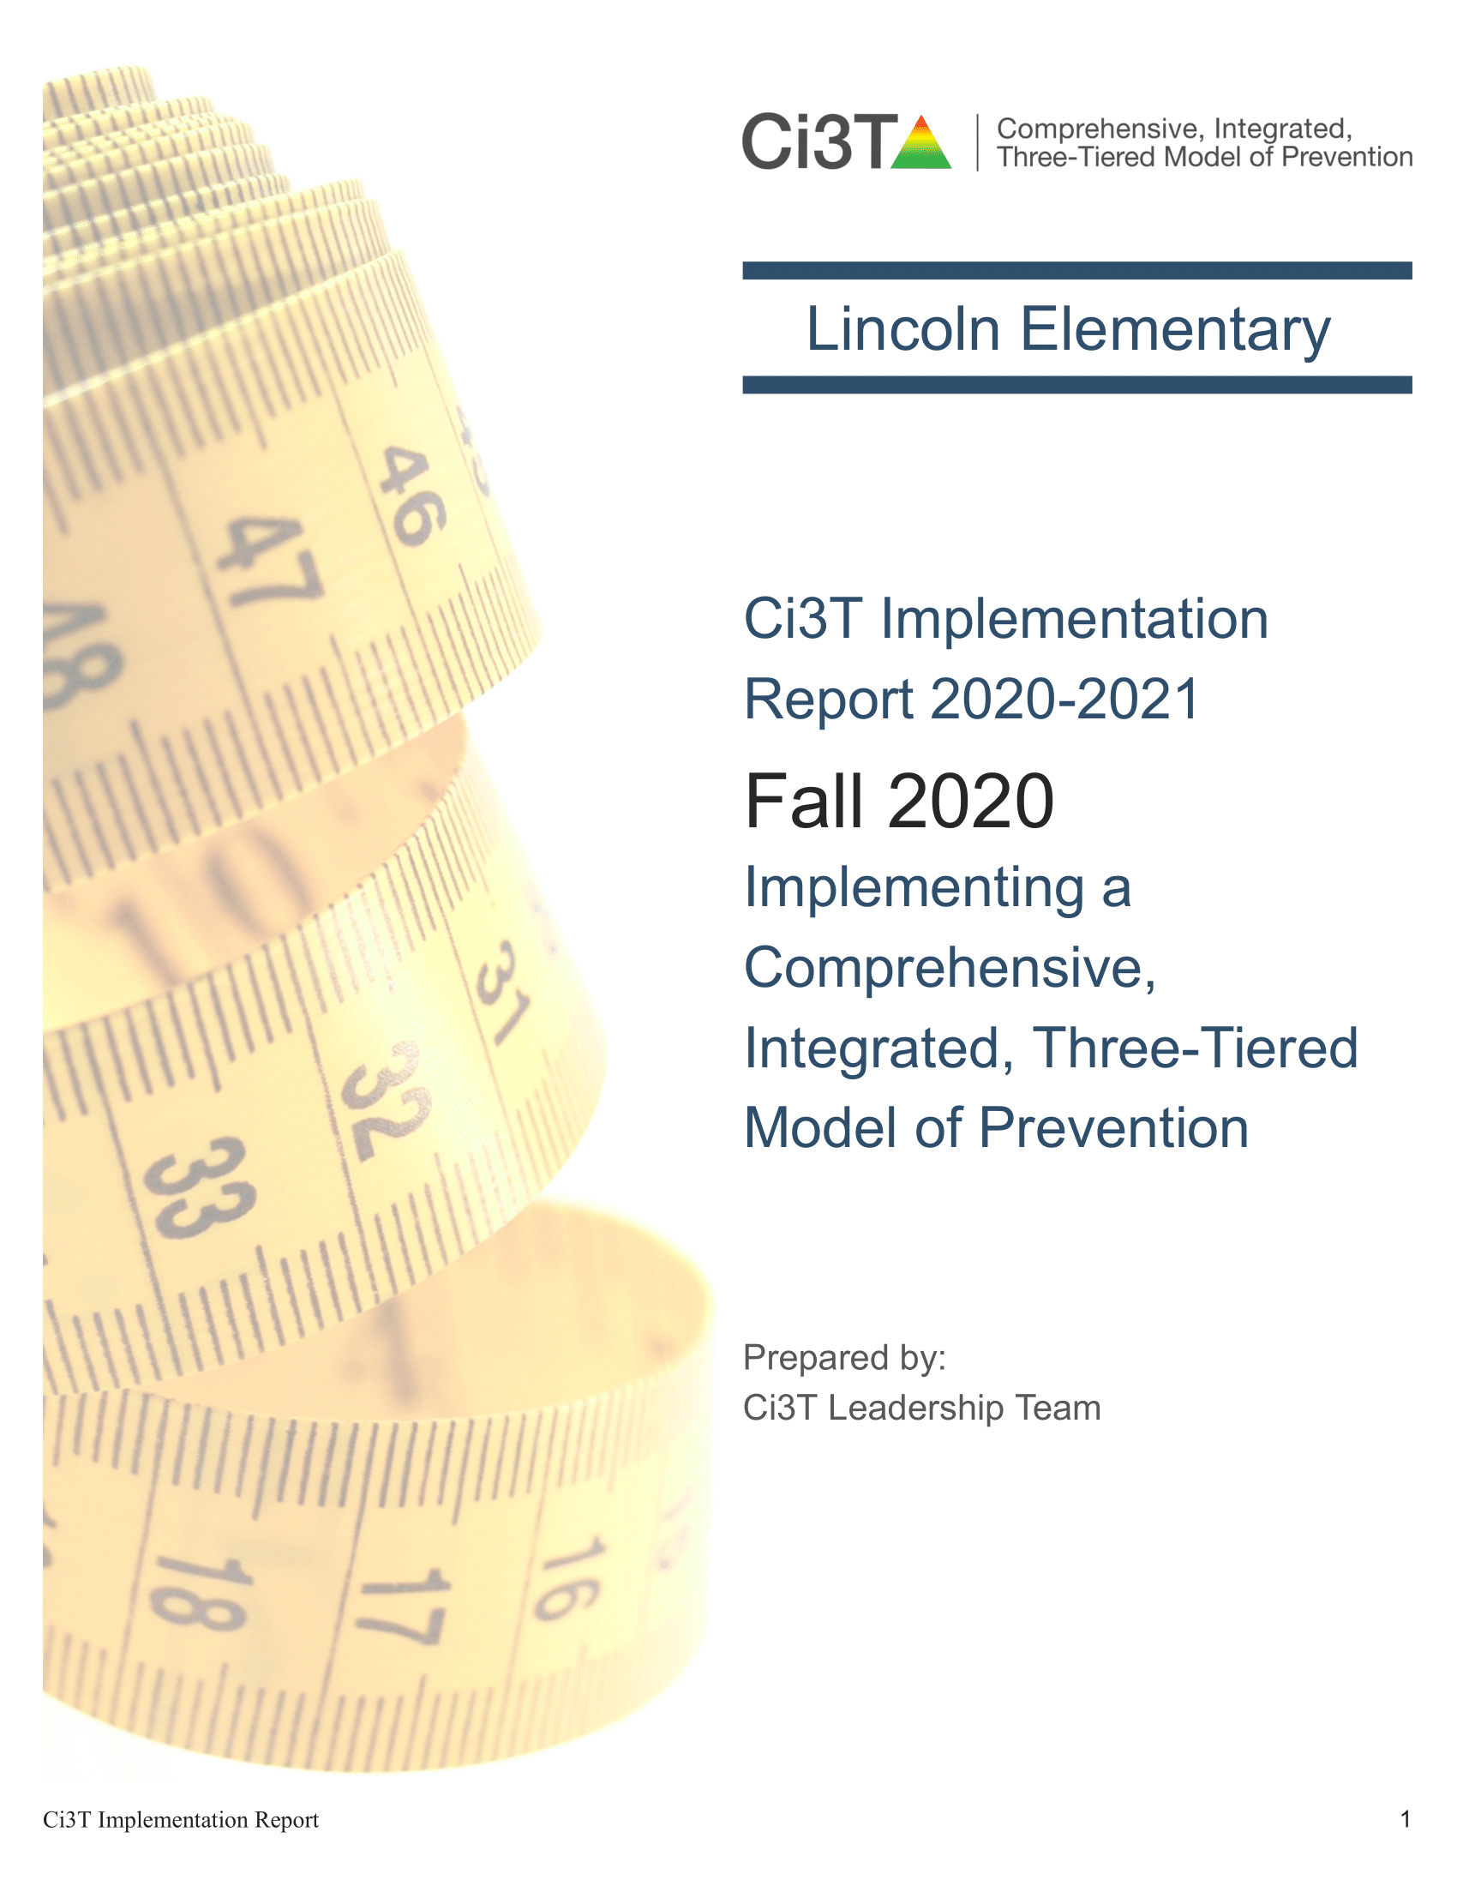
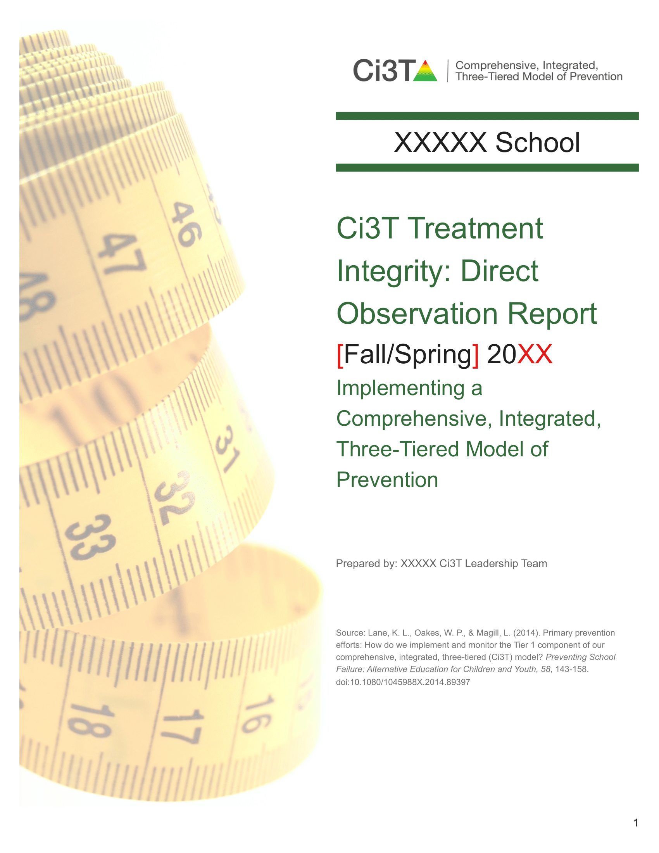
Sneak Peek: Implementation Session 3

Slide 23
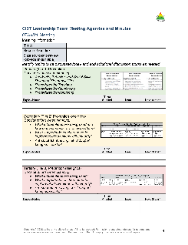











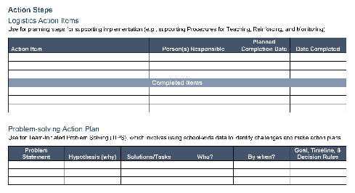

Let’s discuss!
When will our faculty and staff complete the Ci3T Treatment Integrity: Teacher Self-Report & Primary Intervention Rating Scale Survey? When will our Ci3T Leadership Team complete the Tiered Fidelity Inventory (TFI) protocols? How / when will we collect student and staff interviews prior to meeting as a team? How will we share treatment integrity and social validity data with stakeholders (e.g., faculty & staff, families)?
Notes:
10 min timer

Slide 24
Systematic Screening in a Ci3T Model of Prevention

Slide 25
Session Outcomes
Finalize plans to collect and use social validity and treatment integrity data.
Interpret fall screening data at the school- and classroom-level to inform professional learning and use of effective practices to support students (e.g., low-intensity strategies, Tier 2 and 3 interventions).
3. Reflect on use of strategies for communicating to and supporting all stakeholders and make adjustments as necessary to support the creation of collaborative, positive, productive, and safe learning environments

Slide 26
Essential Components of Primary (Tier 1) Prevention Efforts
Social Validity
Systematic Universal Screening
Academic
Behavior
Treatment Integrity
ci3t.org/measures
ci3t.org/screening
for behavior

Slide 27

Systematic Screening … Logistics
Fall
Winter
Spring
Selecting
Installing
Analyzing

Slide 28


Behavior Screening

Slide 29
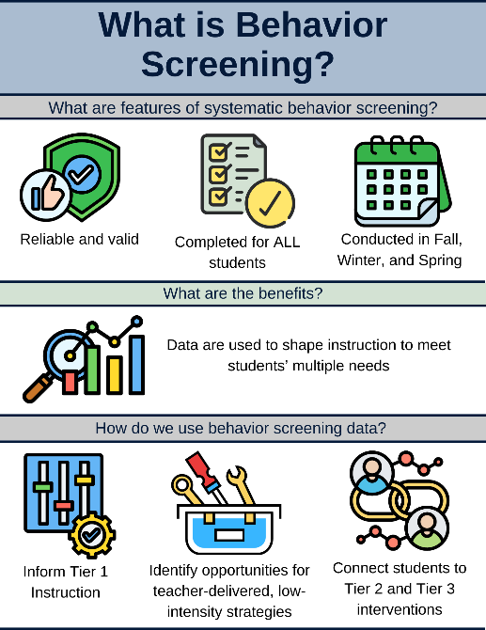



Systematic Behavior Screening

Slide 30


Slide 32

Student Risk Screening Scale – Internalizing and Externalizing (SRSS-IE; Drummond, 1994; Lane & Menzies, 2009)
Elementary
Notes:
***note to presenter***
If you would like to feature middle or high school data – hide the elementary slides and unhide the middle or high school slides!

Slide 33

Student Risk Screening Scale – Internalizing and Externalizing (SRSS-IE; Drummond, 1994; Lane & Menzies, 2009)
Secondary

Slide 34
SRSS-IE: Cut Scores
Elementary School |  | Middle and High School
SRSS-E7 | SRSS-I5 | SRSS-E7 | SRSS-I6
Items 1-7 | Items 8-12 | Items 1-7 | Items 4, 8-12
0-3 = low risk 4-8 = moderate risk 9-21 = high risk | 0-1 = low risk 2-3 = moderate risk 4-15 = high risk | 0-3 = low risk 4-8 = moderate risk 9-21 = high risk | 0-3 = low risk 4-5 = moderate risk 6-18 = high risk
Elementary School Level:
Lane, K. L., Oakes, W. P., Swogger, E. D., Schatschneider, C., Menzies, H., M., & Sanchez, J. (2015). Student risk screening scale for internalizing and externalizing behaviors: Preliminary cut scores to support data-informed decision making. Behavioral Disorders, 40, 159-170.
Middle and High School Levels:
Lane, K. L., Oakes, W. P., Cantwell, E. D., Schatschneider, C., Menzies, H., Crittenden, M., & Messenger, M. (2016). Student Risk Screening Scale for Internalizing and Externalizing Behaviors: Preliminary cut scores to support data-informed decision making in middle and high schools. Behavioral Disorders, 42(1), 271-284

Slide 35
Fall 2022
SRSS-Externalizing Results – Elementary School
n = 44
n = 43
n = 47
n = 27
n = 36
n = 29
n = 6
n = 17
n = 22
n = 30
n = 69
n = 61
n = 85
n = 94
n = 86
n = 83
n = 118
n = 100
n = 283
n = 276
n = 335
n = 329
n = 306
n = 293
n = 333
n = 346
n = 352

Slide 36
Fall 2022
SRSS-Internalizing Results – Elementary School
n = 59
n = 62
n = 39
n = 39
n = 31
n = 18
n = 13
n = 32
n = 23
n = 82
n = 65
n = 67
n = 46
n = 47
n = 35
n = 69
n = 73
n = 62
n = 304
n = 292
n = 361
n = 338
n = 351
n = 340
n = 321
n = 338
n = 343
Cut scores vary by school level:
Elementary (I5): Low (0-1), Moderate (2-3), High (4-15)
Middle and High (I6): Low (0-3), Moderate (4-5), High (6-18)

Slide 37
Fall 2022
SRSS-Internalizing Results – Elementary School
Grade Level | N Screened | Low n (%) | Moderate n (%) | High n (%)
K | 64 | 52 (81.25%) | 7 (10.94%) | 5 (7.81%)
1 | 81 | 69 (85.19%) | 9 (11.11%) | 3 (3.70%)
2 | 56 | 44 (78.57%) | 11 (19.64%) | 1 (1.79%)

Slide 38
Reviewing Screening Data
Ci3T Leadership Teams review screening data at the following levels:
Screening Practice
School-wide (e.g., Tier 1 efforts)
Grade or department (e.g., Tier 1 efforts, low-intensity strategies)
Class level (e.g., low-intensity strategies)
Individual student level (e.g., Tier 2 and Tier 3)

Slide 39

Academic Screening

Slide 40



Academic Screening
Notes:
Might consider beginning by looking at data broadly
compared against district or state benchmarks
Subgroup analyses

Slide 41



Academic Screening
Notes:
Then, might zoom in at the grade-level looking at distribution across risk category, mastery, or growth

Slide 42

Reviewing Multiple Sources of Data in an Integrated Way
attendance
behavior
screening
academic screening

Slide 43

Sharing Systematic Screening Data
Once academic and behavior screening data are collected, data are shared at the:
Screening Practice
School-wide (e.g., Tier 1 efforts)
Grade or department (e.g., Tier 1 efforts, low-intensity strategies)
Class level (e.g., low-intensity strategies)
Individual student level (e.g., Tier 2 and Tier 3)

Slide 44
























Let’s discuss!
Use the Working with Your Screening Data Handout to review Fall screening data Where are there strengths or bright spots? What are the greatest areas of need? School-level (e.g., Tier 1)? Grade or department level (e.g., Tier 1, low intensity strategies)? Classroom level (e.g., low intensity strategies)? Student-level (e.g., Tier 2 & Tier 3)
Notes:
20 min timer

Slide 45
Using Fall Screening Data to Inform Instruction
Primary (Tier 1) Prevention Efforts
Teacher-Delivered, Low-Intensity Strategies
Secondary (Tier 2) and Tertiary (Tier 3) Interventions

Slide 46

Using Systematic Screening Data
Academic and behavior screening data are reviewed alongside other data collected as part of typical school practices (e.g., attendance, office discipline referrals, grades) to:

Slide 47




Jigsaw Preview
Using Systematic Screening Data to…
Inform Tier 1 Instruction | Teacher-Delivered, Low-Intensity Strategies | Connect Students with Validated Tier 2 and Tier 3 Supports

Slide 48



Tip!
Use your Ci3T Leadership Team agenda to record notes, ideas to bring back to your team, and any action items!
Notes:
After this jigsaw, there is one more breakout room where you will be back with your team and have the opportunity to share what you learned and generate ideas for action planning based on your Fall screening data. To do so, we encourage you to use your Ci3T Leadership Team agenda to record notes, ideas to bring back to your team, and any action items that come up during the jigsaw activity.

Slide 49
Jigsaw
Using Systematic Screening Data to…
Inform Tier 1 Instruction | Teacher-Delivered, Low-Intensity Strategies | Connect Students with Validated Tier 2 and Tier 3 Supports

Slide 50

Jigsaw Room 1:
Using Fall Screening Data to Inform Primary (Tier 1) Prevention Efforts

Slide 51
Social Skills Improvement System – Performance Screening Guide Spring 2012 – Total School
N = 54
N = 22
N = 35
N = 31
N = 223
N = 233
N = 180
N = 187
N = 212
N = 235
N = 275
N = 271
n = 489 n = 490 n = 490 n = 489
Lane, K. L., Oakes, W. P., & Magill, L. (2013). Primary prevention efforts: How do we implemented and monitor the Tier 1 component of our Comprehensive, Integrated, Three-Tiered (Ci3T) Model?, Preventing School Failure, 58(1), 143-158.

Slide 52



A Focus on: Integrated Lesson Planning

Slide 53



Slide 54

Integrated Lesson Plan: An Illustration
Notes:
Watch video 01:40 OR model how to access via module https://kusurvey.ca1.qualtrics.com/jfe/form/SV_0HWM8d2BdorMHDo

Slide 55



Let’s Chat!
What is one way you (or a teacher in your building) could integrate social skills or a behavioral objective into an upcoming lesson?
What low-intensity teacher-delivered strategies might you (or a teacher in your building) integrate into an upcoming lesson?

Slide 56






Module Connection!
6-Step Instructional Approach for Responding to Challenging Behavior

Slide 57


A Focus on: Responding to Challenging Behavior

Slide 58


Slide 59

6-Step Instructional Approach for Responding to Challenging Behavior
Step 1
Acknowledge other students meeting expectations
Step 2
Redirect and reteach expected behavior
Step 6
Allow time and space
Step 5
Maintain the flow of instruction
Show empathy
Step 3
Step 4
Recognize and reinforce

Slide 60



Slide 61


Slide 62
Let’s Chat!
What components of the six-step instructional approach do you see implemented most effectively or consistently throughout your building?
What components of the six-step instructional approach could be strengthened or are not yet implemented with consistency throughout the building?

Slide 63




Module Connection!
6-Step Instructional Approach for Responding to Challenging Behavior

Slide 64


Reflection
How could integrated lesson planning help respond to your fall screening data?
How could the six-step instructional support help respond to your fall screening data?
What professional learning is necessary to support a focus on integrated lesson planning or the six-step instructional approach?
Notes:
15 min timer

Slide 65
Jigsaw Room 2:
Using Fall Screening Data to Inform Teacher-Delivered, Low-Intensity Strategies

Slide 66

Data to Indicate a Focus on Low-Intensity Teacher-Delivered Strategies

Slide 67

Low-Intensity Teacher-Delivered Strategies

Slide 68

Academics
Area II: Academics Responsibilities Faculty and Staff: Teach core programs according to district and state standards with integrity Use teacher-delivered, low-intensity strategies to support students’ active engagement | Area II: Behavior Responsibilities Faculty and Staff: Implement Positive Behavioral Interventions and Supports (PBIS) with integrity. Teach all setting Expectations within the first week of school and reteach Expectations (monthly). Display and model school-wide expectations in classrooms and other key settings. Implement the reactive plan with integrity. | Area II: Social Responsibilities Faculty and Staff: Teach schoolwide social skills/ character education curricula with integrity: Teach daily Second Step ® lessons (link to grade level instructional schedules) Seek ways to engage parents as partners in the school program

Slide 69



Slide 70


Slide 71


Slide 72


Slide 73


Slide 74


Slide 75


Slide 76


Notes:
Video = 2:45

Slide 77
Let’s Chat!
How do you (or how have you seen teachers) integrate low-intensity teacher-delivered strategies into lessons or daily routines?
OR
What opportunities exist to integrate low-intensity teacher-delivered strategies into lessons or daily routines?

Slide 78







Module Connection!
Instructional Feedback

Slide 79




Slide 80



Resources to Support Implementation

Slide 81



Family Resources

Slide 82
Low-Intensity Strategies
Ci3T EMPOWER⁺ Sessions Location: Remote via Zoom Attended by: School Ci3T Leadership Teams, Ci3T District Trainers and Coaches, Faculty and Staff, Families (adults only). Community Members
Session | Date | Times
1. Ci3T FIT: Start the Year Strong | Sep. 24, 2024 (Tues) | 2:30 - 4:30 p.m. (Pacific) 4:30 - 6:30 p.m. (Central) 5:30 - 7:30 p.m. (Eastern)
2. Data-Informed Instruction: This is how we do it! | Oct. 9, 2024 (Wed) | 2:30 - 4:30 p.m. (Pacific) 4:30 - 6:30 p.m. (Central) 5:30 - 7:30 p.m. (Eastern)
3. Practical, Low Intensity Strategies to Maximize Engagement and Limit Disruption: Part 1 | Precorrection & Active Supervision | Nov. 19, 2024 (Tues) | 2:30 - 4:30 p.m. (Pacific) 4:30 - 6:30 p.m. (Central) 5:30 - 7:30 p.m. (Eastern)
4. Practical, Low Intensity Strategies to Maximize Engagement and Limit Disruption: Part 2 | Instructional Choice and Increased Opportunities to Respond | Jan. 22, 2025 (Wed) | 2:30 - 4:30 p.m. (Pacific) 4:30 - 6:30 p.m. (Central) 5:30 - 7:30 p.m. (Eastern)
5. Tier 2: Behavior Contracts | Feb. 11, 2025 (Tues) | 2:30 - 4:30 p.m. (Pacific) 4:30 - 6:30 p.m. (Central) 5:30 - 7:30 p.m. (Eastern)
6. Tier 2: Direct Behavior Ratings (DBR) | Mar. 26, 2025 (Wed) | 2:30 - 4:30 p.m. (Pacific) 4:30 - 6:30 p.m. (Central) 5:30 - 7:30 p.m. (Eastern)
7. Tier 3: Functional Assessment-based Interventions (FABI) | Apr. 29, 2025 (Tues) | 2:30 - 4:30 p.m. (Pacific) 4:30 - 6:30 p.m. (Central) 5:30 - 7:30 p.m. (Eastern)

Slide 83
Reflection
How could teacher-delivered low-intensity strategies help respond to your fall screening data?
What professional learning is necessary to support a focus on low-intensity strategies?
Notes:
15 min timer

Slide 84


Jigsaw Room 3:
Using Fall Screening Data to Inform Secondary (Tier 2) and Tertiary (Tier 3) Interventions

Slide 85



Slide 87
Fall 2022
SRSS-Externalizing Results – Middle School
n = 19
n = 23
n = 24
n = 9
n = 11
n = 3
n = 18
n = 16
n = 31
n = 27
n = 75
n = 57
n = 53
n = 75
n = 67
n = 53
n = 541
n = 475
n = 517
n = 400
n = 515
n = 552
n = 518
n = 460
Notes:
Fill in <year> based on current academic year. This is located in column A of the data sheet. Edit by right clicking and selecting “Edit data”.

Slide 88
Fall 2022
SRSS-Internalizing Results – Middle School
n = 87
n = 43
n = 37
n = 13
n = 21
n = 19
n = 53
n = 37
n = 13
n = 42
n = 26
n = 39
n = 30
n = 27
n = 40
n = 88
n = 460
n = 486
n = 518
n = 414
n = 550
n = 536
n = 510
n = 450
Cut scores vary by school level:
Elementary (I5): Low (0-1), Moderate (2-3), High (4-15)
Middle and High (I6): Low (0-3), Moderate (4-5), High (6-18)
Notes:
Fill in <year> based on current academic year. This is located in column A of the data sheet. Edit by right clicking and selecting “Edit data”.
IMPORTANT NOTE: The INTERNALIZING subscale and CUT SCORES are specific to school level.
Elementary: SRSS-I5, Items 8-12, 0-1 = low risk, 2-3 = moderate risk, 4-15 = high risk
Middle and High: SRSS-I6, Items 4, 8-12, 0-3 = low risk, 4-5 = moderate risk, 6-18 = high risk

Slide 89
Fall 2022
SRSS-Internalizing Results – Middle School
Grade Level | N Screened | Low n (%) | Moderate n (%) | High n (%)
6 | 176 | 151 (85.80%) | 15 (8.52%) | 10 (5.68%)
7 | 176 | 141 (80.11%) | 17 (9.66%) | 18 (10.23%)
8 | 177 | 158 (89.21%) | 10 (5.65%) | 9 (5.08%)

Slide 90
Data to Suggest a Focus on Connecting Students with Tier 2 and Tier 3 Supports
attendance
behavior
screening
academic screening

Slide 91


Getting Started with Data-Informed Decision Making

Slide 92

Tier 2 and Tier 3 Intervention Grids
Notes:
Support- name of strategy, practice, or program. Notice this is not the name of a person or role

Slide 93


Secondary (Tier 2) Intervention Grids

Slide 94


Tier 2: Behavior Contract

Slide 95
Tier 2 and Tier 3 Supports
Ci3T EMPOWER⁺ Sessions Location: Remote via Zoom Attended by: School Ci3T Leadership Teams, Ci3T District Trainers and Coaches, Faculty and Staff, Families (adults only). Community Members
Session | Date | Times
1. Ci3T FIT: Start the Year Strong | Sep. 24, 2024 (Tues) | 2:30 - 4:30 p.m. (Pacific) 4:30 - 6:30 p.m. (Central) 5:30 - 7:30 p.m. (Eastern)
2. Data-Informed Instruction: This is how we do it! | Oct. 9, 2024 (Wed) | 2:30 - 4:30 p.m. (Pacific) 4:30 - 6:30 p.m. (Central) 5:30 - 7:30 p.m. (Eastern)
3. Practical, Low Intensity Strategies to Maximize Engagement and Limit Disruption: Part 1 | Precorrection & Active Supervision | Nov. 19, 2024 (Tues) | 2:30 - 4:30 p.m. (Pacific) 4:30 - 6:30 p.m. (Central) 5:30 - 7:30 p.m. (Eastern)
4. Practical, Low Intensity Strategies to Maximize Engagement and Limit Disruption: Part 2 | Instructional Choice and Increased Opportunities to Respond | Jan. 22, 2025 (Wed) | 2:30 - 4:30 p.m. (Pacific) 4:30 - 6:30 p.m. (Central) 5:30 - 7:30 p.m. (Eastern)
5. Tier 2: Behavior Contracts | Feb. 11, 2025 (Tues) | 2:30 - 4:30 p.m. (Pacific) 4:30 - 6:30 p.m. (Central) 5:30 - 7:30 p.m. (Eastern)
6. Tier 2: Direct Behavior Ratings (DBR) | Mar. 26, 2025 (Wed) | 2:30 - 4:30 p.m. (Pacific) 4:30 - 6:30 p.m. (Central) 5:30 - 7:30 p.m. (Eastern)
7. Tier 3: Functional Assessment-based Interventions (FABI) | Apr. 29, 2025 (Tues) | 2:30 - 4:30 p.m. (Pacific) 4:30 - 6:30 p.m. (Central) 5:30 - 7:30 p.m. (Eastern)

Slide 96


Tier 2: Direct Behavior Rating

Slide 97
Tier 2 and Tier 3 Supports
Ci3T EMPOWER⁺ Sessions Location: Remote via Zoom Attended by: School Ci3T Leadership Teams, Ci3T District Trainers and Coaches, Faculty and Staff, Families (adults only). Community Members
Session | Date | Times
1. Ci3T FIT: Start the Year Strong | Sep. 24, 2024 (Tues) | 2:30 - 4:30 p.m. (Pacific) 4:30 - 6:30 p.m. (Central) 5:30 - 7:30 p.m. (Eastern)
2. Data-Informed Instruction: This is how we do it! | Oct. 9, 2024 (Wed) | 2:30 - 4:30 p.m. (Pacific) 4:30 - 6:30 p.m. (Central) 5:30 - 7:30 p.m. (Eastern)
3. Practical, Low Intensity Strategies to Maximize Engagement and Limit Disruption: Part 1 | Precorrection & Active Supervision | Nov. 19, 2024 (Tues) | 2:30 - 4:30 p.m. (Pacific) 4:30 - 6:30 p.m. (Central) 5:30 - 7:30 p.m. (Eastern)
4. Practical, Low Intensity Strategies to Maximize Engagement and Limit Disruption: Part 2 | Instructional Choice and Increased Opportunities to Respond | Jan. 22, 2025 (Wed) | 2:30 - 4:30 p.m. (Pacific) 4:30 - 6:30 p.m. (Central) 5:30 - 7:30 p.m. (Eastern)
5. Tier 2: Behavior Contracts | Feb. 11, 2025 (Tues) | 2:30 - 4:30 p.m. (Pacific) 4:30 - 6:30 p.m. (Central) 5:30 - 7:30 p.m. (Eastern)
6. Tier 2: Direct Behavior Ratings (DBR) | Mar. 26, 2025 (Wed) | 2:30 - 4:30 p.m. (Pacific) 4:30 - 6:30 p.m. (Central) 5:30 - 7:30 p.m. (Eastern)
7. Tier 3: Functional Assessment-based Interventions (FABI) | Apr. 29, 2025 (Tues) | 2:30 - 4:30 p.m. (Pacific) 4:30 - 6:30 p.m. (Central) 5:30 - 7:30 p.m. (Eastern)

Slide 98


Tier 2: SRSD for Writing

Slide 99





Tertiary (Tier 3) Intervention Grids

Slide 100


Tier 3: Functional Assessment-Based Intervention

Slide 101
Tier 2 and Tier 3 Supports
Ci3T EMPOWER⁺ Sessions Location: Remote via Zoom Attended by: School Ci3T Leadership Teams, Ci3T District Trainers and Coaches, Faculty and Staff, Families (adults only). Community Members
Session | Date | Times
1. Ci3T FIT: Start the Year Strong | Sep. 24, 2024 (Tues) | 2:30 - 4:30 p.m. (Pacific) 4:30 - 6:30 p.m. (Central) 5:30 - 7:30 p.m. (Eastern)
2. Data-Informed Instruction: This is how we do it! | Oct. 9, 2024 (Wed) | 2:30 - 4:30 p.m. (Pacific) 4:30 - 6:30 p.m. (Central) 5:30 - 7:30 p.m. (Eastern)
3. Practical, Low Intensity Strategies to Maximize Engagement and Limit Disruption: Part 1 | Precorrection & Active Supervision | Nov. 19, 2024 (Tues) | 2:30 - 4:30 p.m. (Pacific) 4:30 - 6:30 p.m. (Central) 5:30 - 7:30 p.m. (Eastern)
4. Practical, Low Intensity Strategies to Maximize Engagement and Limit Disruption: Part 2 | Instructional Choice and Increased Opportunities to Respond | Jan. 22, 2025 (Wed) | 2:30 - 4:30 p.m. (Pacific) 4:30 - 6:30 p.m. (Central) 5:30 - 7:30 p.m. (Eastern)
5. Tier 2: Behavior Contracts | Feb. 11, 2025 (Tues) | 2:30 - 4:30 p.m. (Pacific) 4:30 - 6:30 p.m. (Central) 5:30 - 7:30 p.m. (Eastern)
6. Tier 2: Direct Behavior Ratings (DBR) | Mar. 26, 2025 (Wed) | 2:30 - 4:30 p.m. (Pacific) 4:30 - 6:30 p.m. (Central) 5:30 - 7:30 p.m. (Eastern)
7. Tier 3: Functional Assessment-based Interventions (FABI) | Apr. 29, 2025 (Tues) | 2:30 - 4:30 p.m. (Pacific) 4:30 - 6:30 p.m. (Central) 5:30 - 7:30 p.m. (Eastern)

Slide 102


Tier 3: Individualized De-Escalation Plan

Slide 103


Tier 3: Reading Intervention

Slide 104




Selecting an Intervention
How do I decide when the entry criteria are similar for multiple interventions?

Slide 105
Selecting an Intervention
Collaborate with families, colleagues, and the student to review available options
Consider what you know about the student (e.g., strengths, preferences, pre-requisite skills)
Consider possible function of the behavior
  Check-In Check Out is may be more effective for students who find accessing adult attention reinforcing
Consider your own strengths, support available (e.g., coach, professional learning), and feasibility of available options
Adjust as needed based on pre-intervention social validity

Slide 106

Let’s Practice Together!
Notes:
Facilitator has copy of Ci3T Data Dashboard- https://docs.google.com/spreadsheets/d/135hDmcTOIjAwb_8Ci-hNR38uF9vs7oUcVzjeSxVM2a8/edit?usp=sharing
Model:
Filter
Moderate internalizing
Below grade level reading
Attendance – now what do you notice
Ci3T Implementation Manual
What intervention(s) might be appropriate for this student? (e.g., self-monitoring w/ reading, breathing strategy)

Slide 107

Document Decisions and Plan for Next Steps

Slide 108

Document Decisions and Plan for Next Steps

Slide 109





Module Connection!
The Tier 2 Process: Using Data to Connect Students to Validated Supports

Slide 110

Reflection
Based on your screening data, which Tier 2 and Tier 3 supports are most needed?
What structures currently exist to connect students with Tier 2 and Tier 3 supports?
What professional learning is necessary to support a focus on connecting students with Tier 2 and Tier 3 supports?

Slide 111
Facilitating Clear Communication and Collaborations with Stakeholders
Communicating and Collaborating with your:
District
Ci3T Leadership Team
Faculty and Staff
Students, Parents, and Community
Policy Makers

Slide 112
Session Outcomes
Finalize plans to collect and use social validity and treatment integrity data.
Interpret fall screening data at the school- and classroom-level to inform professional learning and use of effective practices to support students (e.g., low-intensity strategies, Tier 2 and 3 interventions).
3. Reflect on use of strategies for communicating to and supporting all stakeholders and make adjustments as necessary to support the creation of collaborative, positive, productive, and safe learning environments

Slide 113



Slide 114
Foundational Ci3T Implementation & Professional Learning Activities

Slide 115
Foundational Ci3T Implementation & Professional Learning Activities

Slide 116
Foundational Ci3T Implementation & Professional Learning Activities

Slide 117


Communicating and Collaborating with Families

Slide 118


Communicating and Collaborating with Families
Notes:
https://www.pbis.org/resource/resources-to-support-systematic-screening-in-k-12-schools

Slide 119


Communicating and Collaborating with Families

Slide 120


Communicating and Collaborating with Faculty and Staff

Slide 121







Communicating and Collaborating with Faculty and Staff

Slide 122

Communicating with Stakeholders

Slide 123

















Let’s discuss!
Debrief Jigsaw Share key takeaways from the breakout room you attended: Inform Tier 1 Instruction Empower teachers with low-intensity strategies Connect students with Tier 2 and Tier 3 supports What are the next steps to respond to your fall screening data? Be ready to share at least one concrete action step your team is taking coming out of today’s session! | Communicating and Collaborating with Stakeholders What upcoming opportunities exist to communicate and collaborate with families? What strategies do you currently use to communicate and collaborate with faculty and staff? What new strategies to communicate and collaborate with faculty & staff are you interested in trying?
Notes:
15-min timer

Slide 124
Wrapping Up and Moving Forward

Slide 125
Let’s Chat!
What is 1 action item you or your team is taking following today’s session?

Slide 126
ENHANCE Ci3T Implementation Professional Learning Series
Ci3T Implementation Professional Learning Series Location: Remote via Zoom Attended by: School Ci3T Leadership Teams Sessions A and B available: Ci3T Leadership Teams can select which they would like to attend.
Session | Date | Times (Session A and B)
 |  | Pacific | Central | Eastern
Summer Session | June. 24, 2024 (Mon) | 7:30 am – 1:30 pm | 9:30 am – 3:30 pm | 10:30 am – 4:30 pm
Session 1 | Sept. 10, 2024 (Tues) | 9:00 am – 11:00 am | 11:00 am – 01:00 pm | 12:00 pm – 2:00 pm
 |  | 2:30 pm – 4:30 pm | 4:30 pm – 6:30 pm | 5:30 pm – 7:30 pm
Session 2 | Nov. 12, 2024 (Tues) | 9:00 am – 11:00 am | 11:00 am – 01:00 pm | 12:00 pm – 2:00 pm
 |  | 2:30 pm – 4:30 pm | 4:30 pm – 6:30 pm | 5:30 pm – 7:30 pm
Session 3 | Jan. 14, 2025 (Tues) | 9:00 am – 11:00 am | 11:00 am – 1:00 pm | 12:00 pm – 2:00 pm
 |  | 2:30 pm – 4:30 pm | 4:30 pm – 6:30 pm | 5:30 pm – 7:30 pm
Session 4 | Mar. 04, 2025 (Tues) | 9:00 am – 11:00 am | 11:00 am – 1:00 pm | 12:00 pm – 2:00 pm
 |  | 2:30 pm – 4:30 pm | 4:30 pm – 6:30 pm | 5:30 pm – 7:30 pm
Session 5 | Apr. 15, 2025 (Tues) | 9:00 am – 11:00 am | 11:00 am – 1:00 pm | 12:00 pm – 2:00 pm
 |  | 2:30 pm – 4:30 pm | 4:30 pm – 06:30 pm | 5:30 pm – 7:30 pm

Slide 127
Project EMPOWER +
Ci3T EMPOWER⁺ Sessions Location: Remote via Zoom Attended by: School Ci3T Leadership Teams, Ci3T District Trainers and Coaches, Faculty and Staff, Families (adults only). Community Members
Session | Date | Times
1. Ci3T FIT: Start the Year Strong | Sep. 24, 2024 (Tues) | 2:30 - 4:30 p.m. (Pacific) 4:30 - 6:30 p.m. (Central) 5:30 - 7:30 p.m. (Eastern)
2. Data-Informed Instruction: This is how we do it! | Oct. 9, 2024 (Wed) | 2:30 - 4:30 p.m. (Pacific) 4:30 - 6:30 p.m. (Central) 5:30 - 7:30 p.m. (Eastern)
3. Practical, Low Intensity Strategies to Maximize Engagement and Limit Disruption: Part 1 | Precorrection & Active Supervision | Nov. 19, 2024 (Tues) | 2:30 - 4:30 p.m. (Pacific) 4:30 - 6:30 p.m. (Central) 5:30 - 7:30 p.m. (Eastern)
4. Practical, Low Intensity Strategies to Maximize Engagement and Limit Disruption: Part 2 | Instructional Choice and Increased Opportunities to Respond | Jan. 22, 2025 (Wed) | 2:30 - 4:30 p.m. (Pacific) 4:30 - 6:30 p.m. (Central) 5:30 - 7:30 p.m. (Eastern)
5. Tier 2: Behavior Contracts | Feb. 11, 2025 (Tues) | 2:30 - 4:30 p.m. (Pacific) 4:30 - 6:30 p.m. (Central) 5:30 - 7:30 p.m. (Eastern)
6. Tier 2: Direct Behavior Ratings (DBR) | Mar. 26, 2025 (Wed) | 2:30 - 4:30 p.m. (Pacific) 4:30 - 6:30 p.m. (Central) 5:30 - 7:30 p.m. (Eastern)
7. Tier 3: Functional Assessment-based Interventions (FABI) | Apr. 29, 2025 (Tues) | 2:30 - 4:30 p.m. (Pacific) 4:30 - 6:30 p.m. (Central) 5:30 - 7:30 p.m. (Eastern)

Slide 128

Sustaining and Disseminating Professional Learning
 | 0 | 1 | 2 | 3 | 4 | 5 | 6 | 7 | 8 | 9 | 10 | 11
 | July | Aug | Sep | Oct | Nov | Dec | Jan | Feb | Mar | Apr | May | Jun
Ci3T EMPOWER |  |  | Ci3T EMPOWER Session 1 | Ci3T EMPOWER Session 2 | Ci3T EMPOWER Session 3 |  | Ci3T EMPOWER Session 4 | Ci3T EMPOWER Session 5 | Ci3T EMPOWER Session 6 | Ci3T EMPOWER Session 7
Designate two staff to attend trainings to become on-site coaches
Ci3T fit: Start the year strong
Data-informed instruction
Precorrection & active supervision
Instructional choice & OTR
Behavior Contracts
Direct behavior ratings
FABI
10 min @ next faculty meeting

Slide 129
Wrap Up and Preview
Today
Next time
Preparing to Collect and Use Social Validity & Treatment Integrity Data
Systematic Screening in a Ci3T Model of Prevention
Using Fall Screening Data to Inform:
  Primary (Tier 1) Prevention Efforts
  Teacher-Delivered, Low-Intensity Strategies
  Secondary (Tier 2) and Tertiary (Tier 3) Supports
Facilitating Clear Communication and Collaborations with Stakeholders
Wrapping Up and Moving Forward
Procedures for Monitoring
  Review your School’s Social Validity & Treatment Integrity Data
  Review your School’s Winter Screening Data
Data-informed Decision-making
  Professional Learning Targets and Resources
  Communication Plans

Slide 130


Action Planning
Schedule time for staff to complete TSR and PIRS
Elise
11/01/24
Complete student and staff interviews for TFI
Allison
11/08/24
Prepare screening data presentation for 11/13 faculty meeting
Mark
11/08/24
Notes:
Encourage you to leave a note in your Ci3T LT agenda to indicate where your team will pick up at your next meeting and to record any action items.

Slide 131


Coaching Protocol Reminder
Notes:
If you’re a coach, you might consider setting aside time to review coaching protocol for Session 1 especially the after coaching tips, action items, and reflection!

Slide 132






@Ci3Tmodel
@Ci3Tmodel
Tag us in your Ci3T highlights, we love to see Ci3T in action!
Follow us on X and Instagram for updates and new resources!
Thank you!
ci3t.org
#Ci3T
Notes:
Tag us in your Ci3T highlights- we’d love to see Ci3T in action! Follow us on Twitter or Instagram for updates and links to resources! @Ci3TModel
You will receive a brief session evaluation – we value your feedback and would greatly appreciate you taking a few minutes to share your thoughts on what you liked about the session and how we can improve

