Slide 1
Using the SESSS to Build Data-Informed Behavior Expectation
Matrices
David James Royer, PhD, BCBA University of Louisville
Katie Scarlet Lane Pelton, MA University of Connecticut
Kathleen Lynne Lane, PhD, BCBA-D, CF-L2 University of Kansas
Wendy Peia Oakes, PhD Arizona State University
Notes:
Concurrent session on Thursday, March 12, 2026, from 2:15–3:15 PM
Abstract: Teams use the Schoolwide Expectations Survey for Specific Settings (SESSS) to gather opinions on behaviors critical for student success across settings. We used a standardized rubric to score data from 10 schools and determined to what extent and which data from the survey were included in their expectation matrices.
Rationale: In this presentation we walk attendees through the SESSS, the rubric we used, and the results, which indicated all schools included most items rated as critical for success by 75% or more faculty and staff. This adds to the validity for the SESSS as a usable and feasible tool school leadership teams can use as part of their data-informed approach to building and revising a schoolwide behavior expectation matrix.
Participant Outcomes: (1) Describe the SESSS, know where to obtain it online at no cost, and understand its utility as a measure for building data-informed schoolwide behavior expectation matrices. (2) Use the SESSS in practice at their school to build a new expectation matrix and/or update an existing matrix, now with data from all faculty and staff. They will have confidence in using the SESSS because they will know the outcomes of our analysis of 10 schools showed heavy reliance on the SESSS to build their matrices which added to the measure’s validity (they will also know about the SESSS’s reliability from prior studies we will share in brief. (3) Understand the importance of obtaining input from all faculty and staff to inform building a matrix, one that is then relevant to all adults in the building (having provided input) and therefore a matrix all adults are more likely to use as an instructional tool with all students (teach, practice, reinforce; calmly redirect to expectations when students are not meeting expectations). Participants will also understand the importance of considering including family and community members to build more culturally relevant expectations in their matrix.
Presentation Outline: This session will begin by with a brief introduction to the Ci3T Model of Prevention with PBIS at its core, applied behavior analysis taken to scale schoolwide with behavior expectation matrices clearly stating what students should do, instead of what not to do. We will summarize published literature showing it is rare faculty and staff contribute to building their matrix, then explain how important it is because when all adults provide input, the matrix is data-informed and likely to be taught by all adults to all students. To accomplish this, the SESSS is a tool we will guide participants through, then our analysis of 10 schools’ data using a standardized rubric, and how results showed most SESSS data was indeed used by teams to build their matrices. We conclude with educational implications, such as participants can use the SESSS at no cost with confidence knowing it has initial validity.
Research: Schools implementing tiered systems featuring PBIS have an expectation matrix with 3-5 broad expectations as rows and school settings as columns. Each cell describes the row’s broad expectation in that setting. Educators teach students these are essential for success (Lynass et al., 2012). Then, all adults reinforce expectations observed with “tickets” paired with behavior-specific praise. Therefore, adults need to know the matrix and what to reinforce, and may notice and reinforce matrix behaviors more when they helped select them (Lane et al., 2014).
School leadership teams decide expectations in a matrix ~68% of the time and share the matrix with faculty and staff for feedback less than 25% of the time (Author, 2025). When faculty and staff help build the matrix, it will contain expectations they believe are critical, increasing buy-in when matrices reflect their values and cultures, along with the school community (Menzies et al., 2022).
We analyzed 10 schools’ expectation matrices built by Ci3T Leadership Team members (n = 51) compared to SESSS data completed by faculty and staff (n = 260). We created a matrix to standardize the comparative analysis, scoring SESSS items as 0 = not on matrix, 1 = included with modification, and 2 = included exactly. We scored the number of SESSS items per setting on the matrix and how many were rated critical for success for 75% or more faculty and staff. Results indicate most items rated critical by 75% or more were included on expectation matrices, most exactly, and a few modified.

Slide 2
Agenda
Comprehensive, Integrated, Three-Tiered (Ci3T) Model of Prevention
  Positive Behavioral Interventions and Supports (PBIS)
  Behavior Expectation Matrices
  Schoolwide Expectations Survey for Specific Settings (SESSS)
Examining the Use of the SESSS
  Method
  Results
  Educational Implications
This work was funded in part by a cooperative research agreement between the University of Kansas Center for Research, Inc. and Keystone Learning Service. The opinions expressed herein should not be interpreted as an endorsement by either party.

Slide 3
Comprehensive, Integrated, Three-Tiered (Ci3T)
Model of Prevention

Slide 5




Positive Action
District & State Standards
High-Quality Instruction
Positive behavioral interventions and supports

Slide 6
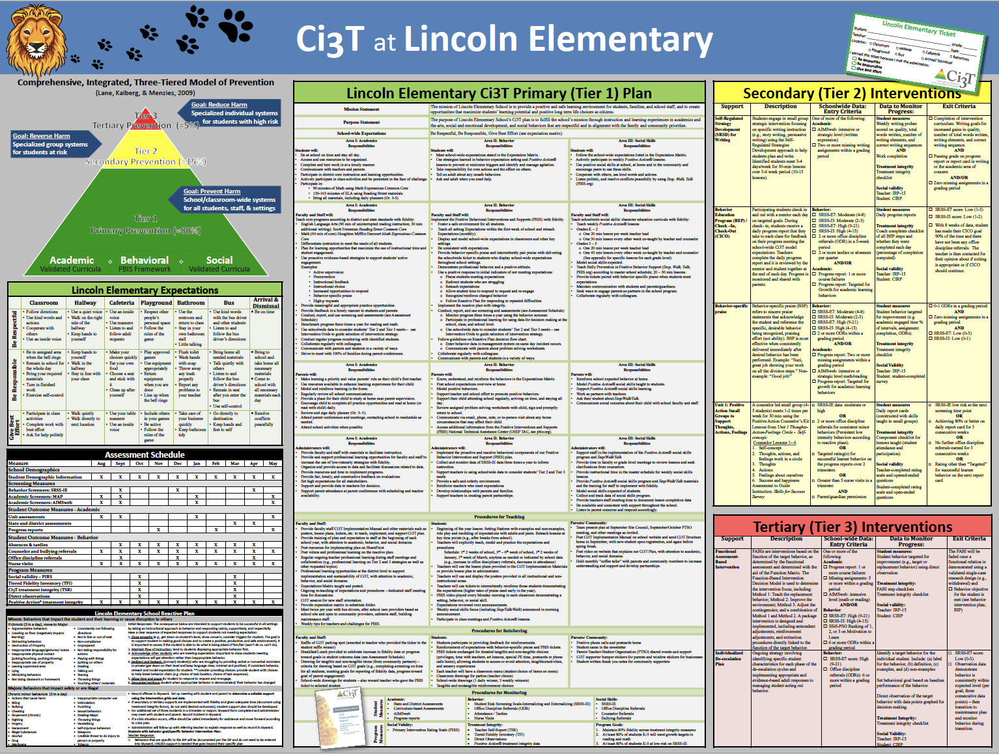
Everything connects to the
Tier 1 Plan
Including procedures for teaching, reinforcing, and monitoring across academic, behavior, and social domain roles and responsibilities.

Slide 7
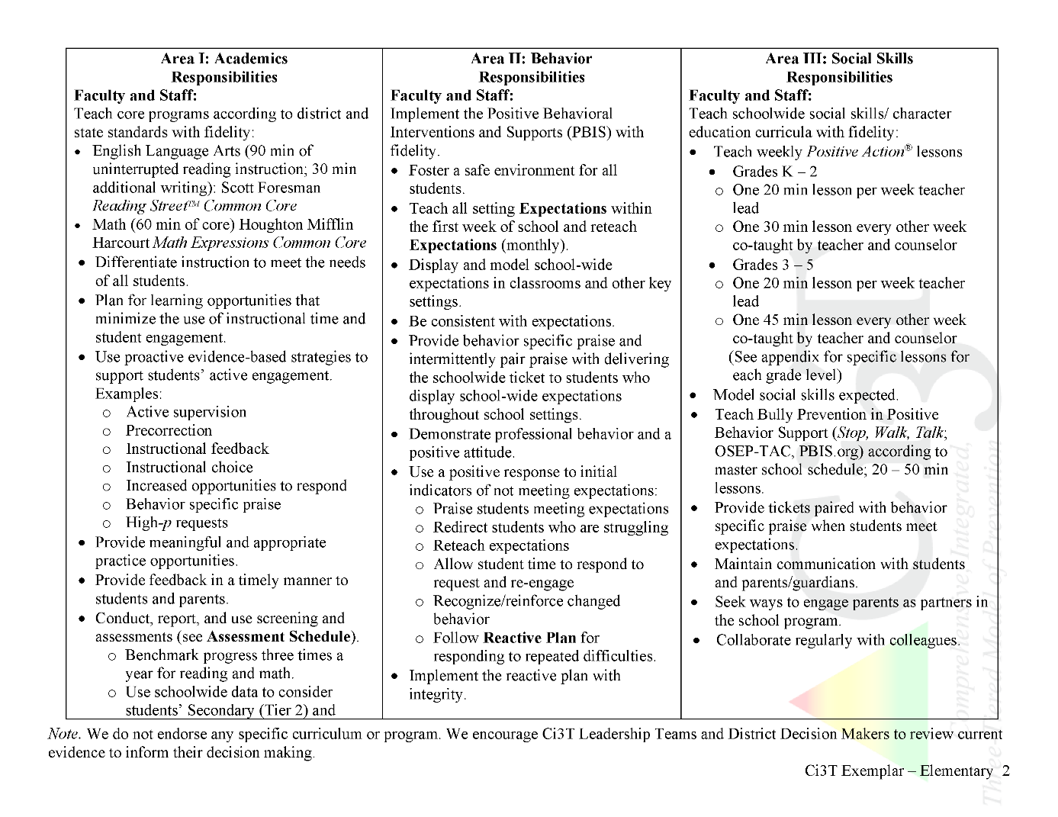

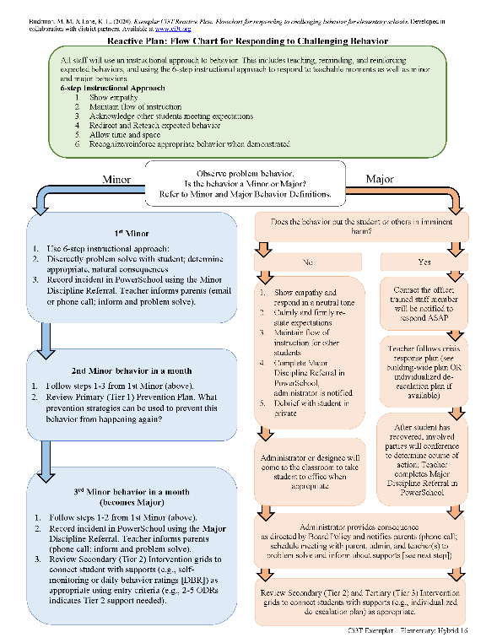
Ci3T Primary Plan: Procedures for Teaching
Ci3T Primary Plan: Procedures for Reinforcing
Ci3T Primary Plan: Procedures for Monitoring

Slide 8
Essential Components of
Primary Prevention Efforts
Social Validity
Systematic Universal Screening
Academic
Behavior
Treatment Integrity
for behavior

Slide 9
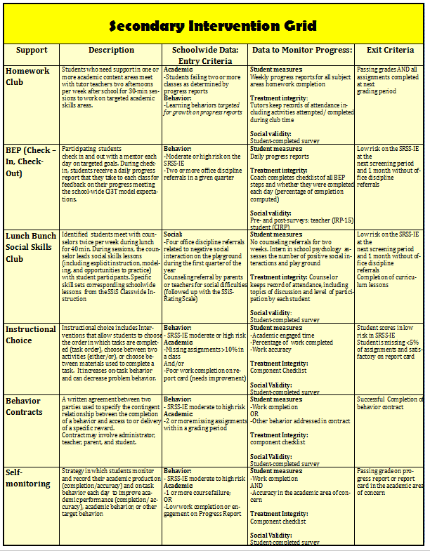

Secondary (Tier 2) Intervention Grids

Slide 10

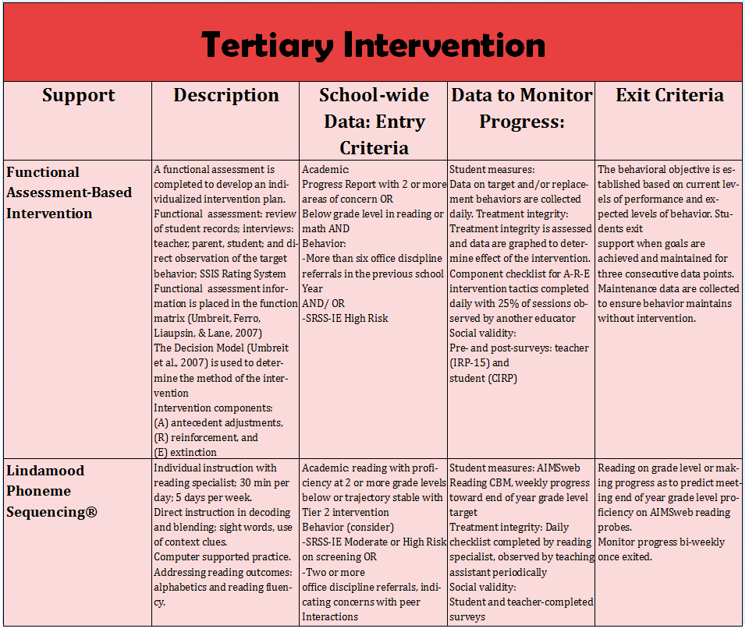
Tertiary (Tier 3) Intervention Grids

Slide 11
Consider tiered models of prevention like Ci3T.
What components are currently in place at your school?
Notes:
Lots of people? Turn to your neighbor
A few people? Shout out for the room

Slide 12
Positive behavioral interventions and supports

Slide 13


Positive Behavioral Interventions and Supports (PBIS)
A Framework, Not a Curriculum
Establish, clarify, and define expectations
Teach all students the expectations, planned and implemented by all adults in the school
Give opportunities to practice
Reinforce consistently, facilitate success
Consider rules, routines, and physical arrangements
Monitor the plan using school-wide data to identify students who need more support
Monitor student progress
Source: Horner, R.H., & Sugai, G. (2015). School-wide PBIS: An example of applied behavior analysis implemented at a scale of social importance. Behavior Analysis in Practice, 8, 80-85.

Slide 14
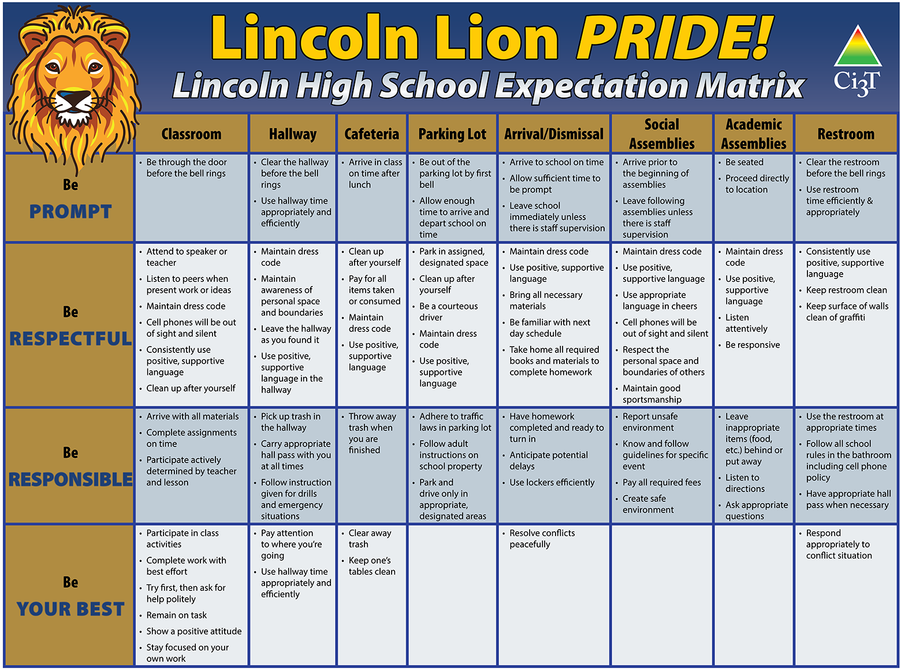
Behavior Expectation Matrices

Slide 15
Behavior Expectation Matrices

Slide 16
Behavior Expectation Matrices
Notes:
3-5 broad schoolwide expectations are operationally defined for each setting

Slide 17

Behavior Expectation Matrices
Notes:
Settings are customized, like this Islamic K-12 school defining expectations for their masjid (Arabic word for mosque, means place of worship or prostration in prayer)

Slide 18
How are expectation matrices built?
Literature review: 37 schools provided information
67.6% school leadership team
  team size averaged 7.9, range = 5-11
21.6% faculty and staff
  through consensus at 1 or 2 meetings
13.5% unclear (e.g., “administrators and teachers” but did not specify full faculty or small team)
Only two schools surveyed faculty and staff
  survey results were used to create an expectation matrix through discussion with faculty and staff (Valenti and Kerr, 2015)
Notes:
Literature review: Royer, Common, Lane, Oakes (2026 manuscript in progress)

Slide 20
Schoolwide Expectations Survey For Specific Settings (SESSS)
ci3t.org/measures
Notes:
The SESSS was developed to facilitate a data-informed approach to building expectation matrices where faculty and staff input identifies specific student behaviors critical for school success.

Slide 21
Schoolwide Expectations Survey For Specific Settings (SESSS)
Notes:
144 items

Slide 22
Schoolwide Expectations Survey For Specific Settings (SESSS)

Slide 23
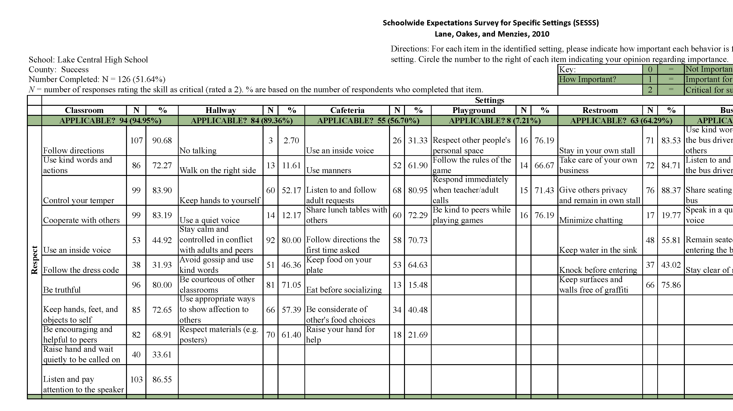
SESSS Report
Notes:
Ci3T leadership teams get a SESSS Report like this showing N and % of faculty staff who rated each item as critical for success (2)

Slide 24
Research Question
To what extent were behavior expectation priorities, as identified from SESSS data, featured in schoolwide expectation matrices?
Notes:
We analyzed 10 schools’ expectation matrices built by Ci3T Leadership Team members (n = 51) compared to SESSS data completed by faculty and staff (n = 260). We created a matrix to standardize the comparative analysis, scoring SESSS items as 0 = not on matrix, 1 = included with modification, and 2 = included exactly. We scored the number of SESSS items per setting on the matrix and how many were rated critical for success for 75% or more faculty and staff. Results indicate most items rated critical by 75% or more were included on expectation matrices, most exactly, and a few modified.

Slide 25
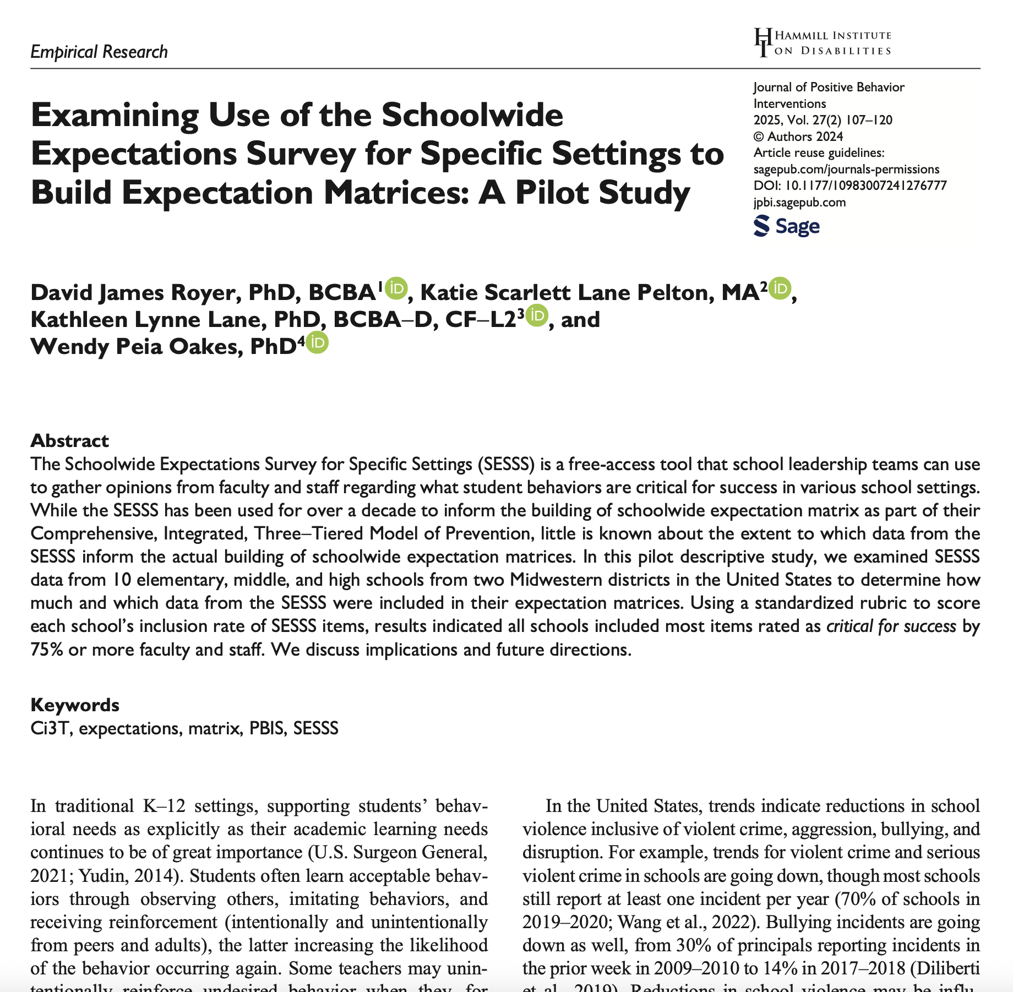
Method
Notes:
SESSS has been used for almost two decades to support data-informed expectation matrices.
This is the first study to compare priorities measured by the SESSS to behaviors included in schoolwide behavior expectation matrices.
We examined the percentage of SESSS items rated by faculty and staff as critical for success in key school settings that Ci3T Leadership Teams included on their draft matrix, and the degree to which wording did or did not change.

Slide 26
Participants and Setting
10
10
51
Average:
40.8 years old
15.4 years exp
schools
teams
participants
Midwest
District A
town: distant
1,655 students
District B
rural: remote
747 students
1 principal
2 general educators
1 special educator
1 district rep
1 parent rep
1 student rep
Optional:
counselor
social worker
school psych
74.5% female
96.1 white
51.0 master’s degree
35.3 general educators
23.5 administrators
15.7 special educators
13.7 related services
9.8 parent reps
2.0 staff
Notes:
10 Ci3T Leadership teams from 10 schools from 2 districts. Teams = 2 gened teachers, 1 sped teacher, district rep, parent rep, student rep, and up to three additional members (e.g., counselor, social worker).
51 adults.

Slide 27

Procedures
Six-part year-long Ci3T design professional learning series
All faculty and staff invited to complete SESSS
Ci3T Leadership Teams reviewed SESSS Reports at Session 1-2
  Highlighted items rated critical for success by 75%+
  Highlighted items rated critical for success by 50-75%
Determined broad schoolwide expectations
  Be Respectful, Be Organized, Be Awesome, Be Responsible
Drafted Ci3T Blueprint C: Ci3T Expectation Matrix
Shared matrix with faculty & staff after Session 4 for feedback
Notes:
Paper and pencil SESSS

Slide 28
Procedures
Created the SESSS vs. Expectation Matrix Comparison Rubric
Two raters
Independently scored each school’s Ci3T expectation matrix
Reviewed disagreements after each (for first 5, then 3, then 2)
Overall interrater agreement was 97.75%
(SD = 1.75; range = 94.04-100%)

Slide 29
SESSS Rubric

Slide 30
SESSS Rubric
Notes:
When the scoring rubric was first drafted, authors shared it with another researcher who had participated in the Ci3T Professional Learning Series, including SESSS data entry and reliability checking. We asked for feedback as to the usability and feasibility of scoring procedures, received no concerns, and received comments for a well-designed tool that would be easy to use to compare a SESSS report to items on a drafted expectation matrix.

Slide 31
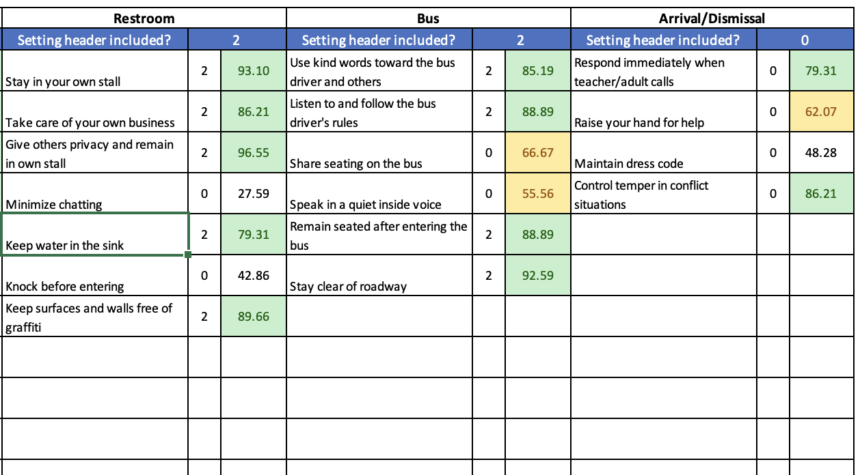
SESSS Rubric
Score
Paste % from report
Notes:
% rated critical for success (copy paste from SESSS report) had conditional formatting: green ≥75%, yellow 50% to <75% (<50% unshaded)
Scored each item using rubric placing no judgment on teams using exact wording over modified wording:
0 = not included on matrix
1 = included on matrix with modification
2 = included on matrix with exact wording
At the top of each setting column on the rubric is a cell to score if the setting appeared on the school’s expectation matrix using the same scale: 0 = not included on matrix, 1 = included on matrix with modification, 2 = included on matrix with exact wording. Some schools do not include every setting from the SESSS on their expectation matrix (e.g., no bus setting if no school bus), while other schools create new settings unique to their building and schedules (e.g., columns for assemblies, extracurricular activities, technology). When a SESSS setting was not included on a school’s matrix in any variation (score = 0), all items for that setting were scored 0 = not included on the matrix. When a setting was included with modification (score = 1), raters scored individual items as described previous. For example, some schools combined the bus and arrival/dismissal settings from the SESSS on their expectation matrix and raters scored individual items on the rubric under the respective setting where each item was original located.

Slide 32
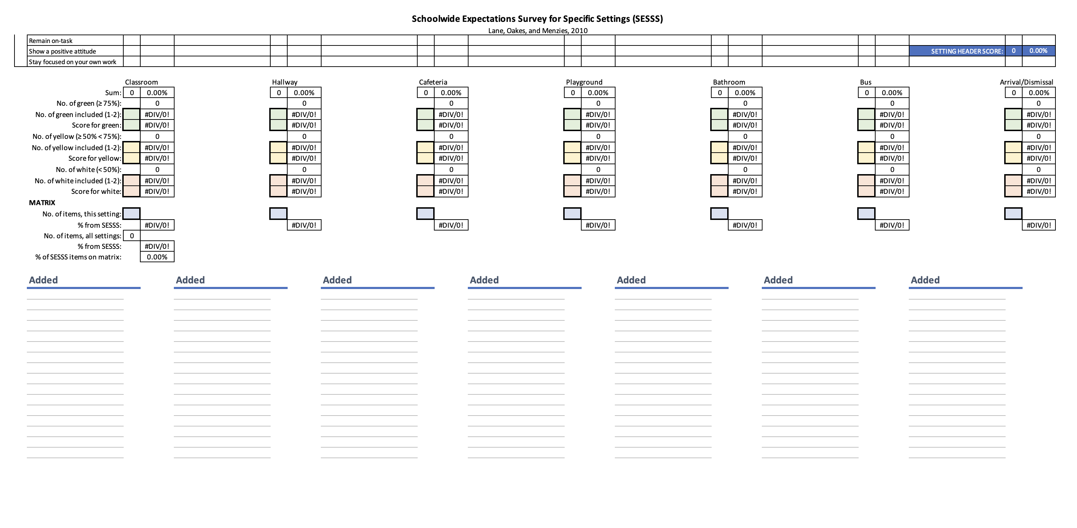
SESSS Rubric Page 2
Notes:
After scoring each expectation, raters count the number per setting appearing in the school’s matrix rated as critical for success by (a) ≥75%, (b) 50% to <75%, or (c) <50% of respondents.

Slide 33
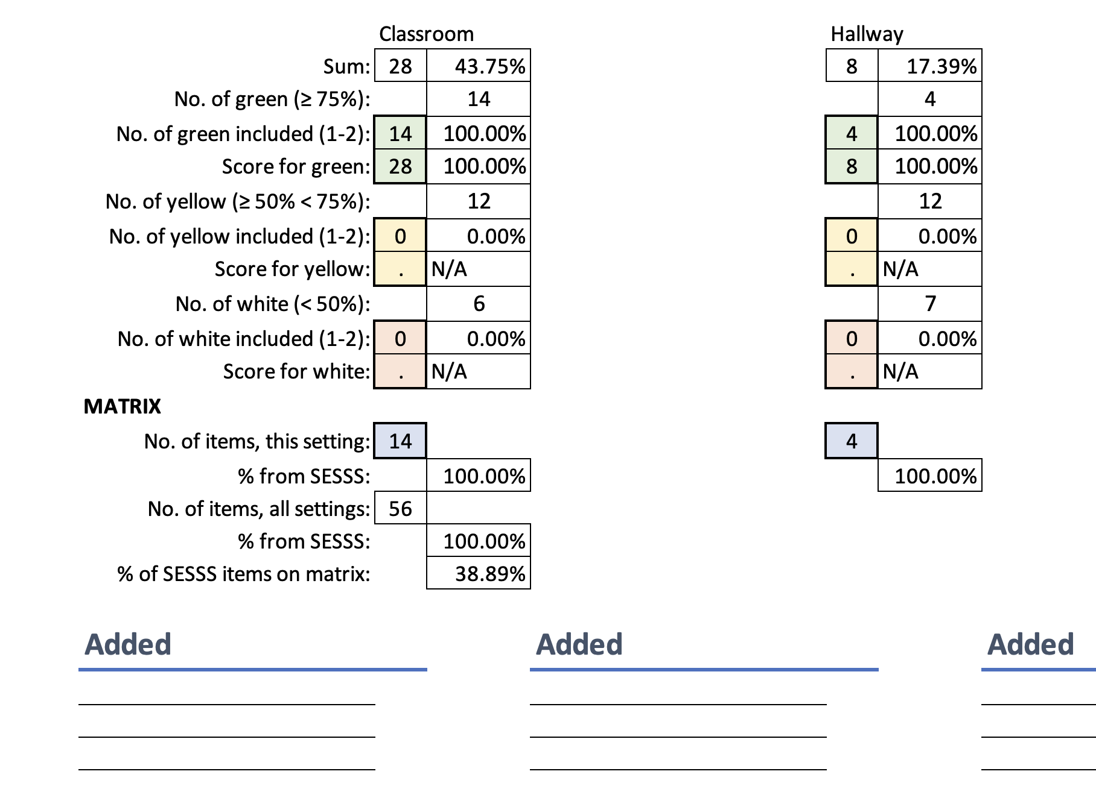
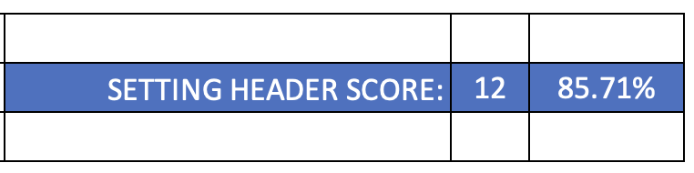
SESSS Rubric Page 2
Notes:
A formula then calculates a percentage score indicating, of the items included on the matrix, to what degree were they included with exact wording. For example, in the classroom:
Sum of all item scores is 28 out of a possible 64 points (32 items in classroom setting x 2 = 64) = 43.75% of max score.
Formula says 14 items were >= 75% (green)
How many of those did we find included on their matrix? 14 so 100% included
And each item appeared on the matrix exactly as was on the SESSS so got 2 points each, so 14 x 2 = 28 pts score for green, max possible since all were exact wording
There were 12 yellow and 6 white but none were included on matrix.
MATRIX
On their draft matrix for classroom we counted 14 items. If they had added some of their own making not from the SESSS, then that count would be higher and the % from SESSS would be lower. But this school only put items from the SESSS onto their matrix, and all were the critical for success by the vast majority (75%+) items.
144 items total on the SESSS. This school used 56 of them on their draft matrix (38.89%).

Slide 34



Results
Notes:
Overall, people used the SESSS Report data as intended to draft their Ci3T expectation matrix.

Slide 35
Most Item Were Included
Items rated critical for success by ≥ 75% of faculty and staff almost always on the matrix
  Most exactly as written on the SESSS
  A few with modifications
Ci3T Leadership Teams included less than half of items rated critical for success by 50 to <75%
  Most exactly as written on the SESSS
Notes:
Could be less 50-75% items were included b/c matrix cells were full from the >= 75% items.
Remarkably few items rated critical for success by < 50% of respondents were included in matrices.

Slide 36
Classroom (32 SESSS items)
Items rated critical for success by ≥ 75% of faculty and staff ranged from 7-24 per school
91.2% (avg.) of those items were included on each school matrix
  Range = 54.2-100%
  5 of 10 teams included 100%
Average rubric score = 95.5% (range = 82.4-100%)
  5 teams = 100% (retained exact wording for all items)
Notes:
Indicates the vast majority of SESSS items’ exact wording was retained when placed in each school’s draft matrix.

Slide 37
Classroom (32 SESSS items)
Items rated critical for success by 50 to < 75% of faculty and staff ranged from 6-19 per school
0-42.1% of those items were included on each school matrix
  6 of 10 teams included 0%
Average rubric score = 100%
  4 teams retained exact wording when including 1-8 items
Items rated critical for success by < 50% of faculty and staff ranged from 6-19 per school
Zero items were included on any school matrix
Notes:
Indicates the vast majority of SESSS items’ exact wording was retained when placed in each school’s draft matrix.

Slide 38
Hallway (23 SESSS items)
How many faculty & staff rated items critical for success?
 | ≥75% | 50-75% | 0-50%
Number per school | 3-8 | 4-16 | 3-16
M% (range) included on matrix | 97.3 (85.7-100) | 23.8 (0-100) | 3.9 (0-20.0)
Score M% (range) (exact wording) | 95.8 (83.3-100) | 95.9 (90.0-100) | 83.3 (50-100)
8 teams 100%
7 teams 100%
Notes:
Indicates teams included items scored critical for success by faculty and staff, and the vast majority of SESSS items’ exact wording was retained when placed in each school’s draft matrix.

Slide 39
Cafeteria (24 SESSS items)
How many faculty & staff rated items critical for success?
 | ≥75% | 50-75% | 0-50%
Number per school | 1-8 | 4-15 | 4-17
M% (range) included on matrix | 94.6 (83.3-100) | 22.5 (0-100) | 0.8 (0-8.3) 1 school, 1 item
Score M% (range) (exact wording) | 98.0 (80.0-100) | 81.0 (50-100) | 100
6 teams 100%
9 teams 100%

Slide 40
Playground (15 SESSS items)
How many faculty & staff rated items critical for success?
 | ≥75% | 50-75% | 0-50%
Number per school | 0-12 | 3-10 | 1-10
M% (range) included on matrix | 83.9 (0-100) | 23.0 (0-100) | 6.5 (0-33.3)
Score M% (range) (exact wording) | 96.9 (87.5-100) | 97.2 (91.7-100) | 100
6 teams 100%
5 teams 100%
Notes:
The school with 0 items at >=75% was a high school (neither high school from this sample included the playground setting in their draft matrix).
The 0-100 larger range included on matrix perhaps indicated a divergence in appropriateness by student population.

Slide 41
Restroom (18 SESSS items)
How many faculty & staff rated items critical for success?
 | ≥75% | 50-75% | 0-50%
Number per school | 3-12 | 3-10 | 2-6
M% (range) included on matrix | 92.0 (66.7-100) | 18.0 (0-100) | 0
Score M% (range) (exact wording) | 90.6 (75.0-100) | 86.1 (66.7-100) | n/a
7 teams 100%
2 teams 100%

Slide 42
Bus (19 SESSS items)
How many faculty & staff rated items critical for success?
 | ≥75% | 50-75% | 0-50%
Number per school | 6-15 | 3-10 | 0-4
M% (range) included on matrix | 78.9 (0-100) | 22.4 (0-100) | 7.1 (0-50.0) 1 school, 1 item
Score M% (range) (exact wording) | 98.0 (92.9-100) | 91.0 (75.0-100) | 100
5 teams 100%
6 teams 100%
Notes:
One school did not include a bus setting on their matrix.

Slide 43
Arrival/Dismissal (13 SESSS items)
How many faculty & staff rated items critical for success?
 | ≥75% | 50-75% | 0-50%
Number per school | 3-9 | 2-9 | 0-4
M% (range) included on matrix | 55.7 (0-100) | 23.2 (0-100) | 0
Score M% (range) (exact wording) | 94.6 (83.3-100) | 95.0 (80.0-100) | n/a
5 teams 100%
3 teams 100%
Notes:
6 of 10 teams retained the arrival/dismissal setting

Slide 44
Educational Implications
Notes:
Results add additional evidence for the SESSS being a tool leadership teams can use to build schoolwide behavior expectation matrices with input from all faculty and staff.

Slide 45
Educational Implications
SESSS was designed to increase likelihood expectations taught reflect opinions of all adults in the building
Ci3T leadership teams relied heavily on SESSS data to draft matrices
Highly rated items can be placed in expectation matrices with confidence
  more likely to be taught and reinforced by all adults
SESSS can support cultural responsivity of behavior expectations, reflective of local beliefs and values
Notes:
can support the cultural responsivity of behavioral expectations, provided the faculty and staff are representative of the community, work closely with families, and are engaged within the community to know the local values, context, and cultures.

Slide 46
Future Directions
Replicate this pilot study
  More cohorts of schools, with diverse populations
  More geographic regions
Invite families and students to complete the SESSS
  Look for convergent validity with faculty and staff
Schools can adapt items, customize the SESSS
Directly compare degree of effectiveness of this data-informed approach (SESSS) to non-data-informed approaches
  e.g., reinforcement rate ticket count per grading period
Qualitative inquiry on goals, procedures, outcomes of SESSS
Notes:
Cognitive interviews: what did team members think during each step of the data-informed expectation building process (their metacognition reviewing SESSS report, how determined which items to place onto matrix, how edited settings and item working to fit unique school needs). Interviews would “help researchers understand why teams elected to not include certain items in the matrix even when they had a high level of faculty and staff endorsement, and why a few items rated as critical for success by less than half of respondents were, none the less, retained. This type of inquiry could better explain how SESSS data were used as well as provide insights into how SESSS reports could be more helpful for Ci3T Leadership Team members.”

Slide 47
Thank you!
ci3t.org
david.royer@louisville.edu
katie.lane@uconn.edu
kathleen.lane@ku.edu
wendy.oakes@asu.edu

