Slide 1

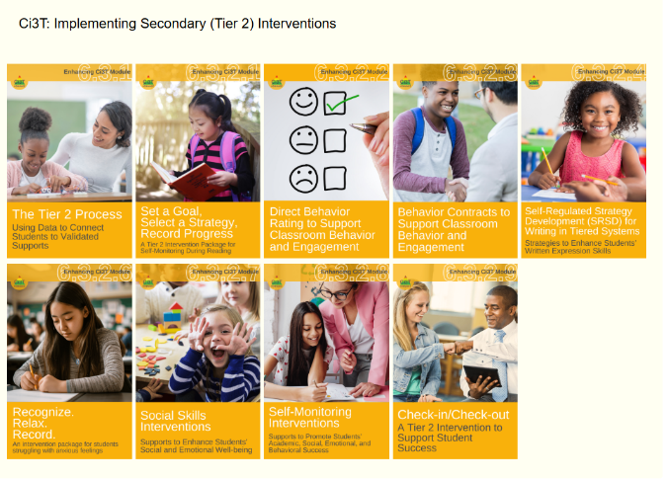
Getting Started
Step 1: Go to ci3t.org/enhance
Step 2: If you have not already registered to access Enhancing Ci3T Modules, consider doing so.
Step 3: Sign into the Recognize. Relax. Record. module (see Ci3T: Implementing Secondary (Tier 2) Interventions)

Slide 2
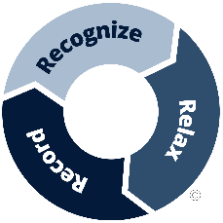
Recognize. Relax. Record.: A Practical Teacher-led Tiered 2 Intervention Managing Anxious Feelings
Midwest Symposium for Leadership in Behavioral Disorders
February 6, 2026
Kathleen Lynne Lane, University of Kansas
Allison Bernard, University of Kansas
Elise Sarasin, University of Kansas
Carrie Brandon, Arizona State University
We invite you to visit ci3t.org/enhance to access our collection of Enhancing Ci3T Modules following a one-time registration process!
This presentation was funded in part by Project ENHANCE (U.S. Department of Education, Institute of Education Sciences: Award Number: R324N190002), Project ENGAGE (U.S. Department of Education, Institute of Education Sciences: Award Number: R324X220067), and Project EPIC (U.S. Department of Education, Office of Special Education Programs, Award Number: H325D220011).

Slide 3











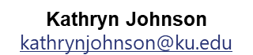
Project ENGAGE Research Team
Rebecca L. Sherod-Adams
rebeccasherod@asu.edu
Joni Weiss
joni.weiss@ku.edu

Slide 4
Starting Activity
Step 1: Go to ci3t.org/enhance
Step 2: If you have not already registered to access Enhancing Ci3T Modules, consider doing so.
Step 3: Sign into the Recognize. Relax. Record. module (see Ci3T: Implementing Secondary (Tier 2) Interventions)

Slide 5
Agenda
Welcome
Supporting students with internalizing behaviors
Introducing Recognize. Relax. Record.
Baseline
RRR Instruction
RRR In-Class
Sharing preliminary findings of a cluster randomized controlled trial
Next steps and resource sharing

Slide 6
Supporting Students with Internalizing Behaviors

Slide 7
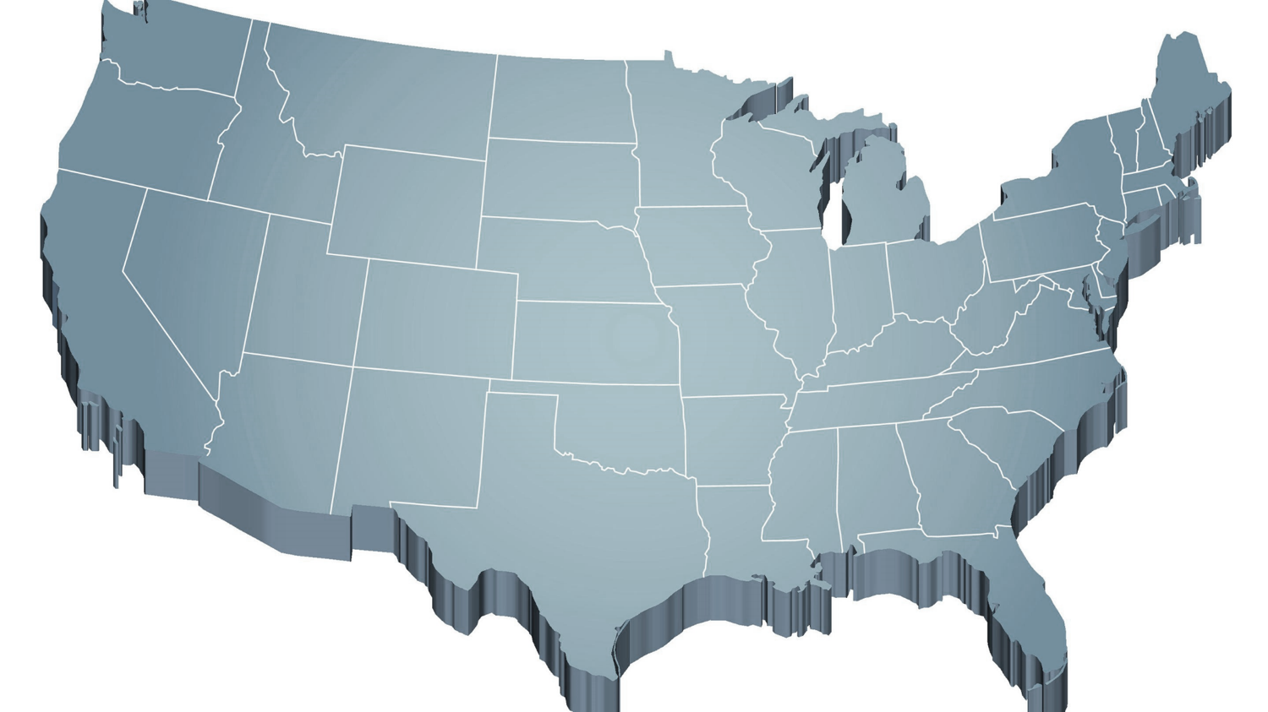
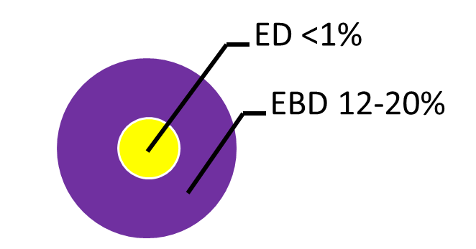
Thank you for your commitment!
Shift to a systems level perspective
Internalizing
Externalizing
Source: Forness, S.R., Freeman, S.F., Paparella, T., Kauffman, J.M., & Walker, H.M. (2012). Special education implications of point and cumulative prevalence for children with emotional or behavioral disorders. Journal of Emotional and Behavioral Disorders, 20, 4-18.

Slide 8
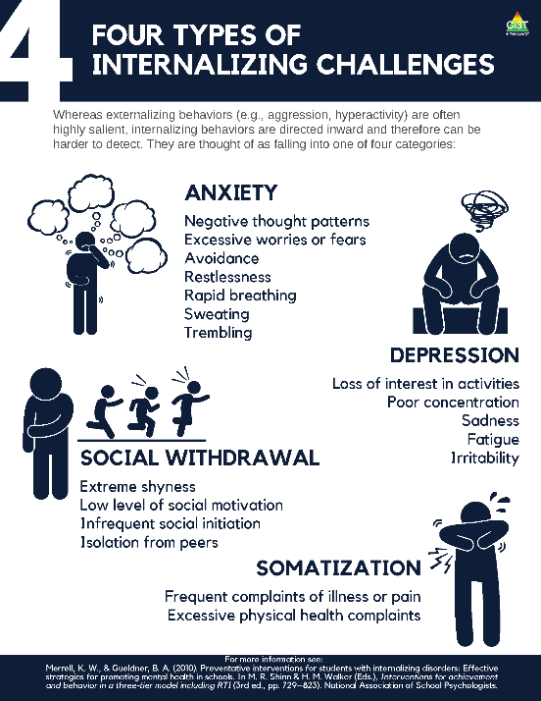
What are internalizing behaviors?
Some examples include:
frequent complaints of illness or pain,
social withdrawal,
irritability,
poor concentration,
restlessness,
emotional outbursts,
rapid breathing,
sweating, or
trembling/shaking.

Slide 9

A Focus on Internalizing Behaviors
Internalizing concerns are associated with multiple worrisome outcomes compared to students who do not have internalizing behavior patterns, such as:
Lower levels of academic achievement (e.g., grade point average, GPA; Vaillancourt et al., 2013)
Lower levels of school adaptation (e.g., ability to learn, ability to meet behavioral expectations, happiness/adjustment; Pedersen et al., 2019)
Higher levels of school dropout (Weist et al., 2018)
Higher levels of social rejection (Weist et al., 2018)
Increased engagement in risk-taking behaviors (e.g., substance use, suicide; Weist et al., 2018)
Increased risk of physical health problems (Jamnik & DiLalla, 2019)

Slide 10
Who do internalizing behaviors impact?
≈ 32% of children experience an anxiety disorder at some point during their childhood (Merikangas et al., 2010)
Onset typically occurs during elementary years (Merikangas et al., 2010)
Prevalence of behavioral, social, and emotional well-being challenges may be on the rise:
Lebrun-Harris and colleagues (2022) found an increase in anxiety and behavioral/conduct disorder from 2016-2020.

Slide 11
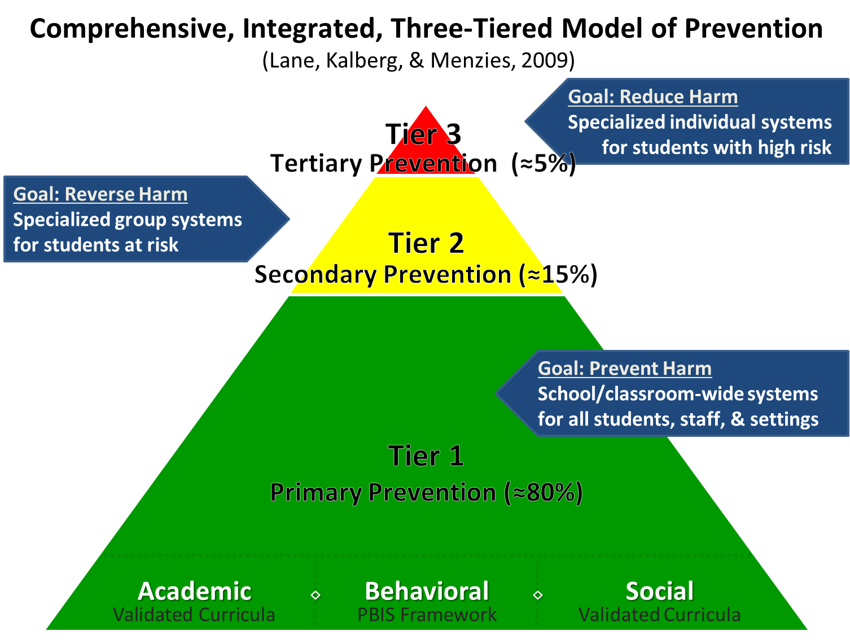


Comprehensive, Integrated, Three-Tiered Model of Prevention 1

Slide 12
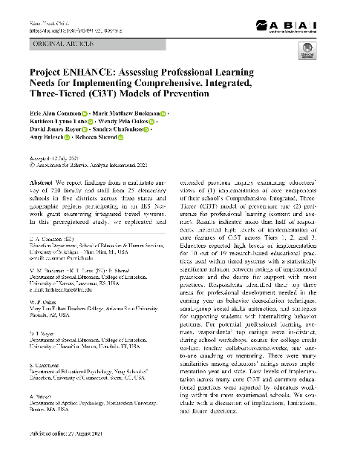
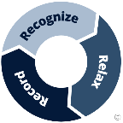
Assessing Professional Learning Needs
Top Professional Learning Needs
De-escalation techniques
Social skill instruction
Supports for students with internalizing behavior patterns
Common, E. A., Buckman, M. M., Lane, K. L., Oakes, W. P., Royer, D. J., Chafouleas, S., Briesch, A., & Sherod, R. (2021). Project ENHANCE: Assessing Professional Learning Needs for Implementing Comprehensive, Integrated, Three-Tiered (Ci3T) Models of Prevention. Education and Treatment of Children. https://doi.org/10.1007/s43494-021-00049-z

Slide 13
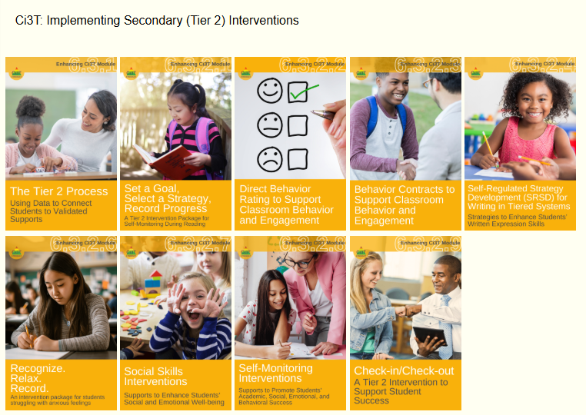
Ci3T: Implementing Secondary (Tier 2) Interventions

Slide 14
An Overview of Recognize.Relax.Record

Slide 15
Comprehensive, Integrated, Three-Tiered Model of Prevention 2

Slide 16

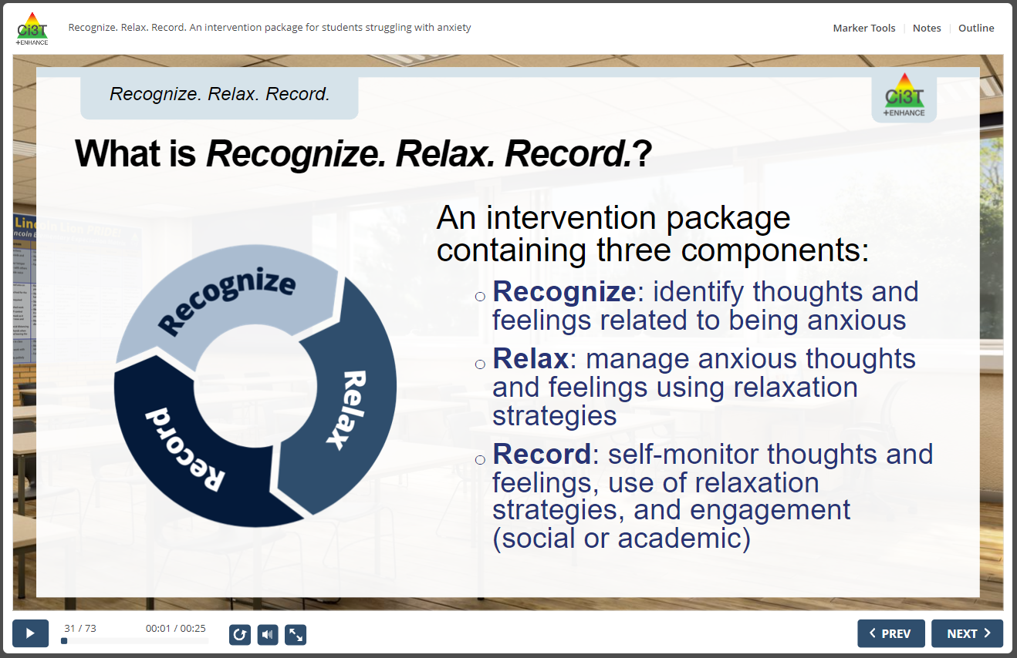
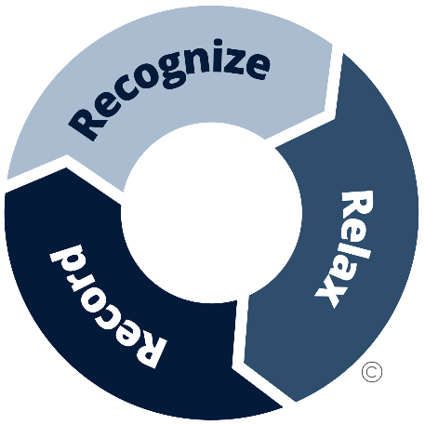
RRR Interactive Resource

Slide 17
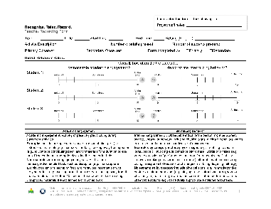
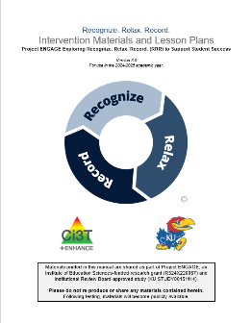
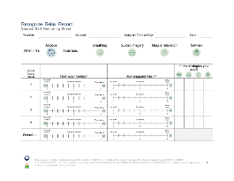
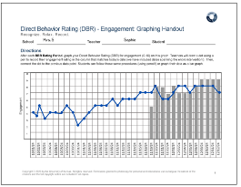
Three Components of Recognize. Relax. Record.
Baseline
RRR Instruction
RRR
In-Class
1
2
3
4
5
6
7
8
9
10
11
12
13
14
15

Slide 18


What does the supporting research for Recognize. Relax. Record. say? (Recognize)
Social-emotional competencies
Self-awareness
Self-management
Social awareness
Responsible decision-making
Relationship Skills
Recognize.
Social-emotional competencies, such as self-awareness and self-management, are related to important long-range outcomes
high school graduation
college degree completion
obtaining employment
Durlak et al., 2011
Adapted from CASEL Framework (2020)

Slide 19

What does the supporting research for Recognize. Relax. Record. say? (Relax)
Relax.
Relaxation training is commonly used in research-based cognitive behavioral interventions for children with anxiety
Chorpita & Daleiden, 2009

Slide 20
What does the supporting research for Recognize. Relax. Record. say? (Record)
Record
Self-management interventions effective for
behavioral and social outcomes
reading, math, and other content areas at elementary
Levendoski & Cartledge, 2000
productivity, engagement, and academic performance at middle and high school
Carr & Punzo, 1993
students with emotional and behavioral disorders
students educated in general and special education classrooms
A.M. Briesch & Briesch, 2016; Briesch & Chafouleas, 2009; Mooney et al., 2005

Slide 21
Step 1
Use data to connect students to RRR

Slide 22
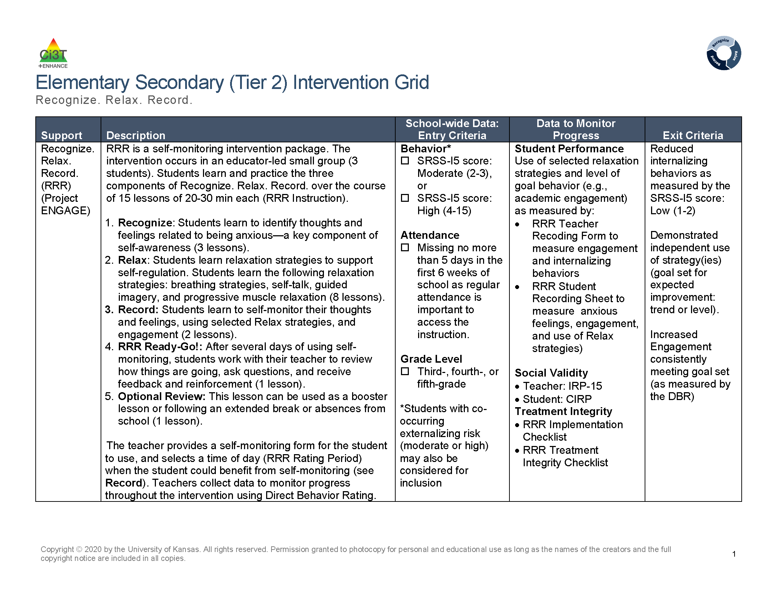
Recognize. Relax. Record. Secondary (Tier 2) Intervention Grid

Slide 23
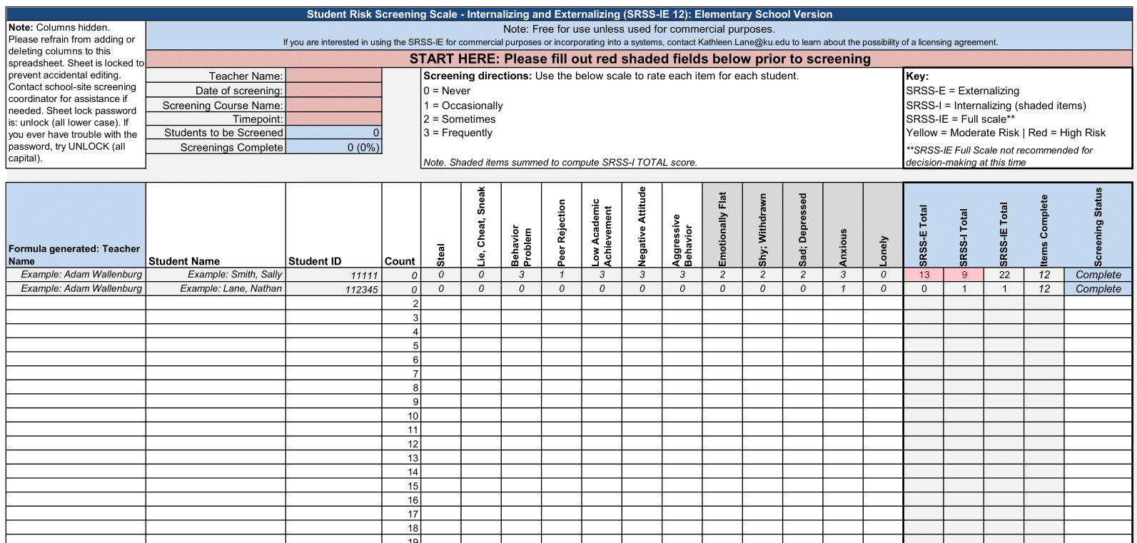
Using data to connect students to Recognize. Relax. Record.

Slide 24
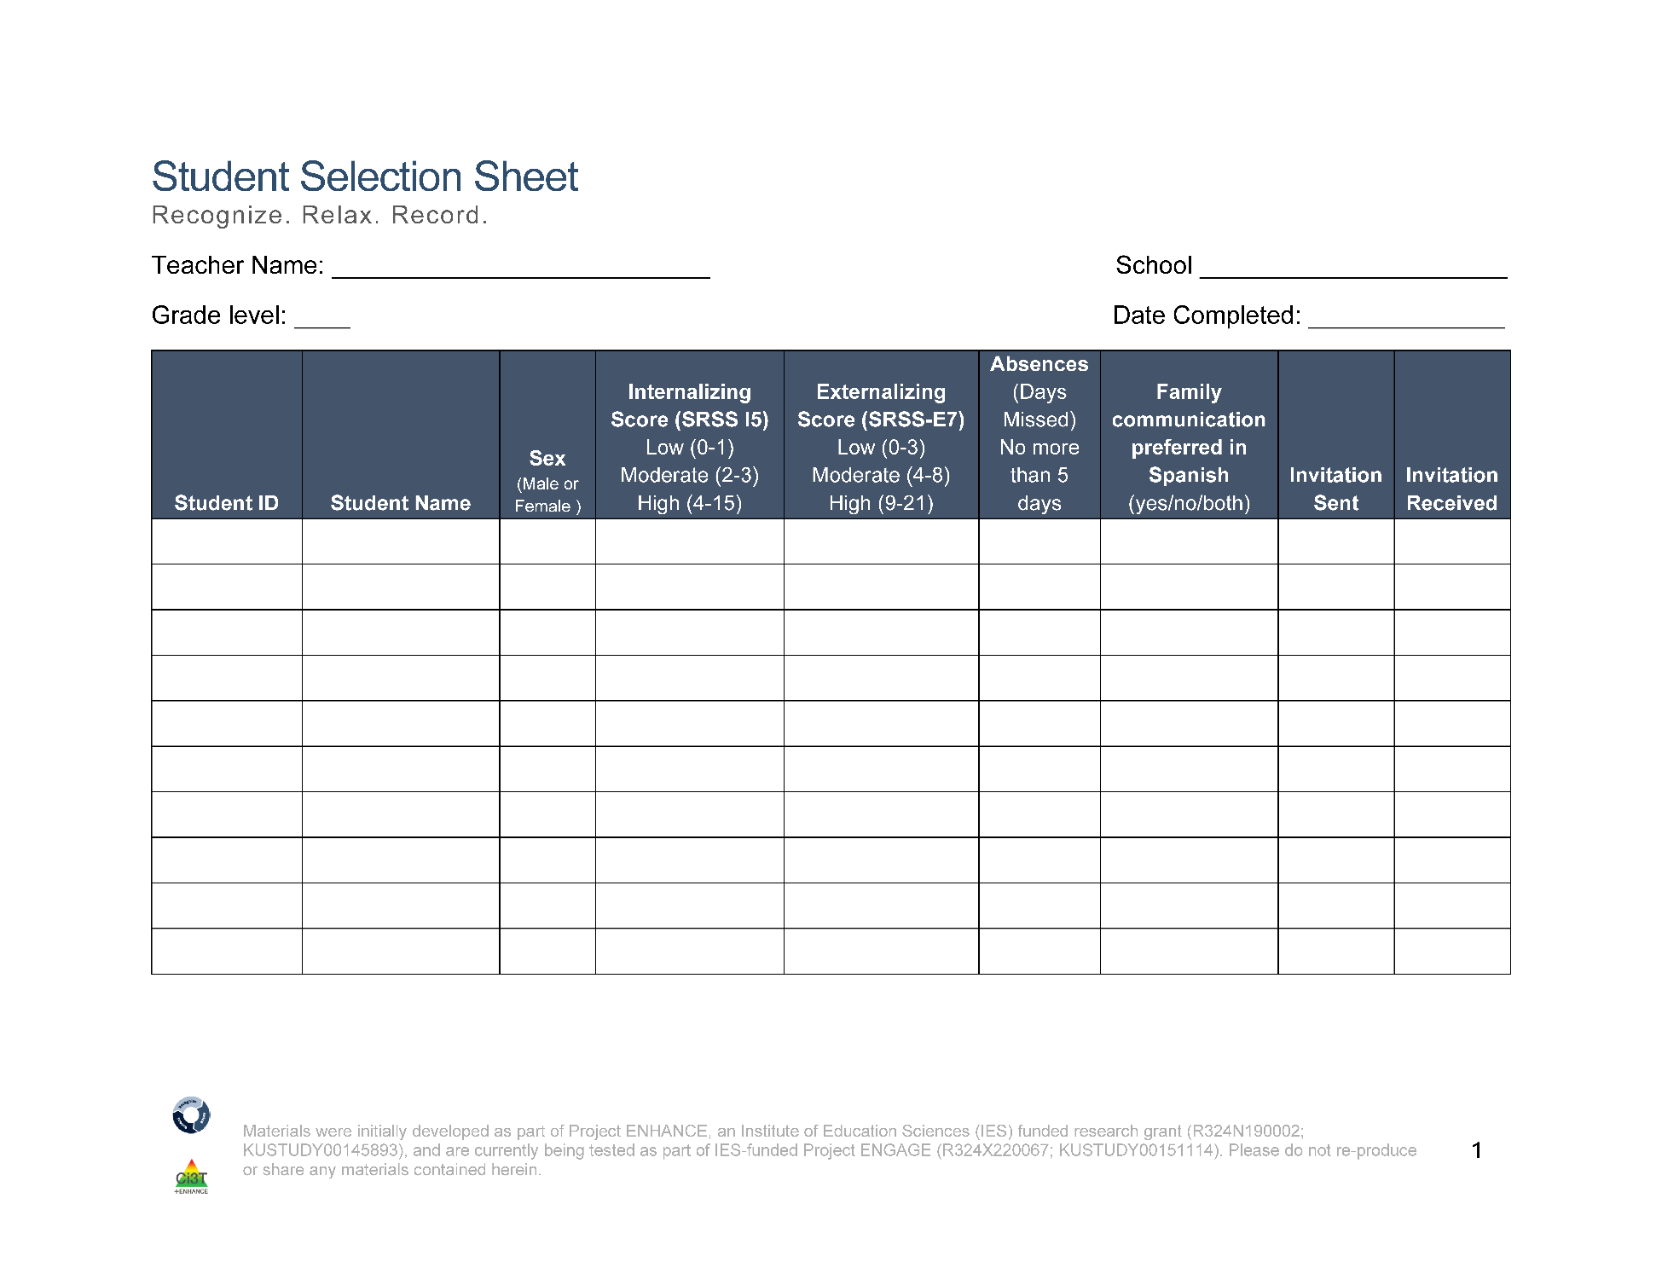
Student Selection Sheet
Ms. Sarasin
Lincoln Elementary
5
10/14/24
2
122006
Smith, John
F
4
3
2
no
122295
Johnson, Emily
F
2
8
5
both
1
122295
Taylor, Sarah
F
8
4
3
no
122295
Anderson, David
F
2
19
7
no
3
122313
Thomas, Jessica
M
5
5
1
no
122318
Harris, James
M
2
3
2
yes
Notes:
Fully translate materials and consent form

Slide 25
Step 2
Plan RRR Procedures

Slide 26
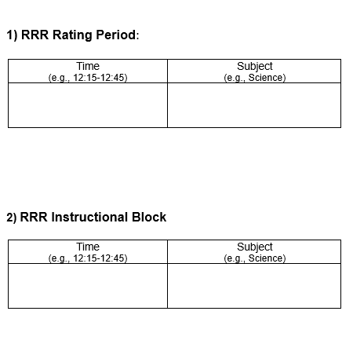
Step 2 Plan RRR Procedures (1 of 2)
Collaborate with parents, families, and colleagues
Gather data to identify students’ strengths, abilities, and needs
Schedule
RRR Rating Period
Time when baseline (Direct Behavior Rating) data collected
Time when students will use self-monitoring during RRR In-Class phase
RRR Instruction Block
Time when small-group instruction will occur (15 lessons, 20-30 min each)
2:00-2:40
Monday-Thursday
Math
10:00-10:25
Monday, Wednesday, Thursday
Independent Work Time

Slide 27
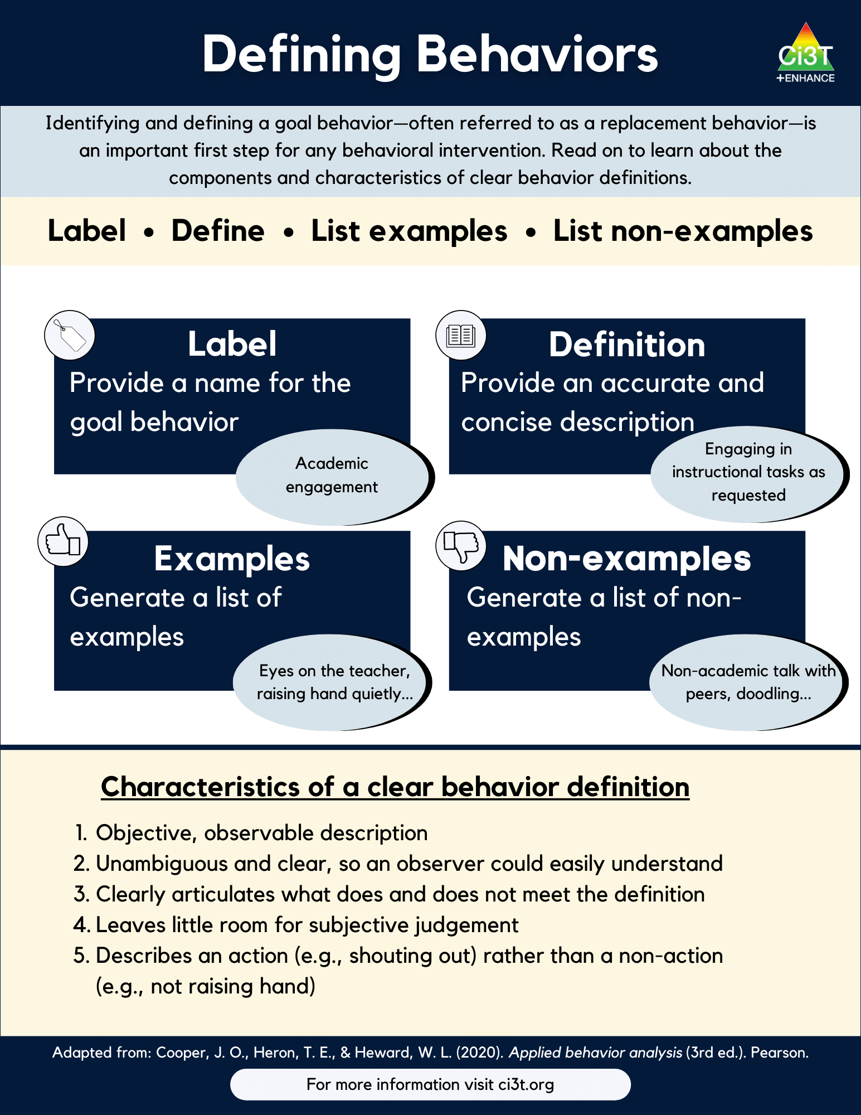
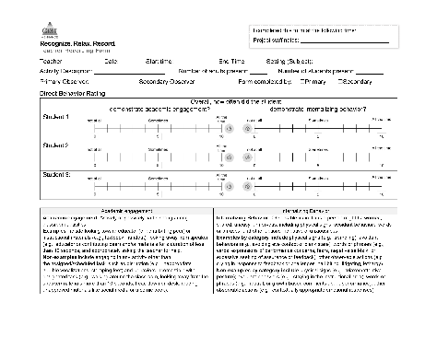
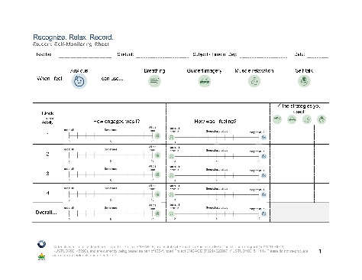
Step 2 Plan RRR Procedures (2 of 2)
Prepare intervention forms and procedures
Teacher Recording Form (Direct Behavior Rating)
Student Self-Monitoring Sheet
Operationalize behaviors of interest

Slide 28
Step 3
Begin baseline data collection

Slide 29
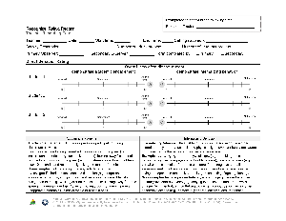
Baseline
This is the time (approximately two weeks) before beginning RRR instruction
Nothing else changes!
This allows for a comparison pre-intervention performance to post-intervention performance
During this time, teachers will collect Direct Behavior Rating (DBR) data four times a week (Monday-Thursday)
Goal is to collect ~6-8 data points during this time!

Slide 30
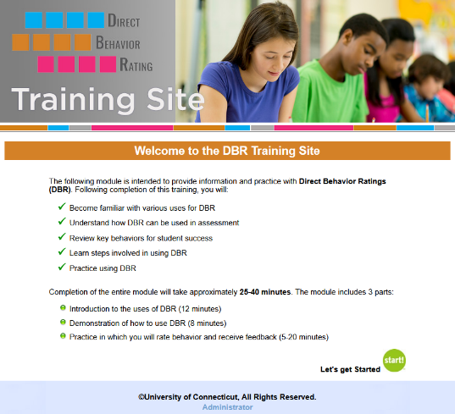
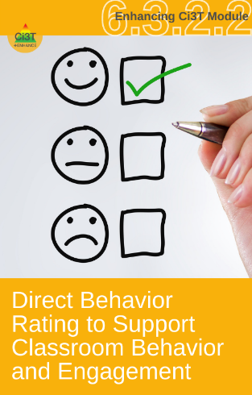
Direct Behavior Rating (DBR)
A tool that involves a brief rating of target behavior immediately following a specified observation period.
Source: University of Connecticut. (n.d.). Direct behavior rating: Assessment training module. [video training module].
www.dbrtraining.education.uconn.edu/video.php

Slide 31
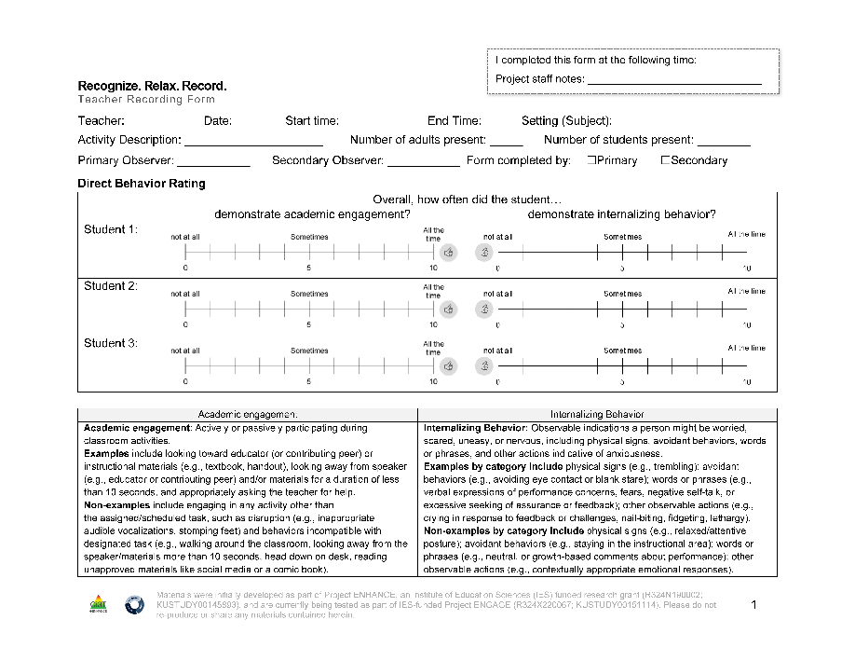
Teacher Recording Form
DBR data are collected using the Recognize.Relax.Record Teacher Recording Form to measure students’:
Academic engagement
Internalizing behavior

Slide 32
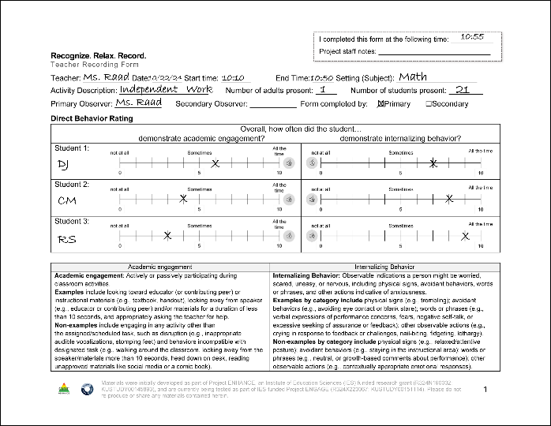
DBR Procedures: RRR Rating Period
Plan to collect DBR data four times a week
Generally, Monday through Thursday
All students on one form per day
At the end of the RRR Rating Period, complete the Teacher Recording Form

Slide 33
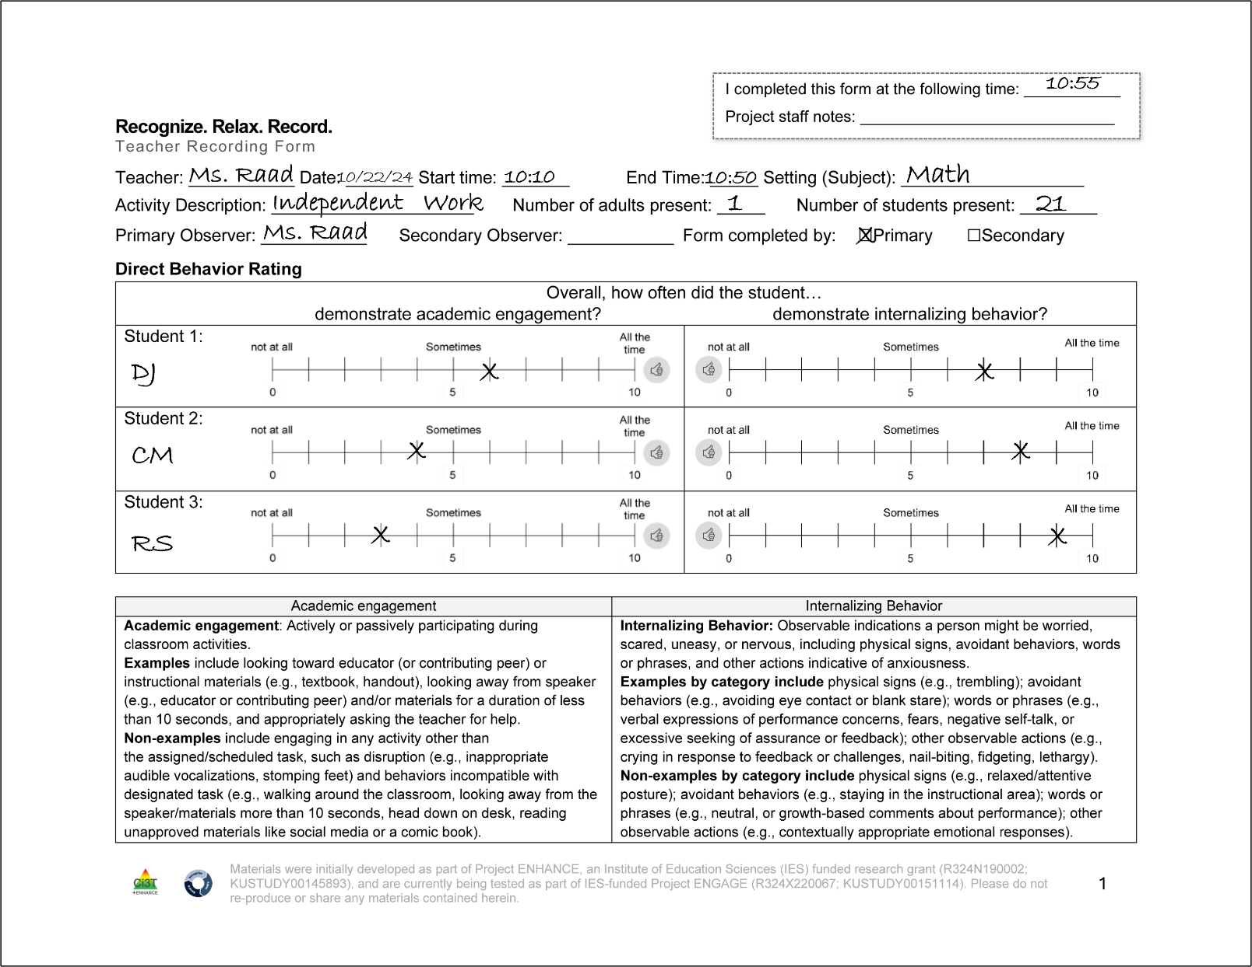
DBR Procedures: RRR Rating Period (Teacher Recording Form)

Slide 34
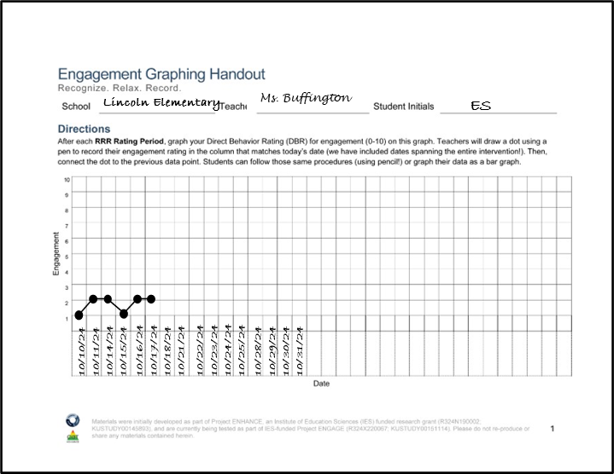
RRR Engagement Graphing Procedures
Each student will have their own Engagement Graphing Handout
Later in the intervention (during RRR In-Class), students will also add their total engagement ratings to this graph!
Once you have completed the Teacher Recording Form, graph each student’s overall engagement score on their graph

Slide 35
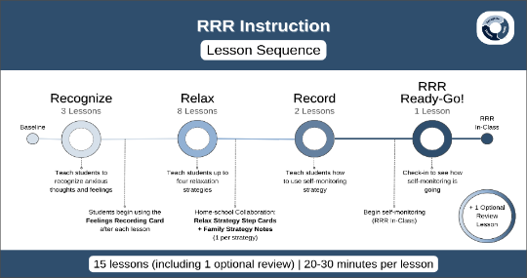
Step 4
Provide RRR Instruction

Slide 36

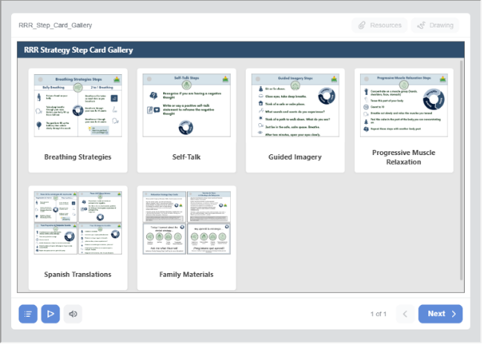
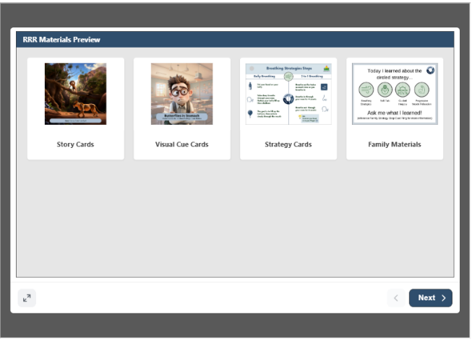
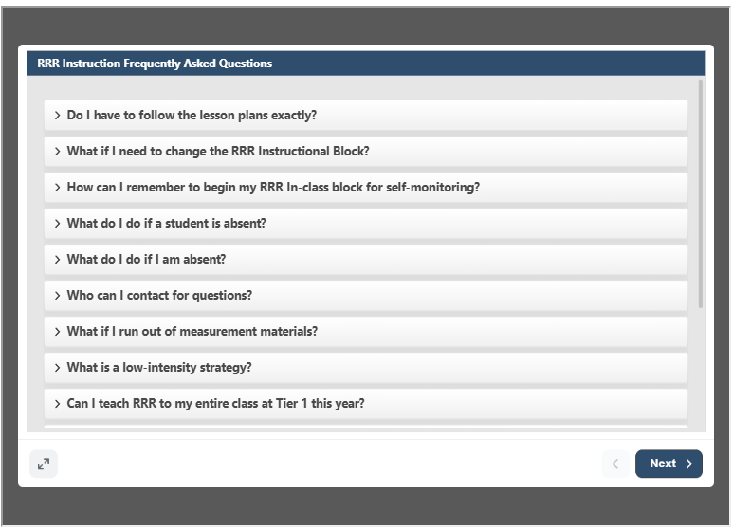
Accessing Materials

Slide 37
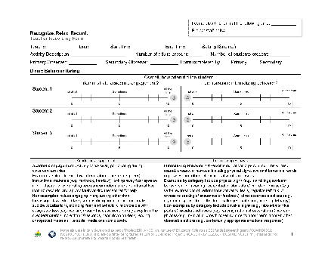

RRR Instruction
Deliver small group RRR Lessons
~20-30 minutes per lesson
Up to 15 lessons (with optional lessons); likely to teach only 10-13 lessons
Taught during a different time than RRR Rating Period
Teachers continue to collect DBR data four times a week (Monday-Thursday) during the RRR Rating Period

Slide 38
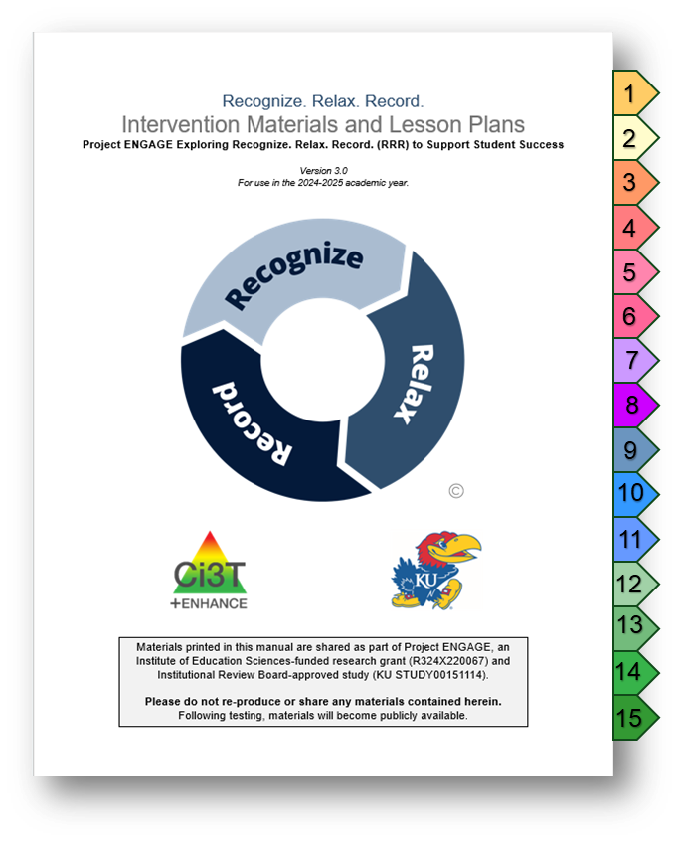
Lesson Plans Overview
15 lessons available
Recognize - 3 lessons
Relax - 8 lessons*
Record - 2 lessons
Ready-Go!
Review (optional)
20-30 min each lesson
Semi-scripted
Teacher-led

Slide 39
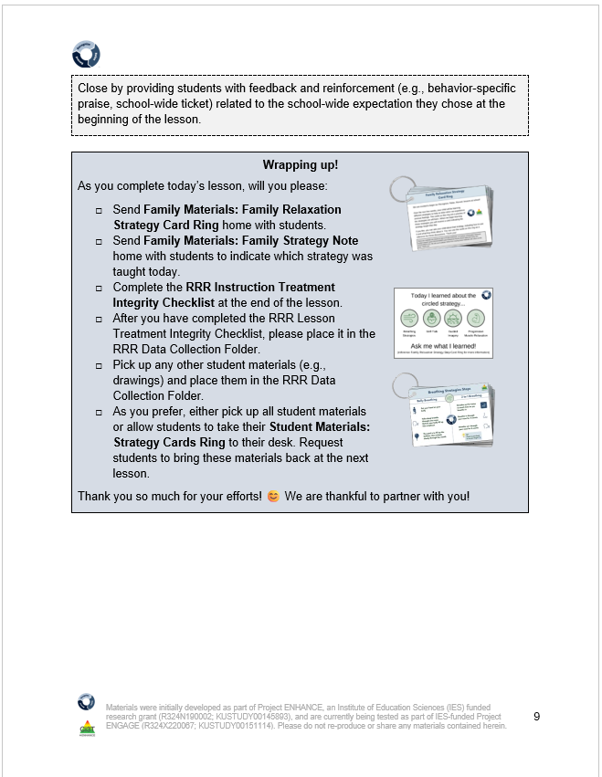
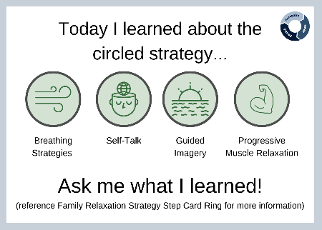
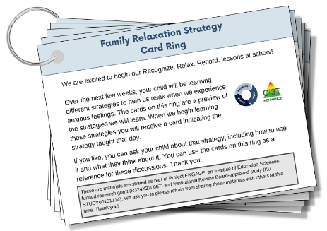
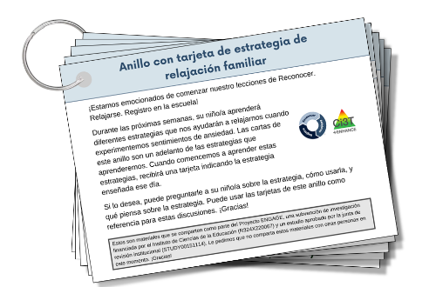
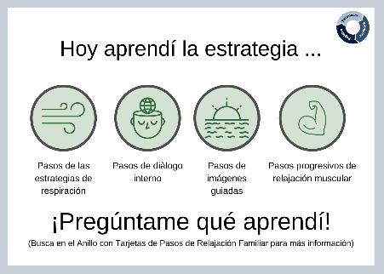
Family Materials
Guidance for sending materials is in each lesson plan, as appropriate
Notes:
Family materials – available in both English and Spanish on one ring (front and back)
Guidance in lessons in the blue wrap up boxes for when to send those home

Slide 40

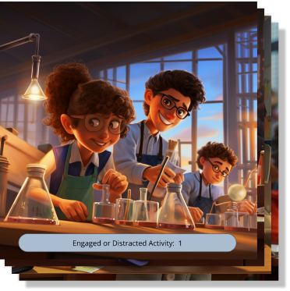
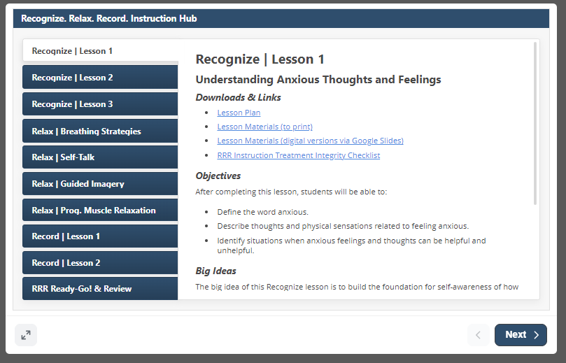
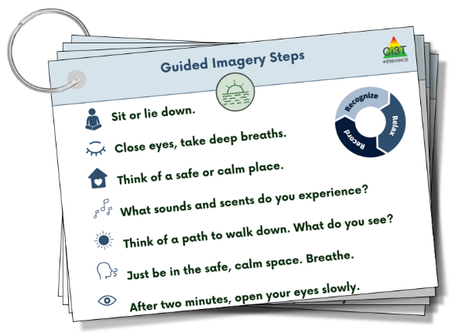
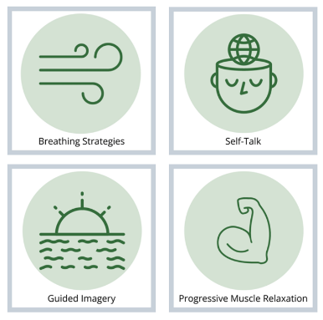
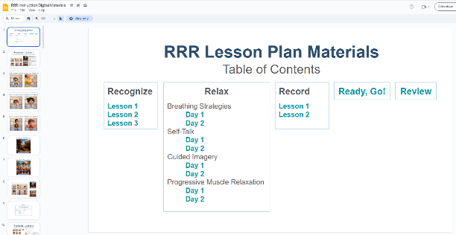
Teacher Materials

Slide 41
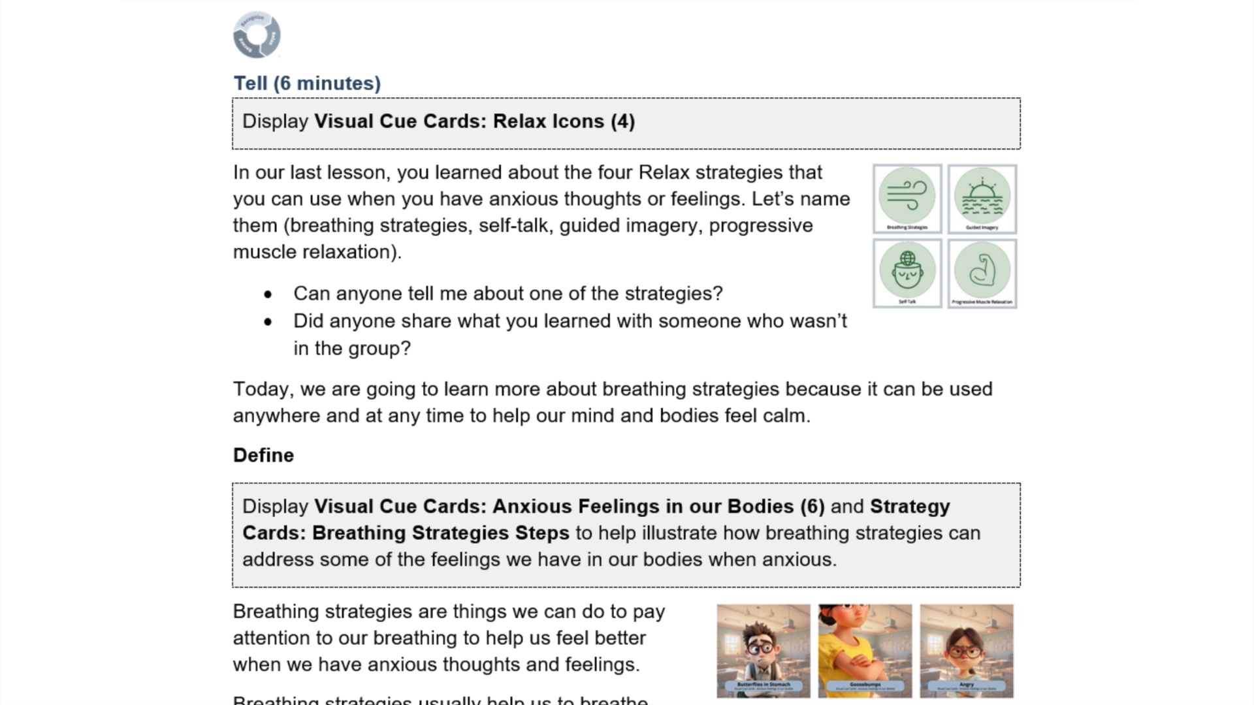

Video Model: The Instructional Hub
Notes:
1:30 second video
Video walkthrough of instructional hub

Slide 42
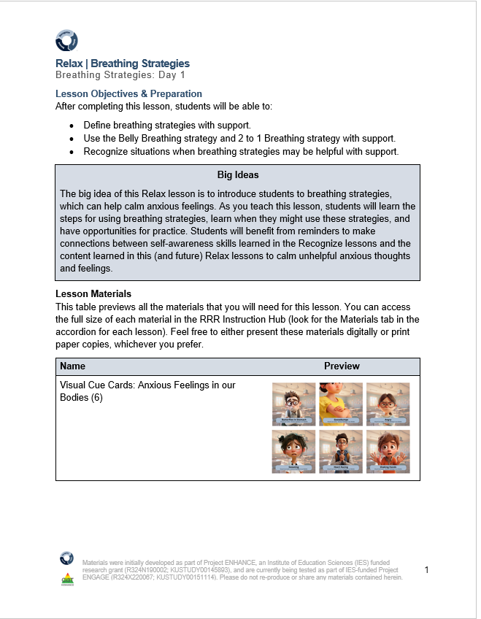
Key Intervention Lesson Features (1 of 2)
Lesson title
Lesson timing
Pacing Guide
Headings
Tell
Show
Do
Practice & Monitor
Generalize & Close
Learning objectives
Big Ideas of the lesson
Materials
Notes:
Lesson plans have consistent format – each lesson has a title, learning objective, big ideas, and materials you will need

Slide 43
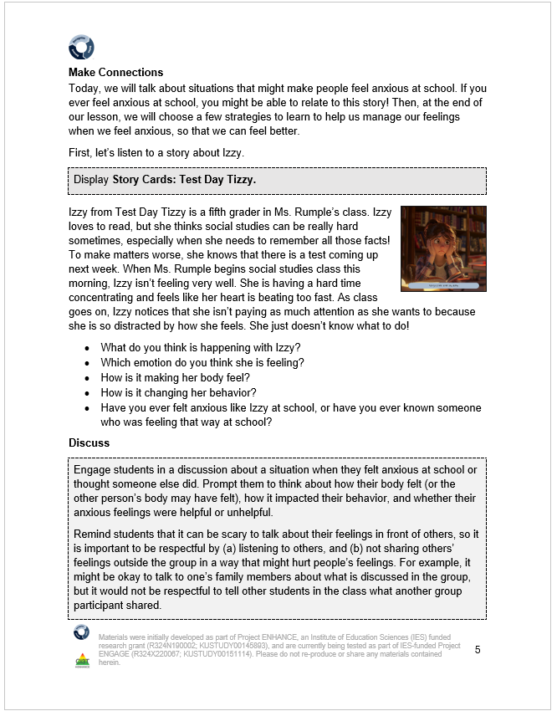





Key Intervention Lesson Features (2 of 2)
Situational stories and other examples
Notes:
Story Cards and examples built in. Can edit to meet needs of students.
Likely teaching at small group table – teachers have used hard-copy materials, flipped their computer around, or used a second monitor. Set up to be flexible and meet your needs!

Slide 44
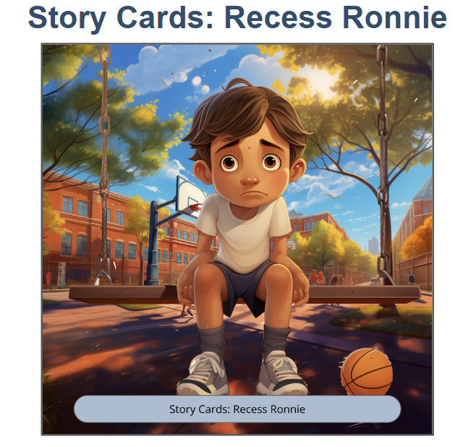

Recess Ronnie

Slide 45


Lesson Activities
Embedded materials throughout

Slide 46
3 Intervention Components

Slide 47

Recognize. Relax. Record. Intervention Component (Recognize)
Recognizing and understanding our emotions is a key component for self-awareness
Students learn to:
Lesson 1: Understanding anxious feelings
Lesson 2: Identifying anxious thoughts and feelings
Lesson 3: Choosing strategies to help manage anxious thoughts and feelings

Slide 48

Recognize. Relax. Record. Intervention Component (Relax)
Students learn strategies to respond when they feel anxious
Breathing Strategies
Self-talk
Guided Imagery
Progressive Muscle Relaxation
For each strategy, students will:
Define
Learn to use
Recognize situations for when to use
Demonstrate (and practice)

Slide 49
Recognize. Relax. Record. Intervention Component (Record)
Students learn how to monitor their own feelings and behaviors
Lesson 1: Learning to Self-Monitor (Record) our Behaviors
Focus: Academic Engagement
Lesson 2: Learning to Self-Monitor (Record) our Thoughts, Feelings, and Behaviors
Focus: Anxious thoughts and feelings
Focus: Use of relaxation strategies

Slide 50



Engaged or Distracted

Slide 51


RRR Ready-Go! and Optional Review Lessons
Lesson taught after a few
days of RRR In-Class
Optional customizable lesson following an extended break

Slide 52
Step 5
Implement RRR In-Class and Monitor Student Performance

Slide 53



RRR In-Class
Teachers continue to collect DBR data four times a week (Monday-Thursday)
Students use the Student Self-Monitoring sheet to self-monitor their engagement, anxious feelings, and use of relaxation strategies
Teachers facilitate self-monitoring (e.g., audio cue, brief check-ins)

Slide 54


Student Self-Monitoring Sheet
RRR-Ding provides
audio cue for intervals

Slide 55
Video Model: RRR In-Class Procedures
Notes:
01:30

Slide 56
Step 6
Monitor maintenance and generalization

Slide 57


Step 6 Monitor maintenance and generalization
Notes:
To support these endeavors of extending the application of the intervention, we have family materials that Amy showcased earlier as well as infographics specifically for families embedded throughout the module to help educate families on the practice and encourage generalization outside of the school building ☺

Slide 58
Step 7
Seek input from students, families, and teachers

Slide 59



Step 7: Seek input from student, families, and teachers

Slide 60

Project ENGAGE
A special thank you to teachers who participated! It was gift to learn from and with you!!!

Slide 61
Preliminary findings of a cluster randomized controlled trial

Slide 62

Method: Research Questions
Does RRR decrease anxious feelings for third-, fourth- and fifth-grade students with and at-risk for EBD, specifically internalizing behaviors when implemented with limited university support?
To what extent is RRR implemented as designed when implemented with limited university support?
Do consumers view RRR to be socially valid?

Slide 63
Method: Group Descriptions
Treatment Condition (Group 1)
Waitlist-Control Condition (Group 2)
Engage in ≈ 6 hours of paid professional learning
Learn how to use RRR with their students
Work with up to three students who meet criteria
15 small group sessions (20-30 min)
During the school day
Support selected students in using new skills and self-monitoring during another time of the day
4 days per week for ≈ 4-6 weeks
Implement regular school practices until spring break, then:
Engage in ≈ 6 hours of paid professional learning
Learn how to use RRR with their students
Work with up to three students who meet criteria
15 small group sessions (20-30 min)
During the school day
Support selected students in using new skills and self-monitoring during another time of the day
4 days per week for ≈ 4-6 weeks

Slide 64
Method: Student Selection Criteria
Behavior
SRSS-I5 score: Moderate (2-3) or High (4-15)
Attendance
Missing no more than 5 days in first 6 weeks of school
Grade-level
3rd, 4th, 5th grade

Slide 65
Method: Primary Measures
Student Outcomes
ASEBA Teacher Report Form (TRF; Teachers)
Social Skills Improvement System (SSiS; Teachers, Families, Students)
Direct Behavior Rating
Treatment Integrity
RRR Instruction Treatment Integrity form (Teachers, Research Staff)
RRR In-Class Treatment Integrity form (Teachers, Research Staff)
Social Validity
IRP-15 (Teachers, Families)
CIRP (Students)
Teacher and student interviews

Slide 66
Method: Teacher Training
Timepoint & Topic | Group 1 (Will start in Fall) | Group 2 (Will start in Spring)
Training 1: Overview & Direct Behavior Ratings 4:30 pm – 6:30 pm | Tuesday, October 29, 2024 or Wednesday, October 30, 2024 | Tuesday, February 18, 2025 or Wednesday, February 19, 2025
Training 2: RRR Instruction 4:30 pm – 6:30 pm | Tuesday, November 5, 2024 or Wednesday, November 6, 2024 | Wednesday, March 5, 2025 or Thursday, March 6, 2025
Training 3: RRR In-Class 4:30 pm – 6:30 pm | Tuesday, December 3, 2024 or Wednesday, December 4, 2024 | Tuesday, April 1, 2025 or Wednesday, April 2, 2025
Notes:
Share key details- at Bishop, with teachers from other schools
Don’t need to worry about jotting down these dates, we’ve got a copy to share with you later!

Slide 67


Discussion
Preliminary results show moderate intervention effects on teacher-rated internalizing behaviors
On whole, with coaching and support, teachers were able to successfully implement Recognize. Relax. Record. with a high degree of fidelity
Social validity ratings indicate the intervention met (or even exceeded) expectations
Further analysis and testing needed, but results indicate Recognize. Relax. Record. is a promising Tier 2 intervention

Slide 68
Next steps and resource sharing

Slide 69



Resource Sharing: Enhancing Ci3T Modules
ci3t.org/enhance

Slide 70

Project EMPOWER+
EMPOWER+ Session | Date
Starting Strong: Effective Tier 1 Practices for Educators | September 24, 2025 (Wednesday)
From Data to Action: Using Systematic Screening to Inform Instruction | October 8, 2025 (Wednesday)
Ci3T In Action: Integrated Lesson Planning for Enhanced Instruction | November 18, 2025 (Tuesday)
Mastering Behavior Specific Praise and Precorrection | January 21, 2026 (Wednesday)
A 6-Step Instructional Approach for Responding to Challenging Behaviors: A Tier 1 Practice | February 10, 2026 (Tuesday)
A Tier 2 Support for Students Experiencing Anxious Feelings: Recognize. Relax. Record. | March 25, 2026 (Wednesday)
A Tier 3 Support for Students with Intensive Intervention Needs: Functional Assessment-Based Intervention (FABI) | April 28, 2026 (Tuesday)

Slide 71
Action Items
Action Item | Person(s) Responsible | Planned Completion Date | Date Completed
Review systematic screening data (winter) to see which students might benefit from Recognize. Relax. Record. (RRR) | Amy | 3/25/26
Explore the possibility of implementing RRR with your school site colleagues and principal | Amy | 3/25/26
Visit the UConn DBR Training Site | Allison | 3/20/26

Slide 72




Thank you!
#Ci3T
@Ci3Tmodel
Tag us in your Ci3T highlights, we love to see Ci3T in action!
Follow us on Instagram for updates and new resources!
Kathleen.lane@ku.edu
Notes:
Tag us in your Ci3T highlights- we would love to see Ci3T in action! Follow us on Instagram for updates and links to resources! @Ci3TModel

Slide 73



Conference Evaluation
Please take a few moments to complete the conference evaluation as you attend sessions.
Thank you for sharing your time and insights!
Scan the QR code to link to the Conference Evaluation

