Slide 1

Using Systematic Screening Data to Inform Instruction (5D)
Presenters: Kathleen Lynne Lane, PhD, BCBA-D, CF-L2 | University of Kansas
Mark Buckman, PhD| University of Kansas
Rebecca Sherod Adams, MSE | Arizona State University

Slide 2
Learning Objectives
Describe Systematic Screening
Use Systematic Screening data to:
Inform instruction
Empower teachers with low-intensity strategies
Connect students to Tier 2 and Tier 3 interventions
Identify resources to learn about screening

Slide 3
Agenda
What is Systematic Screening?
Using Screening Data to Inform Instruction – Illustrations of using data to
Shape Tier 1 Efforts
Empower Teachers with Low-intensity Strategies
Connect Students to Tier 2 and Tier 3 Efforts
Additional Resources and Wrap Up

Slide 4
What is Systematic Screening?

Slide 5
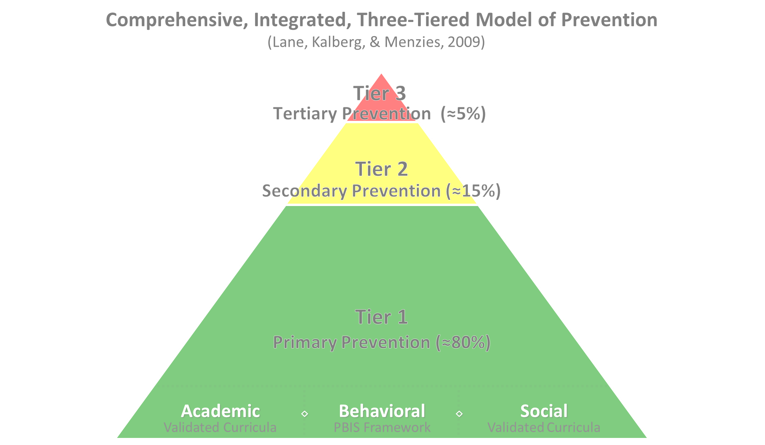

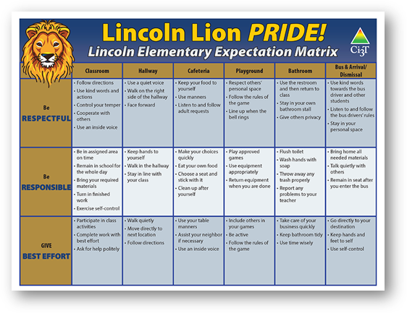
Comprehensive, Integrated, Three-Tiered Model of Prevention 2
Positive Behavioral Interventions and Supports
District & State Standards Quality Instruction
Validated Curricula and Resources

Slide 6

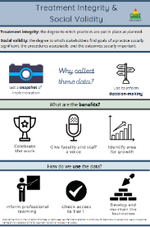
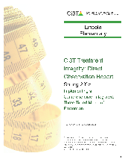

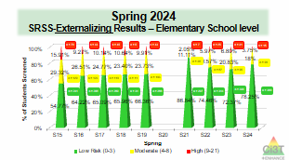
Essential Components of Primary (Tier 1) Prevention Efforts
Social Validity
Systematic Universal Screening
Academic
Behavior
Treatment Integrity
ci3t.org/measures
ci3t.org/screening

Slide 7

Systematic Screening … Logistics
Fall
Winter
Spring
Selecting
Installing
Analyzing

Slide 8
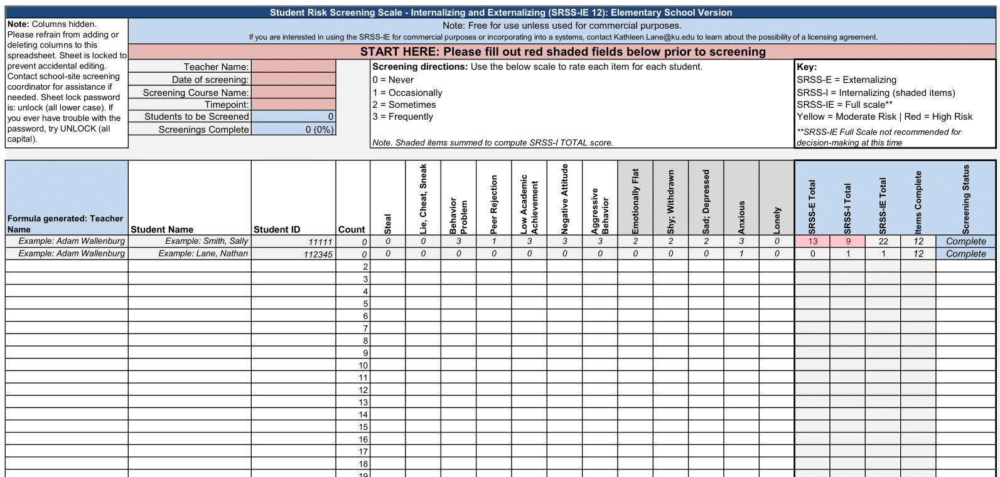
Student Risk Screening Scale – Internalizing and Externalizing (SRSS-IE; Drummond, 1994; Lane & Menzies, 2009) Elementary
Internalizing
Externalizing

Slide 9
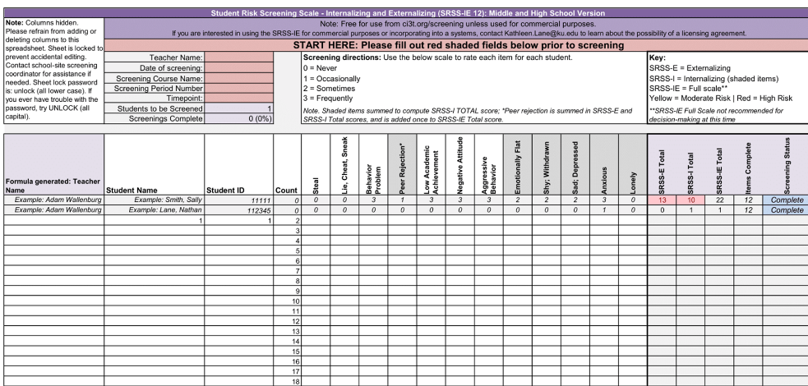
Student Risk Screening Scale – Internalizing and Externalizing (SRSS-IE; Drummond, 1994; Lane & Menzies, 2009) Secondary
Internalizing
Externalizing

Slide 10
SRSS-IE: Cut Scores
Elementary School
Middle and High School
SRSS-E7 | SRSS-I5
Items 1-7 | Items 8-12
0-3 = low risk 4-8 = moderate risk 9-21 = high risk | 0-1 = low risk 2-3 = moderate risk 4-15 = high risk
SRSS-E7 | SRSS-I6
Items 1-7 | Items 4, 8-12
0-3 = low risk 4-8 = moderate risk 9-21 = high risk | 0-3 = low risk 4-5 = moderate risk 6-18 = high risk
Elementary School Level:
Lane, K. L., Oakes, W. P., Swogger, E. D., Schatschneider, C., Menzies, H., M., & Sanchez, J. (2015). Student risk screening scale for internalizing and externalizing behaviors: Preliminary cut scores to support data-informed decision making. Behavioral Disorders, 40, 159-170.
Middle and High School Levels:
Lane, K. L., Oakes, W. P., Cantwell, E. D., Schatschneider, C., Menzies, H., Crittenden, M., & Messenger, M. (2016). Student Risk Screening Scale for Internalizing and Externalizing Behaviors: Preliminary cut scores to support data-informed decision making in middle and high schools. Behavioral Disorders, 42(1), 271-284

Slide 11
Fall Over Time SRSS-Externalizing Results – Elementary School Level (1 of 2)
Notes:
Fill in <year> based on current academic year. This is located in column A of the data sheet. Edit by right clicking and selecting “Edit data”.

Slide 12
Fall Over Time SRSS-Internalizing Results – Elementary School Level (1 of 2)
Notes:
Fill in <year> based on current academic year. This is located in column A of the data sheet. Edit by right clicking and selecting “Edit data”.

Slide 13
Fall 2024 SRSS-Internalizing Results – Elementary School Grade Level
Grade Level | N Screened | Low n (%) | Moderate n (%) | High n (%)
K | 46 | 26 (56.52) | 9 (19.57) | 11 (23.91)
1 | 60 | 41 (68.33) | 9 (15.00) | 10 (16.67)
2 | 85 | 66 (77.65) | 15 (17.65) | 4 (4.71)
Notes:
Fill in <year> based on current academic year. This is located in column A of the data sheet. Edit by right clicking and selecting “Edit data”.

Slide 14
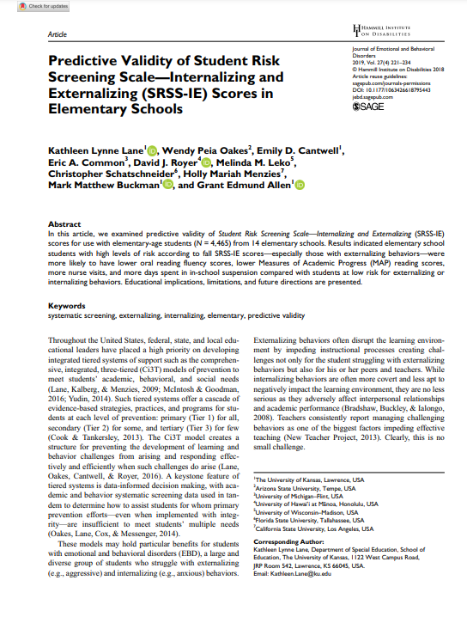
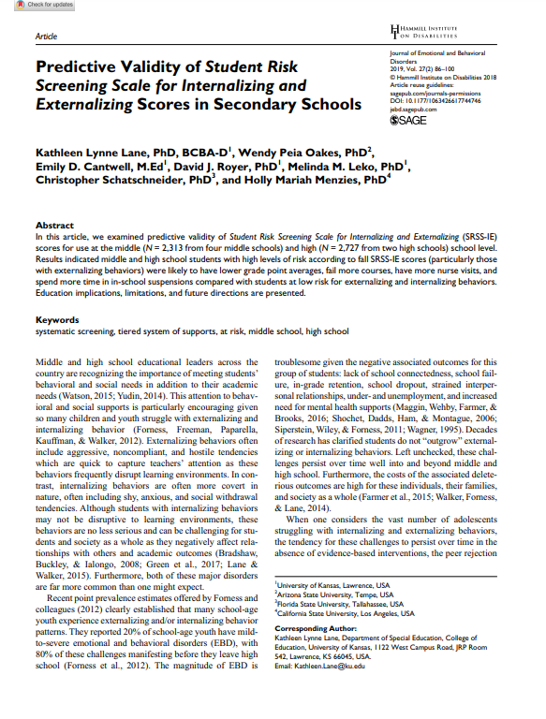
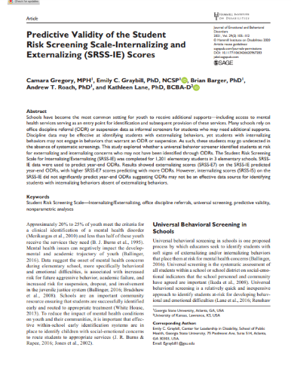
SRSS-IE Scores Predict Student Outcomes
Fall
Winter
Year End
ODR Suspensions
Nurse Visits
Course Failures

Slide 15
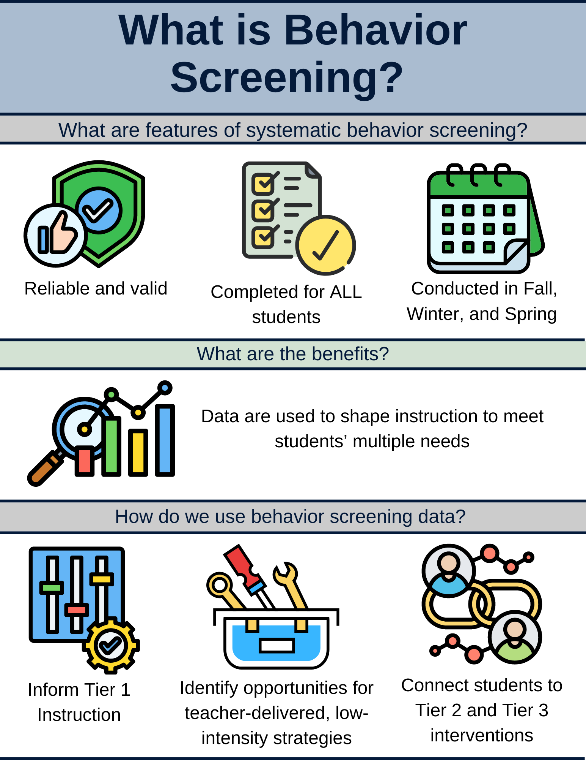
What is Behavior Screening? 1

Slide 16
What is Behavior Screening? 2

Slide 17
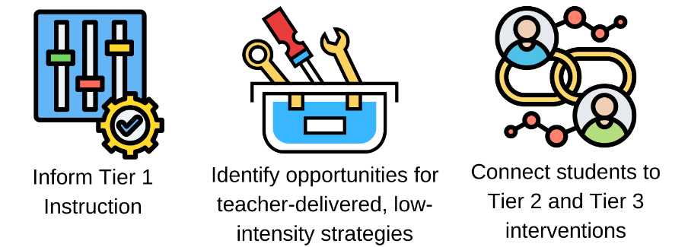
Using Academic and Behavior Screening Data
These academic and behavior screening data are then reviewed alongside other data collected as part of typical school practices (e.g., attendance, office discipline referrals, grades) to:

Slide 18
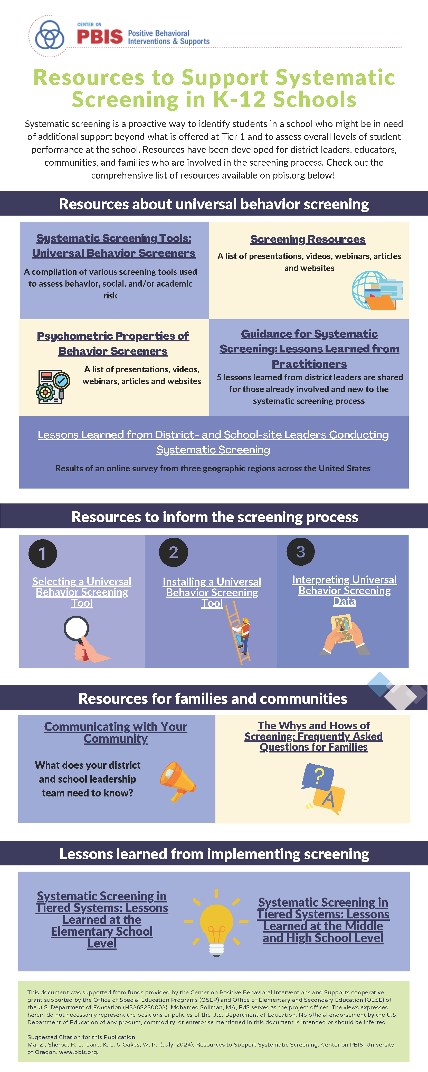


Systematic Screening Resources

Slide 19
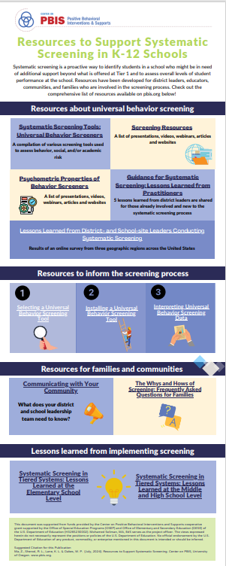

Resources for screening:
PBIS.org…

Slide 20
PBIS Infographic: Resources to Support Systematic Screening in K-12 Schools (1 of 2)

Slide 21
PBIS Infographic: Resources to Support Systematic Screening in K-12 Schools (2 of 2)

Slide 22
Using Systematic Screening Data to Inform Instruction – Illustrations of Using Data to… Shape Tier 1 Efforts

Slide 23
Fall Over Time SRSS-Externalizing Results – Elementary School Level (2 of 2)
Notes:
Fill in <year> based on current academic year. This is located in column A of the data sheet. Edit by right clicking and selecting “Edit data”.

Slide 24
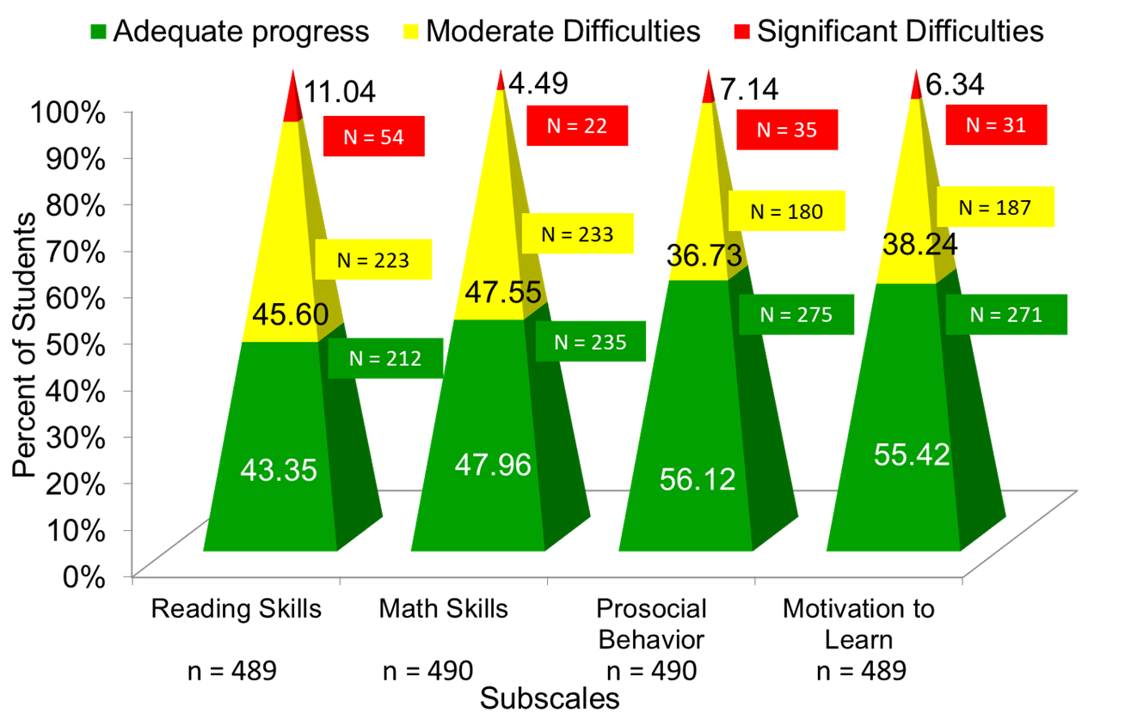
Data to Indicate a Focus on Tier 1: School Level
Social Skills Improvement System – Performance Screening Guide Spring 2012 – Total School
Lane, K. L., Oakes, W. P., & Magill, L. (2013). Primary prevention efforts: How do we implemented and monitor the Tier 1 component of our Comprehensive, Integrated, Three-Tiered (Ci3T) Model?, Preventing School Failure, 58(1), 143-158.

Slide 25
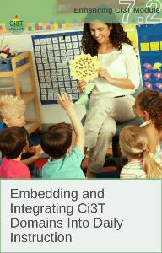
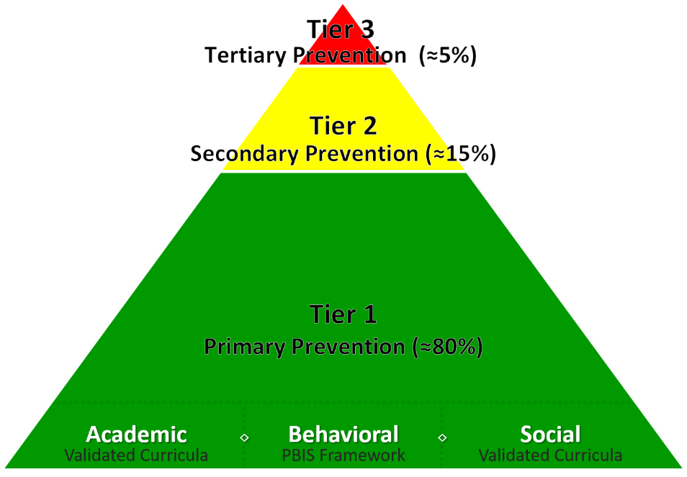
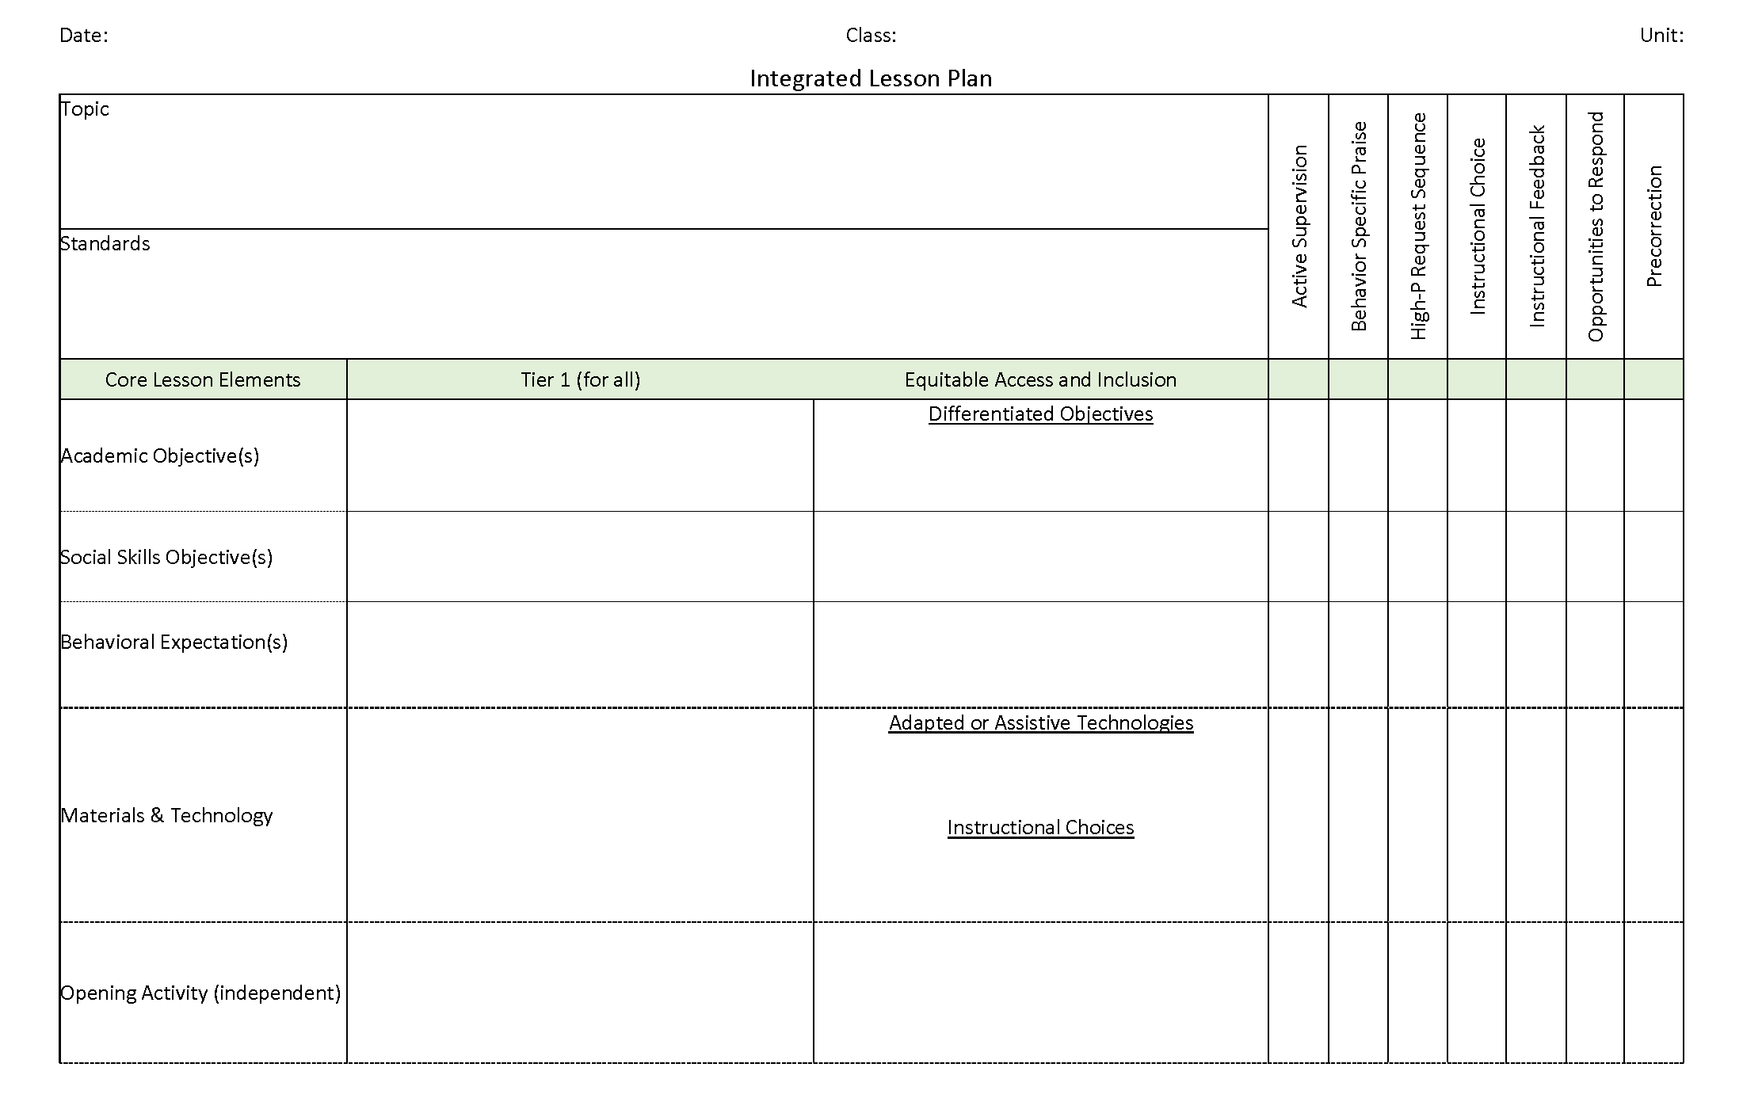
Ci3T Integrated Lesson Planning
Citation. Oakes, W. P., Lane, K. L., Lane, K. S., & Buckman, M. M. (2019). Ci3T integrated lessons plan template. www.ci3t.org.
Completed examples available in: Ci3T Project ENHANCE Research Team. (2022, July). Embedding and integrating Ci3T domains into daily instruction. Author. https://doi.org/10.17161/ci3t.42880

Slide 26
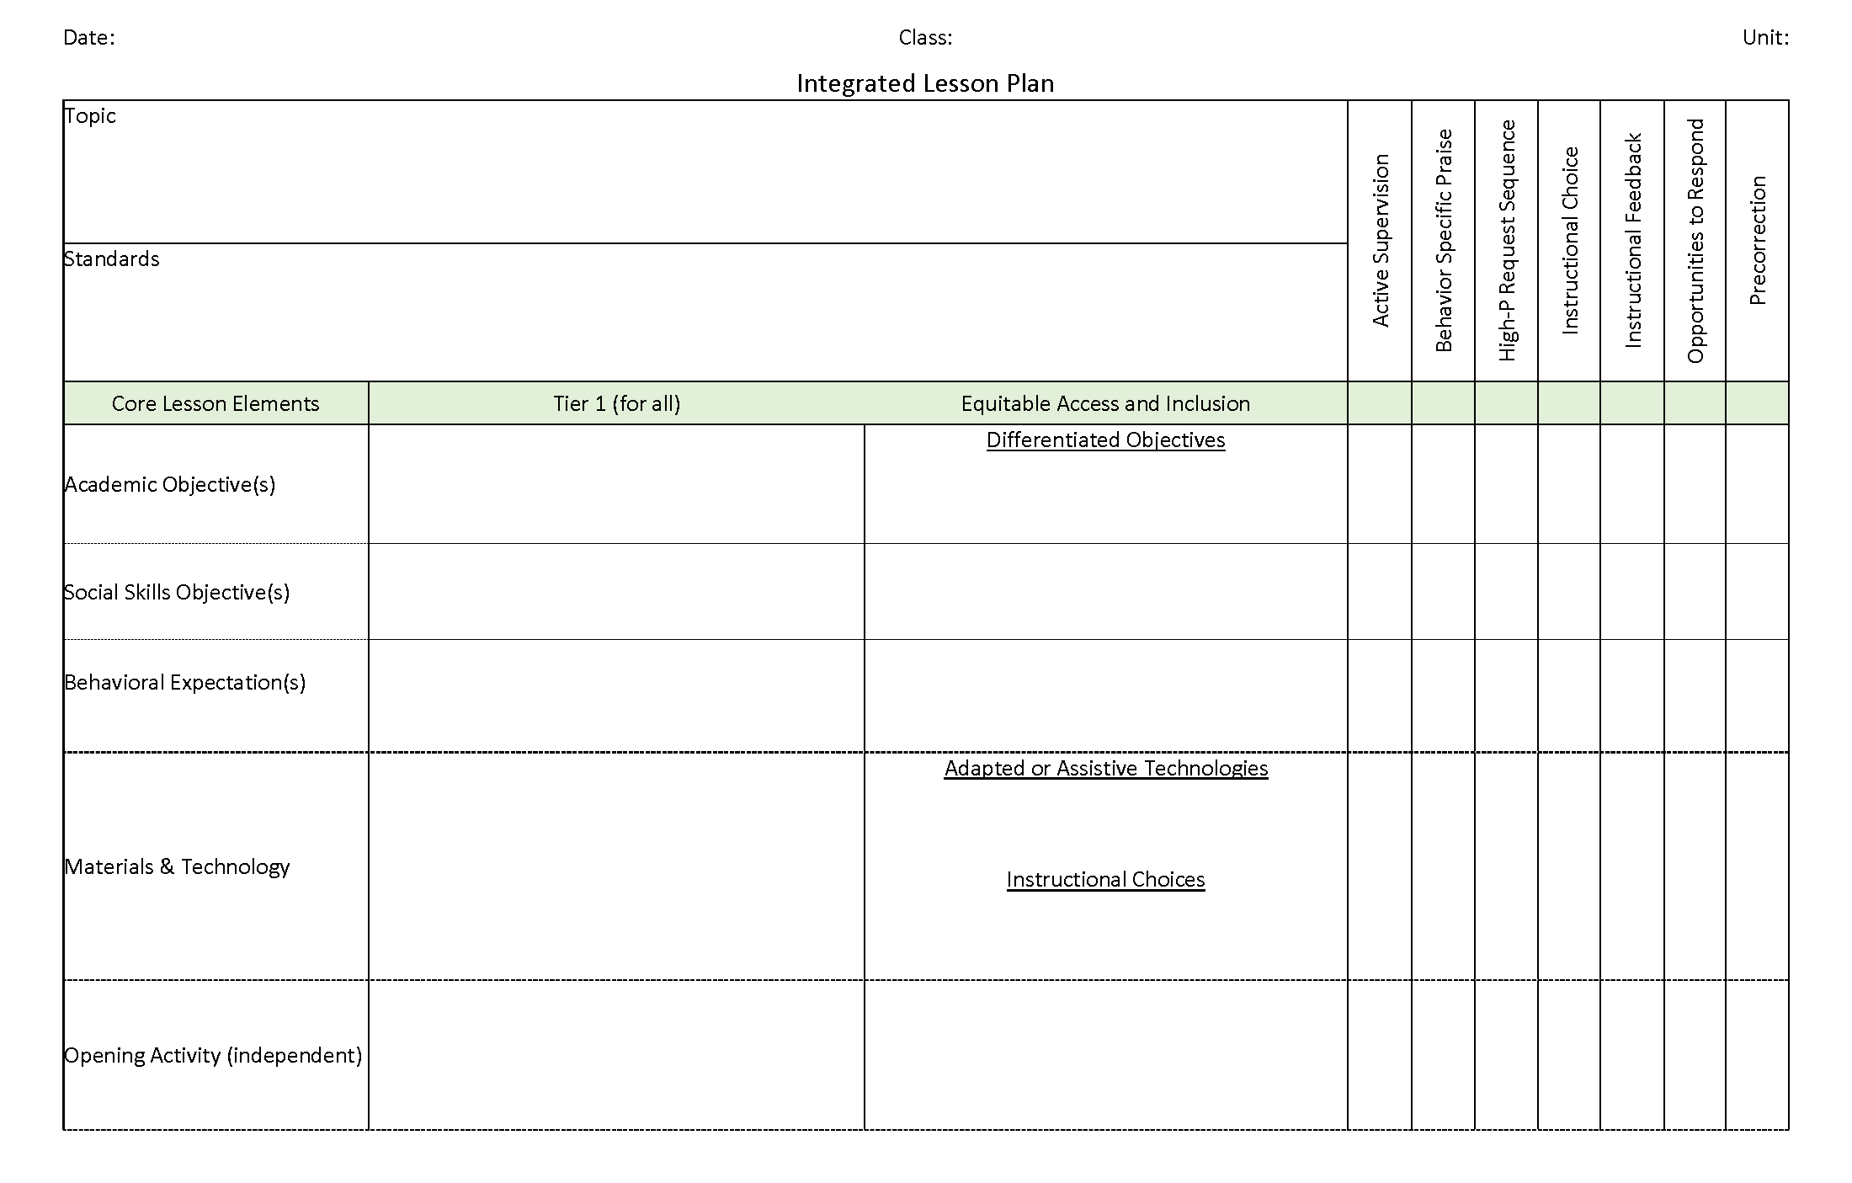
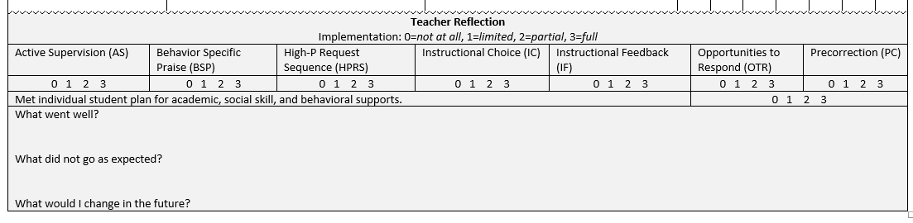
Integrated Lesson Plan
Citation. Oakes, W. P., Lane, K. L., Lane, K. S., & Buckman, M. M. (2019). Ci3T integrated lessons plan template. www.ci3t.org.​

Slide 27

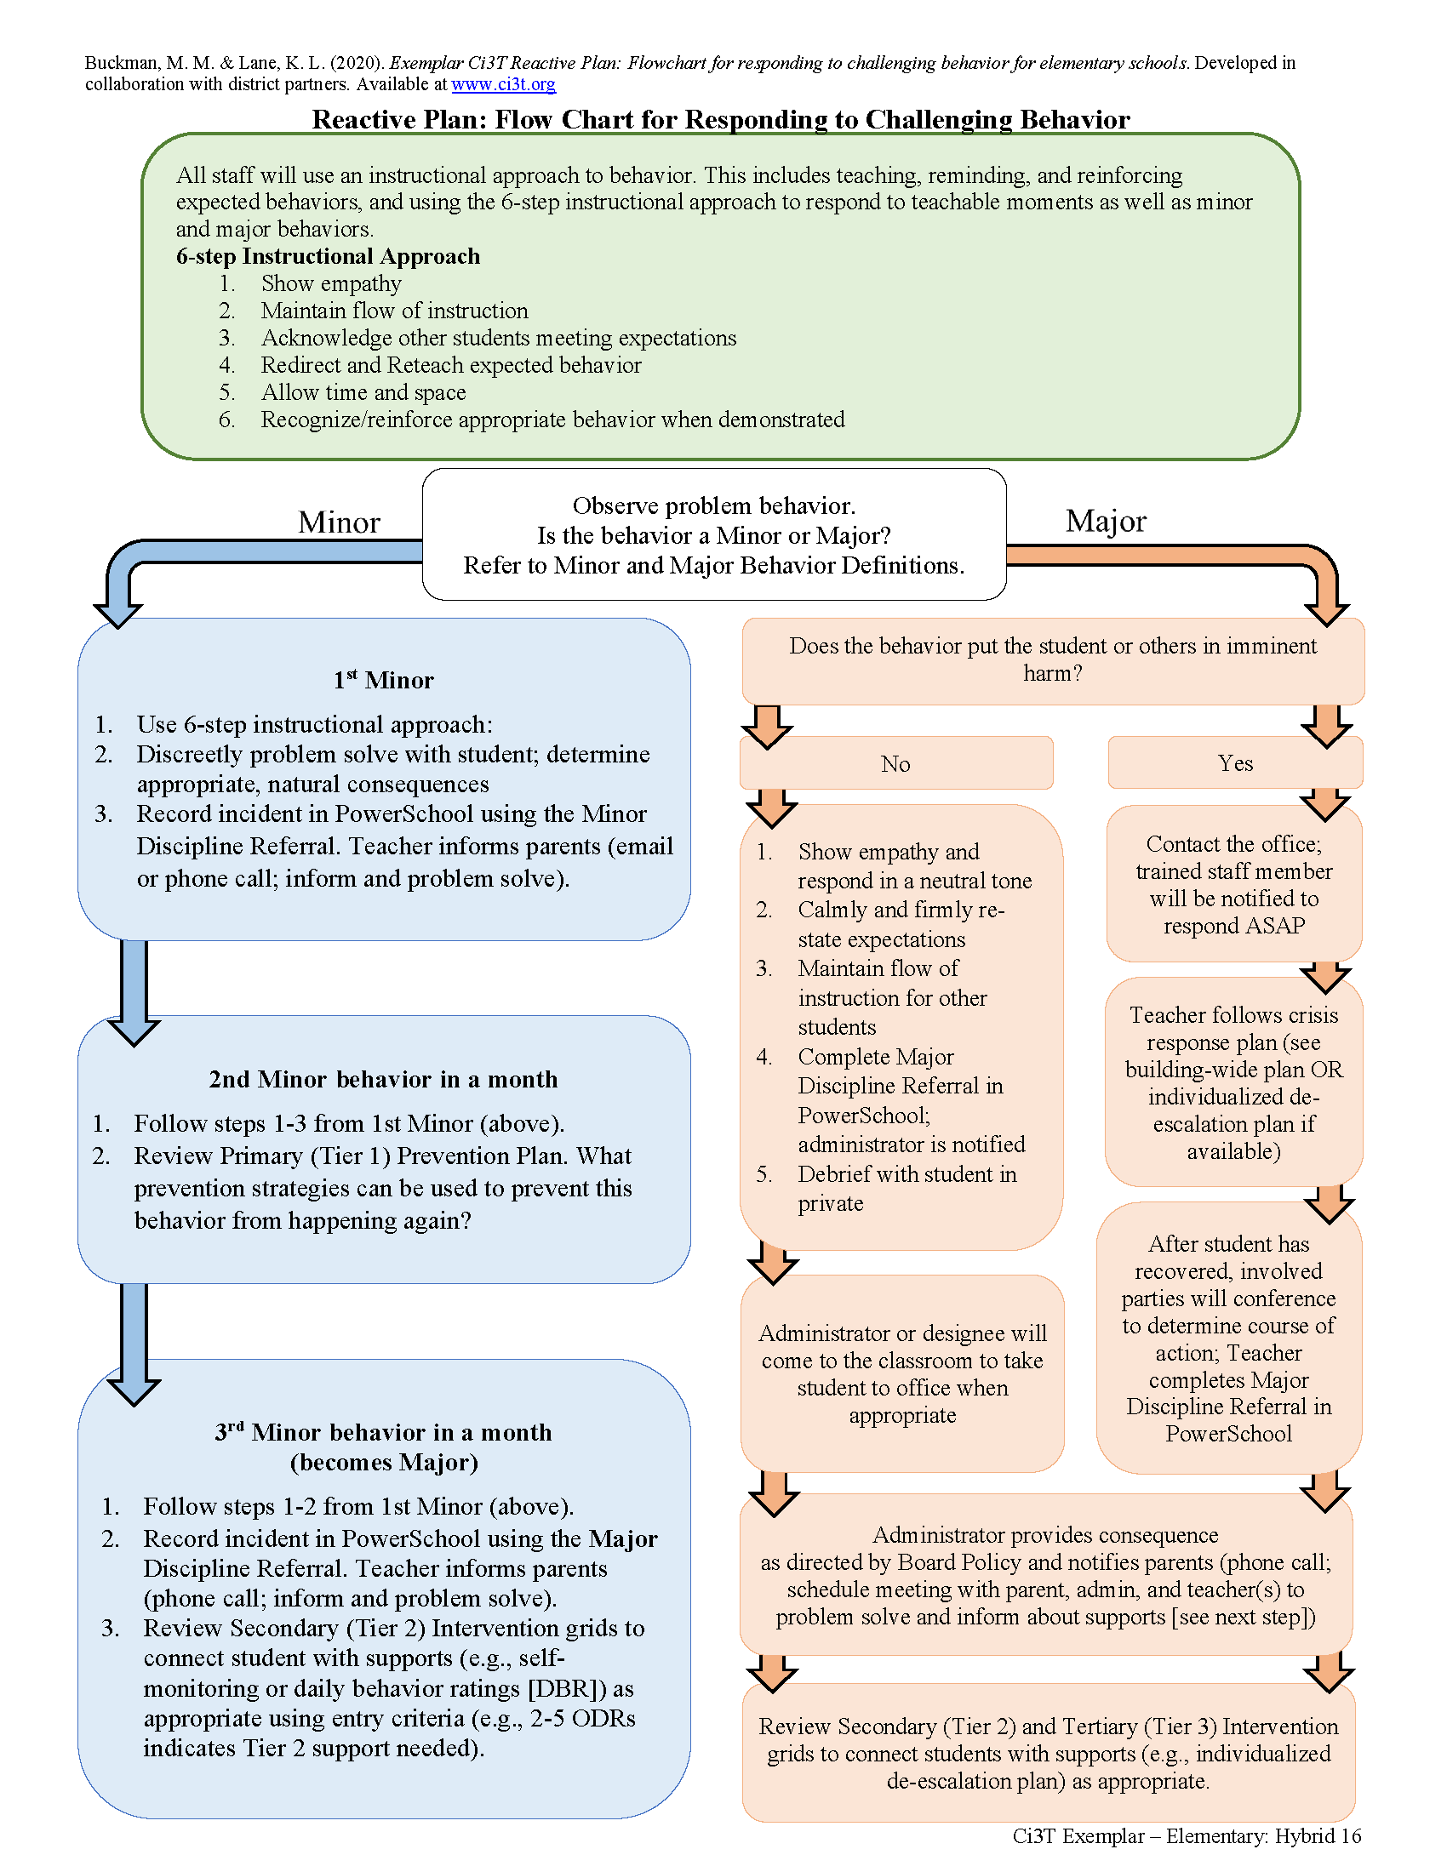

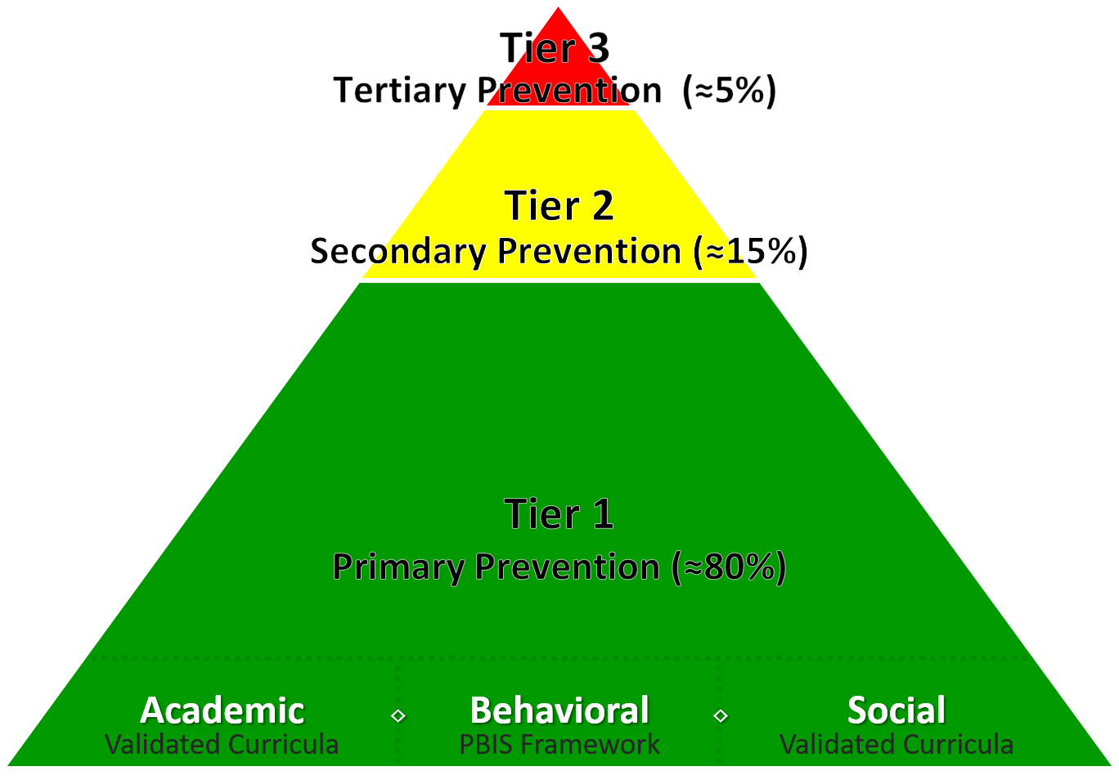
A Focus on: Responding to Challenging Behavior

Slide 28
Reactive Plan: Flow Chart for Responding to Challenging Behavior 2

Slide 29

6-Step Instructional Approach for Responding to Challenging Behavior
Step 1
Show empathy
Step 2
Maintain the flow of instruction
Step 3
Acknowledge other students meeting expectations
Step 4
Redirect and reteach expected behavior
Step 5
Allow time and space
Step 6
Recognize and reinforce

Slide 30
Using Systematic Screening Data to Inform Instruction – Illustrations of Using Data to… Empower Teachers with Low-Intensity Strategies

Slide 31
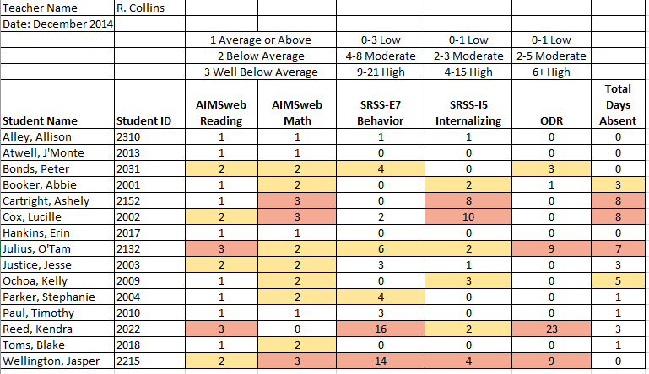
Examining Academic and Behavioral Data
Lane, K. L., Menzies, H. M., Ennis, R. P., & Oakes, W. P. (2015). Supporting Behavior for School Success: A Step-by-Step Guide to Key Strategies. Guilford Press.
Notes:
Lane, K. L., Oakes, W. P., Ennis, R. P., & Hirsch, S. E. (2014). Identifying students for secondary and tertiary prevention efforts: How do we determine which students have Tier 2 and Tier 3 needs? Preventing School Failure, 58, 171-182, DOI: 10.1080/1045988X.2014.895573

Slide 32
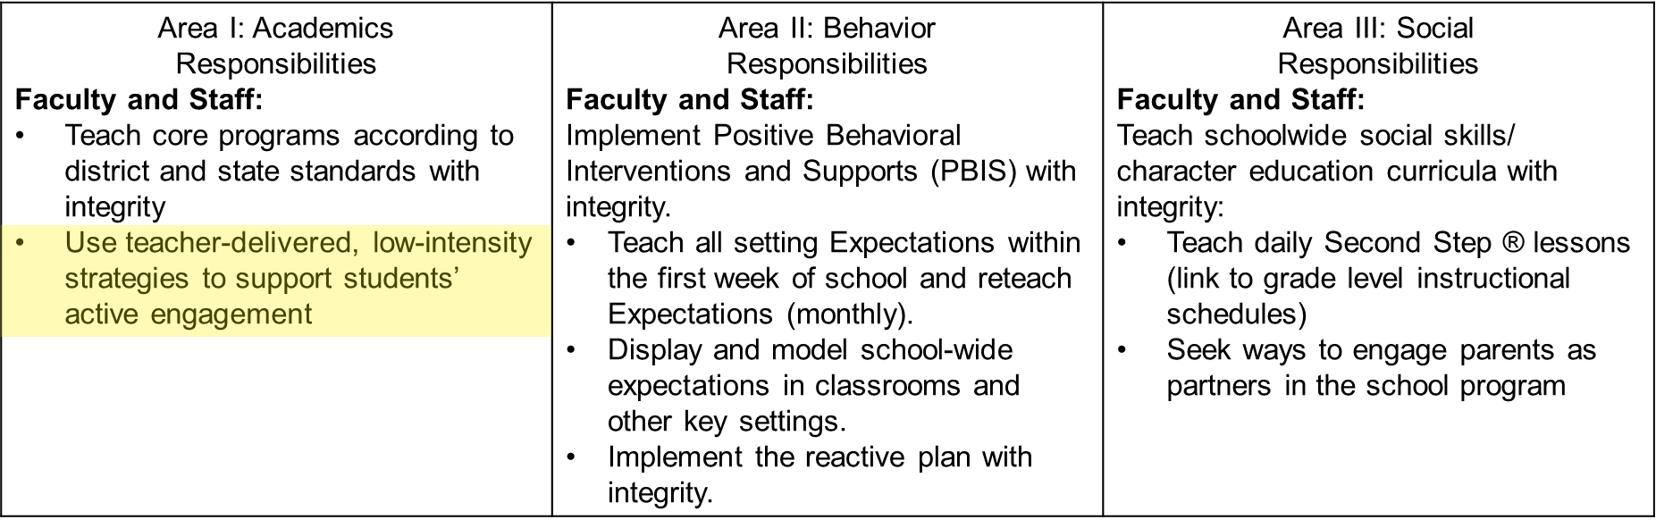

Low-Intensity Teacher-Delivered Strategies

Slide 33
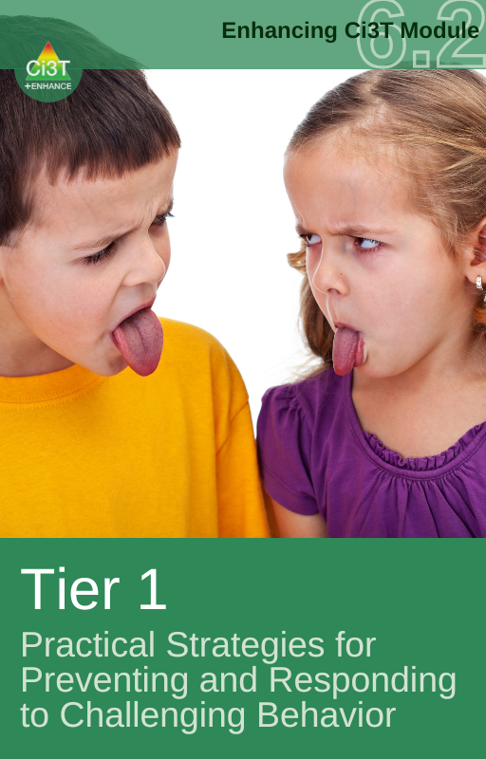
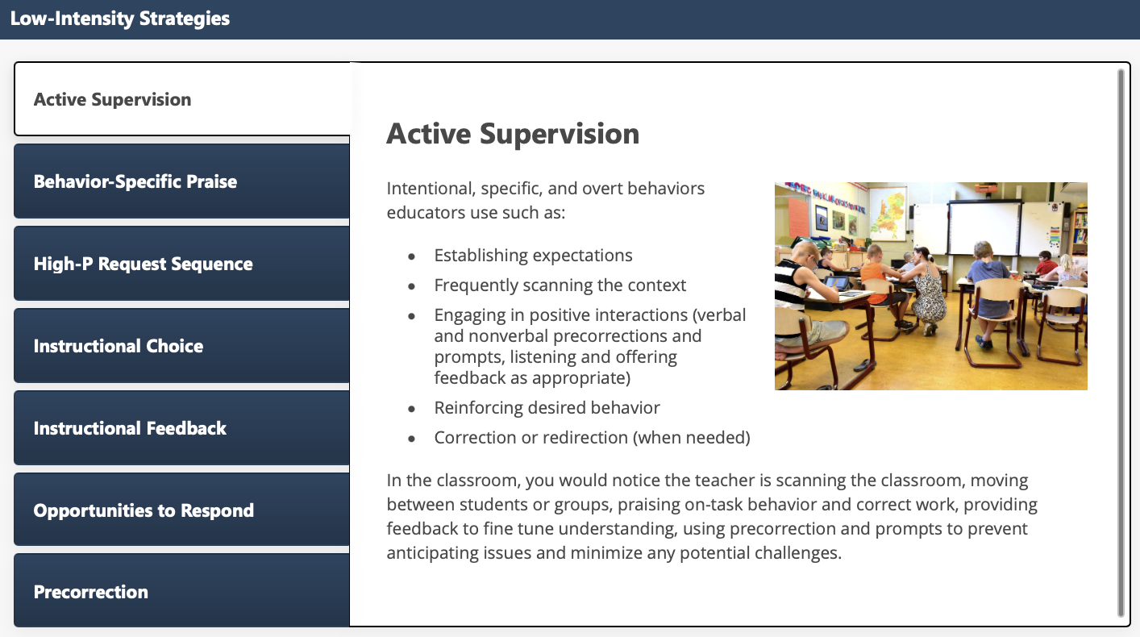
Low-Intensity Strategies: Academic Supervision

Slide 34
Low-Intensity Strategies
Low-Intensity Strategy | Franklin High School On-Site Expert
Behavior-Specific Praise: Identifying the specific expectation the student met. “Niama, I noticed you outlined your paper and used the graphic organizer to draft your essay. Well done!” “Justice, thank you for pushing in your chair to keep the walkway safe.” | Eric Common, Behavior Specialist Mark Buckman, Special Education Grant Allen, Parent Volunteer Paloma Pérez-Clark, School Psychologist
Opportunities to Respond: Providing 4-6 opportunities per minute for students to respond individually, choral, verbal, written, gesture, or symbol. “Show me thumbs or thumbs down if...” “Show me on your white board what…” “Turn to your elbow partner and say…” “All together now, what is…” | David Royer, Administration Emily Cantwell, 12th Grade Scarlett Lane, 11rd Grade Mallory Messenger, Counselor
Instructional Choice: Providing within-task or between task choices to increase academic engaged time and motivation. “Ronaldo, our of our 3 learning objectives today, which would you like to work on first?” “Suzy, do you want to work on the laptop, or handwrite your answers for this assignment?” | Abbie Jenkins, 10th Grade Scarlett Lane, 11th Grade José Sousa, PE Liane Johl, 9th Grade

Slide 35
Using Systematic Screening Data to Inform Instruction – Illustrations of Using Data to… Connect Students to Tier 2 and Tier 3 Efforts

Slide 36
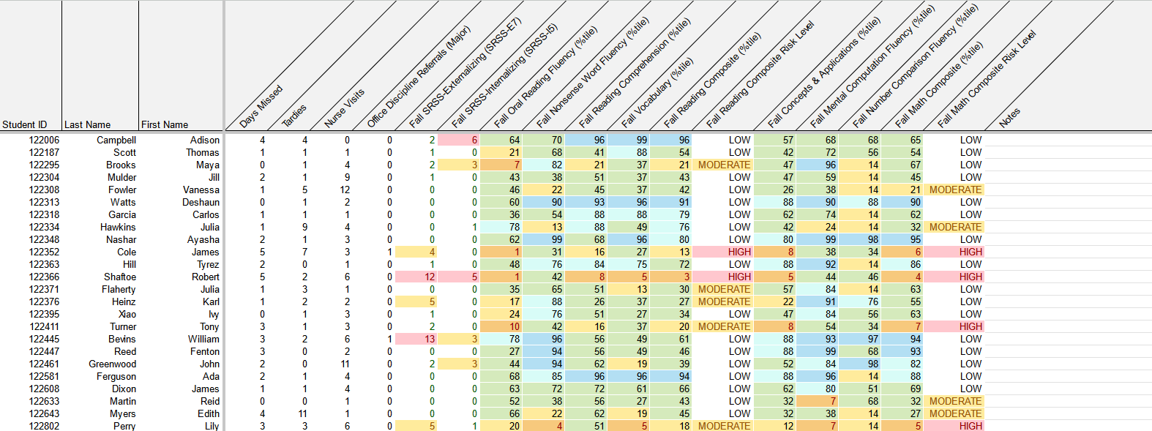
Data Reporting: Integrated Data Dashboards (1)
attendance
behavior
screening
academic screening

Slide 37
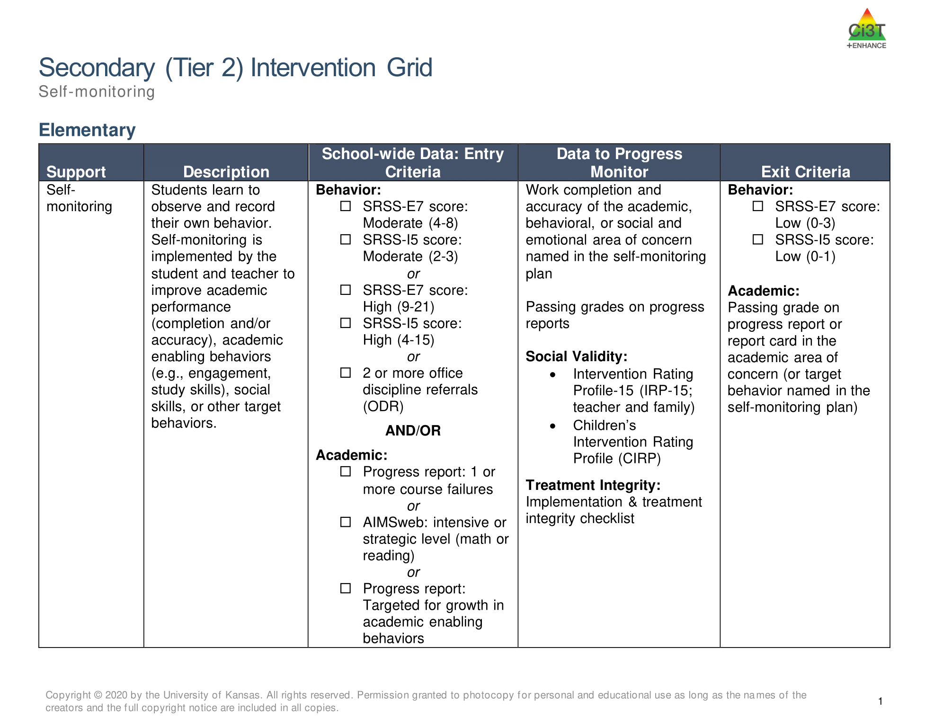
Tier 2 and Tier 3 Intervention Grids
Notes:
Support is the name of the strategy, practice, or program. Notice this is not the name of a person or role.

Slide 38

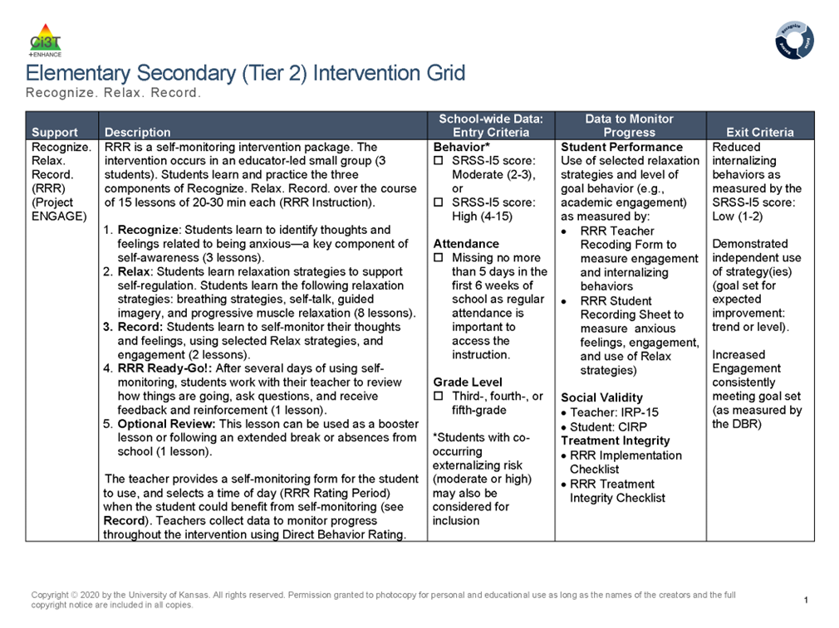
Tier 2: Recognize. Relax. Record

Slide 39

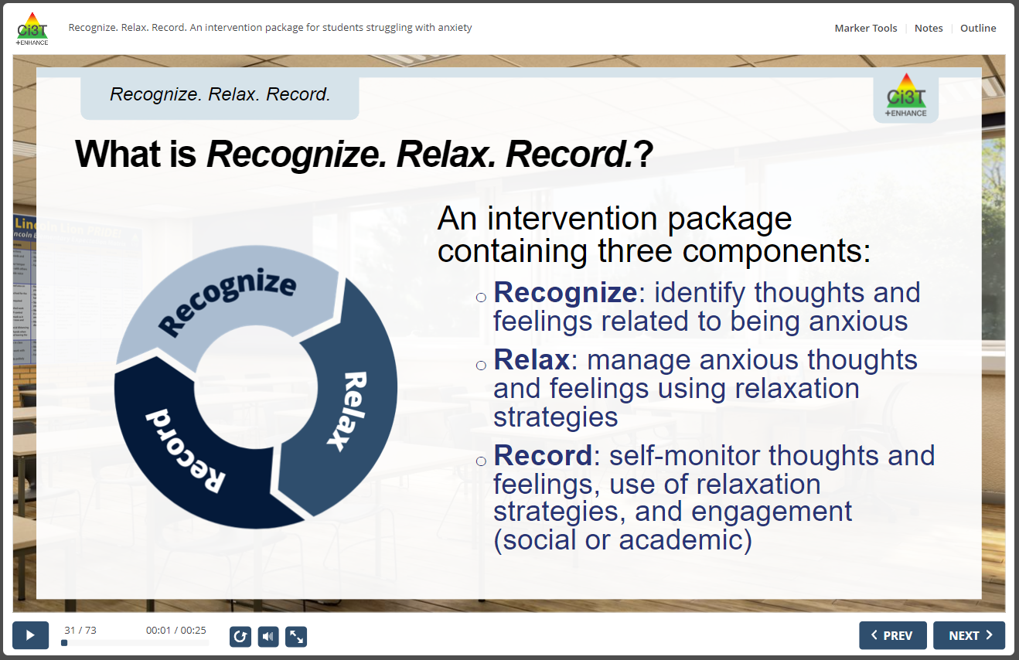
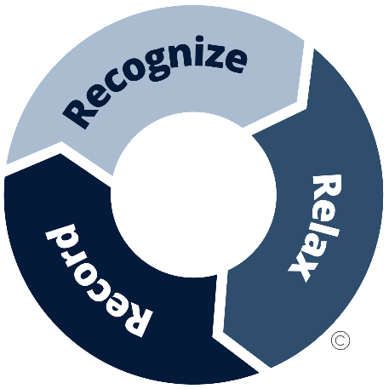
RRR Interactive Resource

Slide 40
Resources to Support Screening

Slide 41
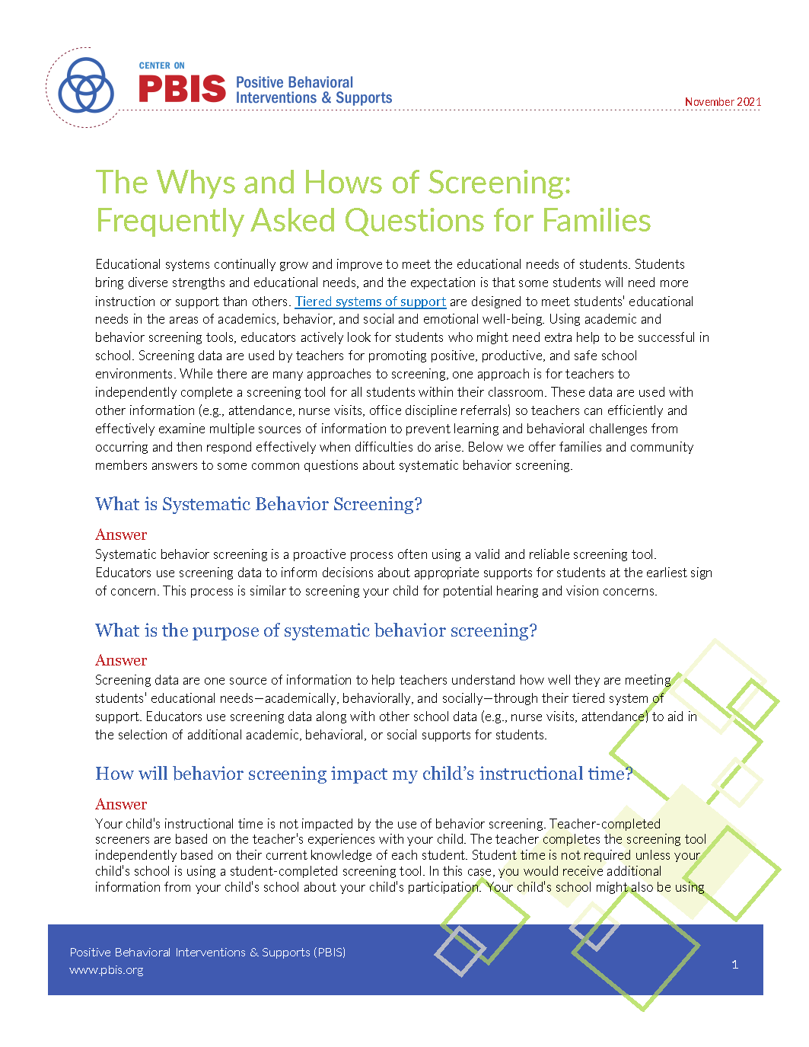
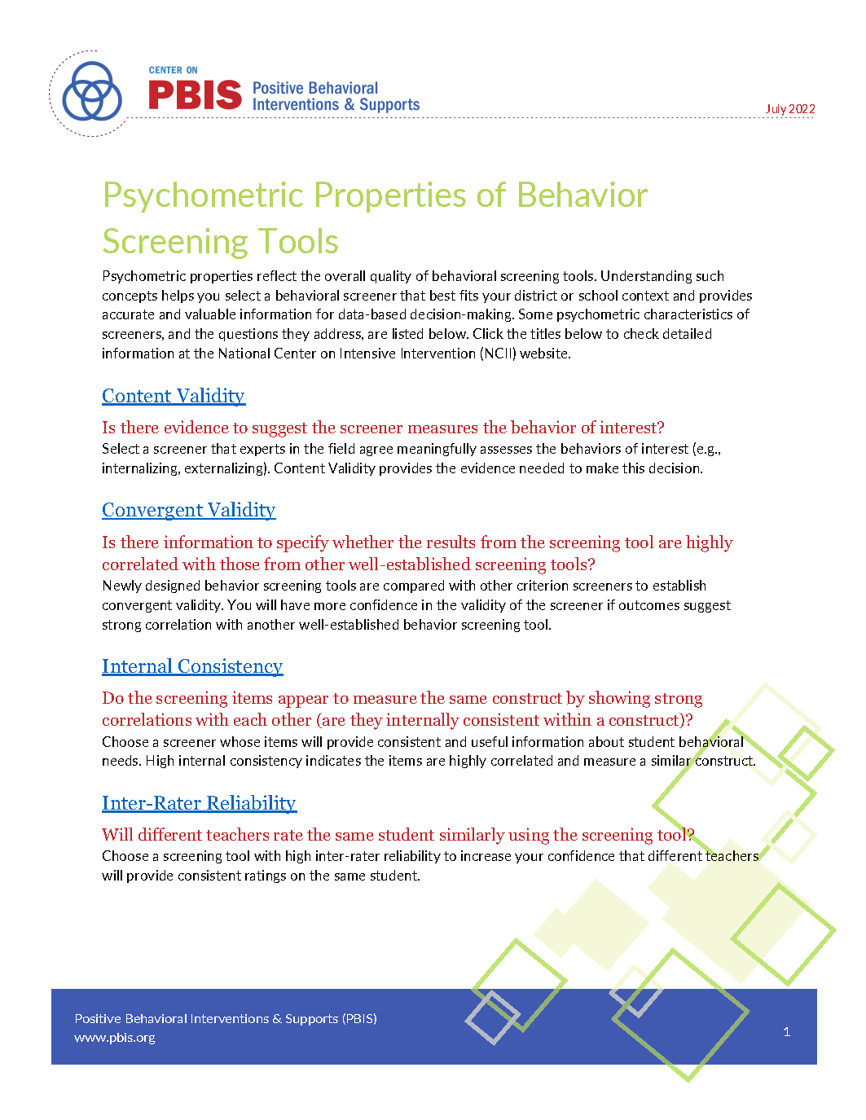
Systematic Screening Resources (PBIS)

Slide 42


Enhancing Ci3T Modules
40+ free-access professional learning modules available at ci3t.org/enhance
Topic areas:
Serving as a Ci3T Leader
Selecting and Installing Behavior Screeners
Primary (Tier 1) Prevention efforts
Low-intensity, Teacher-delivered Strategies
Implementing Secondary (Tier 2) Strategies
Implementing Tertiary (Tier 3) Strategies
Foundational Knowledge

Slide 43
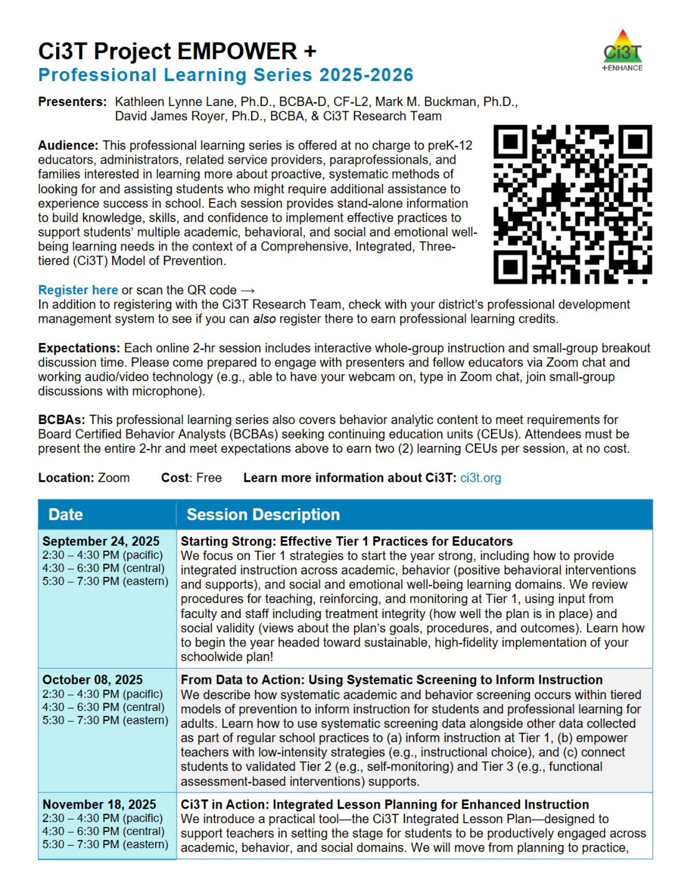
Ci3T EMPOWER Sessions
Free-access, standalone professional learning sessions for any interested person (implementers, community members)
Content focused on building knowledge, skills, and confidence to implement effective practices to support students’ multiple academic, behavioral, and social and emotional well-being needs
Sign-up at ci3t.org/pl

Slide 44
Let’s talk! Screening to Inform Instruction

