Slide 1
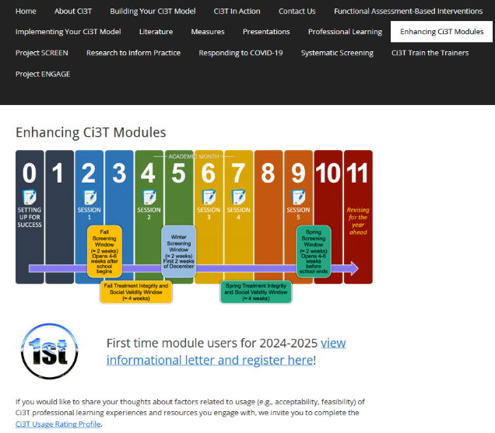
Exploring Lessons Learned from Comprehensive, Integrated Approach to a Three-tiered (Ci3T)
Kathleen Lynne Lane, Ph.D., BCBA-D, CF-L2
Georgia Department of Education
February 4, 2026
We invite you to visit ci3t.org/enhance to access modules and complete a one-time registration process!
*wait 10 minutes after registering to open modules

Slide 2

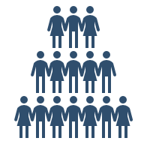

The GaMTSS Journey
Goal: We have established GaMTSS
We will explore lessons learned from Ci3T inquiry
We will use lessons learned from Ci3T inquiry to scale up GaMTSS

Slide 3


With sincere gratitude
The Ci3T Journey

Slide 4
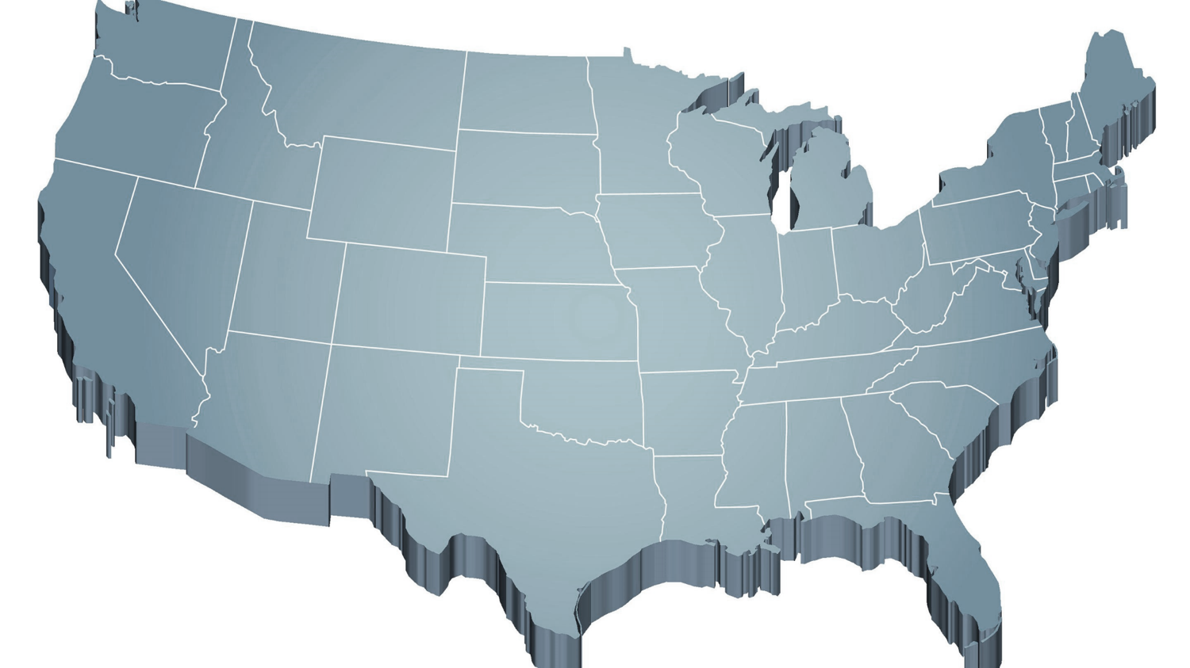
Internalizing and Externalizing
Internalizing
Externalizing
ED <1%
EBD 12-20%
Source: Forness, S.R., Freeman, S.F., Paparella, T., Kauffman, J.M., & Walker, H.M. (2012). Special education implications of point and cumulative prevalence for children with emotional or behavioral disorders. Journal of Emotional and Behavioral Disorders, 20, 4-18.

Slide 5
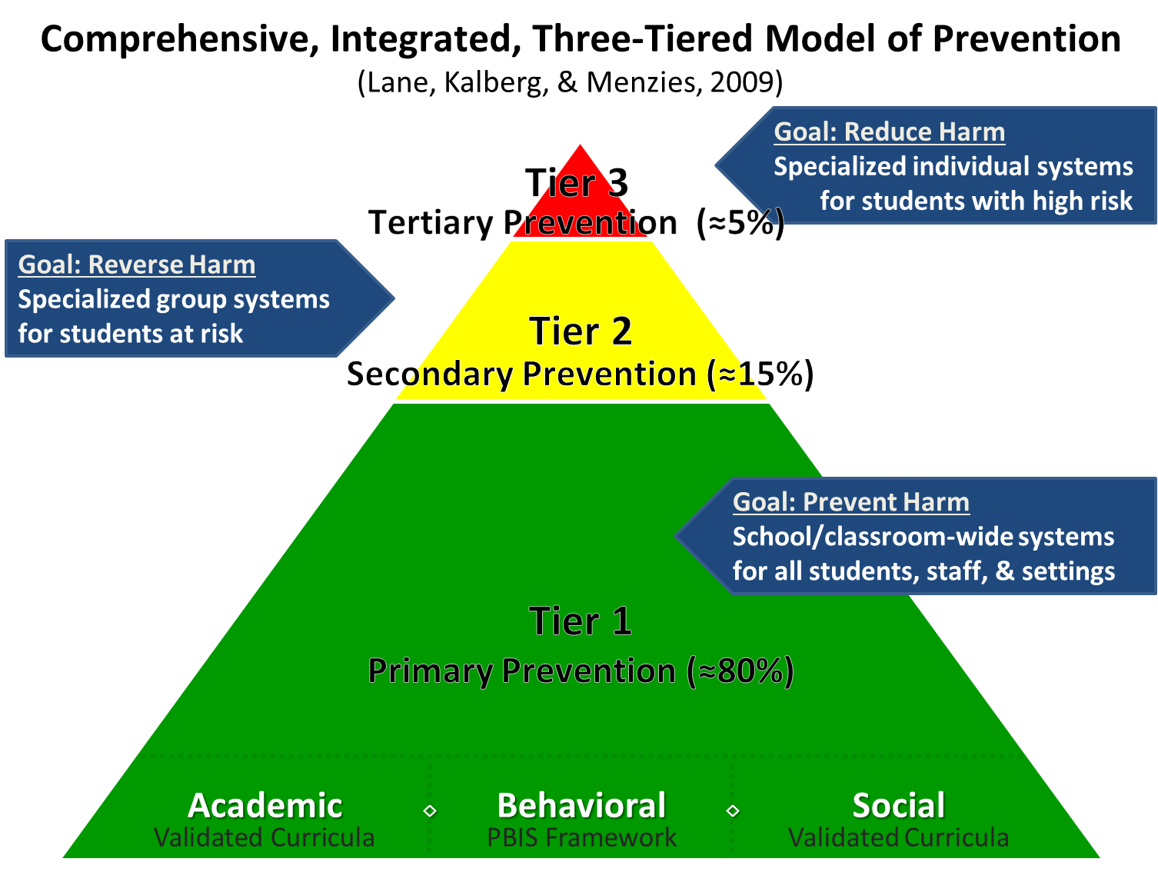
Comprehensive, Integrated, Three-Tiered Model of Prevention 1

Slide 6









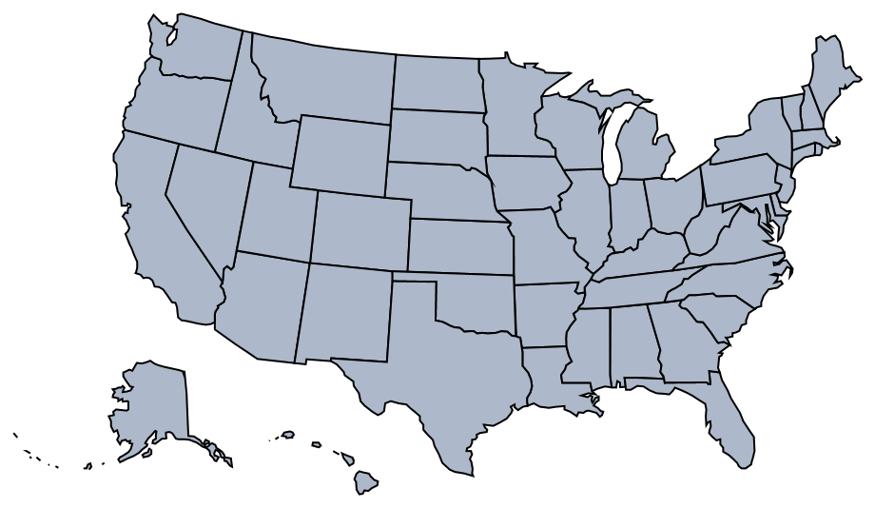

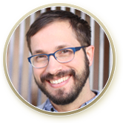













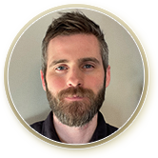







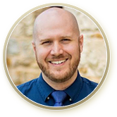











The Journey of Ci3T
1996
Notes:
CA & AZ start→ Tennessee → North Carolina→ Kansas
Trainings in MO, KS, VT, AZ
More trainings and grants: MO, KS, AL, SC, HI, KY

Slide 7
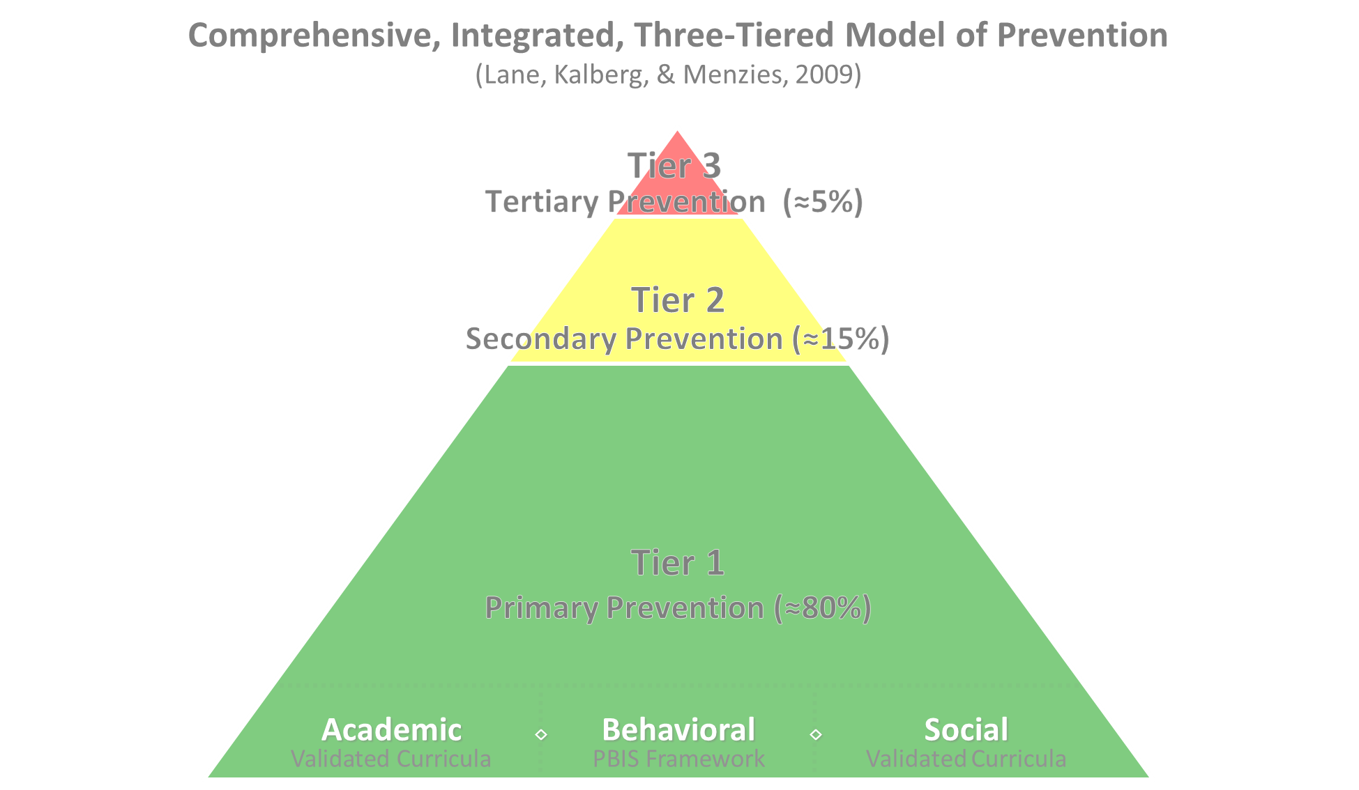

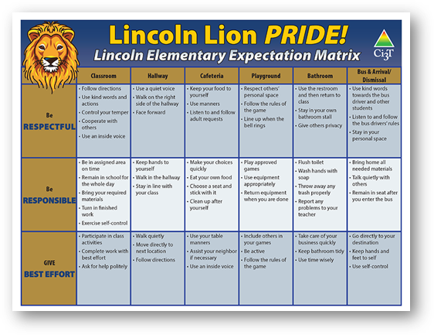
Comprehensive, Integrated, Three-Tiered Model of Prevention 2
Positive Behavioral Interventions and Supports
District & State Standards Quality Instruction
Validated Curricula and Resources

Slide 8
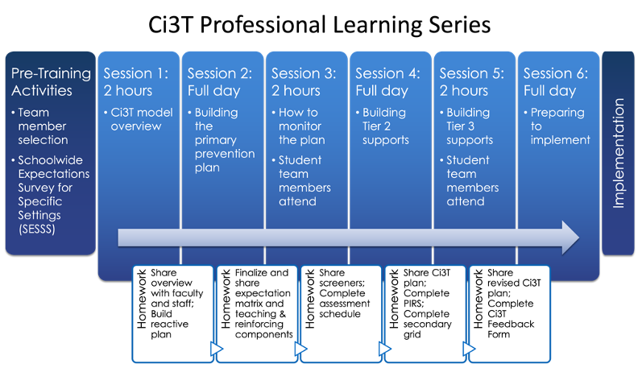
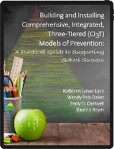
Ci3T Professional Learning Series

Slide 9



Ci3T Implementation Manual

Slide 10
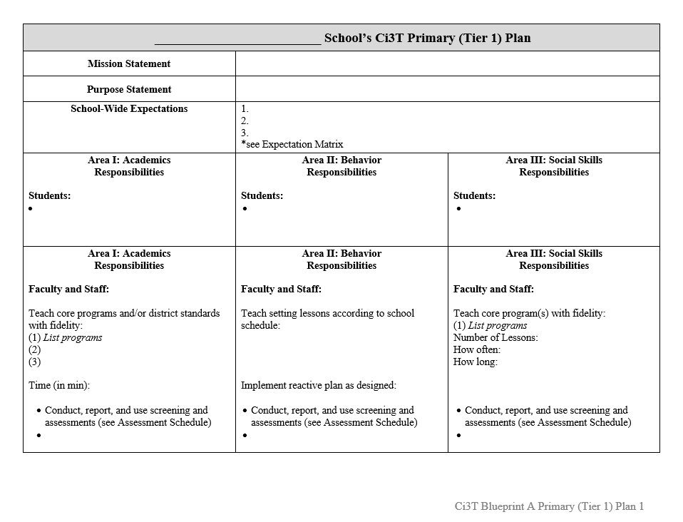
Ci3T Implementation Manual Primary Plan
Ci3T Implementation Manual Primary (Tier 1) Plan
What are ALL students accessing?

Slide 11
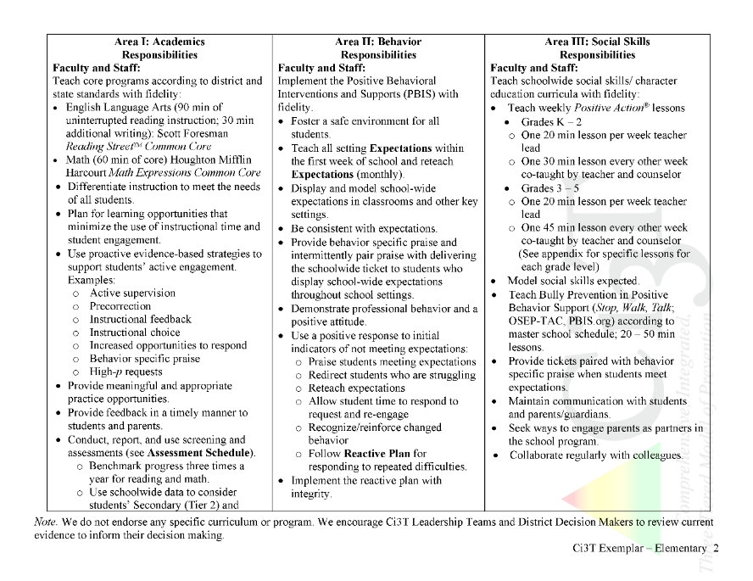
Implementation Report Example
Ci3T Primary Plan: Procedures for Teaching
Ci3T Primary Plan: Procedures for Reinforcing
Ci3T Primary Plan: Procedures for Monitoring

Slide 12

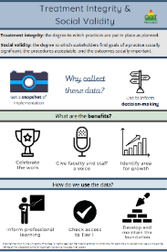


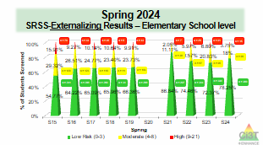
Essential Components of Primary (Tier 1) Prevention Efforts (1 of 2)
Social Validity
Systematic Universal Screening
Academic
Behavior
Treatment Integrity
ci3t.org/measures
ci3t.org/screening

Slide 13
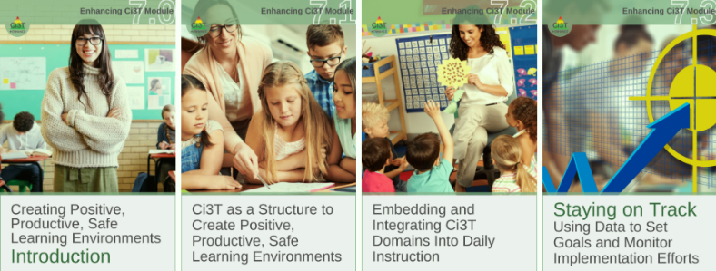
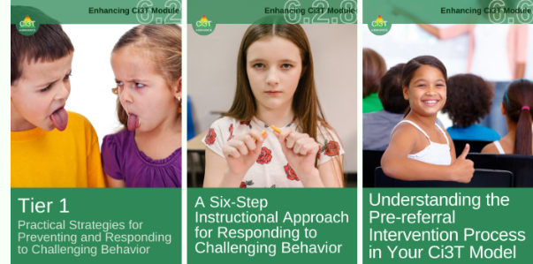
Primary Prevention (Tier 1)

Slide 14

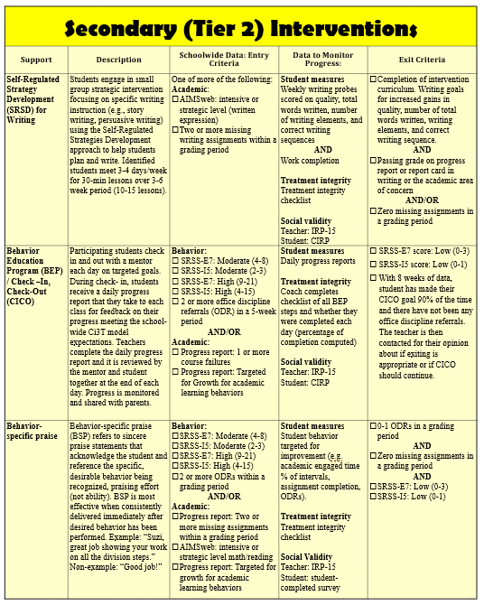
Secondary (Tier 2) Intervention Grid
Secondary (Tier 2) Intervention Grid
Notes:
In addition to the module featured here outlining how to use multiple sources of data to connect students with Tier 2 supports, we offer a full suite of modules highlighting validated Tier 2 interventions such as Self-Regulated Strategy Development (SRSD) for Writing and Check-In/Check Out that may appear in your Secondary (Tier 2) Intervention Grid

Slide 15

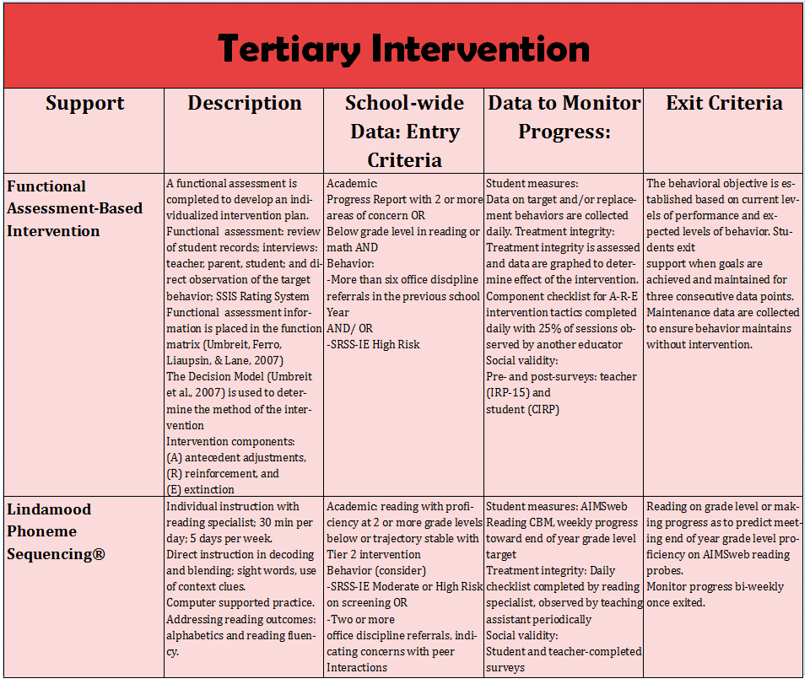
Tertiary (Tier 3) Intervention Grid
Tertiary (Tier 3) Intervention Grid
Notes:
In addition to the module featured here outlining how to use multiple sources of data to connect students with Tier 3 supports, we offer a full suite of modules highlighting validated Tier 3 interventions such as Functional Assessment-Based Intervention (FABI) that may appear in your Tertiary (Tier 3) Intervention Grid

Slide 16

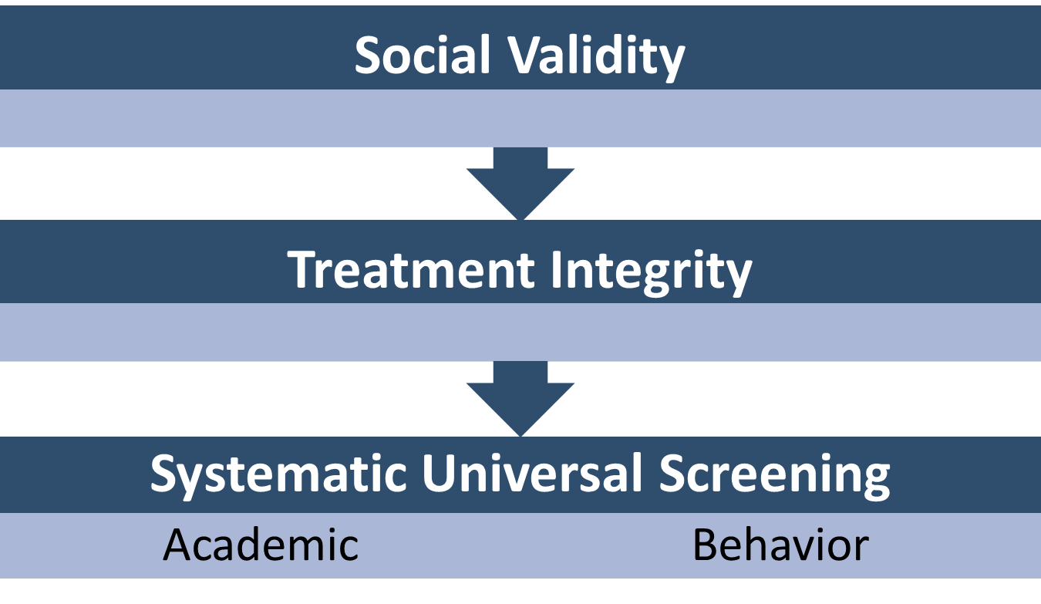
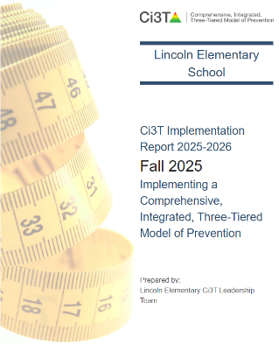
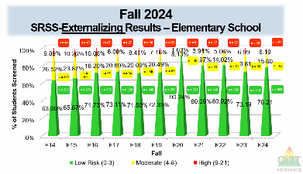
Essential Components of Primary (Tier 1) Prevention Efforts (2 of 2)

Slide 17

Systematic Screening … Logistics
Fall
Winter
Spring
Selecting
Installing
Analyzing

Slide 18
The Role of Systematic Screening Using Screening Data to…
Inform Instruction at Tier 1
Empower Teachers with Low-Intensity Strategies
Connect Students to Validated Tier 2 and Tier 3 Supports

Slide 19
Fall Over Time SRSS-Externalizing Results – Elementary School Level
Notes:
Fill in <year> based on current academic year. This is located in column A of the data sheet. Edit by right clicking and selecting “Edit data”.

Slide 20
Fall Over Time SRSS-Internalizing Results – Elementary School Level
Notes:
Fill in <year> based on current academic year. This is located in column A of the data sheet. Edit by right clicking and selecting “Edit data”.

Slide 21
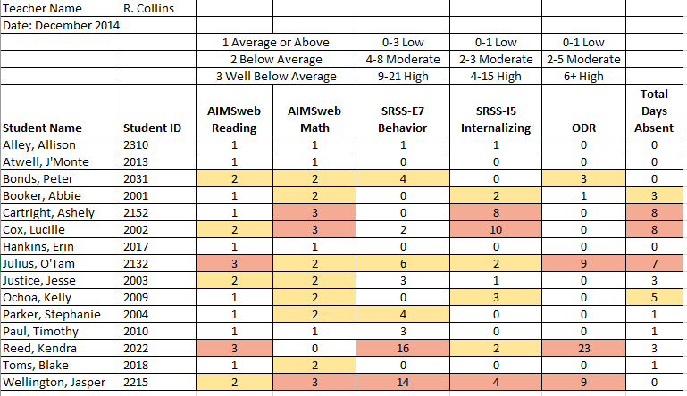
Examining Academic and Behavioral Data
Lane, K. L., Menzies, H. M., Ennis, R. P., & Oakes, W. P. (2015). Supporting Behavior for School Success: A Step-by-Step Guide to Key Strategies. Guilford Press.
Notes:
Lane, K. L., Oakes, W. P., Ennis, R. P., & Hirsch, S. E. (2014). Identifying students for secondary and tertiary prevention efforts: How do we determine which students have Tier 2 and Tier 3 needs? Preventing School Failure, 58, 171-182, DOI: 10.1080/1045988X.2014.895573

Slide 22
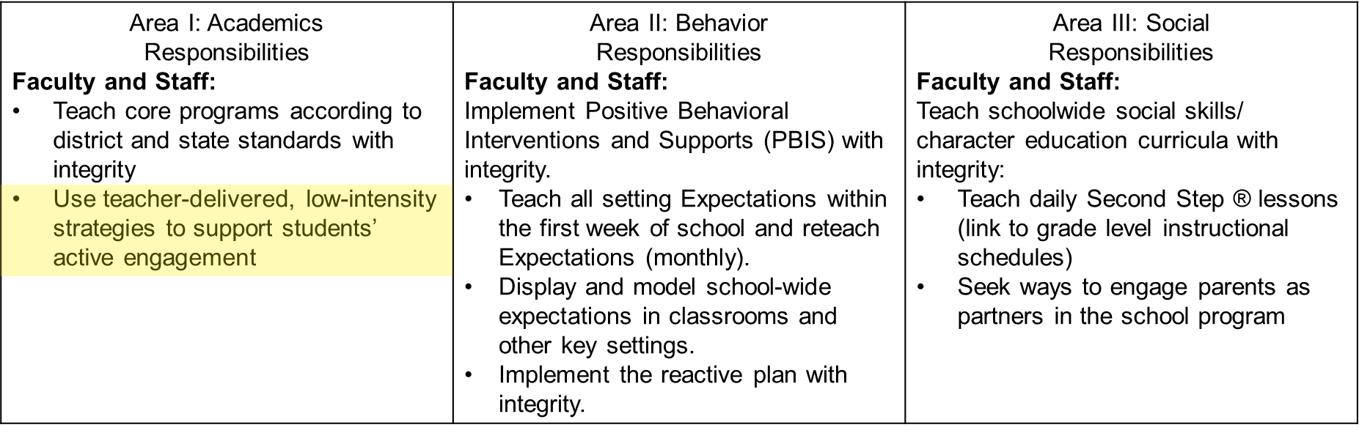

Low-Intensity Teacher-Delivered Strategies

Slide 23
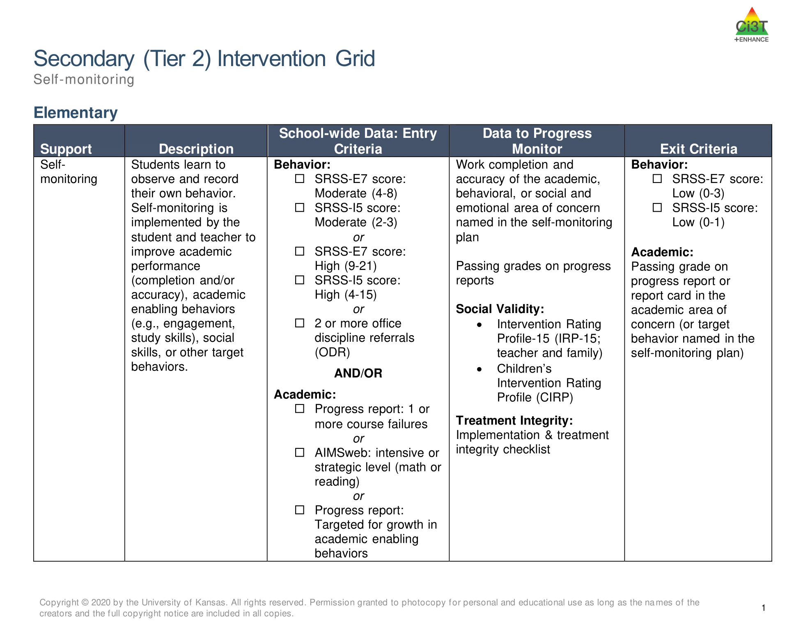
Tier 2 and Tier 3 Intervention Grids
Notes:
Support is the name of the strategy, practice, or program. Notice this is not the name of a person or role.

Slide 24



Enhancing Ci3T Modules
ci3t.org/enhance

Slide 25
Ci3T Training & Implementation
Phase |  |  |  | Year
 | 2013-14 | 14-15 | 15-16 | 16-17 | 17-18 | 18-19 | 19-20
Elementary School
Ci3T Training
Implementation Year 1
Implementation Year 2
Sustain and Develop Practices
Middle and High Schools
Ci3T Training
Implementation Year 1
Implementation Year 2
Sustain and Develop Practices
College and Career Center
Ci3T Training
Implementation Year 1
Implementation Year 2
Sustain and Develop Practices

Slide 26
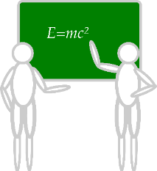







Communication and Continuous Improvement
Effective
Teams
Ci3T District Leadership Team
Ci3T School Leadership Team
College & Career
Ci3T School Leadership Team
Ci3T School Leadership Team
Ci3T School Leadership Team
Ci3T School Leadership Team
Ci3T School Leadership Team
Ci3T School Leadership Team
Ci3T School Leadership Team
Ci3T School Leadership Team
Ci3T School Leadership Team
Ci3T School Leadership Team
Ci3T School Leadership Team
Ci3T School Leadership Team
Ci3T School Leadership Team
Ci3T School Leadership Team
Ci3T School Leadership Team
Ci3T School Leadership Team
Ci3T School Leadership Team
Ci3T School Leadership Team
Ci3T School Leadership Team
Ci3T School Leadership Team
Middle
High
Elementary
Notes:
Structure for positive, productive discussions
Data-informed professional development

Slide 27
Implementation Science Adapted from Fixsen & Blasé, 2005
Exploration & Adoption
Installation
Initial Implementation
We think we know what we need so we are planning to move forward (evidence-based)
Let’s make sure we’re ready to implement (capacity infrastructure)
Let’s give it a try & evaluate (demonstration)
Full Implementation
Let’s make it our way of doing business (institutionalized use)
Sustainability & Continuous Regeneration
That worked, let’s do it for real (investment)

Slide 28
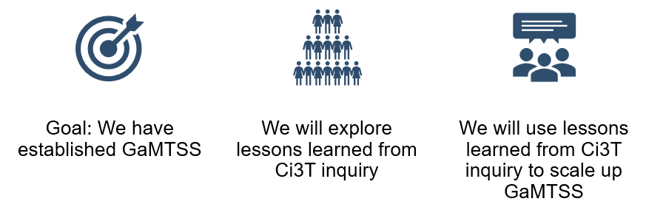
Transparency, Access, & Collaboration
Benefits of Ci3T Models

