Slide 1




Welcome: LPS Learning Exchange Session 2
Functional Assessment-Based Intervention (FABI): An Effective Approach for Supporting Students with Intensive Behavior Intervention Needs
Elise Sarasin, M.S.E
Kathleen Lynne Lane, PhD., BCBA-D, CF-L2
This project was funded in part by Project EPIC (USDE, OSEP Award Number: H325D220011) and Project ENHANCE (IES Project Number R324N190002)
Part 2: January 5, 2026

Slide 2
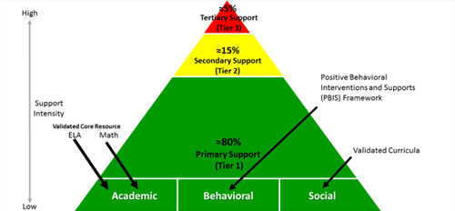

Reflect & Connect: Ci3T
Why is it be important to identify where today’s learning connects to our Ci3T framework?
What is your role in supporting students’ academic, behavior and social needs?
Today, we are focused on Tier 3 to support students with intesive intervention needs across domains

Slide 3
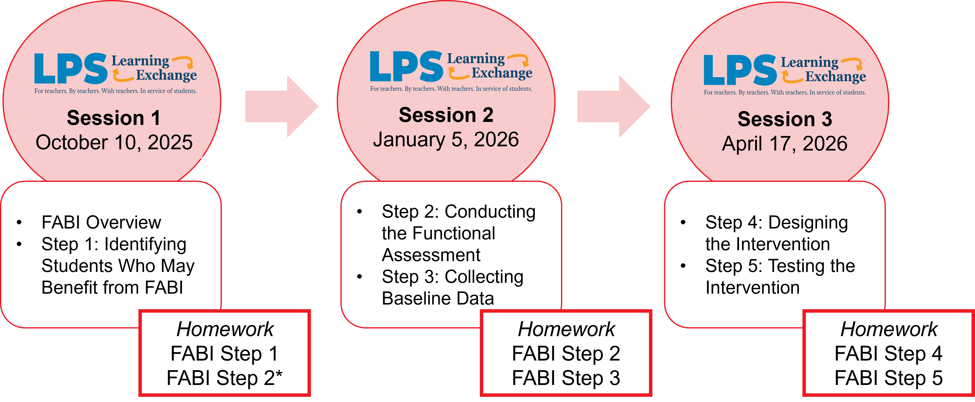
LPS Learning Exchange Series Progression

Slide 4


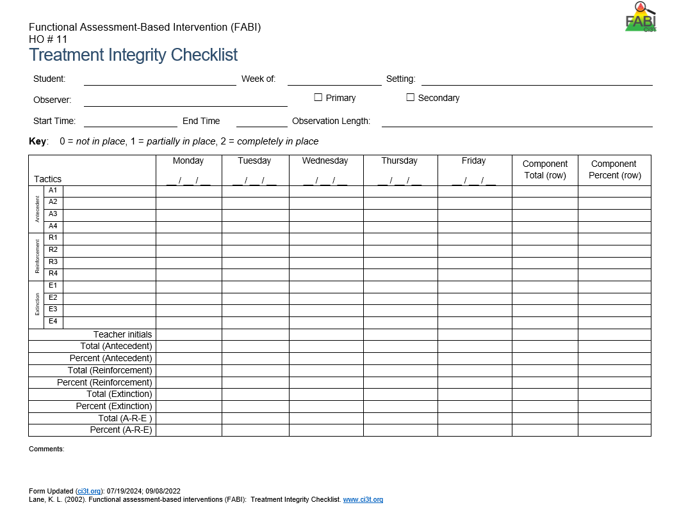
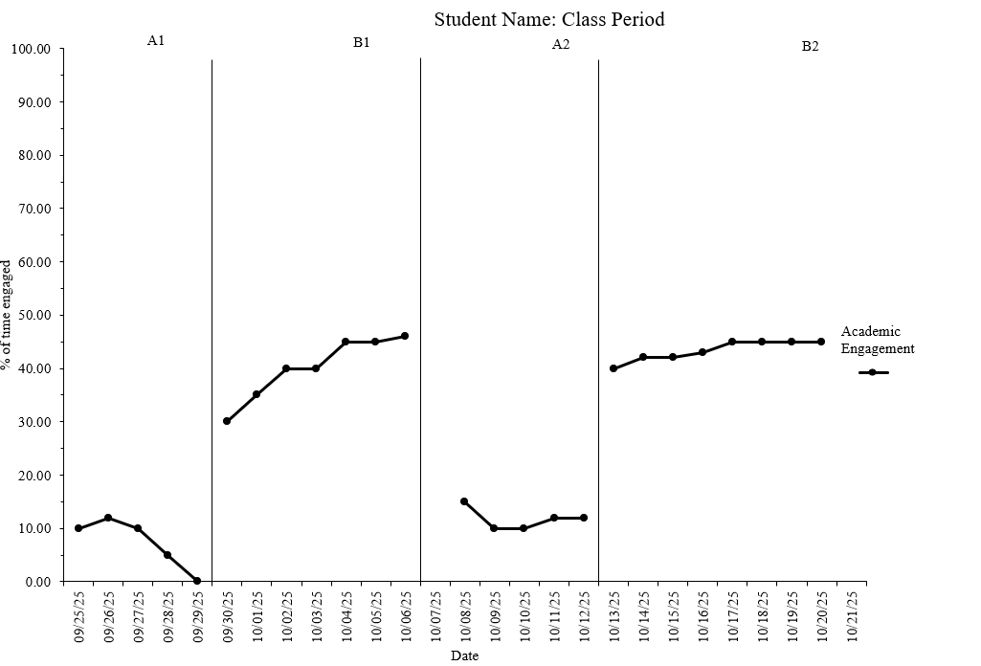
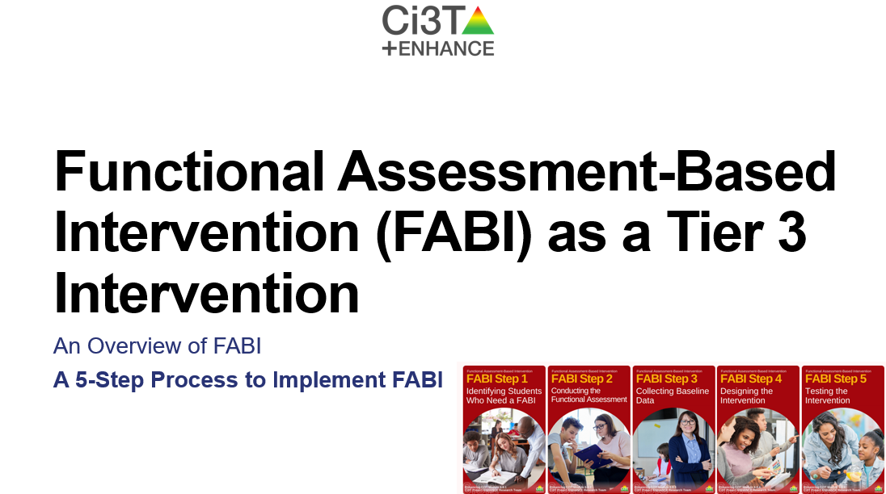
Knowledge, Application, Impact Points
On-Task Behavior: Jackson
You can earn 2 x PD points for application and 3 x for impact!
We are happy to review your materials before you upload ☺
Notes:
Tonight’s session lays the foundation with knowledge building and getting you oriented to the modules that can support application and impact efforts!

Slide 5
Session 1 Outcomes
Revise operational definitions to be clear, objective, and complete
Conduct A-B-C data collection
Sort data collected as part of FABI Step 2 into the Function Matrix
Conduct duration recording, momentary time sampling, and partial-interval recording
Select an aligned measurement system based on the target behavior and dimension of interest

Slide 6
Agenda
Welcome
Functional Assessment-Based Intervention (FABI)
FABI Step 2: Conducting the Functional Assessment
Interviews and Operationally Defining Behavior
ABC Data
Function Matrix
FABI Step 3: Collecting Baseline Data
Selecting a Measurement System
Baseline Data Collection Procedures
Putting it All Together
Wrapping Up and Moving Forward

Slide 7

Functional Assessment-Based Intervention (FABI)

Slide 8
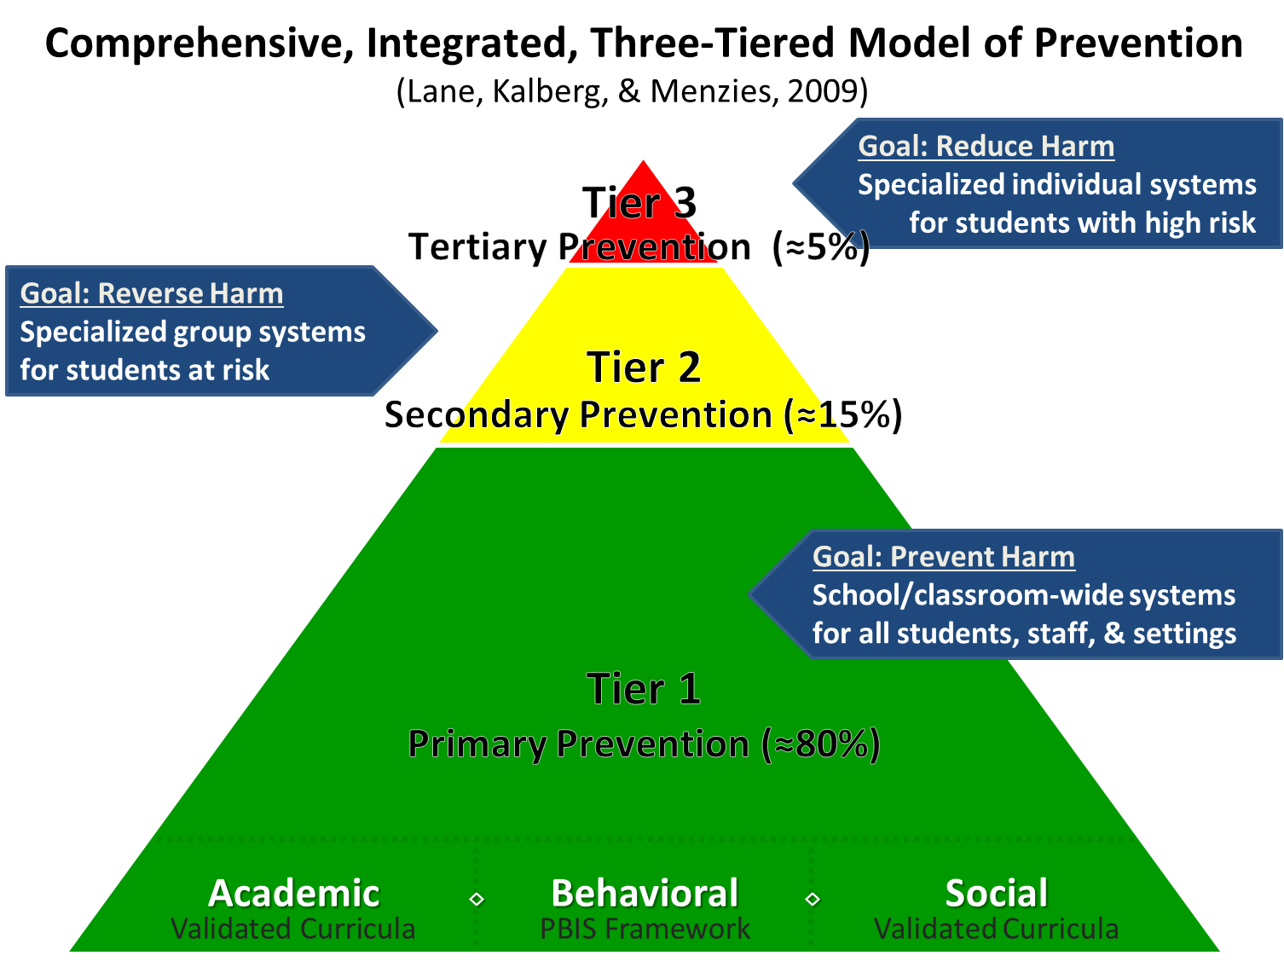
Comprehensive, Integrated, Three-Tiered Model of Prevention 1

Slide 9
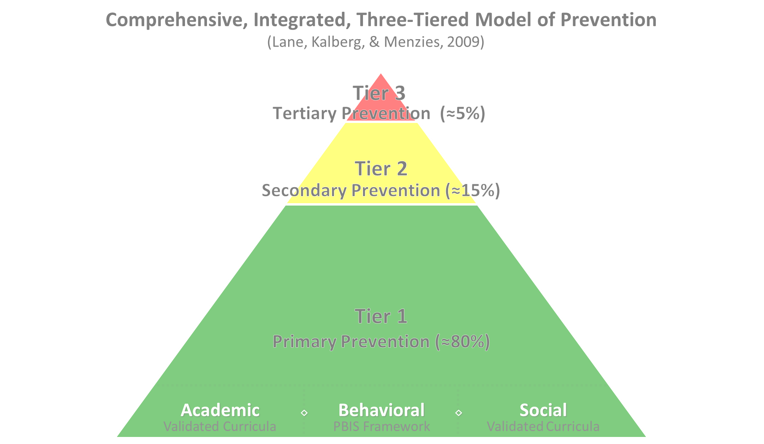

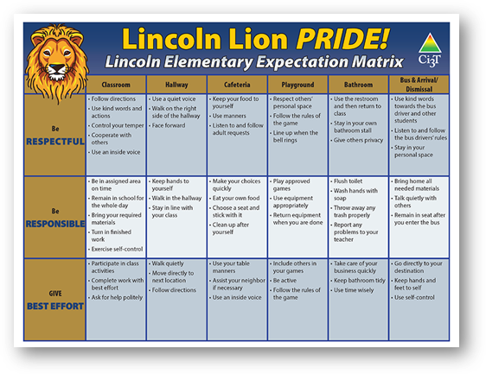
Comprehensive, Integrated, Three-Tiered Model of Prevention 2
Positive Behavioral Interventions and Supports
District & State Standards Quality Instruction
Validated Curricula and Resources

Slide 10

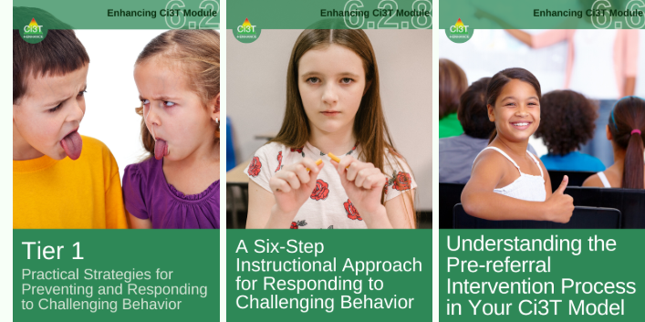
Primary Prevention (Tier 1)

Slide 11

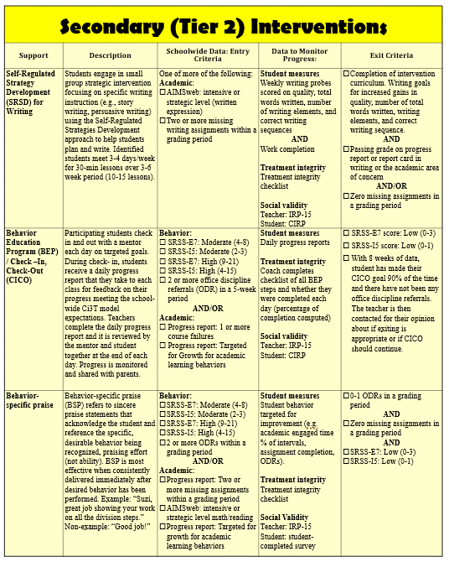
Secondary (Tier 2) Intervention Grid
Secondary (Tier 2) Intervention Grid
Notes:
In addition to the module featured here outlining how to use multiple sources of data to connect students with Tier 2 supports, we offer a full suite of modules highlighting validated Tier 2 interventions such as Self-Regulated Strategy Development (SRSD) for Writing and Check-In/Check Out that may appear in your Secondary (Tier 2) Intervention Grid

Slide 12

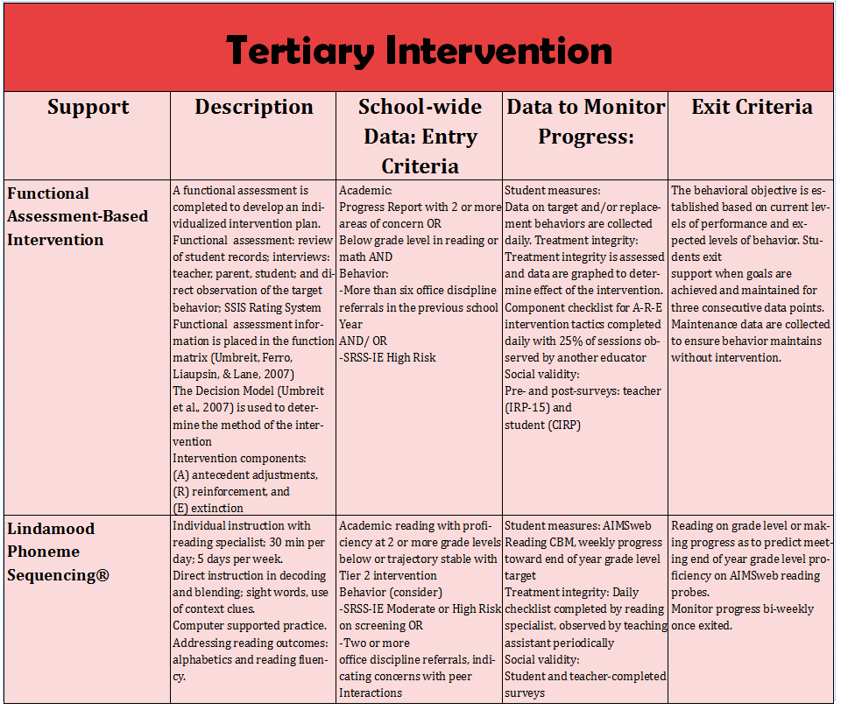
Tertiary (Tier 3) Intervention Grid
Tertiary (Tier 3) Intervention Grid
Notes:
In addition to the module featured here outlining how to use multiple sources of data to connect students with Tier 3 supports, we offer a full suite of modules highlighting validated Tier 3 interventions such as Functional Assessment-Based Intervention (FABI) that may appear in your Tertiary (Tier 3) Intervention Grid

Slide 13

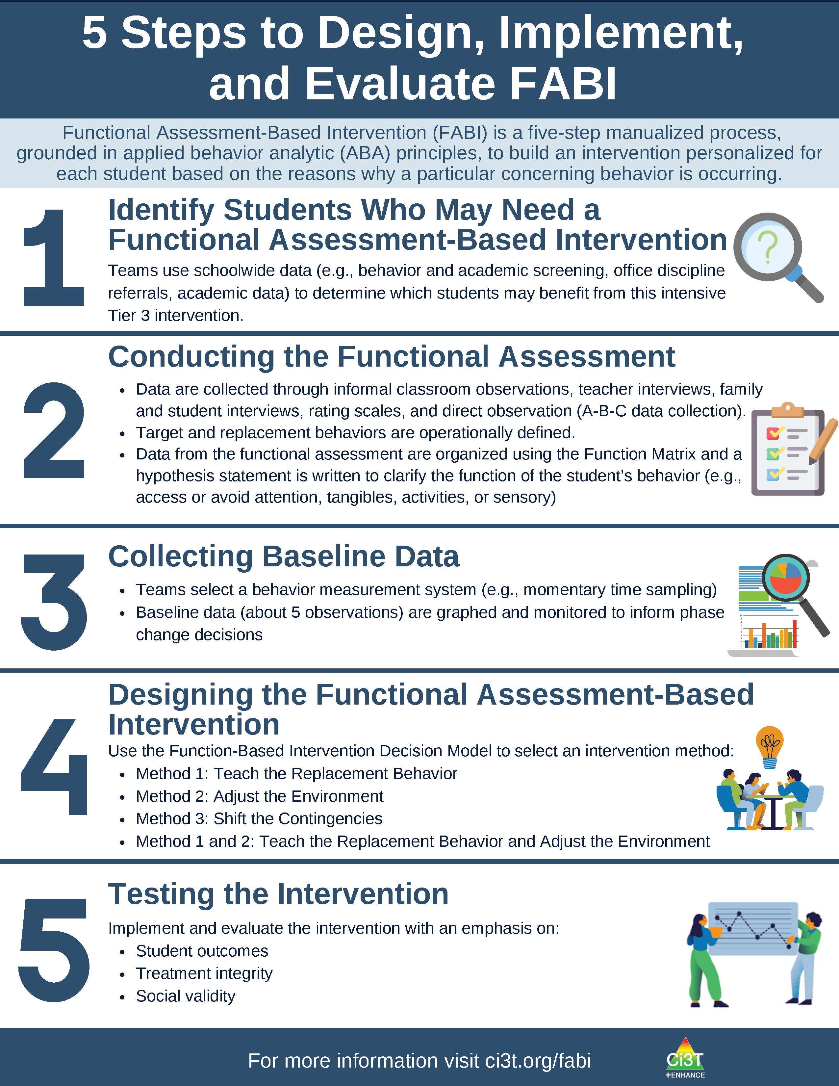
What is Functional Assessment-Based Intervention (FABI)?
Customized intervention designed for each student based on the reasons why a particular concerning behavior is occurring
Developed through a five-step, team-based, manualized process
Grounded in applied behavior analytic (ABA) principles (e.g., reinforcement, antecedent, consequence)
Notes:
PRESENTER NOTE:
FABI is one type of FBA (functional behavioral assessment)
Can be used as a Tier 3 intervention, as we are discussing in this presentation
Can also be used as a process to conduct a functional behavioral assessment (FBA) and develop a behavior intervention plan (BIP) for student’s with IEPs as required under certain conditions of IDEA
See state regulations for more information regarding FBAs as part of a student’s IEP

Slide 14
5 Steps to Design, Implement, and Evaluate FABI 1

Slide 15
5 Steps to Design, Implement, and Evaluate FABI 2

Slide 16

Building Your FABI Team
Two people who serve on this “standing” team
Member of Ci3T Leadership Team
Staff with behavioral expertise (e.g., behavior specialist, instructional coach, counselor, school psychologist)
Classroom teacher(s) of the student who might benefit from this support
Family member of the student
Student

Slide 17
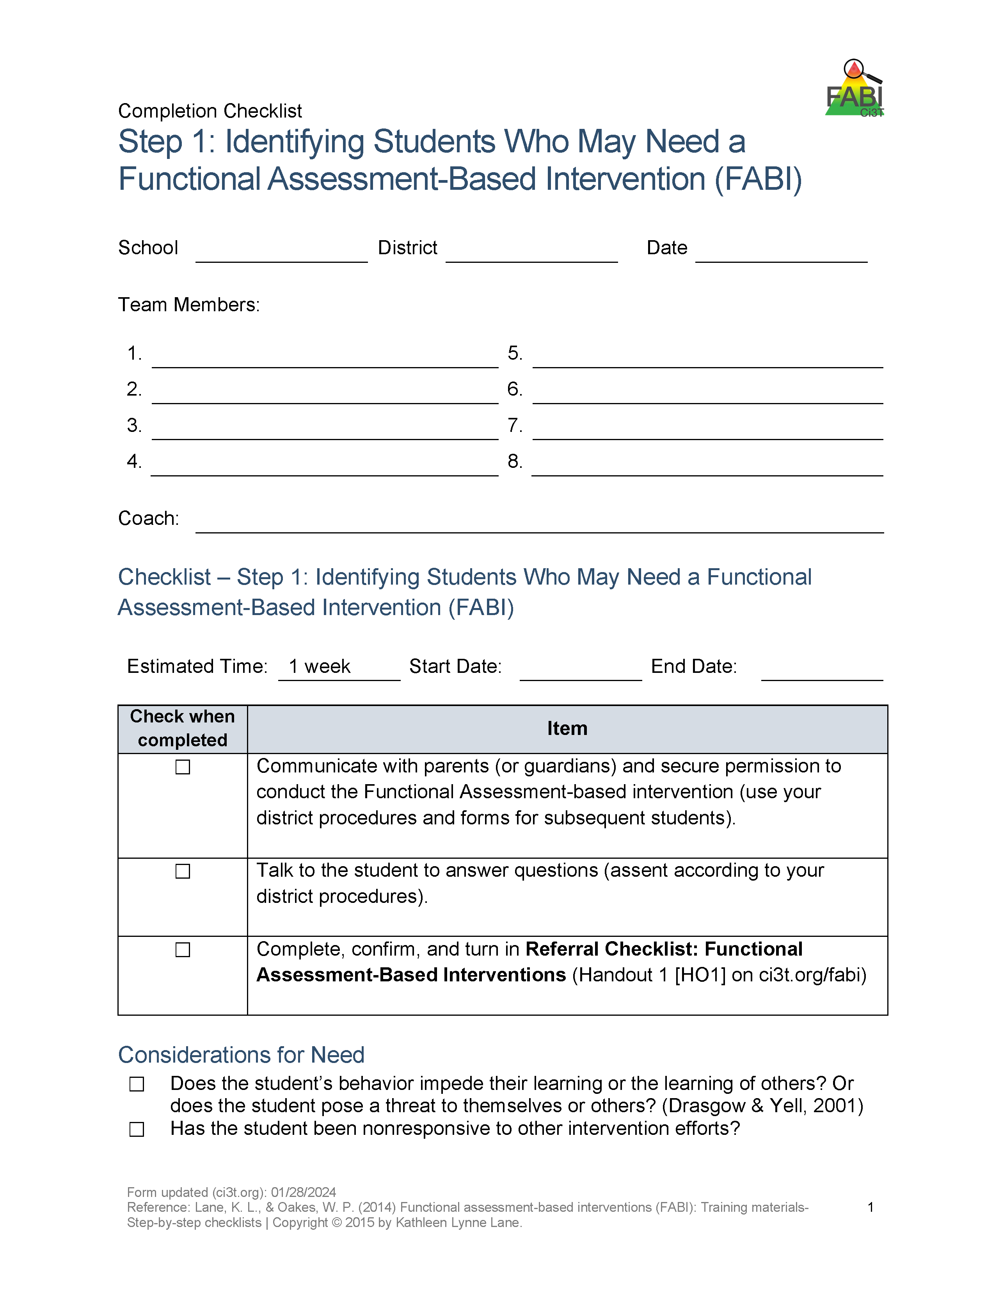
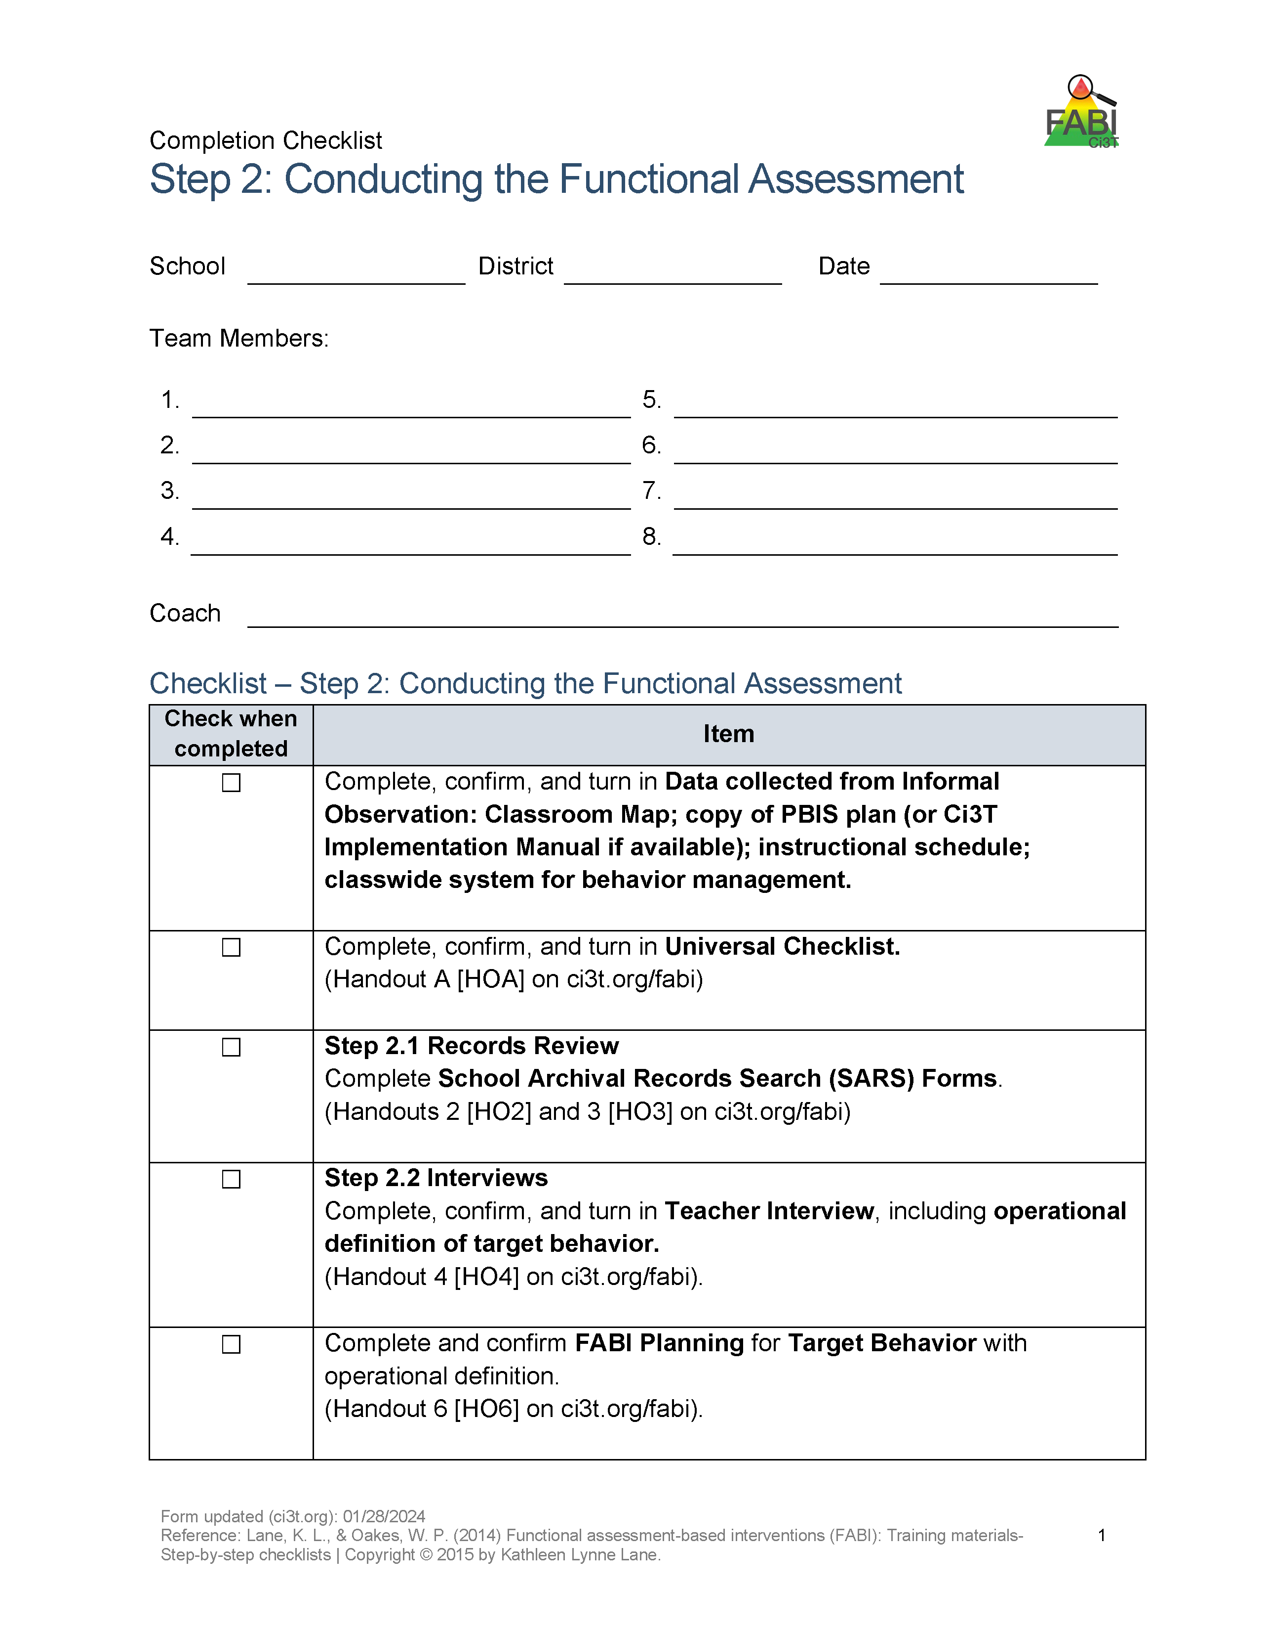


Action Items: Between Session 1 and 2

Slide 18

Step 1: Identifying Students Who May Need a FABI
Review multiple sources of data
Connect with family member(s)
Meet with student

Slide 19

Step 2: Conducting the Functional Assessment
Understanding the learning environment and context
Records review
Notes:
Today, we are going to focus on these three components of Step 2

Slide 20

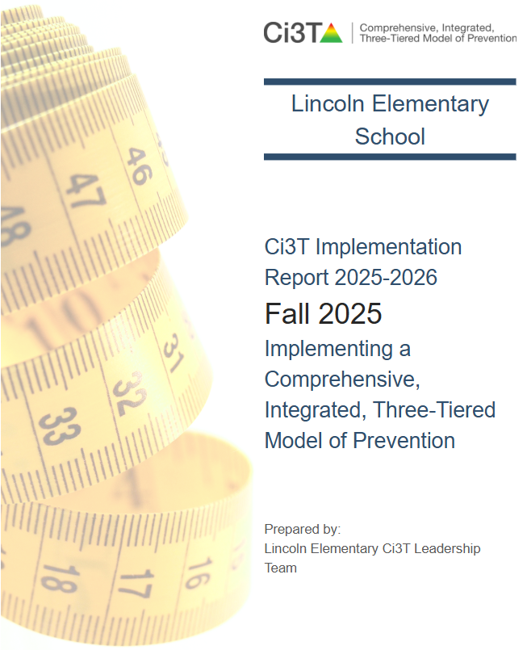
Understanding the Learning Environment and Context: School Context
Ci3T Implementation Manual
Treatment Integrity and Social Validity Reports
Informal observations of teacher-teacher, teacher-student, and student-student interactions across settings (e.g., hallways, cafeteria, arrival and dismissal)
Notes:
want the Tier 3 intervention to build on the foundation of Tier 1 efforts to promote generalization and maintenance of newly acquired skills across people, settings, and behaviors – as well as over time.

Slide 21
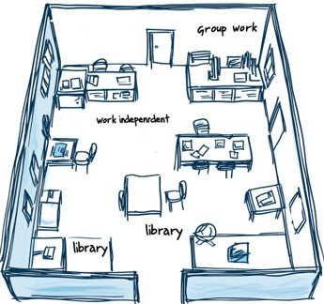
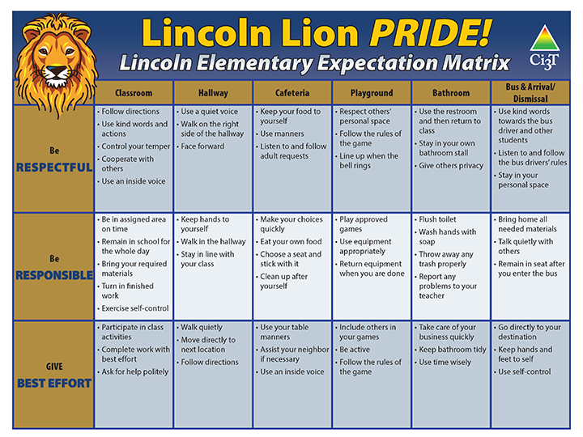
Understanding the Learning Environment and Context: Classroom Context
Classroom Map
Instructional schedule
Tier 1
Expectation matrix
Universal reinforcement system (e.g., tickets)
Classwide system for behavior management
Universal Checklist
Teacher Ci3T Treatment Integrity: Direct Observation

Slide 22
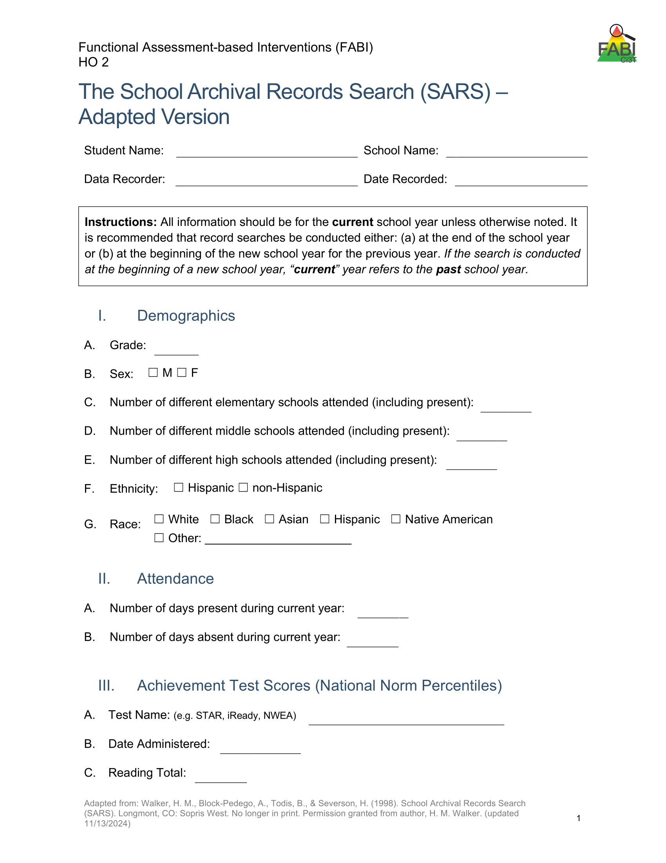
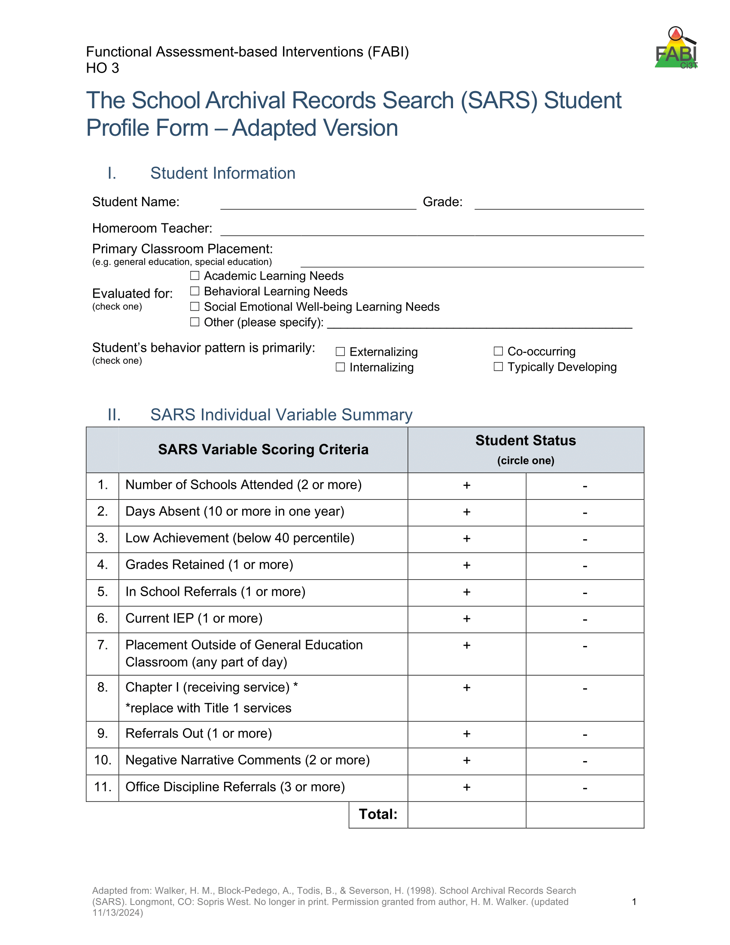
Records Review: School Archival Records Search (SARS)
Notes:
Systematic review of the student’s file to ensure a comprehensive understanding of both the student’s areas of strengths and the ways in which they may have struggled. Covers transiency, attendance, academic achievement, retention, disciplinary contacts, referrals, and comments from file.

Slide 23













Table Talk: Describe Your Student*
What sources of data did you use to determine this student might benefit from a FABI?
What information did you glean from FABI Step 2 so far?
School context: Ci3T Implementation Manual, Treatment Integrity and Social Validity Reports, informal observation across settings
Classroom context: classroom map, instructional schedule, tier 1 practices, universal checklist
School Archival Records Search (SARS)
*Please use a pseudonym
Notes:
10-min timer

Slide 24

Step 2: Conducting the Functional Assessment Interviews and Operationally Defining Behavior

Slide 25
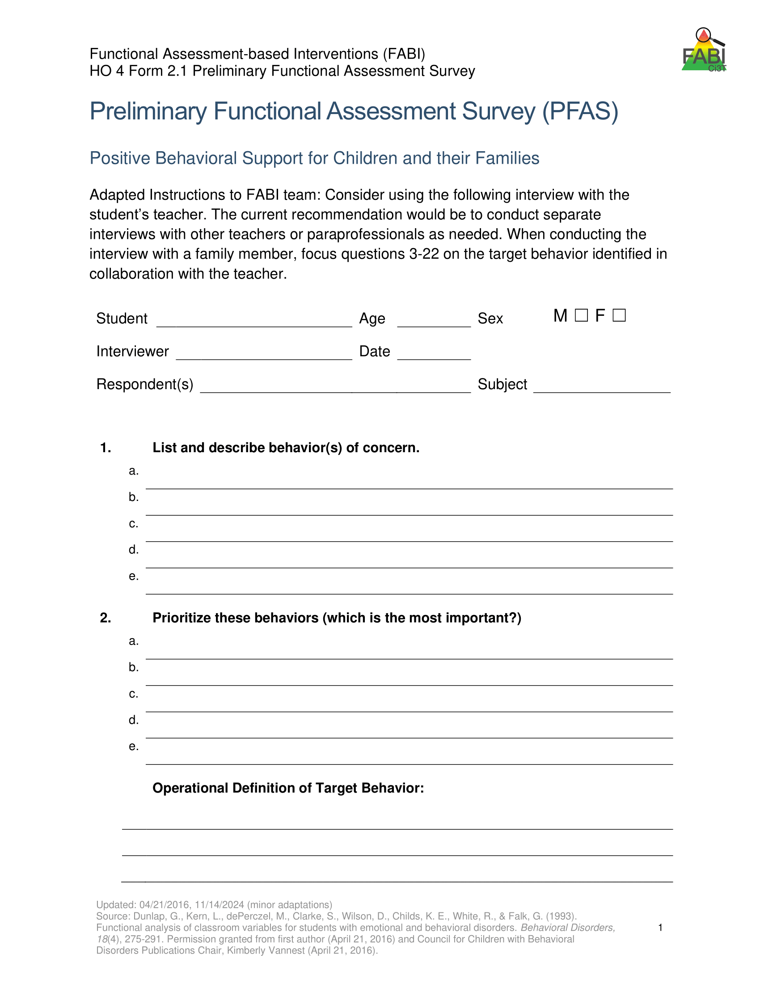
Teacher Interview
Administer Preliminary Functional Assessment Survey (PFAS; Dunlap et al., 1993)
Operationally define the target behavior
Understand more about the behavior (e.g., when it does / does not occur)

Slide 26
Family and Student Interviews
Family Interview
Student Interview
Preliminary Functional Assessment Survey (PFAS; Dunlap et al., 1993)
Glean additional information about the target behavior from the family’s perspective
Student Assisted Functional Assessment Interview (Kern et al., 1994)
Understand more about the behavior from the student’s perspective

Slide 27
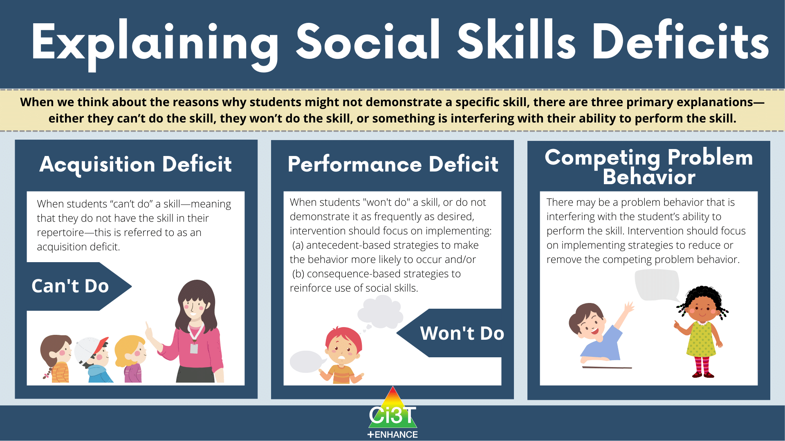
Rating Scale
After each interview, administer a rating scale such as the Social Skills Improvement System Rating Scales (SSiS-RS; Gresham & Elliott, 2008)

Slide 28

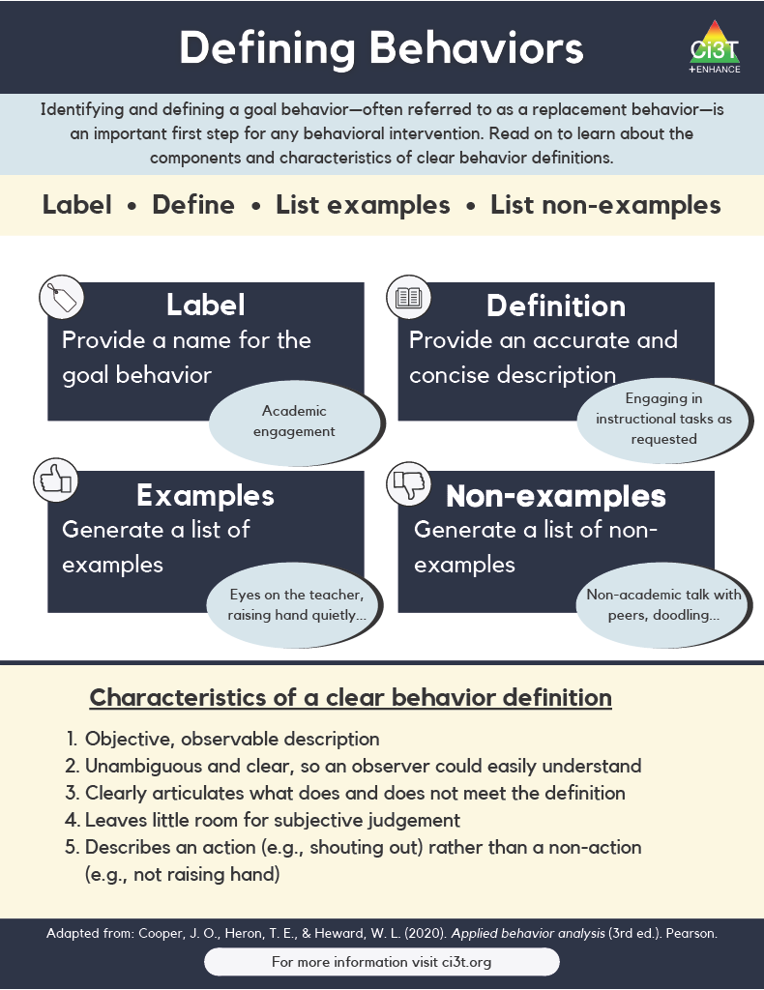
Operationally Defining the Target Behavior
Notes:
During the teacher interview, you will work with the teacher to identify all behaviors of interest and then create a prioritized list to determine the one keystone behavior. In other words, what is the one behavior, that if modified, could allow students to enjoy school more fully?
This becomes the target behavior (or the behavior you are seeking to reduce) which you will then operationally define

Slide 29
Defining Behaviors 1

Slide 30
Defining Behaviors 2

Slide 31
Example Operational Definition: Off-Task
Component | Description
Label | Off-task
Definition | Off-task is defined as attending to activities in class other than assignments.
Examples | Playing with materials inappropriately, talking to peers, putting head on the desk, drawing, and looking around the room
Non-Examples | Completing assignments using materials only for assignments, and watching the teacher when delivering instruction

Slide 32
Example Operational Definition: Verbal Aggression
Component | Description
Label | Verbal aggression
Definition | Verbal aggression is defined as any vocalization directed towards a peer or adult at a volume above expected conversational level for a given setting alongside use profanity or language that is not appropriate for the setting.
Examples | Yelling “I hate you” at a voice level 3 during classroom instruction, verbal threats directed towards peer (e.g., “if you don’t stop, I’m going to…”), name-calling, profanity.
Non-Examples | Level 3 voice level at recess, shouting out an answer during choral response, sighing (“uhhhggg”), negative self-talk (e.g., “this is too hard”)

Slide 33
Operational Definition Tips
Consider how to quantify subjective terms like “loud” or “inappropriate”
Operational definitions include only facts and observable behavior. Operational definitions do not include:
inferences related to motivation, feelings, intentions
function of the behavior
Operational definitions must pass the “dead person test” (i.e., if a dead person can do it – it is not a behavior!)
not paying attention -> attending to a person other than the speaker

Slide 34
Let’s Practice – Revising an Operational Definition
Component | Description
Label | Disrespectful
Definition | Disrespectful is defined as having a bad attitude towards teachers and peers.
Examples | Talking back, rolling their eyes, inappropriate comments, ignoring requests
Non-Examples | Asking a question, giving a compliment

Slide 35
Revising an Operational Definition: Example Revisions
Component | Description
Label | Negative peer interactions
Definition | Negative peer interactions are defined as any instance of verbal or non-verbal behavior directed towards a peer that disrupts the peer’s participation or causes observable discomfort.
Examples | Insulting comments (e.g., “nobody likes you”), name-calling (e.g., “you are weird”), mocking, eye-rolling, making faces
Non-Examples | Asking a question

Slide 36
Let’s Practice: Operational Definitions
Sort the operational definitions
Yes – operational definition is clear, objective, and complete
No - operational definition is not yet clear, objective, and complete
Revise operational definitions to ensure they are clear, objective, and complete
Notes:
10-min timer

Slide 37
Step 2: Conducting the Functional Assessment ABC Data Collection

Slide 38
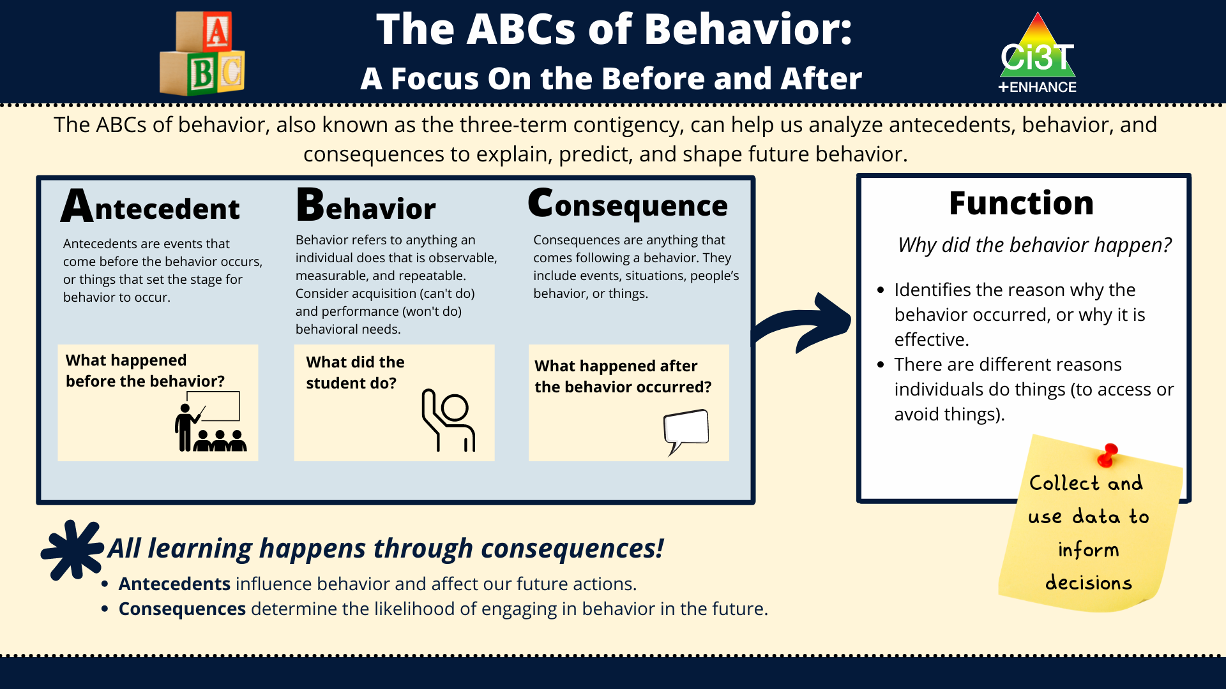
The ABCs of Behavior: A Focus on the Before and After

Slide 39
A-B-C Data Example
A teacher hands out math computation worksheet, starts the timer, and tells students that they will be timed in completing the math worksheet. The student then tears up the worksheet. The teacher scolds the student and has the student clean up the mess without completing the worksheet.

Slide 40
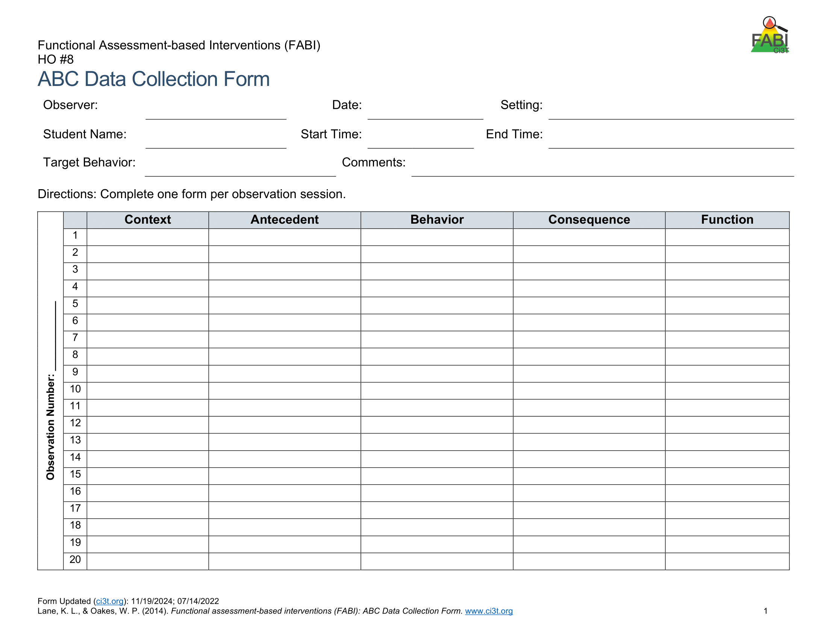
Direct Observation (A-B-C Data Collection)
Determine the time of day and setting during which the behavior most often occurs
3 observation sessions (minimum)
Aim to observe 8-10 occurrences of the target behavior or three hours of observations
Record only instances of target behavior
Each instance of the target behavior will be numbered and later placed in the Function Matrix

Slide 41

A-B-C Data Collection Example
Reading instruction
Pencil breaks
Student throws pencil
Teacher looks at student
Notes:
Each time the target behavior occurs you will record details in a new row. Each instance of the target behavior will be numbered and later placed in the function matrix.
You should will note the context in which the behavior occurred, such as reading instruction, morning circle time, or math instruction, and the antecedent, or what happened immediately before the behavior.
Additionally, record the target behavior itself, the consequence, or what happened immediately after the target behavior.
The function of the behavior, such as access to or avoidance of attention, tasks or tangibles, or sensory experiences will be completed later.

Slide 42
Let’s Practice A-B-C Data Collection!
Component | Description
Label | Off-task
Definition | Off-task is defined as attending to activities in class other than assignments.
Examples | Playing with materials inappropriately, talking to peers, putting head on the desk, drawing, and looking around the room, humming
Non-Examples | Completing assignments using materials only for assignments, and watching the teacher when delivering instruction

Slide 43
A-B-C Data Practice Video #1 Debrief
Antecedent | Behavior | Consequence
Teacher faced away | Eddie hums | Teacher attends

Slide 44
Table Talk: A-B-C Data Collection
Share your practice A-B-C data with the people at your table
What was easy or challenging about this practice activity?
What challenges might you encounter when collecting A-B-C data for your student? How might you overcome those challenges?
Notes:
5-min timer

Slide 45
Break
Use a sticky note to add any questions to the Parking Lot
Stretch your legs, drink some water, we will be back in 5 minutes
Parking Lot
Add questions here!
Notes:
5-min

Slide 46
Step 2: Conducting the Functional Assessment The Function Matrix

Slide 47
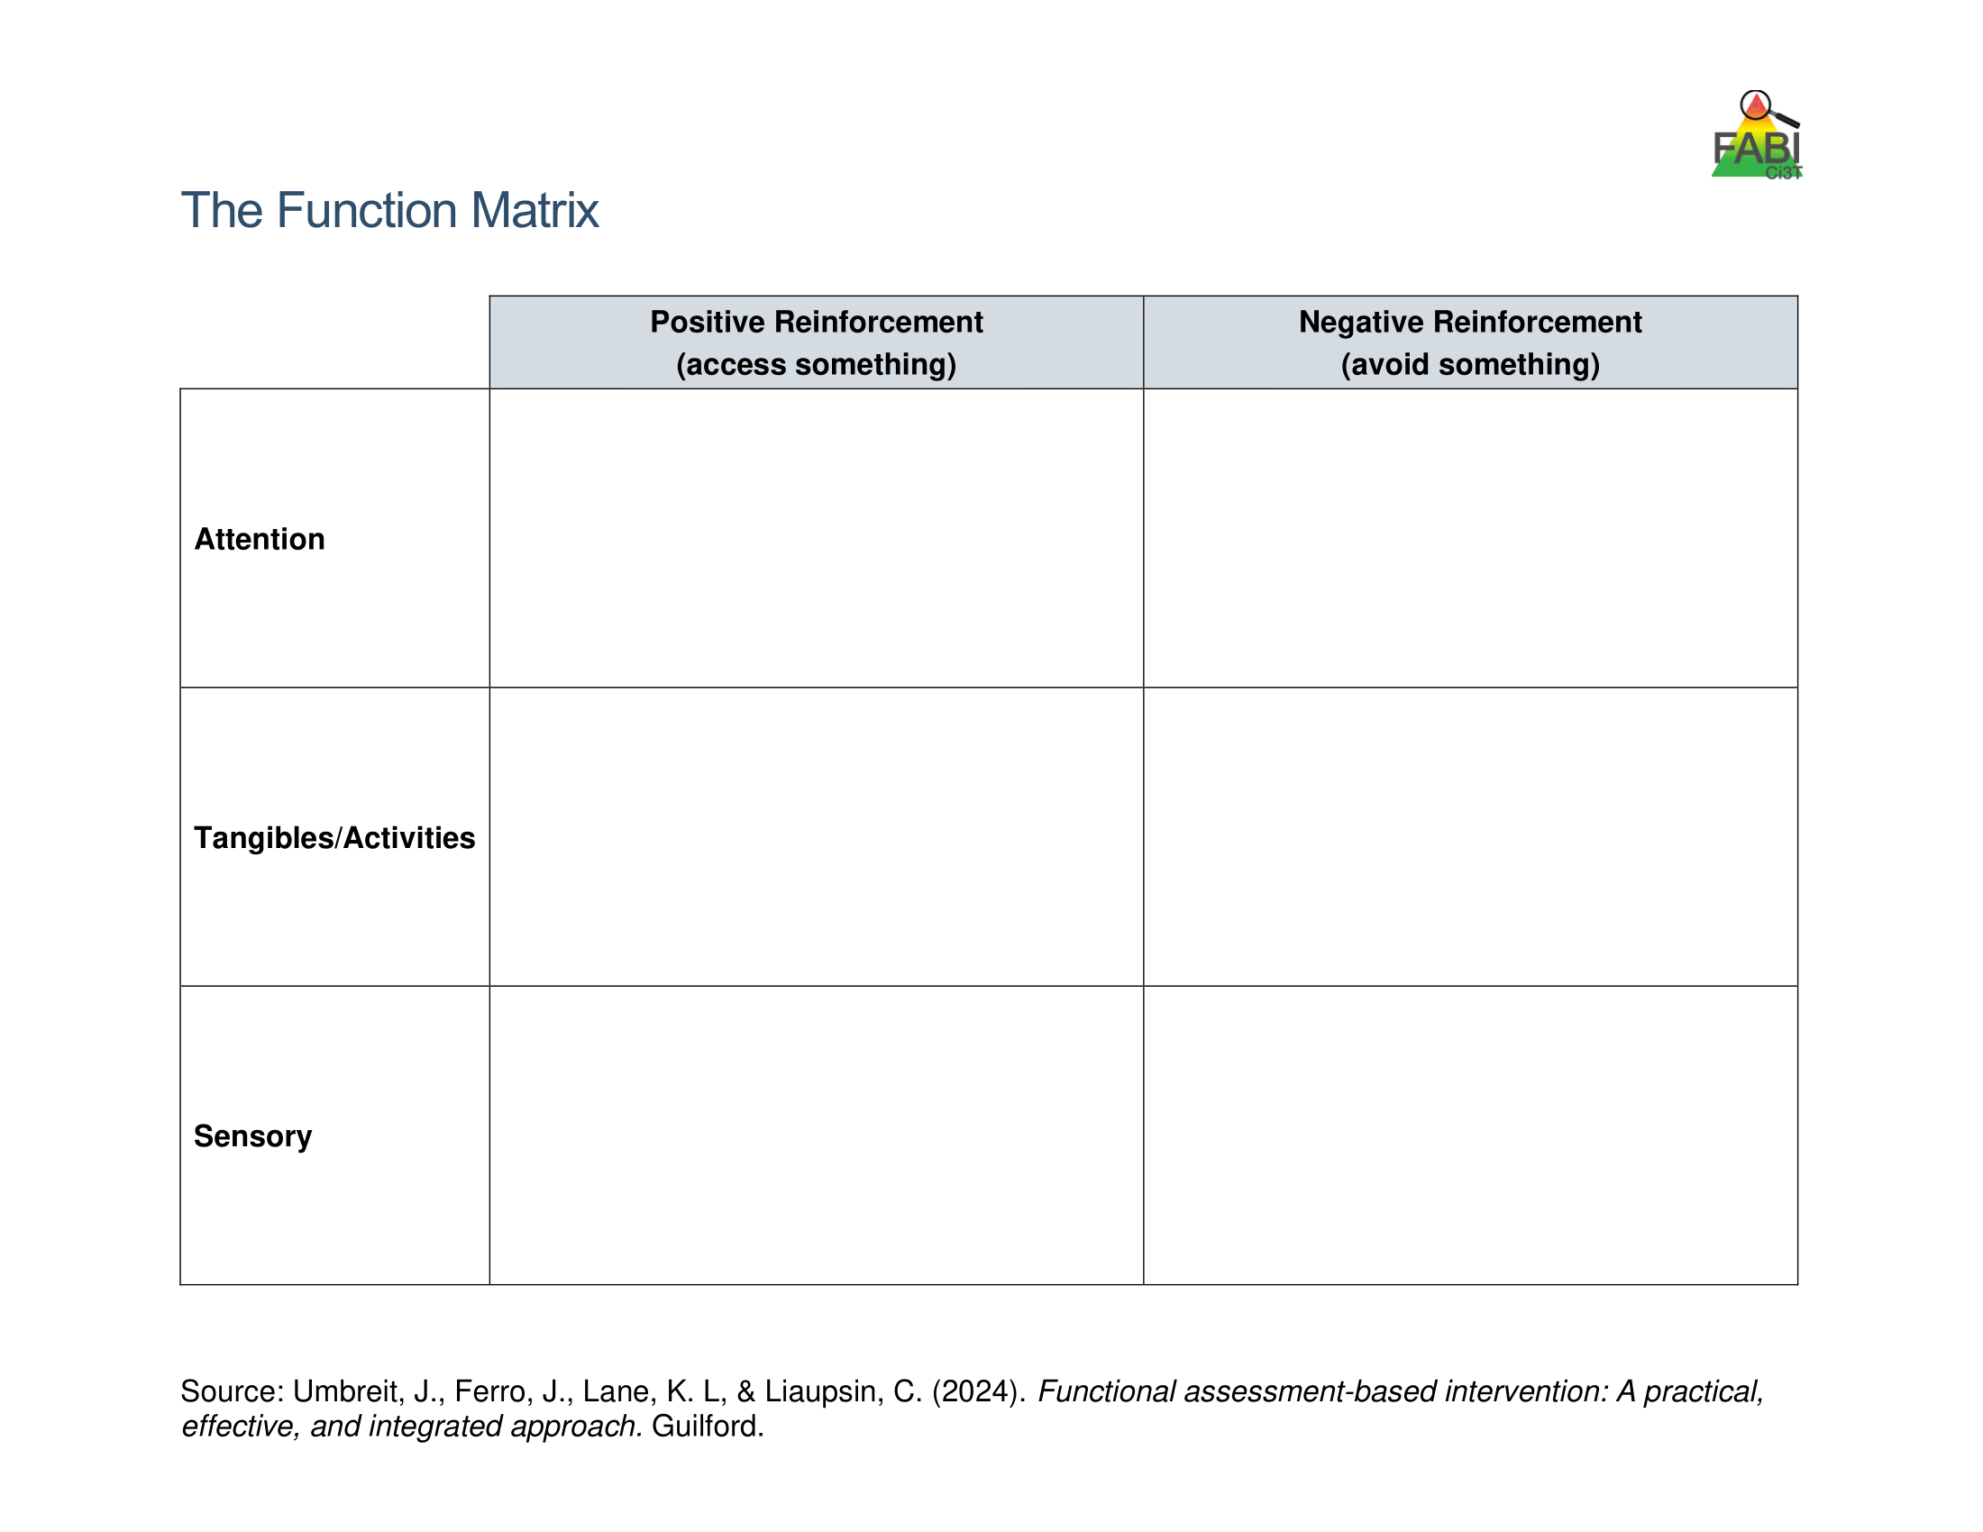
Using the Function Matrix to identify the hypothesized function(s)
Peers laugh
Teacher provides 1:1 assistance
Work alone
Ignored by peers or adults
Preferred activity (e.g., tablet)
Do not have to complete academic task
Access to fidgets
Noise cancelling headphones
Notes:
The Function Matrix, developed by Umbreit and colleagues is a practical, effective, and novel tool for visually organizing multiple sources of information from informal observations, interviews, rating scales, and A-B-C observation data to identify the function of the target behavior.
The Function Matrix is organized based on the principles of applied behavior analysis, with columns reflecting the two ways behaviors are reinforced: positive reinforcement (meaning to get or access something) and negative reinforcement (meaning to escape or avoid something).
Then, the three rows reflect three behavioral categories (the “something or somethings”) the person is trying get or avoid: attention, tangibles or activities, and sensory experiences.

Slide 48
Function Matrix
 | Positive Reinforcement (access something) | Negative Reinforcement (avoid something)
Attention | Teacher Interview – “During Independent work time, frequently comes to me to ask a question during math. Often, she already knows the answer” Parent Interview “She wants me to check her homework every night. Not just one math problem but all of them.” ABC Data- 1.2, 1.3, 2.1, 2.4, 3.1
Tangibles/Activities |  | Records Review - Tammy’s low grades were due to lack of class work completion. Teacher Interview- “She is the last one to get started when it is time for independent reading.” Student Interview- “I hate worksheets, they’re so boring” ABC Data: 1.1, 1.4, 2.2, 2.3, 2.5, 3.2
Sensory
Number of the observation
session (Day 1)
Number of the occurrence in the
observation session
(second instance of the behavior on Day 1)
Source: Umbreit, Ferro, Lane, & Liaupsin (2024); Umbreit, Ferro, Liaupsin, & Lane (2007); Umbreit, Lane, & Dejud (2004)
Notes:
Information from all parts of the functional assessment are added to Function Matrix. This includes: informal observations, interviews, rating scales, and A-B-C observation data.
ABC Data are using the following notation: Number of the observation session (e.g., observation session 1, 2, 3) dot number of the occurrence of target behavior in that observation session (e.g., the second instance of behavior) – this is the number of the row.

Slide 49
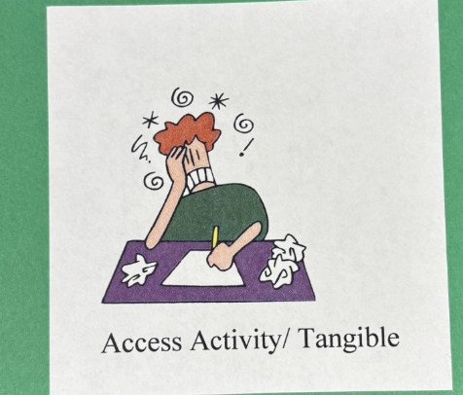
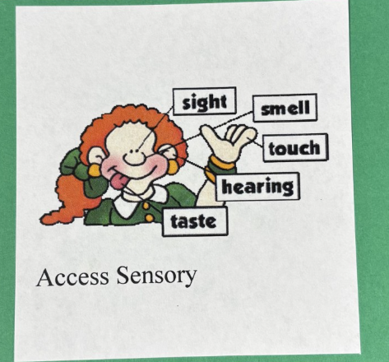


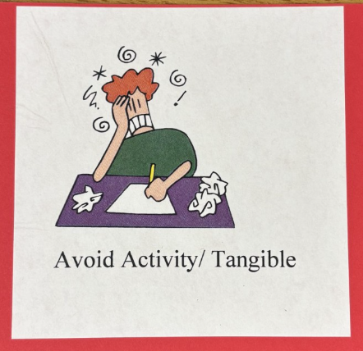
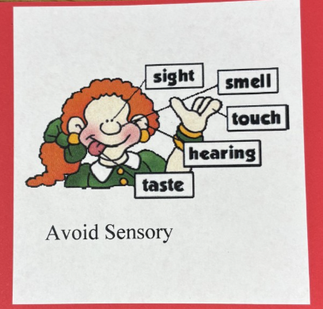
Let’s Practice – Determining the Function

Slide 50
Determining the Function 1
Antecedent | Behavior | Consequence
Teacher faced away | Eddie hums | Teacher attends
Notes:
A...

Slide 51
Determining the Function 2
“If we go somewhere crowded or noisy, she immediately wants to leave or melts down.”

Slide 52
Determining the Function 3
Antecedent | Behavior | Consequence
Teacher provides redirect “Jackson, pick up your pencil and start writing” | Jackson begins to tantrum (falls out of seat, kicks legs, yells “no no, no”) | Teacher sends Jackson to a buddy room
Notes:
A...

Slide 53
Determining the Function 4
“If I feel like the teacher is going to call on me, I usually put my head down or look away.”

Slide 54
Determining the Function 5
Antecedent | Behavior | Consequence
Teacher hands out math computation worksheet, starts the timer, and tells students that they will be timed in completing the math worksheet | The student then tears up the worksheet | The teacher scolds the student and has the student clean up the mess without completing the worksheet
Notes:
A...

Slide 55
Determining the Function 6
“If I think I’ll have to talk in front of the class, I’ll ask to go to the bathroom or try to leave.”

Slide 56
Determining the Function 7
Antecedent | Behavior | Consequence
The teachers asks for a volunteer to answer the math question | Student puts her head on her desk and says that her stomach hurts. | Teacher asks is she is ok to stay in class or needs to go to the nurse.

Slide 57
Determining the Function 8
“He behaves fine when someone is playing with him, but the second I walk away, he starts throwing things.”

Slide 58
Hypothesized Function
During [context], [student name] engages in [target behavior] in order to [maintaining function(s)].
Example:
During independent reading activities (CONTEXT), Frank (STUDENT NAME) engages in noncompliant behavior (TARGET BEHAVIOR) to (a) escape too difficult tasks and (b) access peer and teacher attention (MAINTAINING FUNCTIONS).

Slide 59

Step 3: Collecting Baseline Data Selecting A Measurement System

Slide 60
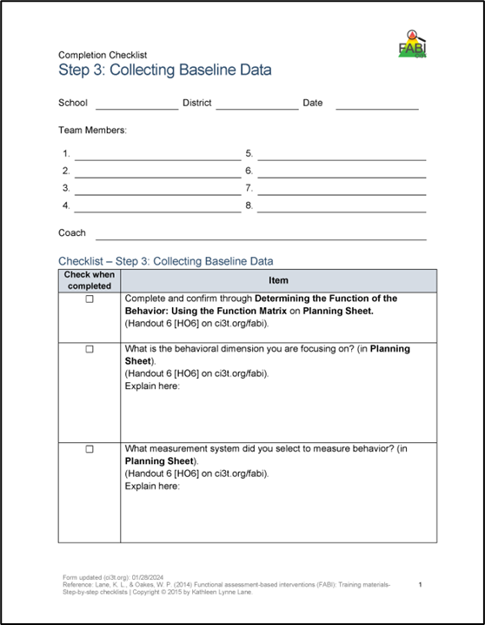
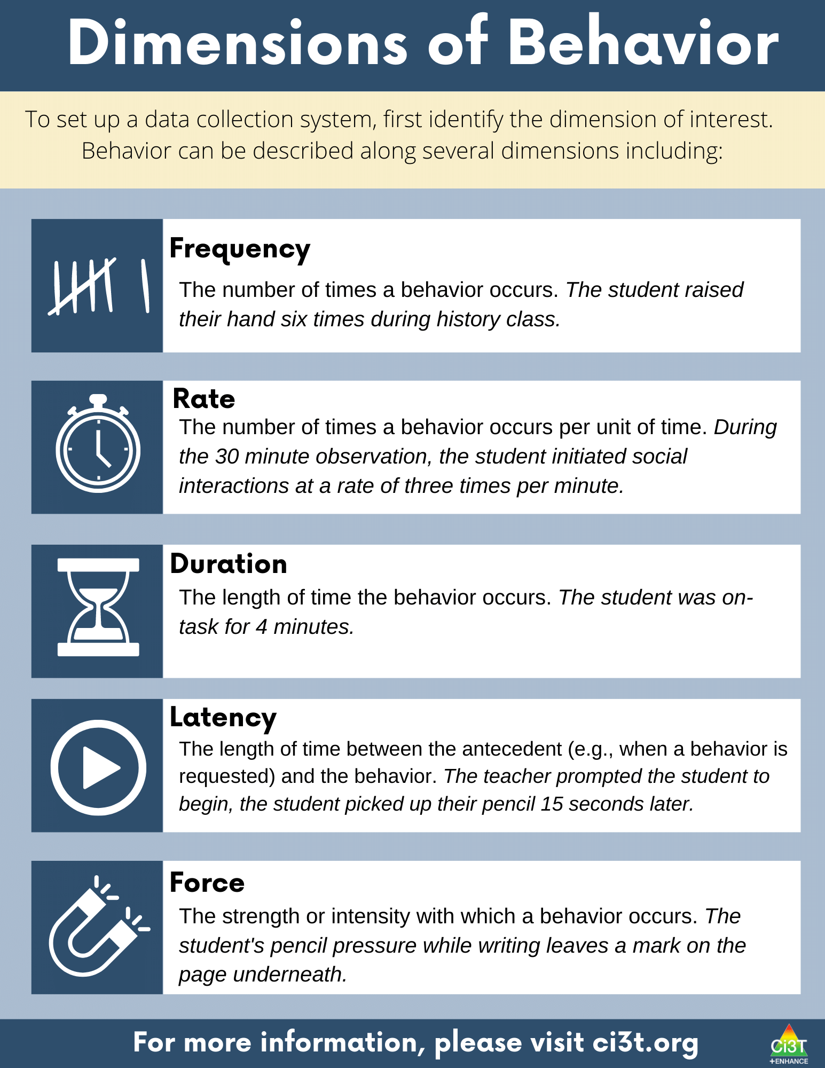
Step 3: Collecting Baseline Data
Determine behavioral dimension of focus
Select a measurement system
Develop data collection procedures
Train data collectors
Collect baseline data
Graph baseline data
Notes:
Today, we are going to focus on these three components of Step 3

Slide 61
Dimensions of Behavior 1

Slide 62
Dimensions of Behavior 2

Slide 63
Dimension of Behavior Example
Behavior = out of seat
Frequency – number of times out of seat
Out of seat 8x during lunch
Duration – amount of time out of seat
Out of seat 1-2x during lunch BUT lasts for 5+ minutes each time

Slide 64
Select an Aligned Measurement System
Event-Based Methods
Frequency
Rate
Time-Based Methods
Duration
Latency
Interval Recording
Whole-Interval
Partial-Interval
Momentary Time Sampling

Slide 65

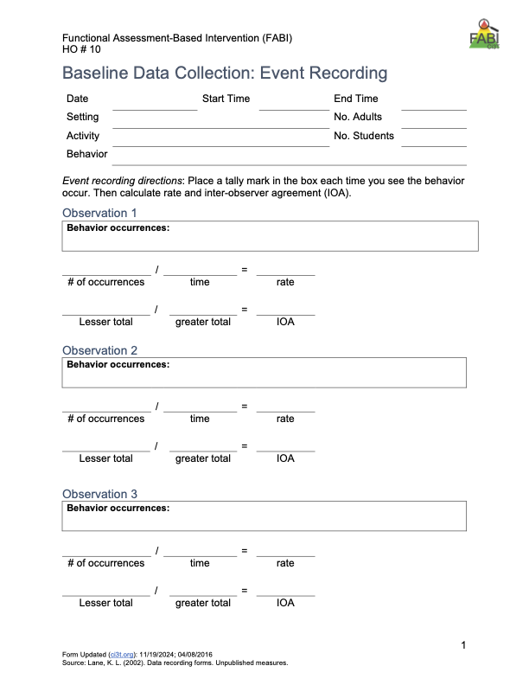
Types of event-based measurement:
Frequency
Rate
Most appropriate for behaviors that are:
Countable and discrete (e.g., relatively brief, clear start and end, and uniform in length)
Examples: talking out of turn, swearing, pushing
Event-Based Measurement Systems

Slide 66
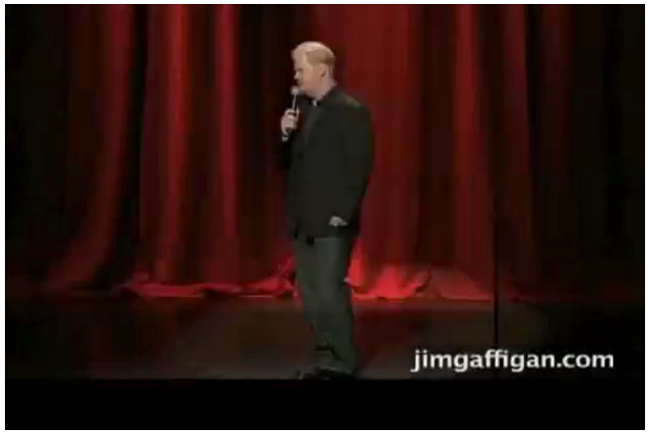
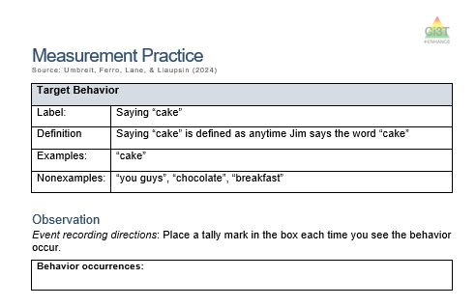
Tips for Event-Based Recording
Select a specific period for data collection (e.g., first 20 minutes of the day, recess, math block)
Keep track of each time the target behavior occurs within that specified time
Tally marks on paper (e.g., post it, label, data-collection sheet)
Move paperclips from one pocked to another
Counter

Slide 67
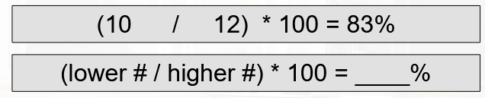
Interobserver Agreement (IOA)
Interobserver agreement (IOA) is degree to which two observers are seeing the same thing
IOA provides insight on the reliability of data collection
To calculate IOA for frequency or rate

Slide 68
Time-Based Measurement Systems
Time Based
Duration
Latency
Interval (whole-interval, partial interval, momentary time sampling)
Most appropriate for behaviors that are:
Not countable or discrete (e.g., less defined start/end, span a period of time) and/or vary in length each time
Examples of non-uniform behaviors include: academic engagement, off-task, leaving designated area (e.g., desk, carpet spot), tantrum

Slide 69

Tips for Duration and Latency
Duration and Latency
Select a specific period for data collection (e.g., first 20 minutes of the day, recess, math block)
Use a stopwatch (or app) to note:
Duration – when behavior begins and ends
Latency – start timer when direction is given, stop timer when student engages in expected behavior

Slide 70
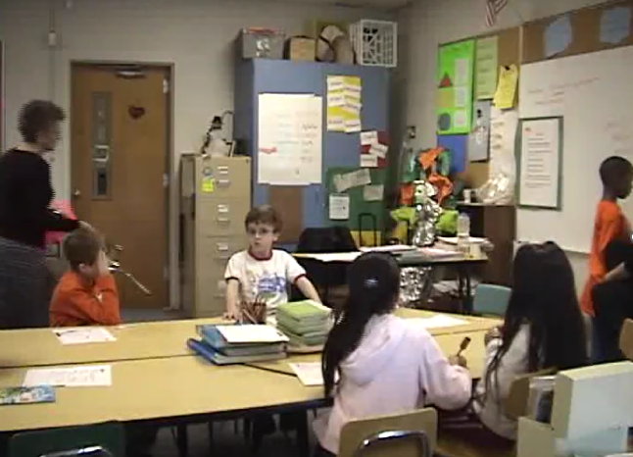
Let’s Practice: Duration Recording
Sam
(in white shirt)
Component | Description
Label | Off-Task
Definition | Off-Task is defined being engaged in activities other than those directed by the teacher.
Examples | Looking at a peer’s paper, out of location, coloring, throwing materials
Non-Examples | Writing, looking at the teacher or board, reading, following teacher directions

Slide 71
Table Talk: Duration Recording
Share your duration recording data with the people at your table
Calculate interobserver agreement (smaller # / larger #) x 100
What about duration recording was challenging?
What challenges might you encounter if collecting duration data for your student? How might you overcome those challenges?

Slide 72
Tips for Interval Recording
Select a specific period for data collection (e.g., first 20 minutes of the day, recess, math block)
Divide observation period into equal intervals (e.g., 30-second, 1 minute)
Set up cue to go off at end of each interval (e.g., audio cue, phone or watch app, MotivAider)
Record whether behavior occurred:
Whole-interval: behavior occurred the entire interval
Partial-interval: behavior occurred at any time during the interval
Momentary Time Sampling: behavior occurred at exact moment interval ends

Slide 73
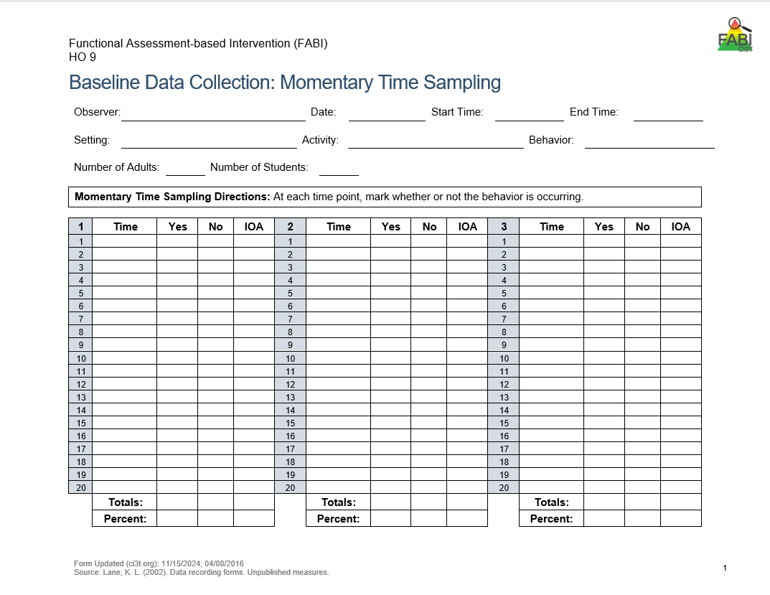
Momentary Time Sampling
Record if the behavior occurs (yes / no) at the exact moment the interval ends
Feasible as it does not require watching the student the entire time
Tends to underestimate behavior

Slide 74
Let’s Practice: Momentary Time Sampling
Component | Description
Label | Holding microphone in left hand
Definition | Any instance where Jim holds the microphone in his left hand
Examples | using only the left hand to hold the microphone
Non-Examples | holding the microphone in the right hand or with both hands
Notes:
Interval Timer

Slide 75
Table Talk: Momentary Time Sampling
Share your momentary time sampling data with the people at your table
Calculate interobserver agreement
(# intervals agree / total # of intervals) x 100
What about momentary time sampling was challenging?

Slide 76
Partial Interval Recording
Record if the behavior occurred (yes / no) at any point during the interval
Requires watching the student the entire time
Tends to overestimate behavior

Slide 77
Let’s Practice: Partial Interval Recording
Component | Description
Label | Holding microphone in left hand
Definition | Any instance where Jim holds the microphone in his left hand
Examples | using only the left hand to hold the microphone
Non-Examples | holding the microphone in the right hand or with both hands
Notes:
Interval Timer

Slide 78
Table Talk: Interval Recording
Share your partial interval recording data with the people at your table
Calculate interobserver agreement
(# intervals agree / total # of intervals) x 100
How did data from partial interval recording compare to data collected using momentary time sampling?
What challenges might you encounter if collecting data using interval recording for your student? How might you overcome those challenges?
Notes:
5-minute timer

Slide 79
Capture Questions in the Parking Lot!
Use a sticky note to add any questions to the Parking Lot
Parking Lot
Add questions here!

Slide 80
Step 3: Collecting Baseline Data Baseline Data Collection Procedures

Slide 81
Data Collection Procedures: Materials
Create data collection forms
Student’s Name
Observer’s name
Date
Setting
Operational Definition
Time observation started and ended
Materials (e.g., stopwatch, phone app)
System to organize and store data forms (e.g., clipboard, folder)

Slide 82
Data Collection Procedures: Logistics
Choosing when to observe
Setting where behavior most likely to occur and / or most problematic
Consistent time (e.g., 1:00-1:30, lunch, first 20 minutes of independent work)
Choosing where to sit
Student within line of sight
Close enough to hear (if applicable)
Unobtrusive
Discrete

Slide 83
Training Observers
Identify primary and secondary observers
Training focuses on:
Operational definition of behavior being measured
How to record behavior using selected measurement system
Conduct practice sessions until reach 90% accuracy across three consecutive sessions

Slide 84
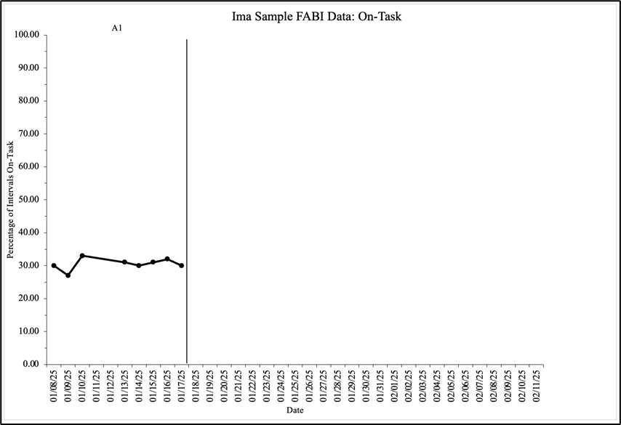
Collect and Graph Baseline Data
Baseline data serves as the control condition to compare against data collected when the FABI is introduced
Collect a minimum of 3-5 baseline data points
Collect IOA for 25% of baseline data collection sessions

Slide 85
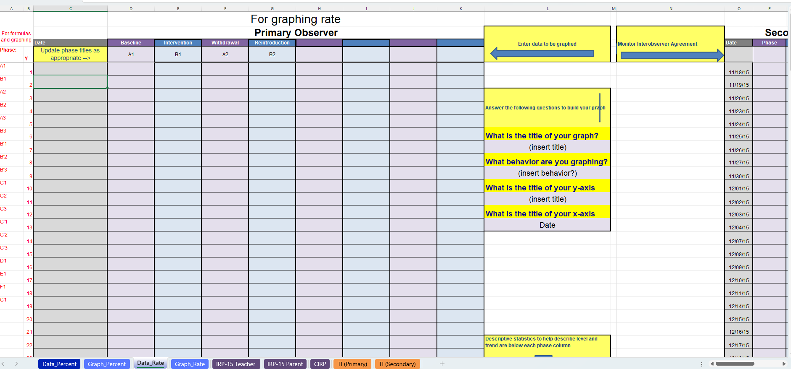
FABI Data Manager

Slide 86
Putting it All Together

Slide 87
Let’s Practice: Designing Measurement Systems
Choose an example article (pre-k, elementary, middle school)
Review content in article related to FABI Step 2
Work with your group to draft measurement procedures
Compare your measurement procedures to those used in the article
How are the procedures similar?
How are they different?

Slide 88
Connect – Extend – Challenge Reflection
Consider:
How are the ideas and information presented connected to what you already know or do?
What new ideas did you get that extended or broadened your thinking?
What challenges or puzzles have come up in your mind from the ideas and information presented?
Add your reflections to each poster
Read and respond to (e.g., star, heart, add a note) to the reflections at each poster

Slide 89

Work Time: Calendar FABI Steps 2 and 3
Review FABI Step 2 and FABI Step 3 Implementation Checklists
Consider when and how you will complete each item
Add action items to your calendar

Slide 90
Wrapping Up and Moving Forward

Slide 91
Learning Exchange Series Progression: Next Steps

Slide 92
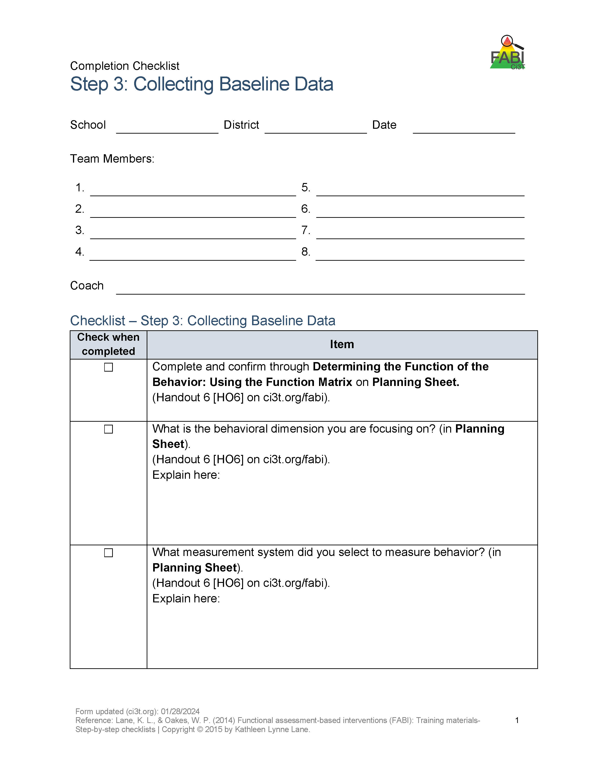
Action Items: Between Session 2 and 3

Slide 93

Optional: FABI Support
We are happy to provide support as you complete FABI Steps 2 and 3 ☺
Please email us to schedule a zoom call!
Kathleen Lynne Lane kathleen.lane@ku.edu
Elise Sarasin elise.sarasin@ku.edu

Slide 94



Opportunities to Learn More

Slide 95
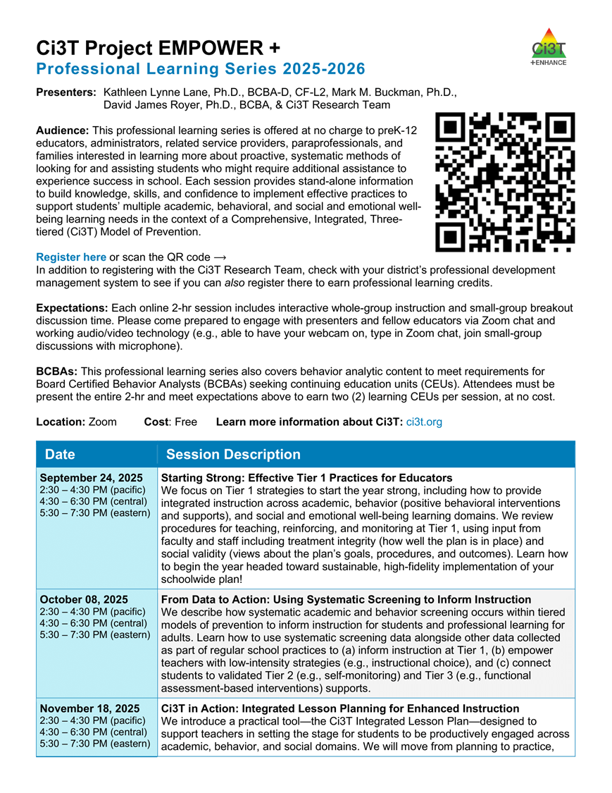
Project EMPOWER+
EMPOWER+ Session | Date
Starting Strong: Effective Tier 1 Practices for Educators | September 24, 2025 (Wednesday)
From Data to Action: Using Systematic Screening to Inform Instruction | October 8, 2025 (Wednesday)
Ci3T In Action: Integrated Lesson Planning for Enhanced Instruction | November 18, 2025 (Tuesday)
Mastering Behavior Specific Praise and Precorrection | January 21, 2026 (Wednesday)
A 6-Step Instructional Approach for Responding to Challenging Behaviors: A Tier 1 Practice | February 10, 2026 (Tuesday)
A Tier 2 Support for Students Experiencing Anxious Feelings: Recognize. Relax. Record. | March 25, 2026 (Wednesday)
A Tier 3 Support for Students with Intensive Intervention Needs: Functional Assessment-Based Intervention (FABI) | April 28, 2026 (Tuesday)
Notes:
Builds knowledge and skill sets aligned to FABI Steps. For example – BSP and pre-correct often Antecedent Adjustment

Slide 96
Reminder: Knowledge, Application, Impact Points
On-Task Behavior: Jackson
In Kansas, you can earn 2 x PD points for application and 3 x for impact!
We are happy to review your materials before you upload!
Notes:
Tonight’s session lays the foundation with knowledge building and getting you oriented to the modules that can support application and impact efforts!

Slide 97
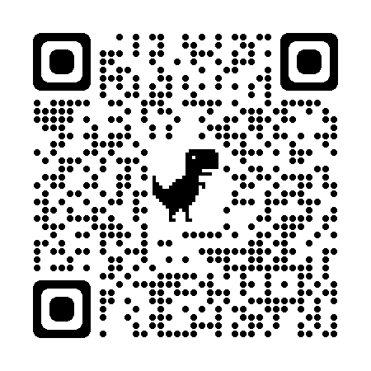
Application & Impact
Also, did you know when you apply your learning…
you can take your learning activity in MLP to “Application” and earn double the points?
and demonstrate its’ impact, you can get triple your original knowledge points?
Check out the example below!
A total of 6 points
for Salary Enhancement
Original Activity = 2 points
These are “knowledge
points” and can be used for
relicensure.
Application = 4 points
These are “application points”
and can be used towards horizontal movement on the salary schedule.
Impact = 2 add’l points
These are “impact points” and can be used towards horizontal movement on the salary schedule.
And, the BEST part?
Application and Impact points can be used to move horizontally
on the salary schedule! Click HERE to learn more (or use the QR code). See your PDC Representative if you have questions!
Use code: lnhgi6q
Notes:
lnhgi6q

Slide 98
Thank You!
Elise Sarasin
elise.sarasin@ku.edu
Kathleen Lynne Lane
kathleen.lane@ku.edu

