Slide 1



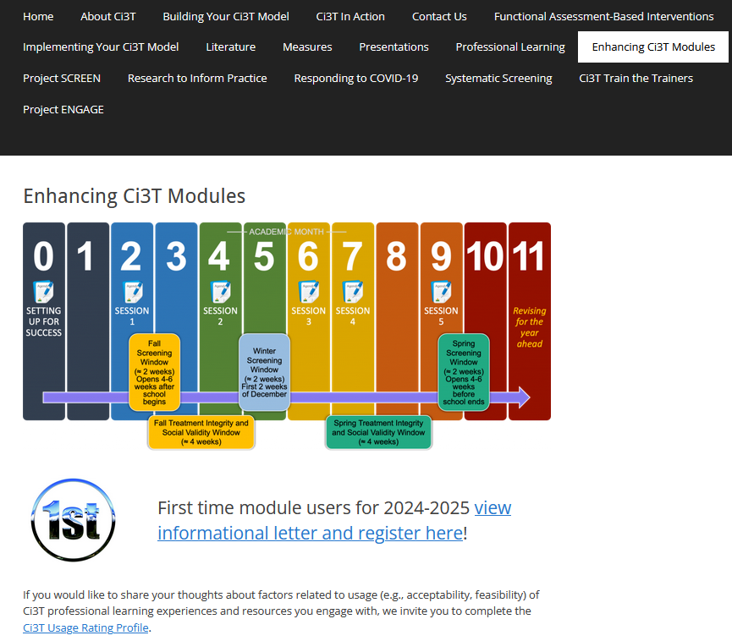
Tier 3 Supports for Students with
Intensive Intervention Needs:
Functional Assessment-Based Intervention & Managing Acting Out Behaviors
Kathleen Lynne Lane, Ph.D., BCBA-D, CF-L2
If you have not done so already, we invite you to visit ci3t.org/enhance to access modules after a one-time registration process!

Slide 2
Agenda
Welcome
Using Systematic Screening Data to Inform Instruction: Situating Tertiary (Tier 3) Interventions in Ci3T Models
Functional Assessment-Based Intervention (FABI)
  Introduction to FABI
  5-Step Process to Implement FABI
Managing Acting Out Behavior: Acting Out Cycle
  Stages
  Intervention Strategies
Core Components: Treatment Integrity, Social Validity, & Student Performance
Wrapping Up and Moving Forward

Slide 3
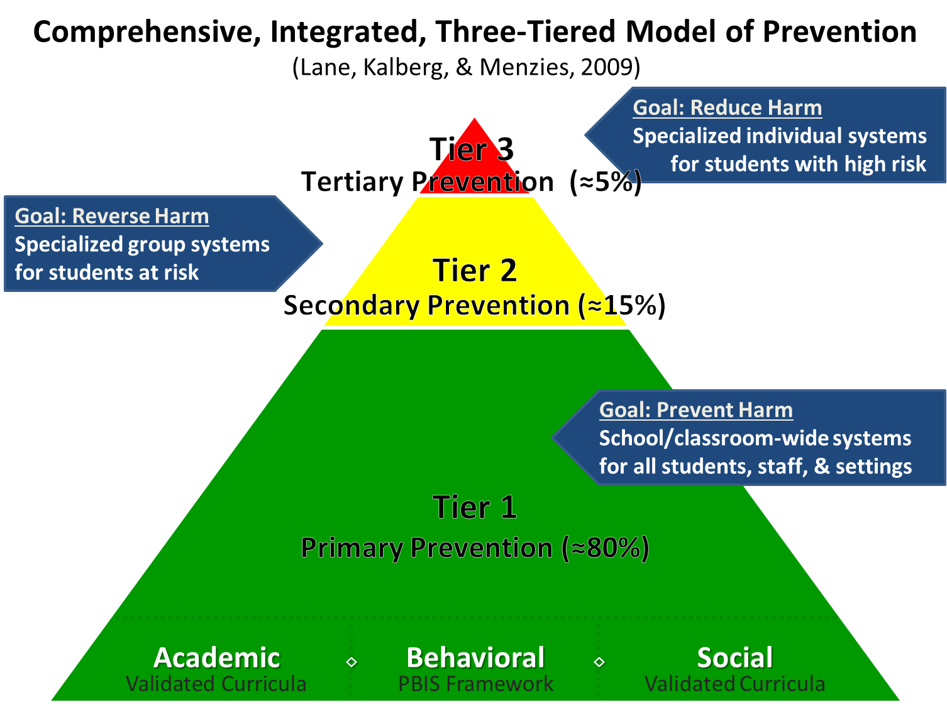
Comprehensive, Integrated, Three-Tiered Model of Prevention 1

Slide 4
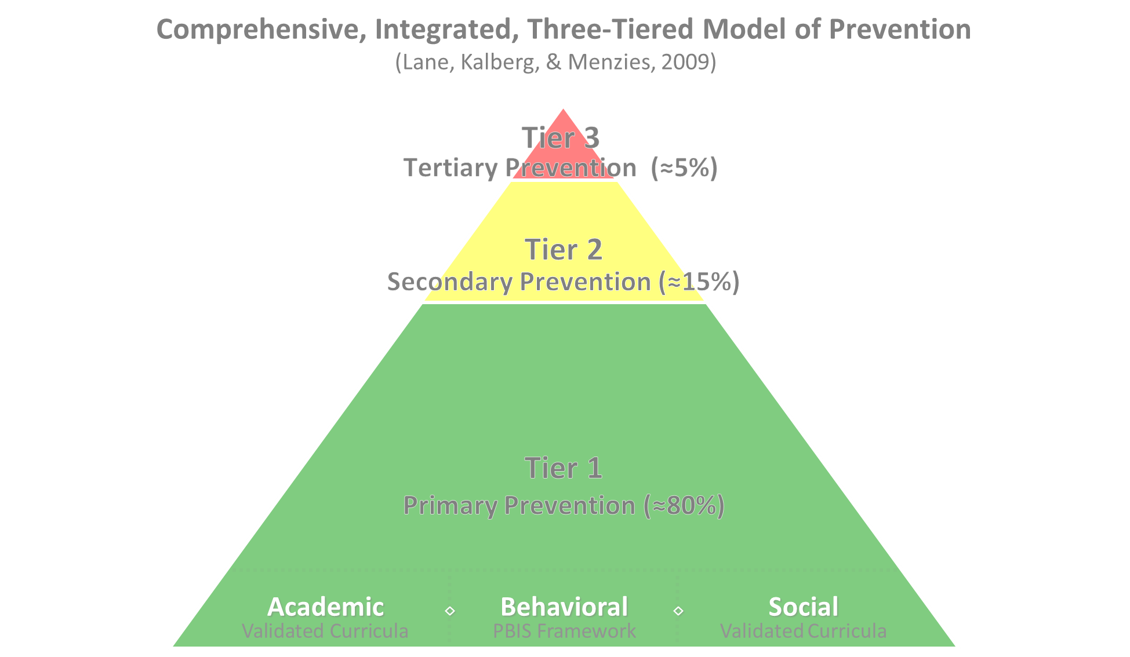

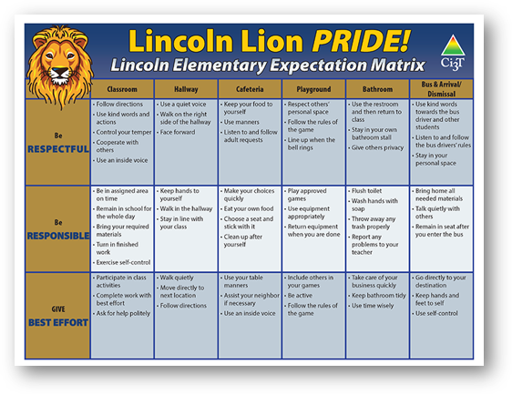
Comprehensive, Integrated, Three-Tiered Model of Prevention 2
Positive Behavioral Interventions and Supports
District & State Standards Quality Instruction
Validated Curricula and Resources

Slide 5


Primary Prevention (Tier 1)

Slide 6

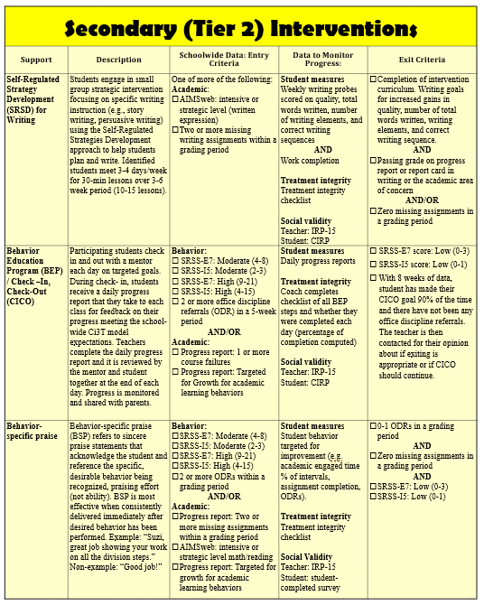
Secondary (Tier 2) Intervention Grid
Notes:
In addition to the module featured here outlining how to use multiple sources of data to connect students with Tier 2 supports, we offer a full suite of modules highlighting validated Tier 2 interventions such as Self-Regulated Strategy Development (SRSD) for Writing and Check-In/Check Out that may appear in your Secondary (Tier 2) Intervention Grid

Slide 7

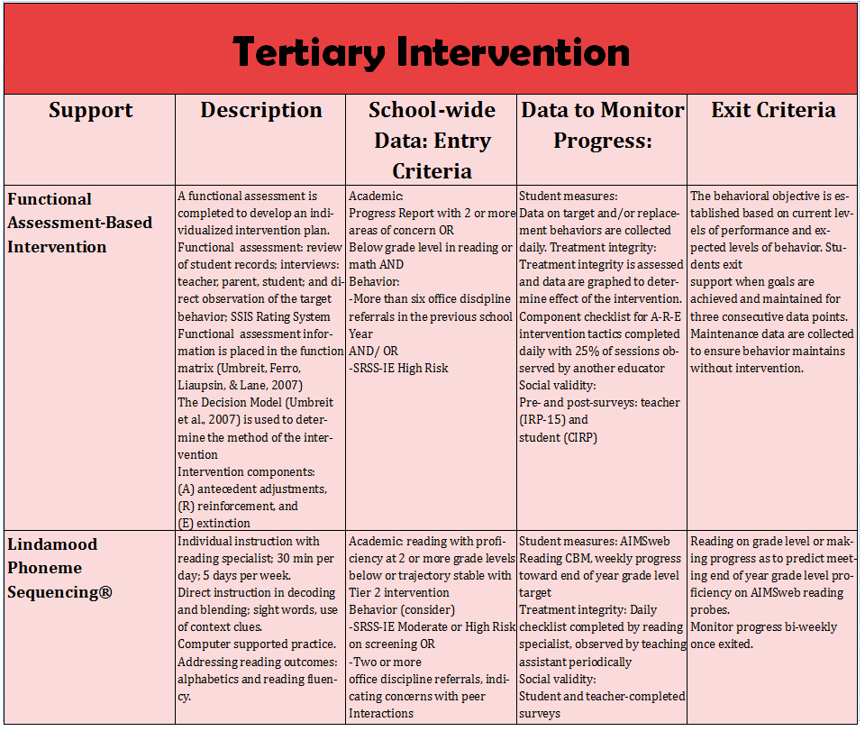
Tertiary (Tier 3) Intervention Grid
Notes:
In addition to the module featured here outlining how to use multiple sources of data to connect students with Tier 3 supports, we offer a full suite of modules highlighting validated Tier 3 interventions such as Functional Assessment-Based Intervention (FABI) that may appear in your Tertiary (Tier 3) Intervention Grid

Slide 8

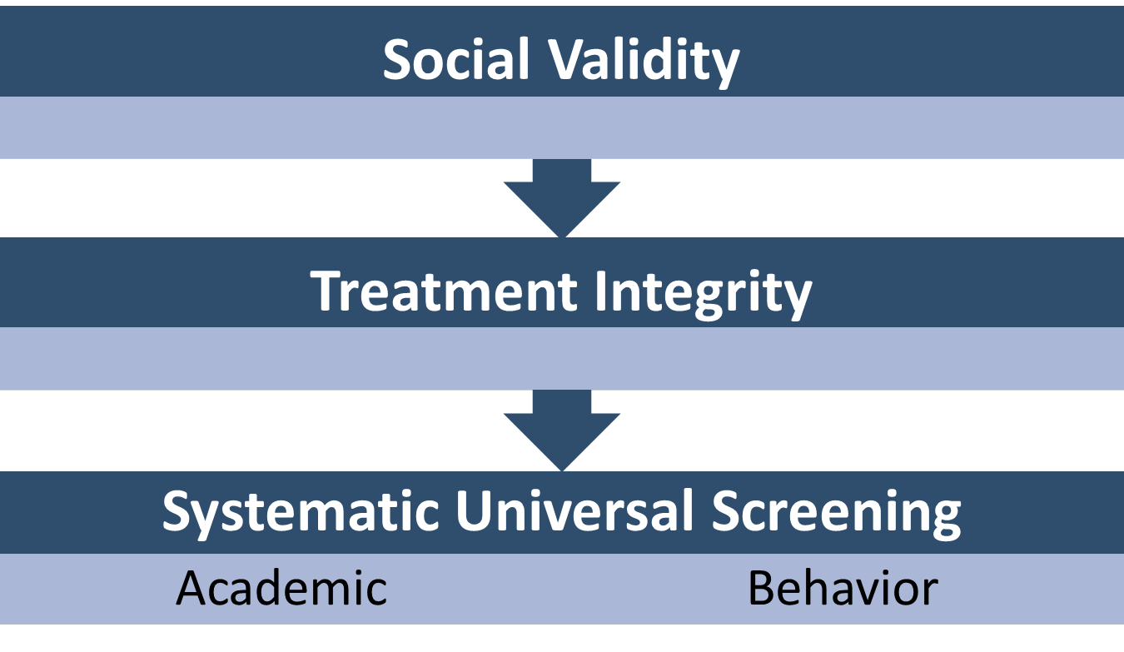
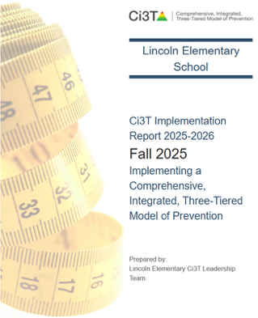
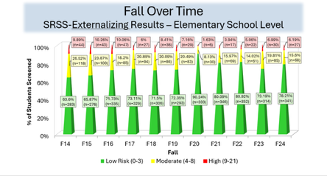
Essential Components of Primary (Tier 1) Prevention Efforts
Essential Components of Primary (Tier 1) Prevention Efforts 1

Slide 9



Enhancing Ci3T Modules
ci3t.org/enhance

Slide 10


Using Systematic Screening Data to Inform Instruction:
Situating Tertiary (Tier 3) Interventions in Ci3T Models

Slide 11
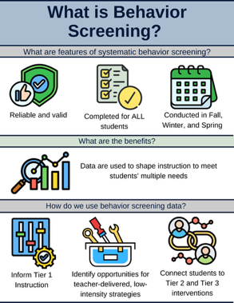
Essential Components of Primary (Tier 1) Prevention Efforts
Essential Components of Primary (Tier 1) Prevention Efforts 2

Slide 12
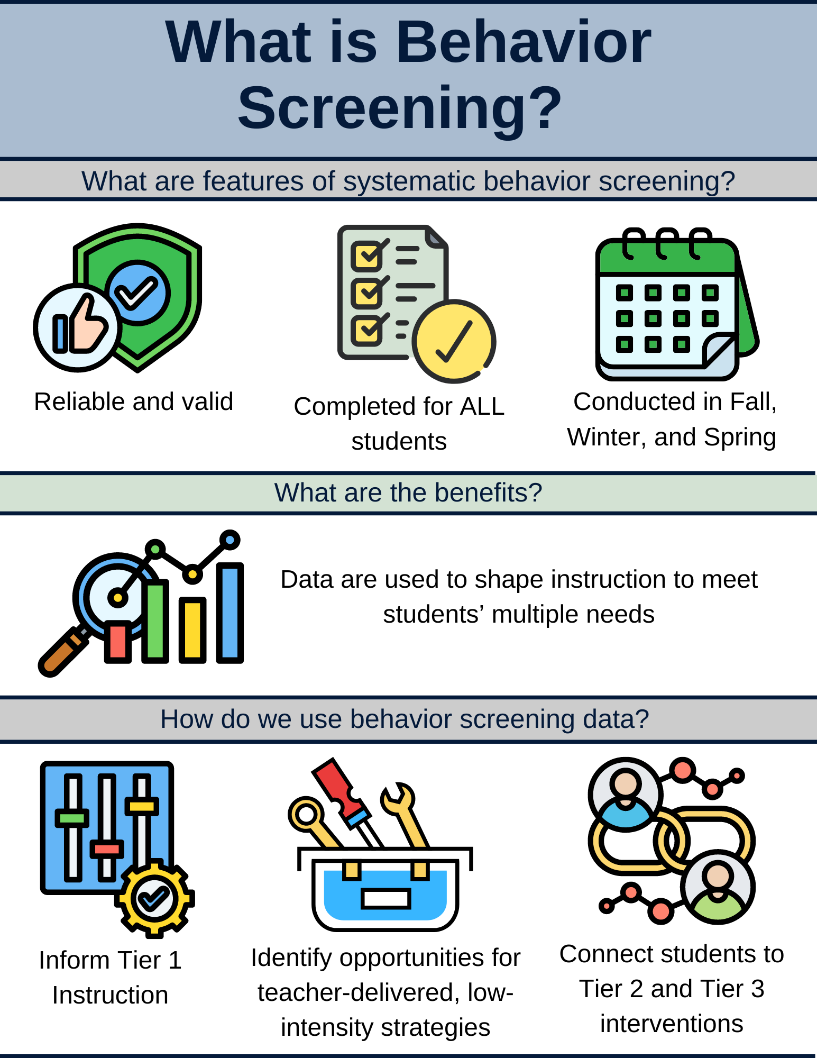
What is Behavior Screening? 1

Slide 13
What is Behavior Screening? 2

Slide 14
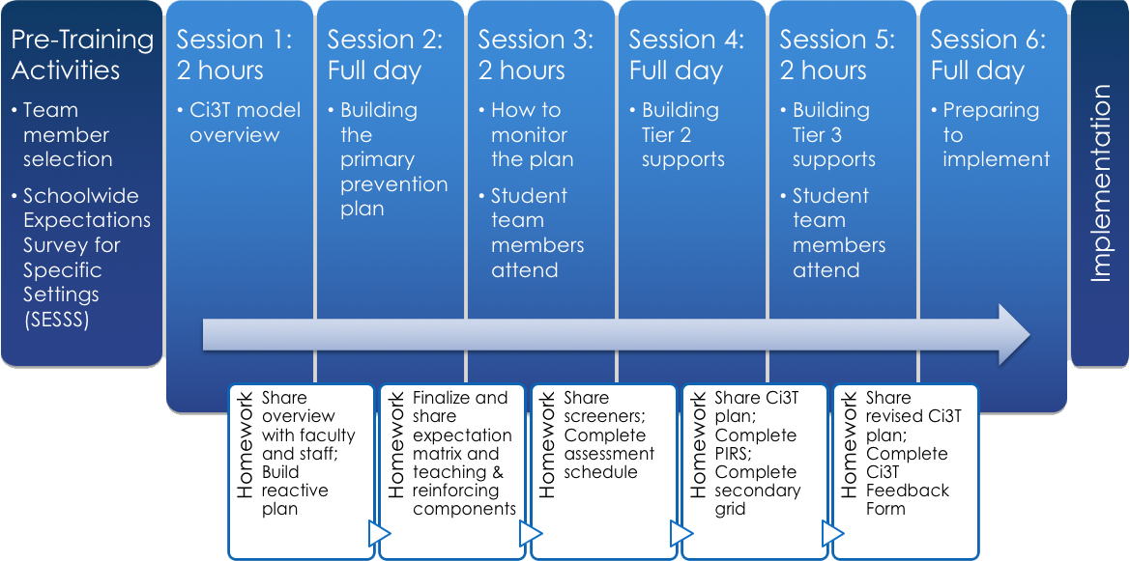

Selecting a Systematic Screener
Notes:
https://www.pbis.org/resource/selecting-a-universal-behavior-screening-tool-questions-to-consider

Slide 15

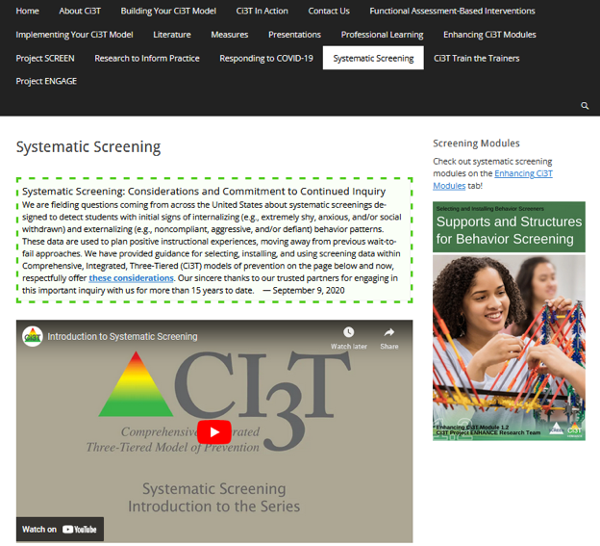
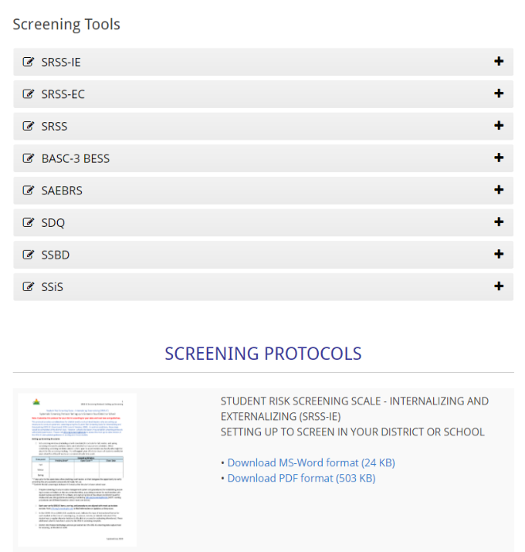
Finding the SRSS-IE on the Ci3T Website
https://www.ci3t.org/screening

Slide 16
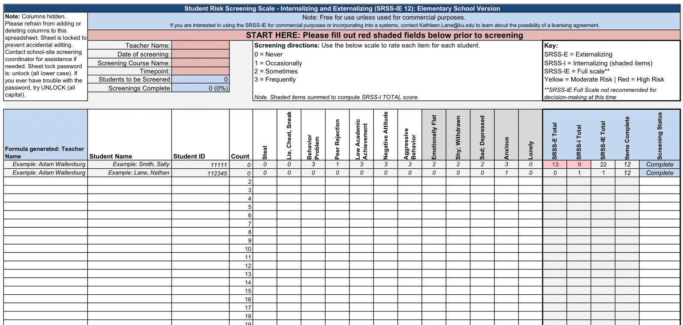
Student Risk Screening Scale – Internalizing and Externalizing (SRSS-IE; Drummond, 1994; Lane & Menzies, 2009)
Elementary

Slide 17
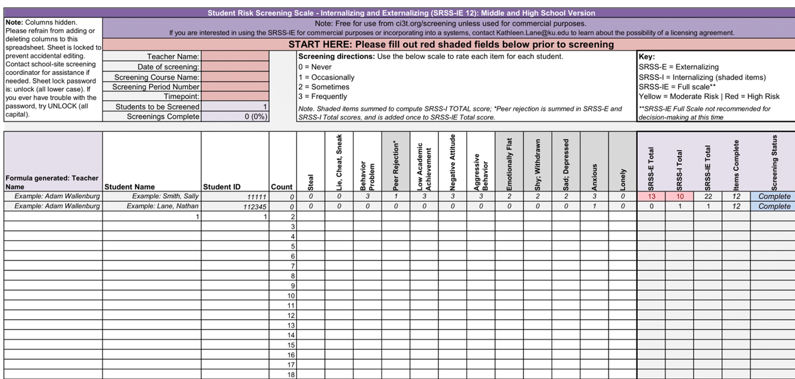
Student Risk Screening Scale – Internalizing and Externalizing (SRSS-IE; Drummond, 1994; Lane & Menzies, 2009)
Secondary

Slide 18
SRSS-IE: Cut Scores
Elementary School
Middle and High School
SRSS-E7 | SRSS-I5
Items 1-7 | Items 8-12
0-3 = low risk 4-8 = moderate risk 9-21 = high risk | 0-1 = low risk 2-3 = moderate risk 4-15 = high risk
SRSS-E7 | SRSS-I6
Items 1-7 | Items 4, 8-12
0-3 = low risk 4-8 = moderate risk 9-21 = high risk | 0-3 = low risk 4-5 = moderate risk 6-18 = high risk
Elementary School Level:
Lane, K. L., Oakes, W. P., Swogger, E. D., Schatschneider, C., Menzies, H., M., & Sanchez, J. (2015). Student risk screening scale for internalizing and externalizing behaviors: Preliminary cut scores to support data-informed decision making. Behavioral Disorders, 40, 159-170.
Middle and High School Levels:
Lane, K. L., Oakes, W. P., Cantwell, E. D., Schatschneider, C., Menzies, H., Crittenden, M., & Messenger, M. (2016). Student Risk Screening Scale for Internalizing and Externalizing Behaviors: Preliminary cut scores to support data-informed decision making in middle and high schools. Behavioral Disorders, 42(1), 271-284

Slide 19
Fall Over Time
SRSS-Externalizing Results – Elementary School Level
Notes:
Fill in <year> based on current academic year. This is located in column A of the data sheet. Edit by right clicking and selecting “Edit data”.

Slide 20
Fall Over Time
SRSS-Internalizing Results – Elementary School Level
Notes:
Fill in <year> based on current academic year. This is located in column A of the data sheet. Edit by right clicking and selecting “Edit data”.

Slide 21
Fall 2024
SRSS-Internalizing Results – Elementary School Grade Level
Grade Level | N Screened | Low n (%) | Moderate n (%) | High n (%)
K | 46 | 26 (56.52) | 9 (19.57) | 11 (23.91)
1 | 60 | 41 (68.33) | 9 (15.00) | 10 (16.67)
2 | 85 | 66 (77.65) | 15 (17.65) | 4 (4.71)
Notes:
Fill in <year> based on current academic year. This is located in column A of the data sheet. Edit by right clicking and selecting “Edit data”.

Slide 22
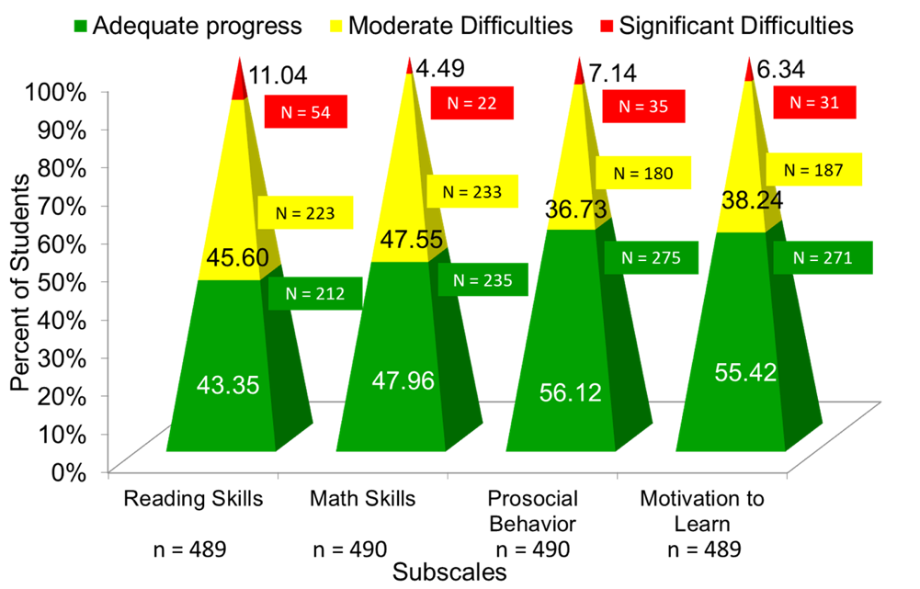
Data to Indicate a Focus on Tier 1: School Level
Social Skills Improvement System – Performance Screening Guide Spring 2012 – Total School
Lane, K. L., Oakes, W. P., & Magill, L. (2013). Primary prevention efforts: How do we implemented and monitor the Tier 1 component of our Comprehensive, Integrated, Three-Tiered (Ci3T) Model?, Preventing School Failure, 58(1), 143-158.

Slide 23

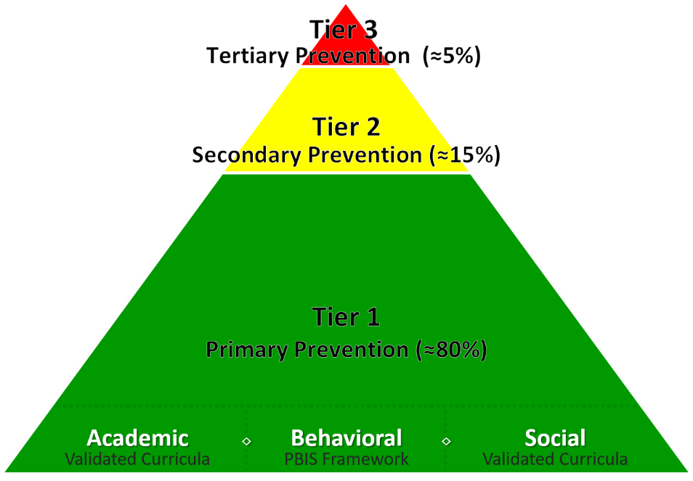
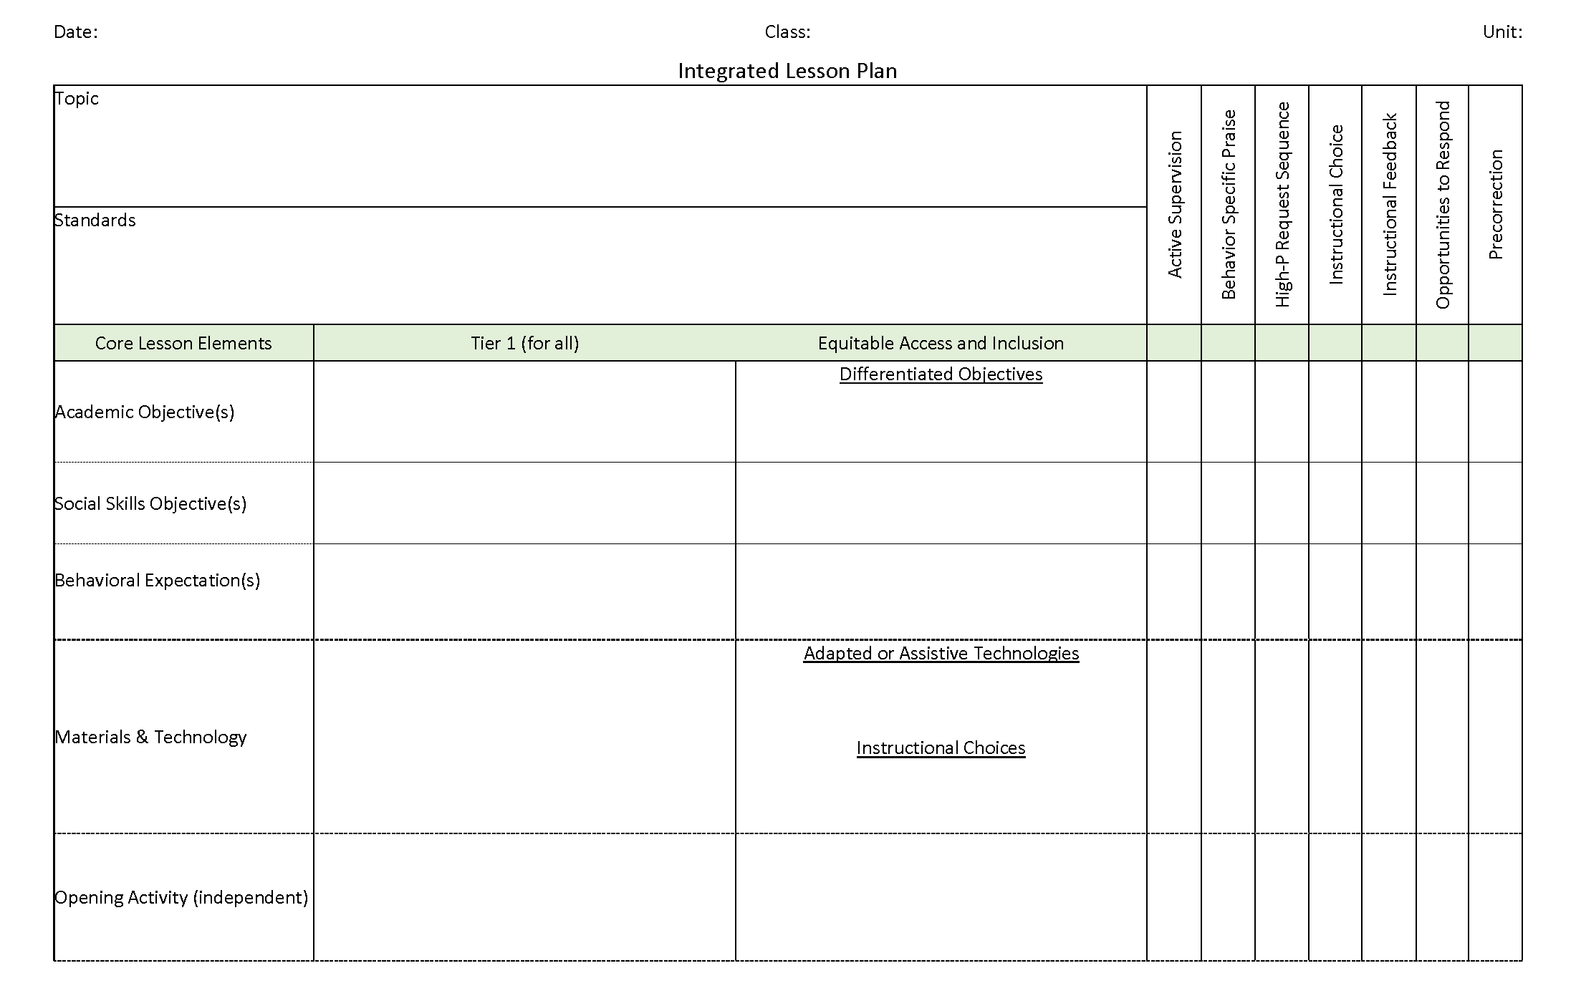
Ci3T Integrated Lesson Planning
Citation. Oakes, W. P., Lane, K. L., Lane, K. S., & Buckman, M. M. (2019). Ci3T integrated lessons plan template. www.ci3t.org.
Completed examples available in: Ci3T Project ENHANCE Research Team. (2022, July). Embedding and integrating Ci3T domains into daily instruction. Author. https://doi.org/10.17161/ci3t.42880

Slide 24
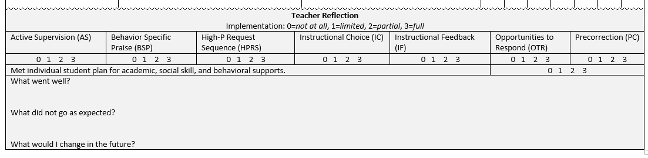
Integrated Lesson Plan
Citation. Oakes, W. P., Lane, K. L., Lane, K. S., & Buckman, M. M. (2019). Ci3T integrated lessons plan template. www.ci3t.org.​

Slide 25

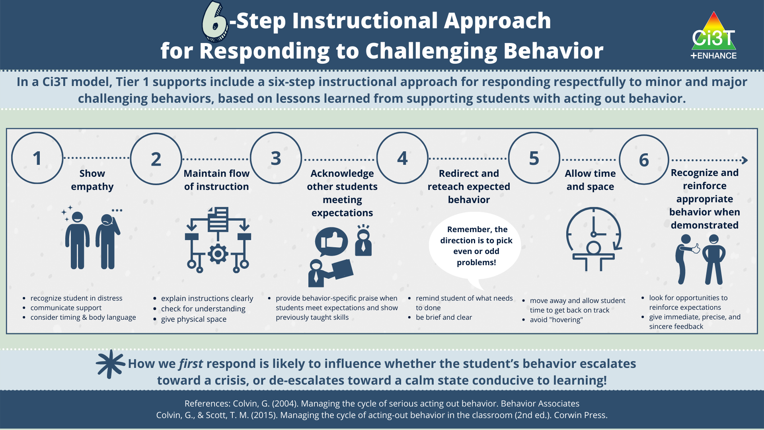
6-Step Instructional Approach for Responding to Challenging Behavior

Slide 26


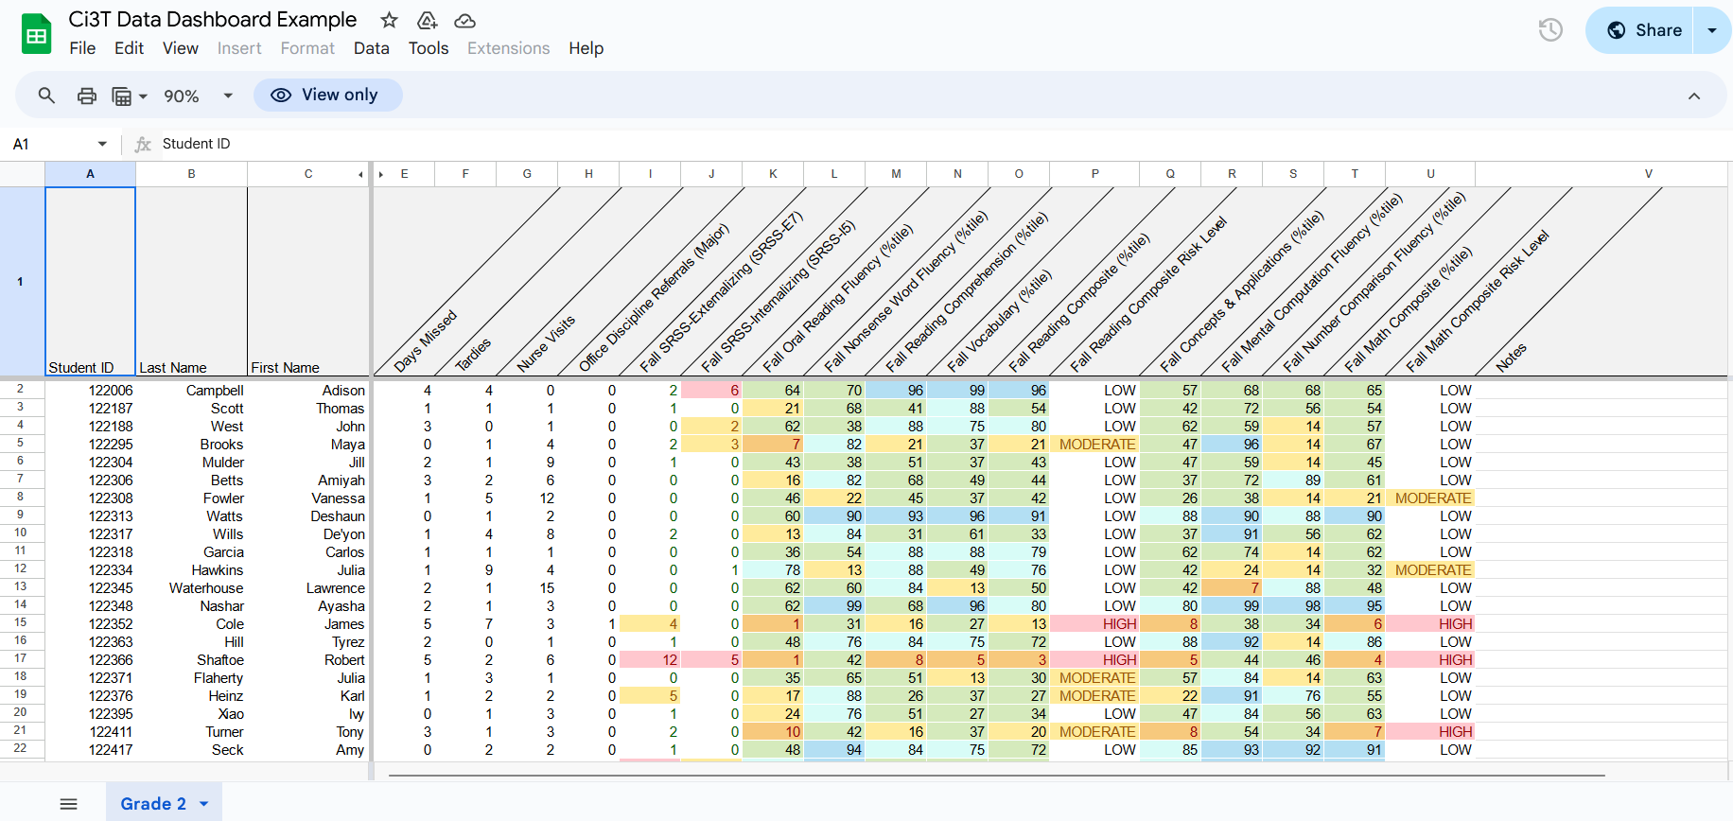
Let’s Practice Together!
Notes:
Facilitator has copy of Ci3T Data Dashboard- https://docs.google.com/spreadsheets/d/135hDmcTOIjAwb_8Ci-hNR38uF9vs7oUcVzjeSxVM2a8/edit?usp=sharing
Model:
Filter
Moderate ext
Below grade level reading
Attendance – now what do you notice
Ci3T Implementation Manual
What intervention(s) might be appropriate for this student? (e.g., self-monitoring w/ reading, breathing strategy)

Slide 27


Low-Intensity Strategies: Instructional Choice

Slide 28

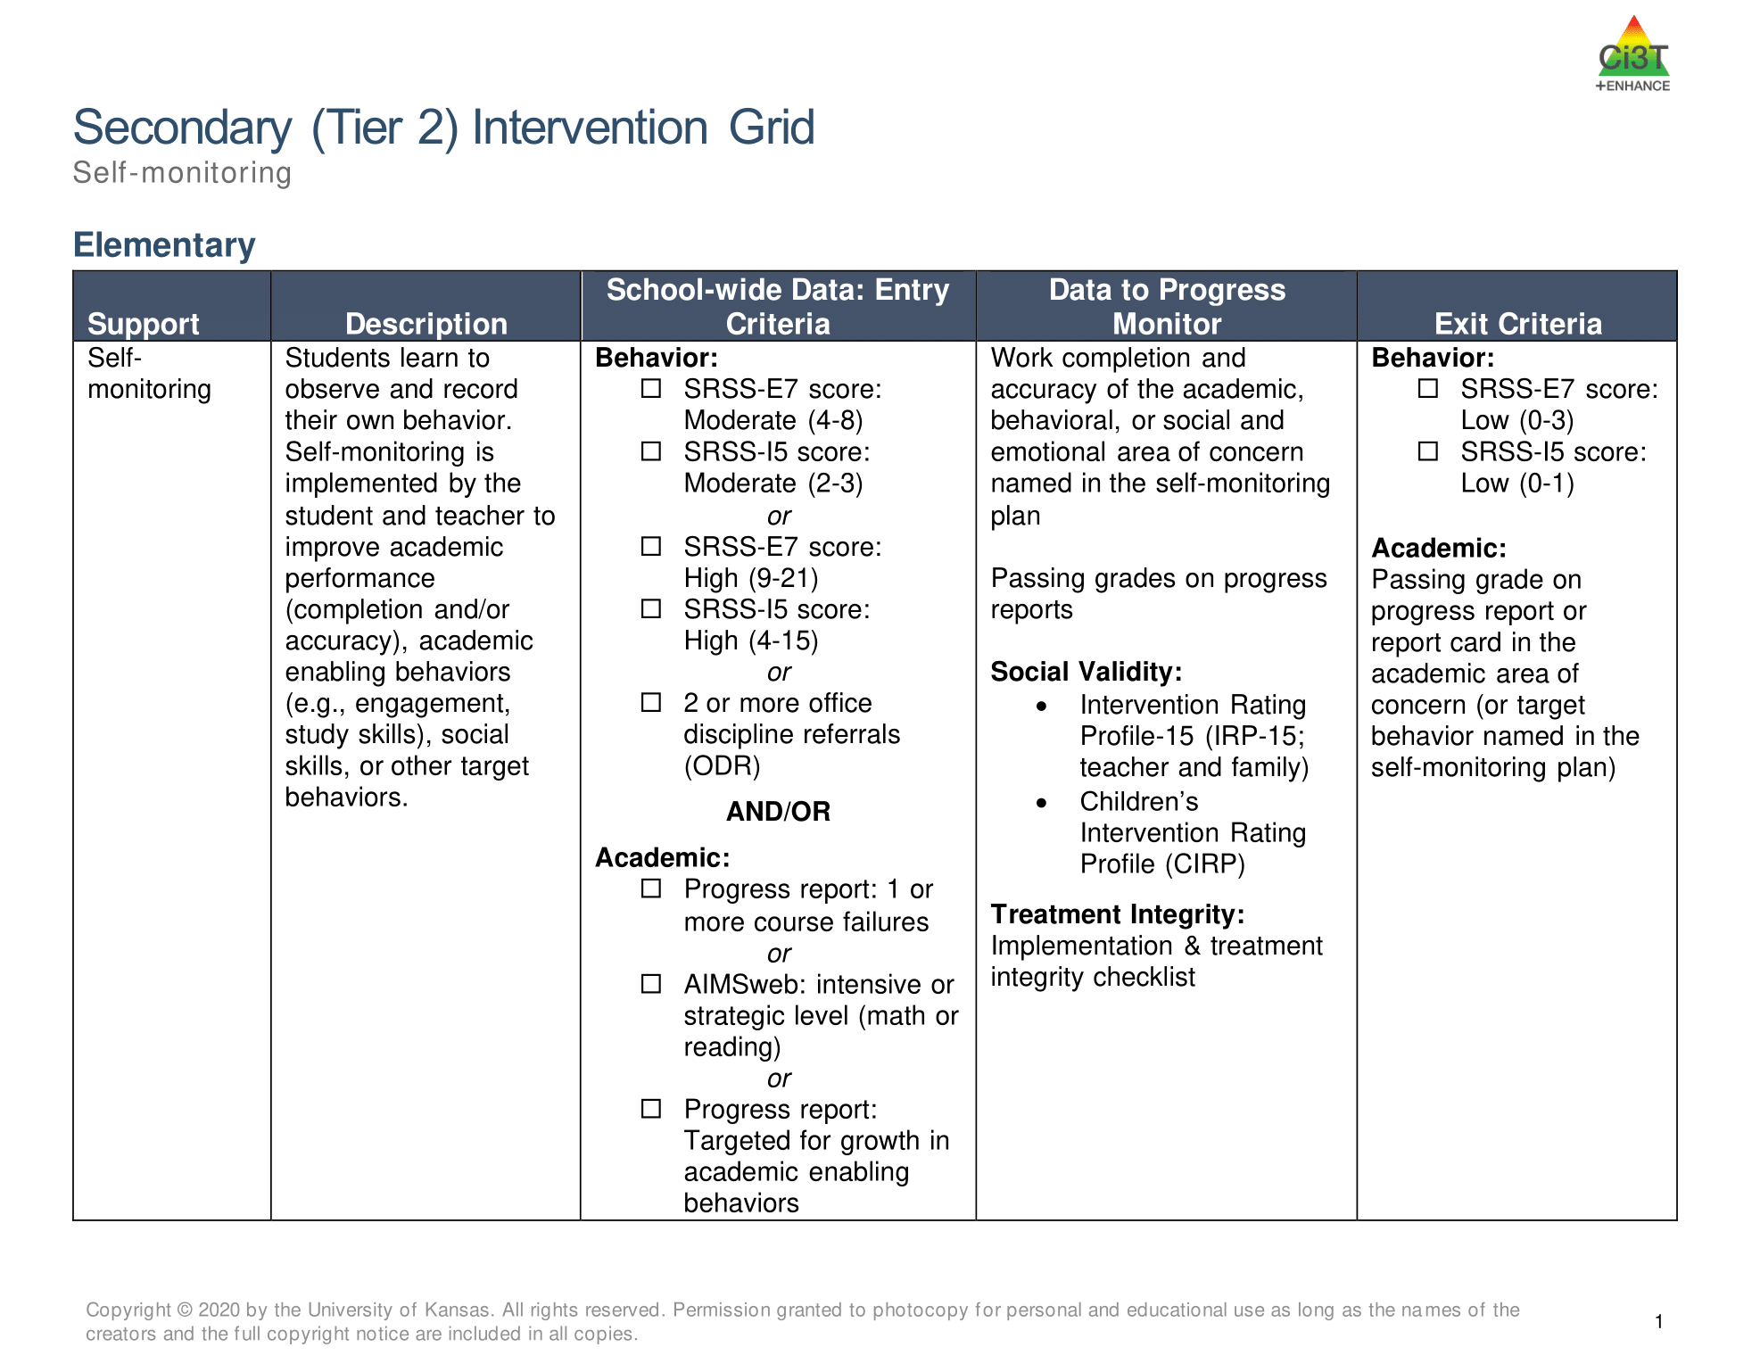
Tier 2 and Tier 3 Intervention Grids
Notes:
Support is the name of the strategy, practice, or program. Notice this is not the name of a person or role.

Slide 29
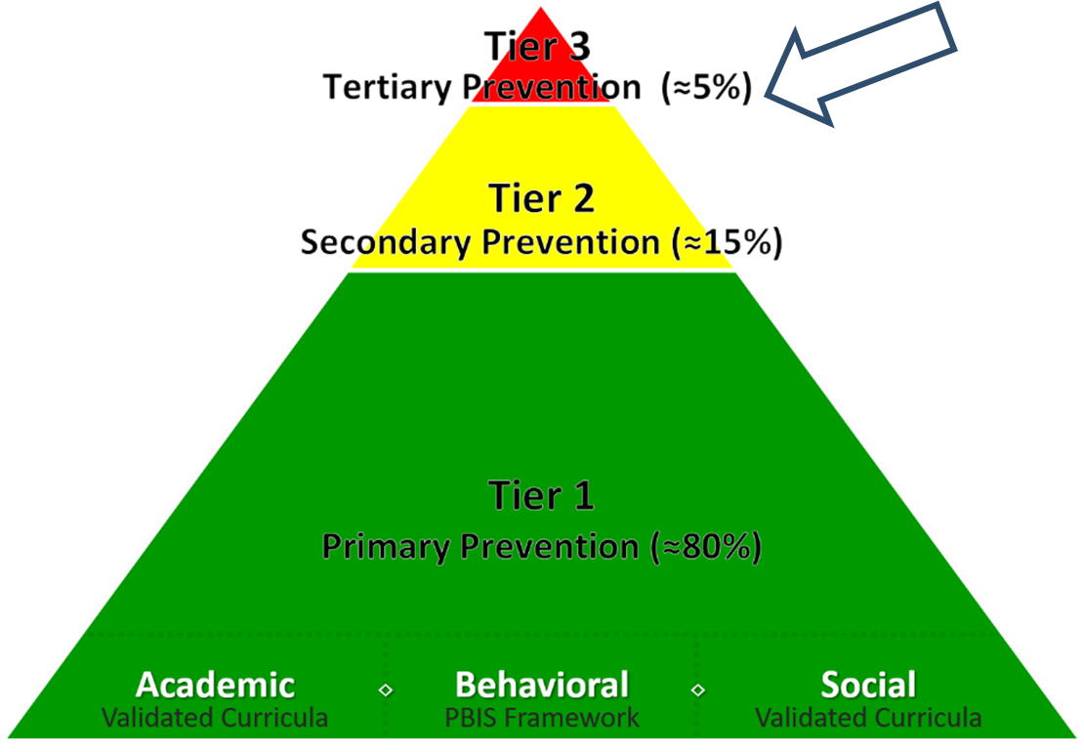
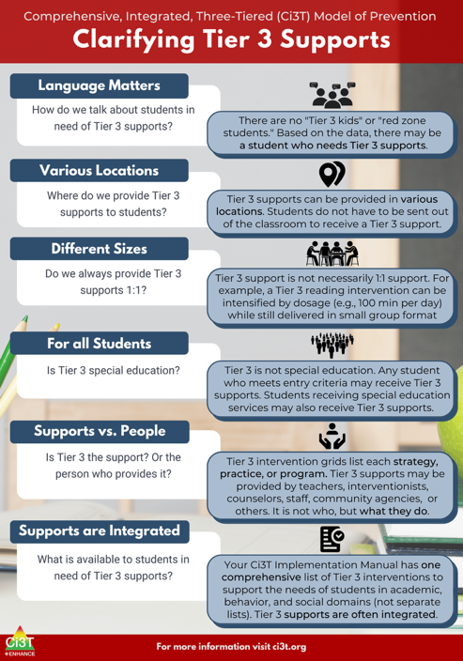
What are Tier 3 Interventions?

Slide 30

Clarifying Tier 3 Supports 1

Slide 31
Clarifying Tier 3 Supports 2

Slide 32


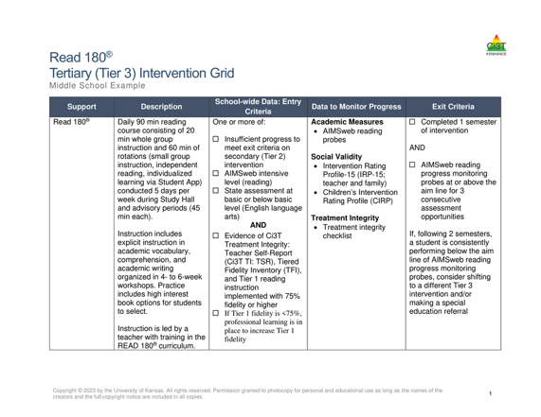
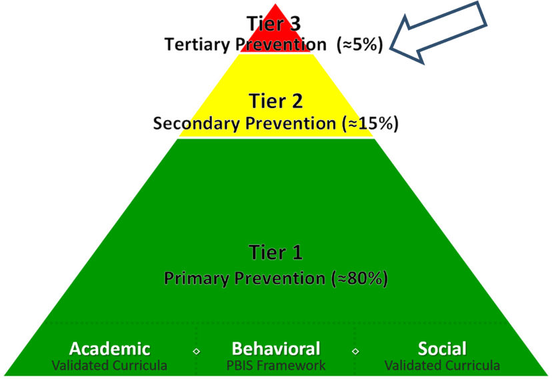
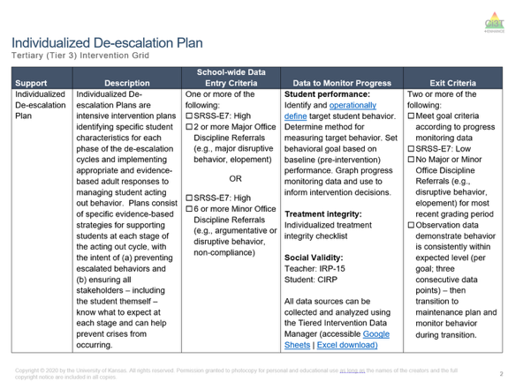
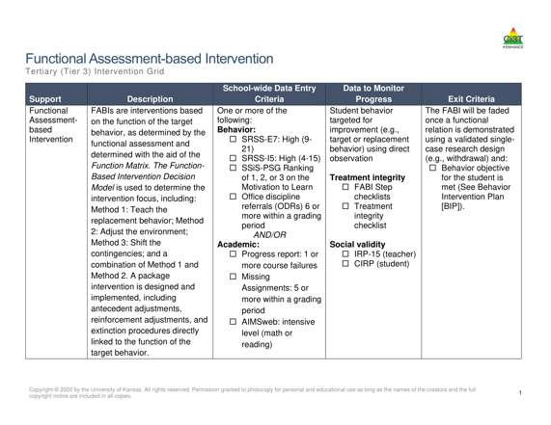
Tertiary (Tier 3) Intervention Grid
Tertiary (Tier 3) Intervention Grid 2

Slide 33

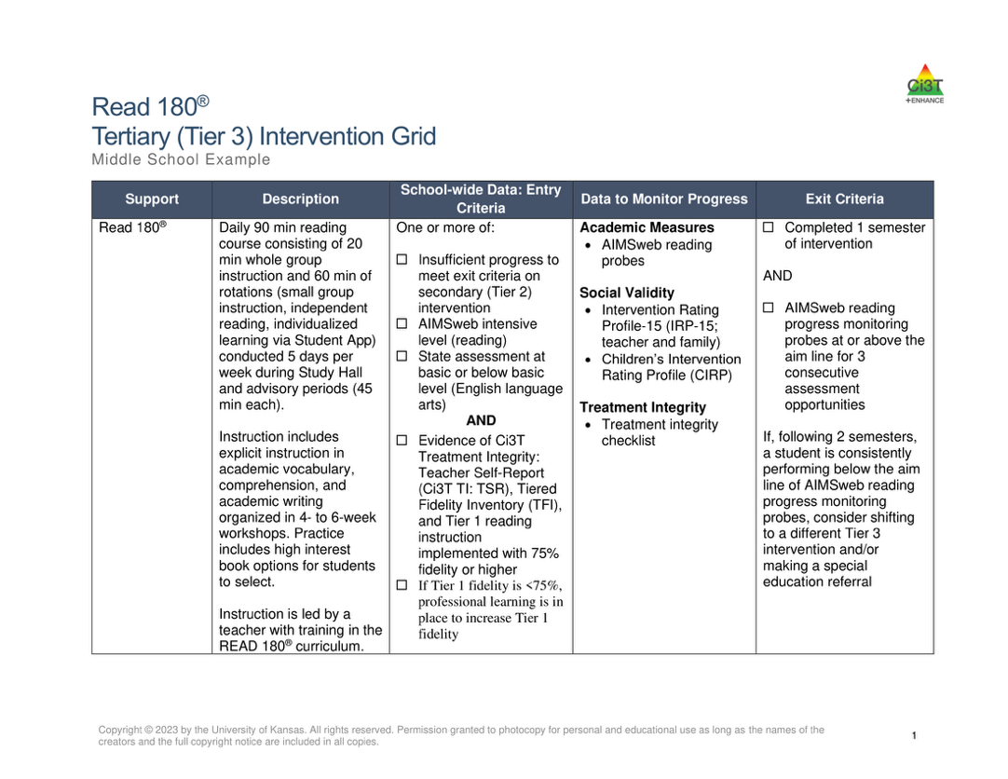
Components of Tier 3 Intervention Grid
Notes:
Support- name of strategy, practice, or program. Notice this is not the name of a person or role

Slide 34


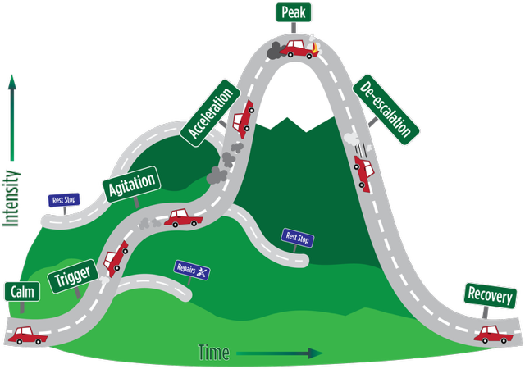
Tier 3: Stand-Alone Intervention

Slide 35

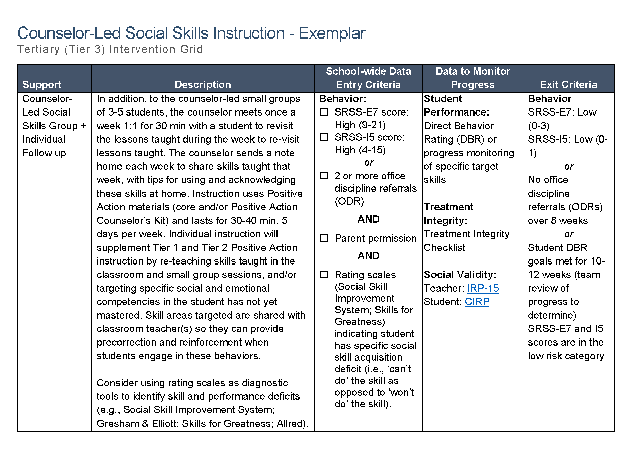
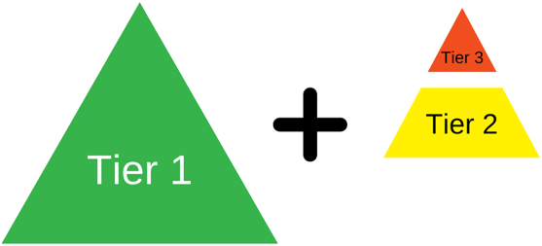
Tier 3: Intensification of Tier 2 Support
Notes:
Sometimes – Tier 3 is an intensification of a Tier 2 support such as coupling a Tier 2 support (i.e., counselor-led social skills group) with an individual follow up.

Slide 36
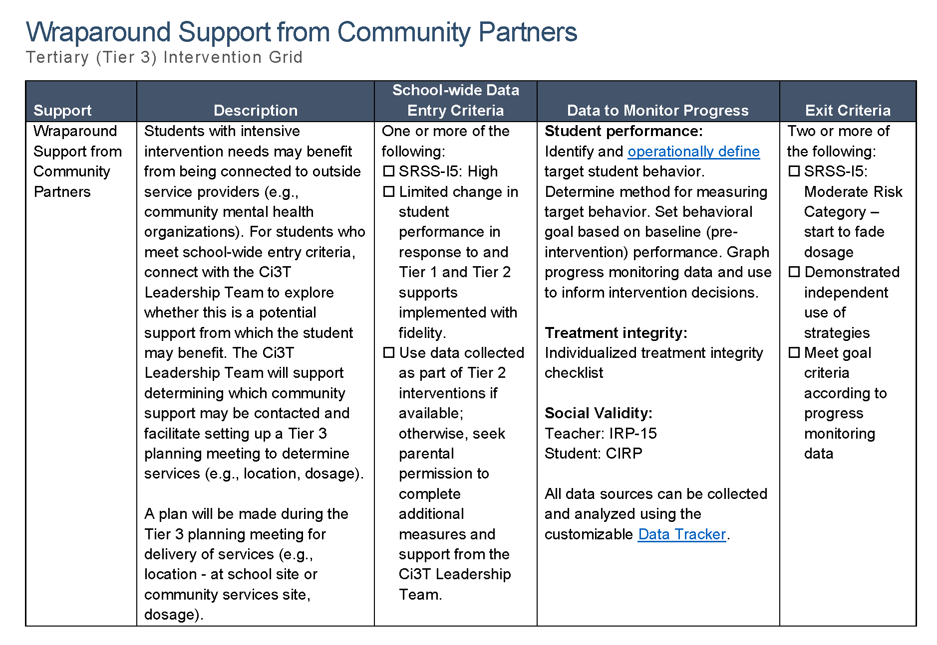
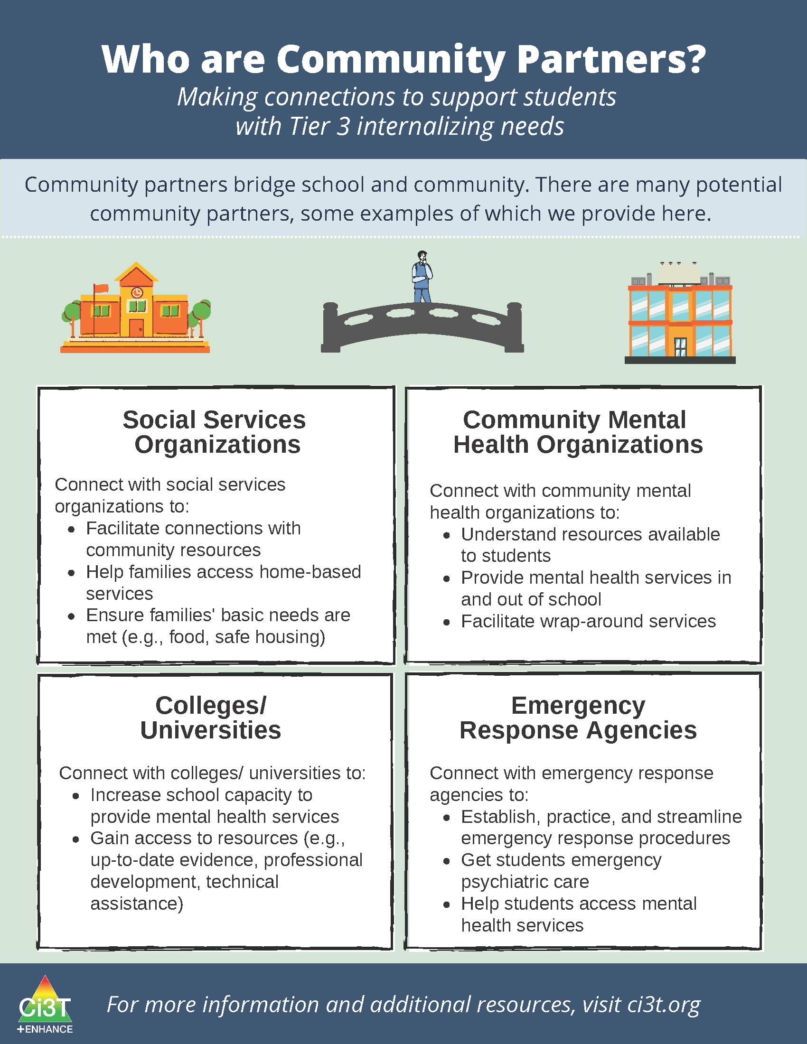
Tier 3: Wraparound Support

Slide 37
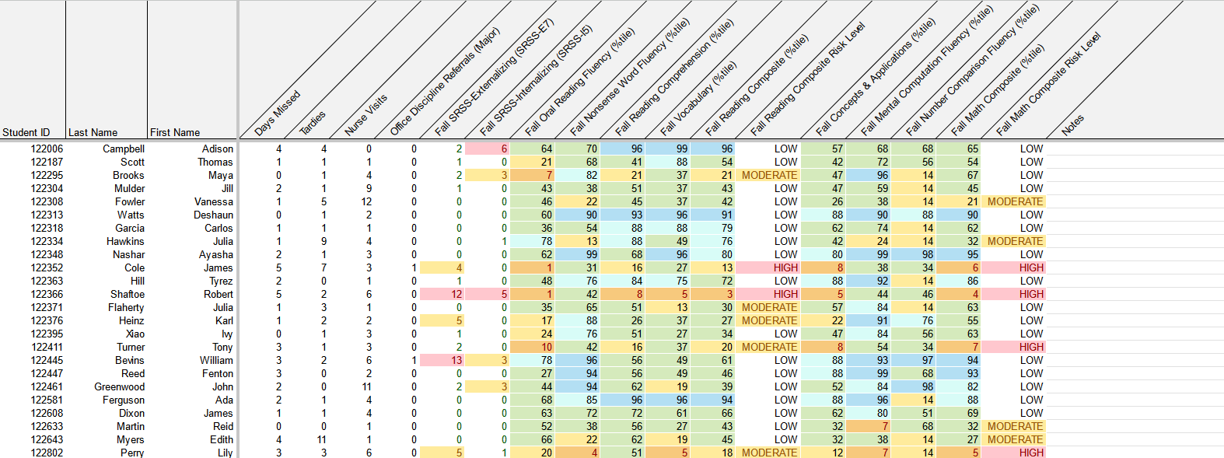
Using Multiple Sources of Data to Connect Students with Tier 3 Supports
attendance
office discipline referrals
behavior
screening
academic screening

Slide 38


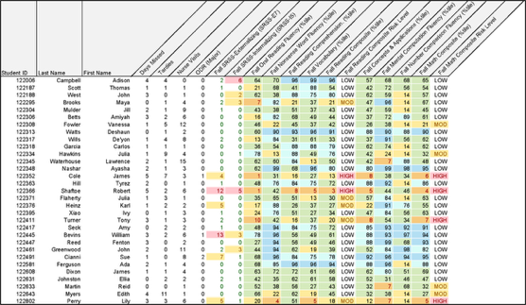
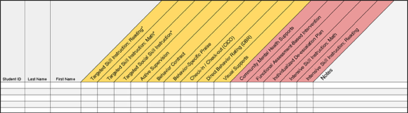
Getting Started with Data-Informed Decision Making

Slide 39
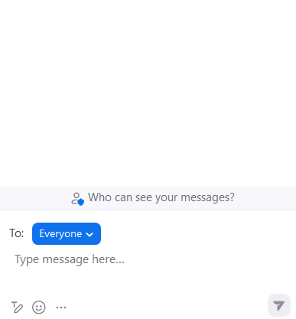


Let’s Chat!
Let’s Chat! 1
Which Tier 3 interventions are offered in your setting?

Slide 40

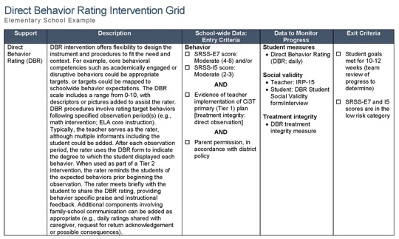
Functional Assessment-Based Intervention (FABI)
  Introduction to FABI
  5-Step Process to Implement FABI

Slide 41

Functional Assessment-based Intervention

Slide 42
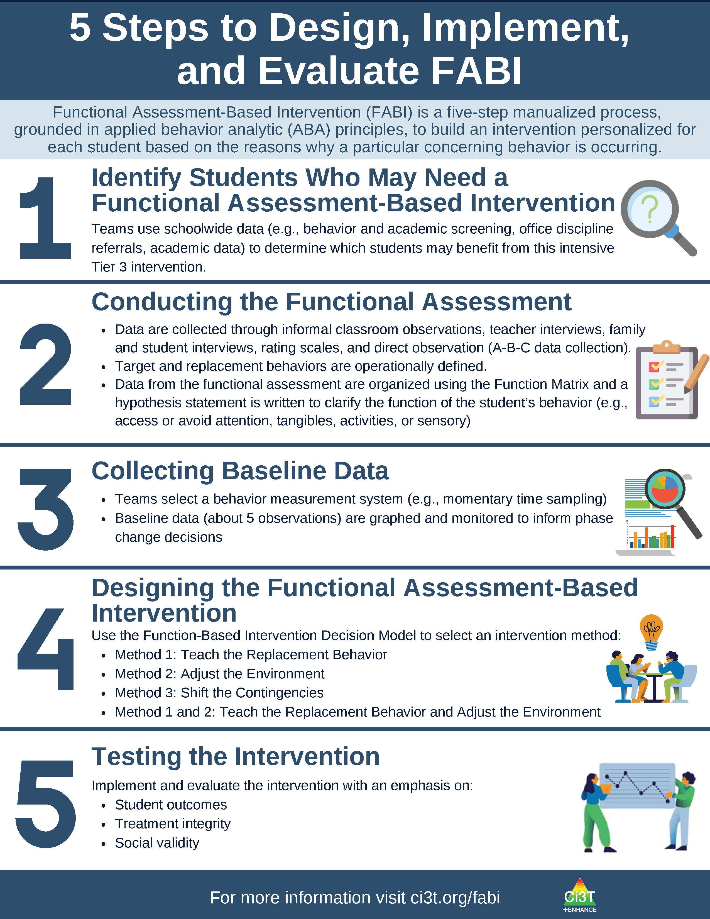
What is Functional Assessment-Based Intervention (FABI)?
Customized intervention designed for each student based on the reasons why a particular concerning behavior is occurring
Developed through a five-step, team-based, manualized process
Grounded in applied behavior analytic (ABA) principles (e.g., reinforcement, antecedent, consequence)
Notes:
PRESENTER NOTE:
FABI is one type of FBA (functional behavioral assessment)
Can be used as a Tier 3 intervention, as we are discussing in this presentation
Can also be used as a process to conduct a functional behavioral assessment (FBA) and develop a behavior intervention plan (BIP) for student’s with IEPs as required under certain conditions of IDEA
See state regulations for more information regarding FBAs as part of a student’s IEP

Slide 43
5 Steps to Design, Implement, and Evaluate FABI 1

Slide 44
5 Steps to Design, Implement, and Evaluate FABI 2

Slide 45
Why is FABI effective?
Individualized based on the function of behavior (i.e., why the behavior occurs) and needs of the student and environment
Focuses on skill-building and supporting pro-social behavior (i.e., replacement behavior)
Step-by-step manualized process
Team-based process fosters collaboration between educators, families, and the student

Slide 46

Building Your FABI Team
Two people who serve on this “standing” team
  Member of Ci3T Leadership Team
  Staff with behavioral expertise (e.g., behavior specialist, instructional coach, counselor, school psychologist)
Classroom teacher(s) of the student who might benefit from this support
Family member of the student
Student

Slide 47
What are the Benefits and Challenges of Implementing FABI?
Benefits
Challenges
Collaborative, team-based process integrating student, educator, and caregiver voice and perspective
Strong evidence-base demonstrating effectiveness for wide range of students (pre-K – 12), behaviors, and settings
Fully manualized process with templates and checklists to support design and implementation
Time and resource intensive
May require additional training (e.g., measuring behavior, ABC data collection)
Adjustment from more ”traditional” FBA/BIP practices

Slide 48
Let’s Chat!
Let’s Chat! 2
What are your initial thoughts and reactions?
  What components of FABI seem most feasible?
  What might be challenging about implementing FABI?

Slide 49

Functional Assessment-Based Intervention (FABI) as a Tier 3 Intervention
An Overview of FABI
A 5-Step Process to Implement FABI

Slide 50

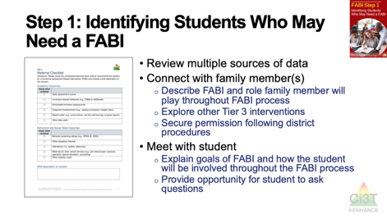

Session Preview
Notes:
In this next section we will break down and provide a high-level overview for each of the five steps to implement FABI
Throughout the presentation, we will pause and invite participation in the chat or move into breakout rooms to give you the change to apply what you are learning!

Slide 51


Opportunities to Learn More
Opportunities to Learn More 1
Notes:
Our intention in this professional learning is to provide high-level overview of FABI and opportunities to practice the key components. If you are interested in learning more or implementing FABI in your setting, we encourage you to access these additional resources to more comprehensively learn about each of the five steps.

Slide 52

Step 1: Identifying Students Who May Need a FABI
Step 1: Identifying Students Who May Need a FABI 1

Slide 53

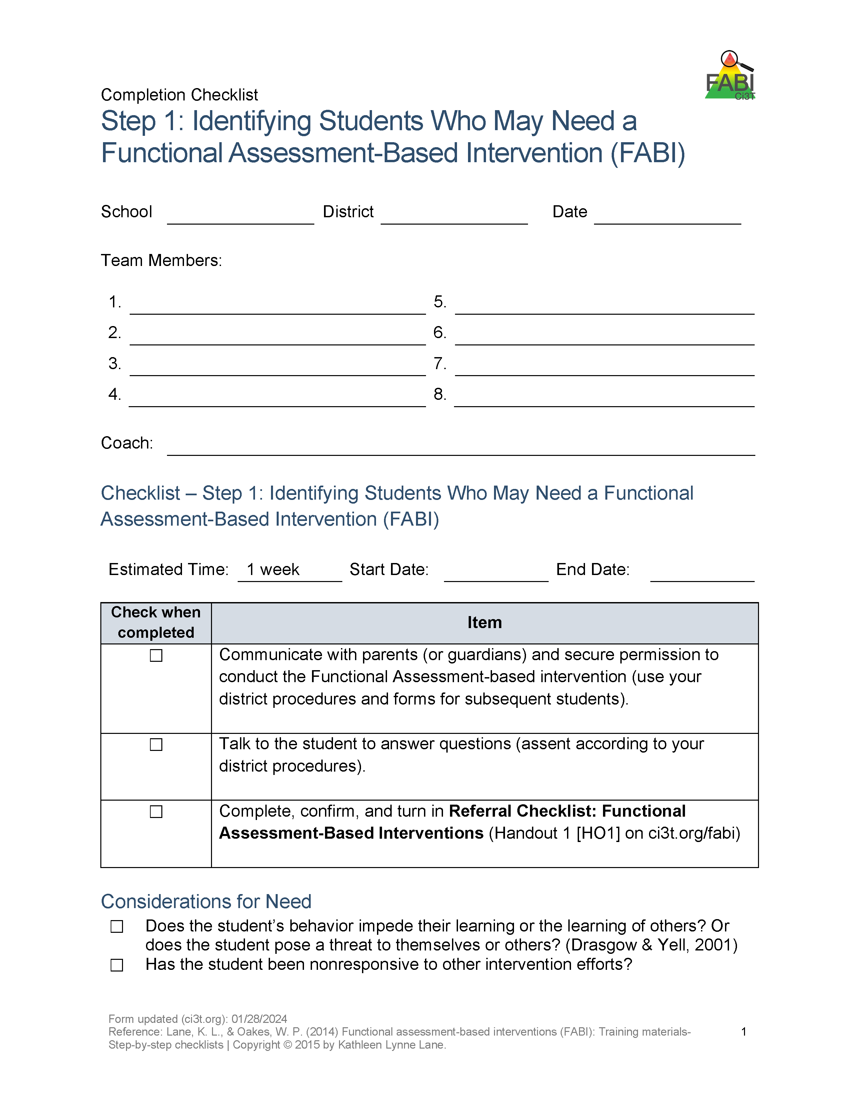
Step 1: Identifying Students Who May Need a FABI
Step 1: Identifying Students Who May Need a FABI 2
Review multiple sources of data
Connect with family member(s)
Meet with student

Slide 54
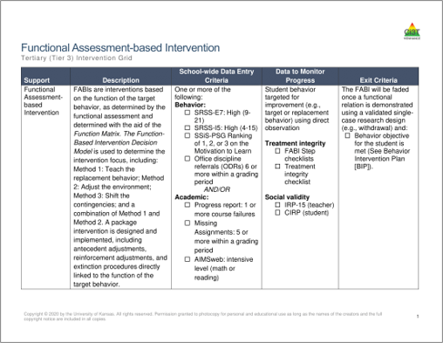
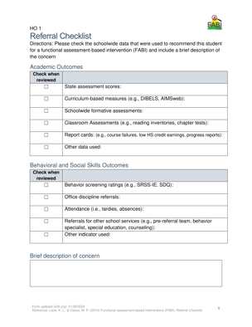
Review multiple sources of data
Use the Tertiary (Tier 3) Intervention Grid and referral checklist to review multiple sources of data such as:
  Academic assessment data (e.g., screening, curriculum-based measures)
  Behavior screening tools
  Office discipline referrals (ODRs)
  Attendance records

Slide 55
Connect with Family Member(s) and Student
Family Member(s)
Student
Describe FABI and role family member will play throughout FABI process
Explore other Tier 3 interventions
Secure permission following district procedures
Explain goals of FABI and how the student will be involved throughout the FABI process
Provide opportunity for student to ask questions

Slide 56

Step 2: Conducting the Functional Assessment
Step 2: Conducting the Functional Assessment 1

Slide 57

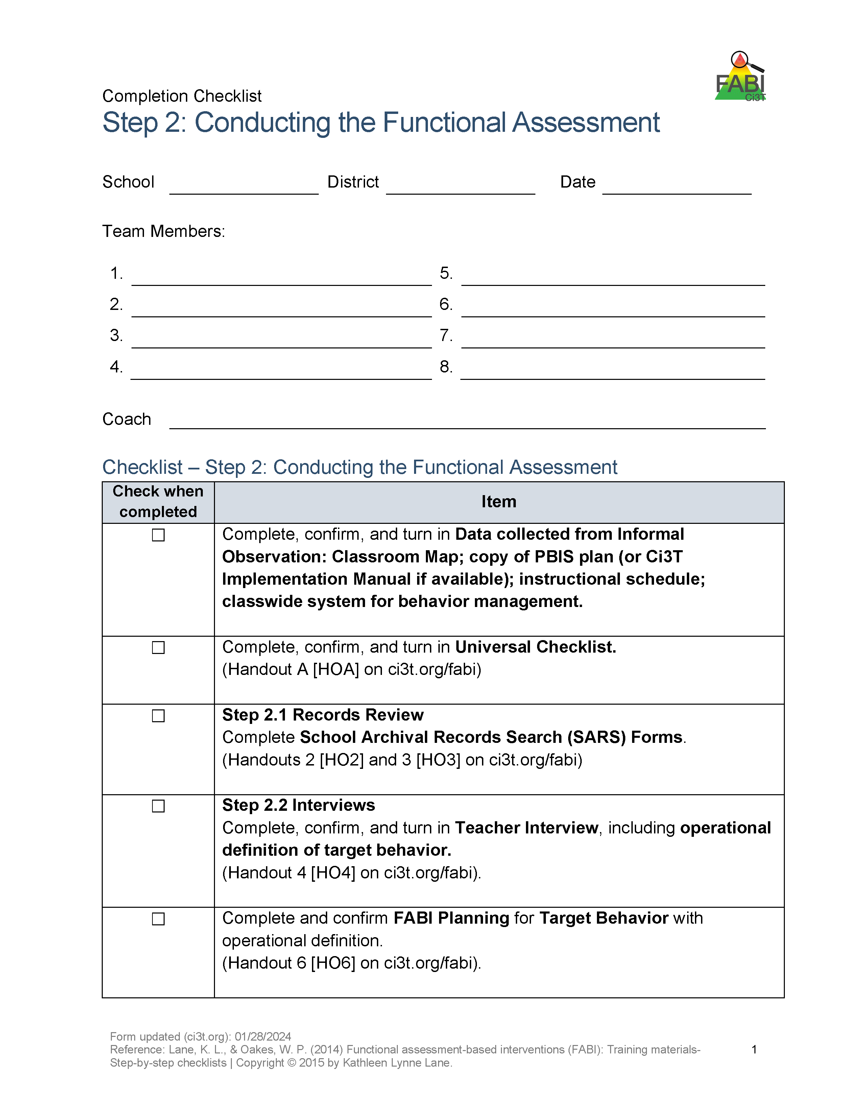
Step 2: Conducting the Functional Assessment
Step 2: Conducting the Functional Assessment 2
Understanding the learning environment and context
Records review
Interviews
Operationally define target behavior
Rating scales
A-B-C data collection
Use Function Matrix to identify the hypothesized function(s)
Identify replacement behavior
Notes:
Today, we are going to focus on these three components of Step 2

Slide 58
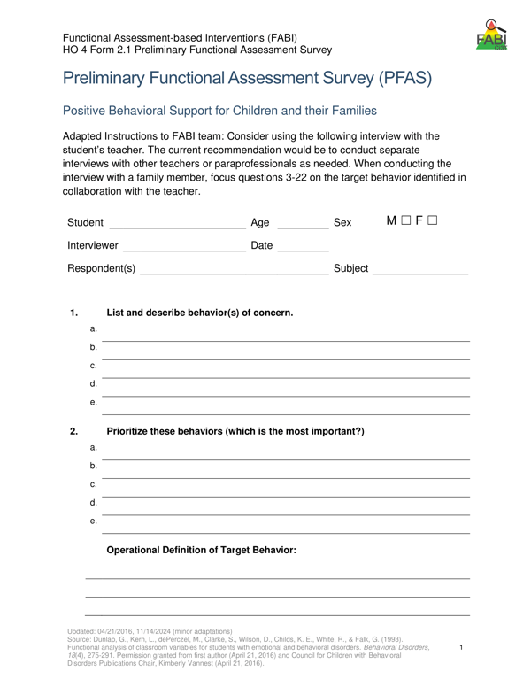
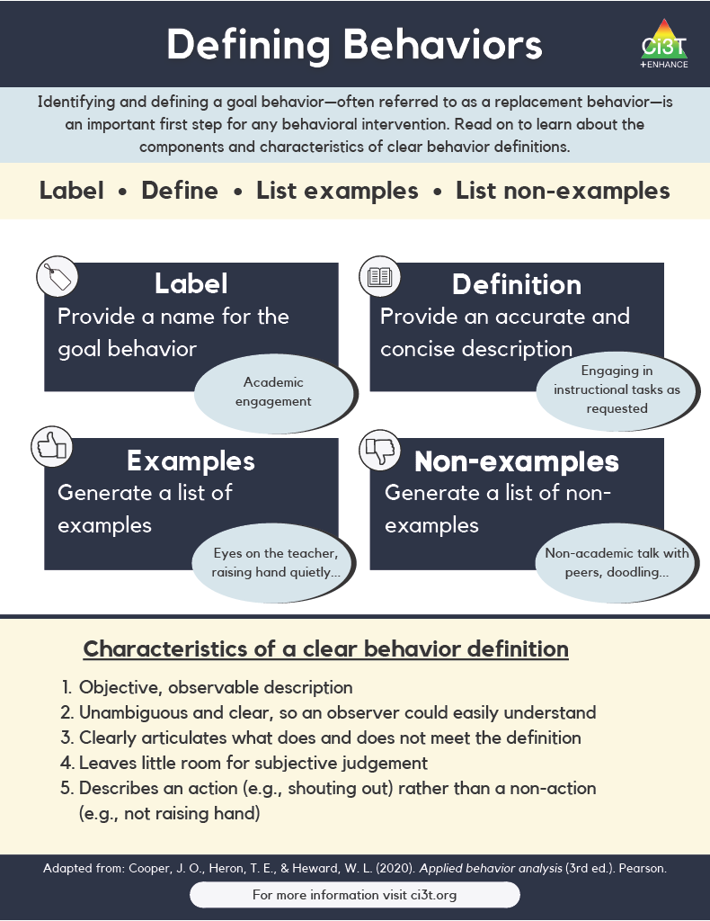
Operationally Defining the Target Behavior
Notes:
During the teacher interview, you will work with the teacher to identify all behaviors of interest and then create a prioritized list to determine the one keystone behavior. In other words, what is the one behavior, that if modified, could allow students to enjoy school more fully?
This becomes the target behavior (or the behavior you are seeking to reduce) which you will then operationally define

Slide 59
Defining Behaviors 2

Slide 60
Defining Behaviors 2

Slide 61
Example Operational Definition
Example Operational Definition 1
Component | Description
Label | Off-task
Definition | Off-task is defined as attending to activities in class other than assignments.
Examples | Playing with materials inappropriately, talking to peers, putting head on the desk, drawing, and looking around the room
Non-Examples | Completing assignments using materials only for assignments, and watching the teacher when delivering instruction

Slide 62
Example Operational Definition
Example Operational Definition 2
Component | Description
Label | Verbal aggression
Definition | Verbal aggression is defined as any vocalization directed towards a peer or adult at a volume above expected conversational level for a given setting alongside use profanity or language that is not appropriate for the setting.
Examples | Yelling “I hate you” at a voice level 3 during classroom instruction, verbal threats directed towards peer (e.g., “if you don’t stop, I’m going to…”), name-calling, profanity.
Non-Examples | Level 3 voice level at recess, shouting out an answer during choral response, sighing (“uhhhggg”), negative self-talk (e.g., “this is too hard”)

Slide 63
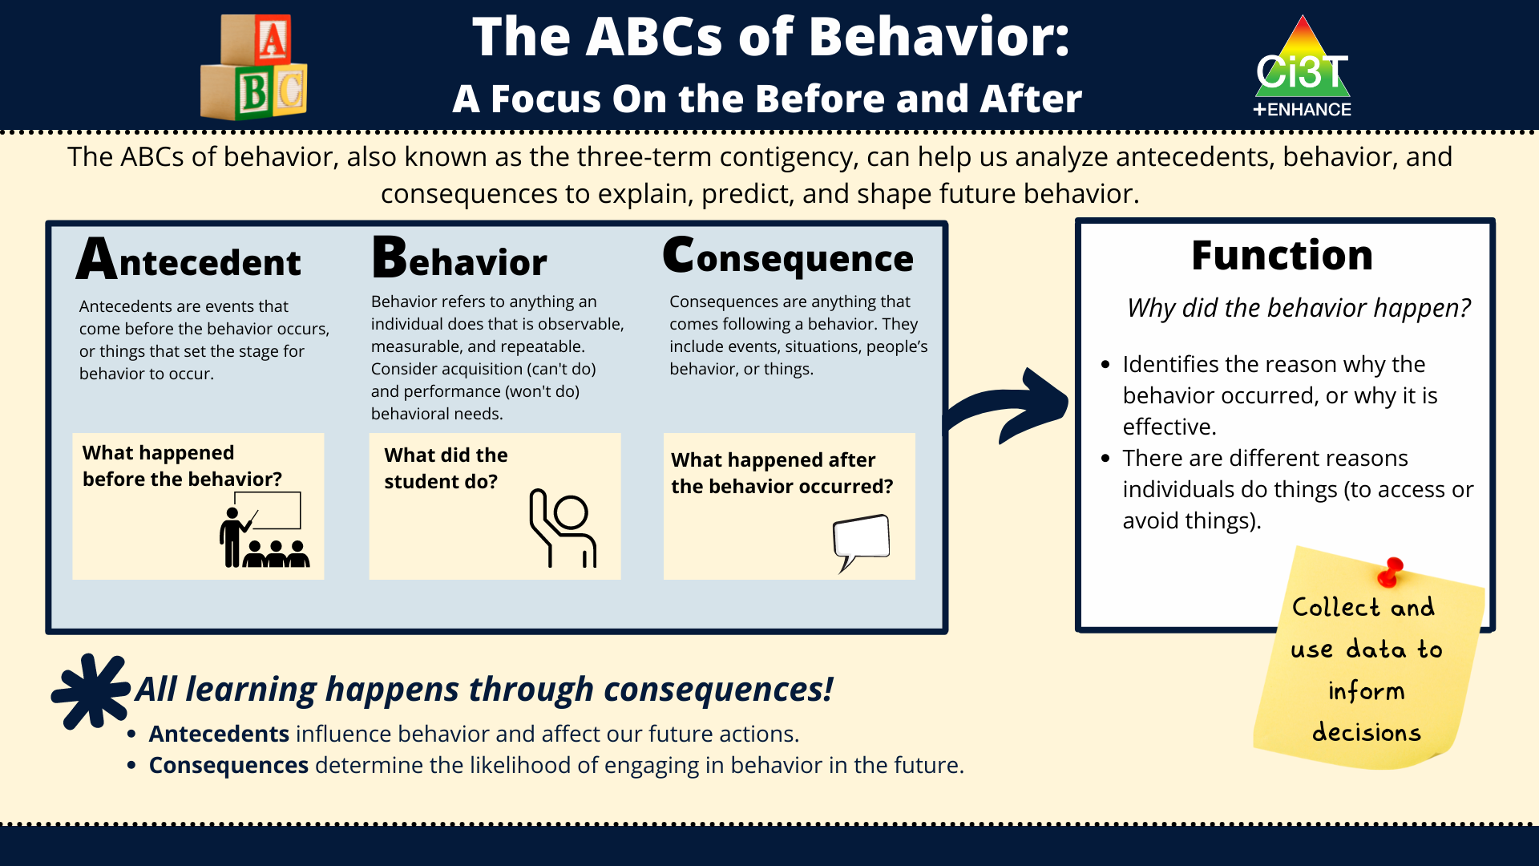
Direct Observation (A-B-C Data Collection)
Direct Observation (A-B-C Data Collection) 1

Slide 64
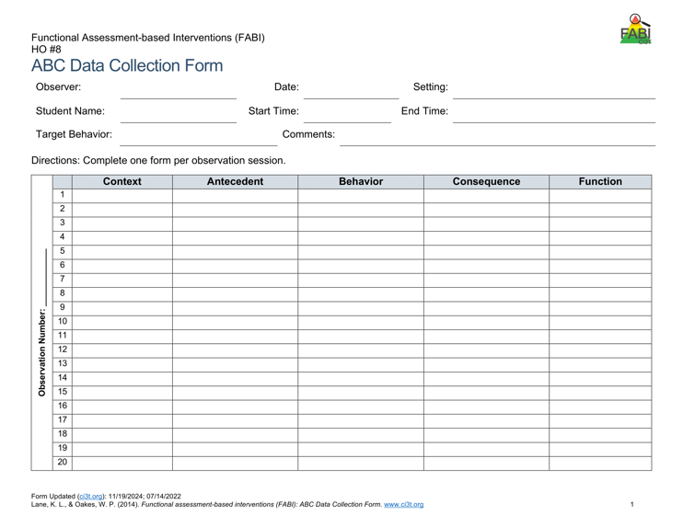
Direct Observation (A-B-C Data Collection)
Direct Observation (A-B-C Data Collection) 2
Determine the time of day and setting during which the behavior most often occurs
3 observation sessions (minimum)
Aim to observe 8-10 occurrences of the target behavior or three hours of observations
Record only instances of target behavior
Each instance of the target behavior will be numbered and later placed in the Function Matrix

Slide 65


A-B-C Data Collection Example
Reading instruction
Pencil breaks
Student throws pencil
Teacher looks at student
Notes:
Each time the target behavior occurs you will record details in a new row. Each instance of the target behavior will be numbered and later placed in the function matrix.
You should will note the context in which the behavior occurred, such as reading instruction, morning circle time, or math instruction, and the antecedent, or what happened immediately before the behavior.
Additionally, record the target behavior itself, the consequence, or what happened immediately after the target behavior.
The function of the behavior, such as access to or avoidance of attention, tasks or tangibles, or sensory experiences will be completed later.

Slide 66

Use Function Matrix to identify the hypothesized function(s)
Peers laugh
Teacher provides 1:1 assistance
Work alone
Ignored by peers or adults
Preferred activity (e.g., tablet)
Do not have to complete academic task
Access to fidgets
Noise cancelling headphones
Notes:
The Function Matrix, developed by Umbreit and colleagues is a practical, effective, and novel tool for visually organizing multiple sources of information from informal observations, interviews, rating scales, and A-B-C observation data to identify the function of the target behavior.
The Function Matrix is organized based on the principles of applied behavior analysis, with columns reflecting the two ways behaviors are reinforced: positive reinforcement (meaning to get or access something) and negative reinforcement (meaning to escape or avoid something).
Then, the three rows reflect three behavioral categories (the “something or somethings”) the person is trying get or avoid: attention, tangibles or activities, and sensory experiences.

Slide 67
Function Matrix
 | Positive Reinforcement (access something) | Negative Reinforcement (avoid something)
Attention | Teacher Interview – “During Independent work time, frequently comes to me to ask a question during math. Often, she already knows the answer” Parent Interview “She wants me to check her homework every night. Not just one math problem but all of them.” ABC Data- 1.2, 1.3, 2.1, 2.4, 3.1
Tangibles/Activities |  | Records Review - Tammy’s low grades were due to lack of class work completion. Teacher Interview- “She is the last one to get started when it is time for independent reading.” Student Interview- “I hate worksheets, they’re so boring” ABC Data: 1.1, 1.4, 2.2, 2.3, 2.5, 3.2
Sensory
Number of the observation
session (Day 1)
Number of the occurrence in the
observation session
(second instance of the behavior on Day 1)
Source: Umbreit, Ferro, Lane, & Liaupsin (2024); Umbreit, Ferro, Liaupsin, & Lane (2007); Umbreit, Lane, & Dejud (2004)
Notes:
Information from all parts of the functional assessment are added to Function Matrix. This includes: informal observations, interviews, rating scales, and A-B-C observation data.
ABC Data are using the following notation: Number of the observation session (e.g., observation session 1, 2, 3) dot number of the occurrence of target behavior in that observation session (e.g., the second instance of behavior) – this is the number of the row.

Slide 68

Let’s Practice!
Let’s Practice! 1
What’s the Function?
Access – Attention
Avoid – Attention
Access – Tangibles / Activities
Avoid – Tangibles / Activities
Access – Sensory
Avoid - Sensory
?
?
?
?
?

Slide 69

Hypothesized Function
During [context], [student name] engages in [target behavior] in order to [maintaining function(s)].
Example:
During independent reading activities (CONTEXT), Frank (STUDENT NAME) engages in noncompliant behavior (TARGET BEHAVIOR) to (a) escape too difficult tasks and (b) access peer and teacher attention (MAINTAINING FUNCTIONS).

Slide 70













Let’s Practice
In a breakout room, work with your
group to explore the Function Matrix.
Notes:
10-min

Slide 71

Step 3: Collecting Baseline Data
Step 3: Collecting Baseline Data 1

Slide 72


Step 3: Collecting Baseline Data
Step 3: Collecting Baseline Data 2
Determine behavioral dimension of focus
Select a measurement system
Develop data collection procedures
Train data collectors
Collect baseline data
Graph baseline data
Notes:
Today, we are going to focus on these three components of Step 3

Slide 73

Dimensions of Behavior 1

Slide 74
Dimensions of Behavior 2

Slide 75

Let’s Practice!
Let’s Practice 2
 | Dimension
Susan worked math problems for 15 minutes | Duration
Jessica initiated use of her communication device six times | Frequency
Once directed to return to his seat, it took 7 minutes for Charlie to leave the beanbag in the class reading area | Latency
Levi completed four math problems in 10 minutes | Rate
?
?
?
?

Slide 76

Types of event-based measurement:
  Frequency
  Rate
Most appropriate for behaviors that are:
  Countable and discrete (e.g., relatively brief, clear start and end, and uniform in length).
  Examples: talking out of turn, swearing, pushing
Select a Measurement System: Event-Based

Slide 77
Tips for Event-Based Recording
Select a specific period for data collection (e.g., first 20 minutes of the day, recess, math block)
Keep track of each time the target behavior occurs within that specified time
  Tally marks on paper (e.g., post it, label, data-collection sheet)
  Move paperclips from one pocked to another
  Counter

Slide 78


Let’s Practice – Frequency Recording
Notes:
https://youtu.be/ofRn9zCjy8s?si=1W6vo_yTak1yDSQ7&t=88

Slide 79
Debrief – Frequency Recording
How many times did Jim say the word cake?
What about frequency recording was challenging?
Given those challenges, how could the measurement procedures be improved?
Notes:
PRESENTER NOTES:
Jim says cake 18 times
Challenges
Pancake? Cupcake?
Hearing / audio quality
Frequency (happened a lot, hard to keep up) -
Procedures could be improved by:
Revising operational definition – whether or not to “count” compound words
Set up with good vantage point / audio to conduct observation
Consider whether frequency is appropriate / feasible (e.g., if happening too much to keep up maybe partial interval would be more appropriate)

Slide 80
Select a Measurement System: Time-Based
Time Based
  Duration
  Latency
  Interval (whole-interval, partial interval, momentary time sampling)
Most appropriate for behaviors that are:
  Not countable or discrete (e.g., less defined start/end, span a period of time) and/or vary in length each time
  Examples of non-uniform behaviors include: academic engagement, off-task, leaving designated area (e.g., desk, carpet spot), tantrum

Slide 81
Tips for Time-Based Recording
Tips for Time-Based Recording 1
Duration and Latency
Select a specific period for data collection (e.g., first 20 minutes of the day, recess, math block)
Use a stopwatch (or app) to note:
  Duration – when behavior begins and ends
  Latency – start timer when direction is given, stop timer when student engages in expected behavior

Slide 82
Tips for Time-Based Recording
Tips for Time-Based Recording 2
Interval Recording
Select a specific period for data collection (e.g., first 20 minutes of the day, recess, math block)
Divide observation period into equal intervals (e.g., 30 second, 1 minute)
Set up cue to go off at end of each interval (e.g., audio cue, phone or watch app, MotivAider)
Record whether behavior occurred:
  Whole-interval: behavior occurred the entire interval
  Partial-interval: behavior occurred at any time during the interval
  Momentary Time Sampling: behavior occurred at exact moment interval ends

Slide 83

Step 3: Collecting Baseline Data
Step 3: Collecting Baseline Data 3
Determine behavioral dimension of focus
Select a measurement system
Develop data collection procedures
Train data collectors
Collect baseline data
Graph baseline data
Reminder- although we aren’t discussing these today developing data collection procedures, training data collectors, and collecting baseline data are key components of this step!

Slide 84

Step 4: Design the FABI
Step 4: Design the FABI 1

Slide 85


Step 4: Design the FABI
Step 4: Design the FABI 2
Select an intervention method
Develop A-R-E intervention components
Draft treatment integrity checklist
Assess pre-intervention social validity
Develop intervention materials
Introduce FABI to educators and family
Introduce FABI to student
Revise and finalize FABI
Notes:
Today, we are going to focus on these components of Step 4

Slide 86


Function-Based Intervention Decision Model
An intervention method is selected based on the response to these two questions:
Can the student perform the replacement behavior?
Do antecedent conditions represent effective practices for this student?

Slide 87

Function-Based Intervention Decision Model 1

Slide 88
A-R-E Components
Antecedent Adjustments - adjusting the antecedent conditions to increase likelihood replacement behavior will occur and (if applicable) providing instruction in the replacement behavior
Reinforcement Shifts - reinforcing the replacement behavior to strengthen its occurrence
Extinction Procedures - ensuring that the target behavior is not followed by reinforcement

Slide 89

A-R-E Components 1

Slide 90

A-R-E Components 2

Slide 91

A-R-E Components 3

Slide 92
Illustration 1:
David (2nd Grade)
Germer, K. A., Kaplan, L. M., Giroux, L. N., Markham, E. H., Ferris, G. J., Oakes, W. P., & Lane, K. L. (2011). A function-based intervention to increase a second-grade student's on-task behavior in a general education classroom. Beyond Behavior, 20(3).

Slide 93
Target Behavior: Off -Task Behavior
Target Behavior: Off-Task Behavior 1
Component | Description
Label | Off-task
Definition | Off-task behavior refers to engaging in behaviors or making verbal comments unrelated to instructional tasks.
Examples | leaving assigned instructional area without teacher permission inappropriately making comments to teacher or peers unrelated to instruction attending to anything other than the academic task doing unassigned tasks using instructional materials inappropriately taking more than 30 s to prepare for instructional task
Non-Examples | staying in assigned instructional area appropriately making comments to teacher or peers related to instruction attending to academic tasks working on assigned task using instructional materials appropriately preparing for instructional task in less than 30 s

Slide 94
Replacement Behavior: On-Task
Component | Description
Label | On-task
Definition | On-task behavior refers to engaging in behaviors or making verbal comments related to instructional tasks.
Examples | staying in assigned instructional area appropriately making comments to teacher or peers related to instruction attending to academic tasks working on assigned task using instructional materials appropriately preparing for instructional task in less than 30 s
Non-Examples | leaving assigned instructional area without teacher permission inappropriately making comments to teacher or peers unrelated to instruction attending to anything other than the academic task doing unassigned tasks using instructional materials inappropriately taking more than 30 s to prepare for instructional task.

Slide 95

Function Matrix
Function Matrix 1

Slide 96
Hypothesized Function
Hypothesized Function 1
When presented with an instructional task, David engages in off-task behavior (such as leaving instructional areas, inappropriately making comments, and engaging in unassigned tasks) to access attention and/or to escape tasks.
In other words, when David is off-task he gets attention from his teacher and peers and does not have to complete assignments (positive reinforcement-attention and negative reinforcement-activity)

Slide 97

Function-Based Intervention Decision Model
Function-Based Intervention Decision Model 1

Slide 98


Measurement
Measurement 1
Duration
  Measured academic engagement
  20-min sessions during morning instructional time

Slide 99
Component 1- Adjust the Antecedents
Component 1- Adjust the Antecedents 1
Adjust Antecedents | Adjust antecedent variables so the conditions that set the occasion for the target behavior are eliminated and new conditions are established in which the replacement behavior is more likely to occur. | Seating change - David will sit facing the whiteboard Stoplight system Self-monitoring system Teacher will review picture schedule for the morning work period prior to the work period. Teacher will check-in with David at the beginning of independent tasks to ensure that he understood the assignment.

Slide 100

Classroom Example: Intervention Seating
Note: David’s seat pre-intervention
Note: David’s seat during the intervention

Slide 101
Component 1- Adjust the Antecedents
Component 1-Adjust the Antecedents 2
Stoplight System
Affixed to the side of David’s desk
  David used a clothespin to signal which “light” he was on
Green, yellow, and red “lights”
  Green: “I’m doing my work!”
  Yellow: “I’m asking a friend for help!”
  Red: “I still need help! I’m asking my teacher.”
“I’m done!” to signal completion

Slide 102
Component 2- Reinforcement Rates
Component 2- Reinforcement Rates 2
Reinforcement Rates | Provide appropriate reinforcement for the replacement behavior. | Teacher will provide behavior-specific praise when David is on-task. Teacher will acknowledge David’s need for help when his clothespin was on red and assist him as quickly as possible. Teacher will check David’s work upon completion, provide praise, and allow him to take a short break. At the end of the morning independent work period, teacher will help David complete his self-monitoring form and write one specific incidence of good behavior at the bottom.

Slide 103
Component 3- Extinguish the Target Behavior
Component 3 - Extinguish the Target Behavior 1
Extinguish Target Behavior | Withhold the consequence that previously reinforced the target behavior. | Teacher will provide no praise or attention when David is off-task, with the exception of one verbal or gestural redirect per minute. When David is off-task, teacher will praise other students who are behaving appropriately.

Slide 104

Treatment Integrity

Slide 105



Pre-Intervention Social Validity

Slide 106






Let’s Practice
Let’s Practice 3
In a breakout room, work with your group
to generate A-R-E components
Notes:
15-min

Slide 107
Illustration 2: Harry
5th Grader

Slide 108
Target Behavior: Off -Task Behavior
Target Behavior: Off-Task Behavior 2
Off-task is defined as attending to activities in class other than assignments
Examples
Playing with materials inappropriately, talking to peers, putting head on the desk, drawing, and looking around the room
Non-examples
Completing assignments using materials only for assignments, and watching the teacher when delivering instruction

Slide 109
Replacement Behavior: Academic Engagement
Academic engagement is defined as anytime Harry is attending to class instructions and/or assignments
Examples
Completing assignments using materials only for assignments, and watching the teacher when delivering instruction
Non-examples
Playing with materials inappropriately, talking to peers, putting head on the desk, drawing, and looking around the room

Slide 110
Function Matrix
Function Matrix 2
 | Positive Reinforcement (Access something) | Negative Reinforcement (Avoid something)
Attention | ABC 1.1, ABC 1.2, ABC 1.19, ABC 2.1(peer), ABC 2.2, ABC 2.3, ABC 2.4, ABC 2.7, ABC 2.8, ABC 2.10, S.I. # 4 (wants peer att.)
Tangibles/ activities | ABC 2.9, S.I. #4 (wants more fun activity) | ABC 1.2, ABC 1.3, ABC 1.4, ABC 1.6, ABC 1.7, ABC 1.8, ABC 1.9, ABC 1.10, ABC 1.11, ABC 1.12, ABC 1.13, ABC 1.14-1.19, ABC 2.1, ABC 2.2, ABC 2.4, ABC 2.5, ABC 2.6, ABC 2.7, ABC 2.9, Avoiding work when not structured. T.I. #4, T.I. #9, S.I. #2 & #3
Sensory | ABC 1.1, ABC 1.5, ABC 1.6, ABC 1.18, ABC 1.19, ABC 2.1, ABC 2.2, ABC 3.1-3.4

Slide 111
Hypothesized Function
Hypothesized Function 2
When presented with academic tasks or instruction, Harry became off-task (engaged in an activity other than the one assigned) to escape tasks and gain attention.
That is, Harry, engaged in off-task behaviors
to access teacher and/or peer attention
(positive reinforcement- attention)
or to escape the instruction by the teacher
or the activity that the teacher assigned
(negative reinforcement- activity).

Slide 112
Function-Based Intervention Decision Model
Function-Based Intervention Decision Model 2

Slide 113
Measurement
Measurement 2
Whole Interval recording
  Measured academic engagement
  20 min sessions, ~8:45-9:05 am
  Each interval was 20 s

Slide 114
Component 1- Adjust the Antecedents
Component 1- Adjust the Antecedents 3
Adjust Antecedents | Adjust antecedent variables so the conditions that set the occasion for the target behavior are eliminated and new conditions are established in which the replacement behavior is more likely to occur. | Integrate instructional choice into independent work (e.g., complete evens or odds, select any six problems to complete, choice of math manipulative to use)
Notes:
WWC - https://ies.ed.gov/ncee/wwc/PracticeGuide/31
Low-Intensity, Teacher Delivered Strategies (module)

Slide 115
Component 2- Reinforcement Rates
Component 2- Reinforcement Rates 2
Reinforcement Rates | Provide appropriate reinforcement for the replacement behavior. | Provide behavior-specific praise paired with a universal reinforcer (e.g., ticket) when Harry begins independent work

Slide 116
Component 3- Extinguish the Target Behavior
Component 3- Extinguish the Target Behavior 2
Extinguish Target Behavior | Withhold the consequence that previously reinforced the target behavior. | Non-verbal redirection (e.g., gestural prompt)

Slide 117

Step 5: Test the Intervention

Slide 118


Step 5: Testing the Intervention
Implement the intervention
Monitor treatment integrity
Collect and graph data
Implement a single-case design to “test” how well intervention is working
  ABAB
  Multiple baseline
  Changing criterion
Assess social validity
Fade the intervention

Slide 119

Harry’s Intervention Outcomes
Harry’s Intervention Outcomes 1
Cox, M., Griffin, M. M., Hall, R., Oakes, W. P., & Lane, K. L. (2011). Using a Functional Assessment-Based Intervention to Increase Academic Engaged Time in an Inclusive Middle School Setting. Beyond Behavior, 20(3).

Slide 120

Harry’s Intervention Outcomes
Harry’s Intervention Outcomes 2
Cox, M., Griffin, M. M., Hall, R., Oakes, W. P., & Lane, K. L. (2011). Using a Functional Assessment-Based Intervention to Increase Academic Engaged Time in an Inclusive Middle School Setting. Beyond Behavior, 20(3).

Slide 121
Opportunities to Learn More
Opportunities to Learn More 2

Slide 122



Managing Acting Out Behavior:
Acting Out Cycle
  Stages
  Intervention Strategies

Slide 123


Sample Tier 3 Individualized De-escalation Plan

Slide 124
Antecedents -Behavior - Consequences
Function!
A
B
C
Precorrection: Identifies predictable contexts that often result in problem behavior and provides students with supports, prompts, and reinforcement for engaging in appropriate behavior

Slide 125

Acting Out Cycle
Whether the problem behavior is managed safely or not
or is defused
in a large measure depends on
YOUR INITIAL RESPONSE
-Dr. Geoff Colvin

Slide 126








Behavior Chains
Each ensuing behavior in a given behavior chain becomes more serious than the one preceding it.
(Walker, Ramsey, & Gresham, 2004)

Slide 127



Change the Behavioral Momentum
(Nevin, 1970)
Interrupt the behavioral chain at any time to prevent the occurrence of more serious types of behavior.

Slide 128

Stages of the Acting Out Cycle
Colvin (1992)
Calm
Triggers
Agitation
Acceleration
Peak
De-Escalation
Recovery

Slide 129

Managing Acting Out Behavior: Seven Phases

Slide 130
Phase 1: Calm
Phase 1: Calm 1

Slide 131

Phase 1: Calm
Phase 1: Calm 2
Overall behavior is cooperative, compliant, and desirable.
Academically Engaged
Following Rules & Expectations
Responsive to Praise and Feedback
Initiates Interactions
Goal Directed Behaviors
Colvin, G., & Scott, T. (2015). Managing the cycle of acting-out behavior in the classroom (2nd Edition). Thousand Oaks, CA: Corwin.

Slide 132
Strategies
Strategies 1
Intervention is focused on proactive strategies. Focus on instruction and positive behavior support.
Implement the schoolwide Ci3T plan
Implement low-intensity teacher-delivered strategies (e.g. precorrection, active supervision, behavior specific praise, instructional choice)
Carefully plan instruction with a focus on differentiation and integrated lesson plans
Re-teach expectations and implement clear routines and procedures
Colvin, G., & Scott, T. (2015). Managing the cycle of acting-out behavior in the classroom (2nd Edition). Thousand Oaks, CA: Corwin.

Slide 133
Pitfalls
Pitfalls 1
Teacher hesitation to engage with a student who has a history of explosive behavior (“I’m nervous about saying anything that could set him off”)
Colvin, G., & Scott, T. (2015). Managing the cycle of acting-out behavior in the classroom (2nd Edition). Thousand Oaks, CA: Corwin.

Slide 134
Phase 2: Trigger

Slide 135
Phase 2: Trigger
Overall behavior involve a series of unresolved problems.
School-Based Triggers
Non-School-Based Triggers
Conflicts
Changes in routine
Provoked by peers
Pressure or stress
Limited problem-solving skills
Facing Errors in Instruction
Facing Correction Procedures
Denial of Something Needed
Uncertain home life
Medical and health complications
Food insecurity
Inadequate sleep
Substance abuse
Commitments to gangs or unhealthy peer groups
Colvin, G., & Scott, T. (2015). Managing the cycle of acting-out behavior in the classroom (2nd Edition). Thousand Oaks, CA: Corwin.

Slide 136
Strategies
Strategies 2
Intervention is focused on prevention and redirection.
Identify the situation(s) where the behavior is likely to occur
Use low-intensity teacher-delivered strategies to prevent triggers from occurring and/or help students manage triggers effectively
Rehearse the expectations, prompt or remind students as needed, provide specific praise and reinforcement
Consider additional Tier 2 supports to build academic skills, social skills, or other self-regulation skills
Work with families for outside supports of non-school-based triggers
Colvin, G., & Scott, T. (2015). Managing the cycle of acting-out behavior in the classroom (2nd Edition). Thousand Oaks, CA: Corwin.

Slide 137

Ci3T: Low-Intensity Teacher-Delivered Strategies

Slide 138
Pitfalls
Pitfalls 2
Ensure that students’ strengths (as well as areas of concern) are centered when partnering with families
Avoid assigning blame for triggering events or circumstances
Ensure you consider and plan to address all triggers

Slide 139
Phase 3: Agitation

Slide 140
Phase 3: Agitation
Overall behavior is unfocused, off task, and distracted.
Increases in Behavior
Decreases in Behavior
Busy hands (tapping fingers on a desk; rubbing their clothing)
Darting eyes (shifting attention rapidly, looking about with little focus)
Joining and leaving groups
Rapidly moving between being on- and off-task
Non-conversational language (e.g., grunts, very few words used in response to questions)
Staring off (day dreaming, appearing “lost in thought”)
Averting eye contact (looking downward, pulling a hoody sweatshirt over their head)
Contained hands (hands clasped or behind their back)
Social withdrawal
Colvin, G., & Scott, T. (2015). Managing the cycle of acting-out behavior in the classroom (2nd Edition). Thousand Oaks, CA: Corwin.

Slide 141
Strategies
Intervention is focused on reducing anxiety.
Follow the 6-Step Instructional Approach for Responding to Challenging Behavior
Colvin, G., & Scott, T. (2015). Managing the cycle of acting-out behavior in the classroom (2nd Edition). Thousand Oaks, CA: Corwin.

Slide 142
6-Step Instructional Approach for Responding to Challenging Behavior 2

Slide 143
Pitfalls
Pitfalls 2
Remember – this is an opportunity for students to practice self-reflection, choice-making, goal setting, and self-regulation
While it might be nerve-wracking – don’t skip step 6 (acknowledging the student when they’re back on track)
Colvin, G., & Scott, T. (2015). Managing the cycle of acting-out behavior in the classroom (2nd Edition). Thousand Oaks, CA: Corwin.

Slide 144
Phase 4: Acceleration
Phase 4: Acceleration 1

Slide 145
Phase 4: Acceleration
Phase 4: Acceleration 2
Overall behavior is teacher-engaging.
Argumentative
Non-compliant and defiant
Un-engaged
Provoking peers or teachers
Compliance with accompanying inappropriate behaviors (e.g. completing a worksheet but also writing inappropriate words at the top)
Criterion problems (e.g. marking every answer “I don’t know)
Whining
Avoidance and escape
Threatening
Minor destruction of property
Verbal abuse
Colvin, G., & Scott, T. (2015). Managing the cycle of acting-out behavior in the classroom (2nd Edition). Thousand Oaks, CA: Corwin.

Slide 146

Strategies
Strategies 3
Intervention is focused on safety.
Eliminate triggers
Approach the student in a nonthreatening manner
Prompt and then walk away.
  If student complies, provide immediate feedback acknowledging the desired behavior
Maintain calmness, respect, and detachment
Use non-confrontational limit-setting procedures
Notes:
How to Set Limits:
https://institute.crisisprevention.com/Refresh-How-to-Set-Limits.html
5 Easy Steps for Limit Setting:
https://www.crisisprevention.com/Blog/5-easy-tips-for-effective-limit-setting
How to Avoid Power Struggles:
https://www.crisisprevention.com/Blog/How-to-Avoid-Power-Struggles

Slide 147
Pitfalls
Pitfalls 3
Avoid engaging with the student in anything but a neutral manner (e.g. angry, sarcastic, overly cheery)
Remain outwardly neutral, objective, calm, caring, and in control

Slide 148
Phase 5: Peak
Phase 5: Peak 1

Slide 149
Phase 5: Peak
Phase 5: Peak 2
Overall behavior is out of control.
Physical aggression
Hyperventilating
Running away (elopement)
Self-injurious behavior
Major destruction of property
Severe tantrums
Colvin, G., & Scott, T. (2015). Managing the cycle of acting-out behavior in the classroom (2nd Edition). Thousand Oaks, CA: Corwin.

Slide 150
Strategies
Strategies 4
Focus on safety only.
Remain calm
Implement your school’s safety plan (e.g., evacuating remaining students, calling a designated person to remove the student)
Colvin, G., & Scott, T. (2015). Managing the cycle of acting-out behavior in the classroom (2nd Edition). Thousand Oaks, CA: Corwin.

Slide 151
Pitfalls
Pitfalls 4
Consider what the student finds reinforcing (e.g., escaping tasks; accessing or avoiding attention) to avoid unintentionally reinforcing the peak behavior
Colvin, G., & Scott, T. (2015). Managing the cycle of acting-out behavior in the classroom (2nd Edition). Thousand Oaks, CA: Corwin.

Slide 152
Phase 6: De-Escalation

Slide 153
Phase 6: De-Escalation
Overall behavior displays confusion.
Disoriented
Denial of what just happened
Eager to make amends
Avoids interacting with others
Colvin, G., & Scott, T. (2015). Managing the cycle of acting-out behavior in the classroom (2nd Edition). Thousand Oaks, CA: Corwin.

Slide 154
Strategies
Strategies 1
Intervention is focused on monitoring for re-escalation of behavior and helping the student move forward in a constructive manner.
Provide the student with a space to cool down that is away from other students but not punitive
Engage student in an independent task that they can easily accomplish (e.g. simple worksheet)
Monitor for health / safety of all involved
Colvin, G., & Scott, T. (2015). Managing the cycle of acting-out behavior in the classroom (2nd Edition). Thousand Oaks, CA: Corwin.

Slide 155
Pitfalls
Pitfalls 5
Avoid initiating a conversation with the student that they may perceive as placing blame on them for what has happened
Colvin, G., & Scott, T. (2015). Managing the cycle of acting-out behavior in the classroom (2nd Edition). Thousand Oaks, CA: Corwin.

Slide 156
Phase 7: Recovery
Phase 7: Recovery 1

Slide 157
Phase 7: Recovery
Phase 7: Recovery 2
Overall behaviors focus on shifting attention away from and moving past the incident.
Eagerness for independent work or activity
Reluctance to interact or discuss the situation that occurred
Subdued behavior
Defensives and not wanting to discuss what happened
Colvin, G., & Scott, T. (2015). Managing the cycle of acting-out behavior in the classroom (2nd Edition). Thousand Oaks, CA: Corwin.

Slide 158
Strategies
Strategies 2
Intervention is focused debriefing with the student and helping them transition back to normal activities
Debrief/rehearse problem solving routine
Positively reinforce displays of appropriate behavior
Colvin, G., & Scott, T. (2015). Managing the cycle of acting-out behavior in the classroom (2nd Edition). Thousand Oaks, CA: Corwin.

Slide 159
Debriefing Session
Facilitates transition back to task/activity… not further negative consequence.
Goal is to increase appropriate behavior
Focus on problem solving
Pinpoint events that contributed to the incident
Teach replacement behaviors
Debriefing activities and forms

Slide 160
Pitfalls
Pitfalls 6
Follow through on consequences (e.g., filling out an office discipline referral, notifying a parent) while minimizing disruption to the flow of instruction
Colvin, G., & Scott, T. (2015). Managing the cycle of acting-out behavior in the classroom (2nd Edition). Thousand Oaks, CA: Corwin.

Slide 161
Tier 3: Building a De-escalation Plan

Slide 162



Planning

Slide 163


How do I create an individualized de-escalation plan?
Step 1
Step 3
Step 4
Use the Tertiary (Tier 3) Intervention Grid to identify students who need an Individualized De-escalation Plan
Identify a team and prepare for team meeting by gathering existing data, collecting new data (if needed), and summarizing all information
Conduct team meeting to draft Individualized De-escalation Plan, including describing student behaviors across the acting-out cycle, identifying strategies, and creating goals
Step 2
Contact parents, guardians, and/or family members as appropriate

Slide 164
How do I create an individualized de-escalation plan?
Step 5
Step 6
Step 7
Step 8
Step 9
Solicit stakeholder input (student, family, teacher) via social validity forms
Create treatment integrity checklist and any necessary intervention materials
Provide opportunities to check for understanding of procedures from adults who will use the intervention
Teach student and provide practice for strategies across phases of acting-out cycle. Provide opportunities to check for student understanding
Implement and evaluate Individualized De-escalation Plan; monitor treatment integrity, social validity, and student outcome data

Slide 165














Talk Time
Is this Tier 3 intervention in your Tertiary (Tier 3) Intervention Grid?
How might you use this Tier 3 intervention?
How might you share this Tier 3 intervention with others?

Slide 166
Essential Components of Primary (Tier 1) Prevention Efforts
Essential Components of Primary (Tier 1) Prevention Efforts 1

Slide 167




Knowledge, Application, Impact Points
Knowledge, Application, Impact Points 2
On-Task Behavior: Jackson
If you are in Kansas, you can earn 2 x PD points for application and 3 x for impact!
We are happy to review your materials before you upload!
Notes:
Tonight’s session lays the foundation with knowledge building and getting you oriented to the modules that can support application and impact efforts!

Slide 168
Action Items
Action Item | Person(s) Responsible | Planned Completion Date | Date Completed
Schedule time to review FABI modules | Kathleen | 01/29/26
Email behavior specialist to coordinate FABI book study for next school year | Kathleen | 01/29/26
Schedule time to explore the Acting Out Cycle Module | Kathleen | 01/15/26

Slide 169

Project EMPOWER+
EMPOWER+ Session | Date
Starting Strong: Effective Tier 1 Practices for Educators | September 24, 2025 (Wednesday)
From Data to Action: Using Systematic Screening to Inform Instruction | October 8, 2025 (Wednesday)
Ci3T In Action: Integrated Lesson Planning for Enhanced Instruction | November 18, 2025 (Tuesday)
Mastering Behavior Specific Praise and Precorrection | January 21, 2026 (Wednesday)
A 6-Step Instructional Approach for Responding to Challenging Behaviors: A Tier 1 Practice | February 10, 2026 (Tuesday)
A Tier 2 Support for Students Experiencing Anxious Feelings: Recognize. Relax. Record. | March 25, 2026 (Wednesday)
A Tier 3 Support for Students with Intensive Intervention Needs: Functional Assessment-Based Intervention (FABI) | April 28, 2026 (Tuesday)

Slide 170

Ci3T Trainers and Coaches Calls
Ci3T Trainers and Coaches Calls Session | Date
Ci3T Trainers and Coaches Call 1 | August 20, 2025 (Wednesday)
Ci3T Trainers and Coaches Call 2 | September 3, 2025 (Wednesday)
Ci3T Trainers and Coaches Call 3 | October 1, 2025 (Wednesday)
Ci3T Trainers and Coaches Call 4 | November 5, 2025 (Wednesday)
Ci3T Trainers and Coaches Call 5 | December 2, 2025 (Tuesday)
Ci3T Trainers and Coaches Call 6 | January 22, 2026 (Thursday)
Ci3T Trainers and Coaches Call 7 | February 17, 2026 (Tuesday)
Ci3T Trainers and Coaches Call 8 | March 10, 2026 (Tuesday)
Ci3T Trainers and Coaches Call 9 | April 15, 2026 (Wednesday)
Ci3T Trainers and Coaches Call 10 | May 13, 2026 (Wednesday)

Slide 171






Thank you!
Thank you!
ci3t.org
#Ci3T
@Ci3Tmodel
Tag us in your Ci3T highlights, we love to see Ci3T in action!
Follow us on Instagram for updates and new resources!
Kathleen.Lane@ku.edu
Notes:
Tag us in your Ci3T highlights- we would love to see Ci3T in action! Follow us on Instagram for updates and links to resources! @Ci3TModel
You will receive a brief session evaluation – we value your feedback and would greatly appreciate you taking a few minutes to share your thoughts on what you liked about the session and how we can improve

