Slide 1

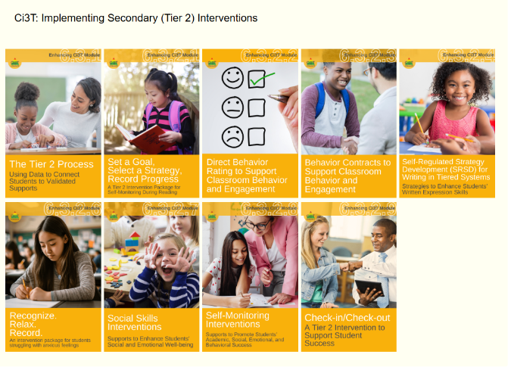
Starting Activity
Step 1: Go to ci3t.org/enhance
Step 2: If you have not already registered to access Enhancing Ci3T Modules, consider doing so.
Step 3: Sign into the Recognize. Relax. Record. module (see Ci3T: Implementing Secondary (Tier 2) Interventions)

Slide 2
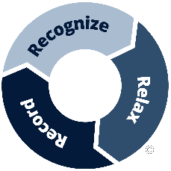
Recognize. Relax. Record. A Tier 2 Support for Students Experiencing Anxious Feelings A Presentation for Topeka Public Schools
Allison M. Bernard, M. Ed.
Amy A. Buffington, M. Ed.
Kathryn L. Johnson, M.A.
University of Kansas
We invite you to visit ci3t.org/enhance to access our collection of Enhancing Ci3T Modules following a one-time registration process!
This presentation was funded in part by Project ENHANCE (U.S. Department of Education, Institute of Education Sciences: Award Number: R324N190002), Project ENGAGE (U.S. Department of Education, Institute of Education Sciences: Award Number: R324X220067), and Project EPIC (U.S. Department of Education, Office of Special Education Programs, Award Number: H325D220011).

Slide 3











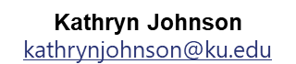
Project ENGAGE Research Team
Rebecca L. Sherod-Adams
rebeccasherod@asu.edu
Joni Weiss
joni.weiss@ku.edu

Slide 4
Session Outcomes
Explain how to review school-wide data to determine which students might benefit from this Tier 2 intervention.
Describe three key components of Recognize. Relax. Record.
Describe how to implement Recognize. Relax. Record. in a classroom setting.
Explain how to measure (a) implementation (treatment integrity), (b) users’ views of goals, procedures, and outcomes (social validity), and (c) student behavior (e.g., engagement, anxious feelings).

Slide 5
Agenda
Welcome
Situating Secondary (Tier 2) Interventions in Ci3T Models
Describing Key Components of Recognize. Relax. Record.
Implementing Recognize. Relax. Record.
Baseline
RRR Instruction
RRR In-Class
Measuring what Matters: Treatment Integrity, Social Validity, and Student Behavior
Wrapping Up and Moving Forward

Slide 6
A Focus on Students with Internalizing Behaviors

Slide 7
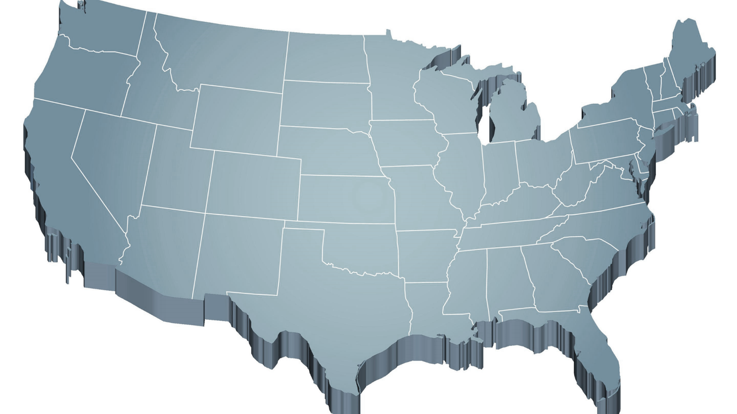
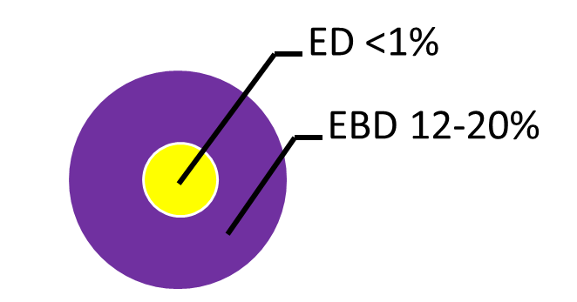
Thank you for your commitment!
Shift to a systems level perspective
Internalizing
Externalizing
Source: Forness, S.R., Freeman, S.F., Paparella, T., Kauffman, J.M., & Walker, H.M. (2012). Special education implications of point and cumulative prevalence for children with emotional or behavioral disorders. Journal of Emotional and Behavioral Disorders, 20, 4-18.

Slide 8
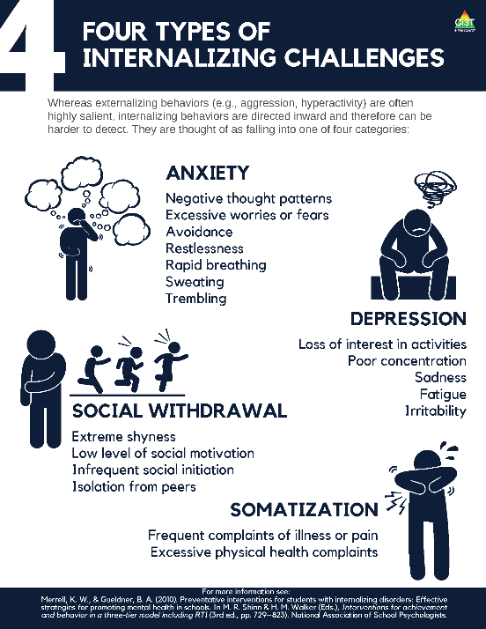
What are internalizing behaviors? (2)
Some examples include:
frequent complaints of illness or pain,
social withdrawal,
irritability,
poor concentration,
restlessness,
emotional outbursts,
rapid breathing,
sweating, or
trembling/shaking.

Slide 9
Who do internalizing behaviors impact? (1)
≈ 32% of children experience an anxiety disorder at some point during their childhood (Merikangas et al., 2010)
Onset typically occurs during elementary years (Merikangas et al., 2010)
Prevalence of behavioral, social, and emotional well-being challenges may be on the rise:
Lebrun-Harris and colleagues (2022) found an increase in anxiety and behavioral/conduct disorder from 2016-2020.

Slide 10
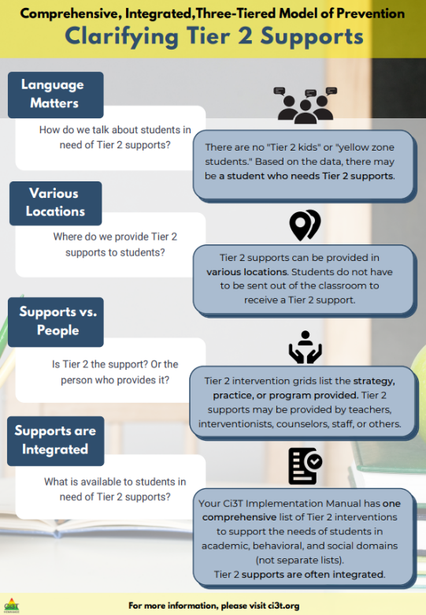
Situating Secondary (Tier 2) Interventions in Ci3T Models

Slide 11
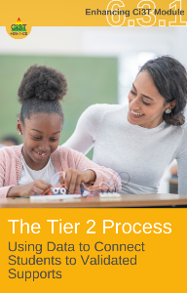
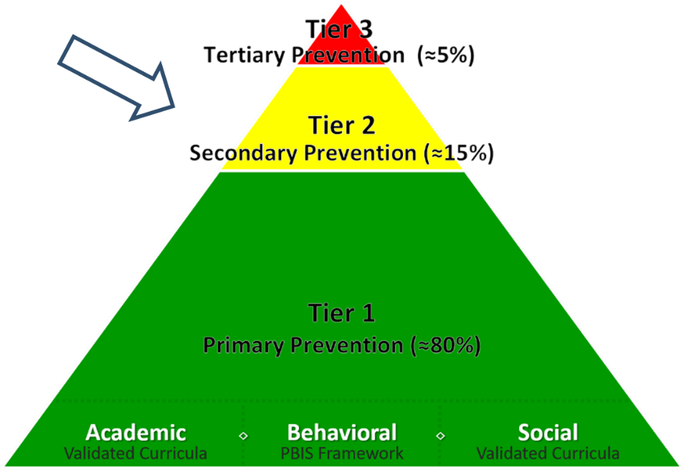
What are Tier 2 Interventions?
Evidenced-based or research-based strategies, practices, and programs
Additive (i.e., compliment rather than replace Tier 1 efforts)
Implemented by teachers, interventionists, counselors, paraprofessionals, and other staff
Occur in a variety of formats and locations (e.g., small-group, 1:1, embedded within whole group instruction)

Slide 12
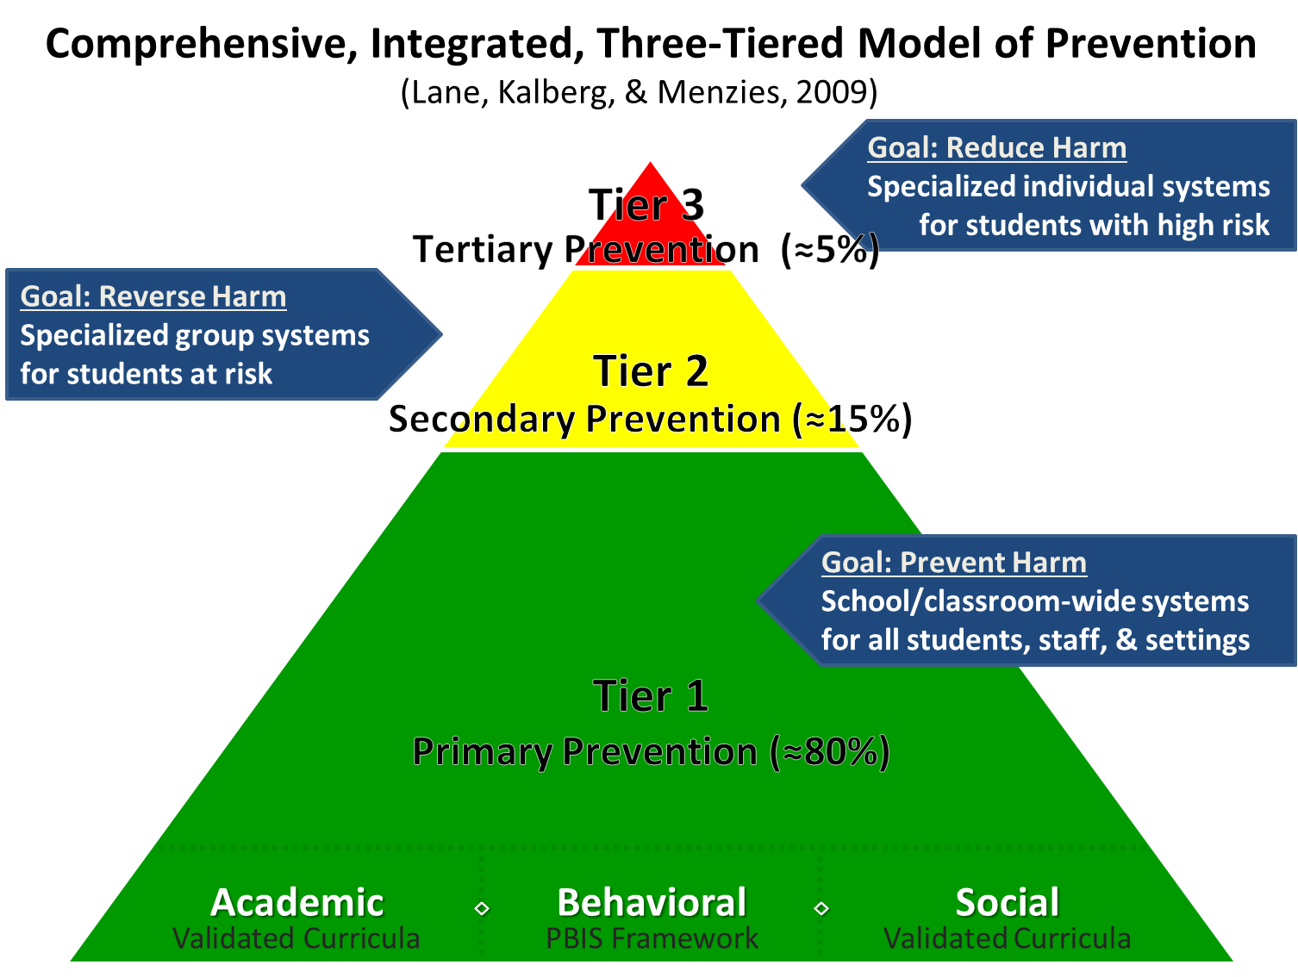

Comprehensive, Integrated, Three-Tiered Model of Prevention 1

Slide 13
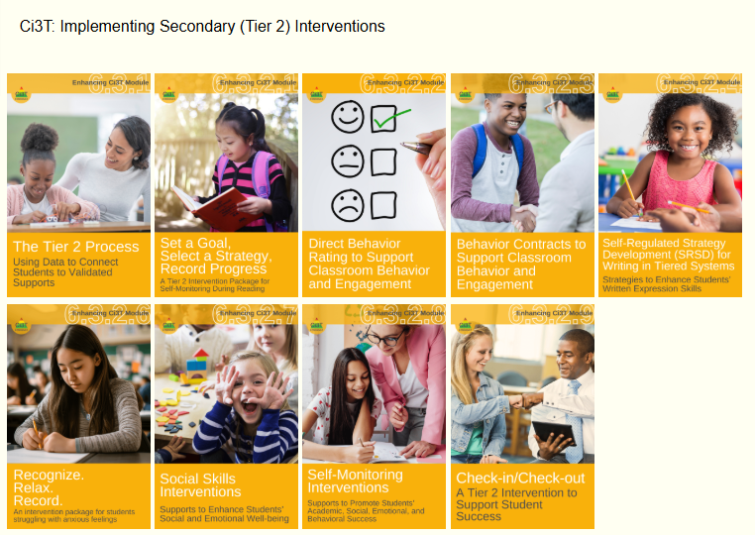
Ci3T: Implementing Secondary (Tier 2) Interventions

Slide 14
An Overview of Recognize.Relax.Record

Slide 15

Comprehensive, Integrated, Three-Tiered Model of Prevention 2

Slide 16

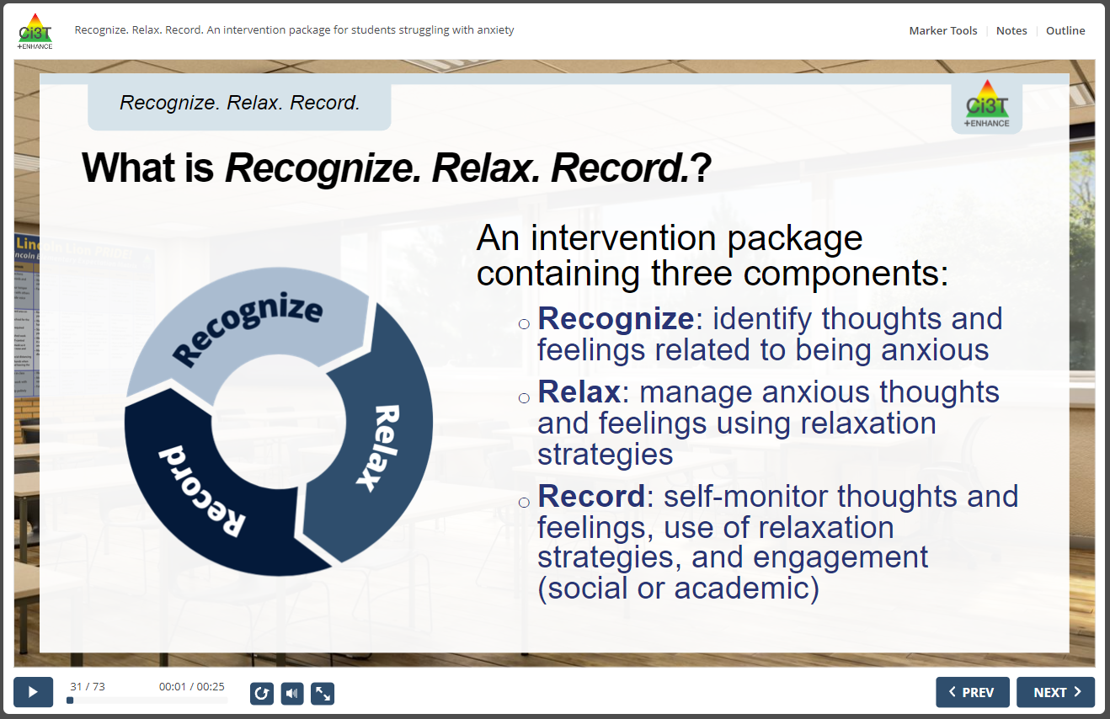
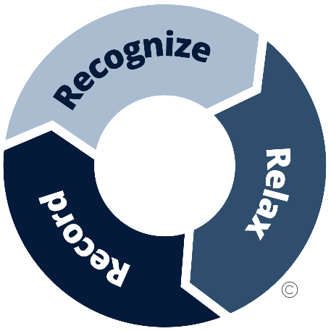
RRR Interactive Resource

Slide 17
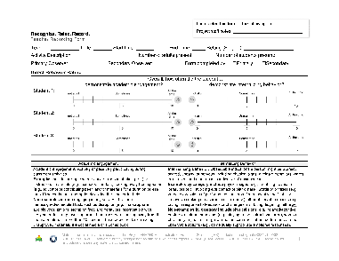
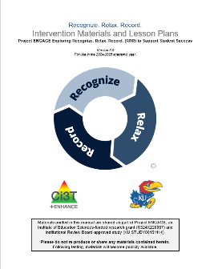
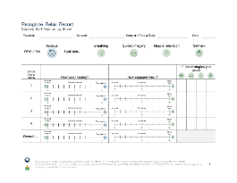
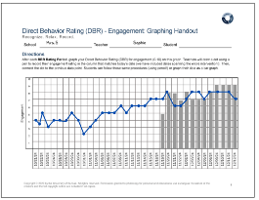
Three Components of Recognize. Relax. Record.
Baseline
RRR Instruction
RRR
In-Class
1
2
3
4
5
6
7
8
9
10
11
12
13
14
15

Slide 18

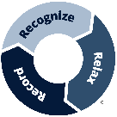
What does the supporting research for Recognize. Relax. Record. say?
What Does the Supporting Research for Recognize. Relax. Record. Say? 1
Social-emotional competencies
Self-awareness
Self-management
Social awareness
Responsible decision-making
Relationship Skills
Recognize.
Social-emotional competencies, such as self-awareness and self-management, are related to important long-range outcomes
high school graduation
college degree completion
obtaining employment
Durlak et al., 2011
Adapted from CASEL Framework (2020)

Slide 19
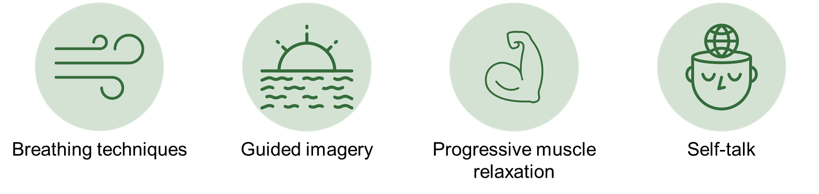
What does the supporting research for Recognize. Relax. Record. say?
What Does the Supporting Research for Recognize. Relax. Record. Say? 2
Relax.
Relaxation training is commonly used in research-based cognitive behavioral interventions for children with anxiety
Chorpita & Daleiden, 2009

Slide 20
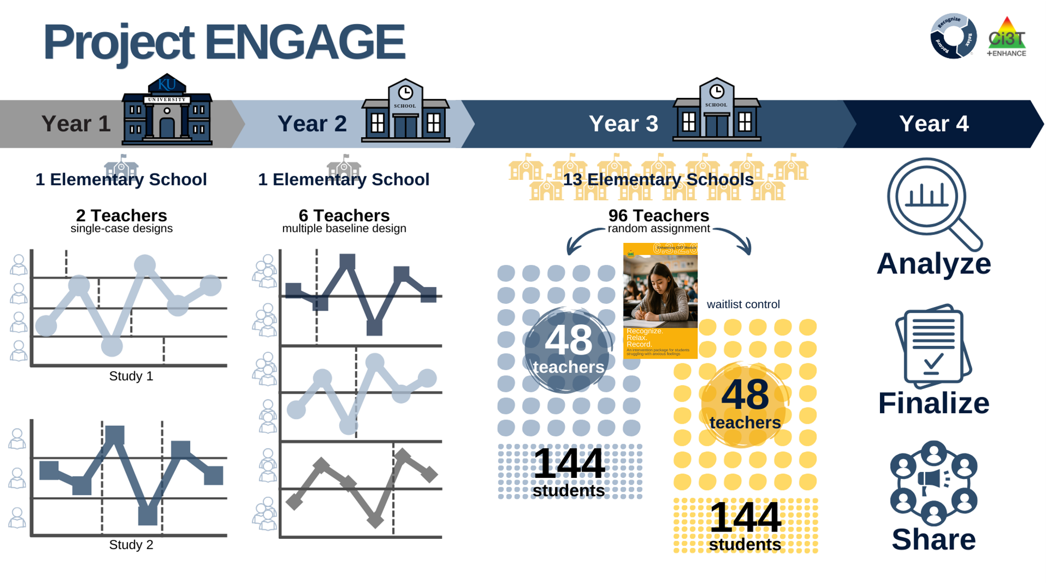
Project ENGAGE
A special thank you to teachers who participated! It was gift to learn from and with you!!!

Slide 21












Talk Time! (1)
What does internalizing behavior look like for your students?
Thinking back to previous or current groups of students you have taught, are there students you think might have benefited from RRR?

Slide 22
Implementing RRR
A 7-step process

Slide 23
Step 1
Use data to connect students to RRR

Slide 24
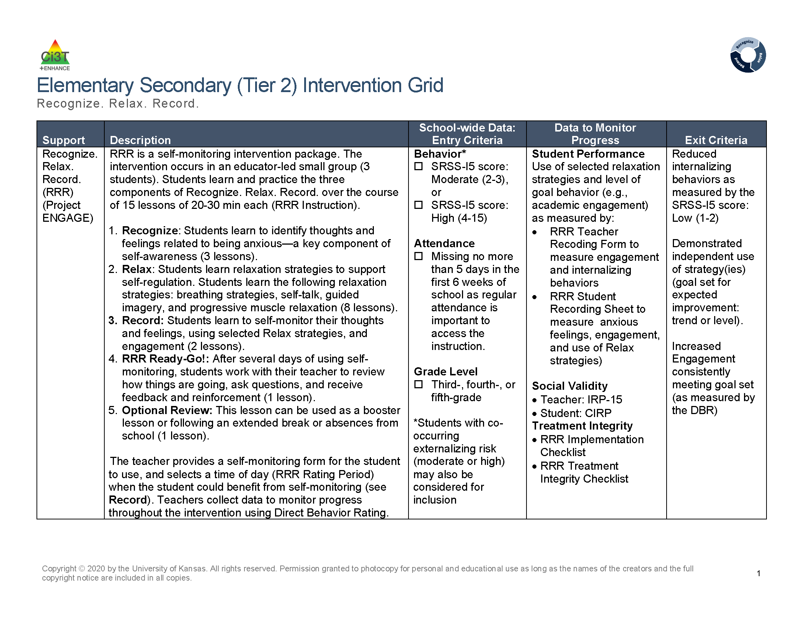
Recognize. Relax. Record. Secondary (Tier 2) Intervention Grid
Recognize. Relax. Record. Secondary (Tier 2) Intervention Grid 2

Slide 25
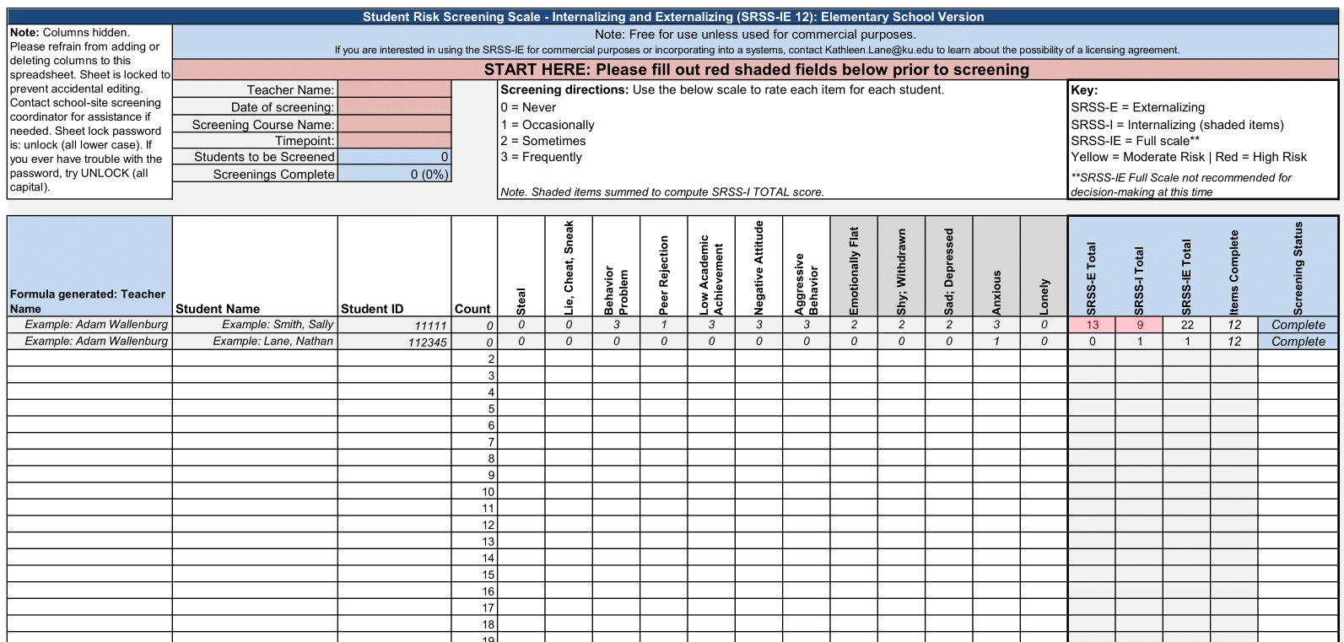
Using data to connect students to Recognize. Relax. Record.

Slide 26
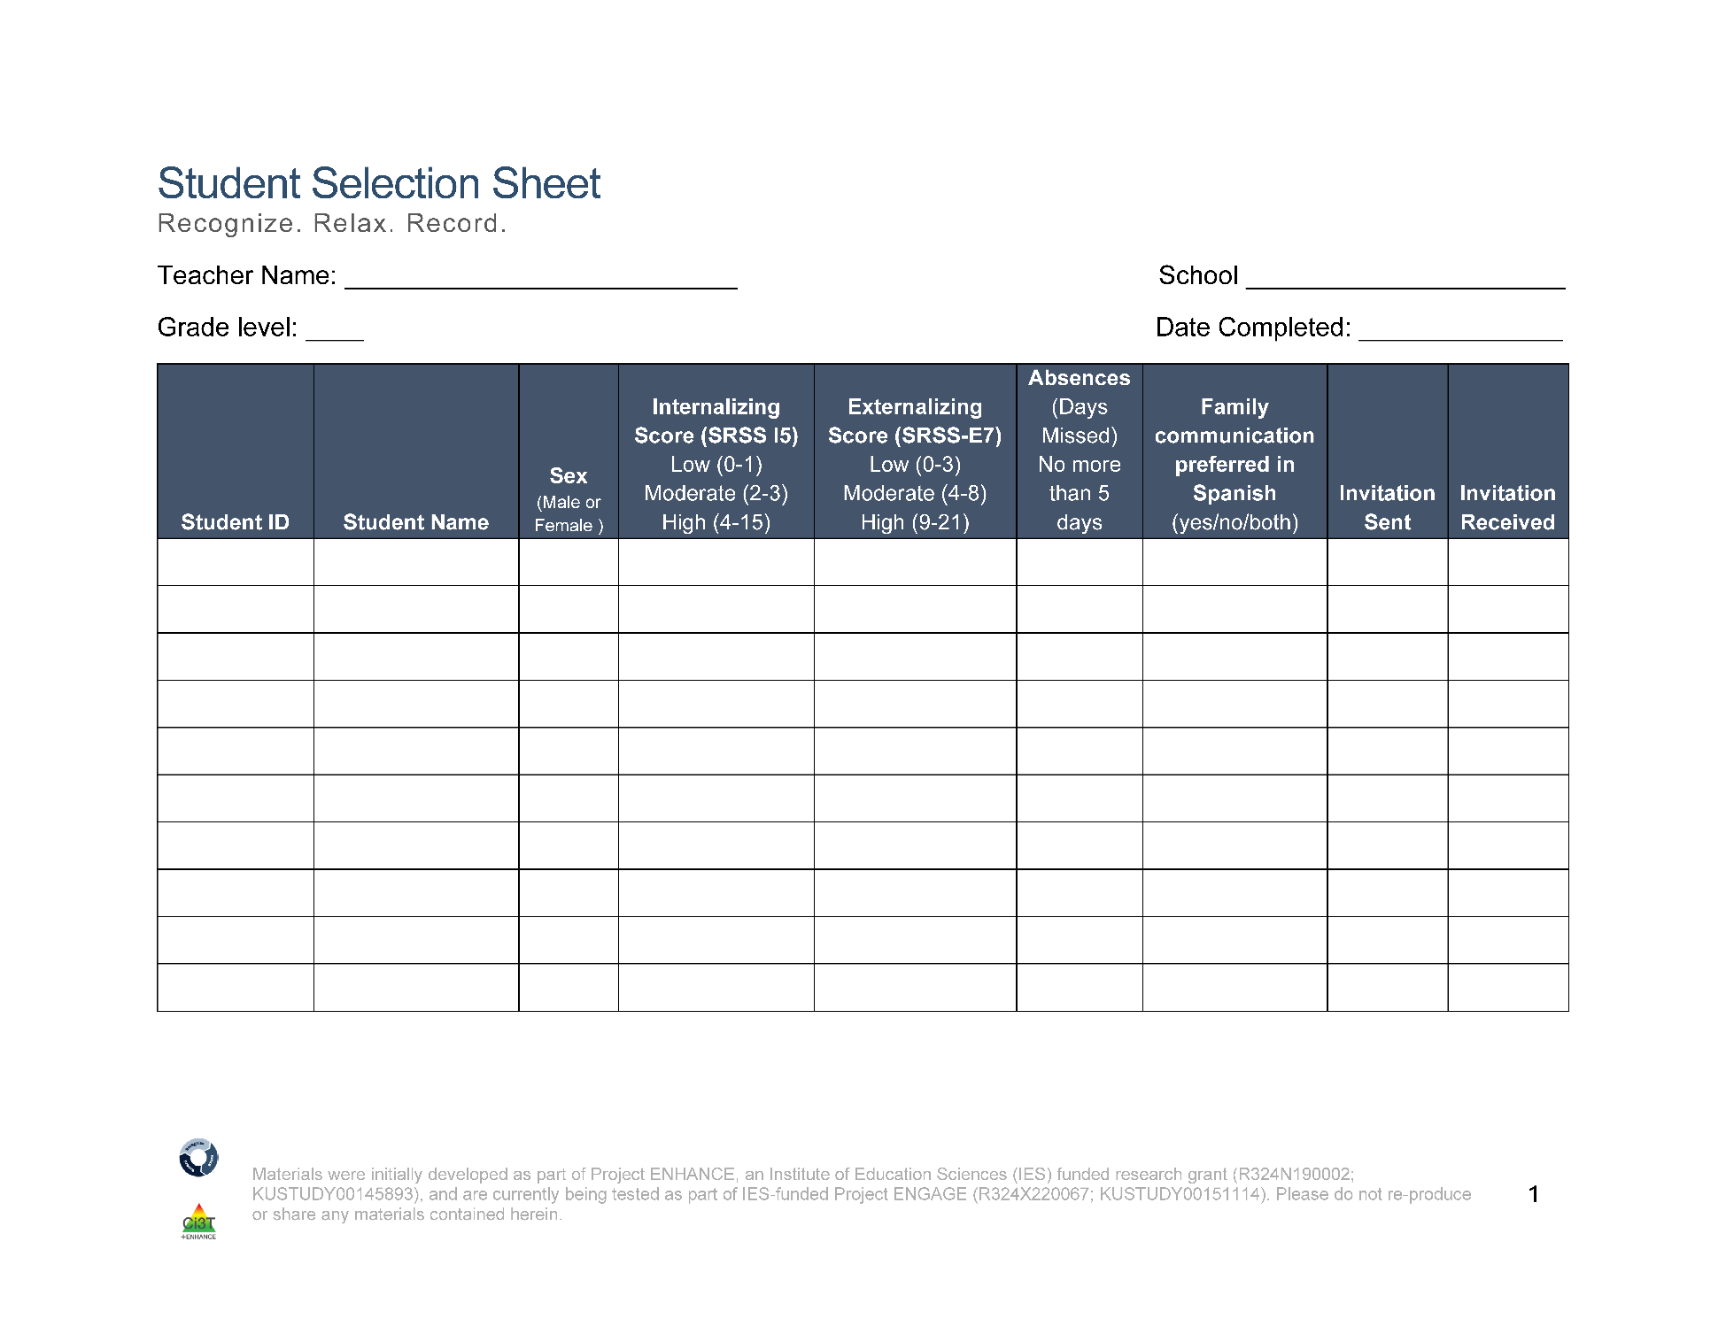
Student Selection Sheet
Ms. Sarasin
Lincoln Elementary
5
10/14/24
2
122006
Smith, John
F
4
3
2
no
122295
Johnson, Emily
F
2
8
5
both
1
122295
Taylor, Sarah
F
8
4
3
no
122295
Anderson, David
F
2
19
7
no
3
122313
Thomas, Jessica
M
5
5
1
no
122318
Harris, James
M
2
3
2
yes
Notes:
Fully translate materials and consent form

Slide 27
Step 2
Plan RRR Procedures

Slide 28
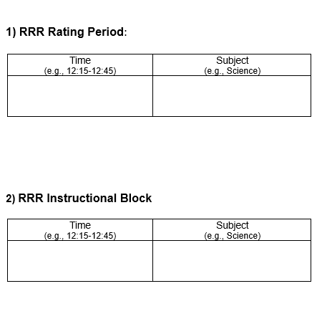
Step 2 Plan RRR Procedures
Step 2 Plan RRR Procedures 1
Collaborate with parents, families, and colleagues
Gather data to identify students’ strengths, abilities, and needs
Schedule
RRR Rating Period
Time when baseline (Direct Behavior Rating) data collected
Time when students will use self-monitoring during RRR In-Class phase
RRR Instruction Block
Time when small-group instruction will occur (15 lessons, 20-30 min each)
2:00-2:40
Monday-Thursday
Math
10:00-10:25
Monday, Wednesday, Thursday
Independent Work Time

Slide 29
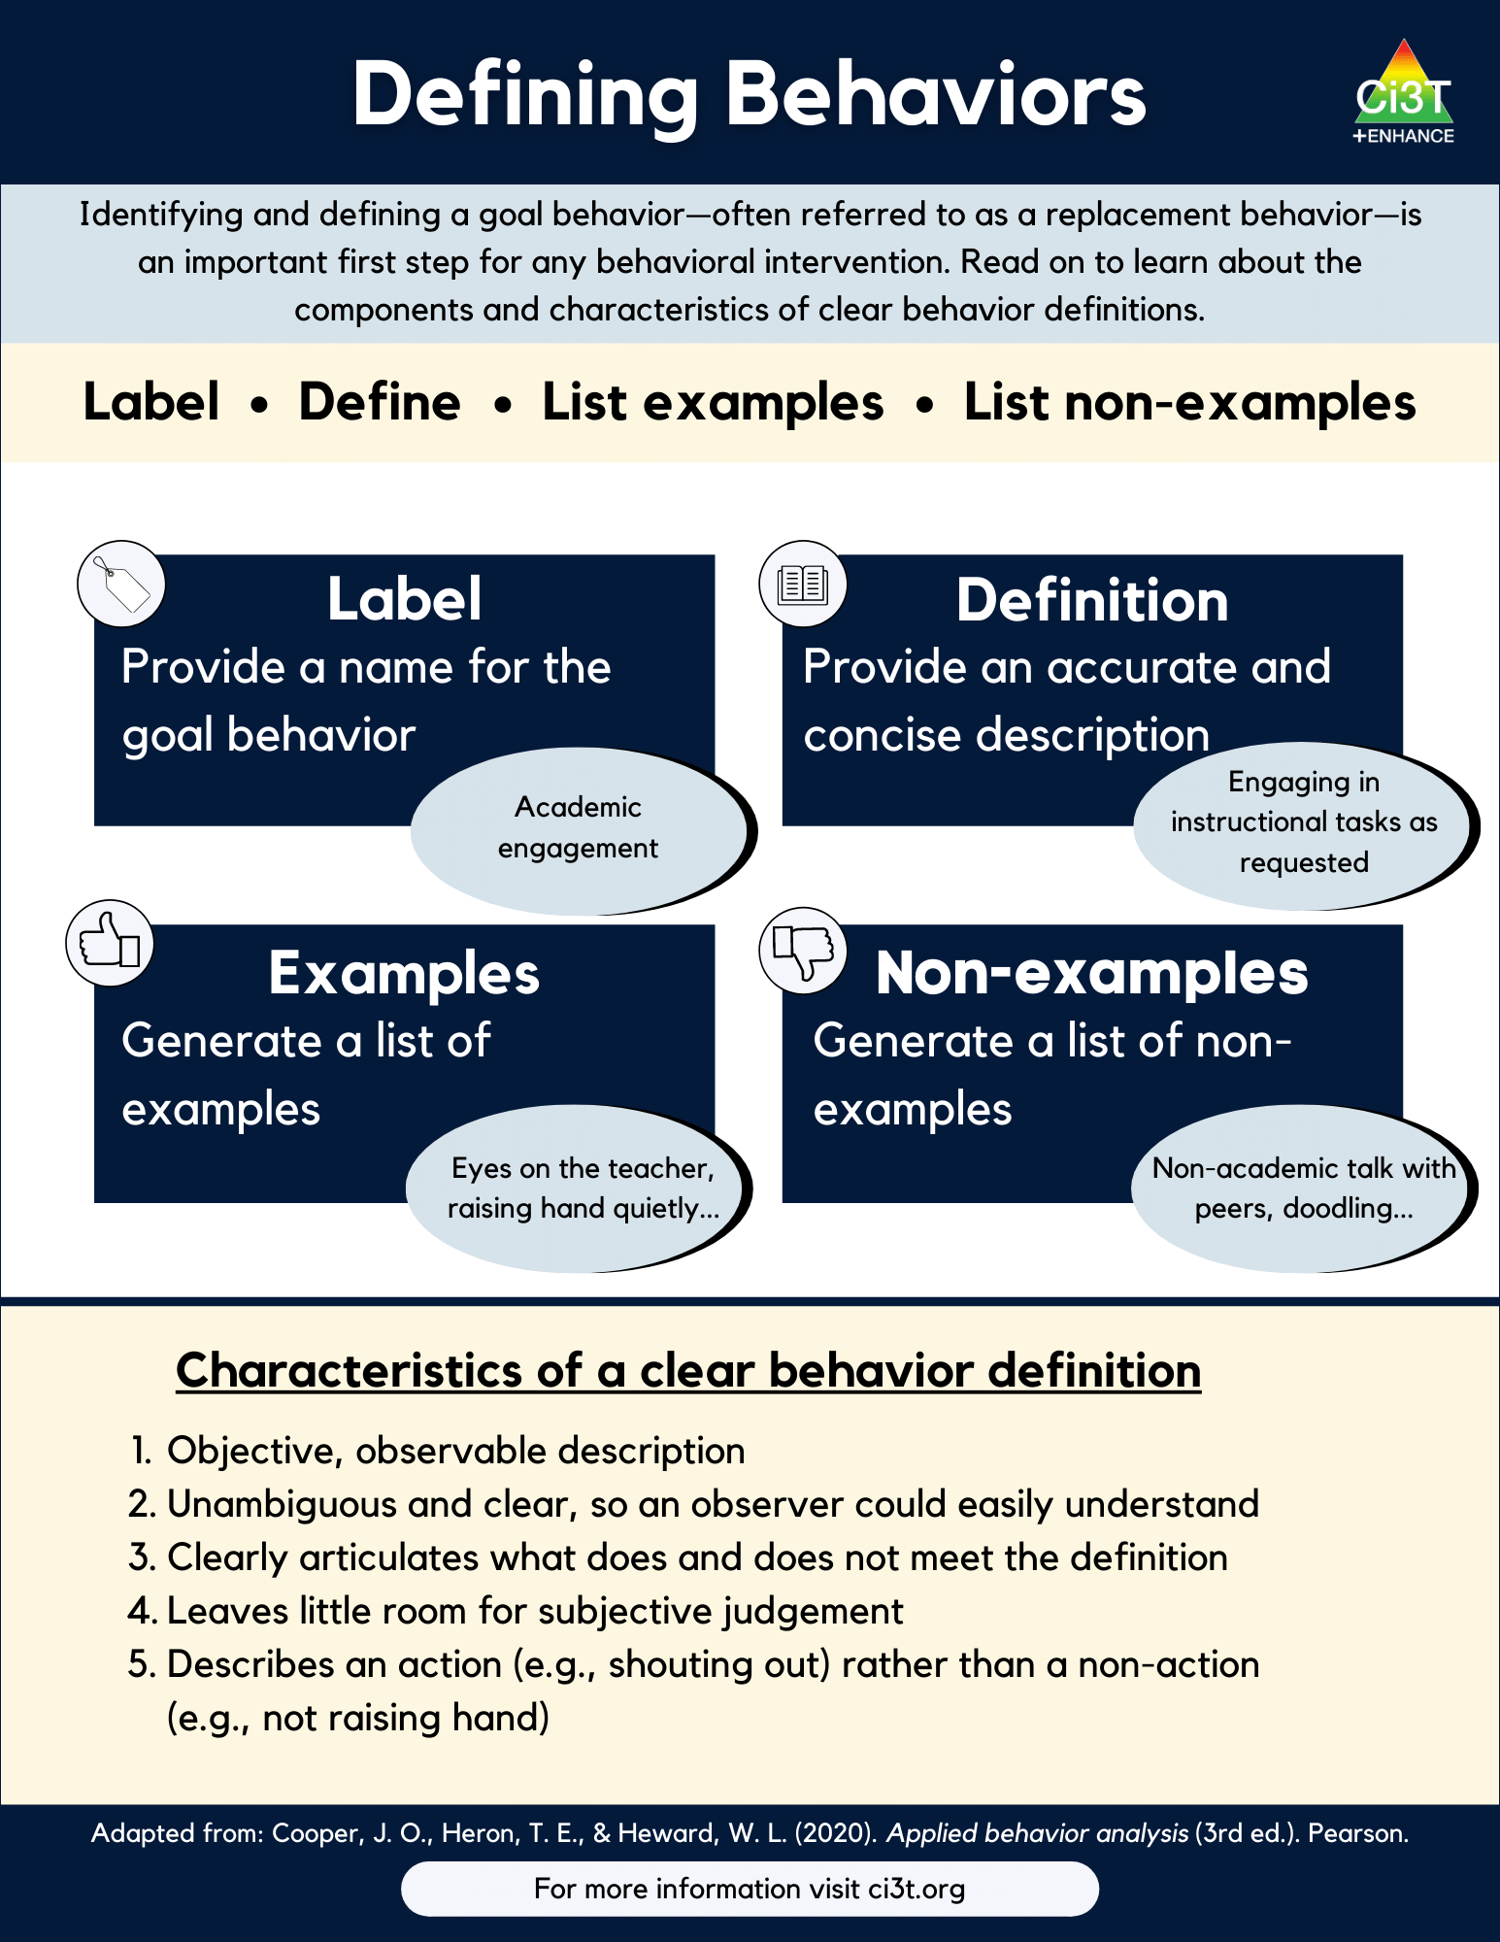
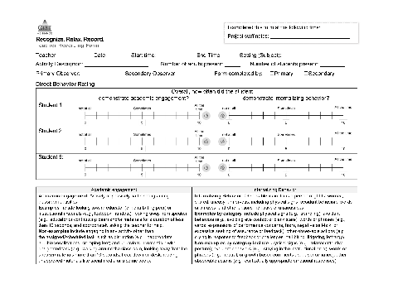
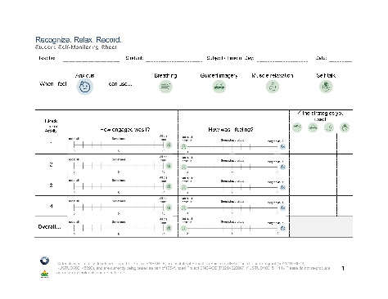
Step 2 Plan RRR Procedures
Step 2 Plan RRR Procedures 2
Prepare intervention forms and procedures
Teacher Recording Form (Direct Behavior Rating)
Student Self-Monitoring Sheet
Operationalize behaviors of interest

Slide 30
Step 3
Begin baseline data collection

Slide 31
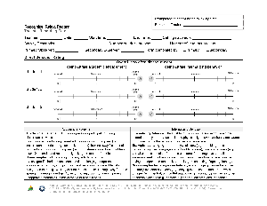
Baseline
Baseline 2
This is the time (approximately two weeks) before beginning RRR instruction
Nothing else changes!
This allows for a comparison pre-intervention performance to post-intervention performance
During this time, teachers will collect Direct Behavior Rating (DBR) data four times a week (Monday-Thursday)
Goal is to collect ~6-8 data points during this time!

Slide 32
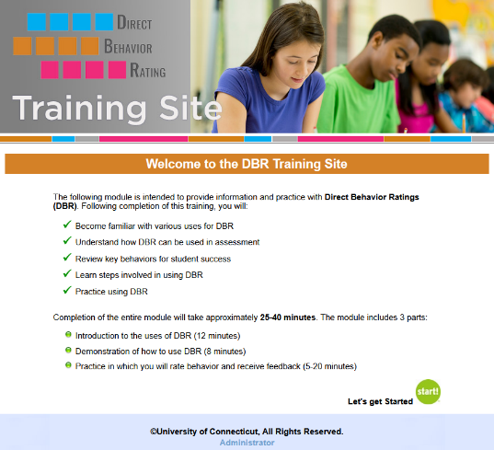
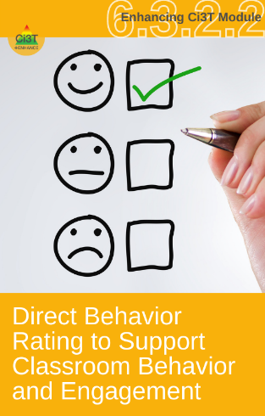
Direct Behavior Rating (DBR)
A tool that involves a brief rating of target behavior immediately following a specified observation period.
Source: University of Connecticut. (n.d.). Direct behavior rating: Assessment training module. [video training module].
www.dbrtraining.education.uconn.edu/video.php

Slide 33
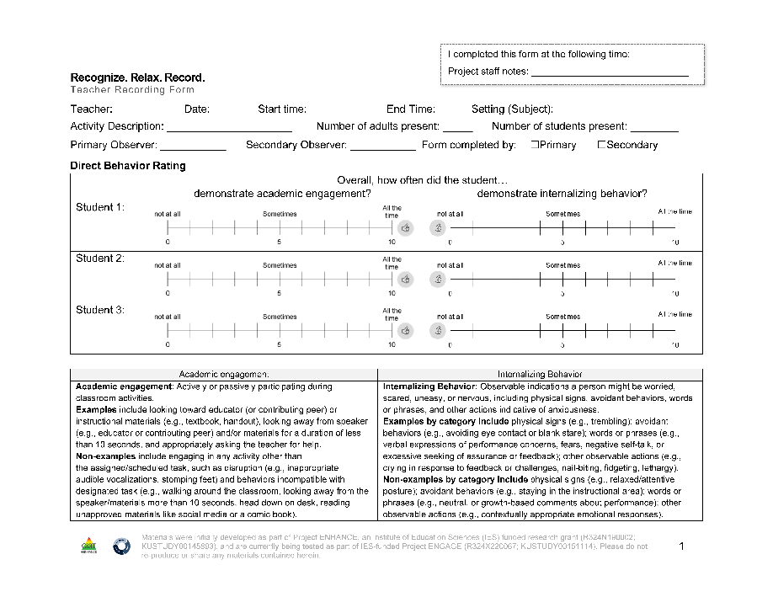
Teacher Recording Form
DBR data are collected using the Recognize.Relax.Record Teacher Recording Form to measure students’:
Academic engagement
Internalizing behavior

Slide 34
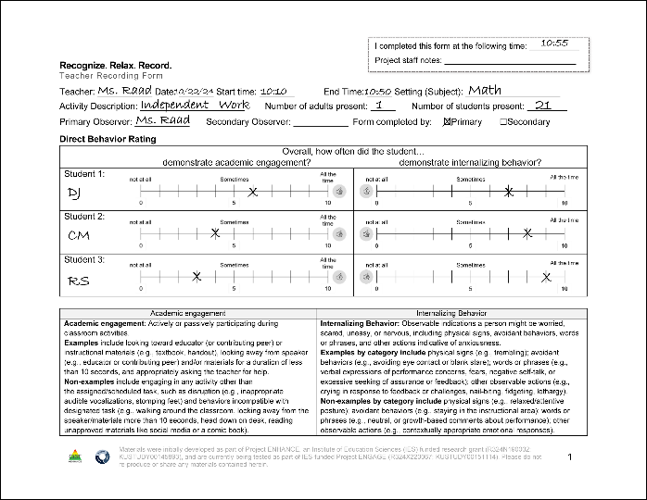
DBR Procedures: RRR Rating Period
DBR Procedures: RRR Rating Period 1
Plan to collect DBR data four times a week
Generally, Monday through Thursday
All students on one form per day
At the end of the RRR Rating Period, complete the Teacher Recording Form

Slide 35
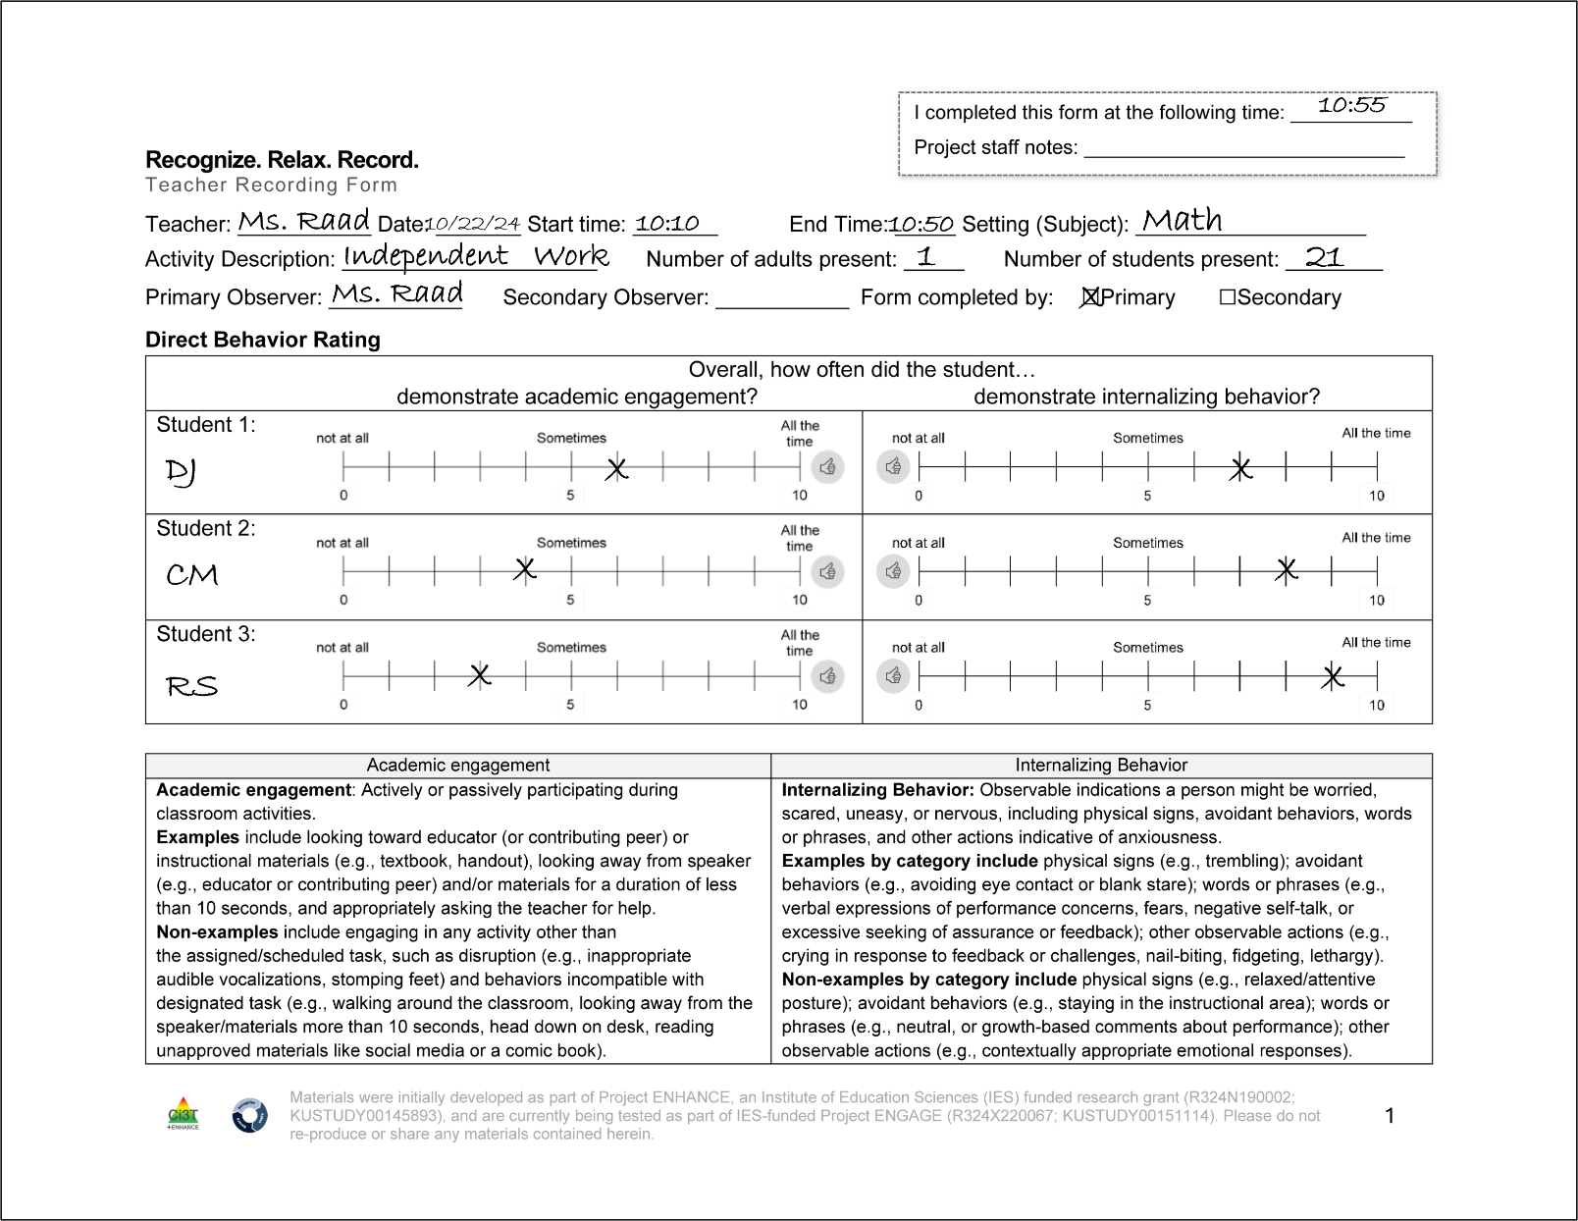
DBR Procedures: RRR Rating Period
DBR Procedures: RRR Rating Period 1

Slide 36
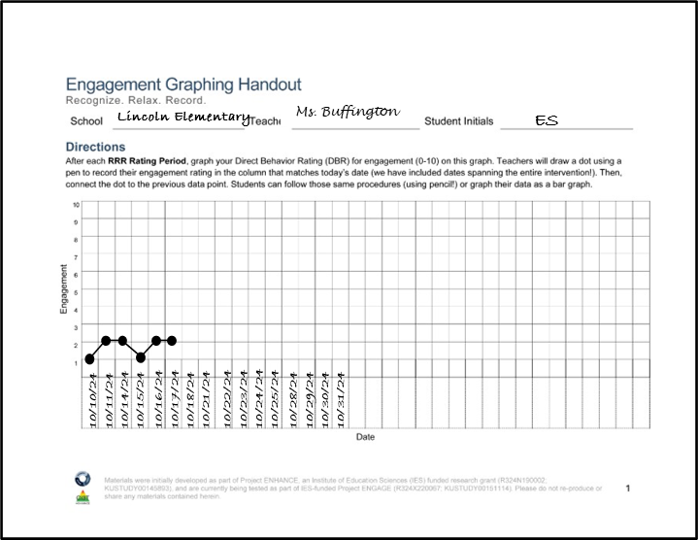
RRR Engagement Graphing Procedures
Each student will have their own Engagement Graphing Handout
Later in the intervention (during RRR In-Class), students will also add their total engagement ratings to this graph!
Once you have completed the Teacher Recording Form, graph each student’s overall engagement score on their graph

Slide 37


Table Talk
During what time of day would be beneficial for conducting DBR with your students?

Slide 38
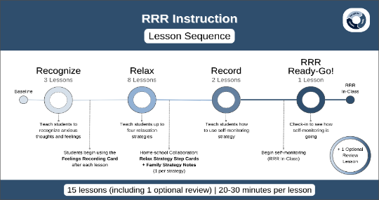
Step 4
Provide RRR Instruction

Slide 39

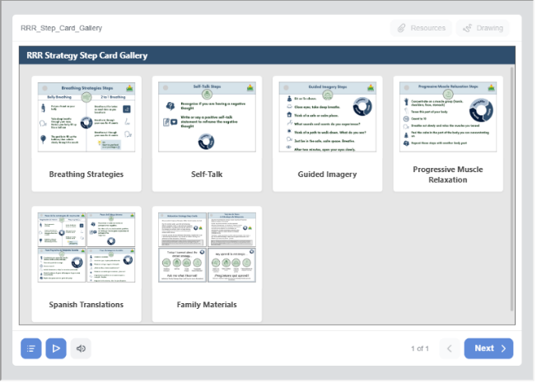
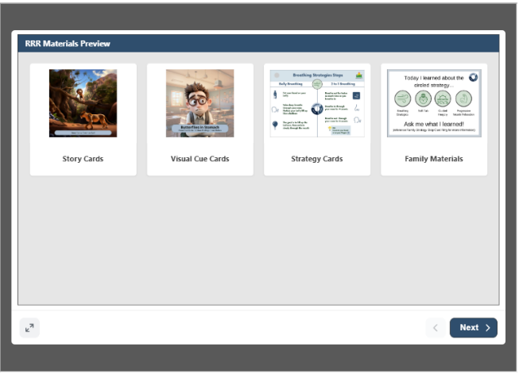
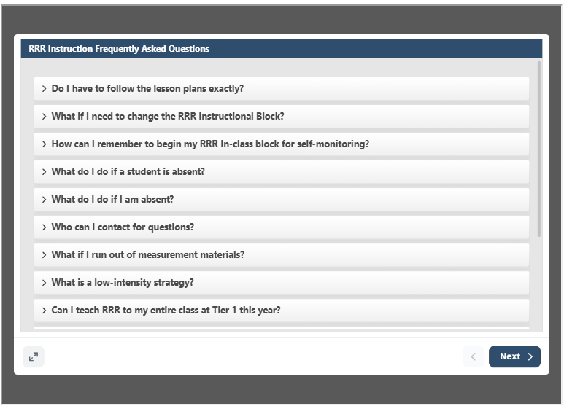
Accessing Materials

Slide 40
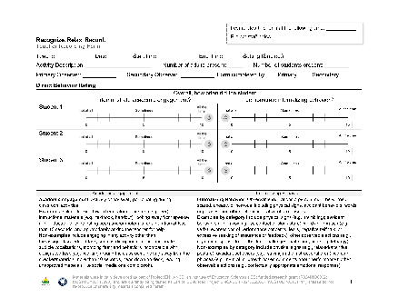

RRR Instruction
Deliver small group RRR Lessons
~20-30 minutes per lesson
Up to 15 lessons (with optional lessons); likely to teach only 10-13 lessons
Taught during a different time than RRR Rating Period
Teachers continue to collect DBR data four times a week (Monday-Thursday) during the RRR Rating Period

Slide 41
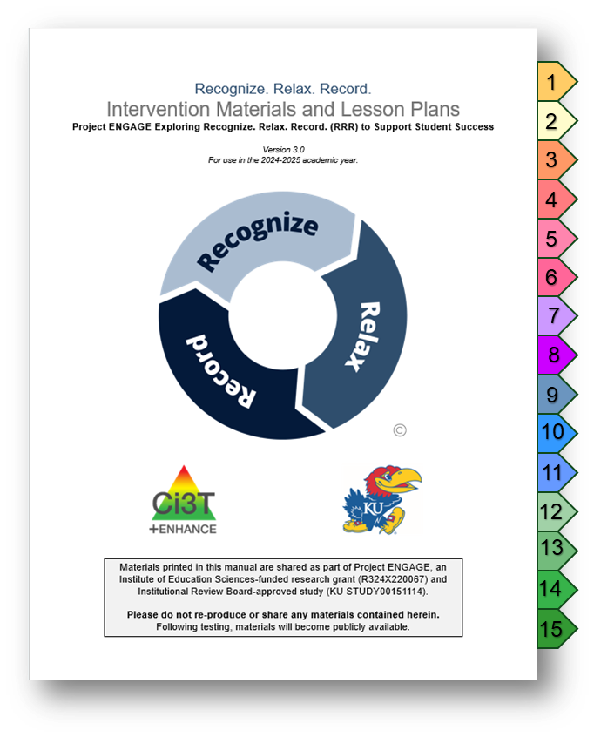
Lesson Plans Overview
15 lessons available
Recognize - 3 lessons
Relax - 8 lessons*
Record - 2 lessons
Ready-Go!
Review (optional)
20-30 min each lesson
Semi-scripted
Teacher-led

Slide 42
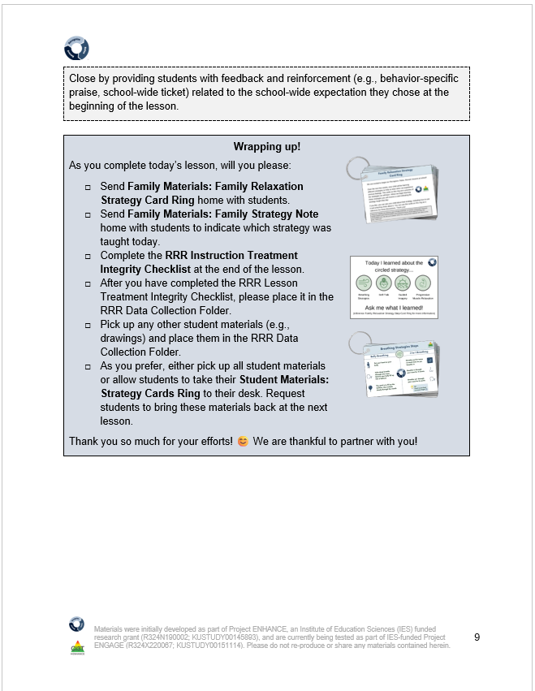
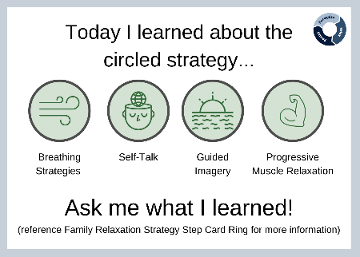
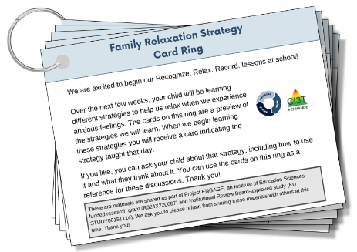
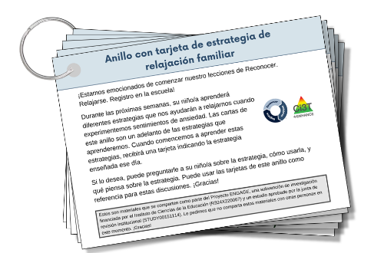
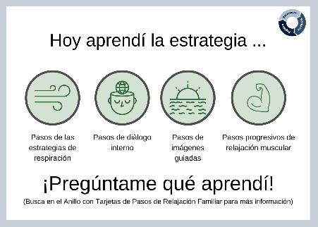
Family Materials (1)
Guidance for sending materials is in each lesson plan, as appropriate
Notes:
Family materials – available in both English and Spanish on one ring (front and back)
Guidance in lessons in the blue wrap up boxes for when to send those home

Slide 43
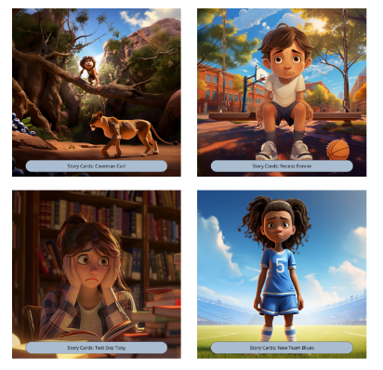
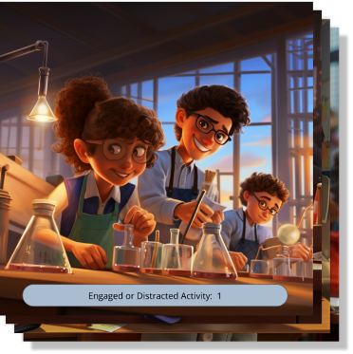
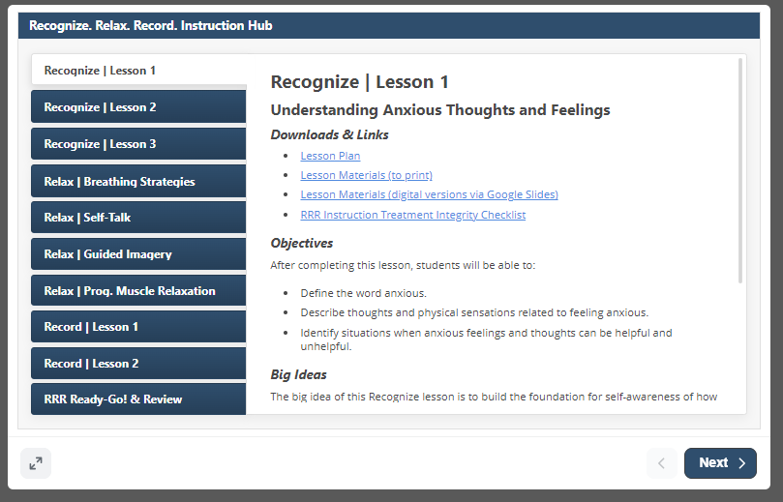
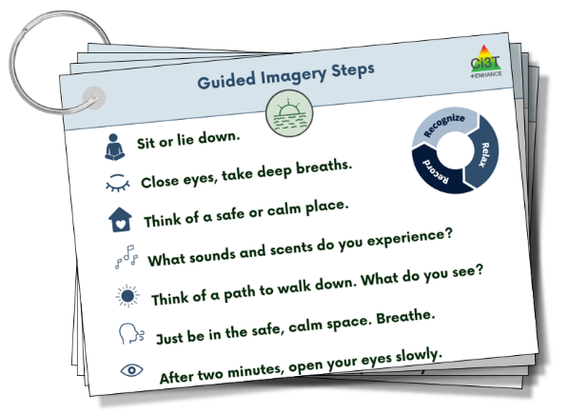
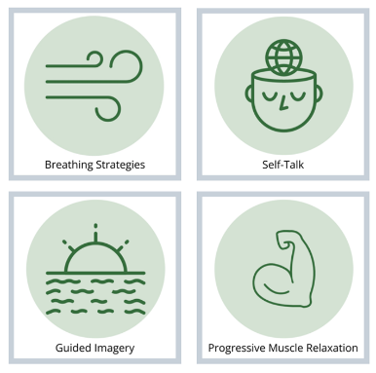

Teacher Materials

Slide 44

Video Model: The Instructional Hub
Notes:
1:30 second video
Video walkthrough of instructional hub

Slide 45

Key Intervention Lesson Features (1)
Lesson title
Lesson timing
Pacing Guide
Headings
Tell
Show
Do
Practice & Monitor
Generalize & Close
Learning objectives
Big Ideas of the lesson
Materials
Notes:
Lesson plans have consistent format – each lesson has a title, learning objective, big ideas, and materials you will need

Slide 46






Key Intervention Lesson Features (2)
Situational stories and other examples
Notes:
Story Cards and examples built in. Can edit to meet needs of students.
Likely teaching at small group table – teachers have used hard-copy materials, flipped their computer around, or used a second monitor. Set up to be flexible and meet your needs!

Slide 47


Recess Ronnie

Slide 48



Student Examples 2
Anxious feelings:
soccer tryouts
Guided Imagery Example
Guided Imagery Example

Slide 49


Lesson Activities
Embedded materials throughout

Slide 50

Student Examples 1
Identifying anxious feelings in your body: sweating
Guided Imagery Example
Anxious feelings:
public speaking

Slide 51
Student Examples 2
Anxious feelings:
soccer tryouts
Guided Imagery Example
Guided Imagery Example

Slide 52
3 Intervention Components

Slide 53

Recognize. Relax. Record. Intervention Component
Recognize. Relax. Record. Intervention Component 1
Recognizing and understanding our emotions is a key component for self-awareness
Students learn to:
Lesson 1: Understanding anxious feelings
Lesson 2: Identifying anxious thoughts and feelings
Lesson 3: Choosing strategies to help manage anxious thoughts and feelings

Slide 54

Recognize. Relax. Record. Intervention Component
Recognize. Relax. Record. Intervention Component 2
Students learn strategies to respond when they feel anxious
Breathing Strategies
Self-talk
Guided Imagery
Progressive Muscle Relaxation
For each strategy, students will:
Define
Learn to use
Recognize situations for when to use
Demonstrate (and practice)

Slide 55
Recognize. Relax. Record. Intervention Component
Recognize. Relax. Record. Intervention Component 3
Students learn how to monitor their own feelings and behaviors
Lesson 1: Learning to Self-Monitor (Record) our Behaviors
Focus: Academic Engagement
Lesson 2: Learning to Self-Monitor (Record) our Thoughts, Feelings, and Behaviors
Focus: Anxious thoughts and feelings
Focus: Use of relaxation strategies

Slide 56



Engaged or Distracted

Slide 57


RRR Ready-Go! and Optional Review Lessons
Lesson taught after a few
days of RRR In-Class
Optional customizable lesson following an extended break

Slide 58















Work Time
Step 1: Go to ci3t.org/enhance
Step 2: Locate the Recognize. Relax. Record. module (see Ci3T: Implementing Secondary (Tier 2) Interventions)
Locate the RRR Instructional Hub (see Steps) Explore one of the lesson plans. Review screening data.
Step 3: Sign into the module using your district email (if you haven’t yet registered, directions will be provided to do so)
Step 4: On the toolbar, Section 13 (Getting Started with Recognize. Relax. Record.). Scroll down until you find the RRR Instructional Hub.
Notes:
10-min timer

Slide 59
Step 5
Implement RRR In-Class and Monitor Student Performance

Slide 60



RRR In-Class
Teachers continue to collect DBR data four times a week (Monday-Thursday)
Students use the Student Self-Monitoring sheet to self-monitor their engagement, anxious feelings, and use of relaxation strategies
Teachers facilitate self-monitoring (e.g., audio cue, brief check-ins)

Slide 61


Student Self-Monitoring Sheet
RRR-Ding provides
audio cue for intervals

Slide 62
Video Model: RRR In-Class Procedures
Notes:
01:30

Slide 63

Engagement Graphing Handout
Opportunities for feedback & discussion with students!

Slide 64
Step 6
Monitor maintenance and generalization

Slide 65


Step 6 Monitor maintenance and generalization
Notes:
To support these endeavors of extending the application of the intervention, we have family materials that Amy showcased earlier as well as infographics specifically for families embedded throughout the module to help educate families on the practice and encourage generalization outside of the school building ☺

Slide 66

Maintenance of RRR

Slide 67
Step 7
Seek input from students, families, and teachers

Slide 68



Step 7: Seek input from student, families, and teachers

Slide 69

Feedback from Families

Slide 70



Teacher Interviews
“At first I thought it was going to be a lot of work, but it worked seamlessly into our routine.”
In this school we have a lot of trauma and students struggling. I think kids with anxiety are often overlooked-they have a need and now we have something to do for them for the first time.”

Slide 71
Student Interviews
“I got really mad at home and did some breathing.”
It definitely made me improve on a bunch of stuff. Helped with my self-control.”
“Helped when I couldn’t sleep at night.”
“When I am frustrated, it helps me remember to take a breath.”
“This would help my friends in math say, “I can do this”.”
“When my brother makes me mad, I take deep breaths and visualize being somewhere calm.”

Slide 72
Considerations for Implementing RRR

Slide 73



Teacher Recommendations (1)
Hang strategy cards on desks
Set phone reminders for RRR Rating Period
Whole-class participates in self-monitoring
Student leaders
Passing out materials
Reminders for in-class procedures

Slide 74

Teacher Recommendations (2)
Showcase icons in classroom for all to see
Laptop & monitor
Students teach whole class relax strategies as Tier 1 practice
Set timers for lesson activities

Slide 75

Individualized Cognitive Behavior Therapy Plan

Slide 76
Wrap Up and Moving Forward

Slide 77
Action Items
Action Item | Person(s) Responsible | Planned Completion Date | Date Completed
Review systematic screening data (winter) to see which students might benefit from Recognize. Relax. Record. (RRR) | Amy | 1/10/26
Explore the possibility of implementing RRR with your school site colleagues and principal | Amy | 1/15/26
Visit the UConn DBR Training Site | Allison | 1/20/26

Slide 78

Project EMPOWER+
EMPOWER+ Session | Date
Starting Strong: Effective Tier 1 Practices for Educators | September 24, 2025 (Wednesday)
From Data to Action: Using Systematic Screening to Inform Instruction | October 8, 2025 (Wednesday)
Ci3T In Action: Integrated Lesson Planning for Enhanced Instruction | November 18, 2025 (Tuesday)
Mastering Behavior Specific Praise and Precorrection | January 21, 2026 (Wednesday)
A 6-Step Instructional Approach for Responding to Challenging Behaviors: A Tier 1 Practice | February 10, 2026 (Tuesday)
A Tier 2 Support for Students Experiencing Anxious Feelings: Recognize. Relax. Record. | March 25, 2026 (Wednesday)
A Tier 3 Support for Students with Intensive Intervention Needs: Functional Assessment-Based Intervention (FABI) | April 28, 2026 (Tuesday)

Slide 79



Thank you!
Thank you!
ci3t.org
#Ci3T
@Ci3Tmodel
Tag us in your Ci3T highlights, we love to see Ci3T in action!
Follow us on Instagram for updates and new resources!
Kathleen Lane
kathleen.lane@ku.edu
Allison Bernard
Allison.Bernard@ku.edu

