Slide 1
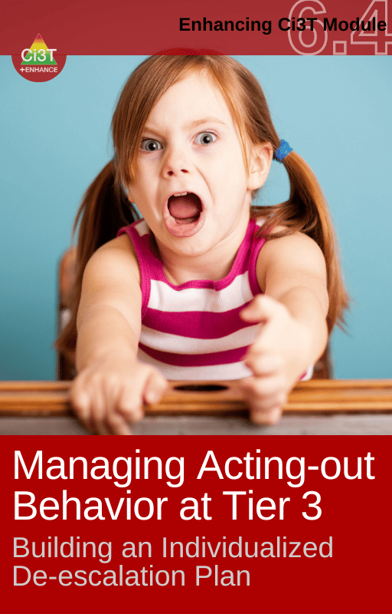

Responding to Crisis Navigating the Acting-Out Cycle
Pennsylvania Training and Technical Assistance Network
Emotional Support Teachers Networking Series ✧ January 7, 2026
David James Royer, PhD, BCBA
Notes:
APR: Attract, Prepare, Retain

Slide 2
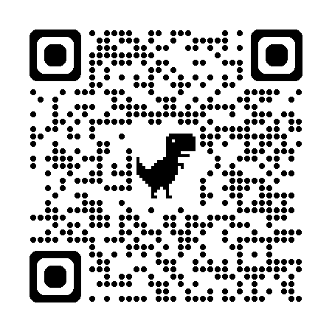
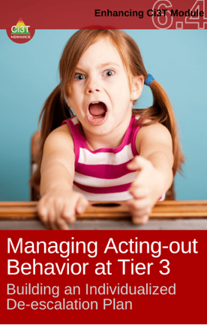

Session materials are available at ci3t.org/enhance
Register your email (demographic information optional) using the QR code ↑ or clicking the first time module users link

Slide 3
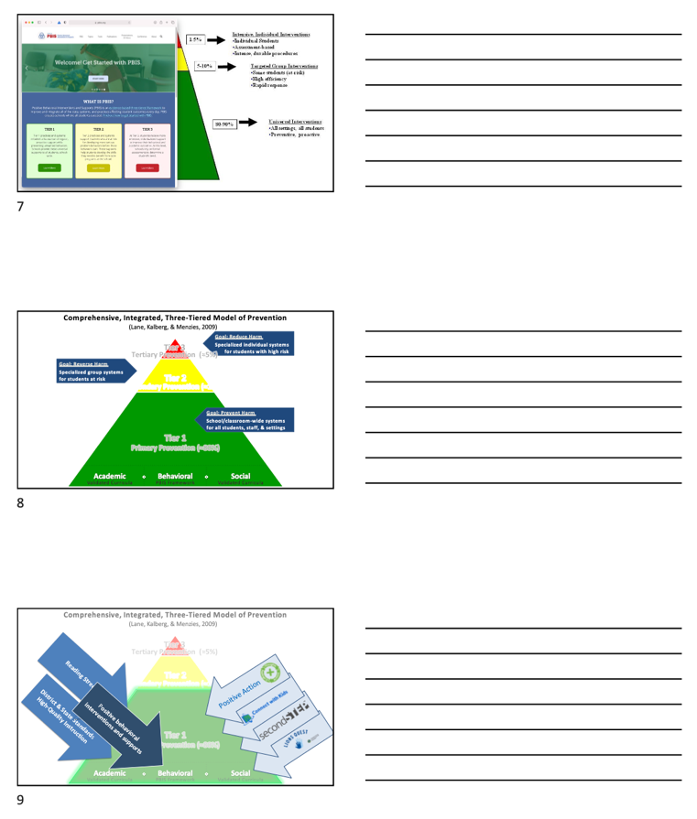
Slide notes are available at
ci3t.org/presentations

Slide 4
Agenda
Comprehensive, Integrated, Three-Tiered (Ci3T) Model of Prevention
A respectful approach to preventing and responding to challenging behavior
A look at acting-out behavior: Timing is everything!
Managing acting-out behavior: Seven phases
Pathways to success: Defusing various behaviors
Tier 3: Building an individualized de-escalation support plan
Wrapping up: Resources
ci3t.org/enhance

Slide 5
Comprehensive, Integrated, Three-Tiered (Ci3T) Model of Prevention
A respectful approach to preventing and responding to challenging behavior

Slide 7




Positive Action
District & State Standards
High-Quality Instruction
Positive behavioral interventions and supports
Notes:
SEL leads to improved attitudes about self, others, and school, Positive social behavior, fewer conduct problems, less emotional distress, academic success

Slide 8
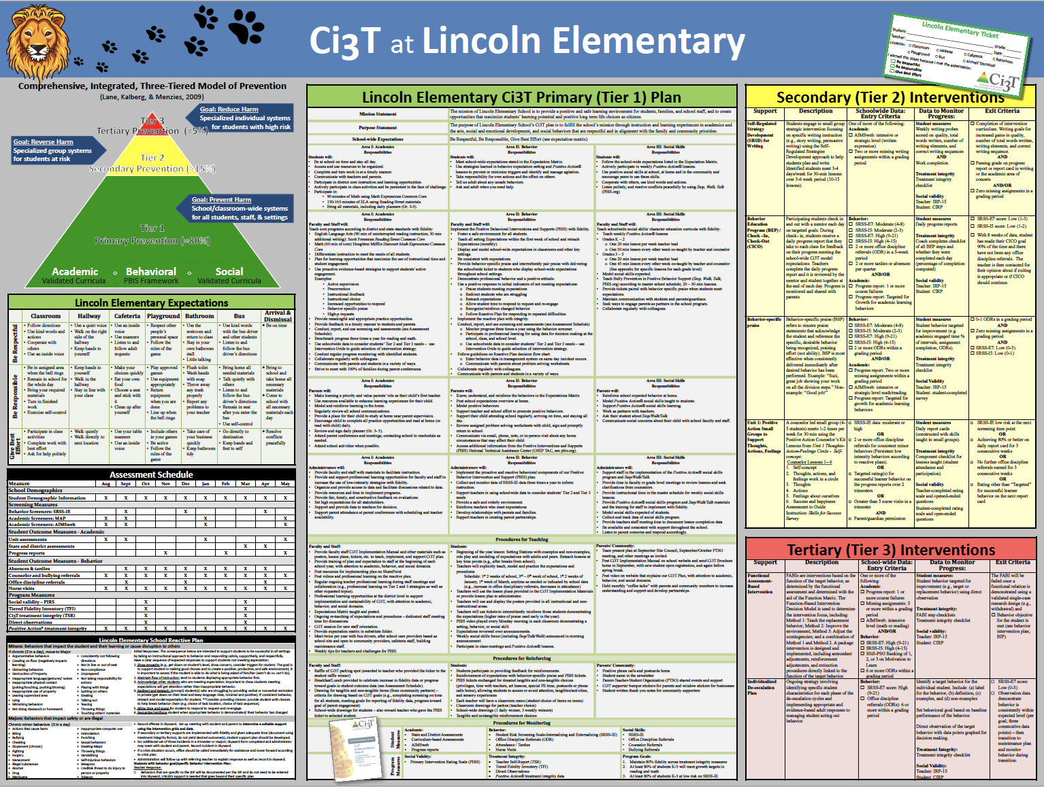
Everything connects to the Primary (Tier 1) Plan
Including procedures for teaching, reinforcing, and monitoring across academic, behavior, and social roles and responsibilities.

Slide 9
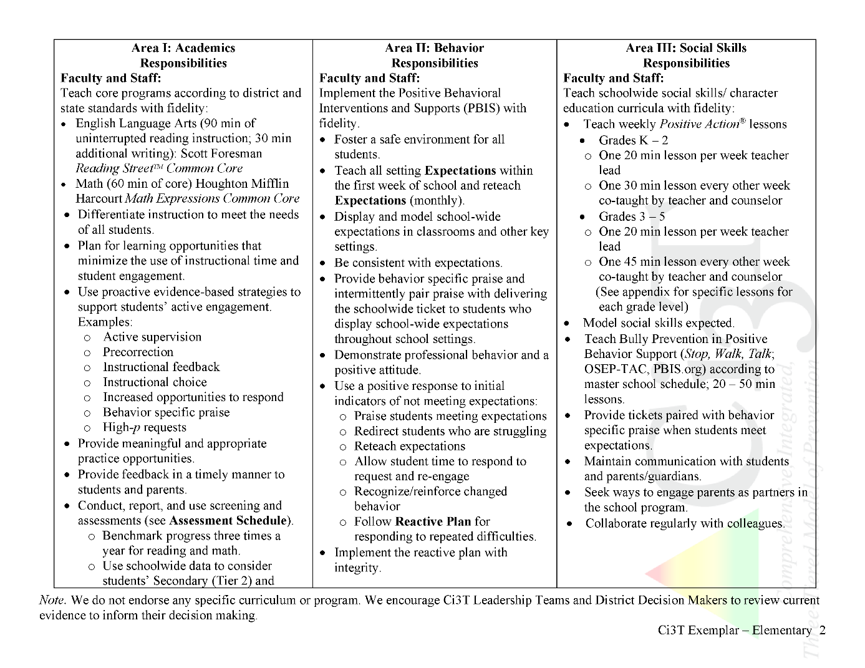

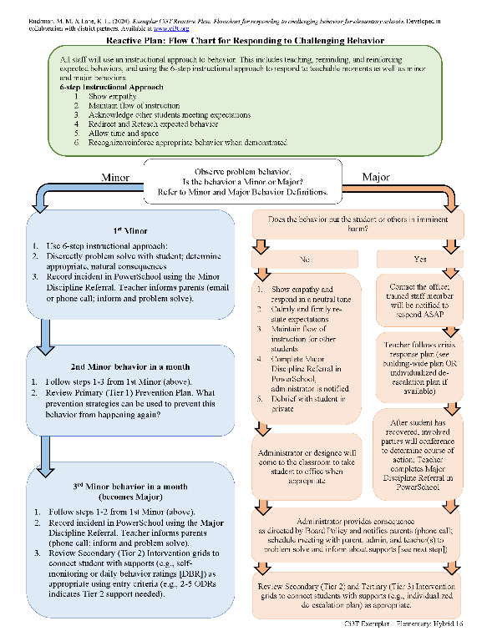
Ci3T Primary Plan: Procedures for Teaching
Ci3T Primary Plan: Procedures for Reinforcing
Ci3T Primary Plan: Procedures for Monitoring

Slide 10
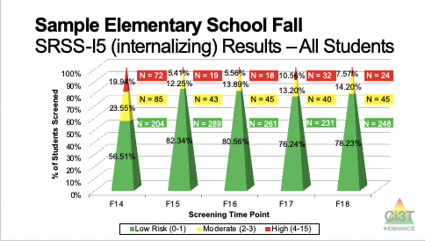
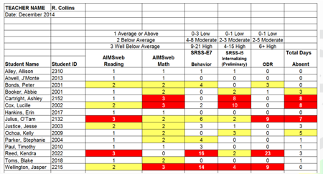
Essential Components of Primary Prevention Efforts
Social Validity
Systematic Universal Screening
Academic
Behavior
Treatment Integrity
for behavior

Slide 11
Middle School Behavior & Academic Characteristics of SRSS Risk Groups
Variable |  | Risk
 | Low (n = 422) M (SD) | Moderate (n = 51) M (SD) | High (n = 12) M (SD) | Significance Testing
ODR | 1.50 (2.85) | 5.02 (5.32) | 8.42 (7.01) | L<M<H
In-School Suspensions | 0.08 (0.38) | 0.35 (1.04) | 1.71 (2.26) | L<M<H
GPA | 3.35 (0.52) | 2.63 (0.65) | 2.32 (0.59) | L>M, H M=H
Course Failures | 0.68 (1.50) | 2.78 (3.46) | 4.17 (3.49) | L<M, H M=H
(Lane, Parks, Kalberg, & Carter, 2007)
Notes:
predictive power
Learn more about systematic universal behavior screening at ci3t.org/screening

Slide 12

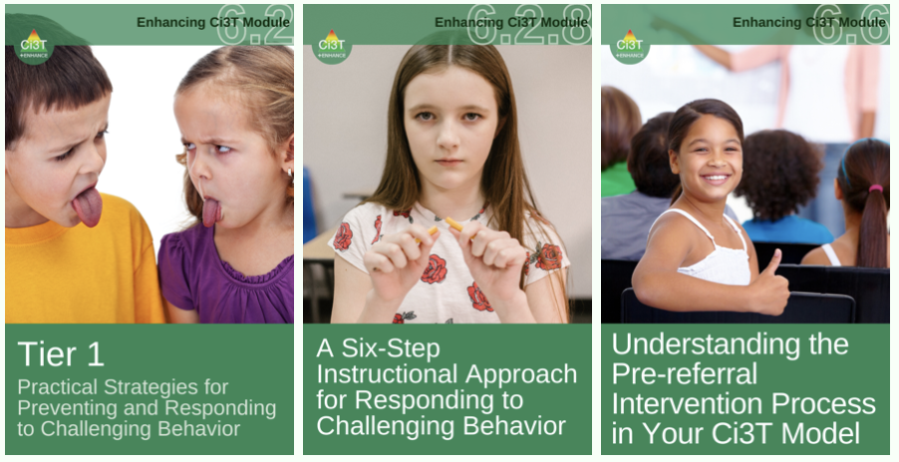
Notes:
Greatest efforts at Tier 1

Slide 13




Low-Intensity Strategies ci3t.org/enhance
Opportunities to Respond
Behavior-Specific Praise
Proximity
Active Supervision
Overlappingness
Instructional Feedback
With-it-ness
High-p Requests
Pacing
Precorrection
Self-Monitoring
Behavior Contracts
Incorporating Choice
Notes:
Universal behavior screening data help us know when to improve our Tier 1 instruction including low-intensity strategies, or when to intensify these as Tier 2 interventions

Slide 14
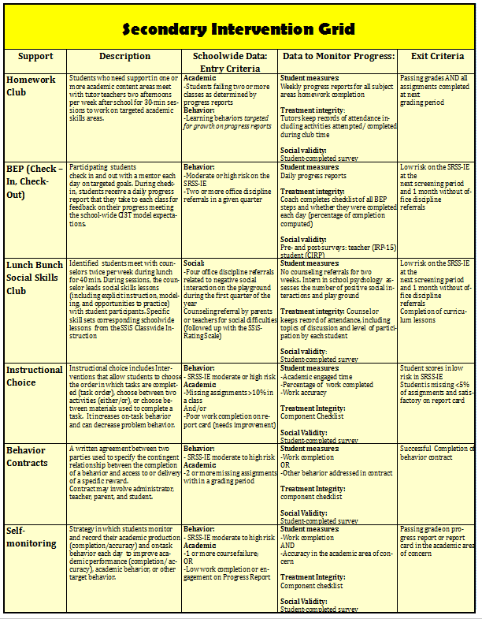

Secondary (Tier 2) Intervention Grids
Notes:
Ci3T models have intervention grids for complete transparency

Slide 15



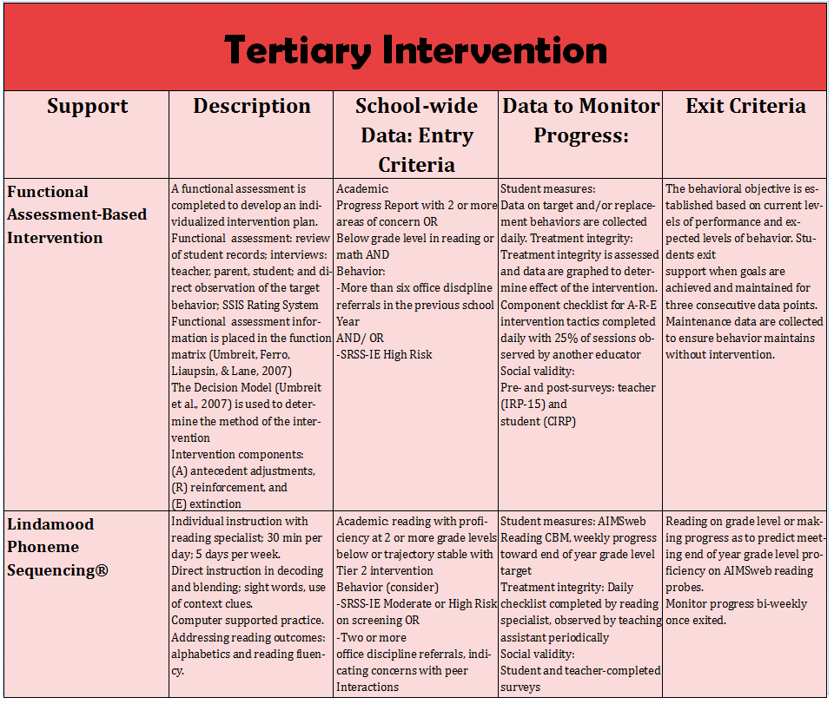
Tertiary (Tier 3) Intervention Grids

Slide 16
Consider tiered models of prevention like Ci3T.
In the chat, please share:
What MTSS components are currently in place at your school?
Notes:
5-min

Slide 17

A Look at Acting-Out Behavior
Timing is everything!

Slide 18
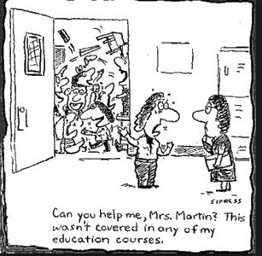
Antecedents - Behavior - Consequences
A
B
C
Function!
Precorrection: Identifies predictable contexts that often result in problem behavior and provides students with supports, prompts, and reinforcement for engaging in appropriate behavior
Notes:
Managing behavior with precorrections:
Anticipate what activities may cause inappropriate behaviors
“Get in front” of problem behaviors
Example: Who can tell me one of the expected behaviors in the hallway before dismissing for lunch?

Slide 19
Managing Acting-Out Behaviors
ED 0.5%
EBD 20%
Classrooms are becoming increasingly more diverse
Culturally
Academically
Behaviorally
Social skill sets
(Lane, Wehby, & Robertson, 2008)
Students with exceptionalities are accommodated in inclusive settings (MacMillian, Gresham, & Forness, 1996)

Slide 20

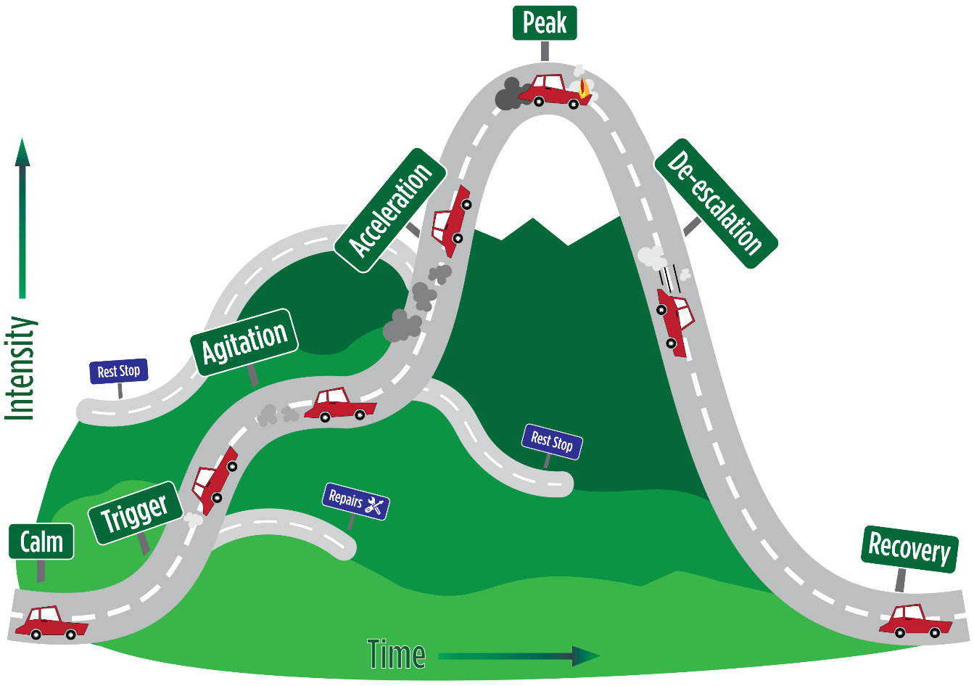
Whether the problem behavior is managed safely or not
or is defused
in a large measure depends on
YOUR INITIAL RESPONSE
-Dr. Geoff Colvin
Notes:
Runaway truck off ramps

Slide 21





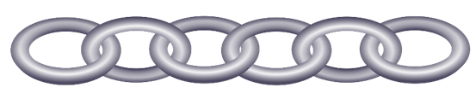


Behavioral Chains
Each ensuing behavior in a given behavior chain becomes more serious than the one preceding it.
(Walker, Ramsey, & Gresham, 2004)
Notes:
A student becomes agitated … engages in active noncompliance …
“the make me routine” is usually referred to as violence
… looking at a series of escalating interactions that involve BOTH teacher and student behavior.
My turn, your turn … what if the teacher doesn’t take a turn?
If the chain is interrupted at any early stage, there would be nothing to prompt the more serious forms of behavior occurring at the end of the chain.

Slide 22


Change the Behavioral Momentum (Nevin, 1970)
Interrupt the behavioral chain at any time to prevent the occurrence of more serious types of behavior.
Notes:
A critical component in managing this kind of reactive behavior pattern is to recognize we are dealing with successive interactions; if these interactions were managed differently (especially teacher behavior), then the behavioral chain could be dismantled or prevented from occurring.
Goal: manage the student’s initial agitation
intervene early in the chain
manage the successive interventions

Slide 23
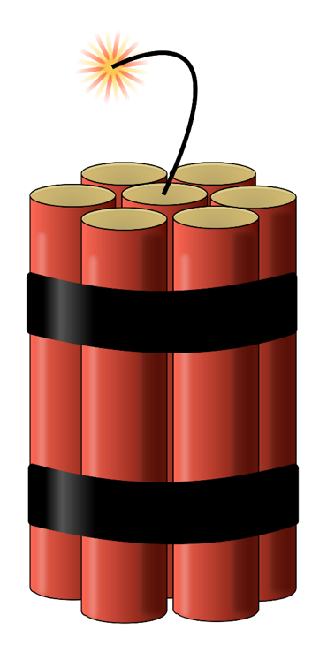
Stages of the Acting-Out Cycle Colvin (1992)
Calm
Triggers
Agitation
Acceleration
Peak
De-escalation
Recovery
Notes:
Teachers, as well as parents and peers, are often inadvertently trapped in escalating social interactions with antisocial students that prove to be extremely disruptive and damaging to relationships.
Students with antisocial behavior patterns carry high levels of agitation due to the stresses they are under and the neglect and abuse to which they are exposed to in nonschool settings.
Agitation … fuel that drives a behavioral process often triggered by innocuous events.

Slide 24

Managing Acting-Out Behavior
Seven Phases

Slide 25
Phase 1: Calm

Slide 26
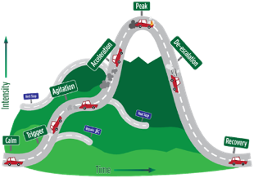

Phase 1: Calm Overall behavior is cooperative, compliant, and desirable
Strategies:
Intervention is focused on proactive strategies. Focus on instruction and positive behavior support.
Implement the schoolwide Ci3T plan
Vary instructional delivery
Provide high rates of behavior-specific praise
Implement low-intensity teacher-delivered strategies (e.g., precorrection, instructional choice, active supervision, OTR)
Carefully plan instruction with integrated lesson planning and differentiation
Re-teach expectations
Implement clear routines and procedures
Attend to the physical environment
Academically engaged
Follows rules & expectations
Responsive to praise and feedback
Initiates interactions
Goal-directed behaviors
Colvin, G., & Scott, T. (2015). Managing the cycle of acting-out behavior in the classroom (2nd Edition). Thousand Oaks, CA: Corwin.
Notes:
On-task behavior
Initiate interactions … sharing or providing assistance to peers; prosocial behaviors
Goal directed behavior … work toward goals they feel they are likely to accomplish
Pitfalls:
Teacher hesitation to engage with a student who has a history of explosive behavior
“I’m nervous about saying anything that could set them off”

Slide 27


Low-Intensity Strategies
Opportunities to Respond
Behavior-Specific Praise
Proximity
Active Supervision
Overlappingness
With-it-ness
Instructional Feedback
Pacing
High-p Requests
Self-Monitoring
Precorrection
Behavior Contracts
Incorporating Choice
Direct Behavior Rating

Slide 28
ci3t.org/enhance
Low-Intensity Strategies
Opportunities to Respond
Behavior-Specific Praise
Proximity
Active Supervision
Overlappingness
With-it-ness
Instructional Feedback
Pacing
High-p Requests
Self-Monitoring
Precorrection
Behavior Contracts
Incorporating Choice
Direct Behavior Rating

Slide 29


Phase 2: Trigger Overall behaviors involve a series of unresolved problems
Strategies:
Intervention is focused on prevention and redirection.
Identify situations where the behavior is likely to occur
Use low-intensity teacher-delivered strategies to prevent triggers and help students manage triggers effectively
Rehearse the expectations, prompt or remind students as needed, provide behavior-specific praise / reinforcement
Consider Tier 2 supports to build academic skills, social skills, and other self-regulation skills
Work with families for outside supports of non-school-based triggers
School-based triggers
Nonschool-based triggers
Conflicts
Changes in routine
Provoked by peers
Pressure or stress
Ineffective problem solving
Facing errors in instruction
Facing correction procedures
Denial of something needed
Uncertain home life
Medical and health complications
Food insecurity
Inadequate sleep
Substance abuse
Commitments to gangs or unhealthy peer groups
Colvin, G., & Scott, T. (2015). Managing the cycle of acting-out behavior in the classroom (2nd Edition). Thousand Oaks, CA: Corwin.
Notes:
Conflicts
Denial of something the students want or need
Something negative is inflicted on the students
Limited verbal skills … difficulty expressing themselves- frustrating!
Interpret neutral cues as hostile
Provocation … other “normal” students will provoke these students because they know that they can get a reaction out of the student.
Pressure … poor time management, poor planning, limited adaptive behavior skills
Errors … tend to stop working when they make errors or avoid new work
LIS: precorrection to prevent, active supervision to notice, high-p to manage responding, BSP to reinforce effective responding to triggers
PITFALLS: center student strengths when partnering with families; avoid assigning blame to triggers, events, circumstances; consider and plan to address all triggers

Slide 30


Phase 3: Agitation Overall behavior is unfocused and off-task
Increases in behavior
Decreases in behavior
Strategies:
Intervention is focused on reducing anxiety, tensions, and stress.
Follow the 6-Step Instructional Approach for Responding to Challenging Behavior
Darting eyes
Busy hands
Joining and leaving groups
Rapidly moving between being on and off task
Staring off (day dreaming, lost in thought)
Avoiding eye contact
Non-conversational language (e.g., grunts, short responses)
Clasped hands
Social withdrawal
Colvin, G., & Scott, T. (2015). Managing the cycle of acting-out behavior in the classroom (2nd Edition). Thousand Oaks, CA: Corwin.
Notes:
This phase can last for a considerable amount of time depending on the event that takes place or on which stimuli are present
Agitation is a behavioral term that includes emotional dispositions such as being angry, upset, depressed, worried, anxious, and frustrated.
PITFALLS:
This is an opportunity for students to practice self-reflection, choice-making, goal setting, and self-regulation.
While it might be nerve-racking, don’t skip Step 6 (acknowledging the student when they’re back on track)

Slide 31
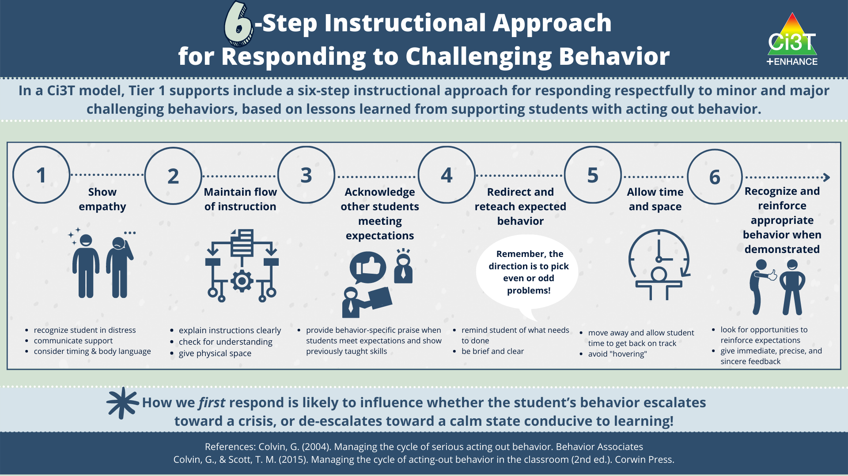

Phase 3: Agitation Overall behavior is unfocused and off-task
Strategies:
Intervention is focused on reducing anxiety, tensions, and stress.
Follow the 6-Step Instructional Approach for Responding to Challenging Behavior
Increases in behavior
Decreases in behavior
Darting eyes
Busy hands
Joining and leaving groups
Rapidly moving between being on and off task
Staring off (day dreaming, lost in thought)
Avoiding eye contact
Non-conversational language (e.g., grunts, short responses)
Clasped hands
Social withdrawal
Colvin, G., & Scott, T. (2015). Managing the cycle of acting-out behavior in the classroom (2nd Edition). Thousand Oaks, CA: Corwin.
Notes:
During the Agitation phase, efforts should be focused on reducing anxiety or tensions as quickly as possible. Although agitation is a sign that behavior is escalating, it is still possible to assist the student in getting back on track using the same 6-Step Instructional Approach for Responding to Challenging Behaviors.

Slide 32
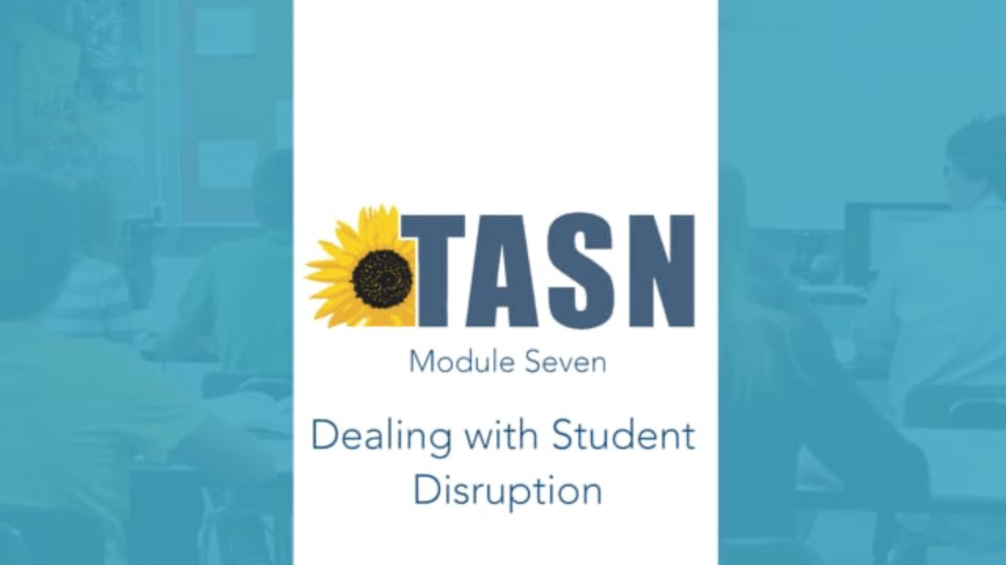
Agitation Nonexample & Example
Notes:
https://www.ksdetasn.org/resources/1110
6:15-7:05 nonexample (classroom, “no chips, water only”)
Vimeo direct link: https://vimeo.com/196772953#t=375s
7:50-9:10 example
Vimeo direct link: https://vimeo.com/196772953#t=470s

Slide 33
What are common triggers and signs of agitation in your context? Type in the chat!
Notes:
What works to prevent triggers?
What successes have you had reducing anxiety / stress?
What low-intensity strategies are currently in place?

Slide 34

Phase 4: Acceleration Overall behavior is teacher-engaging
Compliance with accompanying inappropriate behaviors (e.g., writing bad words on worksheets)
Criterion problems (getting starting, marking “IDK” on all items)
Argumentative
Non-compliant and defiant
Un-engaged
Provoking peers and/or teachers
Minor destruction of property
Avoidance and escape
Whining
Threatening
Verbal abuse
Strategies:
Intervention is focused on safety.
Eliminate triggers
Approach the student in a non-threatening manner
Prompt and walk away
Acknowledge compliance and desired behavior
Maintain calmness, respect, and detachment
Utilize non-confrontational limit-setting procedures
Colvin, G., & Scott, T. (2015). Managing the cycle of acting-out behavior in the classroom (2nd Edition). Thousand Oaks, CA: Corwin.
Notes:
Students exhibit escalating behavior that assures a predictable and rapid response from the teacher.
PITFALLS:
Avoid engaging with the student in anything but a neutral manner (e.g., angry, sarcastic, overly cheery)
Remain outwardly neutral, objective, calm, caring, and in control
How to Set Limits:
https://institute.crisisprevention.com/Refresh-How-to-Set-Limits.html
5 Easy Steps for Limit Setting:
https://www.crisisprevention.com/Blog/5-easy-tips-for-effective-limit-setting
How to Avoid Power Struggles:
https://www.crisisprevention.com/Blog/How-to-Avoid-Power-Struggles

Slide 35

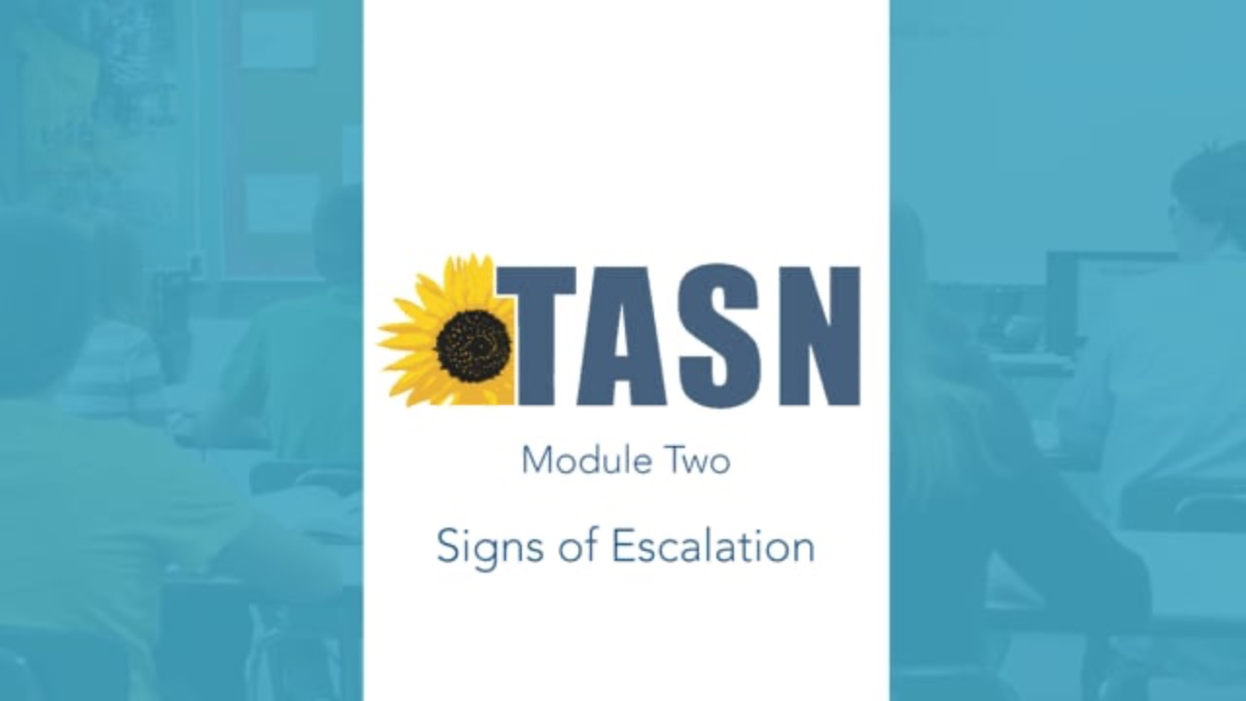
Acceleration Nonexample
Notes:
“Cindy” hallway nonexample at 05:14 -- https://www.ksdetasn.org/resources/1100
Vimeo direct link: https://vimeo.com/196772653#t=314s

Slide 36


Acceleration Example
Notes:
“Cindy” hallway example at 04:13 -- https://www.ksdetasn.org/resources/1104
Vimeo direct link: https://vimeo.com/197283708#t=253s

Slide 37

Phase 5: Peak Overall behavior is out of control
Physical aggression
Hyperventilating
Running away (elopement)
Self-injurious behavior
Major destruction of property
Severe tantrums
Strategies:
Focus on safety
Remain calm
Implement your school’s safety plan
Room clear: evacuate remaining students, call designated person to help
Learn from it (e.g., FBA, BIP, mental health assessment)
Prevent unintentionally reinforcing peak behavior (what is reinforcing the student?)
Colvin, G., & Scott, T. (2015). Managing the cycle of acting-out behavior in the classroom (2nd Edition). Thousand Oaks, CA: Corwin.
Notes:
Room clear video (doesn’t always play in Safari)
https://www.ket.org/embedded/ksenb+000222/
PITFALLS:
Consider what the student finds reinforcing (e.g., escaping tasks; accessing or avoiding attention) to prevent unintentionally reinforcing the peak behavior

Slide 38

Room Clear
Notes:
“Gerald” classroom clear example at 06:57 -- https://www.ksdetasn.org/resources/1106
Vimeo direct link: https://vimeo.com/196772895#t=357s
“Cindy” hallway wordless clearing example at 05:35 -- https://www.ksdetasn.org/resources/1106
Vimeo direct link: https://vimeo.com/196772895#t=335s
A better “Cindy” hallway clear with directions to students example at 07:59 -- https://www.ksdetasn.org/resources/1104
Vimeo direct link: https://vimeo.com/197283708#t=479s

Slide 39

Phase 6: De-Escalation Overall behavior displays confusion
Confusion, disorientation
Denial of what just happened
Blaming others
Eager to make amends
Responsive to directions
Responsive to manipulative or mechanical tasks
Social withdrawal
Avoidance of discussion
Avoidance of debriefing
Strategies:
Intervention is focused on monitoring for re-escalation of behavior and helping the student reengage in a constructive manner.
Allow cool-down time and space away from other students but not punitive
Engage student in an independent task they can easily accomplish (e.g., simple worksheet, concrete task)
Monitor for health / safety of all involved
Colvin, G., & Scott, T. (2015). Managing the cycle of acting-out behavior in the classroom (2nd Edition). Thousand Oaks, CA: Corwin.
Notes:
Marks the beginning of the student’s disengagement and corresponding reduction in agitation. However, the students in this phase are not especially cooperative or responsive to adult social influence
Denial about their behavior … blame someone else.
PITFALL: Avoid initiating a conversation with the student that they may perceive as placing blame on them for what has happened

Slide 40
De-escalation Example
Notes:
“Cindy” hallway example with room clear (with directions to students) at 07:56 -- https://www.ksdetasn.org/resources/1104
Vimeo direct link: https://vimeo.com/197283708#t=476s

Slide 41

Phase 7: Recovery Overall behavior shows eagerness to move past the incident
Seeks independent work or activity
Reluctant to interact
Subdued behavior
Defensiveness and avoidance of discussing what happened
Strategies:
Intervention focuses on returning to normal activities.
Positively reinforce displays of appropriate behavior
Later, debrief/rehearse problem solving routine
Colvin, G., & Scott, T. (2015). Managing the cycle of acting-out behavior in the classroom (2nd Edition). Thousand Oaks, CA: Corwin.
Notes:
Behavior returns to a nonagitated state, but not yet calm
Seeks busy work
Could easily accelerate again to peak if demands or talk of consequences occur
Activities involving interactions with other students are difficult. Strategies such as cooperative learning should not be initiated in this phase.
Defensive, cautious behavior.
PITFALL: Follow through on consequences (e.g., filling out an office discipline referral, notifying a parent) while minimizing disruption to the flow of instruction

Slide 42
Recovery Nonexample
Notes:
“Cindy” hallway nonexample at 09:01 -- https://www.ksdetasn.org/resources/1100
Vimeo direct link: https://vimeo.com/196772653#t=541s

Slide 43
Recovery Example / Nonexample / Example
Notes:
“Cindy” hallway example at 09:08 -- https://www.ksdetasn.org/resources/1104
(shows example, nonexample, example)
Vimeo direct link: https://vimeo.com/197283708#t=548s

Slide 44

Debriefing Session
Facilitates transition back to task/activity
…not further negative consequence
Goal is to increase appropriate behavior
Focus on problem solving
Pinpoint events that contributed to the incident
Teach replacement behaviors
Debriefing activities and forms

Slide 45
Debriefing Session Nonexample
Notes:
“Cindy” nonexample at 01:43 -- https://www.ksdetasn.org/resources/1106
Vimeo direct link: https://vimeo.com/196772895#t=103s
If student perceives consequence was idea of teacher, student takes it personal as if the teacher was being purposefully harsh (or easy).

Slide 46
Debriefing Session Example
Notes:
“Cindy” example at 11:11 -- https://www.ksdetasn.org/resources/1104
Vimeo direct link: https://vimeo.com/197283708#t=671s
Instead, students need to know ahead of time what the consequences will be so teacher can simply remind of the consequence, that it’s standard, and not the teacher’s idea.
Allows teacher to be sympathetic and offer to help avoid errors in the future. Teachers can provide reminders and offer choice when students know consequences in advance.

Slide 47
What resonated the most with you for the students you support?​ How could you share this module with your colleagues?
ci3t.org/enhance
Notes:
Type in the chat

Slide 48
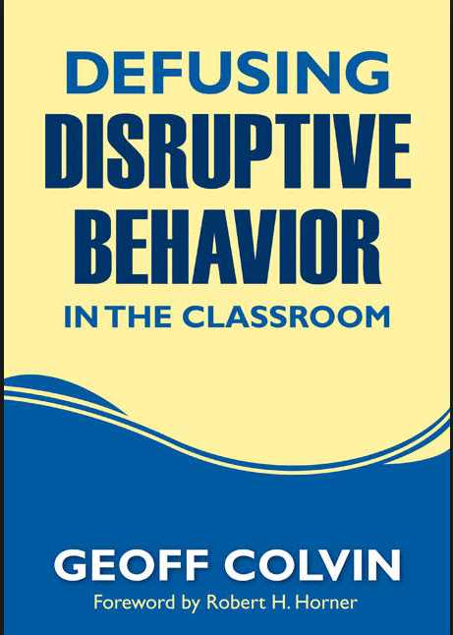
Pathways to Success
Understanding educator-student interactions

Slide 49

Four Key Strategies
Take an instructional approach to behavior schoolwide
Intervene early in the acting-out cycle
Learn strategies to intervene at each stage in the acting-out cycle
Be respectful at all times
Notes:
Teach what to do and when to do it. Teach standard consequences.
Maintain the flow of instruction
Recognize on-task students, making no response to off-task students
Show empathy first
Redirect (focus on task, brief language/gestures, prompt procedures for asking for help)
Give time and space
Acknowledge compliance

Slide 50
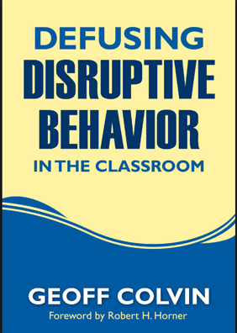
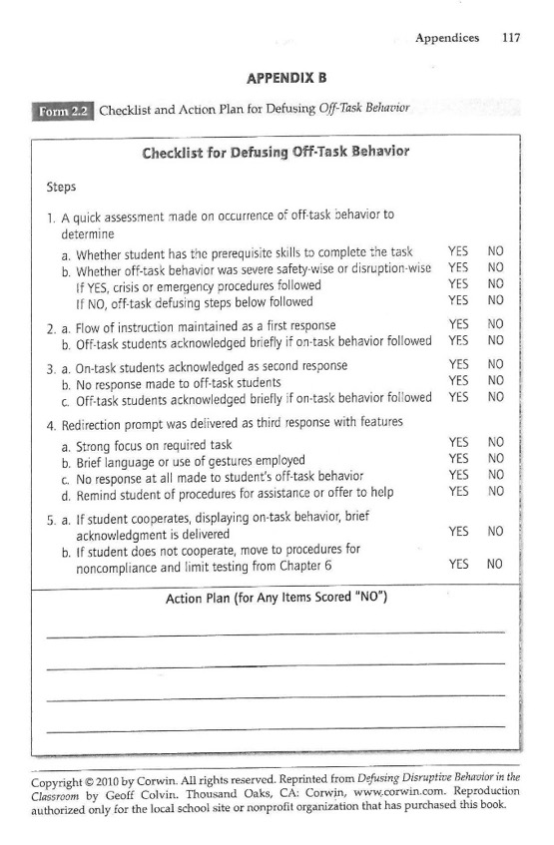
Defusing Off-Task Behavior
Assess the situation: determine “can’t do” or “won’t do”
Is it an emergency situation? If so, follow crisis procedures. If not, follow off-task defusing steps.
Maintain the flow of instruction
Recognize on-task students, making no response to off-task students
Show empathy
Redirect (focus on task, brief language/gestures, prompt procedures for asking for help)
Give time and space
Acknowledge compliance
Notes:
Precision requests can help with redirect too.
“Please return to your seat.” (walk away)
“Kāwika I need you to return to your seat.” (walk away)
“You have 30 s to return to your seat.” (walk away. It may take 90 s but he’ll grumble to friends to save face and make it back to seat.)
“Thank you for returning to your seat so we can get started with…”
If student refuses follow through with bottom line consequence, delivered in a neutral matter-of-fact manner.

Slide 51

Defusing Non-Compliance and Limit Testing
Provide one clear direction
“Alright everyone, return to your desks, get out your book and paper, and begin work.” Kāwika does not comply.
“Hey Kāwika, time to return to your desk.”
“But I can’t sit at my desk because I don’t have A, B, C and I need to…”
“I’d be happy to help you with all those things as soon as you are sitting at your desk.”
Be neutral but direct and stay with the direction
All student requests are contingent on compliance with first step
Follow-up with student quietly
Continue to acknowledge other on-task students
Acknowledge cooperation or implement consequence in a neutral manner Scott, 2018
Consider offering choices
Notes:
Teach following directions and be clear how to demonstrate compliance. Model with students and engage in discussion. Use precorrection. Praise compliance/ following directions.
Gently but firmly correct those who do not comply.
https://hawaii.pbslearningmedia.org/resource/ket-pd-deescalation6/
Start at 0:35-1:20 nonexample
Start at 2:11-3:10 example
(bus driver video for choices)

Slide 52
Defusing Disrespectful Behavior
Indicate in a neutral manner the action was disrespectful and continue with instruction
“That’s what we call disrespectful, let’s talk about it later.”
“I don’t see how that was disrespectful!”
“Which is why we should discuss it after everyone masters these 2-step equations by using…”
Do not allow disrespectful behavior to escalate your emotions or interrupt the lesson
Personal and genuine apologies are sometimes effective for peer disrespect (e.g., restorative practice)
If student refuses to comply, follow through with bottom line consequence
Notes:
Teach what it means to be respectful (examples and nonexamples; perspective taking; precorrect) and regularly praise use of respectful behavior.
Don’t let kids know they got under your skin. The more disrespectful a student is, the calmer the teacher should become.
Don’t be insulted, upset, or offended – just refer to behavior as not in alignment with established expectations
Disrespect toward peers and adults have same consequence
Do not allow disrespect toward you to interrupt the lesson
“Mandy” nonexample at 05:43-06:12 -- https://www.ksdetasn.org/resources/1112
“Mandy” example at 07:07-07:40 -- https://www.ksdetasn.org/resources/1112

Slide 53

Defusing Disrespectful Behavior Nonexample and Example
Notes:
“Mandy” nonexample at 05:43-06:12 -- https://www.ksdetasn.org/resources/1112
“Mandy” example at 07:07-07:40 -- https://www.ksdetasn.org/resources/1112

Slide 54
Defusing Disruptive Behavior
Recognize and respond quickly to student agitation
Redirect
Clearly state the expected task first step: focus on behaviors taught
Communicate concern privately
Present options – not an ultimatum
Allow student space and time – do not hover
Assist student to begin task: remind to use appropriate behavior
Attend to other students and prepare for the worst
Acknowledge compliance or institute standard consequence in neutral manner
Scott, 2014
Notes:
Teach appropriate ways to get peer and adult attention. Teach appropriate ways to ask for help when frustrated with work. Model and engage in discussion. Precorrection.
What to do before a behavior escalates:
Achieve eye contact
Use the student’s name
Use a non-verbal signal
Proximity/praise
Relaxation techniques
Do the unexpected (break the chain of behaviors). “Hey come here I want to show you something neat.”
Give them time to think – give them time to decide.
Engage in movement activities.
Give more “start” requests instead of “stop” requests.

Slide 55
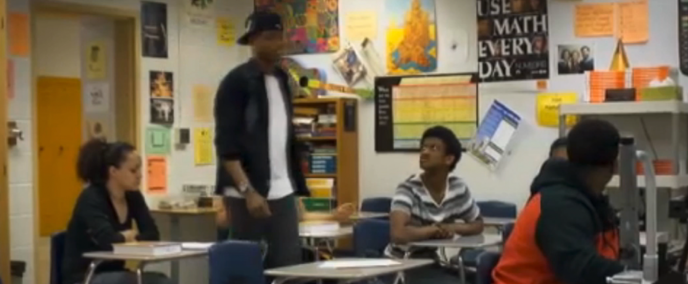
Disruptive Classroom: Non-example
Notes:
Alternate host for Caleb:
Full video (start at 0:25, then 2:09): https://ket.org/program/promoting-positive-behavior-in-schools/de-escalation-strategy-disruptive-behavior-classroom/
Nonexample: https://vimeo.com/1022594922?fl=pl&fe=sh#t=3s
Example: https://vimeo.com/1022589016?fl=pl&fe=sh#t=3s
Collection: https://hawaii.pbslearningmedia.org/collection/managing-challenging-student-behaviors/
“Caleb” disruptive behavior: https://www.pbslearningmedia.org/resource/ket-pd-deescalation3/disruptive-behavior/
0:18-1:18 nonexample
2:00-3:15 example
“Kristin” alternative: https://www.ksdetasn.org/resources/1110
https://vimeo.com/196772953?fl=pl&fe=sh#t=6m15s
6:15-7:05 non-example
https://vimeo.com/196772953?fl=pl&fe=sh#t=7m50s
7:50-9:10 example

Slide 56
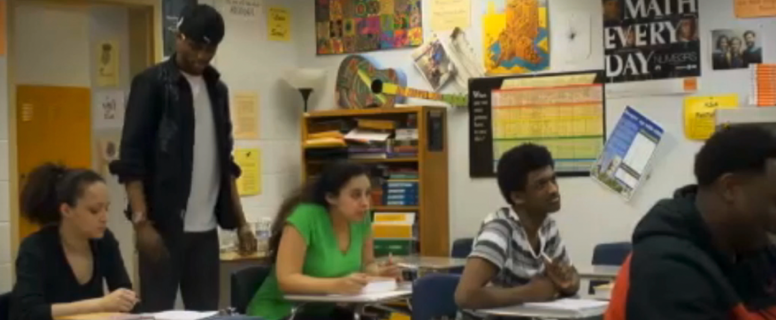
Disruptive Classroom: Example
Notes:
Collection: https://hawaii.pbslearningmedia.org/collection/managing-challenging-student-behaviors/
“Caleb” disruptive behavior: https://www.pbslearningmedia.org/resource/ket-pd-deescalation3/disruptive-behavior/
0:18-1:18 nonexample
2:00-3:15 example
“Kristin” alternative: https://www.ksdetasn.org/resources/1110
6:15-7:05 non-example
7:50-9:10 example

Slide 57
Defusing Provocative Behaviors
Privately identify the behavior as a problem for the student, not you
“Hey, I personally don’t mind that shirt, but it pretty clearly violates dress code expectations. Here are options for how to fix it, but it’s up to you, you know the consequences.”
“But my mom bought this for me!”
“All the more reason I’d hate for you to lose it, so which of those options…”
Don’t argue, don’t show shock or offense – it’s simply a violation of expectations and you are there to help
Acknowledge cooperation
If student refuses to comply with a solution, follow through with bottom line consequence
Delivered in a matter-of-fact manner as a choice the student made
Notes:
Of course teach expectations first with relevant examples and nonexamples. Teach a standard consequence for specific types of provocative behavior (dress code, language/guestures, sexually inappropriate, etc.). Discuss why specific expectations are necessary.
Present options as a choice to avoid consequences and ask the student to choose. Offer assistance but ask the student to take care of the problem.
Provocative behavior https://www.ksdetasn.org/resources/1114
Start at 5:28 (nonexample)
Start at 6:48 (example)

Slide 58
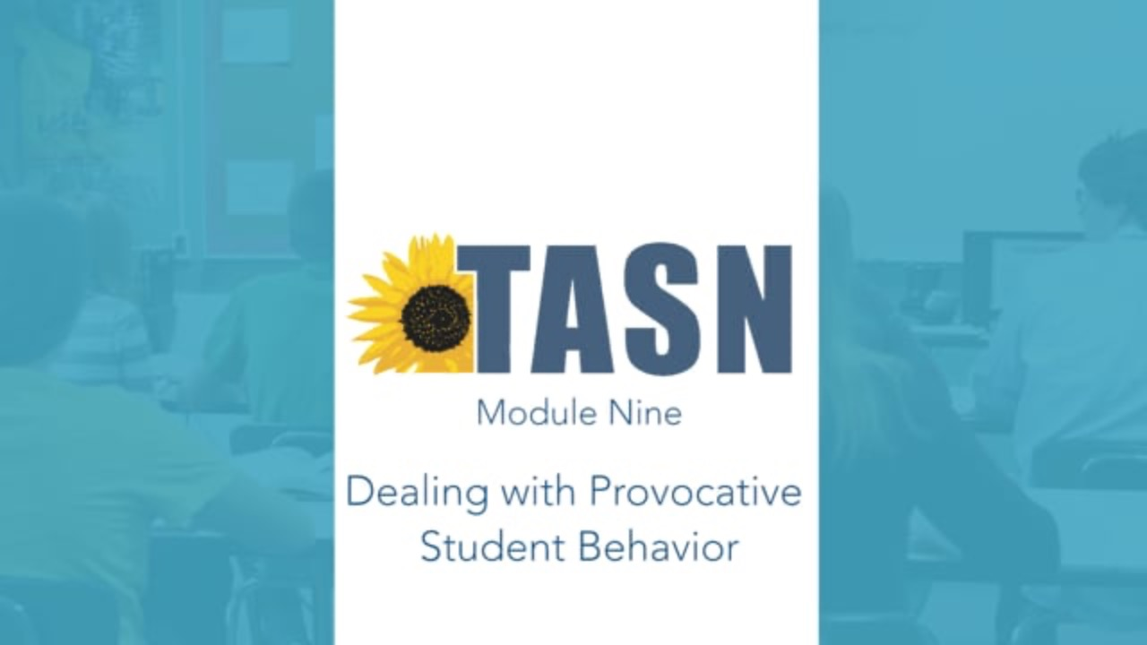
Defusing Provocative Behaviors Nonexample and Example
Notes:
https://www.ksdetasn.org/resources/1114
Start at 5:28 (nonexample)
Start at 6:48 (example)

Slide 59
Defusing Aggressive Behavior
Recognize conditions under which conflict is likely and attempt to avoid by using
Assigned seats ○ Space, options, preferred activities
Independent activities ○ Relaxation activities
Teacher proximity – stay between as long as there is no physicality
Verbal altercation = verbal intervention
Provide specific and concrete directions
Redirect / distract – get attention away from altercation
Separate as much as possible without placing hands on students
Physical altercation = initiate crisis procedures
Call office or send runner
Provide clear, loud, and concrete directions to both students
Clear other students away to keep safe
Wait for assistance
Notes:
Don’t go by seating chart, the other kid will be triggered. Don’t go by who has always sat there, the other kid will be triggered. Just solve it for today. (e.g., let one sit at teacher desk, nice chair; flip coin for future).

Slide 60
What is your biggest “Aha!” moment or greatest take-away from the keys to addressing various types of behavior? Type in the chat
Notes:
Reflect …and make plans!

Slide 61
Tier 3
Building an individualized de-escalation plan

Slide 62
Tertiary (Tier 3) Intervention Grids

Slide 63
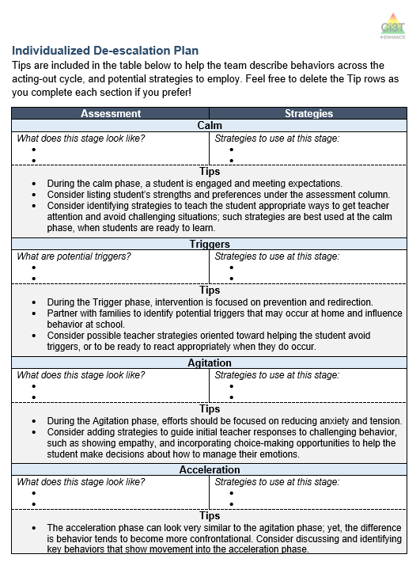
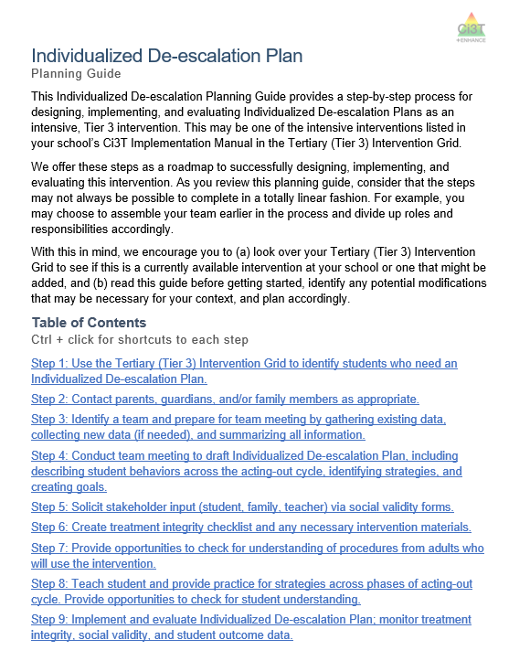
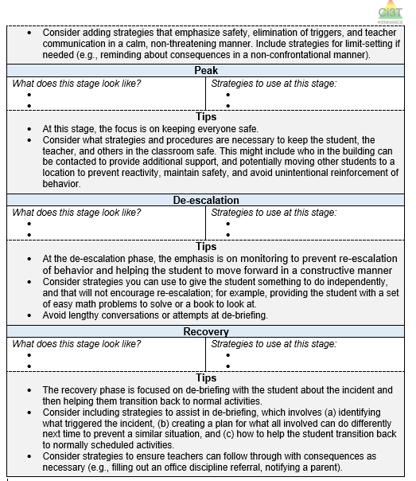
Planning

Slide 64


How do I create an individualized de-escalation plan?
Step 1
Step 3
Step 4
Use the Tertiary (Tier 3) Intervention Grid to identify students who need an Individualized De-escalation Plan
Identify a team and prepare for team meeting by gathering existing data, collecting new data (if needed), and summarizing all information
Conduct team meeting to draft Individualized De-escalation Plan, including describing student behaviors across the acting-out cycle, identifying strategies, and creating goals
Step 2
Contact parents, guardians, and/or family members as appropriate

Slide 65
How do I create an individualized de-escalation plan?
Step 5
Step 6
Step 7
Step 8
Step 9
Solicit stakeholder input (student, family, teacher) via social validity forms
Create treatment integrity checklist and any necessary intervention materials
Provide opportunities to check for understanding of procedures from adults who will use the intervention
Teach student and provide practice for strategies across phases of acting-out cycle. Provide opportunities to check for student understanding
Implement and evaluate Individualized De-escalation Plan; monitor treatment integrity, social validity, and student outcome data

Slide 66
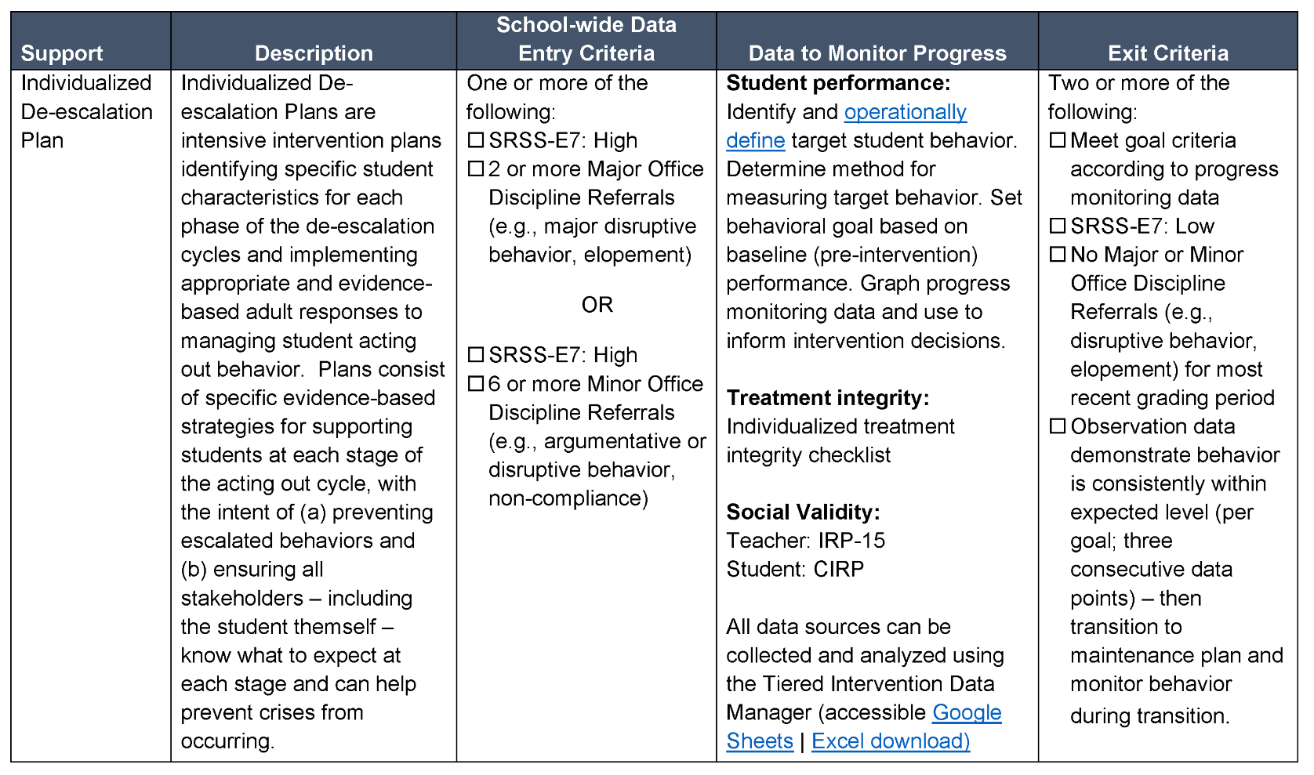
Sample Tier 3 Intervention Grid

Slide 67
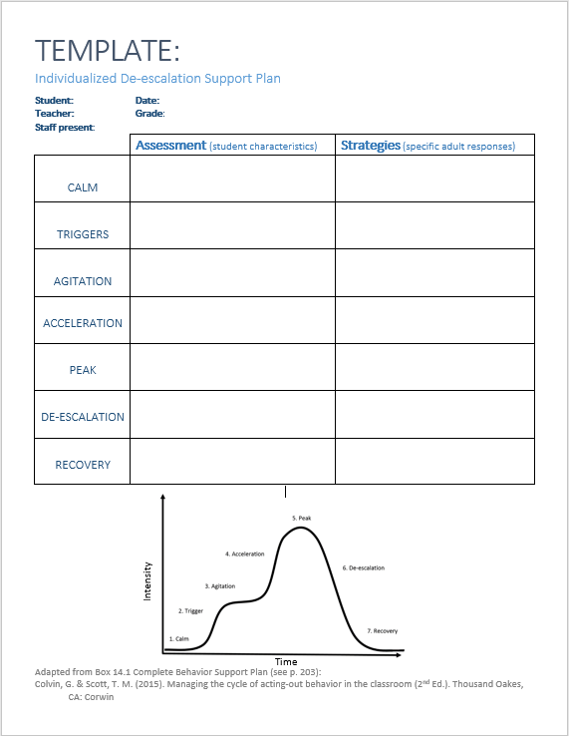
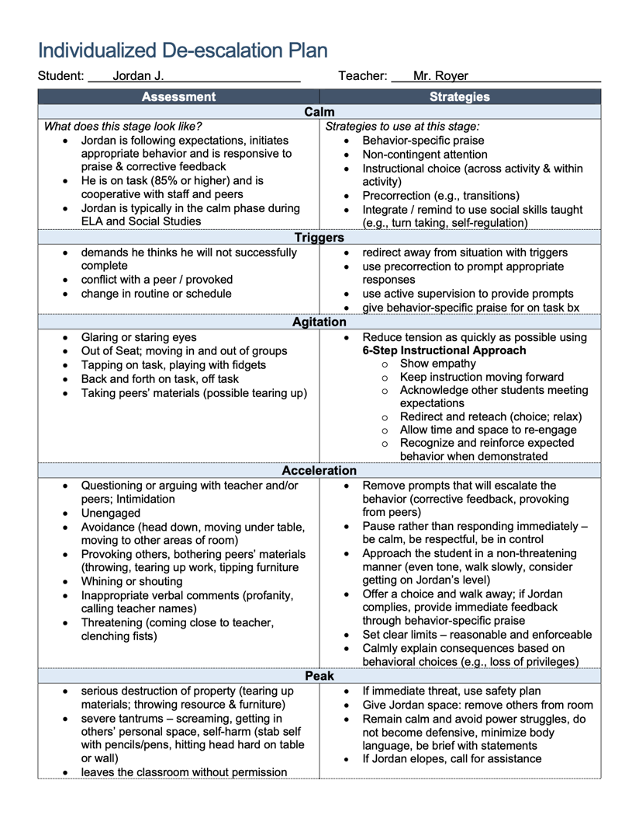

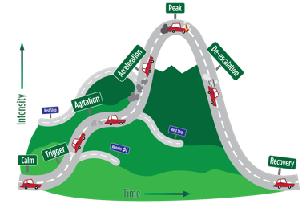
Planning
“It is much like a map to the behavior train the student takes us on.”
“The teachers appreciated the strategies column the most.”
“I enjoyed creating this plan by using the “Acting Out Cycle” as it provides a clear and structured guide for any adult who may be implementing this with a student.”
“I am more likely to implement this type of de-escalation plan compared to others because it was so easy to follow.”
“I feel I have added another tool to my kit!”
“It is an ‘active’ plan!”
Notes:
Quotes from Project KUALIMA participants 2021-2022.

Slide 68
Wrapping Up
Resources

Slide 69



Resources
ci3t.org/enhance
Enhancing Ci3T Modules including Managing Acting-out Behavior at Tier 3
iris.peabody.vanderbilt.edu/module/bi1
Addressing Disruptive and Noncompliant Behaviors: Understanding the Acting-Out Cycle
ksdetasn.org
Kansas DOE Technical Assistance System Network. Search “de-escalation” for videos and more
cibrs.com
Center for Instructional and Behavioral Research in Schools: Video modules on behavior
Notes:
ksdetasn.org search for Module 1 of the “De-escalation of Behavior” doesn’t show up in results, but the rest of the modules do. Module 1 = https://www.ksdetasn.org/resources/1033
PBS video modules = https://ket.pbslearningmedia.org/collection/managing-challenging-student-behaviors/

Slide 70
Low-Intensity Strategies
Opportunities to Respond
Behavior-Specific Praise
Proximity
Active Supervision
Overlappingness
With-it-ness
Instructional Feedback
Pacing
High-p Requests
Self-Monitoring
Precorrection
Behavior Contracts
Incorporating Choice
Direct Behavior Rating

Slide 71
ci3t.org/enhance
Low-Intensity Strategies
Opportunities to Respond
Behavior-Specific Praise
Proximity
Active Supervision
Overlappingness
With-it-ness
Instructional Feedback
Pacing
High-p Requests
Self-Monitoring
Precorrection
Behavior Contracts
Incorporating Choice
Direct Behavior Rating

Slide 72

ci3t.org/enhance
Thank you!
david.royer@louisville.edu

