Slide 1

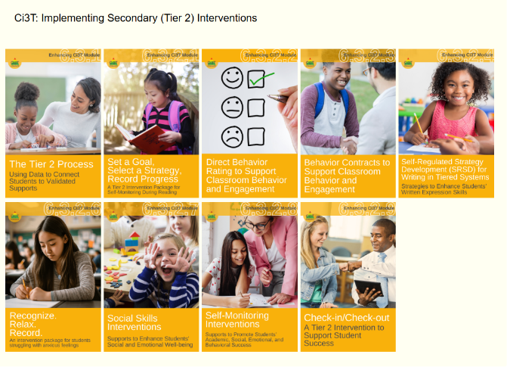
Starting Activity
Step 1: Go to ci3t.org/enhance
Step 2: If you have not already registered to access Enhancing Ci3T Modules, consider doing so.
Step 3: Sign into the Recognize. Relax. Record. module (see Ci3T: Implementing Secondary (Tier 2) Interventions)

Slide 2
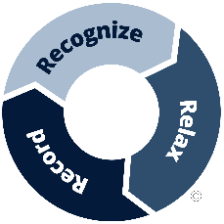
Recognize. Relax. Record. A Tier 2 Support for Students Experiencing Anxious Feelings A Presentation for Fort Mill Public Schools
Kathleen Lynne Lane, Ph. D., BCBA-D, CF-L2, University of Kansas
Allison M. Bernard, M. Ed., University of Kansas
Amy A. Buffington, M. Ed., University of Kansas
Rebecca L. Sherod-Adams, M.S.E. Arizona State University
We invite you to visit ci3t.org/enhance to access our collection of Enhancing Ci3T Modules following a one-time registration process!
This presentation was funded in part by Project ENHANCE (U.S. Department of Education, Institute of Education Sciences: Award Number: R324N190002), Project ENGAGE (U.S. Department of Education, Institute of Education Sciences: Award Number: R324X220067), and Project EPIC (U.S. Department of Education, Office of Special Education Programs, Award Number: H325D220011).

Slide 3











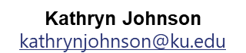
Project ENGAGE Research Team
Rebecca L. Sherod-Adams
rebeccasherod@asu.edu
Joni Weiss
joni.weiss@ku.edu

Slide 4

Session Outcomes
Explain how to review school-wide data to determine which students might benefit from this Tier 2 intervention.
Describe three key components of Recognize. Relax. Record.
Describe how to implement Recognize. Relax. Record. in a classroom setting.
Explain how to measure (a) implementation (treatment integrity), (b) users’ views of goals, procedures, and outcomes (social validity), and (c) student behavior (e.g., engagement, anxious feelings).
If you are a Board Certified Behavior Analyst (BCBA), you may accrue up to 2 learning continuing education units (CEUs) for attending this session. See agenda for task list alignment. Throughout the session we will share 4 key words, write those down to turn in after the session!

Slide 5
Agenda
Welcome
Situating Secondary (Tier 2) Interventions in Ci3T Models
Describing Key Components of Recognize. Relax. Record.
Implementing Recognize. Relax. Record.
Baseline
RRR Instruction
RRR In-Class
Measuring what Matters: Treatment Integrity, Social Validity, and Student Behavior
Wrapping Up and Moving Forward

Slide 6
A Focus on Students with Internalizing Behaviors

Slide 7
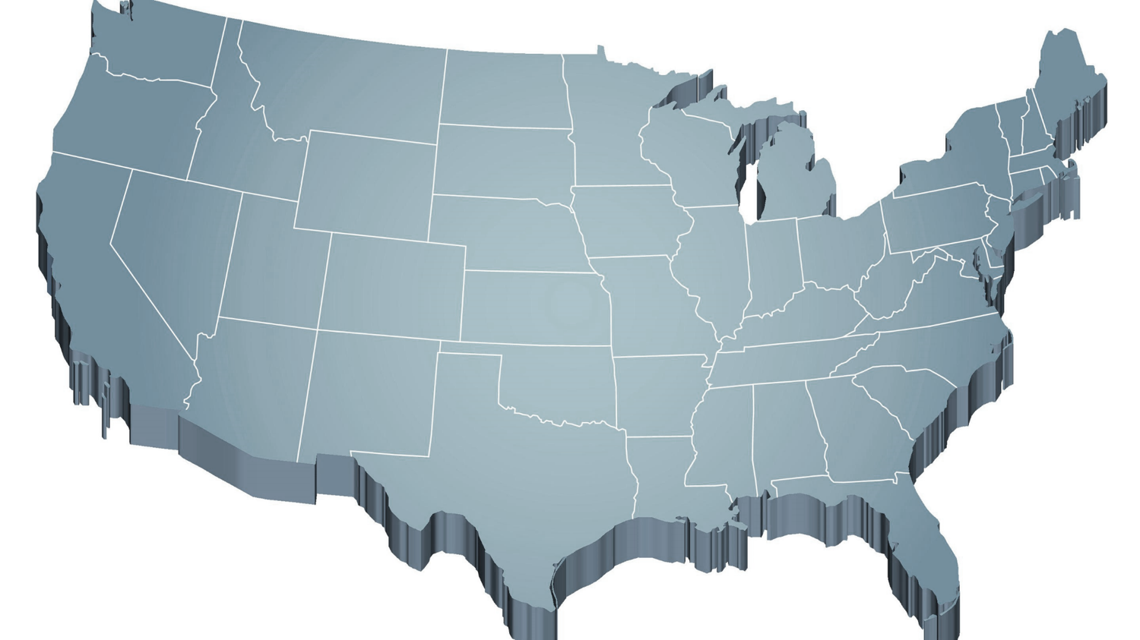
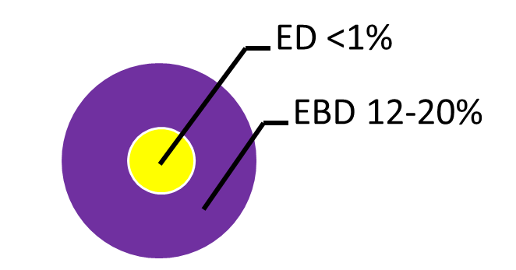
Thank you for your commitment!
Shift to a systems level perspective
Internalizing
Externalizing
Source: Forness, S.R., Freeman, S.F., Paparella, T., Kauffman, J.M., & Walker, H.M. (2012). Special education implications of point and cumulative prevalence for children with emotional or behavioral disorders. Journal of Emotional and Behavioral Disorders, 20, 4-18.

Slide 8
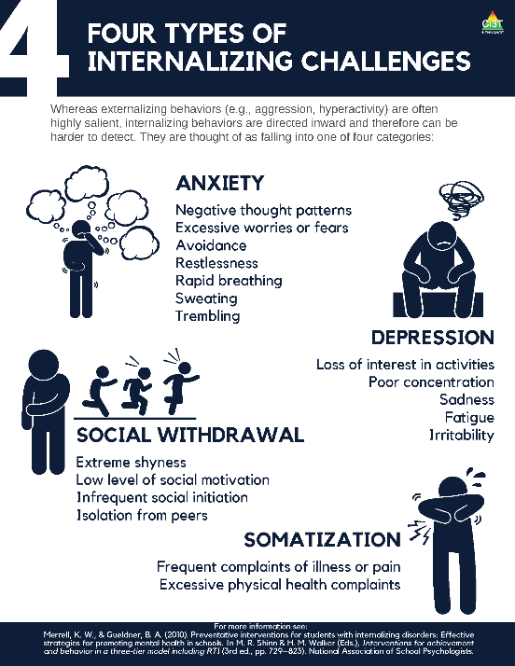
What are internalizing behaviors? (1)
Compared to externalizing behaviors, internalizing behaviors tend to be:
More covert
Less disruptive
but…
Internalizing challenges often co-occur with externalizing behaviors.

Slide 9
What are internalizing behaviors? (2)
Some examples include:
frequent complaints of illness or pain,
social withdrawal,
irritability,
poor concentration,
restlessness,
emotional outbursts,
rapid breathing,
sweating, or
trembling/shaking.

Slide 10

Why should we be concerned about internalizing behaviors?
Internalizing concerns are associated with multiple worrisome outcomes compared to students who do not have internalizing behavior patterns, such as:
Lower levels of academic achievement (e.g., grade point average, GPA; Vaillancourt et al., 2013)
Lower levels of school adaptation (e.g., ability to learn, ability to meet behavioral expectations, happiness/adjustment; Pedersen et al., 2019)
Higher levels of school dropout (Weist et al., 2018)
Higher levels of social rejection (Weist et al., 2018)
Increased engagement in risk-taking behaviors (e.g., substance use, suicide; Weist et al., 2018)
Increased risk of physical health problems (Jamnik & DiLalla, 2019)

Slide 11
Who do internalizing behaviors impact? (1)
≈ 32% of children experience an anxiety disorder at some point during their childhood (Merikangas et al., 2010)
Onset typically occurs during elementary years (Merikangas et al., 2010)
Prevalence of behavioral, social, and emotional well-being challenges may be on the rise:
Lebrun-Harris and colleagues (2022) found an increase in anxiety and behavioral/conduct disorder from 2016-2020.

Slide 12
Who do internalizing behaviors impact? (2)

Slide 13
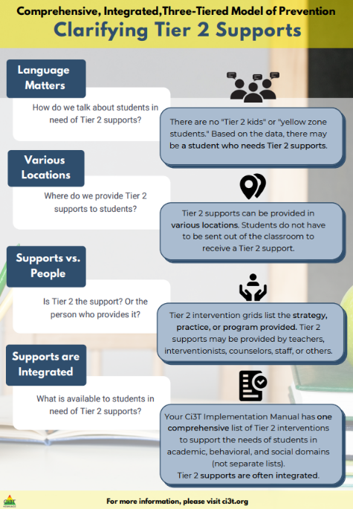
Situating Secondary (Tier 2) Interventions in Ci3T Models

Slide 14
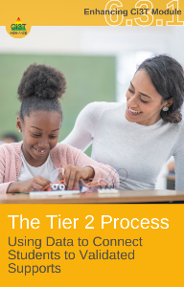
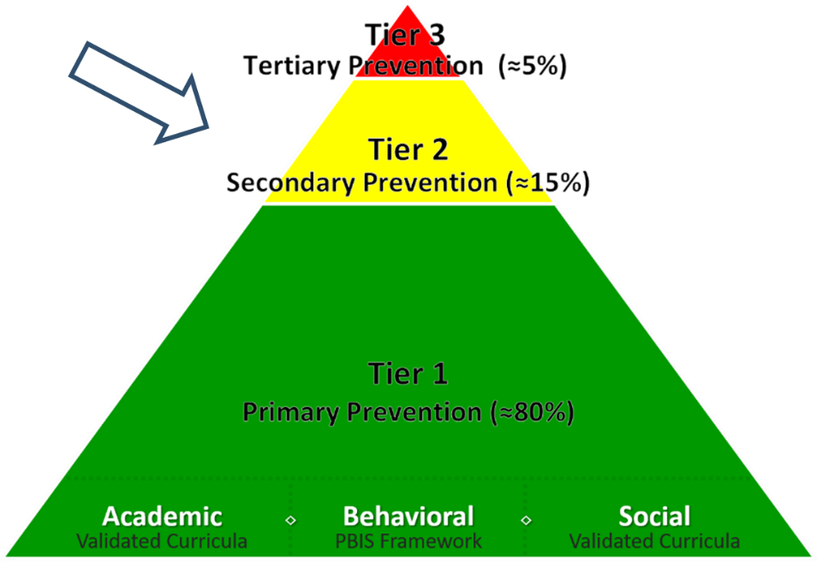
What are Tier 2 Interventions?
Evidenced-based or research-based strategies, practices, and programs
Additive (i.e., compliment rather than replace Tier 1 efforts)
Implemented by teachers, interventionists, counselors, paraprofessionals, and other staff
Occur in a variety of formats and locations (e.g., small-group, 1:1, embedded within whole group instruction)

Slide 15
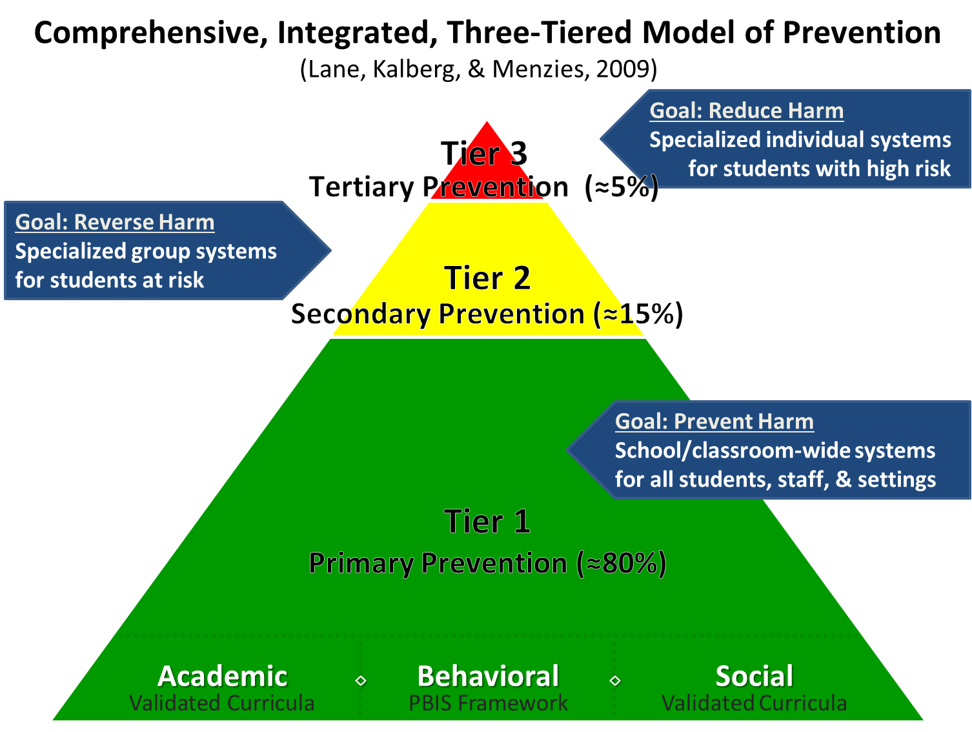

Comprehensive, Integrated, Three-Tiered Model of Prevention 1

Slide 16
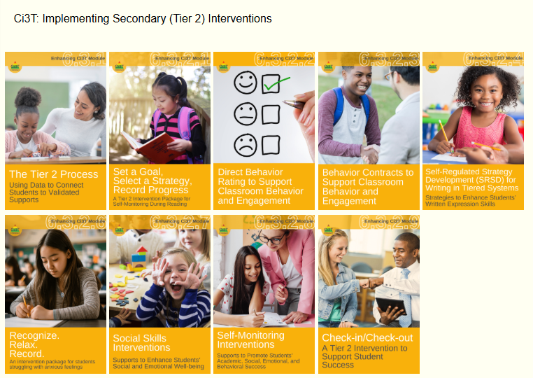
Ci3T: Implementing Secondary (Tier 2) Interventions

Slide 17
An Overview of Recognize.Relax.Record

Slide 18

Comprehensive, Integrated, Three-Tiered Model of Prevention 2

Slide 19

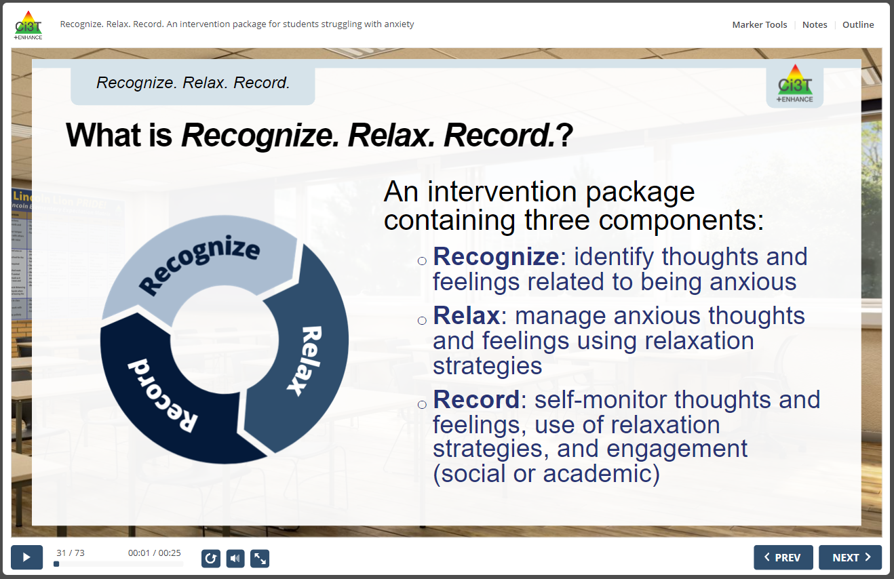
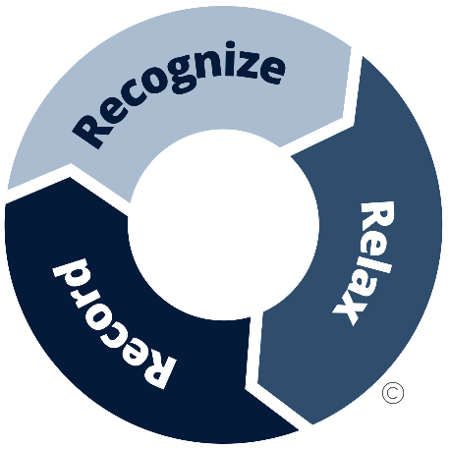
RRR Interactive Resource

Slide 20


What does the supporting research for Recognize. Relax. Record. say?
What Does the Supporting Research for Recognize. Relax. Record. Say? 1
Social-emotional competencies
Self-awareness
Self-management
Social awareness
Responsible decision-making
Relationship Skills
Recognize.
Social-emotional competencies, such as self-awareness and self-management, are related to important long-range outcomes
high school graduation
college degree completion
obtaining employment
Durlak et al., 2011
Adapted from CASEL Framework (2020)

Slide 21
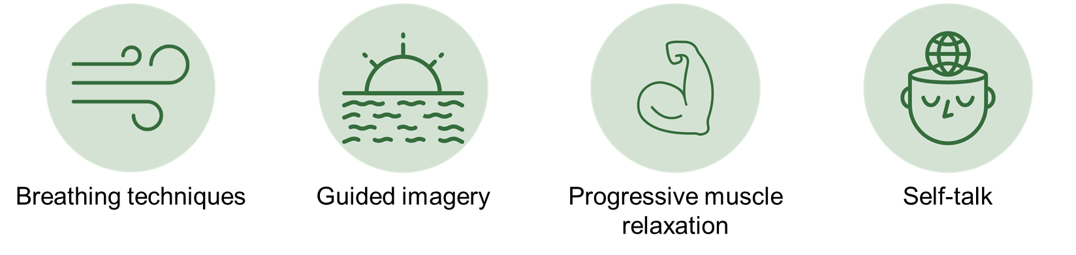
What does the supporting research for Recognize. Relax. Record. say?
What Does the Supporting Research for Recognize. Relax. Record. Say? 2
Relax.
Relaxation training is commonly used in research-based cognitive behavioral interventions for children with anxiety
Chorpita & Daleiden, 2009

Slide 22
What does the supporting research for Recognize. Relax. Record. say?
What Does the Supporting Research for Recognize. Relax. Record. Say? 3
Record
Self-management interventions effective for
behavioral and social outcomes
reading, math, and other content areas at elementary
Levendoski & Cartledge, 2000
productivity, engagement, and academic performance at middle and high school
Carr & Punzo, 1993
students with emotional and behavioral disorders
students educated in general and special education classrooms
A.M. Briesch & Briesch, 2016; Briesch & Chafouleas, 2009; Mooney et al., 2005

Slide 23
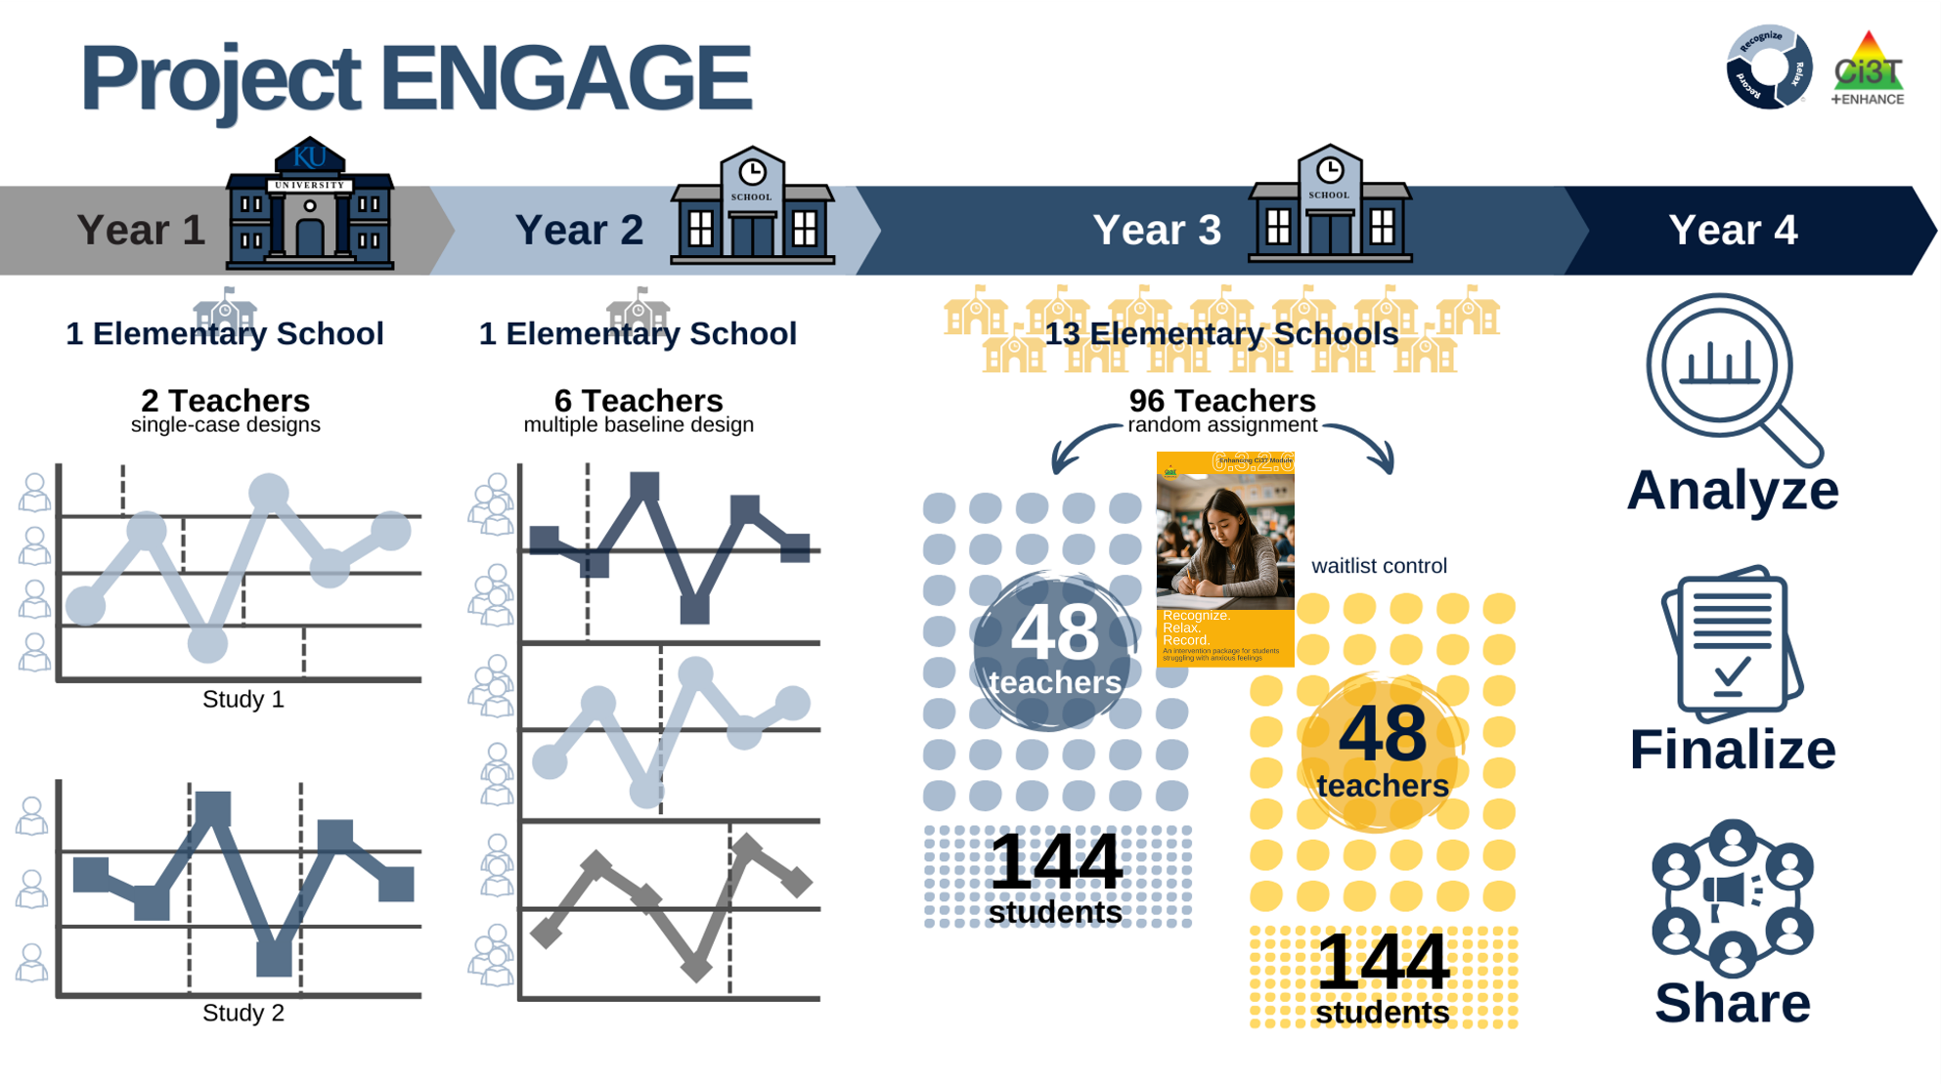
Project ENGAGE
A special thank you to teachers who participated! It was gift to learn from and with you!!!

Slide 24
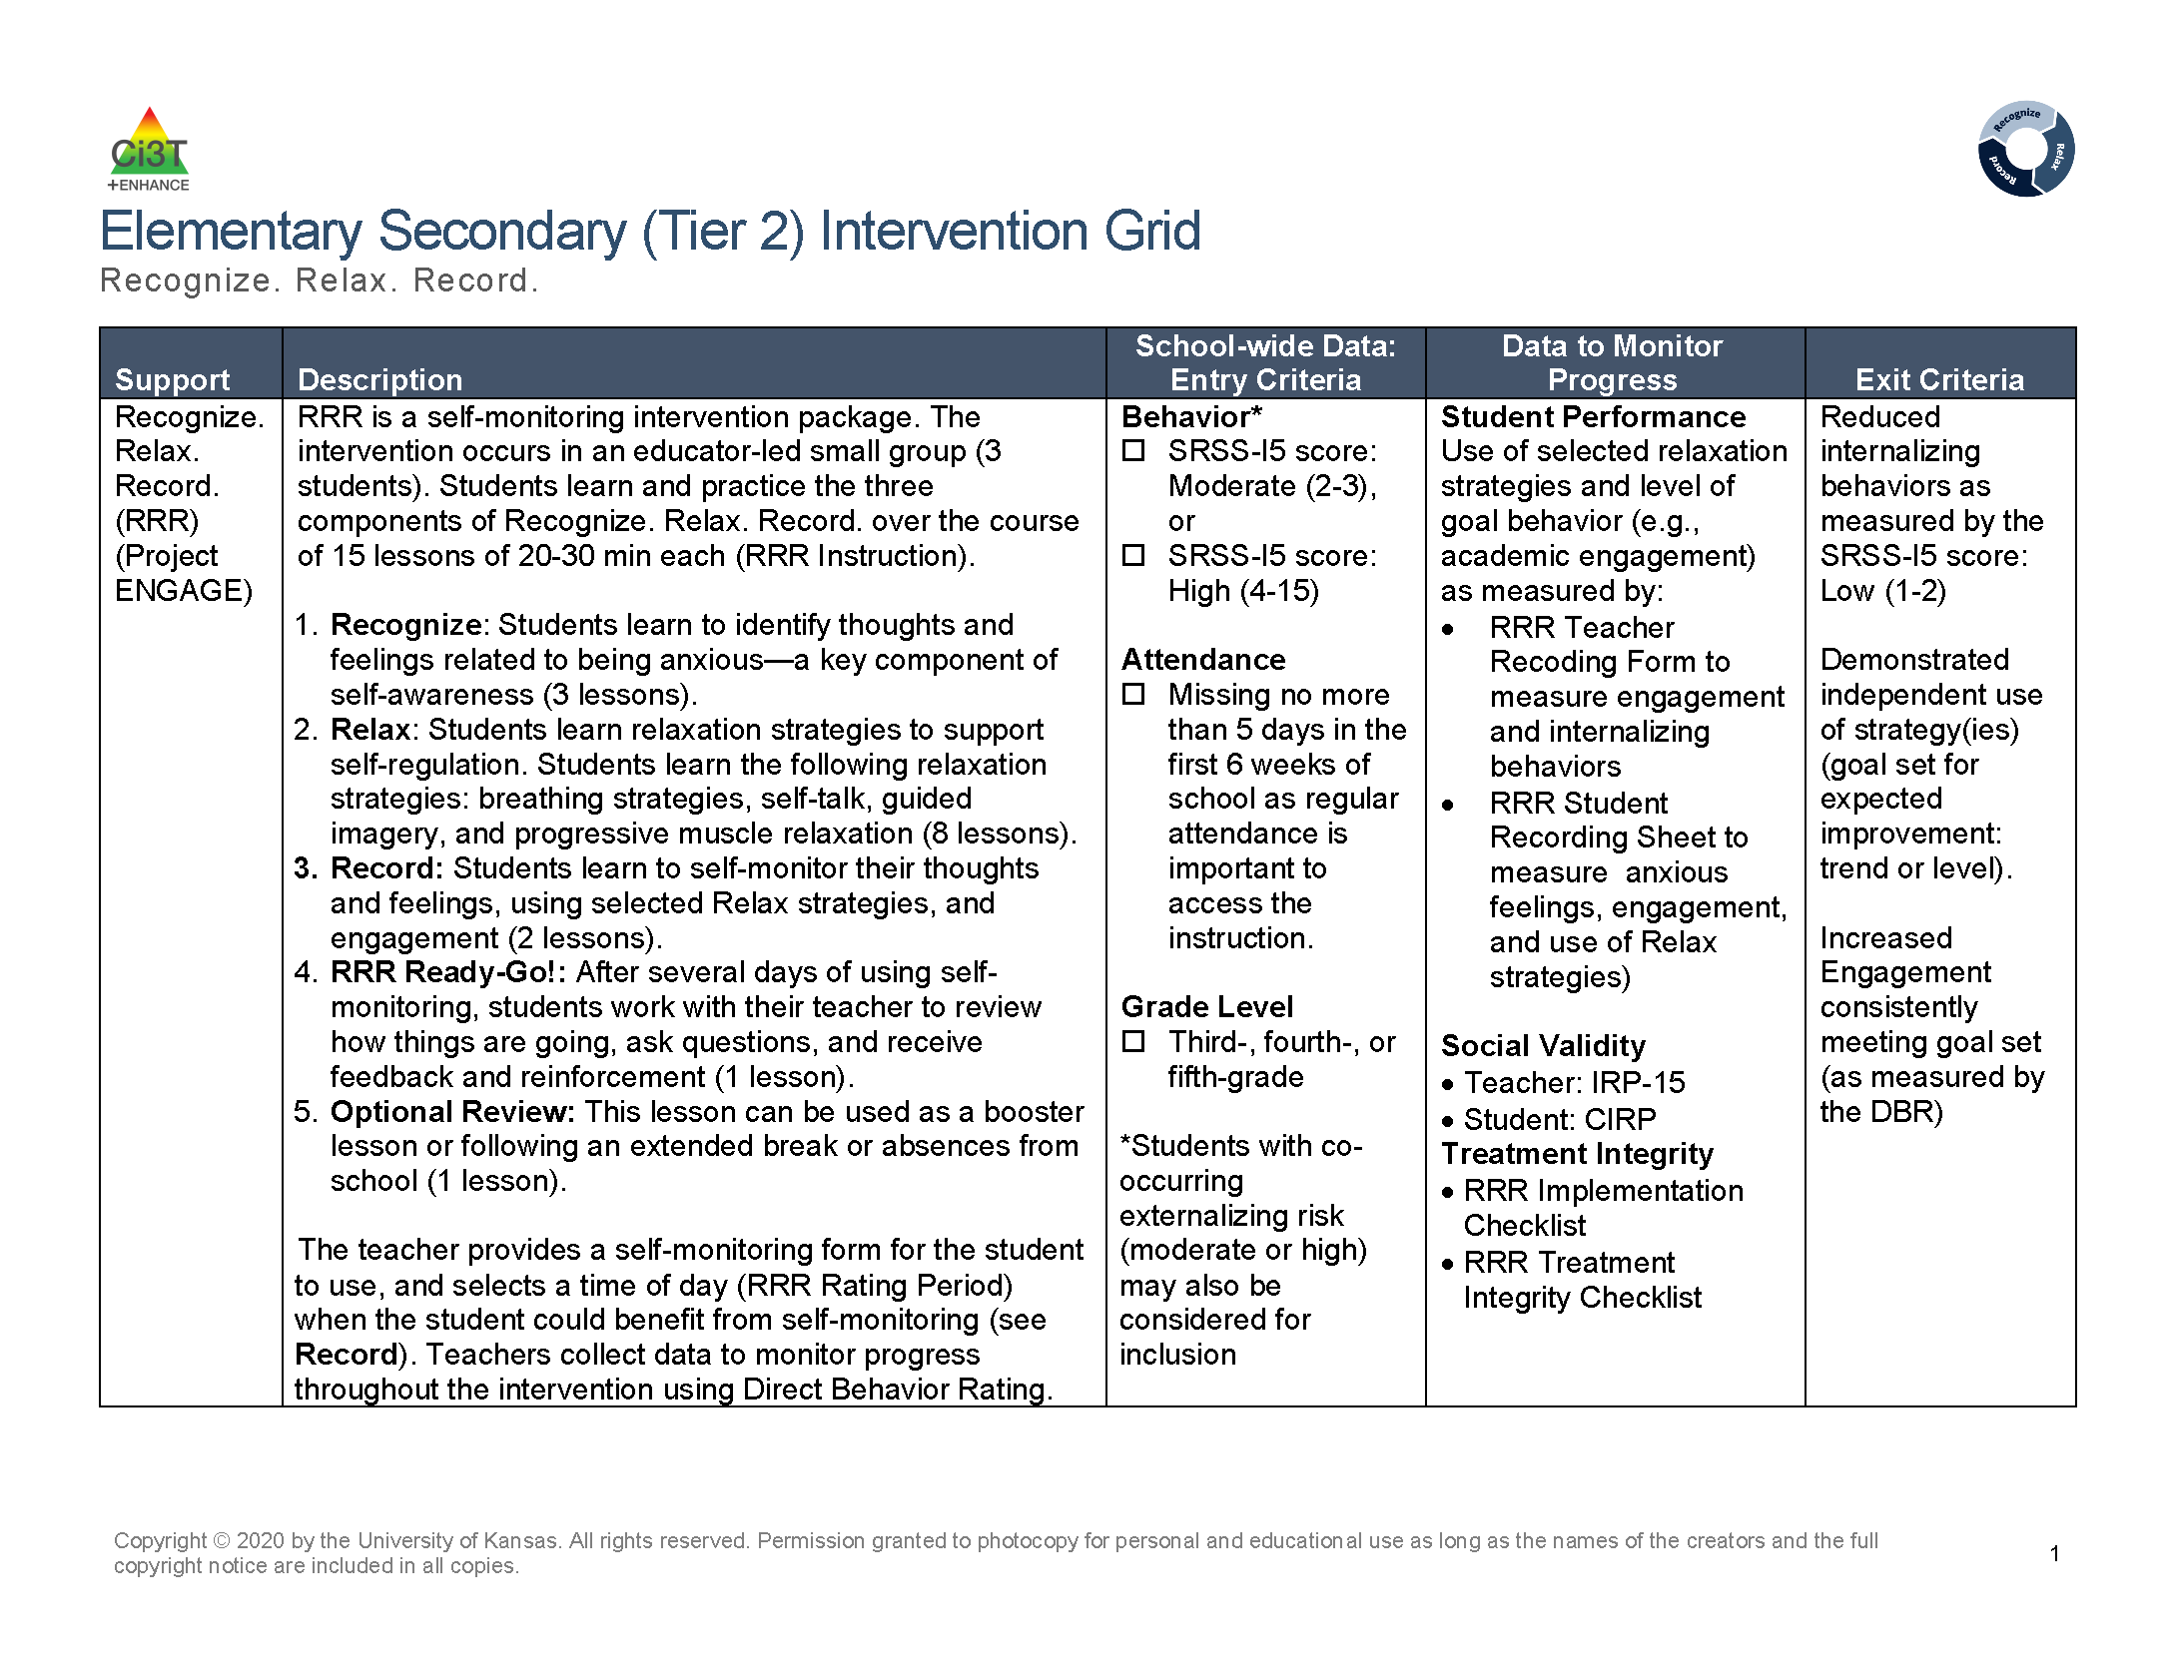
Recognize. Relax. Record. Secondary (Tier 2) Intervention Grid
Recognize. Relax. Record. Secondary (Tier 2) Intervention Grid 2

Slide 25
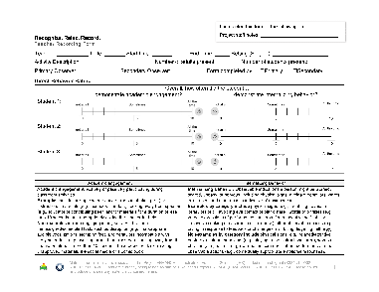
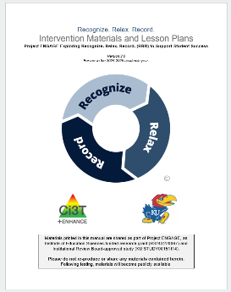
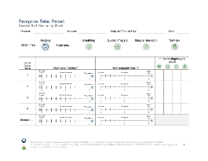
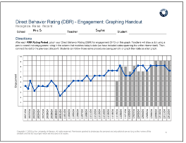
Three Components of Recognize. Relax. Record.
Baseline
RRR Instruction
RRR
In-Class
1
2
3
4
5
6
7
8
9
10
11
12
13
14
15

Slide 26
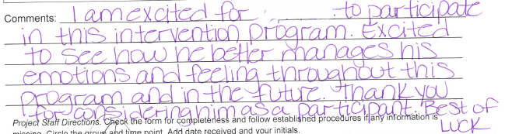
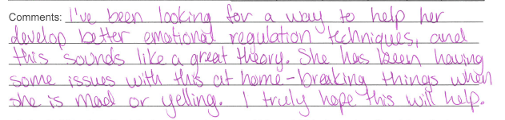
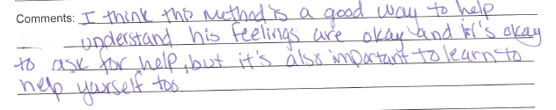
Feedback from Families Before Intervention

Slide 27












Four Corner Conversation! (1)
What are your initial impressions of RRR?
What does internalizing behavior look like for your students?
Thinking back to previous or current groups of students you have taught, are there students you think might have benefited from RRR?
To what extent do you feel comfortable providing interventions to support students with internalizing behaviors?

Slide 28
Implementing RRR
A 7 step process

Slide 29
Step 1
Use data to connect students to RRR

Slide 30
Recognize. Relax. Record. Secondary (Tier 2) Intervention Grid
Recognize. Relax. Record. Secondary (Tier 2) Intervention Grid 2

Slide 31
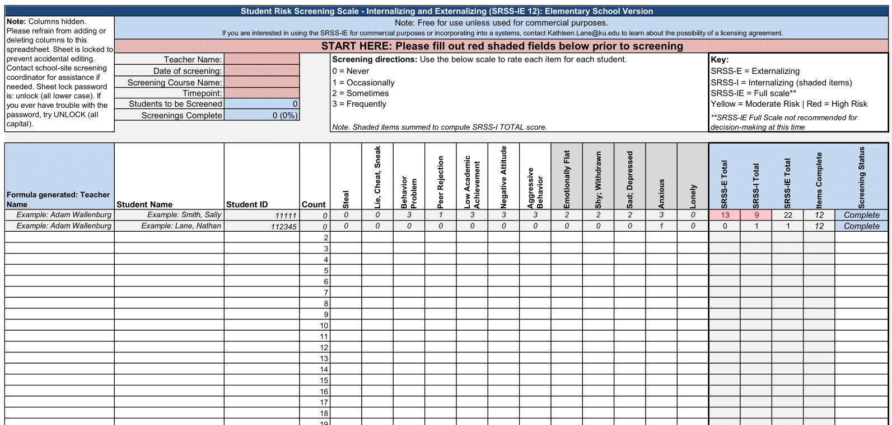
Using data to connect students to Recognize. Relax. Record.

Slide 32

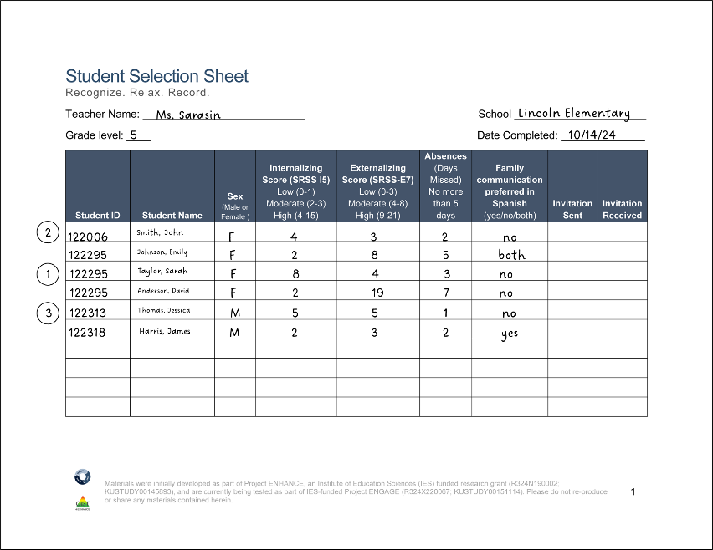
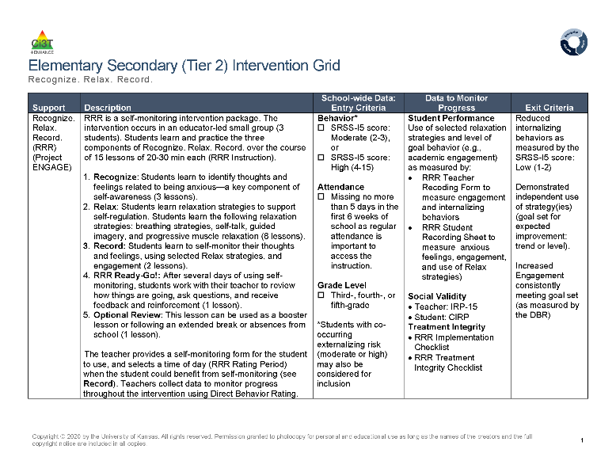
Step 1 Use data to connect students to Recognize. Relax. Record.
Screening

Slide 33
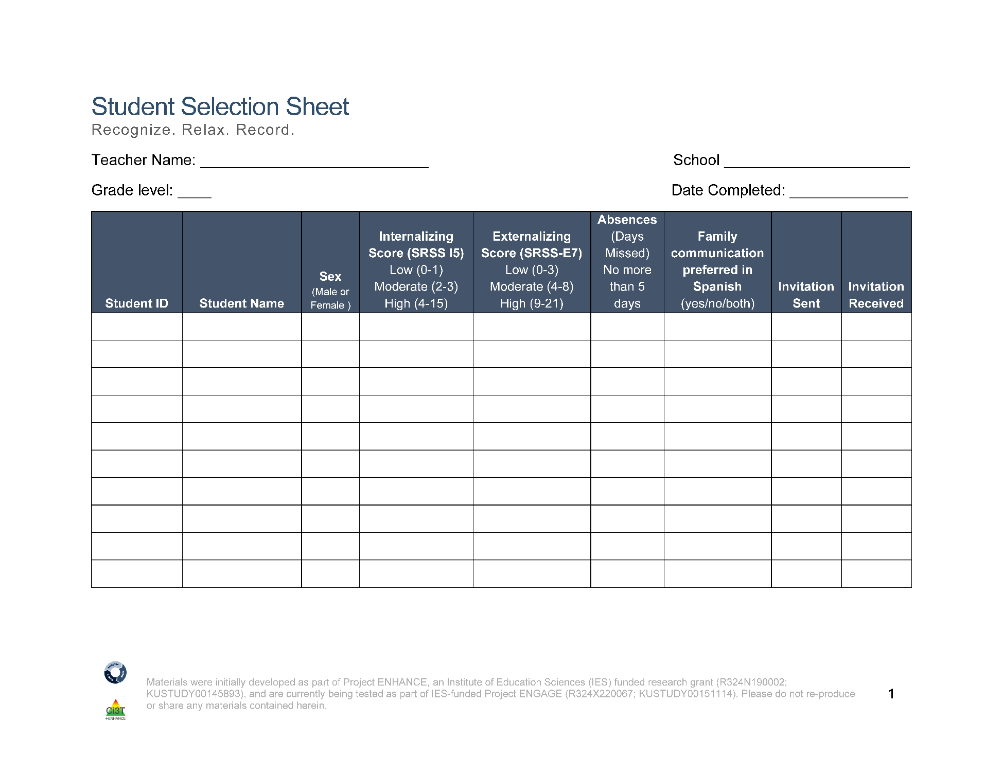
Student Selection Sheet
Ms. Sarasin
Lincoln Elementary
5
10/14/24
2
122006
Smith, John
F
4
3
2
no
122295
Johnson, Emily
F
2
8
5
both
1
122295
Taylor, Sarah
F
8
4
3
no
122295
Anderson, David
F
2
19
7
no
3
122313
Thomas, Jessica
M
5
5
1
no
122318
Harris, James
M
2
3
2
yes
Notes:
Fully translate materials and consent form

Slide 34
Step 2
Plan RRR Procedures

Slide 35
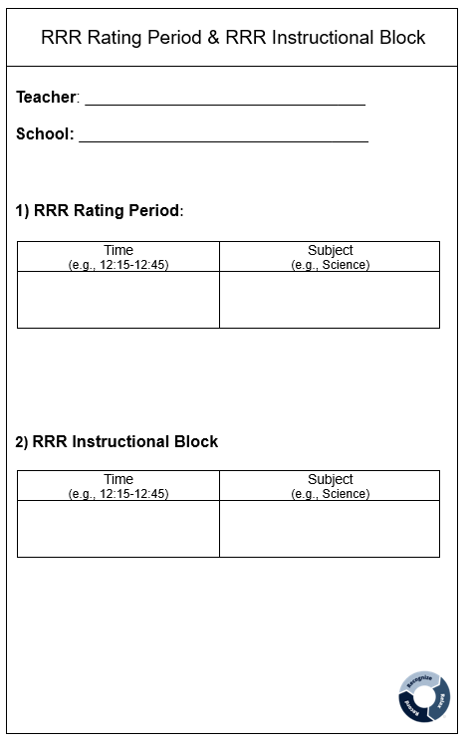
Step 2 Plan RRR Procedures
Step 2 Plan RRR Procedures 1
Collaborate with parents, families, and colleagues
Gather data to identify students’ strengths, abilities, and needs
Schedule
RRR Rating Period
Time when baseline (Direct Behavior Rating) data collected
Time when students will use self-monitoring during RRR In-Class phase
RRR Instruction Block
Time when small-group instruction will occur (15 lessons, 20-30 min each)
2:00-2:40
Monday-Thursday
Math
10:00-10:25
Monday, Wednesday, Thursday
Independent Work Time

Slide 36
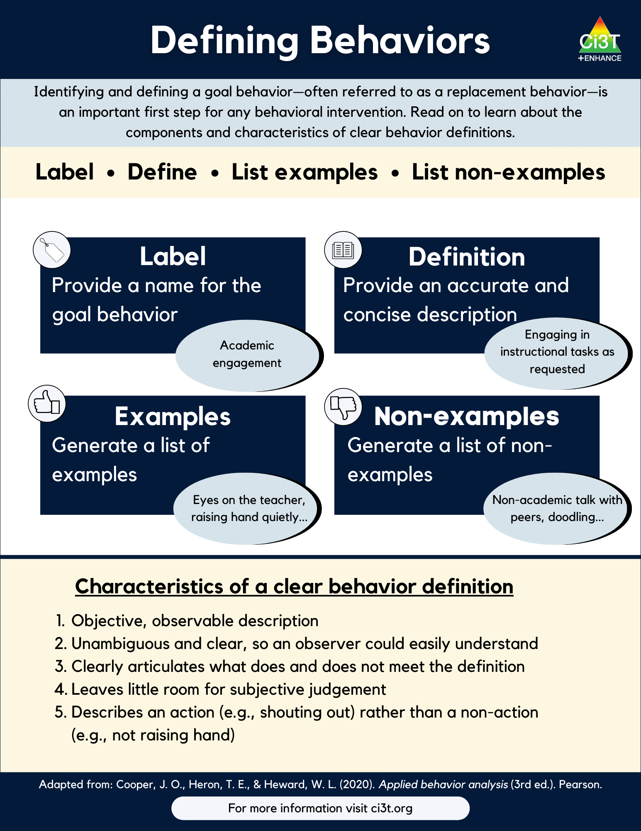
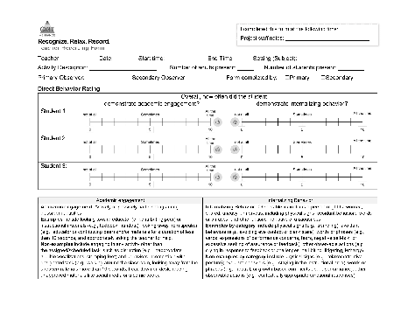
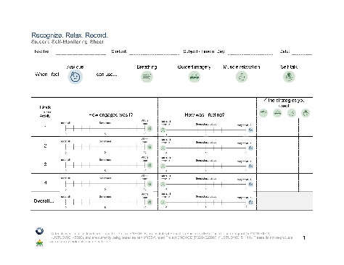
Step 2 Plan RRR Procedures
Step 2 Plan RRR Procedures 2
Prepare intervention forms and procedures
Teacher Recording Form (Direct Behavior Rating)
Student Self-Monitoring Sheet
Operationalize behaviors of interest

Slide 37
Step 3
Begin baseline data collection

Slide 38
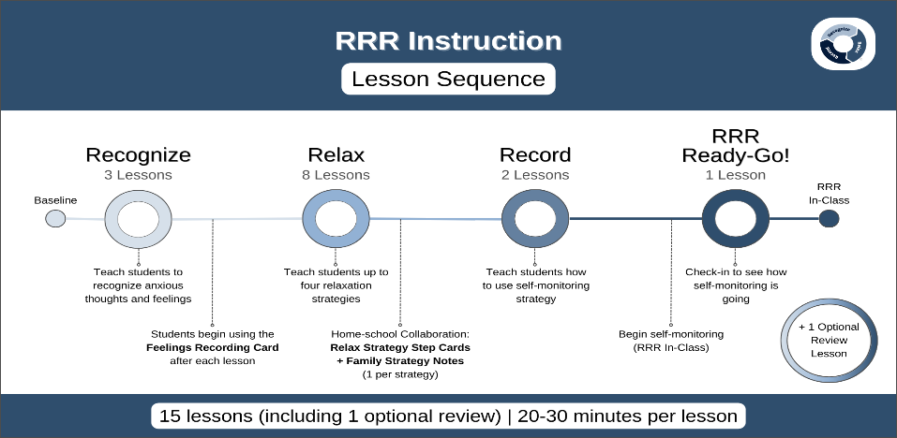
Baseline

Slide 39
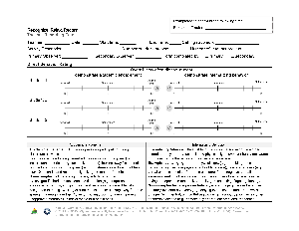
Baseline
Baseline 2
This is the time (approximately two weeks) before beginning RRR instruction
Nothing else changes!
This allows for a comparison pre-intervention performance to post-intervention performance
During this time, teachers will collect Direct Behavior Rating (DBR) data four times a week (Monday-Thursday)
Goal is to collect ~6-8 data points during this time!

Slide 40
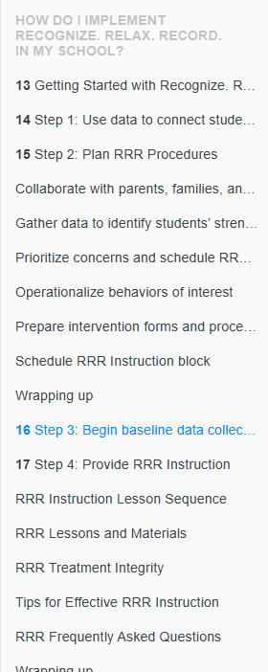
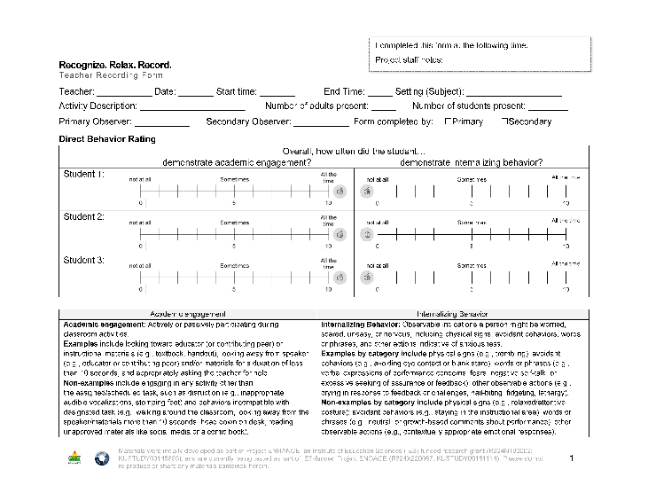
RRR Module Highlight! (1)

Slide 41
Direct Behavior Rating

Slide 42

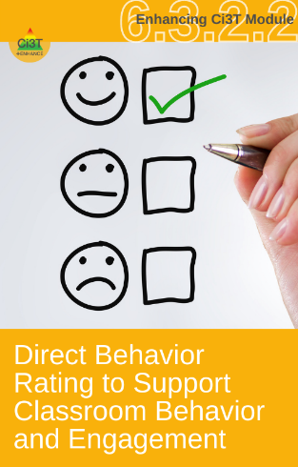
Direct Behavior Rating (DBR)
A tool that involves a brief rating of target behavior immediately following a specified observation period.
Source: University of Connecticut. (n.d.). Direct behavior rating: Assessment training module. [video training module].
www.dbrtraining.education.uconn.edu/video.php

Slide 43
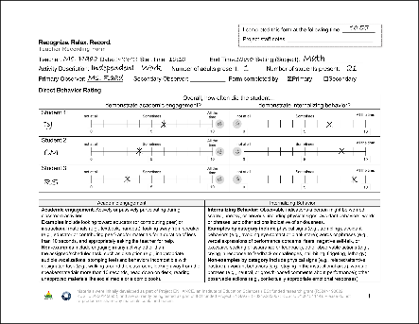
How is DBR used in this intervention?
DBR data are collected during the RRR Rating Period a 40-minute instructional block during which students would most benefit from using their new strategies to increase engagement and regulate anxious feelings
Later in the intervention (during RRR In-Class), students will self-monitor their own behavior during this time
Teachers will collect DBR data throughout all stages of intervention:
Baseline (~6-8 days)
RRR Instruction
RRR In-Class

Slide 44
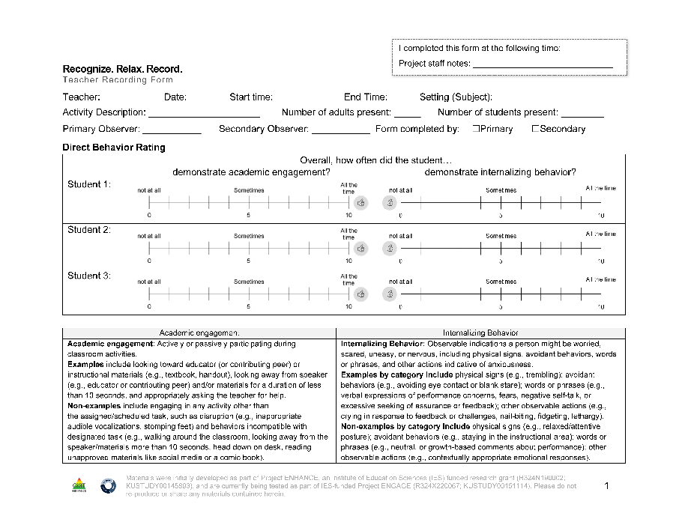
Teacher Recording Form
DBR data are collected using the Recognize.Relax.Record Teacher Recording Form to measure students’:
Academic engagement
Internalizing behavior

Slide 45
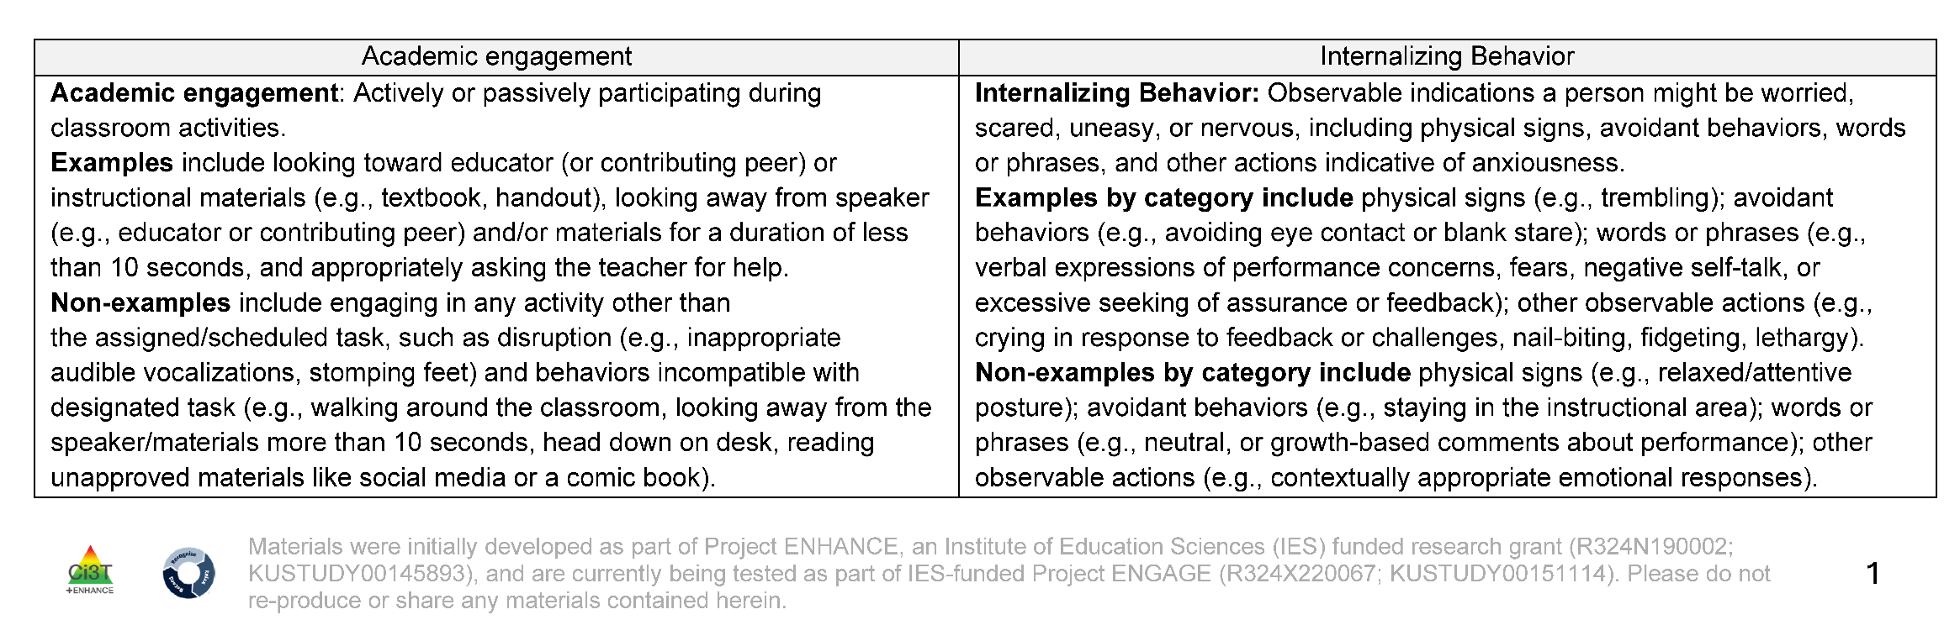
Operational Definition: Academic Engagement

Slide 46
Operational Definition: Internalizing Behavior

Slide 47
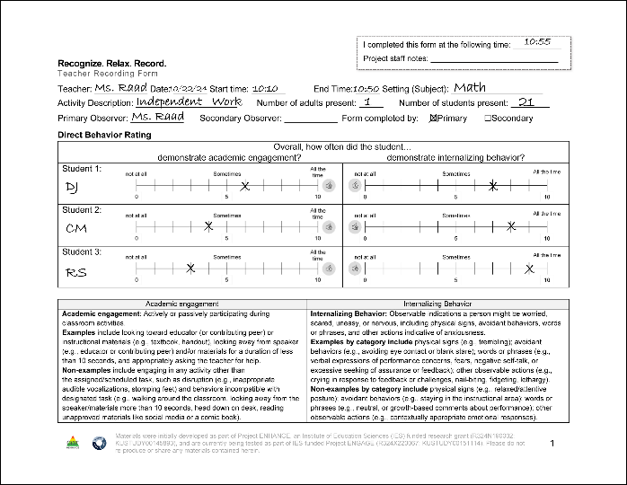
DBR Procedures: RRR Rating Period
DBR Procedures: RRR Rating Period 1
Plan to collect DBR data four times a week
Generally, Monday through Thursday
At the end of the RRR Rating Period, complete the Teacher Recording Form

Slide 48
DBR in Action
Academic Engagement & Internalizing Behavior

Slide 49
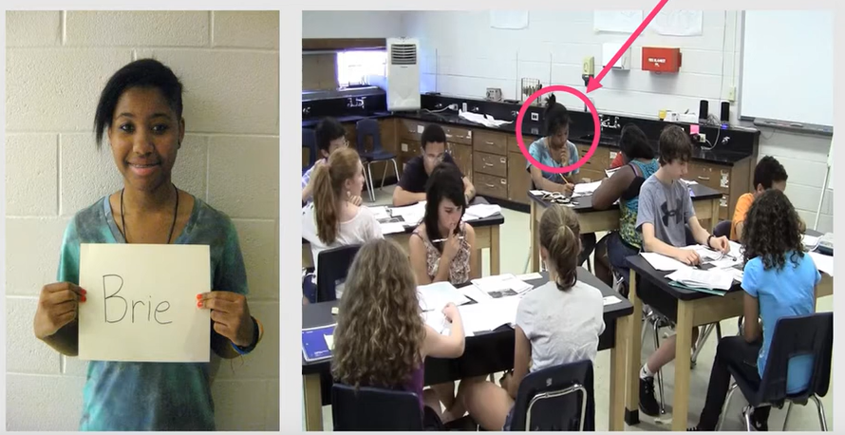
Brie
Context: Students are completing seat work.
Internalizing behavior for Brie looks like:
Head down
Complete shut down / withdrawal

Slide 50

DBR video: Brie
Notes:
https://youtu.be/XjT5eYz_00U?si=ejmIbSYwYgX5jqxO&t=15

Slide 51


Let’s Chat: Brie
With your table – discuss how you rated Brie’s:
Engagement
Internalizing Behavior

Slide 52
Whole Group: Brie
Engagement – 1
For most of the observation, Brie is engaging in behavior other than the assigned task (e.g., talking, poking peers, tapping pencil)
At the very beginning and end of the clip, Brie appears to be attempting to engage in the assigned activity
Internalizing – 0
Don’t see evidence of head down or complete withdrawal/shut down

Slide 53
DBR Procedures: RRR Rating Period
DBR Procedures: RRR Rating Period 2
Plan to collect DBR data four times a week
Generally, Monday through Thursday
At the end of the RRR Rating Period, complete the Teacher Recording Form

Slide 54
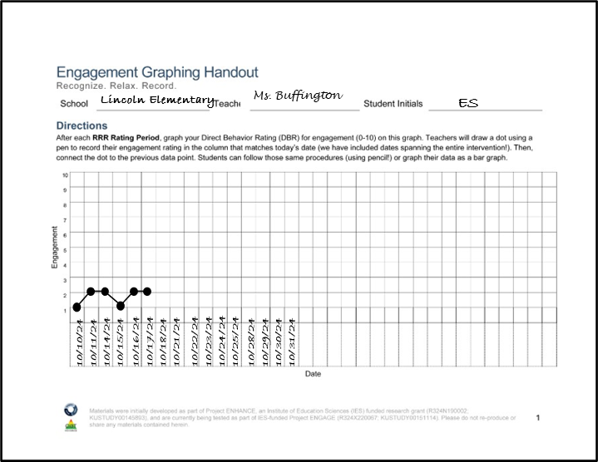
RRR Engagement Graphing Procedures
Each student will have their own Engagement Graphing Handout
Later in the intervention (during RRR In-Class), students will also add their total engagement ratings to this graph!
Once you have completed the Teacher Recording Form, graph each student’s overall engagement score on their graph

Slide 55
Example of an Engagement Graphing Handout

Slide 56
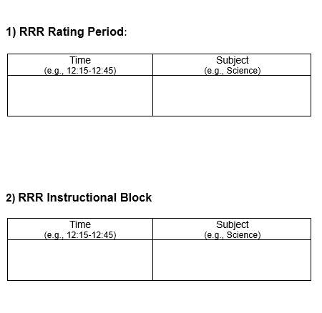
Four Corner Conversation (2)
During what time of day would be beneficial for conducting DBR with your students?

Slide 57

Step 4
Provide RRR Instruction

Slide 58

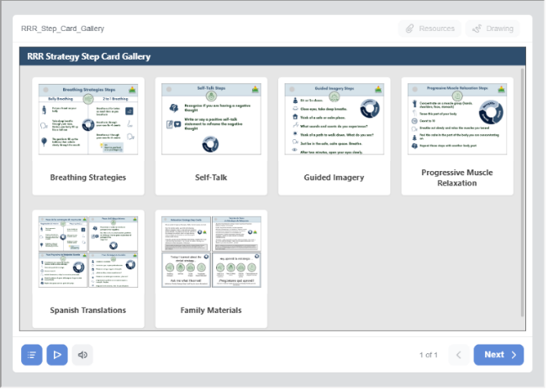
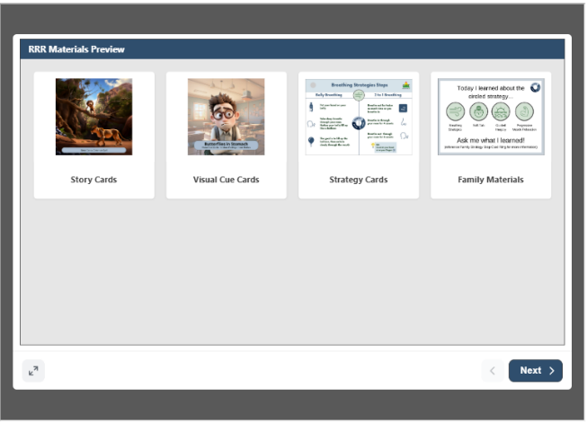
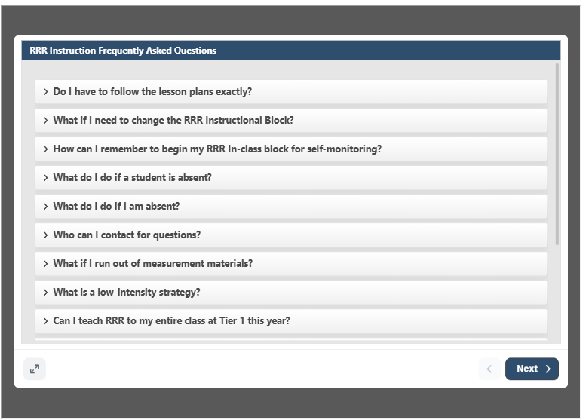
Accessing Materials

Slide 59
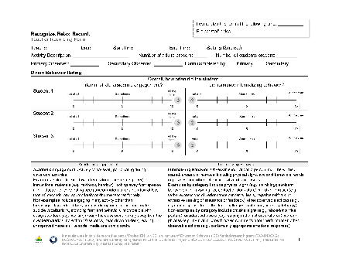

RRR Instruction
Deliver small group RRR Lessons
~20-30 minutes per lesson
Up to 15 lessons (with optional lessons); likely to teach only 10-13 lessons
Taught during a different time than RRR Rating Period
Teachers continue to collect DBR data four times a week (Monday-Thursday) during the RRR Rating Period

Slide 60
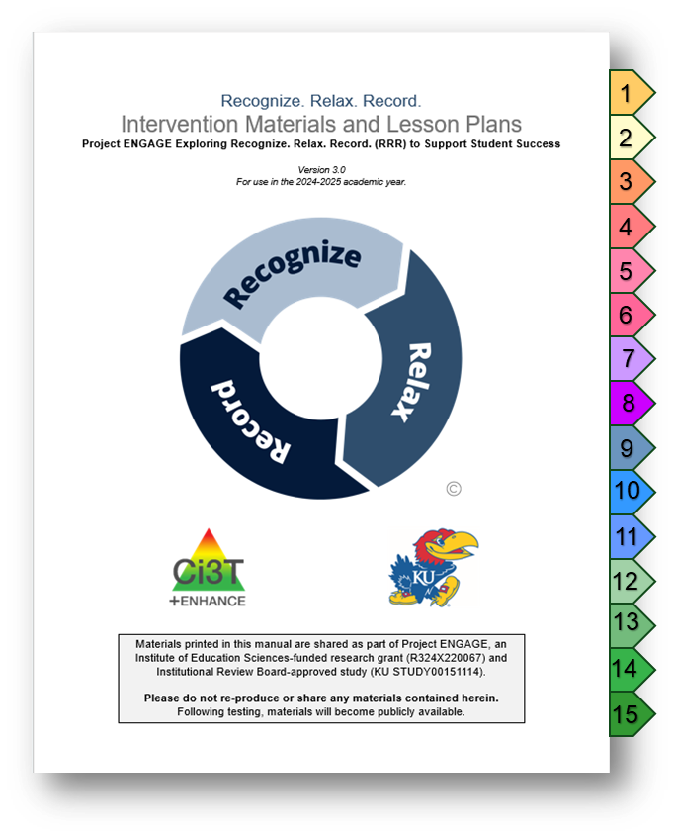
Lesson Plans Overview
15 lessons available
Recognize - 3 lessons
Relax - 8 lessons*
Record - 2 lessons
Ready-Go!
Review (optional)
20-30 min each lesson
Semi-scripted
Teacher-led

Slide 61
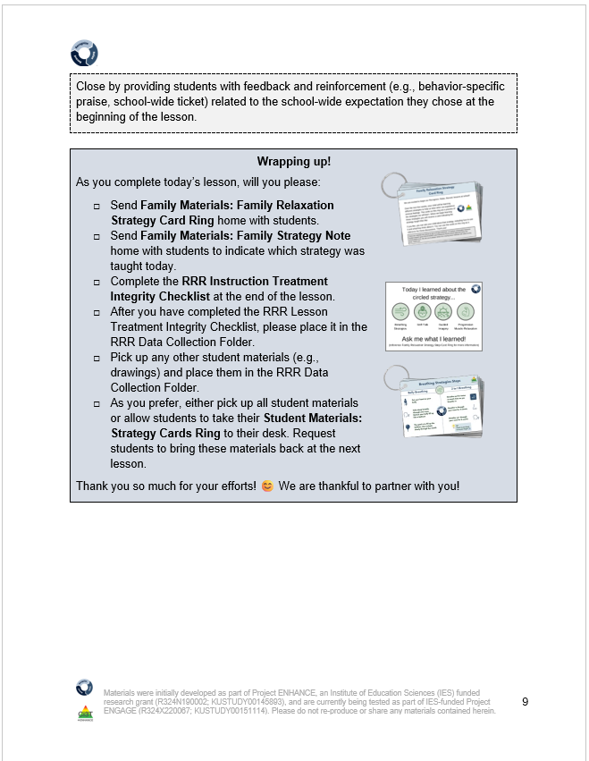
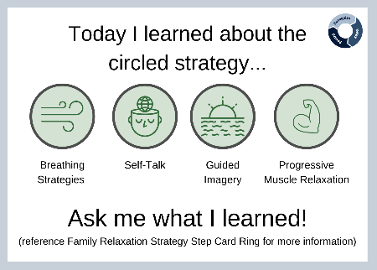



Family Materials (1)
Guidance for sending materials is in each lesson plan, as appropriate
Notes:
Family materials – available in both English and Spanish on one ring (front and back)
Guidance in lessons in the blue wrap up boxes for when to send those home

Slide 62






Teacher Materials

Slide 63



Instructional Hub
Notes:
Instructional Hub includes digital version of lesson, digital print out version of the materials, and GoogleSlide version of materials

Slide 64


Video Model: The Instructional Hub
Notes:
1:30 second video
Video walkthrough of instructional hub

Slide 65

Key Intervention Lesson Features (1)
Lesson title
Lesson timing
Learning objectives
Big Ideas of the lesson
Materials
Notes:
Lesson plans have consistent format – each lesson has a title, learning objective, big ideas, and materials you will need

Slide 66


Key Intervention Lesson Features (2)
Treatment Integrity
Pacing guide
Headings
Tell
Show
Do
Practice & Monitor
Generalize & Close
Notes:
Outlined pacing guide – tell / show / do / practice & monitor / generalize and closing
Semi-scripted so can adjust pacing and content
Can document on TI form – we’ll dive into this later in the session.

Slide 67






Key Intervention Lesson Features (3)
Situational stories and other examples
Notes:
Story Cards and examples built in. Can edit to meet needs of students.
Likely teaching at small group table – teachers have used hard-copy materials, flipped their computer around, or used a second monitor. Set up to be flexible and meet your needs!

Slide 68

Key Intervention Lesson Features (4)
Embedded materials
Notes:
Added picture of materials throughout to help cue what you’ll need for that portion of the lesson

Slide 69


Planning Your RRR Journey
Notes:
Each strategy has (2) lessons. Both lessons have a tell, show, do, practice & monitor; can choose to reduce number of lessons

Slide 70


Lesson Activities
Embedded materials throughout

Slide 71

Student Examples 1
Guided Imagery Example
Anxious feelings:
public speaking
Identifying anxious feelings in your body: sweating

Slide 72



Student Examples 2
Anxious feelings:
soccer tryouts
Guided Imagery Example
Guided Imagery Example

Slide 73



Family Materials (2)
After Breathing Strategies Lesson 1, you will send home a copy of the Strategy Step Cards to families
After each strategy lesson- you will send home a Family Strategy Note

Slide 74
3 Intervention Components

Slide 75

Recognize. Relax. Record. Intervention Component
Recognize. Relax. Record. Intervention Component 1
Recognizing and understanding our emotions is a key component for self-awareness
Students learn to:
Lesson 1: Understanding anxious feelings
Lesson 2: Identifying anxious thoughts and feelings
Lesson 3: Choosing strategies to help manage anxious thoughts and feelings

Slide 76

Recognize. Relax. Record. Intervention Component
Recognize. Relax. Record. Intervention Component 2
Students learn strategies to respond when they feel anxious
Breathing Strategies
Self-talk
Guided Imagery
Progressive Muscle Relaxation
For each strategy, students will:
Define
Learn to use
Recognize situations for when to use
Demonstrate (and practice)

Slide 77

Recognize. Relax. Record. Intervention Component
Recognize. Relax. Record. Intervention Component 3
Students learn how to monitor their own feelings and behaviors
Lesson 1: Learning to Self-Monitor (Record) our Behaviors
Focus: Academic Engagement
Lesson 2: Learning to Self-Monitor (Record) our Thoughts, Feelings, and Behaviors
Focus: Anxious thoughts and feelings
Focus: Use of relaxation strategies

Slide 78



Preparing Students for RRR In-Class
Notes:
https://www.youtube.com/watch?v=vW0D1KVtcf4&t=1s (not watching video)

Slide 79

RRR Ready-Go!
Final lesson in sequence
Lesson taught after students have had a few days of RRR In-Class
Flexible lesson to review:
Self-Monitoring Sheet
Engagement Graphing Handout

Slide 80


Optional Review Lesson
Optional customizable lesson to use as needed following an extended break in instruction.

Slide 81



Video Model: Opening & Closing a Lesson

Slide 82















Work Time
Step 1: Go to ci3t.org/enhance
Step 2: Locate the Recognize. Relax. Record. module (see Ci3T: Implementing Secondary (Tier 2) Interventions)
Locate the RRR Instructional Hub (see Steps) Explore one of the lesson plans. Review screening data.
Step 3: Sign into the module using your district email (if you haven’t yet registered, directions will be provided to do so)
Step 4: On the toolbar, Section 13 (Getting Started with Recognize. Relax. Record.). Scroll down until you find the RRR Instructional Hub.
Notes:
10-min timer

Slide 83
Step 5
Implement RRR In-Class and Monitor Student Performance

Slide 84



RRR In-Class
Teachers continue to collect DBR data four times a week (Monday-Thursday)
Students use the Student Self-Monitoring sheet to self-monitor their engagement, anxious feelings, and use of relaxation strategies
Teachers facilitate self-monitoring (e.g., audio cue, brief check-ins)

Slide 85

Student Self-Monitoring Sheet

Slide 86

Self-Monitoring Treatment Integrity Checklist
Self-Monitoring Treatment Integrity Checklist located on the back of the RRR Rating Form
Completed daily at end of RRR In-Class Period
rate all procedures on a scale from 0 (not implemented) to 3 (fully implemented)
each procedure is rated for each student

Slide 87

Video Model: RRR In-Class Procedures
Notes:
01:30

Slide 88

Student Check-in and Feedback: Praise
Behaviors | Behavior-specific Praise Examples
Correctly completing the student self-monitoring form | “Mia, it looks like you filled out the form for every interval today. Thanks for remembering!”
Demonstrating academic engagement | “Omar, it looks like you took great notes during the lesson today and did all the practice problems. Nice job setting yourself up for success!”
Accurately rating their academic engagement (even when not rated highly) | “Jian, I really appreciate how you noticed you were not so engaged during the last block. I appreciate the honesty. Now, what can you do to get back on track? How can I help?”
Using relaxation strategies | “Isabella, it looks like you were feeling a bit anxious during that block, but you used guided imagery. That’s a great job of using our new skills. How are you feeling now – and is there anything I can do to help?”

Slide 89

Student Check-In and Feedback: Tips from Teachers
Student skips an interval
“That was the third ding, fill out your ratings in this row”
Student ratings are very different than teacher ratings
“I see you rated yourself a 9 for engagement. I noticed you playing inside your desk and drawing in your math book so my rating for you would be a 5 or 6. Can you tell me about your rating?
Nonverbal feedback (e.g., thumbs up, smile, nod)

Slide 90

Student Check-in and Feedback Practice
We are going to review 3 example RRR Student Self-Monitoring Sheets to practice checking in with students and delivering feedback
View form (on slide)
Turn and Talk
What do you notice?
What feedback would you give this student?
Whole Group Discussion

Slide 91

Self-monitoring practice 1
Notes:
I noticed...student did not score two intervals
Feedback:
“Oops! Looks like we missed a few. Remember- every time you hear the ding you will complete a row on the form. Is there anything that is making it tricky to complete?”

Slide 92

Self-monitoring practice 2
Notes:
I noticed... overall rating does not match interval ratings
Feedback:
“Great job remembering to fill out the form for every interval! I noticed you rated anxious feelings as mostly 1s but then a 6 for overall score. Remember, your overall score represents how you did throughout the whole math lesson. If your interval ratings are 1s and 2s, your overall score would also be a 1 or 2”

Slide 93

Self-monitoring practice 3
Notes:
I noticed... Sophie reports feeling anxious but does not indicate using any relaxation strategies.
Feedback:
“It looks like you were feeling a bit anxious today. Remember, you can use your strategies! If you are feeling anxious during math tomorrow, what strategy do you want to try?”

Slide 94



Engagement Graphing (1)
Notes:
At the end of the RRR Rating Period, students add their overall engagement score to their graph. Students can either add a dot OR shade the column like a bar graph. Then, once you check in the with student you will add your dot the graph just like you have been doing!

Slide 95
Engagement Graphing (2)
Notes:
Graphing is meant to be a quick routine to support students in their self-monitoring!

Slide 96

Engagement Graphing Handout
Opportunities for feedback & discussion with students!

Slide 97
Step 6
Monitor maintenance and generalization

Slide 98


RRR Module Highlight! (2)
Notes:
Reference where we are in the module sequence of pages. Say “ and we have materials for students to keep with them during the school day as well as at home. Throughout the lessons, we really encourage students to share out with other adults, students, friends, at home and at school, on what they are learning and to use in other settings other than just in academic learning times. We have had students share that they are telling their friends on the playground about these strategies, with students who are and are not in the intervention, as well as during state assessments, and across other subject areas than what we predicted they are typically having these feelings in”

Slide 99


Step 6 Monitor maintenance and generalization
Notes:
To support these endeavors of extending the application of the intervention, we have family materials that Amy showcased earlier as well as infographics specifically for families embedded throughout the module to help educate families on the practice and encourage generalization outside of the school building ☺

Slide 100
Step 7
Seek input from students, families, and teachers

Slide 101



Step 7: Seek input from student, families, and teachers

Slide 102

Feedback from Families

Slide 103



Teacher Interviews
“At first I thought it was going to be a lot of work, but it worked seamlessly into our routine.”
In this school we have a lot of trauma and students struggling. I think kids with anxiety are often overlooked-they have a need and now we have something to do for them for the first time.”

Slide 104
Student Interviews
“I got really mad at home and did some breathing.”
It definitely made me improve on a bunch of stuff. Helped with my self-control.”
“Helped when I couldn’t sleep at night.”
“When I am frustrated, it helps me remember to take a breath.”
“This would help my friends in math say, “I can do this”.”
“When my brother makes me mad, I take deep breaths and visualize being somewhere calm.”

Slide 105














What do you think about goals, procedures, and intended outcomes?
Step 1
Let's Chat!
What are some potential benefits of implementing RRR in your setting?
What are some benefits of having the general education teacher be person teaching RRR lessons?
Step 2
Walk the room!
Take five stickers
Place one sticker on each of the five rating scales underneath each social validity statement

Slide 106
Considerations for Implementing RRR

Slide 107



Teacher Recommendations (1)
Hang strategy cards on desks
Set phone reminders for RRR Rating Period
Whole-class participates in self-monitoring
Student leaders
Passing out materials
Reminders for in-class procedures

Slide 108

Teacher Recommendations (2)
Showcase icons in classroom for all to see
Laptop & monitor
Students teach whole class relax strategies as Tier 1 practice
Set timers for lesson activities

Slide 109
Wrap Up and Moving Forward

Slide 110
Action Items
Action Item | Person(s) Responsible | Planned Completion Date | Date Completed
Review systematic screening data (fall and winter) to see which students might benefit from Recognize. Relax. Record. (RRR) | Amy | 11/20/25
Explore the possibility of implementing RRR with your school site colleagues and principal | Amy | 12/01/25
Schedule time with a Ci3T RRR coach for support | Allison | 12/05/25
Submit BCBA CEU form with four passwords | Elise | 11/06/25

Slide 111

Project EMPOWER+
EMPOWER+ Session | Date
Starting Strong: Effective Tier 1 Practices for Educators | September 24, 2025 (Wednesday)
From Data to Action: Using Systematic Screening to Inform Instruction | October 8, 2025 (Wednesday)
Ci3T In Action: Integrated Lesson Planning for Enhanced Instruction | November 18, 2025 (Tuesday)
Mastering Behavior Specific Praise and Precorrection | January 21, 2026 (Wednesday)
A 6-Step Instructional Approach for Responding to Challenging Behaviors: A Tier 1 Practice | February 10, 2026 (Tuesday)
A Tier 2 Support for Students Experiencing Anxious Feelings: Recognize. Relax. Record. | March 25, 2026 (Wednesday)
A Tier 3 Support for Students with Intensive Intervention Needs: Functional Assessment-Based Intervention (FABI) | April 28, 2026 (Tuesday)

Slide 112



Thank you!
Thank you!
ci3t.org
#Ci3T
@Ci3Tmodel
Tag us in your Ci3T highlights, we love to see Ci3T in action!
Follow us on Instagram for updates and new resources!
Kathleen Lane
kathleen.lane@ku.edu

