Slide 1
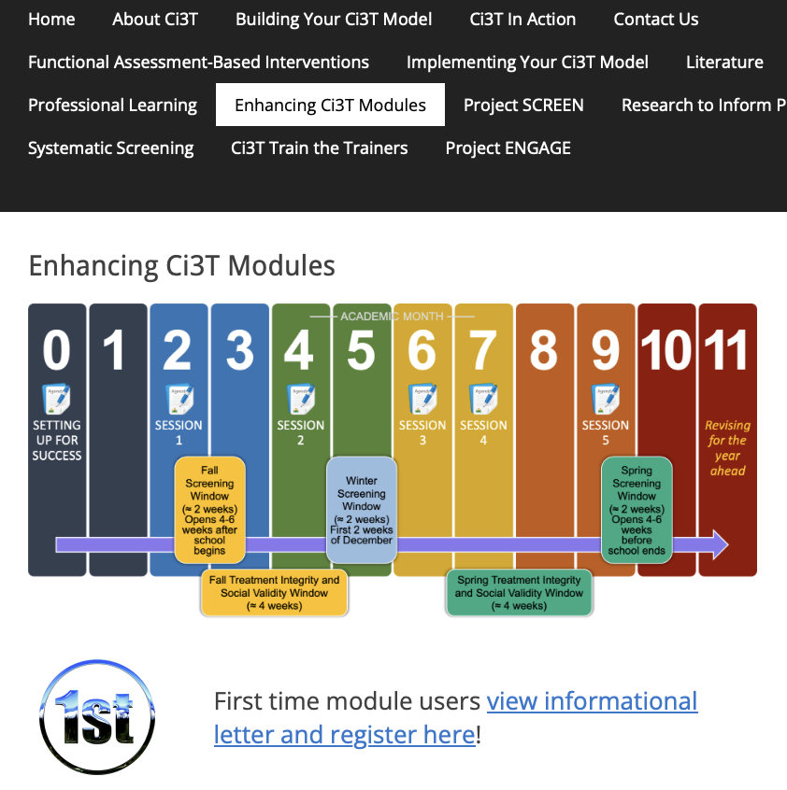
Practical, Research-based, On-Demand Professional Learning Resources for Supporting Productive K-12 Environments: New Free-Access Ci3T Resources!
Kathleen Lynne Lane, Ph.D., BCBA-D, CF-L2
Elise Sarasin, M.S.E.
University of Kansas
If you have not done so already, we invite you to visit ci3t.org/enhance to access modules after a one-time registration process!
This project was funded in part by Project EPIC (USDE, OSEP Award Number: H325D220011) and Project ENHANCE (IES Project Number R324N190002)

Slide 2
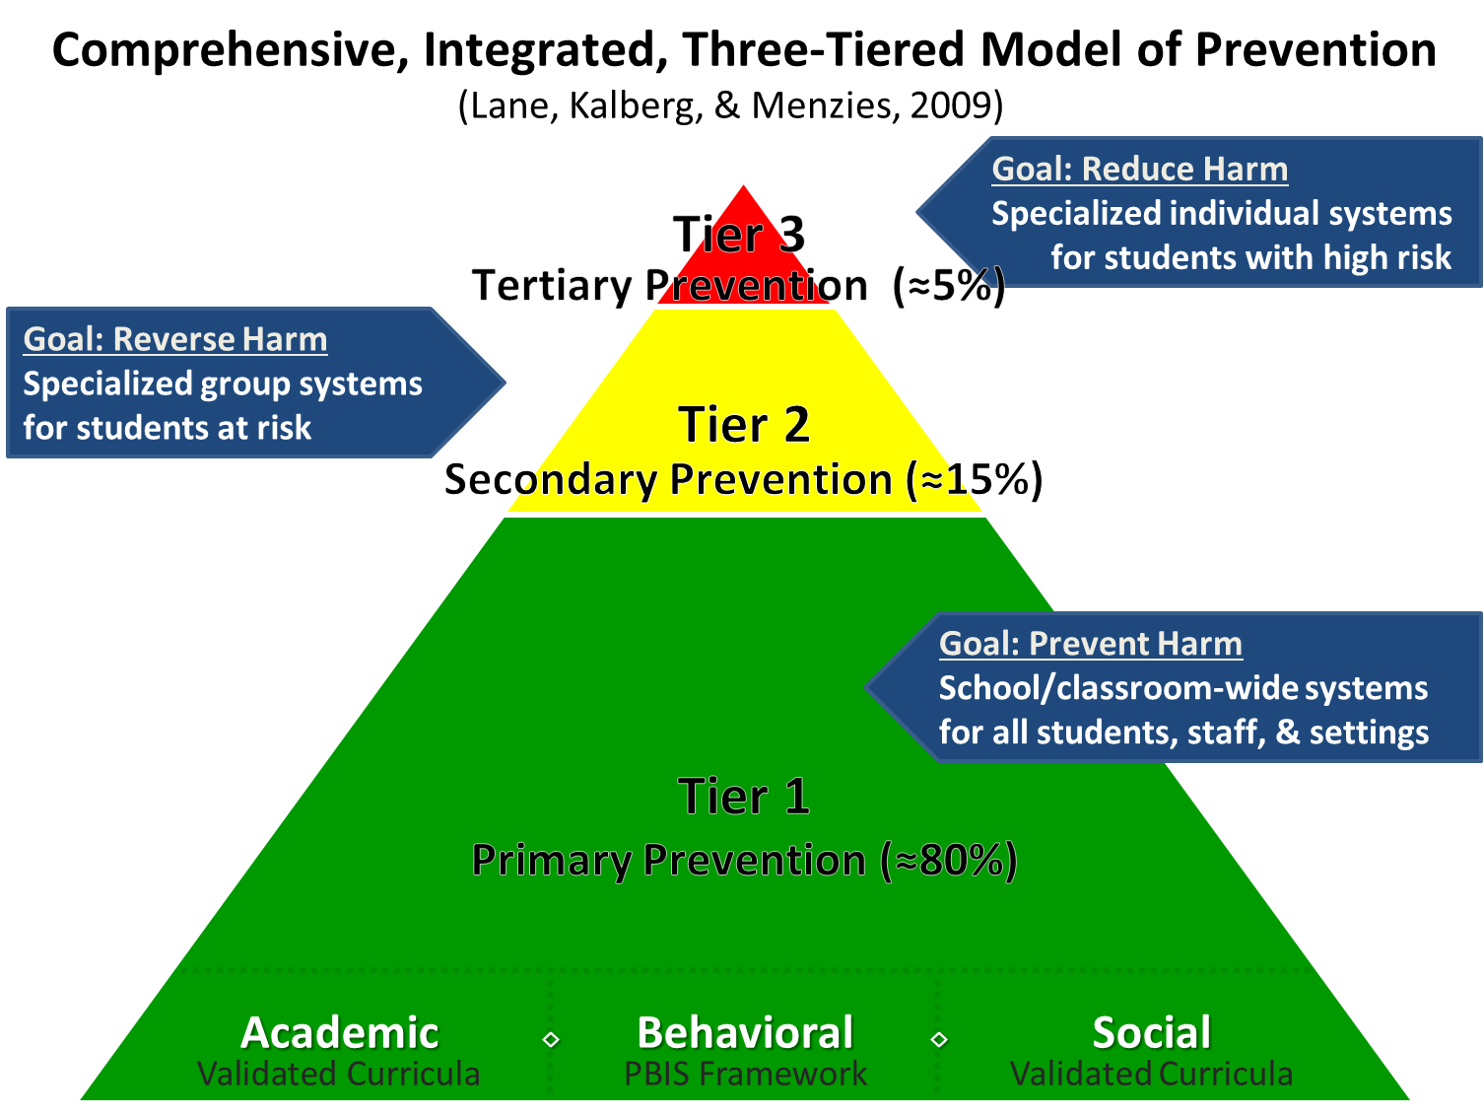
Comprehensive, Integrated, Three-Tiered Model of Prevention

Slide 3
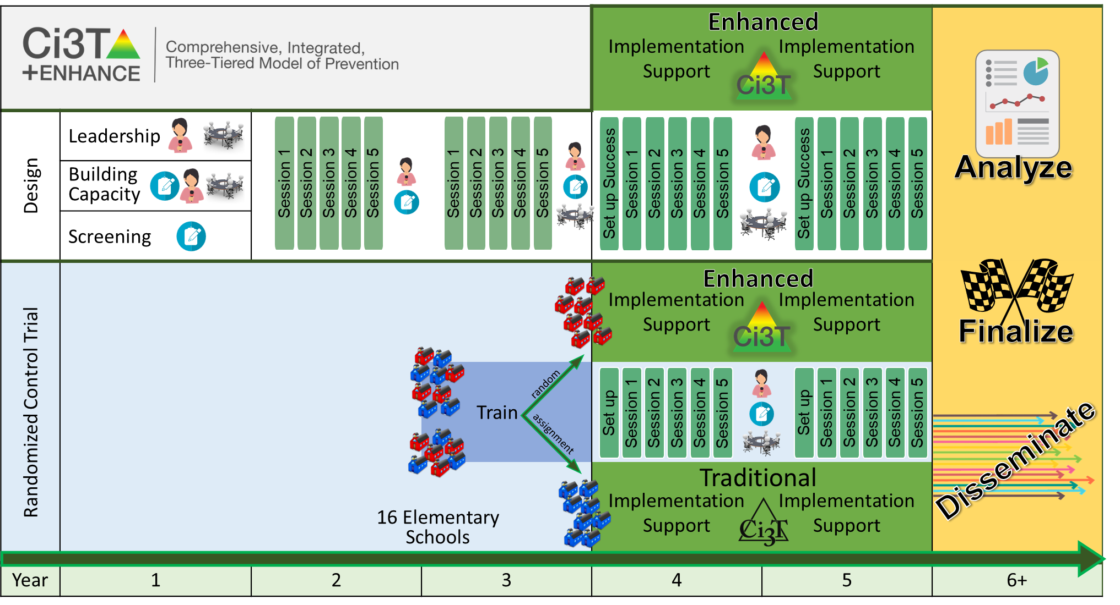
Ci3T Enhance Diagram

Slide 4
Year 1

Slide 5


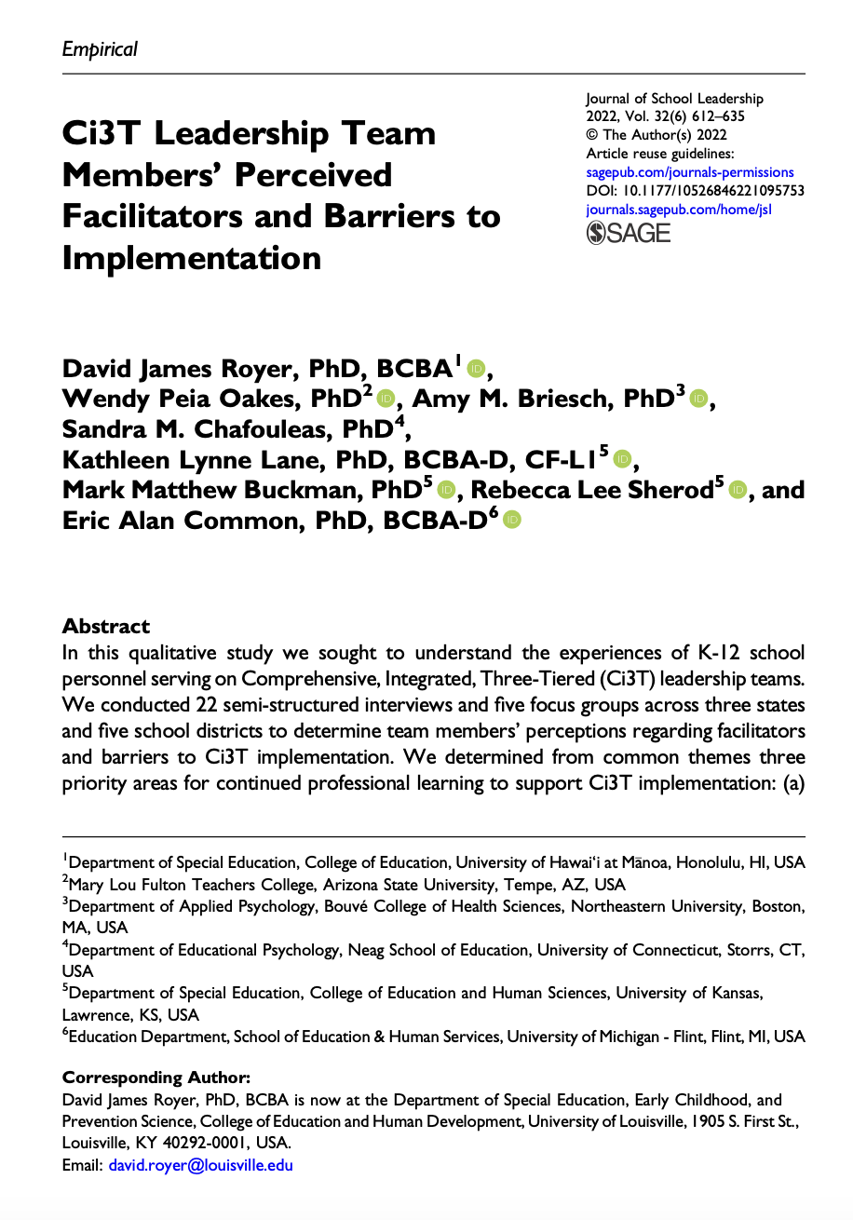
Leadership: District and School Leadership Resource Needs
Top Leadership Needs
Onboarding and Training
Communicating the Vision of Ci3T
Providing Professional Learning for Faculty and Staff
Royer, D. J., Oakes, W. P., Briesch, A. M., Chafouleas, S. M., Lane, K. L., Buckman, M. M., Sherod, R. L., & Common, E. A. (2021). Ci3T Leadership Team Members’ perceived facilitators and barriers to implementation. Journal of School Leadership, 32(6). https://doi.org/10.1177/10526846221095753

Slide 6

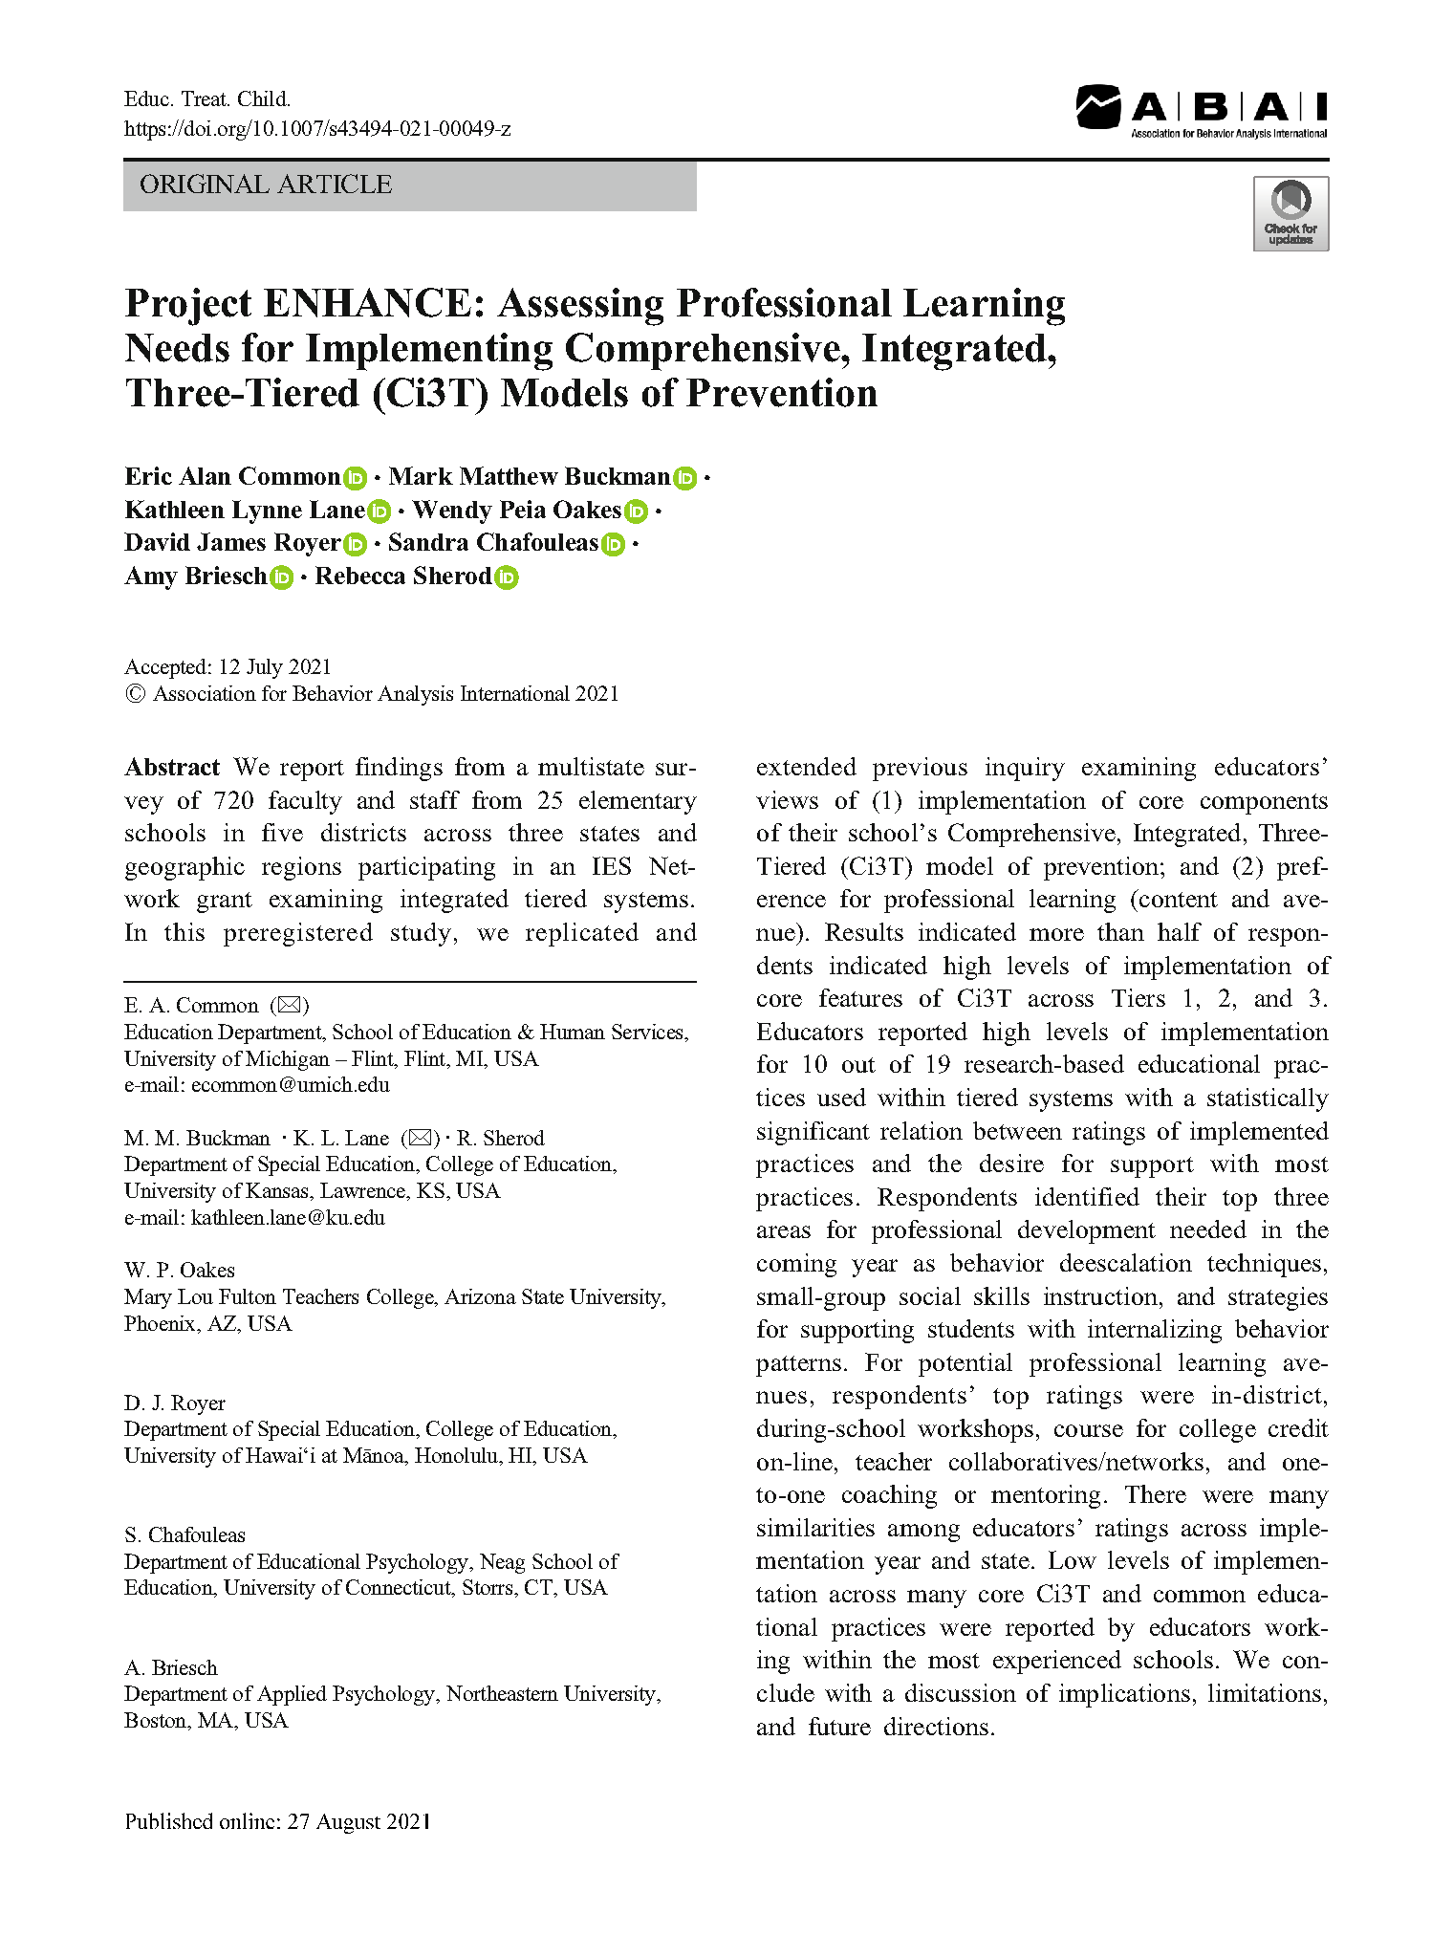
Building Capacity: Assessing Professional Learning Needs
Top Professional
Learning Needs
De-escalation techniques
Social skill instruction
Supports for students with internalizing behavior patterns
Common, E. A., Buckman, M. M., Lane, K. L., Oakes, W. P., Royer, D. J., Chafouleas, S., Briesch, A., & Sherod, R. (2021). Project ENHANCE: Assessing Professional Learning Needs for Implementing Comprehensive, Integrated, Three-Tiered (Ci3T) Models of Prevention. Education and Treatment of Children. https://doi.org/10.1007/s43494-021-00049-z

Slide 7
Building Capacity: Assessing Professional Learning Avenue Preferences
Preferred Professional
Learning Avenues
In-district workshops
(during school hours)
Online courses for college credit
Teacher collaborative networks
Asynchronous opportunities
(e.g., web-based modules, webinars)
Common, E. A., Buckman, M. M., Lane, K. L., Oakes, W. P., Royer, D. J., Chafouleas, S., Briesch, A., & Sherod, R. (2021). Project ENHANCE: Assessing Professional Learning Needs for Implementing Comprehensive, Integrated, Three-Tiered (Ci3T) Models of Prevention. Education and Treatment of Children. https://doi.org/10.1007/s43494-021-00049-z

Slide 8
Year 2 and 3

Slide 9
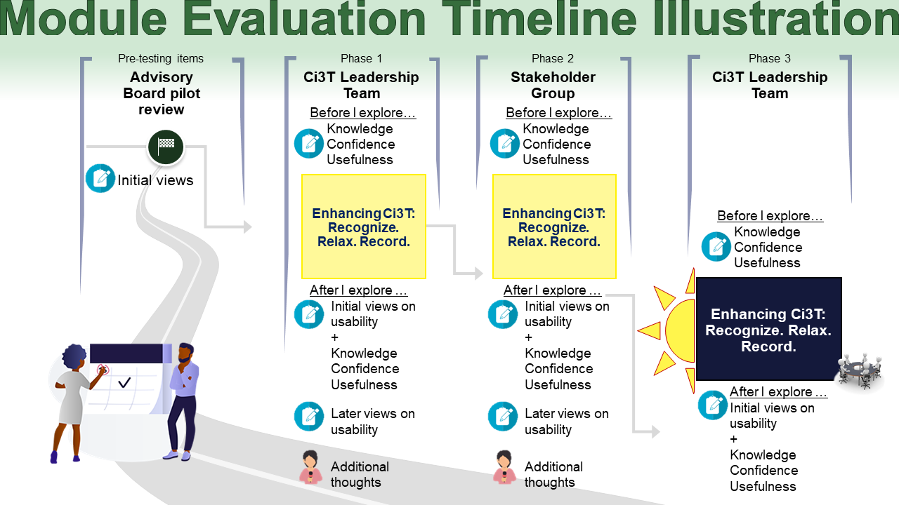
Module Evaluation Timeline Illustration

Slide 10
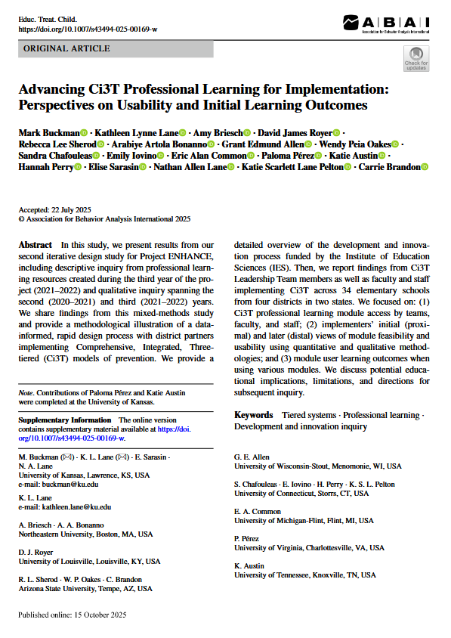
High Levels of Acceptability & Feasibility
Appreciation for variety of formats (e.g., infographics, videos) and examples (e.g., real-world examples, tips)
Ci3T Leadership Teams used modules in their school-based professional learning
Greatest interest in Enhancing Ci3T Modules aimed at supporting student behavior and Tier 2 interventions
Buckman, M. M., Lane, K. L., Briesch, A., Royer, D. J., Sherod, R. L., Artola Bonanno, A., Allen, G. E., Oakes, W. P., Chafouleas, S., Iovino, E., Common, E. A., Pérez, P., Austin, K., Perry, H., Sarasin, E., Lane, N. A., Pelton, K. S., L., Brandon, C. (2025). Advancing Ci3T professional learning for implementation: Perspectives on usability and initial learning outcomes. Education and Treatment of Children. Advance online publication. https://doi.org/10.1007/s43494-025-00169-w
Notes:
Ci3T Leadership Teams indicated high levels of acceptability, feasibility, and understanding of content across Enhancing Ci3T Modules as expressed in interviews and focus groups and Ci3T Usage Rating Profile.
In addition to reports of integrating modules into school-based PL, module usage patterns reflected professional learning dates (e.g., district-professional learning days, Ci3T Implementation and Delivery offerings)
Greatest interest in Enhancing Ci3T Modules aimed at supporting student behavior and Tier 2 interventions

Slide 11
Year 4 and 5

Slide 12
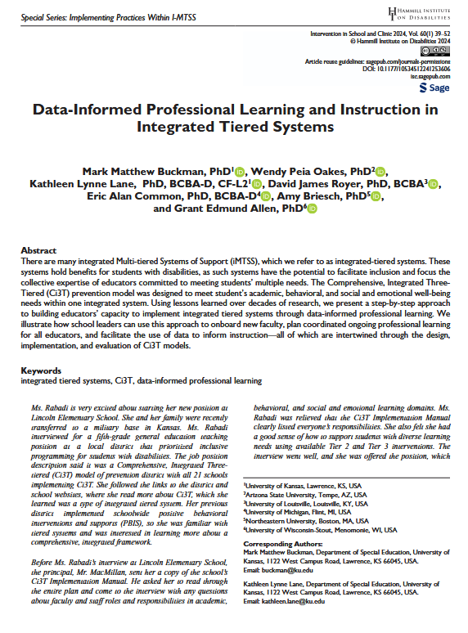



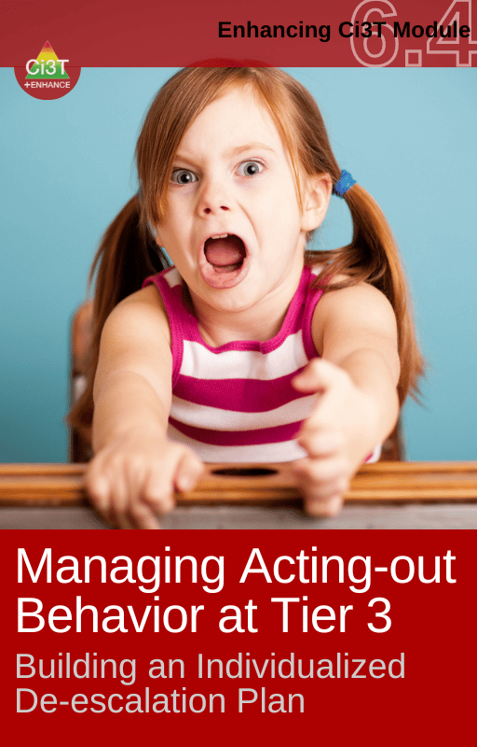
E-Ci3T Implementation Series and Delivery: Module Access
Buckman, M. M., Oakes, W. P., Lane, K. L., James Royer, D., Common, E. A., Briesch, A., & Allen, G. E. (2024). Data-Informed Professional Learning and Instruction in Integrated Tiered Systems. Intervention in School and Clinic, 60(1), 39-52.https://doi.org/10.1177/10534512241253606
Notes:
The most accessed modules for both new and seasoned implementers tended to be behaviorally focused, particularly at Tier 1
Pattern – higher usage for modules featured during Ci3T ISD sessions (builds familiarity, encourages repeated use, addresses barrier of time)

Slide 13
Enhancing Ci3T Modules Overview & Key Features

Slide 14



Enhancing Ci3T Modules
ci3t.org/enhance

Slide 15
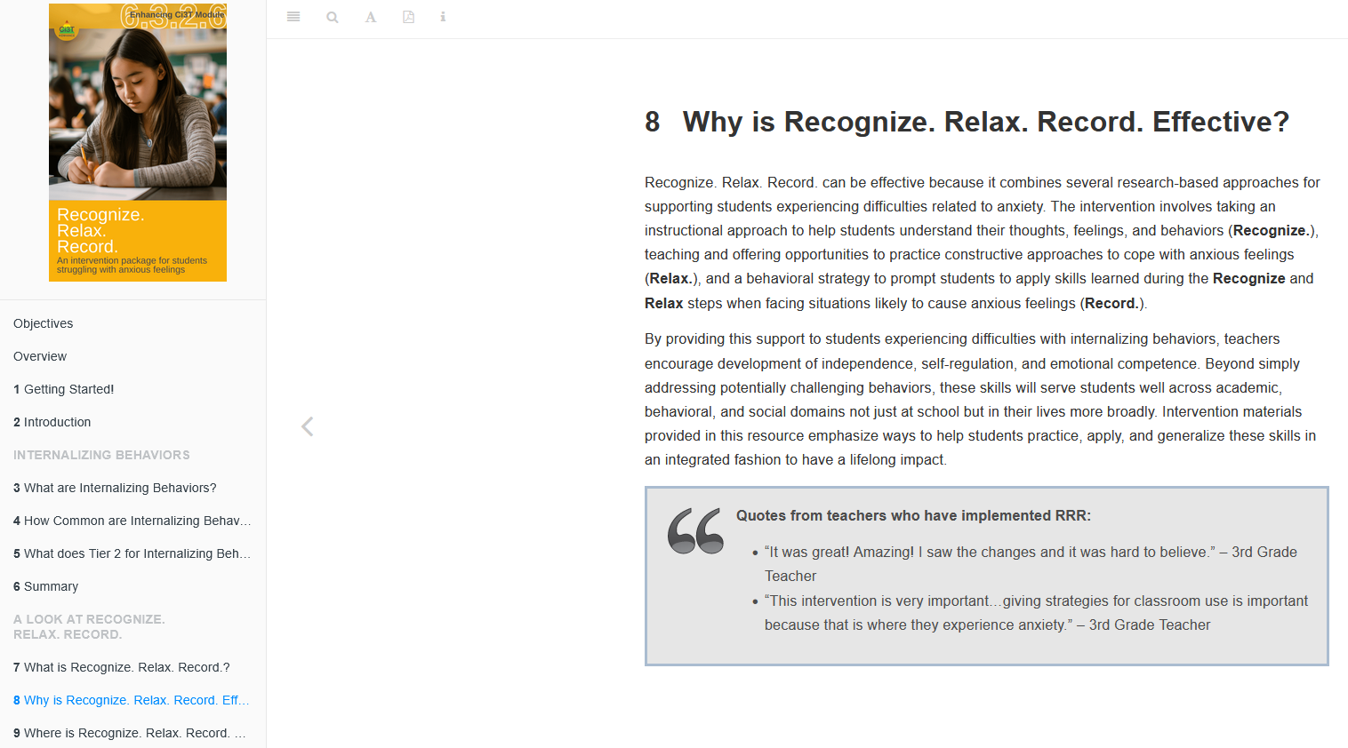
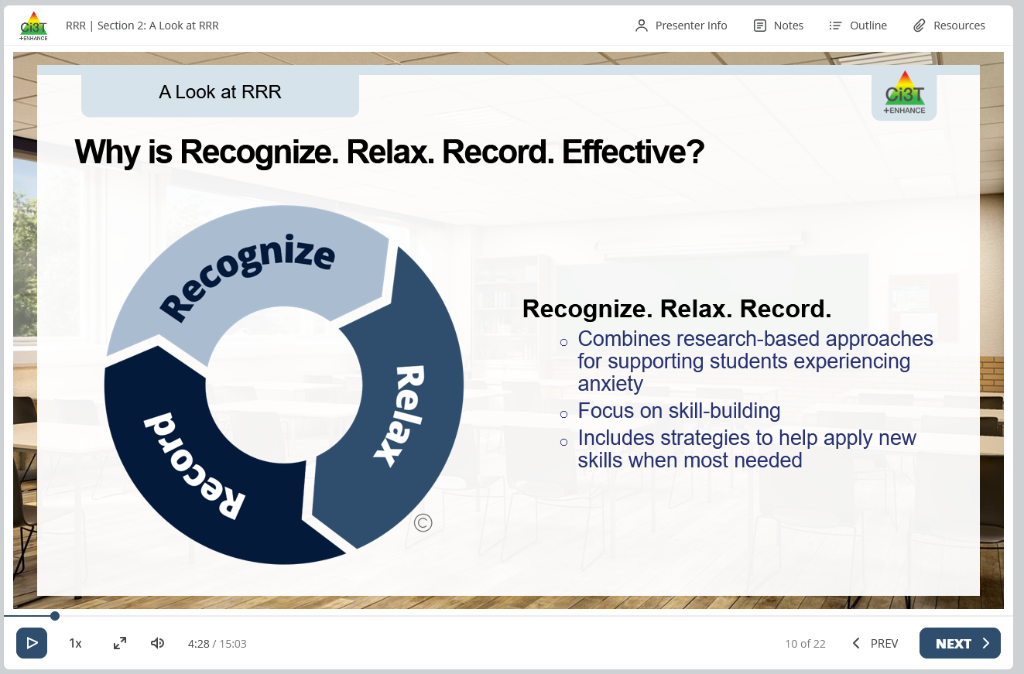
Accessing Module Content
eBook
Interactive Resource

Slide 16
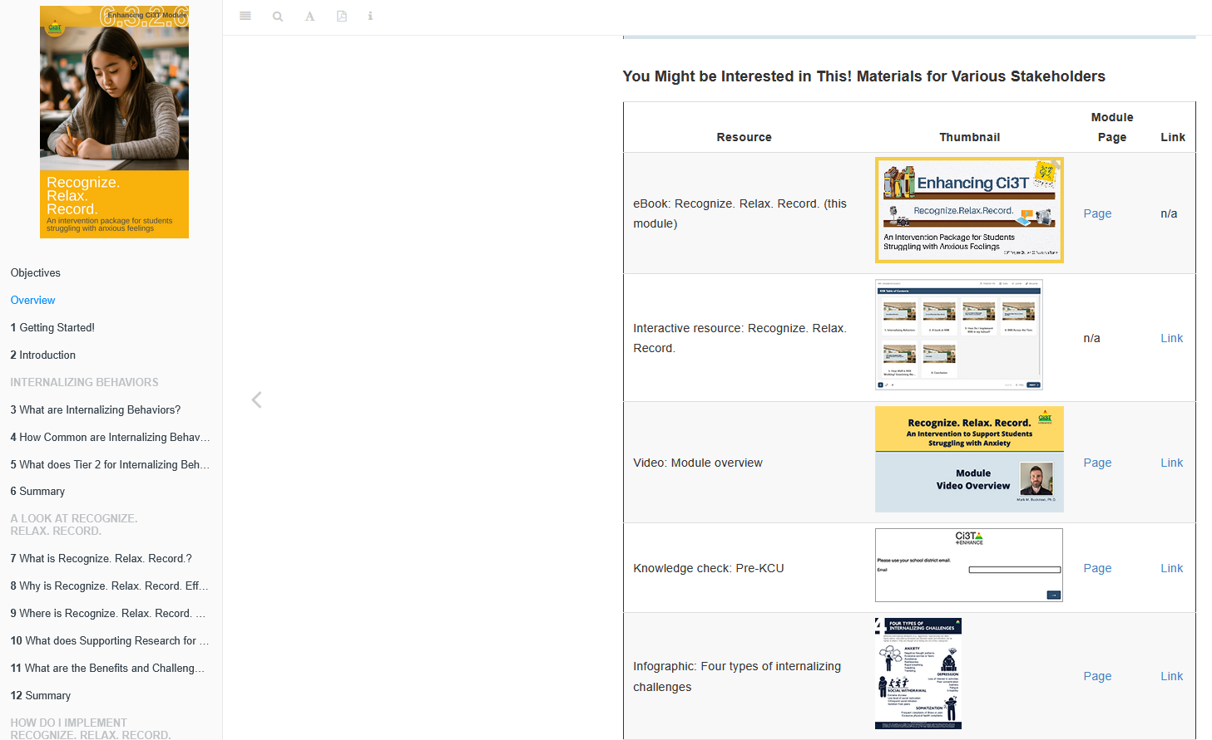
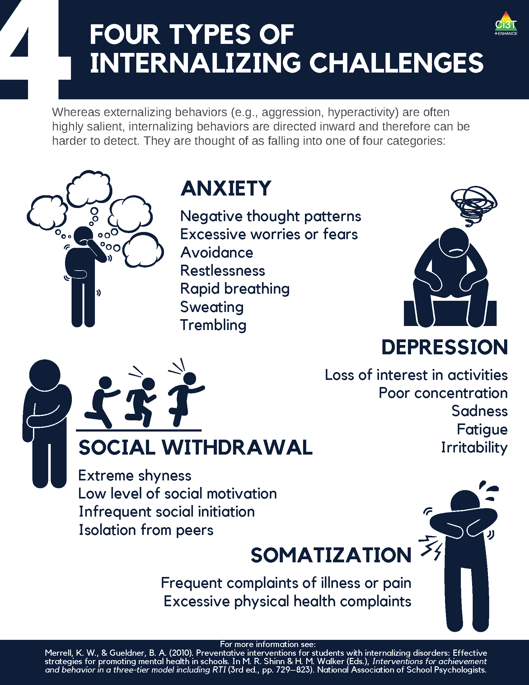
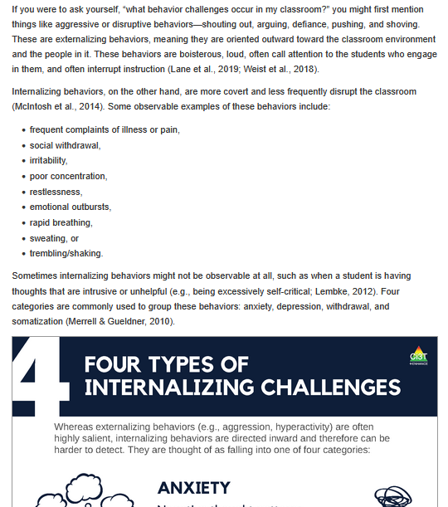
Table of Resources

Slide 17
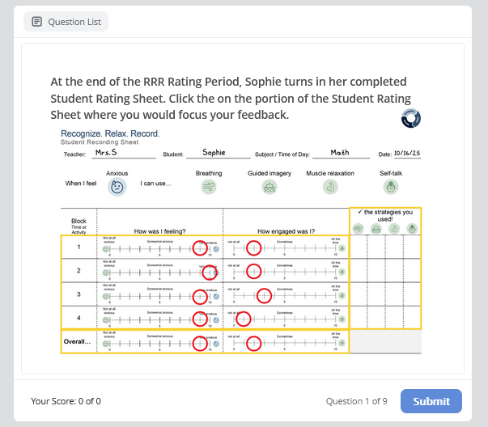
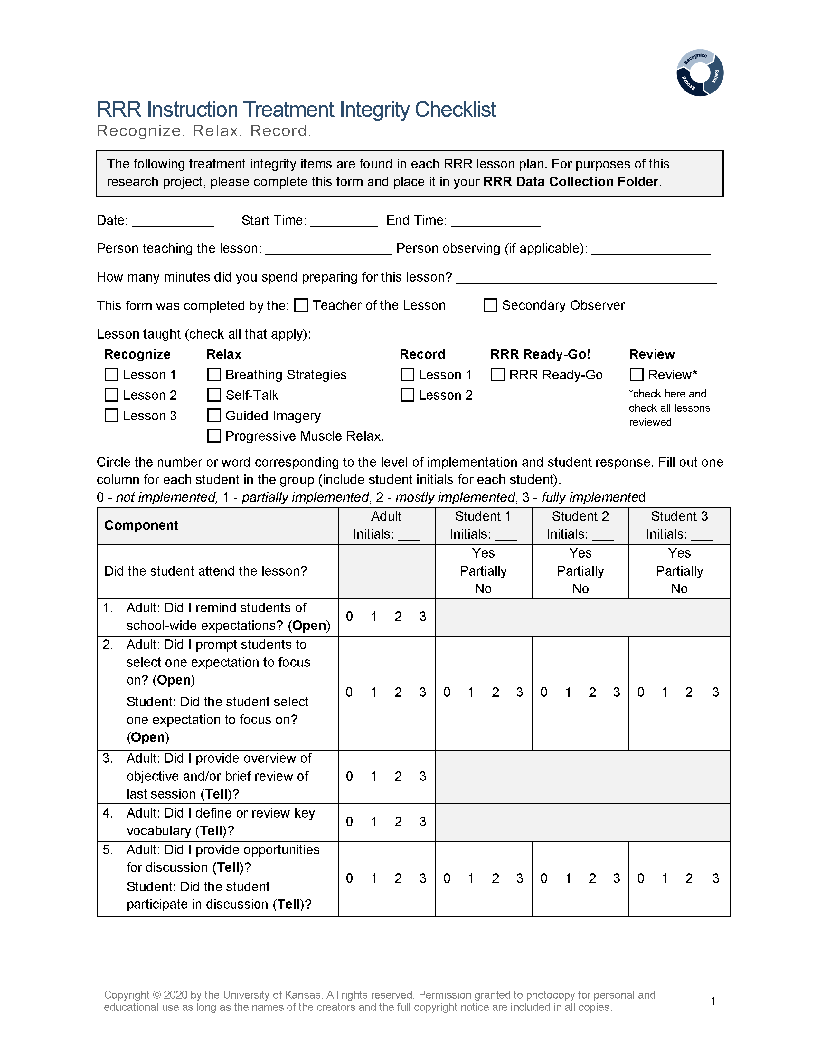
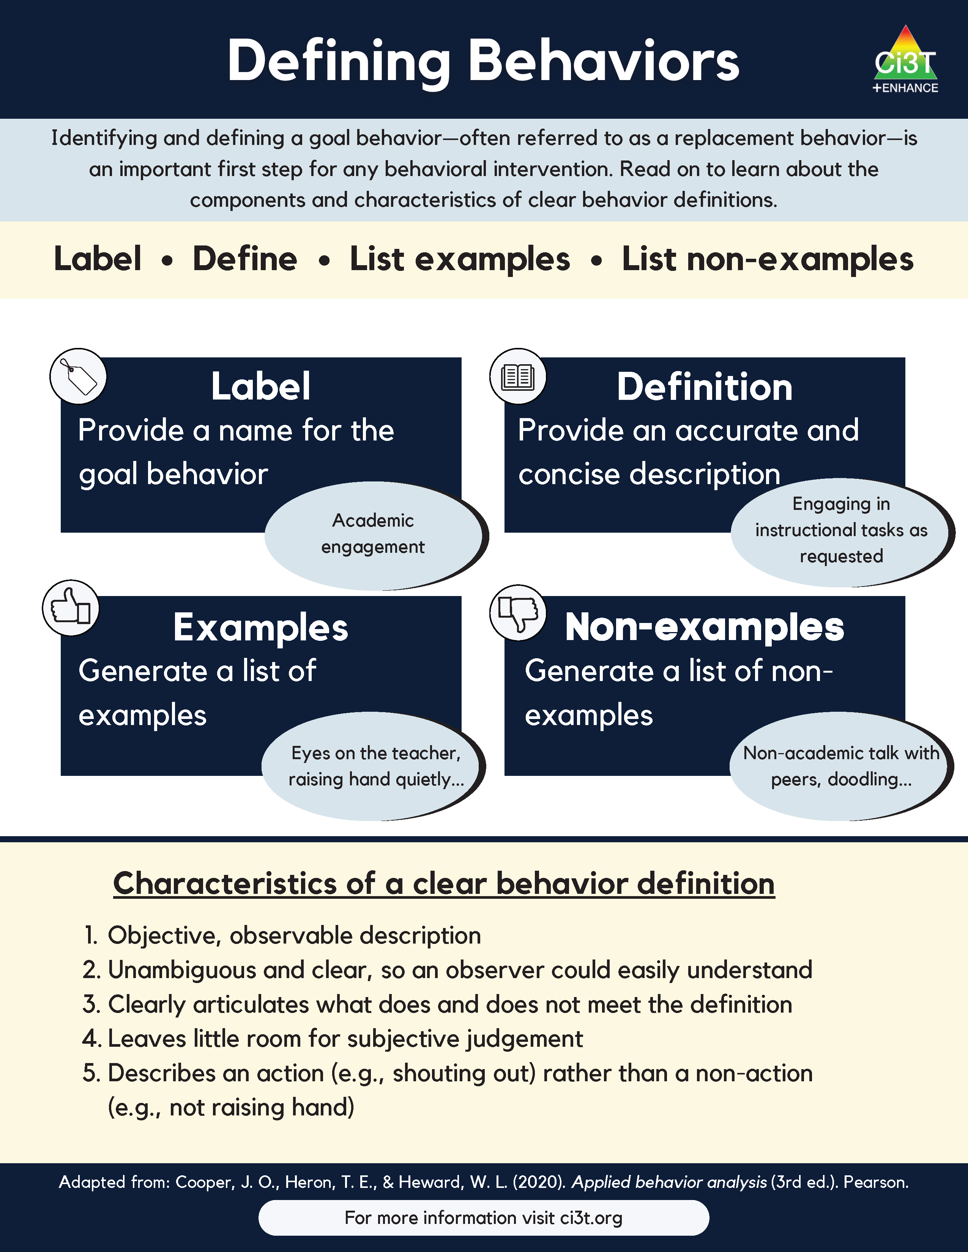
Example Module Resources
infographics
interactive activities and checks for understanding
implementation materials

Slide 18
Opportunities to Embed Enhancing Ci3T Modules into Professional Learning

Slide 19
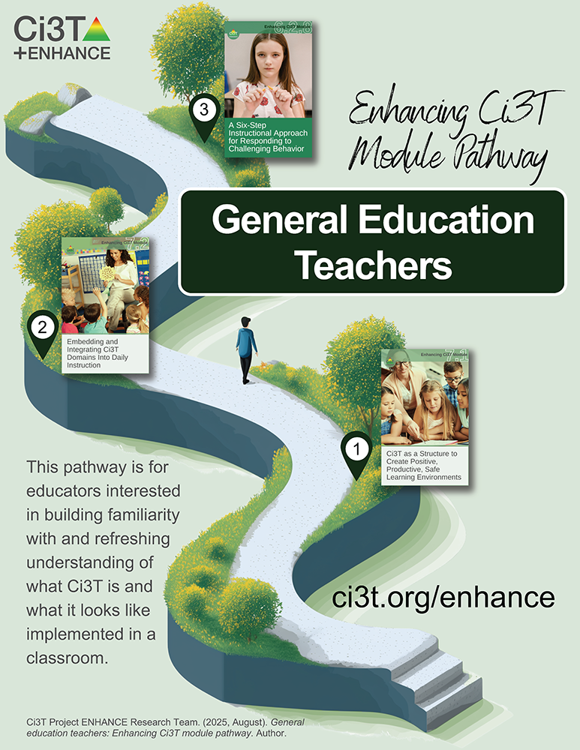
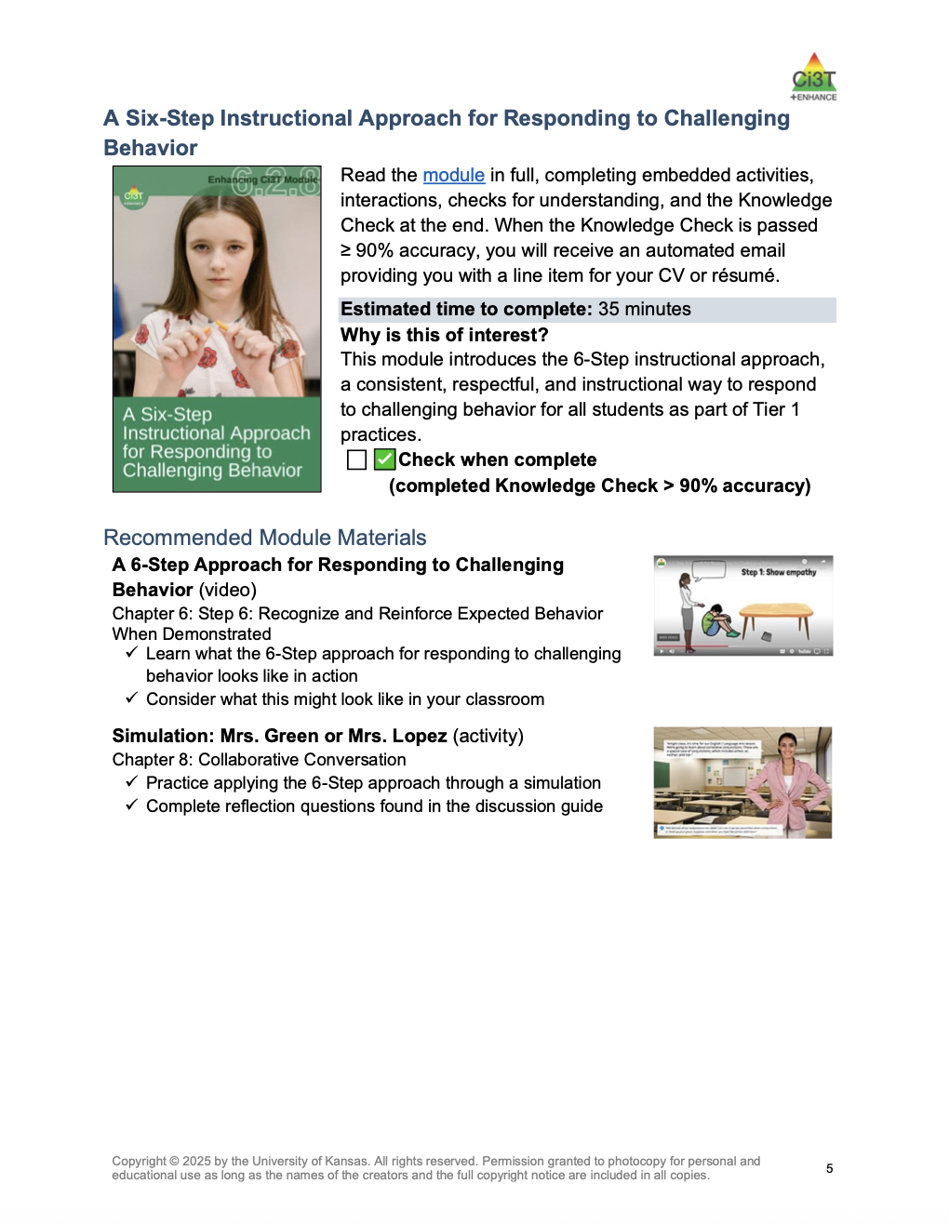
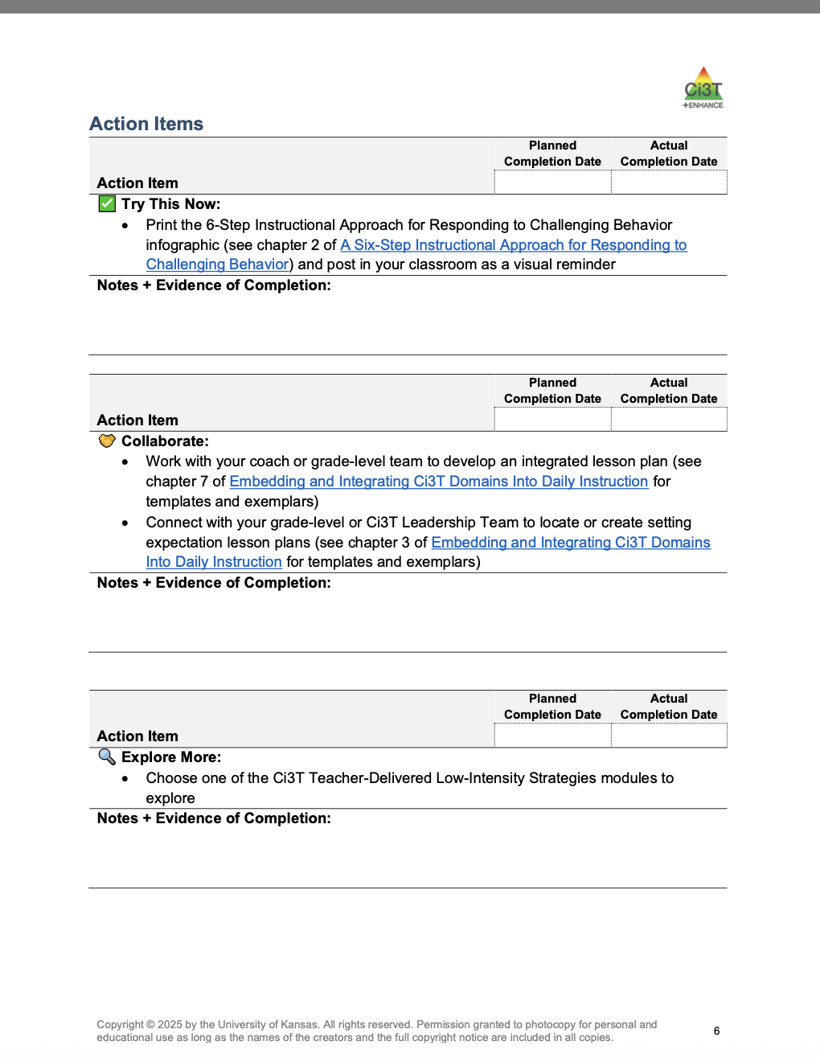
Module Pathways: Independent Journey or Collaborative Learning Experience

Slide 20
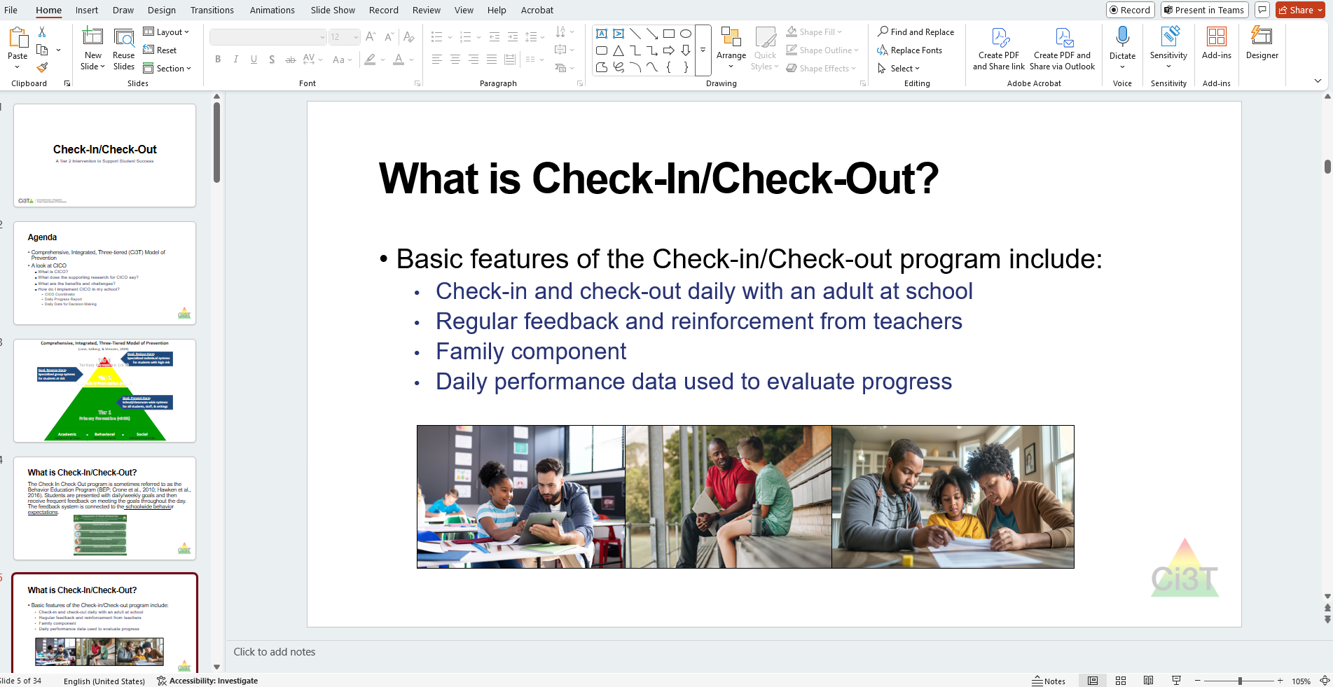
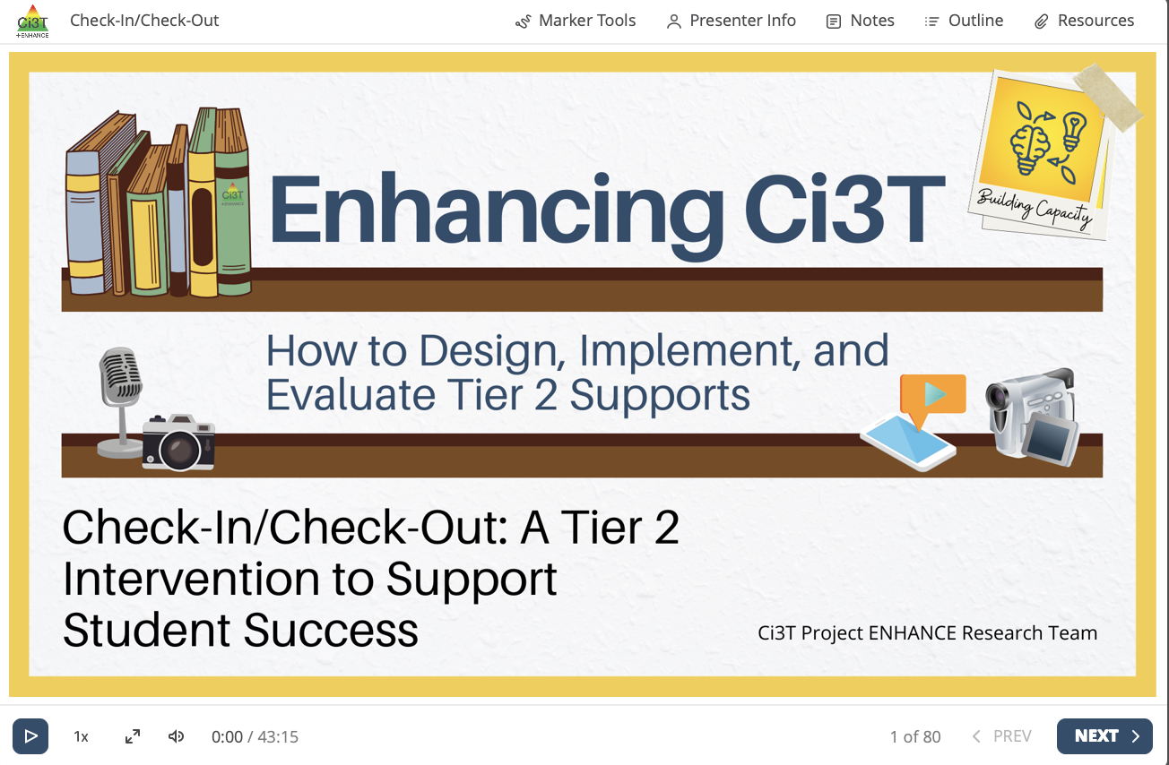
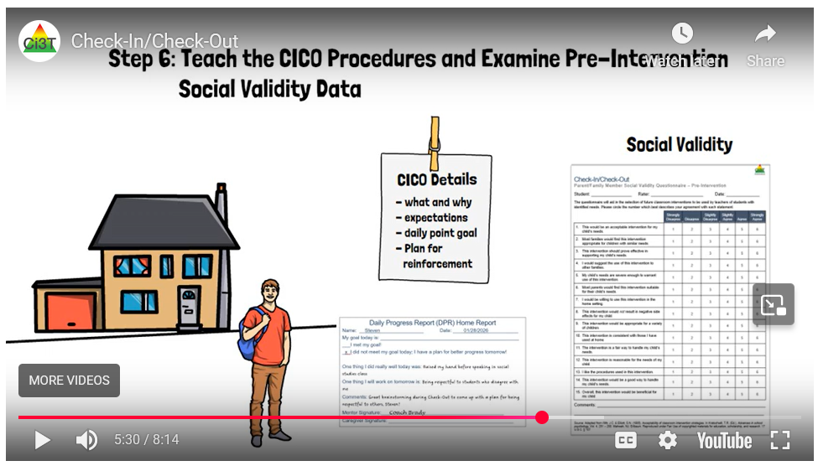
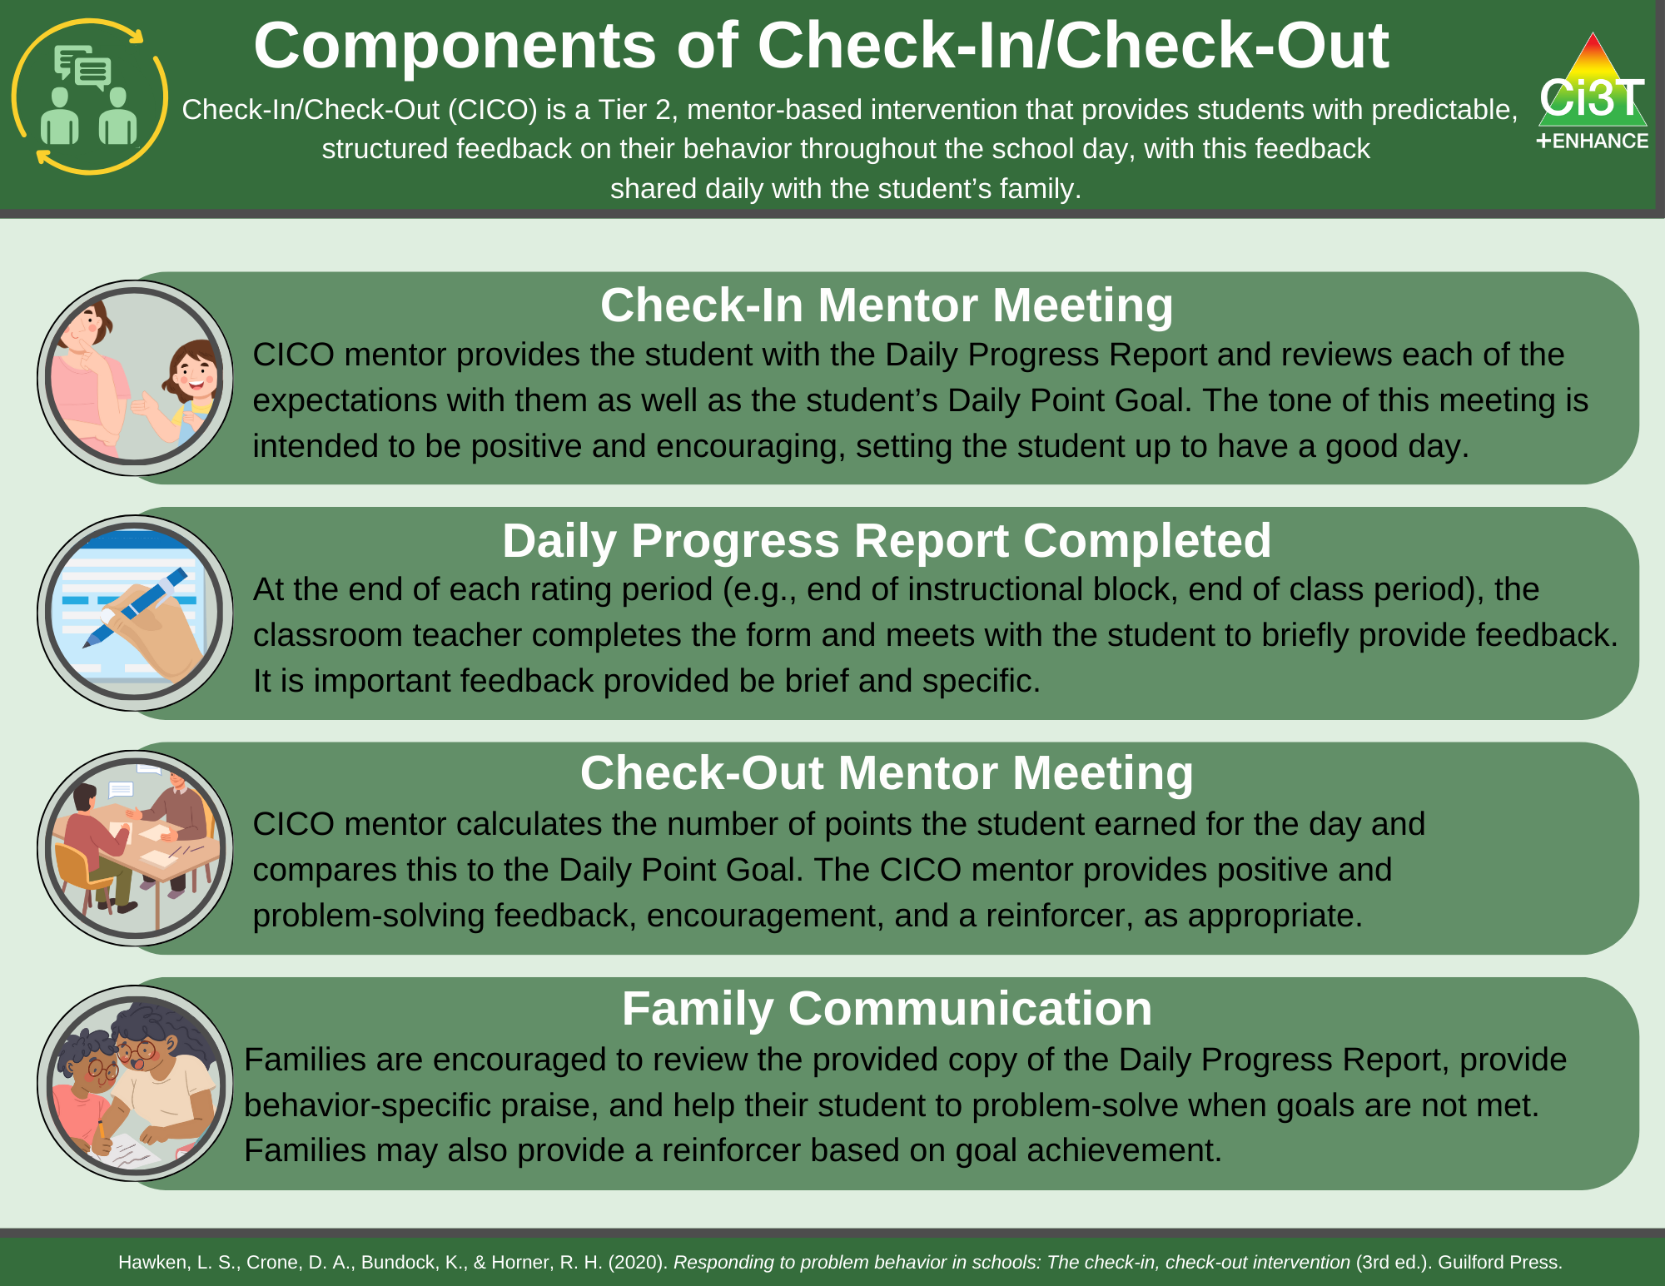
Module Resources As Building Blocks for Stand-Alone Professional Learning Sessions
personalize PowerPoint
play interactive resource
embed module resources

Slide 21
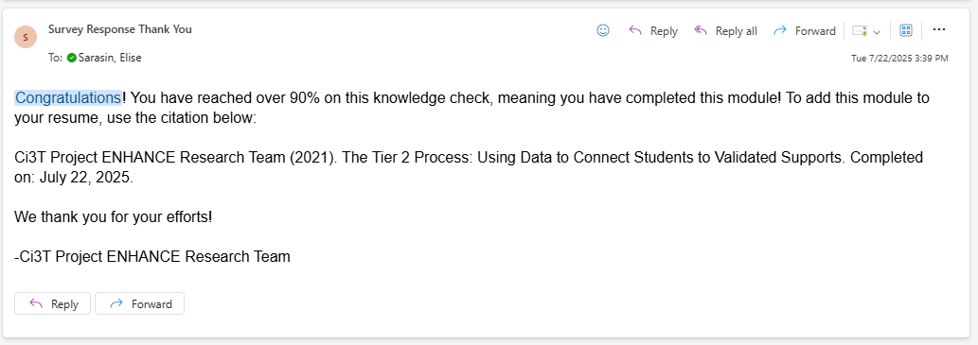
Module Completion as a Course Participation and Engagement Activity

Slide 22
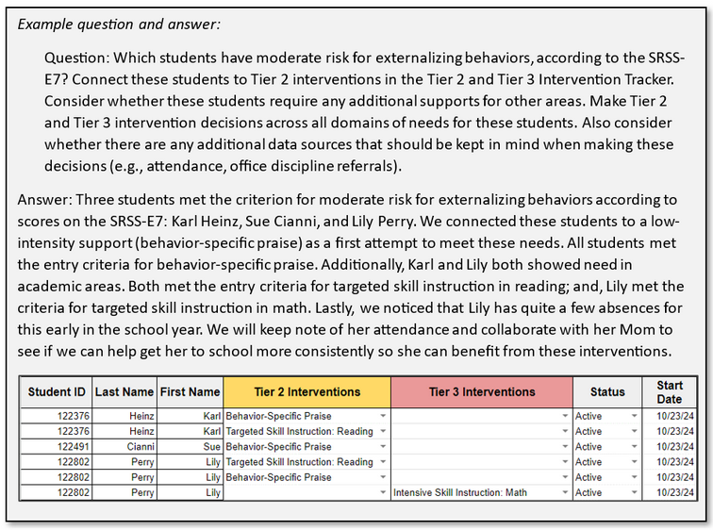
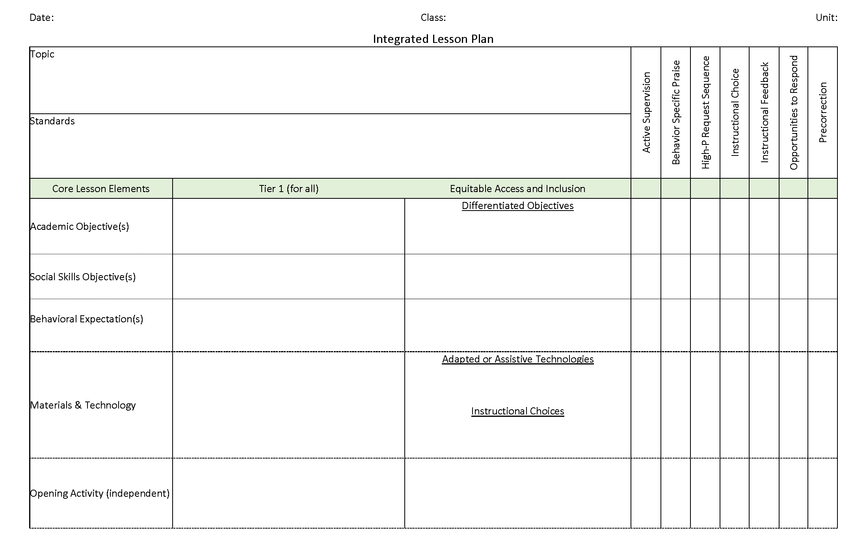


Embedding Modules into Course Assignments
Citation. Oakes, W. P., Lane, K. L., Lane, K. S., & Buckman, M. M. (2019). Ci3T integrated lessons plan template. www.ci3t.org.
Completed examples available in: Ci3T Project ENHANCE Research Team. (2022, July). Embedding and integrating Ci3T domains into daily instruction. Author. https://doi.org/10.17161/ci3t.42880

Slide 23
Thank you!
Kathleen Lynne Lane
Kathleen.lane@ku.edu
Elise Sarasin
elise.Sarasin@ku.edu
ci3t.org/enhance

