Slide 1
How are Elementary Teachers Faring in Ci3T Systems?
Allison M. Bernard, M.Ed., University of Kansas
Rebecca L. Sherod-Adams, M.S.E., Arizona State University
Mark M. Buckman, Ph.D., University of Kansas
Nelson C. Brunsting, Ph.D., University of Florida
David J. Royer, Ph.D., BCBA, University of Louisville
Grant Edmund Allen, Ph.D., University of Wisconsin-Stout
Wendy Peia Oakes, Ph.D., Arizona State University
Kathleen Lynne Lane, Ph.D., BCBA-D, CF-L2, University of Kansas
This project was funded in part by Project EPIC (USDE, OSEP Award Number: H325D220011)
and Project ENHANCE (IES Project Number R324N190002)

Slide 2
Agenda
Overview of Comprehensive, Integrated, Three-Tiered (Ci3T) Model of Prevention
Project ENHANCE
A Preliminary Look
  Elementary Teacher Well-being Beyond Initial Ci3T Implementation
  Elementary Teacher Well-being During Initial Ci3T Implementation
Future Inquiry and Next Steps

Slide 3
Overview of Comprehensive, Integrated, Three-Tiered (Ci3T) Model of Prevention
Notes:
Here’s what we mean by Ci3T, here’s what we have learned: teachers fare well in these systems. Risks shift for students over time, fall scores for screening … teachers fare, ONE slide with outcomes

Slide 4
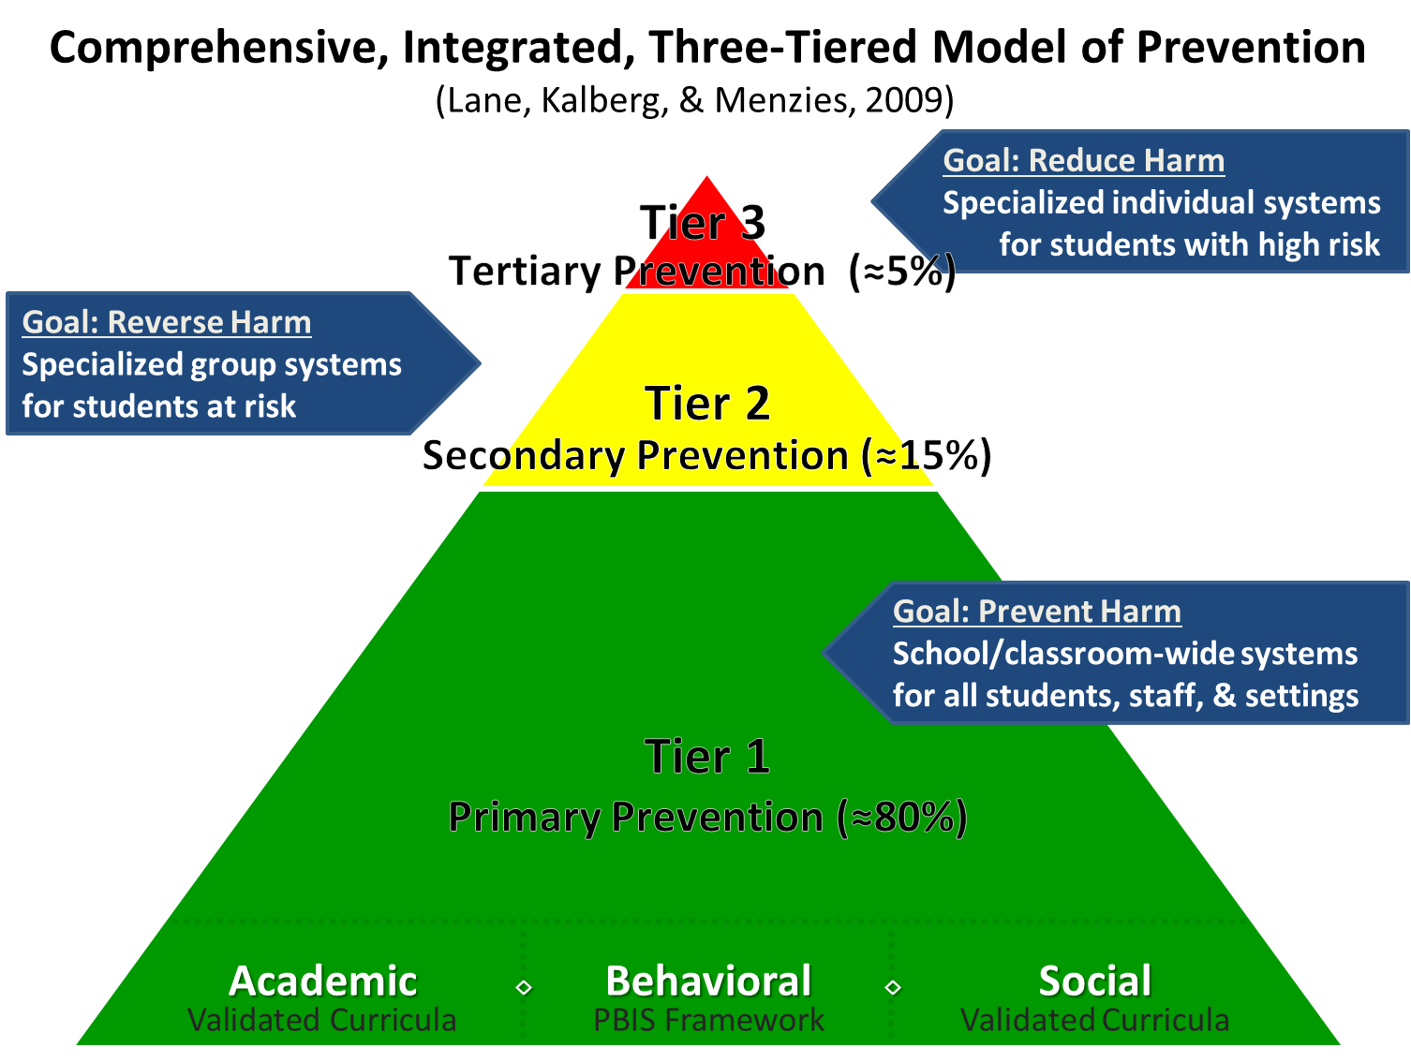
Comprehensive, Integrated, Three-Tiered Model of Prevention 1
Notes:
Here’s what we mean by Ci3T, here’s what we have learned: teachers fare well in these systems. Risks shift for students over time, fall scores for screening … teachers fare, ONE slide with outcomes

Slide 5
Project ENHANCE

Slide 6

Project Enhance Map

Slide 7
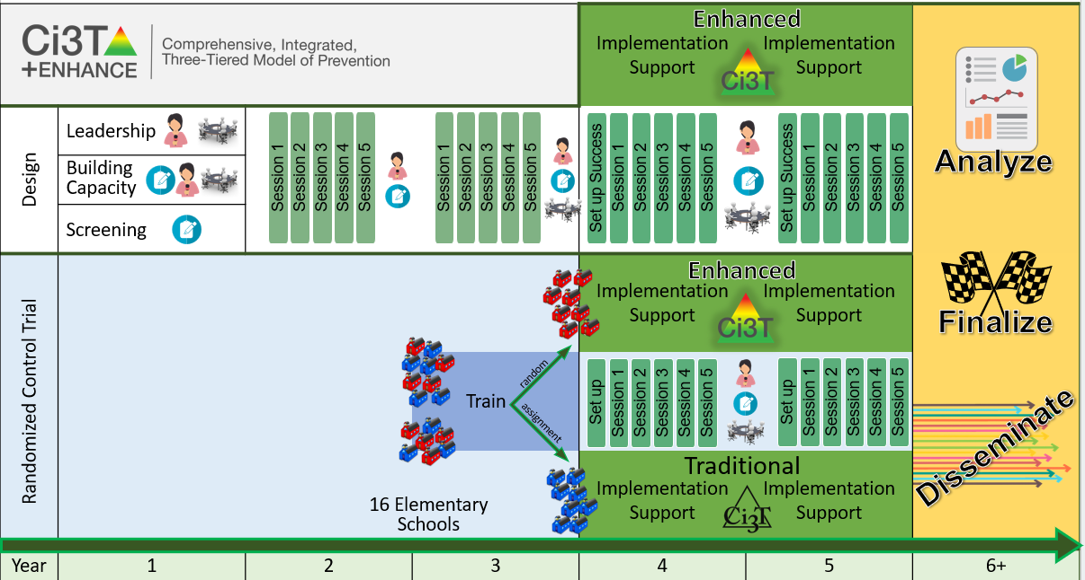
Ci3T Project Enhance

Slide 8
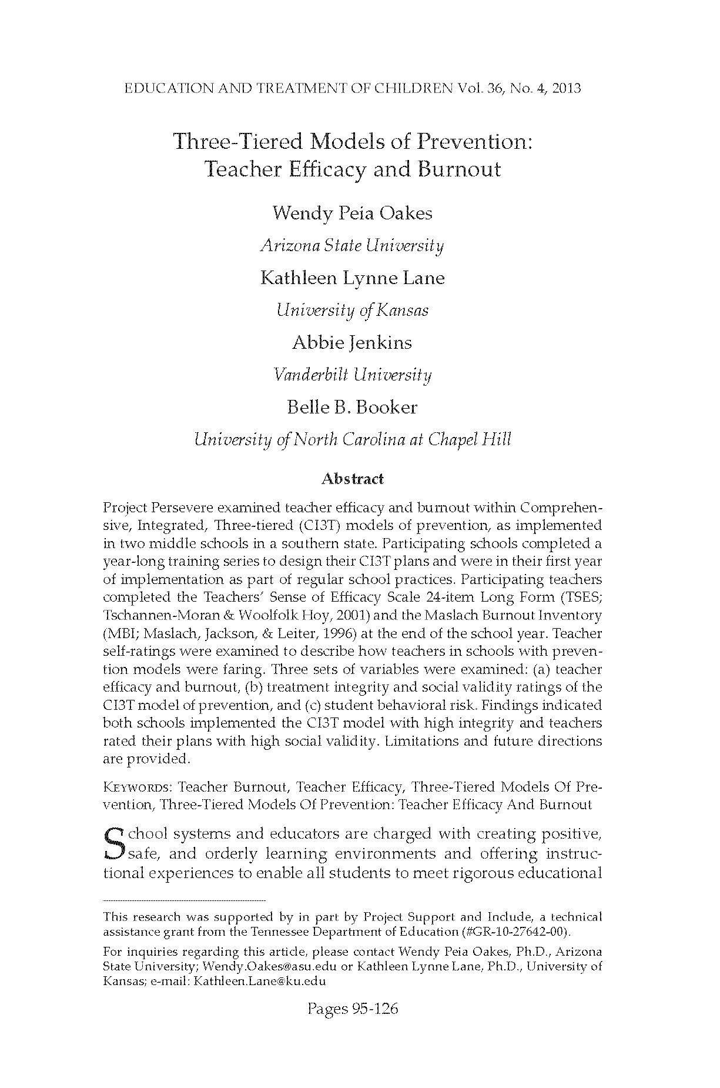

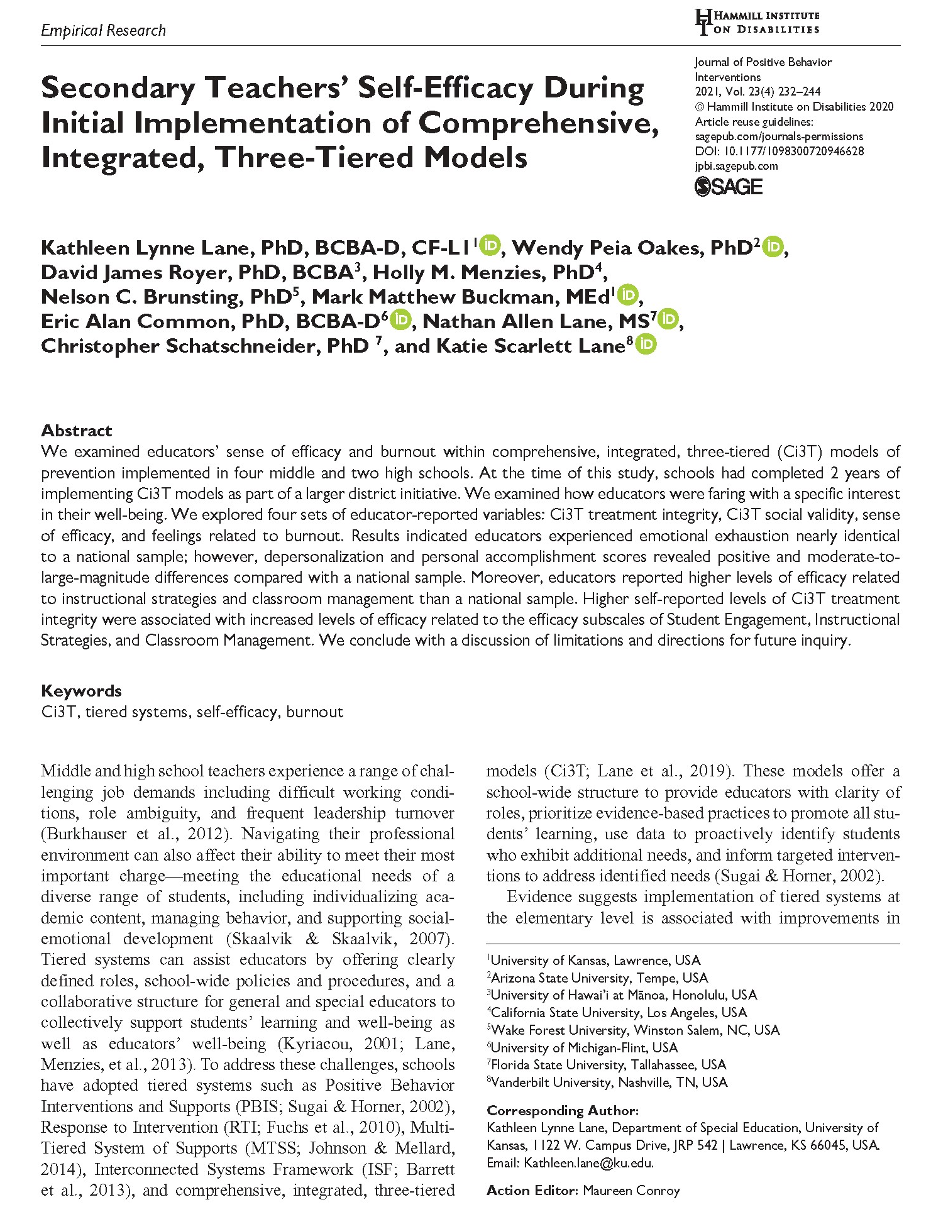
Teacher Well-being: What we know
Oakes et al. (2013)
Oakes et al. (2021)
Lane et al. (2021)
Notes:
Teacher well-being: What we know. Objective 2: Determine impact of E-Ci3T Implementation Series and Delivery on teacher outcomes for individual schools at different stages of implementation

Slide 9

A Preliminary Look:
Teacher Well-being Beyond Initial Ci3T Implementation
Study 2 – Exploring
Enhanced-Ci3T Implementation Series and Delivery
Notes:
Novice implementers in Traditional and Enhanced conditions

Slide 10
Research Questions
Research Questions 1
To what extent did elementary educators working in schools with experience implementing Ci3T report feelings of emotional exhaustion, depersonalization, and personal accomplishment?
  When compared to a National sample (1996)?
  When compared to Oakes et al. (2021)?
To what extent did elementary educators working in schools with experience implementing Ci3T report feelings of teacher self-efficacy?
  When compared to a National sample (1996)?
  When compared to Oakes et al. (2021)?
Notes:
RQ 2.1: To what extent do E-Ci3T teachers at schools in different stages of implementation differ in their level and change over time in Ci3T implementation (treatment integrity), social validity, burnout, and efficacy when controlling for baseline (fall 2022) differences?
To what extent do educator burnout, self-efficacy, and social validity ratings influence educators implementation at both the within and between person levels?

Slide 11
Method: Procedures
Method: Procedures 1
Three-week window at each timepoint where educators could complete the survey ​
Surveys sent out electronically with Qualtrics​
Three follow-up prompts for each timepoint were given ​
    One week after send date​
    Two weeks after send date​
    One day before window closed
Fall 2022
(timepoint 1)
Spring 2023
(timepoint 2)
Fall 2023
(timepoint 3)
Spring 2024
(timepoint 4)
Notes:
This is when we sent them out

Slide 12
Method: Measures
Method: Measures 1
Maslach Burnout Inventory – Educators’ Survey (MBI; Maslach et al., 1996)
Teacher Self-Efficacy Scale – long form
(TSES; Tschannen-Moran & Woolfolk Hoy, 2001)
Teacher completed
22-item scale
Measures
  Emotional exhaustion
  Depersonalization
  Personal accomplishment
Scale responses are 0 (never) to 6 (every day)
Teacher completed
24-item scale
Subscales
  Student engagement
  Instructional strategies
  Classroom management
Item responses range from 0 (nothing/not at all) to 9 (a great deal)
Notes:
We used two measures to look at burnout and efficacy

Slide 13
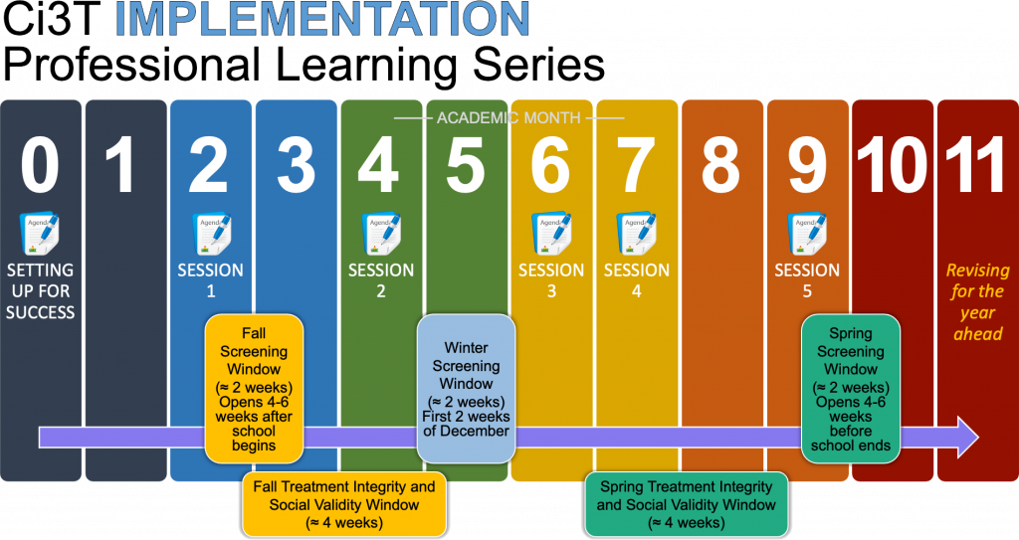


Discussion
Discussion 1
Burnout
Efficacy

Slide 14


A Preliminary Look:
Teacher Well-being During Initial Ci3T Implementation
Study 2 – Traditional Ci3T vs. Enhanced Ci3T
Notes:
Novice implementers in Traditional and Enhanced conditions

Slide 15
Research Questions
Research Questions 2
To what extent did elementary educators working in schools during initial implementation of Ci3T report feelings of emotional exhaustion, depersonalization, and personal accomplishment?
  When compared to a National sample (1996)?
  When compared to Oakes et al. (2021)?
To what extent did elementary educators working in schools during initial implementation of Ci3T report feelings of teacher self-efficacy?
  When compared to a National sample (1996)?
  When compared to Oakes et al. (2021)?

Slide 16
Method: Procedures
Method: Procedures 2
Three-week window at each timepoint where educators could complete the survey ​
Surveys sent out electronically with Qualtrics​
Three follow-up prompts at each timepoint were given ​
    One week after send date​
    Two weeks after send date​
    One day before window closed
Fall 2022
(timepoint 1)
Spring 2023
(timepoint 2)
Fall 2023
(timepoint 3)
Spring 2024
(timepoint 4)
Notes:
This is when we sent them out

Slide 17
Method: Measures
Method: Measures 2
Maslach Burnout Inventory – Educators’ Survey (MBI; Maslach et al., 1996)
Teacher Self-Efficacy Scale – long form (TSES; Tschannen-Moran & Woolfolk Hoy, 2001)
Teacher completed
22-item scale
Measures
  Emotional exhaustion
  Depersonalization
  Personal accomplishment
Scale responses are 0 (never) to 6 (every day)
Teacher completed
24-item scale
Subscales
  Student engagement
  Instructional strategies
  Classroom management
Item responses range from 0 (nothing/not at all) to 9 (a great deal)
Notes:
We used two measures to look at burnout and efficacy

Slide 18
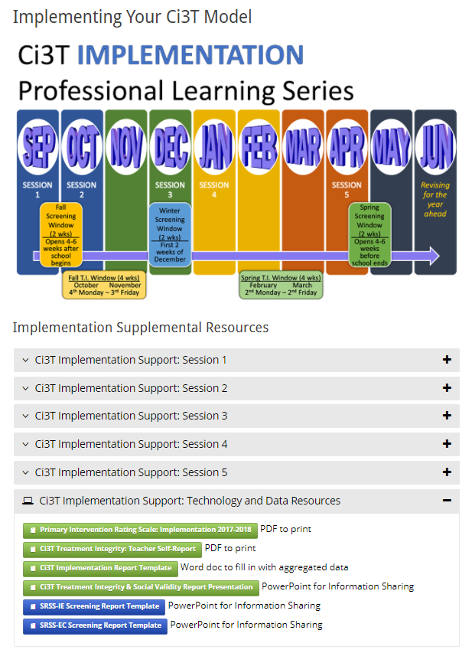
Discussion
Discussion 2
Burnout
Efficacy
ci3t.org/enhance
Traditional

Slide 19

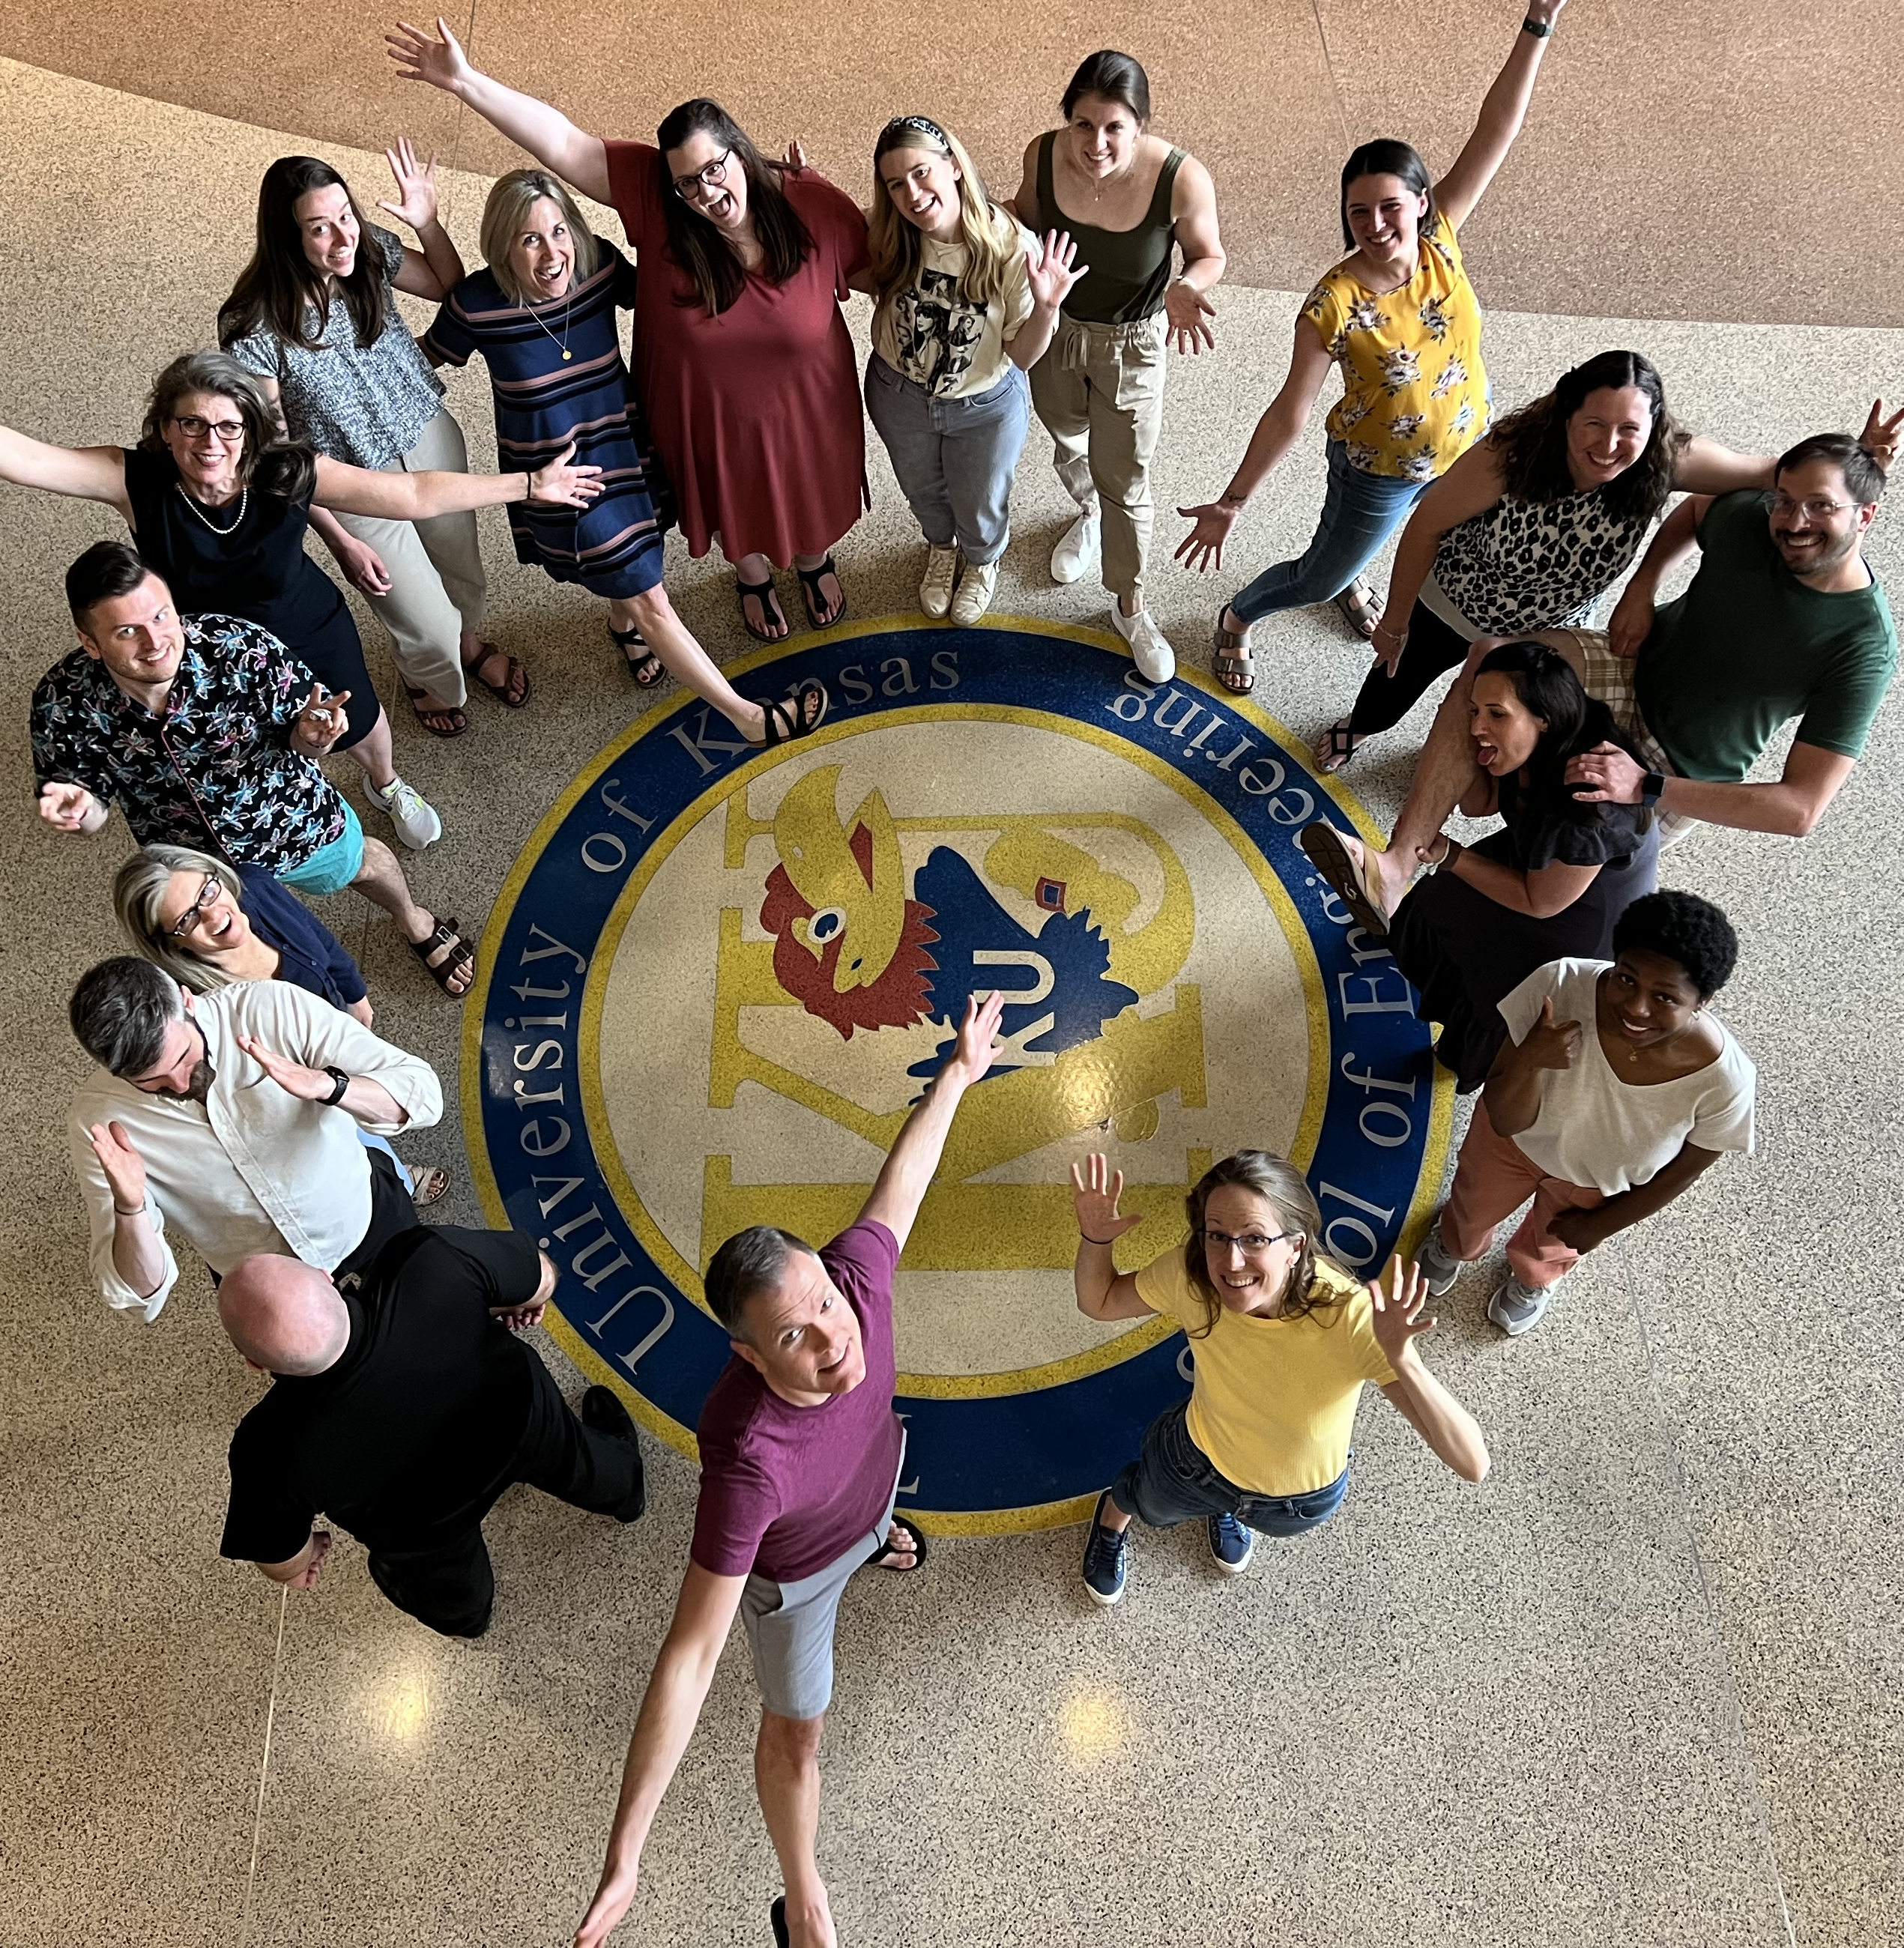

Thank you!
Thank you!
ci3t.org
#Ci3T
@Ci3Tmodel
Tag us in your Ci3T highlights, we love to see Ci3T in action!
Follow us on Instagram for updates and new resources!
Notes:
Tag us in your Ci3T highlights- we would love to see Ci3T in action! Follow us on Instagram for updates and links to resources! @Ci3TModel
You will receive a brief session evaluation – we value your feedback and would greatly appreciate you taking a few minutes to share your thoughts on what you liked about the session and how we can improve

