Slide 1
What’s New in Systematic Screening with the SRSS-IE?
A Focus on Logistics
Mark M. Buckman, University of Kansas
Kathleen Lynne Lane, University of Kansas
Rebecca L. Sherod Adams, Arizona State University
Wendy Peia Oakes, Arizona State University
Institute of Education Sciences, U.S. Department of Education
R324A190013 University of Kansas
Notes:
We introduce new lessons learned about psychometric properties of the SRSS-IE and share resources to support educators in using systematic screening data to shape instruction. We introduce free-access professional learning and implementation resources and provide new information about digital systems for collecting and reporting SRSS-IE data.

Slide 2
Agenda
What is the SRSS-IE? A Brief Introduction
What’s new in SRSS-IE research?
What new resources exist to support screening using the SRSS-IE?
What’s next for the SRSS-IE?
Notes:
We present preliminary findings of an underpowered randomized control trail examining the impact of a new Tier 2 intervention: Recognize. Relax. Record., being tested as part of a new IES-funded project to support elementary age students with internalizing behavior. We highlight social validity findings as well as students’ outcomes.

Slide 3
What is the SRSS-IE?
A Brief Introduction

Slide 4
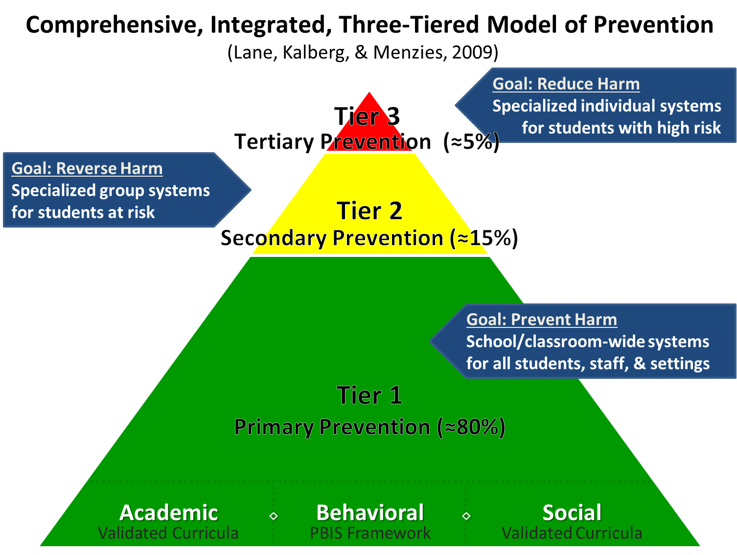
Comprehensive, Integrated, Three-Tiered Model of Prevention 1

Slide 5
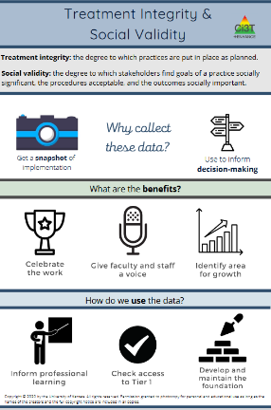
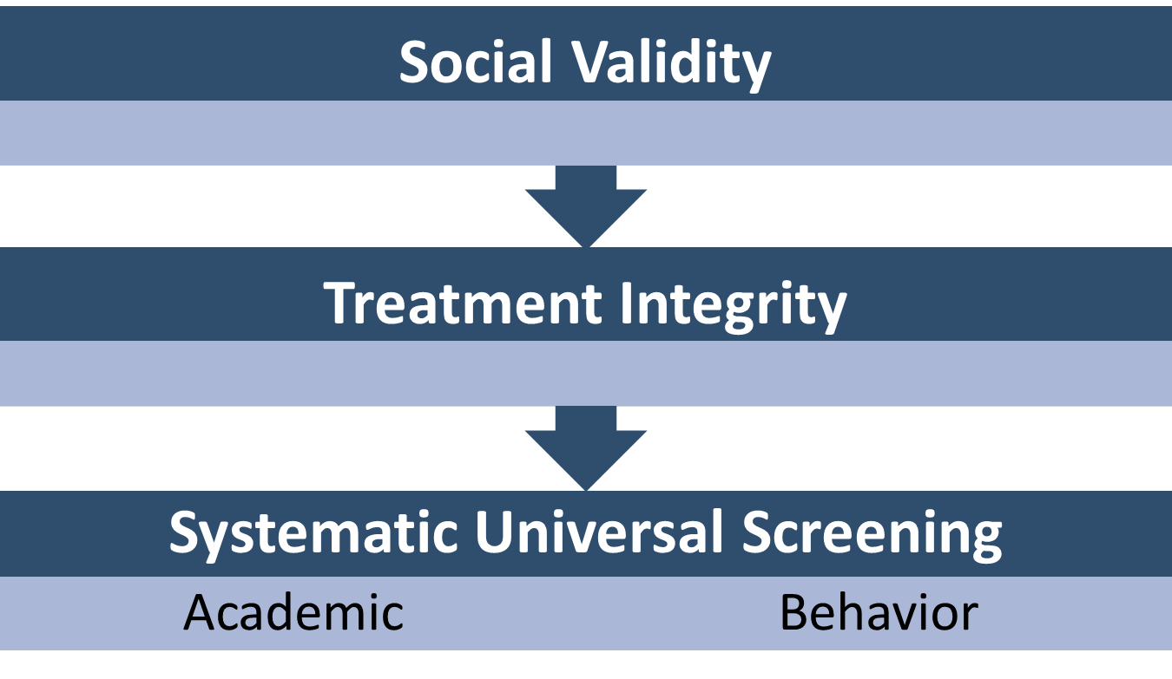
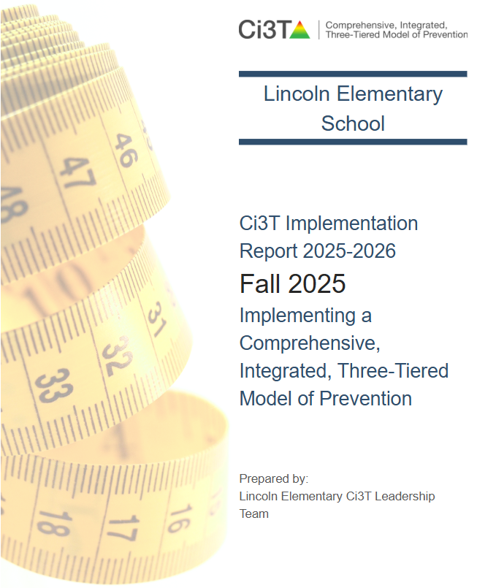
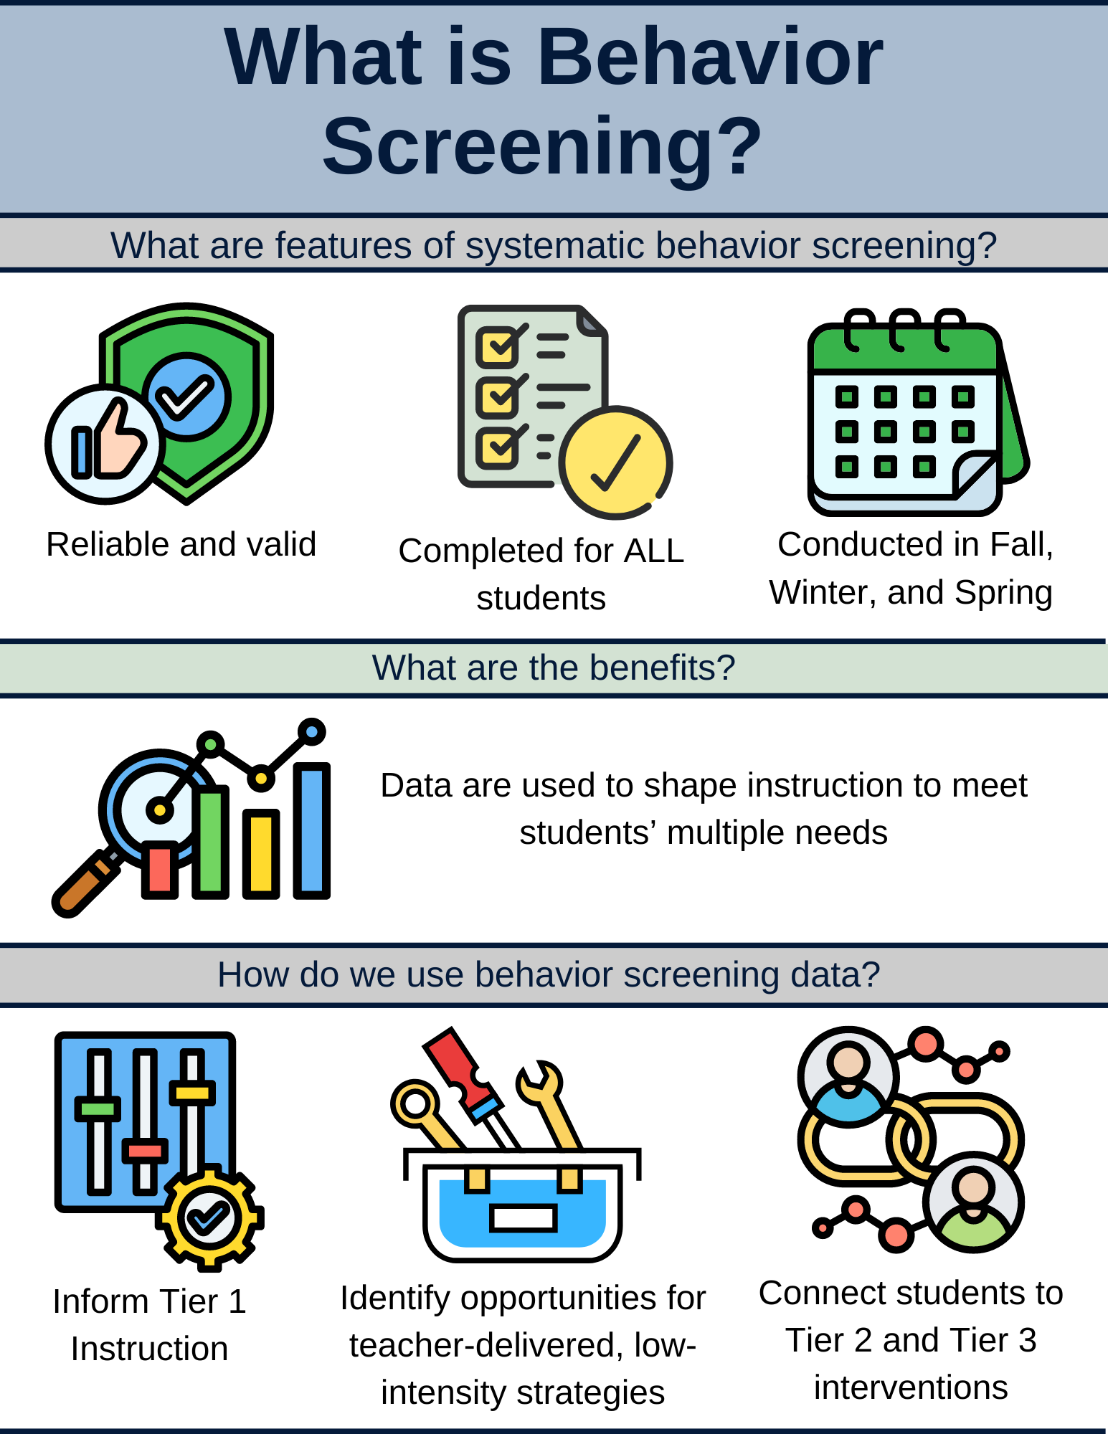
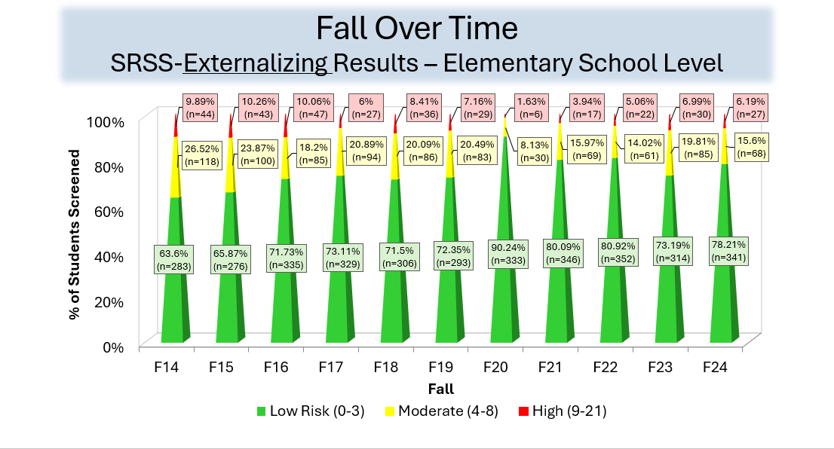
Essential Components of Primary (Tier 1) Prevention Efforts
Essential Components of Primary (Tier 1) Prevention Efforts 1

Slide 6
What is Behavior Screening? 1

Slide 7
What is Behavior Screening? 2

Slide 8
SRSS-IE 12: Cut Scores
Elementary School
Middle and High School
SRSS-E7 | SRSS-I5
Items 1-7 | Items 8-12
0-3 = low risk 4-8 = moderate risk 9-21 = high risk | 0-1 = low risk 2-3 = moderate risk 4-15 = high risk
SRSS-E7 | SRSS-I6
Items 1-7 | Items 4, 8-12
0-3 = low risk 4-8 = moderate risk 9-21 = high risk | 0-3 = low risk 4-5 = moderate risk 6-18 = high risk
Elementary School Level:
Lane, K. L., Oakes, W. P., Swogger, E. D., Schatschneider, C., Menzies, H., M., & Sanchez, J. (2015). Student risk screening scale for internalizing and externalizing behaviors: Preliminary cut scores to support data-informed decision making. Behavioral Disorders, 40, 159-170.
Middle and High School Levels:
Lane, K. L., Oakes, W. P., Cantwell, E. D., Schatschneider, C., Menzies, H., Crittenden, M., & Messenger, M. (2016). Student Risk Screening Scale for Internalizing and Externalizing Behaviors: Preliminary cut scores to support data-informed decision making in middle and high schools. Behavioral Disorders, 42(1), 271-284

Slide 9
Fall Over Time
SRSS-Externalizing Results – Elementary School Level
Notes:
Fill in <year> based on current academic year. This is located in column A of the data sheet. Edit by right clicking and selecting “Edit data”.

Slide 10
Fall Over Time
SRSS-Internalizing Results – Elementary School Level
Notes:
Fill in <year> based on current academic year. This is located in column A of the data sheet. Edit by right clicking and selecting “Edit data”.

Slide 11
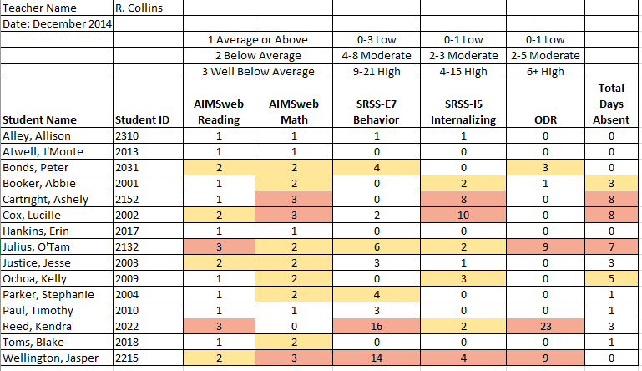
Examining Multiple Sources of Data
Lane, K. L., Menzies, H. M., Ennis, R. P., & Oakes, W. P. (2015). Supporting Behavior for School Success: A Step-by-Step Guide to Key Strategies. Guilford Press.
Notes:
Lane, K. L., Oakes, W. P., Ennis, R. P., & Hirsch, S. E. (2014). Identifying students for secondary and tertiary prevention efforts: How do we determine which students have Tier 2 and Tier 3 needs? Preventing School Failure, 58, 171-182, DOI: 10.1080/1045988X.2014.895573

Slide 12
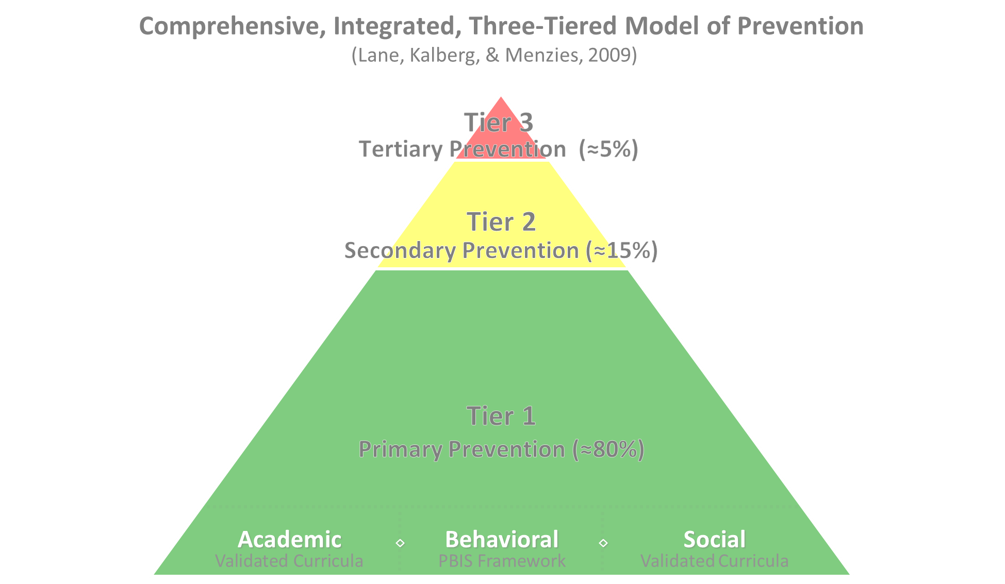

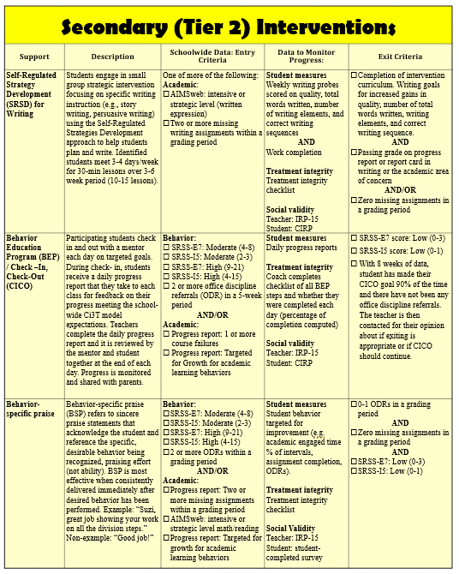
Secondary (Tier 2) Intervention Grid
Notes:
In addition to the module featured here outlining how to use multiple sources of data to connect students with Tier 2 supports, we offer a full suite of modules highlighting validated Tier 2 interventions such as Self-Regulated Strategy Development (SRSD) for Writing and Check-In/Check Out that may appear in your Secondary (Tier 2) Intervention Grid

Slide 13

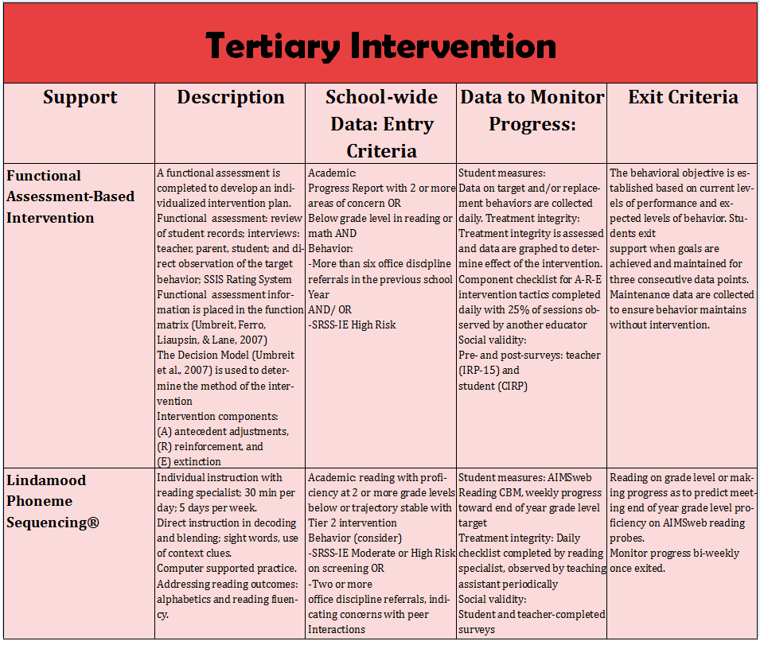
Tertiary (Tier 3) Intervention Grid
Notes:
In addition to the module featured here outlining how to use multiple sources of data to connect students with Tier 3 supports, we offer a full suite of modules highlighting validated Tier 3 interventions such as Functional Assessment-Based Intervention (FABI) that may appear in your Tertiary (Tier 3) Intervention Grid

Slide 14
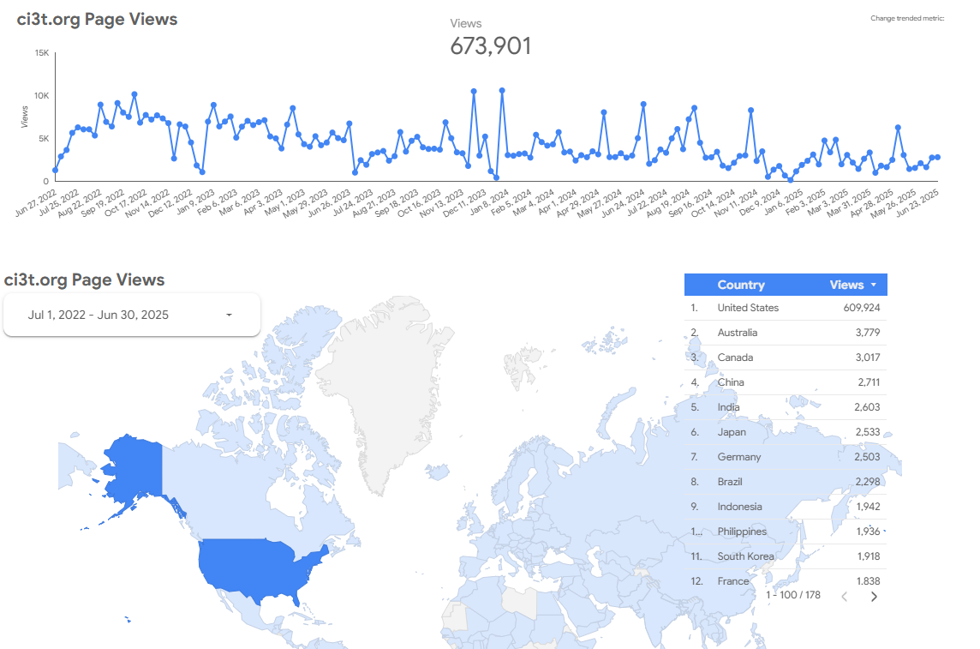
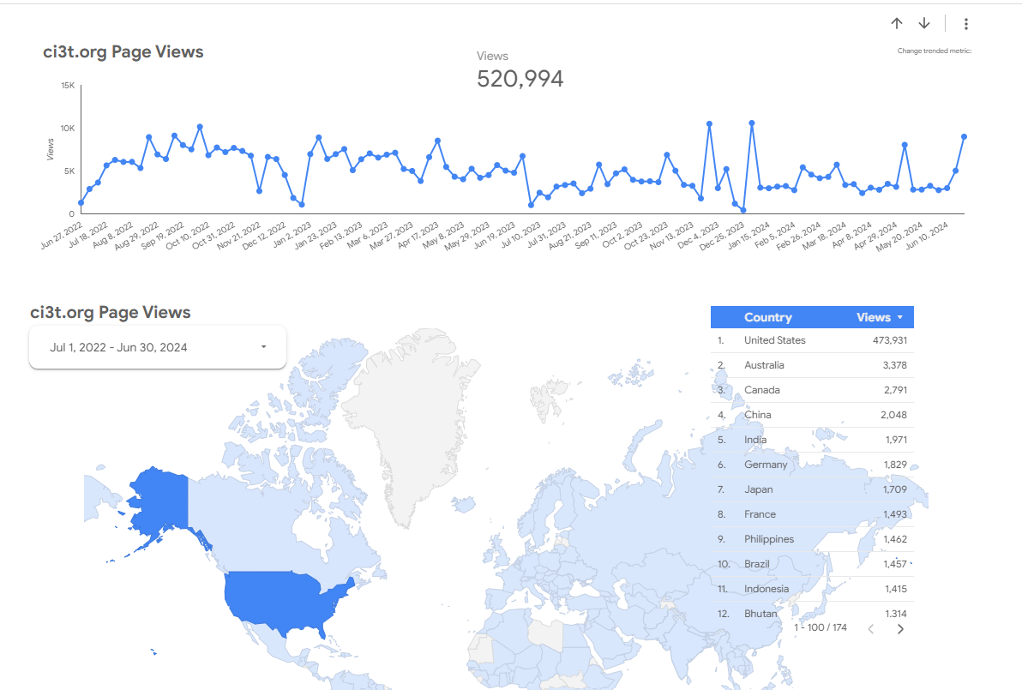
Ci3T.org Page Views
ci3t.org
July 1, 2022 to June 30,2025

Slide 15
What is new in SRSS-IE research?

Slide 16
The Latest in SRSS-IE Inquiry
Examine measurement models
Assess measurement invariance across groups and time
Estimate predictive validity of key outcomes
  Latent variable scores
  Subscales scores (raw total)

Slide 17
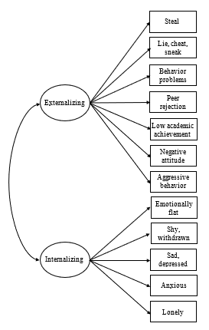
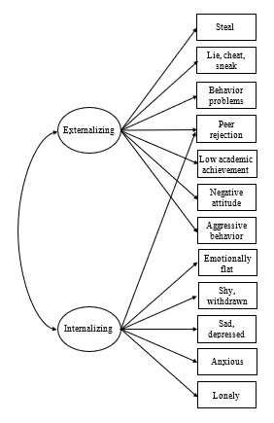
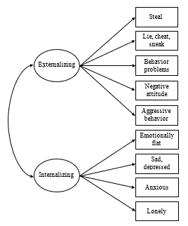
Confirmatory Factor Analysis
Current Practice: SRSS-IE 12
Elementary School Middle & High School
New Model: SRSS-IE 9
Elementary, Middle & High School

Slide 18
Measurement Invariance
Established strict invariance across groups & time suggesting the SRSS-IE functions in the same way for these groups of students:
  Male & Female
  White & Students of Color
  White & Black
  Hispanic & non-Hispanic
  Sped & non-Sped
  Overtime: Fall – Winter – Spring
Lane, K. L., Oakes, W. P., Buckman, M. M., Lane, N. A., Lane, K. S, Fleming, K., Swinburne Romine, R., Sherod, R., Chang, C., Jones, J.,
Cantwell, E., & Crittenden, M. (2023). Examination of the factor structure and measurement invariance of the SRSS-IE. Remedial and Special Education, 45(3), 152-172. https://doi.org/10.1177/07419325231193147

Slide 19
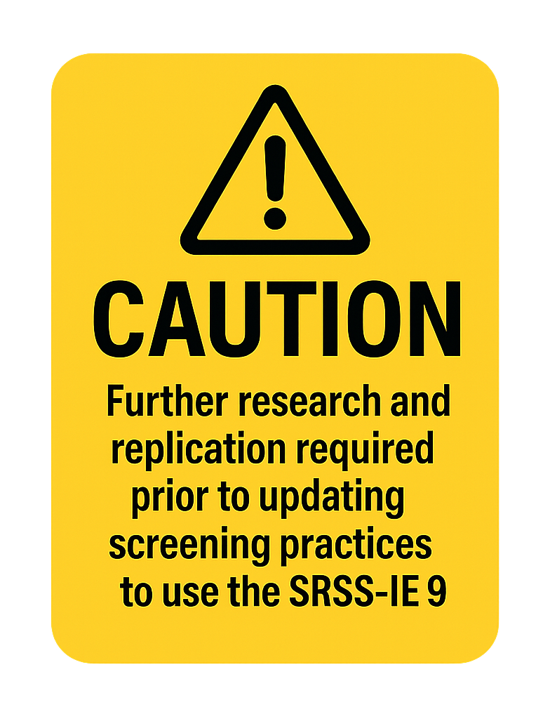
SRSS-IE 9
Items retained
  Externalizing
    Steal
    Lie, cheat, sneak
    Behavior problems
    Negative attitude
    Aggressive behavior
  Internalizing
    Emotionally flat
    Sad, depressed
    Anxious
    Lonely

Slide 20
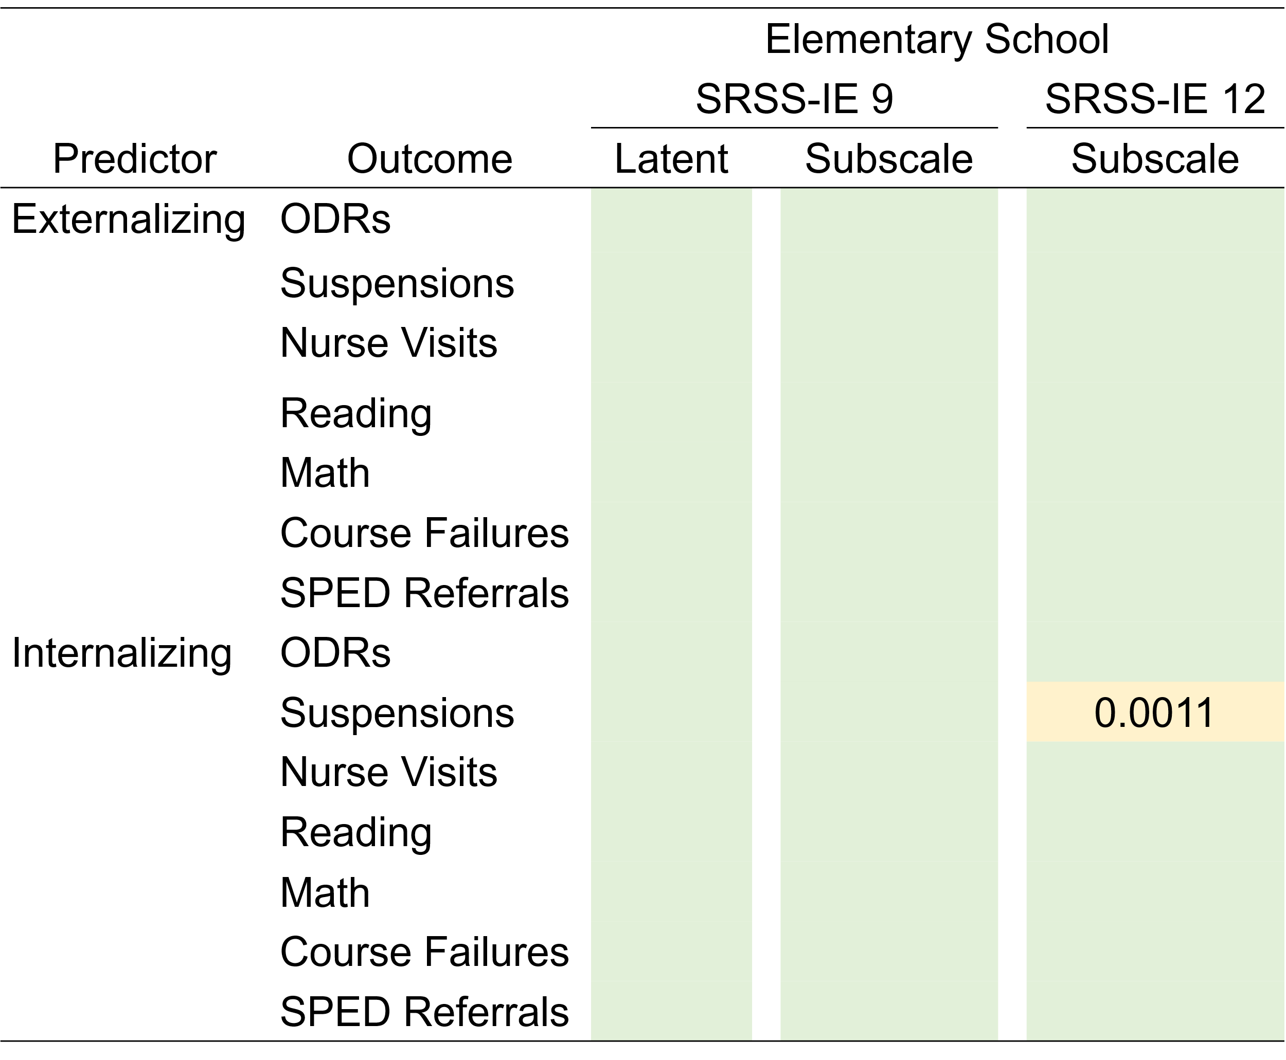
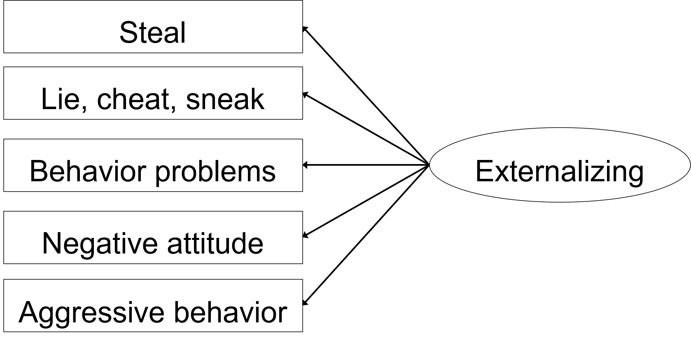
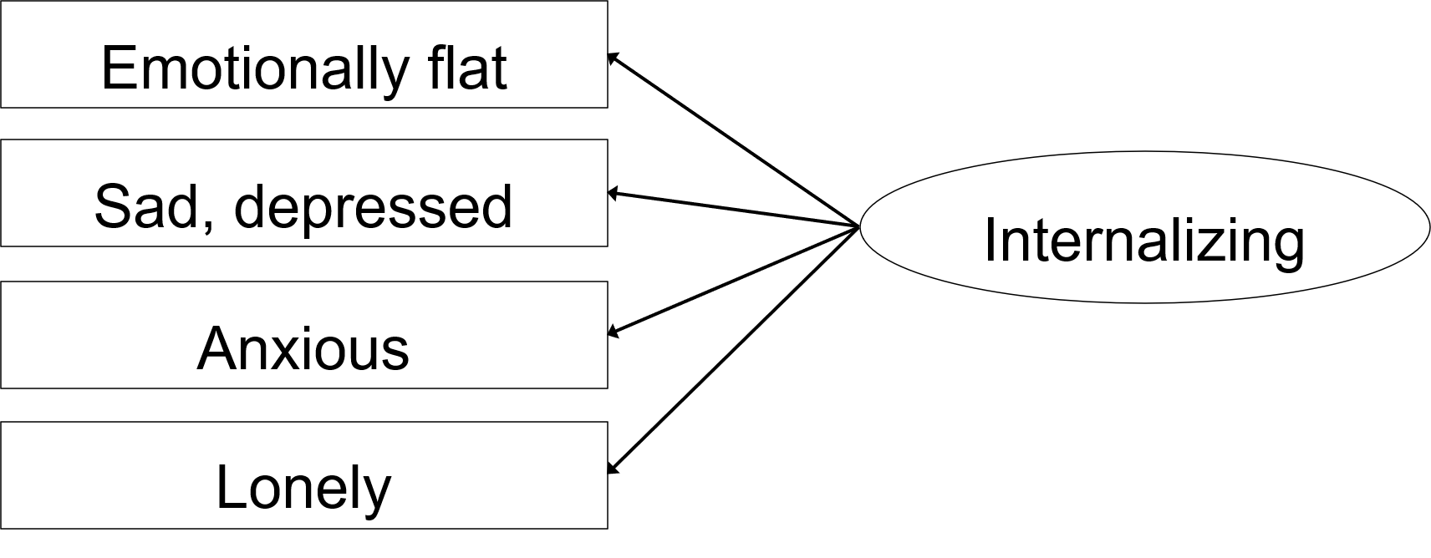
SRSS-IE 9 Predictive Validity
Elementary School
24,535 students in grades K-6
64 schools in 4 geographic regions
Green shading indicates the predictive relationship was statistically significant at p < .0001.
Lane, K. L., Oakes, W. P., Buckman, M. M., Lane, N. A., Lane, K. S., Fleming, K., Swinburne Romine, R., Sherod, R. L., Chang, C., & Cantwell, E. D. (2024) Additional evidence of predictive validity of SRSS-IE scores with elementary students. Behavioral Disorders. 49(3), 189-204. https://doi.org/10.1177/01987429231222890

Slide 21
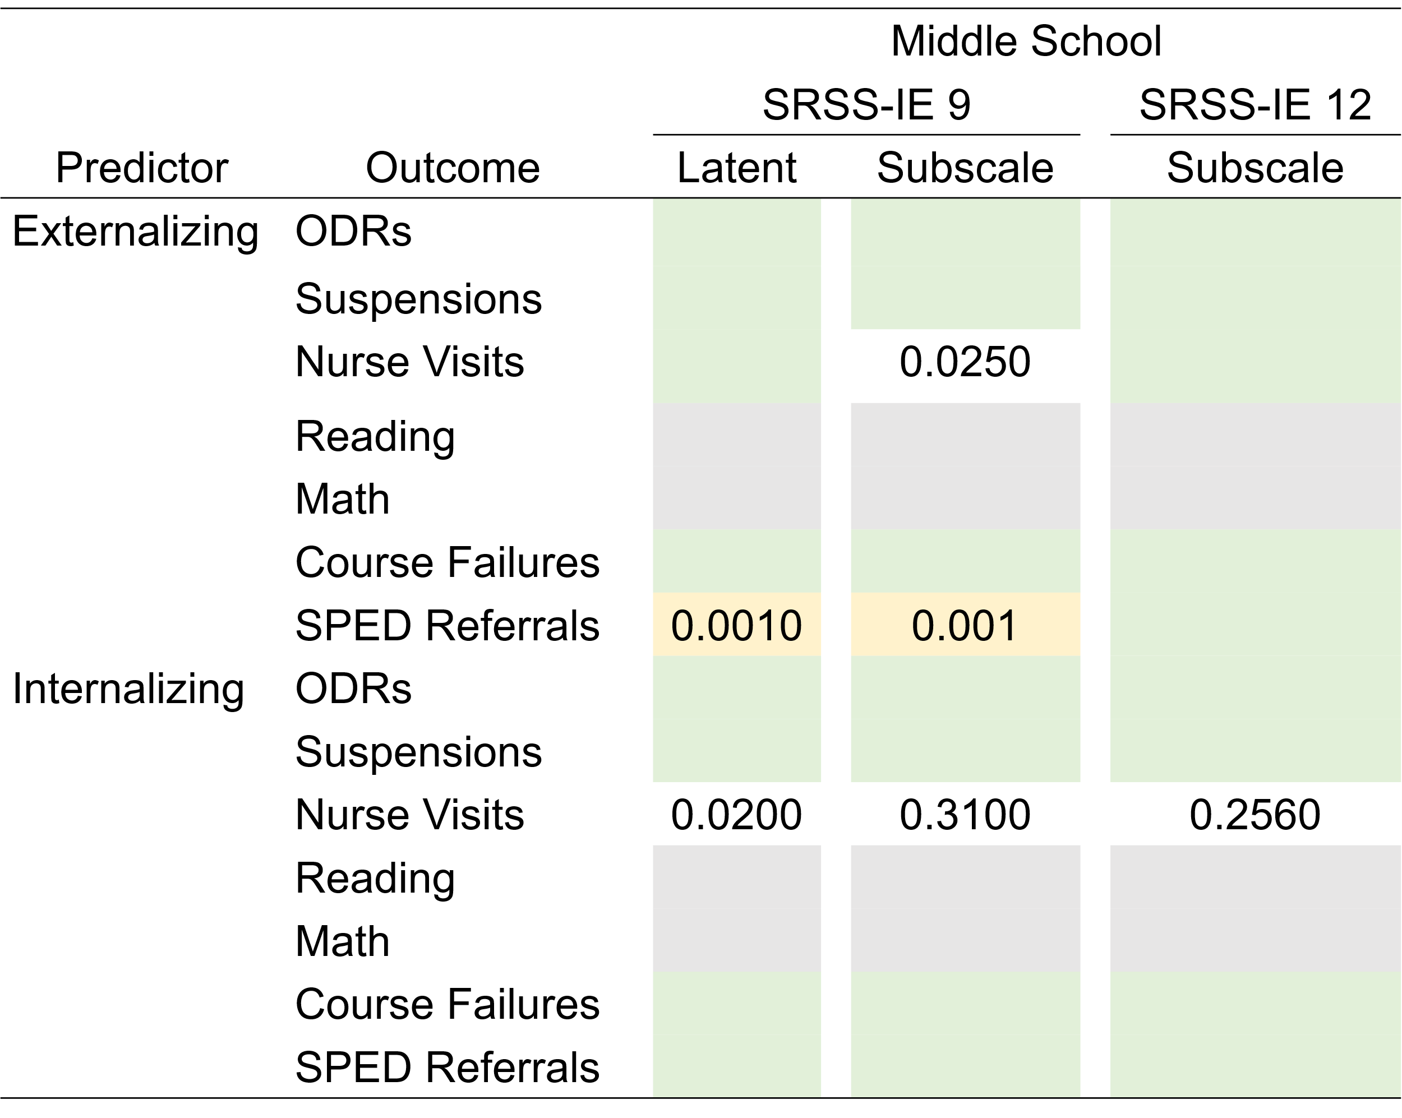
SRSS-IE 9 Predictive Validity
Middle School
11,773 students in grades 6-8
4 geographic regions
Green shading indicates the predictive relationship was statistically significant at p < .0001. Gray indicates a test was not conducted.
Lane, K. L., Oakes, W. P., Buckman, M. M., Lane, N. A., Lane, K. S., Fleming, K., Swinburne Romine, R., Sherod, R. L., Cantwell, E. D & Chang, C. (2024). New evidence of predictive validity of SRSS-IE scores with middle and high school students. Frontiers in Education. 8:1251063. https://doi.org/10.3389/feduc.2023.1251063

Slide 22
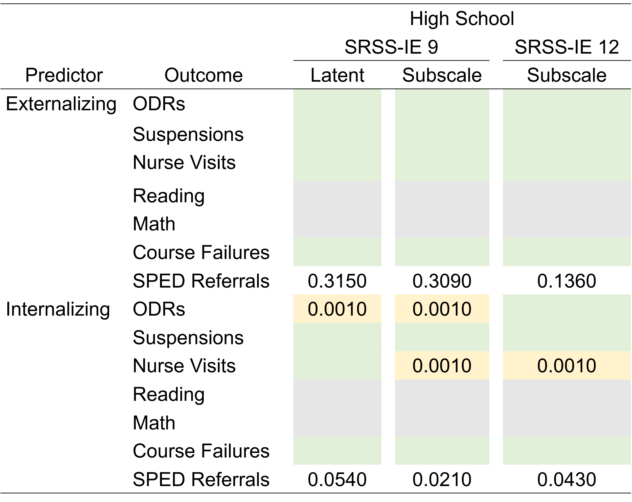
SRSS-IE 9 Predictive Validity
High School
7,244 students in grades 9-12
3 geographic regions
Green shading indicates the predictive relationship was statistically significant at p < .0001. Gray indicates a test was not conducted.
Lane, K. L., Oakes, W. P., Buckman, M. M., Lane, N. A., Lane, K. S., Fleming, K., Swinburne Romine, R., Sherod, R. L., Cantwell, E. D & Chang, C. (2024). New evidence of predictive validity of SRSS-IE scores with middle and high school students. Frontiers in Education. 8:1251063. https://doi.org/10.3389/feduc.2023.1251063

Slide 23
SRSS-E5
Cut Scores
Dimension | Low vs. Borderline or Clinical | Low or Borderline vs. Clinical
Elementary
Cut score | 0–1 | ≥ 4
Sensitivity | .857 | .769
Specificity | .881 | .859
Classification Accuracy | 87.4% | 84.6%
Secondary
Cut score | 0–4 | ≥ 7
Sensitivity | .878 | .741
Specificity | .837 | .940
Classification Accuracy | 84.6% | 91.6%
Externalizing Cut Scores for Middle and High School
Re-analysis using SRSS-IE 9 (E5 items) using data from a previous paper (Lane, Oakes, Swogger et al., 2015)
Used Teacher Report Form (TRF) data as criterion measure

Slide 24
SRSS-I4
Cut Scores
Dimension | Low vs. Borderline or Clinical | Low or Borderline vs. Clinical
Elementary
Cut score | 0–1 | ≥ 3
Sensitivity | .703 | .593
Specificity | .848 | .878
Classification Accuracy | 81.7% | 83.4%
Secondary
Cut score | 0–2 | ≥ 4
Sensitivity | .829 | .663
Specificity | .785 | .883
Classification Accuracy | 79.3% | 83.4%
Internalizing Cut Scores for Middle and High School
Re-analysis using SRSS-IE 9 (E5 items) using data from a previous paper (Lane, Oakes, Swogger et al., 2015)
Used Teacher Report Form (TRF) data as criterion measure

Slide 25
SRSS-I9 Cut Scores & Risk Categories
 | Elementary
 | SRSS-IE 12 |  |  | SRSS-IE 9
Risk Level | SRSS-E7 Externalizing | SRSS-I5 Internalizing |  | SRSS-E5 Externalizing | SRSS-I4 Internalizing
Low | 0–3 | 0–1 |  | 0–1 | 0–1
Moderate | 4–8 | 2–3 |  | 2–3 | 2
High | 9–21 | 4–15 |  | 4–15 | 3–12
 | Secondary
 | SRSS-IE 12 |  |  | SRSS-IE 9
Risk Level | SRSS-E7 Externalizing | SRSS-I5 Internalizing |  | SRSS-E5 Externalizing | SRSS-I4 Internalizing
Low | 0–3 | 0–3 |  | 0–4 | 0–2
Moderate | 4–8 | 4–5 |  | 5–6 | 3
High | 9–21 | 6–18 |  | 7–15 | 4–12

Slide 26
What new resources exist to support screening using the SRSS-IE?

Slide 27
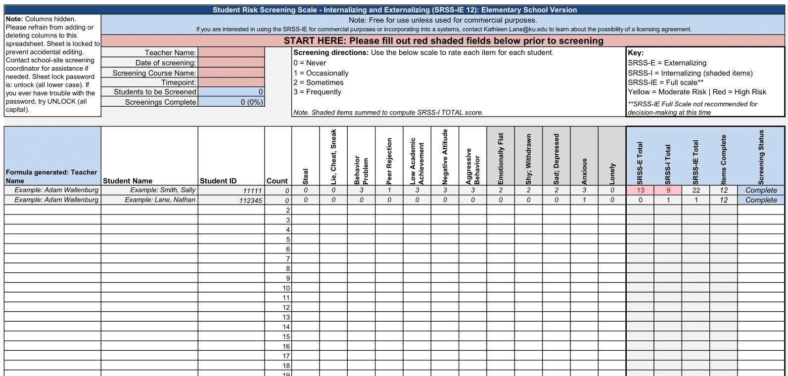
Student Risk Screening Scale – Internalizing and Externalizing (SRSS-IE)
Elementary | Drummond, 1994; Lane & Menzies, 2009

Slide 28
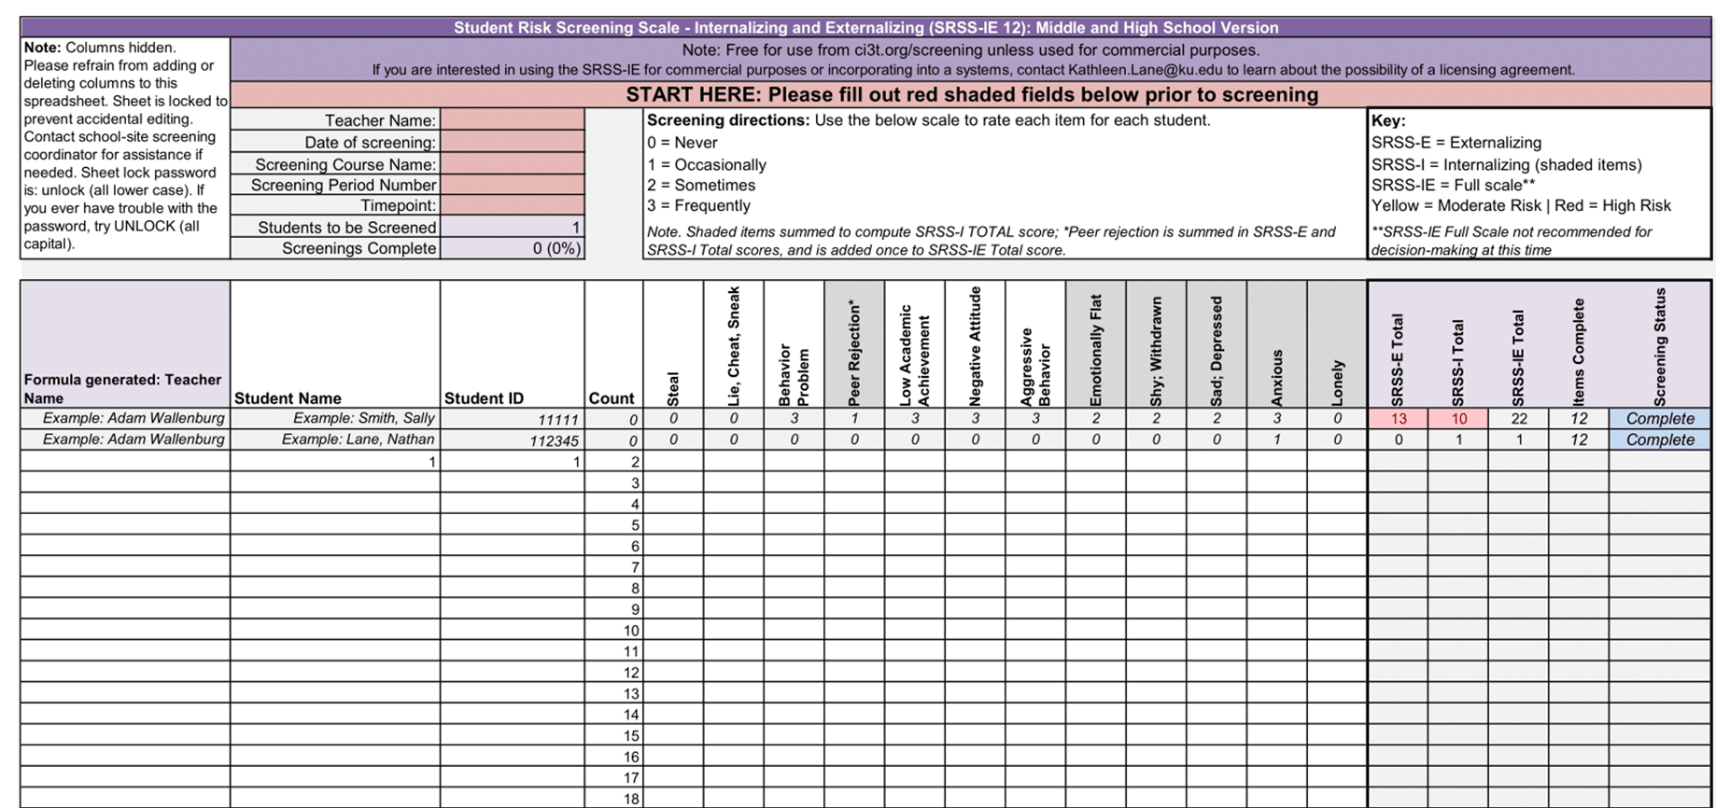
Student Risk Screening Scale – Internalizing and Externalizing (SRSS-IE)
Secondary | Drummond, 1994; Lane & Menzies, 2009

Slide 29


Enhancing Ci3T Modules (1)
ci3t.org/enhance

Slide 30
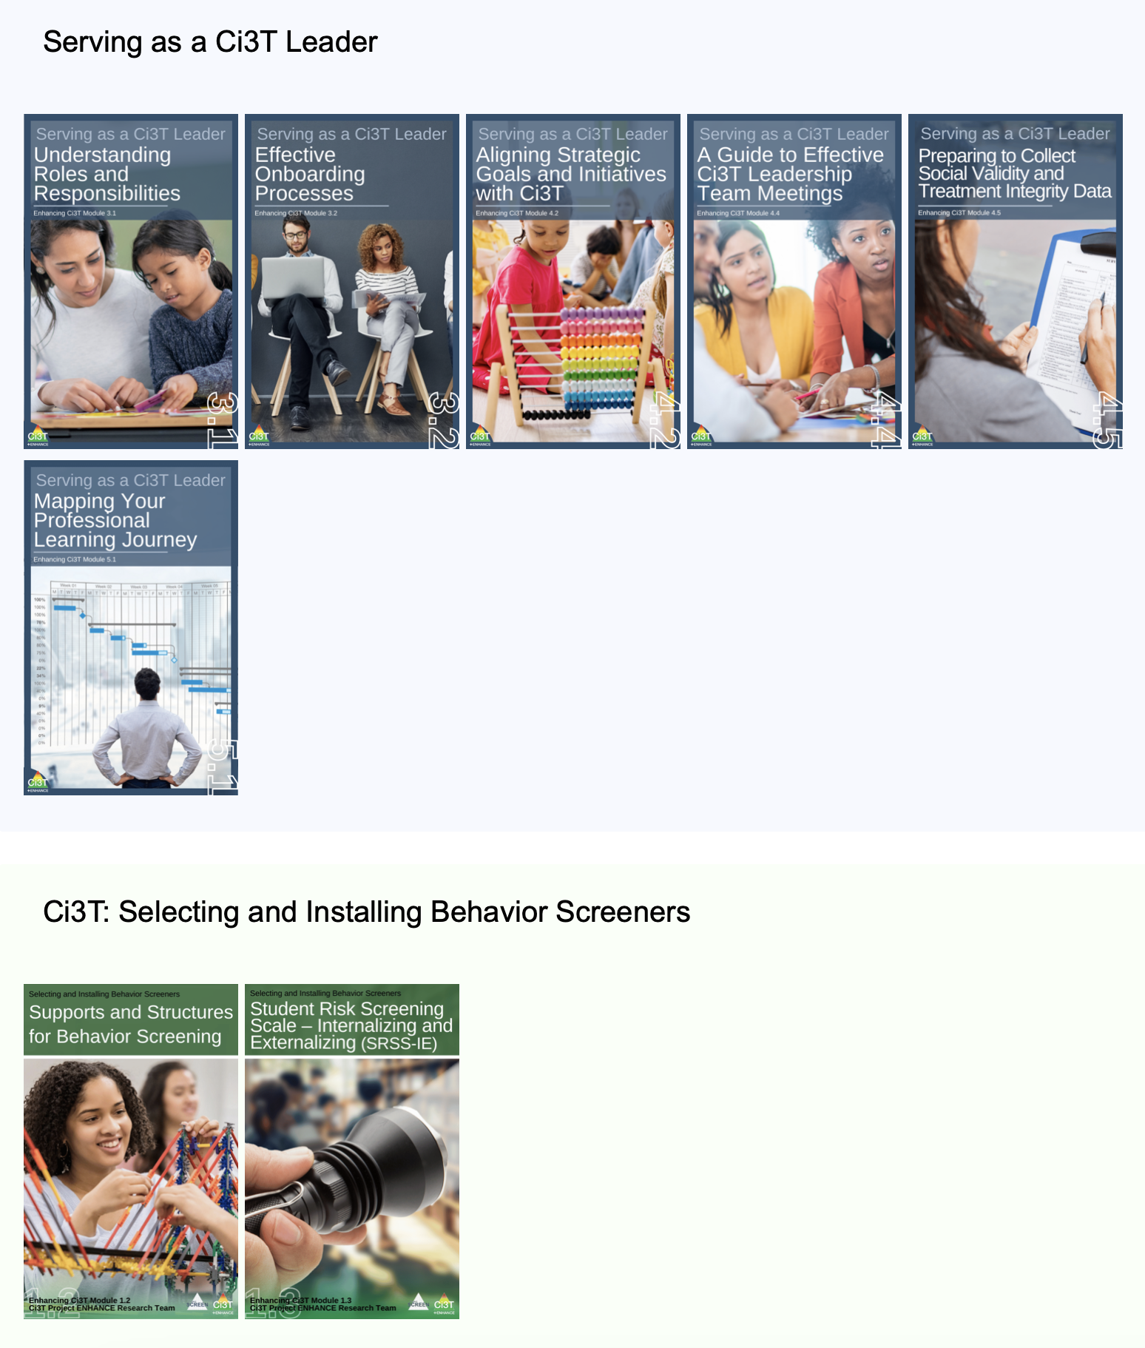
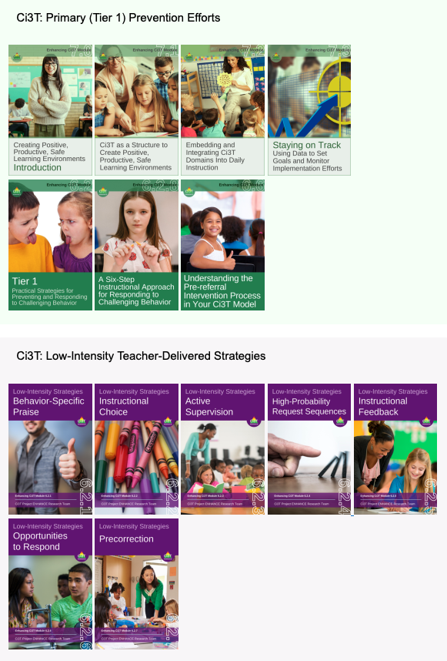
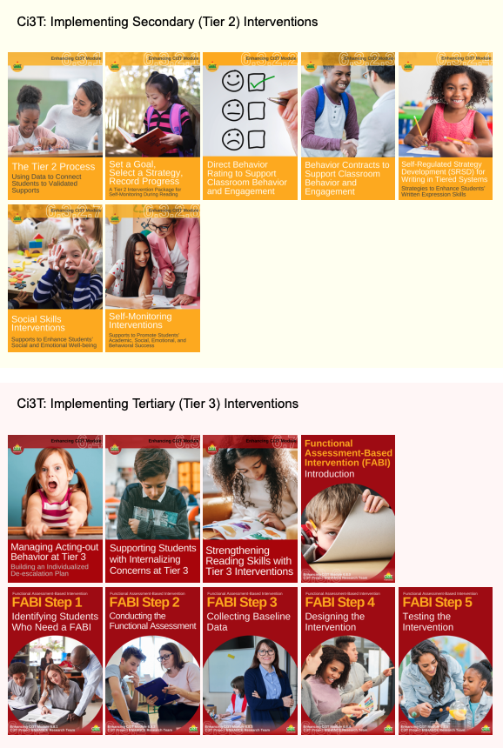
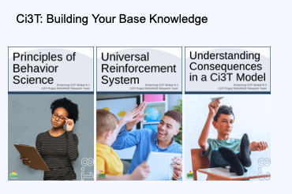
Enhancing Ci3T Modules (2)

Slide 31
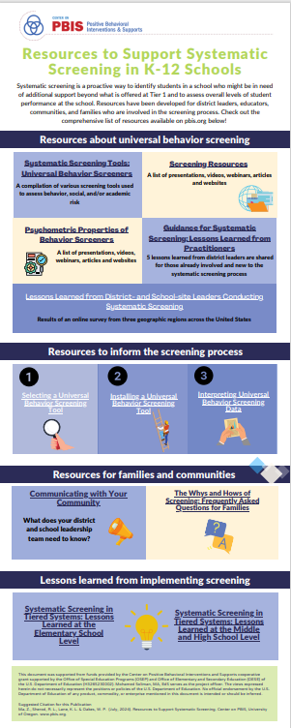

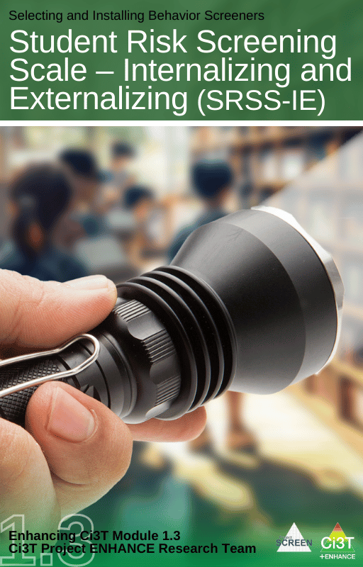
Systematic Screening Resources
Notes:
https://www.pbis.org/resource/resources-to-support-systematic-screening-in-k-12-schools

Slide 32
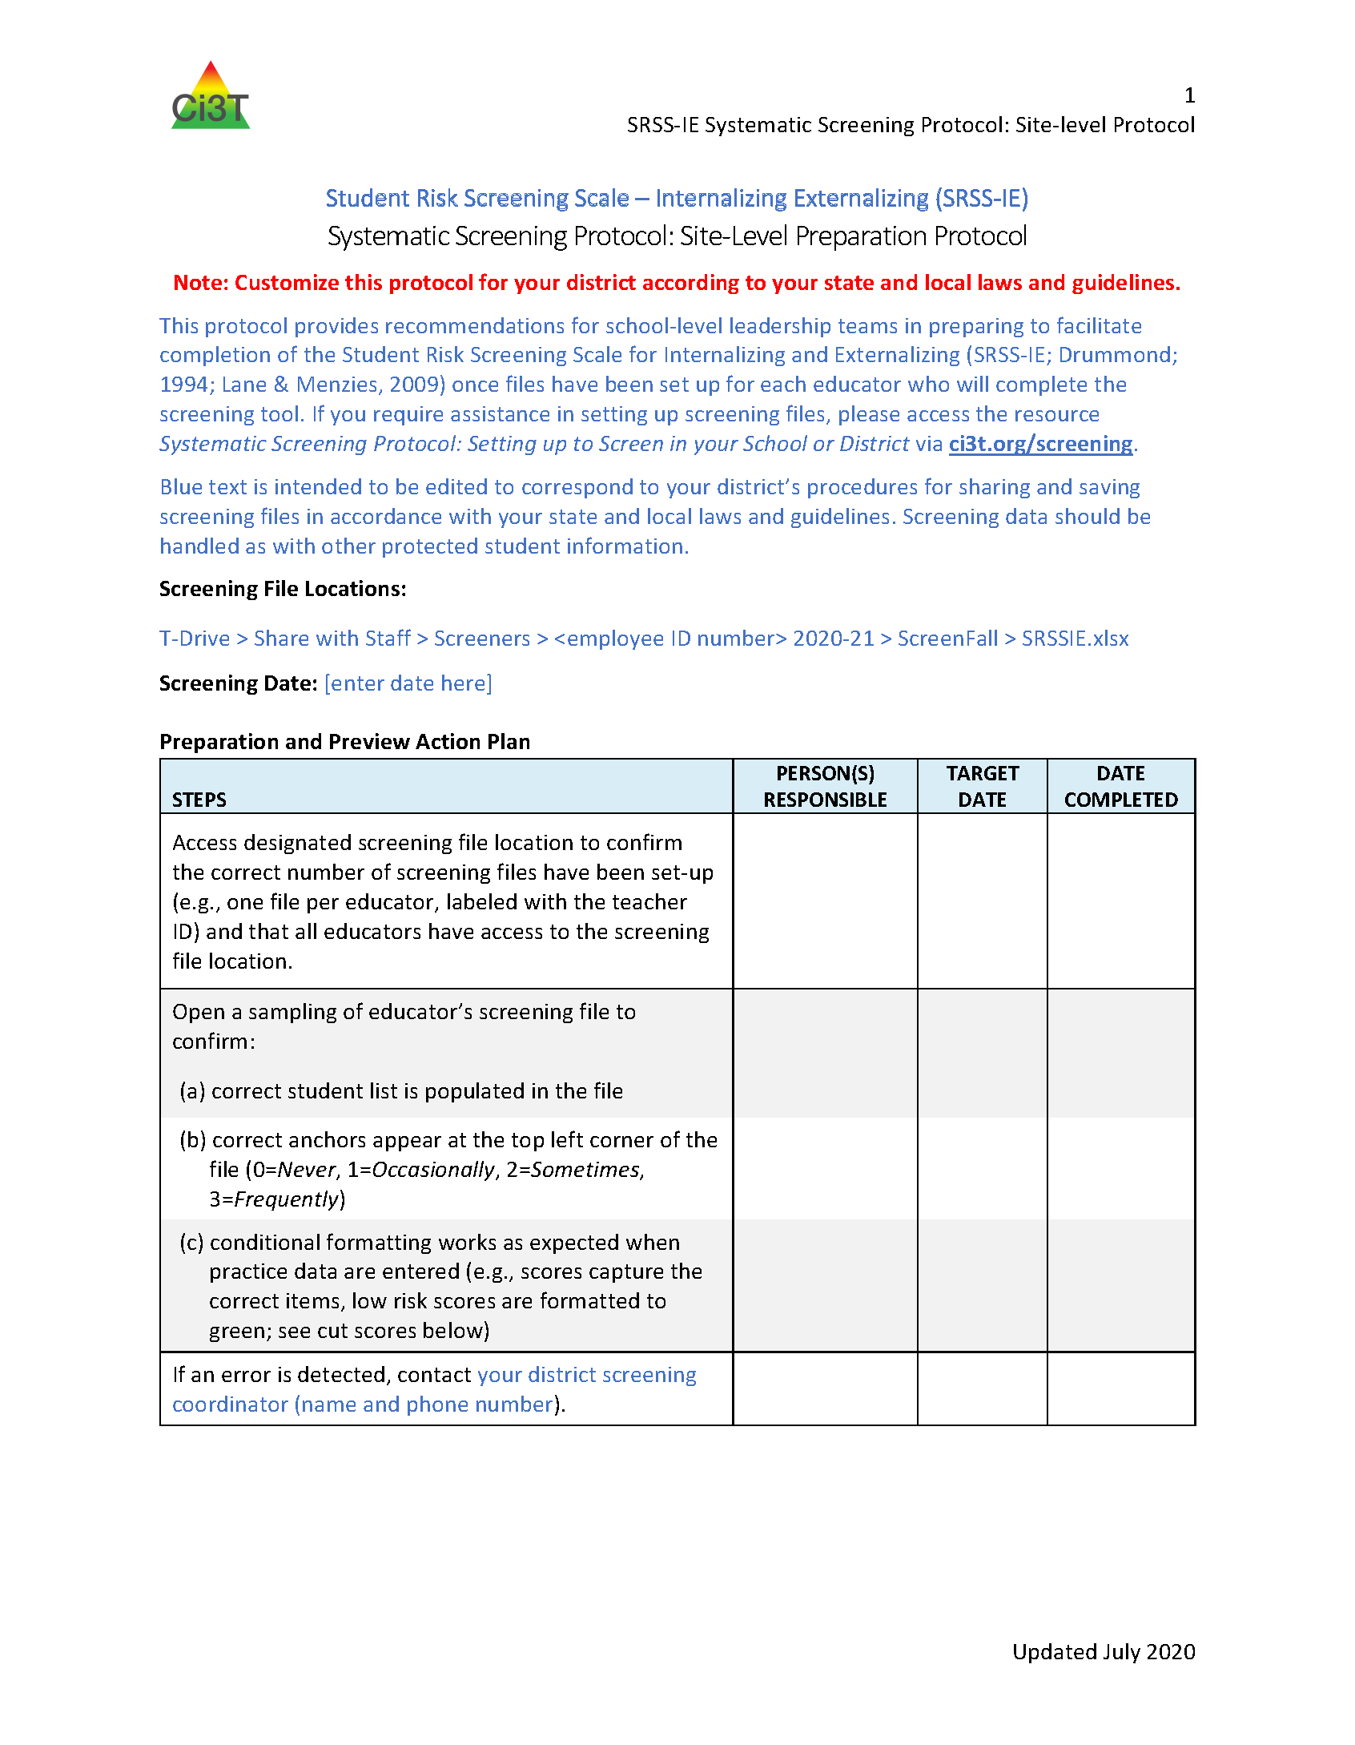
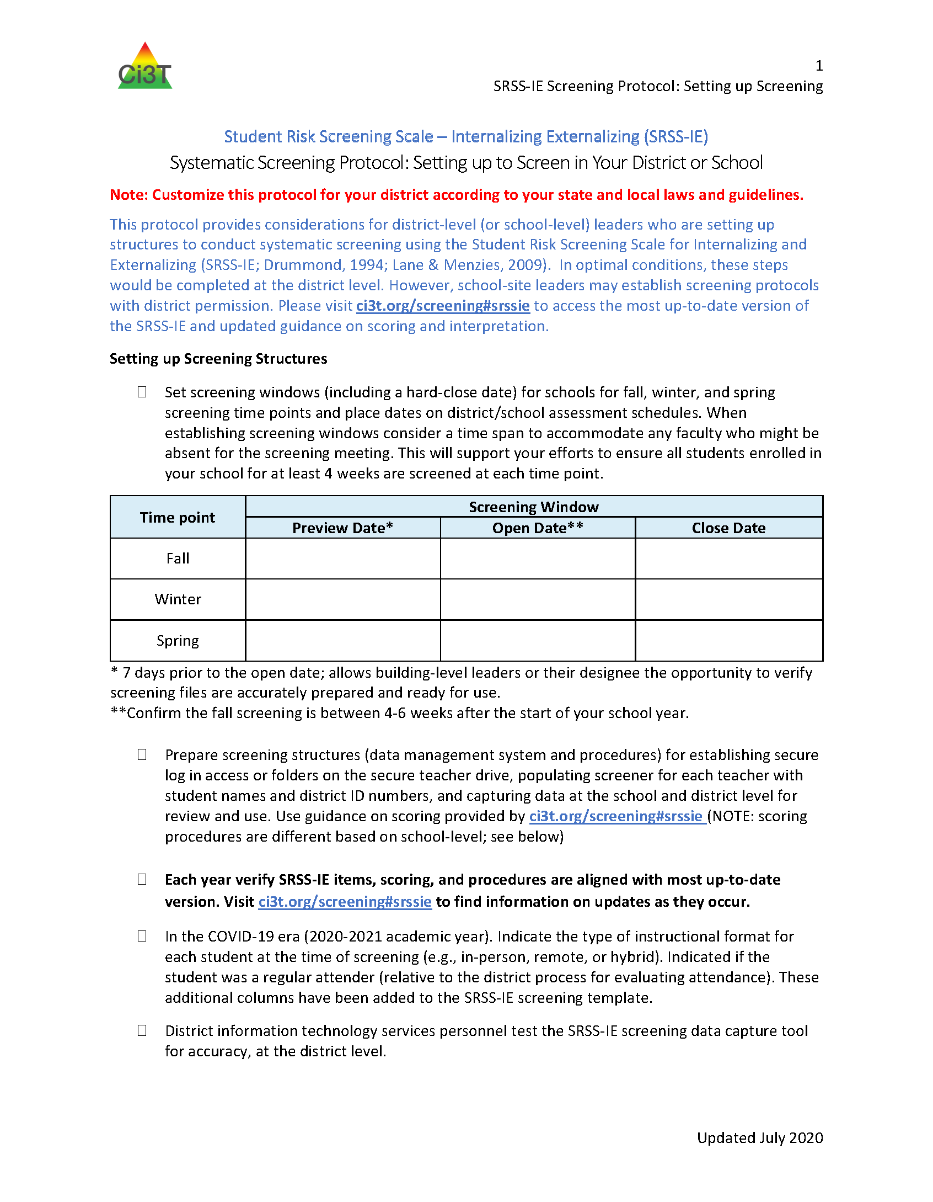
Selecting and Installing Behavior Screeners

Slide 33
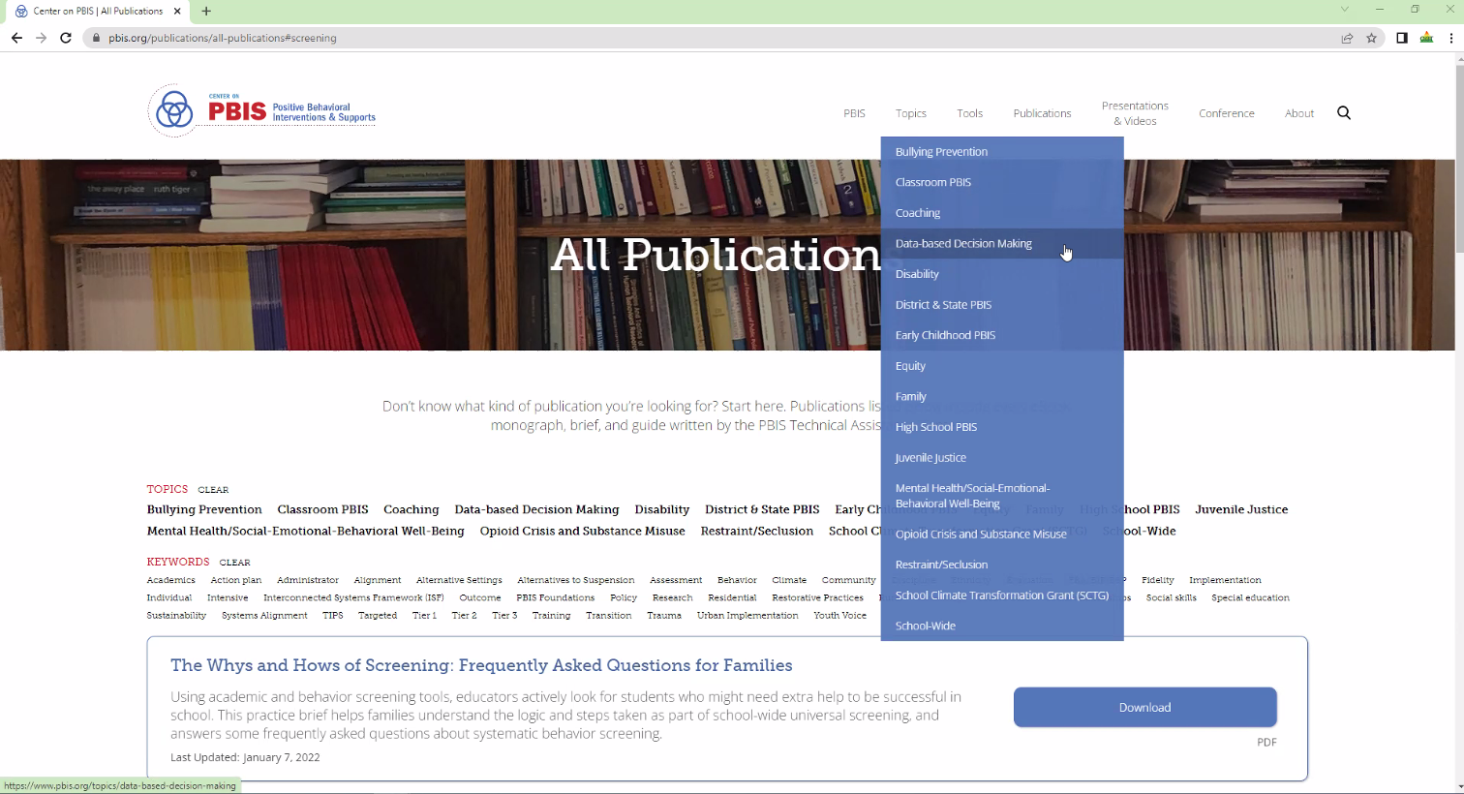
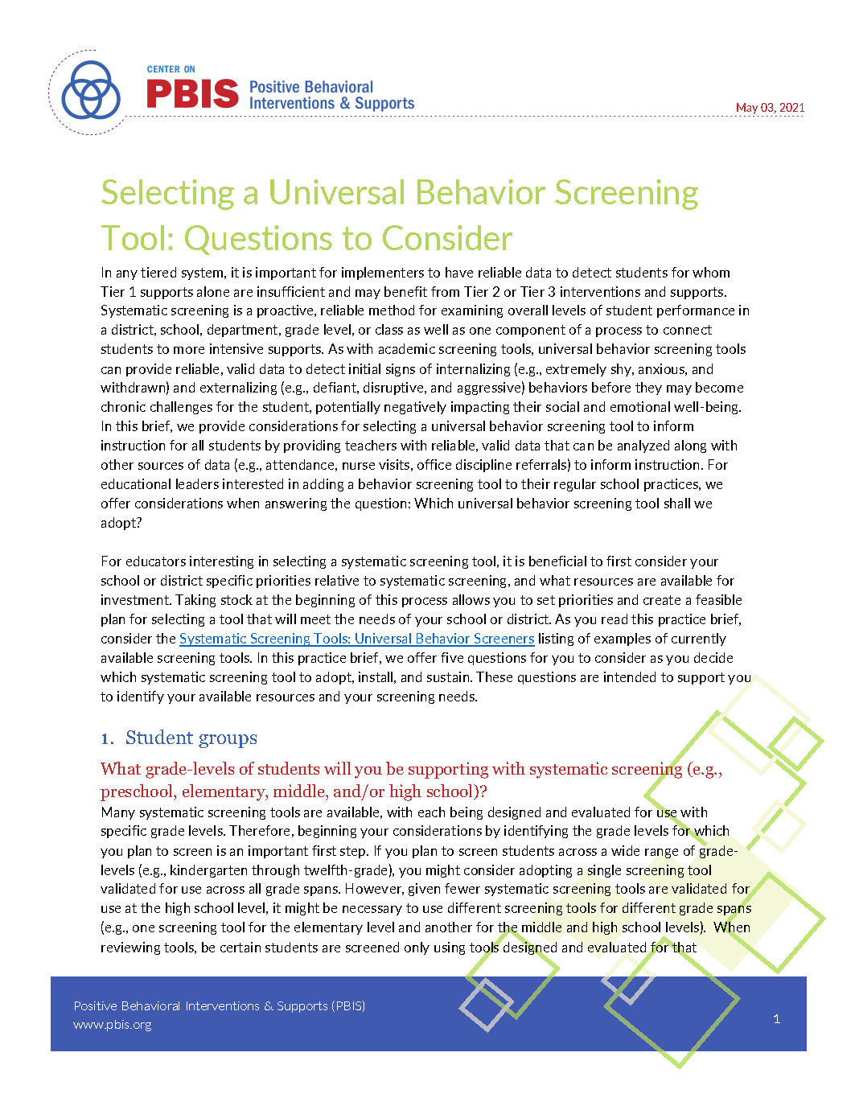
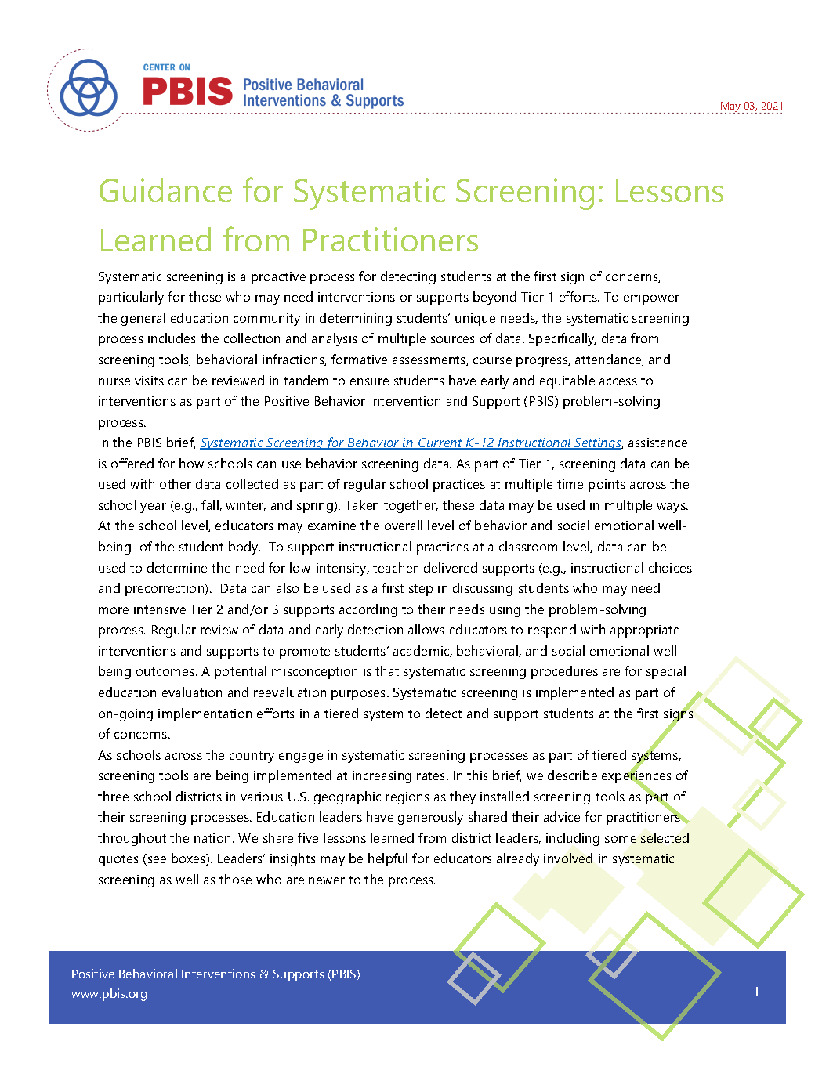
Resources for screening available on PBIS.org…

Slide 34
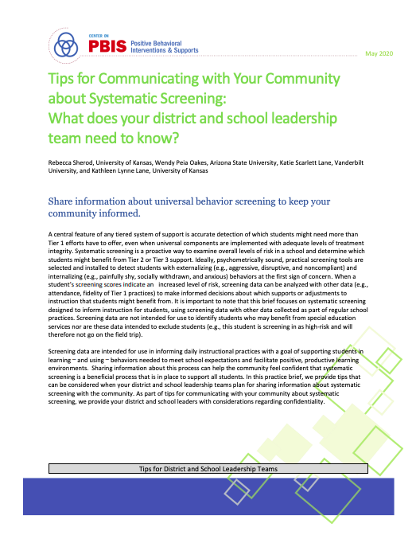
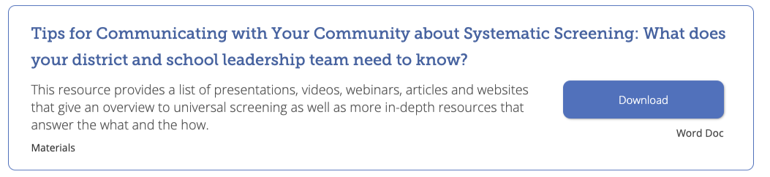
Tips for Communicating with Your Community about Systematic Screening

Slide 35
What’s next for the SRSS-IE?
Inquiry & Innovation

Slide 36
Inquiry
Replication + Extension
SRSS-IE 9 replication and extension studies
  Implementation stages (e.g., advanced implementers)
  Geographic regions
Cost Analyses
  Cost to implement screening using district-built systems
  Cost to implement screening using commercially available screening

Slide 37
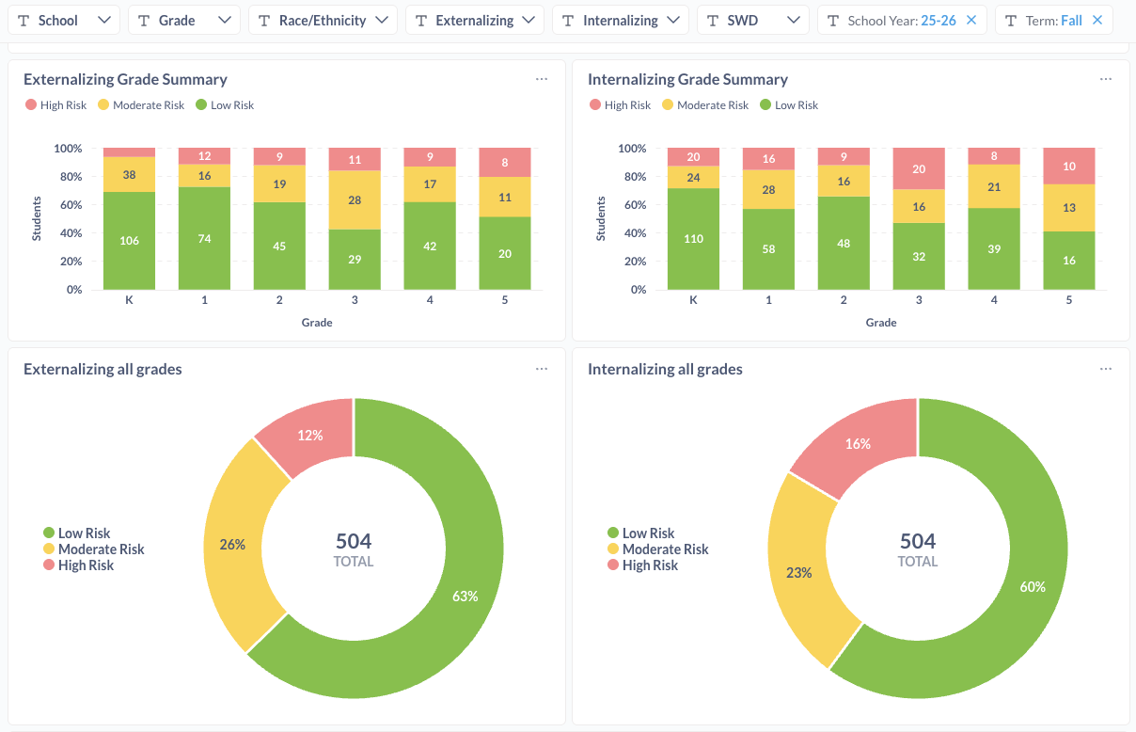
Innovation (1)
Digital Platforms for Collecting and Reporting SRSS-IE Data
Growing emphasis on establishing industry partners to make the SRSS-IE more accessible, useful, and cost effective.
  Standard Code
  Branching Minds
  ProactPulse
  …more on the way
Used with permission from Standard Co.

Slide 38
Innovation (2)
Digital Platforms for Collecting and Reporting SRSS-IE Data
Used with permission from Standard Co.

Slide 39
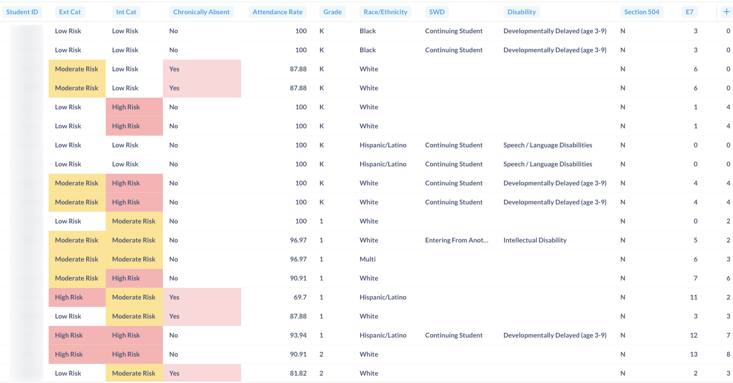
Innovation (3)
Digital Platforms for Collecting and Reporting SRSS-IE Data
Used with permission from Standard Co.

Slide 40
Q&A

Slide 41

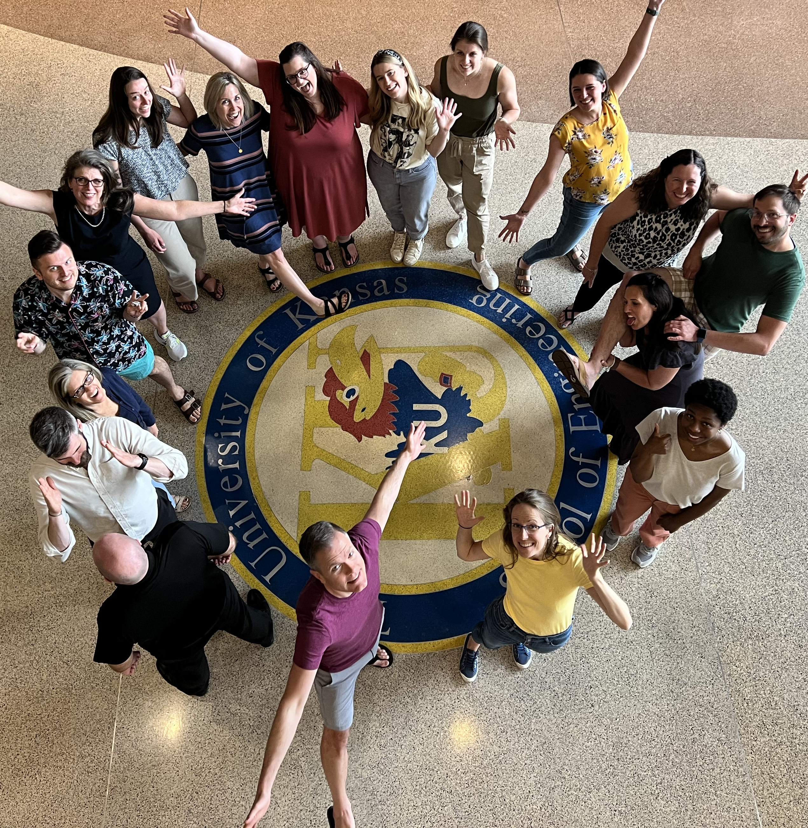
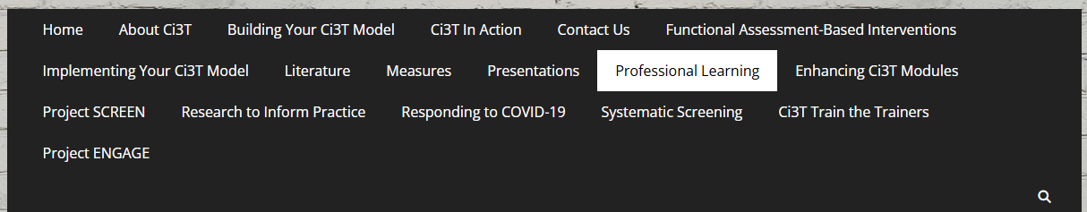
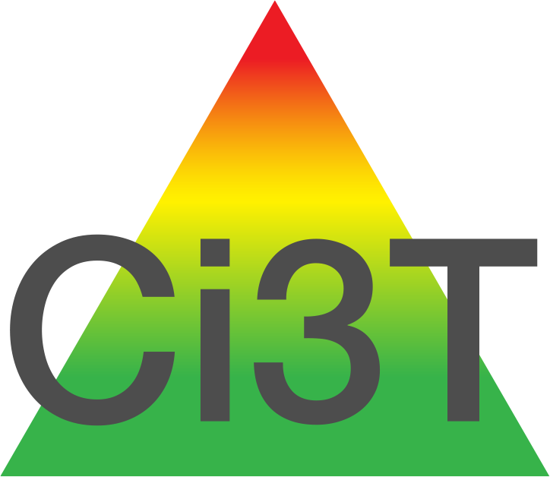
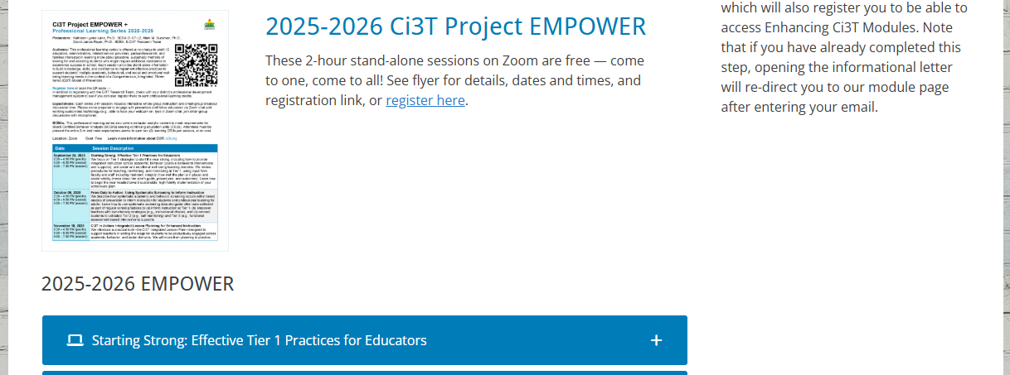
Thank you!
#Ci3T
@Ci3Tmodel
Thank you!
ci3t.org
Tag us in your Ci3T highlights, we love to see Ci3T in action!
Follow us on Instagram for updates and new resources!
Notes:
Tag us in your Ci3T highlights- we would love to see Ci3T in action! Follow us on Instagram for updates and links to resources! @Ci3TModel

