Slide 1

Navigating the Tides of Change
A Three-Year Retrospective on Ci3T Implementation in the Hilo-Waiākea Complex Area on Hawai‘i Island
David James Royer, PhD, BCBA 🌴 University of Louisville
Angie Graham, PsyD 🌴 Hawai‘i Public Schools
Magdalene Carta, PhD, EdD 🌴 Hawai‘i Public Schools
Lindsay Aubrey, EdS 🌴 Hawai‘i Public Schools
Notes:
Abstract
We present an in-depth examination of the three-year journey to implement a comprehensive, integrated, three-tiered (Ci3T) model of prevention across the Hilo-Waiākea Complex in Hawai‘i. As a geographically and culturally unique educational landscape, our complex faced both anticipated and unforeseen challenges, alongside significant successes, in building and sustaining a robust Ci3T framework. We unpack the "goods" — highlighting the tangible benefits observed in student behavior, academic engagement, and staff collaborative practices, as well as the successful strategies employed for stakeholder buy-in, professional learning, and data-driven decision making. We candidly address the "difficult parts" of implementation as well, including initial barriers, resource allocation complexities, fidelity challenges across diverse school contexts, and the ongoing need for adaptation in response to evolving student and community needs. Attendees will gain valuable insights into the iterative process of systems change, learning from our practical experiences in fostering a sustainable Ci3T model within a complex educational environment. This session is designed for educators, administrators, and policymakers interested in the realities of large-scale Ci3T adoption and the critical factors that contribute to implementation facilitators and overcoming barriers leading to triumphs.

Slide 2
Agenda
Introductions
Comprehensive, Integrated, Three-Tiered (Ci3T) Model of Prevention Overview
Hilo-Waiākea Complex Area, Hawai‘i Island
A Three-Year Systems Change Journey
Where did we start?
Our Ci3T Journey
Building a respectful university-district partnership
Anticipated and unforeseen challenges
Significant successes
Where are we now?
Ongoing need for adaptation
The journey continues: Next steps
Notes:
D

Slide 3
Introductions
Aloha! Mahalo nui loa!
Notes:
D & M & L

Slide 4
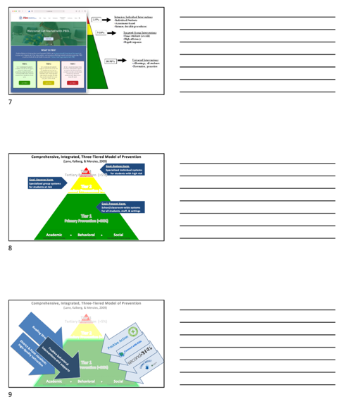
Slide notes are available at
ci3t.org/presentations
Notes:
D

Slide 5
Comprehensive, Integrated, Three-Tiered (Ci3T) Model of Prevention
A brief overview
Notes:
D
(will speed through this section)

Slide 6
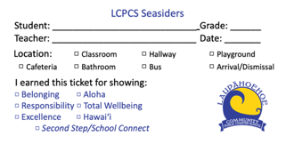

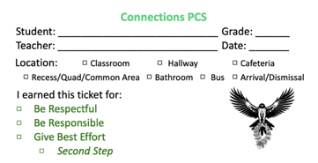



Reading Street
Positive Action
District & State Standards
High-Quality Instruction
Positive behavioral interventions and supports

Slide 7
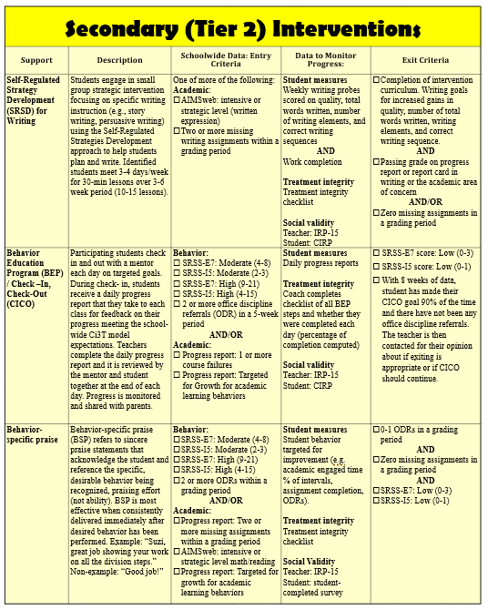

Secondary (Tier 2) Intervention Grids

Slide 8
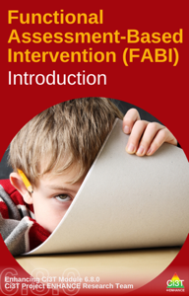

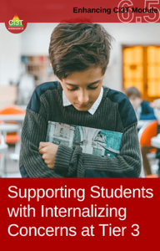
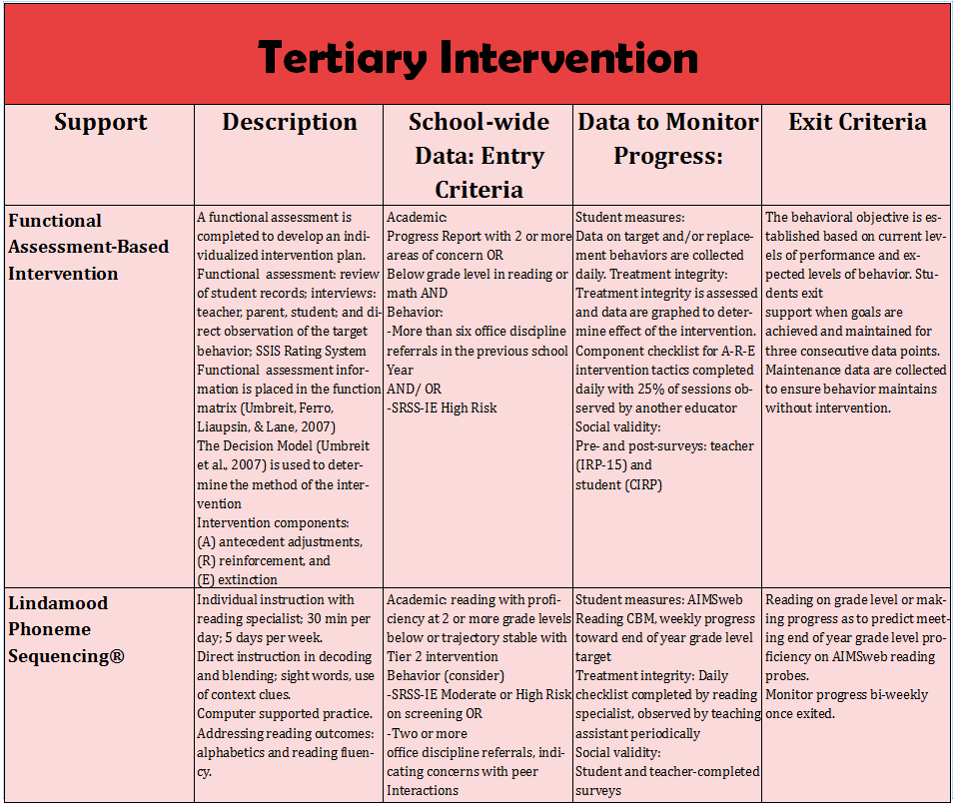
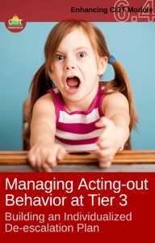
Tertiary (Tier 3) Intervention Grids

Slide 9


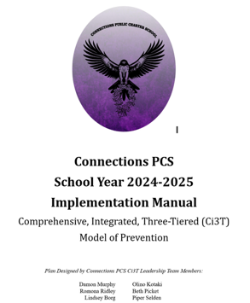
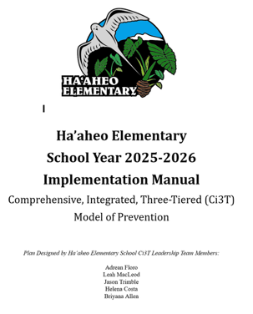

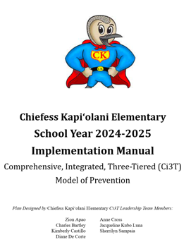
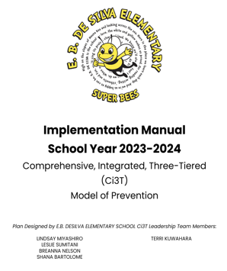

Slide 10
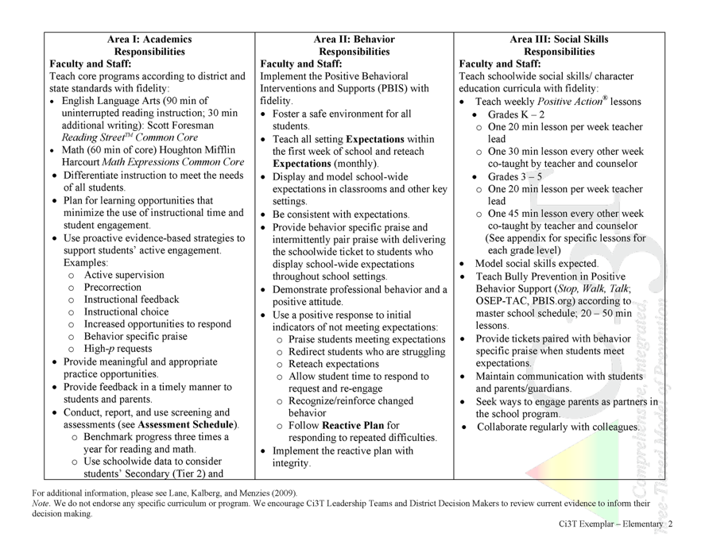
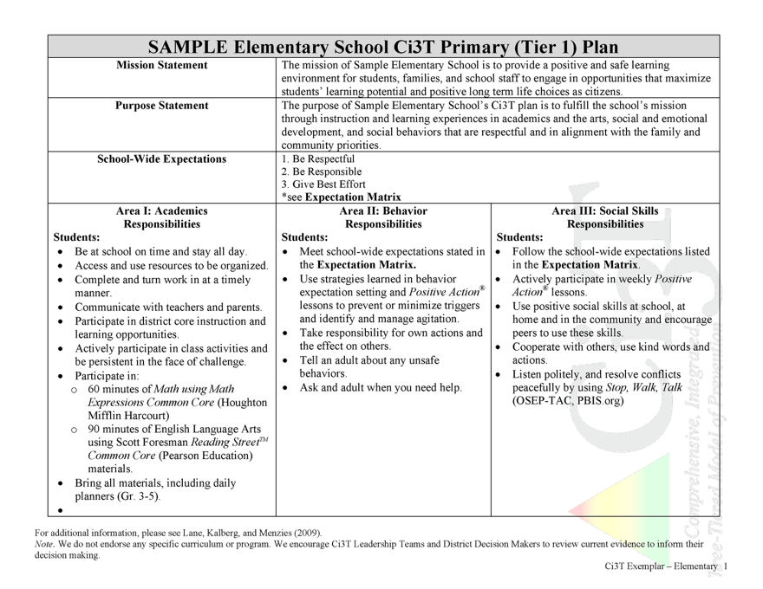
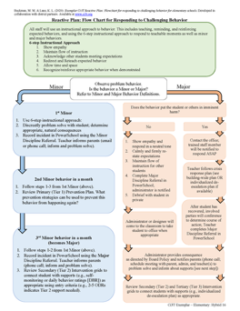
Procedures for Teaching
Procedures for Reinforcing
Procedures for Monitoring
Notes:
Ci3T Implementation Manuals
Roles & Responsibilities Academic, Behavior, & Social Domains
Procedures for teaching, reinforcing, monitoring
Reactive plan

Slide 11

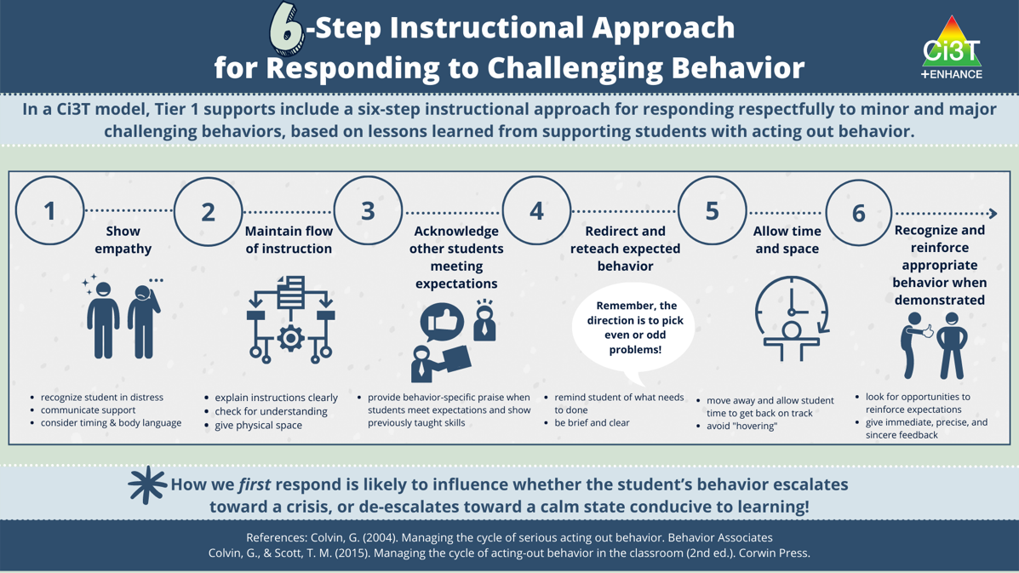
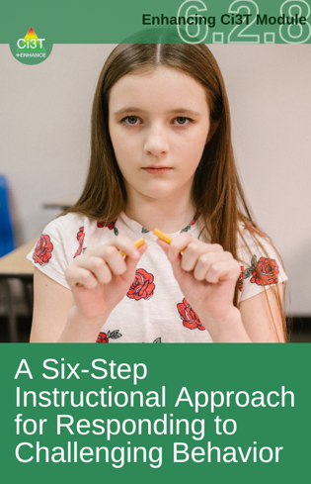
Ci3T Primary Plan: Procedures for Teaching
Ci3T Primary Plan: Procedures for Reinforcing
Ci3T Primary Plan: Procedures for Monitoring

Slide 12
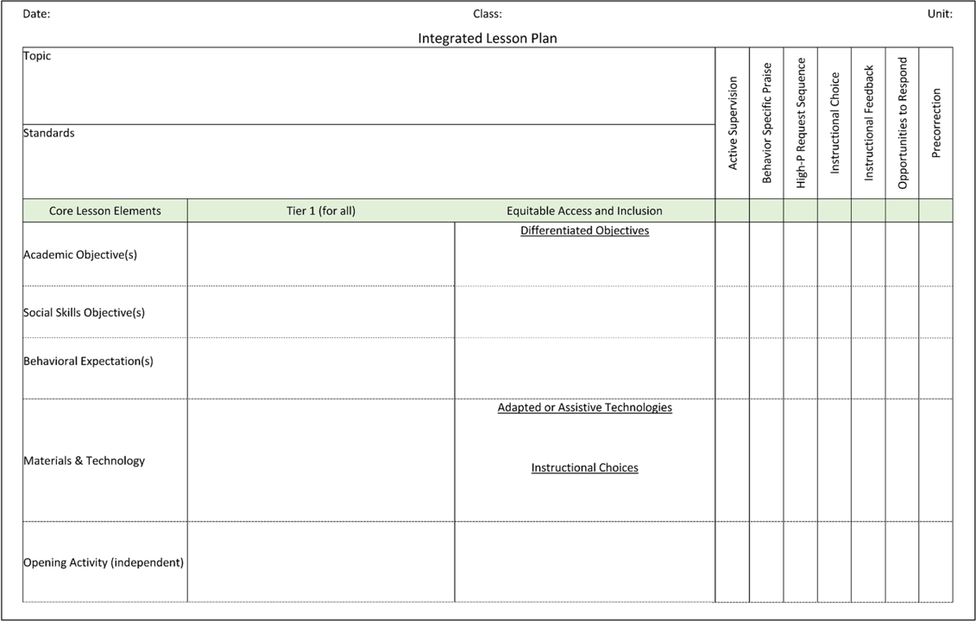
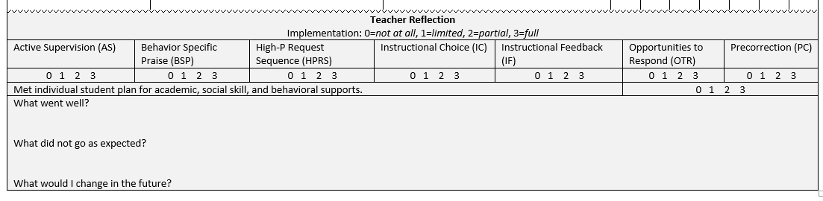
Planning for an Integrated Approach

Slide 13
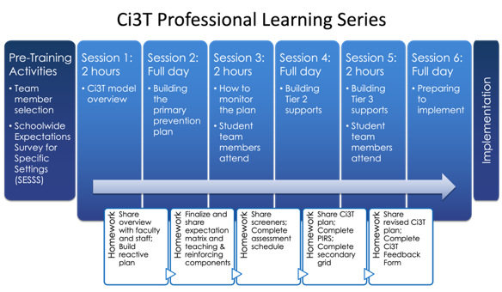
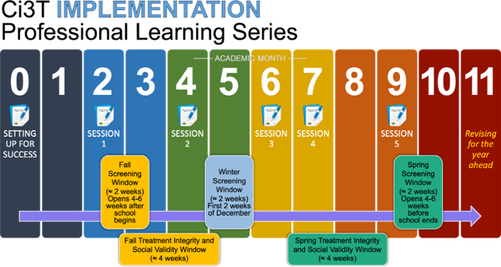

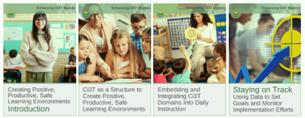


Ci3T Comprehensive Professional Learning Plan

Slide 14
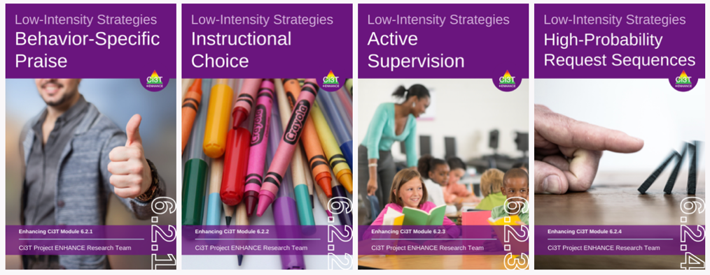
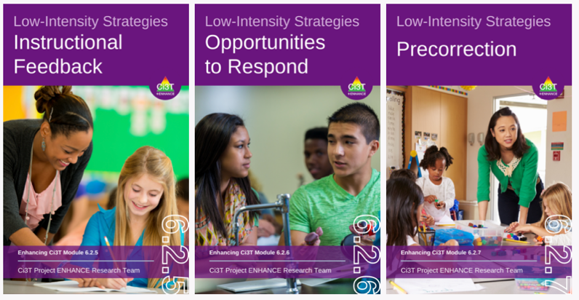


Low-Intensity Strategies ci3t.org/enhance
Opportunities to Respond
Behavior-Specific Praise
Proximity
Active Supervision
Overlappingness
Instructional Feedback
With-it-ness
High-p Requests
Pacing
Precorrection
Self-Monitoring
Behavior Contracts
Incorporating Choice
Notes:
…and online modules to support independent learning or Ci3T Leadership Team presentations to faculty and staff.

Slide 15
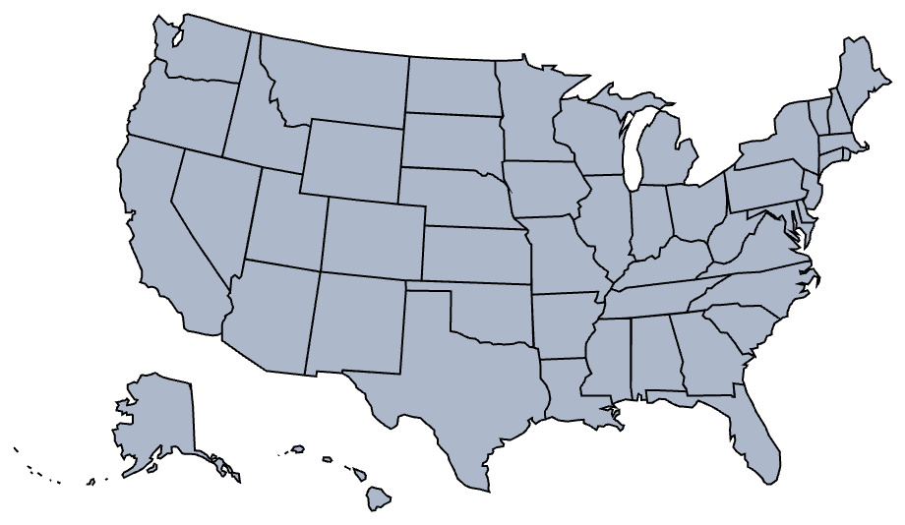

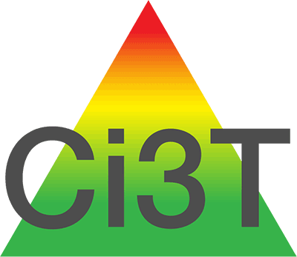
Map alone, pins auto animate
The Journey of Ci3T
1996
Notes:
Ci3T didn’t start in Hawaii, started field tests in 1996 in Southern California. Came to Hawaii in 2018 (first schools trained). Continues to grow nationwide as an expanded form of MTSS.
CA & AZ start→ Tennessee → North Carolina→ Kansas
Trainings in MO, KS, VT, AZ
More trainings and grants: MO, KS, AL, SC, HI, KY

Slide 16
Hilo-Waiākea Complex Area
Hawai‘i Island
A geographically and culturally unique educational landscape
Notes:
L

Slide 17

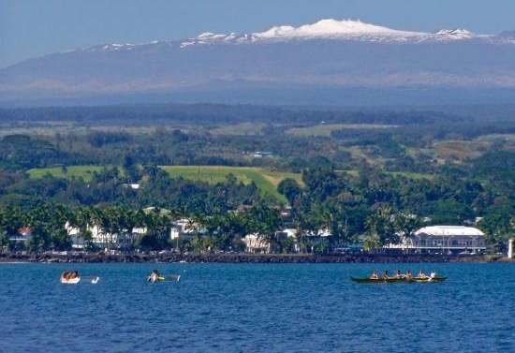
Hilo-Waiākea Complex Area
Geographically and culturally unique educational landscape
Mauna Kea from Hilo Bay
Notes:
L

Slide 18

Hilo-Waiākea Complex Area
Hilo (9 schools)
Waiākea (4 schools)
E.B. DeSilva Elementary
Ha‘aheo Elementary
Hilo High (1906)
Hilo Intermediate
Hilo Union (1912)
Kalaniana‘ole
Kapi‘olani
Ka‘ūmana
Keaukaha
Waiākea Elementary
Waiākea Intermediate
Waiākea High School
Waiākeawaena Elementary (1915)
Connections PCS
Ka ‘Umeke Ka‘eo PCS
Ke Ana La‘ahana PCS
Laupahoehoe Community PCS
Public Charter Schools (4 schools)
Notes:
L
17 total schools

Slide 19
Hilo-Waiākea Complex Area
Total Students
2024-2025 Hilo-Waiākea Complex Area fall enrollment 7,568 students
Charter schools 953 students
Hilo Complex (3,893 students)
65% economically disadvantaged, 14% special education, 7% English learners, 81% graduated on-time
Waiākea (3,450 students)
51% economically disadvantaged, 12% special education, 6% English learners, 87% graduated on-time
Most common languages:
English, Hawaiian, Pidgin, Chuukese, Marshallese
Notes:
L

Slide 20


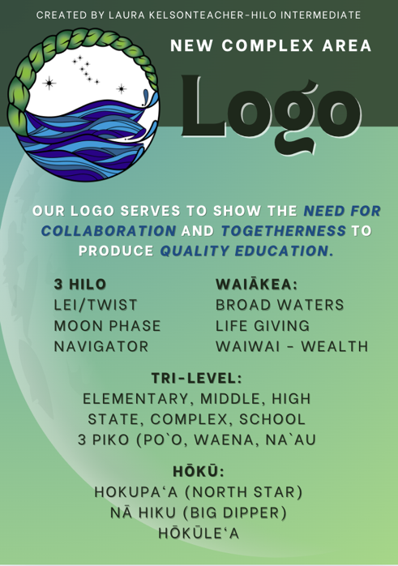
Notes:
L & M

Slide 21
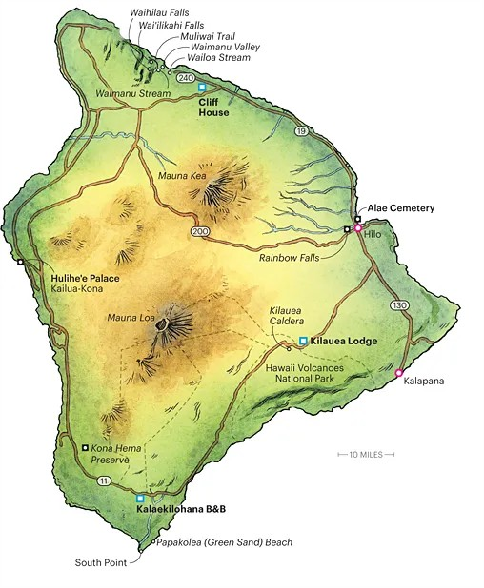
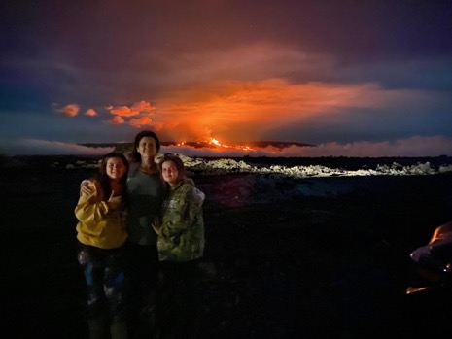
Hilo-Waiākea Complex Area
Hawai‘i Island
Mauna Loa eruption November 2022
Notes:
M
The Hilo and Waiakea Complex area is located on the eastern, windward side of the Big Island of Hawaii (also known as Hawaiʻi Island), which is the largest island in the Hawaiian chain.
Topography and Geography: Hilo and Waiakea are situated on the lower flanks of two prominent shield volcanoes, Mauna Loa (active) and Mauna Kea (dormant), which dominate the island's landscape. The area slopes down towards Hilo Bay, a crescent-shaped bay that has historically been impacted by tsunamis (notably in 1946 and 1960). The Waiakea area itself, historically an ahupuaʻa (ancient Hawaiian land division), stretches from the coast (Waiākea-Kai) inland to Waiākea-Uka, the "mountain-side" portion on the lower slopes of Mauna Loa. Waiākea Stream flows from Mauna Loa into Waiākea Pond.
Climate: Hilo has a tropical rainforest climate, making it one of the wettest cities in the United States. Rainfall is substantial year-round, with higher elevations receiving over 200 inches annually. This abundant rainfall contributes to lush, verdant landscapes, including tropical rainforests, flourishing gardens, and numerous waterfalls

Slide 22

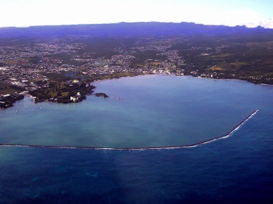
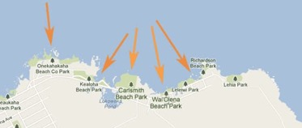
Natural Landmarks
Wailuku River State Park: Home to Rainbow Falls (Waiānuenue), famous for the rainbows seen in its mist, and the Boiling Pots, a series of cascading potholes and turbulent waters.
Hilo Bay: The central aquatic feature, offering views of the volcanoes.
Four Mile: Beaches that are all very different and unique.
Notes:
M
(No time to discuss, just show how amazing nearby landmarks etc. are)

Slide 23


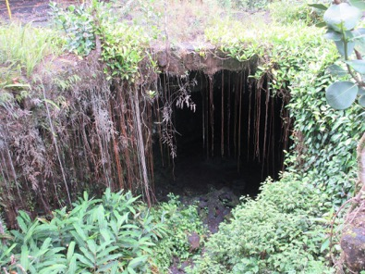
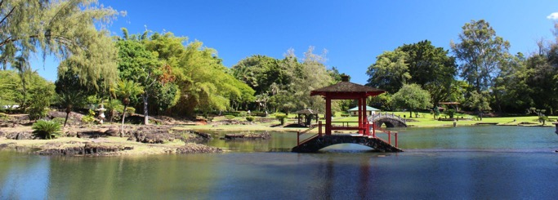
Coconut Island (Moku Ola): A small island in Hilo Bay popular for recreation and Tower Jumping.
Liliʻuokalani Park and Gardens: A meticulously manicured 30-acre Japanese garden with fishponds, pagodas, and views of Hilo Bay.
Kaumana Cave: A lava tube formed by the 1881 Mauna Loa lava flow.
Notes:
L
(No time to discuss, just show how amazing nearby landmarks etc. are)

Slide 24
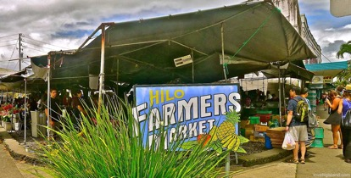
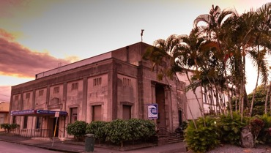
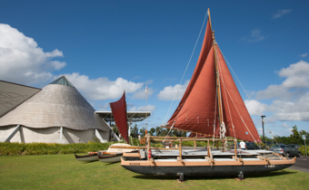
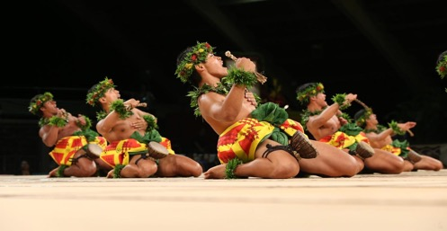
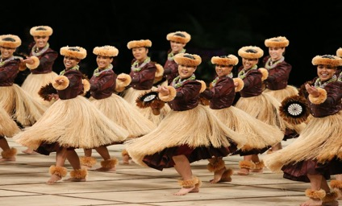
Cultural Landmarks
Hilo Farmers Market: A vibrant open market offering local produce, crafts, and a taste of local culture.
Pacific Tsunami Museum: Chronicles Hilo's history with tsunamis and their impact on the community.
'Imiloa Astronomy Center of Hawaiʻi: Connects ancient Hawaiian wayfinding and cultural traditions with modern astronomy
Merrie Monarch Festival: A world-renowned annual week-long celebration of ancient and modern hula.
Notes:
L
(No time to discuss, just show how amazing nearby landmarks etc. are)

Slide 25
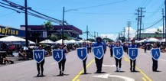
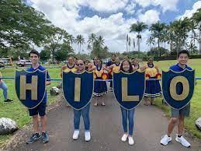
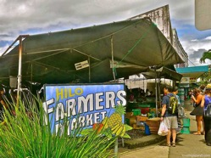


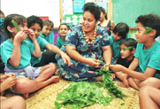
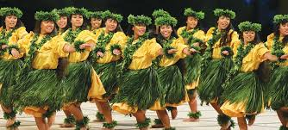
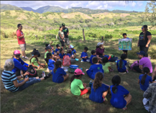
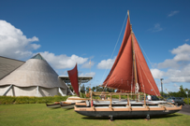
Culture and Climate
Local Pride
Bringing people together
Local practices/traditions
Values
Project-Based and Place-Based learning
Notes:
L
(No time to discuss, just show how rich Hawaii / Hilo culture is)
Local pride: The want and need to preserve local values and traditions are strong while trying to embrace the need for tourism and modernization.
Local practices/traditions: Don't take without returning, respect your kupuna, family (`ohana) goes beyond blood relatives
Sense of belonging: The need to be respected for where one comes from.
What brings people together: Cultural traditions like May Day, Merrie Monarch, festivals, family and community celebrations.
Project-based and Place-Based learning: Most of our schools effectively use project-based and place-based learning, crafting academies that offer students unique internship opportunities. These include vocational training, partnerships with local companies, and deep dives into culturally relevant areas of focus throughout East Hawaii. This approach not only provides valuable skills but also connects students directly with their heritage and community.
Values: The desire for pilina (relationship building) to promote connections with others, the community. Taking care of family. Families want schools to celebrate all aspects of their child(ren), not just academic achievement.

Slide 26
Keaukaha Elementary A Culturally Unique School and Community
Keaukaha Elementary is located at the heart of the community
Long generational bonds
Family connection is at its core
All events are focused on bringing families together to celebrate the traditions of Keaukaha and the Hawaiian values that connect them
be strong, be proud, be pono
May Day
Notes:
M
4 minute video

Slide 27
A Three-Year Systems Change Journey
Where did we start?
Notes:
L
In this section:
What was happening before we decided to build a Ci3T model of prevention complex-area wide?
What were academics and behavior etc. like that made us want to build a schoolwide model of prevention?
Talk about state directive to build MTSS.
Describe what life was like before Ci3T in Hilo-Waiākea.

Slide 28
2019-2021 Hilo-Waiākea Complex Area
Before Ci3T
Focus was on RTI for academics
Consistency between schools was lacking
Every school could choose how they set up tiered supports and curriculum
Upside down triangle with heavy supports at Tier 3
Tier 1 was not a focus, especially for the behavior domain
PBIS was underutilized
District staff (behavioral health specialists, school psychologists, social workers, clinical psychologists, district teachers) were overused at Tier 3 and for crisis support
Heavy assessment caseloads at the IDEA level
Staff levels were low at the specialist level (school psychologists and clinical psychologists)
Notes:
L

Slide 29
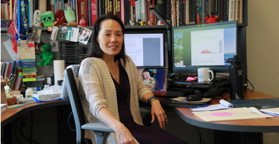
2019 HIDOE Push for MTSS
Rollout of MTSS in June of 2019 for the 2019-2020 school year.
SBBH attended the 3-day July 2019 Ci3T Train the Trainer in Honolulu
Slow start then complete stop in Hilo-Waiākea Complex Area
…and across Hawai‘i Island as COVID-19 hit January 2020
March 2020: Focus was moved to how to educate online
Big focus on student ability to get food, medical supports, transportation, wi-fi, computers, and IDEA services
District staff focus was on those with the most needs – locating students and making sure basic needs were met
Students remained online through 2020-2021 school year
Notes:
L

Slide 30
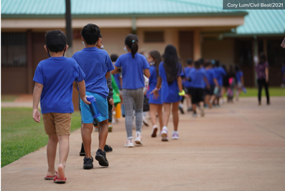
2021-2022 School Year
Students came back from online learning
with gaps in academic and social-emotional skills
(at least a 1-year gap in reading, math, and writing)
Not all students wanted to come back to school
Increased student anxiety, especially at the middle school level
Elementary student difficulties with transitions and the structure of a classroom setting
The push from HIDOE returned: Support these students by building strong tiered supports
Notes:
L

Slide 31
Implementation Science Adapted from Fixsen & Blasé, 2005
Exploration & Adoption
Installation
Initial Implementation
We think we know what we need so we are planning to move forward (evidence-based)
Let’s make sure we’re ready to implement (capacity infrastructure)
Let’s give it a try & evaluate (demonstration)
Full Implementation
Let’s make it our way of doing business (institutionalized use)
Sustainability & Continuous Regeneration
That worked, let’s do it for real (investment)
Notes:
D
The Hilo-Waiākea journey generally follows implementation science
Star is where we are now after three years of training schools to build their Ci3T Model of Prevention, some schools are in their 3rd year of implementation, some 2nd, one school is in their 1st year of implementation. Some schools are going through training this year.

Slide 32

Ci3T Professional Learning & Implementation
Hilo-Waiākea Complex Area | 22-23 | 23-24 | 24-25 | 25-26 | 26-27 | 27-28 | 28-29
Cohort 1 (6 schools)
Ci3T Training
Implementation Year 1
Implementation Year 2
Sustain and Develop Practices
Cohort 2 (4 schools)
Ci3T Training
Implementation Year 1
Implementation Year 2
Sustain and Develop Practices
Cohort 3 (1 school + SBBH)
Ci3T Training
Implementation Year 1
Implementation Year 2
Sustain and Develop Practices
Cohort 4 (5 schools)
Ci3T Training
Implementation Year 1
Implementation Year 2
Sustain and Develop Practices
Notes:
D
Cohort 4 ideally would be:
HHS
HUES
KEIS
WHS
WKES

Slide 33
Our Ci3T Journey
Building a respectful university-district partnership
Anticipated and unforeseen challenges
Significant successes
Notes:
D

Slide 34




Timeline: Building Capacity
2017-2021
2022-2023
2023-2024
2024-2025
University of Hawai‘i at Mānoa
Ci3T Professional Learning Series trainings on O‘ahu
2019 Ci3T Train the Trainers
2020 COVID-19
Year 1
Train Cohort 1
3 elementary (K-6)
1 elementary (K-5)
1 intermediate (6-8)
1 K-12 charter school
Year 2
Implementation support for Cohort 1
Train Cohort 2
1 elementary (K-6)
1 intermediate (7-8)
2 K-12 charter schools
Year 3
Implementation support Cohorts 1-2
Train Cohort 3
1 elementary (K-6)
school-based behavior health specialists team
Notes:
D
How we built our respectful university-district partnership.
David was at UHM for 4 years, including covid which slowed down schools’ ability to build or implement their Ci3T model. Moved to Kentucky for University of Louisville. Blake reached out from Hilo-Waiākea Complex Area about Ci3T training, found funding, and we started fall 2022 with Cohort 1 at hotel.
Transitioned to Angie in Year 1 when Blake retired/transitioned off MTSS. Year 2 and Year 3 at Arc of Hilo. Melissa joined Year 2.
Goal was to build the capacity of Hawaii leadership team to train schools and support schools in implementing Ci3T. Gradual release: David did everything Year 1 in person with Kristina Brown’s help. David did most presenting in Year 2 but not all, Kristina ran student sessions (David remote presented or was on standby while Angie presented for sessions 1 3 5), and Angie’s team took charge of preparation and setup. Year 3 David presented half (full days in person), Angie presented half (2-hr sessions, with David on standby remotely), and Angie’s team ran all logistics (no student session b/c only one school).

Slide 35

Taking the Lead in Ci3T Rollout
Notes:
M

Slide 36


Hilo-Waiākea SBBH Expectations
Show Aloha
Be collaborative
Be engaged
Have an open mind
Notes:
M
The SBBH Team also went through Ci3T training sessions and developed their own expectations.

Slide 37




Fading in New Staff/Training to Build Capacity
2022-2023
2023-2024
2024-2025
2025-2026
School teams trained included school psychologists
Summers of 2019, 2022, 2023: School psychologists and social workers attend Ci3T Train the Trainers
School teams now include school psychologists and social workers as Ci3T Coaches and district representatives. Lead SBBH admin helps conduct Ci3T introduction meetings at each school.
Learning year for SRSS-IE behavior screener implementation for district staff.
Division of Services
Filled new position:
Focus MTSS supports. Melissa Brilhante, district teacher, supports Ci3T training and implementation sessions.
District Level Supports: TFI / TSR / PIRS school psychologist / social workers supporting.
Lead for district trainings: SBBH admin
SBBH admin and district teacher: Ci3T Training at district level.
District teacher: supporting schools for updates, scheduling, and building capacity.
School Psychologists: Ci3T Coaches and support staff with tiered training and behavior screeners. Review data. TFI scheduling & assess.
Notes:
M

Slide 38
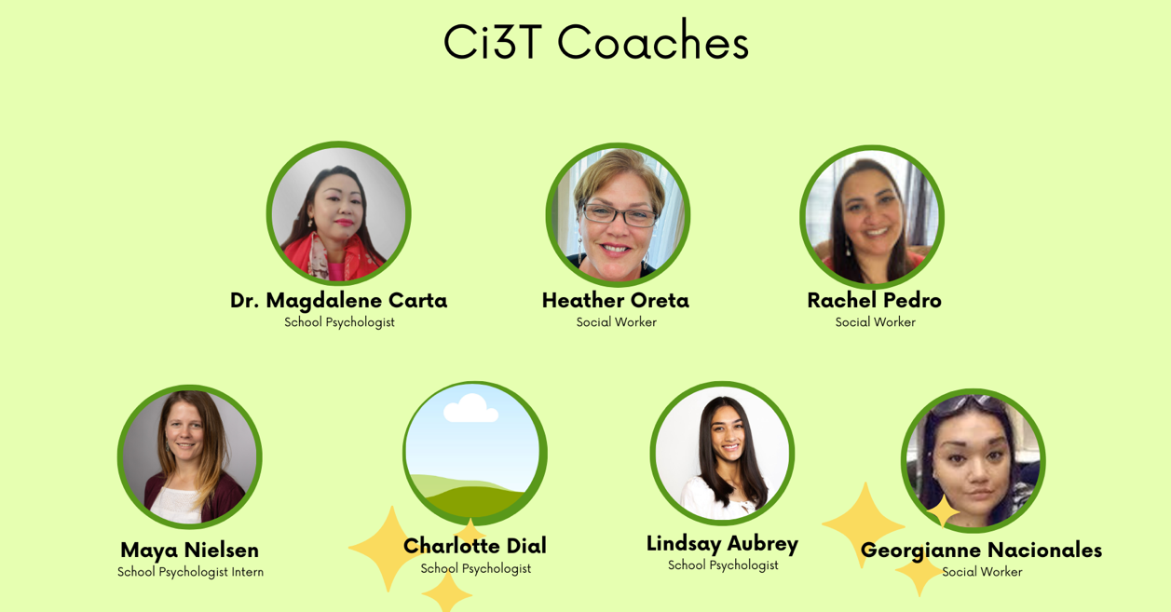
Ci3T Coaches
Notes:
M

Slide 39
Challenges
The cultural landscape and melding in cultural components
Showing principals and vice principals how Ci3T can be utilized to fit their unique campus needs
Continuous state initiatives that need to be weaved into Ci3T plans
threat assessment, suicide prevention training, sexual violence training/ curriculum, vulnerability assessments
Vocabulary: Ci3T is MTSS and includes PBIS and RTI
How to train new staff at school and district level
Building staff capacity without overwhelming any particular role
Continuous training opportunities provided by the district
Scheduling schools for staff training and data collection
Notes:
M
We candidly address the "difficult parts" of implementation as well, including initial barriers, resource allocation complexities, fidelity challenges across diverse school contexts, and the ongoing need for adaptation in response to evolving student and community needs.

Slide 40
Successes
Complex Superintendent is invested in Ci3T
10 out of 13 schools have completed Ci3T training
3 out of 4 charter schools have completed Ci3T training
All schools conduct TFI to gather PBIS data fall and spring
All schools will have a behavior screener in place by end of this school year – SRSS-IE or BEISY
Cultural components are being weaved into Ci3T blueprints
Training of district staff to support Ci3T implementation is in year 3
more staff are supporting tiered interventions – training, modeling, fidelity checks and support, data collection
working with teams to schedule tiered supports throughout campus
Fully staffed with school psychologists and clinical psychologists
Division of school needs to not overwhelm one role group
Notes:
M
We unpack the "goods" — highlighting the tangible benefits observed in student behavior, academic engagement, and staff collaborative practices, as well as the successful strategies employed for stakeholder buy-in, professional learning, and data-driven decision making.
1 school is currently in Ci3T building year. 1 school plans to attend next year. The final school is working to build a hybrid of Ci3T

Slide 41


Expected Behavior Chart
 | Arrival/ Dismissal | Piko | Classroom/ Instruction | Passing/ Hallway | Bathroom | Cafeteria/ Eating Area | Common Area/ Recess Area | Bus/ Huakaʻi
ʻanoʻano | Hōʻea mai me ka mākaukau a hoʻi ika hale me nā mea pono. Hōʻea ma kahi kūpono ke hiki mai i ke kula a ma hope pono o ke kula. ʻAʻole e hoʻopaʻakikī ka haʻalele i ka makua E puka i waho ke kāhea ʻia. E lawe i kāu mau mea. | Maiau a maʻemaʻe (Lole Makalike, kou kino). Pali ke kua, mahina ke alo, kū me ka mākaukau (lima ma ka ʻaoʻao, ʻaʻohe leo. Komo ma ka hana. Hōʻea ma ka ma ka manawa kūpono. | Mālama kūpono i ka manawa ma ka papa. E komo piha i ka hana. E hoʻokō maikaʻi i nā kuleana a pau. Mai kikahō i ke kumu i ka papa. Makaʻala i ka maʻemaʻe. E hahai i nā lula o ka lumi papa. | Holoē -e kū laina. Keeping hands and feet to myself. ʻIke i nā lula no kēlā me kēia wahi a mālama. Holoē- e hele wāwae, ʻaʻole e holo. Kiloi i ka ʻōpala i kahi kūpono. Be aware of you and not others. | Hele i ka lua ma ka manawa kūpono. Holoi I kou mau lima me ke kopa. Holoi i kou mau lima. E hoʻoholo i ka wai. Kīloi i nā kāwele I hoʻohana ʻia ma kahi kūpono. Hoi mua i ke kumu ma mua oka hele ʻana ka lua. (?) | Cleaning up after yourself. E mālama i nā lima iā ʻoe iho. Eating your own food or asking to share. Eating breakfast/lunch to nourish your body and mind. | E haʻi i ka makua inā he pilikia. Hoʻi i nā lumi papa ke pau ka wā pāʻani. Hoʻomaʻemaʻe/ Hoʻihoʻi i nā mea i hoʻohana ʻia. (Nā kinipōpō, apwa) ʻŌlelo kūpono. E pāʻani ma kahi pololei. Extras Below | Noho me kāu ʻeke/paisi ma kou uhā. Kaʻa ʻohua- E ʻae iā haʻi e noho ma kou ʻaoʻao. Mālama iā ʻoe iho. Lima i loko o ke kaʻa ʻōhua. E makaʻala i ke alanui.
lau | Ma waho-ʻaʻole e puka i waho o ka pā. Aloha i ke kumu a me nā hoa. Waiho i ke ukana ma kahi kūpono Wehe i ke kahipa Lawe I kāu mau ukana I ka hale. | Kali a i ka hoʻokuʻu ʻana. E oli/mele i nā oli/mele e pono ai ma ka Piko. Hoʻolohe i nā manaʻo a nā Kumu i haʻi ʻōlelo ai ma ka Piko me ka maopopo. | Kū ma ka ʻoiaʻiʻo. E mālama kūpono i kāu lawena. Mālama i kāu haʻawina a kākau ma ka ʻalemanaka maʻemaʻe kahi i noho ai, apwa. Launa ʻoluʻolu me nā hoapapa like ʻole. Extras Below | Being aware of those around me. Using medium/soft voices, especially by classrooms and offices. Hele pololei i kou papa. (Koe wale nō e hele i ka lua/hoʻopihapiha ʻōmole wai/ inu wai. | Mālama I ka maʻemaʻe o ka lua. E pani i ka piula wai. Mai hele i ka lua inā ʻaʻole ʻoe e hoʻopau pilikia ana. Mai ʻai i ka meaʻai iā ʻoe e noho ana ma ka lua. Mai pāʻani ma ka lua. Extras Below | Keeping food on your plate. Listening to adults and following adult directions. E kiloi i ka ʻōpala ma ke kini ʻōpala, ʻaʻole e hoʻopulu i ka papahele. E mālama i nā loina kūpono ma nā ʻaha. | Playing kindly/friendly with others. E makaʻala i ka lawena kūpono. E ʻōlelo ʻoluʻolu kekahi i kekahi. E hoʻolohe i nā kumu/makua. Stayin within approved student zones. | Hoʻolohe i ke kanaka kalaiwa kaʻaohua. ʻŌlelo kūpono: leo hawanawana; ʻōlelo ʻoluʻolu
lālā | Kīʻi i ka mea ʻai. Hele i ka lua | E mālama i kou wahi ponoʻi. Redirect peers discretely. | Kāohi i ka ʻōlelo/hana kūpono ʻole E mālama i ke aloha/hōʻihi ma ka wā pilikia. E mālama i nā lako kula, nā lako pono. Ke komo pū ʻana o nā haumāna i ke kamaʻilio ʻana no kekahi ʻano kumuhana ma kahi o ka noho mū wale ʻana I ka papa. Extras Below | Ka hiki ke launa kūpono me nā haumāna a pau, ʻaʻohe ʻōlelo ʻino, kōkua aku kōkua mai, kaʻana aku kaʻana mai. E ʻoluʻolu ka ʻōlelo. Hiki nā keiki ke noho malie, mai alae i ke alahele, ke aloha nā kumu i nā keiki. Aloha aku i nā kumu kekahi. | E hoʻoholo i nā mea kūpono wale nō ma ka lua. | Hiki ke noho pono me nā keiki like ʻole. | E kaʻanalike i nā mea pāʻani. ʻĀe i nā hoa e pāʻani. | E ʻoluʻolu me ka launa. Maʻemaʻe ke ka aʻohua. Kōkua i nā hoʻokipa, nā kumu a me ke kaiā ulu ma ka huakaʻi.
hua | Hana haʻawina Kōkua i nā haumāna/kumu ma nā kuleana kakahiaka/ma hope o ke kula. Hoʻomaʻemaʻe i ke kula/papa E hoʻopaʻanaʻau i nā hua ʻōlelo o nā mele oli o ke kula | Komo piha a haʻaheo leo Kāhea. Kōkua a kākoʻo kekahi i kekahi. Haʻi ʻōlelo E hoʻopaʻa (?) i nā manaʻo o ka pule a hiki ke haʻi hou a hāpai i laʻana hoʻopili I kou ola. | E kākau (noka) i kā ke kumu e kākau ai i ka papa keʻokeʻo. Ka paipai ʻana o kekahi i kekahi e holomua like ai lākou a pau. E hoʻokō i nā haʻawina āpau ma mua o ka lā palena pau. | None | E haʻi i kekahi kumu/limahana inā he pilikia ma ka lua. Hoʻomaʻemaʻe hoʻoia maʻemaʻe. | Kōkua me ka meaʻai. | Alakaʻi i ka pāʻani. Mālama mea pono. | Kōkua i nā keiki kanaka kalaiwa (?). Wehe/pani i nā pukaaniani
Notes:
L

Slide 42
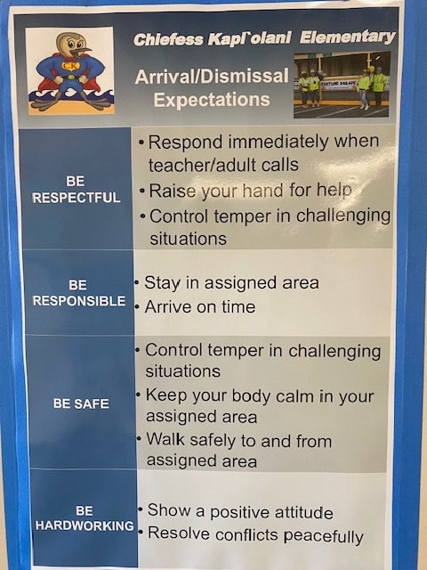



ADD GIANT Ci3T POSTER
Notes:
L

Slide 43



Notes:
L

Slide 44




Notes:
L (or M?)

Slide 45
Ci3T Implementation PL Sessions
Ci3T/MTSS Implementation Professional Learning Series Timeline
Each school’s Ci3T/MTSS Leadership Team will attend the implementation support sessions. Only team members are asked to attend the trainings.
September 23
December 2
January 27
February 24
March 24
April 21
Review, MTSS/Ci3T teams, Tier 1 EBPs, TFI purpose
Review data, supports needed, adding TA, SP, and SVP
Tiers 2 & 3 EBPs and how to collect data
Tiers 2 & 3 academic support, collecting & using data
Review fall data, make adjustments, EBPs for behavior
Discuss TFI and next steps, polish plans, where to begin next
8:30-3:00
8:30-3:00
8:30-3:00
8:30-3:00
8:30-3:00
8:30-3:00
Notes:
L
Example of HW schedule of Ci3T implementation professional learning.

Slide 46



Essential Components of Primary (Tier 1) Prevention Efforts
Social Validity
Systematic Universal Screening
Academic
Behavior
Treatment Integrity
ci3t.org/measures
ci3t.org/screening
for behavior
Notes:
L
We administer surveys to faculty and staff to garner understanding of social validity, self-reports to assess treatment integrity, and systematic screening of all students for academics and behavior. We believe schools thrive when faculty and staff are keenly aware of their school-wide data.

Slide 47
Ci3T Data Collection to Data-Informed Decision Making and Dissemination
01
02
03
04
05
06
Electronic measures (TSR, PIRS, TFI)
Data checked for erroneous outliers
Auto-report customized
Report distributed
District leaders
Principals
Ci3T teams
Data-informed decision making
Dissemination
Dissertation
Conference presentations
Journal publications
Distributed
1-week follow up
2-week closed
Accuracy Check
Notes:
L
We send out those surveys with Qualtrics for social validity and treatment integrity twice a year, fall and spring. Analyze results and share back with faculty and staff.
Schools screen all students for academics and behavior three times a year, fall, winter, and spring. They build reports and share back with faculty and staff, using all data to inform decision making.

Slide 48


Enhancing Ci3T Modules: Tier 2 and Tier 3
used at 2025-2026 Ci3T Implementation Professional Learning Series
ci3t.org/enhance
Notes:
L
We are utilizing the ready made Powerpoints and materials to help us with our rollout of Tier 2 and 3 behavioral Intervention training at the complex level with school teams. We are modeling to the school teams how to take this material back to their school staff to help build better intervention skills and data collection.

Slide 49


Data and Positive Testimonials Are Our Greatest Successes
Notes:
M

Slide 50
2024-2025 TFI Data Fall and Spring
Five Schools
100%
80%
Goal: 70%
60%
40%
20%
Fall
Spring
0%
Average TFI Score = 50.6%
Average TFI Score = 66.4%
Notes:
M
Beginning of School Year 2024 started rollout with TFI for schools in Implementation Year. Scheduling was the hardest part of this process: Gathering the school teams together. Data pulled from PBIS Apps

Slide 51

Ci3T Treatment Integrity: Teacher Self-Report Fall 2023 vs. Fall 2024
Is there a significant difference in mean Ci3T TI: Teacher Self-Report scores from fall 2023 to fall 2024?
Notes:
M
• The consistency in high scores — mostly in the 80s and above — indicates that teachers’ perceptions of the Ci3T model’s goals, procedures, and outcomes remained favorable and stable over time.
• Possible ceiling effect: Spring scores were already high.
• This stability suggests early buy-in to the model and may reflect strong initial training or alignment with staff values.
• Suggests stable perception of Ci3T's acceptability and relevance during early implementation.

Slide 52

Relation Between Social Validity (PIRS) and Treatment Integrity (TSR)
Notes:
M
Magda’s Slide - Research Question 3 – Relationship between Social Validity and Treatment Integrity
To what extent is an educator’s social validity score related to that educator’s treatment integrity score at a given time point during Ci3T implementation?
Findings:
• Pearson r = 0.323 for PIRS vs. TSR in Fall 2023, with a p-value = 0.017. This correlation is statistically significant (at the 0.05 level) and can be characterized as a moderate positive relationship.
• Educators with high social validity scores tended to have higher treatment integrity in implementation

Slide 53
Cultural Integration: Tier 1 in Action
Hilo Intermediate School- schoolwide culturally inclusive activities and awards with SEL Focus. Living ALOHA, knowing your KULEANA and Being PONO.
Every quarter, every teacher (40) nominates a child for excellence in Courage, Gratitude, Forgiveness, Compassion in action, and the SPARTAN awards
Winners get free dress for a month (don't have to wear uniform), get their pictures up on walls, and family joins them during the awards assemblies to encourage everyone to live these values every day.
Japanese week! Spam Musubi and shave ice during a Bon Dance on campus.
Micronesian week! Dance performances and sharing
Filipino week! Keiki (children) bring in food and desserts to share with all
Hawaiian week! Keiki can wear anything Hawaiian and even have a paniolo day with horses
Our teachers have gone on Huaka'i around Hilo to incorporate place-based learning and then share at various family engagement nights
We have meet & greet nights for families with pizza and goodies
We strive to have Hilo Intermediate vision to Know your Kuleana, Be Pono, Live Aloha - from top and throughout this OHANA
Hilo Intermediate BON Dance
Notes:
L
Hilo Inter BON Dance 4 min 44 sec

Slide 54


SBBH Individual Bright Spots: Utilizing MTSS supports for Transition
A Success Story: Behavioral Health Specialist
“Middle School student having some difficulties and his team were worried about his transition to Middle and then High School. The schools arranged early visits to introduce him to the Middle School and to me prior to the 4th quarter of the school year. We also met daily during the summer transition, and he had some incidents early on but with support and reinforcement of coping skills that he practiced daily he has made a lot of progress. He has practiced and learned to use his voice to advocate for himself when he feels overwhelmed or stressed and will seek support when needed. He was even the key speaker of 3 group presentations here on campus. This has been especially evident this 24-25 school year with him going on to 9th grade transition. Parents are elated and can't wait to see what else is in store for this young man. The High School team is ready for him and although he will miss me, he shared; he will continue to visit and give me updates of his continued progress.”
Notes:
L

Slide 55
SBBH Individual Bright Spots: Utilizing MTSS supports for Social-Emotional
A Success Story: Teacher
“A student I was working with this year was having difficulty transitioning back to a full-time student. Together with his care team and family, we set up a consistent schedule of Tier 1 and 2 supports and reinforcements. We noticed an increase in confidence and motivation, which resulted in more positive social interactions, less challenging behavior, and he is now performing at or above grade level academically.”
Notes:
L

Slide 56
Where are we now?
Ongoing need for adaptation Next steps
Notes:
M

Slide 57
Timeline: Building Capacity
2025-2026
2026-2027
2027-2028
2028-2029
Year 4 : District Team Lead
Implementation support Cohorts 1-3
Train Cohort 4
1 High School (9-12)
Year 5 : District Team Lead
Implementation support Cohorts 1-4
Train Cohort 5
1 HS and 1 Elementary
Year 6: District Team Lead
Implementation support Cohorts 1-5
Year 7: District Team Lead
Implementation support Cohorts 1-5
Notes:
M

Slide 58


2025-2026 Ci3T Professional Learning Series Training Schedule
Notes:
L
Each year we send out our complex wide training memo- describing what will be provided for our Ci3T school teams. Our Complex Lead team plans out how long and where the training will be held, during the summer before school starts.

Slide 59


2025-2026 Ci3T Implementation Professional Learning Series
Notes:
L
The Schools in the Implementation years will have some sessions that are the same every year to get everyone ready for the data collection process. Then each year we add in some new training that school teams can take back to their campus staff. This school year we focused on State initiatives that needed to be added into the schools Ci3T plans. We also focused on Tiered intervention practice for behavior and SEL.

Slide 60

Ongoing Need for Adaptation
Updating Ci3T Implementation Manuals yearly
TFI data collection dates scheduled before school year starts
Continuous and ongoing training of district staff to ensure supporting schools is manageable
The district must have their own Ci3T district leadership team
trainings
updates
adding in state initiatives
supporting data collection
Notes:
M

Slide 61

The Journey Continues Next Steps
Create a data dashboard for schools to access Ci3T data
PIRS, TSR, TFI
Create a larger Ci3T/MTSS district team to schedule trainings in summer for the next school year
Provide additional support for behavior screening data use
Model tiered interventions to all faculty and staff
Support scheduling needs at the middle school level for Ci3T/MTSS implementation
Notes:
M

Slide 62

Notes:
M

Slide 63

Ci3T Professional Learning Calendar
 | 0 | 1 | 2 | 3 | 4 | 5 | 6 | 7 | 8 | 9 | 10 | 11
 | July | Aug | Sep | Oct | Nov | Dec | Jan | Feb | Mar | Apr | May | Jun
Ci3T Training |  |  |  |  | Ci3T Professional Learning Series Session 1 | Ci3T Professional Learning Series Session 2 | Ci3T Professional Learning Series Session 3 | Ci3T Professional Learning Series Session 4 | Ci3T Professional Learning Series Session 5 | Ci3T Professional Learning Series Session 6
Ci3T Implementation Support | Ci3T Implementation PL Series Setup for Success |  | Ci3T Implementation PL Series Session 1 |  | Ci3T Implementation PL Series Session 2 |  | Ci3T Implementation PL Series Session 3 |  | Ci3T Implementation PL Series Session 4 | Ci3T Implementation PL Series Session 5
Ci3T EMPOWER |  |  | Ci3T EMPOWER Session 1 | Ci3T EMPOWER Session 2 | Ci3T EMPOWER Session 3 |  | Ci3T EMPOWER Session 4 | Ci3T EMPOWER Session 5 | Ci3T EMPOWER Session 6 | Ci3T EMPOWER Session 7
Ci3T Trainers & Coaches Calls |  | Trainers & Coaches Call Session 1 | Trainers & Coaches Call Session 2 | Trainers & Coaches Call Session 3 | Trainers & Coaches Call Session 4 | Trainers & Coaches Call Session 5 | Trainers & Coaches Call Session 6 | Trainers & Coaches Call Session 7 | Trainers & Coaches Call Session 8 | Trainers & Coaches Call Session 9 | Trainers & Coaches Call Session 10
Notes:
L
We continue to offer training to schools to build their Ci3T model of prevention (a few schools remain), and Ci3T Implementation Professional Learning Series sessions, plus additional professional learning like encouraging faculty and staff to attend Project EMPOWER sessions online or watch recordings after.

Slide 64


Sustaining and Disseminating Professional Learning
 | 0 | 1 | 2 | 3 | 4 | 5 | 6 | 7 | 8 | 9 | 10 | 11
 | July | Aug | Sep | Oct | Nov | Dec | Jan | Feb | Mar | Apr | May | Jun
Ci3T EMPOWER |  |  | Ci3T EMPOWER Session 1 | Ci3T EMPOWER Session 2 | Ci3T EMPOWER Session 3 |  | Ci3T EMPOWER Session 4 | Ci3T EMPOWER Session 5 | Ci3T EMPOWER Session 6 | Ci3T EMPOWER Session 7
ci3t.org/pl
Staff to attend trainings / watch recordings to become on-site coaches
Effective Tier 1 Practices
Screening to Inform Instruction
Integrated Lesson Planning
Behavior-Specific Praise & Precorrection
Responding to Challenging Behavior
A Tier 2 Support for Anxiety: R.R.R.
Functional Assessment-Based Intervention
and share for 10 min @ next faculty meeting
Notes:
L
We continue to learn and grow with our faculty and staff such as by having Ci3T Leadership Teams designate who will attend Project EMPOWER live, or when will the team get together to watch the recording after, pausing to discuss breakout room topics.

Slide 65

Building a Ci3T Data Dashboard
Notes:
D
HIDOE next step, work in progress to get all data in one place for Ci3T Leadership Teams and teachers to be able to examine (e.g., at SST meetings)

Slide 66





@Ci3Tmodel
@Ci3Tmodel
Mahalo!
#Ci3T
ci3t.org
david.royer@louisville.edu
angie.graham@k12.hi.us
magdalene.carta@k12.hi.us
lindsay.aubrey@k12.hi.us
Notes:
D & L & M
Any questions?
Tag us in your Ci3T highlights- we’d love to see Ci3T in action! Follow us on Twitter or Instagram for updates and links to resources! @Ci3TModel

