Slide 1
Functional Assessment-Based Interventions in School Settings: Preliminary Findings of a Study Examining Adult Learning Outcomes
Elise Sarasin, M. S. E., University of Kansas
Allison Bernard, M. Ed., University of Kansas
Mark M. Buckman, Ph.D., University of Kansas
Kathleen Lane, Ph.D., BCBA-D, CF-L2, University of Kansas
This project was funded in part by Project EPIC (USDE, OSEP Award Number: H325D220011) and Project ENHANCE (IES Project Number R324N190002)
Notes:
We provide an overview of the Functional Assessment-based Intervention (FABI; Umbreit et al., 2004) model. We describe preliminary outcomes of a study examining adult learning outcomes as they learn this FABI process.

Slide 2
Agenda
Overview of Functional Assessment-Based Intervention
Preliminary Findings of Adult Learning Outcomes
Purpose & Research Questions
Method
Results
Discussion
Future Inquiry and Next Steps
Question & Answer

Slide 3
Overview of Functional Assessment-Based Intervention

Slide 4
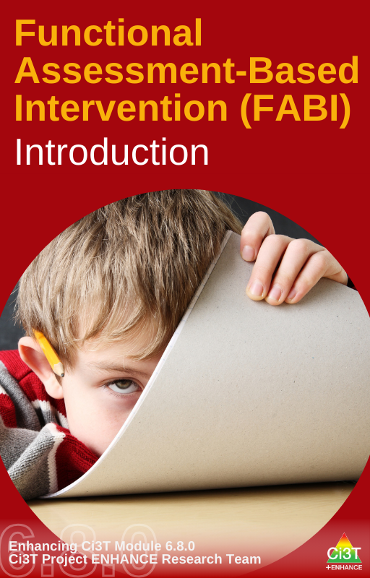
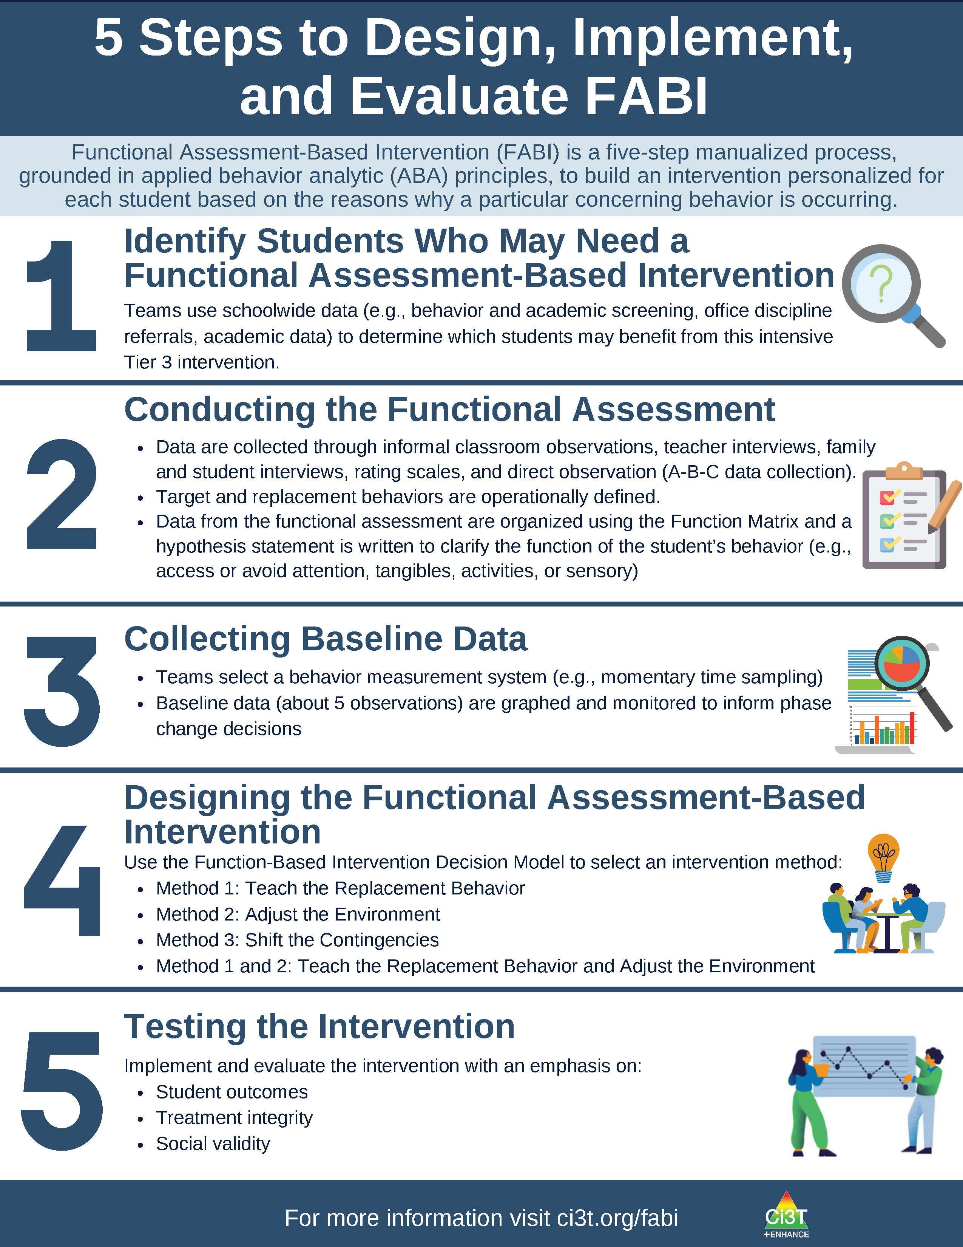
What is Functional Assessment-Based Intervention (FABI)?
Five-step, team-based, manualized process developed by Umbreit and colleagues (2004, 2007, 2024)
Customized intervention designed for each student based on the reasons why a particular concerning behavior is occurring
Grounded in applied behavior analytic (ABA) principles (e.g., reinforcement, antecedent, consequence)

Slide 5
5 Steps to Design, Implement, and Evaluate FABI 1

Slide 6
5 Steps to Design, Implement, and Evaluate FABI 2

Slide 7
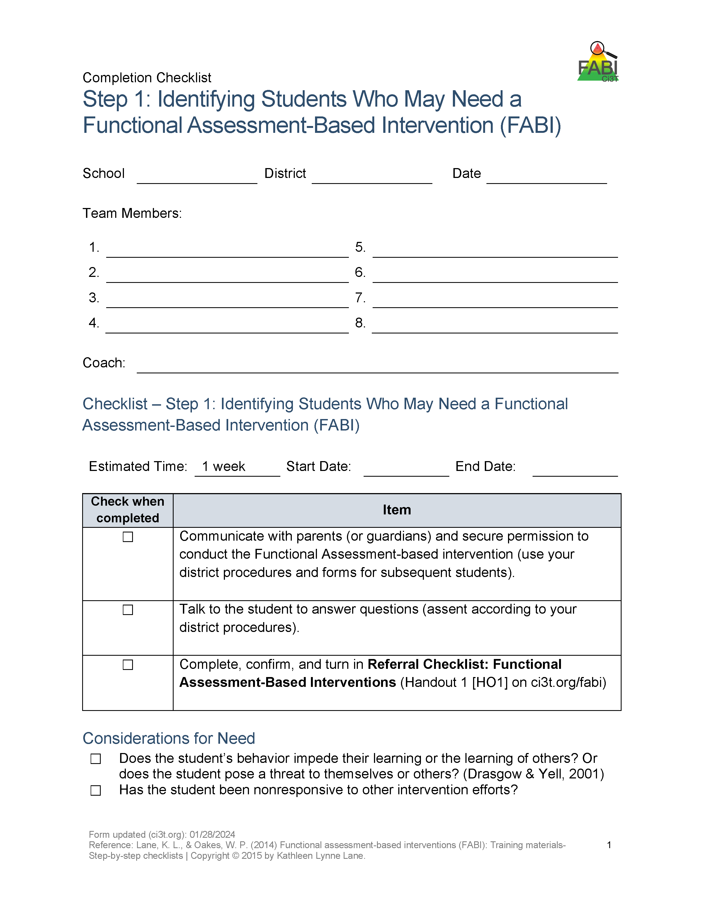
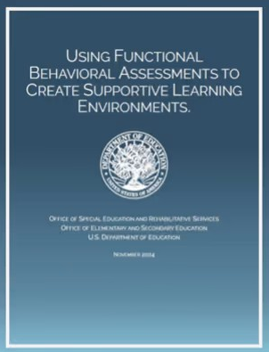
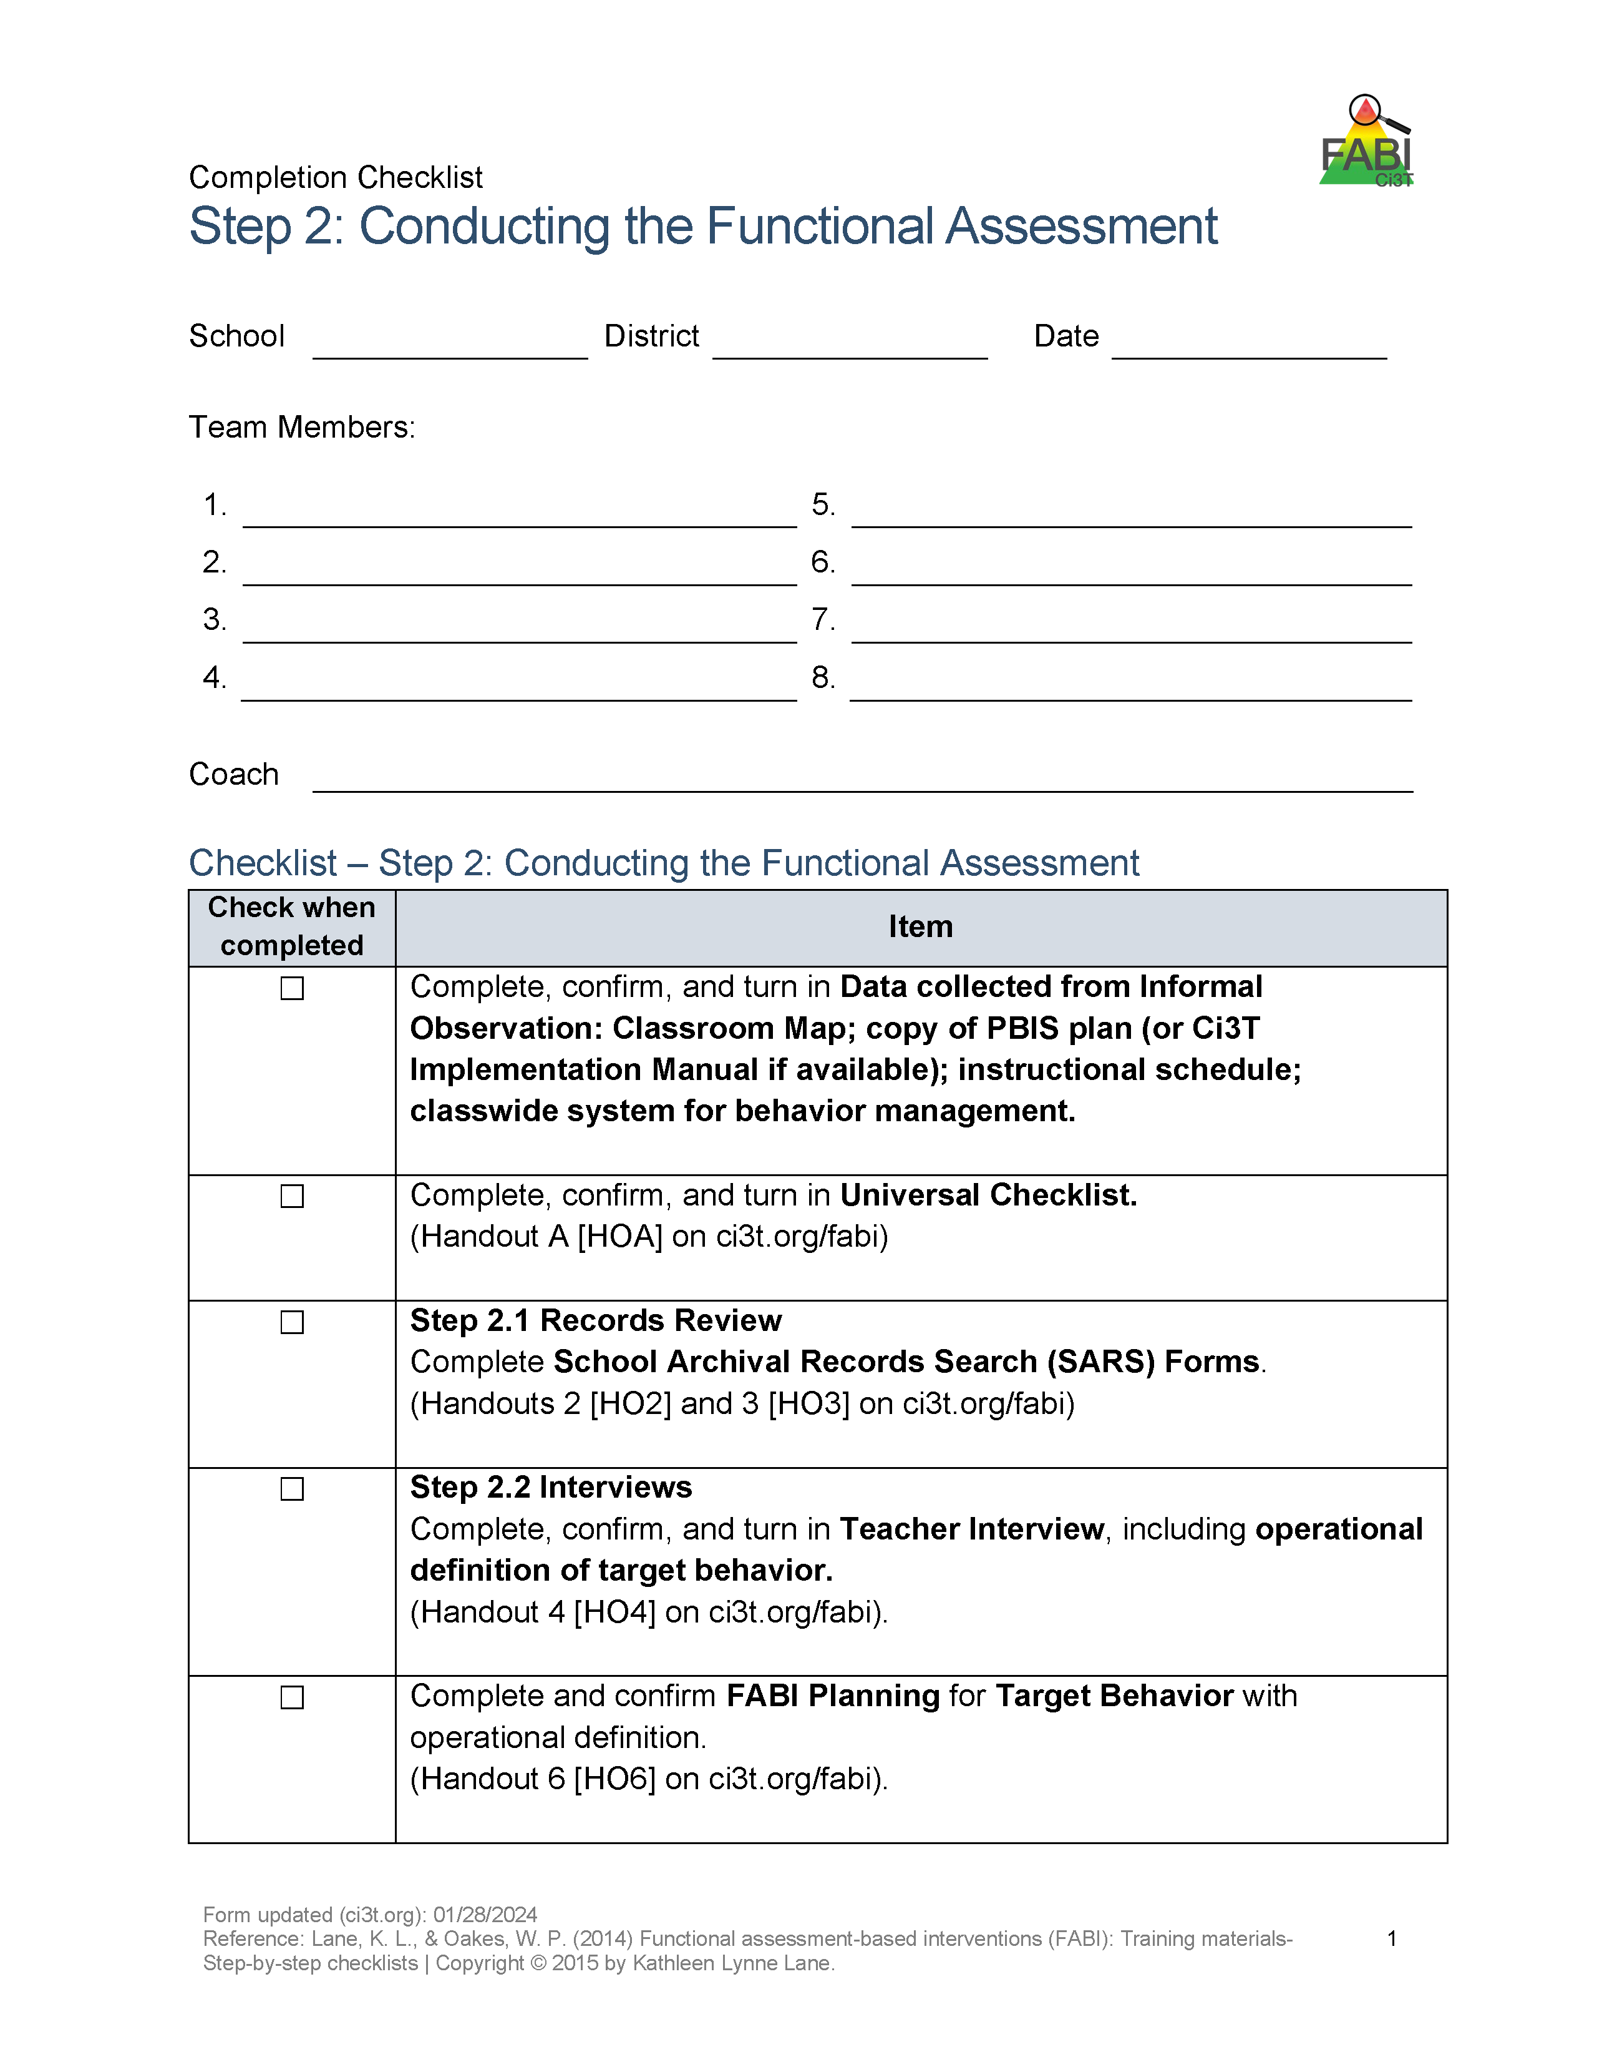

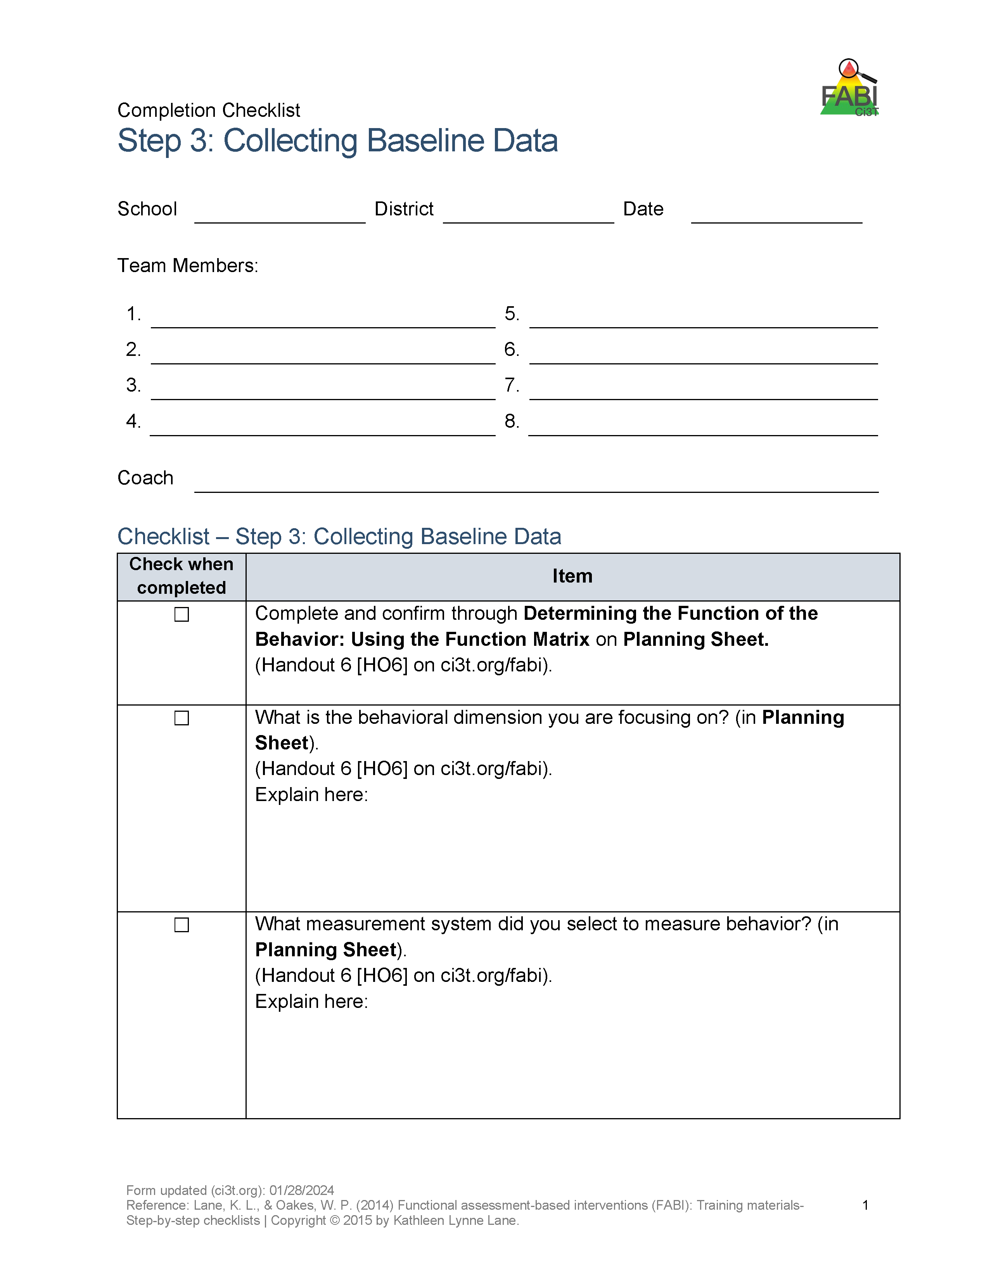
What are Potential Benefits of FABI?
Potentially evidence-based practice (Sarasin et al., 2025)
Notes:
Potentially evidence-based practice (Sarasin et al., 2025) with 20+ years of research for range of students (pre-K – 12), behaviors, and settings (Common et al., 2017)
Fully manualized process with templates and checklists to support design and implementation
Collaborative, team-based process integrating student, educator, and caregiver voice and perspective
Aligned with call to action to expand function-based supports for students without disabilities whose intensive behavioral or social-emotional well-being needs interfere with learning (OSERS & OESE, 2024)

Slide 8
Preliminary Findings of Adult Learning Outcomes
Purpose and Research Questions

Slide 9
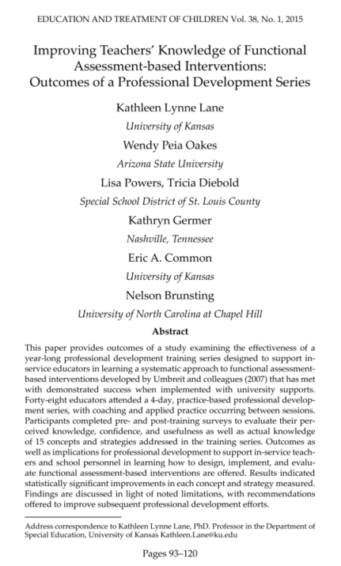
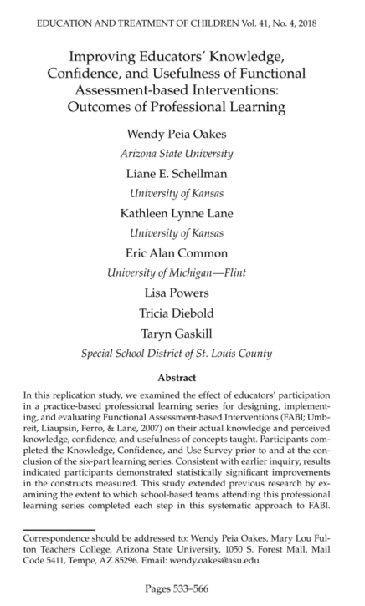
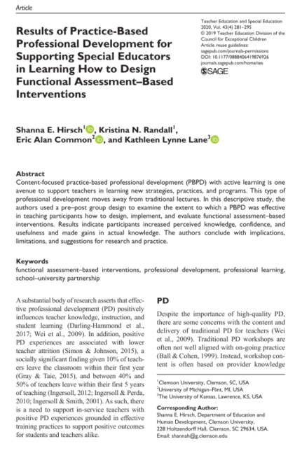
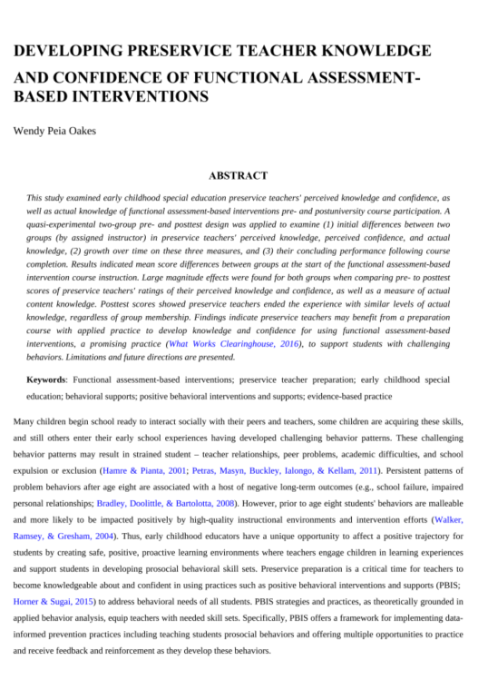
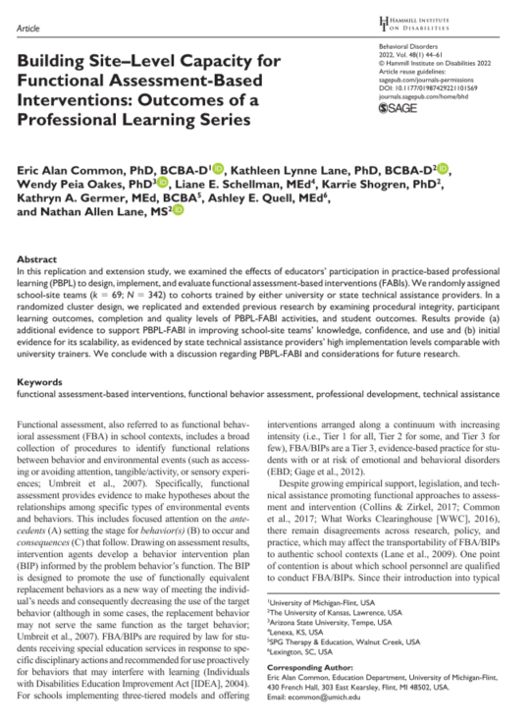
In-Person FABI Practice-Based Professional Learning (PBPL) Inquiry
descriptive experimental

Slide 10



In-Person FABI PBPL Key Findings
Statically significant improvement in-service educators’ actual knowledge, perceived knowledge, confidence, usefulness of FABI concepts
High stable perceptions of social validity of PL series
Statically significant improvement pre-service educators’ actual knowledge, perceived knowledge, perceived confidence of FABI concepts

Slide 11
Purpose
Can educators increase their knowledge, confidence, and perceived usefulness of FABI via an asynchronous format?
descriptive experimental
Notes:
Gap in literature – can educators increase their knowledge, confidence, and perceived usefulness of FABI via an asynchronous format?
First study in a planned line of inquiry replicating the progression from descriptive to experimental for asynchronous FABI PBPL
Replicate and extend Lane et al. (2015) and Oakes et al. (2018)
Systematic replication
Extend – examine social validity of FABI and asynchronous PBPL

Slide 12
Research Questions
Changes in:
Perceived Knowledge
Actual Knowledge
Perceived Confidence
Perceived Usefulness
Changes in Social Validity of:
FABI
8-Week Asynchronous Course
Notes:
To what extent do participants demonstrate increased perceived and actual knowledge of core features of FABI following completion of an eight-week asynchronous graduate level course?
To what extent do participants report increased perceived confidence in their ability to use the FABI techniques taught as part of an eight-week asynchronous graduate level course?
To what extent do participants report increased perceived usefulness of the FABI techniques taught as part of an eight-week asynchronous graduate level course?
To what extent do participants perceive FABI as a socially valid method to support students with intensive behavioral needs?
To what extent do participants perceive an eight-week asynchronous graduate level course as a socially valid method to teach FABI?

Slide 13
Method

Slide 14
Procedures
Institutional Review Board approval – research procedures embedded into normal teaching practices
Eight-week asynchronous graduate level course
1 module per week (~16 hours of work)
Practice-Based Professional Learning
Direction Instruction: readings (Umbreit et al., 2024; FABI articles)
Authentic Practice Opportunities
Independent Assignments (e.g., measurement activity)
FABI Signature Assignment
Opportunities for Feedback

Slide 15
Measures
Research Question | Measure
RQ 1-3 | FABI Knowledge, Confidence, and Use Survey (FABI KCU; Lane et al., 2025)
RQ 4 | Intervention Rating Profile (IRP-15; Witt & Elliott, 1985)
RQ 5 | FABI Professional Learning Questionnaire (Sarasin & Lane, 2024)

Slide 16
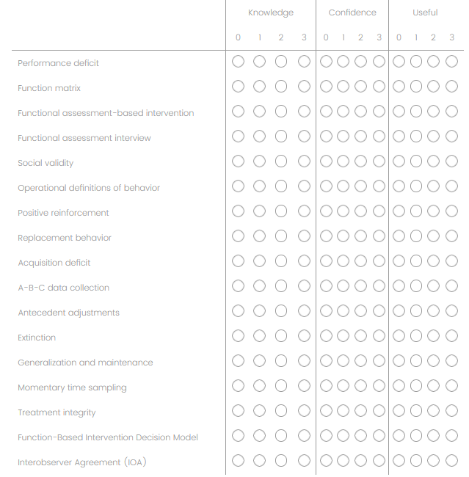
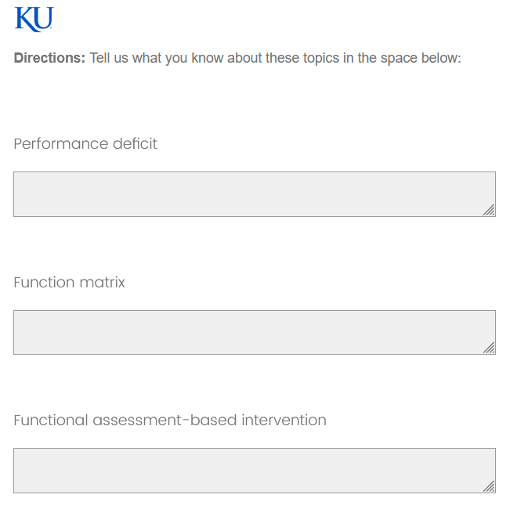
FABI Knowledge, Confidence, and Use Survey (FABI KCU; Lane et al., 2025)
Notes:
Section 1 –
Rate their perceived knowledge, confidence, and usefulness for 17 items using 4-point Likert-type scale with zero representing no knowledge, no confidence, and no perceived use for the concept or strategy and three representing a substantial amount of knowledge, confidence, and perceived use of the concept or strategy
For each construct (i.e., perceived knowledge, perceived confidence, perceived usefulness), we sum all items to create a total score. Total scores for each construct ranged from 0-51 with higher scores reflecting greater levels of perceived knowledge, confidence, and usefulness of FABI concepts.
Section 2
Same 17 items are presented as open-ended questions and students are invited to define each term in their own words
To determine actual knowledge scores, open-ended responses are scored using a four-point scale (i.e., 0 = no knowledge, 1 = partially accurate knowledge, incorrect information included, 2 = partially accurate knowledge with no incorrect information, 3 = fully accurate knowledge). Total scores for actual knowledge range from 0-51 with higher scores indicating higher actual knowledge

Slide 17
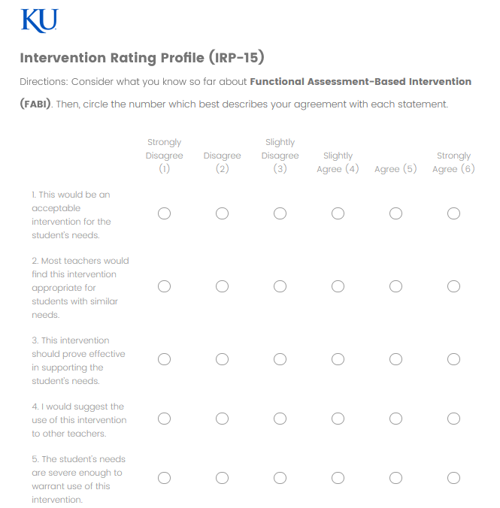
Intervention Rating Profile (IRP-15; Witt & Elliott, 1985)
Notes:
15 statements related to the effectiveness, feasibility, and acceptability of an intervention, each of which is rated using a six-point Likert-type scale (strongly agree to strongly disagree). Total scores range from 15-90, with higher scores indicating higher rates of social validity.

Slide 18
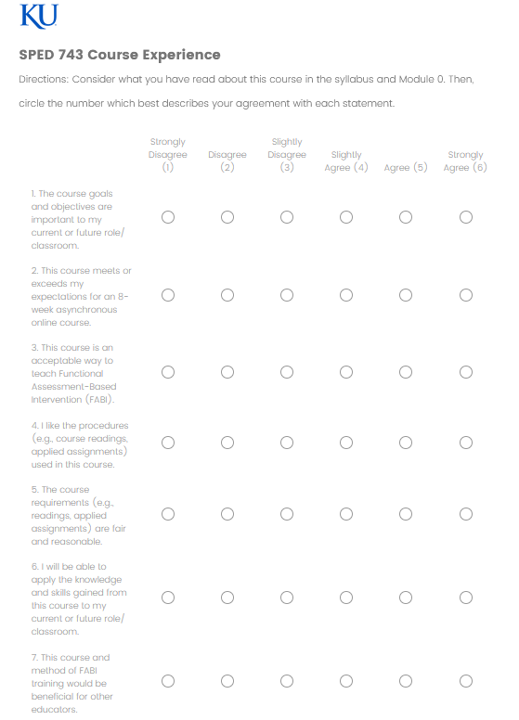
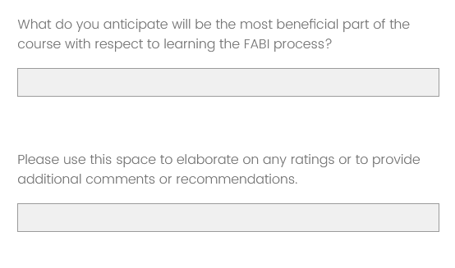
FABI Professional Learning Questionnaire (Sarasin & Lane, 2024)
Notes:
Developed the measure by adapting the Function-Based Support (FBS) Training and Implementation Social Validity Questionnaire (Renshaw et al., 2008) and Ci3T Professional Learning Series Session Evaluation (Lane, 2001).
7 items are presented on a six-point Likert-type scale (strongly agree to strongly disagree) followed by two open-response questions (a) what do you anticipate / was the most beneficial part of the course with respect to learning the FABI process? and (b) please use this space to elaborate on any ratings or to provide additional comments or recommendations.
Total scores range from 7-42, with higher scores indicating higher rates of social validity.

Slide 19
Data Analysis
Pre-Post Comparison Design
Replicated data analysis plans of Lane et al. (2015) and Oakes et al. (2018)
Paired t-tests (α = .05)
Effect size - Hedge’s g
Pearson Correlation Coefficient (actual knowledge and perceived knowledge)

Slide 20
Results

Slide 21
Discussion

Slide 22
Future Inquiry and Next Steps

Slide 23




Asynchronous FABI Practice-Based Professional Learning (PBPL) Inquiry
descriptive experimental
AI
Notes:
Conduct additional analyses (e.g., regression models) with larger sample (i.e., additional cohorts)
Continue progression from descriptive to experimental designs
Mixed-Methods
Expectations for asynchronous courses
Perceived barriers and facilitators re: course requirements (e.g., group work, volume of assigned reading)
Protections against AI

Slide 24
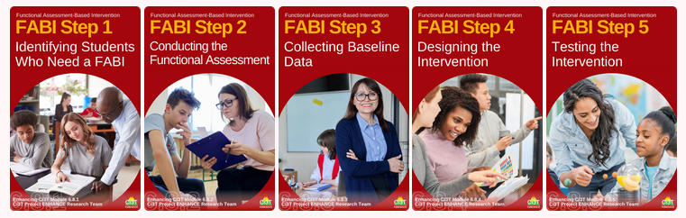
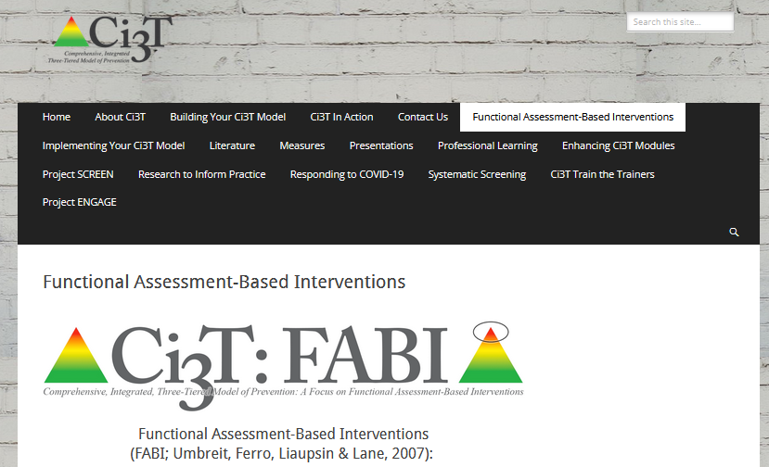
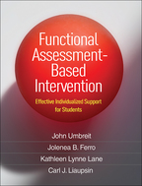
Thank You!

