Slide 1
Project ENGAGE: Preliminary Findings of a Randomized Control Trail Examining a Tier 2 Intervention—Recognize. Relax. Record.—to Support Elementary Students Struggling with Anxious Feelings
Mark M. Buckman¹
Allison Bernard¹
Amy Buffington¹
Carrie Brandon²
Stacie Williams¹
Mattew Aschliman²
Elise Sarasin¹
Jessica Matus²
Rebecca Sherod²
Wendy Oakes²
Kathleen Lane¹
University of Kansas¹
Arizona State University²
Institute of Education Sciences, U.S. Department of Education
R324X220067 University of Kansas

Slide 2
Agenda
Supporting students with internalizing behavioral challenges
Introducing Recognize. Relax. Record.
Preliminary findings of a cluster randomized controlled trial
Next steps and resource sharing
Notes:
We present preliminary findings of an underpowered randomized control trail examining the impact of a new Tier 2 intervention: Recognize. Relax. Record., being tested as part of a new IES-funded project to support elementary age students with internalizing behavior. We highlight social validity findings as well as students’ outcomes.

Slide 3
Supporting students with internalizing behavioral challenges

Slide 4

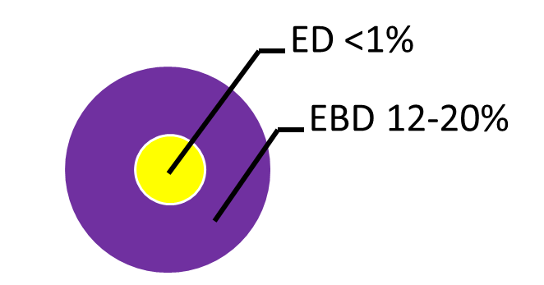
Internalizing & Externalizing Challenges
Shift to a systems level perspective
Internalizing
Externalizing
Source: Forness, S.R., Freeman, S.F., Paparella, T., Kauffman, J.M., & Walker, H.M. (2012). Special education implications of point and cumulative prevalence for children with emotional or behavioral disorders. Journal of Emotional and Behavioral Disorders, 20, 4-18.

Slide 5
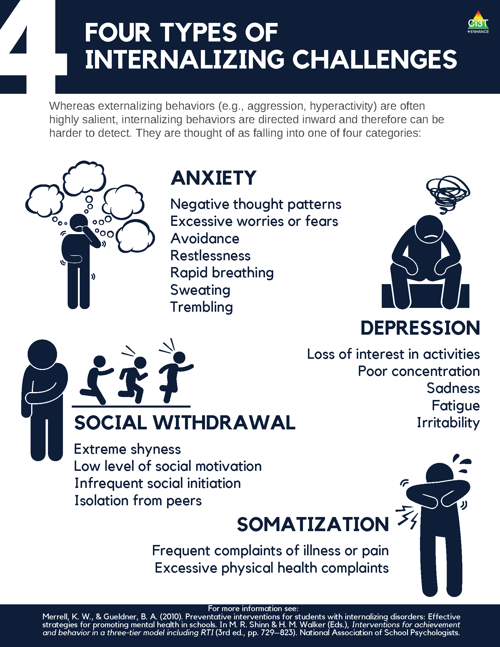
What are internalizing behaviors?

Slide 6
What are internalizing behaviors? (2)

Slide 7
Internalizing behaviors in the classroom (1)
Compared to externalizing behaviors, internalizing behaviors tend to be:
More covert
Less disruptive
but…
Internalizing challenges often co-occur with externalizing behaviors.

Slide 8
Internalizing behaviors in the classroom (2)
Some examples include:
frequent complaints of illness or pain,
social withdrawal,
irritability,
poor concentration,
restlessness,
emotional outbursts,
rapid breathing,
sweating, or
trembling/shaking.

Slide 9

A Focus on Internalizing Behaviors (3)
Internalizing concerns are associated with multiple worrisome outcomes compared to students who do not have internalizing behavior patterns, such as:
Lower levels of academic achievement (e.g., grade point average, GPA; Vaillancourt et al., 2013)
Lower levels of school adaptation (e.g., ability to learn, ability to meet behavioral expectations, happiness/adjustment; Pedersen et al., 2019)
Higher levels of school dropout (Weist et al., 2018)
Higher levels of social rejection (Weist et al., 2018)
Increased engagement in risk-taking behaviors (e.g., substance use, suicide; Weist et al., 2018)
Increased risk of physical health problems (Jamnik & DiLalla, 2019)

Slide 10
A Focus on Internalizing Behaviors (4)
≈ 32% of children experience an anxiety disorder at some point during their childhood (Merikangas et al., 2010)
Onset typically occurs during elementary years (Merikangas et al., 2010)
Prevalence of behavioral, social, and emotional well-being challenges may be on the rise:
Lebrun-Harris and colleagues (2022) found an increase in anxiety and behavioral/conduct disorder from 2016-2020.

Slide 11
Introducing Recognize. Relax. Record.

Slide 12
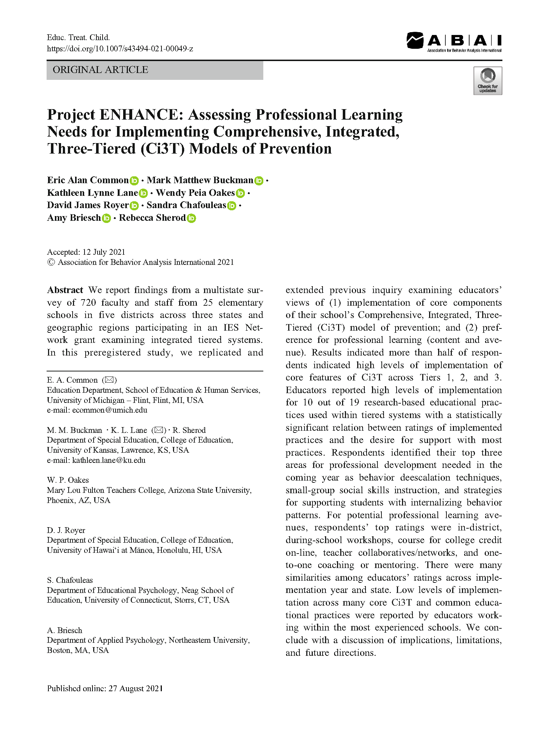
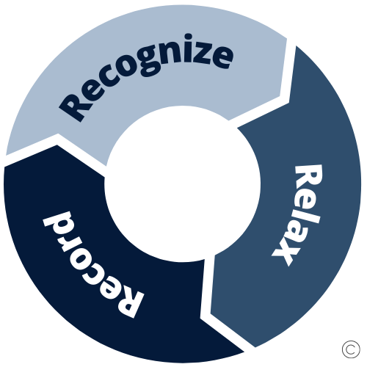
Assessing Professional Learning Needs
Top Professional Learning Needs
De-escalation techniques
Social skill instruction
Supports for students with internalizing behavior patterns
Common, E. A., Buckman, M. M., Lane, K. L., Oakes, W. P., Royer, D. J., Chafouleas, S., Briesch, A., & Sherod, R. (2021). Project ENHANCE: Assessing Professional Learning Needs for Implementing Comprehensive, Integrated, Three-Tiered (Ci3T) Models of Prevention. Education and Treatment of Children. https://doi.org/10.1007/s43494-021-00049-z

Slide 13
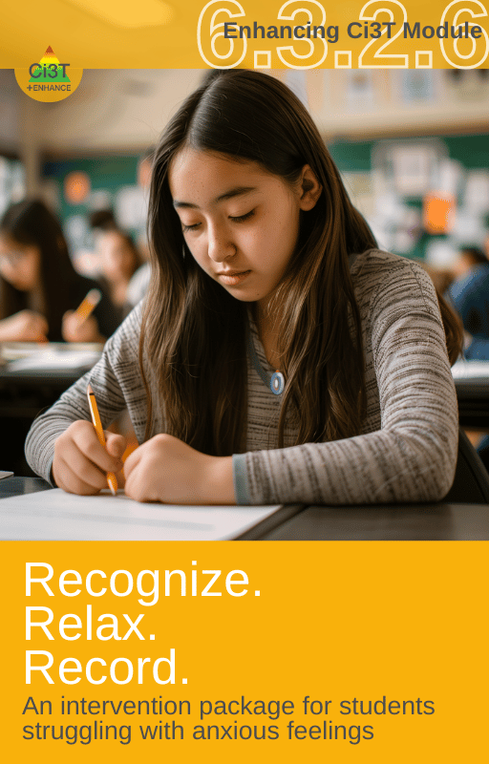

What is Recognize. Relax. Record.?
An intervention package containing three components:
Recognize
identify thoughts and feelings related to being anxious
Relax
manage anxious thoughts and feelings using relaxation strategies
Record
self-monitor thoughts and feelings, use of relaxation strategies, and engagement (social or academic)

Slide 14
What does the supporting research for Recognize. Relax. Record. say?
What Does the Supporting Research for Recognize. Relax. Record. Say? 1
Social-emotional competencies
Self-awareness
Self-management
Social awareness
Responsible decision-making
Relationship Skills
Recognize.
Social-emotional competencies, such as self-awareness and self-management, are related to important long-range outcomes
high school graduation
college degree completion
obtaining employment
Durlak et al., 2011
Adapted from CASEL Framework (2020)

Slide 15
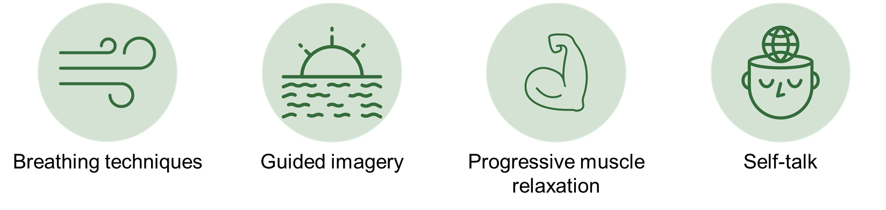
What does the supporting research for Recognize. Relax. Record. say?
What Does the Supporting Research for Recognize. Relax. Record. Say? 2
Relax.
Relaxation training is commonly used in research-based cognitive behavioral interventions for children with anxiety
Chorpita & Daleiden, 2009

Slide 16
What does the supporting research for Recognize. Relax. Record. say?
What Does the Supporting Research for Recognize. Relax. Record. Say? 3
Record
Self-management interventions effective for
behavioral and social outcomes
reading, math, and other content areas at elementary
Levendoski & Cartledge, 2000
productivity, engagement, and academic performance at middle and high school
Carr & Punzo, 1993
students with emotional and behavioral disorders
students educated in general and special education classrooms
A.M. Briesch & Briesch, 2016; Briesch & Chafouleas, 2009; Mooney et al., 2005

Slide 17
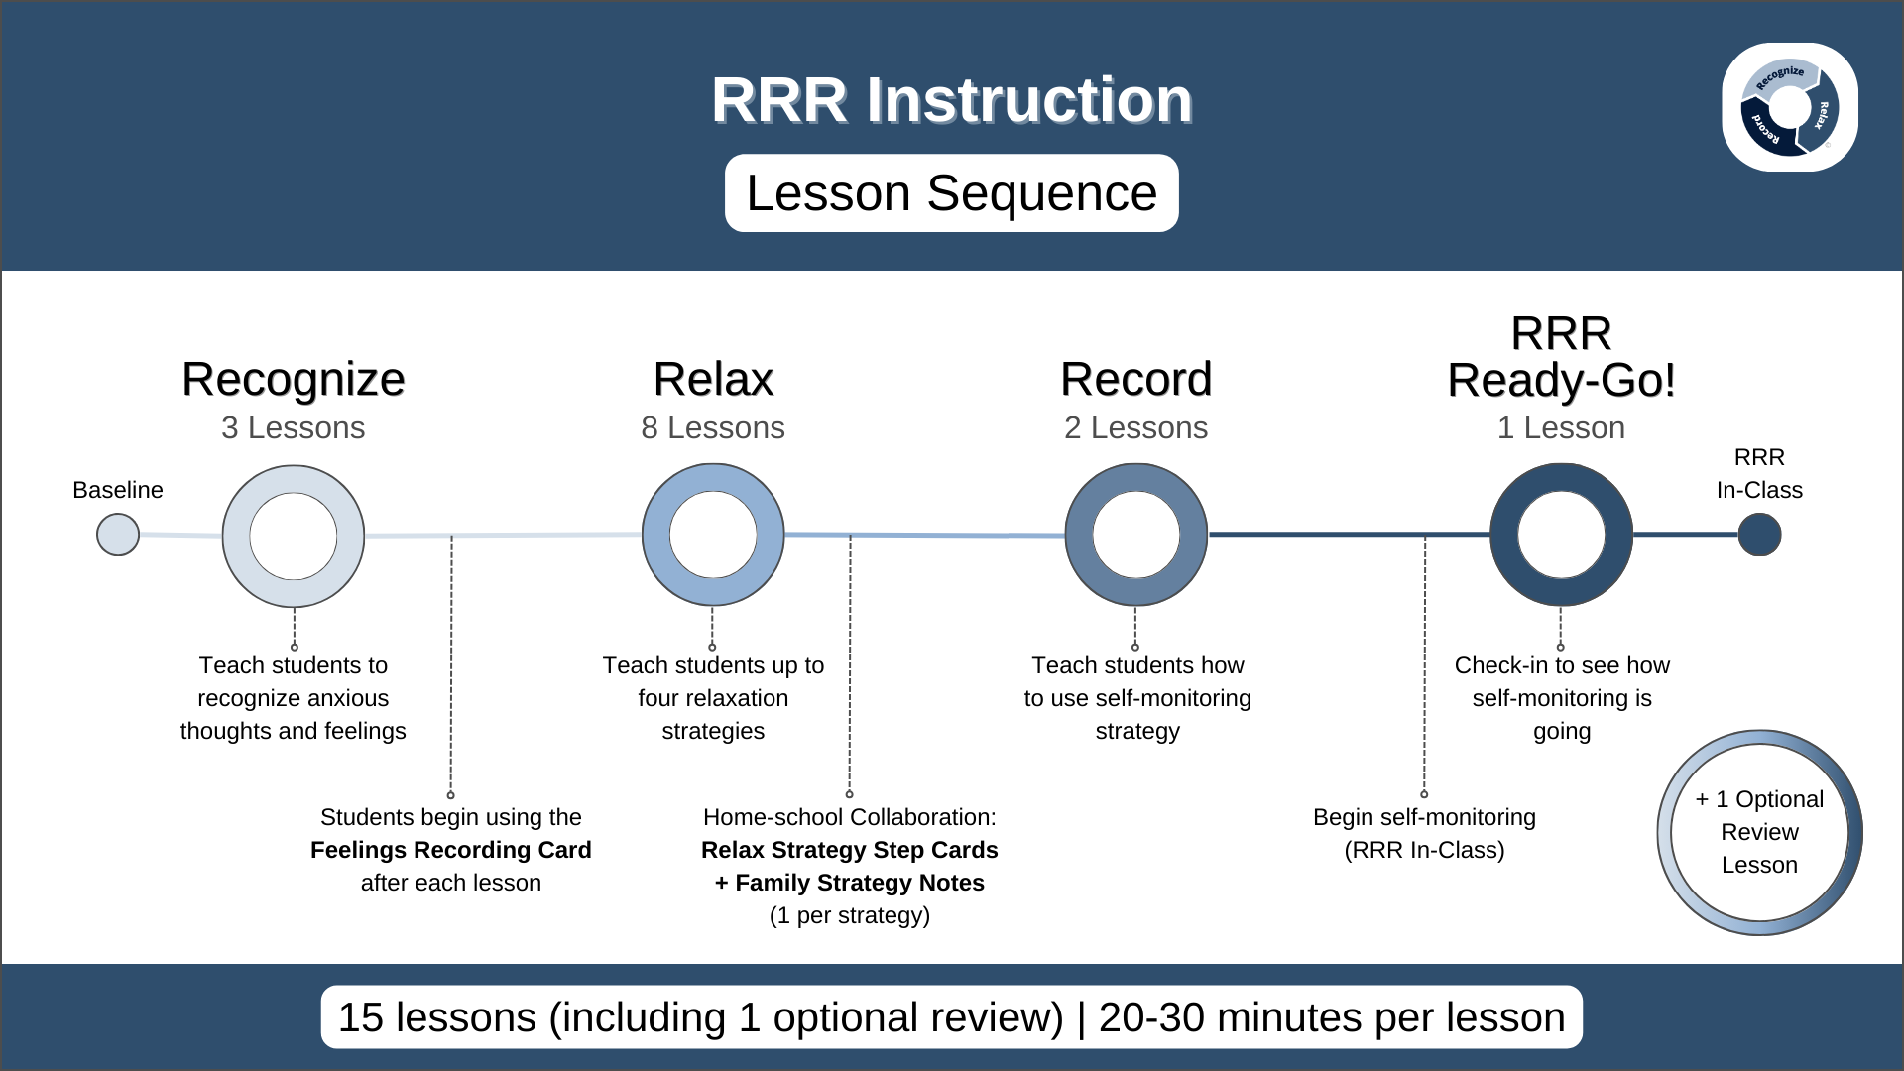
RRR Instruction Lesson Sequence

Slide 18
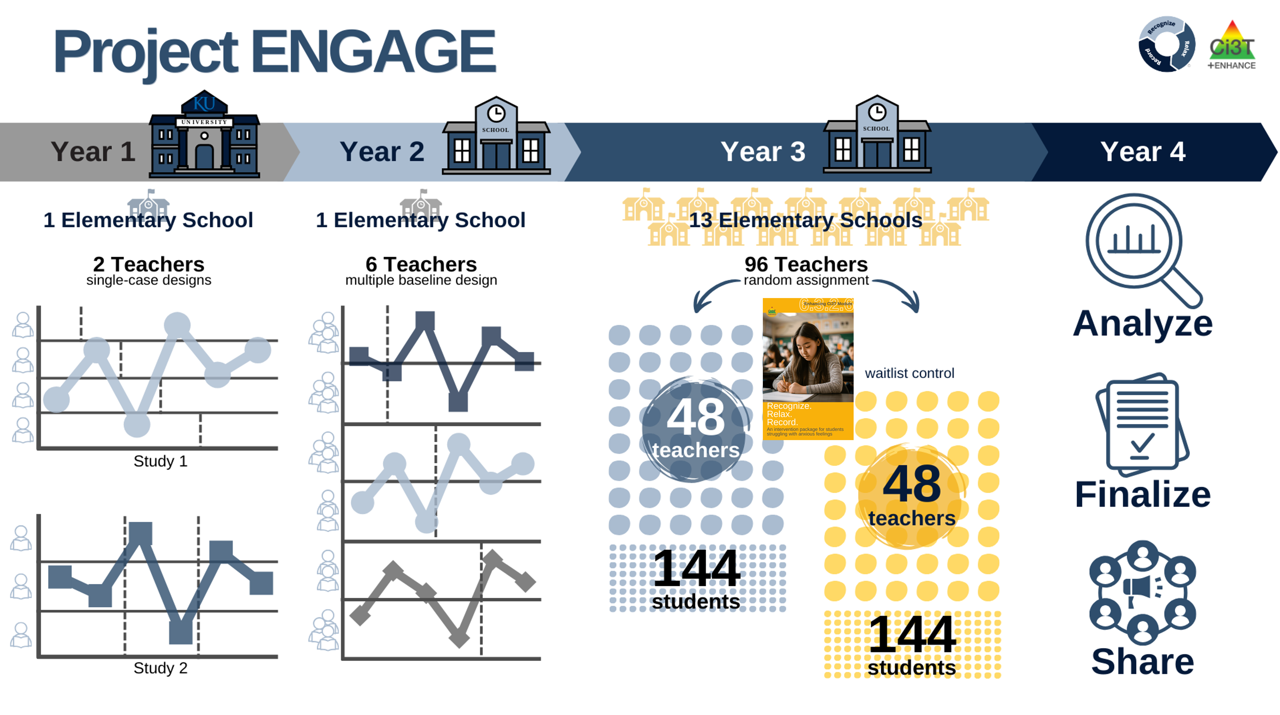
Project ENGAGE

Slide 19
Year 1 Study 1
Multiple baseline across participants
RRR Instruction implemented by researchers; RRR In-class implemented by teachers
Useful feedback received across stakeholders to inform intervention revision
Some promising effect
Increase in engagement for some students
Reduction in academic engagement variability for some students

Slide 20
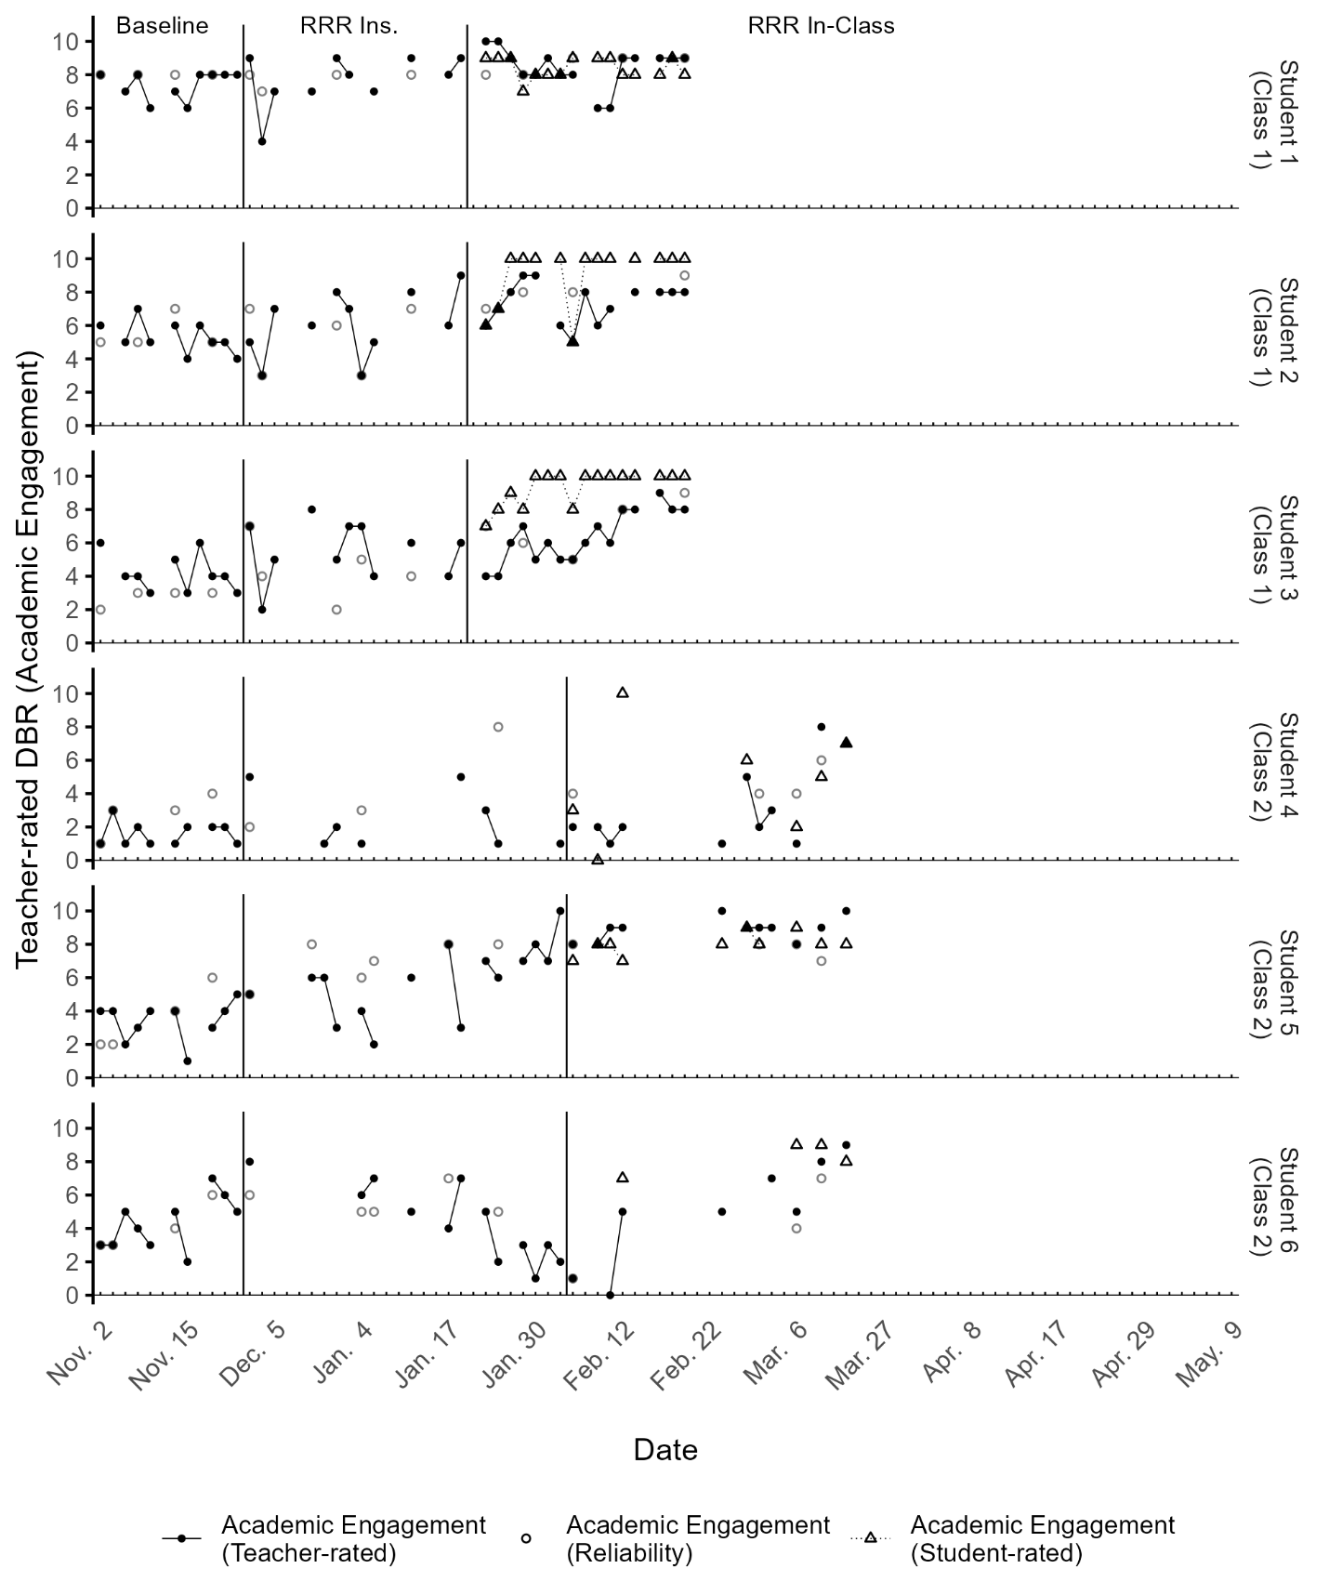
Year 2 Study 2: Results
Both RRR Instruction and RRR In-class implemented by teachers
Majority of teachers were able to implement all RRR components with fidelity
RRR met or exceeded expectations for most stakeholders
Outcomes variable across students and behaviors (academic engagement, internalizing behaviors)

Slide 21
Preliminary findings of a cluster randomized controlled trial

Slide 22

Method: Research Questions
Does RRR decrease anxious feelings for third-, fourth- and fifth-grade students with and at-risk for EBD, specifically internalizing behaviors when implemented with limited university support?
To what extent is RRR implemented as designed when implemented with limited university support?
Do consumers view RRR to be socially valid?

Slide 23
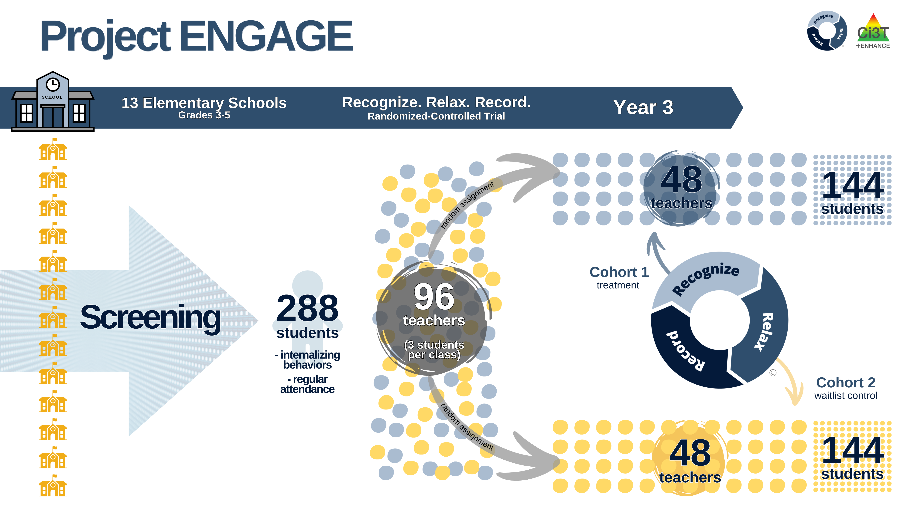
Method: Overview

Slide 24
Method: Group Descriptions
Treatment Condition (Group 1)
Waitlist-Control Condition (Group 2)
Engage in ≈ 6 hours of paid professional learning
Learn how to use RRR with their students
Work with up to three students who meet criteria
15 small group sessions (20-30 min)
During the school day
Support selected students in using new skills and self-monitoring during another time of the day
4 days per week for ≈ 4-6 weeks
Implement regular school practices until spring break, then:
Engage in ≈ 6 hours of paid professional learning
Learn how to use RRR with their students
Work with up to three students who meet criteria
15 small group sessions (20-30 min)
During the school day
Support selected students in using new skills and self-monitoring during another time of the day
4 days per week for ≈ 4-6 weeks

Slide 25
Method: Student Selection Criteria
Behavior
SRSS-I5 score: Moderate (2-3) or High (4-15)
Attendance
Missing no more than 5 days in first 6 weeks of school
Grade-level
3rd, 4th, 5th grade

Slide 26
Method: Primary Measures
Student Outcomes
ASEBA Teacher Report Form (TRF; Teachers)
Social Skills Improvement System (SSiS; Teachers, Families, Students)
Direct Behavior Rating
Treatment Integrity
RRR Instruction Treatment Integrity form (Teachers, Research Staff)
RRR In-Class Treatment Integrity form (Teachers, Research Staff)
Social Validity
IRP-15 (Teachers, Families)
CIRP (Students)
Teacher and student interviews

Slide 27
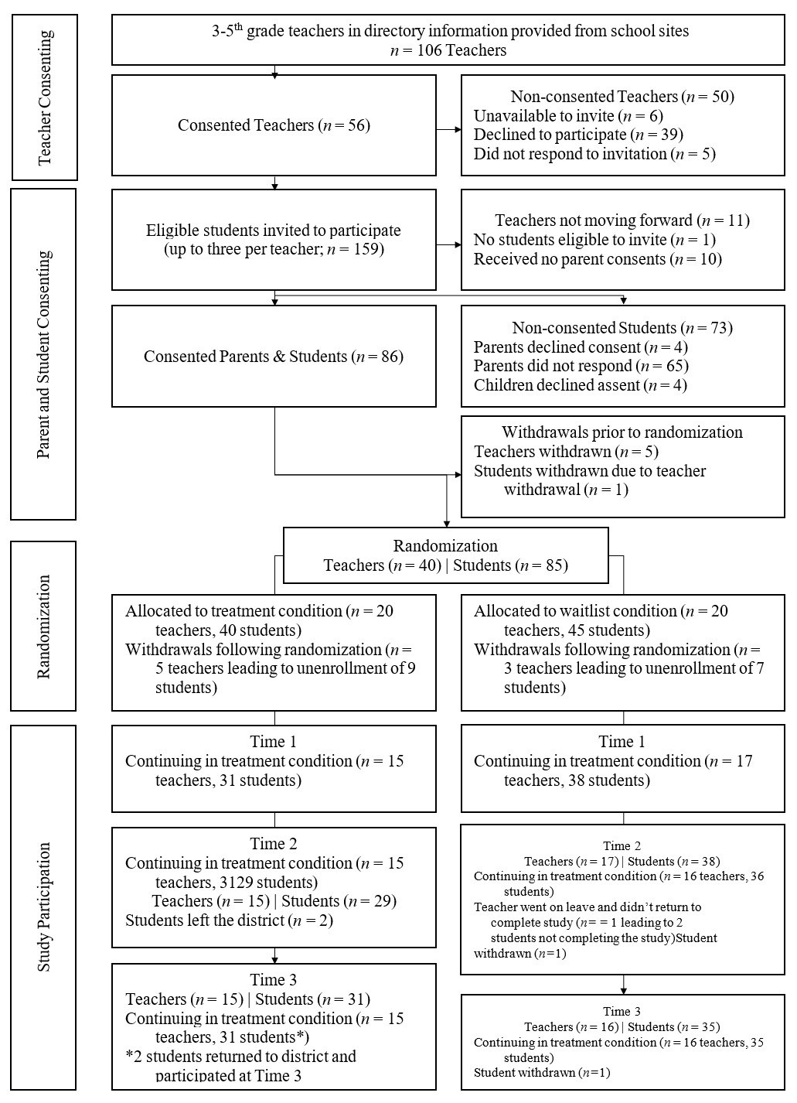
Method: CONSORT Summary
Invited 100 teachers, 56 consented
Invited 159 students/families, 86 consented
Randomized 40 teachers
Some teachers withdrew; others had no participating students
Attrition following randomization
Teacher Attrition (20%)
Treatment: 12.50%
Waitlist: 7.50%
Differential: 5.00%
Student Attrition (20%)
Treatment: 10.59%
Waitlist: 9.41%
Differential: 1.18%

Slide 28
Method: Teacher Training
Timepoint & Topic | Group 1 (Will start in Fall) | Group 2 (Will start in Spring)
Training 1: Overview & Direct Behavior Ratings 4:30 pm – 6:30 pm | Tuesday, October 29, 2024 or Wednesday, October 30, 2024 | Tuesday, February 18, 2025 or Wednesday, February 19, 2025
Training 2: RRR Instruction 4:30 pm – 6:30 pm | Tuesday, November 5, 2024 or Wednesday, November 6, 2024 | Wednesday, March 5, 2025 or Thursday, March 6, 2025
Training 3: RRR In-Class 4:30 pm – 6:30 pm | Tuesday, December 3, 2024 or Wednesday, December 4, 2024 | Tuesday, April 1, 2025 or Wednesday, April 2, 2025
Notes:
Share key details- at Bishop, with teachers from other schools
Don’t need to worry about jotting down these dates, we’ve got a copy to share with you later!

Slide 29

Preliminary results removed from posted slides.
Look for the published study soon!

Slide 30
Next steps and resource sharing

Slide 31
Next Steps
Dissemination
Intervention material revision
Replication
Extension for middle school

Slide 32

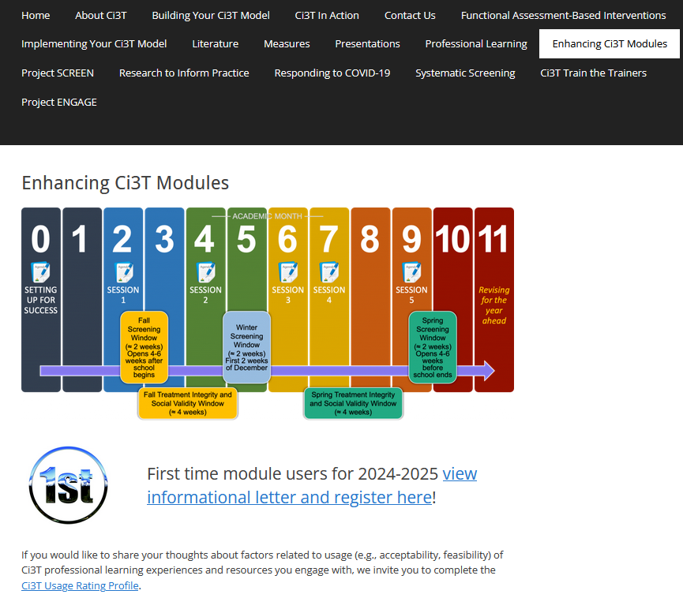

Resource Sharing: Enhancing Ci3T Modules
ci3t.org/enhance

Slide 33
Questions?

Slide 34

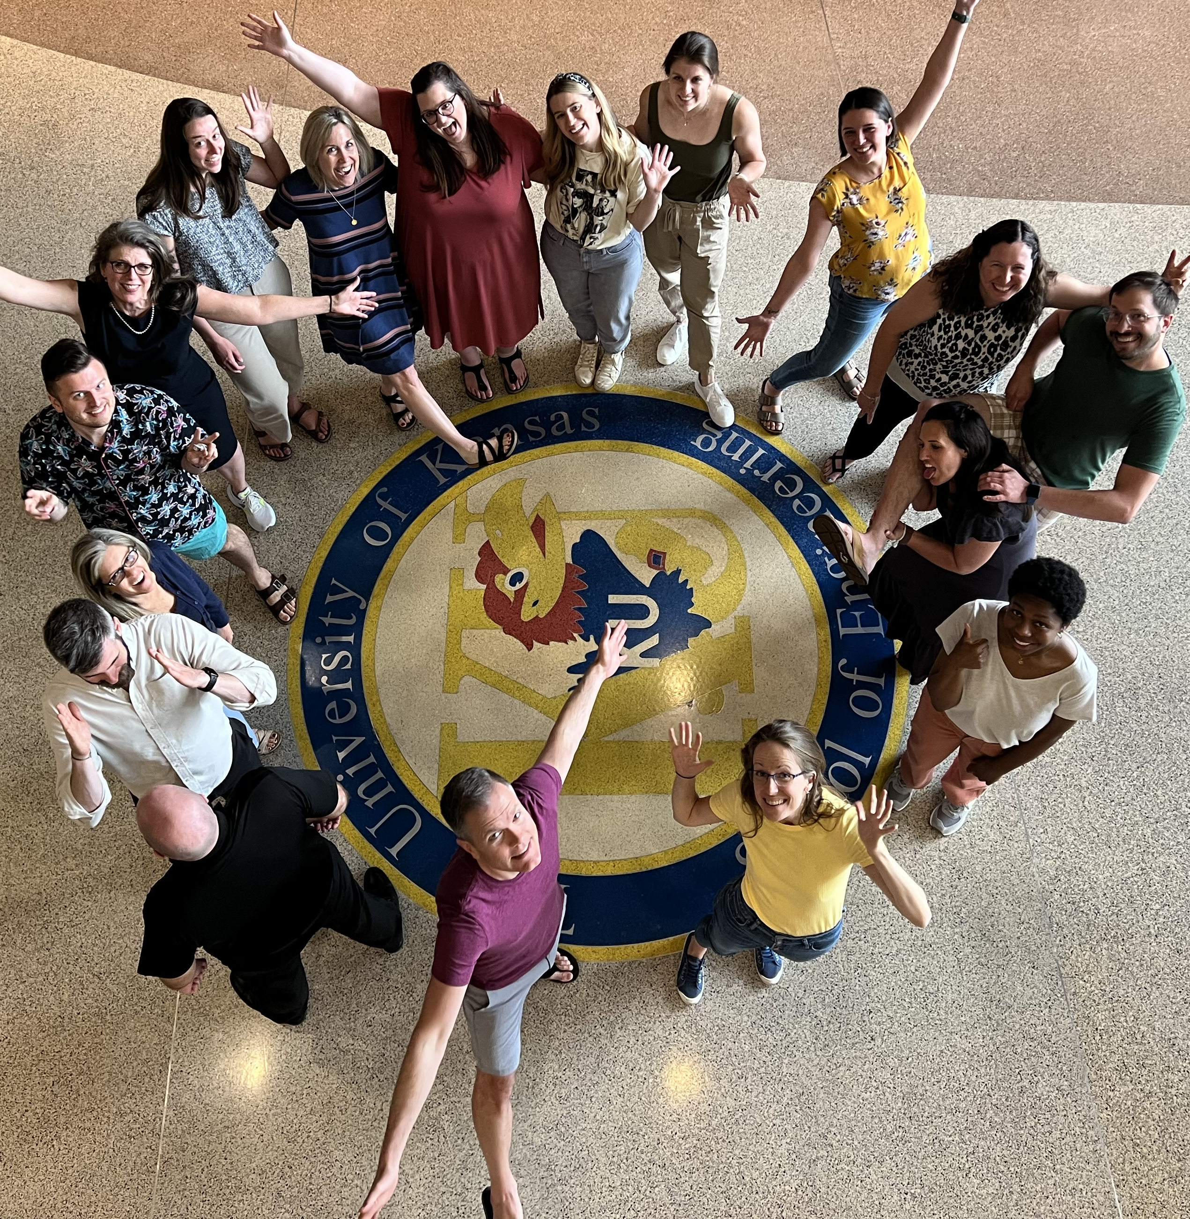
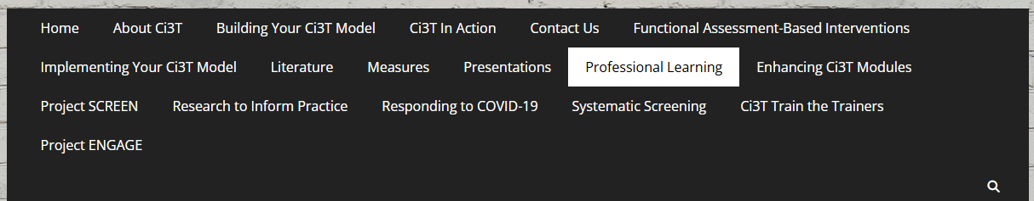

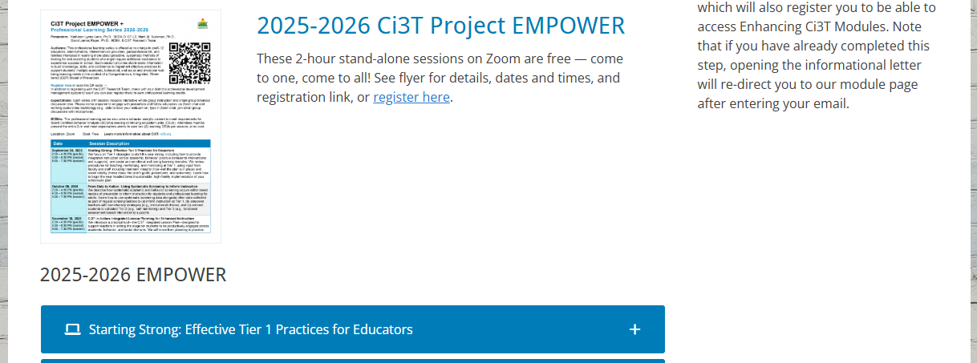
Thank you!
#Ci3T
@Ci3Tmodel
Thank you!
ci3t.org
Tag us in your Ci3T highlights, we love to see Ci3T in action!
Follow us on Instagram for updates and new resources!
Notes:
Tag us in your Ci3T highlights- we would love to see Ci3T in action! Follow us on Instagram for updates and links to resources! @Ci3TModel

