Slide 1
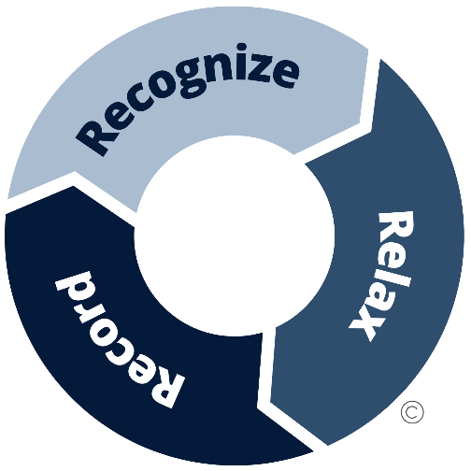
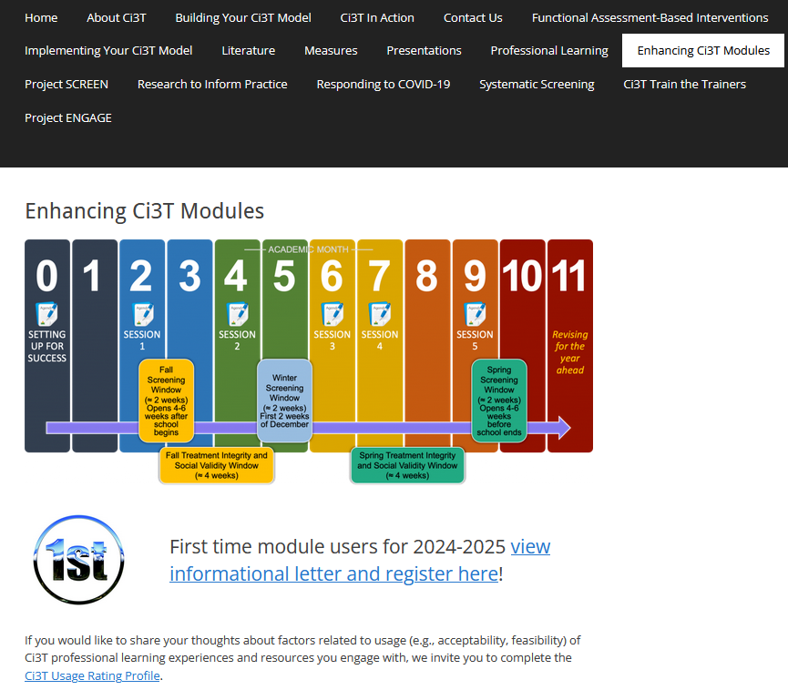
A Tier 2 Support for Students Experiencing Anxious Feelings: Recognize. Relax. Record.
EMPOWER+ Session 6
If you have not done so already, we invite you to visit ci3t.org/enhance to access modules after a one-time registration process!

Slide 2
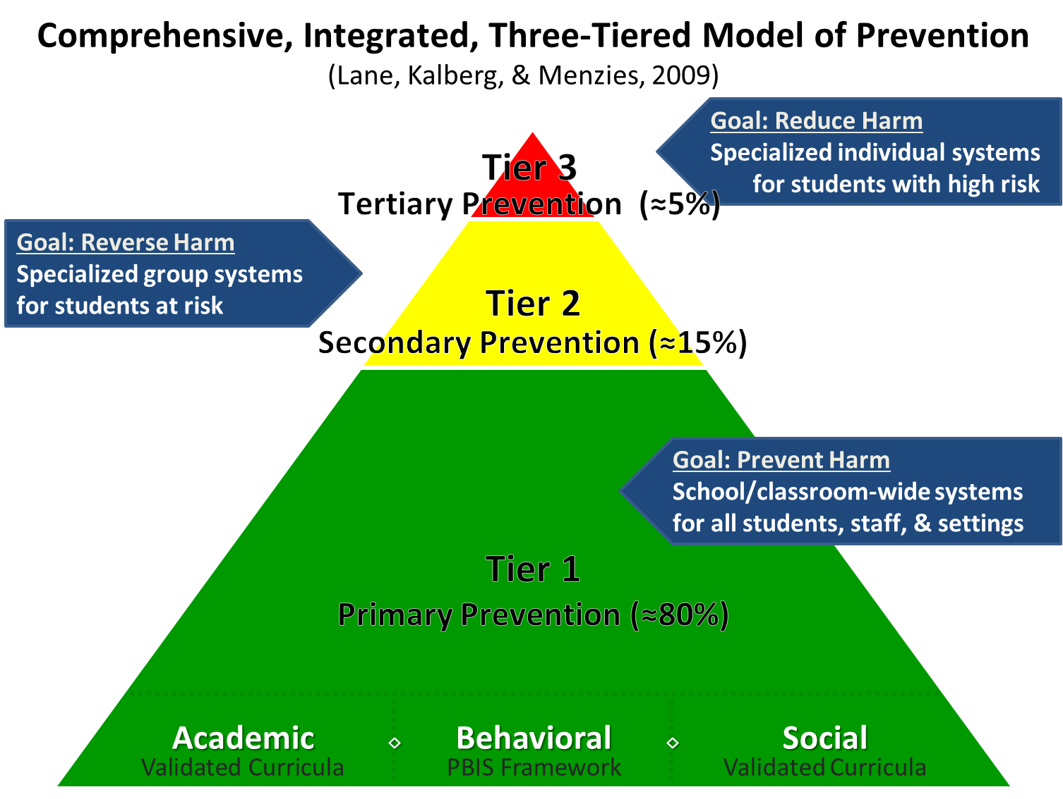
Comprehensive, Integrated, Three-Tiered Model of Prevention 1

Slide 3
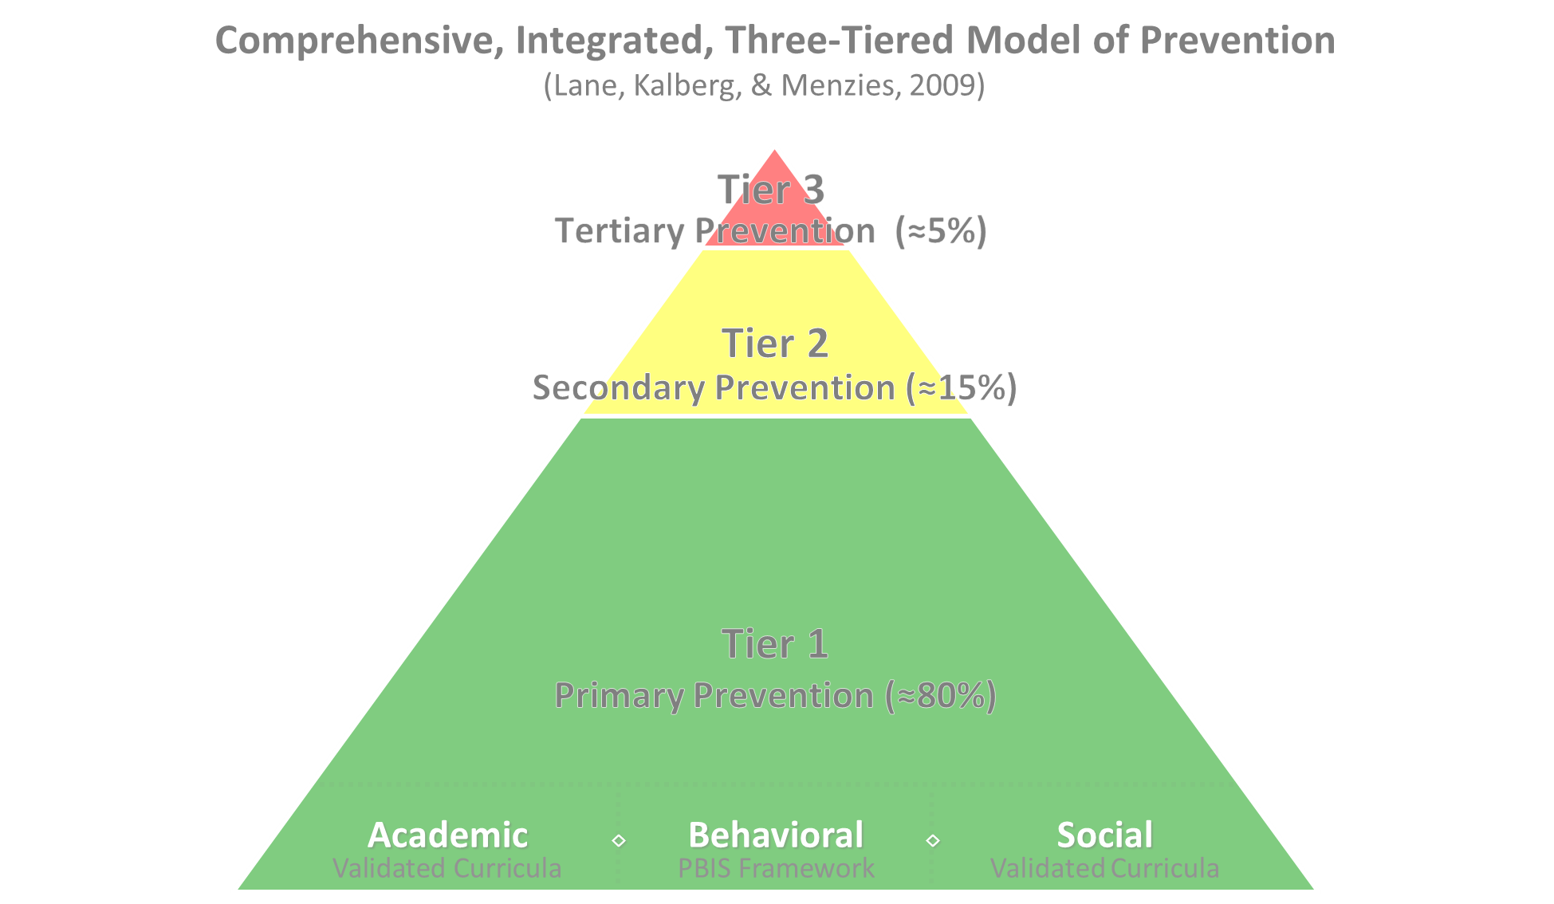

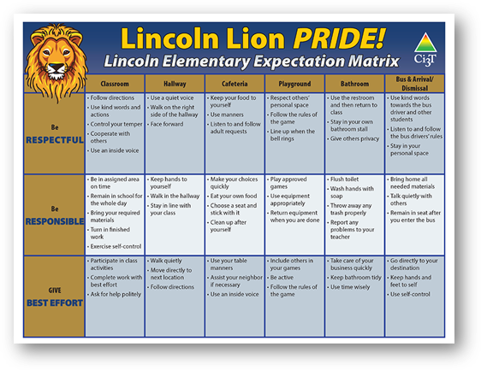
Comprehensive, Integrated, Three-Tiered Model of Prevention 2
Positive Behavioral Interventions and Supports
District & State Standards Quality Instruction
Validated Curricula and Resources

Slide 4

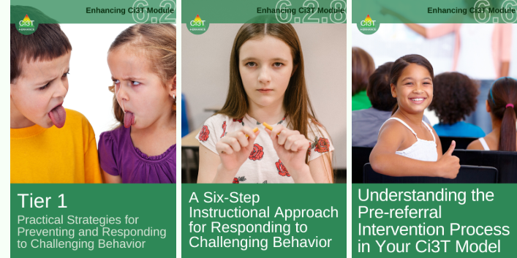
Primary Prevention (Tier 1)

Slide 5

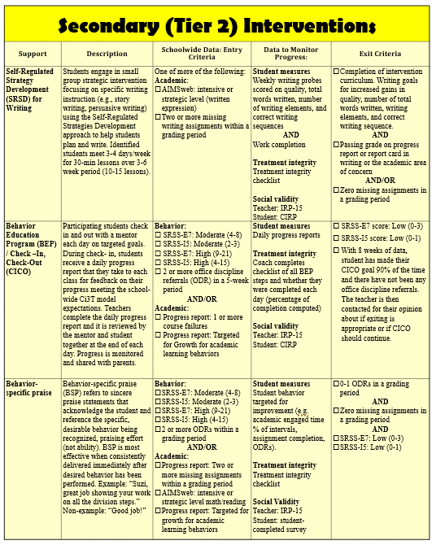
Secondary (Tier 2) Intervention Grid

Slide 6

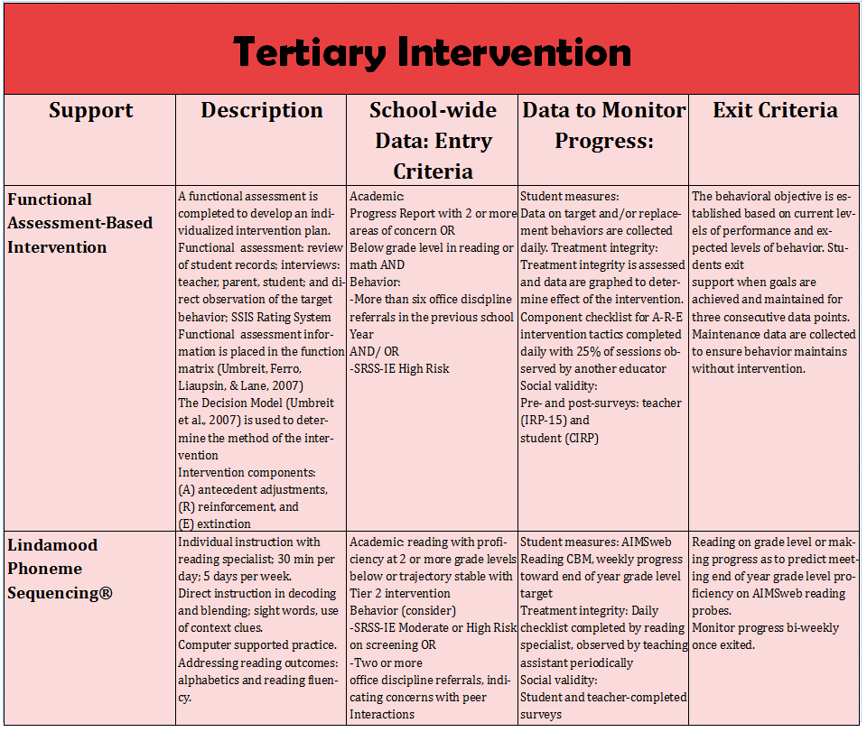
Tertiary (Tier 3) Intervention Grid

Slide 7

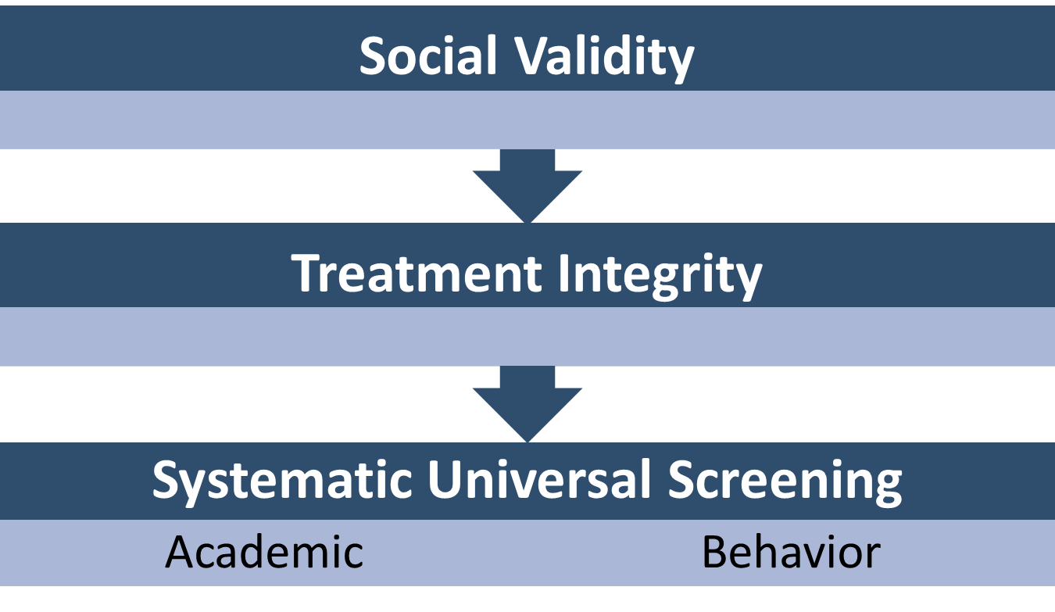
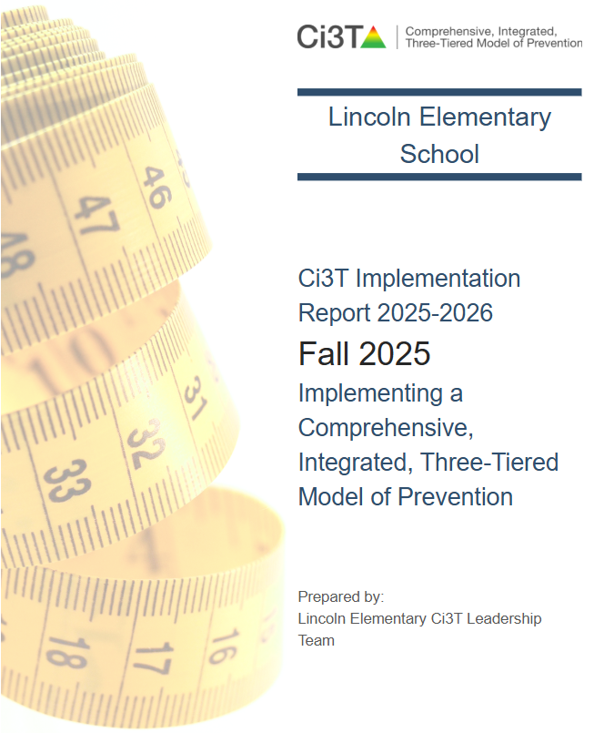
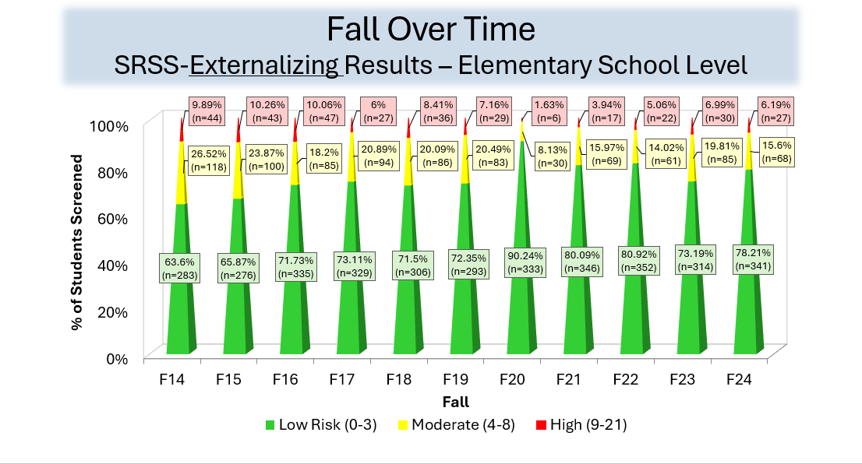
Essential Components of Primary (Tier 1) Prevention Efforts
Essential Components of Primary (Tier 1) Prevention Efforts 1

Slide 8


Enhancing Ci3T Modules
ci3t.org/enhance

Slide 9
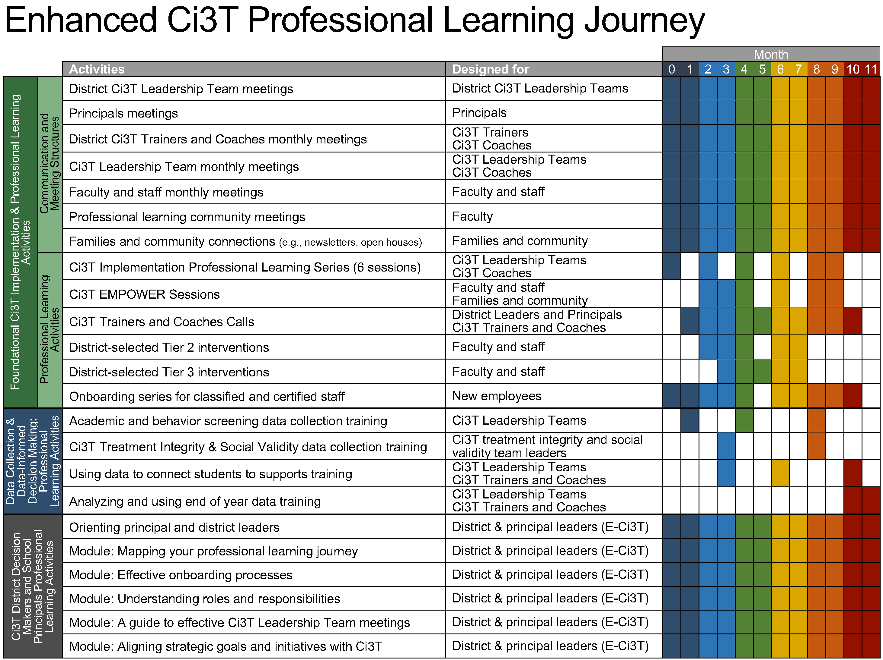
Enhanced Ci3T Implementation Series and Delivery

Slide 10
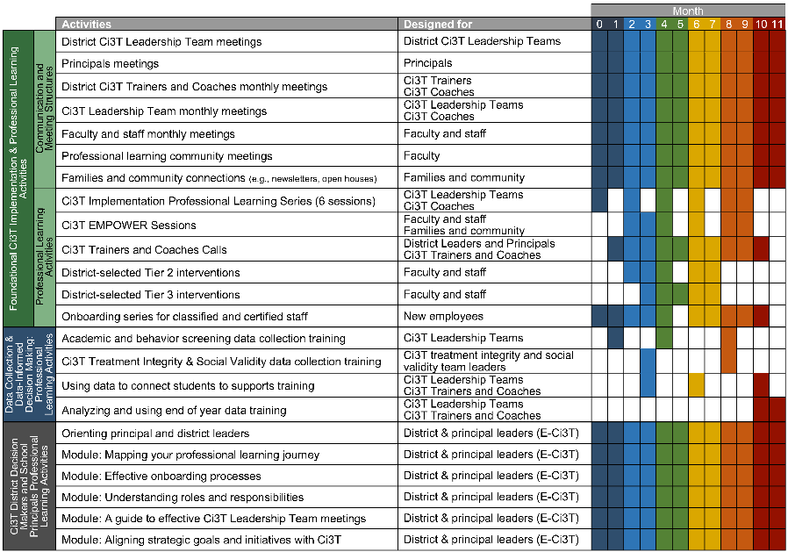
Session Outcomes
Explain how to review school-wide data to determine which students might benefit from this Tier 2 intervention.
Describe three key components of Recognize. Relax. Record.
Describe how to implement Recognize. Relax. Record. in a classroom setting.
Explain how to measure (a) implementation (treatment integrity), (b) users’ views of goals, procedures, and outcomes (social validity), and (c) student behavior (e.g., engagement, anxious feelings).

Slide 11
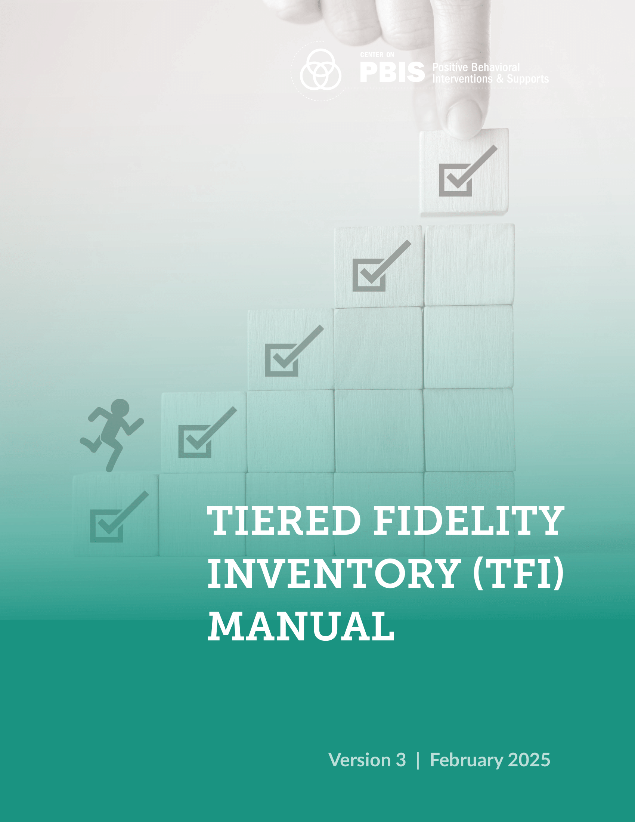
TFI Version 3 Connection
TFI Item | Description
2.3 SCREENING | Tier 2 leadership team uses decision rules and multiple sources of data (e.g., discipline referrals, academic progress, screening tools, attendance, nominations), available from multiple informants (e.g., teacher, family, student), at multiple points in time (e.g., screening at identified points, on-going data review, on-going access to nomination process) to identify students who require Tier 2 internalizing or externalizing supports and to inform the modification or intensification of Tier 1 supports as needed.
2.5 OPTIONS FOR TIER 2 INTERVENTIONS | Tier 2 continuum has multiple ongoing SEB support interventions available schoolwide that meet a range of student SEB internalizing or externalizing needs and behavioral functions, are designed to support groups of students, have documented evidence of effectiveness, and provide (a) additional instruction/time for student skill development, (b) additional structure/predictability, (c) increased opportunity for feedback (e.g., daily progress report), (d) increased communication with families, and (e) include planned modifications to address a range of behavioral function, mental health needs, or academic skill

Slide 12
Agenda
Welcome
Situating Secondary (Tier 2) Interventions in Ci3T Models
Recognize. Relax. Record.
Introduction to Recognize. Relax. Record.
A Step-by-Step Guide to Implementation
Wrapping Up and Moving Forward

Slide 13
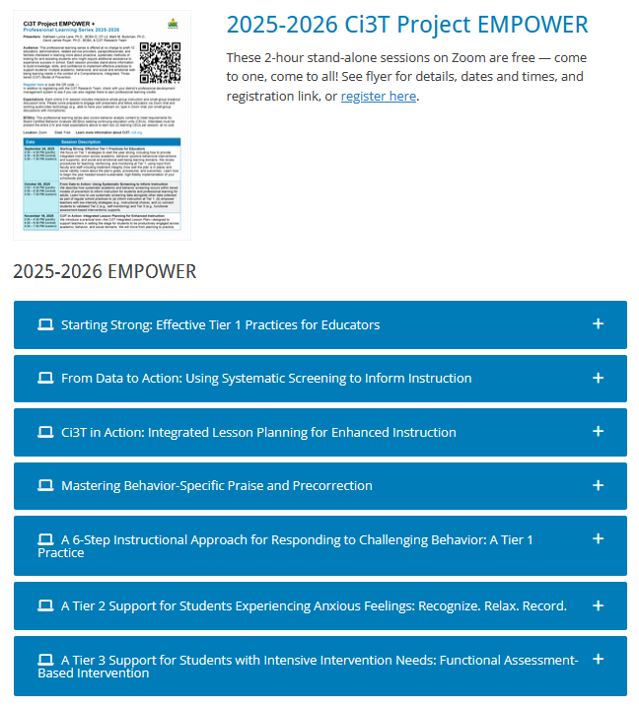
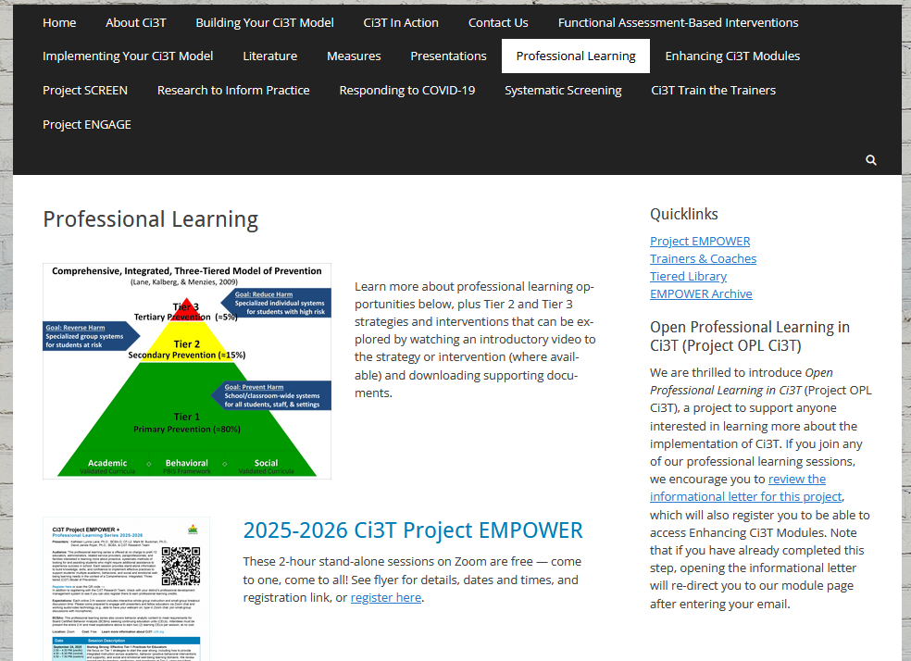
Accessing Professional Learning Materials
ci3t.org/pl

Slide 14


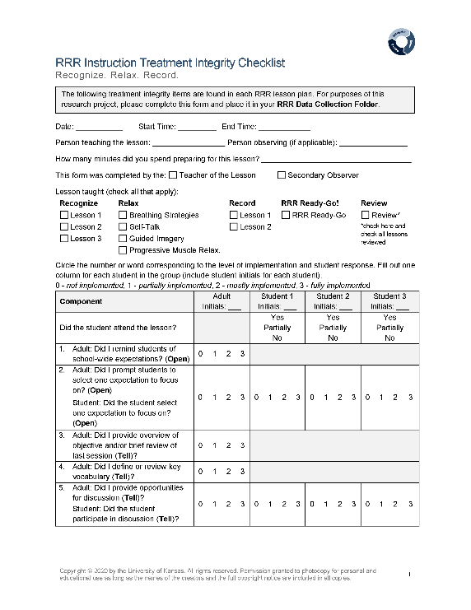
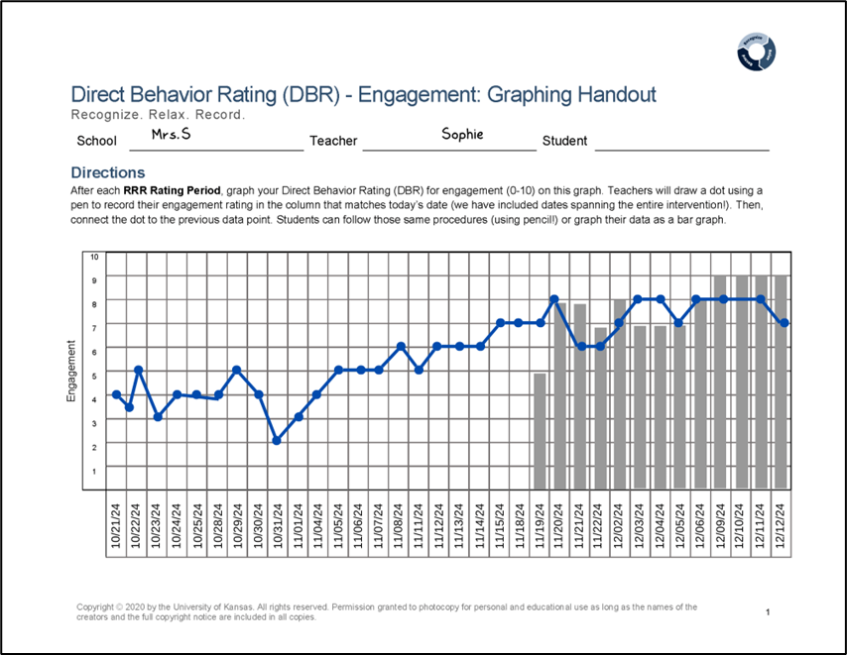
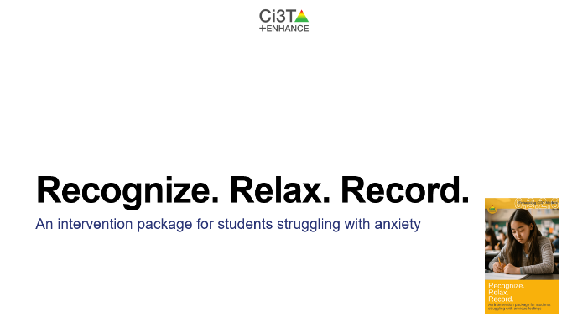
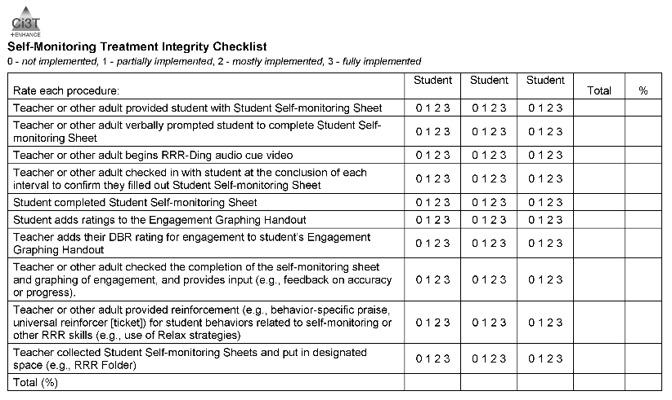
Knowledge, Application, Impact Points
Knowledge, Application, Impact Points 1
If you are in Kansas, you can earn 2 x PD points for application and 3 x for impact!
We are happy to review your materials before you upload!

Slide 15
Situating Secondary (Tier 2) Interventions in Ci3T Models

Slide 16
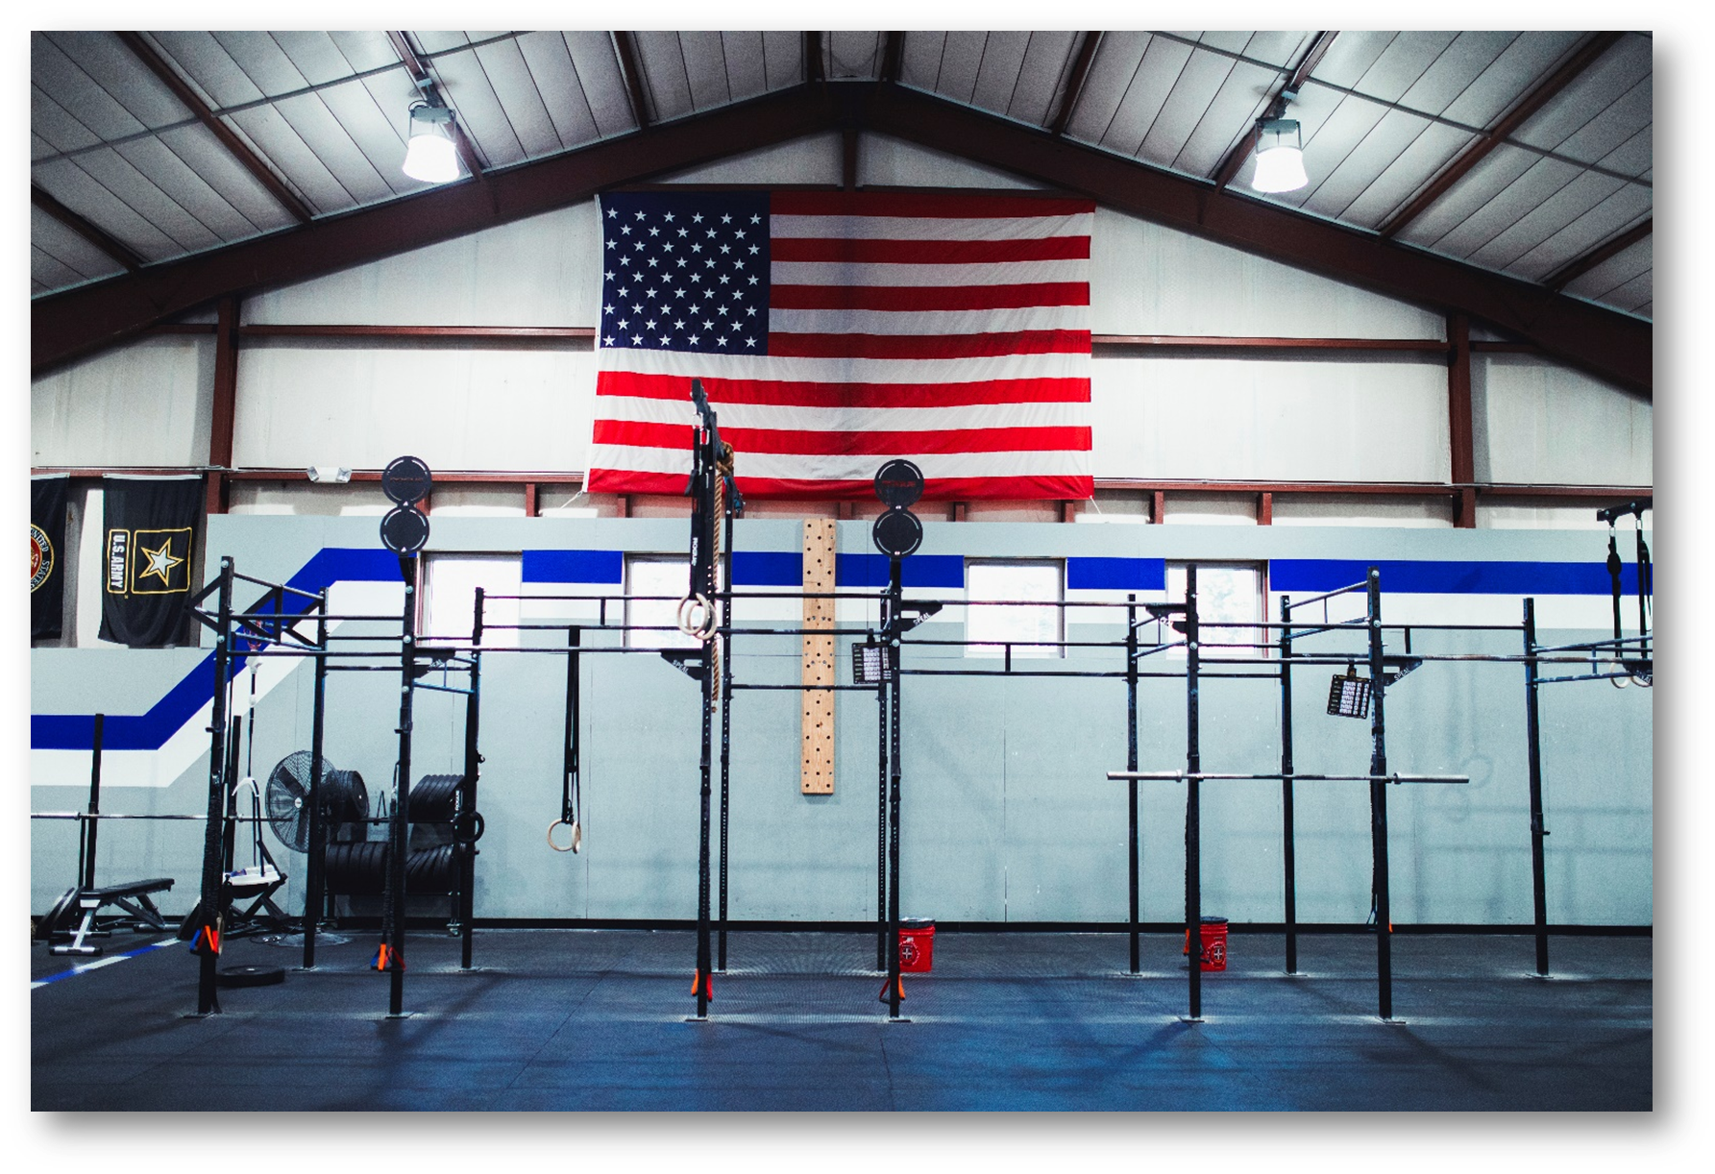
A CrossFit Analogy 1

Slide 17
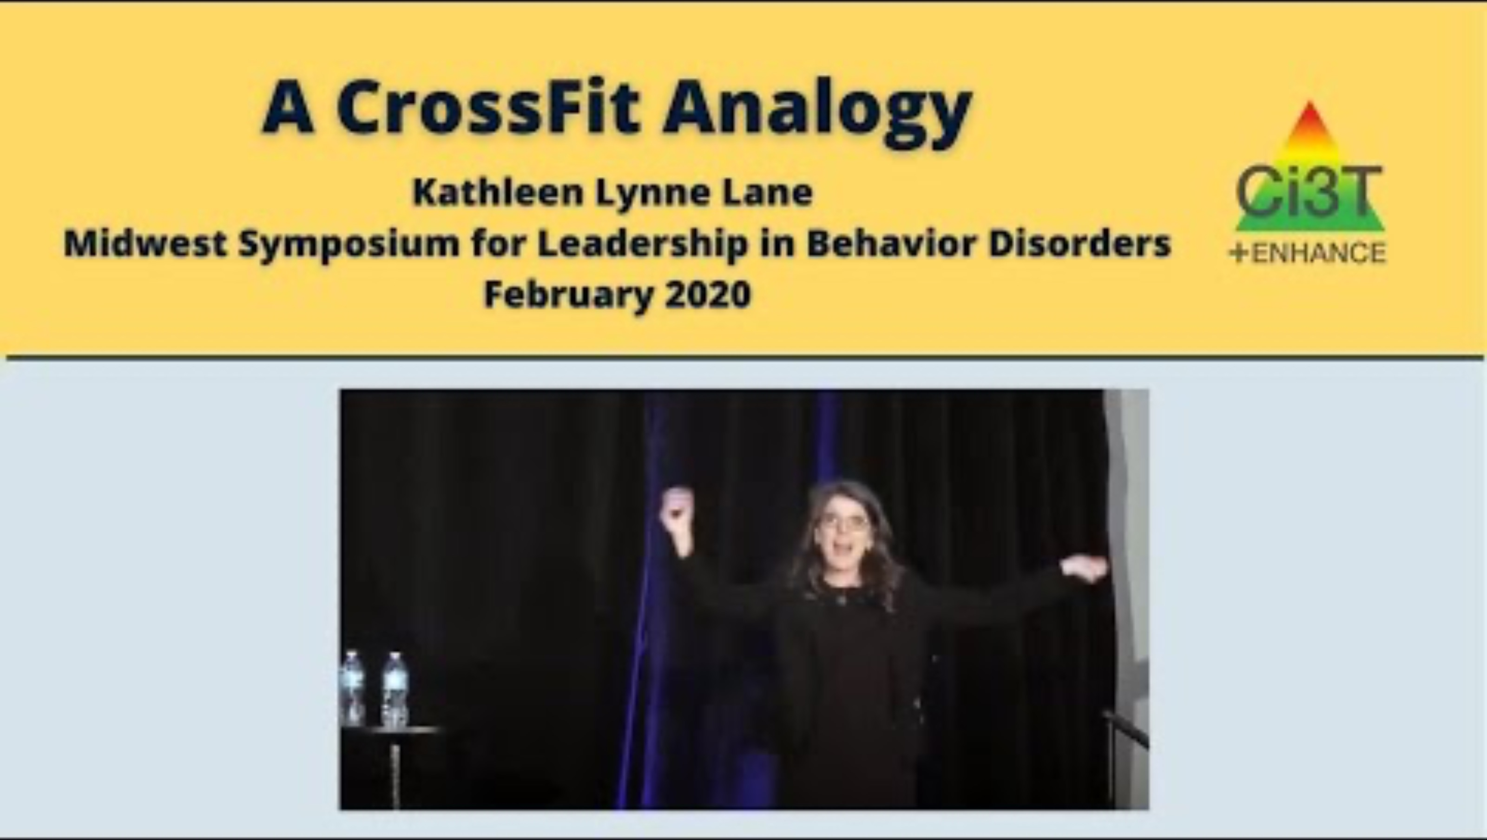
A CrossFit Analogy 2
Notes:
https://youtu.be/rqdH_NKzIZ0
03:35
*If KLL not at session, watch video

Slide 18
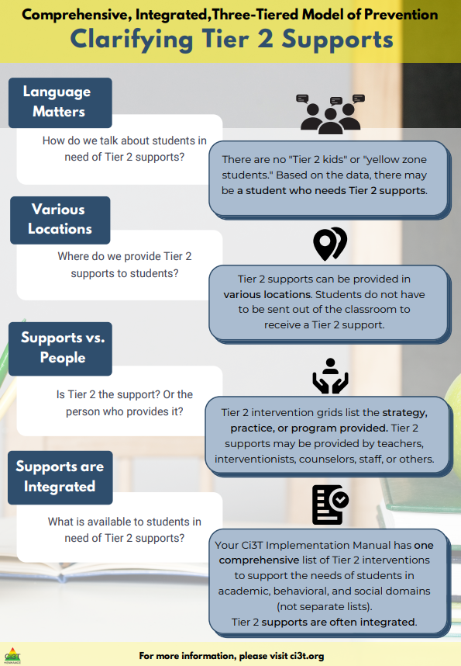
Clarifying Tier 2 Supports 1

Slide 19
Clarifying Tier 2 Supports 2

Slide 20
Clarifying Tier 2 Supports 3

Slide 21
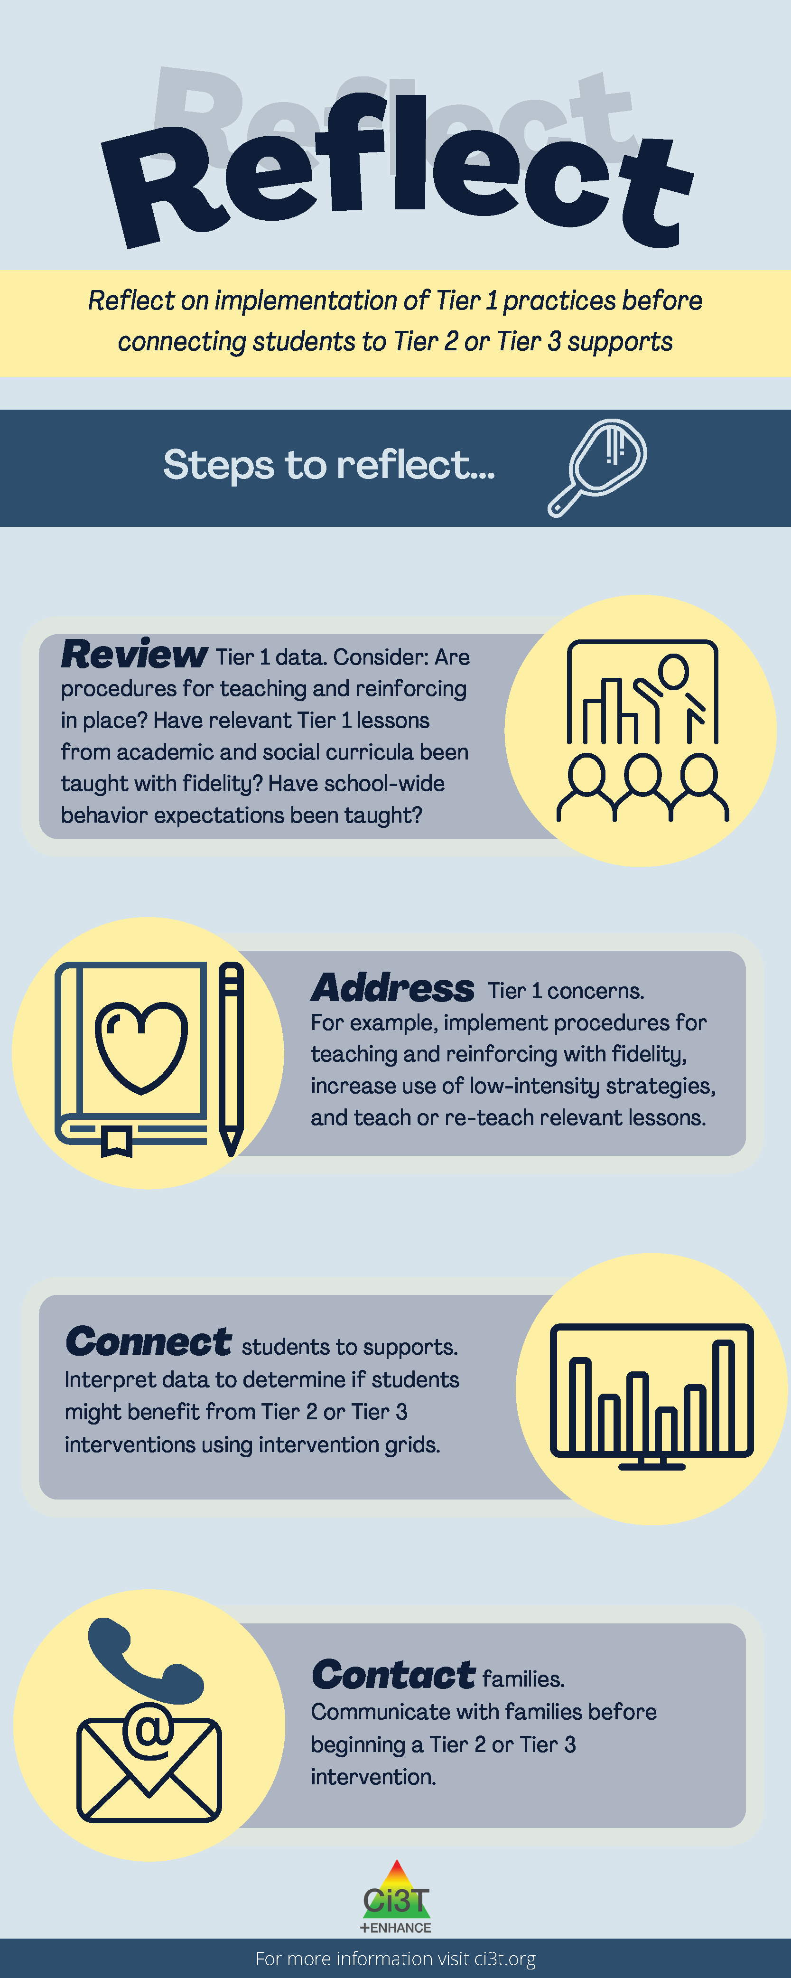
Reflect on Implementation of Tier 1 Practices

Slide 22

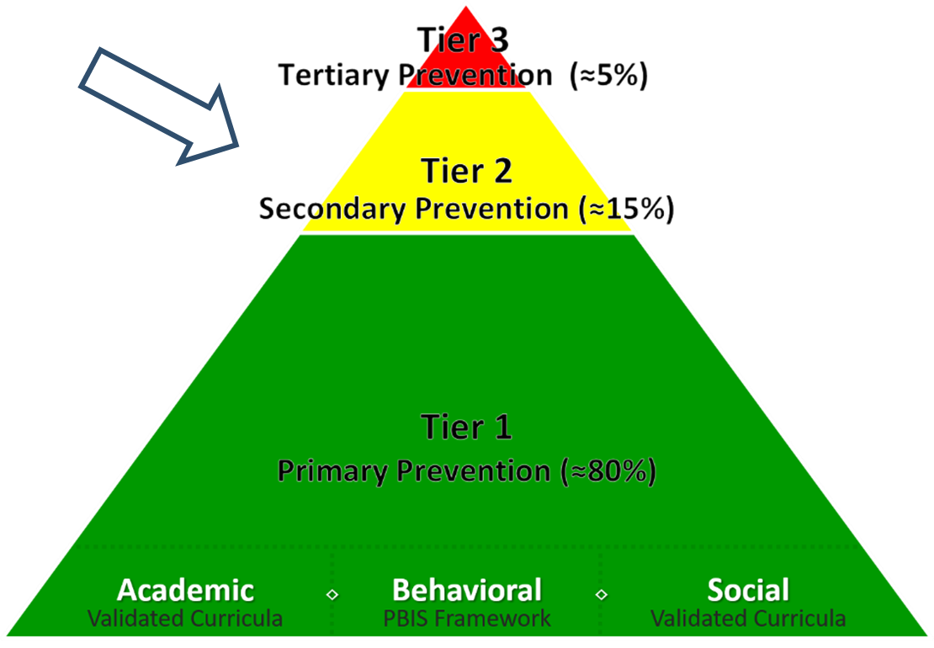
What are Tier 2 Interventions?
What are Tier 2 Interventions 1

Slide 23
What are Tier 2 Interventions?
What are Tier 2 Interventions 2
Evidenced-based or research-based strategies, practices, and programs
Additive (i.e., compliment rather than replace Tier 1 efforts)
Implemented by teachers, interventionists, counselors, paraprofessionals, and other staff
Occur in a variety of formats and locations (e.g., small-group, 1:1, embedded within whole group instruction)

Slide 24

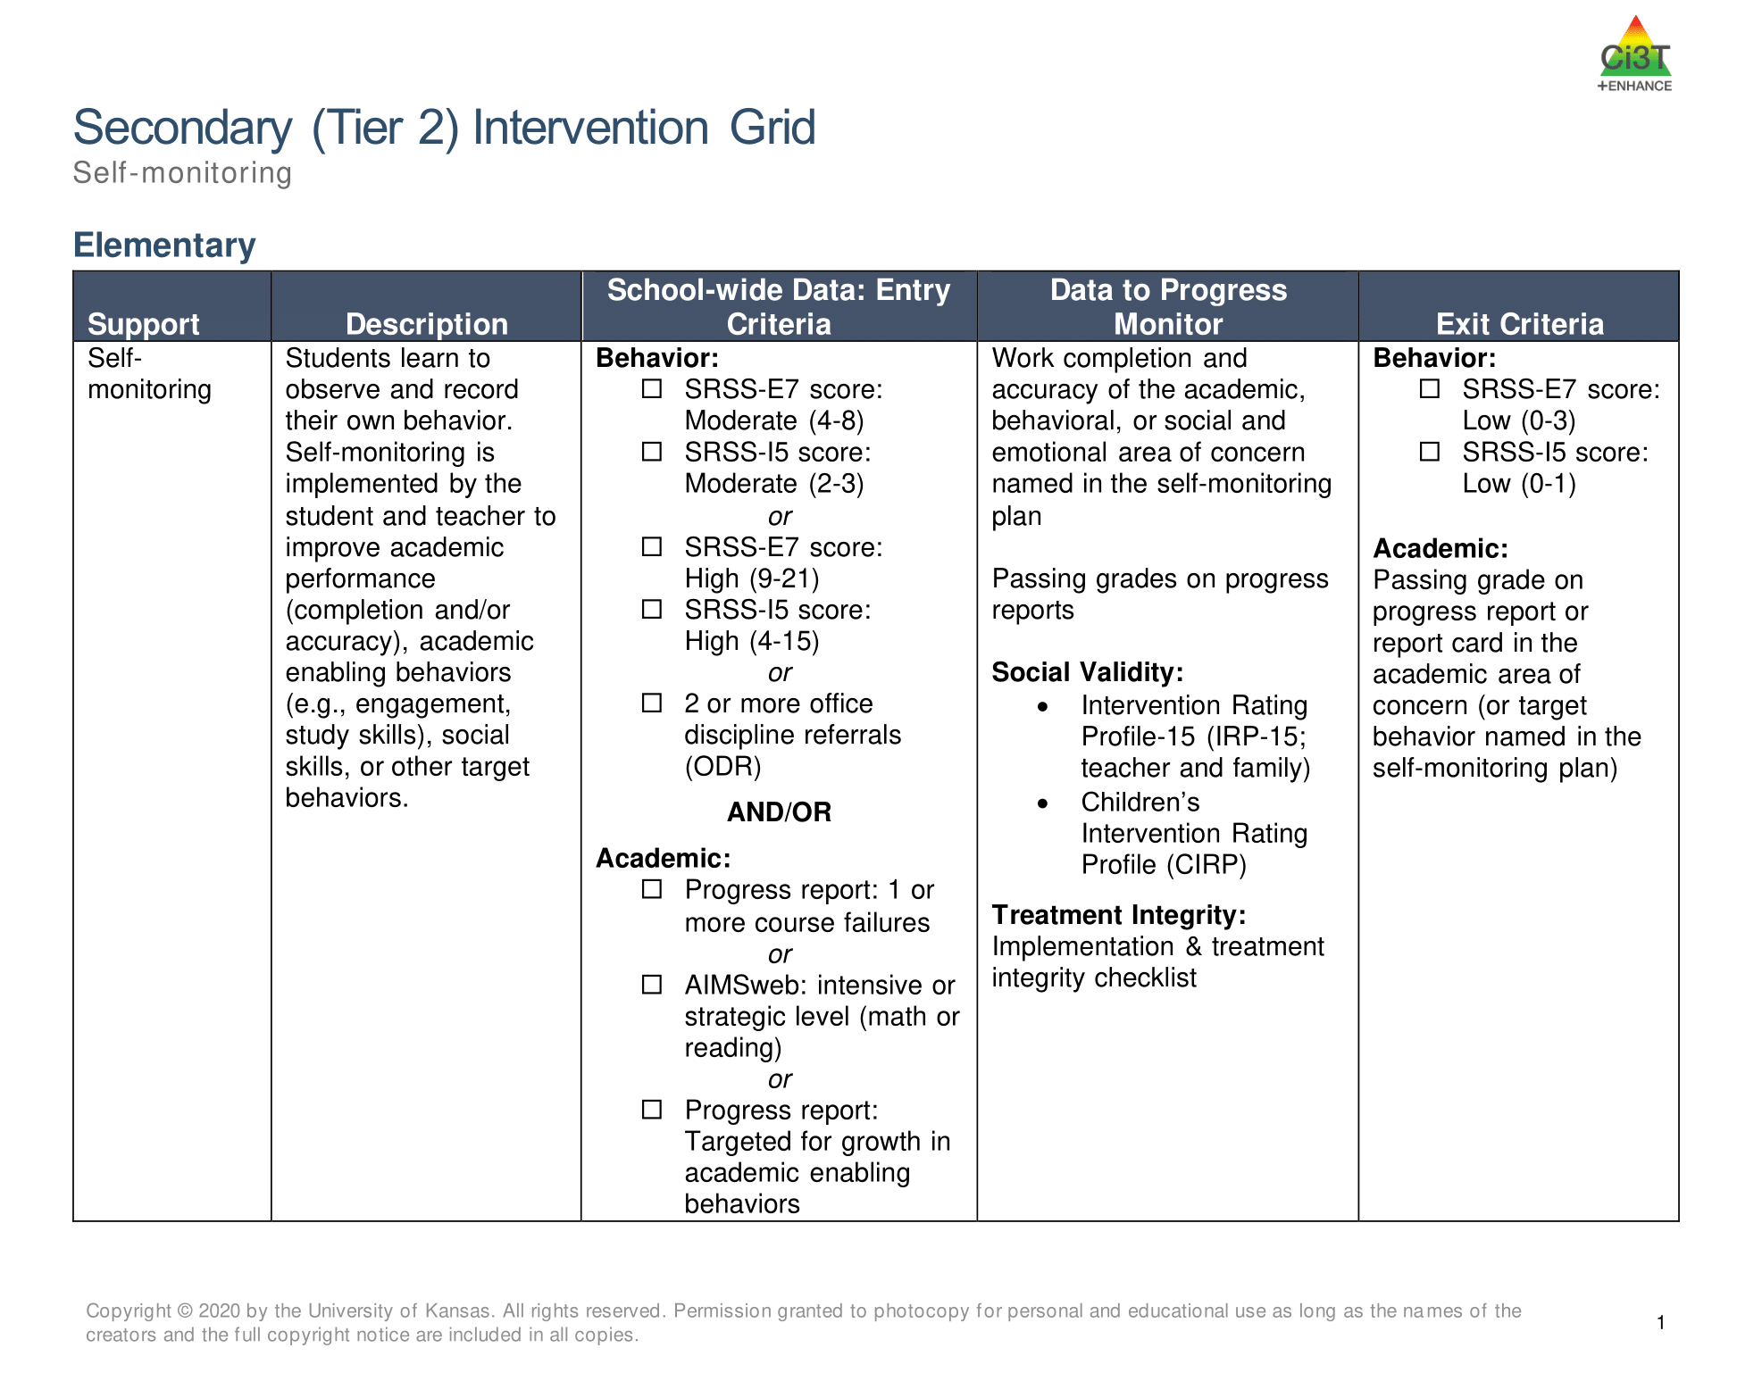
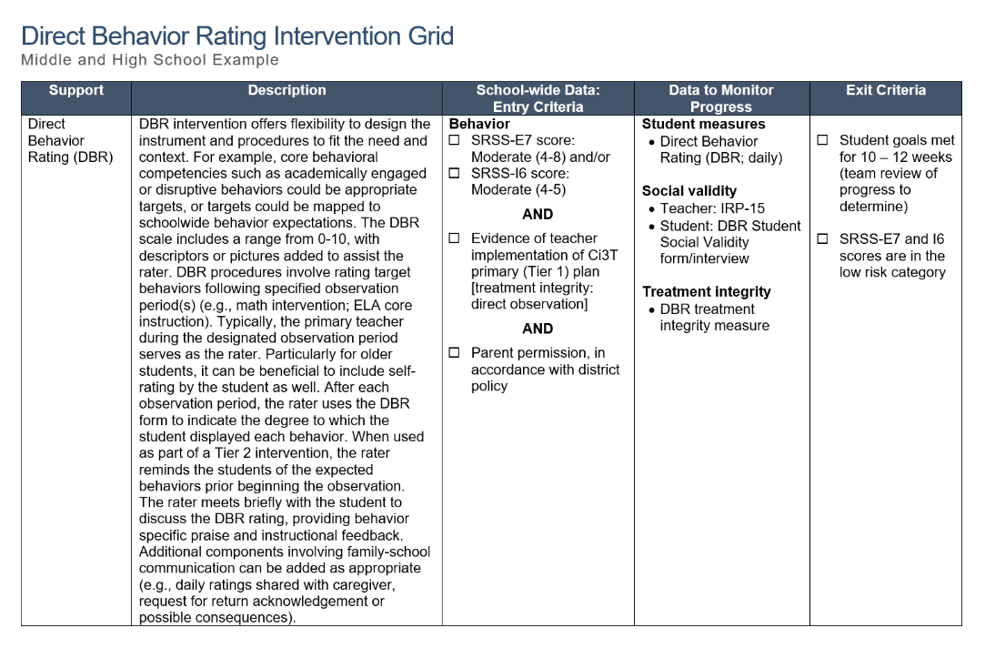
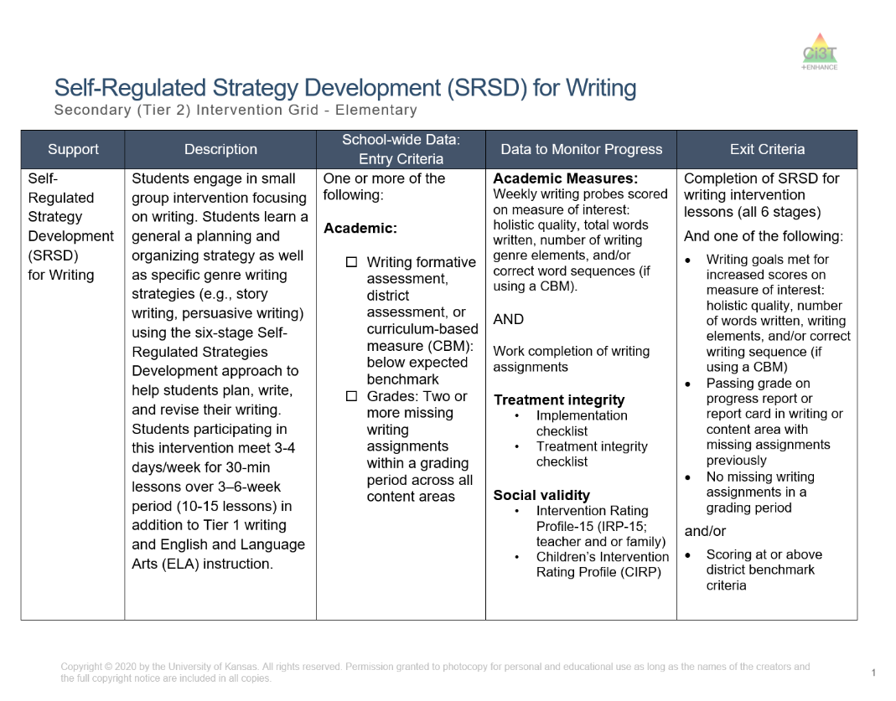
Secondary (Tier 2) Intervention Grid
Secondary (Tier 2) Intervention Grid 1

Slide 25

Components of Secondary (Tier 2) Intervention Grid
Secondary (Tier 2) Intervention Grid 1

Slide 26
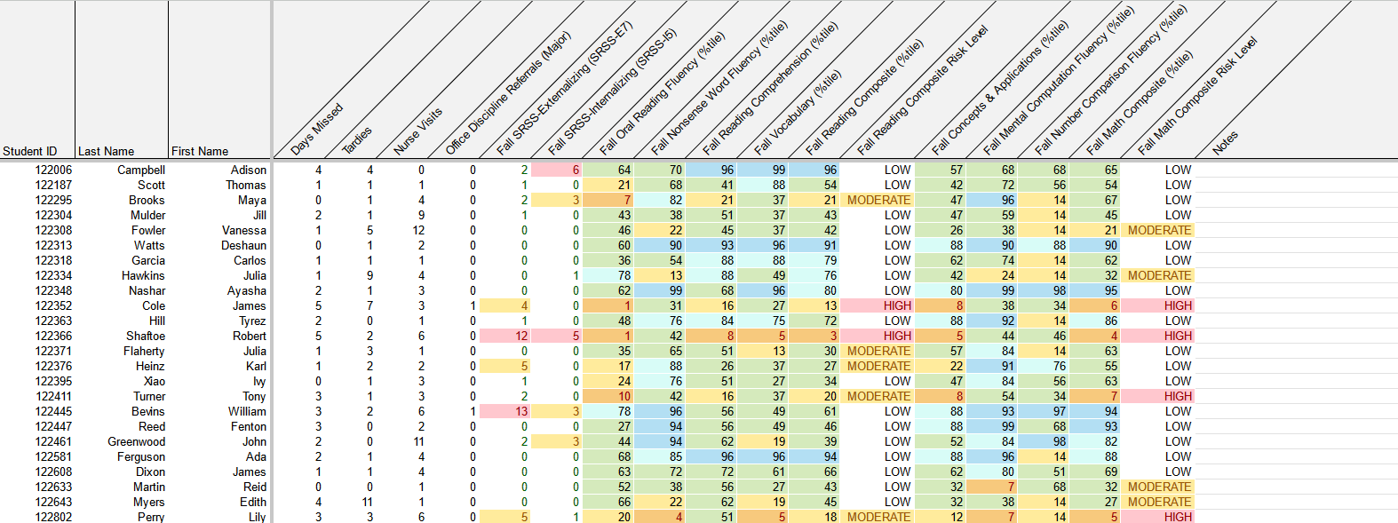
Data to Suggest a Focus on Connecting Students with Tier 2 Supports
attendance
behavior
screening
academic screening

Slide 27

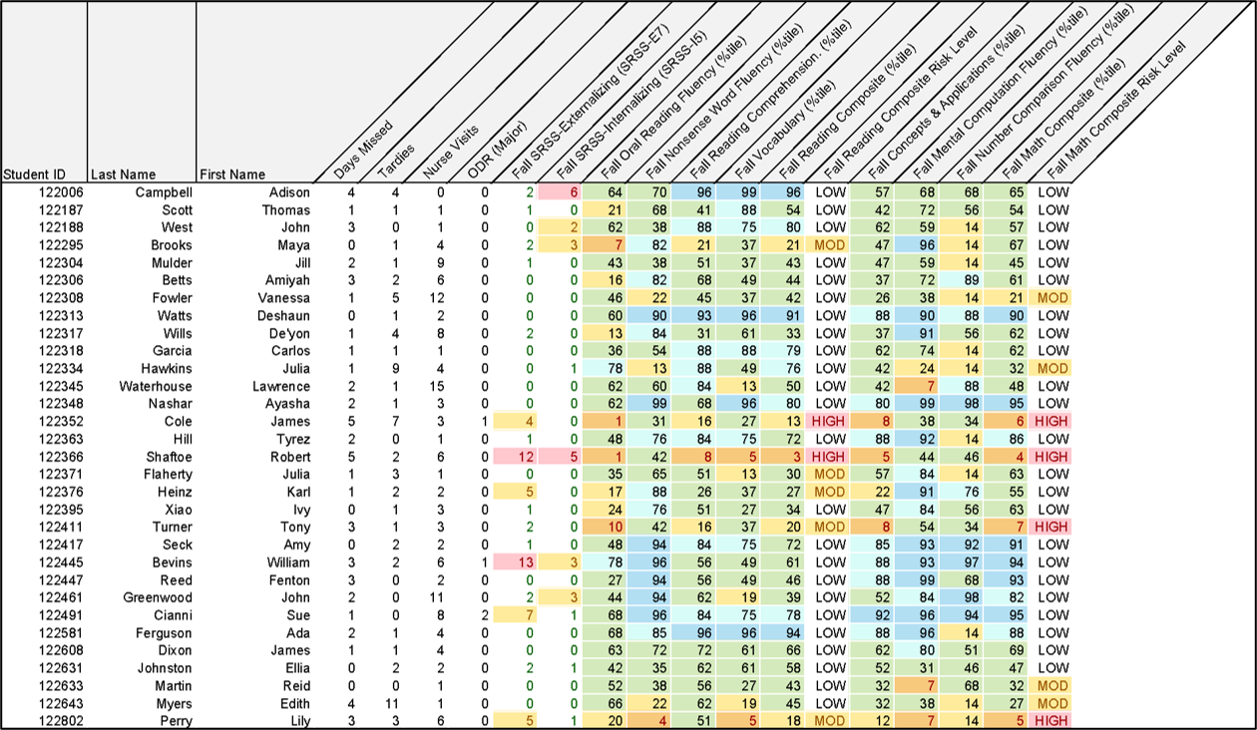
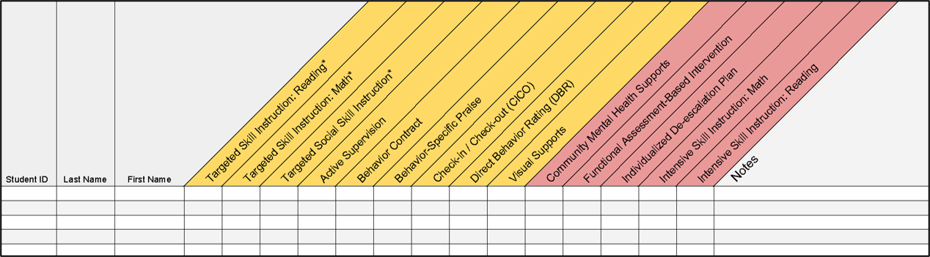
Getting Started with Data-Informed Decision Making

Slide 28
Secondary (Tier 2) Intervention Grid
Secondary (Tier 2) Intervention Grid 2

Slide 29
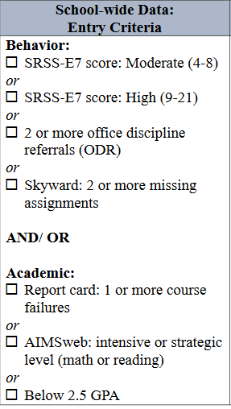
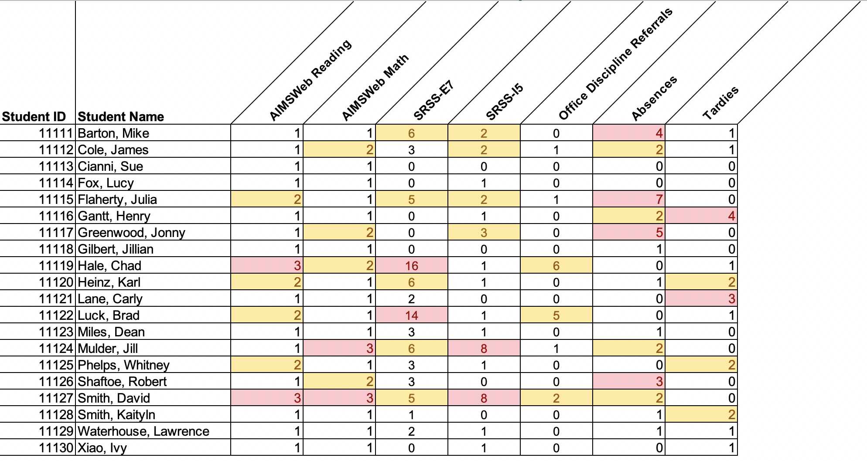
Data in Action
Data in Action 1

Slide 30
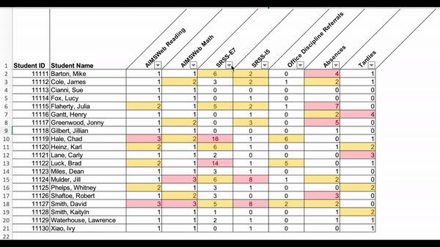
Data in Action
Data in Action 2

Slide 31
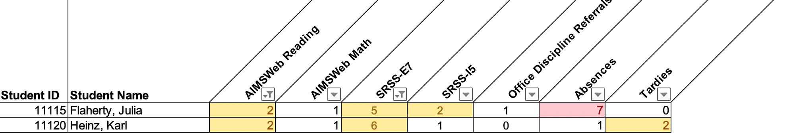
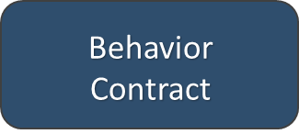

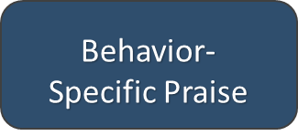

Data in Action
Data in Action 3
Other Tier 2 Options

Slide 32
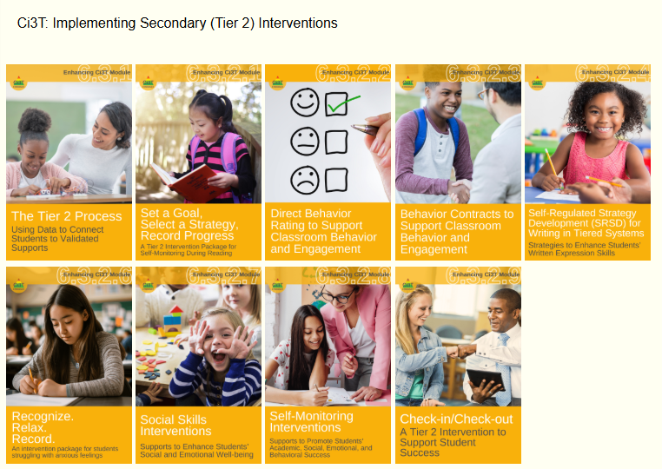
Ci3T: Implementing Secondary (Tier 2) Interventions

Slide 33

Comprehensive, Integrated, Three-Tiered Model of Prevention 3

Slide 34

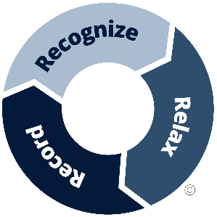
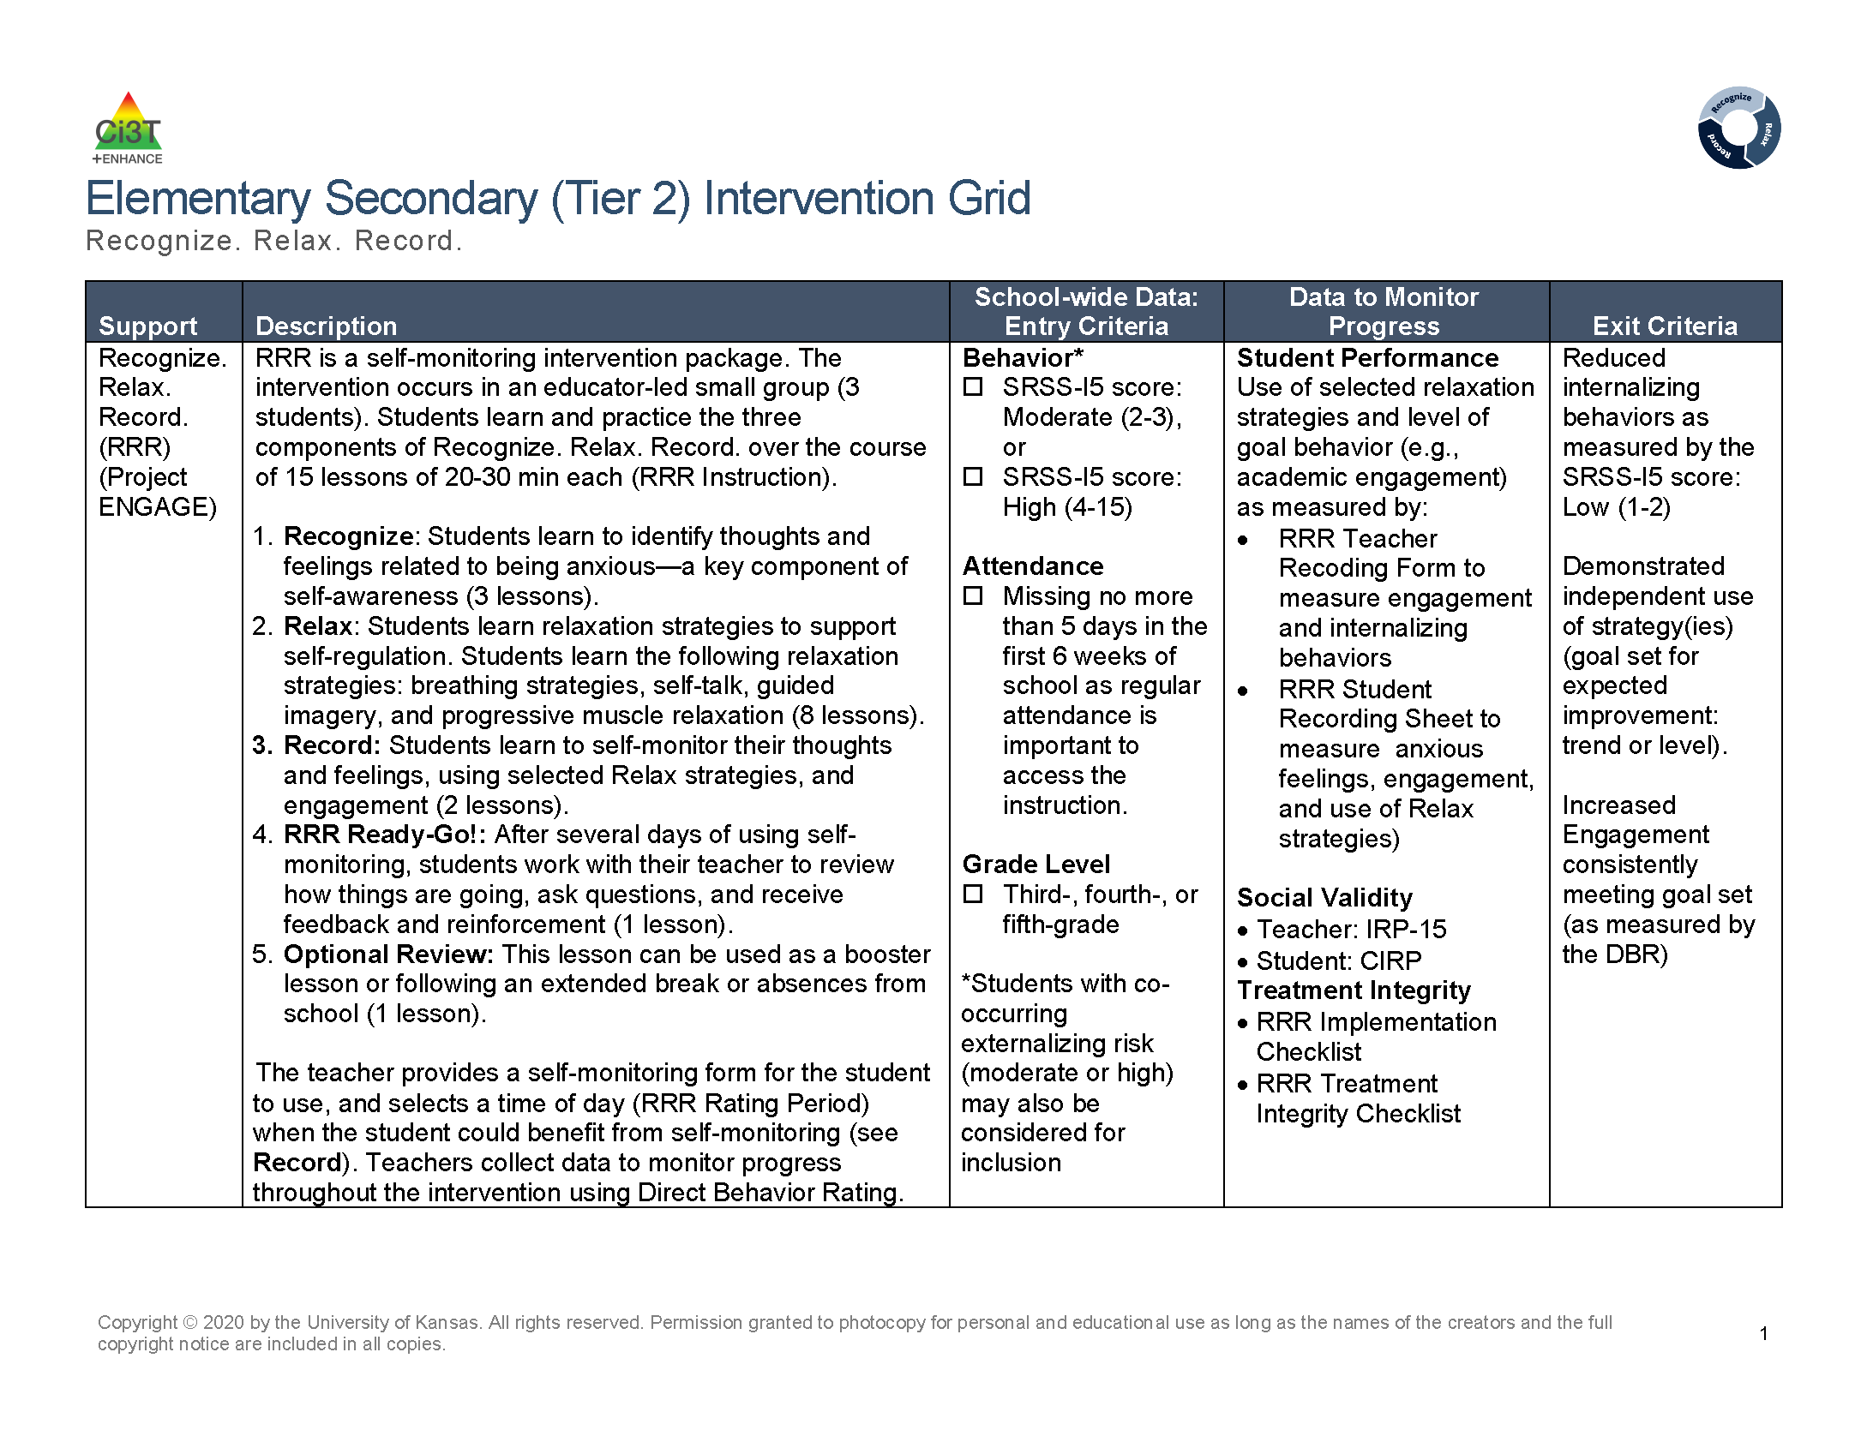
Recognize. Relax. Record. Secondary (Tier 2) Intervention Grid
Recognize. Relax. Record. Secondary (Tier 2) Intervention Grid 1

Slide 35
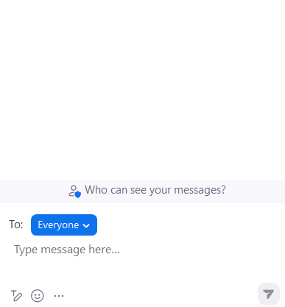

Let’s Chat!
Let’s Chat 1
Which Tier 2 interventions are offered in your setting?

Slide 36
Recognize. Relax. Record.

Slide 37
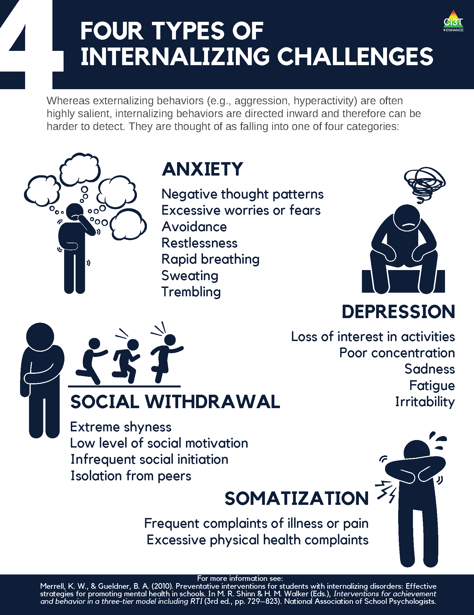
Four Types of Internalizing Challenges

Slide 38
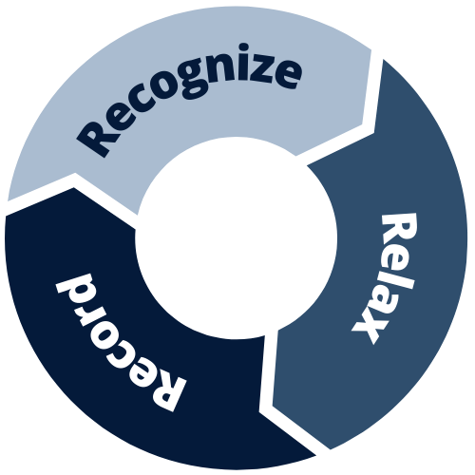
What is Recognize. Relax. Record.?
An intervention package containing three components:
Recognize
identify thoughts and feelings related to being anxious
Relax
manage anxious thoughts and feelings using relaxation strategies
Record
self-monitor thoughts and feelings, use of relaxation strategies, and engagement (social or academic)

Slide 39
What does the supporting research for Recognize. Relax. Record. say?
What Does the Supporting Research for Recognize. Relax. Record. Say? 1
Social-emotional competencies
Self-awareness
Self-management
Social awareness
Responsible decision-making
Relationship Skills
Recognize.
Social-emotional competencies, such as self-awareness and self-management, are related to important long-range outcomes
high school graduation
college degree completion
obtaining employment
Durlak et al., 2011
Adapted from CASEL Framework (2020)

Slide 40

What does the supporting research for Recognize. Relax. Record. say?
What Does the Supporting Research for Recognize. Relax. Record. Say? 2
Relax.
Relaxation training is commonly used in research-based cognitive behavioral interventions for children with anxiety
Chorpita & Daleiden, 2009

Slide 41
What does the supporting research for Recognize. Relax. Record. say?
What Does the Supporting Research for Recognize. Relax. Record. Say? 3
Record
Self-management interventions effective for
behavioral and social outcomes
reading, math, and other content areas at elementary
Levendoski & Cartledge, 2000
productivity, engagement, and academic performance at middle and high school
Carr & Punzo, 1993
students with emotional and behavioral disorders
students educated in general and special education classrooms
A.M. Briesch & Briesch, 2016; Briesch & Chafouleas, 2009; Mooney et al., 2005

Slide 42
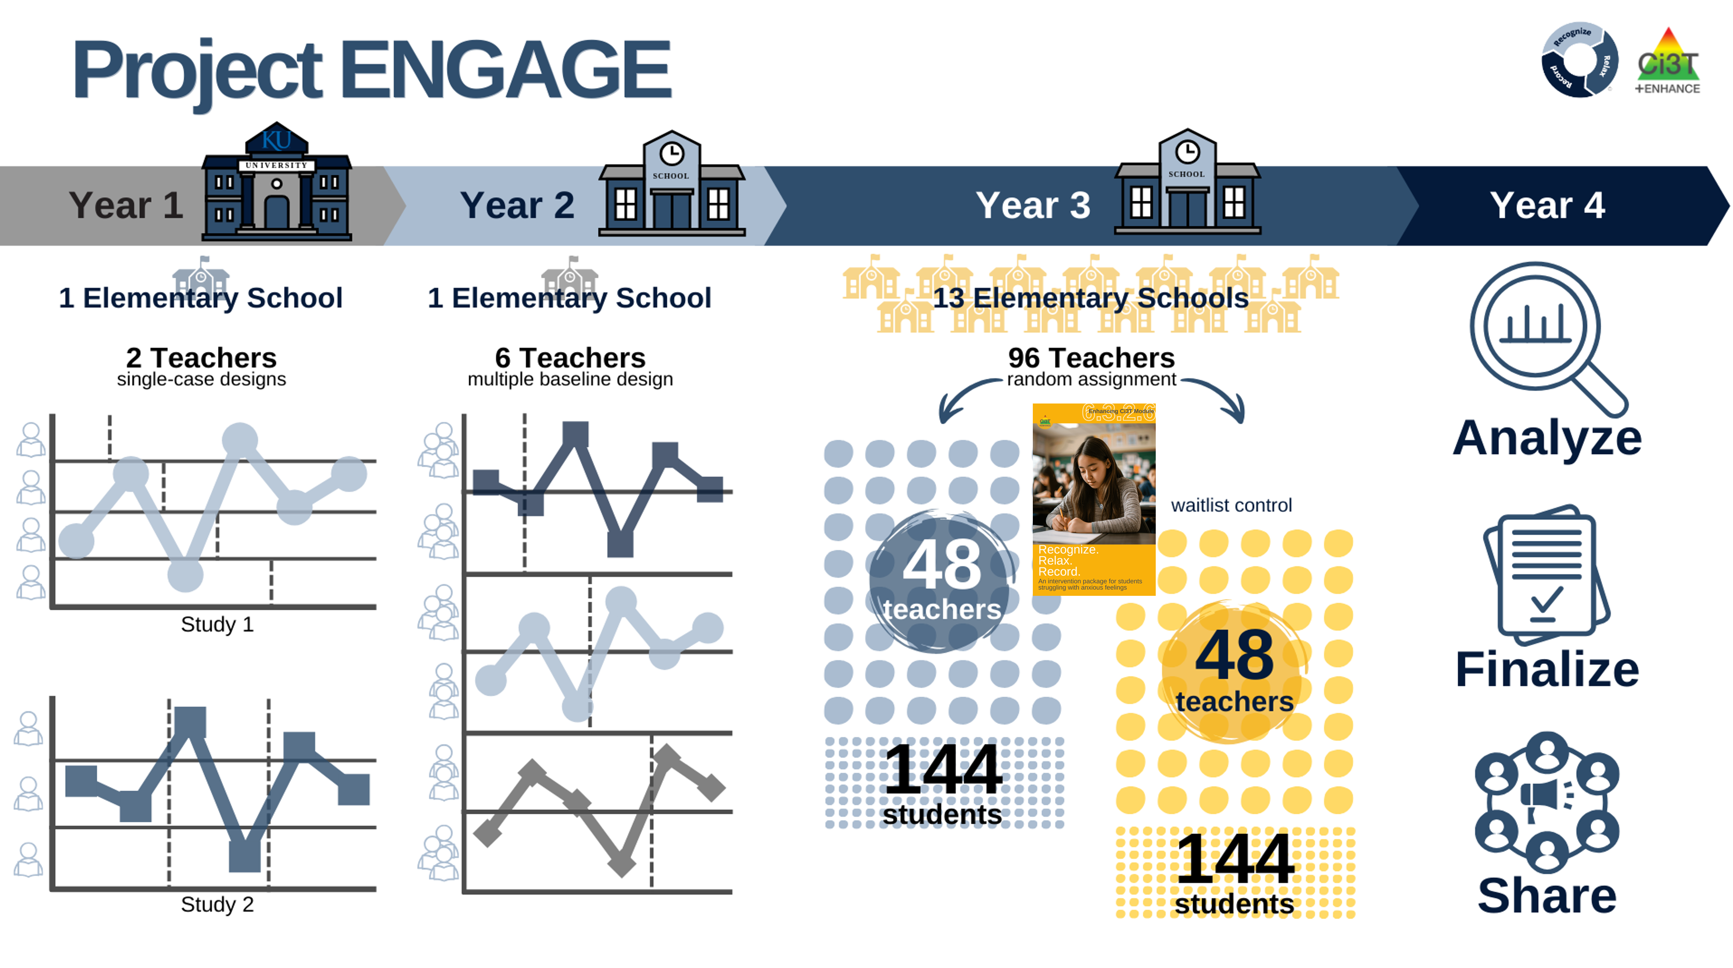
Project ENGAGE
A special thank you to teachers who participated! It was gift to learn from and with you!!!

Slide 43
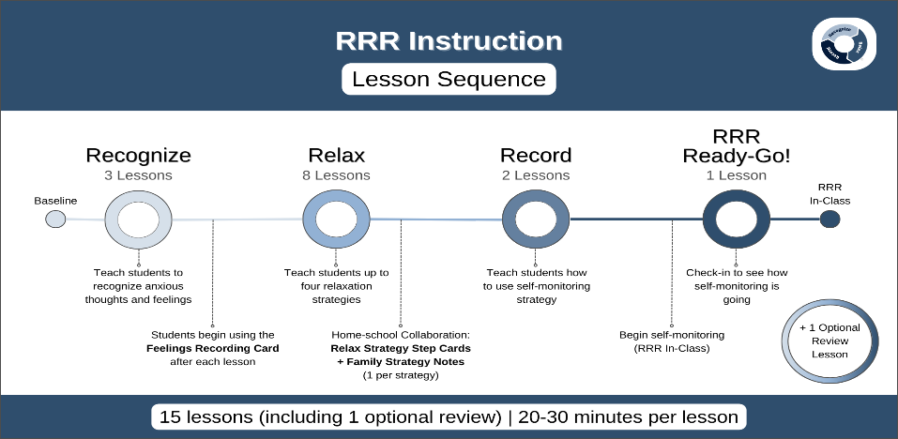
RRR Instruction Lesson Sequence

Slide 44
Baseline
This is the time (approximately two weeks) before beginning RRR instruction
Nothing else changes!
This allows for a comparison pre- & post-intervention
Direct Behavior Rating (DBR)
Goal is to collect ~6-8 data points

Slide 45
RRR Instruction
Deliver small group RRR Lessons
~20-30 minutes per lesson
Up to 15 lessons
Teacher-led small group (3-5 students)
Teachers continue to collect DBR

Slide 46
RRR In-Class
Continue to collect DBR data
Student Self-Monitoring
Teachers facilitate self-monitoring

Slide 47
Step 1
Use data to connect students to Recognize. Relax. Record

Slide 48
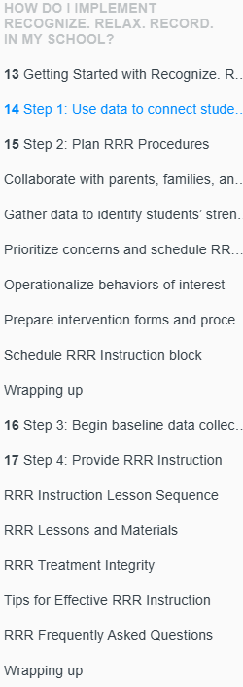

RRR Module Highlight!
RRR Module Highlight 1

Slide 49

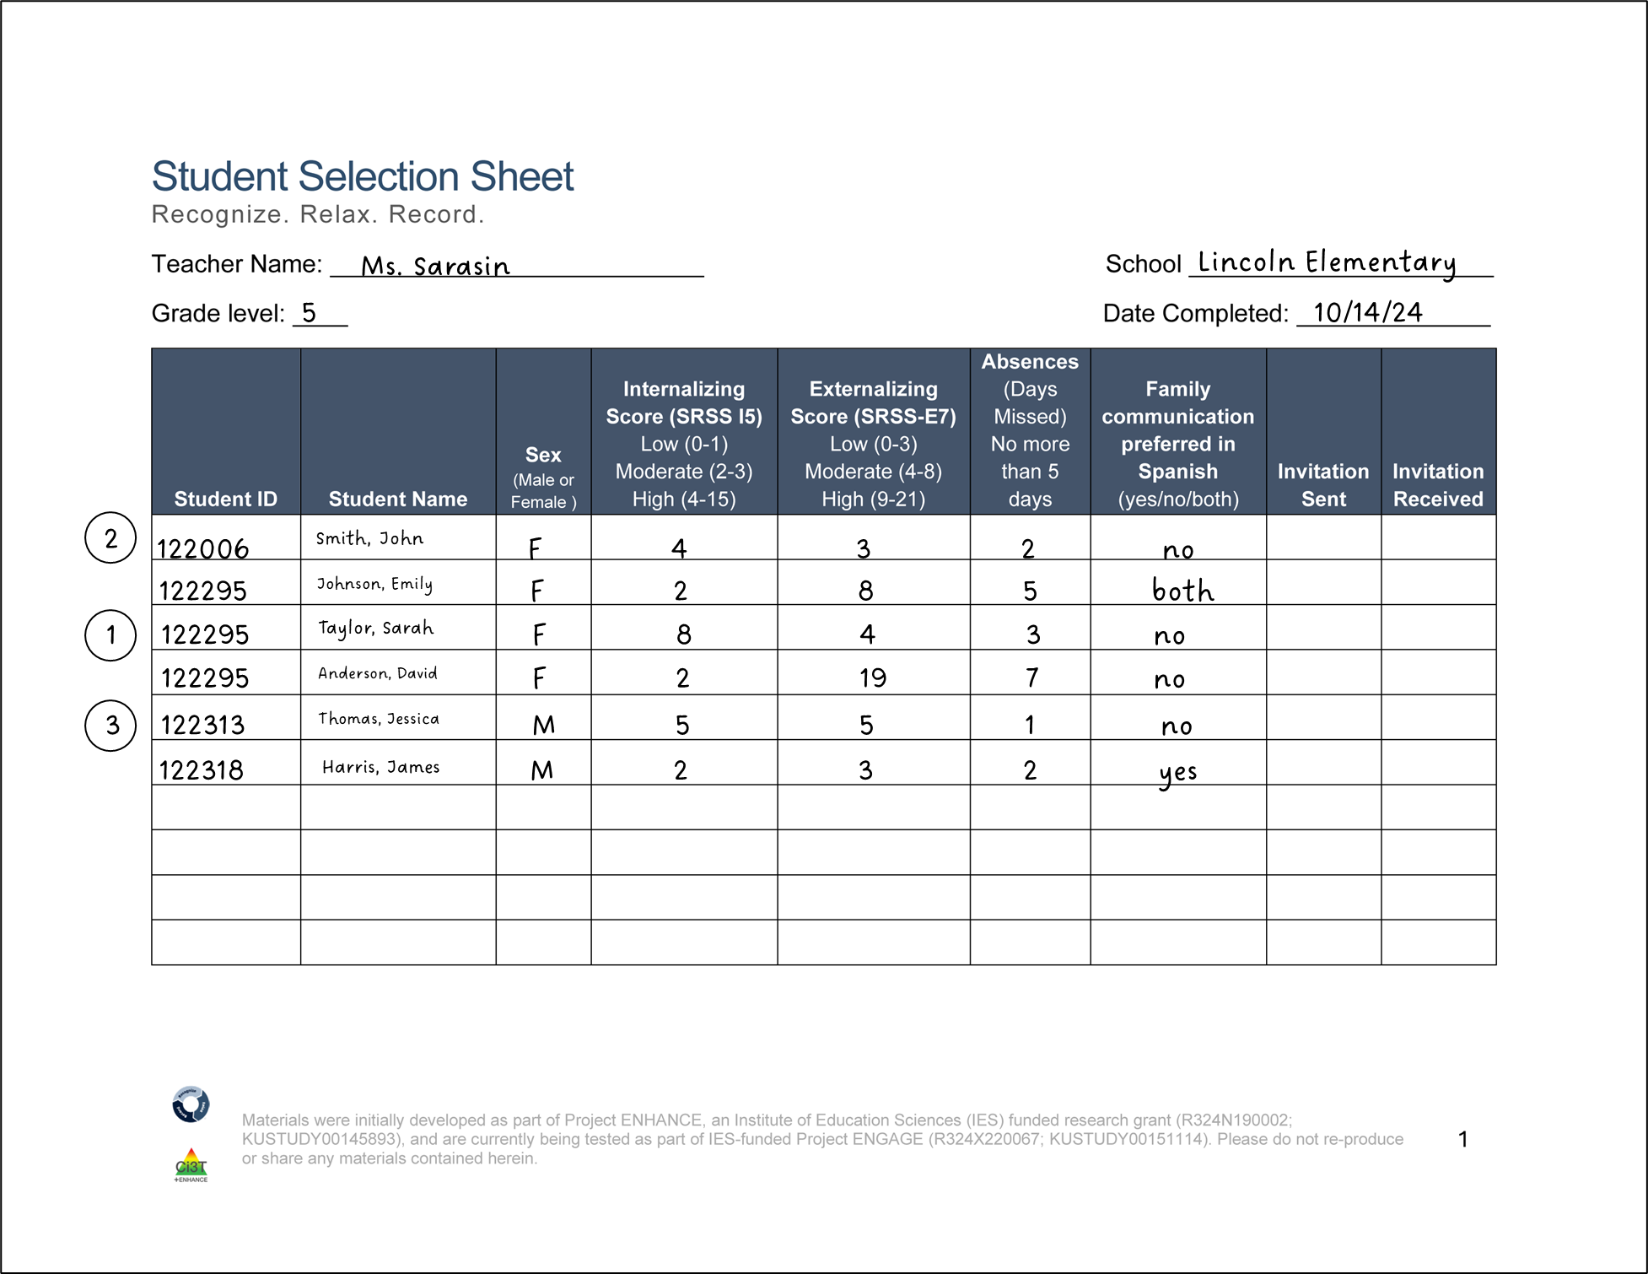
Step 1 Use data to connect students to Recognize. Relax. Record.
Screening

Slide 50
Recognize. Relax. Record. Secondary (Tier 2) Intervention Grid
Recognize. Relax. Record. Secondary (Tier 2) Intervention Grid 2

Slide 51
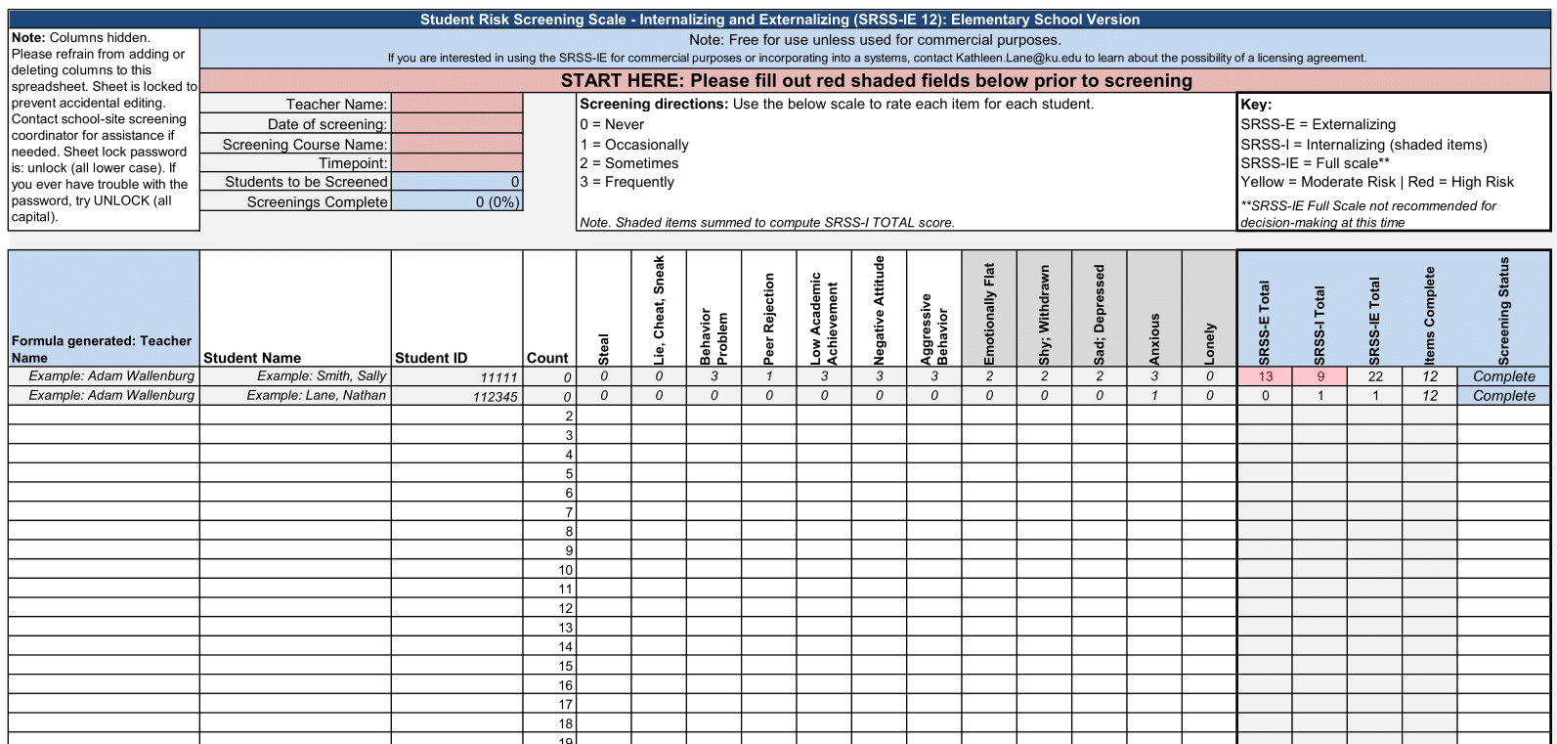
Using data to connect students to Recognize. Relax. Record.

Slide 52
Step 2
Plan RRR Procedures

Slide 53
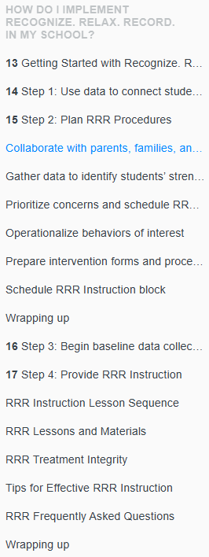
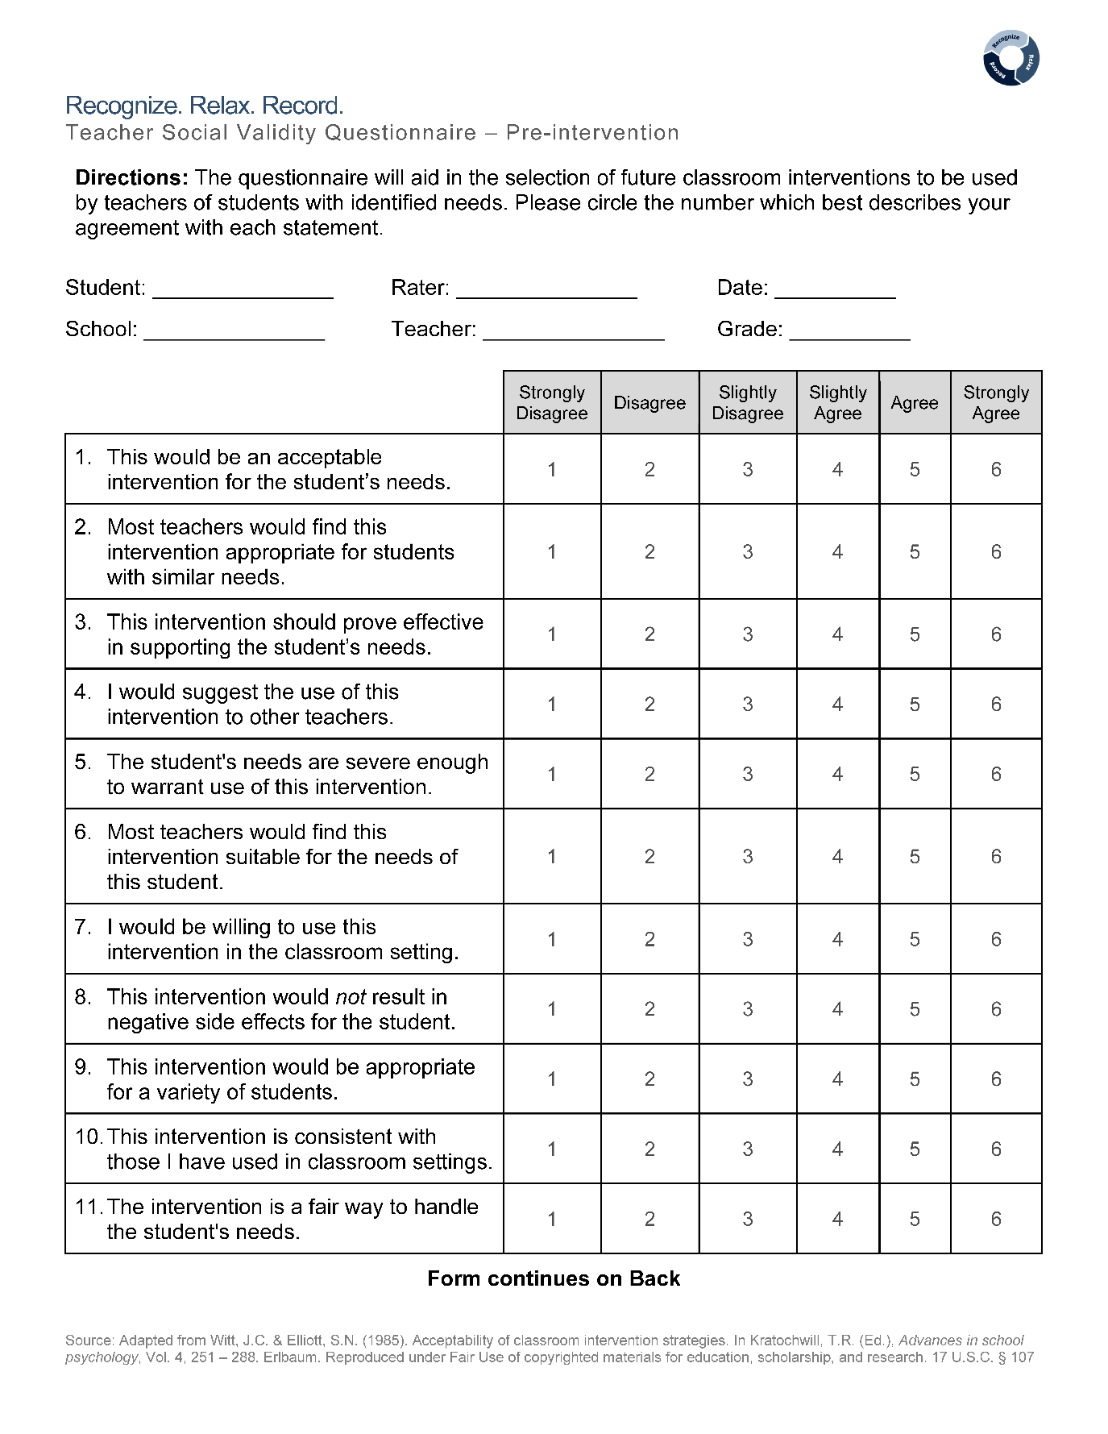
RRR Module Highlight!
RRR Module Highlight 2

Slide 54

Step 2 Plan RRR Procedures
Step 2 Plan RRR Procedures 1
Collaborate with parents, families, and colleagues
Gather data to identify students’ strengths, abilities, and needs
Schedule
RRR Rating Period
Time when baseline (Direct Behavior Rating) data collected
Time when students will use self-monitoring during RRR In-Class phase
RRR Instruction Block
Time when small-group instruction will occur (15 lessons, 20-30 min each)
2:00-2:40
Monday-Thursday
Math
10:00-10:25
Monday, Wednesday, Thursday
Independent Work Time

Slide 55



Step 2 Plan RRR Procedures
Step 2 Plan RRR Procedures 2
Prepare intervention forms and procedures
Teacher Recording Form (Direct Behavior Rating)
Student Self-Monitoring Sheet
Operationalize behaviors of interest

Slide 56
Step 3
Begin baseline data collection

Slide 57


RRR Module Highlight!
RRR Module Highlight 3

Slide 58


Step 3 Begin baseline data collection

Slide 59


Direct Behavior Rating (DBR)
A tool that involves a brief rating of target behavior immediately following a specified observation period.
Source: University of Connecticut. (n.d.). Direct behavior rating: Assessment training module. [video training module].
www.dbrtraining.education.uconn.edu/video.php

Slide 60

How is DBR used in this intervention?
DBR data are collected during the RRR Rating Period a 40-minute instructional block during which students would most benefit from using their new strategies to increase engagement and regulate anxious feelings
Later in the intervention (during RRR In-Class), students will self-monitor their own behavior during this time
Teachers will collect DBR data throughout all stages of intervention:
Baseline (~6-8 days)
RRR Instruction
RRR In-Class

Slide 61

Teacher Recording Form
DBR data are collected using the Recognize.Relax.Record Teacher Recording Form to measure students’:
Academic engagement
Internalizing behavior

Slide 62

Operational Definition: Academic Engagement

Slide 63
Operational Definition: Internalizing Behavior

Slide 64

Direct Behavior Rating: Internalizing Behavior Definition

Slide 65

DBR Procedures: RRR Rating Period
Plan to collect DBR data four times a week
Generally, Monday through Thursday
At the end of the RRR Rating Period, complete the Teacher Recording Form

Slide 66

RRR Engagement Graphing Procedures
Each student will have their own Engagement Graphing Handout
Later in the intervention (during RRR In-Class), students will also add their total engagement ratings to this graph!
Once you have completed the Teacher Recording Form, graph each student’s overall engagement score on their graph

Slide 67













Talk Time
What are your initial thoughts and reactions to RRR?
What does internalizing behavior look like for your students?
What time of day might work best for your RRR Rating Period?
Notes:
2-minute timer

Slide 68
Step 4
Provide RRR Instruction

Slide 69


RRR Module Highlight!
RRR Module Highlight 4

Slide 70

Step 4 Provide RRR Instruction

Slide 71

Lesson Plans Overview
15 lessons available
Recognize - 3 lessons
Relax - 8 lessons*
Record - 2 lessons
Ready-Go!
Review (optional)
20-30 min each lesson
Semi-scripted
Teacher-led

Slide 72




Family Materials
Available in both Spanish and English!

Slide 73






Teacher Materials

Slide 74


Video Model: The Instructional Hub
Notes:
1:30 second video
Video walkthrough of instructional hub

Slide 75


Key Intervention Lesson Features
Big Idea
Suggested Pacing & Prompts
Embedded Materials
Situational Stories
Activities
Semi-scripted & predictable layout

Slide 76

Recognize. Relax. Record. Intervention Component
Recognize. Relax. Record. Intervention Component 1
Recognizing and understanding our emotions is a key component for self-awareness
Students learn to:
Lesson 1: Understanding anxious feelings
Lesson 2: Identifying anxious thoughts and feelings
Lesson 3: Choosing strategies to help manage anxious thoughts and feelings

Slide 77

Recognize. Relax. Record. Intervention Component
Recognize. Relax. Record. Intervention Component 2
Students learn strategies to respond when they feel anxious
Breathing Strategies
Self-talk
Guided Imagery
Progressive Muscle Relaxation
For each strategy, students will:
Define
Learn to use
Recognize situations for when to use
Demonstrate (and practice)

Slide 78


Lesson Activities: Interactive

Slide 79

Recognize. Relax. Record. Intervention Component
Recognize. Relax. Record. Intervention Component 3
Students learn how to monitor their own feelings and behaviors
Lesson 1: Learning to Self-Monitor (Record) our Behaviors
Focus: Academic Engagement
Lesson 2: Learning to Self-Monitor (Record) our Thoughts, Feelings, and Behaviors
Focus: Anxious thoughts and feelings
Focus: Use of relaxation strategies

Slide 80



Preparing Students for RRR In-Class
Notes:
https://www.youtube.com/watch?v=vW0D1KVtcf4&t=1s (not watching video)

Slide 81

RRR Ready-Go!
Final lesson in sequence
Lesson taught after students have had a few days of RRR In-Class
Flexible lesson to review:
Self-Monitoring Sheet
Engagement Graphing Handout

Slide 82


Optional Review Lesson
Optional customizable lesson to use as needed following an extended break in instruction.

Slide 83

Video Model: Opening & Closing a Lesson

Slide 84




A Deeper Dive
Recognize. Relax. Record.
Module Exploration | Explore Instructional Hub | Implementation Planning | A Trainer/Coach
During this time, we invite you to join the breakout room that most closely matches how you plan to learn more about RRR in your role!

Slide 85
Step 5
Implement RRR In-Class and Monitor Student Performance

Slide 86


RRR Module Highlight!
RRR Module Highlight 5

Slide 87


Step 5 Implement RRR In-Class and Monitor Student Performance
Step 5 Implement RRR In-Class and Monitor Student Performance 1

Slide 88

Self-Monitoring Treatment Integrity Checklist
Self-Monitoring Treatment Integrity Checklist located on the back of the RRR Rating Form
Completed daily at end of RRR In-Class Period
rate all procedures on a scale from 0 (not implemented) to 3 (fully implemented)
each procedure is rated for each student

Slide 89

Video Model: RRR In-Class Procedures
Notes:
01:30

Slide 90

Student Self-Monitoring Sheet

Slide 91

Step 5 Implement RRR In-Class and Monitor Student Performance
Step 5 Implement RRR In-Class and Monitor Student Performance 2
Behaviors | Behavior-specific Praise Examples
Correctly completing the student self-monitoring form | “Mia, it looks like you filled out the form for every interval today. Thanks for remembering!”
Demonstrating academic engagement | “Omar, it looks like you took great notes during the lesson today and did all the practice problems. Nice job setting yourself up for success!”
Accurately rating their academic engagement (even when not rated highly) | “Jian, I really appreciate how you noticed you were not so engaged during the last block. I appreciate the honesty. Now, what can you do to get back on track? How can I help?”
Using relaxation strategies | “Isabella, it looks like you were feeling a bit anxious during that block, but you used guided imagery. That’s a great job of using our new skills. How are you feeling now – and is there anything I can do to help?”

Slide 92

Student Check-In and Feedback: Tips from Teachers
Student skips an interval
“That was the third ding, fill out your ratings in this row”
Student ratings are very different than teacher ratings
“I see you rated yourself a 9 for engagement. I noticed you playing inside your desk and drawing in your math book so my rating for you would be a 5 or 6. Can you tell me about your rating?
Nonverbal feedback (e.g., thumbs up, smile, nod)

Slide 93
Student Check-in and Feedback Practice
We are going to review 3 example RRR Student Self-Monitoring Sheets to practice checking in with students and delivering feedback
View form (on slide)
Answer Poll
Whole Group Discussion

Slide 94

Self-monitoring practice 1

Slide 95
James
I noticed...student did not score two intervals
Feedback:
“Oops! Looks like we missed a few. Remember- every time you hear the ding you will complete a row on the form. Is there anything that is making it tricky to complete?”

Slide 96

Self-monitoring practice 2

Slide 97
Riley
I noticed... overall rating does not match interval ratings
Feedback:
“Great job remembering to fill out the form for every interval! I noticed you rated anxious feelings as mostly 1s but then a 6 for overall score. Remember, your overall score represents how you did throughout the whole math lesson. If your interval ratings are 1s and 2s, your overall score would also be a 1 or 2”

Slide 98

Self-monitoring practice 3

Slide 99

Sophie
I noticed... Sophie reports feeling anxious but does not indicate using any relaxation strategies.
Feedback:
“It looks like you were feeling a bit anxious today. Remember, you can use your strategies! If you are feeling anxious during math tomorrow, what strategy do you want to try?”

Slide 100

Engagement Graphing
Engagement Graphing 1

Slide 101



Engagement Graphing
Engagement Graphing 2
Notes:
At the end of the RRR Rating Period, students add their overall engagement score to their graph. Students can either add a dot OR shade the column like a bar graph. Then, once you check in the with student you will add your dot the graph just like you have been doing!

Slide 102
Step 6
Monitor maintenance and generalization

Slide 103


RRR Module Highlight!
RRR Module Highlight 6

Slide 104

Step 6 Monitor maintenance and generalization

Slide 105
Step 7
Seek input from student, families, and teachers

Slide 106


RRR Module Highlight!
RRR Module Highlight 7

Slide 107



Step 7: Seek input from student, families, and teachers

Slide 108
Social Validity Interviews …
Social Validity Interviews 1
From Teachers … Group 1
“Literally saw a shift in body language after lessons.”
“I wish everyone put together lessons like you guys did. It was so well put together.”
“At first I thought it was going to be a lot of work, but it worked seamlessly into our routine.”
“Boys wanted to talk about their graphs and how they improved.”
“You came and changed my life.”
From Teachers … Group 2
“Instead of internalizing she was able to verbalize her feelings more and talk about things that have happened at home. She has gained confidence in expressing her feelings.”
“In this school we have a lot of trauma and students struggling. I think kids with anxiety are often overlooked-they have a need and now we have something to do for them for the first time.”
“I don’t always feel like I know students well that don’t have big behaviors. It was good for me to get to know them a little better.”
“This program had done wonders for this student in a short amount of time.”

Slide 109
Social Validity Interviews …
Social Validity Interviews 2
From Students
“I got really mad at home and did some breathing.”
“It definitely made me improve on a bunch of stuff. Helped with my self-control.”
“Helped when I couldn’t sleep at night.”
“When I am frustrated, it helps me remember to take a breath.”
“This would help my friends in math say, “I can do this”.”
“When my brother makes me mad, I take deep breaths and visualize being somewhere calm.”

Slide 110

Let’s Chat!
Let’s Chat 2
What are some potential benefits of implementing RRR in your setting?
What are some benefits of having the general education teacher be person teaching RRR lessons?

Slide 111
Wrapping Up and Moving Forward

Slide 112
Knowledge, Application, Impact Points
Knowledge, Application, Impact Points 2
If you are in Kansas, you can earn 2 x PD points for application and 3 x for impact!
We are happy to review your materials before you upload!

Slide 113
Action Items
Action Item | Person(s) Responsible | Planned Completion Date | Date Completed
Review winter screening data to see if any students might benefit from RRR | Amy | 03/30/26
Reach out to families to discuss the possibility of RRR for spring | Amy | 04/01/26

Slide 114

Project EMPOWER+
EMPOWER+ Session | Date
Starting Strong: Effective Tier 1 Practices for Educators | September 24, 2025 (Wednesday)
From Data to Action: Using Systematic Screening to Inform Instruction | October 8, 2025 (Wednesday)
Ci3T In Action: Integrated Lesson Planning for Enhanced Instruction | November 18, 2025 (Tuesday)
Mastering Behavior Specific Praise and Precorrection | January 21, 2026 (Wednesday)
A 6-Step Instructional Approach for Responding to Challenging Behaviors: A Tier 1 Practice | February 10, 2026 (Tuesday)
A Tier 2 Support for Students Experiencing Anxious Feelings: Recognize. Relax. Record. | March 25, 2026 (Wednesday)
A Tier 3 Support for Students with Intensive Intervention Needs: Functional Assessment-Based Intervention (FABI) | April 28, 2026 (Tuesday)

Slide 115

Ci3T Trainers and Coaches Calls
Ci3T Trainers and Coaches Calls Session | Date
Ci3T Trainers and Coaches Call 1 | August 20, 2025 (Wednesday)
Ci3T Trainers and Coaches Call 2 | September 3, 2025 (Wednesday)
Ci3T Trainers and Coaches Call 3 | October 1, 2025 (Wednesday)
Ci3T Trainers and Coaches Call 4 | November 5, 2025 (Wednesday)
Ci3T Trainers and Coaches Call 5 | December 2, 2025 (Tuesday)
Ci3T Trainers and Coaches Call 6 | January 22, 2026 (Thursday)
Ci3T Trainers and Coaches Call 7 | February 17, 2026 (Tuesday)
Ci3T Trainers and Coaches Call 8 | March 10, 2026 (Tuesday)
Ci3T Trainers and Coaches Call 9 | April 15, 2026 (Wednesday)
Ci3T Trainers and Coaches Call 10 | May 13, 2026 (Wednesday)

Slide 116




Thank you!
Thank you!
ci3t.org
#Ci3T
@Ci3Tmodel
Tag us in your Ci3T highlights, we love to see Ci3T in action!
Follow us on Instagram for updates and new resources!
Notes:
Tag us in your Ci3T highlights- we would love to see Ci3T in action! Follow us on Instagram for updates and links to resources! @Ci3TModel
You will receive a brief session evaluation – we value your feedback and would greatly appreciate you taking a few minutes to share your thoughts on what you liked about the session and how we can improve

