Slide 1
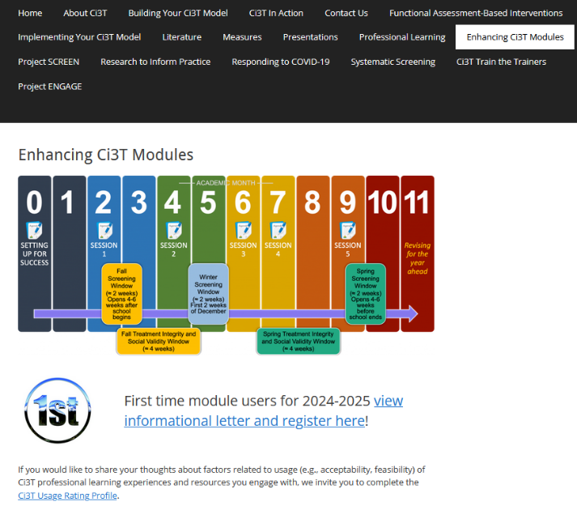
Mastering Behavior-Specific Praise and Precorrection
EMPOWER+ Session 4
If you have not done so already, we invite you to visit ci3t.org/enhance to access modules after a one-time registration process!

Slide 2
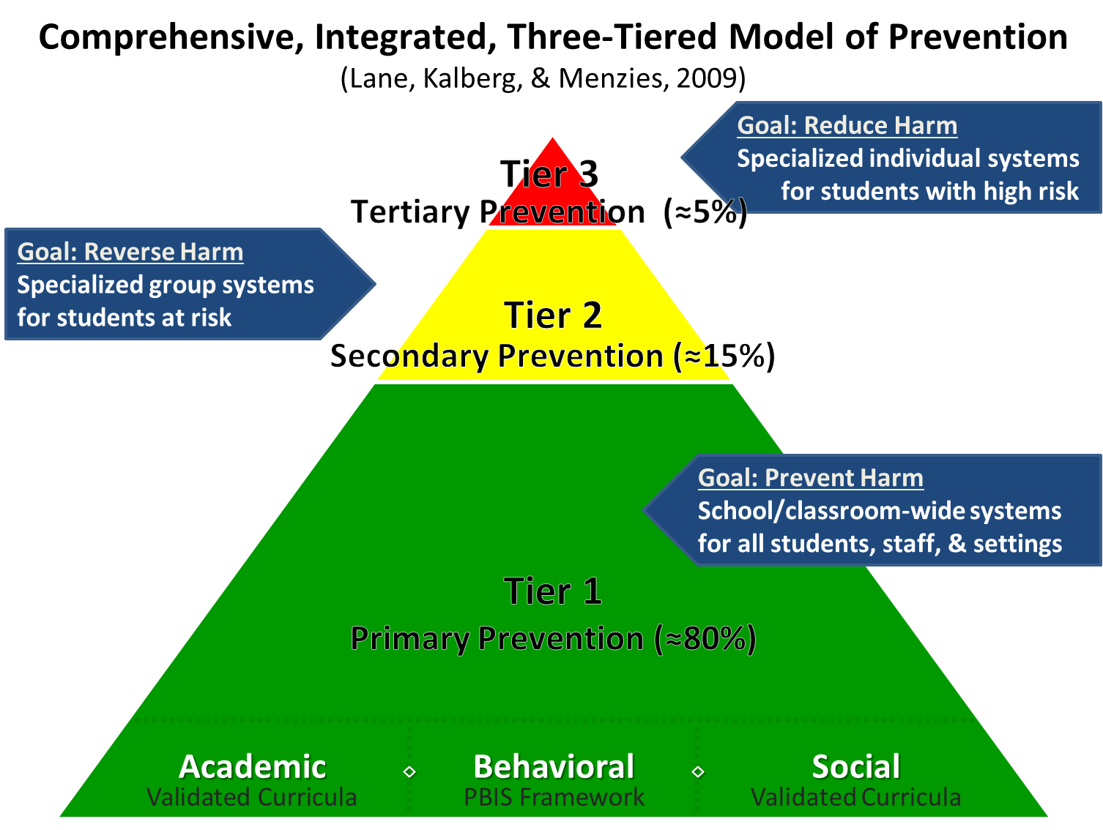
Comprehensive, Integrated, Three-Tiered Model of Prevention 1

Slide 3
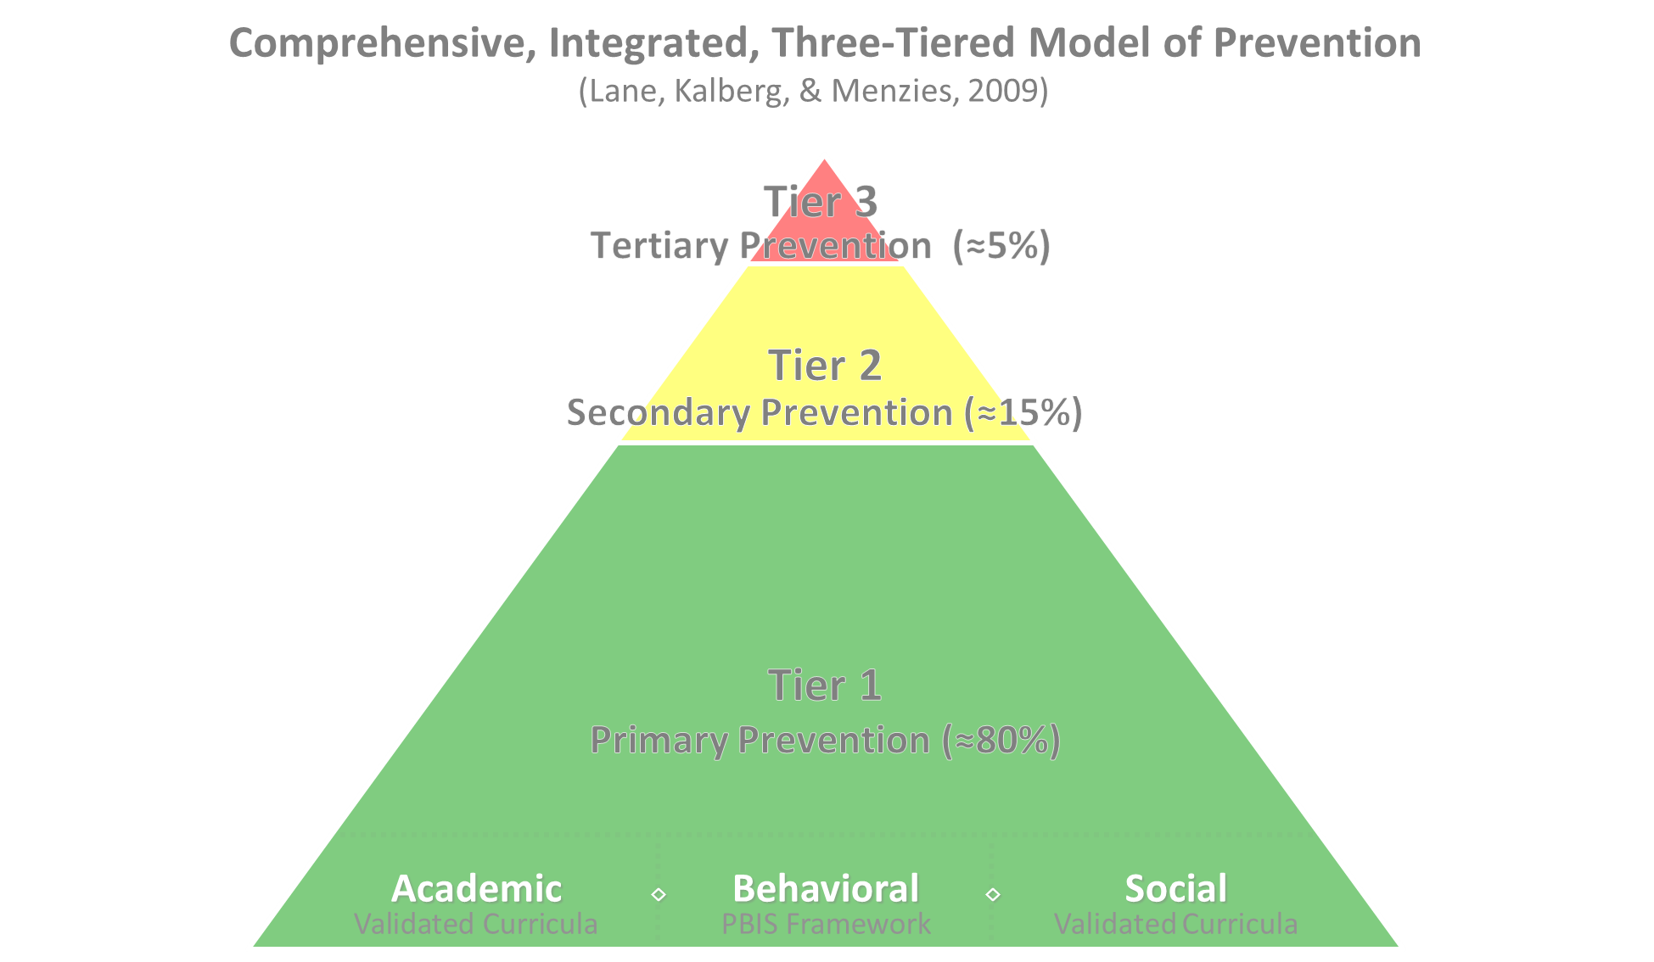

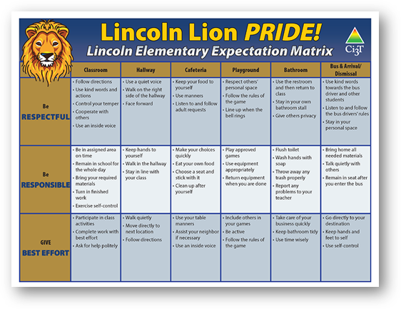
Comprehensive, Integrated, Three-Tiered Model of Prevention 2
Positive Behavioral Interventions and Supports
District & State Standards Quality Instruction
Validated Curricula and Resources

Slide 4


Primary Prevention (Tier 1)

Slide 5

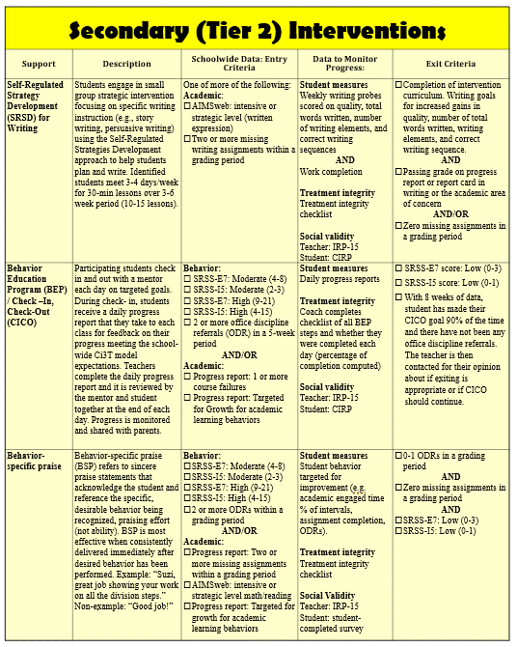
Secondary (Tier 2) Intervention Grid
Notes:
In addition to the module featured here outlining how to use multiple sources of data to connect students with Tier 2 supports, we offer a full suite of modules highlighting validated Tier 2 interventions such as Self-Regulated Strategy Development (SRSD) for Writing and Check-In/Check Out that may appear in your Secondary (Tier 2) Intervention Grid

Slide 6

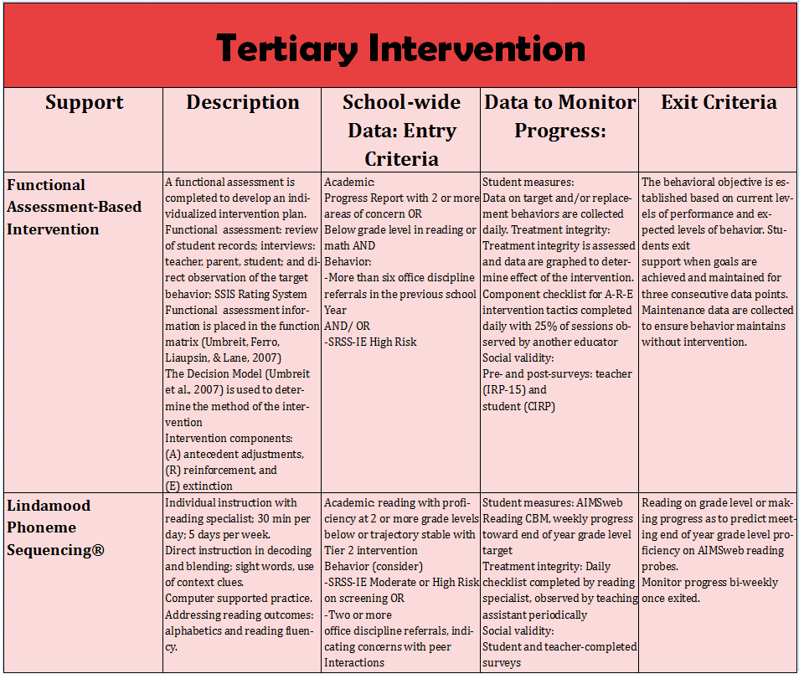
Tertiary (Tier 3) Intervention Grid
Notes:
In addition to the module featured here outlining how to use multiple sources of data to connect students with Tier 3 supports, we offer a full suite of modules highlighting validated Tier 3 interventions such as Functional Assessment-Based Intervention (FABI) that may appear in your Tertiary (Tier 3) Intervention Grid

Slide 7
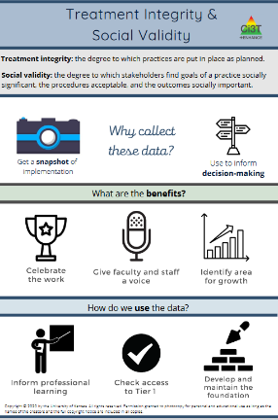
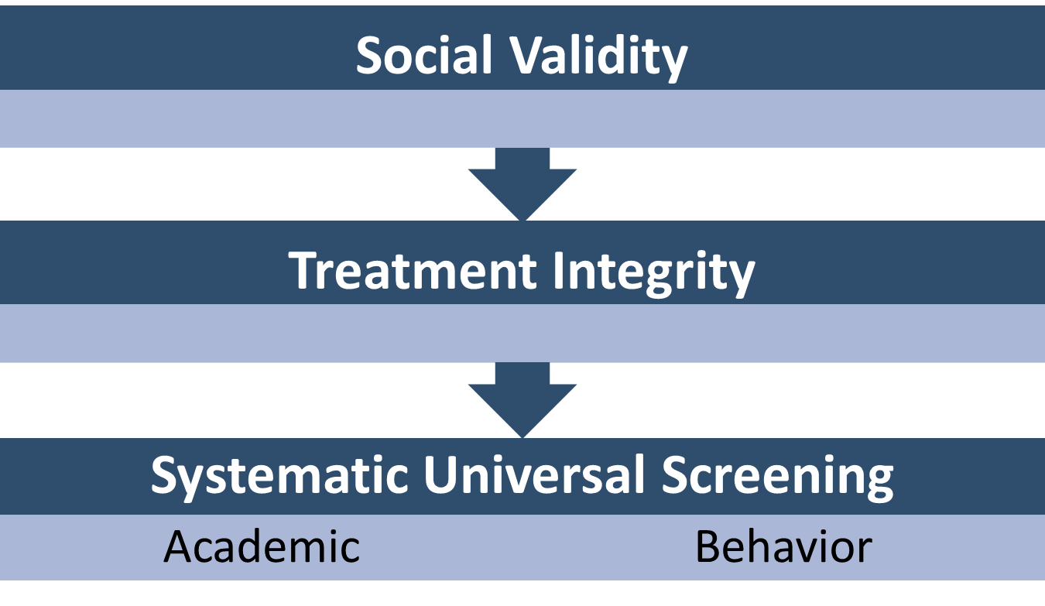
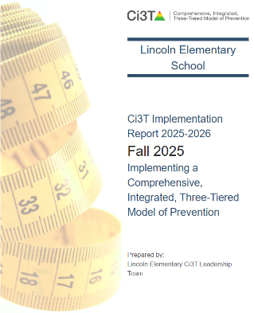
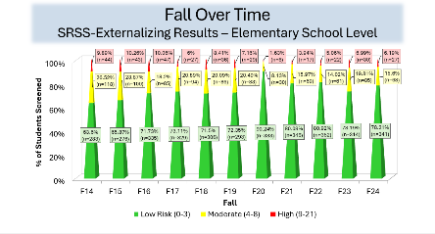
Essential Components of Primary (Tier 1) Prevention Efforts
Essential Components of Primary (Tier 1) Prevention Efforts 1

Slide 8



Enhancing Ci3T Modules
ci3t.org/enhance

Slide 9
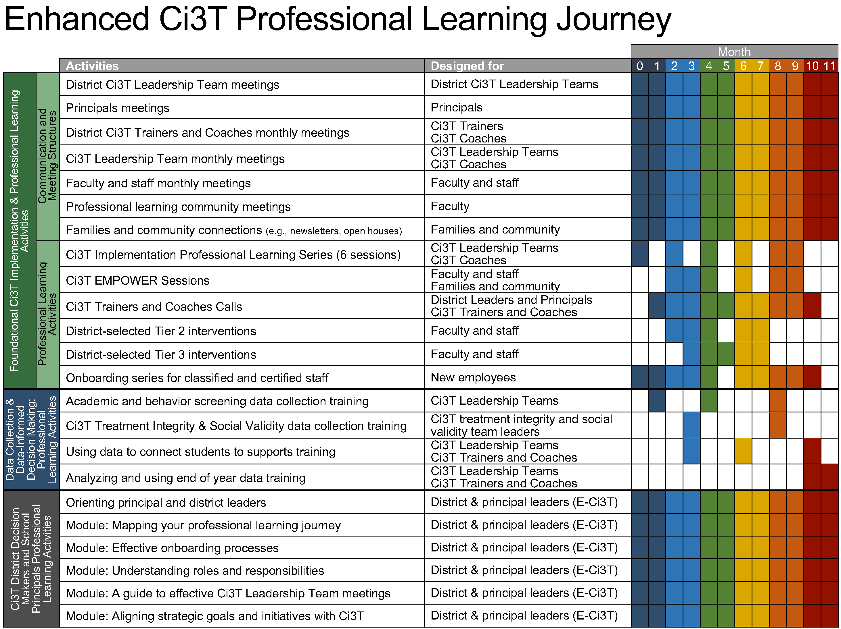
Enhanced Ci3T Implementation Series and Delivery

Slide 10
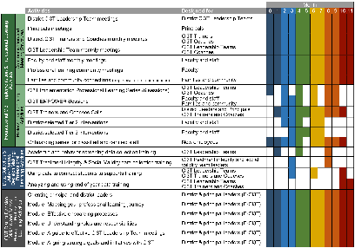
Session Outcomes
Describe how teacher-delivered, low-intensity strategies can be used as a part of Tier 1 efforts, as a stand-alone Tier 2 intervention, or as a component of a Tier 2 or Tier 3 intervention.
Follow a step-by-step process to implement behavior-specific praise.
Follow a step-by-step process to implement precorrection.
Explain the importance of and prepare to monitor treatment integrity, social validity, and student performance data.

Slide 11

TFI Version 3 Connection
TFI Item | Description
1.10 CLASSROOM PRACTICE | Educators consistently and equitably implement positive and proactive classroom practices—including building relationships with students; developing a safe environment; prompting predictable routines and expected behavior; actively providing OTRs, active supervision, and specific feedback (i.e., specific praise and supportive corrections); and ensuring a high ratio (≥ 5:1) of positive to corrective feedback.
2.5 OPTIONS FOR TIER 2 INTERVENTIONS | Tier 2 continuum has multiple ongoing SEB support interventions available schoolwide that meet a range of student SEB internalizing or externalizing needs and behavioral functions, are designed to support groups of students, have documented evidence of effectiveness, and provide (a) additional instruction/time for student skill development, (b) additional structure/predictability, (c) increased opportunity for feedback (e.g., daily progress report), (d) increased communication with families, and (e) include planned modifications to address a range of behavioral function, mental health needs, or academic skill

Slide 12
Agenda
Welcome
Situating Teacher-Delivered, Low-Intensity Strategies in Ci3T Models
Strategy 1: Behavior-Specific Praise
Strategy 2: Precorrection
Wrapping Up and Moving Forward

Slide 13
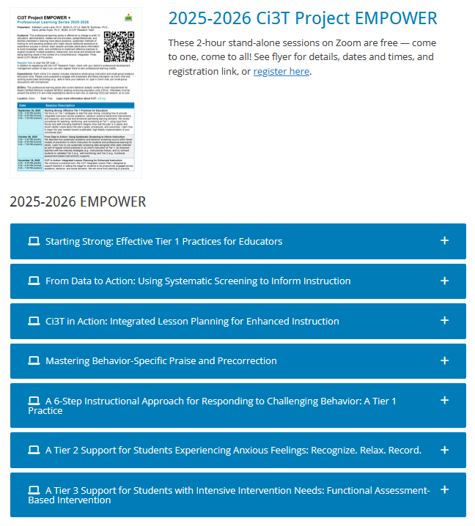
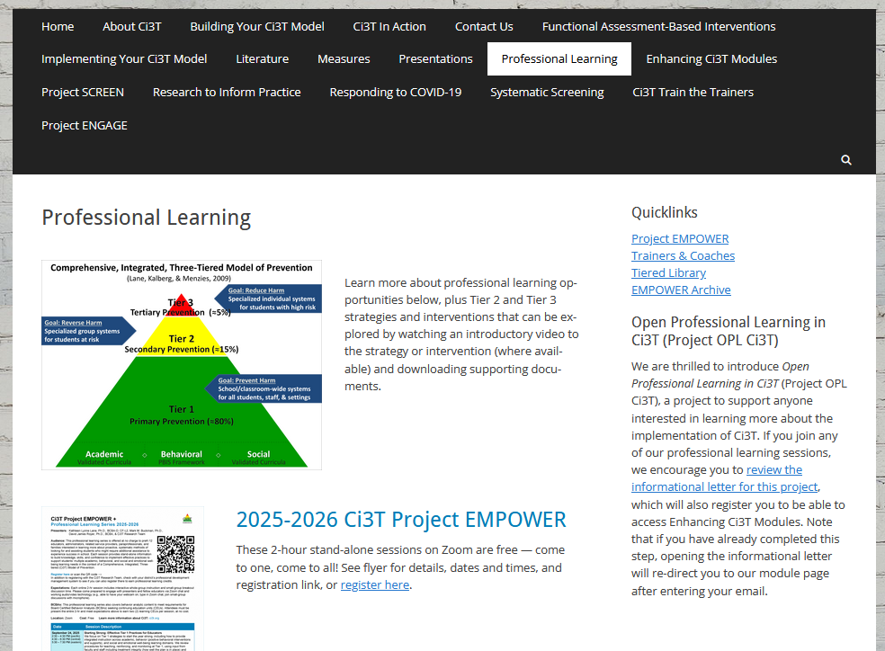
Accessing Professional Learning Materials
ci3t.org/pl

Slide 14


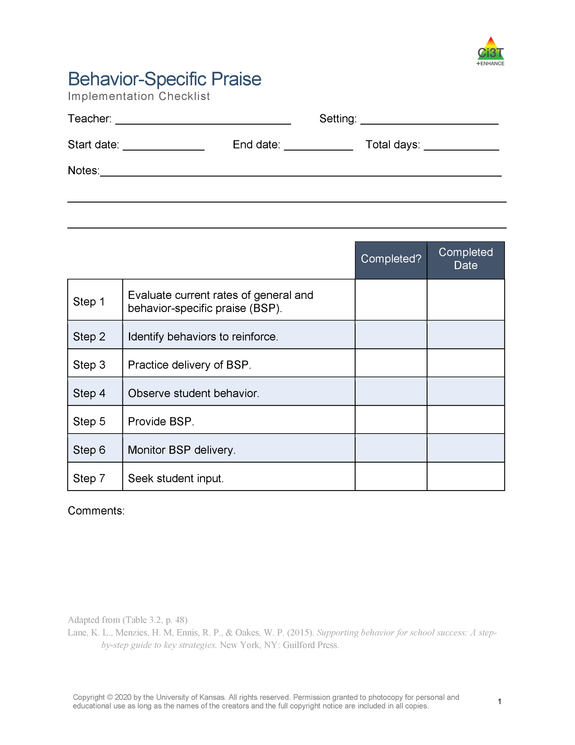
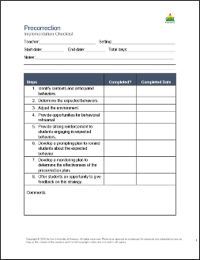
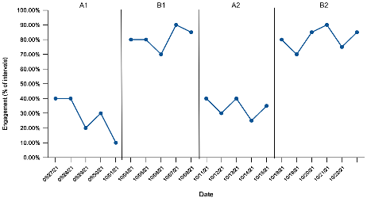
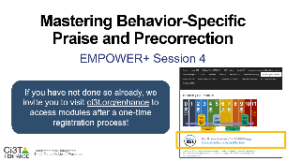
Knowledge, Application, Impact Points
Knowledge, Application, Impact Points 1
If you are in Kansas, you can earn 2 x PD points for application and 3 x for impact!
We are happy to review your materials before you upload!
Notes:
Tonight’s session lays the foundation with knowledge building and getting you oriented to the modules that can support application and impact efforts!

Slide 15
Situating Teacher-Delivered, Low-Intensity Strategies in Ci3T Models

Slide 16
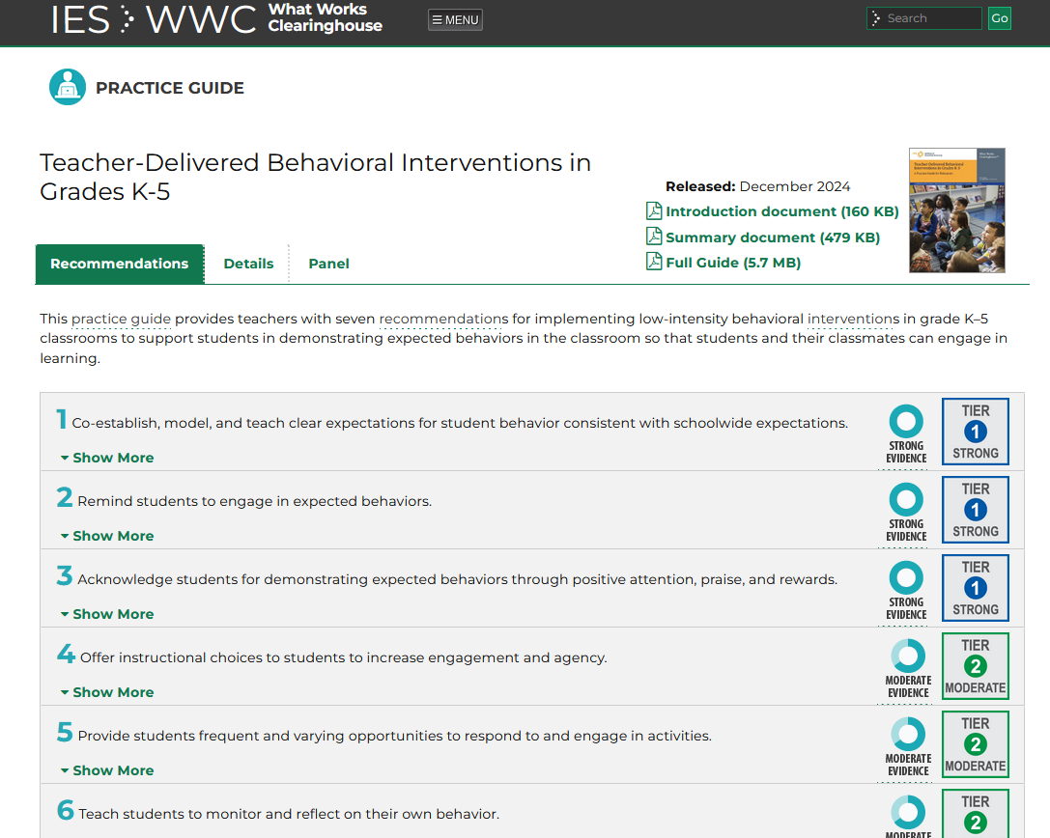

Resource Spotlight!
Notes:
What Works Clearing House Practice Guide – Teacher-Delivered Behavioral Interventions in Grades K-5- https://ies.ed.gov/ncee/wwc/PracticeGuide/31
Notice similar strategies and connections. In this presentation, we will situate these low-intensity strategies withing Ci3T

Slide 17
Comprehensive, Integrated, Three-Tiered Model of Prevention 2

Slide 18
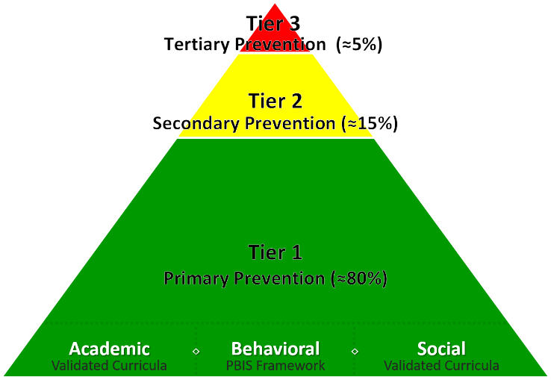
Low-Intensity, Teacher-Delivered Strategies Across the Tiers
Low-intensity teacher-delivered strategies can be used as a:
component of Tier 1 instruction to increase engagement and prevent counter productive behavior
stand-alone Tier 2 intervention
component of a Tier 2 intervention
(e.g., embedding into targeted skill instruction reading, writing, or math group)
component of a Tier 3 intervention
(e.g., embedded into a functional assessment-based intervention; FABI)

Slide 19

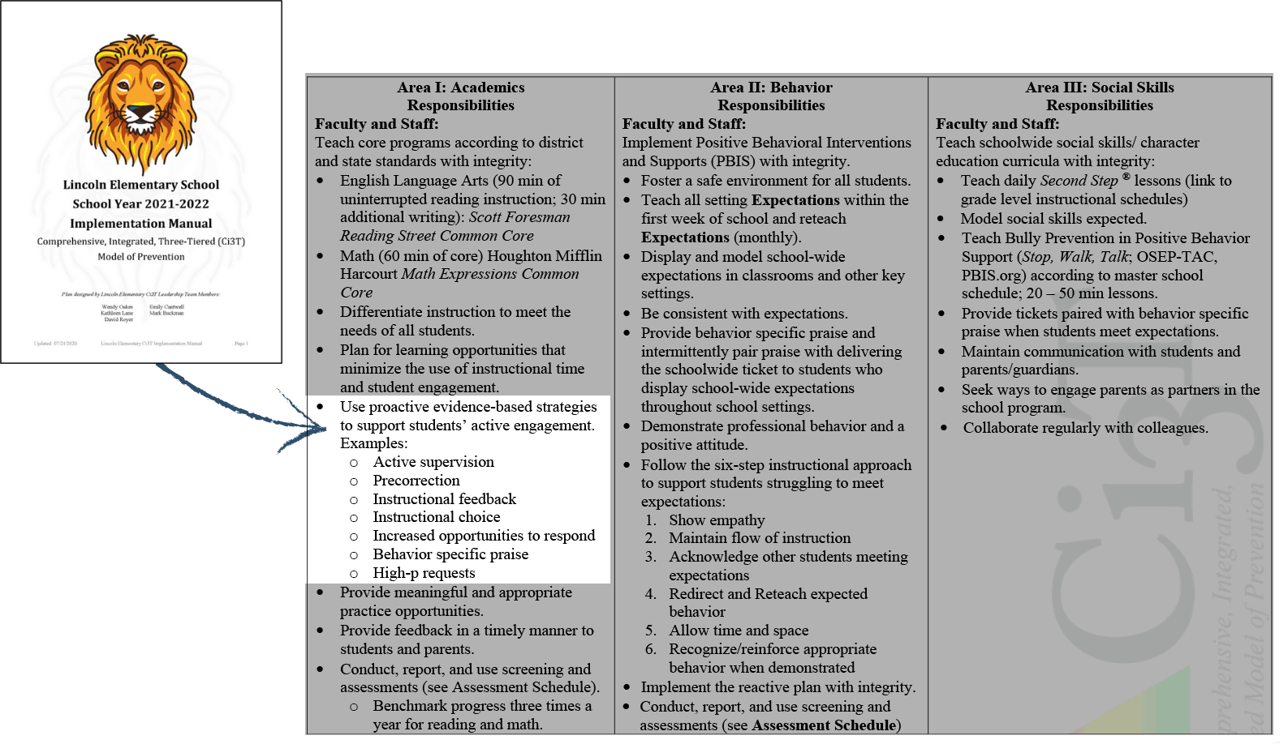
Low-Intensity, Teacher-Delivered Strategies at Tier 1
Notes:
If you have Ci3T in place, here’s where it is in your manual

Slide 20

Embedding Low-Intensity Supports in Daily instruction
Notes:
02:45

Slide 21
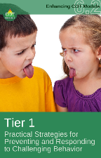
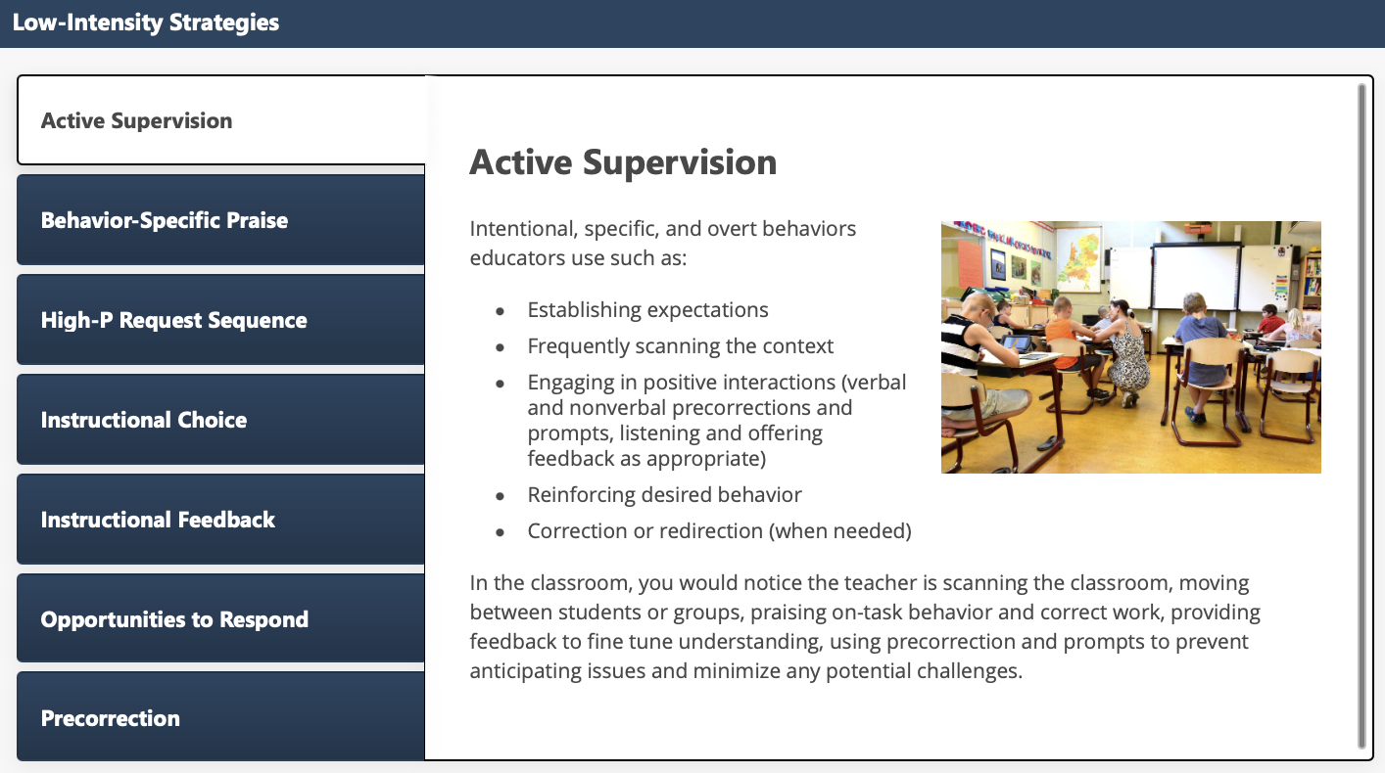
Low-Intensity Strategies: Active Supervision

Slide 22
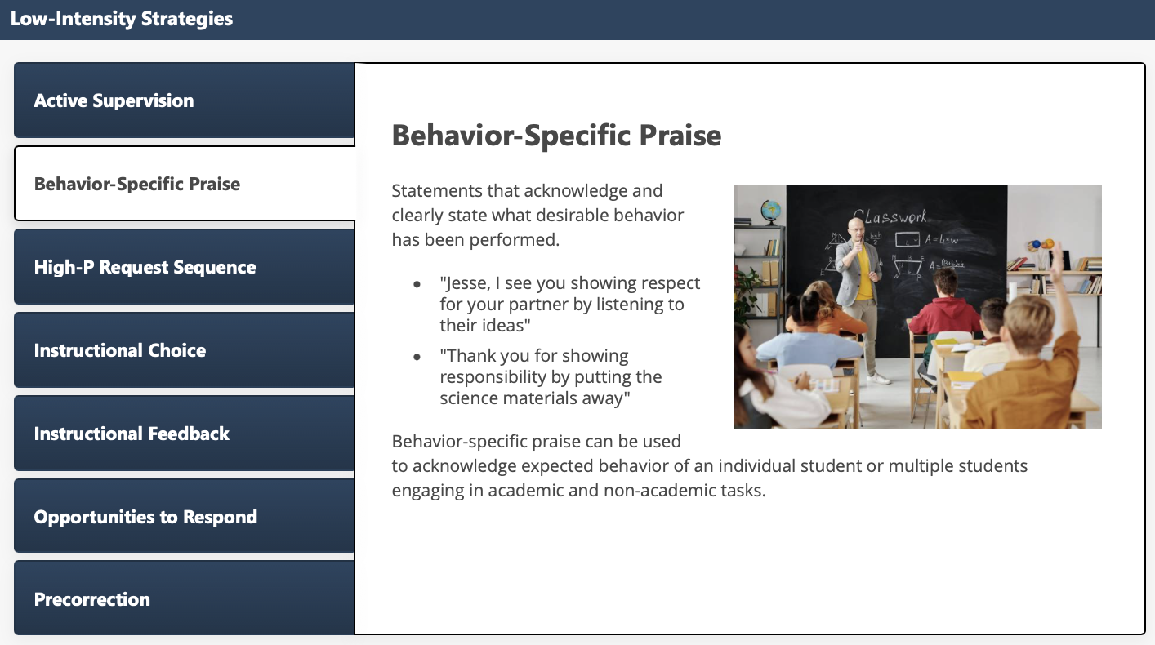
Low-Intensity Strategies: Behavior-Specific Praise

Slide 23
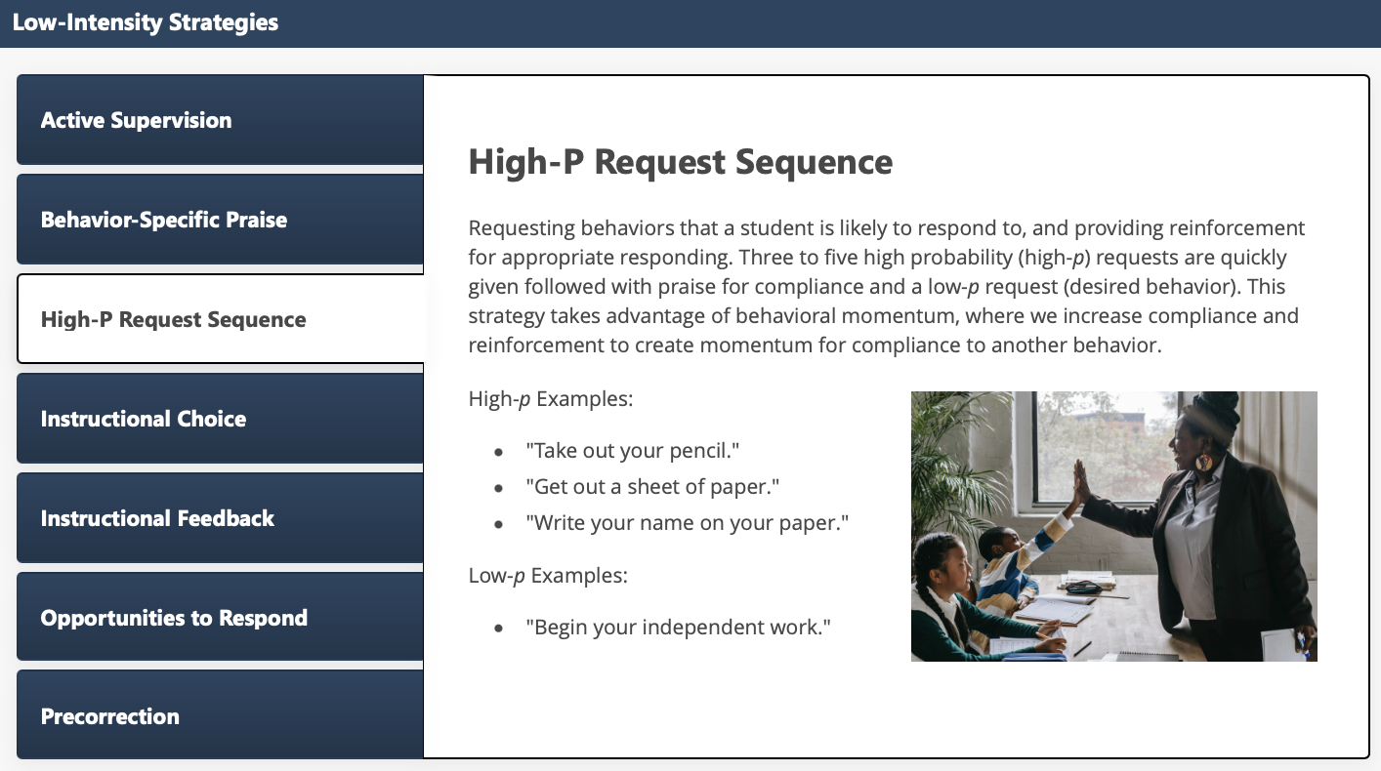
Low-Intensity Strategies: High-P Request Sequence

Slide 24
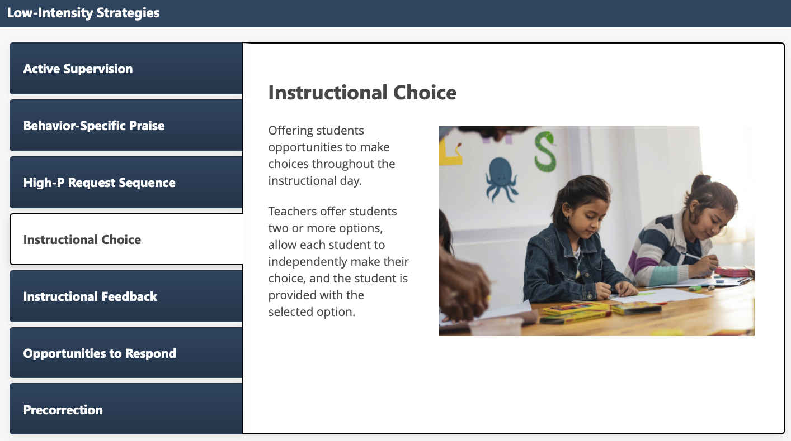
Low-Intensity Strategies: Instructional Choice

Slide 25
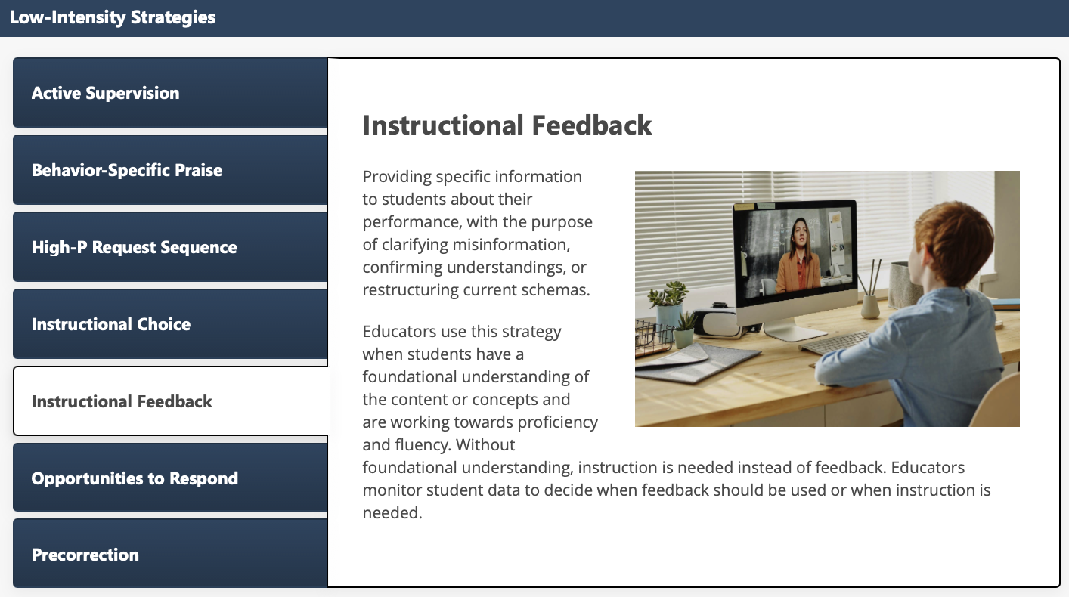
Low-Intensity Strategies: Instructional Feedback

Slide 26
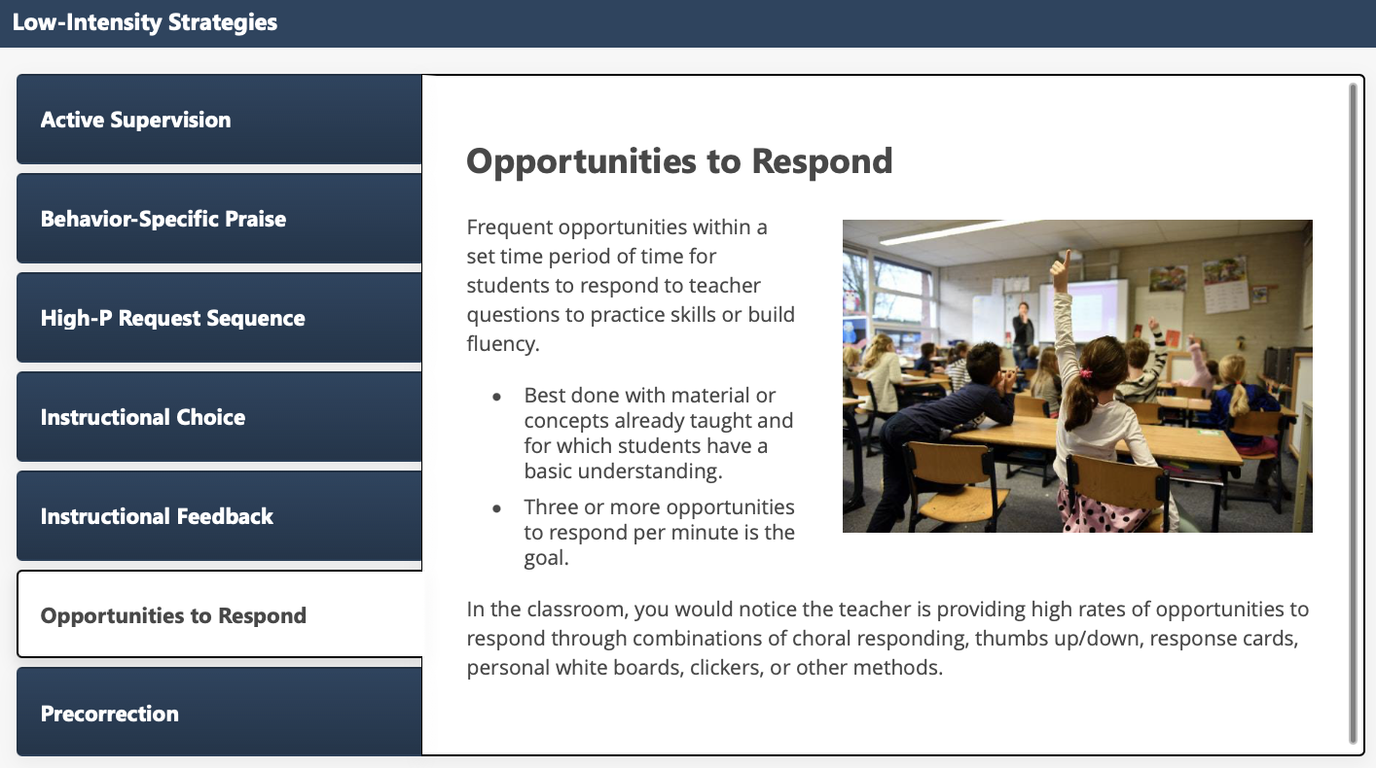
Low-Intensity Strategies: Opportunities to Respond

Slide 27
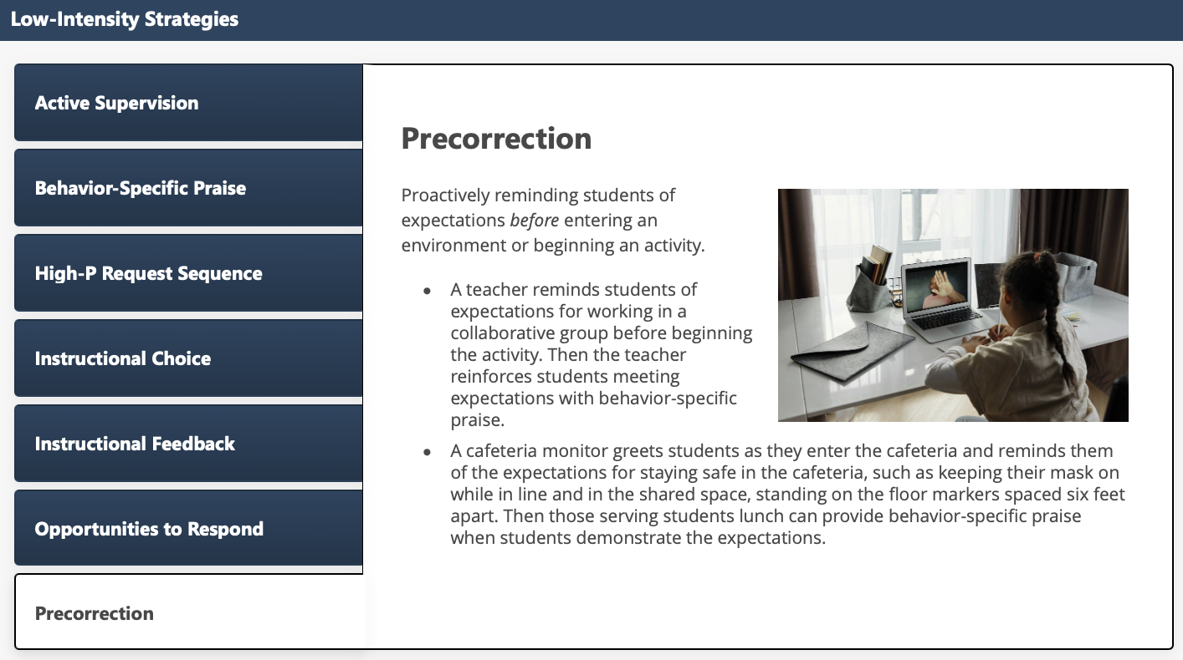
Low-Intensity Strategies: Precorrection

Slide 28
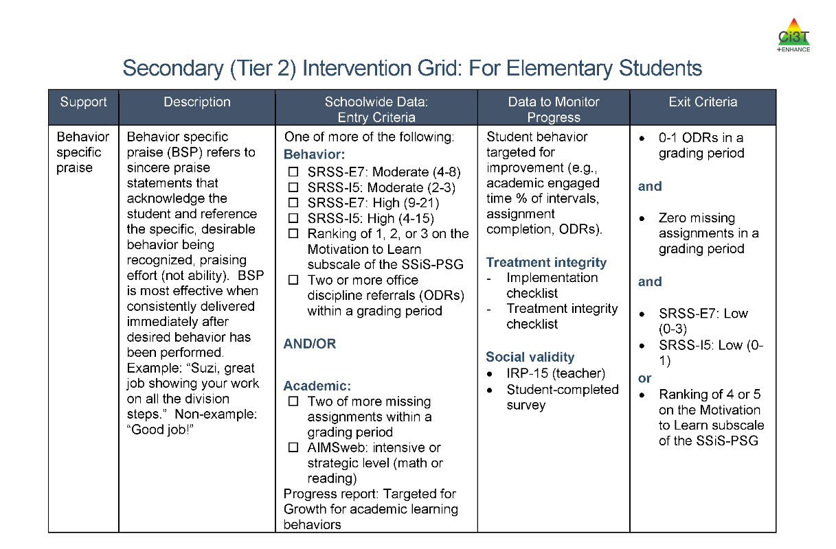
Low-Intensity, Teacher-Delivered Strategies as a Stand-Alone Tier 2 Intervention
Low-Intensity, Teacher-Delivered Strategies as a Stand-Alone Tier 2 Intervention 1
Notes:
If it is a stand alone, here’s what it might look like in your grid

Slide 29
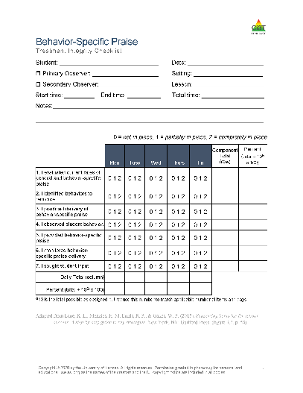
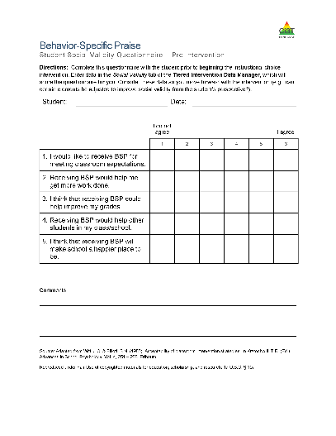

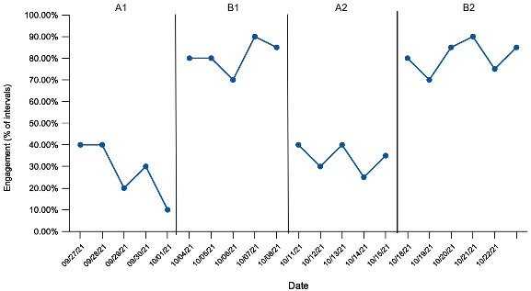
Low-Intensity, Teacher-Delivered Strategies as a Stand-Alone Tier 2 Intervention
Low-Intensity, Teacher-Delivered Strategies as a Stand-Alone Tier 2 Intervention 2
Notes:
If it is a stand alone, here’s what it might look like in your grid

Slide 30
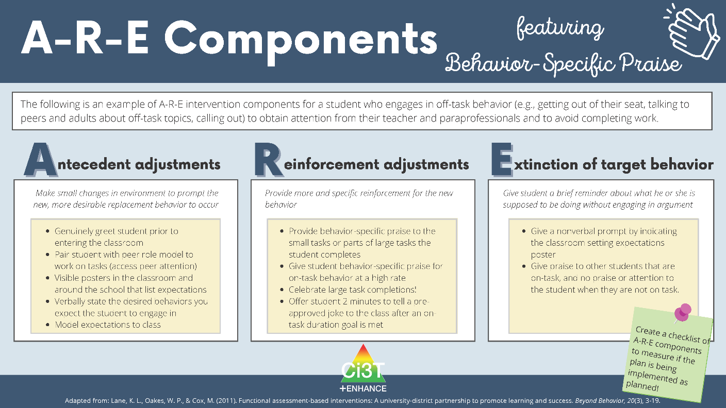
Low-Intensity, Teacher-Delivered Strategies as a Component of a Tier 2 or Tier 3 Intervention

Slide 31


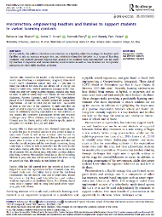

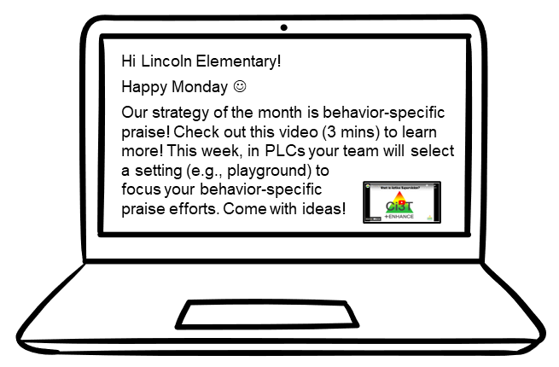
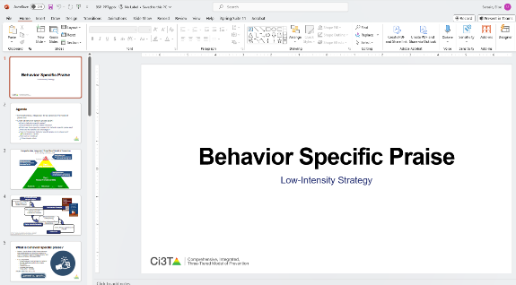
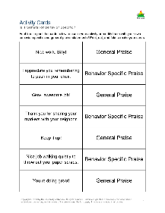
Building Capacity to Implement Teacher-Delivered Low-Intensity Strategies
Stand-alone professional learning
Book or article study
Build into PLC (e.g., video, infographic)
Independent module exploration
Building on-site experts
Notes:
Empowering teachers to use LIS; here’s a few ways you can do that. “experts—who are the people who are already crushing active supervision? How can we use them as a model?”

Slide 32







Talk Time
Which low-intensity, teacher-delivered strategy do you use most often? How is it built into your lessons or daily routines?
Which low-intensity, teacher-delivered strategy are you most interested in trying? How might you build it into your lessons or daily routines?
What opportunities do you see to use low-intensity, teacher-delivered strategies as part of Tier 1 instruction, as stand-alone Tier 2 intervention, or as a component of a Tier 2 or Tier 3 intervention?

Slide 33

Strategy 1: Behavior-Specific Praise

Slide 34

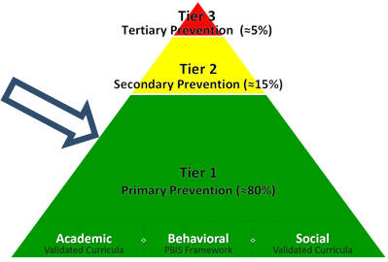
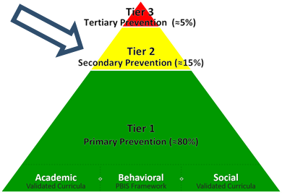

Behavior-Specific Praise Work Time Preview
Using Behavior-Specific Praise as….
Module Exploration | Component of Tier 1 Instruction | Stand-Alone Tier 2 Intervention | A Trainer/Coach
During work time, we invite you to join the breakout room that most closely matches how you plan to apply precorrection in your setting! Our hope is that you can walk out of here tonight ready to implement tomorrow or with a clear action plan of next steps!

Slide 35

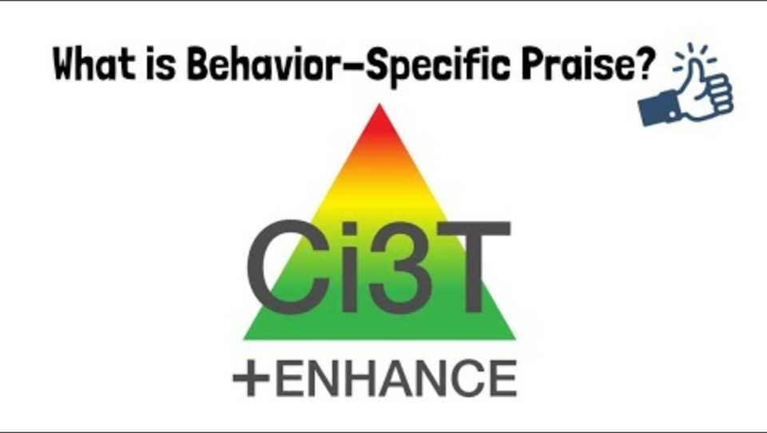
What is Behavior-Specific Praise?
Notes:
2:59

Slide 36
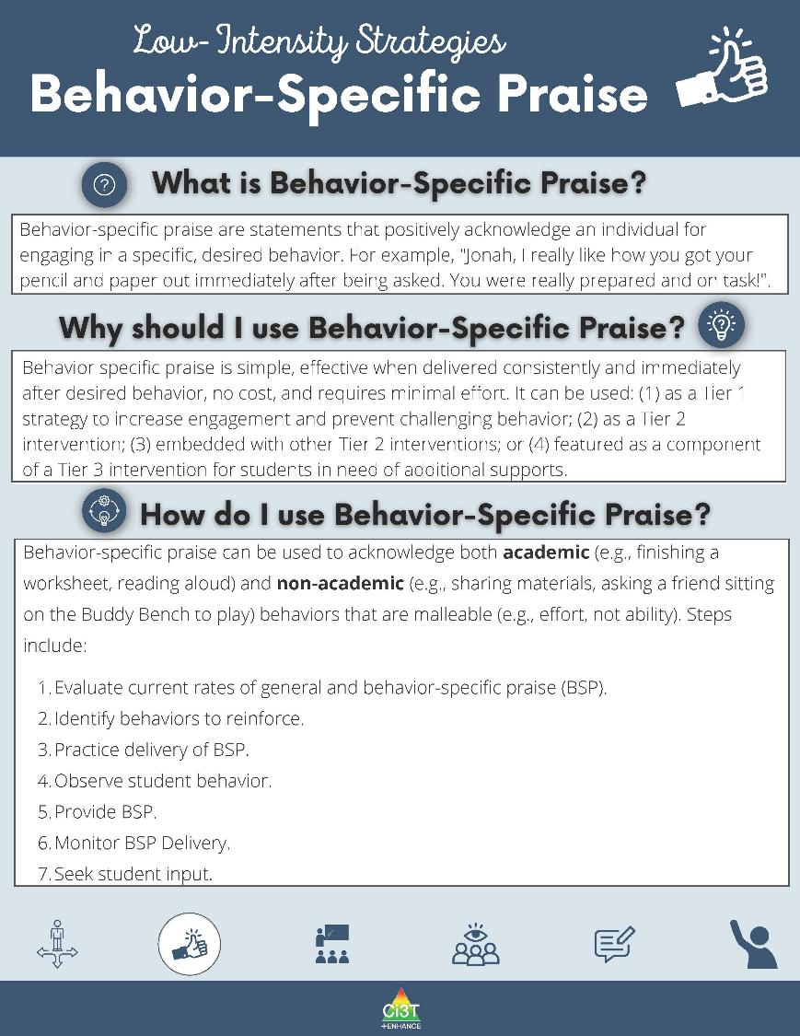
Low-Intensity Strategies: Behavior-Specific Praise 1

Slide 37
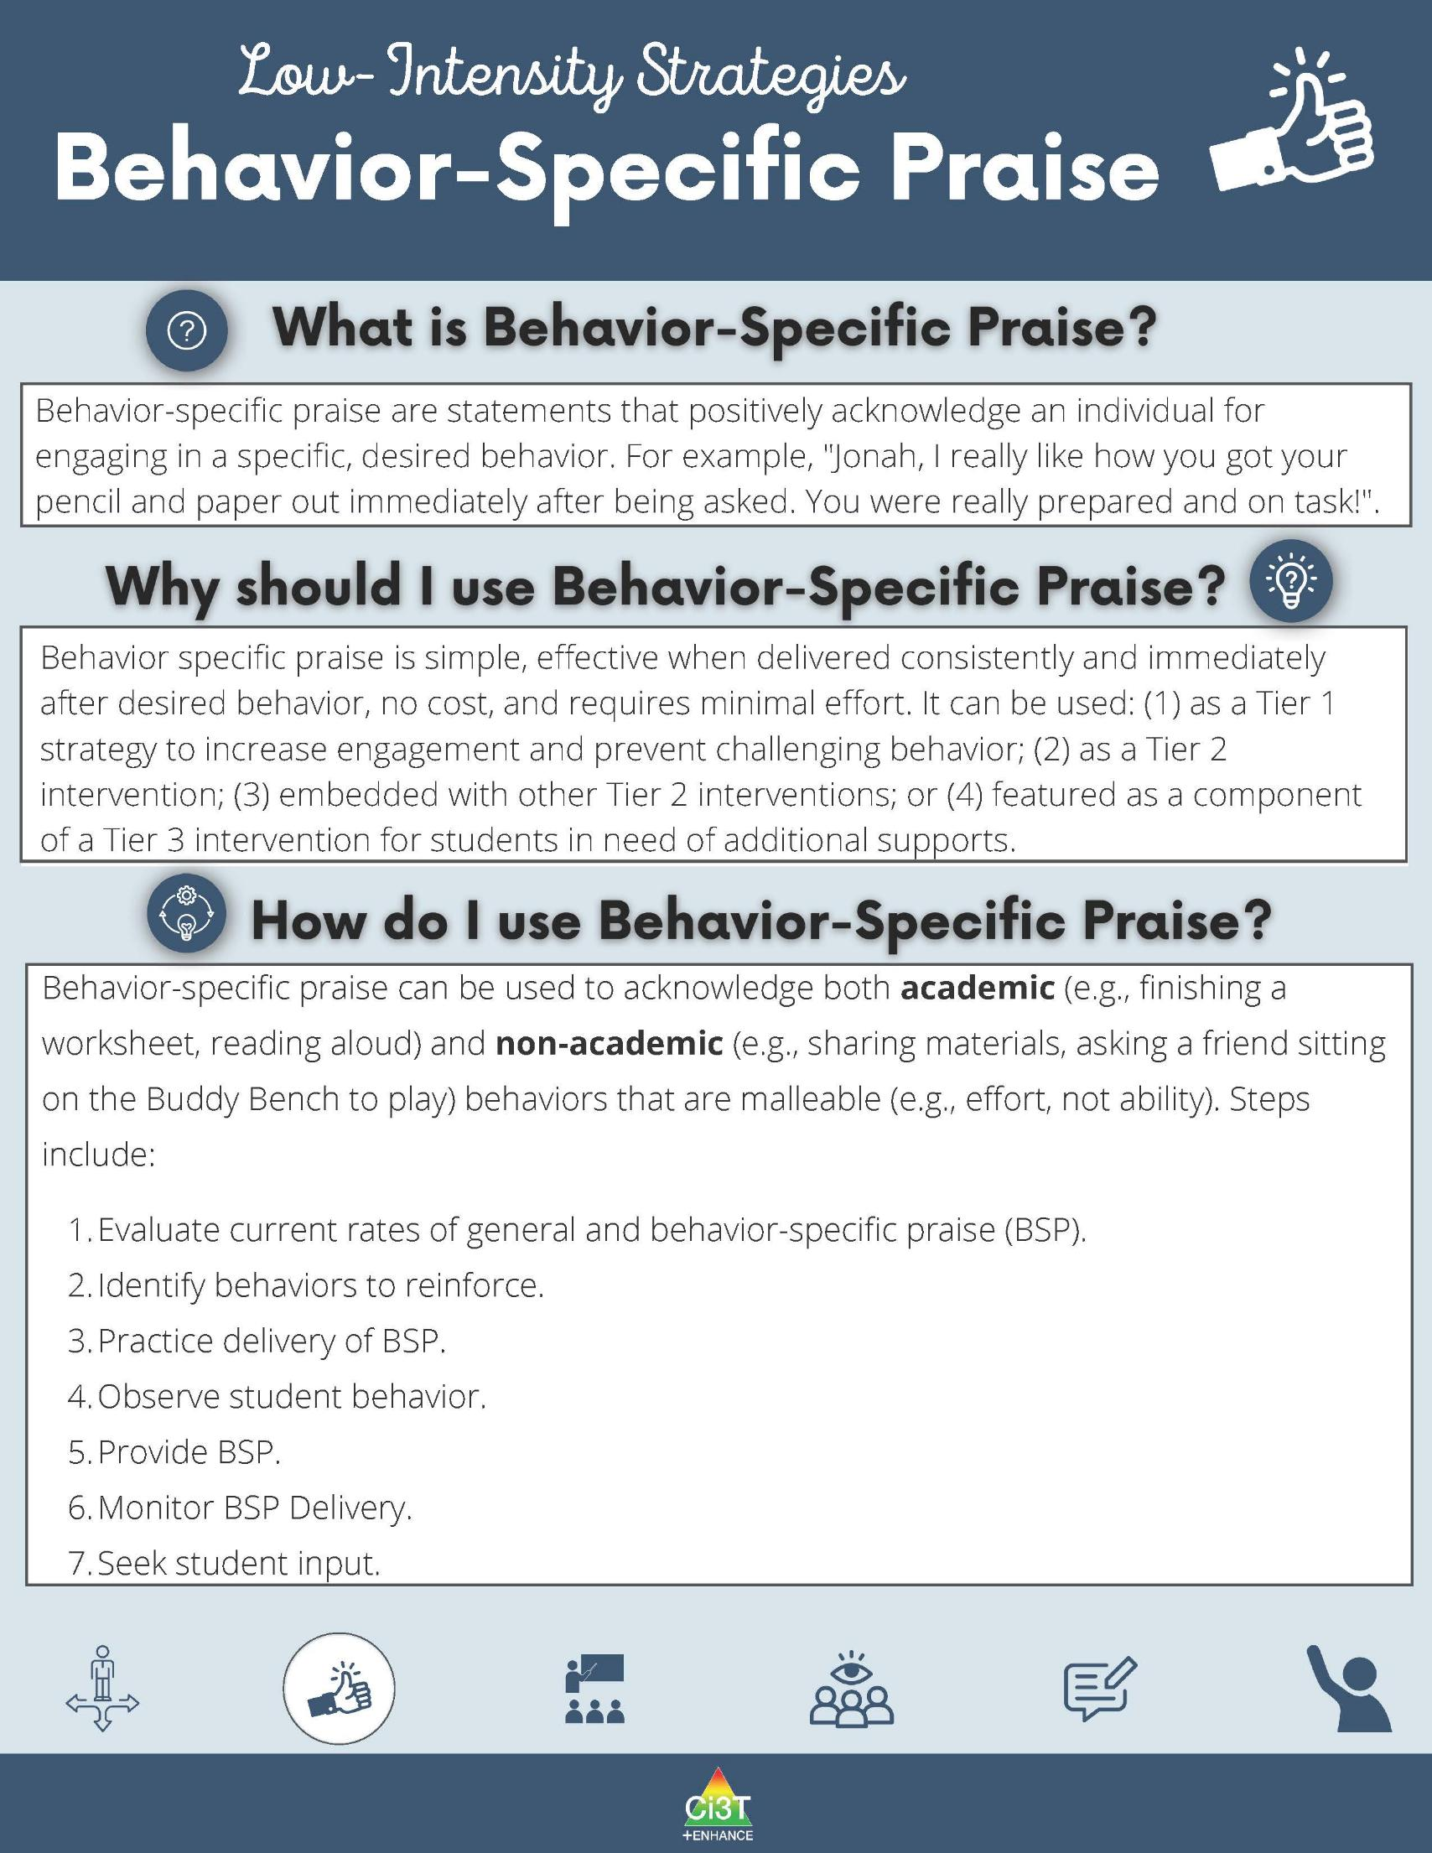
Low-Intensity Strategies: Behavior-Specific Praise 2

Slide 38
Low-Intensity Strategies: Behavior-Specific Praise 3

Slide 39
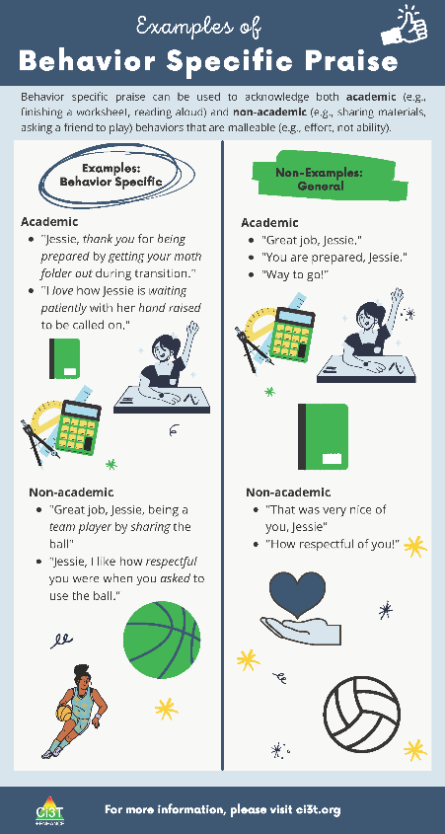
Examples of Behavior-Specific Praise
Examples of Behavior-Specific Praise 1
Notes:
To further support our understanding of BSP lets look at an infographic show examples and non examples.

Slide 40

Examples of Behavior-Specific Praise 2
Notes:
Lets begin with non-examples Non-examples tend to be general expressions of praise such as great job, great, way to go, I’m so proud of you that may be timely and encouraging but are missing the specific action that the praise is being given for.
Other non-examples include statements of the behavior that do not include the praise. Comments such as you turned in your homework, you got on task. In some cases the reciepent may feel the praise component based on your use of voice tone or body language, but best practice is to use a complete praise statement such as, Great job turning in your homework.
Praise statements can be given for academic and non academic behavior. This is part of what makes this strategy so effective is that you can use it to support each student based on their unique needs to further engage with skills in specific domains. You can also use it depending on the feel of your room. For example during a particularly hard math lesson you may increase your praise for persistence or when introducing a new transition activity you may increase your use of praise provided to students following the new routine or those who began the new routine but need additional support to complete the routine.
Praise can be given for demonstration of a complete behavior, a step in a sequence or an approximation. You decide based on what the individual may need.

Slide 41
Examples of Behavior-Specific Praise 3
Notes:
Here are some nonacademic examples

Slide 42



General Praise vs Behavior Specific Praise Game
Wow, that was awesome!
You are so smart!
Thank you for being on time.
Great job picking up around your area.
You do a lot for our school, thanks!
General Praise
Behavior-Specific Praise

Slide 43
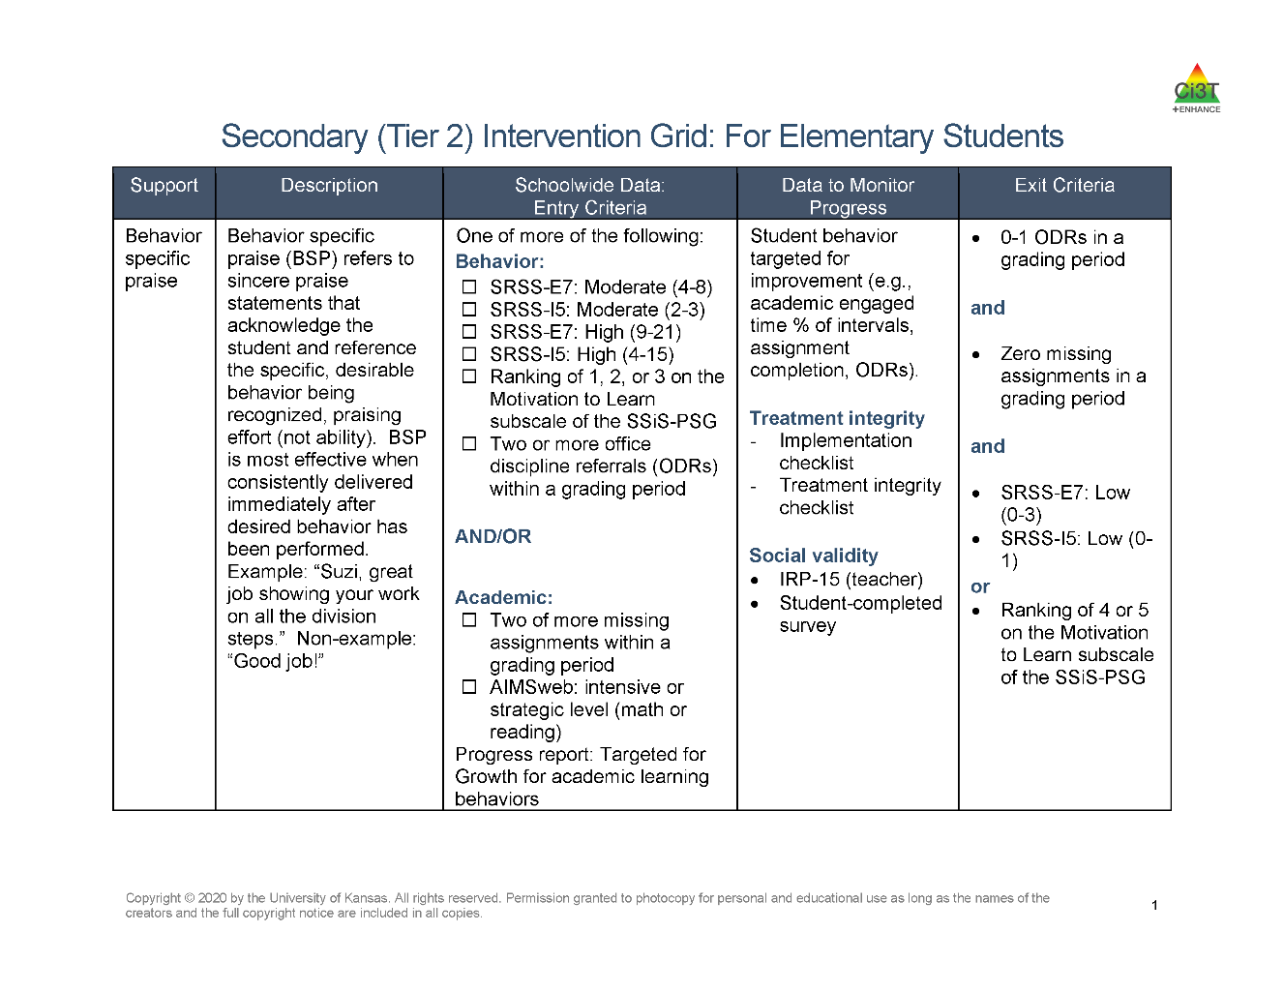
Secondary (Tier 2) Intervention Grid: For Elementary Students

Slide 44

A-R-E Components featuring Behavior-Specific Praise

Slide 45


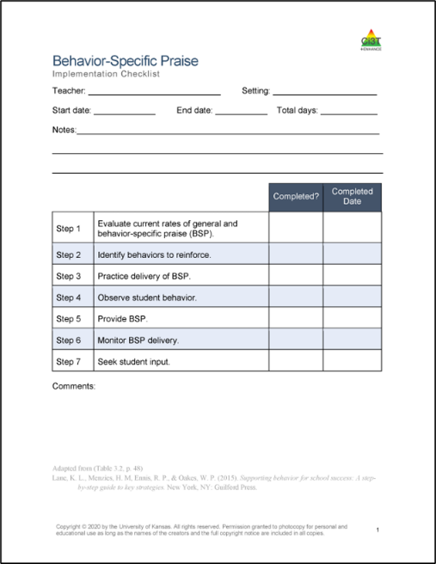

7 Steps to Implement Behavior-Specific Praise
Step 1
Practice delivery of behavior specific praise.
Step 2
Observe student behavior.
Step 6
Provide behavior specific praise.
Step 5
Identify behaviors to reinforce.
Evaluate current rates of general and behavior specific praise.
Step 3
Step 4
Monitor the behavior specific praise delivery.
Step 7
Seek student input.

Slide 46
Step 1: Evaluate current rates of general and behavior-specific praise (BSP)
Evaluate your current rate of general and behavior-specific praise statements
You can accomplish this in a few ways:
Have someone else observe you in action
Audio or video record yourself over a set period
Track your use of praise statements in real time

Slide 47
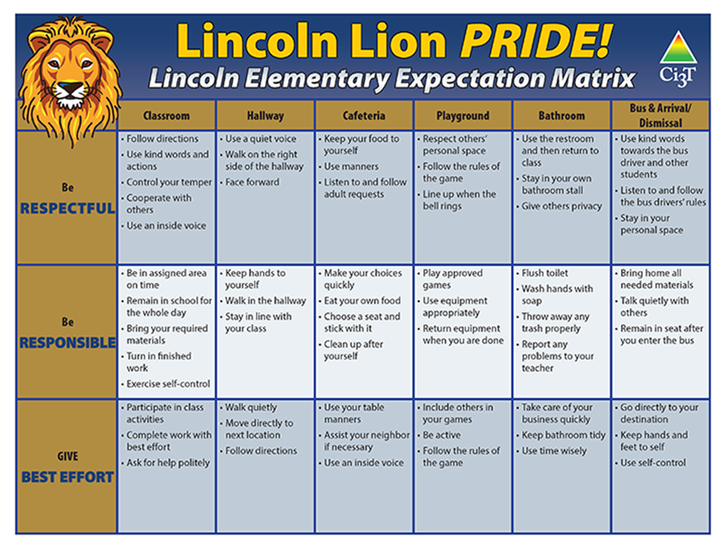
Step 2: Identify behaviors to reinforce

Slide 48
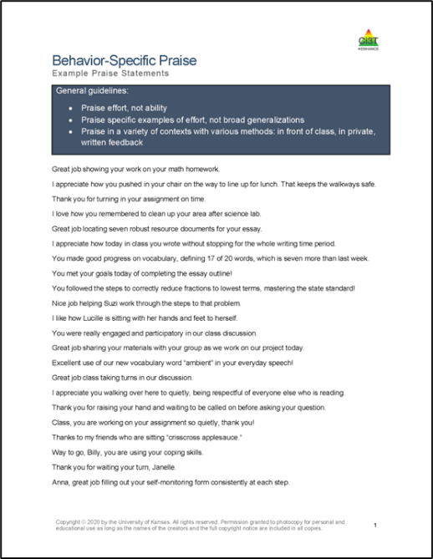
Step 3: Practice delivery of BSP
General guidelines:
Praise effort, not ability
Praise specific examples of effort, not broad generalizations
Praise in a variety of contexts with various methods:
In front of class
In private
Written feedback

Slide 49

Step 4: Observe student behavior
Watch for opportunities to deliver behavior-specific praise

Slide 50

Step 5: Provide BSP
It is important that behavior-specific praise is:
Sincere
Contingent on the appropriate behavior
Delivered in a manner that is most appropriate for the student

Slide 51

Step 6: Monitor BSP delivery
Monitor your use of behavior-specific praise by:
Asking a coach or peer to observe
Recording yourself (audio or video)
Self-monitoring (e.g., tally mark, moving paperclip from pocket to pocket)

Slide 52
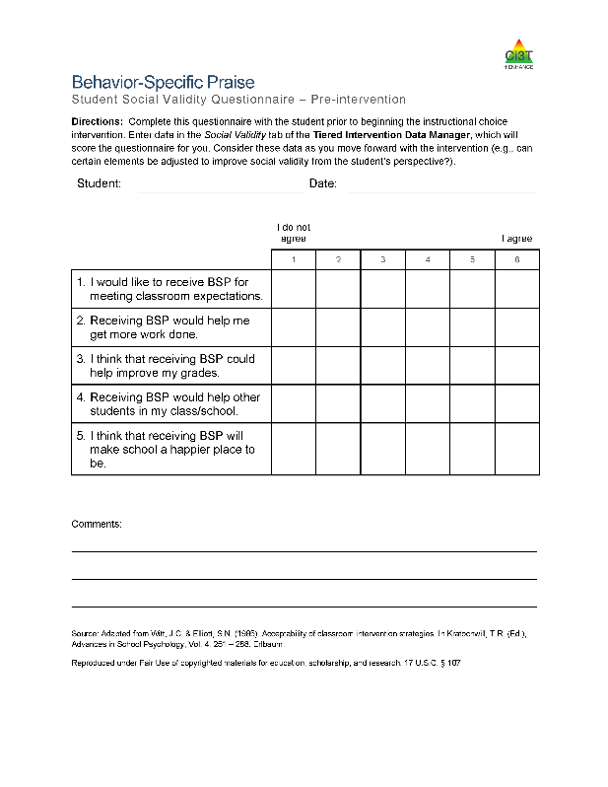
Step 7: Seek student input

Slide 53
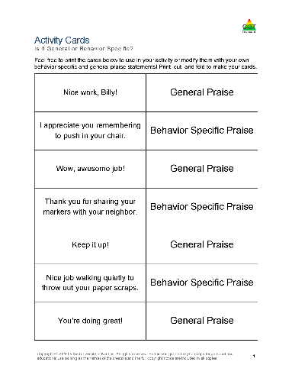






Module Spotlight

Slide 54










Behavior-Specific Praise Work Time
Using Behavior-Specific Praise as….
Module Exploration | Component of Tier 1 Instruction | Stand-Alone Tier 2 Intervention | A Trainer/Coach

Slide 55

Strategy 2: Precorrection

Slide 56

Precorrection Work Time Preview
Using Precorrection as….
Module Exploration | Component of Tier 1 Instruction | Stand-Alone Tier 2 Intervention | A Trainer/Coach
During work time, we invite you to join the breakout room that most closely matches how you plan to apply precorrection in your setting! Our hope is that you can walk out of here tonight ready to implement tomorrow or with a clear action plan of next steps!

Slide 57


Low-Intensity Strategies: Precorrection 1

Slide 58

Low-Intensity Strategies: Precorrection 2

Slide 59
Low-Intensity Strategies: Precorrection 3

Slide 60

Examples of Precorrection

Slide 61



Let’s Chat!
How do you integrate precorrection into your lessons or daily routines?
OR
What opportunities exist to integrate precorrection into your lessons or daily routines?

Slide 62

Secondary (Tier 2) Intervention Grid: For Middle and High School Students

Slide 63

8 Steps to Implement Precorrection

Slide 64

Step 1: Identify contexts and anticipated behaviors
Operationally define challenging behavior(s) you are looking to reduce
Identify in which contexts those challenging behaviors are most likely to occur
Time of day?
Type of activity?
Location?
Notes:
The first step is to identify (a) what challenging behaviors you are looking to reduce and (b) in which contexts those challenging behaviors are most likely to occur. It is helpful to operationally define the target behaviors so that everyone has a shared understanding of what the challenging behavior looks like.
When considering contexts in which challenging behaviors are most likely to occur, you may think about such factors as time of day (e.g., Are students more likely to call out in the morning? Later in the day?), type of activity (e.g., Are students more likely to engage in off-task behavior during small-group activities than during large-group instruction?), and location (e.g., Are students more likely to engage in aggressive behavior on the playground in elementary schools or during lunchtime in secondary schools? In the hallway?).

Slide 65

Defining Behaviors

Slide 66
Let’s Practice!
Behavior to reduce
When does the behavior most often occur?
Label: Rough-housing in the hallway
Definition: Physical, high-energy play involving direct physical interaction between students with observable signs of enjoyment (e.g., laughter, positive verbal feedback) and the absence of injury or distress
Examples: pushing, shoving, tickling, wrestling, or chasing
Non-Examples: walking, talking, waving
Transition to and from lunch
Dismissal

Slide 67

Step 2: Determine the expected behaviors
Notes:
The second step is to clearly define what appropriate behaviors you expect to see during the context you will target.

Slide 68
Step 3: Adjust the environment
Alter the environment
Changing seating arrangement
Incorporation more structured playground activities
Change teacher behavior
Increase scanning and movement around classroom / cafeteria / hallway (i.e., active supervision)
Change schedule
Notes:
Make antecedent adjustments to the context(s) identified in Step 1 to reduce the likelihood of challenging behaviors occurring and set the stage for the desired behavior to occur.

Slide 69


Step 4: Provide opportunities for behavioral rehearsal
Notes:
After explaining what each expected behavior entails, it can be helpful for the classroom teacher to model what the behavior looks like. Students can then practice carrying out the expected behavior within a role play scenario. For example, a classroom teacher may take their students out into the hallway to practice what it looks like to be respectful when walking to the library (e.g., quiet voices, hands and feet to self, walking in a line on the right side of the hall).

Slide 70


Step 5: Provide strong reinforcement to students engaging in expected behaviors
“Joe, you did a great job of quietly pulling out a book to read while your friends finish their worksheet!”
Notes:
As students practice engaging in the expected behavior, it is important that they receive feedback on their performance. When students are engaging in the expected behavior accurately, the classroom teacher should provide behavior-specific praise to acknowledge this.
It is also important during this training phase to provide students with “strong reinforcement.” In other words, we want to provide reinforcement (e.g., behavior-specific praise) at a higher rate or of a higher quality (e.g., providing tickets in addition to behavior-specific praise) than is typical in that setting. The goal in doing this is to ensure that students receive a greater level of reinforcement for engaging in the expected behavior than they previously did for engaging in the challenging behavior.

Slide 71



Step 6: Develop a prompting plan to remind students about the expected behavior
Gestural prompt (e.g., holding up hand in stop position)
Verbal (e.g., counting down from 10, reminder of expectations)
Environmental (e.g., tape on floor, expectations poster)
“Seated and working in 10…9…8…7!”
Notes:
Although we hope that the precorrection will be effective in pre-empting challenging behaviors for all students in the classroom, we know that some students will need something more. It is therefore important to come up with a proactive plan for how to prompt those students who do not respond to the general precorrection.

Slide 72
Step 7: Develop a monitoring plan to determine the effectiveness of the precorrection plan
Step 7: Develop a monitoring plan to determine the effectiveness of the precorrection plan 1
Treatment Integrity
Is it happening?
Social Validity
What do stakeholders think about the goals, procedures, and outcomes?
Student Outcomes
How well did this support work for this student?
Notes:
When implementing any strategy or intervention, it will be important to determine how well it is working. In this case, it will be important to develop a plan that is practical for the teacher or other adult to use to determine what people think about proposed plan (social validity), if the plan is put in place as planned (treatment integrity), and how well it is working (e.g., maximizing student engagement and/or decreasing disruption).

Slide 73



Step 7: Develop a monitoring plan to determine the effectiveness of the precorrection plan
Step 7: Develop a monitoring plan to determine the effectiveness of the precorrection plan 2

Slide 74

Step 8: Offer students an opportunity to give feedback on this strategy
Notes:
After you have had a chance to implement precorrection a few times, it can be helpful to solicit feedback from students regarding what they thought of the strategy.

Slide 75






Module Spotlight!
Notes:
In addition to the resources we’ve used in this presentation so far, the module also features:
Infographics
Family resources
Videos

Slide 76
Precorrection Work Time
Using Precorrection as….
Module Exploration | Component of Tier 1 Instruction | Stand-Alone Tier 2 Intervention | A Trainer/Coach

Slide 77
Wrapping Up and Moving Forward

Slide 78
Action Items
Action Item | Person(s) Responsible | Planned Completion Date | Date Completed
Print implementation checklist and bring to Friday PLC meeting | Kathryn | 01/24/26

Slide 79

Project EMPOWER+
EMPOWER+ Session | Date
Starting Strong: Effective Tier 1 Practices for Educators | September 24, 2025 (Wednesday)
From Data to Action: Using Systematic Screening to Inform Instruction | October 8, 2025 (Wednesday)
Ci3T In Action: Integrated Lesson Planning for Enhanced Instruction | November 18, 2025 (Tuesday)
Mastering Behavior Specific Praise and Precorrection | January 21, 2026 (Wednesday)
A 6-Step Instructional Approach for Responding to Challenging Behaviors: A Tier 1 Practice | February 10, 2026 (Tuesday)
A Tier 2 Support for Students Experiencing Anxious Feelings: Recognize. Relax. Record. | March 25, 2026 (Wednesday)
A Tier 3 Support for Students with Intensive Intervention Needs: Functional Assessment-Based Intervention (FABI) | April 28, 2026 (Tuesday)

Slide 80

Ci3T Trainers and Coaches Calls
Ci3T Trainers and Coaches Calls Session | Date
Ci3T Trainers and Coaches Call 1 | August 20, 2025 (Wednesday)
Ci3T Trainers and Coaches Call 2 | September 3, 2025 (Wednesday)
Ci3T Trainers and Coaches Call 3 | October 1, 2025 (Wednesday)
Ci3T Trainers and Coaches Call 4 | November 5, 2025 (Wednesday)
Ci3T Trainers and Coaches Call 5 | December 2, 2025 (Tuesday)
Ci3T Trainers and Coaches Call 6 | January 22, 2026 (Thursday)
Ci3T Trainers and Coaches Call 7 | February 17, 2026 (Tuesday)
Ci3T Trainers and Coaches Call 8 | March 10, 2026 (Tuesday)
Ci3T Trainers and Coaches Call 9 | April 15, 2026 (Wednesday)
Ci3T Trainers and Coaches Call 10 | May 13, 2026 (Wednesday)

Slide 81
Knowledge, Application, Impact Points
Knowledge, Application, Impact Points 2
If you are in Kansas, you can earn 2 x PD points for application and 3 x for impact!
We are happy to review your materials before you upload!
Notes:
Tonight’s session lays the foundation with knowledge building and getting you oriented to the modules that can support application and impact efforts!

Slide 82




Thank you!
Thank you!
ci3t.org
#Ci3T
@Ci3Tmodel
Tag us in your Ci3T highlights, we love to see Ci3T in action!
Follow us on Instagram for updates and new resources!
Notes:
Tag us in your Ci3T highlights- we would love to see Ci3T in action! Follow us on Instagram for updates and links to resources! @Ci3TModel
You will receive a brief session evaluation – we value your feedback and would greatly appreciate you taking a few minutes to share your thoughts on what you liked about the session and how we can improve

