Slide 1
Using AI to Support Data Informed Decision Making and the Use of Low-Intensity, Teacher Delivered Strategies
Session Eligible for BACB CEU Units
Rebecca Lee Sherod Adams, Arizona State University
Kathleen Lynne Lane, University of Kansas
Ronald Beghetto, Arizona State University
This project was funded in part by Project EPIC (USDE, OSEP Award Number: H325D220011) and Project ENHANCE (IES Project Number R324N190002).
This work was supported, in part, by ASU's Mary Lou Fulton Teachers College (MLFTC). The opinions and findings expressed in this work represent those of the author(s) and not ASU or MLFTC.

Slide 2
Agenda
Welcome
Ci3T: A Model to Support Educators and Students
Leveraging AI to Support Educators Implementing Ci3T
Chatbot 1: Low-intensity Strategies (LIS) Coach
Chatbot 2: Tier 2 and 3 Intervention Grid Searcher
Discussion and Next Steps

Slide 3
Ci3T: A Model to Support Educators and Students

Slide 4
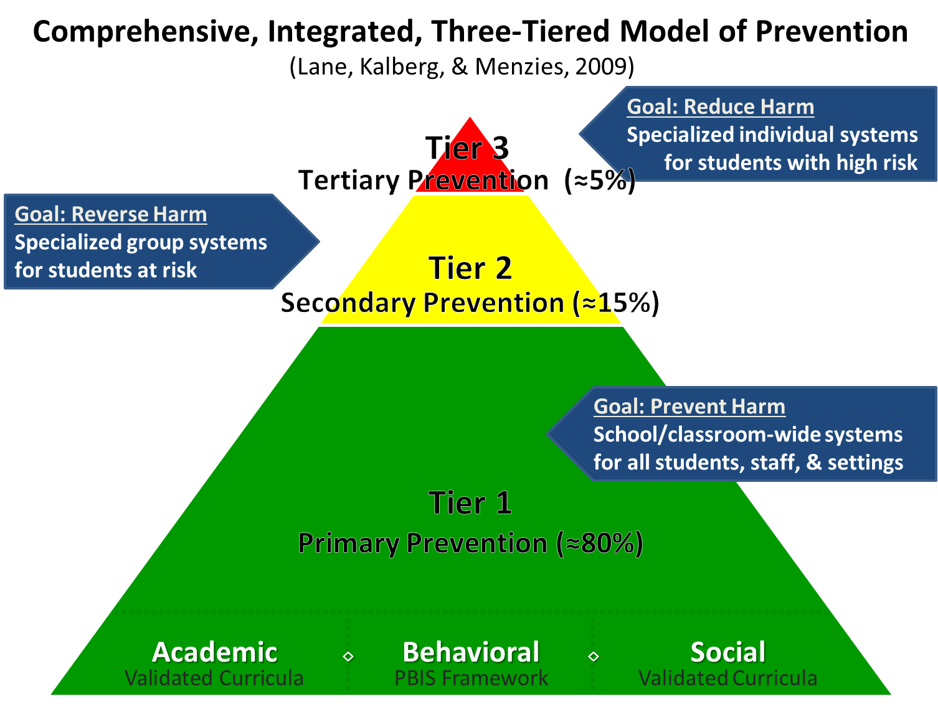
Comprehensive, Integrated, Three-Tiered Model of Prevention 1

Slide 5
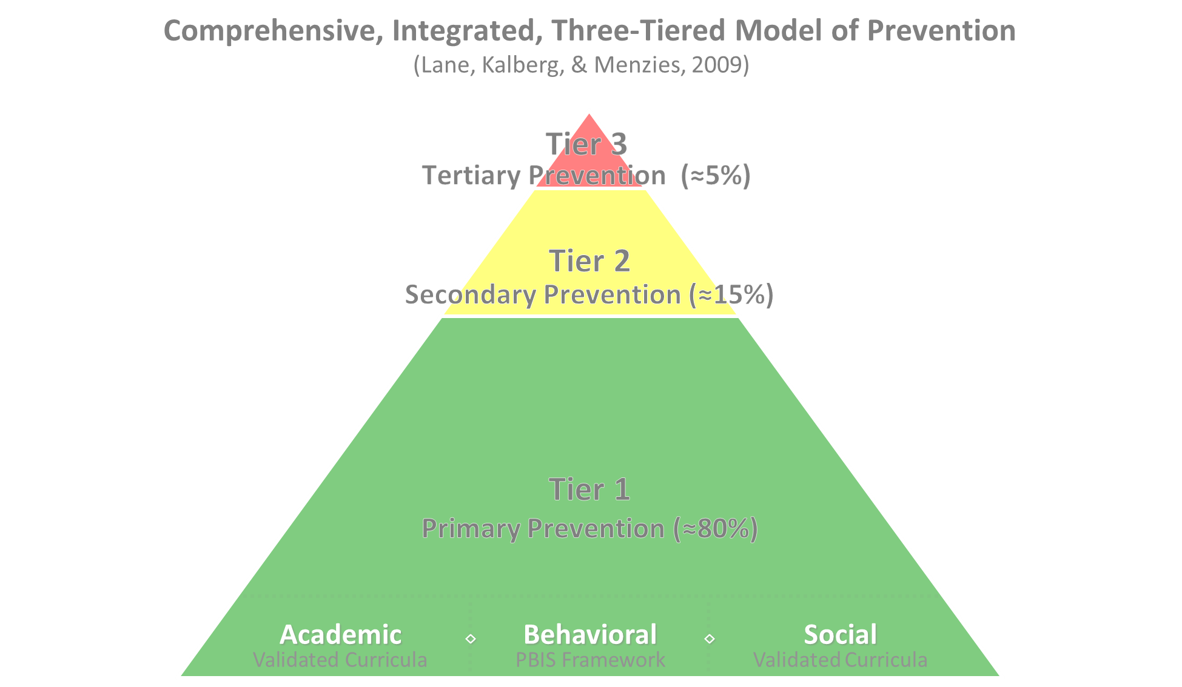
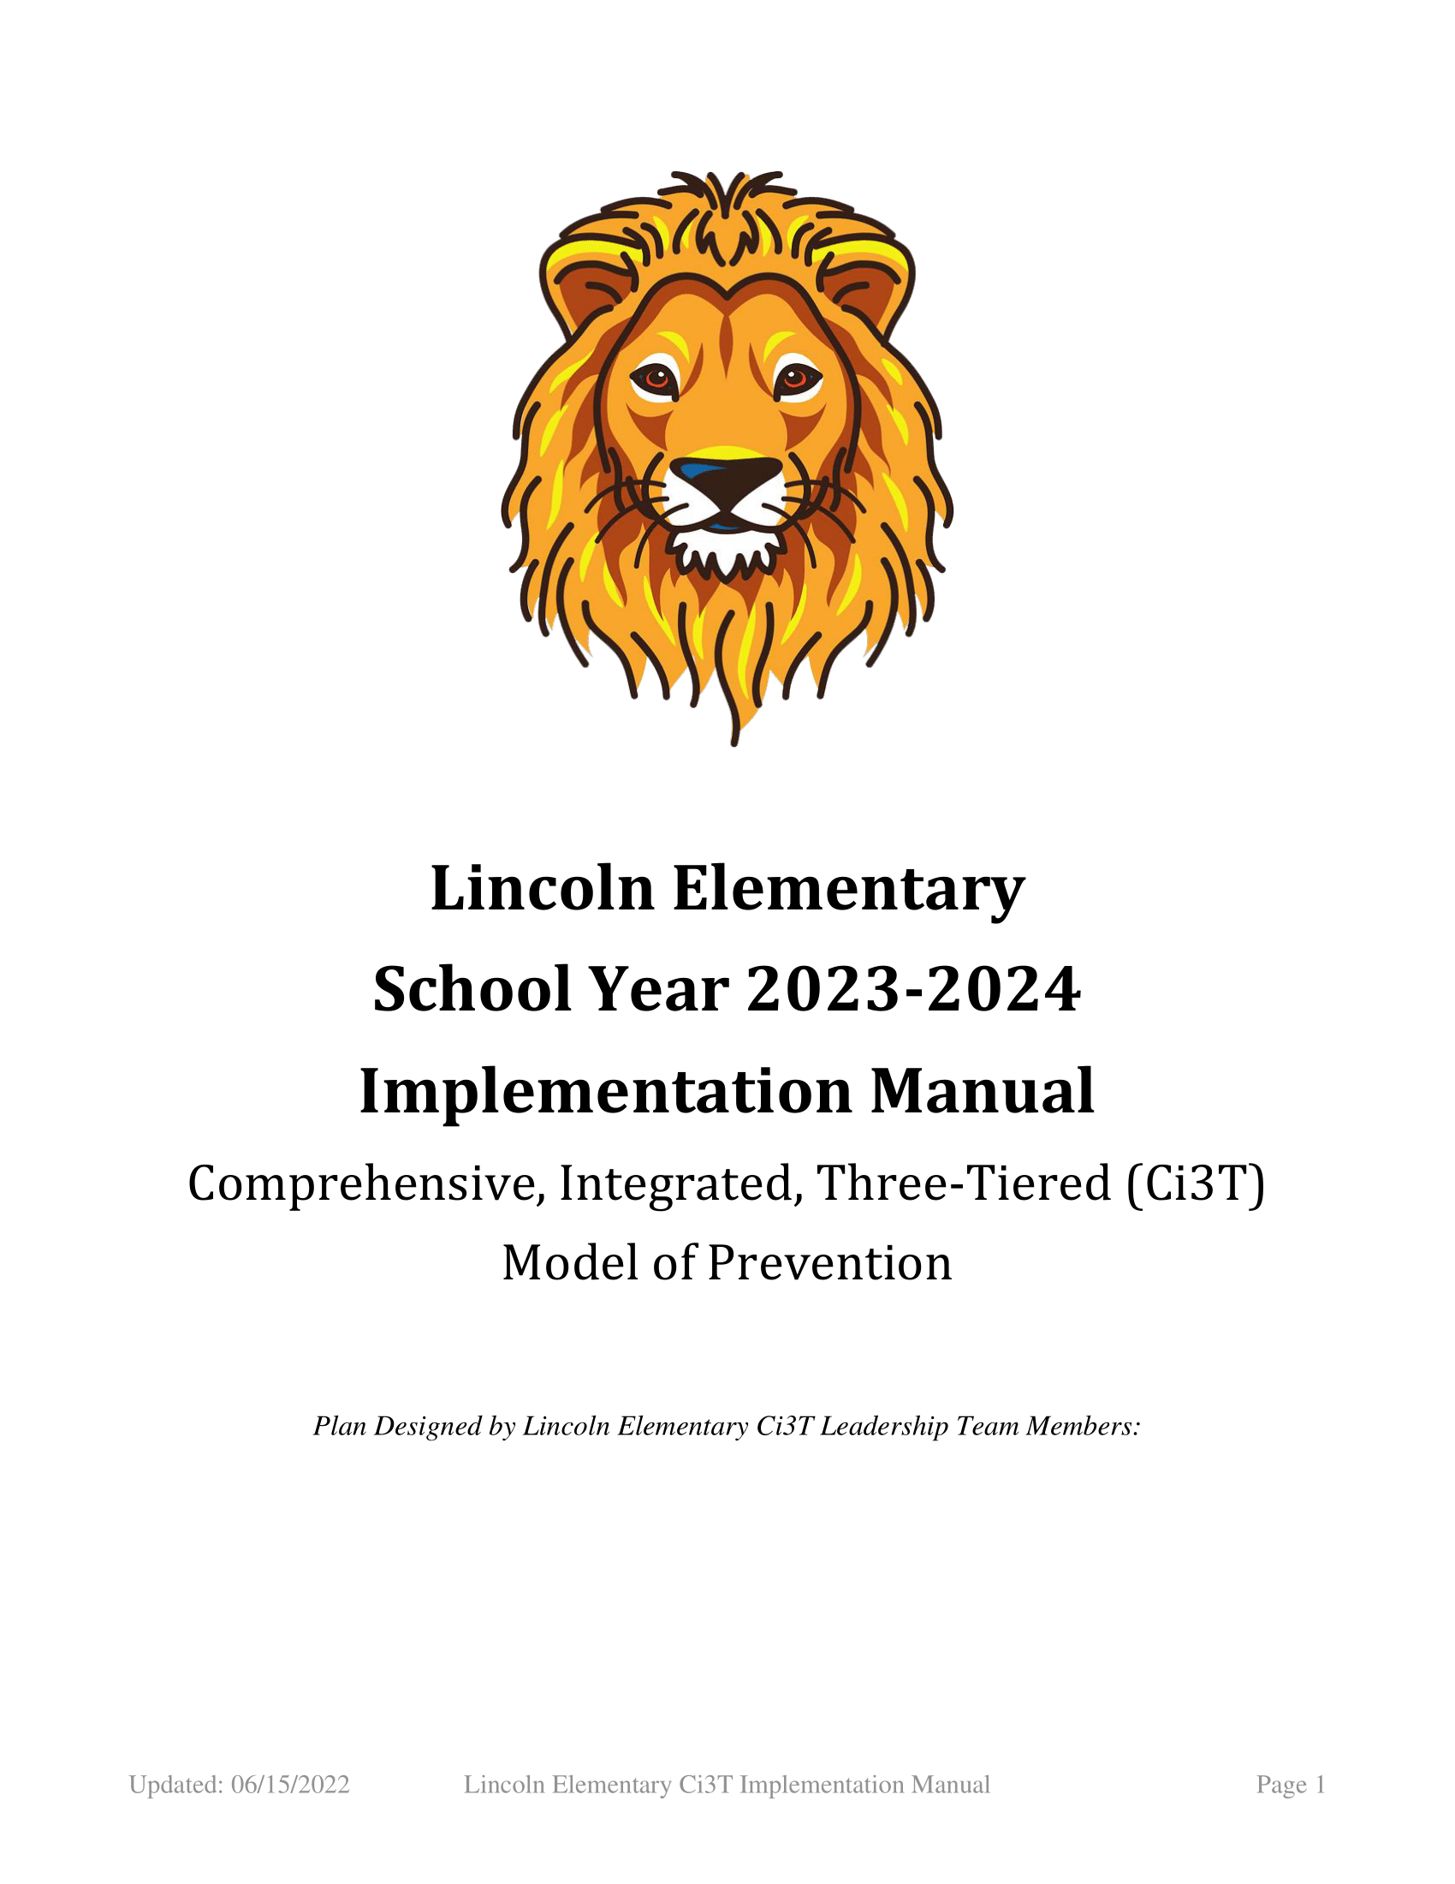
Comprehensive, Integrated, Three-Tiered Model of Prevention 2
Positive Behavioral Interventions and Supports
District & State Standards Quality Instruction
Validated Curricula and Resources

Slide 6
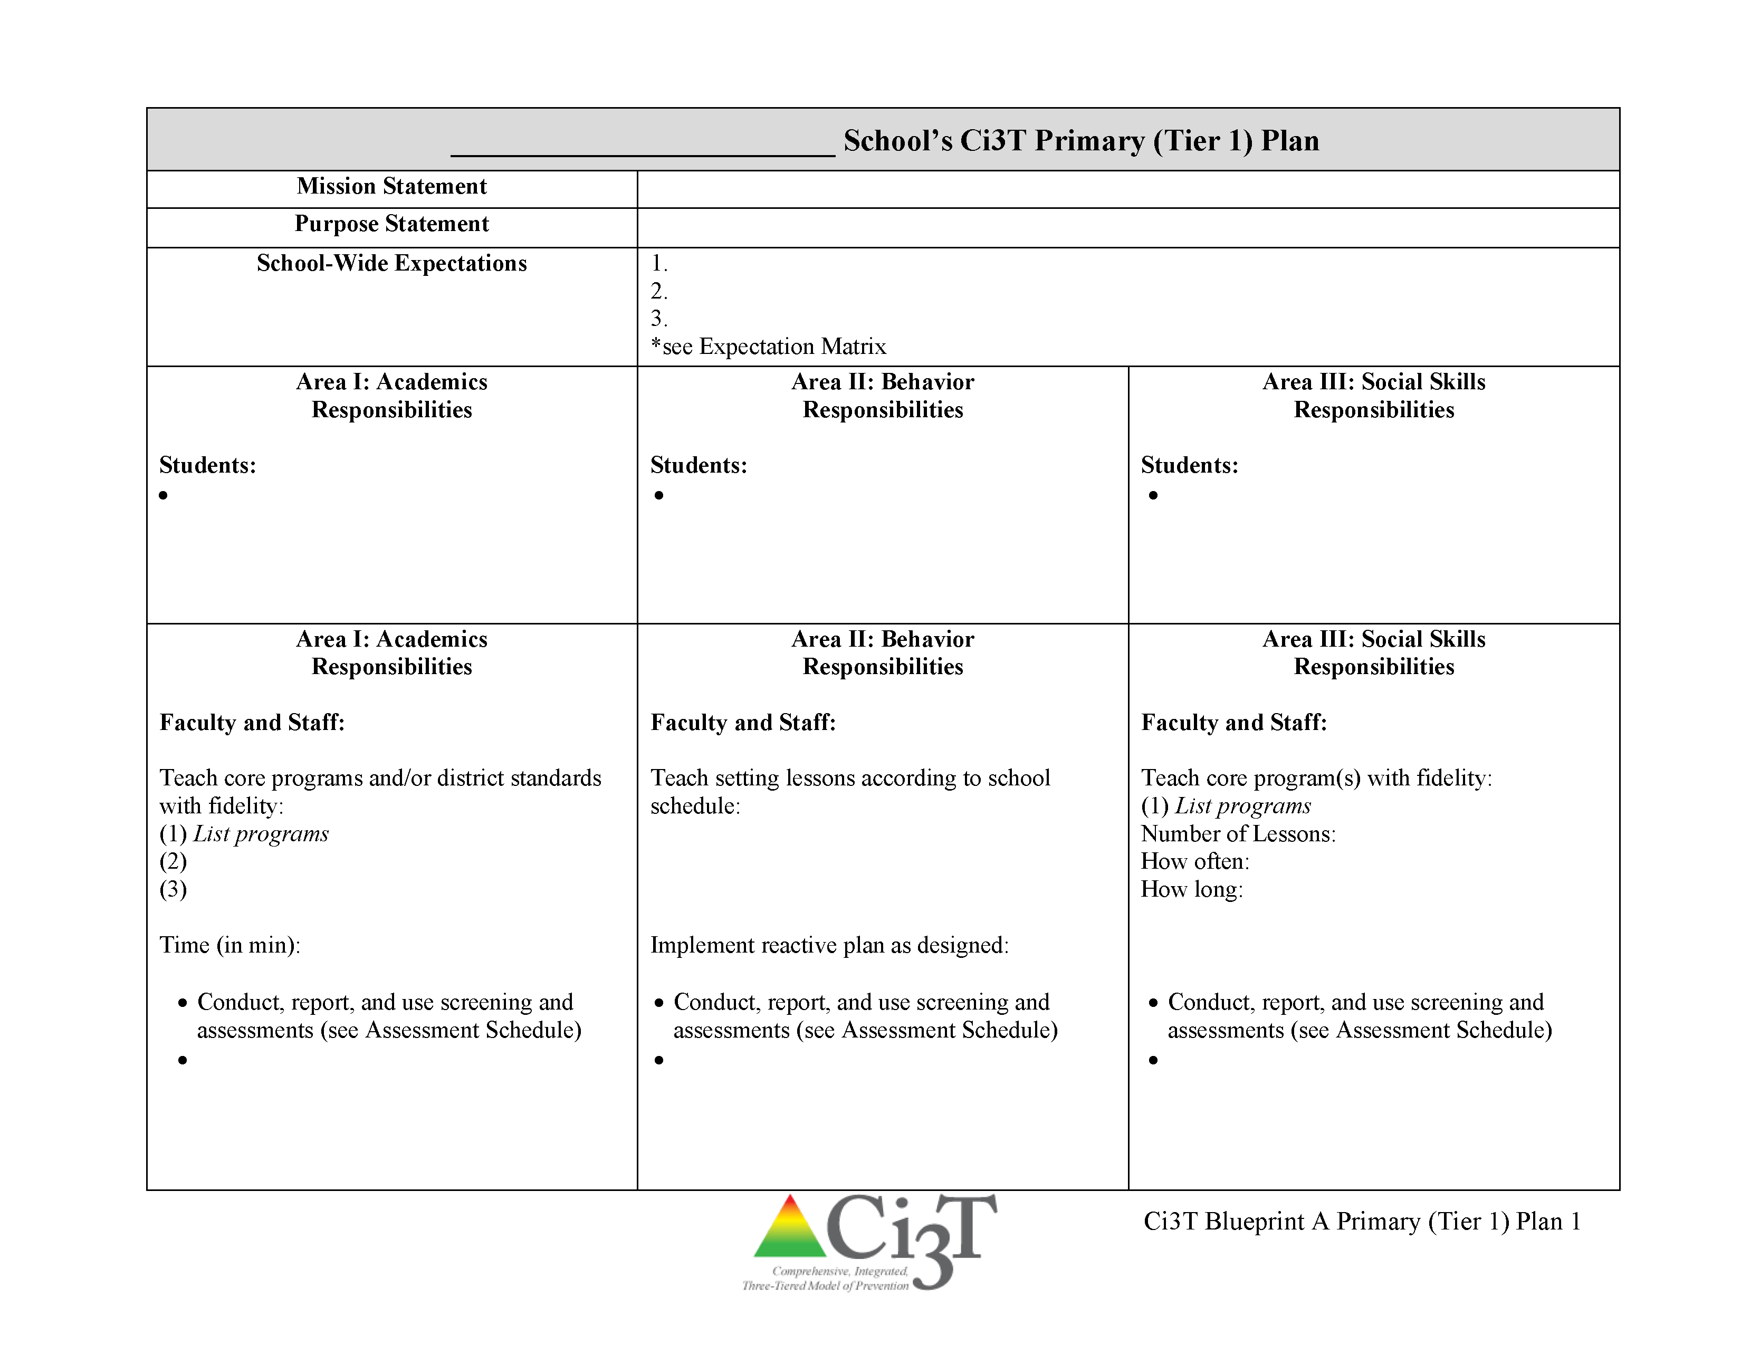
Ci3T Primary Plan: Faculty and Staff Roles and Responsibilities

Slide 7
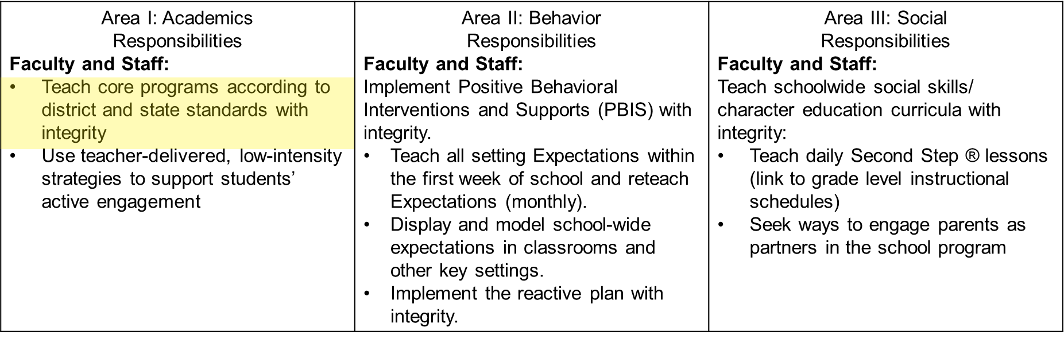
Academics
Academics 1

Slide 8
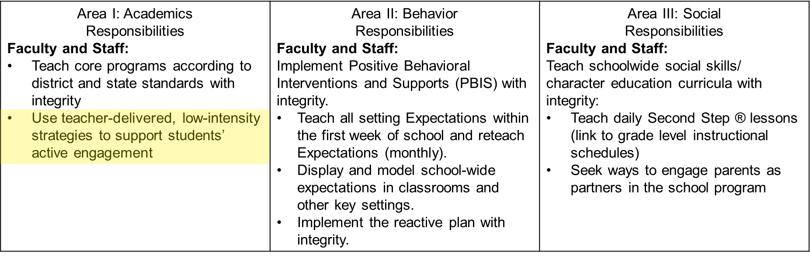
Academics
Academics 2

Slide 9
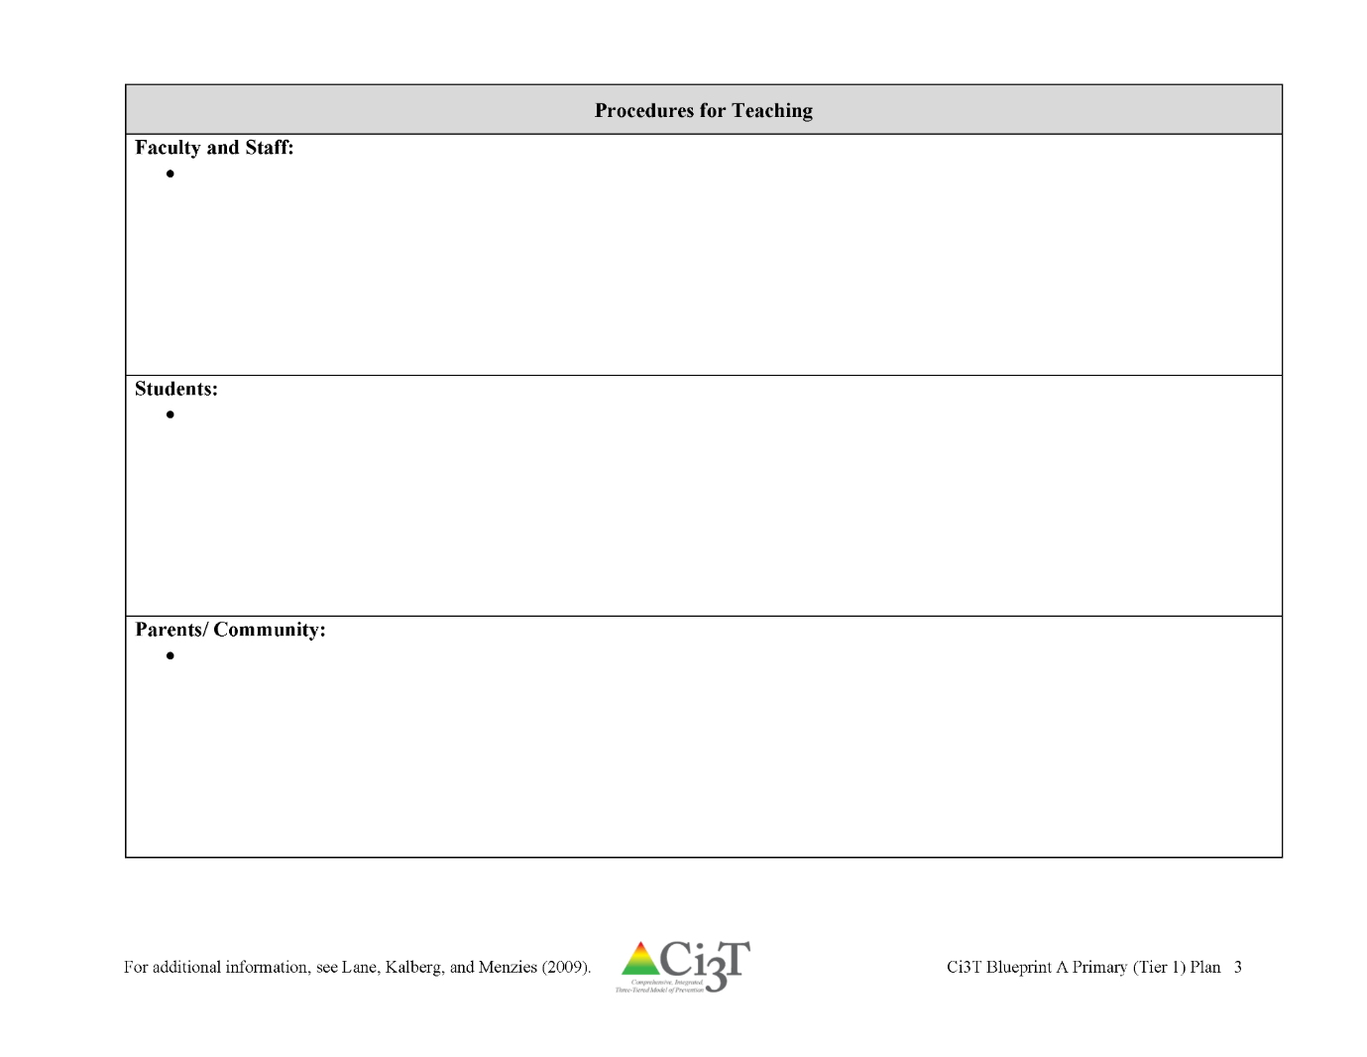
Procedures for Teaching: Template

Slide 10
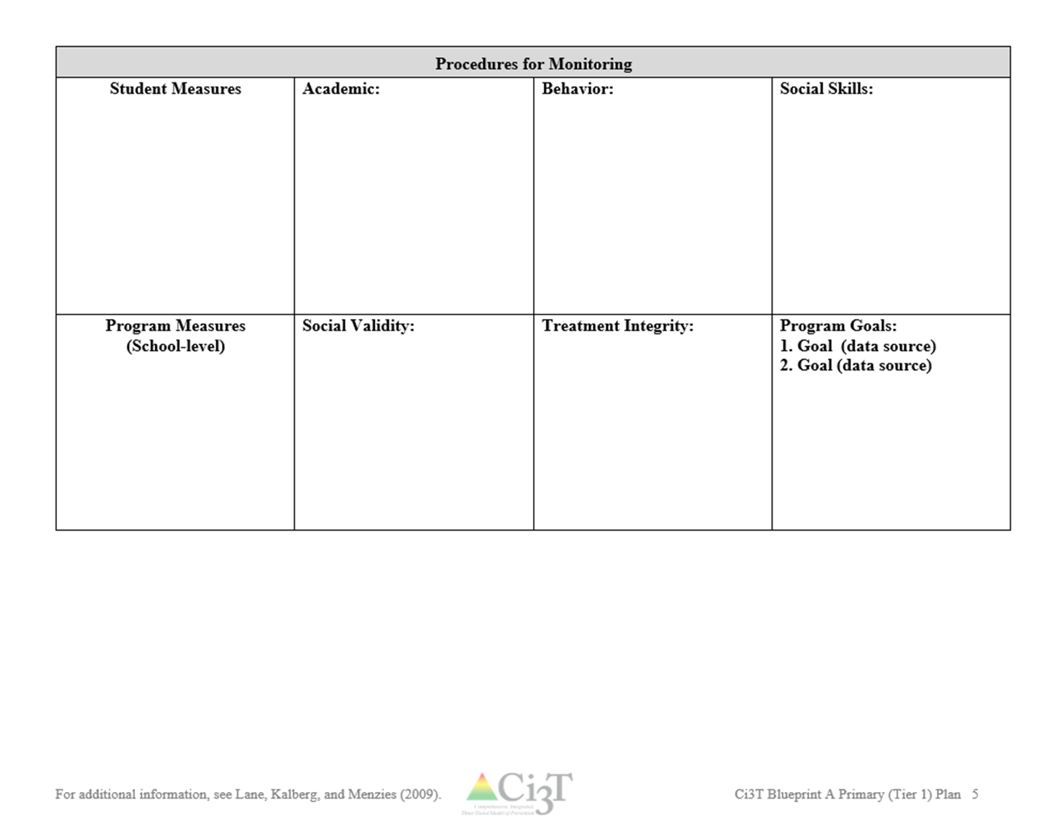
Procedures for Monitoring Worksheet 1

Slide 11
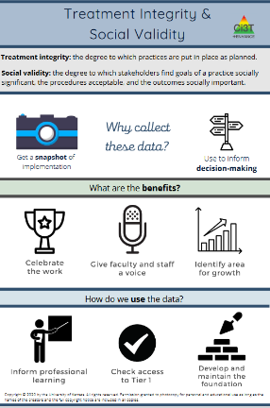
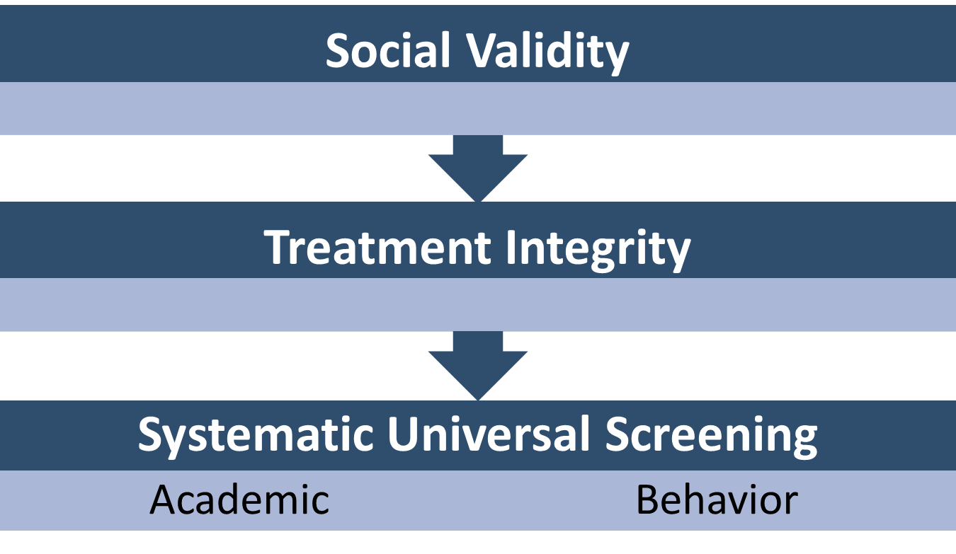
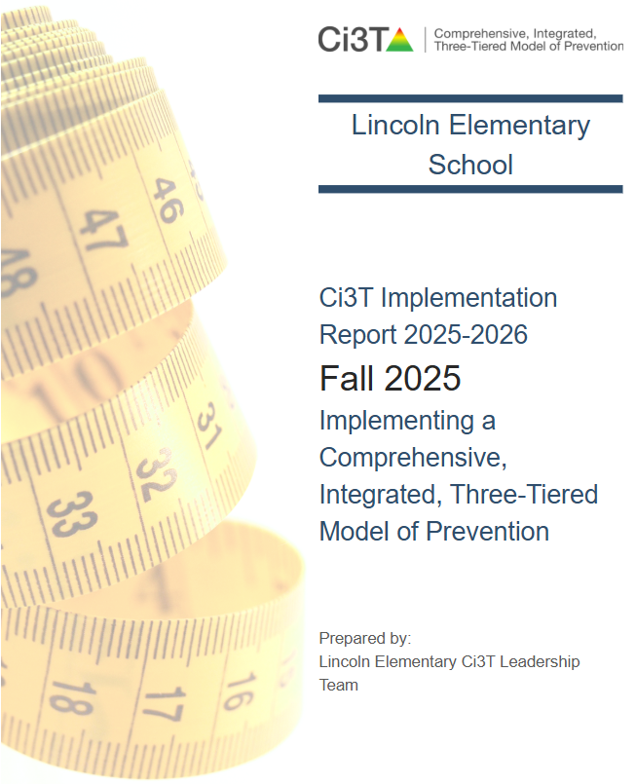
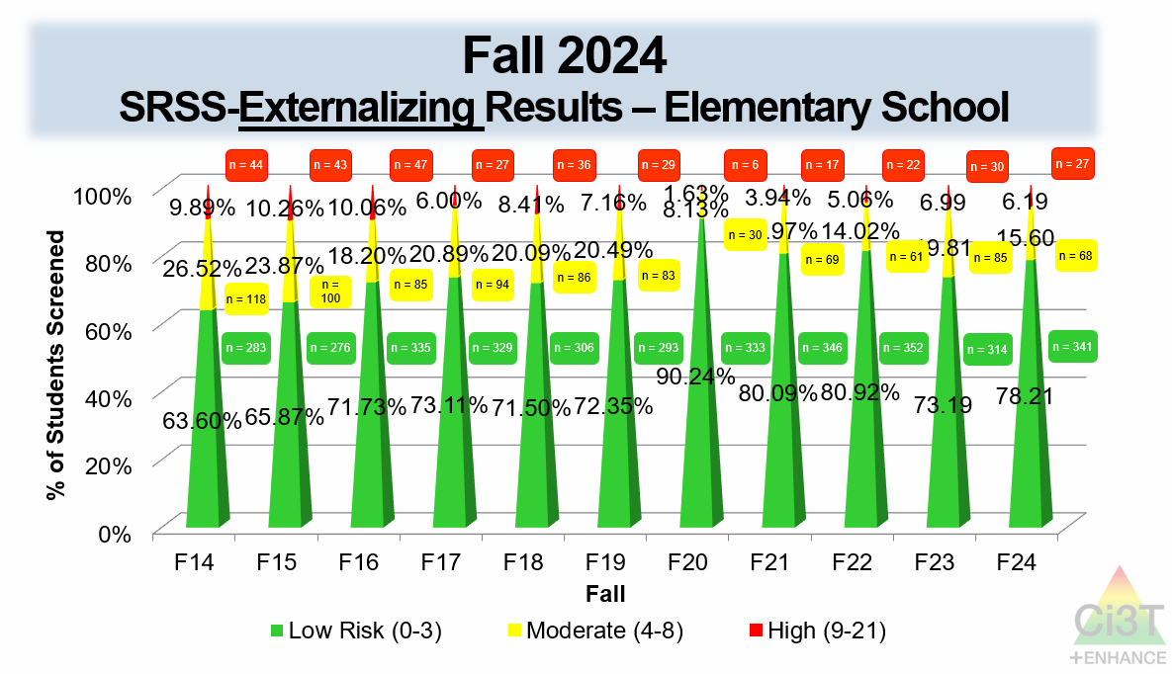
Essential Components of Primary (Tier 1) Prevention Efforts

Slide 12
Comprehensive, Integrated, Three-Tiered Model of Prevention 2
Notes:
In addition to the module featured here outlining how to use multiple sources of data to connect students with Tier 2 supports, we offer a full suite of modules highlighting validated Tier 2 interventions such as Self-Regulated Strategy Development (SRSD) for Writing and Check-In/Check Out that may appear in your Secondary (Tier 2) Intervention Grid

Slide 13
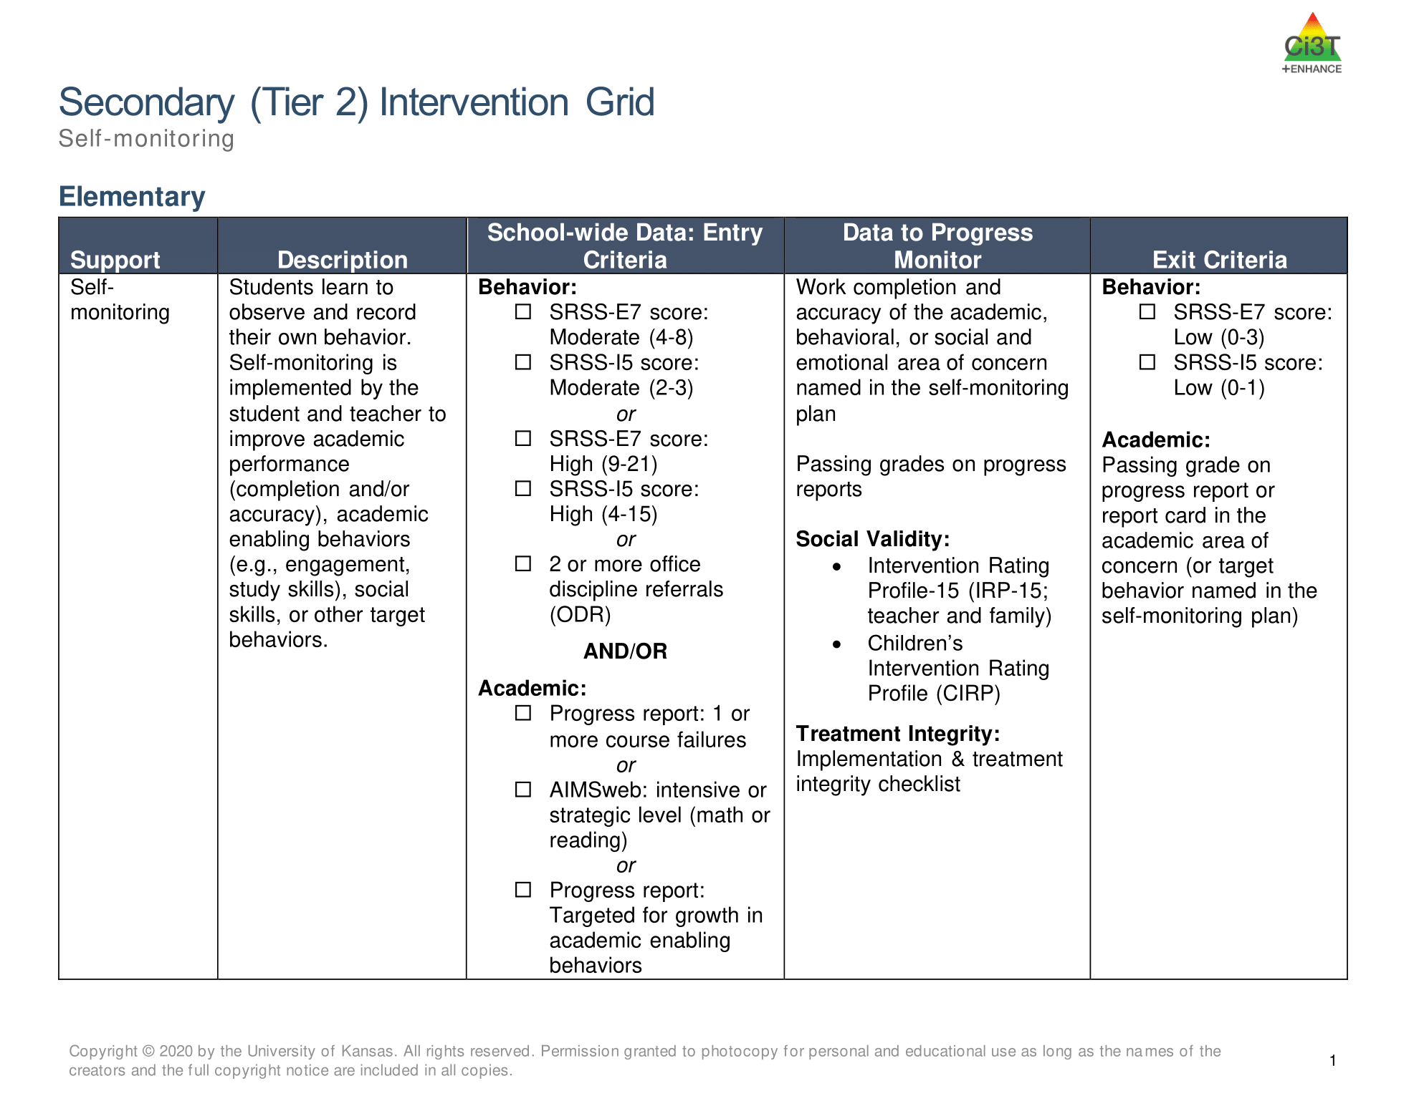
Tier 2: Self Monitoring

Slide 14
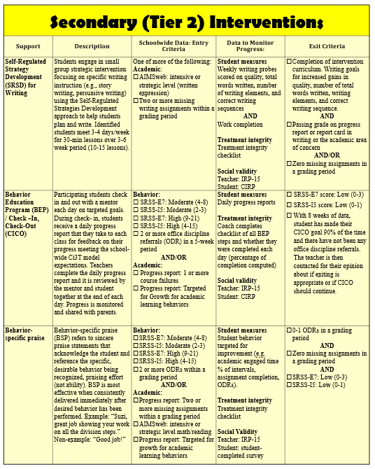
Secondary (Tier 2) Intervention Grid

Slide 15
Comprehensive, Integrated, Three-Tiered Model of Prevention 3
Notes:
In addition to the module featured here outlining how to use multiple sources of data to connect students with Tier 3 supports, we offer a full suite of modules highlighting validated Tier 3 interventions such as Functional Assessment-Based Intervention (FABI) that may appear in your Tertiary (Tier 3) Intervention Grid

Slide 16
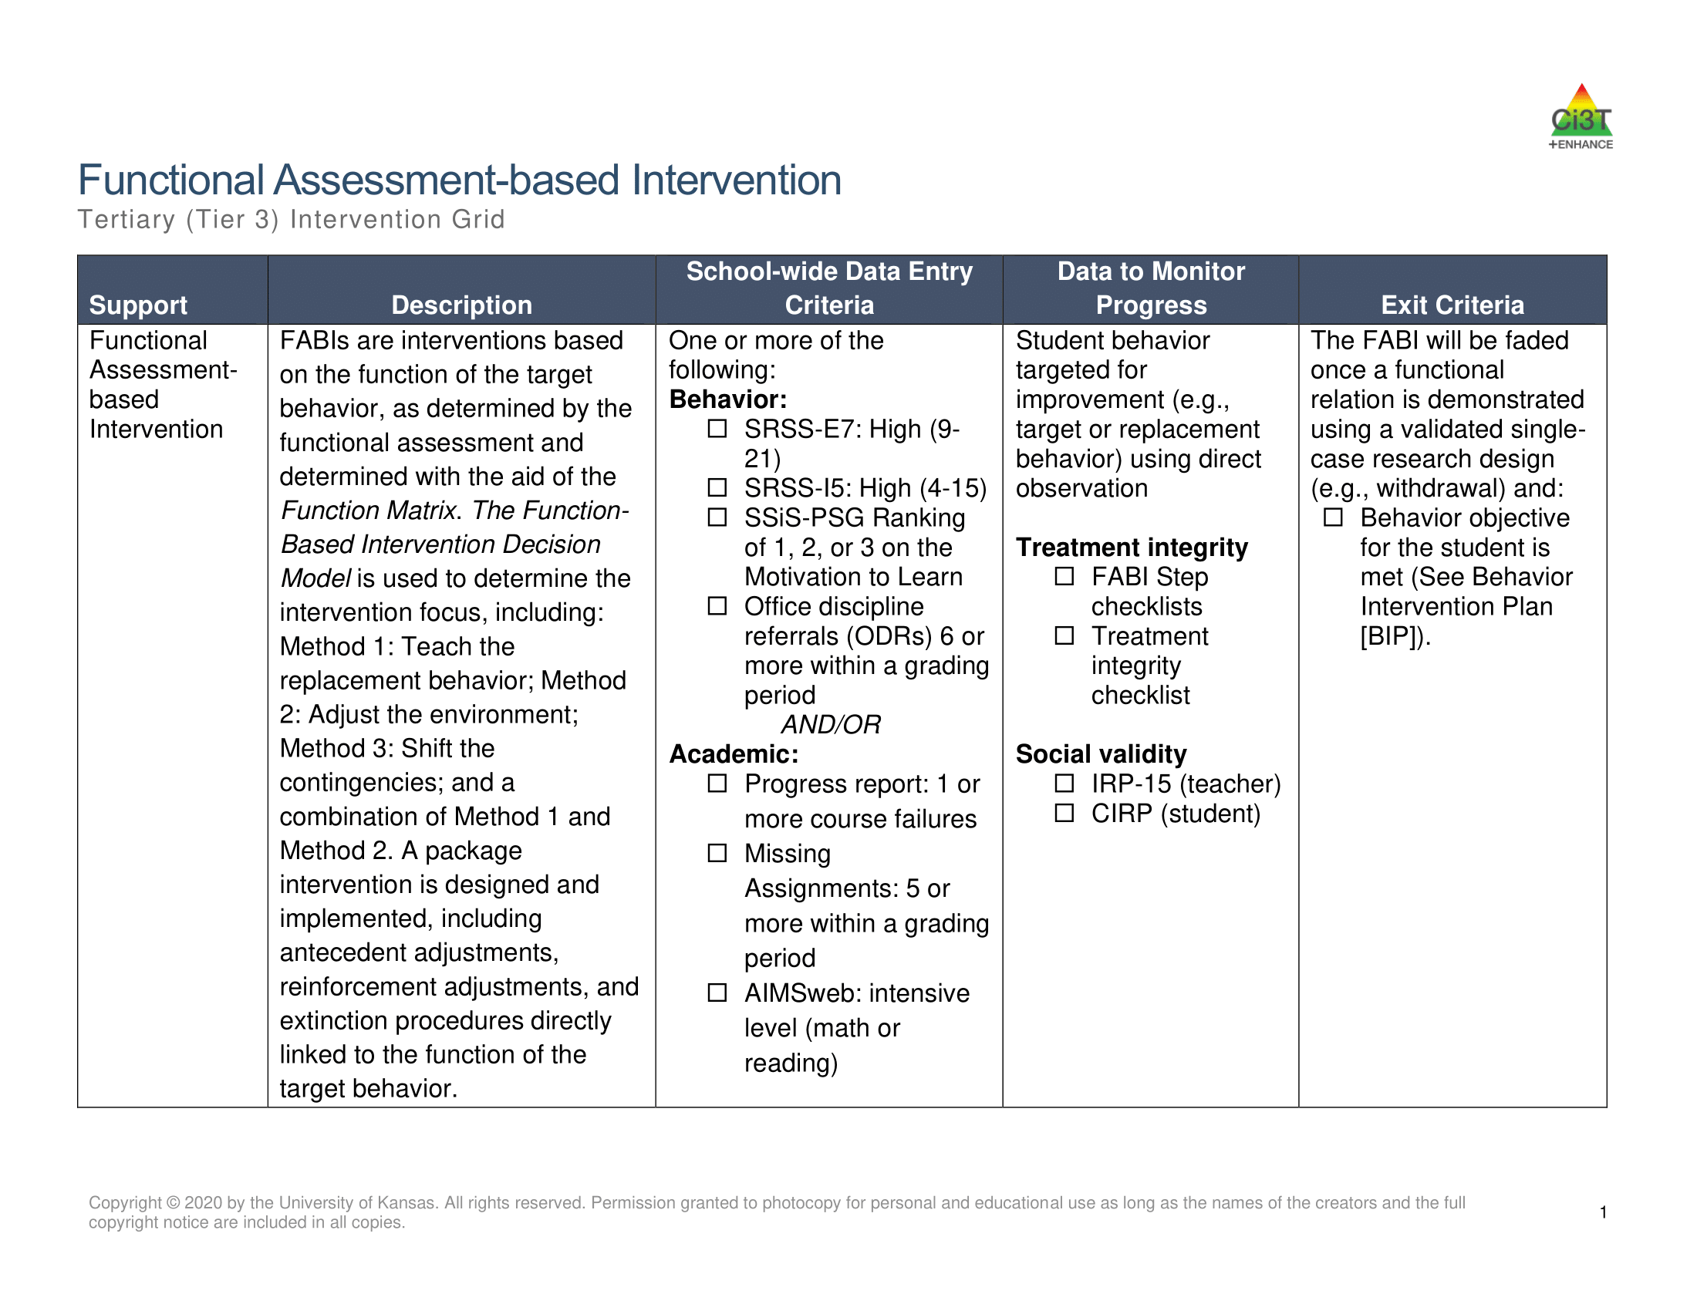
Tier 3: Functional Assessment-Based Intervention

Slide 17
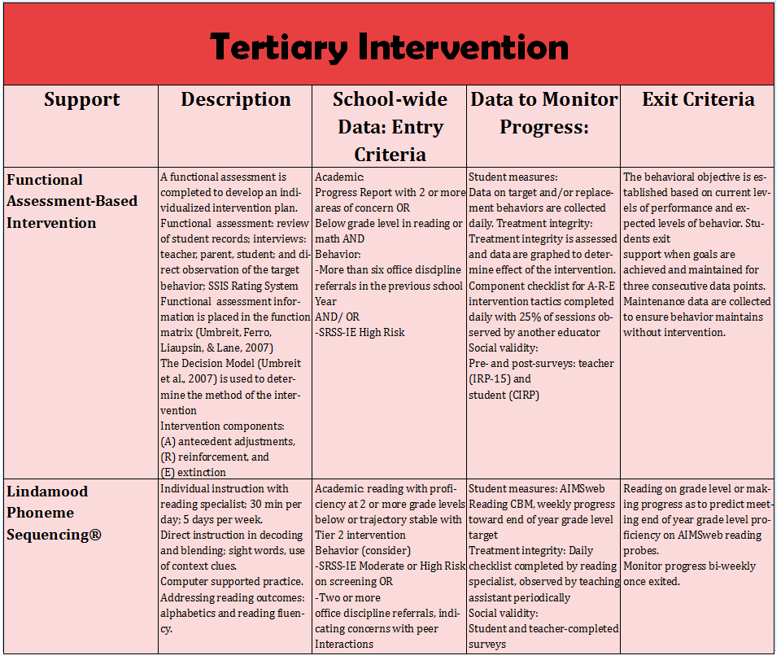
Tertiary (Tier 3) Intervention Grid

Slide 18
Leveraging AI to Support Educators Implementing Ci3T
Chatbot 1: Low-intensity Strategies (LIS) Coach
Chatbot 2: Tier 2 and 3 Intervention Grid Searcher

Slide 19
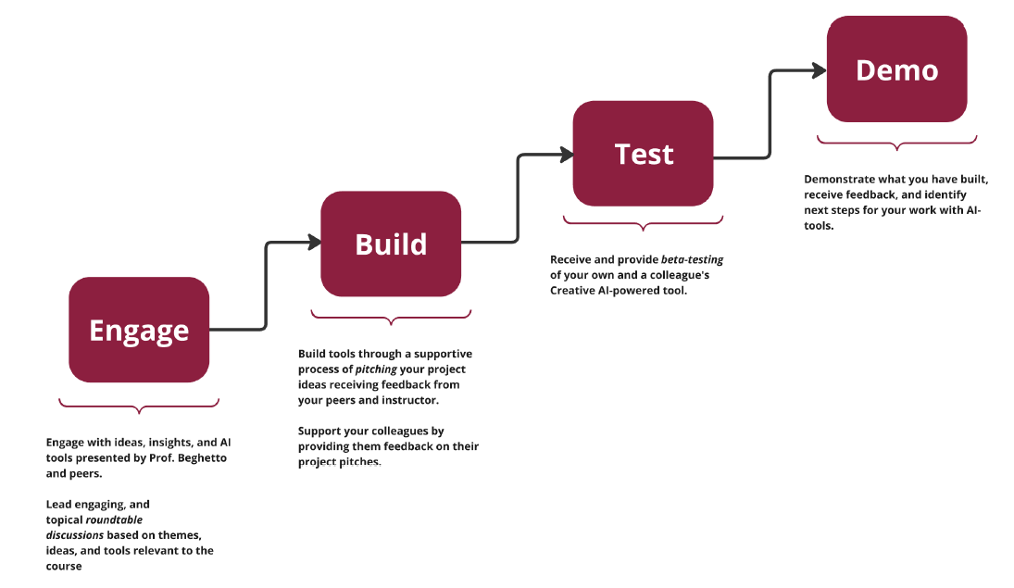
A bot was born
Human Creativity x AI in Education
A class offered at Arizona State University by Dr. Ron Beghetto
Build to Learn, Learn to Create Approach
Human Creativity x AI in Education (Beghetto, 2024)

Slide 20
Build to Learn, Learn to Create Approach
Human Creativity x AI in Education (Beghetto, 2024)

Slide 21
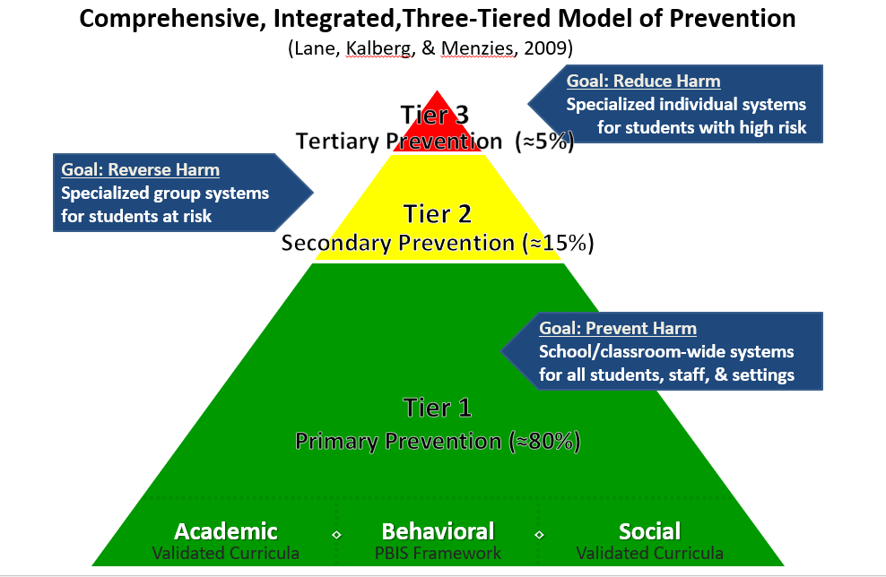
Ci3T Integration
How can AI be leveraged to support educators with Ci3T Implementation?
Two ideas came to mind
Low-intensity Strategies
Tier 2 and 3 Intervention Grids

Slide 22

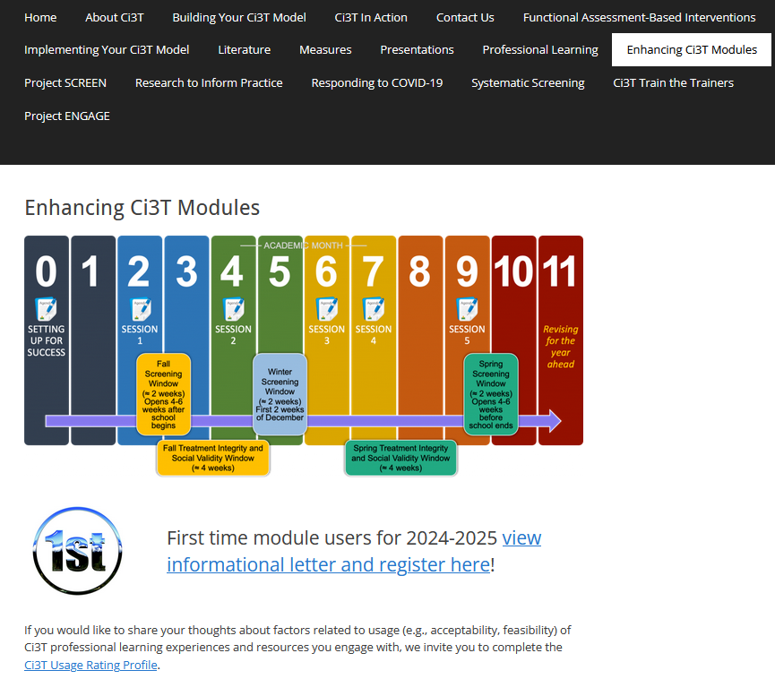

Both bots programmed with available resources on ci3t.org
ci3t.org/enhance

Slide 23
LIS Coach

Slide 24

Low-Intensity Strategies (LIS)
Active Supervision
Behavior-Specific Praise
High-Probability Request Sequence
Instructional Choice
Instructional Feedback
Opportunities to Respond
Precorrection

Slide 25
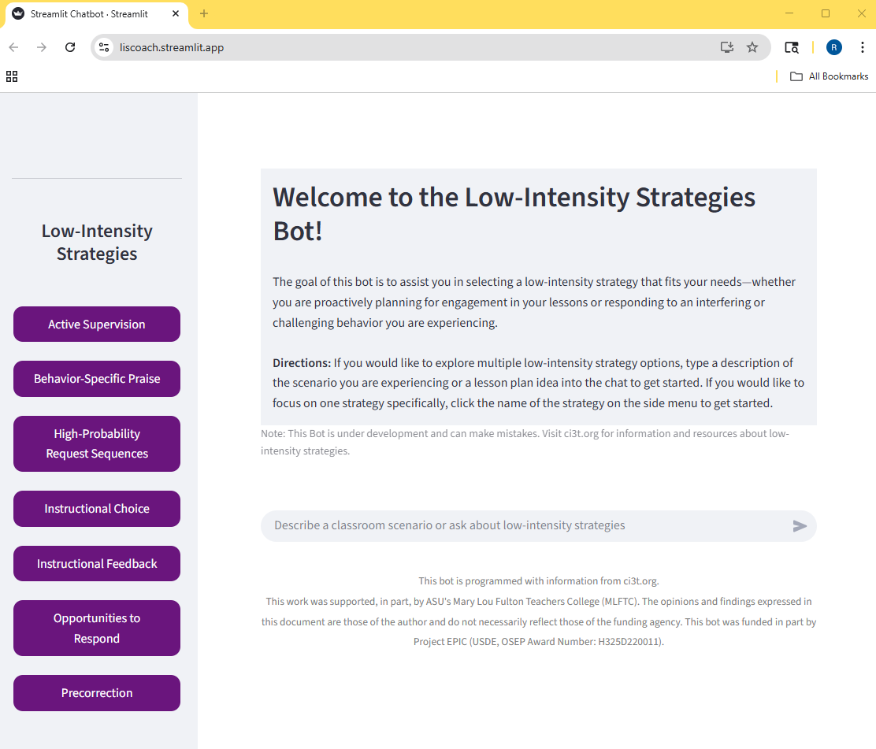
Bot Overview
Bot Overview 1
Designed to assist educators increase their use of low-intensity strategies at Tier 1
User can chat on the main section which will consider all 7 strategies or click on one specific strategy to focus on just one

Slide 26
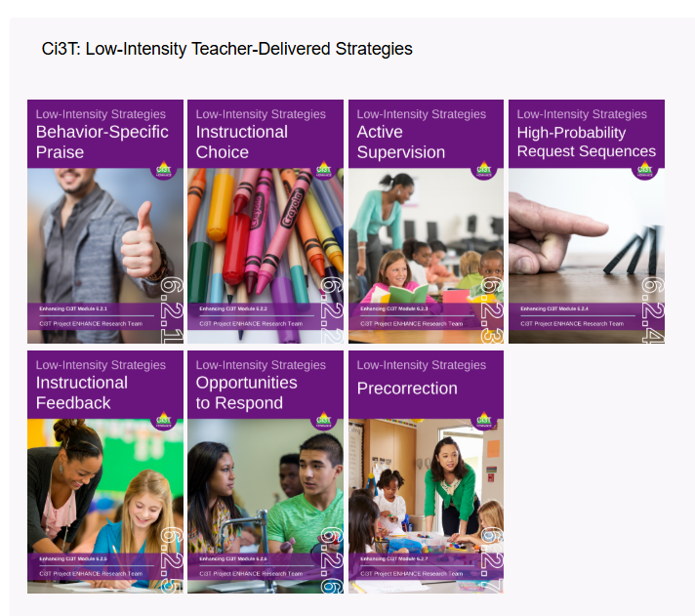
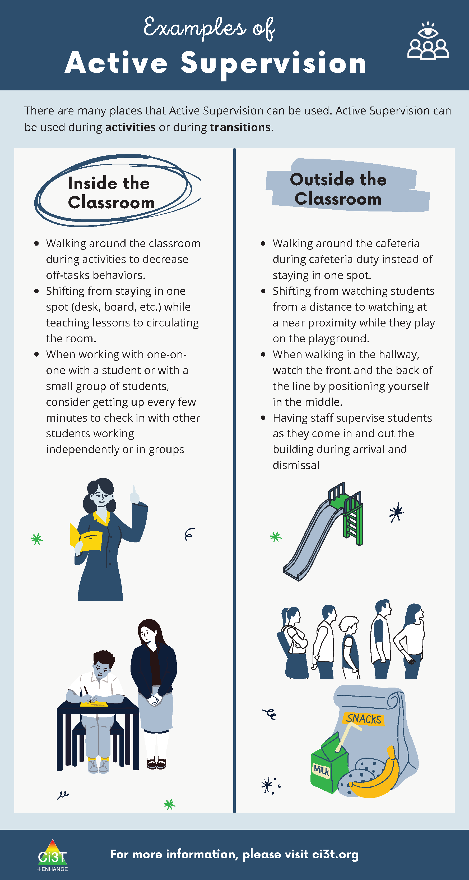
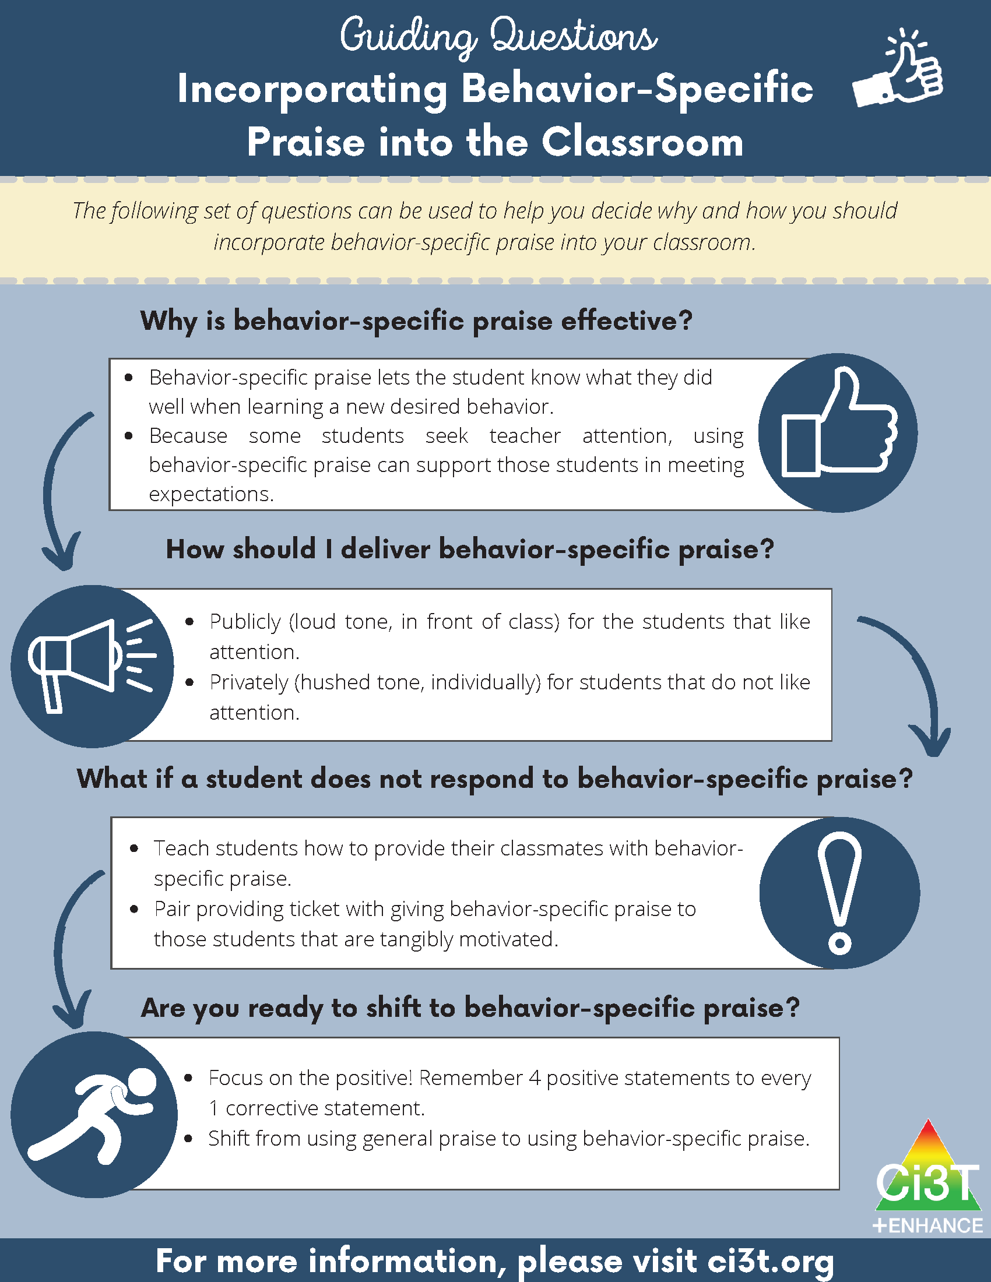

Programming Information
Infographics from the LIS Modules

Slide 27
System Instructions
Provide the bot with guidelines for interactions
Instructions to only use information about the strategies form the infographics

Slide 28
LIS Coach in Action!

Slide 29
Tier 2 and 3 Intervention Grid Searcher

Slide 30
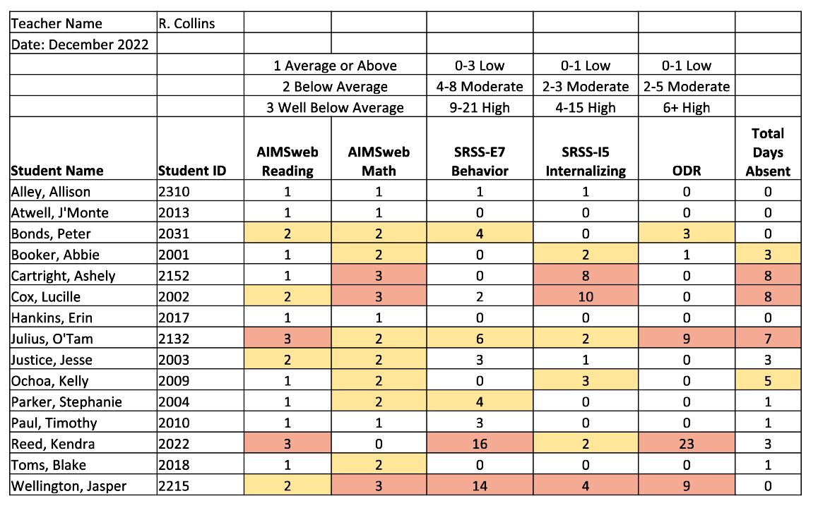
Data Dashboard

Slide 31
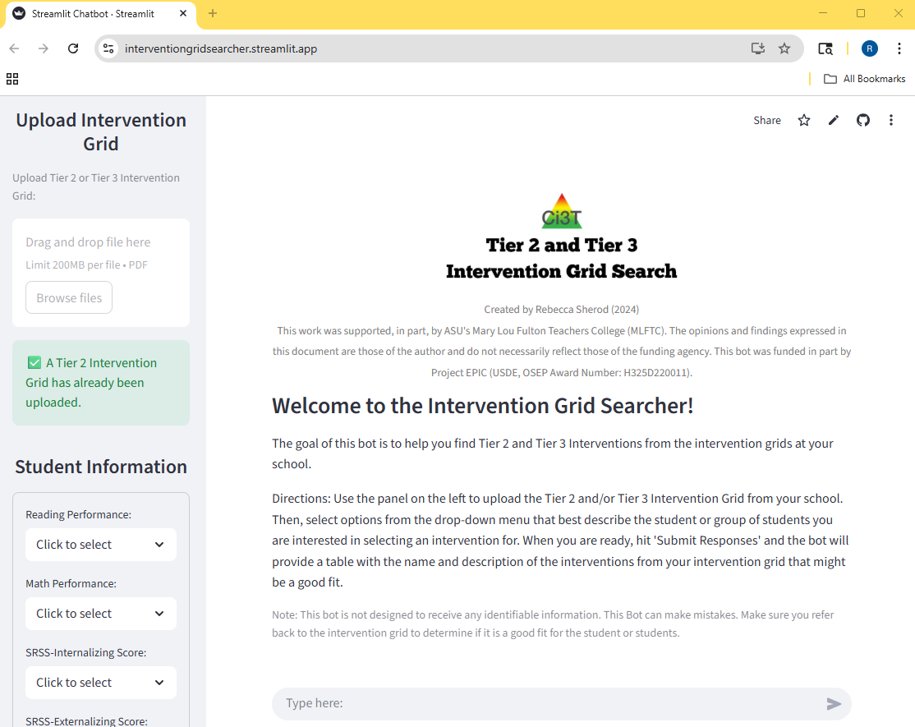
Bot Overview
Bot Overview 2
Designed to help users utilize the Tier 2 and/or Tier 3 Intervention Grid at their school
Users upload the intervention grid from their schools, answer basic questions about students (nothing identifiable) and the bot provides a list of interventions that might be a good fit based on entry criteria

Slide 32
Programming Information and System Instructions
Programmed with general information about the structure of an intervention grid
Instructions are to review the responses provided by the user (lower than average reading ability, etc.), review the uploaded intervention grid, and provide a table of all interventions in the grid where the entry criteria matches the information that was shared

Slide 33
Intervention Grid Searcher in Action!

Slide 34
Discussion and Next Steps

Slide 35

AI in Education
What have you seen?
What have you used?

Slide 36

Next Steps for These Bots
Examining
If the bots are providing accurate information to users
How users feel about their overall experience interacting with the bot
If there are any shifts (even preliminarily) in users perceived knowledge, confidence, and feelings of usefulness around the bot content topics

Slide 37

Interested in participating?
Email rsherod@asu.ed to get the necessary links!

Slide 38

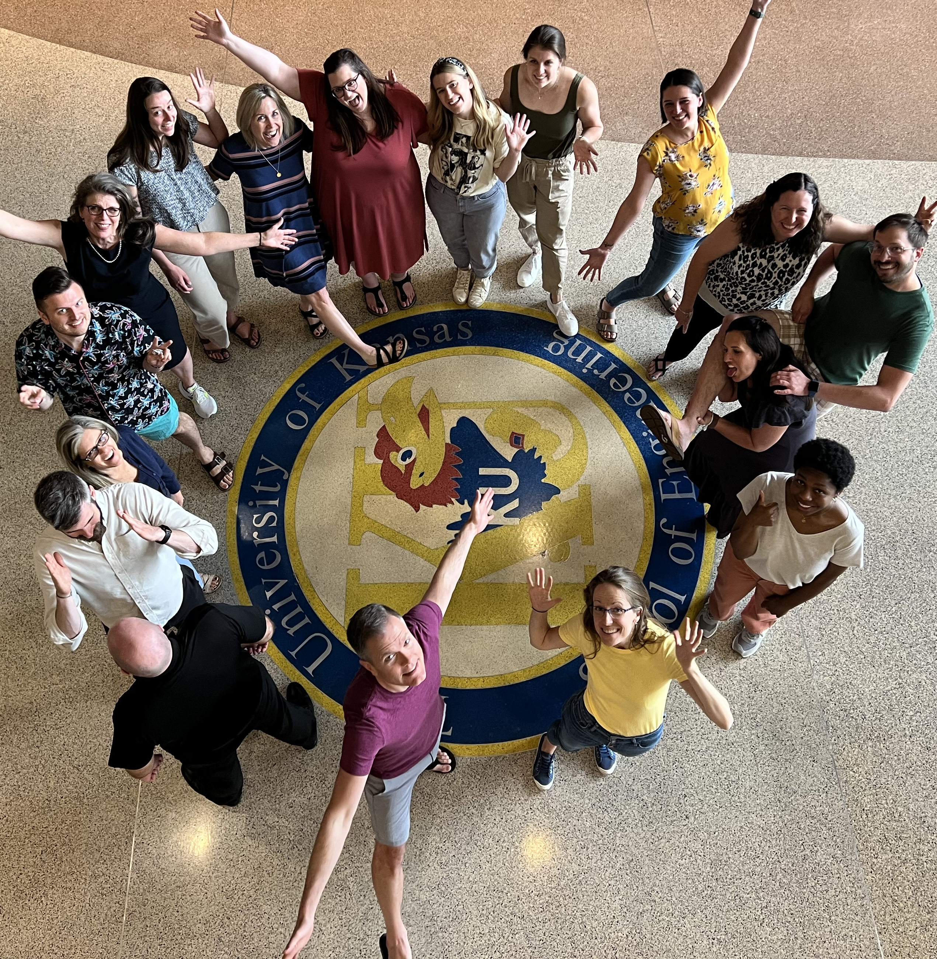
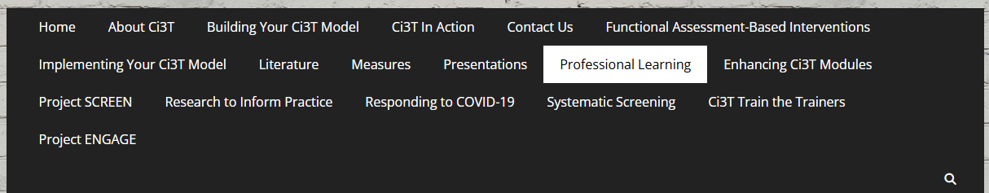

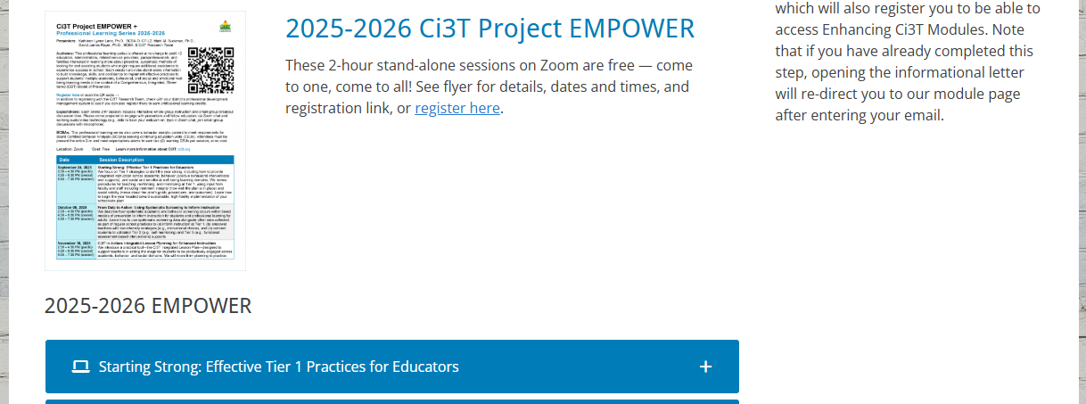
Thank you!
#Ci3T
@Ci3Tmodel
Thank you!
ci3t.org
Tag us in your Ci3T highlights, we love to see Ci3T in action!
Follow us on Instagram for updates and new resources!
Notes:
Tag us in your Ci3T highlights- we would love to see Ci3T in action! Follow us on Instagram for updates and links to resources! @Ci3TModel

