Slide 1
Students With or At Risk for Behavior Disorders: Identification, Assessment, & Intervention
www.ci3t.org/enhance
Strand TECBD 2025 Lane & Oakes
Project ENHANCE: Enhanced Ci3T Professional Learning Series and Delivery: Initial Learning of School-site Leaders
What’s New in Systematic Screening with the SRSS-IE? A Focus on Logistics
Project ENGAGE: Preliminary Findings of a Randomized Control Trail Examining a Tier 2 Intervention – Recognize. Relax. Record. – to Support Elementary Students Struggling with Anxious Feelings
How are Elementary Teachers Faring in Ci3T Systems?
Functional Assessment-based Interventions in School Settings: Preliminary Findings of a Study Examining Adult Learning Outcomes
Using AI to Support Data Informed Decision Making and the Use of Low-Intensity, Teacher Delivered Strategies
Ci3T: Advancing Professional Learning Efforts to Support the Design, Installation, and Evaluation of Complex, Integrated Systems
Notes:
Purpose: This strand reviews works in progress that focus on students with or at risk for emotional and behavioral disorders (EBD) across the K-12 grade span. Specifically, presentations focus on providing supports within Ci3T models of prevention, with an emphasis on systematic screening.

Slide 2
Starting Project ENHANCE: Enhanced Ci3T Professional Learning Series and Delivery: Initial Learning of School-site Leaders
Session Eligible for BACB CEU Units
Rebecca Lee Sherod Adams¹, Mark Matthew Buckman²,
David James Royer³, Elise Sarasin², Grant Edmund Allen⁴, Allison M. Bernard²,
Stacie Williams², Carrie L. Brandon¹, Matthew Bruce Aschliman¹, Jessica Matus¹, Nelson Brunsting⁵,
Wendy Peia Oakes¹, ​and Kathleen Lynne Lane²,
Arizona State University¹, University of Kansas², University of Louisville³​,
University of Wisconsin - Stout​⁴, University of Florida⁵
This project was funded in part by Project EPIC (USDE, OSEP Award Number: H325D220011) and Project ENHANCE (IES Project Number R324N190002)

Slide 3
Agenda
Welcome
Ci3T: A Framework to Support Educators and Students
Project ENHANCE Overview
A Look at Two Studies
Study 1 - Educational Leaders’ Learning Outcomes: A Comparison of Traditional and Enhanced Ci3T Professional Learning Series and Delivery
Study 2 - Learning Outcomes of School Leaders in Experienced Ci3T Schools: Exploring the Impact of the Enhanced Ci3T Professional Learning Series and Delivery
Next Steps

Slide 4
Ci3T: A Model to Support Educators and Students

Slide 5
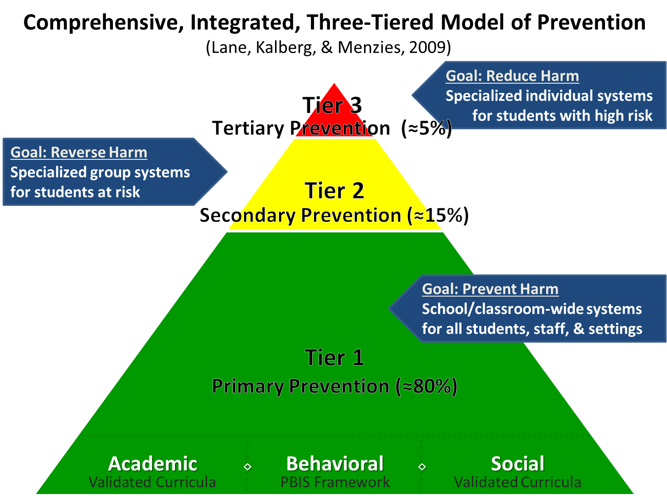
Comprehensive, Integrated, Three-Tiered Model of Prevention 1

Slide 6
Project ENHANCE Overview

Slide 7

Institute of Education Sciences Project ENHANCE Team

Slide 8
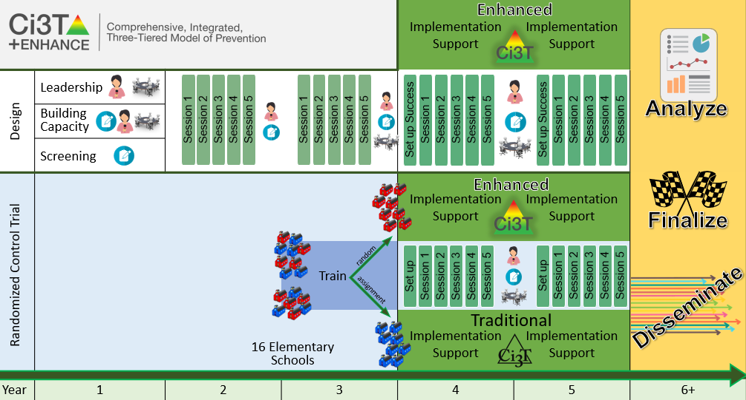
Ci3T Enhance Diagram 1

Slide 9
Ci3T Enhance Diagram 2

Slide 10
Ci3T Enhance Diagram 3

Slide 11

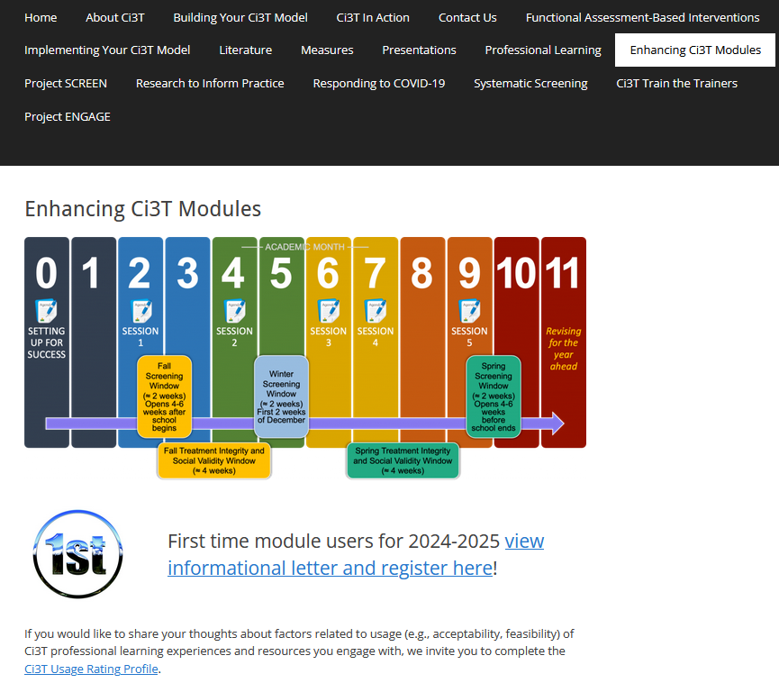

Enhancing Ci3T Modules
ci3t.org/enhance

Slide 12
A Look at Two Studies
Study 1 – Educational Leaders’ Learning Outcomes: A Comparison of Traditional and Enhanced Ci3T Professional Learning Series and Delivery
Study 2 - Learning Outcomes of School Leaders in Experienced Ci3T Schools: Exploring the Impact of the Enhanced Ci3T Professional Learning Series and Delivery

Slide 13
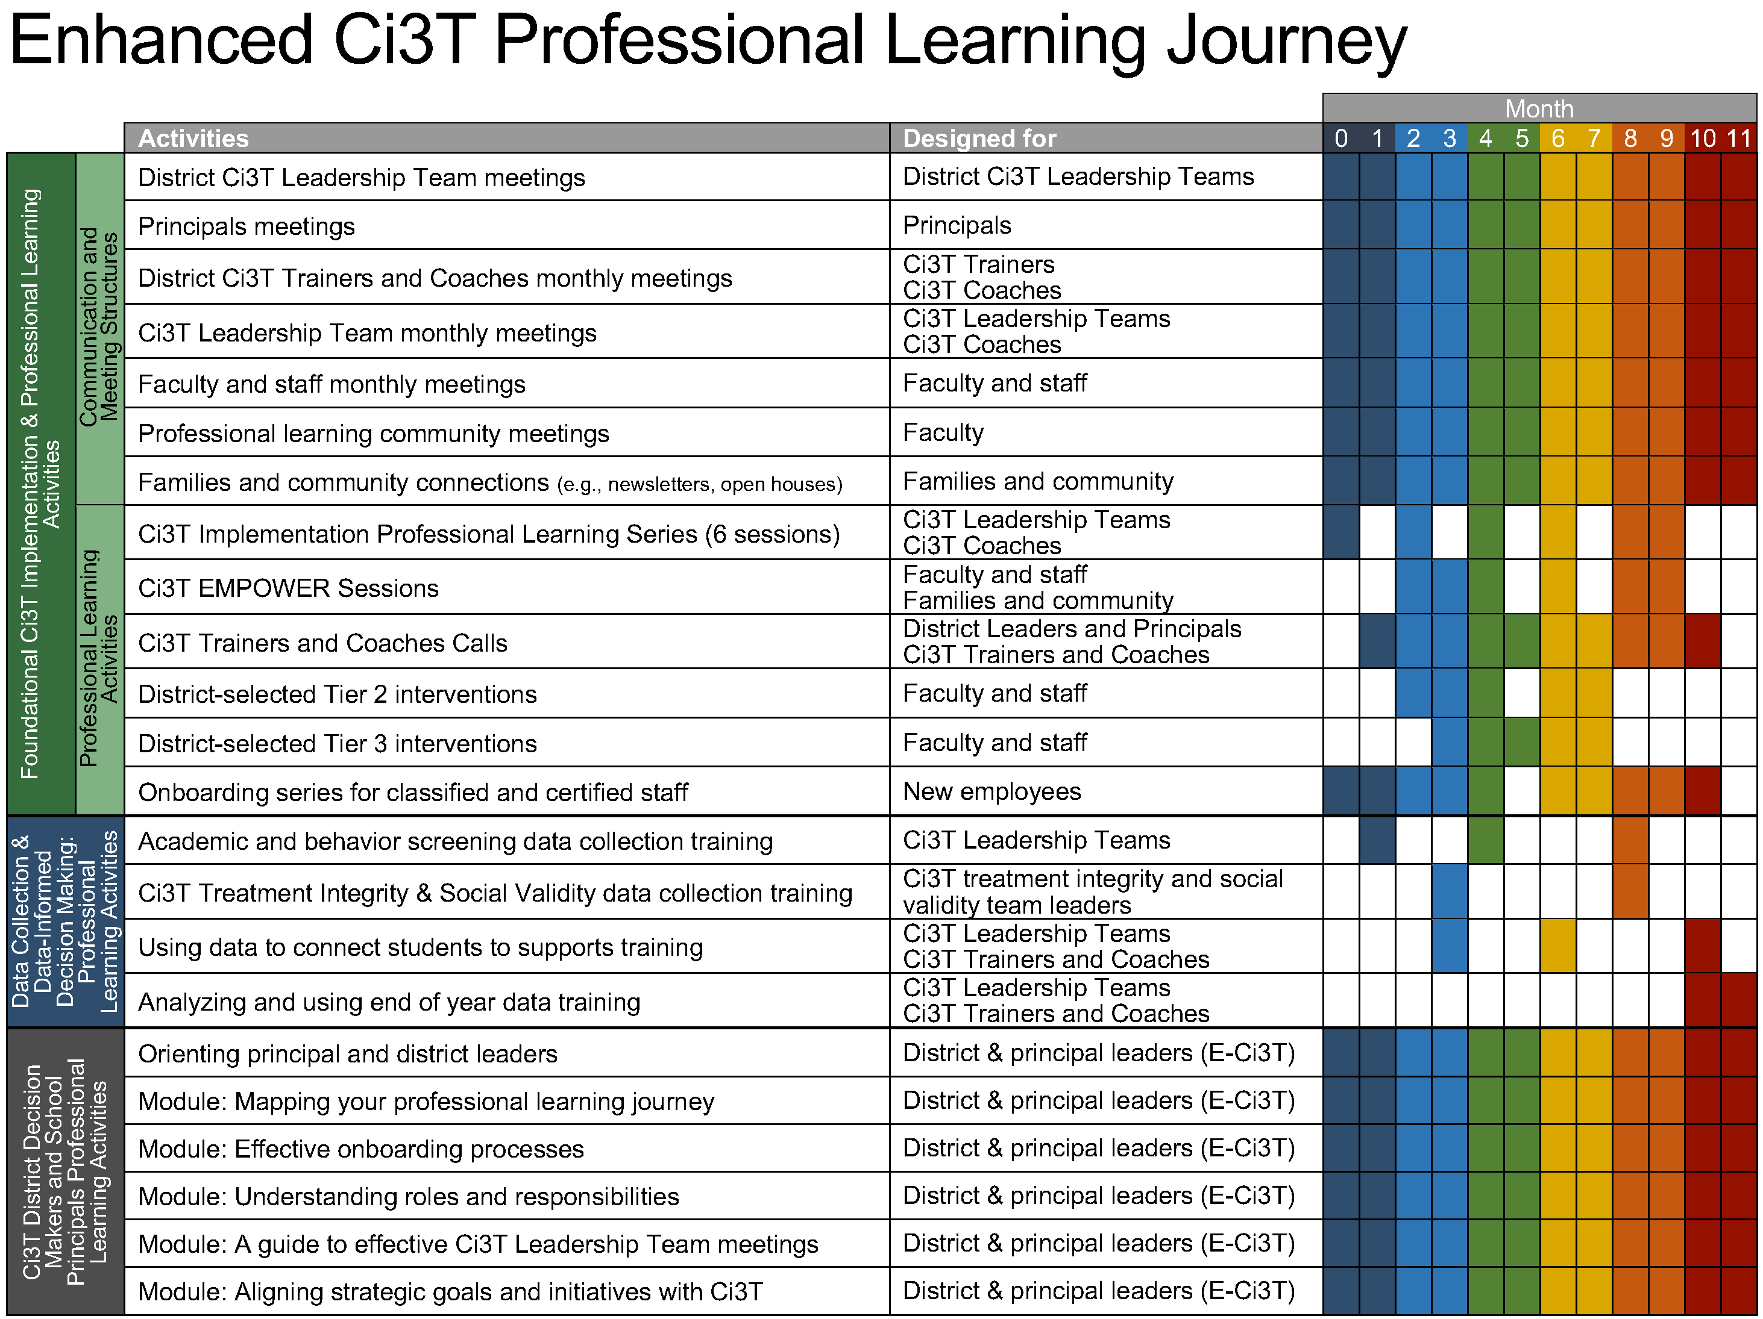
Ci3T Implementation Series and Delivery (ISD)

Slide 14
Ci3T Enhance Diagram 4

Slide 15
Study 1 – Educational Leaders’ Learning Outcomes: A Comparison of Traditional and Enhanced Ci3T Professional Learning Series and Delivery (T-Ci3T ISD vs. E-Ci3T ISD)

Slide 16
Research Questions
Research Questions 1
How did Ci3T Leadership Team members new to Ci3T in each condition view the usability of T-Ci3T ISD and E-Ci3T ISD for supporting initial Ci3T implementation?
To what extent did Ci3T Leadership Team members engage in the T-Ci3T ISD and E-Ci3T ISD with integrity?
What were the professional learning outcomes of Ci3T Leadership Team members participating in the T-Ci3T ISD compared to E-Ci3T ISD, including
shifts in perceived knowledge, confidence, and usefulness of Ci3T concepts and strategies over time, and
the relation between perceived and actual knowledge over time?

Slide 17
Method
Method 2
Procedures
Coordinated T-Ci3T and E-Ci3T ISD dates
Conducted Random Assignment
Connected with Principals & Ci3T Leadership Teams for formal invitations
Participate in the T-Ci3T or E-Ci3T ISD

Slide 18
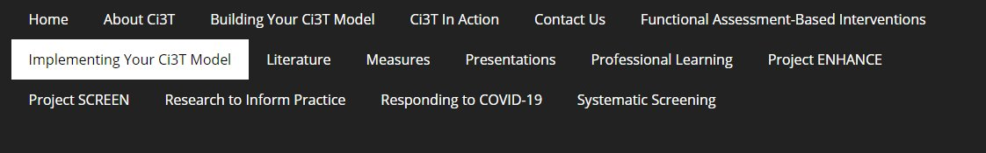
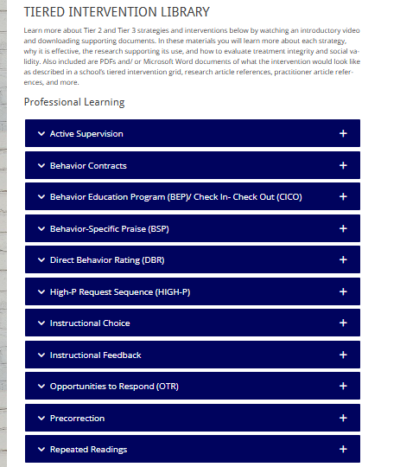
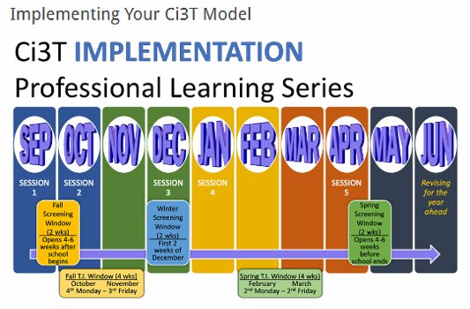
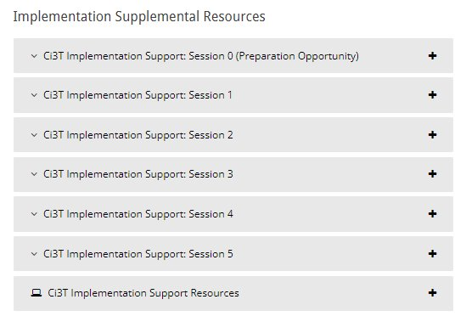
T-Ci3T ISD

Slide 19
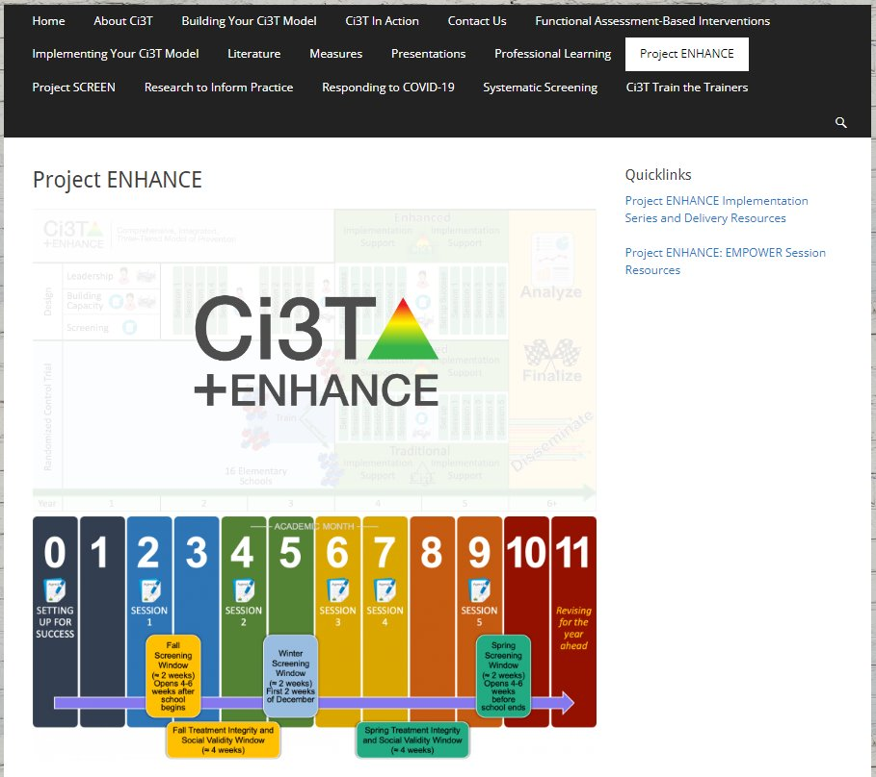

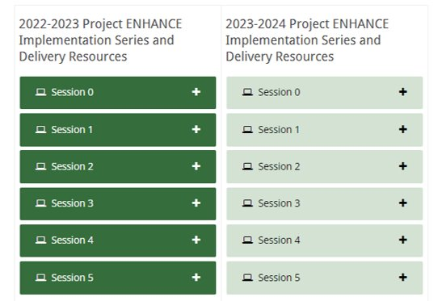
E-Ci3T ISD
E-Ci3T ISD 1

Slide 20
Method
Method 3
Measures
Ci3T-Usage Rating Profile: Ci3T Leadership Team (Ci3T-URP: LT)
Adapted from the Usage Rating Profile-Intervention, Revised (URP-IR; Chafouleas et al., 2011)
Assess usage factors related to Ci3T professional learning experiences from the perspective of school and district leadership team members across:
Acceptability
Feasibility
Understanding
System Climate
System Support
Family Collaboration
Rating Scale: 1 = strongly disagree–6 = strongly agree)
17 items
E-Ci3T & T-Ci3T Session and Meeting Attendance
Research team members recorded Ci3T Leadership Team member attendance at each session across PL series across conditions
Ci3T PL Series
EMPOWER
Trainer and Coaching Calls
Research team members recorded attendance at monthly Ci3T Leadership Team meetings

Slide 21
Method
Method 4
Measures
Enhancing Ci3T Module Access
Monitored participant access of each Enhancing Ci3T Module in the E-Ci3T Condition
Participants registered one time with an email which was used to access all modules
Every module login attempt was recorded in Qualtrics was recorded as a unique observation
Data from July 1, 2022 (beginning of academic year 2022-2023) through June 20, 2024 (end of academic year 2023-2024)
Sample includes Ci3T Leadership Team members only
Ci3T Knowledge, Confidence, and Use (Ci3T KCUv2.0)
Completed 4 times over the course of the project (beginning and end of the academic year)
Participants rate their perceived knowledge, perceived confidence, and perceived usefulness of 16 core components of Ci3T
Rating Scale: 0-3, higher scores reflect greater levels of perceived knowledge, confidence, and usefulness
16 Open ended items
Tell us what you know about these topics in the space provided, for each of the 16 core components of Ci3T

Slide 22
Ci3T Enhance Diagram 4

Slide 23
Ci3T Enhance Diagram 4

Slide 24
Study 2 – Learning Outcomes of School Leaders in Experienced Ci3T Schools: Exploring the Impact of the Enhanced Ci3T Professional Learning Series and Delivery (E-Ci3T ISD)

Slide 25
Research Questions
Research Questions 2
How did Ci3T Leadership Team members view the usability of the E-Ci3T ISD for supporting Ci3T implementation?
To what extent did Ci3T Leadership Team members engage in the E-Ci3T ISD with integrity?
What were the professional learning outcomes of Ci3T Leadership Team members participating in the E-Ci3T ISD, including
shifts in perceived knowledge, confidence, and usefulness of Ci3T concepts and strategies over time, and
the relation between perceived and actual knowledge over time?

Slide 26
Method
Method 6
Procedures
Invite Faculty and Staff Ci3T Leadership Team Members
Participate in the E-Ci3T ISD

Slide 27
E-Ci3T ISD
E-Ci3T 2

Slide 28
Method
Method 7
Note!
These were the same measures as Study 1, with only the E-Ci3T component for session attendance
Measures
Ci3T-Usage Rating Profile: Ci3T Leadership Team (Ci3T-URP: LT)
Adapted from the Usage Rating Profile-Intervention, Revised (URP-IR; Chafouleas et al., 2011)
Assess usage factors related to Ci3T professional learning experiences from the perspective of school and district leadership team members across:
Acceptability
Feasibility
Understanding
System Climate
System Support
Family Collaboration
Rating Scale: 1 = strongly disagree–6 = strongly agree)
17 items
E-Ci3T Session Attendance
Research team members recorded Ci3T Leadership Team member attendance at each session across PL series
Ci3T PL Series
EMPOWER
Trainer and Coaching Calls

Slide 29
Method
Method 8
Note!
These were the same measures as Study 1, with only the E-Ci3T component for session attendance
Measures
Enhancing Ci3T Module Access
Monitored participant access of each Enhancing Ci3T Module
Participants registered one time with an email which was used to access all modules
Every module login attempt was recorded in Qualtrics was recorded as a unique observation
Data from July 1, 2022 (beginning of academic year 2022-2023) through June 20, 2024 (end of academic year 2023-2024)
Sample includes Ci3T Leadership Team members only
Ci3T Knowledge, Confidence, and Use (Ci3T KCUv2.0)
Completed 4 times over the course of the project (beginning and end of the academic year)
Participants rate their perceived knowledge, perceived confidence, and perceived usefulness of 16 core components of Ci3T
Rating Scale: 0-3, higher scores reflect greater levels of perceived knowledge, confidence, and usefulness
16 Open ended items
Tell us what you know about these topics in the space provided, for each of the 16 core components of Ci3T

Slide 30
Next Steps

Slide 31

Teacher well-being
Teacher well-being

Slide 32

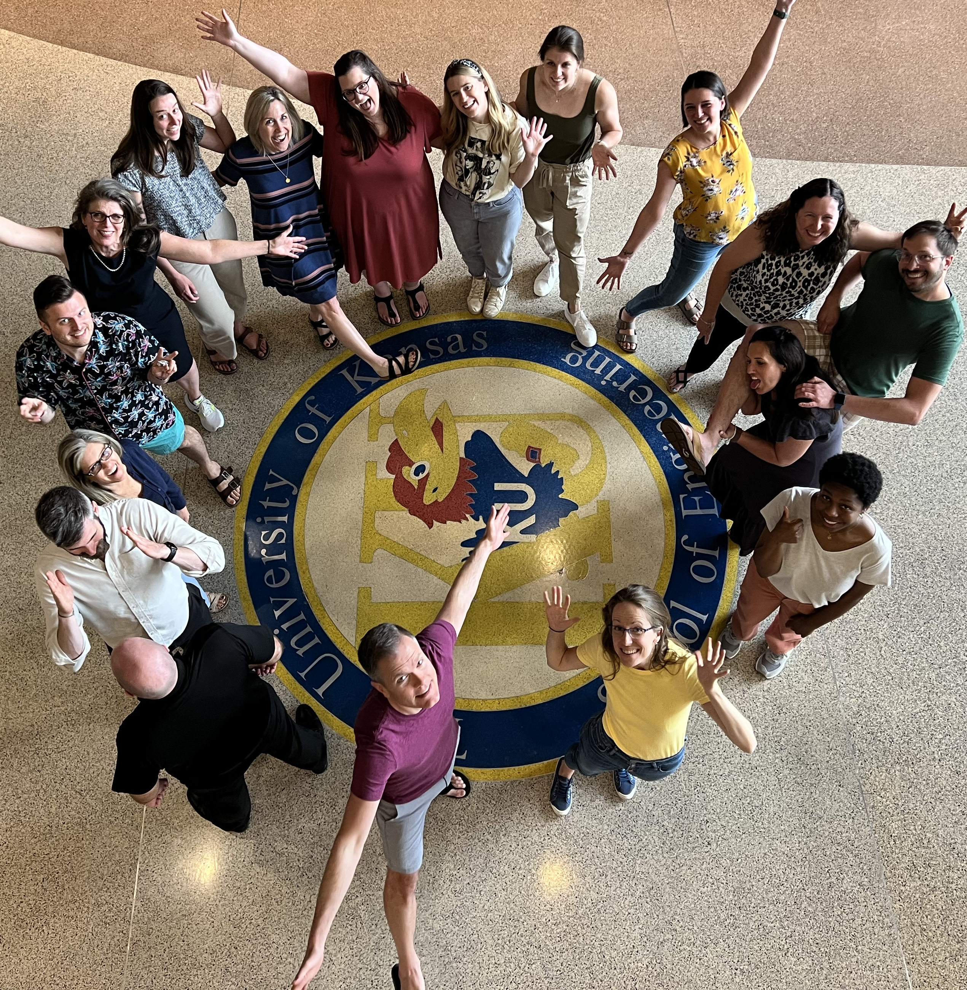
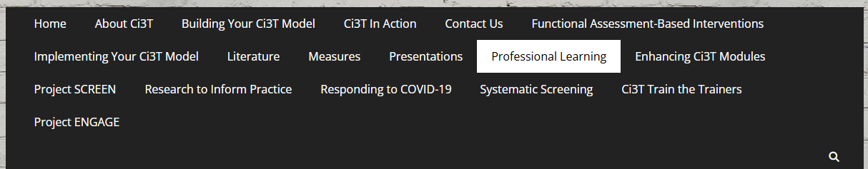

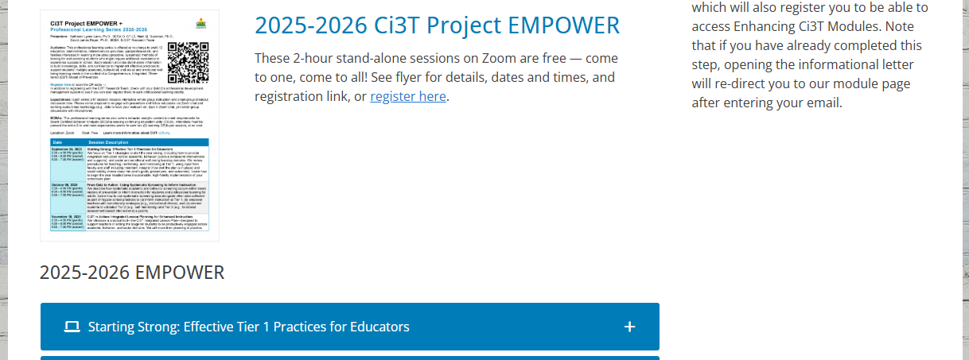
Thank you!
#Ci3T
@Ci3Tmodel
Thank you!
ci3t.org
Tag us in your Ci3T highlights, we love to see Ci3T in action!
Follow us on Instagram for updates and new resources!
Notes:
Tag us in your Ci3T highlights- we would love to see Ci3T in action! Follow us on Instagram for updates and links to resources! @Ci3TModel

