Slide 1


Starting Activity
Step 1: Go to ci3t.org/enhance
Step 2: If you have not already registered to access Enhancing Ci3T Modules, consider doing so.
Step 3: Sign into The Tier 2 Process module (see Ci3T: Implementing Secondary (Tier 2) Interventions)

Slide 2
The Tier 2 Process A Presentation for Topeka Public Schools
This project was funded in part by Project EPIC (USDE, OSEP Award Number: H325D220011) and Project ENHANCE (IES Project Number R324N190002)
Mark Buckman
Kathryn L. Johnson
We invite you to visit ci3t.org/enhance to access our collection of Enhancing Ci3T Modules following a one-time registration process!

Slide 3
Agenda
Getting Started
Ci3T Implementation Manual: A Guide to Tier 2 Decisions
The Role of Tier 2 in Ci3T
Using School-wide Data to make Tier 2 Decisions
Essential Elements of Tier 2 Implementation
Wrapping Up and Moving Forward

Slide 4

Learning Outcomes
At the end of this session, learners will be able to:
Use information in your school’s Ci3T Implementation Manual to guide Tier 2 decision making
Explain the role of Tier 2 interventions in Ci3T models
Use school-wide data to connect students to Tier 2 supports
Identify essential elements of implementing and monitoring Tier 2 interventions
Complete a Knowledge Check to get a line item for your resume!

Slide 5

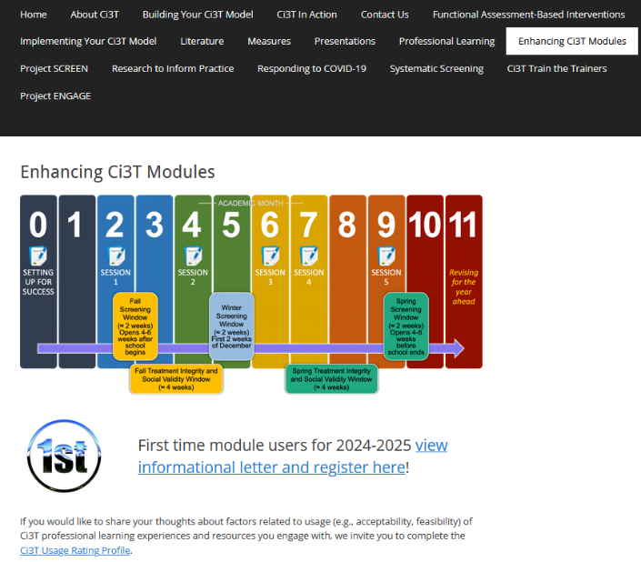


Enhancing Ci3T Modules
ci3t.org/enhance

Slide 6
Getting Started
Setting the Stage for Intervention with Ci3T

Slide 7
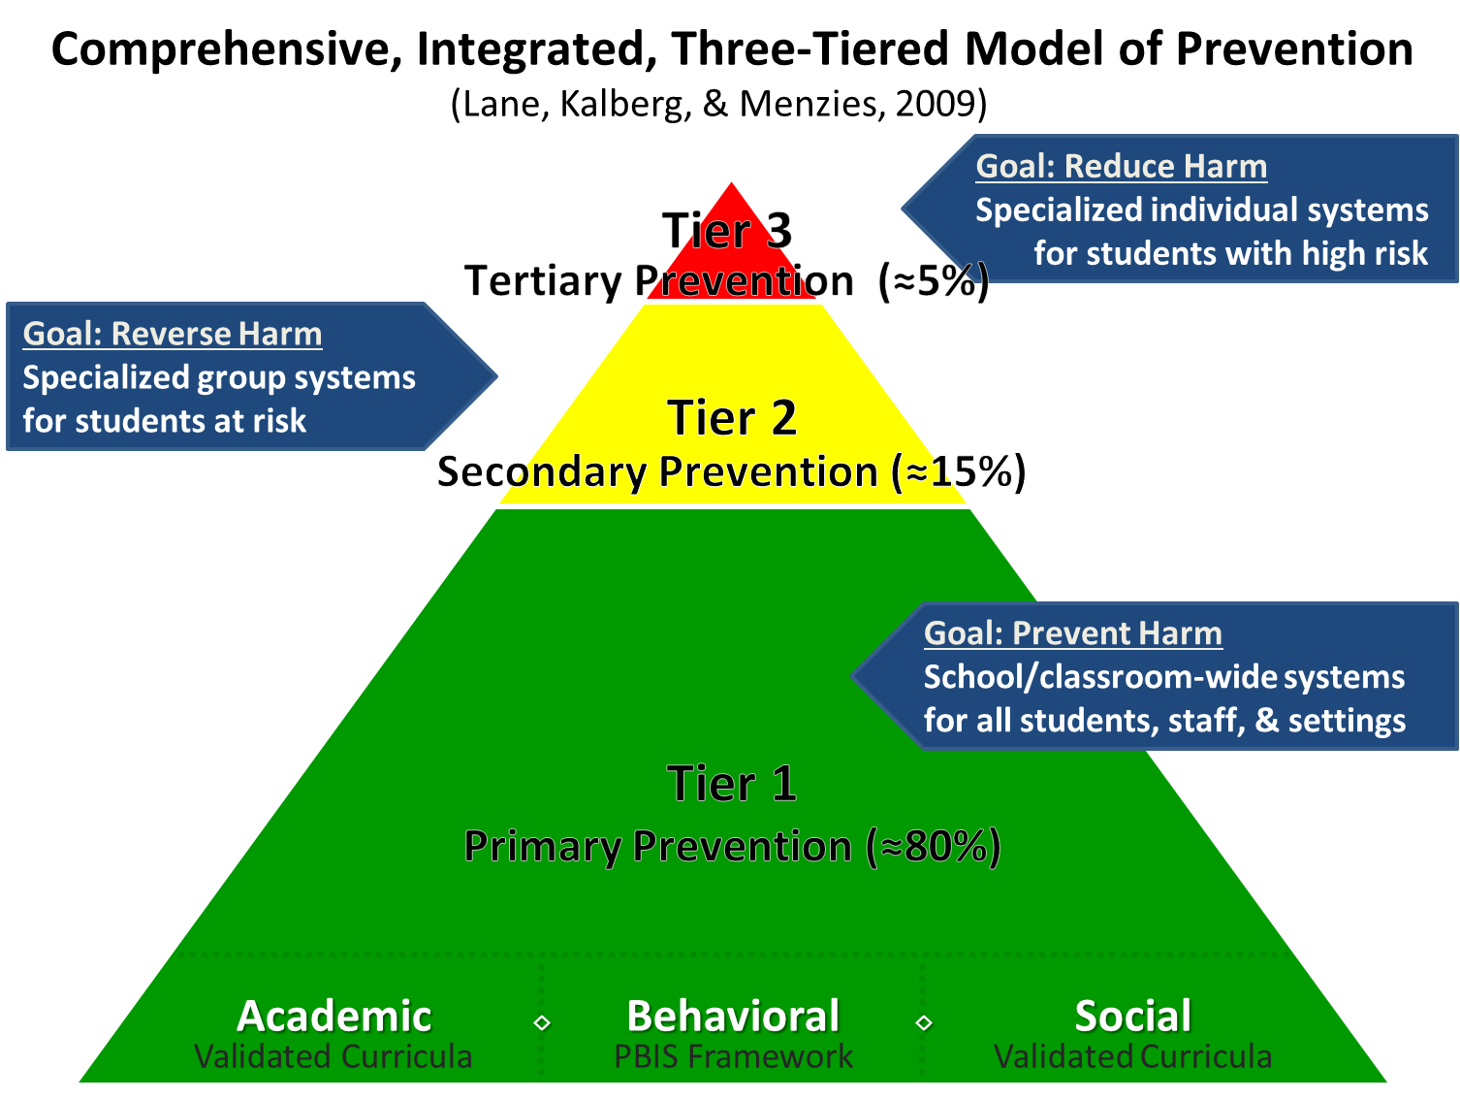
Comprehensive, Integrated, Three-Tiered Model of Prevention 1

Slide 8
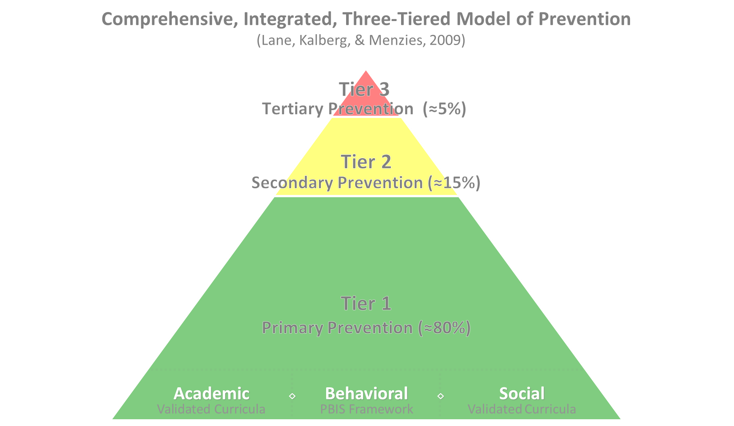

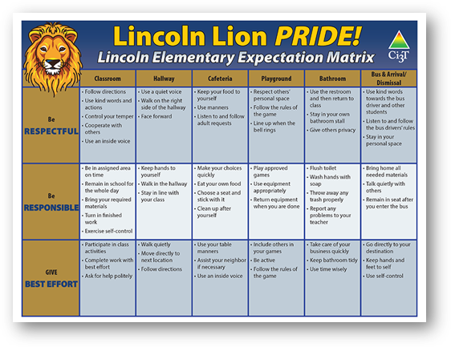
Comprehensive, Integrated, Three-Tiered Model of Prevention 2
Positive Behavioral Interventions and Supports
District & State Standards Quality Instruction
Validated Curricula and Resources

Slide 9


Primary Prevention (Tier 1)

Slide 10
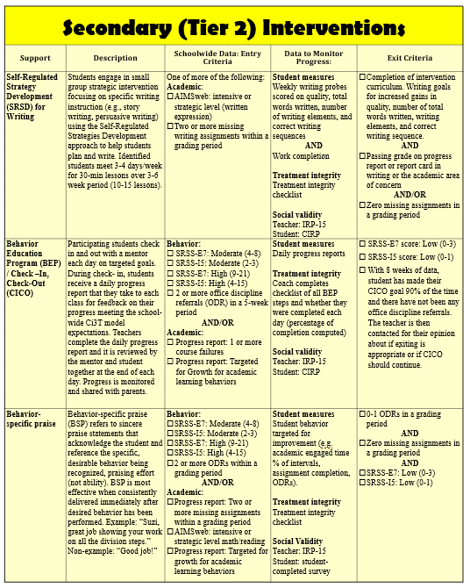
Secondary (Tier 2) Intervention Grid
Secondary (Tier 2) Intervention Grid 1
Notes:
In addition to the module featured here outlining how to use multiple sources of data to connect students with Tier 2 supports, we offer a full suite of modules highlighting validated Tier 2 interventions such as Self-Regulated Strategy Development (SRSD) for Writing and Check-In/Check Out that may appear in your Secondary (Tier 2) Intervention Grid

Slide 11

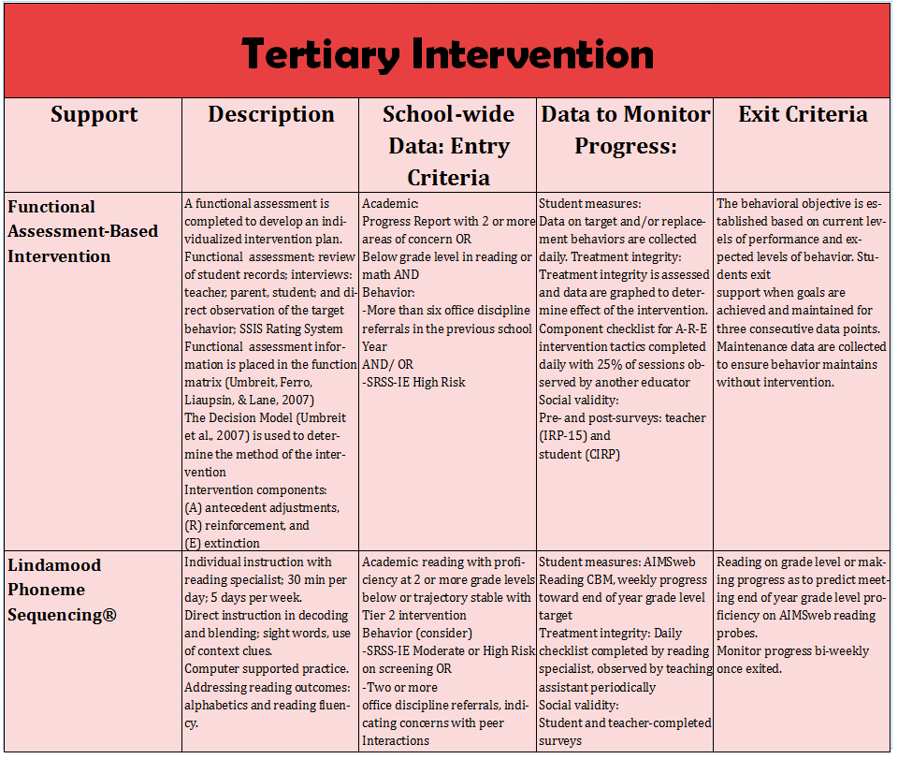
Tertiary (Tier 3) Intervention Grid
Notes:
In addition to the module featured here outlining how to use multiple sources of data to connect students with Tier 3 supports, we offer a full suite of modules highlighting validated Tier 3 interventions such as Functional Assessment-Based Intervention (FABI) that may appear in your Tertiary (Tier 3) Intervention Grid

Slide 12
Ci3T Implementation Manual
A Guide to Tier 2 Decisions

Slide 13


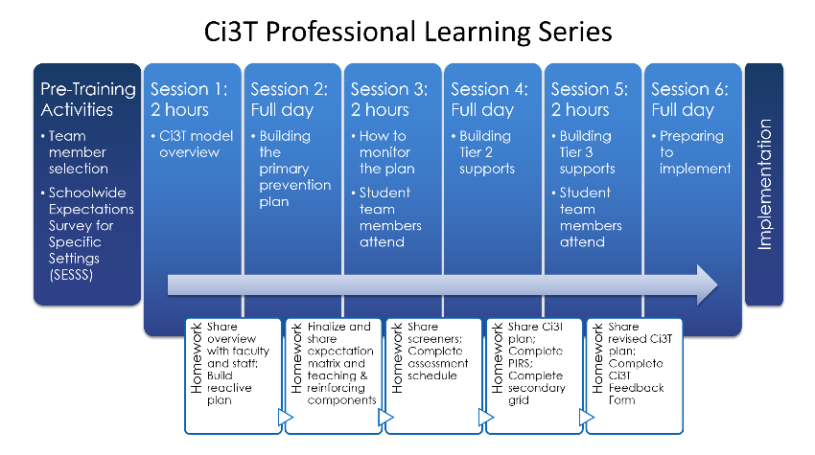

A Quick History Lesson
2015-2020
Ci3T Building Process in TPS

Slide 14

Ci3T Implementation Manual (1)
What’s the purpose?
Transparency
Consistency
Communication and collaboration
Sharing data
Guiding professional learning
Informing intervention decisions

Slide 15
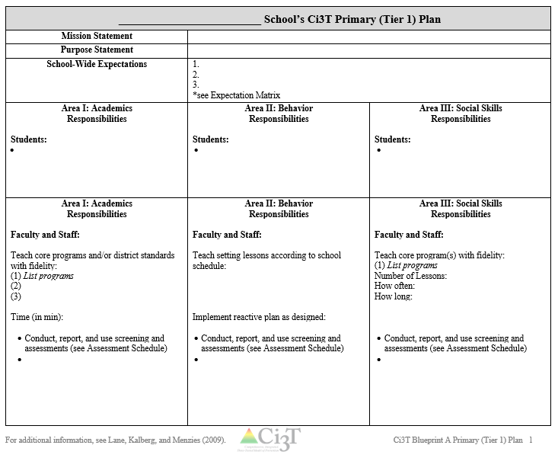
Ci3T Implementation Manual (2)
Primary (Tier 1) Plan
Roles & Responsibilities
Academics
Behavior
Social Skills
Procedures for:
Teaching
Reinforcing
Monitoring

Slide 16
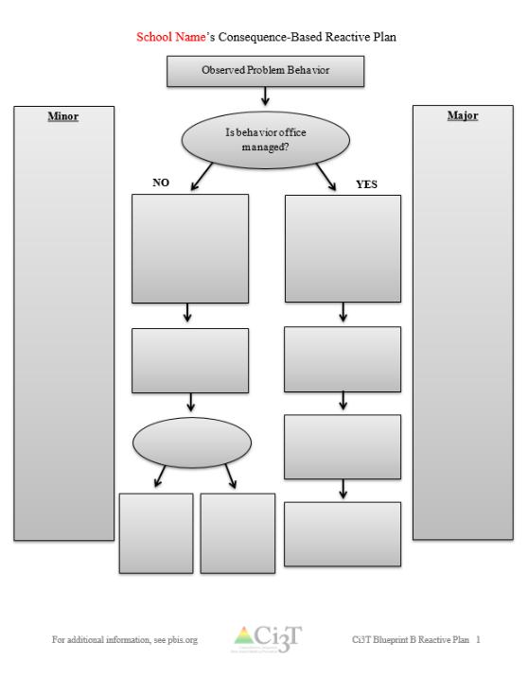
Ci3T Implementation Manual (3)
Reactive Plan
Flowchart describing procedures for responding to challenging behavior
Definitions of terms and behaviors

Slide 17
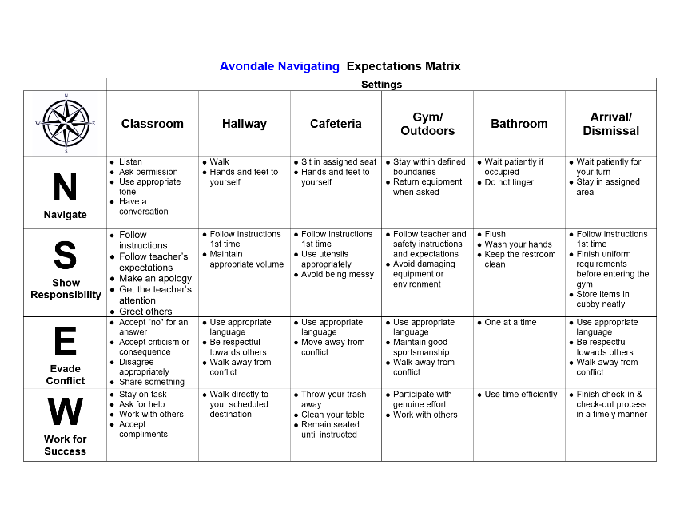
Ci3T Implementation Manual (4)
Schoolwide Expectation Matrix
Expectations across school settings

Slide 18
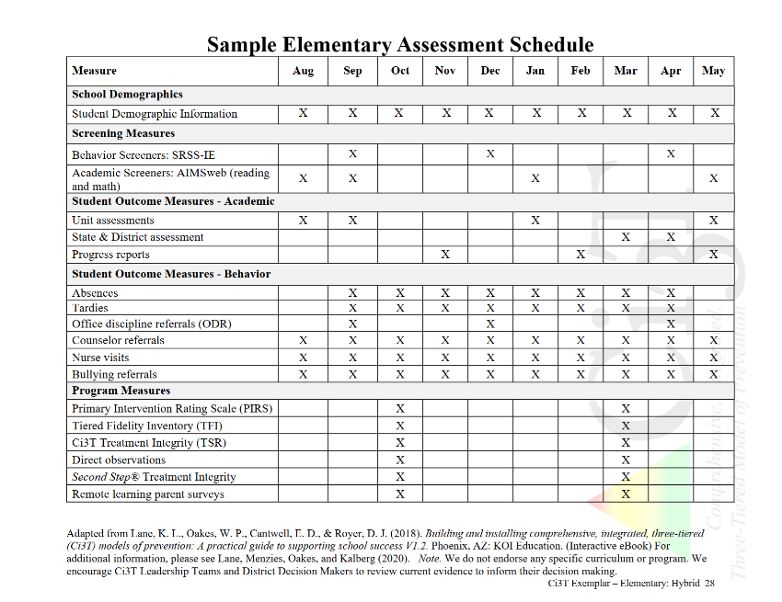
Ci3T Implementation Manual (5)
Assessment Schedule
Presents all data collected, including data collection windows

Slide 19
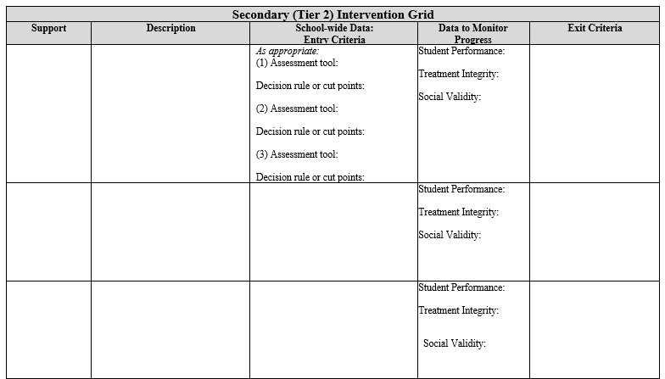
Ci3T Implementation Manual (6)
Secondary (Tier 2) Intervention Grid
Names and describes available interventions
Presents entry criteria and exist using school-wide data sources
Lays out a progress monitoring plan

Slide 20
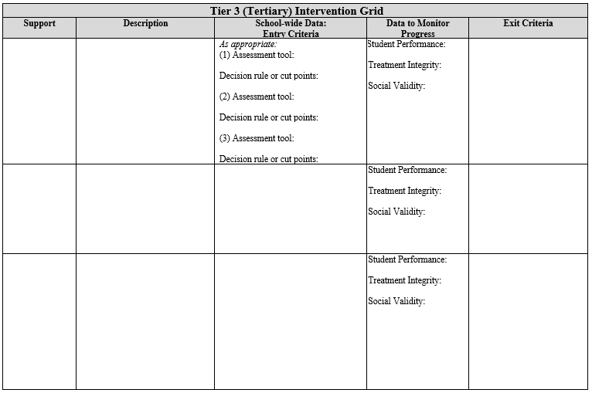
Ci3T Implementation Manual (7)
Secondary (Tier 3) Intervention Grid
Names and describes available interventions
Presents entry criteria and exist using school-wide data sources
Lays out a progress monitoring plan

Slide 21
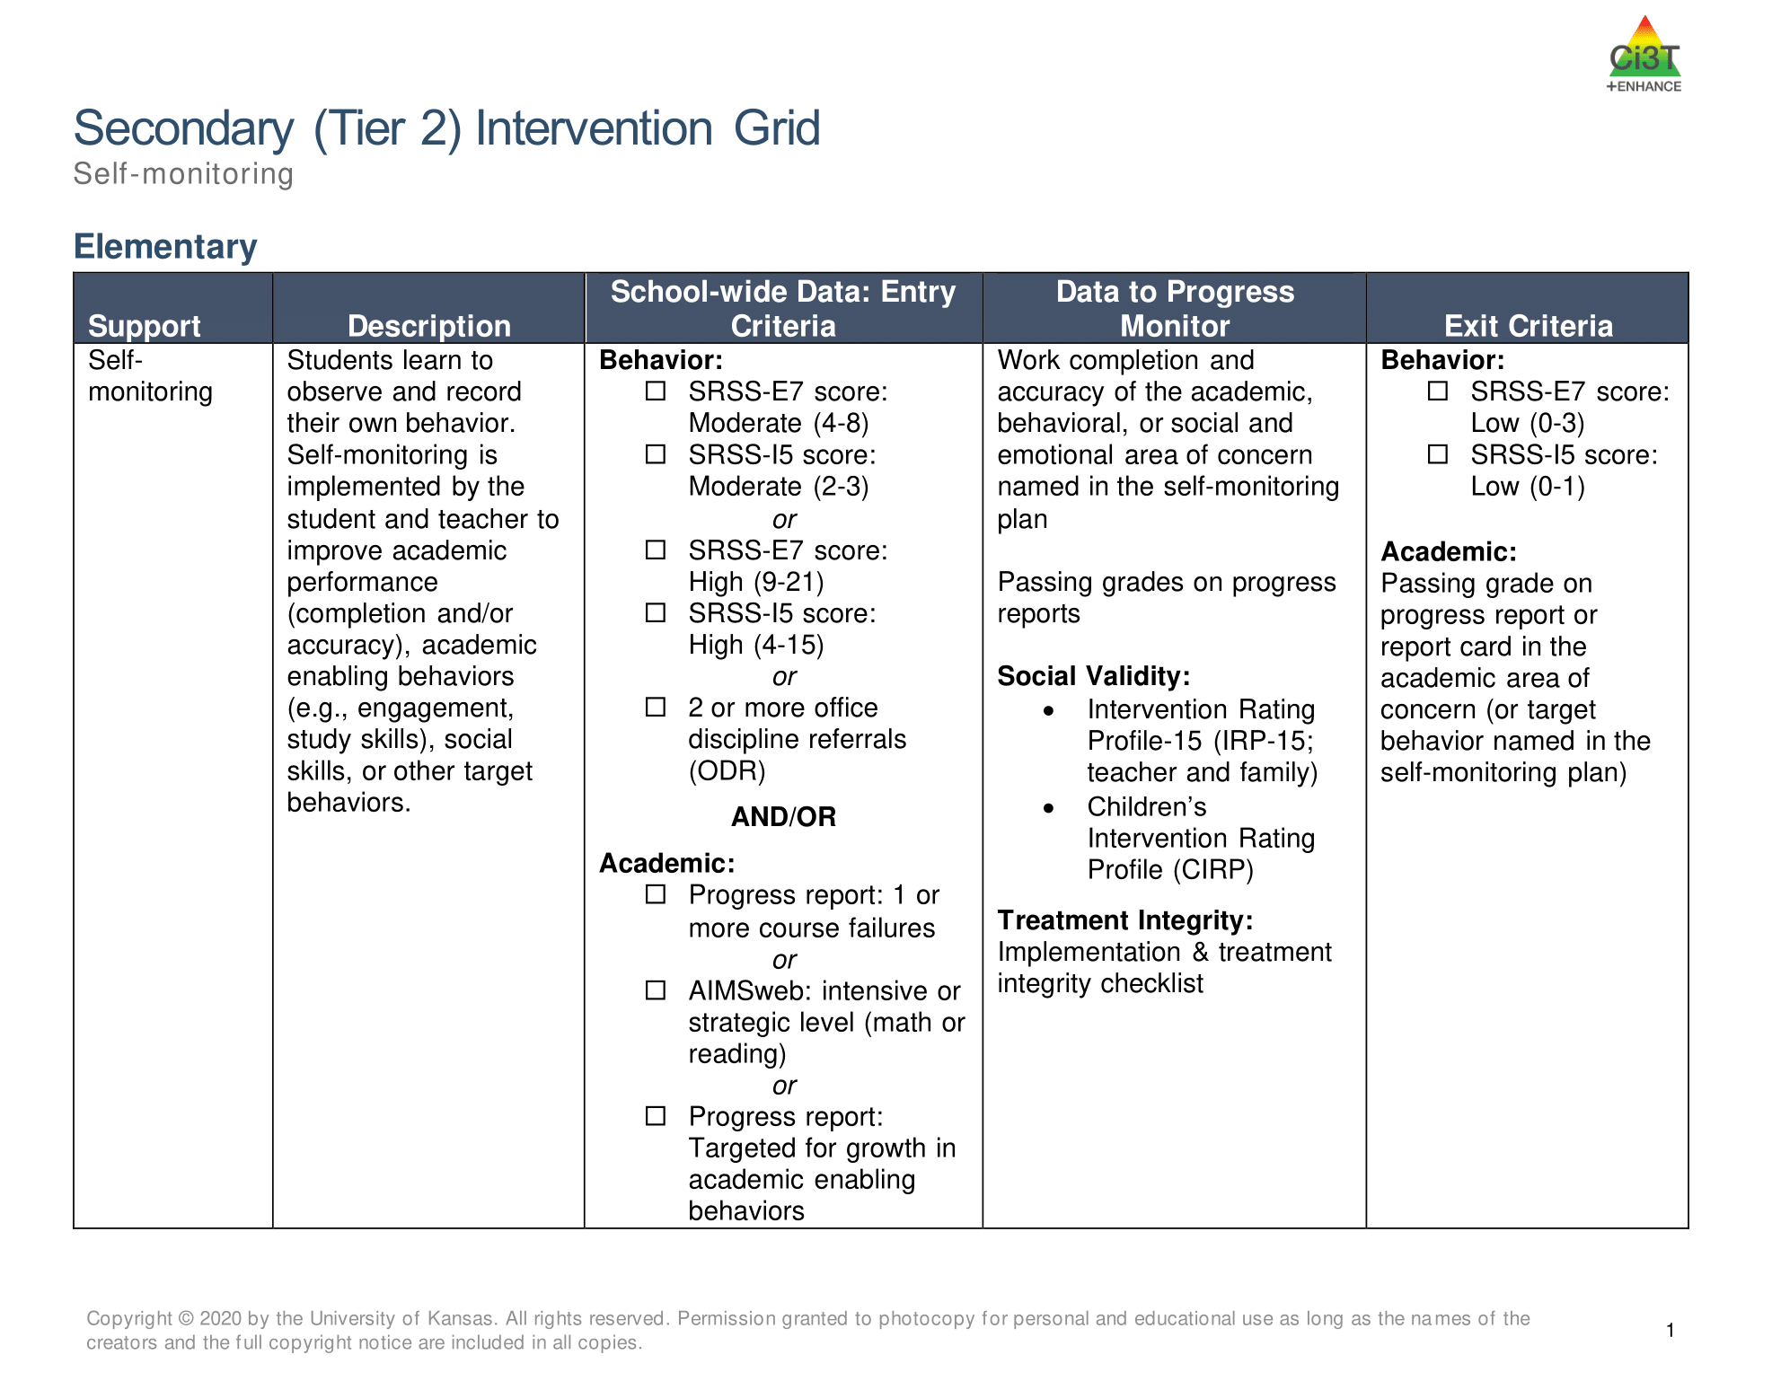
Secondary (Tier 2) Intervention Grid A Closer Look
What’s the purpose?
Guidance on school-supported interventions
Intervention “shopping”
Reducing guess-work

Slide 22
Secondary (Tier 2) Intervention Grid: A Closer Look
What’s the purpose?
Guidance on school-supported interventions
Intervention “shopping”
Reducing guess-work

Slide 23








Work Time (1)
Work Time
Take a few minutes to: Locate your school’s Ci3T Implementation Manual Within the manual, review available Secondary (Tier 2) Intervention Grid
Notes:
5-min timer

Slide 24
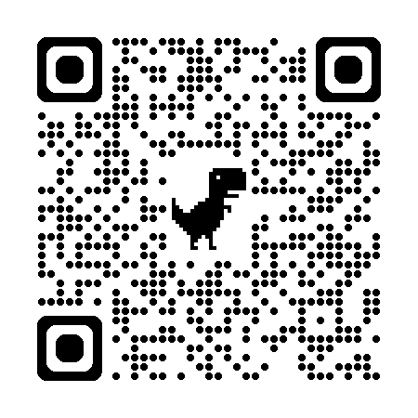
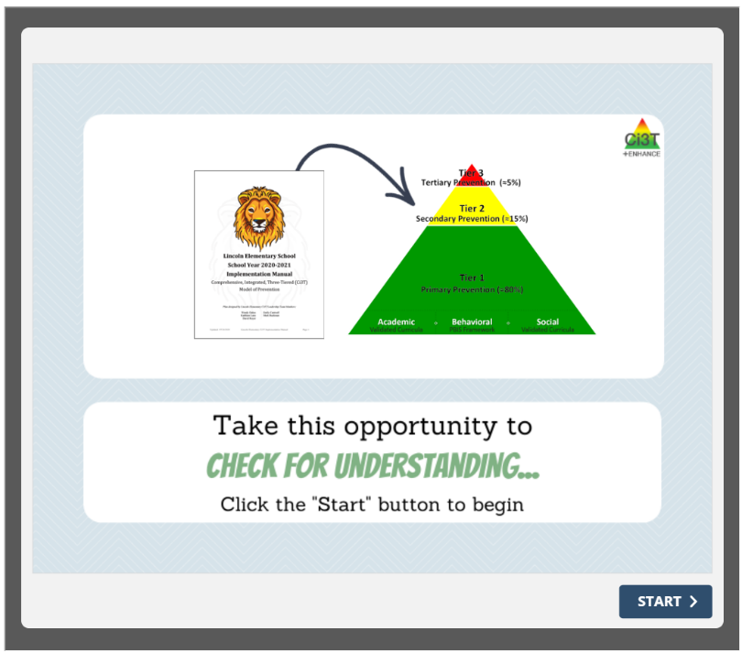
Check for Understanding Ci3T Implementation Manual

Slide 25
The Role of Tier 2 in Ci3T

Slide 26

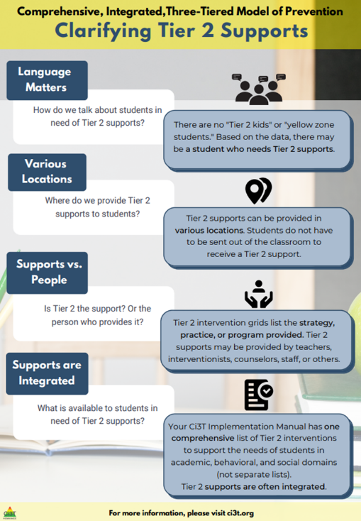
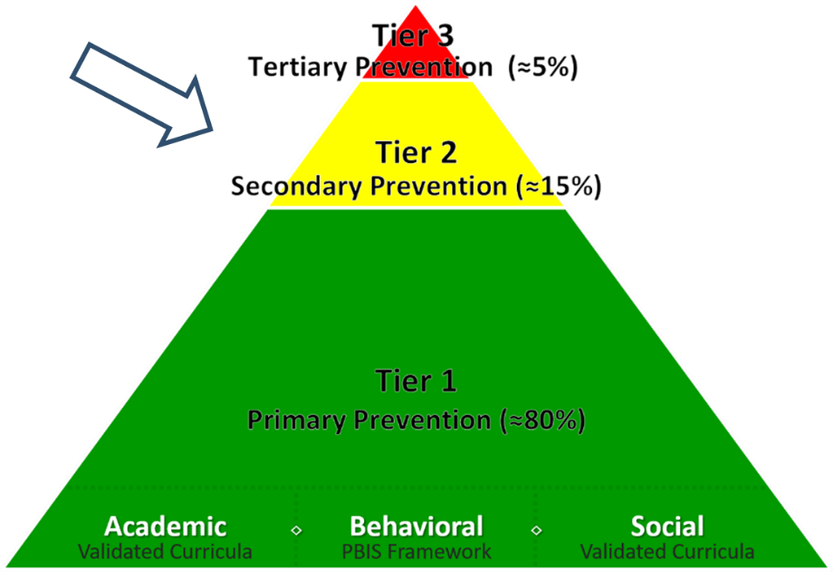
Tier 2 in Ci3T

Slide 27

Clarifying Tier 2 Supports 2

Slide 28
Clarifying Tier 2 Supports 3

Slide 29
What are Tier 2 Interventions?
Evidenced-based or research-based strategies, practices, and programs
Additive (i.e., compliment rather than replace Tier 1 efforts)
Implemented by teachers, interventionists, counselors, paraprofessionals, and other staff
Occur in a variety of formats and locations (e.g., small-group, 1:1, embedded within whole group instruction)

Slide 30

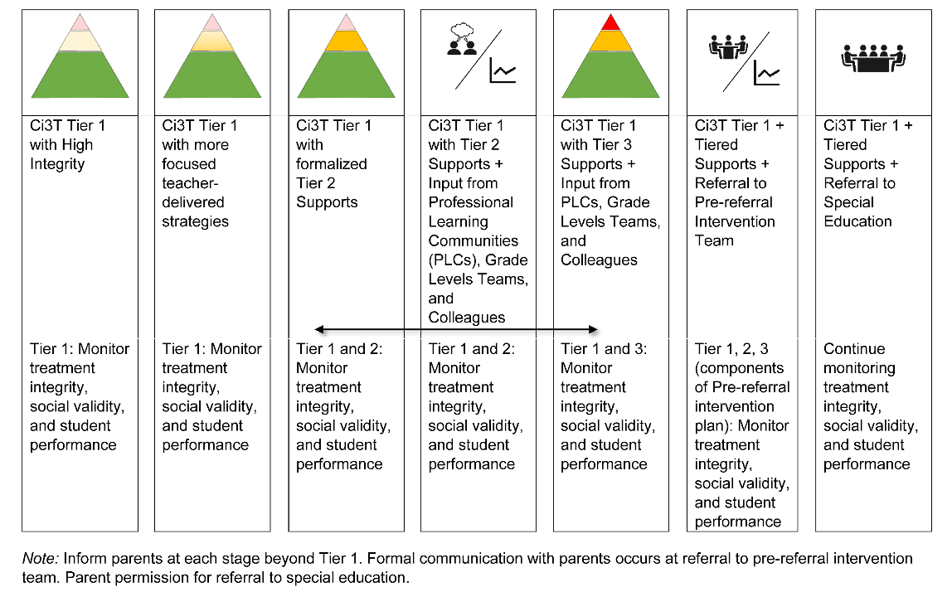
Tier 2 and GEI? (1)

Slide 31
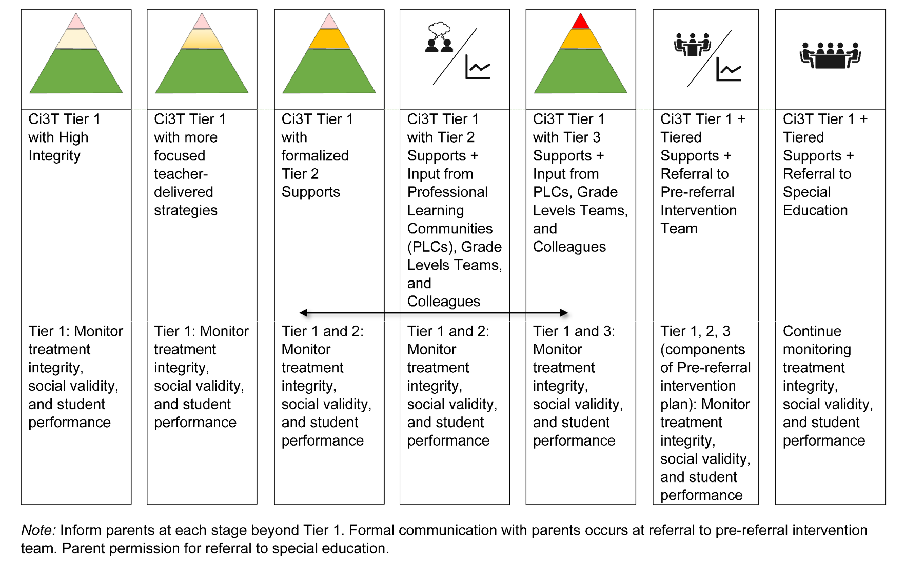
Tier 2 and GEI? (2)
Tiered Intervention
GEI

Slide 32

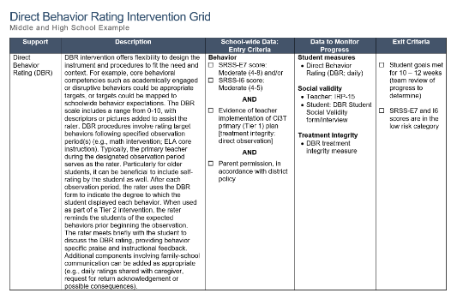
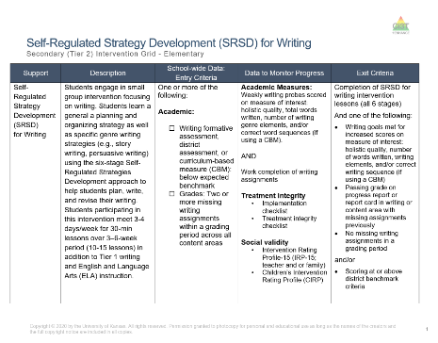
Secondary (Tier 2) Intervention Grid A Review

Slide 33

School-wide Data: Entry Criteria

Slide 34
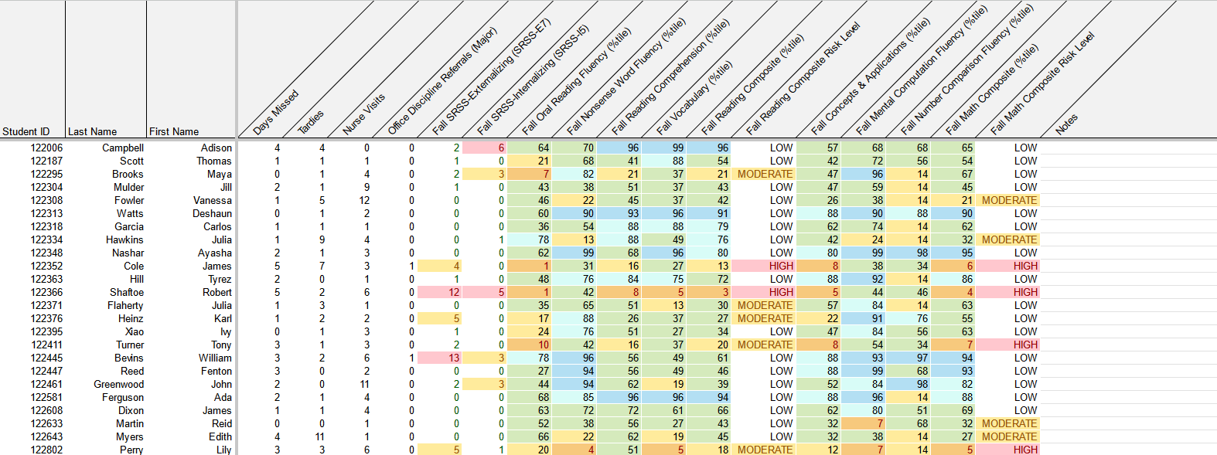
School-Wide Data Sources to Consider
attendance
behavior
screening
academic screening

Slide 35
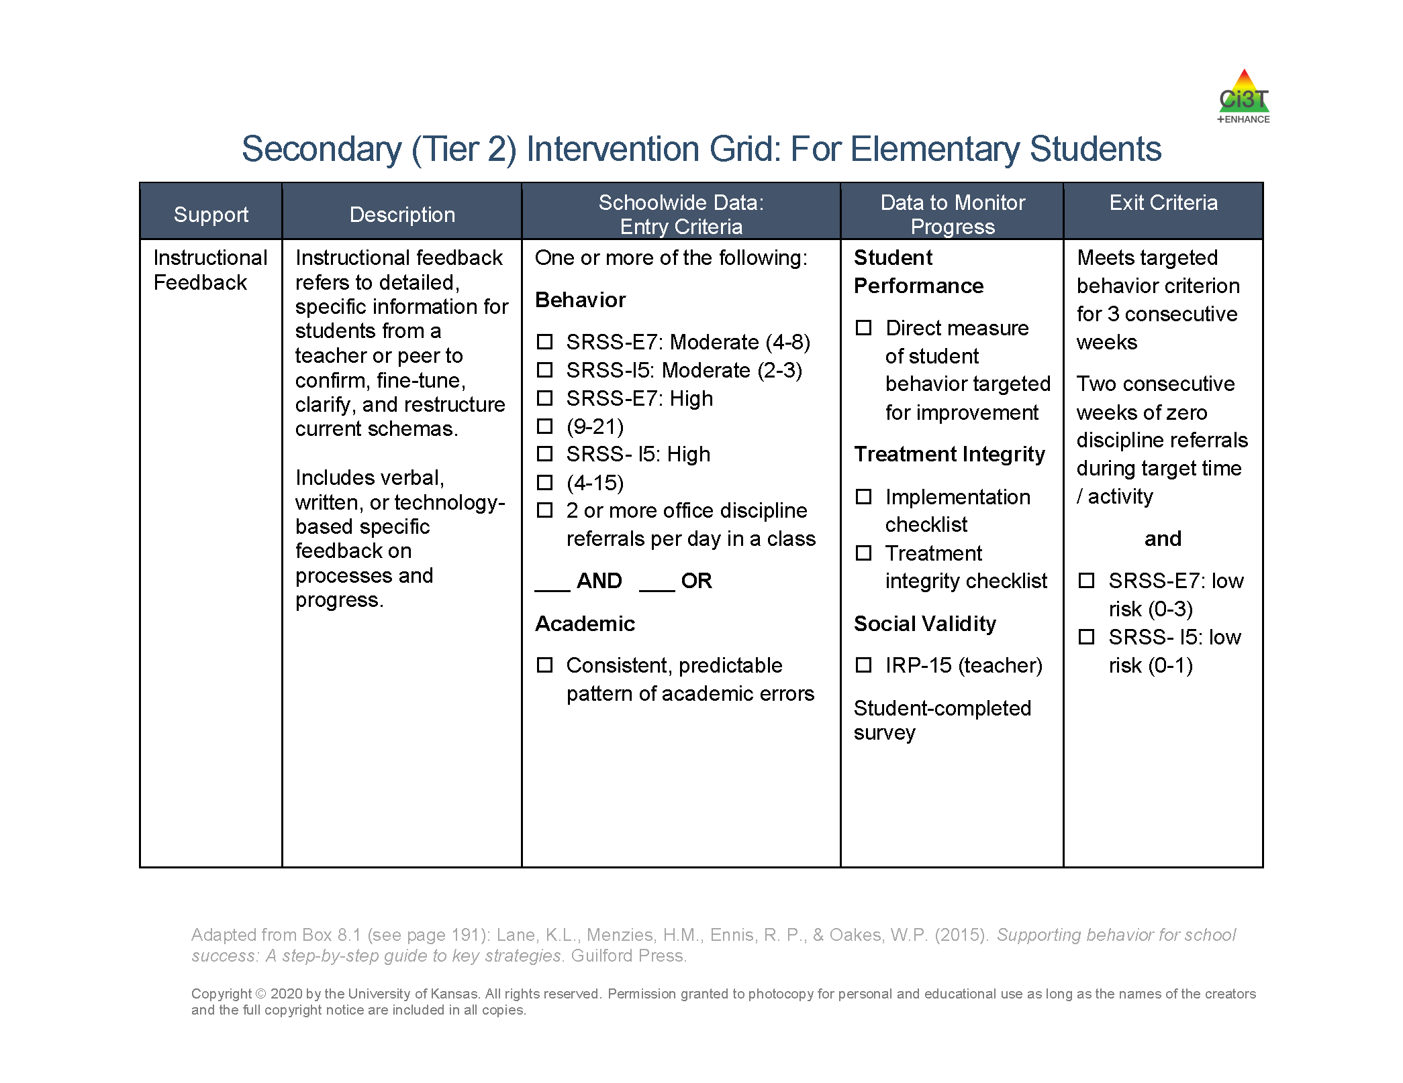

Low-Intensity, Teacher-Delivered Strategies as a Stand-Alone Tier 2 Intervention

Slide 36

Tier 2 Modules (1)

Slide 37

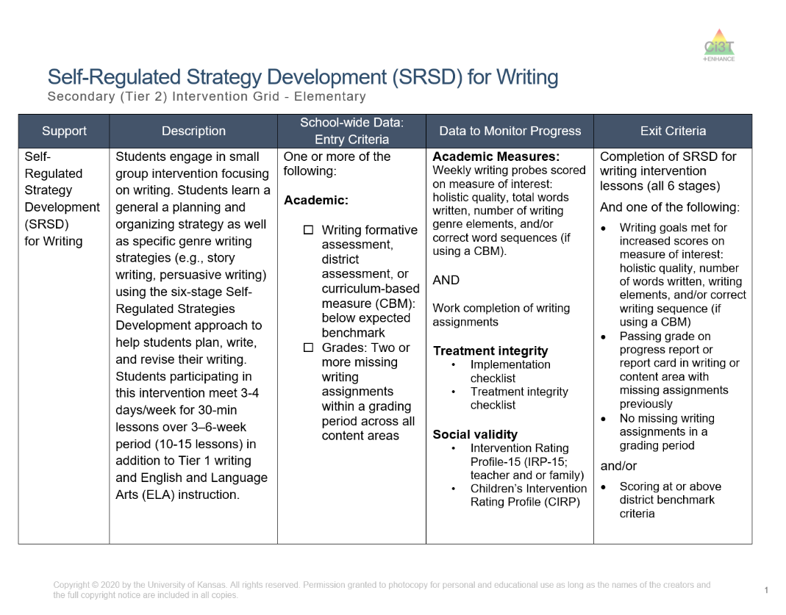
SRSD for Writing

Slide 38

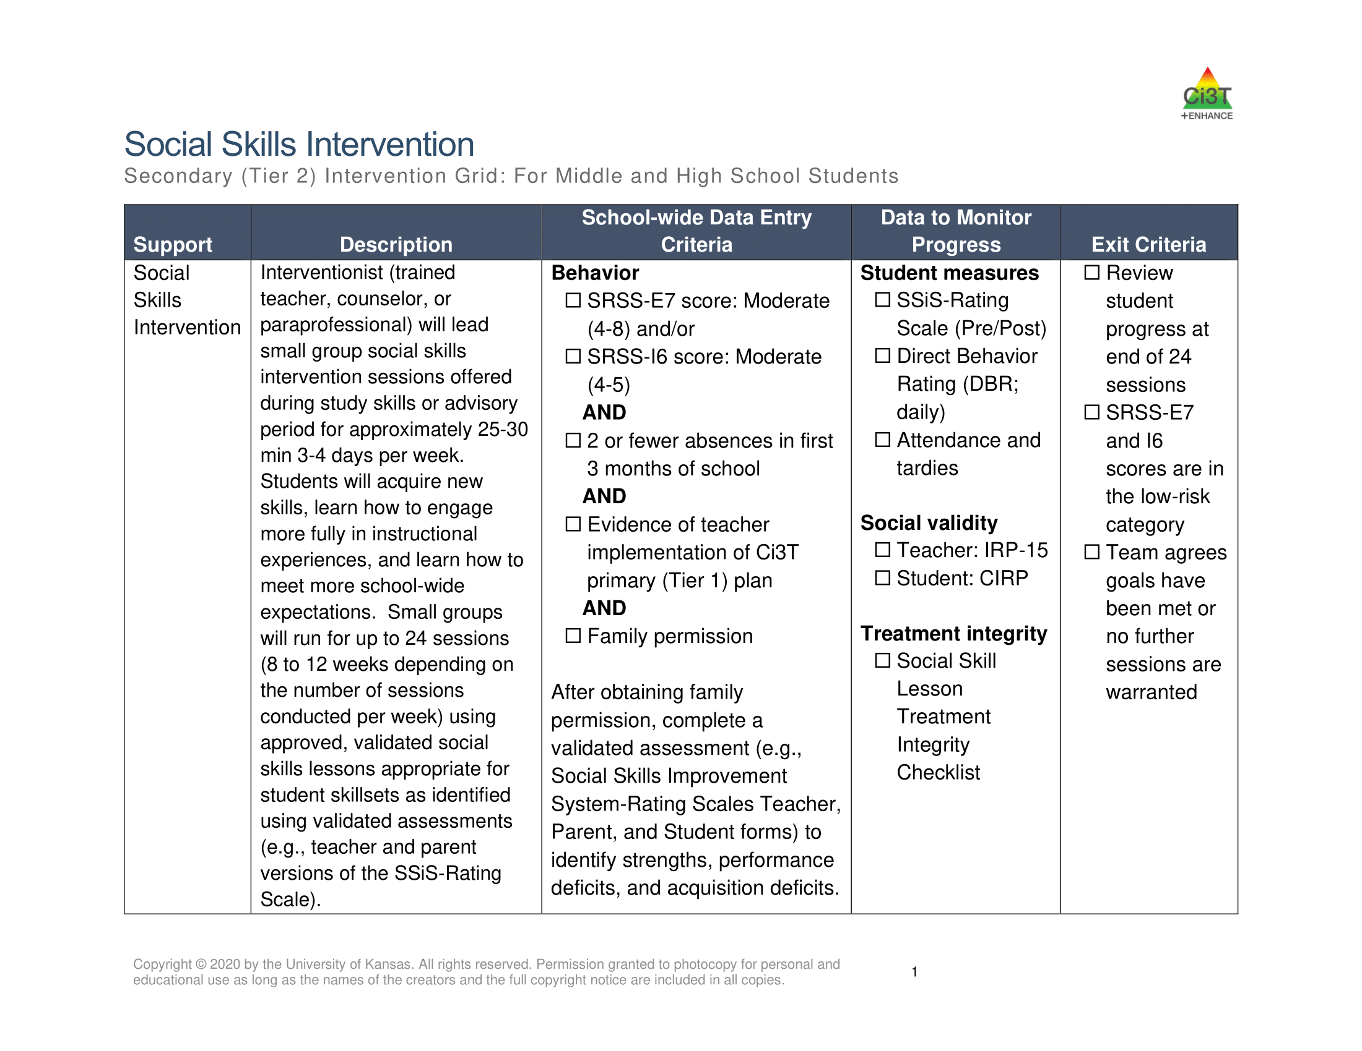
Social Skills

Slide 39

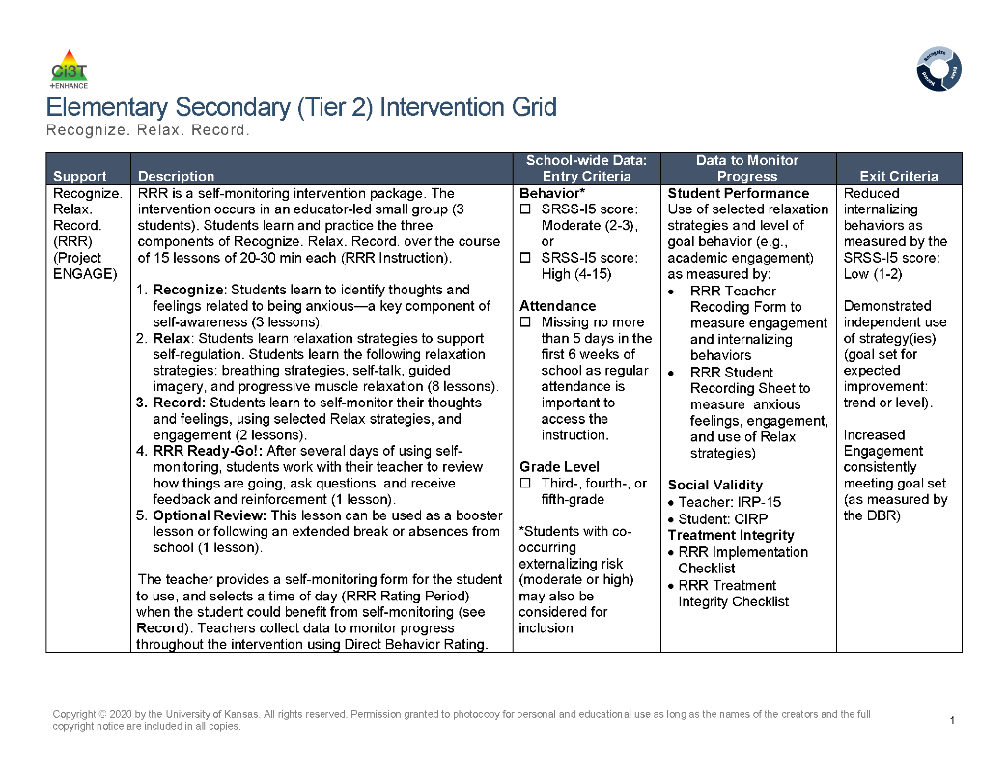
Recognize.Relax.Record

Slide 40

Join us at future EMPOWER+ to learn more!
EMPOWER+ Session | Date
Starting Strong: Effective Tier 1 Practices for Educators | September 24, 2025 (Wednesday)
From Data to Action: Using Systematic Screening to Inform Instruction | October 8, 2025 (Wednesday)
Ci3T In Action: Integrated Lesson Planning for Enhanced Instruction | November 18, 2025 (Tuesday)
Mastering Behavior Specific Praise and Precorrection | January 21, 2026 (Wednesday)
A 6-Step Instructional Approach for Responding to Challenging Behaviors: A Tier 1 Practice | February 10, 2026 (Tuesday)
A Tier 2 Support for Students Experiencing Anxious Feelings: Recognize. Relax. Record. | March 25, 2026 (Wednesday)
A Tier 3 Support for Students with Intensive Intervention Needs: Functional Assessment-Based Intervention (FABI) | April 28, 2026 (Tuesday)

Slide 41
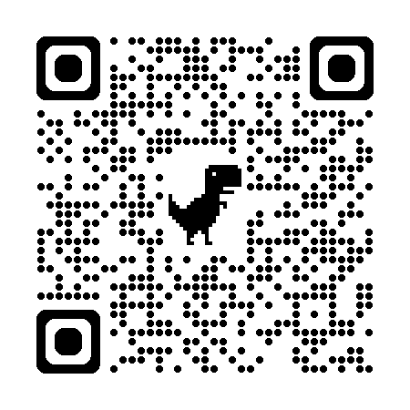
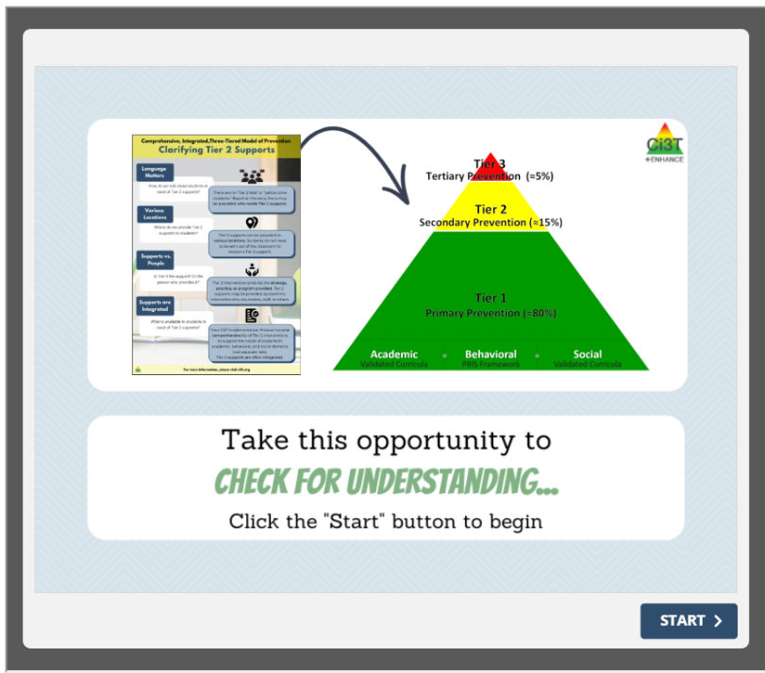
Check for Understanding The Role of Tier 2 in Ci3T

Slide 42
Using Systematic Screening Data to Connect Students to Validated Tier 2 Supports

Slide 43
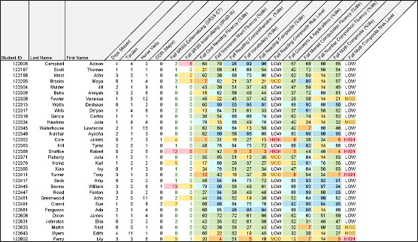
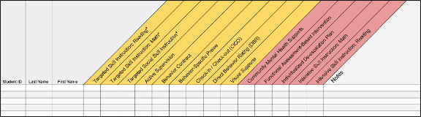
Getting Started with Data-Informed Decision Making

Slide 44

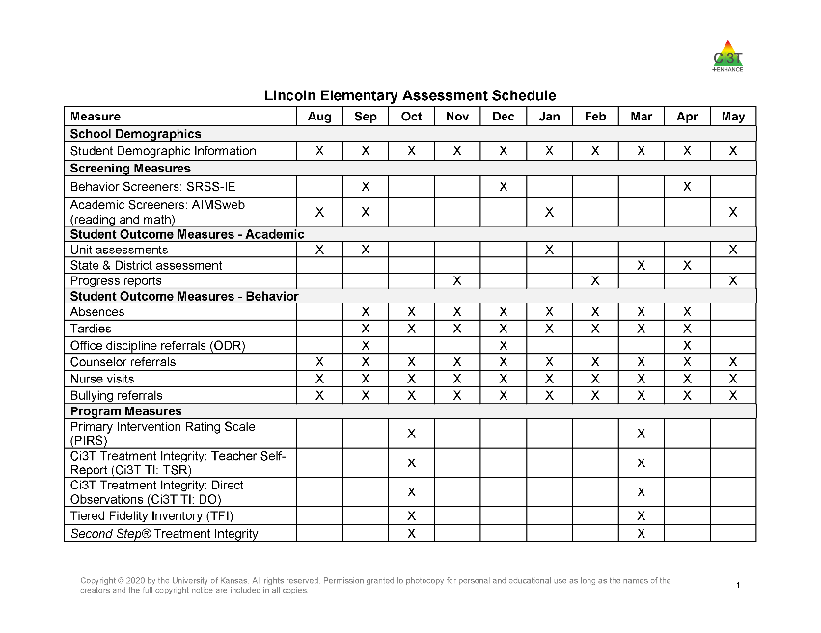
School-wide Data Sources
Tier 1 data
social validity
treatment integrity
Student-level data
Systematic screening (academics + behavior)
Attendance
Office discipline referrals
Nurse visits
Grades

Slide 45
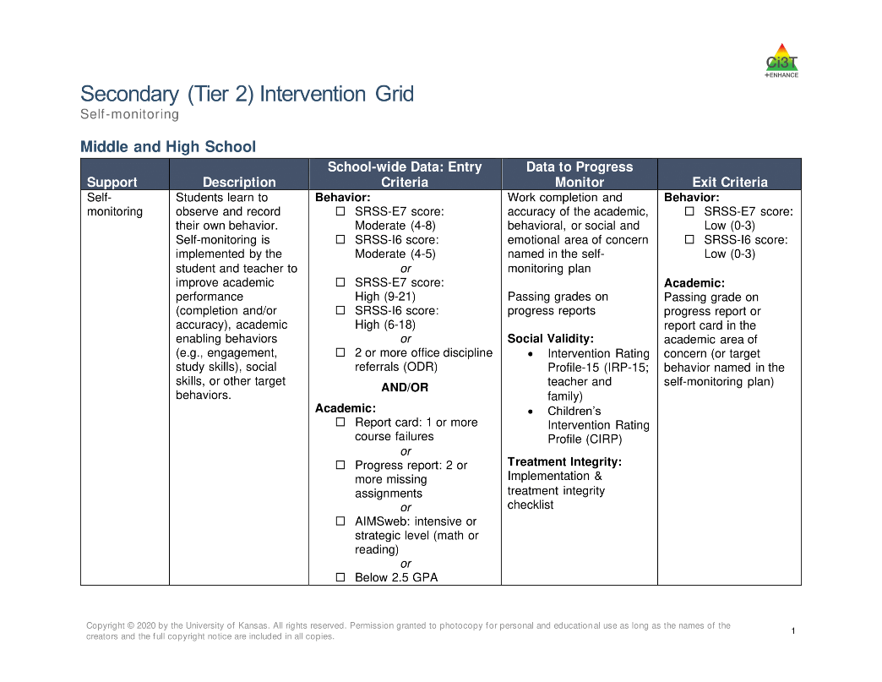
Tier 2 Intervention Grid

Slide 46

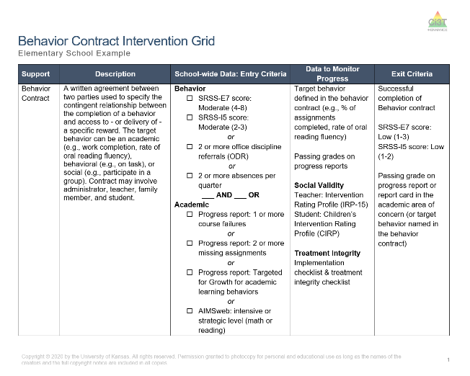
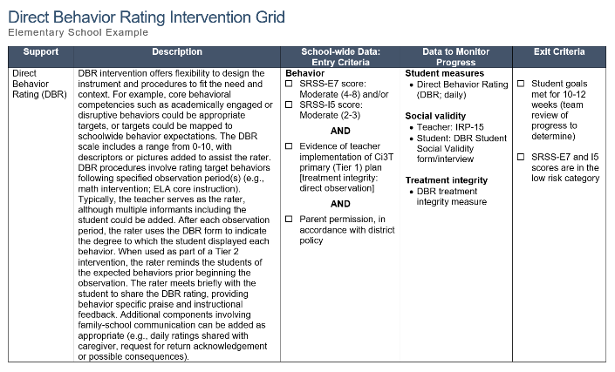
Selecting an Intervention (1)

Slide 47

Selecting an Intervention (2)
Collaborate with families, colleagues, and the student to review available options
Consider what you know about the student (e.g., strengths, preferences, pre-requisite skills)
Consider possible function of the behavior
Check-In Check Out is may be more effective for students who find accessing adult attention reinforcing
Consider your own strengths, support available (e.g., coach, professional learning), and feasibility of available options
Adjust as needed based on pre-intervention social validity

Slide 48
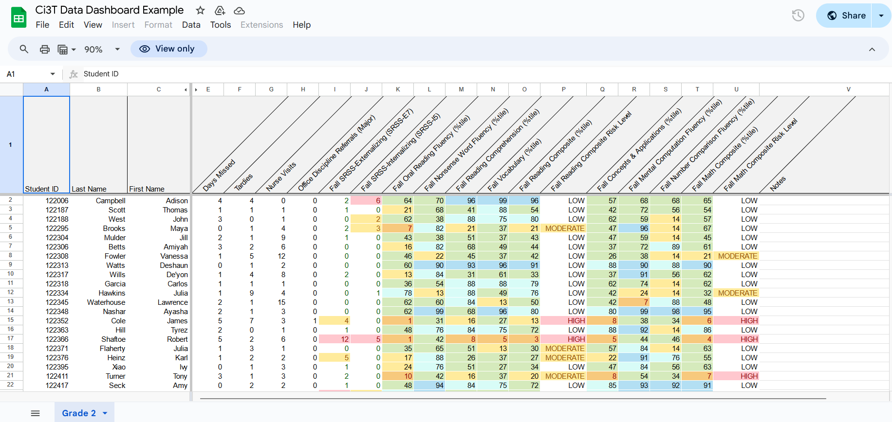
Tool 1: Ci3T Data Dashboard
Notes:
Interact with the Ci3T Data Dashboard!
Model:
Filter
Moderate internalizing
Below grade level reading
Attendance – now what do you notice
Ci3T Implementation Manual
What intervention(s) might be appropriate for this student? (e.g., self-monitoring w/ reading, breathing strategy)

Slide 49
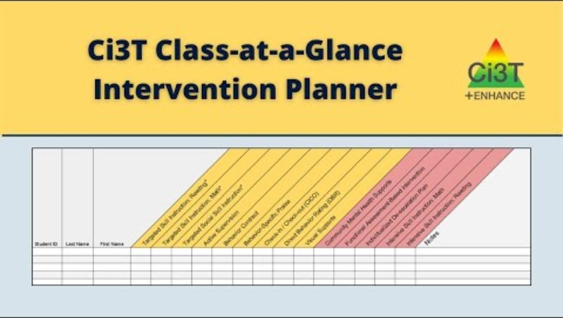
Tool 2: Ci3T Class-at-a-Glance Intervention Planner
Notes:
Spreadsheet Template: Ci3T Class-at-a-Glance Intervention Planner

Slide 50
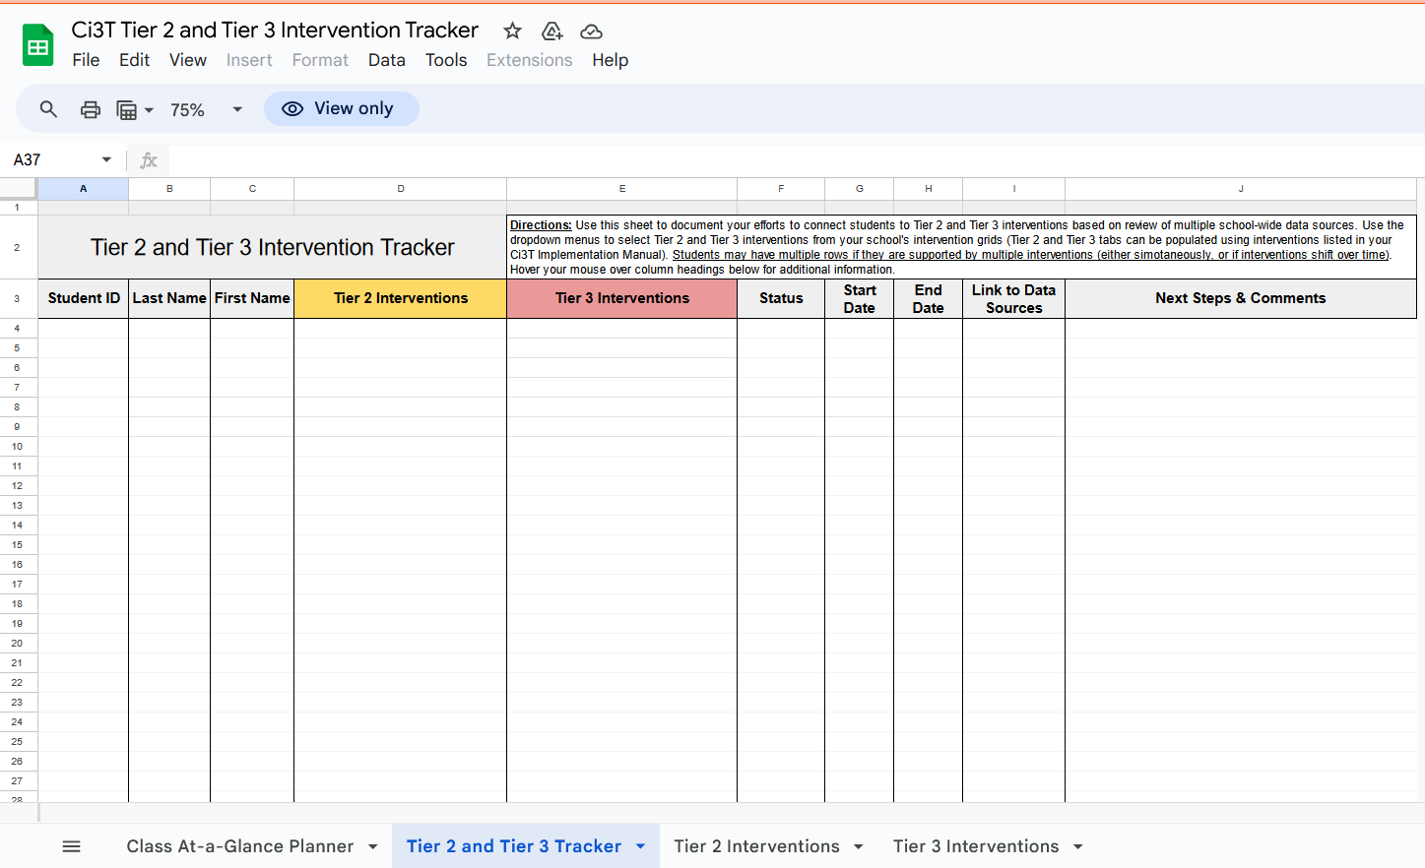
Tool 3: Ci3T Tier 2 and Tier 3 Intervention Tracker
Notes:
Spreadsheet Template: Ci3T Tier 2 and Tier 3 Intervention Tracker (see tab 2)

Slide 51
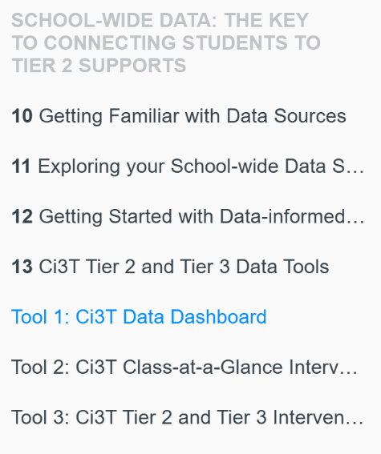

Activity Preparation Access Tool 1, Tool 2, and/or Tool 3
Step 1: Go to ci3t.org/enhance
Step 4: On the toolbar, locate the resource you would like to explore (Tool 1, Tool 2, or Tool 3)
Step 2: Locate The Tier 2 Process module (see Ci3T: Implementing Secondary (Tier 2) Interventions)
Step 3: Sign into the module using your district email (if you haven’t yet registered, directions will be provided to do so)

Slide 52


















Work Time (2)
Work Time
Locate data tools in the Enhancing Ci3T Module The Tier 2 Process Tool 1: Ci3T Data Dashboard Tool 2: Ci3T Class-at-a-Glance Intervention Planner Tool 3: Ci3T Tier 2 and Tier 3 Intervention Tracker Explore the tool of most interest/relevance to you Practice using data to connect students from the Ci3T Data Dashboard to Tier 2 and Tier 3 interventions using either Tool 2 or Tool 3.
Notes:
15-min timer

Slide 53
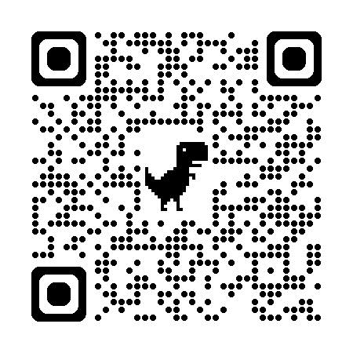
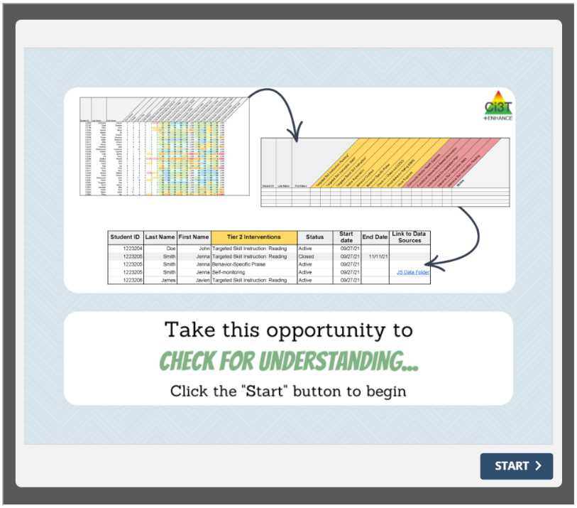
Check for Understanding Using Systematic Screening Data to Connect Students to Validated Tier 2 Supports

Slide 54
Essential Elements of Tier 2 Implementation

Slide 55

Tier 2 Ingredients
Effective Tier 2 interventions (across academic, behavioral, and social and emotional domains) mix and match these ingredients based on students’ needs:
Extra time and instruction to promote skill development (“can’t do” growth areas)
Increased opportunities for feedback (“won’t do” growth areas)
Added structure and predictability

Slide 56
Tier 2 Modules (2)

Slide 57

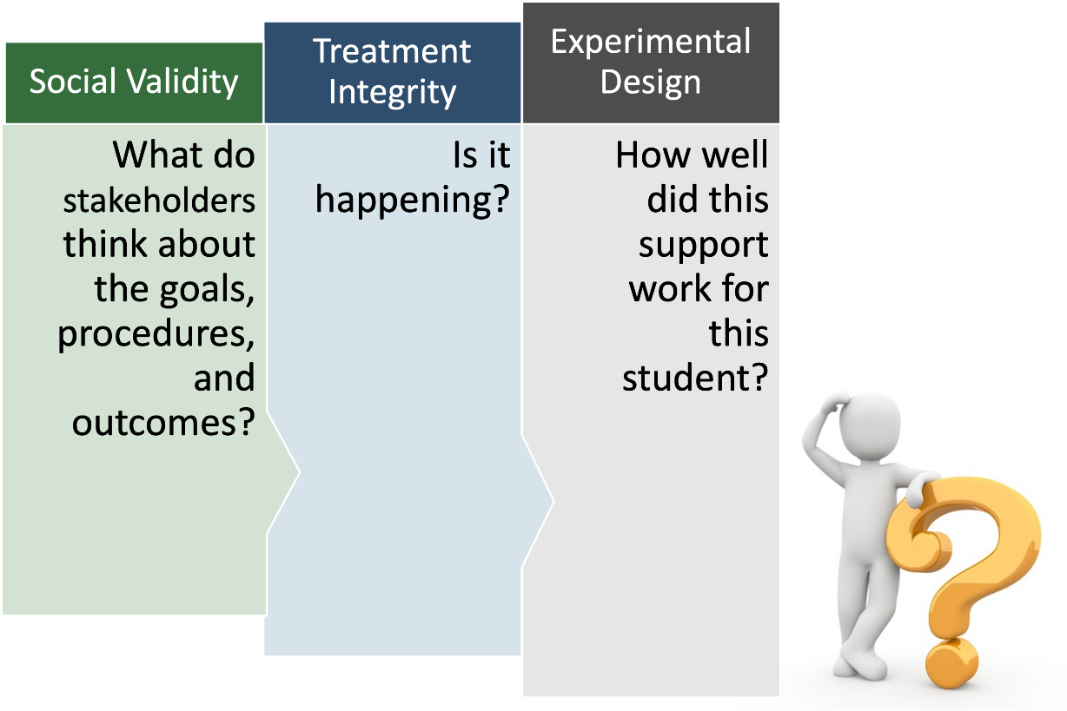
Tier 2 Three Important Data Sources

Slide 58
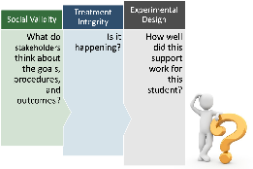
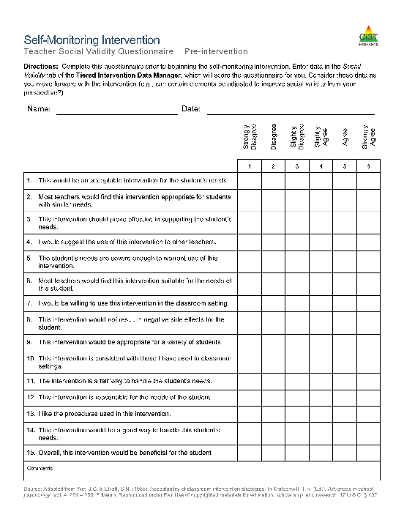
Tier 2 Social Validity
Acceptability of intervention:
goals
procedures
outcomes
Commonly assessed using short rating scales from multiple perspectives:
Student
Teacher
Parents/Family

Slide 59
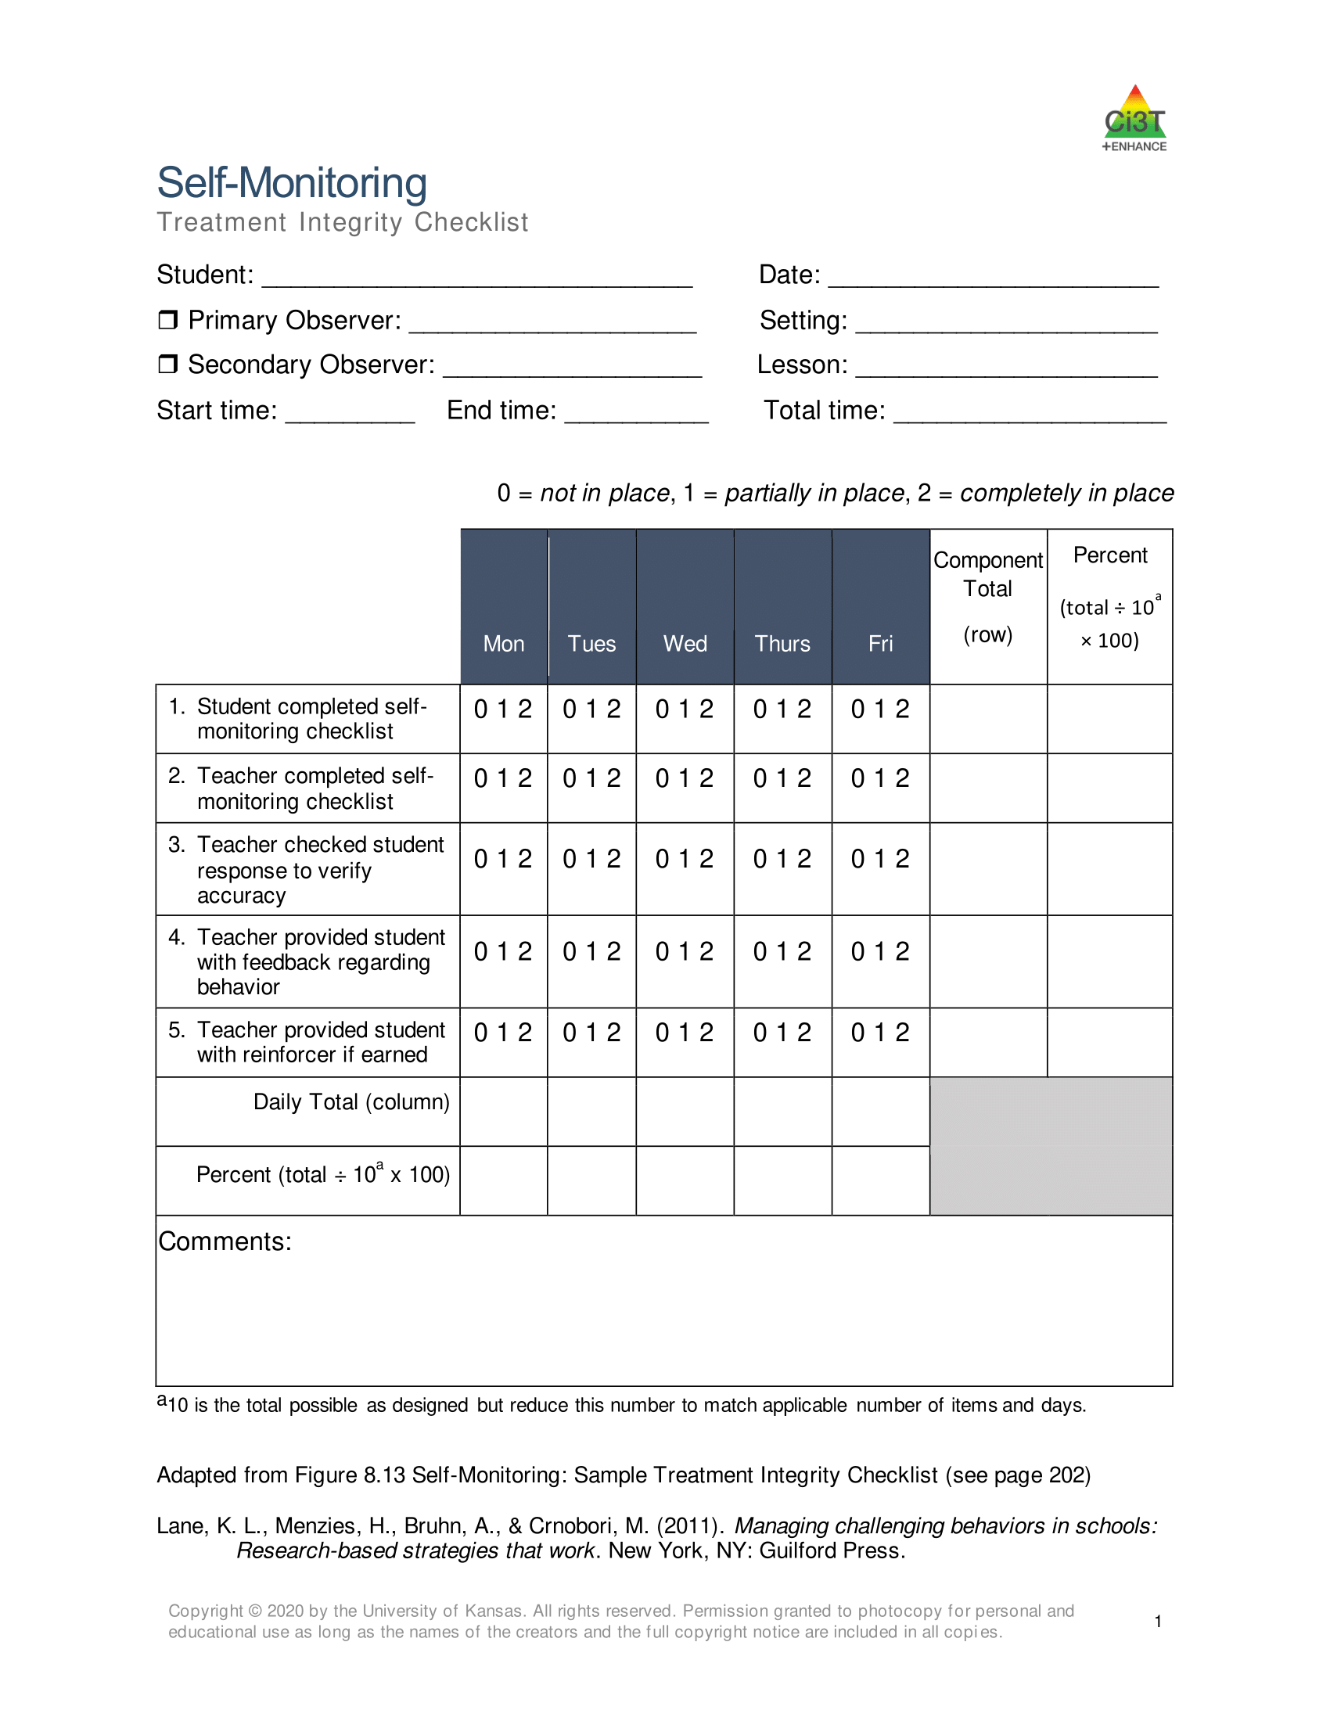
Tier 2 Treatment Integrity
Assess the degree to which the intervention is put in place
Commonly assessed daily using intervention component checklists

Slide 60
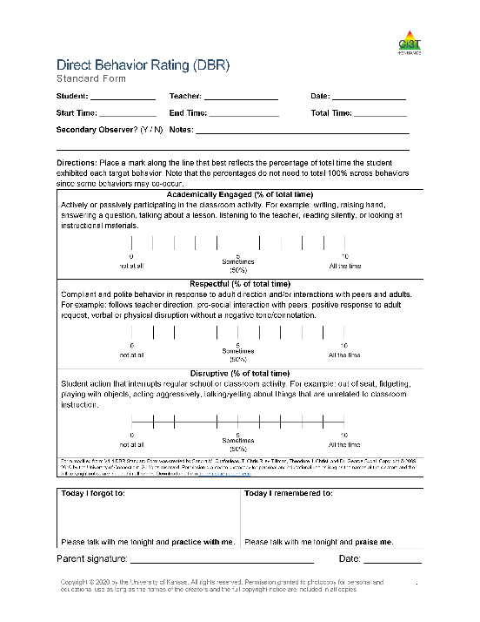
Tier 2 Student Outcomes
Monitor student progress
Commonly assessment methods:
Academic interventions
Curriculum-based measures
Behavioral interventions:
Systematic direct observation (more intensive)
Direct Behavior Rating (less intensive)

Slide 61
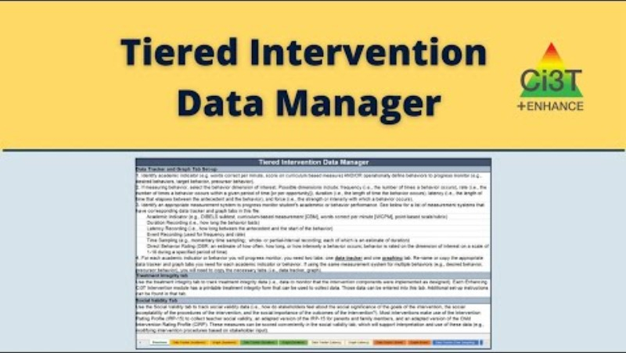
Tier 2 Data Tracking
Goal:
Regular review of social validity, treatment integrity, and student outcome data
Resource:
Tiered Intervention Data Manager
Microsoft Excel | Google Sheets
Tiered Intervention Data Manager.xlsx | Tiered Intervention Data Manager Google

Slide 62


Work Time
Select one of the intervention-focused Enhancing Ci3T Modules from the Ci3T: Implementing Secondary (Tier 2) Interventions collection on ci3t.org/enhance. Explore the module, with a focus on reviewing social validity, treatment integrity, and student outcome data forms
Notes:
10-min timer

Slide 63
Wrapping Up and Moving Forward

Slide 64

Project EMPOWER+
EMPOWER+ Session | Date
Starting Strong: Effective Tier 1 Practices for Educators | September 24, 2025 (Wednesday)
From Data to Action: Using Systematic Screening to Inform Instruction | October 8, 2025 (Wednesday)
Ci3T In Action: Integrated Lesson Planning for Enhanced Instruction | November 18, 2025 (Tuesday)
Mastering Behavior Specific Praise and Precorrection | January 21, 2026 (Wednesday)
A 6-Step Instructional Approach for Responding to Challenging Behaviors: A Tier 1 Practice | February 10, 2026 (Tuesday)
A Tier 2 Support for Students Experiencing Anxious Feelings: Recognize. Relax. Record. | March 25, 2026 (Wednesday)
A Tier 3 Support for Students with Intensive Intervention Needs: Functional Assessment-Based Intervention (FABI) | April 28, 2026 (Tuesday)

Slide 65
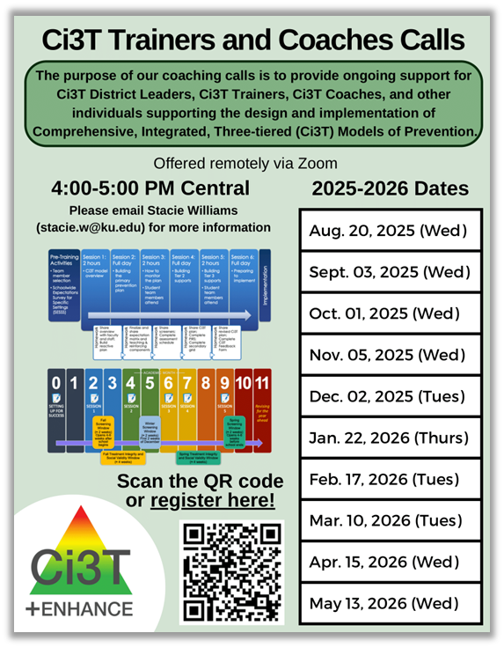
Ci3T Trainers and Coaches Calls
Ci3T Trainers and Coaches Calls Session | Date
Ci3T Trainers and Coaches Call 1 | August 20, 2025 (Wednesday)
Ci3T Trainers and Coaches Call 2 | September 3, 2025 (Wednesday)
Ci3T Trainers and Coaches Call 3 | October 1, 2025 (Wednesday)
Ci3T Trainers and Coaches Call 4 | November 5, 2025 (Wednesday)
Ci3T Trainers and Coaches Call 5 | December 2, 2025 (Tuesday)
Ci3T Trainers and Coaches Call 6 | January 22, 2026 (Thursday)
Ci3T Trainers and Coaches Call 7 | February 17, 2026 (Tuesday)
Ci3T Trainers and Coaches Call 8 | March 10, 2026 (Tuesday)
Ci3T Trainers and Coaches Call 9 | April 15, 2026 (Wednesday)
Ci3T Trainers and Coaches Call 10 | May 13, 2026 (Wednesday)

Slide 66
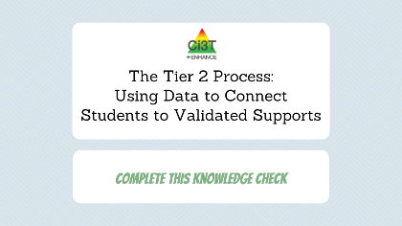
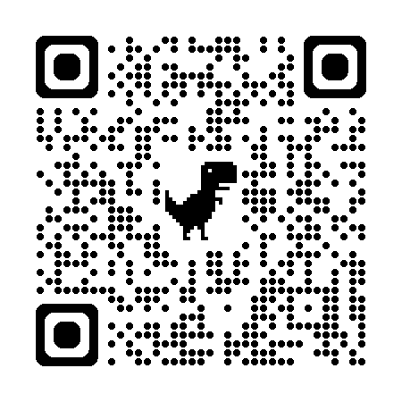
Knowledge Check
Rate perceived knowledge, confidence, and usefulness of content after completing this session
Answer a few questions to gauge your actual knowledge
Receive (via email) a line-item for your resume or CV!

Slide 67



Thank you!
Thank you!
ci3t.org
#Ci3T
@Ci3Tmodel
Tag us in your Ci3T highlights, we love to see Ci3T in action!
Follow us on Instagram for updates and new resources!
Mark Buckman
buckman@ku.edu
Notes:
Tag us in your Ci3T highlights- we would love to see Ci3T in action! Follow us on Instagram for updates and links to resources! @Ci3TModel
You will receive a brief session evaluation – we value your feedback and would greatly appreciate you taking a few minutes to share your thoughts on what you liked about the session and how we can improve

