Slide 1
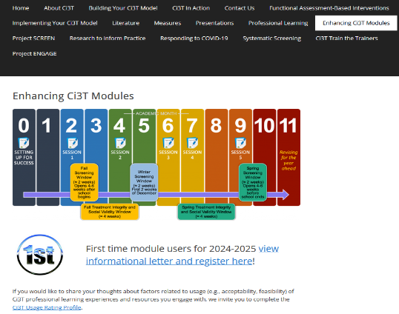
Functional Assessment-Based Intervention: A Tier 3 Support for Students with
Intensive Intervention Needs
Elise Sarasin, The University of Kansas
Carrie Brandon, Arizona State University
Joni Weiss, The University of Kansas
If you have not done so already, we invite you to visit ci3t.org/enhance to access modules after a one-time registration process!
This project was funded in part by Project EPIC (USDE, OSEP Award Number: H325D220011) and Project ENHANCE (IES Project Number R324N190002)

Slide 2
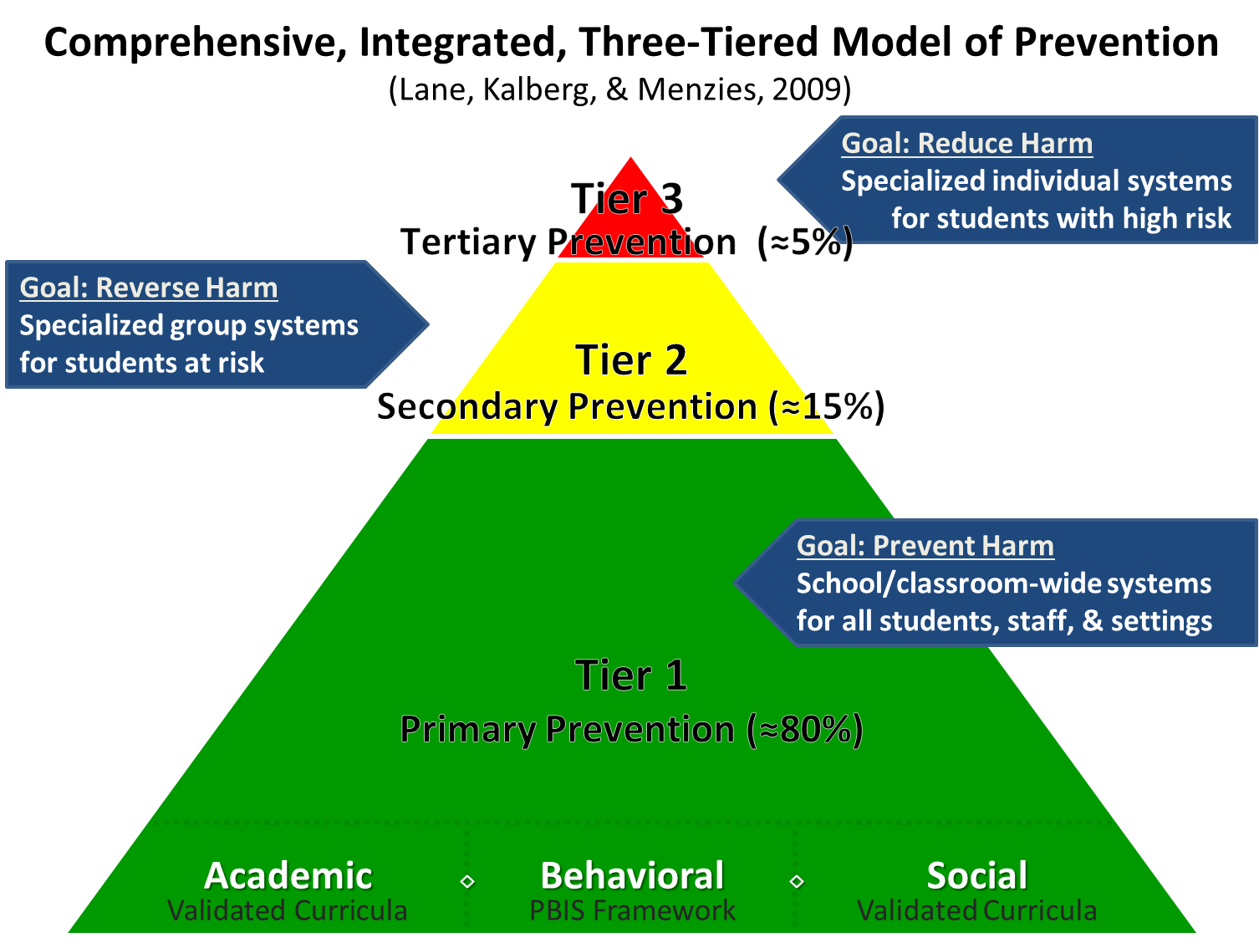
Comprehensive, Integrated, Three-Tiered Model of Prevention 1

Slide 3
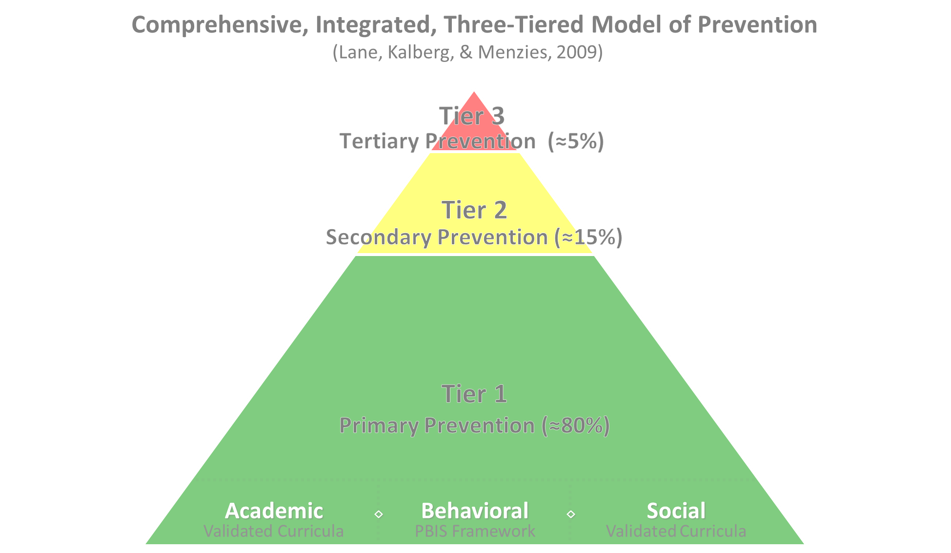

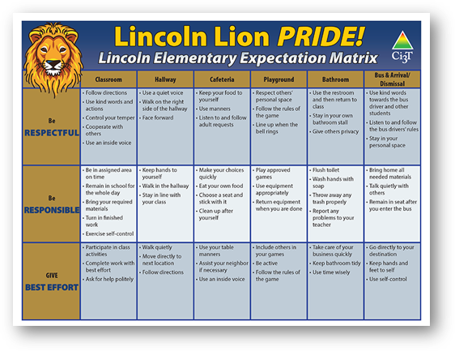
Comprehensive, Integrated, Three-Tiered Model of Prevention 2
Positive Behavioral Interventions and Supports
District & State Standards Quality Instruction
Validated Curricula and Resources

Slide 4


Primary Prevention (Tier 1)

Slide 5

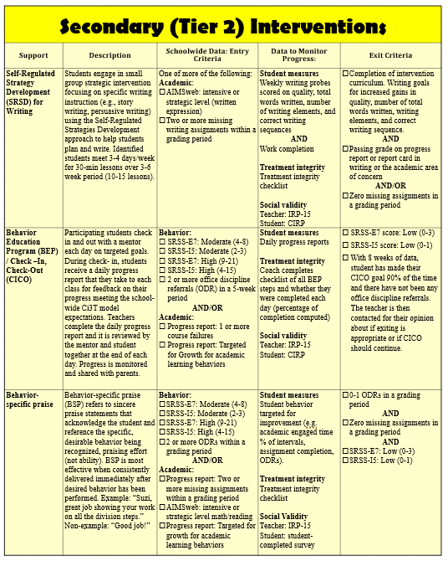
Secondary (Tier 2) Intervention Grid
Notes:
In addition to the module featured here outlining how to use multiple sources of data to connect students with Tier 2 supports, we offer a full suite of modules highlighting validated Tier 2 interventions such as Self-Regulated Strategy Development (SRSD) for Writing and Check-In/Check Out that may appear in your Secondary (Tier 2) Intervention Grid

Slide 6

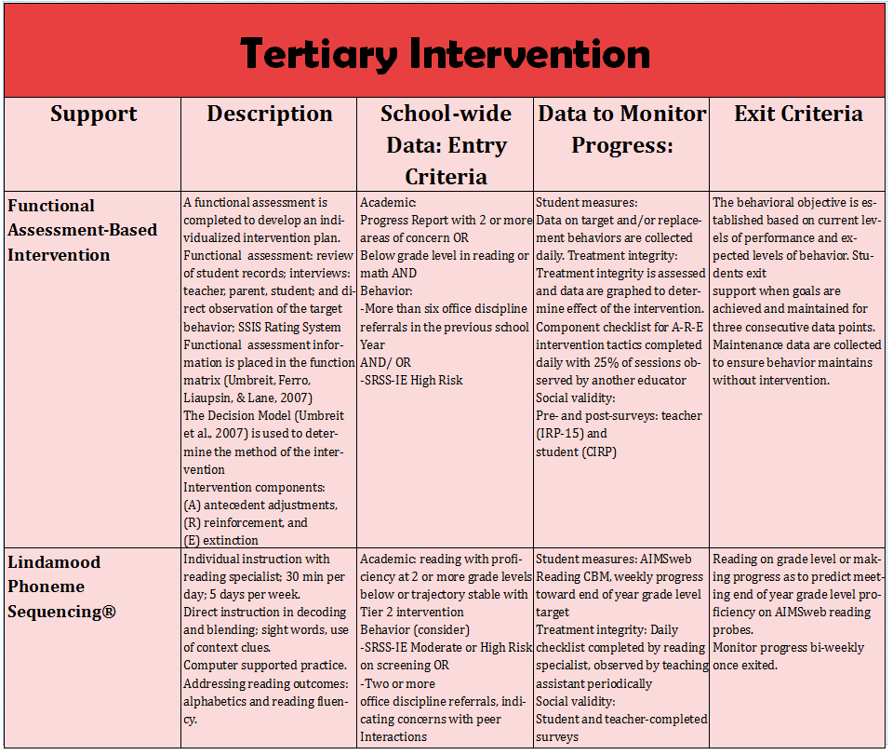
Tertiary (Tier 3) Intervention Grid
Notes:
In addition to the module featured here outlining how to use multiple sources of data to connect students with Tier 3 supports, we offer a full suite of modules highlighting validated Tier 3 interventions such as Functional Assessment-Based Intervention (FABI) that may appear in your Tertiary (Tier 3) Intervention Grid

Slide 7
Session Outcomes
Describe how tertiary (Tier 3) interventions are situated in a Ci3T model of prevention including the purpose and organization of Tertiary (Tier 3) Intervention Grids
Describe a step-by-step process to implement Functional Assessment-Based Intervention (FABI) as a Tier 3 support.

Slide 8
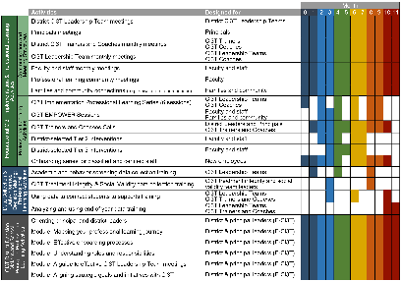
Agenda
Welcome
Situating Tertiary (Tier 3) Interventions in Ci3T Models
Functional Assessment-Based Intervention (FABI)
  Introduction to FABI
  5-Step Process to Implement FABI
Wrapping Up and Moving Forward

Slide 9


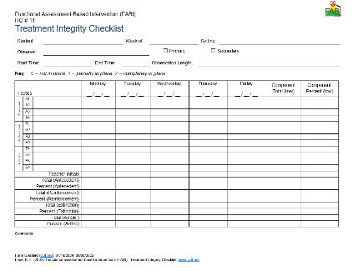
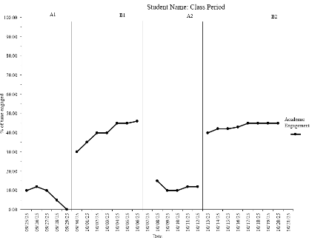
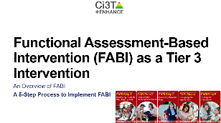
Knowledge, Application, Impact Points
Knowledge, Application, Impact Points 1
On-Task Behavior: Jackson
If you are in Kansas, you can earn 2 x PD points for application and 3 x for impact!
We are happy to review your materials before you upload!
Notes:
Tonight’s session lays the foundation with knowledge building and getting you oriented to the modules that can support application and impact efforts!

Slide 10
Situating Tertiary (Tier 3) Interventions in Ci3T Models

Slide 11
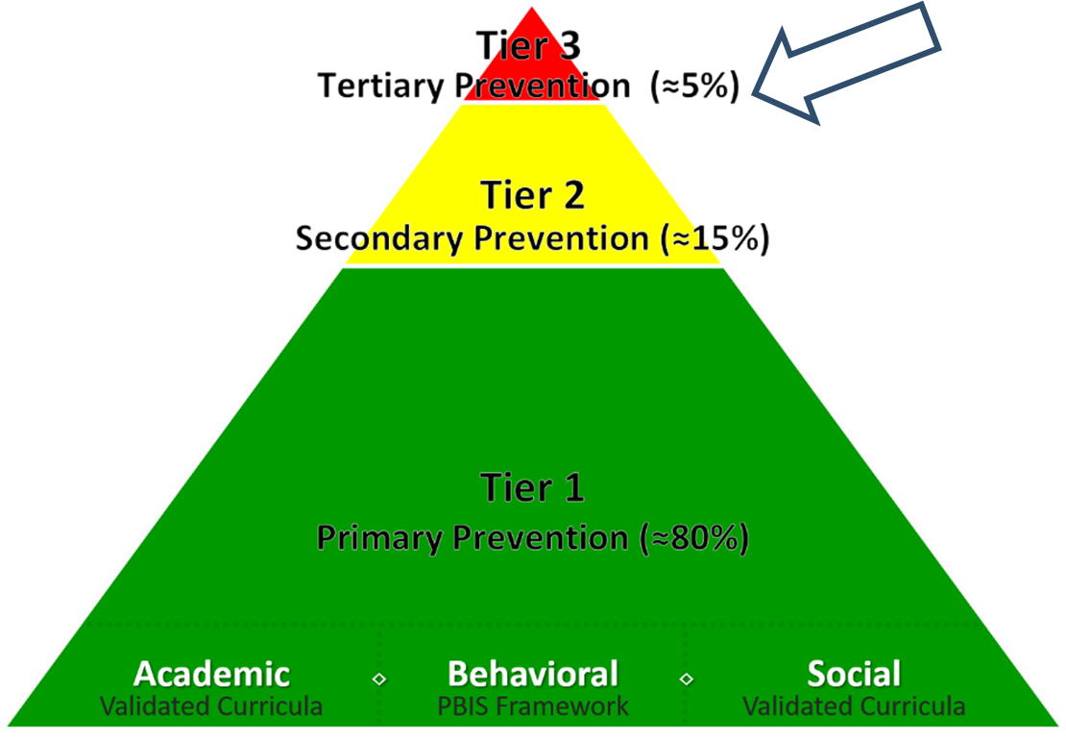
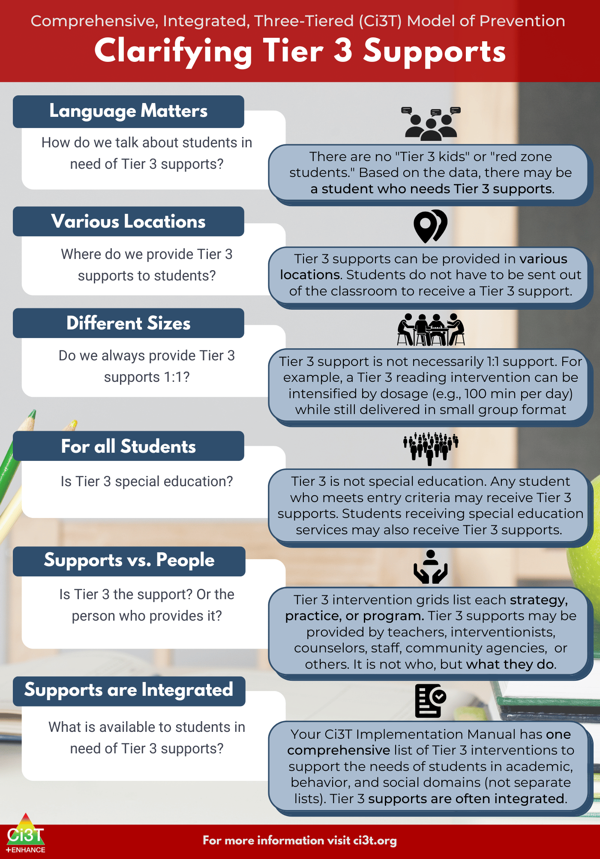
What are Tier 3 Interventions?

Slide 12
Clarifying Tier 3 Supports 1

Slide 13
Clarifying Tier 3 Supports 2

Slide 14


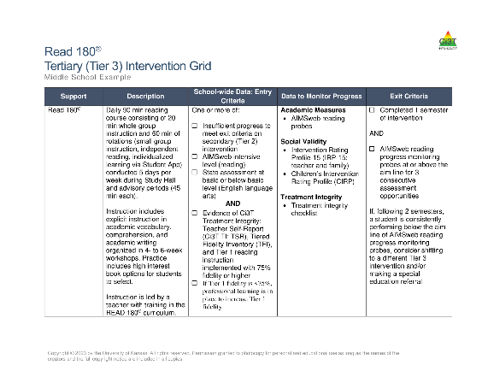
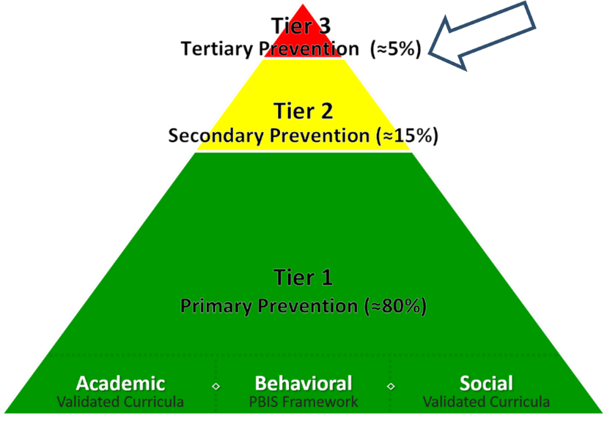
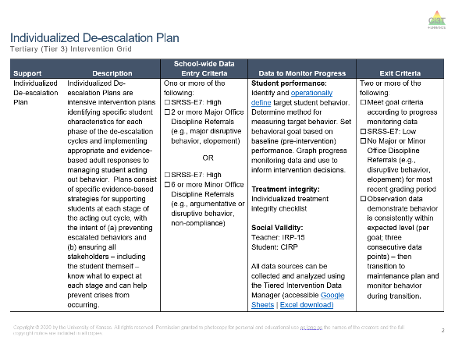
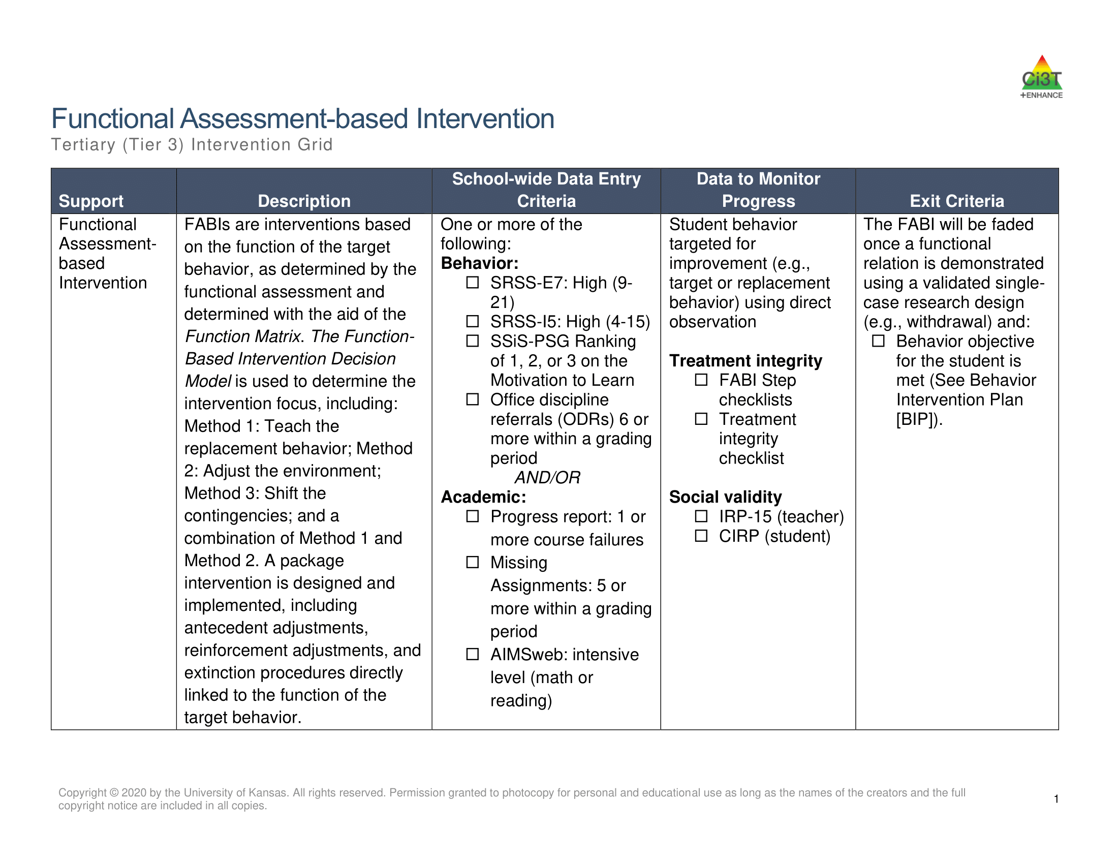
Tertiary (Tier 3) Intervention Grid
Tertiary (Tier 3) Intervention Grid 2

Slide 15


Components of Tier 3 Intervention Grid
Notes:
Support- name of strategy, practice, or program. Notice this is not the name of a person or role

Slide 16
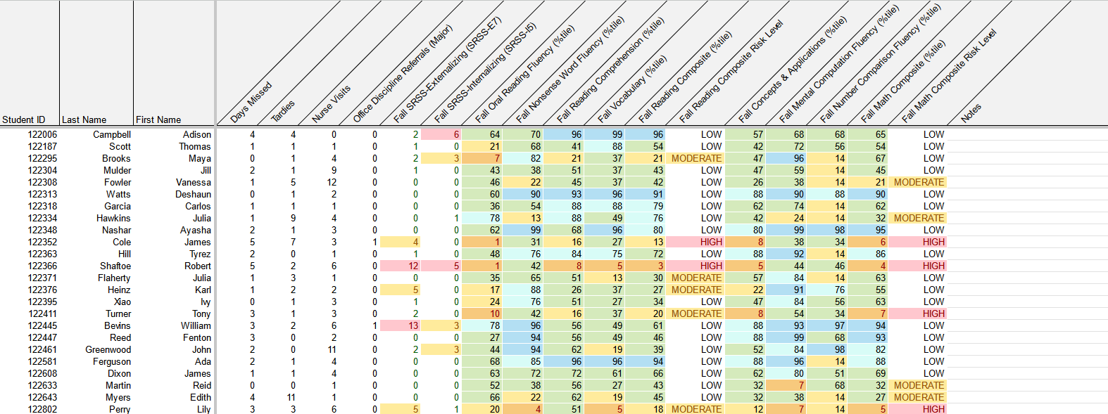
Using Multiple Sources of Data to Connect Students with Tier 3 Supports
attendance
office discipline referrals
behavior
screening
academic screening

Slide 17

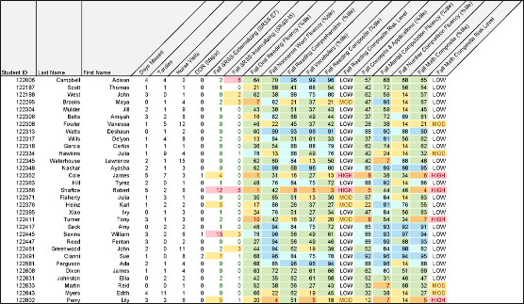
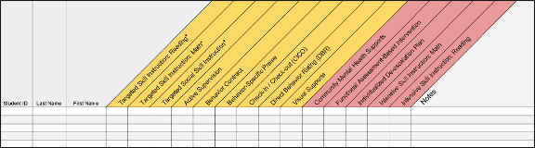
Getting Started with Data-Informed Decision Making

Slide 18






Table Talk
Introduce yourself – name, school, role/grade level taught
What Tier 3 interventions are offered at your school?
Notes:
3-min timer

Slide 19

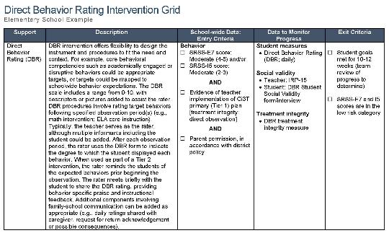
Functional Assessment-Based Intervention (FABI)
An Overview of FABI
A 5-Step Process to Implement FABI

Slide 20

Functional Assessment-based Intervention

Slide 21
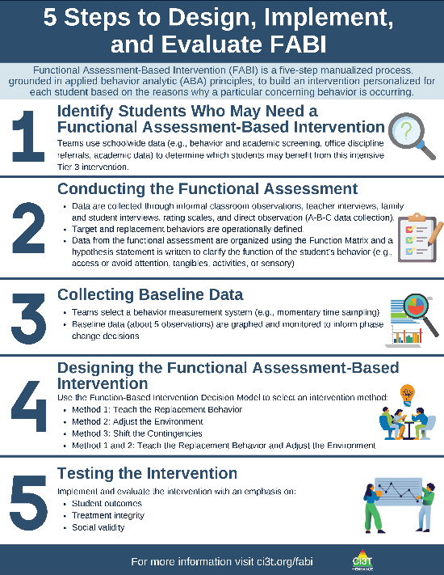
What is Functional Assessment-Based Intervention (FABI)?
Customized intervention designed for each student based on the reasons why a particular concerning behavior is occurring
Developed through a five-step, team-based, manualized process
Grounded in applied behavior analytic (ABA) principles (e.g., reinforcement, antecedent, consequence)
Notes:
PRESENTER NOTE:
FABI is one type of FBA (functional behavioral assessment)
Can be used as a Tier 3 intervention, as we are discussing in this presentation
Can also be used as a process to conduct a functional behavioral assessment (FBA) and develop a behavior intervention plan (BIP) for student’s with IEPs as required under certain conditions of IDEA
See state regulations for more information regarding FBAs as part of a student’s IEP

Slide 22
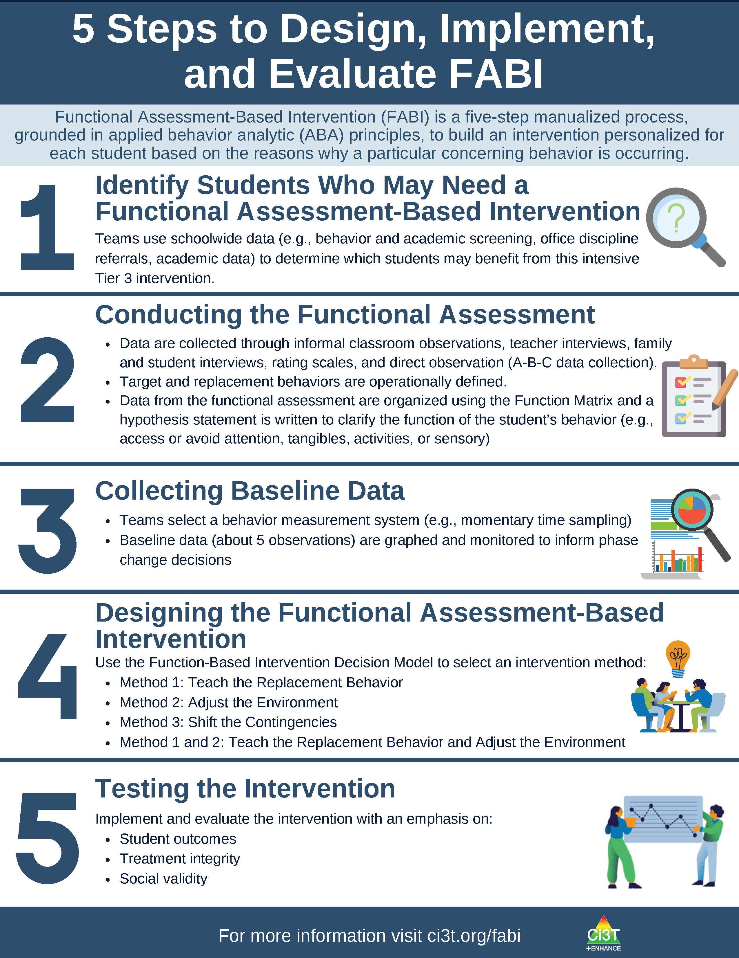
5 Steps to Design, Implement, and Evaluate FABI 1

Slide 23
5 Steps to Design, Implement, and Evaluate FABI 2

Slide 24
Why is FABI effective?
Individualized based on the function of behavior (i.e., why the behavior occurs) and needs of the student and environment
Focuses on skill-building and supporting pro-social behavior (i.e., replacement behavior)
Step-by-step manualized process
Team-based process fosters collaboration between educators, families, and the student

Slide 25

Building Your FABI Team
Two people who serve on this “standing” team
  Member of Ci3T Leadership Team
  Staff with behavioral expertise (e.g., behavior specialist, instructional coach, counselor, school psychologist)
Classroom teacher(s) of the student who might benefit from this support
Family member of the student
Student

Slide 26
What are the Benefits and Challenges of Implementing FABI?
Benefits
Challenges
Collaborative, team-based process integrating student, educator, and caregiver voice and perspective
Strong evidence-base demonstrating effectiveness for wide range of students (pre-K – 12), behaviors, and settings
Fully manualized process with templates and checklists to support design and implementation
Time and resource intensive
May require additional training (e.g., measuring behavior, ABC data collection)
Adjustment from more ”traditional” FBA/BIP practices

Slide 27
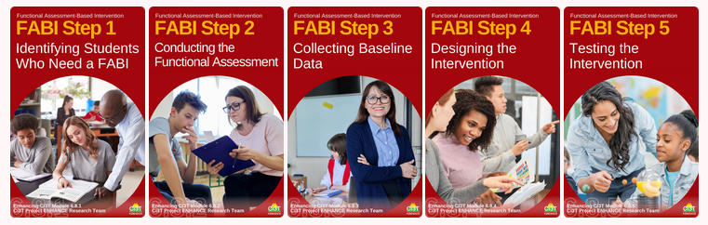
Functional Assessment-Based Intervention (FABI) as a Tier 3 Intervention
An Overview of FABI
A 5-Step Process to Implement FABI

Slide 28


Opportunities to Learn More
Opportunities to Learn More 1
Notes:
Our intention in this professional learning is to provide high-level overview of FABI and opportunities to practice the key components. If you are interested in learning more or implementing FABI in your setting, we encourage you to access these additional resources to more comprehensively learn about each of the five steps.

Slide 29

Step 1: Identifying Students Who May Need a FABI
Step 1: Identifying Students Who May Need a FABI 1

Slide 30
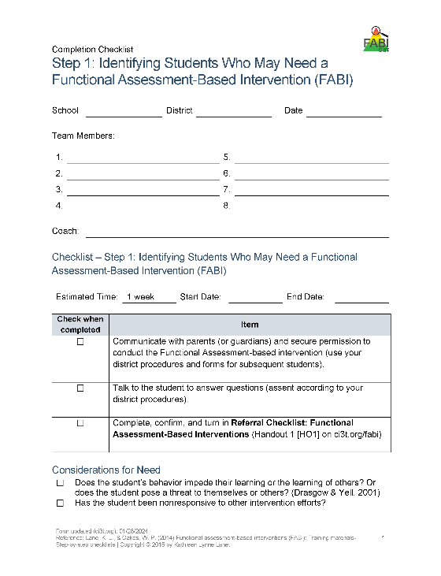
Step 1: Identifying Students Who May Need a FABI
Step 1: Identifying Students Who May Need a FABI 2
Review multiple sources of data
Connect with family member(s)
Meet with student
Notes:
Use the Tertiary (Tier 3) Intervention Grid and referral checklist to review multiple sources of data such as:
Academic assessment data (e.g., screening, curriculum-based measures)
Behavior screening tools
Office discipline referrals (ODRs)
Attendance records

Slide 31

Step 2: Conducting the Functional Assessment
Step 2: Conducting the Functional Assessment 1

Slide 32

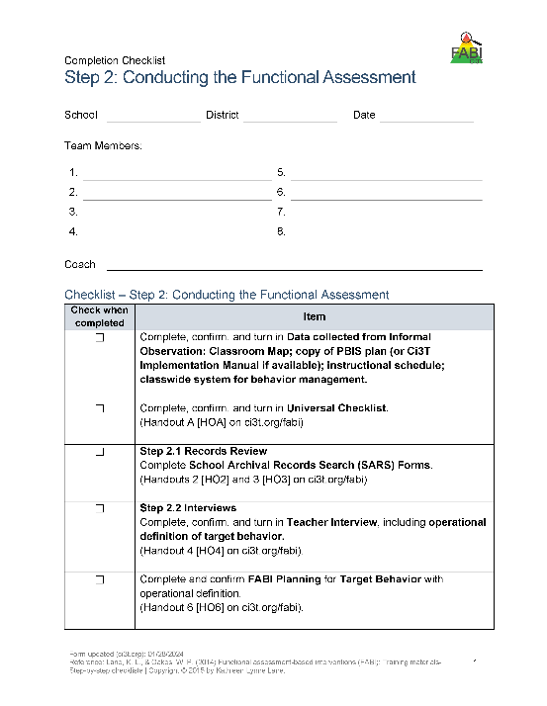
Step 2: Conducting the Functional Assessment
Step 2: Conducting the Functional Assessment 2
Understanding the learning environment and context
Records review
Interviews
Operationally define target behavior
Rating scales
A-B-C data collection
Use Function Matrix to identify the hypothesized function(s)
Identify replacement behavior
Notes:
Today, we are going to focus on these three components of Step 2

Slide 33
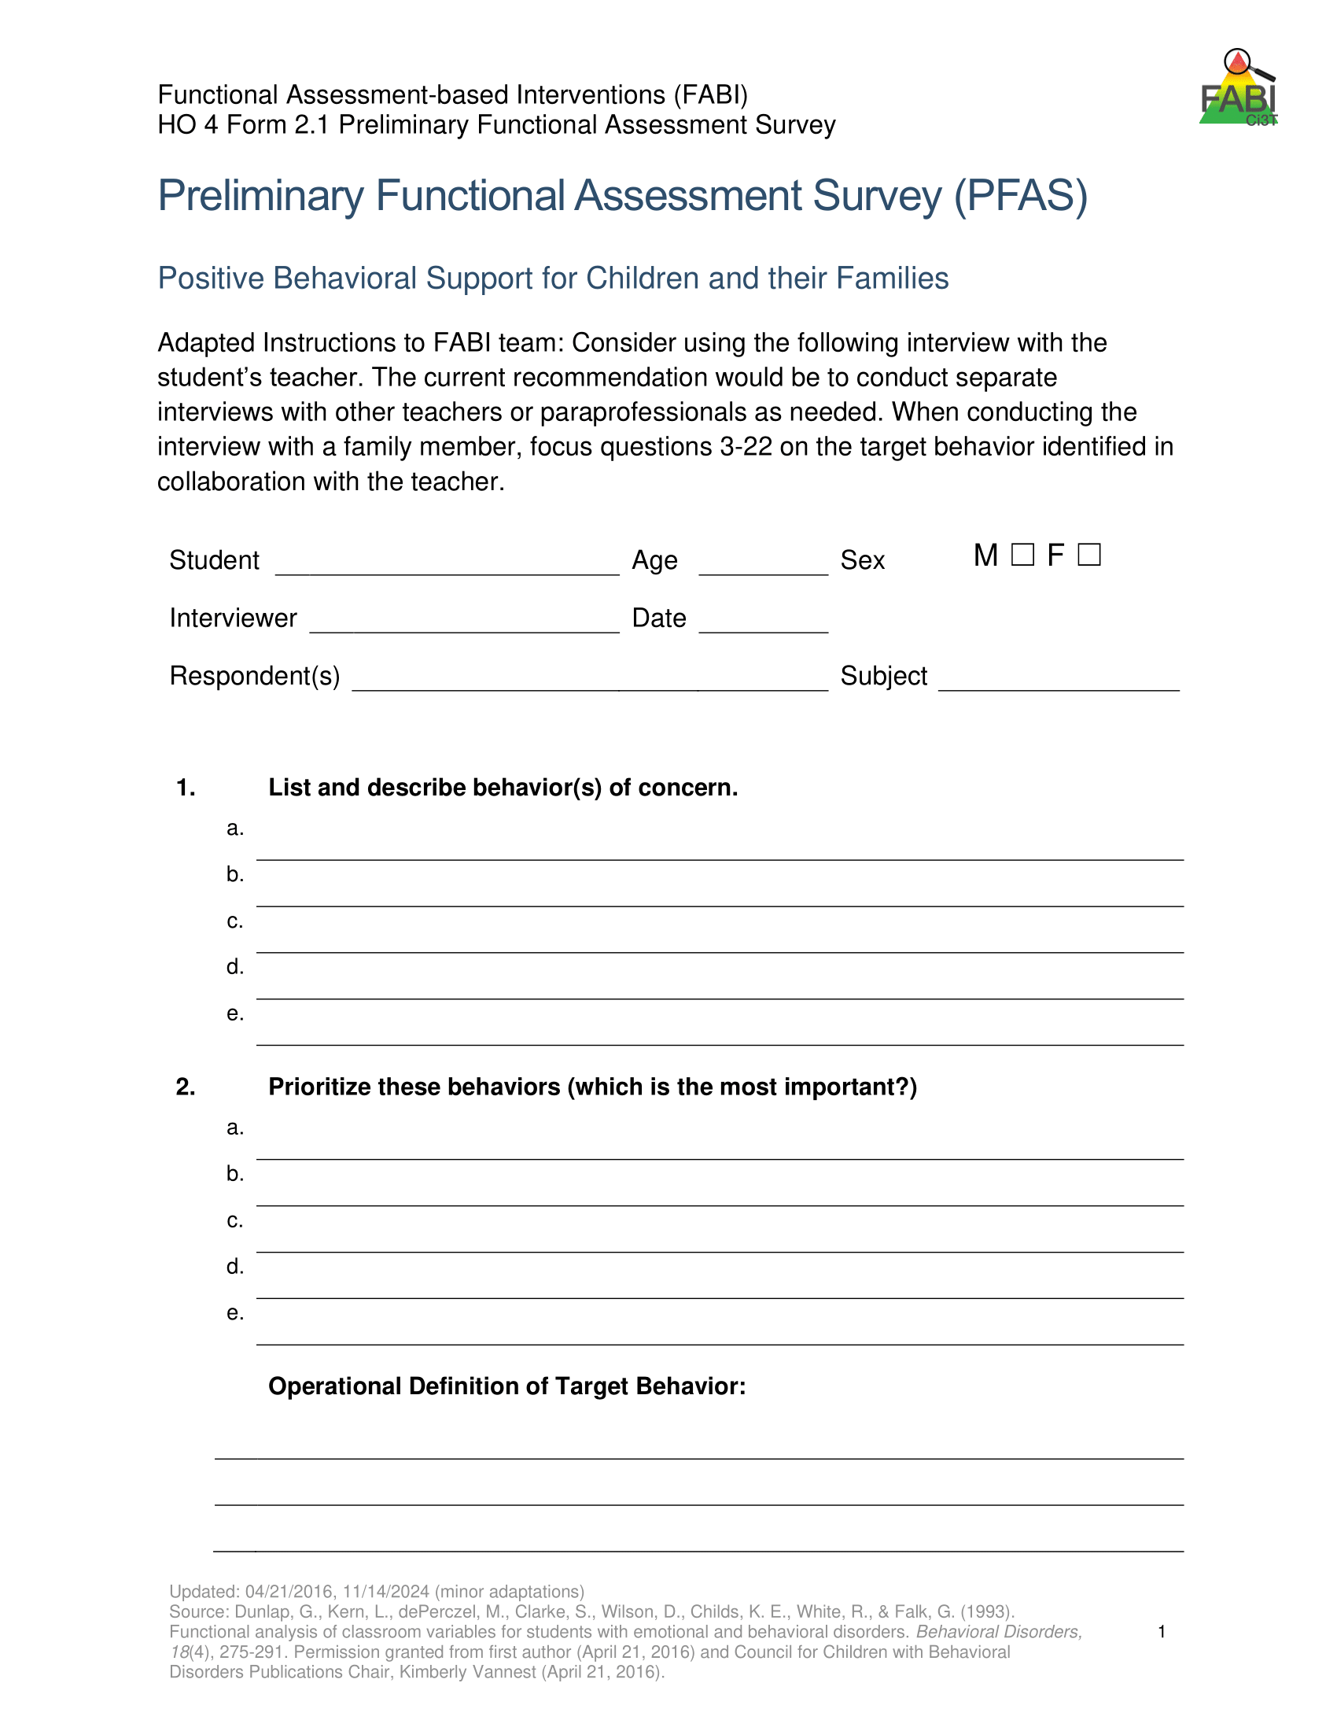
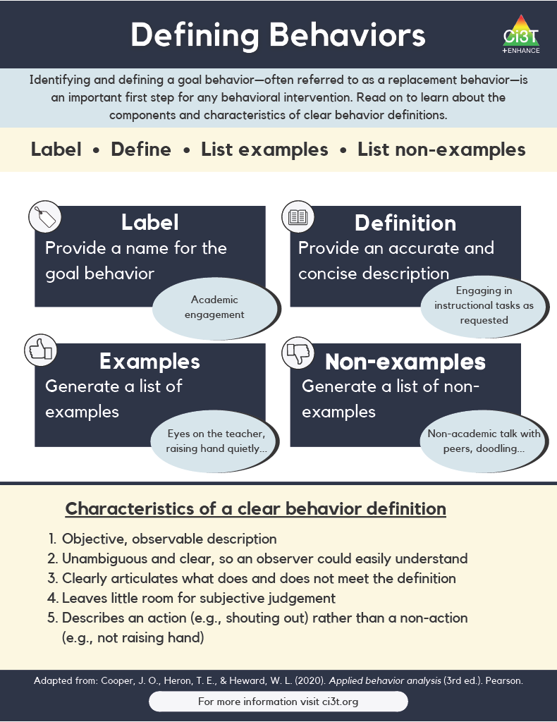
Operationally Defining the Target Behavior
Notes:
During the teacher interview, you will work with the teacher to identify all behaviors of interest and then create a prioritized list to determine the one keystone behavior. In other words, what is the one behavior, that if modified, could allow students to enjoy school more fully?
This becomes the target behavior (or the behavior you are seeking to reduce) which you will then operationally define

Slide 34
Defining Behaviors 2

Slide 35
Defining Behaviors 2

Slide 36
Example Operational Definition
Example Operational Definition 1
Component | Description
Label | Off-task
Definition | Off-task is defined as attending to activities in class other than assignments.
Examples | Playing with materials inappropriately, talking to peers, putting head on the desk, drawing, and looking around the room
Non-Examples | Completing assignments using materials only for assignments, and watching the teacher when delivering instruction

Slide 37
Example Operational Definition
Example Operational Definition 2
Component | Description
Label | Verbal aggression
Definition | Verbal aggression is defined as any vocalization directed towards a peer or adult at a volume above expected conversational level for a given setting alongside use profanity or language that is not appropriate for the setting.
Examples | Yelling “I hate you” at a voice level 3 during classroom instruction, verbal threats directed towards peer (e.g., “if you don’t stop, I’m going to…”), name-calling, profanity.
Non-Examples | Level 3 voice level at recess, shouting out an answer during choral response, sighing (“uhhhggg”), negative self-talk (e.g., “this is too hard”)

Slide 38
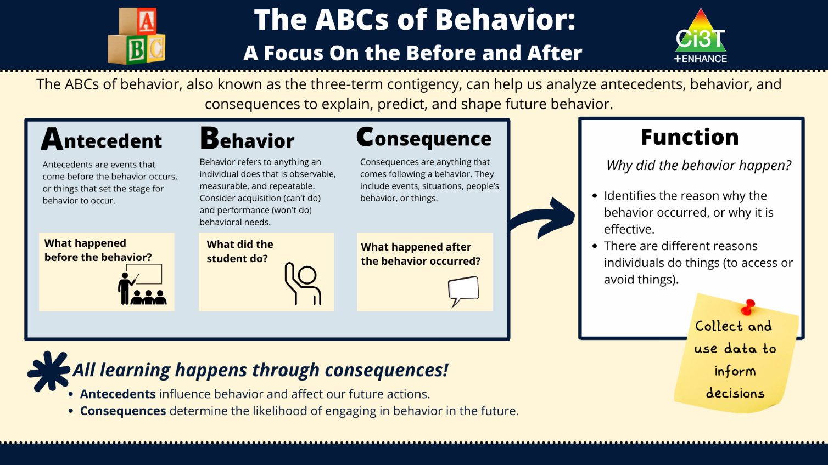
Direct Observation (A-B-C Data Collection)
Direct Observation (A-B-C Data Collection) 1

Slide 39
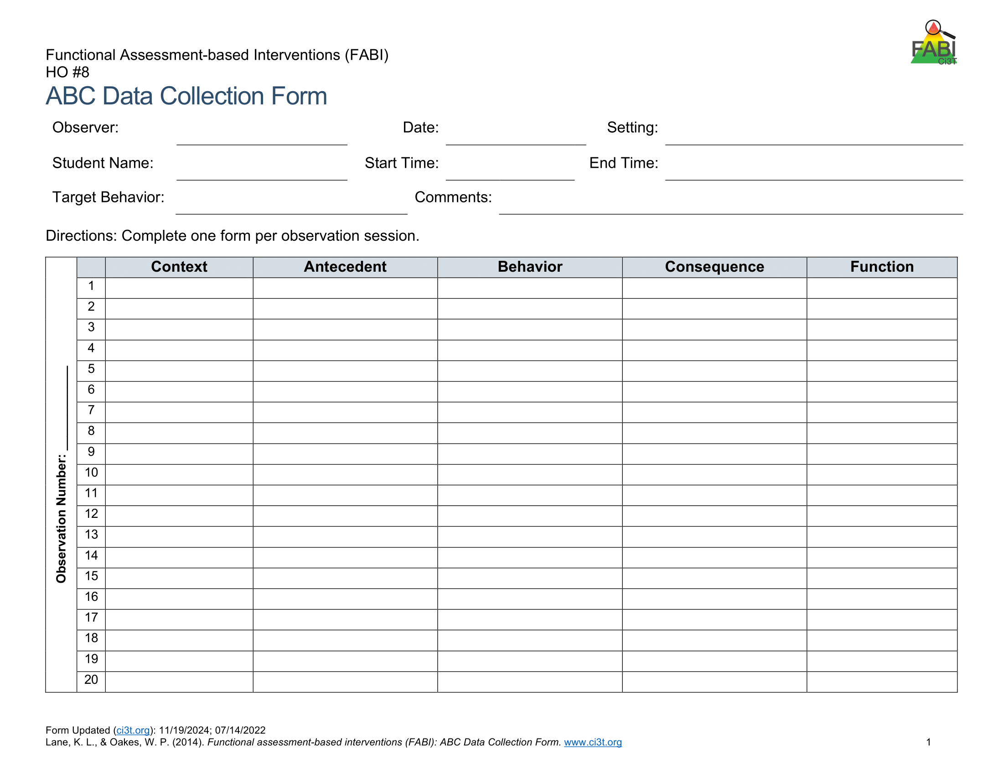
Direct Observation (A-B-C Data Collection)
Direct Observation (A-B-C Data Collection) 2
Determine the time of day and setting during which the behavior most often occurs
3 observation sessions (minimum)
Aim to observe 8-10 occurrences of the target behavior or three hours of observations
Record only instances of target behavior
Each instance of the target behavior will be numbered and later placed in the Function Matrix

Slide 40
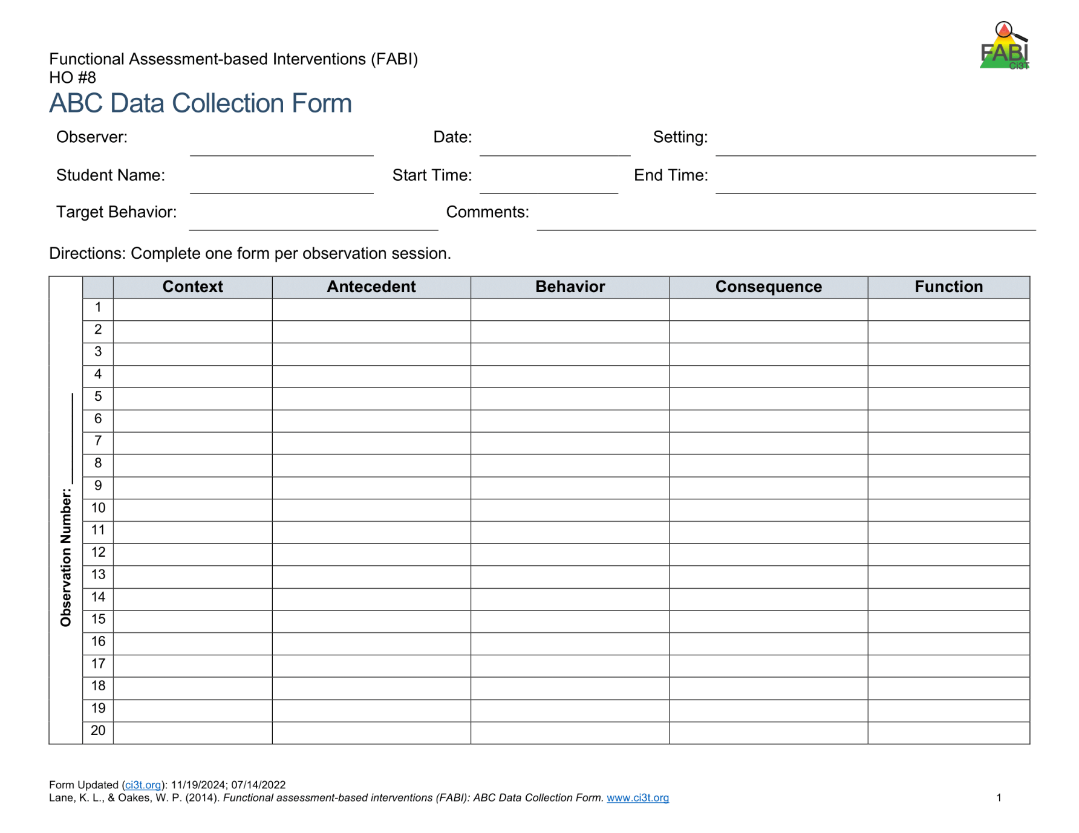

A-B-C Data Collection Example
Reading instruction
Pencil breaks
Student throws pencil
Teacher looks at student
Notes:
Each time the target behavior occurs you will record details in a new row. Each instance of the target behavior will be numbered and later placed in the function matrix.
You should will note the context in which the behavior occurred, such as reading instruction, morning circle time, or math instruction, and the antecedent, or what happened immediately before the behavior.
Additionally, record the target behavior itself, the consequence, or what happened immediately after the target behavior.
The function of the behavior, such as access to or avoidance of attention, tasks or tangibles, or sensory experiences will be completed later.

Slide 41
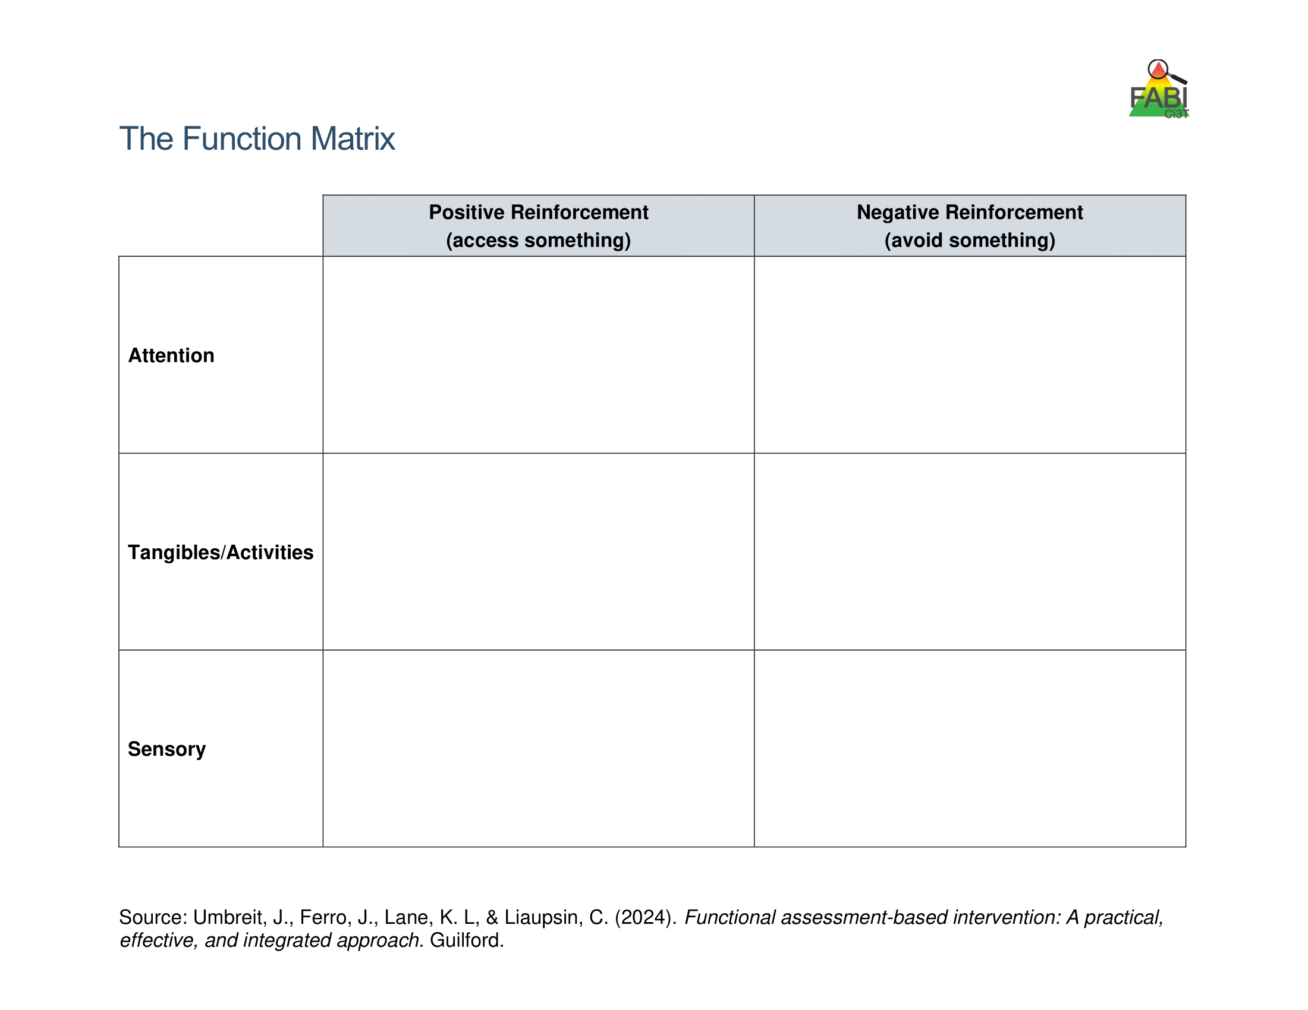
Use Function Matrix to identify the hypothesized function(s)
Peers laugh
Teacher provides 1:1 assistance
Work alone
Ignored by peers or adults
Preferred activity (e.g., tablet)
Do not have to complete academic task
Access to fidgets
Noise cancelling headphones
Notes:
The Function Matrix, developed by Umbreit and colleagues is a practical, effective, and novel tool for visually organizing multiple sources of information from informal observations, interviews, rating scales, and A-B-C observation data to identify the function of the target behavior.
The Function Matrix is organized based on the principles of applied behavior analysis, with columns reflecting the two ways behaviors are reinforced: positive reinforcement (meaning to get or access something) and negative reinforcement (meaning to escape or avoid something).
Then, the three rows reflect three behavioral categories (the “something or somethings”) the person is trying get or avoid: attention, tangibles or activities, and sensory experiences.

Slide 42
Function Matrix
 | Positive Reinforcement (access something) | Negative Reinforcement (avoid something)
Attention | Teacher Interview – “During Independent work time, frequently comes to me to ask a question during math. Often, she already knows the answer” Parent Interview “She wants me to check her homework every night. Not just one math problem but all of them.” ABC Data- 1.2, 1.3, 2.1, 2.4, 3.1
Tangibles/Activities |  | Records Review - Tammy’s low grades were due to lack of class work completion. Teacher Interview- “She is the last one to get started when it is time for independent reading.” Student Interview- “I hate worksheets, they’re so boring” ABC Data: 1.1, 1.4, 2.2, 2.3, 2.5, 3.2
Sensory
Number of the observation
session (Day 1)
Number of the occurrence in the
observation session
(second instance of the behavior on Day 1)
Source: Umbreit, Ferro, Lane, & Liaupsin (2024); Umbreit, Ferro, Liaupsin, & Lane (2007); Umbreit, Lane, & Dejud (2004)
Notes:
Information from all parts of the functional assessment are added to Function Matrix. This includes: informal observations, interviews, rating scales, and A-B-C observation data.
ABC Data are using the following notation: Number of the observation session (e.g., observation session 1, 2, 3) dot number of the occurrence of target behavior in that observation session (e.g., the second instance of behavior) – this is the number of the row.

Slide 43
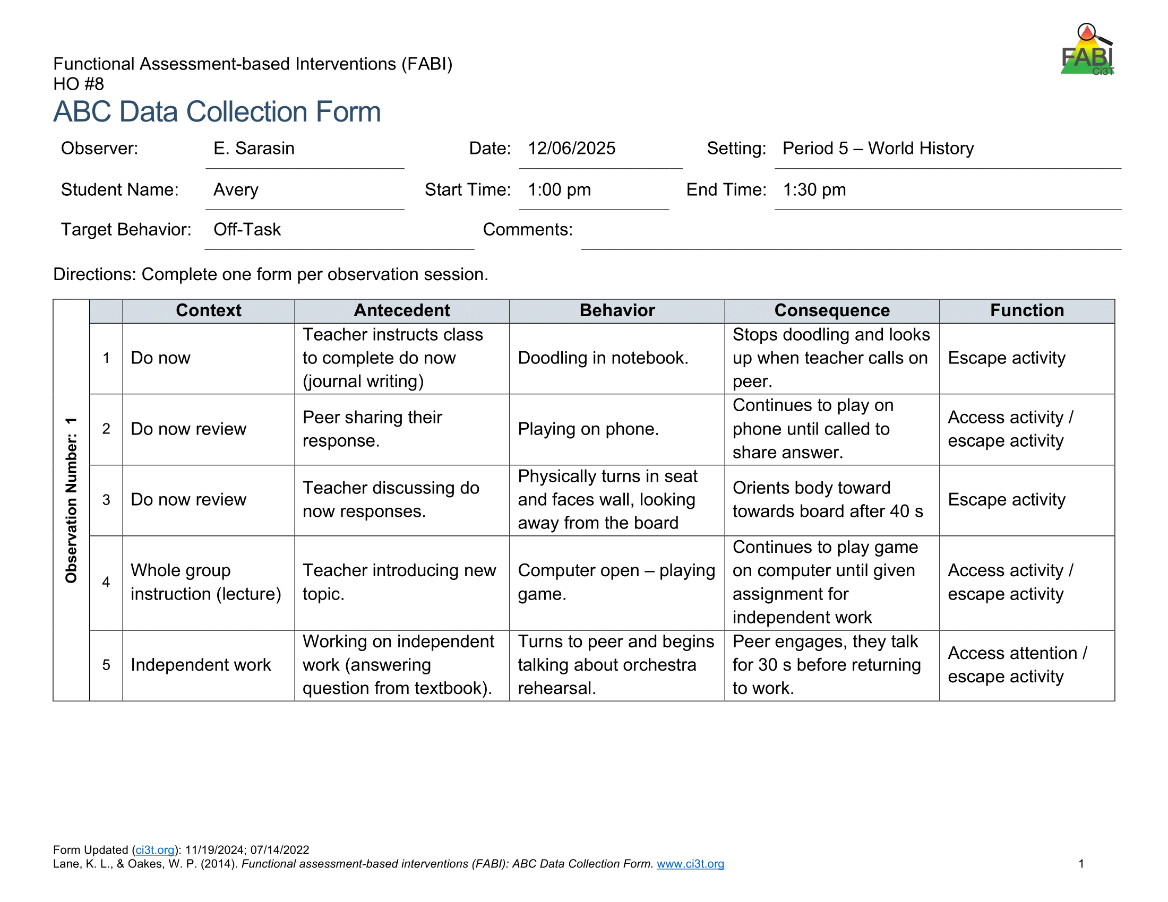
Let’s Practice!
Let’s Practice! 1
What’s the Function?
Access – Attention
Avoid – Attention
Access – Tangibles / Activities
Avoid – Tangibles / Activities
Access – Sensory
Avoid - Sensory
?
?
?
?
?

Slide 44
Hypothesized Function
During [context], [student name] engages in [target behavior] in order to [maintaining function(s)].
Example:
During independent reading activities (CONTEXT), Frank (STUDENT NAME) engages in noncompliant behavior (TARGET BEHAVIOR) to (a) escape too difficult tasks and (b) access peer and teacher attention (MAINTAINING FUNCTIONS).

Slide 45



Let’s Practice
Work with your group to
complete the Function Matrix.
Notes:
10-min

Slide 46

Step 3: Collecting Baseline Data
Step 3: Collecting Baseline Data 1

Slide 47

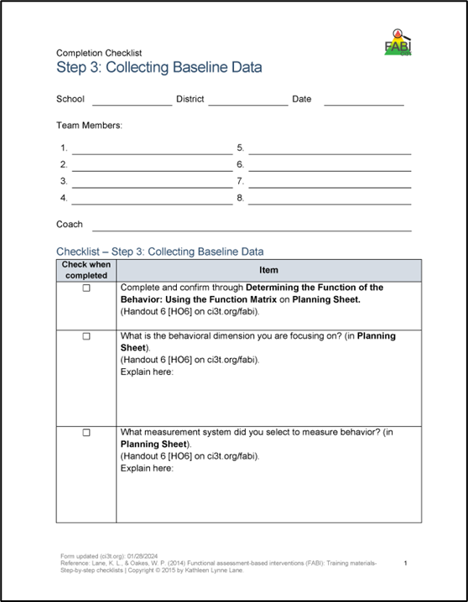
Step 3: Collecting Baseline Data
Step 3: Collecting Baseline Data 2
Determine behavioral dimension of focus
Select a measurement system
Develop data collection procedures
Train data collectors
Collect baseline data
Graph baseline data
Notes:
Today, we are going to focus on these three components of Step 3

Slide 48
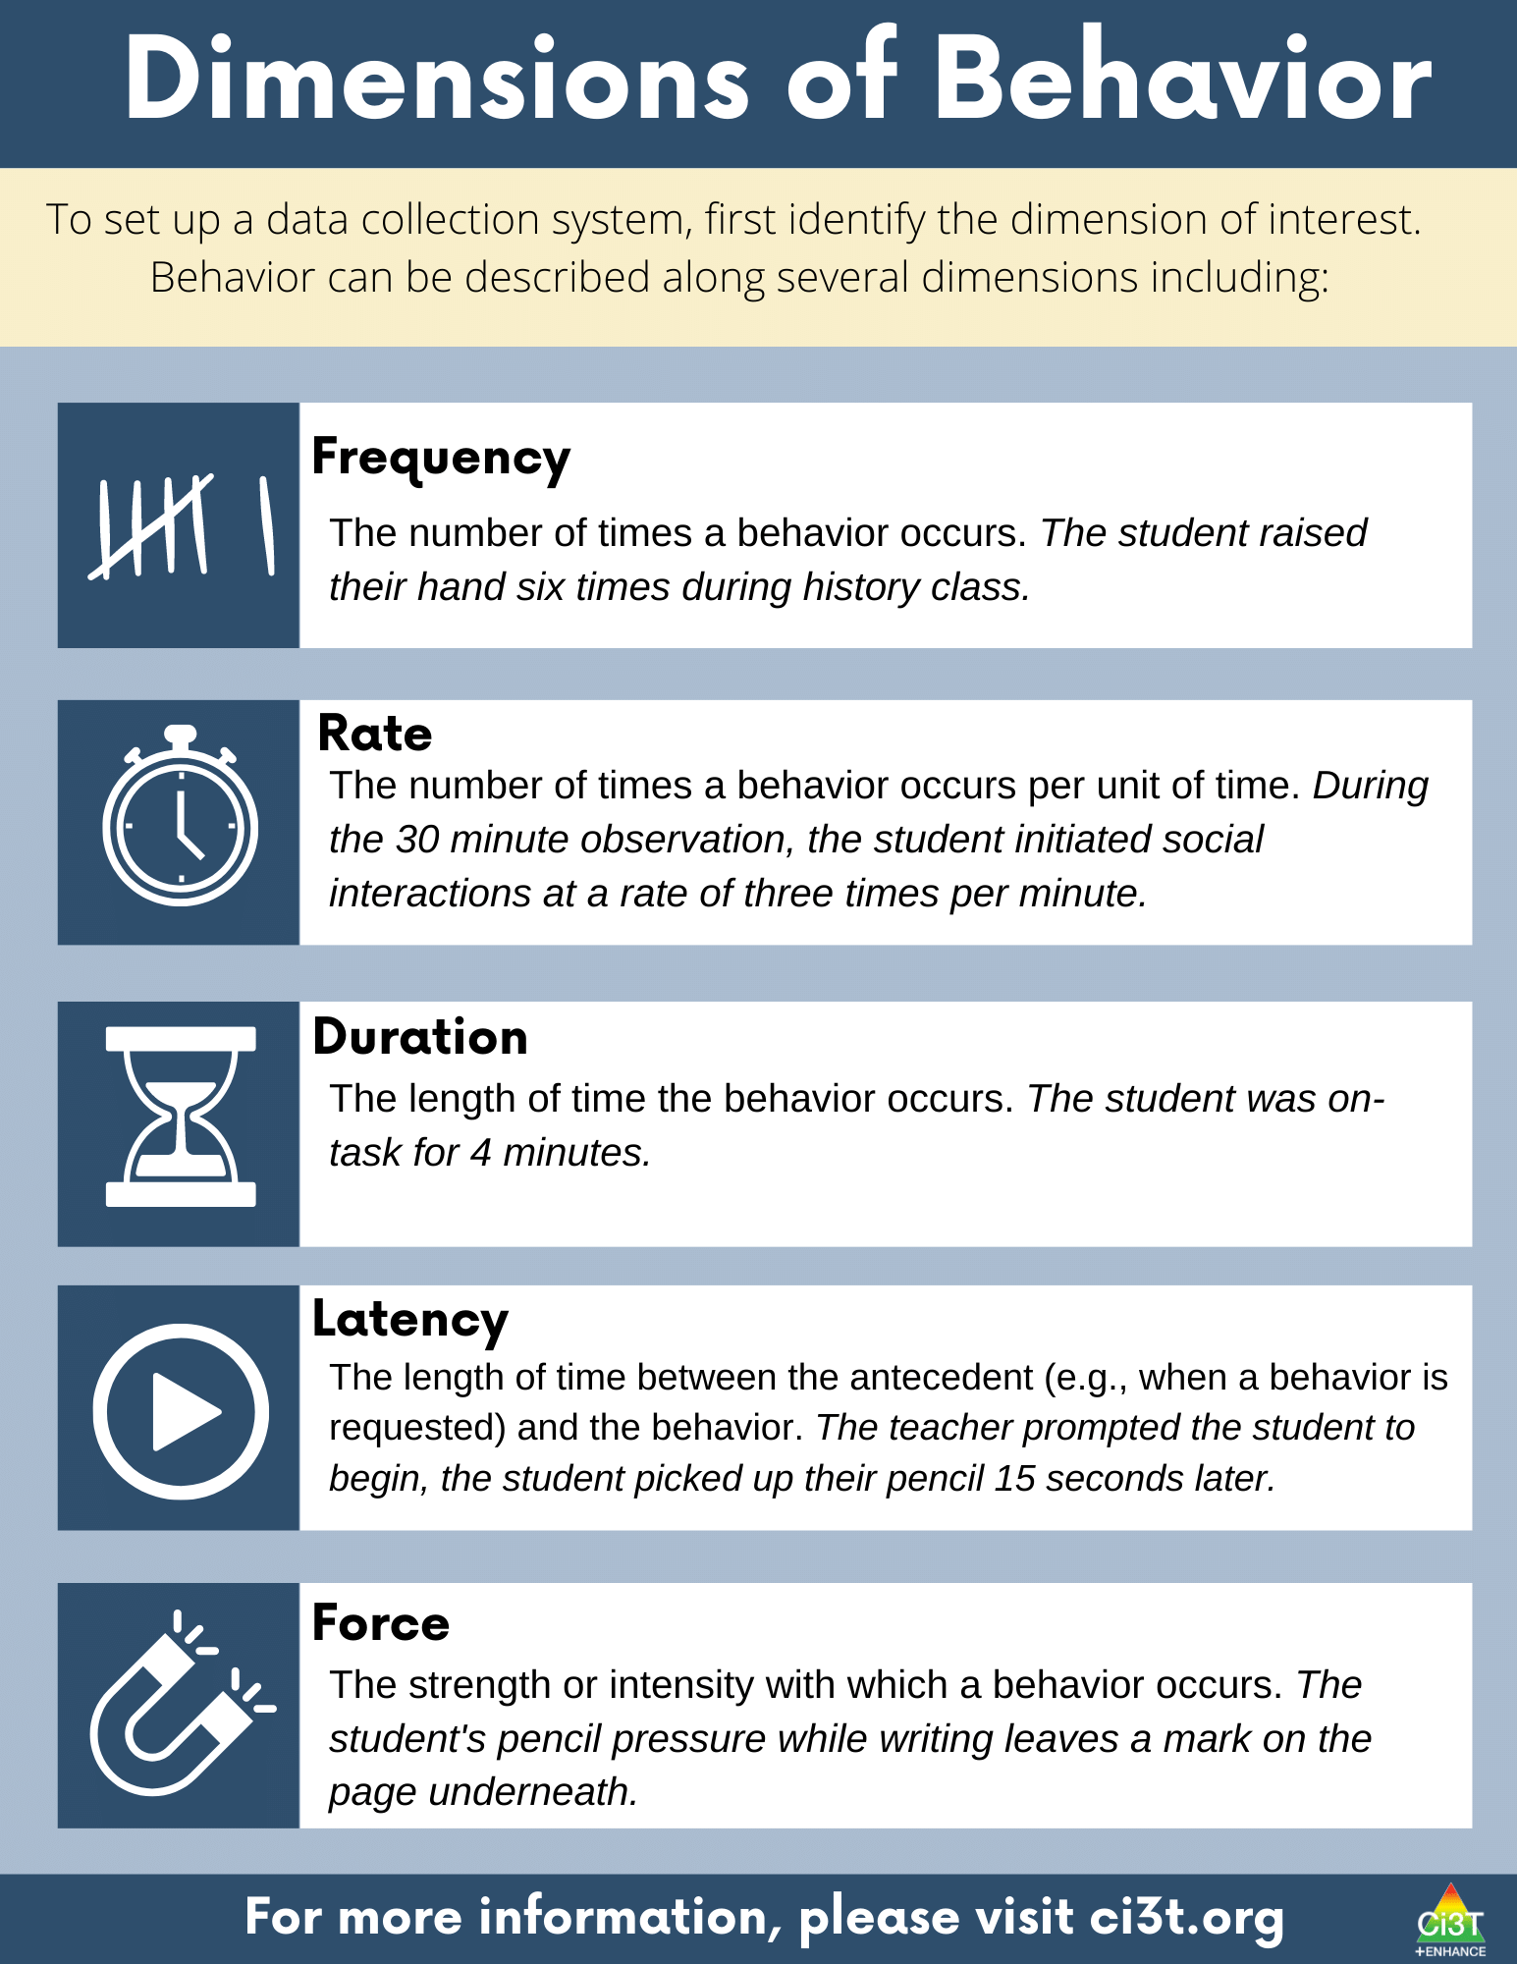
Dimensions of Behavior 1

Slide 49
Dimensions of Behavior 2

Slide 50
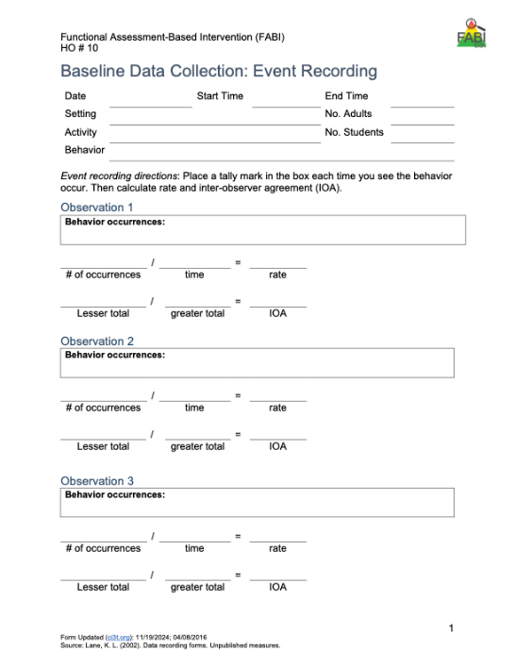
Types of event-based measurement:
  Frequency
  Rate
Most appropriate for behaviors that are:
  Countable and discrete (e.g., relatively brief, clear start and end, and uniform in length).
  Examples: talking out of turn, swearing, pushing
Select a Measurement System: Event-Based

Slide 51

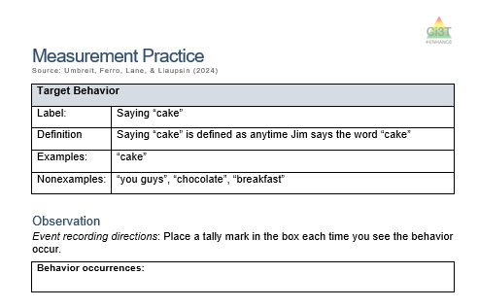
Let’s Practice – Frequency Recording
Notes:
https://youtu.be/ofRn9zCjy8s?si=1W6vo_yTak1yDSQ7&t=88

Slide 52
Debrief – Frequency Recording
How many times did Jim say the word cake?
What about frequency recording was challenging?
Given those challenges, how could the measurement procedures be improved?
Notes:
PRESENTER NOTES:
Jim says cake 18 times
Challenges
Pancake? Cupcake?
Hearing / audio quality
Frequency (happened a lot, hard to keep up) -
Procedures could be improved by:
Revising operational definition – whether or not to “count” compound words
Set up with good vantage point / audio to conduct observation
Consider whether frequency is appropriate / feasible (e.g., if happening too much to keep up maybe partial interval would be more appropriate)

Slide 53

Select a Measurement System: Time-Based
Time Based
  Duration
  Latency
  Interval (whole-interval, partial interval, momentary time sampling)
Most appropriate for behaviors that are:
  Not countable or discrete (e.g., less defined start/end, span a period of time) and/or vary in length each time
  Examples of non-uniform behaviors include: academic engagement, off-task, leaving designated area (e.g., desk, carpet spot), tantrum

Slide 54

Step 3: Collecting Baseline Data
Step 3: Collecting Baseline Data 3
Determine behavioral dimension of focus
Select a measurement system
Develop data collection procedures
Train data collectors
Collect baseline data
Graph baseline data
Reminder- although we aren’t discussing these today developing data collection procedures, training data collectors, and collecting baseline data are key components of this step!

Slide 55

Step 4: Design the FABI
Step 4: Design the FABI 1

Slide 56

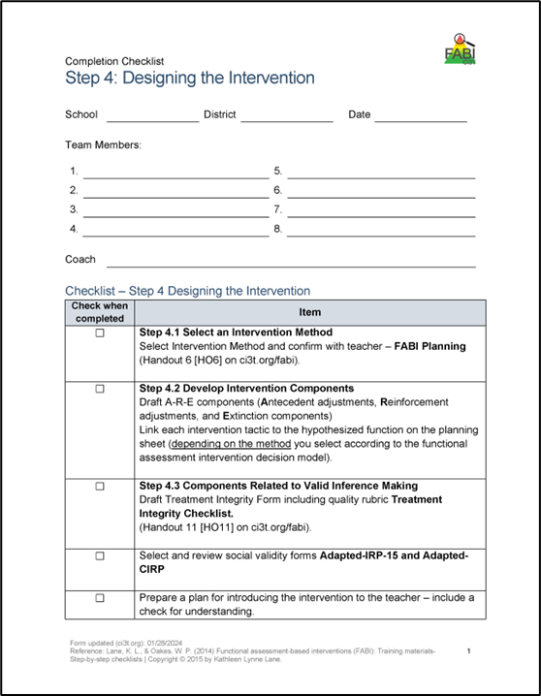
Step 4: Design the FABI
Step 4: Design the FABI 2
Select an intervention method
Develop A-R-E intervention components
Draft treatment integrity checklist
Assess pre-intervention social validity
Develop intervention materials
Introduce FABI to educators and family
Introduce FABI to student
Revise and finalize FABI
Notes:
Today, we are going to focus on these components of Step 4

Slide 57

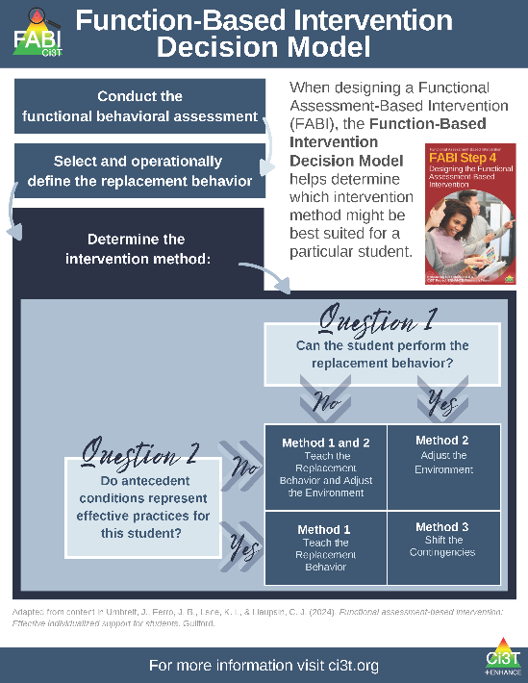
Function-Based Intervention Decision Model
An intervention method is selected based on the response to these two questions:
Can the student perform the replacement behavior?
Do antecedent conditions represent effective practices for this student?

Slide 58

Function-Based Intervention Decision Model 1

Slide 59
A-R-E Components
Antecedent Adjustments - adjusting the antecedent conditions to increase likelihood replacement behavior will occur and (if applicable) providing instruction in the replacement behavior
Reinforcement Shifts - reinforcing the replacement behavior to strengthen its occurrence
Extinction Procedures - ensuring that the target behavior is not followed by reinforcement

Slide 60
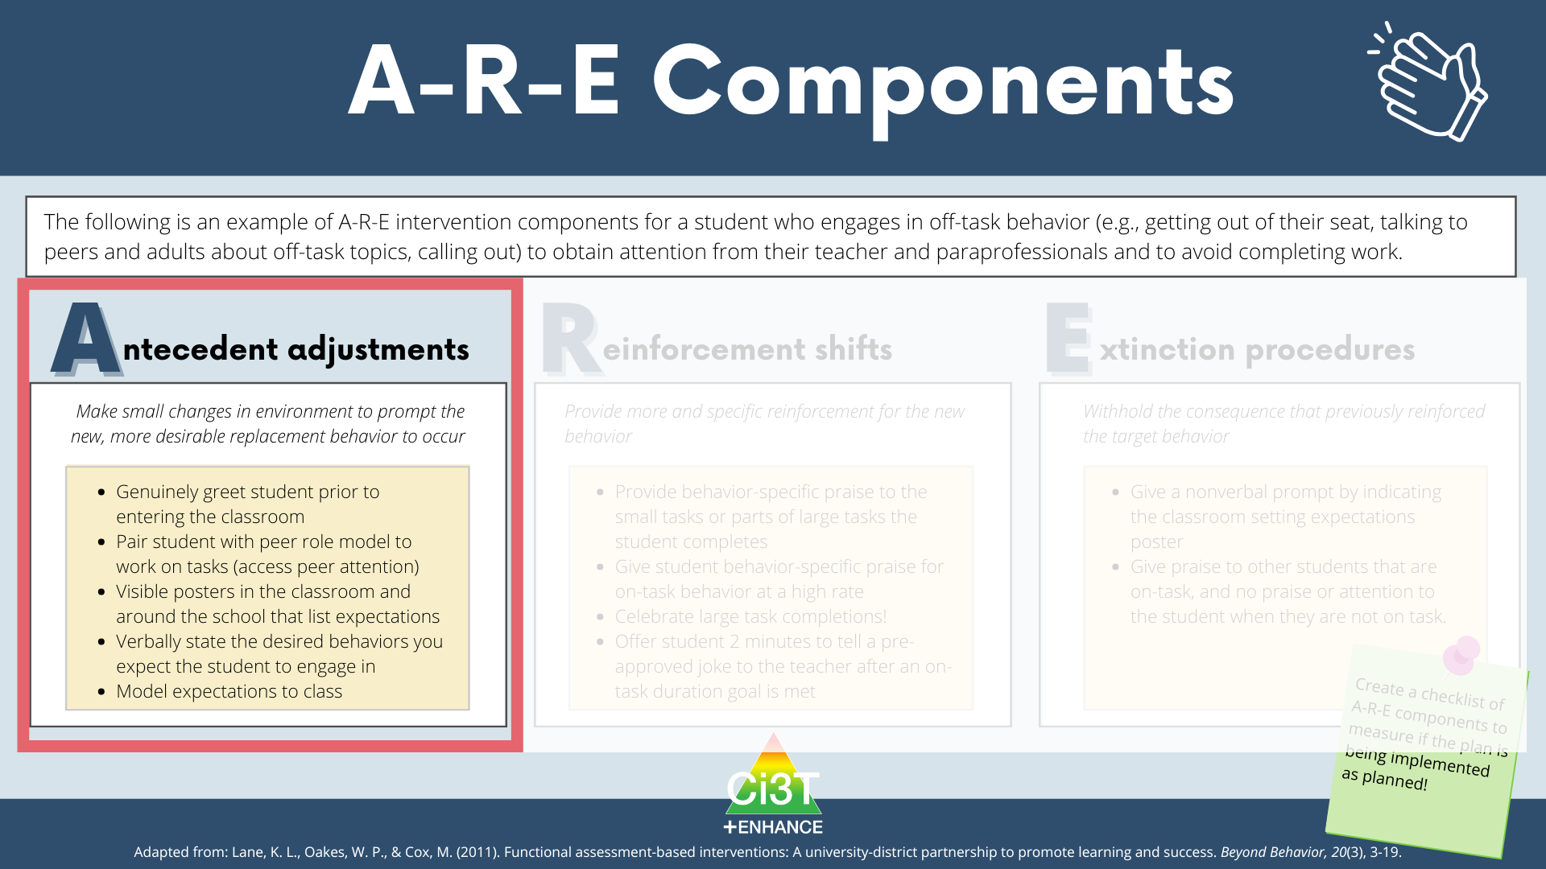
A-R-E Components 1

Slide 61
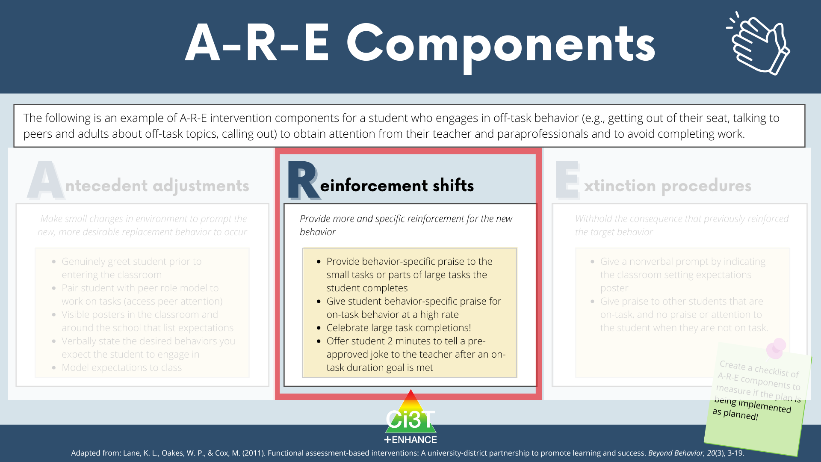
A-R-E Components 2

Slide 62
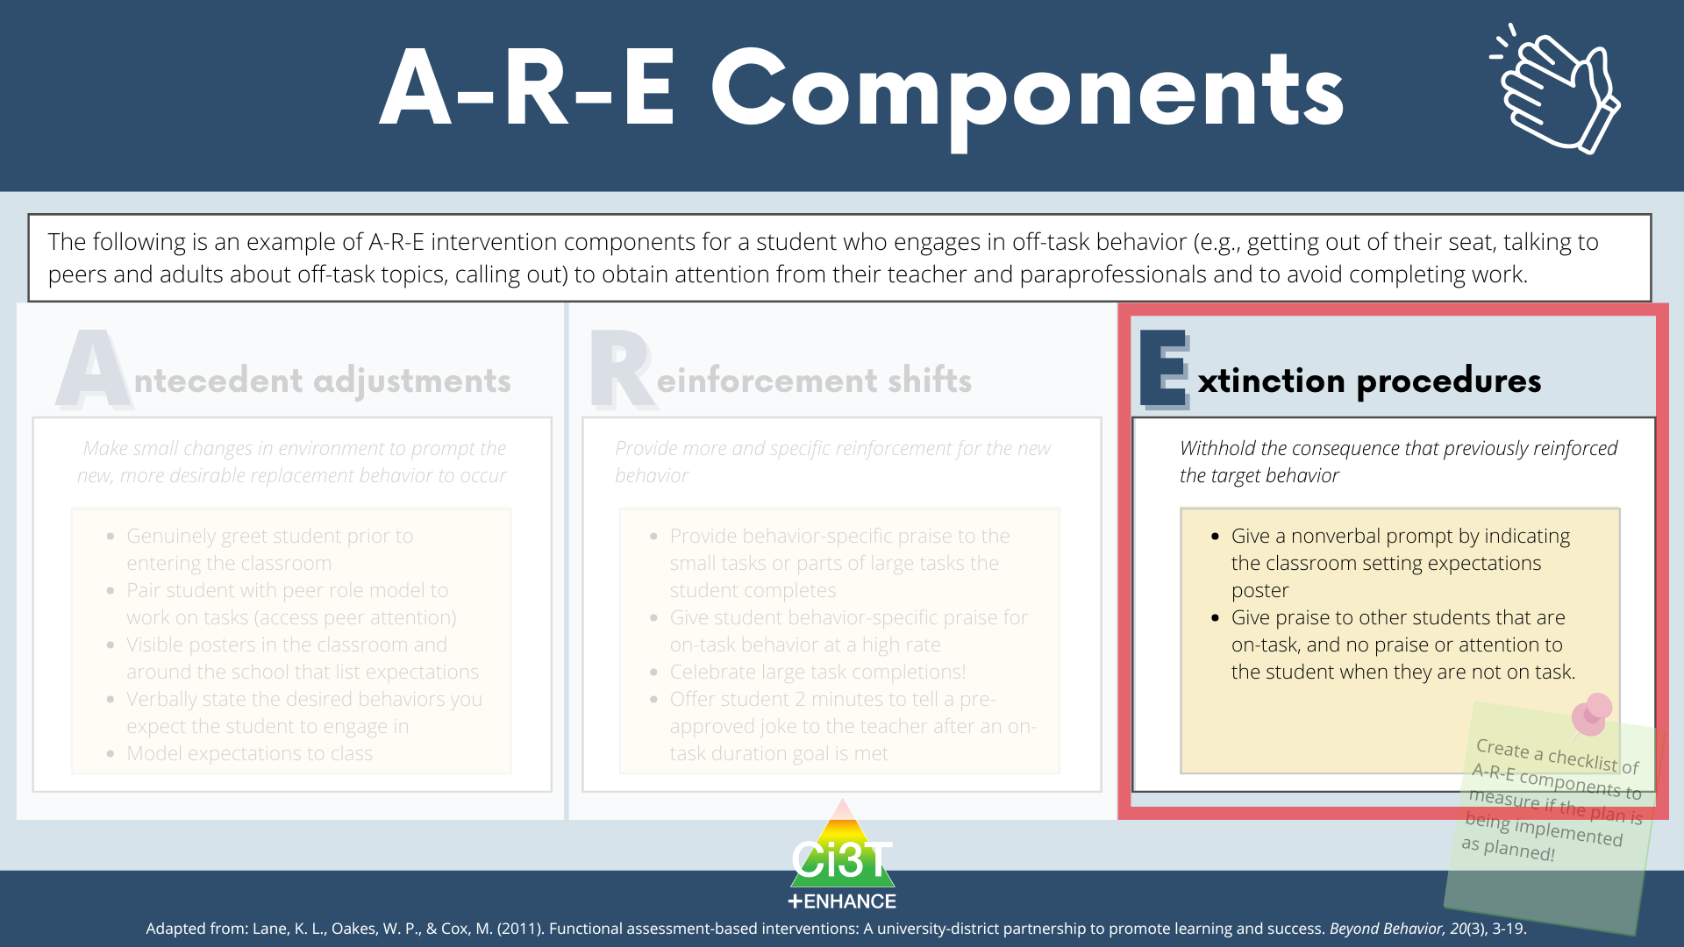
A-R-E Components 3

Slide 63
Illustration:
Harry (5th Grade)
Cox, M., Griffin, M. M., Hall, R., Oakes, W. P., & Lane, K. L. (2011). Using a Functional Assessment-Based Intervention to Increase Academic Engaged Time in an Inclusive Middle School Setting. Beyond Behavior, 20(3).

Slide 64
Target Behavior: Off -Task Behavior
Off-task is defined as attending to activities in class other than assignments
Examples
Playing with materials inappropriately, talking to peers, putting head on the desk, drawing, and looking around the room
Non-examples
Completing assignments using materials only for assignments, and watching the teacher when delivering instruction

Slide 65
Replacement Behavior: Academic Engagement
Academic engagement is defined as anytime Harry is attending to class instructions and/or assignments
Examples
Completing assignments using materials only for assignments, and watching the teacher when delivering instruction
Non-examples
Playing with materials inappropriately, talking to peers, putting head on the desk, drawing, and looking around the room

Slide 66
Function Matrix
Function Matrix 2
 | Positive Reinforcement (Access something) | Negative Reinforcement (Avoid something)
Attention | ABC 1.1, ABC 1.2, ABC 1.19, ABC 2.1(peer), ABC 2.2, ABC 2.3, ABC 2.4, ABC 2.7, ABC 2.8, ABC 2.10, S.I. # 4 (wants peer att.)
Tangibles/ activities | ABC 2.9, S.I. #4 (wants more fun activity) | ABC 1.2, ABC 1.3, ABC 1.4, ABC 1.6, ABC 1.7, ABC 1.8, ABC 1.9, ABC 1.10, ABC 1.11, ABC 1.12, ABC 1.13, ABC 1.14-1.19, ABC 2.1, ABC 2.2, ABC 2.4, ABC 2.5, ABC 2.6, ABC 2.7, ABC 2.9, Avoiding work when not structured. T.I. #4, T.I. #9, S.I. #2 & #3
Sensory | ABC 1.1, ABC 1.5, ABC 1.6, ABC 1.18, ABC 1.19, ABC 2.1, ABC 2.2, ABC 3.1-3.4

Slide 67
Hypothesized Function
Hypothesized Function 2
When presented with academic tasks or instruction, Harry became off-task (engaged in an activity other than the one assigned) to escape tasks and gain attention.
That is, Harry, engaged in off-task behaviors
to access teacher and/or peer attention
(positive reinforcement- attention)
or to escape the instruction by the teacher
or the activity that the teacher assigned
(negative reinforcement- activity).

Slide 68
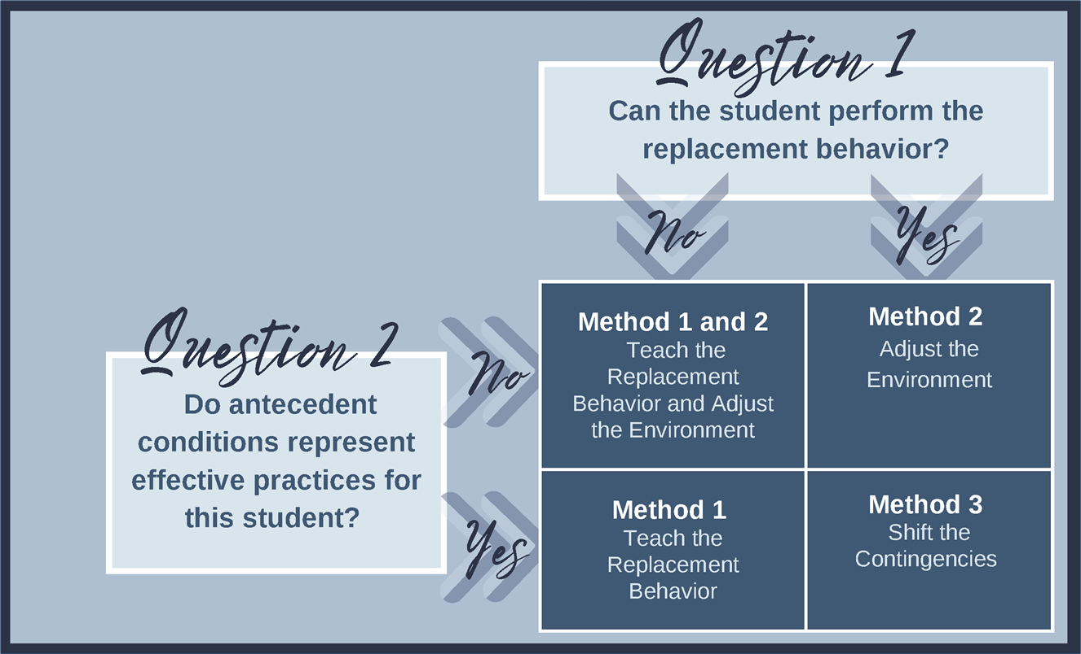
Function-Based Intervention Decision Model
Function-Based Intervention Decision Model 2

Slide 69
Measurement
Whole Interval recording
  Measured academic engagement
  20 min sessions, ~8:45-9:05 am
  Each interval was 20 s

Slide 70
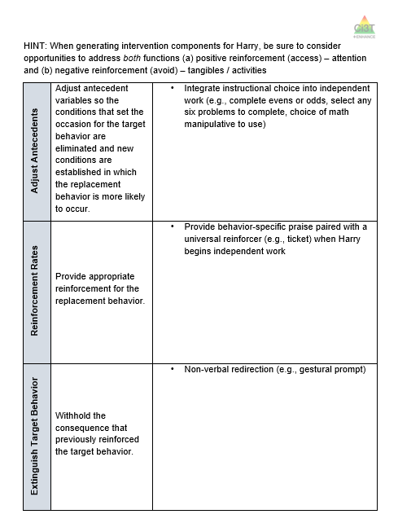
Let’s Practice
Let’s Practice 2
Work with your group to generate A-R-E components
*tip*
Be sure to consider opportunities to address both functions
positive reinforcement (access) – attention
negative reinforcement (avoid) – tangibles / activities
Notes:
6-min

Slide 71
Component 1- Adjust the Antecedents
Component 1- Adjust the Antecedents 3
Adjust Antecedents | Adjust antecedent variables so the conditions that set the occasion for the target behavior are eliminated and new conditions are established in which the replacement behavior is more likely to occur. | Integrate instructional choice into independent work (e.g., complete evens or odds, select any six problems to complete, choice of math manipulative to use) Changes to physical environment (e.g., different assigned seat) Entry routine (e.g., greet teacher, go to seat, start do-now)
Notes:
WWC - https://ies.ed.gov/ncee/wwc/PracticeGuide/31
Low-Intensity, Teacher Delivered Strategies (module)

Slide 72
Component 2- Reinforcement Rates
Component 2- Reinforcement Rates 2
Reinforcement Rates | Provide appropriate reinforcement for the replacement behavior. | Provide behavior-specific praise paired with a universal reinforcer (e.g., ticket) when Harry begins independent work Break Card (3 min walk to lockers or water fountain)

Slide 73
Component 3- Extinguish the Target Behavior
Component 3- Extinguish the Target Behavior 2
Extinguish Target Behavior | Withhold the consequence that previously reinforced the target behavior. | Non-verbal redirection (e.g., gestural prompt) Brief verbal prompt, then shift attention to students who are working and provide them praise

Slide 74
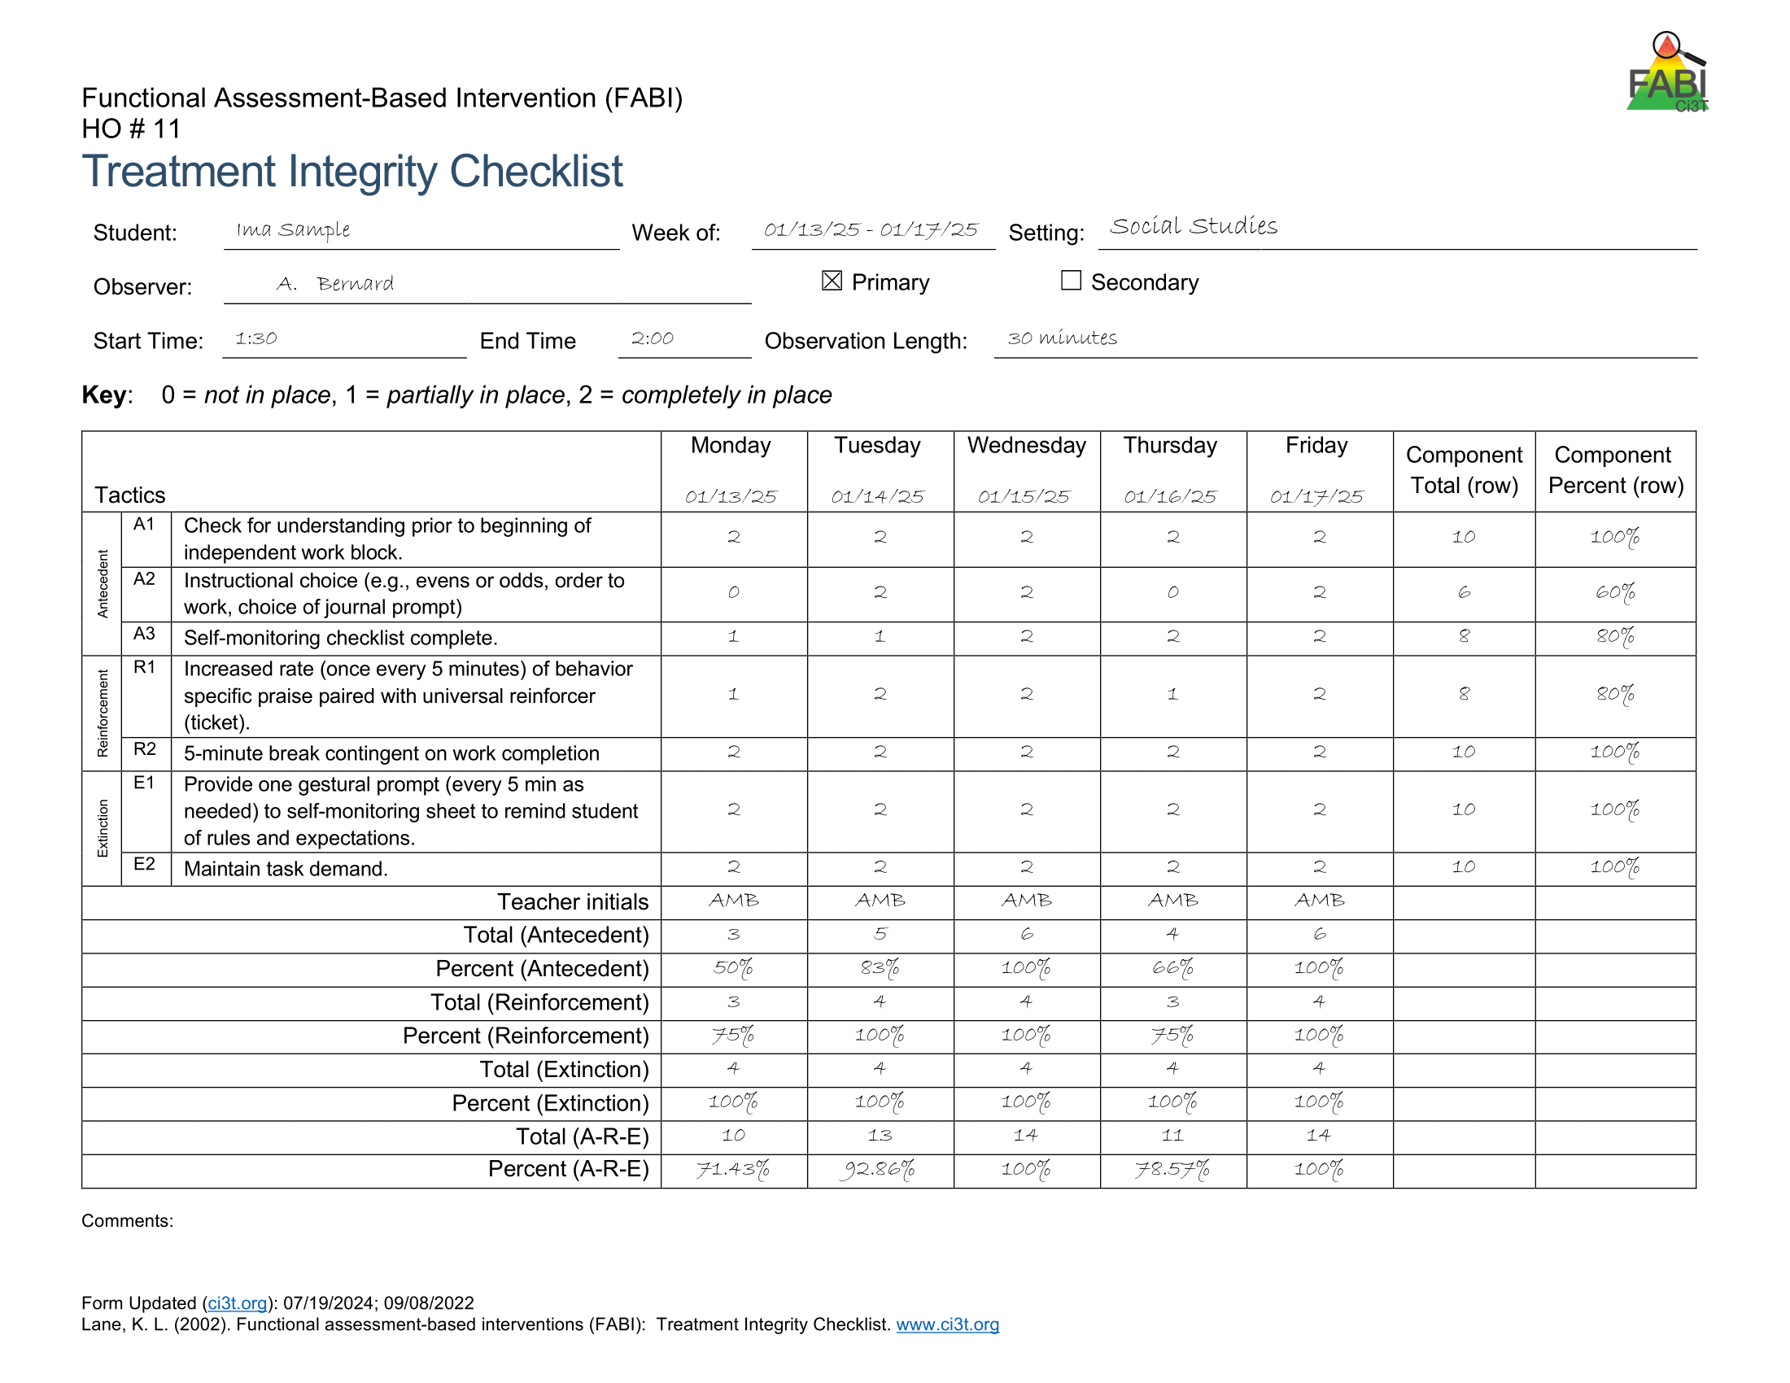
Treatment Integrity

Slide 75
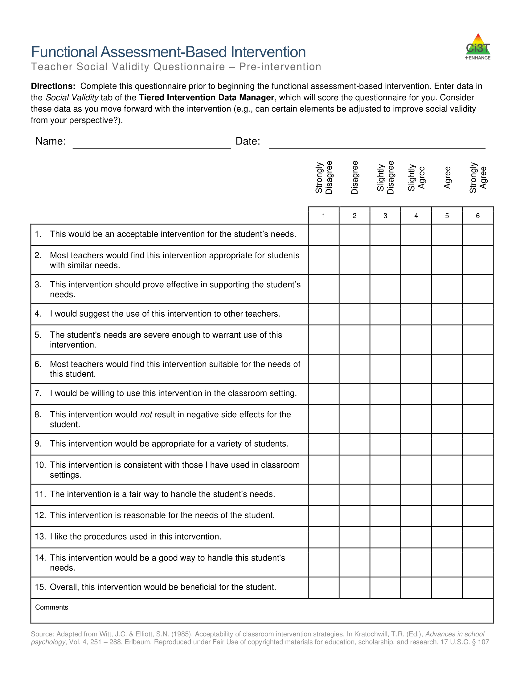
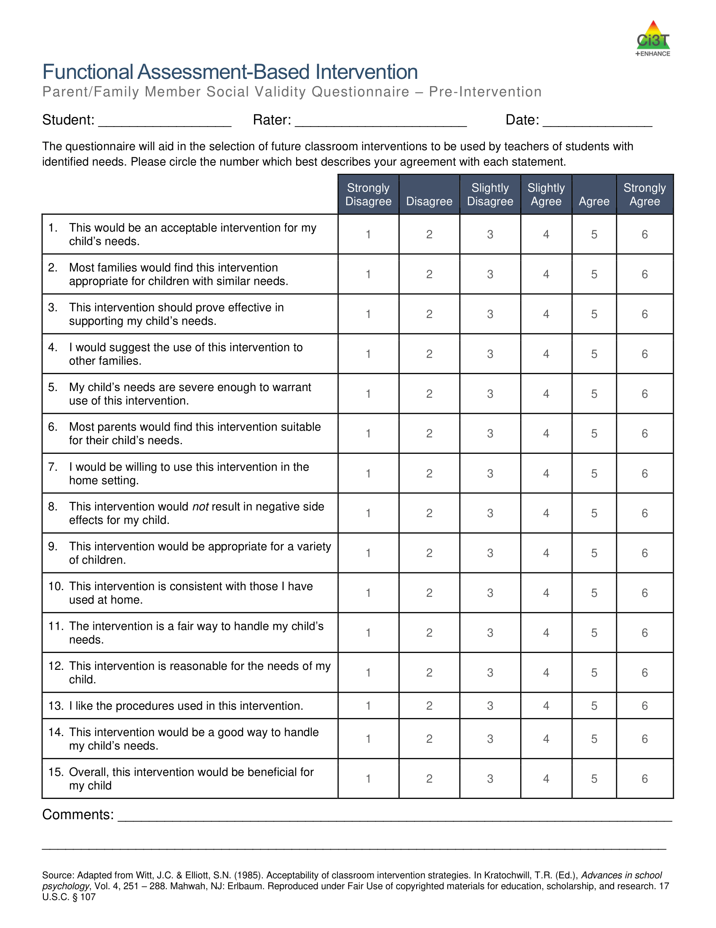
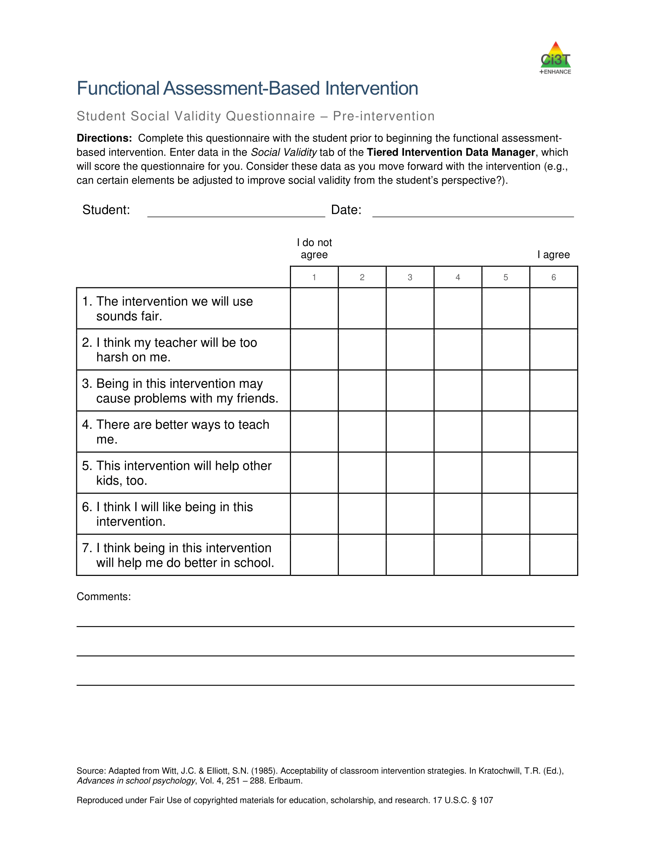
Pre-Intervention Social Validity

Slide 76

Step 5: Test the Intervention

Slide 77

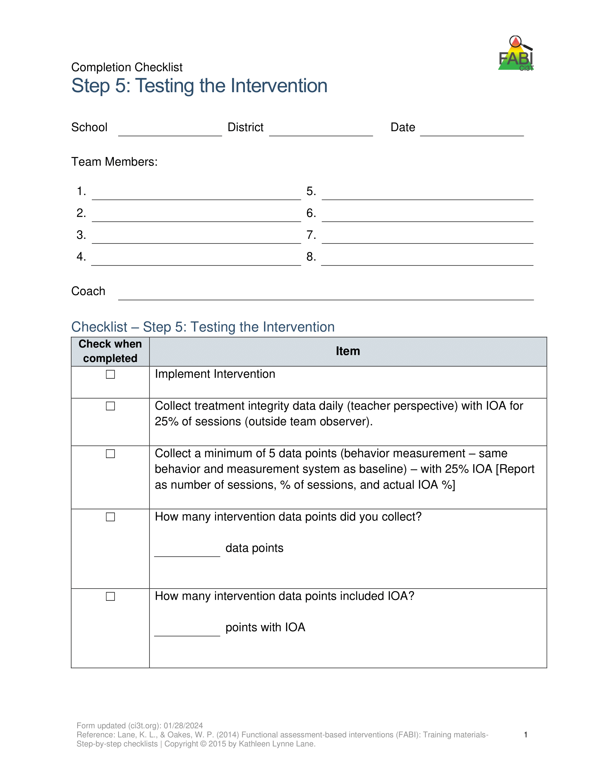
Step 5: Testing the Intervention
Implement the intervention
Monitor treatment integrity
Collect and graph data
Implement a single-case design to “test” how well intervention is working
  ABAB
  Multiple baseline
  Changing criterion
Assess social validity
Fade the intervention

Slide 78
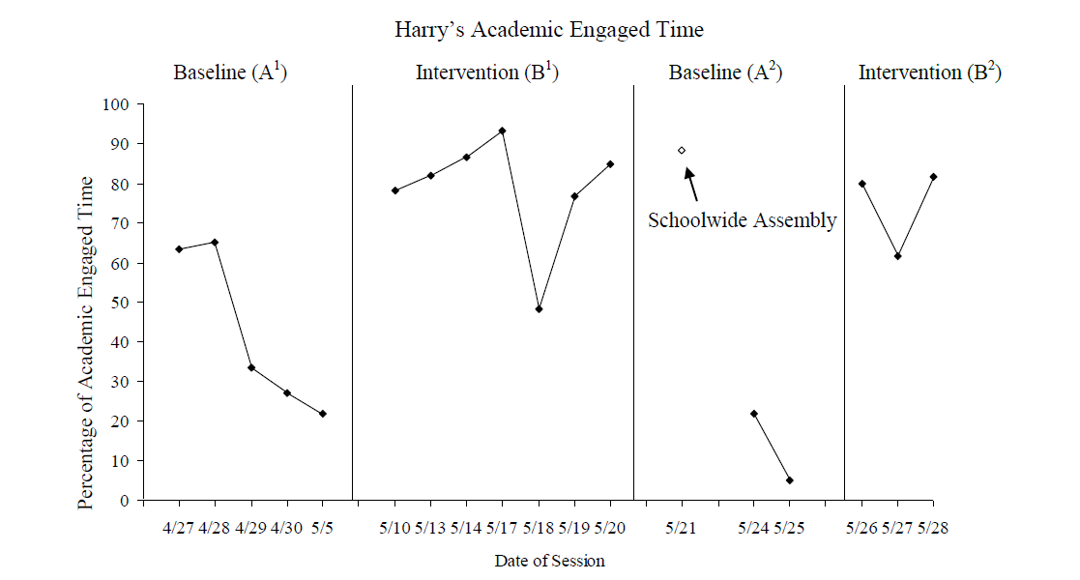
Harry’s Intervention Outcomes
Harry’s Intervention Outcomes 2
Cox, M., Griffin, M. M., Hall, R., Oakes, W. P., & Lane, K. L. (2011). Using a Functional Assessment-Based Intervention to Increase Academic Engaged Time in an Inclusive Middle School Setting. Beyond Behavior, 20(3).

Slide 79
Wrapping Up and Moving Forward

Slide 80
Opportunities to Learn More
Opportunities to Learn More 2

Slide 81
Knowledge, Application, Impact Points
Knowledge, Application, Impact Points 2
On-Task Behavior: Jackson
If you are in Kansas, you can earn 2 x PD points for application and 3 x for impact!
We are happy to review your materials before you upload!
Notes:
Tonight’s session lays the foundation with knowledge building and getting you oriented to the modules that can support application and impact efforts!

Slide 82
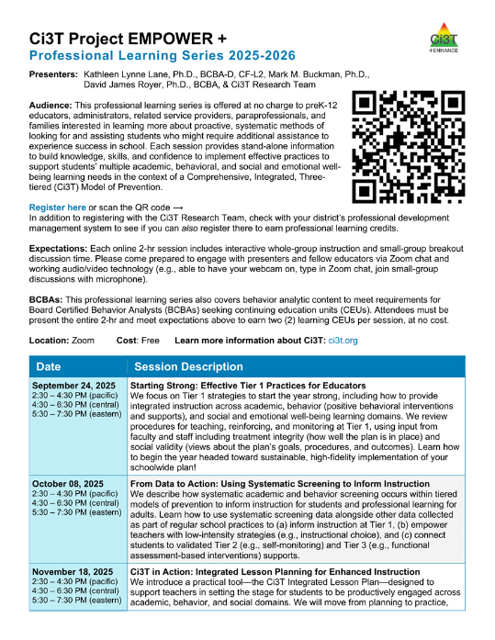
Project EMPOWER+
EMPOWER+ Session | Date
Starting Strong: Effective Tier 1 Practices for Educators | September 24, 2025 (Wednesday)
From Data to Action: Using Systematic Screening to Inform Instruction | October 8, 2025 (Wednesday)
Ci3T In Action: Integrated Lesson Planning for Enhanced Instruction | November 18, 2025 (Tuesday)
Mastering Behavior Specific Praise and Precorrection | January 21, 2026 (Wednesday)
A 6-Step Instructional Approach for Responding to Challenging Behaviors: A Tier 1 Practice | February 10, 2026 (Tuesday)
A Tier 2 Support for Students Experiencing Anxious Feelings: Recognize. Relax. Record. | March 25, 2026 (Wednesday)
A Tier 3 Support for Students with Intensive Intervention Needs: Functional Assessment-Based Intervention (FABI) | April 28, 2026 (Tuesday)

Slide 83



Thank you!
Thank you!
ci3t.org
#Ci3T
@Ci3Tmodel
Tag us in your Ci3T highlights, we love to see Ci3T in action!
Follow us on Instagram for updates and new resources!
Elise Sarasin
elise.sarasin@ku.edu
Notes:
Tag us in your Ci3T highlights- we would love to see Ci3T in action! Follow us on Instagram for updates and links to resources! @Ci3TModel
You will receive a brief session evaluation – we value your feedback and would greatly appreciate you taking a few minutes to share your thoughts on what you liked about the session and how we can improve

