Slide 1
Data-Informed Professional Learning in Integrated Tiered Systems (5e)
Presenters:
Mark Buckman, PhD| University of Kansas
Kathleen Lynne Lane, PhD, BCBA-D, CF-L2 | University of Kansas
Amber Smith, MEd | Fort Mill Public Schools
Topic: Data-based Decision Making
Keywords: Training, Fidelity, Sustainability
Notes:
Sample title slide with topic & keyword information (for all presenters)

Slide 2
Learning Objectives
Participants will:
develop an understanding of a data-informed professional learning process for supporting school-site leadership teams, faculty and staff, and families in implementing integrated tiered systems to meet students’ multiple needs;
learn to access and use a wide-range of free-access, on-demand professional learning resources to support Ci3T implementation across the tiers;
conceptualize how available resources can be used to construct a data-informed professional learning journey capable of meeting the learning needs of implementers and school leaders with varying needs and levels of experience (e.g., onboarding new faculty and staff, supporting experienced implementers).
Institute of Education Sciences, U.S. Department of Education
R324N190002 University of Kansas
R324X220067 University of Kansas
Notes:
Learning Objectives

Slide 3
Agenda
What is data-informed professional learning?
What resources are available to support data-informed professional learning?
How can my school / district / organization use available resources to create a data-informed professional learning journey?
  Partner Spotlight
  Enhanced Ci3T Implementation Series and Delivery
Evaluation + Q&A

Slide 4
What is data-informed professional learning?
A focus on integrated tiered systems
The research reported here was supported by the Institute of Education Sciences, U.S. Department of Education, through Grants R324N190002 and R324X220067 to University of Kansas. The opinions expressed are those of the authors and do not represent views of the Institute or the U.S. Department of Education.

Slide 5
Setting the Stage:
Why Integrated Tiered Systems?
“integration of a number of multiple-tiered systems into one coherent, strategically combined system meant to address multiple domains or content areas in education.”
-McIntosh & Goodman (2016)
Data systems
Evidence-based components
Leadership capacity

Slide 6


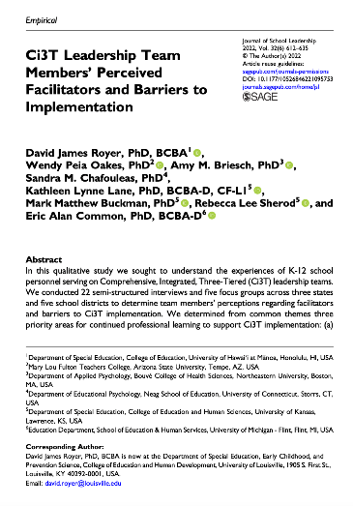
Setting the Stage:
What is the importance of professional learning? (1)
Top Leadership Needs
Onboarding and Training
Communicating the Vision of Ci3T
Providing Professional Learning for Faculty and Staff
Royer, D. J., Oakes, W. P., Briesch, A. M., Chafouleas, S. M., Lane, K. L., Buckman, M. M., Sherod, R. L., & Common, E. A. (2021). Ci3T Leadership Team Members’ perceived facilitators and barriers to implementation. Journal of School Leadership, 32(6). https://doi.org/10.1177/10526846221095753

Slide 7
Setting the Stage:
What is the importance of professional learning? (2)
TFI 1.13 Classroom Professional Development and Coaching
Tier 1 leadership team develops, documents, and implements a comprehensive, data-driven, and differentiated professional development system (PBIS/MTSS for staff), supported by adequate FTE and aligned to other relevant school initiatives, that includes initial and ongoing training, coaching, and supportive performance feedback to support educators’ implementation of positive and proactive classroom practices (described in item 1.10).
Score | Criteria
4 | A written process for training, coaching, and providing feedback includes all staff and all classroom Tier 1 practices, is used as part of continuous PD cycle, additional supports are differentiated based on data-informed need, and PD is aligned with other school initiatives and supports.
Center on PBIS. (February 2025). Tiered Fidelity Inventory (TFI) Manual. University of Oregon. www.pbis.org.

Slide 8
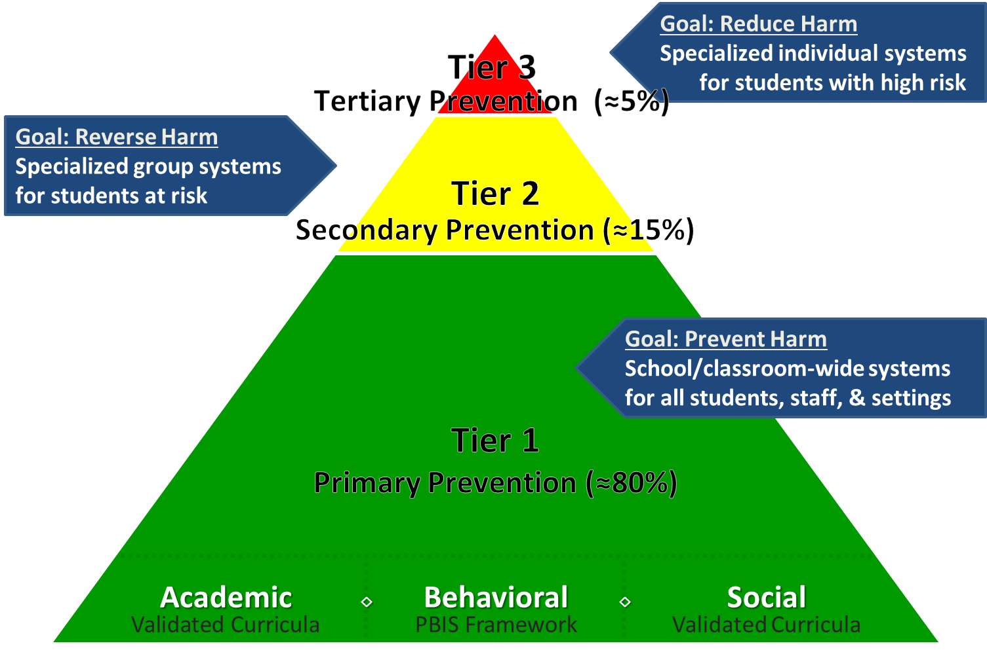
Comprehensive, Integrated, Three-Tiered (Ci3T) Models of Prevention

Slide 9
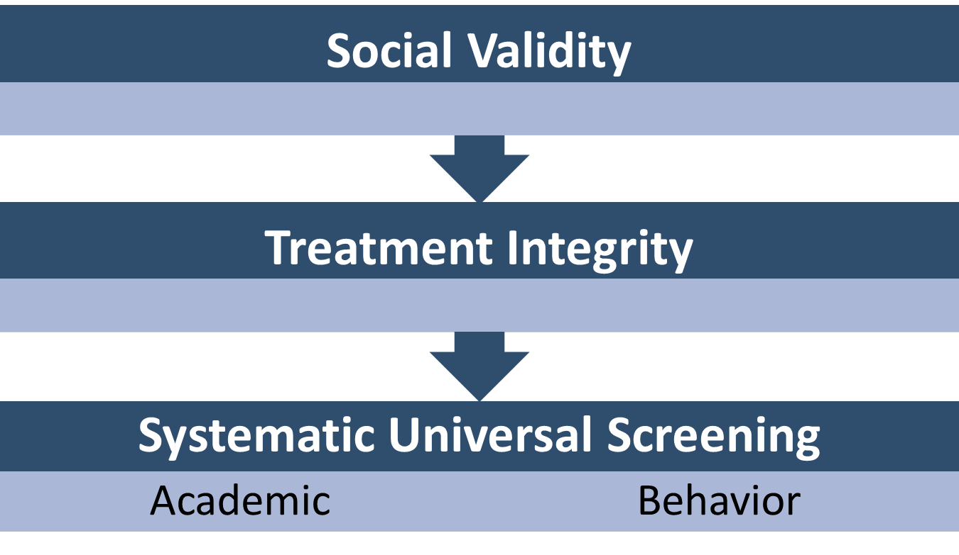
What types of data can be used?

Slide 10
Social Validity:
How do stakeholders view the plan?
Social validity refers to the level of:
Social significance of intervention goals
Social acceptability of intervention procedures
Social importance of intervention outcomes
(Wolf, 1978)
Assessed using the Primary Intervention Rating Scale (PIRS)
Social Validity: PIRS Results
Year | Fall: n | Fall: % (SD) | Spring: n | Spring: % (SD)
2025-2026 | 32 | 85.39 (8.89) | TBD | TBD

Slide 11
Treatment Integrity:
Are we implementing our plan as intended?
Treatment integrity can refer to:
Adherence
Dosage
Quality
Method | Measure Name | Completed by: All Staff | Completed by: Randomly Selected Classrooms | Completed by: Ci3T Leadership Team
Survey | Ci3T Treatment Integrity: Teacher Self-Report and Primary Intervention Rating Scale | X
Observation | Ci3T Treatment Integrity: Direct Observation |  | X
Rubric | Tiered Fidelity Inventory (TFI) |  |  | X

Slide 12

Behavioral and Academic Screening
How are students responding?
Inform Tier 1 Instruction
Identify opportunities for teacher-delivered, low-intensity strategies
Connect students to Tier 2 and Tier 3 interventions

Slide 13

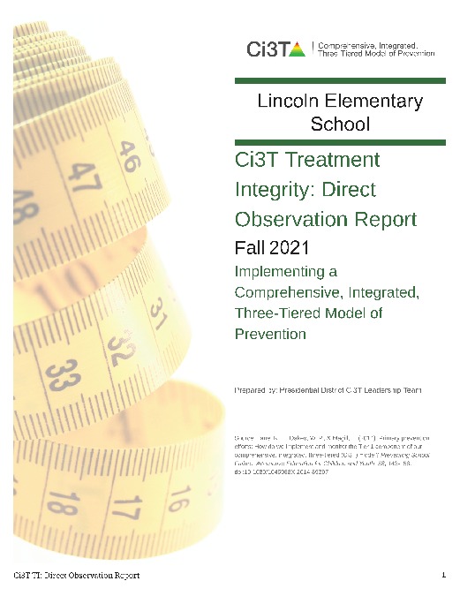
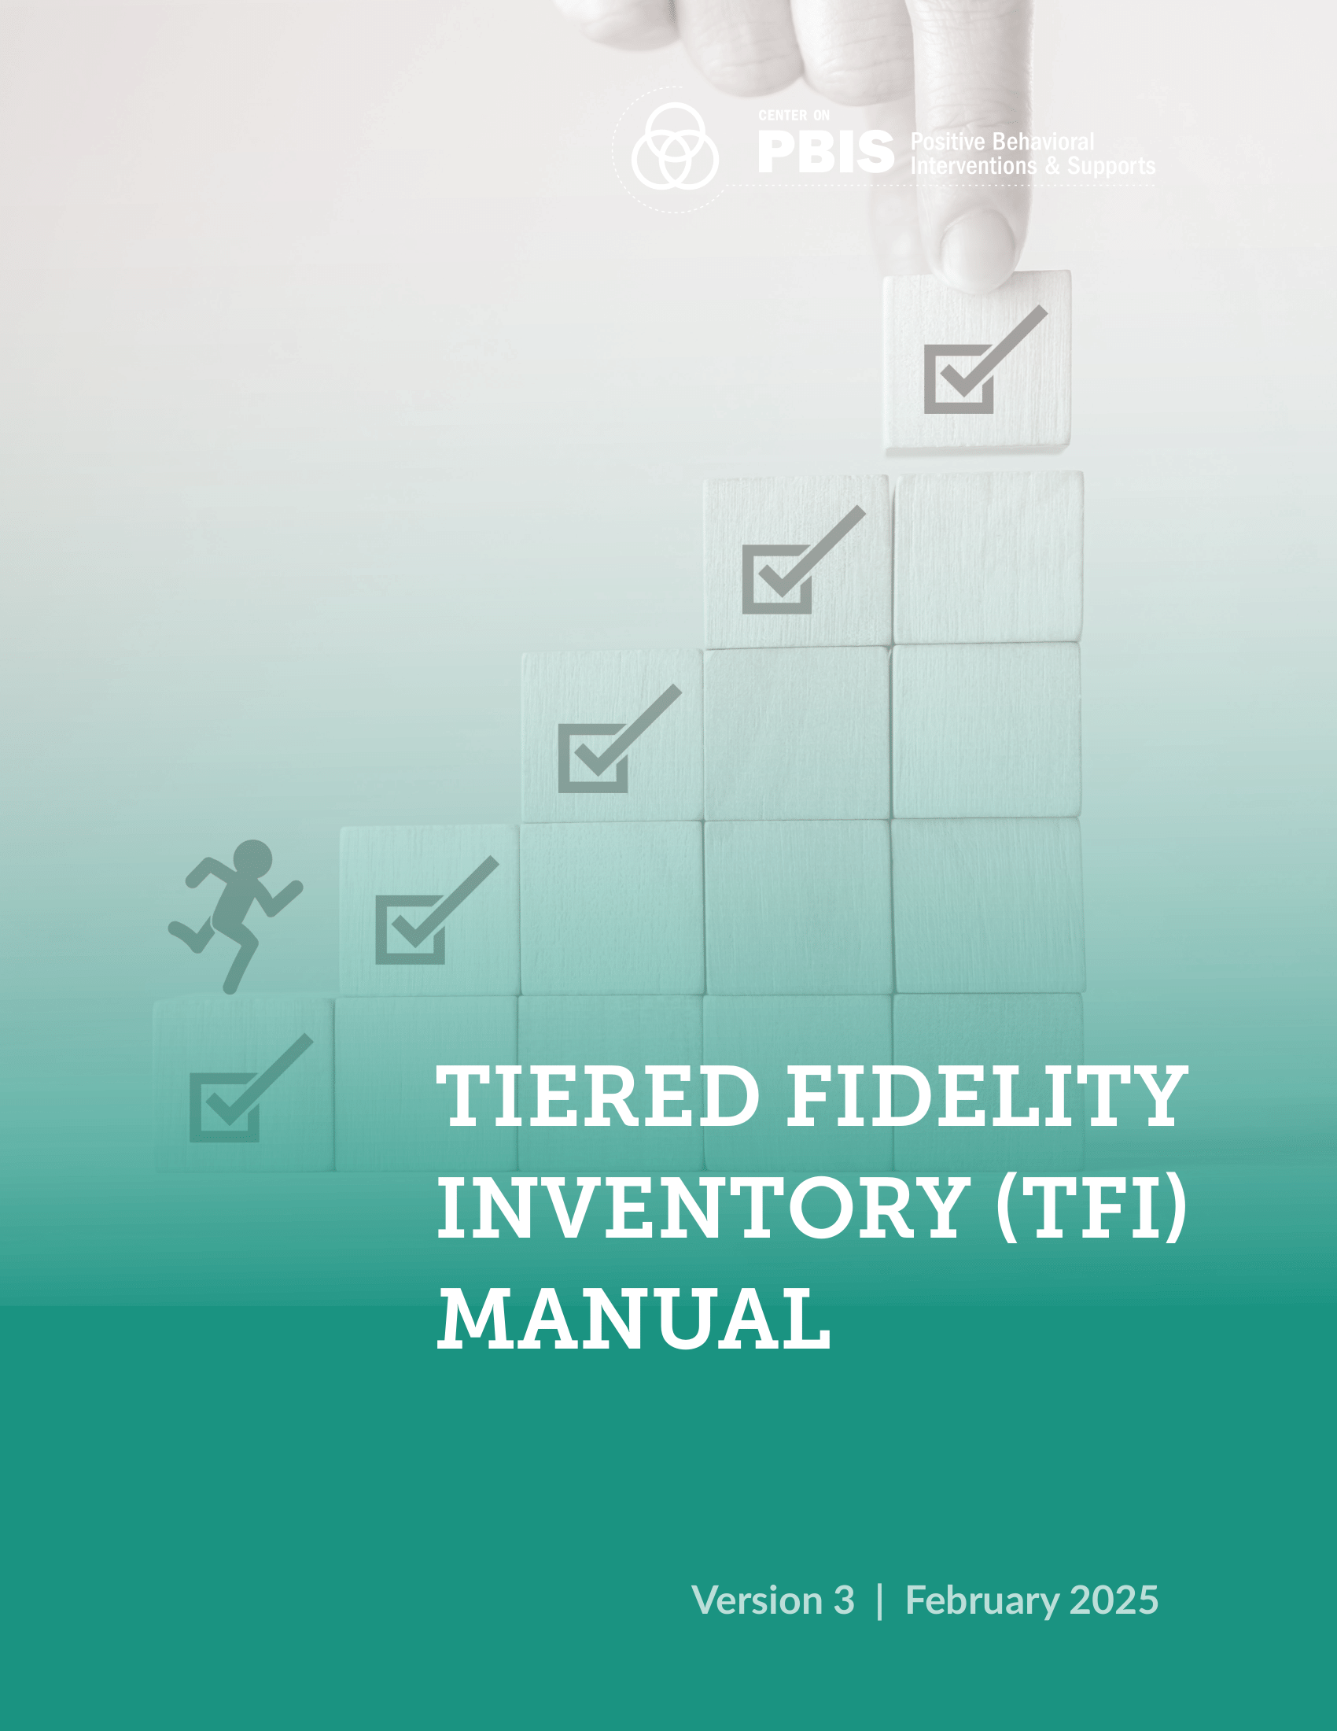
Data Reporting:
Treatment Integrity and Social Validity
Primary Intervention Rating Scale (Social Validity)
Ci3T Treatment Integrity: Teacher Self Report
Ci3T Treatment Integrity: Direct Observation
Tiered Fidelity Inventory
Fall 2025

Slide 14
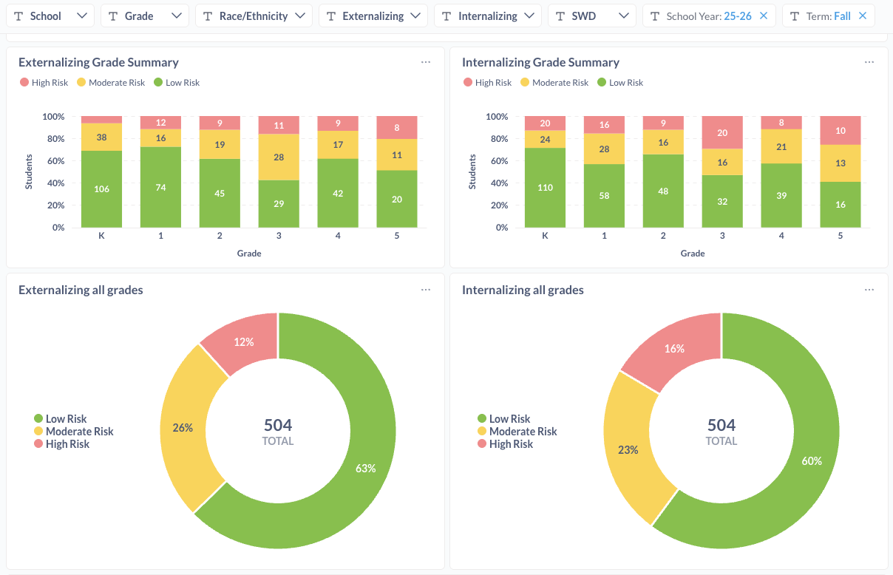
Data Reporting:
Systematic Screening
Used with permission from Standard Co.

Slide 15
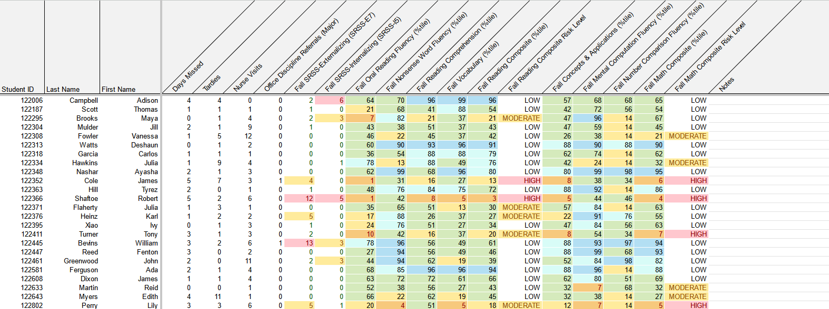
Data Reporting:
Integrated Data Dashboards (1)
attendance
behavior
screening
academic screening

Slide 16
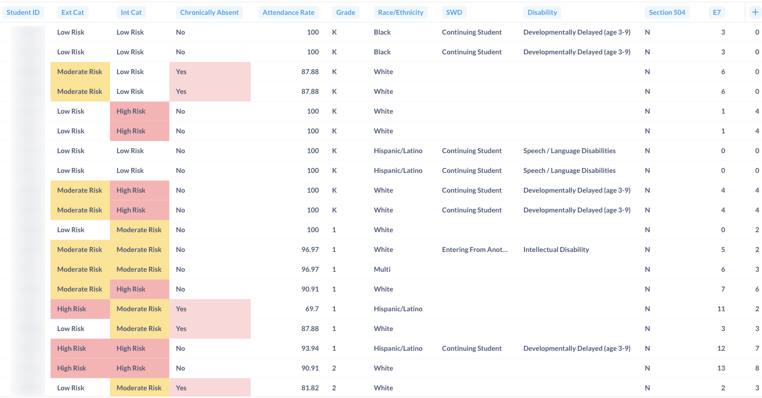
Data Reporting:
Integrated Data Dashboards (2)
Used with permission from Standard Co.

Slide 17
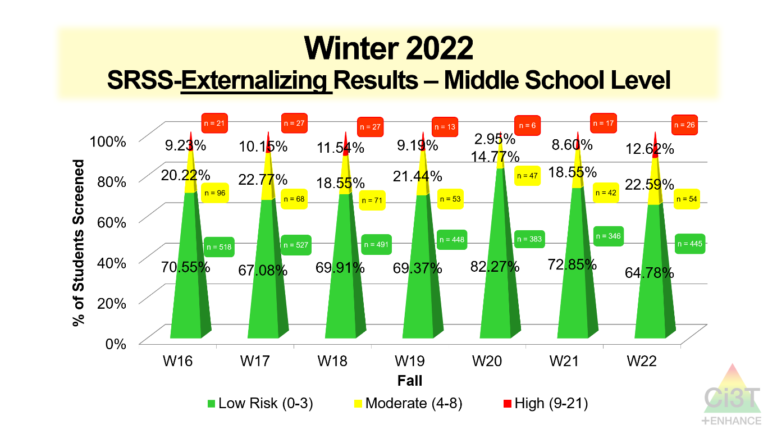
A Scenario (1)

Slide 18
A Scenario (2)
Grade Level | N Screened | Low n (%) | Moderate n (%) | High n (%)
6 | 96 | 68 (70.83%) | 17 (17.71%) | 11 (11.46%)
7 | 126 | 79 (62.70%) | 32 (25.40%) | 15 (11.90%)
8 | 79 | 48 (60.76%) | 19 (24.05%) | 12 (15.19%)

Slide 19
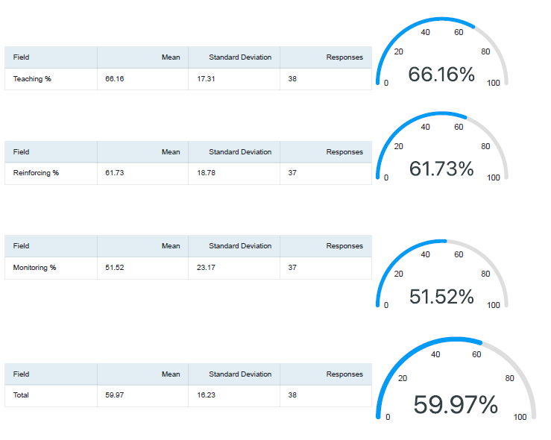

A Scenario (3)
Notes:
In addition to student-level data, procedures for teaching is below 80% indicating Tier 1 is not yet in place as planned

Slide 20
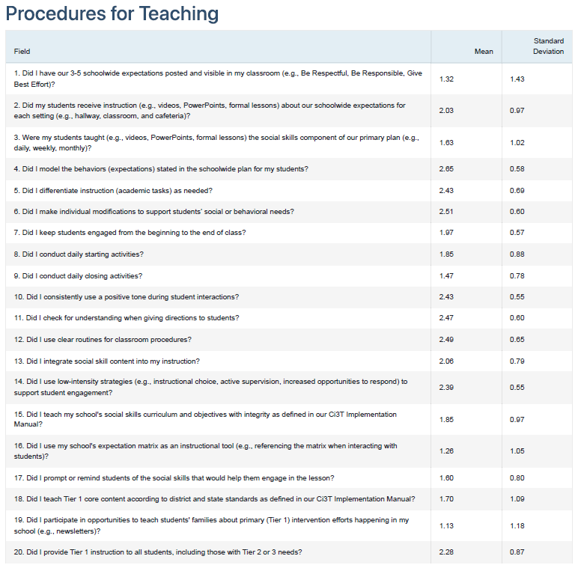

A Scenario (4)

Slide 21
A Scenario (5)

Slide 22
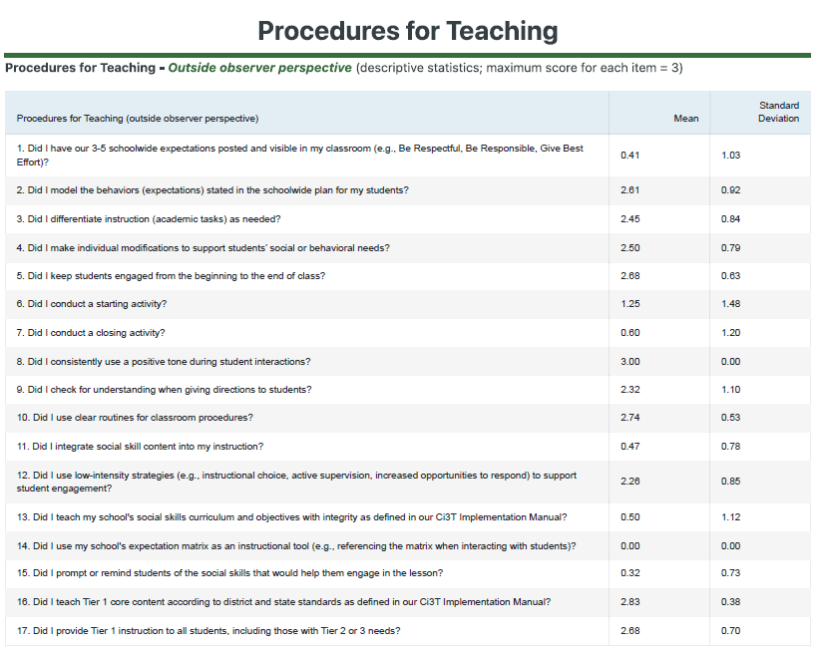
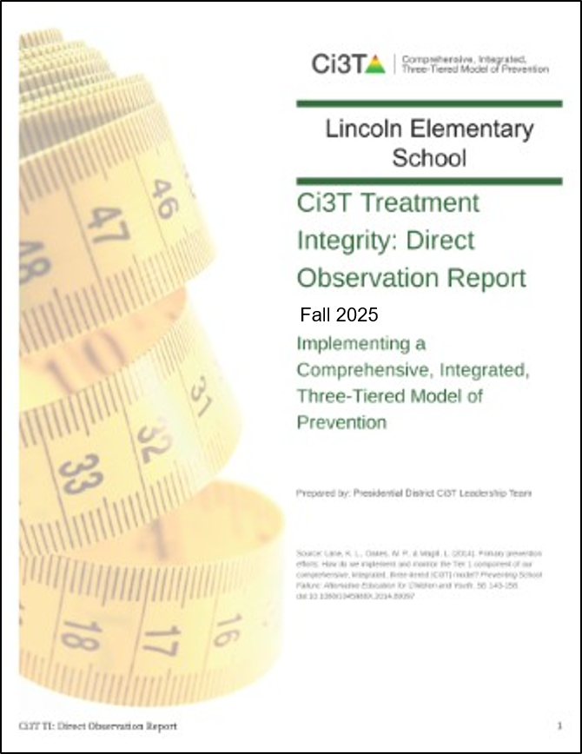
A Scenario (6)
Notes:
We see similar patterns looking at Direct Observation Report

Slide 23
A Scenario (7)
Notes:
We see similar patterns looking at Direct Observation Report

Slide 24
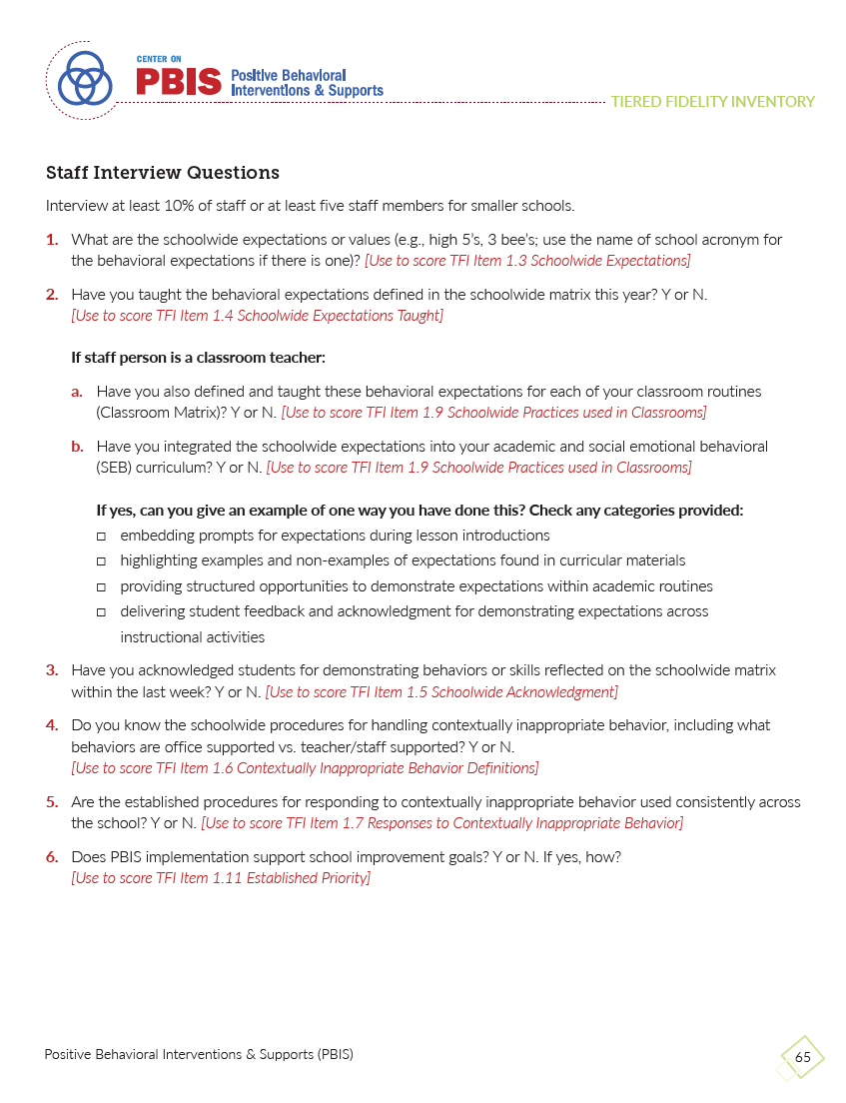
A Scenario (8)
Notes:
We see similar patterns looking at Direct Observation Report

Slide 25

What now?
Wouldn’t it be nice if we had…
  A bank of free-access, well-aligned professional learning materials?
  A teaming structure capable of using data to inform professional learning decisions?
  District support for creating opportunities for professional learning?

Slide 26
What resources are available to support data-informed professional learning?

Slide 27


Enhancing Ci3T Modules (1)
40+ free-access professional learning modules available at ci3t.org/enhance
Topic areas:
  Serving as a Ci3T Leader
  Selecting and Installing Behavior Screeners
  Primary (Tier 1) Prevention efforts
  Low-intensity, Teacher-delivered Strategies
  Implementing Secondary (Tier 2) Strategies
  Implementing Tertiary (Tier 3) Strategies
  Foundational Knowledge

Slide 28
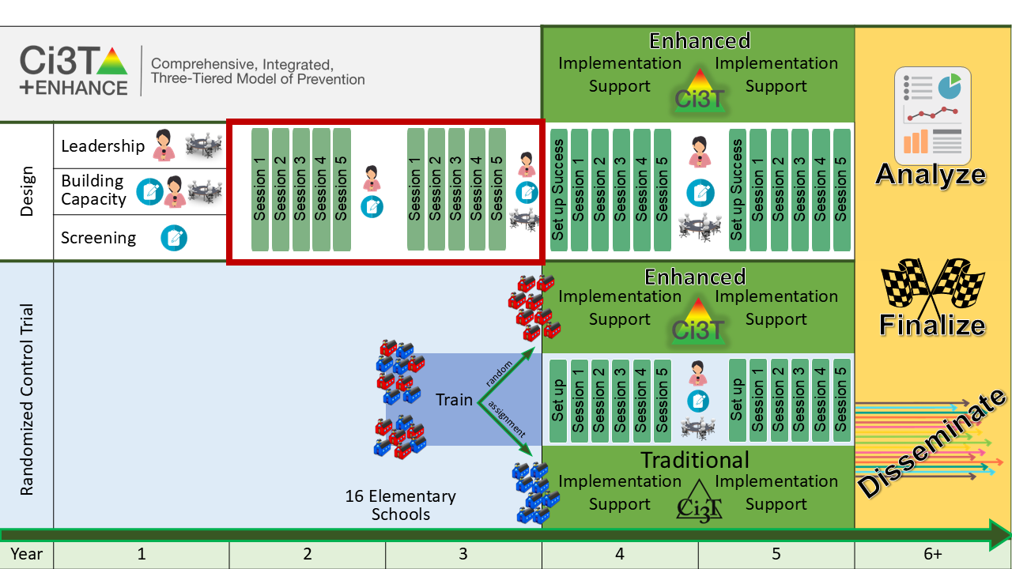
Project ENHANCE:
Designing Data-informed Professional Learning Resources

Slide 29
Leadership:
Perceived facilitators and barriers to implementation
Top Leadership Needs
Onboarding and Training
Communicating the Vision of Ci3T
Providing Professional Learning for Faculty and Staff
Royer, D. J., Oakes, W. P., Briesch, A. M., Chafouleas, S. M., Lane, K. L., Buckman, M. M., Sherod, R. L., & Common, E. A. (2021). Ci3T Leadership Team Members’ perceived facilitators and barriers to implementation. Journal of School Leadership, 32(6). https://doi.org/10.1177/10526846221095753

Slide 30

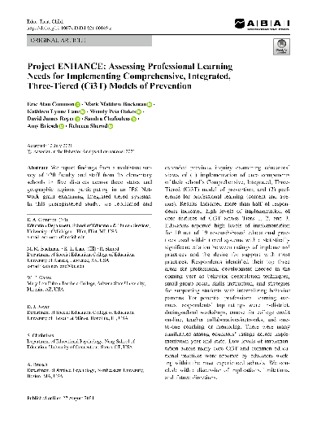
Building Capacity:
Assessing Professional Learning Needs
Top Professional
Learning Needs
De-escalation techniques
Social skill instruction
Supports for students with internalizing behavior patterns
Common, E. A., Buckman, M. M., Lane, K. L., Oakes, W. P., Royer, D. J., Chafouleas, S., Briesch, A., & Sherod, R. (2021). Project ENHANCE: Assessing Professional Learning Needs for Implementing Comprehensive, Integrated, Three-Tiered (Ci3T) Models of Prevention. Education and Treatment of Children. https://doi.org/10.1007/s43494-021-00049-z
Notes:
https://doi.org/10.1007/s43494-021-00049-z

Slide 31
Building Capacity:
Assessing Professional Learning Preferences
Preferred Professional
Learning Avenues
In-district workshops
(during school hours)
Online courses for college credit
Teacher collaborative networks
Asynchronous opportunities
(e.g., web-based modules, webinars)
Common, E. A., Buckman, M. M., Lane, K. L., Oakes, W. P., Royer, D. J., Chafouleas, S., Briesch, A., & Sherod, R. (2021). Project ENHANCE: Assessing Professional Learning Needs for Implementing Comprehensive, Integrated, Three-Tiered (Ci3T) Models of Prevention. Education and Treatment of Children. https://doi.org/10.1007/s43494-021-00049-z
Notes:
https://doi.org/10.1007/s43494-021-00049-z

Slide 32
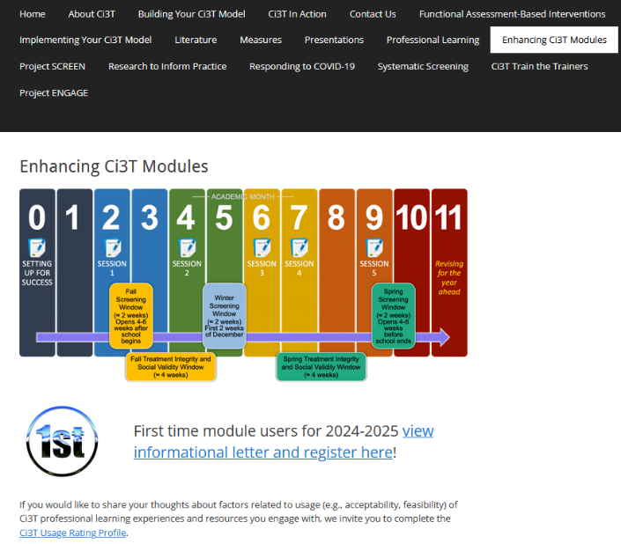

Enhancing Ci3T Modules (2)
ci3t.org/enhance

Slide 33
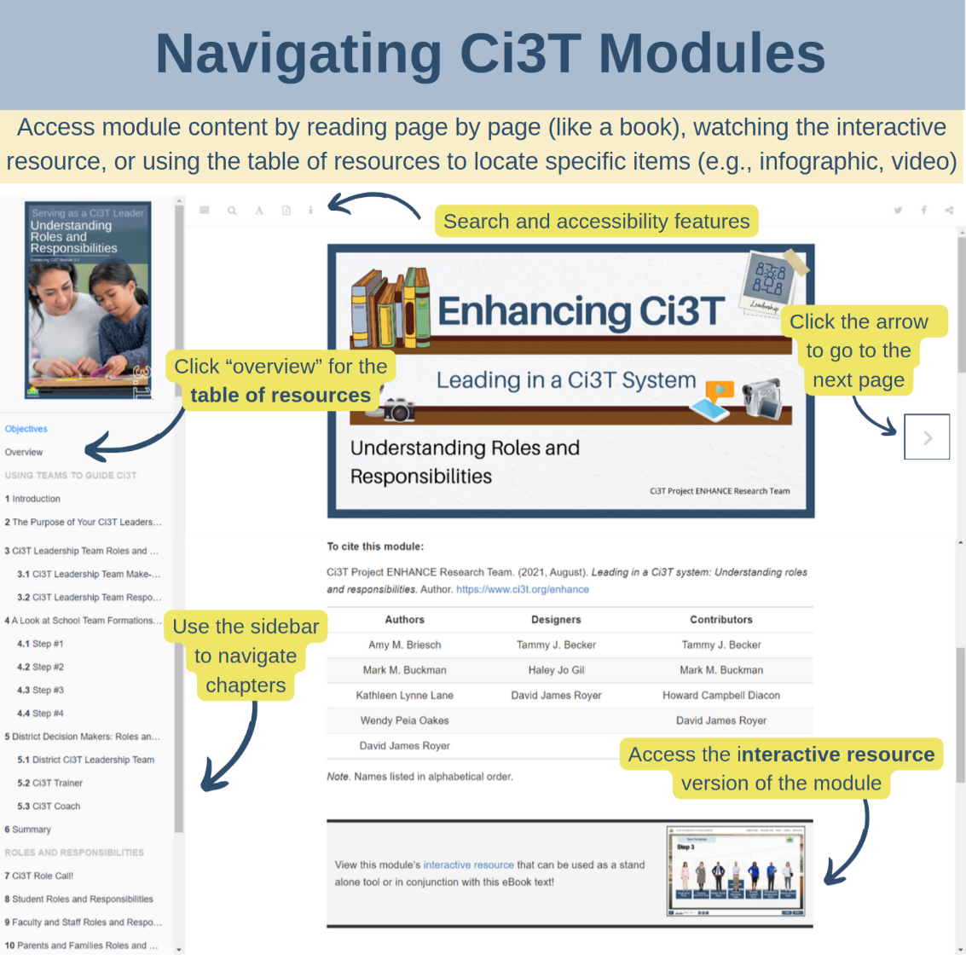
Navigating Ci3T Modules
All modules available as eBook or Interactive Resource
Include downloadable resources (e.g., infographic, templates), multimedia (e.g., videos) and interactive activities

Slide 34




Exploring Enhancing Ci3T Modules:
Examples Across Tiers & Users

Slide 35

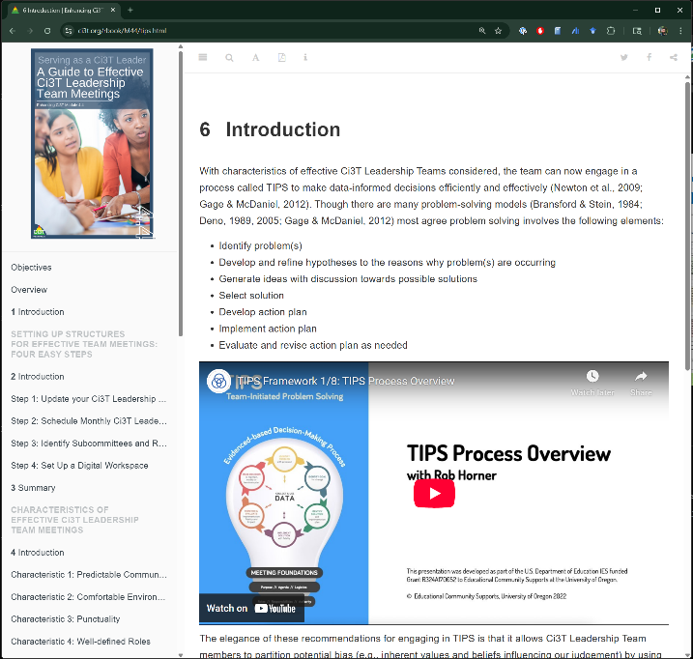
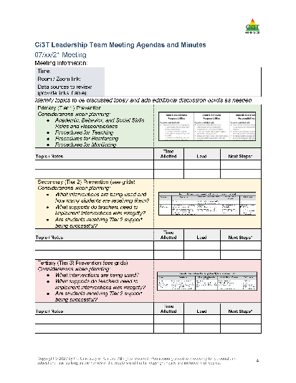
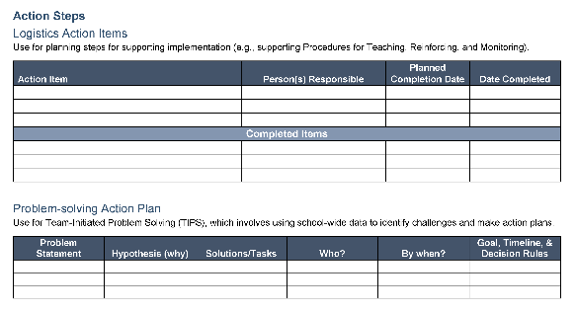
Exploring Enhancing Ci3T Modules:
Ci3T Leadership Team Members
Notes:
A Guide to Effective Ci3T Leadership Team Meetings module objectives:
At the end of this module, learners will be able to
Identify and set up structures necessary for successful Ci3T Leadership Team meetings over the course of a school year.
Identify characteristics of effective Ci3T Leadership Team meetings.
Use Team-initiated Problem Solving (TIPS) to create data-informed action plans during Ci3T Leadership Team meetings.
Create a Ci3T Leadership Team agenda reflecting critical topics to be discussed during (a) individual meetings and (b) over the course of the year.
Ci3T Project ENHANCE Research Team. (2021, August). Enhancing Ci3T: A guide to effective Ci3T leadership team meetings. Author. https://doi.org/10.17161/ci3t.26697

Slide 36
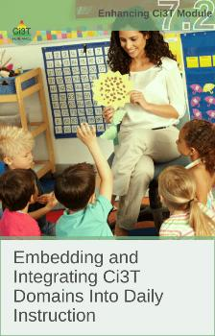
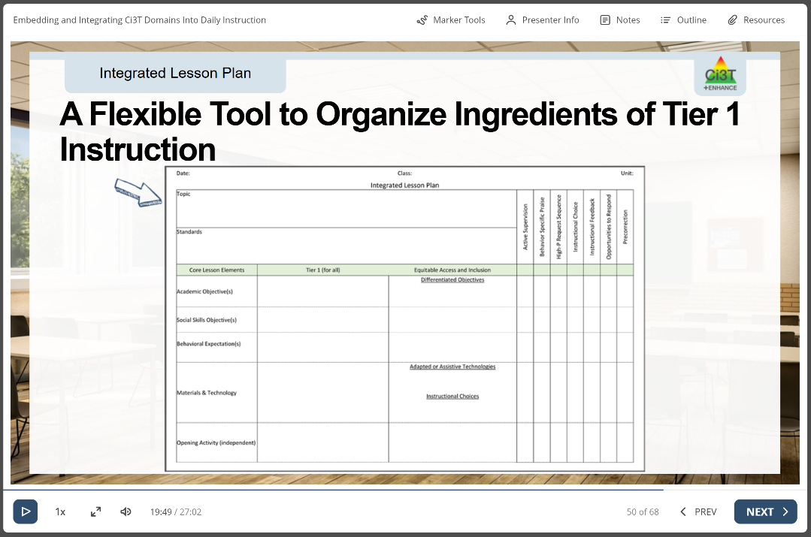
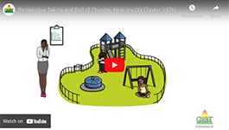
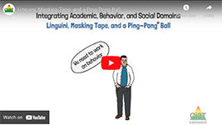
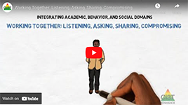
Exploring Enhancing Ci3T Modules:
Tier 1

Slide 37
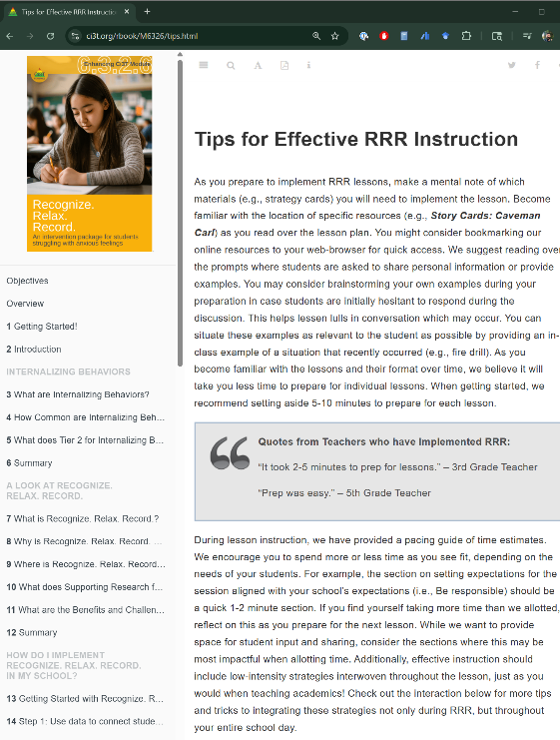
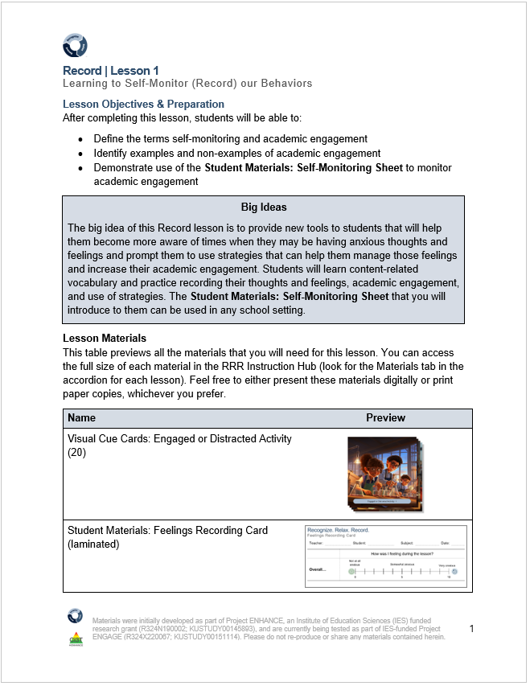
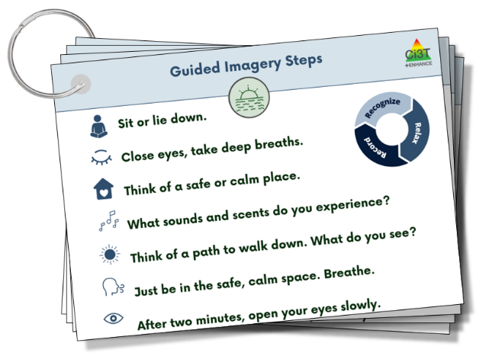
Exploring Enhancing Ci3T Modules:
Tier 2

Slide 38

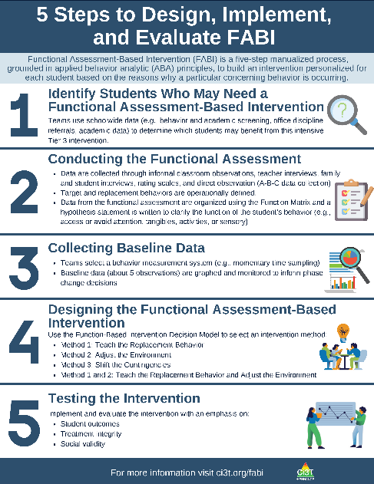
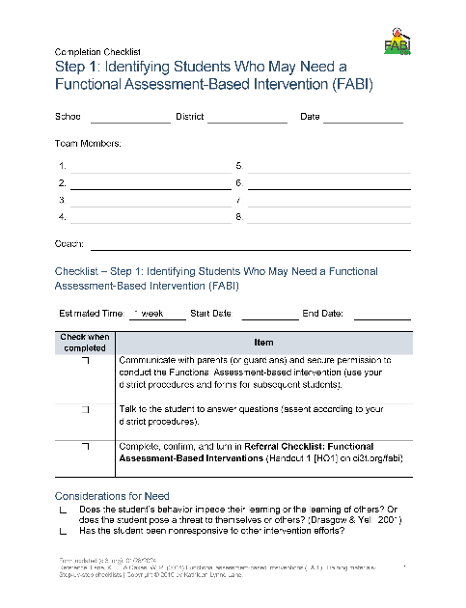
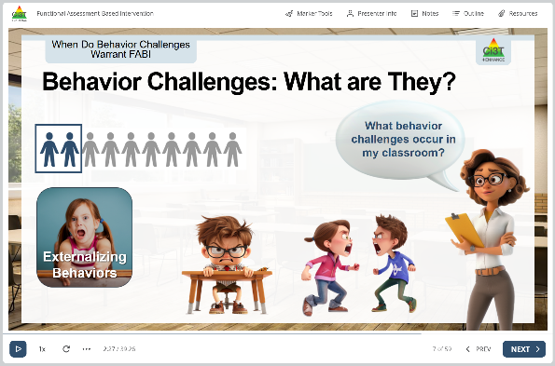
Exploring Enhancing Ci3T Modules:
Tier 3
Notes:
Functional assessment-based intervention: Introduction module objectives:
At the end of this module, learners will be able to:
Explain how FABIs are situated within a Comprehensive, Integrated, Three-Tiered (Ci3T) model of prevention.
Describe the Umbreit et al. (2024) five-step manualized FABI approach, why it is effective, the supporting research, and the benefits and challenges of this intervention.
Explain the importance of examining the effectiveness of FABI including assessing student performance, treatment integrity, and social validity.
Project ENHANCE Research Team. (2024, August). Functional assessment-based intervention: Introduction. Author. https://doi.org/10.17161/ci3t.27768

Slide 39


Enhancing Ci3T Modules:
An Invitation to Explore and Share!
We invite you to visit ci3t.org/enhance to explore all Enhancing Ci3T Modules
You are welcome to use them yourself, and to share with colleagues

Slide 40
How can my school / district / organization use available resources to create a data-informed professional learning journey?

Slide 41
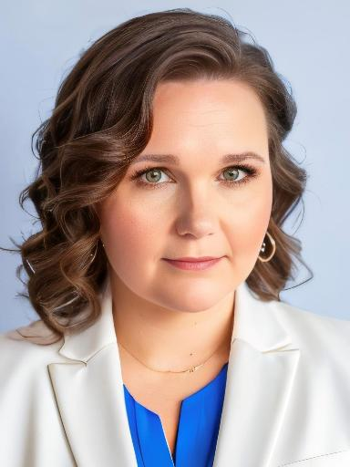
Partner Spotlight!
Amber Smith
Director of Academic Intervention
Fort Mill Schools
South Carolina

Slide 42

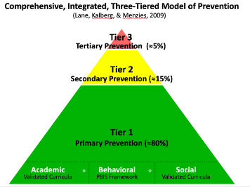
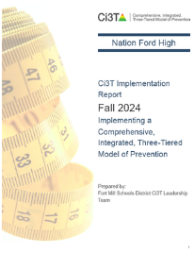
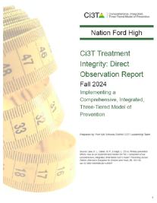


Ci3T support (1)
In what ways can we use the expectation matrix and social skills instruction that has already occurred to support students during content instruction?
Fall 2024 Ci3T Survey Data: District-Wide
Fall 2024 Ci3T Observation Data: District-Wide

Slide 43
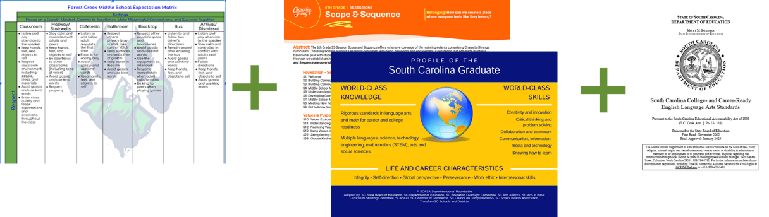
Ci3T support (2)
In what ways can we use the expectation matrix and social skills instruction that has already occurred to support students during content instruction?
Knowing the task you have presented to students, what from the expectation matrix and social skills will be helpful for the students to use to engage most effectively in the lesson?

Slide 44
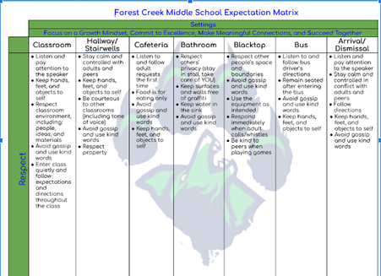


Ci3T support (3)
Low Intensity Supports: Precorrection
Given at the beginning of the lesson
“Our school expectation is to give our best effort. That means staying positive and not giving up. That is an example of perseverance, one of our life & career characteristics. Today you will be working on some tasks that may frustrate you, but we will still want to give our best effort. What will that look like for you and your group?”

Slide 45
Ci3T support (4)
Low Intensity Supports: Behavior-specific Praise
Given during the lesson. Can be behavior, academic or both
“I noticed that when you and your partner had trouble getting your model organized, you took a deep breath and then said “what if we tried it this way” instead of giving up. Way to persevere and give it your best.”
“I can see you giving your best effort when you annotated the article, so you could use it for text evidence later.”
Ask students to acknowledge peers and group members for meeting expectations and using social skills.

Slide 46
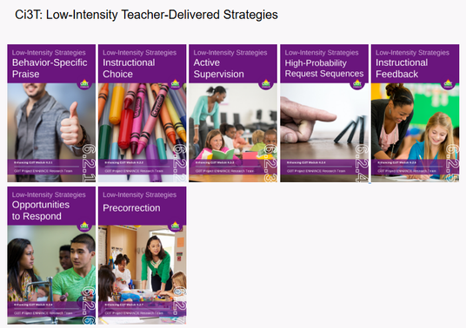
Ci3T support (5)
Low Intensity Supports Tips
  Stick to the language of your matrix and the language of your social skills curriculum
  Limiting your focus to one word from the expectation matrix is fine
  Meeting expectations is the goal--not exceeding. This is how we encourage all students.
  This can feel like a word salad to come up with spontaneously. It’s okay to craft statements ahead of time.
  Consider where this might fit in a PLT agenda

Slide 47
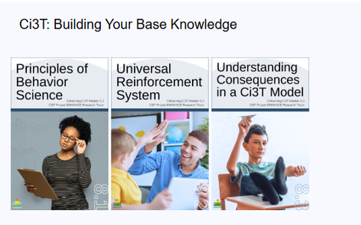
Ci3T support (6)
Tickets & Additional Resources
  If you are looking for ways to expand your use of tickets:
    Precorrection: consider giving tickets to students who share examples of focused expectation or social skill (best effort & perseverance in our example) and acknowledge their contribution.
    Behavior-Specific Praise: consider pairing this praise with tickets, focusing on students that are meeting the focused expectation or social skill (best effort & perseverance in our example) during the work time.

Slide 48
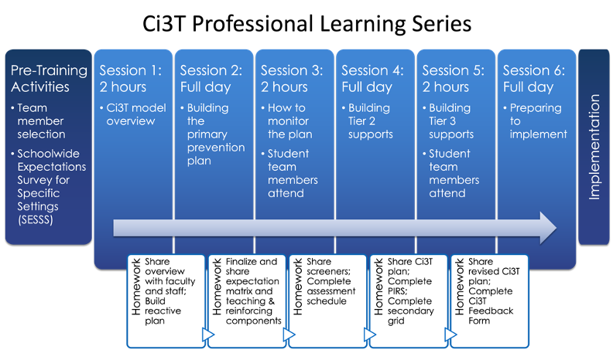
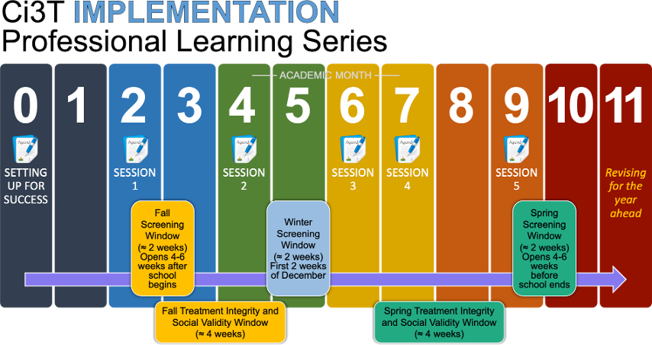

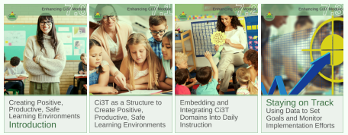


Ci3T Comprehensive
Professional Learning Plan

Slide 49
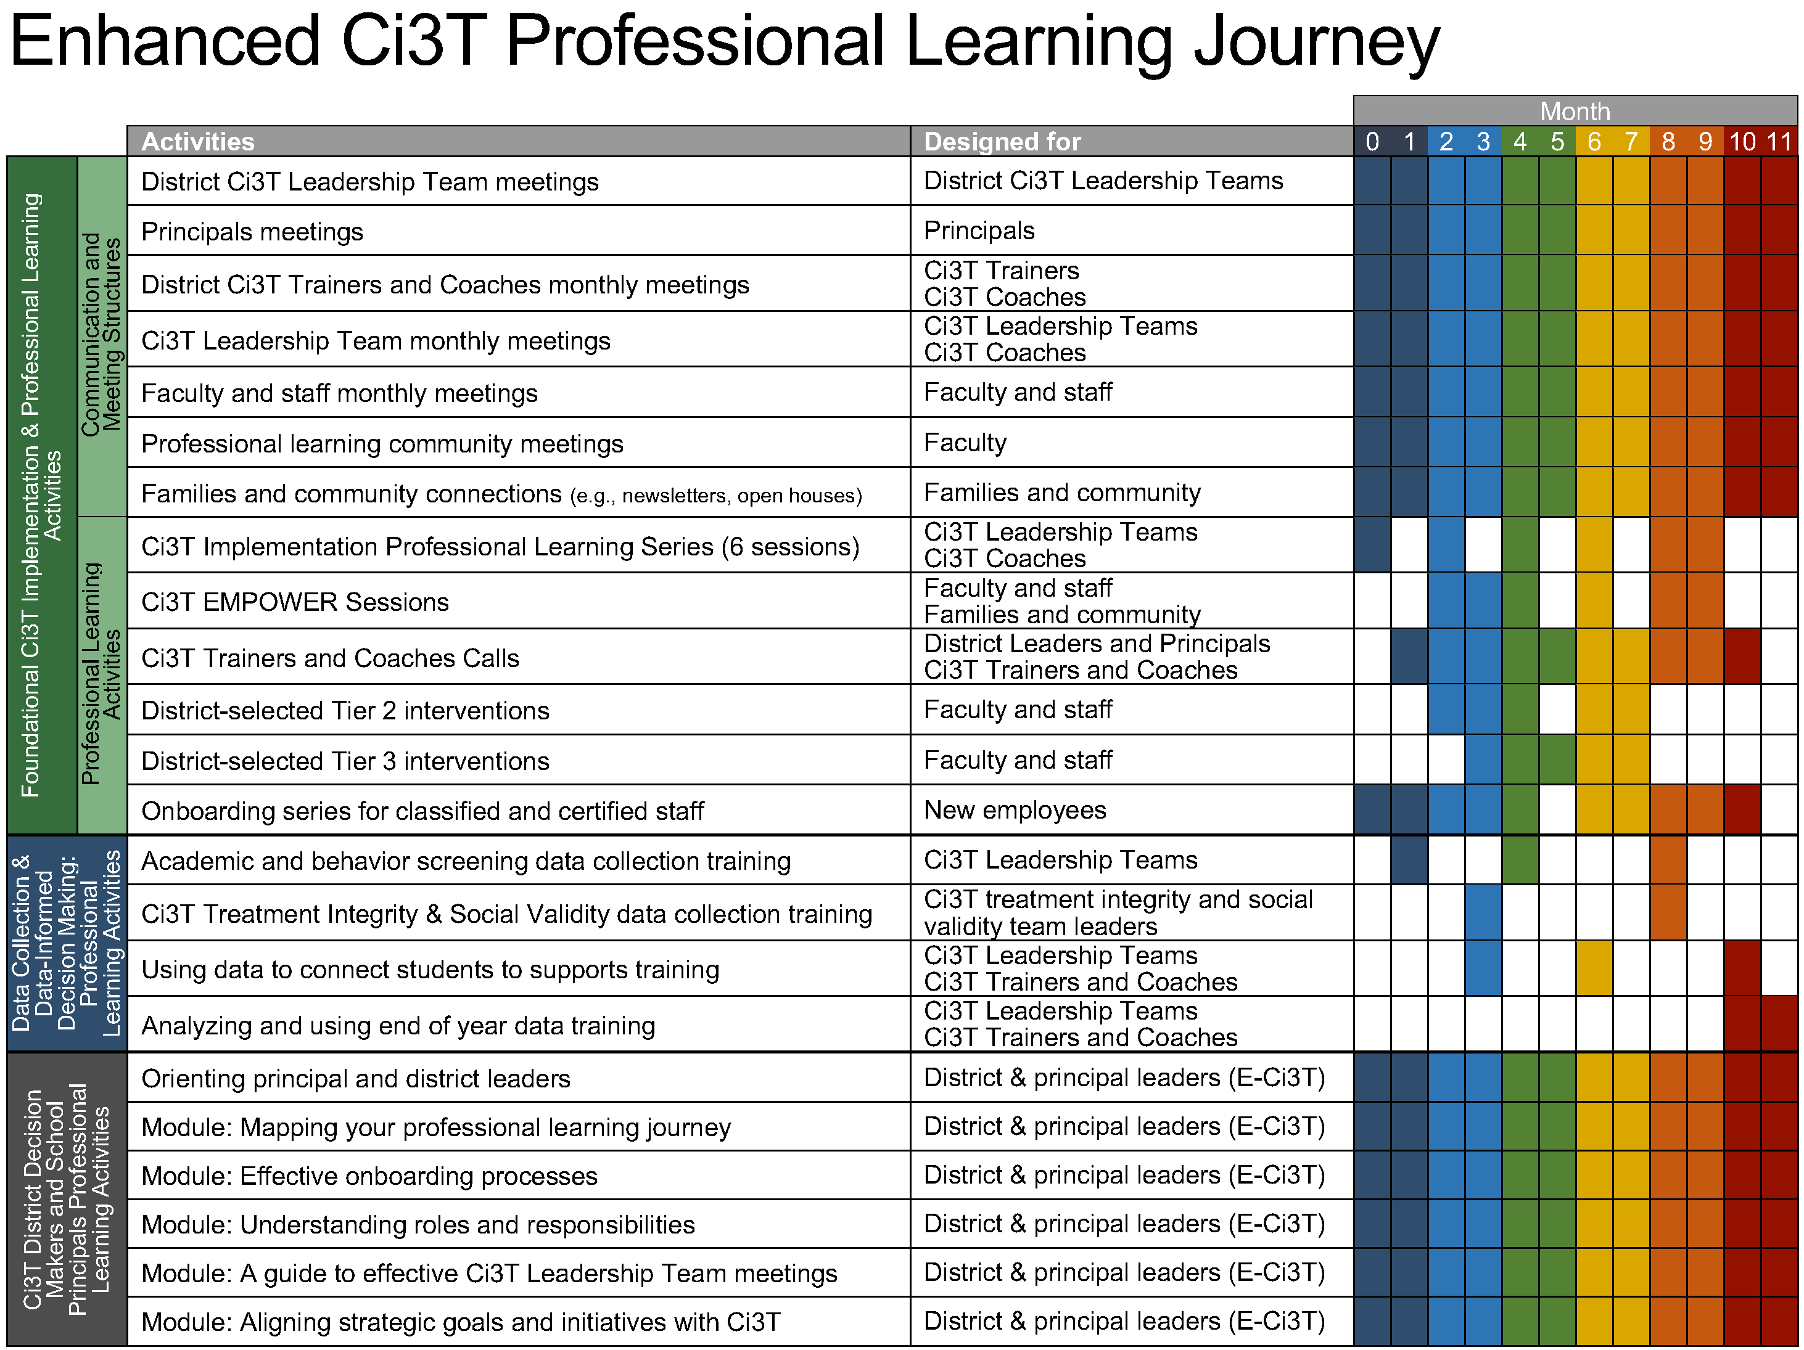
Enhanced Ci3T Implementation Series and Delivery

Slide 50
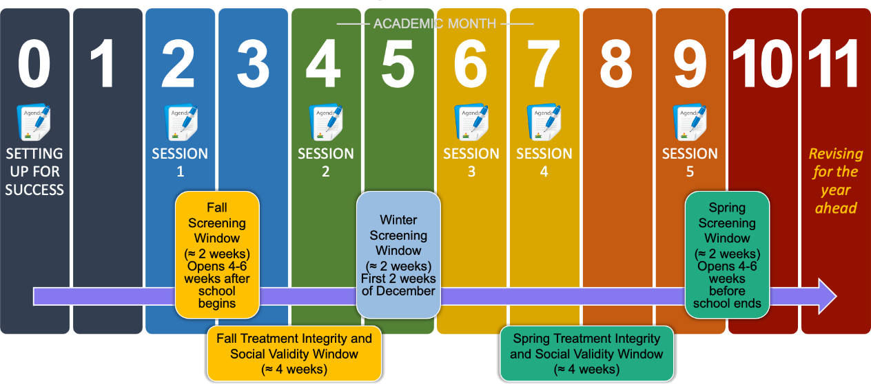
Ci3T Implementation Professional Learning Series
Notes:
The Ci3T Implementation Professional Learning Series is a 6-part series that spans the academic year. Sessions are timed to correspond to important milestones including: the beginning of the school year (e.g., kicking off the year, rolling out the Ci3T plan), screening windows, and treatment integrity and social validity windows.
Each session is data-informed, meaning attending Ci3T Leadership Team members review data, which are used to (a) identify successes, (b) identify focus areas (e.g., aspects of implementation that require additional attention, often via professional learning), and (c) create action plans to share data back and address focus areas.
Sessions applicable for both new and seasoned implementers as the focus is on predicable components of Ci3T implementation, space to review and respond to data, exploring resources to support implementation efforts, and beginning conversations and action plans.

Slide 51
Enhancing Ci3T Modules (3)
ci3t.org/enhance

Slide 52
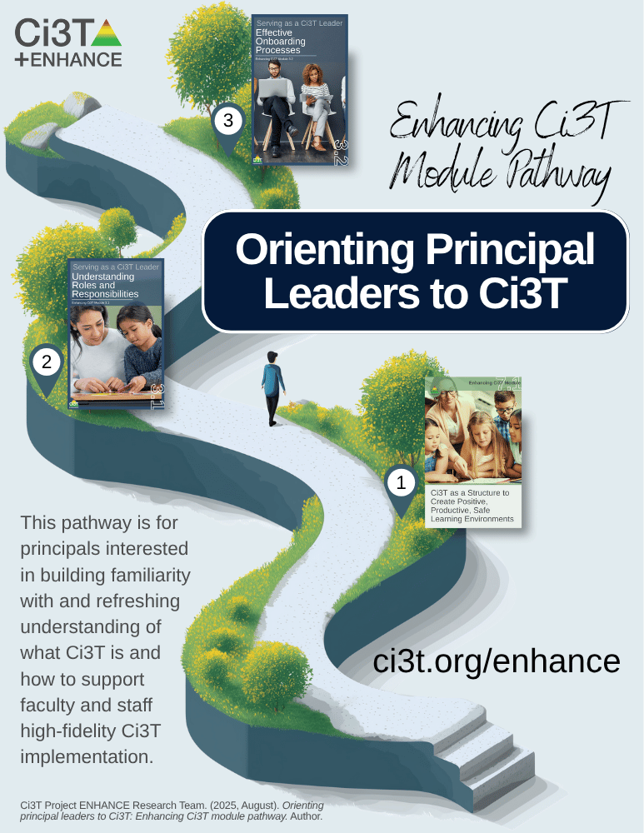
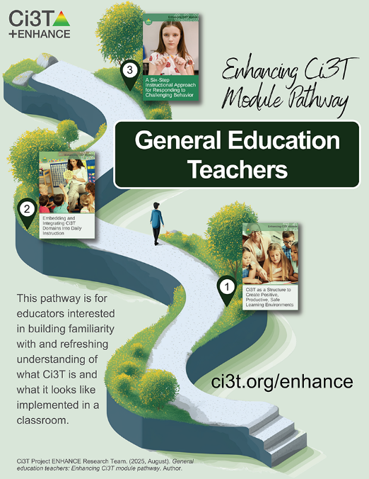
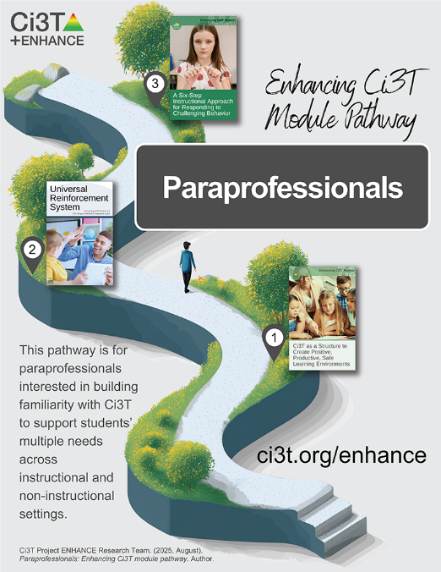
Module Pathways (1)

Slide 53
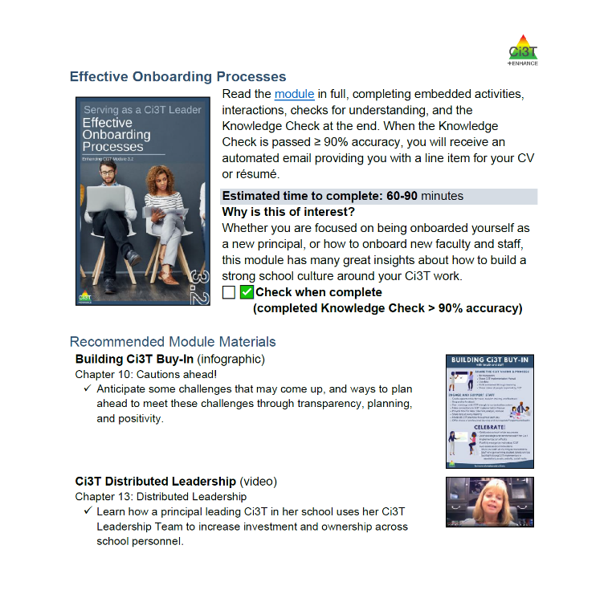

Module Pathways (2)
Recommended series of Enhancing Ci3T Modules based on role and/or need
Recommended module-based activities and materials

Slide 54
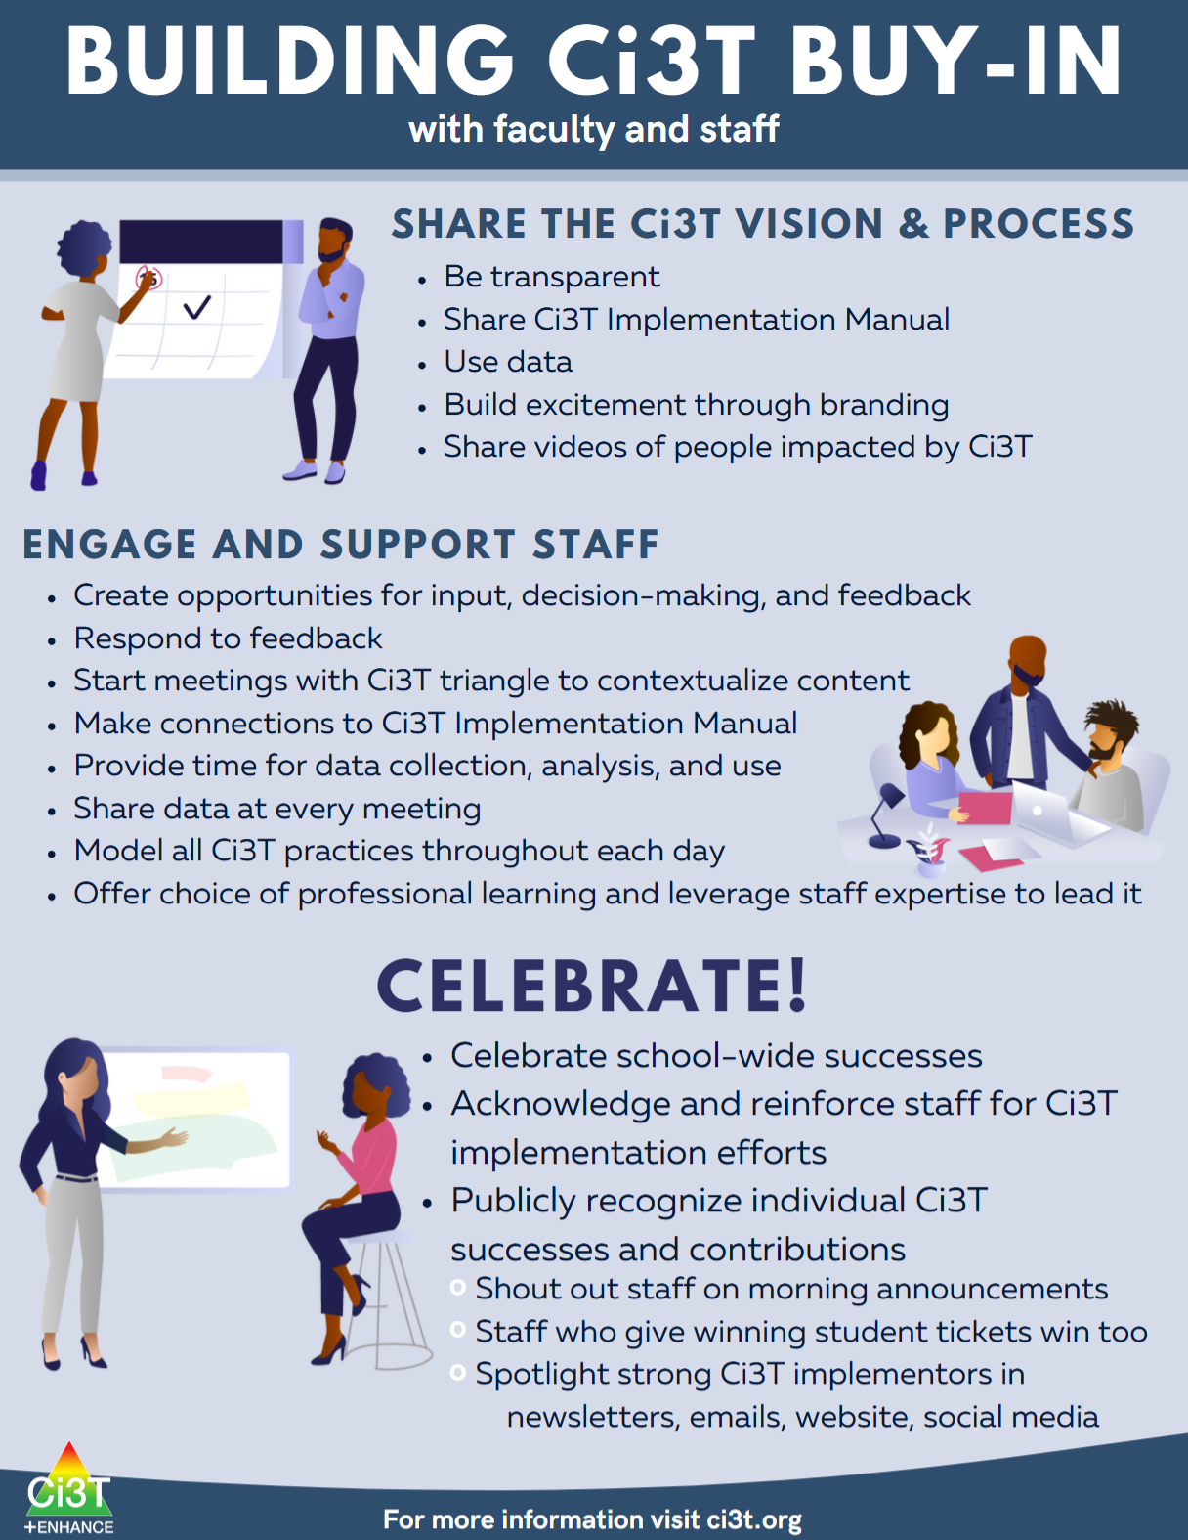
Module Pathways (3)

Slide 55
Module Pathways (4)

Slide 56

Ci3T EMPOWER Sessions
Free-access, standalone professional learning sessions for any interested person (implementers, community members)
Content focused on building knowledge, skills, and confidence to implement effective practices to support students’ multiple academic, behavioral, and social and emotional well-being needs
Sign-up at ci3t.org/pl

Slide 57



Please Complete this Session’s Evaluation
10/23
5E – Data-Informed Professional Learning in Integrated Tiered Systems
Four options, pick one!
1. Mobile App
Click “Take Survey" under the session description.
2. QR Code Scan the code on this slide.
3. Online
Click on the link located next to the downloadable session materials posted online at:
www.pbis.org/conference-and-presentations/pbis-leadership-forum
4. Direct Link
Click the link provided in the email reminder you receive after your session ends.
SAMPLE
Evaluations are anonymous! We send reminder emails to all participants.
After you submit each session evaluation, click the link to enter the gift card raffle!

