Slide 1
4E
Using Data to Facilitate Implementation of Integrated Tiered Systems: Data for the Win!
Presenters:
Kathleen Lynne Lane, University of Kansas
Jennifer Pierce, American Institutes for Research (NY)
Mark Matthew Buckman, University of Kansas
Topic: Data-based Decision Making
Keywords: Fidelity, Implementation, Assessment
Notes:
Sample title slide with topic & keyword information (for all presenters)

Slide 2
Learning Objectives
By participating in this session, attendees will:
Develop an understanding of a new tool for measuring implementation of integrated tiered systems
Describe how to assess faculty and staff’s views of goals, procedures, and outcomes
Learn how to conduct systematic screenings to inform instruction, using these three sources of data in an integrated fashion to guide implementation efforts
Institute of Education Sciences, U.S. Department of Education
R324N190002 University of Kansas
R324N190007 America Institute for Research
Notes:
Learning Objectives

Slide 3
Agenda
Introducing the Integrated MTSS Rubric
Collecting and Using Treatment Integrity and Social Validity Data: An Illustration in Ci3T Models
Collecting and Using Systematic Screening: An Illustration in Ci3T Models

Slide 4

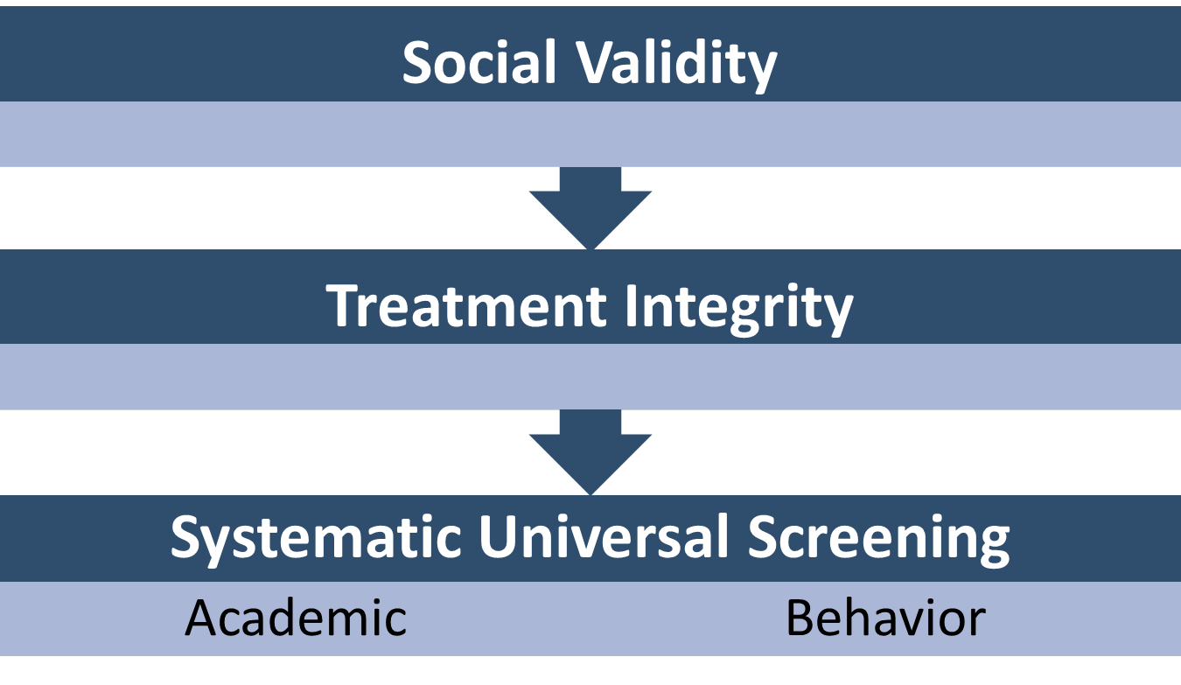
Integrated Tiered Systems of Support

Slide 5
Introducing the Integrated MTSS Rubric
The research reported here was supported in part by the Institute of Education Sciences, U.S. Department of Education, through Grant Number R324N190007 -20 to American Institutes for Research. The opinions expressed are those of the authors and do not represent views of the Institute or the U.S. Department of Education.

Slide 6
Tiered Systems of Support
Tiered System of Support | Student Improvement Area | Distinguishing Feature
Positive Behavior Intervention Support (PBIS), Schoolwide PBIS (Sugai & Horner, 2009) | Behavior/SEB outcomes | Behavior/SEB supports
Response to Intervention (RTI; Fuchs et al., 2003) | Academic outcomes | Academic supports
Multi-Tiered System of Support (MTSS; Sugai & Horner, 2009) | Academic and behavior/SEB outcomes | Academic and behavior/SEB supports
Integrated MTSS (I-MTSS; McIntosh & Goodman, 2016) | Academic and behavior/SEB outcomes | Strategically combined academic and SEB supports
Adapted from Pierce et al., 2025 and the I-MTSS Research Network
Notes:
Although the core components of MTSS also apply to PBIS, I-MTSS, and RTI, there are differences in these frameworks. It’s important to understand the purpose of each of these frameworks so that you can implement what you intend to implement and call that framework by the accurate name.
Explain each row of table, the purpose of the framework, and the expected outcome, which is the distinguishing feature of that framework.
Clarify that I-MTSS is what MTSS was intended to be all along, where the academic and SEB “sides” of a tiered system work in tandem to support improved comprehensive outcomes among all students.
I will use the term I-MTSS to refer to a tiered system that does strategically interweave the academic and SEB sides of the tiered system
Citations:
Pierce, J., Arnold, A., Majeika, C.E., Gandhi, A., Lembke, E. (Submitted for publication). An Evolution of Multi-Tiered Systems of Support (MTSS): Integrated MTSS
I-MTSS Research Network. (2023).
I-MTSS: What’s in a name? Integrated Multi-Tiered Systems of Support Research Network, University of Connecticut, www.mtss.org
A school-wide framework that strategically combines academic and social-emotional behavioral (SEB) supports to improve outcomes for all students.

Slide 7
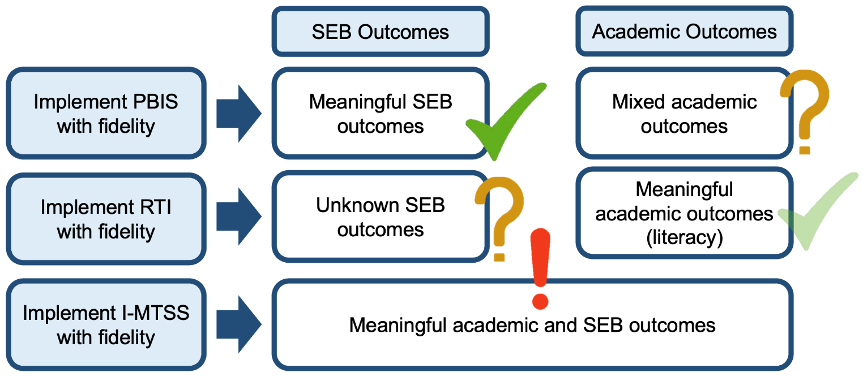
The Impact of I-MTSS on Students
Slide used with permission from Goodman (2025); I-MTSS Research Network (2024)
Notes:
The truth is also that we know from research that de-siloed MTSS – when we implement MTSS that does interweave academic and SEB “sides” can be very productive for students; in fact, when we implement that framework with fidelity, we have seen meaningful improved student outcomes in academics AND SEB Some key reminders: These outcomes presume that we implement ALL of the core components of MTSS with fidelity and not take a piece meal approach. It also presumes that we know how to implement MTSS and do that well. Which gets to another truth….
Explain the slide, starting with top “row” and moving left to right and to the subsequent row.
PBIS is effective in producing meaningful SEB outcomes (Goodman & Peshak George, 2020).
PBIS has mixed results in changing academic achievement (Kim et al., 2018).
RTI for academic produces favorable results (Gersten et al., 2008; Grapin et al., 2018).
Integrated MTSS produces meaningful academic and SEB outcomes (McIntosh et al., 2006; Stewart et al., 2007).
Recall that I mentioned a de-siloed MTSS (or, I-MTSS) is also associated with benefits to staff.
Main slide citation:
I-MTSS Research Network. (2024). Does research support an integrated multi-tiered system of support framework? Integrated Multi-Tiered Systems of Support Research Network, University of Connecticut, mtss.org.
Additional citations undergirding content:
Angus, G., & Nelson, R. B. (2019). School-wide positive behavior interventions and supports and student academic achievement. Contemporary School Psychology, 25(4), 443–465.
Coyne, M. D., Oldham, A., Dougherty, S. M., Leonard, K., Koriakin, T., Gage, N. A., Burns, D., & Gillis, M. (2018). Evaluating the effects of supplemental reading intervention within an MTSS or RTI reading reform initiative using a regression discontinuity design. Exceptional Children, 84(4), 350–367. https://doi.org/10.1177/0014402918772791
Fien, H., Nelson, N. J., Smolkowski, K., Kosty, D., Pilger, M., Baker, S. K., & Smith, J. L. M. (2021). A conceptual replication study of the Enhanced Core Reading Instruction MTSS-Reading model. Exceptional Children, 87(3), 265–288. https://doi.org/10.1177/0014402920953763
Gersten, R., Compton, D., Connor, C. M., Dimino, J., Santoro, L., Linan-Thompson, S., & Tilly, W. D. (2008). Assisting students struggling with reading: Response to Intervention and multi-tier intervention for reading in the primary grades. A practice guide (NCEE 2009-4045). U.S. Department of Education, Institute of Education Sciences, National Center for Education Evaluation and Regional Assistance. http://ies.ed.gov/ncee/wwc/publications/practiceguides/
Goodman, S., & Peshak George, H. (2020). School-wide positive behavioral interventions and supports. In Oxford Research Encyclopedia of Education. Oxford University Press. https://doi.org/10.1093/acrefore/9780190264093.013.1203
Grapin, S. L., Waldron, N., & Joyce-Beaulieu. (2018). Longitudinal effects of RtI implementation on reading achievement outcomes. Psychology in the Schools, 56, 242–254.
Kim, J., McIntosh, K., Mercer, S. H., & Nese, R. N. T. (2018). Longitudinal associations between SWPBIS fidelity of implementation and behavior and academic outcomes. Behavioral Disorders, 43(3), 357–369. https://doi.org/10.1177/0198742917747589
McIntosh, K., Horner, R. H., Chard, D., Boland, J., & Good, R. (2006). The use of reading and behavior screening measures to predict non-response to school-wide positive behavior support: A longitudinal analysis. School Psychology Review, 35, 275–291.
Stewart, R. M., Benner, G. J., Martella, R. C., & Marchand-Martella, N. E. (2007). Three-tier models of reading and behavior: A research review. Journal of Positive Behavior Interventions, 9, 239–253.

Slide 8
The Impact of I-MTSS on Staff
Provides a feasible way to respond to rising academic and SEB needs
Lowers staff burden and burnout by streamlining teams and supports
Improves staff trust, collaboration, satisfaction
Promotes efficiency by de-siloing academic and behavioral supports
Pierce et al., (2025)
Notes:
I-MTSS is becoming more widely used across the country as schools realize that they have been implementing “siloed” tiered systems, such that the academic side of their tiered system of support runs in parallel with the behavior side of that school’s tiered system. The benefits of moving towards a more integrated MTSS are listed on this slide. Notice that staff and students can benefit from I-MTSS, making it an attractive, more efficient, and likely impactful way for schools to approach implementation. Go over benefits.

Slide 9
The Integrated MTSS Fidelity Rubric (IMFR)
Notes:
This section will address the Study Background and then we will explore the IMFR itself

Slide 10
The IMFR
A valid, reliable measure of I-MTSS at the elementary level.
Users report the IMFR offers valuable information.
The IMFR is FREE and includes a suite of materials.
States, districts, and schools are using the IMFR in grades K-12 to assess and improve implementation.
The IMFR can be used in any school, from those just beginning to implement a tiered system to advanced implementers.
Gandhi, et al., (2025).
Notes:
The IMFR is one of the only valid, reliable measures of I-MTSS. It is FREE and users report it provides valuable information about tiered system strengths and challenges. Many states, districts, and schools are using the IMFR to assess and improve implementation of their tiered system. You can use the IMFR in K-12, although the measure has only been tested at the elementary level. You can use the IMFR to assess and improve your school’s tiered system, whether you are a new implementer or an advanced implementer. Access the IMFR at the QR code shown on this slide.

Slide 11
Study Background
The Need: Lack of valid, reliable measure specifically for assessing I-MTSS
Conducted by AIR and University of Missouri from 2019-2025
Part of a network of I-MTSS studies funded by the Institute of Education Sciences (IES)
Sample included school MTSS teams at 65-87 schools in 13-20 districts located in nine states
Examined validity, reliability, and costs
Analytic methods included Many-faced Rasch Model, Exploratory and Confirmatory Factor Analysis, and Inter-rater Reliability
Ghandi et al., (2025)
Notes:
Read slide.

Slide 12
Initial Development Phase
Review existing tiered systems fidelity measures
Identify common concepts and scales
Develop measure, solicit feedback from experts and practitioners, and refine measure based on feedback
Conduct beta testing
Refine measure and materials
Prepare for psychometric testing (e.g., train data collectors, schedule school administrations)
Pierce et al., (2025)
Notes:
Use animation to explain the development of the IMFR

Slide 13
Psychometric Testing Phase (3 Rounds)
Interview school MTSS leadership teams
Solicit feedback from experts, data collectors, and practitioners
Finalize measure and materials
Analyze data and identify potential revisions
Refine measure and materials
Conduct usability focus groups (final round)
Release for free, public use
Gandi et al., 2025
Notes:
School MTSS leadership teams: Principal/Vice Principal, general and special educators, counselors, school psychologists, and others with expertise in academics and SEB supports

Slide 14
Key Findings
Construct validity as comprised of:
  Content validity: Domains and items accurately reflect with I-MTSS is.
  Substantive validity: The scale categories may need refinement in future testing.
  Structural validity: Item-level ratings accurately reflect a school’s I-MTSS implementation status.
  Generalizability: Multiple raters produce similar ratings for schools, although some raters are more severe than others.
Ghandi et al., (2025
Notes:
From Gandi et al. (2025): We examined validity (content, substantive, structural and generalizability), which comprise aspects of construct validity as articulated by Messick (1995) with the analytic approach drawn from Wolfe and Smith (2007). We chose this approach because measuring implementation of a complex systems-level framework such as I-MTSS requires a a comprehensive analysis that takes into account multiple sources of information, rather than discrete indicators of reliability and validity typically used to examine the psychometric properties of MTSS measures. It also requires clear a priori articulation of the purpose of the tool and item development with input from content experts, which aligned with our approach to developing the IMFR.
Content validity refers to the relevance, representativeness, and technical quality of the rubric items in relation to the construct(s) being measured. Content validity was examined in all three administrations using three different diagnostics from the MFRM: item difficulty, item fit statistics, and item-measure correlations. Methods: Many Facet
Substantive validity refers to the degree to which content and models of processing provide for consistency among the rubric ratings. Empirical evidence to support the substantive validity is gathered by examining the psychometric functioning of the rubric response categories. Methods: Many Facet
Structural validity: We tested whether the rubric could support an overall implementation fidelity score for a school and whether meaningful subscores aligned with the four domains of the IMFR. Methods: EFA year 1 and then CFA in next two admins
Generalizability refers to the degree to which scores generalize across demographic populations; items; tasks; and settings, including raters. This aspect of validity was examined in two ways: estimating the reliability for each construct and analyzing the presence of rater effects.
Informally examined predictive (used regression analysis) and concurrent validity. Concurrent not formally examined b/c lack of other I-MTSS tool at the time of the study; used the TFI. Found no significant relaionthips. Predictive validity also informal analysis. Found small but not significant positive relationship between state level R and M results. Did not have enough behavior data from schools to examine for that.

Slide 15
Key Findings (Continued)
Social validity:
  The IMFR provided valuable insight into their school’s I-MTSS implementation effort.
  Team members would participate in the IMFR administration again.
  IMFR ratings accurately reflected their school’s I-MTSS implementation and that the ratings were easy to understand.
  Participating in the IMFR administration was valuable because it helped them better understand their unique I-MTSS implementation strengths and areas for improvement.
  Would recommend other schools use the tool.
  The time required to participate in the process was difficult to manage.
Ghandi et al., (2025
Notes:
From Gandi et al. (2025): We examined validity (content, substantive, structural and generalizability), which comprise aspects of construct validity as articulated by Messick (1995) with the analytic approach drawn from Wolfe and Smith (2007). We chose this approach because measuring implementation of a complex systems-level framework such as I-MTSS requires a a comprehensive analysis that takes into account multiple sources of information, rather than discrete indicators of reliability and validity typically used to examine the psychometric properties of MTSS measures. It also requires clear a priori articulation of the purpose of the tool and item development with input from content experts, which aligned with our approach to developing the IMFR.
Content validity refers to the relevance, representativeness, and technical quality of the rubric items in relation to the construct(s) being measured. Content validity was examined in all three administrations using three different diagnostics from the MFRM: item difficulty, item fit statistics, and item-measure correlations. Methods: Many Facet
Substantive validity refers to the degree to which content and models of processing provide for consistency among the rubric ratings. Empirical evidence to support the substantive validity is gathered by examining the psychometric functioning of the rubric response categories. Methods: Many Facet
Structural validity: We tested whether the rubric could support an overall implementation fidelity score for a school and whether meaningful subscores aligned with the four domains of the IMFR. Methods: EFA year 1 and then CFA in next two admins
Generalizability refers to the degree to which scores generalize across demographic populations; items; tasks; and settings, including raters. This aspect of validity was examined in two ways: estimating the reliability for each construct and analyzing the presence of rater effects.
Informally examined predictive (used regression analysis) and concurrent validity. Concurrent not formally examined b/c lack of other I-MTSS tool at the time of the study; used the TFI. Found no significant relaionthips. Predictive validity also informal analysis. Found small but not significant positive relationship between state level R and M results. Did not have enough behavior data from schools to examine for that.

Slide 16
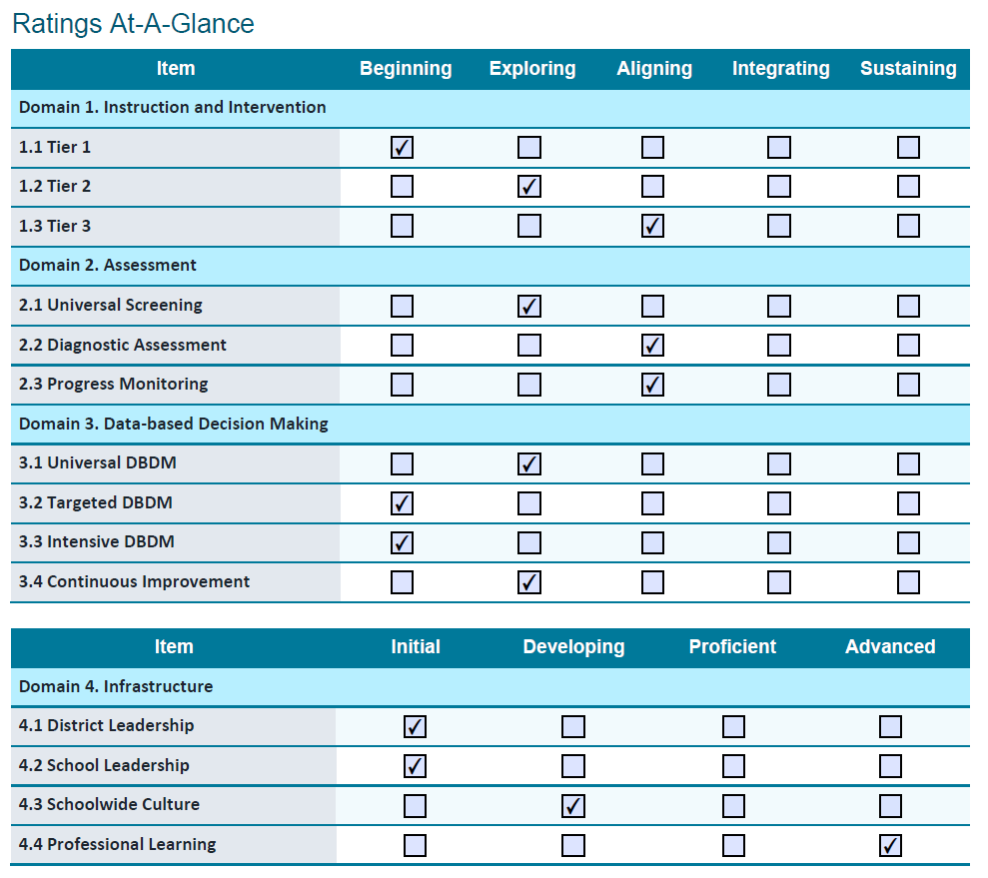
IMFR Domains, Items, and Scales
Notes:
Explain the five point scale (for domains 1-3) and the four point scale (for domain 4, infrastructure)

Slide 17
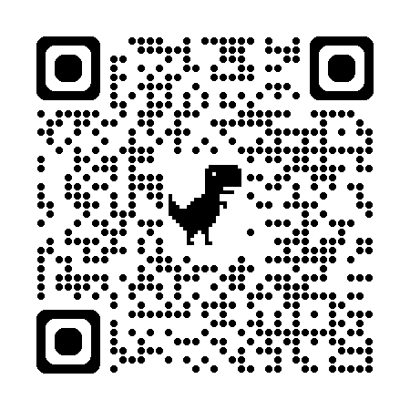
Accessing the IMFR Suite of Materials
Scan the QR code to the AIR IMFR landing page.
Scroll to the bottom of the webpage.
Complete the online form. You will get an automated email. Check your junk folder if you do not get the email.
Open the email, click on the link, and download the documents from Dropbox. You do not need a Dropbox account. The email also contains the link to the IMFR training modules, which are hosted on the Moodle platform.

Slide 18
Using the IMFR With A School Team
Complete the IMFR training modules.
Conduct an interview with school MTSS leadership team using the IMFR Interview Protocol.
Use the IMFR Scoring Worksheet to generate I-MTSS ratings.
Provide the 14 item-level ratings to the school.
Gandhi et al., (2025)

Slide 19
Using the IMFR to Drive School Improvement

Slide 20
Option 1: The Bright Spots Approach
Prioritize improving the “bright spots” that are not yet rated as Integrating, Sustaining, or Advanced.
Review the Scoring Worksheet.
Which criteria were marked “No” for Tier 3, Diagnostic Assessment, and Progress Monitoring?
What would it take to turn each “No” to “Yes” for these items?
Would improving these items likely have a positive impact on IMFR ratings, staff, and students?
Would improving these items directly link to the school’s overall goals for students?
Is it feasible to improve these items?
Notes:
To help the school decide how to improve I-MTSS implementation.: We have a few different directions we could head. One way to approach this is to focus on improving the existing “bright spots”. For example, we know Tier 3, diagnostic Assessment, and Progress monitoring are I-MTSS strengths at the school, but there is still room to improve- so, we could focus on these three items. To do this, we look at Carson’s IMFR scoring worksheet and identify which criteria were marked “no” for Tier 3, DA, and PM. We ask ourselves: What would it take to turn these “nos” to “Yeses”? Would our improvement efforts directly support the school’s overall goals for students? Supporting the school’s overall goals for students is important because we want to ensure our improvement efforts do not conflict with those improvement goals. We also want to consider if focusing on these three items would make implementation easier for staff. Implementing I-MTSS can be difficult, and we want to reduce burdens placed on staff, not add burdens! Next, we want to consider if it is feasible for us to focus on improving Tier 3, DA, and PM. If we tried to improve in these three items, would it take too many resources that are scarce, like time and staffing? It’s important to consider feasibility because we are essentially looking for “quick wins”, and if improving these items is just not feasible, we want to reconsider if focusing on these items makes sense. If we can confidently say that it’s fairly easy to improve Tier 3, PM, and DA, and that these improvements would directly relate to the school’s overall goals, and that improving these three items would also be helpful for staff, then we should indeed focus on improving them.

Slide 21
Step 1: Build on the existing bright spots, which are the highest IMFR ratings.
Notes:
Let’s start by looking at Carson elementary’s schools IMFR ratings and celebrating the school’s I-MTSS bright spots. These bright spots reflect the school’s efforts to more strategically integrate their tiered system. Note that we look for the items with the highest ratings, if the ratings aren’t yet reaching the highest scale categories of Integrating, Sustaining, or Advanced.
At Carson elementary, we celebrate that they have reached aligning in one Instruction and Intervention item, Tier 3. We also see two items from the Assessment domain, Diagnostic Assessment and Progress monitoring have been rated as aligning. Finally, we can celebrate they have reached advanced in professional learning. These items reflect the strongest parts of this school’s I-MTSS implementation effort. Not all of these ratings are in the integrating, sustaining, or advanced rating categories, but nevertheless these items are strengths in relation to their other IMFR ratings.

Slide 22
Option 2: The Biggest Bang Approach
Prioritize improving the items that likely have the biggest positive impact on I-MTSS implementation, staff, and students.
Review the Scoring Worksheet.
Which items are easiest to improve yet would likely improve IMFR ratings and student outcomes yet reduce staff burden?
Would improving these items directly link to the school’s overall goals for students?
Notes:
IF it doesn’t make sense to further improve existing bright spots, the school could take a different approach to improvement. Let’s call this option 2, the “biggest bang” approach. With this approach, we focus on improving the items that we think will likely have the biggest positive impact on I-MTSS implementation, staff, and students. To do this, we review the Scoring Worksheet, identify the items are easiest to improve yet would likely improve the most IMFR ratings and student outcomes, all while reducing staff burdens. We also want to ensure that we focus on improving items that directly link to the school’s overall goals for students.

Slide 23
You could also focus on improving ratings that likely have the most impact on I-MTSS implementation and student outcomes.
Notes:
I’ll walk you through an example of how this looks, again using Carson elementary’s IMFR ratings. We want to focus on the items that will give us the biggest bang for our buck.
After reviewing the school’s ratings-at-a-glance and their Scoring Worksheet we realized that we could dramatically improve all items in one domain, assessment by taking a few actions: First, the reason this school scored “aligning” on DA and PM was because they did not store academic and SEB data in one system, and relevant staff didn’t have access to all data. We realized we could very easily start storing all data in one system, and ensure relevant staff had access to that system. That would bump up our IMFR ratings from aligning to Integrating for DA and PM! Second, this school had previously used a SEB screener, but they stopped using it during the pandemic. If we started administering it again, stored that data alongside academic data, and ensured that relevant staff had access to this data, then we would be able to improve the screening rating from exploring to integrating! The school team thought it made sense to focus on making these improvements, because they were fairly easy steps to take.
But we didn’t stop there with improvement efforts. We also decided to focus on improving school leadership. We knew from research that the strongest predictor of implementation success or failure was the leader’s support for the implementation effort. So, we we worked with the principal and AP on concrete actions they could take, like explicitly communicate their support for I-MTSS to staff, students, and caregivers, the need for I-MTSS and how students and staff would benefit from I-MTSS. The leaders also made an effort to better explain how I-MTSS related to other school initiatives, which was really important because staff were confused about what the school priorities were. We hypothesized school leadership was a “big bang” area because we thought that improving the rating in this area would also have a positive impact on other IMFR ratings, like SW culture. We also hypothesized that by improving leadership support for I-MTSS, teachers might also start integrating their instruction in Tier 1, 2, and 3.

Slide 24
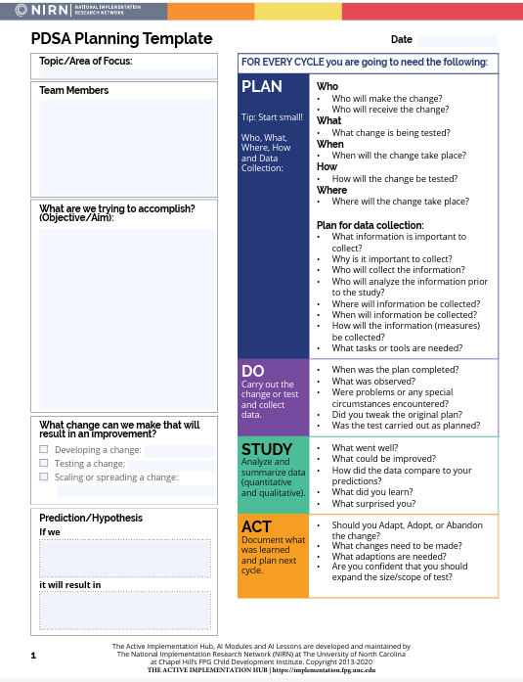
Plan-Do-Study-Act (PDSA) Cycles Tool
https://implementation.fpg.unc.edu/resource/pdsa-planning-template/
Notes:
This slide shows a free, easy to use resource for enacting PDSA cycles. This is from the National Implementation Research Network, or NIRN. You use PDSA cycles once you’ve identified your IMFR items for improving, like school leadership, PM, DA, and Tier 1. This template helps you come up with the action steps to take to improve those IMFR items, and keep track of what happens once you enact those action steps.

Slide 25
Tracking IMFR Results
Enter IMFR item-level ratings and scoring worksheet data for each school into Excel or another spreadsheet.
Update twice annually or annually
Analyze for trends:
  Items with consistently lowest and highest ratings
  Schools/districts with lowest and highest ratings
Conduct PDSA Cycles to support improvement efforts and to inform:
  Resource allocation
  Alignment and coherence across initiatives
  Prioritization of I-MTSS implementation
Notes:
You may have already done this, but the first thing you want to do is enter school item-level ratings and SW data into excel, or another type of spreadsheet. You should do this annually, or twice annually if you administer the IMFR twice in one academic year. Then, you should analyze the data for trends. For example, look for items that consistently have the lowest ratings and the highest ratings. When we did this as a study team, we learned that schools really struggled with all of the Data based decision making items, and consistently had the lowest ratings in those items. You could also analyze schools/districts to identify those with the lowest and highest ratings. You could use the data to feature model demonstration sites, or sites with a lot of implementation bright spots. Of course what you want to avoid doing is using the results for punitive purposes. But you could use the data to identify which schools/district might need additional resources, which might benefit from better alignment of initiatives, and which might need help prioritizing I-MTSS implementation.

Slide 26
Resources and Wrap-Up

Slide 27
I-MTSS Resources
Special Issue on I-MTSS from Intervention and School Clinic: https://mtss.org/intervention-in-school-and-clinic-special-series/
I-MTSS Network: https://mtss.org/
PBIS Network: https://www.pbis.org/video/integrating-academic-social-emotional-behavioral-and-mental-health-supports-for-student-need
AIR: https://mtss4success.org/resource/integrated-mtss-rubric

Slide 28

AIR’s I-MTSS Services
Email Jpierce@air.org or
IMFR@AIR.ORG
to learn how AIR can support your school, district, or state!

Slide 29


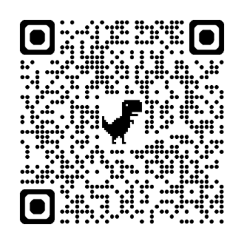
Coaching Resources
Pierce (2024); Pierce & St. Martin (2023)

Slide 30
Collecting and Using Treatment Integrity and Social Validity Data
An Illustration in Ci3T Models
The research reported here was supported by the Institute of Education Sciences, U.S. Department of Education, through Grant R324N190002 to University of Kansas. The opinions expressed are those of the authors and do not represent views of the Institute or the U.S. Department of Education.

Slide 31
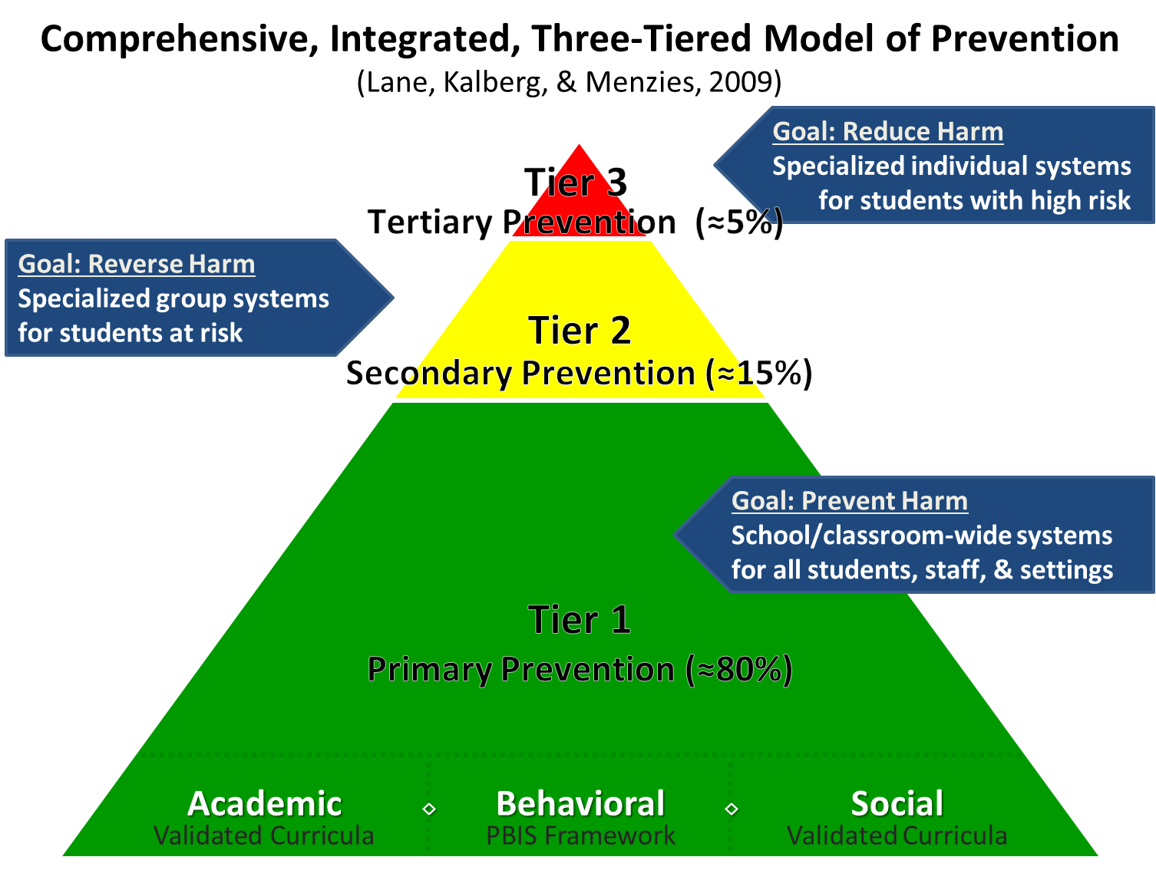
Comprehensive, Integrated, Three-Tiered Model of Prevention 1

Slide 32
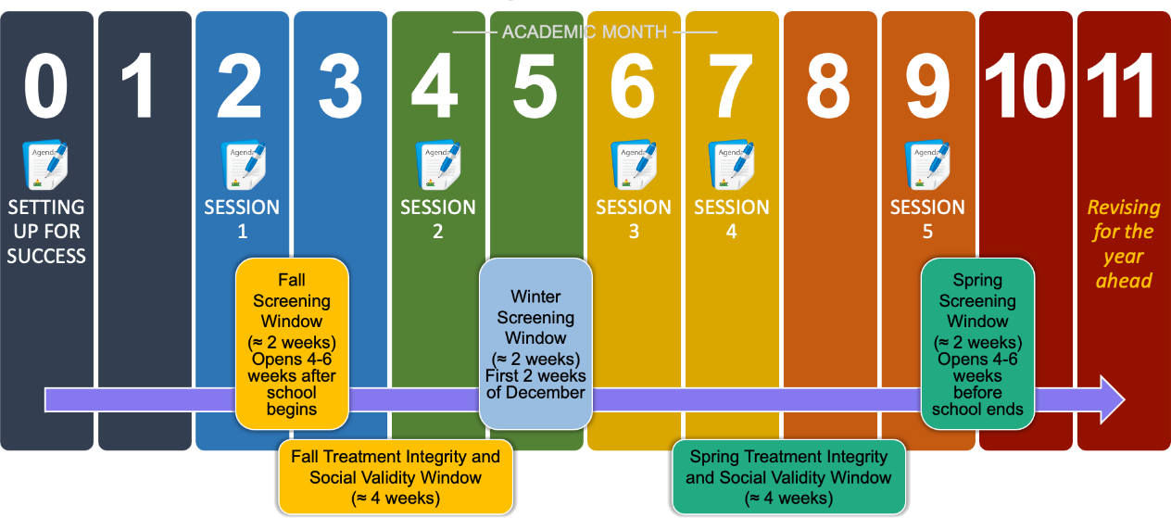
Ci3T Implementation Professional Learning Series
Notes:
The Ci3T Implementation Professional Learning Series is a 6-part series that spans the academic year. Sessions are timed to correspond to important milestones including: the beginning of the school year (e.g., kicking off the year, rolling out the Ci3T plan), screening windows, and treatment integrity and social validity windows.
Each session is data-informed, meaning attending Ci3T Leadership Team members review data, which are used to (a) identify successes, (b) identify focus areas (e.g., aspects of implementation that require additional attention, often via professional learning), and (c) create action plans to share data back and address focus areas.
Sessions applicable for both new and seasoned implementers as the focus is on predicable components of Ci3T implementation, space to review and respond to data, exploring resources to support implementation efforts, and beginning conversations and action plans.

Slide 33
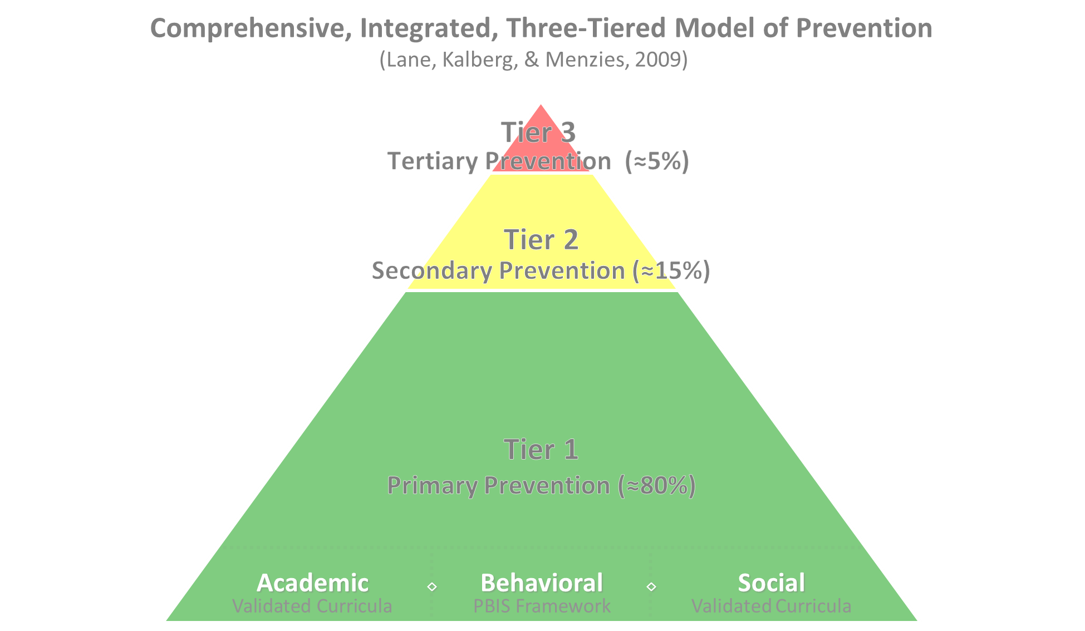

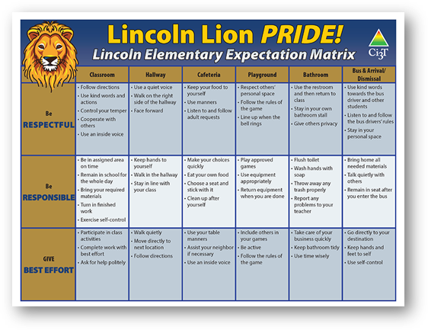
Comprehensive, Integrated, Three-Tiered Model of Prevention 2
Positive Behavioral Interventions and Supports
District & State Standards Quality Instruction
Validated Curricula and Resources

Slide 34


Primary Prevention (Tier 1)

Slide 35

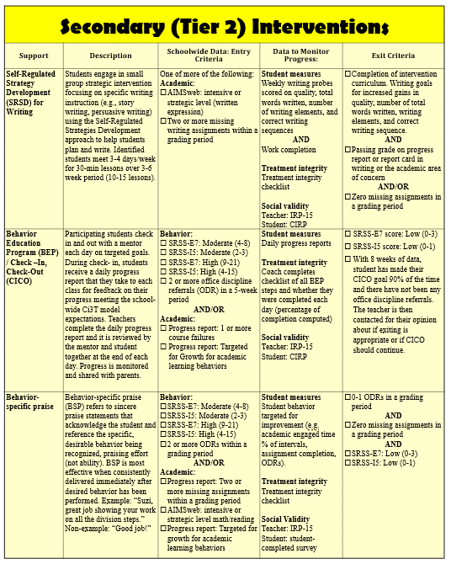
Secondary (Tier 2) Intervention Grid (1)
Notes:
In addition to the module featured here outlining how to use multiple sources of data to connect students with Tier 2 supports, we offer a full suite of modules highlighting validated Tier 2 interventions such as Self-Regulated Strategy Development (SRSD) for Writing and Check-In/Check Out that may appear in your Secondary (Tier 2) Intervention Grid

Slide 36

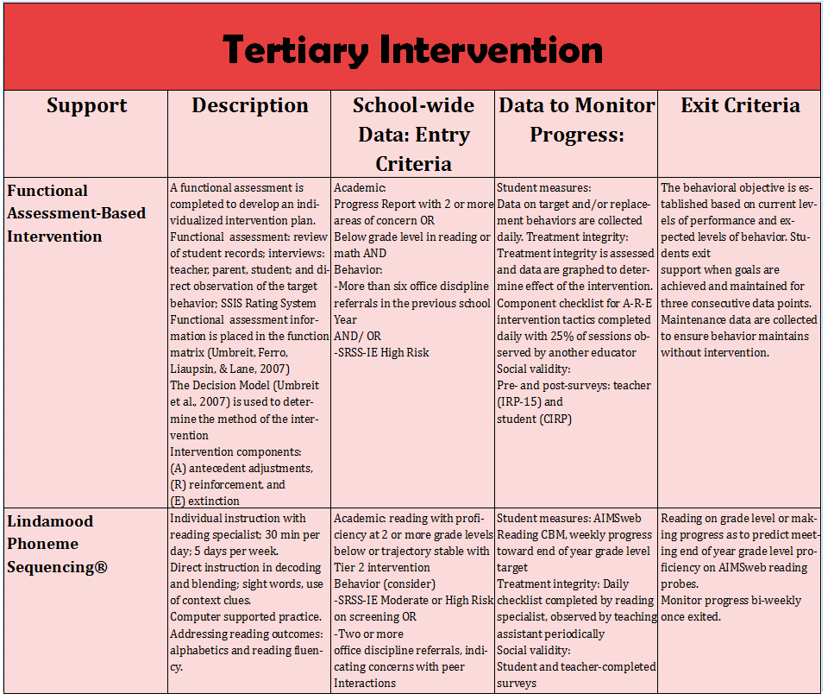
Tertiary (Tier 3) Intervention Grid
Notes:
In addition to the module featured here outlining how to use multiple sources of data to connect students with Tier 3 supports, we offer a full suite of modules highlighting validated Tier 3 interventions such as Functional Assessment-Based Intervention (FABI) that may appear in your Tertiary (Tier 3) Intervention Grid

Slide 37
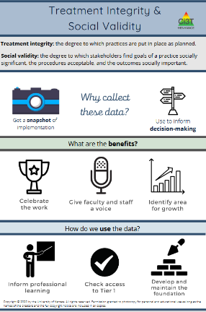
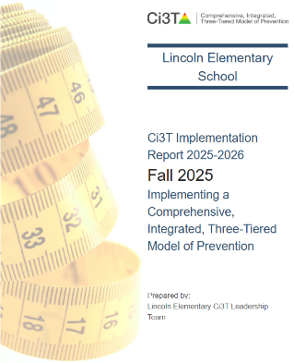
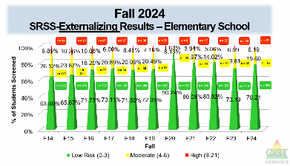
Essential Components of Primary (Tier 1) Prevention Efforts

Slide 38
Social Validity
How do stakeholders view the plan?
Social validity refers to the level of:
Social significance of intervention goals
Social acceptability of intervention procedures
Social importance of intervention outcomes
(Wolf, 1978)
Assessed using the Primary Intervention Rating Scale (PIRS)
Social Validity: PIRS Results
Year | Fall: n | Fall: % (SD) | Spring: n | Spring: % (SD)
2025-2026 | 32 | 85.39 (8.89) | TBD | TBD

Slide 39
Treatment Integrity
Are we implementing our plan as intended?
Treatment integrity can refer to:
Adherence
Dosage
Quality
Assessed using:
Ci3T Treatment Integrity: Teacher Self-Report
Ci3T Treatment Integrity: Direct Observation
Tiered Fidelity Inventory (TFI)
Ci3T Procedures | Fall 2025 Teacher Self-Report* | Educator Direct Observation* | Observer Direct Observation*
 | n = 45 % (SD) | n = 6 % (SD) | n = 7 % (SD)
Teaching | 80.43% (10.86) | 70.72% (13.81) | 75.02% (17.05)
Reinforcing | 80.83% (12.89) | 62.06% (15.33) | 34.99% (16.02)
Monitoring | 75.49% (18.06) | - | -
Total | 79.10% (11.87) | 67.66% (14.03) | 62.28% (14.58)

Slide 40
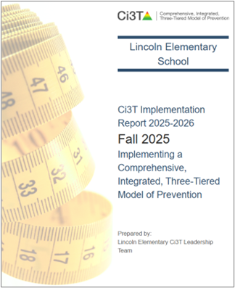
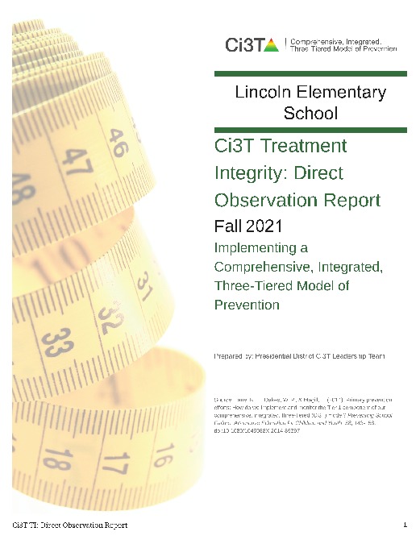
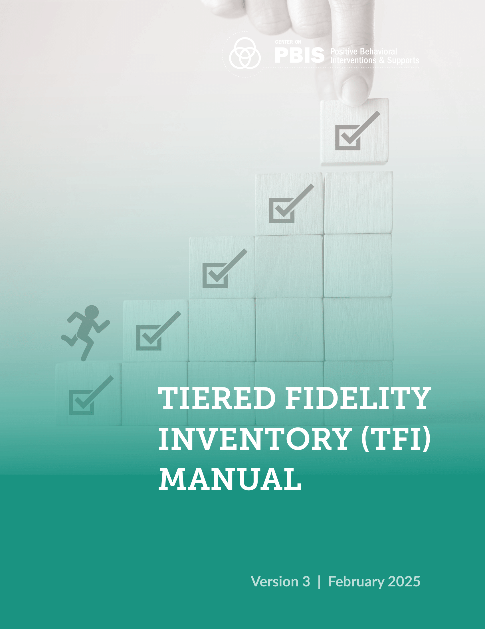
Social Validity and Treatment Integrity: Data Sources (1)
Primary Intervention Rating Scale (Social Validity)
Ci3T Treatment Integrity: Teacher Self Report
Ci3T Treatment Integrity: Direct Observation
Tiered Fidelity Inventory
Fall 2025

Slide 41
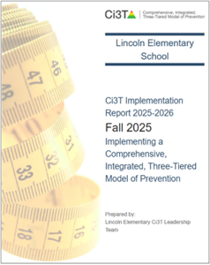
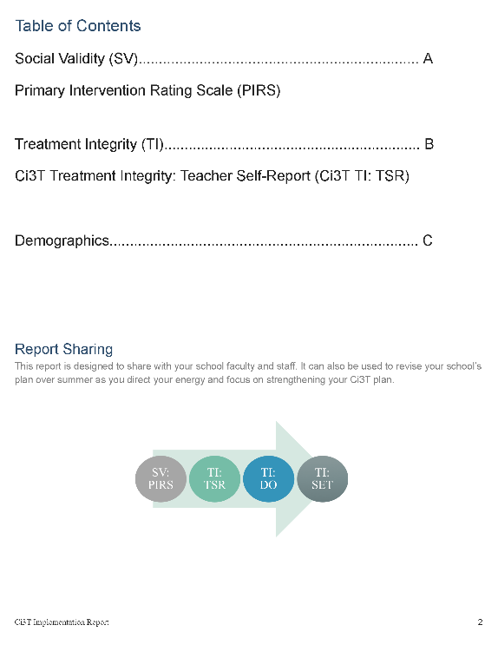
Ci3T Implementation Report
Primary Intervention Rating Scale (Social Validity; PIRS)
Ci3T Treatment Integrity: Teacher Self Report (Ci3T TI: TSR)
Demographics (e.g., role)

Slide 42
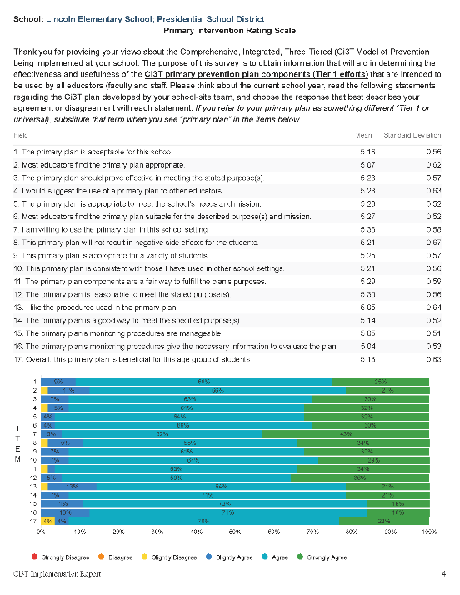
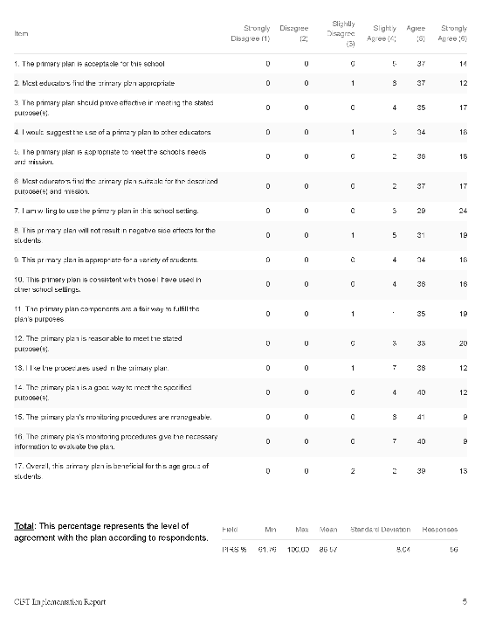
Primary Intervention Rating Scale (PIRS)
Item-level data reported by response category
(e.g., number of people who “strongly agreed”)
Item-level data reported as mean and standard deviation (scale = 1-6)
Item-level data visualization
Total PIRS %
(mean and standard deviation)

Slide 43
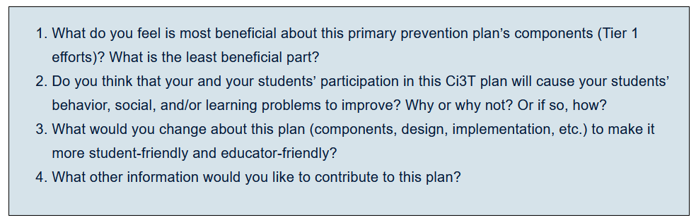
Primary Intervention Rating Scale (PIRS):
Open Ended Items
Read through comments
Highlight success (literally!)
Look for themes for celebrations and focus areas

Slide 44
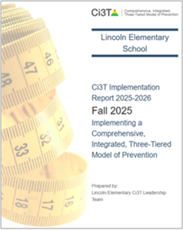
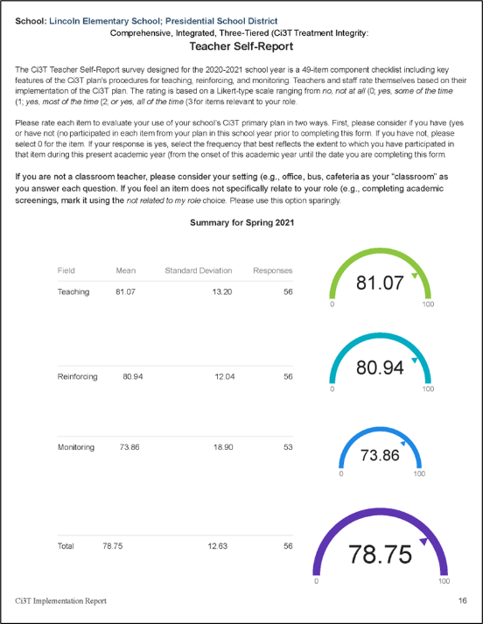
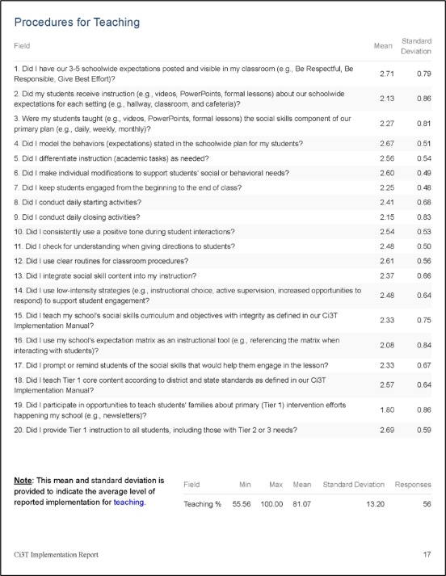
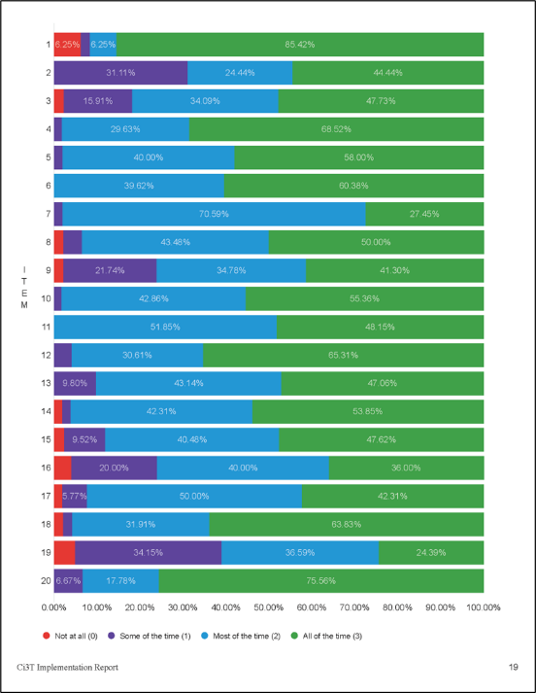
Ci3T Treatment Integrity:
Teacher Self Report (Ci3T TI: TSR)
Total Scores
(mean and standard deviation)
Item-level data reported as mean and standard deviation (scale = 0-3)
Item-level data visualization

Slide 45
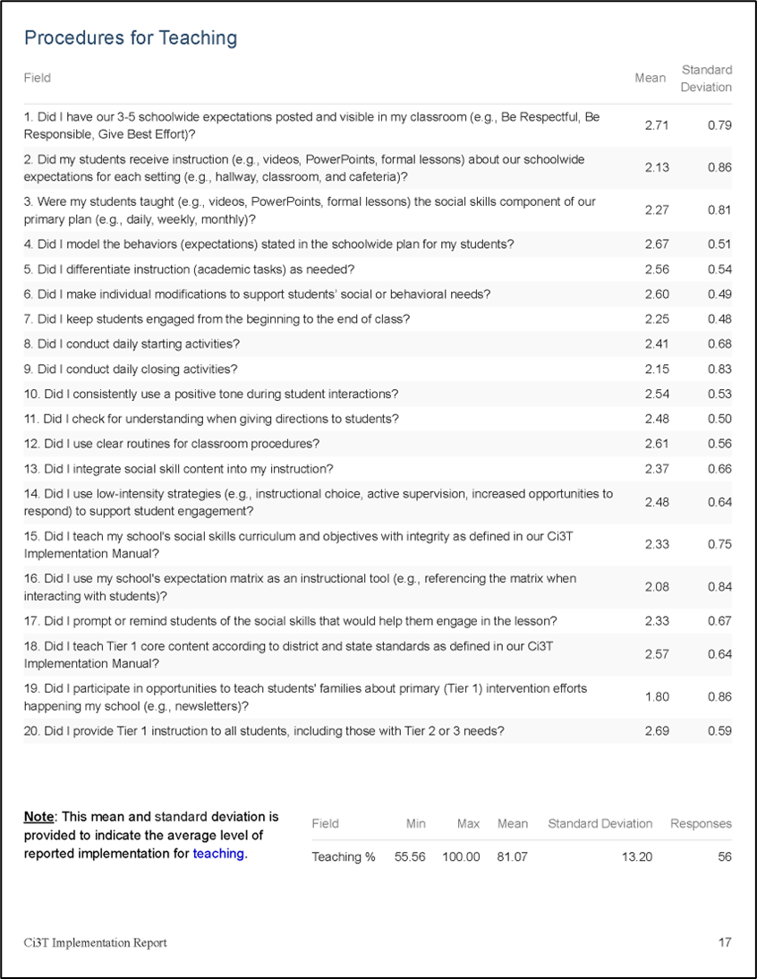
Ci3T Treatment Integrity:
Teacher Self Report - Strengths and Areas of Focus

Slide 46
Social Validity and Treatment Integrity: Data Sources (2)
Primary Intervention Rating Scale (Social Validity)
Ci3T Treatment Integrity: Teacher Self Report
Ci3T Treatment Integrity: Direct Observation
Tiered Fidelity Inventory
Fall 2025

Slide 47
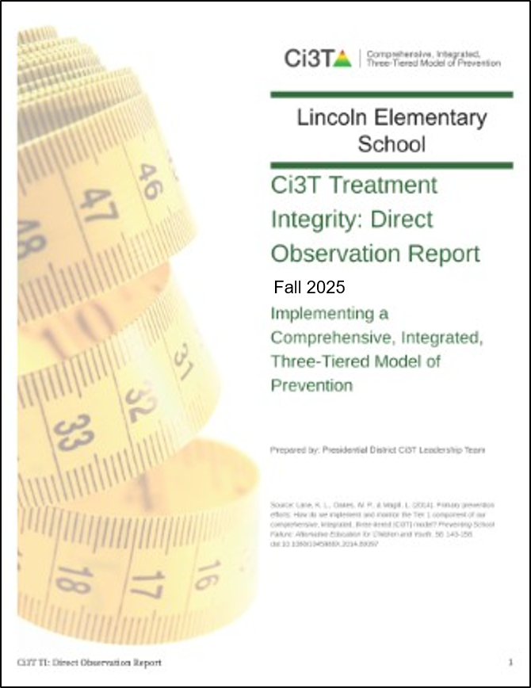
Ci3T Treatment Integrity:
Direct Observation Report (1)
Subset of Ci3T TI: TSR items
Stratified, random selection of educators
  Personnel who directly instruct students
Observers trained to criterion
30-min observations
  Educator perspective
  Observer perspective

Slide 48
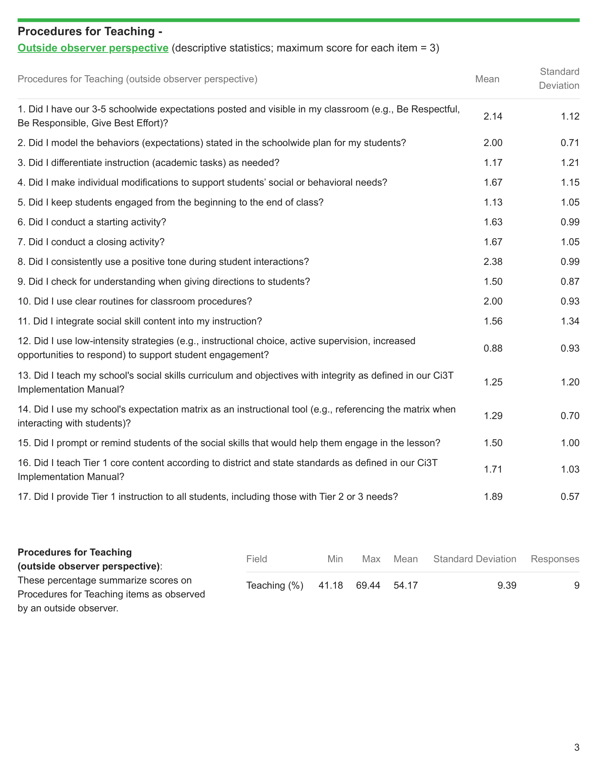
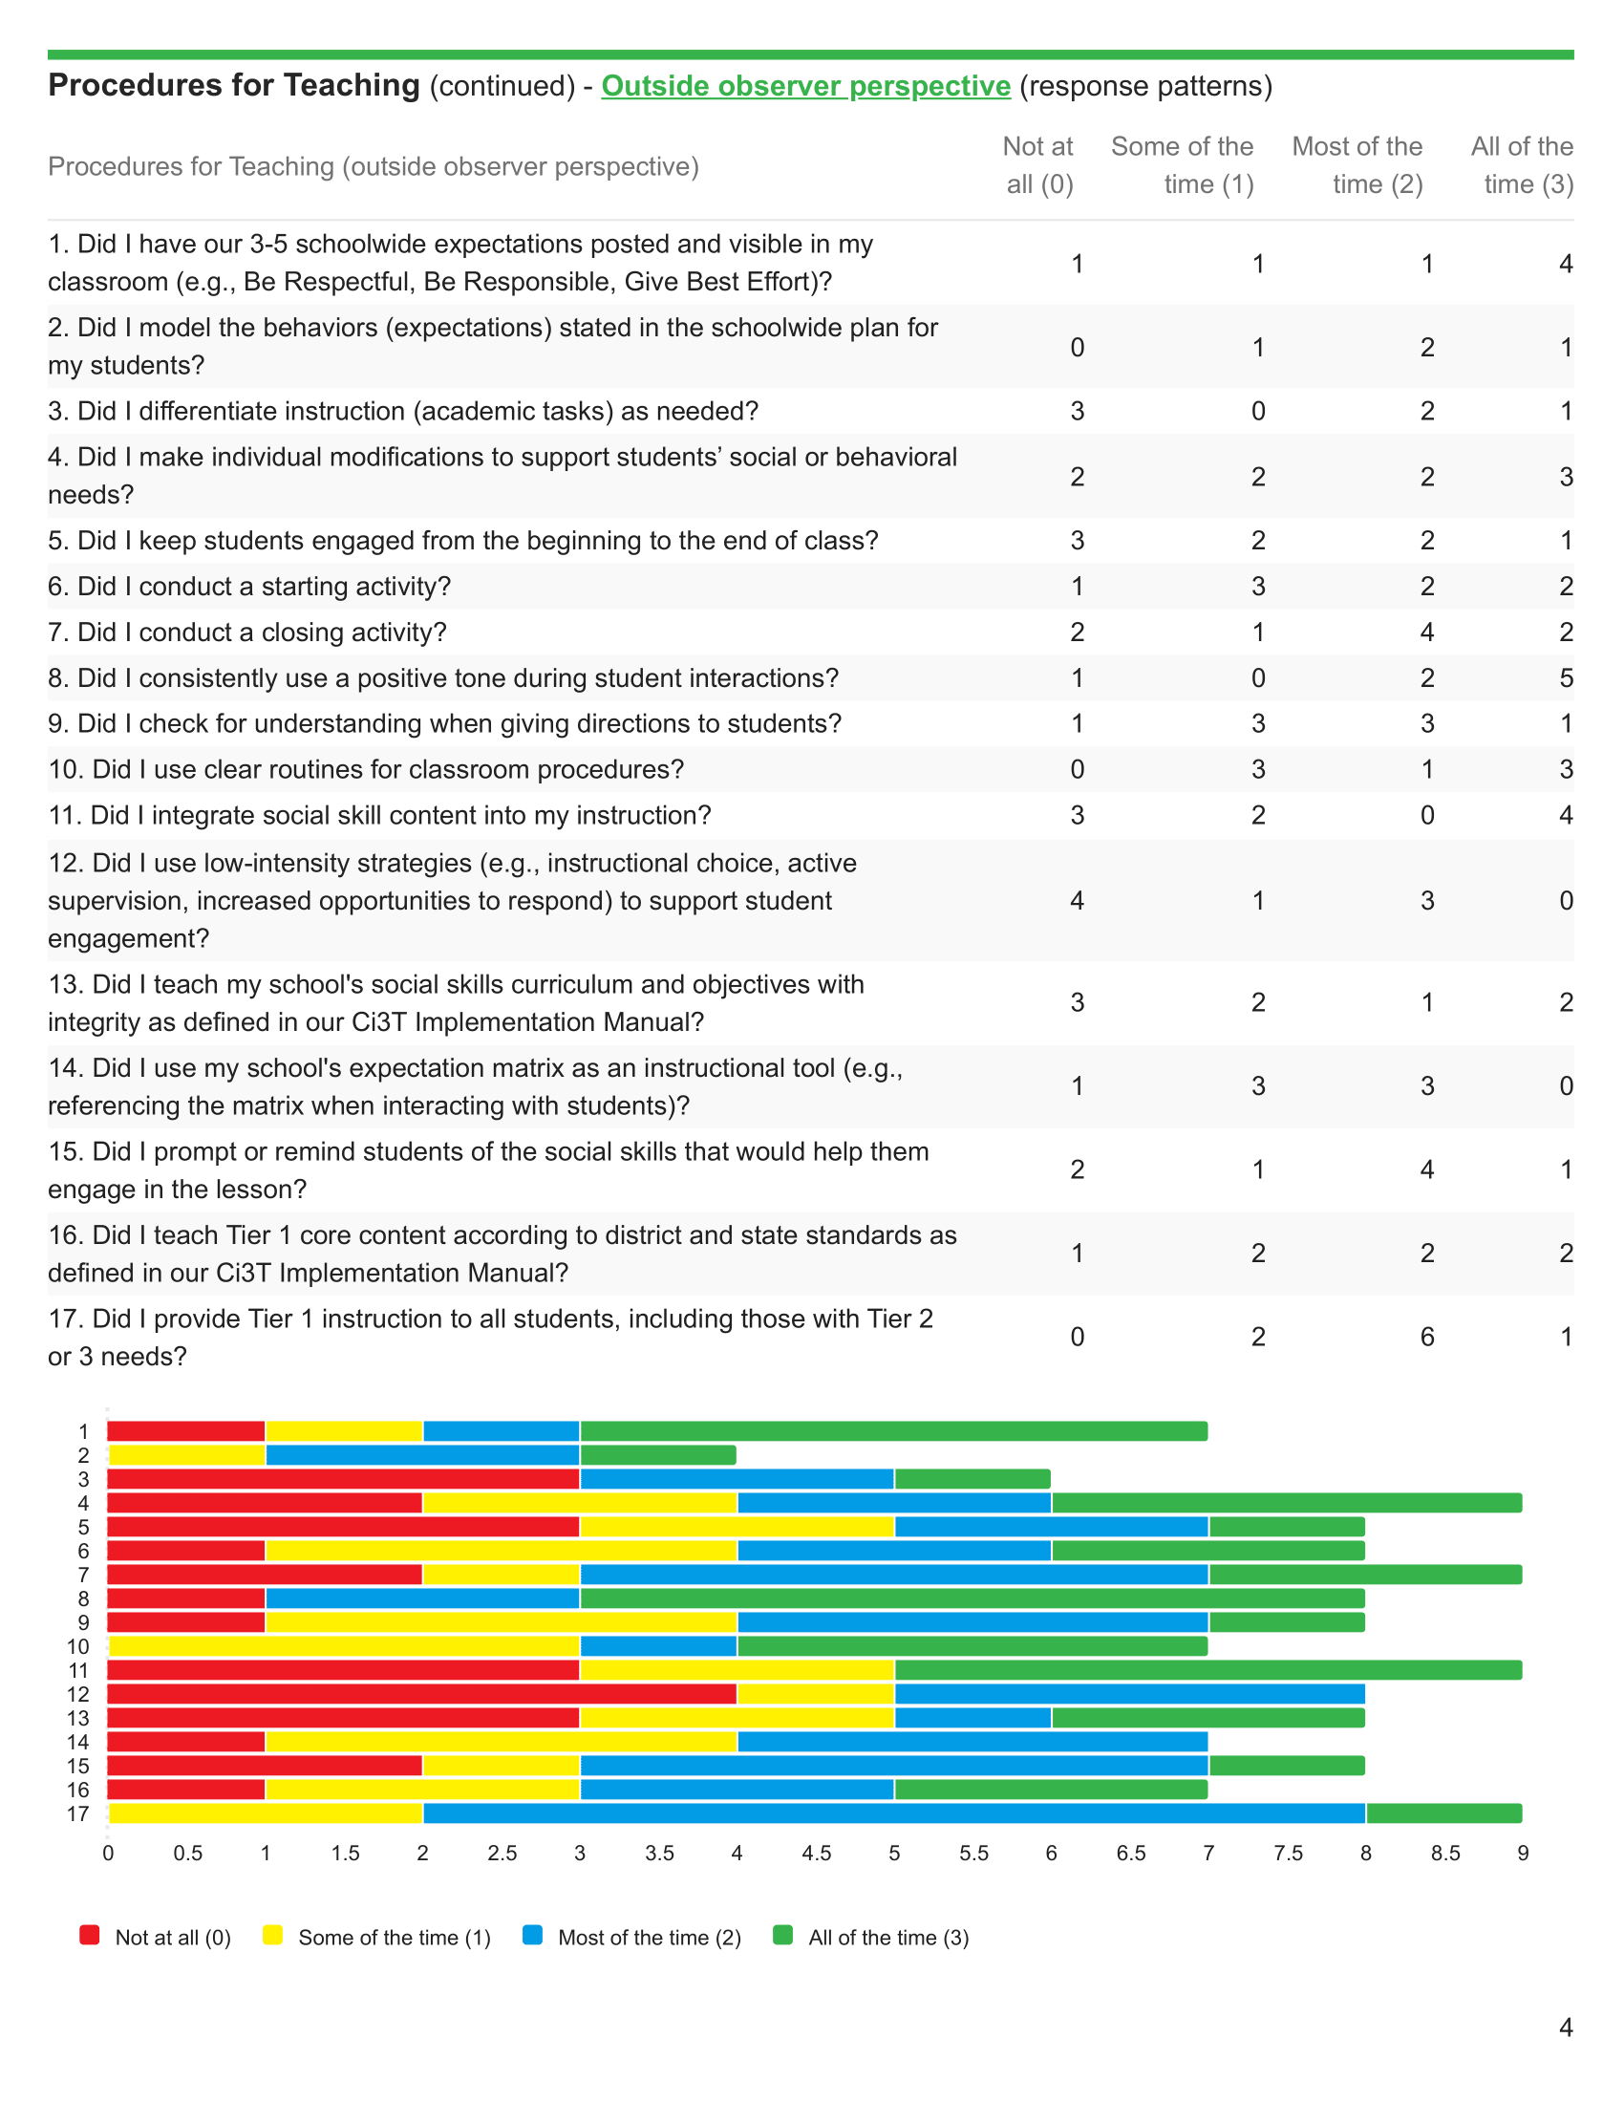
Ci3T Treatment Integrity:
Direct Observation Report – Outside Observer
Item-level data reported by response category
(e.g., number of people who “strongly agreed”)
Item-level data reported as mean and standard deviation (scale = 0-3)
Total %
(mean and standard deviation)
Item-level data visualization

Slide 49
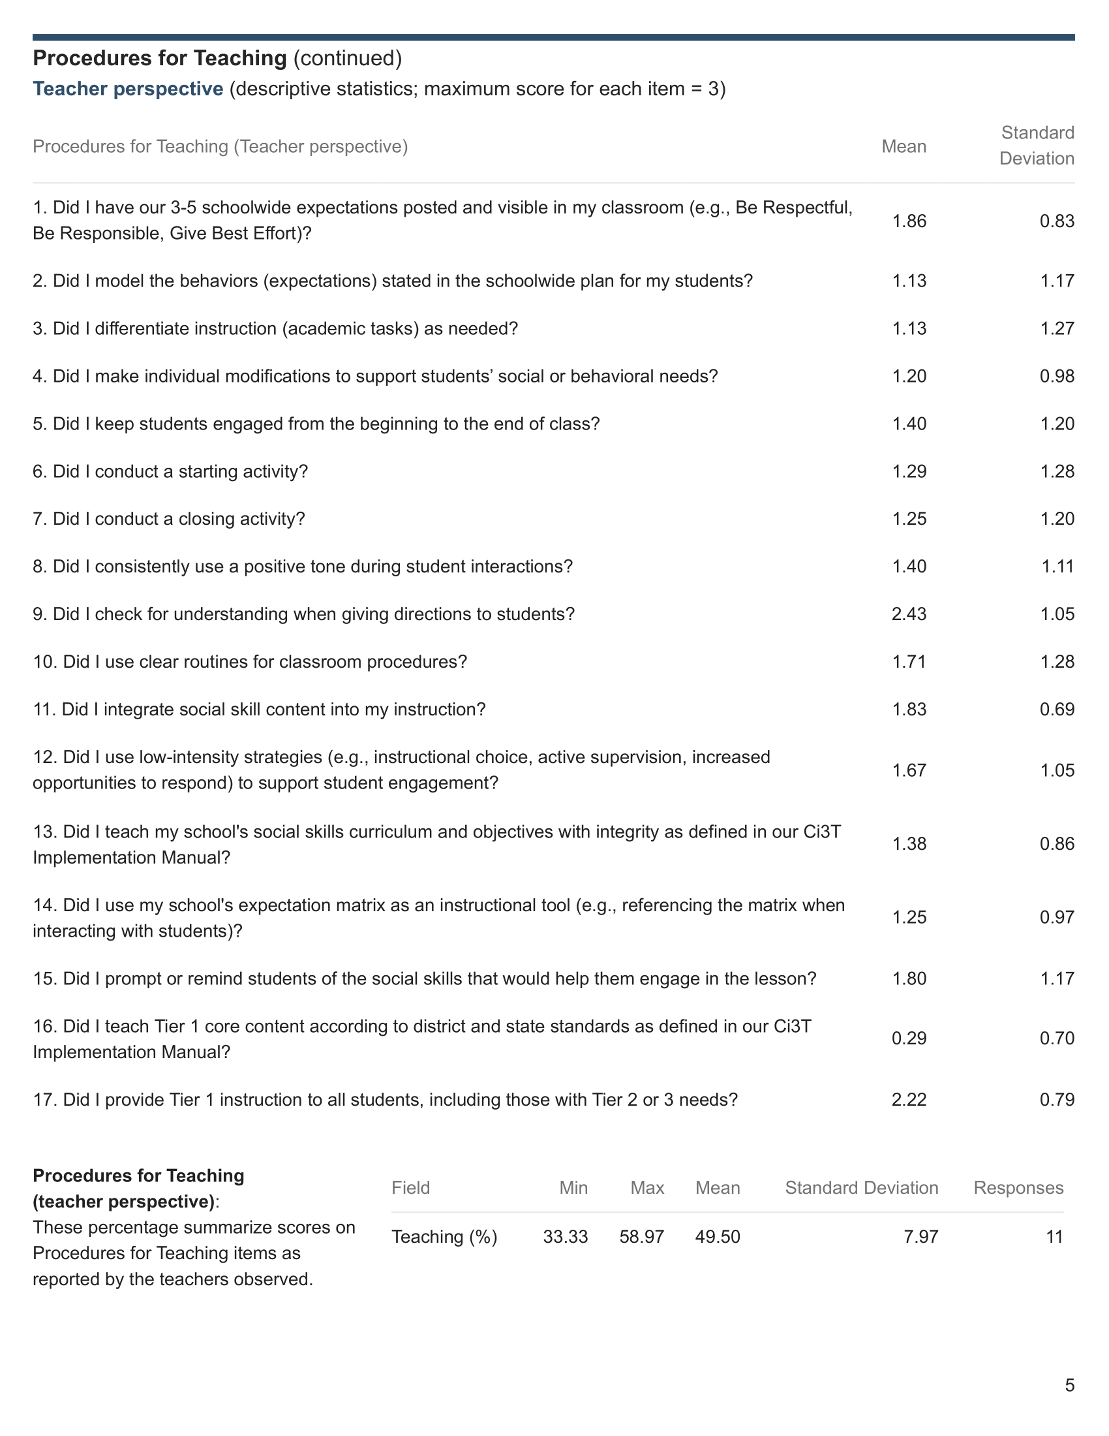
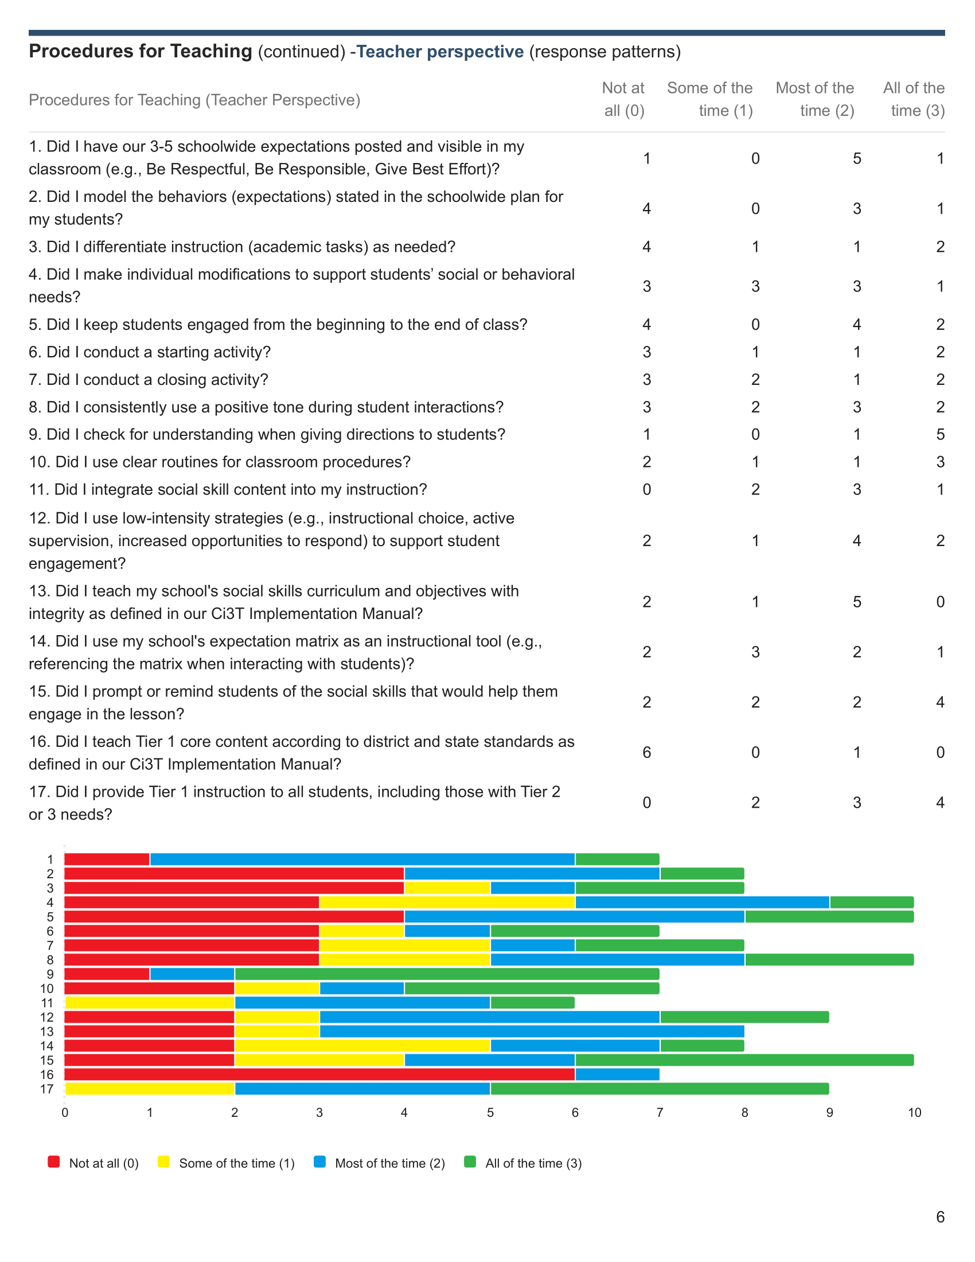
Ci3T Treatment Integrity:
Direct Observation Report – Educator Perspective
Item-level data reported by response category
(e.g., number of people who “strongly agreed”)
Item-level data reported as mean and standard deviation (scale = 0-3)
Total %
(mean and standard deviation)
Item-level data visualization

Slide 50
Ci3T Treatment Integrity:
Direct Observation Report – Areas of Strength and Focus

Slide 51
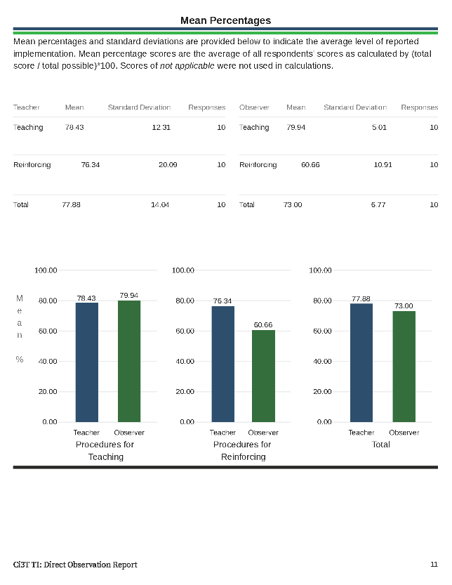
Ci3T Treatment Integrity:
Direct Observation Report Mean Percentages

Slide 52
Social Validity and Treatment Integrity: Data Sources (3)
Primary Intervention Rating Scale (Social Validity)
Ci3T Treatment Integrity: Teacher Self Report
Ci3T Treatment Integrity: Direct Observation
Tiered Fidelity Inventory
Fall 2025

Slide 53
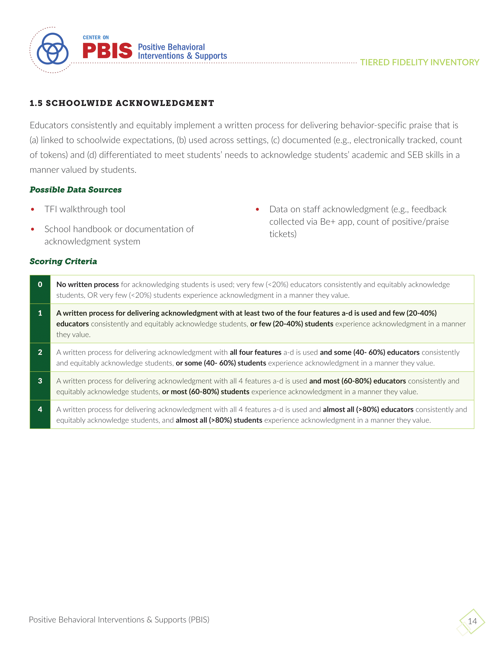
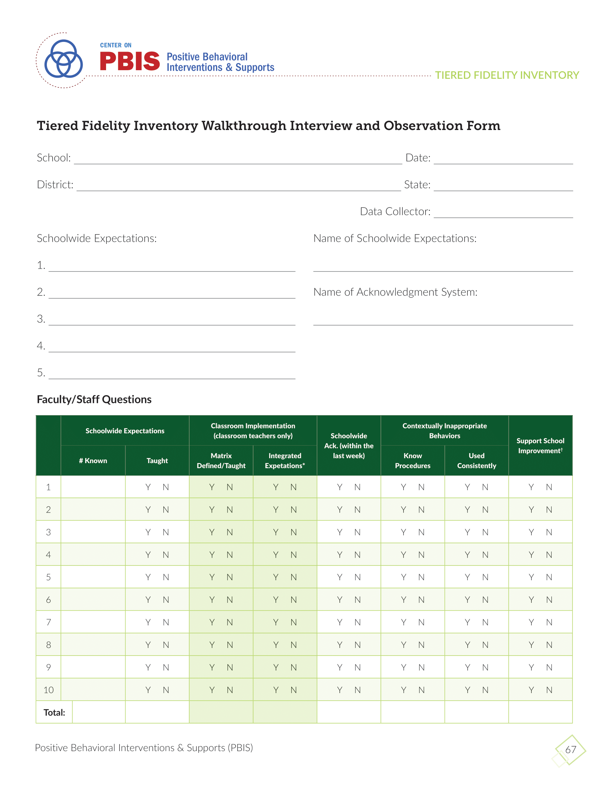
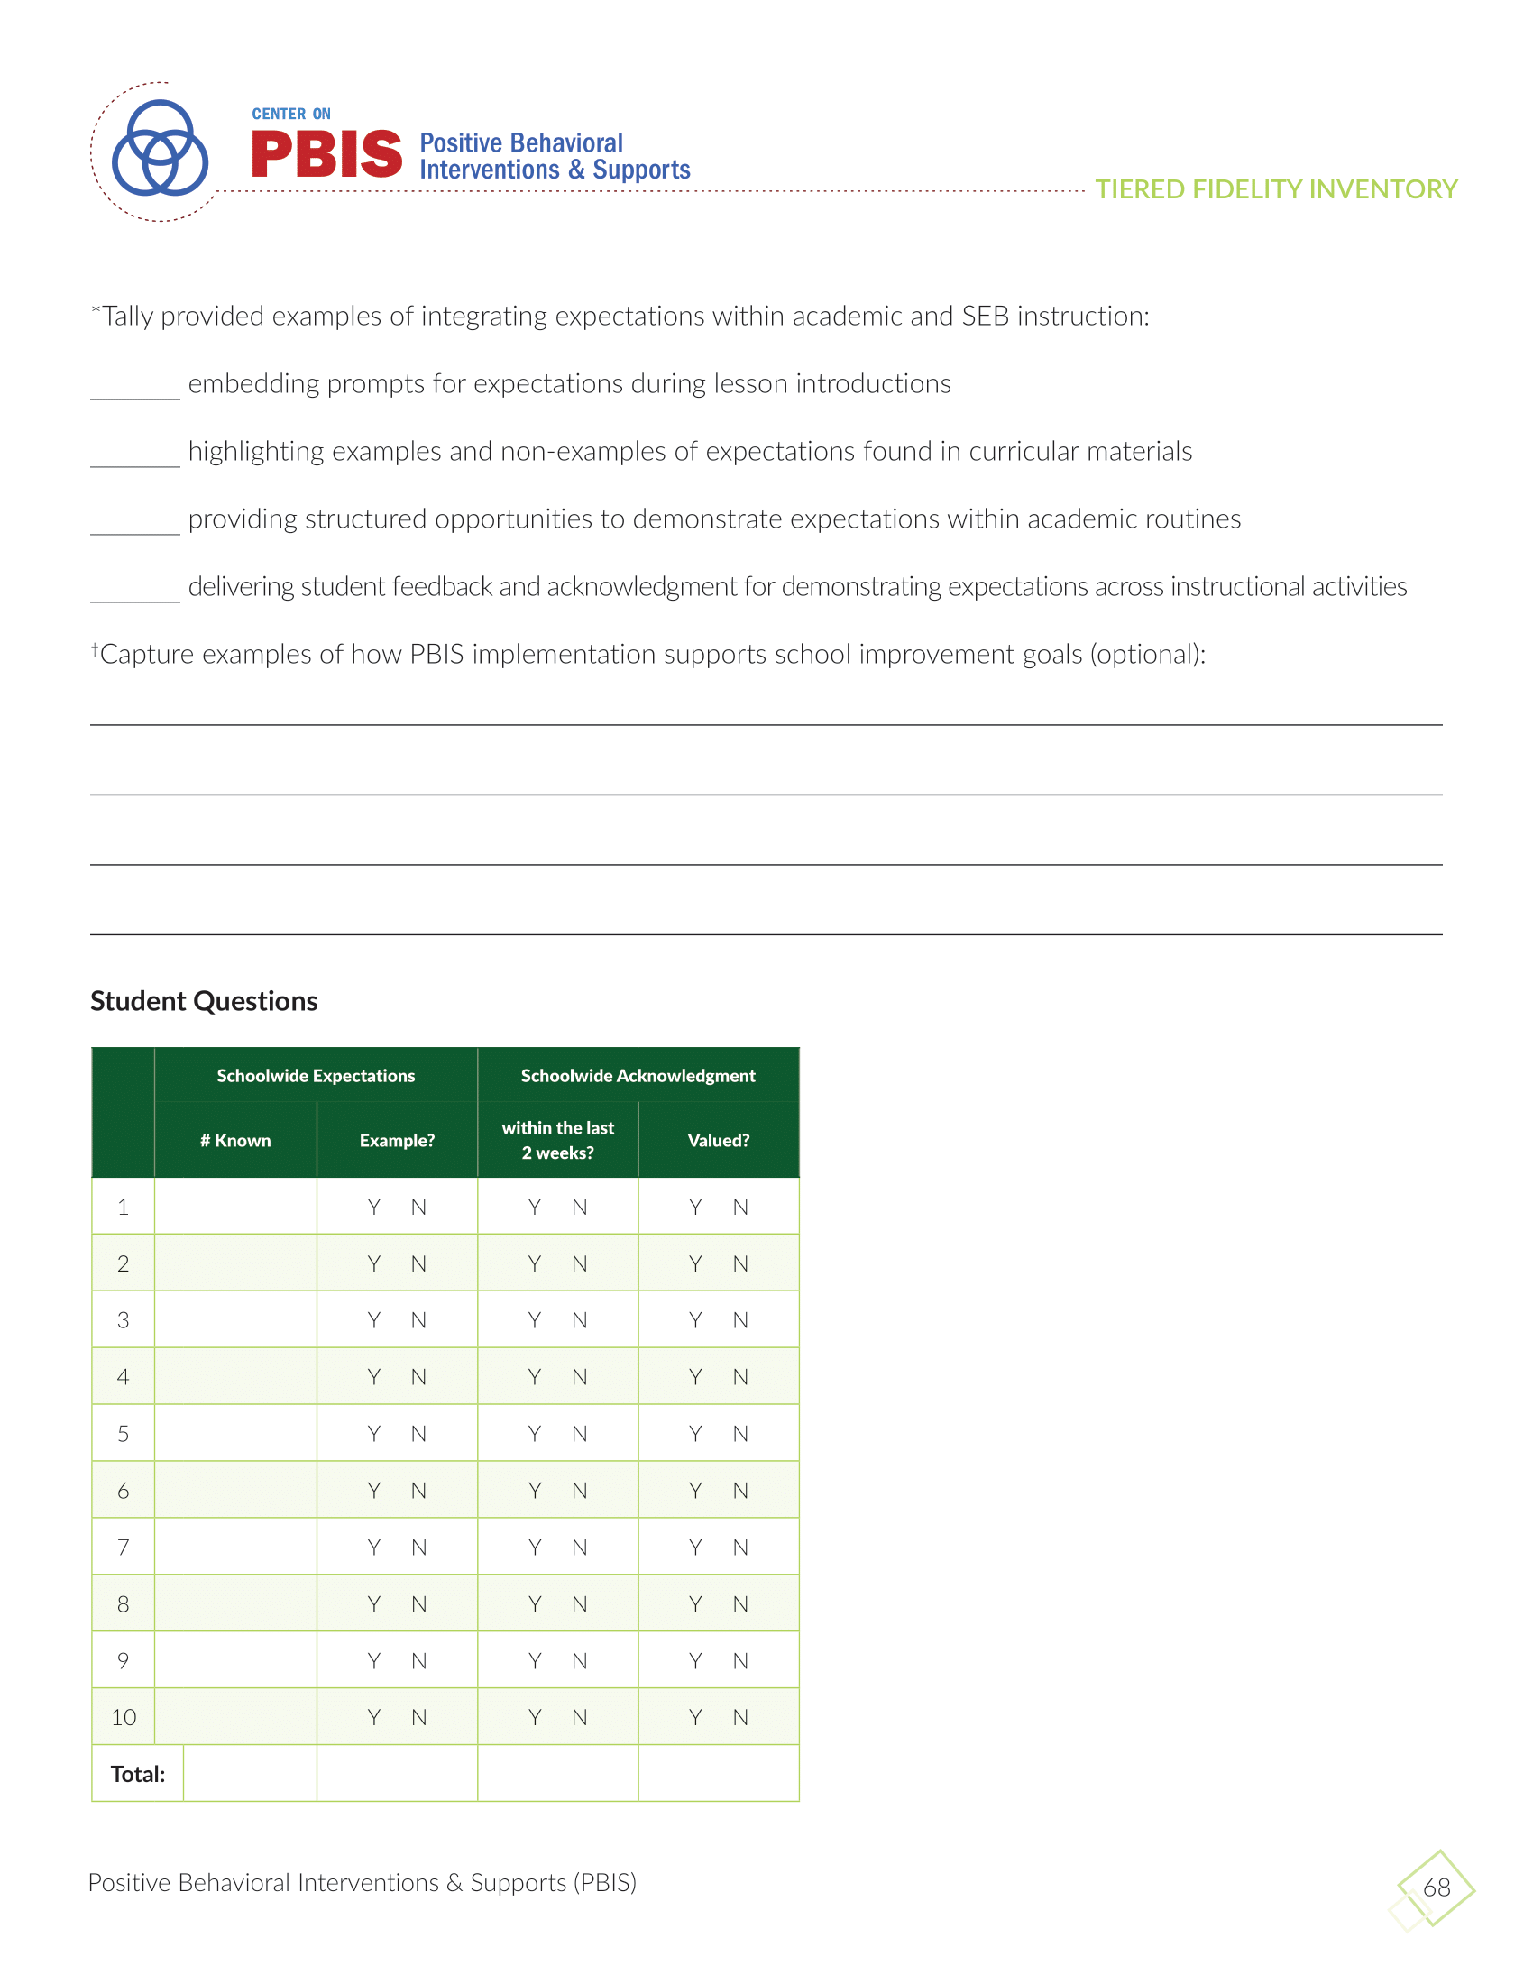
Tiered Fidelity Inventory (TFI)

Slide 54
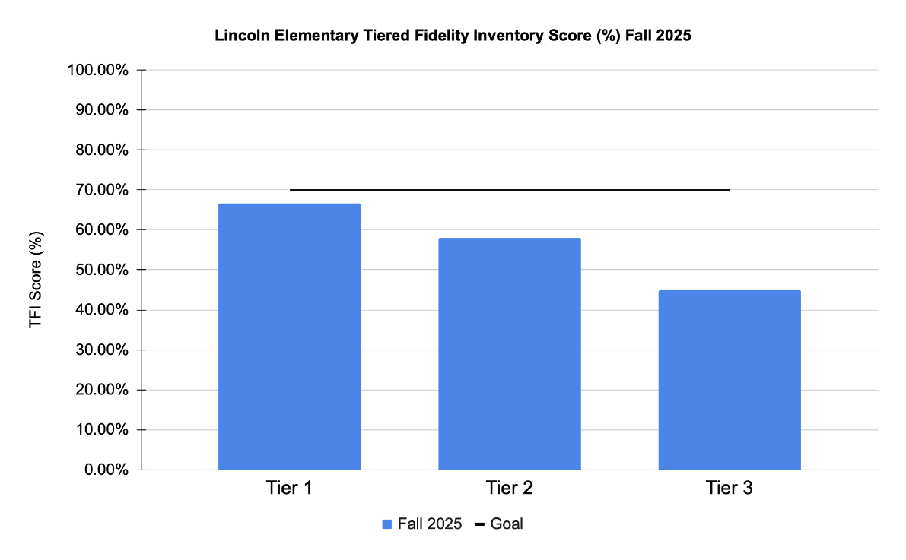
Sharing TFI Data

Slide 55
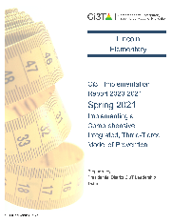

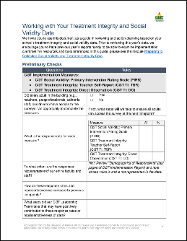
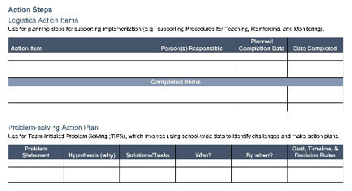

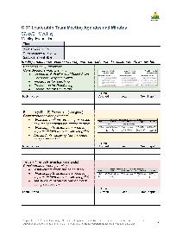
Let’s Discuss
Locate your school’s Social Validity and Treatment Integrity Data
(e.g.,Ci3T Implementation Report, Ci3T Treatment Integrity: Direct Observation Report, Tiered Fidelity Inventory)
2) Review data and:
Highlight successes
Discuss concerns and identify areas of focus
Use HO Working with Treatment Integrity and Social Validity Data
to record plans for addressing these focus areas
Example of a “Talk Time” with School-site Leadership Teams
Notes:
20-min timer

Slide 56
Collecting and Using Systematic Screening Data to Inform Instruction
An Illustration in Ci3T Models

Slide 57
Essential Components of Primary (Tier 1) Prevention Efforts (2)

Slide 58
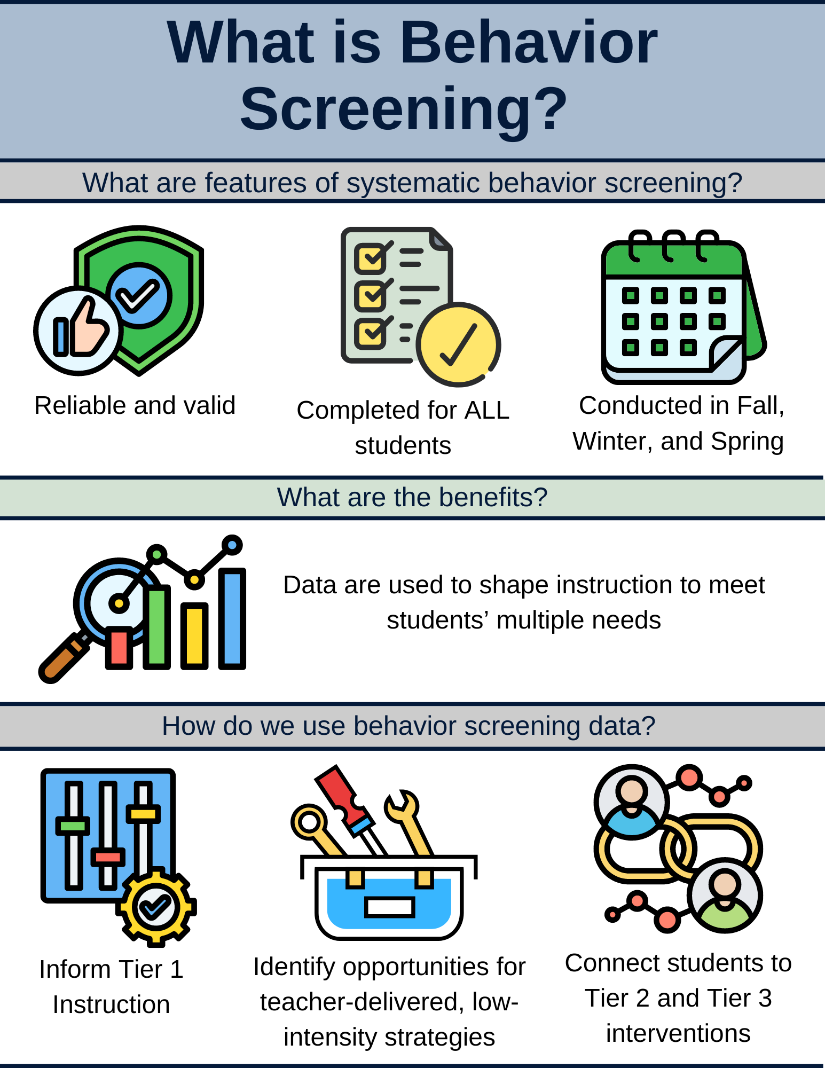
What is Behavior Screening? 1

Slide 59
What is Behavior Screening? 2

Slide 60
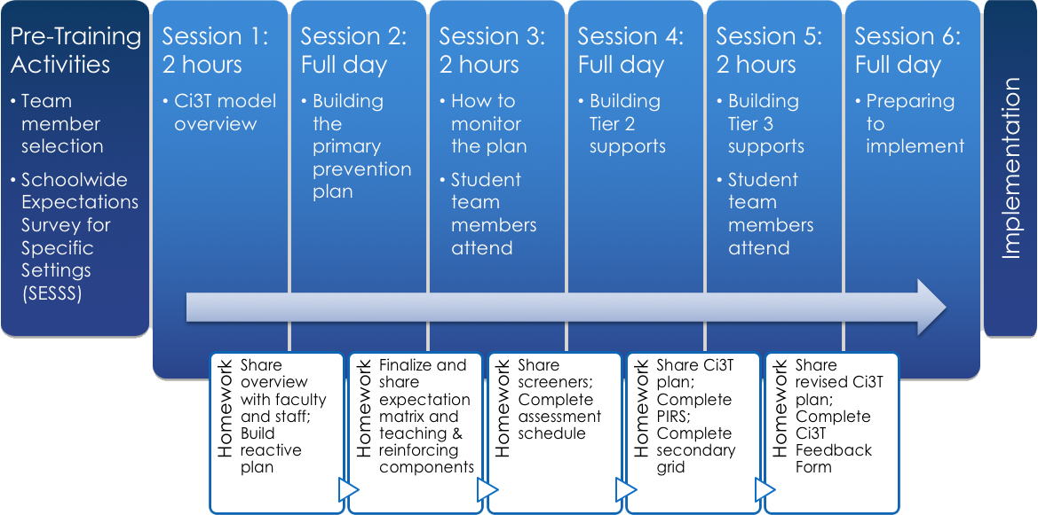
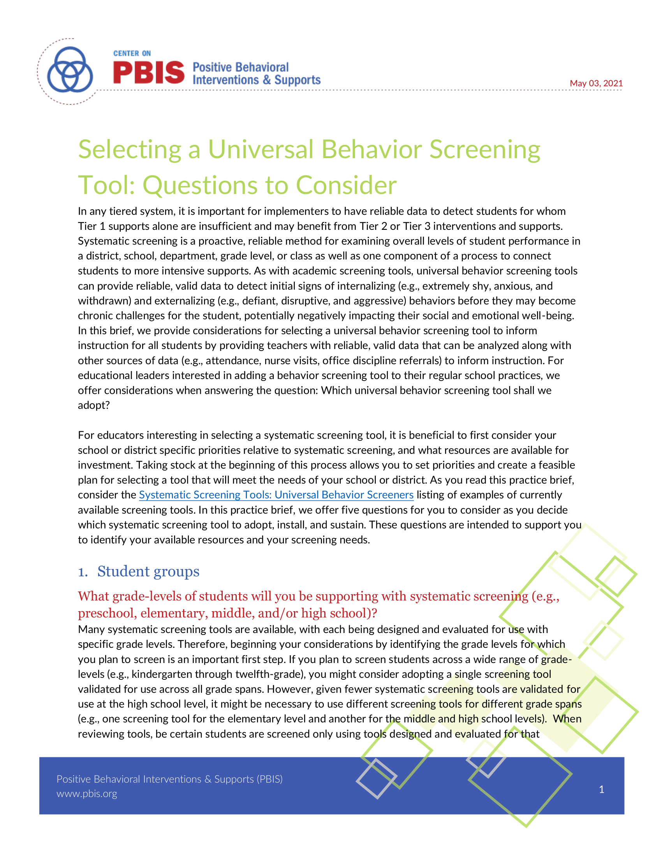
Selecting a Systematic Screener
Notes:
https://www.pbis.org/resource/selecting-a-universal-behavior-screening-tool-questions-to-consider

Slide 61

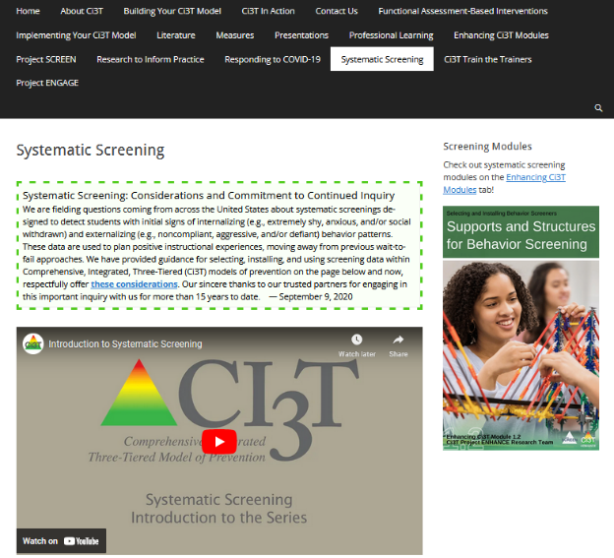
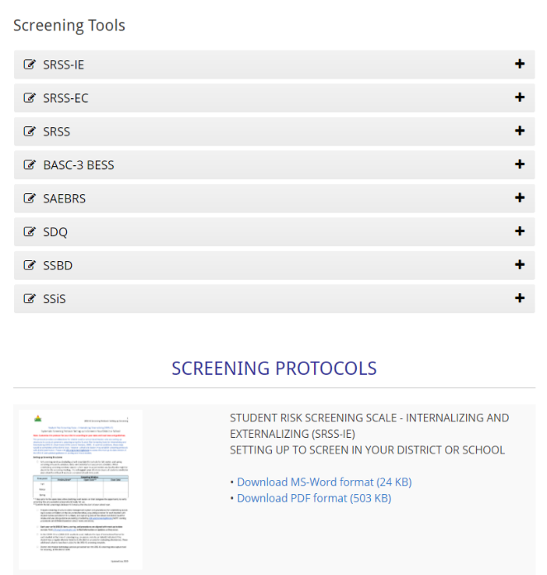
Finding the SRSS-IE on the Ci3T Website
https://www.ci3t.org/screening

Slide 62
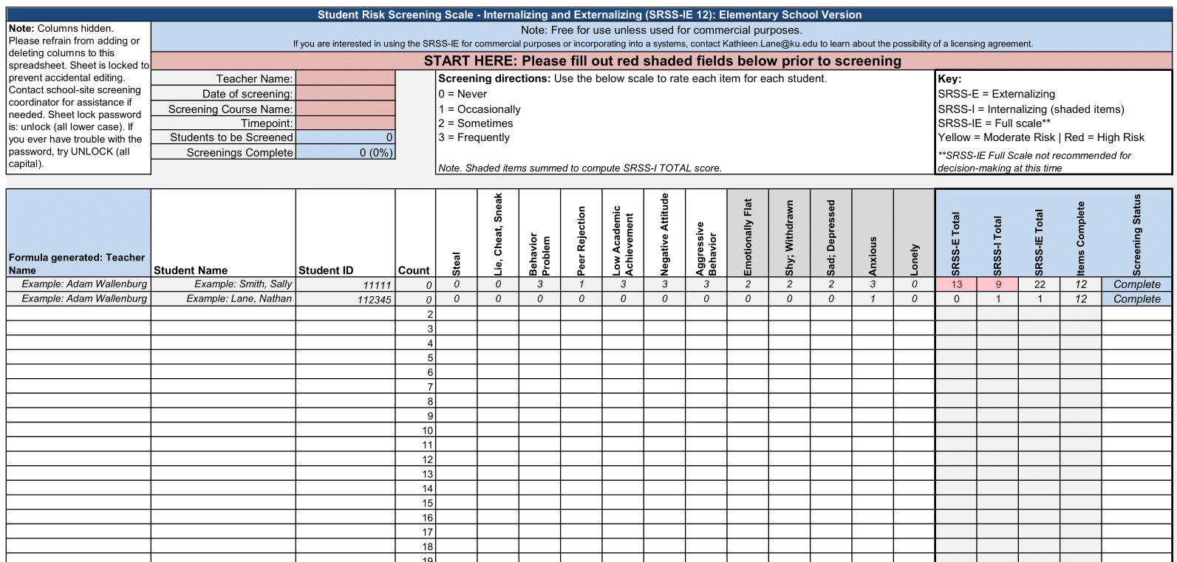
Student Risk Screening Scale – Internalizing and Externalizing (SRSS-IE; Drummond, 1994; Lane & Menzies, 2009)
Elementary

Slide 63
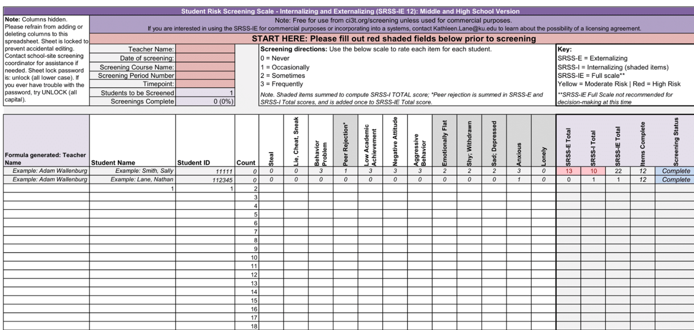
Student Risk Screening Scale – Internalizing and Externalizing (SRSS-IE; Drummond, 1994; Lane & Menzies, 2009)
Secondary

Slide 64
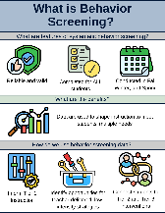
SRSS-IE:
Cut Scores
Elementary School
Middle and High School
SRSS-E7 | SRSS-I5
Items 1-7 | Items 8-12
0-3 = low risk 4-8 = moderate risk 9-21 = high risk | 0-1 = low risk 2-3 = moderate risk 4-15 = high risk
SRSS-E7 | SRSS-I6
Items 1-7 | Items 4, 8-12
0-3 = low risk 4-8 = moderate risk 9-21 = high risk | 0-3 = low risk 4-5 = moderate risk 6-18 = high risk
Elementary School Level:
Lane, K. L., Oakes, W. P., Swogger, E. D., Schatschneider, C., Menzies, H., M., & Sanchez, J. (2015). Student risk screening scale for internalizing and externalizing behaviors: Preliminary cut scores to support data-informed decision making. Behavioral Disorders, 40, 159-170.
Middle and High School Levels:
Lane, K. L., Oakes, W. P., Cantwell, E. D., Schatschneider, C., Menzies, H., Crittenden, M., & Messenger, M. (2016). Student Risk Screening Scale for Internalizing and Externalizing Behaviors: Preliminary cut scores to support data-informed decision making in middle and high schools. Behavioral Disorders, 42(1), 271-284

Slide 65
How do we use behavior screening data?

Slide 66
Inform Instruction at Tier 1

Slide 67

Data to Indicate a Focus on Tier 1:
School Level
Social Skills Improvement System – Performance Screening Guide Spring 2012 – Total School
Lane, K. L., Oakes, W. P., & Magill, L. (2013). Primary prevention efforts: How do we implemented and monitor the Tier 1 component of our Comprehensive, Integrated, Three-Tiered (Ci3T) Model?, Preventing School Failure, 58(1), 143-158.

Slide 68

Data to Indicate a Focus on Tier 1: Breakdown by Grade-Level

Slide 69



Ci3T Integrated Lesson Planning
Citation. Oakes, W. P., Lane, K. L., Lane, K. S., & Buckman, M. M. (2019). Ci3T integrated lessons plan template. www.ci3t.org.
Completed examples available in: Ci3T Project ENHANCE Research Team. (2022, July). Embedding and integrating Ci3T domains into daily instruction. Author. https://doi.org/10.17161/ci3t.42880

Slide 70


Integrated Lesson Plan
Citation. Oakes, W. P., Lane, K. L., Lane, K. S., & Buckman, M. M. (2019). Ci3T integrated lessons plan template. www.ci3t.org.​

Slide 71
Empower Teachers with Low-Intensity Strategies

Slide 72

Data to Indicate a Focus on Low-Intensity Teacher-Delivered Strategies

Slide 73



Low-Intensity Teacher-Delivered Strategies

Slide 74


Low-Intensity Strategies: Instructional Choice

Slide 75









Module Connection!
Instructional Choice
Notes:
LIS modules contain:
Videos and infographics to easily share key information
Resources to support implementation – templates, implementation checklist, treatment integrity forms, social validity, data-tracker
Family resources

Slide 76
Connect Students to Validated Tier 2 and Tier 3 Supports

Slide 77



Getting Started with Data-Informed Decision Making

Slide 78

Tier 2 and Tier 3 Intervention Grids
Notes:
Support is the name of the strategy, practice, or program. Notice this is not the name of a person or role.

Slide 79
Secondary (Tier 2) Intervention Grid (2)

Slide 80


Tier 2: Recognize.Relax.Record

Slide 81



Enhancing Ci3T Modules
ci3t.org/enhance

Slide 82



Please Complete this Session’s Evaluation
10/23
4E – Using Data to Facilitate Implementation of Integrated Tiered Systems: Data for the Win!
Four options, pick one!
1. Mobile App
Click “Take Survey" under the session description.
2. QR Code Scan the code on this slide.
3. Online
Click on the link located next to the downloadable session materials posted online at:
www.pbis.org/conference-and-presentations/pbis-leadership-forum
4. Direct Link
Click the link provided in the email reminder you receive after your session ends.
Evaluations are anonymous! We send reminder emails to all participants.
After you submit each session evaluation, click the link to enter the gift card raffle!

