Slide 1
1G Screening, Triage, & Assessment: Data-Informed Approaches to Meeting Students’ Multiple Needs
Presenters:
Tona McGuire, University of Washington
Kelcey Schmitz, University of Washington
Kathleen Lynne Lane, University of Kansas
Topic: Crisis Preparation, Response, & Recovery
Keywords: Screening, Trauma
Notes:
Sample title slide with topic & keyword information (for all presenters)

Slide 2
Learning Objectives
Define screening, assessment, and triage
Explain how to use systematic screening and triage efforts in the K-12 context
Support recovery phase efforts
Notes:
Learning Objectives

Slide 3
Agenda
Welcome and Introductions
Systematic Screening in Tiered Systems
Triage & Recovery Phase Efforts
Closing Out and Moving Forward
Institute of Education Sciences, U.S. Department of Education
R324N190002 University of Kansas

Slide 4
Welcome and Introductions

Slide 5

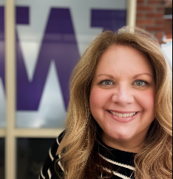

Meet our team!
Tona McGuire
Kelcey Schmitz
Kathleen Lynne Lane

Slide 6
Systematic Screening in Tiered Systems
Kathleen Lynne Lane

Slide 7
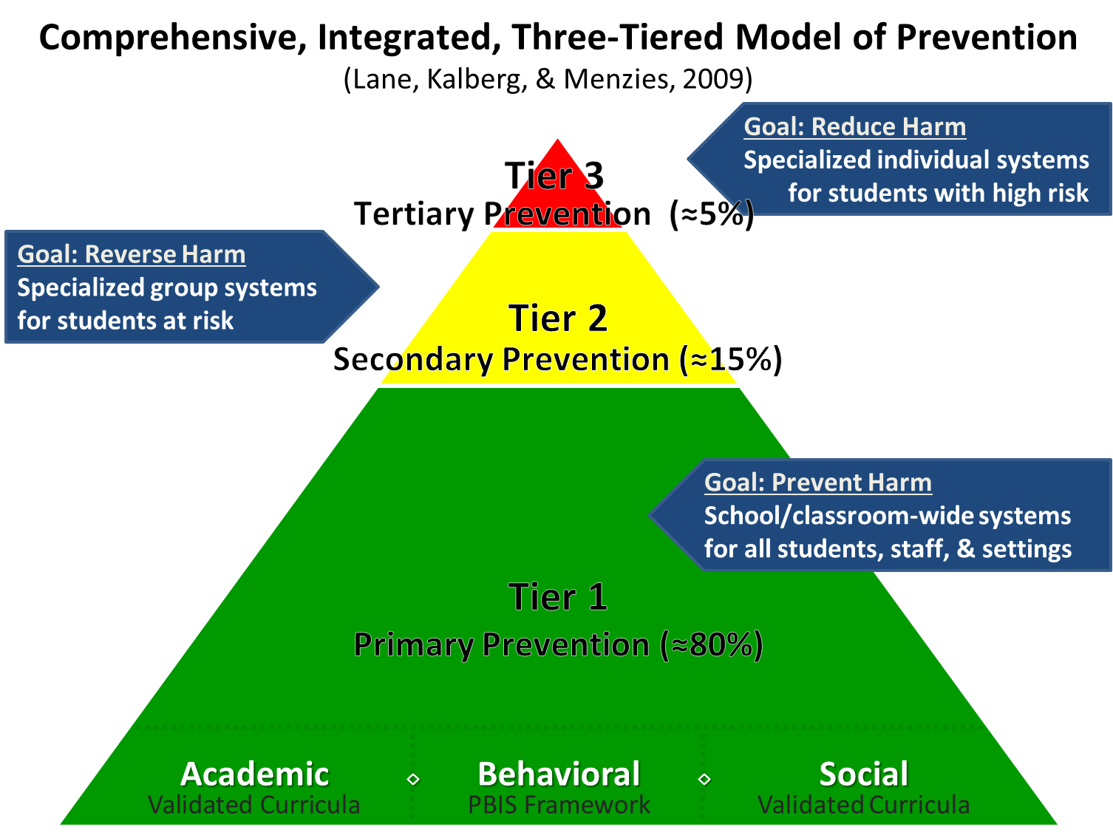
Comprehensive, Integrated, Three-Tiered Model of Prevention 1

Slide 8
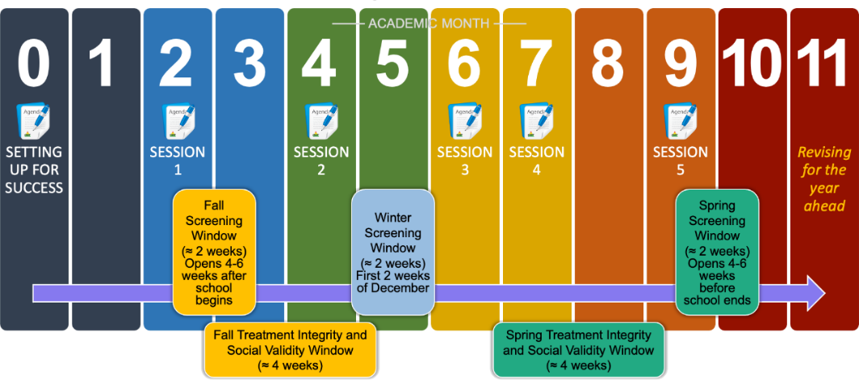
Ci3T Implementation Professional Learning Series
Notes:
The Ci3T Implementation Professional Learning Series is a 6-part series that spans the academic year. Sessions are timed to correspond to important milestones including: the beginning of the school year (e.g., kicking off the year, rolling out the Ci3T plan), screening windows, and treatment integrity and social validity windows.
Each session is data-informed, meaning attending Ci3T Leadership Team members review data, which are used to (a) identify successes, (b) identify focus areas (e.g., aspects of implementation that require additional attention, often via professional learning), and (c) create action plans to share data back and address focus areas.
Sessions applicable for both new and seasoned implementers as the focus is on predicable components of Ci3T implementation, space to review and respond to data, exploring resources to support implementation efforts, and beginning conversations and action plans.

Slide 9
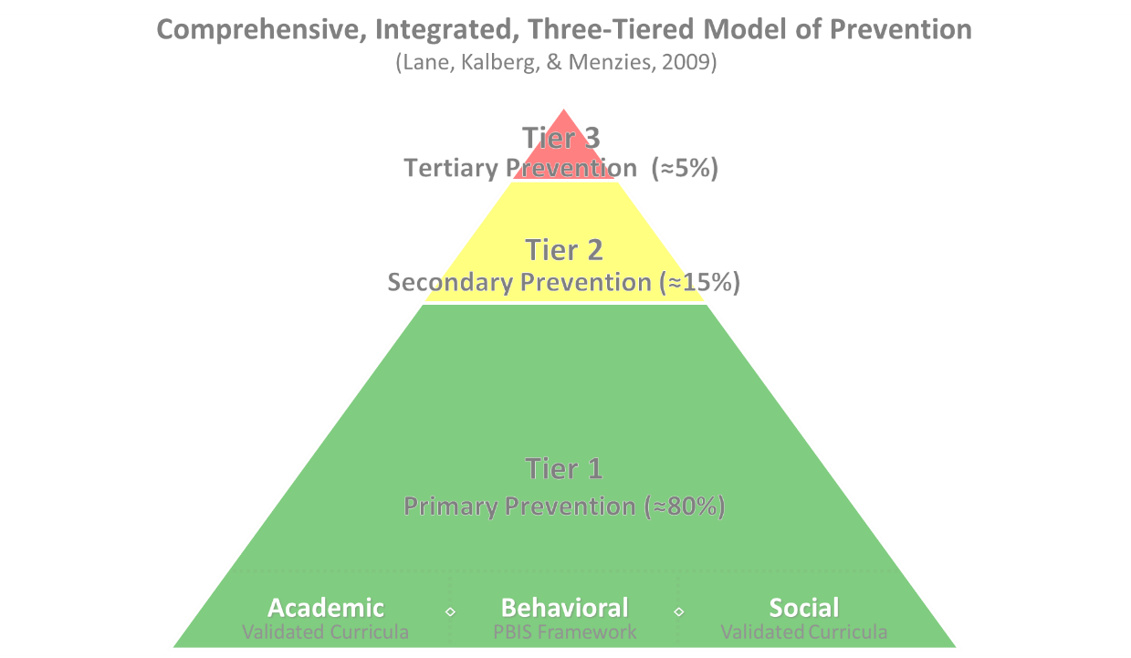

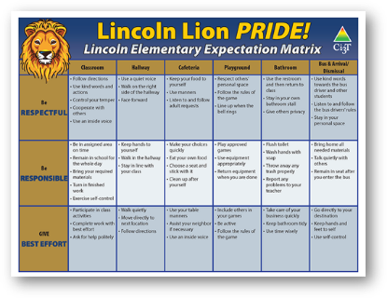
Comprehensive, Integrated, Three-Tiered Model of Prevention 2
Positive Behavioral Interventions and Supports
District & State Standards Quality Instruction
Validated Curricula and Resources

Slide 10


Primary Prevention (Tier 1)

Slide 11
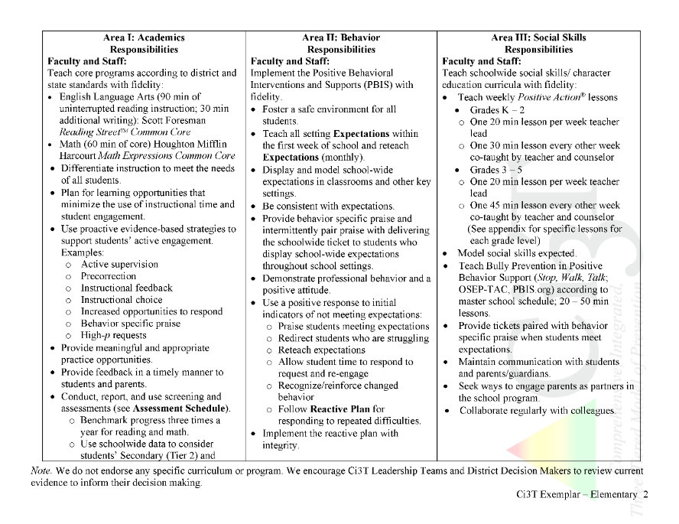

Implementation Report Example
Ci3T Primary Plan: Procedures for Teaching
Ci3T Primary Plan: Procedures for Reinforcing
Ci3T Primary Plan: Procedures for Monitoring

Slide 12
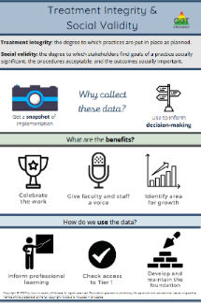
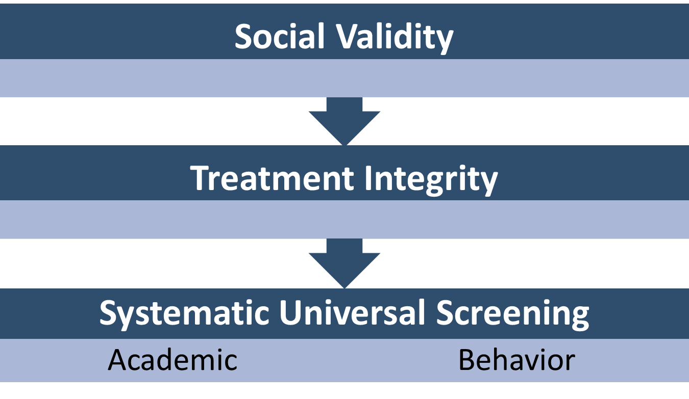
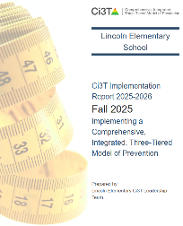
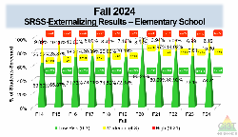
Essential Components of Primary (Tier 1) Prevention Efforts

Slide 13

Systematic Screening … Logistics
Fall
Winter
Spring
Selecting
Installing
Analyzing

Slide 14
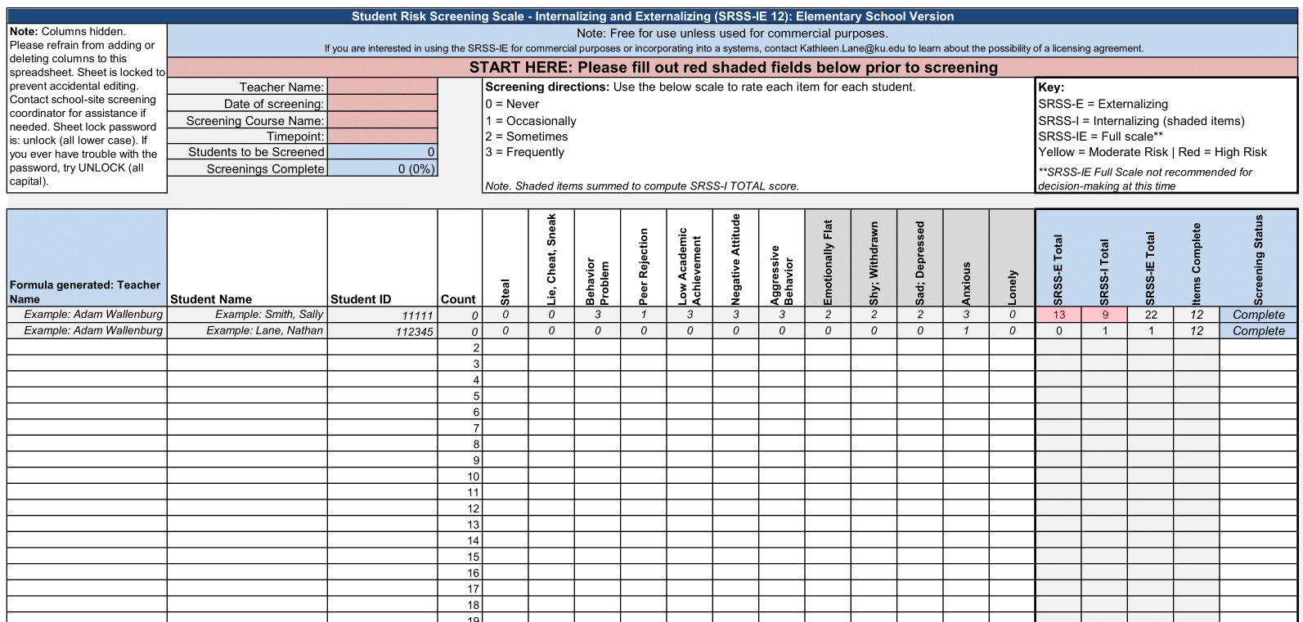
Student Risk Screening Scale – Internalizing and Externalizing (SRSS-IE; Drummond, 1994; Lane & Menzies, 2009)
Elementary
Internalizing
Externalizing

Slide 15
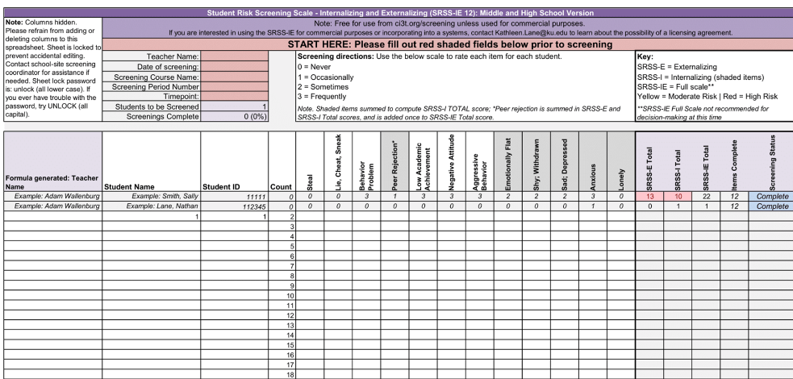
Student Risk Screening Scale – Internalizing and Externalizing (SRSS-IE; Drummond, 1994; Lane & Menzies, 2009)
Secondary
Internalizing
Externalizing

Slide 16
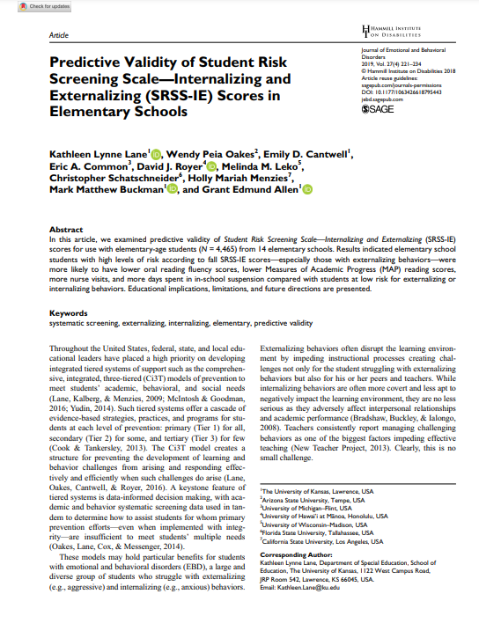
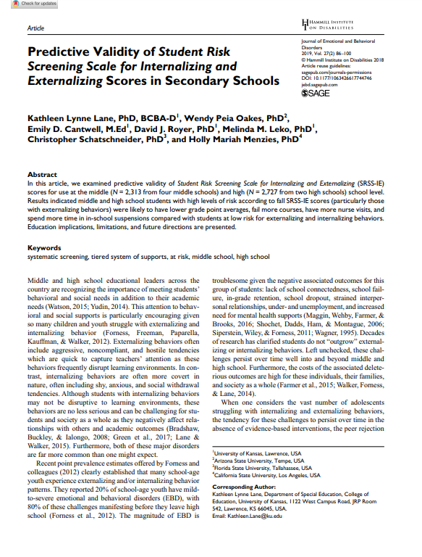
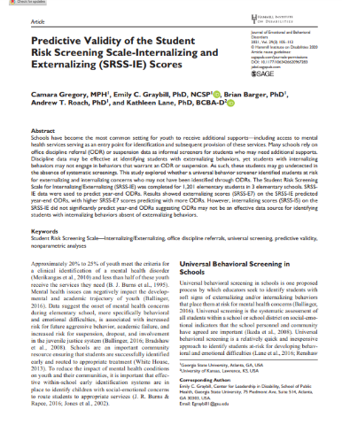
SRSS-IE Scores Predict Student Outcomes
Fall
Winter
Year End
ODR Suspensions
Nurse Visits
Course Failures

Slide 17
Spring 2023
SRSS-Externalizing Results – Elementary School level
n = 70
n = 43
n = 45
n = 5
n = 43
n = 7
n = 25
n = 31
n = 38
n = 87
n = 95
n = 129
n = 123
n = 110
n = 11
n = 103
n = 241
n = 298
n = 289
n = 31
n = 288
n = 297
n = 314
n = 330
Notes:
Fill in <year> based on current academic year. This is located in column A of the data sheet. Edit by right clicking and selecting “Edit data”.

Slide 18
Spring 2023
SRSS-Internalizing Results – Elementary School Level
n = 54
n = 42
n = 36
n = 103
n = 70
n = 68
n = 283
n = 352
n = 340
Cut scores vary by school level:
Elementary (I5): Low (0-1), Moderate (2-3), High (4-15)
Middle and High (I6): Low (0-3), Moderate (4-5), High (6-18)
Notes:
Fill in <year> based on current academic year. This is located in column A of the data sheet. Edit by right clicking and selecting “Edit data”.
IMPORTANT NOTE: The INTERNALIZING subscale and CUT SCORES are specific to school level.
Elementary: SRSS-I5, Items 8-12, 0-1 = low risk, 2-3 = moderate risk, 4-15 = high risk
Middle and High: SRSS-I6, Items 4, 8-12, 0-3 = low risk, 4-5 = moderate risk, 6-18 = high risk

Slide 19
Spring 2023
SRSS-Internalizing Results – Elementary Grade Level
Grade Level | N Screened | Low n (%) | Moderate n (%) | High n (%)
3 | 62 | 51 (82.26%) | 11 (17.74%) | 0 (0.00%)
4 | 81 | 62 (76.54%) | 13 (16.05%) | 6 (7.41%)
5 | 90 | 64 (71.11%) | 13 (14.44%) | 13 (14.44%)

Slide 20
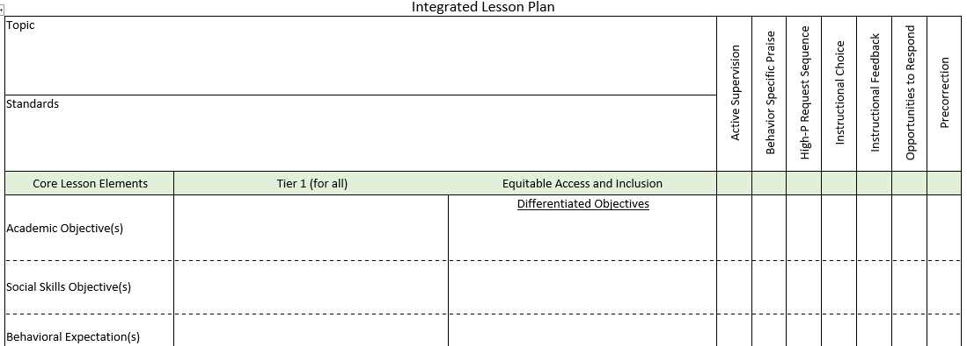
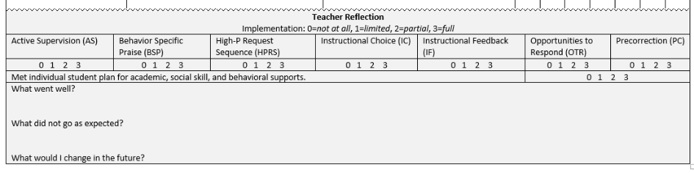
Planning for Integrated Instruction

Slide 21
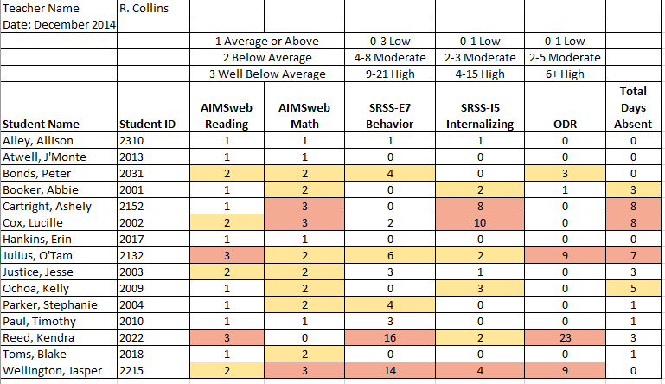
Examining Academic and Behavioral Data
Lane, K. L., Menzies, H. M., Ennis, R. P., & Oakes, W. P. (2015). Supporting Behavior for School Success: A Step-by-Step Guide to Key Strategies. Guilford Press.
Notes:
Lane, K. L., Oakes, W. P., Ennis, R. P., & Hirsch, S. E. (2014). Identifying students for secondary and tertiary prevention efforts: How do we determine which students have Tier 2 and Tier 3 needs? Preventing School Failure, 58, 171-182, DOI: 10.1080/1045988X.2014.895573

Slide 22


Building a Ci3T Tier Library
Teacher Delivered Strategies
Tier 1
Tier 2
Tier 3

Slide 23
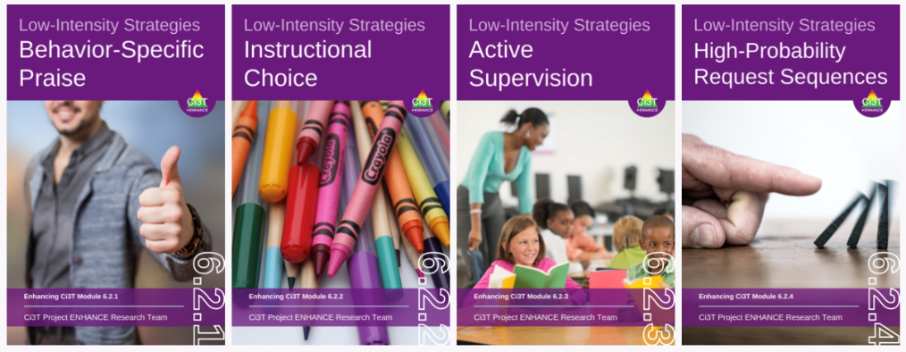




Low-Intensity Strategies
Proximity
Overlappingness
With-it-ness
Pacing
Self-Monitoring
Behavior Contracts
ci3t.org/enhance

Slide 24
Low-Intensity Strategies 2
Low-Intensity Strategy | Franklin High School On-Site Expert
Behavior-Specific Praise: Identifying the specific expectation the student met. “Niama, I noticed you outlined your paper and used the graphic organizer to draft your essay. Well done!” “Justice, thank you for pushing in your chair to keep the walkway safe.” | Eric Common, Behavior Specialist Mark Buckman, Special Education Grant Allen, Parent Volunteer Paloma Pérez-Clark, School Psychologist
Opportunities to Respond: Providing 4-6 opportunities per minute for students to respond individually, choral, verbal, written, gesture, or symbol. “Show me thumbs or thumbs down if...” “Show me on your white board what…” “Turn to your elbow partner and say…” “All together now, what is…” | David Royer, Administration Emily Cantwell, 12th Grade Scarlett Lane, 11rd Grade Mallory Messenger, Counselor
Instructional Choice: Providing within-task or between task choices to increase academic engaged time and motivation. “Ronaldo, our of our 3 learning objectives today, which would you like to work on first?” “Suzy, do you want to work on the laptop, or handwrite your answers for this assignment?” | Abbie Jenkins, 10th Grade Scarlett Lane, 11th Grade José Sousa, PE Liane Johl, 9th Grade

Slide 25
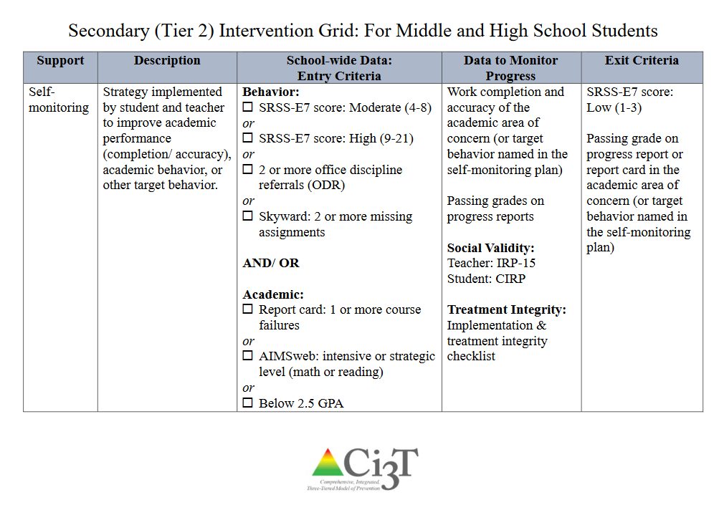
Secondary (Tier 2) Intervention Grid for Middle and High School Students

Slide 26
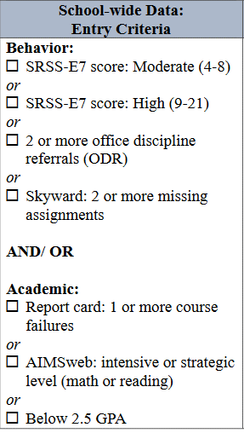
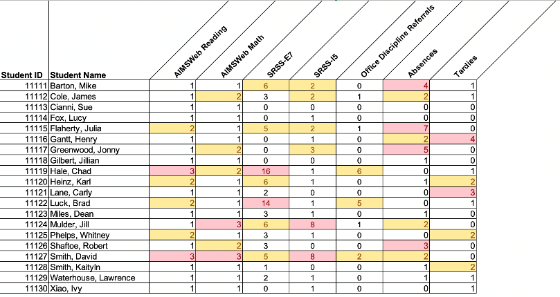
Using multiple data sources

Slide 27

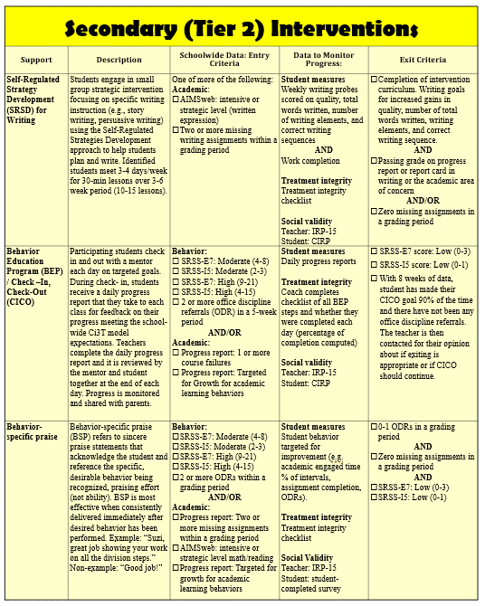
Secondary (Tier 2) Intervention Grid (1)
Notes:
In addition to the module featured here outlining how to use multiple sources of data to connect students with Tier 2 supports, we offer a full suite of modules highlighting validated Tier 2 interventions such as Self-Regulated Strategy Development (SRSD) for Writing and Check-In/Check Out that may appear in your Secondary (Tier 2) Intervention Grid

Slide 28

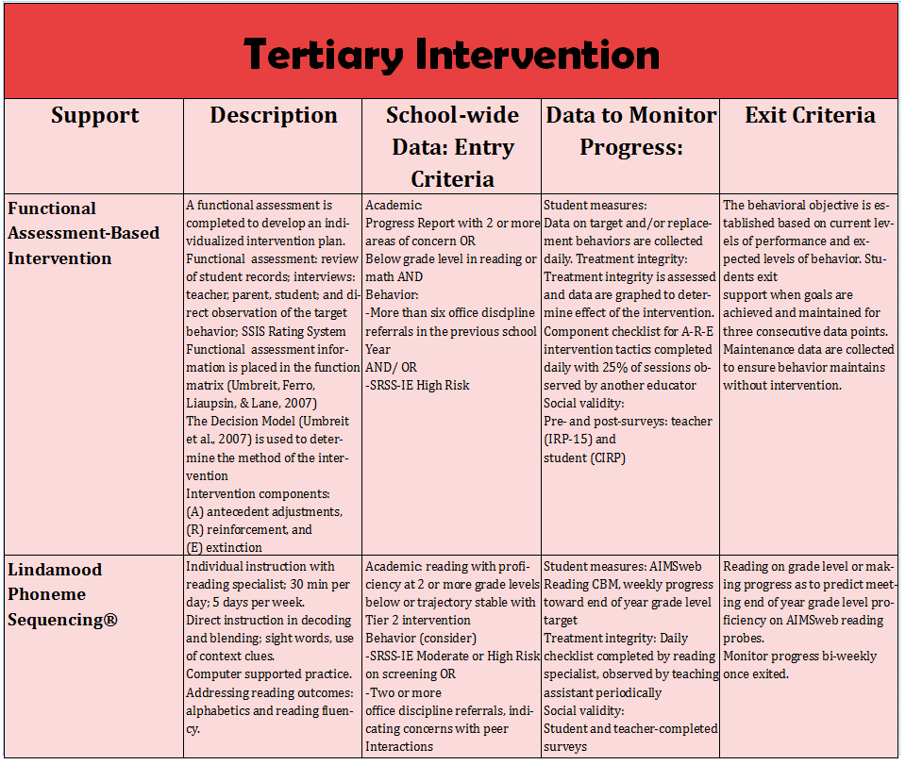
Tertiary (Tier 3) Intervention Grid
Notes:
In addition to the module featured here outlining how to use multiple sources of data to connect students with Tier 3 supports, we offer a full suite of modules highlighting validated Tier 3 interventions such as Functional Assessment-Based Intervention (FABI) that may appear in your Tertiary (Tier 3) Intervention Grid

Slide 29
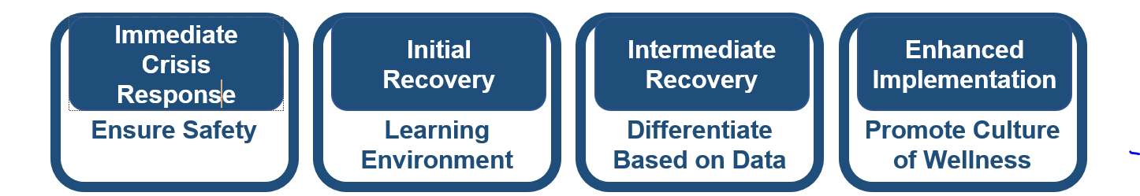
When a crisis occurs ….
Review screening data – if available – to determine which students might be particularly vulnerable
  In the pandemic …
  Following tragic events ..
Move forward with conducting triage activities
Fall
Winter
Spring
Notes:
Review screening data – if available – to determine which students might be particularly vulnerable
In the pandemic …
Following tragic events ..
Move forward with conducting triage activities

Slide 30

Triage and Recovery
Phase Efforts
Tona McGuire

Slide 31
Integrating Psychological Triage into School Screening
Tona McGuire, Ph.D.
PBIS Leadership Conference Oct 2025

Slide 32

Problem (3): Even Pre-COVID There Were Not Enough Mental Health Providers to Address Youth Needs
Even at “Baseline” There Are Not Enough Mental Health Providers to Address Youth Needs
Disproportionate impact on children and youth of color and lower SES
Lack of access due to location or time required to engage in in-person services
Cost of care and limitation of care in both state and private insurance creates barriers

Slide 33

Youth Enter Mental Health Care Via “Touchpoints” and Systems of Care:
Schools are Primary to This With Broader Capacity to Observe and Identify At-Risk Youth
Schools
Primary Care
Hospital Emergency Rooms due to Crisis

Slide 34
GOALS: BH support at higher acuity levels and for more people (MH surge), screening & assessment
ISSUES: Grief, Loss, Hopelessness, Depression, Suicide, Exhaustion, Disaster cascade effects (economics & limits of assistance).
FOCUS: Tiered support, Referral sources, Plan for long-term recovery
GOALS: Adjustment, Reconnection, Purpose, Hope
ISSUES: Grief, Loss, Disaster cascade effects, Exhaustion, “new” focus
FOCUS: Community Connections and Collaboration. Training, Lessons Learned / Readiness
GOALS: Adjust to safety and primary needs, Triage, Initial impact assessment
ISSUES: Shock, Fear, Panic, Uncertainty, Direct loss and exposures
FOCUS: Triage, Psychological First Aid, Safety, Assessment of ongoing or potential threat
GOALS: Establish BH supports & strategies; use energy and attention to prepare for challenges.
ISSUES: Denial of impact, Unrealistic perception of recovery, high bonding & external support
FOCUS: Planning, Training, Prep for Surge, Communicate typical reactions / Reassure
Stage 1:
Impact / Rescue
(hours to weeks post-impact)
Stage 2:
Heroic / Cohesion
(weeks to months post-impact)
Stage 3:
Adversity / Surge
( months post-impact)
Stage 4:
Rebuilding / Resilience
(months to years post-impact)

Slide 35
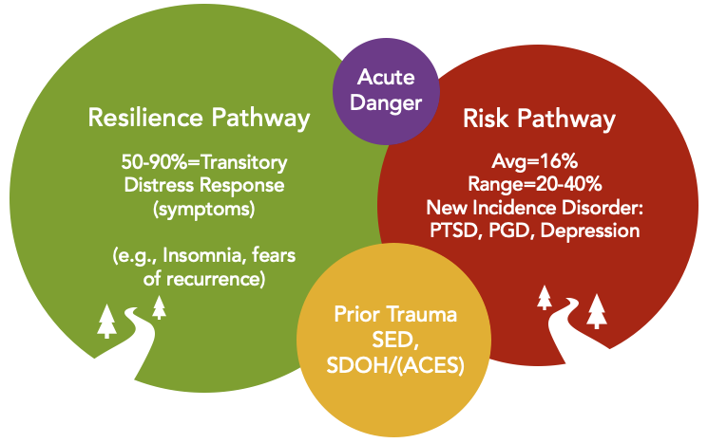
Risk and Resilience Post-Event
SDOH = Social Determinants of Health
SED = Serious Emotional Disturbance
ACES = Adverse Childhood Experiences
PTSD = Post Traumatic Stress Disorder
PGD = Prolonged Grief Disorder

Slide 36

Normative and Non-Clinical Reactions
Worries and fears (increase or new)
Sadness
Anger or irritability
Separation anxiety (particularly in the young)
Sleep disturbances & nightmares
Loss of interest in normal activities
Reduced concentration
Decline in school performance
Somatic complaints
Developmental changes or regressions
All of these can also be present or at increased risk for Children and Youth with Special Healthcare Needs/ and Children with Neurodevelopmental and Cognitive conditions who experience disruption to routine (e.g., care, social, sensory).

Slide 37
Post-Traumatic Stress Disorder
~20-40% with new incidence disorder(s) (e.g., PTSD) after disaster or other traumatic event
Once established, PTSD is frequently:
More complex
Interferes with school success and development
Takes longer to treat
An integrated - triage, screening, and intervention care model are important to reduce disaster/crisis event-related mental health risk
“One size does not fit all”

Slide 38
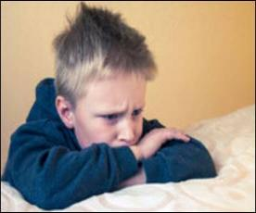
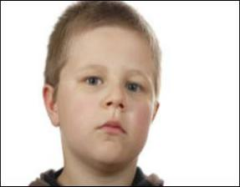
How do you practically predict PTSD at the time of disasters and everyday traumatic events in touchpoints?
Acute Stress Symptoms(<40 day are NOT predictive of clinical PTSD or depression)
Rapid Triage of Experience vs. Distress Symptoms
© Copyright 2021 Merritt Schreiber, PhD. All right reserved

Slide 39
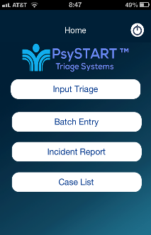
Matching Intervention to Level of Risk
Goal:
Promote the right amount of support to the right children
Emergency
Care - Safety A
TF-CBT
TF- CBT Acute
Disaster Crisis
Intervention”
Digital/Internet (IBI) Secondary Screening
HST (Health Support Team)
Intervention Intensity
Risk---------------Resilience
“Listen, Protect and Connect”
Neighbor to Neighbor
(Psychological First Aid)
(c)copyright M Schreiber, 2023
© copyright m Schreiber, all rights reserved 2023
Notes:
The model is that we tie the level of intervention related to the level of risk. One size does not fit all

Slide 40
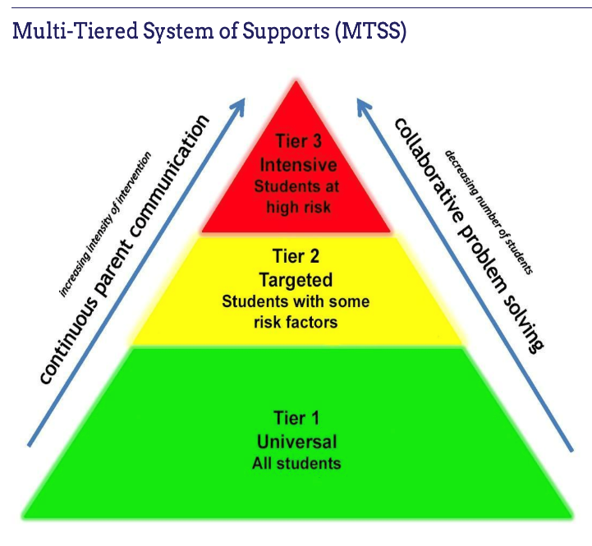

Slide 41
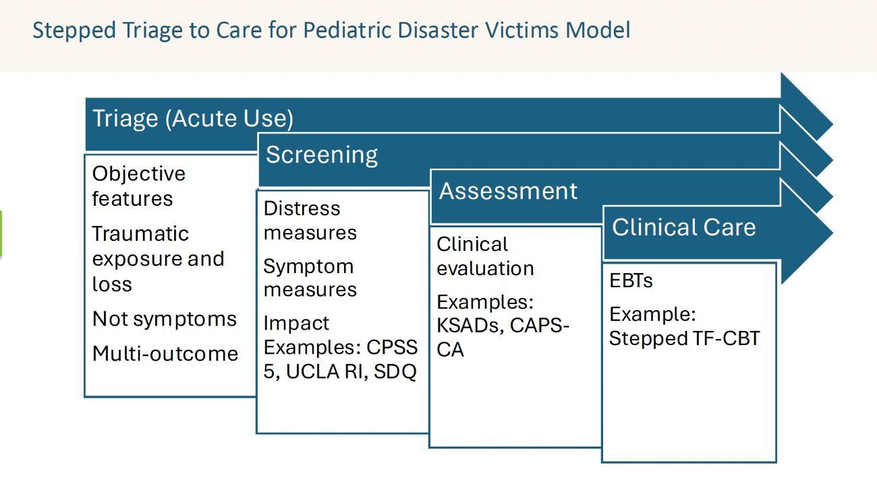
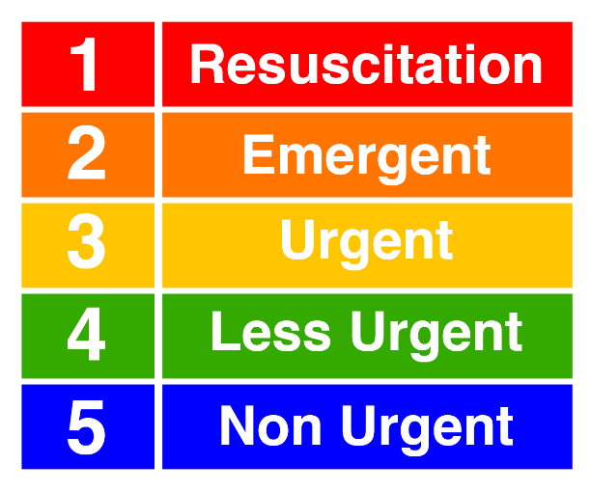
Bottom Line
Following any disaster or other high impact event, mental health needs will vastly exceed the mental health resources. How do we rationally and equitably provide the right amount of resources to the right child?

Slide 42
Triage vs Screening
TRIAGE
Done during acute event in emergency settings
Used to ethically & rationally allocate limited resources to children at high risk for a new mental health disorder
Does not rely on transitory distress symptoms
Does not rely on patient interview
Requires minimal training
Does not require administration by a mental health provider
Same tool can be used in multi-frontline settings (ED, schools, MH, shelters)
SCREENING
Relies on symptoms of a defined disorder
Does not help with prioritization
Requires longer training
Typically requires interview or self report by the child
When used acutely may confound transitory distress with a disorder
May over identify risk
Avoidant/numb children likely will not report symptoms and may appear not to require care when they do

Slide 43
Psychological Simple Triage and Rapid Treatment (PsySTART)©
Takes 2 minutes or less to complete
Is not based on symptoms of distress, but on direct trauma exposures and losses
Evidence–based reliably predicts risk of PTSD and co-occurring conditions such as depression
Can identify those children at highest risk, allowing for equitable prioritization of scarce mental health resources
Provides decision support to providers
Has demonstrated feasibility in disasters, community violence events, pediatric trauma activations
Can be used in paper form or electronic

Slide 44
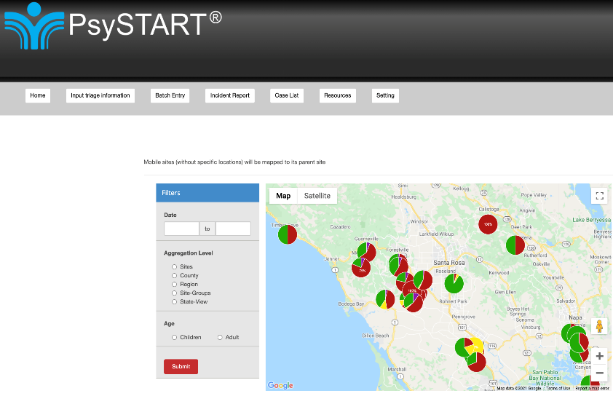
De-identified and Aggregated Data can provide situational awareness in large events

Slide 45
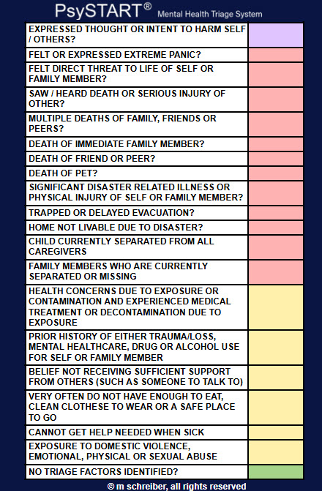
In the immediate Impact of a Crisis Event or Disaster
Start Here
Identify trauma exposure and traumatic loss
Notes:
This is page one of two of the PsySTART PDF option (if you are wanting to create a paper copy for the chart, internal HICS follow-up,
Consultation request or other purposes)
Page one is designed to print in color and is the easiest and fastest to use.
Page 2 provides the same information in a black and version with additional room for comments by mental health, social services or
Spiritual care team members.

Slide 46
What Happens After Positive Triage?

Slide 47

For An Individual Child
Using a “floating” algorithm, children who have 2 or 3 PsySTART Triage risk factors are referred for additional screening by a MH provider either within the triaging organization or by a community provider
If outside resources are available, children demonstrating high risk for potential PTSD would be referred to local community resources for outpatient care, preferably an evidence-based intervention such as TF-CBT

Slide 48
Increasing Access when Mental Health Resources are Insufficient
Stepped Triage to Trauma-Focused Cognitive Behavioral
Positive PsySTART cases assigned to Stepped TF-CBT
Tele-Behavioral Health, in person, or hybrid
”stepped model” increases individual provider efficiency by 60+%, allowing more children to be served

Slide 49
How Does Stepped Triage to Care Work?
Figure 1: Stepped Care Model

Slide 50
Thank you!
Questions? tlmcg01@gmail.com
For more information on PsySTART, please reach out to Dr. Merritt Schreiber m.schreiber@ucla.edu

Slide 51



Universal Social, Emotional, Behavioral, and Mental Health Screening in Washington State
Kelcey Schmitz, MSEd, Project Director
UW Haring Center, College of Education & UW SMART Center, School of Medicine
kelcey1@uw.edu
Special Acknowledgement:
Rayann Silva, Mari Meador, Larissa Gaias, Casey Edhe, Bethlehem Kebede

Slide 52

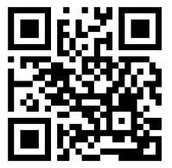


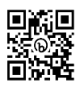
uwsmart@uw.edu
https://smartcenter.uw.edu/
@SMARTCtr
facebook.com/UWSMARTcenter
linkedin.com/company/uw-smart-center
https://www.youtube.com/@OfficialUWSMARTCenter
subscribe: https://bit.ly/3TVauRI
https://haringcenter.org/
Inclusionary Practices Resources​
https://ippdemosites.org/resources-artifacts/
CONNECT WITH US
VIA OUR WEBSITE, EMAIL OR SOCIAL

Slide 53
Social, Emotional, Behavioral, and Mental Health SCREENING in Washington State
The office of the superintendent of public instruction's school safety center, established in RCW 28A.300.630, shall develop a model school district plan for recognition, initial screening, and response to emotional or behavioral distress in students, including but not limited to indicators of possible substance abuse, violence, and youth suicide.
The model plan must incorporate research-based best practices, including practices and protocols used in schools and school districts in other states.
The model plan must be posted by February 1, 2014, on the school safety center website, along with relevant resources and information to support school districts in developing and implementing the plan required under RCW 28A.320.127.
Authorizing State
Legislation for recognition,
screening and response to
emotional or behavioral
distress
State Legislation for
Model District Plan
RCW 28A.320.1271
2014
2014
Notes:
28

Slide 54
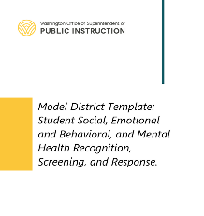
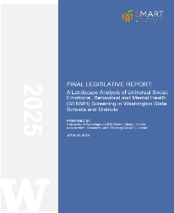
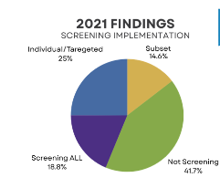


Authorizing State
Legislation for recognition,
screening and response to
emotional or behavioral
distress
(RCW 28A.320.127)
State Legislation for
Model District Plan
RCW 28A.320.1271
K-12 Behavioral Health Audit & Findings and Recs for SEBMH Screening
OSPI Model District Template for Installing Universal SEBMH
Screening
WA Legislative Landscape Analysis of Universal Screening
2014
2014
2021
2022
2025
Notes:
McCarthy, P., Frank, S., Cortines, C., Fleming, T., Cato, C., Clark, B., Patino, N., Cooper, K. (2021). K-12 Student Behavioral Health in Washington: Opportunities to improve access to needed supports and services. Office of the Washington State Auditor.

Slide 55

LANDSCAPE ANALYSIS
2024-2025
AIM 5
An implementation plan for SEBMH screening demonstration sites
to determine the feasibility, acceptability, and effectiveness of
a best practices guide
or resource on universal student SEBMH screening
in Washington.
AIM 4
Recommendations on statutory changes to increase implementation and effectiveness of systematic SEBMH screening of students in schools.
AIM 3
Analysis of schools' current application of existing Washington statute relevant to SEBMH screening requirements.
AIM 2
Identification of facilitators and barriers to selection and effective use of research-based, culturally relevant universal SEBMH screening tools in Washington schools.
AIM 1
Analysis of alignment of current Washington statutes and guidance with national best practices on universal SEBMH screening.

Slide 56
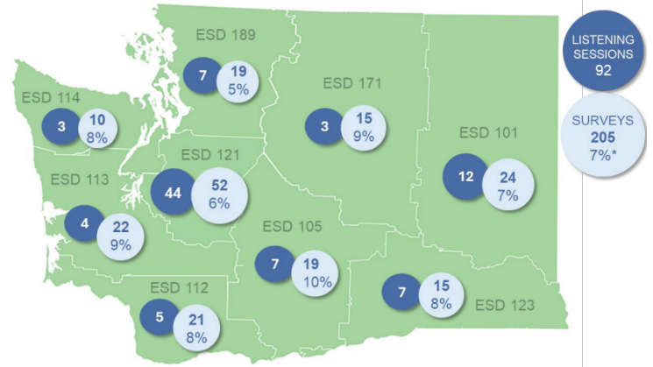
Methods & Participants
Literature Review
Policy
and State Guidance Document Review
District & School Leader Online Survey Responses
(N=205)
Listening Session Participants (N=92)
Notes:
This report presents results and a preliminary summary of findings from four data sources: (1) literature review, (2) policy and state guidance document review, (3) online surveys of 205 key education partners in WA, and (4) 16 listening sessions with 92 participants.

Slide 57

Screening Measures and Considerations
Logistics and Implementation
Assuring
Adequate and Equitable Availability
of Services
Literature Review:
~100 publications (journal articles & reports) reviewed to identify “best practices” aligned with 11 themes
Best practices crosswalked with policy & statewide guidance documents
Informing Tier 1 Universal Strategies and Practices
Assuring Equity
and Cultural Responsiveness in Screening Practices
Supporting Students with Disabilities
Engaging with Families, Students, and Other Partners
Partnering with Community Based Organizations
Complying
with Privacy and Confidentiality Laws
Social Determinants of Health
Training
and Professional Development

Slide 58

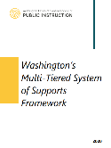
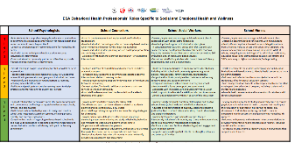
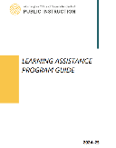

WASHINGTON STATE EDUCATION DOCUMENTS REVIEWED
7 Guidance documents, program guides, & frameworks | ESA Behavioral Health Providers' Roles Specific to Social and Emotional Wellness | Washington MTSS Framework | Learning Assistance Program Guide
Model District Template: Student Social, Emotional, Behavioral, and Mental Health Recognition, Screening, and Response | Child Find Public Awareness Requirements (IDEA) | A Guide to Assessment in Early Childhood | Washington Integrated Student Support Protocol

Slide 59
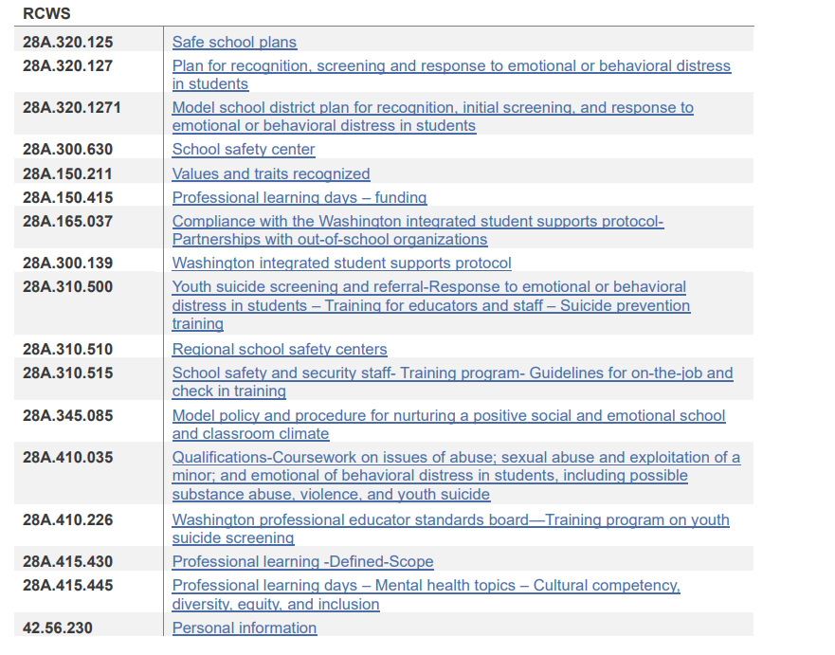
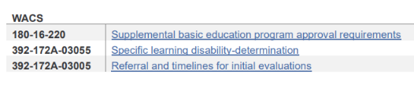
21 Unique Laws & Codes Relevant to Universal Screening Reviewed

Slide 60

1
Substantial support for universal SEBMH screening
FINDINGS
2
Lack of clear definition and shared understanding
3
Inconsistent implementation
4
Structural barriers

Slide 61
Substantial Support for Screening
“Anything that can be brought forward that puts us in a proactive mode versus a reactive mode for the health and well-being of our students and our children and our families is a plus”
-Family Listening Session Participant
“I think when it’s feasible and we’re able to utilize universal screening tools, there can be huge impacts on equity and access”
-District Administrators Listening Session Participant
“It is incredibly valuable to screen as many students as we possibly can. We are a small district, and know our students very well, so often the screening tool matches with what we know/see. However, there are times it does not and by having the screening data available when we meet with students, we are able to have deeper conversations with some students who were not sure who to go to or how to share what has been on their minds. Very effective tool.”
-District Leader Survey Respondent

Slide 62
Lack of clear definition and shared understanding
21 unique laws and codes relevant to universal screening in schools - none included all elements of best practice.
- RCW 28A.300.139 Washington Integrated Student Support Protocol - majority referenced
7 relevant Washington guidance documents, program guides, and frameworks found limited coverage of universal screening best practices
No consistent definition of screening across policy or guidance documents
Contributed to a lot of misunderstanding in listening sessions and surveys about what screening is and how to implement
“My AHA moment as we're having this discussion is: I think we all have different definitions of universal screening, even from the one stated.”
Listening Session Participant

Slide 63
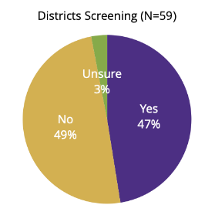
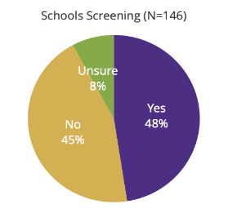
Inconsistent implementation
About half of schools and districts reported conducting screening
Amongst those screening, high variation in:
  What tools are being used (and whether a validated tool designed for screening is being used)
  How often screening is occurring
  What training is provided for school staff regarding screening processes
  What information is communicated to students, parents, and other community members
  Who is reviewing screening data and how frequently
  How decisions are being made to link students to follow-up supports

Slide 64
Structural Barriers
Top Challenges Identified by Districts
Lack of internal (school) resources to refer students requiring follow up
Lack of external (community) resources to refer students requiring follow- up
Cost to conduct screening
Survey/assessment fatigue
Lack of knowing about how to implement (e.g., which tools to use, resources needed, etc,)
“I would state that most of our district agrees with this work and knows the value and importance of it. There are two areas we need support from our state. We need money and we need implementation support. The disagreements often come with the who, when, and where… not the why.”
District Leader Survey Respondent

Slide 65
recommendations
Develop a clear definition of universal SEBMH screening
Update state laws and policies to reflect current realities, needs, and best practices for universal SEBMH screening
Develop statewide guidance, standards, and procedures
Strengthen alignment, integration, and coordination of agencies, partners, initiatives, and frameworks relevant to developing, resourcing, and implementing a comprehensive, accessible, and equitable K-12 mental health system
Provide implementation funding and resources
Enhance family and student and engagement
Provide comprehensive implementation supports
Ensure screening processes and policies counteract inequities
Establish indicators of success for conducting evaluation, monitoring, and data-informed continuous quality improvement
School Mental Health Assessment, Research, and Training (SMART) Center. (2025). A Landscape Analysis of Universal Social, Emotional, Behavioral and Mental Health (SEBMH) Screening in Washington State Schools and Districts Final Report [Report to WA State Legislature as directed by ESSB 5950 (2023-24)]. University of Washington.

Slide 66

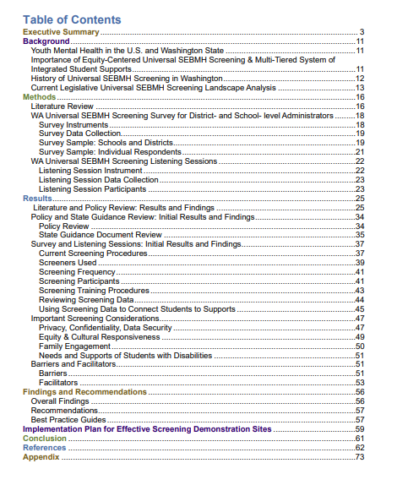
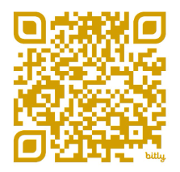

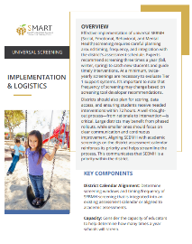
Learning about Universal Mental Health Screening Implementation in Washington
5 Best Practice Guides included
LINK TO REPORT

Slide 67







Download the Best Practices Guide Here

Slide 68


Scaling Up Universal Screening: Training and Technical Assistance
Donor-funded Regional Capacity Building
  Prevent, Detect, Connect: Initial Cohort includes 3 Regional Educational Service Districts (ESDs) & 10 districts
Federal and State Inclusionary Practices Funding
  Inclusionary and Integrated Mental Health Education and Supports through the Washington Office of Superintendent of Public Instruction (OSPI) Inclusionary Practices Technical Assistance Network (IPTN)

Slide 69
Closing Out and Moving Forward

Slide 70
Comprehensive, Integrated, Three-Tiered Model of Prevention 3

Slide 71
When a crisis occurs ….
Review screening data – if available – to determine which students might be particularly vulnerable
  In the pandemic …
  Following tragic events ..
Move forward with conducting triage activities
Fall
Winter
Spring
Notes:
Review screening data – if available – to determine which students might be particularly vulnerable
In the pandemic …
Following tragic events ..
Move forward with conducting triage activities

Slide 72
What about Academics?
Immediate
Crisis Response
Initial
Recovery
Intermediate
Recovery
Enhanced Implementation
Ensure Safety
Stabilize Learning Environment
Differentiate
Based on Data
Promote Culture
of Wellness
Physical and emotional safety are the priority here
Reintroduce academic routines and procedures at an independent instructional level
Slowly increase academic content and challenge level
Monitor student response and either increase emotional supports or decrease academic rigor or rate as needed to maintain recovery progress
Use multiple types of data to identify groups of students needing more support
Provide a full continuum of integrated academic and emotional supports to address full range of student needs
Notes:
The balance between academic pressure and recovery time is sometimes a challenge in the return to school. Teachers can feel pressure to make up for lost time and try to catch up academically. It is important to remember the additional pressure everyone is under as they manage the increased emotions and symptoms following a traumatic event and to give space and time for this healing to happen. In the first few weeks back focus on re-establishing academic routines with independent level content. This reduces the cognitive load for students and can give them time to adjust to being back in the school without the added stress of new content. Monitor your students and over time slowly increase the academic content - if you notice your students reacting negatively consider either reducing academic pressure rigor or rate or adding additional emotional supports to maintain recovery progress.

Slide 73
Planning for Integrated Instruction

Slide 74


Enhancing Ci3T Modules
ci3t.org/enhance

Slide 75






Ci3T Website - modules

Slide 76


Resources for screening:
PBIS.org…

Slide 77


Tips for Communicating with Your Community about Systematic Screening

Slide 78


The Whys and Hows of Screening: Frequently Asked Questions for Families

Slide 79



Please Complete this Session’s Evaluation
10/22
1G – Screening, Triage, & Assessment: Data-informed Approaches to Meeting Students' Multiple Needs
Four options, pick one!
1. Mobile App
Click “Take Survey" under the session description.
2. QR Code Scan the code on this slide.
3. Online
Click on the link located next to the downloadable session materials posted online at:
www.pbis.org/conference-and-presentations/pbis-leadership-forum
4. Direct Link
Click the link provided in the email reminder you receive after your session ends.
SAMPLE
Evaluations are anonymous! We send reminder emails to all participants.
After you submit each session evaluation, click the link to enter the gift card raffle!

