Slide 1
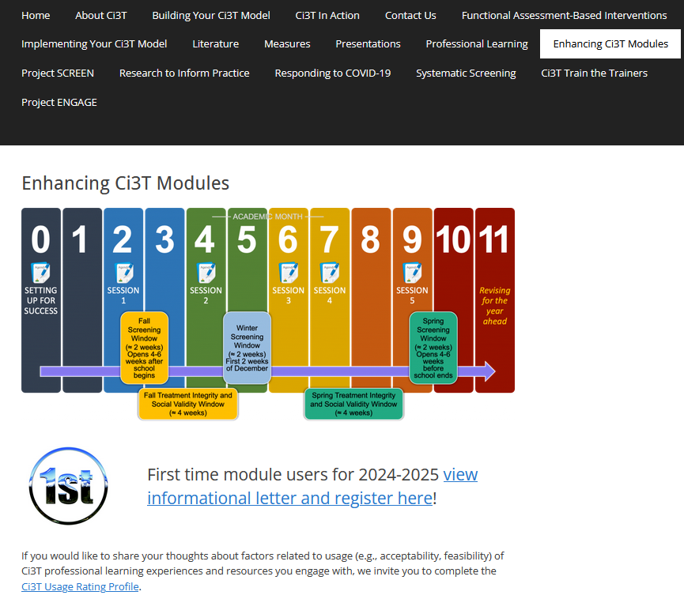
From Data to Action: Using Systematic Screening Data to Inform Instruction
EMPOWER+ Session 2
If you have not done so already, we invite you to visit ci3t.org/enhance to access modules after a one-time registration process!

Slide 2
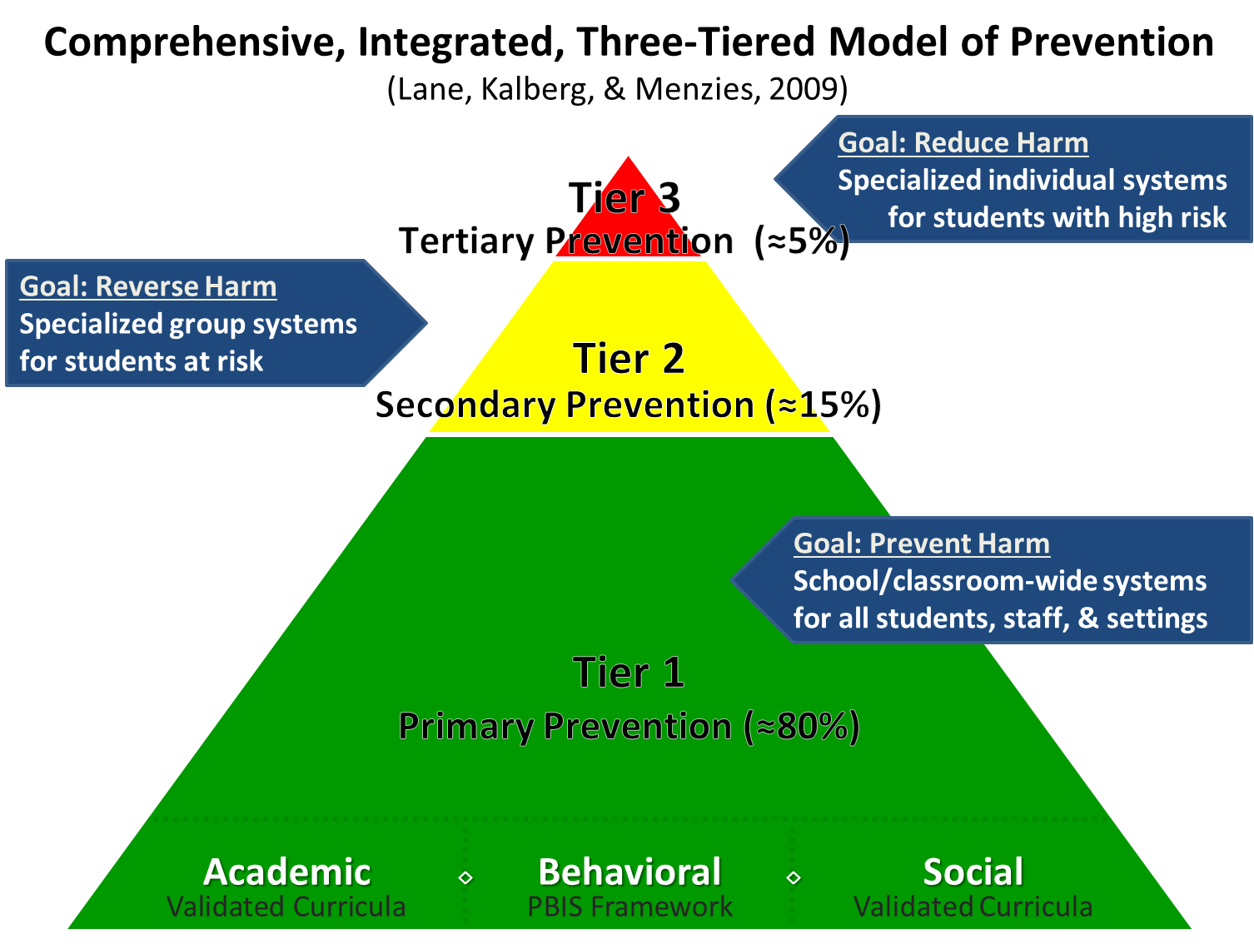
Comprehensive, Integrated, Three-Tiered Model of Prevention 1

Slide 3
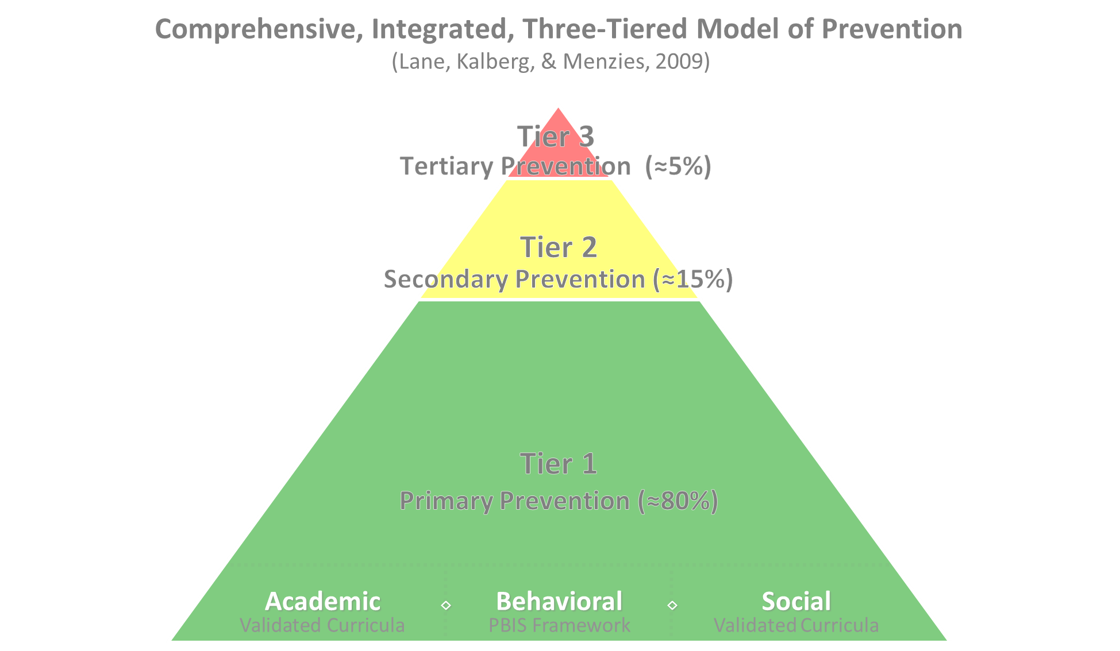

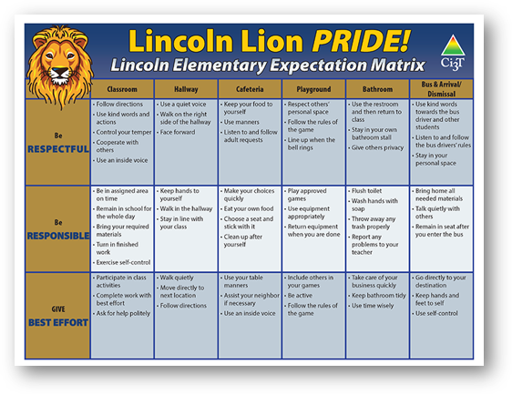
Comprehensive, Integrated, Three-Tiered Model of Prevention 2
Positive Behavioral Interventions and Supports
District & State Standards Quality Instruction
Validated Curricula and Resources

Slide 4


Primary Prevention (Tier 1)

Slide 5

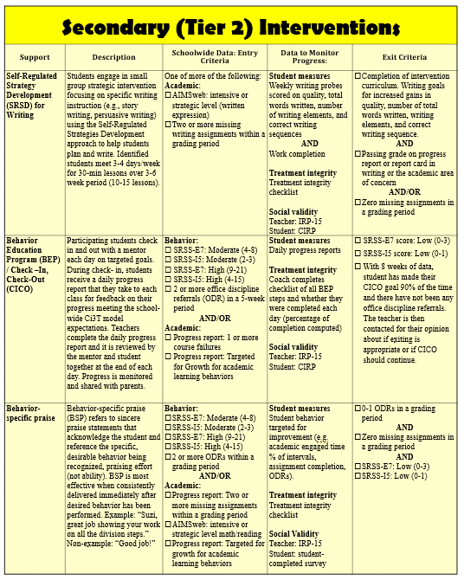
Secondary (Tier 2) Intervention Grid
Notes:
In addition to the module featured here outlining how to use multiple sources of data to connect students with Tier 2 supports, we offer a full suite of modules highlighting validated Tier 2 interventions such as Self-Regulated Strategy Development (SRSD) for Writing and Check-In/Check Out that may appear in your Secondary (Tier 2) Intervention Grid

Slide 6

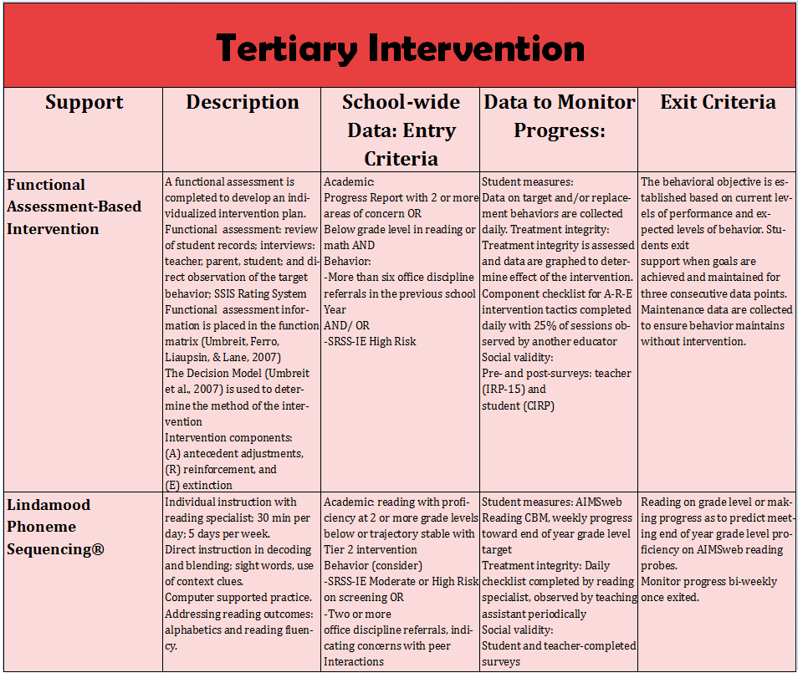
Tertiary (Tier 3) Intervention Grid
Notes:
In addition to the module featured here outlining how to use multiple sources of data to connect students with Tier 3 supports, we offer a full suite of modules highlighting validated Tier 3 interventions such as Functional Assessment-Based Intervention (FABI) that may appear in your Tertiary (Tier 3) Intervention Grid

Slide 7

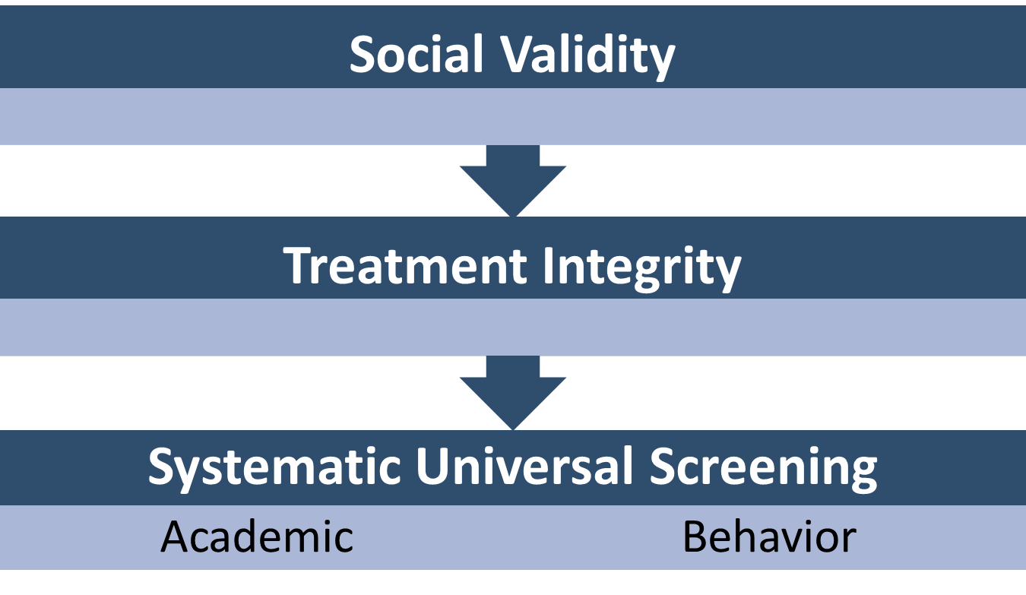
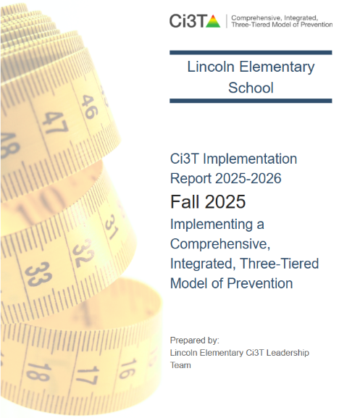
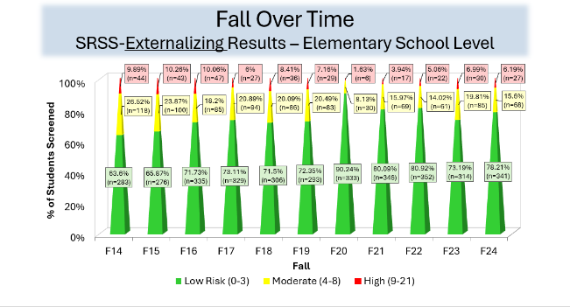
Essential Components of Primary (Tier 1) Prevention Efforts
Essential Components of Primary (Tier 1) Prevention Efforts 1

Slide 8


Enhancing Ci3T Modules
ci3t.org/enhance

Slide 9
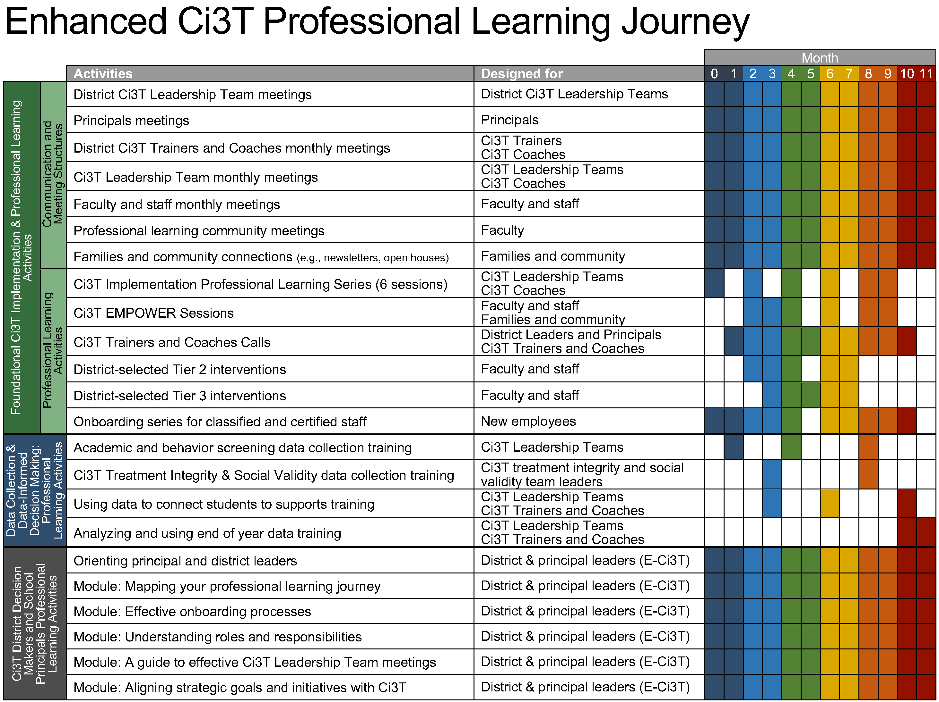
Enhanced Ci3T Implementation Series and Delivery

Slide 10
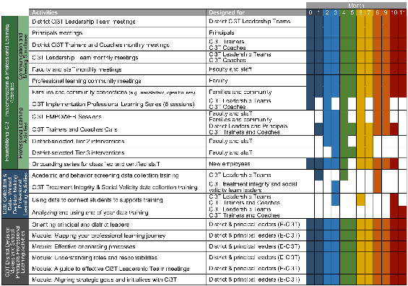
Session Outcomes
Explain the purpose and key features of systematic screening within Comprehensive, Integrated, Three-tiered (Ci3T) models of prevention.
Describe how to use systematic screening data to inform instruction at Tier 1, empower teachers use of low-intensity strategies, and connect students to validated Tier 2 and Tier 3 supports.
Explain the importance of monitoring treatment integrity, social validity, and student performance at each level of prevention.

Slide 11

TFI Version 3 Connection
TFI Item | Description
1.18 USING SCHOOL AND COMMUNITY DATA TO INFORM TIER 1 | Tier 1 leadership team has regular access to and uses a variety of additional schoolwide (e.g., school climate surveys, attendance, nurse or counselor visit logs, universal screening) and community data sources (e.g., community resource profiles, basic needs [e.g., food and housing], health care access, community events), to develop and regularly re-evaluate a profile of overall strengths and needs that informs the development and delivery of equitable Tier 1 foundational and classroom practices
1.10 CLASSROOM PRACTICE | Educators consistently and equitably implement positive and proactive classroom practices—including building relationships with students; developing a safe environment; prompting predictable routines and expected behavior; actively providing OTRs, active supervision, and specific feedback (i.e., specific praise and supportive corrections); and ensuring a high ratio (≥ 5:1) of positive to corrective feedback.

Slide 12
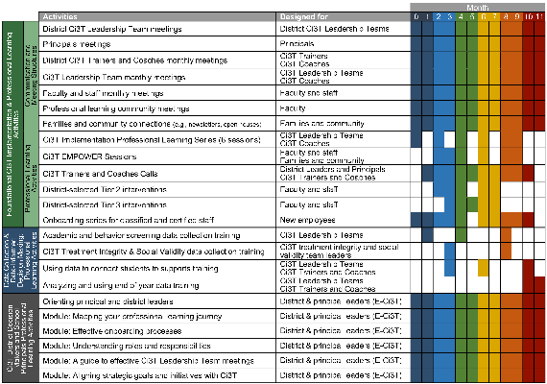
Agenda
Welcome
Situating Systematic Screening in Ci3T Models
Using Systematic Screening Data to:
Inform Instruction at Tier 1
Empower Teachers with Low-Intensity Strategies
Connect Students to Validated Tier 2 and Tier 3 Supports
Wrapping Up and Moving Forward

Slide 13
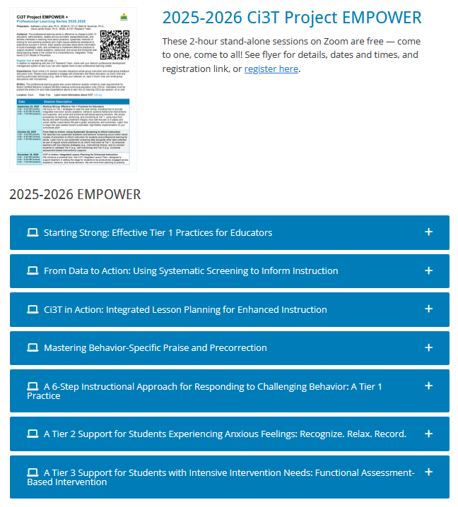
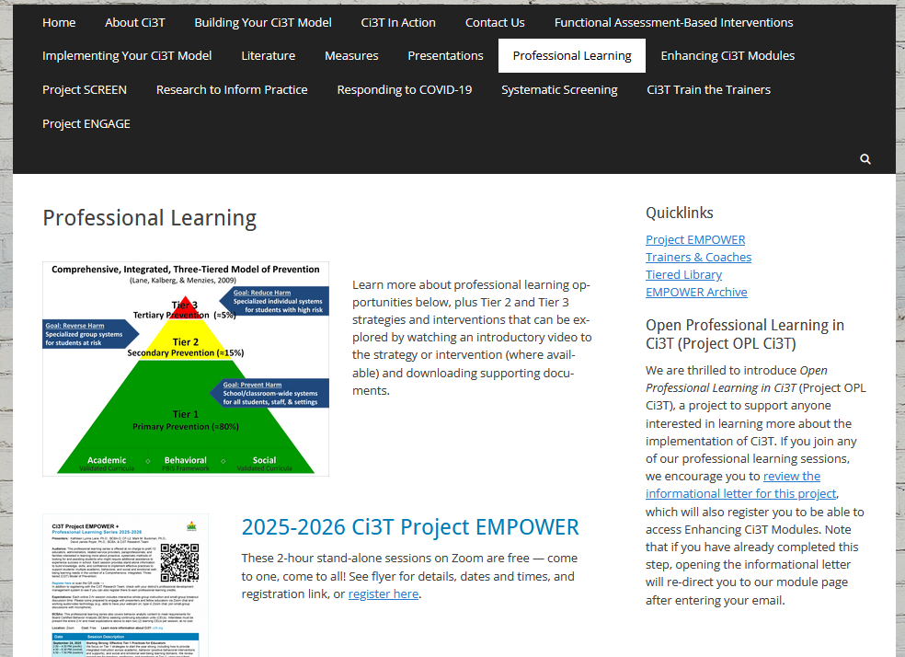
Accessing Professional Learning Materials
ci3t.org/pl

Slide 14
Situating Systematic Screening in Ci3T Models

Slide 15
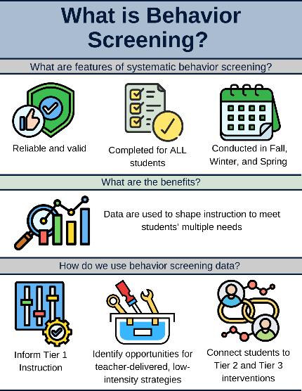
Essential Components of Primary (Tier 1) Prevention Efforts
Essential Components of Primary (Tier 1) Prevention Efforts 2

Slide 16
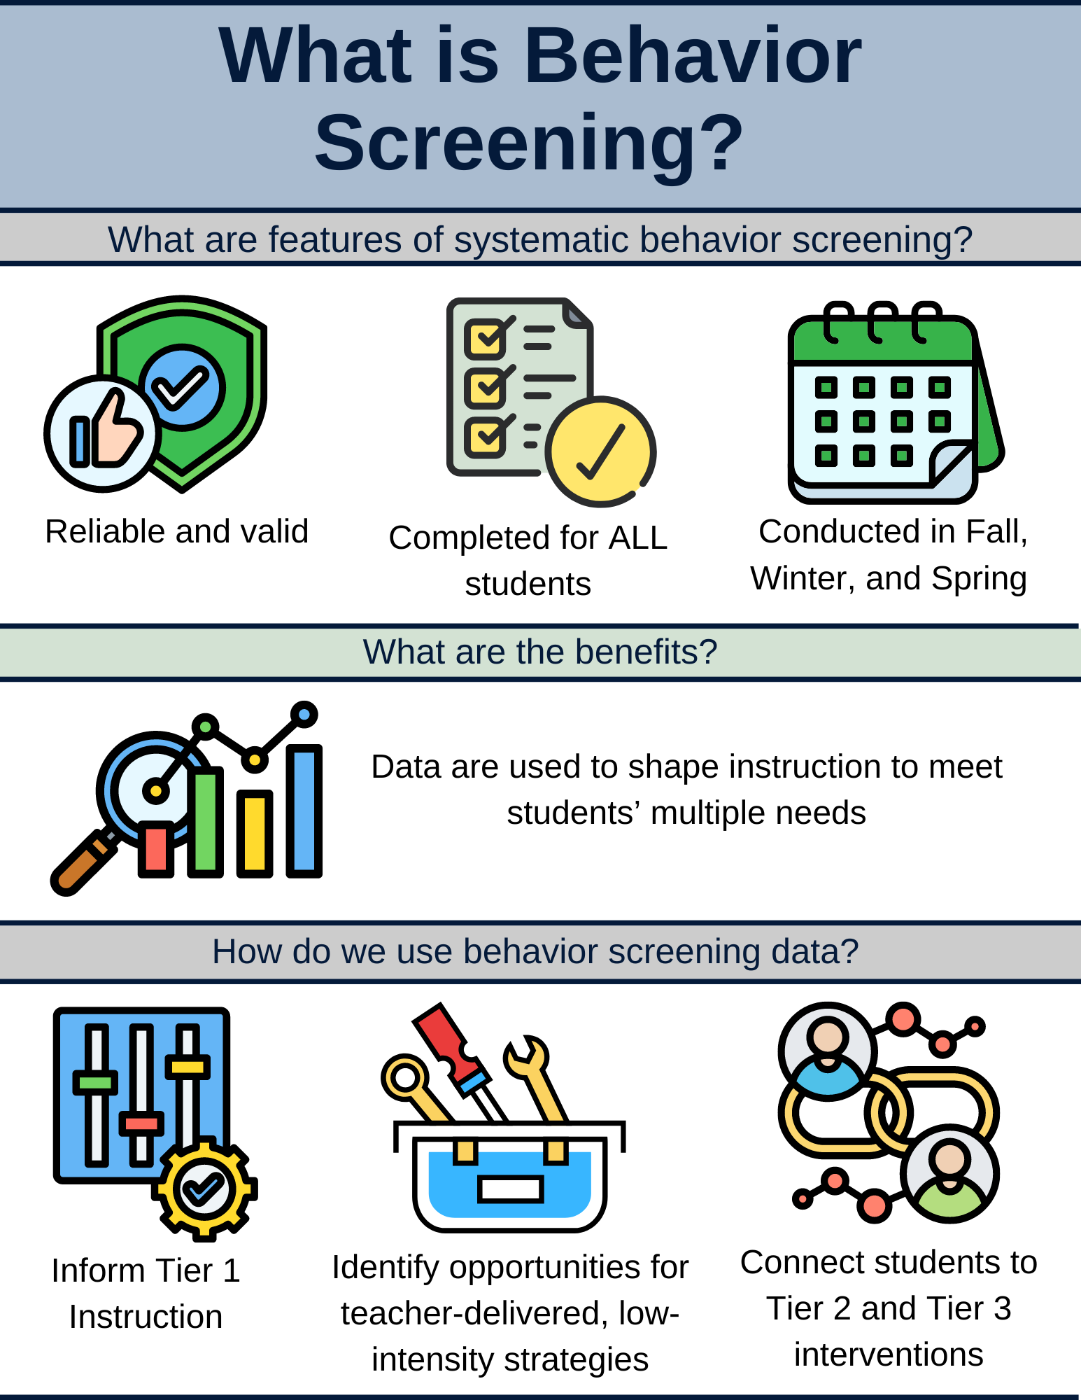
What is Behavior Screening? 1

Slide 17
What is Behavior Screening? 2

Slide 18
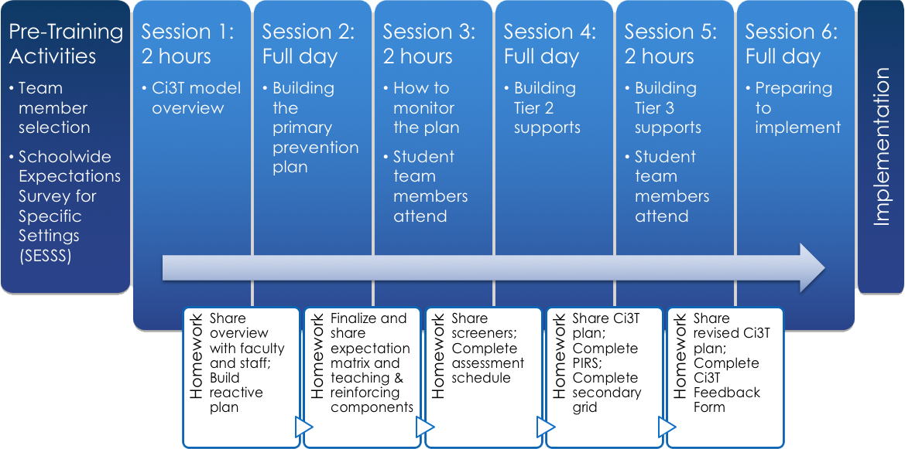
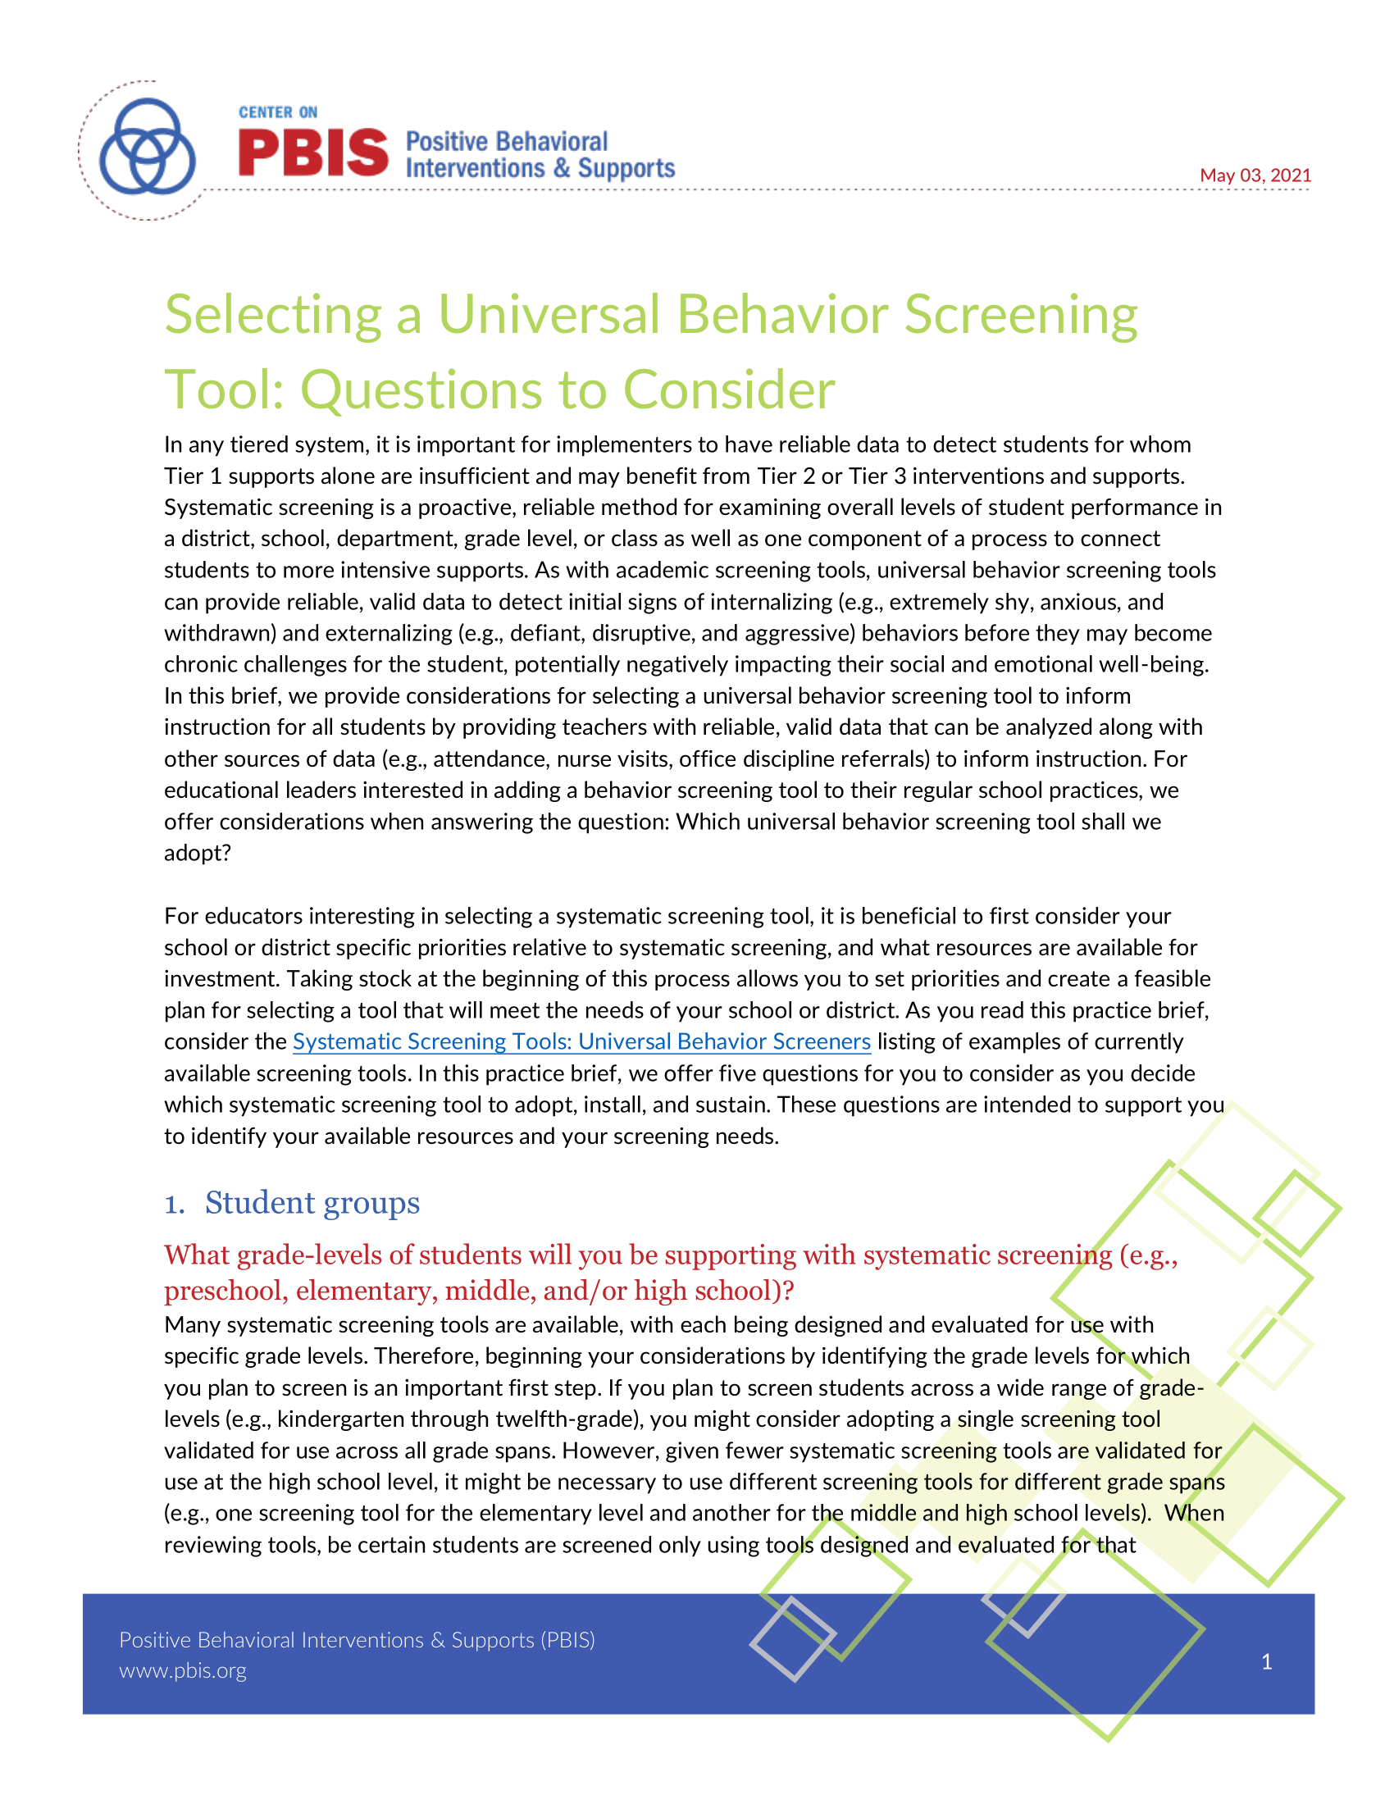
Selecting a Systematic Screener
Notes:
https://www.pbis.org/resource/selecting-a-universal-behavior-screening-tool-questions-to-consider

Slide 19

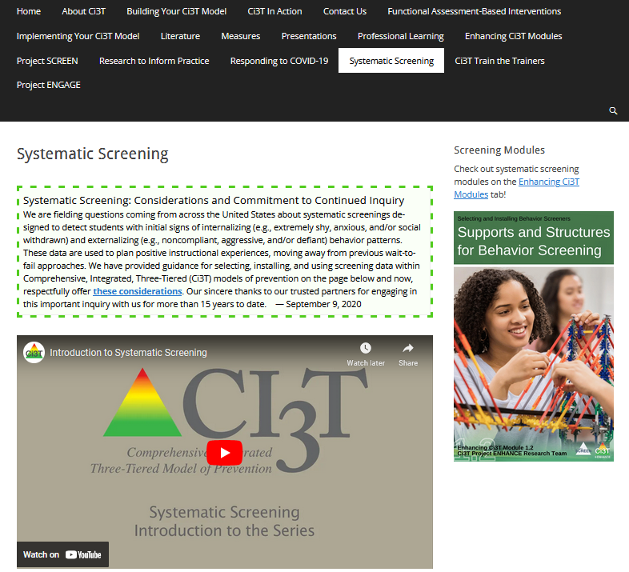
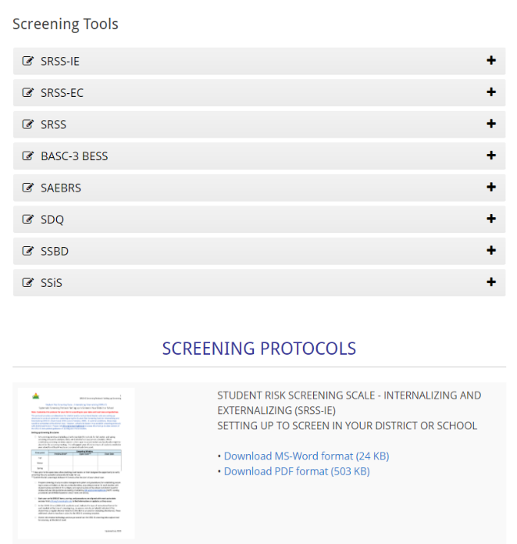
Finding the SRSS-IE on the Ci3T Website
https://www.ci3t.org/screening

Slide 20
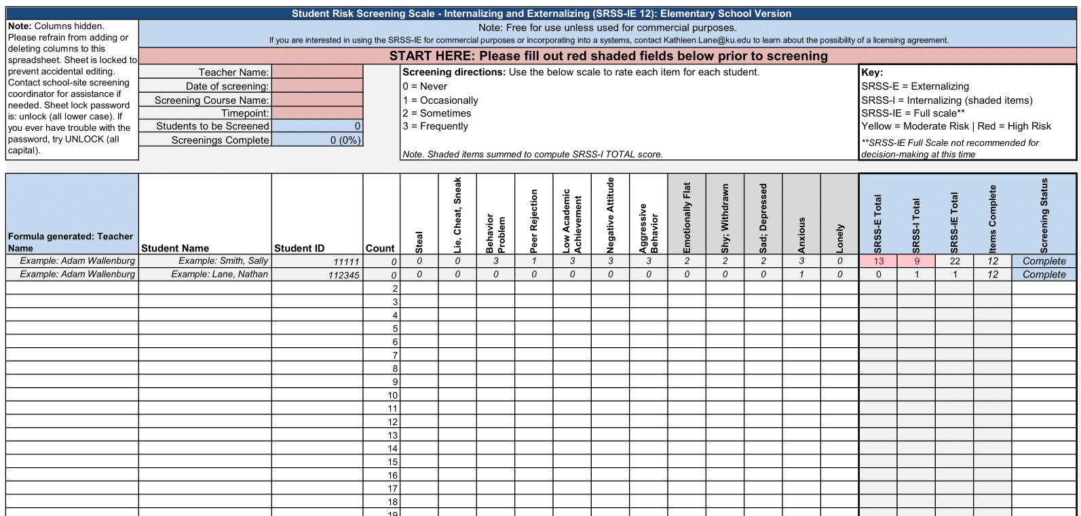
Student Risk Screening Scale – Internalizing and Externalizing (SRSS-IE; Drummond, 1994; Lane & Menzies, 2009) Elementary

Slide 21
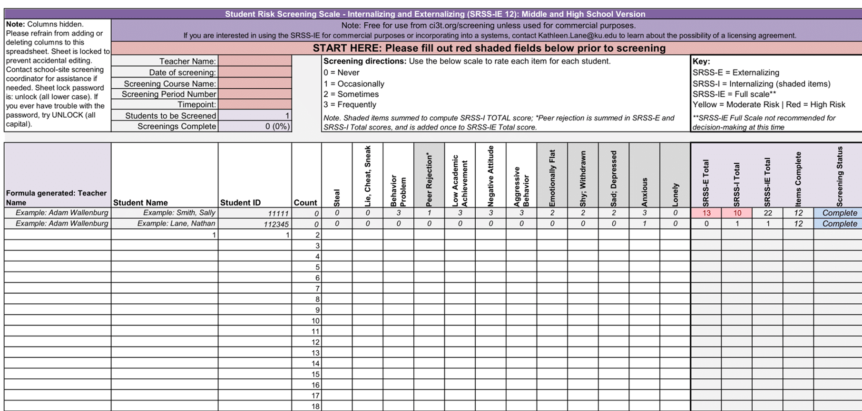
Student Risk Screening Scale – Internalizing and Externalizing (SRSS-IE; Drummond, 1994; Lane & Menzies, 2009) Secondary

Slide 22
SRSS-IE: Cut Scores
Elementary School
Middle and High School
SRSS-E7 | SRSS-I5
Items 1-7 | Items 8-12
0-3 = low risk 4-8 = moderate risk 9-21 = high risk | 0-1 = low risk 2-3 = moderate risk 4-15 = high risk
SRSS-E7 | SRSS-I6
Items 1-7 | Items 4, 8-12
0-3 = low risk 4-8 = moderate risk 9-21 = high risk | 0-3 = low risk 4-5 = moderate risk 6-18 = high risk
Elementary School Level:
Lane, K. L., Oakes, W. P., Swogger, E. D., Schatschneider, C., Menzies, H., M., & Sanchez, J. (2015). Student risk screening scale for internalizing and externalizing behaviors: Preliminary cut scores to support data-informed decision making. Behavioral Disorders, 40, 159-170.
Middle and High School Levels:
Lane, K. L., Oakes, W. P., Cantwell, E. D., Schatschneider, C., Menzies, H., Crittenden, M., & Messenger, M. (2016). Student Risk Screening Scale for Internalizing and Externalizing Behaviors: Preliminary cut scores to support data-informed decision making in middle and high schools. Behavioral Disorders, 42(1), 271-284

Slide 23
Fall Over Time SRSS-Externalizing Results – Elementary School Level
Notes:
Fill in <year> based on current academic year. This is located in column A of the data sheet. Edit by right clicking and selecting “Edit data”.

Slide 24
Fall Over Time SRSS-Internalizing Results – Elementary School Level
Notes:
Fill in <year> based on current academic year. This is located in column A of the data sheet. Edit by right clicking and selecting “Edit data”.

Slide 25
Fall 2024 SRSS-Internalizing Results – Elementary School Grade Level
Grade Level | N Screened | Low n (%) | Moderate n (%) | High n (%)
K | 46 | 26 (56.52) | 9 (19.57) | 11 (23.91)
1 | 60 | 41 (68.33) | 9 (15.00) | 10 (16.67)
2 | 85 | 66 (77.65) | 15 (17.65) | 4 (4.71)
Notes:
Fill in <year> based on current academic year. This is located in column A of the data sheet. Edit by right clicking and selecting “Edit data”.

Slide 26
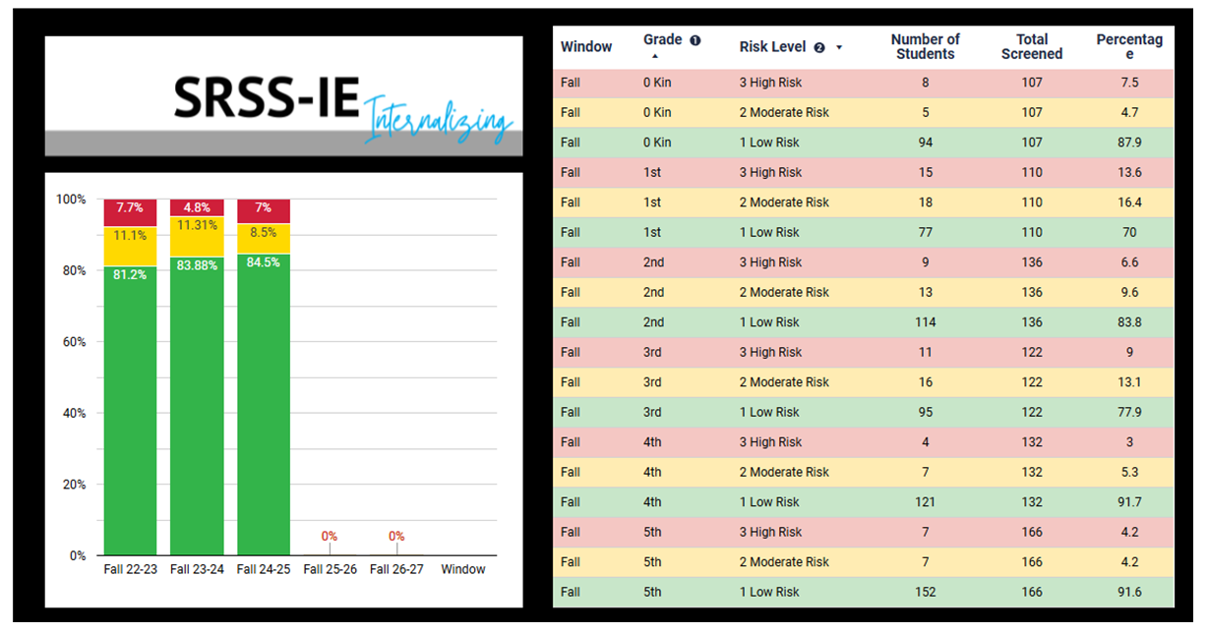
SRSS-IE Internalizing Summary

Slide 27

Academic Screening

Slide 28
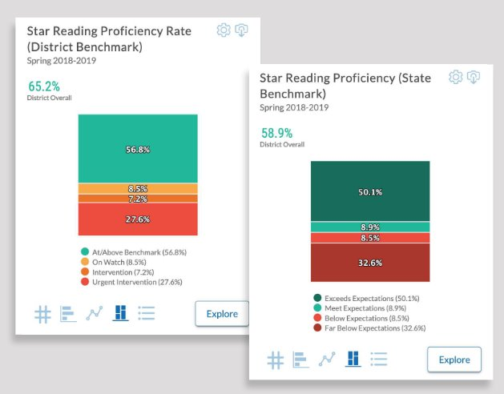
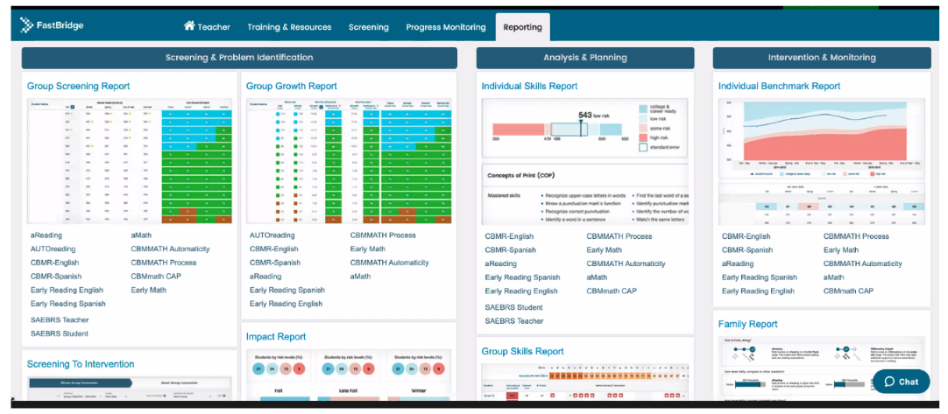
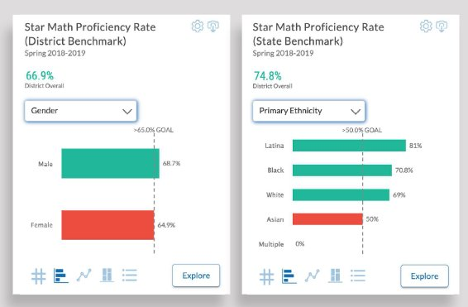

Academic Screening: Examples

Slide 29
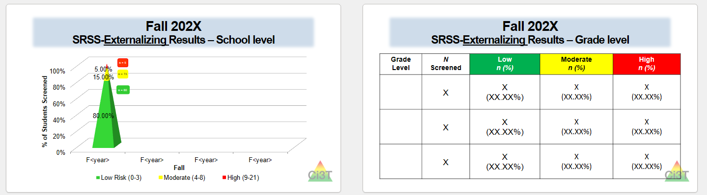
Sharing Systematic Screening Data
Once academic and behavior screening data are collected, data are shared at the:
Schoolwide level
Grade/department/class level
Individual student level

Slide 30
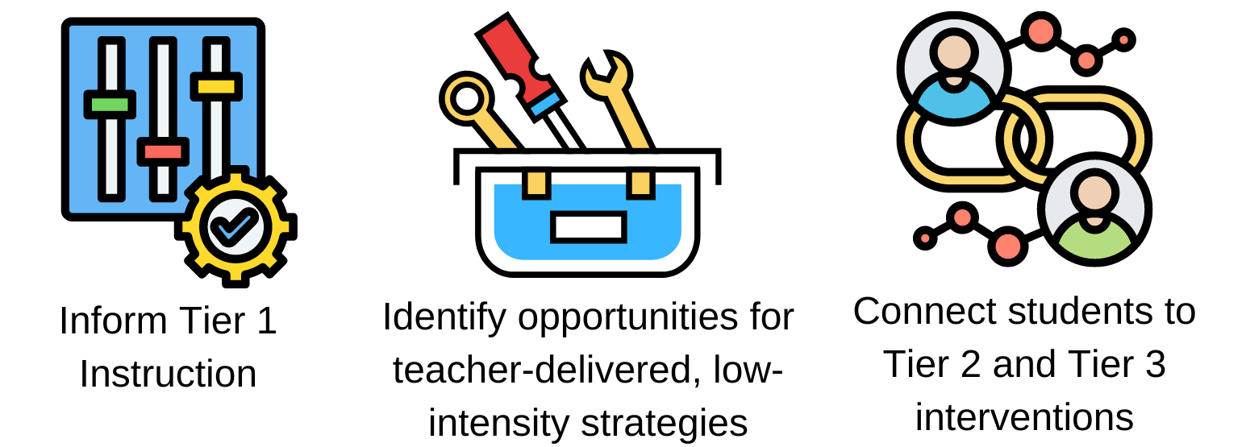
Using Systematic Screening Data
These academic and behavior screening data are then reviewed alongside other data collected as part of typical school practices (e.g., attendance, office discipline referrals, grades) to:

Slide 31



Systematic Screening Resources

Slide 32












Let’s Talk
What are some of the potential benefits of systematic screening?
What are some of the potential challenges of systematic screening?
What questions do you have about systematic screening?
Notes:
10-min timer

Slide 33
Using Systematic Screening Data to…
Inform Instruction at Tier 1
Empower Teachers with Low-Intensity Strategies
Connect Students to Validated Tier 2 and Tier 3 Supports

Slide 34
Inform Instruction at Tier 1

Slide 35
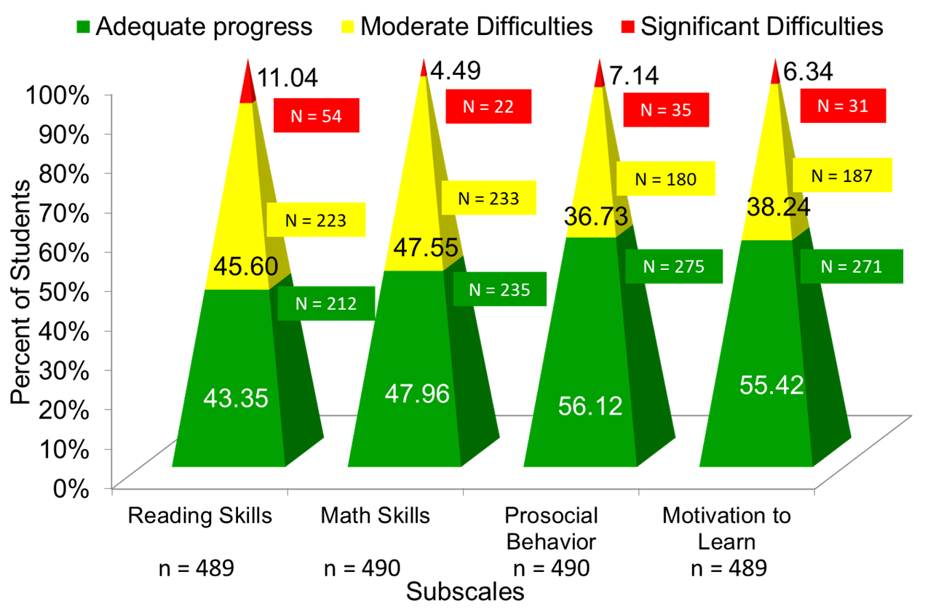
Data to Indicate a Focus on Tier 1: School Level
Social Skills Improvement System – Performance Screening Guide Spring 2012 – Total School
Lane, K. L., Oakes, W. P., & Magill, L. (2013). Primary prevention efforts: How do we implemented and monitor the Tier 1 component of our Comprehensive, Integrated, Three-Tiered (Ci3T) Model?, Preventing School Failure, 58(1), 143-158.

Slide 36
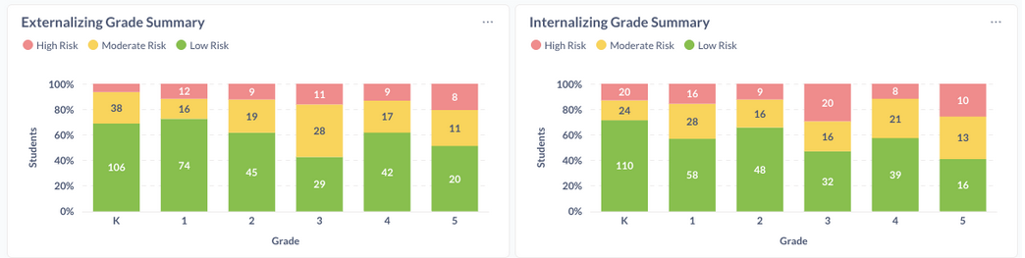
Data to Indicate a Focus on Tier 1: Breakdown by Grade-Level

Slide 37

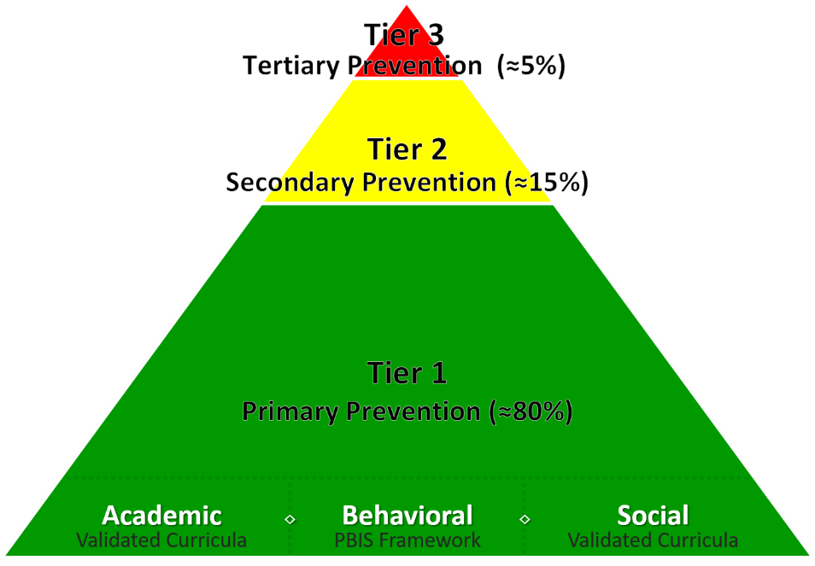
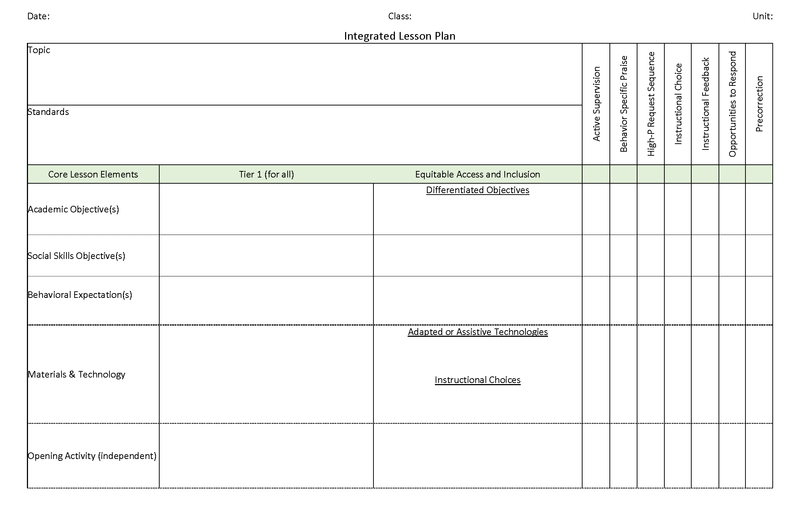
Ci3T Integrated Lesson Planning
Citation. Oakes, W. P., Lane, K. L., Lane, K. S., & Buckman, M. M. (2019). Ci3T integrated lessons plan template. www.ci3t.org.
Completed examples available in: Ci3T Project ENHANCE Research Team. (2022, July). Embedding and integrating Ci3T domains into daily instruction. Author. https://doi.org/10.17161/ci3t.42880

Slide 38
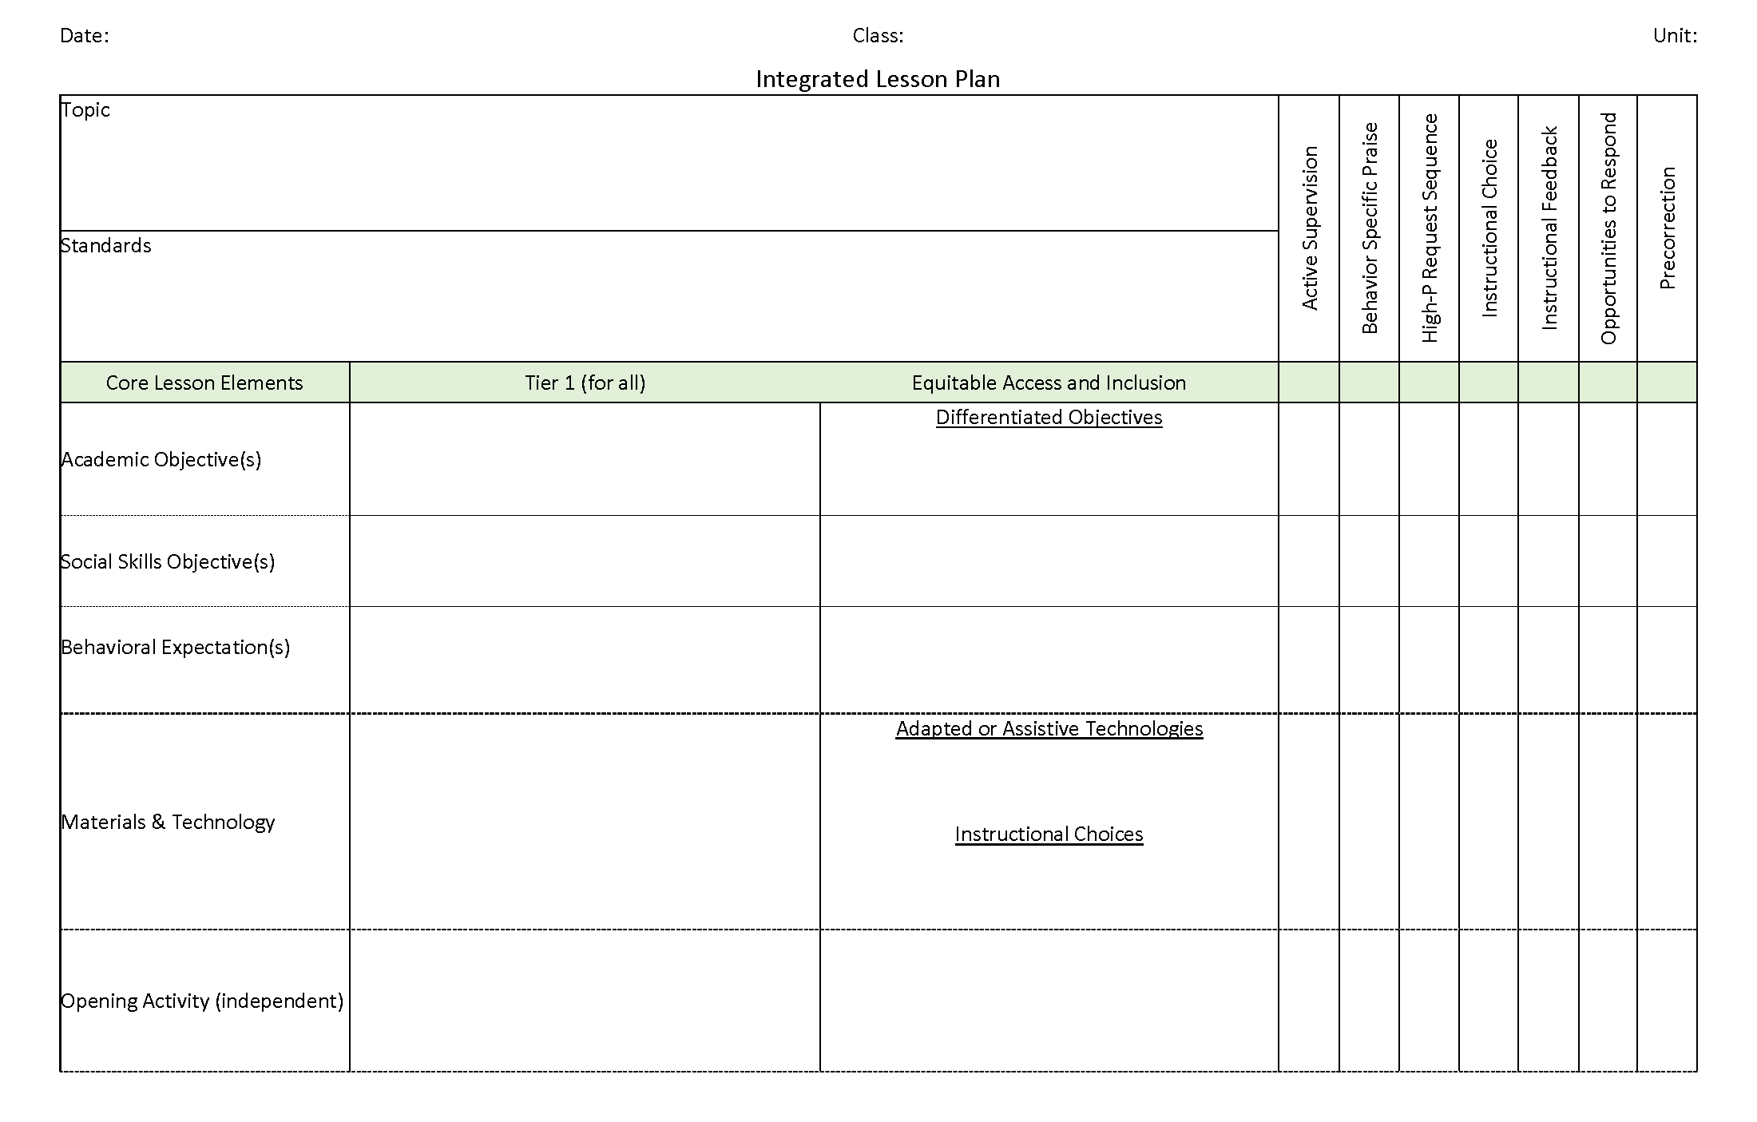
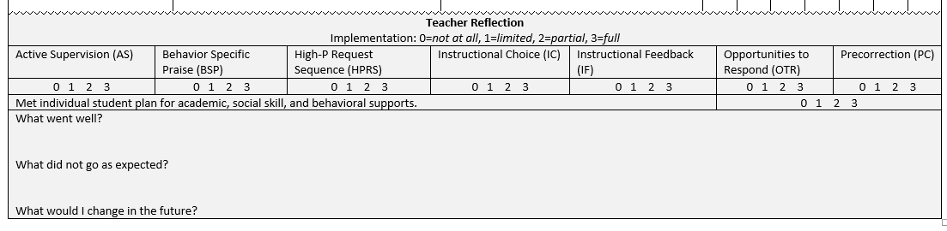
Integrated Lesson Plan
Citation. Oakes, W. P., Lane, K. L., Lane, K. S., & Buckman, M. M. (2019). Ci3T integrated lessons plan template. www.ci3t.org.​

Slide 39


Integrating Academic, Behavior and Social Domains Video
Notes:
Watch video 01:35
https://youtu.be/tRhmenV7M10

Slide 40
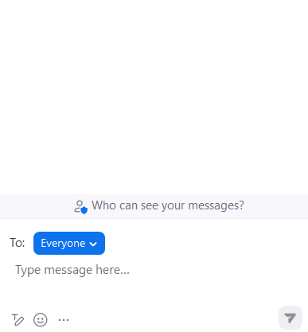


Let’s Chat!
Let’s Chat! 1
What is one way you could integrate social skills or a behavioral objective into an upcoming lesson?
What low-intensity teacher-delivered strategies might you be able to integrate into an upcoming lesson?

Slide 41
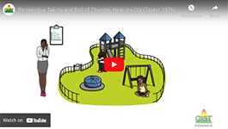
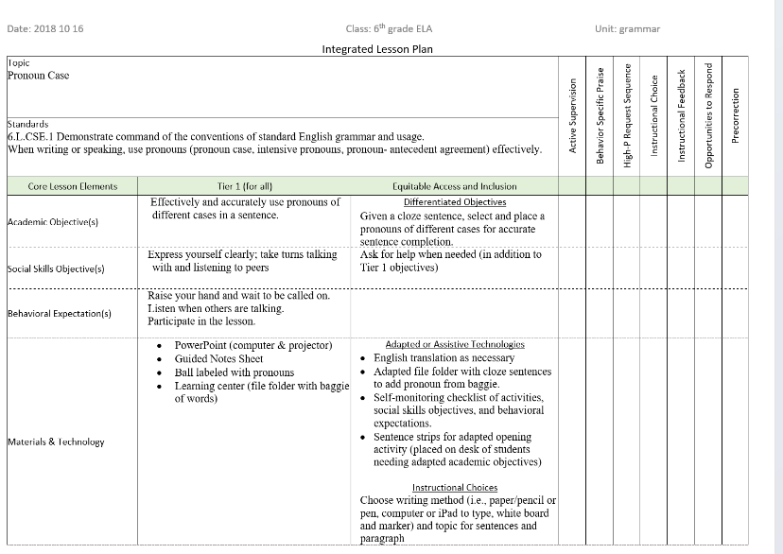

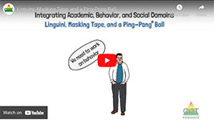
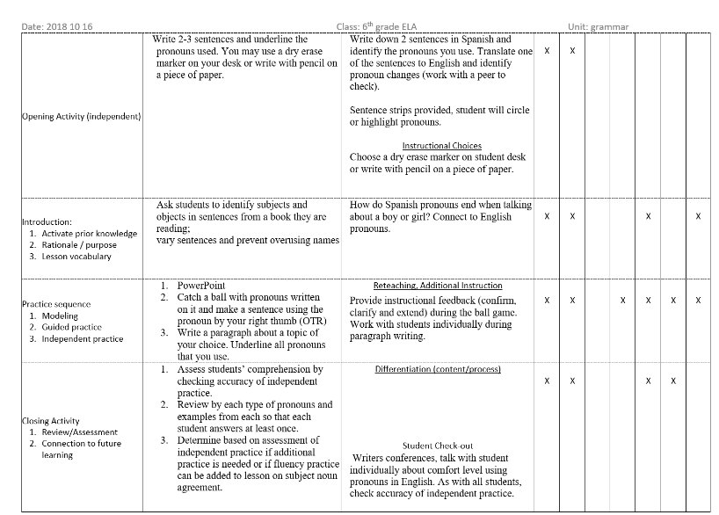

Module Connection 1
Module Connection! 6-Step Instructional Approach for Responding to Challenging Behavior

Slide 42
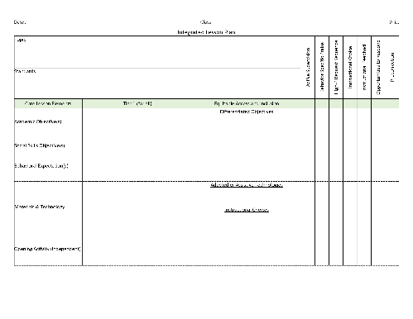
Join us at future EMPOWER+ to learn more! 1
Join us at future EMPOWER+ to learn more!
EMPOWER+ Session | Date
Starting Strong: Effective Tier 1 Practices for Educators | September 24, 2025 (Wednesday)
From Data to Action: Using Systematic Screening to Inform Instruction | October 8, 2025 (Wednesday)
Ci3T In Action: Integrated Lesson Planning for Enhanced Instruction | November 18, 2025 (Tuesday)
Mastering Behavior Specific Praise and Precorrection | January 21, 2026 (Wednesday)
A 6-Step Instructional Approach for Responding to Challenging Behaviors: A Tier 1 Practice | February 10, 2026 (Tuesday)
A Tier 2 Support for Students Experiencing Anxious Feelings: Recognize. Relax. Record. | March 25, 2026 (Wednesday)
A Tier 3 Support for Students with Intensive Intervention Needs: Functional Assessment-Based Intervention (FABI) | April 28, 2026 (Tuesday)

Slide 43

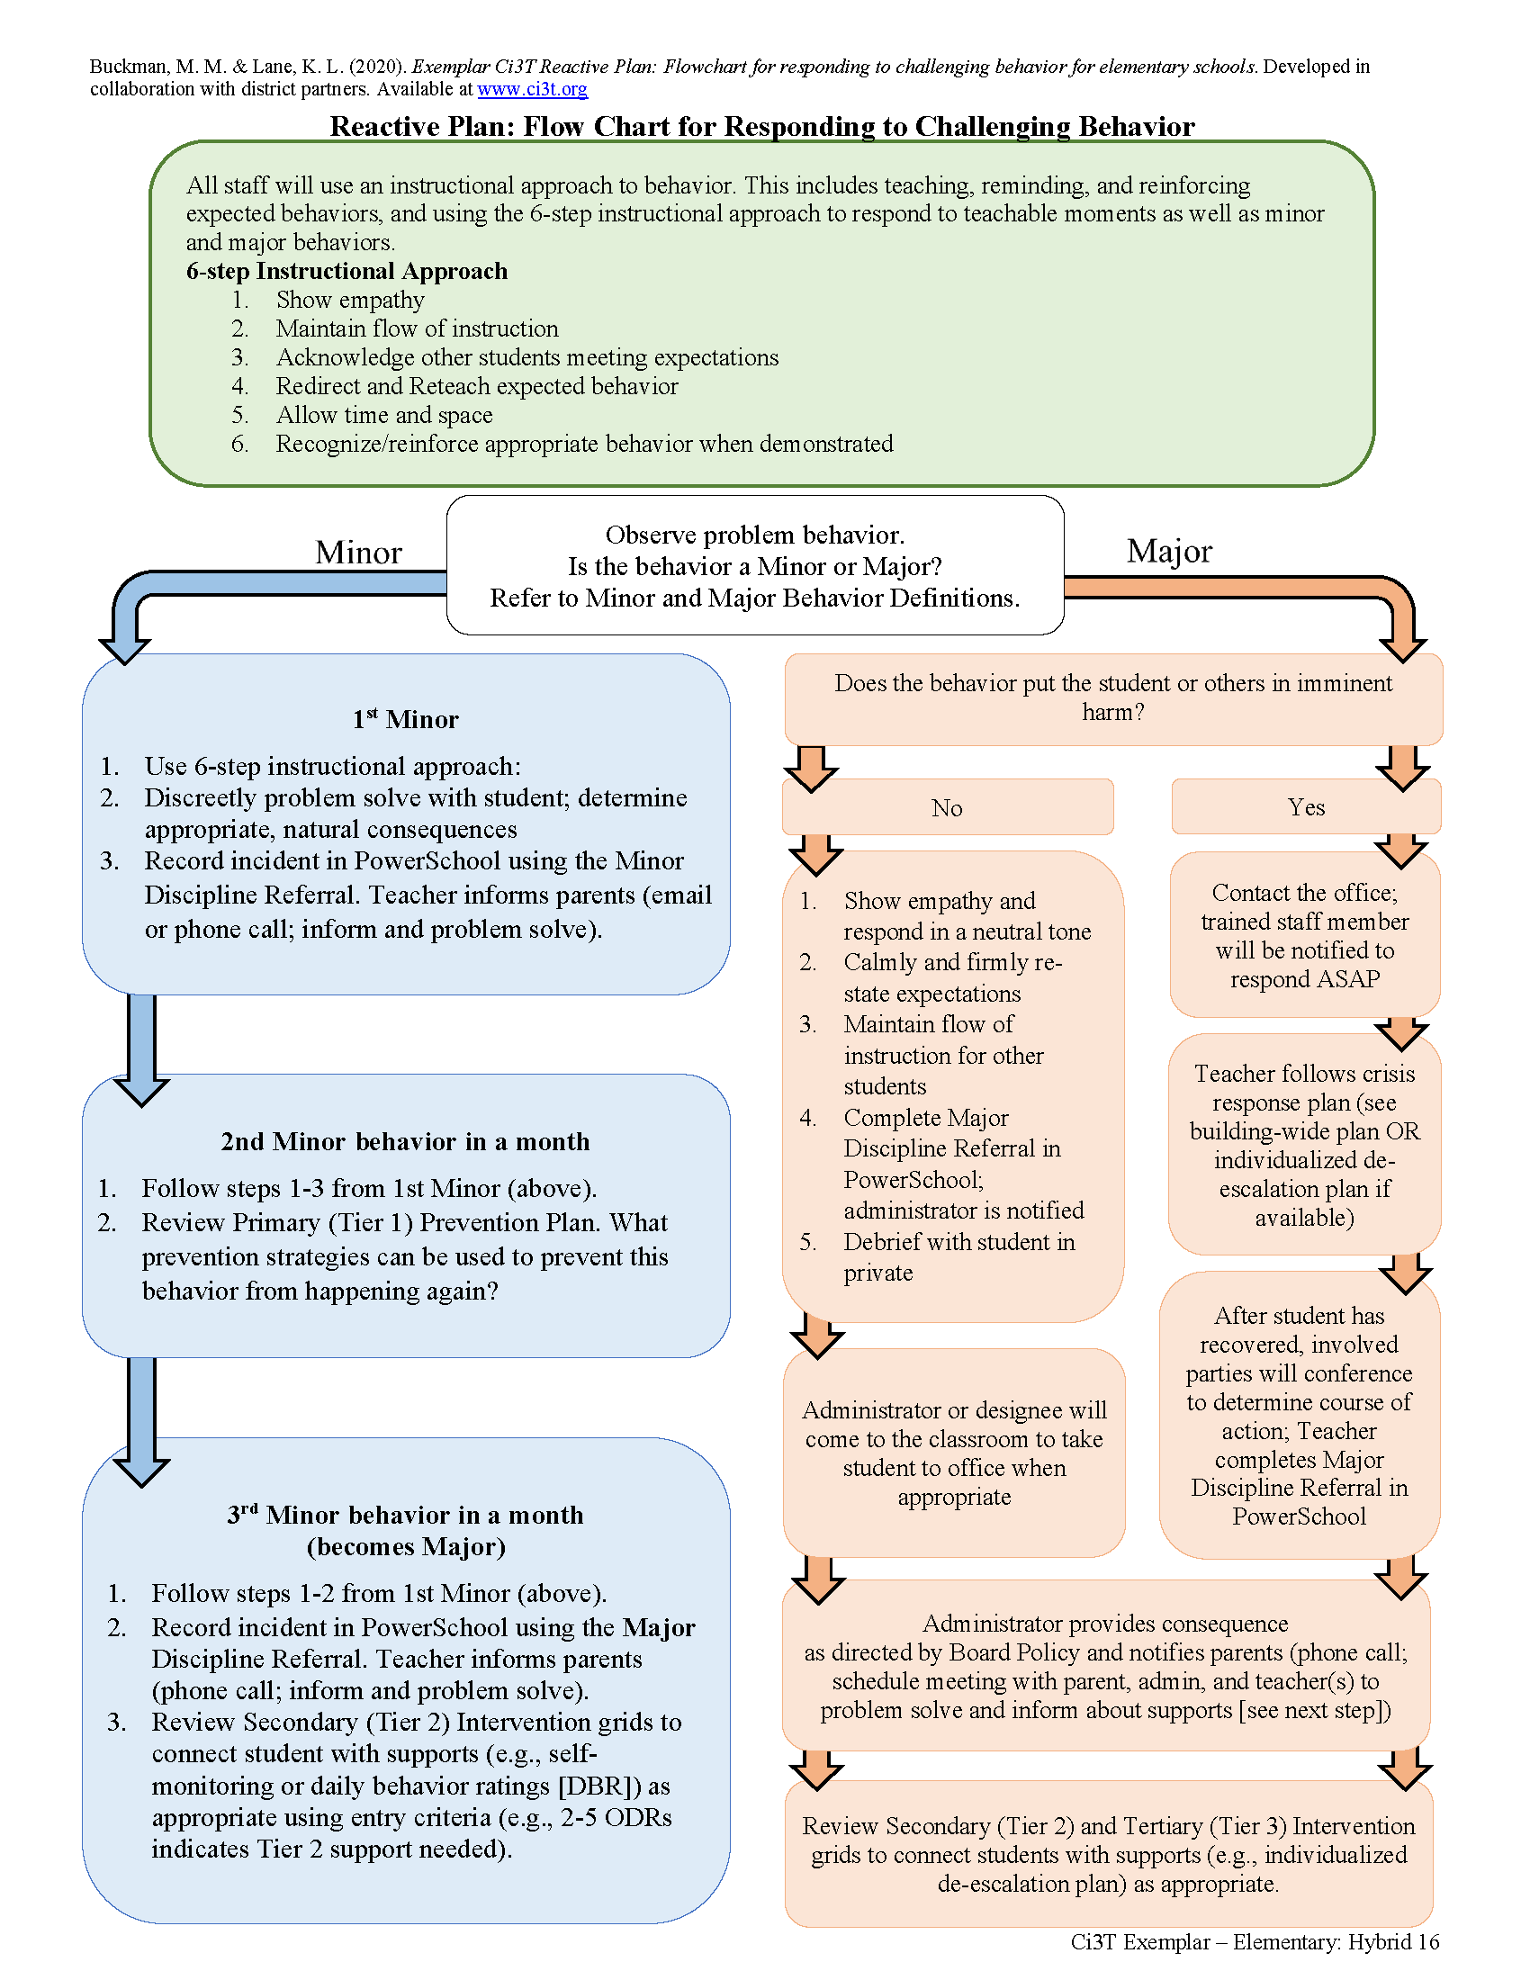

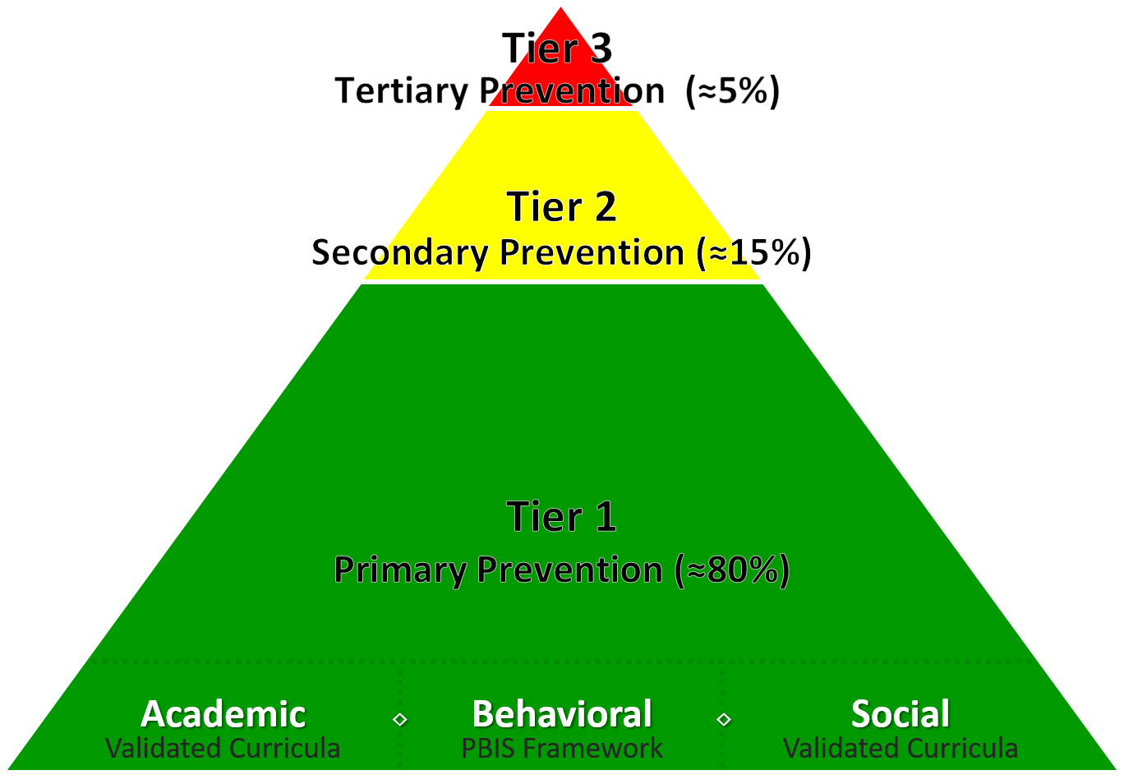
A Focus on: Responding to Challenging Behavior

Slide 44
Reactive Plan: Flow Chart for Responding to Challenging Behavior

Slide 45

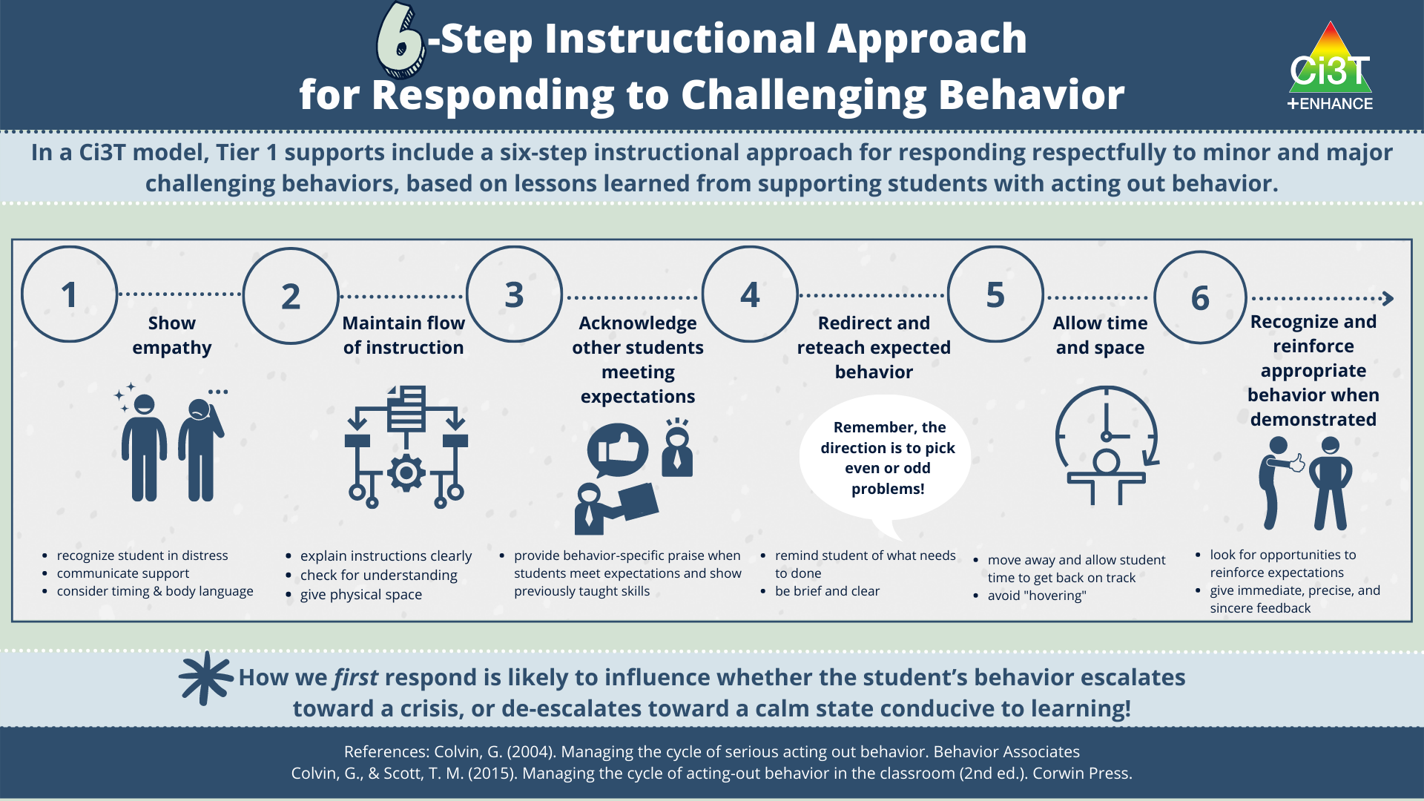
6-Step Instructional Approach for Responding to Challenging Behavior

Slide 46
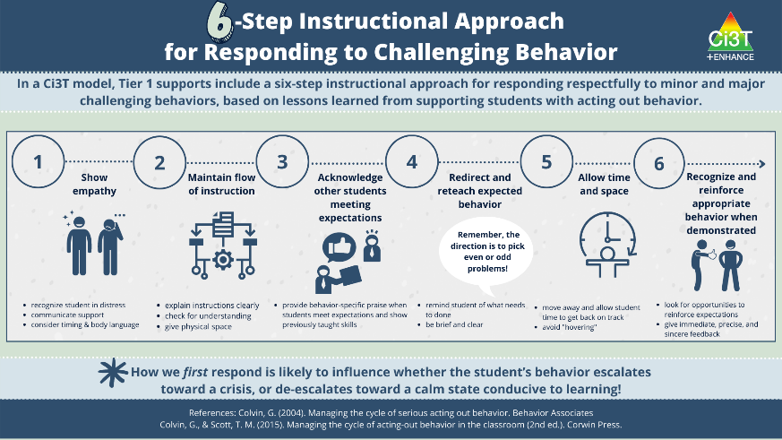
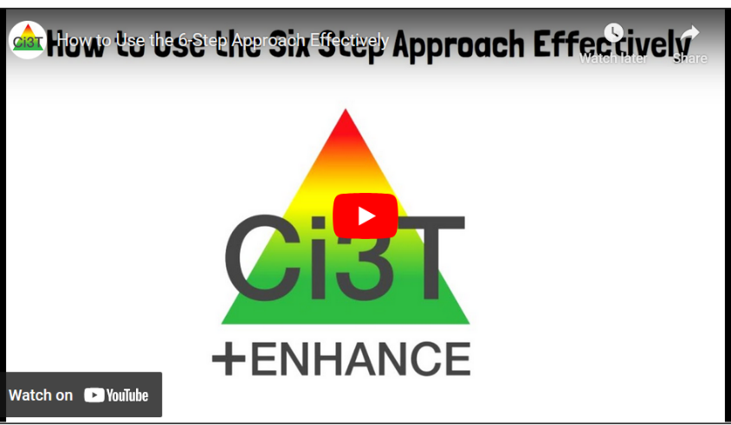



Module Connection! 6-Step Instructional Approach for Responding to Challenging Behavior
Module Connection 2

Slide 47

Join us at future EMPOWER+ to learn more! 2
Join us at future EMPOWER+ to learn more!
EMPOWER+ Session | Date
Starting Strong: Effective Tier 1 Practices for Educators | September 24, 2025 (Wednesday)
From Data to Action: Using Systematic Screening to Inform Instruction | October 8, 2025 (Wednesday)
Ci3T In Action: Integrated Lesson Planning for Enhanced Instruction | November 18, 2025 (Tuesday)
Mastering Behavior Specific Praise and Precorrection | January 21, 2026 (Wednesday)
A 6-Step Instructional Approach for Responding to Challenging Behaviors: A Tier 1 Practice | February 10, 2026 (Tuesday)
A Tier 2 Support for Students Experiencing Anxious Feelings: Recognize. Relax. Record. | March 25, 2026 (Wednesday)
A Tier 3 Support for Students with Intensive Intervention Needs: Functional Assessment-Based Intervention (FABI) | April 28, 2026 (Tuesday)

Slide 48
Empower Teachers with Low-Intensity Strategies

Slide 49
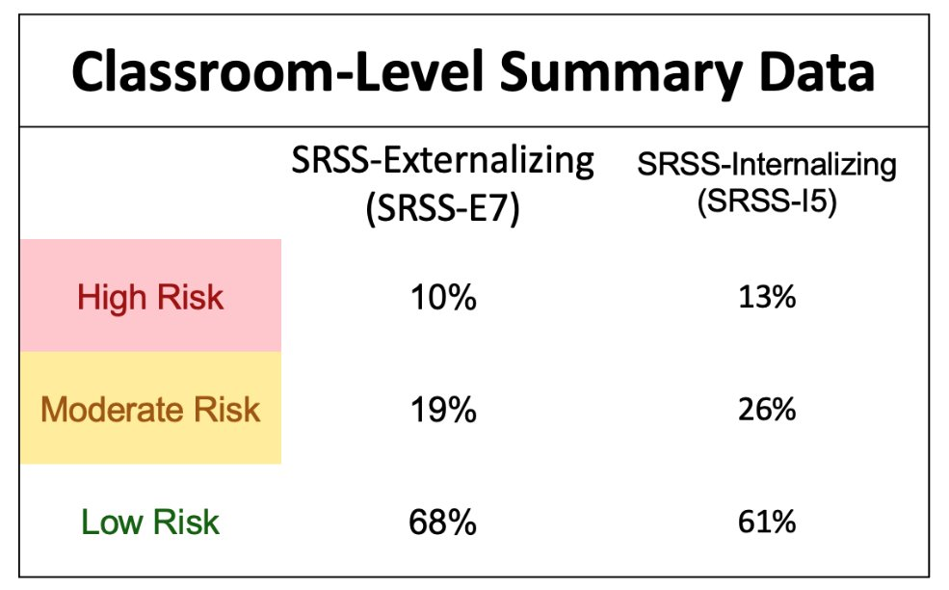
Data to Indicate a Focus on Low-Intensity Teacher-Delivered Strategies

Slide 50
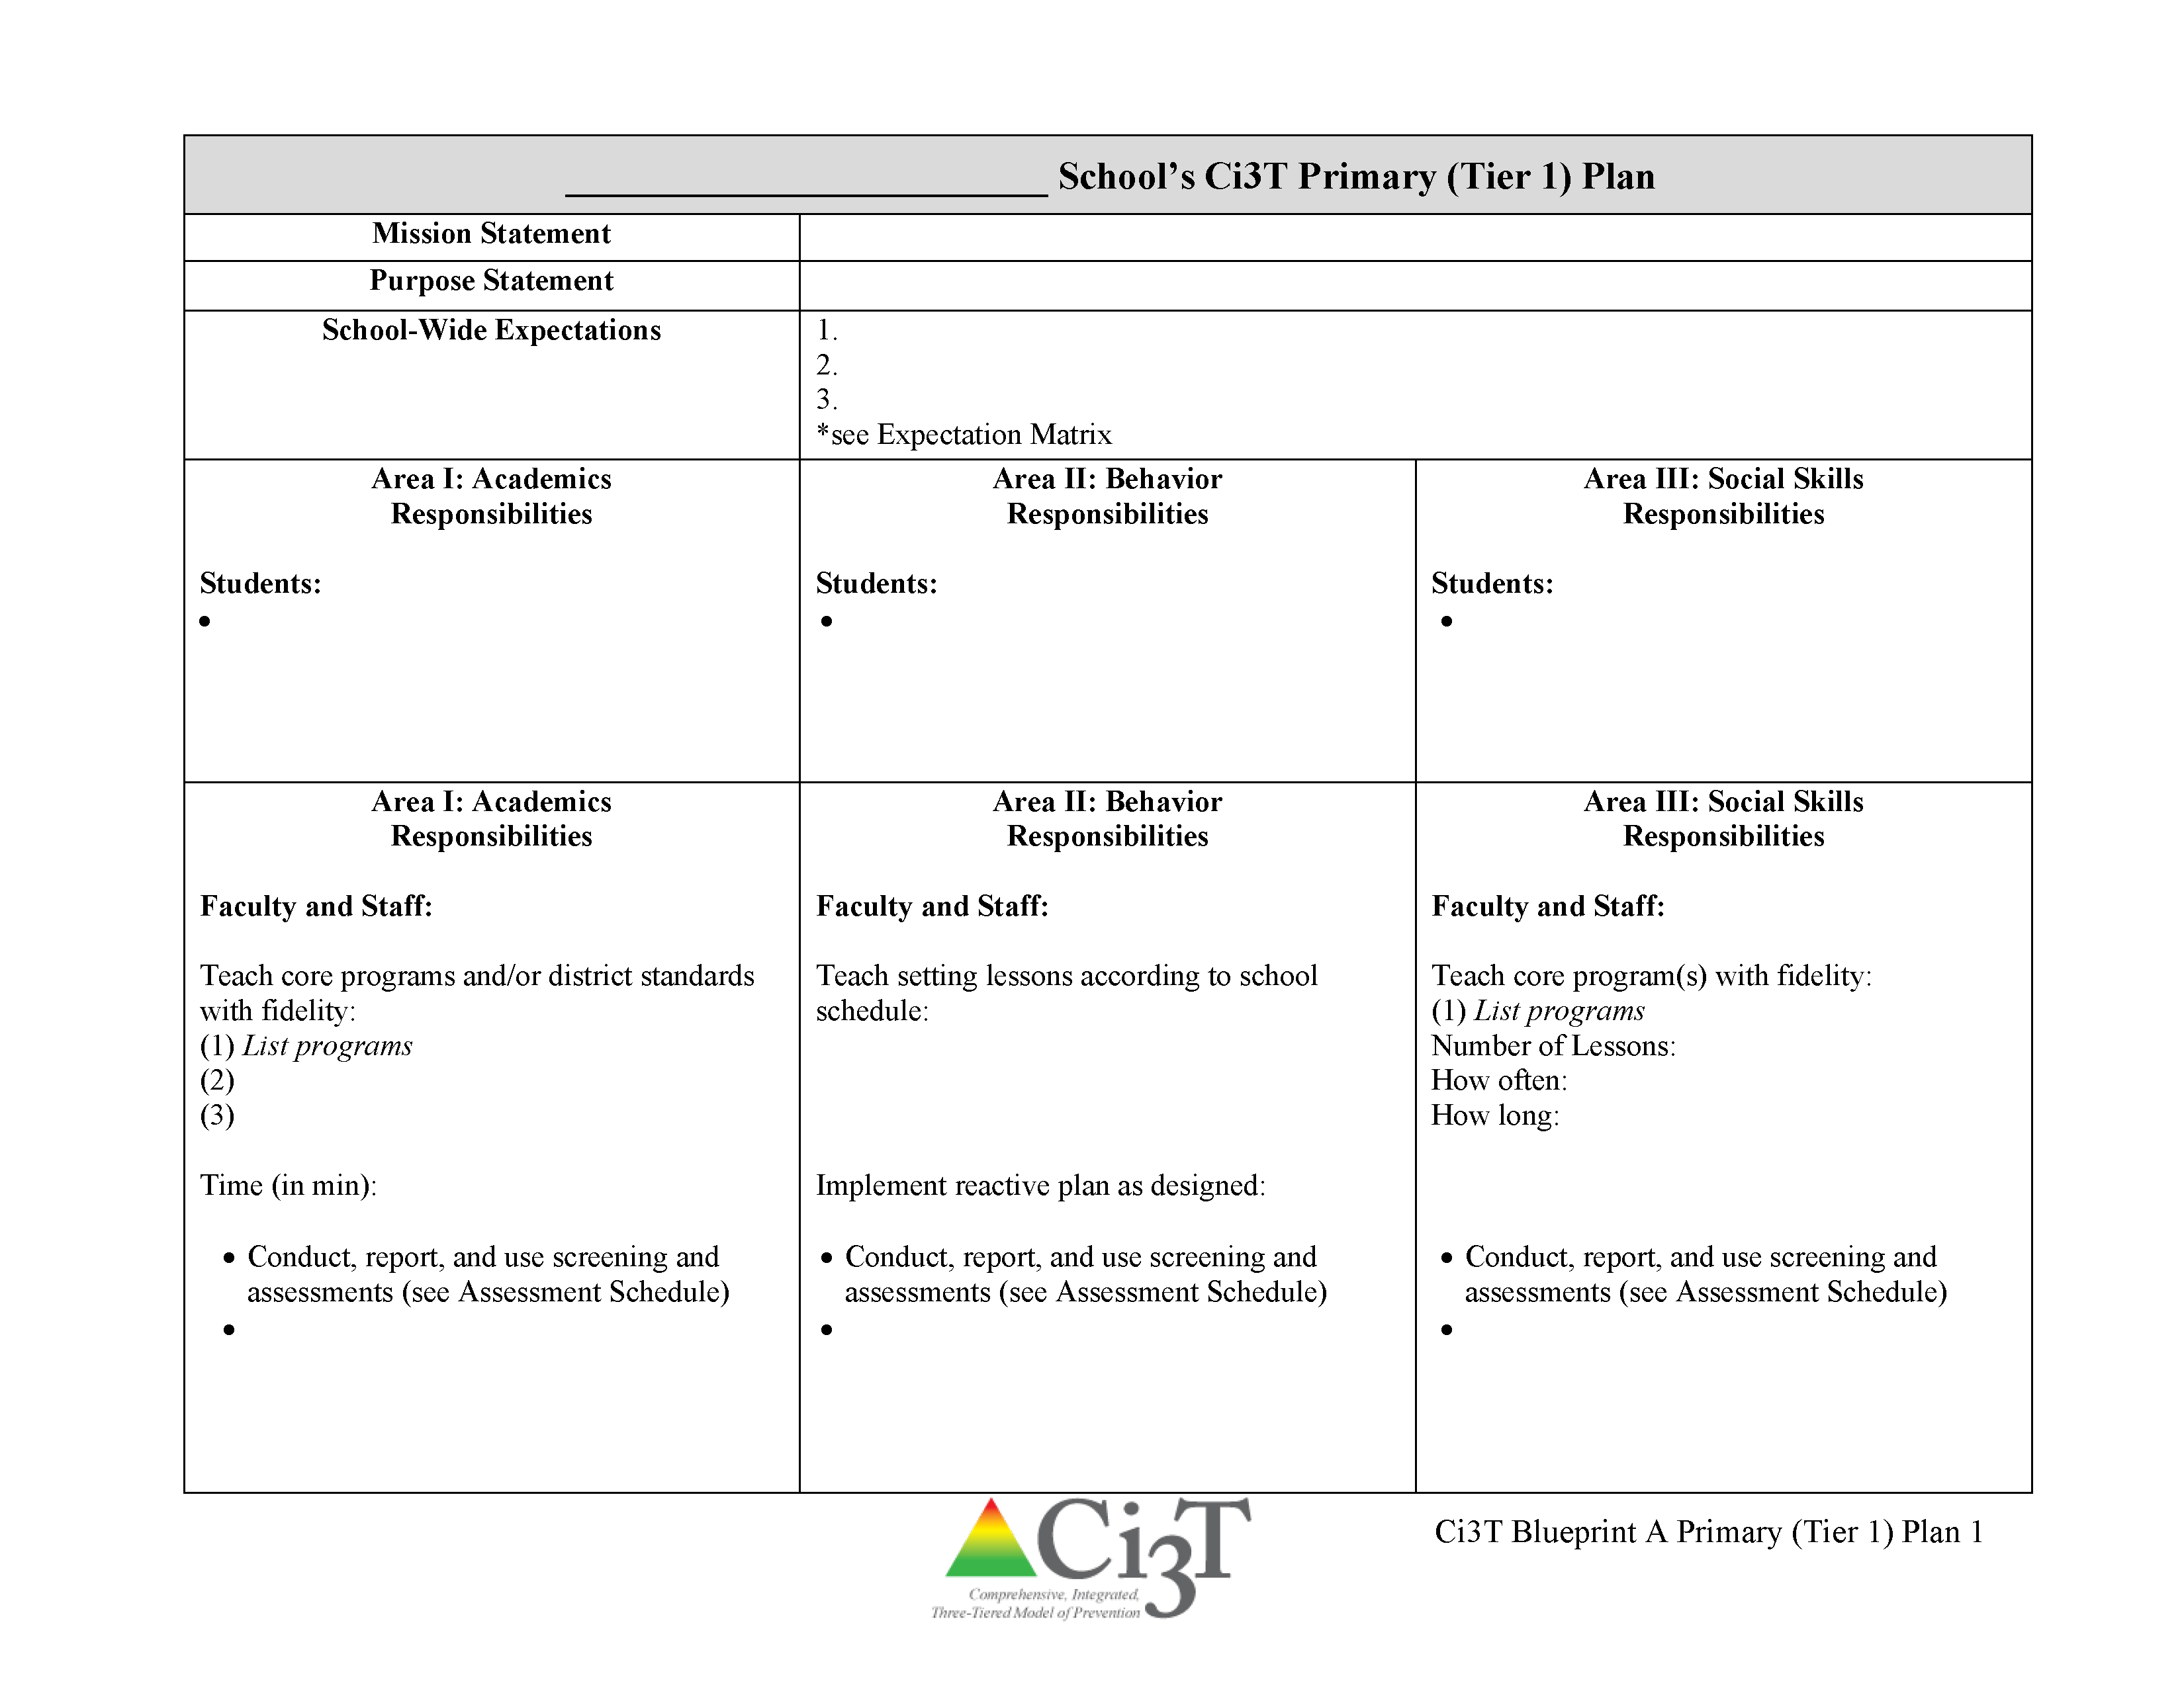

Low-Intensity Teacher-Delivered Strategies

Slide 51

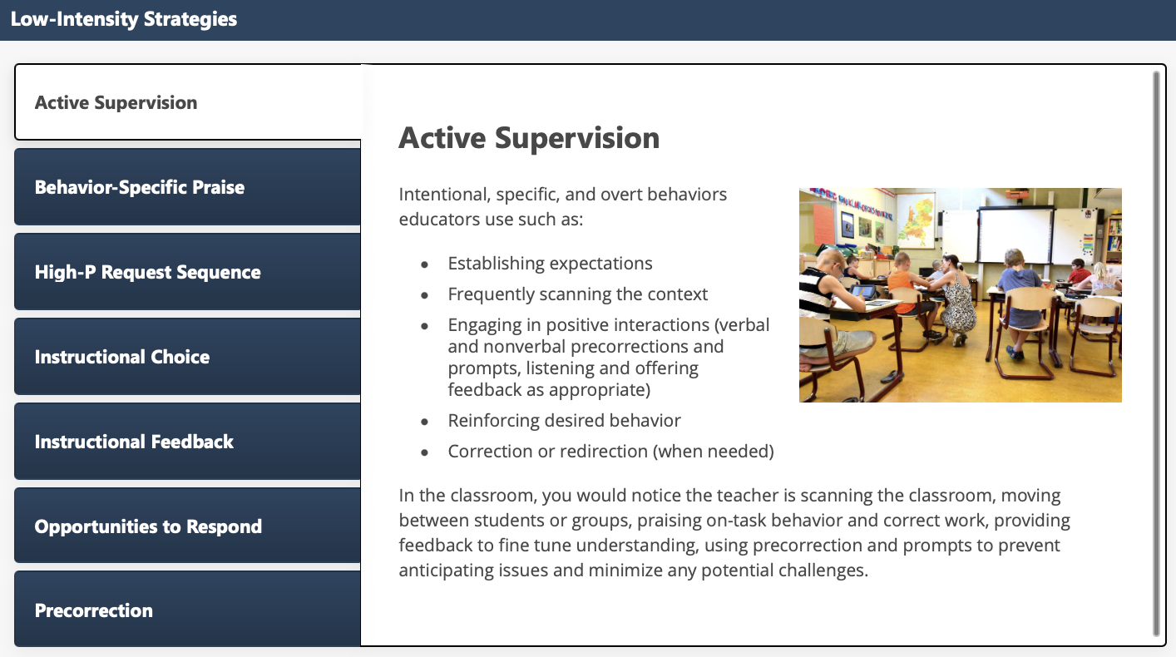
Low-Intensity Strategies: Academic Supervision

Slide 52
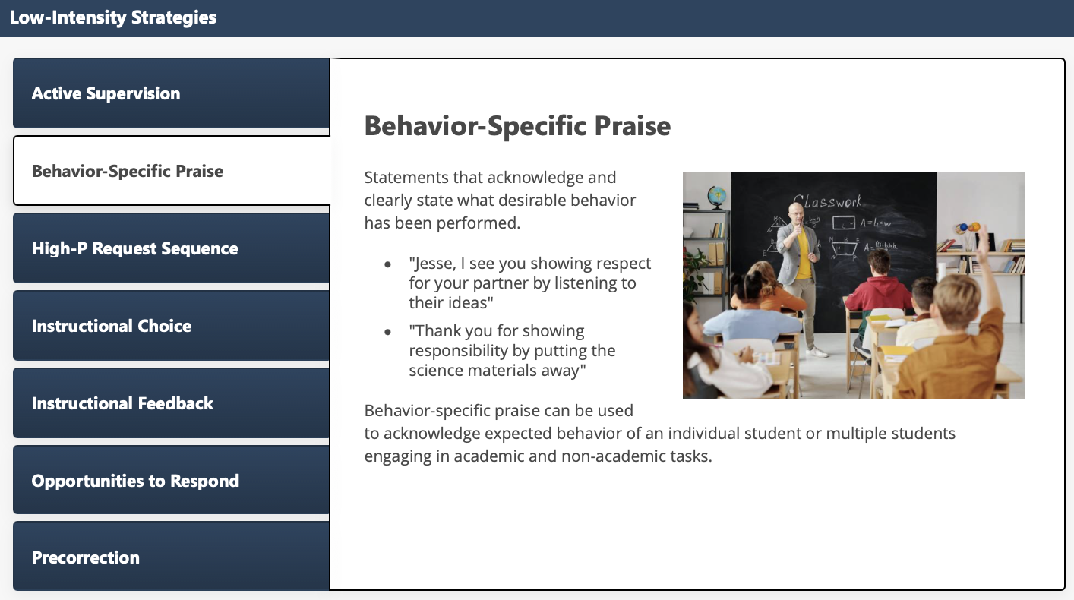
Low-Intensity Strategies: Behavior-Specific Praise

Slide 53
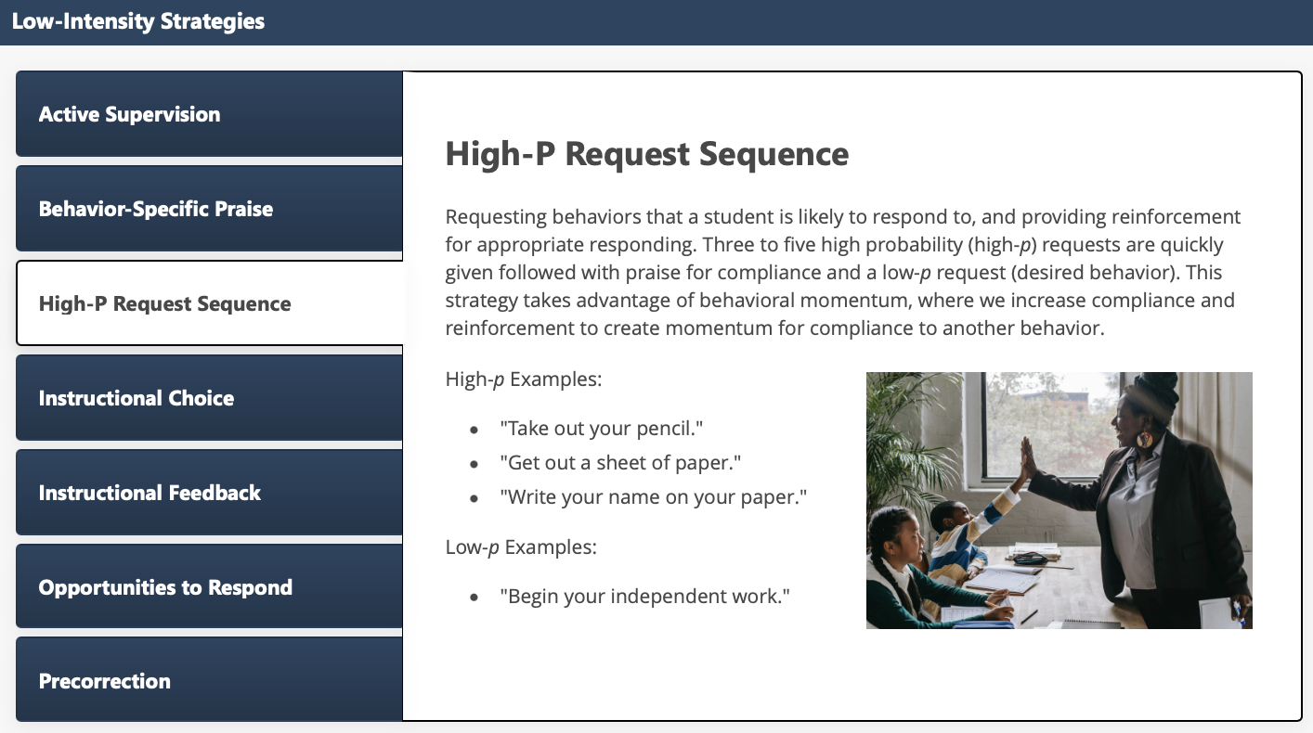
Low-Intensity Strategies: High-P Request Sequence

Slide 54

Low-Intensity Strategies: Instructional Choice

Slide 55

Low-Intensity Strategies: Instructional Feedback

Slide 56

Low-Intensity Strategies: Opportunities to Respond

Slide 57

Low-Intensity Strategies: Precorrection

Slide 58









Module Connection! Instructional Choice
Notes:
LIS modules contain:
Videos and infographics to easily share key information
Resources to support implementation – templates, implementation checklist, treatment integrity forms, social validity, data-tracker
Family resources

Slide 59


Resource Spotlight!
Notes:
What Works Clearing House Practice Guide – Teacher-Delivered Behavioral Interventions in Grades K-5 https://ies.ed.gov/ncee/wwc/PracticeGuide/31

Slide 60


Join us at future EMPOWER+ to learn more!
EMPOWER+ Session | Date
Starting Strong: Effective Tier 1 Practices for Educators | September 24, 2025 (Wednesday)
From Data to Action: Using Systematic Screening to Inform Instruction | October 8, 2025 (Wednesday)
Ci3T In Action: Integrated Lesson Planning for Enhanced Instruction | November 18, 2025 (Tuesday)
Mastering Behavior Specific Praise and Precorrection | January 21, 2026 (Wednesday)
A 6-Step Instructional Approach for Responding to Challenging Behaviors: A Tier 1 Practice | February 10, 2026 (Tuesday)
A Tier 2 Support for Students Experiencing Anxious Feelings: Recognize. Relax. Record. | March 25, 2026 (Wednesday)
A Tier 3 Support for Students with Intensive Intervention Needs: Functional Assessment-Based Intervention (FABI) | April 28, 2026 (Tuesday)

Slide 61








Breakout Rooms
Notes:
15-min timer
Facilitators provide overview/orientation to module (< 2 min)
Prompt to register if have not done so already
Point out key features – table of resources (model how to use)
Independent Exploration
Someone in main room to manage difficulty accessing modules

Slide 62
Connect Students to Validated Tier 2 and Tier 3 Supports

Slide 63



Getting Started with Data-Informed Decision Making

Slide 64

Tier 2 and Tier 3 Intervention Grids
Notes:
Support is the name of the strategy, practice, or program. Notice this is not the name of a person or role.

Slide 65
Secondary (Tier 2) Intervention Grid

Slide 66


Tier 2: Recognize.Relax.Record

Slide 67

Join us at future EMPOWER+ to learn more! 3
Join us at future EMPOWER+ to learn more!
EMPOWER+ Session | Date
Starting Strong: Effective Tier 1 Practices for Educators | September 24, 2025 (Wednesday)
From Data to Action: Using Systematic Screening to Inform Instruction | October 8, 2025 (Wednesday)
Ci3T In Action: Integrated Lesson Planning for Enhanced Instruction | November 18, 2025 (Tuesday)
Mastering Behavior Specific Praise and Precorrection | January 21, 2026 (Wednesday)
A 6-Step Instructional Approach for Responding to Challenging Behaviors: A Tier 1 Practice | February 10, 2026 (Tuesday)
A Tier 2 Support for Students Experiencing Anxious Feelings: Recognize. Relax. Record. | March 25, 2026 (Wednesday)
A Tier 3 Support for Students with Intensive Intervention Needs: Functional Assessment-Based Intervention (FABI) | April 28, 2026 (Tuesday)

Slide 68
Tertiary (Tier 3) Intervention Grid

Slide 69


Tier 3: Functional Assessment-Based Intervention

Slide 70

Join us at future EMPOWER+ to learn more! 4
Join us at future EMPOWER+ to learn more!
EMPOWER+ Session | Date
Starting Strong: Effective Tier 1 Practices for Educators | September 24, 2025 (Wednesday)
From Data to Action: Using Systematic Screening to Inform Instruction | October 8, 2025 (Wednesday)
Ci3T In Action: Integrated Lesson Planning for Enhanced Instruction | November 18, 2025 (Tuesday)
Mastering Behavior Specific Praise and Precorrection | January 21, 2026 (Wednesday)
A 6-Step Instructional Approach for Responding to Challenging Behaviors: A Tier 1 Practice | February 10, 2026 (Tuesday)
A Tier 2 Support for Students Experiencing Anxious Feelings: Recognize. Relax. Record. | March 25, 2026 (Wednesday)
A Tier 3 Support for Students with Intensive Intervention Needs: Functional Assessment-Based Intervention (FABI) | April 28, 2026 (Tuesday)

Slide 71



Selecting an Intervention
Selecting an Intervention 1

Slide 72


Selecting an Intervention
Selecting an Intervention 2
Collaborate with families, colleagues, and the student to review available options
Consider what you know about the student (e.g., strengths, preferences, pre-requisite skills)
Consider possible function of the behavior
Check-In Check Out is may be more effective for students who find accessing adult attention reinforcing
Consider your own strengths, support available (e.g., coach, professional learning), and feasibility of available options
Adjust as needed based on pre-intervention social validity

Slide 73

Let’s Practice Together!
Notes:
Facilitator has copy of Ci3T Data Dashboard- https://docs.google.com/spreadsheets/d/135hDmcTOIjAwb_8Ci-hNR38uF9vs7oUcVzjeSxVM2a8/edit?usp=sharing
Model:
Filter
Moderate internalizing
Below grade level reading
Attendance – now what do you notice
Ci3T Implementation Manual
What intervention(s) might be appropriate for this student? (e.g., self-monitoring w/ reading, breathing strategy)

Slide 74

Document Decisions and Plan for Next Steps
Document Decisions and Plan for Next Steps 1

Slide 75

Document Decisions and Plan for Next Steps
Document Decisions and Plan for Next Steps 2

Slide 76





Module Connection! The Tier 2 Process: Using Data to Connect Students to Validated Supports

Slide 77




Module Connection! The Tier 3 Process: Using Data to Connect Students to Validated Supports

Slide 78


Breakout Rooms: Choose Your Own Adventure!
Explore Tier 2 Module Independently explore The Tier 2 Process: Using Data to Connect Students to Validated Supports module | Explore Tier 3 Module Independently explore The Tier 3 Process: Using Data to Connect Students to Validated Supports module | Facilitated Breakout Room Guided practice connecting students to validated Tier 2 and Tier 3 supports using Ci3T Data Dashboard and Exemplar Ci3T Manual
Notes:
15-min timer

Slide 79
Wrapping Up and Moving Forward

Slide 80
Action Items
Action Item | Person(s) Responsible | Planned Completion Date | Date Completed
Submit BCBA CEU form with four passwords | Carrie | 10/08/25
Sign up for EMPOWER Session 4 (Mastering Behavior Specific Praise and Precorrection) | Carrie | 10/08/25
Email instructional coach to schedule time to review Fall screening data to connect students with Tier 2 supports | Carrie | 10/09/25

Slide 81

Project EMPOWER+
EMPOWER+ Session | Date
Starting Strong: Effective Tier 1 Practices for Educators | September 24, 2025 (Wednesday)
From Data to Action: Using Systematic Screening to Inform Instruction | October 8, 2025 (Wednesday)
Ci3T In Action: Integrated Lesson Planning for Enhanced Instruction | November 18, 2025 (Tuesday)
Mastering Behavior Specific Praise and Precorrection | January 21, 2026 (Wednesday)
A 6-Step Instructional Approach for Responding to Challenging Behaviors: A Tier 1 Practice | February 10, 2026 (Tuesday)
A Tier 2 Support for Students Experiencing Anxious Feelings: Recognize. Relax. Record. | March 25, 2026 (Wednesday)
A Tier 3 Support for Students with Intensive Intervention Needs: Functional Assessment-Based Intervention (FABI) | April 28, 2026 (Tuesday)

Slide 82

Ci3T Trainers and Coaches Calls
Ci3T Trainers and Coaches Calls Session | Date
Ci3T Trainers and Coaches Call 1 | August 20, 2025 (Wednesday)
Ci3T Trainers and Coaches Call 2 | September 3, 2025 (Wednesday)
Ci3T Trainers and Coaches Call 3 | October 1, 2025 (Wednesday)
Ci3T Trainers and Coaches Call 4 | November 5, 2025 (Wednesday)
Ci3T Trainers and Coaches Call 5 | December 2, 2025 (Tuesday)
Ci3T Trainers and Coaches Call 6 | January 22, 2026 (Thursday)
Ci3T Trainers and Coaches Call 7 | February 17, 2026 (Tuesday)
Ci3T Trainers and Coaches Call 8 | March 10, 2026 (Tuesday)
Ci3T Trainers and Coaches Call 9 | April 15, 2026 (Wednesday)
Ci3T Trainers and Coaches Call 10 | May 13, 2026 (Wednesday)

Slide 83




Thank you!
Thank you!
ci3t.org
#Ci3T
@Ci3Tmodel
Tag us in your Ci3T highlights, we love to see Ci3T in action!
Follow us on Instagram for updates and new resources!
Notes:
Tag us in your Ci3T highlights- we would love to see Ci3T in action! Follow us on Instagram for updates and links to resources! @Ci3TModel
You will receive a brief session evaluation – we value your feedback and would greatly appreciate you taking a few minutes to share your thoughts on what you liked about the session and how we can improve

