Slide 1




Functional Assessment-Based Intervention (FABI): An Effective Approach for Supporting Students with Intensive Behavior Intervention Needs
Elise Sarasin, M.S.E
Kathleen Lynne Lane, PhD., BCBA-D, CF-L2
This project was funded in part by Project EPIC (USDE, OSEP Award Number: H325D220011) and Project ENHANCE (IES Project Number R324N190002)
Part 1: October 10, 2025

Slide 2
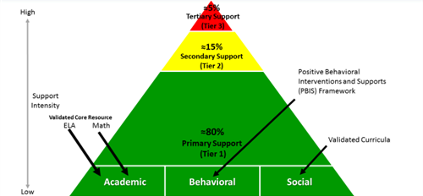

Reflect & Connect: Ci3T
Why is it be important to identify where today’s learning connects to our Ci3T framework?
What is your role in supporting students’ academic, behavior and social needs?
Today, we are focused on Tier 3 to support students with intesive intervention needs across domains

Slide 3

Welcome!
Name
School
Role/grade(s) you support
What inspired you to choose this strand
Notes:
We explore step-by-step procedures for conducting a functional assessment-based intervention (FABI), a validated Tier 3 support to build a customized intervention based on the reasons why a particular behavior of concern (e.g., off-task) occurs. FABIs outline procedures for decreasing the target behavior (i.e., the one you would like to reduce or eliminate) and increasing a more contextually appropriate or productive behavior (called a replacement behavior) to better meet the student’s needs. We explain, practice, and explore resources for each component of the FABI process: Step 1: Identifying Students Who May Need a Functional Assessment-Based Intervention, Step 2: Conducting the Functional Assessment, Step 3: Collecting Baseline Data, Step 4: Designing the Functional Assessment-Based Intervention, Step 5: Testing the Intervention.

Slide 4

LPS Learning Exchange Series Progression
Session 1
October 10, 2025
Session 2
January 5, 2026
Session 3
April 17, 2026
FABI Overview
Step 1: Identifying Students Who May Benefit from FABI
Step 2: Conducting the Functional Assessment
Step 3: Collecting Baseline Data
Step 4: Designing the Intervention
Step 5: Testing the Intervention
Homework
FABI Step 1
FABI Step 2*
Homework
FABI Step 2
FABI Step 3
Homework
FABI Step 4
FABI Step 5

Slide 5


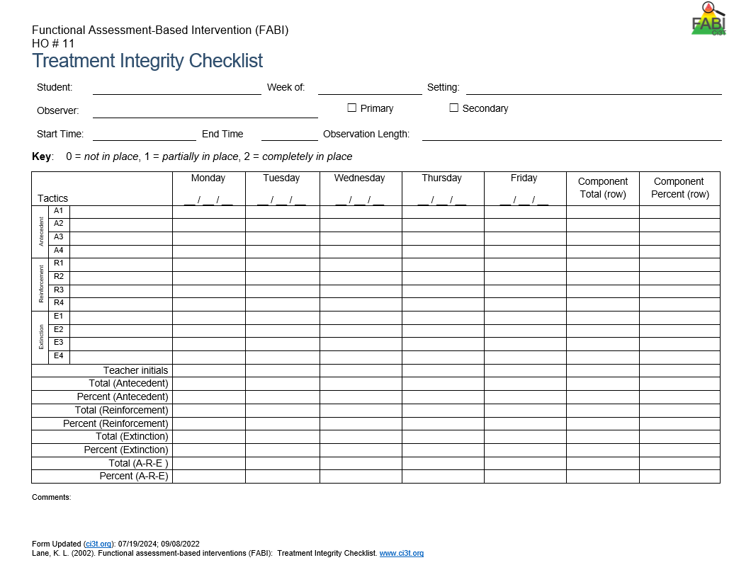
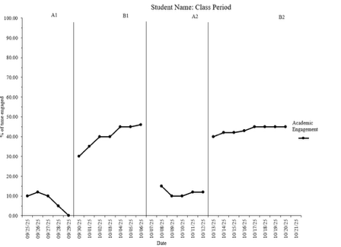

Knowledge, Application, Impact Points
Knowledge, Application, Impact Points 1
On-Task Behavior: Jackson
You can earn 2 x PD points for application and 3 x for impact!
We are happy to review your materials before you upload ☺
Notes:
Tonight’s session lays the foundation with knowledge building and getting you oriented to the modules that can support application and impact efforts!

Slide 6
Session 1 Outcomes
Describe how FABI is situated as a tertiary (Tier 3) intervention within a Ci3T model of prevention
Describe a step-by-step process to implement Functional Assessment-Based Intervention (FABI) as a Tier 3 support
Use school-wide data to identify a student who might benefit from a FABI

Slide 7
Agenda
Welcome
Situating Tertiary (Tier 3) Interventions in Ci3T Models
Functional Assessment-Based Intervention (FABI)
FABI Overview
5-Step Process to Implement FABI
Identifying Students Who Might Benefit from a Functional Assessment-Based Intervention
Wrapping Up and Moving Forward

Slide 8
Situating Tertiary (Tier 3) Interventions in Ci3T Models

Slide 9
Session 1 Outcomes
Describe how FABI is situated as a tertiary (Tier 3) intervention within a Ci3T model of prevention
Describe a step-by-step process to implement Functional Assessment-Based Intervention (FABI) as a Tier 3 support
Use school-wide data to identify a student who might benefit from a FABI

Slide 10
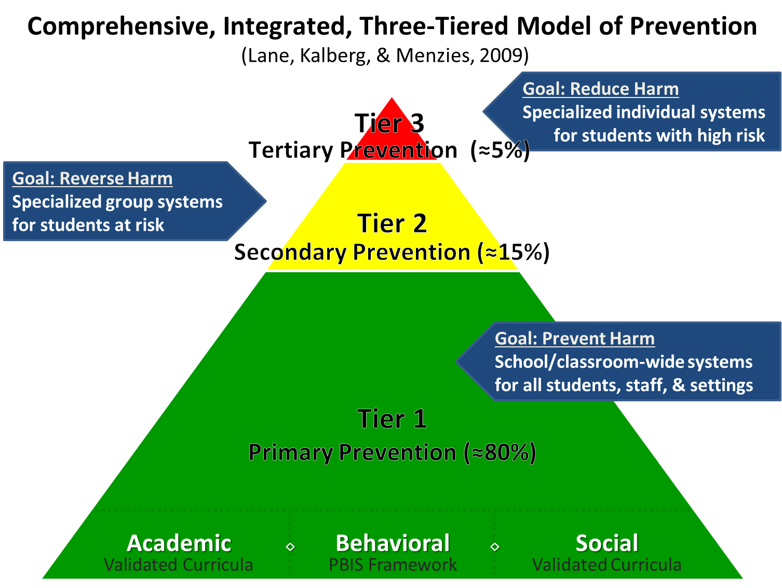
Comprehensive, Integrated, Three-Tiered Model of Prevention 1

Slide 11
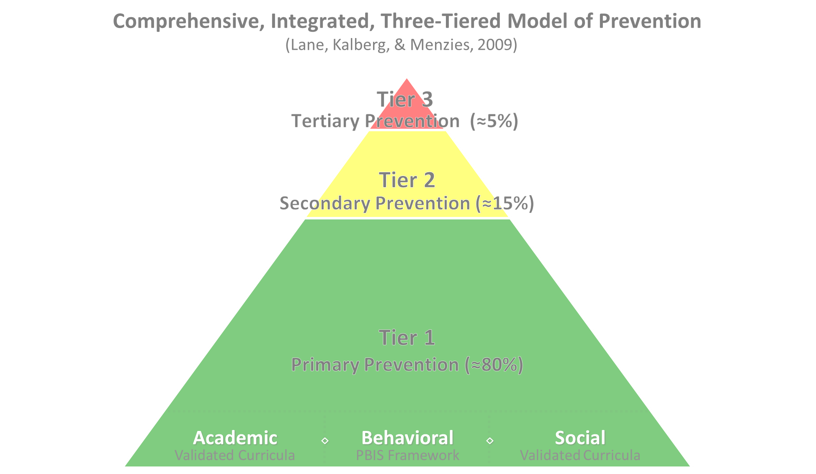

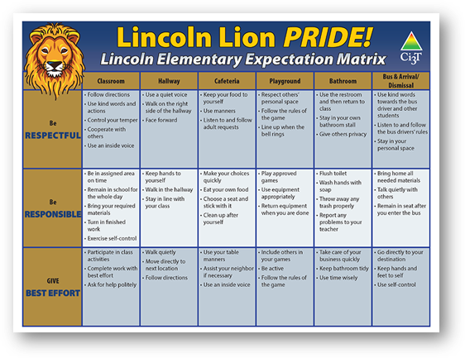
Comprehensive, Integrated, Three-Tiered Model of Prevention 2
Positive Behavioral Interventions and Supports
District & State Standards Quality Instruction
Validated Curricula and Resources

Slide 12

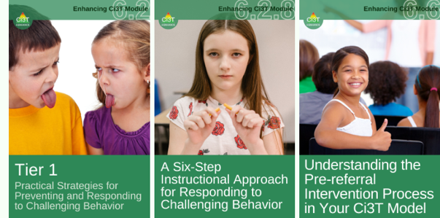
Primary Prevention (Tier 1)

Slide 13

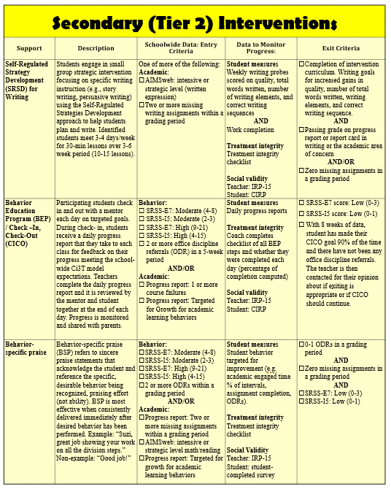
Secondary (Tier 2) Intervention Grid
Notes:
In addition to the module featured here outlining how to use multiple sources of data to connect students with Tier 2 supports, we offer a full suite of modules highlighting validated Tier 2 interventions such as Self-Regulated Strategy Development (SRSD) for Writing and Check-In/Check Out that may appear in your Secondary (Tier 2) Intervention Grid

Slide 14

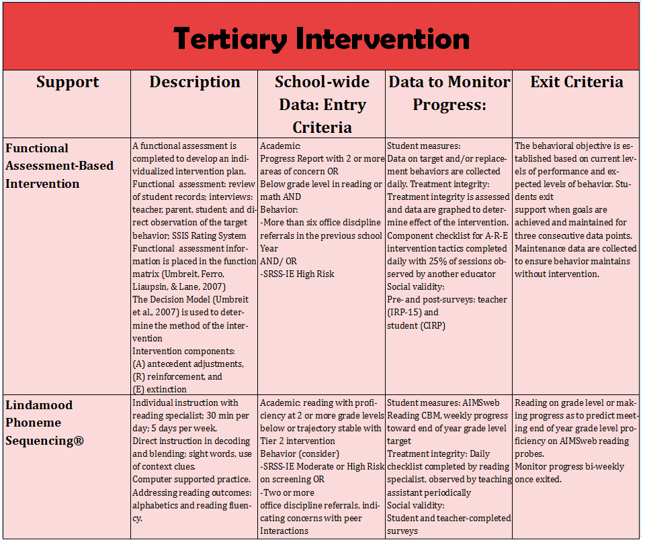
Tertiary (Tier 3) Intervention Grid
Notes:
In addition to the module featured here outlining how to use multiple sources of data to connect students with Tier 3 supports, we offer a full suite of modules highlighting validated Tier 3 interventions such as Functional Assessment-Based Intervention (FABI) that may appear in your Tertiary (Tier 3) Intervention Grid

Slide 15

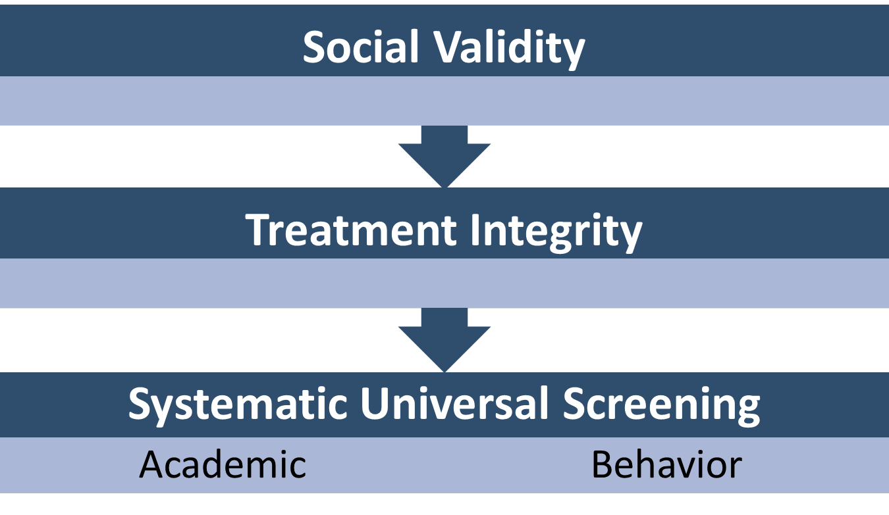

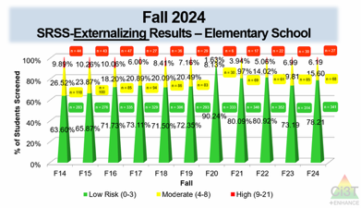
Essential Components of Primary (Tier 1) Prevention Efforts

Slide 16

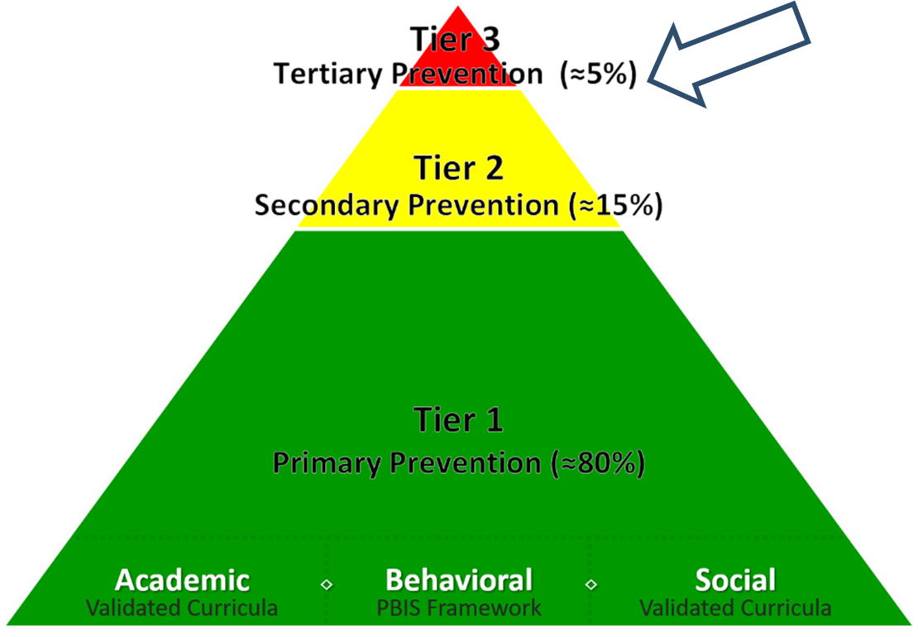
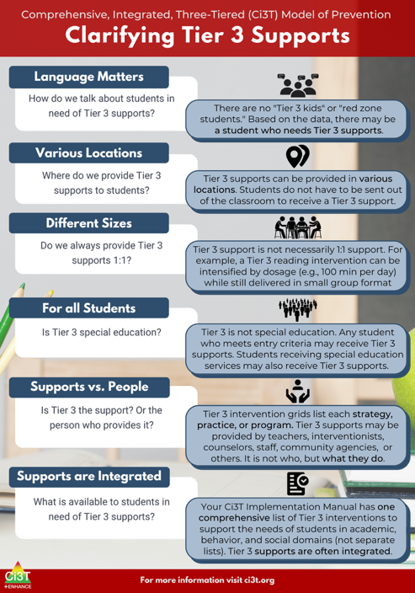
What are Tier 3 Interventions?

Slide 17

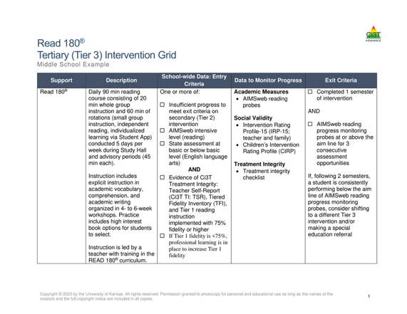
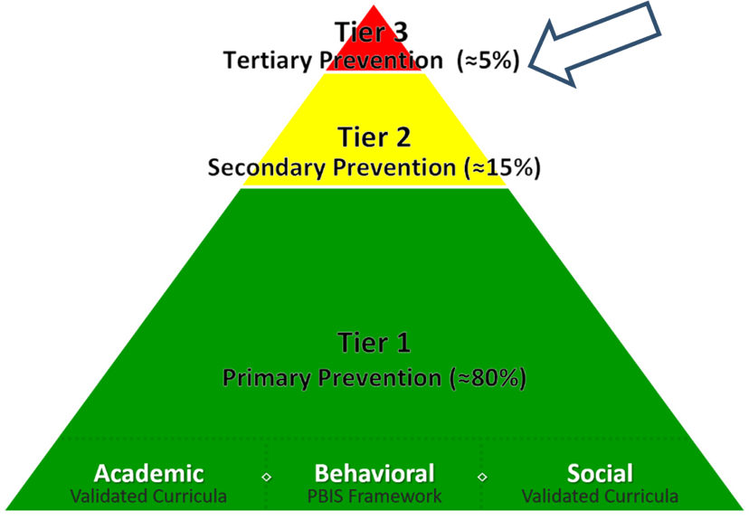
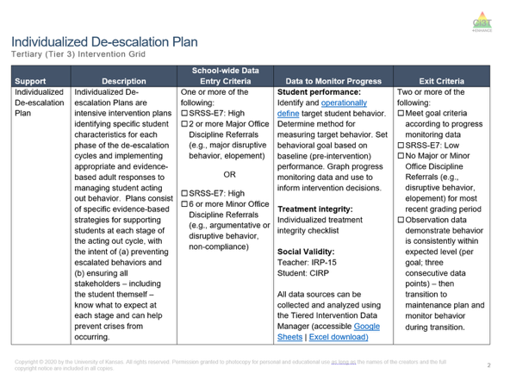
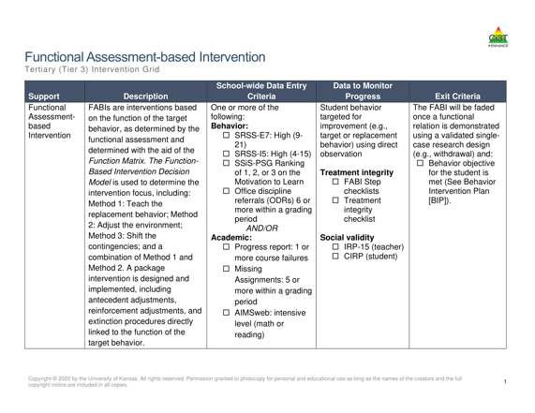
Tertiary (Tier 3) Intervention Grid
Tertiary (Tier 3) Intervention Grid 2

Slide 18

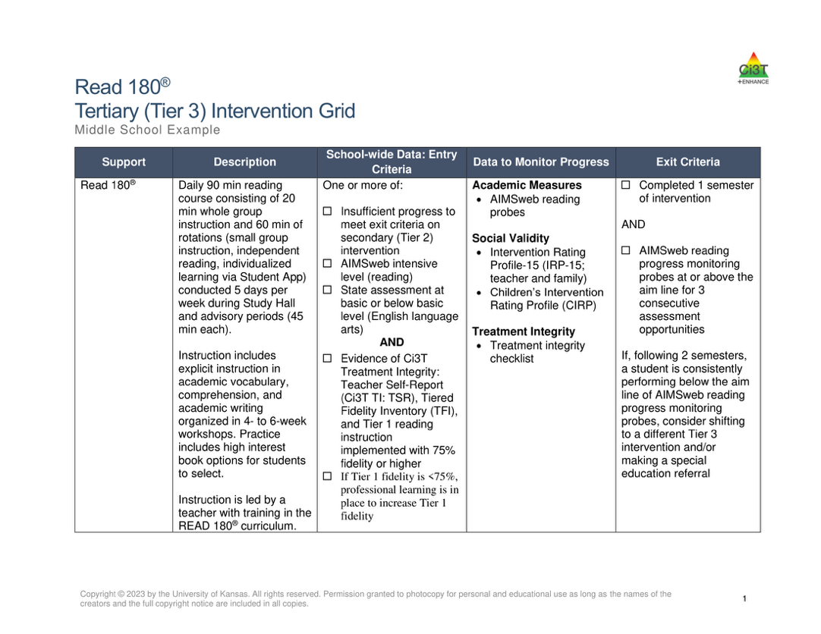
Components of Tier 3 Intervention Grid
Notes:
Support- name of strategy, practice, or program. Notice this is not the name of a person or role

Slide 19


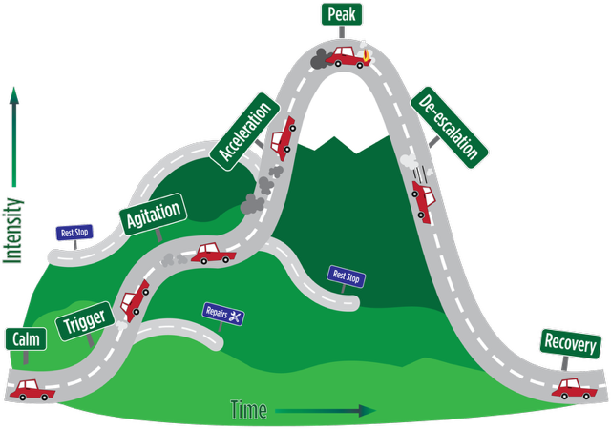
Tier 3: Stand-Alone Intervention

Slide 20

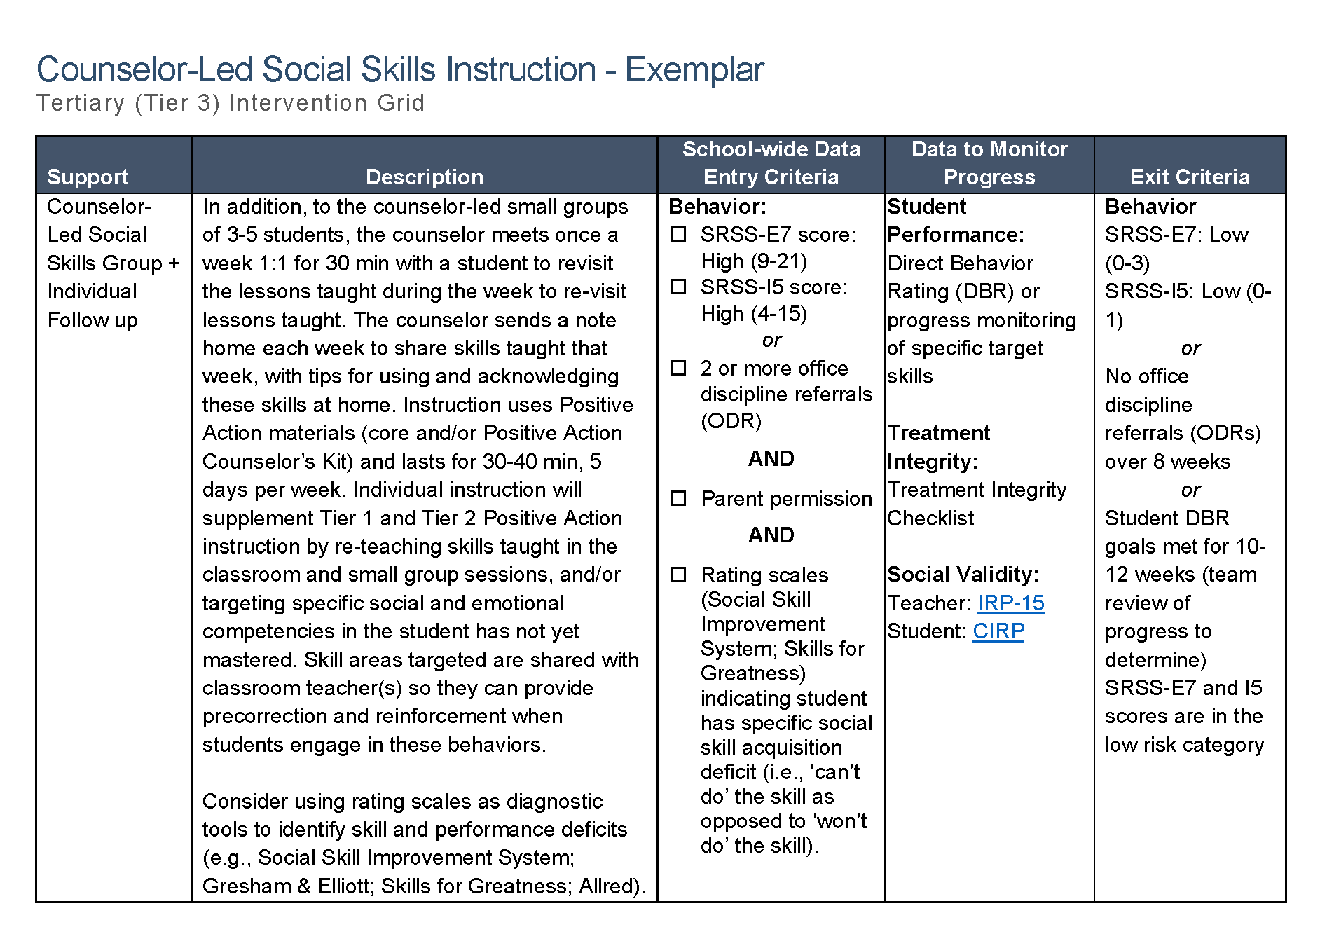
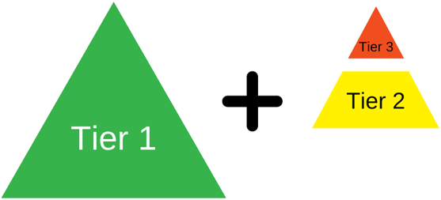
Tier 3: Intensification of Tier 2 Support
Notes:
Sometimes – Tier 3 is an intensification of a Tier 2 support such as coupling a Tier 2 support (i.e., counselor-led social skills group) with an individual follow up.

Slide 21
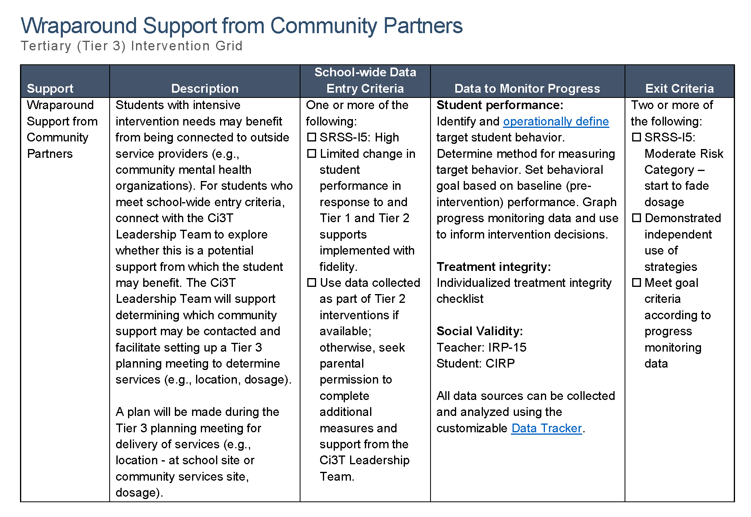
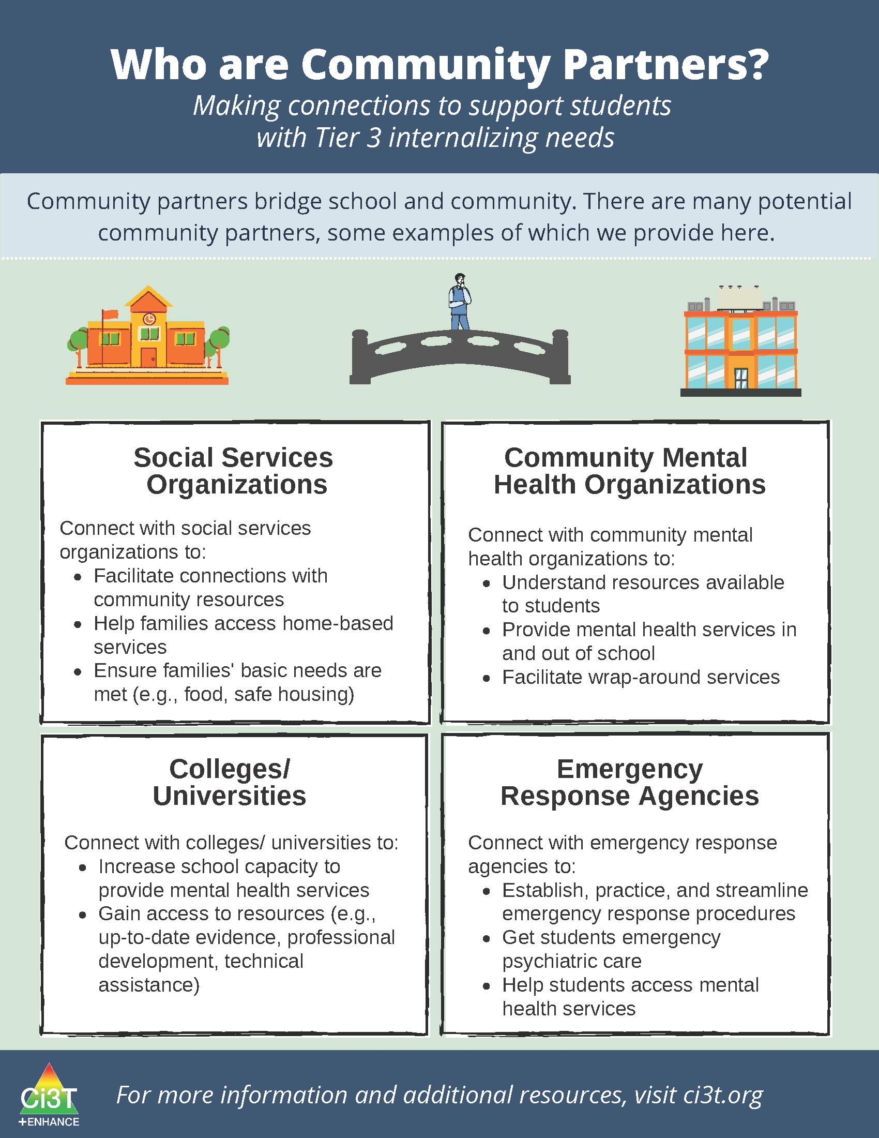
Tier 3: Wraparound Support

Slide 22
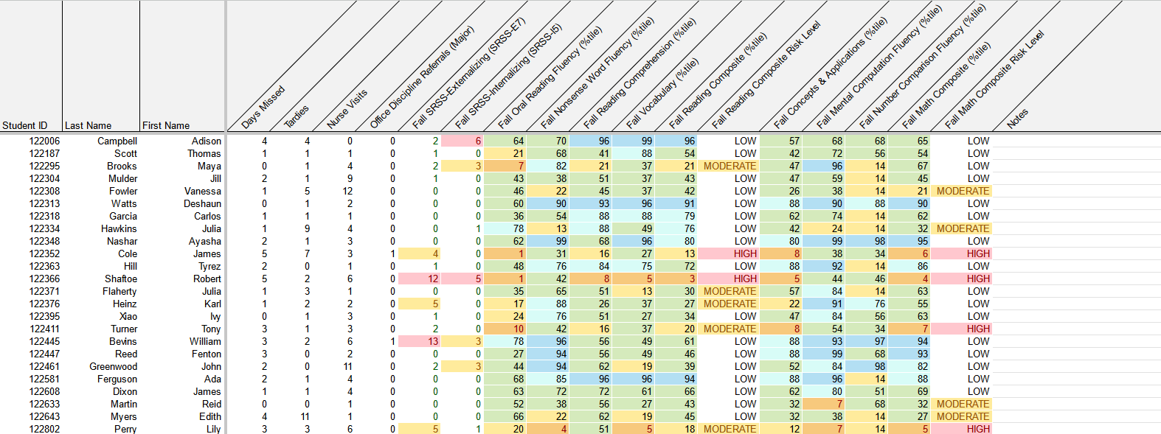
Using Multiple Sources of Data to Connect Students with Tier 3 Supports
attendance
office discipline referrals
behavior
screening
academic screening

Slide 23


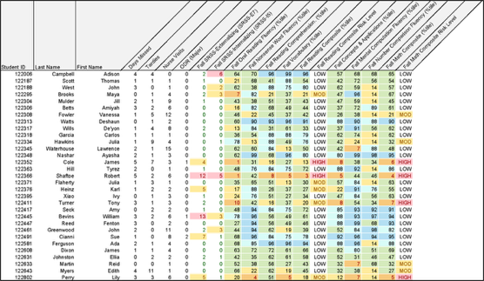
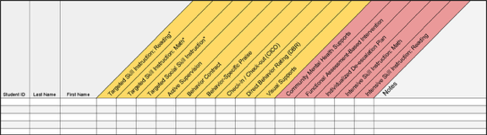
Getting Started with Data-Informed Decision Making

Slide 24





Table Talk
What Tier 3 interventions are offered at your school?
Open your Ci3T Implementation Manual and look at your Tertiary (Tier 3) Intervention Grids
Notes:
3-min timer

Slide 25

Functional Assessment-Based Intervention (FABI)
An Overview of FABI
A 5-Step Process to Implement FABI

Slide 26
Session 1 Outcomes
Describe how FABI is situated as a tertiary (Tier 3) intervention within a Ci3T model of prevention
Describe a step-by-step process to implement Functional Assessment-Based Intervention (FABI) as a Tier 3 support
Use school-wide data to identify a student who might benefit from a FABI

Slide 27


Functional Assessment-based Intervention

Slide 28
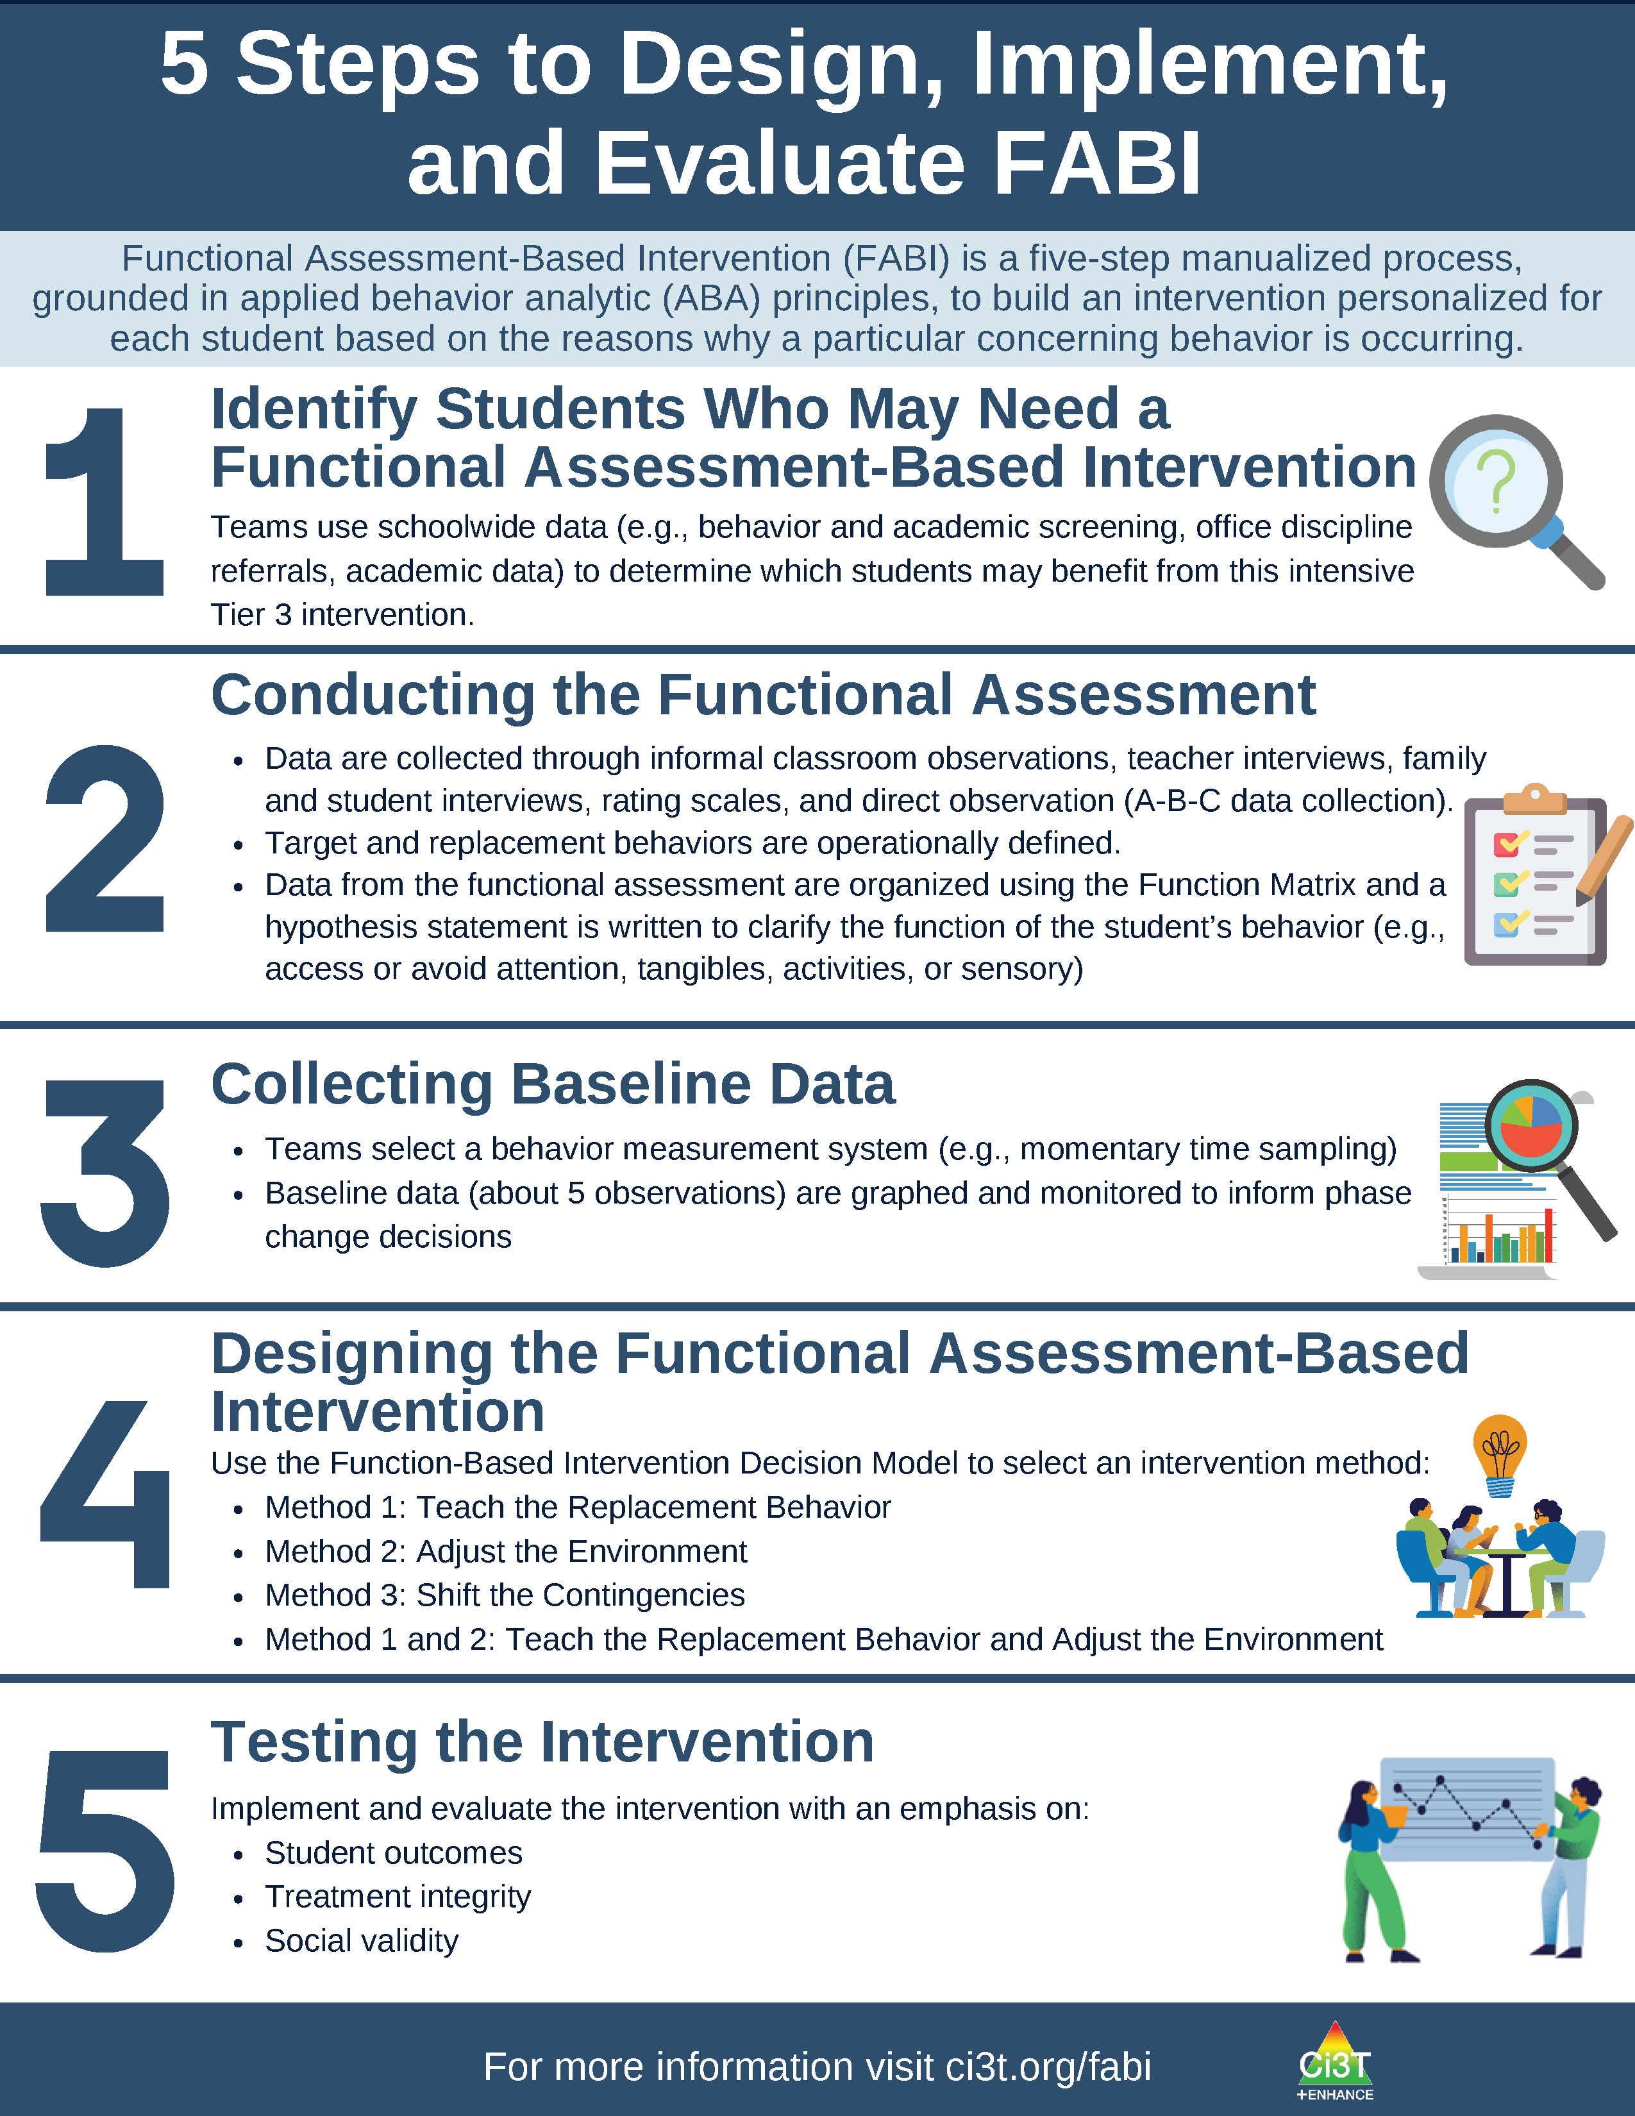
What is Functional Assessment-Based Intervention (FABI)?
Customized intervention designed for each student based on the reasons why a particular concerning behavior is occurring
Developed through a five-step, team-based, manualized process
Grounded in applied behavior analytic (ABA) principles (e.g., reinforcement, antecedent, consequence)
Notes:
PRESENTER NOTE:
FABI is one type of FBA (functional behavioral assessment)
Can be used as a Tier 3 intervention, as we are discussing in this presentation
Can also be used as a process to conduct a functional behavioral assessment (FBA) and develop a behavior intervention plan (BIP) for student’s with IEPs as required under certain conditions of IDEA
See state regulations for more information regarding FBAs as part of a student’s IEP

Slide 29
5 Steps to Design, Implement, and Evaluate FABI 1

Slide 30
5 Steps to Design, Implement, and Evaluate FABI 2

Slide 31
Why is FABI effective?
Individualized based on the function of behavior (i.e., why the behavior occurs) and needs of the student and environment
Focuses on skill-building and supporting pro-social behavior (i.e., replacement behavior)
Step-by-step manualized process
Team-based process fosters collaboration between educators, families, and the student

Slide 32

Building Your FABI Team
Two people who serve on this “standing” team
Member of Ci3T Leadership Team
Staff with behavioral expertise (e.g., behavior specialist, instructional coach, counselor, school psychologist)
Classroom teacher(s) of the student who might benefit from this support
Family member of the student
Student

Slide 33
What are the Benefits and Challenges of Implementing FABI?
Benefits
Challenges
Collaborative, team-based process integrating student, educator, and caregiver voice and perspective
Strong evidence-base demonstrating effectiveness for wide range of students (pre-K – 12), behaviors, and settings
Fully manualized process with templates and checklists to support design and implementation
Time and resource intensive
May require additional training (e.g., measuring behavior, ABC data collection)
Adjustment from more ”traditional” FBA/BIP practices

Slide 34
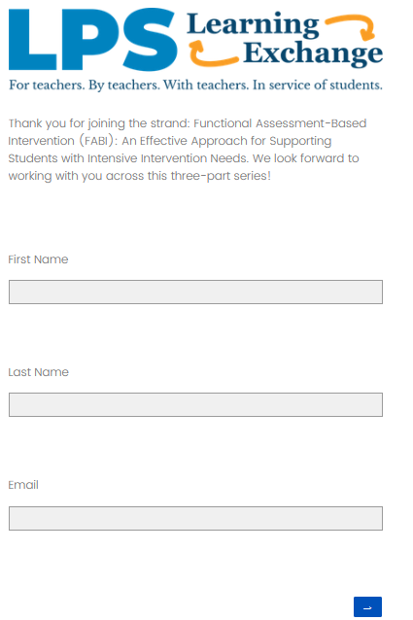
Work Time Set Up: FABI KCU
Please share your initial impressions of Functional Assessment-Based Intervention (FABI) with the FABI Knowledge, Confidence, and Use Survey
These data will:
Inform session 2 and session 3
Support Knowledge – Application – Impact points
Notes:
You’re investing your time in this – we want to make sure we’re providing high quality PL. We are committed to your learning. Use as part of KAI

Slide 35
Work Time Set Up: Initial Impressions
Use a sticky note to answer each question
Add any questions to the Parking Lot
What components of FABI seem most feasible?
What might be challenging about implementing FABI?
Parking Lot
Add questions here!

Slide 36


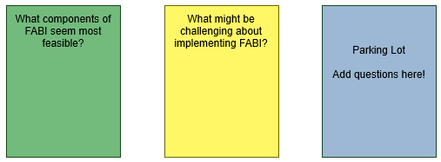

















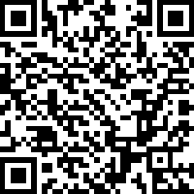
Work Time: Initial Impressions
https://tinyurl.com/LearningExchangeFABI
Notes:
20-mins
https://kusurvey.ca1.qualtrics.com/jfe/form/SV_bJJCb1RgGie9C4u
https://tinyurl.com/LearningExchangeFABI

Slide 37

Functional Assessment-Based Intervention (FABI) as a Tier 3 Intervention
An Overview of FABI
A 5-Step Process to Implement FABI

Slide 38
Session 1 Outcomes
Describe how FABI is situated as a tertiary (Tier 3) intervention within a Ci3T model of prevention
Describe a step-by-step process to implement Functional Assessment-Based Intervention (FABI) as a Tier 3 support
Use school-wide data to identify a student who might benefit from a FABI

Slide 39


Opportunities to Learn More
Opportunities to Learn More 1
Notes:
Our intention in this professional learning is to provide high-level overview of FABI and opportunities to practice the key components. If you are interested in learning more or implementing FABI in your setting, we encourage you to access these additional resources to more comprehensively learn about each of the five steps.

Slide 40

Step 1: Identifying Students Who May Need a FABI
Step 1: Identifying Students Who May Need a FABI 1

Slide 41

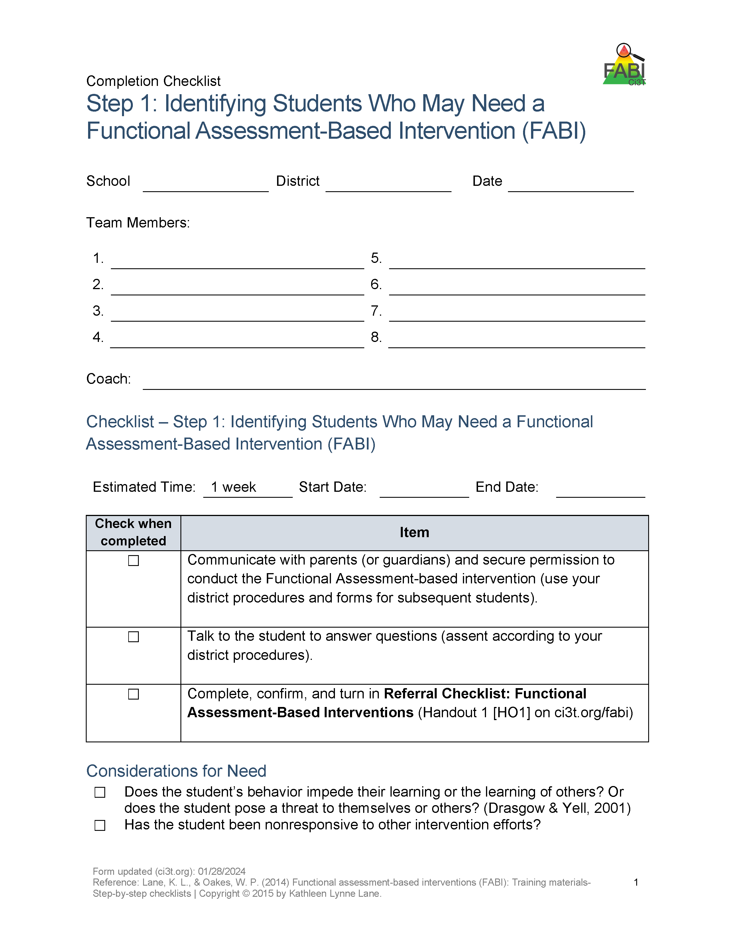
Step 1: Identifying Students Who May Need a FABI
Step 1: Identifying Students Who May Need a FABI 2
Review multiple sources of data
Connect with family member(s)
Meet with student

Slide 42
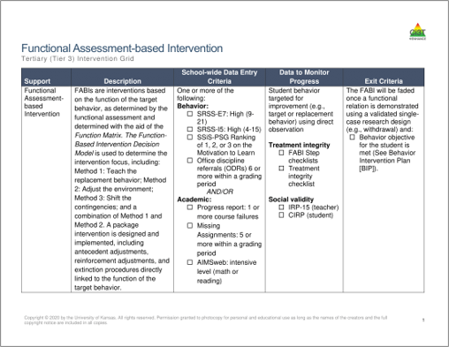
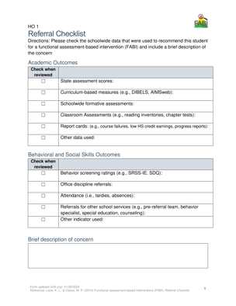
Review multiple sources of data
Use the Tertiary (Tier 3) Intervention Grid and referral checklist to review multiple sources of data such as:
Academic assessment data (e.g., screening, curriculum-based measures)
Behavior screening tools
Office discipline referrals (ODRs)
Attendance records

Slide 43
Connect with Family Member(s) and Student
Family Member(s)
Student
Describe FABI and role family member will play throughout FABI process
Explore other Tier 3 interventions
Secure permission following district procedures
Explain goals of FABI and how the student will be involved throughout the FABI process
Provide opportunity for student to ask questions

Slide 44

Step 2: Conducting the Functional Assessment
Step 2: Conducting the Functional Assessment 1

Slide 45

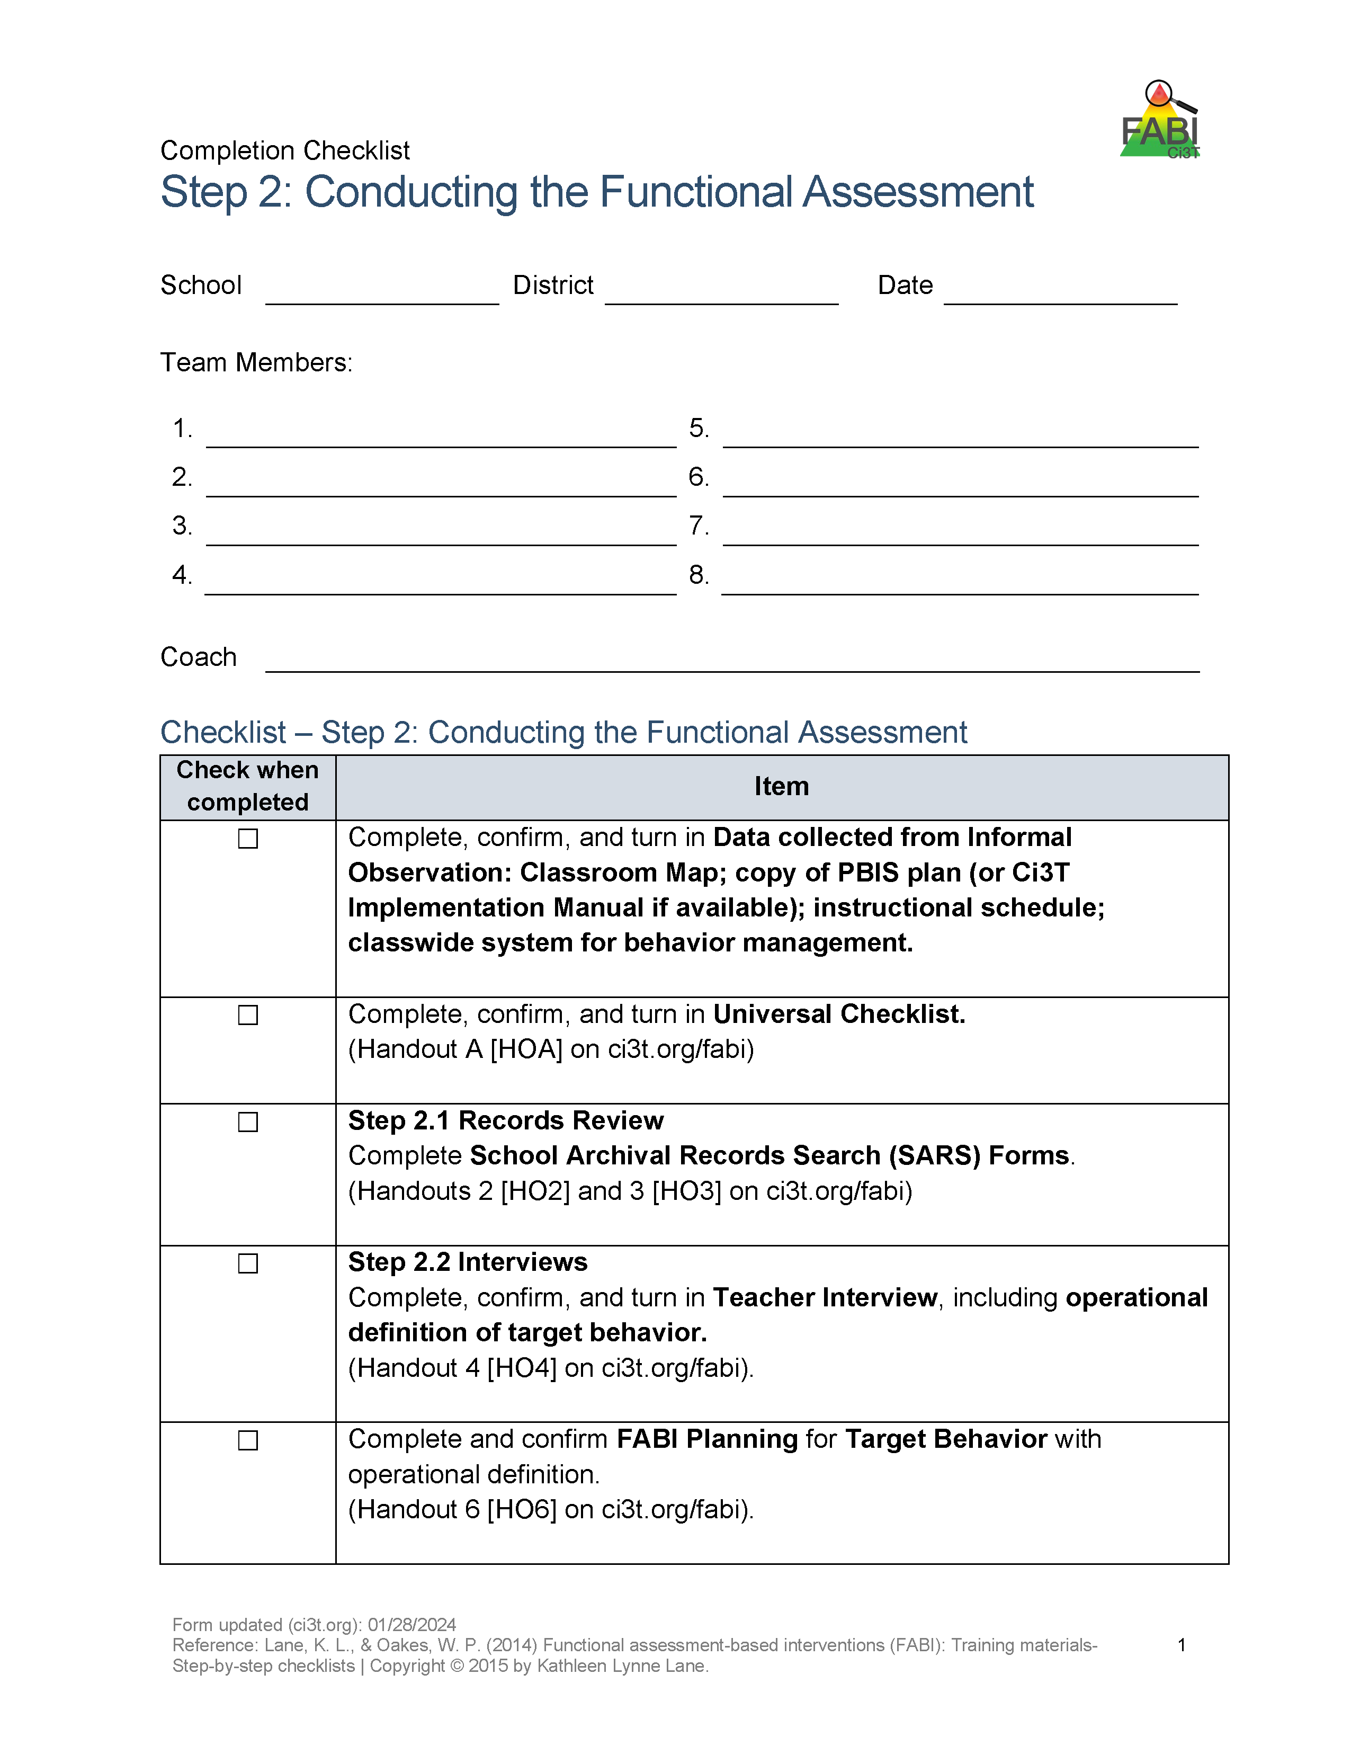
Step 2: Conducting the Functional Assessment
Step 2: Conducting the Functional Assessment 2
Understanding the learning environment and context
Records review
Interviews
Operationally define target behavior
Rating scales
A-B-C data collection
Use Function Matrix to identify the hypothesized function(s)
Identify replacement behavior
Notes:
Today, we are going to focus on these three components of Step 2

Slide 46


Understanding the Learning Environment and Context: School Context
Ci3T Implementation Manual
Treatment Integrity and Social Validity Reports
Informal observations of teacher-teacher, teacher-student, and student-student interactions across settings (e.g., hallways, cafeteria, arrival and dismissal)
Notes:
want the Tier 3 intervention to build on the foundation of Tier 1 efforts to promote generalization and maintenance of newly acquired skills across people, settings, and behaviors – as well as over time.

Slide 47
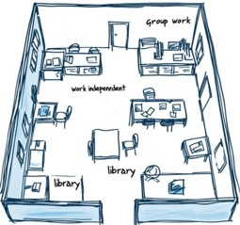
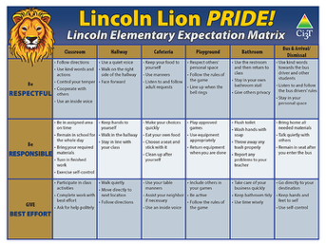
Understanding the Learning Environment and Context: Classroom Context
Classroom Map
Instructional schedule
Tier 1
Expectation matrix
Universal reinforcement system (e.g., tickets)
Classwide system for behavior management
Universal Checklist
Teacher Ci3T Treatment Integrity: Direct Observation

Slide 48
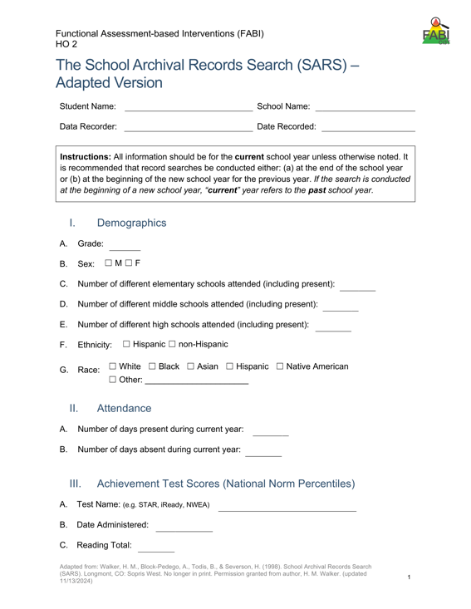
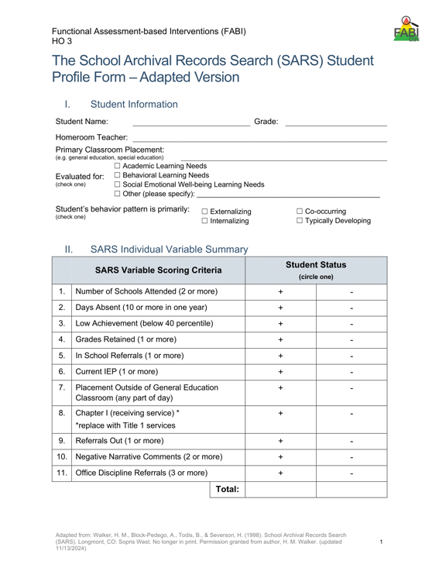
Records Review: School Archival Records Search (SARS)
Notes:
Systematic review of the student’s file to ensure a comprehensive understanding of both the student’s areas of strengths and the ways in which they may have struggled. Covers transiency, attendance, academic achievement, retention, disciplinary contacts, referrals, and comments from file.

Slide 49
Interviews
Teacher interview
Administer Preliminary Functional Assessment Survey (PFAS; Dunlap et al., 1993)
Operationally define the target behavior
Understand more about the behavior (e.g., when it does / does not occur)
Family
Administer Preliminary Functional Assessment Survey (PFAS; Dunlap et al., 1993)
Glean additional information about the target behavior from the family’s perspective
3. Student
Student Assisted Functional Assessment Interview (Kern et al., 1994)
Understand more about the behavior from the student’s perspective

Slide 50
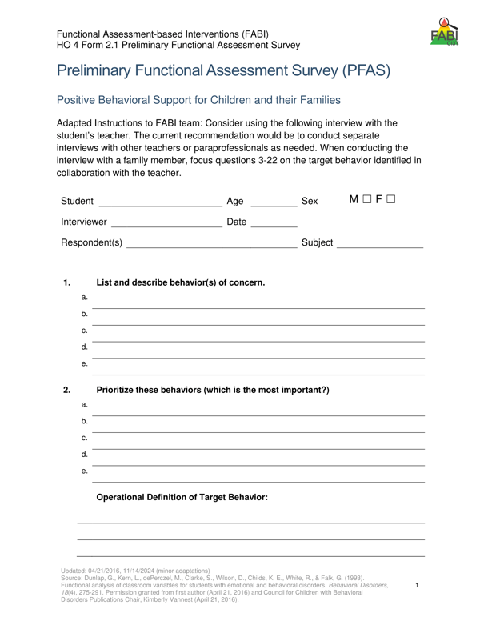
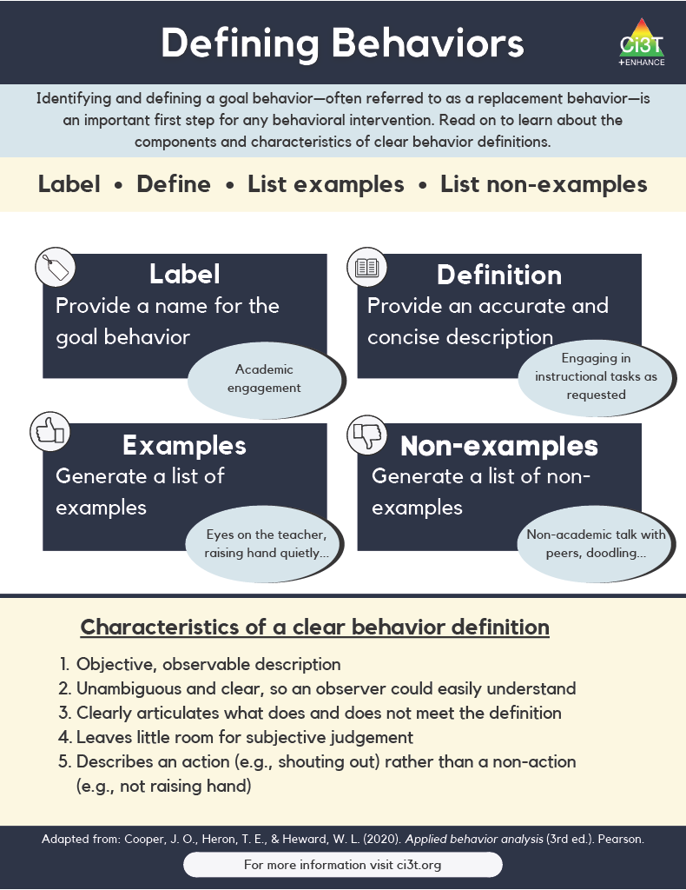
Operationally Defining the Target Behavior
Notes:
During the teacher interview, you will work with the teacher to identify all behaviors of interest and then create a prioritized list to determine the one keystone behavior. In other words, what is the one behavior, that if modified, could allow students to enjoy school more fully?
This becomes the target behavior (or the behavior you are seeking to reduce) which you will then operationally define

Slide 51
Defining Behaviors 2

Slide 52
Defining Behaviors 2

Slide 53
Example Operational Definition
Example Operational Definition 1
Component | Description
Label | Off-task
Definition | Off-task is defined as attending to activities in class other than assignments.
Examples | Playing with materials inappropriately, talking to peers, putting head on the desk, drawing, and looking around the room
Non-Examples | Completing assignments using materials only for assignments, and watching the teacher when delivering instruction

Slide 54
Example Operational Definition
Example Operational Definition 2
Component | Description
Label | Verbal aggression
Definition | Verbal aggression is defined as any vocalization directed towards a peer or adult at a volume above expected conversational level for a given setting alongside use profanity or language that is not appropriate for the setting.
Examples | Yelling “I hate you” at a voice level 3 during classroom instruction, verbal threats directed towards peer (e.g., “if you don’t stop, I’m going to…”), name-calling, profanity.
Non-Examples | Level 3 voice level at recess, shouting out an answer during choral response, sighing (“uhhhggg”), negative self-talk (e.g., “this is too hard”)

Slide 55
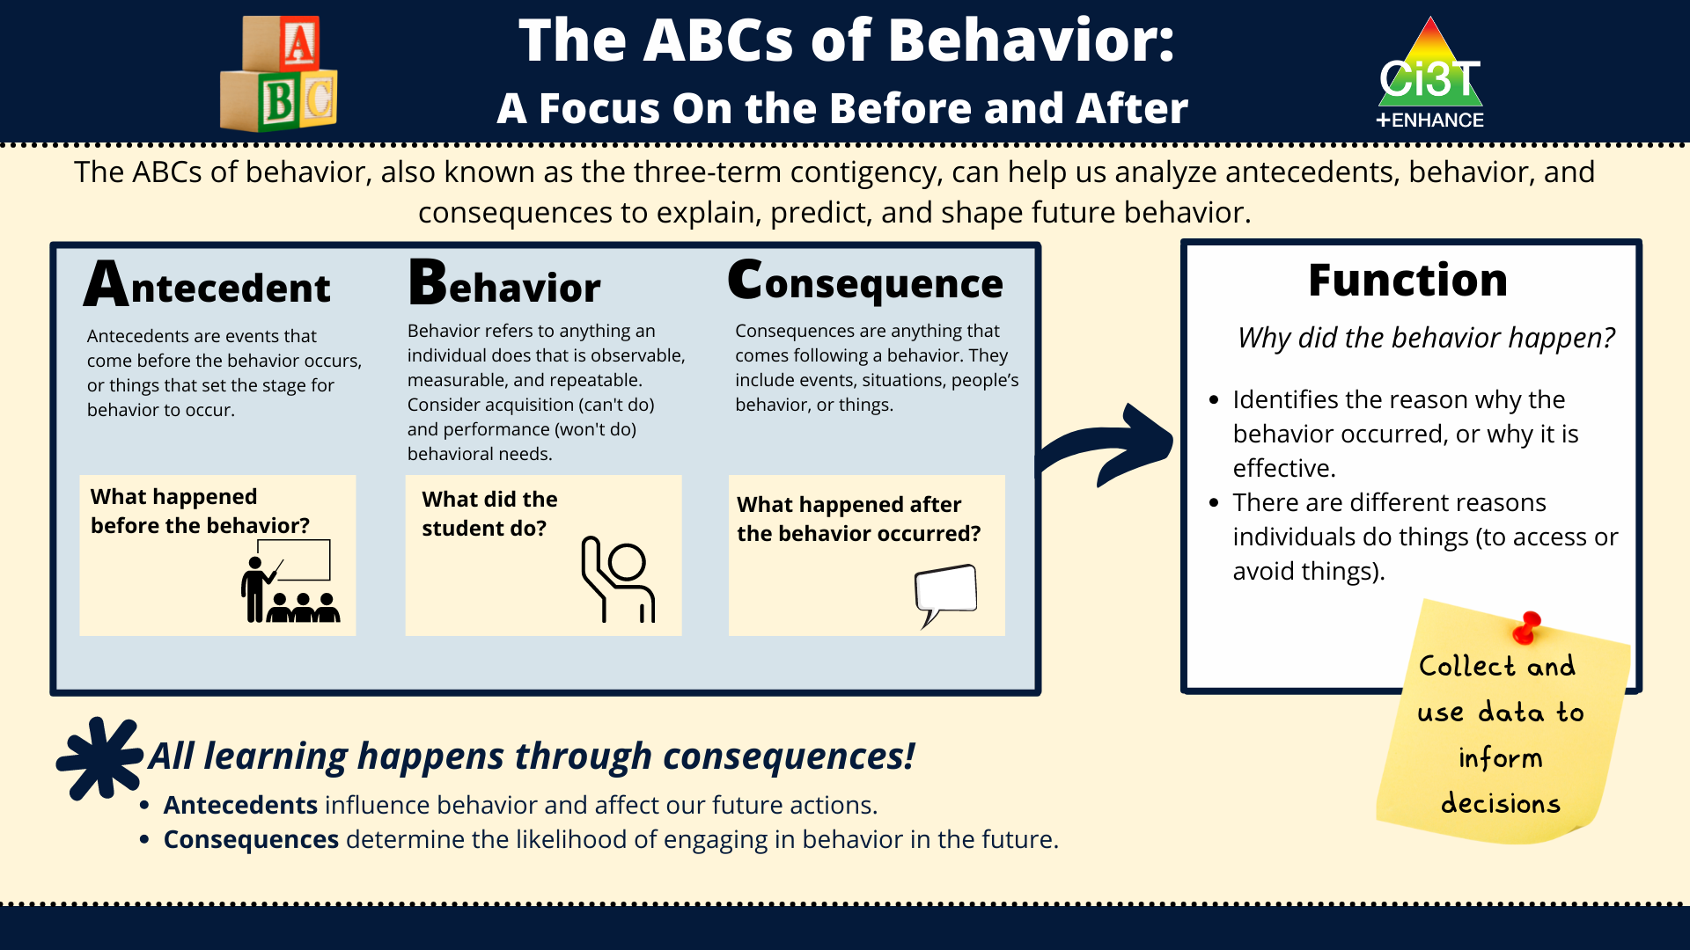
Direct Observation (A-B-C Data Collection)
Direct Observation (A-B-C Data Collection) 1

Slide 56
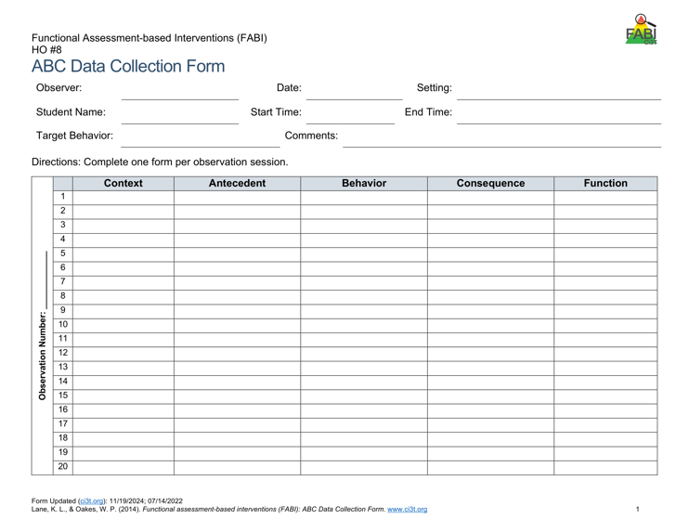
Direct Observation (A-B-C Data Collection)
Direct Observation (A-B-C Data Collection) 2
Determine the time of day and setting during which the behavior most often occurs
3 observation sessions (minimum)
Aim to observe 8-10 occurrences of the target behavior or three hours of observations
Record only instances of target behavior
Each instance of the target behavior will be numbered and later placed in the Function Matrix

Slide 57
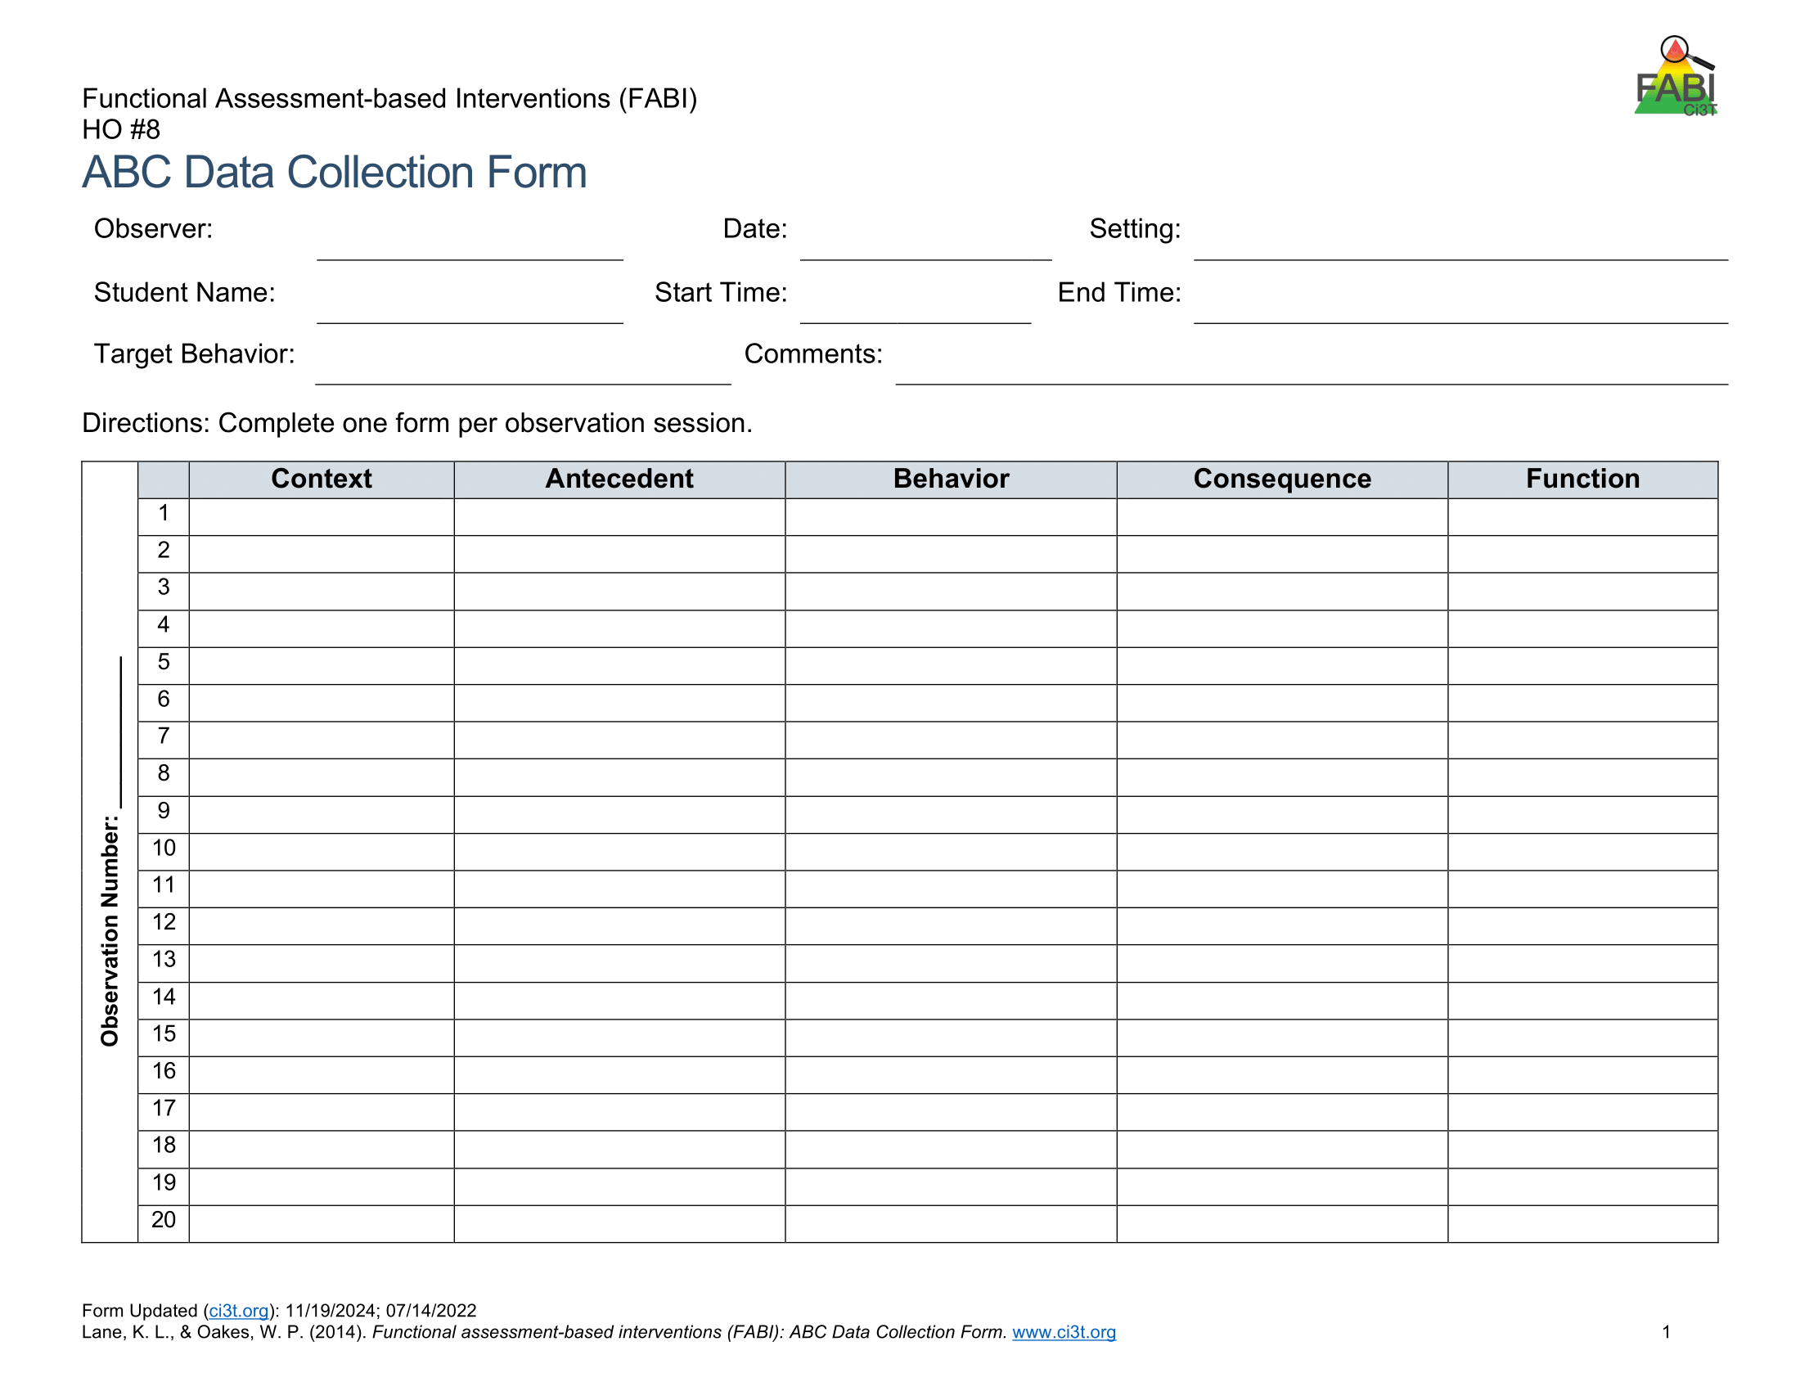

A-B-C Data Collection Example
Reading instruction
Pencil breaks
Student throws pencil
Teacher looks at student
Notes:
Each time the target behavior occurs you will record details in a new row. Each instance of the target behavior will be numbered and later placed in the function matrix.
You should will note the context in which the behavior occurred, such as reading instruction, morning circle time, or math instruction, and the antecedent, or what happened immediately before the behavior.
Additionally, record the target behavior itself, the consequence, or what happened immediately after the target behavior.
The function of the behavior, such as access to or avoidance of attention, tasks or tangibles, or sensory experiences will be completed later.

Slide 58
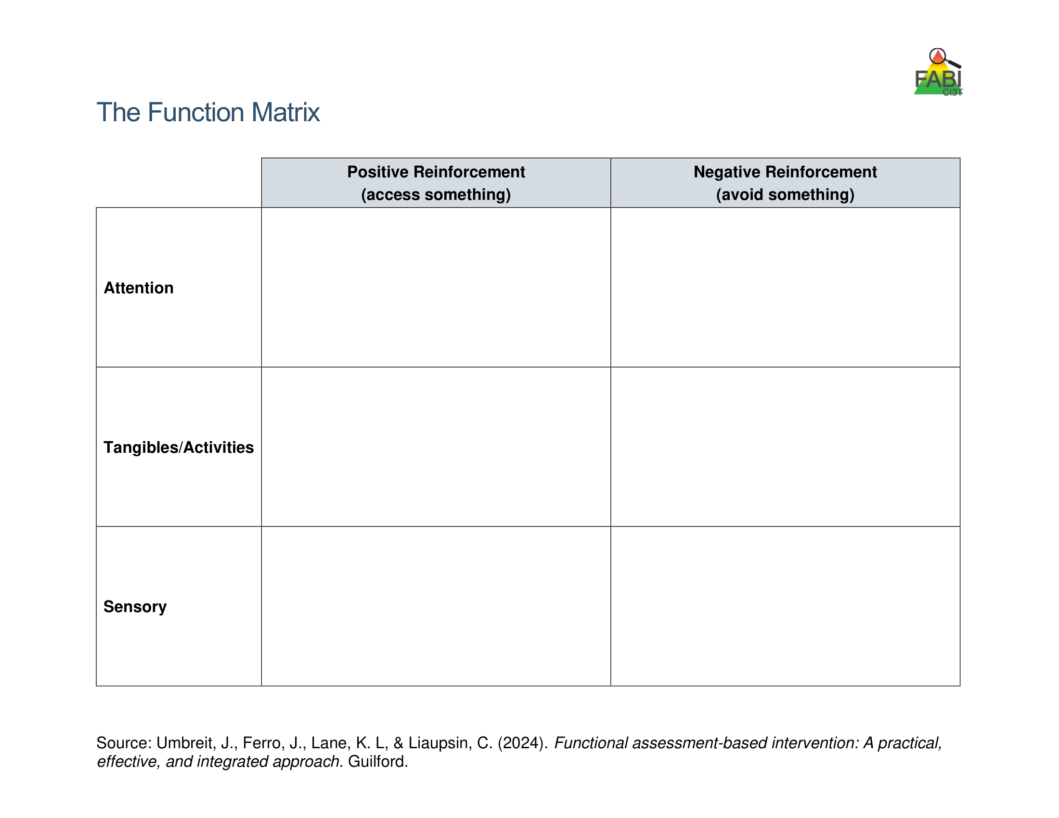
Use Function Matrix to identify the hypothesized function(s)
Peers laugh
Teacher provides 1:1 assistance
Work alone
Ignored by peers or adults
Preferred activity (e.g., tablet)
Do not have to complete academic task
Access to fidgets
Noise cancelling headphones
Notes:
The Function Matrix, developed by Umbreit and colleagues is a practical, effective, and novel tool for visually organizing multiple sources of information from informal observations, interviews, rating scales, and A-B-C observation data to identify the function of the target behavior.
The Function Matrix is organized based on the principles of applied behavior analysis, with columns reflecting the two ways behaviors are reinforced: positive reinforcement (meaning to get or access something) and negative reinforcement (meaning to escape or avoid something).
Then, the three rows reflect three behavioral categories (the “something or somethings”) the person is trying get or avoid: attention, tangibles or activities, and sensory experiences.

Slide 59
Function Matrix
 | Positive Reinforcement (access something) | Negative Reinforcement (avoid something)
Attention | Teacher Interview – “During Independent work time, frequently comes to me to ask a question during math. Often, she already knows the answer” Parent Interview “She wants me to check her homework every night. Not just one math problem but all of them.” ABC Data- 1.2, 1.3, 2.1, 2.4, 3.1
Tangibles/Activities |  | Records Review - Tammy’s low grades were due to lack of class work completion. Teacher Interview- “She is the last one to get started when it is time for independent reading.” Student Interview- “I hate worksheets, they’re so boring” ABC Data: 1.1, 1.4, 2.2, 2.3, 2.5, 3.2
Sensory
Number of the observation
session (Day 1)
Number of the occurrence in the
observation session
(second instance of the behavior on Day 1)
Source: Umbreit, Ferro, Lane, & Liaupsin (2024); Umbreit, Ferro, Liaupsin, & Lane (2007); Umbreit, Lane, & Dejud (2004)
Notes:
Information from all parts of the functional assessment are added to Function Matrix. This includes: informal observations, interviews, rating scales, and A-B-C observation data.
ABC Data are using the following notation: Number of the observation session (e.g., observation session 1, 2, 3) dot number of the occurrence of target behavior in that observation session (e.g., the second instance of behavior) – this is the number of the row.

Slide 60
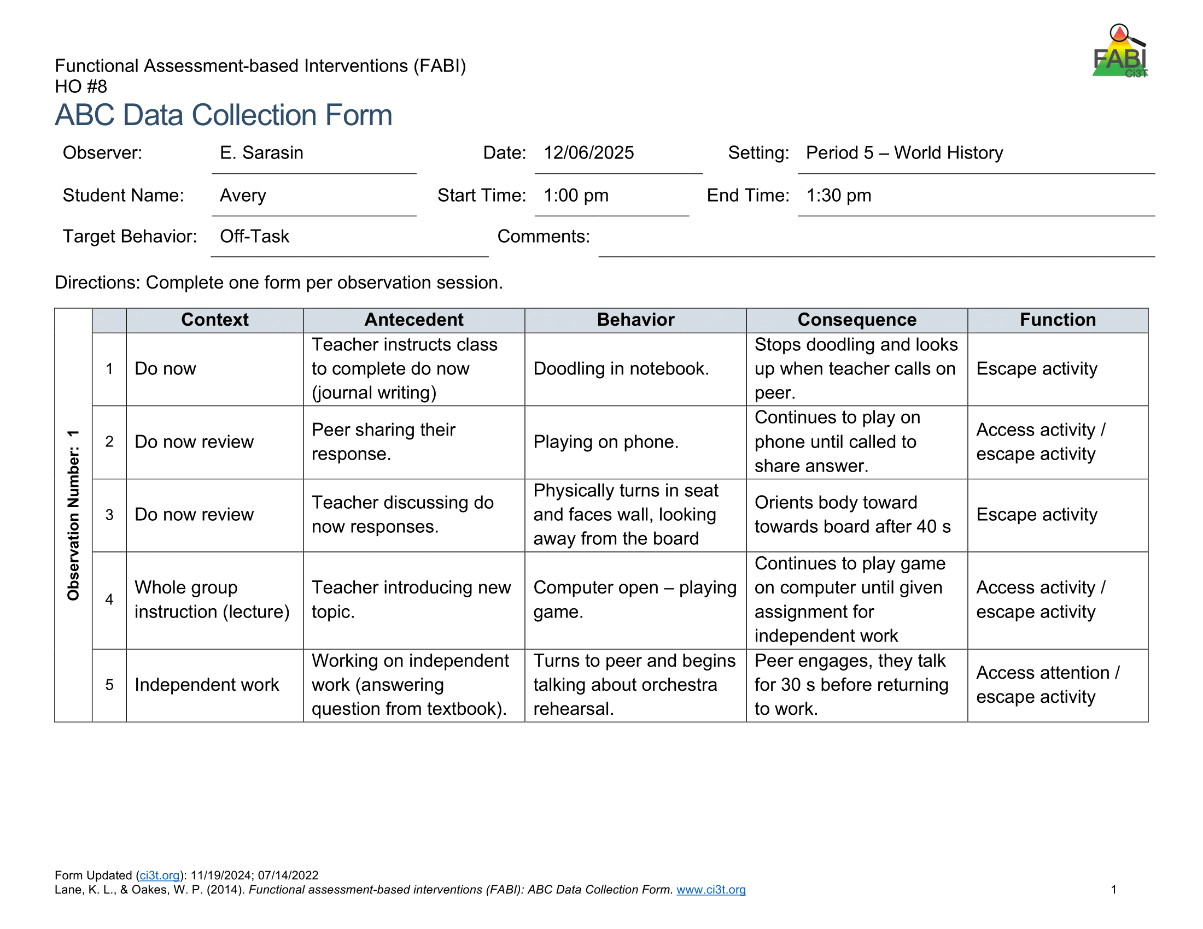
Let’s Practice!
Let’s Practice! 1
What’s the Function?
Access – Attention
Avoid – Attention
Access – Tangibles / Activities
Avoid – Tangibles / Activities
Access – Sensory
Avoid - Sensory
?
?
?
?
?

Slide 61
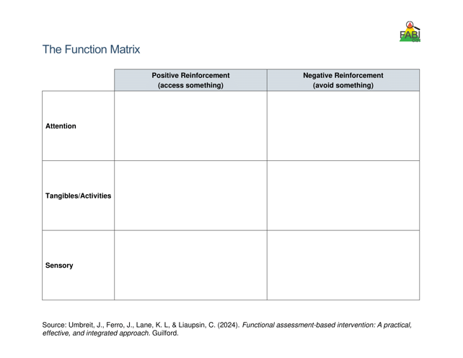
Hypothesized Function
During [context], [student name] engages in [target behavior] in order to [maintaining function(s)].
Example:
During independent reading activities (CONTEXT), Frank (STUDENT NAME) engages in noncompliant behavior (TARGET BEHAVIOR) to (a) escape too difficult tasks and (b) access peer and teacher attention (MAINTAINING FUNCTIONS).

Slide 62

Let’s Practice
Work with your group to
complete the Function Matrix.
Notes:
15-min

Slide 63
Function Matrix Practice Debrief
 | Positive Reinforcement (access something) | Negative Reinforcement (avoid something)
Attention | Teacher Interview: “he likes any opportunity to talk with his peers or make his peers laugh” Teacher Interview: “instead of starting his work he’s out of his seat, playing with materials, talking with the person next to him, or asking me something completely unrelated to the task” ABC Data: 1.1, 2.1, 2.2, 2.3
Tangibles/Activities | Teacher Interview: “he does well in science where we get to do more hands-on activities” Student Interview: “I wish we had more group work or fun activities” | Teacher Interview: “instead of starting his work he’s out of his seat, playing with materials, talking with the person next to him, or asking me something completely unrelated to the task” Student Interview: “math is hard because the worksheets are so boring” ABC Data: 1.2, 1.3, 2.1, 2.3
Sensory | ABC Data: 1.2

Slide 64
Break
Use a sticky note to add any questions to the Parking Lot
Stretch your legs, drink some water, we will be back at:
Parking Lot
Add questions here!

Slide 65

Step 3: Collecting Baseline Data
Step 3: Collecting Baseline Data 1

Slide 66

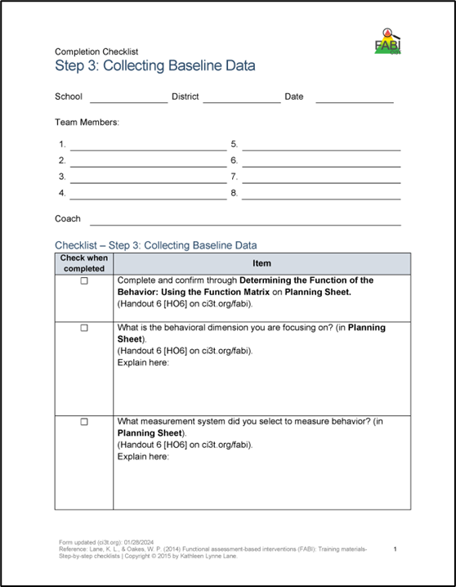
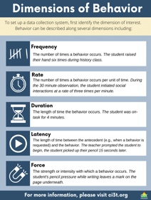
Step 3: Collecting Baseline Data
Step 3: Collecting Baseline Data 2
Determine behavioral dimension of focus
Select a measurement system
Develop data collection procedures
Train data collectors
Collect baseline data
Graph baseline data
Notes:
Today, we are going to focus on these three components of Step 3

Slide 67
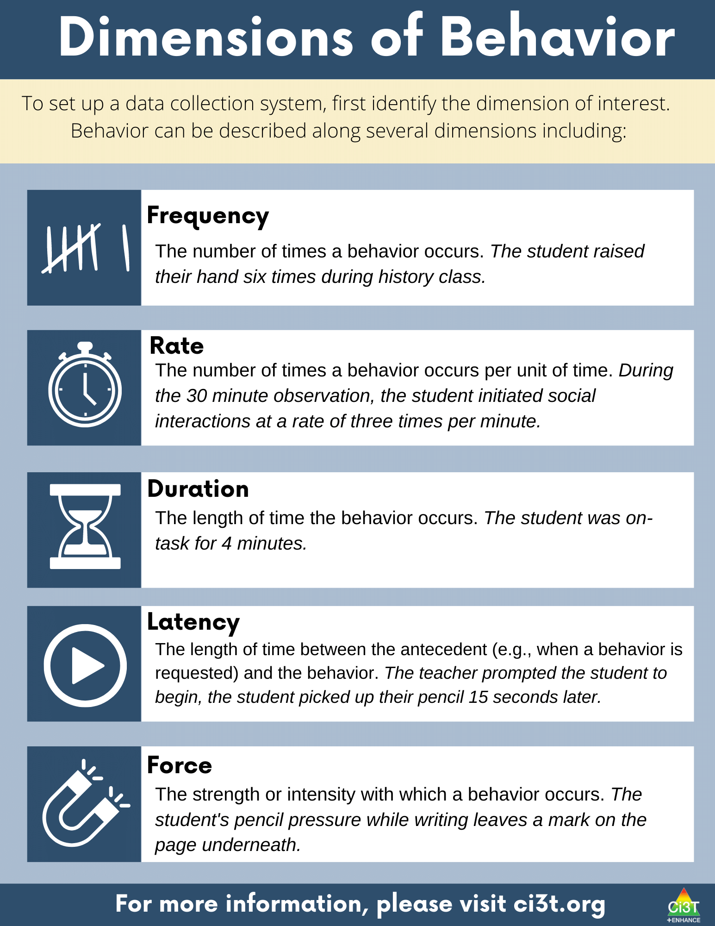
Dimensions of Behavior 1

Slide 68
Dimensions of Behavior 2

Slide 69
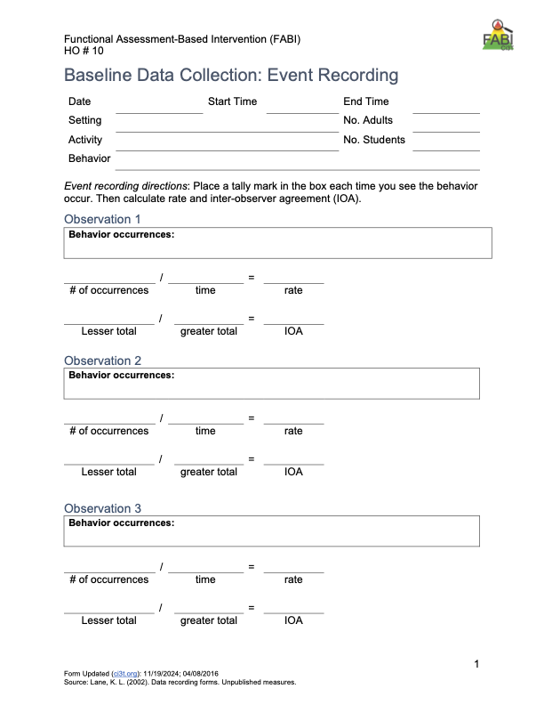
Types of event-based measurement:
Frequency
Rate
Most appropriate for behaviors that are:
Countable and discrete (e.g., relatively brief, clear start and end, and uniform in length).
Examples: talking out of turn, swearing, pushing
Select a Measurement System: Event-Based

Slide 70
Let’s Practice – Frequency Recording
Target Behavior
Label: | Saying “cake”
Definition | Saying “cake” is defined as anytime Jim says the word “cake”
Examples: | “cake”
Nonexamples: | “you guys”, “chocolate”, “breakfast”
Notes:
https://youtu.be/ofRn9zCjy8s?si=1W6vo_yTak1yDSQ7&t=88

Slide 71

Let’s Practice – Frequency Recording 2
Notes:
https://youtu.be/ofRn9zCjy8s?si=1W6vo_yTak1yDSQ7&t=88

Slide 72
Debrief – Frequency Recording
How many times did Jim say the word cake?
What about frequency recording was challenging?
Given those challenges, how could the measurement procedures be improved?
Notes:
PRESENTER NOTES:
Jim says cake 18 times
Challenges
Pancake? Cupcake?
Hearing / audio quality
Frequency (happened a lot, hard to keep up) -
Procedures could be improved by:
Revising operational definition – whether or not to “count” compound words
Set up with good vantage point / audio to conduct observation
Consider whether frequency is appropriate / feasible (e.g., if happening too much to keep up maybe partial interval would be more appropriate)

Slide 73
Select a Measurement System: Time-Based
Time Based
Duration
Latency
Interval (whole-interval, partial interval, momentary time sampling)
Most appropriate for behaviors that are:
Not countable or discrete (e.g., less defined start/end, span a period of time) and/or vary in length each time
Examples of non-uniform behaviors include: academic engagement, off-task, leaving designated area (e.g., desk, carpet spot), tantrum

Slide 74

Step 3: Collecting Baseline Data
Step 3: Collecting Baseline Data 3
Determine behavioral dimension of focus
Select a measurement system
Develop data collection procedures
Train data collectors
Collect baseline data
Graph baseline data
We will discuss these items at Session 2!

Slide 75
Capture Questions in the Parking Lot!
Use a sticky note to add any questions to the Parking Lot
Parking Lot
Add questions here!

Slide 76

Step 4: Design the FABI
Step 4: Design the FABI 1

Slide 77


Step 4: Design the FABI
Step 4: Design the FABI 2
Select an intervention method
Develop A-R-E intervention components
Draft treatment integrity checklist
Assess pre-intervention social validity
Develop intervention materials
Introduce FABI to educators and family
Introduce FABI to student
Revise and finalize FABI
Notes:
Today, we are going to focus on these components of Step 4

Slide 78


Function-Based Intervention Decision Model
An intervention method is selected based on the response to these two questions:
Can the student perform the replacement behavior?
Do antecedent conditions represent effective practices for this student?

Slide 79

Function-Based Intervention Decision Model 1

Slide 80
A-R-E Components
Antecedent Adjustments - adjusting the antecedent conditions to increase likelihood replacement behavior will occur and (if applicable) providing instruction in the replacement behavior
Reinforcement Shifts - reinforcing the replacement behavior to strengthen its occurrence
Extinction Procedures - ensuring that the target behavior is not followed by reinforcement

Slide 81

A-R-E Components 1

Slide 82

A-R-E Components 2

Slide 83

A-R-E Components 3

Slide 84
Illustration 1: David (2nd Grade)
Germer, K. A., Kaplan, L. M., Giroux, L. N., Markham, E. H., Ferris, G. J., Oakes, W. P., & Lane, K. L. (2011). A function-based intervention to increase a second-grade student's on-task behavior in a general education classroom. Beyond Behavior, 20(3).

Slide 85
Target Behavior: Off -Task Behavior
Component | Description
Label | Off-task
Definition | Off-task behavior refers to engaging in behaviors or making verbal comments unrelated to instructional tasks.
Examples | leaving assigned instructional area without teacher permission inappropriately making comments to teacher or peers unrelated to instruction attending to anything other than the academic task doing unassigned tasks using instructional materials inappropriately taking more than 30 s to prepare for instructional task
Non-Examples | staying in assigned instructional area appropriately making comments to teacher or peers related to instruction attending to academic tasks working on assigned task using instructional materials appropriately preparing for instructional task in less than 30 s

Slide 86
Replacement Behavior: On-Task
Component | Description
Label | On-task
Definition | On-task behavior refers to engaging in behaviors or making verbal comments related to instructional tasks.
Examples | staying in assigned instructional area appropriately making comments to teacher or peers related to instruction attending to academic tasks working on assigned task using instructional materials appropriately preparing for instructional task in less than 30 s
Non-Examples | leaving assigned instructional area without teacher permission inappropriately making comments to teacher or peers unrelated to instruction attending to anything other than the academic task doing unassigned tasks using instructional materials inappropriately taking more than 30 s to prepare for instructional task.

Slide 87

Function Matrix
Function Matrix 1

Slide 88
Hypothesized Function
Hypothesized Function 1
When presented with an instructional task, David engages in off-task behavior (such as leaving instructional areas, inappropriately making comments, and engaging in unassigned tasks) to access attention and/or to escape tasks.
In other words, when David is off-task he gets attention from his teacher and peers and does not have to complete assignments (positive reinforcement-attention and negative reinforcement-activity)

Slide 89

Function-Based Intervention Decision Model
Function-Based Intervention Decision Model 1

Slide 90


Measurement
Measurement 1
Duration
Measured academic engagement
20-min sessions during morning instructional time

Slide 91
Component 1- Adjust the Antecedents
Component 1- Adjust the Antecedents 1
Adjust Antecedents | Adjust antecedent variables so the conditions that set the occasion for the target behavior are eliminated and new conditions are established in which the replacement behavior is more likely to occur. | Seating change - David will sit facing the whiteboard Stoplight system Self-monitoring system Teacher will review picture schedule for the morning work period prior to the work period. Teacher will check-in with David at the beginning of independent tasks to ensure that he understood the assignment.

Slide 92

Classroom Example: Intervention Seating
Note: David’s seat pre-intervention
Note: David’s seat during the intervention

Slide 93
Component 1- Adjust the Antecedents
Component 1-Adjust the Antecedents 2
Stoplight System
Affixed to the side of David’s desk
David used a clothespin to signal which “light” he was on
Green, yellow, and red “lights”
Green: “I’m doing my work!”
Yellow: “I’m asking a friend for help!”
Red: “I still need help! I’m asking my teacher.”
“I’m done!” to signal completion

Slide 94
Component 2- Reinforcement Rates
Component 2- Reinforcement Rates 2
Reinforcement Rates | Provide appropriate reinforcement for the replacement behavior. | Teacher will provide behavior-specific praise when David is on-task. Teacher will acknowledge David’s need for help when his clothespin was on red and assist him as quickly as possible. Teacher will check David’s work upon completion, provide praise, and allow him to take a short break. At the end of the morning independent work period, teacher will help David complete his self-monitoring form and write one specific incidence of good behavior at the bottom.

Slide 95
Component 3- Extinguish the Target Behavior
Component 3 - Extinguish the Target Behavior 1
Extinguish Target Behavior | Withhold the consequence that previously reinforced the target behavior. | Teacher will provide no praise or attention when David is off-task, with the exception of one verbal or gestural redirect per minute. When David is off-task, teacher will praise other students who are behaving appropriately.

Slide 96

Treatment Integrity

Slide 97



Pre-Intervention Social Validity

Slide 98
Illustration 2: Harry 5th Grader

Slide 99
Target Behavior: Off -Task Behavior
Off-task is defined as attending to activities in class other than assignments
Examples
Playing with materials inappropriately, talking to peers, putting head on the desk, drawing, and looking around the room
Non-examples
Completing assignments using materials only for assignments, and watching the teacher when delivering instruction

Slide 100
Replacement Behavior: Academic Engagement
Academic engagement is defined as anytime Harry is attending to class instructions and/or assignments
Examples
Completing assignments using materials only for assignments, and watching the teacher when delivering instruction
Non-examples
Playing with materials inappropriately, talking to peers, putting head on the desk, drawing, and looking around the room

Slide 101
Function Matrix
Function Matrix 2
 | Positive Reinforcement (Access something) | Negative Reinforcement (Avoid something)
Attention | ABC 1.1, ABC 1.2, ABC 1.19, ABC 2.1(peer), ABC 2.2, ABC 2.3, ABC 2.4, ABC 2.7, ABC 2.8, ABC 2.10, S.I. # 4 (wants peer att.)
Tangibles/ activities | ABC 2.9, S.I. #4 (wants more fun activity) | ABC 1.2, ABC 1.3, ABC 1.4, ABC 1.6, ABC 1.7, ABC 1.8, ABC 1.9, ABC 1.10, ABC 1.11, ABC 1.12, ABC 1.13, ABC 1.14-1.19, ABC 2.1, ABC 2.2, ABC 2.4, ABC 2.5, ABC 2.6, ABC 2.7, ABC 2.9, Avoiding work when not structured. T.I. #4, T.I. #9, S.I. #2 & #3
Sensory | ABC 1.1, ABC 1.5, ABC 1.6, ABC 1.18, ABC 1.19, ABC 2.1, ABC 2.2, ABC 3.1-3.4

Slide 102
Hypothesized Function
Hypothesized Function 2
When presented with academic tasks or instruction, Harry became off-task (engaged in an activity other than the one assigned) to escape tasks and gain attention.
That is, Harry, engaged in off-task behaviors
to access teacher and/or peer attention
(positive reinforcement- attention)
or to escape the instruction by the teacher
or the activity that the teacher assigned
(negative reinforcement- activity).

Slide 103
Function-Based Intervention Decision Model
Function-Based Intervention Decision Model 2

Slide 104
Measurement
Measurement 2
Whole Interval recording
Measured academic engagement
20 min sessions, ~8:45-9:05 am
Each interval was 20 s

Slide 105

Let’s Practice
Let’s Practice 2
Work with your group to generate A-R-E components:
Antecedent Adjustments
Reinforcement Shifts
Extinction Procedures
Notes:
15-min

Slide 106
Component 1- Adjust the Antecedents
Component 1- Adjust the Antecedents 3
Adjust Antecedents | Adjust antecedent variables so the conditions that set the occasion for the target behavior are eliminated and new conditions are established in which the replacement behavior is more likely to occur. | Integrate instructional choice into independent work (e.g., complete evens or odds, select any six problems to complete, choice of math manipulative to use)
Notes:
WWC - https://ies.ed.gov/ncee/wwc/PracticeGuide/31
Low-Intensity, Teacher Delivered Strategies (module)

Slide 107
Component 2- Reinforcement Rates
Component 2- Reinforcement Rates 2
Reinforcement Rates | Provide appropriate reinforcement for the replacement behavior. | Provide behavior-specific praise paired with a universal reinforcer (e.g., ticket) when Harry begins independent work

Slide 108
Component 3- Extinguish the Target Behavior
Component 3- Extinguish the Target Behavior 2
Extinguish Target Behavior | Withhold the consequence that previously reinforced the target behavior. | Non-verbal redirection (e.g., gestural prompt)

Slide 109
Capture Questions in the Parking Lot!
Use a sticky note to add any questions to the Parking Lot
Parking Lot
Add questions here!

Slide 110

Step 5: Test the Intervention

Slide 111


Step 5: Testing the Intervention
Implement the intervention
Monitor treatment integrity
Collect and graph data
Implement a single-case design to “test” how well intervention is working
ABAB
Multiple baseline
Changing criterion
Assess social validity
Fade the intervention

Slide 112

Harry’s Intervention Outcomes
Harry’s Intervention Outcomes 1
Cox, M., Griffin, M. M., Hall, R., Oakes, W. P., & Lane, K. L. (2011). Using a Functional Assessment-Based Intervention to Increase Academic Engaged Time in an Inclusive Middle School Setting. Beyond Behavior, 20(3).

Slide 113

Harry’s Intervention Outcomes
Harry’s Intervention Outcomes 2
Cox, M., Griffin, M. M., Hall, R., Oakes, W. P., & Lane, K. L. (2011). Using a Functional Assessment-Based Intervention to Increase Academic Engaged Time in an Inclusive Middle School Setting. Beyond Behavior, 20(3).

Slide 114
Capture Questions in the Parking Lot!
Use a sticky note to add any questions to the Parking Lot
Parking Lot
Add questions here!

Slide 115
Work Time
Identifying Students Who Might Benefit from a Functional Assessment-Based Intervention

Slide 116
Session 1 Outcomes
Describe how FABI is situated as a tertiary (Tier 3) intervention within a Ci3T model of prevention
Describe a step-by-step process to implement Functional Assessment-Based Intervention (FABI) as a Tier 3 support
Use school-wide data to identify a student who might benefit from a FABI

Slide 117

Work Time: Identifying Students Who Might Benefit from a Functional Assessment-Based Intervention
Review FABI entry criteria in your Ci3T Implementation Manual
Which students might benefit from FABI?
Narrow down your list to focus on a student who would potentially benefit but does not have the most intensive intervention needs
Notes:
Narrow down list to focus on a student who would potentially benefit but not with the most intensive intervention needs. As this is a learning experience that spans between now and April, we want to make sure students with the most significant needs access support earlier
Encourage – pull up screening, looking at TOTAL score (E7) not item level

Slide 118
Wrapping Up and Moving Forward

Slide 119
Learning Exchange Series Progression
Session 1
October 10, 2025
Session 2
January 5, 2026
Session 3
April 17, 2026
FABI Overview
Step 1: Identifying Students Who May Benefit from FABI
Step 2: Conducting the Functional Assessment
Step 3: Collecting Baseline Data
Step 4: Designing the Intervention
Step 5: Testing the Intervention
Homework
FABI Step 1
FABI Step 2*
Homework
FABI Step 2
FABI Step 3
Homework
FABI Step 4
FABI Step 5

Slide 120


Action Items: Between Session 1 and 2

Slide 121

Optional: FABI Drop In (Zoom)
Wednesday, October 15, 2025
3:00-3:45

Slide 122
Opportunities to Learn More
Opportunities to Learn More 2

Slide 123

Project EMPOWER+
EMPOWER+ Session | Date
Starting Strong: Effective Tier 1 Practices for Educators | September 24, 2025 (Wednesday)
From Data to Action: Using Systematic Screening to Inform Instruction | October 8, 2025 (Wednesday)
Ci3T In Action: Integrated Lesson Planning for Enhanced Instruction | November 18, 2025 (Tuesday)
Mastering Behavior Specific Praise and Precorrection | January 21, 2026 (Wednesday)
A 6-Step Instructional Approach for Responding to Challenging Behaviors: A Tier 1 Practice | February 10, 2026 (Tuesday)
A Tier 2 Support for Students Experiencing Anxious Feelings: Recognize. Relax. Record. | March 25, 2026 (Wednesday)
A Tier 3 Support for Students with Intensive Intervention Needs: Functional Assessment-Based Intervention (FABI) | April 28, 2026 (Tuesday)
Notes:
Builds knowledge and skill sets aligned to FABI Steps. For example – BSP and pre-correct often Antecedent Adjustment

Slide 124
Knowledge, Application, Impact Points
Knowledge, Application, Impact Points 2
On-Task Behavior: Jackson
In Kansas, you can earn 2 x PD points for application and 3 x for impact!
We are happy to review your materials before you upload!
Notes:
Tonight’s session lays the foundation with knowledge building and getting you oriented to the modules that can support application and impact efforts!

Slide 125

Application & Impact
Also, did you know when you apply your learning…
you can take your learning activity in MLP to “Application” and earn double the points?
and demonstrate its’ impact, you can get triple your original knowledge points?
Check out the example below!
A total of 6 points for Salary Enhancement
Example
Original Activity = 2 points
These are “knowledge
points” and can be used for
relicensure.
Application = 4 points
These are “application points”
and can be used towards horizontal movement on the salary schedule.
Impact = 2 add’l points
These are “impact points” and can
be used towards horizontal movement on the salary schedule.
And, the BEST part?
Application and Impact points can be used to move horizontally
on the salary schedule! Click HERE to learn more (or use the QR code). See your PDC Representative if you have questions!
Use code: lnhgi6q
Notes:
lnhgi6q

Slide 126



Thank You!
Elise Sarasin
elise.sarasin@ku.edu
Kathleen Lynne Lane
kathleen.lane@ku.edu

