Slide 1
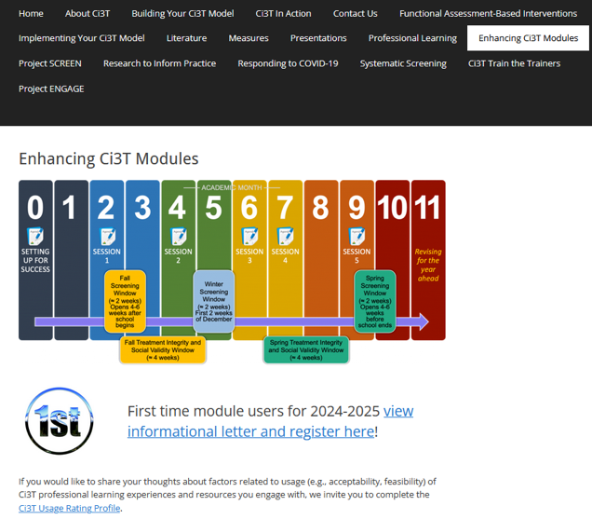
Implementing Comprehensive, Integrated, Three-tiered (Ci3T) Models: Planning for the Year Ahead
Enhanced Ci3T Implementation Series and Delivery (E-Ci3T) Session 5
If you have not done so already, we invite you to visit ci3t.org/enhance to access modules and complete a one-time registration process!

Slide 2
















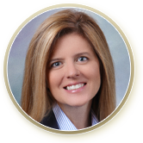





Ci3T Research Team
Grant Allen
Matthew Aschliman
Tammy Becker
Allison Bernard
Carrie Brandon
Amy Briesch
Mark Buckman
Amy Buffington
Donna Cauley
Sandy Chafouleas
Eric Common
Howard Diacon
Kathleen Lynne Lane
Jessica Matus
Wendy P. Oakes
David Royer
Elise Sarasin
Rebecca Sherod
Joni Weiss
Stacie Williams

Slide 3

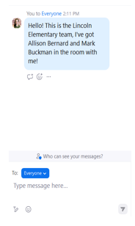
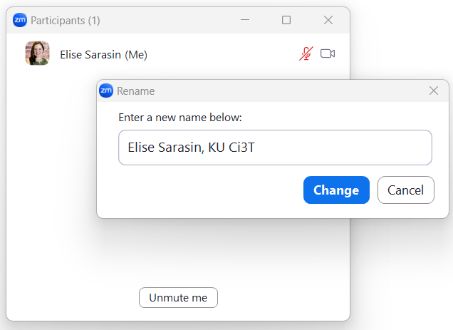

Zoom Logistics
If you are facilitating a Ci3T Leadership Team Symposium session at a satellite location, please email us a list of the names, email addresses, and schools of those attending.
To help us put you in breakout rooms with your colleagues today we are renaming you with your school initials and first and last name
If there are multiple people in the room with you, please list their first and last names and email in the chat!

Slide 4
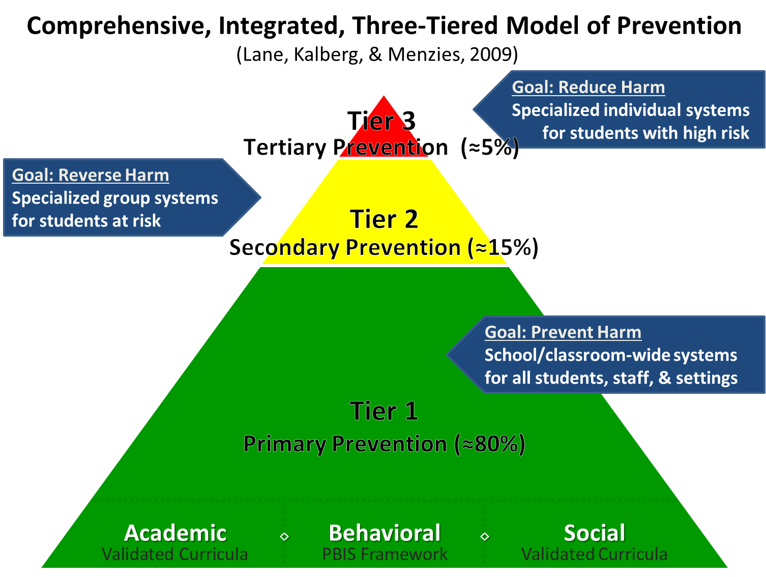
Comprehensive, Integrated, Three-Tiered Model of Prevention 1

Slide 5
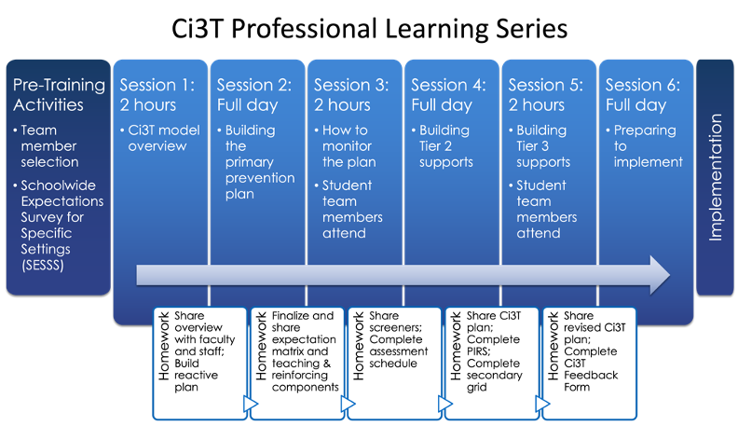
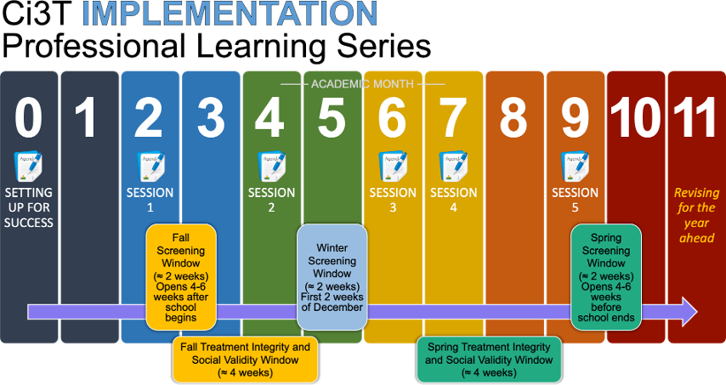

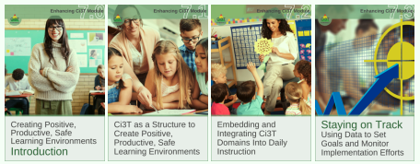


Ci3T Comprehensive
Professional Learning Plan

Slide 6
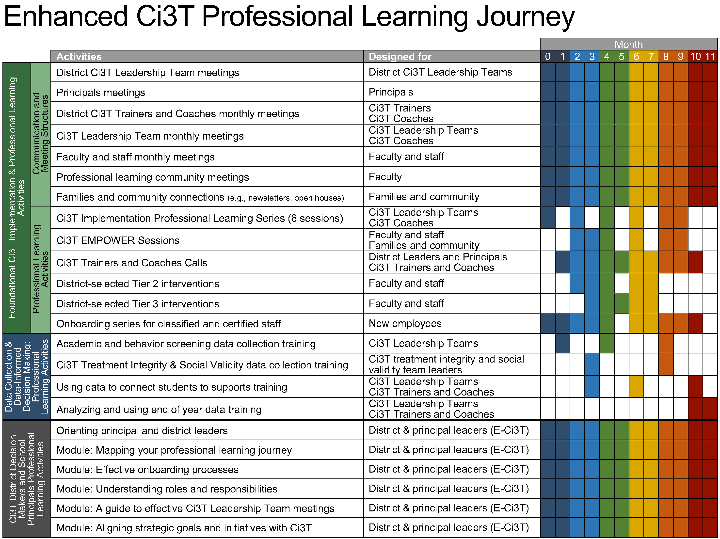
Enhanced Ci3T Implementation Series and Delivery

Slide 7
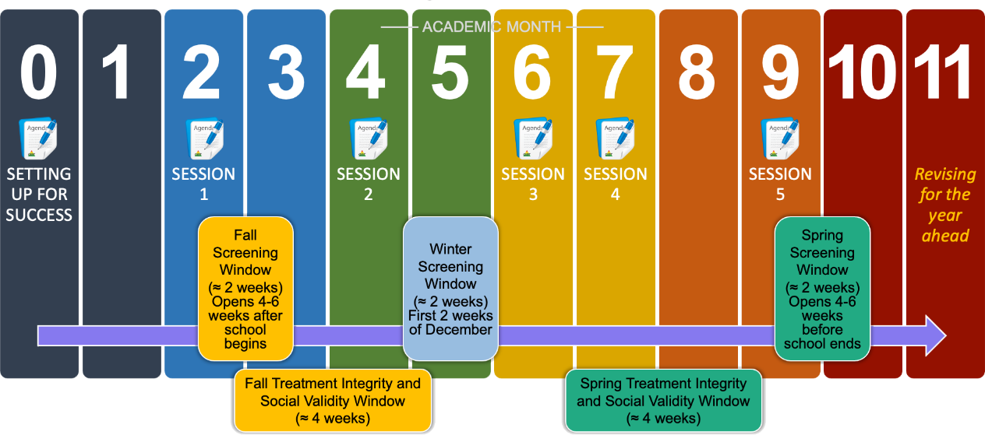
Ci3T Implementation Professional Learning Series
Notes:
The Ci3T Implementation Professional Learning Series is a 6-part series that spans the academic year. Sessions are timed to correspond to important milestones including: the beginning of the school year (e.g., kicking off the year, rolling out the Ci3T plan), screening windows, and treatment integrity and social validity windows.
Each session is data-informed, meaning attending Ci3T Leadership Team members review data, which are used to (a) identify successes, (b) identify focus areas (e.g., aspects of implementation that require additional attention, often via professional learning), and (c) create action plans to share data back and address focus areas.
Sessions applicable for both new and seasoned implementers as the focus is on predicable components of Ci3T implementation, space to review and respond to data, exploring resources to support implementation efforts, and beginning conversations and action plans.

Slide 8
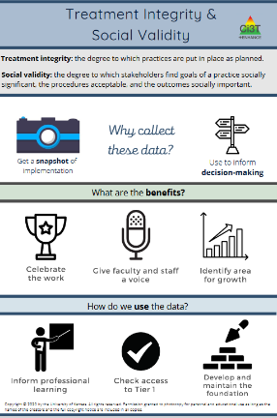
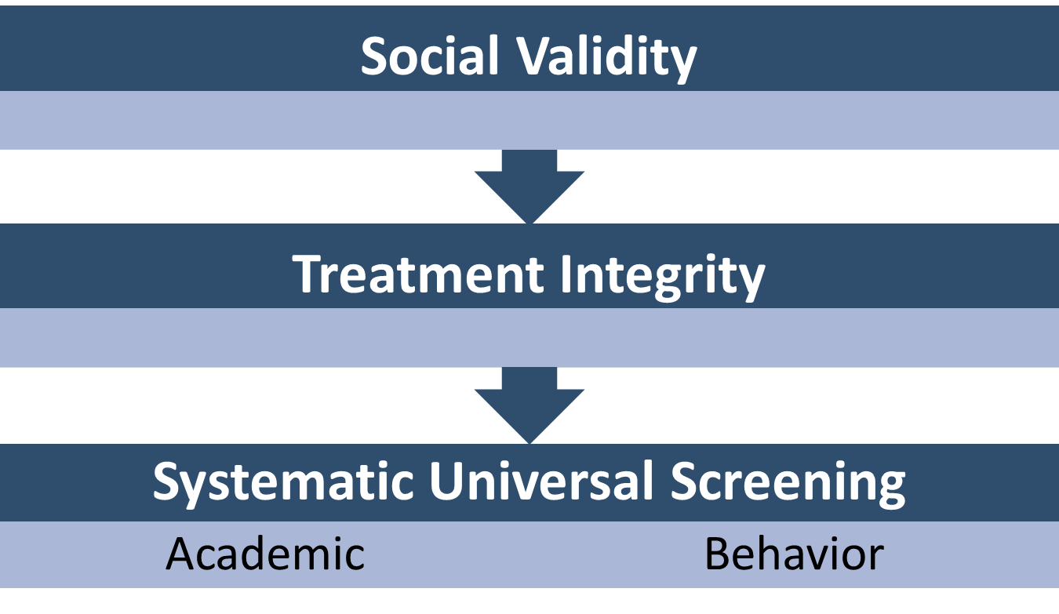
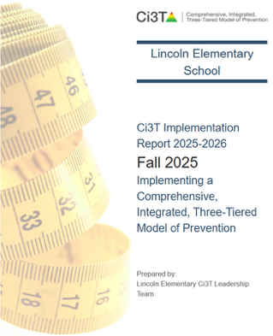
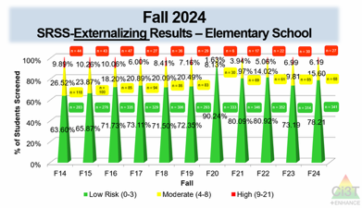
Essential Components of Primary (Tier 1) Prevention Efforts

Slide 9



Enhancing Ci3T Modules
ci3t.org/enhance

Slide 10
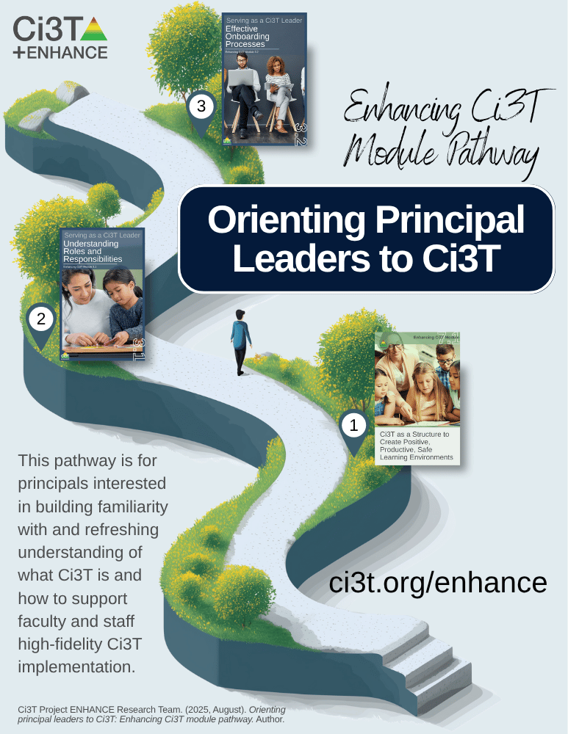
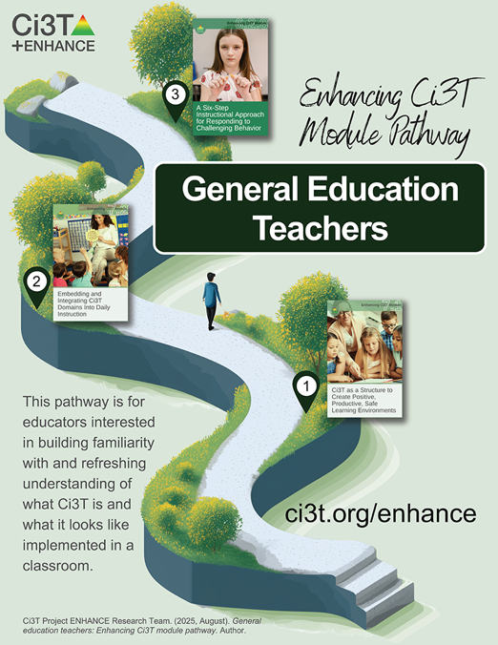
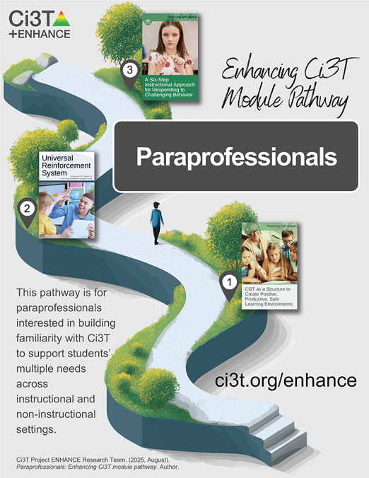
Module Pathways

Slide 11
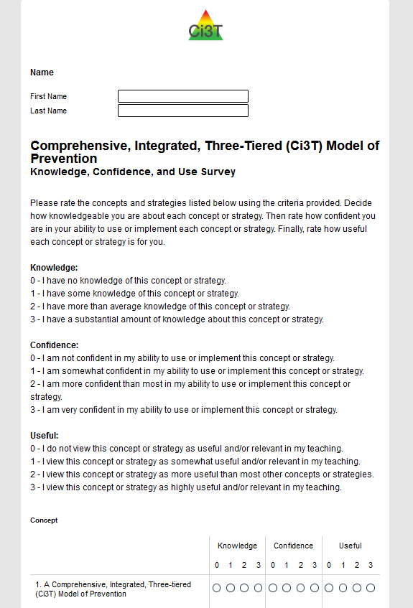
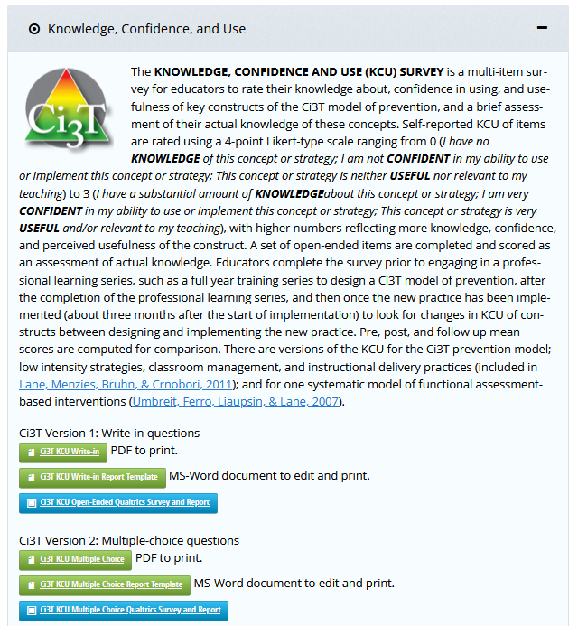
Knowledge, Confidence, Use (KCU) Survey
ci3t.org/measures
Notes:
If you are a district participating as a research partner in Sustaining Ci3T, we appreciate your time and effort in sharing your knowledge, confidence, we wrap up the school year!
If you are not participating in Sustaining Ci3T but would like to measure your or your team’s knowledge, confidence, and use, a version of the KCU survey is available on our website at ci3t.org/measures

Slide 12



















Work Time
First,
Then, explore one of the following modules:
If you have not yet done so already, please complete your Knowledge, Confidence, Use (KCU) Survey
What content could you build into upcoming professional learning to help finish the year strong?
How might this module support 2026-2027 beginning of year professional learning?
What content could you use to share Spring screening data?
How might this module support 2026-2027 behavior screening at your school?
Notes:
Give 15 minutes for KCU

Slide 13
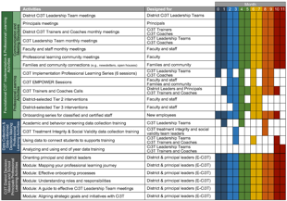

Session Outcomes
Interpret social validity, treatment integrity, and spring screening data at the school- and classroom-level to identify successes and focus areas relative to Ci3T implementation.
Use needs of faculty, staff, and students – as identified in social validity, treatment integrity, and spring screening data – to inform professional learning for faculty and staff, use of effective practices to support students (e.g., low-intensity strategies, Tier 2 and 3 interventions), and updates to your school’s Ci3T Implementation Manual.
If you are a Board Certified Behavior Analyst (BCBA), you may accrue up to 2 continuing education units (CEUs) for attending this session. See agenda for task list alignment. Throughout the session we will share 4 key words, write those down to turn in after the session!

Slide 14
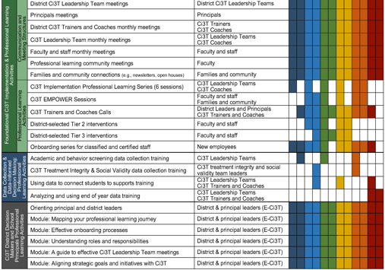
Agenda
Welcome
Procedures for Monitoring
  Review your School’s Social Validity & Treatment Integrity Data
  Review your School’s Spring Screening Data
Planning for the Year Ahead 2025-2026
Focusing on Data-Informed Professional Learning
Wrapping Up and Moving Forward

Slide 15
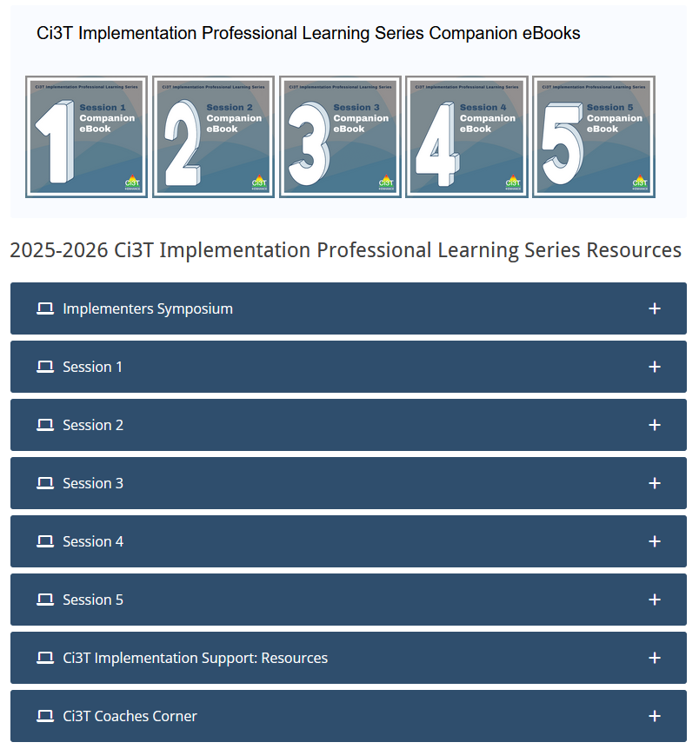
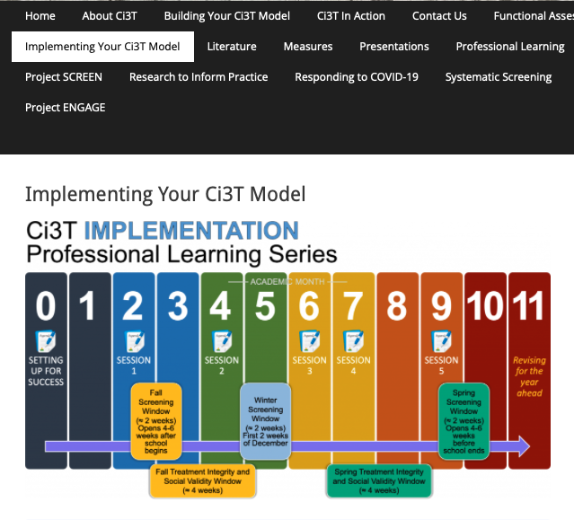
Accessing Professional Learning Materials
ci3t.org/imp

Slide 16
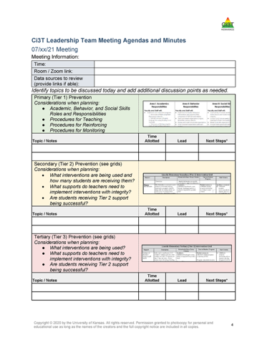

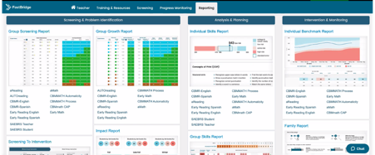

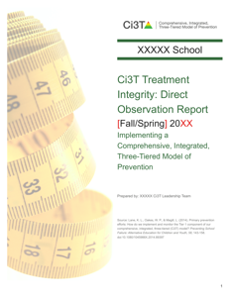
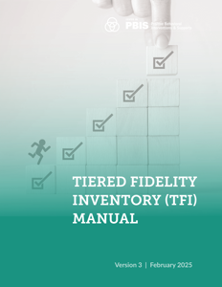
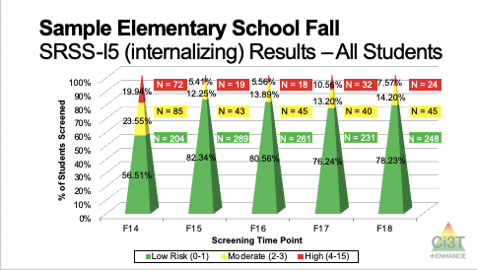
Materials for Today’s Session
Ci3T Leadership Team Agenda
Ci3T Implementation Manual
Spring Screening Data
Spring Treatment Integrity and Social Validity Data

Slide 17

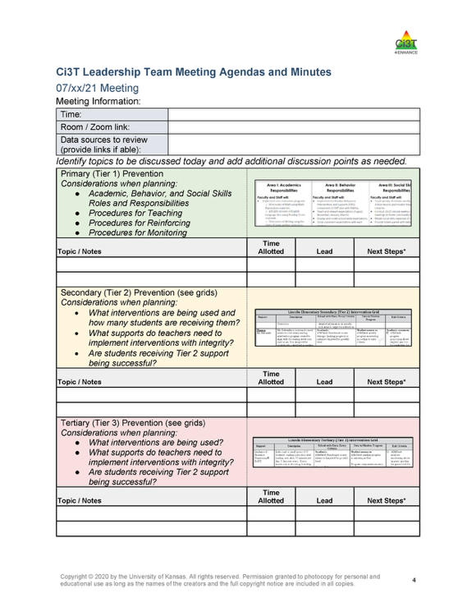
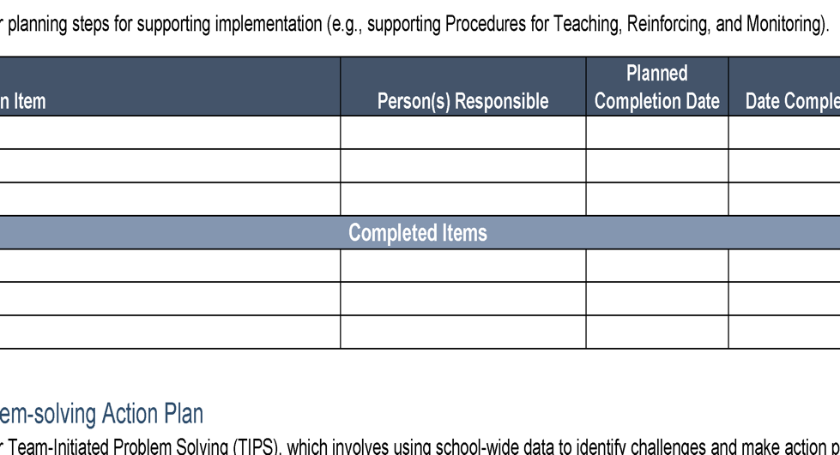

Ci3T Leadership Team Agenda Template
1.2 TEAM OPERATING PROCEDURES
Tier 1 leadership team has (a) regular meeting format/agenda that prompts the regular review of Tier 1 practices, systems, and data, (b) minutes available to all staff for review, (c) established and regularly used team norms, (d) defined meeting roles (e.g., timekeeper, facilitator, recorder), (e) regular (e.g., quarterly) two-way data sharing and communication with advanced tiers teams to inform decision making, (f) a current action plan, (g) procedure for evaluating fidelity of team operating procedures (e.g., Team Initiated Problem Solving [TIPS] Fidelity Checklist) at least twice annually, and (h) a formal process to monitor the impact of team norms and procedures on ensuring all team members are able to participate as equal partners

Slide 18
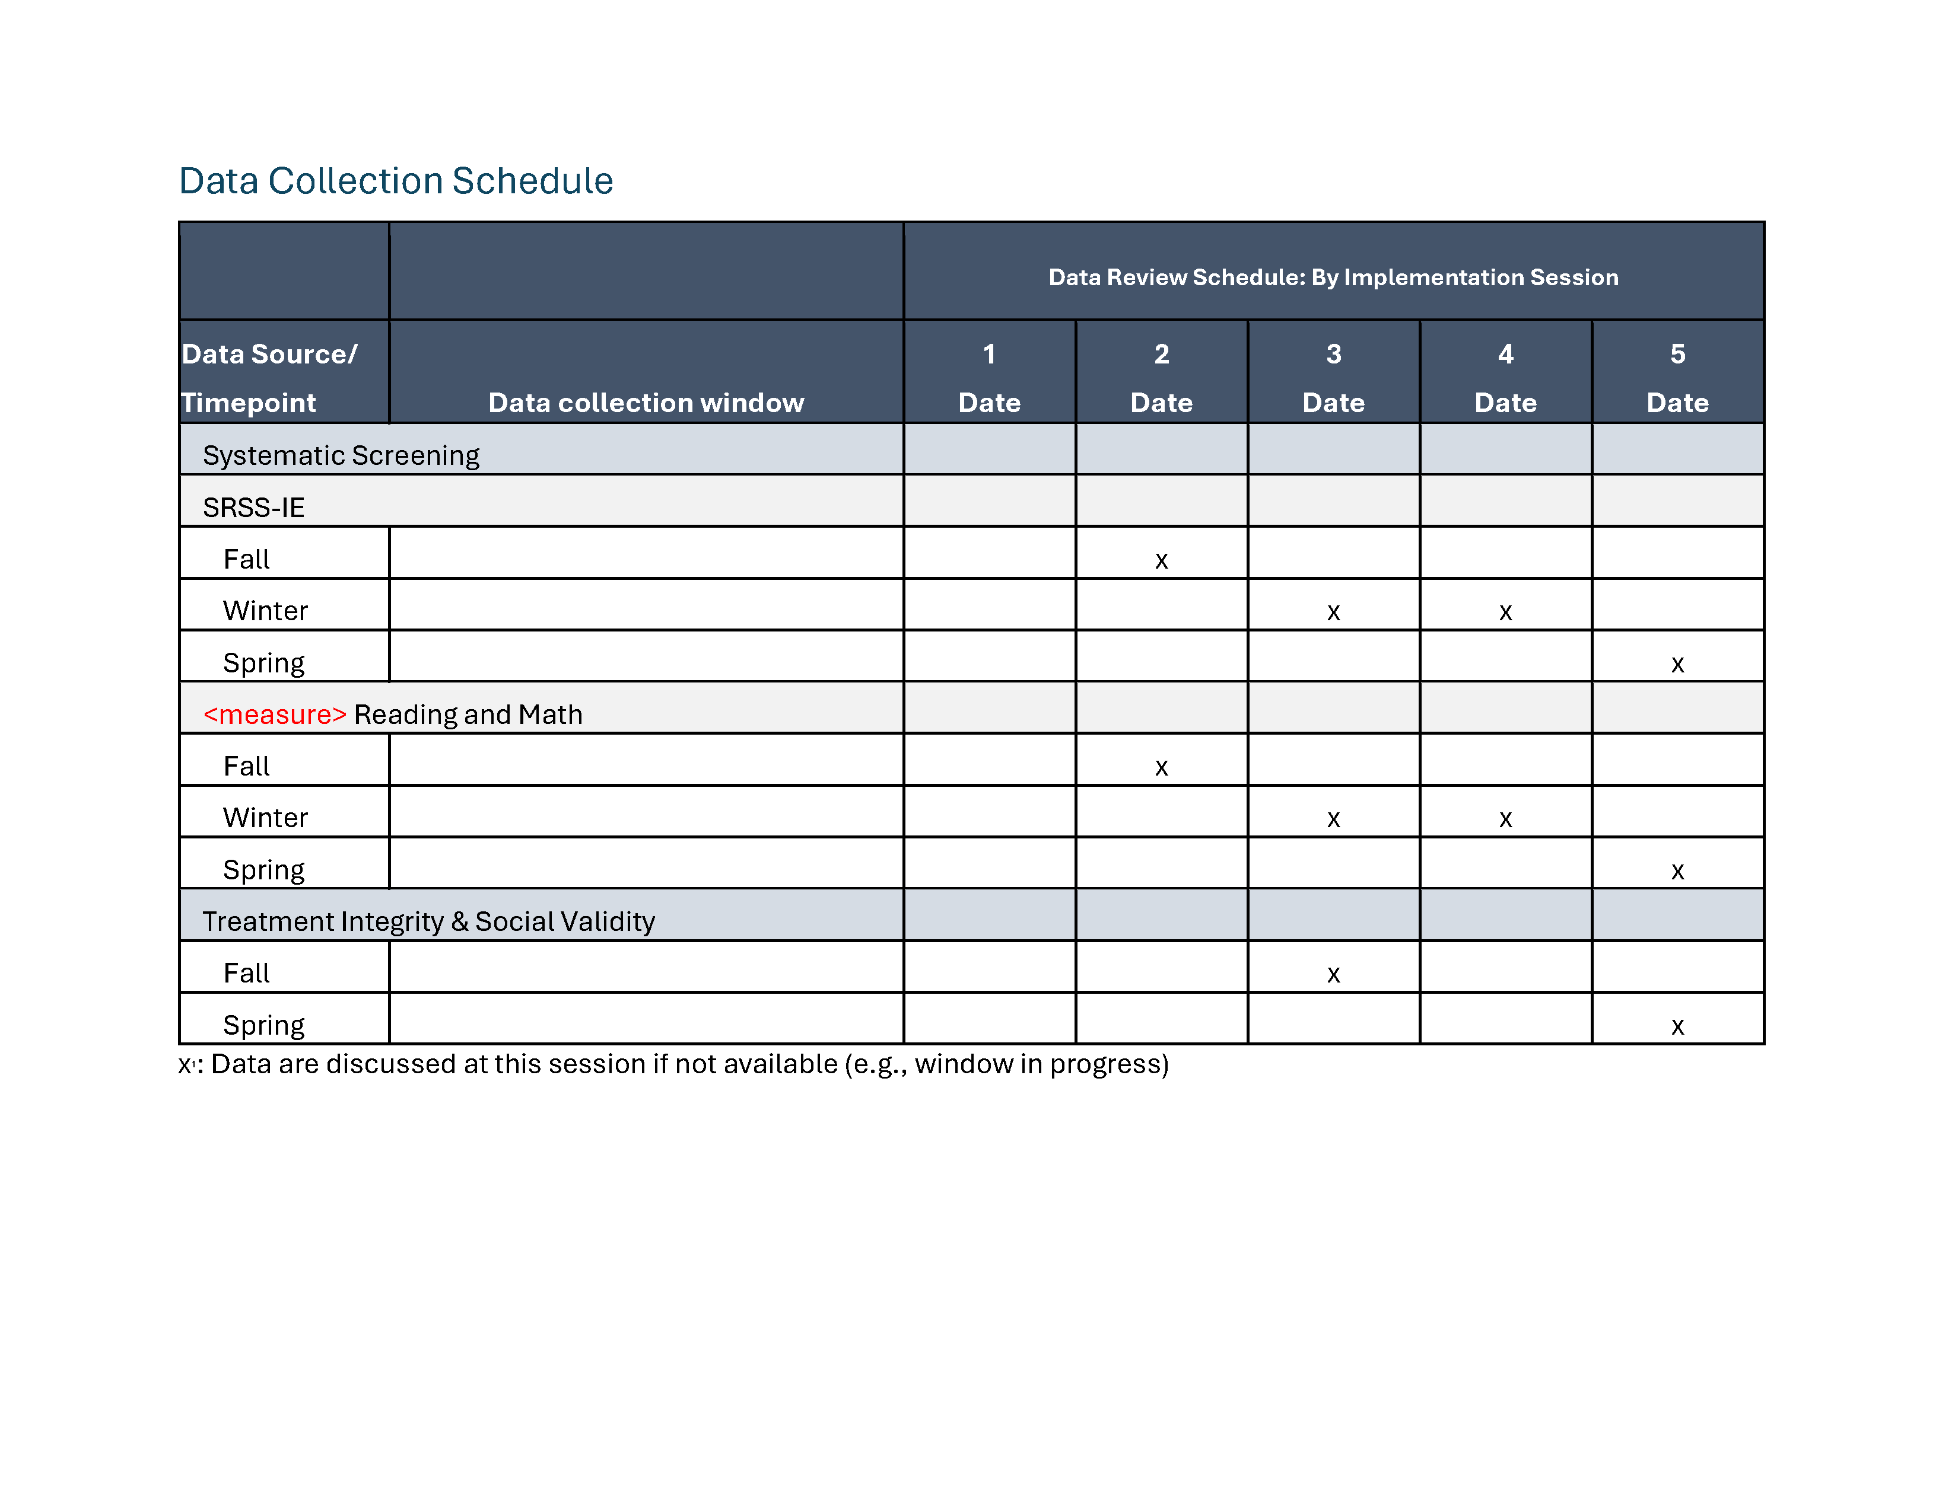
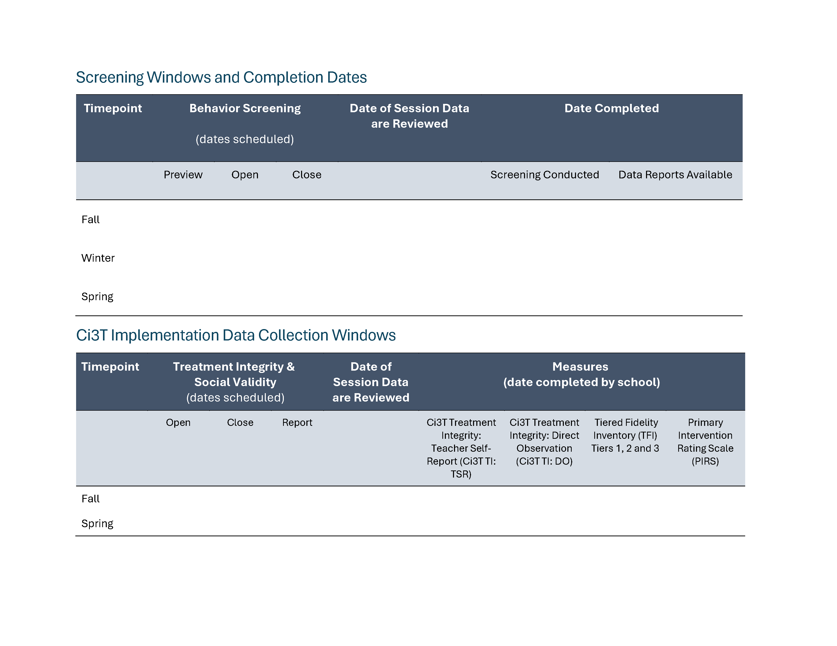
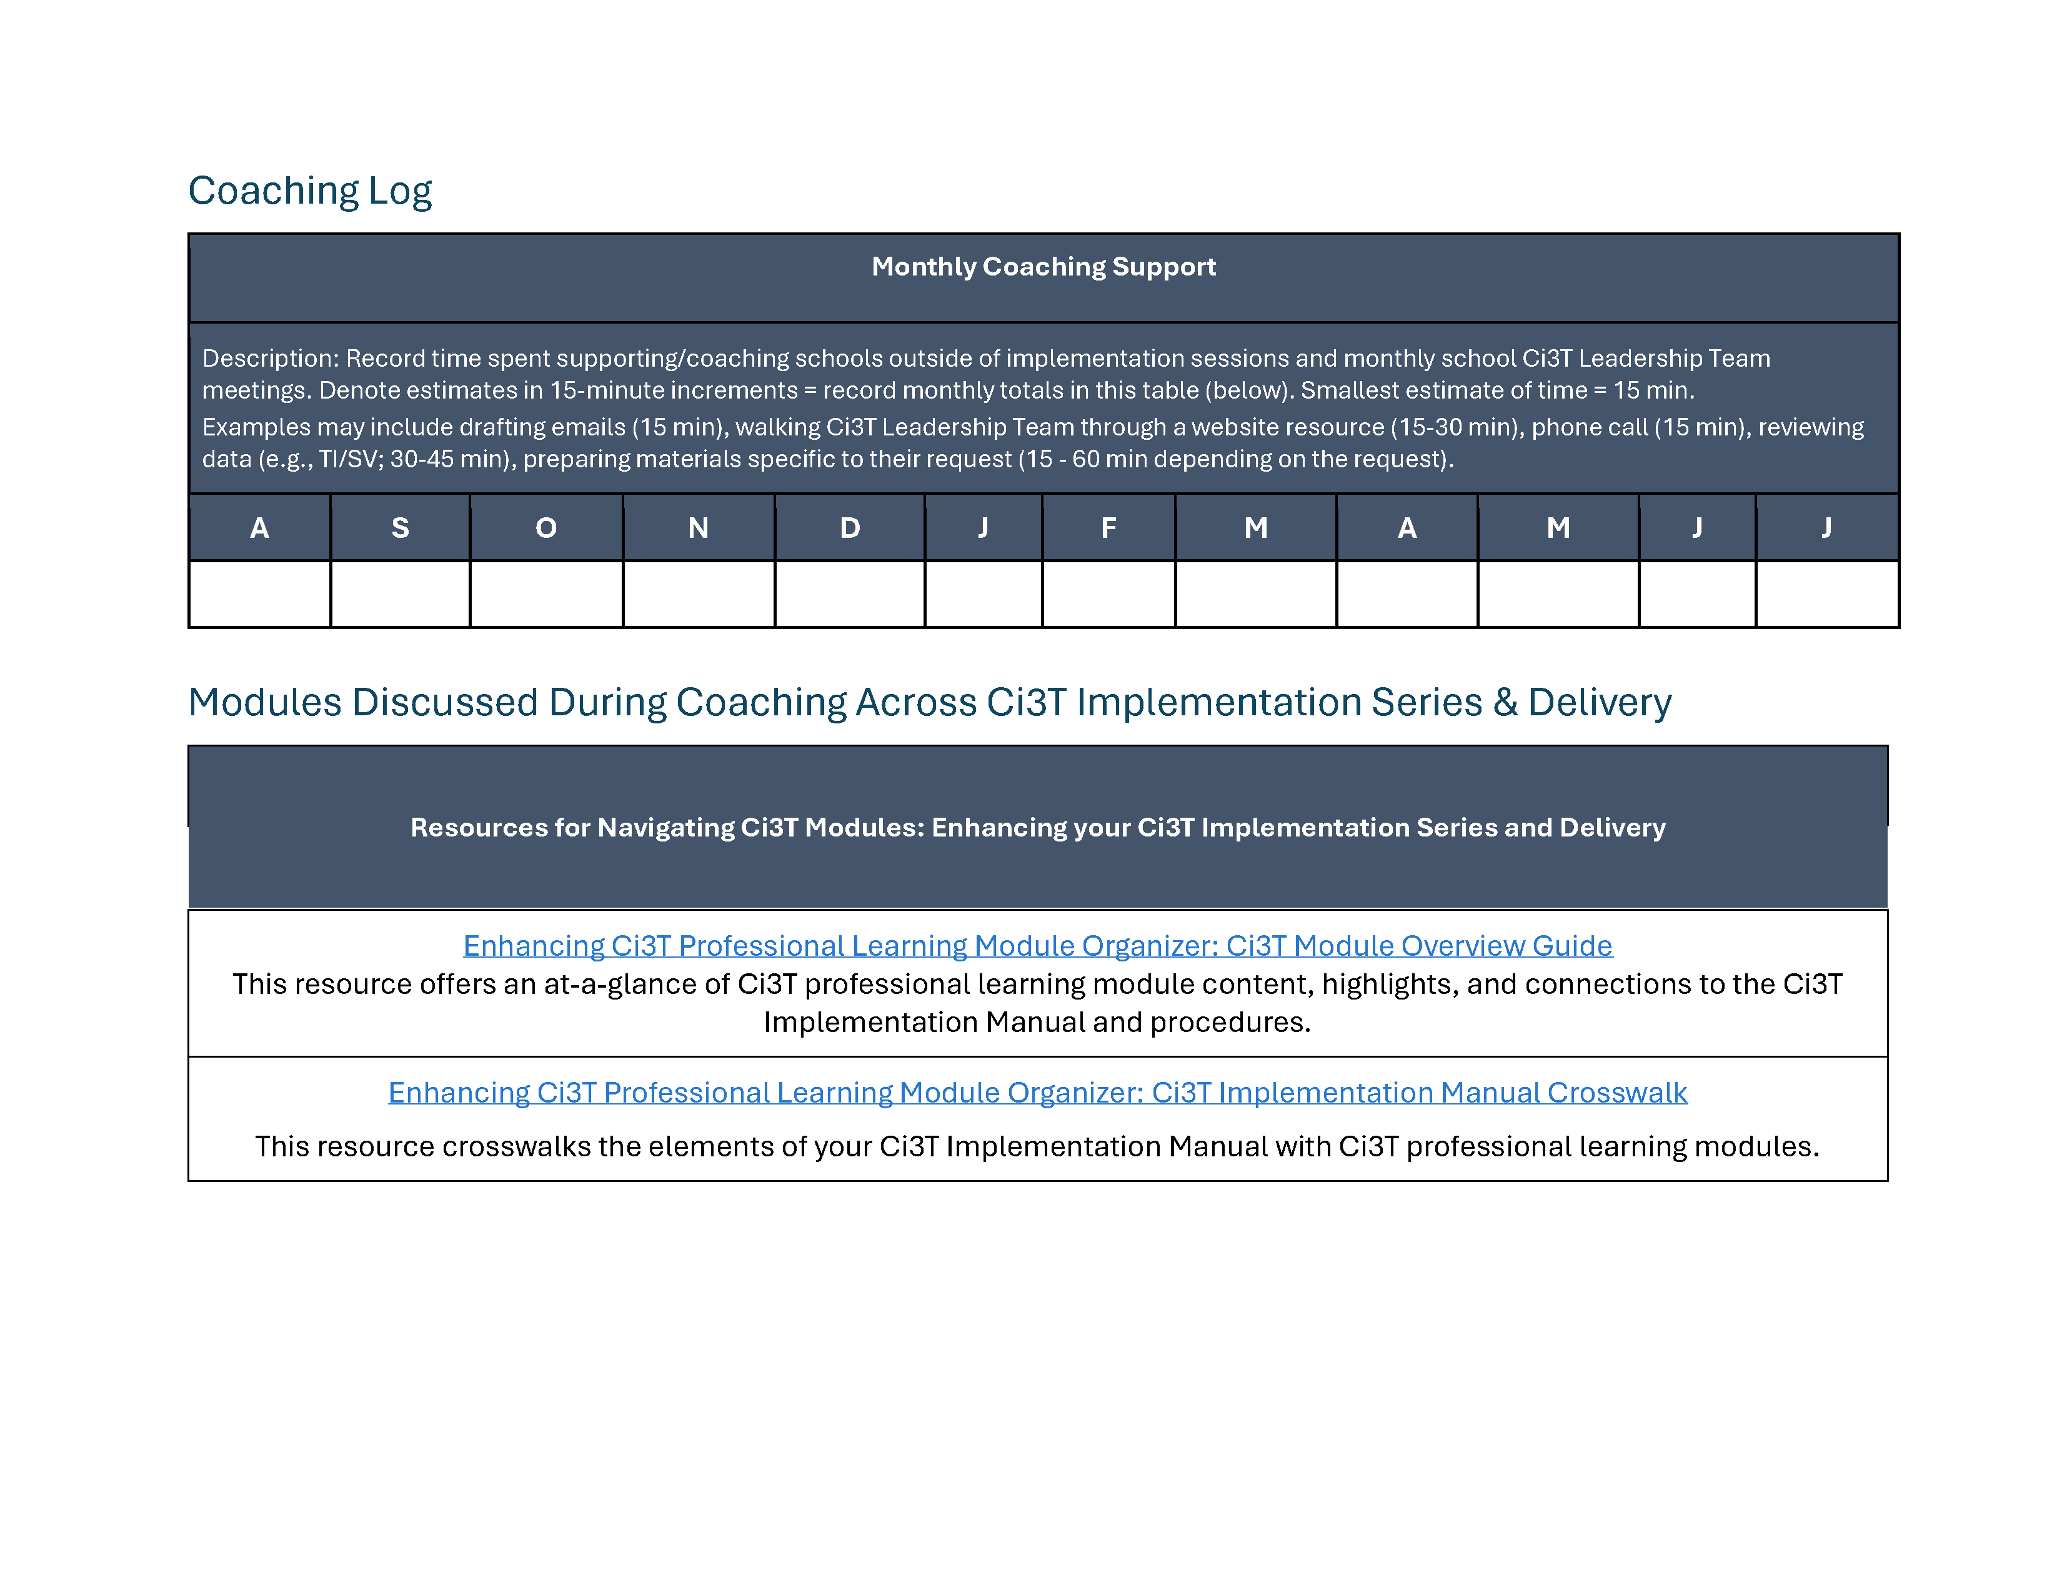
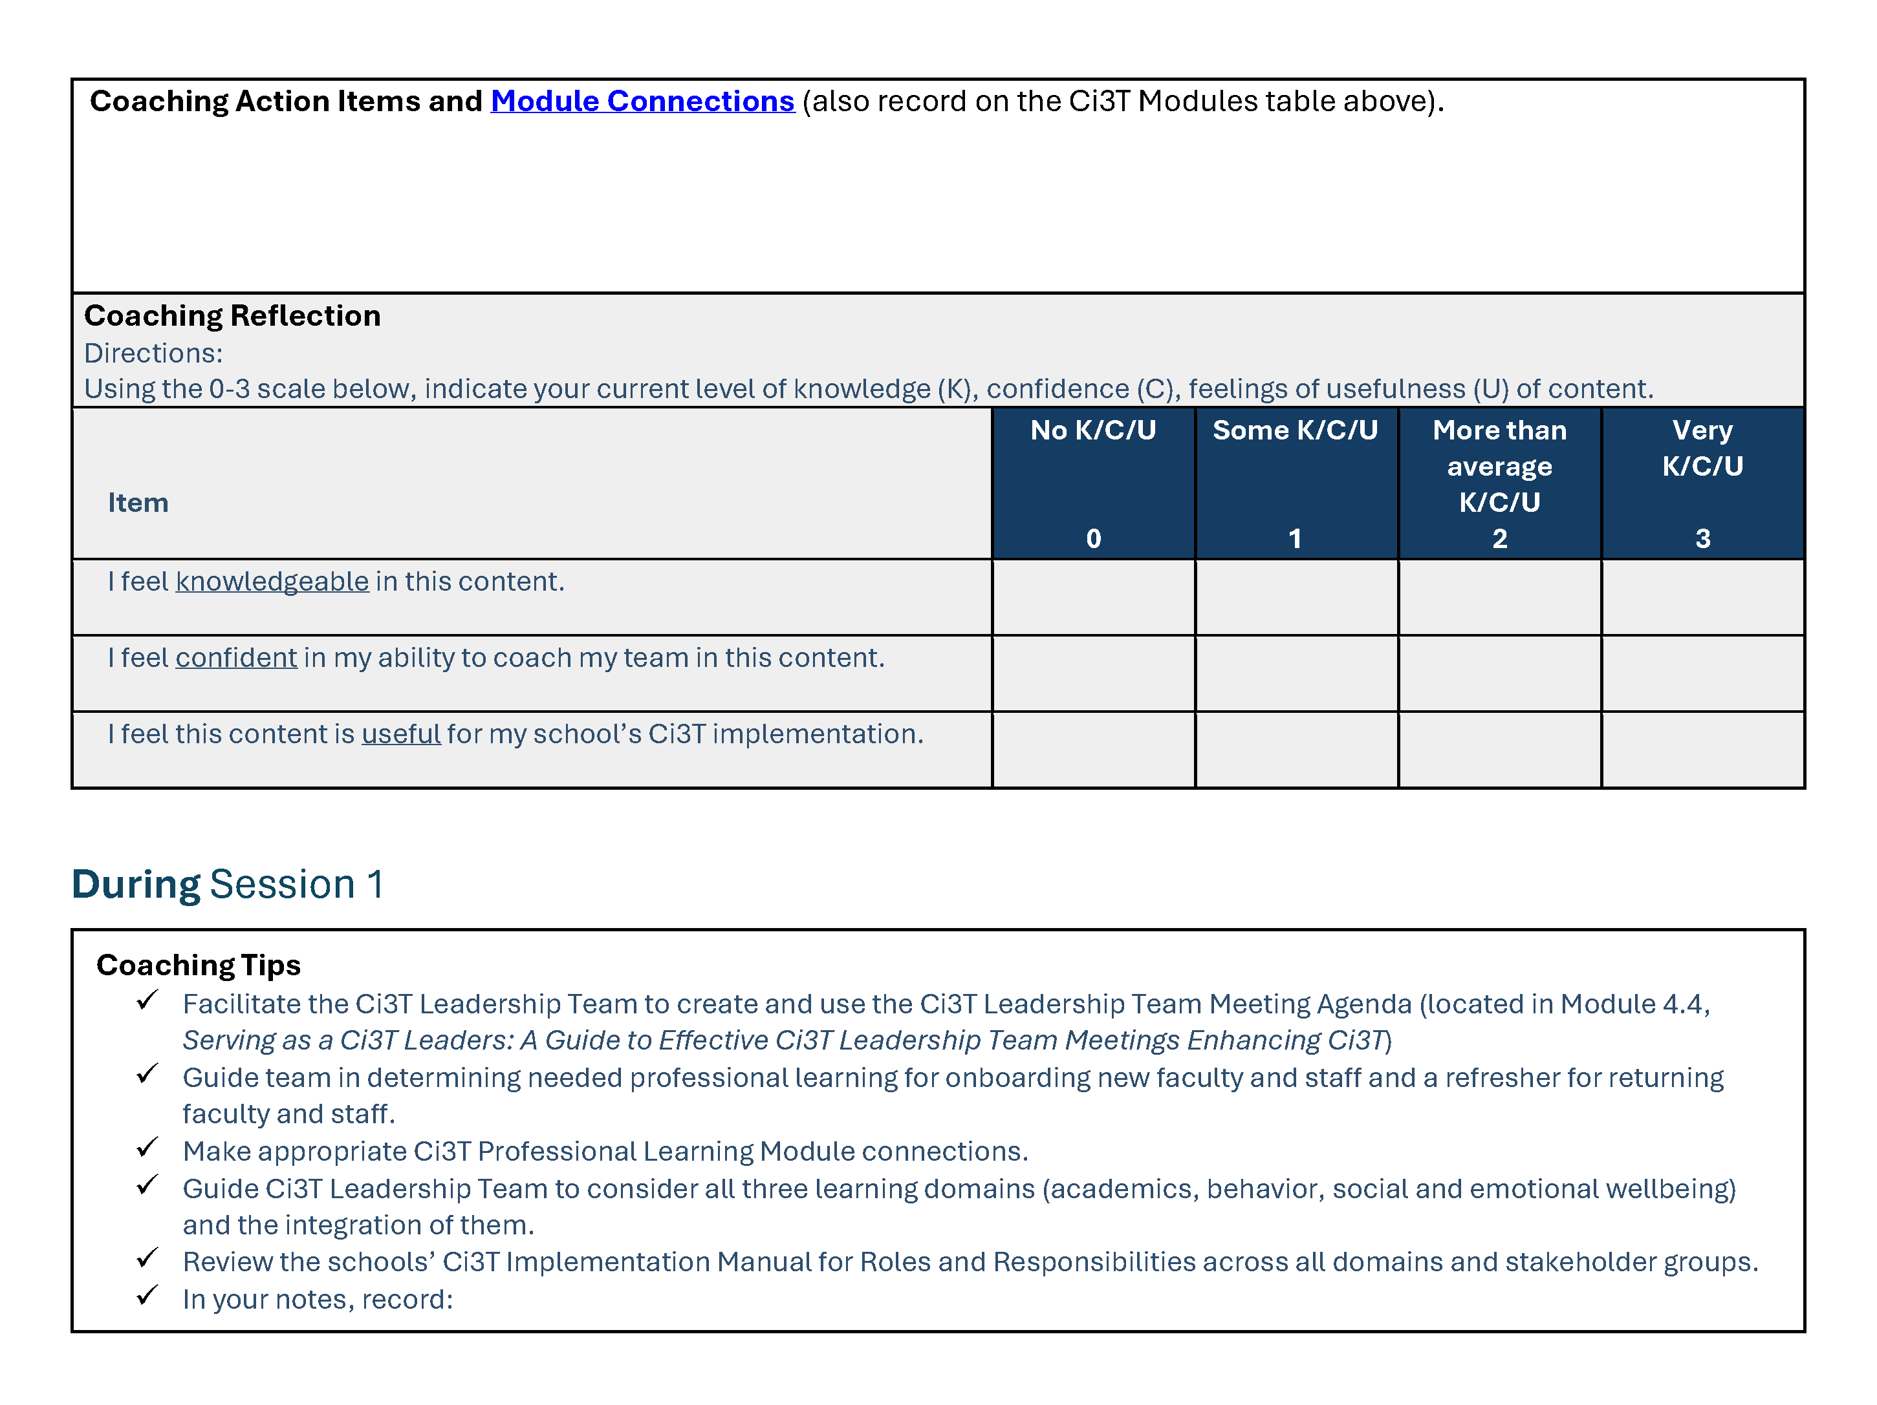
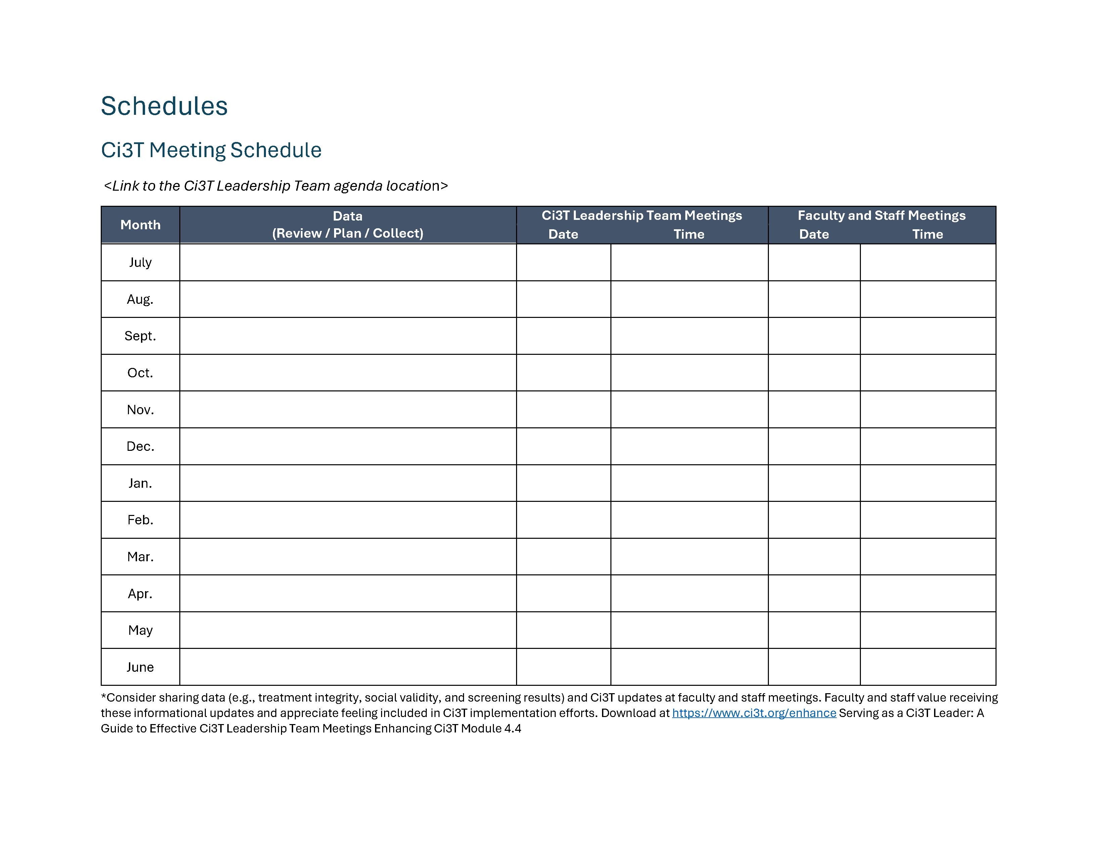
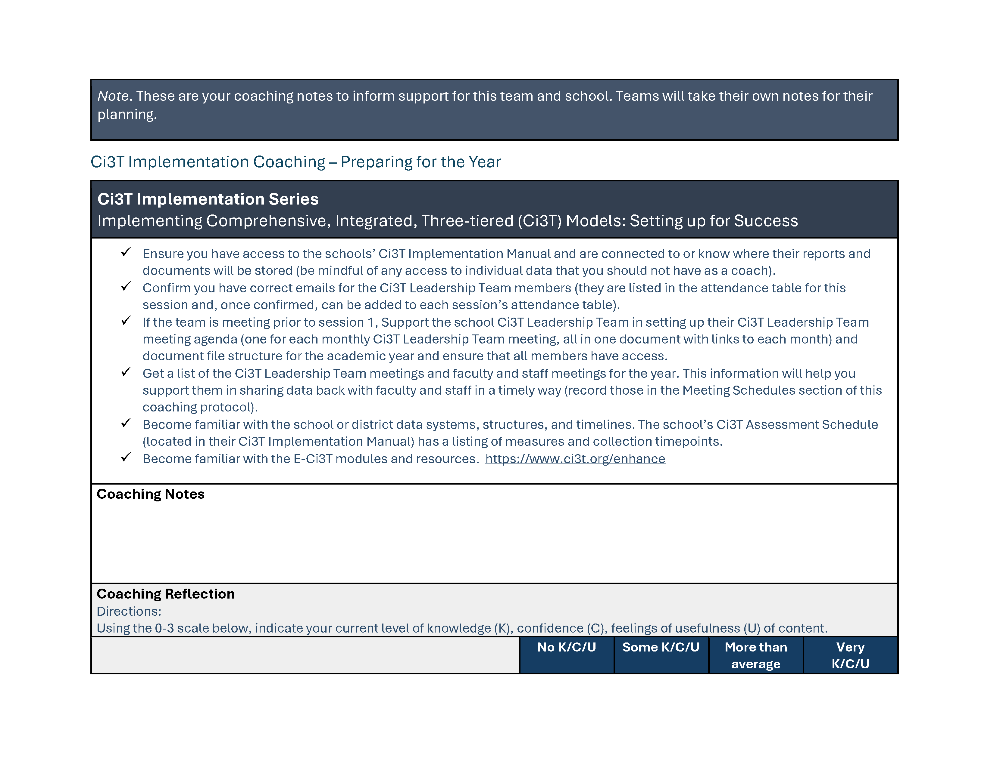
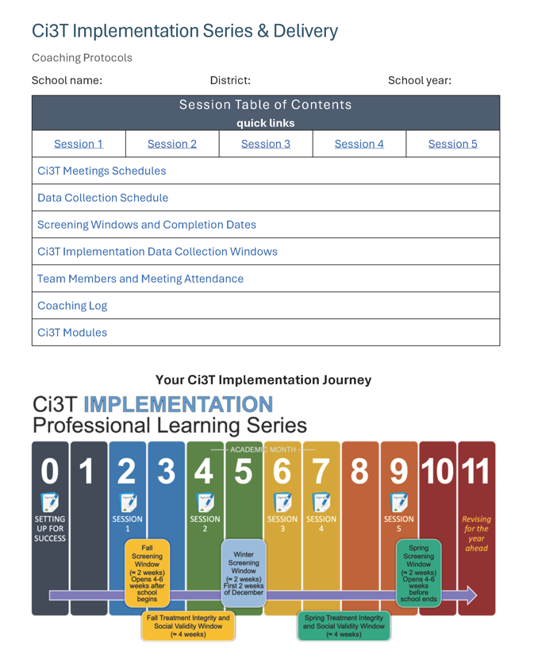
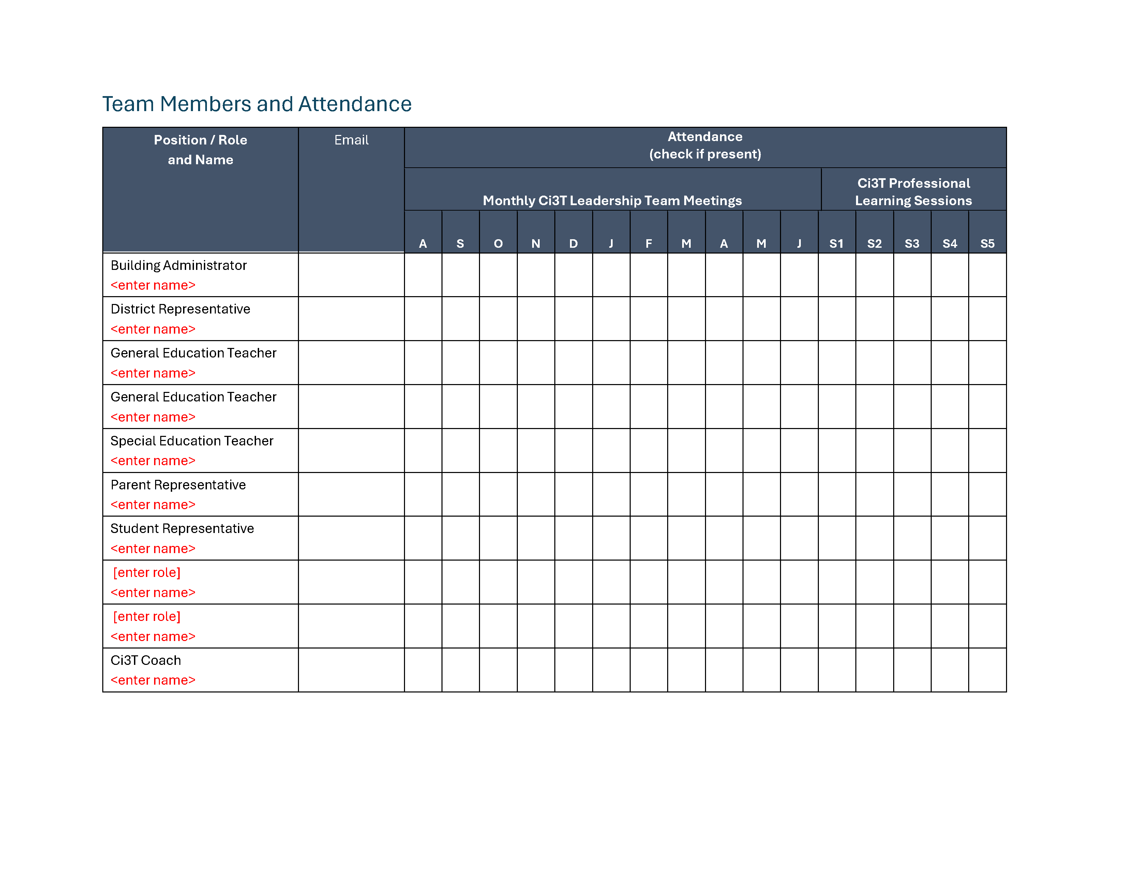
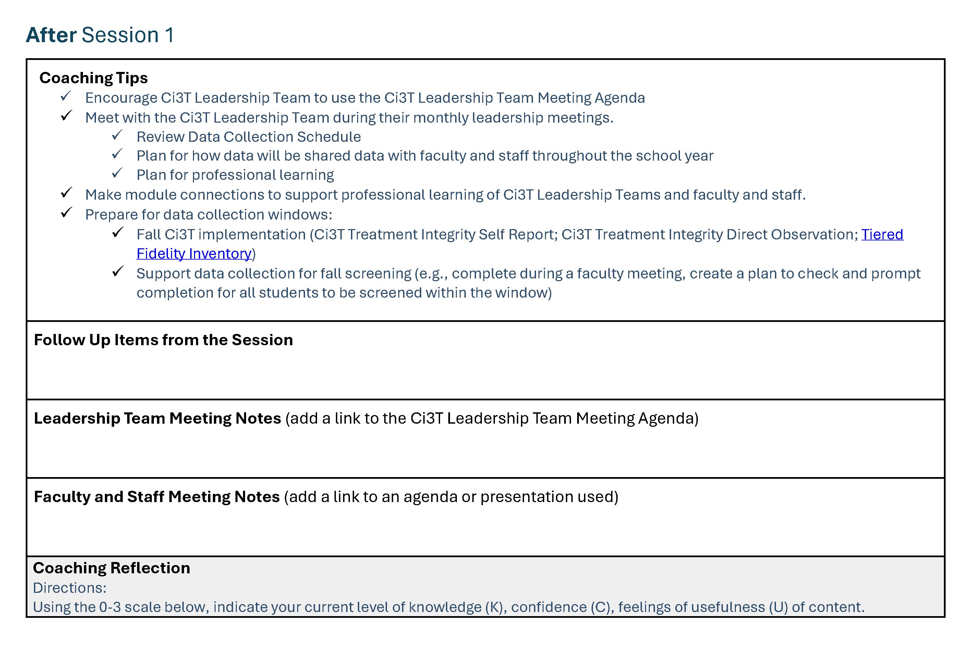
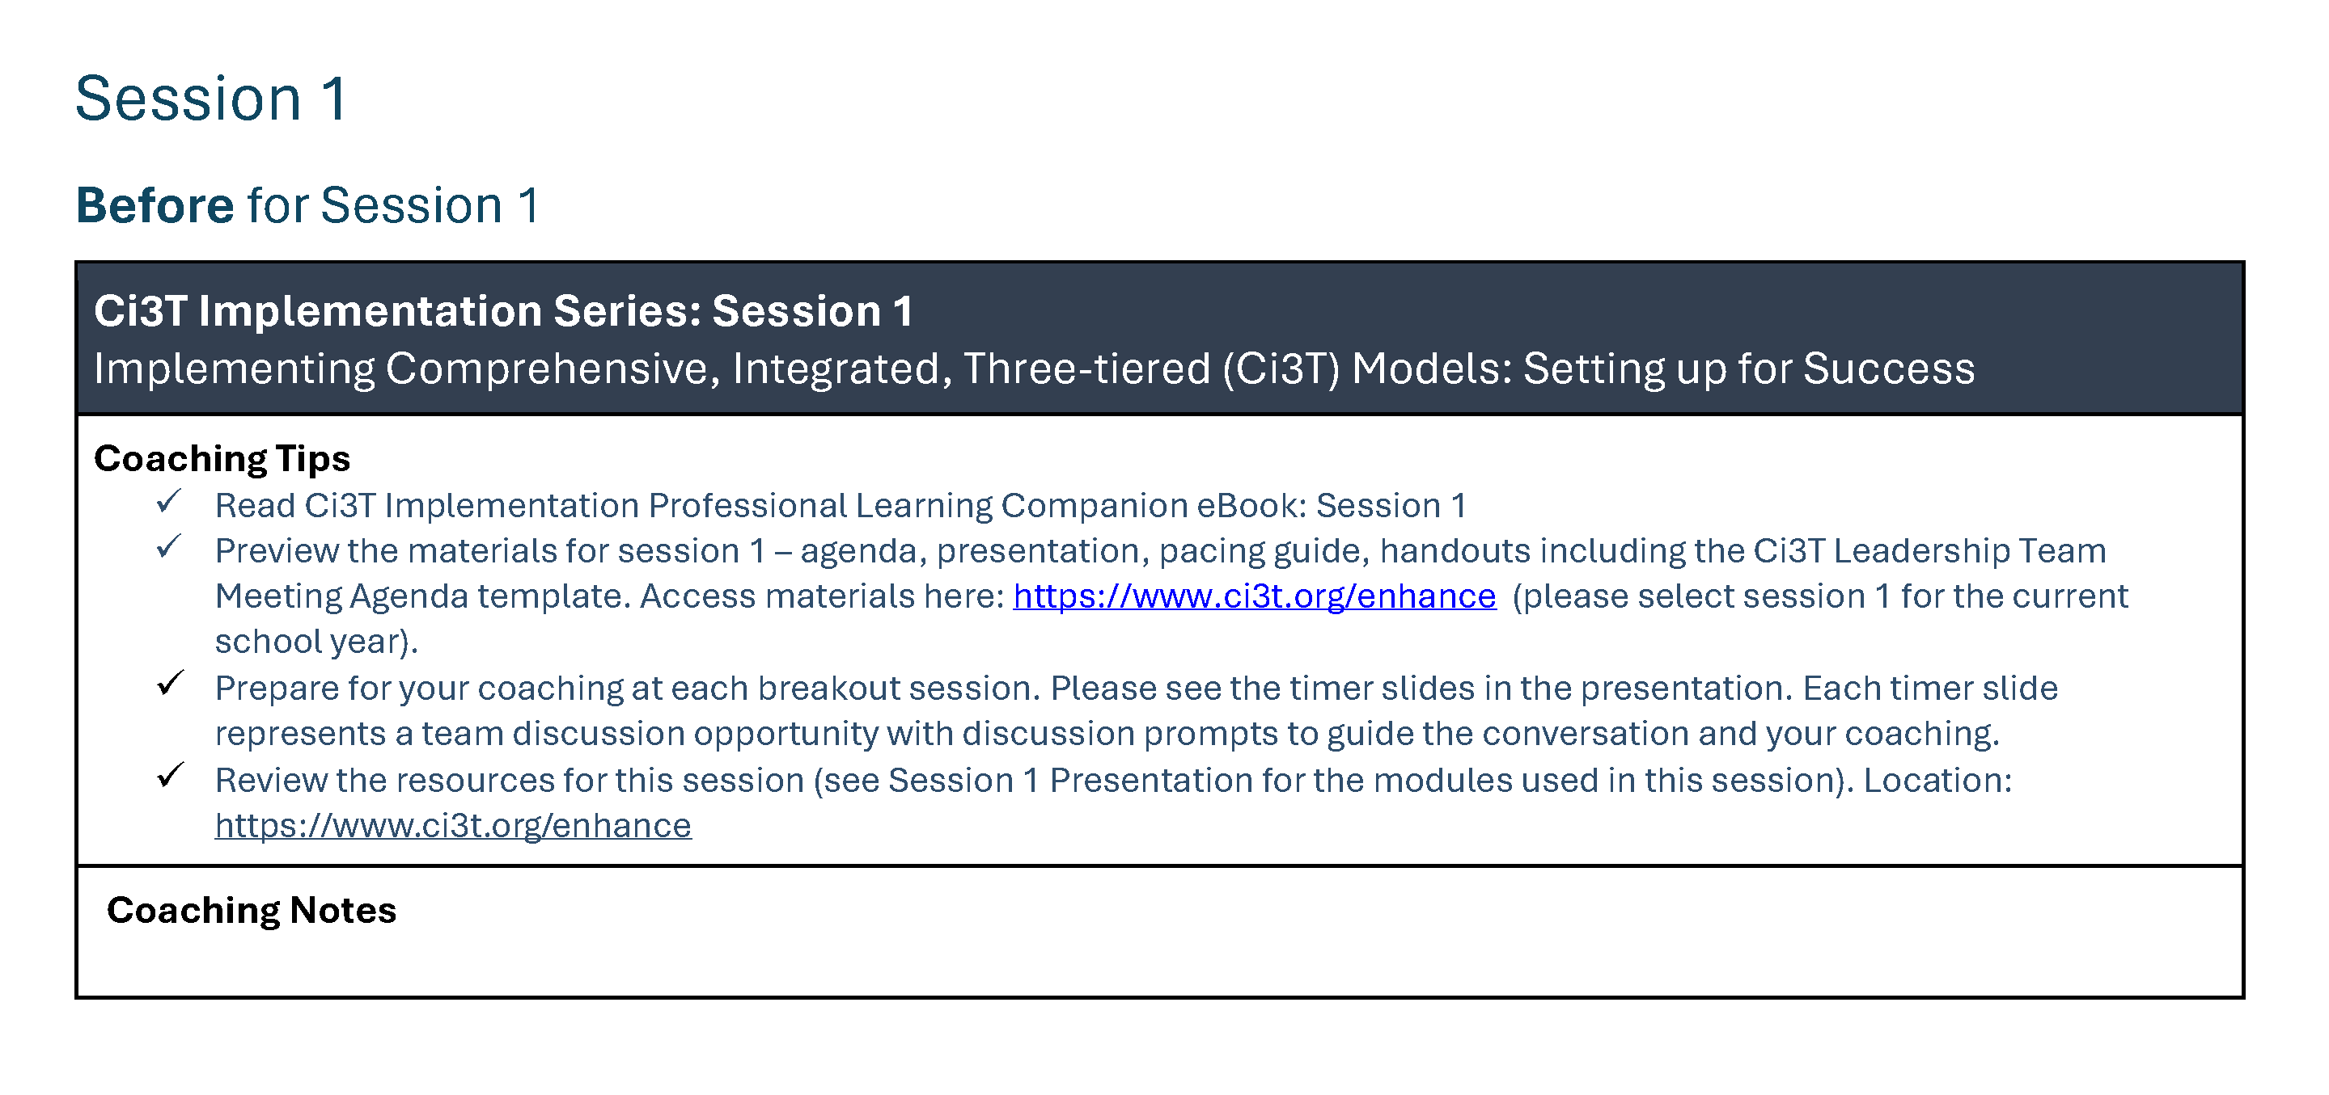
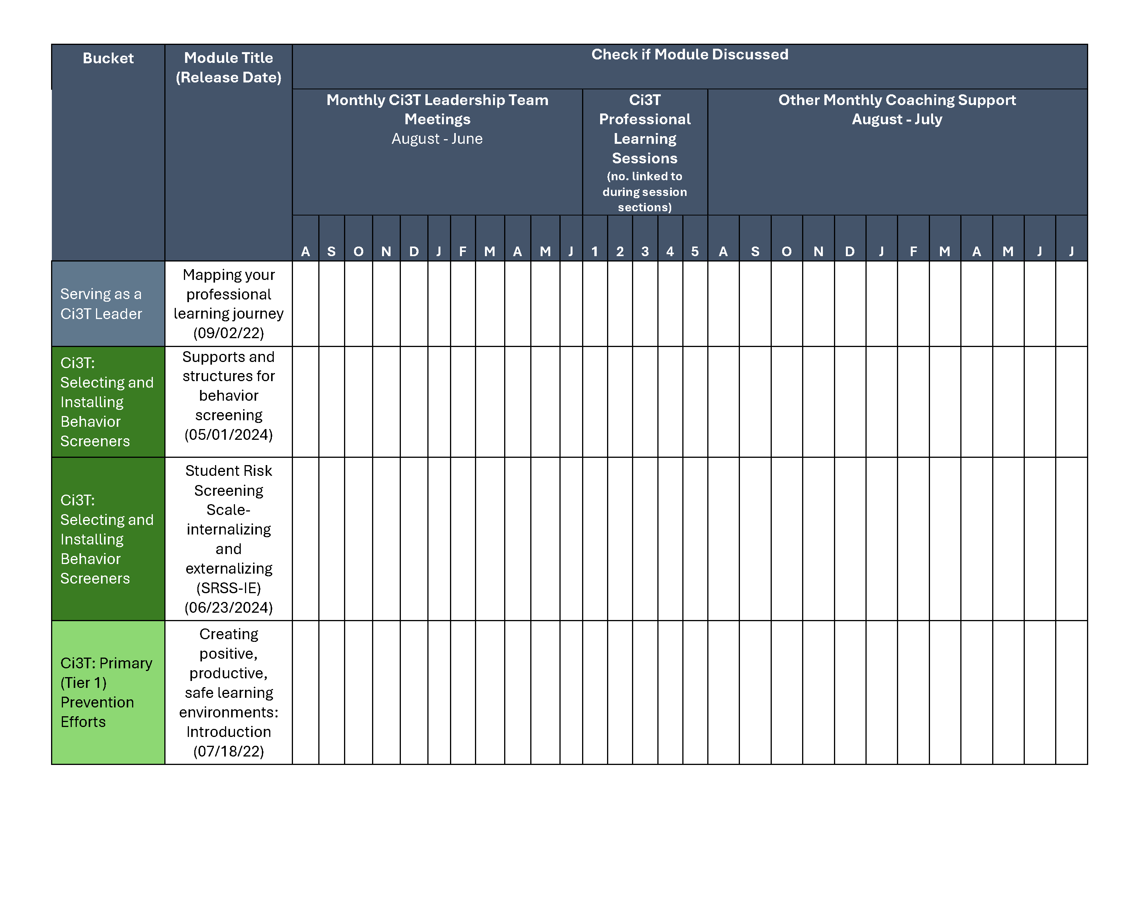
Coaching Protocol

Slide 19
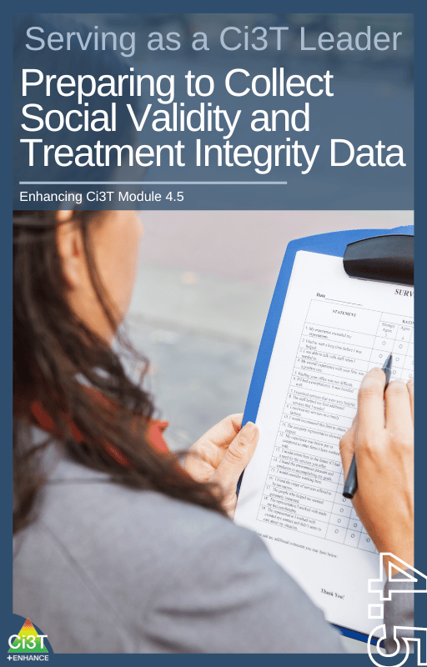
Procedures for Monitoring
Review your School’s Social Validity & Treatment Integrity Data
Review your School’s Spring Screening Data

Slide 20
Session Outcomes
Interpret social validity, treatment integrity, and spring screening data at the school- and classroom-level to identify successes and focus areas relative to Ci3T implementation.
Use needs of faculty, staff, and students – as identified in social validity, treatment integrity, and spring screening data – to inform professional learning for faculty and staff, use of effective practices to support students (e.g., low-intensity strategies, Tier 2 and 3 interventions), and updates to your school’s Ci3T Implementation Manual.

Slide 21
Procedures for Monitoring
Review your School’s Social Validity & Treatment Integrity Data
Review your School’s Spring Screening Data
1.19 DECISION MAKING WITH FIDELITY DATA
Tier 1 leadership team reviews and uses schoolwide (e.g., TFI, BoQ, TIC, SAS, SET) and other fidelity data (e.g.,
classroom implementation, Tier 1 SEB curriculum, staff wellness systems) at least annually.

Slide 22
Essential Components of Primary (Tier 1) Prevention Efforts

Slide 23
Social Validity
How do stakeholders view the plan?
Social validity refers to the level of:
Social significance of intervention goals
Social acceptability of intervention procedures
Social importance of intervention outcomes
(Wolf, 1978)
Assessed using the Primary Intervention Rating Scale (PIRS)
Social Validity: PIRS Results
Year | Fall |  | Spring
 | n | % (SD) | n | % (SD)
2023-2024 | 32 | 85.39 (8.89) | 43 | 81.45 (12.22)
1.14 FACULTY AND STAFF ENGAGEMENT
Tier 1 leadership teams purposefully and regularly engage all faculty and staff in co-designing and actively revising
the content and the implementation of foundational Tier 1 practices (items 1.3-1.10) and systems (items 1.12-
1.13) based on the regular review of schoolwide and community data.

Slide 24
Treatment Integrity
Are we implementing our plan as intended?
Treatment integrity can refer to:
Adherence
Dosage
Quality
Assessed using:
Ci3T Treatment Integrity: Teacher Self-Report
Ci3T Treatment Integrity: Direct Observation
Tiered Fidelity Inventory (TFI)
Ci3T Procedures | Teacher Self-Report* | Direct Observation*
 | Spring 2025 n = 45 % (SD) | Educator n = 6 % (SD) | Observer n = 7 % (SD)
Teaching | 80.43% (10.86) | 70.72% (13.81) | 75.02% (17.05)
Reinforcing | 80.83% (12.89) | 62.06% (15.33) | 34.99% (16.02)
Monitoring | 75.49% (18.06) | - | -
Total | 79.10% (11.87) | 67.66% (14.03) | 62.28% (14.58)

Slide 25
Logistics Planning
Method | Measure Name | Completed by…
Method | Measure Name | All Staff | Randomly Selected Classrooms | Ci3T Leadership Team
Survey | Ci3T Treatment Integrity: Teacher Self-Report and Primary Intervention Rating Scale | X
Observations | Ci3T Treatment Integrity: Direct Observation |  | X
Rubric | Tiered Fidelity Inventory (TFI) |  |  | X

Slide 26

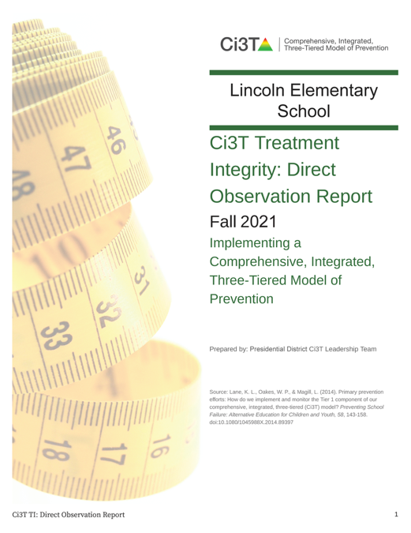

Treatment Integrity and Social Validity Data Sources
Spring 2026
Spring 2026
Primary Intervention Rating Scale (Social Validity)
Ci3T Treatment Integrity: Teacher Self Report
Ci3T Treatment Integrity: Direct Observation
Tiered Fidelity Inventory

Slide 27
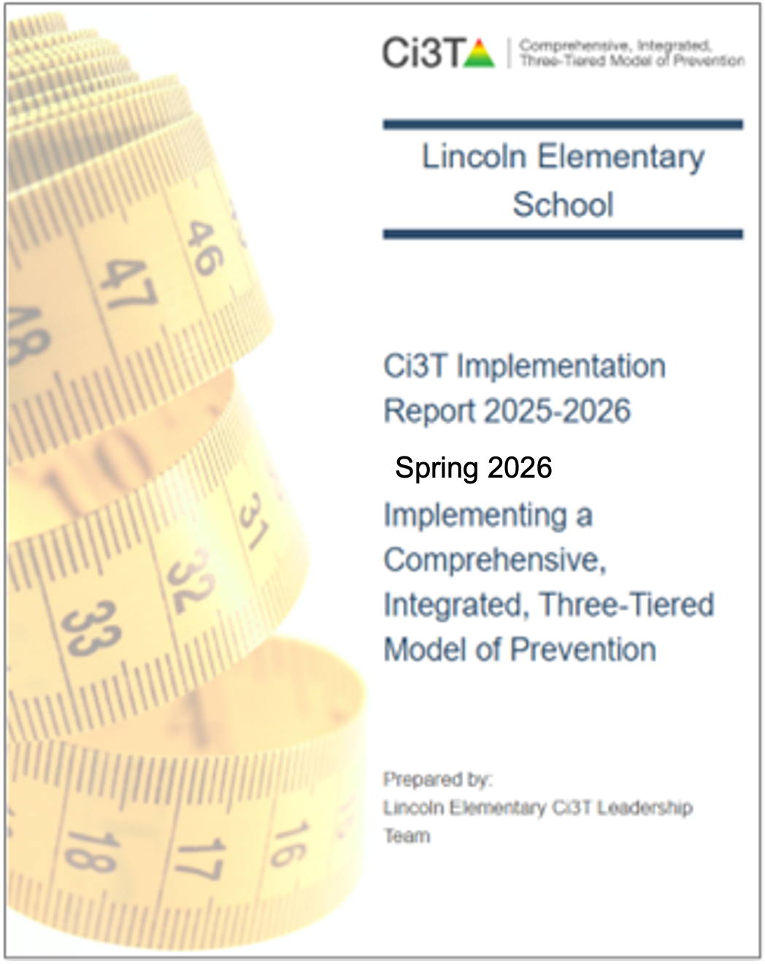
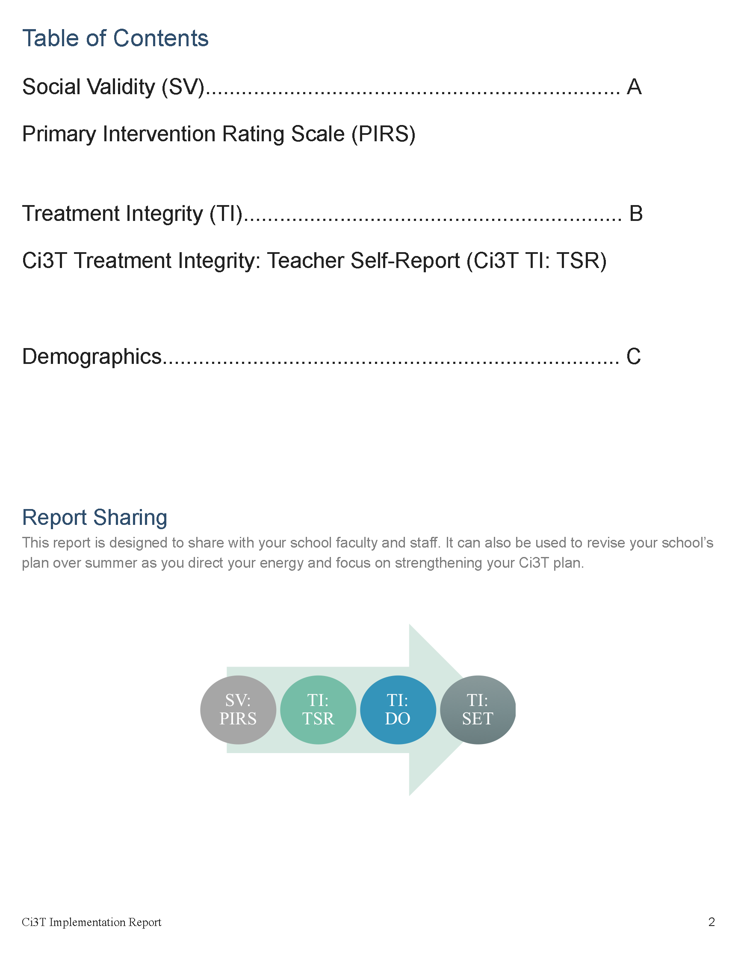
Ci3T Implementation Report
Primary Intervention Rating Scale (Social Validity; PIRS)
Ci3T Treatment Integrity: Teacher Self Report (Ci3T TI: TSR)
Demographics (e.g., role)

Slide 28
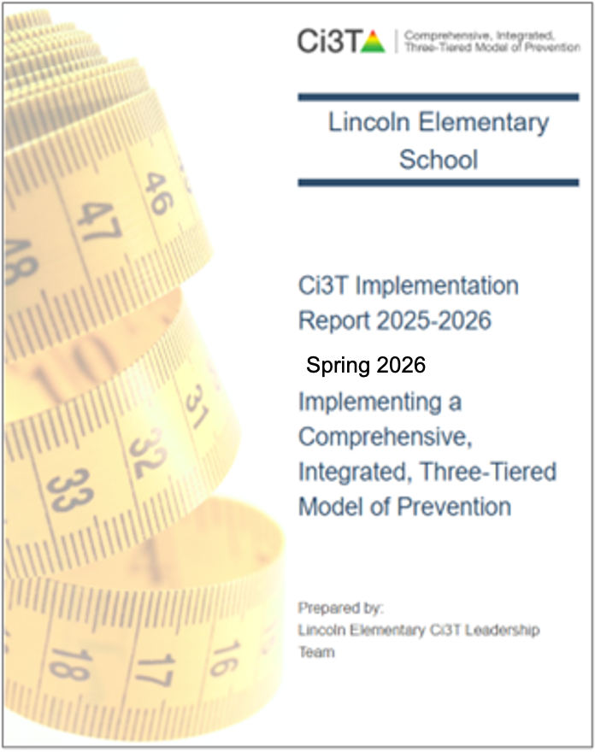
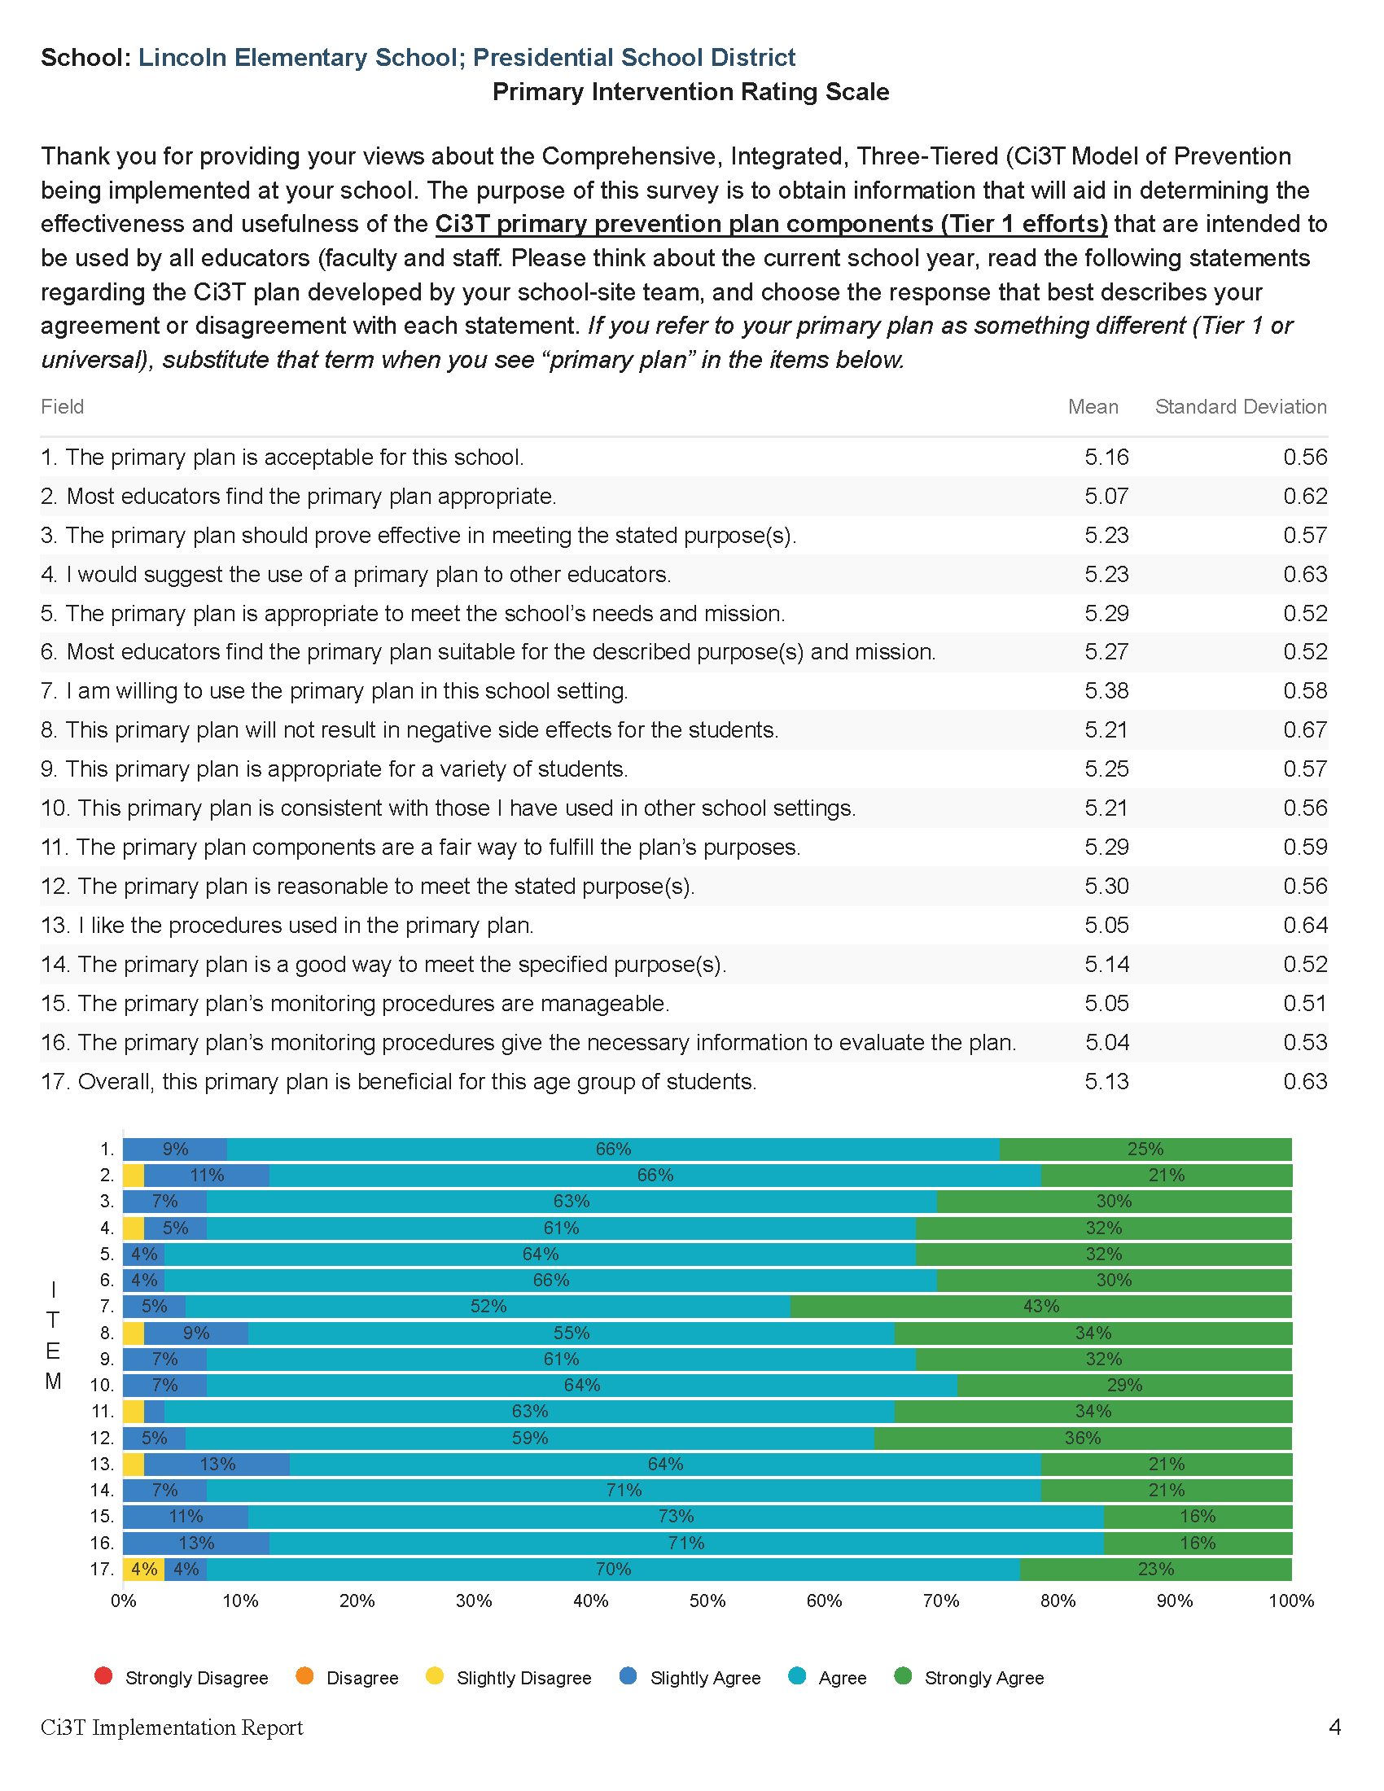
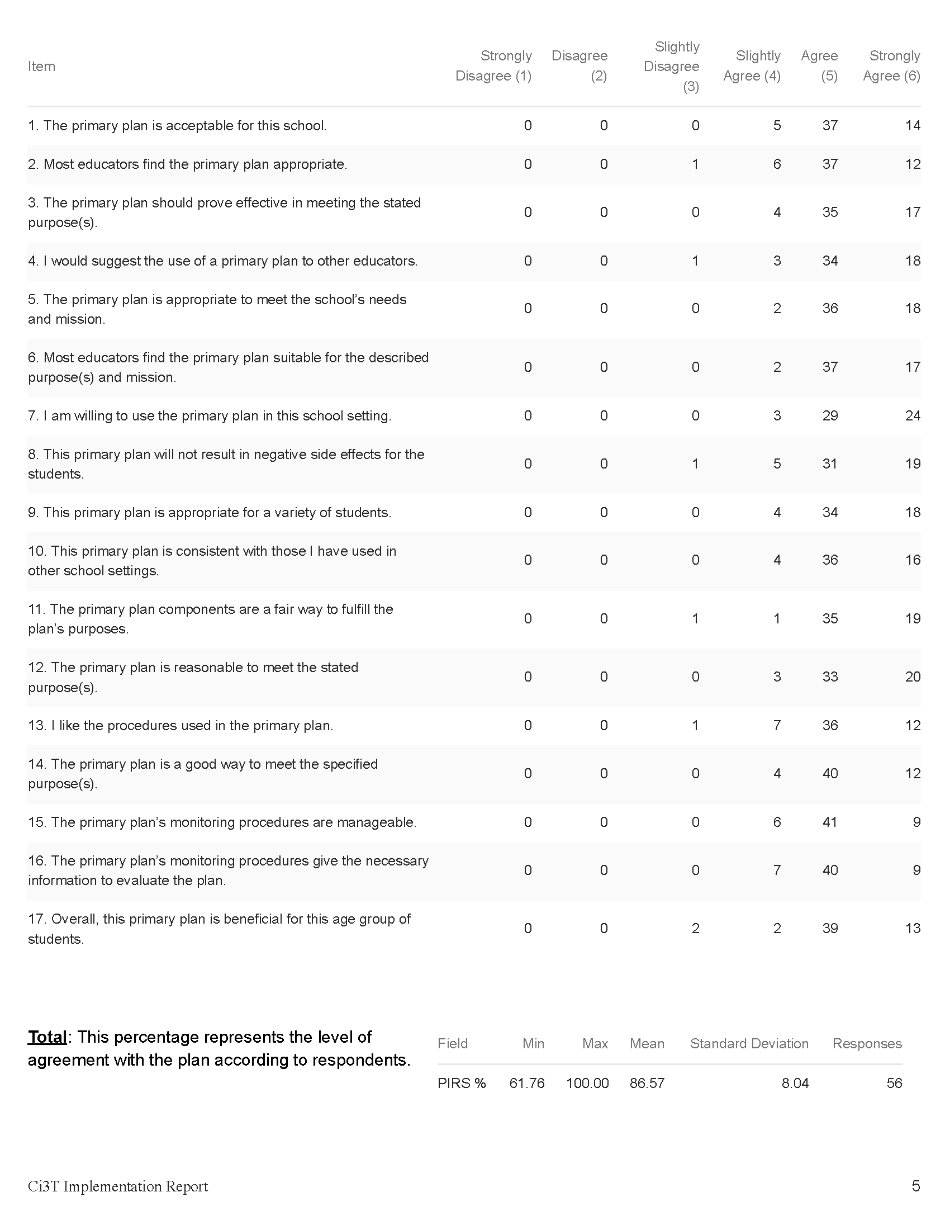
Primary Intervention Rating Scale (PIRS)
Item-level data reported by response category
(e.g., number of people who “strongly agreed”)
Item-level data reported as mean and standard deviation (scale = 1-6)
Item-level data visualization
Total PIRS %
(mean and standard deviation)

Slide 29
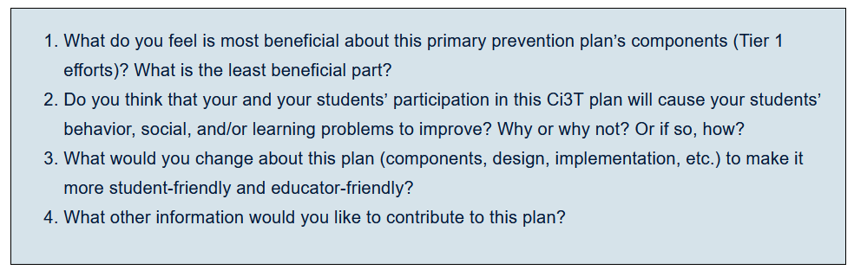
Primary Intervention Rating Scale Open Ended Items
Read through comments
Highlight success (literally!)
Look for themes for celebrations and focus areas

Slide 30
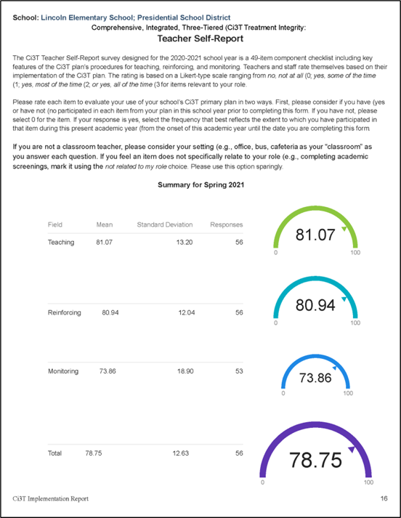


Ci3T Treatment Integrity: Teacher Self Report (Ci3T TI: TSR)
Total Scores
(mean and standard deviation)
Item-level data reported as mean and standard deviation (scale = 0-3)
Item-level data visualization

Slide 31

Ci3T TI: TSR Strengths and Areas of Focus

Slide 32

Treatment Integrity and Social Validity Data Sources
Primary Intervention Rating Scale (Social Validity)
Ci3T Treatment Integrity: Teacher Self Report
Ci3T Treatment Integrity: Direct Observation
Tiered Fidelity Inventory

Slide 33
Ci3T Treatment Integrity: Direct Observation Report
Subset of Ci3T TI: TSR items
Stratified, random selection of educators
  Personnel who directly instruct students
Observers trained to criterion
30-min observations
  Educator perspective
  Observer perspective

Slide 34

Ci3T Treatment Integrity: Direct Observation (Ci3T TI:DO)

Slide 35


Ci3T TI:DO Outside Perspective
Item-level data reported by response category
(e.g., number of people who “strongly agreed”)
Item-level data reported as mean and standard deviation (scale = 0-3)
Total %
(mean and standard deviation)
Item-level data visualization

Slide 36


Ci3T TI:DO Educator Perspective
Item-level data reported by response category
(e.g., number of people who “strongly agreed”)
Item-level data reported as mean and standard deviation (scale = 0-3)
Total %
(mean and standard deviation)
Item-level data visualization

Slide 37

Ci3T TI:DO Strengths and Areas of Focus

Slide 38

Ci3T TI: DO Mean Percentages

Slide 39
Treatment Integrity and Social Validity Data Sources
Primary Intervention Rating Scale (Social Validity)
Ci3T Treatment Integrity: Teacher Self Report
Ci3T Treatment Integrity: Direct Observation
Tiered Fidelity Inventory

Slide 40



Tiered Fidelity Inventory (TFI)

Slide 41

Sharing TFI Data

Slide 42








Sharing and Using Your Data

Slide 43
Accessing Professional Learning Materials
ci3t.org/imp

Slide 44



























Let’s Discuss
Locate your school’s Social Validity and Treatment Integrity Data
(e.g.,Ci3T Implementation Report, Ci3T Treatment Integrity: Direct Observation Report, Tiered Fidelity Inventory)
2) Review data and:
Highlight successes
Discuss concerns and identify areas of focus
Use HO Working with Treatment Integrity and Social Validity Data
to record plans for addressing these focus areas
Notes:
20-min timer

Slide 45

Procedures for Monitoring
Review your School’s Social Validity & Treatment Integrity Data
Review your School’s Spring Screening Data

Slide 46


Essential Components of Primary (Tier 1) Prevention Efforts
Social Validity
Systematic Universal Screening
Academic
Behavior
Treatment Integrity
ci3t.org/measures
ci3t.org/screening
for behavior

Slide 47


Behavior Screening

Slide 48






Systematic Behavior Screening

Slide 49

Student Risk Screening Scale – Internalizing and Externalizing (SRSS-IE; Drummond, 1994; Lane & Menzies, 2009)
Elementary

Slide 50

Student Risk Screening Scale – Internalizing and Externalizing (SRSS-IE; Drummond, 1994; Lane & Menzies, 2009)
Secondary

Slide 51
SRSS-IE: Cut Scores
Elementary School |  | Middle and High School
SRSS-E7 | SRSS-I5 | SRSS-E7 | SRSS-I6
Items 1-7 | Items 8-12 | Items 1-7 | Items 4, 8-12
0-3 = low risk 4-8 = moderate risk 9-21 = high risk | 0-1 = low risk 2-3 = moderate risk 4-15 = high risk | 0-3 = low risk 4-8 = moderate risk 9-21 = high risk | 0-3 = low risk 4-5 = moderate risk 6-18 = high risk
Elementary School Level:
Lane, K. L., Oakes, W. P., Swogger, E. D., Schatschneider, C., Menzies, H., M., & Sanchez, J. (2015). Student risk screening scale for internalizing and externalizing behaviors: Preliminary cut scores to support data-informed decision making. Behavioral Disorders, 40, 159-170.
Middle and High School Levels:
Lane, K. L., Oakes, W. P., Cantwell, E. D., Schatschneider, C., Menzies, H., Crittenden, M., & Messenger, M. (2016). Student Risk Screening Scale for Internalizing and Externalizing Behaviors: Preliminary cut scores to support data-informed decision making in middle and high schools. Behavioral Disorders, 42(1), 271-284

Slide 52
Spring 2024
SRSS-Externalizing Results – Elementary School level
n = 70
n = 43
n = 45
n = 5
n = 43
n = 7
n = 25
n = 31
n = 15
n = 38
n = 90
n = 87
n = 95
n = 129
n = 123
n = 110
n = 11
n = 103
n = 241
n = 298
n = 289
n = 31
n = 288
n = 297
n = 314
n = 330
n = 380
Notes:
Fill in <year> based on current academic year. This is located in column A of the data sheet. Edit by right clicking and selecting “Edit data”.

Slide 53
Spring 2024
SRSS-Externalizing Results – Elementary Grade level
Grade Level | N Screened | Low n (%) | Moderate n (%) | High n (%)
K | 66 | 43 (65.15%) | 20 (30.30%) | 3 (4.55%)
1 | 79 | 65 (82.28%) | 9 (11.39%) | 5 (6.33%)
2 | 78 | 54 (69.23%) | 20 (25.64%) | 4 (5.13%)

Slide 54
Spring 2024
SRSS-Internalizing Results – Elementary School Level
n = 54
n = 42
n = 36
n = 103
n = 70
n = 68
n = 283
n = 352
n = 340
Cut scores vary by school level:
Elementary (I5): Low (0-1), Moderate (2-3), High (4-15)
Middle and High (I6): Low (0-3), Moderate (4-5), High (6-18)
Notes:
Fill in <year> based on current academic year. This is located in column A of the data sheet. Edit by right clicking and selecting “Edit data”.
IMPORTANT NOTE: The INTERNALIZING subscale and CUT SCORES are specific to school level.
Elementary: SRSS-I5, Items 8-12, 0-1 = low risk, 2-3 = moderate risk, 4-15 = high risk
Middle and High: SRSS-I6, Items 4, 8-12, 0-3 = low risk, 4-5 = moderate risk, 6-18 = high risk

Slide 55
Spring 2024
SRSS-Internalizing Results – Elementary Grade Level
Grade Level | N Screened | Low n (%) | Moderate n (%) | High n (%)
3 | 62 | 51 (82.26%) | 11 (17.74%) | 0 (0.00%)
4 | 81 | 62 (76.54%) | 13 (16.05%) | 6 (7.41%)
5 | 90 | 64 (71.11%) | 13 (14.44%) | 13 (14.44%)

Slide 56


Reviewing Screening Data
Ci3T Leadership Teams review screening data at the following levels:
Screening Practice
School-wide (e.g., Tier 1 efforts)
Grade or department (e.g., Tier 1 efforts, low-intensity strategies)
Class level (e.g., low-intensity strategies)
Individual student level (e.g., Tier 2 and Tier 3)

Slide 57


Academic Screening
2.3 Screening

Slide 58

Reviewing Multiple Sources of Data in an Integrated Way
attendance
behavior
screening
academic screening

Slide 59
Sharing Systematic Screening Data
Once academic and behavior screening data are collected, data are shared at the:
School-wide (e.g., Tier 1 efforts)
Grade or department (e.g., Tier 1 efforts, low-intensity strategies)
Class level (e.g., low-intensity strategies)
Individual student level (e.g., Tier 2 and Tier 3)

Slide 60
Accessing Professional Learning Materials
ci3t.org/imp

Slide 61



At your next Ci3T Leadership Team Meeting…
Use the Working with Your Screening Data Handout to review Spring screening data Where are there strengths or bright spots? What are the greatest areas of need? School-level (e.g., Tier 1)? Grade or department level (e.g., Tier 1, low intensity strategies)? Classroom level (e.g., low intensity strategies)? Student-level (e.g., Tier 2 & Tier 3) Determine when and how to share Spring screening data with faculty and staff
Notes:
15-min timer

Slide 62

Planning for the Year Ahead 2026-2027
Review 2025-2026 data: Treatment integrity, social validity, screening, attendance
Review Your Ci3T Implementation Manual for 2026-2027
Incorporate revisions provided by your district: Ci3T District Masters – Updates
Use 2025-2026 data to inform revision for your Ci3T Implementation Manual
1.12 SCHOOLWIDE PROFESSIONAL DEVELOPMENT AND COACHING
Tier 1 leadership team develops, documents, and implements a comprehensive, data-informed, and differentiated professional development system (PBIS/MTSS for staff), supported by adequate FTE and aligned to other relevant school initiatives, that includes initial and ongoing training, coaching, and supportive performance feedback to all school or community-employed faculty/staff on foundational knowledge and Tier 1 practices (items 1.3-1.9).

Slide 63
Session Outcomes
Interpret social validity, treatment integrity, and spring screening data at the school- and classroom-level to identify successes and focus areas relative to Ci3T implementation.
Develop corresponding professional learning opportunities to empower faculty and staff with effective practices to inform instruction at each level of prevention (e.g., Tier 1, low-intensity strategies, Tier 2 and Tier 3 interventions) according to needs identified in social validity, treatment integrity, and spring screening data.

Slide 64


Action Planning
Review 2025- 2026 Implementation Data
Elise
05/24/26
Incorporate updates from the district
Allison
05/15/26
Attend Ci3T Implementation Symposium- update plan!
Mark
06/18/26
Notes:
Encourage you to leave a note in your Ci3T LT agenda to indicate where your team will pick up at your next meeting and to record any action items.

Slide 65




Ci3T Implementation Manual Review
Also available
as a
handout
ci3t.org/enhance
ci3t.org/imp

Slide 66





Slide 67



Professional Learning: Long Range Planning

Slide 68





Using Data to Revise Your Ci3T Plan
Add in plans for Tier 2 & 3

Slide 69


Check to see if your district has updated their District Master Blueprint
Teach, display, and model school-wide expectations
Teach school-wide social skills…, model social skills
Notes:
As you look at your Primary Plan where to you see this expectations for teachers. If you so not see it explicitly stated consider adding this to your summer revision list.

Slide 70


Enhancing Ci3T Modules
ci3t.org/enhance

Slide 71


Slide 72
Tickets don’t work.
It’s too complicated to collect and keep track of tickets.
Tickets don’t build intrinsic motivation. This isn’t preparing them for the real world
Fifth graders don’t care about tickets.

Slide 73



Professional Learning

Slide 74


Professional Learning

Slide 75


Slide 76



Focus:
Embedding Low-Intensity Strategies
1.10 CLASSROOM PRACTICES
Educators consistently and equitably implement positive and proactive classroom practices—including building relationships with students; developing a safe environment; prompting predictable routines and expected behavior; actively providing OTRs, active supervision, and specific feedback (i.e., specific praise and supportive corrections); and ensuring a high ratio (≥ 5:1) of positive to corrective feedback.

Slide 77



Slide 78
Winter 2024
SRSS-Externalizing Results – High School Level
n = 47
n = 72
n = 36
n = 36
n = 40
n = 8
n = 17
n = 38
n = 119
n = 113
n = 47
n = 137
n = 134
n = 114
n = 90
n = 65
n = 1259
n = 1280
n = 1188
n = 994
n = 447
n = 717
n = 750
n = 920

Slide 79


Encourage Review of Tier 2 and Tier 3 Enhancing Ci3T Modules
2.5 OPTIONS FOR TIER 2 INTERVENTIONS
Tier 2 continuum has multiple ongoing SEB support interventions available schoolwide that meet a range of student SEB internalizing or externalizing needs and behavioral functions, are designed to support groups of students, have documented evidence of effectiveness, and provide (a) additional instruction/time for student skill development, (b) additional structure/predictability, (c) increased opportunity for feedback (e.g., daily progress report), (d) increased communication with families, and (e) include planned modifications to address a range of behavioral function, mental health needs, or academic skills.

Slide 80


Whether the problem behavior is managed safely or not
or is defused
in a large measure depends on
YOUR INITIAL RESPONSE
-Dr. Geoff Colvin

Slide 81




Slide 82
Focusing on Data-Informed Professional Learning
Ci3T Monthly Leadership Team Meetings
Project EMPOWER: Building Capacity
Ci3T Trainer and Coaches Calls
Ci3T Summer Symposium

Slide 83

Foundational Ci3T Implementation & Professional Learning Activities

Slide 84



Ci3T Monthly Leadership Team
Meetings & Faculty and Staff Meetings
1.1 TEAM COMPOSITION
Tier 1 leadership team includes the following roles: 1-2 Tier 1 system coordinators (e.g., coaches), a school administrator, a representative group of educators (e.g., grade level or departmental representation, general and special education, certified and non- certified staff), students, family members who do not work for the school district, members from marginalized groups, relevant community partners (e.g., mental health providers), and individuals who actively provide expertise in the following areas: applied behavior support, mental health and trauma, academic instruction, coaching, equity, physical health and wellness (e.g., nurse, health teacher), data systems and information regarding system and student academic and SEB strengths and needs, operations of the school across grade levels and programs.

Slide 85
Ci3T Implementation Professional Learning Series
Please check back for information for 2026-2027!

Slide 86
Project EMPOWER+
Please check back for information for 2026-2027!

Slide 87
Ci3T Trainers and Coaches Calls
Please check back for information for 2026-2027!

Slide 88
Ci3T Implementers Symposium
Please check back for information for 2026-2027!

Slide 89
Accessing Professional Learning Materials
ci3t.org/imp

Slide 90














Reflect & Plan
Plan and schedule action items for closing out the current year and preparing for the upcoming year: Identify potential Ci3T Implementation Manual revisions Schedule time with your Ci3T Leadership Team to: complete Ci3T Implementation Manual revisions prepare for implementation in 2026-2027 Create plans for spring data sharing (e.g., social validity, treatment integrity, academic & behavior screenings) | Plan data-informed professional learning for the upcoming year: What are strengths of our current communication and professional learning systems? How can we share data updates and professional learning opportunities with faculty and staff more regularly? What resources and professional learning do faculty and staff require? Consider: Enhanced Ci3T Professional Learning Modules Empower Sessions Ci3T Trainers and Coaches Calls
Write any action items in your Ci3T Leadership Team Meeting Agenda
Use “Ci3T Imp Manual Review” to revise
Notes:
10-min timer

Slide 91
Wrapping Up and Moving Forward

Slide 92



Let’s Chat!
What is 1 action item you or your team is taking following today’s session?

Slide 93

Project EMPOWER+
EMPOWER+ Session | Date
Starting Strong: Effective Tier 1 Practices for Educators | September 24, 2025 (Wednesday)
From Data to Action: Using Systematic Screening to Inform Instruction | October 8, 2025 (Wednesday)
Ci3T In Action: Integrated Lesson Planning for Enhanced Instruction | November 18, 2025 (Tuesday)
Mastering Behavior Specific Praise and Precorrection | January 21, 2026 (Wednesday)
A 6-Step Instructional Approach for Responding to Challenging Behaviors: A Tier 1 Practice | February 10, 2026 (Tuesday)
A Tier 2 Support for Students Experiencing Anxious Feelings: Recognize. Relax. Record. | March 25, 2026 (Wednesday)
A Tier 3 Support for Students with Intensive Intervention Needs: Functional Assessment-Based Intervention (FABI) | April 28, 2026 (Tuesday)

Slide 94

Ci3T Trainers and Coaches Calls
Ci3T Trainers and Coaches Calls Location: Remote via Zoom Attended by: Ci3T Leadership Teams, Ci3T Trainers and Coaches, Faculty and Staff, Families (adults only), Community Members
Session | Date | Times (Central)
Ci3T Trainers and Coaches Call 1 | Aug. 20, 2025 (Wed) | 4:00 – 5:00 p.m.
Ci3T Trainers and Coaches Call 2 | Sept. 03, 2025 (Wed) | 4:00 – 5:00 p.m.
Ci3T Trainers and Coaches Call 3 | Oct. 01, 2025 (Wed) | 4:00 – 5:00 p.m.
Ci3T Trainers and Coaches Call 4 | Nov. 05, 2025 (Wed) | 4:00 – 5:00 p.m.
Ci3T Trainers and Coaches Call 5 | Dec. 02, 2025 (Tues) | 4:00 – 5:00 p.m.
Ci3T Trainers and Coaches Call 6 | Jan. 22, 2026 (Thurs) | 4:00 – 5:00 p.m.
Ci3T Trainers and Coaches Call 7 | Feb. 17, 2026 (Tues) | 4:00 – 5:00 p.m.
Ci3T Trainers and Coaches Call 8 | Mar. 10, 2026 (Tues) | 4:00 – 5:00 p.m.
Ci3T Trainers and Coaches Call 9 | Apr. 15, 2026 (Wed) | 4:00 – 5:00 p.m.
Ci3T Trainers and Coaches Call 10 | May 13, 2026 (Wed) | 4:00 – 5:00 p.m.

Slide 95
Wrap Up and Preview
Today
Next time
Procedures for Monitoring
  Review your School’s Social Validity & Treatment Integrity Data
  Review your School’s Spring Screening Data
Planning for the Year Ahead 2026-2027
Focusing on Data-Informed Professional Learning
We hope you have a wonderful conclusion to the school year!
Invitation: Ci3T Implementation Symposium!
Invitation: Partner Spotlight!

Slide 96

Homework
At your next Ci3T Leadership Team meeting:
  Begin planning updates to your Ci3T Implementation Manual for next year; consider:
    Takeaways from data reviews conducted this year (social validity, treatment integrity, student outcomes)
    District Master updates
  Update your Ci3T Leadership Team structures for next year, including membership, meeting dates, agendas
  Plan data-informed professional learning to support your staff in 2026-2027
At your next faculty meeting:
  Share successes
  Share spring implementation report and screening data
  Share revisions to Ci3T Implementation Manual based on spring data
  Share professional learning resources and opportunities

Slide 97
Action Planning
Sign up for Implementers Symposium
Elise
04/15/26
Schedule time for Ci3T Implementation Manual edits
Allison
04/15/26
Prepare TI/SV data presentation for 05/10 faculty meeting
Mark
05/03/26
Notes:
Encourage you to leave a note in your Ci3T LT agenda to indicate where your team will pick up at your next meeting and to record any action items.

Slide 98


Coaching Protocol Reminder
Notes:
If you’re a coach, you might consider setting aside time to review coaching protocol for Session 1 especially the after coaching tips, action items, and reflection!

Slide 99






@Ci3Tmodel
@Ci3Tmodel
Tag us in your Ci3T highlights, we love to see Ci3T in action!
Follow us on X and Instagram for updates and new resources!
Thank you!
ci3t.org
#Ci3T
Notes:
Tag us in your Ci3T highlights- we’d love to see Ci3T in action! Follow us on Twitter or Instagram for updates and links to resources! @Ci3TModel
You will receive a brief session evaluation – we value your feedback and would greatly appreciate you taking a few minutes to share your thoughts on what you liked about the session and how we can improve

