Slide 1
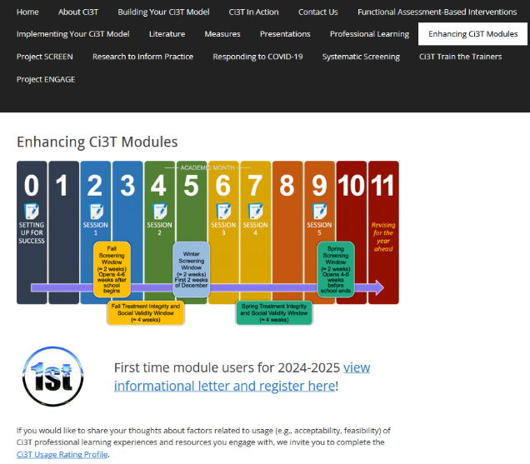
Implementing Comprehensive, Integrated, Three-tiered (Ci3T) Models: Supporting Student Success Across the Tiers
Enhanced Ci3T Implementation Series and Delivery (E-Ci3T) Session 4
If you have not done so already, we invite you to visit ci3t.org/enhance to access modules and complete a one-time registration process!

Slide 2














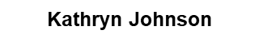







Ci3T Research Team
Grant Allen
Matthew Aschliman
Tammy Becker
Allison Bernard
Carrie Brandon
Amy Briesch
Mark Buckman
Amy Buffington
Donna Cauley
Sandy Chafouleas
Eric Common
Howard Diacon
Kathleen Lynne Lane
Jessica Matus
Wendy P. Oakes
David Royer
Elise Sarasin
Rebecca Sherod
Joni Weiss
Stacie Williams

Slide 3
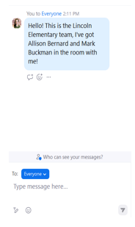

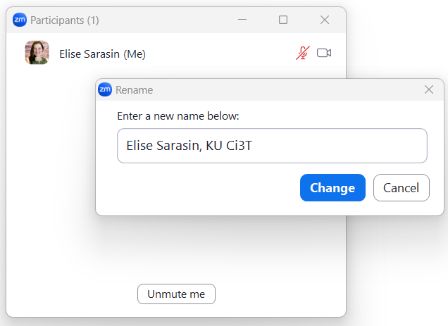
Zoom Logistics
If you are facilitating a Ci3T Leadership Team Symposium session at a satellite location, please email us a list of the names, email addresses, and schools of those attending.
To help us put you in breakout rooms with your colleagues today we are renaming you with your school initials and first and last name
If there are multiple people in the room with you, please list their first and last names and email in the chat!

Slide 4
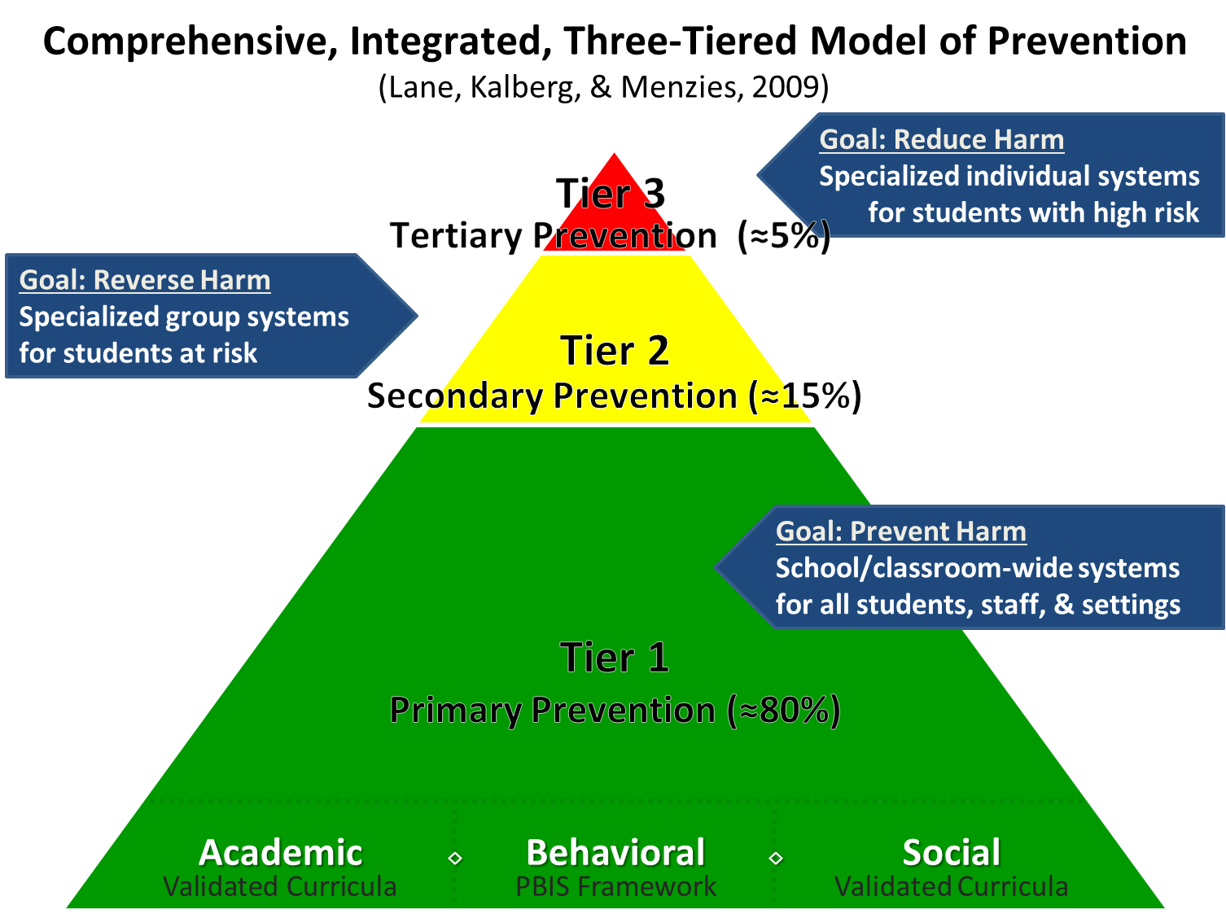
Comprehensive, Integrated, Three-Tiered Model of Prevention 1

Slide 5
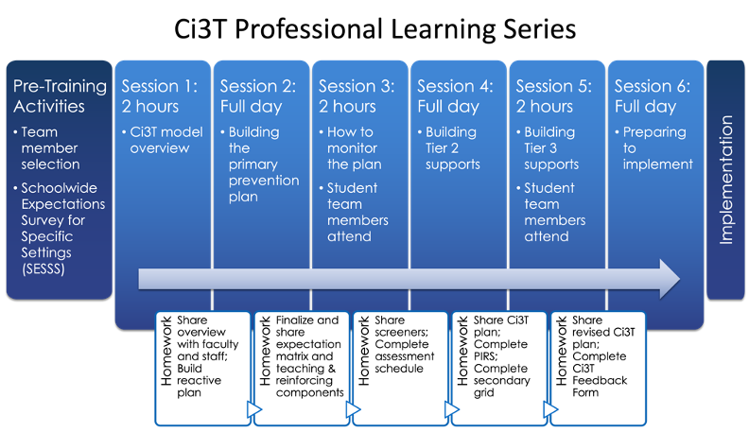
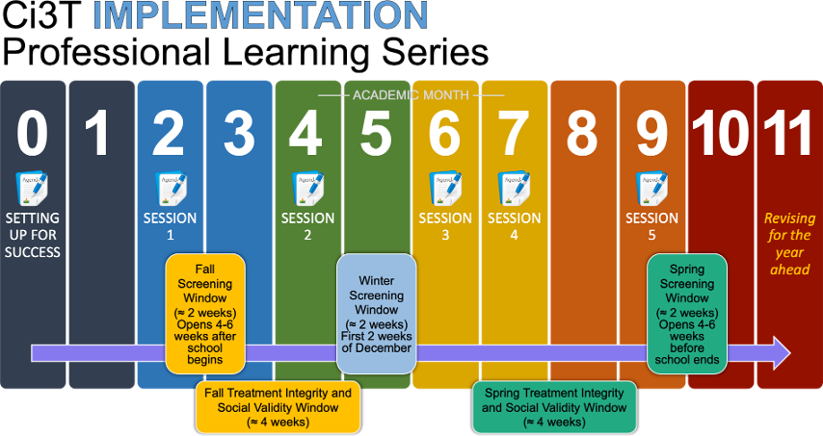




Ci3T Comprehensive
Professional Learning Plan

Slide 6
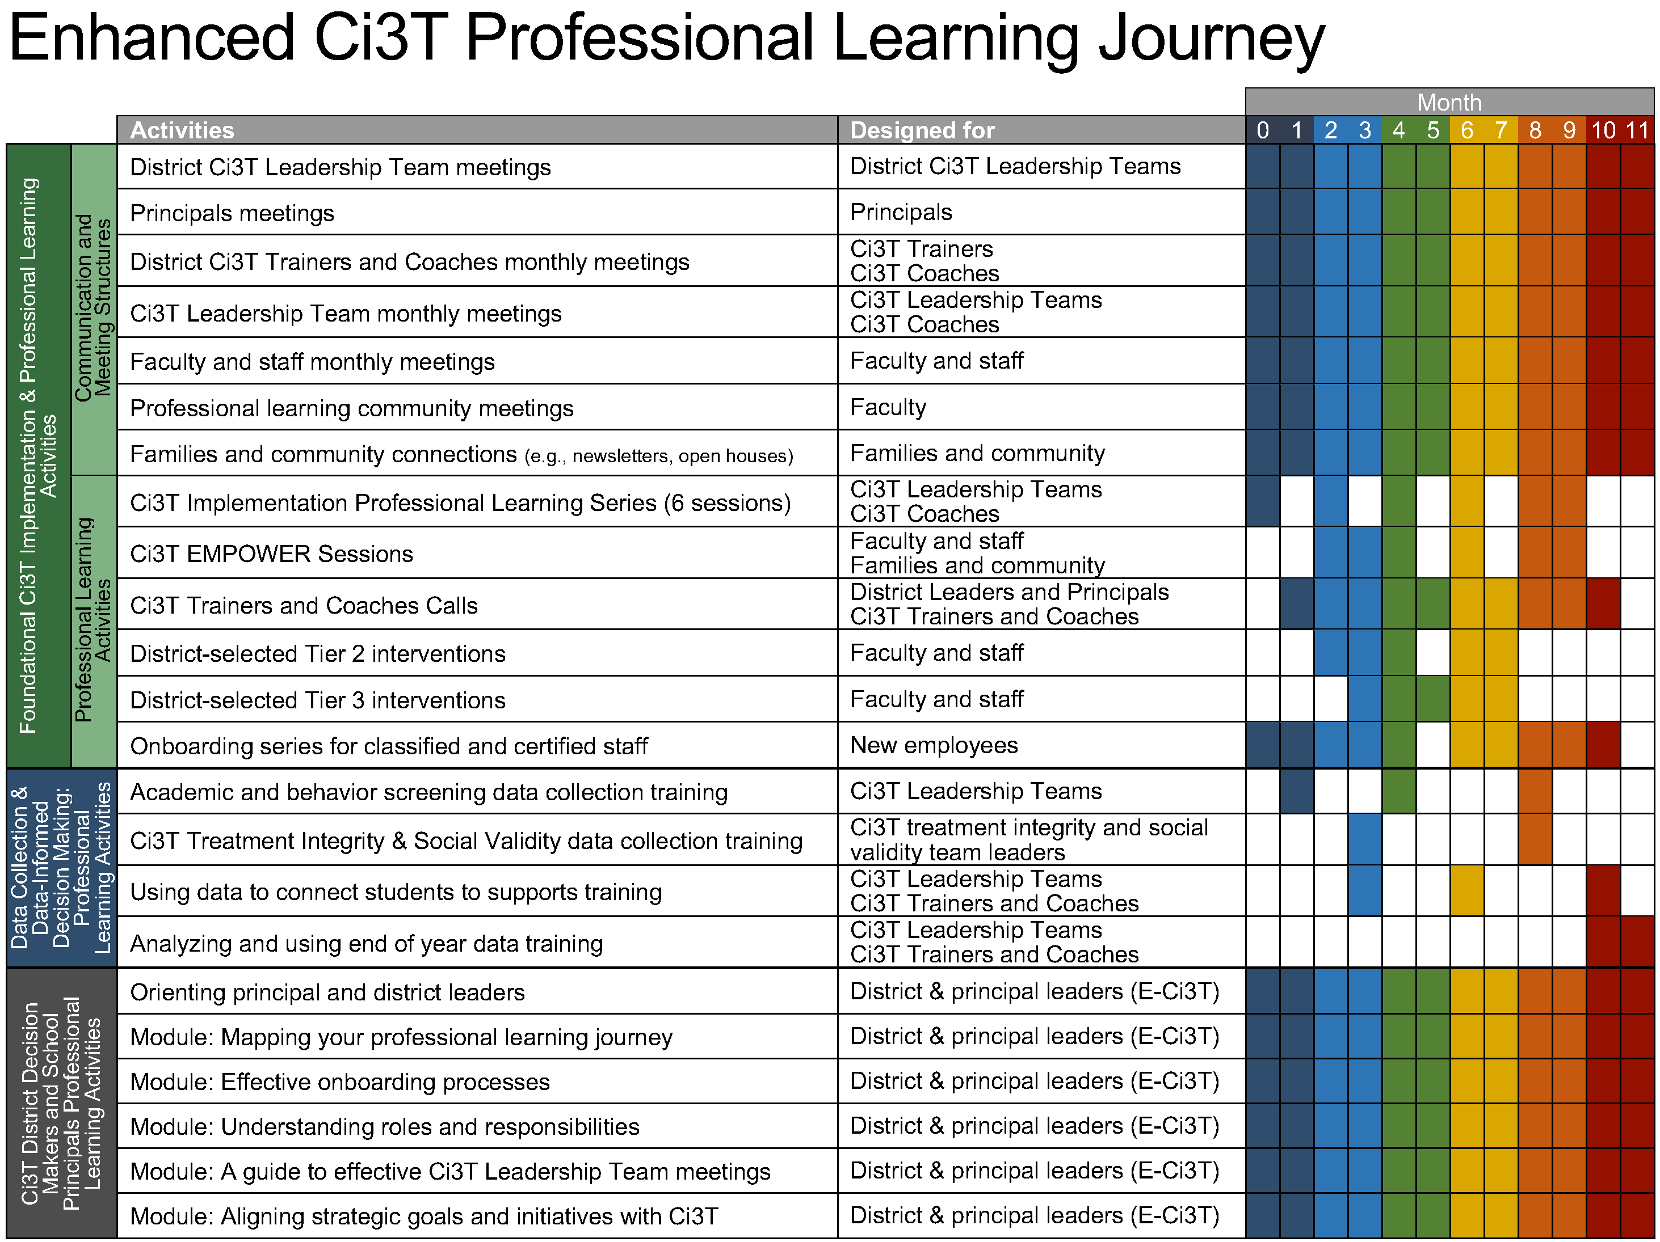
Enhanced Ci3T Implementation Series and Delivery

Slide 7
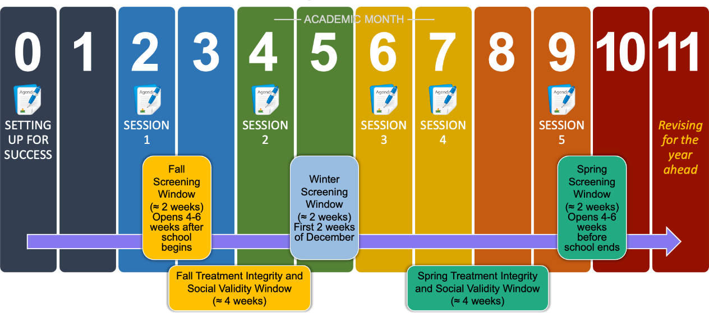
Ci3T Implementation Professional Learning Series
Notes:
The Ci3T Implementation Professional Learning Series is a 6-part series that spans the academic year. Sessions are timed to correspond to important milestones including: the beginning of the school year (e.g., kicking off the year, rolling out the Ci3T plan), screening windows, and treatment integrity and social validity windows.
Each session is data-informed, meaning attending Ci3T Leadership Team members review data, which are used to (a) identify successes, (b) identify focus areas (e.g., aspects of implementation that require additional attention, often via professional learning), and (c) create action plans to share data back and address focus areas.
Sessions applicable for both new and seasoned implementers as the focus is on predicable components of Ci3T implementation, space to review and respond to data, exploring resources to support implementation efforts, and beginning conversations and action plans.

Slide 8
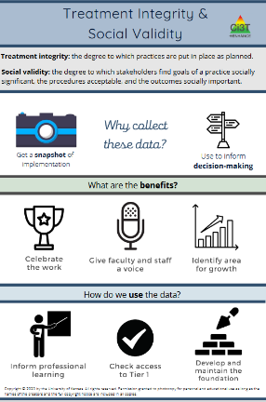
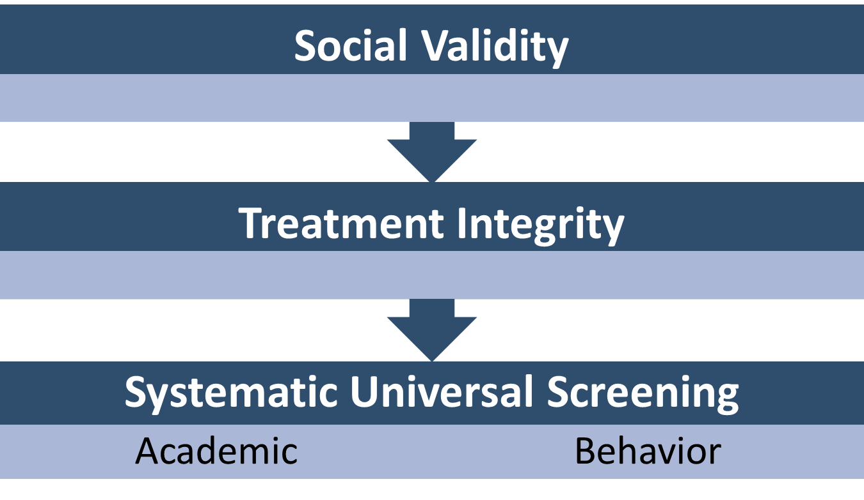
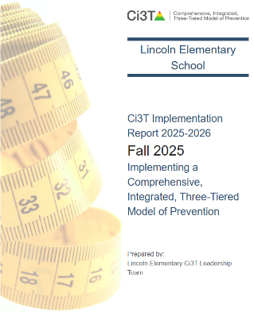
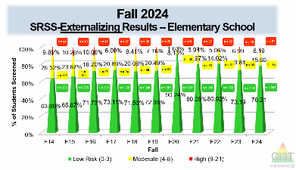
Essential Components of Primary (Tier 1) Prevention Efforts

Slide 9



Enhancing Ci3T Modules
ci3t.org/enhance

Slide 10
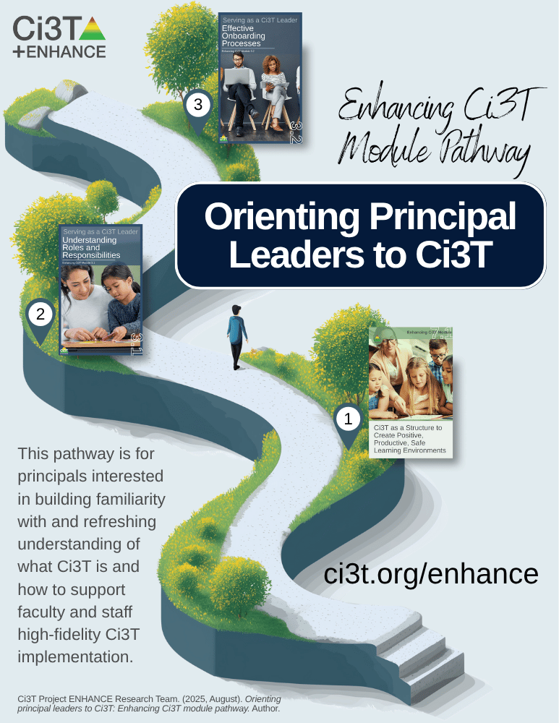
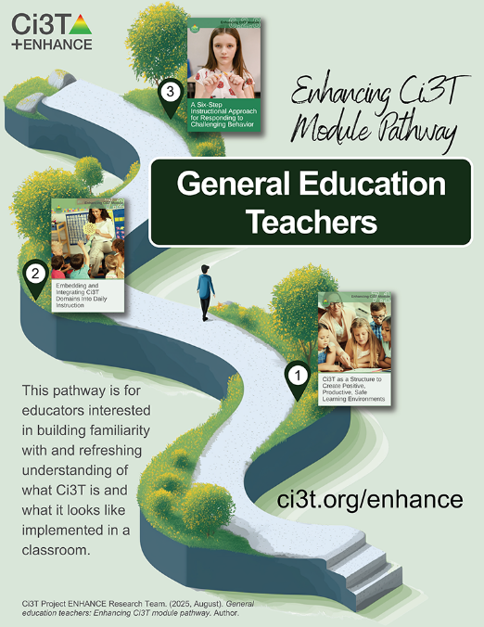
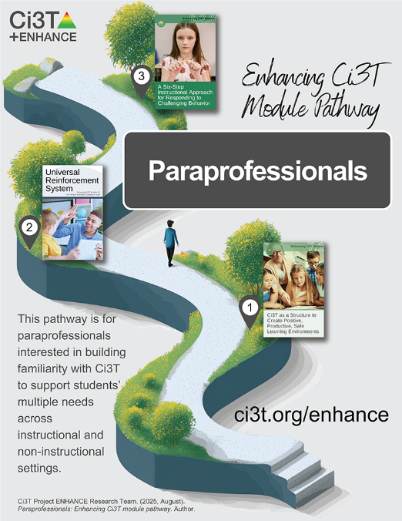
Module Pathways

Slide 11
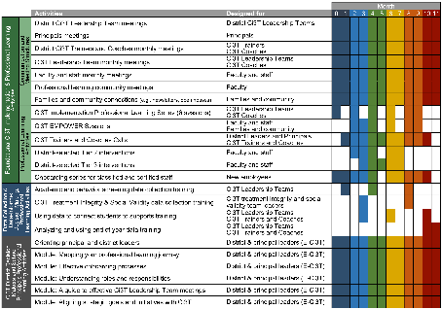

Session Outcomes
Identify continued professional learning needs from the previous session based on available data (e.g., screening, social validity, and treatment integrity).
Develop integrated lesson plans featuring low-intensity strategies to address academic, behavioral, and social and emotional well-being in an integrated fashion to maximize engagement and prevent challenging behaviors from occurring.
Refine data-informed, decision making at Tier 2 and Tier 3, by using school-wide data to connect students to additional strategies, practices, and programs.
Identify professional learning resources available to support work across Tiers 1, 2, and 3, and make plans to connect faculty and staff to these resources.
If you are a Board Certified Behavior Analyst (BCBA), you may accrue up to 2 learning continuing education units (CEUs) for attending this session. See agenda for task list alignment. Throughout the session we will share 4 key words, write those down to turn in after the session!

Slide 12
Agenda
Welcome
Data-Informed Decision-Making
  Sharing Data with Stakeholders
  Using Data to Inform Professional Learning and Instruction
Integrated Lesson Planning at Tier 1
Planning and Implementing Tier 2 Interventions
Planning and Implementing Tier 3 Interventions
Wrapping Up and Moving Forward

Slide 13
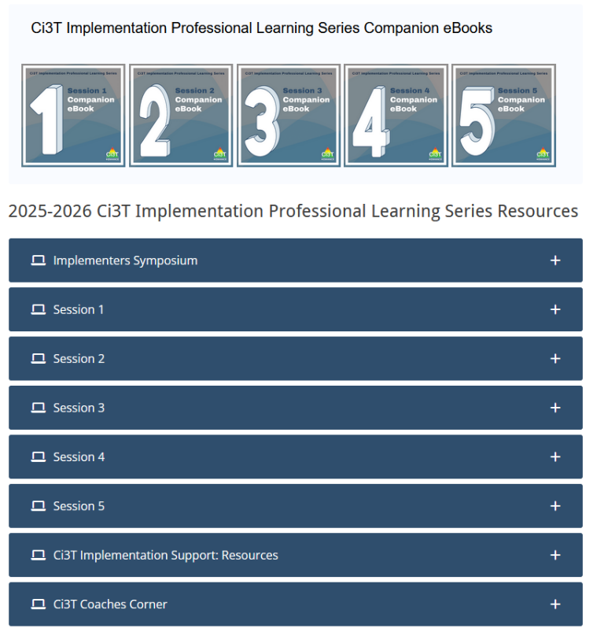
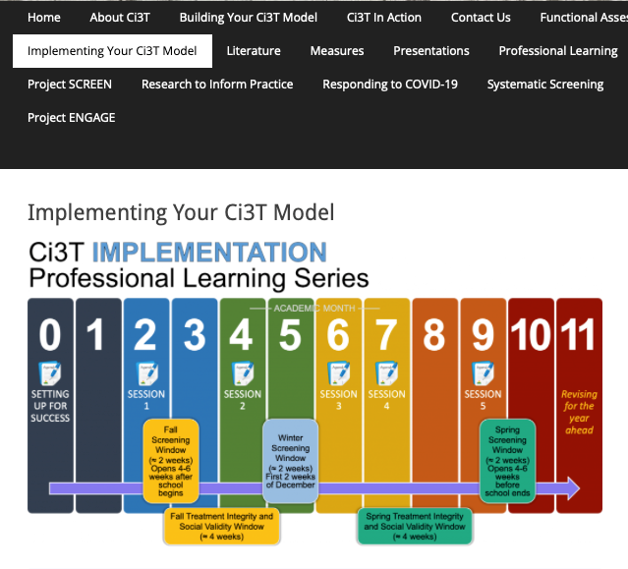
Accessing Professional Learning Materials
ci3t.org/imp

Slide 14
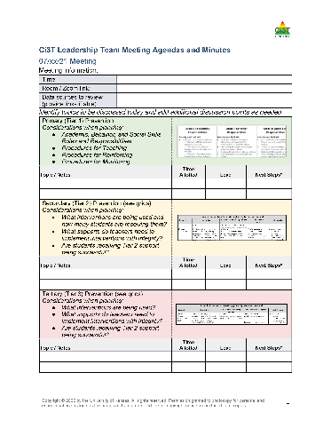

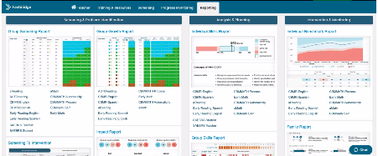


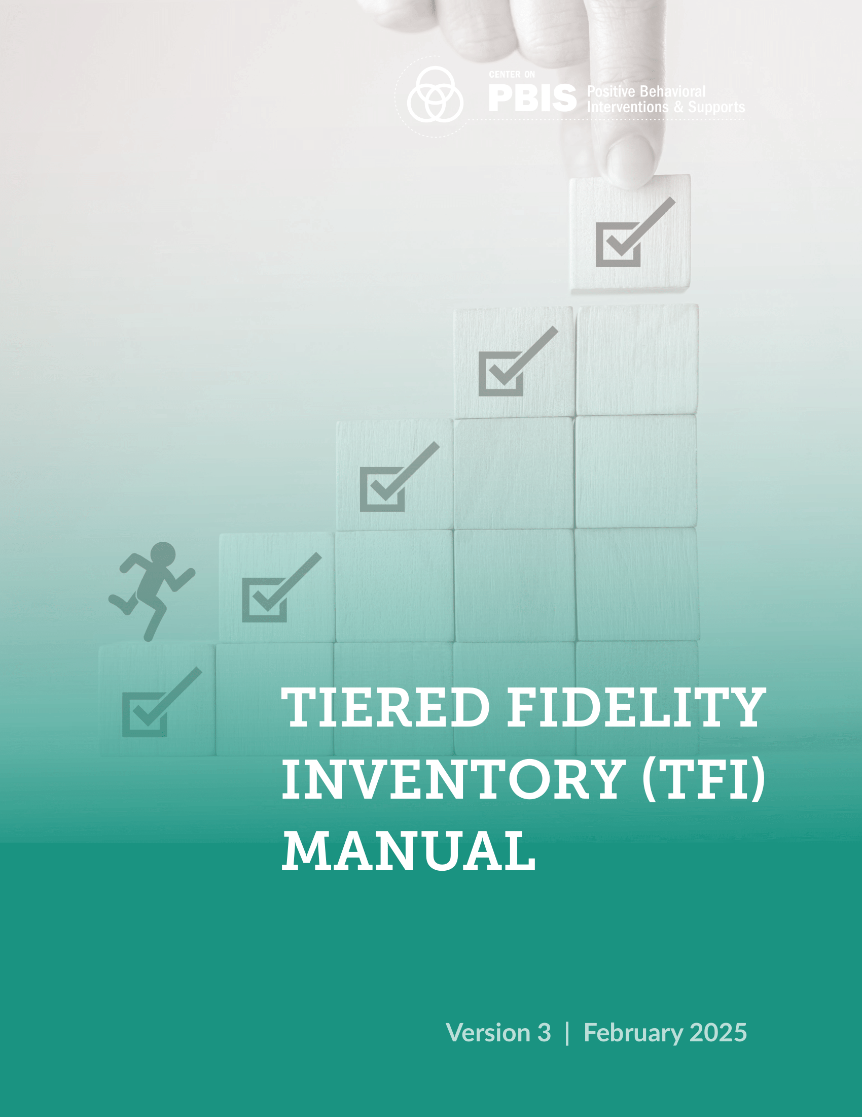
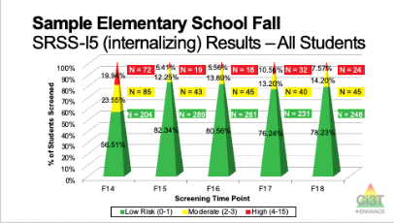
Materials for Today’s Session
Ci3T Leadership Team Agenda
Ci3T Implementation Manual
Winter Screening Data
Fall Treatment Integrity and Social Validity Data

Slide 15

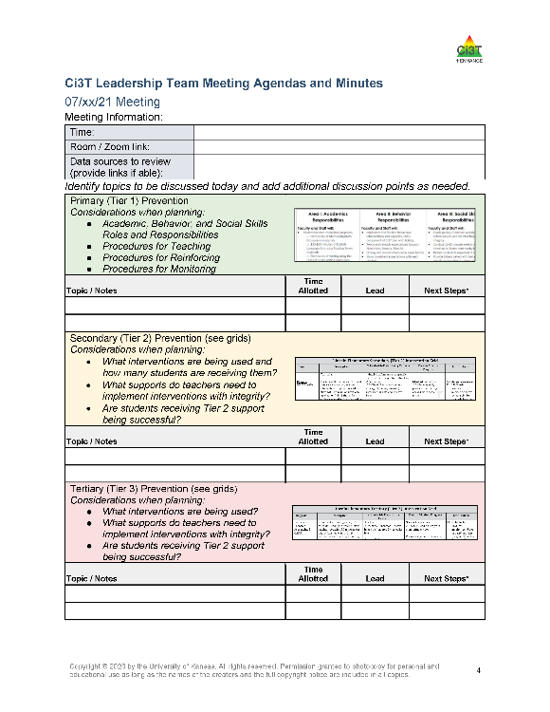
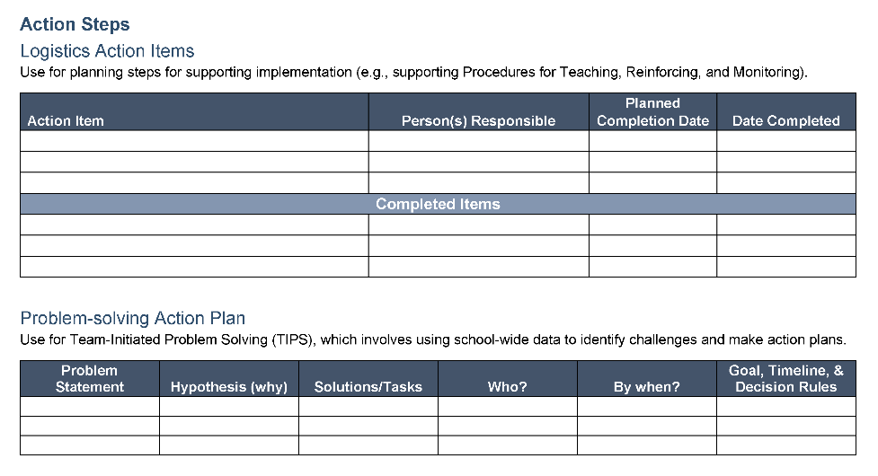

Ci3T Leadership Team Agenda Template
1.2 TEAM OPERATING PROCEDURES
Tier 1 leadership team has (a) regular meeting format/agenda that prompts the regular review of Tier 1 practices, systems, and data, (b) minutes available to all staff for review, (c) established and regularly used team norms, (d) defined meeting roles (e.g., timekeeper, facilitator, recorder), (e) regular (e.g., quarterly) two-way data sharing and communication with advanced tiers teams to inform decision making, (f) a current action plan, (g) procedure for evaluating fidelity of team operating procedures (e.g., Team Initiated Problem Solving [TIPS] Fidelity Checklist) at least twice annually, and (h) a formal process to monitor the impact of team norms and procedures on ensuring all team members are able to participate as equal partners

Slide 16
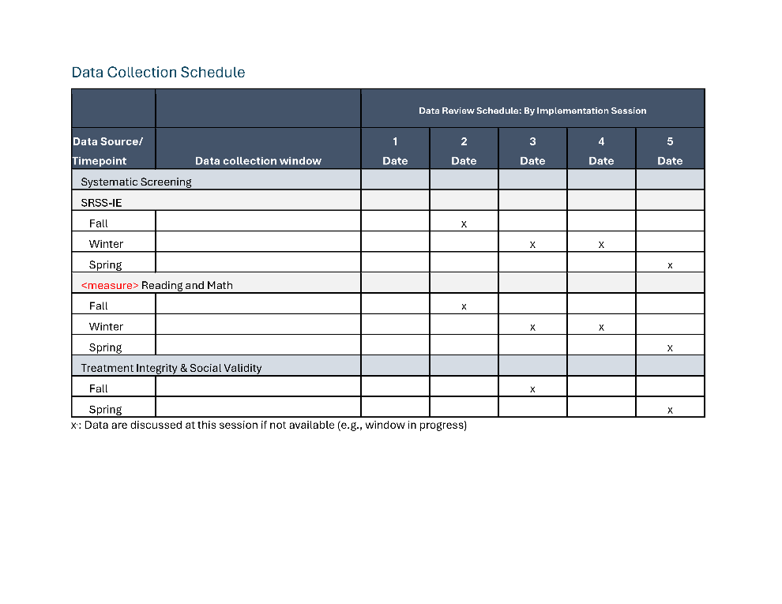
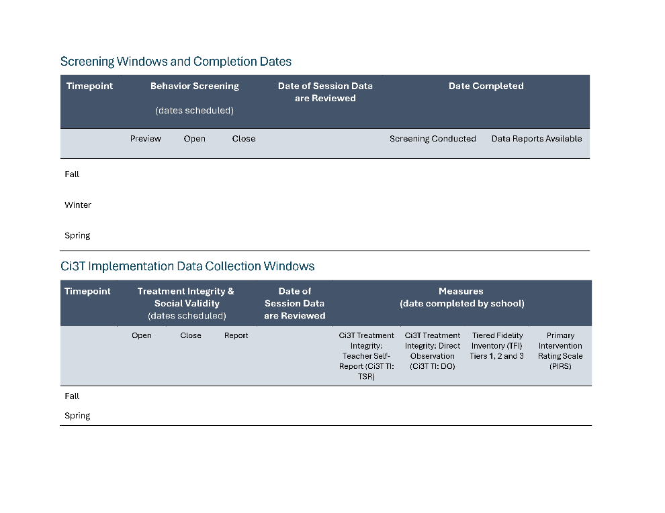
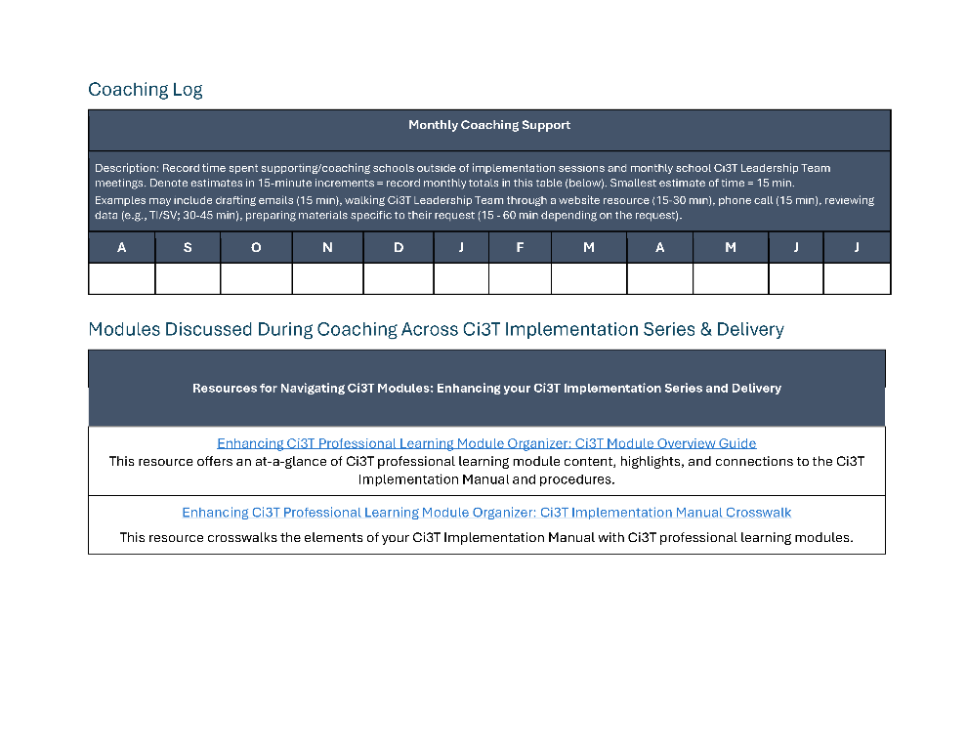
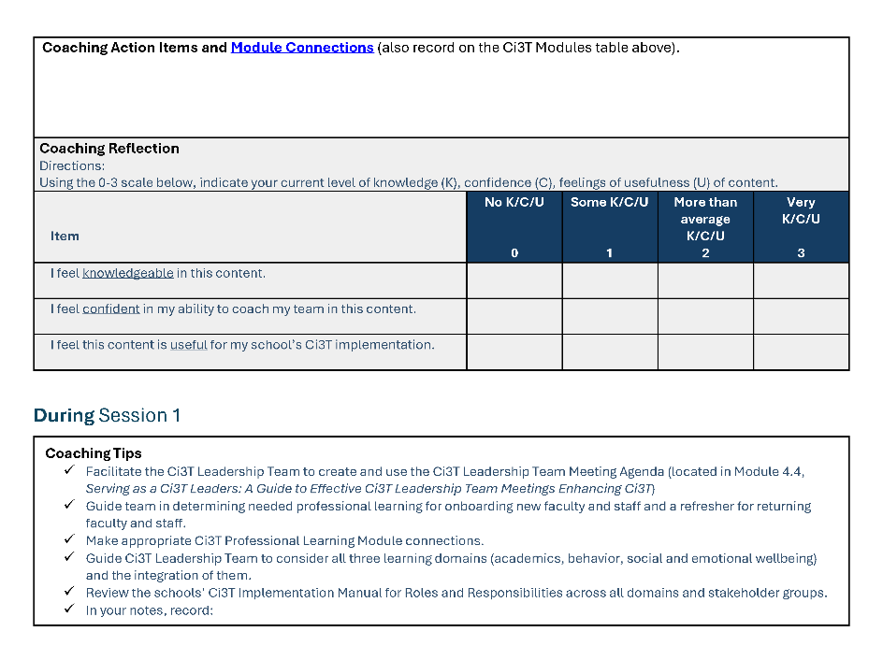
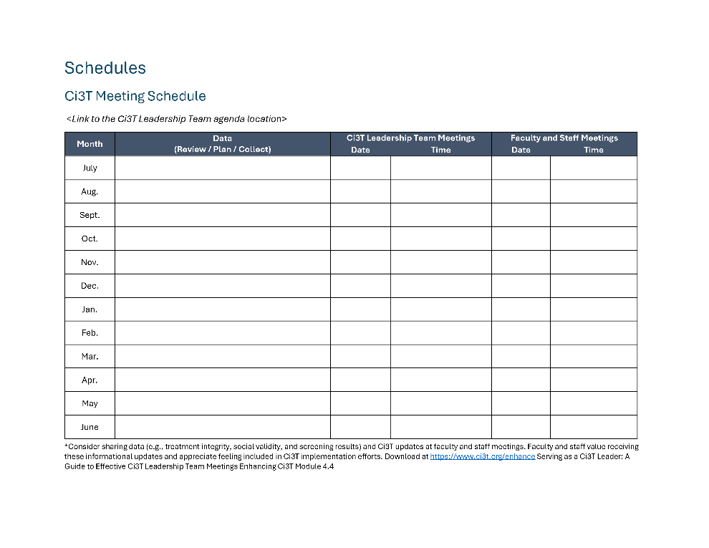
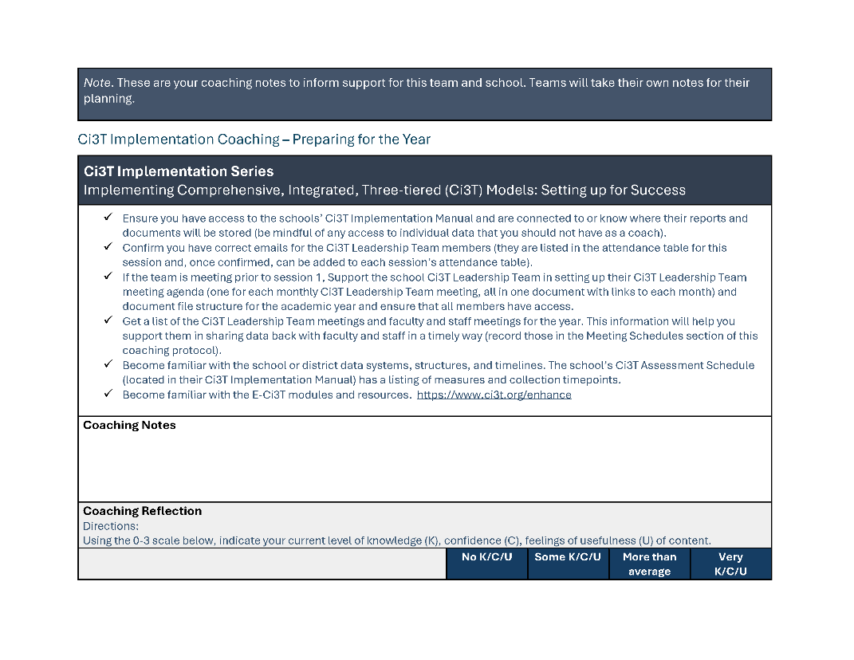
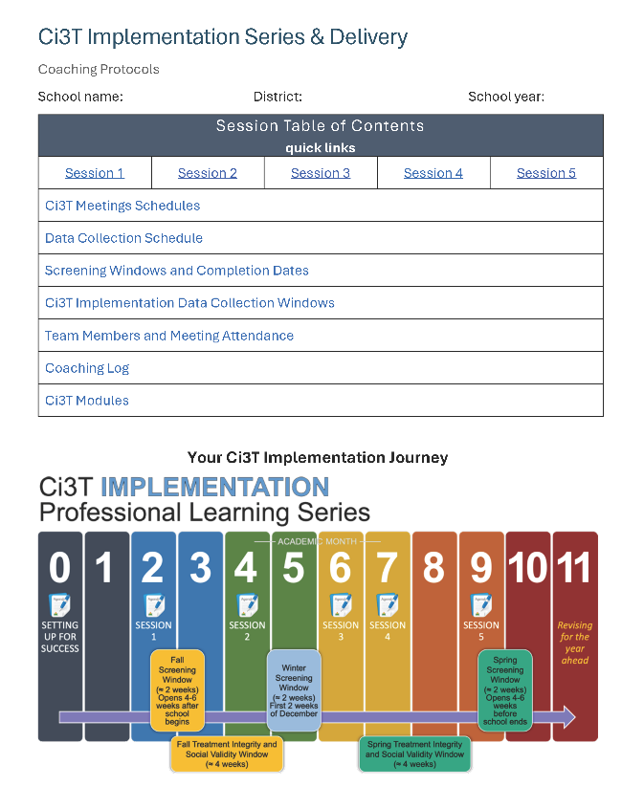
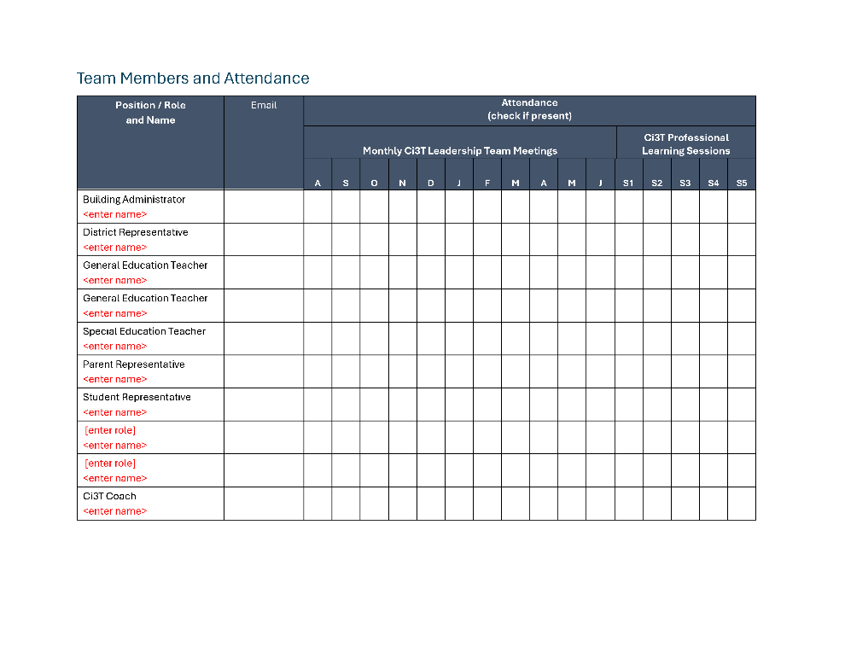
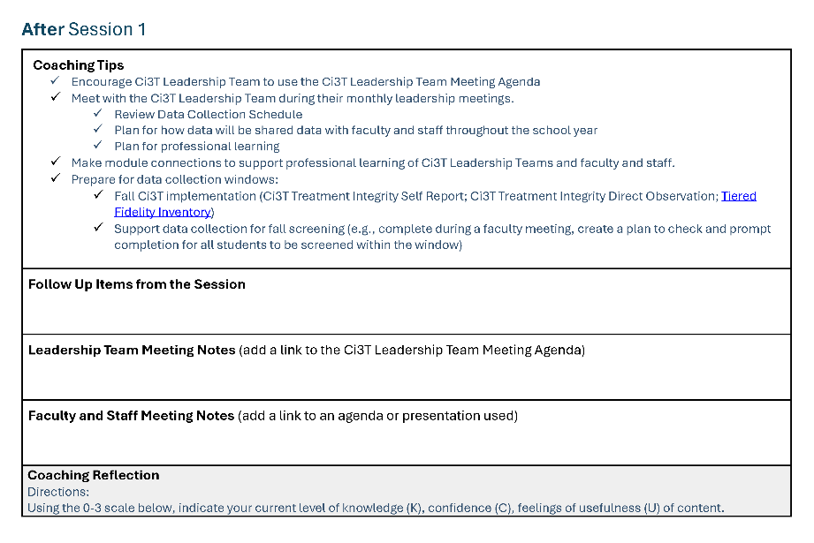
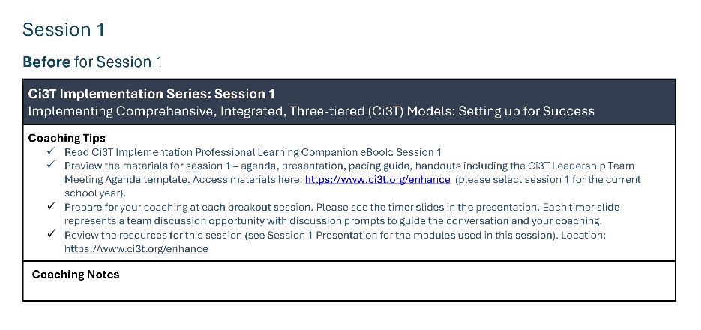
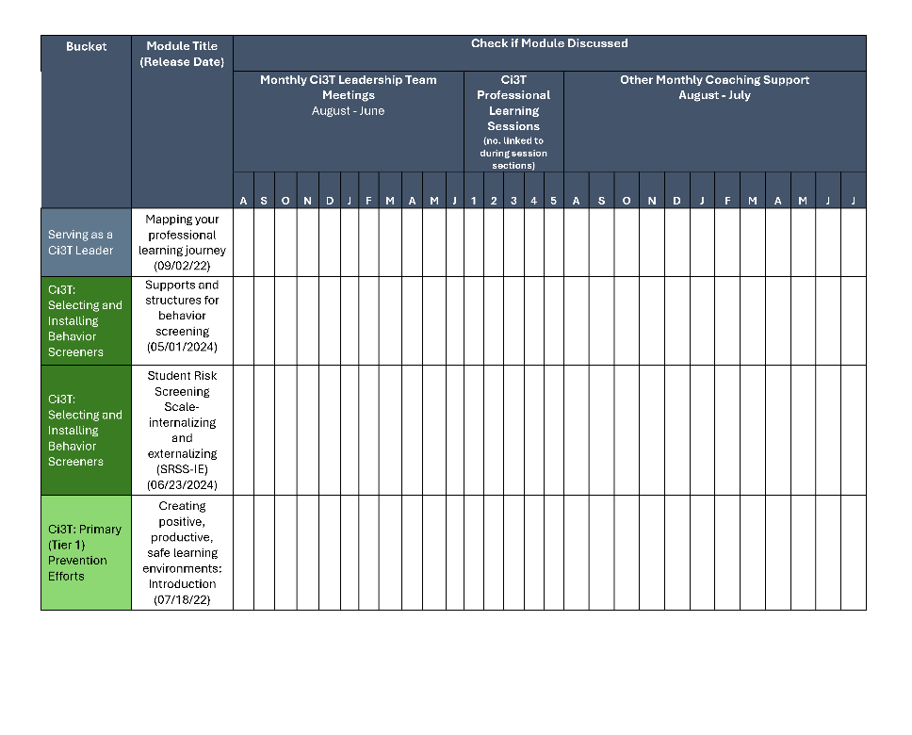
Coaching Protocol

Slide 17
Data-Informed Decision-Making
Sharing Data with Stakeholders
Using Data to Inform Professional Learning and Instruction
1.14 FACULTY AND STAFF ENGAGEMENT
Tier 1 leadership teams purposefully and regularly engage all faculty and staff in co-designing and actively revising the content and the implementation of foundational Tier 1 practices (items 1.3-1.10) and systems (items 1.12-1.13) based on the regular review of schoolwide and community data.

Slide 18
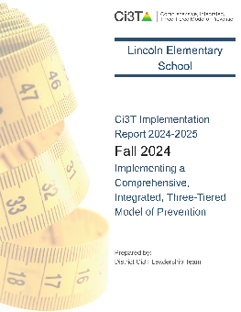

Essential Components of Primary (Tier 1) Prevention Efforts
Social Validity
Systematic Universal Screening
Academic
Behavior
Treatment Integrity
ci3t.org/measures
ci3t.org/screening
for behavior

Slide 19
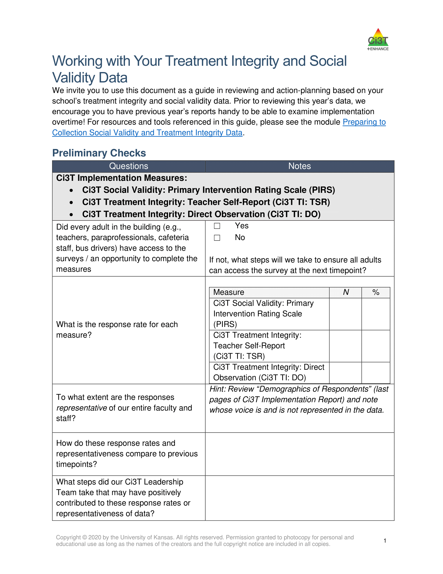
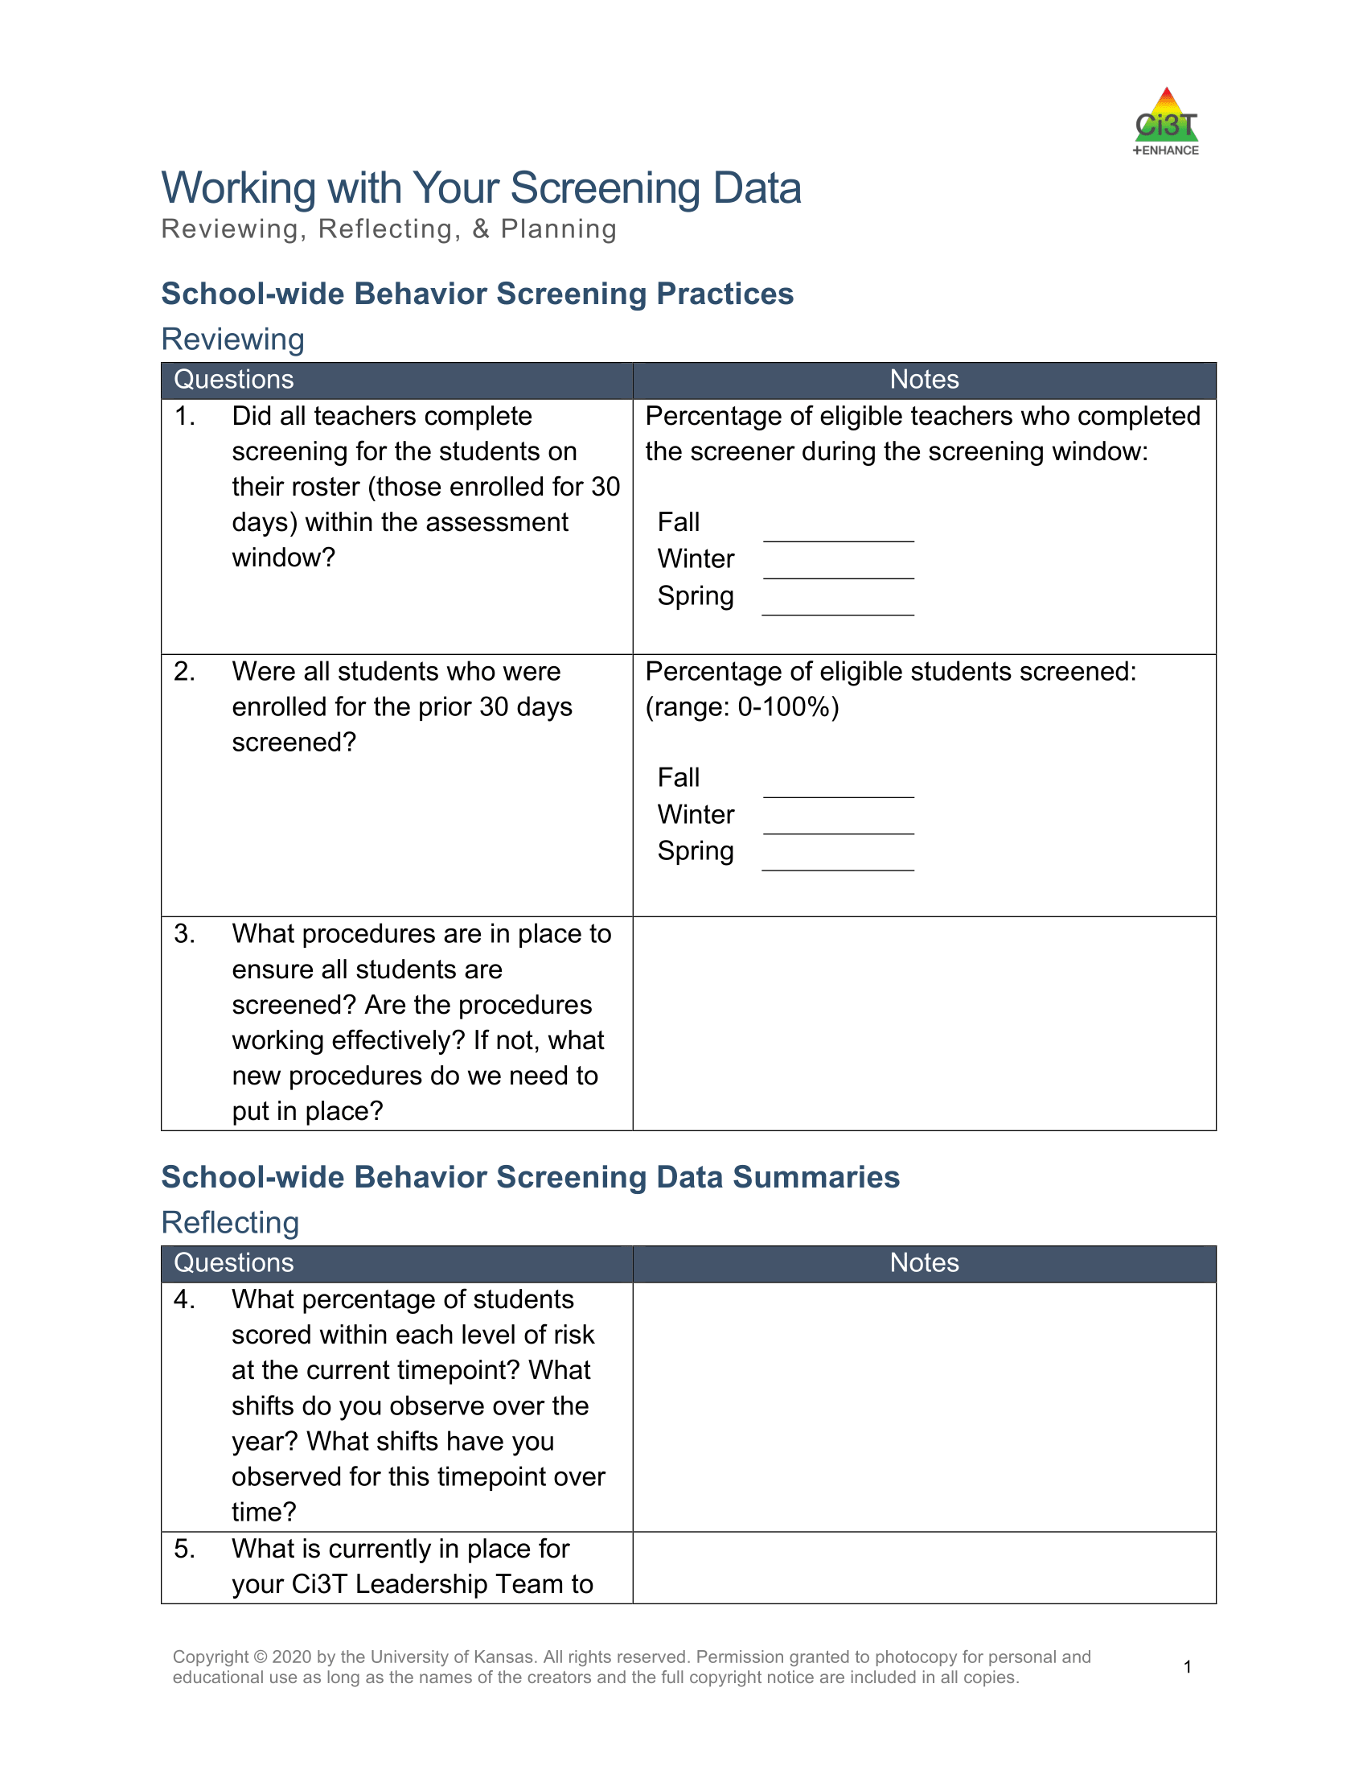
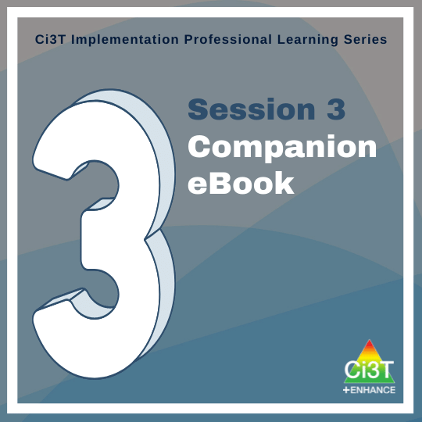
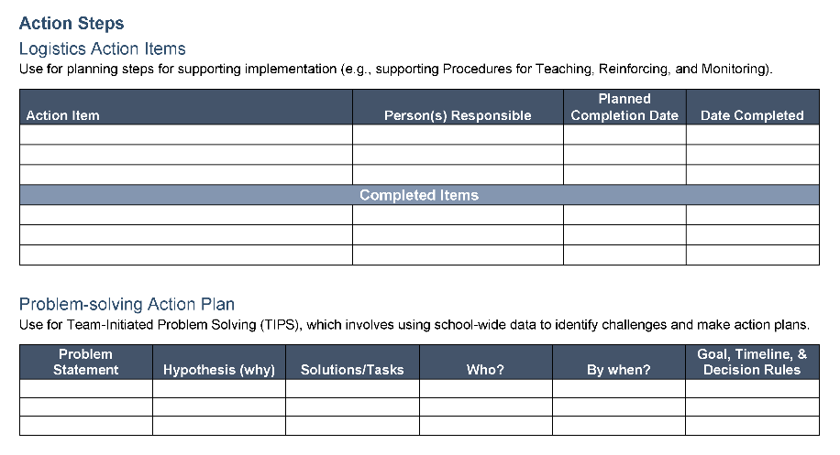
Notes:
In session 3 we started analyzing and building action plans around Fall Treatment Integrity and Social Validity Data and Winter Screening Data

Slide 20

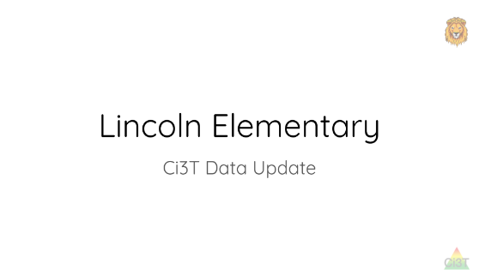
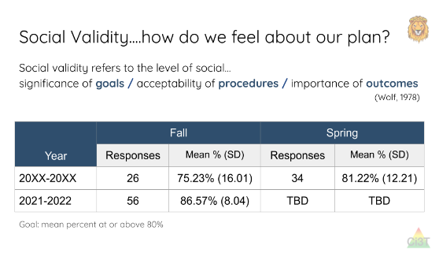
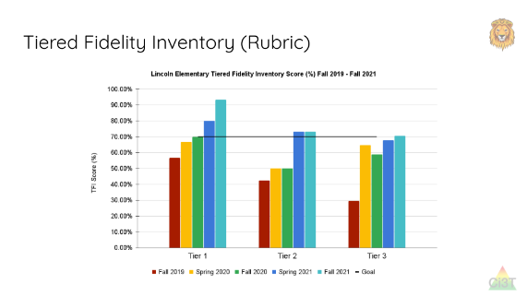
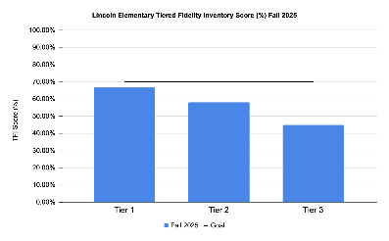
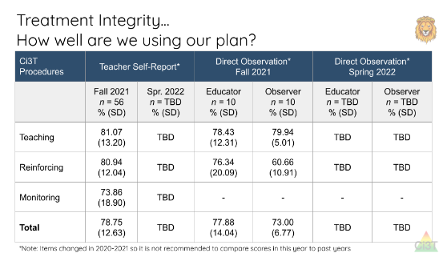
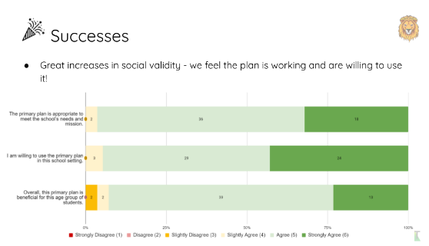
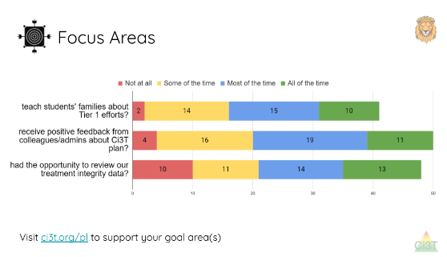
Sharing Treatment Integrity and Social Validity Data

Slide 21
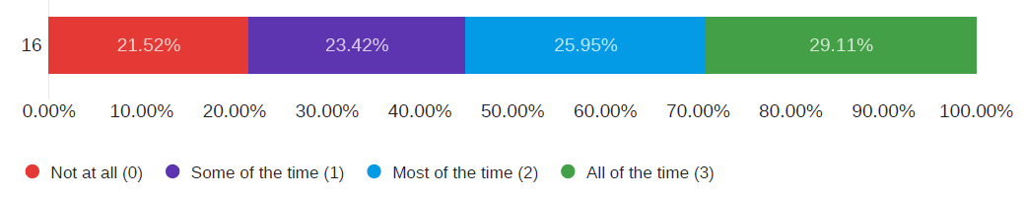
Sharing Treatment Integrity and Social Validity Data

Slide 22
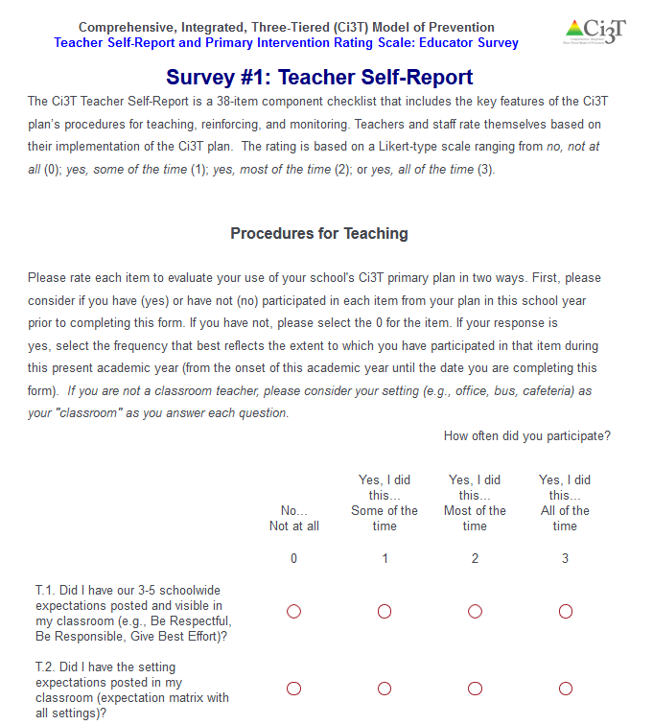

Example: Making Explicit Connections

Slide 23


Sharing Systematic Screening Data
Once academic and behavior screening data are collected, data are shared at the:
School-wide (e.g., Tier 1 efforts)
Grade or department (e.g., Tier 1 efforts, low-intensity strategies)
Class level (e.g., low-intensity strategies)
Individual student level (e.g., Tier 2 and Tier 3)

Slide 24
Foundational Ci3T Implementation & Professional Learning Activities

Slide 25
Foundational Ci3T Implementation & Professional Learning Activities

Slide 26
Foundational Ci3T Implementation & Professional Learning Activities

Slide 27



Let’s Chat!
What is one success your team had in sharing:
treatment integrity and social validity data with faculty and staff?
winter screening data with faculty and staff?
data or Ci3T updates with families?

Slide 28
Data-Informed Decision-Making
Sharing Data with Stakeholders
Using Data to Inform Professional Learning and Instruction
1.19 DECISION MAKING WITH FIDELITY DATA
Tier 1 leadership team reviews and uses schoolwide (e.g., TFI, BoQ, TIC, SAS, SET) and other fidelity data (e.g., classroom implementation, Tier 1 SEB curriculum, staff wellness systems) at least annually.

Slide 29
Session Outcomes
Identify continued professional learning needs from the previous session based on available data (e.g., screening, social validity, and treatment integrity).
Develop integrated lesson plans featuring low-intensity strategies to address academic, behavioral, and social and emotional well-being in an integrated fashion to maximize engagement and prevent challenging behaviors from occurring.
Refine data-informed, decision making at Tier 2 and Tier 3, by using school-wide data to connect students to additional strategies, practices, and programs.
Identify professional learning resources available to support work across Tiers 1, 2, and 3, and make plans to connect faculty and staff to these resources.

Slide 30

Notes:
In session 3 we started analyzing and building action plans around Fall Treatment Integrity and Social Validity Data and Winter Screening Data

Slide 31




Using Multiple Sources of Data to Identify Professional Learning Needs
Notes:
We considered how to look at these data together to identify professional learning needs

Slide 32








Professional Learning Avenues
Stand-alone professional learning
Book / article study
Build into PLC (e.g., video, infographic)
Independent module exploration
Building on-site experts
Hi Lincoln Elementary!
Happy Monday ☺
Our strategy of the month is active supervision! Check out this video (3 mins) to learn more! This week, in PLCs your team will select a setting (e.g., playground) to
focus your active supervision
efforts. Come with ideas!
1.12 SCHOOLWIDE PROFESSIONAL DEVELOPMENT AND COACHING
Tier 1 leadership team develops, documents, and implements a comprehensive, data-informed, and differentiated professional development system (PBIS/MTSS for staff), supported by adequate FTE and aligned to other relevant school initiatives, that includes initial and ongoing training, coaching, and supportive performance feedback to all school or community-employed faculty/staff on foundational knowledge and Tier 1 practices (items 1.3-1.9).

Slide 33

Using Multiple Sources of Data to Identify Instructional Needs
attendance
behavior
screening
academic screening
Notes:
We can also apply this same thinking to our screening data to identify areas of instructional need

Slide 34



Ci3T Data Dashboard
2.3 SCREENING
Tier 2 leadership team uses decision rules and multiple sources of data (e.g., discipline referrals, academic progress, screening tools, attendance, nominations), available from multiple informants (e.g., teacher, family, student), at multiple points in time (e.g., screening at identified points, on-going data review, on-going access to nomination process) to identify students who require Tier 2 internalizing or externalizing supports and to inform the modification or intensification of Tier 1 supports as needed.

Slide 35

Ci3T Data Dashboard In Action!
Notes:
Watch Part 1 only (4:55)
https://ci3t.org/ispring/M6_Tier2_Dashboard_Principal

Slide 36




Module Connection!
The Tier 2 Process: Using Data to Connect Students to Validated Supports

Slide 37





Module Connection!
The Tier 3 Process: Using Data to Connect Students to Validated Supports

Slide 38



















Let’s discuss!
How did we share treatment integrity, social validity, and winter screening data with stakeholders (e.g., faculty & staff, families)? Are there any additional steps we need to take to share these data? How did we respond to our treatment integrity, social validity, and winter screening data based on the ideas we generated in Session 3? Are there any additional steps we need to take to complete action items? What systems do we have in place to examine multiple sources of data to inform professional learning and instruction? What professional learning needs might we address next, based on our treatment integrity, social validity, and winter screening data?
Notes:
15 min timer

Slide 39

Integrated Lesson Planning at Tier 1
1.10 CLASSROOM PRACTICES
Educators consistently and equitably implement positive and proactive classroom practices—including building relationships with students; developing a safe environment; prompting predictable routines and expected behavior; actively providing OTRs, active supervision, and specific feedback (i.e., specific praise and supportive corrections); and ensuring a high ratio (≥ 5:1) of positive to corrective feedback.

Slide 40
Session Outcomes
Identify continued professional learning needs from the previous session based on available data (e.g., screening, social validity, and treatment integrity).
Develop integrated lesson plans featuring low-intensity strategies to address academic, behavioral, and social and emotional well-being in an integrated fashion to maximize engagement and prevent challenging behaviors from occurring.
Refine data-informed, decision making at Tier 2 and Tier 3, by using school-wide data to connect students to additional strategies, practices, and programs.
Identify professional learning resources available to support work across Tiers 1, 2, and 3, and make plans to connect faculty and staff to these resources.

Slide 41



A Focus on: Integrated Lesson Planning

Slide 42


Integrated Lesson Plan
Citation. Oakes, W. P., Lane, K. L., Lane, K. S., & Buckman, M. M. (2019). Ci3T integrated lessons plan template. www.ci3t.org.​

Slide 43

Integrated Lesson Plan: An Illustration
Notes:
Watch video 01:40

Slide 44
Let’s Chat!
What other social skills or behavioral objectives might be appropriate for this lesson?
What other opportunities exist to integrate low-intensity teacher-delivered strategies into this lesson?

Slide 45





Module Connection
Citation. Oakes, W. P., Lane, K. L., Lane, K. S., & Buckman, M. M. (2019). Ci3T integrated lessons plan template. www.ci3t.org.​
Completed examples available in: Ci3T Project ENHANCE Research Team. (2022, July). Embedding and integrating Ci3T domains into daily instruction. Author. https://doi.org/10.17161/ci3t.42880

Slide 46


Embedding Low-Intensity Strategies in Daily instruction
Notes:
02:45

Slide 47



Module Connection!

Slide 48







Module Connection!
Instructional Feedback

Slide 49


Work Time Preparation
Start by downloading the template and examples!

Slide 50



















Let’s Discuss!
Work with your Ci3T Leadership Team to develop an integrated lesson plan
Notes:
15-min timer

Slide 51
Planning and Implementing Tier 2 Interventions

Slide 52
Session Outcomes
Identify continued professional learning needs from the previous session based on available data (e.g., screening, social validity, and treatment integrity).
Develop integrated lesson plans featuring low-intensity strategies to address academic, behavioral, and social and emotional well-being in an integrated fashion to maximize engagement and prevent challenging behaviors from occurring.
Refine data-informed, decision making at Tier 2 and Tier 3, by using school-wide data to connect students to additional strategies, practices, and programs.
Identify professional learning resources available to support work across Tiers 1, 2, and 3, and make plans to connect faculty and staff to these resources.

Slide 53


Secondary (Tier 2) Intervention Grids

Slide 54



Getting Started with Data-Informed Decision Making

Slide 55

Tier 2 Intervention Grid
2.6 DECISION RULES FOR ASSIGNING AND EXITING STUDENTS FOR INTERVENTION
A written process and set of decision rules is used for (a) matching students to Tier 2 interventions that are aligned to student need, cultural fit, and family and student preference and (b) exiting students from intervention after reaching pre-determined levels of performance.
Notes:
Support- name of strategy, practice, or program. Notice this is not the name of a person or role

Slide 56


Data in action

Slide 57

Data in action

Slide 58


Data in action
Other Tier 2 options…
Behavior Contract
Direct Behavior Rating
Behavior Specific Praise
Instructional Choice

Slide 59





Selecting an Intervention
How do I decide when the entry criteria are similar for multiple interventions?
2.5 OPTIONS FOR TIER 2 INTERVENTIONS
Tier 2 continuum has multiple ongoing SEB support interventions available schoolwide that meet a range of student SEB internalizing or externalizing needs and behavioral functions, are designed to support groups of students, have documented evidence of effectiveness, and provide (a) additional instruction/time for student skill development, (b) additional structure/predictability, (c) increased opportunity for feedback (e.g., daily progress report), (d) increased communication with families, and (e) include planned modifications to address a range of behavioral function, mental health needs, or academic skills

Slide 60
Selecting an Intervention
Collaborate with families, colleagues, and the student to review available options
Consider what you know about the student (e.g., strengths, preferences, pre-requisite skills)
Consider possible function of the behavior
  Check-In/Check-Out may be more effective for students who find accessing adult attention reinforcing
Consider your own strengths, support available (e.g., coach, professional learning), and feasibility of available options
Adjust as needed based on pre-intervention social validity

Slide 61

Document Decisions and Plans for Next Steps
2.13 DECISION MAKING WITH STUDENT PERFORMANCE DATA
Tier 2 leadership team establishes and uses decision rules and a written process for regular data review to (a) monitor benefit overall, by group, and for individual students and (b) adjust support (e.g., intensify, modify, or fade) to increase responsiveness.

Slide 62



Structures for Success: Shared Digital Space
Example of Tier 2 Intervention Drive in shared digital space

Slide 63




Tier 2 Intervention Drive – Templated Intervention Materials
Notes:
All materials necessary for an intervention located in one central location. Teachers can “make a copy” of the entire folder and then personalize for the student.

Slide 64


Tier 2 Intervention Drive – Group or Individual Student Folders
Be sure to store these folders in a secure
location accessible to all relevant parties

Slide 65



Tier 2 Intervention Drive – Group or Individual Student Folders

Slide 66


Tier 2 Professional Learning Resources
Notes:
Low-intensity strategies can be used across the tiers including as a stand-alone Tier 2 intervention OR as part of a multi-component Tier 2 intervention (e.g., using pre-correction as part of a behavior contract)

Slide 67


Tier 2 Professional Learning Resources
Notes:
What Works Clearing House Practice Guide – Teacher-Delivered Behavioral Interventions in Grades K-5-
https://ies.ed.gov/ncee/wwc/PracticeGuide/31

Slide 68






Tier 2 Professional Learning Resources

Slide 69

Join us at future EMPOWER+ to learn more! 3
Join us at future EMPOWER+ to learn more!
EMPOWER+ Session | Date
Starting Strong: Effective Tier 1 Practices for Educators | September 24, 2025 (Wednesday)
From Data to Action: Using Systematic Screening to Inform Instruction | October 8, 2025 (Wednesday)
Ci3T In Action: Integrated Lesson Planning for Enhanced Instruction | November 18, 2025 (Tuesday)
Mastering Behavior Specific Praise and Precorrection | January 21, 2026 (Wednesday)
A 6-Step Instructional Approach for Responding to Challenging Behaviors: A Tier 1 Practice | February 10, 2026 (Tuesday)
A Tier 2 Support for Students Experiencing Anxious Feelings: Recognize. Relax. Record. | March 25, 2026 (Wednesday)
A Tier 3 Support for Students with Intensive Intervention Needs: Functional Assessment-Based Intervention (FABI) | April 28, 2026 (Tuesday)

Slide 70
Planning and Implementing Tier 3 Interventions
3.3 SCREENING
Tier 3 leadership team uses decision rules and multiple sources of data (e.g., discipline referrals, Tier 2 performance, request for assistance process, academic progress, screening tools, attendance, nominations, crisis/ safety plan development) to identify students with internalizing or externalizing needs who require Tier 3 supports. Data are available from multiple informants (e.g., teacher, family, student) and at multiple points in time (e.g., screening at identified points, ongoing data review, ongoing access to request for assistance process).

Slide 71
Session Outcomes
Identify continued professional learning needs from the previous session based on available data (e.g., screening, social validity, and treatment integrity).
Develop integrated lesson plans featuring low-intensity strategies to address academic, behavioral, and social and emotional well-being in an integrated fashion to maximize engagement and prevent challenging behaviors from occurring.
Refine data-informed, decision making at Tier 2 and Tier 3, by using school-wide data to connect students to additional strategies, practices, and programs.
Identify professional learning resources available to support work across Tiers 1, 2, and 3, and make plans to connect faculty and staff to these resources.

Slide 72





Tertiary (Tier 3) Intervention Grids

Slide 73


Tier 3 Intervention Grid
Notes:
Notice the same features of Tier 3 grids

Slide 74
Getting Started with Data-Informed Decision Making
Notes:
Same process as pairing students with Tier 2 supports

Slide 75


Tier 3: Functional Assessment-Based Intervention
3.4 COMPREHENSIVE ASSESSMENT PROTOCOL
Tier 3 leadership team (defined in item 3.1) develops, implements, and monitors the use of a comprehensive assessment (e.g., functional behavioral assessment [FBA]) protocol to guide consideration of all data gathered in the context of Tiers 1 and 2, information uncovered during screening (item 3.3), and other relevant data sources on strengths and needs across life domains including behavioral (e.g., attendance, functional behavioral assessment, suspension/expulsion), academic (e.g., reading, math, writing), medical, and mental health data. The protocol prompts the examination of the following student-specific elements: 1. strengths: data-based statement of the student’s SEB strengths that honors student and family values, student identity, and lived experiences that maintain these behaviors (i.e., statement of behavioral function); 2. needs: operational description of internalizing or externalizing SEB need (e.g., chronic or significant display of contextually inappropriate behavior); 3. hypothesis statement: data-based identification of situations (antecedents) that predict and reinforcers; 4. additional information: other relevant indicators of strength and need relevant to developing an
individual support plan (e.g., diagnostic academic data, attendance, mental health/wellness, physical health/wellness, basic needs across life domains)

Slide 76



FABI Professional Learning Resources

Slide 77

Join us at future EMPOWER+ to learn more! 4
Join us at future EMPOWER+ to learn more!
EMPOWER+ Session | Date
Starting Strong: Effective Tier 1 Practices for Educators | September 24, 2025 (Wednesday)
From Data to Action: Using Systematic Screening to Inform Instruction | October 8, 2025 (Wednesday)
Ci3T In Action: Integrated Lesson Planning for Enhanced Instruction | November 18, 2025 (Tuesday)
Mastering Behavior Specific Praise and Precorrection | January 21, 2026 (Wednesday)
A 6-Step Instructional Approach for Responding to Challenging Behaviors: A Tier 1 Practice | February 10, 2026 (Tuesday)
A Tier 2 Support for Students Experiencing Anxious Feelings: Recognize. Relax. Record. | March 25, 2026 (Wednesday)
A Tier 3 Support for Students with Intensive Intervention Needs: Functional Assessment-Based Intervention (FABI) | April 28, 2026 (Tuesday)

Slide 78


FABI Professional Learning Resources

Slide 79

FABI Professional Learning Resources

Slide 80


Tier 3: Individualized De-Escalation Plan

Slide 81


Tier 3: Individualized De-Escalation Plan

Slide 82




Individualized De-Escalation Plan Professional Learning Resources

Slide 83


Individualized De-Escalation Plan Professional Learning Resources

Slide 84







Jigsaw Preview
Tier 2 and 3 Supports
Check-in/Check-out | Recognize. Relax. Record. | Individualized De-Escalation Plan | Functional Assessment-Based Intervention (FABI) | Structures for Success

Slide 85

















Let’s Talk!
Read over the list of Tier 2 and Tier 3 supports listed in your school’s Ci3T Implementation Manual.
Jigsaw breakout session: Divide your team members to attend these sessions:
  Tier 2 Check-In/Check-out
  Tier 2 Recognize. Relax. Record.
  Tier 3 Managing Acting-Out Behavior at Tier 3
  Tier 3 Functional Assessment-Based Intervention (FABI)
  Structures for Success (e.g., shared digital space, intervention tracker)
Post in the chat the one you would like to attend so your Ci3T Leadership Team members can divide up to learn more!
Notes:
15-min timer

Slide 86
Wrapping Up and Moving Forward

Slide 87
Let’s Chat!
What is one action item you or your team will take following today’s session?

Slide 88

Project EMPOWER+
EMPOWER+ Session | Date
Starting Strong: Effective Tier 1 Practices for Educators | September 24, 2025 (Wednesday)
From Data to Action: Using Systematic Screening to Inform Instruction | October 8, 2025 (Wednesday)
Ci3T In Action: Integrated Lesson Planning for Enhanced Instruction | November 18, 2025 (Tuesday)
Mastering Behavior Specific Praise and Precorrection | January 21, 2026 (Wednesday)
A 6-Step Instructional Approach for Responding to Challenging Behaviors: A Tier 1 Practice | February 10, 2026 (Tuesday)
A Tier 2 Support for Students Experiencing Anxious Feelings: Recognize. Relax. Record. | March 25, 2026 (Wednesday)
A Tier 3 Support for Students with Intensive Intervention Needs: Functional Assessment-Based Intervention (FABI) | April 28, 2026 (Tuesday)

Slide 89

Ci3T Trainers and Coaches Calls
Ci3T Trainers and Coaches Calls
Ci3T Trainers and Coaches Calls Session | Date
Ci3T Trainers and Coaches Call 1 | August 20, 2025 (Wednesday)
Ci3T Trainers and Coaches Call 2 | September 3, 2025 (Wednesday)
Ci3T Trainers and Coaches Call 3 | October 1, 2025 (Wednesday)
Ci3T Trainers and Coaches Call 4 | November 5, 2025 (Wednesday)
Ci3T Trainers and Coaches Call 5 | December 2, 2025 (Tuesday)
Ci3T Trainers and Coaches Call 6 | January 22, 2026 (Thursday)
Ci3T Trainers and Coaches Call 7 | February 17, 2026 (Tuesday)
Ci3T Trainers and Coaches Call 8 | March 10, 2026 (Tuesday)
Ci3T Trainers and Coaches Call 9 | April 15, 2026 (Wednesday)
Ci3T Trainers and Coaches Call 10 | May 13, 2026 (Wednesday)

Slide 90
Wrap Up and Preview
Today
Next time
Data-Informed Decision-Making
Working Across the Tiers
  Integrated Lesson Planning
  Tier 2
  Tier 3
Procedures for Monitoring
  Review your school’s social validity and treatment integrity data
  Review your school’s spring screening data
Planning for the Year Ahead 2026-2027
Focusing on Data-Informed Professional Learning

Slide 91

Homework
At your next Ci3T Leadership Team meeting:
  Confirm plans to support completion of spring screening
  Refine and implement plans to share resources and support faculty and staff around Tier 2 and Tier 3 supports
  Make preliminary plans for faculty and staff to complete
    Treatment integrity and social validity surveys during the spring timepoint
    Teacher well-being and input measures during the spring timepoint
  Complete Tiered Fidelity Inventory (TFI) protocols for the spring timepoint
At your next faculty meeting:
  Share professional learning resources and opportunities around Tier 2 and Tier 3 interventions (see ci3t.org/enhance and ci3t.org/fabi)

Slide 92


Action Planning
Schedule time during PLCs- integrated lesson plan demo
Elise
03/12/26
Invite staff to attend EMPOWER sessions in weekly email
David
03/12/26
Notes:
Encourage you to leave a note in your Ci3T LT agenda to indicate where your team will pick up at your next meeting and to record any action items.

Slide 93


Coaching Protocol Reminder
Notes:
If you’re a coach, you might consider setting aside time to review coaching protocol for Session 1 especially the after coaching tips, action items, and reflection!

Slide 94






@Ci3Tmodel
@Ci3Tmodel
Tag us in your Ci3T highlights, we love to see Ci3T in action!
Follow us on X and Instagram for updates and new resources!
Thank you!
ci3t.org
#Ci3T
Notes:
Tag us in your Ci3T highlights- we’d love to see Ci3T in action! Follow us on Twitter or Instagram for updates and links to resources! @Ci3TModel
You will receive a brief session evaluation – we value your feedback and would greatly appreciate you taking a few minutes to share your thoughts on what you liked about the session and how we can improve

