Slide 1
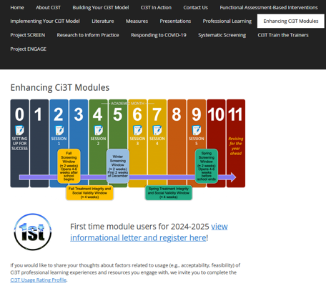
A Tier 3 Support for Students with
Intensive Intervention Needs:
Functional Assessment-Based Intervention
EMPOWER+ Session 7
If you have not done so already, we invite you to visit ci3t.org/enhance to access modules after a one-time registration process!

Slide 2
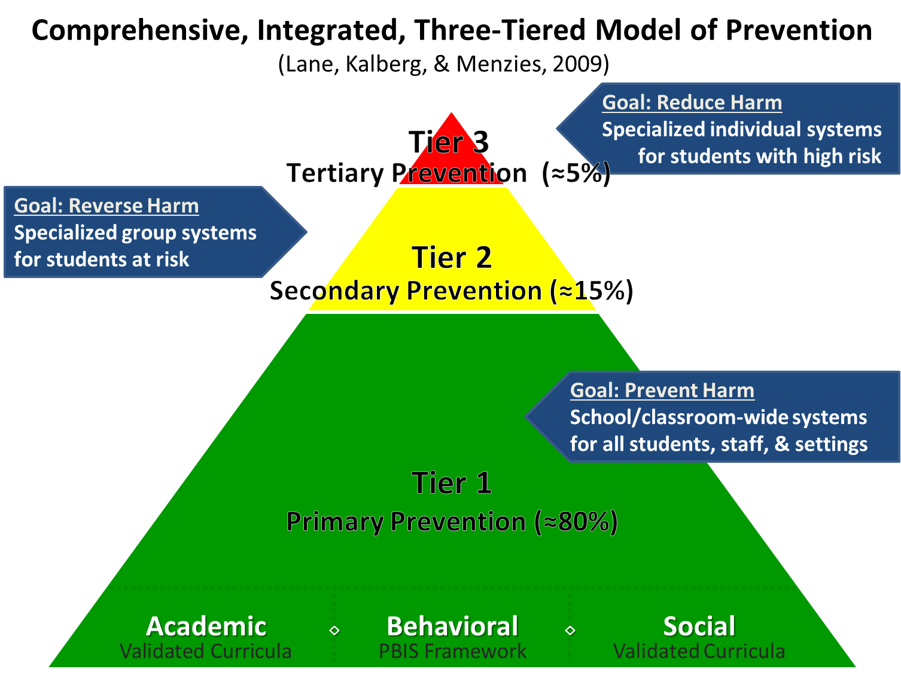
Comprehensive, Integrated, Three-Tiered Model of Prevention

Slide 3
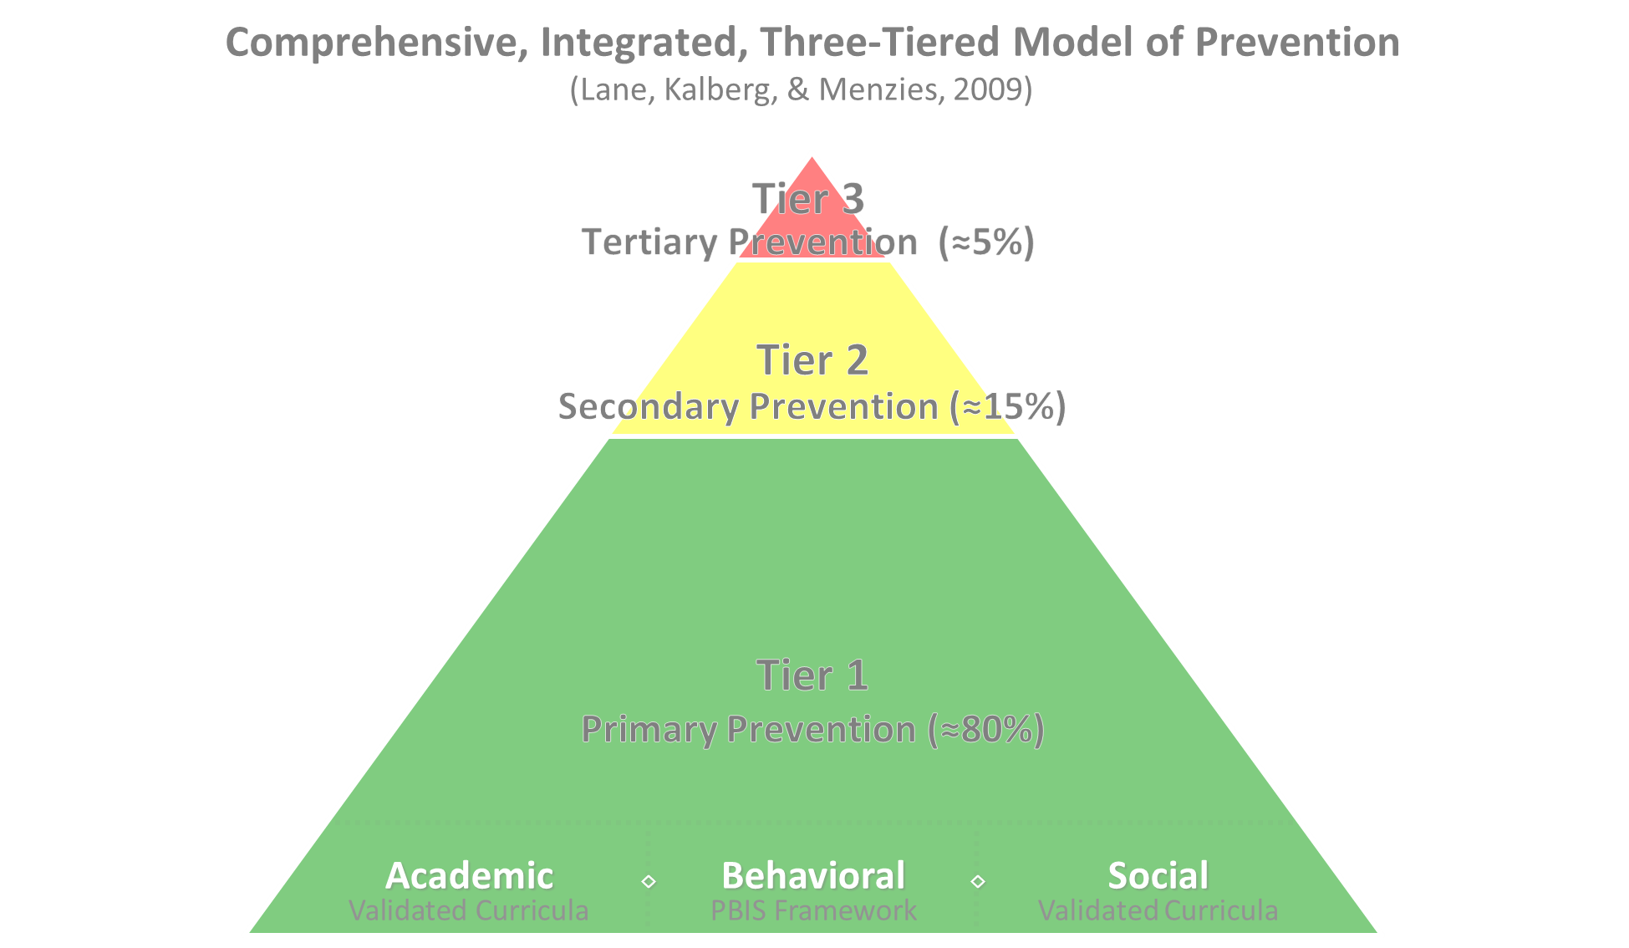

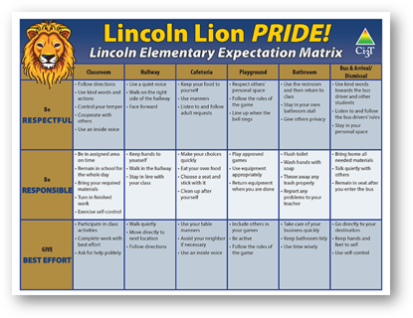
Positive Behavioral Interventions and Supports
District & State Standards Quality Instruction
Validated Curricula and Resources

Slide 4


Primary Prevention (Tier 1)

Slide 5

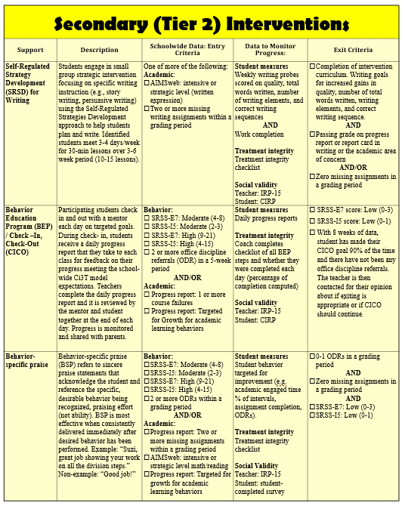
Secondary (Tier 2) Intervention Grid
Notes:
In addition to the module featured here outlining how to use multiple sources of data to connect students with Tier 2 supports, we offer a full suite of modules highlighting validated Tier 2 interventions such as Self-Regulated Strategy Development (SRSD) for Writing and Check-In/Check Out that may appear in your Secondary (Tier 2) Intervention Grid

Slide 6

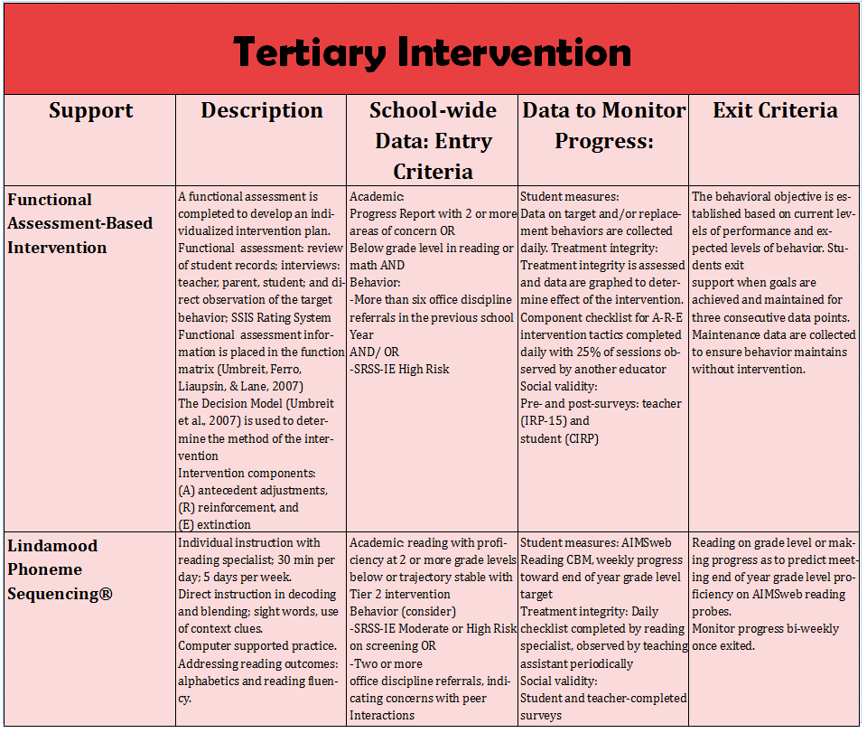
Tertiary (Tier 3) Intervention Grid
Notes:
In addition to the module featured here outlining how to use multiple sources of data to connect students with Tier 3 supports, we offer a full suite of modules highlighting validated Tier 3 interventions such as Functional Assessment-Based Intervention (FABI) that may appear in your Tertiary (Tier 3) Intervention Grid

Slide 7

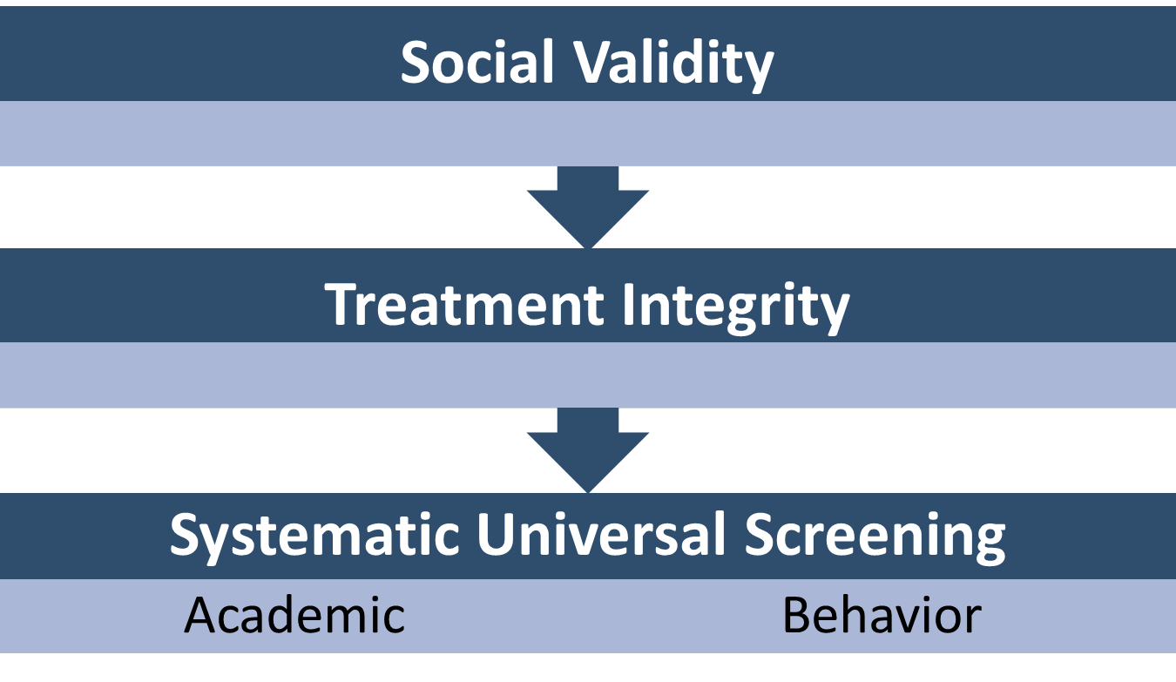

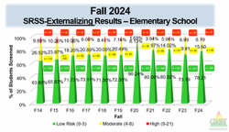
Essential Components of Primary (Tier 1) Prevention Efforts

Slide 8



Enhancing Ci3T Modules
ci3t.org/enhance

Slide 9
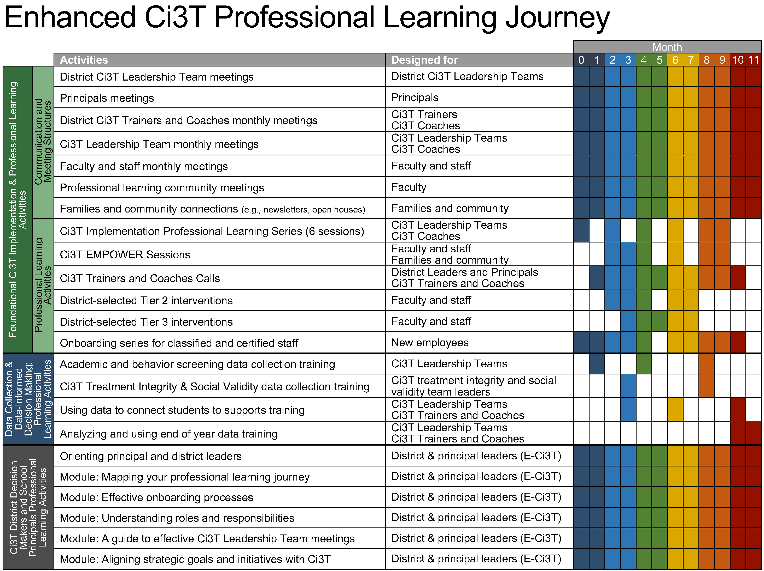
Enhanced Ci3T Implementation Series and Delivery

Slide 10
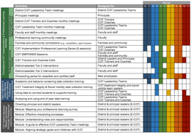

Session Outcomes
Describe how tertiary (Tier 3) interventions are situated in a Ci3T model of prevention including the purpose and organization of Tertiary (Tier 3) Intervention Grids
Describe a step-by-step process to implement Functional Assessment-Based Intervention (FABI) as a Tier 3 support.
Explain the importance of and prepare to monitor treatment integrity, social validity, and student performance data
If you are a Board Certified Behavior Analyst (BCBA), you may accrue up to 2 learning continuing education units (CEUs) for attending this session. See agenda for task list alignment. Throughout the session we will share 4 key words, write those down to turn in after the session!

Slide 11
Agenda
Welcome
Situating Tertiary (Tier 3) Interventions in Ci3T Models
Functional Assessment-Based Intervention (FABI)
  Introduction to FABI
  5-Step Process to Implement FABI
Wrapping Up and Moving Forward

Slide 12
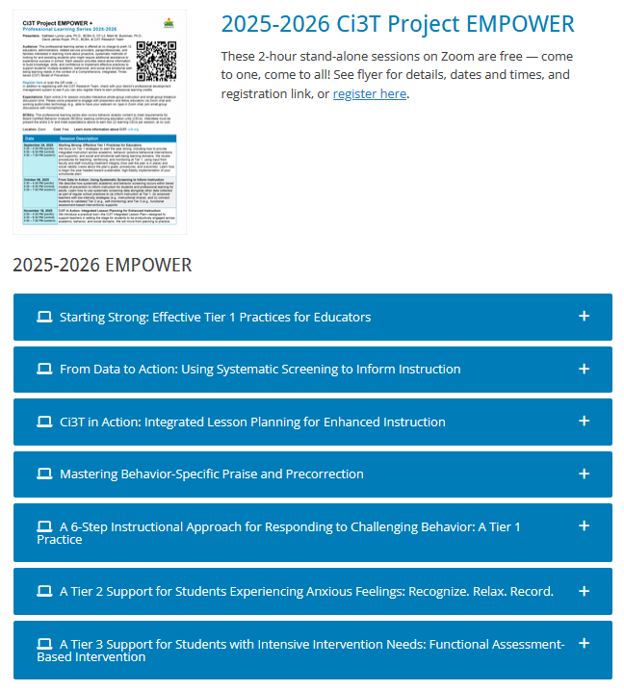
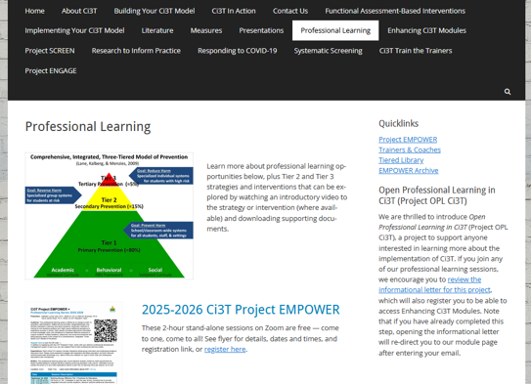
Accessing Professional Learning Materials
ci3t.org/pl

Slide 13


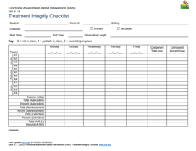
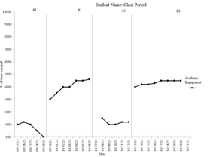

Knowledge, Application, Impact Points
On-Task Behavior: Jackson
If you are in Kansas, you can earn 2 x PD points for application and 3 x for impact!
We are happy to review your materials before you upload!
Notes:
Tonight’s session lays the foundation with knowledge building and getting you oriented to the modules that can support application and impact efforts!

Slide 14
Situating Tertiary (Tier 3) Interventions in Ci3T Models

Slide 15
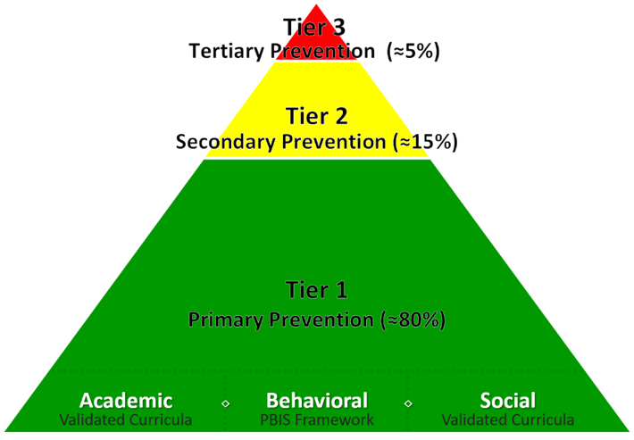
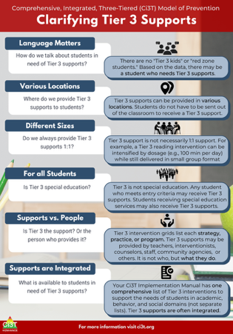
What are Tier 3 Interventions?

Slide 16
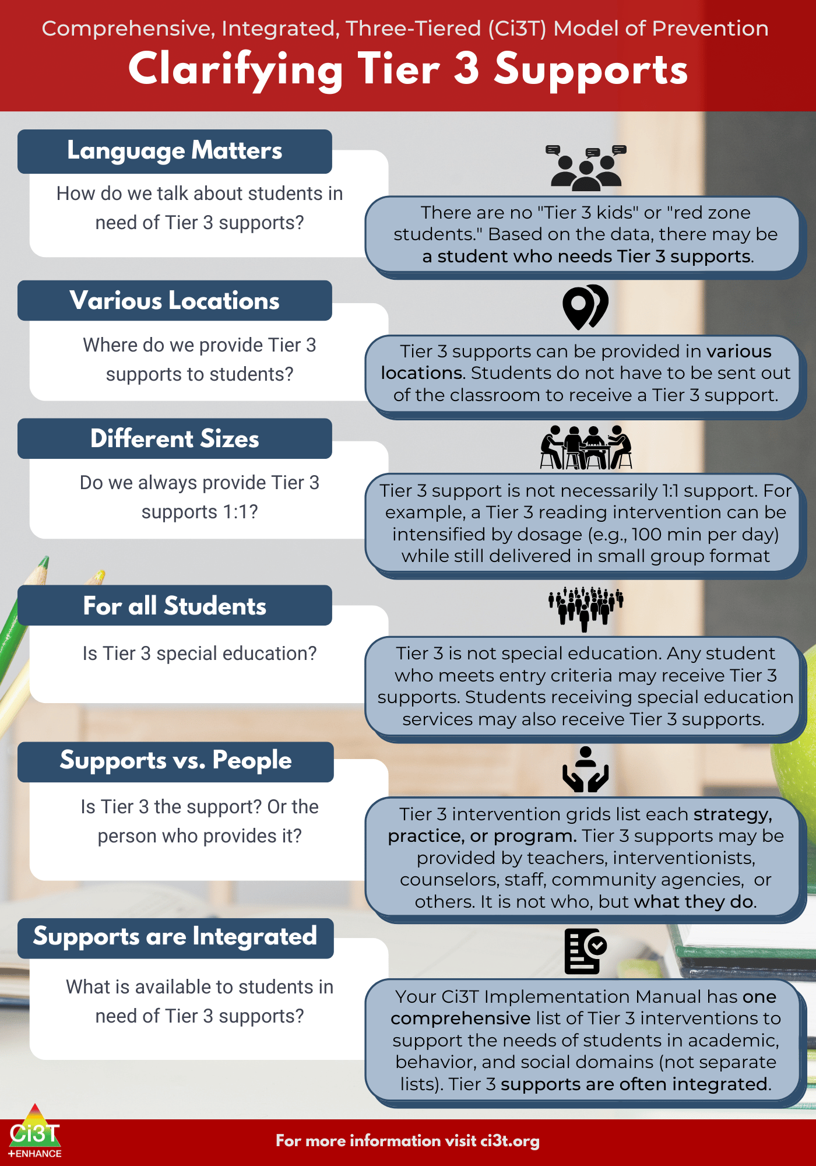

Slide 18


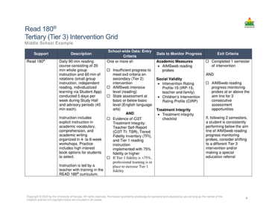
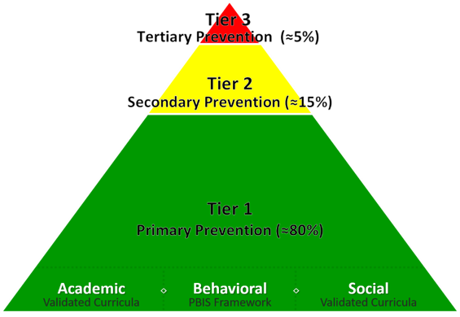
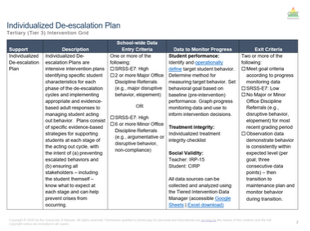
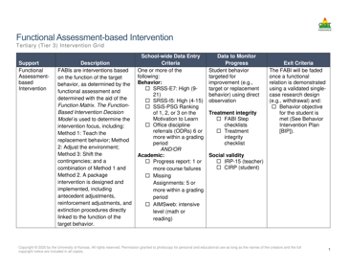
Tertiary (Tier 3) Intervention Grid

Slide 19


Components of Tier 3 Intervention Grid
Notes:
Support- name of strategy, practice, or program. Notice this is not the name of a person or role

Slide 20


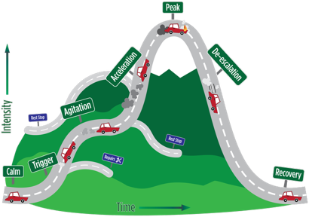
Tier 3: Stand-Alone Intervention

Slide 21

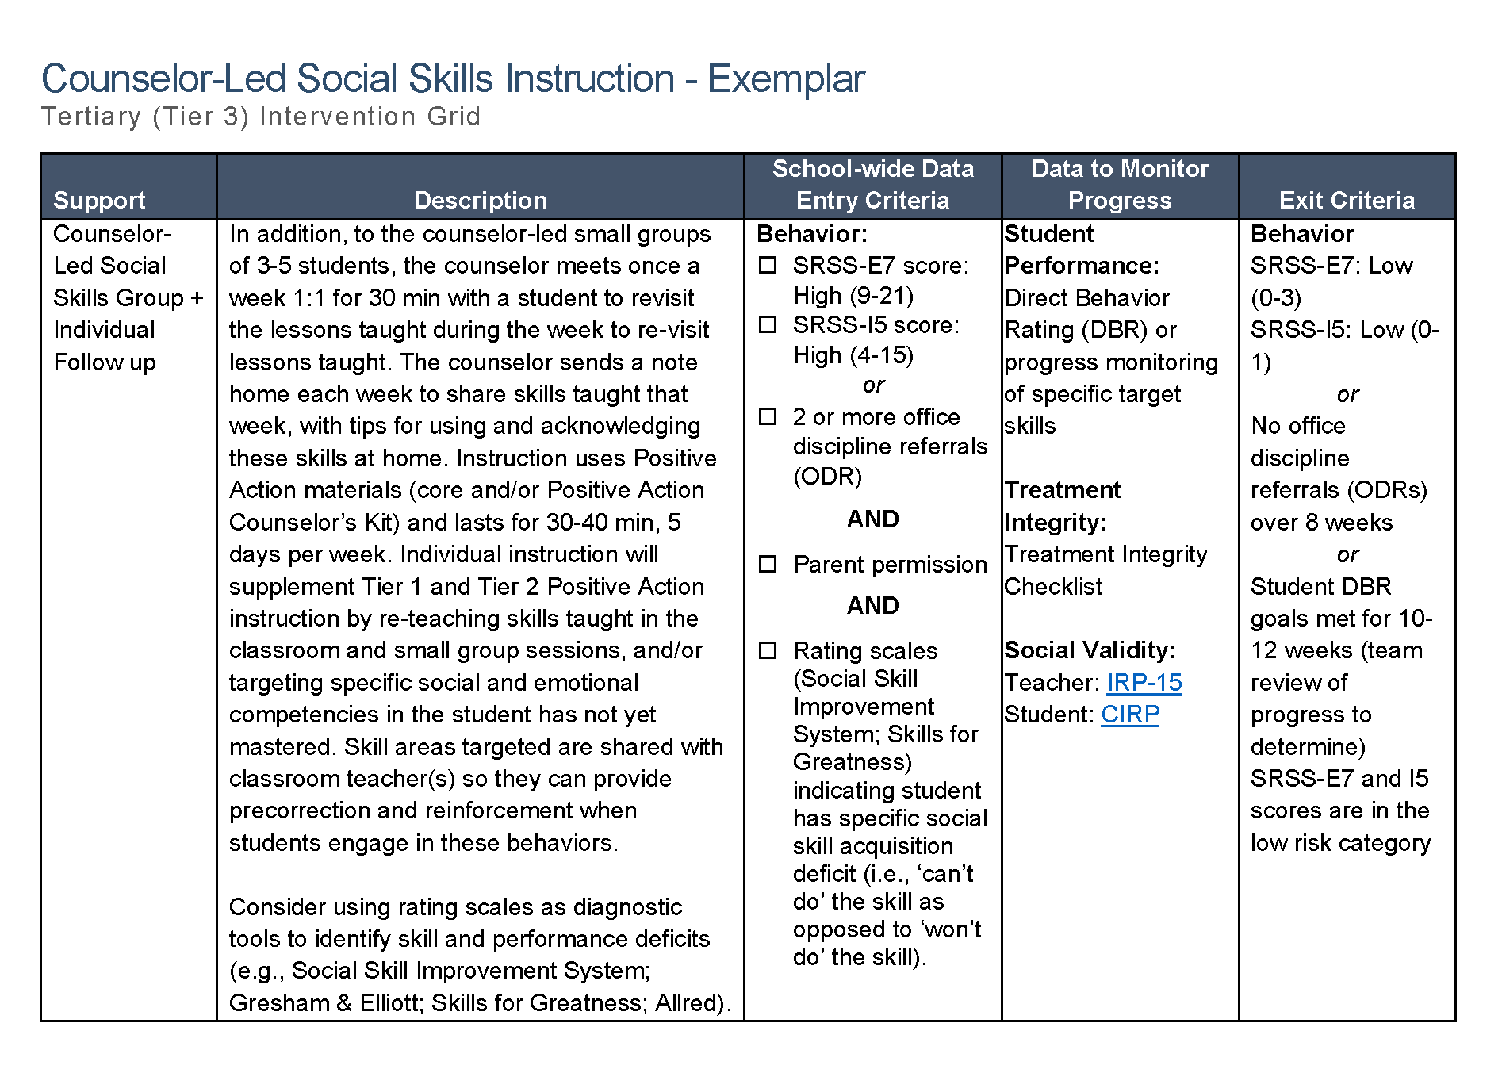
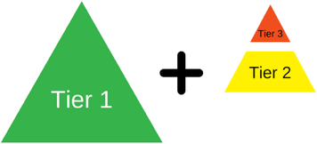
Tier 3: Intensification of Tier 2 Support
Notes:
Sometimes – Tier 3 is an intensification of a Tier 2 support such as coupling a Tier 2 support (i.e., counselor-led social skills group) with an individual follow up.

Slide 22
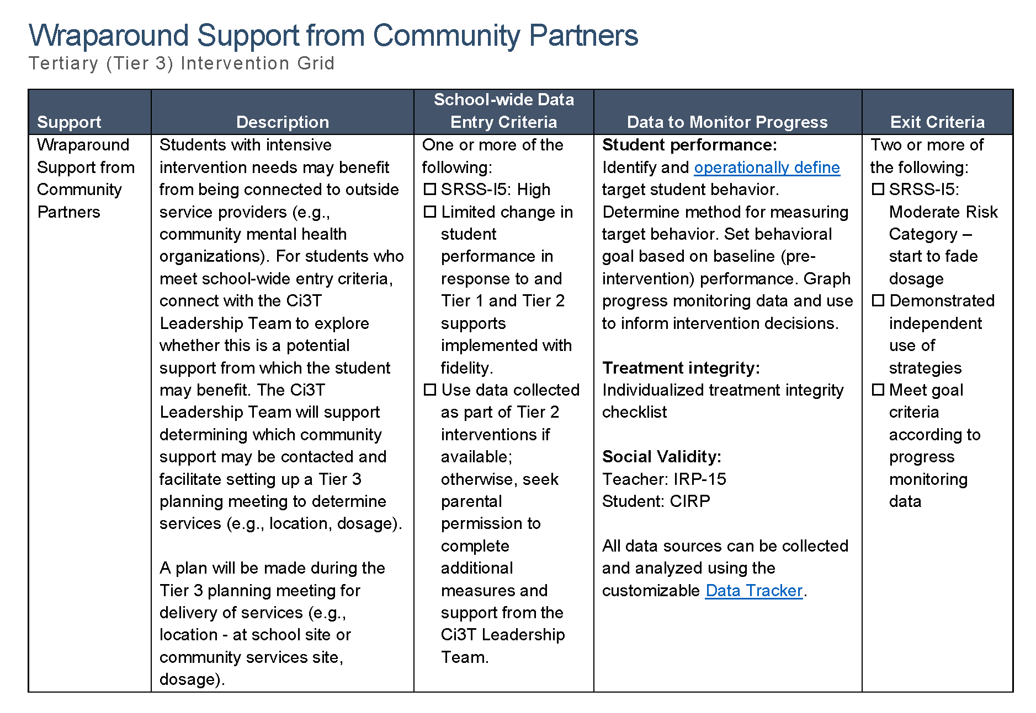

Tier 3: Wraparound Support

Slide 23
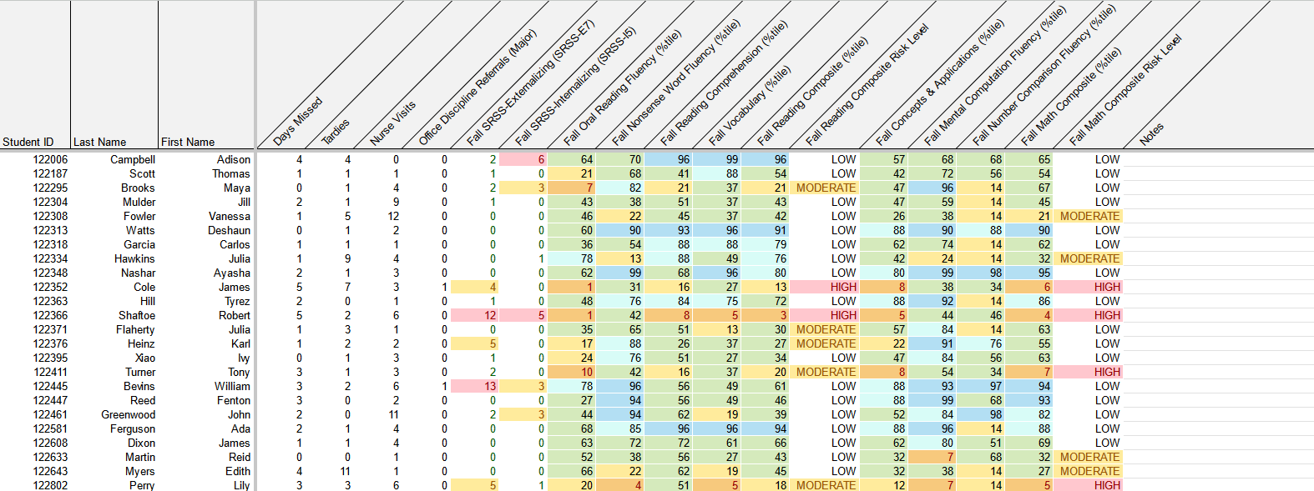
Using Multiple Sources of Data to Connect Students with Tier 3 Supports
attendance
office discipline referrals
behavior
screening
academic screening

Slide 24


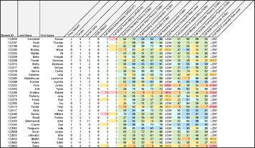
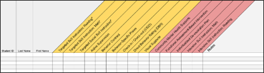
Getting Started with Data-Informed Decision Making

Slide 25
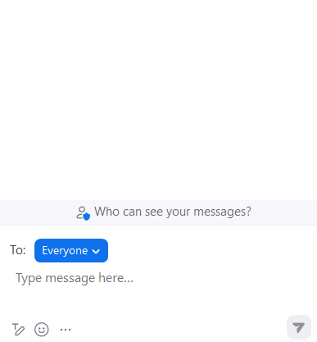


Let’s Chat!
Which Tier 3 interventions are offered in your setting?

Slide 26

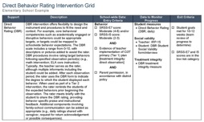
Functional Assessment-Based Intervention (FABI)
An Overview of FABI
A 5-Step Process to Implement FABI

Slide 27



Slide 28
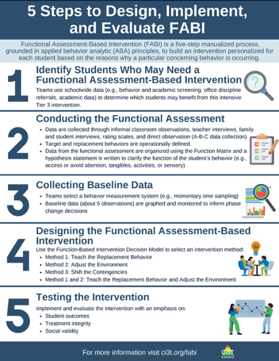
What is Functional Assessment-Based Intervention (FABI)?
Customized intervention designed for each student based on the reasons why a particular concerning behavior is occurring
Developed through a five-step, team-based, manualized process
Grounded in applied behavior analytic (ABA) principles (e.g., reinforcement, antecedent, consequence)
Notes:
PRESENTER NOTE:
FABI is one type of FBA (functional behavioral assessment)
Can be used as a Tier 3 intervention, as we are discussing in this presentation
Can also be used as a process to conduct a functional behavioral assessment (FBA) and develop a behavior intervention plan (BIP) for student’s with IEPs as required under certain conditions of IDEA
See state regulations for more information regarding FBAs as part of a student’s IEP

Slide 29
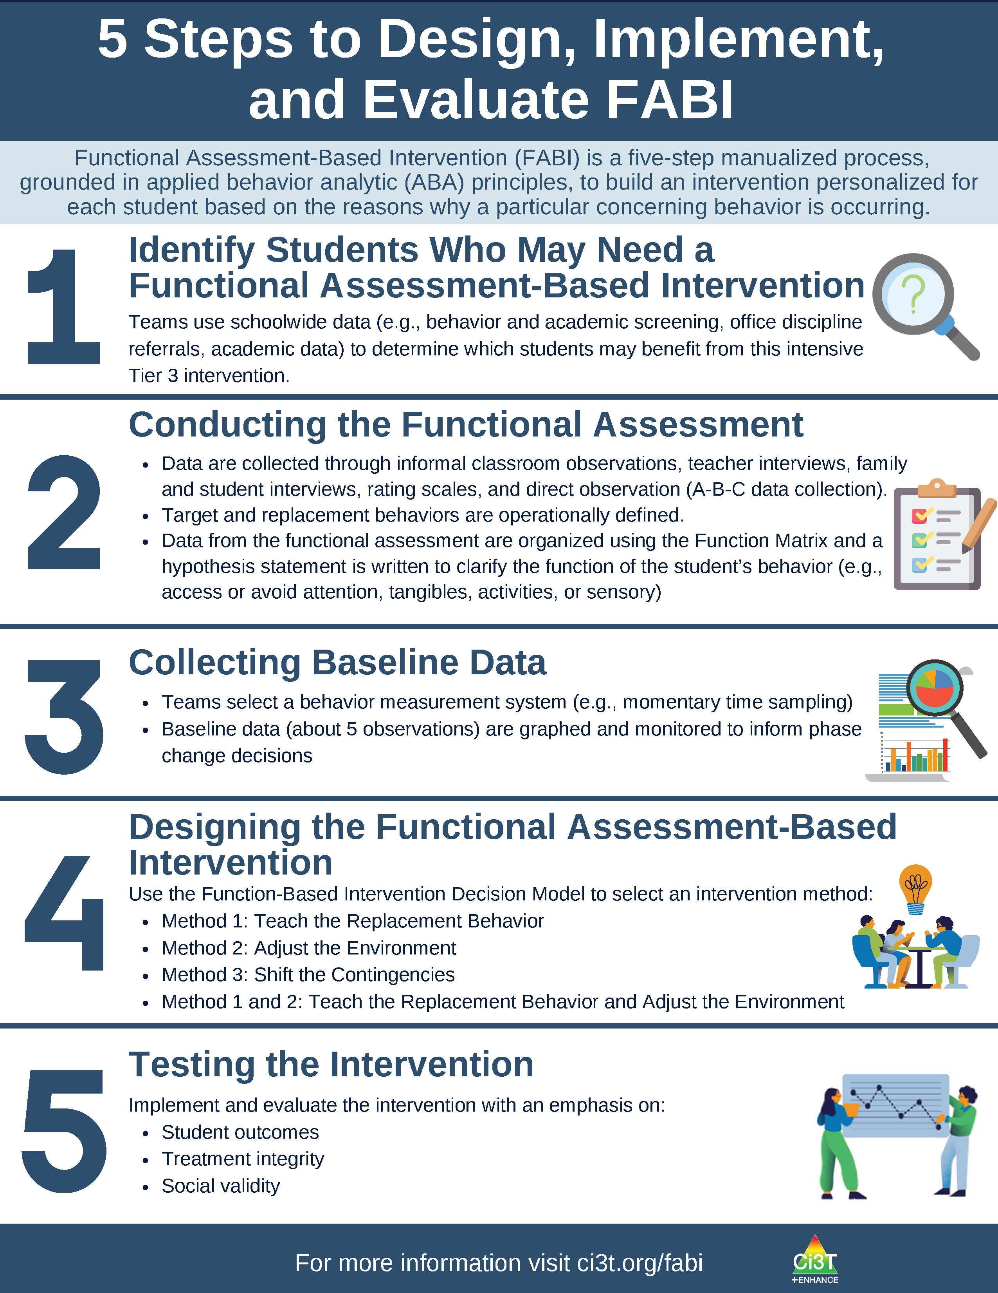

Slide 31
Why is FABI effective?
Individualized based on the function of behavior (i.e., why the behavior occurs) and needs of the student and environment
Focuses on skill-building and supporting pro-social behavior (i.e., replacement behavior)
Step-by-step manualized process
Team-based process fosters collaboration between educators, families, and the student

Slide 32

Building Your FABI Team
Two people who serve on this “standing” team
  Member of Ci3T Leadership Team
  Staff with behavioral expertise (e.g., behavior specialist, instructional coach, counselor, school psychologist)
Classroom teacher(s) of the student who might benefit from this support
Family member of the student
Student

Slide 33
What are the Benefits and Challenges of Implementing FABI?
Benefits
Challenges
Collaborative, team-based process integrating student, educator, and caregiver voice and perspective
Strong evidence-base demonstrating effectiveness for wide range of students (pre-K – 12), behaviors, and settings
Fully manualized process with templates and checklists to support design and implementation
Time and resource intensive
May require additional training (e.g., measuring behavior, ABC data collection)
Adjustment from more ”traditional” FBA/BIP practices

Slide 34
Let’s Chat!
What are your initial thoughts and reactions?
  What components of FABI seem most feasible?
  What might be challenging about implementing FABI?

Slide 35

Functional Assessment-Based Intervention (FABI) as a Tier 3 Intervention
An Overview of FABI
A 5-Step Process to Implement FABI

Slide 36
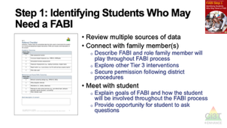

Session Preview
Notes:
In this next section we will break down and provide a high-level overview for each of the five steps to implement FABI
Throughout the presentation, we will pause and invite participation in the chat or move into breakout rooms to give you the change to apply what you are learning!

Slide 37


Opportunities to Learn More
Notes:
Our intention in this professional learning is to provide high-level overview of FABI and opportunities to practice the key components. If you are interested in learning more or implementing FABI in your setting, we encourage you to access these additional resources to more comprehensively learn about each of the five steps.

Slide 38

Step 1: Identifying Students Who May Need a FABI

Slide 39

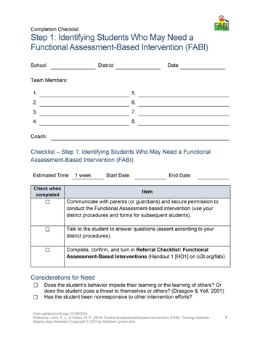
Step 1: Identifying Students Who May Need a FABI
Review multiple sources of data
Connect with family member(s)
Meet with student

Slide 40
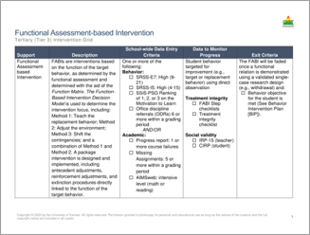
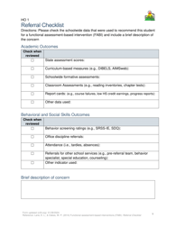
Review multiple sources of data
Use the Tertiary (Tier 3) Intervention Grid and referral checklist to review multiple sources of data such as:
  Academic assessment data (e.g., screening, curriculum-based measures)
  Behavior screening tools
  Office discipline referrals (ODRs)
  Attendance records

Slide 41
Connect with Family Member(s) and Student
Family Member(s)
Student
Describe FABI and role family member will play throughout FABI process
Explore other Tier 3 interventions
Secure permission following district procedures
Explain goals of FABI and how the student will be involved throughout the FABI process
Provide opportunity for student to ask questions

Slide 42

Step 2: Conducting the Functional Assessment

Slide 43

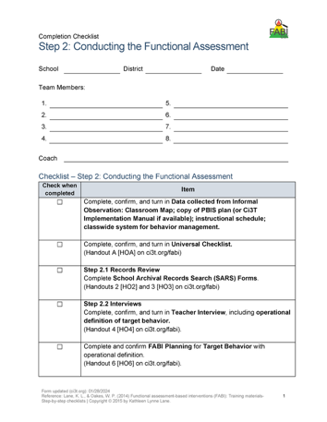
Step 2: Conducting the Functional Assessment
Understanding the learning environment and context
Records review
Interviews
Operationally define target behavior
Rating scales
A-B-C data collection
Use Function Matrix to identify the hypothesized function(s)
Identify replacement behavior
Notes:
Today, we are going to focus on these three components of Step 2

Slide 44
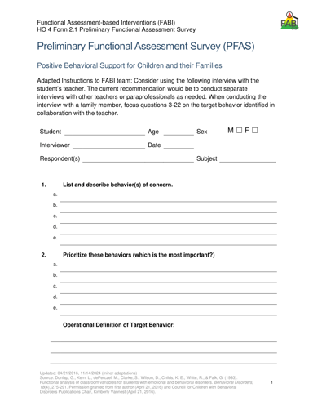
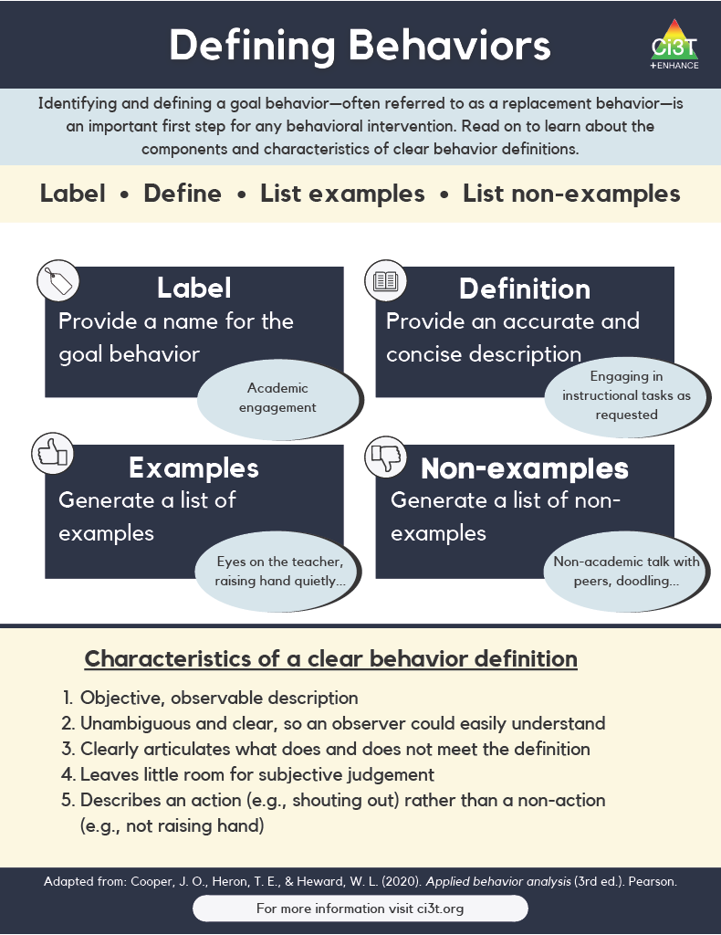
Operationally Defining the Target Behavior
Notes:
During the teacher interview, you will work with the teacher to identify all behaviors of interest and then create a prioritized list to determine the one keystone behavior. In other words, what is the one behavior, that if modified, could allow students to enjoy school more fully?
This becomes the target behavior (or the behavior you are seeking to reduce) which you will then operationally define

Slide 47
Example Operational Definition
Component | Description
Label | Off-task
Definition | Off-task is defined as attending to activities in class other than assignments.
Examples | Playing with materials inappropriately, talking to peers, putting head on the desk, drawing, and looking around the room
Non-Examples | Completing assignments using materials only for assignments, and watching the teacher when delivering instruction

Slide 48
Example Operational Definition
Component | Description
Label | Verbal aggression
Definition | Verbal aggression is defined as any vocalization directed towards a peer or adult at a volume above expected conversational level for a given setting alongside use profanity or language that is not appropriate for the setting.
Examples | Yelling “I hate you” at a voice level 3 during classroom instruction, verbal threats directed towards peer (e.g., “if you don’t stop, I’m going to…”), name-calling, profanity.
Non-Examples | Level 3 voice level at recess, shouting out an answer during choral response, sighing (“uhhhggg”), negative self-talk (e.g., “this is too hard”)

Slide 49
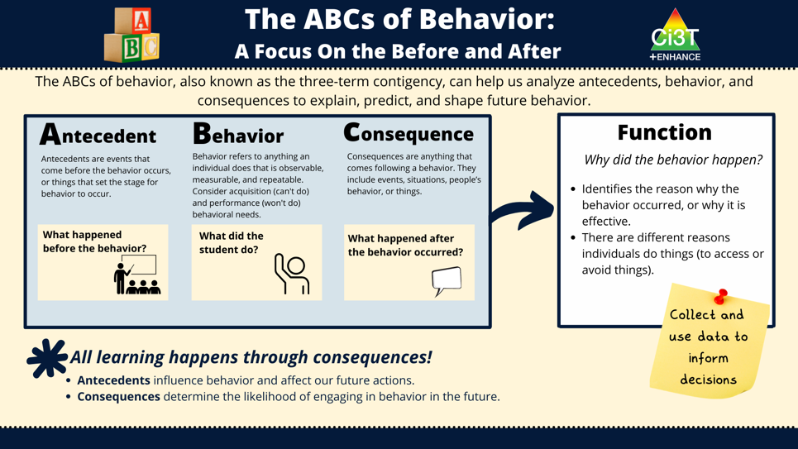
Direct Observation (A-B-C Data Collection)

Slide 50
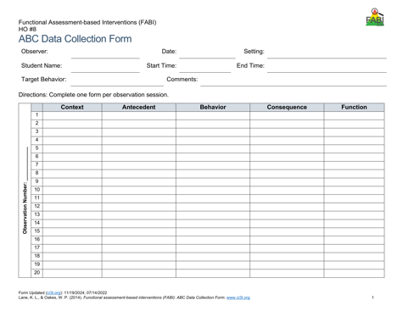
Direct Observation (A-B-C Data Collection)
Determine the time of day and setting during which the behavior most often occurs
3 observation sessions (minimum)
Aim to observe 8-10 occurrences of the target behavior or three hours of observations
Record only instances of target behavior
Each instance of the target behavior will be numbered and later placed in the Function Matrix

Slide 51
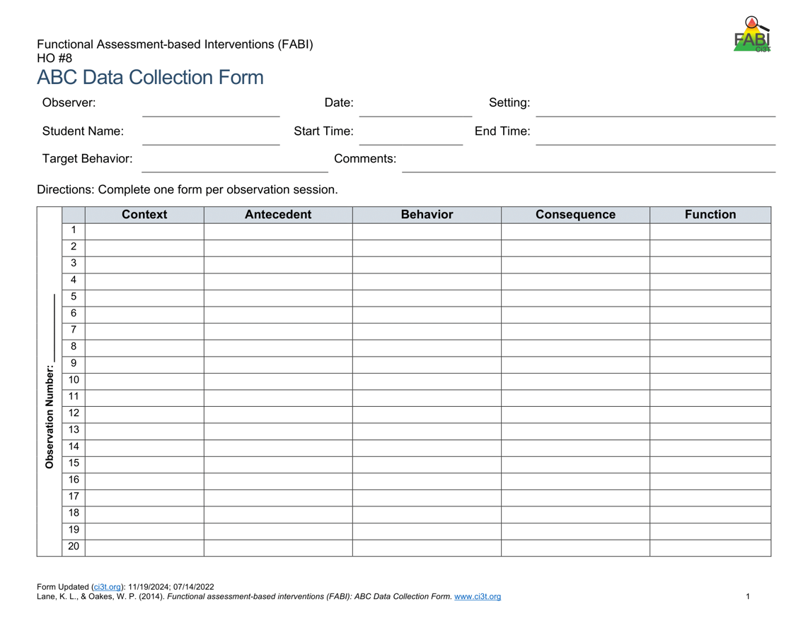

A-B-C Data Collection Example
Reading instruction
Pencil breaks
Student throws pencil
Teacher looks at student
Notes:
Each time the target behavior occurs you will record details in a new row. Each instance of the target behavior will be numbered and later placed in the function matrix.
You should will note the context in which the behavior occurred, such as reading instruction, morning circle time, or math instruction, and the antecedent, or what happened immediately before the behavior.
Additionally, record the target behavior itself, the consequence, or what happened immediately after the target behavior.
The function of the behavior, such as access to or avoidance of attention, tasks or tangibles, or sensory experiences will be completed later.

Slide 52
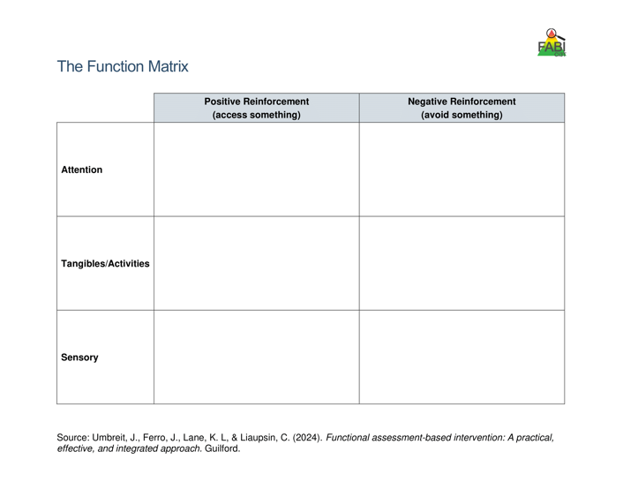
Use Function Matrix to identify the hypothesized function(s)
Peers laugh
Teacher provides 1:1 assistance
Work alone
Ignored by peers or adults
Preferred activity (e.g., tablet)
Do not have to complete academic task
Access to fidgets
Noise cancelling headphones
Notes:
The Function Matrix, developed by Umbreit and colleagues is a practical, effective, and novel tool for visually organizing multiple sources of information from informal observations, interviews, rating scales, and A-B-C observation data to identify the function of the target behavior.
The Function Matrix is organized based on the principles of applied behavior analysis, with columns reflecting the two ways behaviors are reinforced: positive reinforcement (meaning to get or access something) and negative reinforcement (meaning to escape or avoid something).
Then, the three rows reflect three behavioral categories (the “something or somethings”) the person is trying get or avoid: attention, tangibles or activities, and sensory experiences.

Slide 53
 | Positive Reinforcement (access something) | Negative Reinforcement (avoid something)
Attention | Teacher Interview – “During Independent work time, frequently comes to me to ask a question during math. Often, she already knows the answer” Parent Interview “She wants me to check her homework every night. Not just one math problem but all of them.” ABC Data- 1.2, 1.3, 2.1, 2.4, 3.1
Tangibles/Activities |  | Records Review - Tammy’s low grades were due to lack of class work completion. Teacher Interview- “She is the last one to get started when it is time for independent reading.” Student Interview- “I hate worksheets, they’re so boring” ABC Data: 1.1, 1.4, 2.2, 2.3, 2.5, 3.2
Sensory
Number of the observation
session (Day 1)
Number of the occurrence in the
observation session
(second instance of the behavior on Day 1)
Source: Umbreit, Ferro, Lane, & Liaupsin (2024); Umbreit, Ferro, Liaupsin, & Lane (2007); Umbreit, Lane, & Dejud (2004)
Notes:
Information from all parts of the functional assessment are added to Function Matrix. This includes: informal observations, interviews, rating scales, and A-B-C observation data.
ABC Data are using the following notation: Number of the observation session (e.g., observation session 1, 2, 3) dot number of the occurrence of target behavior in that observation session (e.g., the second instance of behavior) – this is the number of the row.

Slide 54
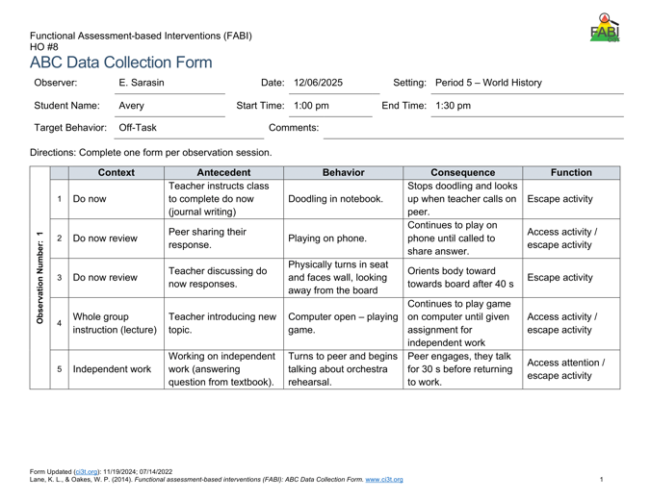
Let’s Practice!
What’s the Function?
Access – Attention
Avoid – Attention
Access – Tangibles / Activities
Avoid – Tangibles / Activities
Access – Sensory
Avoid - Sensory
?
?
?
?
?

Slide 55
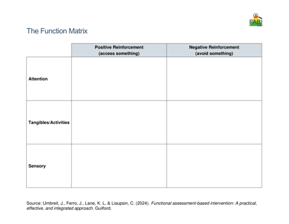
Hypothesized Function
During [context], [student name] engages in [target behavior] in order to [maintaining function(s)].
Example:
During independent reading activities (CONTEXT), Frank (STUDENT NAME) engages in noncompliant behavior (TARGET BEHAVIOR) to (a) escape too difficult tasks and (b) access peer and teacher attention (MAINTAINING FUNCTIONS).

Slide 56
Accessing Professional Learning Materials
ci3t.org/pl

Slide 57
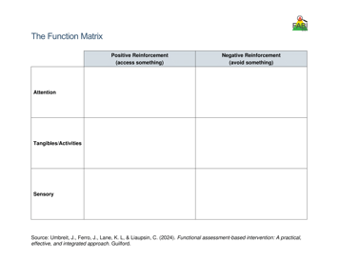












Let’s Practice
In a breakout room, work with your
group to complete the Function Matrix.
Notes:
10-min

Slide 58

Step 3: Collecting Baseline Data

Slide 59

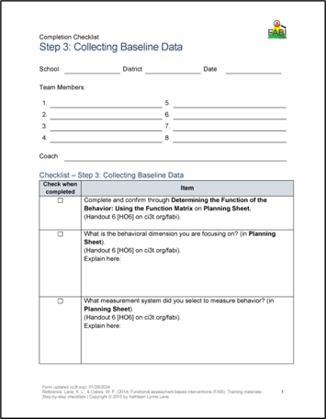
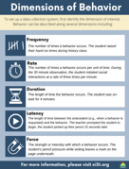
Step 3: Collecting Baseline Data
Determine behavioral dimension of focus
Select a measurement system
Develop data collection procedures
Train data collectors
Collect baseline data
Graph baseline data
Notes:
Today, we are going to focus on these three components of Step 3

Slide 60
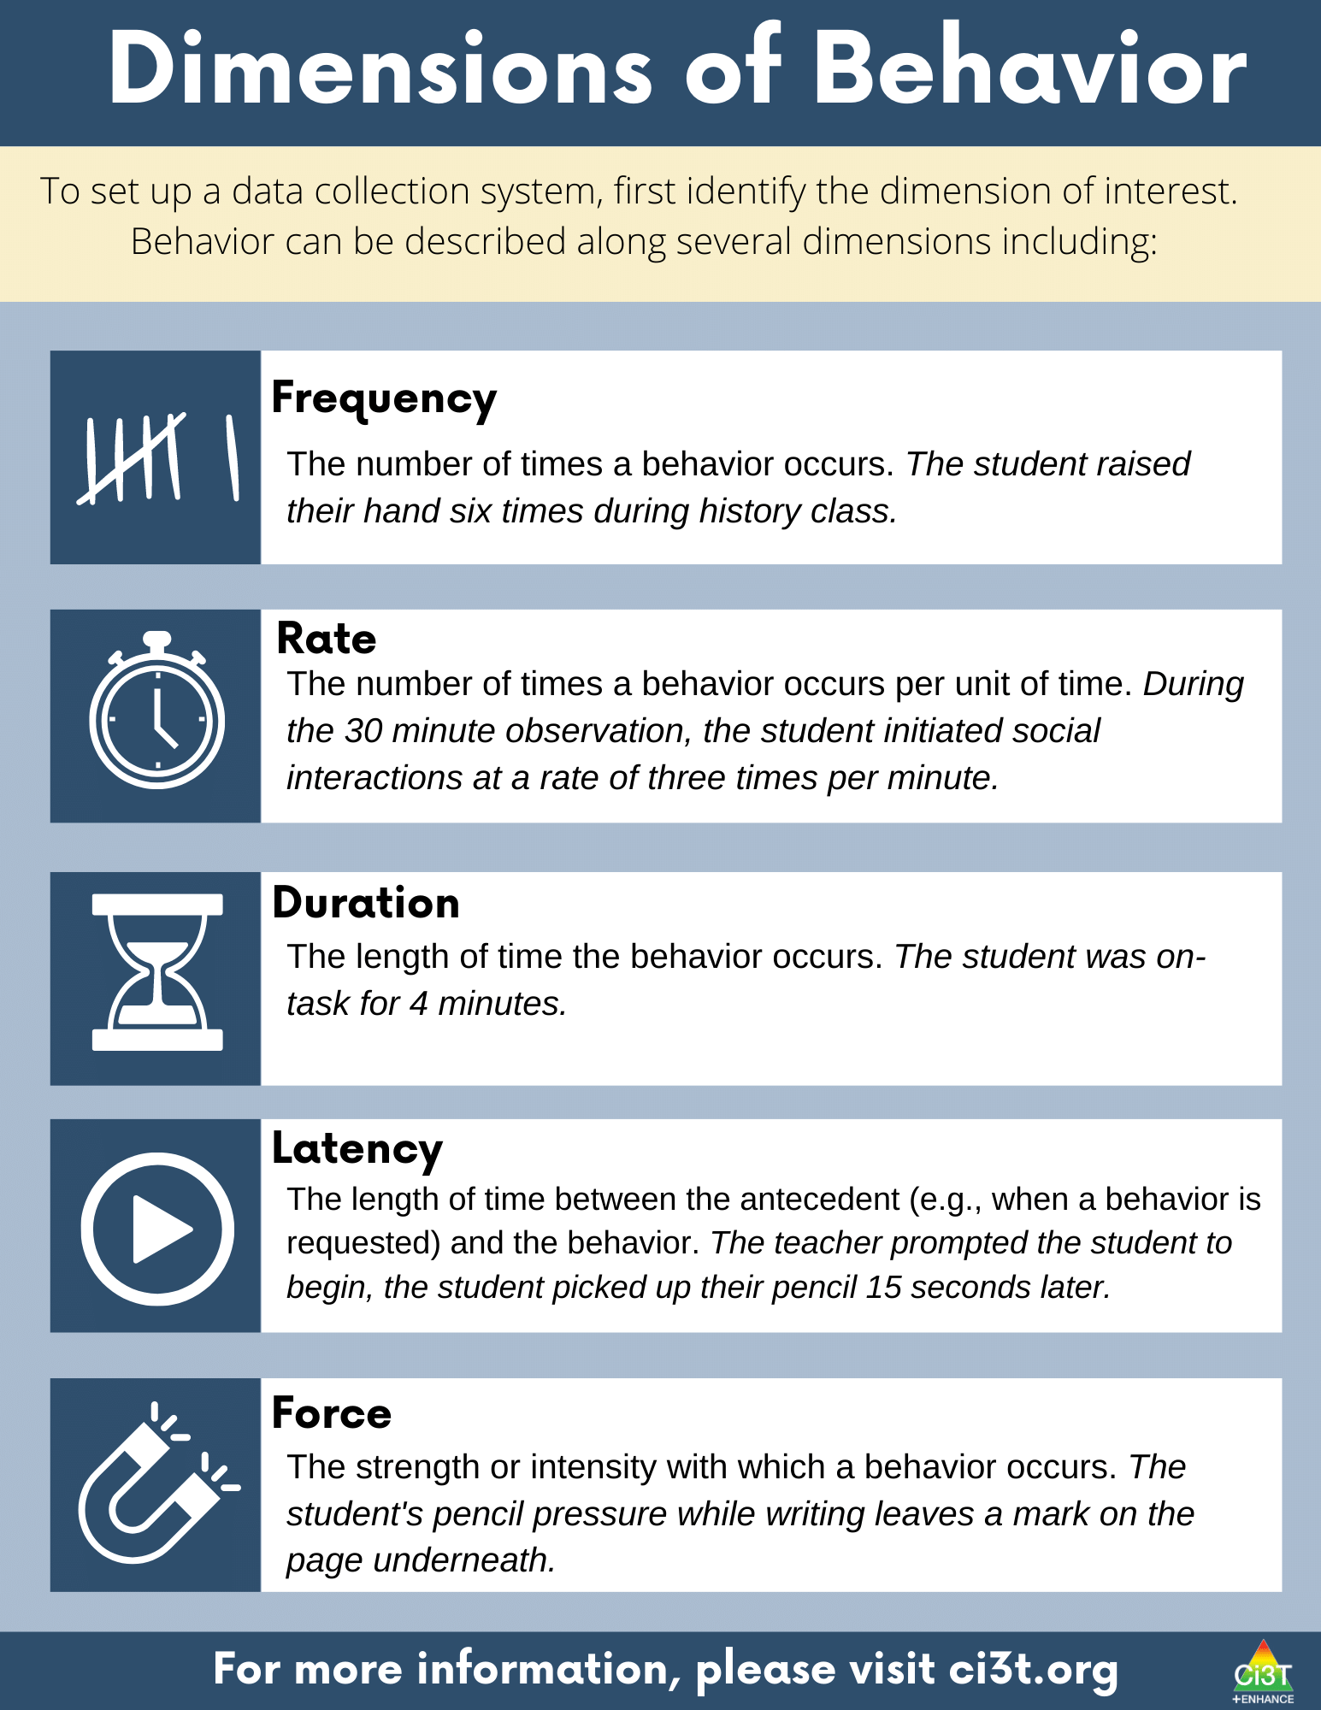

Slide 62

Let’s Practice!
 | Dimension
Susan worked math problems for 15 minutes | Duration
Jessica initiated use of her communication device six times | Frequency
Once directed to return to his seat, it took 7 minutes for Charlie to leave the beanbag in the class reading area | Latency
Levi completed four math problems in 10 minutes | Rate
?
?
?
?

Slide 63
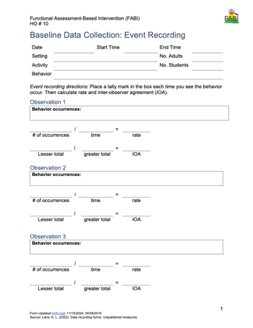
Select a Measurement System: Event-Based
Types of event-based measurement:
  Frequency
  Rate
Most appropriate for behaviors that are:
  Countable and discrete (e.g., relatively brief, clear start and end, and uniform in length).
  Examples: talking out of turn, swearing, pushing

Slide 64
Tips for Event-Based Recording
Select a specific period for data collection (e.g., first 20 minutes of the day, recess, math block)
Keep track of each time the target behavior occurs within that specified time
  Tally marks on paper (e.g., post it, label, data-collection sheet)
  Move paperclips from one pocked to another
  Counter

Slide 65


Let’s Practice – Frequency Recording

Slide 66
Debrief – Frequency Recording
How many times did Jim say the word cake?
What about frequency recording was challenging?
Given those challenges, how could the measurement procedures be improved?
Notes:
PRESENTER NOTES:
Jim says cake 18 times
Challenges
Pancake? Cupcake?
Hearing / audio quality
Frequency (happened a lot, hard to keep up) -
Procedures could be improved by:
Revising operational definition – whether or not to “count” compound words
Set up with good vantage point / audio to conduct observation
Consider whether frequency is appropriate / feasible (e.g., if happening too much to keep up maybe partial interval would be more appropriate)

Slide 67
Select a Measurement System: Time-Based
Time Based
  Duration
  Latency
  Interval (whole-interval, partial interval, momentary time sampling)
Most appropriate for behaviors that are:
  Not countable or discrete (e.g., less defined start/end, span a period of time) and/or vary in length each time
  Examples of non-uniform behaviors include: academic engagement, off-task, leaving designated area (e.g., desk, carpet spot), tantrum

Slide 68
Tips for Time-Based Recording
Duration and Latency
Select a specific period for data collection (e.g., first 20 minutes of the day, recess, math block)
Use a stopwatch (or app) to note:
  Duration – when behavior begins and ends
  Latency – start timer when direction is given, stop timer when student engages in expected behavior

Slide 69
Tips for Time-Based Recording
Interval Recording
Select a specific period for data collection (e.g., first 20 minutes of the day, recess, math block)
Divide observation period into equal intervals (e.g., 30 second, 1 minute)
Set up cue to go off at end of each interval (e.g., audio cue, phone or watch app, MotivAider)
Record whether behavior occurred:
  Whole-interval: behavior occurred the entire interval
  Partial-interval: behavior occurred at any time during the interval
  Momentary Time Sampling: behavior occurred at exact moment interval ends

Slide 70

Step 3: Collecting Baseline Data
Determine behavioral dimension of focus
Select a measurement system
Develop data collection procedures
Train data collectors
Collect baseline data
Graph baseline data
Reminder- although we aren’t discussing these today developing data collection procedures, training data collectors, and collecting baseline data are key components of this step!

Slide 71

Step 4: Design the FABI

Slide 72


Step 4: Design the FABI
Select an intervention method
Develop A-R-E intervention components
Draft treatment integrity checklist
Assess pre-intervention social validity
Develop intervention materials
Introduce FABI to educators and family
Introduce FABI to student
Revise and finalize FABI
Notes:
Today, we are going to focus on these components of Step 4

Slide 73


Function-Based Intervention Decision Model
An intervention method is selected based on the response to these two questions:
Can the student perform the replacement behavior?
Do antecedent conditions represent effective practices for this student?

Slide 74


Slide 75
A-R-E Components
Antecedent Adjustments - adjusting the antecedent conditions to increase likelihood replacement behavior will occur and (if applicable) providing instruction in the replacement behavior
Reinforcement Shifts - reinforcing the replacement behavior to strengthen its occurrence
Extinction Procedures - ensuring that the target behavior is not followed by reinforcement

Slide 76


Slide 77


Slide 78


Slide 79
Illustration 1:
David (2nd Grade)
Germer, K. A., Kaplan, L. M., Giroux, L. N., Markham, E. H., Ferris, G. J., Oakes, W. P., & Lane, K. L. (2011). A function-based intervention to increase a second-grade student's on-task behavior in a general education classroom. Beyond Behavior, 20(3).

Slide 80
Target Behavior: Off -Task Behavior
Component | Description
Label | Off-task
Definition | Off-task behavior refers to engaging in behaviors or making verbal comments unrelated to instructional tasks.
Examples | leaving assigned instructional area without teacher permission inappropriately making comments to teacher or peers unrelated to instruction attending to anything other than the academic task doing unassigned tasks using instructional materials inappropriately taking more than 30 s to prepare for instructional task
Non-Examples | staying in assigned instructional area appropriately making comments to teacher or peers related to instruction attending to academic tasks working on assigned task using instructional materials appropriately preparing for instructional task in less than 30 s

Slide 81
Replacement Behavior: On-Task
Component | Description
Label | On-task
Definition | On-task behavior refers to engaging in behaviors or making verbal comments related to instructional tasks.
Examples | staying in assigned instructional area appropriately making comments to teacher or peers related to instruction attending to academic tasks working on assigned task using instructional materials appropriately preparing for instructional task in less than 30 s
Non-Examples | leaving assigned instructional area without teacher permission inappropriately making comments to teacher or peers unrelated to instruction attending to anything other than the academic task doing unassigned tasks using instructional materials inappropriately taking more than 30 s to prepare for instructional task.

Slide 82

Function Matrix

Slide 83
Hypothesized Function
When presented with an instructional task, David engages in off-task behavior (such as leaving instructional areas, inappropriately making comments, and engaging in unassigned tasks) to access attention and/or to escape tasks.
In other words, when David is off-task he gets attention from his teacher and peers and does not have to complete assignments (positive reinforcement-attention and negative reinforcement-activity)

Slide 84

Function-Based Intervention Decision Model

Slide 85


Measurement
Duration
  Measured academic engagement
  20-min sessions during morning instructional time

Slide 86
Component 1- Adjust the Antecedents
Adjust Antecedents | Adjust antecedent variables so the conditions that set the occasion for the target behavior are eliminated and new conditions are established in which the replacement behavior is more likely to occur. | Seating change - David will sit facing the whiteboard Stoplight system Self-monitoring system Teacher will review picture schedule for the morning work period prior to the work period. Teacher will check-in with David at the beginning of independent tasks to ensure that he understood the assignment.

Slide 87
Storage Shelves and Books
Teacher Storage
Table
Manipulative Shelf
Bookshelf
Teacher Work Space
Windows
Lockers
Computers
Table
Door
Carpet
Charts and Whiteboard
Reading Area
Note: David’s seat pre-intervention
Note: David’s seat during the intervention

Slide 88
Component 1- Adjust the Antecedents
Stoplight System
Affixed to the side of David’s desk
  David used a clothespin to signal which “light” he was on
Green, yellow, and red “lights”
  Green: “I’m doing my work!”
  Yellow: “I’m asking a friend for help!”
  Red: “I still need help! I’m asking my teacher.”
“I’m done!” to signal completion

Slide 89
Component 2- Reinforcement Rates
Reinforcement Rates | Provide appropriate reinforcement for the replacement behavior. | Teacher will provide behavior-specific praise when David is on-task. Teacher will acknowledge David’s need for help when his clothespin was on red and assist him as quickly as possible. Teacher will check David’s work upon completion, provide praise, and allow him to take a short break. At the end of the morning independent work period, teacher will help David complete his self-monitoring form and write one specific incidence of good behavior at the bottom.

Slide 90
Component 3- Extinguish the Target Behavior
Extinguish Target Behavior | Withhold the consequence that previously reinforced the target behavior. | Teacher will provide no praise or attention when David is off-task, with the exception of one verbal or gestural redirect per minute. When David is off-task, teacher will praise other students who are behaving appropriately.

Slide 91

Treatment Integrity

Slide 92



Pre-Intervention Social Validity

Slide 93
Accessing Professional Learning Materials
ci3t.org/pl

Slide 94


















Let’s Practice
In a breakout room, work with your group
to generate A-R-E components
Notes:
15-min

Slide 95
Illustration 2: Harry
5th Grader

Slide 96
Target Behavior: Off -Task Behavior
Off-task is defined as attending to activities in class other than assignments
Examples
Playing with materials inappropriately, talking to peers, putting head on the desk, drawing, and looking around the room
Non-examples
Completing assignments using materials only for assignments, and watching the teacher when delivering instruction

Slide 97
Replacement Behavior: Academic Engagement
Academic engagement is defined as anytime Harry is attending to class instructions and/or assignments
Examples
Completing assignments using materials only for assignments, and watching the teacher when delivering instruction
Non-examples
Playing with materials inappropriately, talking to peers, putting head on the desk, drawing, and looking around the room

Slide 98
Function Matrix
 | Positive Reinforcement (Access something) | Negative Reinforcement (Avoid something)
Attention | ABC 1.1, ABC 1.2, ABC 1.19, ABC 2.1(peer), ABC 2.2, ABC 2.3, ABC 2.4, ABC 2.7, ABC 2.8, ABC 2.10, S.I. # 4 (wants peer att.)
Tangibles/ activities | ABC 2.9, S.I. #4 (wants more fun activity) | ABC 1.2, ABC 1.3, ABC 1.4, ABC 1.6, ABC 1.7, ABC 1.8, ABC 1.9, ABC 1.10, ABC 1.11, ABC 1.12, ABC 1.13, ABC 1.14-1.19, ABC 2.1, ABC 2.2, ABC 2.4, ABC 2.5, ABC 2.6, ABC 2.7, ABC 2.9, Avoiding work when not structured. T.I. #4, T.I. #9, S.I. #2 & #3
Sensory | ABC 1.1, ABC 1.5, ABC 1.6, ABC 1.18, ABC 1.19, ABC 2.1, ABC 2.2, ABC 3.1-3.4

Slide 99
Hypothesized Function
When presented with academic tasks or instruction, Harry became off-task (engaged in an activity other than the one assigned) to escape tasks and gain attention.
That is, Harry, engaged in off-task behaviors
to access teacher and/or peer attention
(positive reinforcement- attention)
or to escape the instruction by the teacher
or the activity that the teacher assigned
(negative reinforcement- activity).

Slide 100
Function-Based Intervention Decision Model

Slide 101
Measurement
Whole Interval recording
  Measured academic engagement
  20 min sessions, ~8:45-9:05 am
  Each interval was 20 s

Slide 102
Component 1- Adjust the Antecedents
Adjust Antecedents | Adjust antecedent variables so the conditions that set the occasion for the target behavior are eliminated and new conditions are established in which the replacement behavior is more likely to occur. | Integrate instructional choice into independent work (e.g., complete evens or odds, select any six problems to complete, choice of math manipulative to use)
Notes:
WWC - https://ies.ed.gov/ncee/wwc/PracticeGuide/31
Low-Intensity, Teacher Delivered Strategies (module)

Slide 103
Component 2- Reinforcement Rates
Reinforcement Rates | Provide appropriate reinforcement for the replacement behavior. | Provide behavior-specific praise paired with a universal reinforcer (e.g., ticket) when Harry begins independent work

Slide 104
Component 3- Extinguish the Target Behavior
Extinguish Target Behavior | Withhold the consequence that previously reinforced the target behavior. | Non-verbal redirection (e.g., gestural prompt)

Slide 105

Step 5: Test the Intervention

Slide 106


Step 5: Testing the Intervention
Implement the intervention
Monitor treatment integrity
Collect and graph data
Implement a single-case design to “test” how well intervention is working
  ABAB
  Multiple baseline
  Changing criterion
Assess social validity
Fade the intervention

Slide 107

Harry’s Intervention Outcomes
Cox, M., Griffin, M. M., Hall, R., Oakes, W. P., & Lane, K. L. (2011). Using a Functional Assessment-Based Intervention to Increase Academic Engaged Time in an Inclusive Middle School Setting. Beyond Behavior, 20(3).

Slide 108

Harry’s Intervention Outcomes
Cox, M., Griffin, M. M., Hall, R., Oakes, W. P., & Lane, K. L. (2011). Using a Functional Assessment-Based Intervention to Increase Academic Engaged Time in an Inclusive Middle School Setting. Beyond Behavior, 20(3).

Slide 109
Wrapping Up and Moving Forward

Slide 110
Opportunities to Learn More

Slide 111
Knowledge, Application, Impact Points
On-Task Behavior: Jackson
If you are in Kansas, you can earn 2 x PD points for application and 3 x for impact!
We are happy to review your materials before you upload!
Notes:
Tonight’s session lays the foundation with knowledge building and getting you oriented to the modules that can support application and impact efforts!

Slide 112
Action Items
Action Item | Person(s) Responsible | Planned Completion Date | Date Completed
Submit BCBA CEU form with four passwords | David | 04/29/26
Schedule time to review FABI modules | David | 04/29/26
Email behavior specialist to coordinate FABI book study for next school year | David | 04/29/26

Slide 113
Project EMPOWER+
Please check back for information for 2026-2027!

Slide 114

Ci3T Trainers and Coaches Calls
Ci3T Trainers and Coaches Calls Session | Date
Ci3T Trainers and Coaches Call 1 | August 20, 2025 (Wednesday)
Ci3T Trainers and Coaches Call 2 | September 3, 2025 (Wednesday)
Ci3T Trainers and Coaches Call 3 | October 1, 2025 (Wednesday)
Ci3T Trainers and Coaches Call 4 | November 5, 2025 (Wednesday)
Ci3T Trainers and Coaches Call 5 | December 2, 2025 (Tuesday)
Ci3T Trainers and Coaches Call 6 | January 22, 2026 (Thursday)
Ci3T Trainers and Coaches Call 7 | February 17, 2026 (Tuesday)
Ci3T Trainers and Coaches Call 8 | March 10, 2026 (Tuesday)
Ci3T Trainers and Coaches Call 9 | April 15, 2026 (Wednesday)
Ci3T Trainers and Coaches Call 10 | May 13, 2026 (Wednesday)

Slide 115




Thank you!
Thank you!
ci3t.org
#Ci3T
@Ci3Tmodel
Tag us in your Ci3T highlights, we love to see Ci3T in action!
Follow us on Instagram for updates and new resources!
Notes:
Tag us in your Ci3T highlights- we would love to see Ci3T in action! Follow us on Instagram for updates and links to resources! @Ci3TModel
You will receive a brief session evaluation – we value your feedback and would greatly appreciate you taking a few minutes to share your thoughts on what you liked about the session and how we can improve

